Slide 1
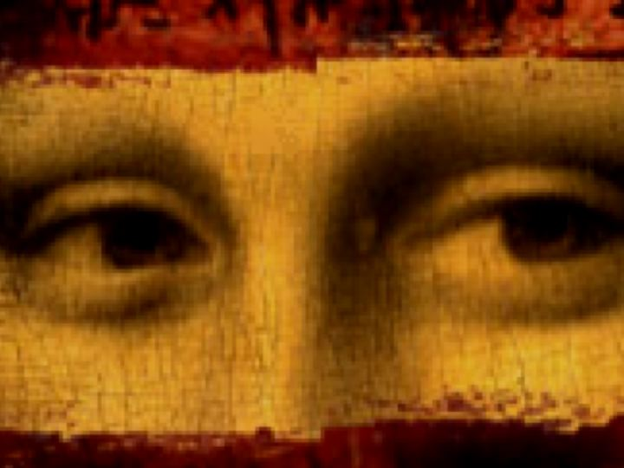
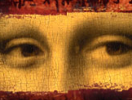
Debunking
The Da Vinci Code
Dr. Rick Griffith • Jordan Evangelical Theological Seminary • BibleStudyDownloads.org

Slide 2
破解
达芬奇密码
Dr. Rick Griffith • 博士 • 新加坡神学院 • www.BibleStudyDownloads.org
Notes:
Presently only 145 of the 224 slides are translated, but they still give a basic critique of Brown's book.

Slide 3
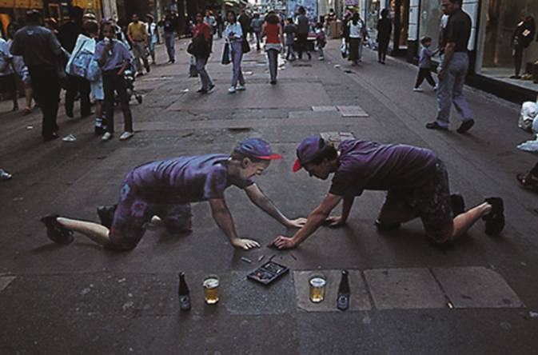
Julian Beever Self-Portrait
Notes:
Julian Beever is an English artist who's famous for his art on the pavement of England, France, Germany, USA, Australia and Belgium. Beever gives to his drawings an amazing 3D illusion.

Slide 4
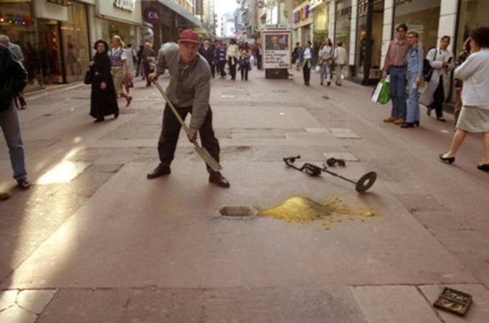
Beginning the Dig for Gold
Notes:
Julian Beever's "gold" looks real but is, in fact, only chalk!

Slide 5
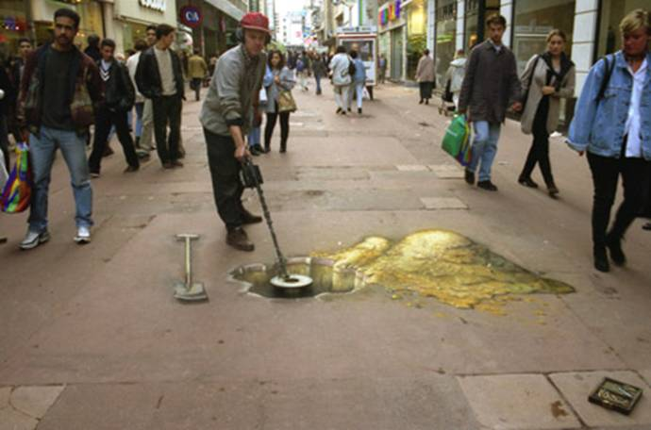
The Shovel is Fake Too
Notes:
Creating more "gold" only costs time and the value of chalk.

Slide 6
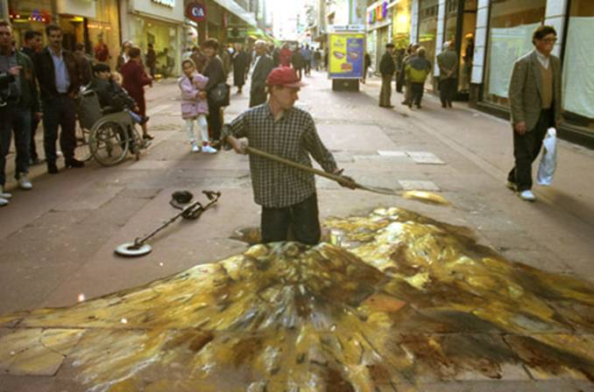
Even More Gold…
Notes:
Is Beever standing in a pit of gold? No, he's on his knees!

Slide 7
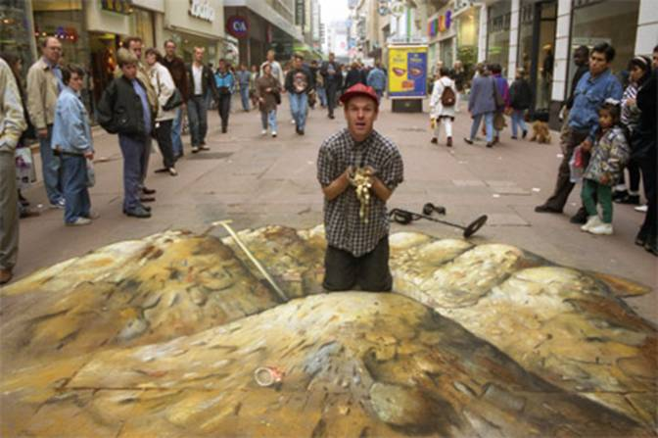
The Gold Digger Hits It Big Time!
Notes:
I still haven't figured how he chalked the "gold" in his hands…

Slide 8

Nice Legs!
Notes:
Julian Beever appears to be climbing into this "pool" with the pretty lady but this also is all chalk drawn.

Slide 9
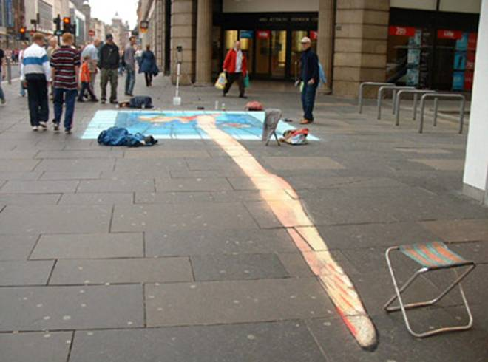
Her Leg at the Wrong Angle…
Tripod for previous picture
Notes:
The tripod at the back was used for the previous picture.

Slide 10
Both Angles
Notes:
Julian Beever is like Dan Brown in that he presents a convincing illusion for something which is actually fake. Our goal in this seminar is to see Brown's book from both angles.

Slide 11

Jesus has always been God
"In the beginning
was the Word,
and the Word was with God,
and the Word was God"
(John 1:1)
Notes:
Scripture is very clear that Jesus is God. Christians have always believed this key doctrine called the deity of Christ.

Slide 12

God became man in Jesus
"So the Word became human and lived here on earth among us. He was full of unfailing love and faithfulness. And we have seen his glory, the glory of the only Son of the Father" (John 1:14 NLT)
Notes:
Any doubt as to who is meant by the "Word" is erased once we reached verse 14, which clearly shows the at "Word was God" means that Jews was God.

Slide 13


Attacks Against Scripture
Since the early church false teaching has tried to undermine our faith
Presentation_ID
13
13
© 2003 Cisco Systems, Inc. All rights reserved.
13
Notes:
Yet still the deity of Christ has always been attacked but the unbelieving world.

Slide 14
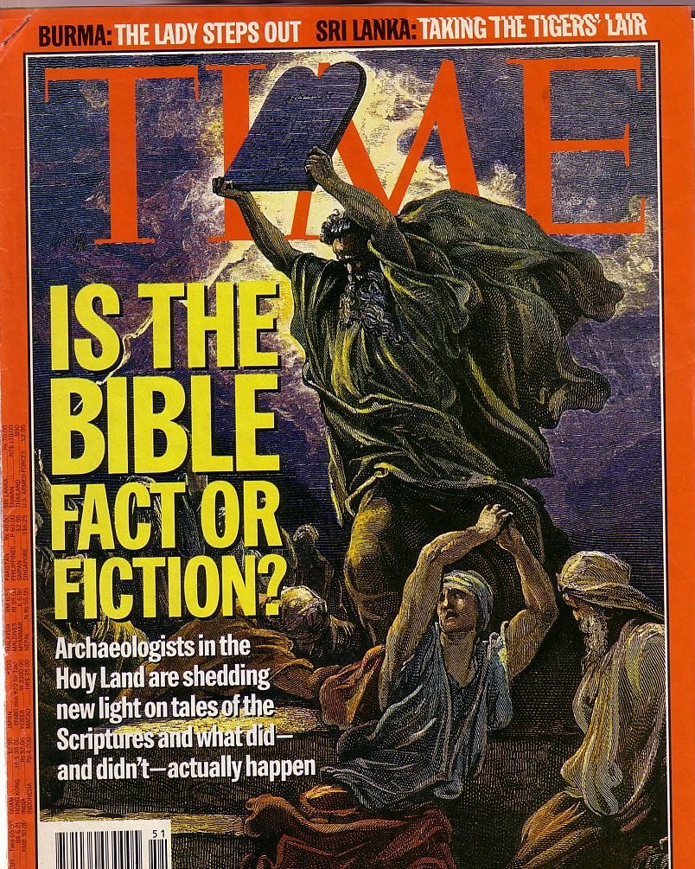
Attacks Continue
The Bible is continually attacked
However, discoveries continue to verify its accuracy
Notes:
The non-Christian world has always attacked Christianity, so today's attacks should be expected.

Slide 15

Answer the Critics
But in your hearts set apart Christ as Lord. Always be prepared to give an answer to everyone who asks you to give the reason for the hope that you have. But do this with gentleness and respect.
1 Peter 3:15
Notes:
Peter tells us the foundation on which to respond (Christ's Lordship of our lives), the "what" to do (answer based on hope), and the "how" to do this (gently and respectfully). This is our desire as we respond to The Da Vinci Code.

Slide 16


A New Heresy
Notes:
You'll see in a minute why I don't hesitate to call this a heresy…

Slide 17
The Influence
Notes:
Initially I had no intent to answer this book since I can't answer every attack that comes at Christians. However, my opinion changed after seeing that this book is a best seller in over 100 countries!

Slide 18


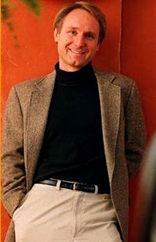


Laughing all the way to the bank…
$260 million
(after 12 million copies sold)
+$100 MILLION
(three other books)
45 million copies sold (May 06)!
Notes:
If you do the math, Brown is probably a billionare--especially after movie royalties come his way.

Slide 19





44 Languages!
Notes:
DVC books and games flood the market. A computer game was also planned for release in May 2006.

Slide 20
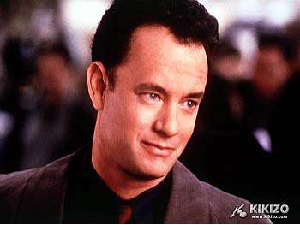


The Movie: 18 May
Tom Hanks (Forrest Gump) plays the lead as Professor Robert Langdon
French actress Audrey Tautou, best-known as the ingenue in Amelie, plays the key female role of Sophie Neveu
Jean Reno (The Professional, Mission Impossible) plays the mysterious French detective Bezu Fache
Notes:
The movie will reach the millions who hate to read. Many of these also hate to think, so they will absorb the story without a critical mind.

Slide 21
The
Plot
Notes:
Many enjoy the plot, but for me it was painful reading to see so many hundreds of inaccuracies plague the book, which doesn't even have a single footnote. Since many of us don't want to take the time to read a nearly 600-page novel, let's see the narrative.

Slide 22
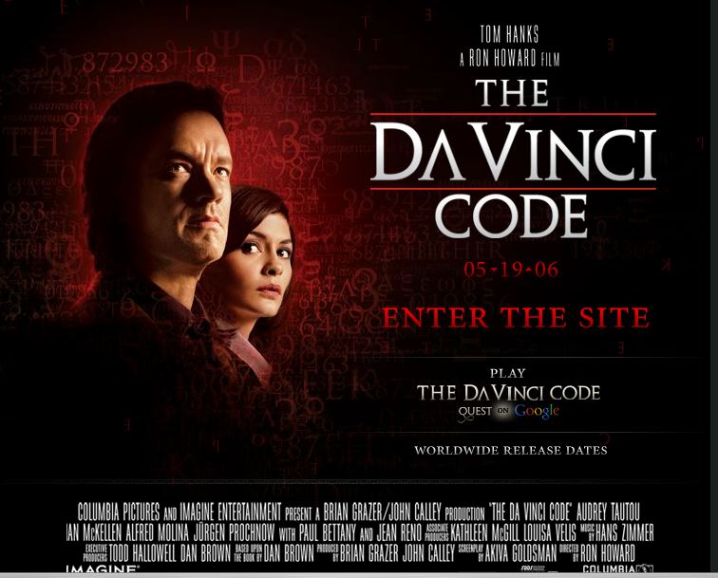
The Movie Cast
(Real names in italics)
Notes:
As we introduce the characters, their real names will appear in italics.

Slide 23
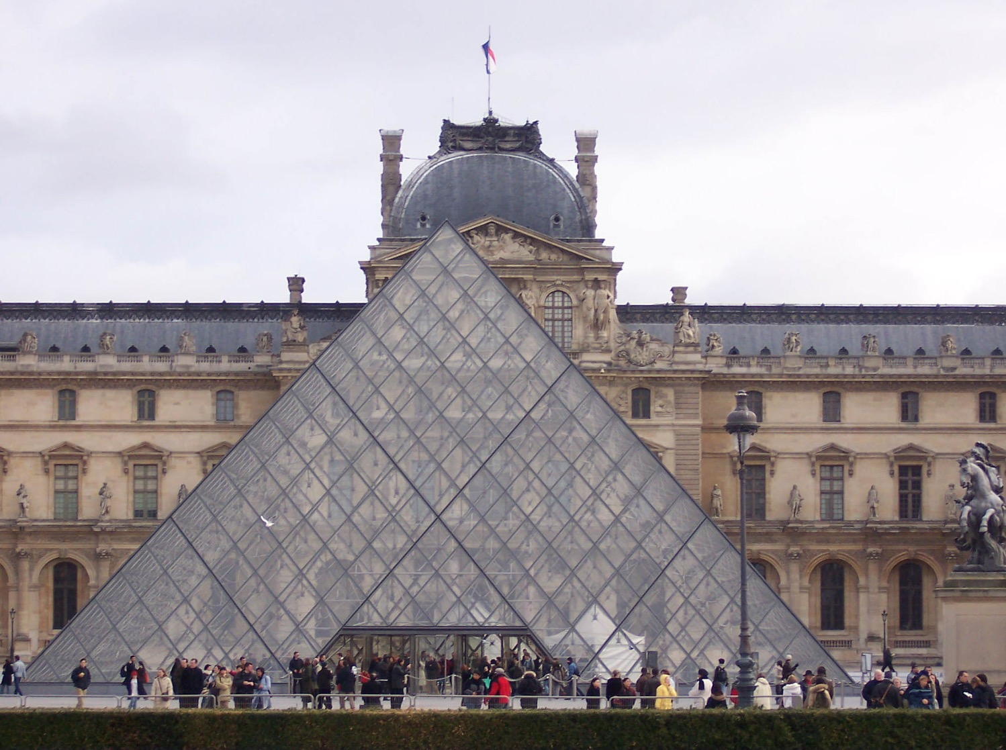
Musee du Louvre, Paris
Notes:
The story starts in Paris at France's best known museum, known for it's striking pyramids surrounded by old art galleries.

Slide 24
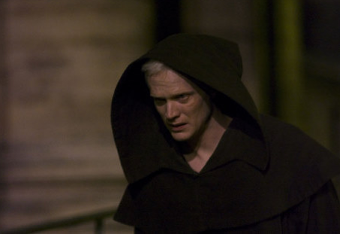
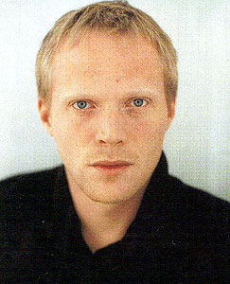
Silas
(Paul Bettany plays the assassin sent by the Catholic Church)
Notes:
A Catholic assassin shoots a bullet into the stomach of the Louvre's curator…

Slide 25
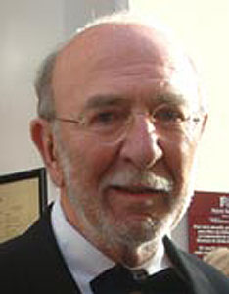
Jacques Sauniére
(Jean Pierre Marielle)
Notes:
The curator, Jacque Sauniere, has but 15 minutes to live.

Slide 26
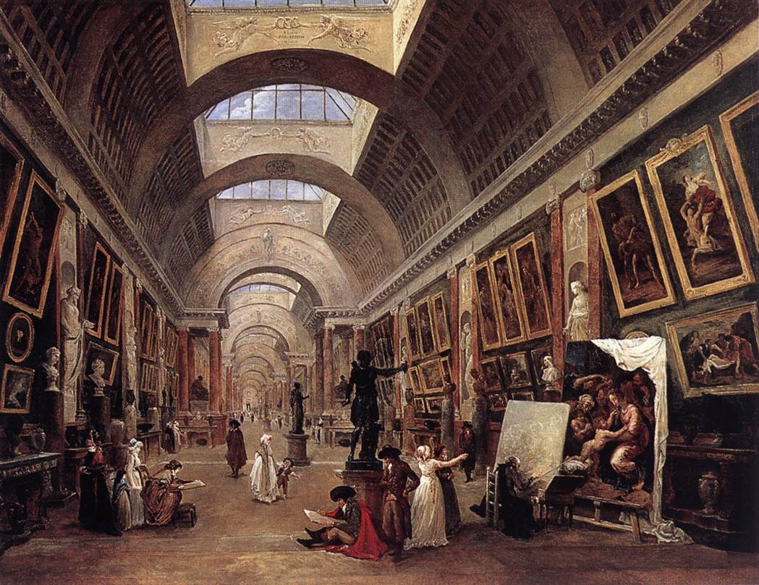
Musee du Louvre, Paris
Notes:
He runs down the gallery of the museum.

Slide 27
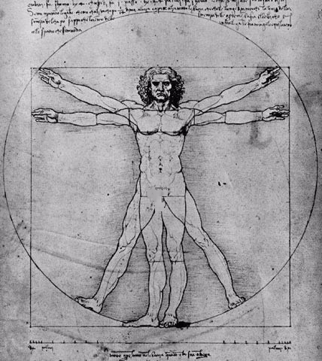
Vitruvian Man
Venice, gallerie dell' Accademia
Notes:
Then he takes off all his clothes, draws a pentagram on his chest, and writes with his own blood on the floor next to him. The clues baffle the police, so they call in an expert lecturing that night in Paris.

Slide 28
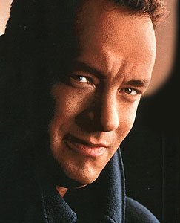
Robert Langdon
(Tom Hanks)
Notes:
The expert is Robert Langdon, played by Tom Hanks. He is a world-class expert in deciphering symbols.

Slide 29

Robert Langdon
Professor Robert Langdon of Harvard "proves" that Christianity as we know it was actually invented around AD 325 by Emperor Constantine to secure his power base.
Notes:
As the plot unfolds, Langdon shows himself an enemy of Christians.

Slide 30

Sophie Neveu
(Audrey Tautou)
Notes:
Of course, he needs a pretty lady to make the story gain Hollywood fame, so Sophie Neveu soon comes to his side. She is a cryptographer whose name means "new wisdom."

Slide 31

Sophie Neveu
Miss Neveu is
the curator's granddaughter who searches for the Grail to keep it from Catholic hit men in their division called Opus Dei. She "discovers" that Christianity is a farce.
Notes:
The "new wisdom" Sophie gains in the storyline is that Christianity is a false religion. But she does discern that Langdon is the chief suspect in the murder so…

Slide 32
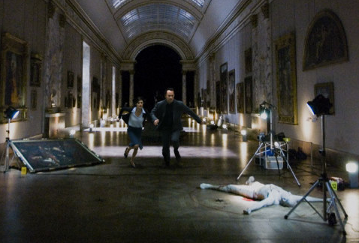
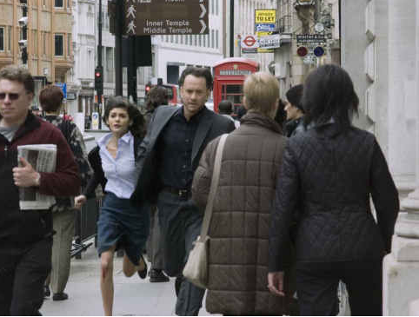
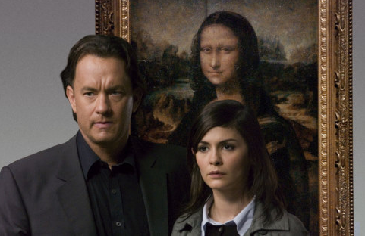

On the run…
Notes:
The duo end up being chased by the police and the rest of the story takes only about 24 hours where they both run from the police as well as discover supposedly hidden truths about Christianity.

Slide 33
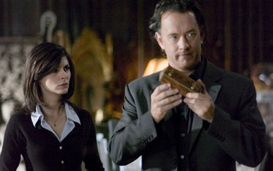
Langdon & Neveu after clues
Notes:
The two decipher cryptic messages in various places in France and England.

Slide 34
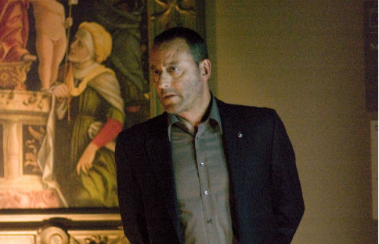

Bezu Fache
(Jean Reno)
This mysterious French detective investigates the murder and chases Langdon and Sophie throughout the story.
Notes:
Sophie's boss never does catch up to them.

Slide 35

Sir Leigh Teabing
(Ian McKellen plays the British royal historian who tells the duo Christianity is a farce)
Notes:
Along the way a supposed historian, Leigh Teabing, joins their search for the holy grail.

Slide 36
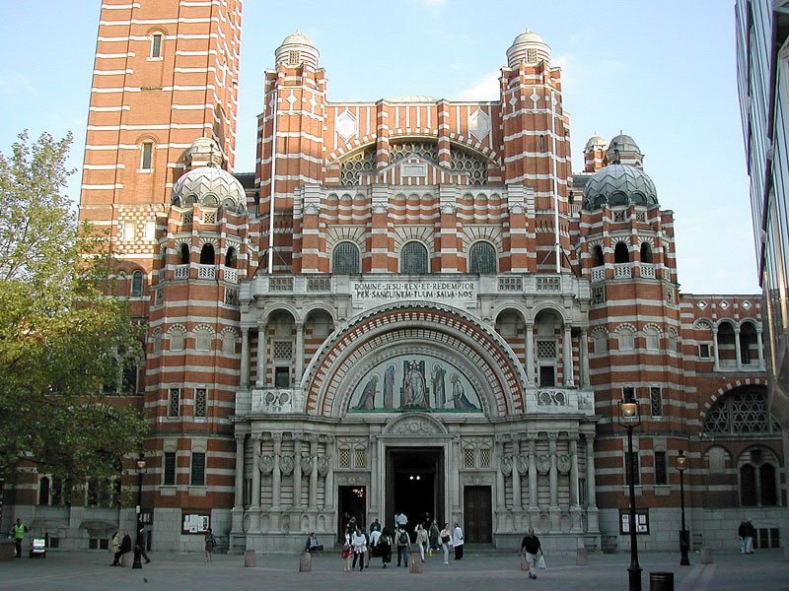
Westminster Abbey
Notes:
Many places of worship provide clues. Interestingly, the leaders at Westminster Abbey refused to allow the film team to use their site in the movie, turning down a huge sum of money to follow their convictions. Lincoln Cathedral in central England then became the site for the film, accepted a reported 100,000 pounds (US$180,000, euro140,000) to double as Westminster Abbey in the Ron Howard-directed film.

Slide 37
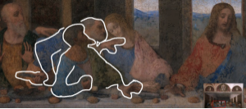
The supposed
"disembodied dagger"
DVC, 209
Notes:
Supposedly Peter's hands are accounting for in red and Judas in yellow, so Brown claims that no one is holding the knife. Actually, the paint between Peter's hand and the knife has chipped away!

Slide 38
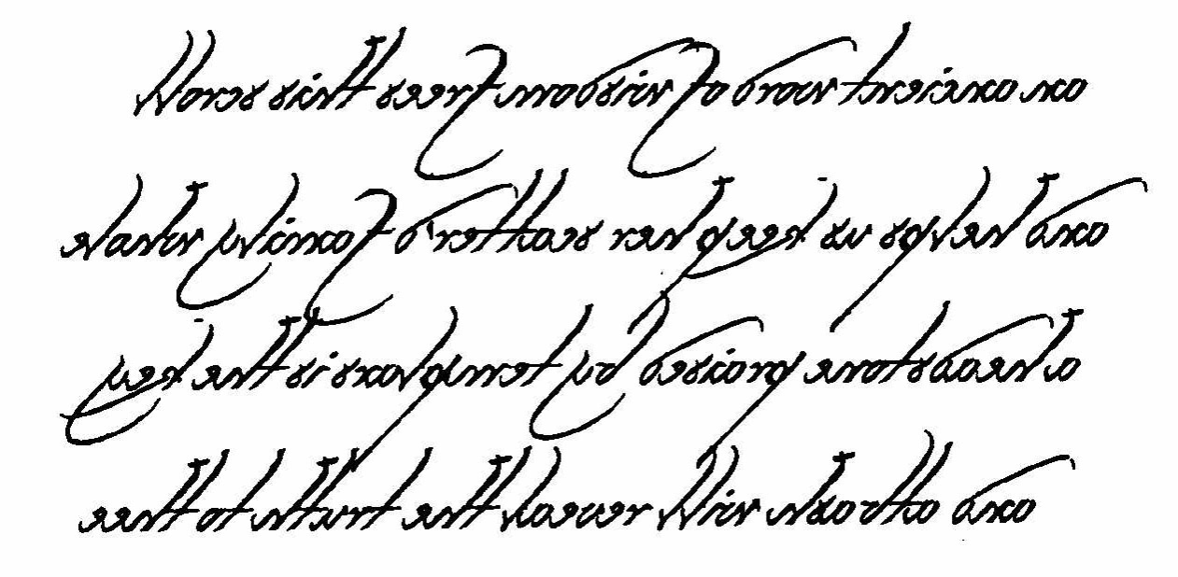
Another "Clue"
Notes:
Can you guess what language this is written in? It's called English! Leonardo often used backwards writing to conceal his theories in astronomy and mathematics from the watchful eye of the church. However, we have no record of him ever using this for religious purposes.

Slide 39
The "Solution"
An ancient word of wisdom frees this scroll...
and helps us keep her scatter'd family whole...
a headstone praised by templars is the key...
and atbash will reveal the truth to thee.
Notes:
This clue helps Sophie's "scattered family" discover that they are descendents of Jesus Christ himself--a secret kept by the Knight's Templars of the Middle Ages.

Slide 40
The Summary
Notes:
So what are these big secrets that show Christianity is a farce? We'll get into details later, but first let's summarize what I like to call…

Slide 41
The Gospel
According to Brown
Jesus married Mary Magdalene
His daughter Sarah grew up in France
His deity was invented in AD 325
We have the wrong NT Gospels
Christianity = the Divine Feminine
Christians cover up this conspiracy
Notes:
Is this the Christianity you know? What makes Brown's heresy unique is that many heresies see what we see in the Bible but don't believe it, but Brown says the early church itself didn't believe what we believe about Jesus.

Slide 42
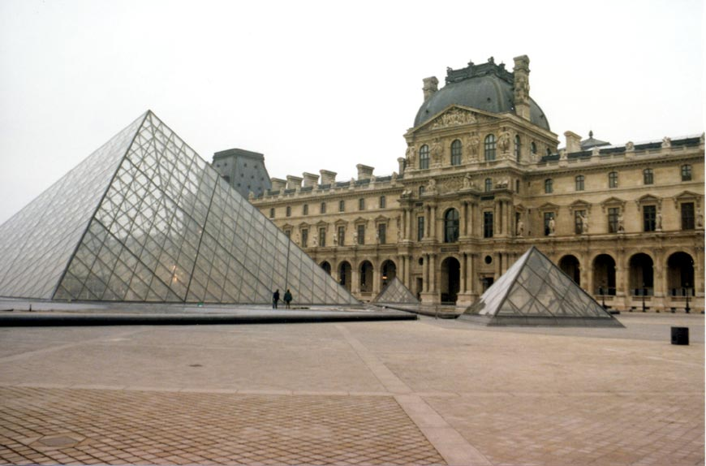

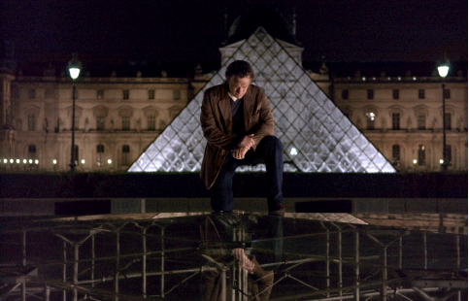
Musee du Louvre, Paris
The $1 Billion Questions:
So where are the bones of Mary, "Jesus' wife"?
And where are the documents "proving" all of Brown's preposterous claims?
Answer: "Right here," underneath the Louvre pyramid.
Notes:
How does the story end? Right back at the Louvre where the whole thing started.

Slide 43
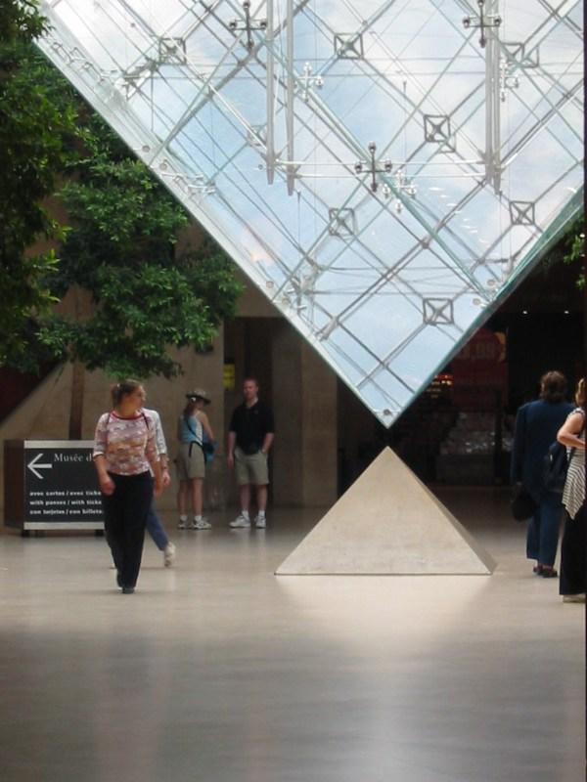
la Pyramide inversée Louvre,
Paris
This is how the paperback ends on page 593, with the characters only thinking that the evidence is beneath them! No proof!
???
Notes:
Langdon stands above the spot where the four chests of documents supposedly lie that prove Mary Magdalene was the wife of Jesus. For me this was an amazingly twist, for Brown could not even prove his preposterous claims in fiction! I kept thinking, "So you are there, huh? Well, DIG and show me the "evidence"!" Even in fiction Brown couldn't being forth real evidence.

Slide 44
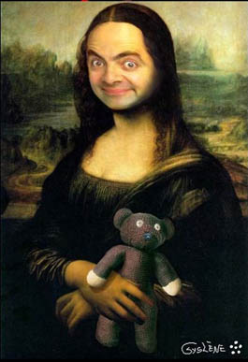
Langdon & Nevue missed some important English works of art
The Beana Lisa, 2006
Notes:
One of Brown's glaring faults is that he neglected to mention certain classics of art in his book.

Slide 45
The Sources
Notes:
You are probably wondering where Brown gets all this stuff about Jesus.

Slide 46
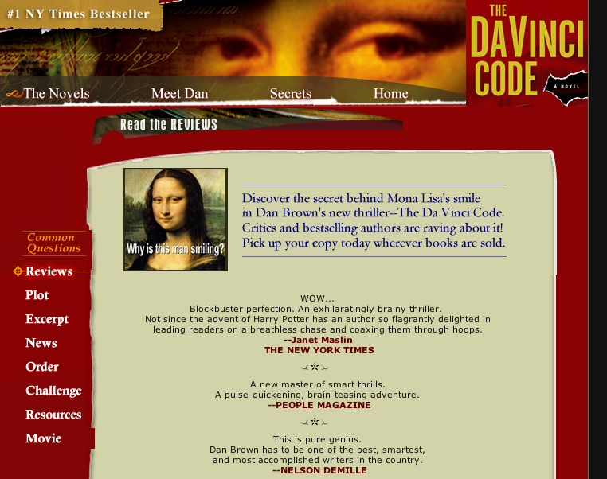
danbrown.com
FAQs:
Q: "Are you a Christian?"
A: "Yes…"
Notes:
His website asks, ARE YOU A CHRISTIAN? He answers, "Yes. Interestingly, if you ask three people what it means to be Christian, you will get three different answers. Some feel being baptized is sufficient. Others feel you must accept the Bible as absolute historical fact. Still others require a belief that all those who do not accept Christ as their personal savior are doomed to hell. Faith is a continuum, and we each fall on that line where we may. By attempting to rigidly classify ethereal concepts like faith, we end up debating semantics to the point where we entirely miss the obvious--that is, that we are all trying to decipher life's big mysteries, and we're each following our own paths of enlightenment. I consider myself a student of many religions. The more I learn, the more questions I have. For me, the spiritual quest will be a life-long work in progress."
Quote from http://www.danbrown.com/novels/davinci_code/faqs.html

Slide 47

Does Brown Really Believe All This Stuff?
"I began as a skeptic. As I started researching The Da Vinci Code, I really thought I would disprove a lot of this theory about Mary Magdalene and Holy Blood and all of that. I became a believer."
ABC News Special "Jesus, Mary, and Da Vinci," aired 3 Nov 2003
Notes:
Cited by Bock, 3.

Slide 48
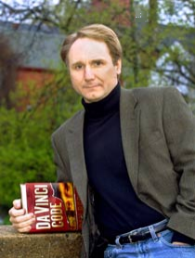
The Claims in the Preface
"All descriptions of artwork, architecture, documents, and secret rituals in this novel are accurate."
Notes:
Each of these areas have been debunked by art experts (none of whom agree with his interpretations of da Vinci), architects who counter his descriptions of European cathedrals, and historians who deny the rituals he claims as fact.

Slide 49
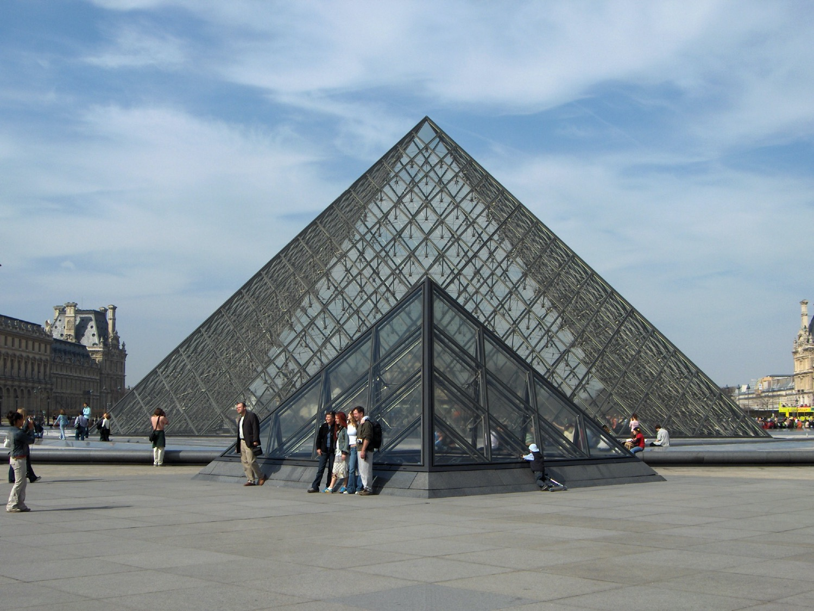
"All descriptions of… architecture… are accurate." Really?
Da Vinci Con
Louvre website
…this pyramid, at President Mitterrand's explicit demand, had been constructed of exactly 666 panes of glass" (DVC, 18).
"673 panes
of glass"

Slide 50
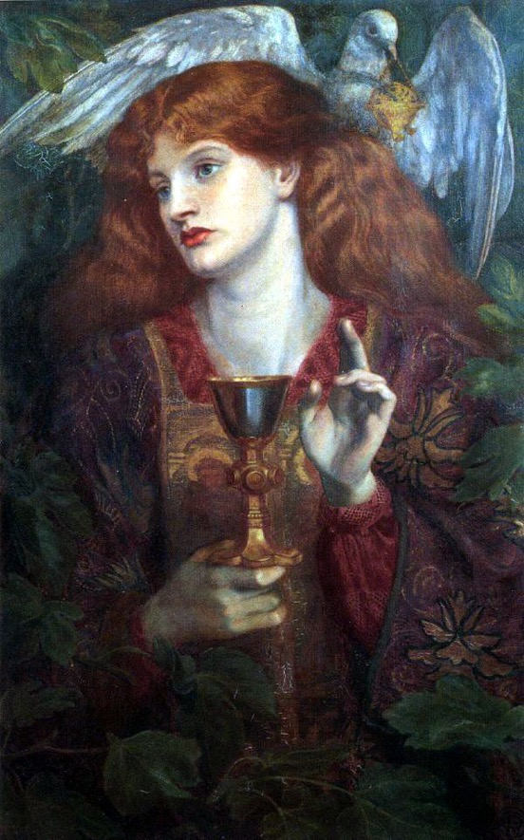
Where did Brown get this stuff?
He notes four books:
THE TEMPLAR REVELATION (1997)
Secret Guardians of the True Identity of Christ
THE WOMAN WITH THE ALABASTER JAR:
Mary Magdalene and the Holy Grail
THE GODDESS IN THE GOSPELS:
Reclaiming the Sacred Feminine
HOLY BLOOD, HOLY GRAIL (1982)
The Acclaimed International Bestseller
Notes:
The last of these is his key source for his claims about Jesus.

Slide 51


Holy Blood, Holy Grail Authors (1982)
ngaibte
Michael Baigent
Richard Leigh
Henry Lincoln
Leigh
Teabing
Notes:
Brown gets most of his ideas from this 1982 book. Even the name of one of the key characters, Leigh Teabing, stems from the authors of Holy Blood, Holy Grail. "Leigh" is repeated, and the letters of "Baigent" get mixed up and form an anagram for "Teabing."

Slide 52
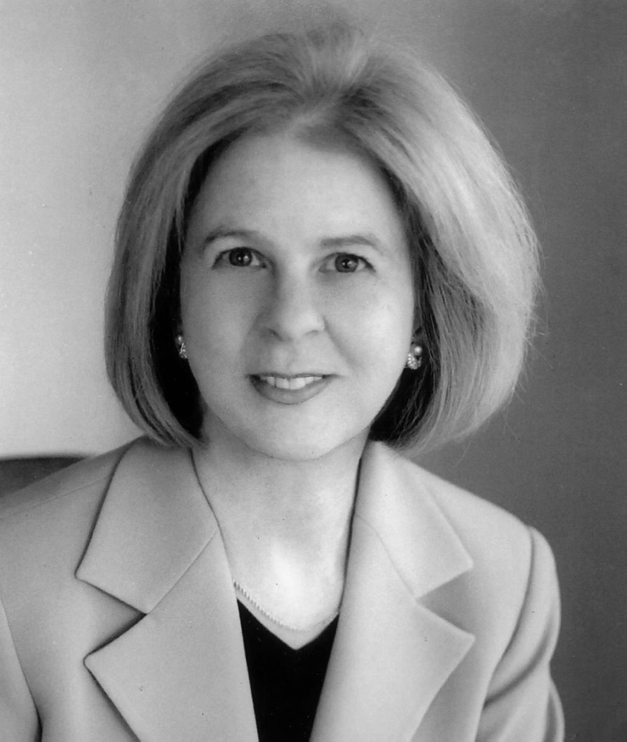
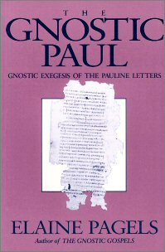
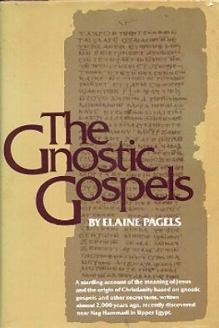
Some Liberal Scholars Back Brown Too
Elaine Pagels teaches at Princeton that first century Christianity was also Gnostic!
Notes:
Pagels is a strong proponent of Gnostic thought which believed that salvation was not by faith in Christ but by receiving a supposed "secret knowledge" from God.

Slide 53
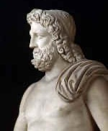
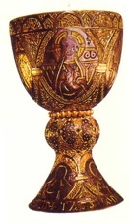
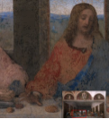

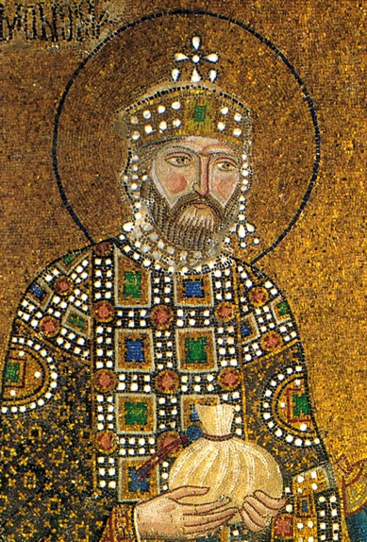
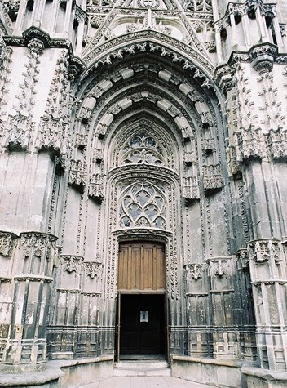

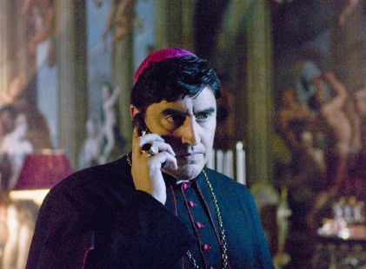
Brown hits on many subjects where people know little…
Art
Ancient documents
Pagan Religions
The Grail
Church Architecture
Early church history
Conspiracy
Theories
Knights Templar

Slide 54

Our Evaluation…
Historical Errors
Art Errors
Bible Interpretation Errors
Notes:
This presentation will largely address these three broad areas.

Slide 55
Historical Errors
Notes:
The history of America's Christian origins has disappeared in recent years, and the Japanese have erased traces of their WWII atrocities from their history books. What is Dan Brown's rewriting of early Christian history?

Slide 56
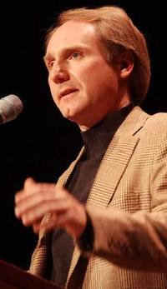
Brown's "Winner" Idea
"History is always written by the winners. When two cultures clash, the loser is obliterated, and the winner writes the history books—books which glorify their own cause" (DVC, 215)
Is this true?

Slide 57

Who were the "Winners"?
Romans "beat" Christians but the NT books still survived
Competing views of history often coexist
History is still revised by losers (e.g., Japanese)
Notes:
Paul Maier also notes, "I can give you some interesting instances where history was written by the losers. For example, one of the greatest civil wars in the ancient world was the famous Peloponnesian War. [Its history] was written by Thucydides, who was an Athenian, and the Athenians lost the war. Sparta won. And yet, Thucydides wrote a very objective treatment of what happened in the Peloponnesian War" (in Lee Strobel and Garry Poole, "Exploring The Da Vinci Code" (Grand Rapids: Zondervan, 2006), 16.

Slide 58
Smearing History
Brown
"Gospel"
Matthew
Mark
Luke
John
Selected for their "Male Bias"
Supposed 80 Gospels!
Matthew
Mark
Luke
John
Gospel
Truth
18 Heretical Gospels Written
1st Cent.
AD 325
Council of Nicaea
Notes:
In reality, of the 20 issues discussed at Nicaea, not one of them related to the correct books for the NT.

Slide 59
Clearing History
Acceptance of the Four Gospels Before Nicaea
Individuals
Didache (120-150)
Papias (130-140)
Pseudo-Barnabas (70-130)
Clement of Rome (95-97)
Polycarp (110-150)
Irenaeus (130-202)
X= Citation
or allusion
Hermas (115-140)
O= Named
as authentic
Matthew
Mark
Luke
John
X
X
X
X
X
O
X
X
X
O
X
X
X
O
X
X
X
O
Gospel of Thomas
AD 50-140
Gospel of Judas
AD 170?
1st Cent.
AD 325
Council of Nicaea
Geisler & Nix, Introduction to the Bible (Chicago: Moody, 1968)
Notes:
This is found in H. Wayne House, Chronological & Background Charts to the New Testament, It is also the last page of the notes for this seminar. The point here is that our four gospels were consistently cited whereas "Brown's Gnostic gospels" were likely not even written until the second century (even if Thomas appeared as early as AD 50 it was still deemed heretical).

Slide 60

Irenaeus (AD 180)
"They declare that Judas the traitor was thoroughly acquainted with these things, and that he alone, knowing the truth as no others did, accomplished the mystery of the betrayal; by him all things, both earthly and heavenly, were thus thrown into confusion. They produce a fictitious history of this kind, which they style the Gospel of Judas."
Against Heresies 1.31.1
Notes:
http://www.ccel.org/fathers2/ANF-01/anf01-60.htm#P7477_2003920

Slide 61
Irenaeus (AD 180)
"It is not possible that the Gospels can be either more or fewer in number than they are. For, since there are four zones of the world… and four principal winds… it is fitting that [the Church] should have four pillars…." (then he lists Matthew, Mark, Luke & John)
Against Heresies 3.11.8
Notes:
http://www.ccel.org/fathers2/ANF-01/anf01-60.htm#P7477_2003920

Slide 62
Irenaeus (AD 180)
"Matthew also issued a written Gospel among the Hebrews in their own dialect, while Peter and Paul were preaching at Rome, and laying the foundations of the Church. After their departure, Mark, the disciple and interpreter of Peter, did also hand down to us in writing what had been preached by Peter. Luke also, the companion of Paul, recorded in a book the Gospel preached by him. Afterwards, John, the disciple of the Lord, who also had leaned upon His breast, did himself publish a Gospel during his residence at Ephesus in Asia."
Against Heresies 3.1
Notes:
http://www.ccel.org/fathers2/ANF-01/anf01-60.htm#P7477_2003920

Slide 63
Clearing History
Acceptance of the Four Gospels Before Nicaea
Individuals
Canons
Translations
Origen (185-254)
Didache (120-150)
Papias (130-140)
Pseudo-Barnabas (70-130)
Clement of Rome (95-97)
Polycarp (110-150)
Justin Martyr (150-155)
Irenaeus (130-202)
Hermas (115-140)
Marcion (140)
Cyril of Jerusalem (315-386)
Tatian Diatesseron (170)
Old Latin (150-170)
Muratorian (170)
Barococcio (206)
Old Syriac (200)
X= Citation
or allusion
Apostolic (300)
O= Named
as authentic
Matthew
Mark
Luke
John
O
O
O
X
X
X
X
X
O
X
X
O
O
O
O
X
X
X
O
X
X
O
O
O
O
O
O
O
X
X
X
O
X
X
O
O
O
O
O
O
O
O
X
X
X
O
O
X
O
O
O
O
O
O
O
Gospel of Thomas
AD 50-140
Gospel of Judas
AD 170?
1st Cent.
AD 325
Council of Nicaea
Geisler & Nix, Introduction to the Bible (Chicago: Moody, 1968)
Notes:
This is found in H. Wayne House, Chronological & Background Charts to the New Testament. It is also the last page of the notes for this seminar. The point here is that our four gospels were consistently cited whereas "Brown's Gnostic gospels" were likely not even written until the second century (even if Thomas appeared as early as AD 40 it was still deemed heretical).

Slide 64
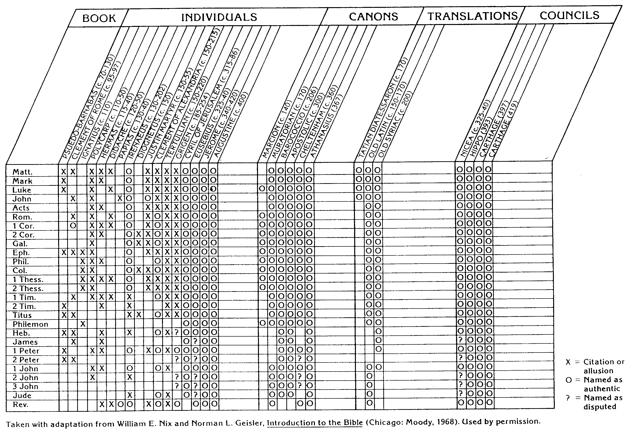
NT Canon during 1st 4C
For Further Details see...
The NT Canon in the First Four Centuries
H. Wayne House, Chronological & Background Charts to the NT
Notes:
This page appears at the end of your notes. Note that the first council that officially affirmed our 27 NT books was not Nicaea, but Hippo in 393.

Slide 65
NT Canonicity
Requirements
What did it take for early documents to be considered Scripture?
Written by Apostle (or under an Apostle)
Widely Accepted (used by churches)
Theologically Sound (no false doctrine)
None of these applied to the books Dan Brown says were the "real Scripture," such as the Gospel of Philip & Gospel of Thomas
Notes:
The "canon" or "rule" meant the officially recognized books of Scripture. None of the councils DETERMINED this list. They only AFFIRMED what the church had believed for generations.

Slide 66
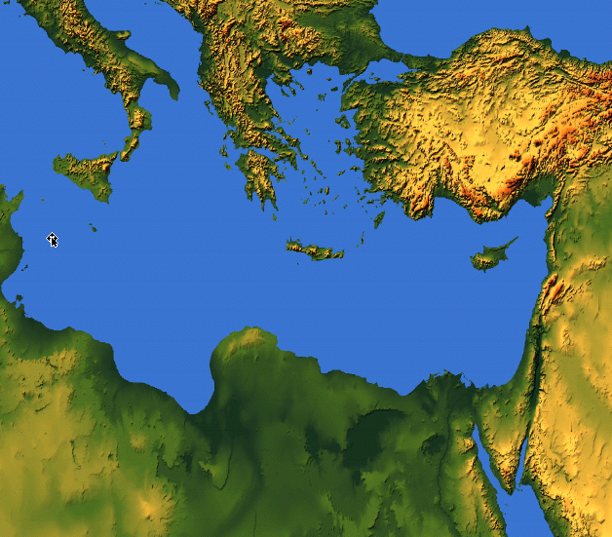
Paul Called Luke's Gospel "Scripture" within 5 years!
For the Scripture says, "Do not muzzle the ox while it is treading out the grain," and "The worker deserves his wages" (1 Timothy 5:18).
Macedonia
Paul Wrote 1 Timothy
AD 62
Caesarea
Luke Written
AD 57-59
Stay in that house, eating and drinking whatever
they give you, for
the worker deserves his wages… (Luke 10:7)
Notes:
Look how EARLY certain books were deemed to be Scripture!

Slide 67
Peter Also Called Paul's Letters "Scripture"!
Paul's Letters Written
AD 49-62
Rome
Peter Wrote 2 Peter
AD 64
"…Our dear brother Paul also wrote to you with the wisdom God gave him. He writes the same way in all his letters, speaking in them of these matters. His letters contain some things that are hard to understand, which ignorant and unstable people distort, as they do the other Scriptures, to their own destruction" (2 Peter 3:15-16)
Notes:
Paul still had three more letters to write (1-2 Tim. Tit) when Peter deemed what he had ALREADY written as Scripture on par with the OT.

Slide 68
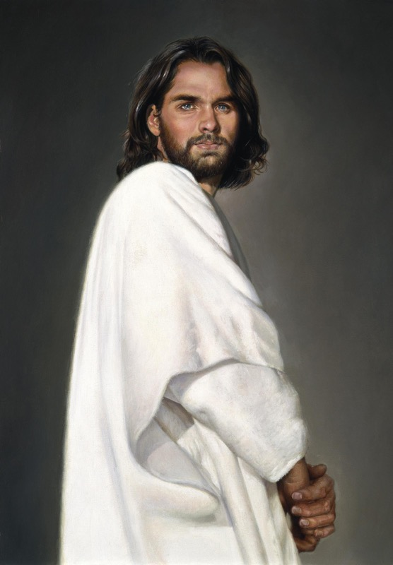
Who is Jesus Christ… really?
Brown:
Bible:
Only human
God-Man
Notes:
Now let's turn our attention away from historical inaccuracies about the canon to the early view of Jesus himself.

Slide 69

Brown's view of Jesus through "historian" Leigh Teabing…
"My dear," Teabing declared, "until [AD 325], Jesus was viewed by His followers as a mortal prophet... a great and powerful man, but a man nonetheless. A mortal."
[Sophie:] "Not the Son of God?"
"Right," Teabing said. "Jesus' establishment as 'the Son of God' was officially proposed and voted on by the Council of Nicaea."
DVC, 197

Slide 70
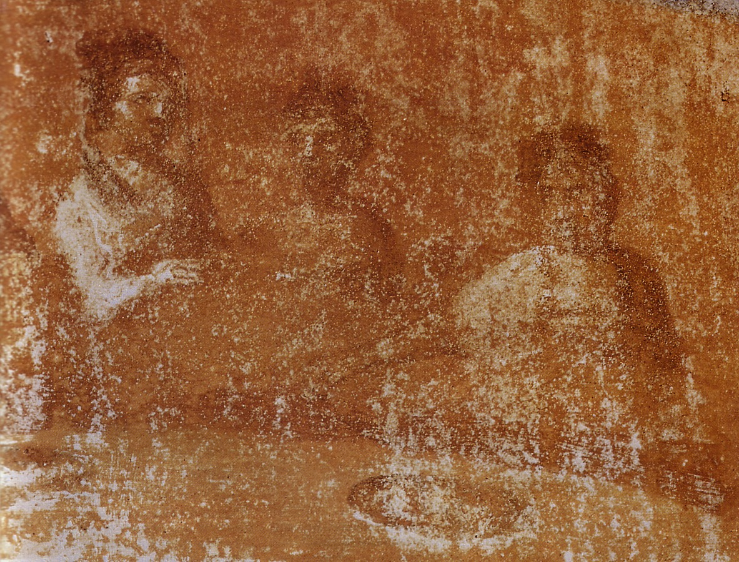
So what did the early Church really believe about Jesus?
Notes:
Here is where Brown rewrites not only the history of what unbelievers thought--he rewrites Christians' view of Jesus.

Slide 71
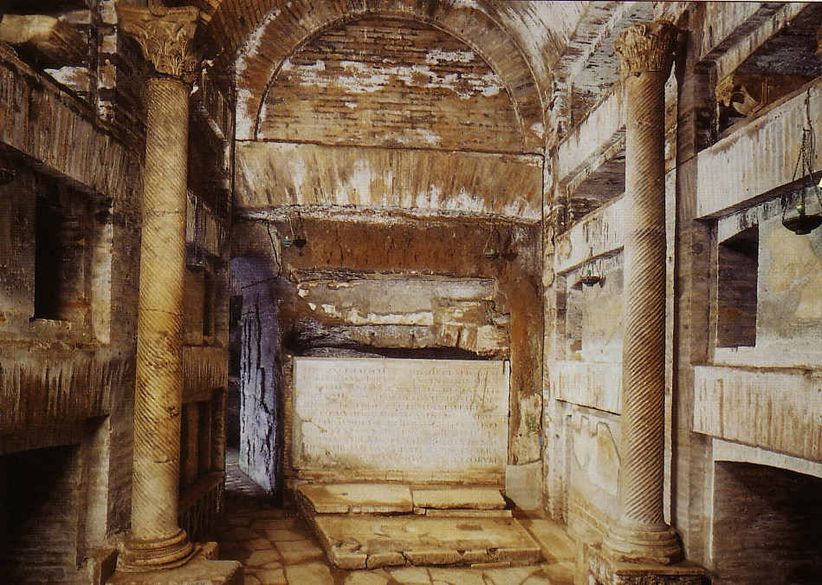
Would Christians who "believed that Jesus was only a man" really need to worship secretly in the catacombs? Nonsense!
Notes:
EVERYONE believed that Jesus was a man.

Slide 72

Would Christians who "believed that Jesus was only a man" die as martyrs? Hardly!
Ignatius, Bishop of Antioch, refused emperor worship and was brought to Rome to be fed to wild beasts.
Notes:
The Romans would have had no problem with Christians who only believed Jesus was a man. Their disagreement came with the Christian belief that Jesus was GOD.

Slide 73

Perpetua's Martyrdom (AD 203)
Notes:
Even women paid the ultimate price.

Slide 74


Alexander versus the Heretic Arius
Father
Father
Son
Son
Creation
Creation
John D. Hannah, Charts of Ancient & Medieval Church History (Grand Rapids: Zondervan, 2001)
Notes:
We have come today to worship Jesus Christ. But why do we believe what we do about Jesus? It’s because the NT says so—but how we interpret it came through seeing what heretics taught too. For example, two hundred years after Christ, Alexander was a key leader who held to the orthodox view that the Father and Son stood apart from creation.
• However, Alexander was the “boss” of the pastor Arius in his city. Arius believed only the Father to be separate from creation. Arius taught that the Father created Jesus, then Jesus created the world after this.

Slide 75


What About Nicea
(AD 325)?
Nicea
Bishops throughout the Eastern Empire gathered & excommunicated Arius of Alexandria
Alexander
Arius
The Atlas of the Bible and the History of Christianity, ed. Tim Dowley (London: Three’s Company, 1997), 77
Notes:
Nicea was a city in what is modern NW Turkey. It was the place where the controversy was resolved and a creed developed.
• The conflict was between Alexander and Arius in Alexandria, Egypt.
• However, to affirm the biblical teaching, 300 church leaders gathered together in the city of Nicea. Here by a vote of 300 to 3 the bishops rejected Arius.

Slide 76
What About Nicaea?
300 votes
Fiction
Fact
3 votes
Arians:
"Jesus Not God"
Orthodox:
"Jesus is God"
Arians:
"Jesus Not God"
Orthodox:
"Jesus is God"
AD 325
Council of Nicaea
Notes:
Brown claims (without support) that the Nicaea vote on whether Jesus was co-eternal with God was very close. The truth is that the vote of the 302 leaders present was 300 to 3. Along with Arius, "The two dissenting bishops were Secundus of Ptolemais and Theonas of Mamarica, both Libyan bishops associated with Arius. All three went into exile after the Council of Nicea" (Paul L. Maier in The Da Vinci Code: Fact or Fiction? with Hank Hanegraaff [Wheaton: Tyndale, 2004], 15, n. 6, on p. 73).

Slide 77

1st century belief in Deity
Paul:
"Christ, who is God over all"
Rom. 9:5
Peter:
"God and Savior Jesus Christ"
2 Pet. 1:1
The Father:
"About the Son He says, 'Your throne, O God…'" Heb. 1:8
Jesus:
"I and the Father are one"
John 10:30
Notes:
There is NO doubt that the earliest Christians believed that Jesus was God! Hebrews 1:8 gives us the witness of the Father himself, and where can one find a more reliable witness than God himself?

Slide 78

Belief in Christ's Deity Before Nicaea
Ignatius: "God Himself was manifest in human form" (AD 105)
Clement: "It is fitting that you should think of Jesus Christ as of God" (AD 150)
Irenaeus: "He is God, for the name Emmanuel indicates this" (AD 180)
Tertullian: "… Christ our God" (AD 200)
Origen: "No one should be offended that the Savior is also God" (AD 225)
Lactantius: "We believe Him to be God"
(AD 304)
Bercot, 93-100 in Garlow & Jones, 94
Notes:
Over and over the early church fathers affirmed that Jesus was God--all long BEFORE Nicaea!

Slide 79

The Nicene Creed (AD 325)
We believe in one God,
the Father All Governing,
Creator of all things
visible and invisible;
And in one Lord Jesus Christ,
the Son of God,
Light from Light,
true God from true God
John D. Hannah, Charts of Ancient & Medieval Church History (Grand Rapids: Zondervan, 2001)
Notes:
The orthodox view won out and was expressed in the Nicene Creed. Let’s remind ourselves of this important teaching as we affirm aloud this great summary of Christian teaching. Reading together…(recite text)

Slide 80
The Nicene Creed (AD 325)
begotten not created,
of the same essence
as the Father,
through whom all things
came into being,
both in heaven and on earth;
Who for us men and for our salvation
came down and was incarnate,
becoming human.
John D. Hannah, Charts of Ancient & Medieval Church History (Grand Rapids: Zondervan, 2001)

Slide 81
The Nicene Creed (AD 325)
He suffered
and the third day he rose,
and ascended
into the heavens.
And he will come to judge
both the living and the dead.
And we believe in the Holy Spirit.
John D. Hannah, Charts of Ancient & Medieval Church History (Grand Rapids: Zondervan, 2001)

Slide 82


The Arian Controversy and Trinitarianism
John D. Hannah, Charts of Ancient & Medieval Church History (Grand Rapids: Zondervan, 2001)
Notes:
Unfortunately, Nicea did not end the Arian controversy, which later resurged until its final rejection almost 60 years later.

Slide 83

The Resurgence of Arianism
John D. Hannah, Charts of Ancient & Medieval Church History (Grand Rapids: Zondervan, 2001)
Notes:
God raised up Basil and the "Two Gregorys" to finally nail the coffin in Arianism. (However, this same heresy came back in the 1800s in a cult called Jehovah's Witnesses which teaches that Jesus was created by the Father.)

Slide 84

Romans worshipped many gods and goddesses, but the high God Jupiter was male.
Notes:
Brown's other preposterous claim is that pagan religion in the first century was matriarchal. While females goddesses certainly were worshiped, NOT ONE ancient religion had a female as the high god. I teach the religions of the Assyrians, Egyptians, Babylonians, Philistines, Canaanites, Edomites, Moabites, and Ammonites. All are polytheistic but NONE have a female high god.

Slide 85


Gnostics Favored Men Anyway
Simon Peter said to them, "Make Mary leave us, for females don't deserve life."Jesus said, "Look, I will guide her to make her male, so that she too may become a living spirit resembling you males. For every female who makes herself male will enter the kingdom of Heaven."
Gospel of Thomas
Saying 114
(final verse)
Notes:
Even Brown's understanding of Gnosticism is flawed. This heresy was flatly anti-feminine. It is no wonder that he makes no mention of this last verse of the second-century Gospel of Thomas! Sometimes facts can harm one's thesis.
http://www.gnosis.org/naghamm/gosthom.html
THE GNOSTIC SOCIETY LIBRARY
The Nag Hammadi Library
The Gospel of Thomas
Translated by Stephen Patterson and Marvin Meyer(

Slide 86


What is the Grail?
Tradition says it was the cup of the Last Supper
Brown says the Grail is the womb of Mary Magdalene that carried Jesus' bloodline!
Notes:
Now our study of historical errors must go farther into church history to 1000 years after Christ.

Slide 87

FACT:
The Holy Grail legend first appeared in 1170 in Perceval, a romantic tale about a legendary King Arthur and his kingdom of Camelot. The Grail was never linked to Mary Magdalene until Holy Blood, Holy Grail (1982).
FICTION:
Supposedly the
"V" shape of cup = "V" shape of Mary's womb
Notes:
Amazingly, the shape of the letters is given as "proof" Mary carrying the bloodline of Christ. This idea doesn't stem from Brown, though, as it is traced back to the "ancient date" of 1982…

Slide 88

Knights Templar
Founded in
AD 1118
to guard pilgrims traveling to the Holy Land
Notes:
The Knights Templar were named after their occupation of the Temple Mount in Jerusalem.

Slide 89

Brown's Inconsistency
Brown says no one knows what the Knights actually found beneath Temple Mount (p. 218 pb. ed.), then his entire book says they found evidence of Jesus and Mary as his wife (pp. 219ff.)

Slide 90

McKellen as Gandalf
Brown says Templars got wealthy by protecting the "secret of Jesus' marriage"
But their wealth came from protecting grateful pilgrims and selling them relics
Notes:
Even the supposed "scholar" Teabing gets into the action as a Templar. This isn't in the book but appears in the movie.

Slide 91

Brown claims Jesus' bloodline continued in France's royalty (debunked in 1993 in French court of law)
Notes:
This incredible claim would be laughable if it were not so serious an accusation.

Slide 92

The Claims in the Preface
"FACT:
"The Priory of Sion—a European secret society founded in 1099—is a real organization. In 1975 Paris's Bibliothèque Nationale discovered parchments known as Les Dossiers Secrets, identifying numerous members of the Priory of Sion, including Sir Isaac Newton, Botticelli, Victor Hugo, and Leonardo da Vinci…."
THE REAL FACTS:
Three "Priory of Sions" existed:
1100-1617 ??
1956-1957 in France. Here is the official registration of Plantard's Prieur de Sion
1960s-1970s forged documents
Notes:
Brown's claim that the Priory "is a real organization" is an inaccurate claim that the Priory still exists. The original Priory merged with the Jesuits in 1617 and the modern one with the same name was founded to help provide low cost housing in France in 1956. After its quick demise, Pierre Plantard reformed it in the 1960-1970s where he and his followers forged documents.
The Priory document is from Abanes, 55.

Slide 93
The Claims in the Preface
THE REAL FACTS:
Les Dossiers Secrets were forged documents planted in libraries throughout France by Pierre Plantard (1920-2000) to "prove" his right to be king of France!
In 1993 he admitted under oath to a French judge that he had fabricated all these documents relating to his "Priory of Sion" (RBC, 10).
"FACT:
"The Priory of Sion—a European secret society founded in 1099—is a real organization. In 1975 Paris's Bibliothèque Nationale discovered parchments known as Les Dossiers Secrets, identifying numerous members of the Priory of Sion, including Sir Isaac Newton, Botticelli, Victor Hugo, and Leonardo da Vinci…."
Notes:
The forged documents are the only "Evidence" that Brown can cite that da Vinci was a member of the Priory.

Slide 94

Jean-Luc Chaumeil with the 1960s forged documents
BBC2 Timewatch Documentary The History of a Mystery,
aired on 17 September 1996
Notes:
"Jean-Luc Chaumeil shows the "parchments" that were created by Philippe de Cherisey during the early 1960s for Gerard de Sede's 1967 book, L'Or de Rennes given to him by Pierre Plantard"
http://priory-of-sion.com/posd/wikipedia.html

Slide 95

Plantard in red confessed it was forged by Philippe de Cherisey
BBC2 Timewatch Documentary The History of a Mystery,
aired on 17 September 1996
Notes:
"Close-up of the smaller 'parchment' showing Plantard's annotation in red ink explaining that the 'parchment' was the handiwork of Philippe de Cherisey (from the same above documentary)"
http://priory-of-sion.com/posd/wikipedia.html

Slide 96

Philippe de Cherisey's handwriting
"Therefore I feel completely free to call myself the sole author of this joke… If today I am only a half-prankster, then shortly I will be a full one" (translation from French)
Discovery Channel satellite documentary Conspiracies On Trial: The Da Vinci Code, first aired on 10 April 2005
Notes:
Close-up of Philippe de Cherisey's handwriting from his unpublished document "Stone and Paper" explaining that he was the creator of the "parchments" and that it was all a joke… Philippe de Cherisey also wrote in "Stone and Paper" Alors je me sentirai tout a fait a lﾕaisle pour me declarer l unique auteur de cette plaisanterie ﾉ Que si aujourd hui je ne serai qu un demi-faceur, jen serai bientot un complet ("Therefore I feel completely free to call myself the sole author of this joke… If today I am only a half-prankster, then shortly I will be a full one") the decoding process of the "parchments" follows this handwritten declaration by Philippe de Cherisey (from the Discovery Channel satellite documentary "Conspiracies On Trial: The Da Vinci Code," first aired on 10 April 2005
http://priory-of-sion.com/posd/wikipedia.html

Slide 97

No Support!
Brown's only "support" that Mary is the grail is his reliance on the forged documents of Pierre Plantard

Slide 98

Claims in the Preface
"FACT…
"The Vatican prelature known as Opus Dei is a deeply devout Catholic sect that has been the topic of recent controversy due to reports of brainwashing, coercion, and a dangerous practice known as 'corporal mortification.' Opus Dei has just completed construction of a $47 million World Headquarters at
243 Lexington Avenue in New York City."
Notes:
This study makes no attempt to defend Catholicism's prelature Opus Dei. For a Catholic defense, see Carl Olson, The Da Vinci Hoax. Ignatius Press, 2004 in the bibliography. Brown's citation of an expensive headquarters is given as a slur to the Catholics. If wealth alone slurs a person or organization, Brown is very suspect. His blasphemy in The Da Vinci Code has made 20 times what the Catholics spent on their Opus Dei headquarters.

Slide 99

Holy Blood Through Catholic Women?
Hardly!
Notes:
It is no wonder that Brown rarely if ever enters the public debate over his book. His so-called "facts" are only his imagination or reliance upon quasi-historians and forged documents.

Slide 100
Art
Errors
Notes:
I'm no expert in art--but neither is Dan Brown. So in this next section we'll look at what some experts say about Brown's interpretations of art.

Slide 101


Is Mona really Leonardo?!
=
Notes:
Brown makes the amazing claim that Leonardo's Mona Lisa was a self-portrait. This genius had over 6000 notebooks of ideas and sketches, but only one picture of himself on the right. Brown says he is on the left too!

Slide 102

How Feminine was Mona?
"By lowering the countryside on the left, Da Vinci made Mona Lisa look much larger from the left side than from the right side. A little Da Vinci inside joke. Historically, the concepts of male and female have assigned sides—left is female, and right is male. Because Da Vinci was a big fan of feminine principles, he made Mona Lisa look more majestic from the left than the right"
(Da Vinci Code, 204).
Notes:
This quote is from Robert Langdon's class lecture…

Slide 103


Brown's book angers Mona Lisa
That's because her real name was
Lisa Gheradini Giocondo
The Mona Lisa (La Gioconda)
Paris, Musee du Louvre
Notes:
If Mona could respond to Brown's claims I suspect she wouldn't be too happy…

Slide 104

The Mona Michael
A classic painting of the confusion of the sexes
Notes:
Brown is not the only one that has confused the sexes…

Slide 105

The Last Supper
What is the focal point of this painting of 13 people?
"The Last Supper practically shouts at the viewer that Jesus and Magdalene were a pair" (DVC, 205). Oh, really?
Notes:
This painting is at the heart of the controversy. Notice how the twelve disciples are grouped into four groups of three men each. Who's the focal point? Jesus, of course. Yet Brown says that the painting practically screams at us that Jesus and "Mary" are a pair!

Slide 106
The Last Supper
"M" for Matrimonio or Mary Magdalene?
DVC, 206
Notes:
Brown sees a big "M" here which he thinks hints that it's actually Mary Magdalene at his side. He doesn't note that it actually cuts right through Peter and Judas!

Slide 107
The Last Supper
Notes:
I asked my 19-year-old son and he didn't see a "M" although he did see a "W."

Slide 108

The Last Supper
Notes:
Actually, I see another "M" because, after all, they were eating supper, right?

Slide 109

A Closer Look…
Notes:
Brown says that the "V" formation between John and Jesus is supposed to hint of the feminine since "V" is a feminine clue. Others say it is for "Veritas" which in Latin means truth! In truth, Leonardo is depicting the moment after Jesus announces to the disciples that one of them would betray him, Peter motions to John with his hand and whispers out of Judas' hearing to ask Christ who the betrayer is (John 13:25). (James has a similar motion with his hand on the left.)

Slide 110

Who is this?
Sophie examined the figure to Jesus' immediate right, focusing in. As she studied the person's face and body, a wave of astonishment rose within her. The individual had flowing red hair, delicate folded hands, and the hint of a bosom. It was, without a doubt... female. "That's a woman!" Sophie exclaimed. Teabing was laughing. "Surprise, surprise. Believe me, it's no mistake. Leonardo was skilled at painting the difference between the sexes" (Da Vinci Code, 204).
Notes:
Brown neglects to also point out that Jesus also has long hair. Also, a "hint" of a bosom doesn't prove a bosom!

Slide 111

Who is this?
John?
or Mary?
Was Mary Magdalene His wife!?
No, da Vinci only depicts John in typical Florentine fashion as "the beautiful young man"
Notes:
The typical manner to paint the youngest disciple at that time was to give him a younger or more effeminate sense. The same is true today as older men typically have more masculine features. "Other Renaissance painters, including Raphael and Bronzino, also depicted men with feminine features. Also, da Vinci was known to have occasionally used a female model to portray John" (Cheong Suk-Wai, "Da Vinci Defamed?" The Sunday Times, May 14, 2006, page L8).

Slide 112



The Virgin of the Rocks
Virgin of the Rocks
Paris, Musee du Louvre
Virgin of the Rocks
London, National Gallery
Notes:
Brown has elaborate theories of Baby John the Baptist on the right blessing Baby Jesus on the left, which supposedly is reversed in da Vinci's second version of the painting on the right.

Slide 113


"Just about everything
[Brown] says about Leonardo da Vinci is wrong."
Jack Wasserman,
retired art history professor,
Temple University, Philadelphia
Notes:
Take it from an art expert…
In Patrick Reardon, The Da Vinci Code Unscrambled, Chicago Tribune, February 5, 2004
Image from http://www.jamsarts.com/animated/characters/characte3.htm

Slide 114
"It looks like a young male. I see no breasts"
Jack Wasserman,
retired art history professor,
Temple University, Philadelphia
Notes:
http://sunday.ninemsn.com.au/sunday/cover_stories/article_1527.asp?s=1
The movie shows John put over on the left side of Jesus, leaning against him—which is exactly what the Gospel of John says. The gospel says nothing of Mary leaning on Jesus!

Slide 115
Biblical Interpretation Errors
Notes:
Our final part about Brown's errors concerns his views of Bible texts themselves.

Slide 116

Is the Bible reliable?
Brown accuses via the mouth of "historian" Leigh Teabing…
"The Bible is a product of man, my dear. Not of God… [It] has evolved through countless translations, additions, and revisions. History has never had a definitive version of the book."
DVC, 195
Notes:
We are led to believe that some versions of the Bible have differing numbers of books--and that the fact that the Bible has been translated into more languages than any other book makes it suspect. No, this is a sign of worldwide recognition of it as the Word of God.

Slide 117
Extant Copies of Pagan vs. NT Writings
# | Author | When Written | Earliest Copy | Time Span | Number of Copies
6 | Plato | 347 BC | AD 900 | 1200 yrs | 7
12 | Catullus | 54 BC | AD 1550 | 1600 yrs | 3
14 | Pliny | AD 113 | AD 850 | 750 yrs | 7
NT | Paul, Luke, etc. | AD 95 | AD 250 | 150 yrs | 24,772
Notes:
The Bible comes out FAR better than ANY ancient document in terms of age and number of manuscript copies. The Greek copies number about 14,000 of these 24,000.

Slide 118


Accuracy of Transmission
This Isaiah scroll matches the A.D. 1000 Masoretic Text upon which all modern translations are based 99% of the time.
Masoretic Isaiah Scroll
Isaiah AD 1000
1200 years earlier!
Isaiah 200 BC
Dead Sea Isaiah Scroll
Notes:
"These are photocopies of the Nag Hammadi and Dead Sea scrolls, which I mentioned earlier," Teabing said. "The earliest Christian records. Troublingly, they do not match up with the gospels in the Bible." (DVC, 207). Christian records? Of the 800 Dead Sea Scrolls, NOT ONE has an NT book. Of the 18,000 fragments, NOT ONE of them is Christian in the least sense. These are all Jewish. As for the Nag Hammadi texts, these are Gnostic, not Christian.

Slide 119


ISAIAH: QUMRAN v. THE MASORETES
200 BC
AD 1000
Of the 166 Hebrew words in Isaiah 53, only seventeen letters in Dead Sea Scroll 1QIsb differ from the Masoretic Text:
10 letters = spelling differences
4 letters = stylistic changes
3 letters = added word for "light" (vs. 11)
17 letters = no affect on biblical teachings
Geisler & Nix, Intro to the NT, 382

Slide 120

Who was Mary Magdalene?
Fictional books are written about her, attributing all kinds of non-biblical teaching
What does the New Testament tell us?
Notes:
Summarized from bock, 16-19

Slide 121

Who was Mary Magdalene?
A prostitute?
"Magdalene was no such thing. That unfortunate misconception is the legacy of a smear campaign launched by the early Church. The Church needed to defame Mary Magdalene in order to cover up her dangerous secret… her marriage to Jesus Christ."
Da Vinci Code, 205
Penance of Mary Magdalene
El Greco (1587-97)
Oil on canvas 109 x 96 cm
Museu del Cau Ferrat, Barcelona
Notes:
Summarized from Bock, 16-19

Slide 122

Who was Mary Magdalene?
Beneficiary of exorcism by Christ
Disciple who traveled with Jesus in a group of women
From the city of Magdala (no husband is named, as in Mary, the wife of Clopas)
Notes:
Summarized from Bock, 16-19. Married women were named after their husband, not their city of origin--as in the case of Mary Magdalene, whose hometown of Magdala was located on the west side of the Sea of Galilee.

Slide 123

Who was Mary Magdalene?
Witness of Christ's crucifixion and burial
Witness of Christ's resurrection
Notes:
Summarized from Bock, 16-19

Slide 124

Who was Mary Magdalene?
"Mary the Penitent"
What was she repentant about?
The Repentant St Mary Magdalene
By Domenico Feti (1617-21)
Oil on canvas, 98 x 78.5 cm
Galleria Doria-Pamphili, Rome
Notes:
Summarized from Bock, 16-19

Slide 125

Luke 7:36-50
Jesus and the Sinful Woman
Notes:
Luke 7 alone notes a "sinful woman" who anointed Jesus' feet at the home of Simon the Pharisee. Since Mary Magdalene was listed among the women of Luke 8, some confuse her with the sinful woman of Luke 7, who presumably was a prostitute. (A similar but different anointing later in Christ's life in John 12 was also performed by Mary of Bethany, who was sister of Lazarus.)

Slide 126

Smearing Mary
Council of Nicaea
Pope Gregory
Why restore her reputation here? It wasn't tarnished yet!
Delivered from Demons
Confused her with sinful woman who washed Jesus' feet
1st Cent.
AD 325
AD 591
Notes:
Pope Gregory was the first to make this confusion of the sinful woman with Mary Magdalene, but this came almost four centuries AFTER Nicaea, which Brown says was supposedly covering up her marriage to Jesus!

Slide 127

Mary Magdalene as the "Companion" (Wife) of Christ
And the companion of the [...] Mary Magdalene. [...] loved her more than [all] the disciples [and used to] kiss her [often] on her […]. The rest of the disciples [...]. They said to him "Why do you love her more than all of us?"
Gospel of Philip 63:32-64:10
(Gnostic NT Apocrypha)
Adapted from http://www.gnosis.org/naghamm/gop.html
Notes:
Here is the ONLY ancient text about Jesus and Mary Magdalene that notes anything close to affection between them. Yet it is hardly convincing. The brackets indicate an ellipsis, or break in the manuscript where we have to supply a word.
http://www.gnosis.org/naghamm/gop.html with adaptations by Bock, 21
Image is of the Gospel of Thomas on the same site.

Slide 128

Mary Magdalene as the "Companion" (Wife) of Christ?!
And the companion of the [...] Mary Magdalene. [...] loved her more than [all] the disciples [and used to] kiss her [often] on her […]. The rest of the disciples [...]. They said to him "Why do you love her more than all of us?"
Gospel of Philip 63:32-64:10
(Gnostic NT Apocrypha)
But…
This is a second-century heretical work.
If Jesus really was married then why would the disciples be jealous?
"Companion" need not indicate a wife. Jesus had several traveling companions, many of them women.
The word rendered "mouth" is obscured in the original and so translators supply it. It could just as easily been her head, hand, or cheek, as in Philip 58:34-59:4.
Notes:
http://www.gnosis.org/naghamm/gop.html
Image is of the Gospel of Thomas on the same site.

Slide 129


Also Noting a "Kiss"…
"For it is by a kiss that the perfect conceive and give birth. For this reason we all kiss one another. We receive conception from the grace which is in one another"
(Gospel of Philip 58:34-59:4)
This is obviously a kiss of fellowship,
presumably on the cheek!
Notes:
From Bock, 21-22.

Slide 130

Luke 2:52
Jesus grew in…
Wisdom
Stature
Favor with God
Favor with Man
Notes:
This is not to say that Jesus was not a man. Luke records that he was a man in the fullest sense.

Slide 131

Was Jesus really single?
Notes:
However, was Jesus single? Brown rightly notes that most men were married in Christ's time--as in most cultures today. However, he then presumes that since MOST were married, then Jesus must have been married: "Because Jesus was a Jew," Langdon said, taking over while Teabing searched for his book, "and the social decorum during that time virtually forbid a Jewish man to be unmarried. According to Jewish custom, celibacy was condemned, and the obligation for a Jewish father was to find a suitable wife for his son. If Jesus were not married, at least one of the Bible's gospels would have mentioned it and offered some explanation for His unnatural state of bachelorhood" (DVC, 207).
http://www.greenwichworkshop.com/media/images/Jesus.jpg

Slide 132



Essenes remained single.
180
Notes:
Brown neglects to note that an entire sect of Jews were bachelors. They were called Essenes who committed themselves to copying the Scriptures.

Slide 133

Does it matter if Christ married?
Marriage is an honorable institution created by God.
But had Jesus married, the NT would have noted this significant point.
Notes:
There is not ONE mention in all ancient sources of Jesus being married--including both orthodox and heretical sources--let alone him being married to Mary Magdalene.

Slide 134

Does it matter if Christ married?
Marriage itself for Jesus would not have destroyed God's plan for Christ.
But had Jesus fathered a child, his offspring would have no sin nature.
Notes:
Romans 5 tells us that the sin nature is passed to children from fathers--not mothers. (My wife sometimes reminds me of this when one of our three sons messes up.) This is how Jesus could have been born sinless even though he had a sinful mother. (The Catholic explanation of how Jesus could have been sinless is that Mary was immaculately conceived, but this only pushes the problem back one generation to ask how this could have happened to Mary, since BOTH of her parents were sinful.)

Slide 135
Brown Blasphemes God's Name
Yahweh
(Supposed "Male Deity")
+
Shekinah
(Supposed "Female Deity")
Notes:
Here is where Brown's blasphemy hits a horrendous level. There is NO evidence for supposing that Judaism worshipped TWO Gods. The basic tenant of Judaism is monotheism, a belief in ONE God.

Slide 136
Monotheism
"Hear, O Israel:
The LORD our God,
the LORD is one"
(Deut. 6:4)
This fundamental Jewish teaching would never allow TWO "gods" in the temple, no less!

Slide 137

Brown's Bizarre Belief
"… the early Jewish tradition involved ritualistic sex. In the temple no less!"
The Da Vinci Code, 411 (paperback)
Notes:
Brown has brought ancient pagan practices into God's holy temple. God wanted to make sure that ritualistic sex would never happen in his house, so he restricted the priesthood to males only. In fact, the word "priestess" does not even appear in the OT.

Slide 138


The Shekinah glory filled God's new palace!
Then the cloud covered the tent of meeting, and the glory of the LORD filled the tabernacle.
Exodus 40:34 ESV
Notes:
Brown has reduced the very glory of God himself to a ritualistic sex symbol. May God have mercy on him.

Slide 139
Brown Blasphemes God's Name
Yah
(Male Deity)
+
Havah
(Female Deity)
= Jehovah?!
Notes:
Brown contradicts his earlier claim that the deity's name was "Yahweh." The reason they didn't teach me this in my Hebrew classes at Dallas Seminary is because this claim is ludicrous.

Slide 140
The Truth About God's Name
YHWH
+
Adonai
= Jehovah
Notes:
Like all Hebrew words, God's name was written without vowels as only four letters, which in English, are rendered YHWH. Jews feared ever saying his name in vain and treated it with such sacredness that they would not even pronounce it at all. Instead, they read "Adonai" ("Lord") in OT readings. Later on the vowels of "Adonai" were added to YHWH to form the word "Jehovah" so Brown's claim of this being a biblical word (especially of sexual union!) is nonsense.

Slide 141
The Summary
Notes:
How can we summarize Brown's thesis? We don't have to since he does a good job of this himself…

Slide 142


Brown's Thesis
"Constantine and his male successors successfully converted the world from matriarchal paganism to patriarchal Christianity by waging a campaign of propaganda that demonized the sacred feminine, obliterating the goddess from modern religion forever" (DVC, 104).
Notes:
In other words, the original feminine Christianity became masculine Christianity by imperial decree. We have already noted that paganism was not strictly feminine since all high gods were male. I should also point out that goddess worship seems hardly eliminated forever.

Slide 143

Brown encourages goddess worship!
Notes:
Sadly, the ultimate experience espoused in Brown's story is a sex ritual with a couple having intercourse with others chanting around them in a circle. Sophie is rightly aghast at this perversion of sex--until she is convinced that all this is the divine design! Brown seeks to bring us back to ritualistic sex outside of marriage. I wonder if his wife agrees with this?

Slide 144



Divine Symbols?
Notes:
The storyline continues with too many symbols to explain: the circle for feminine, the pentagram for paganism, etc.

Slide 145

Modern Gnostics Fuse Symbols…
The symbol, or logo of the Order is definitive of The Marian Order of Mary's Way. The background symbolizes God the Father/Mother. The gold cross symbolizes the Christ. The red heart symbolizes the Holy Spirit.The blue and white sashes draped over the cross form a double M, symbolic of the Order and that Mary has finished the work that Eve began.
http://www.gnostic.org/marys_way_ks/thechapel.html
Notes:
Gnostic teaching such as "M" for Mary Magdalene continues today.

Slide 146





Others Are Trying to Cash in on Brown's Thesis
Same Plot,
Different Names and Places
Notes:
Many hope to make even a fraction of Brown's kind of wealth by inventing all kinds of conspiracy theories about Christianity.

Slide 147


The Unauthorized Biography
This is the only biography on Dan Brown. Drawing on personal interviews with friends, articles and transcripts that date back to his first novel, this story reveals little-known details of Brown's unusual work habits. It investigates why Brown became interested in secret societies, why he has withdrawn from public life and discusses the criticism from Catholics and Protestants.
Notes:
Rogak is an admirer of Brown, though not actually granted an interview by him.

Slide 148

"Saying that Dan Brown's book is about Christianity is like saying 'Finding Nemo' is about marine biology."
"We have just as much evidence to suggest that Jesus was married to Mary Magdalene as we have that clown fish talk."
Kenneth Boa & John Alan Turner, The Gospel According to the Da Vinci Code
Notes:
Well said. Biblical biologists will agree.

Slide 149
Our Context
How could a novel like this achieve such overwhelming success?

Slide 150


Fatalism in Marriage
"So many people expect that fairy tale where everyone is going to be together forever, but I don't subscribe to that. I'd love for it to happen, but I think 10 years with someone is enough."
--Twice divorced actor Jim Carrey
The Internet Movie Database
(www.imdb.com/news/wenn/2004-04-02)
Notes:
Brown's views of "free sex" finds a welcome audience in western society that has largely abandoned the marriage institution. England even has more unmarried living partners than it has married couples.

Slide 151

The Male Brain
Ironing
Toilet aiming cell
Dangerous pursuits
Ball Sports
Ability to change gear
Beer
SEX
SEX
TV remote addiction centre
Listening particle
Beer
Domestic skills
Lame excuses gland
Crotch scratching area
Attention span segment
Avoid all personal questions at all costs segment
Beer
The Male Brain
Notes:
http://www.jwolfe.clara.net/Humour/MedPicts/BrainMaleFemale.gif

Slide 152

The Female Brain
Telephone Skills
Shoe Centre
Indecision Nucleus
Need for Commitment Hemisphere
Jealousy
Chocolate Centre
Listening
Shopping
Sex
Sense of Direction
The Female Brain
Notes:
http://www.jwolfe.clara.net/Humour/MedPicts/BrainMaleFemale.gif

Slide 153

Cathedral Entrance
Notes:
One of the lowest parts of Brown's imagination is his theory that European cathedrals were designed after a woman's body. After entering her via the front door, he supposes one
is in the nave, or womb (DVC, 273-274). Of course, no architects agree with his descriptions and the rest of decent humanity is repulsed.

Slide 154

Life Explained

Slide 155

Danbrown.com on Women
THIS NOVEL IS VERY EMPOWERING TO WOMEN. CAN YOU COMMENT?
Two thousand years ago, we lived in a world of Gods and Goddesses. Today, we live in a world solely of Gods. Women in most cultures have been stripped of their spiritual power. The novel touches on questions of how and why this shift occurred and on what lessons we might learn from it regarding our future.
Notes:
All decent women that I have asked concerning this so-called "empowering" think otherwise. What is so empowering about women once again being reduced to the status of temple sex slave or object of ritualistic perversion by men?
http://www.danbrown.com/novels/davinci_code/faqs.html

Slide 156

It is pagan society that has subjugated women--not Christianity!
Notes:
Let's talk about facts when we speak of Christianity and women.

Slide 157

Common Laborers
Women are often common laborers
in pagan societies today

Slide 158

Hoe Ladies
Notes:
In many non-Christian societies, women do the heavy work while men sip their drinks.

Slide 159

Muslim women suffer 'apartheid'
Some women in other religions are calling into question their treatment of women
TODAY
March 9, 2006
Page 19
Notes:
Comment: Here is another article by ex-PM of Malaysia - Mahathir's daughter. She says that "non-Muslim women have benefited from more progressive laws… while the opposite has happened for Muslim women."
MUSINGS By MARINA MAHATHIR
A FRIEND was relating how after her daughter had read the Da Vinci Code, she had wanted to read the Bible. Which is not in itself a bad thing except that she was concerned that an impressionable young mind would not be able to differentiate fact from fiction. Also it seemed that perhaps what was needed is a Da Vinci Code-type book for Muslims to spark off the same level of interest in young people in their own religion.
Except that if anyone tried to write a similar thriller based around Islam,they'd be hounded and pilloried and threatened with death, thousands would riot in protest and people who would never have been able to read the book either because they are illiterate or can't afford it would have died.
Such is the difference between our religions. While there are many Christians who are upset about the book and movie, they are countering it with seminars and other educational events to balance what is being said in the book, even if the book is only fiction. There have not been Da VinciCode-related riots or deaths thus far. Which speaks volumes for the adherents of the faith.

Slide 160


A "Liberated" Woman Miner
Notes:
How much have women really been liberated by being put into dangerous jobs?

Slide 161





WOW
Bricklayer
(Wider Opportunities for Women)
Electrician
Carpenter
Coach
Notes:
Many see freedom for women by erasing any distinctions between them and men.
www.work4women.org/multimedia/photos.cfm

Slide 162

Women Have Increasing Influence in Society
Notes:
This increasing influence is largely present in societies penetrated by the gospel.

Slide 163

But what does the Bible really say about Women?
Notes:
Does the Bible have a low view of women? I don't think so.

Slide 164
The Bible Exalts Women in Matthew 1
ABRAHAM
Solomon
Shealtiel
Isaac
Rehoboam
Zerubbabel
Jacob
Abijah
Abiud
Tamar
Judah
Asa
Eliakim
Perez
Jehoshaphat
Azor
Hezron
Jehoram
Zadok
Ram
Uzziah
Akim
Amminadab
Jotham
Eliud
Rahab
Nahshon
Ahaz
Eleazar
Salmon
Hezekiah
Matthan
Ruth
Boaz
Manasseh
Jacob
Obed
Amon
Joseph
Mary
Bathsheba
Jesse
Josiah
KING DAVID
JECONIAH (EXILE)
JESUS CHRIST
Notes:
This is the only genealogy that mentions women, showing their exalted status before God.

Slide 165



Sati (Widow Burning) in India killed thousands until William Carey led to its abolishment in 1829
Notes:
Christians have long worked for the rights of women, including the Christian missionary, William Carey. One of his life-time goals was to make sati illegal.
http://www.wholesomewords.org/missions/giants/biocarey2.html

Slide 166

CCC India Staff Women
Notes:
Christianity has given women the freedom and joy of service for Christ, unlike their repression in other religions.

Slide 167


Brown's view of Mona Lisa and John at the Last Supper Blurs the Sexes
The Browna Lisa
Male or female?
Notes:
Buddhism seeks equality for women by erasing male-female differences. Christianity recognizes their differences and yet equal status before God. One artist has given Brown a taste of his own medicine of sex-blurring.

Slide 168


Frey Fabrications
James Frey, author of the 2005 bestseller A Million Little Pieces, confessed in January that he really wasn't a criminal, didn't go to jail, etc.
His Response?
"The writer of a memoir is retailing a subjective story"
Notes:
Frey claimed in his life story in 2005 that he did these things but was called to account this year.

Slide 169

"Much ado about nothing"
Oprah Winfrey's first response when shown that Frey made up parts of his memoir (12 Jan 06)
Two weeks later she changed her view and expressed disappointment in Frey's lying (26 Jan 06)
Notes:
"Why should truth matter?" essentially was the response of Oprah to those who challenged the veracity of her friend, James Frey. When viewers challenged her, she changed her mind.

Slide 170

Entertainment Better Than Truth
[The death of objectivity] "relieves me of the obligation to be right"; it "demands only that I be interesting"
Literary theorist
Stanley Fish
Notes:
Quoted in Michiko Kakutani, "Truth Fast Losing Its Value in Non-Fiction," The Sunday Times, 22 January 2006, p. 33 reprint of The New York Times. Stanley Fish is the Dean of the College of Arts and Sciences at University of Illinois at Chicago and one of the most influential and controversial theorists and critics of literature, law, and philosophy of our time.

Slide 171

"The Enshrinement of Subjectivity"
Movies
Notes:
We used to enshrine (exalt) objectivity in our modern world. Now, in a post-modern world, we exalt subjectivity. Tolerance is our priority now.

Slide 172

"Based on a true story"
The typical prologue to movies that contain some truth
Notes:
Movies no longer say "A True Story." Instead we are left to wonder how much of movies like "Alexander" (2005) has true--50%? 2%?

Slide 173

Today "all literary sources are considered equal"!
Notes:
People still buy tabloids with little care for whether they tell truth or not.

Slide 174
NT Apocrypha: 18 Gospels
GOSPELS
Arabic Gospel of the Infancy
Armenian Gospel of the Infancy
Assumption of the Virgin
Resurrection of Christ by Bartholomew
History of Joseph the Carpenter
Protoevangelium (Infancy Gospel) of James
Notes:
Brown supposes that "all gospels are created equal," including these 18 heretical gospels that came a century after Christ.

Slide 175
NT Apocrypha: 18 Gospels
The Gospel of:
• Bartholomew • the Birth of Mary
• Basilides • Pseudo-Matthew
• Cerinthus • the Hebrews
• the Ebionites • Philip
• Mary Magdalene • Thomas
• Marcion • Infancy Gospel of Thomas
Notes:
These Gnostic works do not amount to "80 gospels" as Brown claims. What they say is so esoteric that few read them.

Slide 176
NT Apocrypha: 21 "Acts"
Apostolic History of Abdias
Fragmentary Story of Andrew
Ascent of James
Martyrdom of Matthew
Passion of Paul
Passion of Peter and Paul
Notes:
Perhaps Brown's "80 gospels" sloppily includes the 16 gospels plus 21 other supposed histories, though none of these (like the Gnostic gospels) is written by an eyewitness. Instead all take on well-known names to take on an air of authenticity.

Slide 177
NT Apocrypha: 21 "Acts"
The Acts of:
• Andrew
• Andrew and Matthias • Peter
• Andrew and Paul • Peter and Andrew
• Barnabas • Peter and Paul
• James the Great • Philip
• John • Pilate
• John by Prochorus • Thaddeus
• Paul • Thomas

Slide 178
NT Apocrypha: Others
APOCALYPSES
James Stephen
Paul Thomas
Peter the Virgin
EPISTLES
Epistles of Christ and Abgarus
Epistle of the Apostles
Third Epistle to the Corinthians
Epistle to the Laodiceans
Epistle of Lentulus
Epistles of Paul and Seneca
Apocryphal Epistle of Titus
Notes:
Even adding these pretend epistles and apocalypses sum up to 50 works.

Slide 179
Brown's Key Sources are Gnostic
Two Types Addressed in 1 John
Docetic Gnosticism
From dokeo, "to seem"
(Christ only seemed to be a man)
Matter is Evil
Depreciated Materialism
Denied Christ's Humanity
Touched Jesus (1:1)
Led to Asceticism
Immorality exalted
Cerinthian Gnosticism
From Cerinthus, founder in Asia
(Christ only seemed to be God)
Spirit is Good
Exalted Knowledge (gnosis)
Denied Christ's Deity
Water & Blood (5:6)
Led to Pride
Education exalted
Notes:
Many Gnostics did the opposite of Brown's thesis--they denied Jesus was a real man. Others exalted the spirit so much that they denied his deity. Brown supposes that this latter heretical group was normative Christianity!

Slide 180

The Gospel of Judas
Judas said, "Master, could it be that my seed is under the control of the rulers?" Jesus answered and said to him, "… you will grieve much when you see the kingdom and all its generation." When he heard this, Judas said to him, "What good is it that I have received it? For you have set me apart for that generation." Jesus answered and said, "You will become the thirteenth, and you will be cursed by the other generations—and you will come to rule over them. In the last days they will curse your ascent [47] to the holy [generation]."
Notes:
Another recent attack is the mantra that the Gospel of Thomas, which is Cerinthian Gnostic--the one that denied Christ's deity.

Slide 181
The Gospel of Judas
Jesus said, "… Truly [I] say to you, Judas... you will exceed all of them. For you will sacrifice the man that clothes me" (sections 55-56).
Notes:
This strange request of Christ for Judas to set him free from his body is the typical Gnostic desire to free oneself from the material world. This is the kind of stuff Brown advocates, but at least there is ONE manuscript of the Gospel of Judas. Brown has NO manuscripts for his heretical beliefs about Jesus and Mary Magdalene.

Slide 182
"The Enshrinement of Subjectivity"
Movies
Commentators serving up opinion instead of news
Talk shows (dozens of them!)
Talk radio (46% of USA radio)
Reality TV
Blogging
Notes:
Many examples of relativism can be cited today. Blogging is perhaps the best example. One used to have to know what he was saying to publicize his views. This was required by the editor and book publisher. Now people can create a blog in ten minutes to share unsubstantiated views with the world apart from a publisher.

Slide 183


Brown Fills in the
"Unknown Middle"
Christians know some about the 1st century
Christians know some about the 21st century
Notes:
Another reason Brown's view have wide appeal is that we are ignorant of history--and too lazy to find out the truth through real research.
http://www.synaxis.org/cn/stjohn/tree_of_church_history.jpg

Slide 184
Our Response
Notes:
How should Christians respond to this heresy? We should riot, burn down the places of worship of those who disagree with us, and kill Dan Brown. OK, so I shouldn't kid about this, but you do know that others have done worse for less offensive claims against their religion. We already noted 1 Peter 3:15, which tells us to answer questions gently and with respect. Let's pray for Dan Brown to come to know the real Jesus, who loves him and died for him.

Slide 185
How Do We Respond to Attacks Against Scripture Today?
1. Know both the Word and the enemy arguments
Presentation_ID
185
185
© 2003 Cisco Systems, Inc. All rights reserved.
185
Notes:
By "enemy" I mean those attacking our faith.

Slide 186

The One Book
Notes:
Of course, don't become an expert on Dan Brown. This heresy will soon pass away, but "the Word of the Lord is forever" so know God's eternal Word better than any book!

Slide 187
danbrown.com
Notes:
Yet still, a little knowledge of Brown can help you gain credibility to talk with people more intelligently since you will know what they have read or seen on the movie screen.

Slide 188













Critiques
Notes:
There are numerous rebuttals to Brown. See the bibliography for books, websites, and DVDs.
Debunking… at www.truthnet.org/davinci/

Slide 189

For a Brief Critique…
Radio Bible Class pdf download at rbc.org
Notes:
I'm recommending this book more than any other. It's also available in Chinese.

Slide 190

For an Audio Critique…
Free iTunes download at apple.itunes
Notes:
I'm recommending this book more than any other. It's also available in Chinese.

Slide 191


Singapore DVC Resource Team
Covenant EFC
Campus Crusade for Christ
Meekness & Truth Ministries
Ravi Zacharias In'l Ministries
www.davincicode.org.sg
Notes:
These four ministries are working together here in Singapore on this excellent website.

Slide 192
My Upcoming Seminar
Wednesday, 31 May (7-10 PM) at International Baptist Church
(81 Kings Road at Farrer & Empress)

Slide 193
What to say to others?
Answer according to where the person is coming from
Person #1
"This is just a work of fiction so I don't understand all the fuss about it."
Tell this person that you agree and let it be.
Notes:
There are three basic types of responses to the film and book. This first person needs you to agree that the DVC claims are unfounded.

Slide 194
What to say to others?
Answer according to where the person is coming from
Person #2
"I didn't know that the church has covered up the truth about Jesus."
Show where the NT itself proves the deity of Christ whereas Brown's use of Pierre Plantard as a key source is a use of forged documents to "prove" his thesis.
Notes:
This person needs a reasoned response.

Slide 195
What to say to others?
Answer according to where the person is coming from
Person #3
"This gives me a reason not to believe.
Counsel this person based on his or her own personal history of where he or she has been hurt by the church.
Notes:
This person needs a pastoral touch. Tell him or her that you care about the hurt that this person feels.

Slide 196

Questions to Ask Others
1. Open: What did you think of the movie?
2. Passion: Why do you think speculation on how Jesus lived stirs so much passion?
3. Cost: Many Christians were persecuted for believing Jesus was God the first 300 years after Christ. Do you think they would die for this belief if they knew it was a lie?
Notes:
What specifically should you say? It's more important to ask good questions than to crusade against the book. Here are six suggestions in order.

Slide 197
Questions to Ask Others
4. Death: Brown does not discuss if Jesus died willingly. If Jesus did not claim to be the Son of God, why didn't he speak up to Pontius Pilate to prevent his death?

Slide 198
Questions to Ask Others
5. Resurrection: It is a fact of history that Jesus' tomb is empty. Can you think of a way to explain the fact of the empty tomb yet also believe that Jesus was just a man as Brown claims?
6. Application: Can I share with you why I believe he is alive and why it makes a difference? (Share the gospel here)

Slide 199

Let the controversy bring you to talk about the cross
Notes:
Brown mentions the cross only in passing as a Christian symbol. We need to complete this with the significance of the cross. Christ died on the cross not for his own sins since he had none. He died for us.

Slide 200



Brown totally misses the significance of the cross

Slide 201

What's So Good About
Good Friday?
Jesus controlled His own arrest
Jesus' illegal trials proved Him innocent
Jesus' death paid for our sin
Jesus' resurrection proved He gives eternal life

Slide 202

Good Friday is good because on this day Jesus Christ paid for your sin.

Slide 203

But Jesus' resurrection proved He is God who can give us eternal life (John 20).

Slide 204

How can we explain the empty tomb?
He never died?
Jesus' strength?
Disciples?
Notes:
Each of us must explain why the body of Jesus was missing on the third day.
To say he never died is preposterous as the Romans were expert executioners.
The theory that the cool tomb refreshed Christ enough to overcome his crucifixion and move the 1.5 ton stone is also ridiculous.
The disciples were the ones LEAST expecting a resurrection, so they are not potential candidates.

Slide 205

What would it take to turn the despondent Peter around?

Slide 206

The empty tomb did it!
Notes:
Nothing short of a genuine miracle would have convinced all eleven disciples to preach his resurrection for a lifetime and then die as martyrs.

Slide 207

Why did John write about Jesus' miracles?
So you can have eternal life by believing in Him!
These [signs] are written so that you may believe that Jesus is the Christ, the Son of God, and that by believing you may have life in his name (John 20:31).
Notes:
The resurrection of Christ is the KEY sign that Christ was indeed who the Bible claims--God himself who took a human body to tell us of his love. And the benefit to us for believing this is no secret…

Slide 208

The Divine Code
For God so loved the world that he gave his one and only Son, that whoever believes in him shall not perish but have eternal life.
John 3:16
Notes:
This may look like a cryptic message but it's actually the best known verse in the Bible. It tells us that God gives us life with him forever when we simply place our trust in Jesus Christ. This is no da Vinci Code. It's the Divine Code!

Slide 209


Jesus rose to give you new life!
Jesus rose to give you new life!
Notes:
In his nearly 600 page paperback that supposedly tells us the "truth" of Christianity, Brown NEVER EVEN ONCE mentions the resurrection of Christ. This is the CHIEF teaching of Christianity--that Christ proved his claims by coming back from the dead.

Slide 210

How can you know Him?
Admit you have sinned
Believe that Jesus died for you
Confess that you want to turn from sin
Notes:
This means Jesus is alive today. This also means you can know him personally. It's as simple as A-B-C. Let's bow our heads and if you wish to come into this new relationship with Christ, please pray to him now, acknowledging these three things to him.

Slide 211
破解
达芬奇密码
These seminar slides are also available in Chinese
A free download at web.me.com/sinaporerick/site/Theology.html
Notes:
If you have Chinese speaking friends or family, please remember to download the more abbreviated simplified text Chinese version of this seminar on my website.

Slide 212
Questions?
Notes:
Let's take a few moments to answer any remaining questions…

Slide 213
Supplements on
Ancient Near East
Women

Slide 214

Ancient Near East Women
Pagan
Israelite
Many laws
Few laws
Property
Person
Inferior to men
Equal to men
Abuse allowed
Honeymoon
Few educated
All educated

Slide 215


Ancient Near East Women
Pagan
Israelite
Veils required
Wedding only
Prostitutes
Prostitution Illegal
Polygamy rare
Polygamy OK
Widow abuse
Widows cared for

Slide 216

Ancient Near East Women
Pagan
Israelite
Adultery guilt
Adultery innocent
Offends property
Offends people
Offends hubby
Offends God too
Varied penalties
Death penalty
Incest banishes
Incest kills

Slide 217

Ancient Near East Women
Pagan
Israelite
No money rights
Some rights
Divorce abuse
Divorce protection
Rape victim
Rape immunity
Sometimes heir
Always heir
Outside work varied
Outside work varied

Slide 218


Ancient Near East Women
Pagan
Israelite
Priestesses
Prohibited
Prophetesses
Rare
Leadership rare
More common
Higher social & legal position
Lower but protected in home

Slide 219

Summary
Jewish women had far greater freedoms than Gentile women
Jewish freedoms gave Christian women the same
Some confuse equality in person as an equality of roles
Freedom for Christian women has given many non-Christian women the same in the world

Slide 220
Supplements on
Mary Magdalene

Slide 221

Was Mary Magdalene the Woman with the Alabaster Jar?
No. In Luke she is not named but in the other gospels she is clearly Mary of Bethany

Slide 222

John 12 Events
64
656
Anointing at Bethany
12:1-11

Slide 223
Luke 7:36-50
Jesus and the Sinful Woman

Slide 224

Anointings of Jesus
Common to all four gospel accounts:
Unannounced visit by woman
Anointed Jesus' feet with her tears
Wiped his feet with her hair
Complaint of waste by disciples/Judas
Disciples rebuked by Jesus
At the home of a man named Simon
Alabaster jar (except in John)

Slide 225

The Two Anointings of Jesus
Luke 7:36-50
Early in Ministry
Weeping
For worship, woman's
sins forgiven (Luke 7:48)
By unnamed harlot at
home of Simon the
Pharisee (Luke 7:40)
John 12:1-11
Matt. 26:6-13; Mark 14:3-9
Began Passion Week
No weeping noted
For burial, woman needed
no forgiveness
By Mary, Lazarus' sister, at home of Simon the Leper
(Matt. 26:6; Mark 14:3)

Slide 226


Theology PPT link at BibleStudyDownloads.org
Get this presentation for free!
Notes:
Theology (th)

Slide 227
Black

