Slide 1

PPT Formats
Dr. Rick Griffith • Jordan Evangelical Theological Seminary • BibleStudyDownloads.org

Slide 2
SBC Title
Dr. Rick Griffith • Singapore Bible College
BibleStudyDownloads.org

Slide 3
Four Objectives:
A Sermon That is…
25
True
Interesting
Clear
Relevant

Slide 4
Black

Slide 5
Black

Slide 6
Black on White

Slide 7
"Scripture" (1: NLT).

Slide 8
"Scripture" (1: NLT).

Slide 9
"Scripture" (1: NLT).

Slide 10
Title
page
Bullets

Slide 11
Title
page
Left
Right

Slide 12
Title
page
Left
Right

Slide 13
Title
page
Left
Right

Slide 14
Title
page
Left
Right

Slide 15
Title
page
Israel
Us

Slide 16
Title

Slide 17
"Scripture" (12: NLT).

Slide 18
Title
Title
Title

Slide 19

Reject Babylon’s idols.
Isaiah
40–48
God, how should we respond to you delivering us from Babylon?
Notes:
40 Comfort/Sovereignty 40:10f. Power, shepherd
41 Cyrus/Israel = Servant
42 Servants contrasted 42:1-3 Spirit, meek, just
43:1–44:5 Restoration
44:6–45:25 God's uniqueness vs. idols
46–48 Babylon's destruction

Slide 20
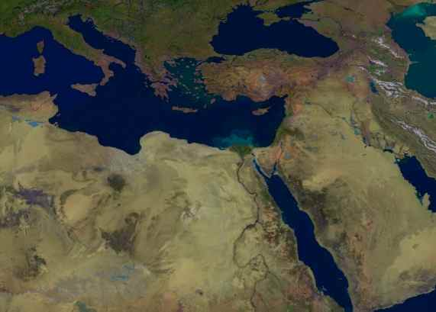
Ezekiel 36:22
219
I am bringing you back, but not because you deserve it. I am doing it to protect my holy name, on which you brought shame while you were scattered among
the nations
Israel
But WHY
would you restore Israel?

Slide 21

"Just do the math."
"God, how old is the earth?"

Slide 22
Cycles in Genesis 1-11
Created
to Rule
1:1–2:3
New Start
8:20–9:17
New Start
11:10-26
World
Failure
6:1–8:19
Family
Failure
2:4–4:26
World
Failure
11:1-9
Family
Failure
9:18-29
=
Seed of Adam
5
Seed of Noah
10
Seed of Terah
11:10-26
The Line of Blessing
Adapted from Mann, Genesis, 13

Slide 23

Walk Thru the Poetical Books
355
Ecclesiastes……..Vanity
Song…..Love in Marriage
“Wisdom can
overcome Life’s Vanities”
“Wisdom can
maintain a godly marriage”
Proverbs 30:31 “Charm is deceitful and beauty is vain, but a woman who fears the Lord will be praised.”
Proverbs 5:18 “Let your fountain be blessed, and rejoice in the wife of your youth.”
Proverbs............Wisdom
“The Fear of the Lord
is the beginning of wisdom.”
Psalm 111:10 “The fear of the Lord is the beginning of wisdom; A good understanding have all those who do His commandments…”
Psalms..............Worship
“Worship develops the
Fear of the Lord”
Job 42:2 “I know that You can do all things, and that no purpose of yours can be thwarted.”
Source:
Walk Thru the Bible Ministries
Job…...........Sovereignty
“Seeing God’s Sovereignty
causes us to worship”

Slide 24
Mark Book Chart
82
Deity Who Models Suffering As Servant
Service |  | Suffering
Sayings and Signs |  | Sacrifice
Galilee & Perea |  | Judea & Jerusalem
Coming | Ministry Opposition | Self- Sacrifice | Resurrection
1:1-13 | 1:14–10:52 | 11–15 | 16
Key Verse
“For even the Son of Man
did not come to be served,
but to serve, and to give his life
as a ransom for many”
(Mark 10:45).
serve
give his life

Slide 25

JUDE
310
Contend Against Pretenders
Why to Contend |  | Chapters 3–41 |  |  |  | How to Contend
Intro |  | Pretenders' Practices |  |  |  | How to Avoid Pretenders' Snares |  |  | Praise for Preservation
Verses 1-2 |  | Verses 3-16 |  |  |  | Verses 17-23 |  |  | Verses 24-25
Greet- ing 1 | Bless- ing 2 | Purpose: Defend the Faith 3-4 | OT Pretenders 5-7 (Past) | Charac-teristics 8-13 (Present) | Judgment on Them 14-16 (Future) | Remember Apostles' Predictions 17-19 | Nurture Self in God's Love 20-21 | Show Mercy to Pretenders' Followers 22-23 | Source of Victory 24 | Only Savior 25
Unknown Origin to Probably Israel
ca. AD 75

Slide 26
82
Job
God’s Incomprehensibility Explains Righteous Suffering
Righteous Suffering |  |  | Unsuccessful Dialogue |  |  |  | Restoration
Chapters 1–2 |  |  | Chapters 3–41 |  |  |  | Chapter 42
Dilemma |  |  | Debate |  |  |  | Deliverance
Ruin |  |  | Reasons |  |  |  | Repentance
Prose |  |  | Poetry |  |  |  | Prose
Heaven and Earth |  |  | Land of Uz (North Arabia) |  |  |  | Heaven and Earth
Job’s Character 1:1-5 | Satan’s Assaults 1:6–2:10 | Job’s Friends 2:11-13 | Cycles 3–26 | Job 27–31 | Elihu 32–37 | God 38–41 | Obedience 42:1-9 | Blessings 42:10-17
Patriarchal Times

Slide 27
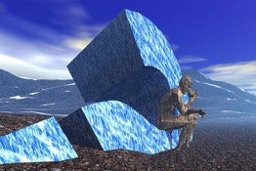
JOB
356
God’s Incomprehensibility Explains Righteous Suffering
Righteous Suffering |  |  | Unsuccessful Dialogue |  |  |  | Restoration
Chapters 1–2 |  |  | Chapters 3–41 |  |  |  | Chapter 42
Dilemma |  |  | Debate |  |  |  | Deliverance
Ruin |  |  | Reasons |  |  |  | Repentance
Prose |  |  | Poetry |  |  |  | Prose
Heaven and Earth |  |  | Land of Uz (North Arabia) |  |  |  | Heaven and Earth
Job’s Character 1:1-5 | Satan’s Assaults 1:6–2:10 | Job’s Friends 2:11-13 | Cycles 3–26 | Job 27–31 | Elihu 32–37 | God 38–41 | Obedience 42:1-9 | Blessings 42:10-17
Patriarchal Times

Slide 28
Mark: Deity Who Models Suffering As Servant
Coming |  | Ministry Opposition |  |  | Self- Sacrifice |  | Resurrection
1:1-13 |  | 1:14–10:52 |  |  | 11–15 |  | 16
Deity & John 1:1-8 | Baptism & Temp-tation 1:9-13 | Mission 1:14–2:12 | Op-posed 2:13– 8:26 | Instruction 8:27– 10:52 | Rejec-tion 11–13 | Passion 14–15 | Proof 16:1-8 | Ending 16:9-20
Authority of Christ Emphasized |  |  |  | Authority- Servant Tension | Servanthood of Christ Emphasized
3 Years |  |  |  | 6 Months | 8 Days
Rome
Written AD 64-68 but Covers AD 29-33
82
Mark

Slide 29
Book Chart
Jew-Gentile Unity Shown in Love
Love as Equals |  |  |  | Love as Testimony
Chapters 1–3 |  |  |  | Chapters 4–6
Doctrine |  |  |  | Application
Position |  |  |  | Practice
Belief |  |  |  | Behaviour
Privileges |  |  |  | Responsibilities
Salutation | Position | Reconcili-ation | Unique-ness | Unity | Holiness | Submission | Reliance | Love
1:1-2 | 1:3-23 | 2 | 3 | 4:1-16 | 4:17–5:20 | 5:21–6:9 | 6:10-20 | 6:21-24
Rome
Fall AD 60 (first Roman imprisonment)
175
Ephesians

Slide 30
Book Chart
Habakkuk: Babylon's Destruction
Chapters 1–2 |  |  |  | Chapter 3
Punishment of Babylon |  |  |  | Praise Song
Habakkuk's Perplexity |  |  |  | Habakkuk's Praise
God's Actions Challenged |  |  |  | God's Actions Commended
Faith Troubled |  |  |  | Faith Triumphant
Problem |  |  |  | Resolution
Habakkuk | God | Habakkuk | God | Habakkuk
Why aren't you judging Judah's sin, God? | I will. I'll judge Judah with the Babylonians! | But can you use a nation more wicked than Judah? | Sure, but I'll judge them too. | In wrath remember mercy. | Our God is an awesome God! | I'll wait patiently for Babylon's judgment and rejoice in God.
1:1-4 | 1:5-11 | 1:12–2:1 | 2:2-20 | 3:1-2 | 3:3-15 | 3:16-19
Judah
c. 607-605 BC
627

Slide 31
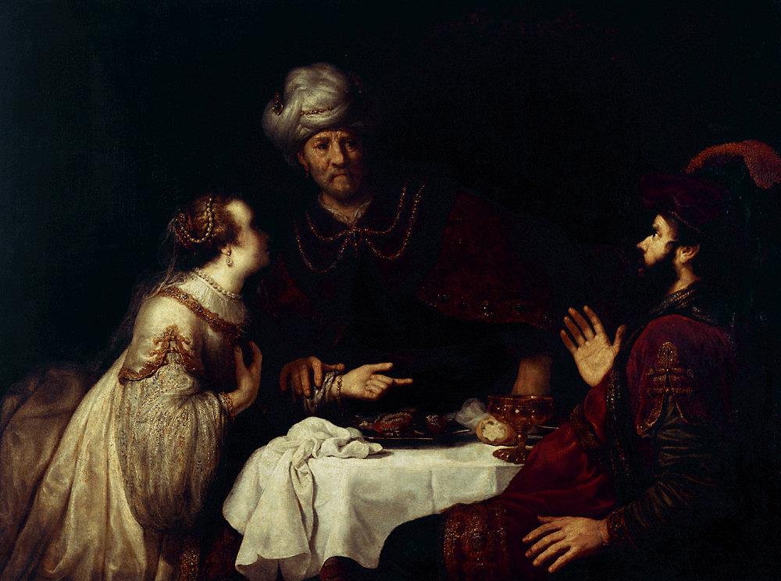
Esther
Extermination Plot Foiled |  | Principles for Growth
Plot Planned |  | Plot Foiled
Chapters 1–4 |  | Chapters 5–10
Threat |  | Triumph
Providence Prepared |  | Providence Enacted
Persecution |  | Preservation
Grave Danger |  | Great Deliverance
Feasts of Ahasuerus | Conduct 2:1-16 | Feasts of Esther & Purim | Eschatology 4:13–5:11
Esther Exalted 1:1–2:18 | Haman Plots 2:19–4:17 | Mordecai over Haman 5:1–8:2 | Mordecai over Persia 10
Persia
10 Years (483-473 BC)
308

Slide 32
Book Chart
1 Thessalonians: Preparation for the Rapture
Innocence of Greed |  |  | Principles for Growth
Chapters 1–3 |  |  | Chapters 4–5
Personal |  |  | Practical
Silence Slanders |  |  | Strengthen Stand
Historical |  |  | Hortatory
Reflections |  |  | Exhortations
Looking Back |  |  | Looking Forward
Commendation 1:1-10 | Conduct 2:1-16 | Concern 2:17–3:13 | Love 4:1-12 | Eschatology 4:13–5:11 | Church Life 5:12-28
“You’re great!” | “I’m innocent!” | “I care for you” | “Please God” | “Be comforted but watchful” | “Live holy”
Corinth
Early Summer AD 51 (on second missionary journey)
203

Slide 33
Book Chart
Degenerate Theocracy to Davidic Monarchy
Theocracy Ended |  | Monarchy Established
Decline of Judges |  | Rise of Kings
Chapters 1–7 |  | Chapters 8–31
Samuel: "Heavenly King" |  | Saul: "Earthly King"
Eli | Samuel | Saul |  | David
Man After Man's Heart | Man After God's Heart | Man After Man's Heart |  | Man After God's Heart
Paralysis | Prayer | Panic |  | Patience
Transition #1 Eli to Samuel (1–3) | Samuel & Ark’s Wanderings (4–7) | Transition #2 Samuel to Saul (8–12) | Saul Rejected (13–15) | Transition #3 Saul to David (16–31)
c. 94 Years
Birth of Samul (1105 BC) to Death of Saul (1011 BC)
203
1 Samuel:
194

Slide 34
Book Chart
Amos
583
Judgment for Social Injustice
Eight Judgments |  | Three Sermons | Five Visions | Promise of Restoration
Chapters 1–2 |  | Chapters 3–6 | 7:1–9:7 | 9:8-15
“This is what the LORD says…” (1:3, 6, 9, 11, 13; 2:1, 4) |  | “Hear this word…” (3:1; 4:1; 5:1) | “This is what the Sovereign LORD showed me…” (7:1, 4, 7; 8:1) | “In that day…” “The days are coming…” (9:11, 13)
God's Impartiality |  | God's Justice | God's Judgments | God's Grace
Pronouncements of Judgment |  | Provocations of Judgment | Future of Judgment | Promises after Judgment
Judgment |  |  |  | Renewal
Horror |  |  |  | Hope
Neighbor Nations | Northern Nation
767-753 BC (before the fall of Samaria)

Slide 35
Book Chart
JOB: Incomprehensibility Explains Righteous Suffering
Righteous Suffering |  |  | Unsuccessful Dialogue |  |  |  | Restoration
Chapters 1–2 |  |  | Chapters 3–41 |  |  |  | Chapter 42
Dilemma |  |  | Debate |  |  |  | Deliverance
Ruin |  |  | Reasons |  |  |  | Repentance
Prose |  |  | Poetry |  |  |  | Prose
Heaven and Earth |  |  | Land of Uz (North Arabia) |  |  |  | Heaven and Earth
Jobs Character | Satan's Assaults | Job's Friends | Cycles | Job | Elihu | God | Obedience | Blessings
1:1-5 | 1:6–2:10 | 2:11-13 | 3–26 | 27–31 | 32–37 | 38–41 | 42:1-9 | 42:10-17
Patriarchal Times (c. 2000 BC)
356

Slide 36
Lamentations
493
Emotions of and Reasons for the Fall
Fall Described | Fall Described | Fall Described | Fall Described | Fall Described
Chapter 1 | Chapter 2 | Chapter 3 | Chapter 4 | Chapter 5
The Suffering | The Suffering | The Suffering | The Suffering | The Suffering
3 Line Acrostic | 3 Line Acrostic | 3 Line Acrostic | 3 Line Acrostic | 3 Line Acrostic
People | People | People | People | People
Third Person Singular (“she”) 1:1-11
Jerusalem (586 BC)

Slide 37
Contrasting Hosea and Amos
590
HOSEA | AMOS
Professional Prophet (1:1) | Nonprofessional Prophet (7:14)
National from Israel (7:5) | Missionary from Judah (1:1)
Concern: Religious Idolatry (Worship) | Concern: Social Injustice (Walk)
Israel's Unfaithfulness | Israel's Injustice
God's Faithfulness | God's Justice
God's Grace | God's Righteousness
God's Loyal Love (Hesed) | God's Judgment
Sympathetic Tone | Stern Tone
Compassionate (11:1) | Coarse (4:1)
Difficult Structure | Simple Structure
Israel Lacks Knowledge | Israel Lacks Morality
“Know God” (4:1, 6; 6:6) | “Seek God” (5:4, 6)

Slide 38
Contrasting Hosea and Amos
590
HOSEA | AMOS
Professional Prophet (1:1) | Nonprofessional Prophet (7:14)
National from Israel (7:5) | Missionary from Judah (1:1)
Concern: Religious Idolatry (Worship) | Concern: Social Injustice (Walk)
Israel's Unfaithfulness | Israel's Injustice
God's Faithfulness | God's Justice
God's Grace | God's Righteousness
God's Loyal Love (Hesed) | God's Judgment
Sympathetic Tone | Stern Tone
Compassionate (11:1) | Coarse (4:1)
Difficult Structure | Simple Structure
Israel Lacks Knowledge | Israel Lacks Morality
“Know God” (4:1, 6; 6:6) | “Seek God” (5:4, 6)

Slide 39
Renewal of the Mosaic Covenant
147
Focus | Intro & 1st Sermon (Past Faithfulness) 1:1 4:43 | 2nd Sermon (Present Love Laws) 4:44 26:19 | 3rd & 4th Sermons (Future Hope) 27:1 34:12 | Intro & 1st Sermon (Past Faithfulness) 1:1 4:43
Divisions | Preamble (1:1-4) God’s Acts for Israel (1:5–4:43) | 10 Commandments (4:44–11:32) Ceremonial Laws (12:1–16:17) Civil & Social Laws (16:18–26:19) | 3rd Blessings & Curses (27–28) 4th Land Covenant (29–30) | Leadership Transition (31–34)
TOPICS | What God Has Done Historical | What God Expects Legal | What God Will Do Prophetic | TOPICS
PLACE | Plains of Moab | Text | Text | Text
TIME | About 1 Month | Text | Text | Text

Slide 40

Structure of the Old Testament
Walk Thru the OT
36
( )
( )
( )
History
17
Poetry
5
Prophecy
17
5
Genesis
Exodus
Leviticus
Numbers
Deuteronomy
Joshua
Judges
Ruth
1 Samuel
2 Samuel
1 Kings
2 Kings
1 Chronicles
2 Chronicles
Ezra
Nehemiah
Esther
Job
Psalms
Proverbs
Ecclesiastes
Song of Solomon
Isaiah
Jeremiah
Lamentations
Ezekiel
Daniel
Hosea
Joel
Amos
Obadiah
Jonah
Micah
Nahum
Habakkuk
Zephaniah
Haggai
Zechariah
Malachi
Major
( )
Exodus
Exile
( )
Law
5
12
Pre-Exilic
History
Pre-Exilic
Prophets
Number of books in the OT:
3 + 9
39
Minor
( )
Number of books in the NT:
27
( )
Narrative
3 x 9
66
Exile
Number of books in the Bible:
Exile
Post-Exilic
History
Post-Exilic
Prophets
12
Events
Experience
Expectation
Actions
Axioms
Alarms
What people did
What people felt
What people should do
Notes:
The Christian arrangement of the OT shows many parallels in structure. The 17 historical books parallel the 17 prophetical books, and both sections are divided after the first 5 books, which is itself parallel to the 5 poetic books. Even the titles of these 5 books in English become longer from Job to Song of Solomon. In the history and prophecy sections, the exile took place prior to the last three books. Finally, subdivisions associated with the second books in the history and prophecy sections (Exodus and Jeremiah) show how Jews were kicked out of Egypt and Israel, respectively. As for remembering the number of OT books, think 3+9, and the NT, 3x9.

Slide 41
Nahum's Prophecies Happened
625
Nahum's Prophecies | Historical Fulfillments
1:8 Nineveh would be destroyed by a flood (2:6, 8) | Nineveh was weakened by an unusually heavy & long flood of the Tigris. This carried away a great section of the huge rampart that surrounded the city and permitted the enemy to force their way in to capture the city.
1:9,14 Nineveh's destruction would be final | It was fulfilled in Assyria's utter destruction & her inability to afflict Israel a 2nd time.
1:10 In the final hours of the attack the Ninevites would be drunk (3:11) | After the Assyrians had repulsed the enemy's attack, they got drunk and feasted, and as a result were surprised by the Medes and the city was taken.
1:11-12 "From you, O Nineveh, has one come forth who plots evil against the Lord and counsels wickedness…" | Sennacherib made arrogant threats in 701 BC against Judah and Jerusalem (cf. 2 Kings 18–19).
1:13 "Now I will break their yoke from your neck and tear your shackles away." | Judah's service to Assyria ended at Nineveh's demise (2 Kings 18:14; 2 Chron. 33:11).
Hobart E. Freeman, An Introduction to the Old Testament Prophets (Chicago: Moody Press, 1977).

Slide 42
Views of Creation
187l
Pagan | Biblical (Genesis)
Polytheistic | Monotheistic (1:1)
Myth | History
Written to satisfy man’s curiosity on origins | Written to glorify God & extend his rule
The gods created themselves and other gods | Jesus existed before creation (John 1:1-3)
The gods struggle for sovereignty | Yahweh sovereign by nature (1:3)
Man mostly not in divine image (low status) | Man created in God’s image (high status)
People made to be slaves of the gods | Man rules over creation (1:26-27)

Slide 43

Hosea: God's Loyalty to Israel
565
Unfaithful Gomer | Unfaithful Israel
Faithful Hosea | Faithful LORD
Marriage of Hosea | Message of Hosea
Personal | National
Chapters 1–3 | Chapters 4–14

Slide 44

Gifts versus Fruit of the Spirit
xlii
Gifts | Fruit
Abilities | Christ-likeness
Relate to service | Relate to character
Means to an end | The end itself
What a Christian has | What a Christian is

Slide 45
Modern License (Phil. 3:18-19)
478
Text | Interpretation | Mormons | Health & Wealth
“Live as enemies of the cross of Christ” | They oppose salvation by faith | Salvation by works | Money is better than salvation
“Their destiny is destruction” | They are unsaved | Claim that all are saved but are not even saved themselves | Rich people go to hell too
“Their god is their stomach” | Their real goal is pleasure | Goal is to be a god to have sex with as many celestial wives as possible | “Embrace comfort, not suffering”
“Their glory is in their shame” | They're proud about things that they should be ashamed of | Temple polygamy is the highest goal | Contrary to the blessing of giving
“Their mind is on earthly things” | They have “here-and-now” priorities | “Become a god for ego and sex” | They give to get something now

Slide 46
5 x 5 Chart
???
Text | Text | Text | Text | Text
Text | Text | Text | Text | Text
Text | Text | Text | Text | Text
Text | Text | Text | Text | Text
Text | Text | Text | Text | Text
Text | Text | Text | Text | Text

Slide 47
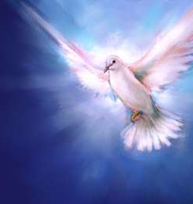
Speaking in Tongues in Acts
123
(Toussaint, Bible Knowledge Commentary, 2:408, adapted)
Text | Speakers | Audience | Related to Salvation | Purpose
2:1-4 | Apostles+ | Unsaved Jews at Pentecost | After salvation | Validate for Jews the fulfillment of Joel 2
8:14-17 | Samaritans | Saved Jews doubting God's plan (Peter+) | After salvation | Validate for Jews God's acceptance of Samaritans
10:44-47 | Gentiles (Cornelius+ others) | Saved Jews doubting God's plan (Peter+) | At salvation | Validate for Jews God's acceptance of Gentiles
19:1-7 | OT believers in Messiah | Jews needing gospel message confirmed | At salvation | Validate for Jews God's message through Paul

Slide 48
Longest Books in the Bible
478
Book | Chapters | Verses | Words
Psalms | 150 | 2461 | 43,743
Jeremiah | 52 | 1364 | 42,659
Ezekiel | 48 | 1273 | 39,407
Genesis | 50 | 1533 | 38,267
Isaiah | 66 | 1292 | 37,044
http://www.kneeholedesk.com/Pages/Did_You_Know/Books_of_the_Bible.html

Slide 49
2 Corinthians Book Chart
2 Corinthians: Defense of Apostolic Authority
Ministry Sincerity |  |  |  | Giving |  |  |  | Ministry Authority
Chapters 1–7 |  |  |  | Chapters 8–9 |  |  |  | Chapters 10–13
Defense of Paul's Motives |  |  |  | Defense of Paul's Worth |  |  |  | Defense of Paul's Traits
Character of Paul |  |  |  | Collection for Saints |  |  |  | Credentials of Paul
Greetings | Defends Conduct | Defends Ministry | Restore Confidence | Example | Purpose | Arrangements | Benefits | Defense | Offense | Warning | Closing
1:1-11 | 1:12–2:16 | 3:1–6:10 | 6:11–7:16 | 8:1-9 | 8:10-16 | 8:16–9:5 | 9:6- 15 | 10 | 11:1–12:18 | 12:19–13:10 | 13:11-14
Macedonia
Fall AD 56
162

Slide 50
Book Chart
181
Philippians: Results of Imitating Christ's Attitude
Joy |  |  | Humility |  | Protection |  | Peace
Chapter 1 |  |  | Chapter 2 |  | Chapter 3 |  | Chapter 4
Joy (5x) |  |  | Joy (7x) |  | Joy (1x) |  | Joy (4x)
Attitude (1x) |  |  | Attitude (7x) |  | Attitude (8x) |  | Attitude (4x)
Suffering |  |  | Submission |  | Salvation |  | Sanctification
Salu-tation 1:1-2 | Thanks & Prayer 1:3-11 | In Prison Ministry1:12-30 | Exhort-ed 2:1-4 | Exempli-fied 2:5-30 | From Legal-ism 3:1-16 | From Indulgence 3:17-21 | With Peo-ple 4:1-3 | With God 4:4-9 | Always 4:10-20 – Greet-ings 4:21-23
From Rome
Early Spring AD 62 (first Roman imprisonment)
17x
20x

Slide 51
Book Chart
2 Thessalonians: Tribulation Corrections
Persevere in Persecution |  | Day Still Future |  |  | Discipline the Idle
Chapter 1 |  | Chapter 2 |  |  | Chapter 3
Emotional |  | Theological |  |  | Practical
Encouragement in Persecution |  | Explanation of the Day |  |  | Exhortation in Body Life
Discouraged Believers |  | Disturbed Believers |  |  | Disobedient Believers
Correction of Perspective |  | Correction of Doctrine |  |  | Correction of Behaviour
Salutation | Judgment v. Reward | Pretrib-ulational Teaching | Antichrist Prerequisite | Stand Firm | Prayer Requests | Discipline Idle | Blessing Given
1:1-2 | 1:3-12 | 2:1-2 | 2:3-12 | 2:13-17 | 3:1-5 | 3:6-15 | 3:16-18
Corinth
AD 51
211

Slide 52

Hebrews Book Chart
254
Christ's Superiority Over Judaism as High Priest
Superior in His Person to... |  |  | Superior in His Priestly Work to... |  |  |  |  | Endurance Through Faith
1:1–4:13 |  |  | 4:14–10:18 |  |  |  |  | 10:19–13:25
Prophets | Angels | Moses | Aaron | Melch | Old Cov. | Taber-nacle | Sacri-fices | Will-ful Sin | Models | Endure as Sons | Ethics | Ignoring God | Exhort
1:1-3 | 1:4–2:18 | 3:1–4:13 | 4:14–6:20 | 7 | 8 | 9:1-10 | 9:11–10:18 | 10:19-39 | 11:1–12:3 | 12:4-13 | 12:14-17 | 12:18-29 | 13
Christ's Majesty |  |  | Christ's Ministry |  |  |  |  | Christian's Manifestation
Theology |  |  |  |  |  |  |  | Practice
Unknown Author, Recipients, Origin, and Destination!
AD 67-68

Slide 53
Summary of Types of Death
48
 | Spiritual | Physical | Second
Definition: Separation | of man & God | of body & soul/spirit | of man & God
Experienced by | unbelievers only | all mankind | unbelievers only
Location of soul | earth | Hades or Paradise/Heaven | Hell (Lake of Fire)
Part of man affected | soul | body | soul and body
Time period involved | before conversion | between life & resurrection | after resurrection
Duration | temporal | temporal | eternal
Key passage | Eph. 2:1, 5, 12 | James 2:26 | Rev. 20:14-15

Slide 54
Ecclesiastes
403
Work & Wisdom Don't Last | Title | Title | Title
Theme: Fleeting Nature of… | Work | Wisdom | Youth
1:1-11 | 1:12–6:9 | 6:10–11:6 | 11:7–12:14
Man’s Humanity | Man’s Hands | Man’s Head | Man’s Heart
Cycles | Work | Ignorance | Aging
Place: Earth (“under the sun”) about 935 BC | Text | Text | Text
Notes:
The major themes of human accomplishments (work) and human intellect (wisdom) dominate this book where Solomon declares them "meaningless" (NIV, NLT) or "vanity" (NASB, KJV). Probably better is "fleeting" or not lasting. The book ends by applying this fleeting nature of work and wisdom to youth.

Slide 55
الجامعة
403
العمل والحكمة لا يدومان | Title | Title | Title
الشباب | الحكمة | العمل | الموضوع الطبيعة الزائلة ل
11:7–12:14 | 6:10–11:6 | 1:12–6:9 | 1:1-11
قلب الانسان | رأس الانسان | يد الانسان | انسانية الانسان
التقدم بالعمر | الجهل | العمل | الدوائر
المكان: الأرض ( "تحت الشمس") حوالي 935 قبل الميلاد | Text | Text | Text
Notes:
لكن الموضوع الآن ينتقل إلى المنطقة الزائلة الثالثة في القسم الأخير من الكتاب.
هذه المرة يتعلق الأمر بالشباب (اشرح مخطط الكتاب).
The major themes of human accomplishments (work) and human intellect (wisdom) dominate this book where Solomon declares them "meaningless" (NIV, NLT) or "vanity" (NASB, KJV). Probably better is "fleeting" or not lasting. The book ends by applying this fleeting nature of work and wisdom to youth.

Slide 56
Gomer's Children
573
Text | Title | Title | Title
Bold | Text | Text | Text
Bold | Text | Text | Text
Bold | Text | Text | Text

Slide 57
Gomer's Children
573
Text | Hosea 1:2-5 | Hosea 1:6-7 | Hosea 1:8
Name | Jezreel | Lo-Ruhamah | Lo-Ammi
Sex | Boy | Girl | Boy
Translation | “He [God] scatters” | “No compassion” | “Not My people”

Slide 58
Distinguishing Terms
xvii
 | Eternal Security | Assurance of Salvation
Believer’s… | Position as child of God (Rom. 8:16b) | Practice of confidence (Rom. 8:16a)
Recipients | All Christians possess | Some Christians doubt
Permanence | Can’t be lost (John 6:39-40; 10:27-29; Rom. 8:30, 38-39; Heb. 7:25) | Can be lost (for this reason John wrote 1 John 5:11-13)
Songs | “I Know Whom I Have Believed” “In Christ Alone” “The Solid Rock” | “Blessed Assurance” (#367)

Slide 59
3 x 8 Chart
573
Title | Title | Title
Text | Text | Text
Text | Text | Text
Text | Text | Text
Text | Text | Text
Text | Text | Text
Text | Text | Text
Text | Text | Text

Slide 60
4 x 7 Chart
xli
 | Title | Title | Title
Text | Text | Text | Text
Text | Text | Text | Text
Text | Text | Text | Text
Text | Text | Text | Text
Text | Text | Text | Text
Text | Text | Text | Text

Slide 61
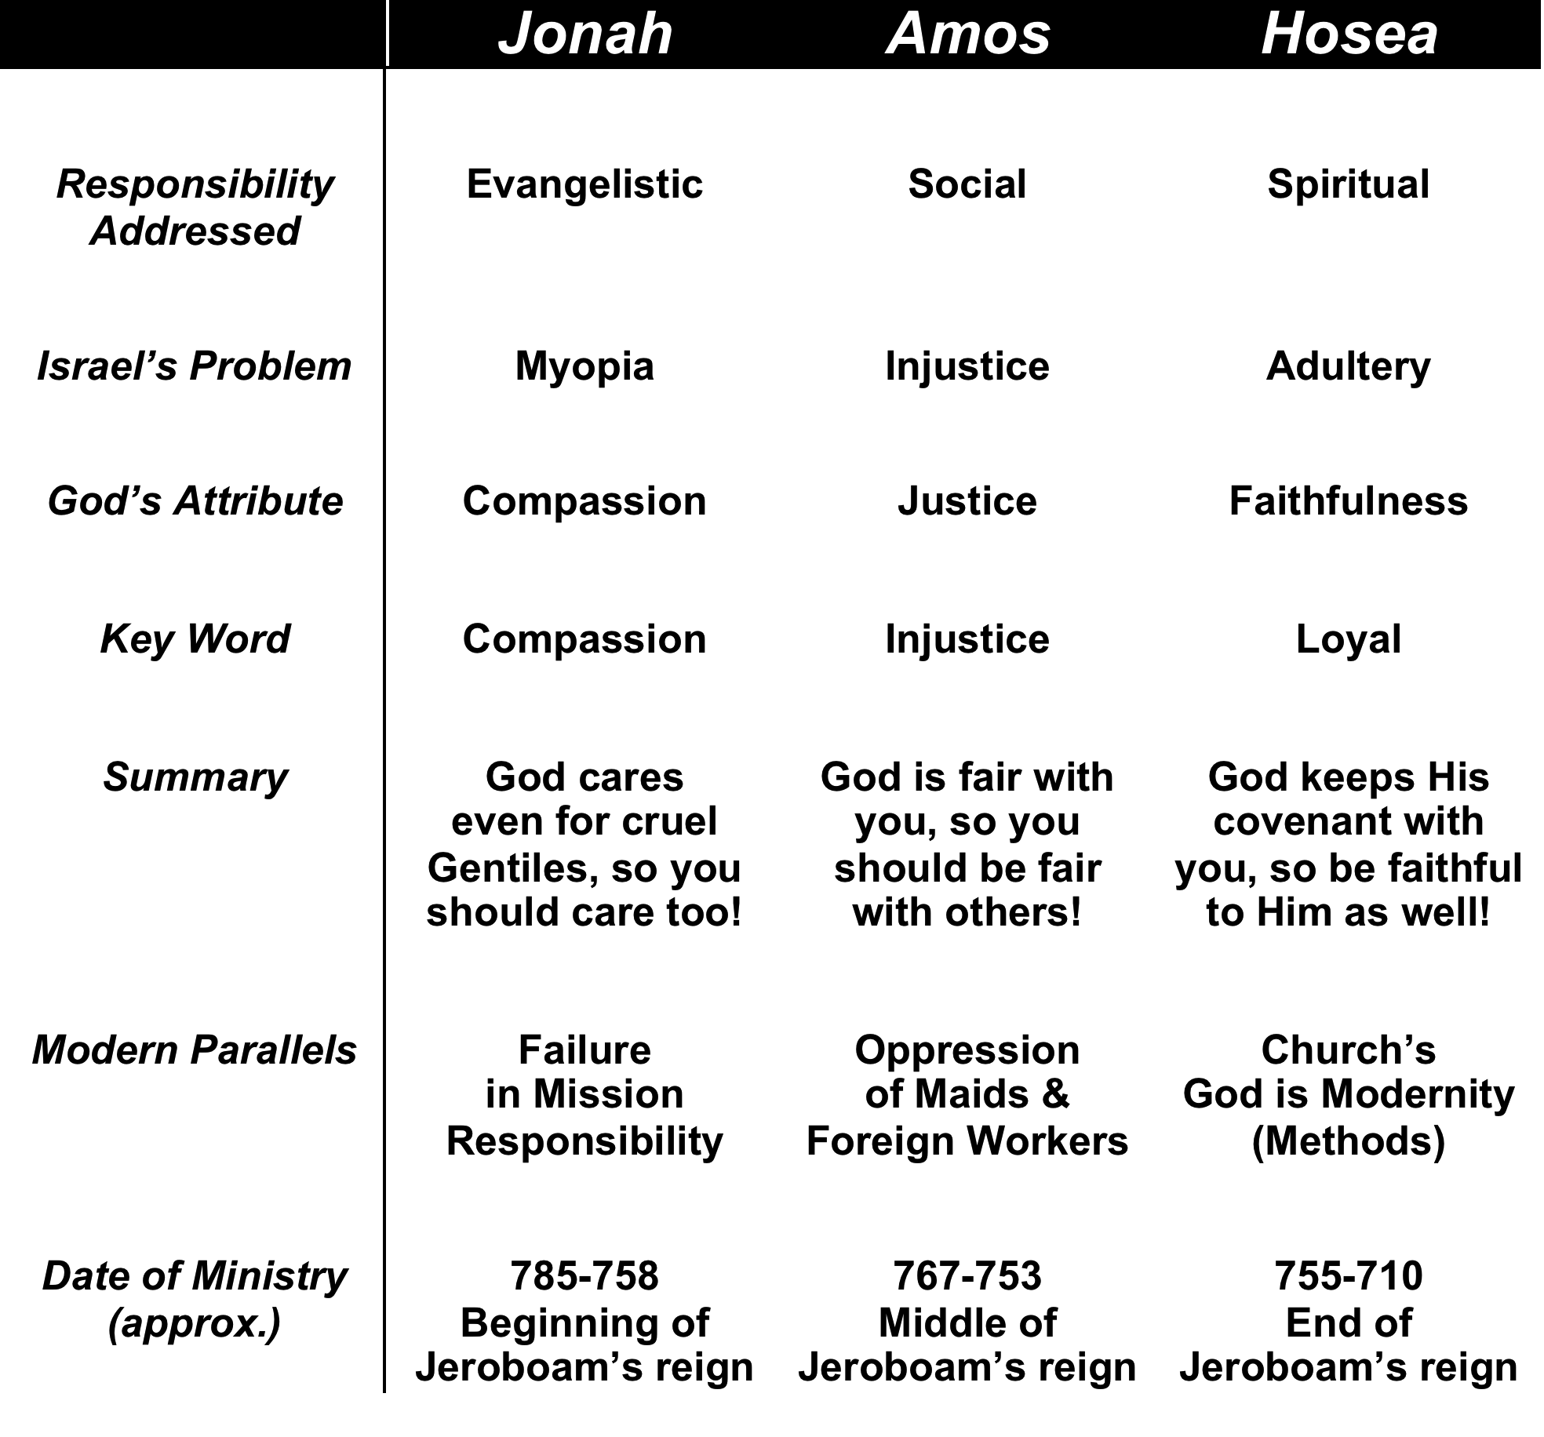
4 x 8 Chart
573
Title | Title | Title | Title
Text | Text | Text | Text
Text | Text | Text | Text
Text | Text | Text | Text
Text | Text | Text | Text
Text | Text | Text | Text
Text | Text | Text | Text
Text | Text | Text | Text

Slide 62
5 x 8 Chart
573
Title | Title | Title | Title | Title
Text | Text | Text | Text | Text
Text | Text | Text | Text | Text
Text | Text | Text | Text | Text
Text | Text | Text | Text | Text
Text | Text | Text | Text | Text
Text | Text | Text | Text | Text
Text | Text | Text | Text | Text

Slide 63
Deuteronomy
573
147
Renewal of the Mosaic Covenant
FOCUS | Intro & 1st Sermon (Past Faithfulness) 1:1 4:43 | 2nd Sermon (Present Love Laws) 4:44 26:19 | 3rd & 4th Sermons (Future Hope) 27:1 34:12
DIVISIONS | Preamble (1:1-4) God’s Acts for Israel (1:5–4:43) | 10 Commandments (4:44–11:32) Ceremonial Laws (12:1–16:17) Civil & Social Laws (16:18–26:19) | 3rd Blessings & Curses (27–28) 4th Land Covenant (29–30) | Leadership Transition (31–34)
TOPICS | What God Has Done Historical | What God Expects Legal | What God Will Do Prophetic
PLACE | Plains of Moab
TIME | About 1 Month
Adapted from Bruce Wilkinson & Kenneth Boa, Talk Thru the Bible, Vol. 1 (Nashville: Nelson, 1983)

Slide 64
8 x 8 Chart
573
Title | Title | Title | Title | Title | Title | Title | Title
Text | Text | Text | Text | Text | Text | Text | Text
Text | Text | Text | Text | Text | Text | Text | Text
Text | Text | Text | Text | Text | Text | Text | Text
Text | Text | Text | Text | Text | Text | Text | Text
Text | Text | Text | Text | Text | Text | Text | Text
Text | Text | Text | Text | Text | Text | Text | Text
Text | Text | Text | Text | Text | Text | Text | Text

Slide 65
9 x 9 Chart
573
Title | Title | Title | Title | Title | Title | Title | Title | Title
Text | Text | Text | Text | Text | Text | Text | Text | Text
Text | Text | Text | Text | Text | Text | Text | Text | Text
Text | Text | Text | Text | Text | Text | Text | Text | Text
Text | Text | Text | Text | Text | Text | Text | Text | Text
Text | Text | Text | Text | Text | Text | Text | Text | Text
Text | Text | Text | Text | Text | Text | Text | Text | Text
Text | Text | Text | Text | Text | Text | Text | Text | Text
Text | Text | Text | Text | Text | Text | Text | Text | Text

Slide 66
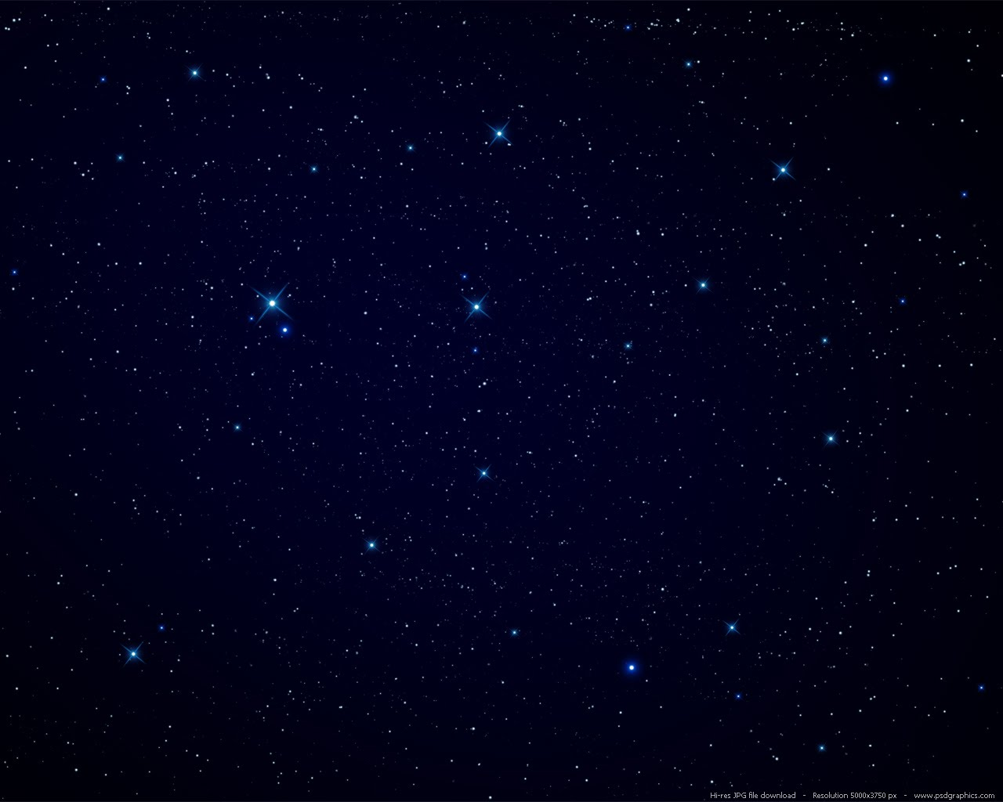
4 x 8 Chart
573
Issue | Heresy at Colosse | New Age Movement | Christianity
Salvation | Christ + Other Ways | Many Ways | Through Jesus Christ alone
Worship | God + Angels | Via Spirit Guides | Through the Holy Spirit
Sanctification | Via Rituals & Ceremonies | Via Enlightenment | Through the Spirit's power
Hope | Uncertain | Reincarnation | Resurrection
Deity | Christ is not God | We are God | Christ is God
Theism | Syncretistic | Many Gods | Trinity
Basis | Human Effort + Secret Knowledge | Human Effort | Christ's Work on the Cross

Slide 67
4 x 8 Chart
573
Issue | Heresy at Colosse | New Age Movement | Christianity
Salvation | Christ + Other Ways | Many Ways | Through Jesus Christ alone
Worship | God + Angels | Via Spirit Guides | Through the Holy Spirit
Sancti-fication | Via Rituals & Ceremonies | Via Enlightenment | Through the Spirit's power
Hope | Uncertain | Reincarnation | Resurrection
Deity | Christ is not God | We are God | Christ is God
Theism | Syncretistic | Many Gods | Trinity
Basis | Human Effort + Secret Knowledge | Human Effort | Christ's Work on the Cross

Slide 68
4 x 8 Chart
573
Issue | Heresy at Colosse | New Age Movement | Christianity
Salvation | Christ + Other Ways | Many Ways | Through Jesus Christ alone
Worship | God + Angels | Via Spirit Guides | Through the Holy Spirit
Sancti-fication | Via Rituals & Ceremonies | Via Enlightenment | Through the Spirit's power
Hope | Uncertain | Reincarnation | Resurrection
Deity | Christ is not God | We are God | Christ is God
Theism | Syncretistic | Many Gods | Trinity
Basis | Human Effort + Secret Knowledge | Human Effort | Christ's Work on the Cross

Slide 69
Rituals for Levitical Offerings
129
Priest's Actions |  |  |  | COMMUNAL | EXPIATORY
 |  |  |  | FELLOWSHIP | SIN | GUILT
 | Manipulation of Blood |  |  | Blood caught in a bowl and splashed against sides of the altar (3:2, 8, 13) | Ritual varied according to the position of the worshiper (but involved “sprinkling” rather than “splashing” of blood), the occasion of sacrifice, or the type of animal (e.g., different if a bird) | Blood caught in a bowl and splashed against the sides of the altar (7:2)
 | Incineration on Altar |  |  | Choice viscera (including “fat tail” of sheep) burned on altar | Choice viscera burned on altar | Choice viscera burned on altar
 | Distribution or Disposal of Carcass | Distribution of Disposal of Carcass |  | Breast of animal was to be a “wave offering” and eaten by priests | Priest received carcass of offering by leader or layperson | Priest received carcass
 |  | Worshiper's portion |  | Communal meal for the worshiper's family at proper time and place
 |  | Remainder |  | Remainder burned | Carcass burned outside the camp for priest or nation
F. Duane Lindsey, “Leviticus,” The Bible Knowledge Commentary, 1:168-69
Notes:
#45 in original file

Slide 70
Special Sacrificial Rituals
130
Special Rituals |  |  |  | DEDICATORY
 |  |  |  | BURNT | GRAIN | DRINK
 | Consecration | 1. Of priests (Ex. 29; Lev. 8) |  | Ram
 |  | 2. Of temple (2 Chron. 29) |  | 70 bulls, 100 rams, 200 male lambs
 | Decon-secration | Fulfillment of Nazirite vow (Num. 6:14-17) |  | Year-old male lamb | Regular grain offering, special bread offering
 | Purification rituals | 1. Broken vow (Num. 6:9-12) |  | Dove and young pigeon
 |  | 2. Cleansing of leper (Lev. 14:12-20) |  | Year-old male lamb (dove or pigeon for poor) | Grain offering
 |  | 3. Man (15:14-15) or woman with hemorrhage (15:29-30) |  | Dove or young pigeon
 |  | 4. Woman after childbirth (12:6-8) |  | Year-old lamb (or dove or pigeon)
F. Duane Lindsey, “Leviticus,” The Bible Knowledge Commentary, 1:168-69
Notes:
#45 in original file

Slide 71
Old Testament Feasts & Sacred Days
133
The Bible Visual Resource Book, 31
NAME | OT TEXTS | OT TIME | MODERN EQUIVALENT | DESCRIPTION | PURPOSE | NT TEXTS
Sacred Assembly | Lev. 23:36b; Num. 29:35-38 | 7th month (Tishi) 22 | Sept-Oct | A day of convocation, rest and offering sacrifices | Commemorate the closing of the cycle of feasts
Purim | Esther 9:18-32 | 12th month (Adar) 14, 15 | Feb-March | A day of joy and feasting and giving presents | Remind the Israelites of their national deliverance in the time of Esther
Notes:
#92 in original file

Slide 72
Hebrew Calendar & Selected Events
111
The Bible Visual Resource Book, 21
NUMBER OF MONTHS |  | HEBREW NAME | MODERN EQUIVALENT | BIBLICAL REFERENCES | AGRICULTURE | FEASTS
1 Sacred Sequence Begins | 7 | Abib; Nisan | March-April | Exod. 12:2, 13:4; 23:15; 34:18; Deut. 16:1; Neh. 2:1; Esther 3:7 | Spring (later) rains; barley and flax harvest begins | Passover; Unleavened Bread; Firstfruits
Notes:
#92 in original file

Slide 73
Does the Law of Moses Apply to Me?
113b
Stanley N. Gundry, ed. Five Views on Law & Gospel summarized by Lee Hwee Chin, SBC, 2001
 | THEONOMIC Bahnsen | REFORMED Van Gemeren | WEIGHTIER ISSUES Kaiser | MODIFIED LUTHERAN Moo | DISPENSATIONAL Strickland
What is the Law?
Notes:
#92 in original file

Slide 74
3 x 5 Chart
xxxix
 | General Grace | Special Grace
First | Answer | Blessings from the Spirit which lead unbelievers to salvation
Second | “The unmerited favor of God toward mankind displayed in His general care for them” (Ryrie, The Holy Spirit, 2d ed., 75) | “The work of the Holy Spirit which effectively moves men to believe in Jesus Christ as Saviour” (Ryrie, The Holy Spirit, 2d ed., 85)
Spirit’s Ministries | Natural revelation (Rom. 1:18-20) Good gifts (Ps. 145:9) Restraint of sin (2 Thess. 2:6-7) Conviction of sin (John 16:8-11) | Call to Christ (Rom. 1:1; 8:28; 1 Tim. 6:12; 2 Pet. 1:3, 10)
Former Name | Common Grace | Efficacious Grace

Slide 75
4 x 3 Chart
10
Metaphor & Text | Ministry of Christ | Ministry of Church | Applications
Priesthood • 1 Pet. 2:5-9 • Rev. 1:4-6 • Rev. 5:9-10 • Rev. 20:6 | Accepts worship from every Christian DEITY of Christ | Each believer should offer a sacrifice of praise to God as a witness to the world Worship, multiplication | No real clergy-laity distinction exists
Flock • Acts 20:28 • 1 Pet. 5:4 • John 10:11, 14 | Cares for sheep as the Good Shepherd CARE of Christ | Focus on needs of sheep rather than ministry: rest, food, guidance, encouragement, healing, etc. Edification | Remain within the flock for protection and care from the Shepherd

Slide 76
4 x 4 Chart
10
Metaphor & Text | Ministry of Christ | Ministry of Church | Applications
Body • 1 Cor. 12 • Col. 1:18 | Sustains church for unity LIFE of Christ | Depends upon Christ Worship, edification | Let diversity within unity focus on Christ as the common source
Bride • Eph. 5:25-27 • Eph. 3:18-19 • 2 Cor. 11:2 | Depth of love Bridegroom (Christ) has for Bride (Church) LOVE of Christ | Purifies herself to show her love Worship, edification | Prepare to meet Christ as a bride prepares for her wedding
Building/Temple • Eph. 2:21-22 • 1 Pet. 2:4-6 • 1 Cor. 3:10-11 | Foundation Stone for growth who indwells each believer PRESENCE of Christ | Grows together as all believers build on the foundation Worship, edification, multiplication | Maintain unity so as not to dishonor Christ's presence

Slide 77
4 x 5 Chart
478
Text | Interpretation | Mormons | Health & Wealth
“Live as enemies of the cross of Christ” | They oppose salvation by faith | Salvation by works | Money is better than salvation
“Their destiny is destruction” | They are unsaved | Claim that all are saved but are not even saved themselves | Rich people go to hell too
“Their god is their stomach” | Their real goal is pleasure | Goal is to be a god to have sex with as many celestial wives as possible | “Embrace comfort, not suffering”
“Their glory is in their shame” | They're proud about things that they should be ashamed of | Temple polygamy is the highest goal | Contrary to the blessing of giving
“Their mind is on earthly things” | They have “here-and-now” priorities | “Become a god for ego and sex” | They give to get something now

Slide 78

祝福 Benediction

Slide 79
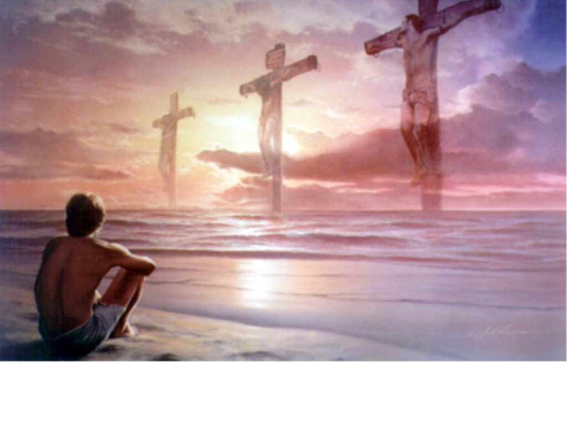
后奏曲 Postlude

Slide 80

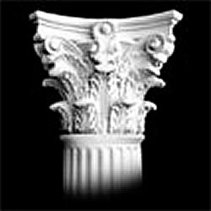
Column
##
Biblical
Pagan
1a
1b
2a
2b
3a
3b
4a
4b

Slide 81

  回应诗歌: 真光普照
  Hymn of Response: Shine, Jesus, Shine
奉献 Offering will be collected.

Slide 82

Transitional Page

Slide 83

TRANSITIONAL PAGE

Slide 84

2. When shall I reach that happy place and be forever blest? When shall I see my Father's face and in His bosom rest?
Chorus (Twice)
I am bound for the promised land
I am bound for the promised land
O who will come and go with me?
I am bound for the promised land
On Jordan's Stormy Banks-by Samuel Stennett. Arr Barry Braman. Copyright 1991, Van Ness Press, Inc.

Slide 85

带领: 地和其中所充满的，世界，
和住在其间的，都属耶和华。
他把地建立在海上，安定在大水之上。
会众: 让我们在上主面前敬拜。

Slide 86

  Worship Leader:
    Such is the generation of those who seek Him,
    who seek Your face, O God of Jacob.
  Congregation:
    Let us worship before the Lord our God.

Slide 87
天上天使助我拜主，常能目见主慈容；
日月星辰大家敬主，普世万民颂声同
哈利路亚！哈利路亚！偕我同颂主光荣。
Angels, help us to adore Him,
Ye behold Him face to face;
Sun and moon, bow down before Him;
Dwellers all in time and space,
Praise Him! Praise Him!
Praise Him! Praise Him!
Praise with us the God of grace!
Hymns of Praise No. 207 #4/4

Slide 88

祷告 Opening Prayer

Slide 89

主爱光辉正照耀人间，
照遍黑暗地方像明灯；
主基督乃真光照亮万邦，
赐予真理，使释放离罪锁。
照耀我灵，照亮我心。
Lord, the light of Your love is shining,
In the midst of the darkness shining;
Jesus, Light of the World, shine upon us.
Set us free by the truth You now bring us;
Shine on me, shine on me.
Hymns of Praise No. 207 #1/3

Slide 90

三一颂 Doxology

Slide 91
Communicating Bad News

Slide 92
Company Handbook

Slide 93
Project

Slide 94
Recommending

Slide 95
Selling

Slide 96
Brainstorming

Slide 97
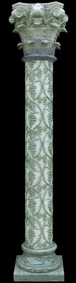

Slide 98
Transitional Page

Slide 99
TRANSITIONAL PAGE

Slide 100

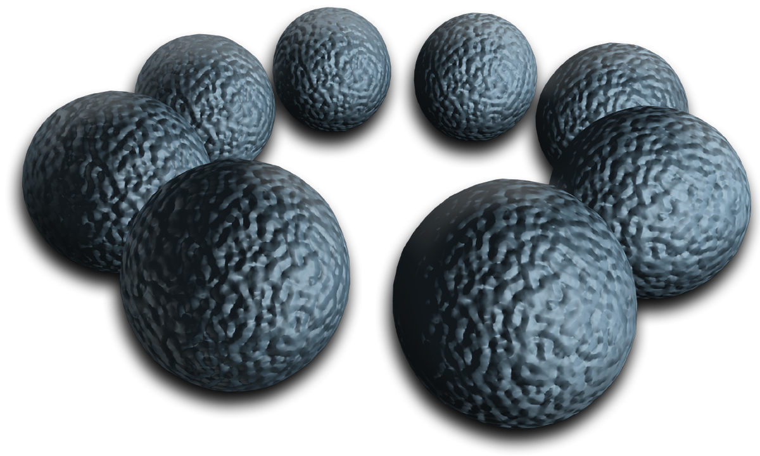
Transitional page

Slide 101

New Perspective

Slide 102

Your Main Topic Goes Here
Your subtopic goes here

Slide 103

Title Slide Over Gavel
Subtitle Over Gavel

Slide 104
Title Slide Over Gavel
Subtitle Over Gavel

Slide 105

Title Over Crosses
Subtitle Over Crosses

Slide 106

E-Learning
Subtitle Over Crosses

Slide 107

Title Slide Over Blue
Subtitle Over Blue

Slide 108
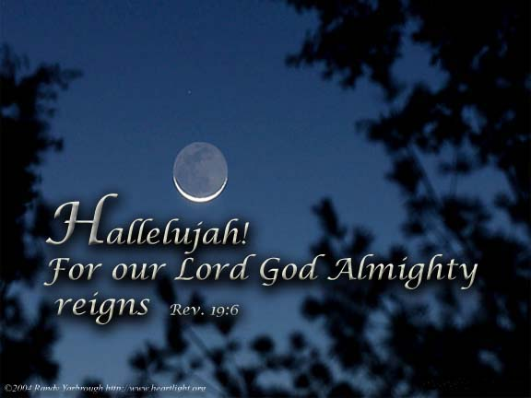
Rev 19:6

Slide 109

Jeremiah 10:7
Subtitle Over Black

Slide 110
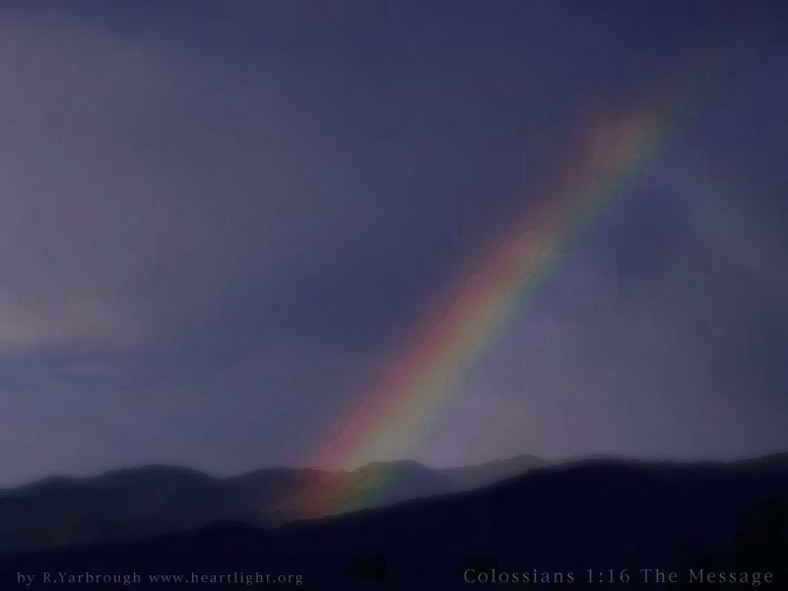
Rainbow
Subtitle Over Black

Slide 112

Three Crosses
Subtitle Over Black

Slide 113
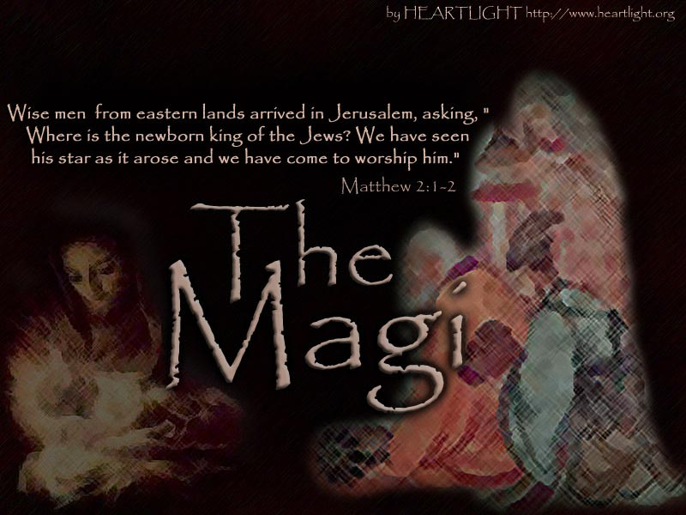
Magi
Subtitle Over Black

Slide 114
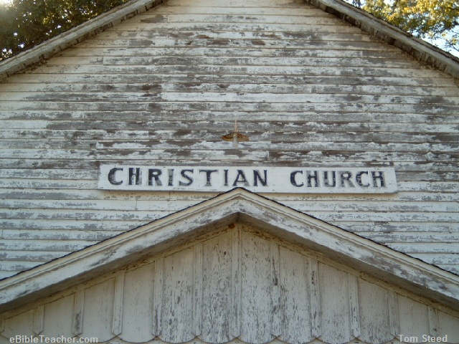
Church Building
Subtitle Over Black

Slide 115

Tunnel
Subtitle Over Black

Slide 116

Title Over Black
Subtitle

Slide 117
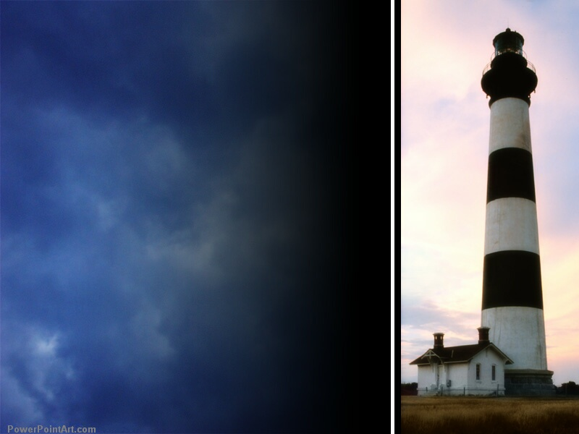
Lighthouse
Subtitle

Slide 118

Nebula
Subtitle

Slide 119

Purple
Subtitle

Slide 120

Open Hands
Subtitle

Slide 121

The Word of God
Subtitle

Slide 122

Communion
Subtitle

Slide 123

Sunset Cross
Subtitle

Slide 124
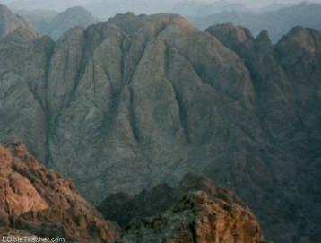
Sinai
Subtitle

Slide 125
Cross on Blue
Subtitle

Slide 126
Title Slide Over White
Subtitle Over White

Slide 127
Black

Slide 128
Blue Transparency

Slide 129
Title on Blue Bar
Subtitle Over White

Slide 130
Title
Subtitle

Slide 131
Title on Green Arrows

Slide 132
Title on Bird Background
Subtitle

Slide 133
Title over Fire
Subtitle Over White

Slide 134
Title Over Blue
Subtitle Over Blue

Slide 135
Title Over White
Subtitle Over White

Slide 136
Title Over Purple
Subtitle Over Purple

Slide 137
Title Over Leaves
Subtitle Over White

Slide 138
Title Pink Lights
Subtitle in Black

Slide 139
Title Black & Blue
Subtitle

Slide 140
Title Yellow
Subtitle

Slide 141
Title Over White
Subtitle Over White

Slide 142
Title on Yellow Trees
Subtitle

Slide 143
An Imaginary Dialogue…
Persecutors | Paul
“Aha! You like to share about Jesus? I'll imprison you!” | “Good! This will give me more time to pray, write letters to the churches, and share Christ with every soldier guarding me.”
“Well, then, I'll torture you!” | “Thank you, for in this way I can share in the sufferings of my Master, Jesus.”
“Oh yeah? Then I'll kill you!” | “This is the best option yet, for then you will usher me into his presence!”
185-186

Slide 144
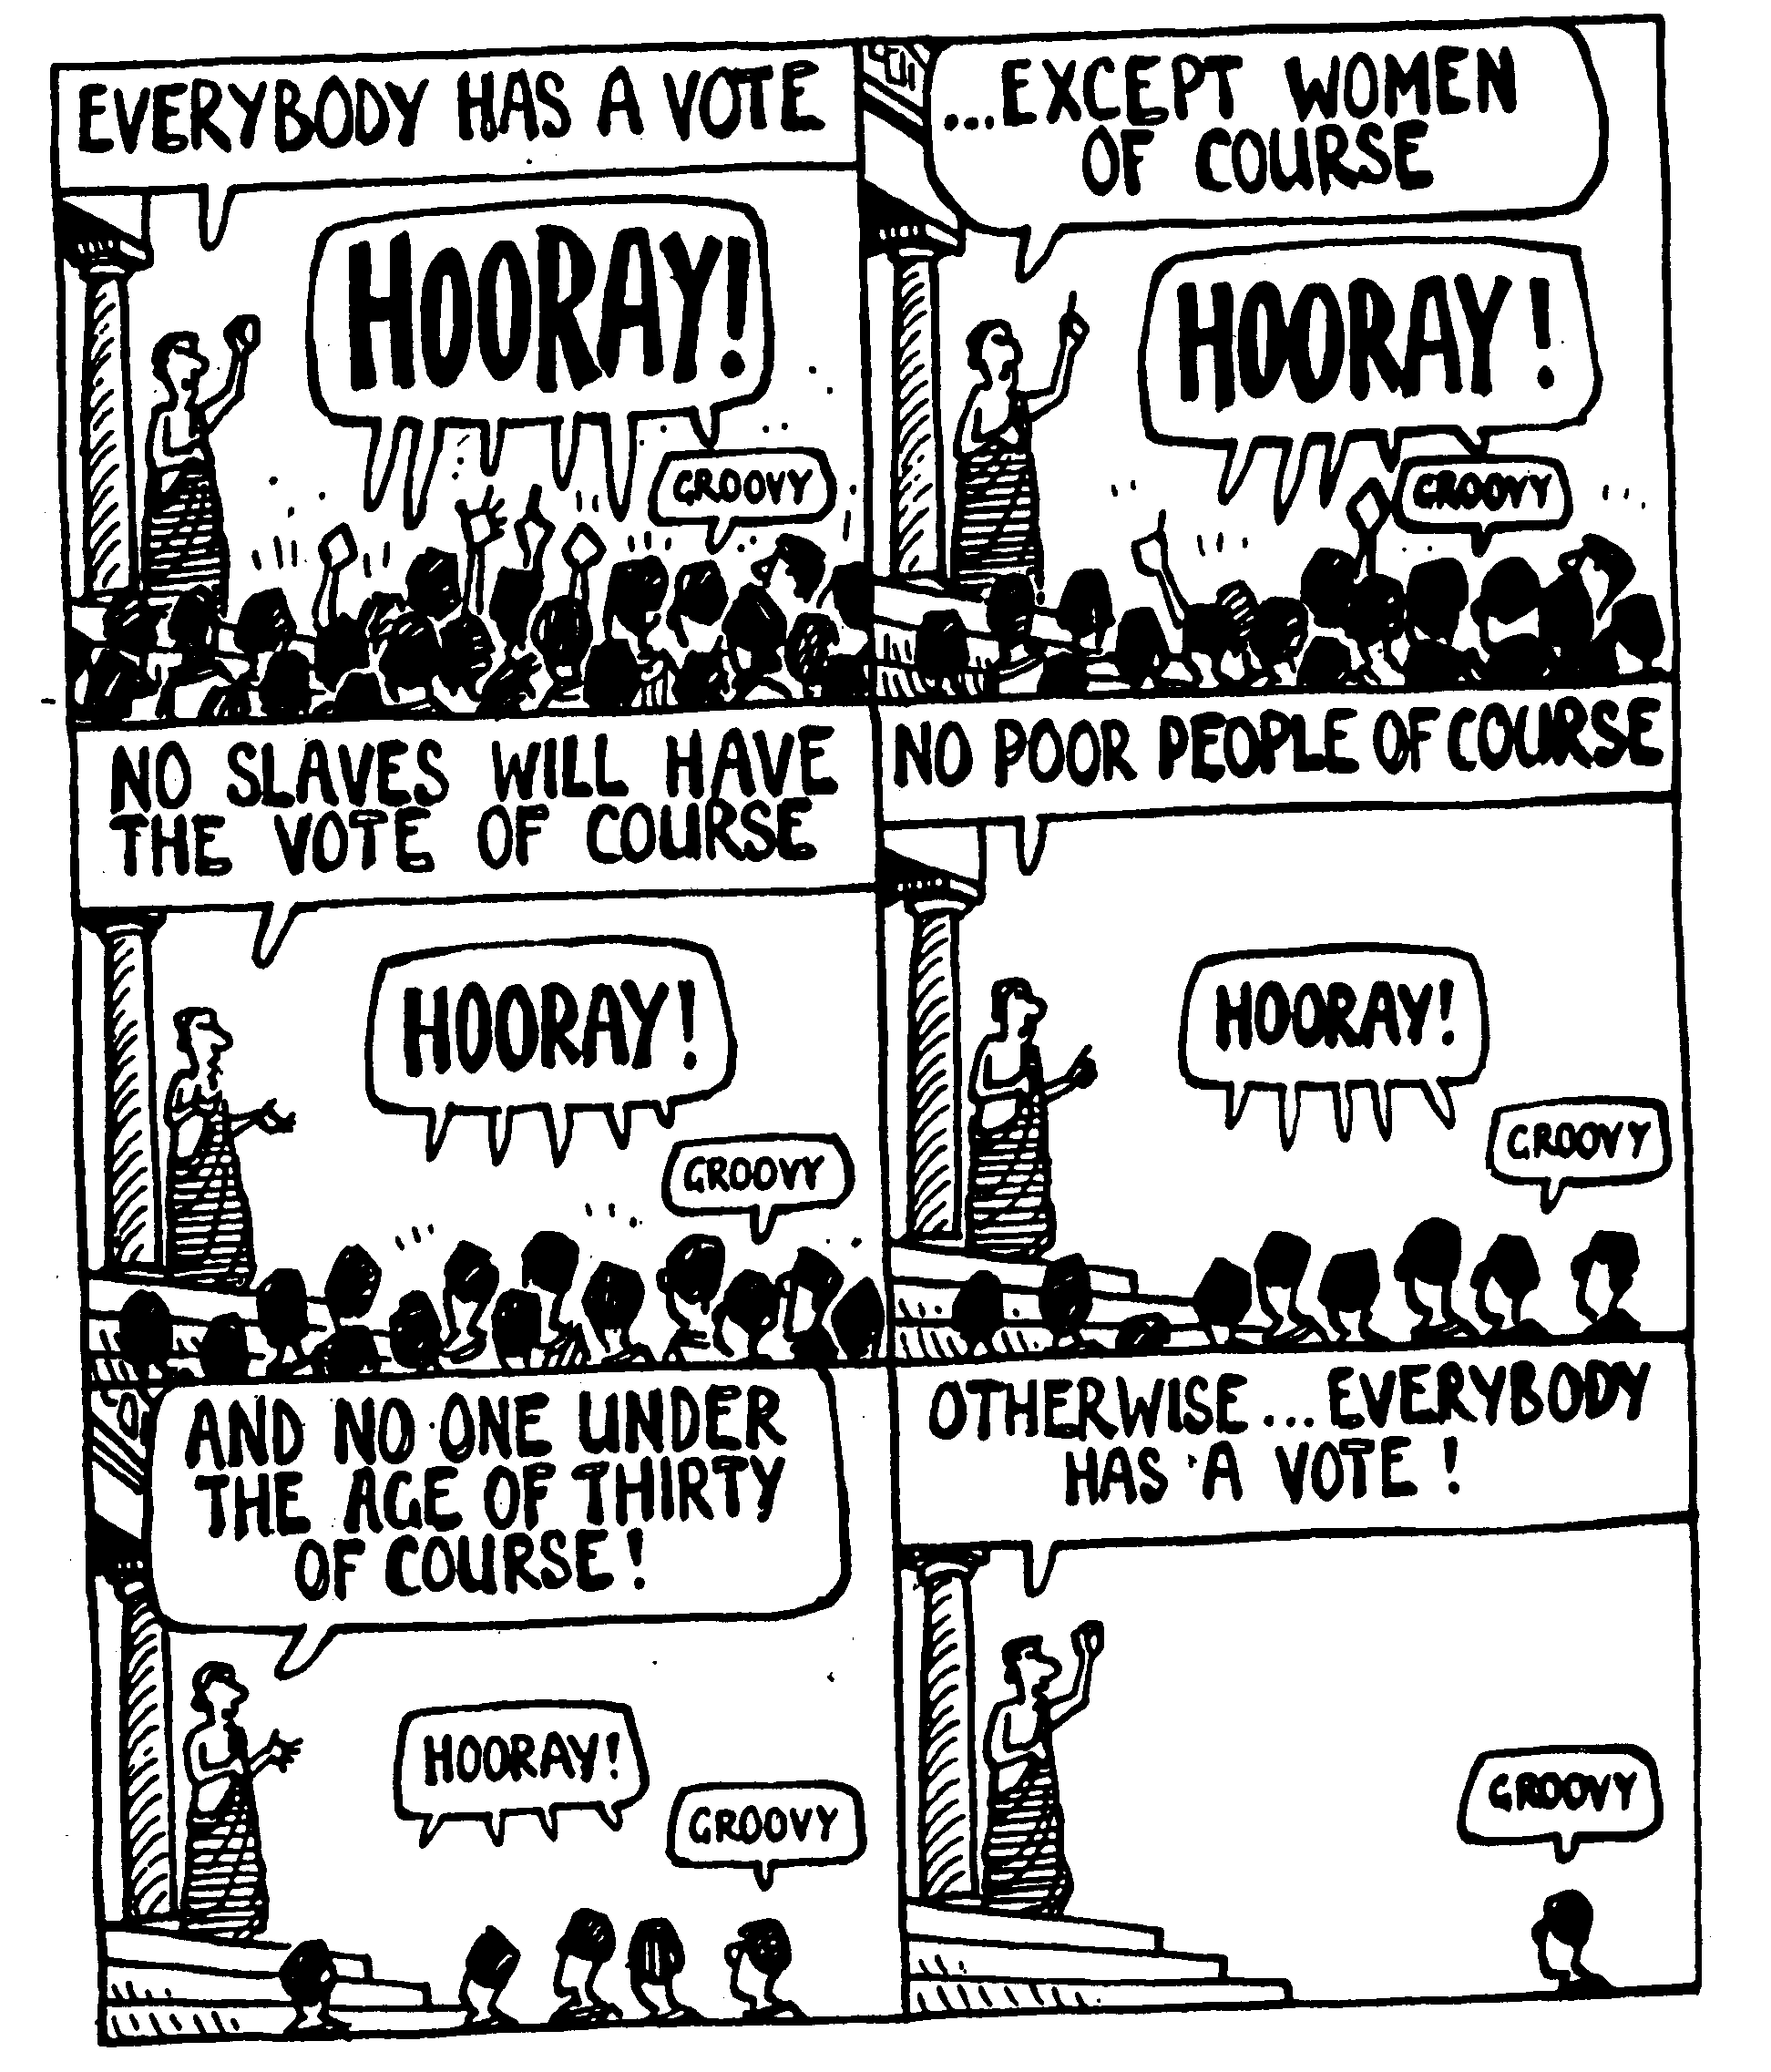
Unfolding Cartoon

Slide 145
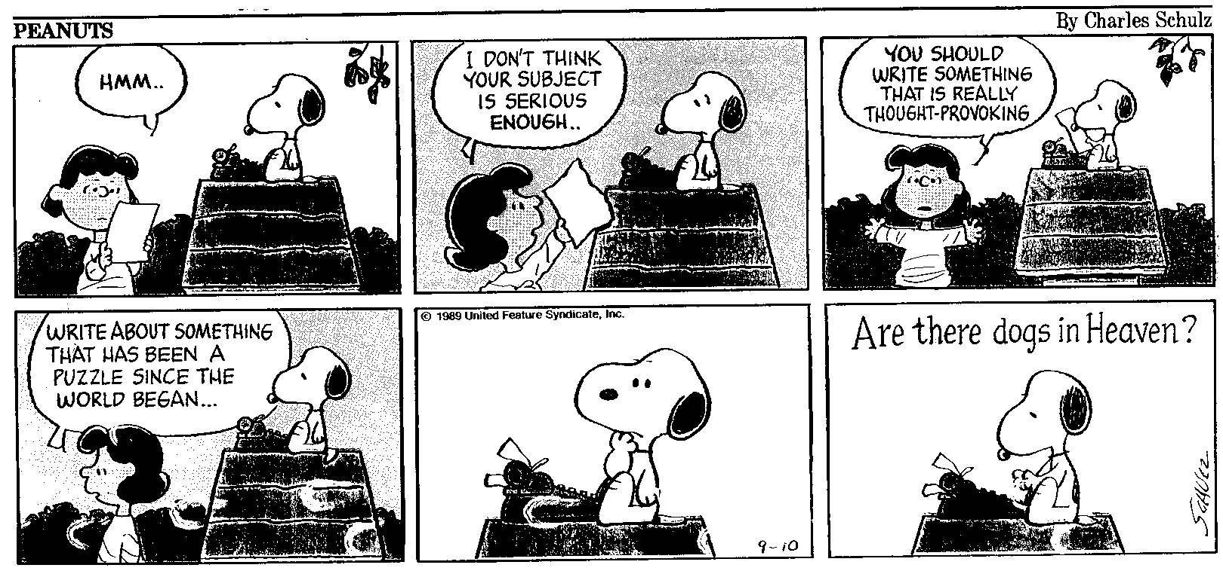
Unfolding Horizontal

Slide 146
Exiting from Chart
33

Slide 147


Title on Black Over Brown
##
Subtitle:
Bullets Over Transparent

Slide 148

Title Over Green
##
Scripture Text italic
Reference

Slide 149
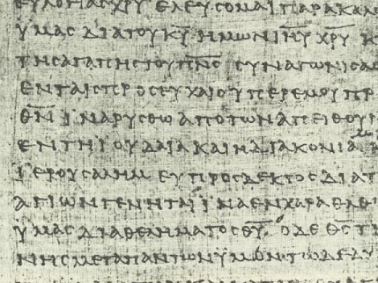
Title Over Greek
##
Subtitle
Bullet

Slide 150
Title Over Greek Text
##
Ca,risma Charisma
Bullet

Slide 151

Title Over Maplewood
186e
Subtitle
Bullet

Slide 152

Title Over Oak Grain
186e
Subtitle
Bullet

Slide 153

Title Over Bible
186e
Subtitle
Bullet

Slide 154
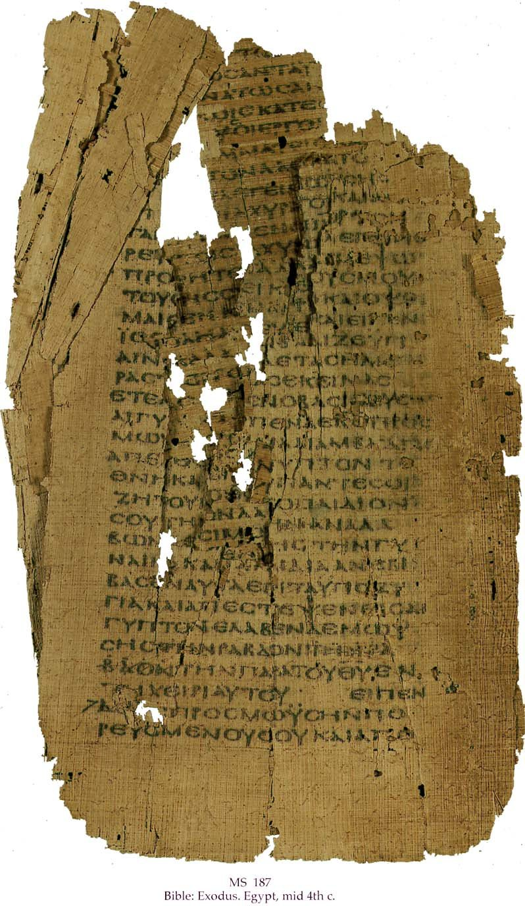
Contrast Over Septuagint Half
##
Biblical
Pagan
1a
1b
2a
2b
3a
3b
4a
4b

Slide 155
7 Contrasts
##
Biblical
Pagan
1a
1b
2a
2b
3a
3b
4a
4b
5a
5b
6a
6b
7a
7b

Slide 156

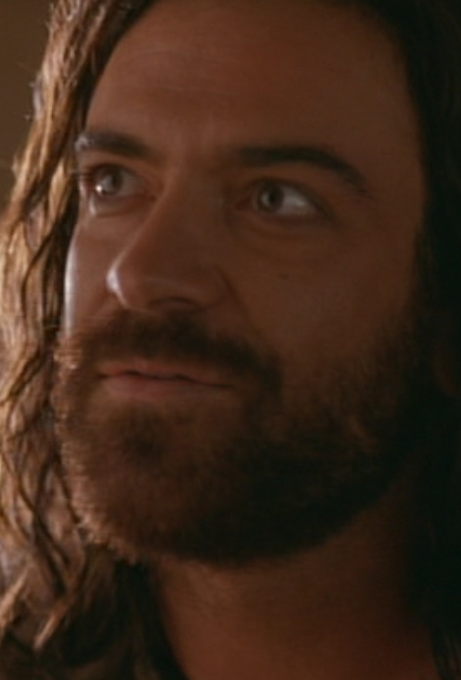
8 Contrasts
Mary (Soft)
Judas (Hard)
Gave
Took
Public
Secret
Sacrificial
Self-serving
Cost her much
Cost him nothing
Humbled herself
Exalted himself
Role of Slave
Treasurer
Fragrant house
Spoilt with criticism
“Mary” names
No “Judas” today

Slide 157
Contrast on Black
##
Biblical
Pagan
1a
1b
2a
2b
3a
3b
4a
4b

Slide 158
Contrast on Dark Hebrew
186a-b
Biblical
Pagan
1a
1b
2a
2b
3a
3b
4a
4b

Slide 159
Contrast on Light Hebrew
186a-b
Biblical
Pagan
1a
1b
2a
2b
3a
3b
4a
4b

Slide 160
3-Fold Contrast on Dark Hebrew
##
Issue
Biblical
Pagan
1a
1b
1c
2a
2b
2c
3a
3b
3c
4a
4b
4c

Slide 161
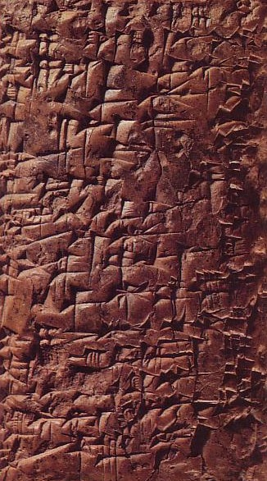
3-Fold Contrast on Hebrew/Cun
##
Issue
Hebrew
Babylon
1a
1b
1c
2a
2b
2c
3a
3b
3c
4a
4b
4c

Slide 162
3-Fold Contrast on Black
##
Issue
Hebrew
Babylon
1a
1b
1c
2a
2b
2c
3a
3b
3c
4a
4b
4c

Slide 163
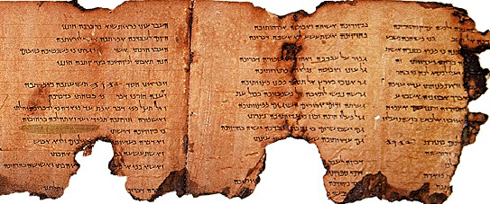
Scroll on White

Slide 164

Septuagint Scroll on Black

Slide 165

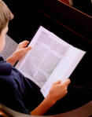
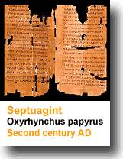
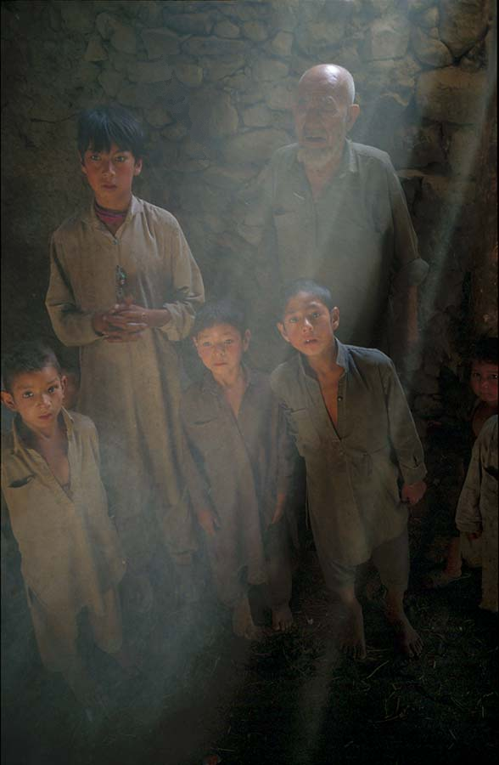
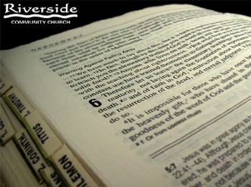

Clip Art

Slide 166
The Millennium
An Introduction

Slide 167
Revelation 20:1-3 (NAU)
¹Then I saw an angel coming down from heaven, holding the key of the abyss and a great chain in his hand. ²And he laid hold of the dragon, the serpent of old, who is the devil and Satan, and bound him for a thousand years; ³and he threw him into the abyss, and shut it and sealed it over him, so that he would not deceive the nations any longer, until the thousand years were completed; after these things he must be released for a short time.

Slide 168
Two Key Millennial Questions
120
When? Will Christ return before of after the millennium?
What? All agree there will be a millennium, but what kind will it be?

Slide 169
Basic Comparisons
120
Amil
Postmil
Premil

Slide 170
Millennial Advocates by Century
121
1
2
3
4
16
17
18
19
20
21
Premil
Amil
Postmil

Slide 171
Amillennialism
27
Second Coming
Spiritual reign of Christ
Tribulations
Church Age
Eternal Kingdom
Judgment

Slide 172
Postmillennialism
27
Second Coming
Golden Age of the Gospel
Tribulations
Church Age
Eternal Kingdom
Judgment

Slide 173
Premillennialism
27
Second Coming
Second
=
Advent
Tribulation
Millennium
Church Age
Eternal Kingdom
7 years
1000 years
Judgment
Judgment

Slide 174
Is there a future for ethnic believing Israel?
Dispensational
Premillennialism
Amillennialism &
Postmillennialism
Church & Israel distinct
Israel has a future
Church is new Israel
Israel has no future
Covenant
Premillennialism

Slide 175
Three Purposes for the Church
14
WORSHIP
To Christ
Body
EDIFICATION
To Believers
Bride
Flock
Building
Priesthood
MULTIPLICATION
To Unbelievers

Slide 176
Title
Subtitle

Slide 184
James 2
Text

Slide 206

Title

