Slide 1
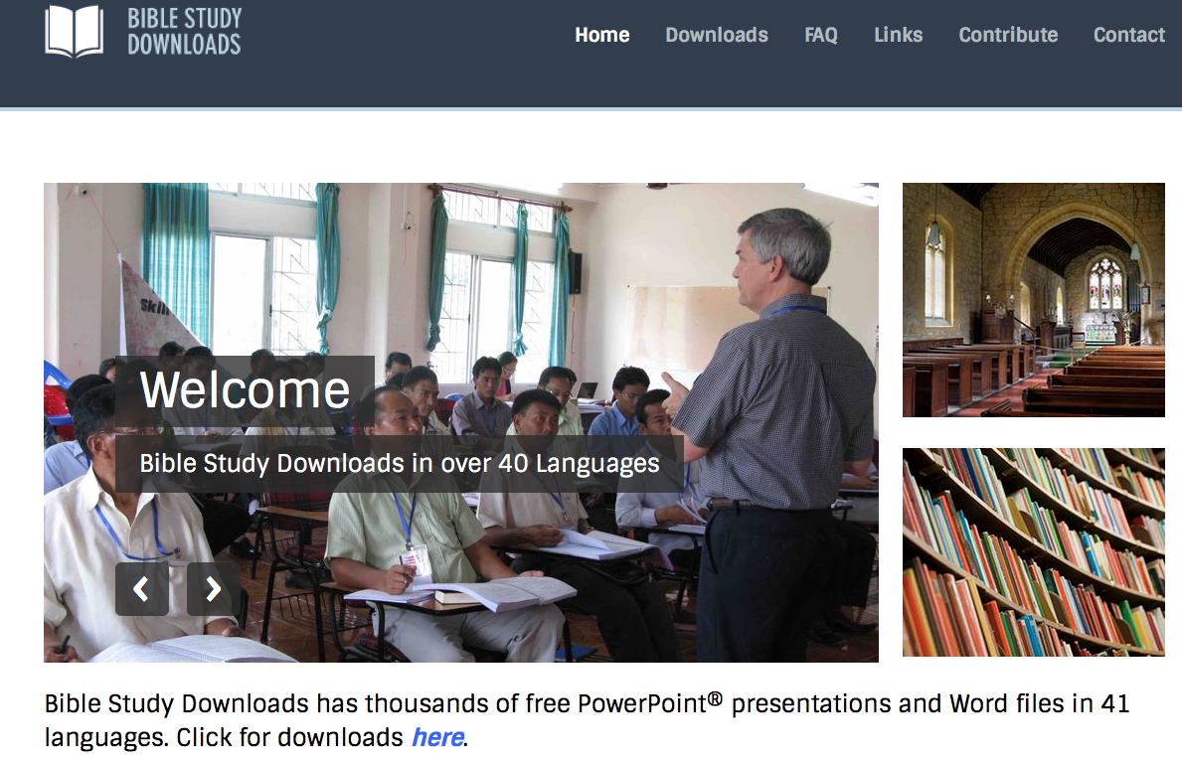
BibleStudyDownloads.org
BSD Overview
Dr. Rick Griffith
BibleStudyDownloads.org
Notes:
I abbreviate my website, BibleStudyDownloads.org, as BSD since the name is so long. The website is complex as well—so it is good to provide this summary of the website so you can better use it for your life and ministry.

Slide 2

Where on the Internet can you…
Find hundreds of PowerPoint (PPT) slides for every Bible book
Download editable files for your teaching (not just PDFs)
Access 40+ free editable courses on theology and practical ministry
Download audio and video
Get translations in 50+ languages

Slide 3


BibleStudyDownloads.org
All 31 of my courses are free + 11 others
Notes:
Student translation since 2003 with 700 translators has resulted in Bible teaching and study materials—mostly PowerPoint—in 49 languages! All a teacher needs to do is to click on a file and it downloads for free to teach any book of the Bible and many other subjects.
NT Survey (ns)

Slide 4

My Mission Organization…

Slide 5
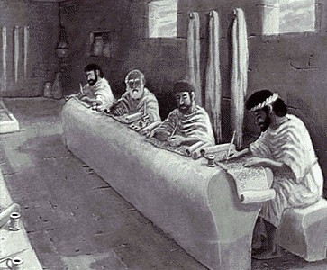
Who Am I? (Education Roots)
BS, Business Marketing (Hay U, 1980)
ThM, Pastoral Ministries (Dallas Seminary, 1987)
PhD, Bible Exposition (also DTS, 1990)

Slide 6
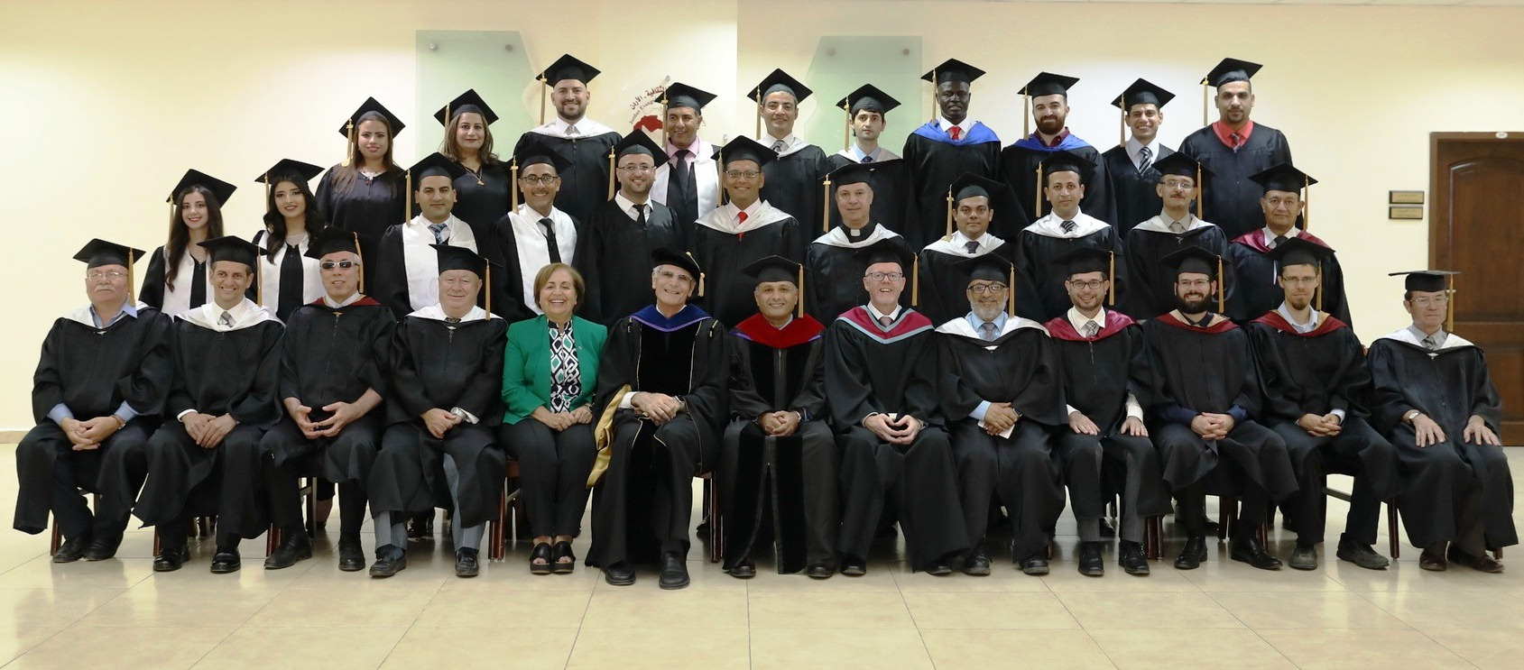
Jordan Evangelical Theological Seminary (JETS)
I teach as Professor of Bible Exposition

Slide 7

SINGAPORE BIBLE COLLEGE
9
I taught at SBC for 30 years (1991-2021)
Notes:
I've served as a seminary professor with 30 other faculty at Singapore's largest training school: Singapore Bible College

Slide 8


Singapore Bible College Students
USA
MONGOLIA
JAPAN
KOREA
CHINA
HONG KONG
MYANMAR
INDIA
THAILAND
VIETNAM
PHILIPPINES
MALAYSIA
SINGAPORE
SRI LANKA
INDONESIA
SBC
Notes:
These faithful leaders are from about 25 countries who come to us in Singapore for masters and doctoral-level training. We train them to build into others back in their home countries.

Slide 9
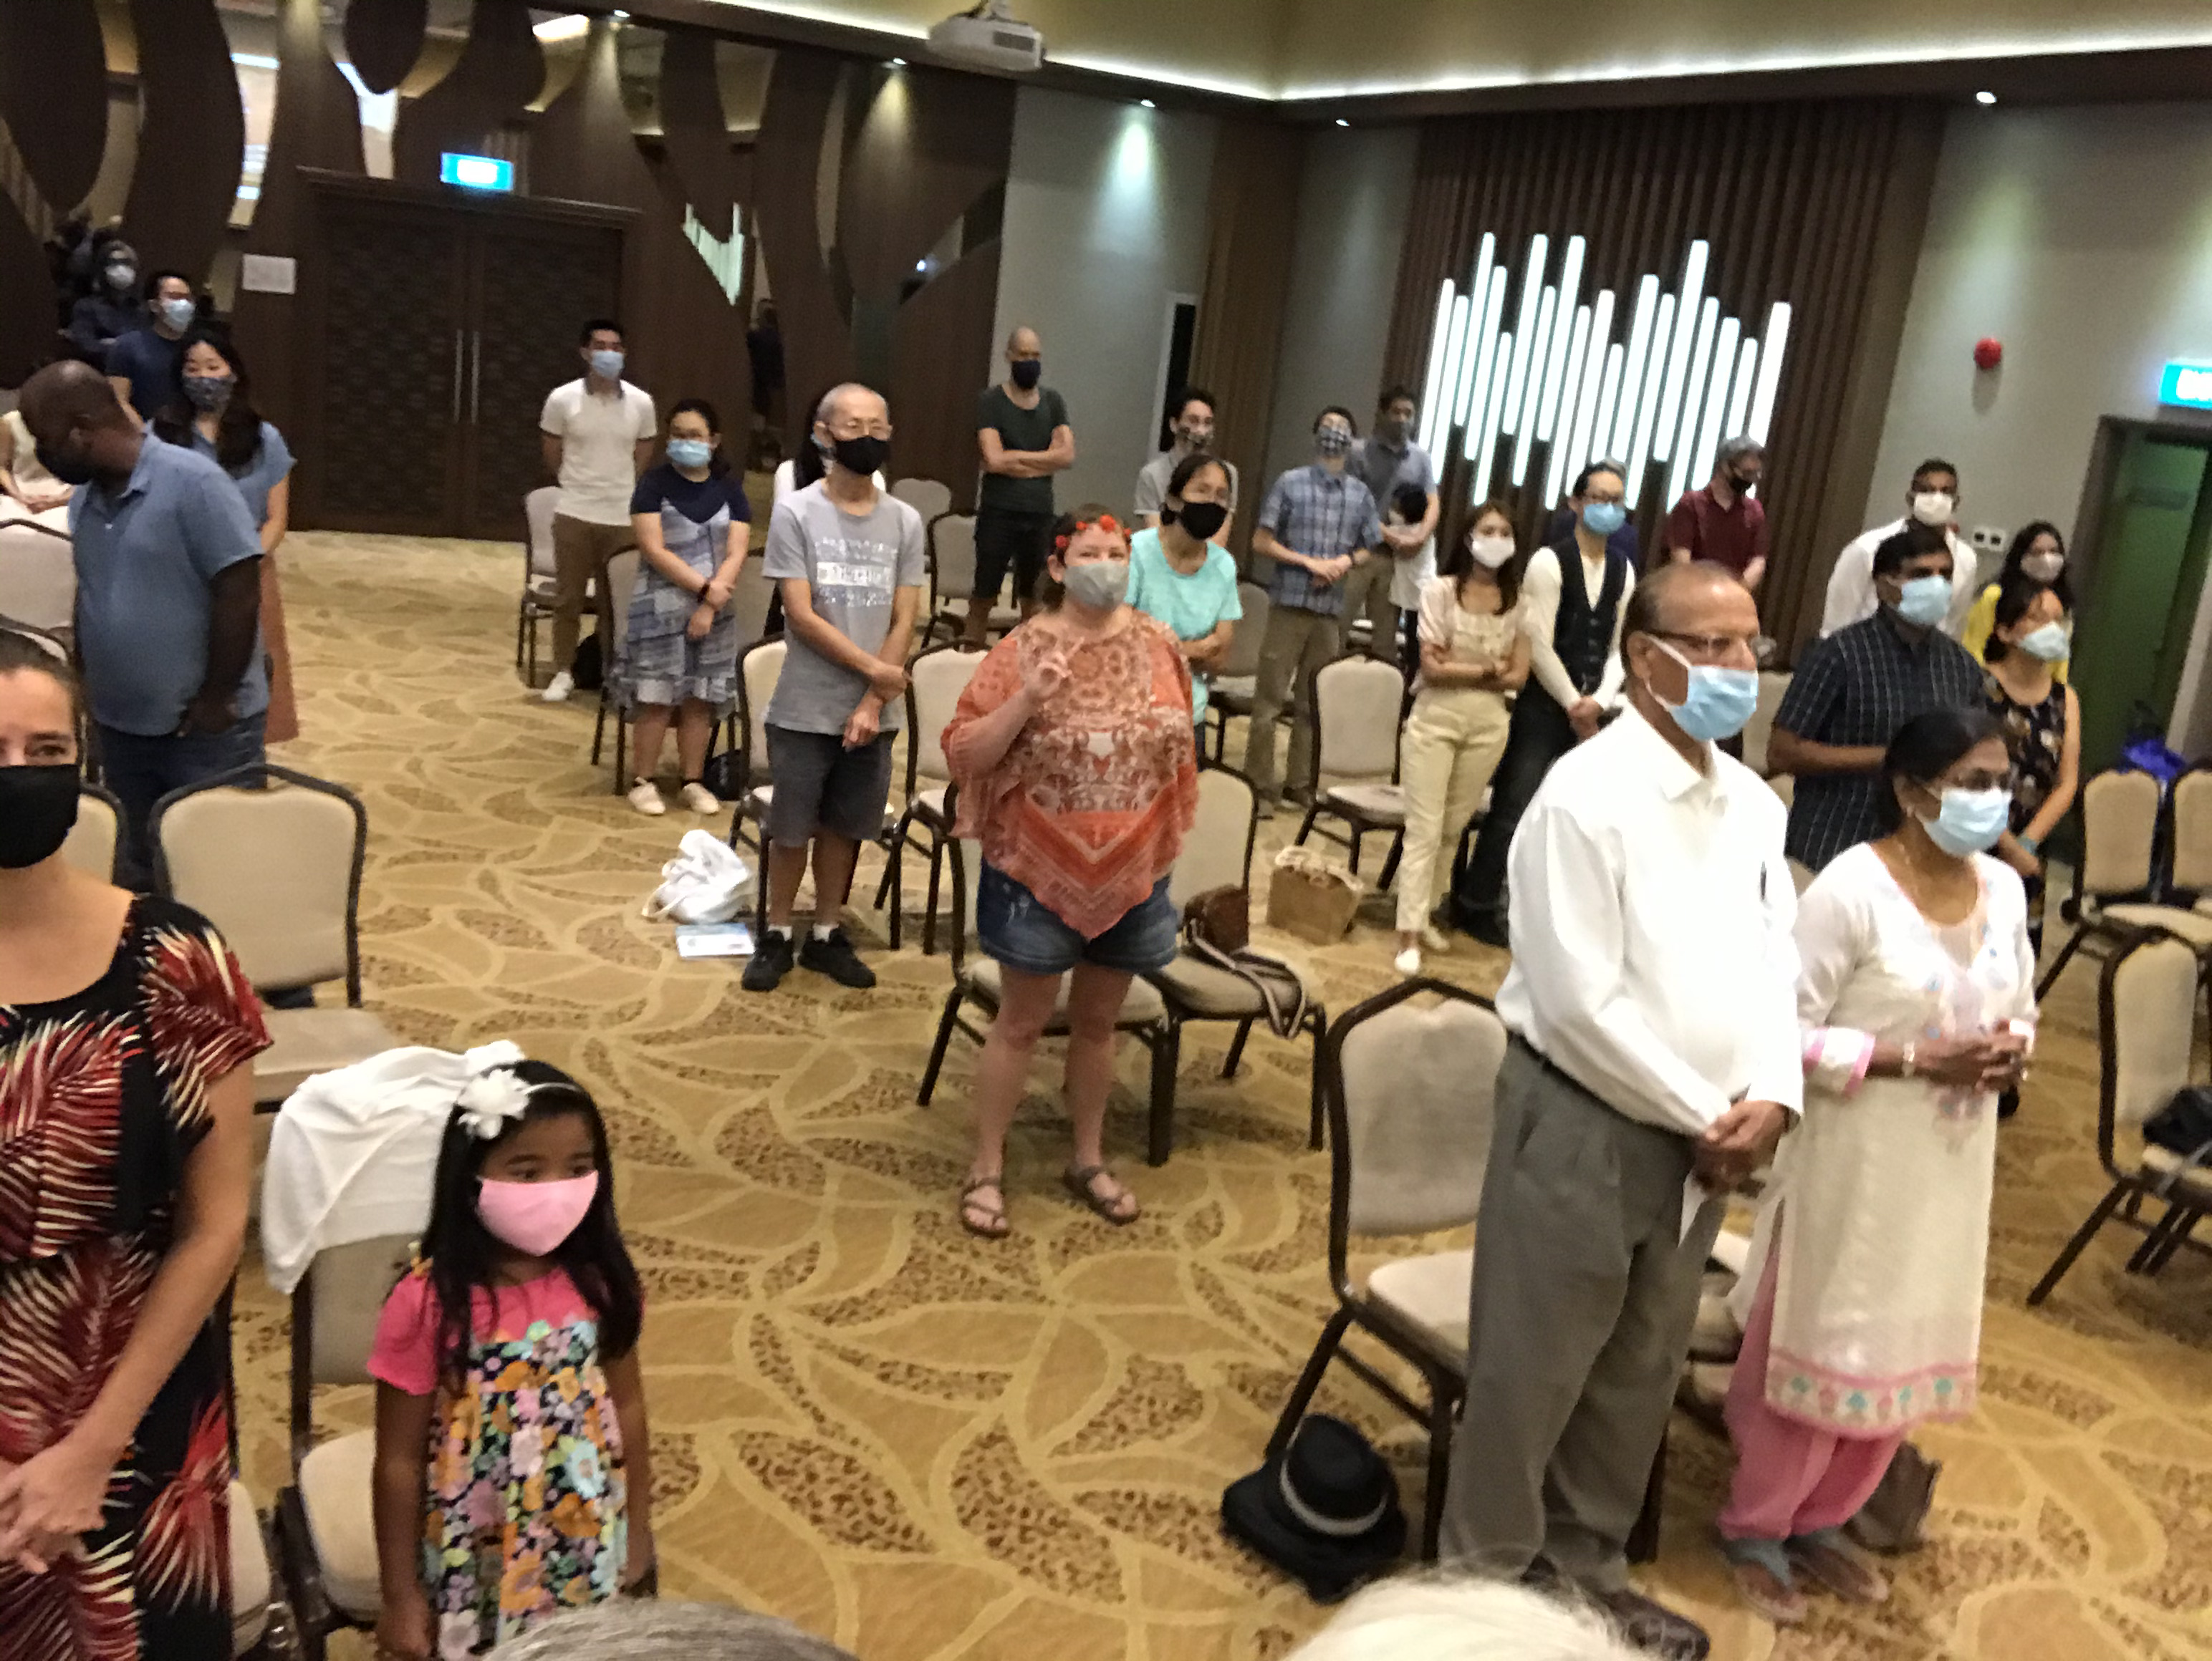

Our People
9
Our church plant: 2006-2021
90 people from 16 nations

Slide 10

Our People
9
Preaching through Scripture
Notes:
Being a pastor gives me the privilege to teach God’s Word on weekends too!

Slide 11

Let's Study Through Scripture
The Bible: Book by Book
Notes:
I have been preaching through the entire Bible, book by book.

Slide 12

BE
FAITHFUL
Genesis
Dr. Rick Griffith, Crossroads International Church Singapore
CICFamily.com • BibleStudyDownloads.org
Notes:
Since we are human beings and not “human doings,” each sermon starts with the word “Be...” So the overview of Genesis is “Be Faithful”…

Slide 13

Be Triumphant
Revelation
Dr. Rick Griffith • Crossroads International Church Singapore
BibleStudyDownloads.org
Notes:
…and so on all the way to Revelation entitled “Be Triumphant.”

Slide 14
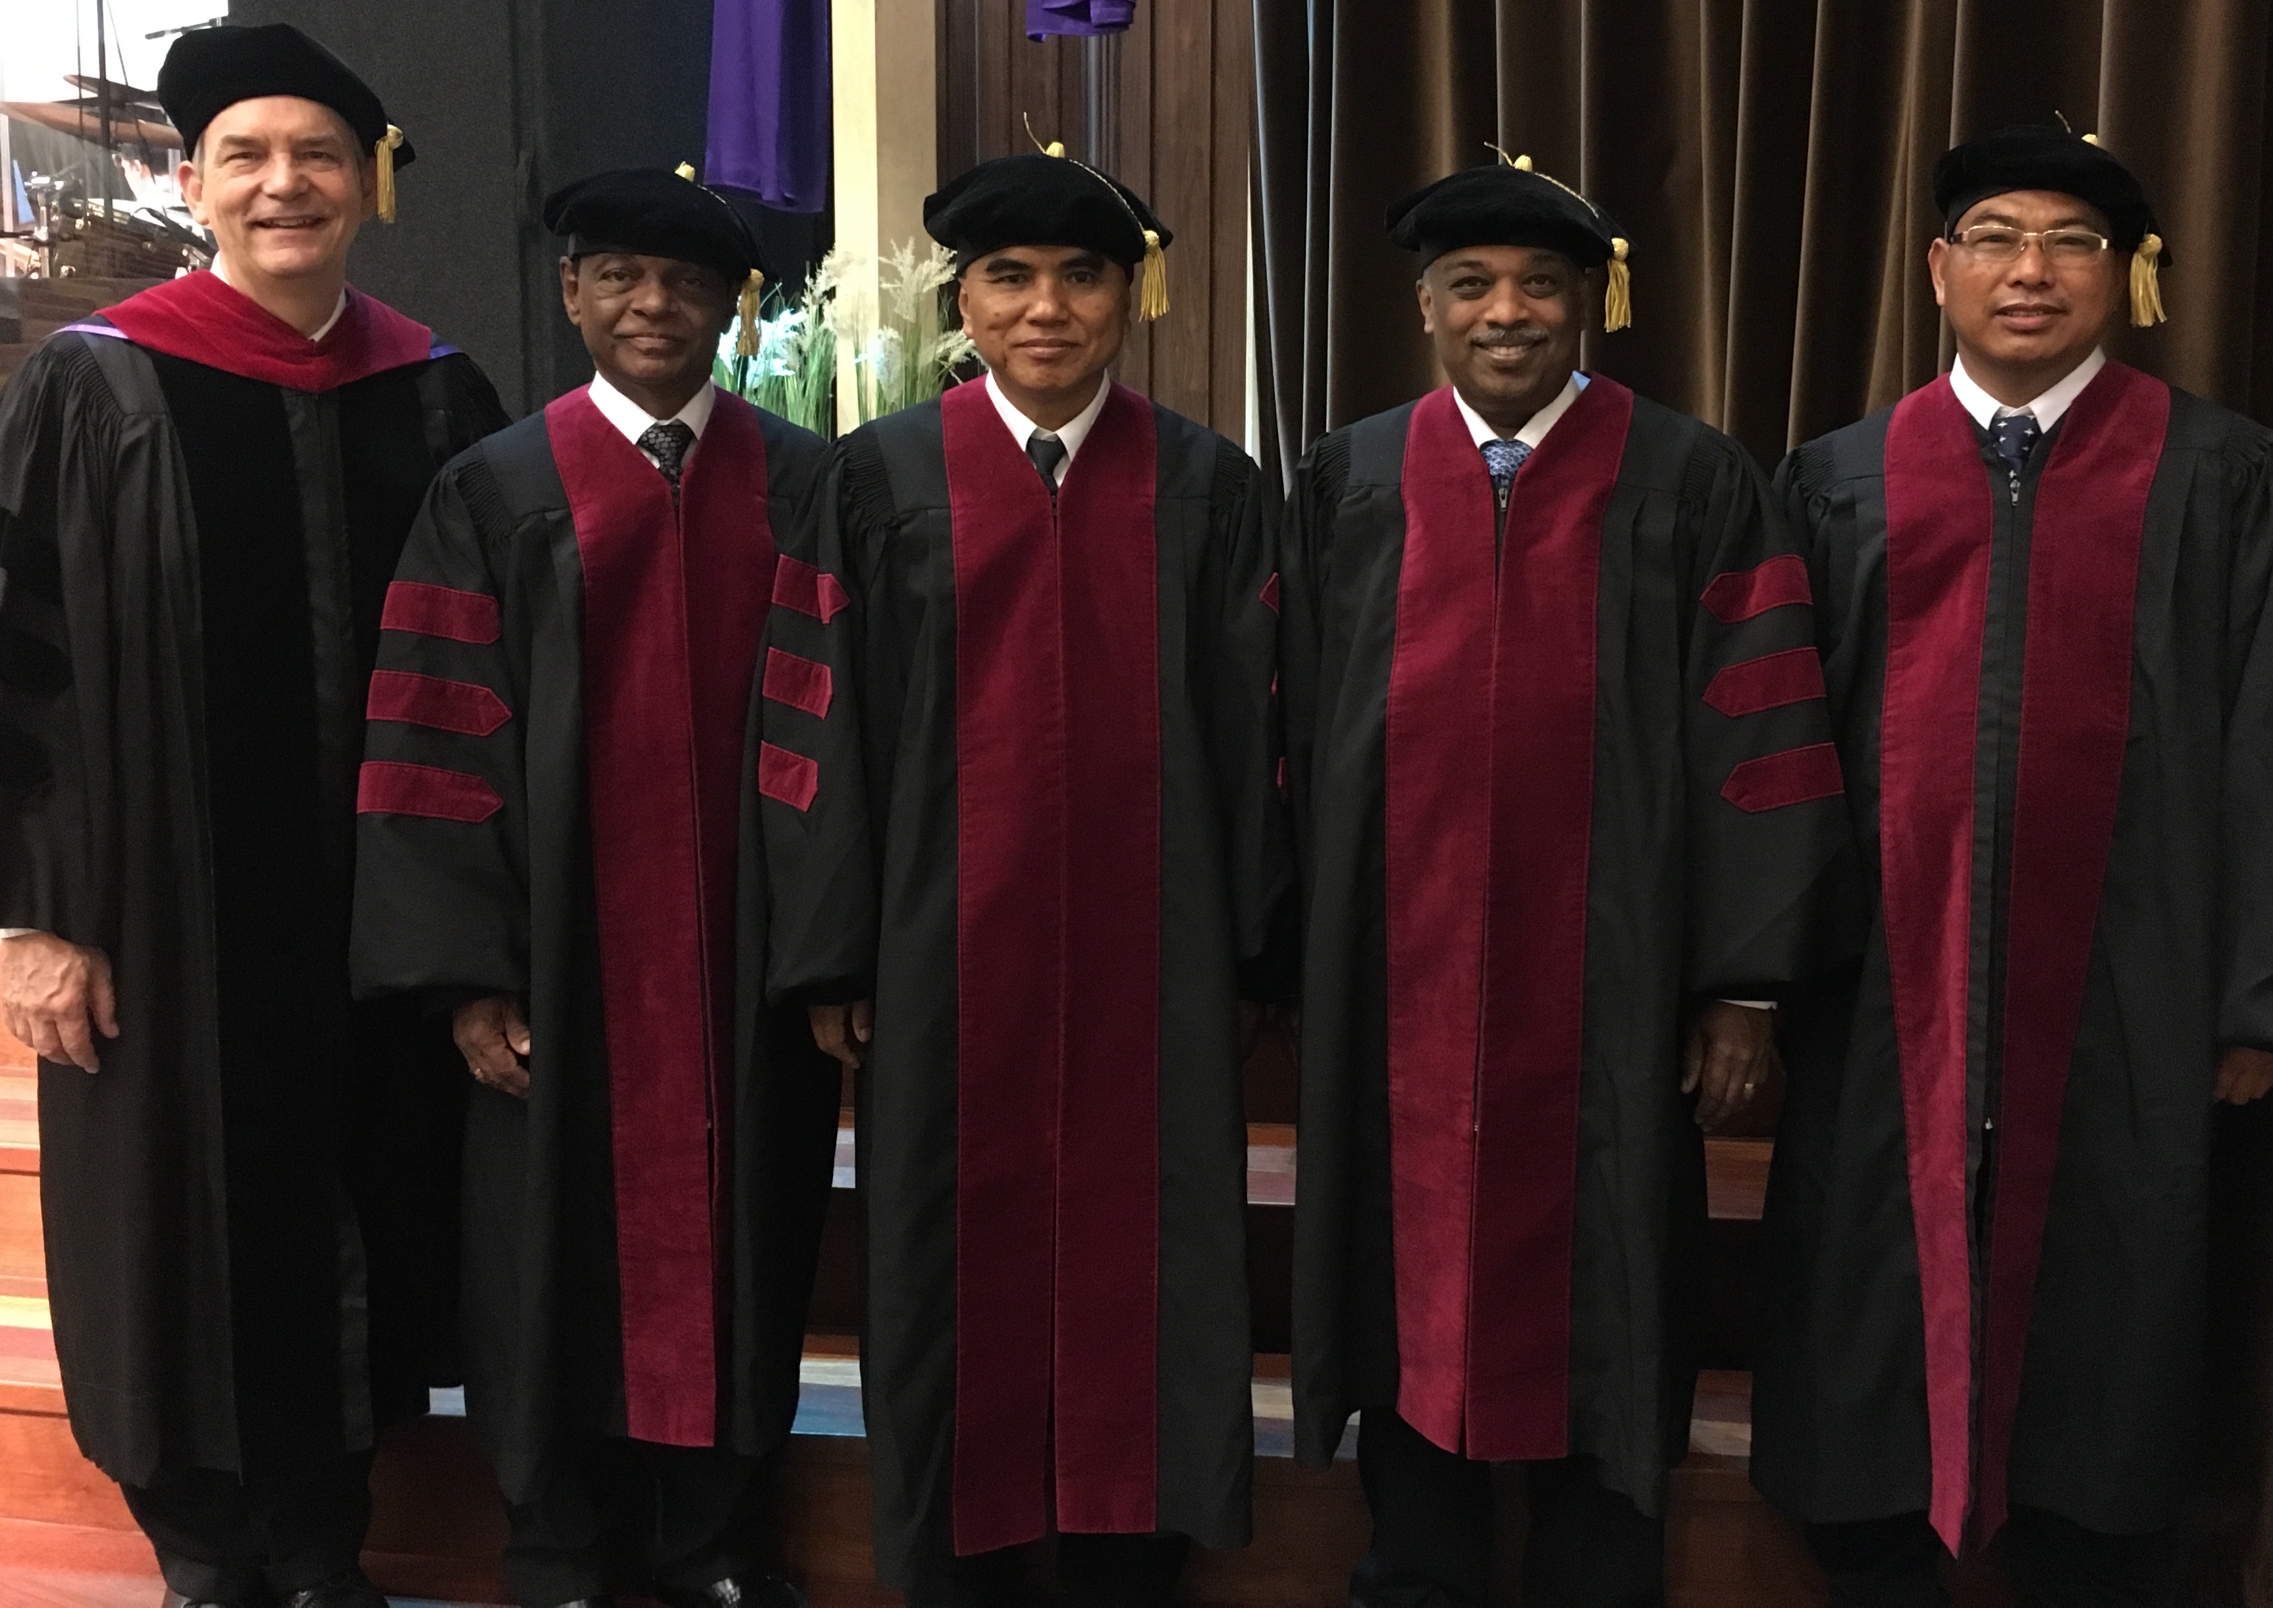
I directed the SBC Doctor of Ministry studies (DMin) from 2012-2021
Notes:
SBC trains about 50 seminary professors and pastors throughout Asia in English and Chinese. Generally each year about 5 of them received their Doctor of Ministry degree.

Slide 15
Courses Taught
(English • Indonesian • Chinese)
Survey • The Bible…Basically
OT NT Bible Study
Backgrounds • Research & Writing
OT NT Geography
Theology • Creation • Jesus
Church • Spirit • Salvation • Future
Preaching
Homiletics 1 Homiletics 2
Notes:
I get to teach these leaders every book of the Bible in survey courses, plus backgrounds to both the OT and NT, three areas of theology, and how to preach.

Slide 16
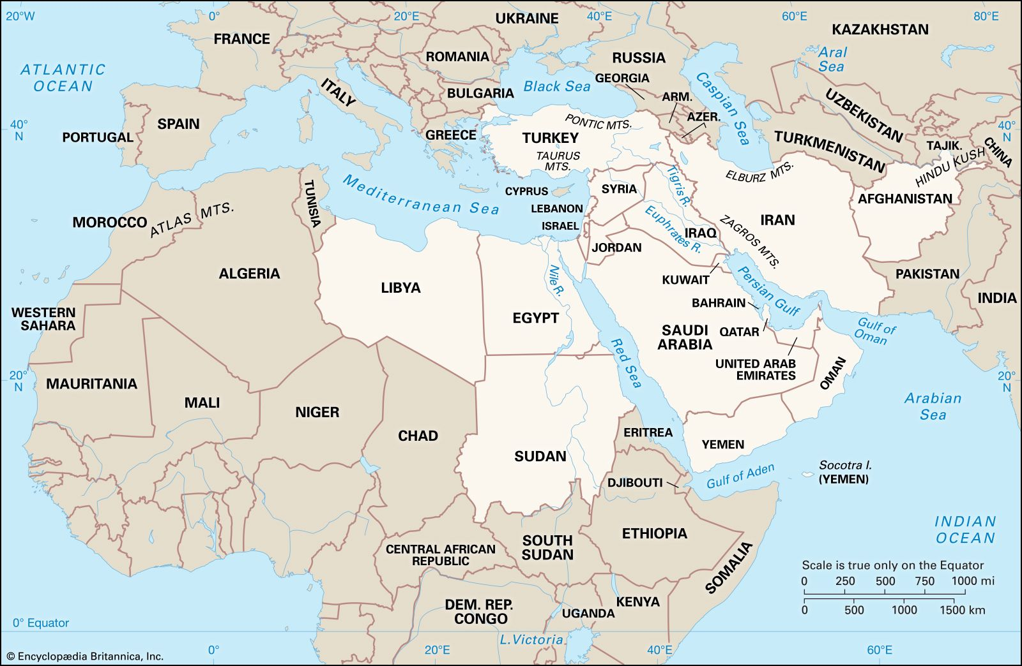
Bible Lands Study Trips 1994-2022
ITALY
TURKEY
GREECE
ISRAEL
JORDAN

Slide 17
Teaching 1994-2021
ISRAEL
MONGOLIA
JORDAN
KOREA
CHINA
NEPAL
MYANMAR
INDIA
THAILAND
VIETNAM
MALAYSIA
SRI LANKA
SINGAPORE
SBC
INDONESIA
Notes:
From 1997-Dec 2020 God has seen fit to grant me the privilege to train pastors in 12 other countries on 73 trips. Often pastors in the US team-teach with me on these trips. To help the poor, I avoid the wealthy countries where listeners can pay an honorarium but instead raise the funds to pay my own way and then teach for free.

Slide 18
Ministries in Asia
Singapore Bible College Bible & preaching professor
Singapore Bible College Doctor of Ministry director
Adjunct Professor teaching in 12 Asian nations
Crossroads International Church pastor-teacher
WorldVenture Singapore field leader
The Bible…Basically translation director
BibleStudyDownloads.org web author
Jordan Evang. Theolog. Seminary Bible professor
Amman International Church speaker

Slide 19

Days of Creation
33
Void
Formless
Forming
Filling
Day 4: Sun, moon & stars arranged
Day 1: Light
Day 2: Water & air separated
Day 5: Fish & fowl
Day 3: Land & sea separated
Day 6: Animals & man
Genesis 1:3-31

Slide 20
六天的创造
空虚
64
充满
混沌
形成
第四天: 太阳，月亮与众星摆列在天
第一天: 光
第二天:
水与空气分开
第五天: 鱼与雀鸟
第三天:
旱地与海分开
第六天: 动物与人
创世记 1:3-31

Slide 21
أيام الخلق
64
خالية
ملأ
خربة
تشكيل
اليوم 4 : ترتيب الشمس و القمر و النجوم
اليوم 1 : نور
اليوم 2 : فصل الجلد و المياه
اليوم 5 : الأسماك و الطيور
اليوم 3 : فصل البحر و اليابسة
اليوم 6 : الحيوانات و الإنسان
تكوين 1 : 3 - 31
Notes:
There is no accident or evolution of trial-and-error in Genesis 1—God carefully made everything by his choice. As expected, he formed the world for three days before he filled it.

Slide 22

How BSD can help you teach
Decide your content
Choose the right BSD course

Slide 23
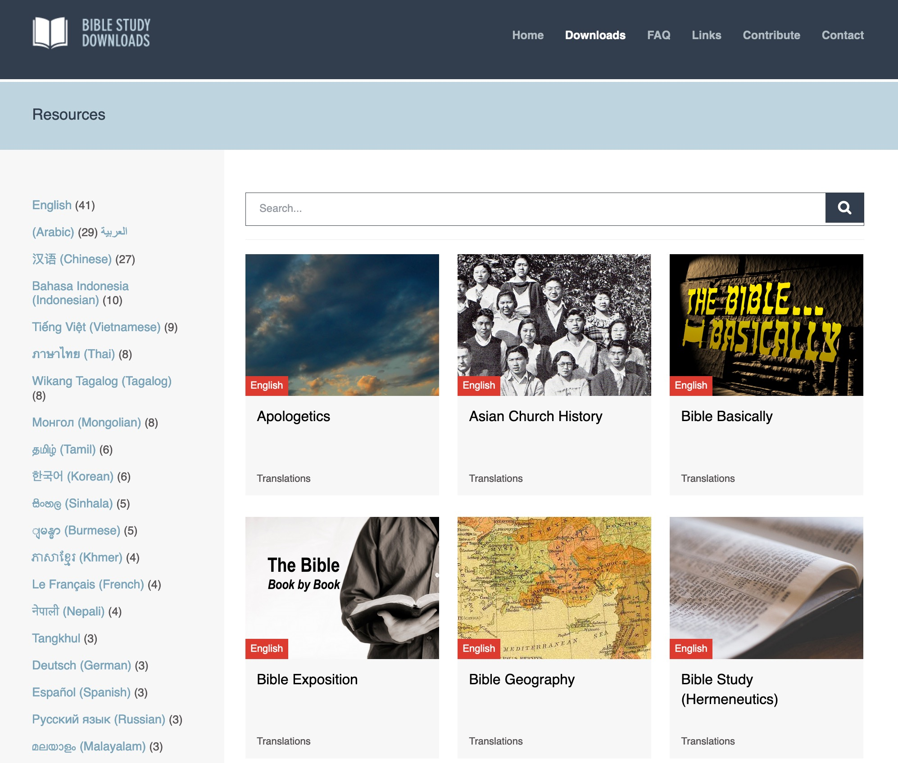
BibleStudyDownloads.org
Use the search feature
Scroll through the 42 courses
Notes:
My SBC teaching has resulted in Bible teaching and study materials—mostly PowerPoint—in 54 languages! All a teacher needs to do is to click on a file and it downloads for free to teach any book of the Bible and many other subjects.

Slide 24
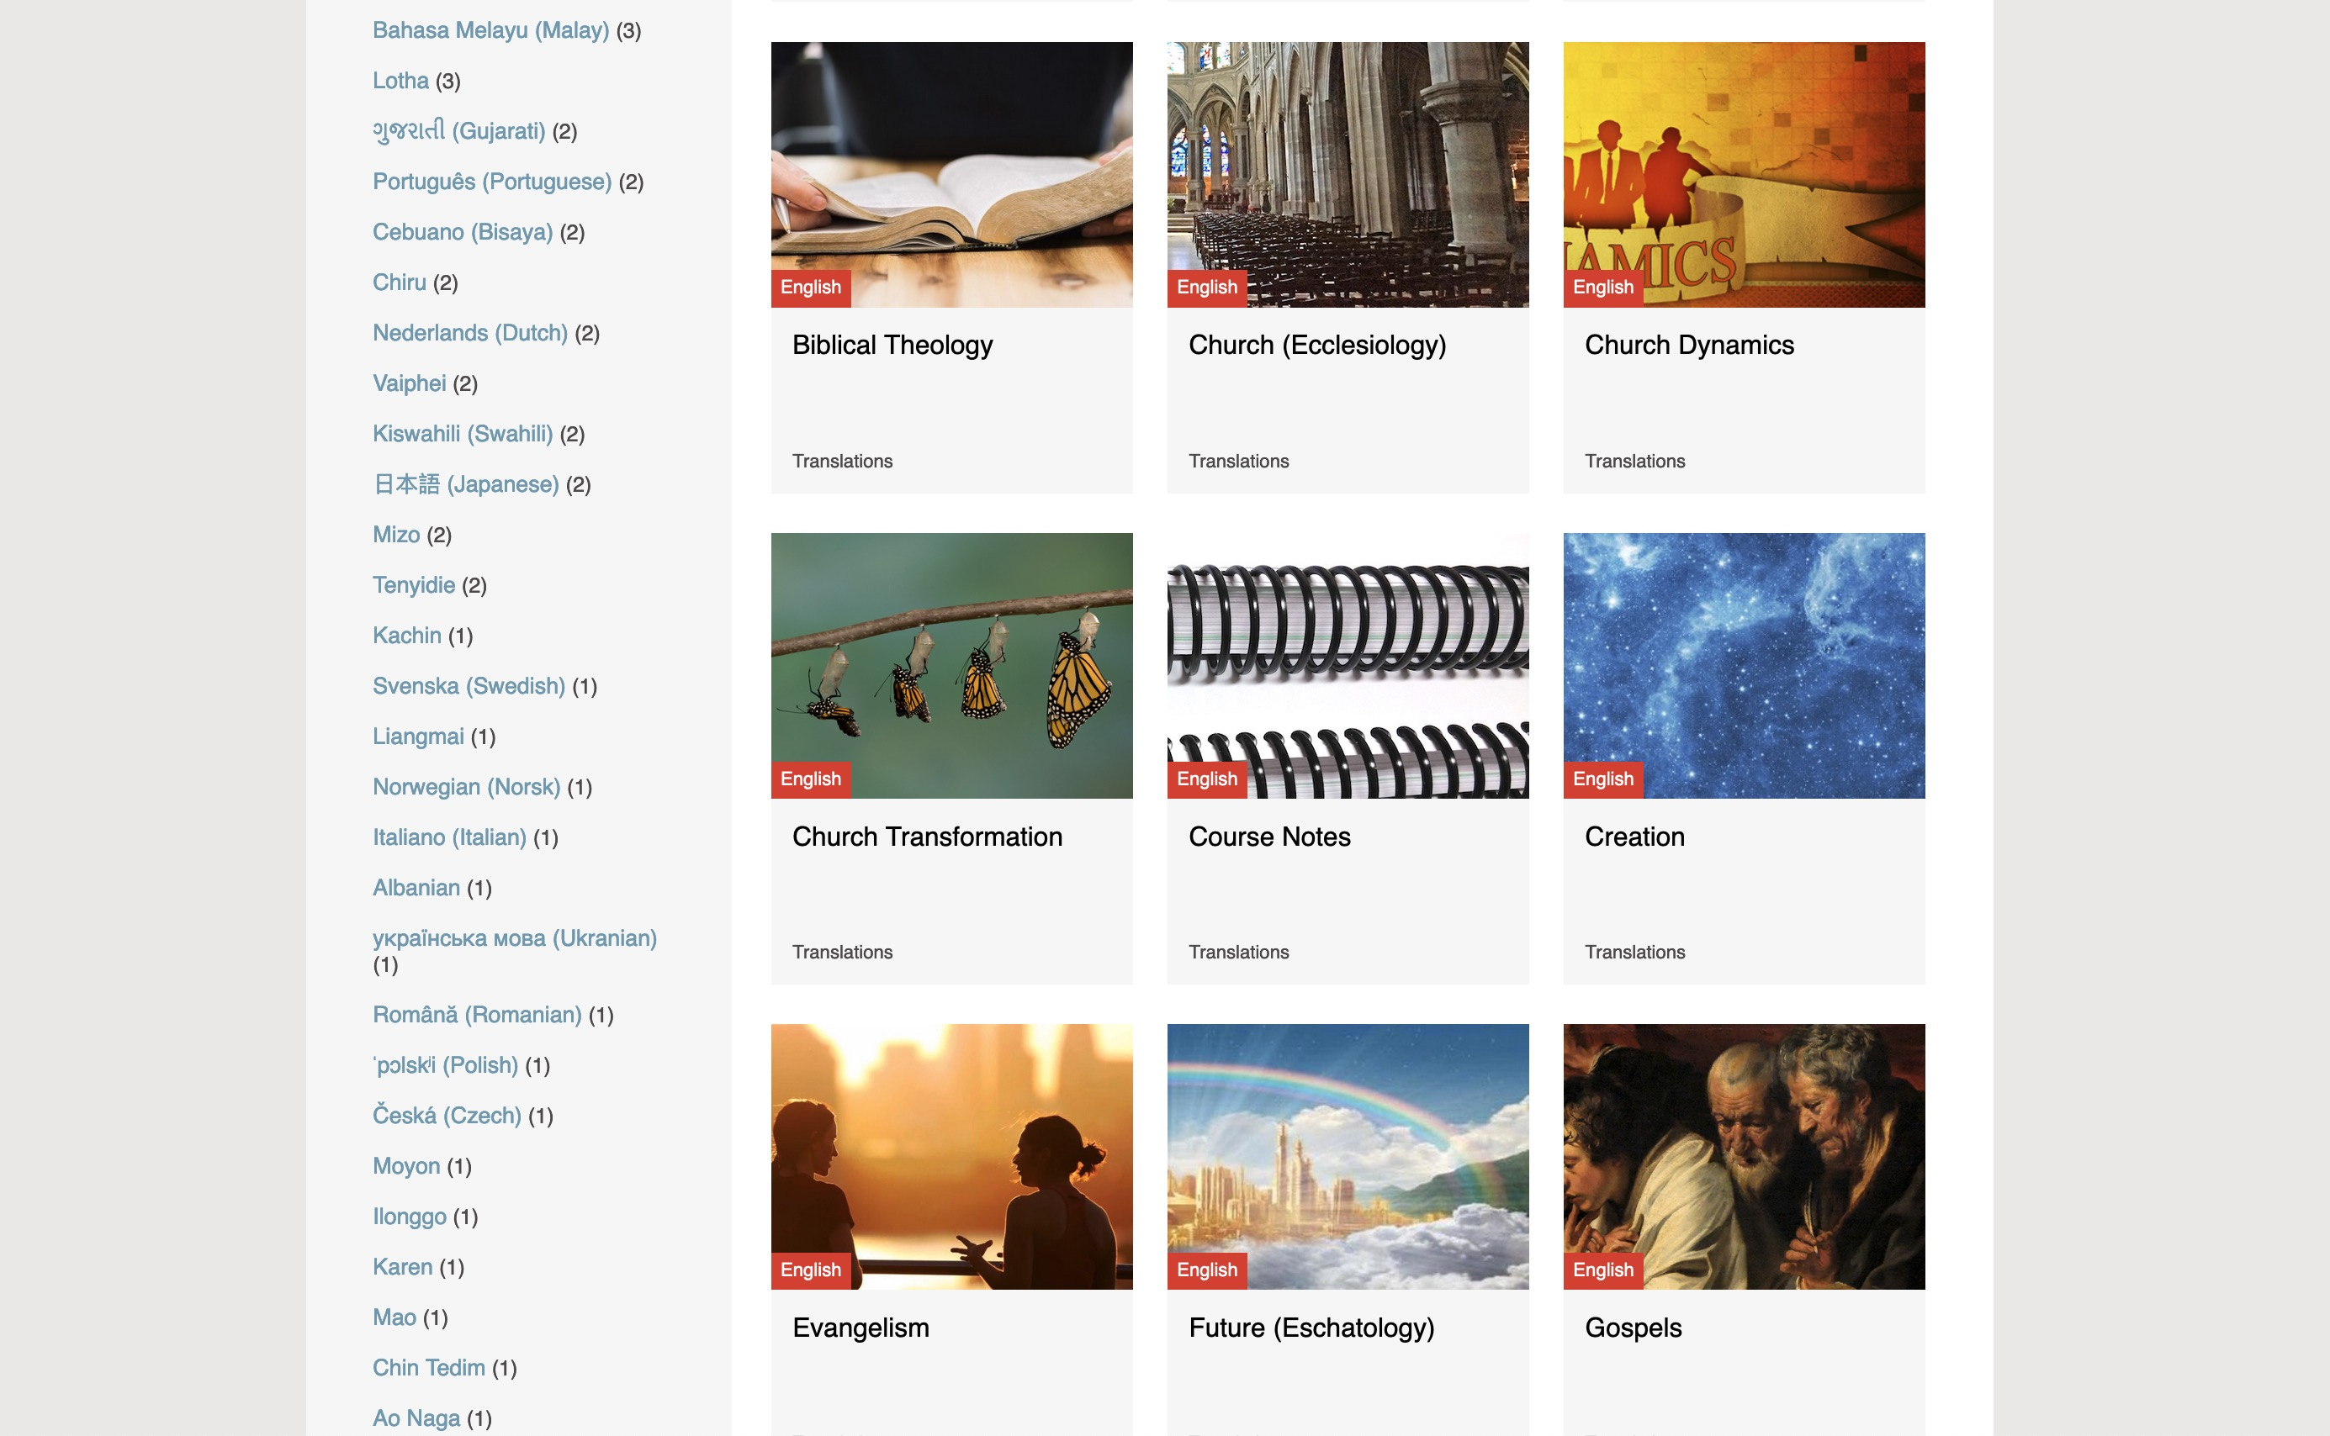
BibleStudyDownloads.org
7
54 languages are on the left
Notes:
My SBC teaching has resulted in Bible teaching and study materials—mostly PowerPoint—in 54 languages! All a teacher needs to do is to click on a file and it downloads for free to teach any book of the Bible and many other subjects.

Slide 25
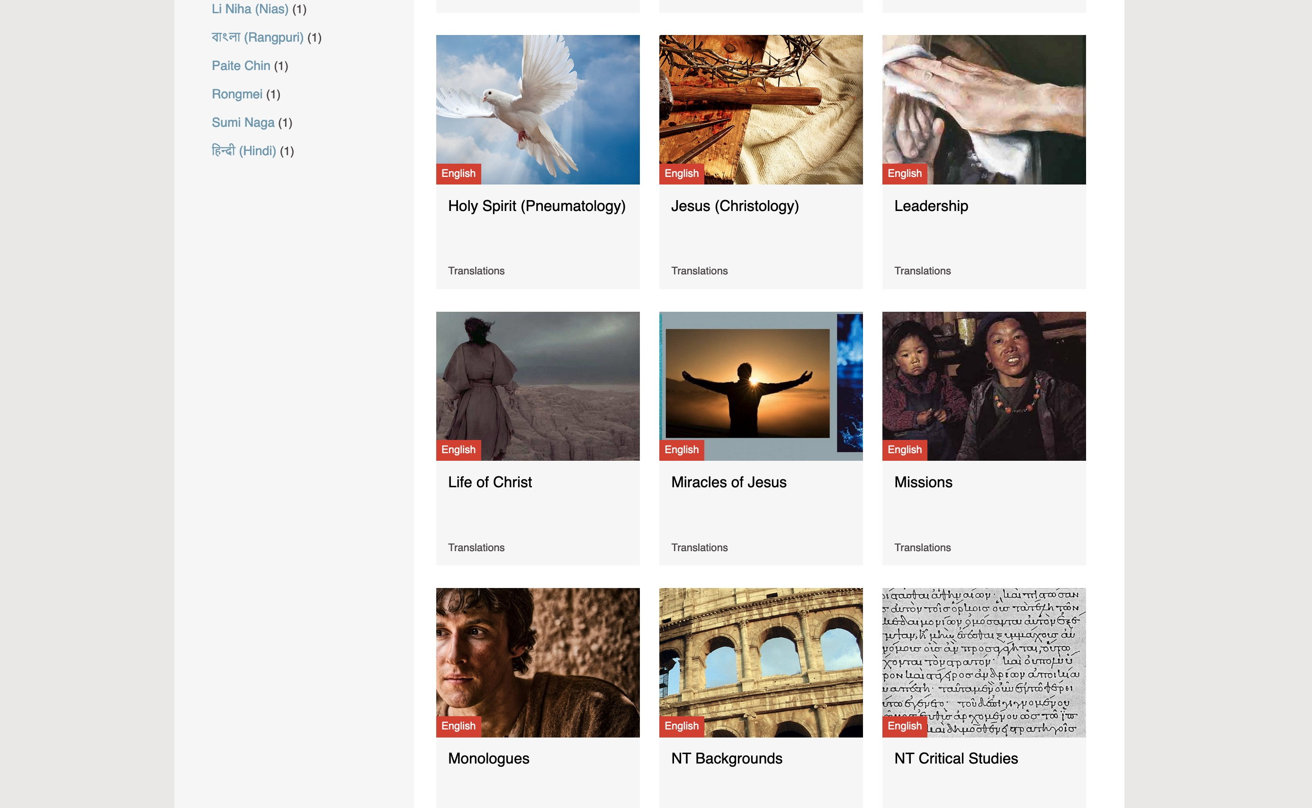
BibleStudyDownloads.org
7
Notes:
My SBC teaching has resulted in Bible teaching and study materials—mostly PowerPoint—in 54 languages! All a teacher needs to do is to click on a file and it downloads for free to teach any book of the Bible and many other subjects.

Slide 26
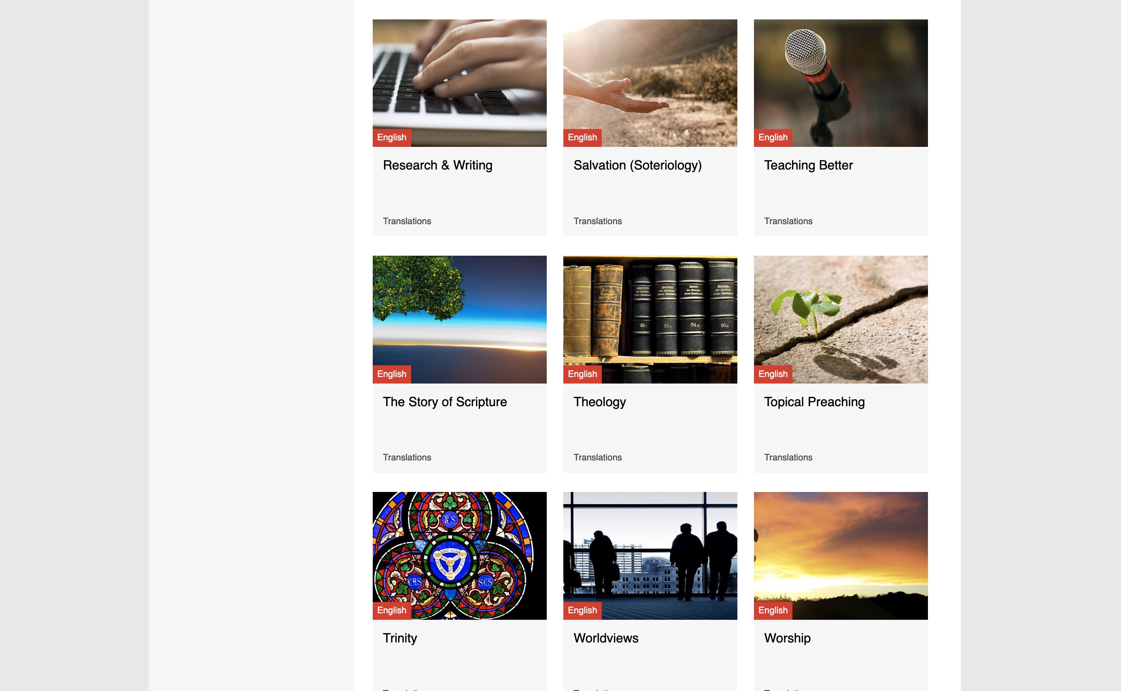
BibleStudyDownloads.org
7
Notes:
My SBC teaching has resulted in Bible teaching and study materials—mostly PowerPoint—in 54 languages! All a teacher needs to do is to click on a file and it downloads for free to teach any book of the Bible and many other subjects.

Slide 27
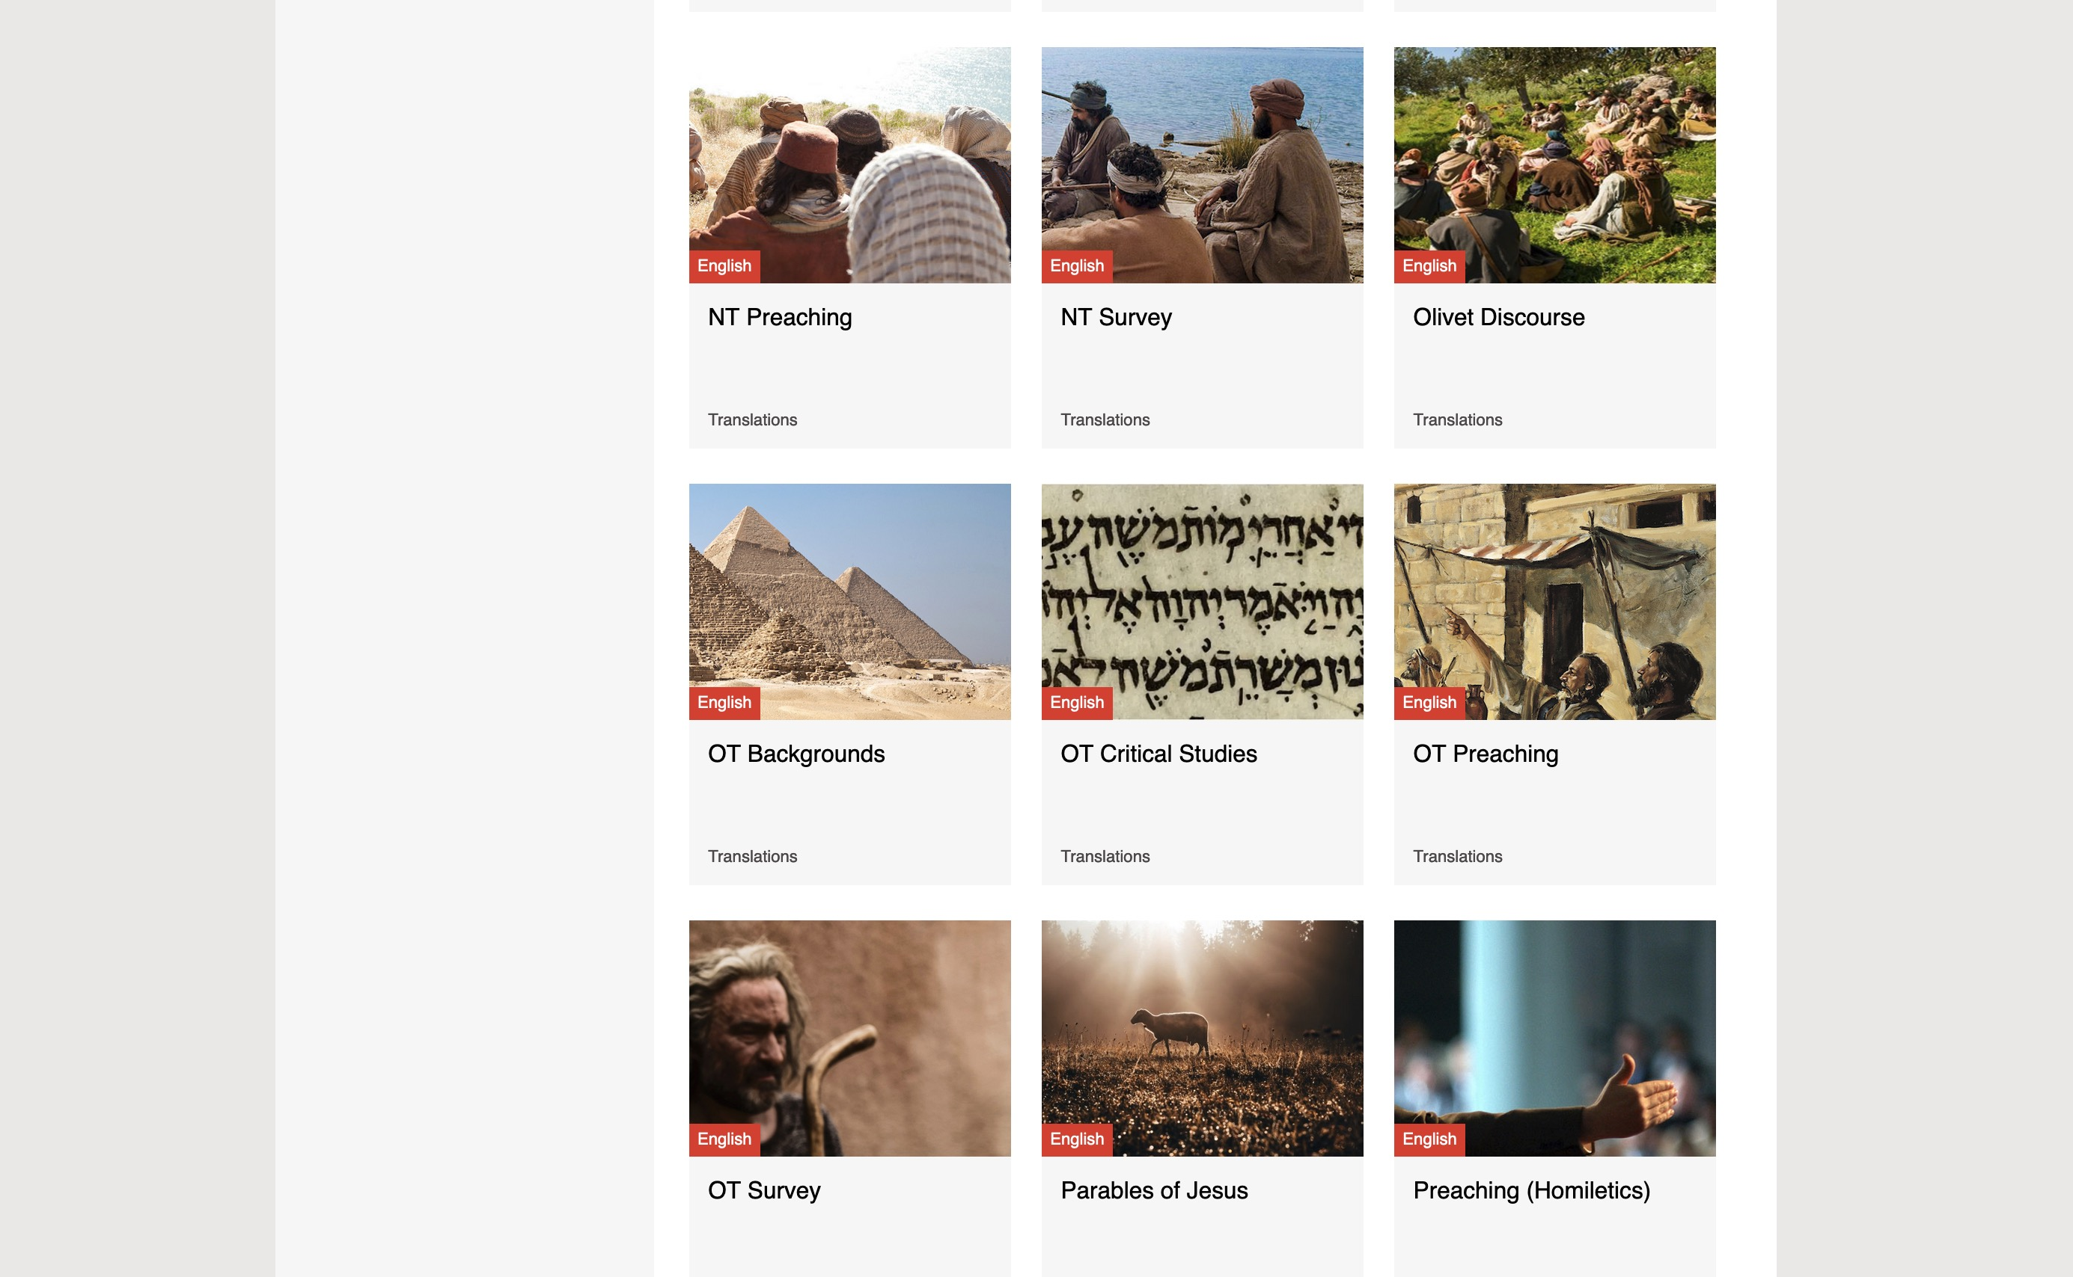
BibleStudyDownloads.org
7
Notes:
My SBC teaching has resulted in Bible teaching and study materials—mostly PowerPoint—in 54 languages! All a teacher needs to do is to click on a file and it downloads for free to teach any book of the Bible and many other subjects.

Slide 28
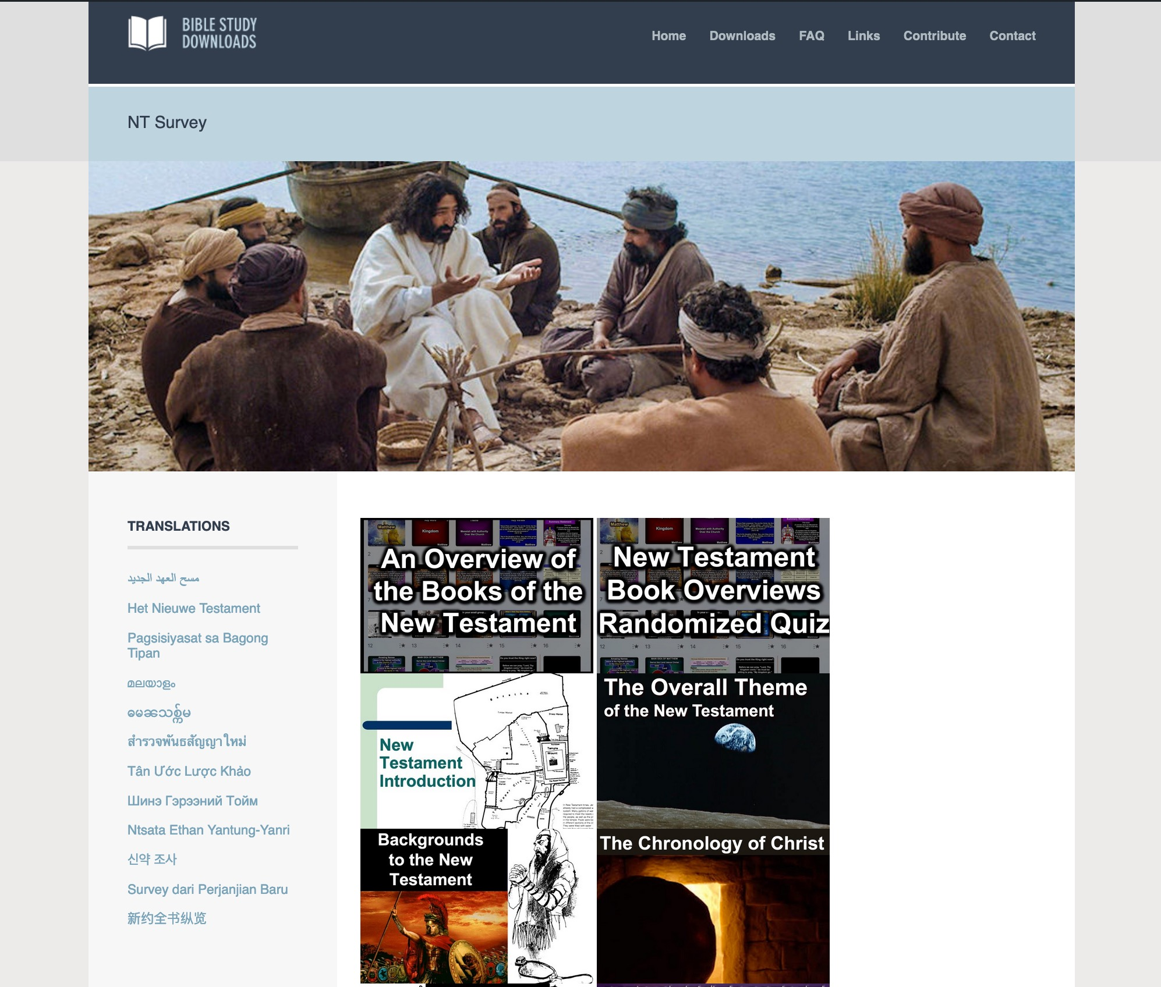
BibleStudyDownloads.org
7
English
Click a PPT image for download
Notes:
My SBC teaching has resulted in Bible teaching and study materials—mostly PowerPoint—in 54 languages! All a teacher needs to do is to click on a file and it downloads for free to teach any book of the Bible and many other subjects.

Slide 29
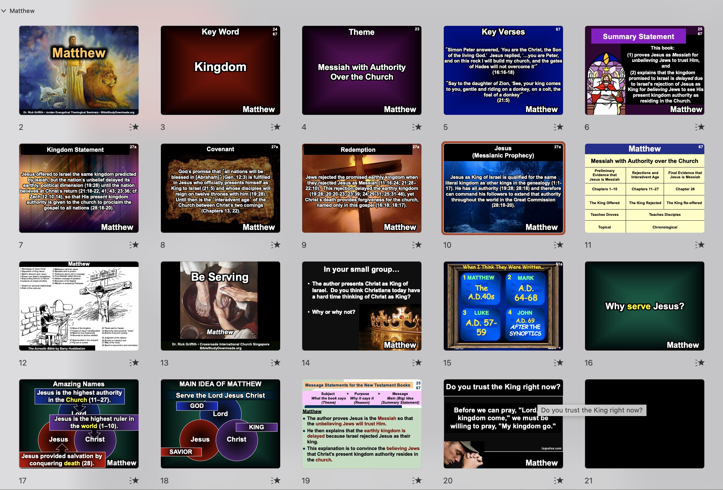
BibleStudyDownloads.org
7
Select Slides to Use
The Presentation Itself
Notes:
My SBC teaching has resulted in Bible teaching and study materials—mostly PowerPoint—in 54 languages! All a teacher needs to do is to click on a file and it downloads for free to teach any book of the Bible and many other subjects.

Slide 30

Matthew
Dr. Rick Griffith • Jordan Evangelical Theological Seminary • BibleStudyDownloads.org
Notes:
Matthew portrays Jesus as both the lion (ruling king) and the lamb (sacrificial Saviour).

Slide 31
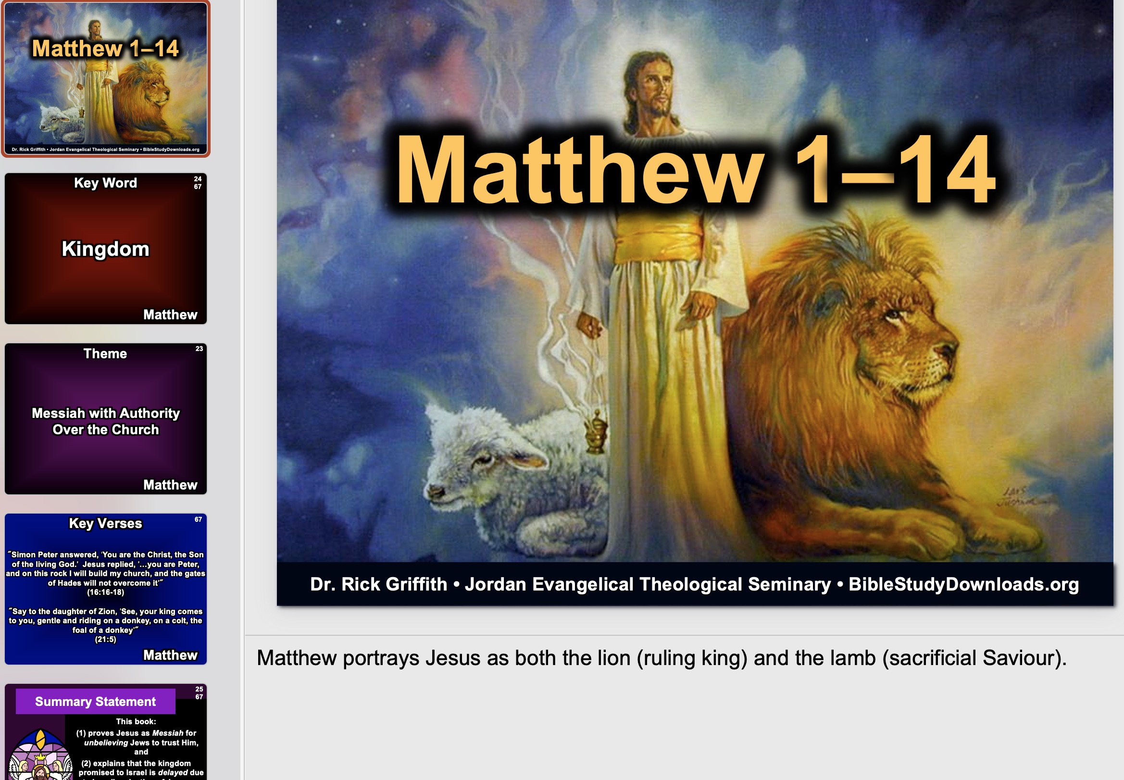
Matthew
Read the Notes for the Slide
Dr. Rick Griffith • Jordan Evangelical Theological Seminary • BibleStudyDownloads.org
Notes:
Matthew portrays Jesus as both the lion (ruling king) and the lamb (sacrificial Saviour).

Slide 32
Key Word
24
67
Kingdom
Matthew
Notes:
Perhaps the best single-word summary for the first gospel is KINGDOM. This book portrays Jesus as Israel's king.

Slide 33
Theme
23
Messiah with Authority
Over the Church
Matthew
Notes:
But Jesus was rejected by Israel and now shows his authority over those believing in him.

Slide 34
Key Verses
67
"Simon Peter answered, 'You are the Christ, the Son of the living God.' Jesus replied, '…you are Peter, and on this rock I will build my church, and the gates of Hades will not overcome it'"
(16:16-18)
"Say to the daughter of Zion, 'See, your king comes to you, gentle and riding on a donkey, on a colt, the foal of a donkey'"
(21:5)
Matthew
Notes:
Typically, we have only one verse that sums up a biblical book—but for Matthew, we will make an exception. This is because he addresses both the Church and Israel. Matthew is the only gospel that mentions the Church (16:18; 18:17), but he also shows Jesus officially offered to Israel as king at the Triumphal Entry.

Slide 35
Summary Statement
25
67
Summary Statement
This book:
(1) proves Jesus as Messiah for unbelieving Jews to trust Him, and
(2) explains that the kingdom promised to Israel is delayed due to Israel's rejection of Jesus as King for believing Jews to see His present kingdom authority as residing in the Church.
Matthew
Notes:
Usually, we also offer a single subject-purpose statement for a biblical book. Again, Matthew is exceptional as it teaches about Jesus for both unbelievers (evangelistic purpose) and believers (discipleship purpose).

Slide 36

Kingdom Statement
27a
Jesus offered to Israel the same kingdom predicted by Isaiah, but the nation's unbelief delayed its earthly, political dimension (19:28) until the nation believes at Christ's return (21:18-22, 41, 43; 23:36; cf. Zech 12:10-14), so that His present kingdom authority is given to the church to proclaim the gospel to all nations (28:18-20).
Matthew
Notes:
Matthew alone includes the repeated phrase "the kingdom of heaven" in the teaching of Jesus, such as in chapter 13. Many scholars note that Matthew may have called this "the kingdom of heaven" as the phrase "the kingdom of God" could have been offensive to his Jewish audience who were more sensitive to God's name being misused. Thus, it is better not to mention God at all, lest he be dishonored.

Slide 37

Covenant
27a
God's promise that "all nations will be blessed in [Abraham]" (Gen. 12:3) is fulfilled in Jesus who officially presents himself as King to Israel (21:5) and whose disciples will reign on twelve thrones with him (19:28). Until then is the "interadvent age" of the Church between Christ's two comings (Chapters 13, 22).
Matthew
Notes:
Matthew's kingdom emphasis does not mean he lacks any mention of the Abrahamic covenant at all. In fact, Jesus is the completion or fulfillment of the old covenant (5:18) now that he has established the new covenant. Note Matt. 26:28—"for this is my blood, which confirms the covenant between God and his people. It is poured out as a sacrifice to forgive the sins of many."

Slide 38

Redemption
27a
Jews rejected the promised earthly kingdom when they rejected Jesus as Messiah (11:16-24; 21:28–22:10). This rejection delayed the earthly kingdom (19:28; 20:20-23; 23:39; 24:29-31; 25:31-46), yet Christ's death provides forgiveness for the church, named only in this gospel (16:18; 18:17).
Matthew
Notes:
Matthew presents Jesus not only as King but also as Savior. Note again Matt. 26:28—"for this is my blood, which confirms the covenant between God and his people. It is poured out as a sacrifice to forgive the sins of many." Forgiveness of people is often noted as the proper response to God forgiving us:
Matt. 6:12 and forgive us our sins,
as we have forgiven those who sin against us.
Matt. 6:14 “If you forgive those who sin against you, your heavenly Father will forgive you. ¹⁵ But if you refuse to forgive others, your Father will not forgive your sins.
Matt. 9:2 Some people brought to him a paralyzed man on a mat. Seeing their faith, Jesus said to the paralyzed man, “Be encouraged, my child! Your sins are forgiven.”
Matt. 9:5 Is it easier to say ‘Your sins are forgiven,’ or ‘Stand up and walk’? ⁶ So I will prove to you that the Son of Manª has the authority on earth to forgive sins.” Then Jesus turned to the paralyzed man and said, “Stand up, pick up your mat, and go home!”
Matt. 12:31 “So I tell you, every sin and blasphemy can be forgiven—except blasphemy against the Holy Spirit, which will never be forgiven. ³² Anyone who speaks against the Son of Man can be forgiven, but anyone who speaks against the Holy Spirit will never be forgiven, either in this world or in the world to come.
Matt. 18:21 Then Peter came to him and asked, “Lord, how often should I forgive someoneª who sins against me? Seven times?”
Matt. 18:27 Then his master was filled with pity for him, and he released him and forgave his debt.
Matt. 18:32 Then the king called in the man he had forgiven and said, ‘You evil servant! I forgave you that tremendous debt because you pleaded with me.
Matt. 18:35 “That’s what my heavenly Father will do to you if you refuse to forgive your brothers and sistersª from your heart.”
Matt. 26:28 for this is my blood, which confirms the covenantª between God and his people. It is poured out as a sacrifice to forgive the sins of many.

Slide 39

Jesus
(Messianic Prophecy)
27a
Jesus as King of Israel is qualified for the same literal kingdom as other kings in the genealogy (1:1-17). He has all authority (19:28; 28:18) and therefore can command his followers to extend that authority throughout the world in the Great Commission (28:19-20).
Matthew
Notes:
Jesus is not simply a "spiritual king" but one literally in the line of David. As Messiah, he rules above all, and those believing in him in essence become co-rulers with his authority to bring him to the nations.

Slide 40
Matthew
67
Messiah with Authority over the Church
Preliminary Evidence that
Jesus is Messiah
Rejections and
Interadvent Age
Final Evidence that
Jesus is Messiah
Chapters 1–10
Chapters 11–27
Chapter 28
The King Rejected
The King Re-offered
The King Offered
Teaches Droves
Teaches Disciples
Topical
Chronological
Notes:
The title includes both the Jewish (Messiah) and Gentile (Church) elements in the book. The outline follows a threefold outline of (1) proofs, (2) responses, and (3) results.

Slide 41
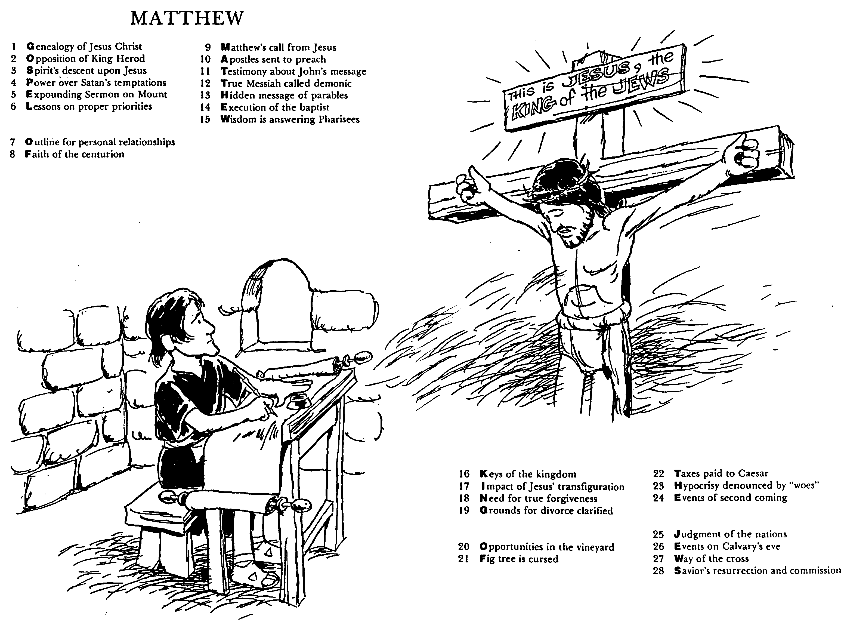
The Acrostic Bible by Barry Huddleston
Matthew
1 Genealogy of Jesus Christ
2 Opposition of King Herod
3 Spirit's descent upon Jesus
4 Power over Satan's temptations
5 Expounding Sermon on Mount
6 Lessons on proper priorities
7 Outline for personal relationships
8 Faith of the centurion
9 Matthew's call from Jesus
10 Apostles sent to preach
11 Testimony about John's message
12 True Messiah called demonic
13 Hidden message of parables
14 Execution of the Baptist
15 Wisdom is answering Pharisees
16 Keys of the kingdom
17 Impact of Jesus' transfiguration
18 Need for true forgiveness
19 Grounds for divorce clarified
20 Opportunities in the vineyard
21 Fig tree is cursed
22 Taxes paid to Caesar
23 Hypocrisy denounced by "woes"
24 Events of second coming
25 Judgment of the nations
26 Events on Calvary's eve
27 Way of the cross
28 Savior's resurrection and commission
Notes:
Huddleston insightfully gives a summation of each chapter in four words, but the first letter of each chapter forms the theme of Matthew: GOSPEL OF MATTHEW, KING OF THE JEWS.

Slide 42
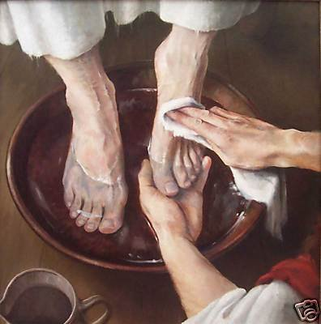
Be Serving
Matthew
Dr. Rick Griffith • Crossroads International Church Singapore
BibleStudyDownloads.org
Notes:
The title of this message covers the entire book of Matthew in one sermon. But it emphasizes the application of Matthew's gospel. If Jesus is indeed king, the proper response to this King is to be serving him with our all.

Slide 43

In your small group…
The author presents Christ as King of Israel. Do you think Christians today have a hard time thinking of Christ as King?
Why or why not?
Matthew
Notes:
Many of us come from democracies where we elect leaders and then proceed to tear them down afterward. This anti-authority view too often can be applied to Jesus himself. Jesus is not up for election. He is the King of kings and Lord of lords. We should embrace this reality no matter what type of earthly government we have over us.

Slide 44


When I Think They Were Written…
51a
1
MATTHEW
2
MARK
TO:
JEWS
TO:
ROMANS
The A.D.40s
A.D. 64-68
AS:
KING
AS:
SERVANT
WHAT
HE:
WHAT
HE:
SAID
DID
3
LUKE
4
JOHN
GREEKS
CHURCH
A.D. 57-59
A.D. 69 AFTER THE SYNOPTICS
TO:
TO:
AS:
GOD/MAN
AS:
GOD
WHAT
HE:
WHAT
HE:
FELT
MEANT
27
4
Notes:
Now…what about the dates of the writing of these crucial documents? And here we are left to our best scholarly guesses. There will ALWAYS be argument here. But some of the best guesses, based on decades of academic research and study are these – in suggested order…
//// MATTHEW…composed sometime during the A.D. 40s…
//// LUKE is suggested as next, between the years A.D. 57 and 59 A.D…
//// Mark…in the next decade…between 64 and 68…
//// and finally…John's Gospel…around A.D. 69….but certainly after the Synoptics were set down. Again, you will always find disagreement on these dates. However, these dates are from the research of well-known Christian scholars and teachers.

Slide 45
Why serve Jesus?
Matthew
Notes:
This is a fair question to ask. Believers should know the answer as to the reason we place ourselves under the authority of Christ.

Slide 46
Amazing Names
Jesus is the highest authority in the Church (11–27).
Lord
Jesus is the highest ruler in the world (1–10).
Jesus
Christ
Jesus provided salvation by conquering death (28).
Matthew
Notes:
Here is the basic outline of Matthew, designed around the three names of the Lord Jesus Christ.

Slide 47
MAIN IDEA OF MATTHEW
Serve the Lord Jesus Christ
GOD
Lord
KING
Jesus
Christ
SAVIOR
Notes:
Serve Jesus as Savior, God, and King of your life! This is the essential message and application of the entire gospel of Matthew.

Slide 48
25
67
Message Statements for the New Testament Books
Subject + Purpose = Message
What the book says Why it says it Main (Big) Idea (Theme) (Reason) (Summary Statement)
Matthew
The author proves Jesus is the Messiah so that the unbelieving Jews will trust Him.
He then explains that the earthly kingdom is delayed because Israel rejected Jesus as their king.
This explanation is to convince the believing Jews that Christ's present kingdom authority resides in the church.
Notes:
This course will give both the “what” and the “why” of each NT book. Generally this will be in a single sentence, but Matthew is a bit more complicated with what I consider and dual purpose.

Slide 49
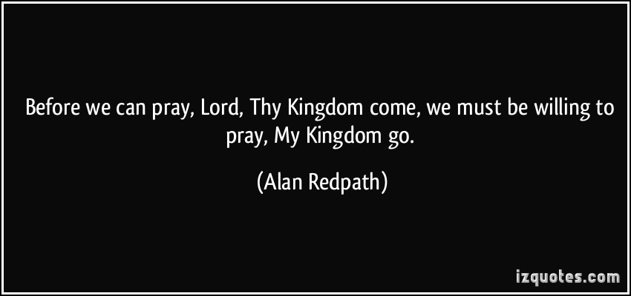

Do you trust the King right now?
Before we can pray, "Lord, Thy kingdom come," we must be willing to pray, "My kingdom go."
Matthew
Notes:
What is holding you back in your own kingdom before you can embrace Christ’s kingdom?
—Your career?
—Trusting God to meet your financial needs?
—A relationship?
—Can you tell him now that you want his kingdom instead of your own?

Slide 51
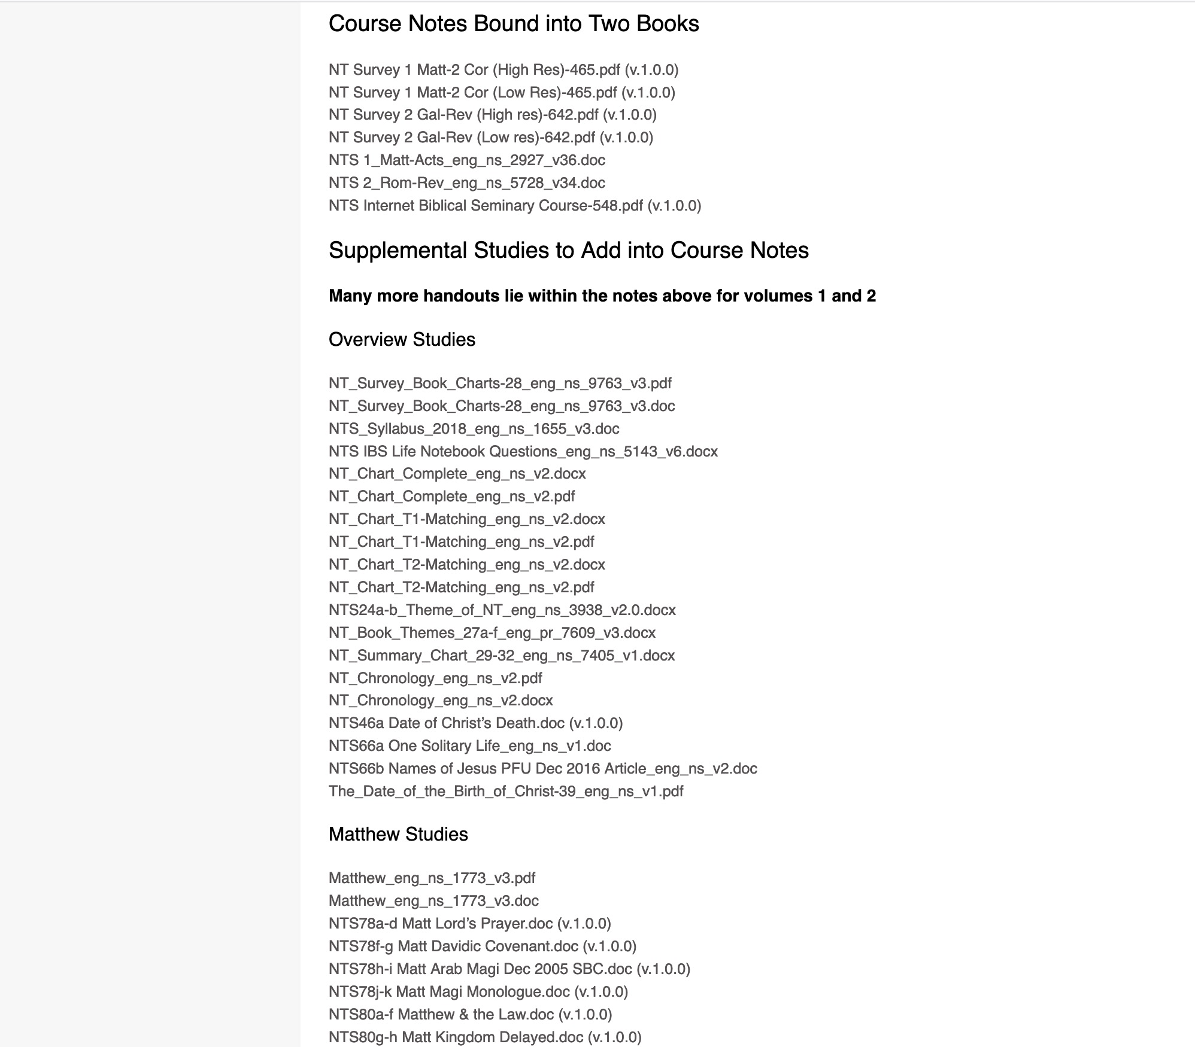
BibleStudyDownloads.org
7
Scroll to the bottom for handouts
NT Survey
Class Notes
Notes:
My SBC teaching has resulted in Bible teaching and study materials—mostly PowerPoint—in 54 languages! All a teacher needs to do is to click on a file and it downloads for free to teach any book of the Bible and many other subjects.

Slide 52
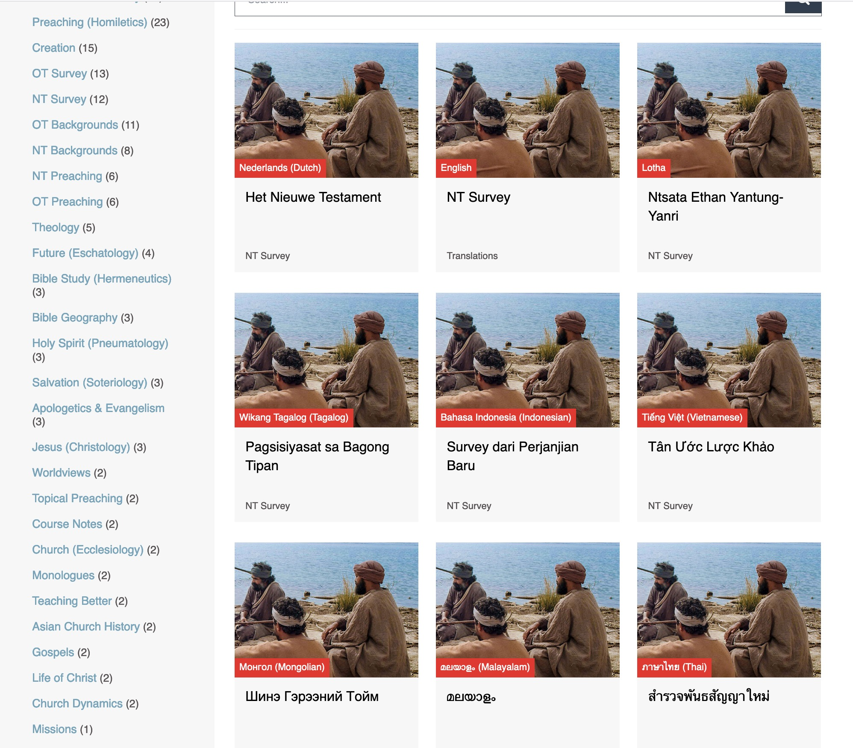
BibleStudyDownloads.org
7
Translations
Notes:
Here are 9 languages featured.

Slide 53


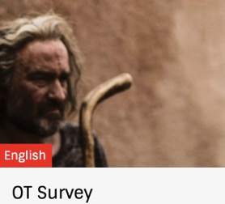

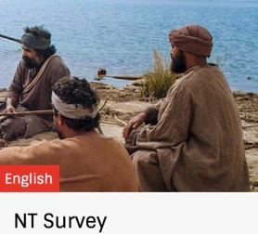
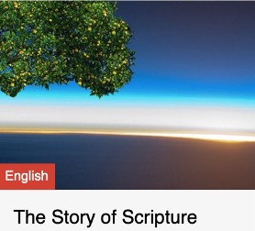
Bible Overview Options
With Number of Slides (& Sessions)
7477
(66 sermons)
15,203
(averages 10 sessions per book)
+
1030
(30)
15,026
(averages 20 sessions per book)
495
(13)
= 30,229
Notes:
OT Survey averages 361 slides per book—if 36 slides are covered per session, a book would take 10 sessions
NT Survey averages 557 slides per book—if 27 slides are covered per session, a book would take 20 sessions

Slide 54
Teaching All 42 Courses
92,299 total English slides
÷30 slides taught per session
_____________________________
= 3077 sessions
Notes:
If you taught 30 slides per session, teaching the 92,299 English slides would take 3077 sessions!

Slide 55
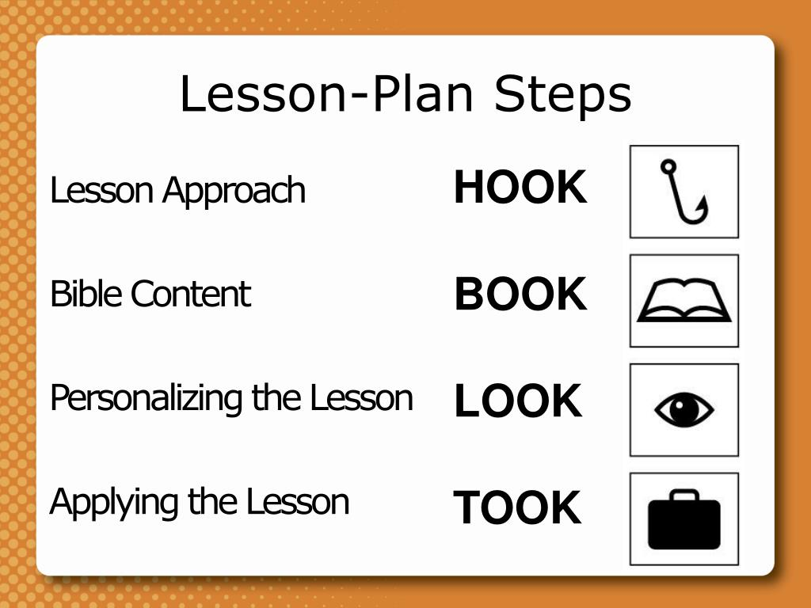
Lesson Plan Steps
Gain Interest
Read Passage
Observe & Interpret
Apply for Life Change
Notes:
Here is a good Bible study outline that many have used. BSD presentations include all four of these in the slides but you can adapt them for your own use.

Slide 56

Teaching Better link at BibleStudyDownloads.org
Get this presentation for free!

