Slide 1
PowerPoint Tips for Teachers
How to Keep an Audience
Dr. Rick Griffith Jordan Evangelical Theological Seminary
https://biblestudydownloads.org/resources/teaching-better/
NOTES
Notes:
Microsoft PowerPoint has become more prevalent in leading worship, teaching, and preaching. However, audiences are also becoming more demanding that PPT be done well. How can you improve the quality of your presentations?

Slide 2
Layout
Notes:
Slide Design: How can we improve the way the slides look?

Slide 3
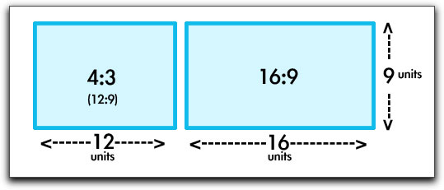
Full/Standard (4:3) or Widescreen (16:9) Format?

Slide 4
BE FAITHFUL
Genesis
Dr. Rick Griffith, Crossroads International Church Singapore
CICFamily.com • BibleStudyDownloads.org
Notes:
Put your name and presentation title on the first slide

Slide 5
Side Bar Outline View
Notes:
Design the overall presentation by typing the basic flow into the outline on the left side column when in the normal view mode. This will create a slide with the title repeated on the slide itself. Having these titles in the left column helps you see the presentation as a whole and will help you quickly switch the slide order when editing.

Slide 6
Italics!
Notes:
It also makes it easier to change the look of every slide title simply by changing the master slide (rather than manually changing every title).

Slide 7
Vary the Design
Notes:
Vary the types of layouts by using the built-in layout design templates. This means you don’t have each slide give a title and bulleted text, but sometimes you put the title at the bottom of the slide instead of the top, etc.

Slide 8
Vary the Design
Notes:
Change where your image appears on the slide, too—sometimes on the right, sometimes on the left, etc. Use columns to contrast one idea with its opposite. The key is ensuring each slide doesn’t look like all the others.

Slide 9
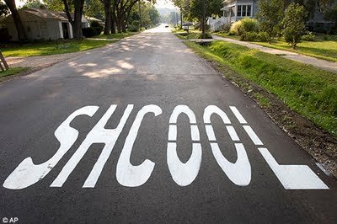
Grammar & Spelling
Notes:
Use the spelling and grammar checker on your Office software to avoid silly typos.

Slide 10
Grammar & Spelling
Notes:
Your credibility in presenting your material will decrease if you have several misspelled words.

Slide 11
Grammar & Spelling
Proposals are returned if a grammatical or spelling error is found.
Notes:
Your credibility in presenting your material will decrease if you have several misspelled words.

Slide 12
Grammarly.com
Notes:
I find Grammarly worth the $8 monthly fee to catch my typos.

Slide 13
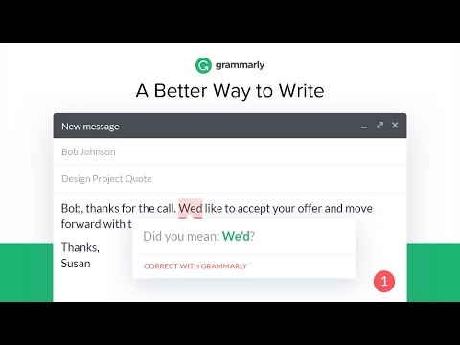
Grammarly.com
Notes:
It catches your mistakes that the eye often overlooks.

Slide 14
Use Formats
Notes:
Use the templates at the BSD Teaching Better link at https://biblestudydownloads.org/resources/teaching-better/ so you do not have to design standard layouts repeatedly.

Slide 15
Pictures

Slide 16
Let's Study Through Scripture
The Bible: Book by Book
Notes:
Use BIG and BOLD images to fill the slide.
This one is for my preaching through the entire Bible, book by book.

Slide 17
Ministry Research & Writing (Dr. Sng Bee Bee & Rick May 2016)
Notes:
Remember that PPT is a visual medium more than a written medium of instruction.
This type is so tiny that it would be better removed from the slide. Why frustrate your viewers with text they cannot read?
The most important part is not the sign and background but the faces. But you cannot see the faces.

Slide 18
Preaching the Genres of the Bible May 2014

Slide 19
Dr. Desmond & Wendy Soh
Preaching the Literary Genres of the Bible 5-9 May 2014
Notes:
It is better to have a close-up view with large text.

Slide 20
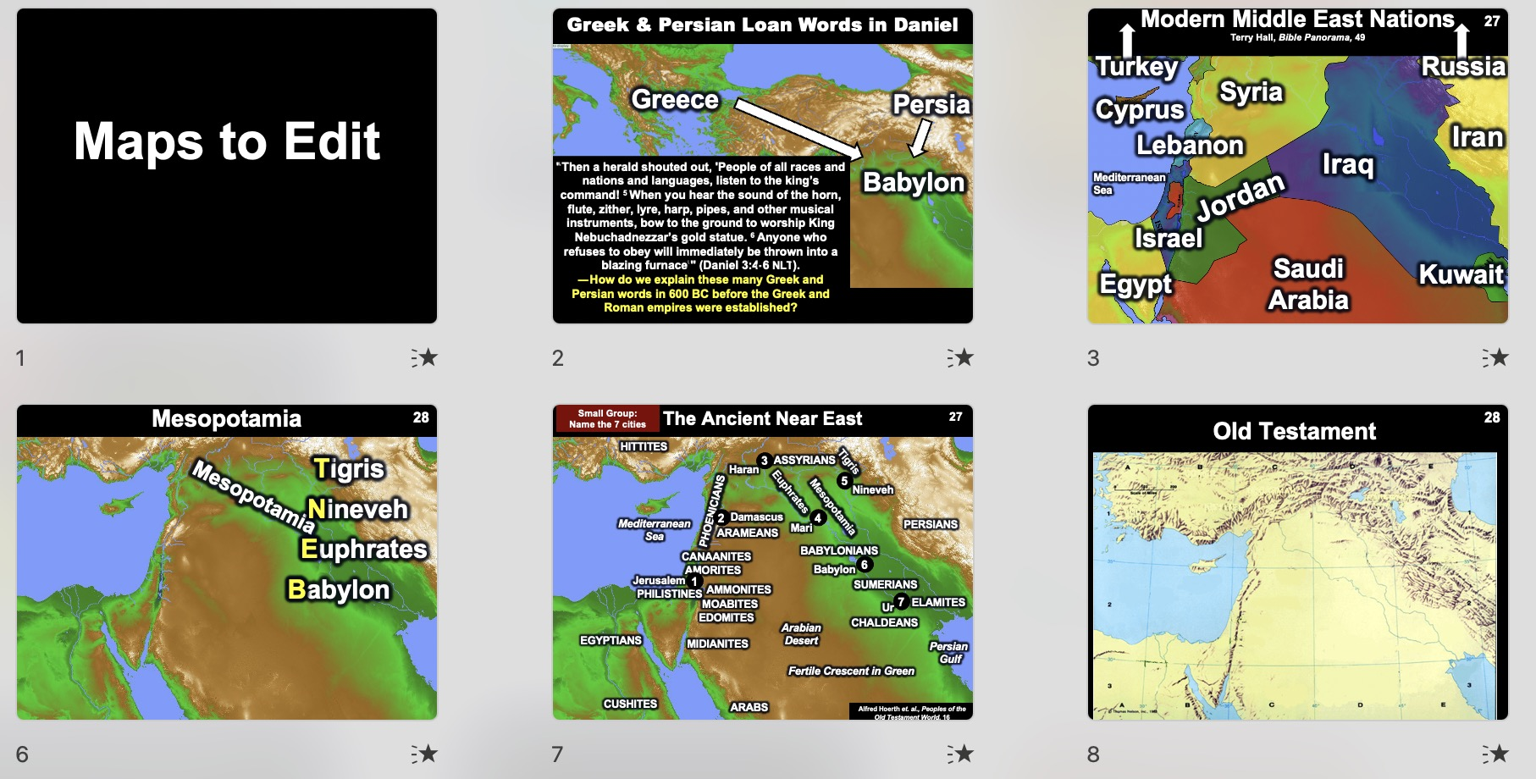
Maps to Edit has 140 maps
Notes:
For example, rather than describe a location, show it visually on a map.
This presentation on the Teaching Better link has editable text over unmarked maps. This way you can include or exclude whatever locations that you want.

Slide 21
6 Steps to Complete Your Dissertation
DRUDGERY
PROCRASTINATE
PANIC
DESPAIR
DRUDGERY
PRINTING
Notes:
Instead of explaining a process verbally or as text, design it spatially, such as a diagram or arrows pointing to the next step.

Slide 22
Research & Writing Assignments
Reading
25%
Topic Approval Form
10%
Present PPT
15%
Proposal
25%
Pilot Project
25%
Notes:
Do not give the entire slide at once. Unfold it with animations.

Slide 23
Where on the Internet can you…
Find hundreds of PowerPoint (PPT) slides for every Bible book
Download editable files for your teaching (not just PDFs)
Access 40+ free editable courses on theology and practical ministry
Download audio and video
Get translations in 50+ languages
Notes:
Don’t include much text that people must copy down—include this in a handout instead. If you have fill-in blanks on your handout, highlight the fill-in words on the slide in an easier-to-read color (not harder to read!). For example, often, slides have the most critical word in red on a black background, which is nearly impossible to see from the back of the room.

Slide 24
Where on the Internet can you…
Find hundreds of PowerPoint (PPT) slides for every Bible book
Download editable files for your teaching (not just PDFs)
Access 40+ free editable courses on theology and practical ministry
Download audio and video
Get translations in 50+ languages
Notes:
Instead, use white text and highlight the most critical word in bright yellow.

Slide 25
Matthew
Matthew portrays Jesus as both the lion (ruling king) and the lamb (Sacrificial Savior)
Notes:
Do not include small text on the slide.

Slide 26
Matthew
Read the Notes for the Slide
Notes:
Explain it in the notes that only you can see, but the audience can only hear.

Slide 27
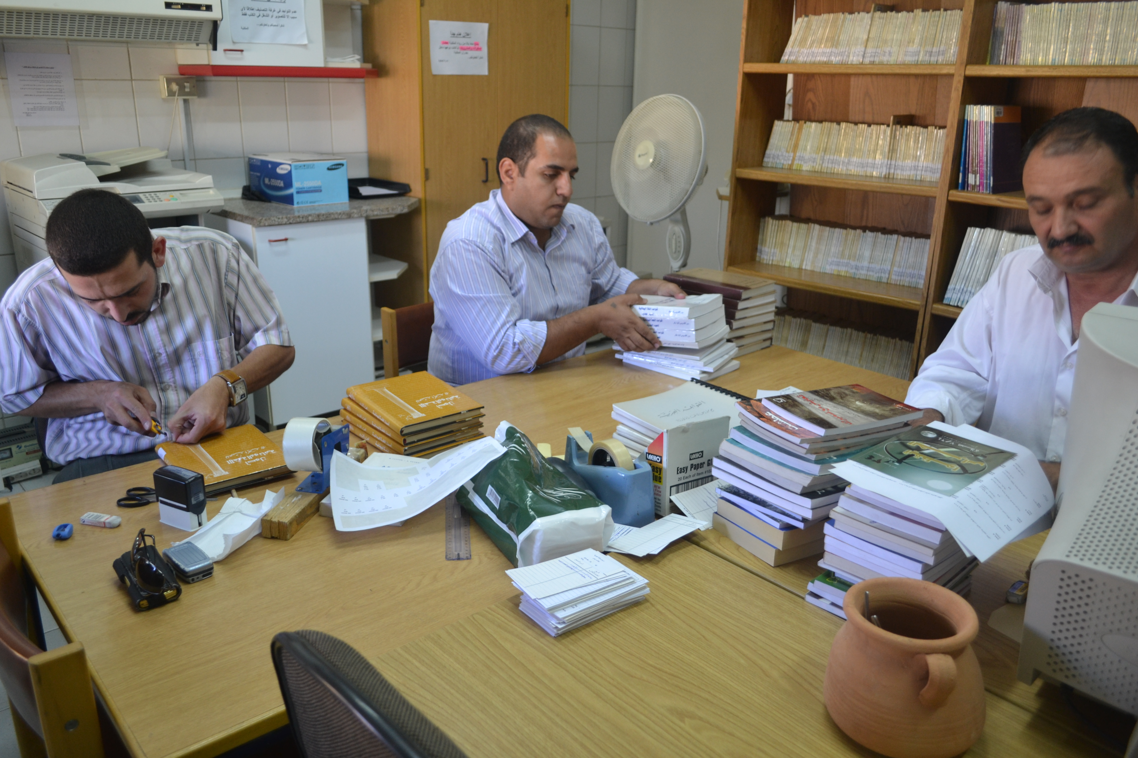
Publishing
Notes:
Remember that colors and pictures look better on your computer screen than when projected, so get as high-quality images as possible (though blurry ones are OK for a dark background with text in front). Usually, 300 x 400 pixel resolution is best. You don’t need 1200 x 1500 images, as they are so detailed that they take up a lot of memory and make your presentation megabytes too large.
Animation on slides is engaging if it is varied.

Slide 28
How BSD can help you teach
Decide your content
Choose the right BSD course
Notes:
Import images from google.com by clicking the image link and then clicking the “advanced image search” link. Type in your search data and click for “medium” images. This way, you will get only high-resolution images (about 300 x 400 pixels) that can be enlarged. When you enlarge them, they will not be blurry on the screen. Be sure to copy these only in full-image mode. Do not save them in a larger size than is needed, though, as this hogs memory.

Slide 29
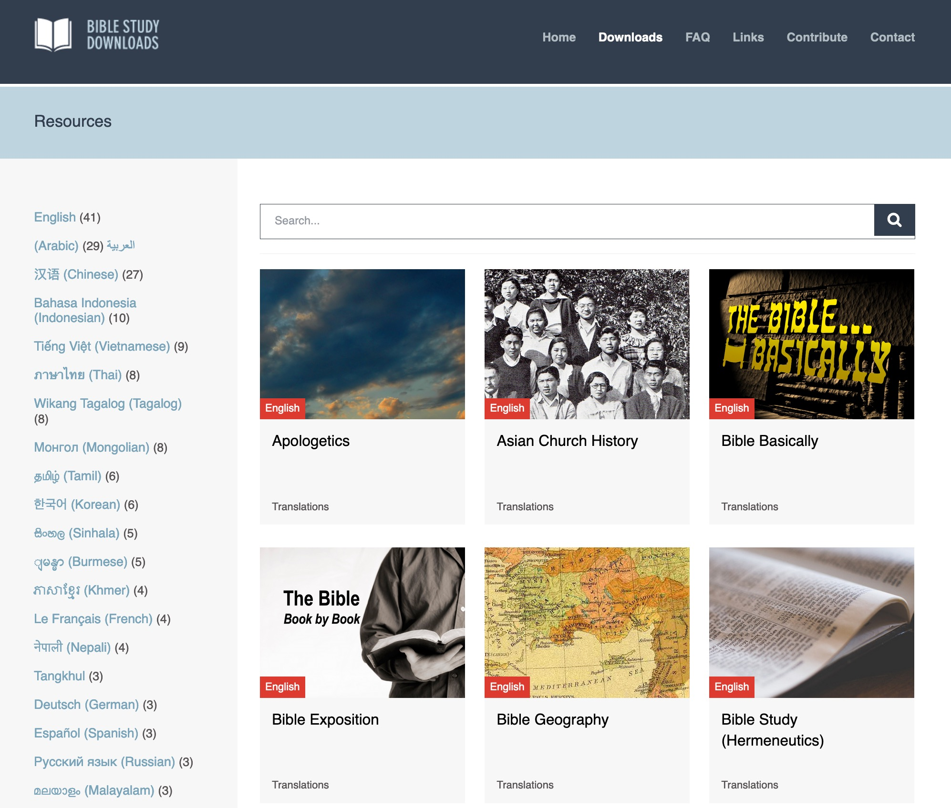
BibleStudyDownloads.org
Use the search feature
Scroll through the 43 courses
Notes:
My SBC teaching has resulted in Bible teaching and study materials—mostly PowerPoint—in 54 languages! All a teacher needs to do is to click on a file and it downloads for free to teach any book of the Bible and many other subjects.

Slide 30
Fonts

Slide 31
Which Fonts?
Use Sans Serif:
Arial, Geneva, Helvetica, Futura, Monaco, Tahoma, Verdana
Avoid Serif:
Times New Roman, Courier, Garamond
Notes:
Avoid using many fonts in the presentation, as this requires others who will use your presentation in the future to find these odd fonts to show on their computers. Instead, use basic fonts such as Arial and Geneva.

Slide 32
Non-English Fonts
Greek
Ἑλληνικά
עִברִית
Hebrew
عربي
Arabic

Slide 33
Arabic Fonts
عربي
Traditional Arabic
عربي
Arial

Slide 34
Key Word
24
67
Kingdom
Matthew
Notes:
Never use smaller than 24-point fonts on a slide.

Slide 35
Key Verses
67
"Simon Peter answered, 'You are the Christ, the Son of the living God.' Jesus replied, '…you are Peter, and on this rock I will build my church, and the gates of Hades will not overcome it'"
(16:16-18)
"Say to the daughter of Zion, 'See, your king comes to you, gentle and riding on a donkey, on a colt, the foal of a donkey'" (21:5)
Matthew
Notes:
Each word should be visible from the back of the classroom.

Slide 36
Key Verses
67
"Simon Peter answered, 'You are the Christ, the Son of the living God.' Jesus replied, '…you are Peter, and on this rock I will build my church, and the gates of Hades will not overcome it'"
(16:16-18)
Matthew
Notes:
Having many separate slides is far better than having viewers straining to see everything on a single slide.

Slide 37
Key Verses
67
"Say to the daughter of Zion, 'See, your king comes to you, gentle and riding on a donkey, on a colt, the foal of a donkey'" (21:5)
Matthew
Notes:
Extra slides are free!

Slide 38
Where on the Internet can you…
Find hundreds of PowerPoint (PPT) slides for every Bible book
Download editable files for your teaching (not just PDFs)
Access 40+ free editable courses on theology and practical ministry
Download audio and video
Get translations in 50+ languages
44 words (32-point Arial)
Notes:
Using larger fonts will prevent the temptation to put too many words on a slide. Only put up to 50 words on a single slide.
• This slide has 44 words in 32-point Arial font.

Slide 39
Be Triumphant
Revelation
Dr. Rick Griffith • Crossroads International Church Singapore
BibleStudyDownloads.org
Notes:
The smallest fonts (24-point) should be only for the source of your information that you put in the lower right corner. Always cite sources!

Slide 40
Transitions
Notes:
Insert a transition slide when going to the next section of your presentation. This is a simple word title or phrase across the screen with an appropriate picture or graphic. This is a transition slide. I have used them throughout this presentation in white text on black background.

Slide 41
Do not start the slide blank.
Notes:
When moving to the next slide, do not have it start completely blank; instead, show the first image or text. Use as few clicks as possible per slide.

Slide 42
Fade

Slide 43
Push

Slide 44
Wipe

Slide 45
Curtains

Slide 46
Reveal

Slide 47
Theme
23
Page in Notes
Messiah with Authority Over the Church
Matthew
Notes:
If the slide correlates to the class notes, put the page number of the class notes in a 24-point bold Arial font in the upper right corner of the slide. Then, you will not have to announce which page you present each time you change slides.

Slide 48
Color

Slide 49
Where on the Internet can you…
Find hundreds of PowerPoint (PPT) slides for every Bible book
Download editable files for your teaching (not just PDFs)
Access 40+ free editable courses on theology and practical ministry
Download audio and video
Get translations in 50+ languages
Notes:
Don’t include much text that people must copy down—include this in a handout instead. If you have fill-in blanks on your handout, highlight the fill-in words on the slide in an easier-to-read color (not harder to read!). For example, often, slides have the most critical word in red on a black background, which is nearly impossible to see from the back of the room.

Slide 50
Where on the Internet can you…
Find hundreds of PowerPoint (PPT) slides for every Bible book
Download editable files for your teaching (not just PDFs)
Access 40+ free editable courses on theology and practical ministry
Download audio and video
Get translations in 50+ languages
Notes:
Instead, use white text and highlight the most critical word in bright yellow.

Slide 51
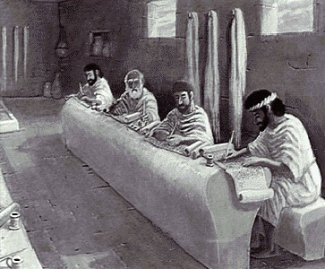
Who Am I? (Education Roots)
BS, Business Marketing (Hay U, 1980)
ThM, Pastoral Ministries (Dallas Seminary, 1987)
PhD, Bible Exposition (also DTS, 1990)
Notes:
This title is mainly over a darker background but gets washed out when it is white behind it.

Slide 52
Who Am I? (Education Roots)
BS, Business Marketing (Hay U, 1980)
ThM, Pastoral Ministries (Dallas Seminary, 1987)
PhD, Bible Exposition (also DTS, 1990)
Notes:
Use PPT's glow or shadow feature to put a dark shadow on the words. This enables them to be seen over pictures with backgrounds that vary between light and dark.

Slide 53
Giving the Presentation
Notes:
Make some of your slides black and white only. This eases the eyestrain of the viewers and provides variety in the presentation by bringing a viewer’s attention to the speaker rather than always looking at the screen.

Slide 54
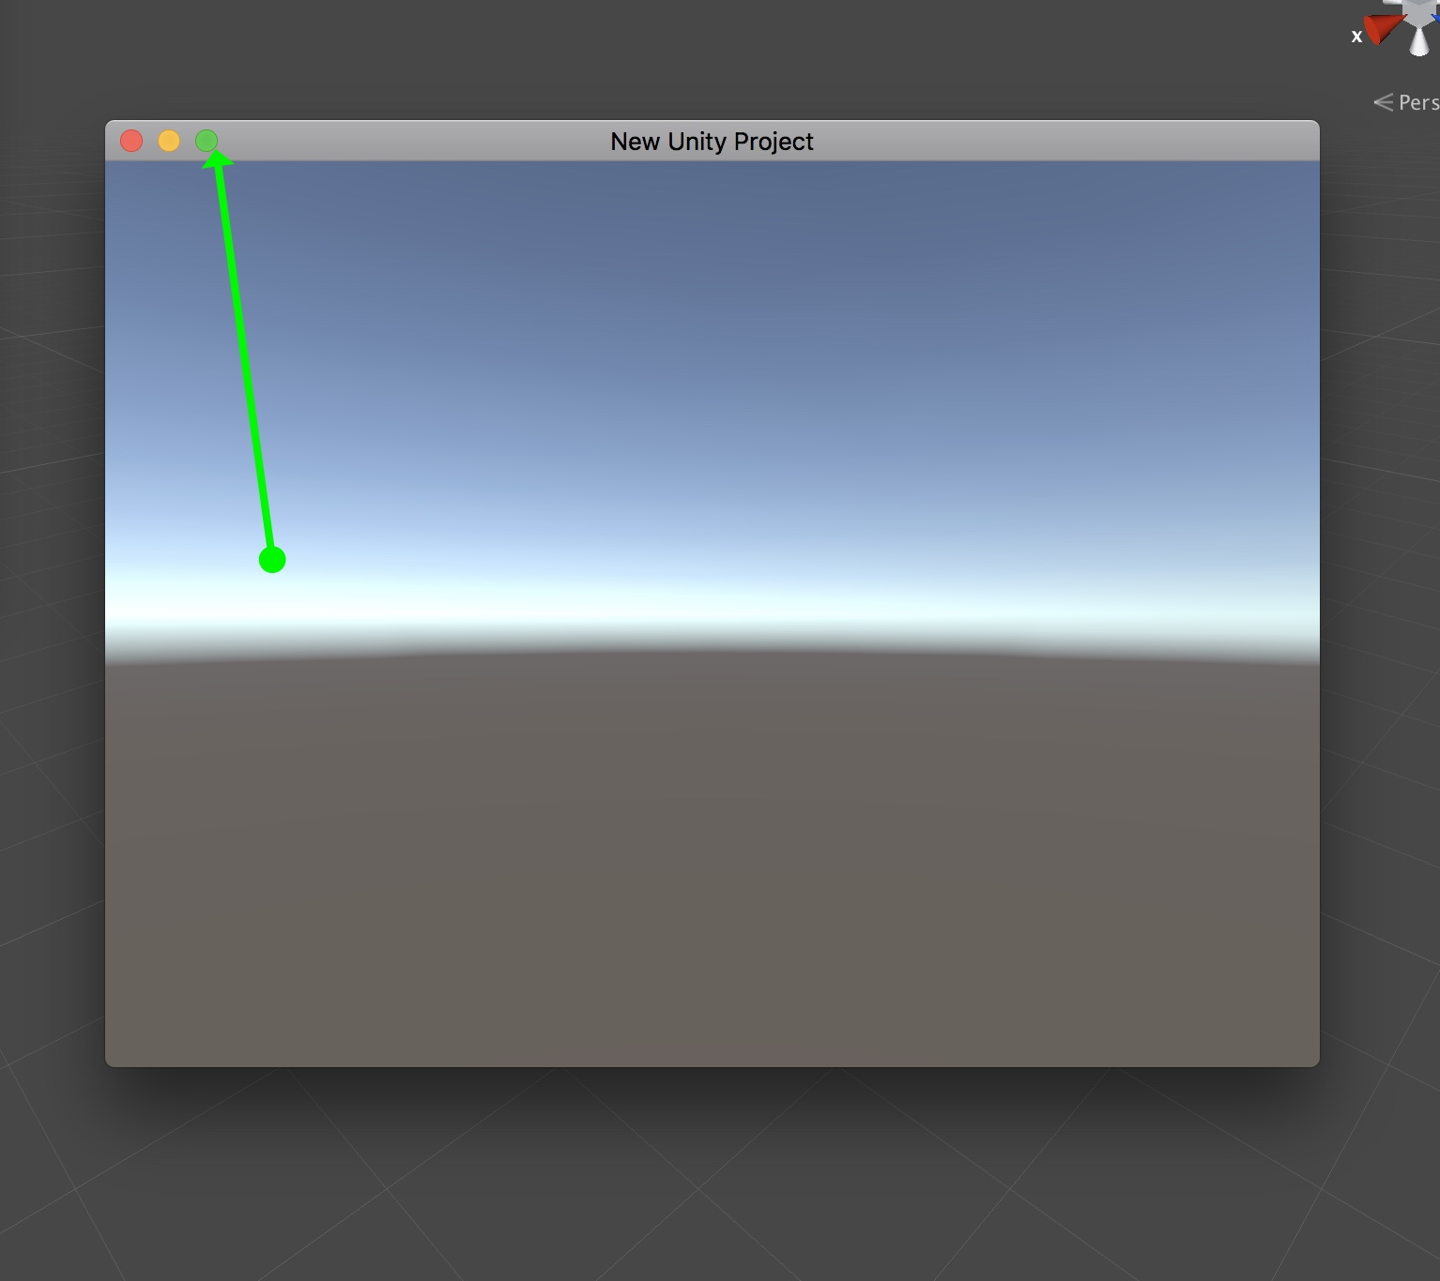
Use the whole screen
Notes:
Project as large an image as possible onto the screen or wall. Bigger is better.

Slide 55
Black
Notes:
When you want to give the audience a visual break, plan this by inserting a black slide. If you decide to make the screen black over an existing visible slide, hit “B” on the keyboard in the lower left corner of the screen when you are in “Slide Show” mode. Hit “B” again to see the slide and continue the presentation.

Slide 56
Matthew
Read the Notes for the Slide
Dr. Rick Griffith • Jordan Evangelical Theological Seminary • BibleStudyDownloads.org
Notes:
Matthew portrays Jesus as both the lion (ruling king) and the lamb (sacrificial Saviour).

Slide 57
Discussion: What have you found effective in PPT presenting?

Slide 58
Grade Sheet

Slide 59
Black

Slide 60
Teaching Better • BibleStudyDownloads.org
Get this presentation and script for free!
Notes:
https://biblestudydownloads.org/resources/teaching-better/

