Slide 1
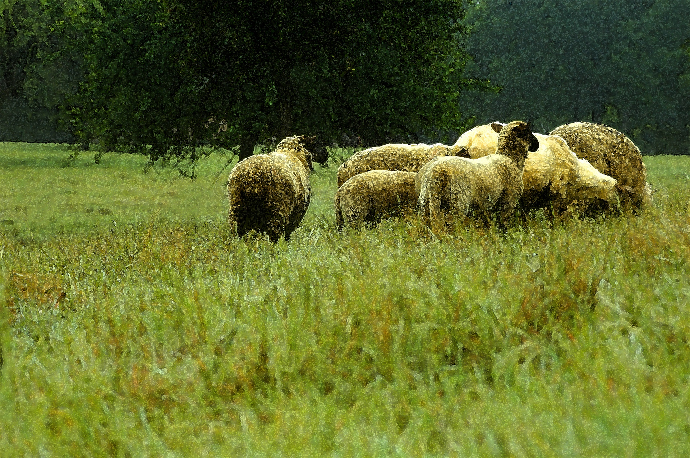
Session 5
Davidic Covenant

Slide 2
The Story of Scripture:
Understanding the Bible from Genesis to Revelation
Taught by Faculty of Dallas Theological Seminary • Used with Permission Uploaded by Dr. Rick Griffith • Jordan Evangelical Theological Seminary Files in many languages for free download at BibleStudyDownloads.org

Slide 3
5-12-5-5-12
4-1-21-1
Notes:
Session 1 taught us about this memory device.
Can you tell the person next to you what these numbers mean?

Slide 4
5-12-5-5-12
Old Testament
P______________
H___________
P____________
M________ P_____________
M________ P_____________
5 books
12 books
5 books
5 books
12 books
P______________
H___________
P____________
M________ P_____________
M________ P_____________
5 books
12 books
5 books
5 books
12 books
Pentateuch | History | Poetry | Major Prophets | Minor Prophets
5 Books | 12 Books | 5 Books | 5 Books | 12 Books
Notes:
The OT has 5 sections of two lengths—either 5 or 12 books.

Slide 5
4-1-21-1
New Testament
P______________
H___________
P____________
M________ P_____________
M________ P_____________
5 books
12 books
5 books
5 books
12 books
P______________
H___________
P____________
M________ P_____________
M________ P_____________
5 books
12 books
5 books
5 books
12 books
Gospels | History | Letters | Prophecy
4 Books | 1 Book | 21 Books | 1 Book
Notes:
The 4-1-21-1 tells us the 4 sections of the NT.

Slide 6
5-12-5-5-12
4-1-21-1
Notes:
Now, turning to your neighbor, could the one whose birthday comes first in the year walk the other through the top line? Then the other should explain line 2

Slide 7
5-12-5-5-12
Old Testament
P______________
H___________
P____________
M________ P_____________
M________ P_____________
5 books
12 books
5 books
5 books
12 books
P______________
H___________
P____________
M________ P_____________
M________ P_____________
5 books
12 books
5 books
5 books
12 books
Pentateuch | History | Poetry | Major Prophets | Minor Prophets
5 Books | 12 Books | 5 Books | 5 Books | 12 Book
Notes:
We continue now to review the Pentateuch and then move to the History section.

Slide 8
Creation
Notes:
God’s perfect creation in Genesis…

Slide 9
The Problem
Notes:
…was marred by sin…

Slide 10
The Problem
Notes:
…and this gave us a huge problem.

Slide 11
The Solution: Covenant God
Notes:
But God made a promise to Abraham to restore us.

Slide 12
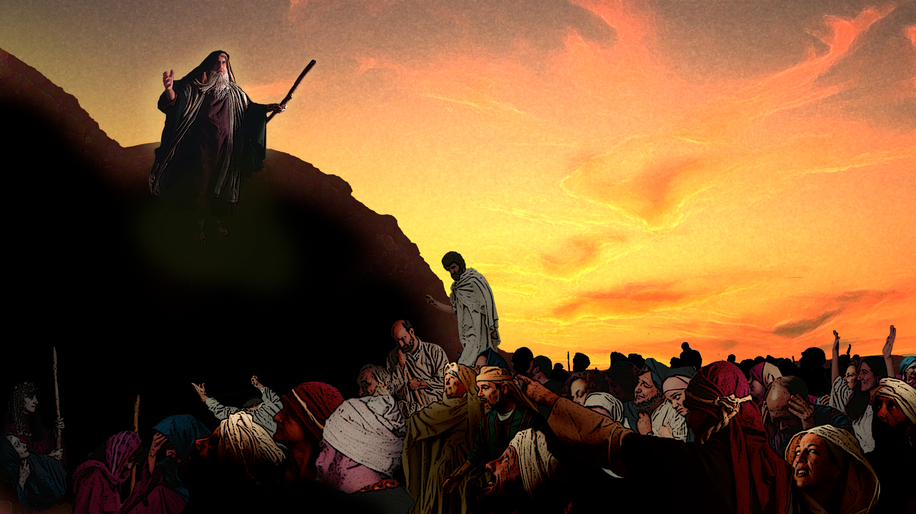
Covenant Promises
Notes:
This promise included both benefits and penalties noted to Israel.

Slide 13
Objectives:
1. Understand the Davidic Covenant
2. Recognize our need for God’s true King
Notes:
In this session, we will see how further promises to David apply.
But even David wasn’t the ideal ruler—we need the real earthly King.

Slide 14
*Blessings/Curses (Deut 28)
*Joshua
*Judges, Ruth
Covenant Promises
Notes:
In session 4, we saw that obedience would bring blessings and disobedience, cursing.
Under Joshua, Israel experienced mostly blessings as they inherited the land.
But the book of Judges shows how the curses came through disobedience.
Yet even at that time, honorable people like Ruth and Boaz could still be blessed!

Slide 15
Covenant Promises
Notes:
But God had also said that they would eventually ask for a king.

Slide 16
The Covenant King
Notes:
Their motive was wrong, but God knew they would reject him for an earthly king.
This was part of his plan to anoint David as the start of a new dynasty.

Slide 17
Walter Brueggeman “...dramatic and theological center of the entire Samuel corpus”
Robert Gordon “...ideological summit in the OT as a whole”
John Levenson “...receives more attention in the Hebrew Bible than any covenant”
The Covenant King
Notes:
Scholars note the importance of the Davidic Covenant.

Slide 18
Covenant Kingship
* 1 Samuel 8
* 2 Samuel 7:1-16 (1Chronicles 17:1-14)
1) 7:8-11a
2) 7:11b-16
* House (11a), Seed (12), Kingdom
* Psalm (2 and110)
* Sonship
* Messianic Expectations
The Covenant King
Notes:
1 Samuel records how the people reject God’s kingship by demanding an earthly king.
Saul is a washout, but their request ultimately ends up with David in 2 Samuel 7.
God promises David a dynasty, descendants, and the right to rule.
Psalms 2 and 110 tell us that one of his descendants will rule forever.
Sonship: The right to rule Israel and the world belongs to David’s house.
Messiah means "anointed" to rule, so people rightfully expect God to fulfill his promise.

Slide 19
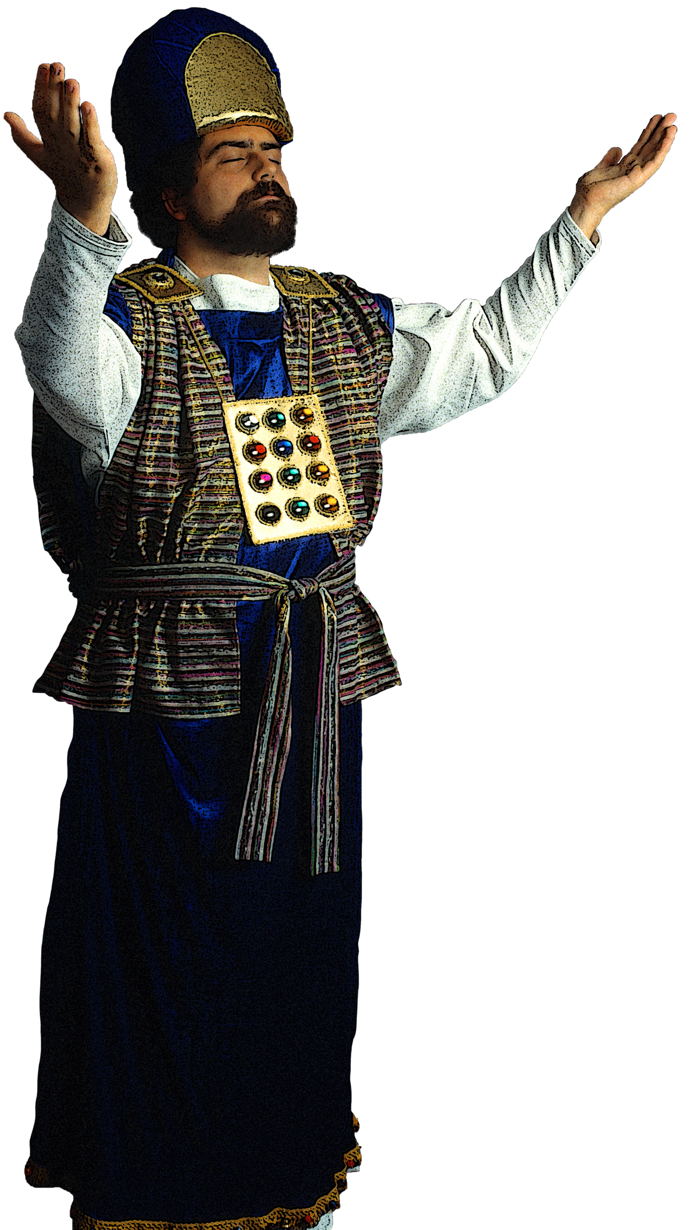
The Covenant King
Notes:
All the kings that ruled in Jerusalem were related to David!
But what about that obligation for Israel to worship the true God?

Slide 20
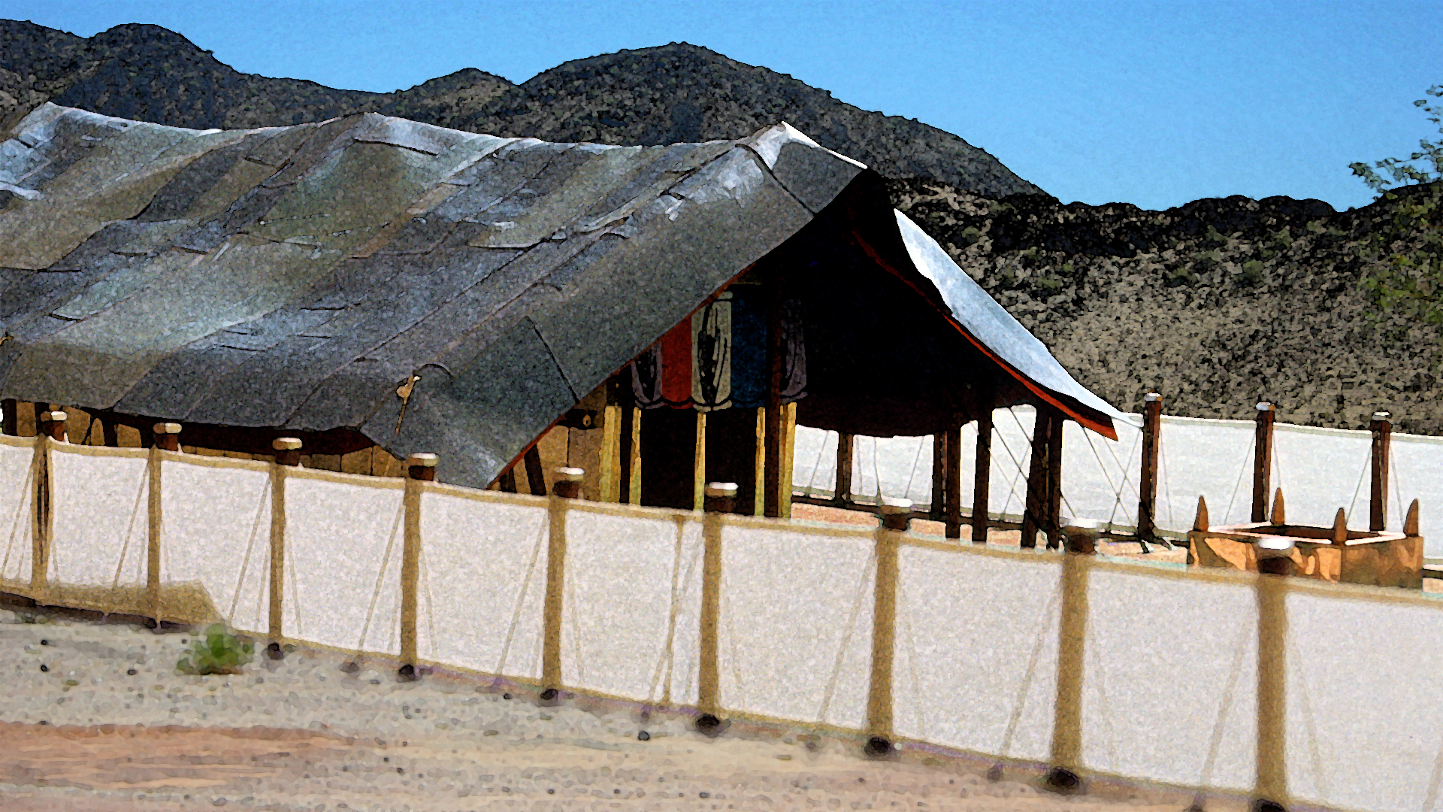
Covenant Worship
Notes:
God still expected covenant worship.
In the next session, we will see how the nation did in this respect.

Slide 22
Download this presentation for free!
Story of Scripture at BibleStudyDownloads.org

