Slide 1

The Inheritance of the Believer
Old Testament Summary
Message 1 of 4
Soteriology: God’s Rescue Program
Dr. Rick Griffith • Jordan Evangelical Theological Seminary
BibleStudyDownloads.org
Notes:
Here is Part 1 of the 4-part study on The Inheritance of the Believer.

Slide 2
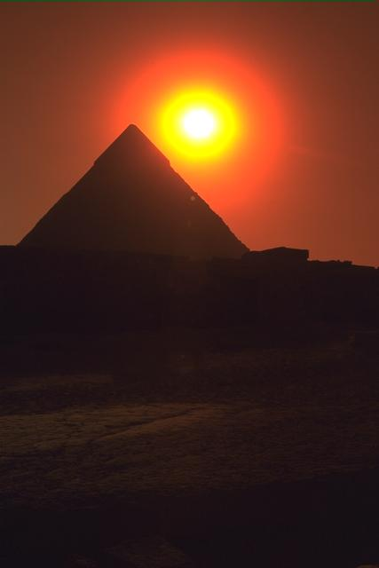
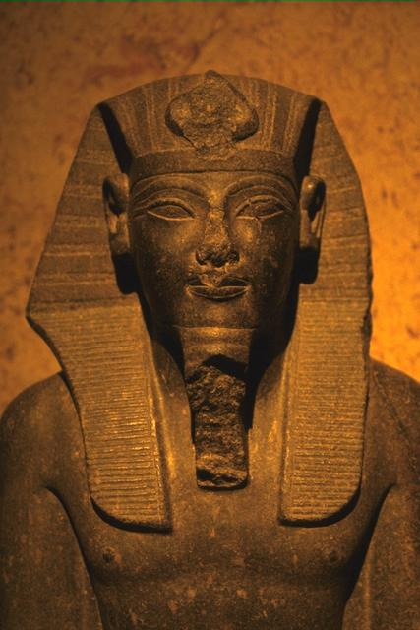
Were the Israelites of the Exodus saved from sin as well as saved from Egypt?
Give why you hold your view
Notes:
Turn to the person next to you and give your answer (YES or NO) and why.
Some say these Israelites were mostly unbelievers as we see them as idolaters in the wilderness—so they were not saved from sin.
Others say that they were saved from sin since they rejected the gods of Egypt—but they were not rewarded.

Slide 3

How can we balance the Bible’s teaching on salvation and rewards?
This Photo by Unknown Author is licensed under CC BY
Notes:
Were these Israelites saved? Our answer to this question will impact how we look at many OT and NT texts.
Was Canaan for them representative of entering heaven? There are huge theological implications of this question, so we will take four weeks to explore such issues.

Slide 4
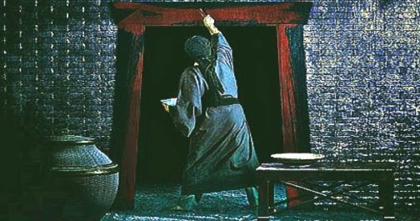
1. God saved Israel from Egypt and from sin by simple faith.
Notes:
[The Exodus generation was saved by faith shown in killing a Passover lamb.]
_______
This Photo by Unknown Author is licensed under CC BY-NC-ND

Slide 5
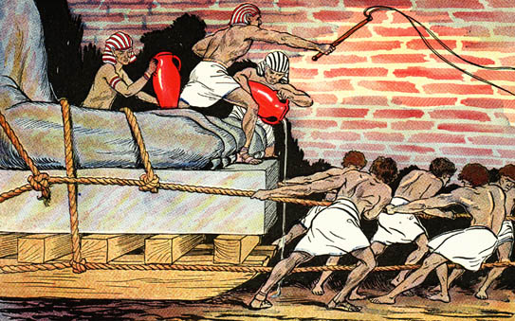
Egyptians Ruthlessly Oppressed Israel

Slide 6
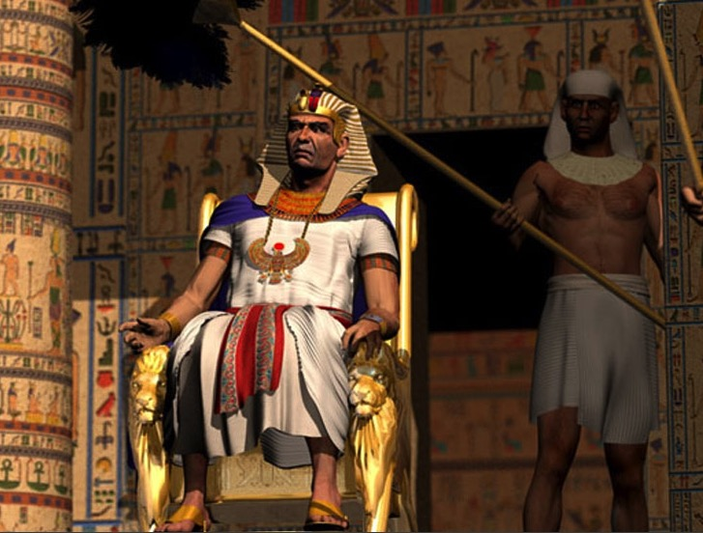
"Ultimate" Power

Slide 7
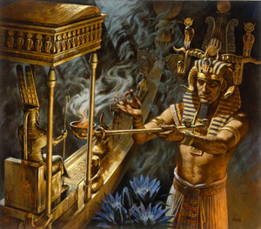
Who has greater power – Pharaoh or Yahweh?

Slide 8
God used Moses to urge Pharaoh to free Israel from slavery to show that:
The Point of Exodus 1–11
• the LORD cared,
• was faithful to the Abrahamic Covenant, and
• was sovereign over Egypt’s gods.
Notes:
BE-02-Exodus-52
OS-02-Exodus-70
SA-15-Inheritance-6

Slide 9

Traditional Route of the Exodus
Canaan
107
Goshen
Nile River
Mt. Sinai
Egypt
Midian
Notes:
(But how did God defeat the superpower of the day and bring Israel out of Egypt?)

Slide 10

Passover Protection
"The blood will be a sign for you on the houses where you are; and when I see the blood, I will pass over you. No destructive plague will touch you when I strike Egypt."
Exodus 12:13 (NIV)
Notes:
Israelites were saved from sin also by doing what seemed silly.
God commanded blood on the doorposts (Exodus 12:13).

Slide 11
Faith Pictured
"By faith he kept the Passover and the sprinkling of blood, so that the destroyer of the firstborn would not touch the firstborn of Israel."
Hebrews 11:28 (NIV)
Notes:
They did this seemingly silly act by faith (Heb 11:28).

Slide 12
The Lamb Pictured
"The next day John saw Jesus coming toward him and said, 'Look, the Lamb of God, who takes away the sin of the world!'"
John 1:29 (NIV)
Notes:
The lamb depicted the real Passover Lamb (John 1:29).
(So what is the typology here?)

Slide 13

2. Jesus is our New Exodus who delivers us from sin as our Passover Lamb.
Notes:
[Christ saves from sin’s slavery like the Passover lamb saved Israel from Egypt’s slavery.]

Slide 14



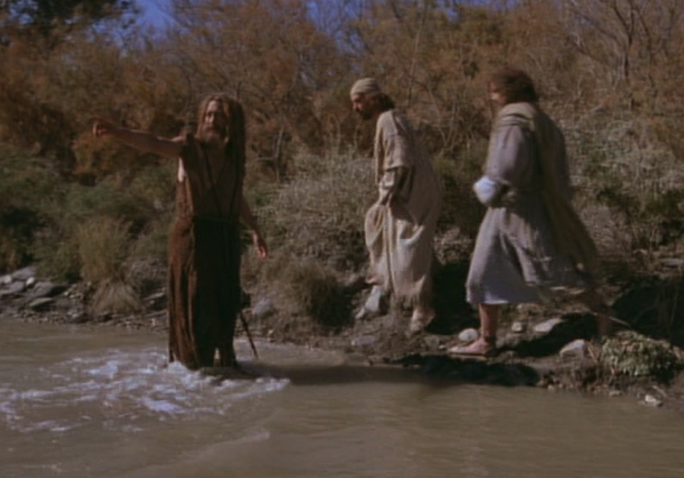
The Passover Lamb
"Look, the Lamb of God,
who takes away
the sin of the world!"
(John 1:29)
Notes:
Jesus takes away our sin like Israel placed their faith in a lamb.
John told his disciples that Jesus would atone for sin like the Passover lamb atoned for Israel’s sin.

Slide 15
The Cross Pictured
"For Christ, our Passover lamb, has been sacrificed."
1 Corinthians 5:7 (NIV)
Notes:
Jesus is our Passover Lamb like the bloody cross on the door (1 Cor 5:7).

Slide 16

Faith in a Lamb
Notes:
Israel’s faith in their lamb ultimately pointed to their faith in the Lamb.

Slide 17

"This is my body…"
Notes:
“This is my body” meant that Jesus’s death paid for our sin.

Slide 18
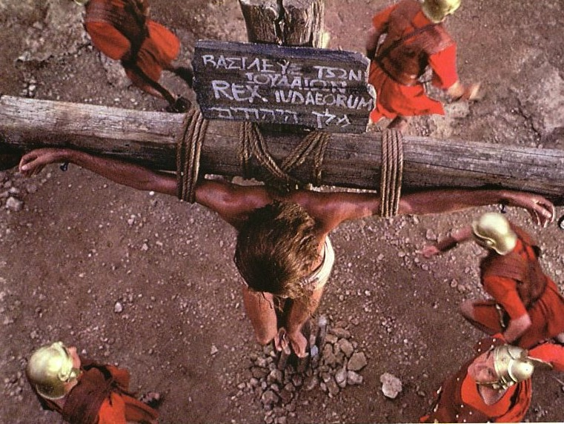
Jesus' death paid for our sin

Slide 19

Exodus 12:1-16
The Angel of Death Passed Over Houses with Blood on the Doors
Thus says the LORD, "About midnight I will go out in the midst of Egypt" (Exod. 11:4)
Notes:
The Passover Angel of Death depicts God seeing us through the blood of Christ.

Slide 20
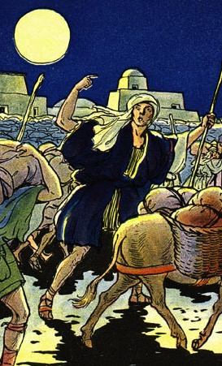
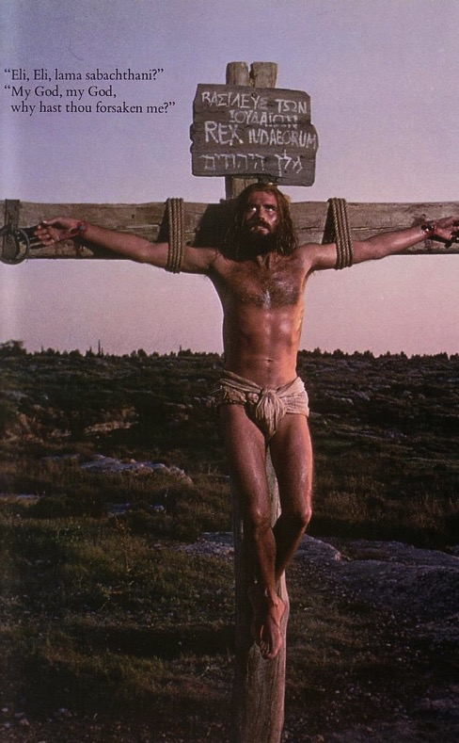
The Common Thread
What the Exodus is to the Old Testament…
the cross of Christ is to the New Testament
Deliverance!
Notes:
The common thread to the Exodus and the Cross is deliverance.

Slide 21
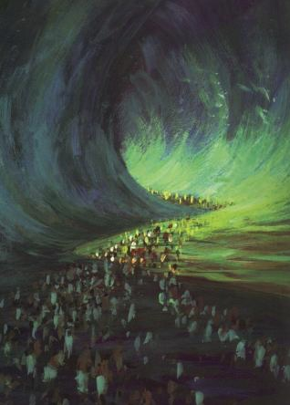
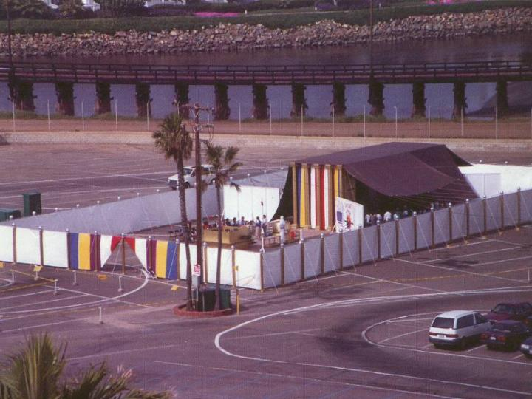
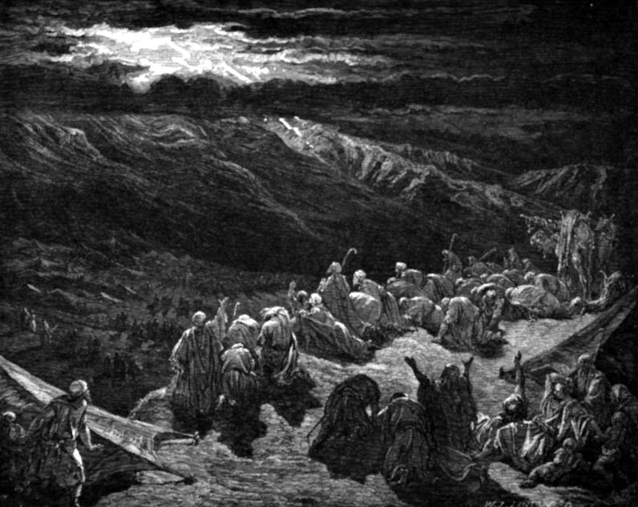
The Exodus Pictures Redemption
"For he has rescued us from the dominion of darkness and brought us into the kingdom of the Son he loves, in whom we have redemption, the forgiveness of sins."
Colossians 1:13-14 (NIV)
Notes:
The Exodus pictures redemption in that all in the Exodus were saved.

Slide 22

1 Corinthians 10:1-5 (NLT)
"I don't want you to forget, dear brothers and sisters, about our ancestors in the wilderness long ago. All of them were guided by a cloud that moved ahead of them, and all of them walked through the sea on dry ground. ²In the cloud and in the sea, all of them were baptized as followers of Moses. ³All of them ate the same spiritual food, ⁴and all of them drank the same spiritual water. For they drank from the spiritual rock that traveled with them, and that rock was Christ. ⁵ Yet God was not pleased with most of them, and their bodies were scattered in the wilderness."
Notes:
All delivered from Egypt were believers but most were judged (1 Cor 10:1-5).

Slide 23
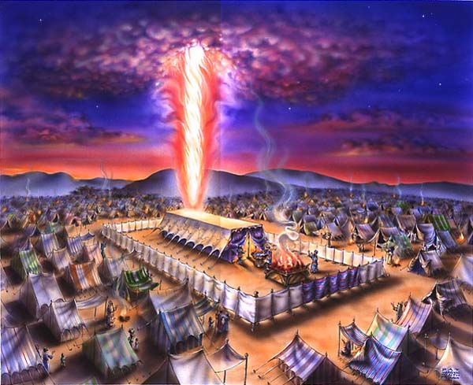
The Cloud
Exodus 40;
1 Cor. 10:1-4
Notes:
“All of them were guided by a cloud that moved ahead of them”

Slide 24


The Sea
Exodus 40;
1 Cor. 10:1-4
Notes:
“All of them walked through the sea on dry ground.”

Slide 25

The Leader
Exodus 40;
1 Cor. 10:1-4
Notes:
“All of them were baptized as followers of Moses.”

Slide 26
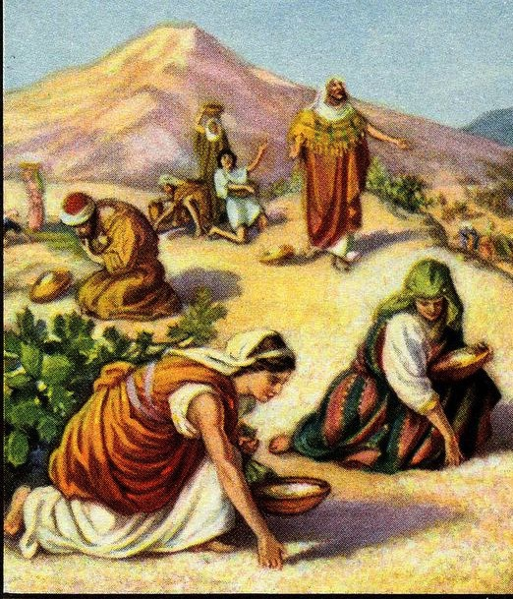
The Food
Exodus 40;
1 Cor. 10:1-4
Notes:
“All of them ate the same spiritual food.”

Slide 27
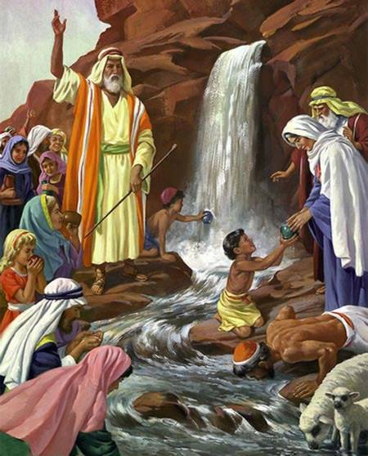
The Water
Exodus 40;
1 Cor. 10:1-4
Notes:
“All of them drank the same spiritual water. For they drank from the spiritual rock that traveled with them, and that rock was Christ.”

Slide 28

Which is the Most Accurate?
121a
Salvation by…
Faith + Works
Faith Alone
Faith + Works
OT
Works
Faith Alone
Faith Alone
Faith + Works
NT
Faith
• Which verses in the Bible support your answer?
cf. OTS 119e
Notes:
Did God change the means of salvation from the OT to the NT?
We are NOT talking about whether people should do good works—we all agree on that. But are works needed for salvation?
Paul answers this question in Romans 4 with the example of Abraham who was saved by faith alone—see Gen 15:6.
Salvation has always been by faith alone.
________
BE-03-Lev-27
OB-37-Sacrifices-72_eng_ob_1667_v5—slide 17
OB-39-Salvation-2
OS-03-Leviticus-13
OP-03-Lev-27
OP-Lev_6v24-7v10 Why All That Blood Sin & Guilt Offerings-49_eng_op_v4.0—slide 34
OS-04-Num-27
NP-Acts_15v1-35_Dont_Be_Law_Abiding_(Rick_Griffith)-61_eng_pr_v4—slide 5
NS-05-Acts15-16-slide 26
NS-Rom3-4-slide 77
NS-09-Galatians-48
NS-20-James-30
NS-23-1Jn-58
SA-03-Biblical Terms-6
SA-15-Inheritance-26

Slide 29
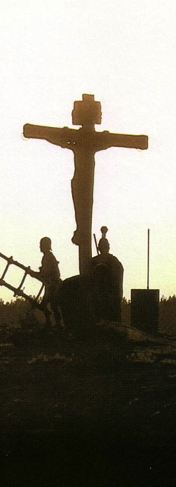
Salvation in All Ages:
The Centrality of the Cross
B.C.
Looked forward to the
Cross of Christ
A.D.
Look
back at the
Cross of Christ
Notes:
We must see the centrality of the cross—how people before Jesus believed by looking toward the cross while those of us after Jesus look back at the cross. In other words…
The grounds of salvation has always been the death of Christ—for believers before and after the cross.
____________________
Common-198
BE-03-Leviticus-73
OB-37-Sacrifices-19
OB-38-Salvation-4
OS-03-Leviticus-193
NS-09-Galatians-16, 50
NS-20-James-32
SA-03-Biblical Terminology-10
SA-15-Inheritance-26
TP-01-Our Inheritance OT Summary-29

Slide 30
Salvation & Sanctification
121a
Man's Role
God's Response
Life of Faith
Restored Fellowship
Faith in God as offered Passover Lamb
Journey to Canaan
Sacrifices
(Sin, Guilt)
OT
Exodus
Type
|
Antitype
Type
|
Antitype
Type
|
Antitype
Type
|
Antitype
Faith in Christ as Lamb of God (1 Cor. 5:7)
Salvation
(1 Cor. 10:1-4)
Growth
(1 Cor. 10:5)
Confession
(1 John 1:9)
NT
Positional Sanctification
Progressive Sanctification
Notes:
• The OT plan of salvation is mirrored in the NT—both by simple faith in the Lamb pictured in the Passover.
• Exodus from Egypt is a type of the believer who leaves his slavery to sin—all believers in the Lamb are saved, including all Israelites who left Egypt as they demonstrated that faith by putting the blood on the doorposts of their homes (=positional sanctification).
• But both OT and NT believers must live a life of faith in God, pictured in Israel’s journey to Canaan and mirrored in the Christian’s growth or progressive sanctification.
• Finally, as OT believers confessed their ongoing sins in the sin and guilt sacrifices (for restoring fellowship with God—NOT for salvation!), so NT believers confess sins even after they are saved to restore their fellowship (NOT relationship!) with God.
_________
Common English-78
OB-37-Sacrifices-18
OS-00-Book Overviews-73
OS-04-Numbers-13
NS-09-Galatians-49
NS-20-James-31
SA-03-Biblical Terms-7
SA-15-Inheritance-26

Slide 31

OT Forgiveness of Sin
121b
Pipe = Relationship with God (never changing)
Sin
Clog = Fellowship with God (hindered by sin)
Sacrifices = Confession of Sin (sin forgiven to restore fellowship but relationship was never threatened)
Notes:
But believers—then and now—still need confession.
Did Israelites still have a relationship with God when they sinned? Yes!
Sin did not hinder their relationship with God but their fellowship with Him.
OT sacrifices did not establish a relationship with God but rather they restored their fellowship with God
________
OS-03-Leviticus-14
OS-04-Num-29
OP-02-Lev-28
NS-23-1Jn-58
SA-03-Biblical Terms-9
SA-15-Inheritance-27

Slide 32
NT Forgiveness of Sin
121b
"If we confess our sins,
He is faithful and righteous to forgive us our sins and to cleanse us from all unrighteousness"
(1 John 1:9 NAU)
Pipe = Relationship with God (never changing)
Sin
Clog = Fellowship with God (hindered by sin)
Christ's Sacrifice = The Basis for Confession of Sin (sin is forgiven to restore fellowship but relationship has never been never threatened)
Notes:
Our relationship with God can be compared to a pipe.
Occasionally the pipe gets a clog—like sin—that hinders our fellowship with God.
Do we still have a relationship with God when we sin? Yes!
Sin does not hinder our relationship with God but our fellowship with Him.
_________
OB-38-Salvation-11
OS-03-Leviticus-56, 72, 130
OS-04-Numbers-30
NS-23-1Jn-59
SA-03-Biblical Terms-9
SA-15-Inheritance-28

Slide 33
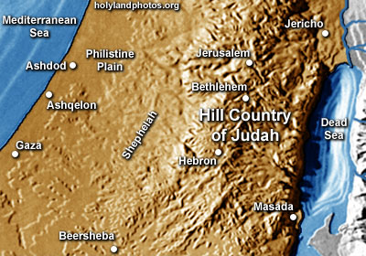
Inheritance in the OT
Notes:
(So if the Israelites of the Exodus were saved, why didn’t they enter Canaan?)

Slide 34

3. Inheritance in the OT included both salvation and reward.
Notes:
[The OT teaches two inheritances—one by faith and one by works.]

Slide 35


The Reign of the Servant Kings
Jody Dillow is the key author of the Partakers View
Final Destiny
The Future Reign of the Servant Kings
Joseph Dillow
Notes:
• There is a future reign of the Servant Kings—that is you and me!
• Our future inheritance is well articulated by Joseph Dillow in his massive book, Final Destiny
• Dillow is the key author of what he calls the Partakers View.
This view explains inheritance in the OT.
Inheritance in the OT was of two types:
All Israelites who believed in the LORD would have God as their inheritance—or be saved.
But only those Israelites that obeyed the LORD wholeheartedly would inherit Canaan—or be rewarded.
Dillow calls this view the Partakers View based on Hebrews 3:14 that promises believers who persevere to be partakers or sharers with Jesus in his future rule.
___________
Common-257
OS-04-Numbers-148
OS-06-Joshua-175
NS-19-Hebrews-58, 186, 448
SA-15-Inheritance-35, 173
TP-01-Our Inheritance OT Summary-35
TP-03-Our Inheritance Hebrews Warnings-56

Slide 36
Inheritance in the OT
1. A difference exists between inheriting the land of Canaan and living there. The former refers to ownership and the latter to mere residence.
2. While Israel was promised the inheritance as a nation, the condition for maintaining their inheritance right to the land of Canaan was faith, obedience, and completion of one's task. The promise, while national, was applied only to the believing and obedient remnant.
Joseph Dillow, Final Destiny, 56
Notes:
Dillow sums up the OT inheritance in six truths…
These first two show that inheritance was conditioned on obedience. That is why only two men out of the more than 600,000 fighting men who left Egypt made it into Canaan. Even Moses, Aaron, and Miriam did not enter the land, so the inheritance obviously does not signify heaven!
________
Common-259
OP-04-Numbers-88
OS-04-Numbers-147
OS-06-Joshua-175
NS-19-Hebrews-60, 188
TP-01-Our Inheritance OT Summary-36

Slide 37
Inheritance in the OT
3. The inheritance is not to be equated with heaven but with something in addition to heaven, promised to those believers who faithfully obey the Lord.
4. Just as Old Testament believers forfeited their earthly inheritance through disobedience, we can also forfeit our future reward (inheritance) by a similar failure. Loss of inheritance, however, does not mean loss of salvation.
Joseph Dillow, Final Destiny, 56
Notes:
Inheritance is the earthly reward for perseverance.
________
Common-260
OP-04-Numbers-89
OS-04-Numbers-137
OS-06-Joshua-176
NS-19-Hebrews-61, 189
TP-01-Our Inheritance OT Summary-37

Slide 38
Inheritance in the OT
5. Two kinds of inheritance were enjoyed in the Old Testament. All Israelites who had believed and were therefore regenerate had God as their inheritance but not all inherited the land. This paves the way for the concept that the New Testament may also teach two inheritances. We are all heirs of God, but we are not all joint-heirs with Christ, unless we persevere to the end of life. The former refers to our salvation and the latter to our reward.
Joseph Dillow, Final Destiny, 56
Notes:
All Israelites and the rabble (Egyptians who believed) who came out of Egypt placed the lamb's blood on their doors, signifying their trust in the LORD instead of the Egyptian gods. Thus they had the inheritance of salvation. Yet the great majority did not continue to believe in God to bring them into Canaan, as this was an inheritance only for those who persevered. Likewise, the NT has two types of inheritance: salvation for those who believe and reward for the saved who persevere.
________
Common-261
OP-04-Numbers-90
OS-04-Numbers-138
OS-06-Joshua-177
NS-19-Hebrews-62, 190
TP-01-Our Inheritance OT Summary-38

Slide 39
Inheritance in the OT
6. A child of Israel was both an heir of God and an heir of Canaan by virtue of faith in God resulting in regeneration. Yet only those believers in Israel who were faithful would maintain their status as firstborn sons who would actually receive what had been promised to them as an inheritance.
Joseph Dillow, Final Destiny, 56
Notes:
The firstborn sons in the OT by right were promised the double portion of their father's estate. Yet this was conditioned on faithfulness. Reuben was Jacob's firstborn, but his unfaithfulness caused the rights of the firstborn to pass to Joseph, whose two sons each received an inheritance (1 Chronicles 5:1-2). Yet this did not relate to the salvation of Reuben, who was saved by faith. It only spoke of his reward. Likewise, NT inheritance for the believer is conditioned on continued obedience.
________
Common-262
OP-04-Numbers-92
OS-04-Numbers-139
OS-06-Joshua-178
NS-19-Hebrews-63, 191
TP-01-Our Inheritance OT Summary-39

Slide 40

Salvation is by faith but rewards are by works.
Main Idea
Notes:
We come into a right relationship with God by placing our trust in Christ—but that is just the beginning as we need to obey him to be fully blessed (MI restated).

Slide 41
1. God saved Israel from Egypt and from sin by simple faith.
Notes:
[The Exodus generation was saved by faith shown in killing a Passover lamb.]
_______
This Photo by Unknown Author is licensed under CC BY-NC-ND

Slide 42
2. Jesus is our New Exodus who delivers us from sin as our Passover Lamb.
Notes:
[Christ saves from sin’s slavery like the Passover lamb saved Israel from Egypt’s slavery.]

Slide 43
3. Inheritance in the OT included both salvation and reward.
Notes:
[The OT teaches two inheritances—one by faith and one by works.]

Slide 44
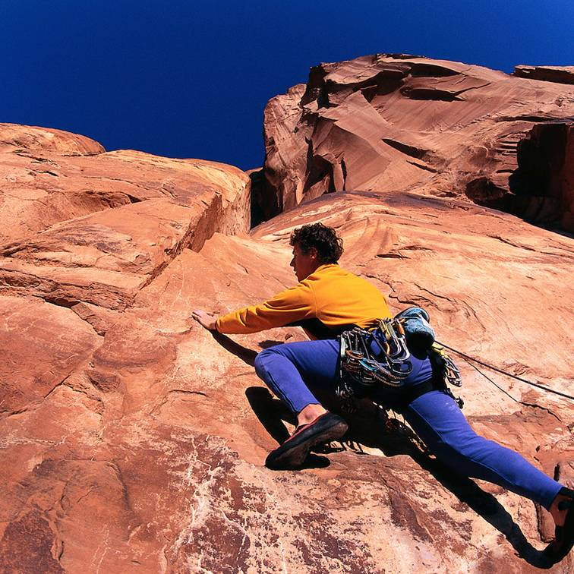
How can you better press on in your own journey of faith?
This Photo by Unknown Author is licensed under CC BY-NC-ND
Notes:
Exhortation: Are you also “in the wilderness”? How can you better press on in your own journey of faith?
If you feel like your fellowship with God is hindered now, do you need to “clean the pipe”? What must you confess?
Do things seem dark now? Do not fail to trust God in the darkness what he has revealed in the light.

Slide 45


Salvation link at BibleStudyDownloads.org
Get this presentation and script for free!

Slide 46
Black

Slide 47
The Inheritance of the Believer
New Testament Summary
Message 2 of 4
Soteriology: God’s Rescue Program
Dr. Rick Griffith • Jordan Evangelical Theological Seminary
BibleStudyDownloads.org
Notes:
Here is Part 2 of the 4-part study on The Inheritance of the Believer.

Slide 48

Will each genuine Christian persevere in faithfulness at death?
Notes:
I suspect every one of us knows someone who used to walk with Jesus but doesn't follow Christ anymore. What do you think of this person now? It raises this key question:
• Will each genuine Christ persevere in faithfulness at death?
We are talking ONLY about TRUE Christians here—not those who THINK they are believers but are not.
We all still struggle with sin after trusting Christ, but this question asks if every REAL Christian will continue to walk with Christ to the extent that he or she will die believing.
Or can that genuine believer deny Jesus during his or her life and die in that state of disbelief?
Turn to your neighbor and answer YES, NO, or DON’T KNOW.

Slide 49
Distinguishing Terms
67
 | Eternal Security | Assurance of Salvation
Basic Meaning | Being saved from the penalty of sin forever (once saved, always saved) | Knowing that we are saved from the penalty of sin forever
Definition | “The work of God which guarantees that the gift of salvation, once received, is forever and cannot be lost” (Ryrie, Basic Theology, 328) | “The realization of the truth of eternal security or perseverance” (Ryrie, Basic Theology, 328)
Notes:
Two often we use these terms interchangeably, but they are distinct.
——
HS-04-Sealing, Indwelling-79
NS-04-John1-11-slide 97
NS-04-John12-21-slide 288
NS-19-Hebrews-50
NS-23-1 John-151
SA-14-Eternal Security-57
SA-15-Inheritance-47

Slide 50
Distinguishing Terms
67
 | Eternal Security | Assurance of Salvation
Spirit’s Ministry | Sealing (Eph 1:13-14) | Assuring (Rom 8:15-17)
Believer’s… | Position as child of God (Rom 8:16b) | Practice or confidence (Rom 8:16a)
Recipients | All Christians possess | Some Christians doubt
Permanence | Can’t be lost (John 6:39-40; 10:27-29; Rom 8:30, 38-39; Heb 7:25) | Can be lost (for this reason John wrote 1 John 5:11-13)
Songs | “I Know Whom I Have Believed” “In Christ Alone” “The Solid Rock” | “Blessed Assurance” “Now I Belong to Jesus”
Notes:
God wants us to have both eternal security and assurance of salvation.
Sadly, some believers are not taught correctly and have eternal security, but they do not know assurance of salvation.
There are even others who falsely think they have assurance when in fact, they are not saved and thus do not have eternal security.
——
HS-04-Sealing, Indwelling-80
NS-04-John1-11-slide 98
NS-04-John12-21-slide 289
NS-19-Hebrews-51
NS-23-1 John-152
SA-14-Eternal Security-58
SA-15-Inheritance-48

Slide 51
Will each genuine Christian persevere in faithfulness at death?
274j
Yes
No
Reformed
Partakers
Arminian
Apostasy
Cannot Happen
Apostasy Leads to Loss of Rewards
Apostasy Leads to Loss of Salvation
Eternal Security but No Assurance
Eternal Security
and Assurance
No Eternal Security and No Assurance
Notes:
Essentially three views are possible to answer the perseverance question. Though the Partakers View is the newest, I believe it is the most faithful to the Bible. It also has the strengths of the other views while avoiding their weaknesses, thus advocating a mediating view.
______________
Common English-155
NS-19-Hebrews-52
NS-20-James-115
SA-15-Inheritance-47

Slide 52

Views on Apostasy
Reformed
(Calvinist)
Arminian
(Wesleyan)
The Bible distinguishes our two inheritances.
Perseverance of believers
(Apostasy impossible)
Partakers
Apostasy leads to loss of salvation
Security but
no assurance
Eternal
Security
Apostasy Possible
No security, no assurance
Apostasy leads to loss of rewards
How can we hold both apostasy and assurance?
Assurance
Notes:
52
Believers hold one of three basic views on eternal security, perseverance, and rewards.
1 • The Reformed view upholds perseverance saying that no believer can deny the faith—if someone does, he was not really a Christian as apostasy cannot happen.
2 • The Reformed View thus believes in security but you cannot tell if the person is a true believer until he dies without denying the Lord—thus no assurance of salvation.
3 • Arminians are the opposite. They advocate that true Christians can and do turn away from Christ—and this leads to them losing eternal life!
4 • Thus there is no security in salvation for the Arminian as one must keep walking with Christ to maintain salvation, which provides no assurance that one is saved.
5 • The Partakers View seeks to draw the best from both camps.
6 • Partakers teach that true Christians do abandon the faith—so they share this in common with the Arminian camp.
7 • But Partakers also share with the Reformed View the belief in eternal security—once saved, always saved—so salvation cannot be lost.
8 • Partakers also agree with Arminians that some believers do turn away, but this apostasy is seen as depriving them of rewards rather than losing salvation.
9 • In contrast to the other views, the Partakers have genuine assurance of salvation. But they do not give assurance of reward.
Though the Partakers View is the newest, I believe it is the most faithful to the Bible. It also has the strengths of the other views while avoiding their weaknesses, thus advocating a mediating view.
[Both the OT and NT teach that we can be heirs in two ways.]
______________
NS-19-Hebrews-64
SA-15-Inheritance-36

Slide 53
The Reign of the Servant Kings
Jody Dillow is the key author of the Partakers View
Final Destiny
The Future Reign of the Servant Kings
Joseph Dillow
Notes:
The Partakers View explains inheritance in the OT.
Inheritance in the OT was of two types:
All Israelites who believed in the LORD would have God as their inheritance—or be saved.
But only those Israelites that obeyed the LORD wholeheartedly would inherit Canaan—or be rewarded.
———————————
Common English slide 109
NS-19-Hebrews-419
SA-15-Inheritance-35, 173

Slide 54
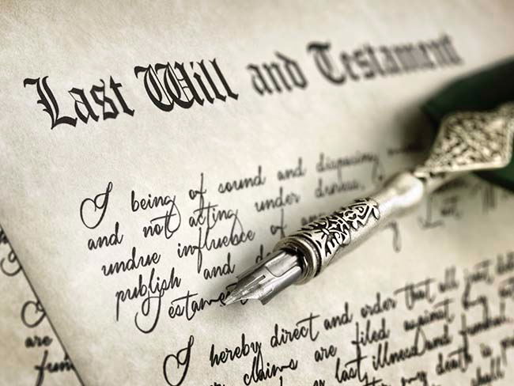
Inheritance Today

Slide 55
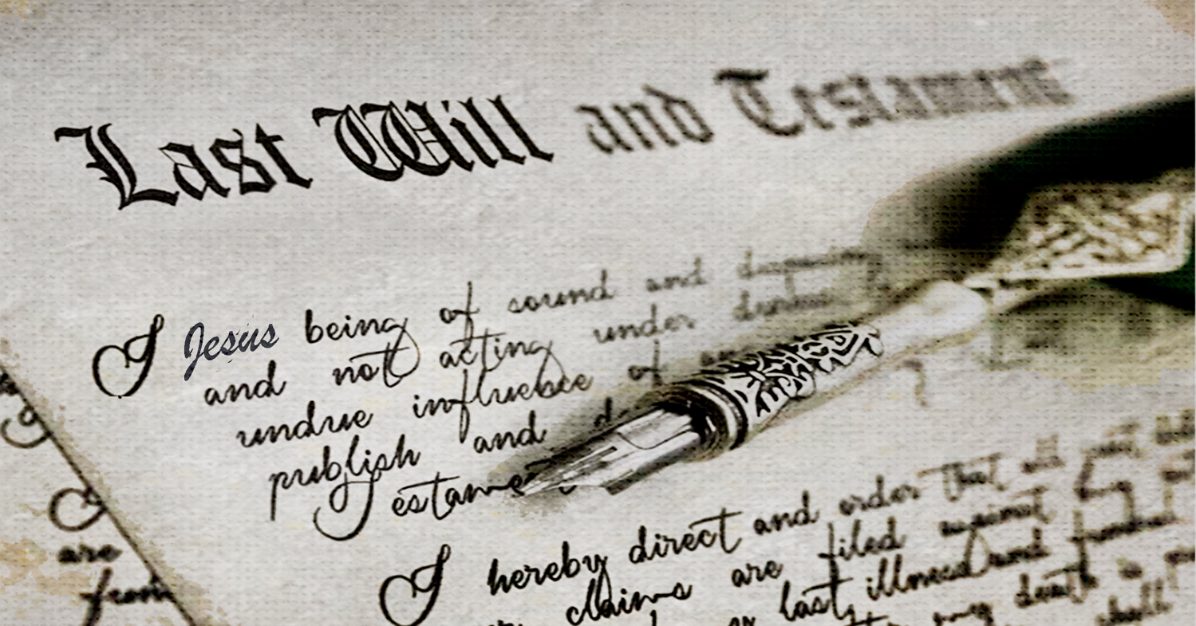
Inheritance from Christ

Slide 56

Inheritance in the NT

Slide 57
Two Types of Inheritance
"Now if we are children, then we are heirs—heirs of God and co-heirs with Christ, if indeed we share in his sufferings in order that we may also share in his glory"
(Romans 8:17 NIV).
= Salvation
= Reward
Notes:
Being "heirs of God" and "co-heirs with Christ" are different blessings in Romans 8:17. We know this because the latter has a conditional "if"—"if indeed we share in his sufferings."
All Christians are "heirs of God" by faith in Jesus Christ, leading to salvation. This means that they all have eternal life and a new standing (position) with God as sons. Paul explains this much in Romans 8.
But not all believers share in his sufferings, as Paul notes in 1 Corinthians 2:14–3:5 which shows many to be carnal (fleshly), or not walking with Christ in a consistent manner as is true of the "spiritual man." However, those Christians that sacrifice for Christ will also suffer with Christ and then "share in his glory" as "co-heirs with Christ," meaning that they will reign with him on the earth after Jesus returns (1 Cor 6:1-2; Rev 20:4-6).
________
Common-264
OP-04-Numbers-93
OS-04-Numbers-141
OS-37-Haggai-148
OS-06-Joshua-182
NP-02-Inheritance NT Summary-11
NS-Rom5-8-Slide127
NS-19-Hebrews-66, 193
SA-15-Inheritance-35

Slide 58
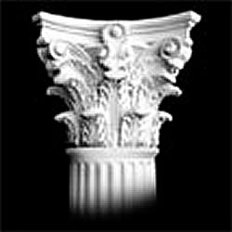
Kingdom Entering
##
Enter into Salvation
Enter into Discipleship
Salvation
Rewards
Entering into a Rich Experience of Life!
All believers
Faithful believers
Millennial dwelling
Millennial ruling
Wood, hay, straw
Gold, silver, jewels
Based on faith alone
Based on works
Notes:
"There are two kinds of inheritance - a salvation inheritance and a reward inheritance - see chapter 4. There are also several kinds of 'entering'—e.g., entering into salvation or into a way of kingdom living, a call to discipleship. E.g. Matt 5:19-20" (taught by Joseph Dillow, Final Destiny, 4th ed.) but I cannot find the exact quote.

Slide 59
##
Kingdom Entering
Enter into Salvation
Enter into Discipleship
Faith for salvation
Matt. 5:19 “So if you ignore the least commandment and teach others to do the same, you will be called the least in the Kingdom of Heaven. But anyone who obeys God’s laws and teaches them will be called great in the Kingdom of Heaven.’”
Notes:
Matthew certainly believed in salvation by faith alone, but here he says that some disciples who are not very faithful will still be in the kingdom. "Jesus has made it clear in Matthew 5:19 that a life of good works is not necessary to be in the kingdom" (Joseph Dillow, Final Destiny, 4th ed., 242).
_____________
"Are Works a Condition for Entering the Kingdom?
The New Testament includes 23 references to entering the kingdom, entering into “life,” seeking “life,” or seeking the kingdom. These passages, commonly called the “entry sayings,” are usually understood to refer to entrance into personal salvation either now or in the eschatological future. However, in many of these passages, entry into the kingdom or into “life” appears to be predicated on works. If the traditional idea that “the kingdom” always refers to individual salvation and that “entrance into the kingdom” always refers to “getting saved” or going to heaven when one dies is accepted, as Bill did, then there emerges an apparent conflict with the faith-alone gospel of the New Testament.
For example to “enter the kingdom” requires a righteousness that is greater than that of the scribes and Pharisees (Matthew 5:20). Those who enter the kingdom must do so through the path of discipleship, the narrow gate (Matthew 7:13, 14). In order to enter the kingdom, one must do the “will of the Father,” that is, obey the precepts taught in the Sermon on the Mount (Matthew 7:21). To “enter into life,” which is an equivalent phrase, one must deal radically with sin, reject it, and remove it from one’s lifestyle (Matthew 18:3, 9). To enter the kingdom, one must be “converted” (Matthew 18:3, 9). Jesus tells the rich young ruler that to “enter into life” (which he equates with entering the kingdom, v. 23) one must “keep the commandments” (Matthew 19:17). Strenuous moral effort is required if one is to enter the kingdom (Mark 10:24, “how hard”).
It should be obvious to any unbiased reader that the calls to enter the kingdom are conditioned upon works" (Joseph Dillow, Final Destiny, 4th ed., 230-31).

Slide 60
##
Kingdom Entering
Enter into Salvation
Enter into Discipleship
Faith for salvation
Matt. 5:20 “But I warn you—unless your righteousness is better than the righteousness of the teachers of religious law and the Pharisees, you will never enter the Kingdom of Heaven!”
Notes:
Is this imputed righteousness? "The factor causing most scholars to reject this view is that Matthew himself defines what he means by “righteousness.” The word “righteousness” in Matthew’s gospel never means “imputed righteousness.” In this sermon righteousness refers to ethical kingdom behavior as will be demonstrated in the following discussion….
"The view that most closely fits the immediate context is that the greater righteousness is the ethical behavior described in the Sermon on the Mount. This behavior is achieved by daily dependence upon Christ and reflects an inner attitude that complies with the spirit of the Law. When the Law is obeyed with this spirit, it leads to a kingdom way of living and higher status in the kingdom. The Pharisees had reduced Torah to external legalisms and specific acts of obedience.
Matthew is writing to a Jewish audience, an audience steeped in the Old Testament. Therefore, a starting place to understanding righteousness is their Scripture744 which speaks of righteousness in two ways. First, and fundamentally, they knew that their faith could be counted as righteousness, as the encounter with Abraham clearly explained (Genesis 15:6). That kind of righteousness led to personal salvation. But the Old Testament also spoke of righteousness as ethical behavior, just like Matthew does" (Joseph Dillow, Final Destiny, 4th ed., 233).

Slide 61
##
Kingdom Entering
Enter into Salvation
Enter into Discipleship
Faith for salvation
Matt. 7:21 “Not everyone who calls out to me, ‘Lord! Lord!’ will enter the Kingdom of Heaven. Only those who actually do the will of my Father in heaven will enter.”
Notes:
"Entering the kingdom now involves entering into an aspect of the future kingdom available under the New Covenant, a new way of life now, a rich way of living before God by means of the Spirit" (Joseph Dillow, Final Destiny, 4th ed., 254).
______
Footnote 731: "The “entry sayings” refer to these phrases: (1) “enter the kingdom of heaven” (Matthew 5:20; 7:21; 18:3; 19:23, 24; 23:13; Mark 9:47; 10:15, 25; Luke 18:17, 24, 25; John 3:5; Acts 14:22); (2) “entering into life” (Matthew 18:8, 9; 19:17; Mark 9:43; (3) “seeking life” (Luke 17:33; Romans 2:7); (4) “seeking the kingdom” (Matthew 6:33; 13:45; Luke 12:31). These seem to be parallel and explain one another" (Dillow, 230).

Slide 62
##
Kingdom Entering
Enter into Salvation
Enter into Discipleship
Faith for salvation
Matt. 19:23 "Then Jesus said to his disciples, ‘I tell you the truth, it is very hard for a rich person to enter the Kingdom of Heaven.’"
Notes:
"Jesus tells the rich young ruler that to “enter into life” (which he equates with entering the kingdom, v. 23) one must “keep the commandments” (Matthew 19:17)…
It should be obvious to any unbiased reader that the calls to enter the kingdom are conditioned upon works" (Joseph Dillow, Final Destiny, 4th ed., 231).

Slide 63
The Kingdom
##
Enter
Inherit
Faith for salvation
1 Cor. 6:9 "Don’t you realize that those who do wrong will not inherit the Kingdom of God …Those who indulge in sexual sin, or who worship idols, or commit adultery, or are male prostitutes, or practice homosexuality…
Notes:
When we "do wrong" do we then not have salvation? Are we saved by faith plus not "doing wrong"? No, this verse does not show the requirements for salvation. It warns believers that sin keeps us from inheriting rewards after salvation.

Slide 64
The Kingdom
##
Enter
Inherit
Faith for salvation
1 Cor. 6:10 “or are thieves, or greedy people, or drunkards, or are abusive, or cheat people—none of these will inherit the Kingdom of God.”
Notes:
Being greedy doesn't keep one from maintaining salvation. It keeps us from entering into a rich experience of life with Christ—that is, sin keeps us from fully appreciating our reward.

Slide 65


Crowns in the NT
Incorruptible
1 Cor 9:25
Hope
1 Thess 2:19
Righteousness
2 Tim 4:8
Life
Jas 1:12;
Rev 2:10
Glory
1 Pet 5:4
Notes:
Rick Griffith, Eschatology notes, 189
2. What is the nature of the heavenly rewards? What will these rewards be like?
a. Rewards of Possession
1) Five crowns (stephanos) are noted as personal possessions in heaven (cf. p. 76). These crowns are not kingly crowns (diadems) but victor’s wreaths made of vines or leaves (or even gold and silver in the form of a garland or wreath):
An incorruptible crown is for those who master their flesh (1 Cor. 9:25).
A crown of hope or joy is for those who bore fruit in others’ lives for Christ (1 Thess. 2:19). This is sometimes called the soul-winner’s crown.
A crown of life is for believers who patiently endure trials and suffering (James 1:12; Rev. 2:10).
A crown of glory rewards spiritual shepherds who feed the flock (1 Pet. 5:4).
A crown of righteousness is for one longing for Christ’s return (2 Tim. 4:8).
b. Rewards of Responsibility (cf. W. A. Criswell and Paige Patterson, Heaven, 208-14)
1) In Luke 19:11-27 (Parable of the Ten Minas) Jesus taught that before going on a journey, a nobleman gave each of his ten servants the same amount of money—one mina each. Upon returning, the master rewarded each accordingly with differing degrees of responsibility based on their faithfulness.
2) Matthew 25:14-30 (Parable of the Talents) records a similar story, except each man received a different amount of money to invest for his master (the one who buried his master’s money depicts an unsaved man, v. 30). This parable also depicts varying degrees of reward: “His master replied, ‘Well done, good and faithful servant! You have been faithful with a few things; I will put you in charge of many things. Come and share your master’s happiness’” (v. 21).
2) We too often view ownership as sinful, though this is not scriptural.
a) As joint-heirs with Christ (Rom. 8:17; Heb. 1:2), we own what He owns! This is joint-ownership in a communal sense but “to deny private property inevitably ends in denying privacy” (Gilmore, 302) much like the mystical idea of blending into the “Total One.” Ownership in heaven will not include the sinful possessiveness of earth.
b) We have a heavenly inheritance which is “imperishable and undefiled, and will not fade away, reserved in heaven for you” (1 Pet. 1:4 NASB).
3. However, a recent article argues against levels of reward (Craig L. Blomberg, “Degrees of Reward in the Kingdom of Heaven?” Journal of the Evangelical Theological Society 35 [June 1992]: 159-72). He provides some interesting thoughts:
a. The vineyard worker parable teaches that each worker received the same pay no matter how long he worked (Matt. 20:1-16). This teaches that all believers are rewarded equally since all receive pay by grace. The ending, “the last shall be first, and the first, last” (v. 16), means that all positions in heaven are interchangeable.
Response: Do they indeed receive pay by grace? In each case the pay was for work, not faith. The main point that “the last shall be first, and the first, last” (v. 16) may better indicate that God’s system of ranking people in heaven differs from that which man uses on earth.
b. Scholars do not agree on the form these differing heavenly rewards will take. Suggestions include capacity for service, added responsibilities, degree of bliss, possessions, and an enriched relationship with God.
Response: Our ignorance of the type of reward does not deny its existence (see preceding discussion for more details on types of reward).
c. If heaven is perfection, how can there be varying degrees of perfection?
Response: This may seem inappropriate from our vantage point since we are not God, but he has made many perfect things which differ in quality even in our present world. For example, plants are perfectly made yet less durable than jewels.
d. Blomberg considers passages generally used to teach rewards not convincing.
1) The crown passages speak of the reward of eternal life itself, not something in addition to it (1 Cor. 9:25; 1 Thess. 2:19; 2 Tim. 4:8; Jas. 1:12; 1 Pet. 5:4). [But this does not seem to be the normal reading of each passage.]
2) The texts about those who are the “least” or “greatest” relate only to the “present aspects of the kingdom” (Matt. 5:19; 11:11; 18:4; Mark 9:34-35; Luke 9:48). [No, for people here are compared with the least of the people there.]
3) The quality of each man’s work and their rewards (1 Cor. 3:11-15) relates to degree of shame or satisfaction at the judgment (cf. 1 John 2:28), not the lasting results of it which persist for all time in an everlasting hierarchy. [Even this is not correct, since verse 14 declares that “if what he has built survives, he will receive his reward.” It is true that the nature of the reward is not stated, so the belief that it is merely momentary satisfaction may be true or false—no one knows. However, 2 Corinthians 5:10 does indicate that each will be judged for his deeds and “will receive what is due him.”]
Other arguments of Blomberg should be considered. This article is worth reading. Perhaps we need to re-evaluate long-held views in this area.
______________
Common-269
BE-04-Numbers-183
OP-04-Numbers-183
OS-04-Numbers-269
NS-19-Hebrews-68
SA-15-Inheritance-65

Slide 66
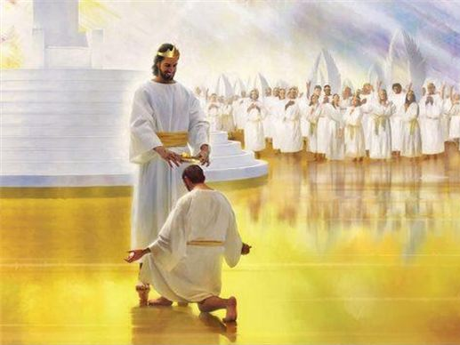
"And there will be no night there—no need for lamps or sun—for the Lord God will shine on them. And they will reign forever and ever"
(Rev 22:5 NLT).

Slide 67
Assurance and Apostasy
Reformed
(Calvinist)
Arminian
(Wesleyan)
The Bible distinguishes our two inheritances.
Perseverance of believers
(Apostasy impossible)
Partakers
Apostasy leads to loss of salvation
Only overcomers will reign with Christ.
Security but
no assurance
Eternal
Security
Apostasy Possible
No security, no assurance
Apostasy leads to loss of rewards
How can we hold both apostasy and assurance?
Assurance
Notes:
67
[The privilege to rule with Jesus is reserved for the faithful.]

Slide 68
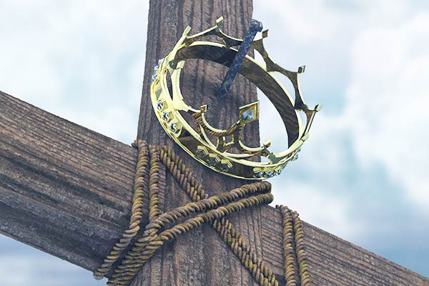
The Overcomers of Revelation 2–3

Slide 69

The 7 Churches (Rev. 2–3)
345
Adramyttium
Aezani
Pergamum
Thyatira
Cyme
Erythrae
Sardis
Smyrna
Eumenia
Philadelphia
Lebedus
Colophon
Ephesus
Nysa
Laodicea
Hierapolis
Trailes
Heraclea
Aphrodisias
Colossae
Alabanda
Patmos
Miletus
Notes:
Jesus designed a brilliant strategy by having his revelation sent to the capital of the province, Ephesus. It included an individual letter to Ephesus, as well as letters to 6 other key churches. The Ephesians copied the entire book of Revelation, though, and sent the original to the next city, Smyrna. Smyrna then made their own copy and sent the original to Pergamum, which lay on the main road to the north. This city then sent the prophecy to Thyatira, which sent it to Sardis, then Philadelphia, and finally to Laodicea.
_______________
NP-02-Inheritance NT Summary-23
NS-27-Rev2-slide 6
SA-15-Inheritance-69

Slide 70
The Overcomers (Rev. 2–3)
365
“For everyone born of God overcomes the world. This is the victory that has overcome the world, even our faith. ⁵Who is it that overcomes the world? Only he who believes that Jesus is the Son of God”
(1 John 5:4-5 NIV)
The overcomer has “kept my command to endure patiently” (Rev 3:10 NIV) and “does my will to the end” (Rev 2:26 NIV)
All
believers overcome
Faithful believers overcome

Slide 71
The Overcomers (Rev. 2–3)
365
“…whoever hates his brother
is in the darkness and walks around in the darkness… because the darkness has blinded him” (1 John 2:11)
“Only the crowned and rewarded church in heaven will rule” (Dillow, 664)
Are all Christians overcomers?
“You have made them to be a kingdom and priests to serve our God,
and they will reign on the earth” (Rev 5:10).
All believers overcome in 1 John 5:4-5, yet some will still “shrink away in shame”
(1 John 2:28)
No. Only faithful ones.

Slide 72
The Overcomers (Rev. 2–3)
365
Unbelievers: “But the cowardly, the unbelieving, the vile, the murderers, the sexually immoral, those who practice magic arts, the idolaters and all liars—their place will be in the fiery lake of burning sulphur. This is the second death” (21:8).
The context of Rev 21:6-8 presents three types of people:
All Saints: “He said to me: 'It is done. I am the Alpha and the Omega, the Beginning and the End. To him who is thirsty I will give to drink without cost from the spring of the water of life'” (21:6).
He who overcomes will inherit these things, and I will be his God and he will be My son (21:7)

Slide 73
The Overcomers (Rev. 2–3)
365
If all overcome, then none could lose their crown: “I am coming soon. Hold on to what you have, so that no one will take your crown” (3:11).
“The seven letters deal with Christian works, not salvation (2:2, 9, 13, 19; 3:1, 8, 15)” —Yates, BibSac (2006): 227
Are all Christians overcomers?
If we all overcome, then why all the warnings and promises?
No. Only faithful ones.
His name will not be removed from the book of life (3:5)

Slide 74
The Overcomers (Rev. 2–3)
365
Pergamum
Thyatira
"He who overcomes" (NAU) is used once for each of the 7 churches, plus 21:7 with a total of 8 times in Revelation
Smyrna
Sardis
Ephesus
Philadelphia
Laodicea

Slide 75
The Overcomers (Rev. 2–3)
365
Pergamum
Thyatira
To him who overcomes, I will grant to eat of the tree of life which is in the Paradise of God (2:7)
Smyrna
Sardis
Ephesus
Philadelphia
2:7
Laodicea

Slide 76
The Overcomers (Rev. 2–3)
365
Pergamum
Thyatira
He who overcomes will not be hurt by the second death (2:11)
Smyrna
Sardis
2:11
Ephesus
Philadelphia
2:7
Laodicea

Slide 77
The Overcomers (Rev. 2–3)
365
Pergamum
Thyatira
To
him
who
overcomes,
to him I will give some of the hidden manna, and I will give him a white stone, and a new name written
on the stone which
no one knows but he
who receives it (2:17)
2:17
Smyrna
Sardis
2:11
Ephesus
Philadelphia
2:7
Laodicea

Slide 78
The Overcomers (Rev. 2–3)
365
Pergamum
Thyatira
2:17
2:26
He who overcomes, and he who keeps My deeds until the end, TO HIM I WILL GIVE AUTHORITY OVER THE NATIONS (2:26)
Smyrna
Sardis
2:11
Ephesus
Philadelphia
2:7
Laodicea

Slide 79
The Overcomers (Rev. 2–3)
365
Pergamum
Thyatira
2:17
2:26
He
who
overcomes will thus be clothed in white garments; and I will not erase his name from the book of life, and I
will confess his name
before My Father and before His angels (3:5)
Smyrna
Sardis
2:11
3:5
Ephesus
Philadelphia
2:7
Laodicea

Slide 80
The Overcomers (Rev. 2–3)
365
Pergamum
Thyatira
2:17
2:26
He who
overcomes, I will make him a pillar in the temple of My God, and he will not go out from it anymore; and I will write on him the name of My God, and the name of the city of My God, the new Jerusalem, which comes
down out of heaven from My
God, and My new name (3:12)
Smyrna
Sardis
2:11
3:5
Ephesus
Philadelphia
2:7
3:12
Laodicea

Slide 81
The Overcomers (Rev. 2–3)
365
Pergamum
Thyatira
2:17
2:26
He who overcomes, I will grant to him to sit down with Me on My throne, as I also overcame and sat down with My Father on His throne (3:21)
Smyrna
Sardis
2:11
3:5
Ephesus
Philadelphia
2:7
3:21
3:12
Laodicea

Slide 82
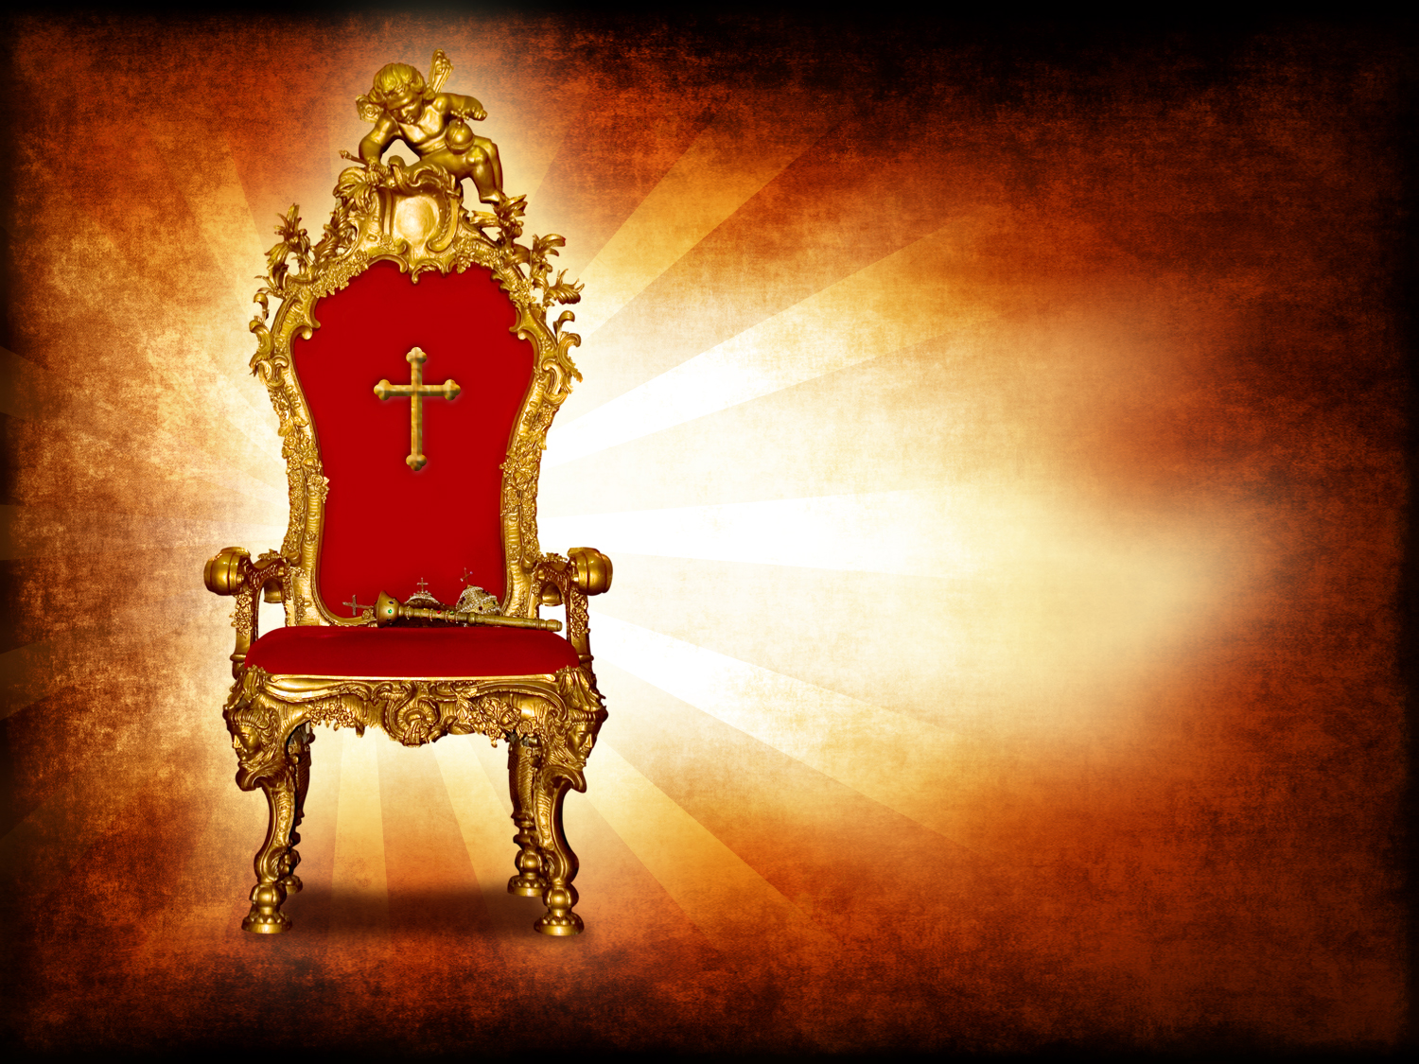
Rule with Christ just as he rules with the Father (Rev 3:21-22).
365

Slide 83
Laodicea (Rev. 3:14-22)
363
Promise
Overcomers will eat with Christ and rule with Christ
Warning
None!
Pergamum
Thyatira
Exhortation
Buy from Christ refined gold, white clothes, and eye salve.
Be earnest and repent.
Rebuke
Lukewarm, neither cold nor hot.
Wretched, pitiful, poor, blind, and naked
Christ:
The Amen, the faithful and true Witness, the Ruler of God's creation
Commendation:
None!
Smyrna
Sardis
Ephesus
Philadelphia
Laodicea
Notes:
http://www.truthwhys.com/news/revelation-part-15-chapter-3-sardis-philadelphia-and-laodicea/ has many good historical notes

Slide 84
The Overcomers (Rev. 2–3)
365
Pergamum
Thyatira
2:17
2:26
Smyrna
He who overcomes will inherit these things, and I will be his God and he will be My son (21:7)
Sardis
2:11
3:5
Ephesus
Philadelphia
2:7
3:21
3:12
Laodicea

Slide 85
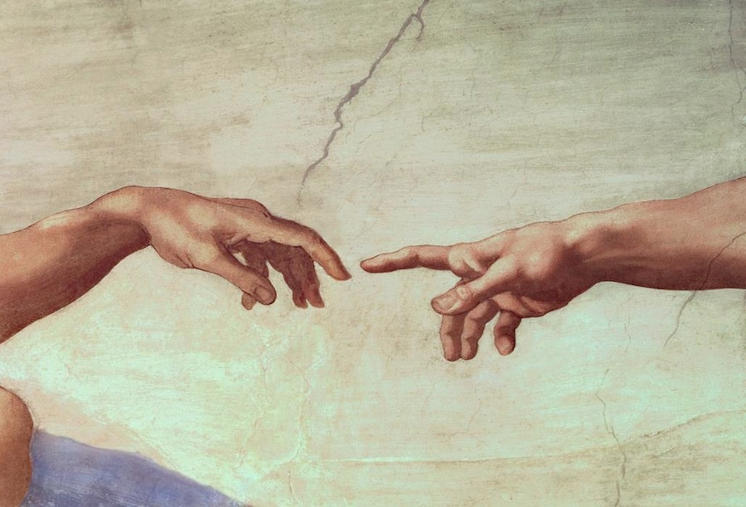
Are you ready to rule the world?

Slide 86

The Rule of Christ
Psalm 2:8-9 quoted in Rev. 2:27

Slide 87



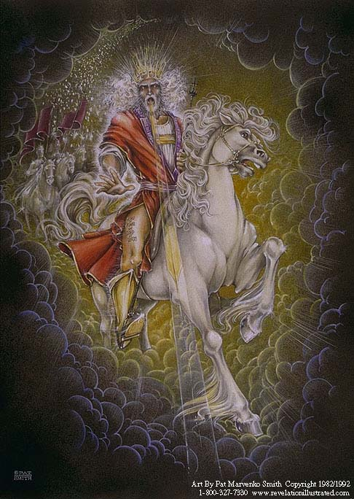
Our Future
(Rev. 19–20)
Heaven
(Rev. 21–22)
Millennium
(Rev. 20)
Return
(Rev. 19)

Slide 88
Revelation 20:4 (NAU)
⁴Then I saw thrones, and they sat on them, and judgment was given to them. And I saw the souls of those who had been beheaded because of their testimony of Jesus and because of the word of God, and those who had not worshiped the beast or his image, and had not received the mark on their forehead and on their hand; and they came to life and reigned with Christ for a thousand years.

Slide 89
"Do you not know that saints will judge the world?"
(1 Cor. 6:2a)

Slide 90

"If we endure hardship, we will reign with him"
(2 Tim. 2:12 NLT)

Slide 91
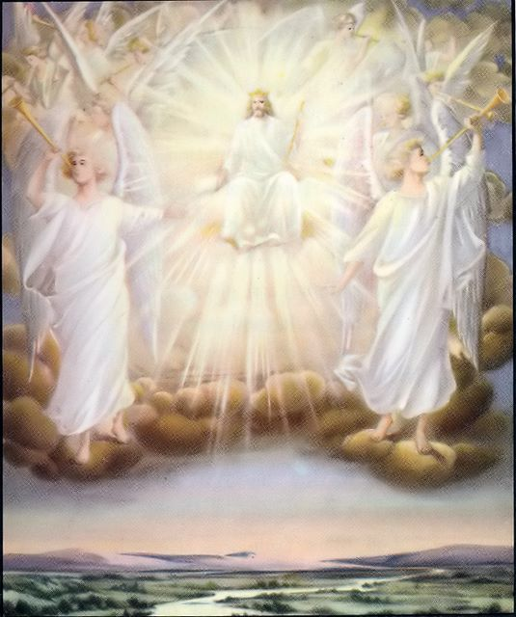
"Those who are victorious will sit with me on my throne, just as I was victorious and sat with my Father on his throne"
(Rev. 3:21 NLT).

Slide 92
Assurance and Apostasy
Reformed
(Calvinist)
Arminian
(Wesleyan)
The Bible distinguishes our two inheritances.
Perseverance of believers
(Apostasy impossible)
Partakers
Apostasy leads to loss of salvation
Only overcomers will reign with Christ.
Security but
no assurance
Eternal
Security
Apostasy Possible
No security, no assurance
Believers abandoning Jesus lose rewards and rule.
Apostasy leads to loss of rewards
How can we hold both apostasy and assurance?
Assurance
Notes:
92
[Apostates will be saved but not rewarded.]

Slide 93
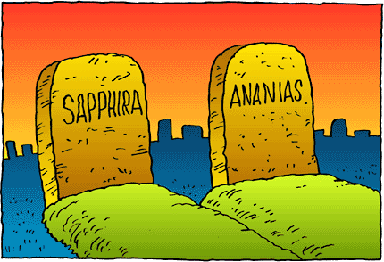
However, there is still divine discipline…

Slide 94
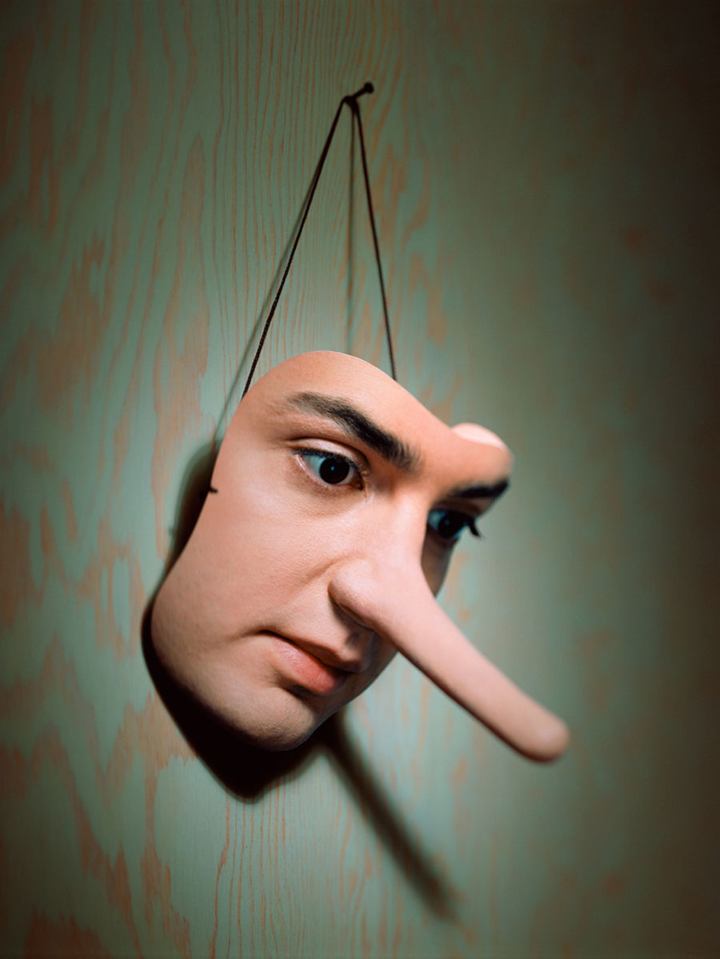
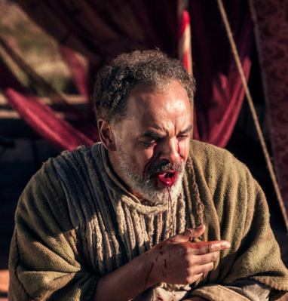
Ananias & Sapphira
Acts 5

Slide 95
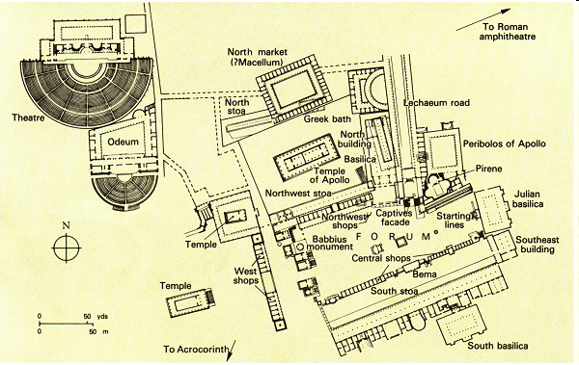
The Bema at Corinth
Lawsuits
1 Cor. 6
Bema
Paul at the speaker rostrum
Acts 18

Slide 96
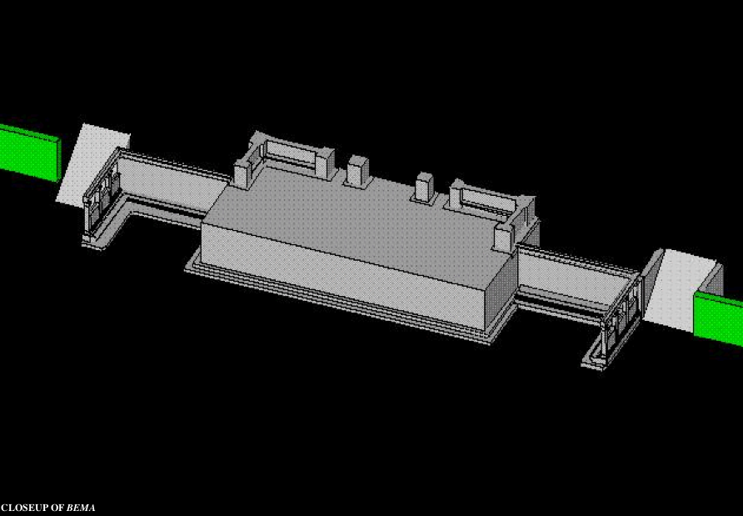
Bema Close-up
“So we make it our goal to please him, whether we are at home in the body or away from it. ¹⁰For we must all appear before the judgment seat [bema] of Christ, that each one may receive what is due him for the things done while in the body, whether good or bad” (2 Cor. 5:9-10 NIV).
Notes:
96
http://corinth.sas.upenn.edu/schola.html

Slide 97
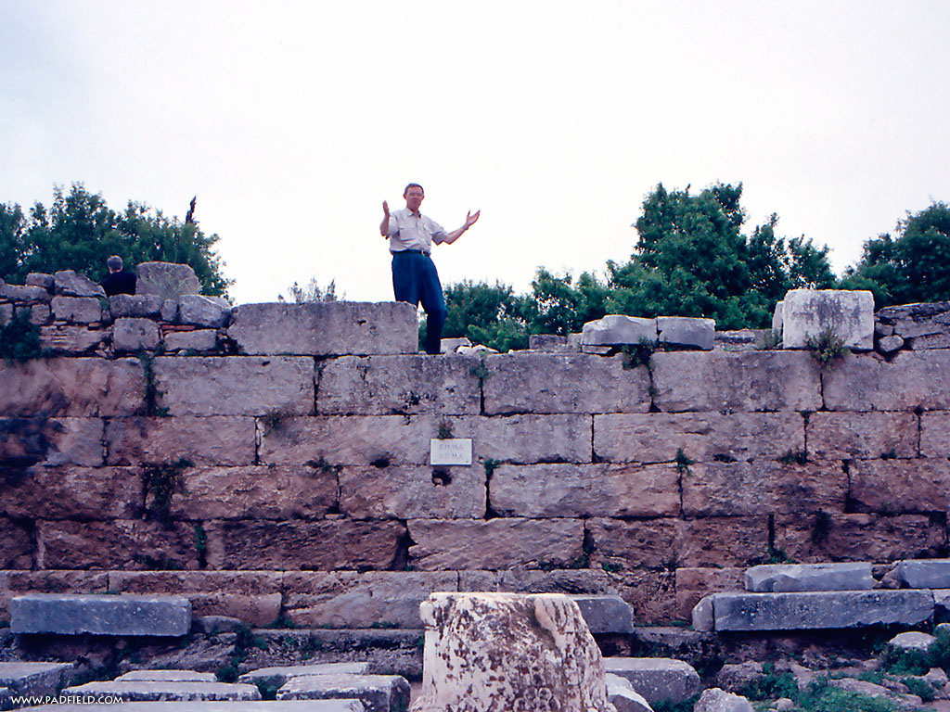
The Speaker or Judge Above
The Speaker or Judge Above
Notes:
97

Slide 98
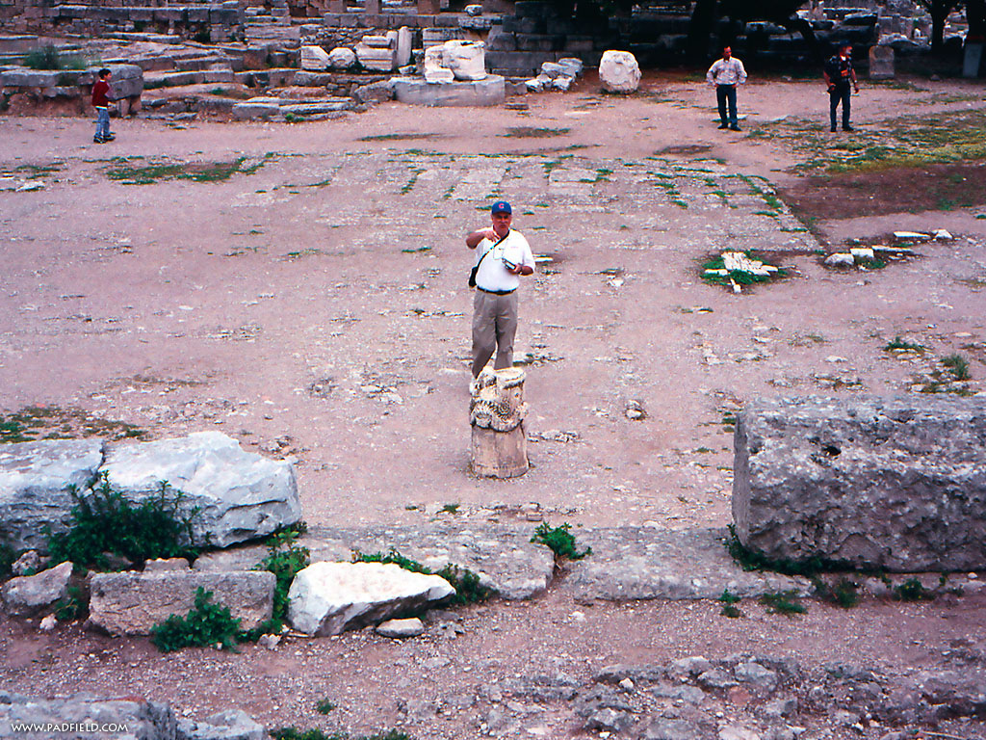
The One Being Judged or Rewarded Stood Below
Notes:
98

Slide 99
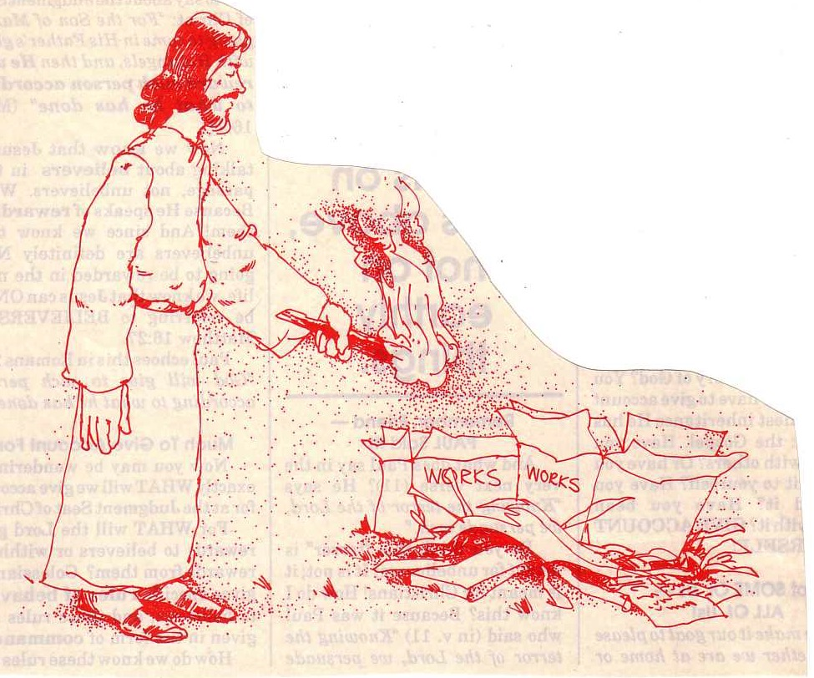
"… the fire will test the quality of each man's work"
(1 Cor. 3:13)

Slide 100


Lasting Building Materials (3:12a)
Silver
Gold
Jewels
Foundation: Apostles & Prophets (Eph. 2:20)
Foundation: The Lord Jesus Christ (1 Cor. 3:11)
Adapted from Charles R. Swindoll. "Spiritual Gifts Study Guide" (IFL, 1983), 7

Slide 101


Perishable Building Materials (3:12b)
Hay
Wood
Straw
Foundation: Apostles & Prophets (Eph. 2:20)
Foundation: The Lord Jesus Christ (1 Cor. 3:11)
Adapted from Charles R. Swindoll. "Spiritual Gifts Study Guide" (IFL, 1983), 7

Slide 102
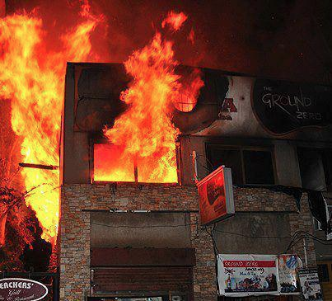
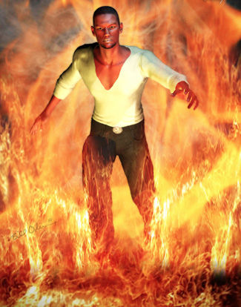
"saved as through fire…"
(1 Cor 3:15)

Slide 103

Believers Can Be “Disqualified”
"Don’t you realize that in a race everyone runs, but only one person gets the prize? So run to win! ²⁵All athletes are disciplined in their training. They do it to win a prize that will fade away, but we do it for an eternal prize. ²⁶So I run with purpose in every step. I am not just shadowboxing. ²⁷I discipline my body like an athlete, training it to do what it should. Otherwise, I fear that after preaching to others I myself might be disqualified"
(1 Cor. 9:24-27 NLT).

Slide 104
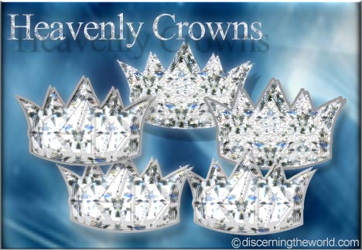
Christ promises rewards for perseverance (Rev. 3:11b).
"I am coming soon. Hold on to what you have, so that no one will take away your crown" (NLT).

Slide 105

Rewards can be lost!
"Watch out that you do not lose what we have worked so hard to achieve. Be diligent so that you receive your full reward" (2 John 8 NLT)
"I have given you an open door that no one can shut" (3:8)

Slide 106

1 Corinthians 11:27-29 (NIV)
²⁷Therefore, whoever eats the bread or drinks the cup of the Lord in an unworthy manner will be guilty of sinning against the body and blood of the Lord. ²⁸A man ought to examine himself before he eats of the bread and drinks of the cup. ²⁹For anyone who eats and drinks without recognizing the body of the Lord eats and drinks judgment on himself.
Notes:
106

Slide 107
1 Corinthians 11:30-32 (NIV)
³⁰ That is why many among you are weak and sick, and a number of you have fallen asleep. ³¹But if we judged ourselves, we would not come under judgment. ³²When we are judged by the Lord, we are being disciplined so that we will not be condemned with the world.
Notes:
107

Slide 108
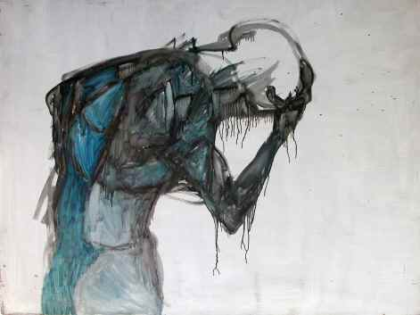
Some sin leads to premature death (1 John 5:16-17 NIV)
“If anyone sees his brother commit a sin that does not lead to death, he should pray and God will give him life. I refer to those whose sin does not lead to death. There is a sin that leads to death. I am not saying that he should pray about that. ¹⁷All wrongdoing is sin, and there is sin that does not lead to death.”

Slide 109
Assurance and Apostasy
Reformed
(Calvinist)
Arminian
(Wesleyan)
The Bible distinguishes our two inheritances.
Perseverance of believers
(Apostasy impossible)
Partakers
Apostasy leads to loss of salvation
Only overcomers will reign with Christ.
Security but
no assurance
Eternal
Security
Apostasy Possible
No security, no assurance
Believers abandoning Jesus lose rewards and rule.
Apostasy leads to loss of rewards
How can we hold both apostasy and assurance?
Assurance
Notes:
109
Believers hold one of three basic views on eternal security, perseverance, and rewards.
1 • The Reformed view upholds perseverance saying that no believer can deny the faith—if someone does, he was not really a Christian as apostasy cannot happen.
2 • The Reformed View thus believes in security but you cannot tell if the person is a true believer until he dies without denying the Lord—thus no assurance of salvation.
3 • Arminians are the opposite. They advocate that true Christians can and do turn away from Christ—and this leads to them losing eternal life!
4 • Thus there is no security in salvation for the Arminian as one must keep walking with Christ to maintain salvation, which provides no assurance that one is saved.
5 • The Partakers View seeks to draw the best from both camps.
6 • Partakers teach that true Christians do abandon the faith—so they share this in common with the Arminian camp.
7 • But Partakers also share with the Reformed View the belief in eternal security—once saved, always saved—so salvation cannot be lost.
8 • Partakers also agree with Arminians that some believers do turn away, but this apostasy is seen as depriving them of rewards rather than losing salvation.
9 • In contrast to the other views, the Partakers have genuine assurance of salvation. But they do not give assurance of reward.
Though the Partakers View is the newest, I believe it is the most faithful to the Bible. It also has the strengths of the other views while avoiding their weaknesses, thus advocating a mediating view.
On the left are three ways we can balance assurance with apostasy.
______________
NS-19-Hebrews-64
NS-24-2John-135
SA-15-Inheritance-109

Slide 110
Our salvation is secure but defectors lose rewards.
Main Idea
Notes:
The Bible teaches both assurance and apostasy—so believers can lose rewards but not salvation (MI restated).

Slide 111

All believers are clothed with Christ’s righteousness.

Slide 112
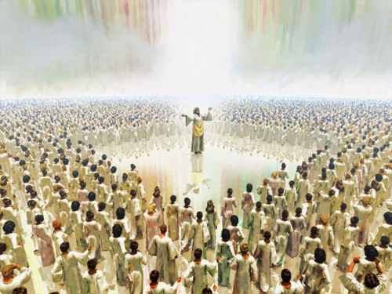
All believers will enjoy heaven.

Slide 113
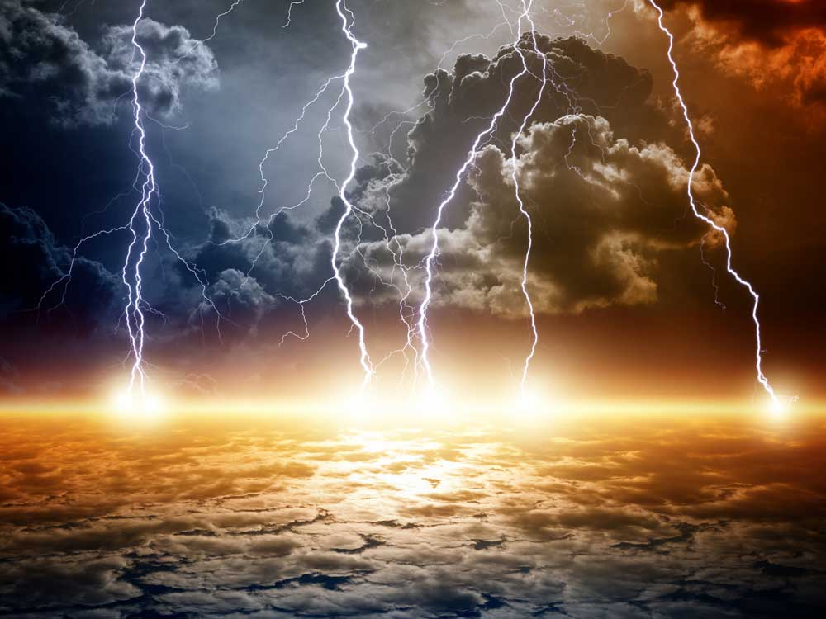
But Jesus will judge the earth.

Slide 114

Jesus will reward the faithful.

Slide 115

Live Towards Your Future!

Slide 116

Turning away from Christ forfeits your future rule.
Notes:
Christians who abandon Jesus will not reign with him after he returns.

Slide 117
Salvation link at BibleStudyDownloads.org
Get this presentation and script for free!

Slide 118
Black

Slide 119
The Inheritance of the Believer
Warnings in Hebrews
Message 3 of 4
Soteriology: God’s Rescue Program
Dr. Rick Griffith • Jordan Evangelical Theological Seminary
BibleStudyDownloads.org
Notes:
Here is Part 3 of the 4-part study on The Inheritance of the Believer.

Slide 120
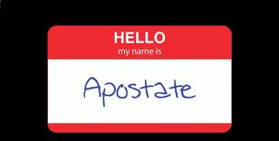
Apostates don't wear nametags
Notes:
I guess that you have never seen a nametag like this.
• That’s because apostates don’t wear nametags.

Slide 121

Apostates Destroy From Within
The Men who Destroyed the Christian West
Notes:
Believers have failed to fight apostasy for the past 200+ years.
• Apostates are believers who turn away from Christ and yet live among the saints and destroy the church within. This has happened significantly in what used to be called the "Christian West."

Slide 122
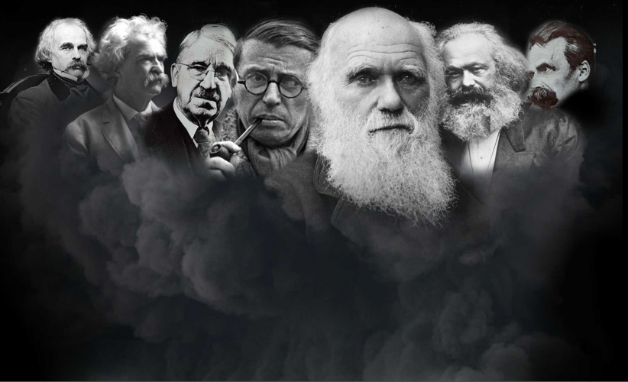
Who are the apostates?
Charles Darwin
Nathaniel Hawthorne
John Dewey
Friedrich Nietzsche
Mark Twain
Karl Marx
Jean-Paul Sartre
Ernest Hemingway
Lady Gaga
Notes:
This includes many well-known men of the past—and even moderns like Ernest Hemingway and Lady Gaga. One thing they all have in common is that they all grew up in Christian homes but later turned away from the faith. The word “apostate” means to turn away so they originally trusted in Christ but then turned away. Notice that none of them smile.

Slide 123
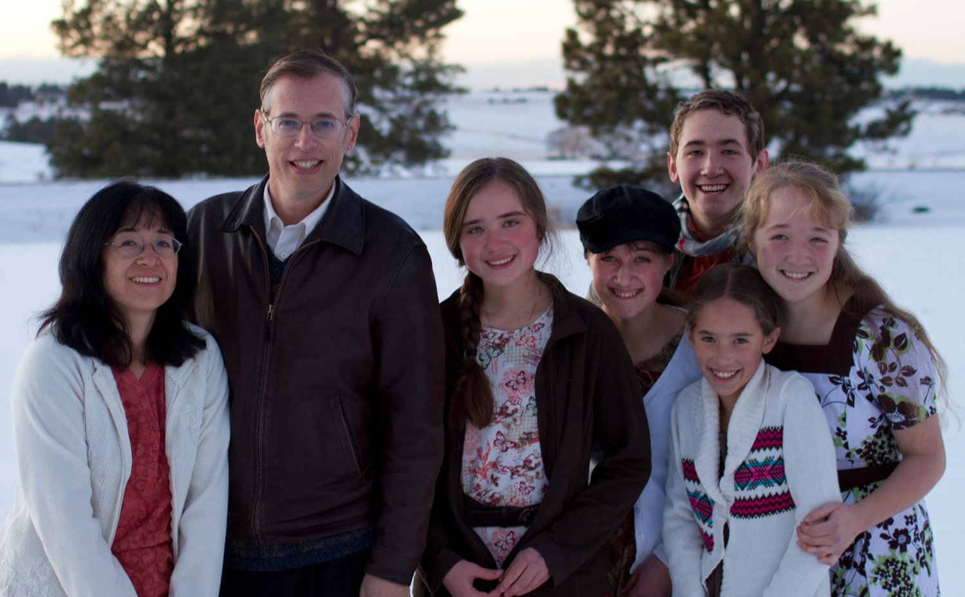
The Book Apostate
Kevin Swanson and his family
Notes:
Kevin Swanson chronicles the history of Western apostasy in his book called Apostate.

Slide 124

Why are they significant?
"This is the story of the decline and fall of Western civilization. It is the story of uncommonly powerful men, unfathomably evil men. . . apostates."
–Kevin Swanson

Slide 125
What did the apostates teach?
Charles Darwin
Nathaniel Hawthorne
John Dewey
Friedrich Nietzsche
Mark Twain
Karl Marx
Jean-Paul Sartre
"Eliminate home schools!"
"There is no God!"
"God didn't create. We evolved!"
Notes:
• John Dewey founded the US public education system to eliminate home schools.
• Darwin convinced the world to believe in evolution instead of creation.
• And Marx was an atheist.

Slide 126
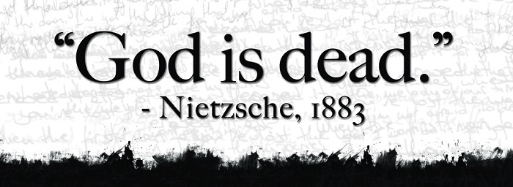
Godless Philosophy
"God is dead."
– Nietzsche, 1883
"Nietzsche is dead."
– God, 1900
Used with permission
Notes:
Nietzsche popularized the saying, “God is dead” in 1883.
• But God responded 17 years later, “Nietzsche is dead.”

Slide 127

Rob Bell & Oprah Winfrey
Notes:
Modern apostates who also grew up in Christian homes include Rob Bell (author of Love Wins, a universalist book), and Oprah Winfrey—the most popular apostate in the world as the most influential woman who teaches the same belief that all are saved.

Slide 128
The Inheritance of the Believer
Warnings in Hebrews
Message 3 of 4
Soteriology: God’s Rescue Program
Dr. Rick Griffith • Jordan Evangelical Theological Seminary
BibleStudyDownloads.org
Notes:
Here is Part 3 of the 4-part study on The Inheritance of the Believer.

Slide 129
Salvation is by faith, but rewards are by works.
Main Idea of Message 1
Notes:
This is message 3 of my 4-part series on the Inheritance of the Believer. In the first message, we saw this key truth: We come into a right relationship with God by placing our trust in Christ—but that is just the beginning as we need to obey him to be fully blessed (MI restated).
Then, the second message concluded that…

Slide 130

Our salvation is secure, but defectors lose rewards.
Main Idea of Message 2
Notes:
Then we learned that the Bible teaches both assurance and apostasy—so believers can lose rewards but not salvation (MI restated).

Slide 131
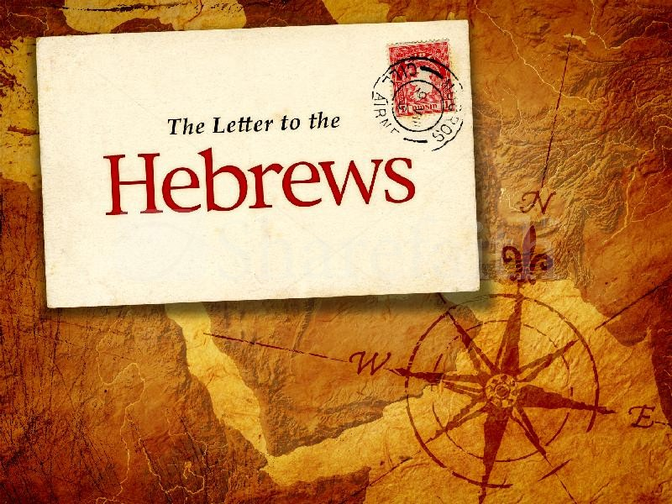

Hebrews
The Letter to the
Notes:
Today we will see that the book of Hebrews warns Jewish believers from apostasy—do you know what they are warned about?

Slide 132
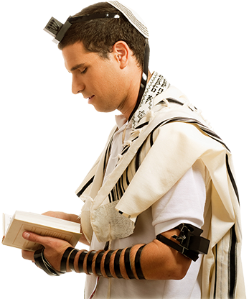
How do we know that the readers were Jews?
Notes:
The whole book assumes they know the OT law and sacrifices.

Slide 133
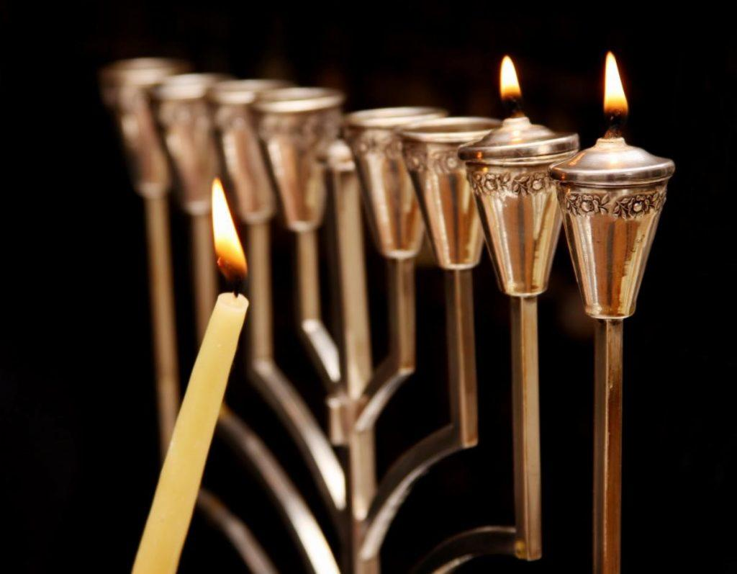
The readers were Jewish Christians
"brothers and sisters who belong to God and are partners with those called to heaven" (3:1)
"…let us hold firmly to what we believe. This High Priest of ours understands…"
(4:14b-15a)
"…dear brothers and sisters, we can boldly enter heaven's Most Holy Place because of the blood of Jesus" (10:19)
"…those early days when you first learned about Christ…you remained faithful even though it meant terrible suffering" (10:32)
Notes:
We also know the readers were Christians. These are clearly believers—why else would he repeatedly call them "brothers and sisters"? These Jews were second-generation (2:1-4) believers (3:1; 4:14b-15a; 10:19, 32; cf. 12:7; 13:1, 20-22) who should have matured beyond their present immature state in Christ (5:11-14).

Slide 134
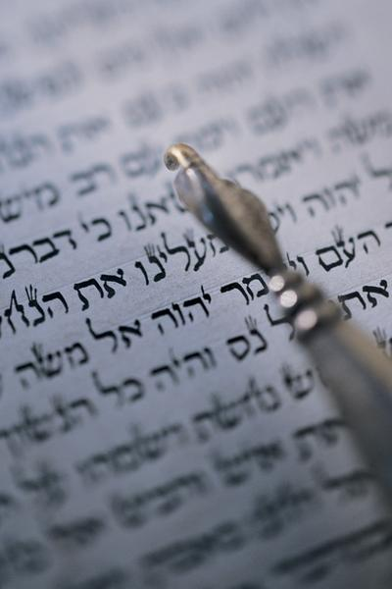
"Should I go back?"
"So we must listen very carefully to the truth we have heard, or we may drift away from it" (Hebrews 2:1 NLT).
Notes:
These believing Jews were undergoing so much difficulty that they were considering a return to Judaism—a temptation to turn away or turn back to their Jewish roots.

Slide 135

The Supremacy of Jesus in the Book of Hebrews
Notes:
So the writer sought to convince them that Jesus is better than anything they ever experienced in Judaism.

Slide 136

The "Better" Book
Hebrews uses the word "better" 13 times…
266f
1:4 Christ is "better than the angels"
6:9 We are confident of "better things in your case"
7:7 Melchizedek "better" ("greater") than Abraham
7:19 "We have confidence in a better hope"
7:22 Jesus is the "guarantee of a better covenant"
8:6 Christ is the "mediator of a better covenant"
8:6 New covenant "established on better promises"
9:23 Priestly garments need "better sacrifices"
10:34 Heaven a "better and lasting possession"
11:16 Heaven a "better country"
11:35 They obtain a "better resurrection" experience
11:40 God "provided something better for us"
12:24 Christ's blood is "better than the blood of Abel"
Note:
11:4 "Abel offered to God a better sacrifice" uses a different Greek word often translated "better"
Notes:
The writer told them not to reject the superior NT walk with Jesus for the inferior OT law.

Slide 137

Christ is Superior in His Person (1:1–4:13)
Notes:
The first movement of the book notes that Christ is superior in his person to anyone in the OT.

Slide 138

5 Warnings in Hebrews
258
Warning of drifting from truth (2:1-4)
Warning of unbelief (3:7-19)
Warning of immaturity (5:11–6:12)
Warning of wilful sin (10:19-39)
Warning of unconcern (12:14-29)
Today we will see two key warnings in Hebrews on apostasy
Notes:
Spread throughout the letter are FIVE dire admonitions not to apostatize (read them).
• Subject: Today we will see two key warnings from Hebrews about apostasy.
There are 5 warnings in total.
But we do not have time for all 5 today.
Preview: We will look only at Warning 3 and Warning 4.
Text: These are the two most controversial texts in Hebrews—and probably the whole NT.

Slide 139

Warning 1
Abandoning Jesus brings discipline
(2:1-4).
Notes:
Turning our backs on Christ makes God turn up the heat in our lives.

Slide 140
Warning 2
Abandoning Jesus forfeits our future rule (3:7-19).
Notes:
Turning our backs on Christ disinherits us from our millennial reign with Christ.

Slide 141
Warning 3
Rejecting Christ can lead to physical death (5:11–6:20).
Notes:
Christians who later reject Jesus can die before their time.

Slide 142
Warning 4
Willful sin can lead to physical death
(10:26-31).
Notes:
Believers who purposely reject Christ can die before their time.

Slide 143
Warning 5
Refusing God has consequences
(12:25-29).
Notes:
Ignore the Lord and you will experience his discipline rather than his grace.

Slide 144
Warning 3
Rejecting Christ can lead to physical death (5:11–6:20).
Notes:
Christians who later reject Jesus can die before their time.

Slide 145

It is impossible to repent from apostasy because you’re dead
(Hebrews 6:4-8).

Slide 146

An Impossibility (Heb. 6:4-6 NLT)
"For it is impossible to bring back to repentance those who were once enlightened—those who have experienced the good things of heaven and shared in the Holy Spirit, ⁵who have tasted the goodness of the word of God and the power of the age to come— ⁶and who then turn away from God. It is impossible to bring such people back to repentance; by rejecting the Son of God, they themselves are nailing him to the cross once again and holding him up to public shame."
Notes:
Too often we read this as if it says, “For it is impossible to bring back to SALVATION…”
But it doesn’t say “SALVATION.” It says “REPENTANCE” and no one can be brought BACK to repentance unless he has already FIRST repented, right? This text refers to Christians!

Slide 147

Will some Christians go to hell?
He says yes.
Notes:
The two-volume massive commentary series by William Lane addresses questions relevant to us all.

Slide 148

What is the danger in 6:4-8?
A Christian who loses his salvation?
A hypothetical, impossible situation that could never happen?
A profession that really wasn't genuine and thus results in hell?
A believer who is disqualified for Christian service and will never again return to spiritual commitment due to death has the best evidence

Slide 149


I think the readers lived in Israel
256
Rome
Israel

Slide 150




The Qumran Ruins
De Vaux
Notes:
Maybe they were even from a secluded community like Qumran.
• Excavated by Roland De Vaux

Slide 151

Israel
(AD 67-68)
Jerusalem
Notes:
During the Jewish Revolt of AD 66-73, all the Jews—believers and unbelievers alike—found refuge in Jerusalem against the Roman armies.

Slide 152


The Jewish War (AD 66-73)
257
Caesarea desecration
Jerusalem revolt
Temple sacrifice for Nero stopped
Rome sent Vespasian
Nero died
Siege of Jerusalem by Titus (April-Sept. 70)
Notes:
The various events of AD 66-70 led to Titus sieging the capital.

Slide 153


Jerusalem Siege Wall (AD 70)
Josephus notes that a siege wall surrounded the entire city, including the tomb of Annas, located among the tombs of Akeldama. This lends support to these being a wealthy burial place (not Potter's Field).
Leen & Kathleen Ritmeyer, "Akeldama: Potter's Field or High Priest's Tomb?" BAR 20 (Nov/Dec 94): 34
Notes:
The Romans built a siege wall to protect their troops from marauding Jewish fanatical defenders who left the city at night to attack the Roman troops.

Slide 154

The Temple Sanctuary
Notes:
The temple had stood for almost 600 years. In fact, this Second Temple had just been completed in AD 64 but Jesus said that not one of its stones would remain on another (Matt 24:2).

Slide 155

The Temple from the east
Notes:
The temple was a massive complex that ended up being the last part of the city for the Jews to defend. Was this temple worth defending?

Slide 156

Antonia Fortress
Notes:
Of particular importance was this fortress with four towers overlooking the temple complex.

Slide 157

Antonia Fortress Leveled
Notes:
The Romans strategically focused their attack on the northern side to capture Antonia Fortress.

Slide 158


Antonia Fortress Leveled
Notes:
Finally it was leveled except for one tower that Titus used to command his troops.

Slide 159


The Temple Assault
Notes:
The assault was an absolute bloodbath.
• This was especially against commoners and priests inexperienced in war to face the professional Roman soldiers, who killed them by the thousands.

Slide 160

Jerusalem Christians
Notes:
But before this time, Jerusalem also had many Christians. This letter addressed believing Jews during these years of the Jewish-Roman War (AD 66-73).

Slide 161

Should the Christians stay and fight?
Notes:
The question for Christian Jews was simply this: Should they also join with their unbelieving Jewish brothers to fight against Rome? Should they risk their lives to preserve the obsolete temple system instead of persevering in their belief in a risen Savior?

Slide 162

Jerusalem Christians left
Notes:
The believers left Jerusalem before Rome destroyed it in AD 70.

Slide 163


First Century Jerusalem
Notes:
No Christian was left in the city—but would these readers go with them?

Slide 164

What happened to the Christians in Jerusalem?
A revelation told them to find protection in Pella.
Pella
Jerusalem
Notes:
• The church historian Eusebius says that God gave a revelation.
• So they left Jerusalem, crossed over into modern-day Jordan, and settled in Pella.
• This peaceful city has the same name today.
________
"Pella/Pehel is not mentioned explicitly in the Bible but it was prominent in biblical times. In the days of the judges, it led a rebellion against Egypt which was crushed by Pharaoh Seti I. In NT days, Pella was the site where Christians sought refuge during the Jewish Revolt against the Romans in 66-70 A.D. Eusebius records that the Jewish believers fled here in obedience to a revelation, which some correlate with Jesus' words in Matthew 24:16. This photo views the tell from the east. Several Byzantine churches have been excavated as well as a building believed to be a Late Bronze temple. The Jordan Rift and the mountains of Israel are visible in the background.” —Todd Bolen, BIblePlaces.com
___________
https://en.wikipedia.org/wiki/Flight_to_Pella
Accessed 29 Oct 2023
Ancient sources
The people of the Church in Jerusalem were commanded by an oracle given by revelation before the war to those in the city who were worthy of it to depart and dwell in one of the cities of Perea which they called Pella. To it those who believed on Christ traveled from Jerusalem, so that when holy men had altogether deserted the royal capital of the Jews and the whole land of Judaea…"
— Eusebius, Church History 3, 5, 3
This heresy of the Nazoraeans exists in Beroea in the neighbourhood of Coele Syria and the Decapolis in the region of Pella and in Basanitis in the so-called Kokaba (Chochabe in Hebrew). From there it took its beginning after the exodus from Jerusalem when all the disciples went to live in Pella because Christ had told them to leave Jerusalem and to go away since it would undergo a siege. Because of this advice they lived in Perea after having moved to that place, as I said."
— Epiphanius, Panarion 29,7,7-8
For after all those who believed in Christ had generally come to live in Perea, in a city called Pella of the Decapolis of which it is written in the Gospel that it is situated in the neighbourhood of the region of Batanaea and Basanitis, Ebion's preaching originated here after they had moved to this place and had lived there."
— Epiphanius, Panarion 30, 2, 7
So Aquila, while he was in Jerusalem, also saw the disciples of the disciples of the apostles flourishing in the faith and working great signs, healings, and other miracles. For they were such as had come back from the city of Pella to Jerusalem and were living there and teaching. For when the city was about to be taken and destroyed by the Romans, it was revealed in advance to all the disciples by an angel of God that they should remove from the city, as it was going to be completely destroyed. They sojourned as emigrants in Pella, the city above mentioned in Transjordania. And this city is said to be of the Decapolis."
— Epiphanius, On Weights and Measures 15
References
G. Uhlhorn, "Ebionites", in: A Religious Encyclopaedia or Dictionary of Biblical, Historical, Doctrinal, and Practical Theology, 3rd ed. (edited by Philip Schaff), p. 684–685 (vol. 2). O. Cullmann, "Ebioniten", in: Religion in Geschichte und Gegenwart, p. 7435 (vol. 2). van Houwelingen, P. H. R. (2003). "Fleeing forward: The departure of Christians from Jerusalem to Pella" (PDF). Westminster Theological Journal. 65. Archived from the original (PDF) on April 3, 2015.

Slide 165
Warning 3
Rejecting Christ can lead to physical death (5:11–6:20).
Notes:
Christians who later reject Jesus can die before their time—so they cannot repent!

Slide 166
Warning 4
Willful sin can lead to physical death
(10:26-31).
Notes:
Christians who deliberately turn away from Jesus can die before their time.
Believers who purposely reject Christ can enter heaven earlier than God intended.

Slide 167

"…if we deliberately continue sinning after we have received knowledge of the truth, there is no longer any sacrifice that will cover these sins. ²⁷There is only the terrible expectation of God's judgment and the raging fire that will consume his enemies"
(10:26-27 NLT).
ARE THESE PEOPLE CHRISTIANS?

Slide 168
Why believers?
The letter repeatedly refers to the readers as believers.
They had already professed this hope in Christ (10:23).
They should build one another up in the faith (10:24-25).
They had "received the knowledge of the truth" (10:26).
The author also could sin like this (10:26).
They had been "sanctified" (10:29).
They had faithfully suffered for Christ (10:32-34).
They had confidence in the Lord (10:35).
They needed only to persevere in that faith (10:36).
They were deemed among "the righteous" (10:38).
Notes:
There are many verses in Hebrews 10 that show them to be believers in Christ.

Slide 169
The Fire
"Dear friends, if we deliberately continue sinning after we have received knowledge of the truth, there is no longer any sacrifice that will cover these sins. ²⁷ There is only the terrible expectation of God's judgment and the raging fire that will consume his enemies" (Hebrews 10:26-27 NLT).
Hell fire?
No, Jerusalem fire!
Notes:
What would be God’s judgment on these readers if they turned away?
• Verses 26-27 define God's judgment as “the raging fire that will consume his enemies." The readers would not be forgiven and would be judged with unbelievers. But when and how?
• Most commentaries claim that this means the readers would go to hell.
But is this hell fire? If so, that would mean these Christians would then go to hell! This is against all that the NT teaches about believers having eternal life.
• No, it refers to Jerusalem fire! Their salvation was secure—but their apostasy would lead to being killed along with the unbelieving Jews who stayed in Jerusalem to protect them temple! The letter consistently calls them believers, but they would bear a punishment of unbelievers by identifying with them. Yet the fire of 10:27 is not hell fire but Jerusalem fire. It was not eternal fire but temporal fire that would take their lives along with the godless who gave their lives in AD 70 while trying to preserve a temple system that was already a generation obsolete.
__________
Common-465
BE-58-Hebrews Be Uncompromising-80
BS-09-Read Paragraphs-33
ES-10-Other Events at the Rapture-52
HS-03-Spirit Ministries to Believer-19
NP-19-Hebrews Be Uncompromising-80
NS-19-Hebrews-421, 458
OS-36-Zephaniah-38
SA-09-Perseverance-42, 66
SA-14-Eternal Security-66
SA-15-Inheritance-169

Slide 170
Hebrews 8:13
"By calling this covenant 'new,'
he has made the first one obsolete; and what is obsolete and aging will soon disappear."
Obsolete
AD 33
Hebrews Written
AD 67-68
Disappeared
AD 70
Notes:
Hebrews 8:13 appropriately warns that the old covenant would soon disappear in the temple destruction.
• The arrival of the new covenant in Jesus meant that God no longer wanted us to follow the old covenant under Moses. It became obsolete at the death of Christ in AD 33.
• Hebrews was written about 35 years later when the sacrificial system still operated. I guess someone sewed the veil of the temple back together!
• The writer then amazingly wrote that this obsolete old covenant would soon disappear—the event that happened in AD 70 with the destruction of the temple and the sacrificial system. Since then a Jew has not been able to offer sacrifices even if he wanted to do so.

Slide 171

Don't convince God to bring you to heaven early!
Main Idea
Notes:
Turning away from Jesus—apostasy—can result in the Lord not only taking away our rewards but also taking away our lives!

Slide 172
Warning 3
Rejecting Christ can lead to physical death (5:11–6:20).
Notes:
Christians who later reject Jesus can die before their time.

Slide 173
Warning 4
Willful sin can lead to physical death
(10:26-31).
Notes:
Christians who deliberately turn away from Jesus can die before their time.

Slide 174

It's happened.
Ananias & Sapphira died
(Acts 5:1-11)
Lord's Supper abuses
(1 Cor. 11:30)
Some sin leads to death
(1 John 5:16-17)
Some escape "as through fire"
(1 Cor. 3:15)
Notes:
We already saw in message 2 how God disciplined believers with death for the serious sin of apostasy.

Slide 175
The Problem with Labels
266c
Must we be one or the other…?
Reformed?
…or…
Arminian?
Many do Fall Away
Loss of Salvation
Weaknesses
Eternal Security
Reality of Apostasy
Strengths
Partakers View Has Both Strengths & Neither Weakness
Notes:
The Partakers View sees death for apostasy while maintaining eternal security.

Slide 176
The Reign of the Servant Kings
Jody Dillow is the key author of the Partakers View
Final Destiny
The Future Reign of the Servant Kings
Joseph Dillow
Notes:
• There is a future reign of the Servant Kings—that is you and me!
• Our future inheritance is well articulated by Joseph Dillow in his massive book, Final Destiny
• Dillow is the key author of what he calls the Partakers View.
This view explains inheritance in the OT.
Inheritance in the OT was of two types:
All Israelites who believed in the LORD would have God as their inheritance—or be saved.
But only those Israelites that obeyed the LORD wholeheartedly would inherit Canaan—or be rewarded.
Dillow calls this view the Partakers View based on Hebrews 3:14 that promises believers who persevere to be partakers or sharers with Jesus in his future rule.
___________
Common-257
OS-04-Numbers-148
OS-06-Joshua-175
NS-19-Hebrews-58, 186, 448
SA-15-Inheritance-35, 173
TP-01-Our Inheritance OT Summary-35
TP-03-Our Inheritance Hebrews Warnings-56

Slide 177
Application: "Leave Jerusalem"
"So also Jesus suffered and died outside the city gates to make his people holy by means of his own blood"
(Heb. 13:12 NLT)
¹³ So let us go out to him, outside the camp, and bear the disgrace he bore"
(Heb. 13:13 NLT)
Leen & Kathleen Ritmeyer, "Akeldama: Potter's Field or High Priest's Tomb?" BAR 20 (Nov/Dec 94): 34
Notes:
The application for the Hebrews was to leave Jerusalem (13:13).

Slide 178

Commit yourself to him.
Notes:
The application for you is to commit yourself to him (leave sin).

Slide 179

Topical Preaching link at BibleStudyDownloads.org
Get this presentation and script for free!
Notes:
TP Topical Preaching

Slide 180
Black

Slide 181
The Inheritance of the Believer
Blessings in Hebrews
Message 4 of 4
Soteriology: God’s Rescue Program
Dr. Rick Griffith • Jordan Evangelical Theological Seminary
BibleStudyDownloads.org
Notes:
Here is Part 4 of the 4-part study on The Inheritance of the Believer.

Slide 182


Have you ever met someone with too high a view of Jesus?
JESUS

Slide 183


Why press on with Christ?
Notes:
What reasons can you give to remain faithful to Jesus?
The Book of Hebrews warns Christians from abandoning the Christian race. They needed reasons to stay in the race.
We already addressed last week their need to press on to avoid God’s discipline.
The Five Warning Passages have at least five different ways to view the salvation race (intro to 5 white slides).

Slide 184

The Arminian View of Hebrews 6:4-8
Bob Deffinbaugh, "13. Dairy Queen or Steak and Ale (Hebrews 6:4-8)"
https://bible.org/seriespage/13-dairy-queen-or-steak-and-ale-hebrews-64-8
Warnings and admonitions raise doubts of receiving the prize.
The prize is salvation,
eternal life.
Already
Not Yet
The race track represents salvation.
Christians may abandon the race and lose salvation.
Notes:
The Arminian View
Summary: A Christian may turn away from his faith and thus may lose his salvation.
Main elements:
Those warned are genuine believers.
Future salvation is not assured (no eternal security).
The warning concerns eternal judgment (hell).
Positive aspects:
It appears to take the description of those warned at face value.
It appears to take the warnings literally.
Concerns:
It contradicts the doctrine of eternal security and raises doubt as to the certainty of one attaining salvation.
Bob Deffinbaugh, "13. Dairy Queen or Steak and Ale (Hebrews 6:4-8)"
https://bible.org/seriespage/13-dairy-queen-or-steak-and-ale-hebrews-64-8

Slide 185

The Reformed (Calvinist) View
Warnings and admonitions call for retrospective and introspective self-examination to assess whether one is already saved.
The prize is salvation,
eternal life.
Already
Saved
The race represents salvation. To abandon the race proves one was never saved. Christians run with their back toward the goal to assess their progress on the track.
Notes:
The Calvinistic View
Summary: If an apparent Christian apostatizes (falls away by denying the faith), then we know he was never really saved in the first place.
Main elements:
Those warned and disciplined are not true believers.
Only an unbeliever can apostatize or fall away from the faith.
The warning of eternal judgment is for unbelievers.
Positive aspects:
It is consistent with the doctrine of eternal security.
It means that a Christian can never lose his faith.
It takes the warning of judgment seriously (for unbelievers).
Difficulties:
Can those described in verses 4-5 really be unsaved?
The emphasis falls on unbelievers, rather than believers (to whom the author appears to have
consistently been speaking up to this point).
Does this view undermine the confidence and assurance of believers in their confession? Will true believers always be doubtful of their salvation?
Bob Deffinbaugh, "13. Dairy Queen or Steak and Ale (Hebrews 6:4-8)"
https://bible.org/seriespage/13-dairy-queen-or-steak-and-ale-hebrews-64-8

Slide 186

The Hypothetical View
Warnings and admonitions only caution what would happen if one could fail to endure to the end.
The prize is salvation,
eternal life.
Already
Saved
The race represents salvation. One who is already saved cannot abandon the race.
Notes:
The Hypothetical View
Summary: If a believer could apostatize, he would be eternally doomed (which will never happen), and thus there is no reason to continue to dwell on the ABC’s of the faith. This is the reason for moving from milk to meat.
Main elements:
It addresses believers hypothetically.
An apostate cannot be restored to salvation.
One should press on toward maturity.
Positive aspects:
It is consistent with the doctrine of eternal security.
It seeks to urge people on to maturity.
Difficulties:
It is only a theoretical view.
It doesn’t mean what the text appears to say.
It undermines the warnings.
It is an inferior motivation for growth.
Bob Deffinbaugh, "13. Dairy Queen or Steak and Ale (Hebrews 6:4-8)"
https://bible.org/seriespage/13-dairy-queen-or-steak-and-ale-hebrews-64-8

Slide 187

The Loss of Rewards View
Warnings and admonitions raise doubts of receiving the prize.
The prize is not salvation,
but rewards.
Already
Saved
The race represents salvation.
Christians may abandon the race and lose rewards.
Notes:
The Loss of Rewards View
Summary: A Christian may fall away and thus lose future rewards, as well as encounter severe discipline in this life.
Main elements:
Those warned are viewed as genuine Christians.
Future salvation is assured for every true believer.
The warnings concern future rewards and earthly discipline.
Positive aspects:
The warnings apply to Christians (just as the exhortations do).
The warnings are taken seriously, as a very real possibility.
This view undergirds assurance and confidence in one’s confession.
Difficulties:
Is "earthly discipline" as severe as the description of the judgment on the one who falls away?
Is "earthly discipline" severe enough to match the description of judgment?
Bob Deffinbaugh, "13. Dairy Queen or Steak and Ale (Hebrews 6:4-8)"
https://bible.org/seriespage/13-dairy-queen-or-steak-and-ale-hebrews-64-8

Slide 188
The Loss of Life View
(held by Randall Gleason & Rick Griffith)
257
Warnings and admonitions exhort to press on with Christ or they may die physically.
The prize is not salvation, but inheritance in the kingdom.
Already
Saved
The race represents salvation.
Christians may abandon the race and lose their life.
Notes:
The Loss of Life View (This is my view as I do not find the other four views satisfactory)
Summary: A Christian may fall away and thus lose future rewards, as well as encounter severe discipline in this life TO THE POINT OF GOD TAKING THEIR LIFE.
Main elements:
Those warned are viewed as genuine Christians.
Future salvation is assured for every true believer.
The warnings concern future rewards and earthly discipline.
Positive aspects:
The warnings apply to Christians (just as the exhortations do).
The warnings are taken seriously, as a very real possibility.
This view undergirds assurance and confidence in one’s confession.
This takes the fire of Hebrews 10:27 in its normal sense of Jerusalem fires.
Difficulties:
This view seems to lack the deficiencies of the other views.

Slide 189


But what is the result for the believer who later rejects Christ?

Slide 190
Views on the Warning Passages
266c
Which Jews are addressed?
False Believer | Former Believer | Carnal Believer
People who are not really believers | Christians who sin by not seeing Christ's superiority | Christians who sin by not seeing Christ's superiority
Notes:
By “False Believer” I am referring to one is actually an unbeliever but people—and maybe the person himself—thinks he is a Christian.
By “Former Believer” I mean one who some would say used to be a Christian as if our position with Christ is not permanent.
By “Carnal Believer” I allude to 1 Corinthians 3:1 where it notes that some Christians live according to the flesh rather than the Spirit. “Carnal” is translated “men of flesh” in some translations (e.g., NAU).
___________
NP-Inheritance of the Believer Message 4-slide 10
NT-19-Hebrews-442
SA-15-Inheritance of the Believer-189

Slide 191
Views on the Warning Passages
266c
What is their punishment?
False Believer | Former Believer | Carnal Believer
Never had Salvation | Loss of Salvation | Loss of Reward
Notes:
The first two views see the recipients of Hebrews as potentially being non-Christians who are not redeemed in the end.
___________
NP-Inheritance of the Believer Message 4-slide 11
NT-19-Hebrews-443
SA-15-Inheritance of the Believer-190

Slide 192
Views on the Warning Passages
266c
What is the result?
False Believer | Former Believer | Carnal Believer
Hell | Hell | Divine Discipline
Notes:
The first two views end up in the same place—hell for unbelievers in the first place and hell for the believer in the second, though they would no longer call the person a believer.
___________
NP-Inheritance of the Believer Message 4-slide 12
NT-19-Hebrews-444
SA-15-Inheritance of the Believer-191

Slide 193
Views on the Warning Passages
266c
Which theological perspective
holds to this view?
False Believer | Former Believer | Carnal Believer
Reformed | Arminian | Partakers
Notes:
Some will call the first perspective Calvinists since John Calvin argued for the perseverance of the saints during the Reformation, so it is deemed the Reformed view. Of course, Arminians lived in the Reformation also, but the label applies to the first view only.
During the past 500 years, Christians have traditionally fallen into either the Reformed or Arminian camps. But the Partakers perspective is an intermediate view that has become more popular since the 1990s with Joseph Dillow’s book, Final Destiny (at first titled The Reign of the Servant Kings).
___________
NP-Inheritance of the Believer Message 4-slide 13
NT-19-Hebrews-445
SA-15-Inheritance of the Believer-192

Slide 194
Views on the Warning Passages
266c
Strengths
False Believer | Former Believer | Carnal Believer
Signifying Hell (sees the judgment as serious) | Signifying Hell (sees the judgment as serious) | Loss of rewards judgment is better than loss of salvation
Notes:
All three views see the judgment of “the fire that will consume God’s enemies” (Heb 10:27) as a very severe judgment. But the first two views see it as referring to hell.
___________
NP-Inheritance of the Believer Message 4-slide 14
NT-19-Hebrews-446
SA-15-Inheritance of the Believer-193

Slide 195
Views on the Warning Passages
266c
Weaknesses
False Believer | Former Believer | Carnal Believer
Consistently speaks of the readers as genuine Christians | Temporal security goes against NT doctrine of justification by grace | 10:27 refers to judging persons, not deeds
Notes:
I wrote my 1990 ThD dissertation at Dallas Seminary called “The Eschatological Significance of the Sabbath.” A major part addressed the “Sabbath rest for the people of God” (4:9). To argue my point, I felt the need to address the recipients of the letter as unbelievers like the False Believer (Reformed) view, but I always felt uncomfortable with that, given the many times the readers are addressed as Christians.
Yet I felt that the second view had even more difficulties to deny eternal life to those truly saved.
I also resisted the third view—to say that only their works are judged denies the clear teaching of 10:27 where the enemies themselves experience the fire.
So I settled on a modified version of the Carnal Believer View where the people—not their deeds—experience fire. But that fire is not hell so that these believers lose their salvation. Instead, it is the AD 70 fire of Jerusalem where the Romans set the city on fire. This keeps the literal sense, which is the normal sense of genuine fire (actually, all three views see the fire as literal). But, better than that, it has a literal sense that avoids the weaknesses of both of the first two views.
___________
NP-Inheritance of the Believer Message 4-slide 15
NT-19-Hebrews-447
SA-15-Inheritance of the Believer-194

Slide 196

Hebrews 4:12-13 (NLT)
For the word of God is alive and powerful. It is sharper than the sharpest two-edged sword, cutting between soul and spirit, between joint and marrow. It exposes our innermost thoughts and desires.
¹³Nothing in all creation is hidden from God. Everything is naked and exposed before his eyes, and he is the one to whom we are accountable.
Notes:
Only God knows our state as nothing is hidden from him (Heb 4:12-13).
————————
What concerns you about the fact that, "Nothing in all creation is hidden from God. Everything is naked and exposed before his eyes, and he is the one to whom we are accountable" (4:13)? Confess this to God.

Slide 197

Why press on with Christ?
ENTER
MILLENNIAL
RULE
Notes:
[Perseverance in the Christian race leads to reigning with Jesus for 1000 years.]

Slide 198

The Hebrews readers were in danger of losing their kingdom rule (Hebrews 3:7–4:13).

Slide 199
Hebrews 3:7-9 (NLT)
That is why the Holy Spirit says, "Today when you hear his voice, ⁸don't harden your hearts as Israel did when they rebelled, when they tested me in the wilderness. ⁹There your ancestors tested and tried my patience, even though they saw my miracles for forty years.

Slide 200
Hebrews 3:10-11 (NLT)
So I was angry with them, and I said, 'Their hearts always turn away from me. They refuse to do what I tell them.' ¹¹So in my anger I took an oath: 'They will never enter my place of rest.'"

Slide 201
Hebrews 3:12-14 (NLT)
Be careful then, dear brothers and sisters. Make sure that your own hearts are not evil and unbelieving, turning you away from the living God. ¹³You must warn each other every day, while it is still "today," so that none of you will be deceived by sin and hardened against God. ¹⁴For if we are faithful to the end, trusting God just as firmly as when we first believed, we will share in all that belongs to Christ.

Slide 202
Hebrews 3:15-16 (NLT)
Remember what it says: "Today when you hear his voice, don't harden your hearts as Israel did when they rebelled." ¹⁶And who was it who rebelled against God, even though they heard his voice? Wasn't it the people Moses led out of Egypt?

Slide 203
Hebrews 3:17-19 (NLT)
And who made God angry for forty years? Wasn't it the people who sinned, whose corpses lay in the wilderness? ¹⁸And to whom was God speaking when he took an oath that they would never enter his rest? Wasn't it the people who disobeyed him? ¹⁹So we see that because of their unbelief they were not able to enter his rest.

Slide 204

"And you have caused them to become a Kingdom of priests for our God.
And they will reign on the earth"
(Rev. 5:10 NLT).
369

Slide 205

But apostates will not rule with Christ.

Slide 206

Rejecting Jesus disqualifies believers from ruling with him
436

Slide 207
Why press on with Christ?
ENTER
MILLENNIAL
RULE
ENTER
MILLENNIAL
REST
Notes:
[Perseverance in the Christian race leads to a “restful rule” for 1000 years.]

Slide 208

Israel's unbelief should warn these Hebrew Christians against rejecting Christ, as disobedience would forfeit their Canaan rest (Hebrews 4:1-13).

Slide 209
Hebrews 4:1-3a (NLT)
God's promise of entering his rest still stands, so we ought to tremble with fear that some of you might fail to experience it. ²For this good news—that God has prepared this rest—has been announced to us just as it was to them. But it did them no good because they didn't share the faith of those who listened to God. ³For only we who believe can enter his rest.
Notes:
The OT Jews believers who stopped believing failed to enter Canaan rest as an example of the same judgment happening to us (4:1-3a).

Slide 210
Hebrews 4:8-11 (NLT)
Now if Joshua had succeeded in giving them this rest, God would not have spoken about another day of rest still to come. ⁹So there is a special [Gr. Sabbath] rest still waiting for the people of God. ¹⁰For all who have entered into God's rest have rested from their labors, just as God did after creating the world. ¹¹So let us do our best to enter that rest. But if we disobey God, as the people of Israel did, we will fall.
Notes:
But the readers could be guilty of also not continuing to trust Christ and thus miss the millennial Sabbath rest.
————————
The millennial view best explains the "work" in 4:10: "for anyone who enters God's rest also rests from his own work, just as God did from his." Most commentators see the work here as a figurative "abstention from servile work" or sinful deeds at all times. However, ceasing work in a literal sense makes better sense since the text compares man's rest with God's rest from His literal work of creation; certainly God does not rest from sinful deeds.

Slide 211

Seven views on the Hebrews 4
"Sabbath-rest for the people of God"
266g-h
Present Sabbath Rest & Future Heavenly Rest
Present Sunday & Grace Rests & Future Heavenly Rest
Present Spiritual Rest
Present Spiritual & Future Heavenly Rest
Future Heavenly Rest
Millennial Rest with Present Day Application
Future Millennial Rest

Slide 212

Support for the Future Millennial Rest in Hebrews 4
Land Allotment in the Millennium (Ezekiel 47–48)
266i
The context

Slide 213
Christ is Superior in His Person (1:1–4:13)

Slide 214
Christ is Superior in His Person
258-59
Superior to the Prophets 1:1-3
Superior to the Angels 1:4–2:18
Superior to Moses 3:1–4:7
Superior to Joshua 4:8-13

Slide 215


Superior to Joshua (4:8-13)

Slide 216
"But to the Son he says,
'Your throne, O God,
endures forever and ever.
You rule with a scepter of justice.
⁹You love justice and hate evil.
Therefore, O God, your God has anointed you, pouring out the oil of joy on you more than on anyone else
[Gr. beside your partakers].'"
(1:8-9 NLT).
Notes:
Believers are designated "companions" (metochoi) with Christ in His anointing by God as messianic King (1:9 quoting Ps. 45:6-7).

Slide 217
"And God never said to any of the angels,
'Sit in the place of honor at my right hand until I humble your enemies,
making them a footstool under your feet.'"
(1:13 NLT).
Notes:
Christ's victory over His enemies before the Millennium (1:13) is linked with the promise that believers will share in that victory (cf. 3:14).

Slide 218

"Therefore, angels are only servants—spirits sent to care for people who will inherit salvation"
(1:14 NLT).
Notes:
In contrast, angels are but servants who care for us (1:14).

Slide 219

(Hebrews 2:5 NLT)
"And furthermore, it is not angels who will control the future world we are talking about."
Notes:
Angels will not control the future world, but Christ will share this rule with man in "the world to come," or millennium (2:5).

Slide 220
Hebrews 3:1-2 (NLT)
And so, dear brothers and sisters who belong to God and are partners with those called to heaven, think carefully about this Jesus whom we declare to be God's messenger [Gr. Apostle] and High Priest. ²For he was faithful to God, who appointed him, just as Moses served faithfully when he was entrusted with God's entire house.
Notes:
We are partners with Jesus (3:1)—but only IF “we keep our courage and remain confident in our hope in Christ” (3:6).
———————
Christ's glory supersedes Moses since Jesus is Apostle, High Priest and Creator (3:1-4).
• Jesus was God's messenger, sent directly from God while Moses was only human. The word can be rendered "Apostle" here—the only time this word is used of Christ, showing that he has the authority of the one who sent him.
• Jesus was High Priest while Moses wasn't

Slide 221
Hebrews 3:5-6 (NLT)
Moses was certainly faithful in God's house as a servant. His work was an illustration of the truths God would reveal later. ⁶But Christ, as the Son, is in charge of God's entire house. And we are God's house, if we keep our courage and remain confident in our hope in Christ.
Notes:
We are partners with Jesus (3:1)—but only IF “we keep our courage and remain confident in our hope in Christ” (3:6).
———————
Christ's position supersedes Moses because He doesn't just serve along with those destined to rule, but he reigns supremely as God's Son (3:5-6).

Slide 222
Support for the Future Millennial Rest in Hebrews 4
Land Allotment in the Millennium (Ezekiel 47–48)
266i
The context
The land promise

Slide 223
Hebrews 4:3-5 (NLT)
For only we who believe can enter his rest. As for the others, God said, "In my anger I took an oath: 'They will never enter my place of rest,'" even though this rest has been ready since he made the world. ⁴We know it is ready because of the place in the Scriptures where it mentions the seventh day: "On the seventh day God rested from all his work." ⁵But in the other passage God said, "They will never enter my place of rest."
Psalm 95
Notes:
Hebrews 3–4 quotes Psalm 95 five times (3:7-11, 15; 4:3, 5, 7) to emphasize millennial rest in Canaan. Surely the "rest" of Psalm 95 is not eternal rest in heaven or the spiritual rest of salvation, but the repose Israel sought in having her own land. Psalm 95 is an enthronement psalm that depicts the time of the Messiah's rule, it is appropriate that the author of Hebrews use this particular psalm to refer to the millennial rest.

Slide 224
Joshua offered rest in Canaan
"I will give you every place where you set your foot, as I promised Moses"
(Josh. 1:3 NIV)
Notes:
The "rest" in this passage must be something that Joshua could have offered his people had they believed. Certainly he could not have offered them salvation (spiritual peace) or eternal life (heaven). But what he did offer was access to the land so that wherever the people would tread, that land would be theirs (Josh. 1:3).

Slide 225
Hebrews 4:8-11 (NLT)
Now if Joshua had succeeded in giving them this rest, God would not have spoken about another day of rest still to come. ⁹So there is a special rest still waiting for the people of God. ¹⁰For all who have entered into God's rest have rested from their labors, just as God did after creating the world. ¹¹So let us do our best to enter that rest. But if we disobey God, as the people of Israel did, we will fall.
Notes:
The millennial view best explains the "work" in 4:10: "for anyone who enters God's rest also rests from his own work, just as God did from his." Most commentators see the work here as a figurative "abstention from servile work" or sinful deeds at all times. However, ceasing work in a literal sense makes better sense since the text compares man's rest with God's rest from His literal work of creation; certainly God does not rest from sinful deeds.

Slide 226
Support for the Future Millennial Rest in Hebrews 4
Land Allotment in the Millennium (Ezekiel 47–48)
266i
The context
The land promise
Other Scripture

Slide 227

Psalm 132:14 (NLT)
"'This is my resting place forever,'
[the LORD] said.
'I will live here, for this is the home I desired.'"
Notes:
Psalm 132:14 depicts God as resting in the millennial age.

Slide 228

Isaiah 14:2-3 (NLT)
"The nations of the world will help the people of Israel to return, and those who come to live in the LORD’s land will serve them. Those who captured Israel will themselves be captured, and Israel will rule over its enemies. ³In that wonderful day when the LORD gives his people rest from sorrow and fear, from slavery and chains"
Notes:
Isaiah 14:2-3 say that God will give the nation rest from pain and turmoil and harsh service in which it has been enslaved.

Slide 229

Isaiah 32:18 (NLT)
"My people will live in safety,
quietly at home.
They will be at rest."
Notes:
He also promises, "My people will live in peaceful dwelling places, in secure homes, in undisturbed places of rest" (Isa. 32:18; cf. Ezek. 34:15).
The kingdom age is spoken of as a time in which God "will rest in His love" (Zeph. 3:17)

Slide 230


Tribal Redistribution
Dan
OTS 531d
531e
Asher
After Conquest
(Josh. 13)
Millennial Israel
(Ezek.
47–48)
Naphtali
Manasseh
Ephraim
Reuben
Judah
Leaders & Temple
Benjamin
Simeon
Issachar
Zebulun
Gad
Notes:
Ezekiel 47–48 show that, in the millennium, the 12 tribal allotments under Joshua will all lie on the west side of the Jordan River.

Slide 231


End Time Geography
OTS
531d
OTS 531e
Highlighted in blue from
Ezek. 45:1-8; 48:9-22
Notes:
The significant differences between the two depictions of the leadership territory is due to two views on the measuring rod used.

Slide 232


Priests, Levites & Prince Comparisons
OTS
531d-e
Highlighted in blue from
Ezek. 45:1-8; 48:9-22
Notes:
In either case, the center of Canaan will comprise land for the priests, Levites, and Prince.

Slide 233

Future Benefits
(Rev. 19–22)
421
Heaven
(Rev. 21–22)
Millennium
(Rev. 20)
Return
(Rev. 19)
Notes:
Believers will reign with Christ for 1000 years! It makes sense that this period is between Christ’s return in Rev 19 and the eternal state in Rev 21–22.
___________
FU-
OS-17-Esther-146
NS-27-Rev20-22-slide

Slide 234
Support for the Future Millennial Rest in Hebrews 4
Land Allotment in the Millennium (Ezekiel 47–48)
266i
The context
The land promise
Other Scripture
Extra-biblical references

Slide 235
Rabbinic Teaching
Messiah's Coming
Present Age
Age to Come
Days 1-6
(Work for
6000 years)
Day 7
(Sabbath for 1000 years)
Notes:
The rabbis around the time of Christ were the first teach the millennial Sabbath. Many taught that the "Present Age" would last 6000 years, followed by a Sabbath in the "Age to Come" of a literal 1000 years.

Slide 236
Earliest Christian Teaching
208
433
Second Coming
Second
=
Advent
Tribulation
Millennium
Church Age
Eternal Kingdom
7 years
1000 years
Judgment
Notes:
The early church for the first 300 years taught the same as the Jewish rabbis—a literal millennium to follow Christ’s return.

Slide 237
Support for the Future Millennial Rest in Hebrews 4
Land Allotment in the Millennium (Ezekiel 47–48)
266i
The context
The land promise
Other Scripture
Extra-biblical references
Hebrews 4:8 time period

Slide 238
Hebrews 4:8-11 (NLT)
Now if Joshua had succeeded in giving them this rest, God would not have spoken about another day of rest still to come. ⁹So there is a special rest still waiting for the people of God. ¹⁰For all who have entered into God's rest have rested from their labors, just as God did after creating the world. ¹¹So let us do our best to enter that rest. But if we disobey God, as the people of Israel did, we will fall.
Notes:
Hebrews 4:8 refers to the Sabbath rest as a time period: "For if Joshua had given them rest, God would not have spoken later about another day." Obviously "day" refers to another time period, not another state of being. This does not definitively argue for the millennial view since the heavenly rest view relates to a future time period; however, it is consistent with the kingdom view and inconsistent with the "present spiritual rest" orientation.

Slide 239
Hebrews 4:1-2 (NLT)
God's promise of entering his rest still stands, so we ought to tremble with fear that some of you might fail to experience it. ²For this good news—that God has prepared this rest—has been announced to us just as it was to them. But it did them no good because they didn't share the faith of those who listened to God.

Slide 240
Hebrews 4:3-5 (NLT)
For only we who believe can enter his rest. As for the others, God said, "In my anger I took an oath: 'They will never enter my place of rest,'" even though this rest has been ready since he made the world. ⁴We know it is ready because of the place in the Scriptures where it mentions the seventh day: "On the seventh day God rested from all his work." ⁵But in the other passage God said, "They will never enter my place of rest."
Notes:
Hebrews 4:8 refers to the Sabbath rest (katapausin) as ”rest” (NIV, NAU) or “place of rest” (NLT). Where else would this place be but the same place Israel entered—Canaan itself?

Slide 241
Hebrews 4:6-7 (NLT)
So God's rest is there for people to enter, but those who first heard this good news failed to enter because they disobeyed God. ⁷So God set another time for entering his rest, and that time is today. God announced this through David much later in the words already quoted: "Today when you hear his voice,
don't harden your hearts."
Notes:
But is that rest today? Certainly what we do today determines if we will enter Canaan rest in the millennium. But note also what the author says in verse 11…

Slide 242
Hebrews 4:8-11 (NLT)
Now if Joshua had succeeded in giving them this rest, God would not have spoken about another day of rest still to come. ⁹So there is a special rest still waiting for the people of God. ¹⁰For all who have entered into God's rest have rested from their labors, just as God did after creating the world. ¹¹So let us do our best to enter that rest. But if we disobey God, as the people of Israel did, we will fall.
Notes:
Verse 11 shows that the readers had not yet entered rest since they are commanded to be faithful to enter in the future.

Slide 243
Why press on with Christ?
ENTER
MILLENNIAL
RULE
ENTER
MILLENNIAL
REST
Notes:
What reasons can you give to remain faithful to Jesus?
I. Press on to enter your millennial rule (Heb 3:7-19).
[Perseverance in the Christian race leads to reigning with Jesus for 1000 years.]
II. Press on to enter your millennial rest (Heb 4:1-13).
[Perseverance in the Christian race leads to a “restful rule” for 1000 years.]

Slide 244

Press on to rule and rest with Christ
Main Idea:
Notes:
Instead of God’s discipline, choose his blessing of reigning with him in the future Sabbath rest in the kingdom (millennial) age (MI restated).

Slide 245
Turning away from Christ forfeits your future rule.
Notes:
Christians who abandon Jesus will not reign with him after he returns.

Slide 246

"There remains, then, a Sabbath-rest for the people of God; ¹⁰for anyone who enters God's rest also rests from his own work, just as God did from his. ¹¹Let us, therefore, make every effort to enter that rest, so that no one will fall by following their example of disobedience" (Hebrews 4:9-11 NIV).
Notes:
But believers whose hearts are soft and lives are faithful will experience a wonderful rule and rest (4:9-11).

Slide 247

"From every tribe, nation, language and people" (Rev. 5:9)
Notes:
Are you committed to help reach people “from every tribe, nation, language, and people” (Rev 5:9)?

Slide 248
Hebrews 3:12-14 (NLT)
Be careful then, dear brothers and sisters. Make sure that your own hearts are not evil and unbelieving, turning you away from the living God. ¹³You must warn each other every day, while it is still "today," so that none of you will be deceived by sin and hardened against God. ¹⁴For if we are faithful to the end, trusting God just as firmly as when we first believed, we will share in all that belongs to Christ.
Notes:
Let’s be “faithful to the end, trusting God just as firmly as when we first believed [so] we will share in all that belongs to Christ” (Heb 3:14).

Slide 249
Hebrews 4:12-13 (NLT)
For the word of God is alive and powerful. It is sharper than the sharpest two-edged sword, cutting between soul and spirit, between joint and marrow. It exposes our innermost thoughts and desires.
¹³Nothing in all creation is hidden from God. Everything is naked and exposed before his eyes, and he is the one to whom we are accountable.
Notes:
What concerns you about the fact that, "Nothing in all creation is hidden from God. Everything is naked and exposed before his eyes, and he is the one to whom we are accountable" (4:13)? Confess this to God.
______________
Only God knows our state as nothing is hidden from him (Heb 4:12-13).

Slide 250

Is your heart hardening?
Notes:
Three times the author told them not let their hearts harden (3:7, 15; 4:7). Is God also telling you? Let's bow for prayer.
Are you softer or harder towards Jesus than 5 years ago? Why? Tell him that you want to be softened.

Slide 251
Black

Slide 252
Salvation link at BibleStudyDownloads.org
Get this presentation and script for free!

