Slide 1

The Security of the Believer
Salvation
Soteriology: God’s Rescue Program
Dr. Rick Griffith • Jordan Evangelical Theological Seminary • BibleStudyDownloads.org

Slide 2
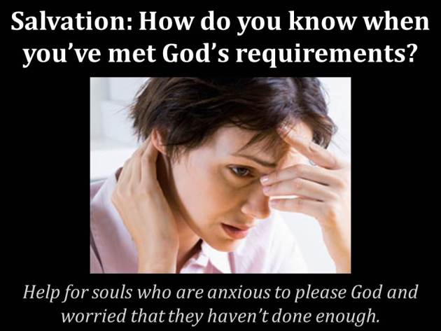
Subject?
Salvation: How do you know when you’ve met God’s requirements?
Help for souls who are anxious to please God and worried that they haven’t done enough.
Notes:
SA-14-Eternal Security-02
NS-26-Jude-22

Slide 3
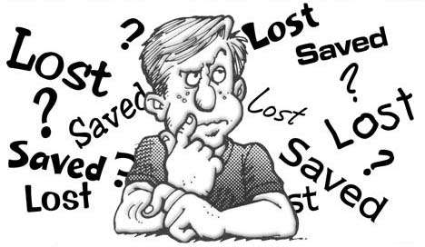
Can you be sure?
Really sure?
迷失
拯救
迷失
拯救
迷失
迷失
拯救
拯救
迷失
Notes:
SA-14-Eternal Security-03
NS-26-Jude-23

Slide 4
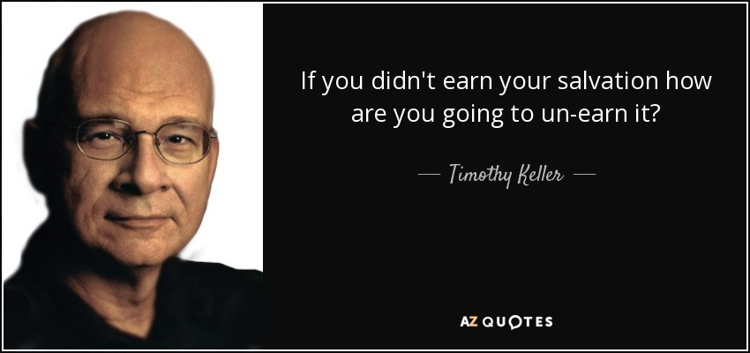
Think about it…
“If you didn’t earn your salvation, how are you going to un-earn it?”
—Timothy Keller—

Slide 5

Eternal Security
61

Slide 6

Eternal Security
296a
ETERNAL
SECURITY
“Once Saved, Always Saved”

Slide 7
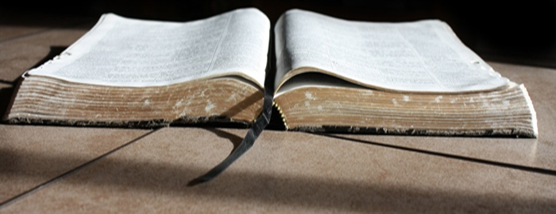
Theological Support for Eternal Security
61

Slide 8
The Work of the Triune God Supports Security
61
Father
is
is not
is not
GOD
is
is
Son
Spirit
is not
H. Wayne House, Charts of Christian Theology and Doctrine, 45

Slide 9
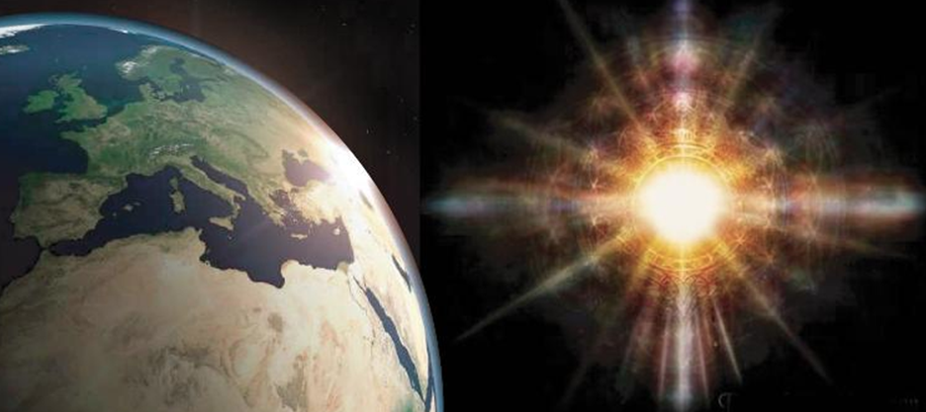
The Work of God the Father
61

Slide 10

Election
61

Slide 11
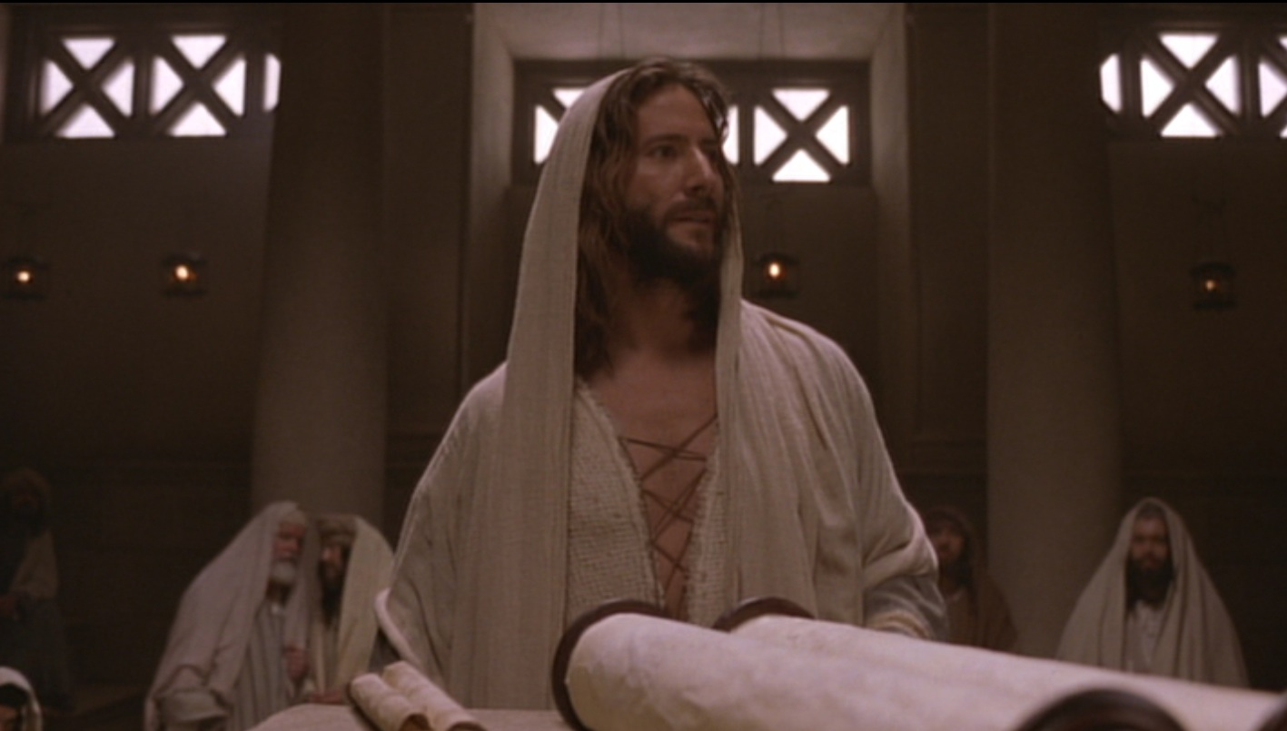
Permanent?
61
“All that the Father gives me will come to me, and whoever comes to me I will never drive away”
(John 6:37 NIV)

Slide 12
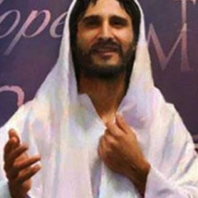
The Work of Christ the Son
61

Slide 13
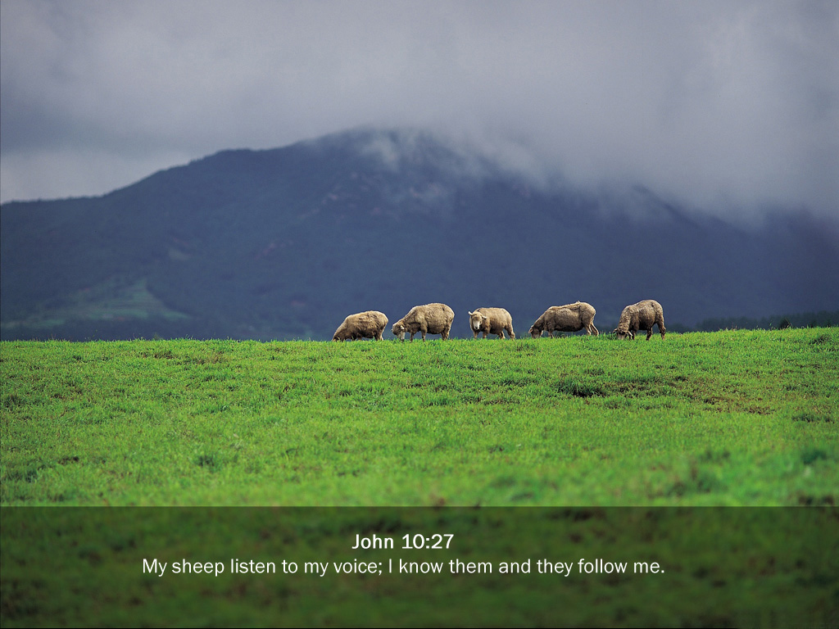
“My sheep listen to my voice; I know them, and they follow me. ²⁸I give them eternal life, and they shall never perish; no one can snatch them out of my hand. ²⁹My Father, who has given them to me, is greater than all; no one can snatch them out of my Father’s hand” (John 10:27-29 NLT)
61

Slide 14
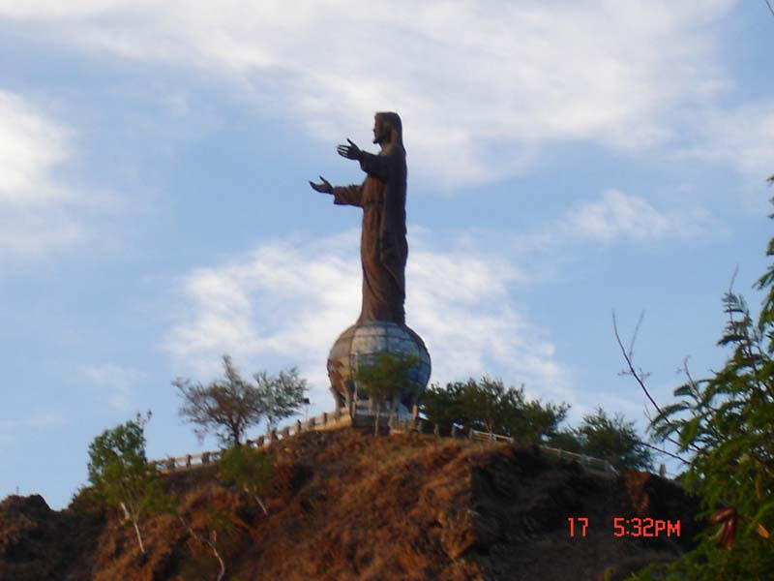

Subject
61
How do we know Jesus has given us eternal life?
Can we know?

Slide 15

An Astonishing Claim!
61
“I tell you the truth, those who listen to my message and believe in God who sent me have eternal life. They will never be condemned for their sins, but they have already passed from death into life”
–– John 5:24
Notes:
Verse 26
Why did the crowd search for Jesus?
The crowd wants follow a prophet who will provide free food and political deliverance.

Slide 16
Permanent?
61
“All that the Father gives me will come to me, and whoever comes to me I will never drive away”
(John 6:37 NIV)

Slide 17
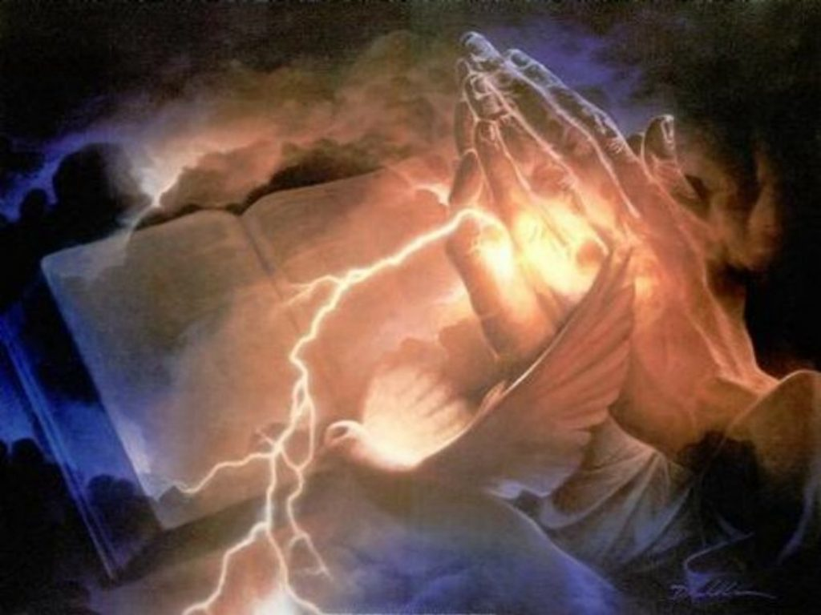
The Sealing Work of the Spirit
62

Slide 18

A Seal Guarantees Security and Provides Assurance
Notes:
In Paul's day, a wax seal on a letter conveyed: (1) ownership in that the seal of the sender was stamped on it, and (2) security by guarding the contents. The result was that the recipient could feel assurance that the contents were guaranteed and safe.

Slide 19
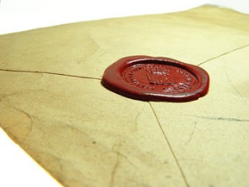
"Having believed, you were marked in him with a seal, the promised Holy Spirit, ¹⁴who is a deposit guaranteeing our inheritance until the redemption of those who are God’s possession—to the praise of his glory" (Eph. 1:13-14 NIV).
66

Slide 20

Assurance of
Salvation
Notes:
Paul used this background to assure his readers their salvation by noting that the Holy Spirit HIMSELF was the seal of their salvation (Eph. 1:13-14).
Please translate the text at the left and then drag everything over this slide so no English shows. Make sure the fonts remain.

Slide 21

Romans 10:9-10 NLT
"If you confess with your mouth that Jesus is Lord and believe in your heart that God raised him from the dead, you will be saved. ¹⁰For it is by believing in your heart that you are made right with God, and it is by confessing with your mouth that you are saved”

Slide 22

The Nature of Salvation
62
b)
Our deliverance from sin proves our security

Slide 23
How did God save us?
62
b) 1
Through His Grace—Not Our Works
"God saved you by his grace when you believed. And you can't take credit for this; it is a gift from God. ⁹Salvation is not a reward for the good things we have done, so none of us can boast about it" (Eph. 2:8-9 NLT)

Slide 24

Assurance in 1 John 5:11-13
62 b) (2)
63
63
Should we
ever doubt?
Should we
ever doubt?
Should we
ever doubt?
"And this is what God has testified:
He has given us eternal life, and this life is in his Son. ¹²Whoever has the Son has life; whoever does not have God’s Son does not have life. ¹³I have written this to you who believe in the name of the Son of God, so that you may know you have eternal life."

Slide 25
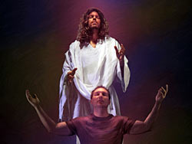
The Believer’s Standing Before God Proves Security
62
c)

Slide 26
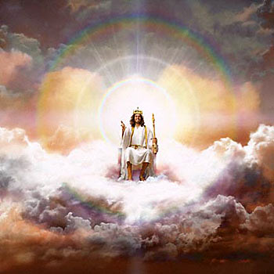
"But when this priest had offered for all time one sacrifice for sins, he sat down at the right hand of God.”
62
c) 1
Hebrews 10:12 (NIV)

Slide 27
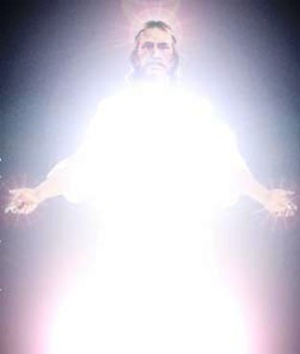
"There he waits until his enemies are humbled and made a footstool under his feet. ¹⁴For by that one offering he forever made perfect those who are being made holy"
(Heb. 10:13-14 NLT).
62
c) 1

Slide 28

No Condemnation (8:1)!
62
c) 2)

Slide 29
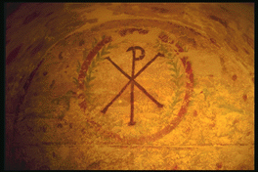
Security in Romans 8
62
c) 3
We are not condemned––no Christian will go to hell (8:1)
We are set free from the law of sin and death (8:2)
We possess the Spirit of Christ (8:9)
The Spirit will give us glorified bodies (8:11)
We are adopted into God's family (8:14, 16, 17, 21, 23)
We will receive the redemption of our bodies (8:23)
We have hope that will be fulfilled (8:24-25)
We will be conformed to Christ's likeness (8:29)
All the predestined will eventually be glorified (8:30)
Nothing can separate us from God's love (8:35-39)
We are already more than conquerors over sin (8:37)

Slide 30

"For I am convinced that neither death, nor life, nor angels, nor principalities, nor things present, nor things to come, nor powers, nor height, nor depth, nor any other created thing, will be able to separate us from the love of God, which is in Christ Jesus our Lord."
62
c) 3
Romans 8:38-39 (NAU)

Slide 31
Biblical Support for Eternal Security
63

Slide 32
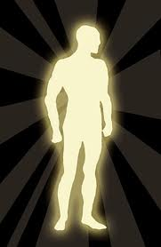
Roman's 3 Tenses of Salvation
10
155a
TENSE | MY STATUS | FREE FROM SIN'S... | TIME | DOCTRINE OF...
Past | I have been saved | Penalty--by His death (3:21-24) Rule--by my death (6:3-7) | When I received Christ | Justification (Positional Sanctification)
Present | I am being saved | Power--by indwelling Spirit (8:2-14) | As I walk in the Spirit | (Progressive) Sanctification
Future | I shall be saved | Presence--by redemption of my body (8:22-25) | When I get my new body | Glorification (Final Sanctification)
Adapted from Kay Arthur, 1 Peter: In & Out (Precept Ministries, 1990), 13

Slide 33
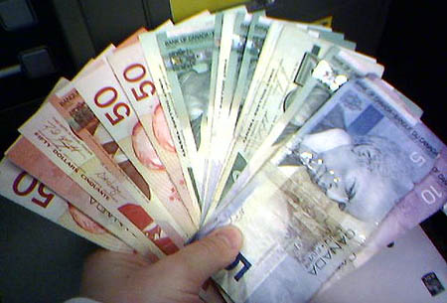
Grace is…
God's
Riches
At
Christ's
Expense
Romans 3:24

Slide 34

Discussion Questions
64
      Why do you think many people struggle to accept the doctrine of the eternal security of the believer?
      “If Christ came to seek and to save that which was lost, and yet we can somehow become unsaved—and therefore undo what Christ came to do—would it not be wise for God to take us on to heaven the moment we are saved to ensure we make it? Isn’t it unnecessarily risky to force us to stay here?” (Stanley, 10) Do you agree?

Slide 35
Discussion Questions
64
      “If our salvation hinges on the consistency of our faith, by what standard are we to judge our consistency? Can we have any doubts at all? How long can we doubt? To what degree can we doubt? Is there a divine quota we dare not exceed?” (Stanley, 95) Agreed?
      Do you think believing in the “once saved, always saved” view causes Christians to neglect their salvation? Why or why not?

Slide 36
Eternal Security in Corinth
65
Surprisingly, Paul affirmed the Corinthians repeatedly that they have eternal security:
1. Their salvation will be maintained until the Lord's return (1 Cor. 1:8-9)
2. Even carnal believers will still enter heaven because of their saving faith but without rewards
(1 Cor. 3:12-15; cf. 2 Cor. 5:10)

Slide 37
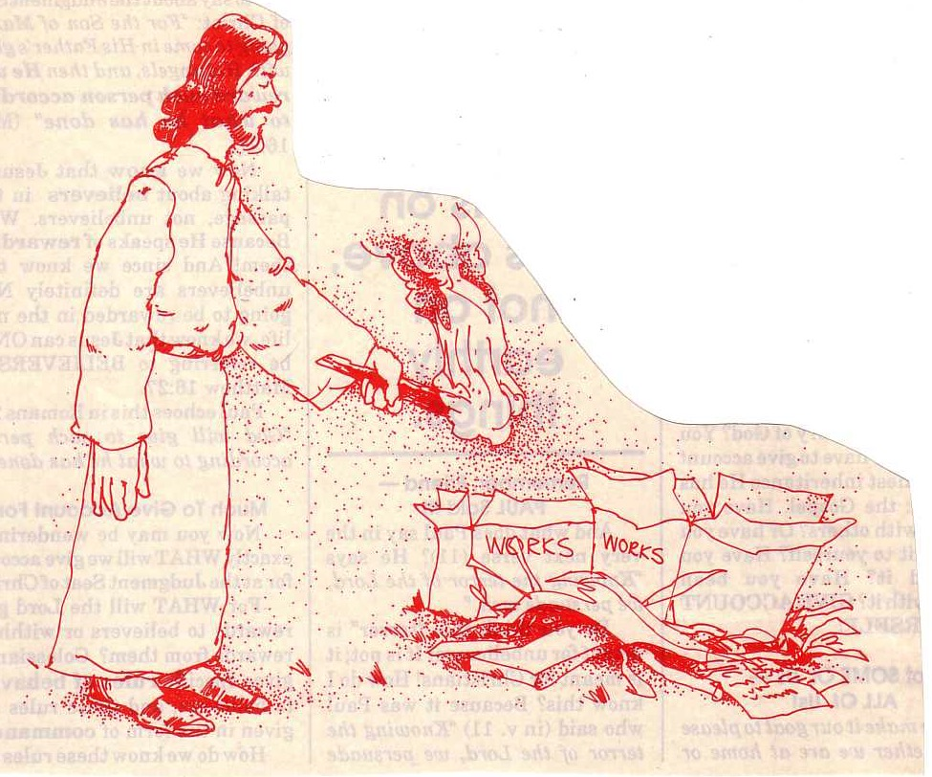
"… the fire will test the quality of each man's work"
(1 Cor. 3:13)
Notes:
37
We see in 1 Corinthians 3 that our deeds are either good and lasting (gold, silver, precious stones) or bad and flammable (wood, hay, straw). The good ones will be rewarded.

Slide 38


Lasting Building Materials (3:12a)
Silver
Gold
Jewels
Foundation: The Lord Jesus Christ (1 Cor. 3:11)
Adapted from Charles R. Swindoll. "Spiritual Gifts Study Guide" (IFL, 1983), 7
Notes:
Every believer is building on the foundation of Christ in his life. Some of us use great building materials—compared to gold, silver, and jewels. These last through the fire that tests them.

Slide 39


Perishable Building Materials (3:12b)
Hay
Wood
Straw
Foundation: The Lord Jesus Christ (1 Cor. 3:11)
Adapted from Charles R. Swindoll. "Spiritual Gifts Study Guide" (IFL, 1983), 7
Notes:
But other Christians spend their lives on temporal building materials like wood, hay, and straw. These are bad deeds or even good works done with the wrong motive.

Slide 40
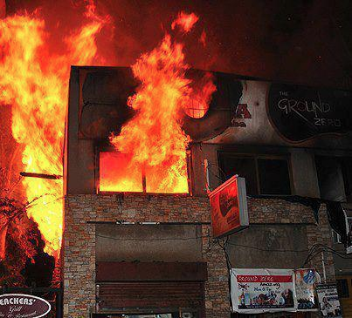
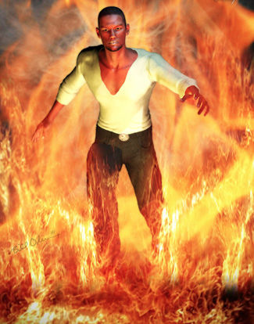
"saved as through fire…"
(3:15)
Notes:
A believer who wastes his life still goes to heaven—his life is spared—but all he has worked for in the kingdom is destroyed so that he enters heaven with little but the clothes on his back, so to speak.

Slide 41
Eternal Security in Corinth
65
Surprisingly, Paul affirmed the Corinthians repeatedly that they have eternal security:
1. Their salvation will be maintained until the Lord's return (1 Cor. 1:8-9)
2. Even carnal believers will still enter heaven because of their saving faith but without rewards
(1 Cor. 3:12-15; cf. 2 Cor. 5:10)
3. They should expel the incestuous man so Satan could even kill him, but he would still be saved (1 Cor. 5:4-5)
4. Even resurrection doubters should serve God fully since their service would be rewarded (1 Cor. 15:58)
5. God alone secured their redemption, for He sealed them with the Spirit to assure their salvation
(2 Cor. 1:21-22)

Slide 42

THE SEALING
OF THE HOLY SPIRIT
66

Slide 43

Backgrounds
66
In ancient times a seal was usually made of melted wax on which a signature or sign of authority was stamped.

Slide 44
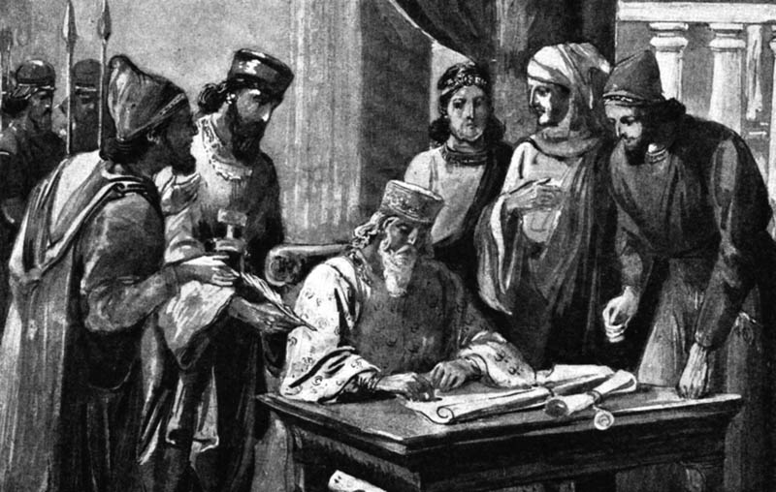
A seal in ancient times meant:
66
Authenticity: It established the integrity and genuineness of a document or object
Ownership: It established who owned an item
Authority: It established who had the right to handle the object

Slide 45
2 Cor. 1:22
66
A & C
The Agent & the Extent
God seals every believer and gives the earnest or pledge of the Spirit.
"…set His seal of ownership on us, and put His Spirit in our hearts as a deposit, guaranteeing what is come" (NIV)

Slide 46
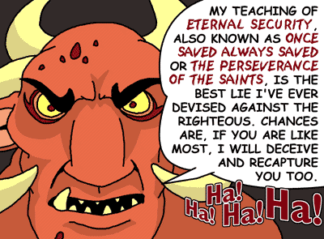
Some Despise Security
MY TEACHING OF ETERNAL SECURITY, ALSO KNOWN AS ONCE SAVED ALWAYS SAVED OR THE PERSEVERANCE OF THE SAINTS, IS THE BEST LIE I'VE EVER DEVISED AGAINST THE RIGHTEOUS. CHANCES ARE, IF YOU ARE LIKE MOST, I WILL DECEIVE AND RECAPTURE YOU TOO.
Notes:
Some teachers imagine that the security of the believer is a doctrine of deception. They also assume that security is the same as perseverance, which remains unproven. All believers are still in their mortal bodies and thus fall short of God's requirements, so their degree of faithfulness or continued belief is one of degree on a spectrum. Otherwise, God would have to draw a line to say that we have denied Jesus too much to have been saved or else we lose our salvation.
__________
Common-463
NS-23-1John-150
SA-14-Eternal Security-46

Slide 47
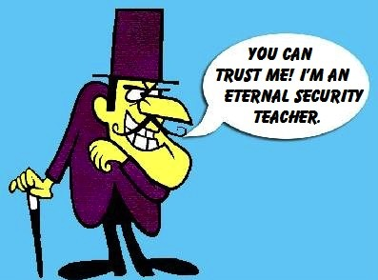
Some Despise Security
YOU CAN
TRUST ME! I'M AN ETERNAL SECURITY TEACHER.
Notes:
Teachers who take God at his word to preserve the salvation of those saved are often looked at with suspicion!
__________
Common-464
NS-23-1John-151
SA-14-Eternal Security-47

Slide 48
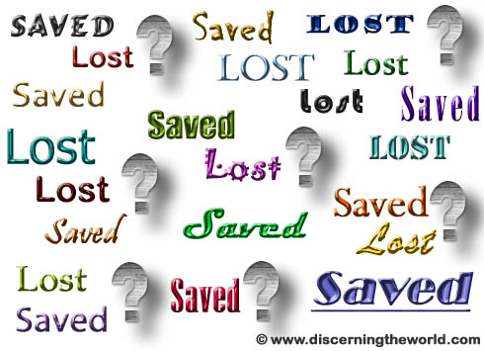
Some Despise Security
得救
得救
迷失
Some Despise Security
迷失
迷失
迷失
得救
迷失
得救
得救
迷失
迷失
迷失
迷失
得救
得救
得救
迷失
迷失
得救
得救
得救

Slide 49
Eph. 1:13b
66
B
The Sphere
We are not sealed "by the Spirit" but "with the Spirit"
"And you also were included in Christ when you heard the word of truth, the gospel of your salvation. Having believed, you were marked in Him with a seal, the promised Holy Spirit."

Slide 50
Eph. 4:30
66
C3
The Extent of the Sealing
Our sealing with the Spirit will last until our day of redemption.
"And do not grieve the Holy Spirit of God, with whom you were sealed for the day of redemption."

Slide 51
Eph. 1:13a
66
D
The Time of Sealing
We were sealed with the Spirit when we believed.
"And you also were included in Christ when you heard the word of truth, the gospel of your salvation. Having believed, you were marked in Him with a seal, the promised Holy Spirit."

Slide 52

The Spirit Guarantees Full Salvation
66
E1
Who also sealed us and gave us the Spirit in our hearts as a pledge (2 Cor. 1:22 NASB)
Now He who prepared us for this very purpose is God, who gave to us the Spirit as a pledge (2 Cor. 5:5 NASB)

Slide 53
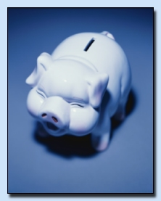
Pledge – avrrabw/n
Down payment
First installment
Pledge
Figuratively in the NT, of the gift of the Holy Spirit to believers
––Friberg Lexicon

Slide 54

The Intent of the Sealing
66
E
Security: We will stay sealed until the day of redemption
Ownership: We are possessed by God
Assurance: We have God's promise of salvation

Slide 55
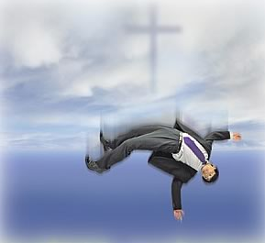
In Summary:
Every believer and only
believers are sealed.
God is the agent of the sealing.
The Spirit is the seal.
Each believer was sealed the moment he received Christ as Savior.
Sealing lasts until the day of our redemption.

Slide 56
Secure!
Sealing is a promise
and guarantee
of eternal security

Slide 57
Distinguishing Terms
67
 | Eternal Security | Assurance of Salvation
Basic Meaning | Being saved from the penalty of sin forever (once saved, always saved) | Knowing that we are saved from the penalty of sin forever
Definition | “The work of God which guarantees that the gift of salvation, once received, is forever and cannot be lost” (Ryrie, Basic Theology, 328) | “The realization of the truth of eternal security or perseverance” (Ryrie, Basic Theology, 328)
Notes:
NS-19-Hebrews-50
SA-14-Eternal Security-57

Slide 58
Distinguishing Terms
67
 | Eternal Security | Assurance of Salvation
Spirit’s Ministry | Sealing (Eph. 1:13-14) | Assuring (Rom. 8:15-17)
Believer’s… | Position as child of God (Rom. 8:16b) | Practice or confidence (Rom. 8:16a)
Recipients | All Christians possess | Some Christians doubt
Permanence | Can’t be lost (John 6:39-40; 10:27-29; Rom. 8:30, 38-39; Heb. 7:25) | Can be lost (for this reason John wrote 1 John 5:11-13)
Songs | “I Know Whom I Have Believed” “In Christ Alone” “The Solid Rock” | “Blessed Assurance” (#367) “Now I Belong to Jesus”
Notes:
NS-19-Hebrews-51
SA-14-Eternal Security-58

Slide 59
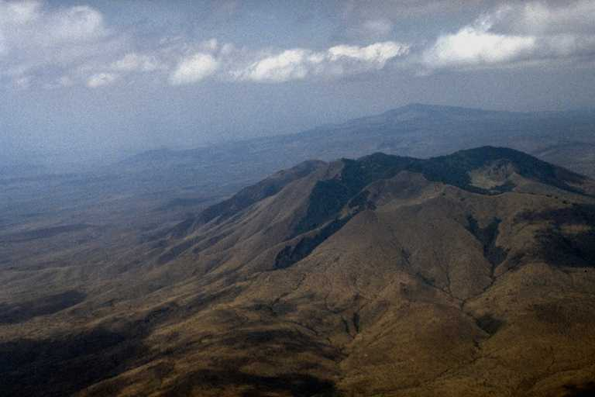
Blessed Assurance 1/7
Blessed Assurance
Fanny Crosby
Notes:
Fanny Crosby was blind but saw spiritual truth better than most of us. She wrote thousands of songs and captured the security of the believer well in this hymn.
_________
ES-14-Eternal Security-59
NS-06-Romans5-8—slide 151

Slide 60
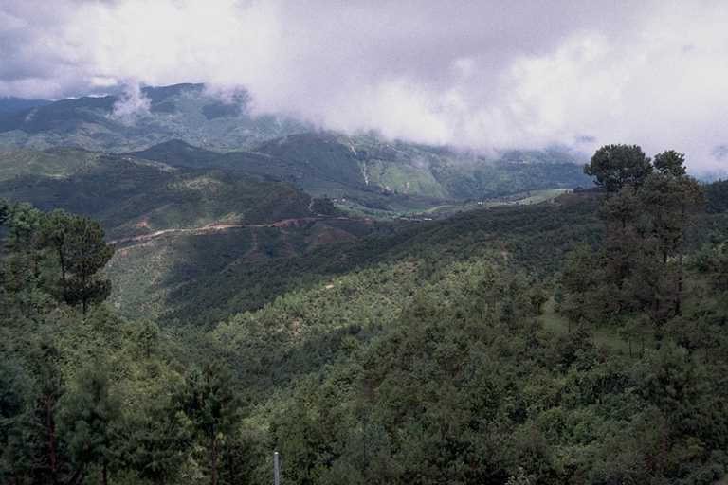
Blessed Assurance 2/7
Blessed assurance, Jesus is mine!
O what a foretaste of glory divine!
Heir of salvation, purchase of God,
born of His Spirit, washed in His blood.

Slide 61
Blessed Assurance 3/7
This is my story, this is my song,
praising my Savior all the day long;
This is my story, this is my song,
praising my Savior all the day long

Slide 62
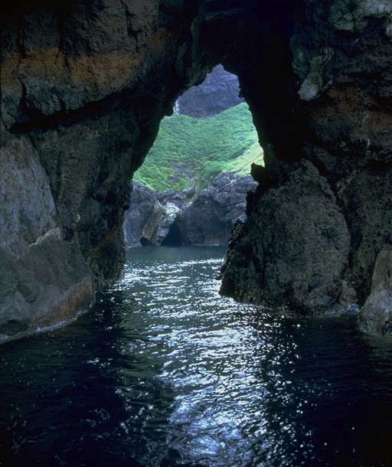
Blessed Assurance 4/7
Perfect submission, all is at rest,
I in my Savior am happy and blest;
Watching and waiting looking above,
filled with His goodness, lost in His love.

Slide 63
Blessed Assurance 5/7
This is my story, this is my song,
praising my Savior all the day long;
This is my story, this is my song,
praising my Savior all the day long

Slide 64
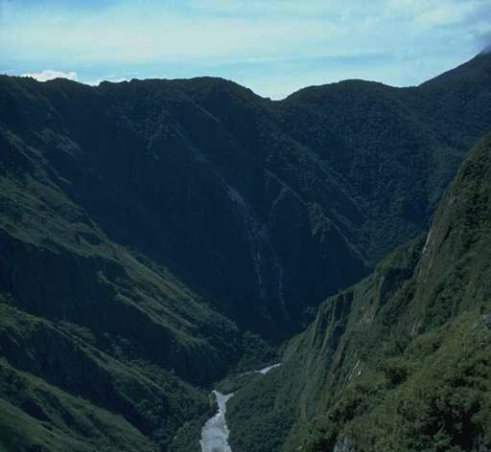
Blessed Assurance 6/7
Perfect submission, perfect delight!
Visions of rapture now burst
on my sight;
Angels descending bring from above
echoes of mercy, whispers of love.

Slide 65
Blessed Assurance 7/7
This is my story, this is my song,
praising my Savior all the day long;
This is my story, this is my song,
praising my Savior all the day long

Slide 66

The Fire
"Dear friends, if we deliberately continue sinning after we have received knowledge of the truth, there is no longer any sacrifice that will cover these sins. ²⁷ There is only the terrible expectation of God's judgment and the raging fire that will consume his enemies" (Hebrews 10:26-27 NLT).
Hell fire?
No, Jerusalem fire!
Notes:
What would be God’s judgment on these readers if they turned away?
• Verses 26-27 define God's judgment as “the raging fire that will consume his enemies." The readers would not be forgiven and would be judged with unbelievers. But when and how?
• Most commentaries claim that this means the readers would go to hell.
But is this hell fire? If so, that would mean these Christians would then go to hell! This is against all that the NT teaches about believers having eternal life.
• No, it refers to Jerusalem fire! Their salvation was secure—but their apostasy would lead to being killed along with the unbelieving Jews who stayed in Jerusalem to protect them temple! The letter consistently calls them believers, but they would bear a punishment of unbelievers by identifying with them. Yet the fire of 10:27 is not hell fire but Jerusalem fire. It was not eternal fire but temporal fire that would take their lives along with the godless who gave their lives in AD 70 while trying to preserve a temple system that was already a generation obsolete.
__________
Common-465
BE-58-Hebrews Be Uncompromising-80
BS-09-Read Paragraphs-33
ES-10-Other Events at the Rapture-52
HS-03-Spirit Ministries to Believer-19
NP-19-Hebrews Be Uncompromising-80
NS-19-Hebrews-421, 458
OS-36-Zephaniah-38
SA-09-Perseverance-42, 66
SA-14-Eternal Security-66
SA-15-Inheritance-169

Slide 67
The Problem with Labels
48
Must we be one or the other…?
Reformed?
…or…
Arminian?
Many do Fall Away
Loss of Salvation
Weaknesses
Eternal Security
Reality of Apostasy
Strengths
Partakers View Has Both Strengths & Neither Weakness

Slide 68


The Future Reign of the Servant Kings
Jody Dillow is the key author of the Partakers View
Final Destiny
The Future Reign of the Servant Kings
Joseph Dillow

Slide 69
Views on the Warning Passages
40
Issues |  | False Believer | Former Believer | Carnal Believer
What group of Jews is being addressed? | Unbelievers: Professing "Christians" in the assembly who are not really believers after all |  | Believers: Christians who sin because they do not see the superiority of Christ | Believers: Christians who sin because they do not see the superiority of Christ
What is the nature of their punishment? | Never had salvation |  | Loss of salvation | Loss of reward
What is the result? | Hell |  | Hell | Divine discipline (even by death)
Which theology perspective holds this view? | Reformed (Presbyterian, BP, etc.), some Arminians |  | Arminian (Methodist, AOG, Nazarene, etc.) | Partakers (Baptist, Bible church, etc.)

Slide 70
Views on Security & Perseverance
40
Issues | Reformed | Arminian | Partakers
How does each system define election and perseverance? | God sovereignly elects to salvation and helps believers persevere in faith until death | God elects those whose free will accepts Christ and preserves them unless they lose faith | God elects to salvation; some do not persevere, but the faithful will partake of rewards
What specific elements of salvation make up this system of belief? | Total depravity Unconditional election Limited atonement Irresistible grace Perseverance | Natural inability Conditional election Unlimited atonement Resistible grace Conditional perseverance | Total depravity Unconditional election Unlimited atonement Irresistible grace Conditional perseverance

Slide 71
Views on Security & Perseverance
40
Issues | Reformed | Arminian | Partakers
How does this view see carnal Christians (e.g., 1 Cor. 3:1-5)? | They aren't Christians or are at a low level of spiritual commitment in a particular area | They spurn Christ to the point of almost losing their salvation | These believers lack blessings now and later (but are still saved)
Do all believers persevere until death? | Yes 1 Cor. 15:2; Phil. 1:6 | No Rom. 8:13; Gal. 5:21; 6:8 | No 1 Cor. 3:15; Rev. 3:26
Can a true Christian lose his salvation? | No, it is eternally secure | Yes, it is not eternally secure | No, it is eternally secure

Slide 72
Views on Security & Perseverance
40
Issues | Reformed | Arminian | Partakers
Is 100% assurance of salvation possible? | No, since no one knows if he has genuine faith that will persevere | No, since no one knows if he will persevere | Yes, if one knows Christ as Saviour
How does this system counsel believers in habitual sin? | "You better re-examine whether you genuinely trusted Christ" | "You either lost your salvation or never were really saved" | "You must turn from your sin to be fully rewarded (Heb. 3:14)"
How do those struggling with sin gain spiritual motivation? | From fear that they may not actually be saved after all | From fear that they may not have sufficiently maintained their salvation | From fear that they will miss key rewards (their inheritance can be lost but not their salvation)

Slide 73
Views on Security & Perseverance
40
Issues | Reformed | Arminian | Partakers
What actually results in the listeners from this teaching? | They may become carnal Christians by doubting their salvation | They believe God must always be appeased (low view of grace) | They will more likely appreciate God's faithfulness to them
Who holds this view? | John Calvin (d. 1564), Reformed churches, Presbyterians, Charles Hodge, Arthur Pink | Jacob Arminius (d. 1609), John Wesley, Methodists, Wesleyans, Nazarenes, Holiness churches, Pentecostals/ Charismatics | Baptists, Bible churches, Joseph Dillow, Zane Hodges, Earl Radmacher, Charles Ryrie

Slide 74
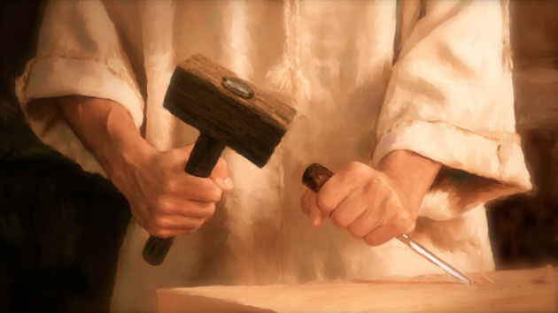
What is the meaning of the cross of Christ?

Slide 75

Biblical Support for Eternal Security
Start only with the Bible.
Show the Bible teaches salvation by grace through faith alone.
Show that since salvation is only by grace, it can only be lost through God’s fault.

Slide 76
Black

Slide 77


Salvation link at BibleStudyDownloads.org
Get this presentation and script for free!

