Slide 1
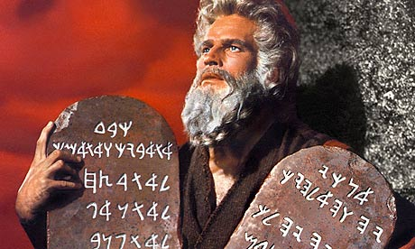
The Christian & the Mosaic Law
Soteriology: God’s Rescue Program
Dr. Rick Griffith • Jordan Evangelical Theological Seminary • BibleStudyDownloads.org

Slide 2

A Quick Quiz About the Law…
35
    T or F Christians should keep parts of the OT law which are not repeated in the NT.
    T or F The Sabbath should still be obeyed by Christians.
    T or F Believers today are obligated to keep all of the Ten Commandments.
    T or F Tithing should be practiced by all followers of Christ.
    T or F Christians today are prohibited from eating blood (e.g., yong tau foo, blood pudding, pig or duck blood at Chinese New Year).
    T or F Believers must not charge other Christians interest based upon the Law (Deut. 23:19; Exod. 22:25; Lev. 25:36-37; Ezek. 18:8, 13, 17; 22:12; Prov. 15:5; 28:8)
    T or F The OT has two laws: the moral is in the Ten Commandments, but ceremonial/civil laws are abolished.
Notes:
----- Meeting Notes (17/5/16 12:05) -----JETS 2024 (29 Feb 2024) 18 students
1 T 7—12
2 T 20—2
3 T 5—12
4 T 7—16
5 T 21—5
6 T 8—12
7 T 13—16

Slide 3

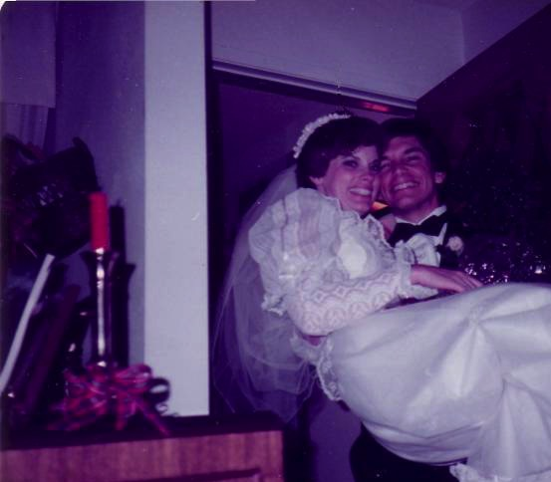
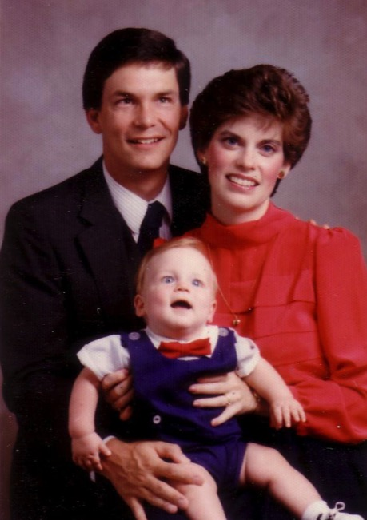
Seminary
My 7-year Tribulation was from 1983-1990
Notes:
I married Susan in 1983 and took her to Dallas Seminary a few days later. The first three years of marriage were easy. I went to class in the morning, studied every afternoon while Susan worked, and then had every evening free with her. I never studied on Sundays as this was also ministry to international students and marriage time. I wondered if was like a ”Christian Sabbath.” I really didn’t need to work on Sunday.
• But three years later our first son was born on his grandpa's 70th birthday, so we named him Kurt in honor of Susan's father. I also pastored a church and later served as a chaplain. Life became extremely busy—more than I had ever imagined!

Slide 4

The Sabbath
Notes:
After becoming parents, I began to scramble for any moment I could to stay up on ministry and full-time doctoral studies.
But then I started also feeling convicted about studying on Sundays to be prepared for my Monday morning classes. Should I be studying on the “Christian Sabbath”? Was God pleased? Was I trusting him?
To answer my questions and also save time, I decided to write my dissertation on the Sabbath! My wife still jokes about this, saying that I lost a lot of rest studying rest! Well, it was 424 pages and took months of work in 12-14 hour days of study. Even the bibliography was 103 pages long!
My dissertation was Richard James Griffith, “The Eschatological Significance of the Sabbath,” Dallas Seminary, 1990, esp. pp. 144-56.

Slide 5
The Eschatological Significance of the Sabbath
23
529
NS 266k
A visual summary of the ThD dissertation by Richard James Griffith, Dallas Theological Seminary, 1990
Christ’s Second Coming in
2 Phases
Pre-Fall
Pre-Mosaic
Mosaic
Church
Tribulation
Millennial Kingdom
Eternity
Creation
Fall of Man
Mount Sinai
Death of Christ
Rapture
Revelation
Rev 20:1-6
Eternity
6 Days
(Work)
Gen 1
7th Day
(Rest)
Gen 2:1-3
Law Instituted
Exod 20
Law Abolished
Rom 7:1-6
Gal 3:19, 23-29
1 Cor 9:20
2 Cor 3:6-11
Daniel’s 70th Week of 70-Week Prophecy
Dan 9:27
Some Aspects of Law Reinstituted
Ezek 40–48
God’s Work
Work of Creation
Gen 1
Work of Sustaining
John 5:17
Work of Recreation
Rev 21–22
Israel Repeatedly Rejected God’s Offer of the Promised Land Rest…
God’s Rest
Not Resting
Rests from Creative Activity
Gen 2:2-3
Rest Stops by Sin
Rest Linked to Canaan
Gen 12; 1-3; 15:18;
Deut 30:1-10
Rejected in Wilderness
Gen 14:23;
Heb 3:9
Rejected in David’s Time
Ps 95:7b-11
Rejected in Messiah
Matt 23:37-39
Rejected in Peter’s Sermon
Acts 3:19-20
Rest Accepted & Reinstituted
Heb 3:7–4:11
Israel’s Sabbath
No Sabbath for Mankind
Israel’s Sabbath Anticipated
Gen 2:3
Sabbath Instituted
Exod 16
Neh 9:13-14
Sign of Mosaic Covenant
Exod 31:13, 17;
Ezek 20:12, 20
Sabbath Abolished
Col 2:16-17
Gal 4:9-10
Rom 14:5
Hos 2:11
Lord’s Day Instituted
Acts 20:7
1 Cor 16:1-2
Rev 1:10
Sabbath Reinstituted
Matt 24:20
Sabbath Reinstituted
Ezek 46:1
Isa 66:23
Transition Begins
Transition Completed
Israel’s National History
Nation Established at Mt Sinai
Exod 19
69 Weeks
（483 years）
444 BC-AD 33
Dan 9:25
Nation Set Aside in
Church Age Gap: “Times of the Gentiles”
Dan 9:26
Luke 21:24
1 Week
(7 Years)
AD ??
Dan 9:27
Nation Repents,
Believes in Messiah,
Sabbath Re-established
Ezek 36–39
Kingdom Typology
Kingdom Language
Gen 1
Abrahamic & Land Covenants
Gen 12:1-3; 15:18
Deut 30:1-10
Sabbath Looks Back at Creation & Redemption
Exod 20:8-11
Deut 5:12-15
Sabbath Looks Forward & Typifies Kingdom
Heb 4:9
Lev 23:1-3
Sabbath Typifies in a Dual Sense
Notes:
Here is a one-page summary of my dissertation. Basically, I argued two things:
The Sabbath came with the Mosaic Law and ended at Christ’s death—so Christians are not under the Sabbath (Col 2:16-17), and
The weekly Sabbath was a type of the rest in the millennial kingdom to come and will, in fact, be reinstituted in that kingdom (Ezek 46:1; Heb 4:9).
OS-00-Intro-26
OS-02-Exodus-320
OS-26-Ezek 40-48-slide 23
NS-19-Hebrews-175

Slide 6
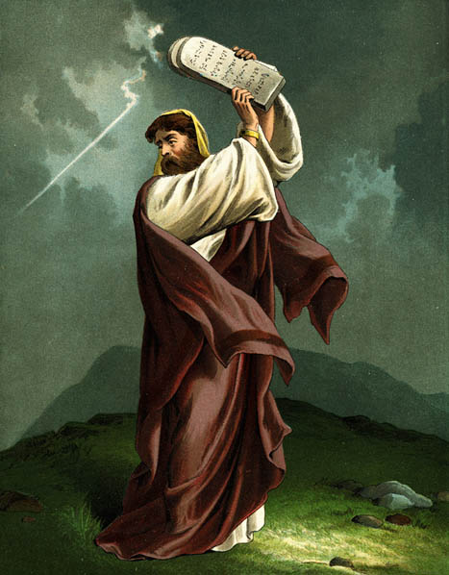
B. Defining "Law"
35
Pentateuch as single book
Pentateuch as 5 books
Whole OT
Legal literature (Exod. 20–Deut. 33)

Slide 7
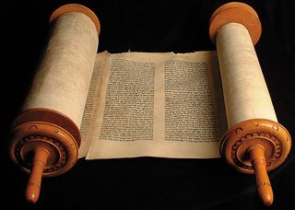
C. The Christian's Relationship to the Law
35

Slide 8
The New Testament
My main fear is that, if we use expressions like “re-definition” or “non-literal,” it would open the door for undermining inerrancy and the integrity of OT affirmations. It would also allow for the dangers of allegorical interpretations, when we are constantly training our students to stay consistent with the literal and normal reading of the Scriptures. I am further afraid that any “re-definition” of OT texts would give an excuse to Islam to re-interpret the NT.
Dr. Imad Shehadeh

Slide 9
The New Testament
There is in the NT a widening and deepening of the application of OT texts in the progress of revelation. The NT thus expands rather than replaces the OT, it explains rather than corrects the OT, it strengthens rather than weakens the OT, it adds rather then subtracts from the OT, it protects rather than reinterprets the OT, it fulfills rather than improves the OT, and it affirms rather than questions the OT. These are hermeneutical values we want to implant in our students.
Dr. Imad Shehadeh

Slide 10
Romans 7
Believers are free from the Law

Slide 11
Righteousness Imparted in Sanctification (Rom. 6–8)
Add to 33
How does the blood of Christ apply to us?
"As a wife is no longer married to her husband when he dies, so a Christian is no longer under the Law"
(John A. Witmer, "Romans," in BKC, 2:465).
Chapter 6
New Basis
––
Identification
Chapter 7
New Relationship
––
Freedom

Slide 12


The Marriage
1955
Navy Lieutenant
Harold F. Griffith (alias Dad)
Navy Ensign
Joyce I. Griffith (alias Mom)
Notes:
The story, of course, must begin with my parents who met in the Navy.
They had a baby boy (my older brother Bob) and then were transferred to Japan.

Slide 13
The Divorce
1962
Navy Commander
Harold F. Griffith (alias Dad)
Social Worker
Joyce I. Griffith (alias Mom)
Notes:
After my younger brother's birth my Mom concluded that my Dad was actually married to the Navy, so she divorced him. Ironically, she became a social worker to help other families put their lives together.

Slide 14

Another Divorce…
Notes:
Mom married a second time but the arguments with my Mom became unbearable so my Mom divorced him too.

Slide 15

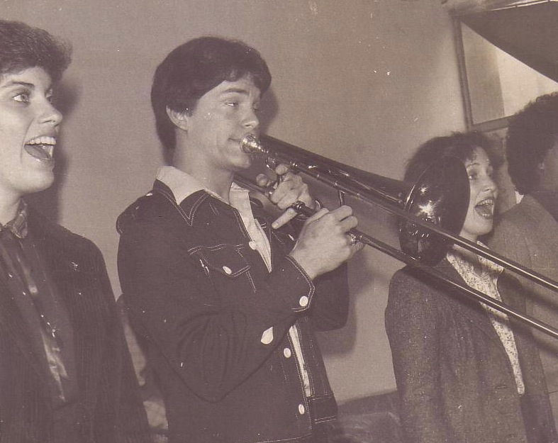

Susan & Rick, 1982
Notes:
After college, I ended up in the Philippines on Cru staff with the Crossroads music team. This opened my eyes to Asia. God also began to open my eyes to the woman singing next to me! She initially despised me but after a year or so she saw the light. That's our engagement picture. In 1983 we returned to the USA..

Slide 16

Marriage:
30 December 1983
Notes:
I married her and took her to Dallas Seminary a few days later. Three years later our first son was born on his grandpa's 70th birthday, so we named him Kurt in honor of Susan's father. I also pastored a church, had a ministry to international students, and served as a chaplain.

Slide 17
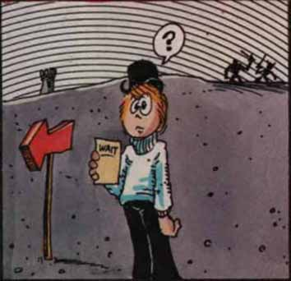

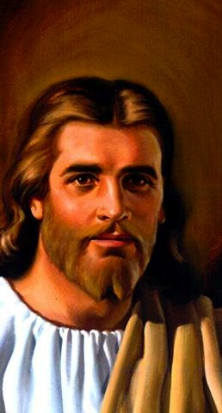
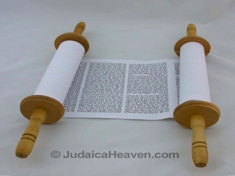
What "Marriages" (7:1-6)?
154a
The Law
Our "BC" Marriage
(Rom. 7:1-4a)
Our "AD" Marriage
(Rom. 7:4b-6)
Notes:
We are the bride who used to be married to the law (BC = Before Christ)
But we died in Christ, and thus are now released from that Law.
Now we are married to Christ (7:4) in our AD state (After Death).

Slide 18
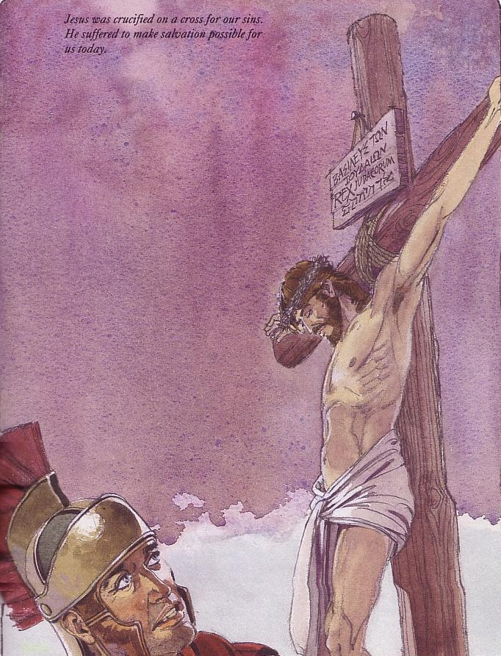
Christ's death (and our death with Him) frees us from "marriage" to the Law since now we are "married" to Christ (Rom. 7:4, 6)
154a

Slide 19
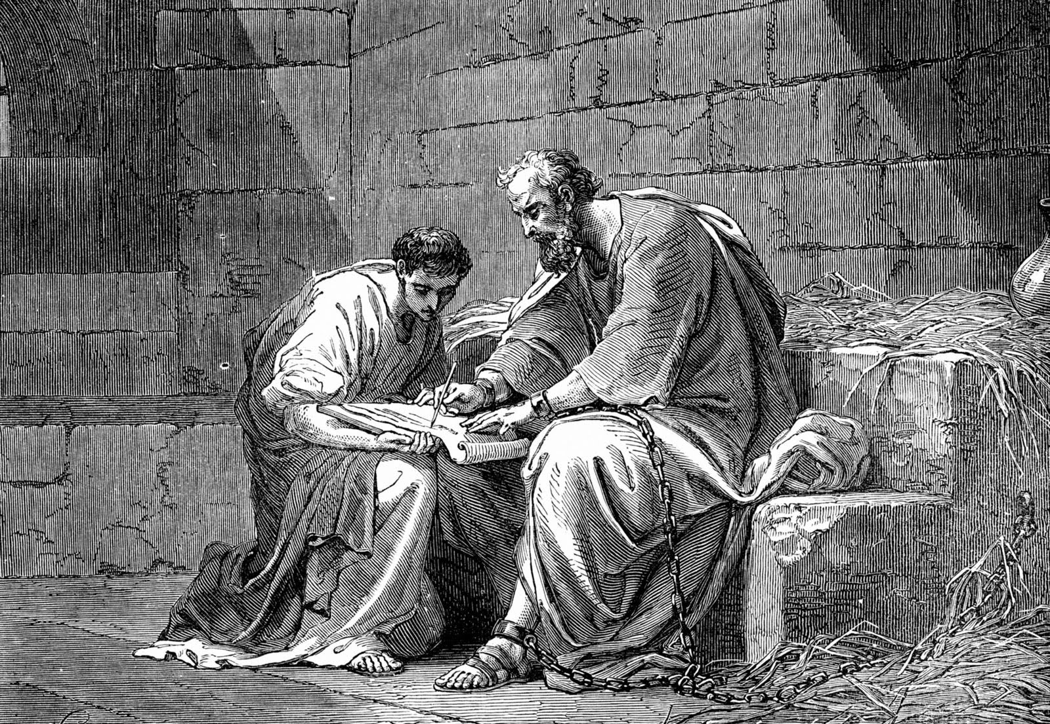
Paul was not under the Law
“When I was with the Jews, I lived like a Jew to bring the Jews to Christ. When I was with those who follow the Jewish law, I too lived under that law. Even though I am not subject to the law, I did this so I could bring to Christ those who are under the law”
1 Corinthians 9:20 NLT

Slide 20
Hebrews 8:13
"By calling this covenant 'new,'
he has made the first one obsolete; and what is obsolete and aging will soon disappear."
Obsolete
AD 33
Hebrews Written
AD 67-68
Disappeared
AD 70

Slide 21
Kingdom & Covenants Timeline
22
CH-34a
OS1-22
OS2-337
NS-9g
SA-19
Dr. Rick Griffith • BibleStudyDownloads.org
Kingdom Teaching...
Adam rules with God (Gen. 1:26, 28; 2:19)
Satan begins rule as god of this world (Gen. 3:15;
2 Cor. 4:4)
God covenants with Abraham to reestablish man's rule via Israel as a "kingdom of priests" (Gen. 12:1-3; Exod. 19:6)
Israel's failure to witness to nations as a kingdom of priests is judged via exile under foreign rule
Israel rejects Messiah's offer of kingdom (Matt. 12:41-42; 23:37-39)
Jesus extends His kingdom in mystery form to the Church (Matt. 13)
Christ subdues Israel's enemies and nation believes (Rom. 11:26-27)
Christ rules over everything with saints (Eph. 1:9-10; Rev. 20:1-6; 22:5b)
Fall of Man (Gen. 3)
Noahic Covenant
Genesis 6:18; 9:8-17
Land Covenant
ISRAEL
CHURCH
MESSIANIC KINGDOM
34a
(National Focus)
The "New Man" (Eph. 2:15)
Millennial Eternal
land
Genesis 15:18 (cf. Deut. 30:1-10) promises:
Land from Wadi of Egypt to Euphrates River (Isa. 27:12)
Eternal possession of land (Gen. 17:8) after exile/restoration
Whole world blessed via the land (Isa. 14:1-2)
Israel judged for rejecting Messiah by dispersion away from land for 19 centuries
(AD 70–AD 1948) but now partially restored (Ezek. 37:1-7)
Full restoration (Ezek. 37:8-28) Jerusalem world capital
(Isa. 2:1-5)
New Jerusalem
(Rev. 21–22)
22
337
Davidic Covenant
Christ is Head over his Church, which is a spiritual temple (Eph. 2:19-22; 2 Cor. 6:16)
Christ reigns over the world
(Isa. 11)
with saints (Rev. 5:10; 20:4-6)
Christ hands kingdom over to Father (1
Cor. 15:24)
9g
Genesis 12:1-3
2 Samuel 7:12-16 promises:
Sons ("house" never wiped out)
Kingdom (political dynasty)
Throne (right to rule by descendants)
Temple (son to build it)
seed
19
Abrahamic Covenant
New Covenant
All
things made new!
(Rev. 21:5)
All 5 elements fulfilled in national restoration (Zech. 8)
Jeremiah 31:31-34 promises:
Forgiveness
Indwelling Spirit
New heart, nature, mind
Reunification of Israel and Judah
No need for evangelism
Mosaic Law is replaced with first three elements of the New Covenant (Luke 22:20; 2 Cor. 3:6)
blessing
Mosaic Covenant
The Law was fulfilled and replaced at the cross (Rom. 7:1-6;
1 Cor. 9:19-21; Heb. 8:13)
14th Edition
29 Feb 2024
Temporary (Gal. 3:19) and conditional (Deut. 28) to reveal sin (Rom. 7:7) and regulate Israel (Gal. 3:23-25)
Scripture has a dual kingdom-covenant theme. Israel's role from Abraham to Christ expands to include the Church (continuity) yet the Church never replaces the nation as the "new Israel" (discontinuity). Israel will enjoy world prominence after trusting Christ at His second coming.
Notes:
This complicated chart combines the two themes of Kingdom and Covenants. God's kingdom rule extends to humanity across the ages at the top. But the major part shows the unfolding of the Abrahamic Covenant in its Land Covenant, Davidic Covenant, and New Covenant promises—partially fulfilled in the present, but fully completed in the Messianic Kingdom. This will happen in the Millennial Age and especially in the Eternal State.
• This chart also shows that the Old (Mosaic) Covenant was replaced by the New Covenant.
All agree that a partial fulfillment of the covenant to Abraham exists now to the Church in the indwelling Holy Spirit and forgiveness of sins (Jer 31:31-34)—and the ultimate fulfillment will be in the eternal state.
The main area of disagreement relates to the time from now to eternity. Will there be a literal land, throne, and worldwide blessing to national (ethnic) Israel before the eternal kingdom? This chart shows verses giving a resounding YES to that question in a present partial fulfillment and a future full fulfillment in the normal sense of language in the verses cited. But the messianic kingdom will be in two stages—first in a millennial fulfillment to last 1000 years, but then, after that, the eternal stage in the new Jerusalem after the destruction of our present heavens and earth (Rev 21–22). What an amazing future remains for those who trust Jesus!
____________
Common-151
BG-13-Present & Future Geog-74
BT-01-OT Biblical Theology-25
CH-02-Nature-103-p34a
OC-10-Chronology-42
OS-00-Intro & Biblical Theology-40 & 103
OS-02-Exodus-267-p22
OS-05-Deut-279, 300
OS-10-2Sam-96-p22
OS-10-Davidic Covenant-29, 79
OS-12-Kings & Prophets Charts-25
OS-13-1 Chron-46
OS-17-Kingdom & Covenants Timeline-01
OS-23-Isaiah-97-p337
OS-24-Jeremiah-174-p337
OS-23-Isaiah-97-p337
OS-28-Hosea-49
OS-31-Obadiah-164
05-Acts1-2-slide 45
NS-00-00-Kingdom & Covenants Timeline-English-1
NS-09-Gal-143-p9g
NS-19-Hebrews-342-p9g
NS-27-Rev20-22-slide 189
SA-08-Mosaic Law-21-p38a

Slide 22


"Old" Fulfilled by "New"
NTS 266hh
Wayne Grudem, Systematic Theology, 521
"What then is the 'old covenant' in contrast with the 'new covenant' in Christ? It is not the whole of the Old Testament, because the covenants with Abraham and David are never called 'old' in the New Testament. Rather, only the covenant under Moses, the covenant made at Mount Sinai (Ex. 19-24) is called the 'old covenant' (2 Cor. 3:14; cf. Heb. 8:6, 13), to be replaced by the "new covenant" in Christ (Luke 22:20; 1 Cor. 11:25; 2 Cor. 3:6; Heb. 8:8, 13; 9:15; 12:24)."
Notes:
What covenant does Jesus mediate that is far better than the old (8:6)?
Christians are not under the covenant with Moses. We are new covenant believers.
_____________
Common-225
BE-05-Deut-46
CH-02-Nature, etc.-104
ES-05-Biblical Covenants-34
OS-02-Exodus-370, 463
OS-05-Deut-185
OS-24-Jeremiah-177
NS-08-2 Corinthians-41
NS-09-Galatians-144
NS-19-Hebrews-298, 344
SA-08-Mosaic Law-22

Slide 23
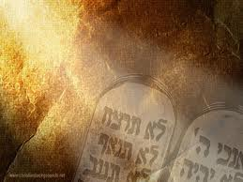
D. The Purposes of the Law
36
BS-110
OS-113
NS-155p
SA-36
    It revealed or exposed the sinfulness of man (Gal. 3:19).
    It revealed the holiness of God (1 Pet. 1:15).
    It revealed the standard of holiness for people in fellowship with God (Ps. 24:3-5).
    It supervised the physical, mental, and spiritual development of the redeemed Israelite until he could come to maturity in Christ (Gal. 3:24).
    J. Dwight Pentecost, "The Purpose of the Law," Bib Sac 128 (July 1971): 227-33
Notes:
BS-28-Law of Moses-18-p110
OS-02-Exodus-240-p113
OS-05-Deut-106-p113
NS-06-Rom5-8-slide93-p155p
SA-08-Mosaic Law-20-p36

Slide 24
D. The Purposes of the Law
36
    It unified the people to establish the nation in voluntary submission to God's decrees (Exod. 19:5-8; Deut. 5:27-28).
    It separated Israel among the nations as a kingdom of priests to mediate God's truth to these nations (Exod. 31:13).
    It provided forgiveness of sins for individual Israelites to restore their fellowship with God, even though they already functioned as a redeemed people (Lev. 1–7).
    J. Dwight Pentecost, "The Purpose of the Law," Bib Sac 128 (July 1971): 227-33
Notes:
BS-28-Law of Moses-19-p110
OS-02-Exodus-241-p113
OS-05-Deut-107-p113
NS-06-Rom5-8-slide94-p155p
SA-08-Mosaic Law-21-p36

Slide 25
D. The Purposes of the Law
36
    It made provision for Israel to worship God as a redeemed people (Lev. 23).
    It tested if one was in the kingdom or the theocracy over which God ruled (Deut. 28). Faith led to obedience and blessing; lack of faith led to disobedience and judgment.
    It revealed Jesus Christ (typology in the sacrificial system; Luke 24:27).
    J. Dwight Pentecost, "The Purpose of the Law," Bib Sac 128 (July 1971): 227-33
Notes:
BS-28-Law of Moses-20-p110
OS-02-Exodus-242-p113
OS-05-Deut-108-p113
NS-06-Rom5-8-slide95-p155p
SA-08-Mosaic Law-22-p36

Slide 26
Interpreting and
Preaching Legal Literature
36
1. Interpretation: Study the intent behind the legal command, asking, "Why was this command given in Israel?"
2. Principlizing: State the law's intent in a general principle showing God's character.
3. Application: Show how this principle relates to a modern parallel situation.
Notes:
BS-28-Law of Moses-21-p110
OS-02-Exodus-243-p113
OS-05-Deut-205-p113
NS-06-Rom5-8-slide96-p155p
SA-08-Mosaic Law-23-p36

Slide 27

A Suggested Strategy for Expounding the OT Law
36
Principlizing: Universal truth
Interpretation:
Intent behind
the command
Application:
Parallel Modern
Situation
Notes:
BS-28-Law of Moses-22-p110
OS-02-Exodus-244-p113
OS-05-Deut-206-p113
NS-06-Rom5-8-slide97-p155p
SA-08-Mosaic Law-24-p36

Slide 28
A Suggested Strategy for Expounding the OT Law
36
Divinely Ordained Laziness?
"When you harvest the crops of your land, do not harvest the grain along the edges of your fields, and do not pick up what the harvesters drop. Leave it for the poor and the foreigners living among you. I am the LORD your God" (Lev. 23:22 NLT).
Notes:
BS-28-Law of Moses-23-p110
OS-02-Exodus-245-p113
OS-05-Deut-207-p113
NS-06-Rom5-8-slide98-p155p
SA-08-Mosaic Law-25-p36

Slide 29
A Suggested Strategy for Expounding the OT Law
36
Principlizing: God wants His people to give
the underprivileged the chance to earn a living
Interpretation:
Do not harvest the corners of the fields because God had compassion on the poor who should glean for their food
Application:
As an employer you should provide opportunities for the poor to support themselves
Notes:
BS-28-Law of Moses-24-p110
OS-02-Exodus-246-p113
OS-05-Deut-208-p113
NS-06-Rom5-8-slide99-p155p
SA-08-Mosaic Law-26-p36

Slide 30
A Suggested Strategy for Expounding the OT Law
36
Divinely Ordained Stealing?
"When you enter your neighbor's vineyard, you may eat your fill of grapes, but you must not carry any away in a basket.
²⁵And when you enter your neighbor's field of grain, you may pluck the heads of grain with your hand, but you must not harvest it with a sickle" (Deut. 23:24-25 NLT).
Notes:
BS-28-Law of Moses-25-p110
OS-02-Exodus-247-p113
OS-05-Deut-209-p113
NS-06-Rom5-8-slide100-p155p
SA-08-Mosaic Law-27-p36

Slide 31
A Suggested Strategy for Expounding the OT Law
36
Principlizing: God allows taking small items for He
cares more for human need than human property
Interpretation:
Do not steal your neighbor's crops, but also don't be so fearful of stealing that you become ridiculous
Application:
As a guest, don't be afraid to take the food given to you––but don't secretly pack a lunch or steal the towels!
Notes:
BS-28-Law of Moses-26-p110
OS-02-Exodus-248-p113
OS-05-Deut-210-p113
NS-06-Rom5-8-slide101-p155p
SA-08-Mosaic Law-28-p36

Slide 32
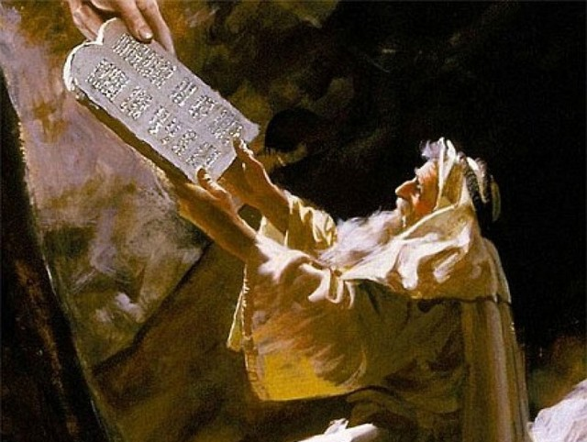
The heart of the Mosaic Covenant is the Ten Commandments
Notes:
OS-02-Exodus-250
OS-05-Deut-109
NS-06-Rom5-8-slide78
SA-08-Mosaic Law-29

Slide 33
TRADITIONAL VIEW ON LAW
Ex. 25-31
155l
A Godly Education In Three Parts:
MORAL: The Ten Commandments; a basis for our current legal system.
CIVIL: How the people are to live with each other in the new social structure.
CEREMONIAL: How to worship God in the new social structure.
BUT ARE THE BIG 10 MORAL LAW?
MOSES
Exodus
Sinai
M - C - C
40
Handbook pg. 26-29
13
Notes:
BS-28-Law of Moses-07
OS-02-Exodus-251
OS-05-Deut-110
NS-06-Rom5-8-slide79
SA-08-Mosaic Law-30

Slide 34

Moral law means God's rules that apply to…
Every time period
Every culture
Every place
Every people
Notes:
BS-28-Law of Moses-07
OS-02-Exodus-252
OS-05-Deut-111
NS-06-Rom5-8-slide79
SA-08-Mosaic Law-31

Slide 35
Does the Law of Moses Apply to Me? (5 Views)
113c
Spectrum on Degree of Applicability:
Theonomic Greg Bahnsen | Reformed Willem VanGemeren | Weightier Issues Walter Kaiser | Modified Lutheran Douglas Moo | Dispensational Wayne G. Strickland
Law as applicable
in every sense
Law as
not applicable
in every sense
This chart summarizes Stanley N. Gundry, ed. Five Views on Law and Gospel (Grand Rapids: Zondervan, 1996), where each author presents his view and responds to the other four views. Generally speaking, views 1-2 are similar as both are Reformed (stressing continuity between the NT and OT) and these stand against views 3-5 which alike stress discontinuity. In my opinion, the dispensational view has the most to commend it as the Mosaic Law in the NT is never broken into component parts and this view clearly distinguishes Israel from the church. Further, it is inconsistent to change the Sabbath (Saturday) to Sunday but not apply the OT penalties for Sabbath-breaking today (i.e., death by stoning; cf. Exod. 31:14-15; 35:2). The following chart is adapted from Lee Hwee Chin, "The Applicability of the Law Today," unpublished research paper for the course "Old Testament Survey," Singapore: Singapore Bible College, 2001, 1.
Notes:
The NT does not specifically say how to apply the OT law, so Christians disagree on how to do this. There exist at least five major approaches to how Christians see the Mosaic Law applying today.
_______
Common-233
BS-28-Law of Moses-12
OS-02-Exodus-256
OS-05-Deut-115
NS-06-Rom5-8-slide80
NS-09-Gal-139
SA-08-Mosaic Law-32

Slide 36
Does the Law of Moses Apply to Me?
113b
Stanley N. Gundry, ed. Five Views on Law & Gospel summarized by Lee Hwee Chin, SBC, 2001
 | THEONOMIC Bahnsen | REFORMED Van Gemeren | WEIGHTIER ISSUES Kaiser | MODIFIED LUTHERAN Moo | DISPENSATIONAL Strickland
What is the Law? | Same definition as the views 3-5 | God's oral or written instructions since creation | The whole Mosaic law given in the Pentateuch (Genesis to Deuteronomy) but also amplified in the rest of the Old Testament
Who is the Law for? | The Elect (Israel = Church) | All mankind (Israel = Church) | Believers (Israel and Church) | Believers (Israel and Church) | Israel only (Israel ≠ Church)
Notes:
36
The NT does not specifically say how to apply the OT law, so Christians disagree on how to do this. There exist at least five major approaches to how Christians see the Mosaic Law applying today.
_______
Common-234
BS-28-Law of Moses-12
OS-02-Exodus-256
OS-05-Deut-115
NS-06-Rom5-8-slide80
NS-09-Gal-139
SA-08-Mosaic Law-32

Slide 37
Does the Law of Moses Apply to Me?
113b
Stanley N. Gundry, ed. Five Views on Law & Gospel summarized by Lee Hwee Chin, SBC, 2001
 | THEONOMIC Bahnsen | REFORMED Van Gemeren | WEIGHTIER ISSUES Kaiser | MODIFIED LUTHERAN Moo | DISPENSATIONAL Strickland
Which parts of the Law apply today? • "Moral law"? (i.e., Decalogue or 10 Command-ments) | All moral laws apply to people of God only in every age, so all elect persons since creation should observe either the Jewish Sabbath (Sat. before Christ) or "Christian Sabbath," (Sunday, after Christ) | All moral laws apply to believers and unbelievers of every age (e.g., all persons–including unbelieving Gentiles since creation–should observe the Sabbath or "Christian Sabbath," being Sunday) | All moral laws that stem from God's character: • 10 Command-ments • Leviticus 18–19 (sex) (i.e., Sabbath is required since Israel's nationhood & prohibited sexual practices still apply) | The Mosaic Law is fully abolished, but its moral contents are good Christian guidelines. Yet Christ holds the final say via the Spirit's ministry in believers today; Sabbath obedience is not consistently applied (?) | God's "moral law" before Moses is now called the "law of Christ" (Gal. 6:2) and governs believers through the Spirit's new covenant indwelling; The Law does not easily divide into "parts" and is done away with in its entirety (Rom. 7:1-6; 1 Cor. 9:19-21; Heb. 8:13), including the Sabbath (Col. 2:16-17)
Notes:
37
The NT does not specifically say how to apply the OT law, so Christians disagree on how to do this. There exist at least five major approaches to how Christians see the Mosaic Law applying today.
_______
Common-235
BS-28-Law of Moses-12
OS-02-Exodus-256
OS-05-Deut-115
NS-06-Rom5-8-slide80
NS-09-Gal-139
SA-08-Mosaic Law-32

Slide 38
Does the Law of Moses Apply to Me?
113b
Stanley N. Gundry, ed. Five Views on Law & Gospel summarized by Lee Hwee Chin, SBC, 2001
 | THEONOMIC Bahnsen | REFORMED Van Gemeren | WEIGHTIER ISSUES Kaiser | MODIFIED LUTHERAN Moo | DISPENSATIONAL Strickland
• Civil laws? (i.e., judicial law) | All apply (e.g., laws today should require death for adultery) | Some apply (e.g., still tithe and don't charge believers interest) | Judicial principles (not laws) apply since moral laws underlie all judicial and ceremon-ial laws | Only principles apply now as the Mosaic law was given only to Israel | None apply as these regulated Israel alone (but principles such as love and compassion still apply)
• Cere-monial laws? | All five views agree that ceremonial aspects such as the sacrificial system and Jewish priesthood are now fulfilled in Jesus Christ
Notes:
38
The NT does not specifically say how to apply the OT law, so Christians disagree on how to do this. There exist at least five major approaches to how Christians see the Mosaic Law applying today.
_______
Common-236
BS-28-Law of Moses-12
OS-02-Exodus-256
OS-05-Deut-115
NS-06-Rom5-8-slide80
NS-09-Gal-139
SA-08-Mosaic Law-32

Slide 39
Does the Law of Moses Apply to Me?
113b
Stanley N. Gundry, ed. Five Views on Law & Gospel summarized by Lee Hwee Chin, SBC, 2001
 | THEONOMIC Bahnsen | REFORMED Van Gemeren | WEIGHTIER ISSUES Kaiser | MODIFIED LUTHERAN Moo | DISPENSATIONAL Strickland
What is the relation-ship of the Abrahamic Covenant to Mosaic Covenant? | Both are God's "covenant of grace." They consist of the same substance of God's saving relation-ship which makes the MC still apply today | MC was added to the AC; both still apply though they are similar in substance but different in form and purpose | MC was given specifically to Israel but its moral principles are still relevant to all believers under the AC | Like dispensa-tionalists, MC was conditional but AC was not; MC was a temporary framework that prescribed terms of obedience for Israel in Law period | MC regulated Israel's life so she could experience the blessings of the AC, but MC is no longer operative as it is fulfilled in Christ
Notes:
39
The NT does not specifically say how to apply the OT law, so Christians disagree on how to do this. There exist at least five major approaches to how Christians see the Mosaic Law applying today.
_______
Common-237
BS-28-Law of Moses-12
OS-02-Exodus-256
OS-05-Deut-115
NS-06-Rom5-8-slide80
NS-09-Gal-139
SA-08-Mosaic Law-32

Slide 40
Does the Law of Moses Apply to Me?
113c
Stanley N. Gundry, ed. Five Views on Law & Gospel summarized by Lee Hwee Chin, SBC, 2001
 | THEONOMIC Bahnsen | REFORMED Van Gemeren | WEIGHTIER ISSUES Kaiser | MODIFIED LUTHERAN Moo | DISPENSATIONAL Strickland
Strengths | • Continuity between the OT and NT upheld • Desires ethics to relate to all of life • Sees positive aspects of the law | • Continuity between the OT and NT upheld • Notes Mosaic law's foreshadow-ing of Christ • Sees a convicting role of the law today for unbelievers | • Biblical support for some law aspects (i.e., moral) being weightier than others (Matt. 23:23) • Holiness Code of Leviticus 18–19 stems from the nature of God | • Accounts for new covenant emphases under the Law of Christ (Gal. 6:2) • Says OT laws repeated in the NT are applicable • Applies law principles today | • Biblical in that Mosaic law began at Sinai and ended as a temporary tutor with Christ's death (Gal. 3:19, 24-25) • Keeps Israel and church separate • Advocates continued guidance in the law of Christ
Notes:
40
The NT does not specifically say how to apply the OT law, so Christians disagree on how to do this. There exist at least five major approaches to how Christians see the Mosaic Law applying today.
_______
Common-238
BS-28-Law of Moses-12
OS-02-Exodus-256
OS-05-Deut-115
NS-06-Rom5-8-slide80
NS-09-Gal-139
SA-08-Mosaic Law-32

Slide 41
Does the Law of Moses Apply to Me?
113c
Stanley N. Gundry, ed. Five Views on Law & Gospel summarized by Lee Hwee Chin, SBC, 2001
 | THEONOMIC Bahnsen | REFORMED Van Gemeren | WEIGHTIER ISSUES Kaiser | MODIFIED LUTHERAN Moo | DISPENSATIONAL Strickland
Weak-nesses | • Dividing law as moral, civil & ceremonial not biblical • Misguided to apply godly commands to unregenerate • All "law" need not be Mosaic (natural law and law of Christ also exist) • The NT never applies the OT to civil matters • Law condemned man (2 Cor. 3:9) | • Dividing law as moral, civil & ceremonial not biblical • Using "law" in differing ways is inconsistent & confusing • Requiring Sabbath for today contradicts Col. 2:16-17 • Unclear if moral law became law of Christ • Merges Israel & church | • Dividing law as moral, civil & ceremonial not biblical • Arbitrary to pick and choose which parts of the law are required • Choice of Decalogue and Lev. 18–19 too narrow for moral law | • Seeks to teach the indivisibility of the law while upholding its moral content • Too extreme to claim that the law has absolutely no purpose today • Fails to see the gospel in the OT by demarcating Law and Gospel into distinct, discontinuous eras | • Distinguishing law's revelatory aspects (eternal, revealing God's nature) from regulatory (temporary, ruled Israel) makes distinctions within an inseparable code–if the OT law is essentially a unity, then why divide it into two parts? • The law is not nullified but actually upheld by faith (Rom. 3:31)
Notes:
41
The NT does not specifically say how to apply the OT law, so Christians disagree on how to do this. There exist at least five major approaches to how Christians see the Mosaic Law applying today.
_______
Common-239
BS-28-Law of Moses-12
OS-02-Exodus-256
OS-05-Deut-115
NS-06-Rom5-8-slide80
NS-09-Gal-139
SA-08-Mosaic Law-32

Slide 42
The Ten Commandments
155l
#
Old Testament Commands
New Testament Repetitions
1
And God spoke all these words: "I am the LORD your God, who brought you out of Egypt, out of the land of slavery. You shall have no other gods before me" (Exod. 20:1-3).
"Men, why are you doing this? We too are only men, human like you. We are bringing you good news, telling you to turn from these worthless things to the living God…" (Acts 14:15; noted 50+ times).
2
"You shall not make for yourself an idol… for I… am a jealous God, punishing the children for the sin of the fathers … but showing love to a thousand generations of those who love me…" (Exod. 20:4-6).
"Dear children, keep yourselves from idols" (1 John 5:21; cf. 1 Thess. 1:9; Rev. 2:14, 20; 9:20; mentioned in the NT 12 times = 12x).
* This chart is adapted and expanded from one by Lewis Sperry Chafer, Systematic Theology, 4:209-10
3
"You shall not misuse the name of the LORD your God, for the LORD will not hold anyone guiltless who misuses his name" (Exod. 20:7).
"Above all…do not swear—not by heaven or by earth or by anything else. Let your 'Yes' be yes, and your 'No,' no, or you will be condemned" (James 5:12; 4x).

Slide 43
The Ten Commandments
155l
#
Old Testament Commands
New Testament Repetitions
4
"Keep the Sabbath day holy. Six days you shall labor... but the seventh day is a Sabbath to the LORD your God. On it you shall not do any work… nor your son or daughter, nor your manservant or maidservant, nor your animals, nor the alien within your gates. For in six days the LORD made the heavens and the earth… but he rested on the seventh day…" (Exod. 20:8-11).
No NT text requires this of Christians.
However, one passage clearly prohibits the practice as required for believers: "Therefore do not let anyone judge you by what you eat or drink, or with regard to a religious festival, a New Moon celebration or a Sabbath day. These are a shadow of the things that were to come; the reality, however, is found in Christ" (Col. 2:16-17; 0x).
5
"Honor your father and your mother, so that you may live long in the land the LORD your God is giving you" (Exod. 20:12).
"Children, obey your parents in the Lord, for this is right. 'Honor your father and mother'—which is the first commandment with a promise—that it may go well with you and that you may enjoy long life on the earth" (Eph. 6:1-3; Matt. 15:4-6; 19:19; Mark 7:10; 10:19; 6x).
6
"You shall not murder" (Exod. 20:13).
"Anyone who hates his brother is a murderer, and you know that no murderer has eternal life in him" (1 John 3:15; cf. Matt. 19:18; Mark 10:19; Luke 18:20; Rom. 13:9; James 2:11; 6x).

Slide 44
The Ten Commandments
155l
#
Old Testament Commands
New Testament Repetitions
The Law (Ten Commandments) fulfilled its
purpose by prohibiting coveting to reveal sin (Rom. 7:7).
Believers died to this law when they were joined to Christ
(7:4, 6). Since the Ten Commandments are a unit,
Christians also died to the other nine as well.
7
"You shall not commit adultery" (Exod. 20:14).
"Marriage should be honored by all, and the marriage bed kept pure, for God will judge the adulterer and all the sexually immoral" (Heb. 13:4; cf. Mark 10:19; 12x).
8
"You shall not steal" (Exod. 20:15).
"He who has been stealing must steal no longer, but must work, doing something useful with his own hands…" (Eph. 4:28; cf. Matt. 27:64; Mark 10:19; Luke 18:20; Rom. 13:9; Titus 2:10; 6x).
9
"You shall not give false testimony against your neighbor" (Exod. 20:16).
"Do not lie to each other, since you have taken off your old self with its practices" (Col. 3:9; cf. Eph. 4:25; 4x).
10
"You shall not covet your neighbor's house… wife, or his manservant or maidservant, his ox or donkey, or anything that belongs to your neighbor" (Exod. 20:17).
"'Watch out! Be on your guard against all kinds of greed; a man's life does not consist in the abundance of his possessions'" (Luke 12:15; Rom. 7:7; 13:9; Eph. 5:3; James 4:2; 2 Pet. 2:3, 14; 9x).

Slide 45
In your small group...
154a
In what ways do believers today still try to live by the Mosaic law?
Sabbath observance
Food laws
Tithing
Not charging Christians interest
Circumcision

Slide 46
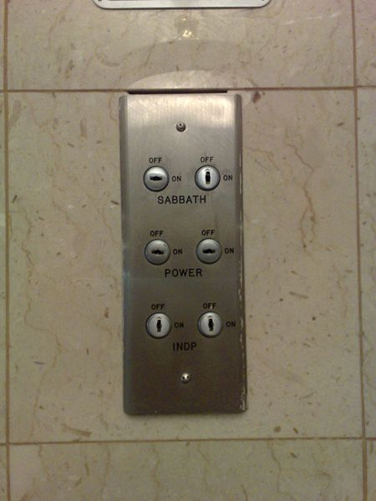
Our Sabbath Lift in Galilee
We arrived at our hotel on the Sabbath, so it would not stop at our floor. Instead, we carried our luggage up two floors by hand in celebration of the day of rest!
Notes:
On my 2007 trip that I led to Israel, the lift was turned on to the Sabbath setting, meaning that it stopped only every fourth floor.

Slide 47
Victory in the Christian Life
154a
"Paul does not view Christian living as
victory apart from any conflict
or as conflict apart from any victory. Instead, he sees the Christian life as a life of victory amid conflict."
"Paul & His Epistles: Life and Teachings of Paul,"
NT Survey (Moody Online Study Guide), p. 7 (emphasis mine)

Slide 48
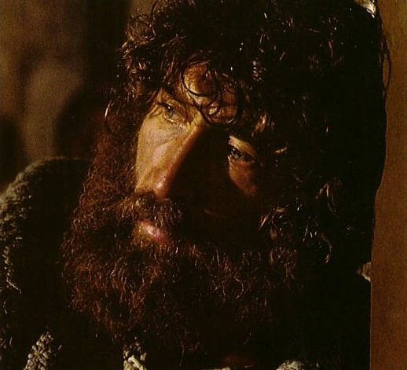
Peter illustrates the struggle between the flesh and Spirit
Notes:
Peter should be commended for his love for Jesus, but he often took matters into his own hands by his flesh:
• Rebuked Jesus for saying that Christ would go to the cross
• Cut off the ear of Malchus at the arrest of Jesus

Slide 49


TWO VIEWS ON STRUGGLING WITH SIN
Rom. 7:7-25
154b
Pre Conversion Arguments
Post Conversion Arguments
How can a believer say, "I am a slave to sin" (7:14)?
This is contrary to the condition of believer that Paul describes in:
  "We died to sin; how can we live in it any longer?" (6:2 NIV)
  "We should no longer be slaves to sin" (6:6 NIV)
"Being in the flesh/being in sinful nature" does not mean physical passion, but a way of life (7:5)
Structure of argument
  7:7-25 interpret 7:5 (pre-conversion)
  8:1-17 interpret 7:6 (post-conversion)
Believers also sin since Paul says,
"Do not let sin reign in your mortal body so that you obey its evil desire" (6:12)
Paul describes his pre-conversion life as free from struggle (Gal. 1:14 and Phil. 3:5-6)
The present tense is used (7:14-25) to describe a present struggle
Chapters 6–8 describe sanctification (post-conversion context)
Fact: Christians continue to struggle with sin

Slide 50
Black

Slide 51
A Quick Quiz About the Law…
112
True (T)? Or False (F)? What's your view?
    1. T or F Christians should keep parts of the OT law which are not repeated in the NT.
    2. T or F The Sabbath should still be obeyed by Christians.
    3. T or F Believers today are obligated to keep all of the Ten Commandments.
    4. T or F Tithing should be practiced by all followers of Christ.
    5. T or F Christians today are prohibited from eating blood (e.g., yong tau foo, blood pudding, pig or duck blood at Chinese New Year).
    6. T or F Believers must not charge other Christians interest based upon the Law (Deut. 23:19; Exod. 22:25; Lev. 25:36-37; Ezek. 18:8, 13, 17; 22:12; Prov. 15:5; 28:8)
    7. T or F There are actually two laws: the moral (Ten Commandments) and ceremonial/civil.
I marked all FALSE

Slide 52


Salvation link at BibleStudyDownloads.org
Get this presentation and script for free!

