Slide 1

Zoom Basics
Dr. Rick Griffith • Singapore Bible College • BibleStudyDownloads.org

Slide 2
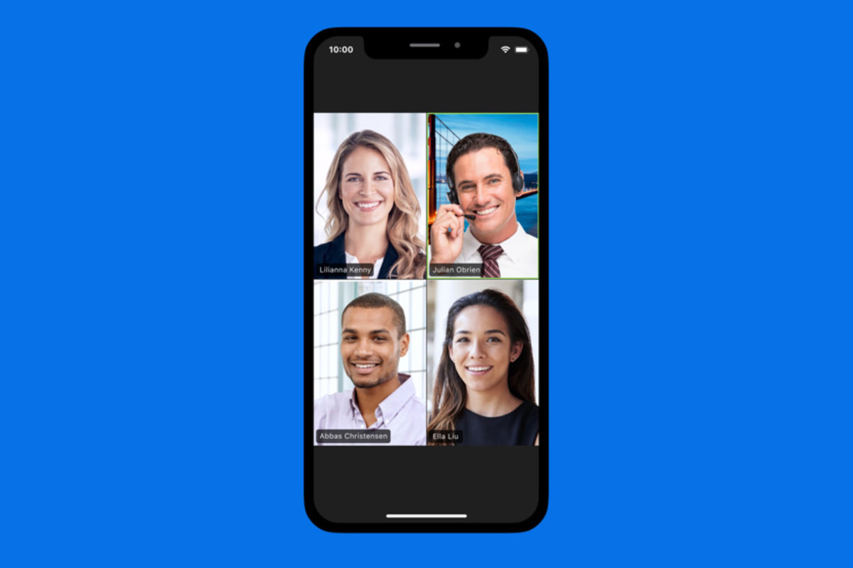
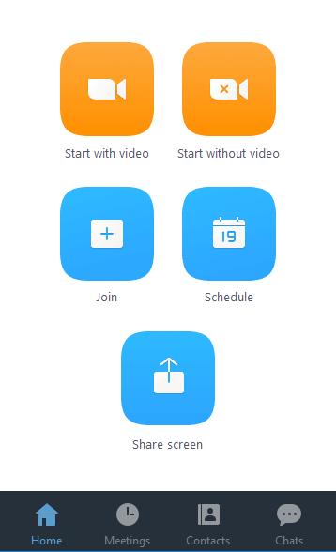
Mobile Version
Notes:
Text

Slide 3
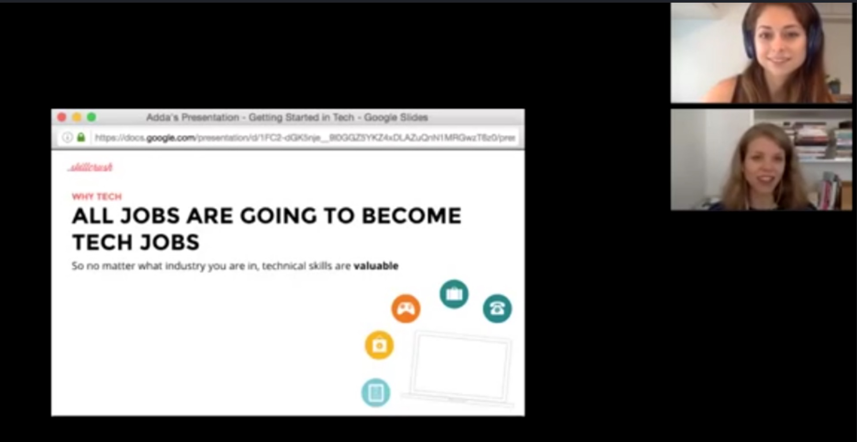
Side-by-Side Mode
Notes:
Text

Slide 4
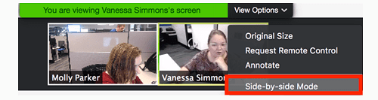
Side-by-Side Mode
Notes:
Text

Slide 5
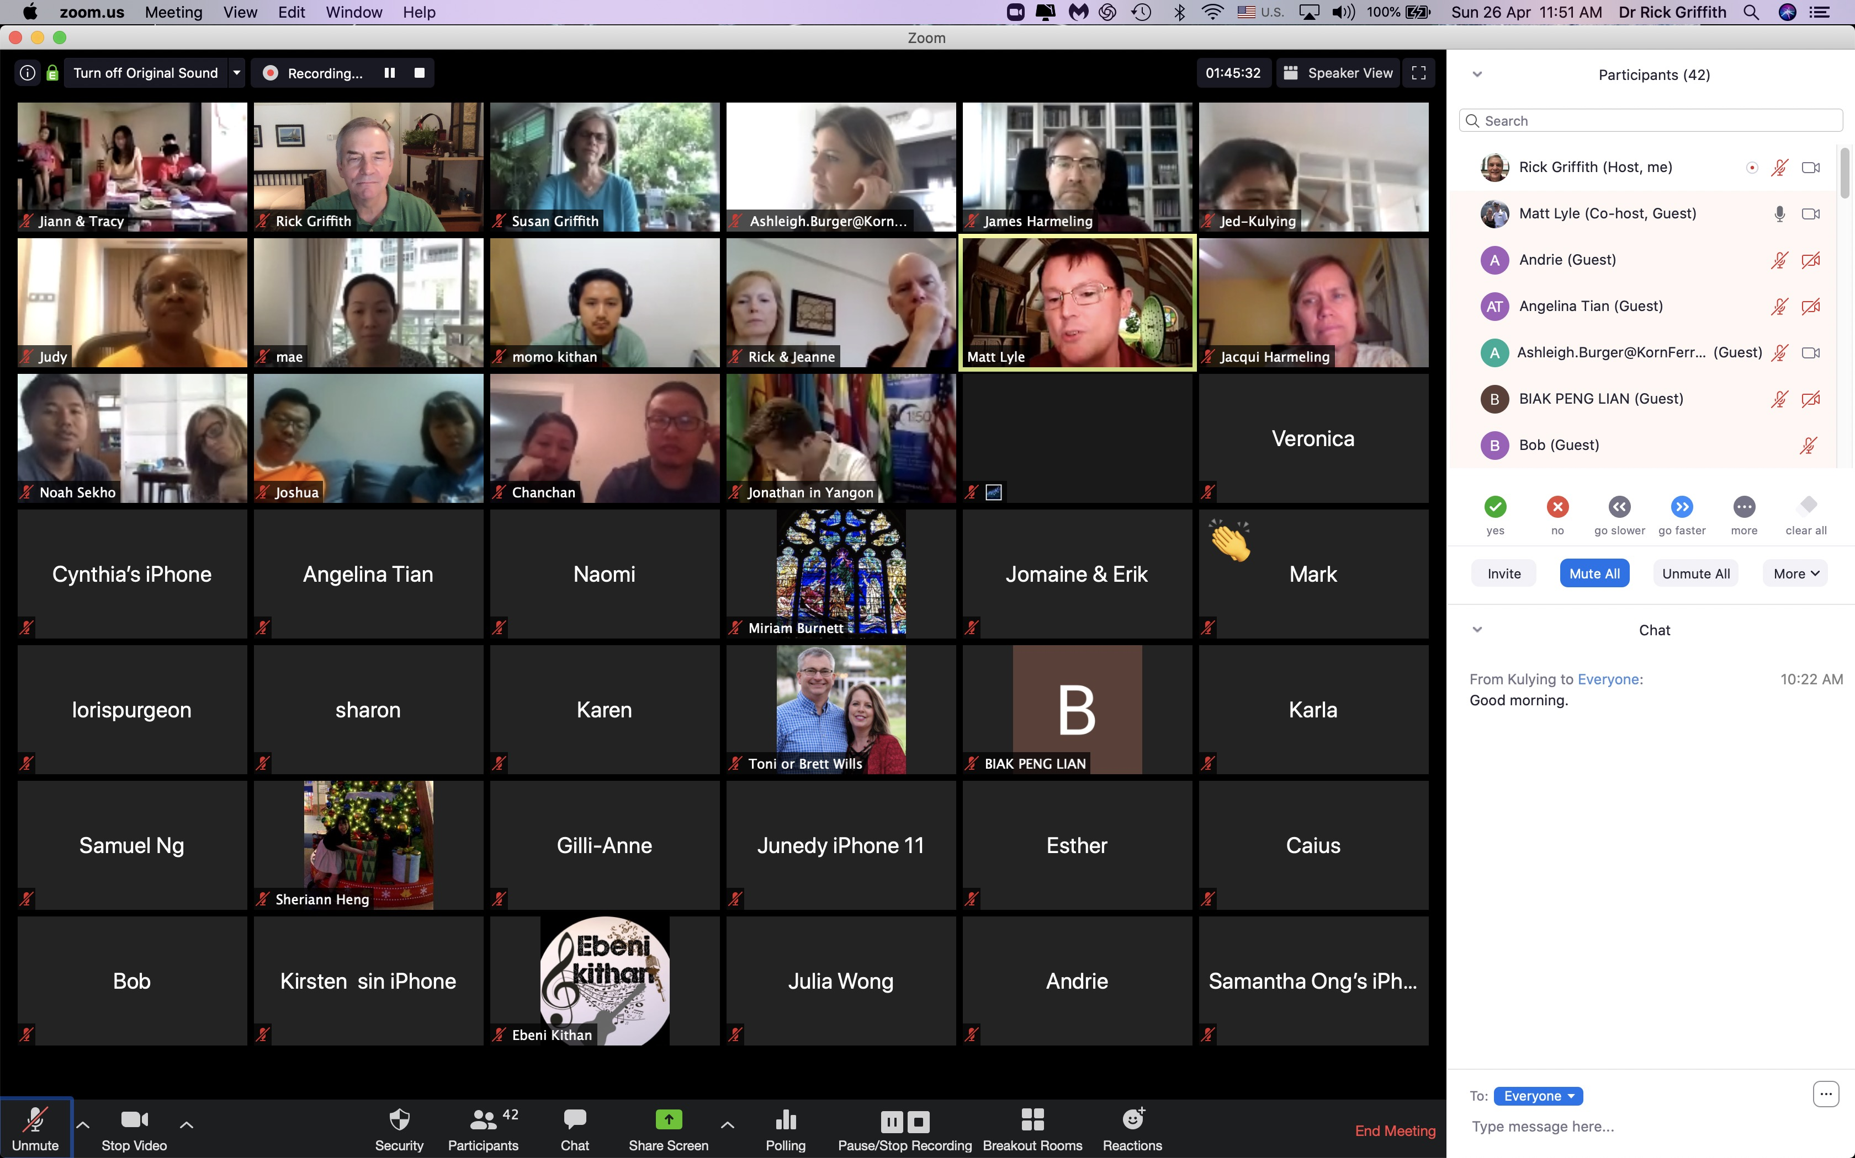
Speaker Highlighted
Notes:
Restatement

Slide 6
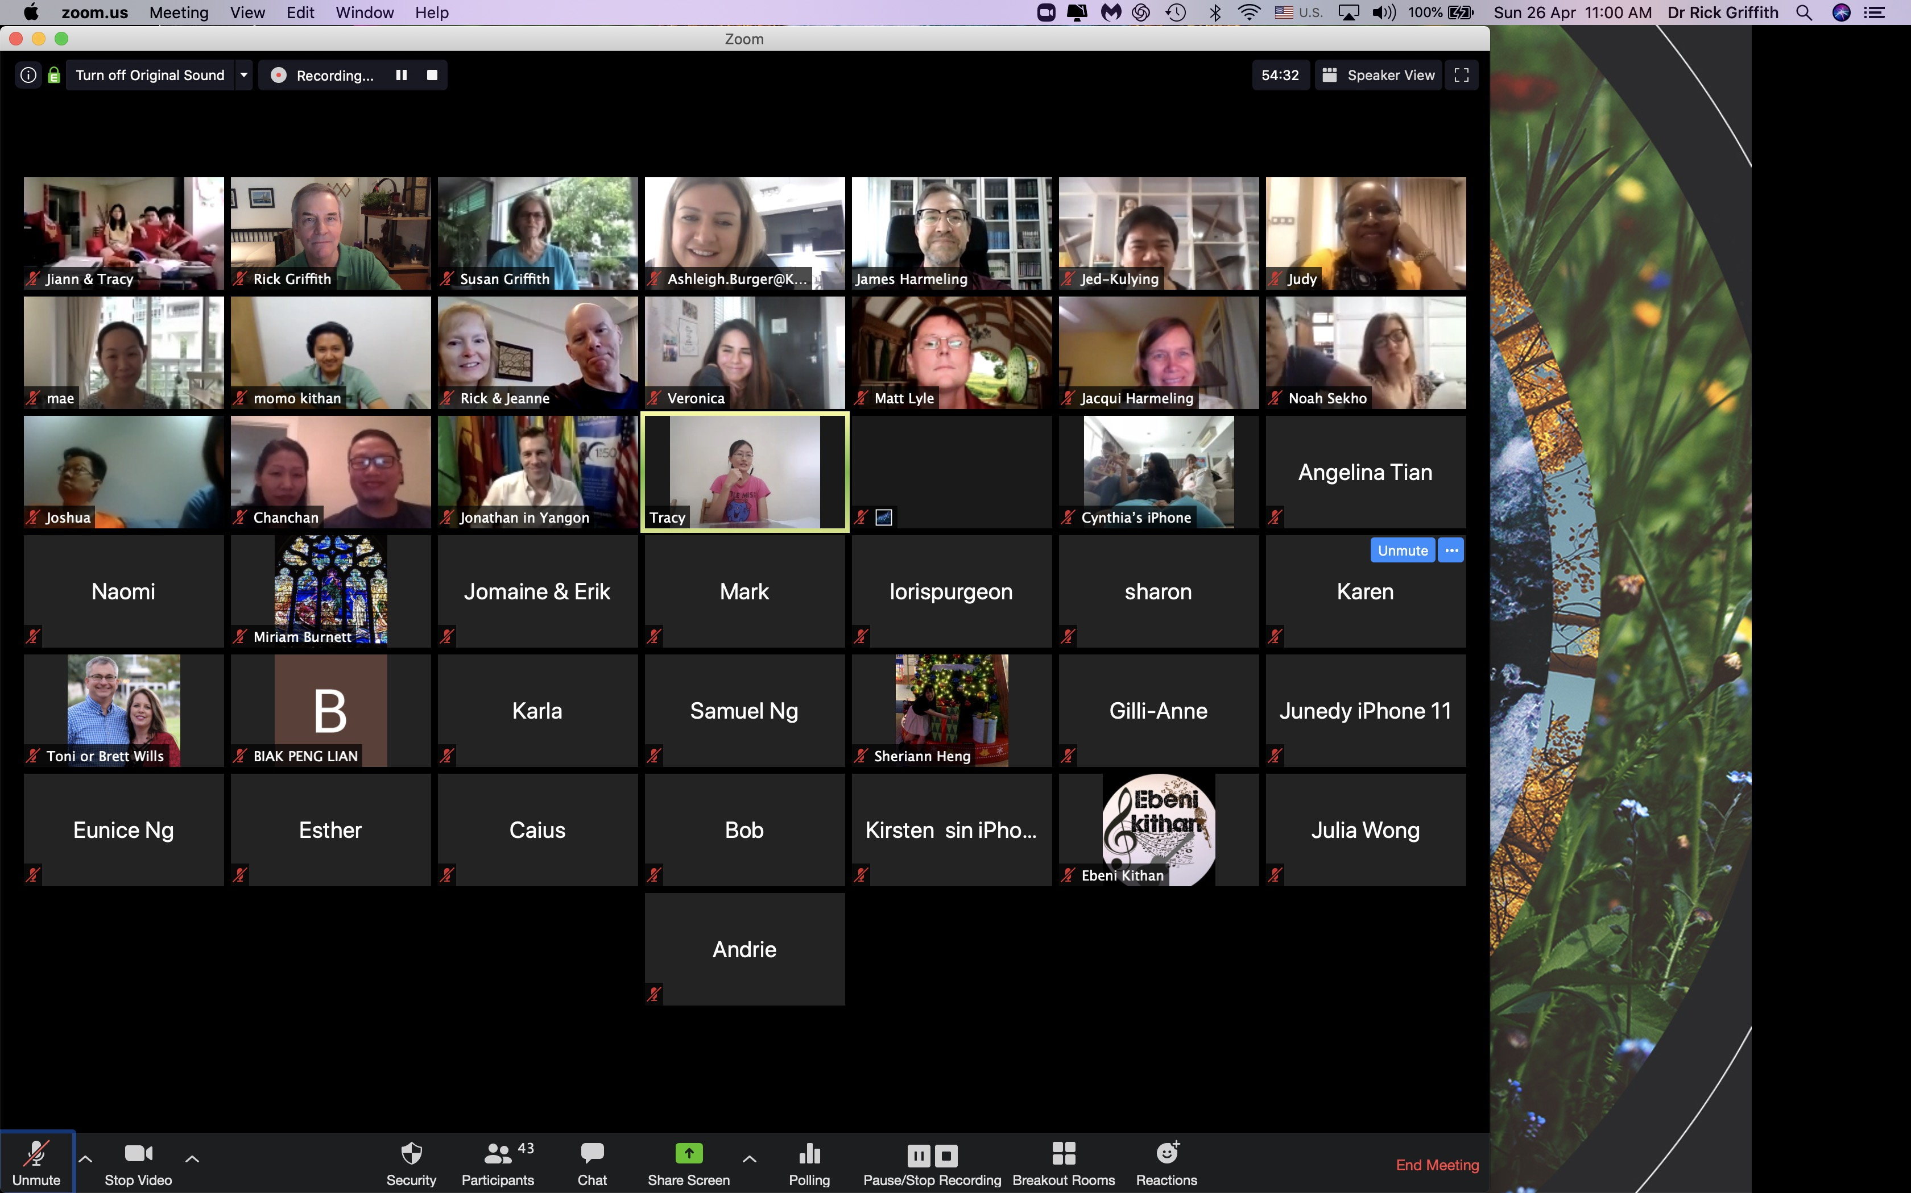
Speaker Highlighted
Notes:
Restatement

Slide 7

Settings
Login to Zoom on browser
Speaker or Gallery View
Security
Breakout Rooms
File sharing
Yes-No buttons
Screen Sharing
Side-by-Side Mode
Participants & Chat
Lock Meeting
Enable Waiting Room
Notes:
Restatement

Slide 8
Research & Writing Assignments
Reading
25%
Topic
Approval
Form
10%
Present PPT
15%
Proposal
25%
Pilot Project
25%

Slide 9
☑️ R&W Checklist
🔳 Syllabus
🔳 TAF
🔳 Dissertation PPT
🔳 Proposal
🔳 Proposal Grade Shee
🔳 Pilot Project
🔳 Email Threads
🔳 Numbering Files
🔳 Word TOC (Contents)
🔳 Word Tracking (Review)
🔳 Word Search-and-Replace
🔳 Dissertation Requirements
🔳 Dissertation Template
🔳 SBC Writing Standards
🔳 Turabian 9th Edition
🔳 Grammarly
🔳 Turnitin
🔳 Zotero
🔳 DTL (Digital Theo. Library)
🔳 Term Paper Template
🔳 Research Paper Grade Sheet
🔳 R&W Website
🔳 Guide to Clear Writing
🔳 Gunnings’ 10 Rules
🔳 Wikipedia
🔳 Questions from Shwu

Slide 10
☑️ R&W Checklist
X Syllabus
X TAF
X Dissertation PPT
X Proposal
🔳 Proposal Grade Sheet
X Pilot Project
X Email Threads
X Numbering Files
X Word TOC (Contents)
X Word Tracking (Review)
X Word Search-and-Replace
X Dissertation Requirements
X Dissertation Template
🔳 SBC Writing Standards
X Turabian 9th Edition
X Grammarly
X Turnitin
X Zotero
🔳 DTL (Digital Theo. Library)
X Term Paper Template
🔳 Research Paper Grade Sheet
🔳 R&W Website
🔳 Guide to Clear Writing
🔳 Gunnings’ 10 Rules
🔳 Wikipedia
🔳 Questions from Shwu

Slide 11
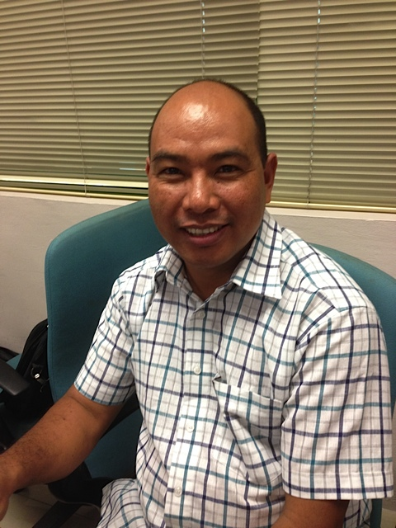
The Dissertation
Proposal: need, research question, hypothesis, scope, methodology & bibliography
Table of Contents:
  Introduction (= Proposal)
  Chapter 1: Literature Review
  Chapter 2: Biblical Basis
  Chapter 3: Procedure & Design
  Chapter 4: Results & Findings
  Conclusion

Slide 12
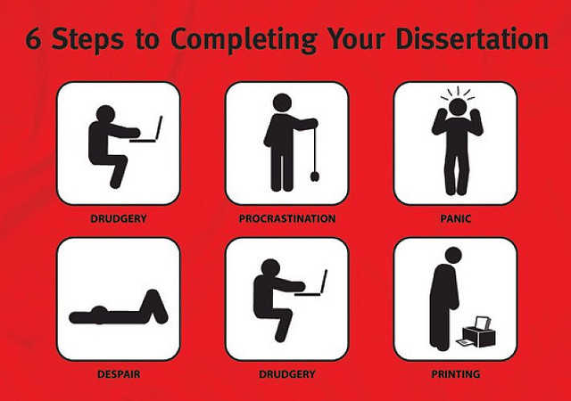
6 Steps to Complete Your Dissertation
DRUDGERY
PROCRASTINATION
PANIC
DESPAIR
DRUDGERY
PRINTING

Slide 13

Dissertation Requirements
SBC Writing Standards basic guide
Turabian 9th ed. where not in WS
Template sets up format
Turnitin.com plagiarism check
Grammarly.com grammar check
Zotero citation used

Slide 14
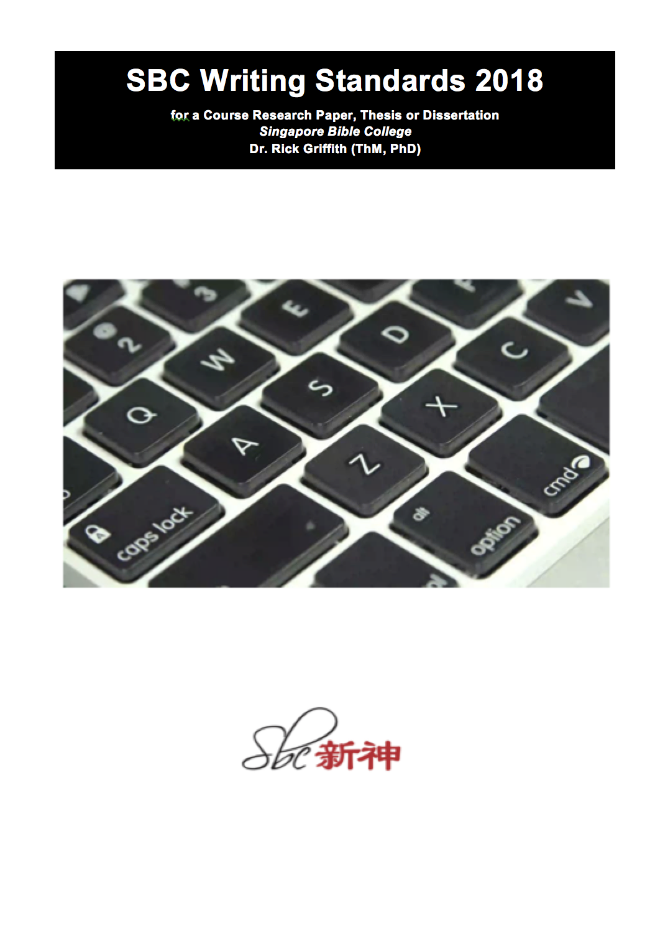
Contents
Getting Started
Front Matter
Main Body
Back Matter
Citations
Bibliography
Appendixes

Slide 15
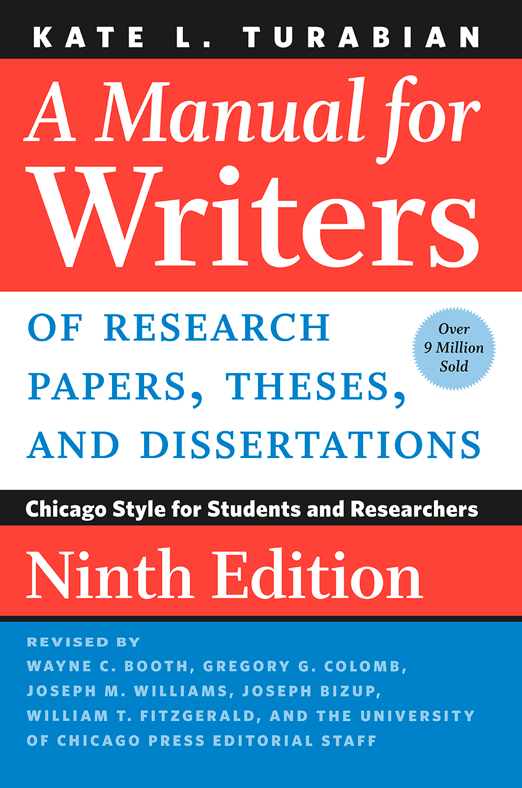
Format
Papers are returned if the format does not abide by Turabian 9th edition & “SBC Writing Standards” 2nd edition (2018)

Slide 16
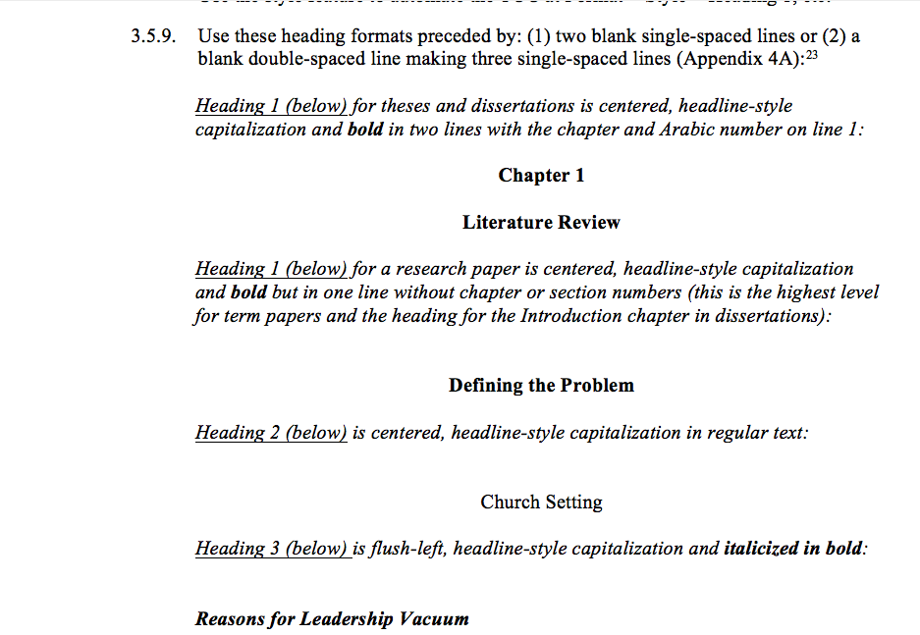
Format

Slide 17
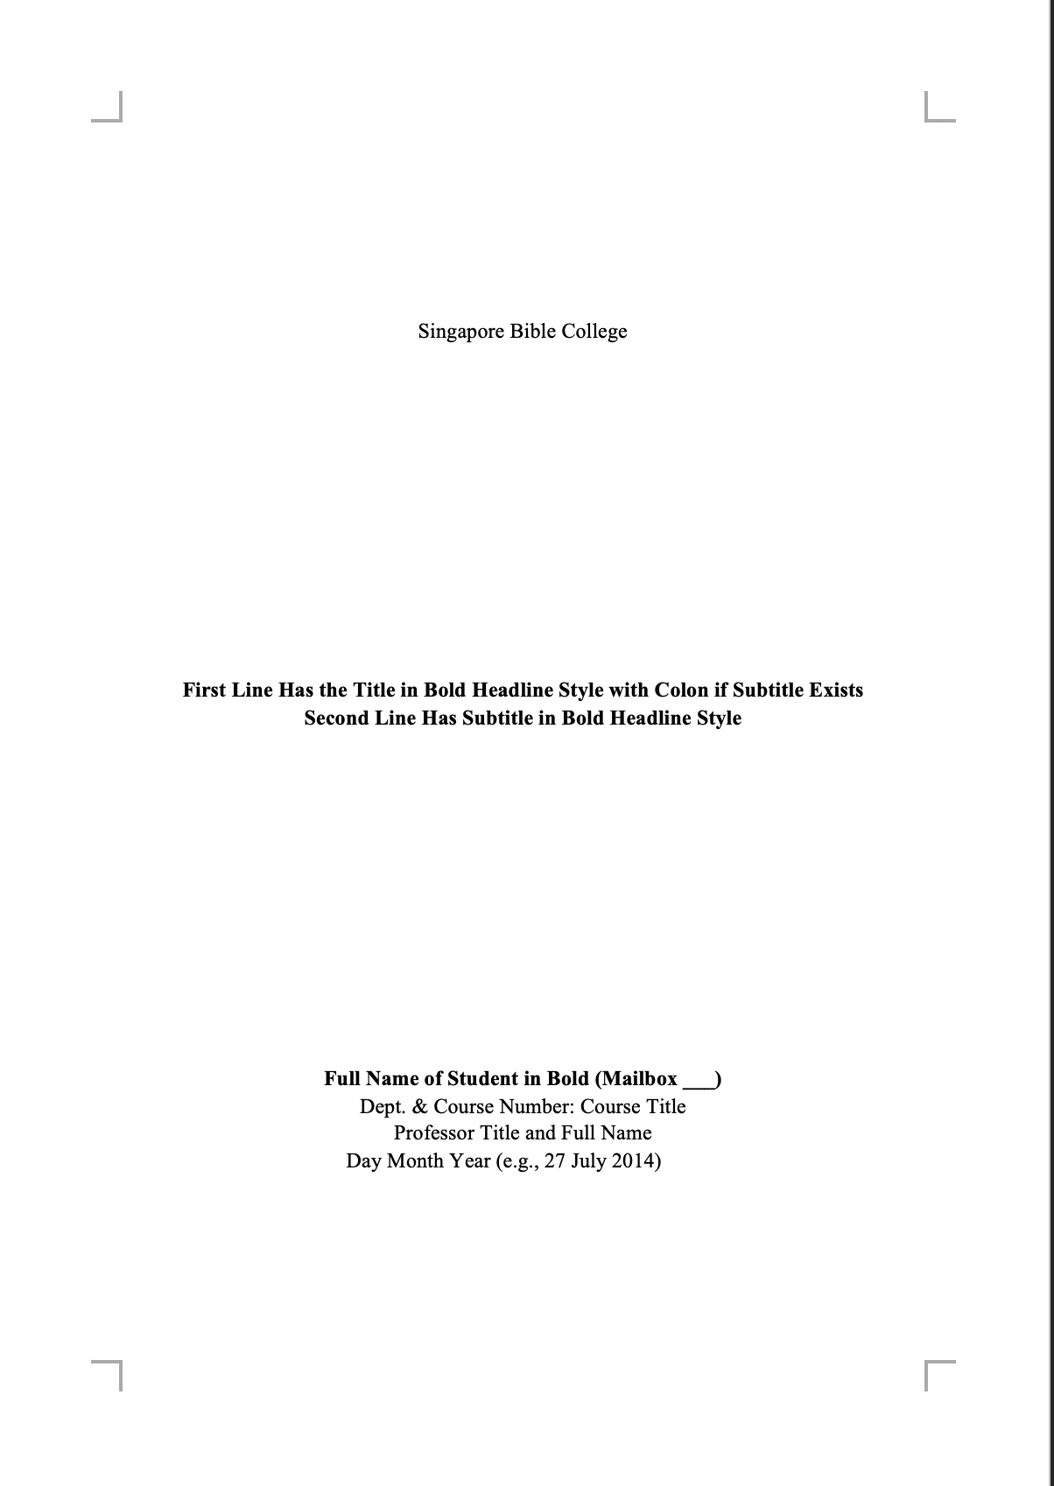
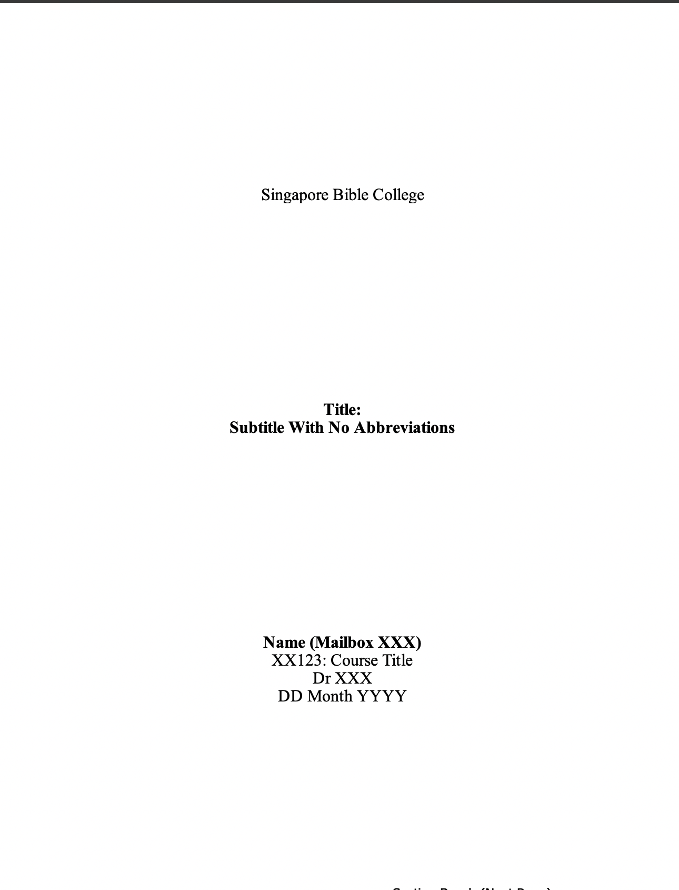
2 Types of Term Paper Templates
No Table of Contents
Table of Contents

Slide 18
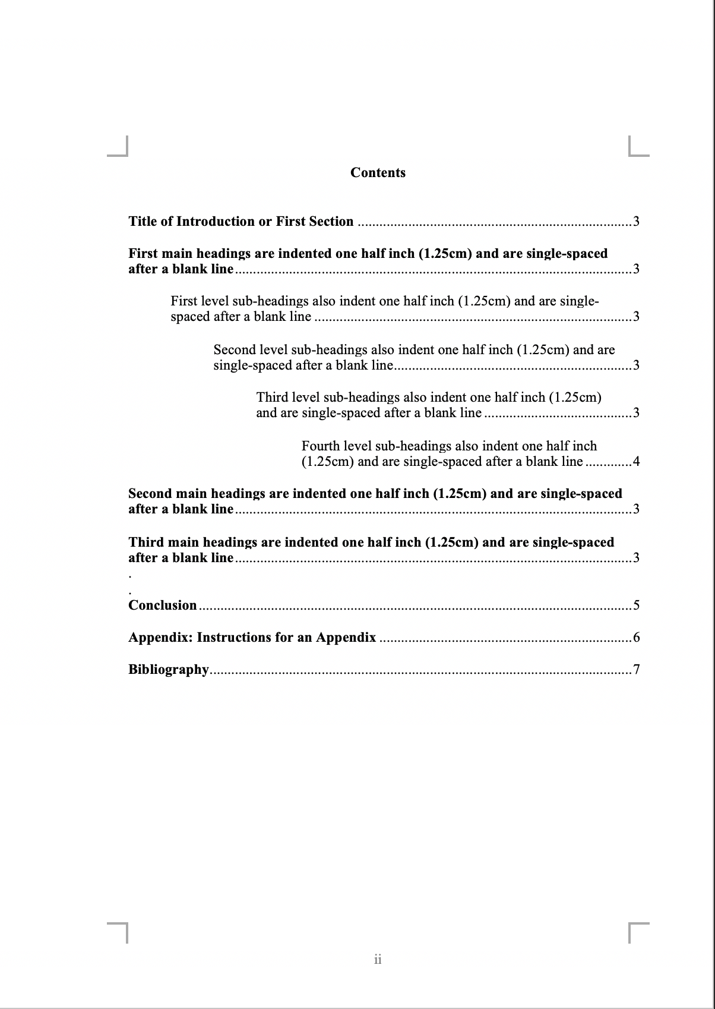
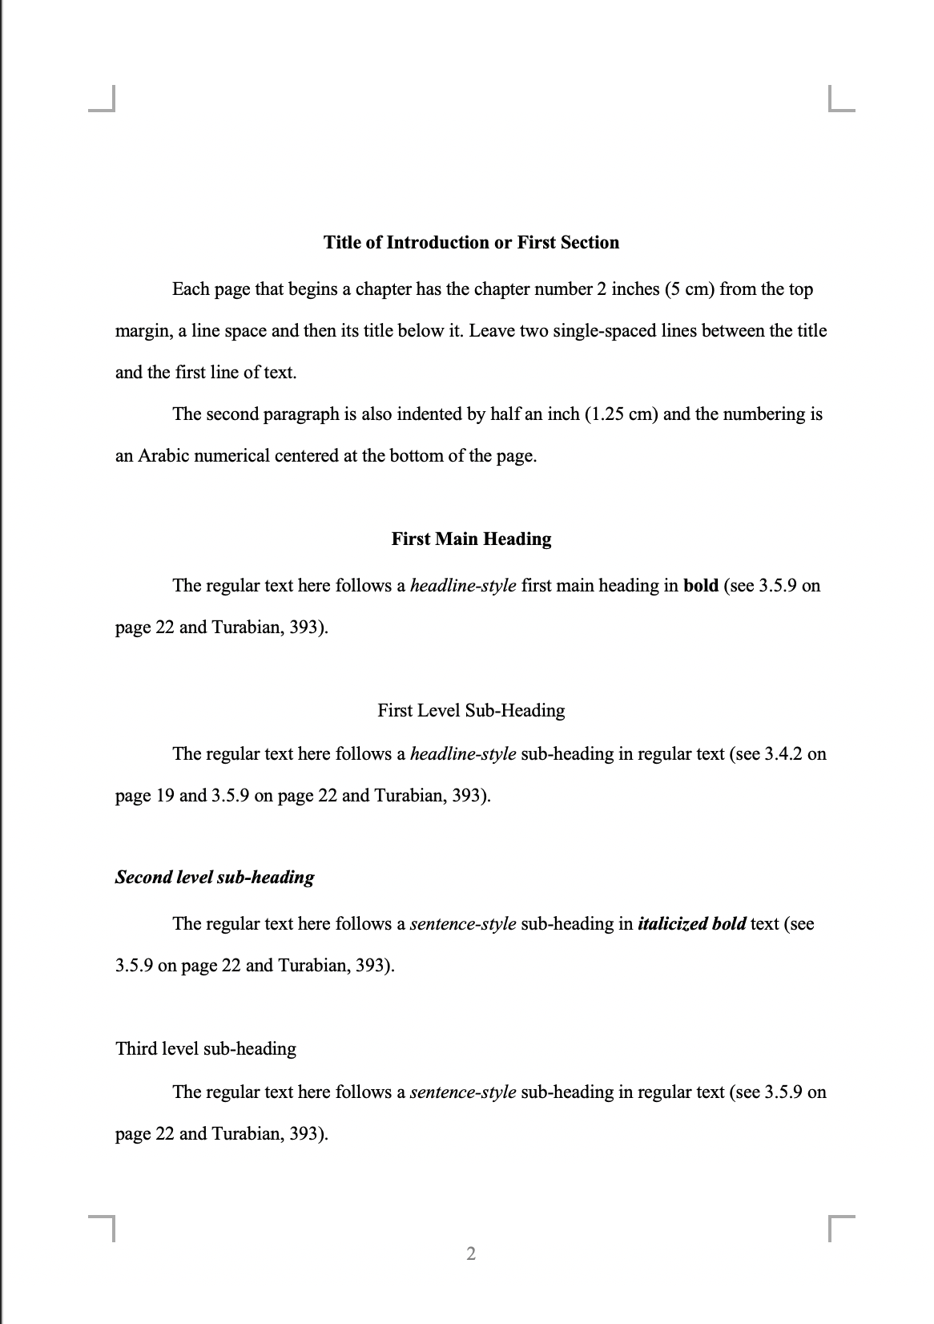
2 Types of Term Paper Templates
No Table of Contents
Table of Contents

Slide 19
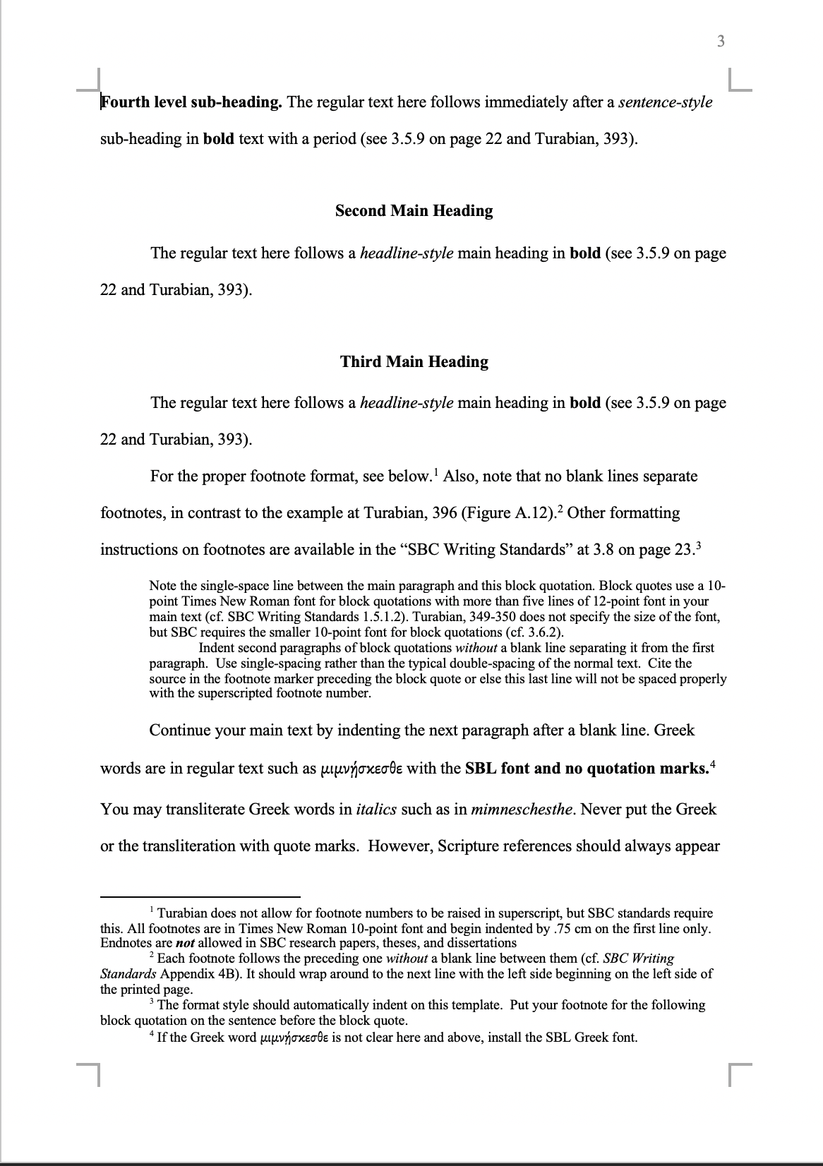
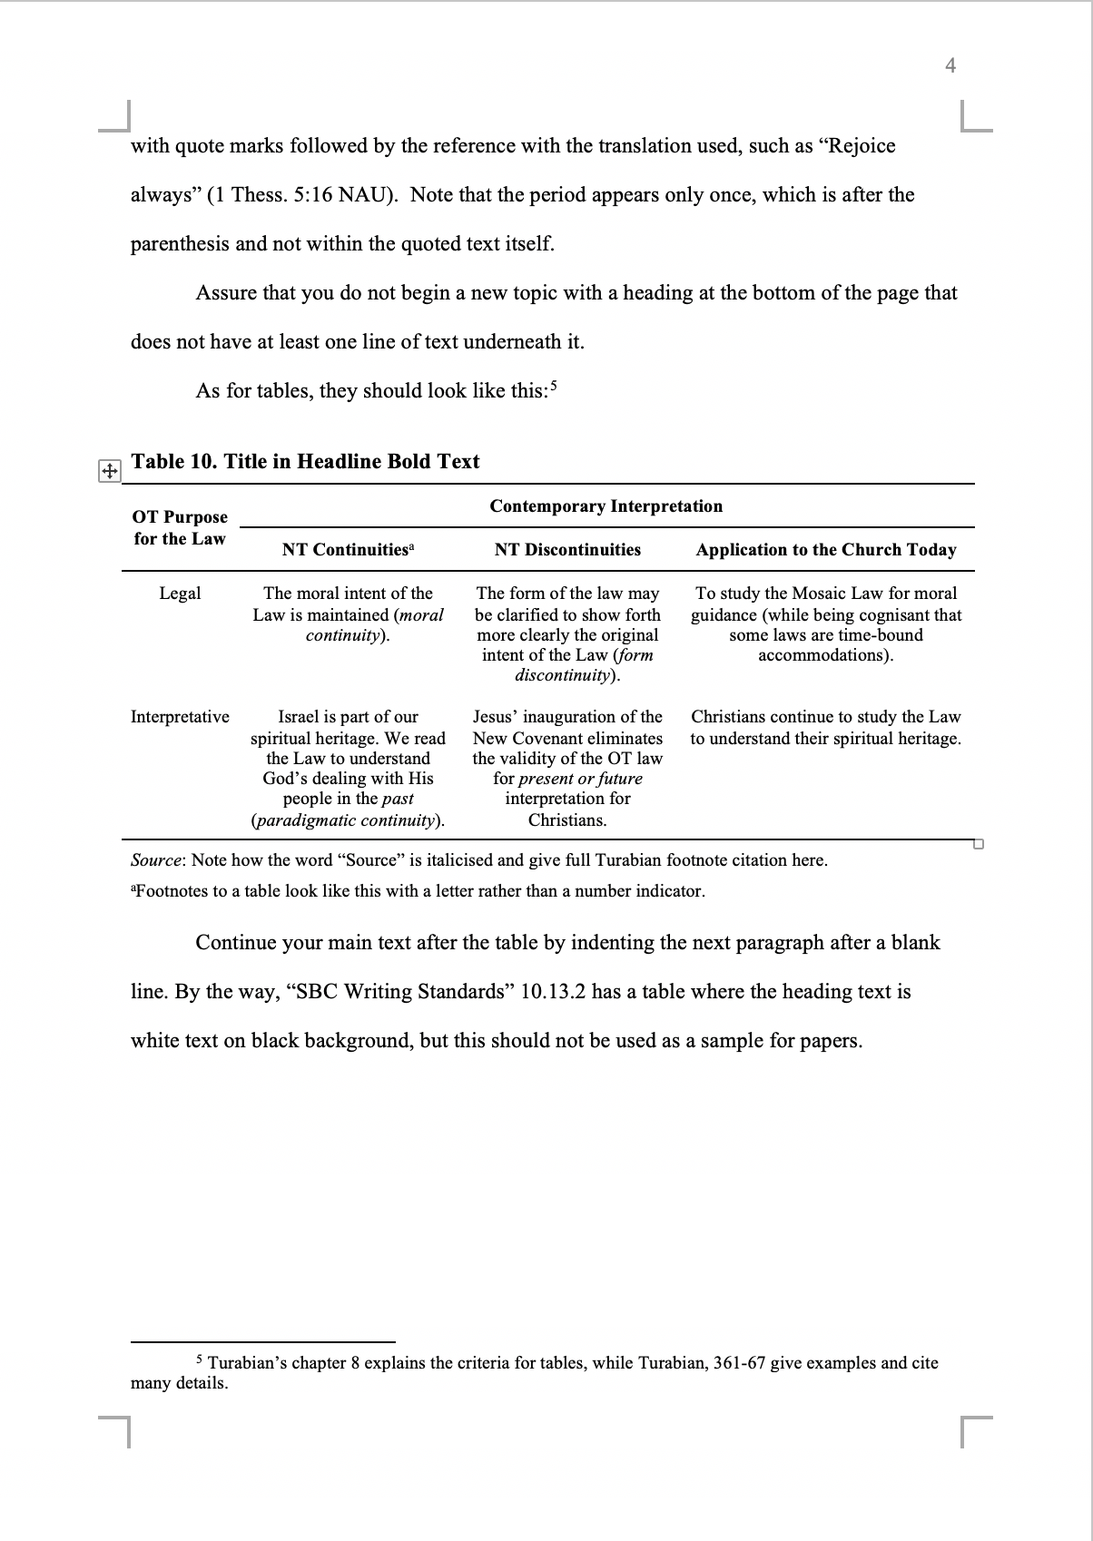
Common to Both Term Paper Templates
Heading Levels
Pagination
Block Quotes
Greek Text
Table Format
Footnote Format

Slide 20
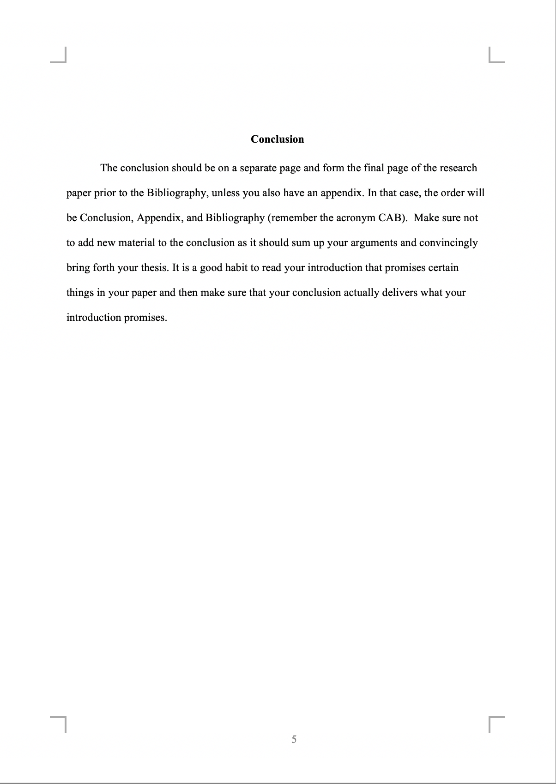
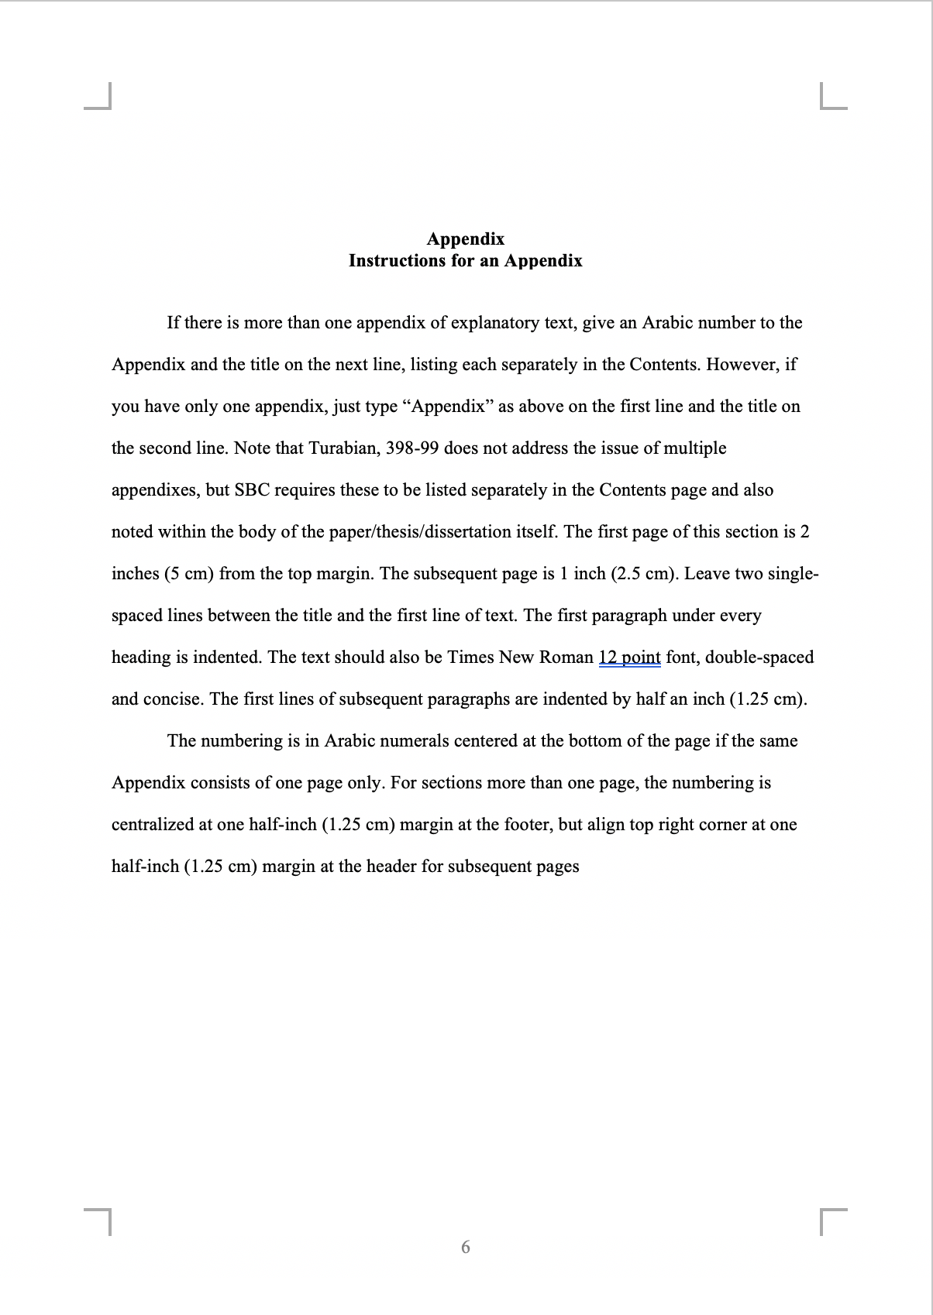
Common to Both Term Paper Templates
Headings
Appendix Format
Tips on writing the conclusion
Bottom Page Pagination

Slide 21
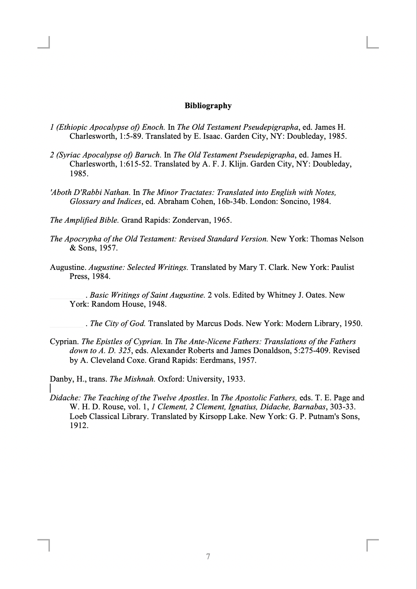
Common to Both Term Paper Templates
Sample Bibliography Entries

Slide 22

Turnitin
This website checks your original usage and prevents sloppy citations

Slide 23
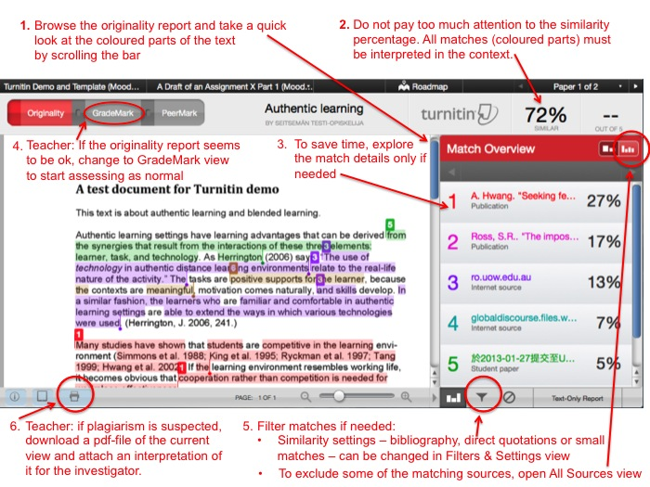
Turnitin

Slide 24

Grammarly.com

Slide 25


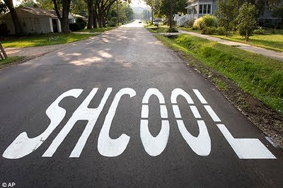
Grammar & Spelling

Slide 26


Grammar & Spelling

Slide 27



Grammar & Spelling
Proposals are returned if a grammatical or spelling error is found.

Slide 28
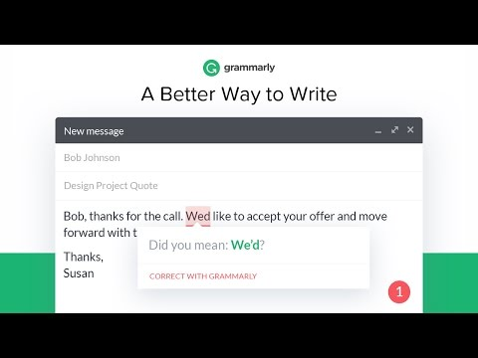
Grammarly.com

Slide 29

Dr. Jim & Jacqui Harmeling
Jim: Associate Pastor at Crossroads International Church
Jacqui: DMin Grammar Checker
Notes:
29
29
We don't need more unpredictable people in our lives. That’s why we brought on Jim and Jacqui Harmeling to our pastoral staff! They have been with us for nearly a year and their stable, godly lives have added much to our church.

Slide 30

Zotero

Slide 31
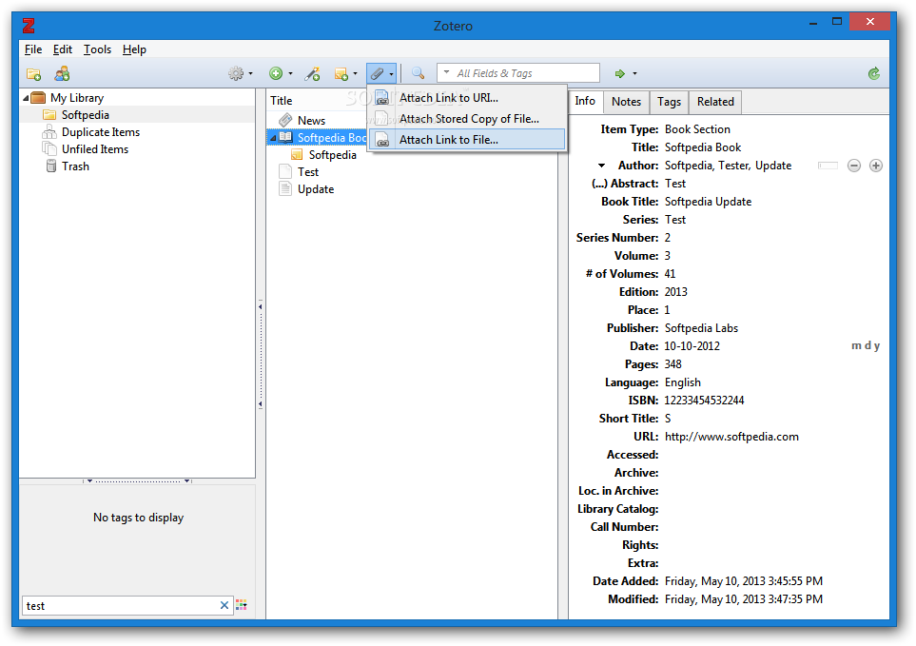
Zotero

Slide 32
Using Zotero for Research and Writing
SBC DMin Train-the-Trainers Session
By Fong Ming Hui, MDiv, ThM (SBC)
2019

Slide 33
What is Zotero?
An open-source bibliographic management software that aids students in research and writing
Completely free! ☺
Best to learn shortcuts and ‘tricks’ to maximize use
In the end: pick-and-mix may work best

Slide 34
Roadmap
Introduction & Installation
Zotero User Guide
Using Zotero for Writing
Q&A

Slide 35
Helpful Links
Zotero User Guide: https://www.zotero.org/static/download/zotero_user_guide.pdf
Some videos:
  For Windows users
  For Mac users

Slide 36
Black

Slide 37


Research & Writing link at BibleStudyDownloads.org
Get this presentation for free!
Notes:
Research & Writing (rw)

