Slide 1
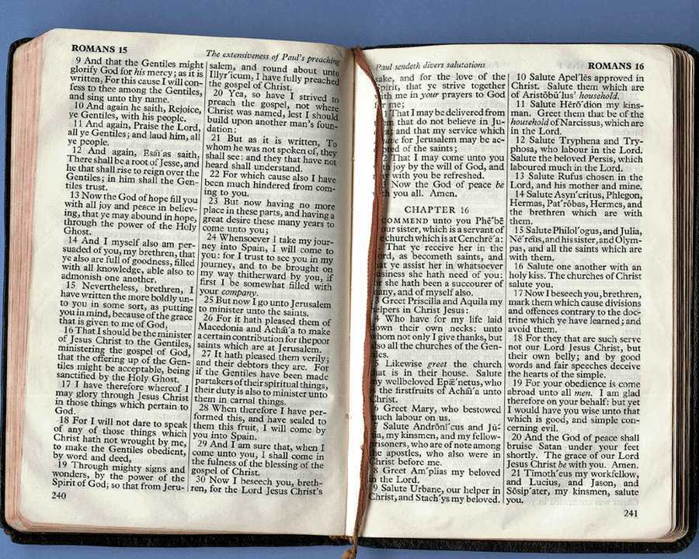
Homiletics
Dr Scott Wooddell
Eastridge Park Christian Church, Mesquite, Texas
Uploaded by Dr. Rick Griffith • Jordan Evangelical Theological Seminary
Files in many languages for free download at BibleStudyDownloads.org
Notes:
Welcome & thanks

Slide 2
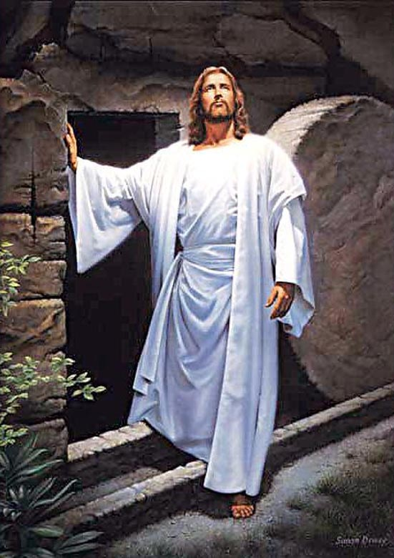
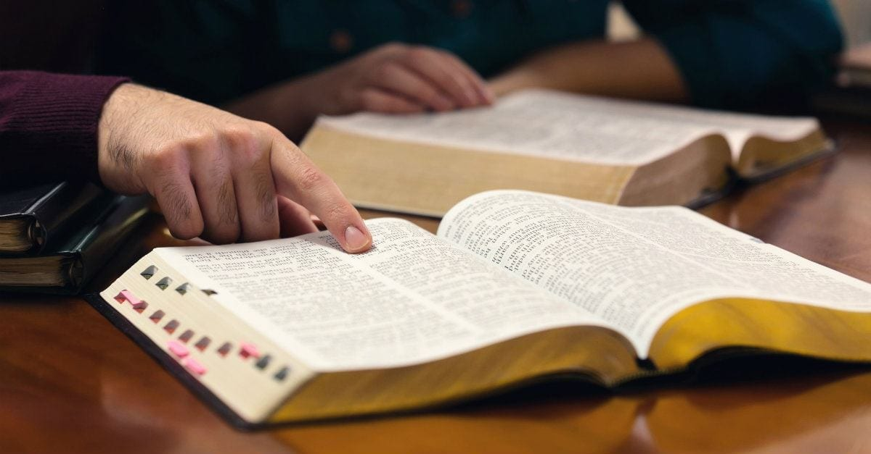
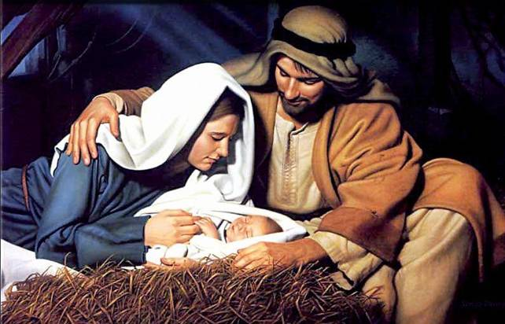
1 Corinthians 2:1-5
Luke 24:25-26

Slide 3
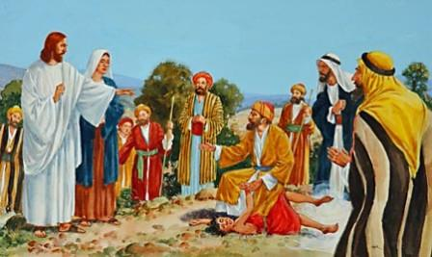
PREACHING
Jesus was a preacher.
The disciples were preachers.
Peter was a preacher.
Paul was a preacher.
Timothy was a preacher.

Slide 4

DEFINITION
"Expository preaching explains a passage in such a way to lead the congregation to a true and practical application of that passage"

Slide 5
DEFINITION
"Expository preaching is the systematic explanation of Scripture done on a week-by-week basis at the regular meeting of the congregation."

Slide 6

A More Detailed Definition
"Expository preaching is the proclamation (or communication) of a biblical concept, derived from and transmitted through a historical, grammatical, literary study of a passage in its context, which the Holy Spirit has first made vital in the personality of the preacher, and then through him applies to the experience of the congregation"
(Robinson, 20, adapted by him in a preaching seminar)

Slide 7
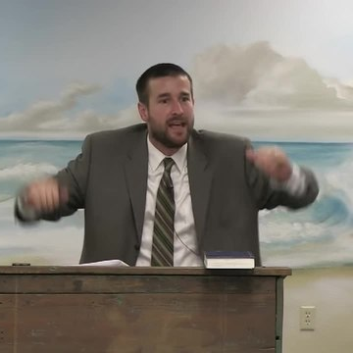
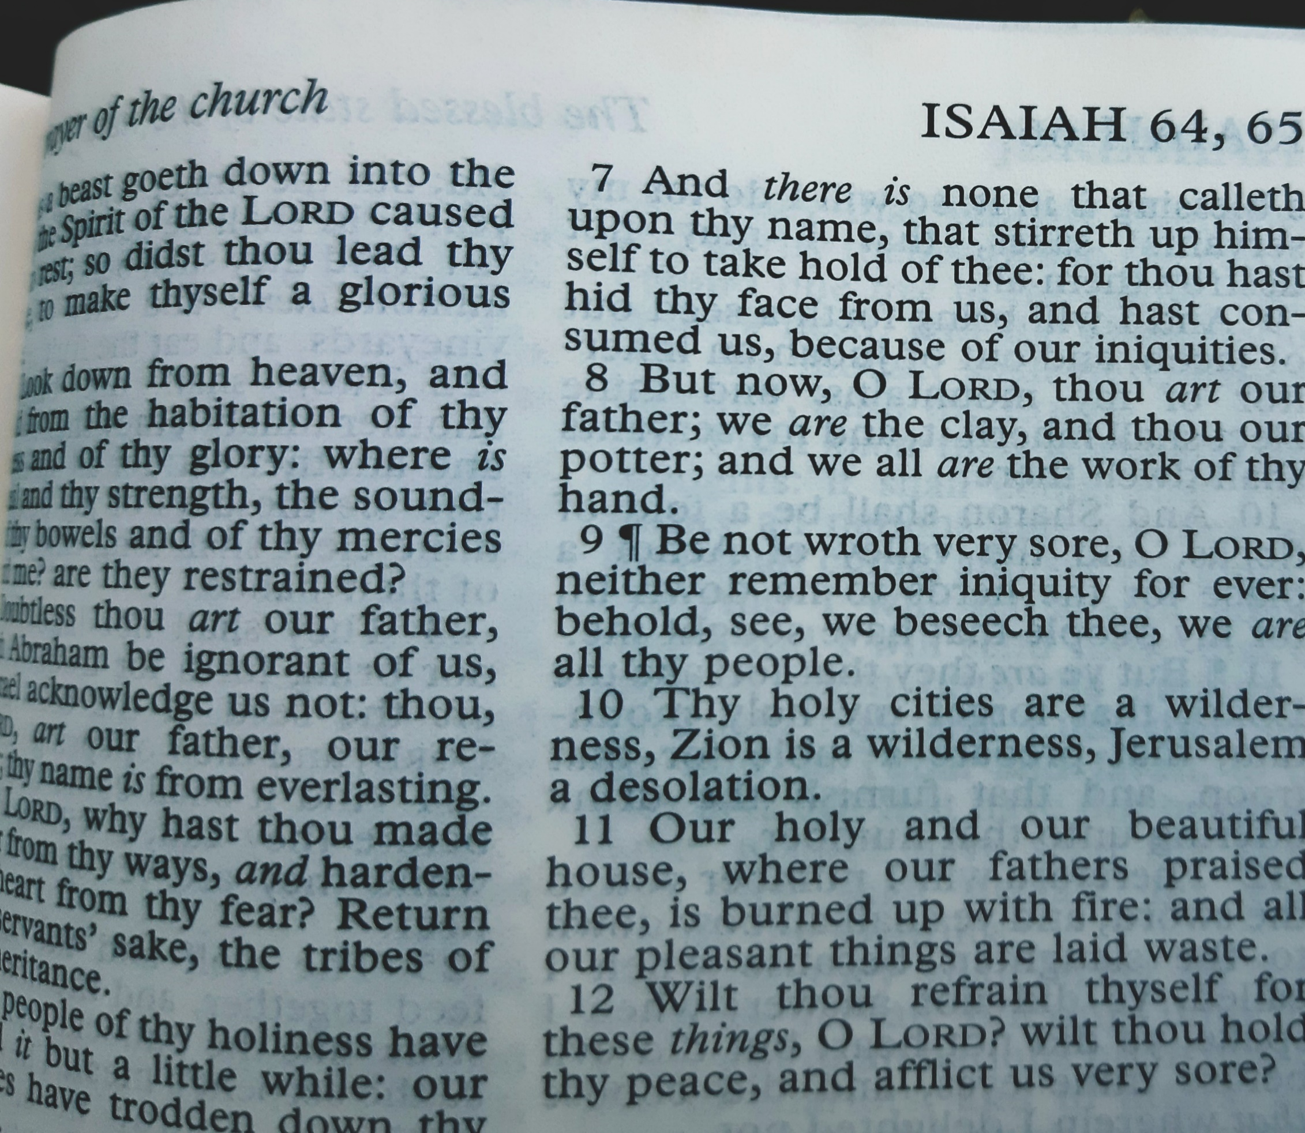
THE CHARACTERISTICS OF EXPOSITORY PREACHING
An expository sermon explains one primary passage of Scripture.

Slide 8
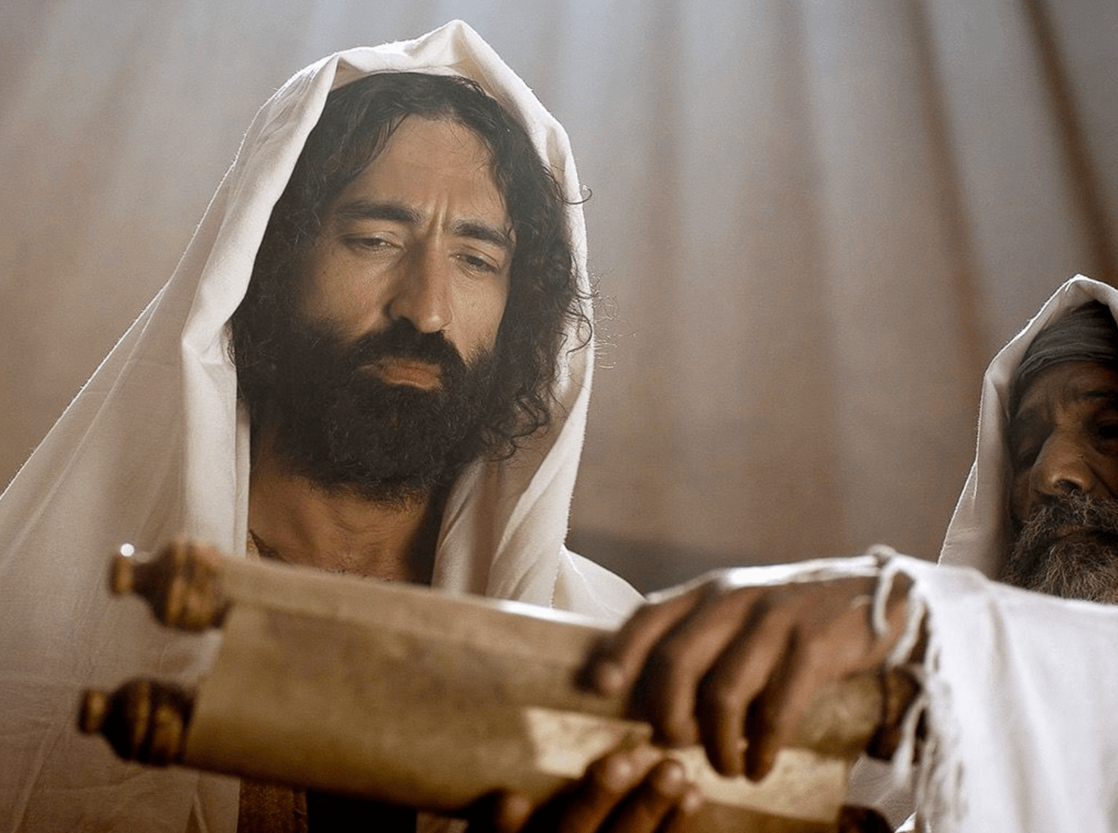
THE CHARACTERISTICS OF EXPOSITORY PREACHING
An expository sermon is faithful to the author’s original intention.
An expository sermon is faithful to the author’s original intention.

Slide 9
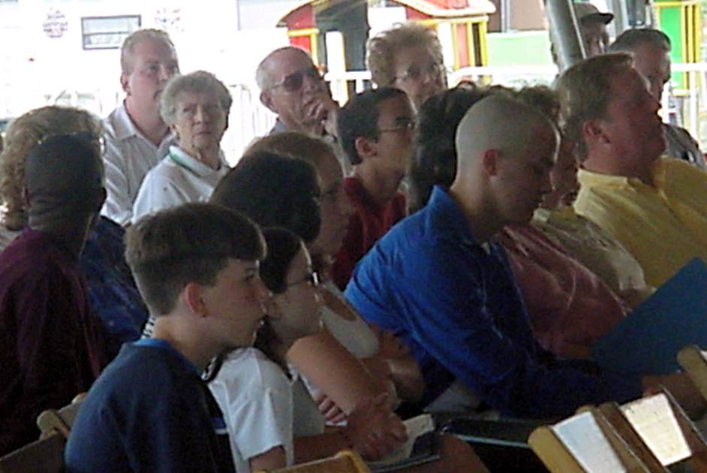
THE CHARACTERISTICS OF EXPOSITORY PREACHING
Take Home Truth
Text Idea
An expository sermon has cohesion and unity and centers around the Take Home Truth or Big Idea.

Slide 10
THE CHARACTERISTICS OF EXPOSITORY PREACHING
I. Relates to the Take Home Truth
II. Relates to the Take Home Truth
III. Relates to the Take Home Truth
The Take Home Truth stated
An expository sermon has movement and direction.

Slide 11
THE CHARACTERISTICS OF EXPOSITORY PREACHING
What the Listener should…
Know
Feel
Do
An expository sermon applies the passage.

Slide 12
THE IMPORTANCE OF EXPOSITORY PREACHING
Expository preaching is based on an inerrant text which shows God’s will.
Expository preaching guards against the misinterpretation of a passage.

Slide 13
THE IMPORTANCE OF EXPOSITORY PREACHING
Expository preaching has inherent authority and power.
Expository preaching directs the attention of the hearer to the Bible, not the preacher.

Slide 14
THE IMPORTANCE OF EXPOSITORY PREACHING
Expository preaching meets people’s true needs for spiritual nourishment.
Expository preaching best enables preaching through entire books of the Bible.

Slide 15
THE IMPORTANCE OF EXPOSITORY PREACHING
Expository preaching saves time by not having to decide what subject to speak on.

Slide 16
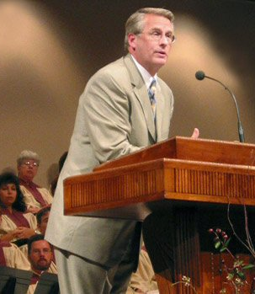
THE ADVANTAGES OF EXPOSITORY PREACHING
Confidence – We are more confident in our preaching when we know our sermon comes directly from the Word of God.

Slide 17
THE ADVANTAGES OF EXPOSITORY PREACHING
Balance – We preach a more balanced diet of sermons when we preach a series of sermons through entire books in the Bible.

Slide 18
THE ADVANTAGES OF EXPOSITORY PREACHING
Example – Preaching through a book in the Bible models systematic Bible study.

Slide 19
THE ADVANTAGES OF EXPOSITORY PREACHING
Saves time – Preaching through a book in the Bible saves the preacher time by not having to provide background material for each sermon.

Slide 20
THE ADVANTAGES OF EXPOSITORY PREACHING
Develops the preacher – Expository preaching keeps the preacher alert to certain areas where he may need personal growth.

Slide 21
THE ADVANTAGES OF EXPOSITORY PREACHING
Prepares congregation – Expository preaching prepares the congregation for next week’s sermon. They know what verses will be preached next week and they will come ready to learn.

Slide 22
THE ADVANTAGES OF EXPOSITORY PREACHING
Protection – When we preach a series of sermons through a book in the Bible, people cannot accuse us of directing our message toward them or other individuals.

Slide 23
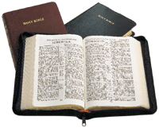
EXPOSITION BEST ENABLES PEACHING THROUGH ENTIRE BOOKS OF SCRIPTURE
2015 Sermon
2013 Sermon
Week 1
Week 4
Week 2
Week 5
2008 Sermon
Week 3
Week 6
2009 Sermon
Exposition
Most Preaching
2011 Sermon
2012 Sermon
Galatians
Galatians
2010 Sermon
2014 Sermon
2017 Sermon
Week 7
Week 10
2016 Sermon
Week 8
Week 11
Week 9
Week 12
Notes:
In a 10 year period, topical preaching might at best hit a third of the text in these two pages.
Systematic exposition provides a vehicle for people to get to know the big picture of each biblical book and cover every passage.

Slide 24

THE GOALS OF EXPOSITORY PREACHING
Evangelism – God uses expository preaching to reach the lost because it is the preaching of His Word, which will never return void.

Slide 25
THE GOALS OF EXPOSITORY PREACHING
Discipleship – The goal of preaching is to help people become more like Christ.

Slide 26
THE GOALS OF EXPOSITORY PREACHING
Meet Human Needs – Expository sermons relate God’s Word to the congregation in a way they can understand and learn and grow. Expository preaching feeds the flock and meets their spiritual needs.

Slide 27
THE GOALS OF EXPOSITORY PREACHING
Declare the Will of God – Expository preaching confidently declares God’s will from God’s Word and moves people toward obeying it.

Slide 28
THE GOALS OF EXPOSITORY PREACHING
Motivate Faith, Obedience, & Growth – Expository preaching presents a passage of Scripture in a relevant way that arouses the congregation to take action.

Slide 29
THE GOALS OF EXPOSITORY PREACHING
Teaching Doctrine or Theology – Expository preaching teaches the doctrines of the Bible, then applies that doctrine to the Believer’s daily life.

Slide 30
THE GOALS OF EXPOSITORY PREACHING
Worship God & Exalt His Name – Expository preaching directs people’s attention to the Lord and His great Name, leading them to worship and honor the Lord.

Slide 31
THE GOALS OF EXPOSITORY PREACHING
Convict of Sin and Rebuild on Grace – Because expository preaching is based on God’s Word, it convicts people of sin and directs them toward righteousness (2 Timothy 3:16).

Slide 32
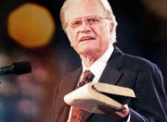
THE DIFFICULTIES OF EXPOSITORY PREACHING
Requires more study – Expository sermons require thorough study of the text including word studies and cultural influences.

Slide 33
THE DIFFICULTIES OF EXPOSITORY PREACHING
Requires context – Expository sermons require the preacher pay attention to the larger context of the book to ensure accuracy.

Slide 34
THE DIFFICULTIES OF EXPOSITORY PREACHING
Requires literary form – Expository sermons require the preacher to consider the literary form of the passage. Is the passage narrative, poetry, parable, prophecy or apocalyptic? This influences the interpretation of the passage.

Slide 35
THE DIFFICULTIES OF EXPOSITORY PREACHING
Requires discernment – Expository sermons require the preacher to discern the Main Idea of the text.

Slide 36
Four objectives:
A Sermon that is…
True
Interesting
Clear
Relevant

Slide 37
1. STUDY THE PASSAGE

Slide 38
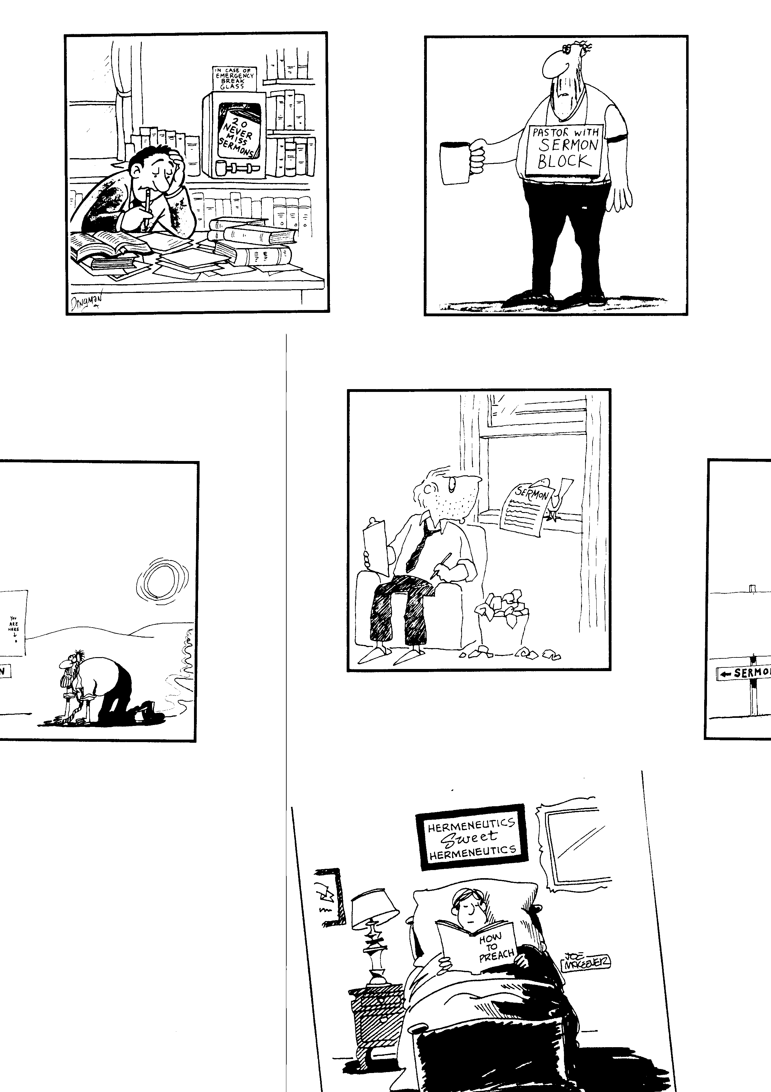
Study is hard work

Slide 39
Bird Delivery

Slide 40
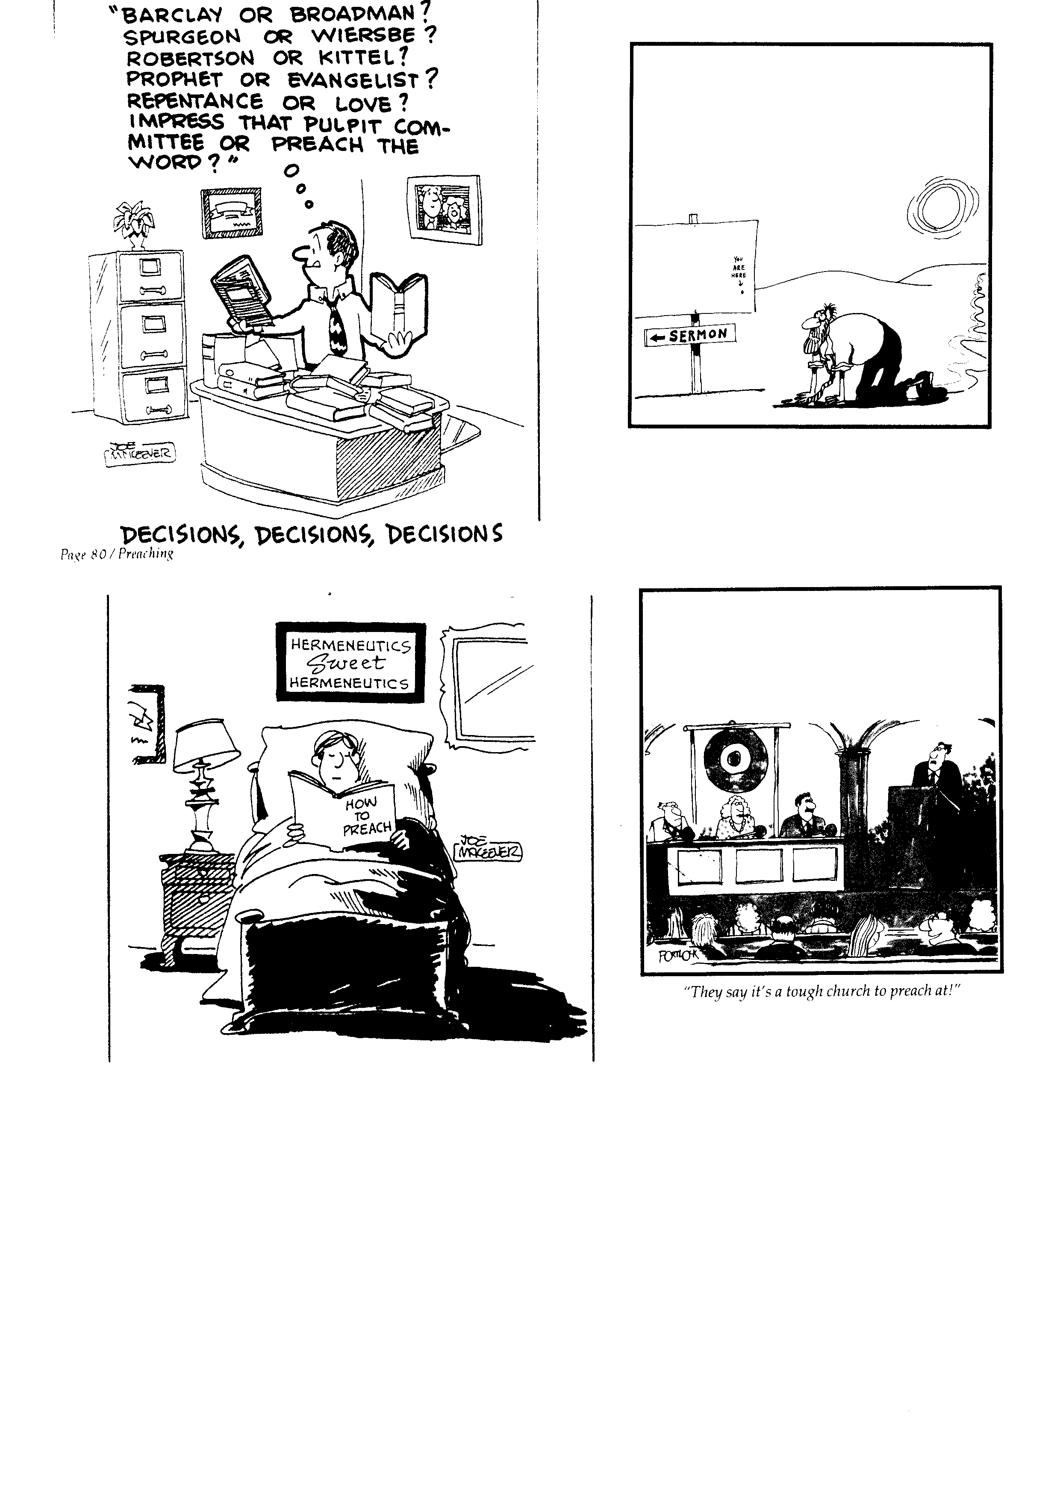
Desert Sermon
MARK 4:35-41
Context
Purpose
Background
You are here!
← BÀI GIẢNG

Slide 41
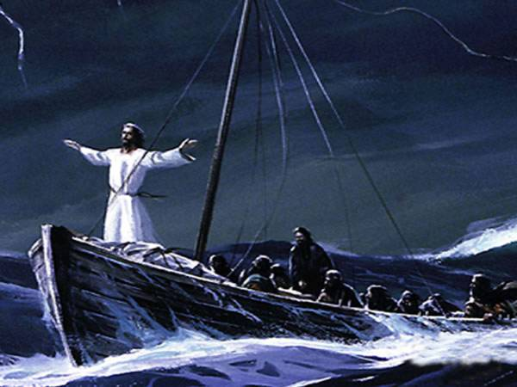
Mark 4:35-41
Who?
What?
Where?
When?
Why?

Slide 42
2. OUTLINE THE PASSAGE

Slide 43
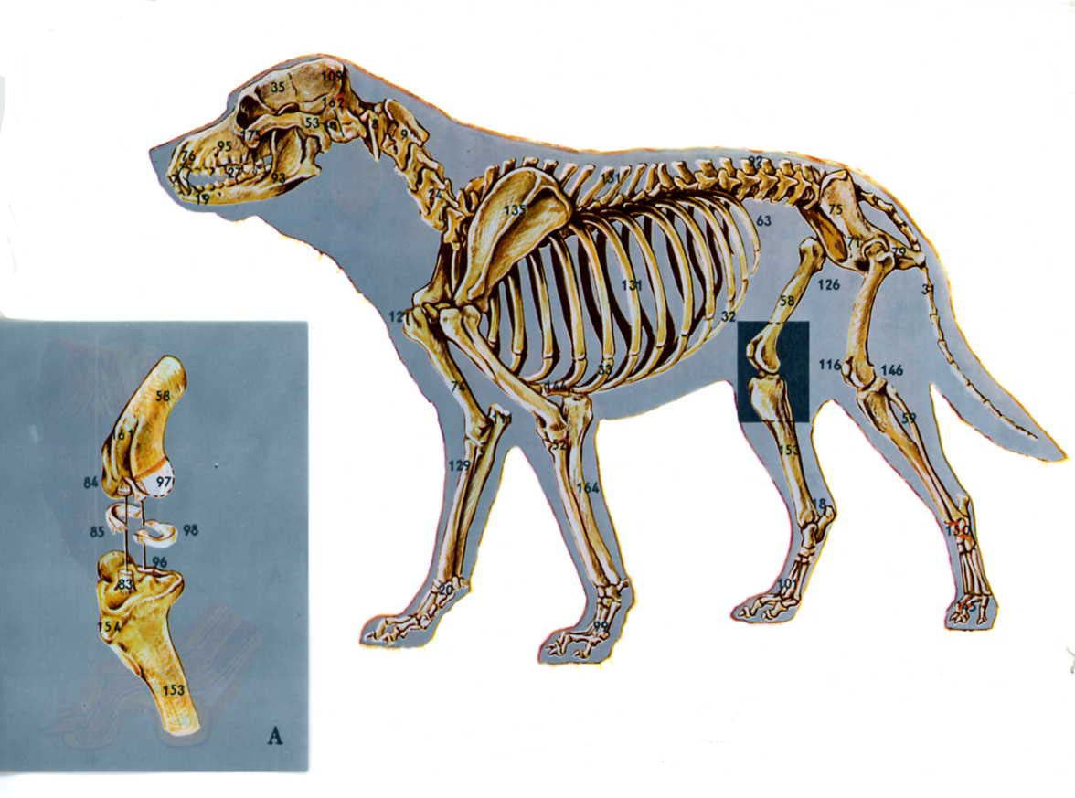

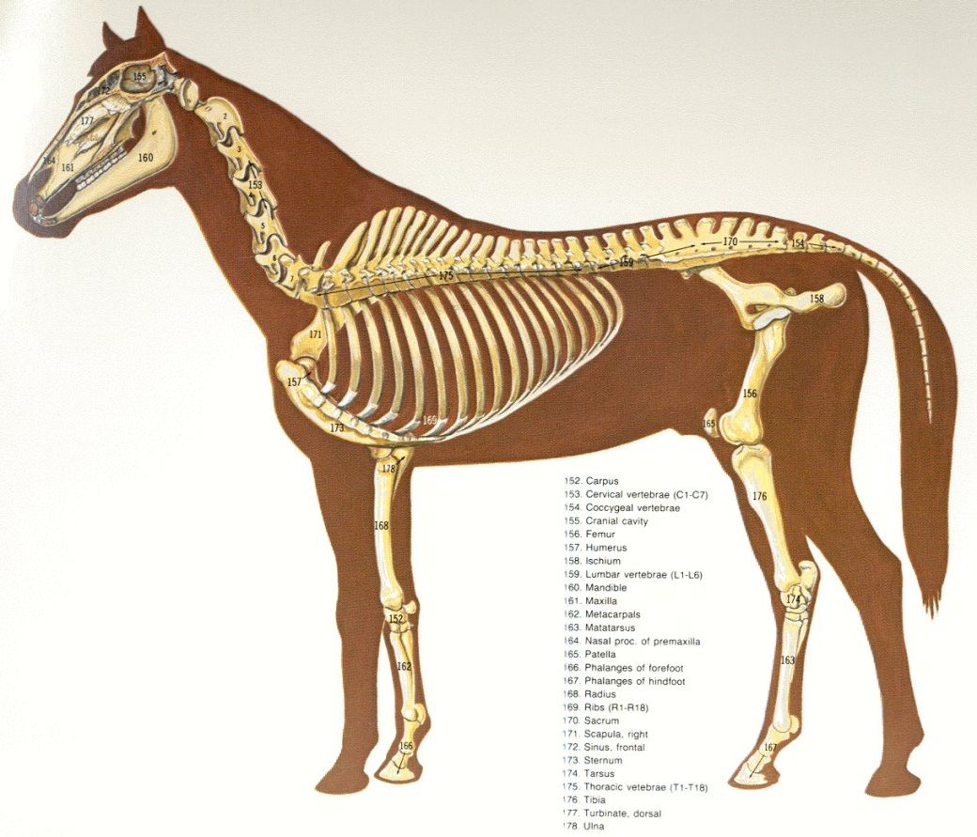
All Creatures need a skeleton
Sermons Too!

Slide 44
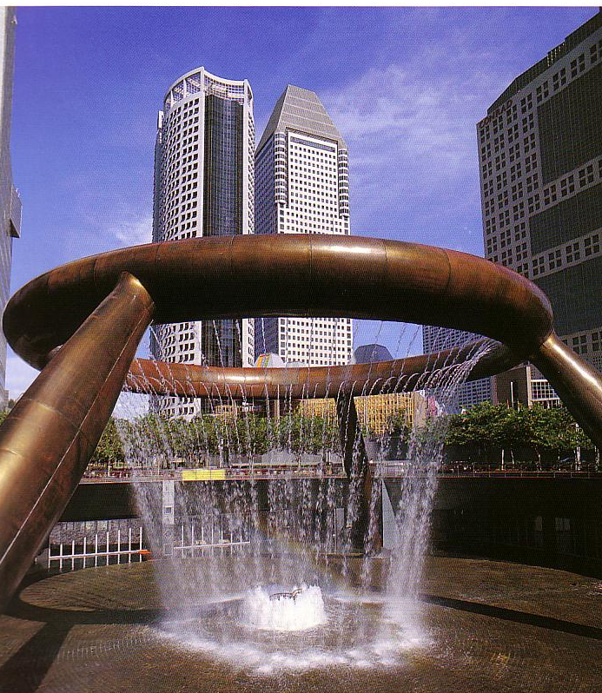
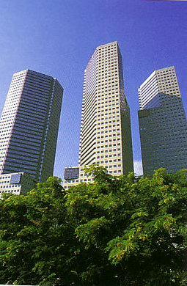
BUILDINGS NEED STRUCTURE TOO
Sermons need structure too!

Slide 45
Why is a sermon outline important?
A Good Outline…
Shows the whole sermon at once to see if it flows naturally.
Clarifies superior from inferior parts.
Help you put parts in the proper order.
Shows you where you need supporting material

Slide 46
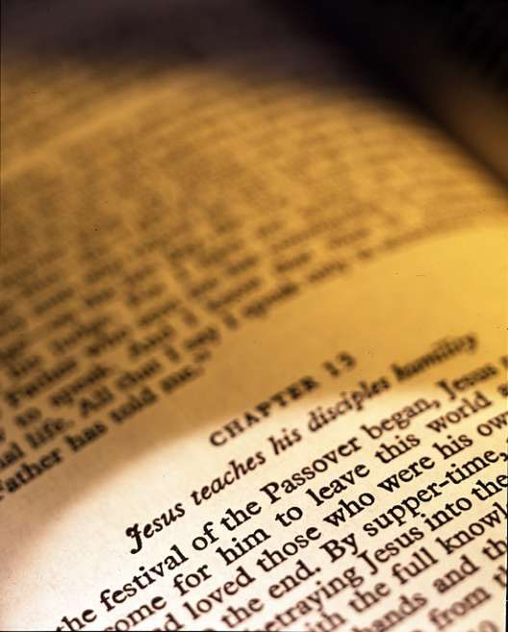
HOW TO OUTLINE CORRECTLY
Distinguish ideas

Slide 47


Superior Point Outlining
I. _________________ (c. 5)
A. _________________ (c. 6)
Why is this incorrect ?
B. _________________ (c. 7)
I. _________________ (cc. 5-7)
A. _________________ (c. 5)
B. _________________ (cc. 6-7)
1. _________________ (c. 6)
2. _________________ (c. 7)

Slide 48
HOW TO OUTLINE CORRECTLY
Distinguish Ideas
Consistent symbols

Slide 49
HOW TO OUTLINE CORRECTLY
Distinguish Ideas
Consistent symbols
Transitions

Slide 50
HOW TO OUTLINE CORRECTLY
Distinguish Ideas
Consistent symbols
Transitions
Full sentences

Slide 51
DON’T OUTLINE LIKE THIS (Acts 6:1-6)
MI: Church growth problems
Give Full Sentences!
I. Their lay leadership
A. Growing (1a)
B. Food (1b)
C. Leaders (2-6)
II. Our lay leaders (MI)
A. Our growth
B. Our key problems
C. Our solutions

Slide 52
HOW TO OUTLINE CORRECTLY
Distinguish Ideas
Consistent symbols
Transitions
Full sentences
Will not use questions

Slide 53
QUALITIES OF A GOOD OUTLINE
Unity
Balance
Movement

Slide 54
Mark 4:35-41
I. Mark 4:35-36
II. Mark 4:37-38
III. Mark 4:39-41

Slide 55
Mark 4:35-41
I. Jesus commands the disciples to cross the sea and they obey and the weather is good (v. 35-36)
II. The disciples find themselves in a storm causing them great fear and they awaken Jesus (v. 37-38)
III. Jesus rebukes the storm and encourages the disciples to trust God’s power (v. 39-41)

Slide 56
I. Jesus commands the disciples to cross the sea and they obey and the weather is good (v. 35-36)
A. Jesus commands the disciples to cross the sea(v. 35)
B. The disciples obey (v. 36a)
C. The weather is good (v. 36b)
PASSAGE OUTLINE: Mark 4:35-41

Slide 57
I. Jesus commands the disciples to cross the sea and they obey and the weather is good (v. 35-36)
A. Jesus commands the disciples to cross the sea(v. 35)
B. The disciples obey (v. 36a)
C. The weather is good (v. 36b)
II. The disciples find themselves in a storm causing them great fear and they awaken Jesus (v. 37-38)
A. The disciples find themselves in a storm(v. 37)
B. The disciples are filled with great fear (v. 38a)
C. The disciples awaken Jesus (v. 38b)
PASSAGE OUTLINE: Mark 4:35-41

Slide 58
I. Jesus commands the disciples to cross the sea and they obey and the weather is good (v. 35-36)
A. Jesus commands the disciples to cross the sea(v. 35)
B. The disciples obey (v. 36a)
C. The weather is good (v. 36b)
II. The disciples find themselves in a storm causing them great fear and they awaken Jesus (v. 37-38)
A. The disciples find themselves in a storm(v. 37)
B. The disciples are filled with great fear (v. 38a)
C. The disciples awaken Jesus (v. 38b)
III. Jesus rebukes the storm and expresses His disappointment with His disciples (v. 39-41)
A. Jesus rebukes the storm (v. 39a)
B. The sea and wind become calm (v. 39b)
C. Jesus expresses His disappointment with His disciples (v. 40-41)
PASSAGE OUTLINE: Mark 4:35-41

Slide 59
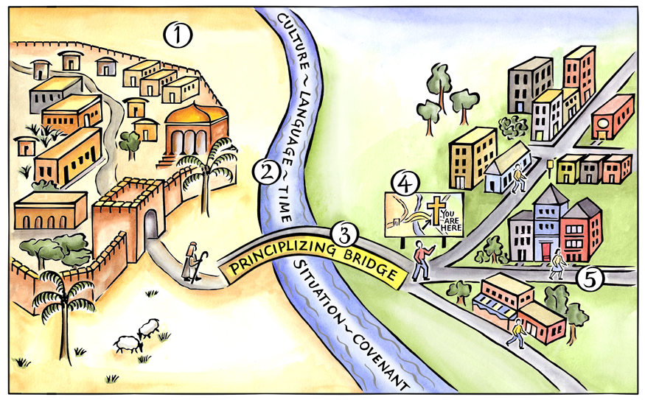
Mark 4:35-41
PASSAGE OUTLINE
TRUTH OUTLINE
2025
Notes:
Above is a pictorial representation of our consistent approach to biblical interpretation. We call it the Interpretative Journey. There are 5 steps on this journey:
Grasping the Text in Their Town
Measuring the Width of the River to Cross
Crossing the Principlizing Bridge
Consult the Biblical Map
Grasping the Text in Our Town
By embarking on this journey we commit to the goal of grasping the meaning of text. We do not create meaning out of a text; rather, we seek to find the meaning that is already there.

Slide 60
I. Jesus sends His people on a mission and they obey and all looks good (v. 35-36)
A. Jesus sends His people on a mission
B. The Lord’s people obey
C. Everything looks good
II. Sometimes the Lord’s people face opposition and are fearful (v. 37-38)
A. Sometimes the Lord’s people face opposition
B. The Lord’s people are filled with fear
C. The Lord’s people complain
III Jesus rebukes Satan and encourages His people to trust God’s power (v. 39-41)
A. Jesus rebukes Satan’s opposition
B. Satan submits and opposition is removed
C. Jesus encourages His people to trust God’s power
TRUTH OUTLINE: Mark 4:35-41

Slide 61
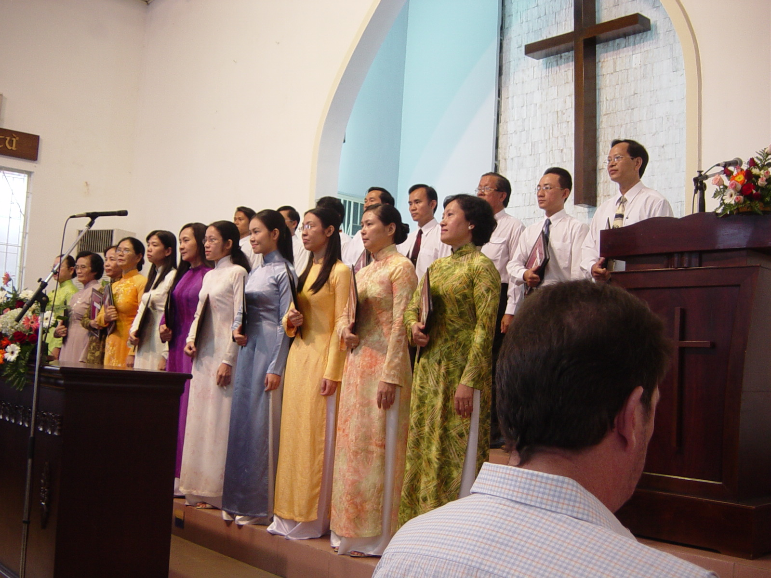
Mark 4:35-41
PASSAGE OUTLINE
SERMON OUTLINE
TRUTH OUTLINE
Notes:
Above is a pictorial representation of our consistent approach to biblical interpretation. We call it the Interpretative Journey. There are 5 steps on this journey:
Grasping the Text in Their Town
Measuring the Width of the River to Cross
Crossing the Principlizing Bridge
Consult the Biblical Map
Grasping the Text in Our Town
By embarking on this journey we commit to the goal of grasping the meaning of text. We do not create meaning out of a text; rather, we seek to find the meaning that is already there.

Slide 62
I. When the Lord sends us on a mission, we obey (v. 35-36)
A. The Lord sends us on missions
B. We obey
C. All looks good
II. When we obey, sometimes things go wrong and we are afraid (v. 37-38)
A. We obey and sometimes things go wrong
B. We are filled with great fear
C. We complain to the Lord
III When this happens we resist Satan’s opposition and trust God’s power (v. 39-41)
A. When Satan’s opposes us we resist him
B. Satan flees and the opposition is removed
C. The Lord encourages us to trust God’s power
SERMON OUTLINE: Mark 4:35-41

Slide 63
MARK 4:35-41
I. Jesus commands the disciples to cross the sea and they obey and the weather is good (v. 35-36)
A. Jesus commands the disciples to cross the sea(v. 35)
B. The disciples obey (v. 36a)
C. The weather is good (v. 36b)
I. Jesus sends His people on a mission and they obey and all looks good (v. 35-36)
A. Jesus sends His people on a mission
B. The Lord’s people obey
C. Everything looks good
I. When the Lord sends us on a mission, we obey (v. 35-36)
A. The Lord sends us on missions
B. We obey
C. All looks good

Slide 64
MARK 4:35-41
II. The disciples find themselves in a storm causing them great fear and they awaken Jesus (v. 37-38)
A. The disciples find themselves in a storm(v. 37)
B. The disciples are filled with great fear (v. 38a)
C. The disciples awaken Jesus (v. 38b)
II. Sometimes the Lord’s people face opposition and are fearful (v. 37-38)
A. Sometimes the Lord’s people face opposition
B. The Lord’s people are filled with fear
C. The Lord’s people complain
II. When we obey, sometimes things go wrong and we are afraid (v. 37-38)
A. We obey and sometimes things go wrong
B. We are filled with great fear
C. We complain to the Lord

Slide 65
MARK 4:35-41
III. Jesus rebukes the storm and expresses His disappointment with His disciples (v. 39-41)
A. Jesus rebukes the storm (v. 39a)
B. The sea and wind become calm (v. 39b)
C. Jesus expresses His disappointment with His disciples (v. 40-41)
III Jesus rebukes Satan and encourages His people to trust God’s power (v. 39-41)
A. Jesus rebukes Satan’s opposition
B. Satan submits and opposition is removed
C. Jesus encourages His people to trust God’s power
III When this happens we resist Satan’s opposition and trust God’s power (v. 39-41)
A. When Satan’s opposes us we resist him
B. Satan flees and the opposition is removed
C. The Lord encourages us to trust God’s power

Slide 66
Mark 4:35-41
PASSAGE OUTLINE
SERMON OUTLINE
TRUTH OUTLINE
Notes:
Above is a pictorial representation of our consistent approach to biblical interpretation. We call it the Interpretative Journey. There are 5 steps on this journey:
Grasping the Text in Their Town
Measuring the Width of the River to Cross
Crossing the Principlizing Bridge
Consult the Biblical Map
Grasping the Text in Our Town
By embarking on this journey we commit to the goal of grasping the meaning of text. We do not create meaning out of a text; rather, we seek to find the meaning that is already there.

Slide 67
3. TAKE HOME TRUTH
(3. MAIN IDEA)

Slide 68
Other names for the Take Home Truth
Homiletic idea
Định Đề
Central Idea
Biblical Concept
Central Proposition of the Text (CPC)
Main Idea
Dominant Idea
Main Thought
Central Thought
Sermon Idea
Thesis Statement
Subject-Complement Statement

Slide 69
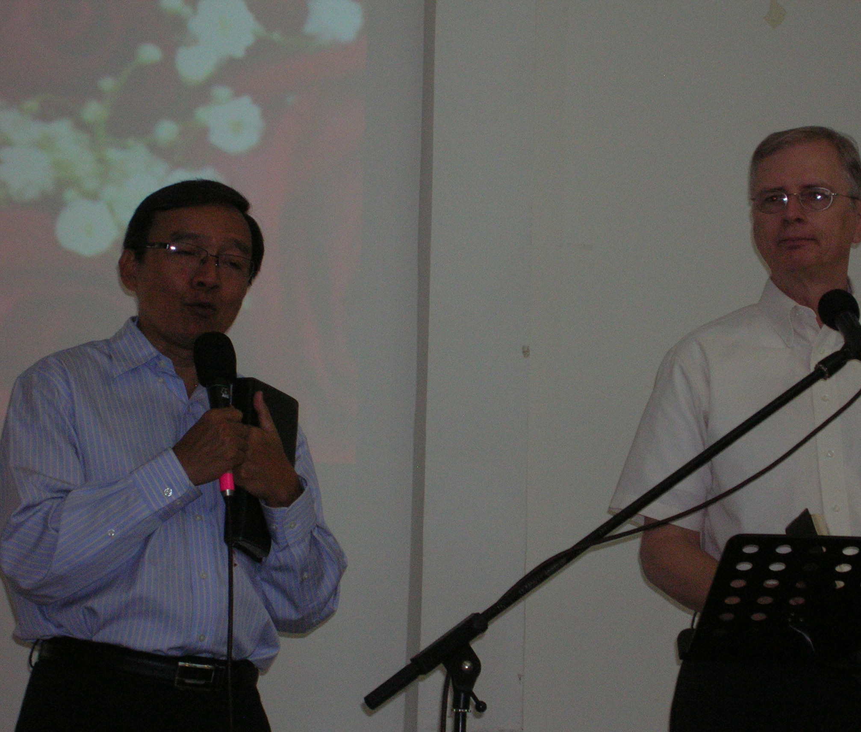
TAKE HOME TRUTH
Ideally, each sermon is the explanation, interpretation and application of a single dominant idea supported by other ideas, all drawn from one passage or several passages of Scripture.

Slide 70
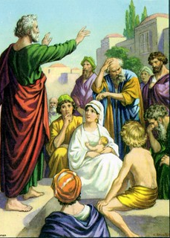
TAKE HOME TRUTH
Acts 2:36
“God has made this Jesus whom you crucified, both Lord and Christ.”

Slide 71
TAKE HOME TRUTH
Acts 7:51
“You are just like your fathers; You always resist the Holy Spirit.”

Slide 72
TAKE HOME TRUTH
Acts 13:38
“I want you to know that through Jesus the forgiveness of sins is proclaimed to you.”

Slide 73
TAKE HOME TRUTH
Acts 17:30
“In the past God overlooked such ignorance, but now He commands all people everywhere to repent.”

Slide 74


TAKE HOME TRUTH
Subject
(Theme)
Complement
(Thrust)
The Question
Take Home Truth

Slide 75
4. THE THREE DEVELOPMENTAL QUESTIONS

Slide 76
THREE DEVELOPMENTAL QUESTIONS
38
There are only three things that can be done with any given idea or statement, whether it be the main idea of the message or one of the points within the outline.
Explain it

Slide 77
THREE DEVELOPMENTAL QUESTIONS
38
There are only three things that can be done with any given idea or statement, whether it be the main idea of the message or one of the points within the outline.
Explain it
Prove it

Slide 78
ASK THE RIGH QUESTIONS
There are three reasons why people do not believe a passage in the Bible:
They don’t see the cause effect connection.
It seems contrary to life.
Something else comes up that is more important.

Slide 79
THREE DEVELOPMENTAL QUESTIONS
38
There are only three things that can be done with any given idea or statement, whether it be the main idea of the message or one of the points within the outline.
Explain it
Prove it
Apply it

Slide 80
SUPPORTING MATERIAL

Slide 81
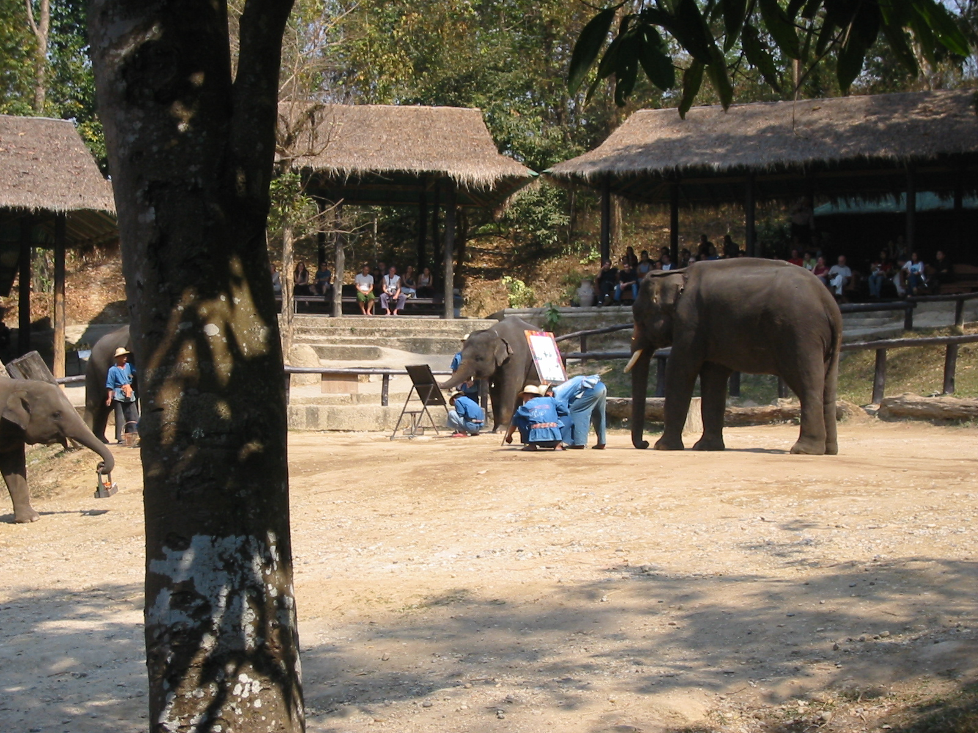
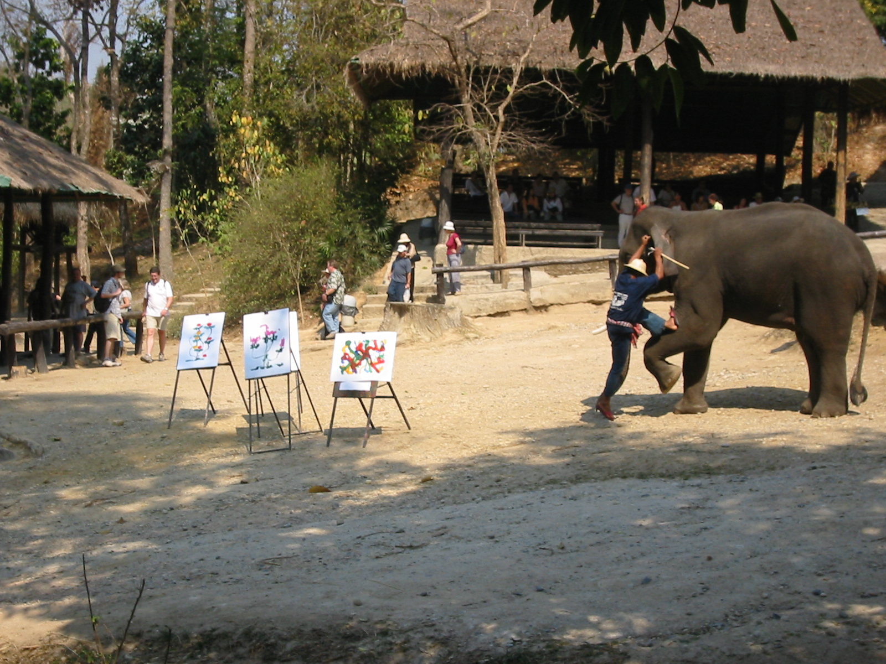
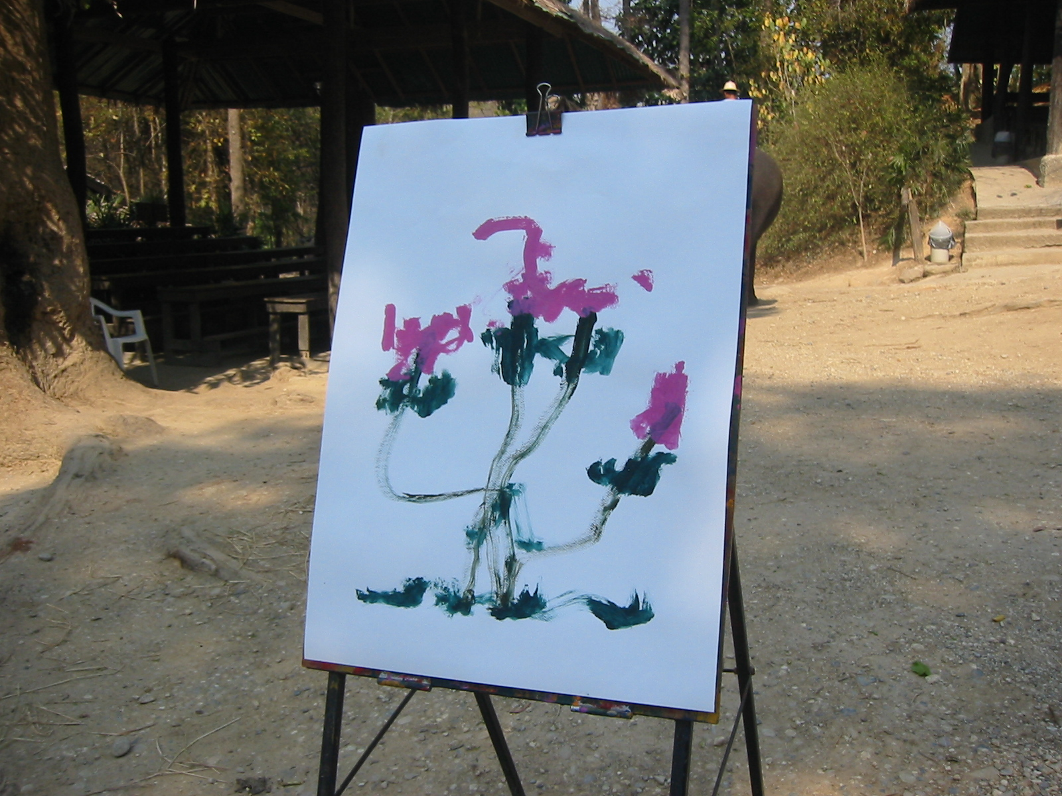
ILLUSTRATIONS
If elephants can illustrate, You can too!
An illustration is a story from outside our lives that helps us understand a Biblical truth.
Notes:
In Thailand elephants paint pictures.

Slide 82

HOW TO GIVE GOOD ILLUSTRATIONS
A. Draw illustrations from your listener’s world, not yours!
World of the listener
(Them)
World of the preacher
(You)
1
2
3
4
Where are your best illustrations?

Slide 83
HOW TO GIVE GOOD ILLUSTRATIONS
A. Draw illustrations from your listener’s world, not yours.
B. Get you outline done early each week. It gives time to find good illustrations.
C. Vary the type of illustrations used.
D. Don’t tell stories – Relive them!

Slide 84

DICTIONARY DEFINITIONS
Defining a word from the dictionary helps us understand the meaning of a word. Then follow the dictionary definition with an example.
The dictionary defines ‘patience’ as, ‘The will or ability to wait or endure without complaining.’
“Patience is reading a book a second time to your children at bedtime.”

Slide 85
DICTIONARY DEFINITIONS
Defining a word from the dictionary helps us understand the meaning of a word. Then follow the dictionary definition with an example.
The dictionary defines ‘patience’ as, ‘The will or ability to wait or endure without complaining.’
“Patience is waiting at a stop light without beeping your horn.”

Slide 86
DICTIONARY DEFINITIONS
Defining a word from the dictionary helps us understand the meaning of a word. Then follow the dictionary definition with an example.
The dictionary defines ‘patience’ as, ‘The will or ability to wait or endure without complaining.’
“Patience is smiling while waiting in a long line.”

Slide 87
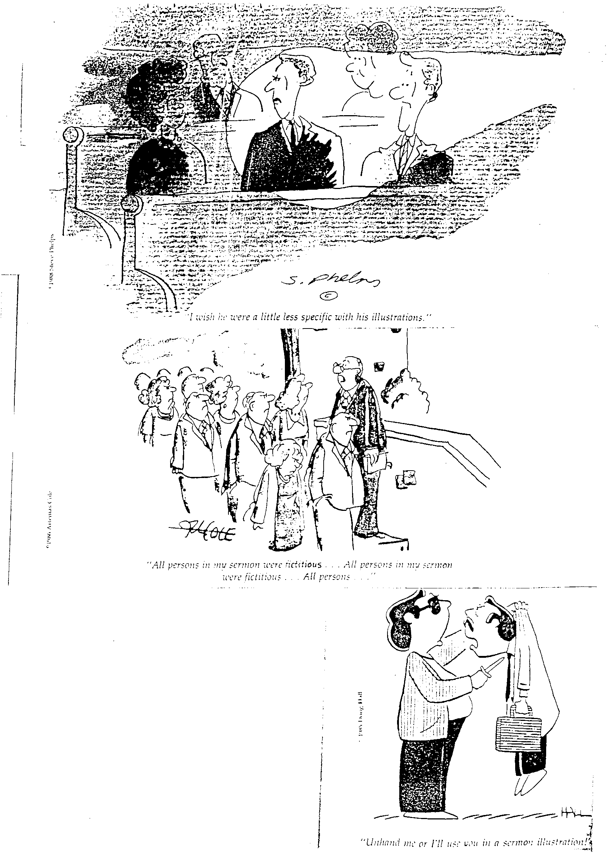
Get approval before using certain individuals in illustrations.

Slide 88
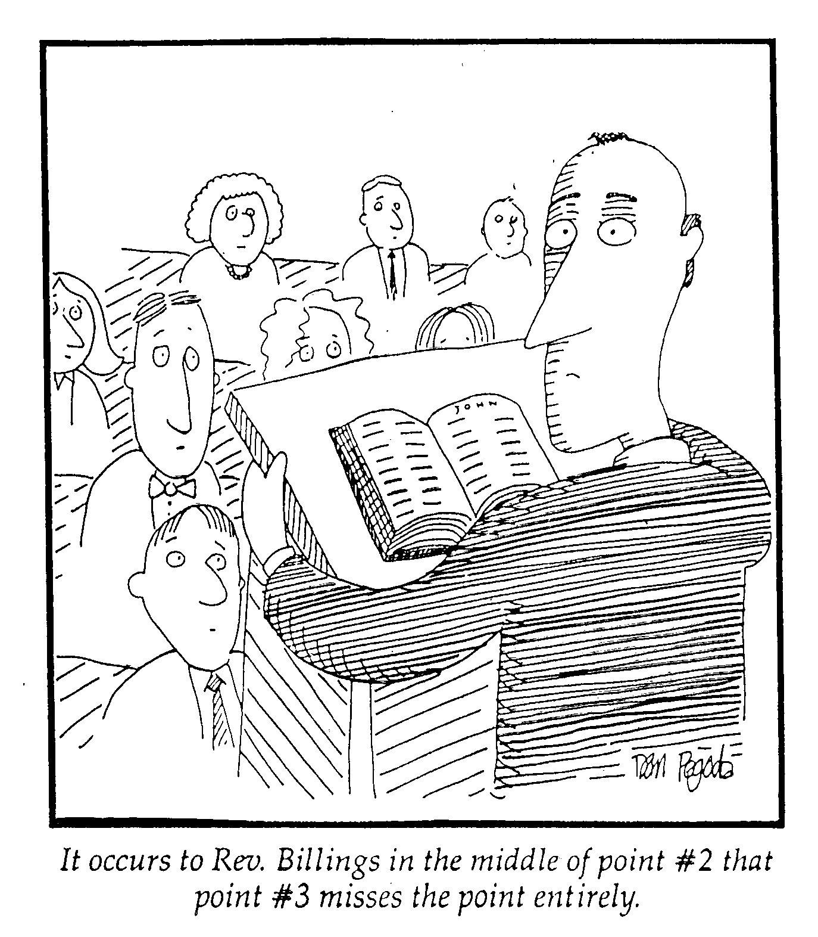
DON’T BE OFFENSIVELY PRECISE
“I wish he was a little less specific with his illustrations.”

Slide 89
CHOOSE EXAMPLES CAREFULLY
“All persons in my sermon were fictitious…”
“All persons in my sermon were fictitious…”
“All persons in my sermon were fictitious…”

Slide 90
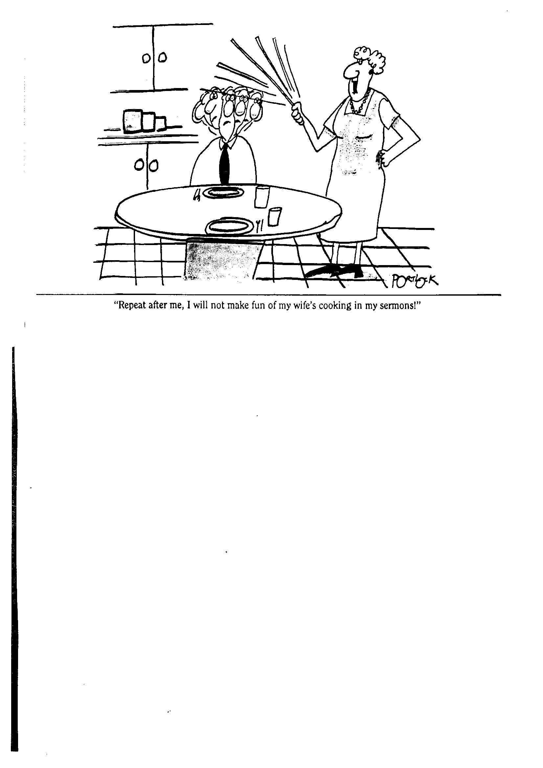
GUARD YOUR MARRIAGE!
“Repeat after me, I will not make fun of my wife’s cooking in my sermons!”

Slide 91
STATISTICS
The science of collecting and analyzing numerical data. When using statistics:
Statistics must be credible and documented.
Use round numbers.
Create a picture of the statistic.
Statistics can be good, but most people today are not impressed with statistics. We hear them all the time and they are often manipulated to prove a point.

Slide 92
QUOTATIONS
Quotations – Quotations can be helpful in the right circumstances. There are only two reasons to quote someone:
The language is powerful and memorable.
The speaker is famous and well respected by your listeners.
All quotations must be short.

Slide 93
PARALLEL PASSAGES
We refer to parallel passages to help explain the sermon text. There are three occasions when parallel passages are helpful:
When the sermon text refers to another passage (Matthew 12:3-5; Romans 4:3).
When you feel your listeners will doubt your interpretation of a difficult passage.
When you wish to demonstrate that the point you are making is frequently found in the Bible.

Slide 94
BIBLCIAL ILLUSTRATIONS
We can refer our listeners to individuals in the Bible who illustrate our point. Biblical illustrations are helpful when our listeners are Christians. If many of our listeners are non-Christian, we may want to find another way to illustrate our point.

Slide 95
5. How Should You Structure Your Sermon?

Slide 96
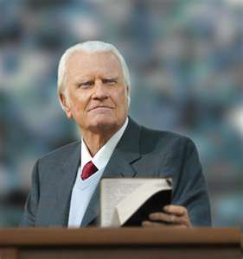
SHAPE THE SERMON- INDUCTIVE
INTRODUCTION (The Question)
I.
II.
III.
CONCLUSION (Take Home Truth)

Slide 97
SHAPE THE SERMON - DEDUCTIVE
INTRODUCTION (TAKE HOME TRUTH)
I.
II.
III.
CONCLUSION (TAKE HOME TRUTH)

Slide 98
SHAPE THE SERMON
INTRODUCTION
I.
APPLICATION
II.
APPLICATION
III.
APPLICATION
CONCLUSION

Slide 99
SHAPE THE SERMON
INTRODUCTION
I.
II.
III.
APPLICATION
CONCLUSION

Slide 100
THE PROCESS OF SERMON PREPARATION
1. Study the passage
Outline the passage
Form the take home truth
The three developmental questions
5. Shape the sermon
Notes:
Welcome & thanks

Slide 101
6. INTRODUCTION

Slide 102



THERE ARE THREE TYPES OF PREACHERS:
Those to whom you cannot listen.
Those to whom you can listen.
Those to whom you must listen.
During the introduction the congregation usually decides the kind of speaker addressing them that morning.

Slide 103

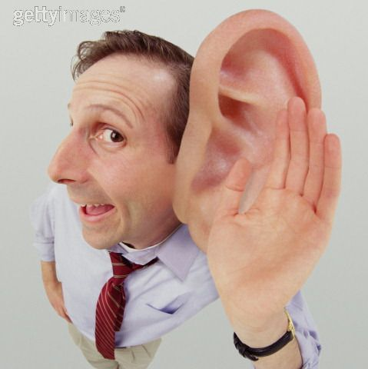
1. Get Attention on the Subject
INTRODUCTION

Slide 104
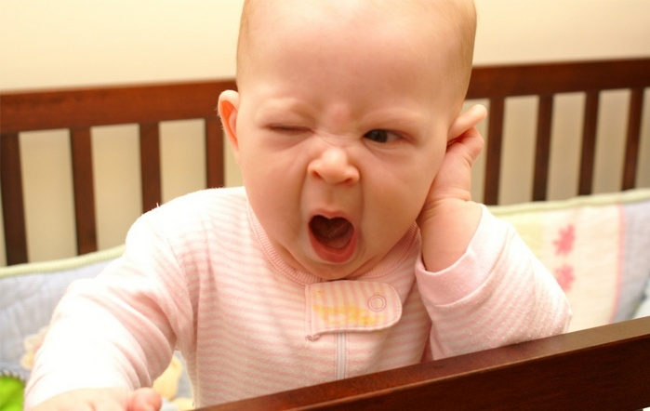
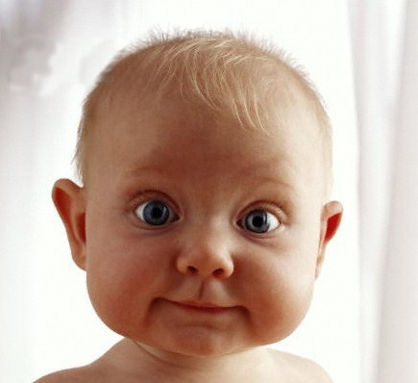
GET ATTENTION ON THE SUBJECT

Slide 105
What are they really thinking?

Slide 106
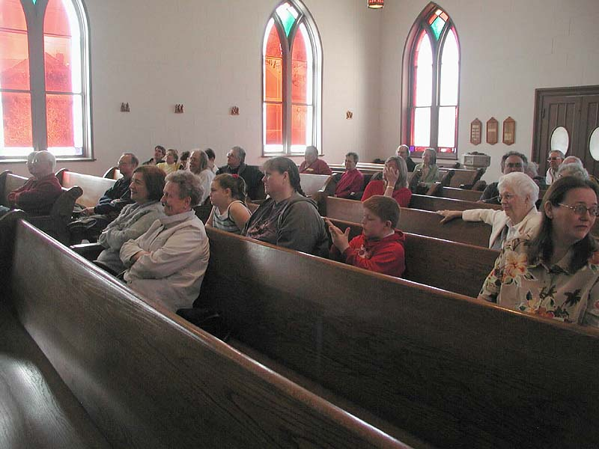


The Remote Syndrome
Audiences have remotes in their heads and can switch channels at any moment when they sense something else is more interesting! Work to keep their interest!

Slide 107
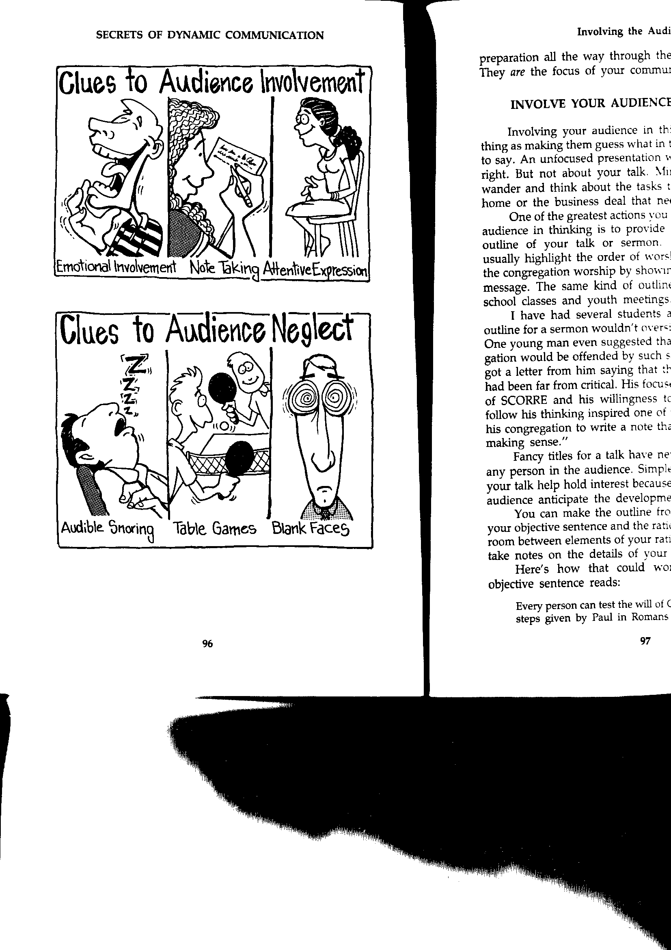
Clues to Audience Involvement

Slide 108
Clues to Audience Neglect

Slide 109
1. Get Attention on the Subject
2. Introduce the Subject
3. Provide the Background
4. Preview the Passage
5. Announce the Text (2-3 Times)
INTRODUCTION

Slide 110

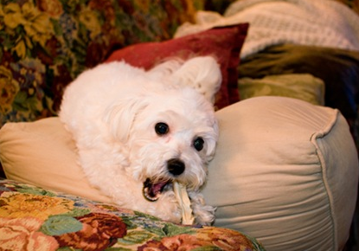
DON’T APOLOGIZE!
What examples of sermons that began with apologies can you give?
“I got a late start on this sermon, so it’s not going to be very good.”
“The dog ate my sermon manuscript, so I had to do it over.”

Slide 111
7. CONCLUSION

Slide 112
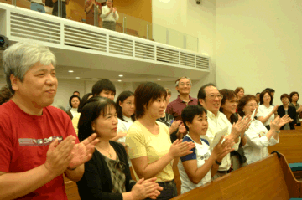
THE CONCLUSION
It is now time to prepare the last thing our listeners will hear!

Slide 113
THE CONCLUSION
The conclusion to a sermon has two purposes:
Summarize the passage – Briefly review the major points of the sermon
Exhort the listeners to apply the Biblical truth to their lives – We want to end our sermon with our listeners looking forward.
The conclusion tells the listeners where they have been and where we want them to go. The conclusion is what we want them to do with what they now know.

Slide 114
EFFECTIVE WAYS TO CONCLUDE YOUR SERMON
Tell a true-life story that shows the truth applied to their lives.
Visualize how they might apply the truth to their lives.
Repeat the same sentence structure for several sentences.
End with a quotation.
Complete a story you started in the introduction.
Focus on the Take Home Truth.

Slide 115
GENERAL PRINCIPLES FOR THE CONCLUSION
Plan the conclusion – Don’t depend on the ‘leading of the Spirit’ to help you in the last minute.
Don’t announce your conclusion – This may cause the listeners to begin packing up to leave.
Maintain eye contact with the listeners – This is when you look directly at them and speak to them from your heart.
End in a positive and encouraging note – We must turn negative passages into a positive motivation to change.

Slide 116
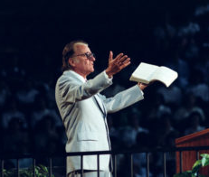
THE BENEFITS OF A POSITIVE SERMON
A positive sermon brings Biblical conviction of sin balanced by God’s grace.
A positive sermon brings high credibility for the preacher.
A positive sermon brings high esteem for the listener.

Slide 117
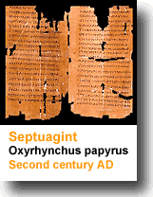
Manuscripting your sermon
ECCLESIASTES 12:9-12

Slide 118

Q: What is a sermon manuscript?
A: Writing your sermon down word for word.

Slide 119

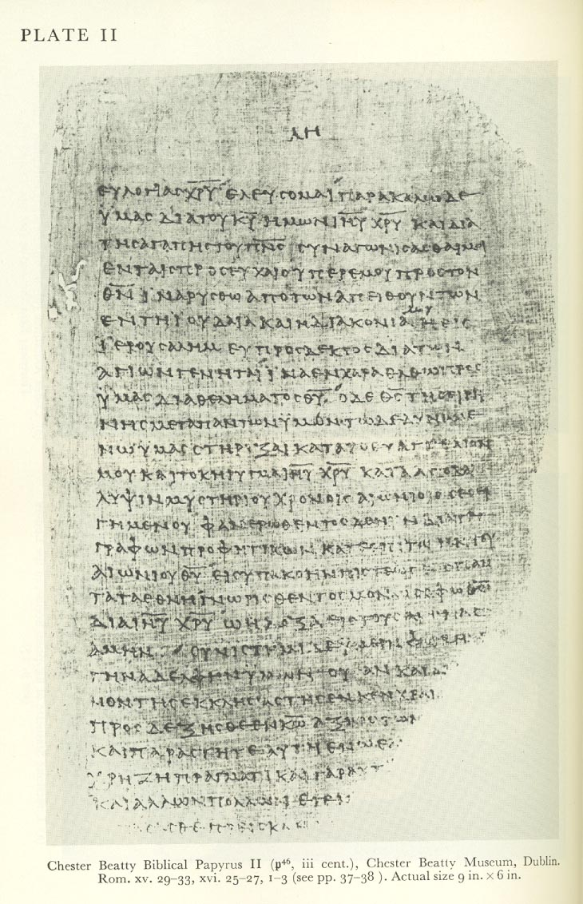
Why Manuscript?
A manuscript of your sermons has an amazing effect on both you and your listeners.
It gives you confidence that you will preach God’s truth clearly and accurately as you planned.
It makes your listeners more attentive as they realize how lovingly and thoroughly you have prepared for them. Your careful wording makes their ears ready to hear.

Slide 120
Why Manuscript?
It forces you to choose the best word.
You can use your sermon later.
It helps you keep to your time limit.

Slide 121
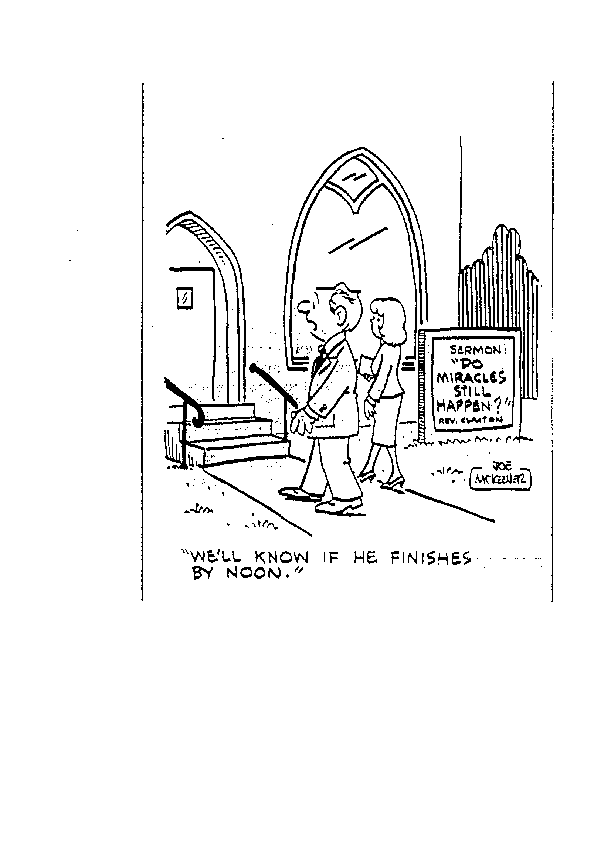
A manuscript keeps you from regularly going overtime
SERMON:
“Do Miracles still Happen?
Sermon: “Do Miracles Still Happen?”
Rev. Clanton
“We will know if he finishes by noon!”

Slide 122
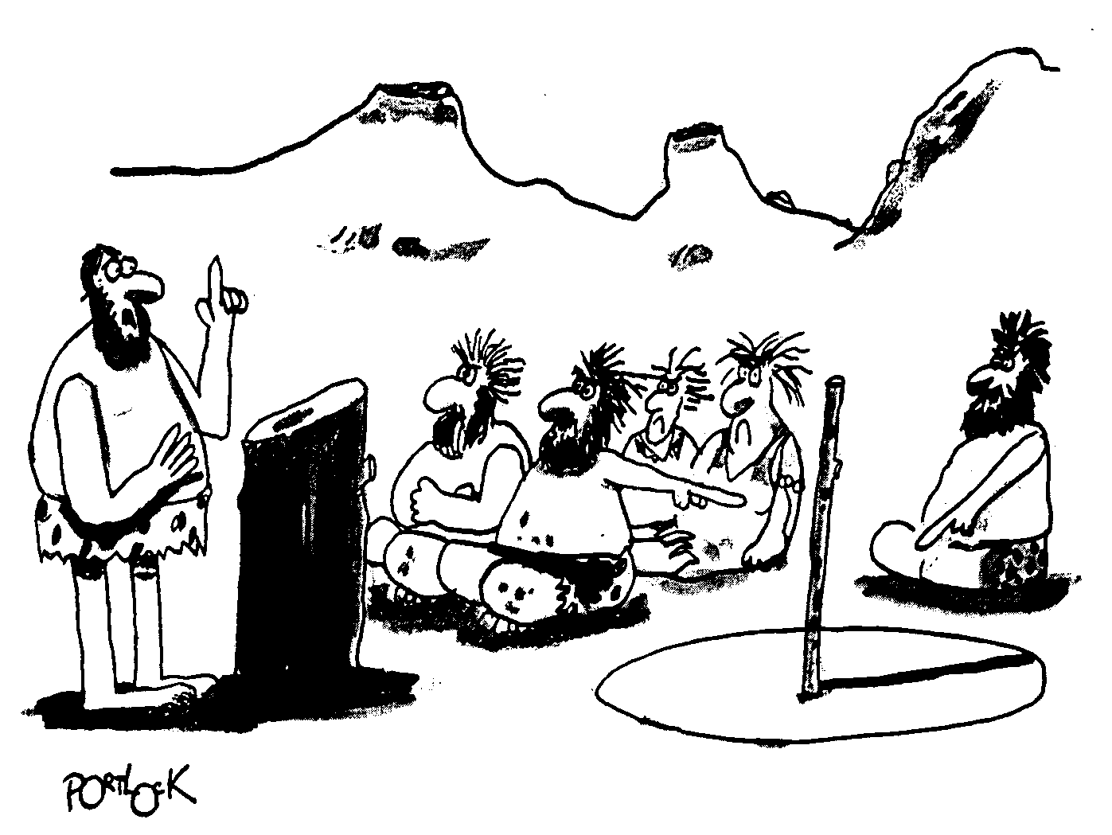
TIME HAS ALWAYS BEEN IMPORTANT!

Slide 123
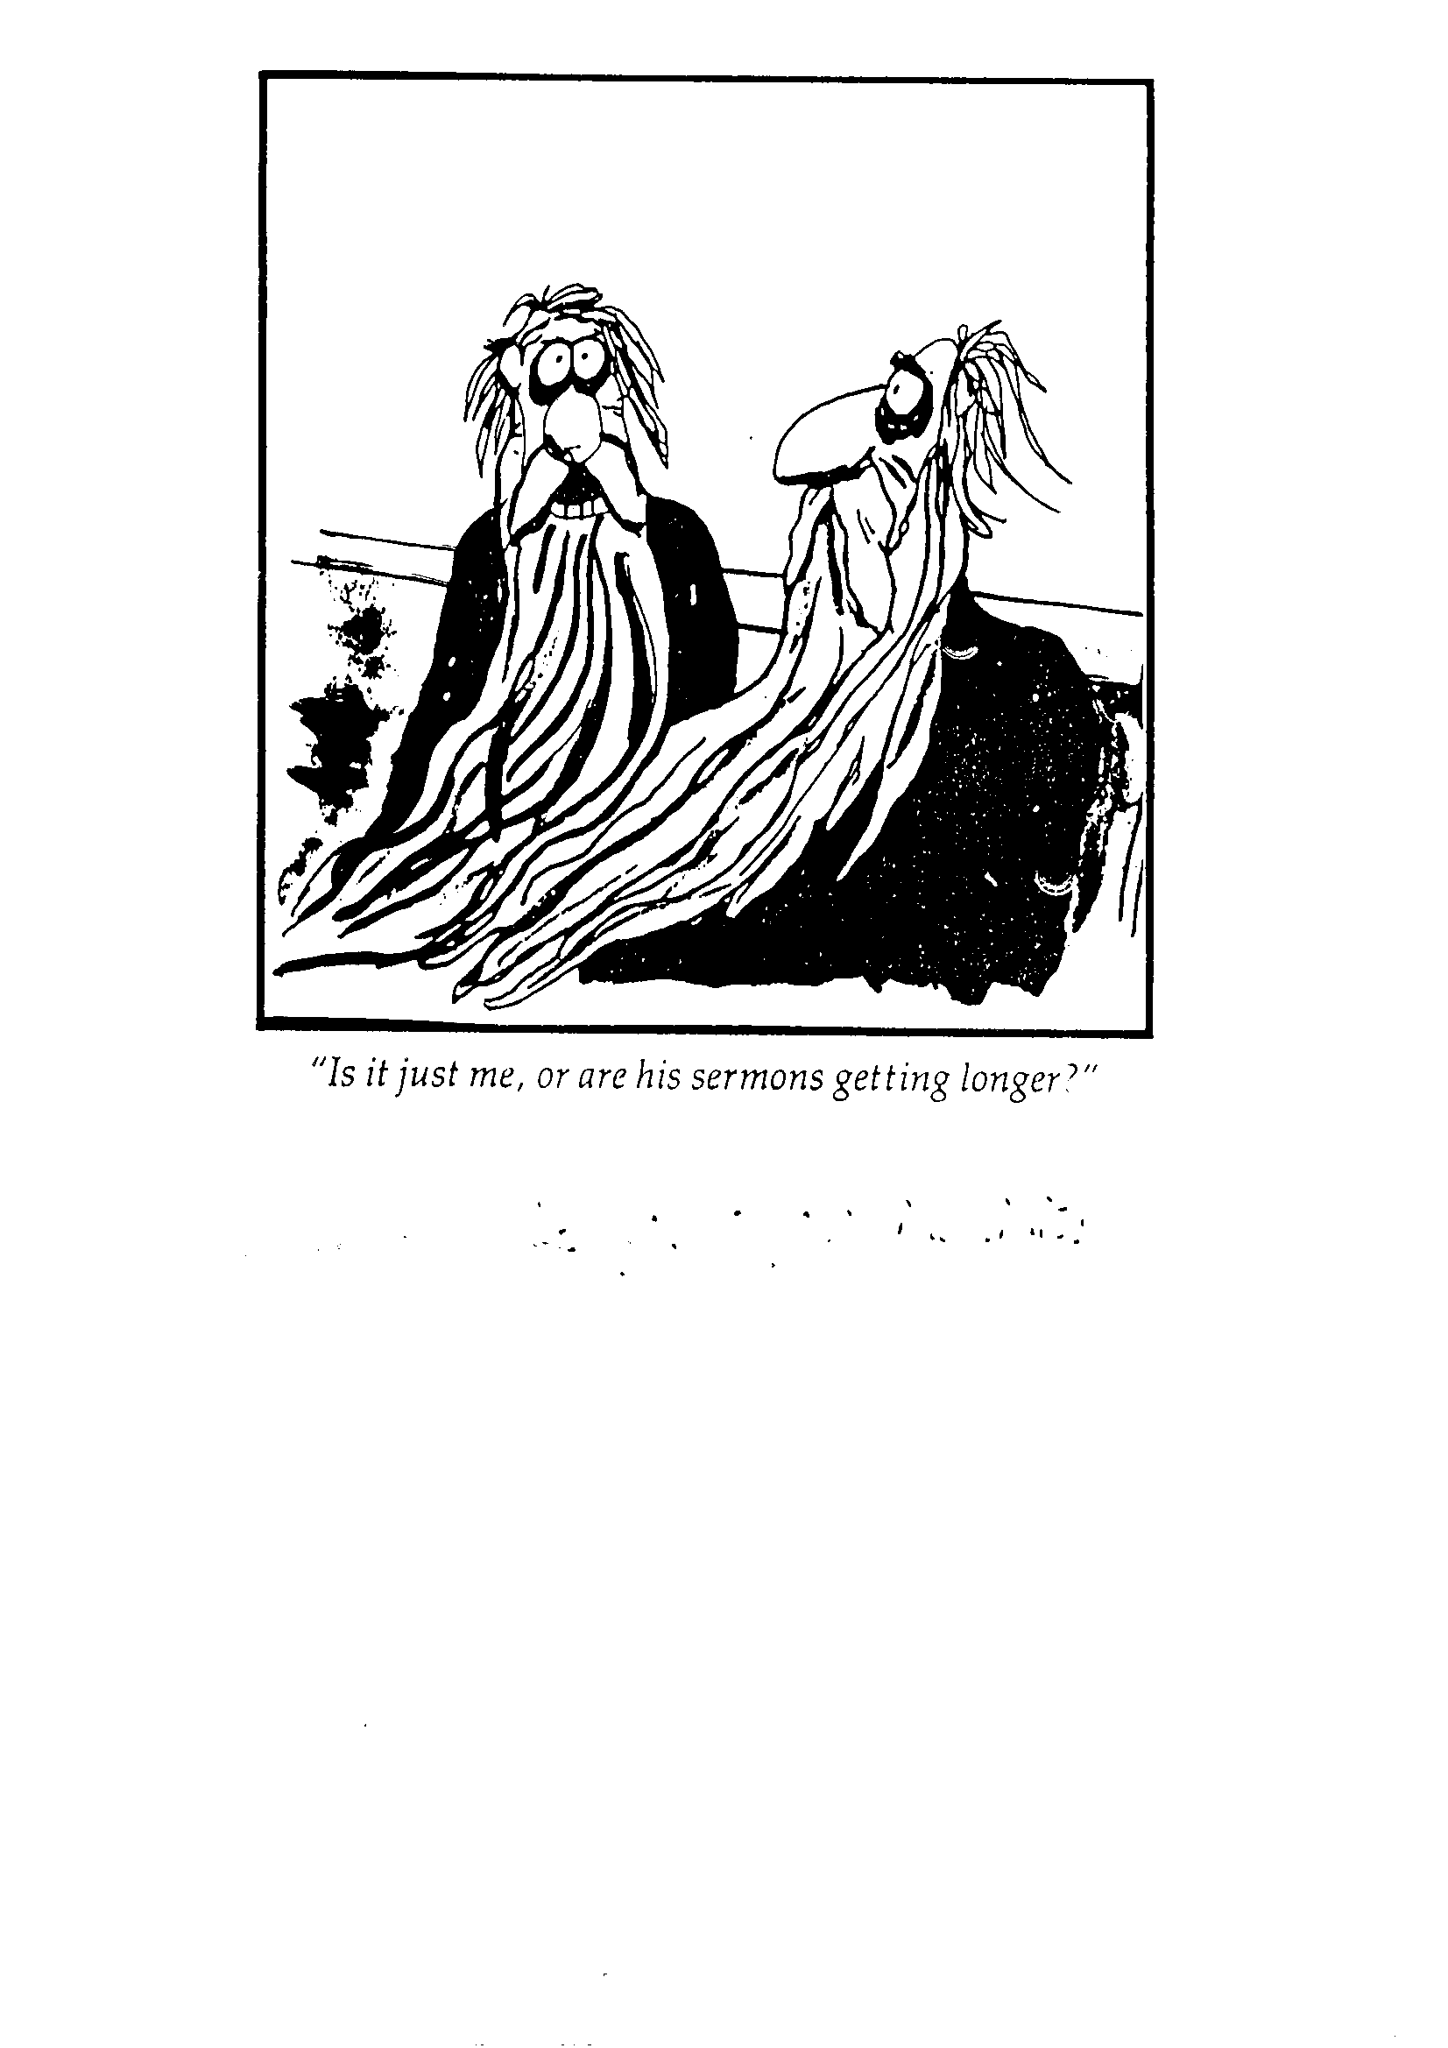
What they feel about sermon length matters!
“Is it just me, or are his sermons getting longer?”

Slide 124
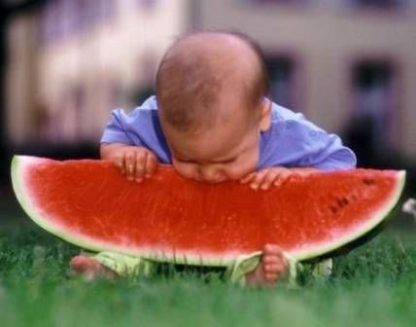
Manuscripts keep us from biting off more than we can chew.

Slide 125
Why Manuscript?
It forces you to choose the best word.
You can use your sermon later.
It helps you keep to your time limit.
It helps you preach better.

Slide 126
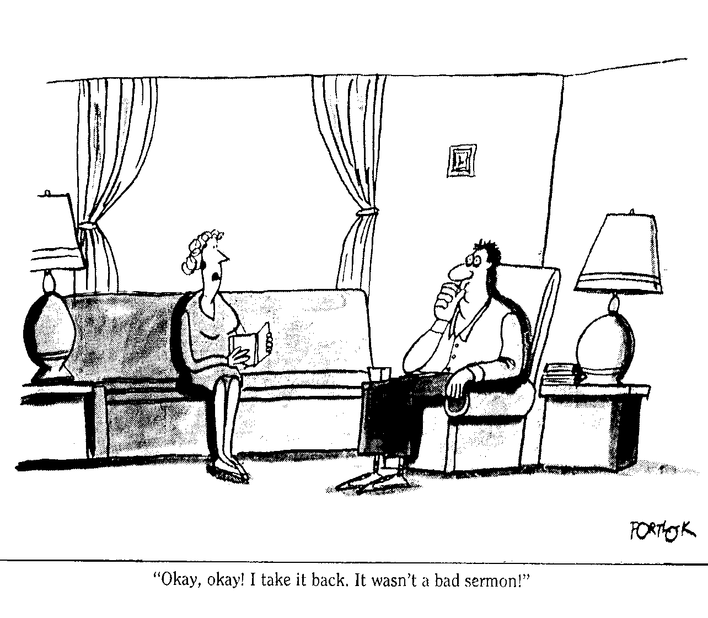
HANDLE HONESTY
“Okay, okay, I take it back. It wasn’t a bad sermon!”

Slide 127
WHAT TO DO WITH THE MANUSCRIPT
Four Options:
Bring it to the pulpit.
Reduce it to a one-page outline.
Memorize it then speak word for word.
Preach it extemporaneously.

Slide 128

MANUSCRIPT FOR THE EAR
Write like you talk, short sentences.
Use active voice rather than passive voice.
Create conversations between people using quotation marks.
Use simple and familiar words.
Be sensitive with your words.

Slide 129
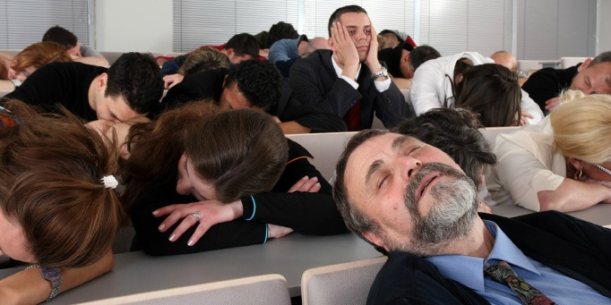
HOW TO PREACH CLEARLY
Some sermons are as clear as ancient Hebrew

Slide 130
OBSTACLES TO CLARITY
Sometimes people have no idea what their pastor is trying to communicate. They may understand all the definition of all the words. But the way sentences and paragraphs connect to each other is confusing. The flow of thought is a mystery.
We lose paragraph indentations.
We lose punctuation.
We lose the ability to re-read it again if we miss it the first time.

Slide 131
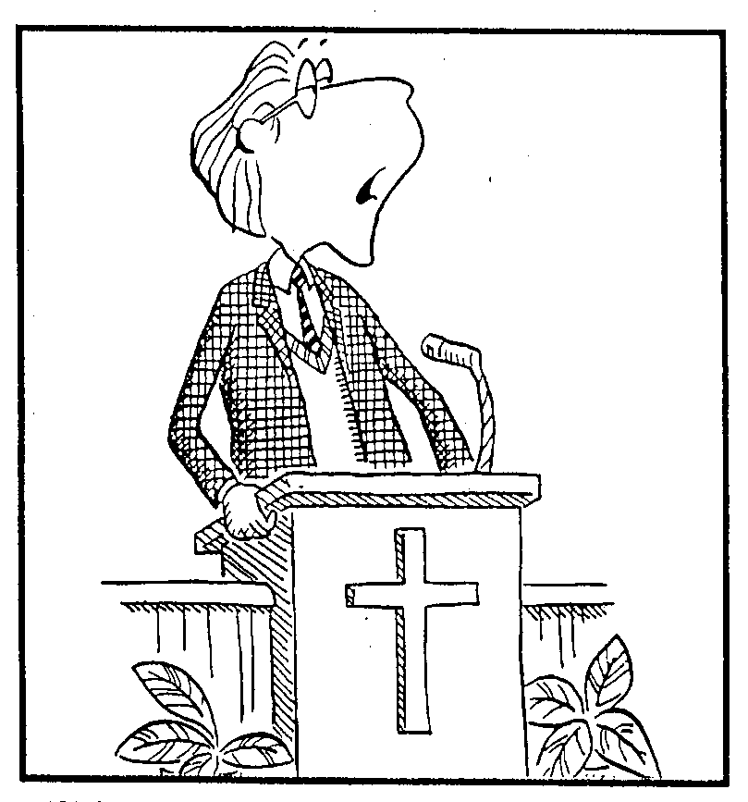
PRINCIPLES FOR CLARITY!
Restate
Consistency

Slide 132
PRINCIPLES FOR CLARITY!
Restate
Consistency
I. Speak Kind Words
1.
2.
3.
II. Speak Words of Wisdom
1.
2.

Slide 133
PRINCIPLES FOR CLARITY!
Restate
Consistency
State Main Points
Preview Verses
Physical Movement
Transitions

Slide 134
TRANSITIONS ADVANCE THOUGHT
Subject: How can we know how to speak to non-Christians? (Col. 4:6c)
I. Speak gracious words (6a)
A.
B.
(Your transition goes here within the parenthesis)
II. Speak wise words (6b)
A.
B.

Slide 135
TYPES OF TRANSITIONS
Subject: How can we know how to speak to non-Christians? (Col. 4:6c)
I. Speak gracious words (6a)
A.
B.
Rhetorical Question
(What is the second way to speak to non-Christians)
II. Speak wise words (6b)
A.
B.

Slide 136
TYPES OF TRANSITIONS
Subject: How can we know how to speak to non-Christians? (Col. 4:6c)
I. Speak gracious words (6a)
A.
B.
Flashback
(We saw that we must speak gracious words to non-Christians. Now…)
II. Speak wise words (6b)
A.
B.

Slide 137
TYPES OF TRANSITIONS
Subject: How can we know how to speak to non-Christians? (Col. 4:6c)
I. Speak gracious words (6a)
A.
B.
Incomplete Sentence
(The second way to speak to non-Christians is to…)
II. Speak wise words (6b)
A.
B.

Slide 138
TYPES OF TRANSITIONS
Incomplete Sentence
Subject: How can we know how to speak to non-Christians? (Col. 4:6c)
(The first way to speak to non-Christians is to…)
I. Speak gracious words (6a)
(The second way to speak to non-Christians is to…)
II. Speak wise words (6b)

Slide 139
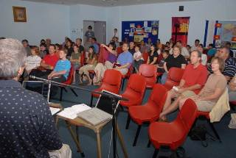
“A mist in the pulpit…
…is a fog in the pew!”

Slide 140

THE PUBLIC READING OF SCRIPTURE
Introduce your sermon text three times.
Wait until you see/hear the pages stop turning before reading.
Look up difficult words to pronounce them correctly.
Practice which words to emphasize when reading.
Vary your speed and volume when reading.
Always hold your Bible up when reading.
This Photo by Unknown Author is licensed under CC BY-NC-ND

Slide 141
NON-VERBAL FACTORS IN DELIVERY
The Importance of Movement and Gestures
Gestures add enthusiasm and help bring our sermon to life.
Gestures maintain interest and hold people's attention. Movement captures people's eyes
Gestures put the speaker at ease. We feel more like ourselves.
Gestures help our listeners experience what we feel as they identify with us.

Slide 142
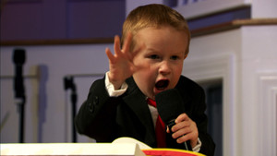
NON-VERBAL FACTORS IN DELIVERY
Characteristics of good physical gestures
  Spontaneous - The best gestures come naturally. They are not manufactured.
  Definite - When you make a gesture, make it. Put your body into it.
  Varied - The repetition of a single gesture will irritate and congregation.
  Properly Timed - Gestures must correspond with our words.

Slide 143
NON-VERBAL FACTORS IN DELIVERY
The Importance of Eye Contact
  one of the most effective single means of non-verbal communication.
  Eyes give feedback and hold an audience's attention.
  Most importantly, our people want us to look at them and speak to them personally.
  Congregations do not listen to preachers who are constantly looking down at their notes.

Slide 144
THE IMPORTANCE OF VOCAL DELIVERY
Pitch – Pitch involves the movement of our voice up and down on the scale.
Punch – Punch is the variation in loudness.
Progress – Progress is the rate in which we are speaking.
Pause – Pause serves as a punction mark such as a period, comma or semi-colon.

Slide 145
PRACTICE - It helps to practice on the night before to see if there are any places in the sermon where you may need to adjust the wording or add a gesture.
Why Practice Preaching?
Practice enables you to...
1. Know the sermon well.
2. Communicate the sermon well.
3. Cut out unnecessary stuff to keep to your time.

Slide 146

PREACHING CALENDARS
The Advantage of a Preaching Calendar
1. There is no wasted time finding a subject or passage each week.
2. It allows us time to find applications and illustrations.
3. It teaches people to study the Bible in a planned and organized way.
Notes:
PREACHING CALENDARS
The Advantage of a Preaching Calendar
1. There is no wasted time finding a subject or passage each week.
2. It allows us time to find applications and illustrations.
3. It teaches people to study the Bible in a planned and organized way.
4. It increases the congregation's confidence in your leadership. They will follow someone who knows where they are going.
5. It provides a balanced diet for the congregation. We plan to preach from both the Old and New Testament.
6. The congregation cannot accuse us of preaching a sermon aimed at them because we are simply following our calendar.

Slide 147
PREACHING CALENDARS
The Advantage of a Preaching Calendar
4. It increases the congregation's confidence in your leadership. They will follow someone who knows where they are going.
5. It provides a balanced diet for the congregation. We plan to preach from both the Old and New Testament.
6. The congregation cannot accuse us of preaching a sermon aimed at them because we are simply following our
Notes:
PREACHING CALENDARS
The Advantage of a Preaching Calendar
1. There is no wasted time finding a subject or passage each week.
2. It allows us time to find applications and illustrations.
3. It teaches people to study the Bible in a planned and organized way.
4. It increases the congregation's confidence in your leadership. They will follow someone who knows where they are going.
5. It provides a balanced diet for the congregation. We plan to preach from both the Old and New Testament.
6. The congregation cannot accuse us of preaching a sermon aimed at them because we are simply following our calendar.

Slide 148
How to Make an Effective Preaching Calendar
1. Spend quiet time with the Lord and seek His guidance in this process.
2. List the books and topics you feel the congregation need to hear in the coming year.
3. Block out special events like Christmas and Easter for these require special sermons.
4. Prepare a chart listing each Sunday and the passage for each Sunday.
5. Balance preaching between the Old and New Testament.

Slide 149
TOPICAL SERMONS
What is a Topical Sermon?
Topical sermons expound a central idea from more than one main text of Scripture
Topical sermons draw from several books or passages.
Topical messages have the danger of inserting your own views
Notes:
Topical sermons expound a central idea from more than one main text of Scripture
Topical sermons draw from several books or passages.
Topical messages have the danger of inserting your own views

Slide 150
A sample topical sermon
on the second coming
What's going to happen
(1 Thessalonians 4:13-18)
When this will happen
(Matthew 24:42; 25:13; 1 Thess 5:4)
Why be ready when it happens (Revelation 22:12-13)
Notes:
sample topical sermon on the second coming
1. What's going to happen (1 Thessalonians 4:13-18)
2. When this will happen (Matthew 24:42; 25:13; 1 Thessalonians 5:4)
3. Why be ready when it happens (Revelation 22:12-13)

Slide 151
A sample topical sermon
on baptism
Christ's baptism declares His mission (Matthew 3:13-17)
Our baptism declares our faith (Matthew 38:19-20)
Notes:
sample topical sermon on baptism
1. Christ's baptism declares His mission (Matthew 3:13-17)
2. Our baptism declares our faith (Matthew 38:19-20)

Slide 152
THE IMPORTANCE OF VOCAL DELIVERY
Pitch – Pitch involves the movement of our voice up and down on the scale.
Punch – Punch is the variation in loudness.
Progress – Progress is the rate in which we are speaking.
Pause – Pause serves as a punction mark such as a period, comma or semi-colon.

Slide 153


Be Clear!

Slide 154

CLARITY IN THE CONCLUSION
State the main idea
(MI)
Repeat the main points
(MPs)

Slide 155

WRITE FOR THE EAR
Not all preachers write out their sermons. But the discipline of writing a manuscript improves preaching (Proverb 25:11).
Write like you talk.
Use active voice rather than passive voice.
Create conversations between people using quotation marks.
Use simple and familiar words.
Be sensitive with your words.
This Photo by Unknown Author is licensed under CC BY-NC

Slide 156
GENERAL PRINCIPLES FOR THE CONCLUSION
PLAN THE CONCLUSION.
DON’T ANNOUNCE THE CONCLUSION.
MAINTAIN EYE CONTACT WITH THE LISTENERS.
END OF A POSITIVE AND ENCOURAGING NOTE.

Slide 157

THE BENEFITS OF A POSITIVE SERMON
A positive sermon brings conviction of sin, balanced by God’s love.
A positive sermon brings high credibility for the preacher.
A positive sermon bring high esteem for the listener.

Slide 158

DON’T BE OFFENSIVELY PRECISE
“I wish he were less specific with his illustrations.”

Slide 159

LOOK AROUND! 3 of 3

Slide 162
3. Ý Chính
3. “Lẽ Thật Mang Về”

Slide 163
“Lẽ Thật Mang Về”
“phần khẳng định chính trong định nghĩa của chúng ta về giảng giải kinh cho rằng “giảng giải kinh là sự truyền thông một khái niệm Kinh Thánh.” Câu ấy khẳng định điều hiển nhiên này. Một bài giảng nên là một viên đạn một đầu (bullet) chứ đừng là viên đạn bi (buckshot). Lý tưởng mà nói, mỗi bài giảng là sự giải nghĩa, giải thích, hay áp dụng chỉ một ý chính được hỗ trợ bởi các ý tưởng khác, hết thảy đều rút ra từ một phân đoạn hay nhiều phân đoạn Kinh Thánh”
(Haddon Robinson, Biblical Preaching, 33)

Slide 164

INCLUDE VARIETY
Finally, my brothers…....
I sense another speech coming on.
Don’t always end with a poem or a prayer.

Slide 165

Don't Announce It
…and in conclusion...
All right!
Yeah!
Amen!
Close it down brother
Do not announce your conclusion

Slide 166

Be clear about your viewpoint!
Of course, there are other interpretations.

Slide 167

“Well, actually, the sermon didn’t quite meet my needs. Where do I go to get a refund on my offering?”

Slide 168


MARK 5:21-43
Mark 5:21-24
Mark 5:25-34
Mark 5:35-43

Slide 169
Mark 5:21-43
I.
II.
III.
Niềm tin vào Chúa Giêsu
Mark 5:33-34
Mark 5:36

Slide 170


Tham lam là tình yêu của tiền bạc

Slide 171
Gong Church
They say it’s a tough church to preach

Slide 172
Don't Announce It
And in conclusion...
I sense another speech coming on.
All right!
Yeah!
Amen!
Close it down brother

Slide 173

Manuscripts need not inhibit our delivery
Nice to hear a good old fashion sermon, Reverend.

Slide 174

LET’S SEE HOW TO OUTLINE CORRECTLY
How can you help listeners see the skeleton of your message without taking the skin off?

Slide 175
PASSAGES FOR PREACHING
Philippians 4:4-7
Philippians 4:8-9
Colossians 1:9-11
Colossians 3:1-4
1 Thessalonians 4:9-12
1 Timothy 6:17-19
Hebrews 4:12-13
Hebrews 12:1-3
James 1:2-5
James 3:13-18
James 4:13-17
1 Peter 5:1-4
1 John 1:5-10
1 John 3:1-3
1 John 4:1-3
1 John 4:7-10
1 John 4:13-17
1 John 5:1-5
Romans 4:1-5
Romans 5:1-5
Romans 12:1-2
1 Corinthians 3:10-15
2 Corinthians 12:7-10
Galatians 6:1-5
Ephesians 1:7-10
Ephesians 2:8-10
Ephesians 3:14-19
Ephesians 4:1-6
Ephesians 4:25-29
Ephesians 6:1-4
Ephesians 6:5-9
Ephesians 6:10-13
Philippians 2:12-16
Philippians 3:17-21

Slide 176
MORE SUPPORTING MATERIAL
Định nghĩa từ điển Statistics?
Sự thống kê Dictionary Def?
Trích dẫn
Câu Kinh Thánh
Minh Họa Kinh Thánh

Slide 177
Black

Slide 178


OT Preaching link at BibleStudyDownloads.org
Get this presentation for free!
Notes:
OT Preaching (op)

