Slide 1
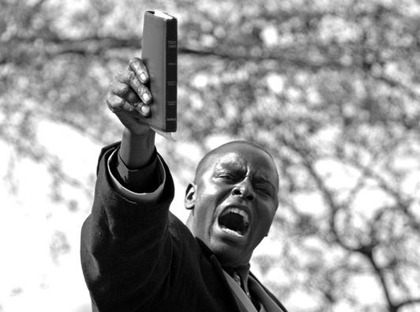
Preaching, Persuasion, and Leadership
Pathos
Dr. Jeffrey Arthurs, Gordon-Conwell Theological Seminary,
as taught at Singapore Bible College DMin module, March 2016
and offered for free download by Dr. Rick Griffith at BibleStudyDownloads.org

Slide 2
Cicero on Pathos
Mankind makes far more determinations through hatred, or love, or desire, or anger, or grief, or joy, or hope, or fear . . . or some other affection of mind, than from regard to truth, or any settled maxim, or principle of right.
Cicero, de Oratore II, 42.

Slide 3
What is Pathos?
Emotional proof.
The rousing and directing of the audience’s feelings to aid persuasion.
All those materials and devices calculated to put the audience in a frame of mind suitable for the reception of the speaker’s ideas.
Thonnsen and Baird, Speech Criticism (New York: Ronald Press, 1948) 358.

Slide 4

What motivates our actions and beliefs?

Slide 5
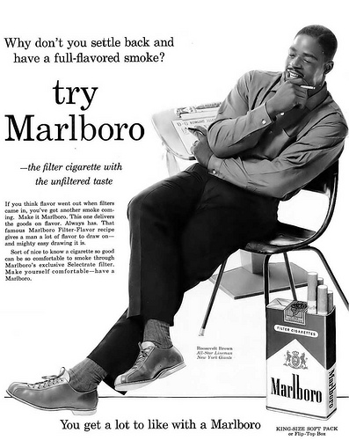
What is the persuasive goal of the advertiser? How does the ad use pathos to achieve that goal?

Slide 6
Maslow’s Hierarchy
Self-Actualization
Esteem
Love and Belongingness
Safety
Physical Survival

Slide 7
Is Maslow biblically defensible?

Slide 8
Pathos in the Bible
What do these verses suggest about a “theology of pathos”? What motivated Paul as a minister?
2 Cor. 1:3-5
2 Cor. 2:11
2 Cor. 2:12-13
2 Cor. 5:14
Phil. 2:16
Phil. 4:1
Col. 3:23-24
1 Thess. 2:19-20

Slide 9
The Bible addresses emotions as part of the “Heart”
Whatever captures the heart’s trust and love also controls the feelings and behavior. What the heart most wants the mind finds reasonable, the emotions find valuable, and the will finds doable. It is all-important, then, that preaching move the heart to stop trusting and loving other things more than God.
Timothy Keller, Preaching, 159.

Slide 10
I cannot continuously say no to this or no to that, unless there is something ten times more attractive to choose. Saying no to my lust, my greed, my needs, and the world’s powers takes an enormous amount of energy. The only hope is to find something so obviously real and attractive that I can devote all my energies to saying yes.
Henri Nouwen, cited in Terry Muck, “Hearing God’s Voice and Obeying His Word,” Leadership Journal (Winter, 1982), 16.

Slide 11
Need to address the Heart
Os Guinness
Fool’s Talk: Recovering the Christian Art of Persuasion (41-42)
Christian persuasion, while addressing the mind, must be faithful to address the heart, including the passions or emotions. From Aristotle on, it has been recognized that the passions have an important role in our human lives—for better or worse they move us to thought and to action.

Slide 12
Continued
Sometimes, for example, we can address the passions to move people to seek God through desire—the longing to possess something they do not have, or through joy—the yearning to possess what they desire. And sometimes we can address the passions to move people to seek God through the equally powerful passion of fear—the aversion to what they do not want, or through grief—the deep realization of where they have gone wrong or what they have lost in their rejection of God.

Slide 13
Jonathan Edwards on Preaching and the Affections:
I should think myself in the way of my duty to raise the affections of my hearers as high as possibly I can, provided that they are affected with nothing but truth, and with affections that are not disagreeable to the nature of what they are affected with.
Works of Jonathan Edwards, vol. 4, The Great Awakening (ed. C. C. Goen; New Haven: Yale Univ. Press, 1957–2008), 387.

Slide 14
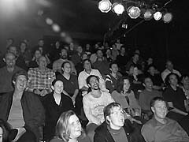
Two Specific Pathetic Appeals: Humor and Fear
  Rhetorical functions of humor:
      Disarm hostility
      Disarm fear/anxiety
      Divert attention
      Hold attention
      Enhance memorableness
      Enhance ethos

Slide 15
Two Specific Pathetic Appeals: Humor and Fear
  “Rules” for using humor:
      Appropriate to group
      Natural and spontaneous
      Relevant to the persuasive effort

Slide 16
Two Specific Pathetic Appeals: Humor and Fear
  How Use Humor?
      Exaggeration
      Surprise
      Incongruity
  High Risk Humor (sets audience expectations:
    “You’re gonna love this. Two
    alligators went into a bar . . . .”)
  Low Risk Humor (Uses everyday situations, prompts identification, pokes fun at self. OK if no one laughs.)

Slide 17
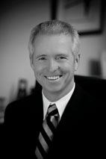
Case Study: John Ortberg
“Doing Justice”
Preaching Today # 253, tracks 25-29
Rhetorical Situation: Who is his audience? What is their disposition toward his topic?
Humor:
  What is the rhetorical effect of the preacher’s humor? Raise ethos, hold attention, lower defenses, enhance memorableness?
  What kind of humor does the preacher use—incongruity, exaggeration, surprise?
  How does the preacher juxtapose humor and seriousness? To what effect?

Slide 18

Two Specific Pathetic Appeals: Humor and Fear
  Humor
  Fear
    What makes a fear appeal effective?
      Susceptibility
      Severity
      Solvency
    What makes a fear appeal ethical?

Slide 19
Daisy Spot

Slide 20
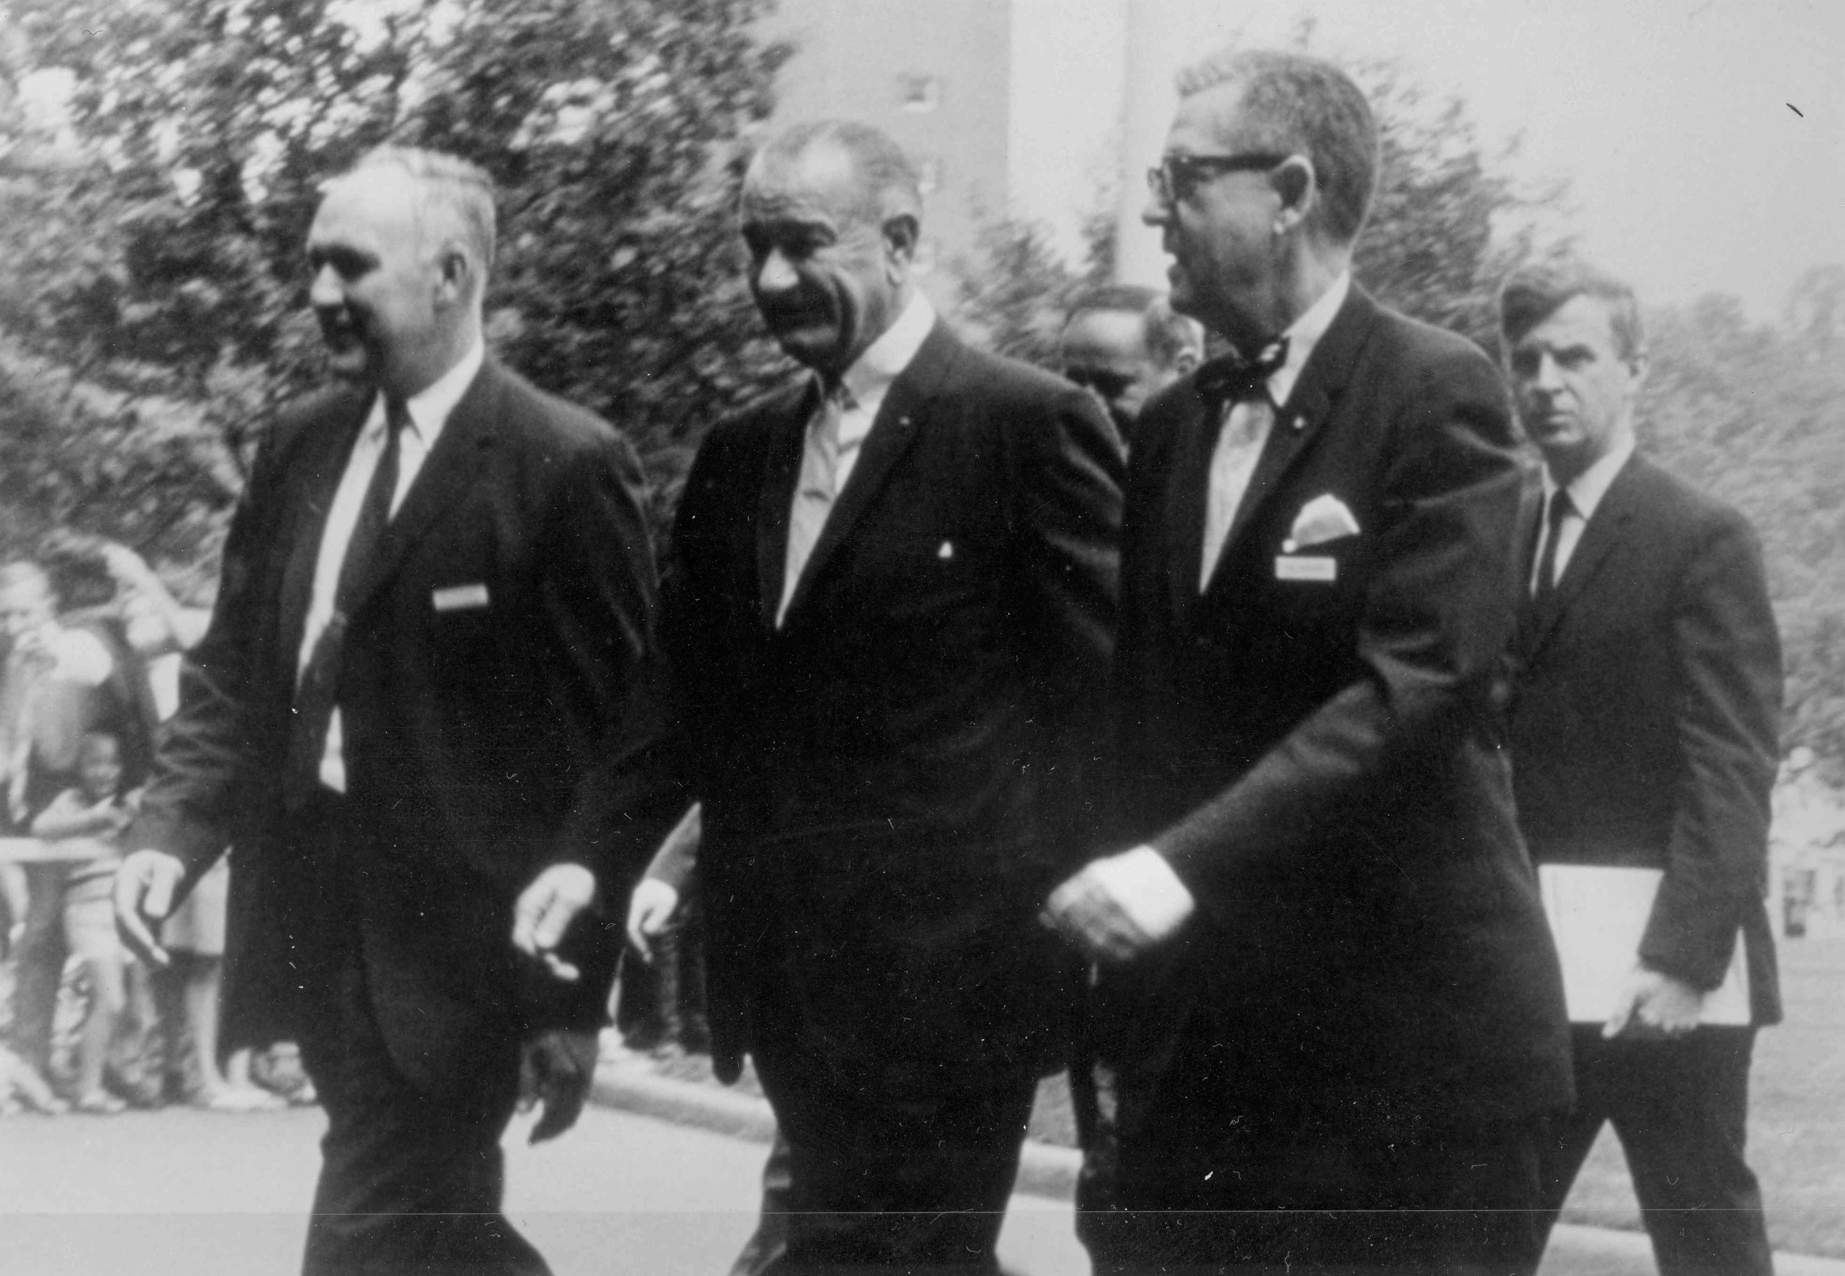
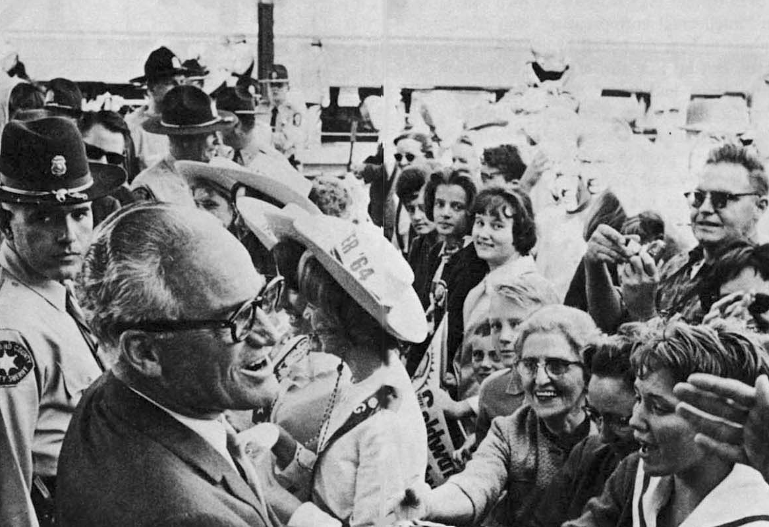
Case Study: “Daisy Spot”
Rhetorical Situation:
  When was this commercial aired?
  What do you know about world politics at that time?
  What do you know about American politics?
What best accounts for the commercial’s power: susceptibility, severity, or solvency?
How does the commercial promise solvency? Is this promise made overtly or subtly?
Is the fear appeal so strong that it is unethical? Defend your answer.

Slide 21
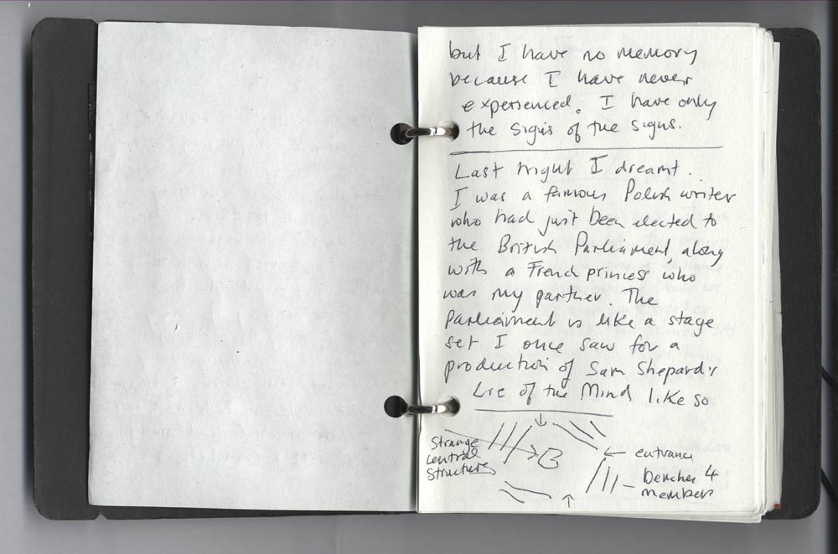
The Pathetic Appeal of Arrangement:
How can we use “form” to use the power of pathos?

Slide 22
Kenneth Burke’s Theory of Form
  Definition:
  “Form is the creation of an appetite in the mind of the auditor, and the adequate satisfying of that appetite.”
  - Counter Statement (1931: rpt. U of CA Press, 1968), 31.
  “Form in literature is an arousing and fulfillment of desires. A work has form in so far as one part of it leads a reader to anticipate another part, to be gratified by the sequence.”
  - Counter Statement, 124.

Slide 23
How Does Form Function in Persuasion?
  Yielding to the form prepares for assent to the matter identified with it. . . . Many purely formal patterns can readily awaken an attitude of collaborative expectancy in us. For instance, imagine a passage built about a set of oppositions (“we do this, but they…do that; we stay here but they go there; we look up but they look down.” etc.) Once you grasp the trend of the form, it invites participation regardless of the subject matter. Formally, you will find yourself swinging along with succession of antitheses, even though you may not agree with the proposition that is being presented in this form.
  Kenneth Burke, A Rhetorical of Motives (1950; rpt. Berkeley: U of California P, 1969) 58-59.

Slide 24

Types of Form
  Repetitive
  Qualitative
  Syllogistic
  Conventional

Slide 25
Repetitive Form:
Arthurs on the deceptiveness of chasing the “American Dream”
You work hard in high school so you can get into a dream college, then you study hard in college so you can get a dream job; you work overtime at your dream job so you can drive a dream car, and that helps you attract a dream spouse; then you have a dream wedding, move into a dream house, and have 1.7 dream kids; then you save money to take a dream vacation to get away from the dream kids; then you plug away to build up a dream 401k, so you can take a dream retirement. Then you die [pause] and you have a dream funeral with a dream casket which is placed in a dream hole in the ground. Isn’t there something better than the American dream?

Slide 26
Case Study: Repetitive and Qualitative Form
Arthurs, “Cover or Be Covered”
Psalm 32
What was the biblical author’s purpose?
Arthurs tries to reproduce the impact of the text through the rhetoric of form.
  What type of form does Arthurs use (repetitive, qualitative, syllogistic, conventional)?
  To what effect?

Slide 27
Case Study: Arthurs, “Cover or Be Covered,” Psalm 32 (Track 11, 0:45)
I rejoiced inordinately, as if a soul were written into the book of life, when the Red Sox won.
Bragged about the Red Sox.
Written snide emails to friends in NY.
Pretended that I’ve been a lifelong Red Sox fan.
Prayed more fervently for the Red Sox than for my pastors, elders, and leaders.
  Who will confess?
This winter, I cursed the snow.
This spring, I cursed the snow.
Last fall, I cursed the snow.
I went into debt to buy a snow blower.
I snickered at my neighbors who do not have a snow blower.
In February, I robbed my children’s college fund in order to take a Florida vacation.
My conscience is seared. I will do it again next Feb.
  Who will confess?

Slide 28
I have zipped into a parking spot in front of someone who got there before I did.
I look at myself every time I pass a mirror.
I wish other people would shut up so I can tell my story.
I have interrupted a slow speaker so I can say what I want to say.
I have promoted myself at every opportunity.
I have not considered others better than myself.
Who will confess?
I have spun the truth to make myself look good.
I have blamed others when I was at fault.
I have drugged myself with TV or the internet so I wouldn’t have to think about my failings.
I have hidden.
I have clammed up.
I have pretended.
I have lied.
I have deceived.
I have tricked.
I have tried to cover my own sin.
Who will confess?

Slide 29
I have put down my friends.
I have cut up those I love.
I have blown up at those who matter most to me.
I have not prayed.
I have not sacrificed.
I have not stewarded God’s money.
I have acted like it were my money.
I have not played my part in the Great Commission.
I don’t care much about the Great Commission.
I don’t care much about the poor, homeless, prisoners, infirm, illiterate, suffering, widows, and orphans.
I do care about myself.
I have taken up and set down and taken up and set down my cross.
I have not left all to follow him.
We sinners sin; we sinners confess.

Slide 30
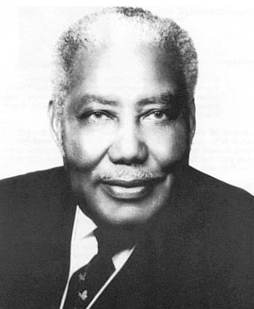
Case Study: Repetitive Form in “Amen,”
Rev. S. M. Lockridge
How does the preacher use repetition in sentence structure?
How does he use repetition
with sound?
How does he use repetition
in concept?
What is the rhetorical effect?

Slide 31
Case Study: Repetitive Form in “Building on the Right Foundation,” Tony Evans
How does the preacher use repeated phrases and even sound effects?
What is the effect?

Slide 32
Exercise
How might you use repetitive form when preaching:
1 Cor. 13:1-3
Phil. 4:8-9
1 Tim. 3:16
Psalm 115:9-11

Slide 33
Formal Appeal of Arrangement on the Macro Level (organization of the whole sermon)
Lowry’s “Homiletical Plot.”
Monroe’s “Motivated Sequence.”

Slide 34
Lowry’s Homiletical Plot
1. Upsetting the Equilibrium
5. Anticipating the Consequences
2. Analyzing the Discrepancy
4. Experiencing the Gospel
3. Disclosing the Clue to Resolution

Slide 35
Monroe’s “Motivated Sequence”
Alan Monroe was a teacher of public speaking at Purdue Univ. in the mid 20th century.
He developed a way to organize persuasive speeches (sales talks) based on audience psychology.
His method is “plot-like” in its rhetorical effect. That is, it takes a listener through an experience like listening to a story with its introduction of conflict, tension/complications, and resolution. In this way, it is similar to the Homiletical Plot.
His method is applicable to homiletics as modified by Haddon Robinson, “Preaching as Listeners Like It.” 15 points extra credit for listening to this lecture. Begin at minute 8, end with Q and A.

Slide 36
Monroe’s Motivated Sequence
Step 1: Attention
Getting attention
Rhetorical Effect
I want to listen.
Step 2: Need
Showing the need: describing the problem
Something needs to be done!
Step 3: Satisfaction
Satisfying the need: presenting the solution
I understand what to do to satisfy the need.
Step 4: Visualization
Visualizing the results
I can see myself enjoying the benefits of such an action.
Step 5: Action
Requesting action or approval
I will do this.
Copyright 1990 Scott, Foresman and Company

Slide 37
Case Study: John Ortberg
“Developing Compassionate Hearts”
Motivated Sequence:
  Can you identify the five stages?
Form:
  How does Ortberg begin (what mood)? What does this contribute to his persuasion?
  What happens next? Next? What does this ordering of audience experience contribute to his persuasion?
  How does the preacher juxtapose humor and seriousness? To what effect?

Slide 38

The Pathetic Appeal of Language:
How Can We Prompt Attitudes and Feelings?

Slide 39
It is not enough to know what we ought to say; we must also say it as we ought; much help is thus afforded toward producing the right impression of a speech.
Aristotle, Rhetoric, 1403b
The truth must dazzle.
Emily Dickenson

Slide 40
Vivid Language: Give it a try with a “cinquain”
Baseball:
The bat smashes
The pitch, projecting it
High over the fence, fans, and cheers.
Homerun!

Slide 41
Vivid Language Can Create “Presence”
An ancient Chinese story describes a powerful king who sees an ox being led to slaughter. Perhaps the ox senses what is about to happen for it trembles like a puppy. Moved with pity, the king orders the handlers to locate a sheep to be used in its place. Later the king is challenged for being stingy—slaughtering a sheep instead of an ox. He defends himself by confessing that he did so because he could see the ox but not the sheep.
That’s what vivid language can do also. It stirs the affections.

Slide 42
Vivid Language has “Vivacity”
George Campbell
Philosophy of Rhetoric
Language has “vivacity” when it has “liveliness,” “force,” “energy,” “brightness,” “brilliancy,” and “luster.”
Ideas which lack vivacity are “faint,” “languid,” and “feeble.”
Vivid language compels attention and wins belief much better than abstract language. Why?

Slide 43
“Vivacity”
The Operations of the Mind
The Operations of the Mind
Highly compelling
Direct Sensory Experience
Somewhat compelling
Memory of Direct Sensory Experience
Least compelling
Imagination of Direct Sensory Experience
An attack by a dog
Memory of an attack by a dog
Language with vivacity to spark imagination of an attack
—George Campbell, Philosophy of Rhetoric

Slide 44
“Vivacity”
“Sinners in the Hands of An Angry God”
Jonathan Edwards’ “strategy”
Highly compelling
Direct Sensory Experience of Hell
Somewhat compelling
Memory of Direct Sensory Experience of Hell
Least compelling
Imagination
Not possible
Not possible
Primary Tool: Language with vivacity to spark imagination
—George Campbell, Philosophy of Rhetoric

Slide 45
How Does Language Create Vicarious Experience?
Theological Theory of Language:
  God’s words do things.
  He has delegated some of that power to us to steward in his behalf.
  “Naming” suggests authority. When we name, we exert authority over people.

Slide 46
Proverbs 18:21
Death and life are in the power of the tongue and those who love it will eat its fruit.
Yad (Heb. יד) “hand”
Death and life are in the
“hand” of the tongue.

Slide 47
How Does Language Create Vicarious Experience?
Rhetorical Theory of Language
Language has the power to influence perception.
  “A way of seeing is a way of not seeing.” (Kenneth Burke)
  “Terministic Screens.” (Kenneth Burke)
Perception leads to attitude (emotion/feeling), and attitude leads to action.

Slide 48

The power of language to influence perception
A researcher labeled two bags, both containing rose petals:
Roses Grass Clippings
Then asked subjects to rate the smells. “Roses” won easily.

Slide 49
The Power of Language to Influence Perception, Attitude and Action:
Experiment summarized in instructional video, “Psycho-Sell” (10:38)

Slide 50
Rhetorical Theory of Language
Language has the power to influence perception. Perception leads to attitude, and attitude leads to action.
  Labeling influences attitudes toward self.

Slide 51
Kinch’s Model of How Communication Intersects with Self Concept
Our perception of their responses
Others’ verbal and nonverbal responses toward us
Our Self Concept
Our Behavior

Slide 52
"Since the parents are seen as godlike authorities by the young child, she [or he] seldom doubts that the parents' feedback is true.“
Trenholm and Jensen, Interpersonal Communication, 2nd ed. (Wadsworth: 1992) 127.

Slide 53

Call a man a thief, and he will steal.

Slide 54
Rhetorical Theory of Language
Language has the power to influence perception. Perception leads to attitude, and attitude leads to action.
  Labeling influences attitudes toward self.
  Labeling influences attitudes toward other people, objects, or events.

Slide 55

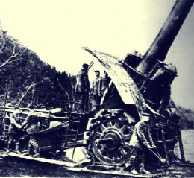
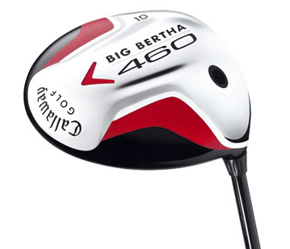
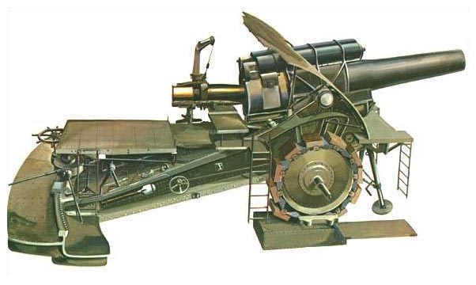

Slide 56

The Impact of “Labeling”
  In 1966, Rosenthall randomly divided laboratory rats into two groups. He labeled them “Maze Bright” and “Maze Dull.” He had his students condition the rats to run a maze. After hundreds of trials, not one rat in the “Dull” category ran as fast as the slowest “Bright” rat. Why? The students expected more from the “Bright” rats. They petted them, coaxed them, and spent more time with them.
  In 1968, Rosenthall and Jacobsen conducted a similar experiment. This time with school children! Some were randomly labeled as “High Scorers” on intelligence tests. By the end of the year, these students achieved sharp increases on IQ tests. Why? The teachers reacted to the labels. They expected more of these students and treated them accordingly.
  Cited in Principles of Human Communication, 2nd edition. Brummett, Putnam, and Crable, eds. (Kendall/Hunt, 1984) 94.

Slide 57
Even Metaphors Influence Perception
Lakoff and Johnson wrote Metaphors We Live By in the 1980s to argue that the way we talk about things influences our beliefs, attitudes, and actions (Univ. of Chicago Press).
In particular, our often unnoticed metaphors influence us because “the essence of metaphor is understanding and experiencing one kind of thing in terms of another” (p. 5).
For example: argument as “war.”
For example: see Arthurs’ short paper on the “Gangster Image” in a speech by FDR.

Slide 58
Argument as “War”
“I’ve never won an argument with him.”
“She attacked every weak point.”
“They marshalled their best arguments.”
“She shot down all my best ideas.”
What if we saw argument as “dance” (and used appropriate labels that guide perception that way) ? Can you “win” a dance with your partner?

Slide 59
Metaphor in the Bible: a primary way we understand God and his covenant
A shoot shall come out of the stump of Jesse.
Enter in through the narrow gate.
No one can serve two masters.
If you forget God, the heavens over your head shall be bronze, and the earthy under you shall be iron.
I am the potter, you are the clay.
All flesh is grass.
Who can endure the day of his coming, for he is like a refiner’s fire.

Slide 60

The Pathetic Appeal of Non Verbal Communication

Slide 61
Cicero on Delivery:
All these parts of oratory succeed according as they are delivered. Delivery, I say, has the sole and supreme power in oratory; without it, a speaker of the highest mental capacity can be held in no esteem; while one of moderate abilities, with this qualification, may surpass even those of highest talent.
On Oratory, Book III, ch. 56.

Slide 62
Significance of Delivery
Allen H. Monroe found that audience members think of effective public speaking more in terms of delivery than content. In a study of student responses to speeches, he discovered that the first six characteristics they associated with an ineffective speaker were related to delivery:
  Monotonous voice Stiffness
  Lack of eye contact Fidgeting
  Lack of enthusiasm Weak voice
The student audience liked direct eye contact, alertness, enthusiasm, a pleasant voice, and physical movement. Another student study discovered that for persuasive speeches, delivery was almost three times as important for effectiveness as content.
From Beeke and Beeke, Public Speaking: An Audience Centered Approach, 223

Slide 63
The fact is ordinary people listen for a preacher’s feelings as much as his ideas, perhaps more. That is simply part of the power of the spoken word . . . it reveals the character of the speaker. A preacher’s tone, inflections, and force are all signs pointing into the hidden realms of character. Whatever excites or depresses a preacher usually reveals a small but significant bit of character.
Bruce Shelley, “The BIG Idea and Biblical Theology’s Grand Theme,” in The Big Idea of Biblical Preaching, Willhite and Gibson, eds. p.102.

Slide 64
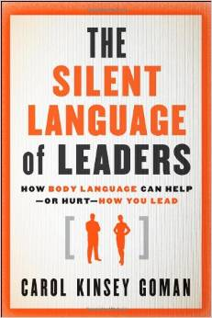
Why Is Delivery So Significant in Persuasion and Leadership?
Carol Kinsey Goman, The Silent Language of Leaders, says we are “wired for body language.” That is, we are wired to give it and interpret it intuitively in the limbic system of the brain.

Slide 65
How Does Delivery Function in Persuasion?
  Inseparable from ethos. We instantly “read” people.

Slide 66

We Instantly Read People
This “reading” is done subconsciously.
We assign meaning to body movement and vocal tone.
This “reading” is done very quickly.
Note, our delivery affects US too. Take a posture of confidence.

Slide 67
“Half a Minute: Predicting Teacher Evaluations from Thin Slices of Nonverbal and Physical Attractiveness”
Study done at Harvard in the mid 90s.
Students shown 30 second clips of teachers teaching and asked to evaluate the teacher for qualities such as “attentive,” “dominant,” “professional,” and “likeable.” Note: Sound turned off or scrambled.
Same teachers had been evaluated with end-of-semester evaluations.

Slide 68
“Half a Minute: Predicting Teacher Evaluations from Thin Slices of Nonverbal and Physical Attractiveness”
How well did the two evaluations match?
  “Remarkably well.”
  Note: The researchers repeated their experiment with thinner and thinner slices of video, getting down to 2 second clips. The results showed only slightly less correlation.
  Reported in “First Impressions,” Boston Globe Magazine 30 (July 1995): 10-11.

Slide 69
How Does Delivery Function in Persuasion?
  Inseparable from ethos
  Reveals attitudes

Slide 70

Communication scholars estimate:
65% of all “social meaning” is communicated non-verbally.
93% of all “emotional meaning” comes through the non-verbal channel.

Slide 71
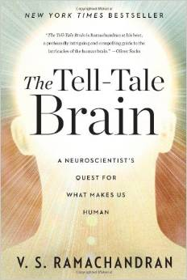
How Does Delivery Function in Persuasion?
  Inseparable from ethos.
  Reveals attitudes.
  Prompts empathy.
    “Mirror neurons.”
    We sync brain patterns when listening (better than when reading).

Slide 72
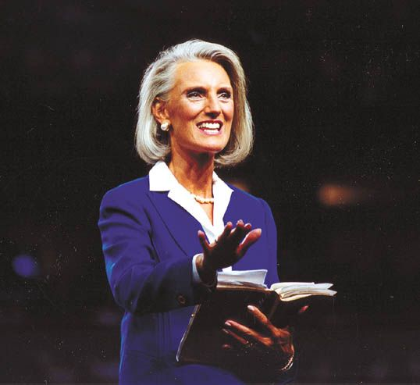
There is obviously a contagion among the passions.
Hugh Blair, Lectures on Rhetoric and Belles Lettres.

Slide 73
How Does Delivery Function in Persuasion?
  Inseparable from ethos
  Reveals attitudes
  Prompts empathy
  Complements and substitutes for the verbal message.

Slide 74
When a verbal message conflicts with the non-verbal message, how do we decide what the speaker means?
55% FACIAL EXPRESSIONS
38% VOICE
7%
WORDS
Source: Albert Mehrabian, “Communication Without Words,” Psychology Today 2 (September 1968), 53.

Slide 75
How Does Delivery Function in Persuasion?
  Inseparable from ethos
  Reveals attitudes
  Prompts empathy
  Complements and substitutes for the verbal message.
  Gains and maintains attention.

Slide 76
Attention and Delivery
Men will not cast away their dearest pleasures upon a drowsy request of someone who does not seem to mean what he says.
The very tone of speech and pronouncement of the preaching is important. The best matters will not move people unless they are delivered movingly. So speak mutually and personally to your audience. The lack of such a familiar tone and expression is a great defect in most of our preaching. A man who has a monotone is like a schoolboy saying his lesson; few will be moved by what he says. Be aroused to the work of the Lord, and speak to your people as though their very lives were at stake.
Richard Baxter, The Reformed Pastor: A Pattern for Personal Growth and Ministry. (Portland: Multnomah, n.d.), 97.

Slide 77
How Does Delivery Function in Persuasion?
  Inseparable from ethos
  Reveals attitudes
  Prompts empathy
  Complements and substitutes for the verbal message
  Gains and maintains attention
  Enhances retention

Slide 79
Two General Qualities of Effective Delivery for Persuasion and Leadership
Passion.
Sincerity.

Slide 80
The chief requisite, then, for moving the feelings of others is . . . that we ourselves be moved, for the assumption of grief, and anger, and indignation, will be often ridiculous, if we adapt merely our words and looks, and not our minds, to those passions.
Quintilian, Institutes of Oratory

Slide 81
Write as if you were dying. At the same time, assume you write for an audience consisting solely of terminal patients. That is, after all, the case. What would you begin writing if you knew you would die soon? What could you say to a dying person that would not enrage by its triviality?
Annie Dillard, The Writing Life (New York: Harper and Row, 1989), 68.

Slide 82
Passion and Sincerity:
The writer seeks to change blood into ink; the preacher seeks to change ink into blood.
Charles Bartow

Slide 83
Matching our perceptions of our delivery with the listeners’ perception:
Which of the following words best describes your pastor’s preaching?
 | Pastors’ Response | Congregations’ Response
“Energetic” | 43% | 29%
“Conversational” | 46% | 22%

Slide 84
Some Specific Delivery Skills Related to Persuasion and Leadership
Bodily Action that reveals passion and sincerity.
  Posture, gestures, facial expression, proxemics, eye contact.

Slide 85
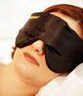
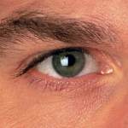

Rhetorical Functions of Eye Contact:
Maintain attention.
Monitor feedback.
Compensate for physical distance.
Signal the nature of a relationship.
Encourage dialogue.

Slide 86
The Power of Eye Contact:
Drink to me only with thine eyes, and I will pledge with mine.
Ben Jonson
The Lord turned and looked straight at Peter. Peter remembered . . . went outside and wept bitterly.
Luke 22:61-62

Slide 87
Delivery Skills Related to Persuasion and Leadership
Bodily Action that reveals passion and sincerity.
  Posture, gestures, facial expression, proxemics, eye contact.
Vocal Variety that reveals passion and sincerity.
  P P P P P

Slide 88

Rhetorical Functions of Silence:
Gain attention, esp. when unexpected.
Show interest in audience feedback.
Can show respect for audience, event, place.
Encourage interaction.
Creates uncertainty or mystery.
Allows time for self-persuasion.

Slide 89
How to Improve Delivery
Watch yourself on video.
Listen to yourself on audio.
Observe (but don’t imitate) good speakers.
Ask for feedback from someone who loves you.
Practice out loud.
Pray and ask God to transform the inner person. Remember: “Out of the heart, the mouth speaks.”

Slide 90
Exercise
Read aloud the passage Dr. Arthurs hands out.
Receive feedback from the class.
Read again, incorporating that feedback.

Slide 91
Black

Slide 92


Preaching (Homiletics) link at BibleStudyDownloads.org
Get this presentation for free!
Notes:
Preaching (pr)
Homiletics

