Slide 1
Preaching Controversial Subjects
Dr. Rick Griffith • Jordan Evangelical Theological Seminary • BibleStudyDownloads.org

Slide 2
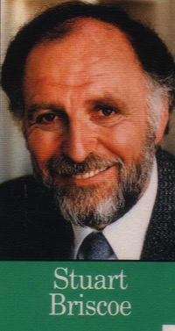
Controversy is unavoidable
"The path toward relevance… is strewn with controversial topics"
- Stuart Briscoe, 80

Slide 3
Singapore's Hot List
246
LGBT
Gambling
Sex/Porn
Singleness
Government
Euthanasia
Divorce
Baby Making
Required army service
Abortion
Living Wills
Upgrading
R-Rated movies
Kid's Education
Religious Harmony
Racial Harmony
Muslim Evangelism
Working Mothers
Role of Women

Slide 4
Why Stay…
1 Corinthians 7:25-40
Single?

Slide 5
Pornography

Slide 6
LGBT

Slide 7
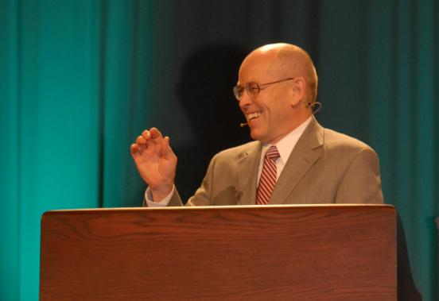
Wayne Grudem's Definition of Prophecy
"telling something that God has spontaneously brought to mind"
"Why Christians Can Still Prophesy" Christianity Today (16 Sept 1988), 29

Slide 8
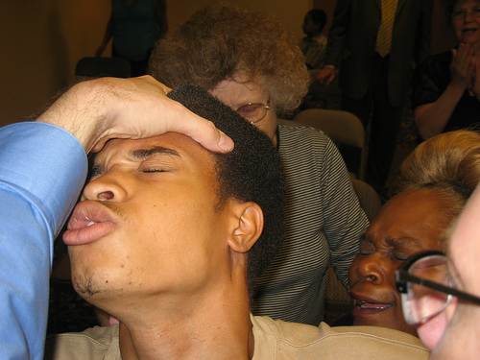
Speaking in Tongues
Notes:
8

Slide 9
1 Timothy 2:11-15
¹¹A woman should learn in quietness and full submission. ¹²I do not permit a woman to teach or to have authority over a man; she must be silent.
¹³For Adam was formed first, then Eve. ¹⁴And Adam was not the one deceived; it was the woman who was deceived and became a sinner. ¹⁵But women {Gr. she} will be saved {or restored} through childbearing— if they continue in faith, love and holiness with propriety.

Slide 10
Guidelines on Preaching Controversies
246
Do your homework
Present both sides
Be humble
Preach the Bible

Slide 11
Benefits of Controversial Preaching
246
People grow in understanding
People grow in maturity
Relevance

Slide 12
Why Stay…
1 Corinthians 7:25-40
Single?

Slide 13
Dangers of Controversial Preaching
246
Dogmatism (legalism = conviction without scriptural support)
People may leave the church (but see John 6:66)

Slide 14
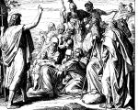
Courageous, Controversial Preachers in the Bible
246
Jeremiah: "Leave Jerusalem"
Paul: "Salvation is by grace"
Jesus: "You hypocrites!"

Slide 15
Black

Slide 16
Preaching (Homiletics) link at BibleStudyDownloads.org
Get this presentation for free!
Notes:
Preaching (pr)
Homiletics

