Slide 1
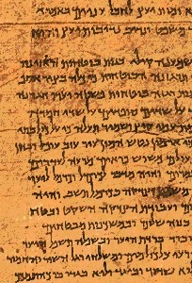
Topical Preaching
Dr. Rick Griffith • Jordan Evangelical Theological Seminary • BibleStudyDownloads.org

Slide 2
The Preparing Expository Sermons Process
27-28, 251
Based on Ramesh Richard's text, Preparing Expository Sermons
TEXT
SERMON
5 Desired Listener Response
Brain
4 The Three
Developmental
Questions
Purpose Bridge
3.2 Exegetical Idea
CPT
Heart
CPS
6 Homiletical Idea
7 Homiletical
Outline
8 Clarity
9 Intro/Concl
3.1 Exegetical
Outline
Structure
Skeleton
Structure
2 Analyze Text
Study
Flesh
Preach
10 MSS &
Preach
1 Choose Text
White text shows 10 steps adapted from Haddon Robinson, Biblical Preaching (notes, 105)

Slide 3
What is the most impactful sermon you have heard in your life?
How did it change your life?
Was it topical or an exposition of one passage?

Slide 4
What is a Topical Sermon?
154
Topical sermons expound a central idea from more than one main text of Scripture

Slide 5
What is a Topical Exposition?
154
"The communication of a biblical concept derived from several different passages in accordance with the author's purpose and the subject/complement of each passage presented"
Dallas Seminary class notes, 1985

Slide 6
Types of Sermons
154
Categories | Types of Sermons
Biblical Content | Biblical Sermon |  |  | Non-Biblical Sermon
Use of Text | Textual or Expository Sermon |  | Topical-Biblical Sermon | Topical Sermon
Length of Text | Textual Unit (Paragraph or Chapter) | Verse or Clause | Many Texts | Non-Textual (No Text)
Sidney Greidanus, The Modern Preacher and the Ancient Text, 12

Slide 7
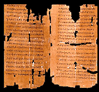
Topical sermons draw from several books
Theme

Slide 8
Some Dangers of Topic Preaching
2
Topical Preaching | Expository Preaching
preaches 2 or more texts of Scripture | focuses on a single passage
more easily selects what the preacher wants to say from the text | discerning what God says through the author
the preacher designs his own outline | the preacher derives his outline from the text
time may not be available to put verses in their proper context | time is available to put verses in context
the preacher can be accused of speaking to certain individuals | the speaker is less easily accused of targeting certain subjects or people as he preaches systematically

Slide 9
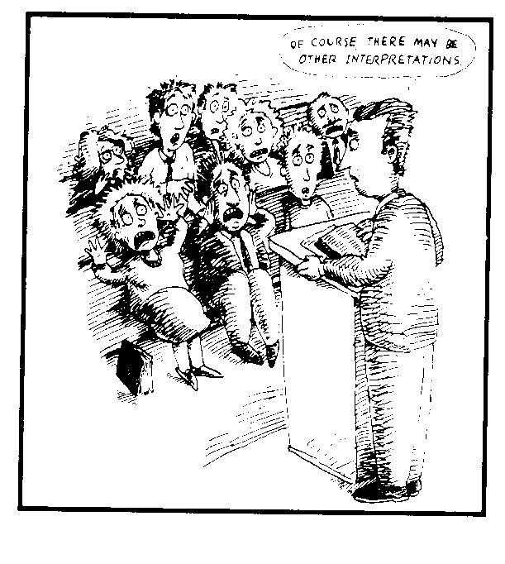
Topical messages have the danger of inserting your own views.
Of course, there may be other interpretations.

Slide 10
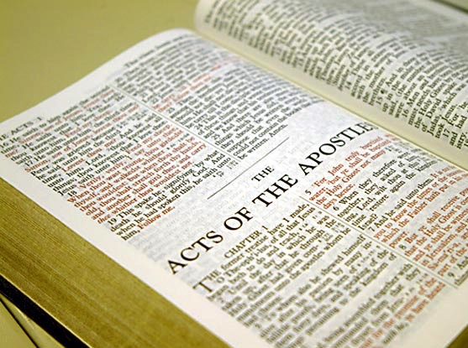
Advantages of Topical Preaching
154-155
Allows fuller development than in one text
Theological: Good to preach systematics
Biographical: Character studies
Procedural: method of doing something
Persuasive: abortion, divorce
Evangelistic: 4 spiritual laws
Proverbs: can preach two-line proverbs
Works nicely between series
Gives variety with a change in style
Enables speaking on topics not in Bible

Slide 11
Disadvantages of Topical Preaching
155
Eisegesis: It can read unintended meanings into texts
Wrong Approach to the Bible: It can see God's Word as answering all questions
Imbalance: It tends to emphasize only the preacher's strengths since few choose to speak on their weaknesses

Slide 12
The Topical Exposition Process
155a
Topic
TEXTS
SERMON
Brain
Purpose Bridge
CPT
Heart
CPS
CPTs
Skeleton
Structure
Structures
Study
Flesh
Preach

Slide 13
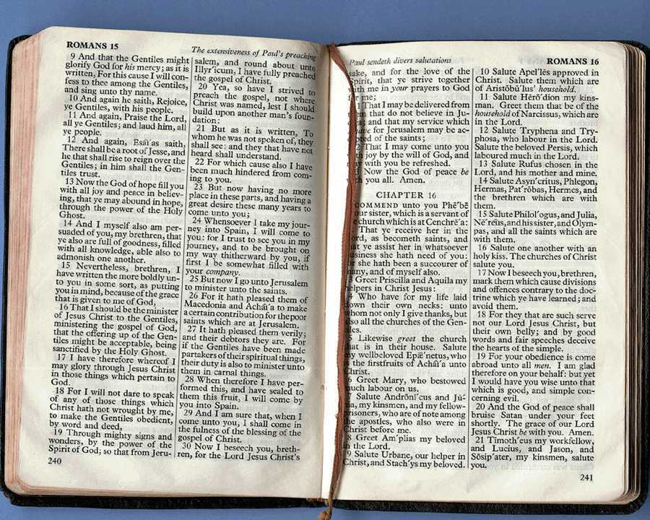
How to Preach Topically
155a
Study topic & texts, exegeting each text
Structure: get EI of each text, order them
CPT: Combine text CPTs to write overall EI
Purpose from developmental questions
CPS: Convert overall EI to overall MI
Structure: Support with ILLs, APPs, etc.
Preach after manuscripting & practice

Slide 14
Topical Examples
156
What in the World is God Doing (p. 156)?
Who Moved the Stone (p. 157a)?
Finding Your Mate (p. 157d)
The Integrity Factor (p. 157h)

Slide 15
Answer: The Big Idea!
Question:
What should the listeners bring home from a topical message?

Slide 16
Lutzer: "Thou Shalt Not Commit Adultery"
What do you think was the sermon's strongest point? Why?
Is it deductive or inductive in structure?
Is the application simple or cyclical?
Biblical Sermons, 31-43

Slide 17
Lutzer: "Thou Shalt Not Commit Adultery"
Prove It: Why did God say, "Thou shalt not commit adultery"?
I. We should not commit adultery because God says we shouldn't.
A. We are unable to have sex outside of marriage without guilt and emotional tension (answers "God is unfair" objection)
B. Sex is bonding (1 Cor. 6:16).
C. Even loving adulterous relationships break five of the ten commandments.
II. We should not commit adultery because of the consequences.
A. Inner destruction, a feeling of guilt, results (Ps. 51:3).
B. Outer destruction & hurt comes when the affair is discovered.
III. We should live in sexual purity because there is a compensation that comes from successfully resisting temptation.
A. The sinful eye and hand must be controlled (Matt. 5:29-30).
B. "Blessed are the pure in heart, for they will see God" (5:8).
C. Sexual temptation [enables us] to prove our love for God.

Slide 18
Lutzer: "Thou Shalt Not Commit Adultery"
Conclusion
1. Repent (ILL: hardhearted adulterous man)
2. Tell your spouse (implied)
3. David got freedom once he stopped pretending (Ps. 32:1).
4. God commanded: "Thou shalt not commit adultery."
a. "We should never be ashamed of believing that he knows best" (MP I restated)*
b. "And with the command comes the divine enablement to live up to the standard" (MP III restated)
5. "Blessed are those who are not ashamed to obey his Word."
* Note that MP II on consequences is not mentioned so as to end on a positive note.

Slide 19
What topical message has God put on your heart to preach?
Why?
How will you do it?

Slide 20
Black

Slide 21
Preaching (Homiletics) link at BibleStudyDownloads.org
Get this presentation for free!
Notes:
Preaching (pr)
Homiletics

