Slide 1
Manuscripting Your Sermon
Dr. Rick Griffith • Jordan Evangelical Theological Seminary • BibleStudyDownloads.org

Slide 2
The Preparing Expository Sermons Process
27-28, 251
Based on Ramesh Richard's text, Preparing Expository Sermons
TEXT
SERMON
5 Desired Listener Response
Brain
4 The Three
Developmental
Questions
Purpose Bridge
3.2 Exegetical Idea
CPT
Heart
CPS
6 Homiletical Idea
7 Homiletical
Outline
8 Clarity
9 Intro/Concl
3.1 Exegetical
Outline
Structure
Skeleton
Structure
2 Analyze Text
Study
Flesh
Preach
10 MSS &
Preach
1 Choose Text
White text shows 10 steps adapted from Haddon Robinson, Biblical Preaching (notes, 105)

Slide 3
Four Objectives: A Sermon That is…
25
True
Interesting
Clear
Relevant

Slide 4
SBC Speakers & Evaluators 2016
vi
July-Nov 16

Slide 5
Manuscripting Your Sermon

Slide 6
Q: What's a Sermon Manuscript?
78
A: Writing your sermon down word-for-word

Slide 7
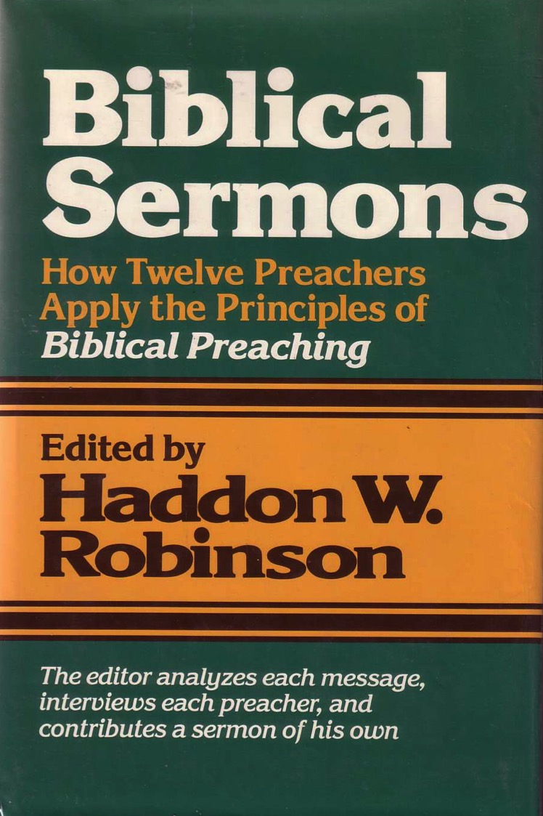
Here is a classic book of sermon manuscripts
Biblical Sermons
How Twelve Preachers Apply the Principles of Biblical Preaching
"A Case Study in Temptation" gives us Robinson's text verbatim
The editor analyzes each message, interviews each preacher, and contributes a sermon of his own

Slide 8
The Preparing Expository Sermons Process
27-28, 251
Based on Ramesh Richard's text, Preparing Expository Sermons
TEXT
SERMON
5 Desired Listener Response
Brain
4 The Three
Developmental
Questions
Purpose Bridge
3.2 Exegetical Idea
CPT
Heart
CPS
6 Homiletical Idea
7 Homiletical
Outline
8 Clarity
9 Intro/Concl
3.1 Exegetical
Outline
Structure
Skeleton
Structure
2 Analyze Text
Study
Flesh
Preach
10 MSS &
Preach
1 Choose Text
White text shows 10 steps adapted from Haddon Robinson, Biblical Preaching (notes, 105)

Slide 9
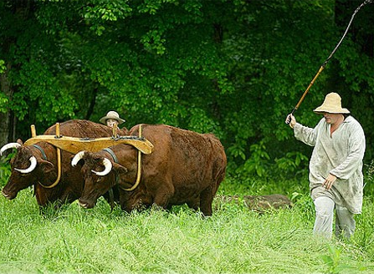
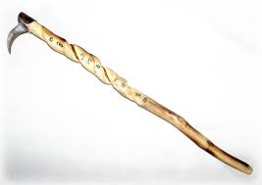
Why Manuscript?
78
It forces you to choose the best word.
⁹Not only was the Teacher wise, but also he imparted knowledge to the people. He pondered and searched out and set in order many proverbs. ¹⁰The Teacher searched to find just the right words, and what he wrote was upright and true.
¹¹The words of the wise are like goads, their collected sayings like firmly embedded nails—given by one Shepherd. ¹²Be warned, my son, of anything in addition to them.
Of making many books there is no end, and much study wearies the body (Eccl. 12:9-12 NIV).

Slide 10
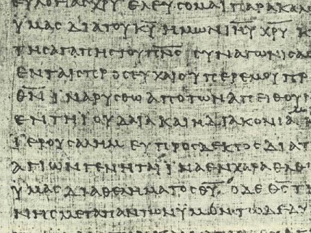
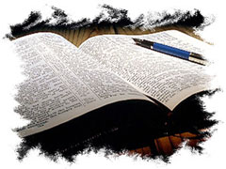
Why Manuscript?
78
It forces you to choose the best word.
Words don't just come for most of us.

Slide 11
Scripts keep you from looking bad
"Honey, I loved your sermon. However, sturgeons spawn, Spurgeon spoke."

Slide 12
Why Manuscript?
78
It forces you to choose the best word.
Words don't just come for most of us.
You can use the sermon later.

Slide 13
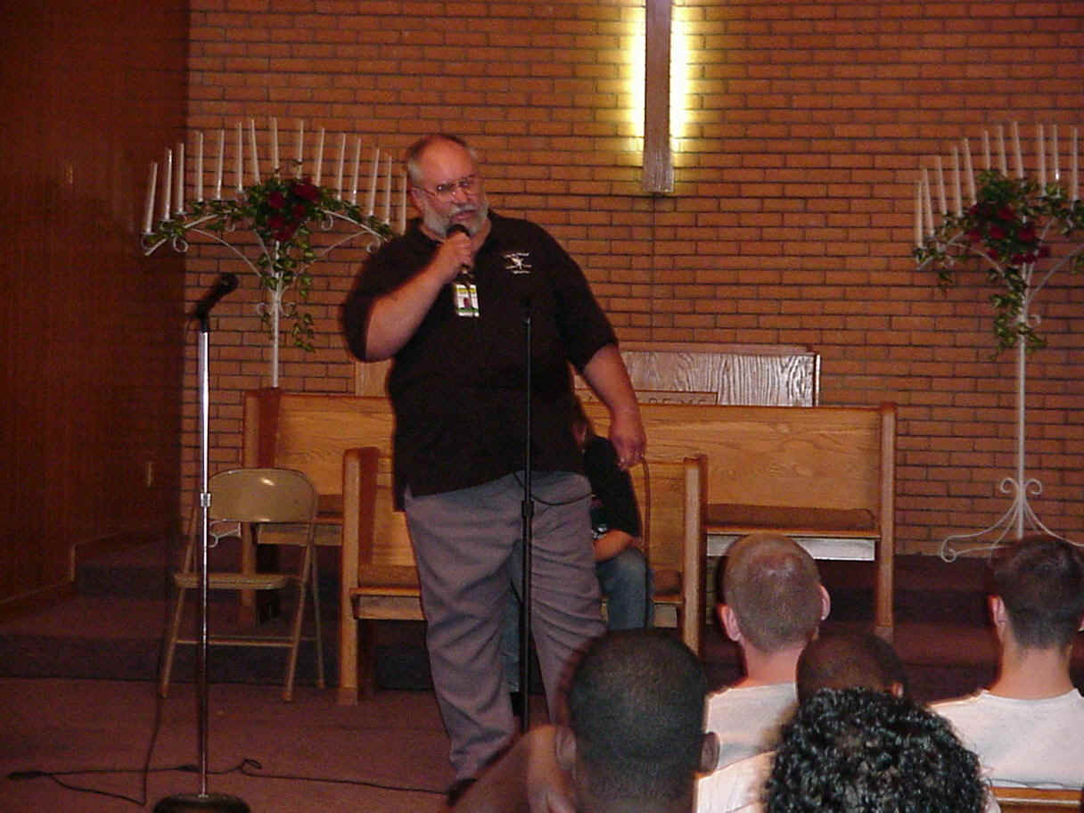
The Value of Manuscripts
After speaking to a seminary audience, one student expressed to Ramesh Richard, "Wow! That was a fantastic message! Have you put that down in writing?"
"No," said Ramesh, "but I hope that someday after I die my wife will put it down in writing."
"Well," the student replied, "I sure hope it's soon."

Slide 14
Why Manuscript?
78
It forces you to choose the best word.
Words don't just come for most of us.
You can use the sermon later.
It helps you keep to your time limit.

Slide 15
A manuscript keeps you from regularly going overtime
Sermon: "Do Miracles Still Happen?" Rev. Clanton
"We'll know if he finishes by noon."

Slide 16
Length has always been important!

Slide 17
Why Manuscript?
78
It forces you to choose the best word.
Words don't just come for most of us.
You can use the sermon later.
It helps you keep to your time limit.

Slide 18
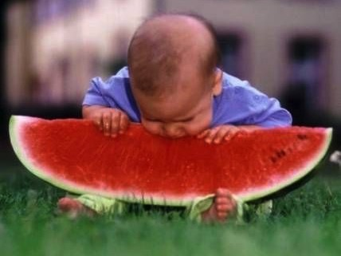
Manuscripts keep us from biting off more than we can chew.

Slide 19
Why Manuscript?
78
It forces you to choose the best word.
Words don't just come for most of us.
You can use the sermon later.
It helps you keep to your time limit.
It just helps you preach better.

Slide 20
How to Manuscript: Two Options
78
pp. 82-85
Prose
pp. 86-90
Outline
pp. 148-50
Int
Need
Sub
Bkgrd
T
MP I
SP A
Text appears in paragraphs without indentation while the structure is shown in a separate column design on the left
Introduction
1. Interest: Text
2. Need: Text
3. Sub: Text
I. Statement of MPI
A. Text
B. Application

Slide 21
Advantages of the Outline Manuscript
81
Outline
Easier to...
Introduction
1. Write
1. Interest: Text
2. Need: Text
2. Read
3. Sub: Text
3. Edit
I. Statement of MPI
4. Memorize
A. Text
B. Application

Slide 22
Whichever option…
78
Be Clear

Slide 23
What is Chafer saying?
78
As has been intimated, it is noticeable that the great majority of the works on Systematic Theology have been satisfied to trace the origin of sin no further than to the fall of man in Eden. It is true that human sin began in Eden, but, though Adam merely re-enacted that sin which before him had been committed in heaven, the essential character of sin is to be determined, to a large measure, by the sin of the first angel rather than by its reproduction by the first man.
Write what he said in one sentence.
Lewis Sperry Chafer, Systematic Theology, 2:242

Slide 24
What is Chafer saying?
78
Write what he said in one sentence.
Most theological works say sin began in Eden, but it really began in heaven.
Sin began in heaven—not earth.

Slide 25
Use Simple Words
79
Avoid specialized vocabulary
Prefer the short word
Use words they already know
Rule of Thumb:
Don't overestimate the people's vocabulary or underestimate their intelligence

Slide 26
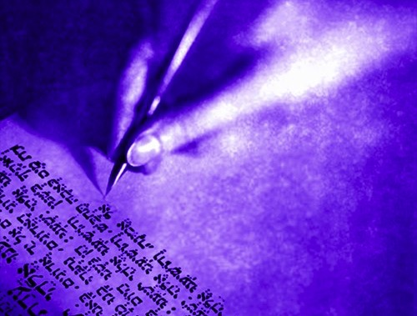
Gunning's 10 Principles for Clear Writing
106
1. Keep sentences short.
Tests show that reading tends to become hard when sentences average more than 20 words. Sentences in Time and Reader's Digest average 16-17 words. Average sentences of business writing exceed 25 words (which is too long).

Slide 27
Gunning's 10 Principles for Clear Writing
106
2. Prefer the simple to the complex.
This applies to sentence structure and the choice of words. Write, "try to find out" rather than "endeavor to ascertain." Avoid excessive use of capital letters.

Slide 28
Gunning's 10 Principles for Clear Writing
106
3. Prefer the familiar word.
If the reader doesn't understand the words you use, he is likely to miss your meaning. This does not suggest that you should have a small vocabulary. You need all the words you can master.

Slide 29
Gunning's 10 Principles for Clear Writing
106
4. Avoid unnecessary words.
Nothing weakens writing more than words that you don't need. Read your copy over closely. Make every word carry its weight. Never write, "It goes without saying that…" since this admits that what you'll say is unnecessary.

Slide 30
Gunning's 10 Principles for Clear Writing
106
5. Put action into your verbs.
Active verbs put life in writing. Don't smother action with too many participles and gerunds (an "ing" word functioning like a noun). Write, "We aim to write clearly" rather than "Clarity in composition is our intention." Avoid the passive voice and "to be" verb as much as possible.

Slide 31
Gunning's 10 Principles for Clear Writing
106
6. Write the way you talk.
Well, anyway, a little that way. A conversational tone is one of the best avenues to readable writing. Don't lapse into a stuffy business jargon that has no relation to the way business people talk face-to-face.

Slide 32
Gunning's 10 Principles for Clear Writing
106
7. Use terms your reader can picture.
Be aware that abstract terms tend to make writing dull and foggy. Prefer the short, concrete words that stand for things you can see and touch.

Slide 33
Gunning's 10 Principles for Clear Writing
106
8. Tie in with your reader's experience
Link your new idea with some old idea already known to your reader. This keeps his attention and leads to greater understanding.

Slide 34
Gunning's 10 Principles for Clear Writing
106
9. Make full use of variety.
Don't smother your individual writing style. Develop a fresh form of expression that represents you. Avoid clichés. Avoid stilted patterns of writing.

Slide 35
Gunning's 10 Principles for Clear Writing
106
10. Write to express—not impress.
Don't show off with complexity. Make your ideas clear with simple, direct writing. The writer who actually makes the best impression is the one who can express complex ideas simply.

Slide 36
Whichever option…
79
Be Clear
Be Direct & Personal
Be Vivid

Slide 37
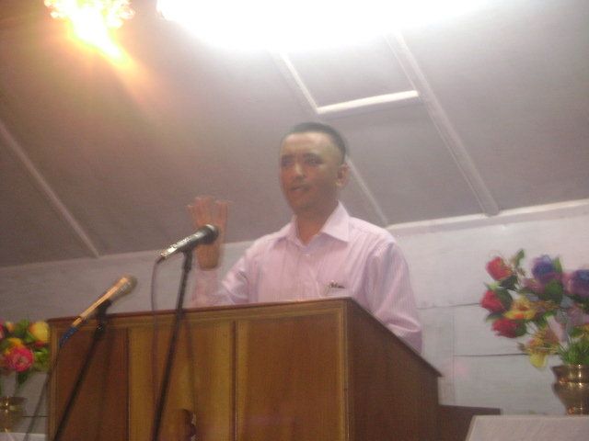
How to Be an Interesting Speaker
79
Pay attention to your own use of language
Study how others use language
Read aloud

Slide 38
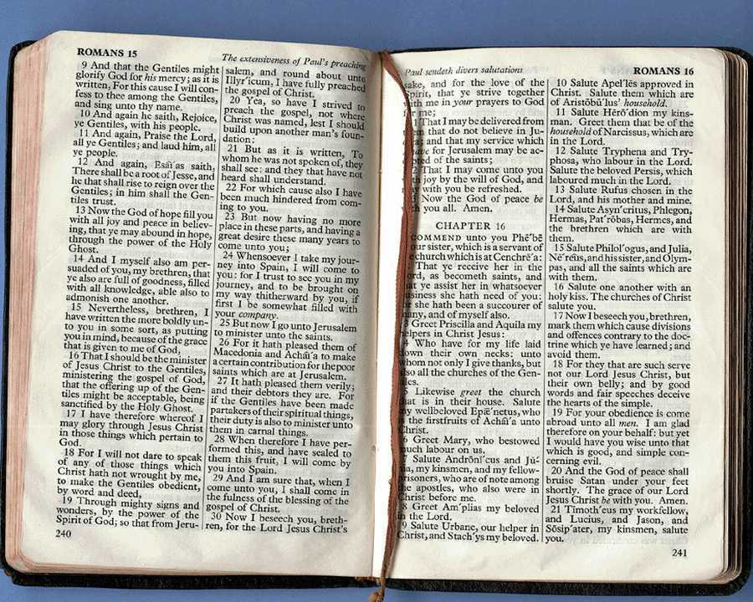
What to Do with the Manuscript
80
Four Options (after this course!):
Bring it into the pulpit
Reduce it to a one-page outline
Memorize it then speak word-for-word
Preach extemporaneously

Slide 39
Manuscripts need not inhibit our delivery
Nice to hear a good
ole-fashioned sermon,
Reverend!

Slide 40
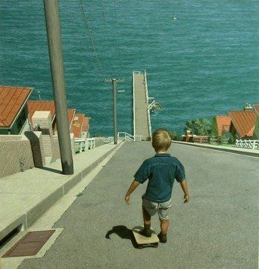
Does preaching without notes look impossible?

Slide 41
Why Preach Without Notes?
80
It forces you to know your material
It enables you to preach with confidence
One preacher's son said to another preacher's son,
"My father is very smart. He speaks without notes!"
His friend responded,
"My father is even smarter. He speaks without thinking!"

Slide 42
Why Preach Without Notes?
80
It forces you to know your material
It enables you to preach with confidence
It frees you up to work on delivery
It helps you speak more naturally

Slide 43
Why Practice Preaching?
80
Practice enables you to…
Know the sermon well
Communicate the sermon well

Slide 44
Handle Honesty
"Okay, okay, I take it back. It wasn't a bad sermon!"

Slide 45
Why Practice Preaching?
80
Practice enables you to…
Know the sermon well
Communicate the sermon well
Cut out stuff to keep to your time

Slide 46
What they feel about sermon length matters
"Is it just me, or are his sermons getting longer?"

Slide 47
How to Practice Preaching
80
for a Sunday Message…
WED
Finish MSS
4 Days Before
THUR
Read it aloud twice
3 Days Before
FRI
Preach twice with glances
2 Days Before
SAT
Preach twice without glances
1 Day Before
SUN
Preach 1-2 times more
Morn

Slide 48
How to Practice Preaching
80
for a Tuesday Message…
FRI
Finish MSS
4 Days Before
SAT
Read it aloud twice
3 Days Before
SUN
Preach twice with glances
2 Days Before
MON
Preach twice without glances
1 Day Before
TUE
Preach 1-2 times more
Morn

Slide 49
How to Practice Preaching
80
for a Thursday Message…
SUN
Finish MSS
4 Days Before
MON
Read it aloud twice
3 Days Before
TUE
Preach twice with glances
2 Days Before
WED
Preach twice without glances
1 Day Before
THUR
Preach 1-2 times more
Morn

Slide 50
How to Practice Preaching
80
for a Friday Message…
MON
Finish MSS
4 Days Before
TUE
Read it aloud twice
3 Days Before
WED
Preach twice with glances
2 Days Before
THUR
Preach twice without glances
1 Day Before
FRI
Preach 1-2 times more
Morn

Slide 51
Summary
80
"There seems to be only one way to combine precision of language with immediacy of delivery, and that is for us to write the sermon in our study but decline to read it from the pulpit."
"The whole process of sermon preparation, from beginning to end, was admirably summed up by the American black preacher who said, 'First, I reads myself full, next I thinks myself clear, next I prays myself hot, and then I lets go.'"
John Stott, Between Two Worlds, 255, 258

Slide 52
Four Objectives: A Sermon That is…
25
True
Interesting
Clear
Relevant

Slide 53
The Preparing Expository Sermons Process
27-28, 251
Based on Ramesh Richard's text, Preparing Expository Sermons
TEXT
SERMON
5 Desired Listener Response
Brain
4 The Three
Developmental
Questions
Purpose Bridge
3.2 Exegetical Idea
CPT
Heart
CPS
6 Homiletical Idea
7 Homiletical
Outline
8 Clarity
9 Intro/Concl
3.1 Exegetical
Outline
Structure
Skeleton
Structure
2 Analyze Text
Study
Flesh
Preach
10 MSS &
Preach
1 Choose Text
White text shows 10 steps adapted from Haddon Robinson, Biblical Preaching (notes, 105)

Slide 54
Black

Slide 55
Preaching (Homiletics) link at BibleStudyDownloads.org
Get this presentation for free!
Notes:
Preaching (pr)
Homiletics

