Slide 1
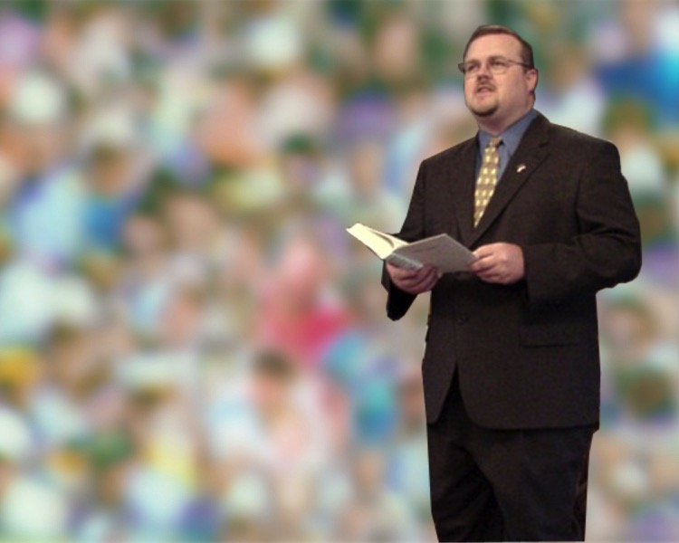
Applications
Where God's Word Shows Up in Real Life
Dr. Rick Griffith • Jordan Evangelical Theological Seminary • BibleStudyDownloads.org

Slide 2
Why do so many speakers fail to apply the text to their listeners?

Slide 3
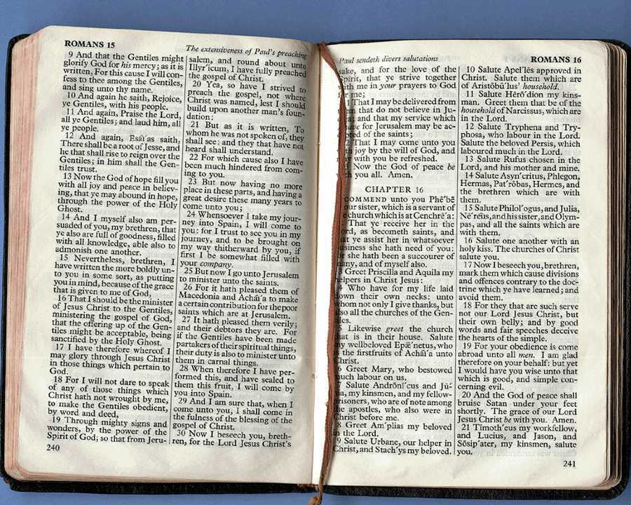
Applying Scripture
70
Pray for a humble spirit
Follow steps 1-6 (pp. 27-28)

Slide 4
The Preparing Expository Sermons Process
27-28, 251
Based on Ramesh Richard's text, Preparing Expository Sermons
TEXT
SERMON
5 Desired Listener Response
Brain
4 The Three
Developmental
Questions
Purpose Bridge
Application
3.2 Exegetical Idea
CPT
Heart
CPS
6 Homiletical Idea
Interpretation
7 Homiletical
Outline
8 Clarity
9 Intro/Concl
3.1 Exegetical
Outline
Structure
Skeleton
Structure
Study
Observation
2 Analyze Text
Flesh
Preach
10 MSS &
Preach
1 Choose Text
White text shows 10 steps adapted from Haddon Robinson, Biblical Preaching (notes, 105)

Slide 5
Applying Scripture
70
Pray for a humble spirit
Follow steps 1-6 (pp. 27-28)
See the CPS in terms of relationships in your life (p. 71)

Slide 6
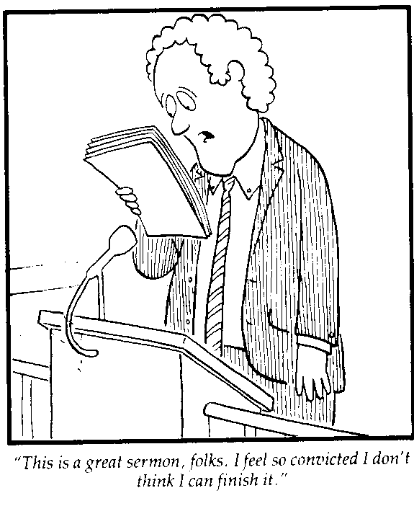
Apply First to Your-self!
“This is a great sermon, folks. I feel so convicted I don't think I can finish it.”

Slide 7
Applying Scripture
70
Pray for a humble spirit
Follow steps 1-6 (pp. 27-28)
See the CPS in terms of relationships in your life (p. 71)
See the CPS relating to the lives of others (p. 71)

Slide 8
Areas of Life to Apply the Bible
71
Your Relation to God
Your Relation to Yourself
Your Relation to Others
Your Relation to the Enemy

Slide 9
Applying Scripture
70
Pray for a humble spirit
Follow steps 1-6 (pp. 27-28)
See the CPS in terms of relationships in your life (p. 71)
See the CPS relating to the lives of others (p. 71)
Apply immediately

Slide 10
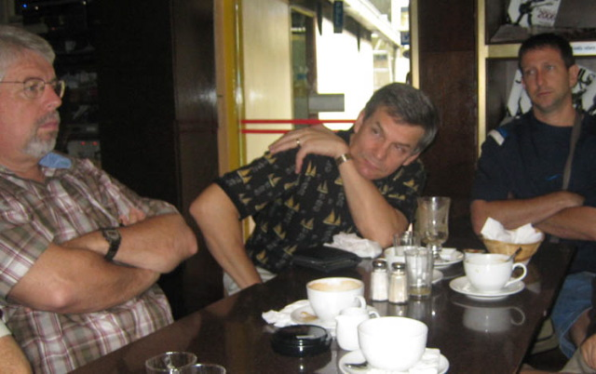
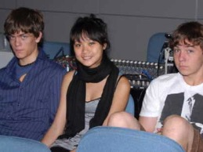
Be Relevant to Different Groups
Men
72
Women
Children
Students

Slide 11
How to Restore Relationships
Matthew 18:15-20
10 December 2006
6 March 2011
Notes:
09.31 EO only
16.11

Slide 12
Matthew 18:15-20
If your brother sins against you, go and show him his fault, just between the two of you. If he listens to you, you have won your brother over. ¹⁶But if he will not listen, take one or two others along, so that 'every matter may be established by the testimony of two or three witnesses.' ¹⁷If he refuses to listen to them, tell it to the church; and if he refuses to listen even to the church, treat him as you would a pagan or a tax collector
How to Restore 15-17
Apply what this means…
Notes:
Jesus ended his teaching on restoring Christians in sin by commanding that unrepentant believers be treated like a pagan or tax collector—but how this? What does it mean?
__________________
BS-18-Exegetical Idea1-slide 15
BS-19-Exegetical Idea2-slide 32
BS-26-Applications-10 focuses only on verses 15-17
NS-01-Matt15-28-slide 33
PR-08-Exegetical Idea1-slide15
PR-09-Exegetical Idea2-slide 32
PR-16-Applications-12 focuses only on verses 15-17

Slide 13
What's God Saying to You?
a. The Church Body
M
M
M
M
M
M
M
M
M
M
M
M
b. Your Own Life
M
M
M
M
S
M
M
M
M
M
M
M
M
c. Helping Others
M
M
M
Notes:
Apply restoring relationships in at least three areas…

Slide 14
How NOT to Discipline
EXCOMMUNICATE !
Notes:
Sometimes we can show what to do by also telling first what NOT to do…
08.32
16.14

Slide 15
How to Discipline Someone Like a "Pagan or Tax Collector"
93
Don't refer to him/her as a Christian.
Evangelize this person.
Don't let him/her take the Lord's Supper.
Remove the person from membership.
Remove this person from church roles.
Unbeliever
“Deliver over to Satan” one in sex sin (1 Cor. 5:5).
Don't eat with him/her (1 Cor. 5:11).
Prohibit him/her from attending church?
Worse
Notes:
08.33
16.15

Slide 16
Illustrate to Apply
72
Go for the moon rather than the reflection
Notes:
Our applications should be clear—and what better way to apply than to share a story of someone doing what you are saying?
Too often our applications are so general that they are an image of the reality that we want to see in people's lives. It is like becoming thrilled to see shimmering water rather than seeing the moon that causes the water to shine.

Slide 17
Restore People in Sin
Restore People in Sin
72
“Brothers, if someone is caught in a sin, you who are spiritual should restore him gently.”
Galatians 6:1
Notes:
Homiletics 16.17
NTS Galatians slide 75

Slide 18
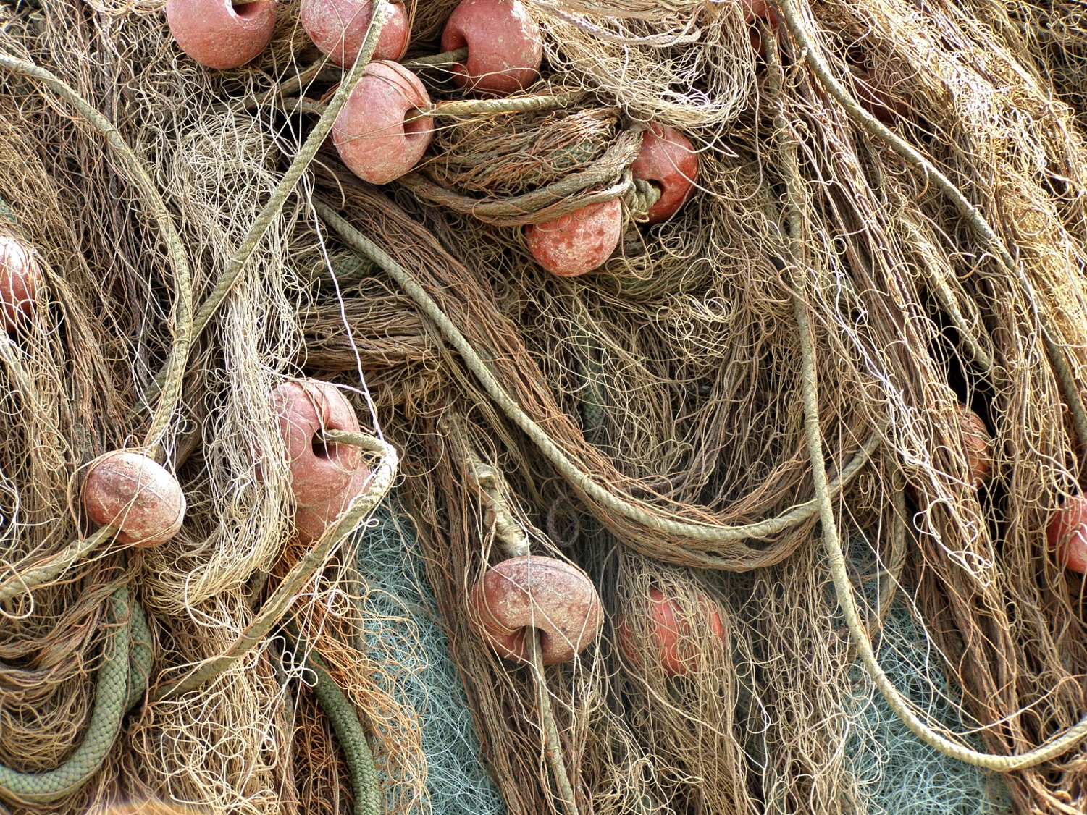
A. Some illustrations only explain a concept as they come from an unrelated area of life.
72
Restore nets
Notes:
Homiletics 16.18
NTS Galatians slide 76

Slide 19
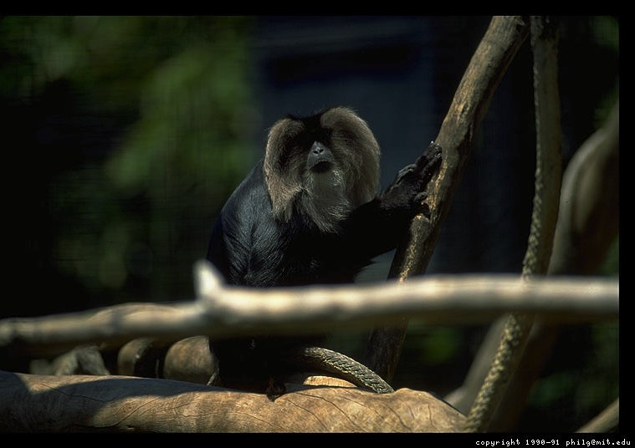
A. Some illustrations only explain a concept as they come from an unrelated area of life.
72
“The love of money is the root of all kinds of evil...” (1 Tim. 6:10)
The monkey & tinsel
“Don't be greedy”
Notes:
Monkeys put their hands in hollowed out logs to grab the tinsel ball inside. However, their clenched hands over the tinsel becomes too large to withdraw from the log. Since they are unwilling to let go of the tinsel, hunters easily club them to death. This illustration has been used to show the perils of wealth--but all it teaches us is how stupid monkeys are! It helps very little to illustrate the point of greed so the sermon time taken is better invested in sharing how a human has gotten trapped due to greed.

Slide 20
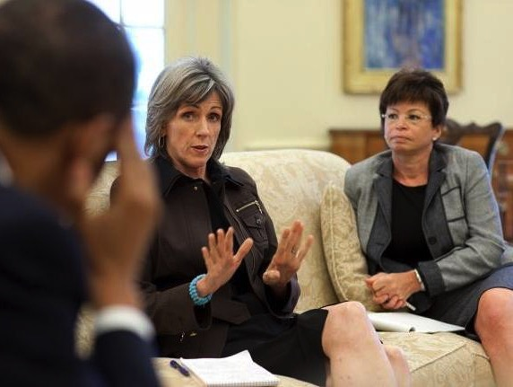
B. Better illustrations apply a concept as they relate to the same area of life.
72
Restore nets
Restore people
Notes:
Instead of restoring nets, share about a genuine reconciliation between people.
Homiletics 08.27 adapted in 16.20
Homiletics 16.23
NTS Galatians slide 77

Slide 21
B. Better illustrations apply a concept as they relate to the same area of life.
72
“The love of money is the root of all kinds of evil...” (1 Tim. 6:10)
The monkey & tinsel
The pastor who fell
“Don't be greedy”
Notes:
Instead of the monkey and tinsel story, to illustrate greed, share about a person who gave up ministry simply for better pay.

Slide 22
Zuck's Ninety Verbs
73
If you can't think of an application based on one of these 90 verbs then you are hopeless!

Slide 23
Zuck's Ninety Verbs
60
Accept | Choose | Decide
Admit | Claim | Develop
Analyze | Collect | Direct
Ask | Commit | Discourse
Ask myself | Compliment | Do
Avoid | Comply | Eliminate
Be sensitive | Confess | Encourage
Be willing | Control | Enjoy
Build | Count | Evaluate
Buy | Create | Exemplify
Notes:
Ninety Verbs to Help Lead Scriptural Applications into Specific Action (Dr. Roy B. Zuck, Dallas Seminary)

Slide 24
Zuck's Ninety Verbs
60
Experiment | Keep | Pray about
Find | List | Pray to
Follow | Listen | Pray with
Give | Look for | Prefer
Go | Look up | Pursue
Guard | Love | Read
Help | Meet | Realize
Invite | Memorize | Record
Isolate | Organize | Rejoice
Keep | Plan out | Repair
Notes:
Ninety Verbs to Help Lead Scriptural Applications into Specific Action (Dr. Roy B. Zuck, Dallas Seminary)

Slide 25
Zuck's Ninety Verbs
60
Respond | Stay away | Value
Sacrifice | Stop | Visit
Save | Study | Wait
Schedule | Substitute | Wake up
Select | Take | Walk
Send | Talk with | Watch
Share | Teach | Witness
Show | Telephone | Work on
Sing | Thank | Write down
Spend time | Think about | Write to
Notes:
Ninety Verbs to Help Lead Scriptural Applications into Specific Action (Dr. Roy B. Zuck, Dallas Seminary)

Slide 26
Hammer the Lesson Home!
Bible Text
Testimony
Explanation
Illustration
Object Lesson
Reflection
Visual Aid
Escapade
Listeners must walk away knowing how they must apply the Main Idea

Slide 27
Black

Slide 28
Preaching (Homiletics) link at BibleStudyDownloads.org
Get this presentation for free!
Notes:
Preaching (pr)
Homiletics

