Slide 1
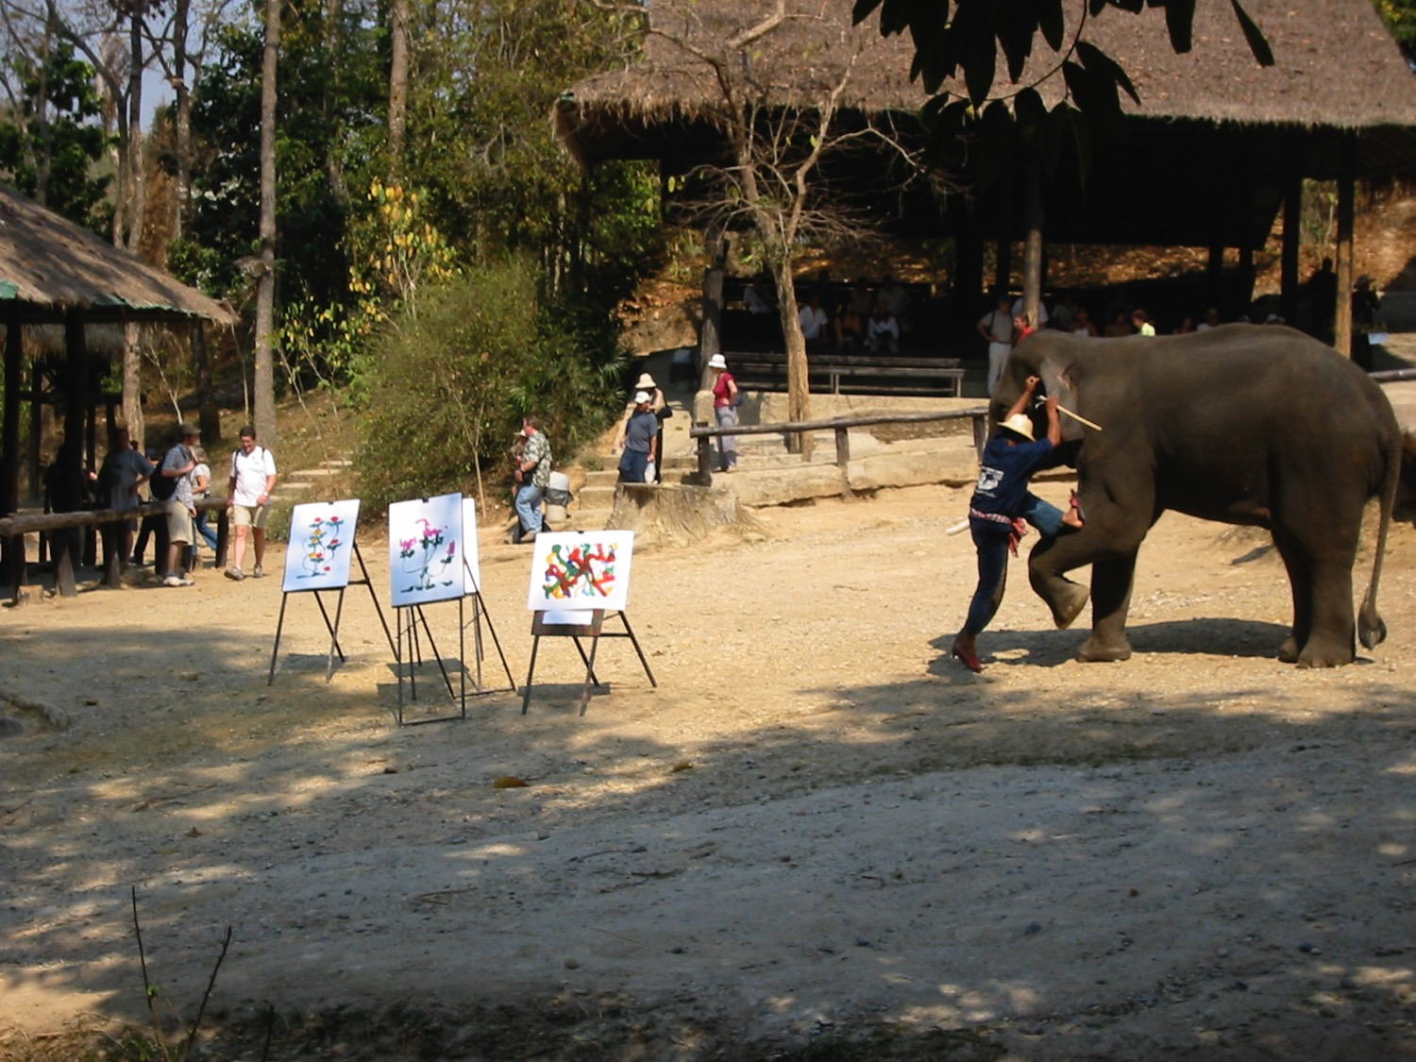
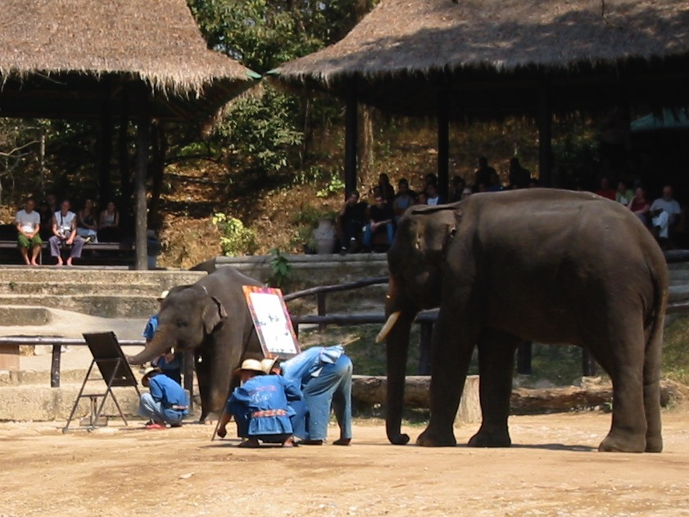
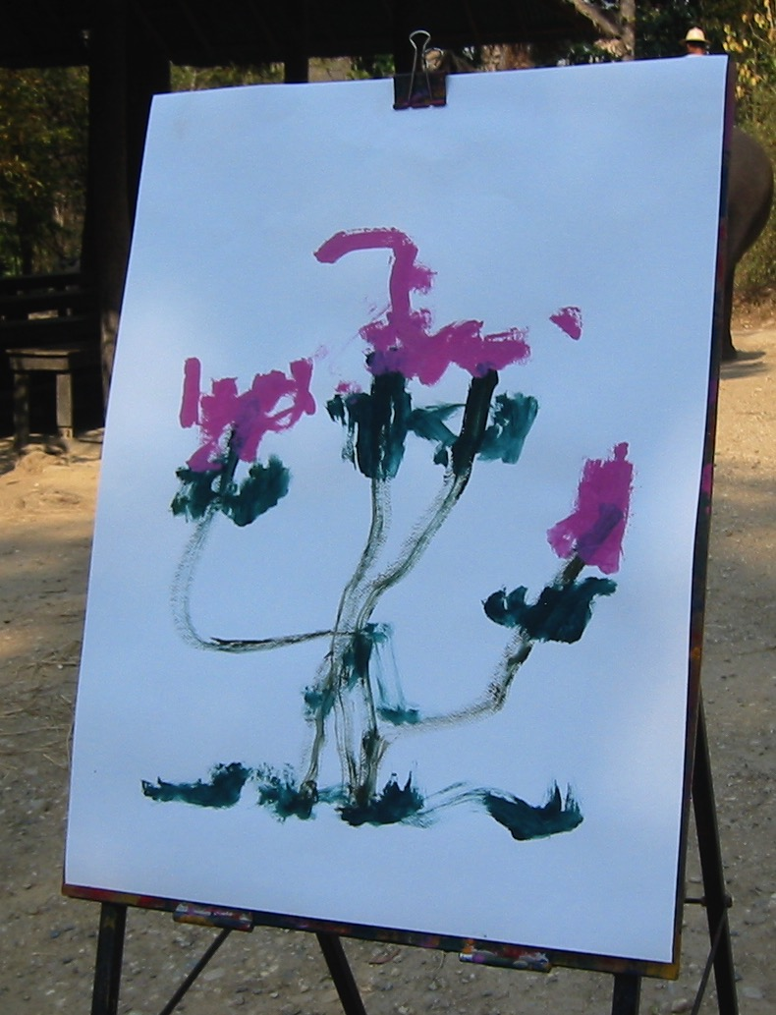
Illustrations
If elephants can illustrate, you can too!
Dr. Rick Griffith • Jordan Evangelical Theological Seminary • BibleStudyDownloads.org
Notes:
In Thailand elephants paint pictures.

Slide 2
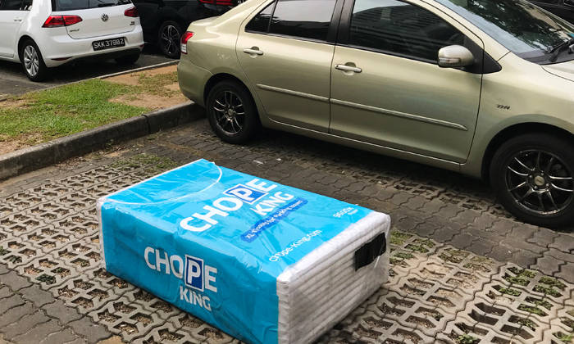
Notes:
Singaporeans have an interesting practice of placing tissue paper packets on public food court seats to reserve them while they get their food. How funny to see the same to reserve a parking space!

Slide 3
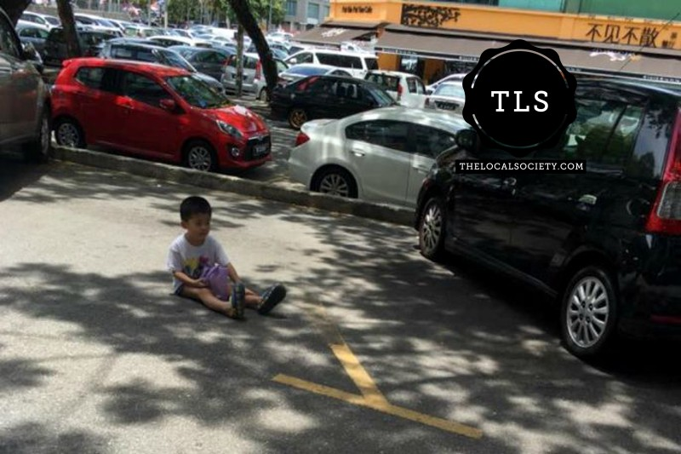
Notes:
One eager driver even placed his young son on the spot to reserve it until he could get his car to that parking slot!

Slide 4

The Importance of
Good Illustrations
64
Why is it important to illustrate the text well when preaching?
Notes:
The class has some interesting answers to this question, so break it into small groups to share.

Slide 5

How to Give Good Illustrations
64
A. Draw illustrations from your listener's world—not yours!
World of the
Listener
(Them)
World of the
Preacher
(You)
1
2
3
4
Where are your best illustrations?
Notes:
Your world = preaching sermons, pastoral counseling, around many Christians
Their world = listening to sermons, secular work conflicts, difficult unbelievers
Common to both = family, food, finances, aging, children, spouse

Slide 6
How to Give Good Illustrations
64
A. Draw illustrations from your listener's world—not yours!
B. Get your outline done early each week—
it gives time to find good illustrations
C. Vary the type of illustration used.

Slide 7
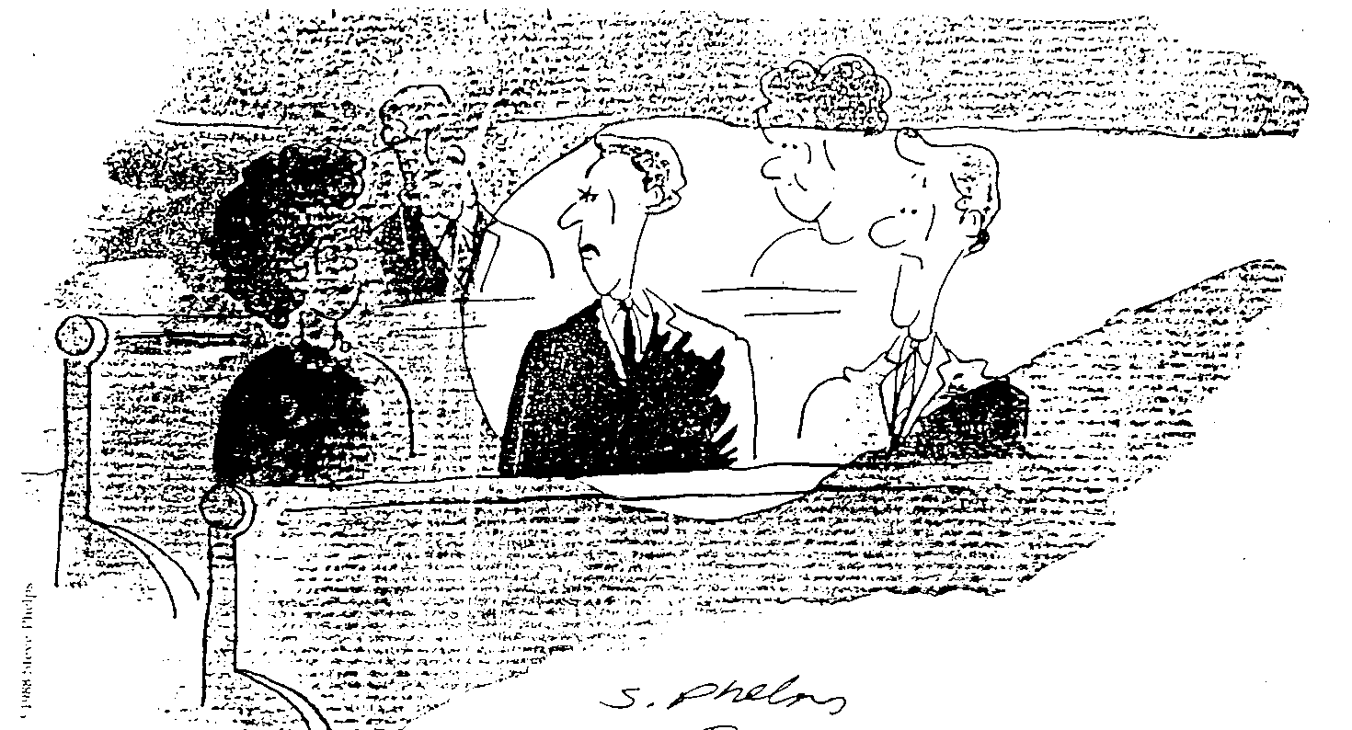
Don't be offensively precise
“I wish he were a little less specific with his illustrations.”

Slide 8
How to Give Good Illustrations
64
A. Draw illustrations from your listener's world—not yours!
B. Get your outline done early each week—
it gives time to find good illustrations
C. Vary the type of illustration used.
D. Don't tell stories—relive them!

Slide 9


Tell Stories & Jokes

Slide 10
How to Give Good Illustrations
64
A. Draw illustrations from your listener's world—not yours!
B. Get your outline done early each week—
it gives time to find good illustrations
C. Vary the type of illustration used.
D. Don't tell stories—relive them!
E. Illustrate for every 3 minutes of preaching (p. 51 has 18 ILLs in 15 minutes!)

Slide 11

Dangers
F. Avoid these dangers when illustrating your points…
65
Check:
Length
Relevance
Humility
Truthfulness
Motive
The embellished story
The superfluous story
The egocentric story
The specious story
The manipulative story
Adapted from LeRoy Patterson Stuart in SBC 100-Fold (Feb 92)

Slide 12
How to Catalog Illustrations
65
HELP!
WHO DID WHAT?
WHO SAID WHAT?
BOOKS
WHY?
PEOPLE
DATES
WHAT RELATES TO WHOM/WHAT?
17

Slide 13
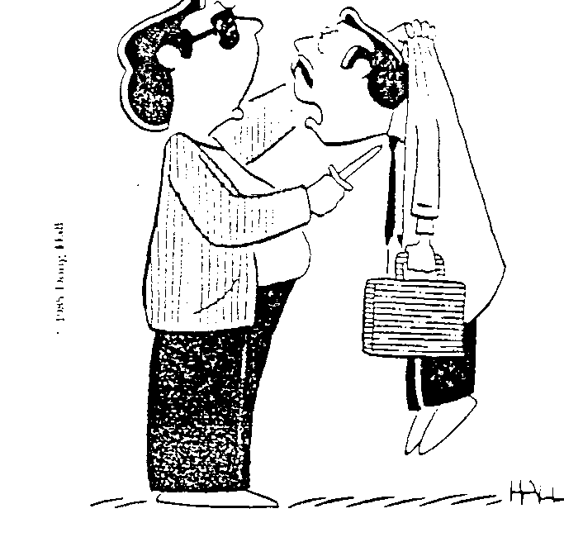
Get approval before using certain individuals in illustrations
“Unhand me or I will use you in a sermon illustration!”

Slide 14

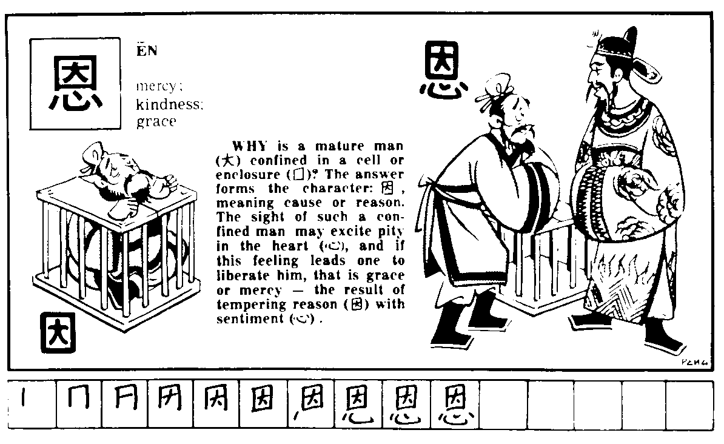
Fun with Chinese Characters

Slide 15
Fun with Chinese Characters
Notes:
Buy this book for insights into how many Chinese characters illustrate truths.

Slide 16
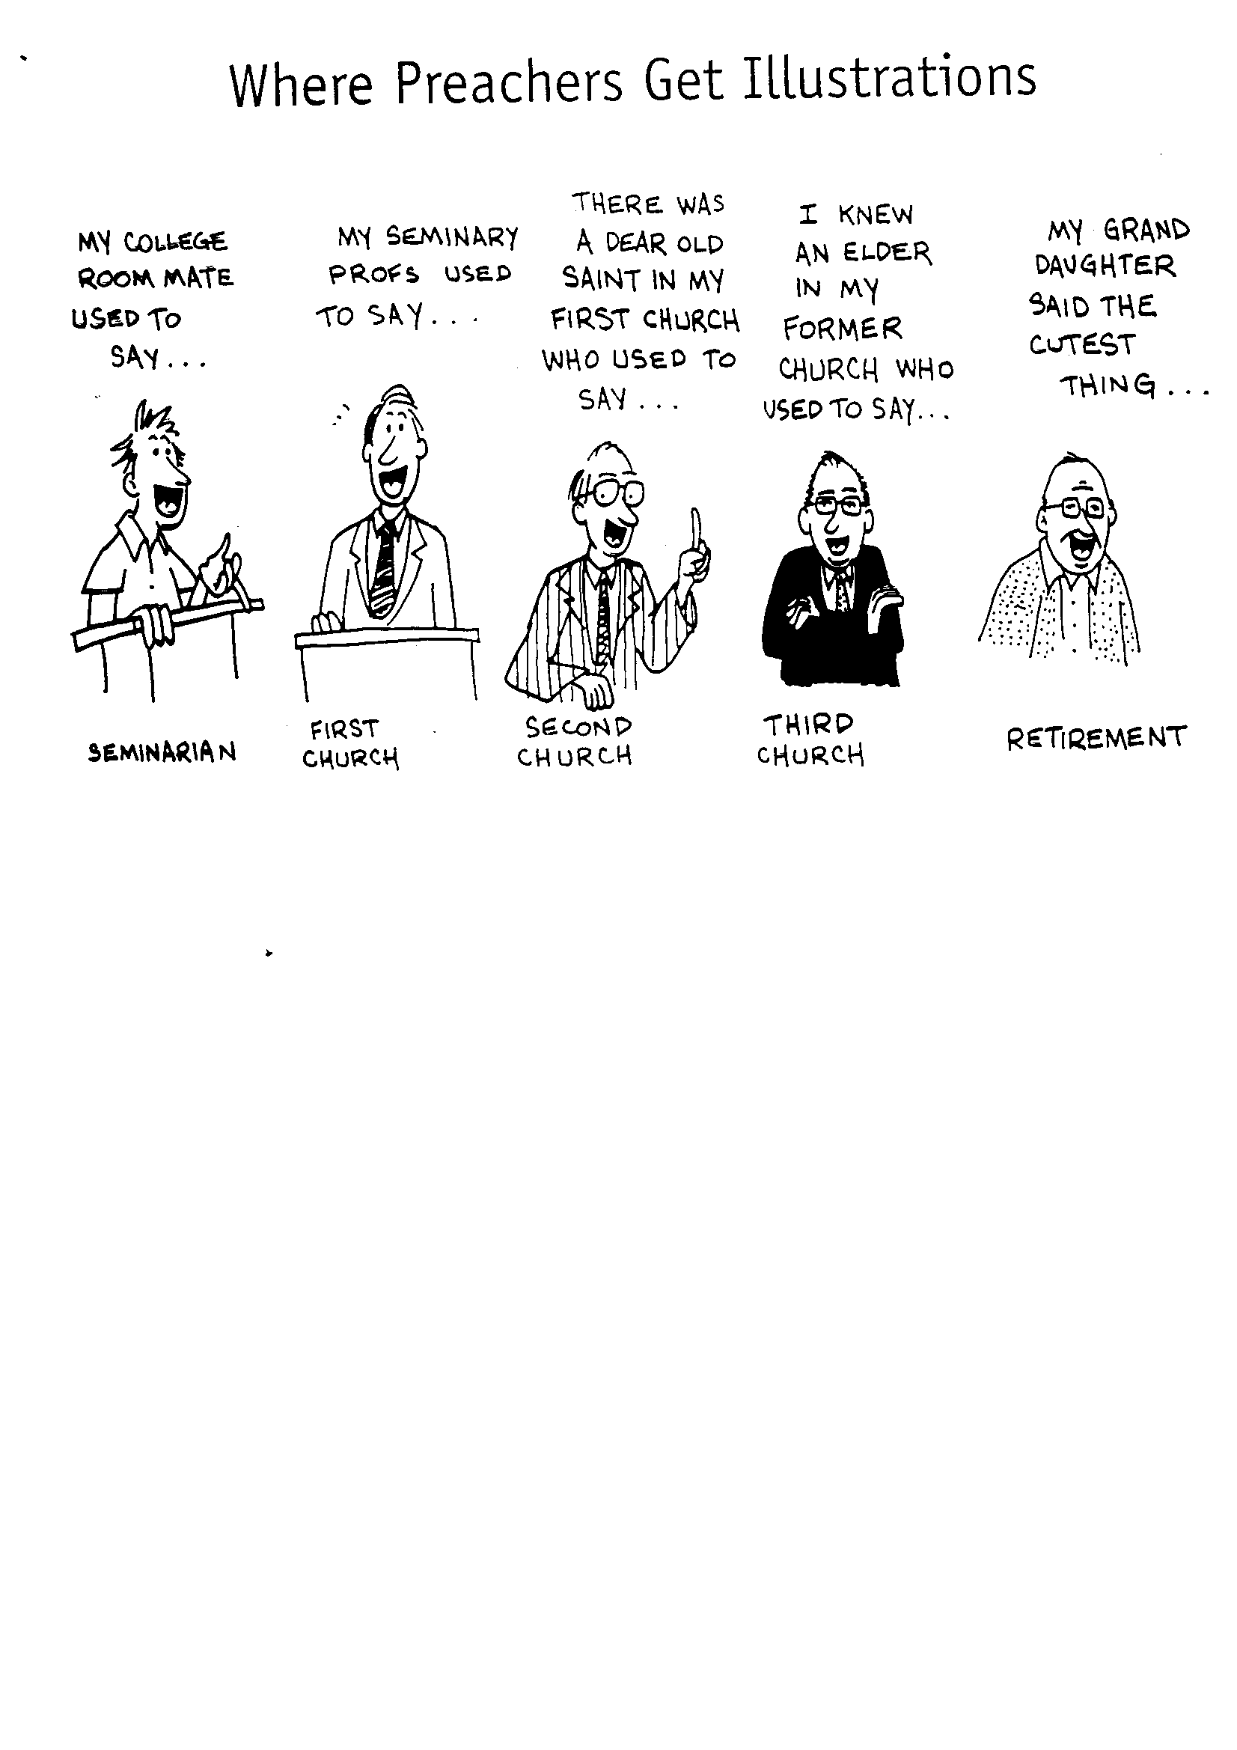
Where Preachers Get Illustrations
MY COLLEGE ROOMMATE USED TO SAY…
MY SEMINARY PROFS USED TO SAY…
THERE WAS A DEAR OLD SAINT IN MY FIRST CHURCH WHO USED TO SAY…
I KNEW AN ELDER IN MY FORMER CHURCH WHO USED TO SAY…
MY GRAND DAUGHTER SAID THE CUTEST THING…
SEMINARIAN
FIRST
CHURCH
SECOND CHURCH
THIRD CHURCH
RETIREMENT

Slide 17
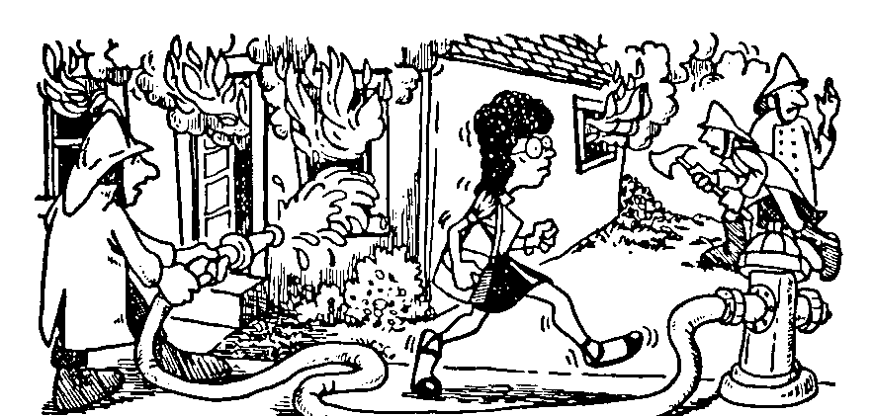
Look Around 1 of 3

Slide 18
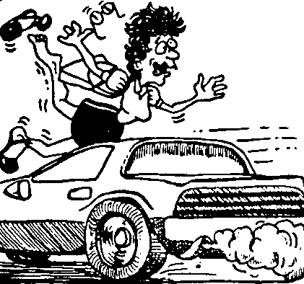
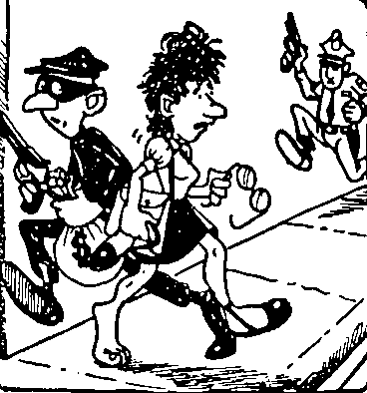
Look Around 2 of 3

Slide 19


Look Around! 3 of 3
Do you have any good resources for illustrations?
Library
Librarian

Slide 20
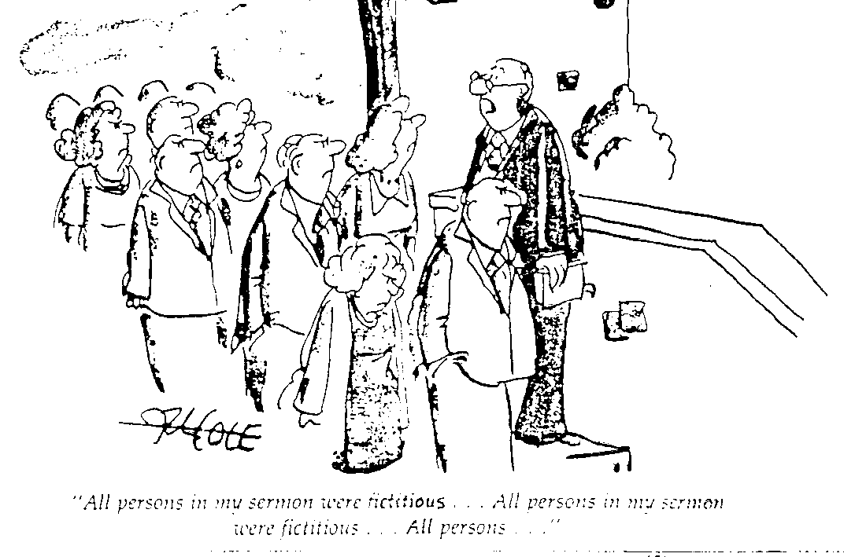
Choose examples carefully
“All persons in my sermon were fictitious…
All persons in my sermon were fictitious…
All persons in my sermon were fictitious… All…”

Slide 21
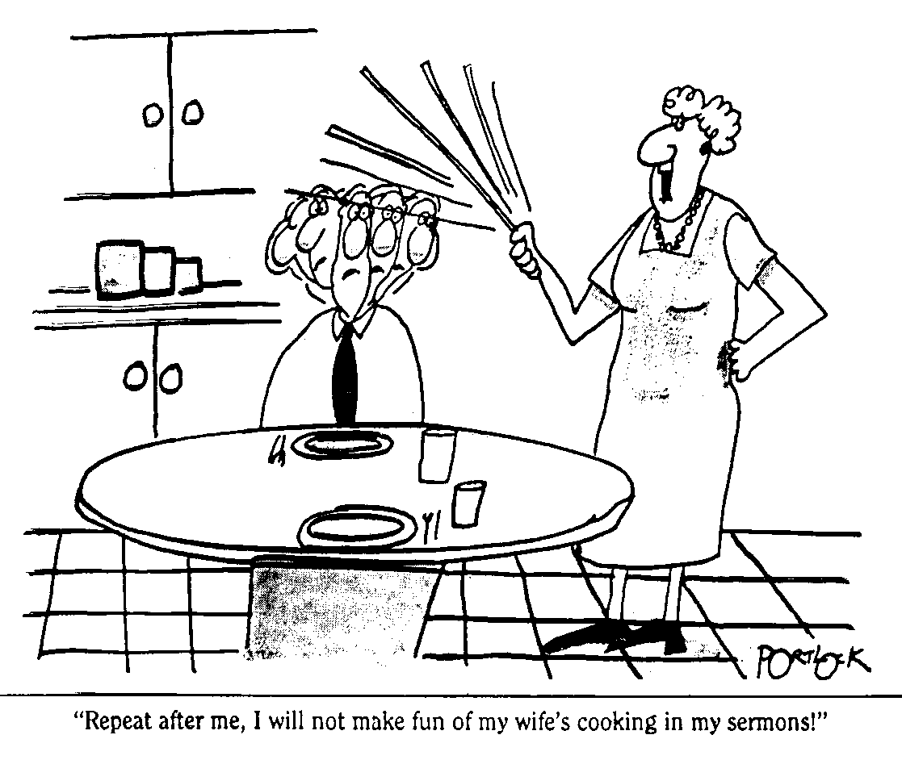
Guard your marriage!
“Repeat after me, I will not make fun of my wife's cooking in my sermons!”

Slide 22



Other Books
66

Slide 23
Illustration Websites
IllustrationExchange.com
PreachingToday.com
SermonCentral.com
SermonIdeas.com
MoreIllustrations.com
Notes:
More Illustrations.com has 25,000 ILLS.

Slide 24
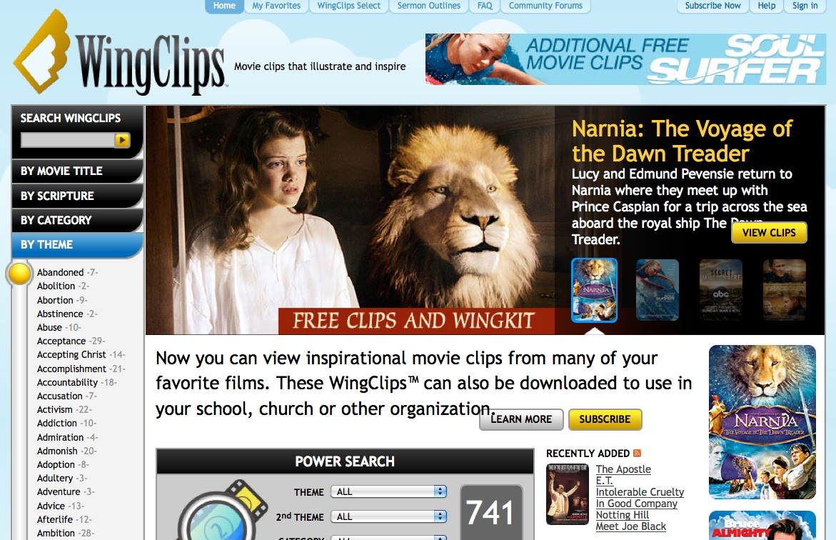
Video Clips at WingClips.com
WingClips.com

Slide 25
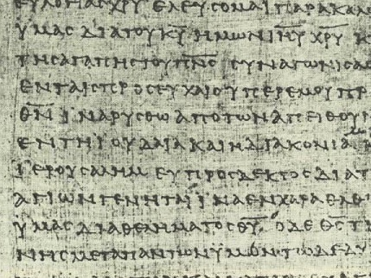
B. Categorize Your Illustrations
66
Give each a TITLE and subtitle
Try this now with the 4 illustrations on page 66...

Slide 26
TITLES and subtitles
66
EXAMPLES bad ones from the world
PHILOSOPHY leads to lifestyle
RAPE impressions of pre-teens on sex
RIGHTS violations of acceptable
SENSES importance of A/V
LEARNING teach visually
BELIEFS survey about Americans
TEACHING badly needed in the church

Slide 27
B. Categorize Your Illustrations
66
Give each a TITLE and subtitle
C. File Your Illustrations
Options:
3 x 5 Card & A4-size Files
Computer file of separate Word documents

Slide 28
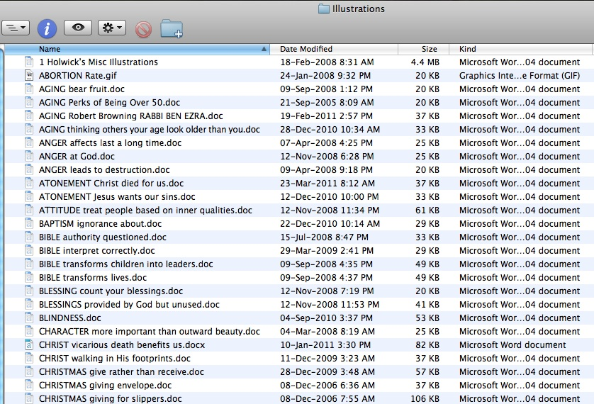
My Computer Folder of Illustrations

Slide 29
Black

Slide 30


Preaching (Homiletics) link at BibleStudyDownloads.org
Get this presentation for free!
Notes:
Preaching (pr)
Homiletics

