Slide 1
What's the BIG Idea?
Dr. Rick Griffith • Jordan Evangelical Theological Seminary • BibleStudyDownloads.org
Notes:
Turn to page 29 in the notes

Slide 2
Importance of the "Big Idea"
29
"A major affirmation of our definition of expository preaching, therefore, maintains that 'expository preaching is the communication of a biblical concept.' That affirms the obvious. A sermon should be a bullet and not buckshot. Ideally each sermon is the explanation, interpretation, or application of a single dominant idea supported by other ideas, all drawn from one passage or several passages of Scripture"
(Haddon Robinson, Biblical Preaching, 33)

Slide 3
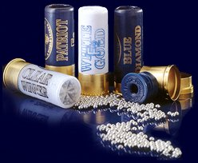
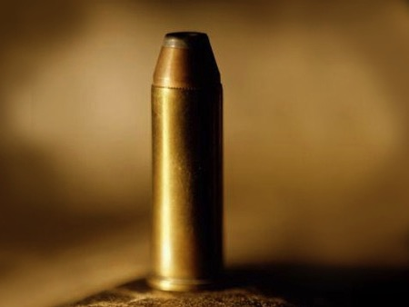
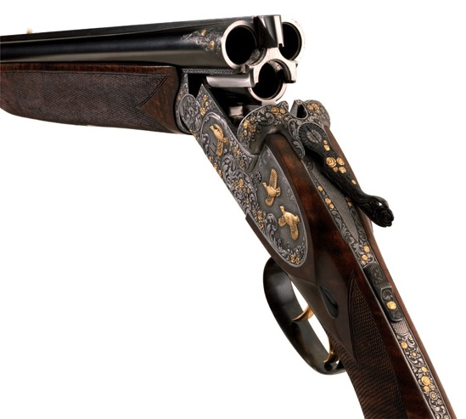

Notes:
There is a HUGE difference between a shotgun and a rifle. The shotgun shoots thousands of little balls called "shot" where even one of them will kill ducks flying overhead. However, a rifle shoots a bullet to kill large game such as a deer. If you try to kill a deer far away with a shotgun you will simply scare it away! The deer might even appreciate the "scratch on the back" before it runs away!
Too often preaching is like the shotgun. Afraid he won't meet some needs of his listeners, the speaker shoots a multitude of ideas at them. The effect is that none of them hits them with any effect. Instead, it would be wiser to expound the central idea of the text in such a way that they are transformed. Now let's look at what Robinson says once again to get the full effect…

Slide 4
Importance of the "Big Idea"
29
"A major affirmation of our definition of expository preaching, therefore, maintains that 'expository preaching is the communication of a biblical concept.' That affirms the obvious. A sermon should be a bullet and not buckshot. Ideally each sermon is the explanation, interpretation, or application of a single dominant idea supported by other ideas, all drawn from one passage or several passages of Scripture"
(Haddon Robinson, Biblical Preaching, 33)

Slide 5
The Preparing Expository Sermons Process
27-28, 251
Based on Ramesh Richard's text, Preparing Expository Sermons
TEXT
SERMON
5 Desired Listener Response
Brain
4 The Three
Developmental
Questions
Purpose Bridge
3.2 Exegetical Idea
CPT
Heart
CPS
6 Homiletical Idea
7 Homiletical
Outline
8 Clarity
9 Intro/Concl
3.1 Exegetical
Outline
Structure
Skeleton
Structure
2 Analyze Text
Study
Flesh
Preach
10 MSS &
Preach
1 Choose Text
White text shows 10 steps adapted from Haddon Robinson, Biblical Preaching (notes, 105)
Notes:
07.04; 07.13; 29.01

Slide 6
Other names for Big Idea
Homiletical Idea
Proposition
29
Central Idea
Synthetic Statement
Take Home Truth
Biblical Concept
Central Proposition of the Sermon (CPS)
Main Idea
Dominant Idea
Main Thought
Central Thought
Sermon Idea
Thesis Statement
Subject-Complement Statement

Slide 7
Forming the Big Idea (CPS)
29
✚
Subject
(Theme)
✚
Complement
(Thrust)
The Question
The Answer
The reason people should praise God…
The test of a person's character…

Slide 8
What's the Difference?
29
Topic
Subject (Theme)
Single word
More than 1 word
Not a question
Can be worded as a question
"Love"
"The way to love"
"How should we love?"
"Reasons to love"
"Why should we love?"

Slide 9
Some Practice…
29a
Topic
Subject
M.I.
1. God has put us together as a family so that we can help one another
2. What is a peacemaker?
Who is a peacemaker?

Slide 10
Some Practice…
29a
Topic
Subject
M.I.
3. No substitute for leadership.
4. What is God's prescription for anxiety?

Slide 11
Some Practice…
29a
Topic
Subject
M.I.
5. One of the essential qualities of a servant of God is dependence on God.
6. Consecrated Christians, courageous commitment, and continuing convictions are the three foundational pillars of a mission-minded church.

Slide 12
Some Practice…
29a
Topic
Subject
M.I.
7. How and why your work matters to God.
8. To be a faithful servant of God till the end is the third quality of a faithful servant of God.

Slide 13
Some Practice…
29a
Topic
Subject
M.I.
9. As a Christian, we must set our mind on Jesus.
10. Why will many who are first be last and many who are last will be first?

Slide 14
The Preparing Expository Sermons Process
27-28, 251
Based on Ramesh Richard's text, Preparing Expository Sermons
TEXT
SERMON
5 Desired Listener Response
Brain
4 The Three
Developmental
Questions
Purpose Bridge
3.2 Exegetical Idea
CPT
Heart
CPS
6 Homiletical Idea
7 Homiletical
Outline
8 Clarity
9 Intro/Concl
3.1 Exegetical
Outline
Structure
Skeleton
Structure
2 Analyze Text
Study
Flesh
Preach
10 MSS &
Preach
1 Choose Text
White text shows 10 steps adapted from Haddon Robinson, Biblical Preaching (notes, 105)
Notes:
07.04; 07.13; 29.01

Slide 15

Exegetical Idea: The reason the church should restore a sinning Christian correctly is because it extends God's authority.
34c
  (15-17) The manner in which the church should correctly restore a sinning Christian is by keeping the matter as private as possible.
  (18-20) The reason the church can restore or continue to seek to restore errant believers is because it extends the authority of God Himself.
Matthew 18:15-20
Notes:
PR 07.15. 09.35; 11.25; 12.16; 16:11 HO subject only
BS 18.43; 20.31; 25.11

Slide 16
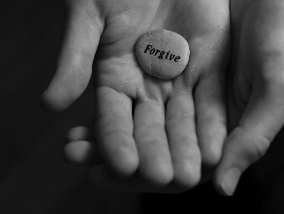
Main Idea:
Exegetical Idea: The reason the church should restore a sinning Christian correctly is because it extends God's authority.
34d
Restore sinners because you act for God
We restore sinning members properly because we act on God's behalf

Slide 17



How do we restore sinning Christians properly?
Our First Question Today (for vv. 15-17)
34d
Notes:
Fill in your bulletin outline

Slide 18

The Point of Verses 15-17
34d
Don't blab the problem.
I. Keep the matter as private as possible
(15-17).
Notes:
07.18
12.19

Slide 19

Our 2nd question is answered in verses 18-20:
Why do we restore sinning Christians properly?
34d

Slide 20

The Point of Verses 18-20
Why do we restore sinning Christians properly?
We extend God's authority
II. Our church extends God’s authority.
Notes:
07.20
08.37 but changed to HO SP in:
11.30
12.21

Slide 21
Black

Slide 22


Preaching (Homiletics) link at BibleStudyDownloads.org
Get this presentation for free!
Notes:
Preaching (pr)
Homiletics

