Slide 1
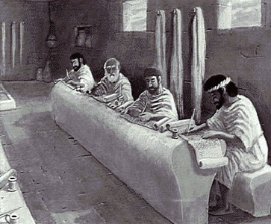
The What and Why of Exposition
Dr. Rick Griffith • Jordan Evangelical Theological Seminary • BibleStudyDownloads.org

Slide 2
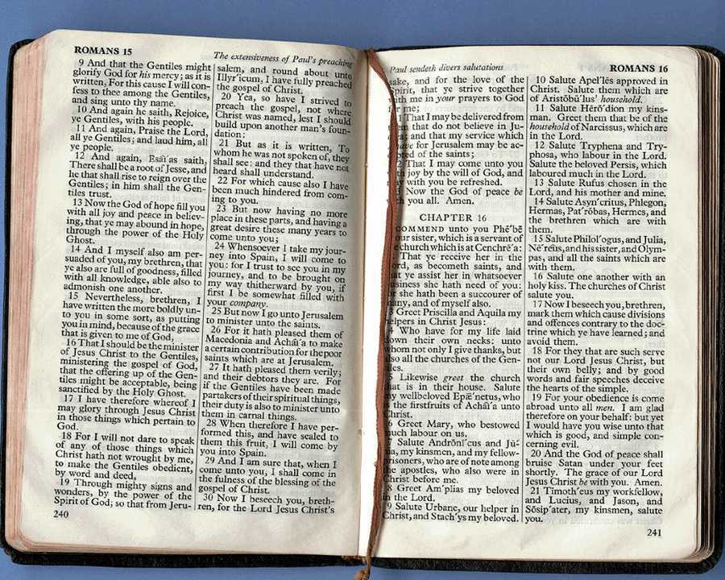
Homiletics: The Art of Expository Preaching
Notes:
Welcome & thanks

Slide 3
"We will take a trip next week."
How should we go?
By Car?
By Train?
By Bus?
By Jet?
By Taxi?
By Foot?
It depends on where we are going!

Slide 4
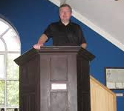
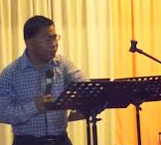
"We will give an expository sermon"
But what is it?
A commentary?
Entertainment?
A Bible lesson?
Passion?
We need a common definition.

Slide 5
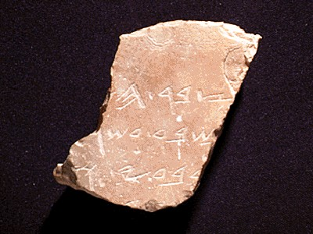
What Makes a Sermon Expository?
1
"Expository preaching explains a passage in such a way to lead the congregation to a true and practical application of that passage"
Definitions
Walter Liefeld, NT Exposition, 6
Notes:
04.03

Slide 6
A More Detailed Definition…
1
"Expository preaching is the proclamation (or communication) of a biblical concept, derived from and transmitted through a historical, grammatical, literary study of a passage in its context, which the Holy Spirit has first made vital in the personality of the preacher, and then through him applies to the experience of the congregation" (Robinson, 20, adapted by him in a preaching seminar)

Slide 7
Characteristics of Exposition
1
Explains one primary passage of Scripture
Liefeld, 6-7
Notes:
E.g., 1 Cor 13:1-7
Reference to other Scriptures is subordinate to the exposition of the main passage

Slide 8
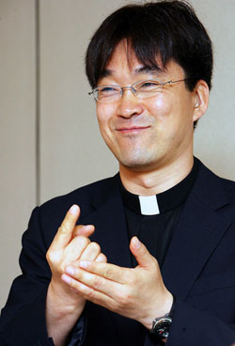
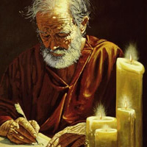
Characteristics of Exposition
1
Faithful to the author's intention
=
Liefeld, 6-7
Notes:
Neh 8:8
Luke 4:16-22 on Isa. 61:1-2
The text is not a box of candy from which one selects his favorite treats. It is the Word of God, which has come to us to be master, not servant.
For example, preaching leadership principles from Nehemiah 1—2 misreads authorial intent.
You can preach a biblical message from the wrong verse!
In other words, you can be held by a great theology so that you preach truth, but it may not be the message of the particular passage before you.

Slide 9
Characteristics of Exposition
1
Cohesion
Big Idea
Text Idea
Liefeld, 6-7
Notes:
True exposition expounds the one, central idea of the text called the Big Idea (homiletical idea or main idea or synthetic statement). Real exposition is not a series of exegetical comments, unrelated truths, or a cute outline that gives a survey of a passage

Slide 10
Characteristics of Exposition
1
Movement and Direction
I. Relates to the Big Idea
II. Relates to the Big Idea
III. Relates to the Big Idea
Big Idea stated
Text Idea
Liefeld, 6-7
Notes:
brings the hearers towards the same point made by the author. The message does not simply state the main idea over and over without some design that brings the listeners along in truth

Slide 11
Characteristics of Exposition
1
Application
What the listener should…
Know
Feel
Do
Text Idea
Liefeld, 6-7
Notes:
It relates biblical truth to the listener's life in line with the original purpose, meaning, or function of the text.
Application must first be applied to the preacher's life to be effective exposition
----- Meeting Notes (7/5/12 10:55) -----
Preaching without application is like making a car but forgetting to put the tyres on! It is "where the rubber meets the road" in this sense, for the sermon will go nowhere without application.

Slide 12
Characteristics Summary
1
Exposition is not… | Exposition is…
preaching from several texts of Scripture | focusing on a single passage
selecting what you want to say from a text | discerning what God says through the author
many verse-by-verse exegetical comments or a captioned survey of a passage | focusing on the single main idea
a running commentary without direction | selected, pertinent comments towards an end
explanation without answering need | explanation that relates the text to life
preaching through a book of Scripture | preaching a text (even if not part of a series)
Notes:
Summary: So then, what is expository preaching and what is it not?

Slide 13
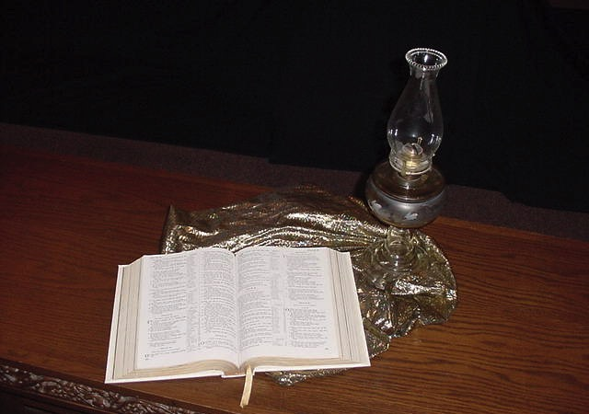
Why is Expository Preaching Important?
2

Slide 14
A. Exposition is based on an inerrant text that shows God's will
2
In our personal devotional lives
In our families
In our work
In our Bible studies (including this one)
Notes:
The more we preach from Scripture, the less false teaching we will have.
We have only ONE inerrant book! Why preach other things?

Slide 15
B. Exposition teaches God's Word in the setting chosen by the Holy Spirit
2
Guards against "prooftexting"
Guards against improper "principalizing"
Notes:
God's Word is much more effective than the best of man's sermons to affect people's will and meet their needs.
"The type of preaching that best carries the force of divine authority is expository preaching" (Robinson, 19).

Slide 16
C. Exposition has inherent authority and power
2
Notes:
Isaiah 55:10-11
----- Meeting Notes (7/5/12 11:23) -----
As water comes from God and blesses the earth, so God's Word comes from him and blesses his people.

Slide 17
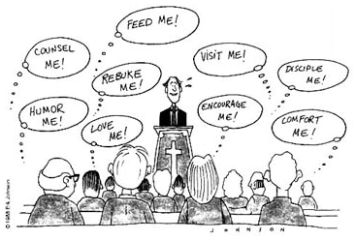
How do you interpret this cartoon?
Feed me!
Counsel me!
Visit me!
Rebuke me!
Disciple me!
Humor me!
Encourage me!
Comfort me!
Love me!
Notes:
Any kind of preaching is tough today!
Yet it still has inherent authority and power when it preaches God’s Word!

Slide 18
D. Exposition directs the attention of the hearer to the Bible
2
Clothes
Lunch
Kids
Notes:
By teaching his people how to get answers from Scripture itself, the pastor frees himself up from always being the authority.
Expository sermons remind people that the final authority is the Bible—not the preacher!

Slide 19
WHY IS GOD'S WORD SO VITAL?
All Scripture is God-breathed and is useful for teaching, rebuking, correcting and training in righteousness, so that the man of God may be thoroughly equipped for every good work.
2 Timothy 3:16-17 (NIV)

Slide 20
Four Results of God's Word
2
Translate text under this black shape
Rebuking
Correcting
Teaching
Training (in Righteousness)
2 Timothy 3:16-17
Notes:
If you preach sequentially through the Bible, you will have the divine balance in these four areas:
Teaching tells people how to walk God's road
Rebuking tells them when they get off the path
Correcting shows how to get back to the right way
Training in righteousness is the result of the cycle of teaching, rebuking and correcting over and over.

Slide 21
E. Exposition meets people's true needs for spiritual nourishment
2
Notes:
Good expository preaching does not impress the congregation; it feeds them.

Slide 22
F. Exposition protects against misinterpretation of Scripture
2
Context
Context
Text
Context
Context
Notes:
"Spiritualizing" (drawing a spiritual lesson while ignoring the actual meaning of a passage) is more difficult to fall into when one preaches from a single text than when the pulpit hits at verses all over the Bible.

Slide 23
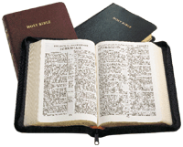
G. Exposition best enables preaching through entire books of Scripture
2
2025 Sermon
2023 Sermon
Week 1
Week 4
Week 2
Week 5
2017 Sermon
Week 3
Week 6
2009 Sermon
Exposition
Most Preaching
2021 Sermon
2022 Sermon
Galatians
Galatians
2020 Sermon
2018 Sermon
Week 7
Week 10
2026 Sermon
2024 Sermon
Week 8
Week 11
Week 9
Week 12
Notes:
In a 10 year period, topical preaching might at best hit a third of the text in these two pages.
Systematic exposition has an advantage in that it enables listeners to see the big picture of each biblical book and cover every passage.

Slide 24
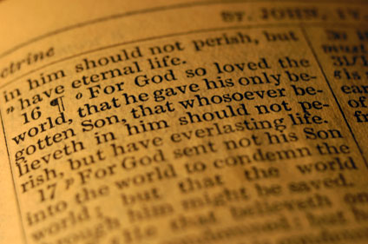
H. Exposition saves time by not having to decide what subject to speak on
2
"God, what topic this week?"
Notes:
It is good to wait upon God. But how sad to be switching topics as you study through the week as you wait on God to show you what to say. How much better to wait on Him to reveal the passage you are committed to preach. Then the text is master and you are the slave, obedient to it dictates.

Slide 25
I. Exposition enables the preacher to speak by faith
2
Giving
Conflict
Sexual purity
Notes:
Who likes to preach on relational problems? Who would volunteer to preach on sex? Most pastors shy away from talking about giving, fearing that some might think they want a raise. Yet in sequential exposition, these important topics come up naturally in the course of preaching through a book of Scripture. No one can accuse the speaker of meddling in their lives as this is what the text shows.

Slide 26
J. Exposition guards us from some of the dangers of topical preaching
2
What dangers?

Slide 27
Some Dangers of Topic Preaching
2
Topical Preaching | Expository Preaching
preaches 2 or more texts of Scripture | focuses on a single passage
more easily selects what the preacher wants to say from the text | discerning what God says through the author
the preacher designs his own outline | the preacher derives his outline from the text
time may not be available to put verses in their proper context | time is available to put verses in context
the preacher can be accused of speaking to certain individuals | the speaker is less easily accused of targeting certain subjects or people as he preaches systematically

Slide 28
Black

Slide 29
Preaching (Homiletics) link at BibleStudyDownloads.org
Get this presentation for free!
Notes:
Preaching (pr)
Homiletics

