Slide 1
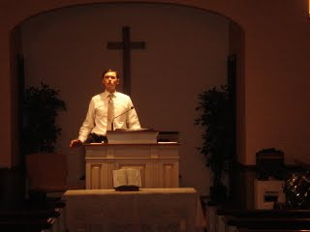
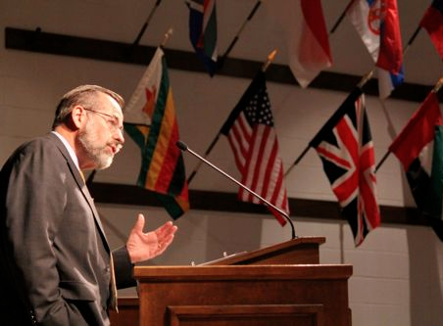
Homiletics:
The Art of
Bible Exposition
Syllabus for Homiletics 1
Dr. Rick Griffith • Jordan Evangelical Theological Seminary • BibleStudyDownloads.org

Slide 2
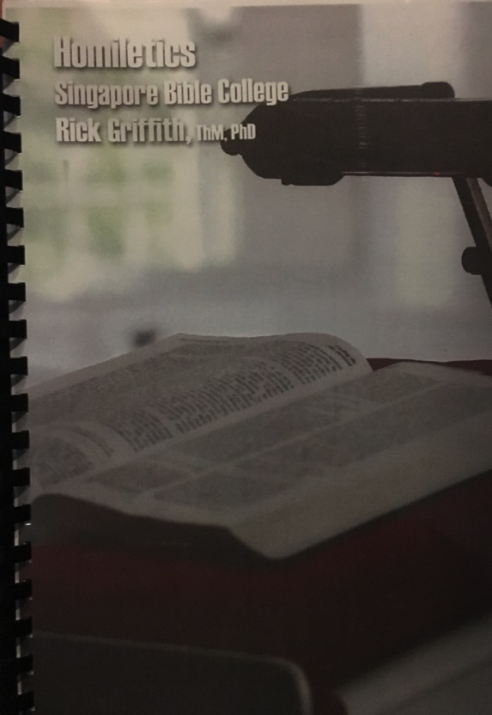

Notes Options
Digital at BibleStudyDownloads Preaching (Homiletics) link (Free)
Printed
($20 each)

Slide 3

Introduce Yourself!
Name
Country
Programme
Family
Church
Ministry Goal

Slide 4


Who Am I? (Family Roots)
Born in Tokyo as a MK (1958)
Moved to California (SF area) at 18 mos.
Parents divorced (age 4)
Mom remarried & divorced (ages 8-10)
Born again (age 13)
Mom married third time (age 14)

Slide 5
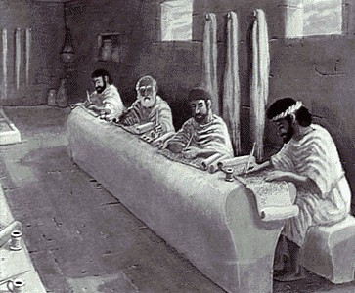
Who Am I? (Education Roots)
BS, Business Marketing (Hay U, 1980)
ThM, Pastoral Ministries (Dallas, 1987)
PhD, Bible Exposition (Dallas, 1990)

Slide 6


Our People
Susan teaches church women
Notes:
Susan leads the woman's Precept Bible study at our church

Slide 7

Thailand • Mongolia • Myanmar • Indonesia
Susan teaches SBC student wives also
Notes:
INTERVIEWER: And Susan, what ministries has the Lord granted you?
SUSAN: I have been teaching the wives of leaders at SBC. These 5 women come from 5 different nations!
SUSAN: I also lead the woman's Bible study at our church

Slide 8
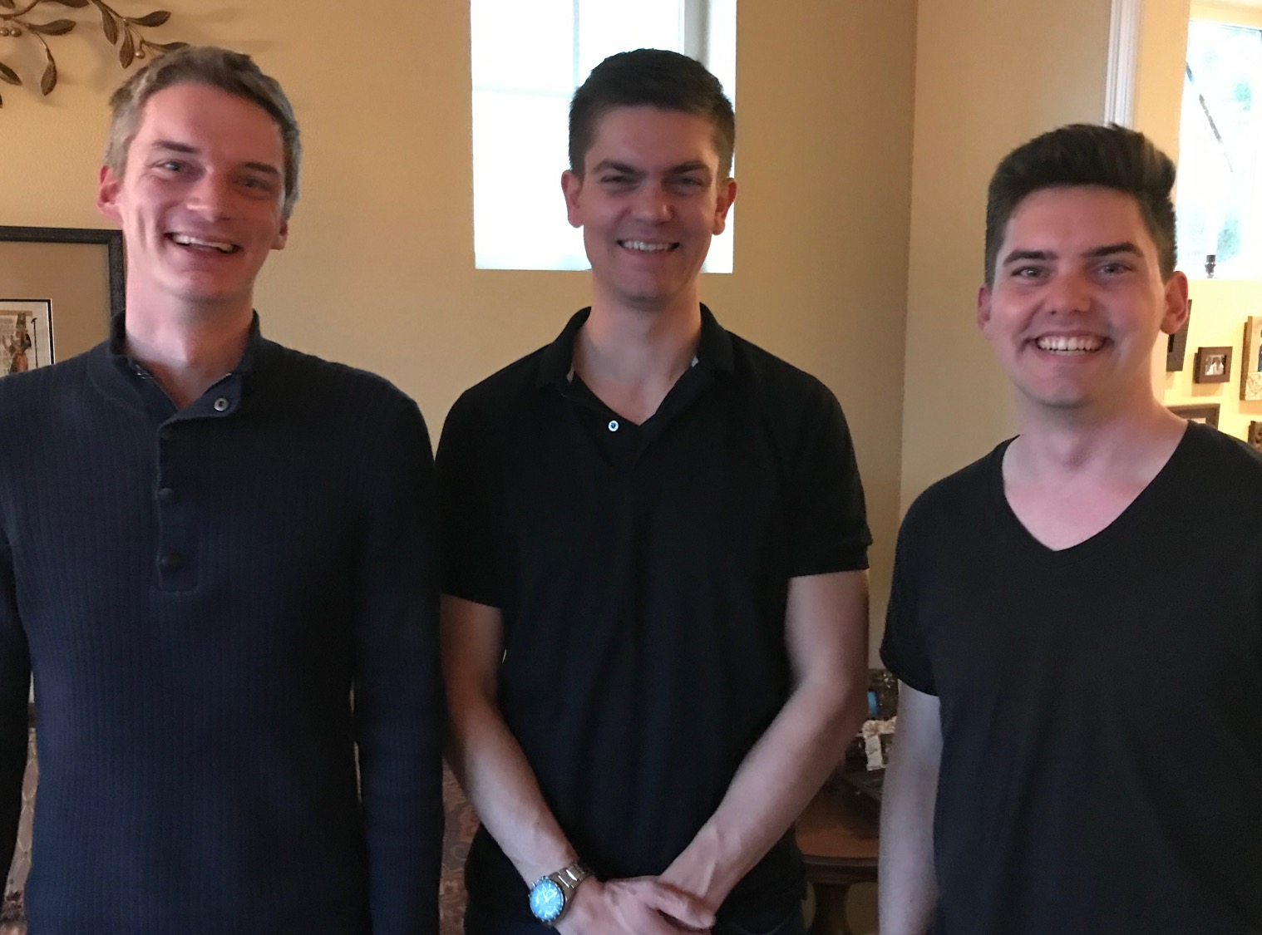
Our Three Sons

Slide 9
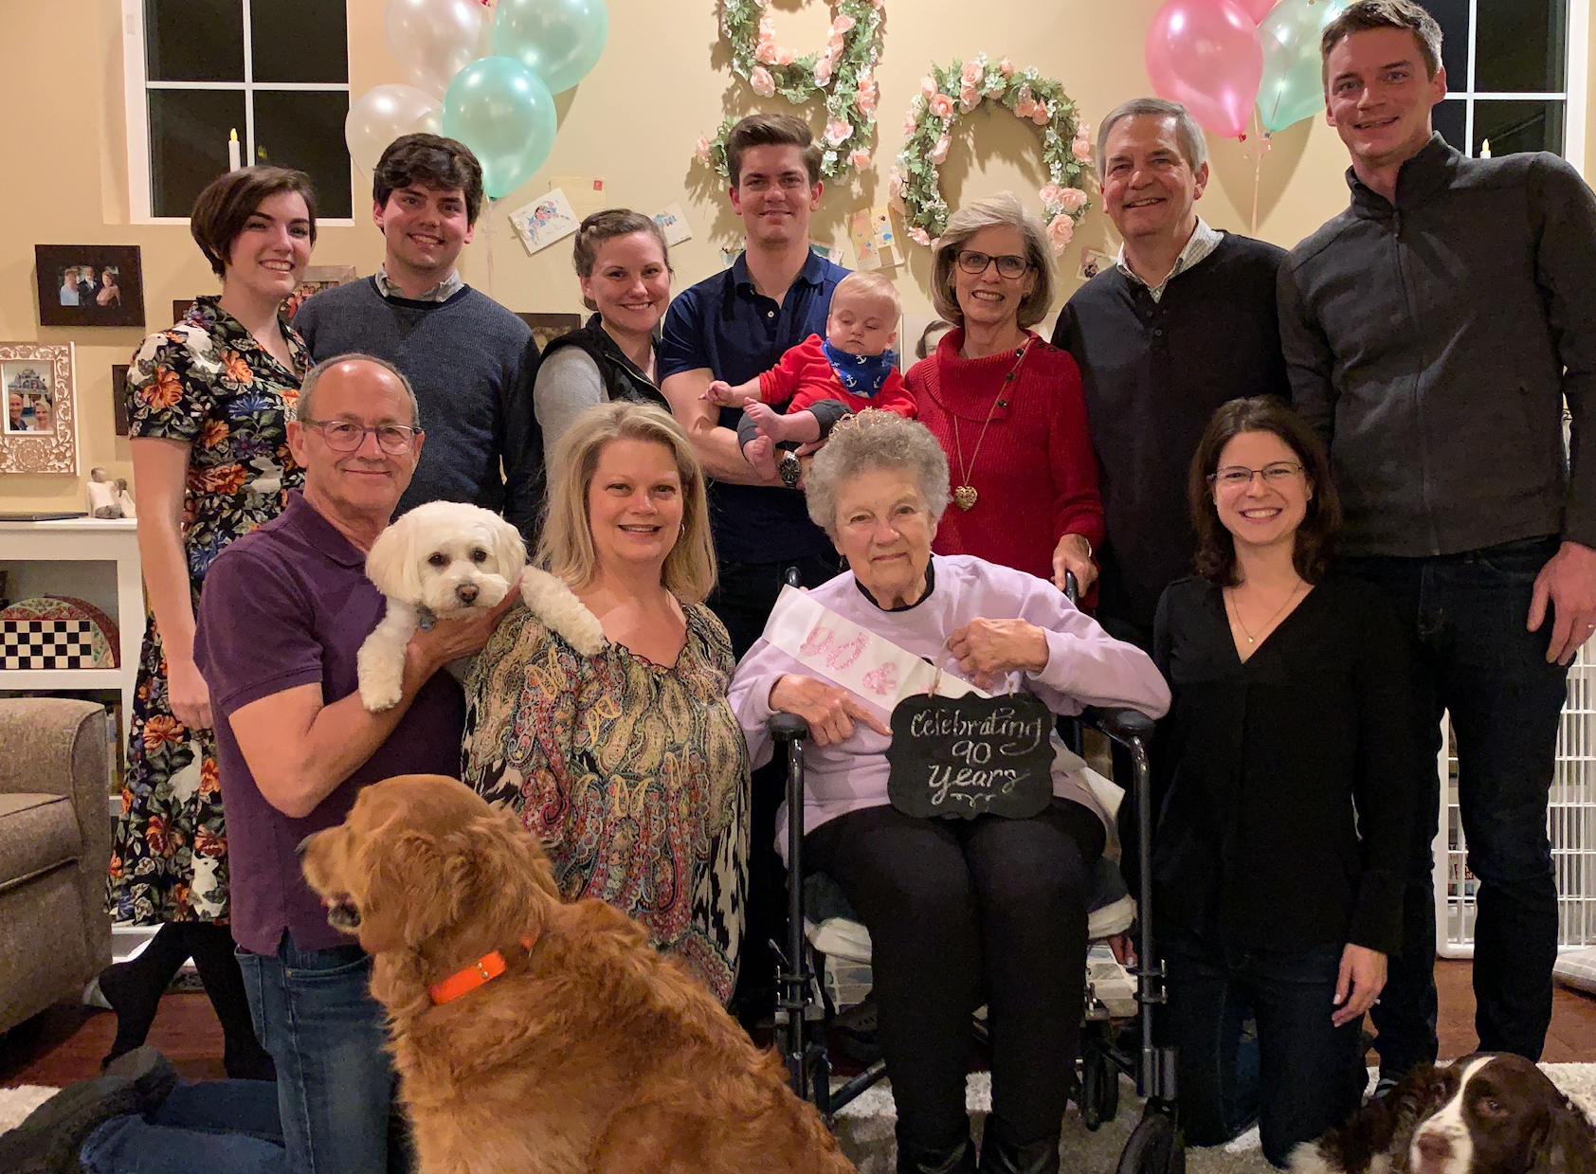
The Griffiths
28 Nov 2019
2020
Rick & Susan
John & Chloe
(28)
Kurt & Cara (34)
Stephen, Katie & Jesse (31)

Slide 10
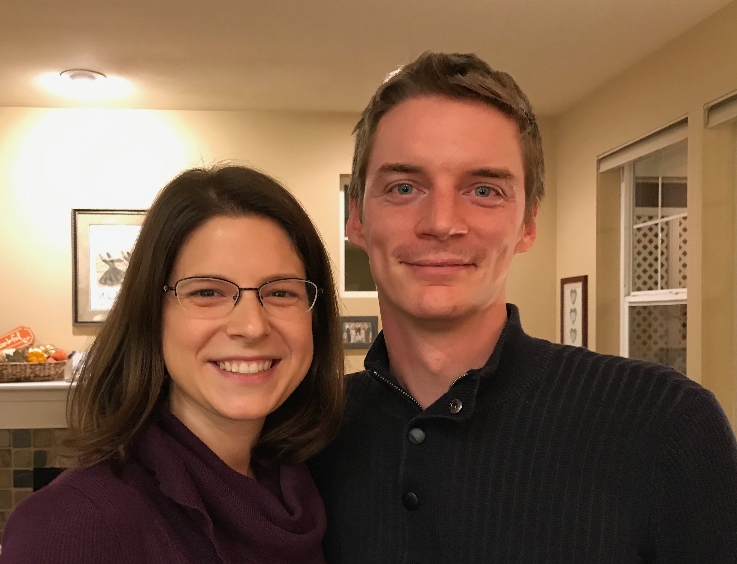
Kurt (34) works in IT and lives in Seattle
Notes:
Kurt and his wife Cara are in Seattle

Slide 11
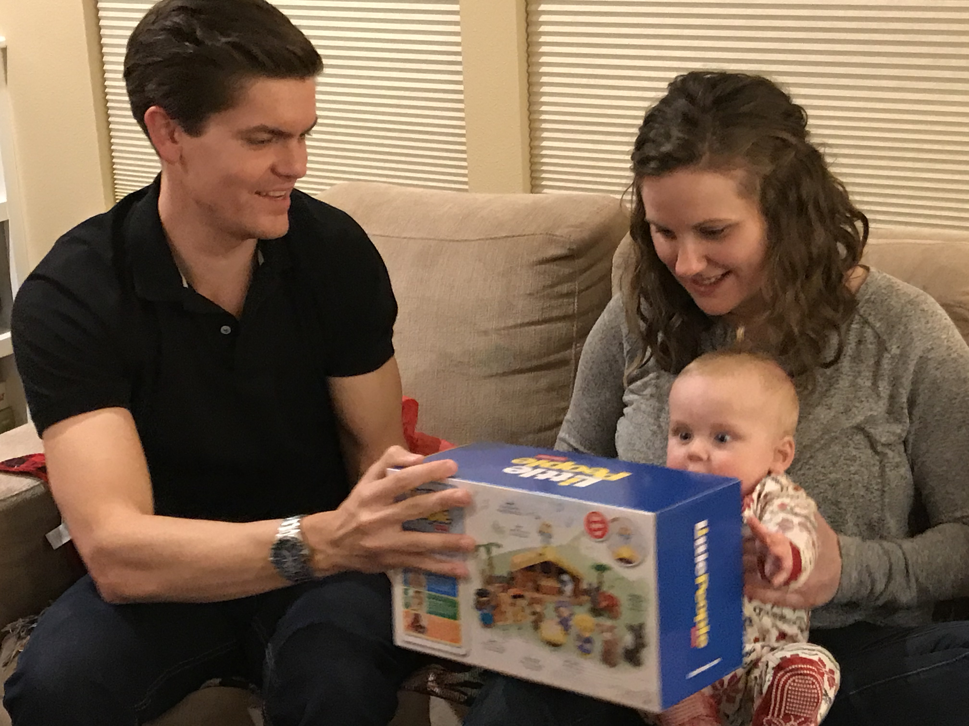
Stephen & Katie gave us Jesse— our first grandson in May 2019
6
Notes:
Stephen and his wife Katie in Boise

Slide 12
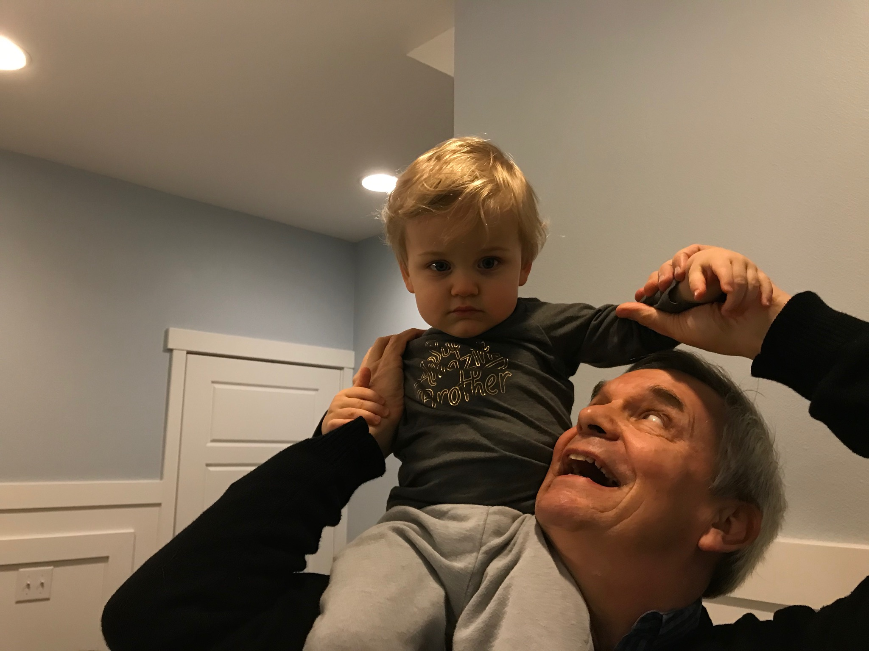
Grandson Jesse

Slide 13
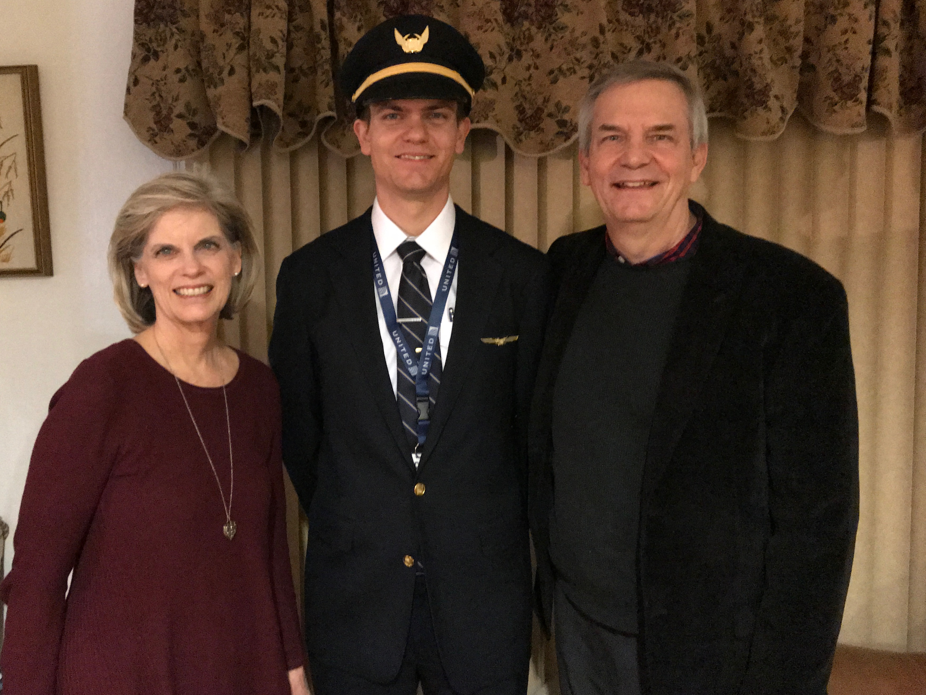
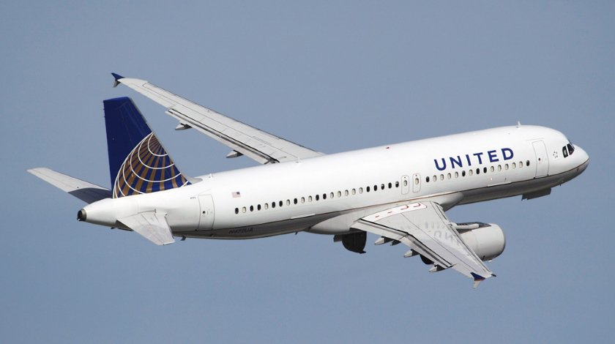
Stephen (31) is a United A320 pilot commuting from Seattle to fly from SFO
6
Notes:
Stephen and his wife Katie in Boise

Slide 14

John (28) is a graphic artist in Redlands, California
8
Notes:
John and his girlfriend Chloe both work for ESRI—Environmental Systems Research Institute—doing web design and graphics for this digital software company.

Slide 15

Our Mission Organization…

Slide 16
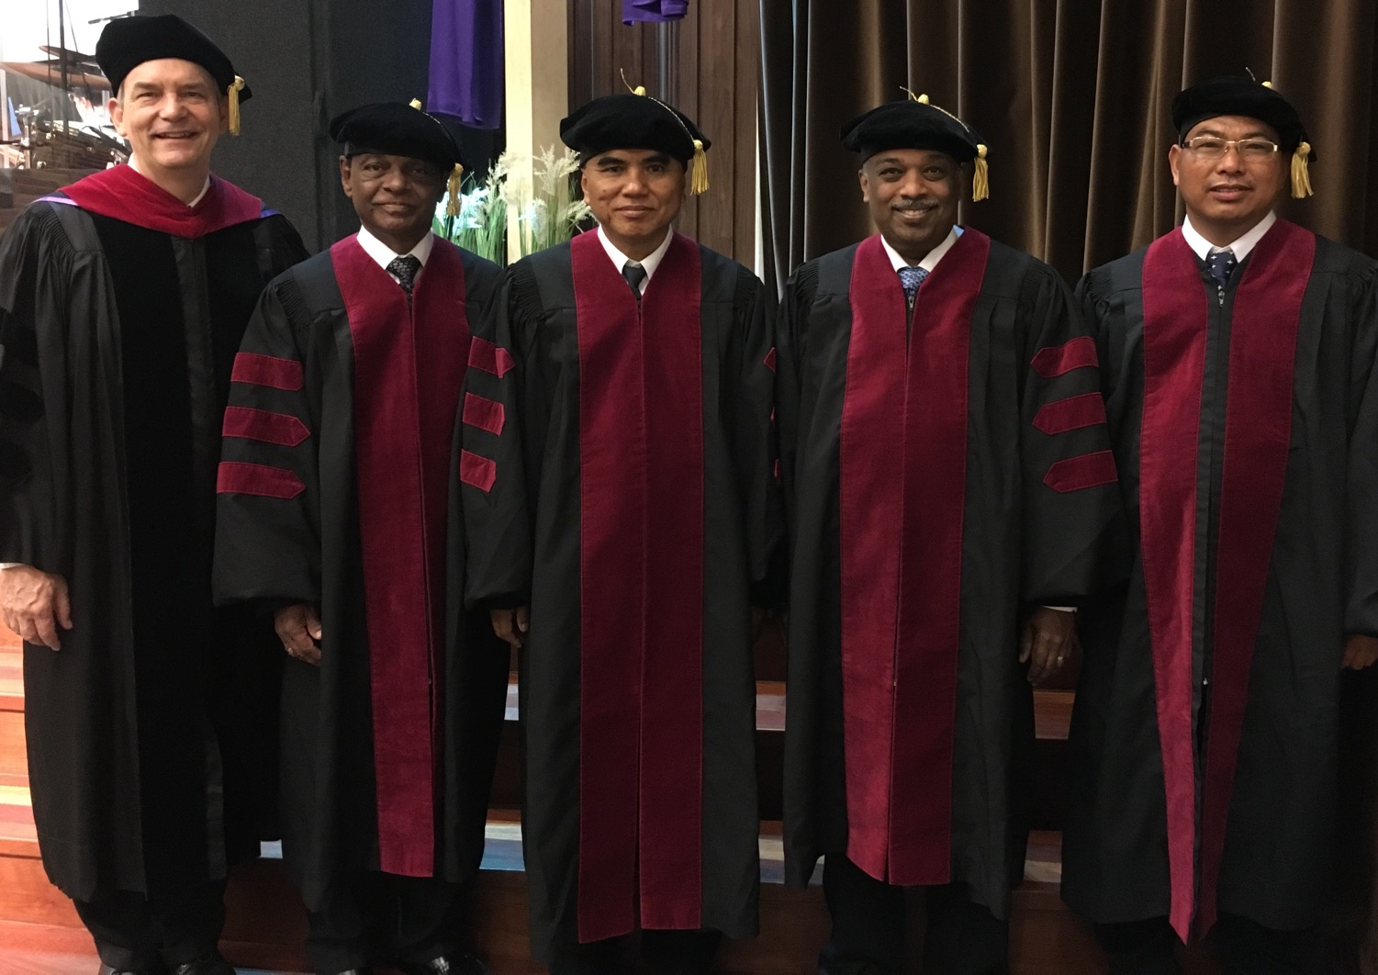
I direct the SBC Doctor of Ministry studies (DMin)
Notes:
I'm also the director of the doctoral program at SBC that trains about 80 seminary professors and pastors throughout Asia in English and Chinese. Generallly each year about 5 of them received their Doctor of Ministry degree.

Slide 17
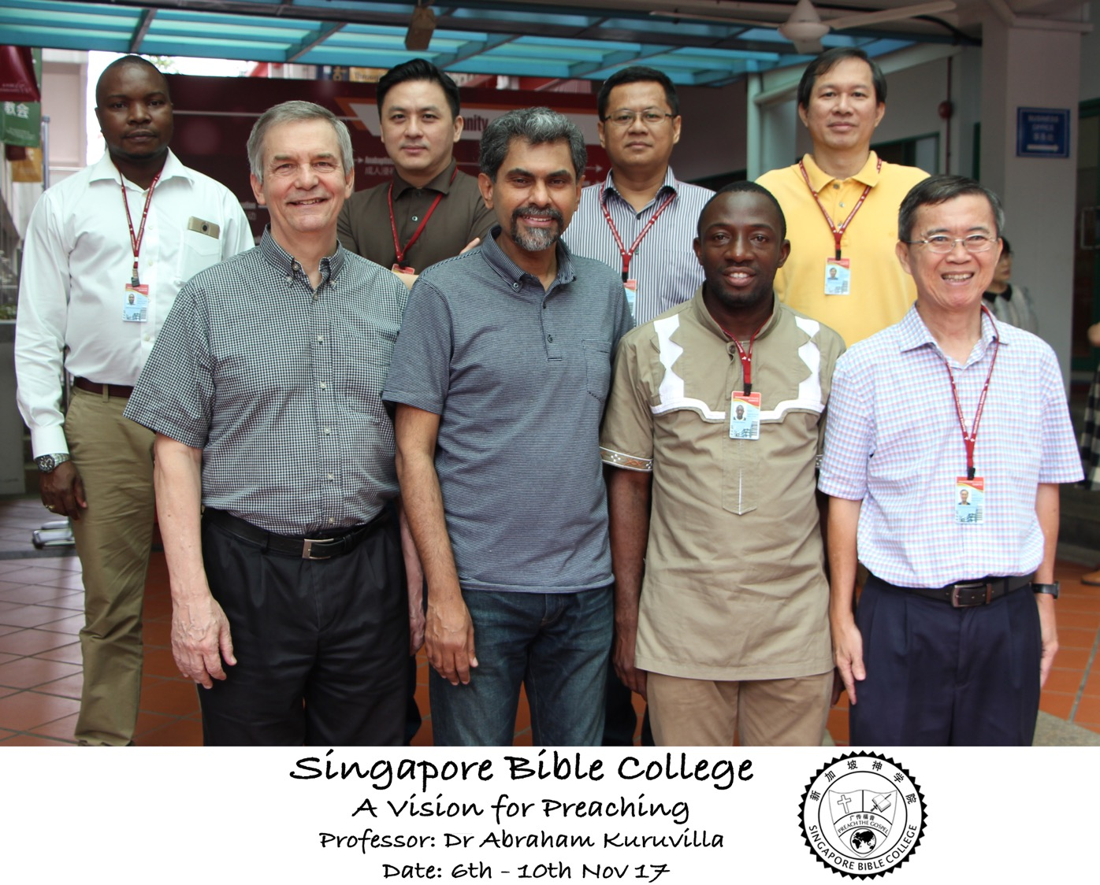
Nov Module

Slide 18

SINGAPORE BIBLE COLLEGE
9
Notes:
I've served as a seminary professor with 30 other faculty at Singapore's largest training school: Singapore Bible College

Slide 19
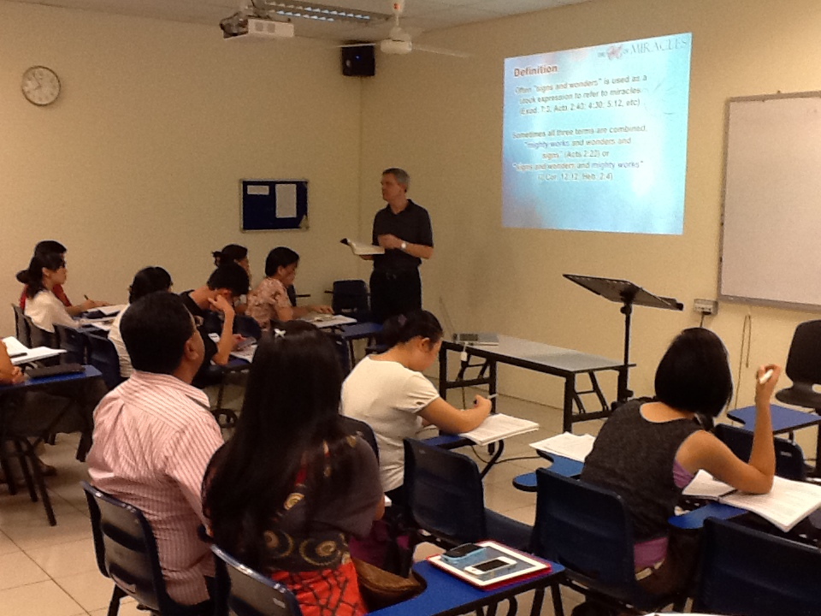
Singapore Bible College Students
9
Notes:
Most of these students are first-generation Christians eager to share the gospel with their own people!

Slide 20
SBC Courses I Teach
(English • Bahasa • Chinese)
Survey • The Bible…Basically
OT NT Bible Study
Backgrounds • Research & Writing
OT NT Geography
Theology • Creation • Jesus
Church • Spirit • Salvation • Future
Preaching
Homiletics 1 Homiletics 2
Notes:
I get to teach these leaders every book of the Bible in survey courses, plus backgrounds to both the OT and NT, three areas of theology, and how to preach.

Slide 21
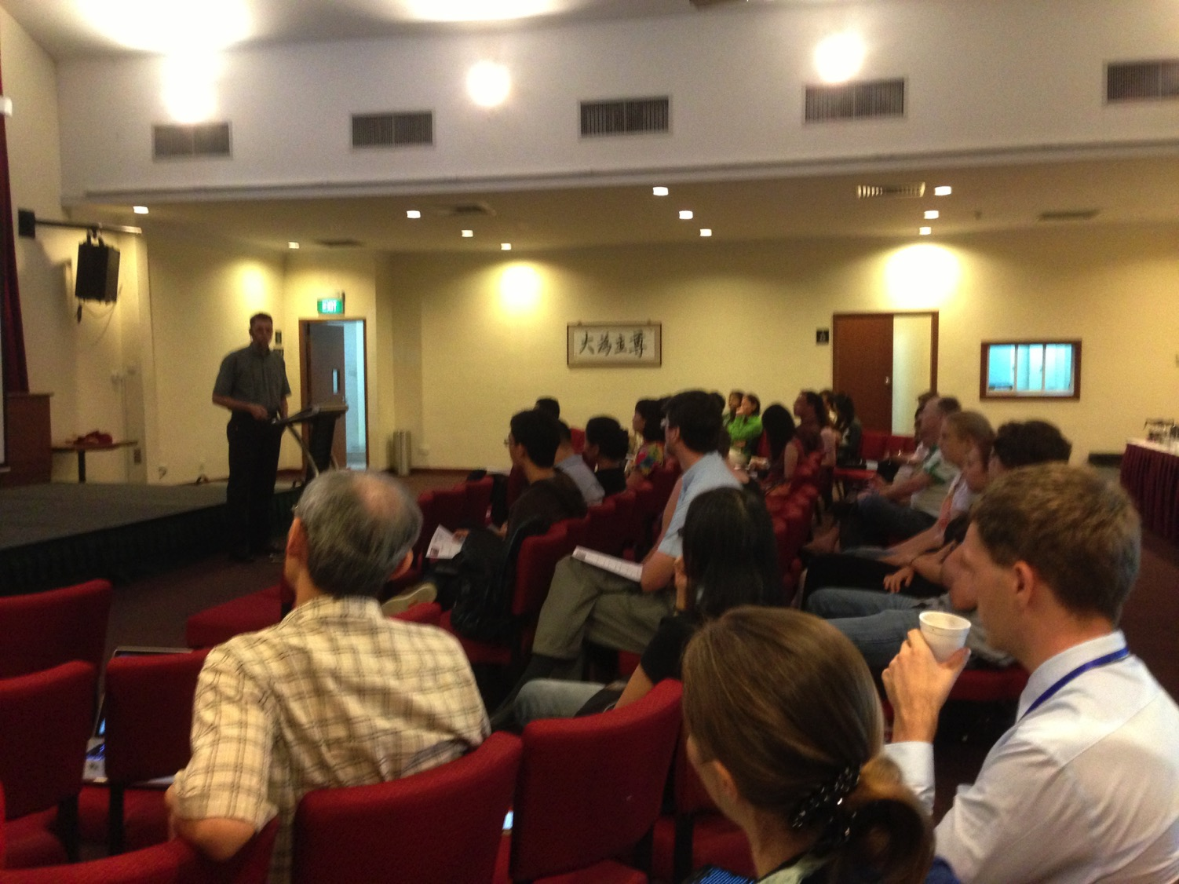
Our People
9
100 people from 16 nations
February 2021

Slide 22


Crossroads People • Feb 2021
GERMANY
MALAYSIA
JAPAN
UNITED KINGDOM
RUSSIA
FRANCE
NETHERLANDS
MONGOLIA
ITALY
FRANCE
KOREA
HONG KONG
LEBANON
CHINA
TAIWAN
GERMANY
NEPAL
TAIWAN
MYANMAR
CANADA
EGYPT
INDIA
USA
THAILAND
ETHIOPIA
MALAYSIA
KENYA
ZIMBABWE
SOUTH AFRICA
PHILIPPINES
SINGAPORE
INDONESIA
SOUTH AFRICA
CIC
AUSTRALIA
NEW ZEALAND
Notes:
We actually have about 20% Indian at CIC, thanks to St. Thomas, who overcame his initial reluctance to witness for Jesus in India.
Our Feb 2021 church of 100 people stem from 16 different countries around the world: Australia (David & Fiona), China (Jianji), France (Valentin), Korea (Grace Kim), India (Cynthia), Indonesia (Rena), Kenya (Jacqueline), Myanmar (Jewel), Nepal (Joshua), Netherlands (Toes), Singapore (Albina), South Africa (Coetsee), Taiwan (Cherry), Thailand (Mae), UK (James & Gabi), USA (Miriam).
This does not include people who have recently attended only once:
Nor does it include missionaries living back in their countries but still are members of CIC: Maple (Taiwan), Budmaa (Mongolia)
Previous: Canada (Gloria Lee), Ethiopia (Lele), Malaysia (Aston, Naomi), Netherlands (Dies & Desiree), Philippines (Micah), South Africa (Melody),

Slide 23

Our People
Preaching through Scripture
Notes:
Susan and I helped start Crossroads International Church in 2006 and I serve as the pastor-teacher because God wants to get his truth out through this church.

Slide 24
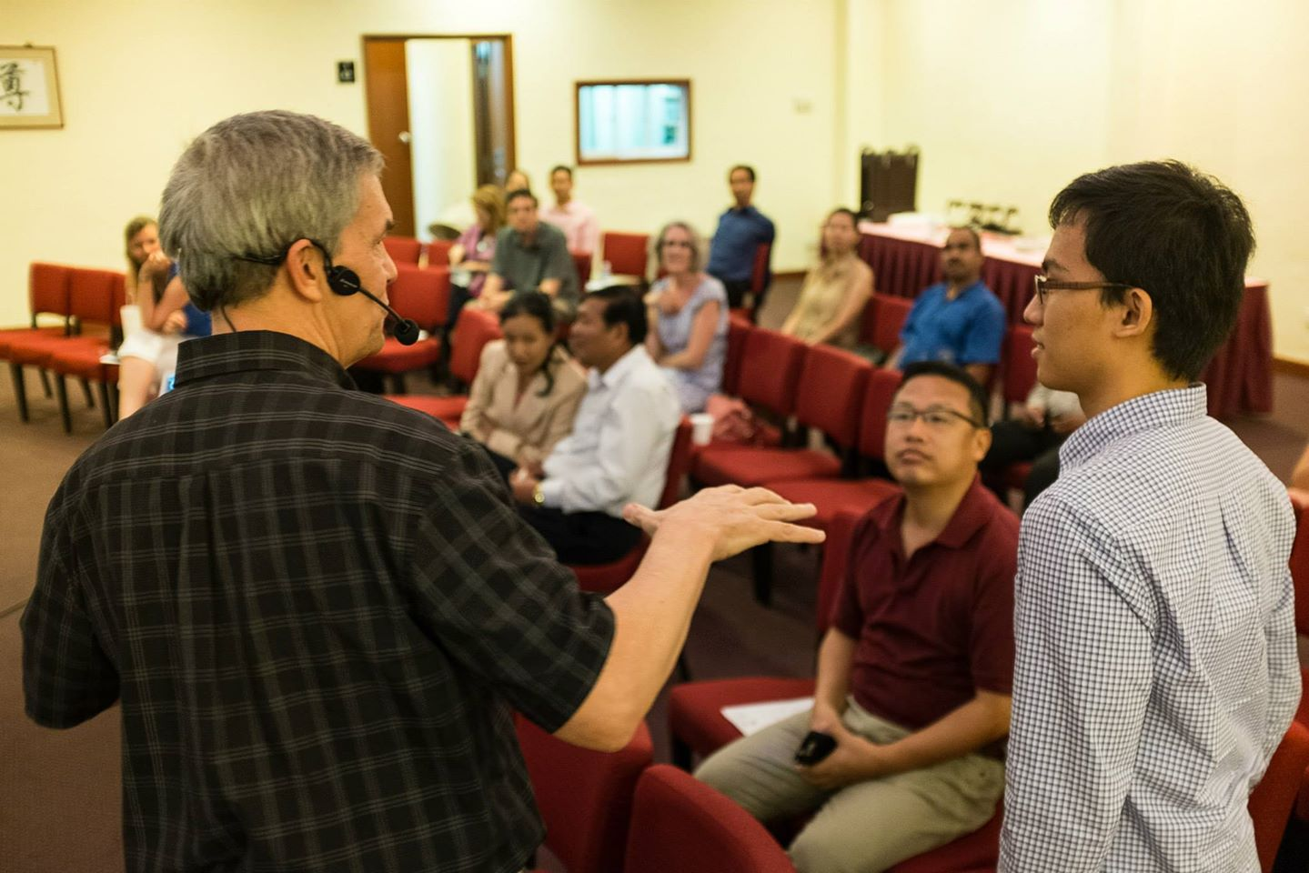
Our People
9
100 people from 16 nations
Notes:
Part of our ministry is to invest in young leaders like Demetrius in 3 John 12.

Slide 25

Our People
9
SBC students serve at church
Notes:
Ober the years, one special joy is mentoring my students who serve with us at church and led ministries to youth, children, home groups, and the worship team.

Slide 26
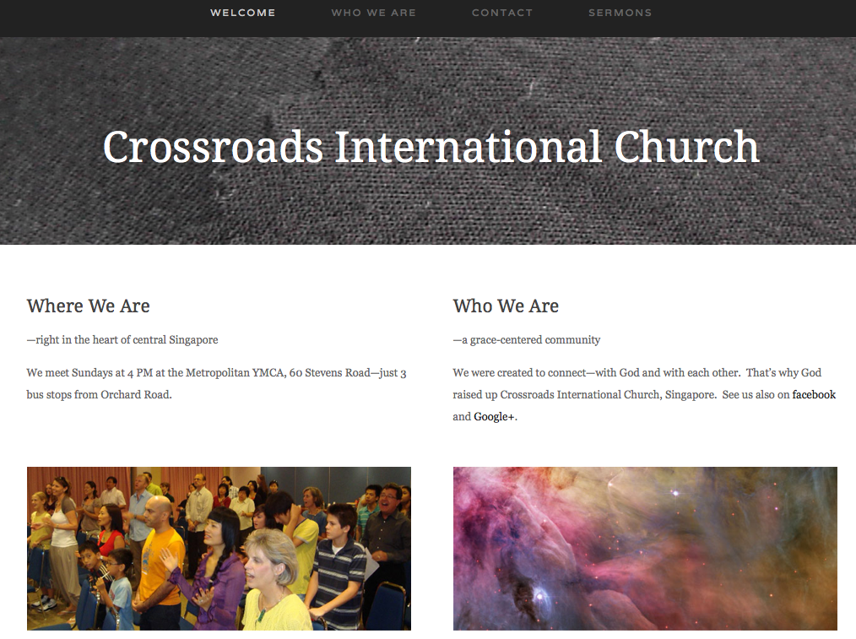
CICFamily.com

Slide 27
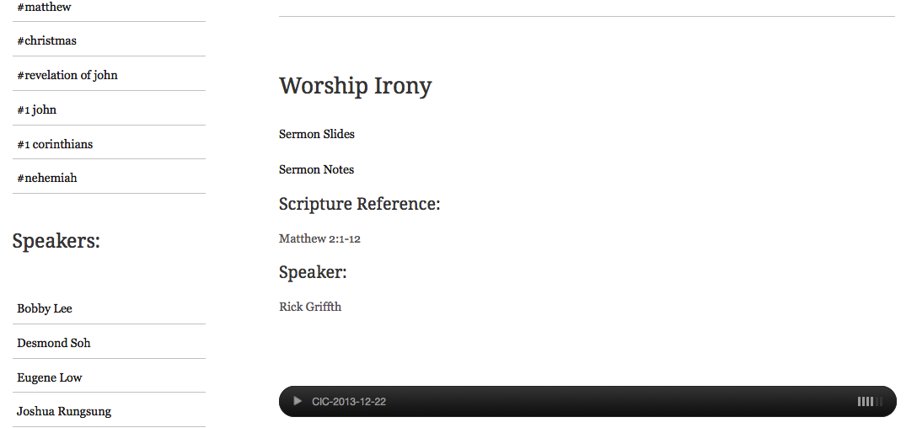
www.cicfamily.com
CICFamily.com

Slide 28

The Power of God's Word (Isa. 55:8-9 NLT)
"My thoughts are nothing like your thoughts," says the LORD.
"And my ways are far beyond anything
you could imagine."
^{"9}For just as the heavens are higher than the earth,
so my ways are higher than your ways
and my thoughts higher than your thoughts."

Slide 29

The Power of God's Word (Isa. 55:10a NLT)
"The rain and snow come down from the heavens
and stay on the ground to water the earth."

Slide 30
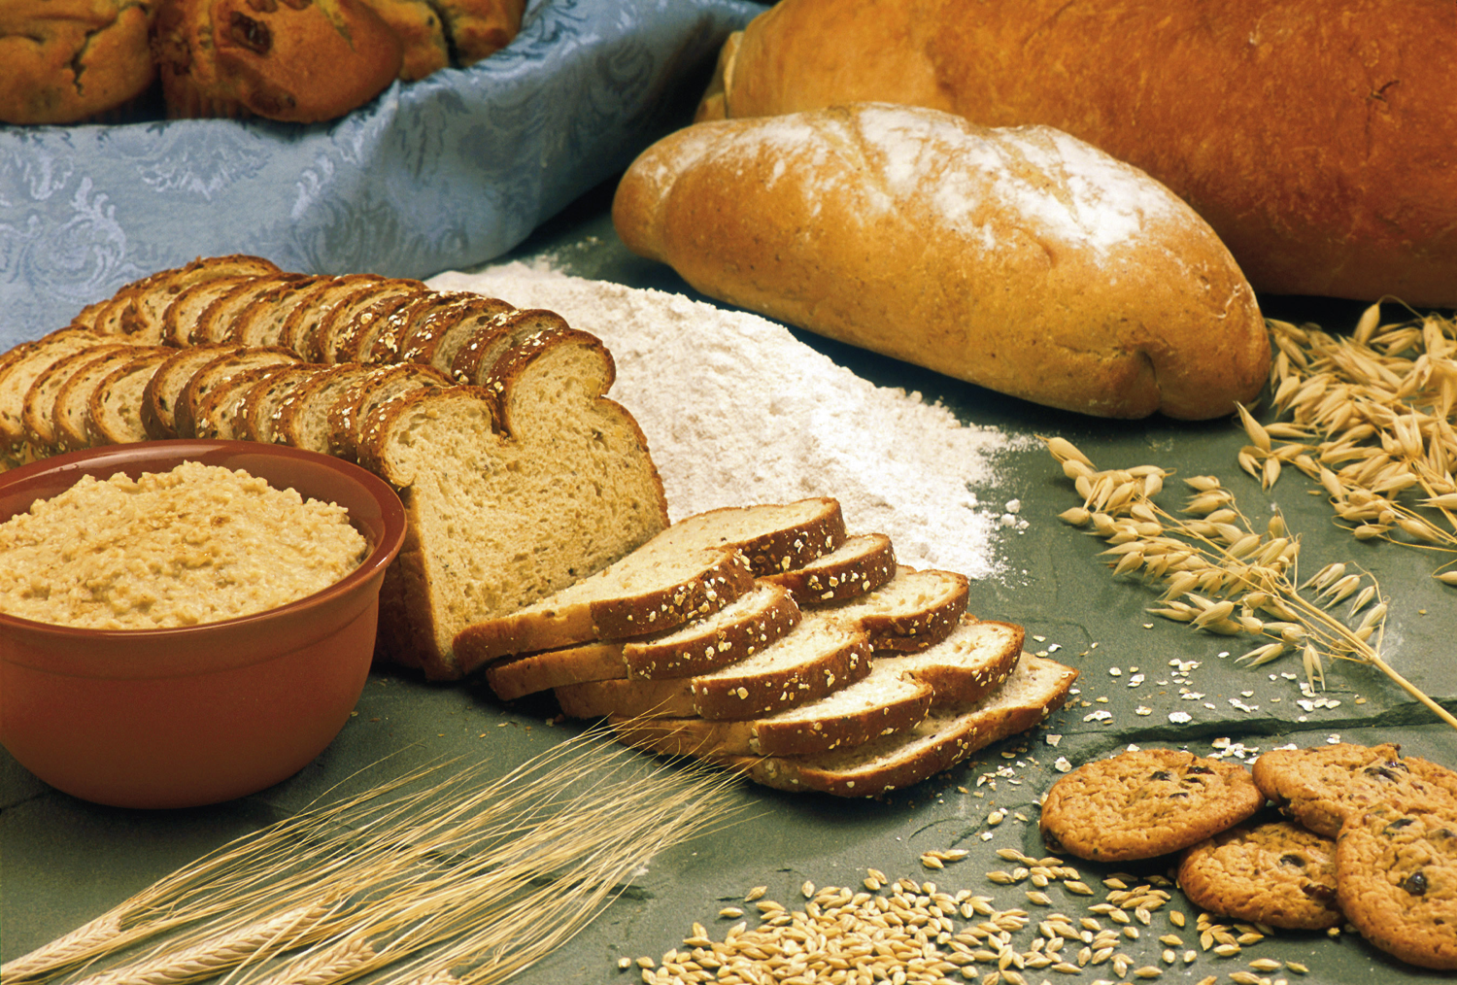
The Power of God's Word (Isa. 55:10b NLT)
"They cause the grain to grow,
producing seed for the farmer
and bread for the hungry."

Slide 31

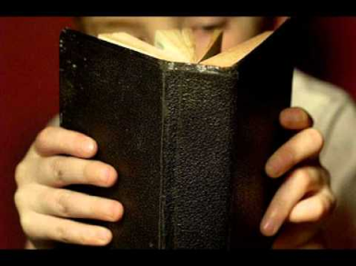
The Power of God's Word (Isa. 55:11 NLT)
"It is the same with my word.
I send it out, and it always produces fruit.
It will accomplish all I want it to,
and it will prosper everywhere I send it."

Slide 32

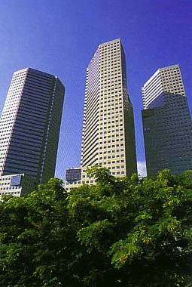
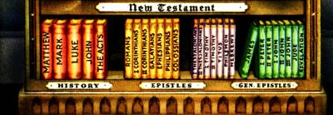
Our Course Goal
Our Goal: To Bridge the Gap!

Slide 33

Course Description
v
Instruction in the crafting of expository sermons,
  through the expositional process of exegesis, theology and homiletics
  with attention given to the strategic use of rhetorical argumentation,
  manuscripting (style and clarity),
  and finally, the preaching of two sermons (an epistle and an OT narrative). 3 hours.
Preaching calendars and specialty sermons (narrative, topical, monologue, evangelistic, wedding, & funeral sermons) are addressed too.

Slide 34
Course Objectives
v
By the course's end you should be able to…
Give the what and why of expository preaching
Form exegetical and homiletical outlines
Explain the introduction, body, and conclusion
Begin to gain confidence preaching
Learn the course by teaching or translating it
Make relevant applications from Scripture
Evaluate sermons to improve them
Preach (the “what”) epistle and narrative sermons
Preach (the “how”) a true, interesting, clear, relevant sermon (the basic goal on page 25).

Slide 35
Four Objectives:
A Sermon That is…
25
True
Interesting
Clear
Relevant

Slide 36
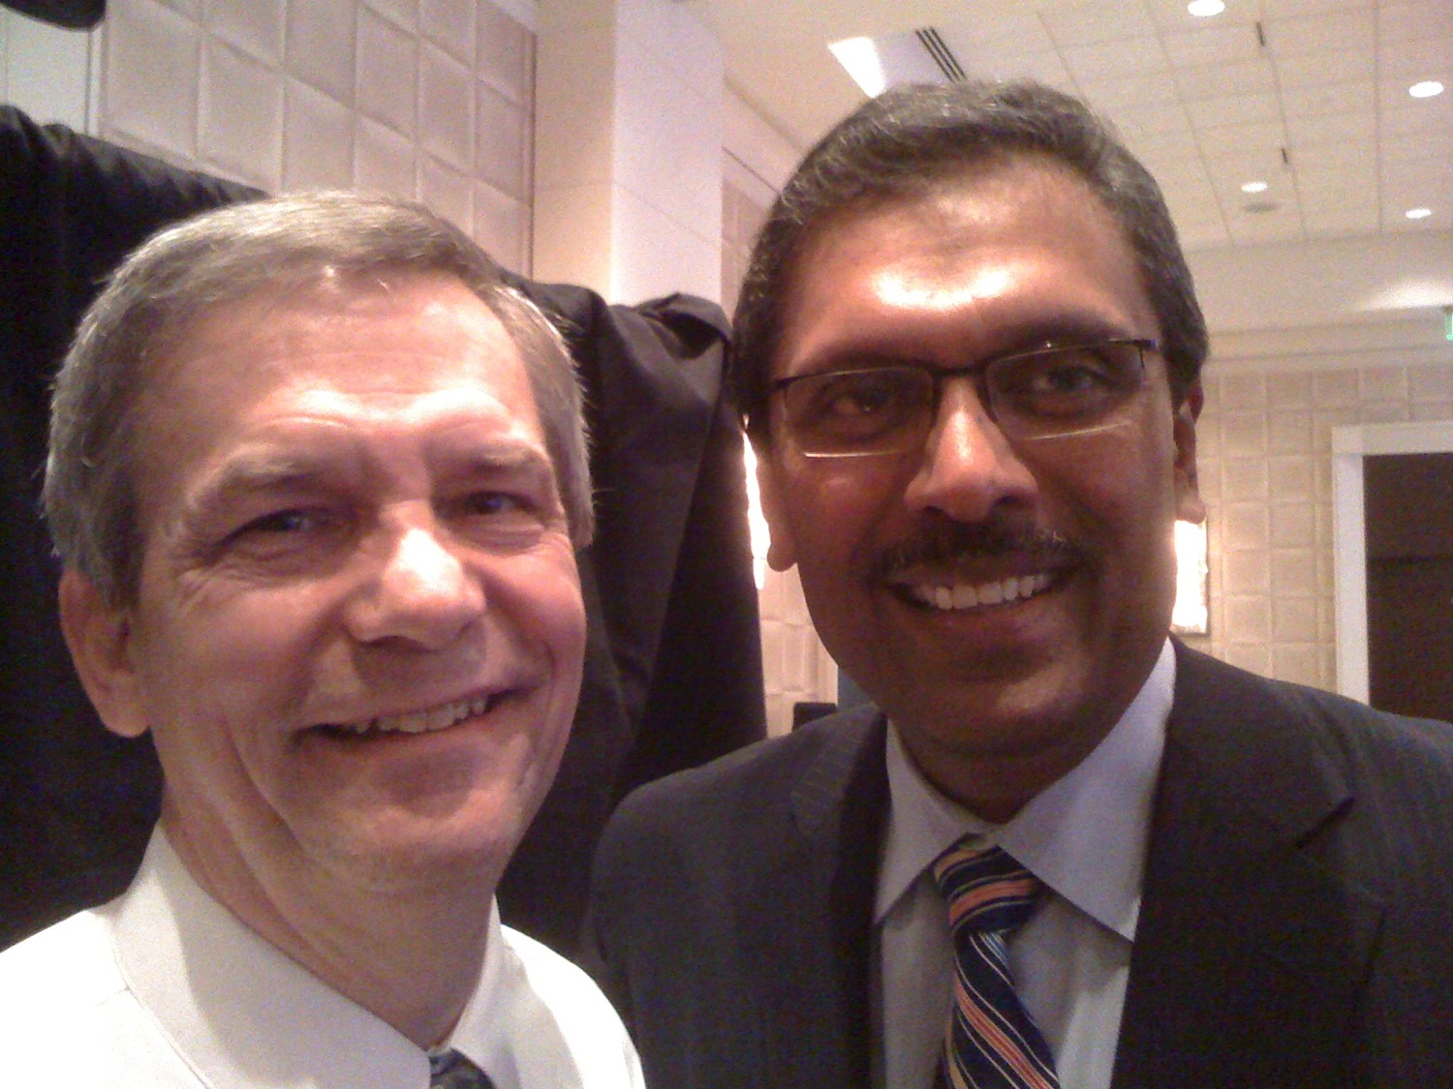
Dr. Rick & Dr. Ramesh Richard

Slide 37



Course Requirements
v
Readings (10%)
PREACHING WITH FRESHNESS
Preparing Expository Sermons
A SEVEN-STEP METHOD FOR BIBLICAL PREACHING

Slide 38

Your First Reading Assignment
Read this 20-page booklet by next period

Slide 39
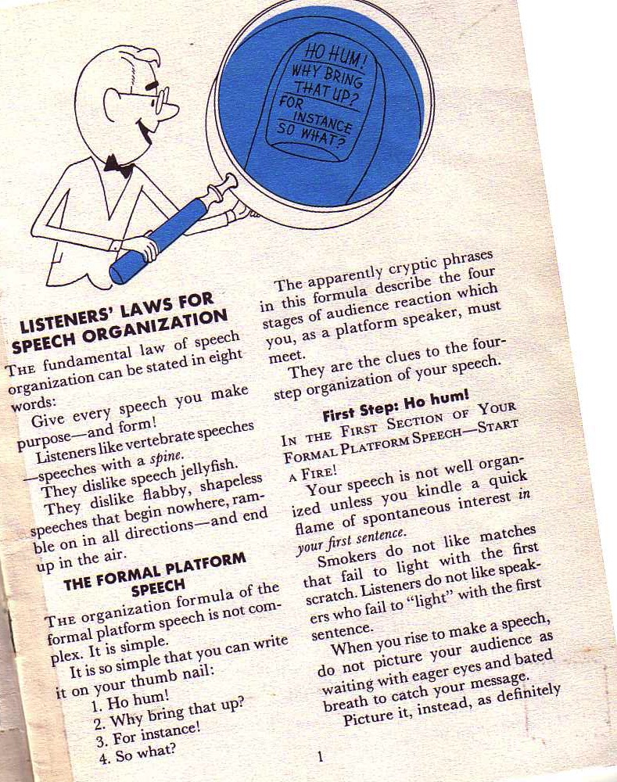
Borden's Basics
10-11
The fundamental law of speech organization can be stated in eight words:
Give every speech you make purpose––and form!
Richard Borden, How to Communicate Ideas, 1
Notes:
Same slide for presentation 01.30 and 03.05 so translators may copy from one to the other

Slide 40
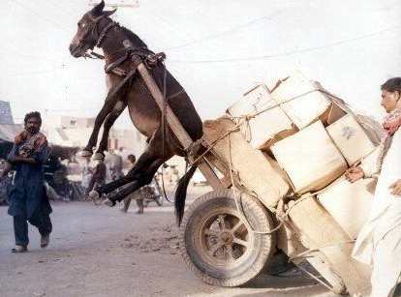
SBC Course Requirements
v
Readings (10%)
Project (15%)

Slide 41

DISCIPLESHIP
"…make disciples of all nations…" (Matt. 28:19)
But how?
Notes:
We all know that our basic calling is to make disciples among the nations.

Slide 42



Let's Teach Others How to Preach Too!
"You have heard me teach things that have been confirmed by many reliable witnesses. Now teach these truths to other trustworthy people who will be able to pass them on to others" (2 Tim. 2:2 NLT).
Discipleship
Paul
Timothy
Reliable Men
Others

Slide 43
Teaching 1994-2020
MONGOLIA
JORDAN
KOREA
ISRAEL
CHINA
NEPAL
MYANMAR
INDIA
THAILAND
VIETNAM
MALAYSIA
SRI LANKA
SINGAPORE
SBC
INDONESIA
Notes:
From 1994-Dec 2020 God has seen fit to grant me the privilege to train pastors in 12 other countries on 73 trips. Often pastors in the US team-teach with me on these trips. To help the poor, I avoid the wealthy countries where listeners can pay an honorarium but instead raise the funds to pay my own way and then teach for free.

Slide 44


Preaching (Homiletics) link at BibleStudyDownloads.org
Get thousands of PPT for free!
Notes:
Preaching (pr)
Homiletics

Slide 45

BibleStudyDownloads.org
7
Notes:
My SBC teaching has resulted in Bible teaching and study materials—mostly PowerPoint—in 49 languages! All a teacher needs to do is to click on a file and it downloads for free to teach any book of the Bible and many other subjects.

Slide 46
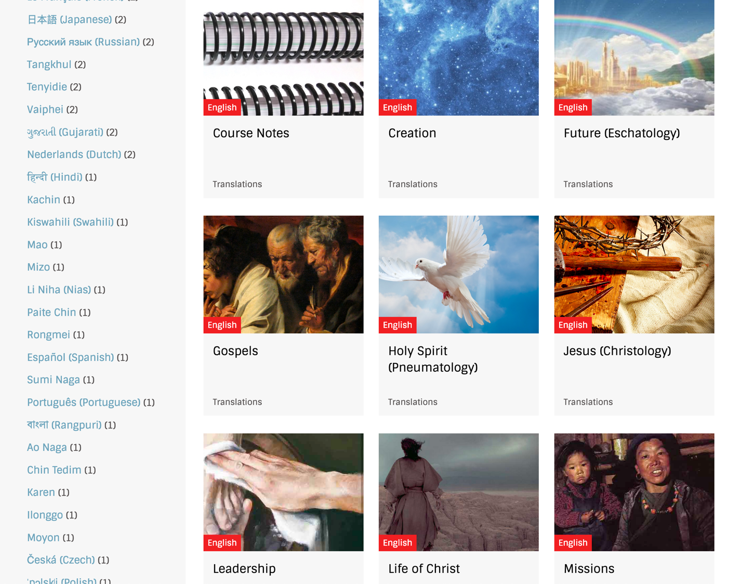
BibleStudyDownloads.org
7
Notes:
My SBC teaching has resulted in Bible teaching and study materials—mostly PowerPoint—in 49 languages! All a teacher needs to do is to click on a file and it downloads for free to teach any book of the Bible and many other subjects.

Slide 47
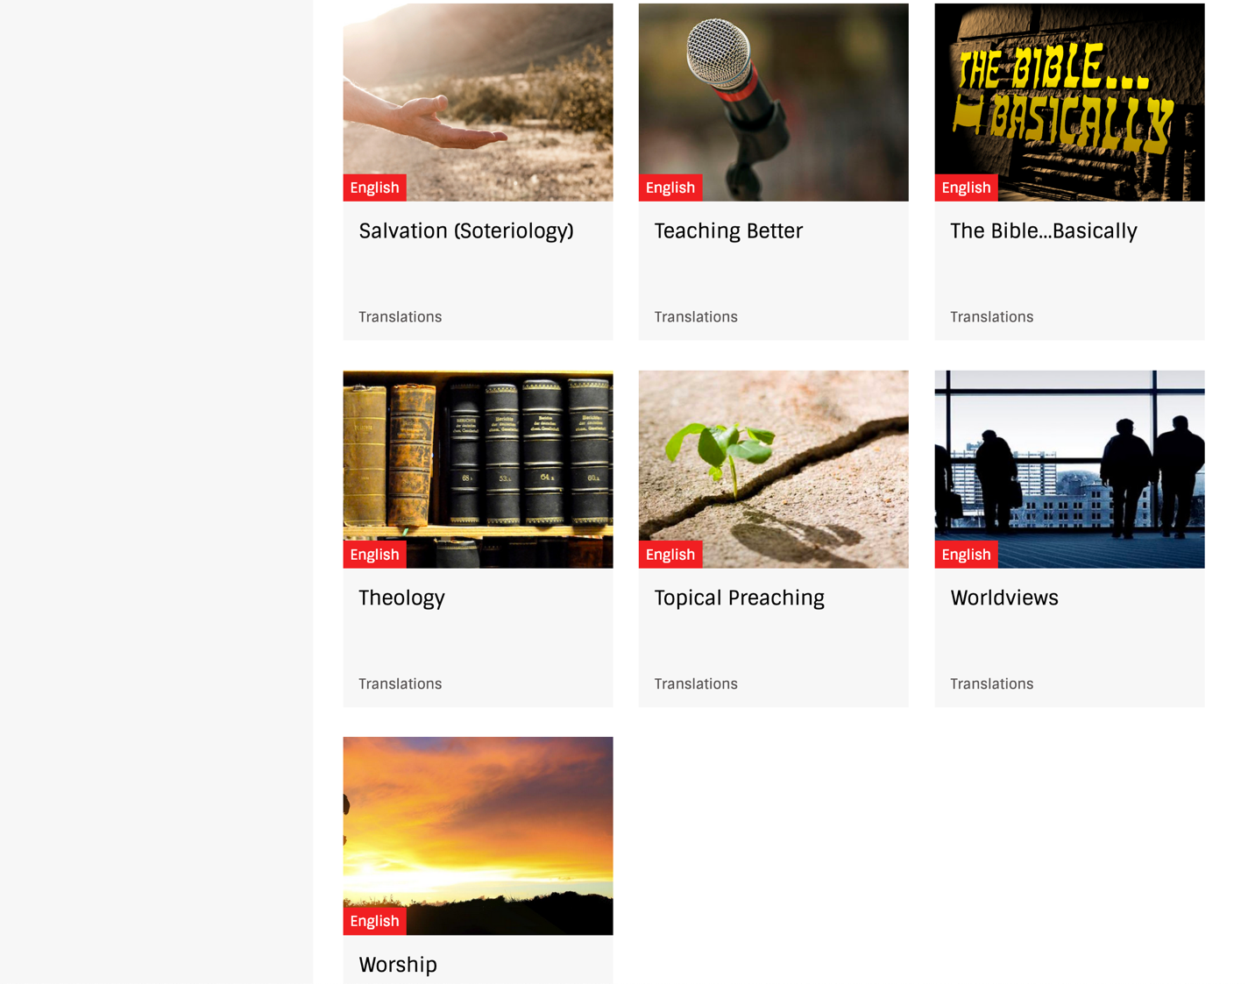
BibleStudyDownloads.org
7
Notes:
My SBC teaching has resulted in Bible teaching and study materials—mostly PowerPoint—in 49 languages! All a teacher needs to do is to click on a file and it downloads for free to teach any book of the Bible and many other subjects.

Slide 48
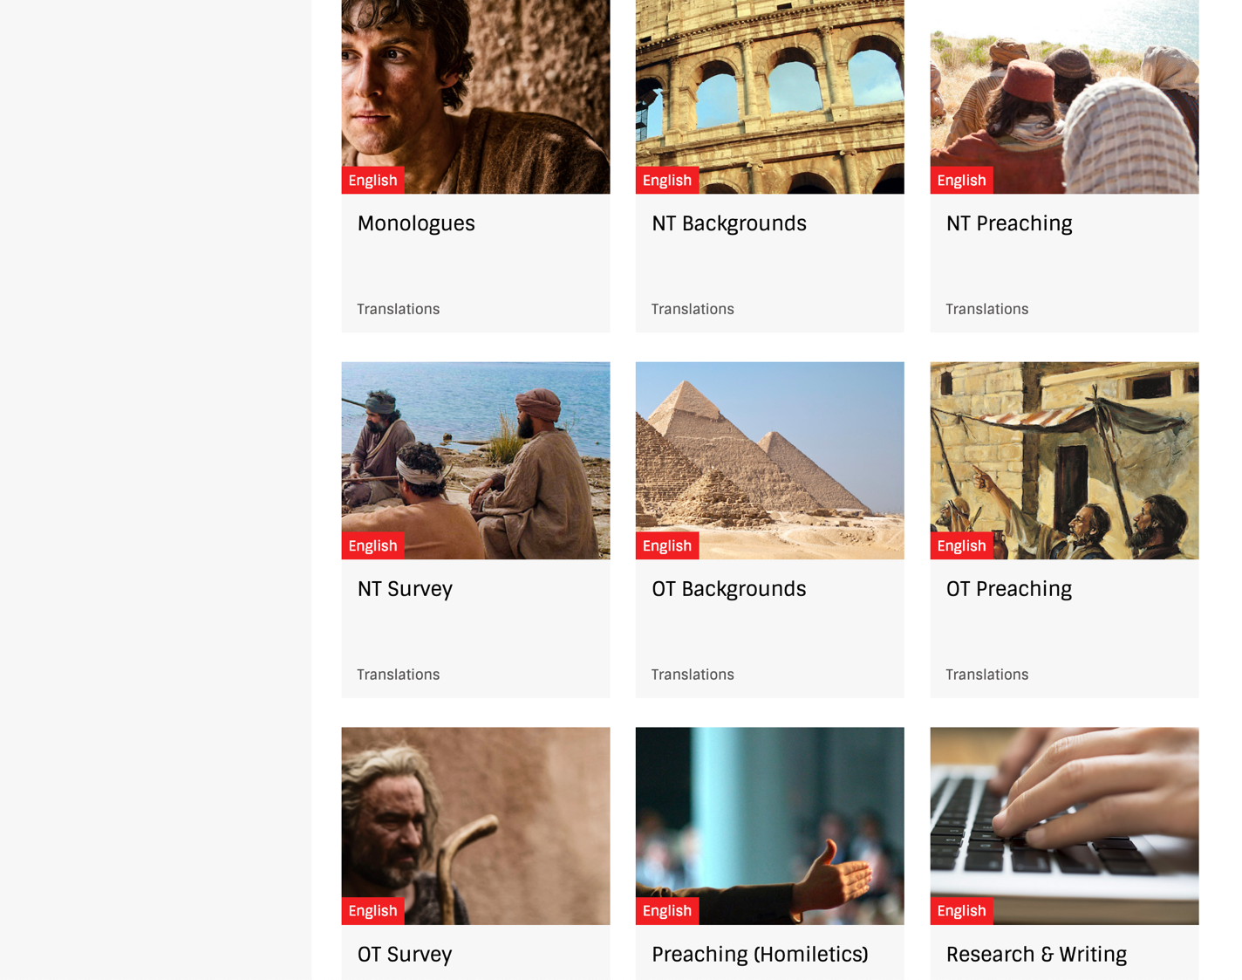
BibleStudyDownloads.org
7
Notes:
My SBC teaching has resulted in Bible teaching and study materials—mostly PowerPoint—in 49 languages! All a teacher needs to do is to click on a file and it downloads for free to teach any book of the Bible and many other subjects.

Slide 49
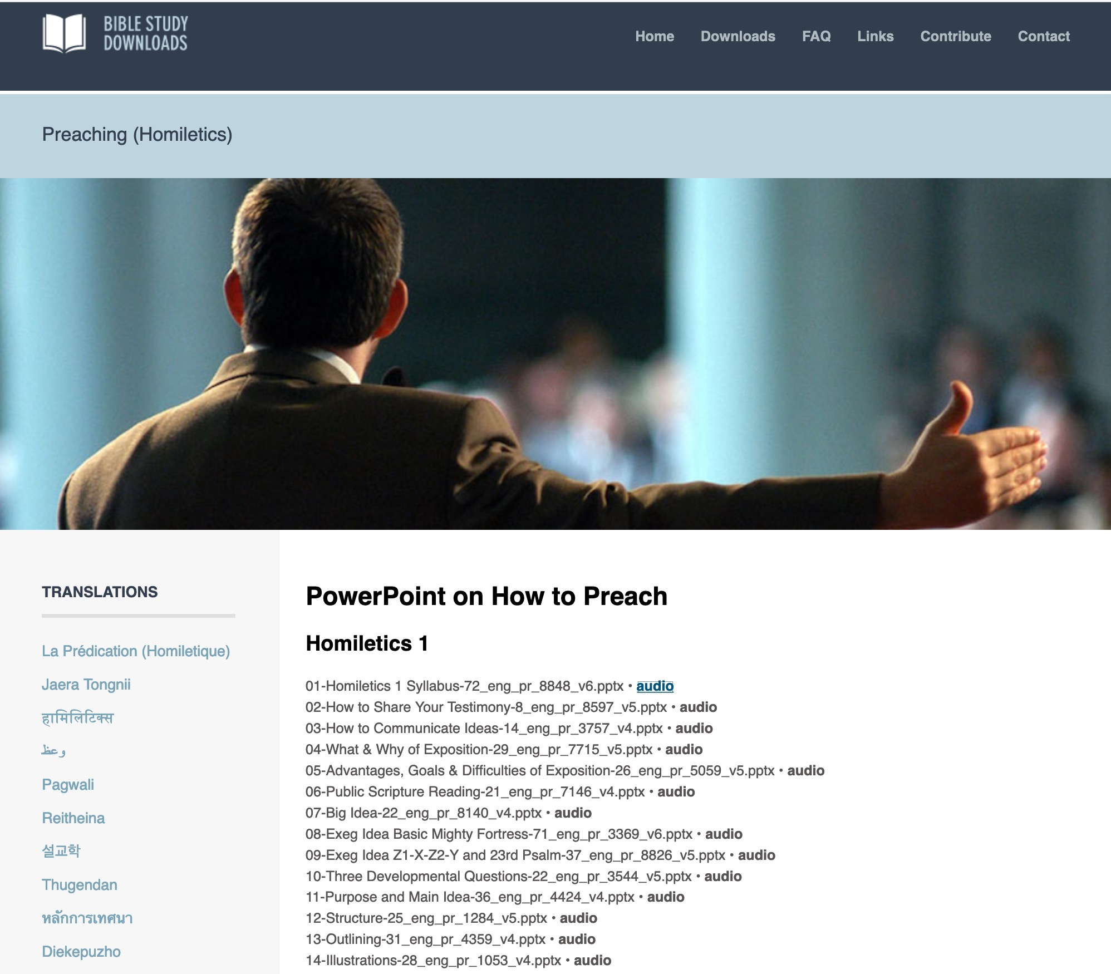
BibleStudyDownloads.org
7
English
Notes:
My SBC teaching has resulted in Bible teaching and study materials—mostly PowerPoint—in 49 languages! All a teacher needs to do is to click on a file and it downloads for free to teach any book of the Bible and many other subjects.

Slide 50
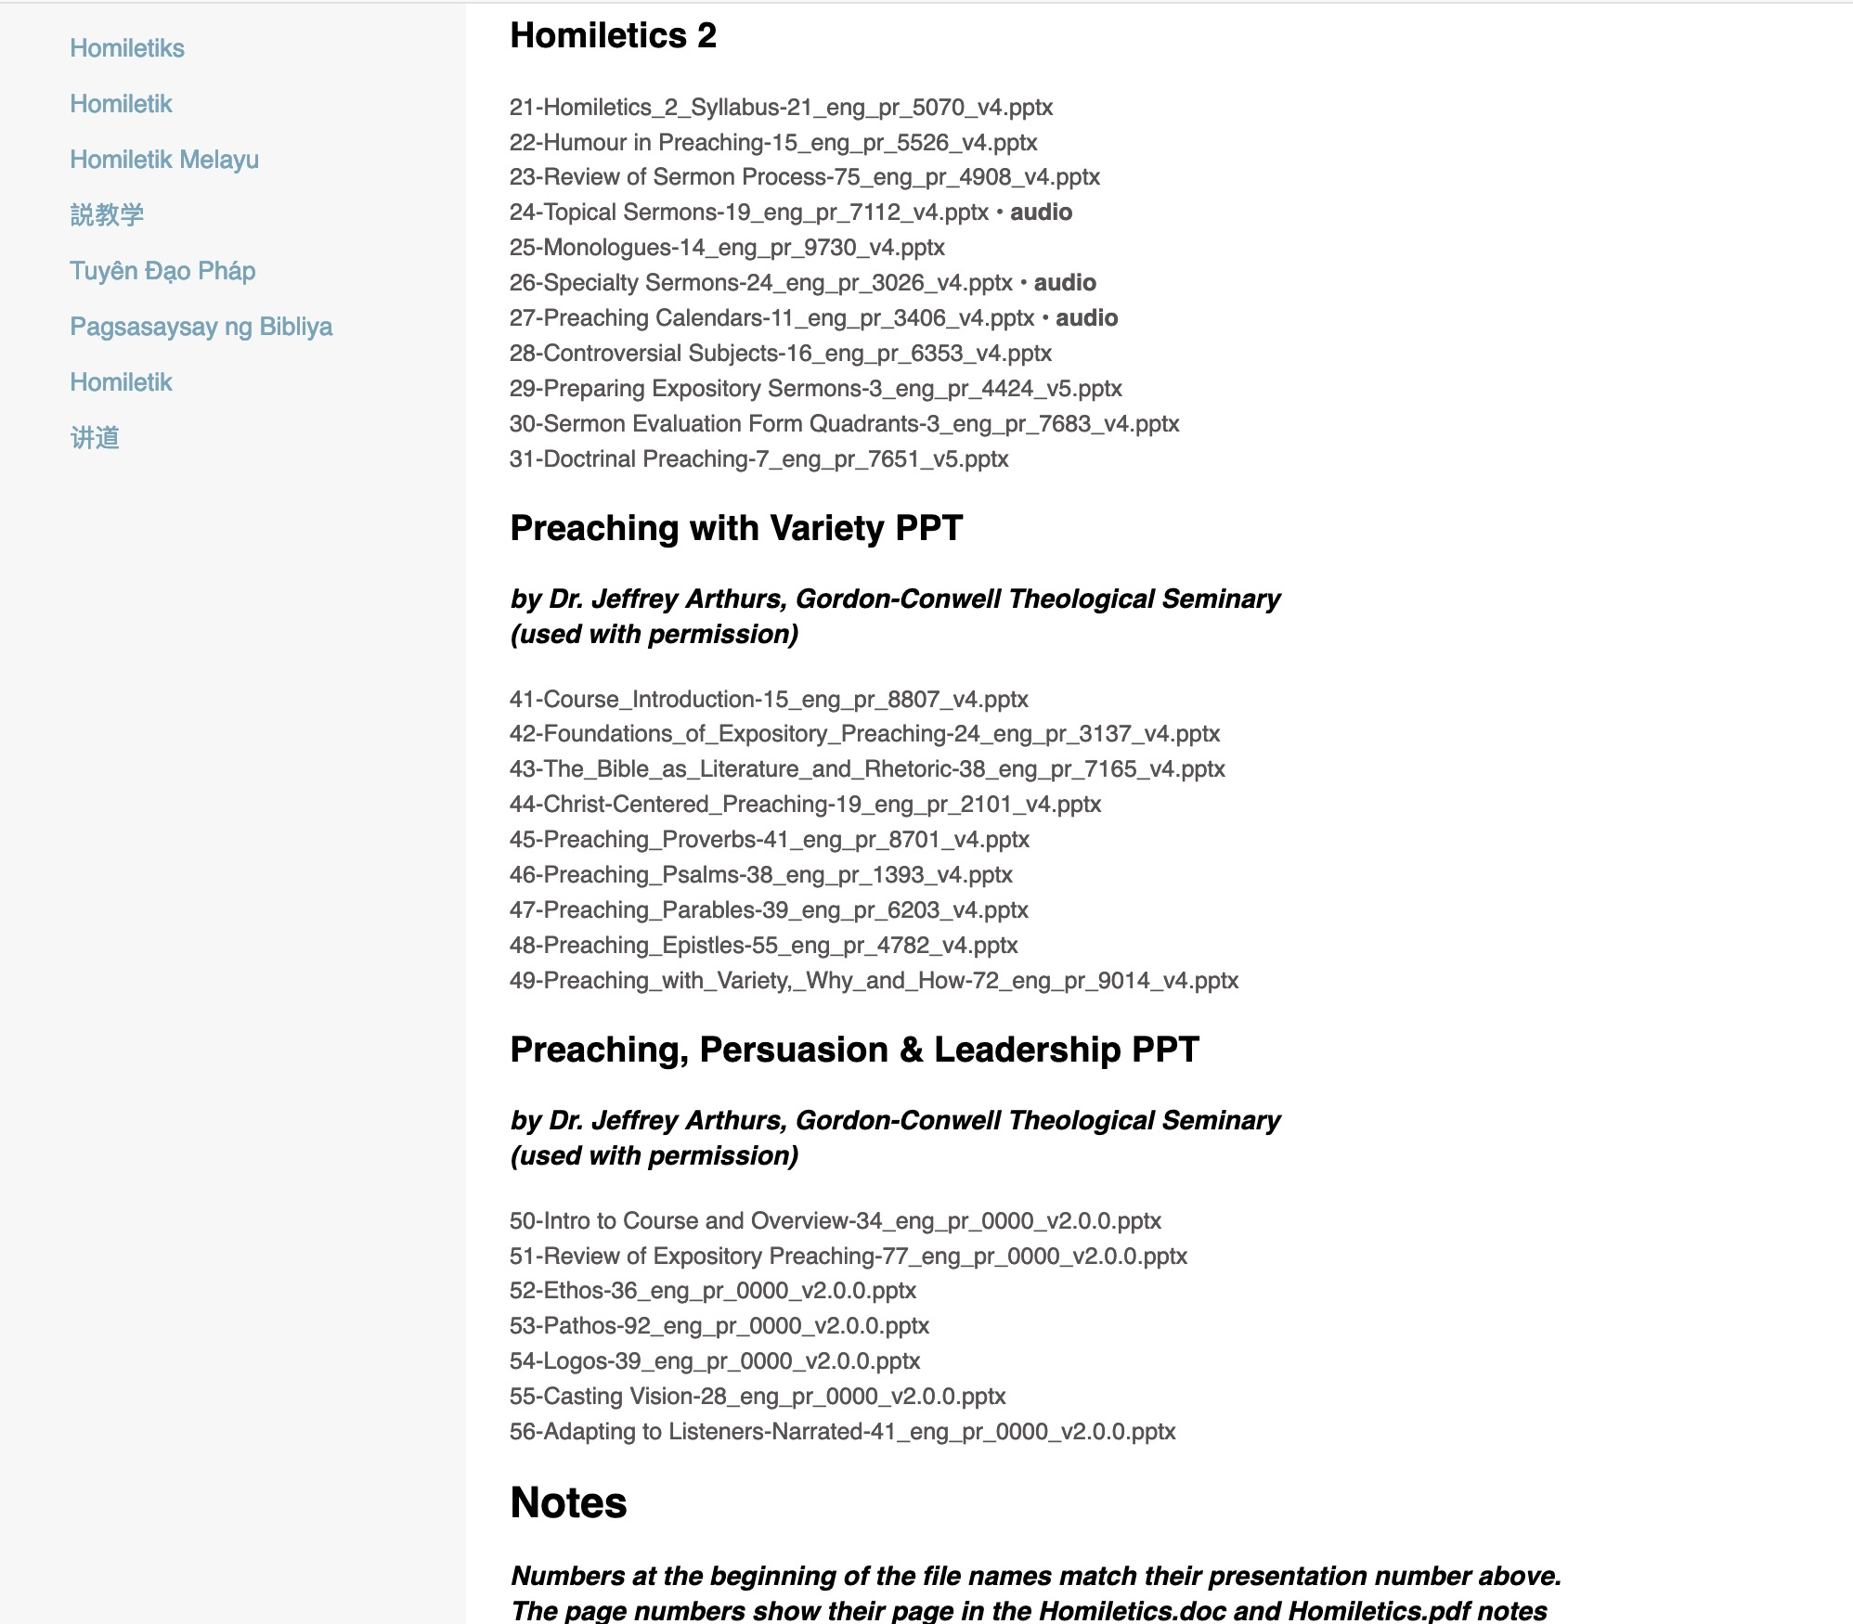
BibleStudyDownloads.org
7
BibleStudyDownloads.org
Notes:
My SBC teaching has resulted in Bible teaching and study materials—mostly PowerPoint—in 49 languages! All a teacher needs to do is to click on a file and it downloads for free to teach any book of the Bible and many other subjects.

Slide 51
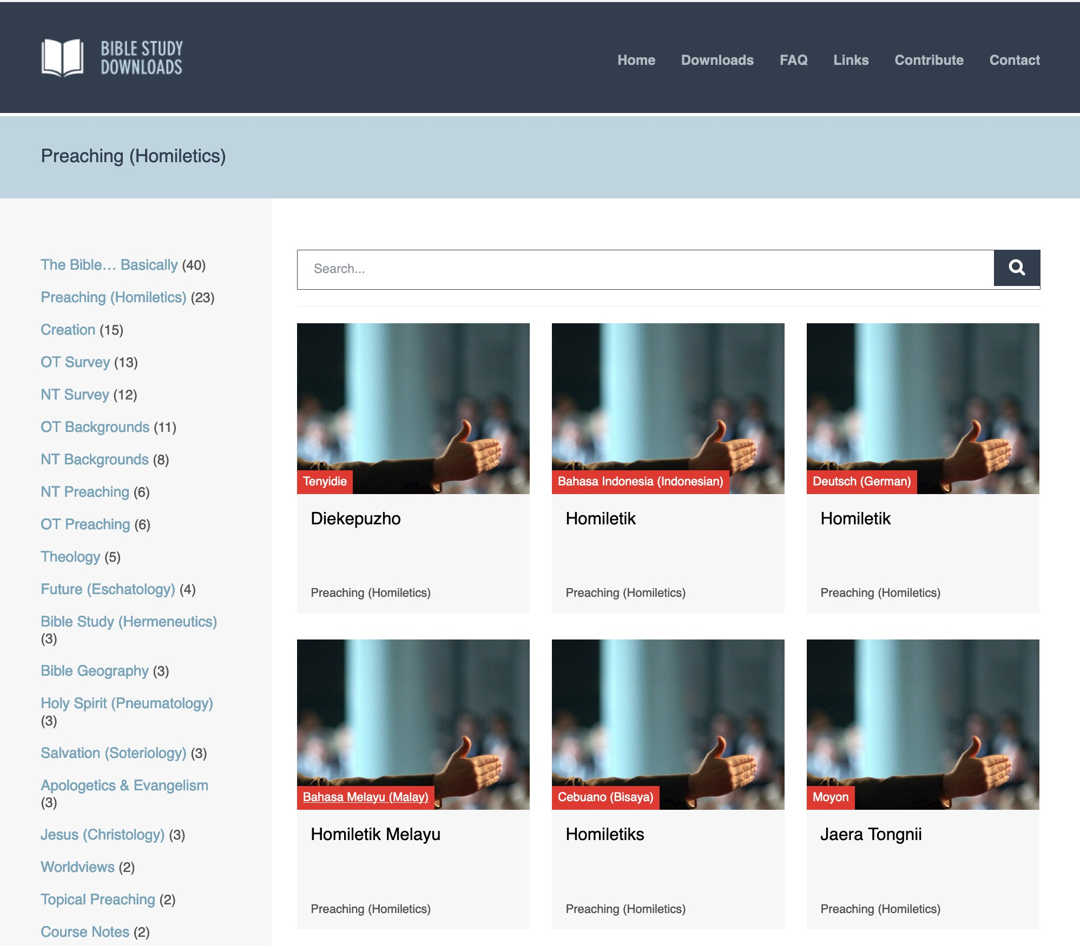
BibleStudyDownloads.org
7
Notes:
Here are 9 languages featured.

Slide 52
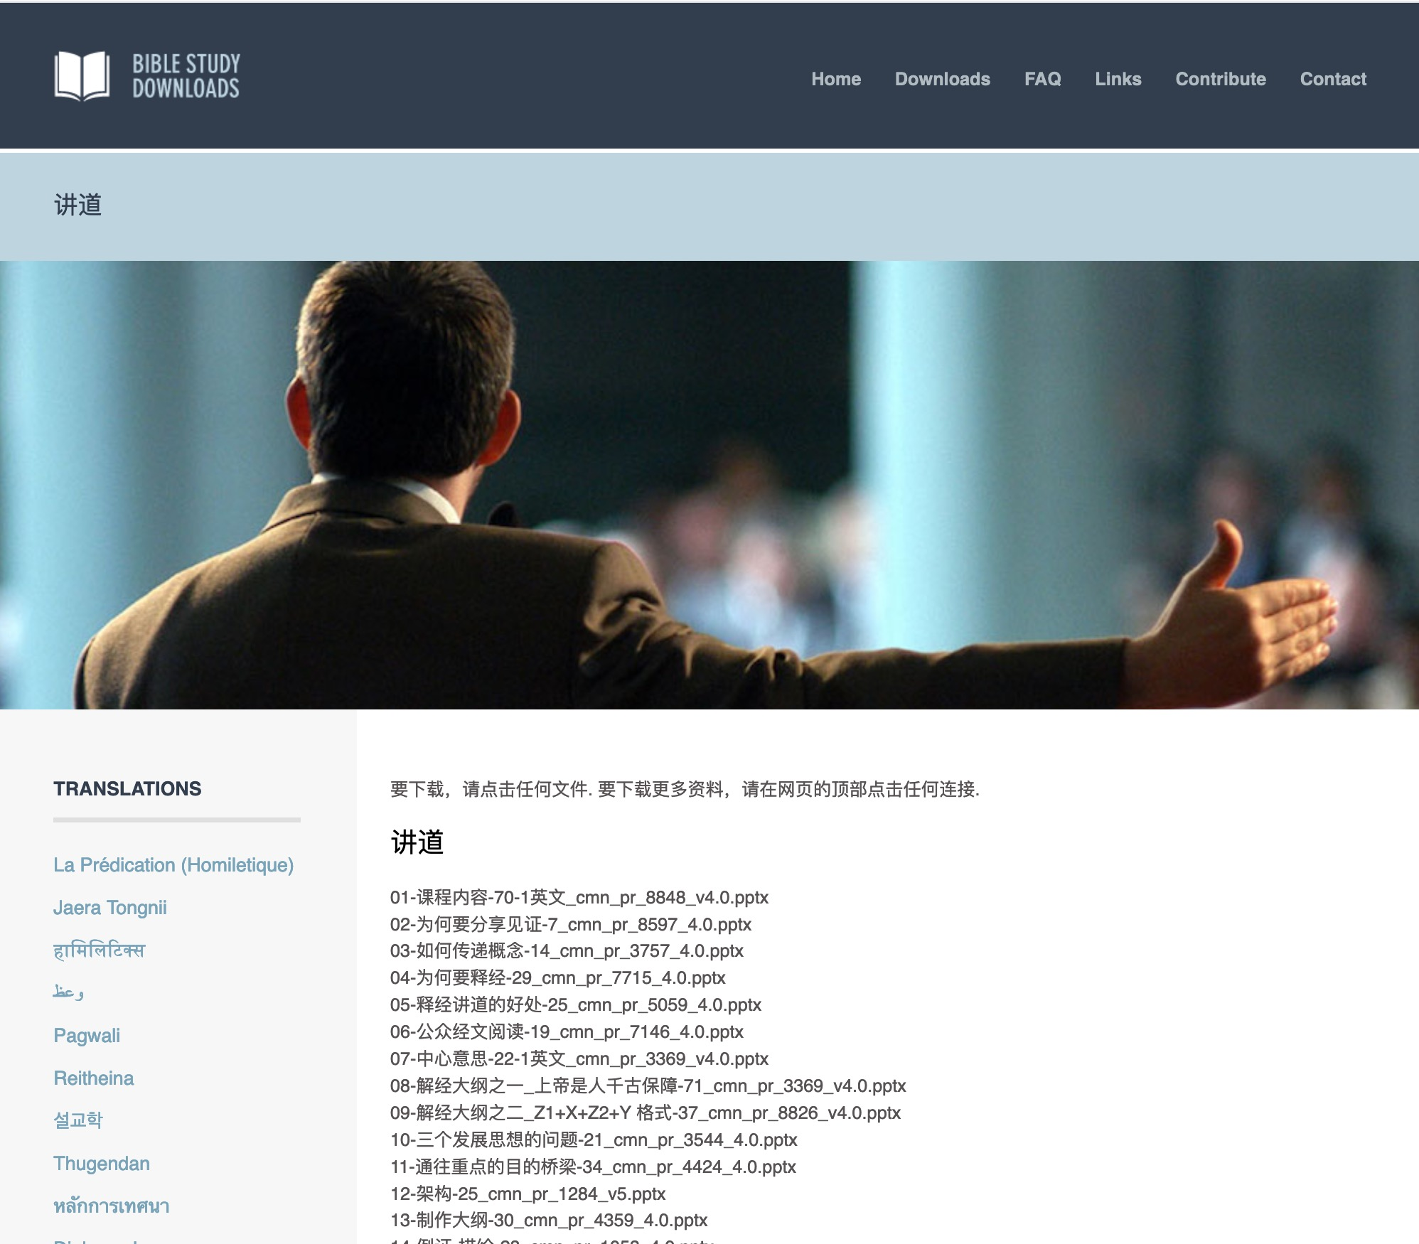
Chinese
7
Notes:
Chinese downloads include more than 37,000 slides as of Jan 2020.

Slide 53
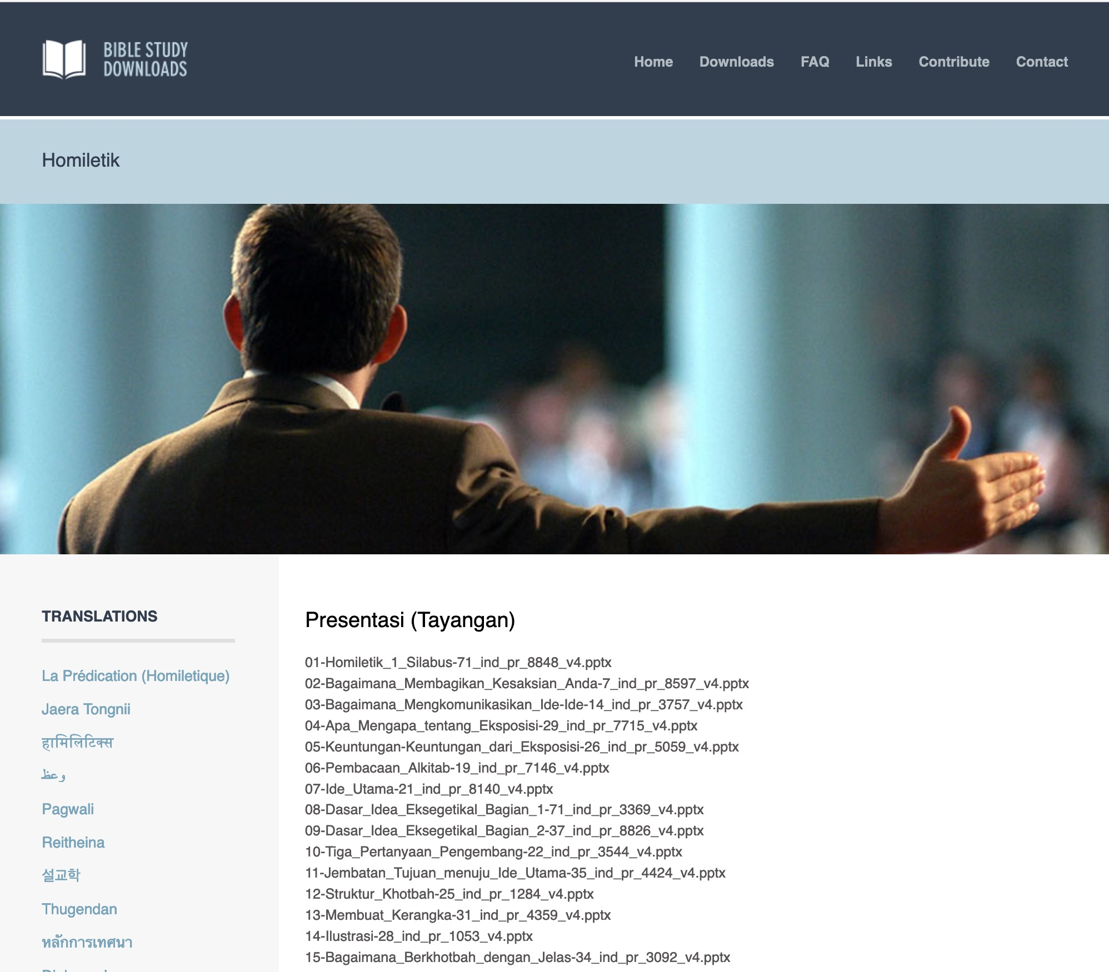
Indonesian
7
Notes:
Indonesian downloads include more than 14,000 slides as of Jan 2020.

Slide 54
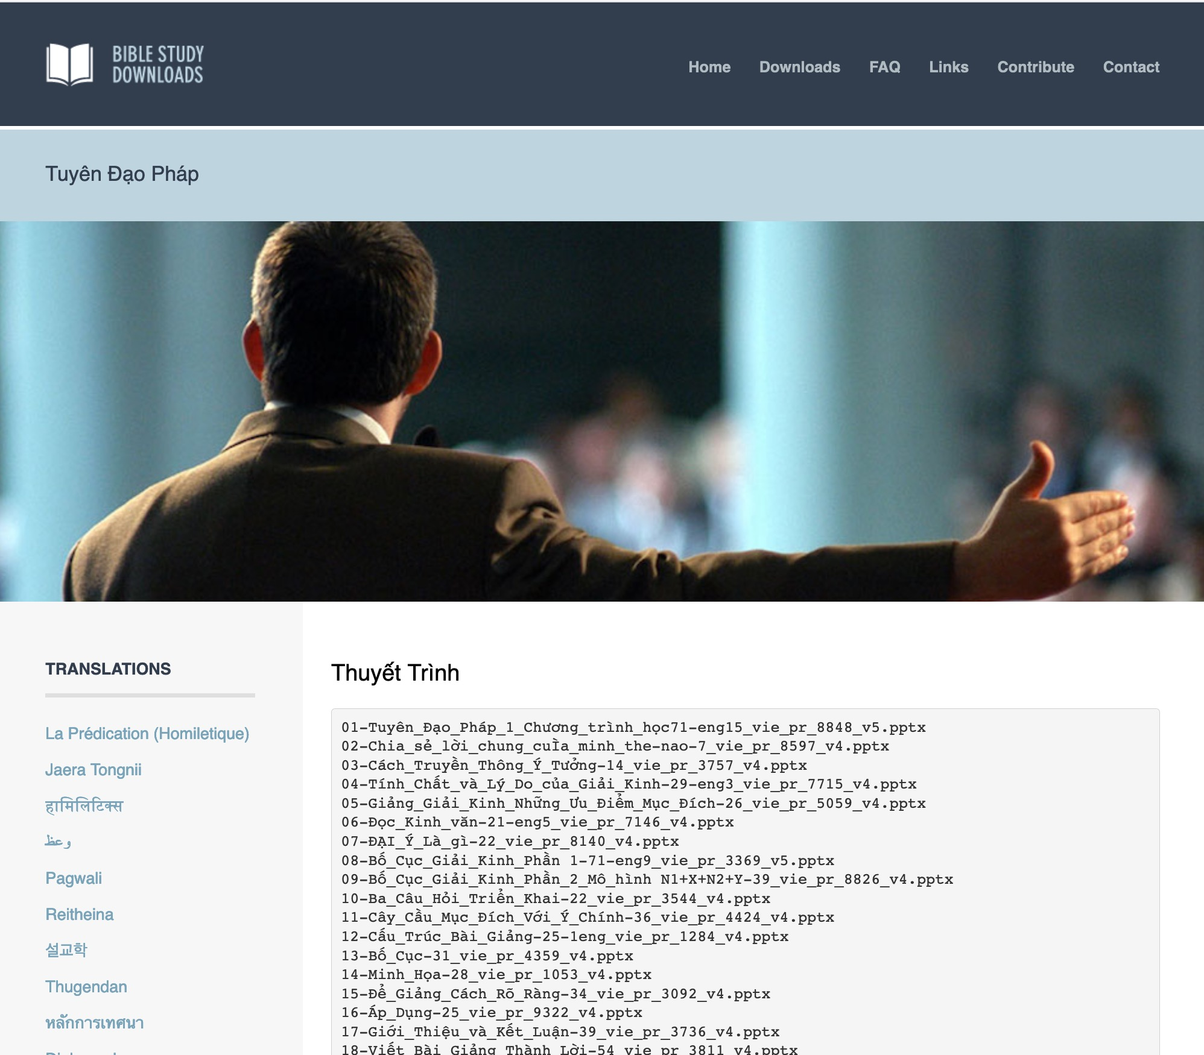
Vietnamese
7
Notes:
Vietnamese downloads include more than 8,000 slides as of Jan 2020.

Slide 55
Homiletics Project Sign Up List
Name | HP | Translate |  |  | Teach
 |  | HOM | HSB | Language | HOM | HSB | Language
X | X | X |  | X
X | X |  | X | X
X | X |  |  |  | X |  | X
X | X |  |  |  |  | X | X

Slide 56
SBC Course Requirements
vi
Readings (10%)
Project (15%)
Assignments (25%)

Slide 57

The 12 Written Assignments
vi
These prepare you for your speaking

Slide 58
Why share your testimony?
16
Easy to talk about yourself
You are the expert
Evangelism opportunities
Notes:
Same slide for presentation 01.49 and 02.03 so translators may copy from one to the other except that 02.03 expands the 01.49 slide

Slide 59
Testimony Flow
16
Post-Conversion:
Your thinking
Specific changes
Be concrete!
Conversion:
Share the event
What you believed
Be concrete!
Keep the
same theme
throughout!
Pre-Conversion:
Your thinking
Your actions
Be concrete!
Notes:
Same slide for presentation 01.50 and 02.04 so translators may copy from one to the other

Slide 60
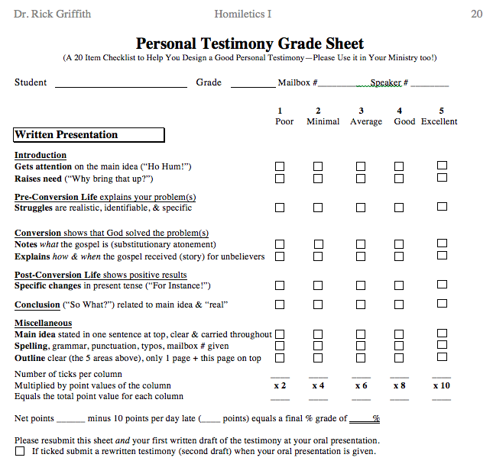
Testimony Grade Sheet
20
Introduction
Pre-Conversion
Conversion
Post-Conversion
Conclusion
Miscellaneous

Slide 61

Our Two Sections
Wednesday
Thursday

Slide 62
SBC Course Requirements
vii
Readings (10%)
Project (15%)
Assignments (25%)
Speaking (50%)

Slide 63


Speaking Progression
vii
Introduction (1 min.)
Personal Testimony (2-3 min.)
Persuasion Speech (2 min.)
Epistle Sermon (15 min.)
Narrative Sermon (15 min.)
Notes:
Same slide for presentation 01.54 and 02.07 so translators may copy from one to the other

Slide 64
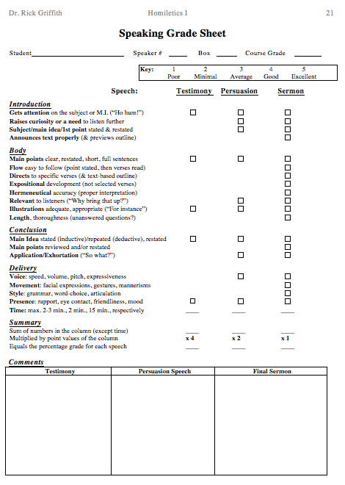
Speaking Grade Sheet
21
"Ho hum!"
Main Points
"For instance!"
Main Idea
Presence

Slide 65
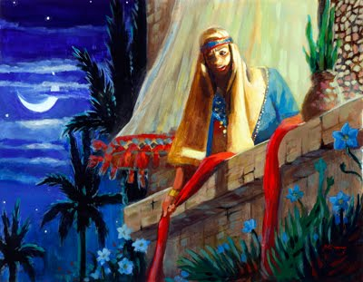
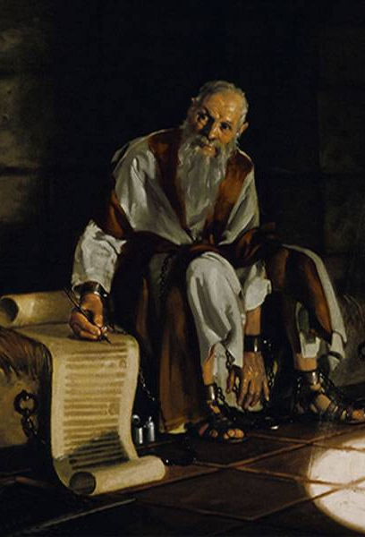
Your Two Sermons
vi
Epistle
Easier
1-2 verses
Narrative
Harder
1 chapter

Slide 66
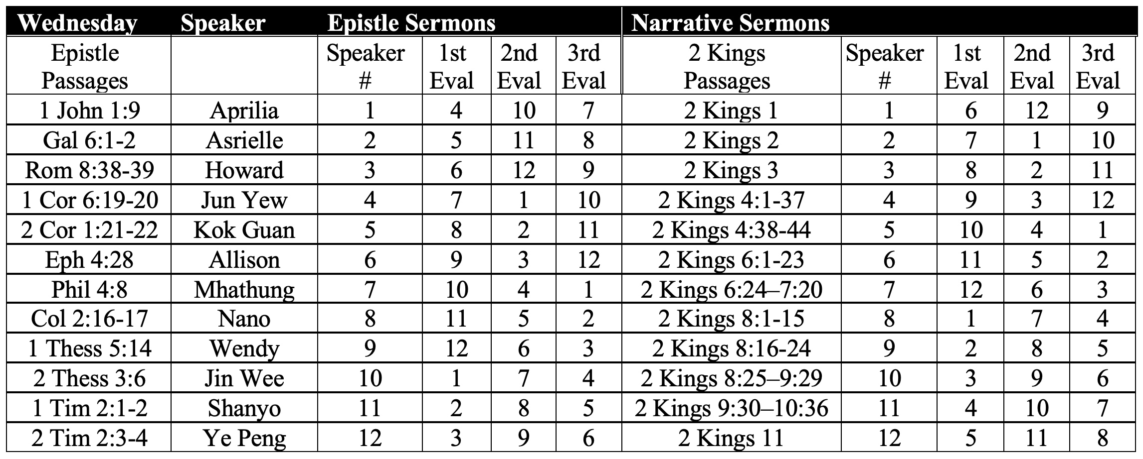
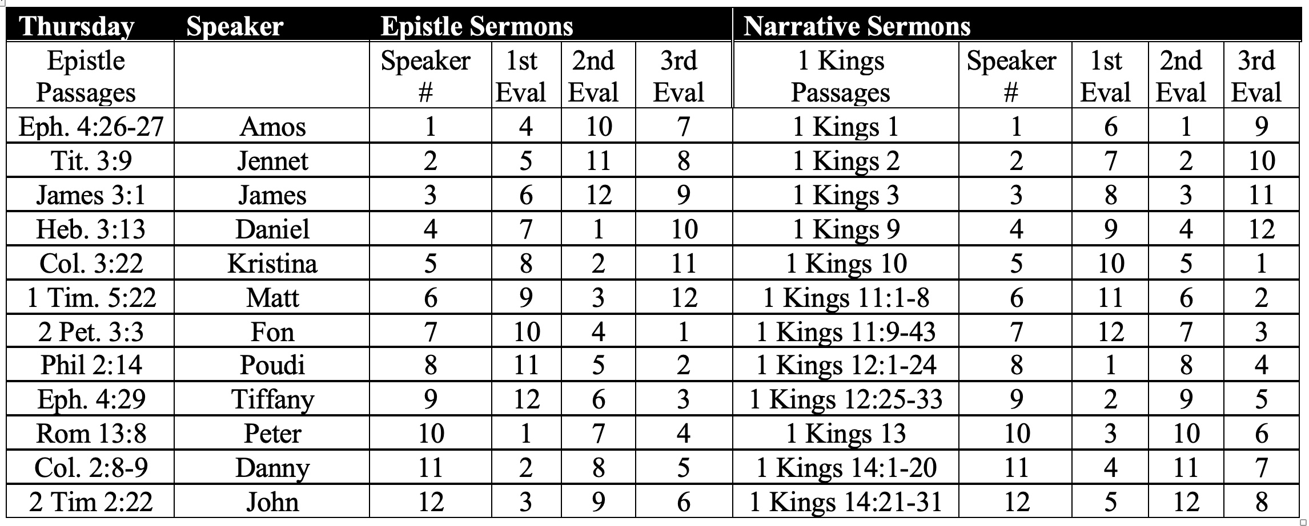
SBC Speakers & Evaluators Jan 2021
vi
Jan-Apr 2021

Slide 67
Epistle Sermon Verses (15 min.)
B
Rom. 13:8
Let no debt remain outstanding, except the continuing debt to love one another, for he who loves his fellowman has fulfilled the law.
Rom. 14:22-23
²²So whatever you believe about these things keep between yourself and God. Blessed is the man who does not condemn himself by what he approves. ²³But the man who has doubts is condemned if he eats, because his eating is not from faith; and everything that does not come from faith is sin.
Gal. 6:2
²Carry each other's burdens, and in this way you will fulfill the law of Christ.

Slide 68
Epistle Sermon Verses (15 min.)
B
Eph. 2:10
¹⁰For we are God's workmanship, created in Christ Jesus to do good works, which God prepared in advance for us to do.
Eph. 4:26-27
²⁶"In your anger do not sin": Do not let the sun go down while you are still angry, ²⁷and do not give the devil a foothold.
Eph. 4:28
²⁸He who has been stealing must steal no longer, but must work, doing something useful with his own hands, that he may have something to share with those in need.
Eph. 4:29
²⁹Do not let any unwholesome talk come out of your mouths, but only what is helpful for building others up according to their needs, that it may benefit those who listen.

Slide 69
Epistle Sermon Verses (15 min.)
B
Eph. 6:4
⁴Fathers, do not exasperate your children; instead, bring them up in the training and instruction of the Lord.
Phil. 2:13
¹³for it is God who works in you to will and to act according to his good purpose.
Phil. 2:14
¹⁴Do everything without complaining or arguing
Col. 2:8-9
⁸See to it that no one takes you captive through hollow and deceptive philosophy, which depends on human tradition and the basic principles of this world rather than on Christ. ⁹For in Christ all the fullness of the Deity lives in bodily form

Slide 70
Epistle Sermon Verses (15 min.)
B
1 Tim. 2:11-12
¹¹A woman should learn in quietness and full submission. ¹²I do not permit a woman to teach or to have authority over a man; she must be silent.
1 Tim. 5:22
²²Do not be hasty in the laying on of hands, and do not share in the sins of others. Keep yourself pure.
Titus 3:9
⁹But avoid foolish controversies and genealogies and arguments and quarrels about the law, because these are unprofitable and useless.
Heb. 3:13
¹³But encourage one another daily, as long as it is called Today, so that none of you may be hardened by sin's deceitfulness.

Slide 71
Epistle Sermon Verses (15 min.)
B
Heb. 13:2
²Do not forget to entertain strangers, for by so doing some people have entertained angels without knowing it.
1 Peter 2:2
²Like newborn babies, crave pure spiritual milk, so that by it you may grow up in your salvation,
1 Peter 3:7
⁷Husbands, in the same way be considerate as you live with your wives, and treat them with respect as the weaker partner and as heirs with you of the gracious gift of life, so that nothing will hinder your prayers.
2 Peter 3:3
³First of all, you must understand that in the last days scoffers will come, scoffing and following their own evil desires.

Slide 72

If you don't preach well, even the rocks will cry out!
Luke 19:40 Jesus replied, “If they kept quiet, the stones along the road would burst into cheers!”

Slide 73
Please Submit These for Both 15 Minute Sermons…
vii
The Day Before You Preach…
Outline Assigns. 7 & 8 (or 11 & 12)
PPT slide(s) of sermon outline
Copies of your sermon outline for all
Manuscript annotated for clarity
The Day You Preach…
Upload sermon to Google drive
Within Two Days After You Preach…
Sermon Self Evaluation (p. 104)

Slide 74
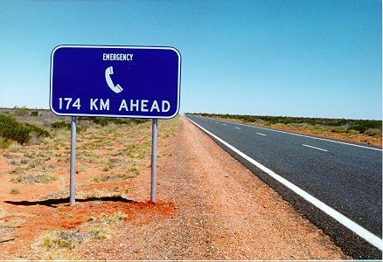
In a fog over your assignment?
Ask for help!

Slide 75

Please type your assignments on a computer
Buy the warranty too!

Slide 76
Other Matters
xi
Copying Class Notes
Contacting Me
SBC box L19 or phone (6559-1513)
Mobile number 9113-7090
Home address is SBC Block 2-302
Home phone number is disconnected
E-mail: griffith@sbc.edu.sg
My office hours are…
Let's have lunch too!

Slide 77
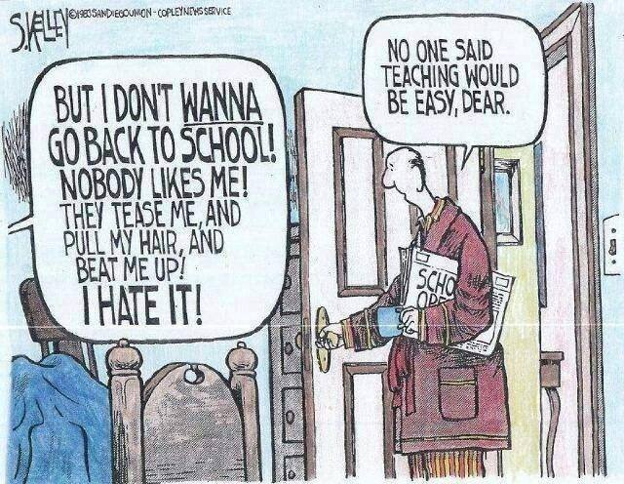
No one said preaching would be easy, Dear
But I don’t WANNA go back to church! Nobody likes me! They tease me, and pull my hair, and beat me up! I hate it!

Slide 78
Black

Slide 79
Preaching (Homiletics) link at BibleStudyDownloads.org
Get this presentation for free!
Notes:
Preaching (pr)
Homiletics

