Slide 1


The New Testament Parchment Project
An Introduction
Taught by Fred Young • Used with Permission Uploaded by Dr. Rick Griffith • Jordan Evangelical Theological Seminary Files in many languages for free download at BibleStudyDownloads.org

Slide 2


As you read the Bible, do you ever struggle to see the forest
for the trees?

Slide 3
Try the bird's-eye view from The New Testament Parchment Project

Slide 4
The New Testament Parchment Project
Features:
27 detailed summary charts
17 letters visible on 2-page layouts
10 long books visible by 2-page literary sections
An appendix with Bible study tools and a reading plan

Slide 5


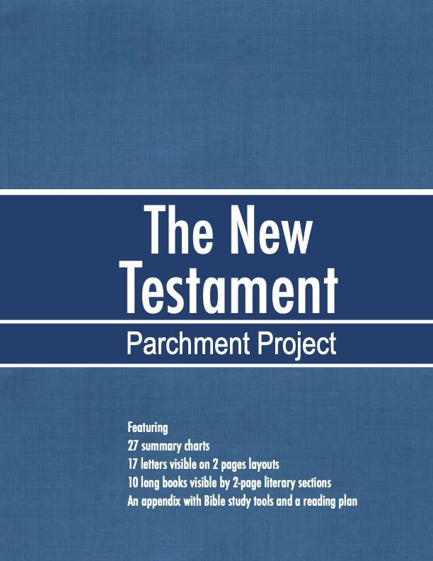

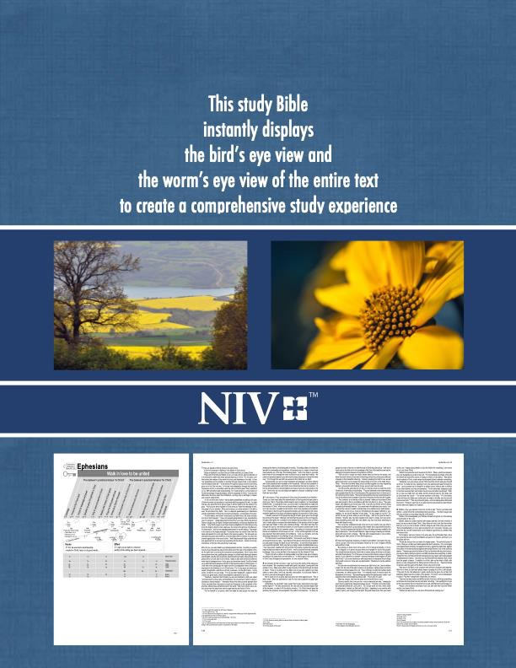
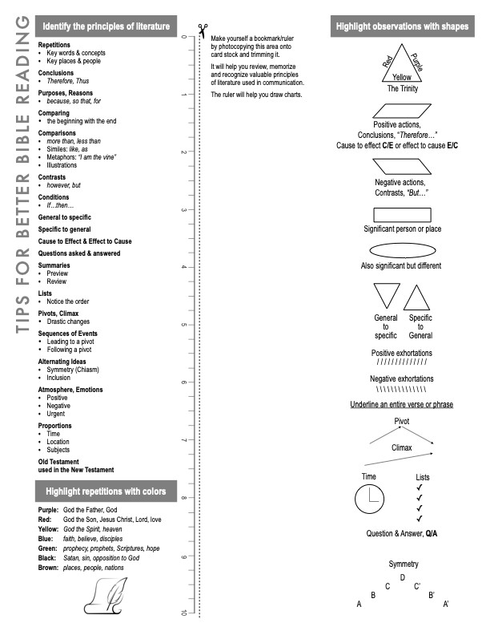
COVERS
Inside*
Front
Back

Slide 6


* The reference guide, inside the front cover, summarizes the
Bible study tips & tools described fully
in the appendix

Slide 7
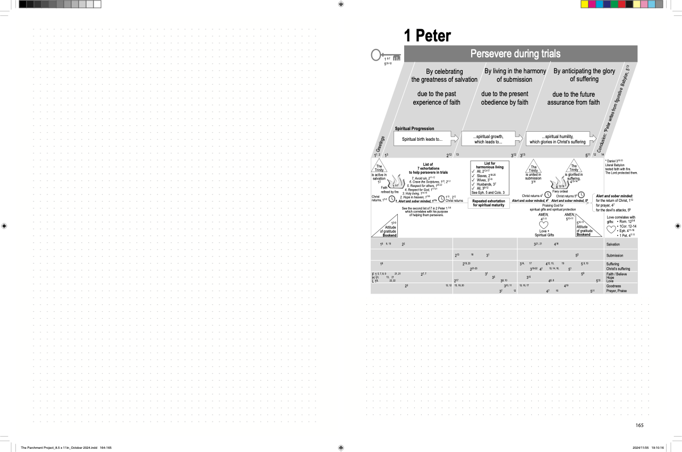
When closed, TPP measures
8.5” x 11”
When open, its double-page layout contains grid pages for personal note-taking
A detailed summary chart
on the facing page contains
Purpose statements
Outlines of major sections
Structural markers
Key verses and traceable themes

Slide 8
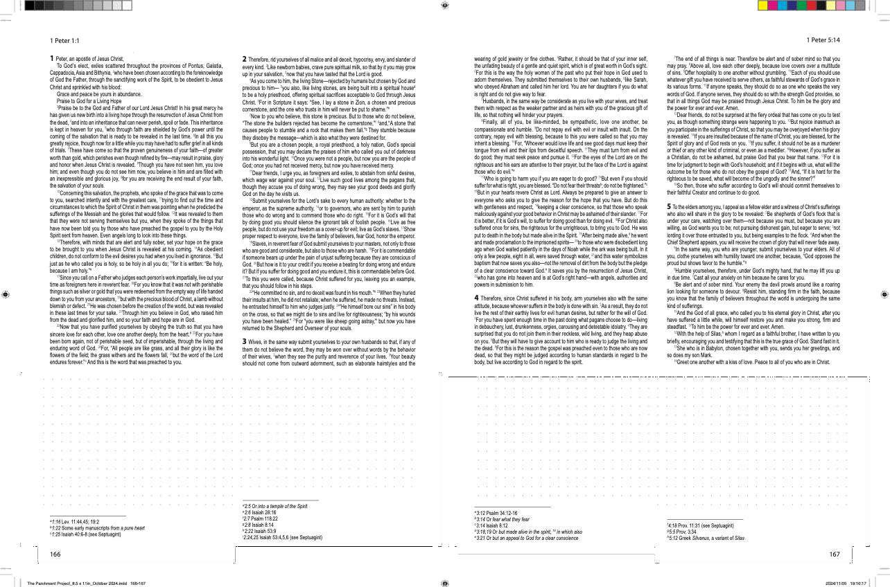
17 letters, like 1st Peter, fit on the 2-page layout
White space remains dedicated to note-taking
Textual notes appear as footnotes

Slide 9
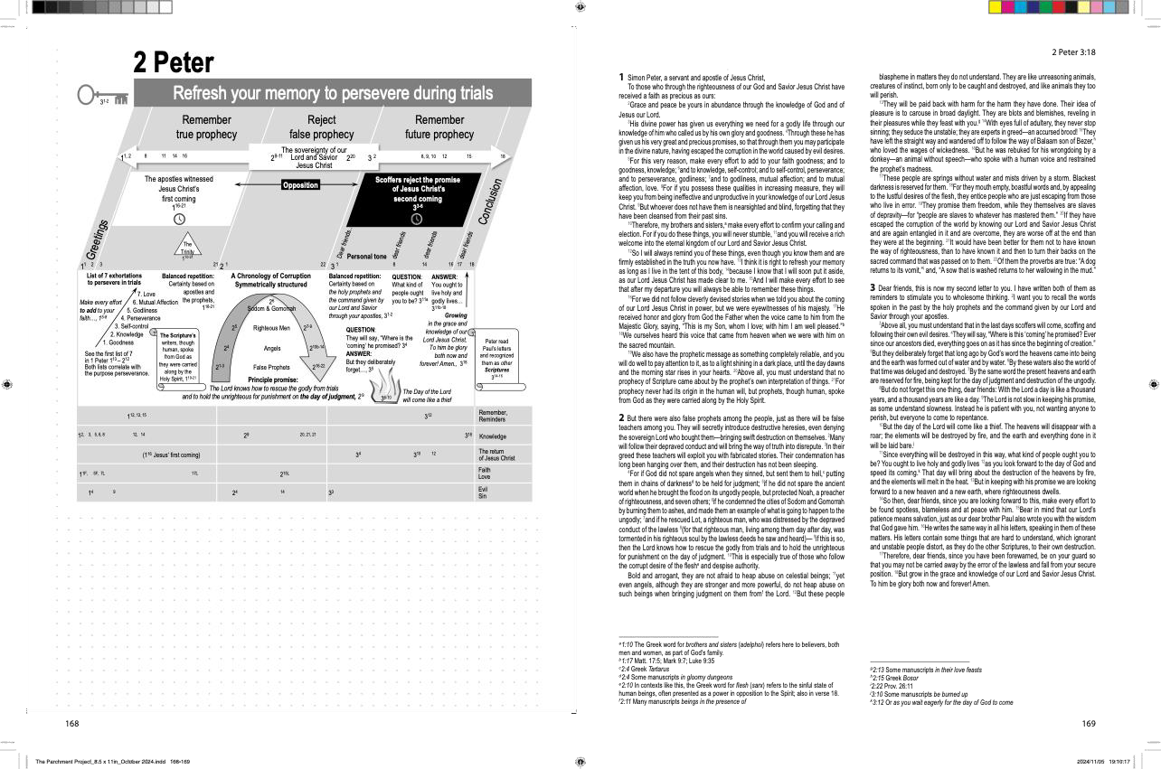
Some letters only need one page

Slide 10
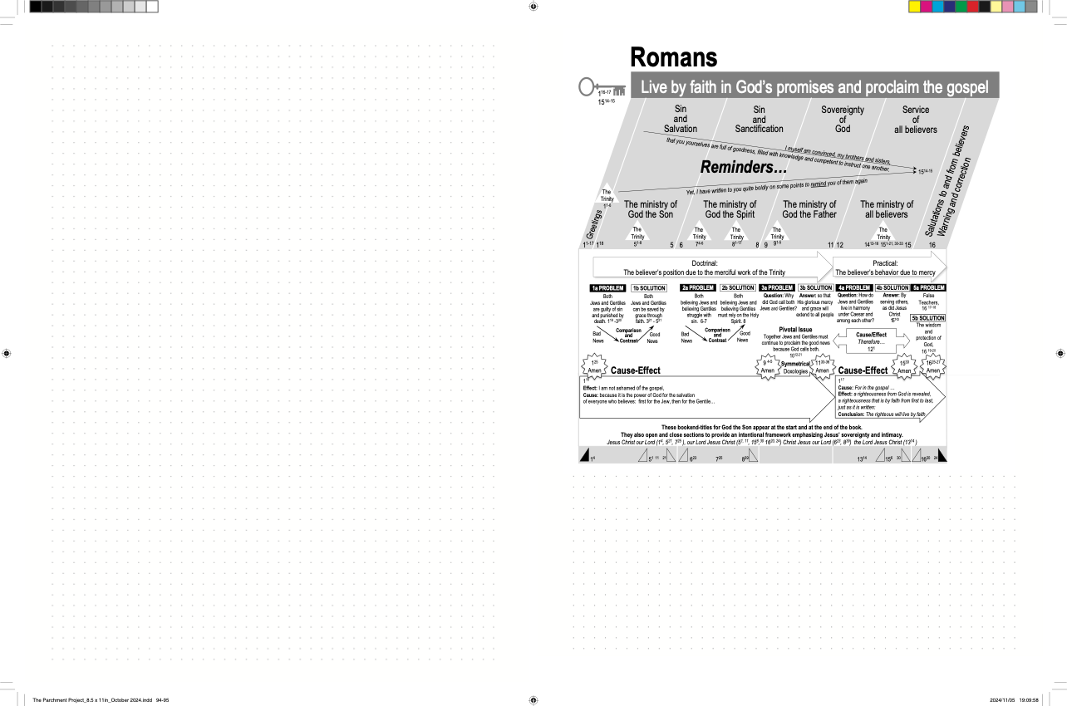
* * * * *
The 2-page layout also serves the 10 longer titles
*Their literary sections occupy 2-page
layouts

Slide 11
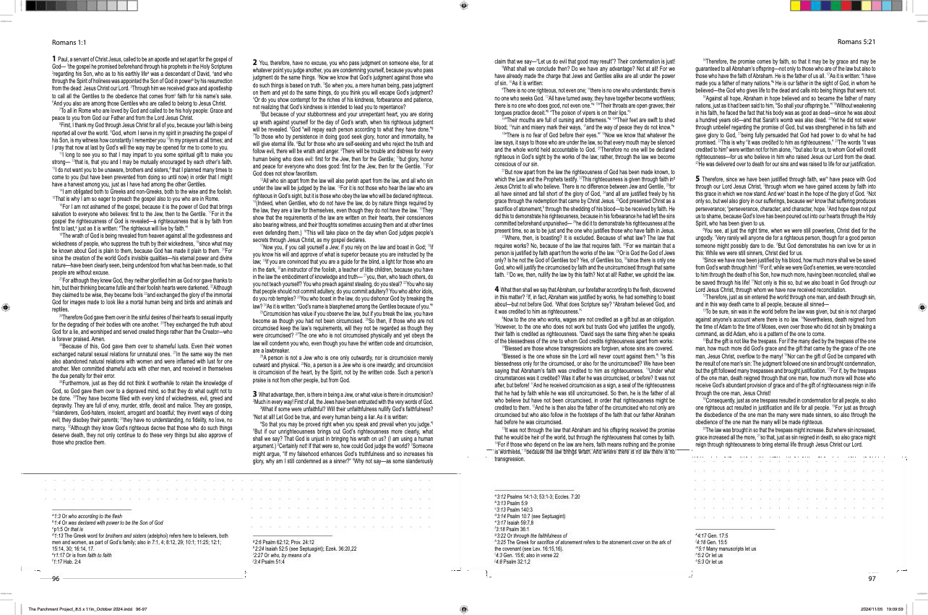
Sin and Salvation, chapters 1-5

Slide 12
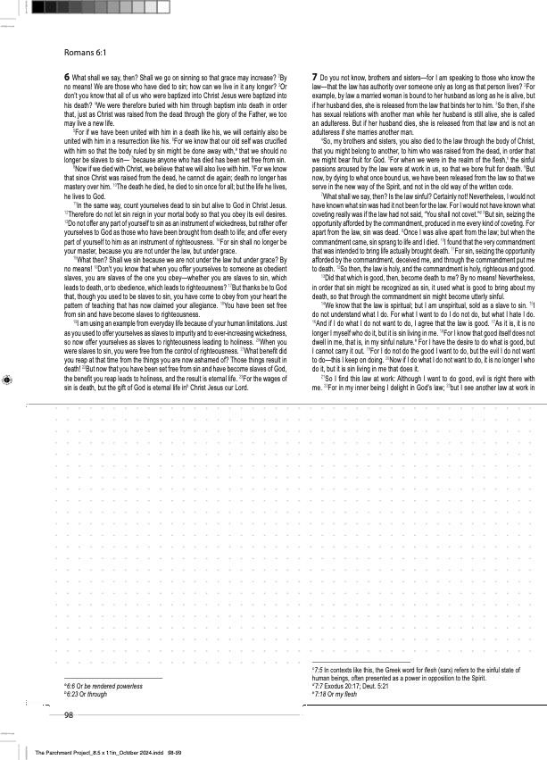
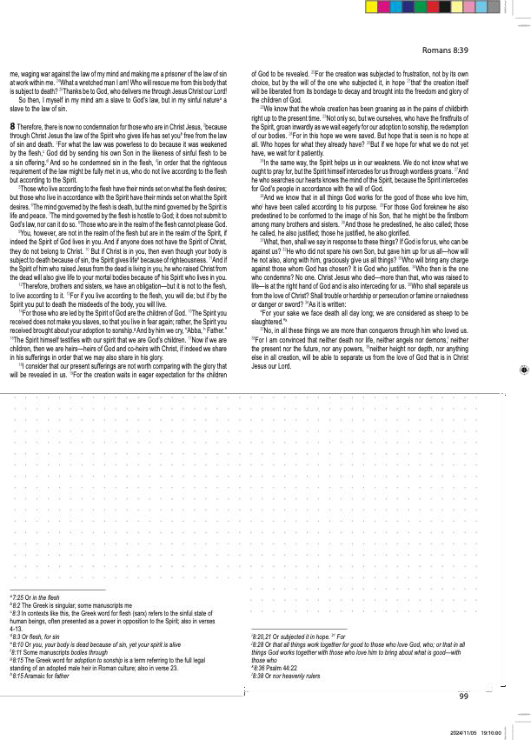

Sin and Sanctification, chapters 6-8
The spiralbound version preserves the lay-flat,
hands-free environment

Slide 13
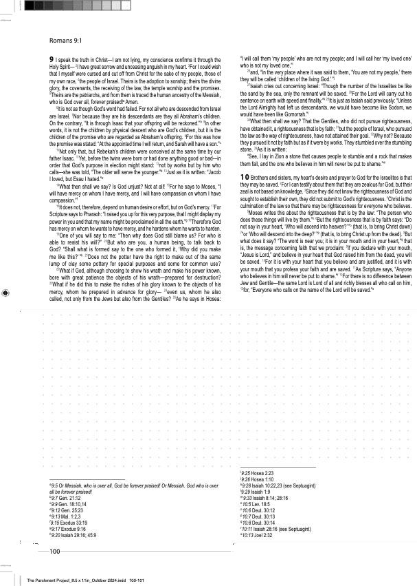
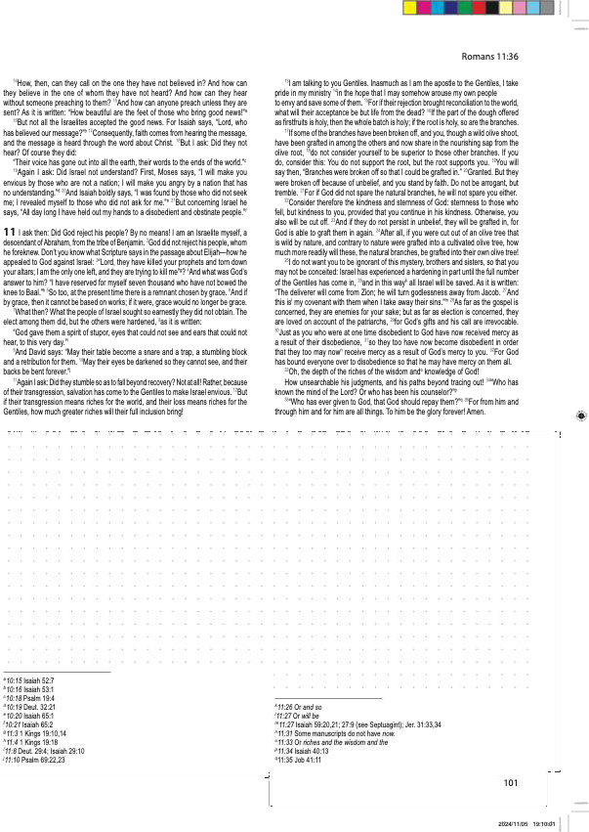
Sovereignty, chapters 9-11
The casebound version offers more durability with the same lay-flat ease
for reading and note-taking

Slide 14
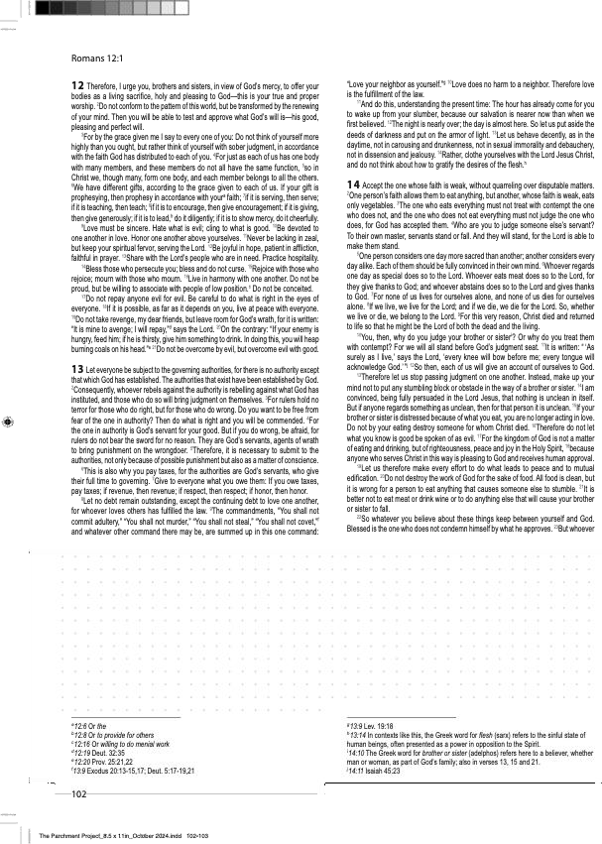
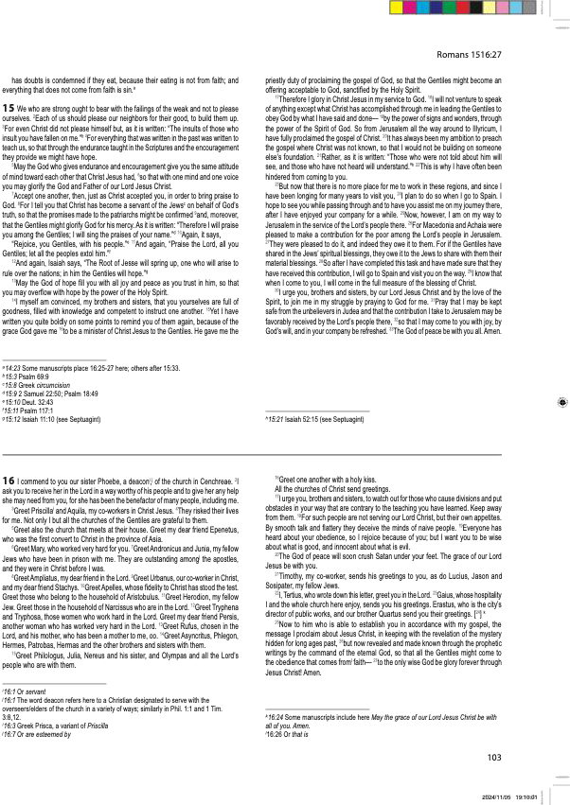
Service of all believers, chapters 12-15
Salutations, chapter 16

Slide 15


Since 1990…
Over 3,000 people, young and old,
read and studied TPP’s four publications,
to engage more fully with the God of eternity.
Sales | Years | Titles
500 | 1990-’92 | The Synthetic Study Aid
500 | 2015-’24 | The Parchment Project (Belgium)
1145 | 2018-’25 | Le Nouveau Testament en vues panoramiques*
1000 3145 | 2019-’22 | Panoramic Bible (United Kingdom)
*Belgique, France & Suisse

Slide 16


As Biblica finishes approving the next edition, contact the designer, Fred Young,
to join the pre-order list:
bible.survol@gmail.com

Slide 17
Black

Slide 18


Parchment Project link at BibleStudyDownloads.org
Get this presentation and script for free!
Notes:
Parchment Project (pp)

