Slide 1
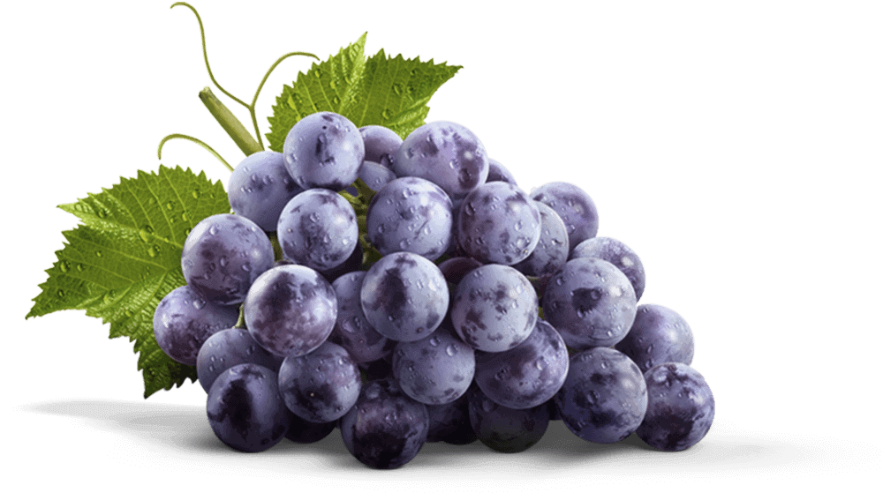
The Laborers in the Vineyard Matthew 19:30-20:16
Dr. David Martin • Amman International Church AmmanChurch.org • BibleStudyDownloads.org

Slide 2
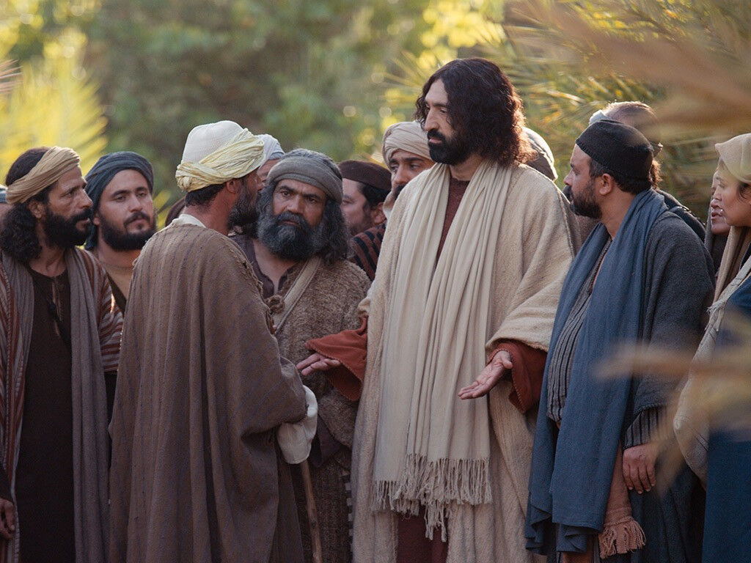
setting: traveling through Perea to Jerusalem
“Go and sell your possessions and give to the poor, and you will have treasure in heaven; and come, follow Me.”
“What good thing shall I do that I may obtain eternal life?”
Matt. 19:16-29; Mark 10:17-31; Luke 18:18-30

Slide 3
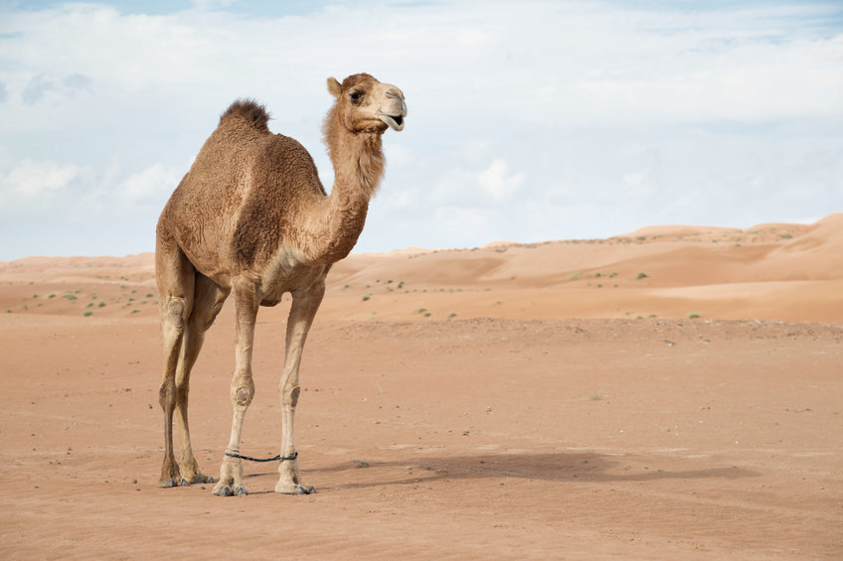
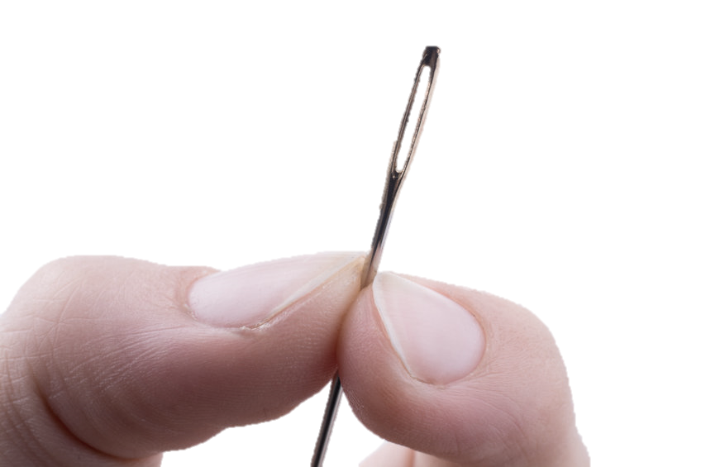
It is easier for a camel to go through the eye of a needle than for a rich man to enter the kingdom of God.
Largest animal in Palestine
Smallest opening
God can enable this to happen! (Matt. 19:26)

Slide 4
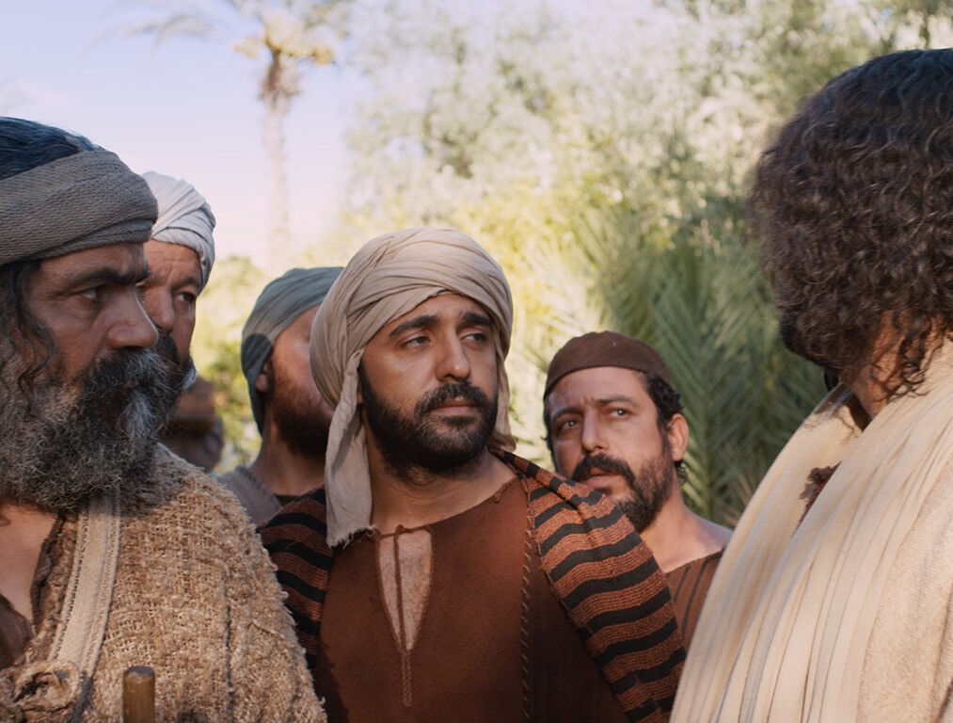
The issue: The rewards and proper attitudes for service
✓Jesus promised generous rewards for sacrificial service (Mark 10:29-30)
✓Jesus promised surprises in rewards for service: “The last will be first; the first, last”

Slide 5
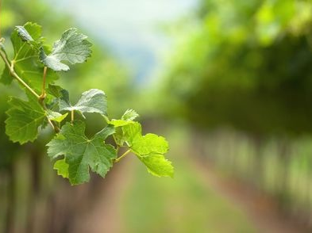
Matthew 20:1-16

Slide 6
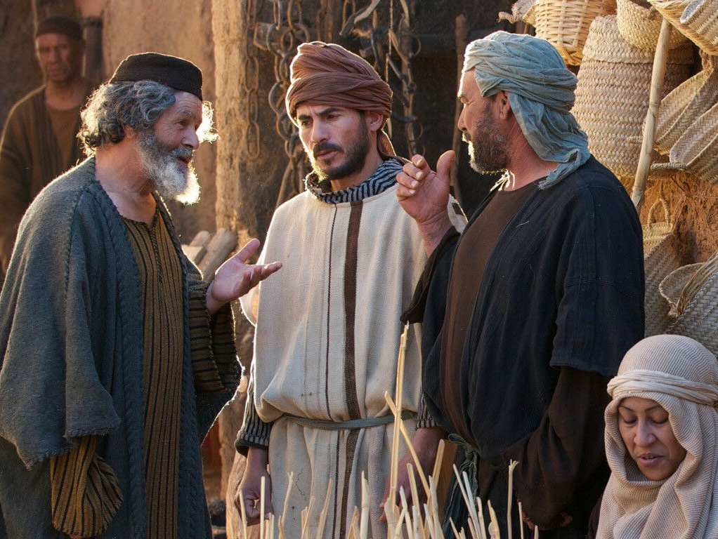
Slippery with
Grape Juice

Slide 7
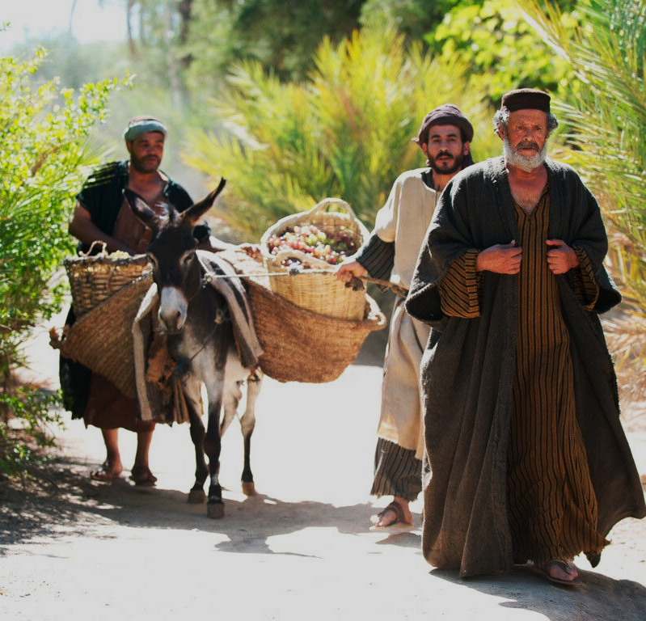
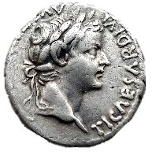
He agreed to their demand: one denarius

Slide 8
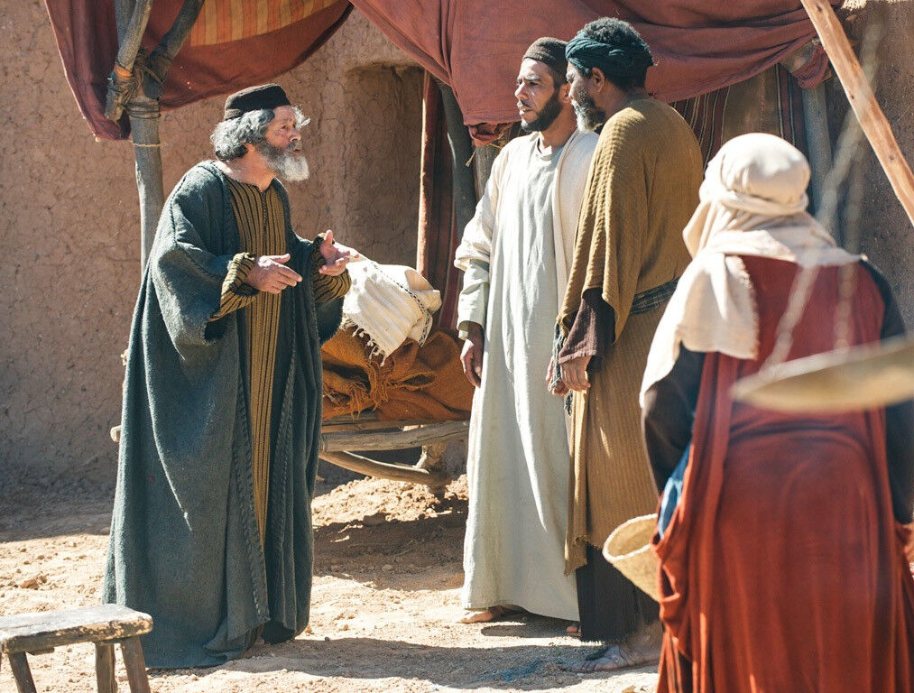
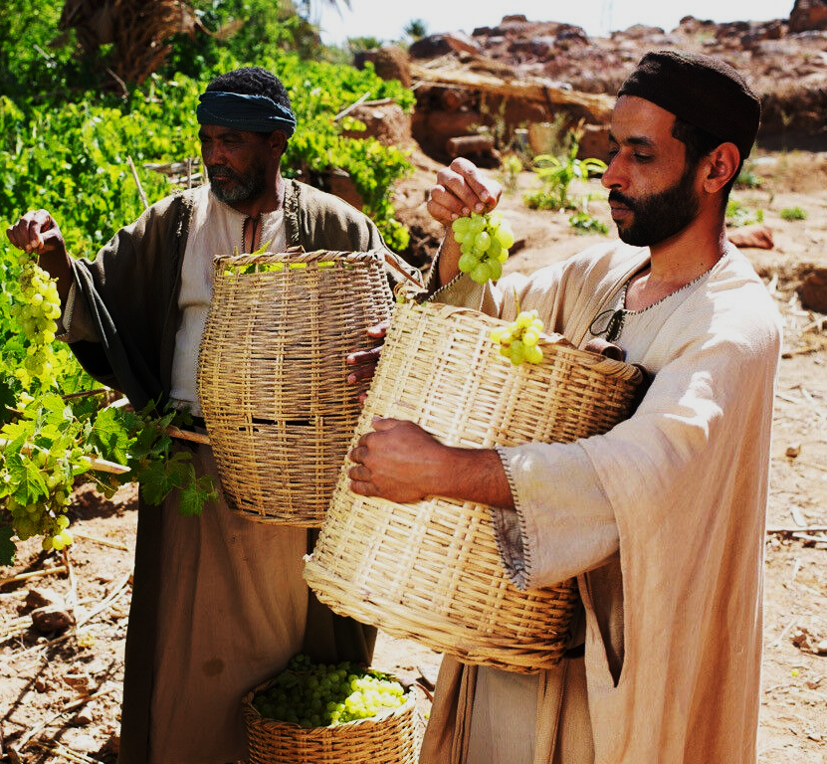
They accepted His offer: “whatever is right”

Slide 9
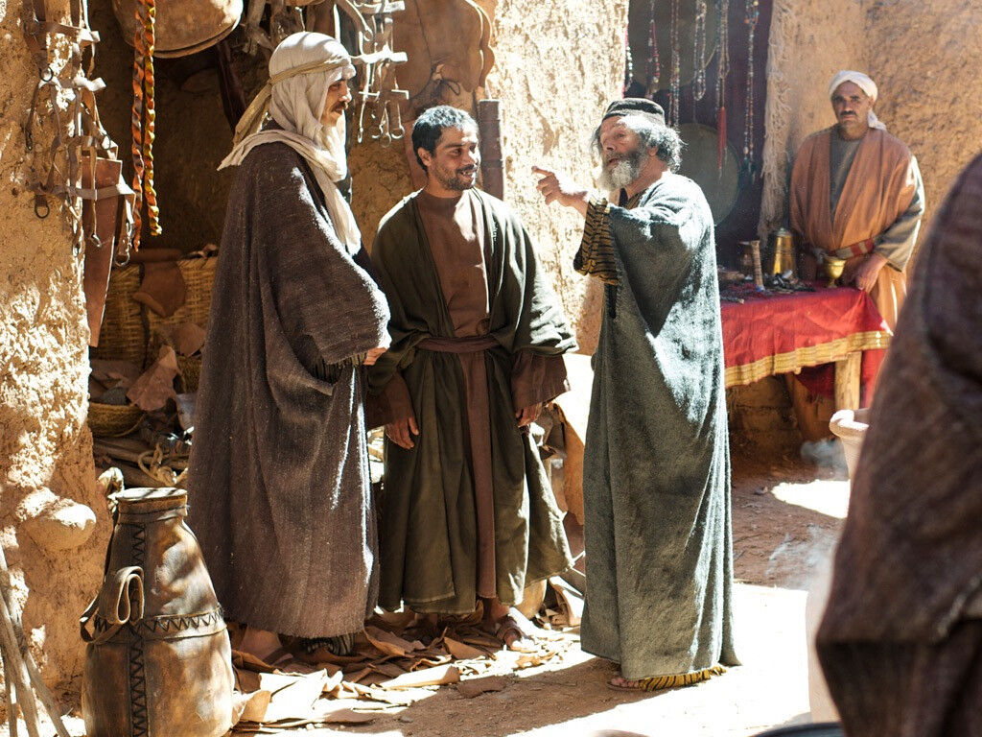
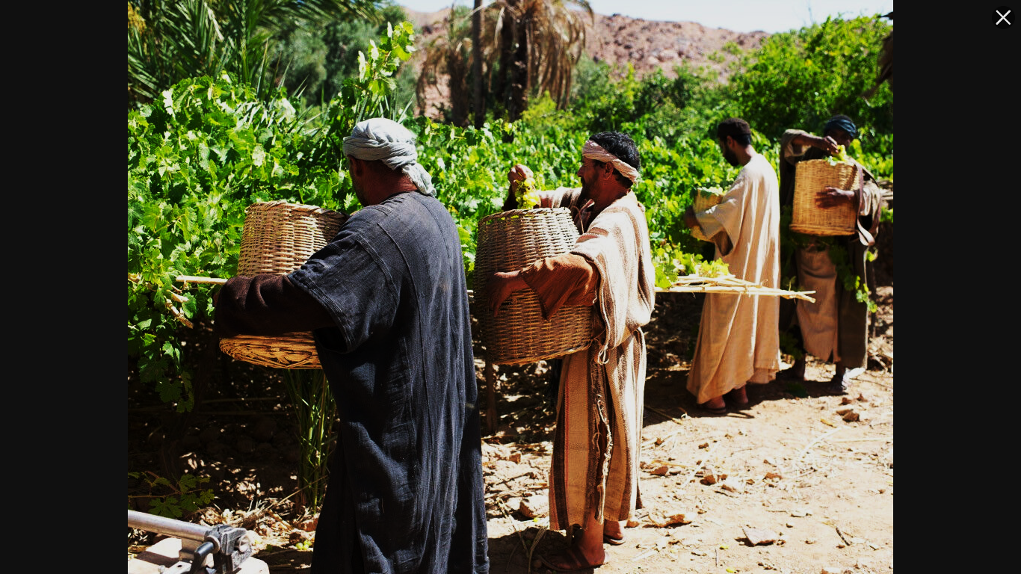
They accepted his offer: “whatever is right”

Slide 10
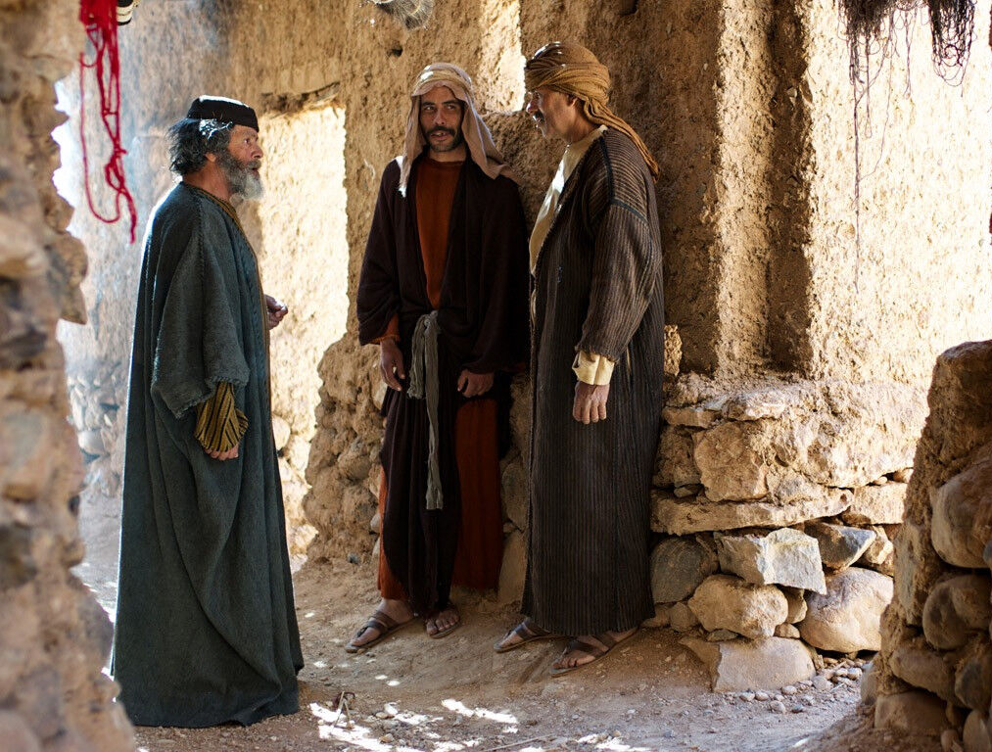
They accepted his offer: “whatever is right”

Slide 11
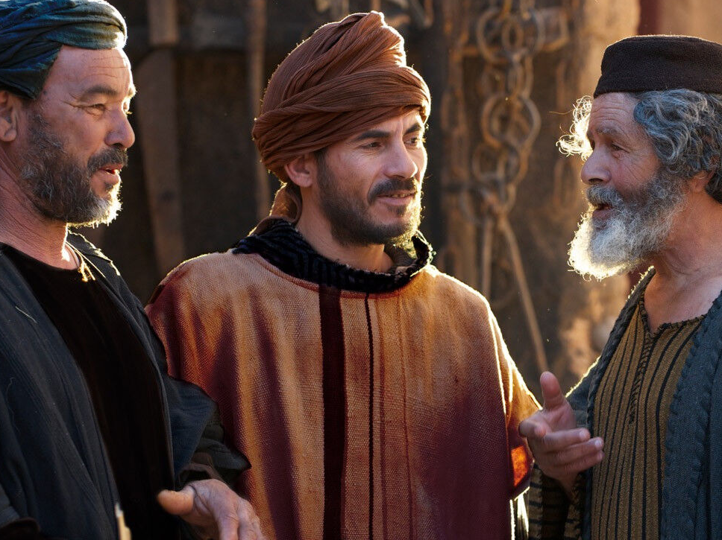
No
wage discussions

Slide 12
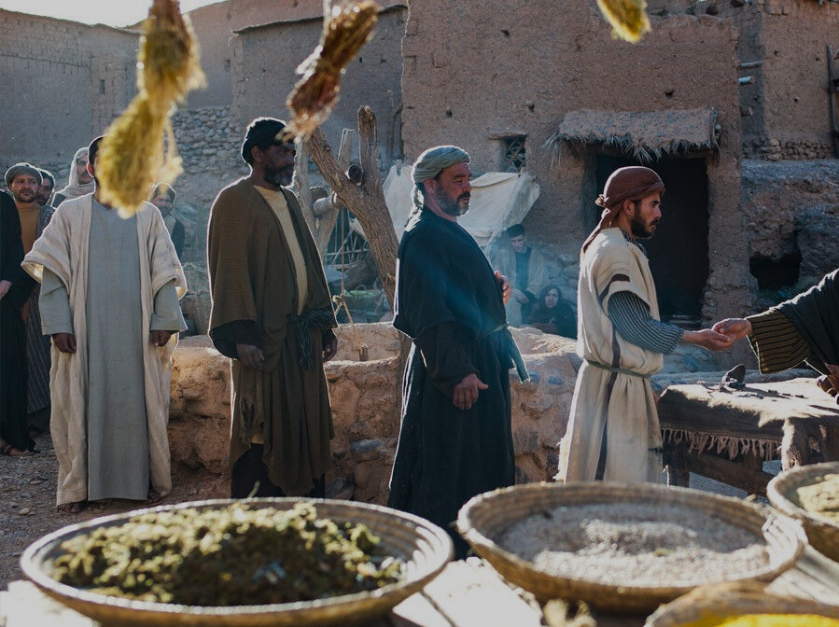
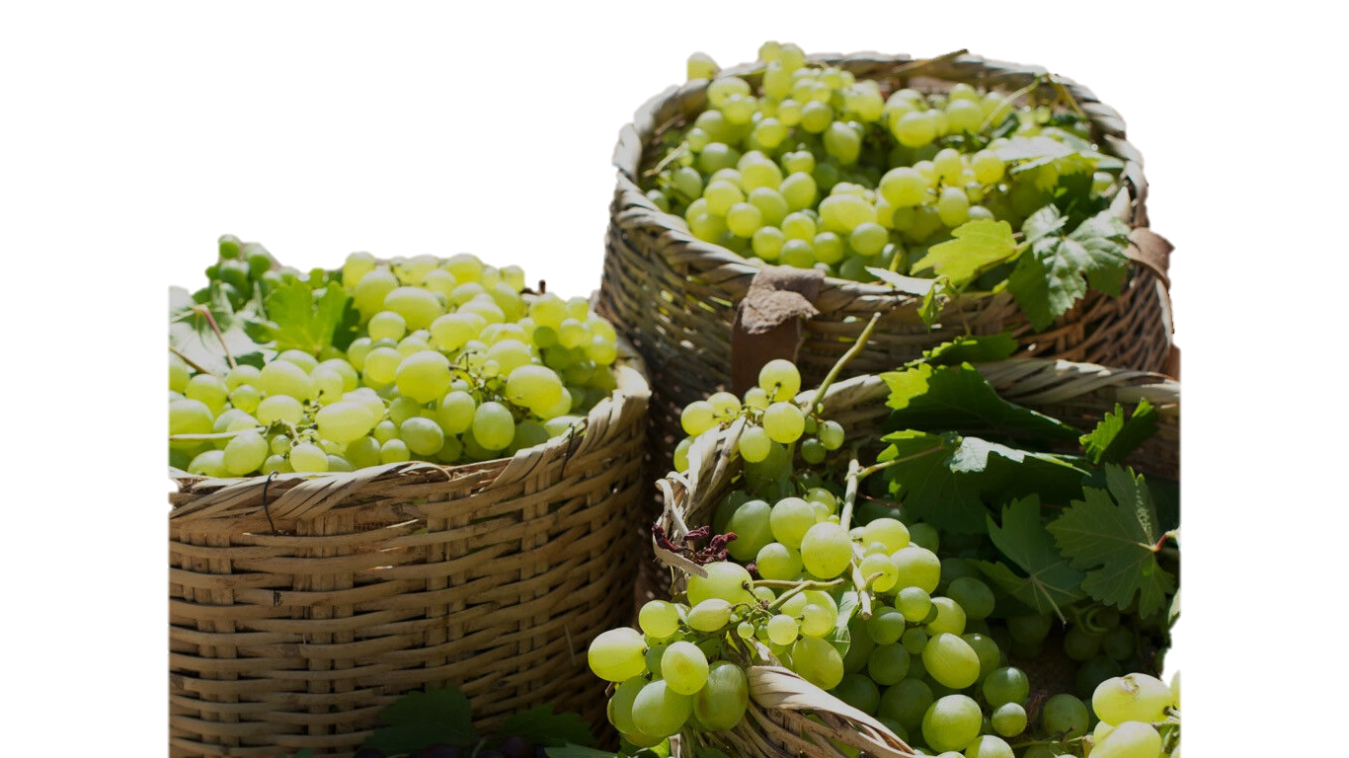
“The last will be first; the first, last”
Deut. 24:14-15

Slide 13
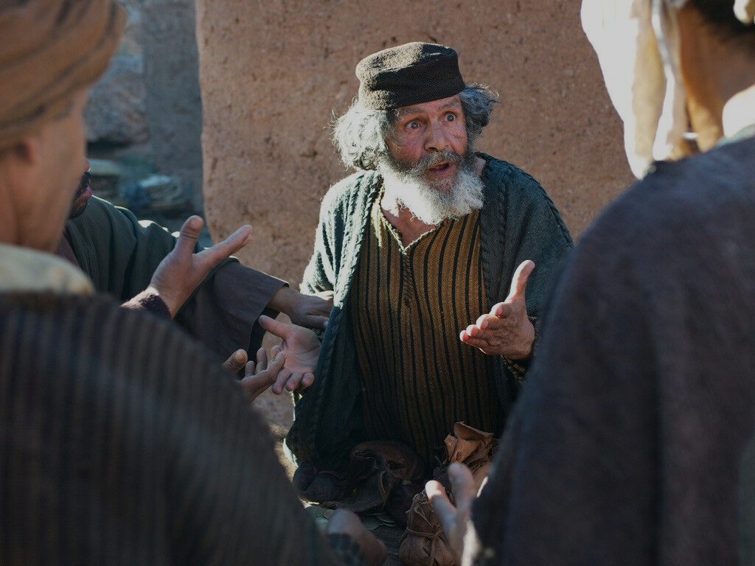
Unfair!!!
✓I gave exactly what you bargained for
✓I can give my money as I choose (sovereign)
✓Is your eye evil (envious) because I’m generous?

Slide 14
1. God keeps a careful eye on His vineyard, and He keeps looking for willing workers for His harvest (Matt. 9:37-38).
Have you joined the harvest?
What do we learn?

Slide 15
2. God will reward all who faithfully serve Him (Mark 10:29-30; Heb. 11:6).
Rewards will be given for faithfulness in the opportunities that we are given.
Rewards should motivate us!
What do we learn?

Slide 16
3. Your attitude in serving matters greatly to God, and will affect your reward.
✓1 Cor. 4:5
✓Phil. 1:15-18
✓2 Peter 1:5-11
What do we learn?

Slide 17
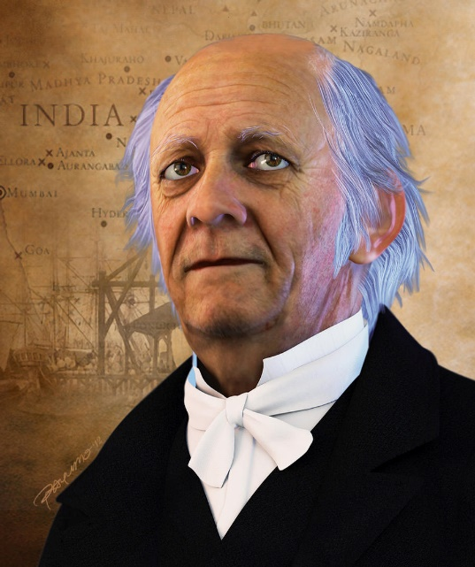
4. Rewards day will be full of surprises! “The last shall be first; the first last.”
Mark 12:41-44
William Carey
What do we learn?

Slide 19
Parables of Jesus • BibleStudyDownloads.org
Get this presentation for free!
Notes:
Parables of Jesus (pj) link

