Slide 1
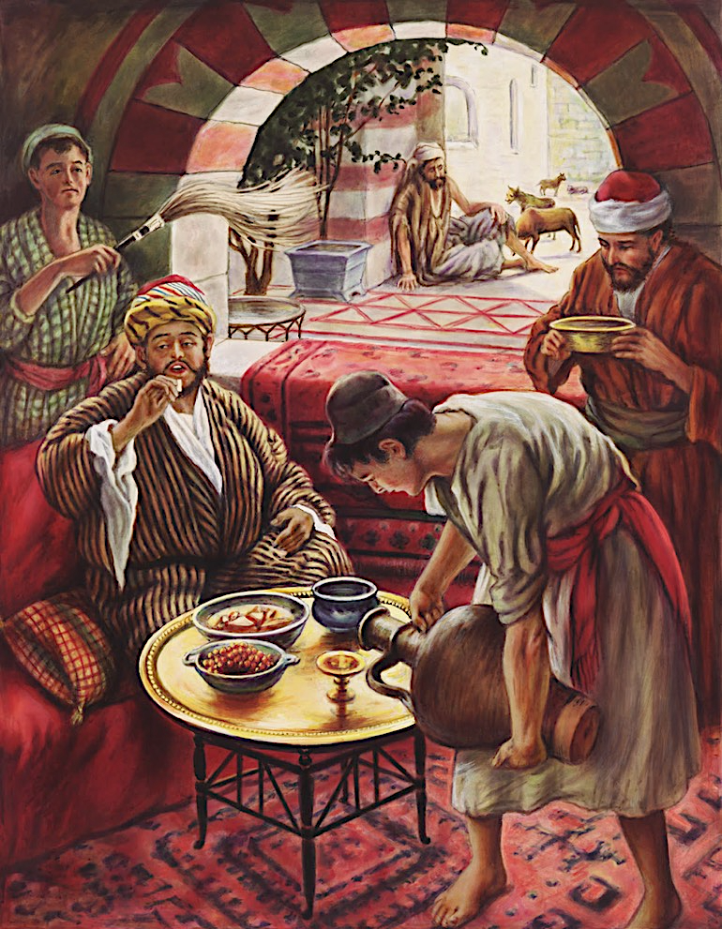
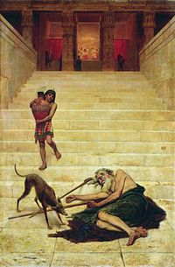
The Rich Man and Lazarus
Luke 16:19-31
Dr. David Martin • Amman International Church AmmanChurch.org • BibleStudyDownloads.org

Slide 2
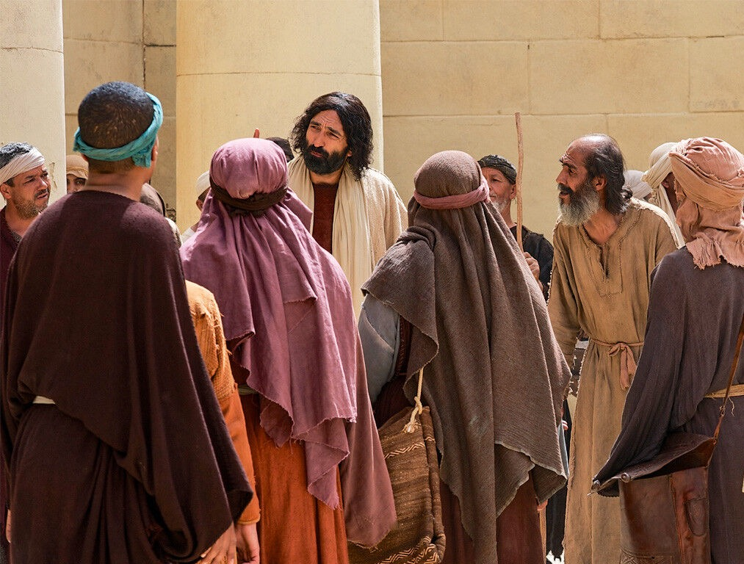
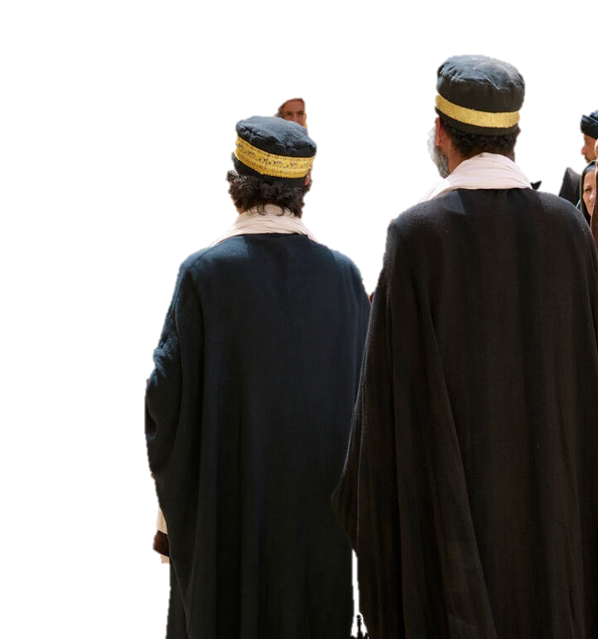
JESUS’ TEACHING ON MAMMON
(Luke 16)
The Shrewd Steward
The Rich Man/Lazarus
Future oriented
Here & now oriented

Slide 3
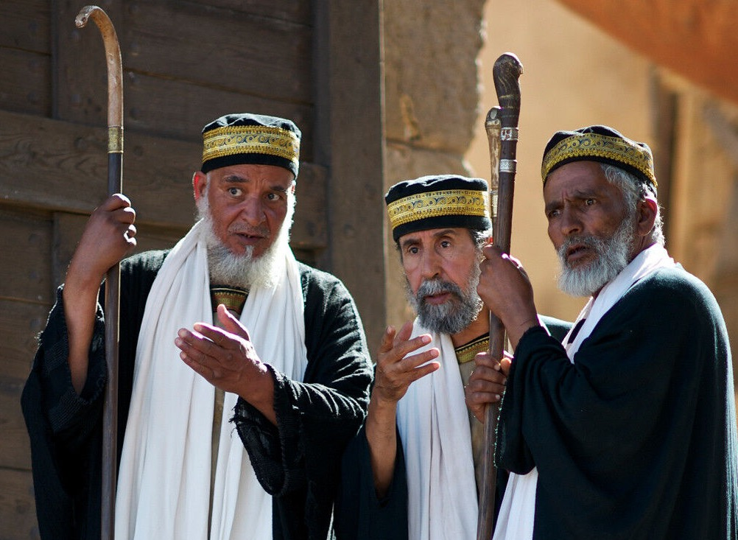
THE CONTEXT OF THE PARABLE
Luke 16:13-15
Matthew 19:23-25
The Issue: Is wealth a sign of God’s acceptance and poverty a sign of His rejection?

Slide 4
The Rich Man
✓He was extremely wealthy
✓He dressed as royalty
✓He feasted sumptuously every day
✓He lived in a gated mansion
✓He appeared to be religious
✓He knew Lazarus but he ignored his needs
✓He was unnamed

Slide 5
LAZARUS
✓He was a destitute beggar
✓His name means “The one whom God helps”
✓He was physically helpless, and covered with open sores
✓He longed for table scraps

Slide 6
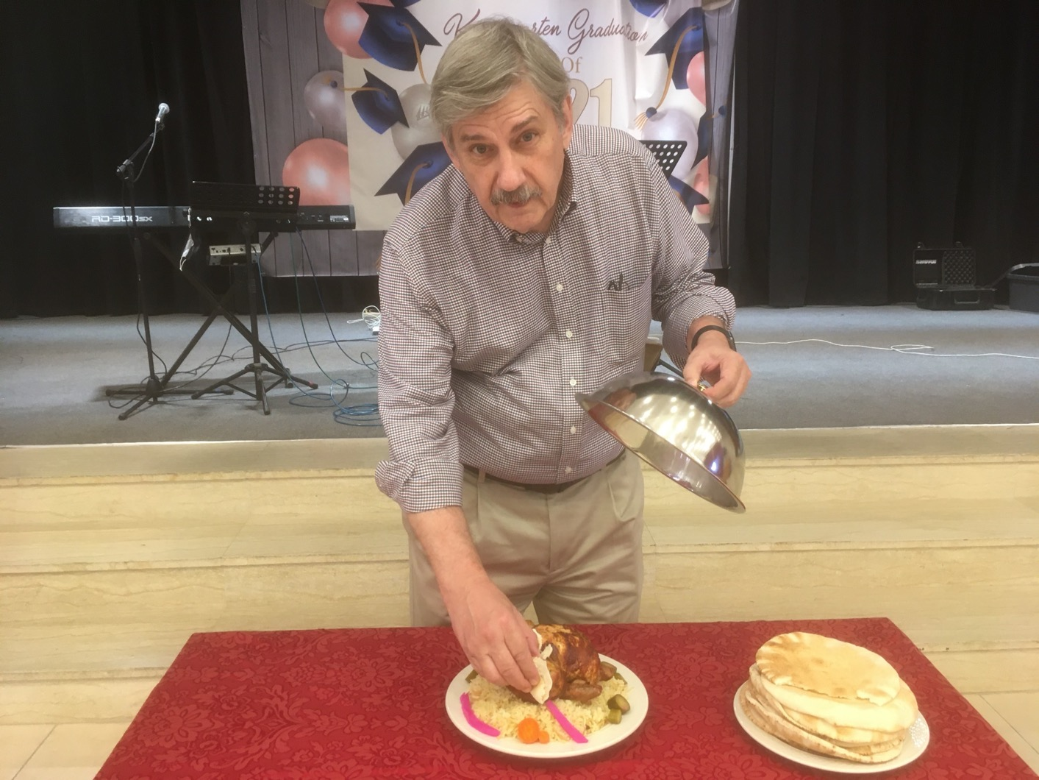

Slide 7
LAZARUS
✓He was a destitute beggar
✓His name means “The one whom God helps”
✓He was physically helpless, and covered with open sores
✓He longed for table scraps
✓Wild dogs licked his wounds

Slide 9
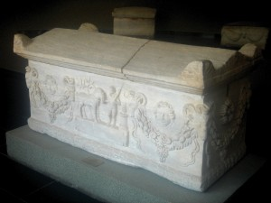
The Rich Man
✓He died and was buried (in splendor and pomp)

Slide 10
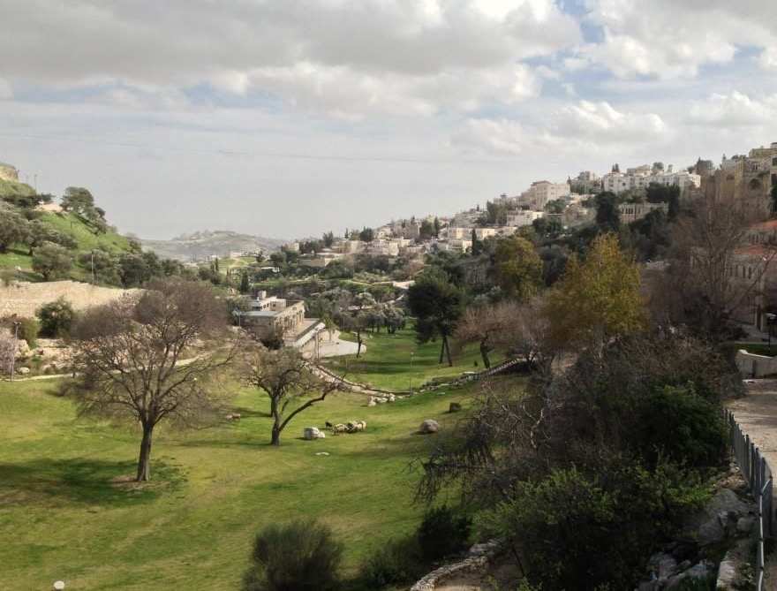
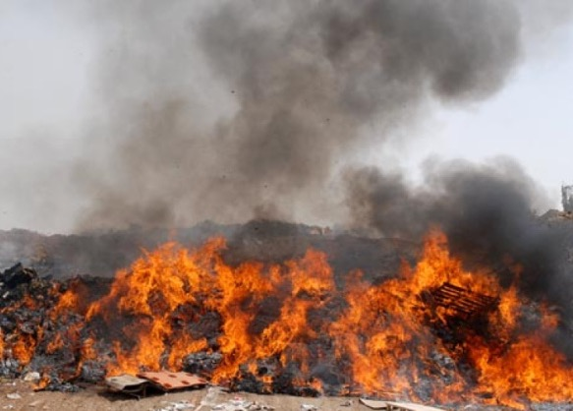
LAZARUS
✓He died and was not even buried
Valley of Gehenna

Slide 11
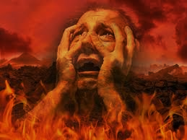
The Rich Man
Riches did NOT indicate God’s acceptance
✓He woke up in Hades/Hell

Slide 12
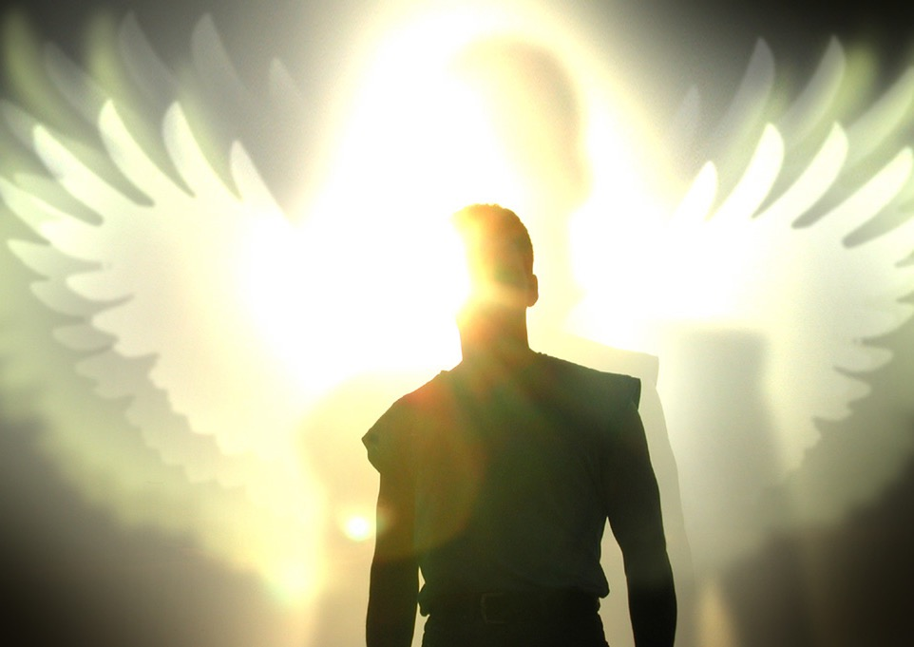
LAZARUS
Poverty did not indicate God’s rejection
✓He died and was carried by angels to “Abraham’s bosom” (paradise; heaven)

Slide 13
The Rich Man
✓He woke up in Hades/Hell
✓He was in torment

Slide 14
LAZARUS
✓He died and was carried by angels to “Abraham’s bosom” (paradise; heaven)
✓He feasted in a place of honor (Matt. 8:11)

Slide 15
The Rich Man
✓He woke up in Hades/Hell
✓He was in torment
✓He cried to “Father Abraham” for mercy

Slide 16
LAZARUS
✓He died and was carried by angels to “Abraham’s bosom” (paradise; heaven)
✓He feasted in a place of honor (Matt. 8:11)
✓He was in comfort

Slide 17
The Rich Man
✓He woke up in Hades/Hell
✓He was in torment
✓He cried to “Father Abraham” for mercy
✓He had received good things in life, but his failure to repent resulted in eternal agony

Slide 18
LAZARUS
✓He died and was carried by angels to “Abraham’s bosom” (paradise; heaven)
✓He feasted in a place of honor (Matt. 8:11)
✓He was in comfort
✓He had received bad things in life, but his trust in God resulted in eternal comfort

Slide 19
Most never expected to end up there
None want friends/family to join them there
All realize there is no second chance
None will claim they are there by mistake
What do we learn about hell?

Slide 20
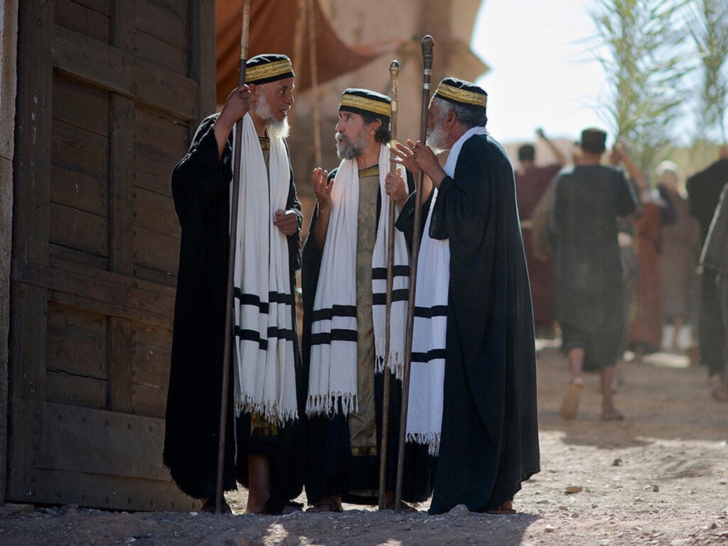
Luke 16:31
They were warned!
✓The Scriptures are a sufficient warning
✓Even miracles won’t convince a hard heart
John 11:43-46,53 (Lazarus)
Matthew 28:11-15 (Jesus)

Slide 21
✓Matthew 3:2 (John the Baptist)
✓Matthew 4:17 (Jesus)
Hebrews 9:27
✓Acts 2:38 (Peter)
✓Acts 17:30-31 (The Apostle Paul)
1) Repentance is a change of mind . . . about sin and its consequences
about who Jesus is and what He did
2) Repentance results in a change in behavior
What do we learn about repentance/faith?

Slide 23
Parables of Jesus • BibleStudyDownloads.org
Get this presentation for free!
Notes:
Parables of Jesus (pj) link

