Slide 1
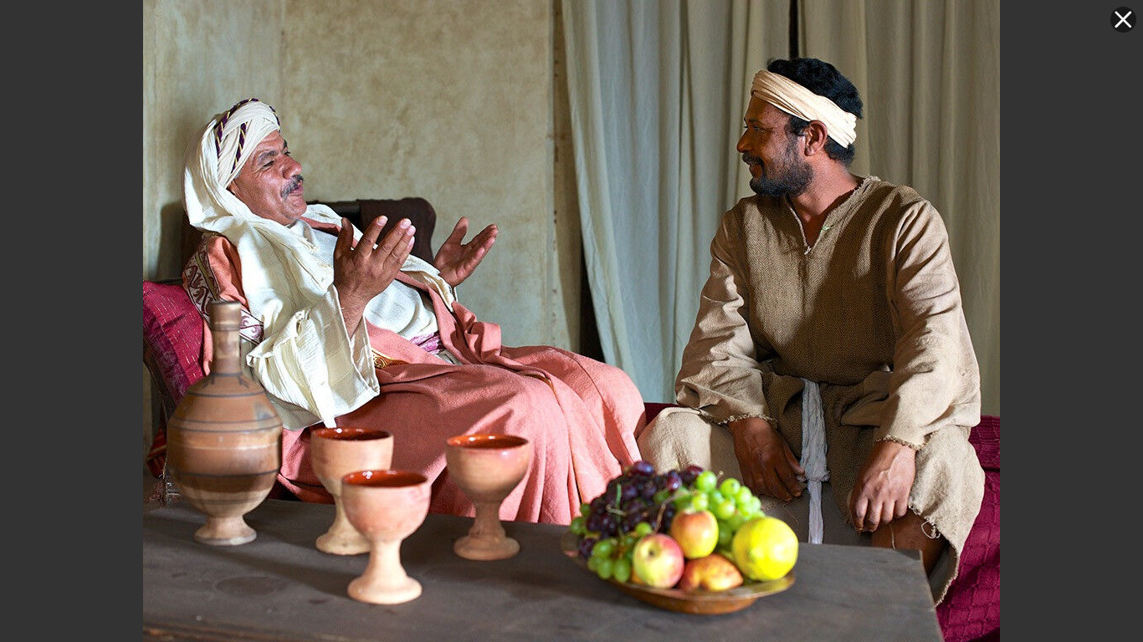
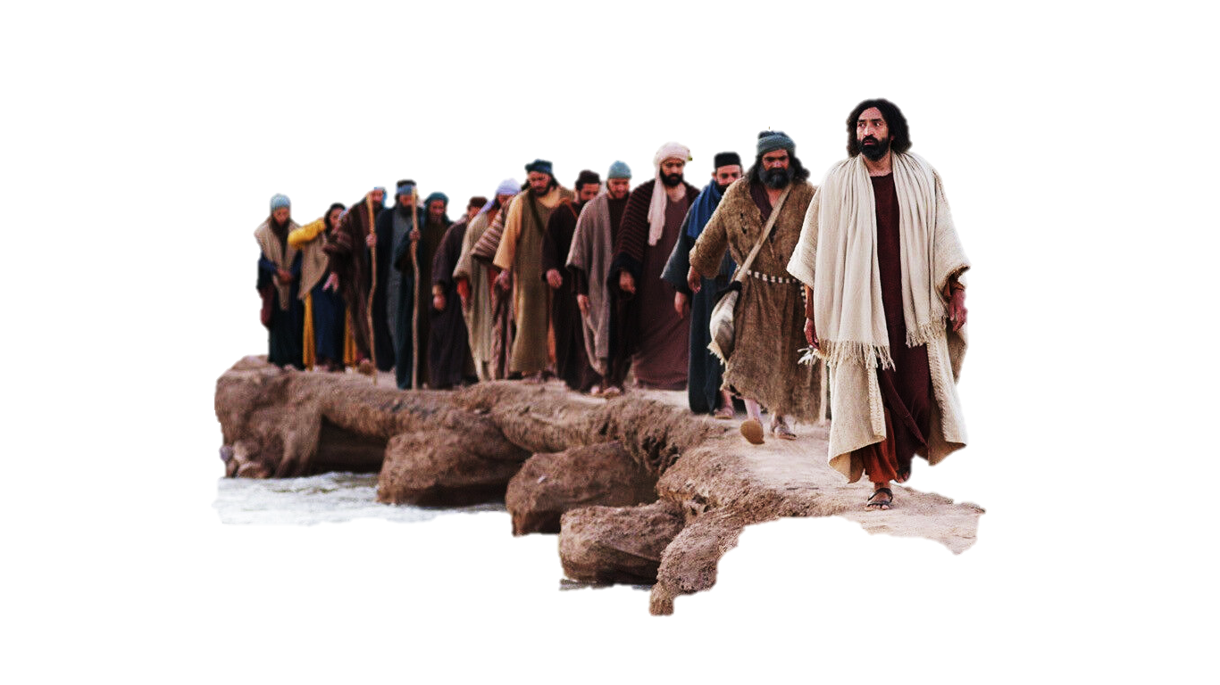
The Shrewd Manager
Luke 16:1-13
Dr. David Martin • Amman International Church
AmmanChurch.org • BibleStudyDownloads.org

Slide 2

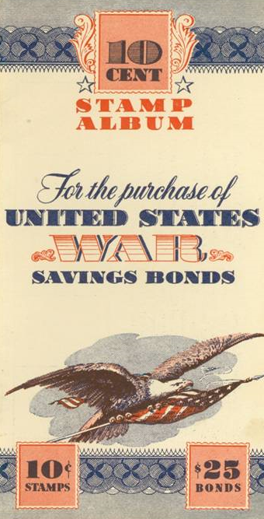
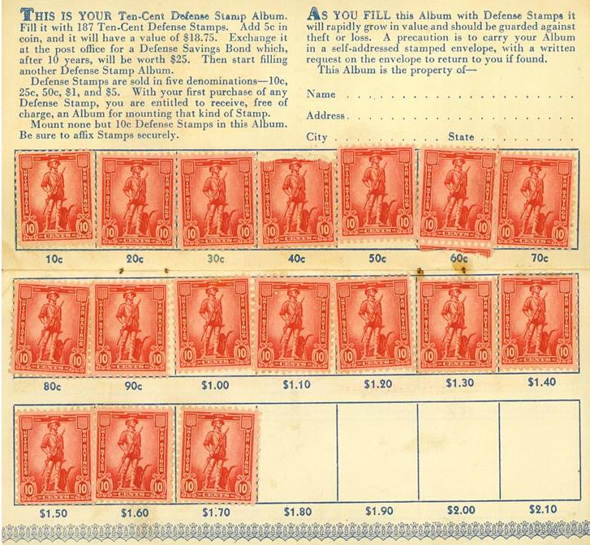
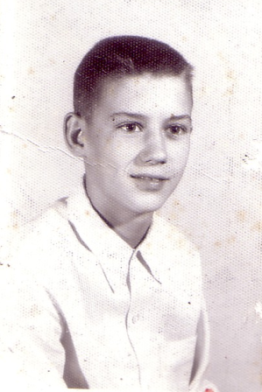

Slide 3
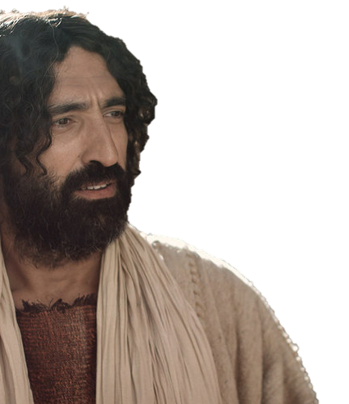
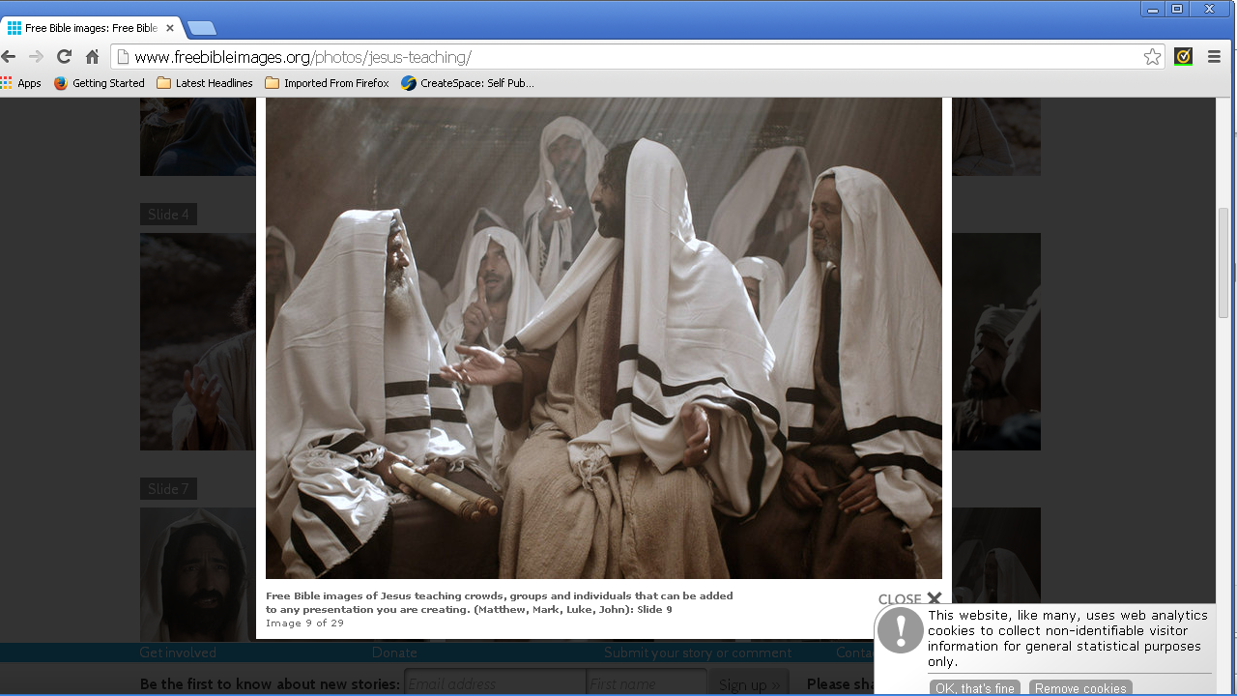
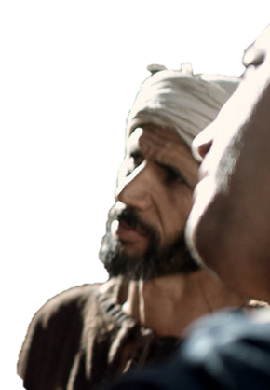
Luke 16:1-13
The Issue:
A disciple’s role as a steward
Jesus addresses key misunderstandings:
Luke 15: Wrong attitudes towards people
Luke 16: Wrong attitudes towards “mammon”

Slide 4
Parable on Stewardship

Slide 5
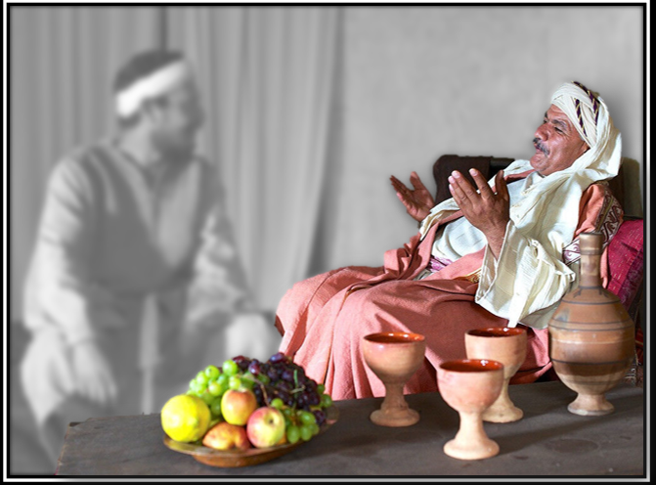
✓He was very wealthy
✓He was a big land owner
✓He delegated complete management
(cf. Gen. 39:1,4-6)
✓He heard bad reports
✓He held the steward
accountable
Luke 16:2

Slide 6
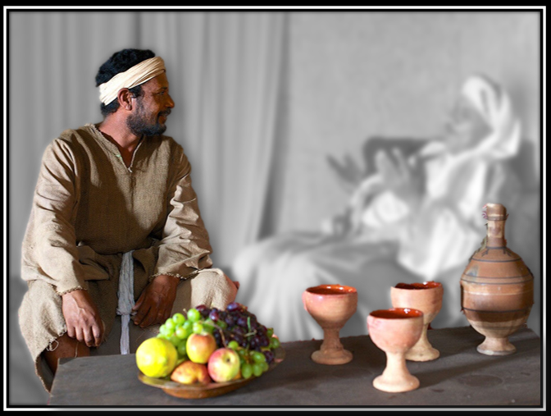
✓He had full legal authority
✓He was supposed to use
assets to benefit the master
✓He squandered his master’s
resources
✓He saw the end coming
✓He considered his options
Luke 16:1,3-4

Slide 7
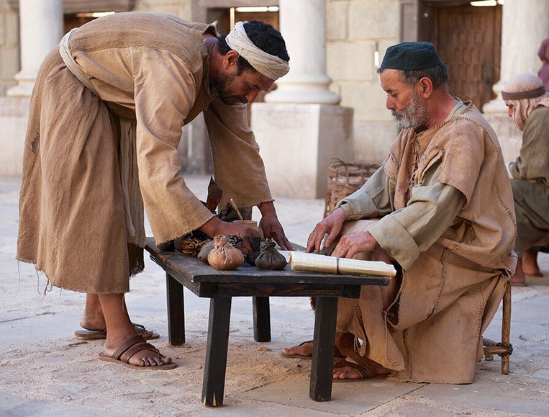

Luke 16:5-7
✓The steward summoned all creditors
✓He significantly reduced each contract

Slide 8

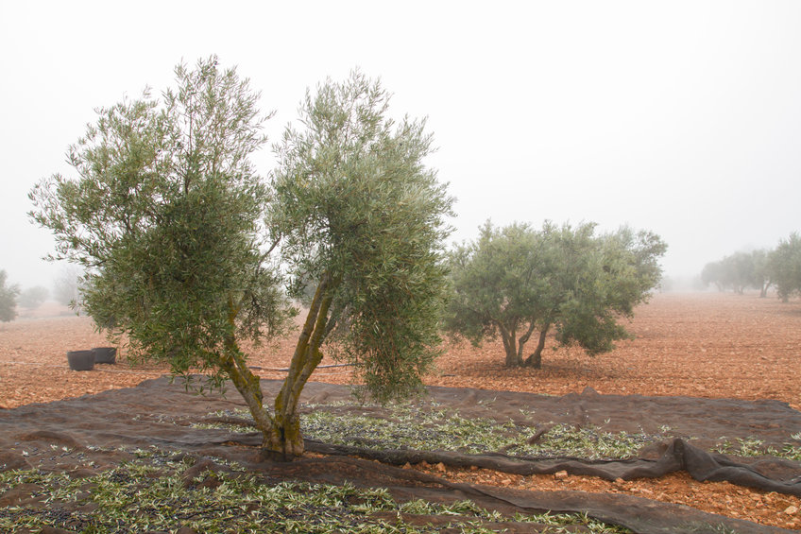
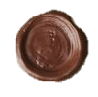
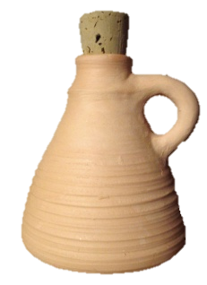
Contract
I owe 100 measures of olive oil
Signed:
Deuteronomy 23:19
50
“You shall not charge interest to your countrymen.”
+100%
interest
=
50 measures borrowed
100 measures debt

Slide 9
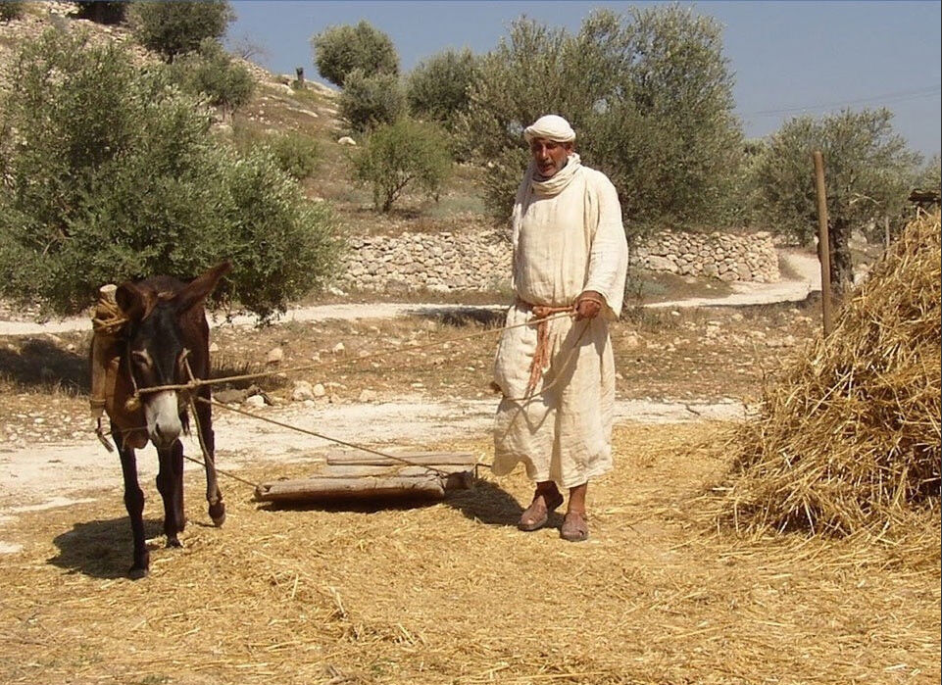
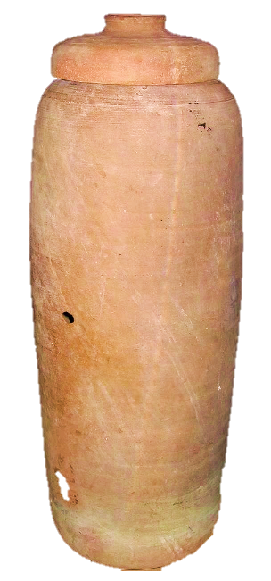
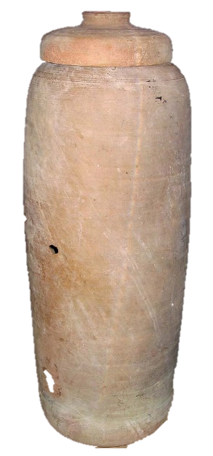
Nazareth Village
Contract
I owe 00 measures of wheat
Signed:
80
+20%
interest
=
80 measures borrowed
100 measures debt

Slide 10
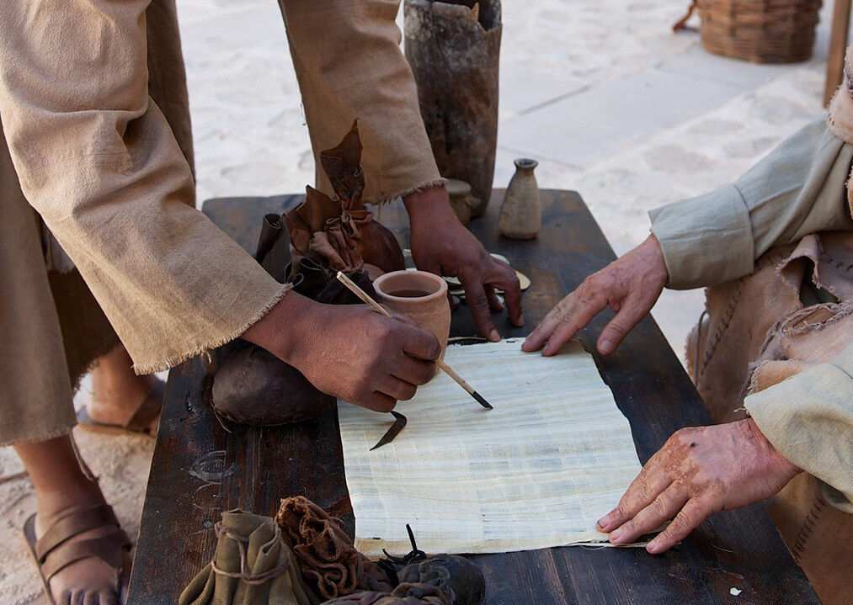
The Steward cancelled
the interest
He was
praised for being
shrewd
✓He had the authority
✓It was completely legal
✓He made many friends that day
✓His future comfort was assured
✓He also made the master look generous
✓His quick planning/action changed his fate

Slide 11
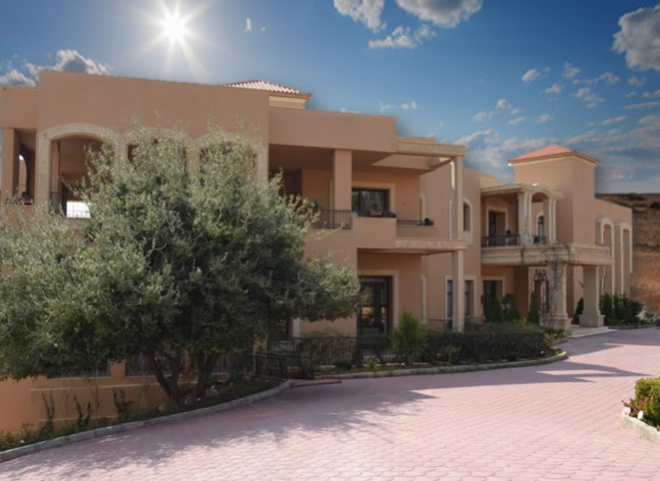
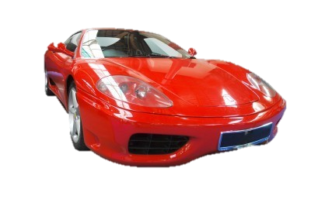
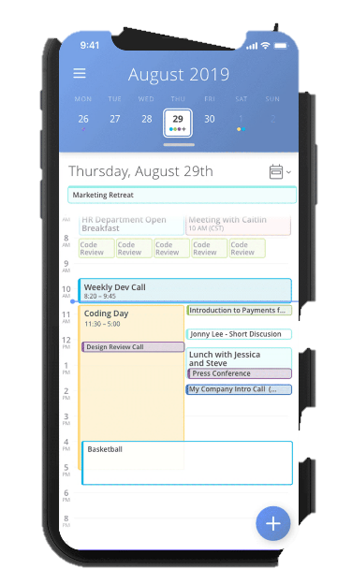

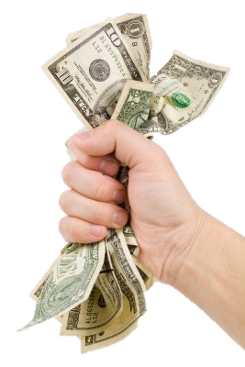
Evaluate your stewardship
while there is still time to make changes

Slide 12
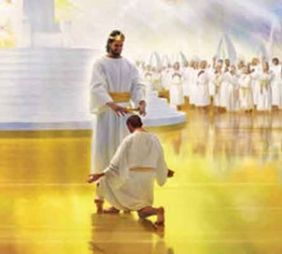
2 Cor. 5:10
You will leave this all behind!
(Ecclesiastes 5:15; 2:19)

Slide 13



Recognize that you are only a “steward” and not the “owner” of all that God puts in your hands (1 Chron. 29:14).
What do we learn?

Slide 14
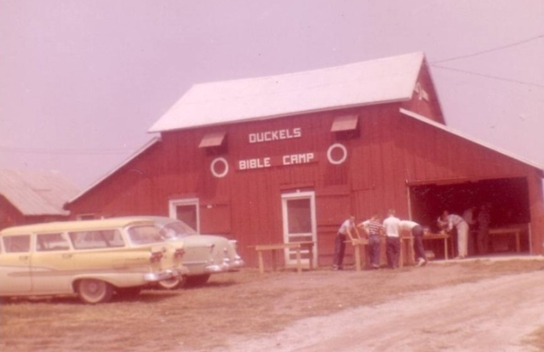
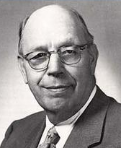
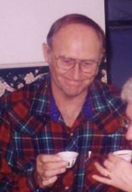
2. Invest your money, possessions, and time
to enhance your welcome into heaven
(Luke 16:9; Matt. 6:19-21).
Will anyone be in heaven because of you?
What do we learn?

Slide 15
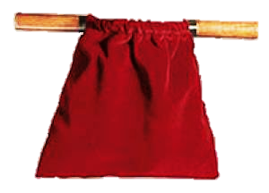
3. Faithfulness in stewardship begins now
with little things (Luke 16:10; 1 Cor. 4:2).
Giving seldom increases proportionally with income
What do we learn?

Slide 16
4. Wasting your money and opportunities
limits how much God will use you now and
reward you later (Luke 16:11; 19:17).
What do we learn?

Slide 17

5. Become “shrewd.” Act quickly to maximize
your treasures in heaven by the way you
invest your resources in God’s work on
earth (Phil. 4:15-17).
What do we learn?

Slide 19


Parables of Jesus • BibleStudyDownloads.org
Get this presentation for free!
Notes:
Parables of Jesus (pj) link

