Slide 1
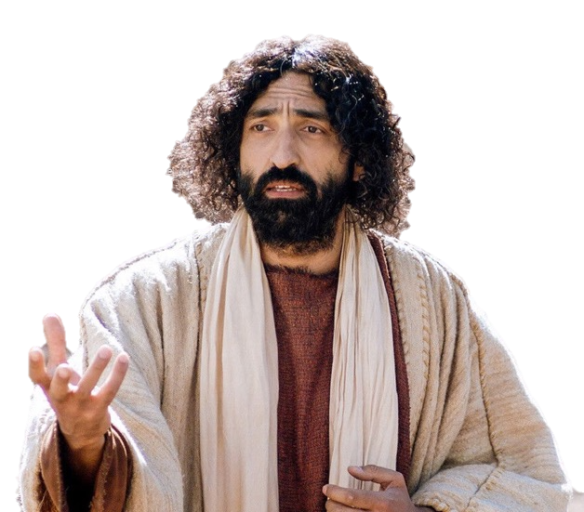
Parable of the Two Debtors
Luke 7:36-50
Dr. David Martin • Amman International Church AmmanChurch.org • BibleStudyDownloads.org

Slide 2
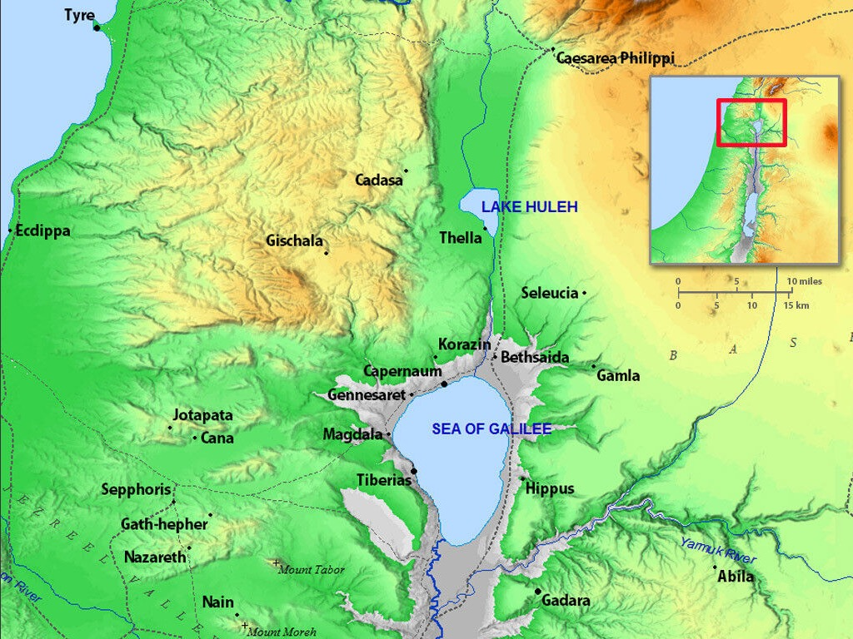
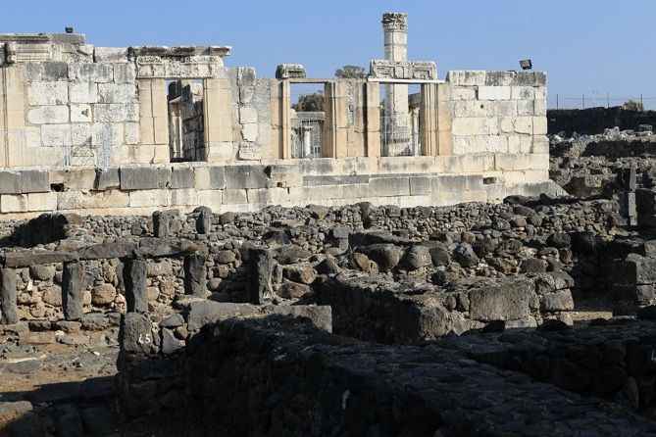
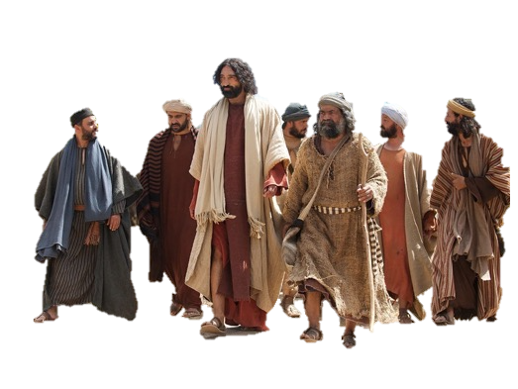

Slide 3
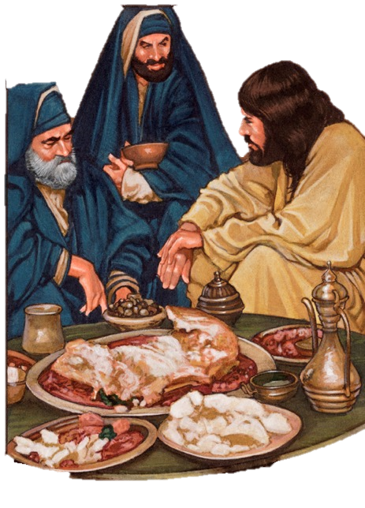
Simon’s dinner party (feast)
✓Simon was a wealthy Pharisee
✓Jesus was Simon’s special guest
Jesus was hailed as a prophet (Luke 7:16)
Simon wanted to know more about Him
Matt. 11:28-30
Luke 7:22
Luke 7:36

Slide 4
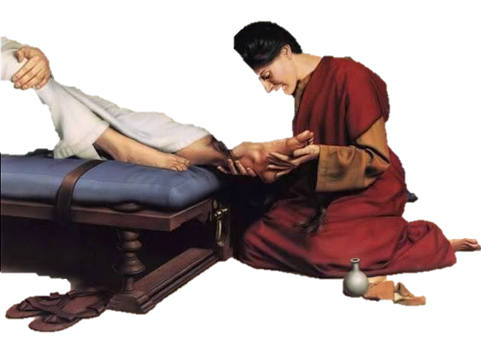
✓An uninvited “sinful” woman attended
She was a well-known “sinner”
She wept tears on Jesus’ feet
She wiped His feet with her hair
She anointed Jesus’ feet with perfume
Luke 7:37-38

Slide 5
Simon’s wrong assumptions:
1) Jesus is no prophet
2) Jesus doesn’t know this woman is such a sinner
Jesus tells a parable to correct Simon’s thinking
Luke 7:39-42

Slide 6
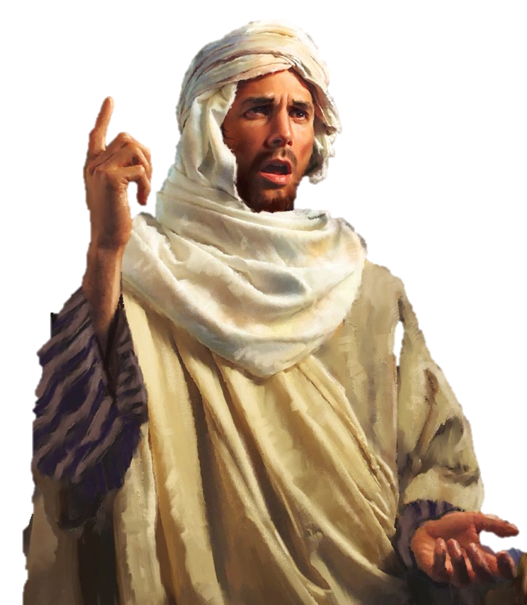
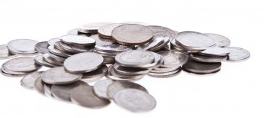
Both unable to pay their debts
Big debtor
Little debtor
He graciously cancelled all debts!
Which one will love him more?
Debts
Debts
Money lender

Slide 7
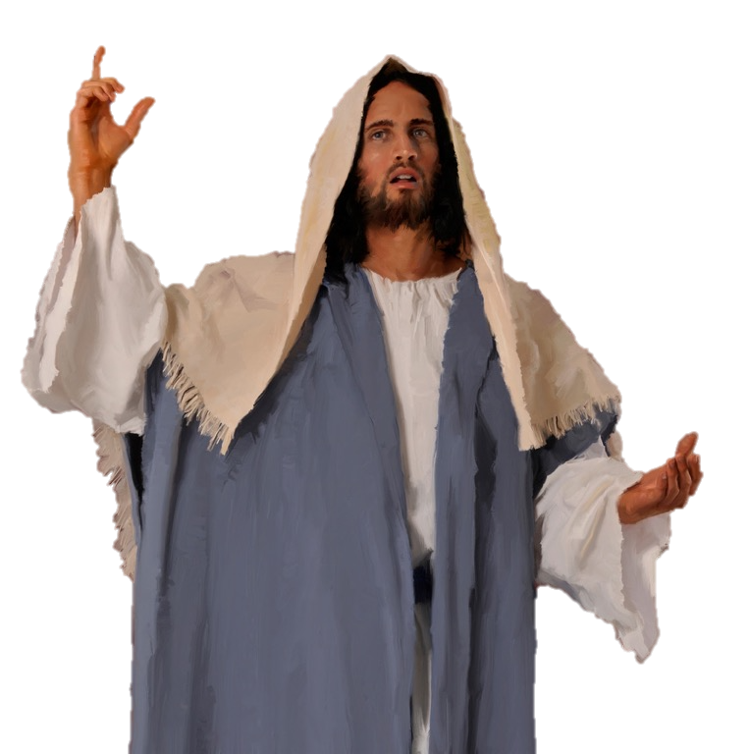
Both unable to pay their debts
Big debtor
Little debtor
Debts
Debts
Sins
Money lender
Sins
God/Jesus

Slide 8
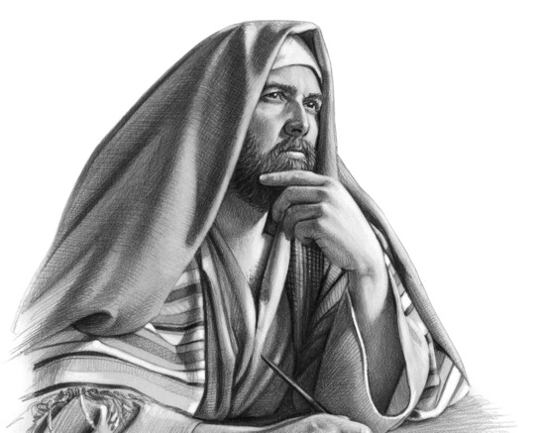
Both unable to pay their debts
Inability to save self (Isaiah 64:6)
Big debtor
Little debtor
Big sinner
Little sinner
Debts
Debts
Sins
Money lender
Sins
God/Jesus

Slide 9
Much Love
No Love
✓Washed with tears
✓No water for washing
✓Kissed His feet
✓No kiss
✓Anointed feet with perfume
✓No anointing with oil
Love demonstrates faith
Not forgiven?

Slide 10
Jesus assures the woman:
✓Your many sins are forgiven (“sent away”)
✓Your faith has saved you
✓Go in peace
Luke 7:48-50

Slide 11
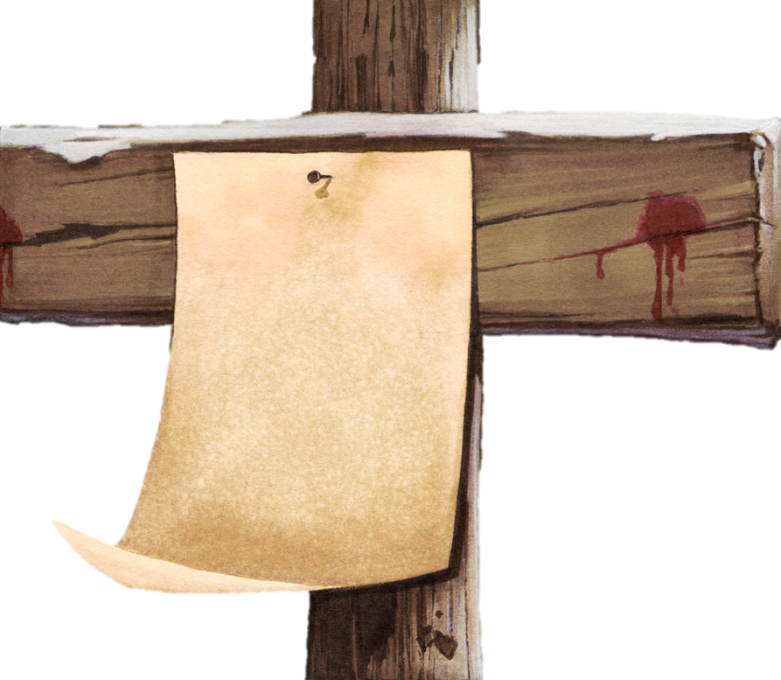
“Who is this who even forgives sins?”
I was proud
I lied
I showed partiality
My pornography
I _____
Col. 2:14
All my debts were paid!

Slide 12
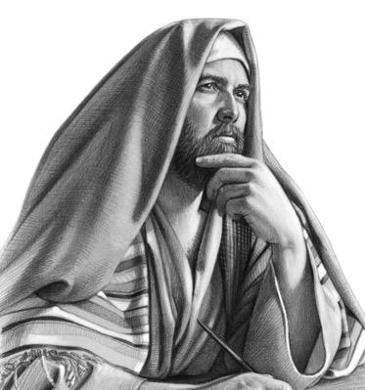
Who are you in this parable?
Stingy lover?
Lavish lover?

Slide 13
1. Jesus shows He’s more than a prophet; He is God, with the power to forgive sins!
2. Divine forgiveness transforms your life! (Forgiveness = your sins are “sent away”)
3. Your demonstration of love for Jesus will be proportional to your understanding of forgiveness.
What do we learn?

Slide 14
4. What are some ways to show our love (agape) to Jesus for His forgiveness?
John 13:34-35 John 14:15 Matt. 5:44 Rom. 12:9-13 2 Cor. 5:14 Matt. 6:9-15
→ Love is my distinctive
→ I obey His commandments
→ I love my enemies
→ I love without hypocrisy
→ Love controls me
→ I forgive others
What do we learn?

Slide 16
Parables of Jesus • BibleStudyDownloads.org
Get this presentation for free!
Notes:
Parables of Jesus (pj) link

