Slide 1
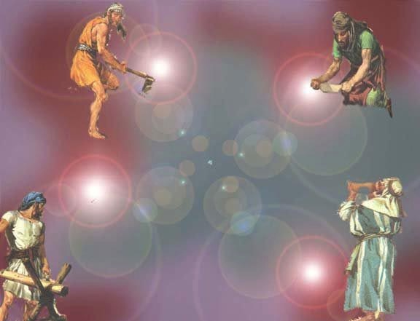
Zechariah
Dr. Rick Griffith • Jordan Evangelical Theological Seminary • BibleStudyDownloads.org

Slide 2
Key Word
649
343
Messiah
Zechariah

Slide 3
Theme
649
Rebuild Temple
for Messiah
Zechariah

Slide 4
Key Verse
649
"This is what the LORD says, 'I will return to Zion and dwell in Jerusalem. Then Jerusalem will be called The City of Truth, and the mountain of the LORD Almighty will be called The Holy Mountain'" (8:3).
Zechariah

Slide 5

Kingdom Statement
343
Judah must rebuild the temple (6:9-15) for blessing in the Messiah's kingdom.
Zechariah

Slide 6

Summary Statement
649
346
Judah must prepare for the Messiah in light of her privileged covenant position among the nations by rebuilding the temple for future blessings when the Messiah rules in the kingdom.
Zechariah

Slide 7

Covenant
347e
Eight covenant visions (1:7–6:8) depict Israel's privileged position and judgment on the nations based on God's promise to Abraham to bless those who bless them and curse those who curse them (cf. Gen. 12:1-3).
Zechariah

Slide 8

Redemption
347e
God's salvation of Jews from many countries of exile (8:7, 13) will come through a humble King (9:9) who brings salvation like a Shepherd (9:16) who was pierced (12:10-13).
Zechariah

Slide 9

Messiah
347e
Christ is the humble King (9:9) who will die for the nation (12:10-13; 13:7) to bring forgiveness (10:1) and salvation at his second coming (ch. 14).
Zechariah

Slide 10
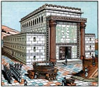
Book Chart
Rebuild Temple for Messiah
God's Covenant Faithfulness |  |  | Future Messianic Rule
Chapters 1–6 |  |  | Chapters 7–14
"The word of the LORD came to Zechariah…" (1:1) |  |  | "The word of the LORD came to Zechariah…" (7:1)
Visions of the Covenant |  |  | Visions of the Messiah
 |  |  |  | Two Burdens
Command to Repent 1:1-6 | Eight Covenantal Visions 1:7–6:8 | Joshua's Symbolic Coronation 6:9-15 | Four Restoration Messages 7–8 | Rejected at First Advent 9–11 | Received at Second Advent 12–14
"The word of the LORD came to Zechariah" | "Then I looked up—and there before me" | "The word of the LORD came to me" | "The word of the LORD came to me" | "The burden of the word of the LORD" (NASB) | "The burden of the word of the LORD" (NASB)
Pictures |  |  | Problems | Predictions
Israel's Fortune |  |  | Israel's Fasting | Israel's Future
While Building the Temple 520-518 BC (1:1; 7:1) |  |  |  | After Building the Temple 480-470 BC (9:13?)
Jerusalem
649
Rebuild Temple for Messiah
Zechariah

Slide 11
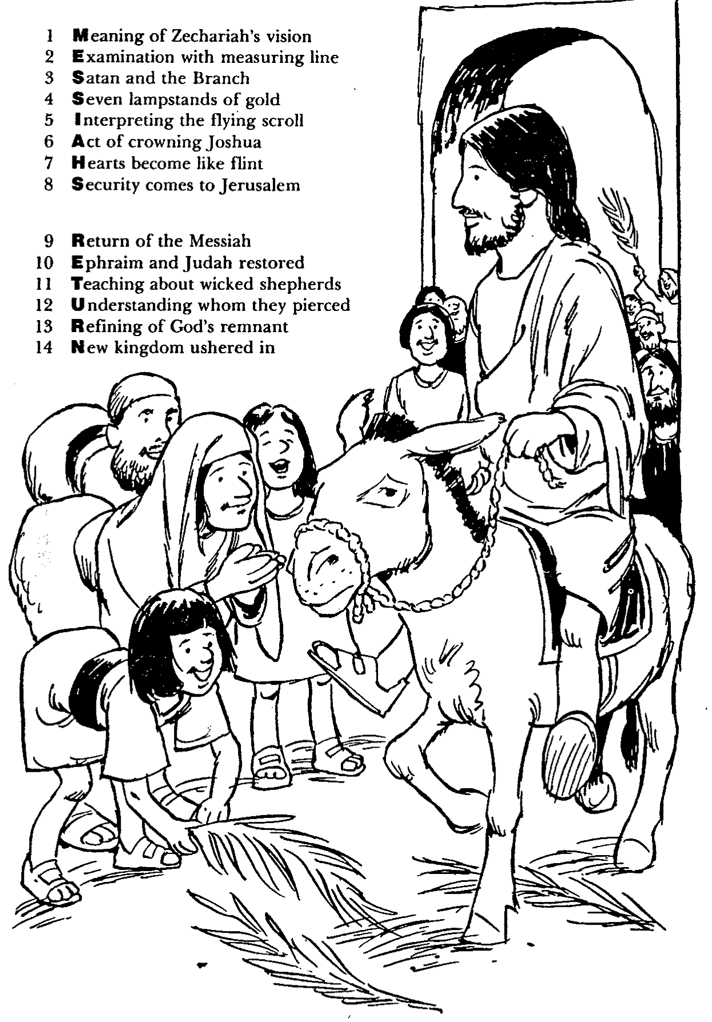
Barry Huddleston, The Acrostic Summarized Bible (Grand Rapids: Baker, 1992)
Zechariah
1 Meaning of Zechariah’s vision
2 Examination with measuring line
3 Satan and the Branch
4 Seven lampstands of gold
5 Interpreting the flying scroll
6 Act of crowning Joshua
7 Hearts become like flint
8 Security comes to Jerusalem
9 Return of the Messiah
10 Ephraim and Judah restored
11 Teaching about wicked shepherds
12 Understanding whom they pierced
13 Refining of God’s remnant
14 New kingdom ushered in

Slide 12
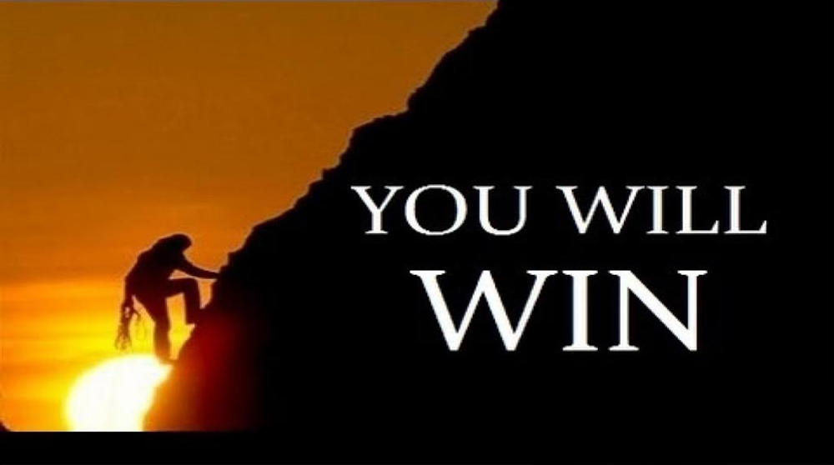
Be Encouraged
Zechariah
Dr. Rick Griffith • Crossroads International Church Singapore
BibleStudyDownloads.org

Slide 13

Discouragement while serving Jesus is real.
Zechariah
the struggle is real
DISCOURAGEMENT

Slide 14

Two 70-Year Exiles
560
People Exile
605
586
539
536
516
Temple Exile
"This entire land will become a desolate wasteland. Israel and her neighboring lands will serve the king of Babylon for seventy years. ¹²Then, after the seventy years of captivity are over, I will punish the king of Babylon and his people for their sins," says the Lord. I will make the country of the Babylonians a wasteland forever"
(Jeremiah 25:11-12).
Notes:
In 539 BC under the rule of Darius, Daniel read Jeremiah 25:11-12 that limited the exile to 70 years (605-536 BC), or only three years away (9:1-2). But another way to see the 70 years is that the temple lay in ruins from 586 until 516 when the second temple was completed.
Jeremiah does not tell us the exact years that begin and end the 70-year exile.
But we can actually determine this in two ways—either the exile of the people beginning with Daniel’s deportation (605) to the people fully returning in 536, or the exile of the temple from its destruction in 586 to its rebuilding in 516.
_____________________
OS-00-OT Book Overviews-294
OS-12-Kings & Prophets Charts-26
OS-12-2Kings-287
OS-14-2Chron-287
OS-15-Ezra-14
OS-24-Jeremiah-53, 140
OS-27-Daniel-94, 284, 340, 361
OS-37-Haggai-32
OS-Zechariah-14

Slide 15
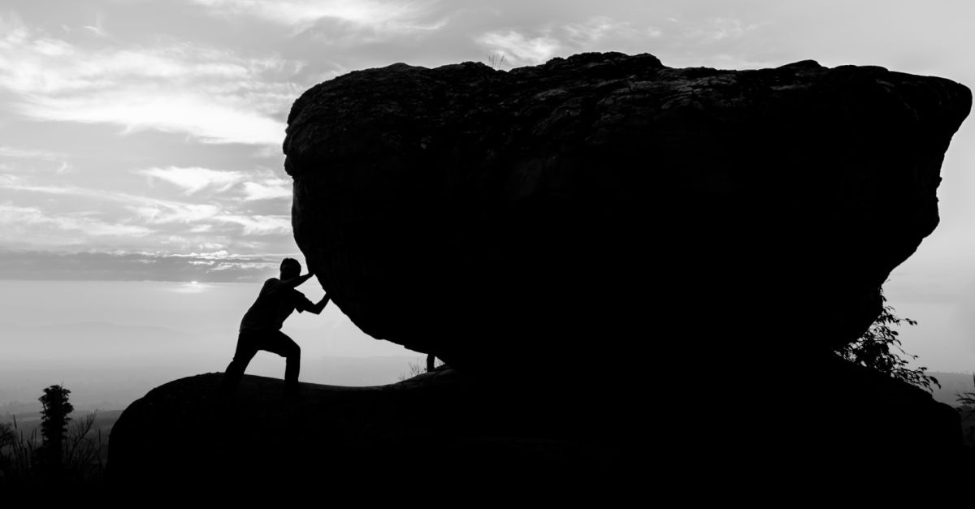
How can you be encouraged in your service for Christ?
Zechariah

Slide 16
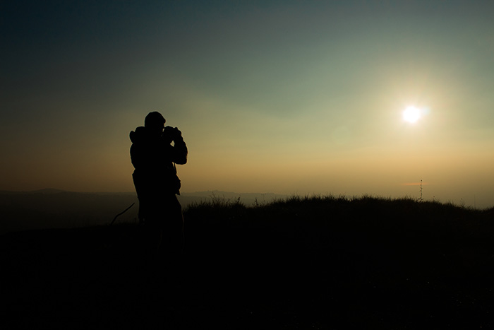
Main Idea
The way to fight discouragement is to...
see who you are
and where you are going.
Zechariah

Slide 17
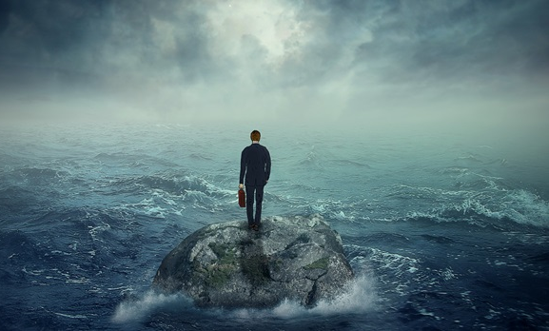
I. See your privileged position.
Zechariah 1–6

Slide 18
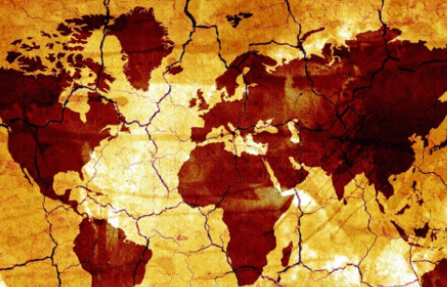
II. See your glorious future.
Zechariah 7–14

Slide 19

Questions to Ponder
How can you better understand your exalted position in Christ?
————————
How can you better serve Christ now in light of your rule with him at his return?
Zechariah

Slide 20
Black

Slide 21
Timeline
h
Zechariah
520
United Kingdom
1050-930
Divided Kingdom
930-722
Solitary Kingdom
722-586
Post- Exile
536-425
1100
1050
1000
950
900
850
800
7 5 0
7 0 0
650
600
550
500
450
Exile 586-536

Slide 22
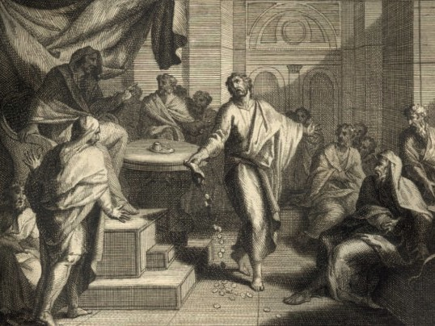
Structure
649
Intro: Call to Return to the LORD (1:1-6)
Visions (1:7–6:15)
Oracles connected with fasting (7:1–8:25)
Eschatology (9–11, 12–14)

Slide 23
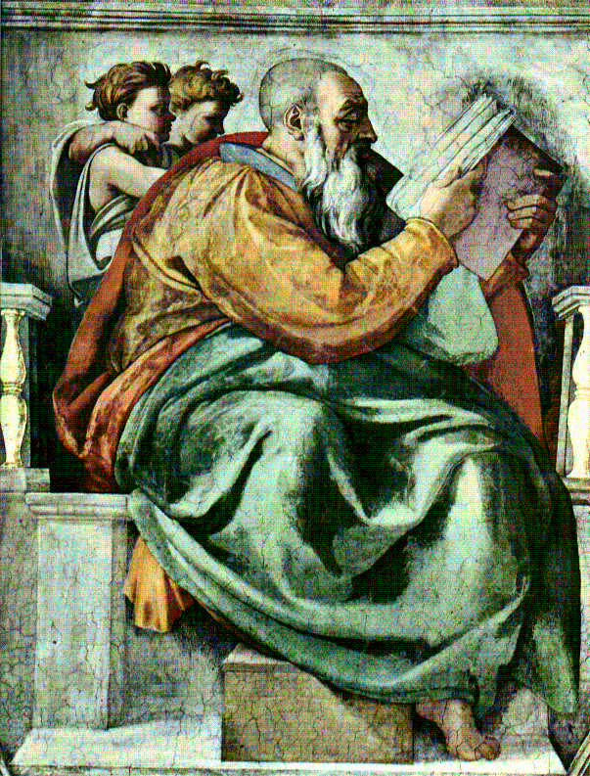
Genre
649
SECTIONS:
Chapters 1–8 → prose except 2:6-13 and 8:1-8 are poetic
Chapters 9–11 → poetry except 11:4-16
Chapters 12–14 → prose except 13:7-9

Slide 24
Zechariah
So many symbols!

Slide 25
Visionary Literature
658
 | Characteristics of Visionary Literature | Therefore, Interpret with These Guidelines
1. Structure | Many separate and equal passages contribute to a whole (“pictures a kaleidoscope structure of self-contained units”) | Interpret each self-contained unit of visionary material in relationship to both its own unit as well as within the context of the section or book where it is found
2. Symbolism | Communicates history through ideological signs, not literal objects | Interpret symbols consistent with symbols in other texts
Adapted from Leland Ryken, How to Read the Bible as Literature
and Mark L. Bailey, Dallas Theological Seminary, 1986

Slide 26
Visionary Literature
658
 | Characteristics of Visionary Literature | Therefore, Interpret with These Guidelines
3. Supernatural | Portrays a transcendental world through God, demons, and angels | Interpret as anticipating divine intervention for the salvation or judgment of both men and nations
4. Scope | Transforms the state of reality at the time of writing to what can be imagined in the future | Interpret present images as depicting future unknowns, especially relating to the Day of the LORD and end times events
Adapted from Leland Ryken, How to Read the Bible as Literature
and Mark L. Bailey, Dallas Theological Seminary, 1986

Slide 27
Visionary Literature
658
 | Characteristics of Visionary Literature | Therefore, Interpret with These Guidelines
5. Subjects | Places both familiar people and places with unfamiliar ones | Know the whole of visionary literature in Scripture in order to separate near from far fulfillments and to protect against spiritualizing the text
6. Scenic | Reveals a cosmic scene rather than localized scenes | Recognize national and cosmic entities in the text instead of individual destinies
Adapted from Leland Ryken, How to Read the Bible as Literature
and Mark L. Bailey, Dallas Theological Seminary, 1986

Slide 28
Visionary Literature
658
 | Characteristics of Visionary Literature | Therefore, Interpret with These Guidelines
7. Strangeness | People, settings and events described in extraordinary realities | Do not interpret every detail of extraordinary descriptions
Adapted from Leland Ryken, How to Read the Bible as Literature
and Mark L. Bailey, Dallas Theological Seminary, 1986

Slide 29
Be Encouraged
Book of Zechariah
Dr. Rick Griffith, Crossroads International Church Singapore
BibleStudyDownloads.org

Slide 30
Discouragement.

Slide 31

We all need encouragement
I am with you.
I care about you.
I am praying for you.
I am listening to you.

Slide 32
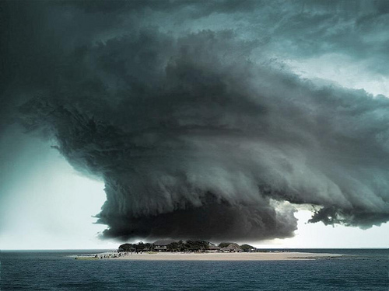
Discouragement.

Slide 33

Discouragement.

Slide 34

Discouragement especially happens with work.

Slide 35
Discouragement while serving Jesus is real.
Zechariah
the struggle is real
DISCOURAGEMENT

Slide 36

http://www.lawrencewilson.com/stop-saying-1700-pastors-leave-the-ministry-every-month/
Stop saying
"1,700 Pastors Leave the Ministry Every Month"
REALLY?
Notes:
In recent years, many Christian publications have popularized the statistic that 1700 American pastors leave the ministry every month. However, none of these reports cite their source!
• So a reporter named Lawrence Wilson investigated the claim.
• He says that we should stop saying this.

Slide 37
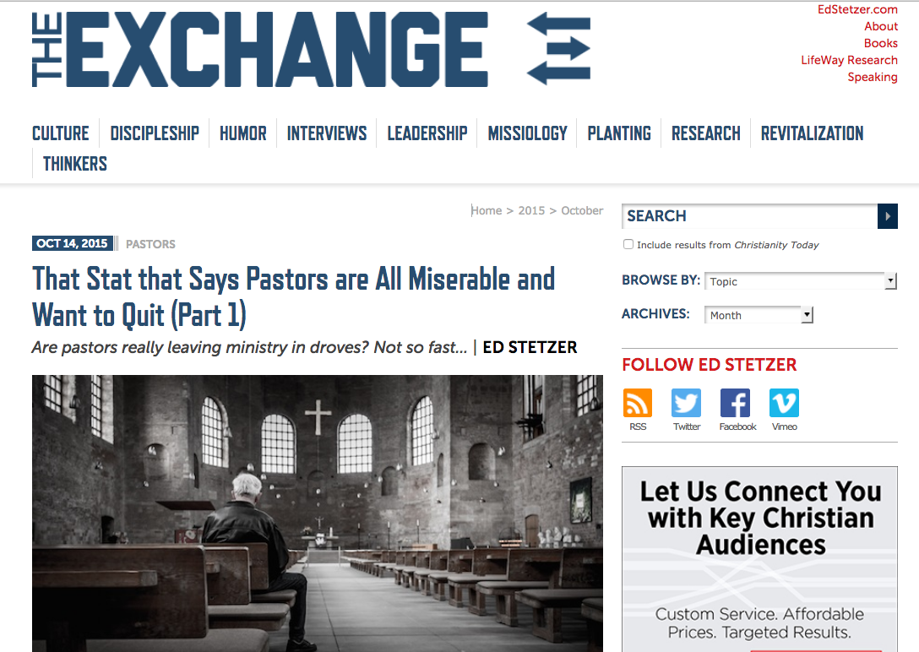
http://www.christianitytoday.com/edstetzer/2015/october/that-stat-that-says-pastors-are-all-miserable-and-want-to-q.html
Are All Pastors Miserable and Want to Quit?
That Stat that Says Pastors are All Miserable and Want to Quit (Part 1)
Are pastors really leaving ministry in droves? Not so fast…
Notes:
Another writer—Ed Stetzer—chimes in on this as well in his article, “That Stat that Says Pastors are All Miserable and Want to Quit.”

Slide 38
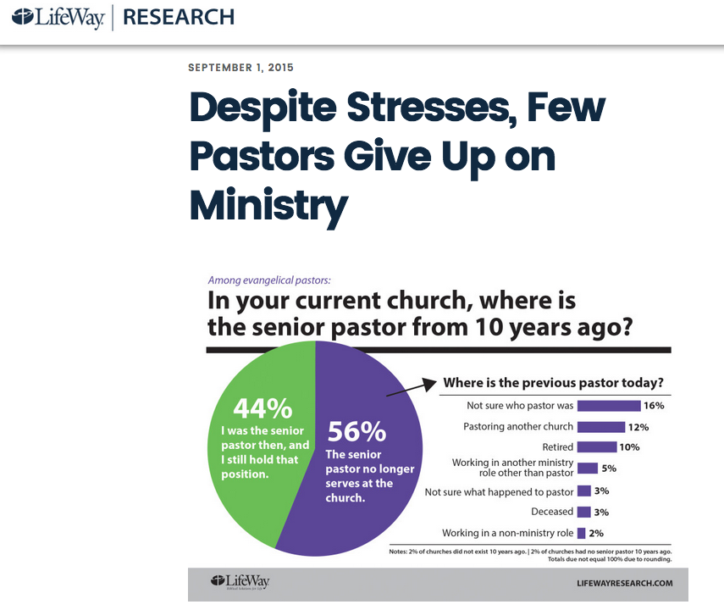
http://lifewayresearch.com/2015/09/01/despite-stresses-few-pastors-give-up-on-ministry/
Are All Pastors Miserable and Want to Quit?
Despite Stresses,
Few Pastors Give Up
on Ministry
Among evangelical pastors:
In your current church, where is the senior pastor from 10 years ago?
Notes:
Stetzer reports answers from evangelical pastors to a LifeWay survey. The question was simple: In your current church, where is the senior pastor from 10 years ago?

Slide 39
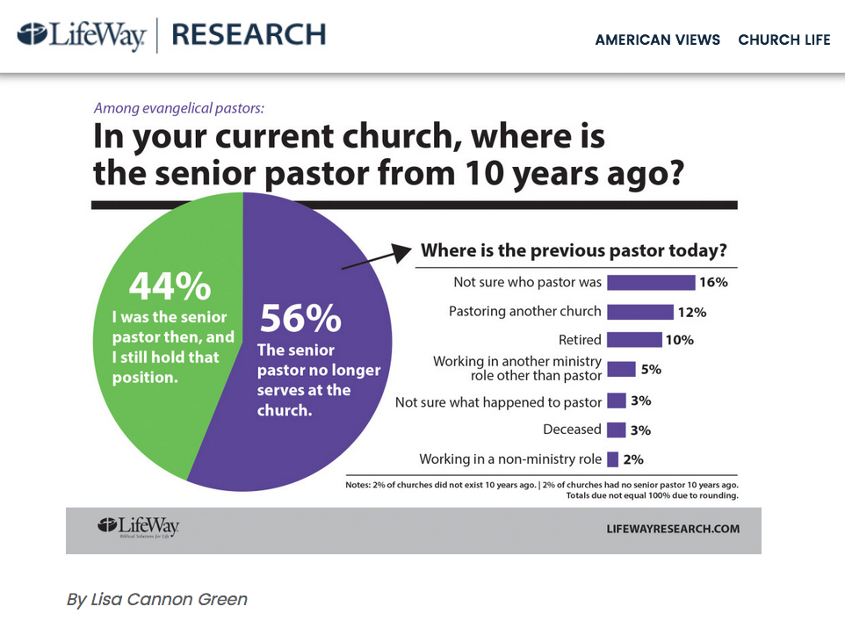
http://lifewayresearch.com/2015/09/01/despite-stresses-few-pastors-give-up-on-ministry/
Are All Pastors Miserable and Want to Quit?
Among evangelical pastors:
In your current church, where is the senior pastor from 10 years ago?
Text
Where is the previous pastor today?
Not sure who pastor was
Pastoring another church
I was the senior pastor then, and I still hold that position.
Retired
The senior pastor no longer serves at the church.
Working in another ministry role other than pastor
Not sure what happened to pastor
Deceased
Working in a non-ministry role
Notes:
The answers are encouraging!

Slide 40
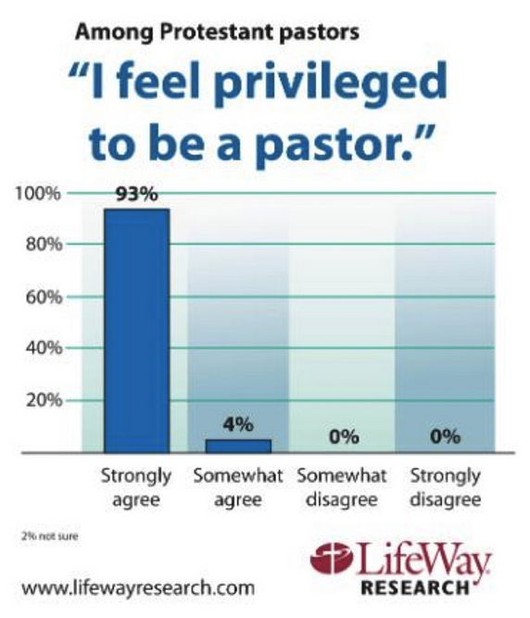
http://lifewayresearch.com/2015/09/01/despite-stresses-few-pastors-give-up-on-ministry/
Are All Pastors Miserable and Want to Quit?
Among Protestant pastors
“I feel privileged to be a pastor.”
Text
Strongly
agree
Somewhat
agree
Somewhat
disagree
Strongly
disagree
2% not sure

Slide 41
How can you be encouraged in your service for Christ?
Zechariah

Slide 42

Background:
Judah hanging on a limb

Slide 43
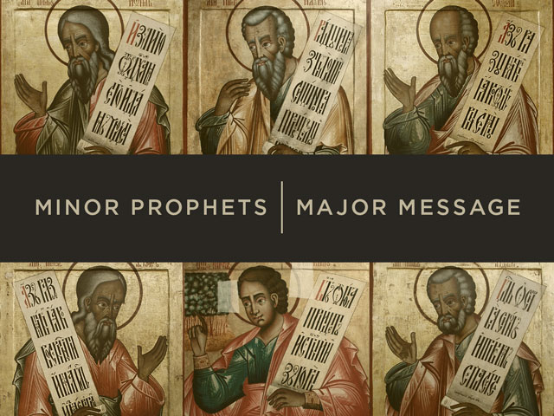
Minor Prophets | Major Message

Slide 44
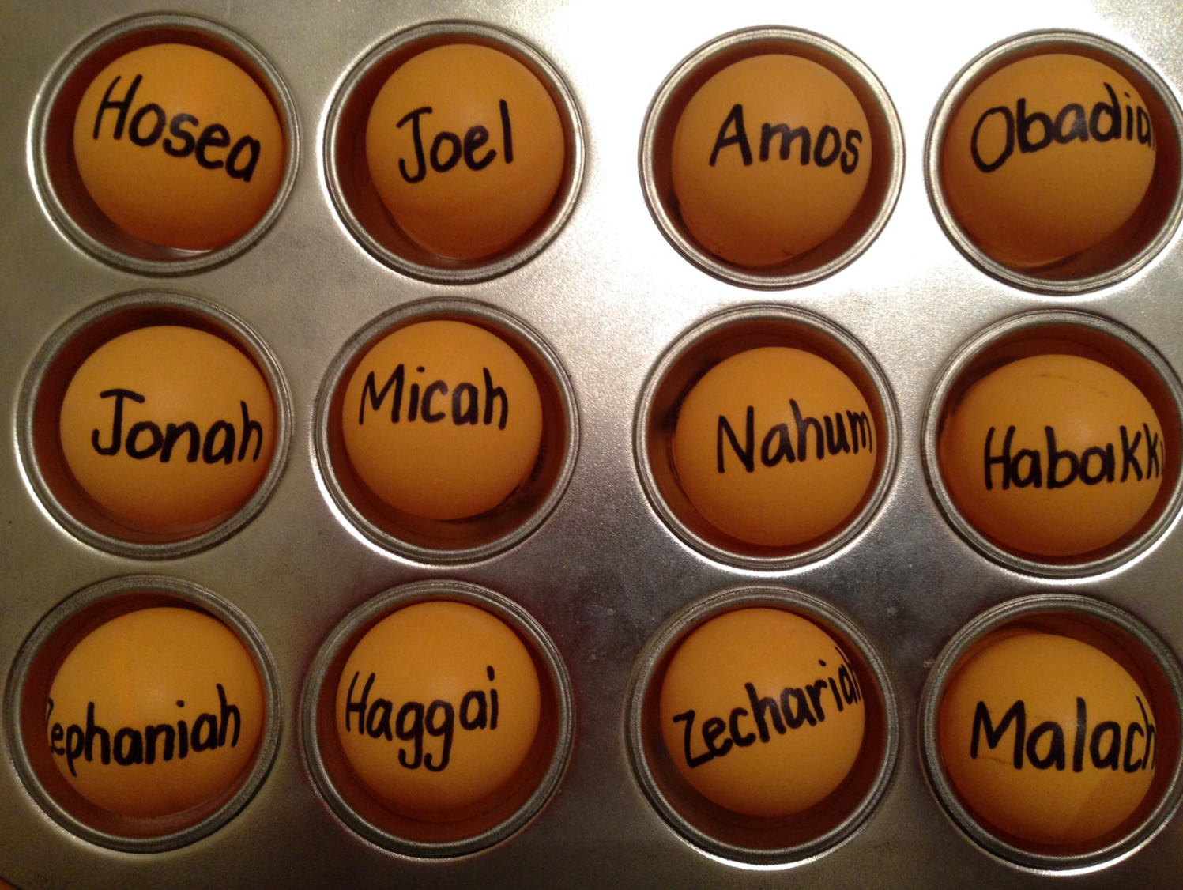
Be...
Loyal
Disciplined
Just
Humble
Caring
Generous
Patient
Amazed
Hopeful
Restored
Encouraged

Slide 45

Be Encouraged

Slide 46


The Postexilic Era
295
296
560
The Postexilic Era
Temple work
Prophets:
Haggai
Zechariah
Malachi
605
586
539
536
520
516
483-473
444-425
Others:
Zerubbabel
Esther
Ezra
Nehemiah
Persian Kings:
Cyrus
Darius
Xerxes
Artaxerxes
Notes:
The Post-Exilic Era was actually three separate periods:
(1) Temple rebuilding led by Zerubbabel, Haggai, and Zechariah in two parts under Cyrus and Darius,
(2) The saving of the nation from destruction by Esther about 30 years later under Xerxes, and
(3) The restoration of Jerusalem’s walls and gates by Nehemiah another 70 years after that under Artaxerxes.
Zechariah 7:1 took place in King Darius's second year, in 520 BC (cf. 1:1).
_________
Common English slides-144
Common Arabic Slides-153
OS-12-Kings & Prophets Charts-24
OS-15-Ezra-36
OS-16-Nehemiah-94
OS-17-Esther-16, 75
OS-27-Daniel-340
OS-35-Haggai-43
OS-38-Zechariah-14, 46, 121
OS-39-Malachi-13, 56

Slide 47
Dates in Zechariah
Begins Preaching
Night Visions Joshua Crowned
Oct/Nov
1:1-6
2/15
1:7-6:15
Prophecy #1
Rebuilding Resumes
Prophecy #2
Prophecies #3-4
Dates in Haggai
8/29
1:1
9/21
1:15
10/17
2:1
12/18
2:10, 18, 20
Aug
Sep
Oct
Nov
Dec
520 BC
519 BC

Slide 48
Book Chart
Rebuild Temple for Messiah
God's Covenant Faithfulness |  |  | Future Messianic Rule
Chapters 1–6 |  |  | Chapters 7–14
"The word of the LORD came to Zechariah…" (1:1) |  |  | "The word of the LORD came to Zechariah…" (7:1)
Visions of the Covenant |  |  | Visions of the Messiah
 |  |  |  | Two Burdens
Command to Repent 1:1-6 | Eight Covenantal Visions 1:7–6:8 | Joshua's Symbolic Coronation 6:9-15 | Four Restoration Messages 7–8 | Rejected at First Advent 9–11 | Received at Second Advent 12–14
"The word of the LORD came to Zechariah" | "Then I looked up—and there before me" | "The word of the LORD came to me" | "The word of the LORD came to me" | "The burden of the word of the LORD" (NASB) | "The burden of the word of the LORD" (NASB)
Pictures |  |  | Problems | Predictions
Israel's Fortune |  |  | Israel's Fasting | Israel's Future
While Building the Temple 520-518 BC (1:1; 7:1) |  |  |  | After Building the Temple 480-470 BC (9:13?)
Jerusalem
649
Rebuild Temple for Messiah

Slide 49
Slides on
Zechariah 1

Slide 50
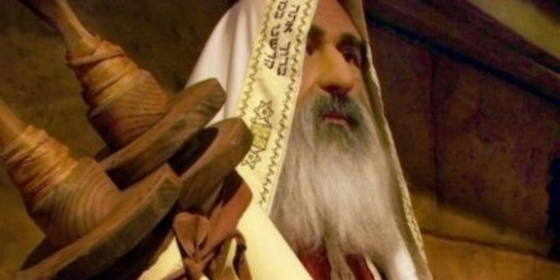
"In November of the second year of King Darius's reign, the LORD gave this message to the prophet Zechariah son of Berekiah and grandson of Iddo" (Zech 1:1 NLT).

Slide 51
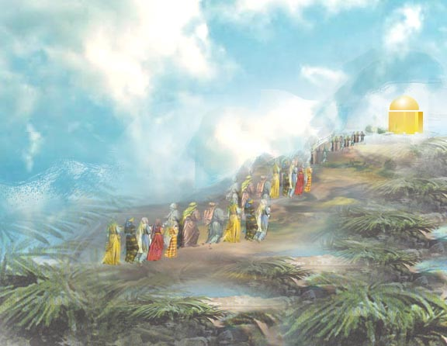

Meaning
650
hy"r>k;z>
"Yahweh has remembered" (Hebrew)
hy"r>k;z>

Slide 52
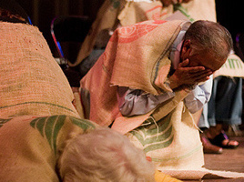
"I, the LORD, was very angry with your ancestors. ³Therefore, say to the people, 'This is what the LORD of Heaven's Armies says: Return to me, and I will return to you, says the LORD of Heaven's Armies'"
(Zech 1:2-3 NLT).

Slide 53
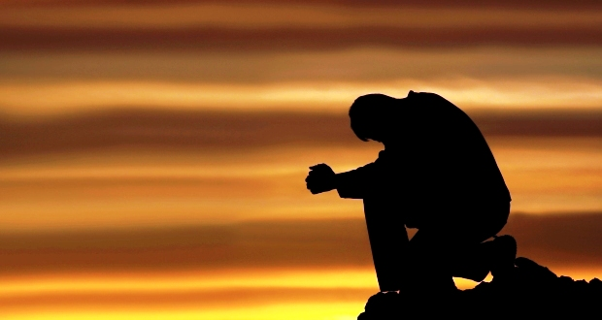
"Don't be like your ancestors who would not listen or pay attention when the earlier prophets said to them, 'This is what the LORD of Heaven's Armies says: Turn from your evil ways, and stop all your evil practices'"
(Zech 1:4 NLT).

Slide 54

"Where are your ancestors now? They and the prophets are long dead. ⁶But everything I said through my servants the prophets happened to your ancestors, just as I said"
(Zech 1:5-6a NLT).

Slide 55
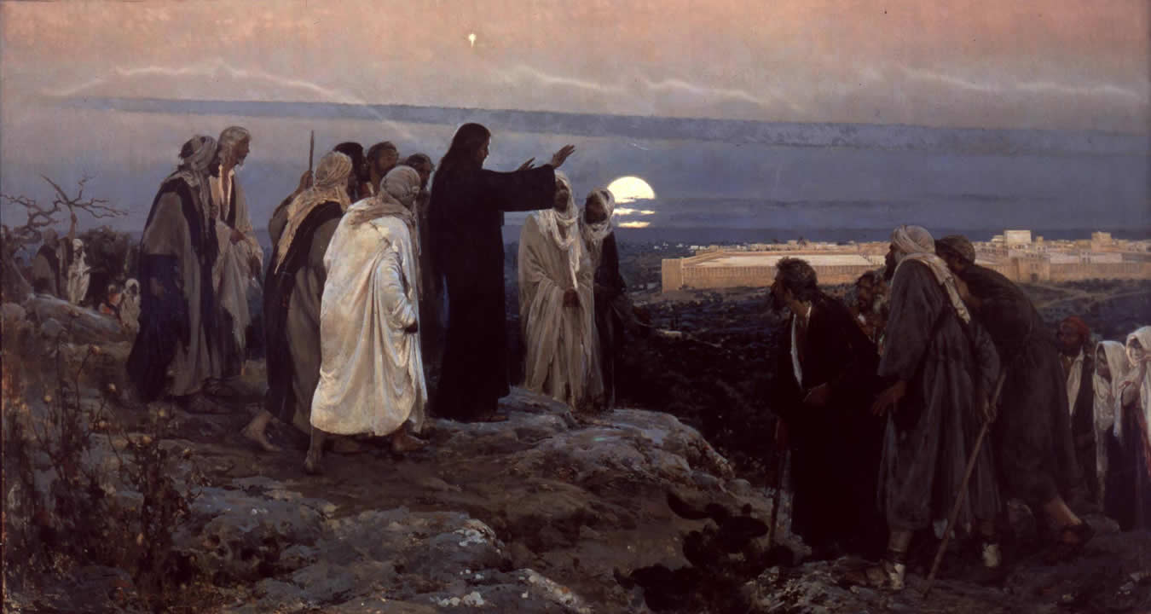
"As a result, they repented and said, 'We have received what we deserved from the LORD of Heaven's Armies. He has done what he said he would do'"
(Zech 1:6b NLT).

Slide 56
How can you be encouraged in your service for Christ?
2 ways

Slide 57
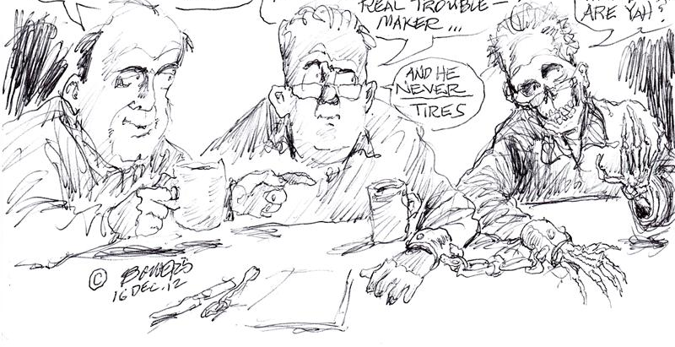
Always there.
He's my old sin nature… He's always around—a real troublemaker…
Hi…
How are ya?
Hey, Bob, who's your Pal?
And he never tires
Notes:
The Christian will struggle with sin as long as he is in this mortal body.
________________
OS-38-Zechariah-57
NS-06-Rom5-8—slide 39

Slide 58
I. See your privileged position.
Zechariah 1–6

Slide 59
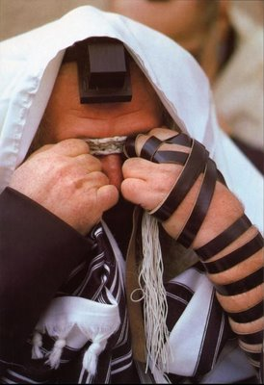
Even today Jews pray every day for the temple rebuilding
Israel's privileged position should result in temple rebuilding
(Chs. 1–6)

Slide 60
Book Chart
Rebuild Temple for Messiah
God's Covenant Faithfulness |  |  | Future Messianic Rule
Chapters 1–6 |  |  | Chapters 7–14
"The word of the LORD came to Zechariah…" (1:1) |  |  | "The word of the LORD came to Zechariah…" (7:1)
Visions of the Covenant |  |  | Visions of the Messiah
 |  |  |  | Two Burdens
Command to Repent 1:1-6 | Eight Covenantal Visions 1:7–6:8 | Joshua's Symbolic Coronation 6:9-15 | Four Restoration Messages 7–8 | Rejected at First Advent 9–11 | Received at Second Advent 12–14
"The word of the LORD came to Zechariah" | "Then I looked up—and there before me" | "The word of the LORD came to me" | "The word of the LORD came to me" | "The burden of the word of the LORD" (NASB) | "The burden of the word of the LORD" (NASB)
Pictures |  |  | Problems | Predictions
Israel's Fortune |  |  | Israel's Fasting | Israel's Future
While Building the Temple 520-518 BC (1:1; 7:1) |  |  |  | After Building the Temple 480-470 BC (9:13?)
Jerusalem
649
Rebuild Temple for Messiah

Slide 61
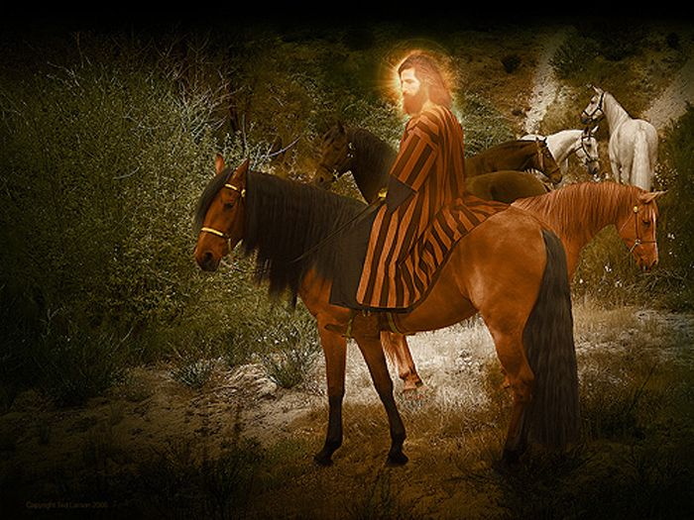
Vision 1: Red-Horse Rider among the Myrtles (Zech 1:7-17)
"Three months later, on February 15, the LORD sent another message to the prophet Zechariah son of Berekiah and grandson of Iddo. ⁸In a vision during the night, I saw a man sitting on a red horse that was standing among some myrtle trees in a small valley. Behind him were riders on red, brown, and white horses. ⁹I asked the angel who was talking with me, 'My lord, what do these horses mean?' 'I will show you,' the angel replied" (1:7-9 NLT).

Slide 62
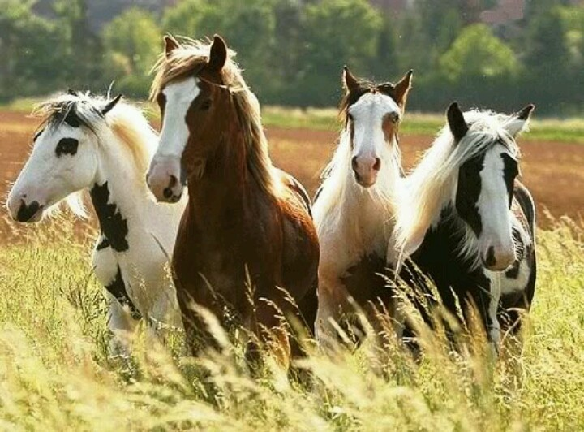
"The rider standing among the myrtle trees then explained, 'They are the ones the LORD has sent out to patrol the earth'" (1:10 NLT).

Slide 63
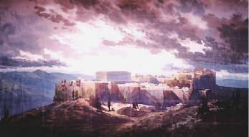
"Then the angel said to me, 'Shout this message for all to hear: "This is what the LORD of Heaven's Armies says: My love for Jerusalem and Mount Zion is passionate and strong. ¹⁵But I am very angry with the other nations that are now enjoying peace and security. I was only a little angry with my people, but the nations inflicted harm on them far beyond my intentions" ' " (1:14-15 NLT).

Slide 64
Vision 1: Red-Horse Rider among the Myrtles (Zech 1:7-17)
God's anger against the nations and blessing on restored Israel
Bible Knowledge Commentary, 1:1549

Slide 65
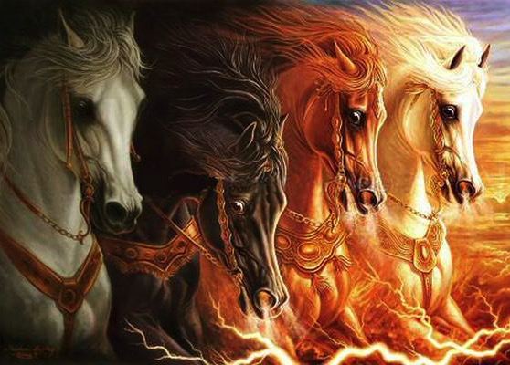
Zechariah 1:8 expands in Revelation 6:1-4

Slide 66
1:16 "My temple will be rebuilt!"
650

Slide 67
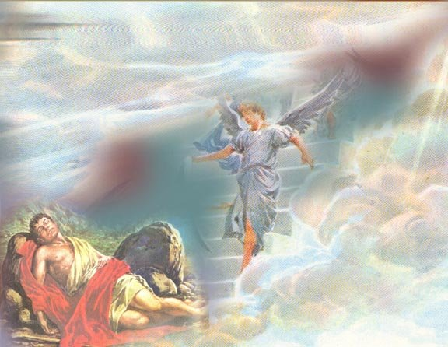
Eight Covenantal Visions
653
Vision | Text | Meaning
Red-Horse Rider among the Myrtles | 1:7-17 | God's anger against the nations and blessing on restored Israel
Four Horns and Four Craftsmen | 1:18-21 | God's judgment on the nations that afflict Israel
Surveyor with a Measuring Line | Zech. 2 | God's future blessing on restored Israel
Cleansing and Crowning of Joshua the High Priest | Zech. 3 | Israel's future cleansing from sin and reinstatement as a priestly nation
Golden Lampstand and Two Olive Trees | Zech. 4 | Israel as the light to the nations under Messiah, the King-Priest
Flying Scroll | 5:1-4 | Severity and totality of divine judgment on individual Israelites
Woman in the Ephah | 5:5-11 | Removal of national Israel's sin of rebellion against God
Four Chariots | 6:1-8 | Divine judgment on Gentile nations
Bible Knowledge Commentary, 1:1549

Slide 68
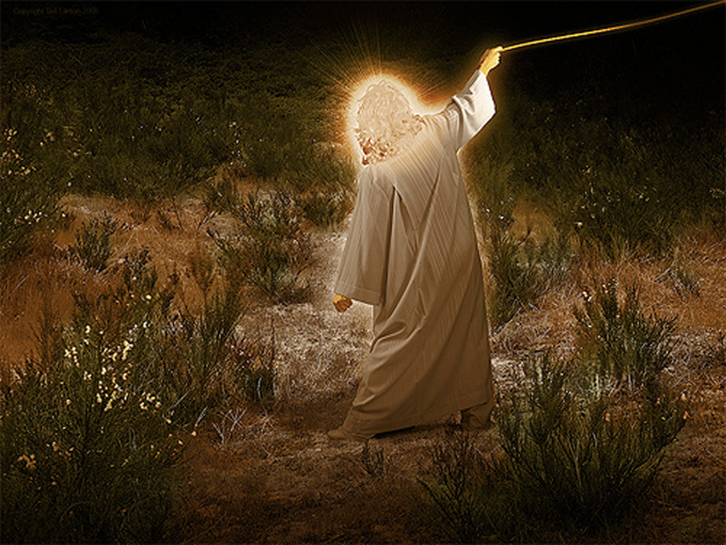
Vision 2: Four Horns and
Four Craftsmen (Zech 1:18-21)
God's judgment on the nations
that afflict Israel
Bible Knowledge Commentary, 1:1549

Slide 69
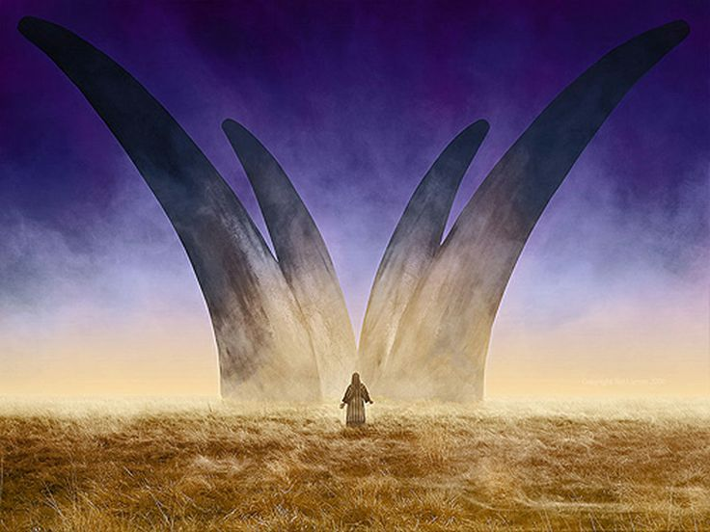
Zechariah's Second Vision:
The Horns and the Smiths (Craftsmen) in Zechariah 1:18-21
"Then I looked up and saw four animal horns. ^{19'}What are these?' I asked the angel who was talking with me. He replied, 'These horns represent the nations that scattered Judah, Israel, and Jerusalem'" (Zech 1:18-19 NLT).

Slide 70
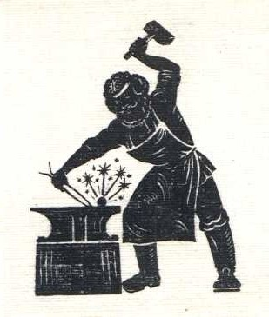
"Then the LORD showed me four blacksmiths. ²¹'What are these men coming to do?' I asked. The angel replied, 'These four horns—these nations—scattered and humbled Judah. Now these blacksmiths have come to terrify those nations and throw them down and destroy them'"
(Zech 1:20-21 NLT).

Slide 71
Slides on
Zechariah 2

Slide 72
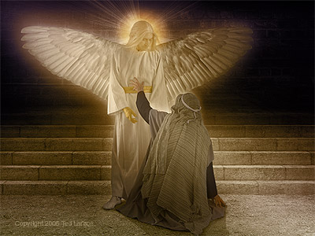
Vision 3: Surveyor with a Measuring Line (Zech 2)
God's future blessing on restored Israel
Bible Knowledge Commentary, 1:1549

Slide 73
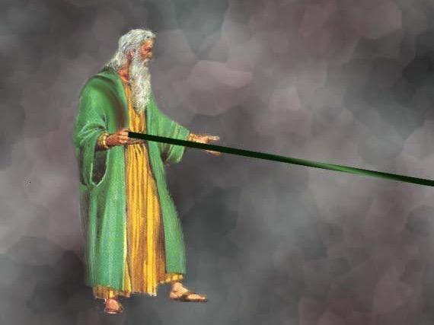
A Measuring Rod for Jerusalem (Zech. 2:1-2 NLT)
"When I looked again, I saw a man with a measuring line in his hand. ²'Where are you going?' I asked. He replied,
'I am going to measure Jerusalem, to see how wide and how long it is.'"

Slide 74

Jerusalem Population (2002)
East = Arabs
West = Jews

Slide 75
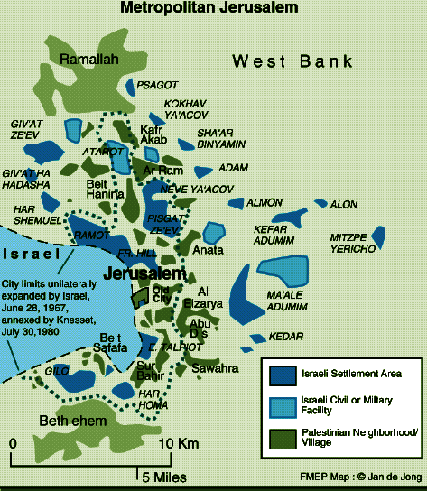
Jerusalem (2002)
Foundation for Middle East Peace
(March 2002)

Slide 76
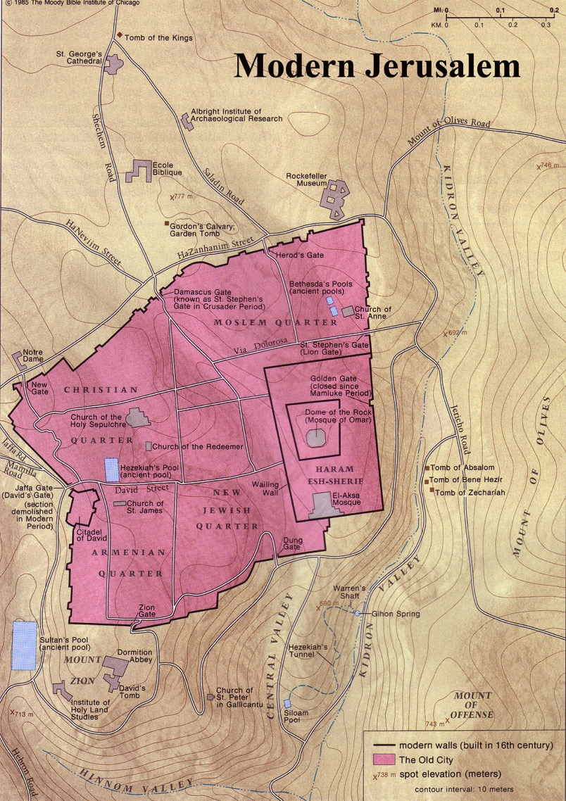
The Old City Today

Slide 77

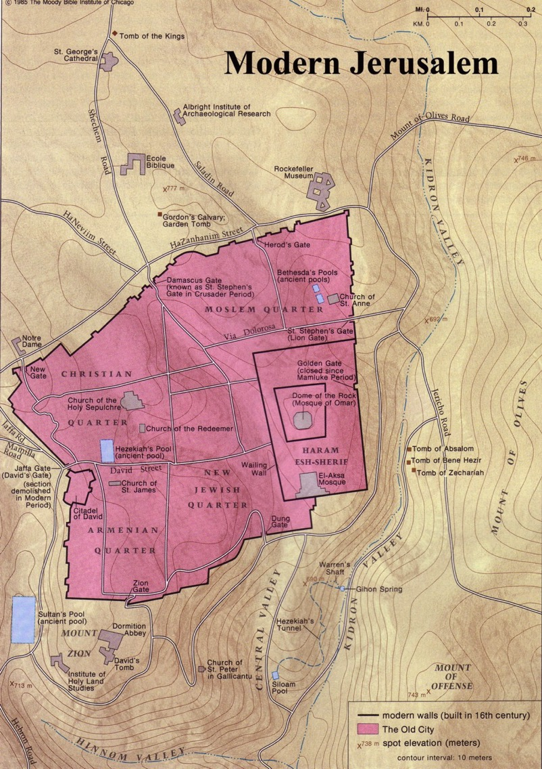

Modern Jerusalem: "Many will live outside the city walls" (Zech. 2:4)

Slide 78
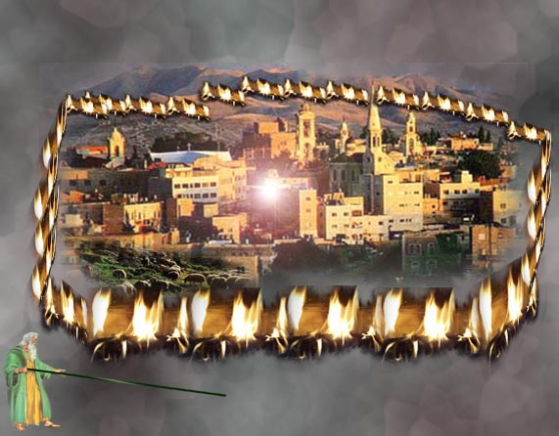
The Wall of Fire (Zech. 2:3-5 NLT)
649
"Then the angel who was with me went to meet a second angel who was coming toward him. ⁴The other angel said, 'Hurry, and say to that young man, 'Jerusalem will someday be so full of people and livestock that there won't be room enough for everyone! Many will live outside the city walls. ⁵Then I, myself, will be a protective wall of fire around Jerusalem, says the LORD. And I will be the glory inside the city!'"

Slide 79
Zechariah 2:10-12 NLT
© EBibleTeacher.com
The LORD says, “Shout and rejoice, O beautiful Jerusalem, for I am coming to live among you. ¹¹ Many nations will join themselves to the LORD on that day, and they, too, will be my people. I will live among you, and you will know that the LORD of Heaven’s Armies sent me to you. ¹²The land of Judah will be the LORD’s special possession in the holy land, and he will once again choose Jerusalem to be his own city."

Slide 80
Slides on
Zechariah 3

Slide 81
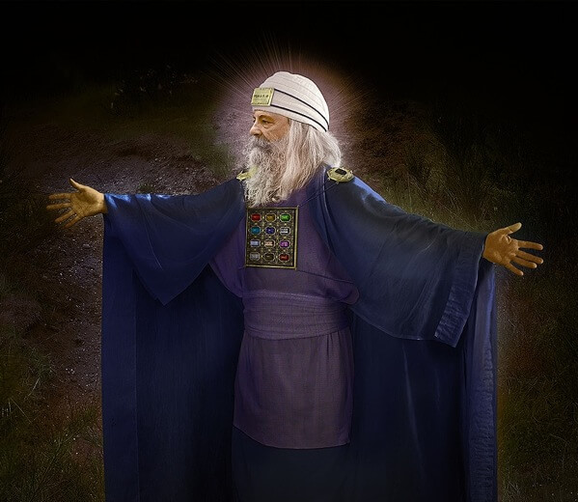
Vision 4: Cleansing and Crowning of Joshua the High Priest (Zech 3)
Israel's future cleansing from sin and reinstatement as a priestly nation
Bible Knowledge Commentary, 1:1549

Slide 82
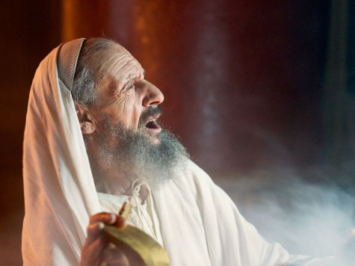
"Then the angel showed me Joshua the high priest standing before the angel of the LORD. The Accuser, Satan, was there at the angel's right hand, making accusations against Joshua. ²And the LORD said to Satan, 'I, the LORD, reject your accusations, Satan. Yes, the LORD, who has chosen Jerusalem, rebukes you. This man is like a burning stick that has been snatched from the fire'" (Zech 3:1-2 NLT).

Slide 83
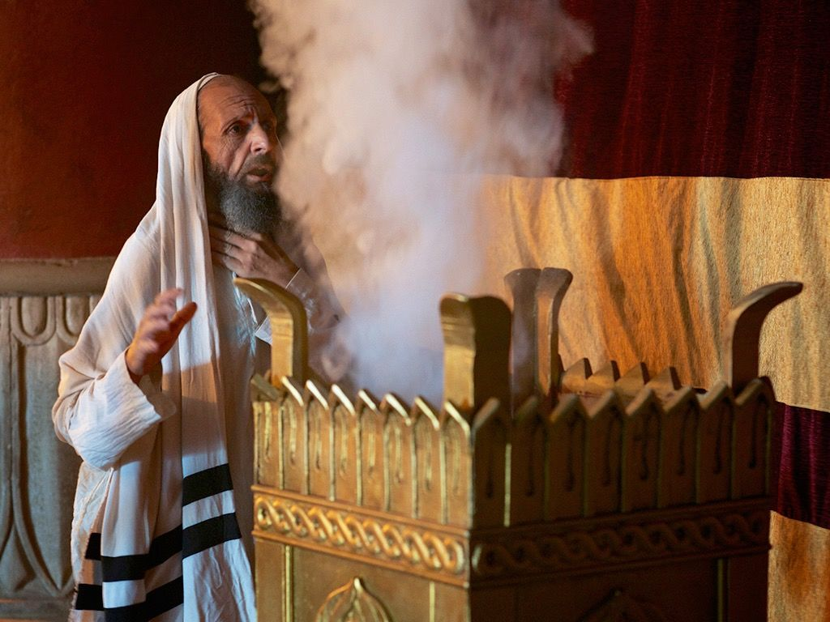
"Joshua's clothing was filthy as he stood there before the angel. ⁴So the angel said to the others standing there, 'Take off his filthy clothes.' And turning to Joshua he said, 'See, I have taken away your sins, and now I am giving you these fine new clothes'" (Zech 3:3-4 NLT).

Slide 84
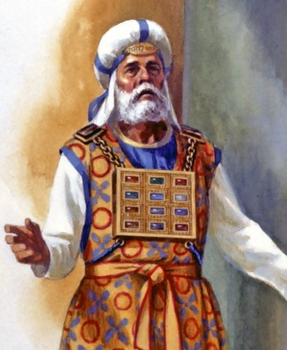
"Then I said, 'They should also place a clean turban on his head.' So they put a clean priestly turban on his head and dressed him in new clothes while the angel of the LORD stood by'"
(Zech 3:5 NLT).

Slide 85
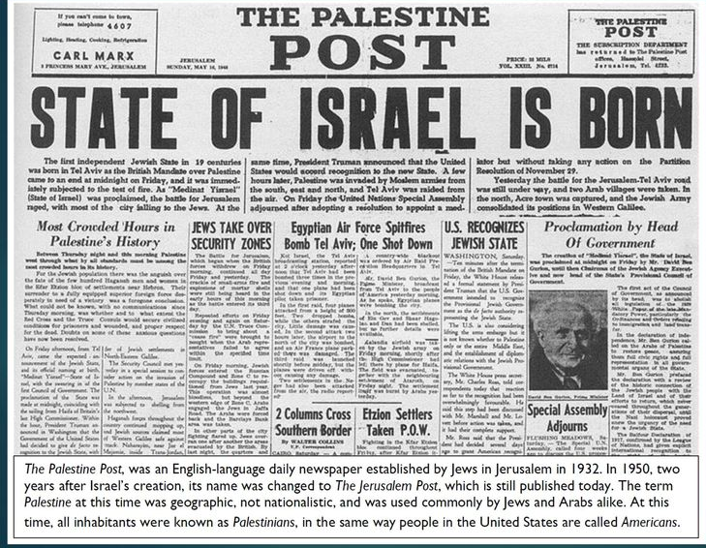
14 May 1948
"Who has ever seen anything as strange as this?
Who ever heard of such a thing?
Has a nation ever been born in a single day?
Has a country ever come forth in a mere moment?
But by the time Jerusalem’s birth pains begin,
her children will be born."
Isaiah 66:8 (NLT)
Notes:
85
Though obviously many events prepared for it in advance, Israel became a nation on the single day of 14 May 1948.
________
OS-23-Isaiah60-66-slide 78
OS-38-Zechariah-84

Slide 86
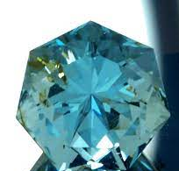
"Now look at the jewel I have set before Jeshua, a single stone with seven facets. I will engrave an inscription on it, says the LORD of Heaven’s Armies, and
I will remove the sins of this land in a single day"
(Zechariah 3:9 NLT).
Notes:
Israel became a nation in one day on 14 May 1948, but the Jews saw themselves as an ethnic rather than a religious people. Even today, about 30% of Jewish immigrants from Russia are atheists. Yet God promises in Zechariah 3:9 to remove the sins of the nation also on a single day.
_______
OS-23-Isaiah60-66-slide 155
OS-26-Ezek33-39-slide 60
OS-38-Zechariah-85

Slide 87
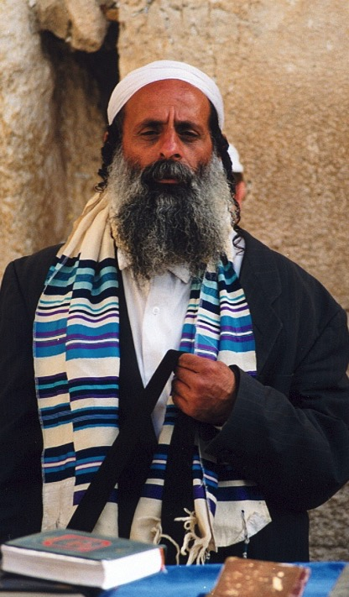
"All Israel will be saved" (Rom. 11:25-27)
NTS 155w
²⁵I do not want you to be ignorant of this mystery, brothers, so that you may not be conceited: Israel has experienced a hardening in part until the full number of the Gentiles has come in.
²⁶And so all Israel will be saved, as it is written:
"The deliverer will come from Zion; he will turn godlessness away from Jacob.
²⁷And this is my covenant with them when I take away their sins."
Notes:
Does this mean that all Jews throughout history will be saved? That would contradict John 3:16 and many other verses that show salvation only in Christ (John 14:6l Acts 4:12). It also cannot mean Gentiles as they are never called the church. But Zechariah 3:9 says that Israel will believe in Jesus as Messiah in a single day at the end of the Tribulation. At that time, "All Israel will be saved" (Rom 11:25-26) for only then will the redeemer come from Jerusalem to save the nation since Paul quotes Isaiah 59:20 whose context is Israel under the new covenant (cf. Jer 31:31-34).
___________________
Common-449
OS-23-Isaiah60-66-slide 154
OS-38-Zechariah-86, 134
NS-06-Rom9-16-slide 53
NS-22-Rev13-19-slide 53

Slide 88
Vision 4: Cleansing and Crowning of Joshua the High Priest (Zech 3)
Israel's future cleansing from sin and reinstatement as a priestly nation
Bible Knowledge Commentary, 1:1549

Slide 89
Slides on
Zechariah 4

Slide 90
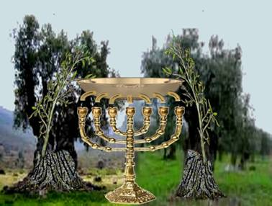
The Lamp & Olive Trees (Zech. 4:1-14)
"Then the angel who had been talking with me returned and woke me, as though I had been asleep. ²'What do you see now?' he asked" (Zech 4:1-2a NLT).

Slide 91
"'I see a solid gold lampstand with a bowl of oil on top of it. Around the bowl are seven lamps, each having seven spouts with wicks" (Zech 4:2b NLT).

Slide 92
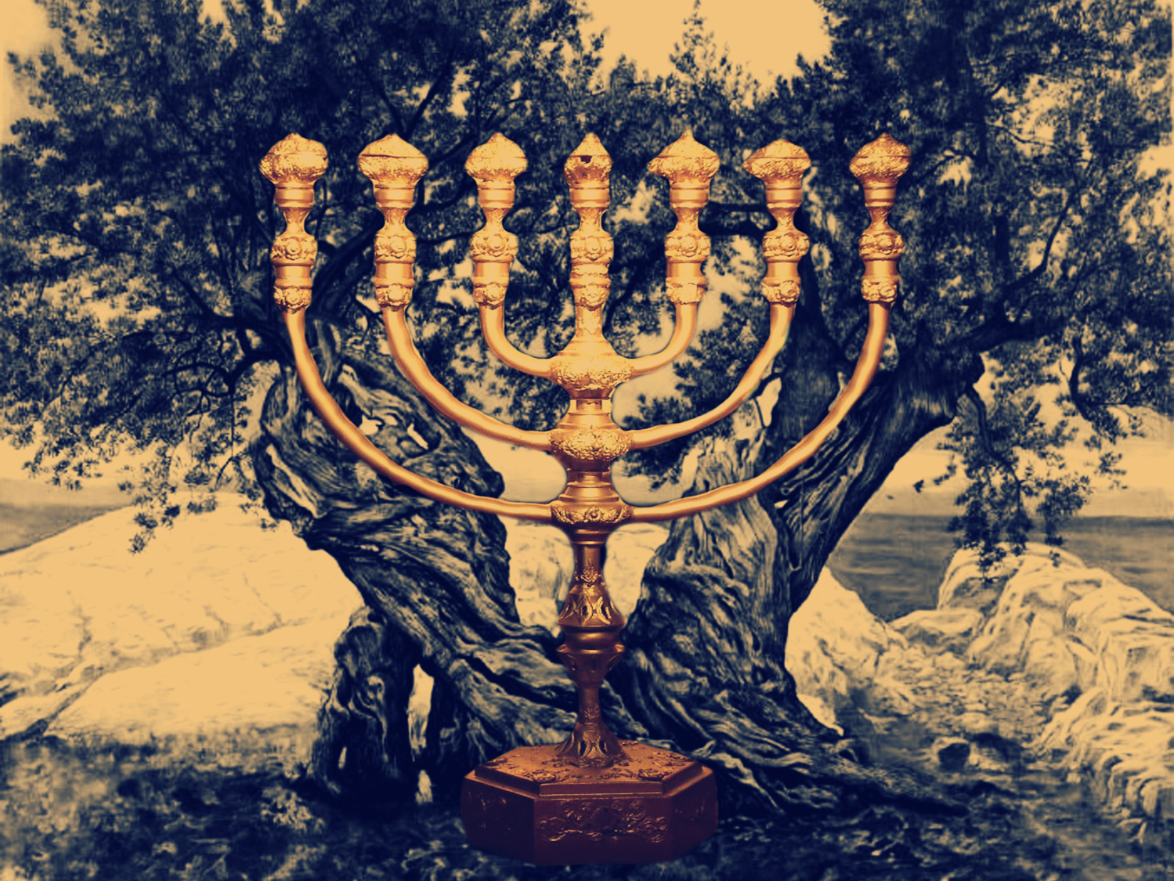
Vision 5: Golden Lampstand and Two Olive Trees (Zech 4)
Israel as the light to the nations under Messiah, the King-Priest
Bible Knowledge Commentary, 1:1549

Slide 93
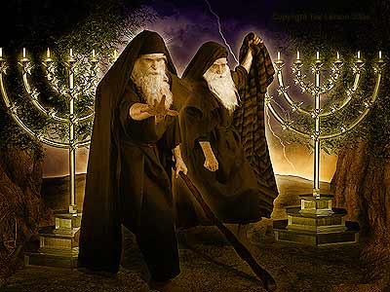
The Two Olive Trees (Rev. 11:4)
330

Slide 94
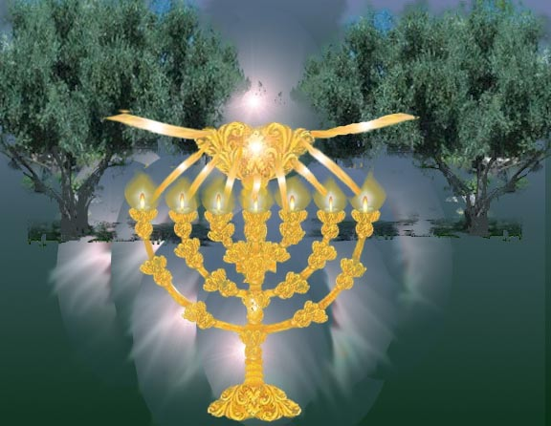
The Lamp & Olive Trees (Zech. 4:1-14)
"'Zerubbabel is the one who laid the foundation of this Temple, and he will complete it. Then you will know that the LORD of Heaven's Armies has sent me. ¹⁰Do not despise these small beginnings, for the LORD rejoices to see the work begin, to see the plumb line in Zerubbabel's hand.' (The seven lamps represent the eyes of the LORD that search all around the world.)" (Zech. 4:9-10 NLT)

Slide 95
Slides on
Zechariah 5

Slide 96
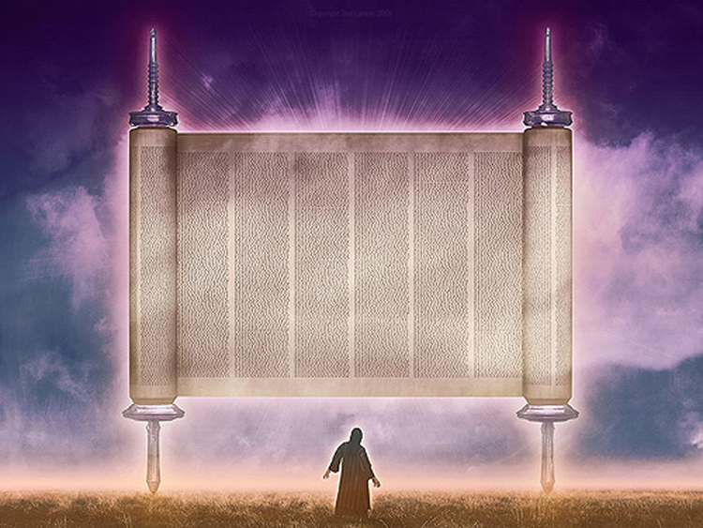
Vision 6: The Flying Scroll (Zech 5:1-4)
Severity and totality of divine judgment on individual Israelites
Bible Knowledge Commentary, 1:1549

Slide 97

5:1-4 Flying Scroll

Slide 98

"I looked up again and saw a scroll flying through the air. ²'What do you see?' the angel asked. 'I see a flying scroll,' I replied. 'It appears to be about 30 feet long and 15 feet wide'" (Zech 5:1-2 NLT).

Slide 99

"Then he said to me, 'This scroll contains the curse that is going out over the entire land. One side of the scroll says that those who steal will be banished from the land; the other side says that those who swear falsely will be banished from the land'"
(Zech 5:3 NLT).

Slide 100

"And this is what the LORD of Heaven's Armies says: I am sending this curse into the house of every thief and into the house of everyone who swears falsely using my name. And my curse will remain in that house and completely destroy it—even its timbers and stones" (Zech 5:4 NLT).

Slide 101

Baskets were very familiar to Zechariah

Slide 102

Vision 7: Woman in the Ephah
(Zech 5:5-11)
Removal of national Israel's sin of rebellion against God
Bible Knowledge Commentary, 1:1549

Slide 103

5:5-8 Woman in Basket
"Then the angel who was talking with me came forward and said, 'Look up and see what's coming.' ⁶'What is it?' I asked. He replied, 'It is a basket for measuring grain, and it's filled with the sins of everyone throughout the land.' ⁷Then the heavy lead cover was lifted off the basket, and there was a woman sitting inside it"
(Zech 5:5-7 NLT).

Slide 104

"The angel said, ‘The woman's name is Wickedness,' and he pushed her back into the basket and closed the heavy lid again"
(Zech 5:8 NLT).

Slide 105

"The angel said, ‘The woman's name is Wickedness,' and he pushed her back into the basket and closed the heavy lid again"
(Zech 5:8 NLT).

Slide 106

5:9-11 Woman in Basket
⁹ "Then I looked up and saw two women flying toward us, gliding on the wind. They had wings like a stork, and they picked up the basket and flew into the sky. ¹⁰ 'Where are they taking the basket?' I asked the angel. ¹¹ He replied, 'To the land of Babylonia, where they will build a temple for the basket. And when the temple is ready, they will set the basket there on its pedestal'" (Zech 5:9-11 NLT).

Slide 107

5:5-8 Woman in Basket
"Then I looked up and saw two women flying toward us, gliding on the wind. They had wings like a stork, and they picked up the basket and flew into the sky"
(Zech 5:9 NLT).

Slide 108

Wickedness sometimes appears in the imagery of women.
Zechariah 5:9 is one of two places that mention female supernatural beings.

Slide 109
Slides on
Zechariah 6

Slide 110

Vision 8: The Four Chariots (Zech 6:1-8)
"Then I looked up again and saw four chariots coming from between two bronze mountains. ²The first chariot was pulled by red horses, the second by black horses, ³the third by white horses, and the fourth by powerful dappled-gray horses."
"⁴'And what are these, my lord?' I asked the angel who was talking with me" (Zech 6:1-4 NLT).
Bible Knowledge Commentary, 1:1549

Slide 111

6:1-8 Chariots
"The angel replied, 'These are the four spirits of heaven who stand before the LORD of all the earth. They are going out to do his work.
649
South
West
⁶The chariot with black horses is going north, the chariot with white horses is going west, and the chariot with dappled-gray horses is going south'"
(Zech 6:5-6 NLT).
North

Slide 112

Vision 8: The Four Chariots (Zech 6:1-8)
Divine judgment on Gentile nations
Bible Knowledge Commentary, 1:1549

Slide 113

The Night Visions Reviewed
  red-horse rider among the myrtles 1:7-17
  four horns & the four craftsmen 1:18-21
  surveyor with the measuring line 2:1-13
  cleansing & crowning of Joshua 3:1-10
  gold lampstand & the two olive trees 4:1-14
  flying scroll 5:1-4
  woman in the ephah 5:5-11
  four chariots 6:1-8

Slide 114

God also encourages us to serve him by revealing our identity in Christ.

Slide 115

Your Identity in Christ

Slide 116

Our Identity in Christ
The Riches of Grace in Christ Jesus
—33 Divine Accomplishments in and for the Sinner
upon Believing on the Lord Jesus Christ
by Lewis S. Chafer
Notes:
The Riches of Grace in Christ Jesus
(33 Divine Accomplishments in and for the Sinner
upon Believing on the Lord Jesus Christ)
by Lewis S. Chafer
Accessed 9 July 2017
Copied for WholesomeWords.org from Salvation by Lewis Sperry Chafer. Philadelphia: Sunday School Times Company, ©1917.
http://www.wholesomewords.org/etexts/chafer/saved.html

Slide 117

Our Identity in Christ
In the Eternal Plan of God
Reconciled
Redeemed
Related to God Through a Propitiation (the satisfaction of God's holiness)
All Sins Covered by Atoning Blood
Vitally Joined together with Christ for Judgment of the "Old Man" Unto a New Walk
Free from the Law
Children of God
Adopted (placed as adult sons)
Acceptable to God by Jesus Christ
Notes:
The Riches of Grace in Christ Jesus
(33 Divine Accomplishments in and for the Sinner
upon Believing on the Lord Jesus Christ)
by Lewis S. Chafer
Accessed 9 July 2017
Copied for WholesomeWords.org from Salvation by Lewis Sperry Chafer. Philadelphia: Sunday School Times Company, ©1917.
http://www.wholesomewords.org/etexts/chafer/saved.html

Slide 118
Our Identity in Christ
Justified
Forgiven All Trespass
Made Nigh (Drawn Near)
Delivered from the Powers of Darkness
Translated into the Kingdom
On the Rock Christ Jesus
A Gift from God the Father to Christ
Circumcised in Christ
Partakers of the Holy and Royal Priesthood
A Chosen Generation and a Peculiar People
Having Access to God
Within the "Much More" Care of God:
Notes:
The Riches of Grace in Christ Jesus
(33 Divine Accomplishments in and for the Sinner
upon Believing on the Lord Jesus Christ)
by Lewis S. Chafer
Accessed 9 July 2017
Copied for WholesomeWords.org from Salvation by Lewis Sperry Chafer. Philadelphia: Sunday School Times Company, ©1917.
http://www.wholesomewords.org/etexts/chafer/saved.html

Slide 119
Our Identity in Christ
His Inheritance
Our Inheritance
A Heavenly Association
Heavenly Citizens
Of the Family and Household of God
Light in the Lord
Vitally United to the Father, Son, and Spirit
Blessed with the "First-Fruits" and the "Earnest" of the Spirit
Glorified
Complete in Him
Possessing Every Spiritual Blessing
Notes:
The Riches of Grace in Christ Jesus
(33 Divine Accomplishments in and for the Sinner
upon Believing on the Lord Jesus Christ)
by Lewis S. Chafer
Accessed 9 July 2017
Copied for WholesomeWords.org from Salvation by Lewis Sperry Chafer. Philadelphia: Sunday School Times Company, ©1917.
http://www.wholesomewords.org/etexts/chafer/saved.html

Slide 120

Our Identity in Christ

Slide 121
How can you be encouraged in your service for Christ?
2 ways

Slide 122
I. See your privileged position.
Zechariah 1–6

Slide 123
II. See your glorious future.
Zechariah 7–14

Slide 124
Slides on
Zechariah 7

Slide 125
The Postexilic Era
295
296
560
The Postexilic Era
Temple work
Haggai
"On December 7 of the fourth year of King Darius's reign, another message came to Zechariah from the LORD"
(Zech 7:1 NLT).
Prophets:
Zechariah
Malachi
605
586
539
536
520
516
483-473
444-425
Others:
Zerubbabel
Esther
Ezra
Nehemiah
Persian Kings:
Cyrus
Darius
Xerxes
Artaxerxes
Notes:
The Post-Exilic Era was actually three separate periods:
(1) Temple rebuilding led by Zerubbabel, Haggai, and Zechariah in two parts under Cyrus and Darius,
(2) The saving of the nation from destruction by Esther about 30 years later under Xerxes, and
(3) The restoration of Jerusalem’s walls and gates by Nehemiah another 70 years after that under Artaxerxes.
Zechariah 7:1 took place in King Darius's second year, in 520 BC (cf. 1:1).
_________
Common English slides-144
Common Arabic Slides-153
OS-12-Kings & Prophets Charts-24
OS-15-Ezra-36
OS-16-Nehemiah-94
OS-17-Esther-16, 75
OS-27-Daniel-340
OS-35-Haggai-43
OS-38-Zechariah-46, 121
OS-39-Malachi-13, 56

Slide 126

"The people of Bethel had sent Sharezer and Regemmelech, along with their attendants, to seek the LORD's favor. ³They were to ask this question of the prophets and the priests at the Temple of the LORD of Heaven's Armies: ‘Should we continue to mourn and fast each summer on the anniversary of the Temple's destruction, as we have done for so many years?'"
(Zech 7:2-3 NLT).

Slide 127
"The LORD of Heaven's Armies sent me this message in reply: ⁵'Say to all your people and your priests, "During these seventy years of exile, when you fasted and mourned in the summer and in early autumn, was it really for me that you were fasting? ⁶And even now in your holy festivals, aren't you eating and drinking just to please yourselves?"'"
(7:4-6 NLT).

Slide 128
Book Chart
Rebuild Temple for Messiah
God's Covenant Faithfulness |  |  | Future Messianic Rule
Chapters 1–6 |  |  | Chapters 7–14
"The word of the LORD came to Zechariah…" (1:1) |  |  | "The word of the LORD came to Zechariah…" (7:1)
Visions of the Covenant |  |  | Visions of the Messiah
 |  |  |  | Two Burdens
Command to Repent 1:1-6 | Eight Covenantal Visions 1:7–6:8 | Joshua's Symbolic Coronation 6:9-15 | Four Restoration Messages 7–8 | Rejected at First Advent 9–11 | Received at Second Advent 12–14
"The word of the LORD came to Zechariah" | "Then I looked up—and there before me" | "The word of the LORD came to me" | "The word of the LORD came to me" | "The burden of the word of the LORD" (NASB) | "The burden of the word of the LORD" (NASB)
Pictures |  |  | Problems | Predictions
Israel's Fortune |  |  | Israel's Fasting | Israel's Future
While Building the Temple 520-518 BC (1:1; 7:1) |  |  |  | After Building the Temple 480-470 BC (9:13?)
Jerusalem
649

Slide 129
7:1–8:23 Fasts in Zechariah
657
Text | Month/Day | Fast Commemorates: | Scripture
8:19d | 10/10 | Nebuchadnezzar Began Jerusalem Siege (15 January 588) | Jer. 39:1; 52:4; 2 Kings 25:1
8:19a | 4/9 | Jerusalem Destroyed (18 July 586) | Jer. 39:2; 52:6; 2 Kings 25:3
7:3, 5 8:19b | 5/10 | Jerusalem & Temple Burned (15-18 August 586) | Jer. 52:12-13; 2 Kings 25:8
7:5 8:19c | 7/3 | Gedaliah Slain (9 October 586) | Jer. 41:1-3 2 Kings 25:25-26
Adapted from a Dallas Theological Seminary Class Handout

Slide 130
Slides on
Zechariah 8

Slide 131

"Then another message came to me from the LORD of Heaven's Armies: 'This is what the LORD of Heaven's Armies says: My love for Mount Zion is passionate and strong; I am consumed with passion for Jerusalem!"
(Zech 8:1-2 NLT).

Slide 132
Key Verse
649
"This is what the LORD says, 'I will return to Zion and dwell in Jerusalem. Then Jerusalem will be called The City of Truth, and the mountain of the LORD Almighty will be called The Holy Mountain'" (Zechariah 8:3).
Zechariah

Slide 133

“Thus says the LORD, 'I will return to Zion and dwell in the midst of Jerusalem. Then Jerusalem will be called the City of Truth, and the mountain of the LORD of hosts will be called the Holy Mountain.”
Zechariah 8:3

Slide 134

“And He will lift up a standard for the nations, and will assemble the banished ones of Israel, and will gather the dispersed of Judah from the four corners of the earth.” Isaiah 11:12
“Thus says the LORD of hosts, ‘Behold, I am going to save My people from the land of the east and from the land of the west; and I will bring them back, and they will live in the midst of Jerusalem, and they will be My people and I will be their God in truth and righteousness.’”
Zechariah 8:7–8
Notes:
OS-23-Isa1-12-slide 345
OS-23-Isa49-59-slide 35
OS-38-Zechariah-129

Slide 135

Jews will be sought out
649
"This is what the LORD of Heaven's Armies says: In those days ten men from different nations and languages of the world will clutch at the sleeve of one Jew. And they will say, 'Please let us walk with you, for we have heard that God is with you'" (Zech. 8:23 NLT).

Slide 136
"All Israel will be saved" (Rom. 11:25-27)
NTS 155w
²⁵I do not want you to be ignorant of this mystery, brothers, so that you may not be conceited: Israel has experienced a hardening in part until the full number of the Gentiles has come in.
²⁶And so all Israel will be saved, as it is written:
"The deliverer will come from Zion; he will turn godlessness away from Jacob.
²⁷And this is my covenant with them when I take away their sins."
Notes:
Zechariah 3:9 says that Israel will believe in Jesus as Messiah in a single day at the end of the Tribulation when "All Israel will be saved" (Rom 11:25-26).
___________________
Arabic Common Slides-339
OS-38-Zechariah-86, 134
NS-06-Rom9-13-slide 50
NS-22-Rev13-19-slide 53

Slide 137

Zech-a-Cry-Ah
= Key Word

Slide 138
8:14-17
"For this is what the LORD of Heaven’s Armies says: I was determined to punish you when your ancestors angered me, and I did not change my mind, says the LORD of Heaven’s Armies. ¹⁵ But now I am determined to bless Jerusalem and the people of Judah. So don’t be afraid. ¹⁶ But this is what you must do: Tell the truth to each other. Render verdicts in your courts that are just and that lead to peace. ¹⁷ Don’t scheme against each other. Stop your love of telling lies that you swear are the truth. I hate all these things, says the LORD"
(Zech 8:14-17 NLT).

Slide 139
Slides on
Zechariah 9

Slide 140
Key Word
649
343
Messiah
Zechariah

Slide 141
Zechariah Kingdom Statement
343
Judah must rebuild the temple (6:9-15) for blessing in the Messiah's kingdom.

Slide 142
Barry Huddleston, The Acrostic Summarized Bible (Grand Rapids: Baker, 1992)
Zechariah
1 Meaning of Zechariah's vision
2 Examination with measuring line
3 Satan and the Branch
4 Seven lampstands of gold
5 Interpreting the flying scroll
6 Act of crowning Joshua
7 Hearts become like flint
8 Security comes to Jerusalem
9 Return of the Messiah
10 Ephraim and Judah restored
11 Teaching about wicked shepherds
12 Understanding whom they pierced
13 Refining of God's remnant
14 New kingdom ushered in

Slide 143

Judgments
Hamath
"This is the message from the LORD against the land of Aram and the city of Damascus, for the eyes of humanity, including all the tribes of Israel, are on the LORD. ²Doom is certain for Hamath, near Damascus, and for the cities of Tyre and Sidon, though they are so clever. ³Tyre has built a strong fortress and has made silver and gold as plentiful as dust in the streets! ⁴But now the LORD will strip away Tyre's possessions and hurl its fortifications into the sea, and it will be burned to the ground."
Damascus
Sidon
Tyre
Aram
Israel
Zechariah 9:1-4 NLT

Slide 144
Book Chart
Rebuild Temple for Messiah
God's Covenant Faithfulness |  |  | Future Messianic Rule
Chapters 1–6 |  |  | Chapters 7–14
"The word of the LORD came to Zechariah…" (1:1) |  |  | "The word of the LORD came to Zechariah…" (7:1)
Visions of the Covenant |  |  | Visions of the Messiah
 |  |  |  | Two Burdens
Command to Repent 1:1-6 | Eight Covenantal Visions 1:7–6:8 | Joshua's Symbolic Coronation 6:9-15 | Four Restoration Messages 7–8 | Rejected at First Advent 9–11 | Received at Second Advent 12–14
"The word of the LORD came to Zechariah" | "Then I looked up—and there before me" | "The word of the LORD came to me" | "The word of the LORD came to me" | "The burden of the word of the LORD" (NASB) | "The burden of the word of the LORD" (NASB)
Pictures |  |  | Problems | Predictions
Israel's Fortune |  |  | Israel's Fasting | Israel's Future
While Building the Temple 520-518 BC (1:1; 7:1) |  |  |  | After Building the Temple 480-470 BC (9:13?)
Jerusalem
649

Slide 145

Triumphal Entry
Zech. 9:9

Slide 146
"Now look at the jewel I have set before Jeshua, a single stone with seven facets. I will engrave an inscription on it, says the LORD of Heaven’s Armies, and
I will remove the sins of this land in a single day"
(Zechariah 3:9 NLT).

Slide 147

"On that day the LORD their God will rescue his people, just as a shepherd rescues his sheep. They will sparkle in his land like jewels in a crown"
(Zechariah 9:16 NLT).

Slide 148
Slides on
Zechariah 10

Slide 149

"Ask the LORD for rain in the spring, for he makes the storm clouds. And he will send showers of rain so every field becomes a lush pasture. ²Household gods give worthless advice, fortune-tellers predict only lies, and interpreters of dreams pronounce falsehoods that give no comfort. So my people are wandering like lost sheep; they are attacked because they have no shepherd" (Zech 10:1-2 NLT).

Slide 150
"My anger burns against your shepherds, and I will punish these leaders.
For the LORD of Heaven’s Armies has arrived to look after Judah, his flock.
He will make them strong and glorious, like a proud warhorse in battle.
⁴ From Judah will come the cornerstone, the tent peg, the bow for battle, and all the rulers.
⁵ They will be like mighty warriors in battle, trampling their enemies in the mud under their feet.
Since the LORD is with them as they fight, they will overthrow even the enemy’s horsemen" (Zech 10:3-5 NLT).

Slide 151
"I will strengthen Judah and save Israel;
I will restore them because of my compassion.
It will be as though I had never rejected them, for I am the LORD their God, who will hear their cries.
⁷ The people of Israel will become like mighty warriors, and their hearts will be made happy as if by wine.
Their children, too, will see it and be glad; their hearts will rejoice in the LORD. When I whistle to them, they will come running, for I have redeemed them.
From the few who are left, they will grow as numerous as they were before"
(Zech 10:6-8 NLT).

Slide 152

Post-Exilic Prophecy
How will there be a second return?
33-34
Assyria
Postexilic prophecy (Zech. 10:9-10)
"Though I have scattered them like seeds among the nations, they will still remember me in distant lands. They and their children will survive and return again to Israel.
¹⁰ I will bring them back from Egypt and gather them from Assyria. I will resettle them in Gilead and Lebanon until there is no more room for them all."
Lebanon
Gilead
Egypt
Notes:
Even Lebanon and Gilead across the Jordan will have the Jewish remnant that returns—but that will still make it crowded!
_________
OS-28-Ezek33-39-slide
OS-36-Zechariah-

Slide 153
The Resettlement
Zechariah 10:11-12 NLT
Assyria
Lebanon
Gilead
"They will pass safely through the sea of distress,
for the waves of the sea will be held back,
and the waters of the Nile will dry up.
The pride of Assyria will be crushed,
and the rule of Egypt will end.
¹² By my power I will make my people strong,
and by my authority they will go wherever they wish.
I, the LORD, have spoken!"
Egypt

Slide 154
Slides on
Zechariah 11

Slide 155
Judgments
"Open your doors, Lebanon,
so that fire may devour your cedar forests.
²Weep, you cypress trees, for all the ruined cedars;
the most majestic ones have fallen.
Weep, you oaks of Bashan,
for the thick forests have been cut down.
³Listen to the wailing of the shepherds,
for their rich pastures are destroyed.
Hear the young lions roaring,
for their thickets in the Jordan Valley are ruined."
Sidon
Lebanon
Tyre
Bashan
Israel
Zechariah 11:1-3 NLT

Slide 156
Slides on
Zechariah 12

Slide 157

"This message concerning the fate of Israel came from the LORD: 'This message is from the LORD, who stretched out the heavens, laid the foundations of the earth, and formed the human spirit"
(Zech 12:1 NLT).
The Day of the LORD

Slide 158

"I will make Jerusalem like an intoxicating drink that makes the nearby nations stagger when they send their armies to besiege Jerusalem and Judah'"
(Zech 12:2 NLT).

Slide 159


"On that day I will make Jerusalem an immovable rock. All the nations will gather against it to try to move it, but they will only hurt themselves"
(Zech 12:3 NLT).
“I will make Jerusalem an immovable rock.”

Slide 160

"On that day," says the LORD, "I will cause every horse to panic and every rider to lose his nerve. I will watch over the people of Judah, but I will blind all the horses of their enemies. ⁵And the clans of Judah will say to themselves, 'The people of Jerusalem have found strength in the LORD of Heaven’s Armies, their God'" (Zech 12:4-5 NLT).

Slide 161

"On that day I will make the clans of Judah like a flame that sets a woodpile ablaze or like a burning torch among sheaves of grain. They will burn up all the neighboring nations right and left, while the people living in Jerusalem remain secure"
(Zech 12:6 NLT).

Slide 162

"The LORD will give victory to the rest of Judah first, before Jerusalem, so that the people of Jerusalem and the royal line of David will not have greater honor than the rest of Judah. ⁸On that day the LORD will defend the people of Jerusalem; the weakest among them will be as mighty as King David! And the royal descendants will be like God, like the angel of the LORD who goes before them! ⁹For on that day I will begin to destroy all the nations that come against Jerusalem" (Zech 12:7-9 NLT).

Slide 163

“For I will defend this city
to save it for My own sake
and for My Servant David's Sake.”
2 Kings 19:34

Slide 164


“And it will come about in that day that I will set about to destroy all the nations that come against Jerusalem. And I will pour out on the house of David and on the inhabitants of Jerusalem, the Spirit of grace and of supplication, and they shall look upon Me whom they have pierced, and shall mourn for Him, as one mourns for his only son.”
Zechariah 12:9-10

Slide 165
Book Chart
Rebuild Temple for Messiah
God's Covenant Faithfulness |  |  | Future Messianic Rule
Chapters 1–6 |  |  | Chapters 7–14
"The word of the LORD came to Zechariah…" (1:1) |  |  | "The word of the LORD came to Zechariah…" (7:1)
Visions of the Covenant |  |  | Visions of the Messiah
 |  |  |  | Two Burdens
Command to Repent 1:1-6 | Eight Covenantal Visions 1:7–6:8 | Joshua's Symbolic Coronation 6:9-15 | Four Restoration Messages 7–8 | Rejected at First Advent 9–11 | Received at Second Advent 12–14
"The word of the LORD came to Zechariah" | "Then I looked up—and there before me" | "The word of the LORD came to me" | "The word of the LORD came to me" | "The burden of the word of the LORD" (NASB) | "The burden of the word of the LORD" (NASB)
Pictures |  |  | Problems | Predictions
Israel's Fortune |  |  | Israel's Fasting | Israel's Future
While Building the Temple 520-518 BC (1:1; 7:1) |  |  |  | After Building the Temple 480-470 BC (9:13?)
Jerusalem
649

Slide 166

The Repentance of Israel
"Then I will pour out a spirit of grace and prayer on the family of David and on the people of Jerusalem. They will look on me whom they have pierced and mourn for him as for an only son. They will grieve bitterly for him as for a firstborn son who has died"
(Zech. 12:10 NLT).
Notes:
"I will pour out on the house of David and on the inhabitants of Jerusalem, the Spirit of
grace and of supplication, so that they will look on Me whom they have pierced, and they will
mourn for Him, as one mourns for an only son, and they will weep bitterly over Him like the
bitter weeping over a firstborn. Zech. 12:10 Some Jewish interpreters see this verse as a
reference to Gentile nations who will look to God for forgiveness for having “pierced” Him by
their inflicting suffering on the Jewish people. But the subject of each of the verbs in this
sentence is clearly the people of Israel. So the most natural way to understand this verse is to see
it as a reference to the Holy Spirit’s moving on the nation Israel to see the One they had pierced
as though He was their own firstborn son, and to seek God’s gracious forgiveness and cleansing.
What is striking about this verse is that the One whom they had pierced, and for whom they will
mourn is the Lord Himself—a not too subtle reference to the deity of Christ."
—Rick Rood email 5 December 2023

Slide 167

Tribulation Results
"They will look on the one they have pierced…"
(Zech. 12:1-10; esp. v. 10)
"The Redeemer will come to Zion, to those in Jacob who repent of their sins" (Isa. 59:20)
"The deliverer will come from Zion; he will turn godlessness away from David"
(Rom. 11:26b)
"And so all Israel will be saved" (Rom. 11:26a)

Slide 168

"Look!
He comes with the clouds of heaven.
And everyone will see him— even those who pierced him.
And all the nations of the world will mourn for him. Yes! Amen!"
Rev. 1:7 NLT
cf. Zech. 12:10

Slide 169

"The sorrow and mourning in Jerusalem on that day will be like the great mourning for Hadad-rimmon in the valley of Megiddo"
(Zech 12:11 NLT).

Slide 170
"All Israel will mourn, each clan by itself, and with the husbands separate from their wives. The clan of David will mourn alone, as will the clan of Nathan,
¹³ the clan of Levi, and the clan of Shimei. ¹⁴ Each of the surviving clans from Judah will mourn separately, and with the husbands separate from their wives" (Zech 12:12-14 NLT).

Slide 171
Amillennialism
473
Second Coming
Spiritual reign of Christ
Tribulations
Church Age
Eternal Kingdom
Judgment
Notes:
171

Slide 172
Premillennialism
473
Second Coming
Second Advent
=
Tribulation
Millennium
Church Age
Eternal Kingdom
7 years
1000 years
Judgment
Judgment
Notes:
172

Slide 173
A Dispensational Timeline
OT Survey page 437
Great White
Throne
(Rev 20:11-14)
Rapture
(1 Thess 4:13-18)
2nd Advent
(Zech 14:3-5)
Day of the LORD
Church Age
Tribulation
(Zech 14:1-2)
Millennium
(Zech 14:6-21)
Gog & Magog
(Armageddon)
(Ezek 38–39)
Gog and Magog
Revisited
(Rev 20:7-10)
Notes:
173
OS-39-Zechariah-158, 168, 184

Slide 174
Slides on
Zechariah 13

Slide 175

"On that day a fountain will be opened for the dynasty of David and for the people of Jerusalem, a fountain to cleanse them from all their sins and impurity" (Zech 13:1 NLT).

Slide 176

"'And on that day,' says the LORD of Heaven's Armies, 'I will erase idol worship throughout the land, so that even the names of the idols will be forgotten. I will remove from the land both the false prophets and the spirit of impurity that came with them'" (Zech 13:2 NLT).

Slide 177

"If anyone continues to prophesy, his own father and mother will tell him, ‘You must die, for you have prophesied lies in the name of the LORD.’ And as he prophesies, his own father and mother will stab him"
(Zech 13:3 NLT).

Slide 178

"On that day people will be ashamed to claim the prophetic gift. No one will pretend to be a prophet by wearing prophet’s clothes. ⁵ He will say, ‘I’m no prophet; I’m a farmer. I began working for a farmer as a boy.’ ⁶ And if someone asks, ‘Then what about those wounds on your chest?’ he will say, ‘I was wounded at my friends’ house!’"
(Zechariah 13:4-6 NLT).

Slide 179

"'Awake, O sword, against my shepherd, the man who is my partner,' says the LORD of Heaven's Armies. 'Strike down the shepherd, and the sheep will be scattered, and I will turn against the lambs. ⁸Two-thirds of the people in the land will be cut off and die,' says the LORD. 'But one-third will be left in the land'"
(Zech 13:7-8 NLT).

Slide 180

"I will bring that group through the fire and make them pure.
I will refine them like silver and purify them like gold.
They will call on my name, and I will answer them.
I will say, 'These are my people,' and they will say, 'The LORD is our God'"
(Zech 13:9 NLT).

Slide 181
Slides on
Zechariah 14

Slide 182
Jerusalem Population (2002)
East = Arabs
West = Jews

Slide 183

The Plundering
"Watch, for the day of the LORD is coming when your possessions will be plundered right in front of you!"
(Zech. 14:1).

Slide 184


The Attack
"I will gather all the nations to fight against Jerusalem. The city will be taken, the houses looted, and the women raped. Half the population will be taken into captivity, and the rest will be left among the ruins of the city" (Zech. 14:2 NLT).

Slide 185
A Dispensational Timeline
OT Survey page 437
Great White
Throne
(Rev 20:11-14)
Rapture
(1 Thess 4:13-18)
2nd Advent
(Zech 14:3-5)
Day of the LORD
Church Age
Tribulation
(Zech 14:1-2)
Millennium
(Zech 14:6-21)
Gog & Magog
(Armageddon)
(Ezek 38–39)
Gog and Magog
Revisited
(Rev 20:7-10)
Notes:
185
OS-39-Zechariah-158, 168, 184

Slide 186

Christ's Return
"Then the LORD will go out to fight against those nations, as he has fought in times past"
(Zech. 14:3 NLT).

Slide 187

The Second Coming
"On that day, his feet will stand on the Mount of Olives east of Jerusalem"
(Zech. 14:4).

Slide 188






The Spirit Leaves & Returns
Mt. of Olives
656
Ezek. 8:4; 9:3; 10:4; 10:18-19; 11:23
Luke 19:37; 24:50; Acts 1:10
Acts 1:11; Zech. 14:4; Ezek. 43:1-5
Notes:
The Mount of Olives plays a significant role in history. It is the last place the Spirit is present in Ezekiel 11:23, the last place Christ was honored as king in Luke 19:37, the last place Christ was seen by his disciples in Acts 1:10, and the NEXT place Christ will appear on earth to fulfill Acts 1:11!
The Kidron Valley below the mount is likely the Valley of Jehoshaphat where Jesus will judge the nations (Joel 3).
_____________
Common Slides English-197
OS-26-Ezek1-39-slide 178
OS-38-Zechariah-179
NS-03-Luke13-24-slide 111
NS-Acts1-2-slide 215

Slide 189

The Second Coming
"On that day, his feet will stand on the Mount of Olives east of Jerusalem…"
(Zech. 14:4a).

Slide 190

The Second Coming
"…And the Mount of Olives will split apart, making a wide valley running from east to west. Half the mountain will move toward the north and half toward the south"
(Zech. 14:4b NLT).

Slide 191
The Second Coming
"You will flee through this valley, for it will reach across to Azal. Yes, you will flee as you did from the earthquake in the days of King Uzziah of Judah. Then the LORD my God will come, and all his holy ones with him"
(Zech. 14:5 NLT).

Slide 192

The Second Coming
"On that day the sources of light will no longer shine, ⁷yet there will be continuous day! Only the LORD knows how this could happen. There will be no normal day and night, for at evening time it will still be light" (Zech. 14:6-7 NLT).

Slide 193

Living Water!
"On that day life-giving waters will flow out from Jerusalem, half toward the Dead Sea and half toward the Mediterranean, flowing continuously in both summer and winter" (Zech. 14:8 NLT).

Slide 194

The River from Ezekiel's Temple
(47:1-12)

Slide 195

The River & the Land (Ezekiel 47:1)
519
The river that starts on the south side of the temple entrance
Wayne ODonnell • "Ezekiel 40–48: Tour of Ezekiel's Temple" • http://bible.ag/en/enezekieltranscript.htm
Notes:
"Ezekiel 47-48. The River and the Land
See Picture #32. The river that starts on the south side of the temple entrance.
Ezekiel 47:1, "Afterward he brought me again unto the door of the house," the temple, "and, behold, waters issued out from under the threshold of the house eastward: for the forefront of the house stood toward the east, and the waters came down from under from the right side of the house, at the south side of the altar." Picture #32 shows a trickle of water flowing from south side of the threshold of the temple. "The right side of the house" is the south side, since the temple faces east."
Wayne ODonnell, "Ezekiel 40–48: Tour of Ezekiel's Temple"
http://bible.ag/en/mr4web.html#EZanchor-anchor
Recorded December 30, 2007
Accessed 30 Aug 2016

Slide 196

The Beginning of the River (Ezekiel 47:2)
519
The river flowing out the south side of the outer east gate
Wayne ODonnell • "Ezekiel 40–48: Tour of Ezekiel's Temple" • http://bible.ag/en/enezekieltranscript.htm
Notes:
"See Picture #33. The river flowing out the south side of the outer east gate.
Ezekiel 47:2, "Then brought he me out of the way of the gate northward, and led me about [around] the way without [outside] unto the utter [outer] gate by the way that looketh eastward; and, behold, there ran out waters on the right side." "The right side" of the gate is the south side, since the gate faces east. Why did the angel take Ezekiel out the north gate and around when he wanted to show him something outside the outer east gate? Why didn't he just take him through the outer east gate? Well, remember, the outside of the outer east gate has been sealed. So in Picture #33, we are outside the outer east gate where we started this tour, and we see the waters from the temple coming from the south side."
Wayne ODonnell, "Ezekiel 40–48: Tour of Ezekiel's Temple"
http://bible.ag/en/mr4web.html#EZanchor-anchor
Recorded December 30, 2007
Accessed 30 Aug 2016

Slide 197

The River from Ezekiel's Temple (47:1-12)
"In my vision, the man brought me back to the entrance of the Temple. There I saw a stream flowing east from beneath the door of the Temple and passing to the right of the altar on its south side"
(Ezek. 47:1 NLT).
Notes:
Bible Study Pictures and Notes for Ezekiel 38-40
http://www.jesuslovesyoutoday.org/bible_study_pictures_and_notes/ezekiel_38-40
Accessed 30 Aug 2016

Slide 198

The River from Ezekiel's Temple (47:1-12)
"In my vision, the man brought me back to the entrance of the Temple. There I saw a stream flowing east from beneath the door of the Temple and passing to the right of the altar on its south side"
(Ezek. 47:1 NLT).

Slide 199

The River from Ezekiel's Temple (47:1-12)
"In my vision, the man brought me back to the entrance of the Temple. There I saw a stream flowing east from beneath the door of the Temple and passing to the right of the altar on its south side"
(Ezek. 47:1 NLT).

Slide 200

The River Gets Deeper (Ezekiel 47:3-5)
519
The river flowing east from the temple compound gets deeper and wider
Wayne ODonnell • "Ezekiel 40–48: Tour of Ezekiel's Temple" • http://bible.ag/en/enezekieltranscript.htm
Notes:
"See Picture #34. The river flowing east from the temple compound and getting deeper and wider.
Ezekiel 47:3-5, "And when the man that had the line in his hand went forth eastward, he measured a thousand cubits, and he brought me through the waters; the waters were to the ankles. Again he measured a thousand, and brought me through the waters; the waters were to the knees. Again he measured a thousand, and brought me through; the waters were to the loins. Afterward he measured a thousand; and it was a river that I could not pass over: for the waters were risen, waters to swim in." The waters get deeper and deeper as they flow east. The angel is using the flax string to measure each 1000 cubit stretch. The angel gets to stay on dry ground, while Ezekiel has to go through the water.
This passage is another reason why the word "reeds" in Ezekiel 42:16-19 seems incongruous. If the angel brought the flax line to measure long distances, like these 1,000 cubit stretches, why would he use the reed to measure 500 reeds, or 3,000 cubits, in Ezekiel 42? But if the word "reeds" was not in the original in 42:16-19, then the 500 cubit outside wall of the temple compound in Ezekiel 42 was the longest distance the angel measured with the reed, and we could assume all longer distances were measured with the flax line, which would probably be in common medium cubits.
Ezekiel 47:7-8, "Now when I had returned, ... then said he unto me, These waters issue out toward the east country, and go down into the desert, and go into the sea: which being brought forth into the sea, the waters shall be healed." The river from the temple goes down to the Dead Sea, and heals their salty waters.
Ezekiel 47:9-11, "And it shall come to pass, that every thing ... whithersoever the rivers shall come, shall live ... And ... fishers shall stand upon it from Engedi even unto Eneglaim, ... their fish shall be according to their kinds, as the fish of the great sea [the Mediterranean], exceeding many. But the miry places thereof and the marshes thereof shall not be healed; they shall be given to salt." There's no fish in the Dead Sea today, but there will be great fishing there soon.
Ezekiel 47:12, "And by the river upon the bank ... shall grow all trees for meat, whose leaf shall not fade, neither shall the fruit thereof be consumed: it shall bring forth new fruit according to his months, because their waters they issued out of the sanctuary: and the fruit thereof shall be for meat, and the leaf thereof for medicine." The trees that are watered by the river from the temple will have leaves that provide healing, so no one will remain sick.
Not only will the waters go east and down to the Dead Sea, but half will go towards the Mediterranean Sea. Zechariah 14:8, "And it shall be in that day, that living waters shall go out from Jerusalem; half of them toward the former sea, and half of them toward the hinder sea: in summer [dryer season] and in winter [wetter season] shall it be."
In the east, the river can go down the great valley through the split in the Mount of Olives we talked about earlier to the Dead Sea. In the west, the waters from the temple, which may be at the highest point on the mountain, may first water the rest of the mountain via irrigation channels and so forth, before being gathered at the western base of the mountain to flow on to the Mediterranean. "Look upon Zion, the city of our solemnities, there the glorious LORD will be unto us a place of broad rivers and streams; wherein shall go no galley with oars, neither shall gallant ship pass thereby," Is33:20,21. See picture #36. "I am the LORD your God dwelling in Zion, my holy mountain: ... in that day ... a fountain shall come forth out of the house of the LORD, and shall water the valley of Shittim," Joel3:17-18."
Wayne ODonnell, "Ezekiel 40–48: Tour of Ezekiel's Temple"
http://bible.ag/en/mr4web.html#EZanchor-anchor
Recorded December 30, 2007
Accessed 30 Aug 2016
"The pictures in this chapter were taken from a video tour of a computer-generated model of the future Messianic Kingdom temple. The video tour is available from http://bible.ag. You can also download the computer model and the software to view it from Google SketchUp Warehouse, and walk through it yourself."

Slide 201

The River from Ezekiel's Temple (47:1-12)
"Measuring as he went, he took me along the stream for 1,750 feet and then led me across. The water was up to my ankles"
(Ezek. 47:3 NLT).

Slide 202

The River from Ezekiel's Temple (47:1-12)
"He measured off another 1,750 feet and led me across again. This time the water was up to my knees"
(Ezek. 47:4a NLT).

Slide 203

The River from Ezekiel's Temple (47:1-12)
"After another 1,750 feet, it was up to my waist"
(Ezek. 47:4b NLT).

Slide 204

The River from Ezekiel's Temple (47:1-12)
"Then he measured another 1,750 feet, and the river was too deep to walk across. It was deep enough to swim in, but too deep to walk through"
(Ezek. 47:5 NLT).

Slide 205

The Millennial River
Geba
Millennial Temple
Rebuilt Jerusalem
Rimmon
Dead Sea
Marshes
Ezekiel 47:1-12
Notes:
At his return, Jesus will split the Mount of Olives in half (Zechariah 14:4), making a large east-west valley for which to channel water eastward from Temple Mount all the way to the Dead Sea.

Slide 206
The Millennial River
Geba
Millennial Temple
Rebuilt Jerusalem
Rimmon
Dead Sea
Marshes
Zechariah 14:8
On that day life-giving waters will flow out from Jerusalem, half toward the Dead Sea and half toward the Mediterranean, flowing continuously in both summer and winter.
Notes:
NLT 2nd ed
The Millennial River from the Temple appears in Ezekiel 47:1-10, but also in Joel 3:17 and Zechariah 14:8. Ezekiel notes only the water flowing eastward, but Zechariah adds that westward water will also reach the Mediterranean.

Slide 207
The Millennial River
Geba
Millennial Temple
Rebuilt Jerusalem
Rimmon
Dead Sea
Marshes
Joel 3:17
In that day the mountains will drip with sweet wine,
and the hills will flow with milk.
Water will fill the streambeds of Judah,
and a fountain will burst forth from the LORD’s Temple,
watering the arid valley of acacias.
Notes:
NLT 2nd ed
The Millennial River from the Temple appears in Ezekiel 47:1-10, but also in Joel 3:17 and Zechariah 14:8.

Slide 208

The Second Coming
"And the LORD will be king over all the earth.
On that day there will be one LORD—
his name alone will be worshiped"
(Zech. 14:9 NLT).

Slide 209

All the land will be changed into a plain from Geba to Rimmon south of Jerusalem; but Jerusalem will rise and remain on its site from Benjamin's Gate as far as the place of the First Gate to the Corner Gate, and from the Tower of Hananel to the king's wine presses. And people will live in it, and there will be no more curse, for Jerusalem will dwell in security.
Zechariah 14:10-11

Slide 210

Jerusalem Repopulated
655
¹⁰ All the land from Geba, north of Judah, to Rimmon, south of Jerusalem, will become one vast plain. But Jerusalem will be raised up in its original place and will be inhabited all the way from the Benjamin Gate over to the site of the old gate, then to the Corner Gate, and from the Tower of Hananel to the king's winepresses. ¹¹ And Jerusalem will be filled, safe at last, never again to be cursed and destroyed"
(Zech. 14:10-11 NLT).
Tower of Hananel
Tower of 100
Mount of Olives
Sheep Gate
Fish Gate
Inspection Gate
Jeshanah (Old Gate?)
East Gate
Broad Wall
Horse Gate
Tower of the Ovens?
Wall of Ophel
Great Projecting Tower
Valley Gate
Water Gate
Dung Gate
The Angle
Pool of Shelah (Siloam)
Fountain Gate

Slide 211

The Plain & Holy Portion in Cubits
(Zech. 14:10)
531e
Wayne ODonnell • "Ezekiel 40–48: Tour of Ezekiel's Temple" • http://bible.ag/en/enezekieltranscript.htm
Notes:
"See picture #37. The Plain and the Holy Portion in Cubits.
Zechariah says the plain that the mountain of the Lord will sit upon will extend from Geba (see picture #37), Jaba today, about 6 miles northeast of Jerusalem; to Rimmon (see picture #37), probably En-Rimmon, about 36 miles southeast of Jerusalem, near Beersheba.
"All the land shall be turned into a plain from Geba to Rimmon south of Jerusalem. She shall be raised up and inhabited in her place from Benjamin's Gate to the place of the First Gate and the Corner Gate, and from the Tower of Hananel to the king's winepresses," NKJV Zech14:10. All the Judean Mountains, which you can see within the dashed oval in the center of picture #37, will be leveled; but the Samarian Hills, the area within the dashed oval to the right of picture #37, will remain. Jerusalem will be lifted up "in her place"; probably with the same geographical features that are there now, only higher.
How much higher? The current elevation of Jerusalem is about 2,500 feet. Altitude sickness, in our present time at least, begins around 8,000 feet. The highest alpine tree line in the world is at about 17,000 feet, so that's not an issue. So probably, the mountain of the Lord's house will be less than 8,000 feet high. But in addition to Jerusalem being raised, other mountains in the earth will be lowered, so the mountain at Jerusalem will be the highest, and yet still have a pleasant environment.
In picture #37, the temple, the very tiny black square at the northeast corner of the city square, is located on the temple mount; and the northeast corner of the city, the small square in the middle of the mountain, is at the location of the original city of Jerusalem (the city of David)."
Wayne ODonnell, "Ezekiel 40–48: Tour of Ezekiel's Temple"
http://bible.ag/en/mr4web.html#EZanchor-anchor
Recorded December 30, 2007
Accessed 30 Aug 2016

Slide 212

The Plain & Holy Portion in Reeds
(Zech. 14:10)
531e
Wayne ODonnell • "Ezekiel 40–48: Tour of Ezekiel's Temple" • http://bible.ag/en/enezekieltranscript.htm
Notes:
"See picture #38. The Plain and the Holy Portion in Reeds.
Although I used a lot of space describing why it seems a scribe may have added the word "reeds" four times to the Hebrew of Ezekiel 42:16-19; it may very well be that "reeds" is the correct reading, so I have presented picture #38 as a possible representation of the holy portion of the land in reeds. However, I used a reed of 6 medium cubits, rather than 6 long cubits, in preparing picture #38.
Again, the temple, the very tiny black square at the northeast corner of the city, is located on the temple mount; and the city's northeast corner is at the location of the original city of Jerusalem (the city of David).
If the measurements are in reeds, the land boundaries for the priests, Levites, the city, and the prince would probably have to extend beyond the mountain of the Lord, because otherwise the mountain would have to extend over the Dead Sea. Now, I have no problem believing the God who made the earth can make major changes to the land of Israel before the Messianic Kingdom is set up. But when God describes the borders of messianic Israel as being from the Jordan River to the Mediterranean Sea, it doesn't sound like he is talking about a repositioned Jordan River and Mediterranean Sea. "From the land of Israel by Jordan, ... this is the east side. ... The west side also shall be the great sea." Ez47:18-20."
Wayne ODonnell, "Ezekiel 40–48: Tour of Ezekiel's Temple"
http://bible.ag/en/mr4web.html#EZanchor-anchor
Recorded December 30, 2007
Accessed 30 Aug 2016

Slide 213

The Second Coming
"And the LORD will send a plague on all the nations that fought against Jerusalem. Their people will become like walking corpses, their flesh rotting away. Their eyes will rot in their sockets, and their tongues will rot in their mouths"
(Zech. 14:12 NLT).

Slide 214

The Second Coming
"On that day they will be terrified, stricken by the LORD with great panic. They will fight their neighbors hand to hand. ¹⁴Judah, too, will be fighting at Jerusalem. The wealth of all the neighboring nations will be captured—great quantities of gold and silver and fine clothing"
(Zech. 14:13-14 NLT).

Slide 215

The Second Coming
"This same plague will strike the horses, mules, camels, donkeys, and all the other animals in the enemy camps"
(Zech. 14:15 NLT).

Slide 216
A Dispensational Timeline
OT Survey page 437
Great White
Throne
(Rev 20:11-14)
Rapture
(1 Thess 4:13-18)
2nd Advent
(Zech 14:3-5)
Day of the LORD
Church Age
Tribulation
(Zech 14:1-2)
Millennium
(Zech 14:6-21)
Gog & Magog
(Armageddon)
(Ezek 38–39)
Gog and Magog
Revisited
(Rev 20:7-10)
Notes:
216
OS-39-Zechariah-158, 168, 184

Slide 217

Millennial Worship
"In the end, the enemies of Jerusalem who survive the plague will go up to Jerusalem each year to worship the King... and to celebrate the Festival of Shelters. ¹⁷Any nation in the world that refuses to come to Jerusalem to worship the King... will have no rain. ¹⁸If the people of Egypt refuse to attend the festival, the LORD will punish them with the same plague that he sends on the other nations who refuse to go. ¹⁹Egypt and the other nations will all be punished if they don't go to celebrate the Festival of Shelters"
(Zechariah 14:16-19 NLT).

Slide 218


Millennial Holiness
^{20 "}On that day even the harness bells of the horses will be inscribed with these words: Holy to the LORD. And the cooking pots in the Temple of the LORD will be as sacred as the basins used beside the altar.
²¹ In fact, every cooking pot in Jerusalem and Judah will be holy to the LORD... All who come to worship will be free to use any of these pots to boil their sacrifices. And on that day there will no longer be traders [Heb. Canaanites] in the Temple of the LORD of Heaven's Armies."
(Zech. 14:20-21 NLT)

Slide 219



Problems Either Way!
525
Premillennial:
Sacrifices for Sin
(Ezek. 40:39) in Light of Christ's Death
Amillennial:
Abandon Normal Hermeneutic for Ezekiel 40–48
Amillennial:
Abandon Normal Hermeneutic for Ezekiel 40-48

Slide 220
Why Millennial Sacrifices?
527
Pre-Cross:
Looked toward Christ's Death
Post-Cross:
Look back on Christ's Death
Theocratic: like confession of sin (1 John 1:9)
Memorial: like Lord's Supper that looks back
Paul offered a temple sacrifice in AD 57 (Acts 21:26) without seeing a "digression problem"

Slide 221
Zechariah
Summary Statement
649
346
Zechariah prepares Judah for the Messiah by encouraging the nation to respond to its privileged covenant position among the nations by rebuilding the temple in light of future blessings when the Messiah rules in the kingdom.

Slide 222

Millennial Jerusalem
106
"The law will go out from Zion,
the word of the LORD from Jerusalem"
––Isaiah 2:3

Slide 223
Theology of Zechariah
The Faithfulness of God
(God keeps His covenant with Israel)
The Wrath of God
(God will punish the enemies of Israel)
The Holiness of God
(God does not compromise with sin)
The Compassion of God
(God calls His people to repent)

Slide 224

Key Word: Messiah
649
Key Verse:
"This is what the LORD says, 'I will return to Zion and dwell in Jerusalem. Then Jerusalem will be called The City of Truth, and the mountain of the LORD Almighty will be called The Holy Mountain'" (Zech. 8:3).

Slide 225
Summary & Application
Summary Statement:
Zechariah prepares Judah for the Messiah by encouraging the nation to respond to its privileged covenant position among the nations by rebuilding the temple in light of future blessings when the Messiah rules in the kingdom.
Application:
How does your future reign with Christ affect the way you make decisions today?
649

Slide 226

We also will rule with Israel after Christ's return.
Notes:
Christians who abandon Jesus will not reign with him after he returns.

Slide 227

The Hebrews readers were in danger of losing their kingdom rule (Hebrews 3:7–4:13).

Slide 228

Hebrews 3:7-9 (NLT)
That is why the Holy Spirit says, "Today when you hear his voice, ⁸don't harden your hearts as Israel did when they rebelled, when they tested me in the wilderness. ⁹There your ancestors tested and tried my patience, even though they saw my miracles for forty years.

Slide 229
Hebrews 3:10-11 (NLT)
So I was angry with them, and I said, 'Their hearts always turn away from me. They refuse to do what I tell them.' ¹¹So in my anger I took an oath: 'They will never enter my place of rest.'"

Slide 230
Hebrews 3:12-14 (NLT)
Be careful then, dear brothers and sisters. Make sure that your own hearts are not evil and unbelieving, turning you away from the living God. ¹³You must warn each other every day, while it is still "today," so that none of you will be deceived by sin and hardened against God. ¹⁴For if we are faithful to the end, trusting God just as firmly as when we first believed, we will share in all that belongs to Christ.

Slide 231

Do you need encouragement today?

Slide 232
How can you be encouraged in your service for Christ?
Zechariah

Slide 233
Main Idea
The way to fight discouragement is to...
see who you are
and where you are going.
Zechariah

Slide 234
I. See your privileged position.
Zechariah 1–6

Slide 235
II. See your glorious future.
Zechariah 7–14

Slide 236
Questions to Ponder
How can you better understand your exalted position in Christ?
————————
How can you better serve Christ now in light of your rule with him at his return?

Slide 237
Black

Slide 238


OT Preaching link at BibleStudyDownloads.org
Get this presentation and script for free!

Slide 239
Kingdom & Covenants Timeline
22
CH-34a
OS1-22
OS2-337
NS-9g
SA-19
34a
Dr. Rick Griffith • BibleStudyDownloads.org
22
Kingdom Teaching...
Adam rules with God (Gen. 1:26, 28; 2:19)
Satan begins rule as god of this world (Gen. 3:15;
2 Cor. 4:4)
God covenants with Abraham to reestablish man's rule via Israel as a "kingdom of priests" (Gen. 12:1-3; Exod. 19:6)
Israel's failure to witness to nations as a kingdom of priests is judged via exile under foreign rule
Israel rejects Messiah's offer of kingdom (Matt. 12:41-42; 23:37-39)
Jesus extends His kingdom in mystery form to the Church (Matt. 13)
Christ subdues Israel's enemies and nation believes (Rom. 11:26-27)
Christ rules over everything with saints (Eph. 1:9-10; Rev. 20:1-6; 22:5b)
337
9g
Fall of Man (Gen. 3)
Noahic Covenant
19
Genesis 6:18; 9:8-17
Land Covenant
ISRAEL
CHURCH
MESSIANIC KINGDOM
(National Focus)
The "New Man" (Eph. 2:15)
Millennial Eternal
land
Genesis 15:18 (cf. Deut. 30:1-10) promises:
Land from Wadi of Egypt to Euphrates River (Isa. 27:12)
Eternal possession of land (Gen. 17:8) after exile/restoration
Whole world blessed via the land (Isa. 14:1-2)
Israel judged for rejecting Messiah by dispersion away from land for 19 centuries
(AD 70–AD 1948) but now partially restored (Ezek. 37:1-7)
Full restoration (Ezek. 37:8-28) Jerusalem world capital
(Isa. 2:1-5)
New Jerusalem
(Rev. 21–22)
Davidic Covenant
Christ is Head over His Church, which is a spiritual temple (Eph. 2:19-22; 2 Cor. 6:16)
Christ reigns over the world
(Isa. 11)
with saints (Rev. 5:10; 20:4-6)
Christ hands kingdom over to Father (1
Cor. 15:24)
Genesis 12:1-3
2 Samuel 7:12-16 promises:
Sons ("house" never wiped out)
Kingdom (political dynasty)
Throne (right to rule by descendants)
Temple (son to build it)
seed
Abrahamic Covenant
New Covenant
All
things made new!
(Rev. 21:5)
All 5 elements fulfilled in national restoration (Zech. 8)
Jeremiah 31:31-34 promises:
Forgiveness
Indwelling Spirit
New heart, nature, mind
Reunification of Israel and Judah
No need for evangelism
Mosaic Law replaced with first three elements of the New Covenant (Luke 22:20; 2 Cor. 3:6)
blessing
Mosaic Covenant
Law abolished, fulfilled, and replaced at the cross (Rom. 7:1-6;
1 Cor. 9:19-21; Heb. 8:13)
11th Edition
29 Jan 2023
Temporary (Gal. 3:19) and conditional (Deut. 28) to reveal sin (Rom. 7:7) and regulate Israel (Gal. 3:23-25)
Scripture has a dual kingdom-covenant theme. Israel's role from Abraham to Christ expands to include the Church (continuity) yet the Church never replaces the nation as the "new Israel" (discontinuity). Israel will enjoy world prominence after trusting Christ at His second coming.
Notes:
This complicated chart combines the two themes of Kingdom and Covenants. God's kingdom rule extends to humanity across the ages at the top. But the major part shows the unfolding of the Abrahamic Covenant in its land, Davidic, and New Covenant promises—partially fulfilled in the present, but fully completed in the Messianic Kingdom. This will happen in the Millennial Age and especially in the Eternal State.
• This chart also shows that the Old (Mosaic) Covenant was replaced by the New Covenant.
All agree that a partial fulfillment of the covenant to Abraham exists now to the Church in the indwelling Holy Spirit and forgiveness of sins (Jer 31:31-34)—and the ultimate fulfillment will be in the eternal state.
The main area of disagreement relates to the time period from now to eternity. Will there be a literal land, throne, and worldwide blessing to national (ethnic) Israel before the eternal kingdom? This chart shows verses giving a resounding YES to that question in a present partial fulfillment and a future full fulfillment in the normal sense of language in the verses cited. But the messianic kingdom will be in two stages—first in a millennial fulfillment to last 1000 years, but then, after that, the eternal stage in the new Jerusalem after the destruction of our present heavens and earth (Rev 21–22). What an amazing future remains for those who trust Jesus!
____________
Common Arabic-154
Common English-85
BT-01-OT Biblical Theology-25
CH-02-Nature-103-p34a
ES-13-Tribulation-23
CH-02-Nature-103-p34a
OC-10-Chronology-42
OS-00-Intro & Biblical Theology-25 & 90
OS-02-Exodus-267-p22
OS-05-Deut-279, 300
OS-10-2Sam-96-p22
OS-12-Kings & Prophets Charts-25
OS-13-1 Chron-46
OS-23-Isaiah-97-p337
OS-24-Jeremiah-174-p337
OS-23-Isaiah-97-p337
OS-28-Hosea-49
OS-31-Obadiah-164
OS-38-Zechariah-220
05-Acts1-2-slide 45
NS-09-Gal-143-p9g
NS-19-Hebrews-342-p9g
SA-08-Mosaic Law-19-p38a

Slide 240
Responding to The Supposed Lack of Unity in Zechariah

Slide 241
The Unity Debate
AGAINST:
  Joseph Mede (Cambridge scholar)
  View: Chapters 9–11 written by Jeremiah
  Argument: Matt. 27:9 attributes Zech. 11:3 to Jeremiah
  H. Corrodi (German scholar)
  View: Chapters 9–14 written long after Zechariah's time
FOR:
  L. Berthold: Isaiah 8:2 prophesies of Zechariah
  W. E. Barnes notes prominence of David and Jerusalem, and sympathy towards Ephraim in both sections
Notes:
"Matthew viewed these events [Judas betraying Jesus for 30 silver pieces] as the fulfillment of a prophecy of Jeremiah. But the prophecy Matthew quoted was primarily from Zechariah, not Jeremiah. There is a close resemblance between Matthew 27:9-10 and Zechariah 11:12-13. But there are also similarities between Matthew’s words and the ideas in Jeremiah 19:1, 4, 6, 11. Why then did [Vol. 2, p. 87] Matthew refer only to Jeremiah? The solution to this problem is probably that Matthew had both prophets in mind but only mentioned the “major” prophet by name. (A similar situation is found in Mark 1:2-3, where Mark mentioned the Prophet Isaiah but quoted directly from both Isaiah and Malachi.) In addition, another explanation is that Jeremiah, in the Babylonian Talmud (Baba Bathra 14b), was placed first among the prophets, and his book represented all the other prophetic books."
—Louis A. Barbieri Jr., Matthew (The Bible Knowledge Commentary; eds. John F. Walvoord and Roy B. Zuck; Accordance electronic ed. 2 vols.; Wheaton: Victor Books, 1983), 2:86-87.

Slide 242
Support for Unity
The Greek Manuscript found at Qumran includes chapters 8–9 with no gap between the two sections of the book
Unity is supported by:
C. H. H. Wright, E. B. Pusey, W. H. Cowe,
A. Van Hoonacher, W. F. Albright, E. J. Young,
J. Ridderbos, R. K. Harrison

Slide 243

Zechariah (Sistine Chapel)
650
Taking the arguments of both parties (those against and for the unity of the book), the better evidence supports the traditional view that the book of Zechariah was written by Zechariah, son of Berekiah, son of Iddo.

Slide 244
Black

Slide 245
OT Survey link at BibleStudyDownloads.org
Get this presentation and script for free!

