Slide 1
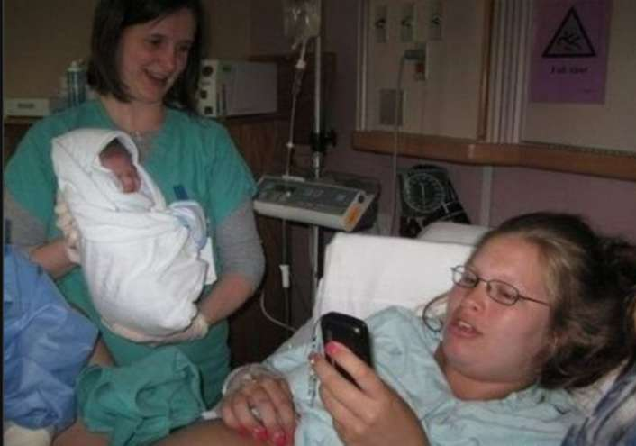
Haggai
Priorities
Dr. Rick Griffith • Jordan Evangelical Theological Seminary • BibleStudyDownloads.org

Slide 2
Key Word
640
343
Priorities
Haggai
Notes:
----- Meeting Notes (24/10/17 15:46) -----
Do people live by their priorities?
Yes or no? Why?
The answer has to be YES. Everyone lives by their priorities. The real issue is whether they have the right priorities! What they prioritize reveals it to be their priority.

Slide 3
Theme
640
Drought for Neglecting
Temple Rebuilding
Haggai

Slide 4
Key Verse
640
(God to Judah) "'You expected much, but see, it turned out to be little. What you brought home, I blew away. Why?' declares the LORD Almighty. 'Because of my house, which remains a ruin, while each of you is busy with his own house'"
(1:9).
Haggai

Slide 5

Kingdom Statement
343
Judah must get the right priorities (1:9) for blessing in the Messiah's kingdom.
Haggai

Slide 6

Summary Statement
640
346
The remnant must correct its wrong priorities judged in a drought and rebuild the temple that God might bless the nation with crops and Zerubbabel with authority, foreshadowing Messiah's authority in the kingdom.
Haggai

Slide 7

Covenant
347e
The promise of God's Spirit with the people fulfills his covenant promise at the Exodus (2:4-5) and is also part of the new covenant (cf. Ezek. 36:27).
Haggai

Slide 8

Redemption
347e
Redemption and prosperity of the land was withheld (1:5-6, 10–11; 2:19) due to the people's lack of faith (1:7-9), but blessing will follow under Messiah's reign (2:19b-23).
Haggai

Slide 9

Messiah
347e
The Lord Jesus is likely the "desired of all nations" (2:7) who will bring greater glory to the temple (2:9) and will arrive after judging the world (2:6), then he will reign as a descendant of Zerubbabel (2:23).
Haggai

Slide 10

Drought for Neglecting Temple Rebuilding
640
Drought for Neglected Temple Rebuilding
Temple |  | Blessings
Wrong Priorities | Greater Glory | Drought Judgment | Zerubbabel's Authority
1 | 2:1-9 | 2:10-19 | 2:20-23
Rebuke #1 | Promise #1 | Rebuke #2 | Promise #2
"Is it a time for you… to be living in your panelled houses, while this house remains in ruins? …Go… and build the house" (1:4, 8a) | "I will fill this house with glory… The glory of this present house will be greater than the glory of the former house" (2:7b, 9a) | "Whatever [my people] do and whatever they offer is defiled… [yet] from this day on I will bless you" (2:14b, 19b) | "I will shake the heavens and the earth. I will overturn royal thrones and shatter the power of the foreign kingdoms" (2:21-22)
Present | Kingdom | Present | Kingdom
Drought | Sadness | Food Shortage | Leadership
August 29, 520 BC | October 17, 520 BC | December 18, 520 BC | December 18, 520 BC
Jerusalem
Haggai

Slide 11
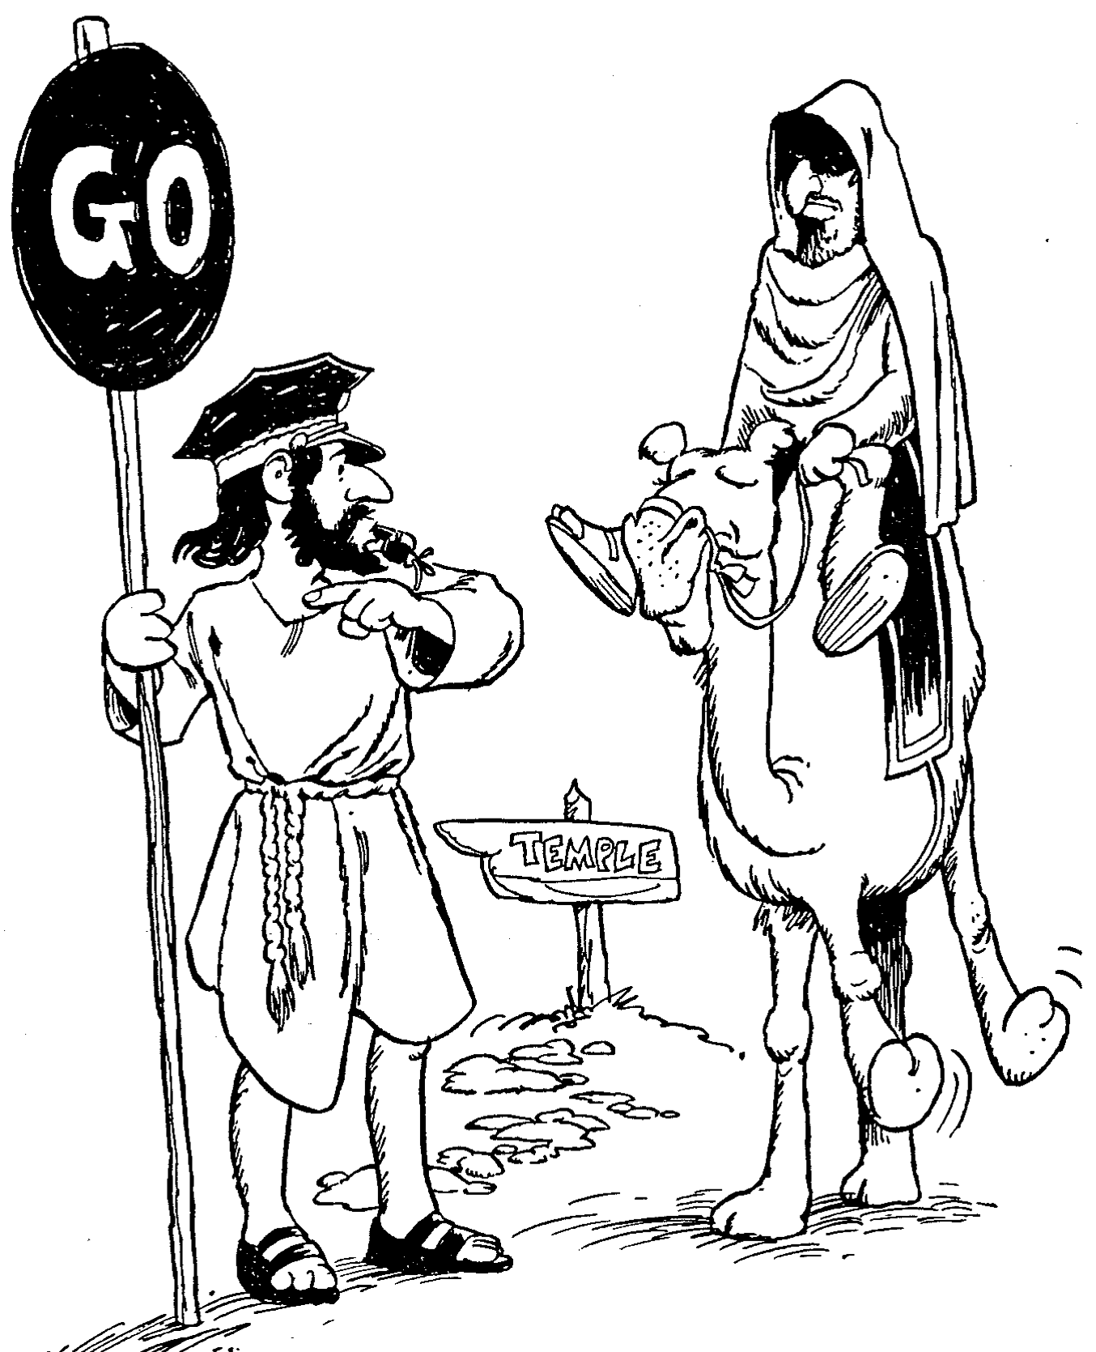
Barry Huddleston, The Acrostic Summarized Bible (Grand Rapids: Baker, 1992)
Haggai
1 God’s temple needs building
2 Older temple less glorious

Slide 12
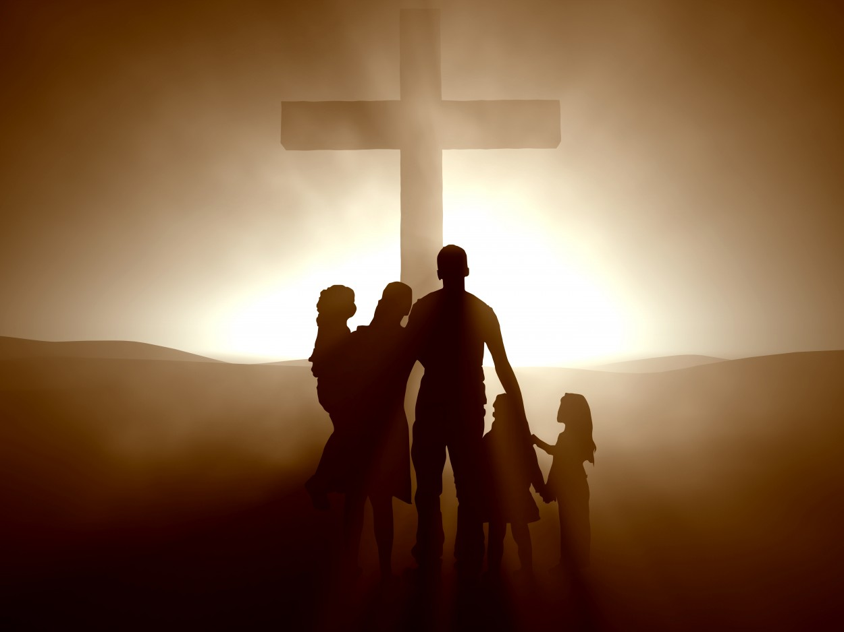
Be Restored
Haggai
Dr. Rick Griffith, Crossroads International Church Singapore
BibleStudyDownloads.org

Slide 13

How can you restore God's
BLESSING when you only see his discipline?
Haggai
Notes:
This short book will show how you can restore God’s blessing when you only see his discipline. The first thing you need to do is to…

Slide 14
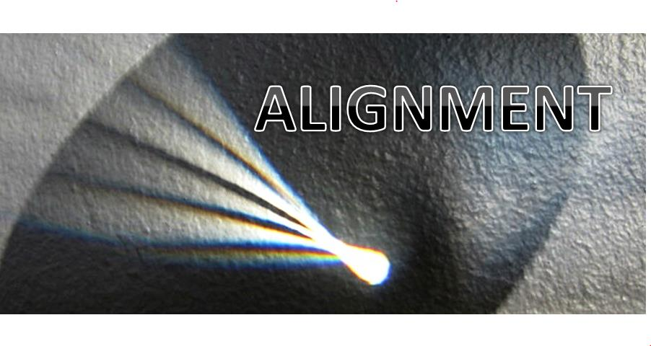
Main Idea
ALIGNMENT
Align with God's priorities.
Haggai
Notes:
God will restore you when you value what he values.

Slide 15
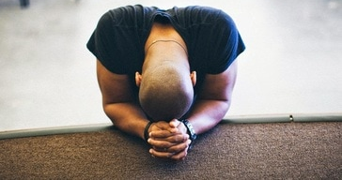
1. Realign your priorities.
been hurt — be restored
RESTORATION
Haggai 1
Notes:
Seeking your own comforts first invites the LORD's reproof.

Slide 16

2. Recall God's presence.
Haggai 2:1-9
Notes:
If you have trusted Christ, the LORD guarantees that he is with you—so don't forget that.

Slide 17

3. Renew your worship.
Haggai 2:10-19
Notes:
Recommit yourself to give glory to God alone.

Slide 18

4. Re-envision God's kingdom.
Haggai 2:20-23
Notes:
Focus again on the fantastic future the LORD has for you.

Slide 19
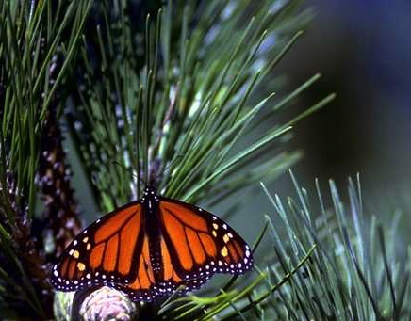
Eternal Priorities
God
God's Word
Souls of People
Notes:
• Which matters more? God or Money?
Do you give proportionally to God’s supply?
Do you incur credit card debt so you can live above your means?
Don’t pursue personal prosperity more than you pursue God’s work.
Honestly, which is more important to you—God? or money?
• God’s Word
How is your Bible reading?
What is your goal in God’s Word? Have you committed to reading a chapter a day? Have you committed to reading a verse a day? If you don’t have a target, you are sure to miss it.
• Souls of People
Are you committed to getting to minister to God’s people here at this church? How?
How much are you praying for the lost?
_______________
OS-00-OT Book Overviews-740
OS-35-Haggai-19

Slide 20
Black

Slide 21
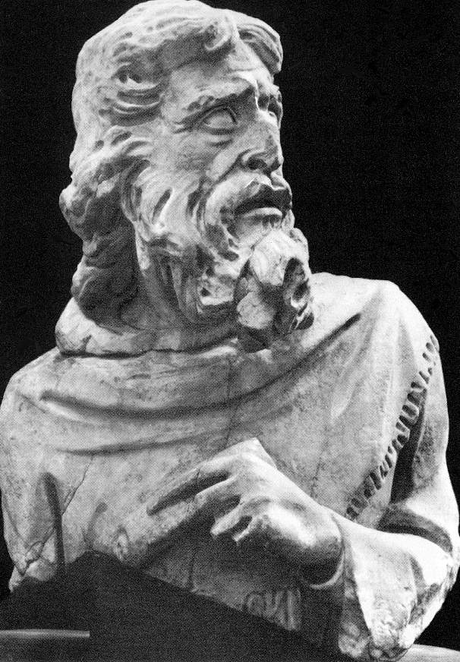
Arguments Against Haggai as Author:
641
Most OT prophetic books collect prophetical utterances, but Haggai reports on the prophet's utterances and how they affect the hearers.
The title "the prophet" is added to the name Haggai (1:1, 3, 12; 2:10).
The book of Haggai often addresses Haggai in the third person.

Slide 22
Arguments For Haggai as Author:
641
Haggai is known only from this book and two cross references to him by Ezra (5:1; 6:14).
Authors often used the third person in ancient writings (e.g., Moses, Jonah, etc.).
Haggai's name appears nine times (1:1, 3, 12-13; 2:1, 10, 13-14, 20).

Slide 23
Conclusions About Authorship
641
Objections to Haggai's authorship are suggestive but not conclusive. Haggai could have purposely presented himself in an objective manner, such as with the title "prophet" or by referring to himself in the third person.
Even if Haggai was not the author, scholars agree that the "author/editor" wrote shortly after the death of the prophet.

Slide 24


The Postexilic Era
295
296
560
The Postexilic Era
Temple work
Prophets:
Haggai
Zechariah
Malachi
605
586
539
536
520
516
483-473
444-425
72 years
Others:
Zerubbabel
Esther
Ezra
Nehemiah
Persian Kings:
Cyrus
Darius
Xerxes
Artaxerxes
Notes:
The Post-Exilic Era involved three separate periods:
(1) Temple rebuilding led by Zerubbabel, Haggai, and Zechariah in two parts under Cyrus and Darius,
(2) The saving of the nation from destruction by Esther about 30 years later under Xerxes, and
(3) The restoration of Jerusalem’s walls and gates by Nehemiah another 72 years after that under Artaxerxes.
_________
Common-321
BE-37-Haggai-15
BE-39-Malachi-21
OS-12-Kings & Prophets Charts-24
OS-15-Ezra-36
OS-16-Nehemiah-94, 156
OS-17-Esther-16, 75
OS-26-Ezek33-39—slide 85
OS-27-Daniel-340
OS-37-Haggai-25, 43
OS-38-Zechariah-46, 121
OS-39-Malachi-13, 56

Slide 25
The Postexilic Period

Slide 26
JUDAH IS PRESERVED!
Isaiah 9:6-7
DRESSING
THE
STAGE
Summing up…
MS
N(A)
H
SG
C
ER
B
J
MN
DS
E
KB
WHY?
U
MS
Because Messiah was long prophesied to appear through the tribe of Judah.
PG
RS
Handbook pg. 37-38
57
8
Notes:
Summing up this time of ROYALTY…
Remember again that crucial difference when the NORTHERN and the SOUTHERN Kingdoms fell. Recall that
//// the NORTHERN Kingdom, Israel, is attacked by Assyria,
//// taken away into captivity and , through time,
//// absorbed into other societies.
But JUDAH, the SOUTHERN KINGDOM and its people…
//// conquered by Babylon under Nebuchadnezzar…
//// is taken over to Babylon for a TEMPORARY captivity. But Judah is destined to continue to play center stage in the long future history of THE LAND.
//// JUDAH IS PRESERVED and eventually returned to The Land.
////` Why?
//// Because the expected Messiah...long prophesied...was destined by the Old Testament prophets to appear through the tribal line of JUDAH.

Slide 27
2 Kings 25:21
7
CAPTIVITY
The THIRD
of
THREE
SOCIETIES
is:
CAPTIVITY
A R C
Handbook pg. 37-38
58
Notes:
And here is CAPTIVITY's file folder from the Bible File sequence ready for the four items important to this period in the life of ancient Judah.

Slide 28

Daniel 1
The Ancient City of Babylon
CAPTIVITY
Euphrates River
Hanging Gardens of Babylon
Handbook pg. 37-38
59
Notes:
Babylon -- that enormous Oriental metropolis next to the Euphrates River -- is the site of JUDAH's 70 years of captivity, shown here in an artist re-creation of the possible appearance of that incredible city. The famed Hanging Gardens of Babylon -- visible on the right -- were among the Seven Wonders of that Ancient World.

Slide 29
7
CAPTIVITY
BABYLON
PERSIAN GULF
THE STAGE OF THE ACTION
Handbook pg. 37-38
60
Notes:
Remember, also, that Babylon -- located on your map many miles upstream from the Persian Gulf – was very near the heart of today's troubled Persian Gulf region in the Middle East.

Slide 30
Jer. 29:10; Ezra 3:8; Neh. 2:5-6
7
CAPTIVITY
70 YEARS
3 TREKS
A R C
CAPTIVITY
70 Years
3 Treks
"JEWS"
"SYNAGOGUE"
Handbook pg. 37-38
61
3
Notes:
After the 70 years of Judah's exile, the Babylonian rulers allowed the captives from the SOUTHERN KINGDOM OF JUDAH to return to Jerusalem, and to rebuild their city, its walls and their Temple.
//// And it was during this time of the Babylonian Exile that the people of JUDAH came to be called Jews -- from the tribal name of JUDAH.
//// The worldwide Jewish tradition of the synagogue was also born in Babylon during Judah's Captivity or Exile.
//// The Return to The Land took place in 3 massive treks. These were difficult trips on foot from Babylon back to the Land.

Slide 31
Returns from Exile
John H. Walton, Chronological and Background Charts of the Old Testament, 35 &
John A. Martin, "Ezra," in The Bible Knowledge Commentary, 1:652, adapted
295
RETURN
FIRST
SECOND
THIRD
Reference
Ezra 1–6
Ezra 7–10
Nehemiah 1–13
Date
538 BC
458 BC
444 BC
Leaders
Sheshbazzar
Zerubbabel
Jeshua
Ezra
Nehemiah
Persian King
Cyrus
Artaxerxes
Longimanus
Artaxerxes Longimanus
Elements
Of the
Decree
As many as wished to could return.
Temple could be rebuilt, partially financed by royal treasury.
Vessels returned.
As many as wished to could return.
Finances provided by royal treasury.
Allowed to have own civil magistrates.
Allowed to rebuild the wall

Slide 32
Returns from Exile
John H. Walton, Chronological and Background Charts of the Old Testament, 35 &
John A. Martin, "Ezra," in The Bible Knowledge Commentary, 1:652, adapted
Returns from Exile
295
RETURN
FIRST
SECOND
THIRD
Number
Returning
42,360
7,337 (servants)
49,697
1,500 men
38 Levites
220 helpers
1,758 + 5000?
Unknown
Events & Problems
Temple begun; sacrifices made & Feast of Tabernacles celebrated.
Samaritans made trouble, & work ceased until 520.
Temple completed in 516.
Problems with
intermarriage
Wall rebuilt in 52 days, despite opposition from Sanballat, Tobiah, & Geshem.
Walls dedicated & Law read.

Slide 33
Be Restored
Book of Haggai
Dr. Rick Griffith, Crossroads International Church Singapore
BibleStudyDownloads.org

Slide 34
Sometimes things don't go our way even when we follow God's leading.
Notes:
You moved to Singapore because God clearly called you.
He made that abundantly evident that you—not someone else more qualified—got the privilege. So you obeyed and came.
But then you discovered that this place is far more expensive than anyone ever let on. It’s also hotter—and wetter. And the relationships that started sweet began to sour, and here you are. Things are hard.
Is God trying to get your attention?
Perhaps you didn’t choose to move here at all. You got a special blessing. You were born here.
But the LORD gave you an opportunity to serve elsewhere for a while. It changed you for the better.
But now you’re back and this country doesn’t seem so special. You find yourself more able to relate to foreigners than to your own people. Believe me, I understand. When return to my country of origin, I don’t fit there. I wonder if I fit anywhere. Is God disciplining me?

Slide 35
Is God trying to get your attention despite the sacrifices you've made for him?
Notes:
You have been faithful to him, as far as you know. You have obeyed.
You weren’t so thrilled to come to a church with an afternoon service that stole your Sunday nap, but you still come.
But things aren’t going so well at home, or work, or with friends, or with someone special to you.
“What’s happening to me?” you ask. “Is God speaking to me through difficulty? What’s he trying to say? What do I do?”

Slide 36
How can you restore God's
BLESSING when you only see his discipline?

Slide 37
Background
Notes:
You aren’t the first one that’s needed to be restored. In today’s text, Judah had faithfully returned to their homeland but the people were still not seeing his full blessing.

Slide 38

MINOR PROPHETS
with a
MAJOR MESSAGE
Notes:
The historical context is a mixed bag.
We’ve been in this series on the Minor Prophets lately.

Slide 39
OT Overall Timeline
h
Haggai
520
United Kingdom
1050-930
Divided Kingdom
930-722
Solitary Kingdom
722-586
Post- Exile
536-425
1100
1050
1000
950
900
850
800
7 5 0
7 0 0
650
600
550
500
450
Exile 586-536
Notes:
These prophets stretch nearly the entirety of Israel’s history. Most were ignored, from the United Kingdom Golden Age under David and Solomon, then ignored after the nation divided, then ignored when Judah was the Solitary kingdom.

Slide 40
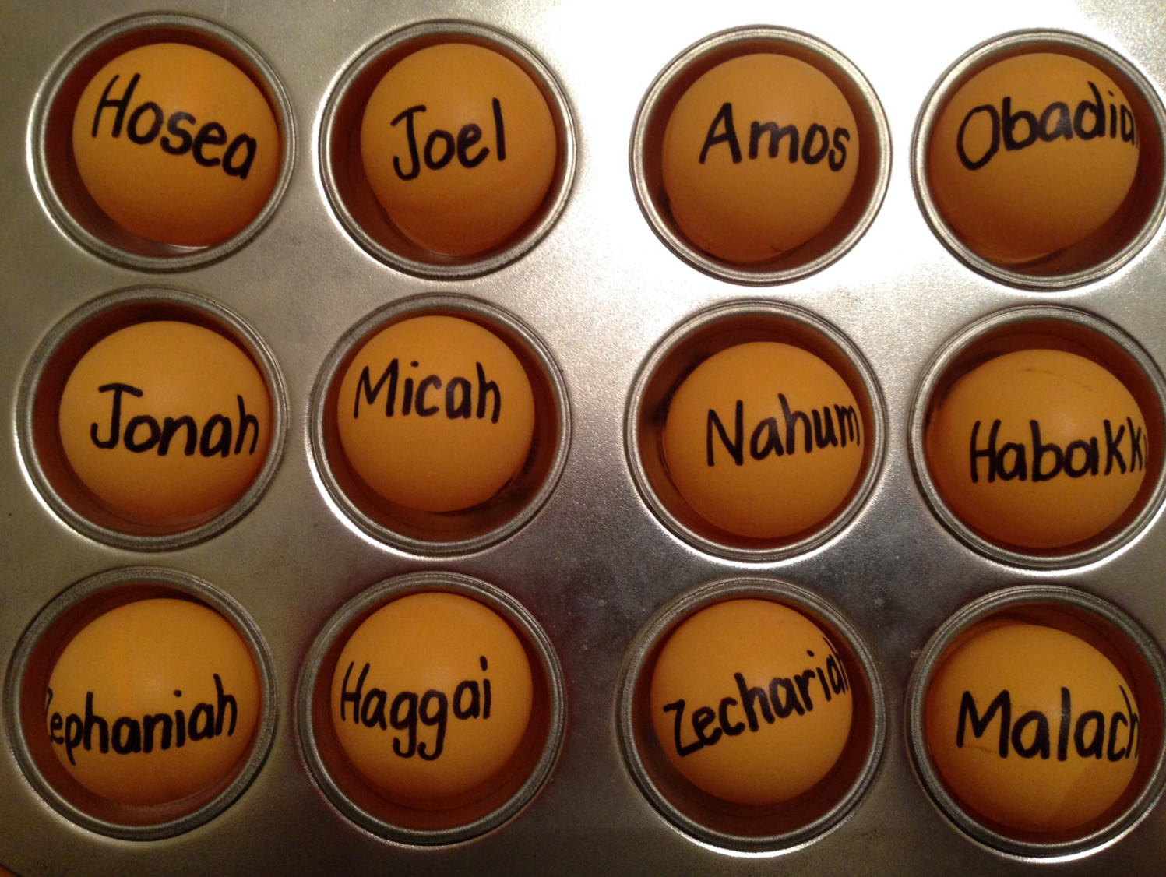
Be...
Loyal
Disciplined
Just
Humble
Caring
Generous
Patient
Amazed
Hopeful
Restored
Notes:
Their ancestors had not heeded the nine prophets we have already studied. Through varying prophets, God had told them to be…humble, caring, etc. Yet they stubbornly worshipped idols and God, faithful to his warning, sent them away to Babylon in modern-day Iraq.

Slide 41
Two 70-Year Exiles
560
People Exile
605
586
539
536
516
Temple Exile
"This entire land will become a desolate wasteland. Israel and her neighboring lands will serve the king of Babylon for seventy years. ¹²Then, after the seventy years of captivity are over, I will punish the king of Babylon and his people for their sins," says the Lord. I will make the country of the Babylonians a wasteland forever"
(Jer. 25:11-12).
Notes:
Jeremiah does not tell us the exact years that begin and end the 70-year exile.
But we can actually determine this in two ways—either the exile of the people beginning with Daniel’s deportation (605) to the people fully returning in 536, or the exile of the temple from its destruction in 586 to its rebuilding in 516.
_____________________
OS-00-OT Book Overviews-294
OS-12-Kings & Prophets Charts-26
OS-12-2Kings-287
OS-14-2Chron-287
OS-15-Ezra-14
OS-24-Jeremiah-53, 139
OS-27-Daniel-94, 284, 340
OS-37-Haggai-32

Slide 42
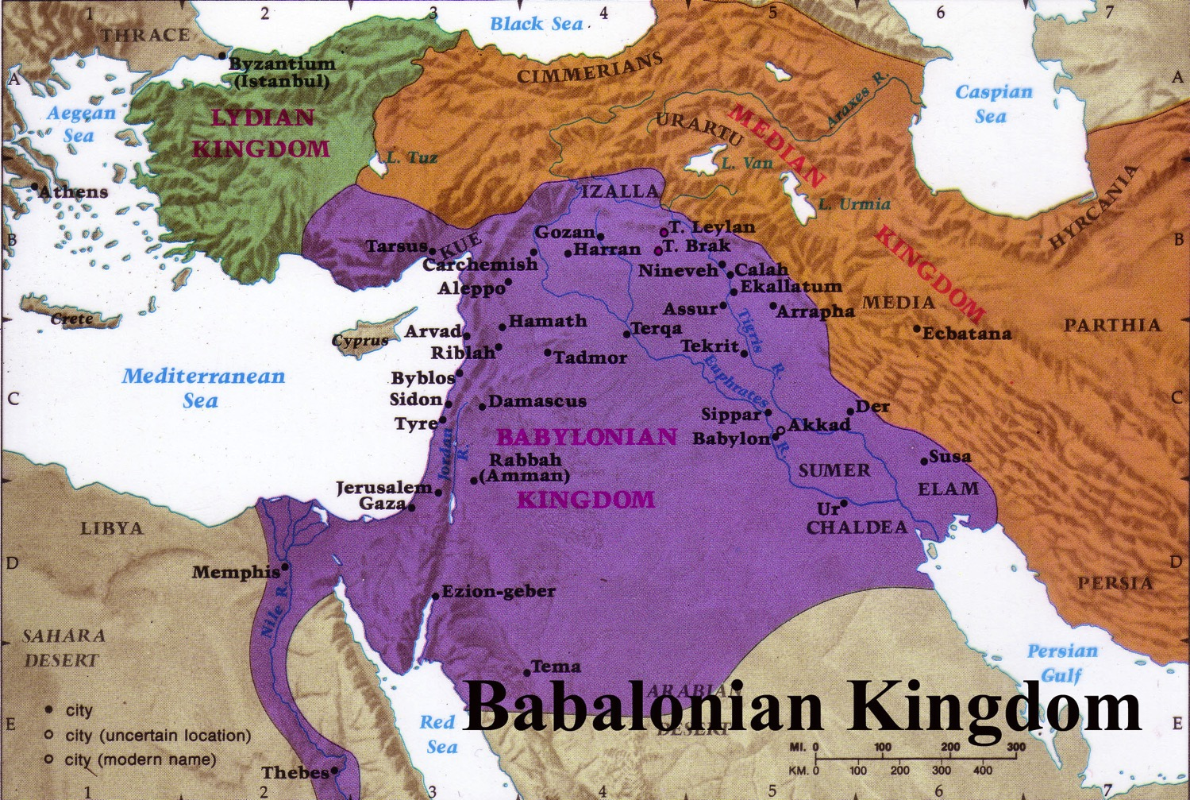
Exile Deportations & Developments
641
Deportations
Developments
Separation
Synagogue
No more idolatry
Even though they had synagogues, Jews still wanted to restore the Jerusalem temple
Exiles led by Zerubbabel returned to the land of Judah after the decree of the Persian emperor Cyrus in 539 BC. The returned exiles started the reconstruction of the temple by laying its foundation (Ezra 5:16).
Notes:
In some sense, you can’t blame them. They had separated from idolatry, developed the synagogue, and been cured of idolatry. Besides these, they were making good money in Babylon—so who would want to return to a ruined country? No money, no homes, no friends—just enemies occupying their country now. But they still came, and they trusted God’s leading. They eagerly rebuilt the temple foundation and altar in 536 BC.

Slide 43
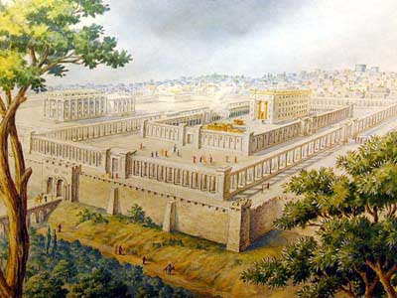
Opposition to Rebuilding
641
External
Notes:
However, opposition struck externally from pagans left in the land as recorded in Ezra 4.

Slide 44
The Context:
Opposition to Temple Rebuilding
536 BC: As soon as the copy of the letter of King Artaxerxes was read to Rehum and Shimshai the secretary and their associates, they went immediately to the Jews in Jerusalem and compelled them by force to stop. Thus the work on the house of God in Jerusalem came to a standstill until the second year of the reign of Darius king of Persia [520 BC].
Ezra 4:23-24 (NIV)

Slide 45
Opposition to Rebuilding
641
Internal
Notes:
Next week we will see the external threats in the book of Zechariah, but today we address the internal problems within the community itself. Often our most severe problems lie within our own midst!
These issues had already stopped the temple project for 16 years. They had started well, but made excuses and forgot God.
God hadn’t forgotten them though. He finally speaks in his land

Slide 46

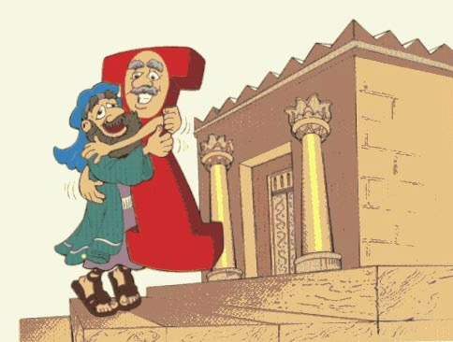
Hug-I
"Temple"
Haggai
Walk Through The Bible ©1989

Slide 47
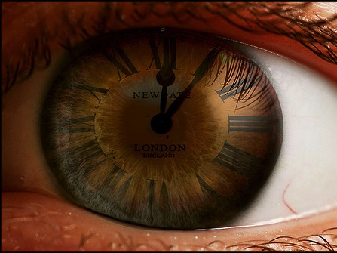
Date
641
Haggai is the most precisely dated book of the Bible, recording messages given between August and December in 520 BC

Slide 48
Dates in Haggai
Prophecy #1
Rebuilding Resumes
Prophecy #2
Prophecies #3-4
8/29
1:1
9/21
1:15
10/17
2:1
12/18
2:10, 18, 20
Aug
Sep
Oct
Nov
Dec
520 B.C.

Slide 49
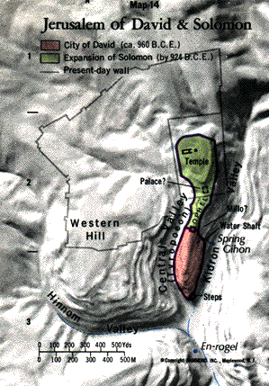
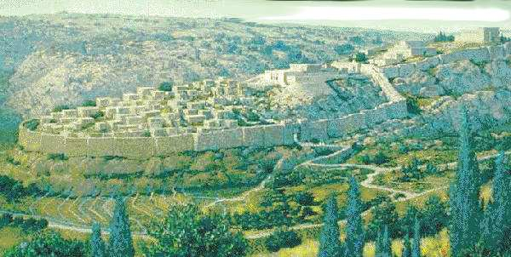
Location of Temple Mount

Slide 50
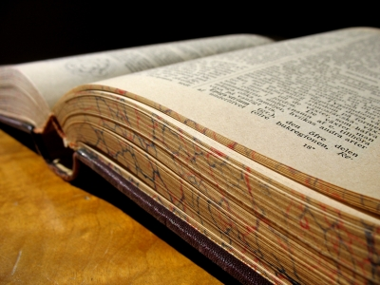
Literary Structure
642
The book contains four oracles.
Each oracle has the same structure:
Date
Divine messenger formula: "thus says the Lord of hosts"
Content of the prophecy

Slide 51
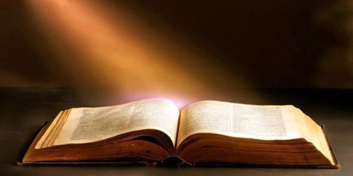
"On August 29 of the second year of King Darius's reign, the LORD gave a message through the prophet Haggai to Zerubbabel son of Shealtiel, governor of Judah, and to Jeshua son of Jehozadak, the high priest" (Haggai 1:1 NLT).
Notes:
The word came to the governor.

Slide 52

The Postexilic Era
295-296
The Postexilic Era
Temple work
Prophets:
Haggai
Zechariah
605
586
539
536
520
516
Others:
Zerubbabel
Persian Kings:
Cyrus
Darius
Notes:
The temple work resumed in King Darius’s second year, in 520 BC (Haggai 1:1)
The Post-Exilic Era involved three separate periods:
(1) Temple rebuilding led by Zerubbabel, Haggai, and Zechariah in two parts under Cyrus and Darius,
(2) The saving of the nation from destruction by Esther about 30 years later under Xerxes, and
(3) The restoration of Jerusalem’s walls and gates by Nehemiah another 72 years after that under Artaxerxes.
_________
Common-321
BE-37-Haggai-15
BE-39-Malachi-21
OS-12-Kings & Prophets Charts-24
OS-15-Ezra-36
OS-16-Nehemiah-94, 156
OS-17-Esther-16, 75
OS-26-Ezek33-39—slide 85
OS-27-Daniel-340
OS-37-Haggai-25, 43
OS-38-Zechariah-46, 121
OS-39-Malachi-13, 56

Slide 53
Prophecy #1: God Speaks Regarding Temple Neglect
8/29
1:1
Aug
Sep
Oct
Nov
Dec
520 B.C.
Notes:
It was the first of four messages through Haggai that year.

Slide 54
Placing the Prophets
Placing the Prophets
342
Key Dates
931
Obadiah
722
Jonah
Amos
Hosea
Isaiah
Micah
Nahum
Zephaniah
Jeremiah
Lamentations
Joel
Daniel
Haggai
Habakkuk
Ezekiel
586
Notes:
This book interrupts the 50+ silent years of prophets in Judah while the people were exiled to Babylon. God was ready to tell them how to restore his blessing. Would they listen?
They had come back to the land, but they had not fully come back to the LORD of the land.

Slide 55

Would they listen?
God speaks today too.
Are we listening?
Notes:
The context may sound familiar since our faithfulness often is also a mixed bag.
Our salvation begins when we believe the simple message of trust in Christ instead of trusting ourselves. The people of Judah had that kind of faith—placed their trust in YHWH instead of the worthless gods of the pagans.
However, that was but a start for them, as it is for us. God has so much more in store for us, so Haggai shows how to realign with his priorities for blessing.

Slide 56

Parallel Structure
642
The oracles have two parallel structures: the first and third focus on accusation, while the second and fourth focus on God's assurance:
Oracle 1 Accusation (1:1-15)
Oracle 2 Assurance (2:1-9)
Oracle 3 Accusation (2:10-19)
Oracle 4 Assurance (2:20-23)
Notes:
Haggai alternates from rebuke to promise to rebuke to promise in a four-fold pattern restore his blessing. That makes four ways to restore God’s blessing.

Slide 57
Drought for Neglecting Temple Rebuilding
640
Drought for Neglected Temple Rebuilding
Temple |  | Blessings
Wrong Priorities | Greater Glory | Drought Judgment | Zerubbabel's Authority
1 | 2:1-9 | 2:10-19 | 2:20-23
Rebuke #1 | Promise #1 | Rebuke #2 | Promise #2
"Is it a time for you… to be living in your panelled houses, while this house remains in ruins? …Go… and build the house" (1:4, 8a) | "I will fill this house with glory…The glory of this present house will be greater than the glory of the former house" (2:7b, 9a) | "Whatever [my people] do and whatever they offer is defiled… [yet] from this day on I will bless you" (2:14b, 19b) | "I will shake the heavens and the earth. I will overturn royal thrones and shatter the power of the foreign kingdoms" (2:21-22)
Present | Kingdom | Present | Kingdom
Drought | Sadness | Food Shortage | Leadership
August 29, 520 BC | October 17, 520 BC | December 18, 520 BC | December 18, 520 BC
Jerusalem
Notes:
Today we’ll study the entire prophecy of Haggai.

Slide 58
Slides on
Haggai 1

Slide 59
How can you restore God's
BLESSING when you only see his discipline?
Haggai
Notes:
This short book will show how you can restore God’s blessing when you only see his discipline. The first thing you need to do is to…

Slide 60
1. Realign your priorities.
been hurt — be restored
RESTORATION
Haggai 1
Notes:
Seeking your own comforts first invites the LORD's reproof.

Slide 61
Haggai Chart
Admonition 1:1-15
Haggai
Rebuke 1-11
Building
520 B. C.
First things first

Slide 62
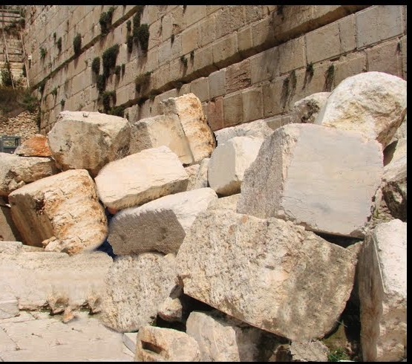
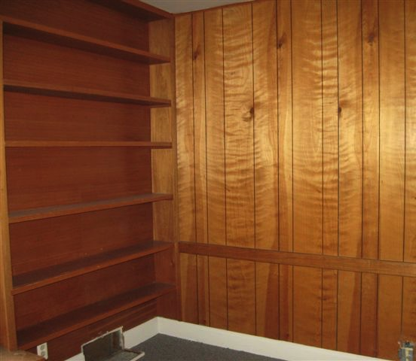
Oracle 1: Accusation
642
"This is what the LORD of Heaven's Armies says: The people are saying, 'The time has not yet come to rebuild the house of the LORD'" (Haggai 1:2).
"Then the LORD sent this message through the prophet Haggai: ⁴'Why are you living in paneled houses while my house lies in ruins?'" (Haggai 1:3-4).

Slide 63

Jewish life revolved around Solomon's temple for 400 years (959-586 BC)
Judaism in Israel and the Diaspora

Slide 64
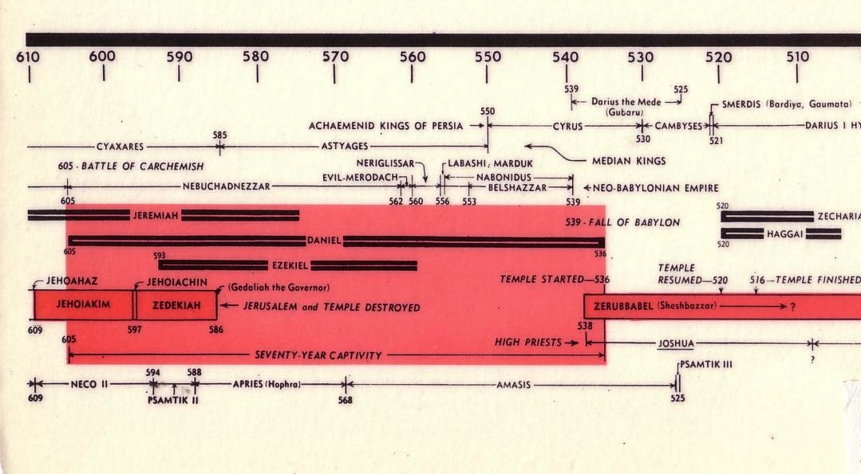
Chart of the Exile
232 & 342
The Babylonian Exile
John C. Whitcomb, 4th rev. ed., Winona Lake, IN: BMH Books, 1962, 1968

Slide 65

Jews Maintained Holiness at the Basin
Temple Destroyed!

Slide 66
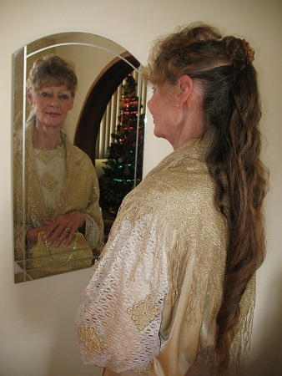
The Problem in Haggai's Day…
641
Due to opposition from nearby enemies, the temple was never finished. For 16 years the priority of building God's temple had gradually diminished.
Although some returning Jews may have been poor, some still had some level of affluence. People had paneled their private homes like Solomon had done in the temple and palace (Hag. 1:4; cf. 1 Kings 6:9; 7:3,7).

Slide 67
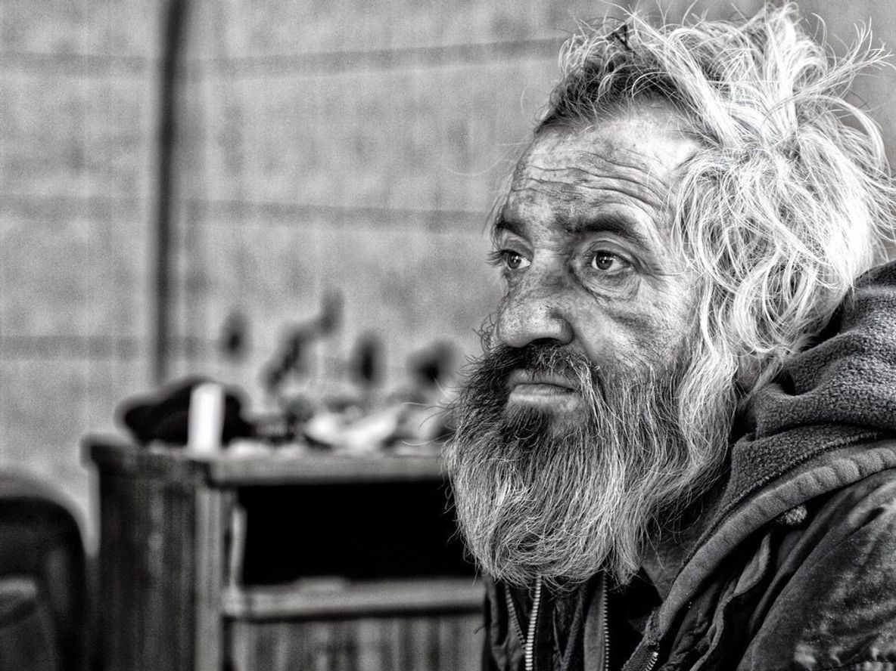
"This is what the LORD of Heaven's Armies says: Look at what's happening to you! ⁶ You have planted much but harvest little. You eat but are not satisfied. You drink but are still thirsty. You put on clothes but cannot keep warm. Your wages disappear as though you were putting them in pockets filled with holes!" (Haggai 1:5-6 NLT).
Notes:
The remnant’s wrong priorities by paneling their own houses instead of rebuilding the temple resulted in a dire economy (1:2-6).

Slide 68

"This is what the LORD of Heaven's Armies says: Look at what's happening to you! ⁸Now go up into the hills, bring down timber, and rebuild my house. Then I will take pleasure in it and be honored, says the LORD" (Haggai 1:7-8 NLT).
Notes:
The people’s financial poverty was shown to be from postponing the temple rebuilding so that they would resume the task to please God and eliminate the drought (1:7-11).

Slide 69
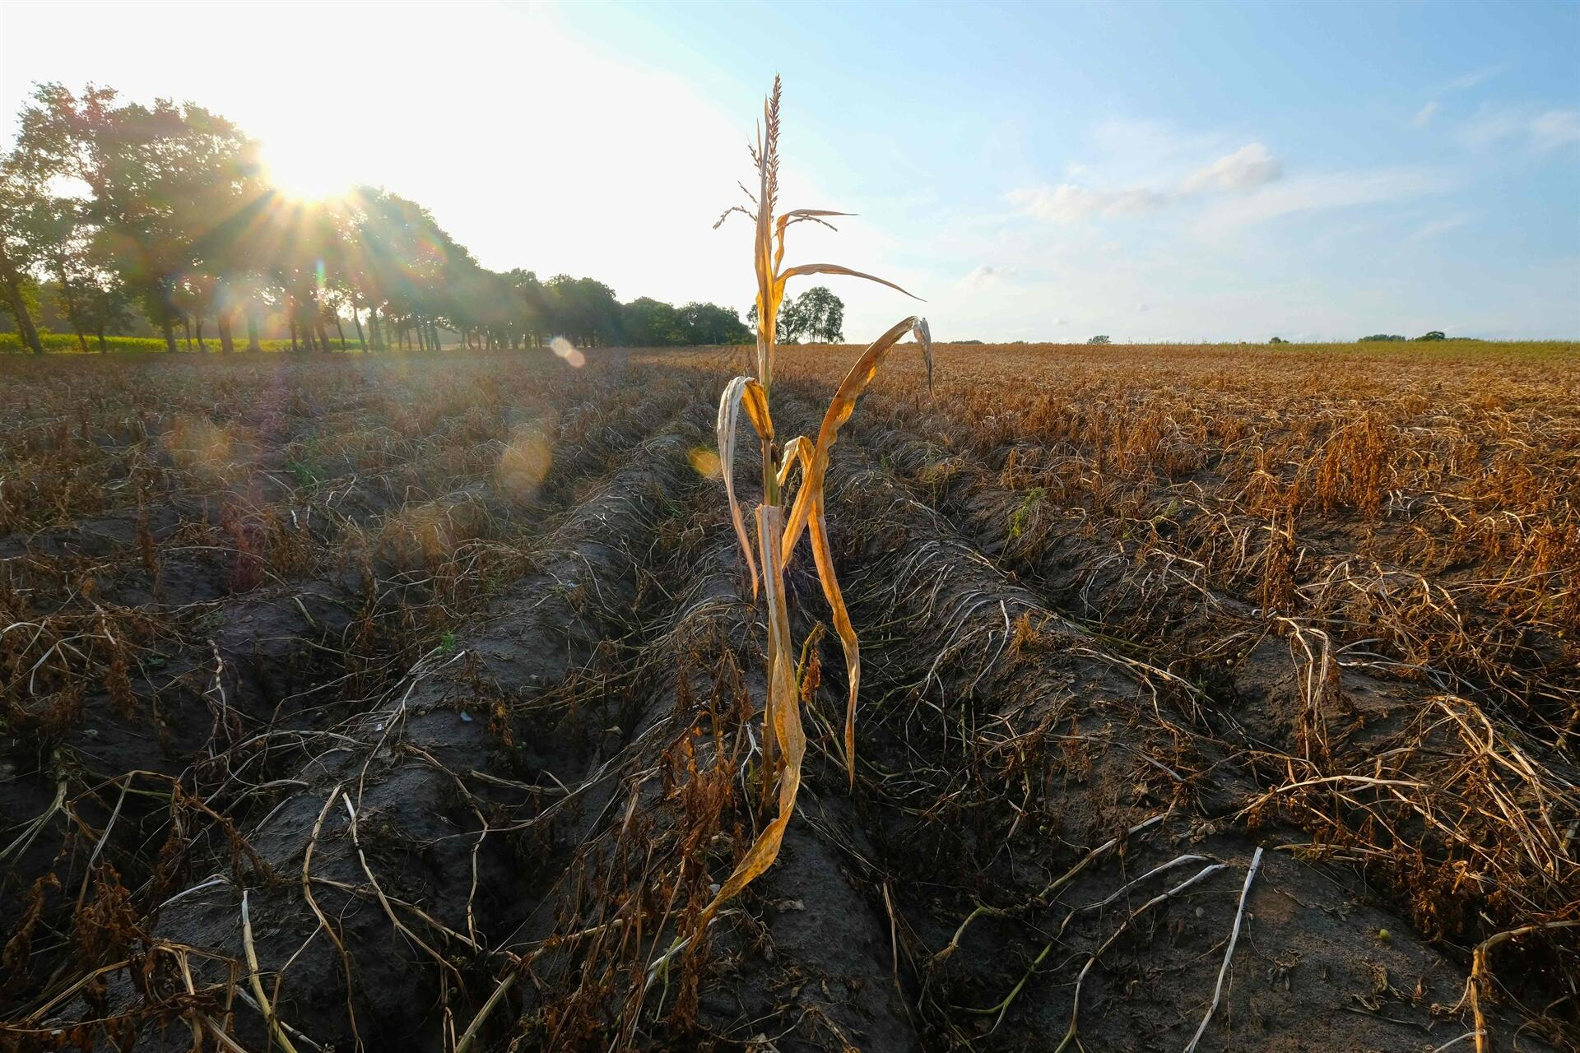
"You hoped for rich harvests, but they were poor. And when you brought your harvest home, I blew it away. Why? Because my house lies in ruins, says the LORD of Heaven's Armies, while all of you are busy building your own fine houses"
(Haggai 1:9 NLT).
Notes:
The people’s financial poverty was shown to be from postponing the temple rebuilding so that they would resume the task to please God and eliminate the drought (1:7-11).

Slide 70
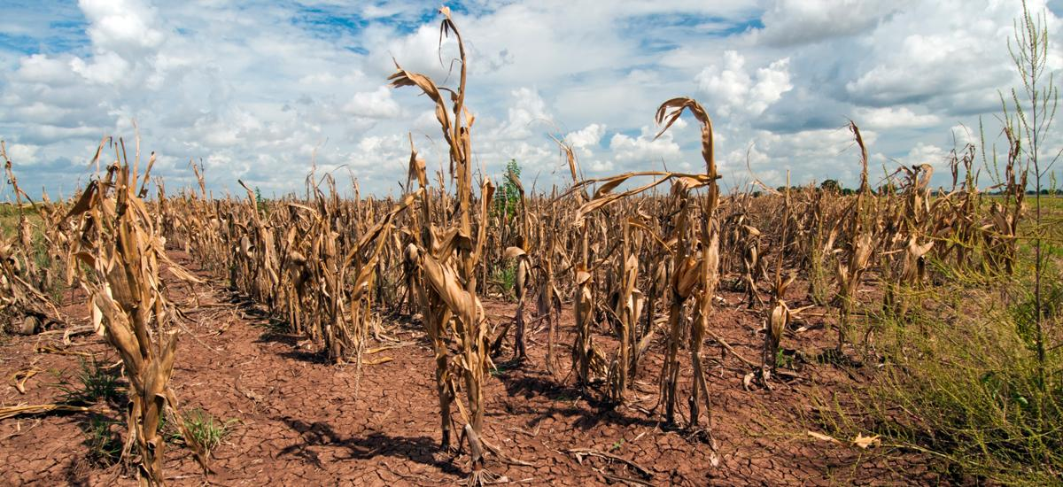
"It's because of you that the heavens withhold the dew and the earth produces no crops. ¹¹ I have called for a drought on your fields and hills—a drought to wither the grain and grapes and olive trees and all your other crops, a drought to starve you and your livestock and to ruin everything you have worked so hard to get" (Haggai 1:10-11 NLT).

Slide 71
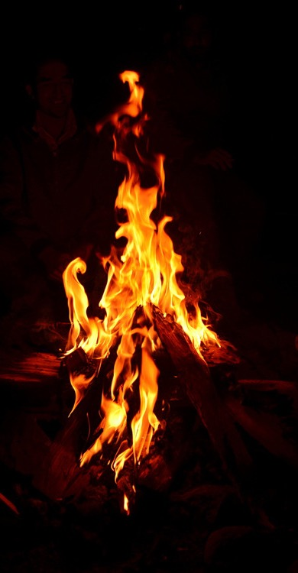
"Then Zerubbabel son of Shealtiel, and Jeshua son of Jehozadak, the high priest, and the whole remnant of God's people began to obey the message from the LORD their God. When they heard the words of the prophet Haggai, whom the LORD their God had sent, the people feared the LORD. ¹³Then Haggai, the LORD's messenger, gave the people this message from the LORD: 'I am with you, says the LORD!’”
(Haggai 1:12-13 NLT).

Slide 72
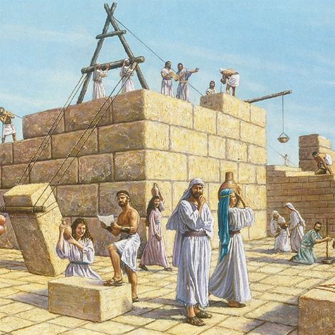
"So the LORD sparked the enthusiasm of Zerubbabel son of Shealtiel, governor of Judah, and the enthusiasm of Jeshua son of Jehozadak, the high priest, and the enthusiasm of the whole remnant of God's people. They began to work on the house of their God, the LORD of Heaven's Armies, ¹⁵on September 21 of the second year of King Darius's reign"
(Haggai 1:14-15 NLT).

Slide 73

Oracle 1: Accusation
642
Problem: wrong priorities (1:2-4)
Consequences: economic inflation and an unsatisfied life (1:5-7)
Command: rebuild the temple (1:8)
Diagnostic Comment (1:9-11)
Response: The leaders and peoples obeyed the voice of the LORD by working on the house of the LORD (1:12-15)

Slide 74
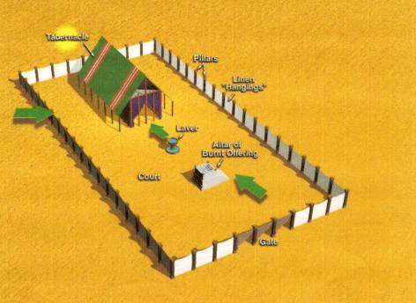
Tabernacle of Moses
Tabernacle
Pillars
Linen Hangings
Laver
Altar of Burnt Offering
Court
Gate

Slide 75
Temple Location

Slide 76
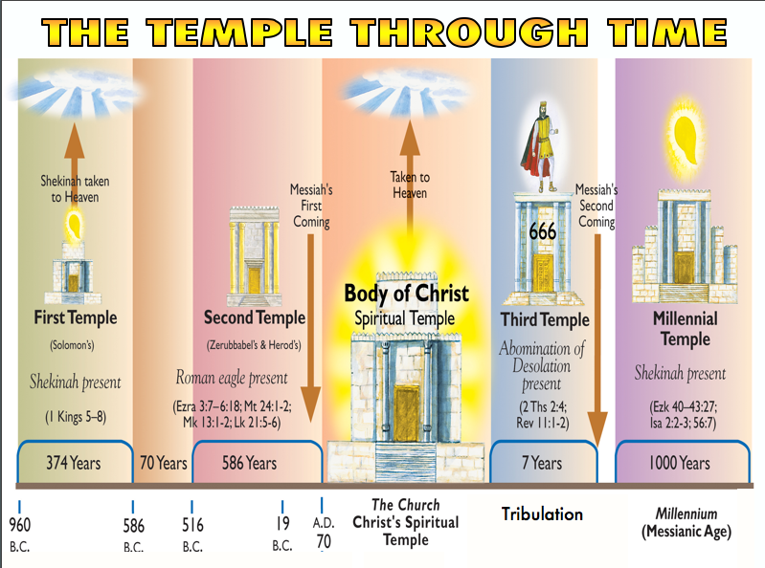
Notes:
The Temple has FIVE forms through time, the central one being the form of the Church (Ephesians 2:19-22).
_____________
OD-05-Matt_24v15_The_Temple_Desecration_(Randall_Price)-17
OS-37-Haggai-76

Slide 77
Temples in the Bible
 | Solomon | Zerubbabel/ Herod | Tribulation | Millennial
Temple Period | First | Second | Third | Fourth
Description | 1 Kings 6–7 | Ezra 3–6 | Rev. 11:1-2 | Ezek. 40–43
Haggai Texts | Haggai 2:3a, 9b | Haggai 1:4, 8-9; 2:3b | — | Haggai 2:7, 9a
Construction | 966-959 BC | 536-516 BC | Materials being gathered now | Still future
Desecrated by | Israelites and pagan kings | Antiochus, money changers, Pompey, Titus | Antichrist (Dan. 9:27) | No one (Zech. 14:20-21)
Destruction | 586 BC (2 Kings 25) | AD 70 (Matt. 24:1-3) | End of Great Tribulation? | Before new heavens and new earth (Rev. 21:22)
Longevity | 380 years | 606 years | Under 7 years? | 1000 years
Sacrifices | Before Christ | Before (approved) and after Christ (unapproved) | After Christ (unapproved) | After Christ (approved)
God's Glory | Filled it (1 Kings 8:10-11) | Didn't fill it | Won't fill it | Will fill it (Ezek. 43:1-5)
Sanctuary | 90' x 30' = 2,700 sq. ft. | ? | ? | 87.5' x 175' = 15,312 sq. ft.
Inner Court | 150' x 400' = 60,000 sq. ft. | ? | ? | 175' x 427.5' = 74,812.5 sq. ft.
Outer Court | 875' x 875' or six times larger! | ? | ? | 875' x 875' = 765,625 sq. ft.
644

Slide 78
Dates in Haggai
8/29
1:2
9/21
1:15
Aug
Sep
Oct
Nov
Dec
520 B.C.

Slide 79
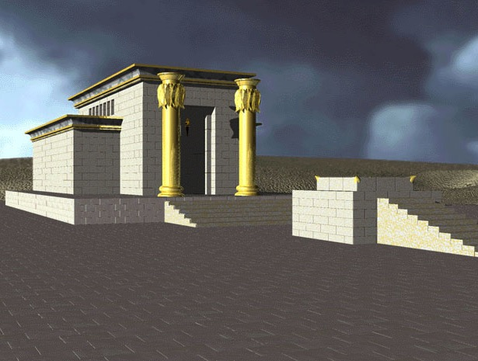
1st Temple - Solomon

Slide 80
They Began Rebuilding!
Admonition 1:1-15
Haggai
Response 12-15
Rebuke 1-11
Building
520 BC
First things first

Slide 81
Historical Parallel in Ezra
"Now Haggai the prophet and Zechariah the prophet, a descendant of Iddo, prophesied to the Jews in Judah and Jerusalem in the name of the God of Israel, who was over them. Then Zerubbabel son of Shealtiel and Jeshua son of Jozadak set to work to rebuild the house of God in Jerusalem. And the prophets of God were with them, helping them."
Ezra 5:1-2 (NIV)

Slide 82

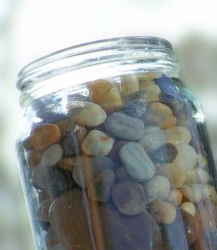
Oracle 1: Accusation
642
Notes:
The teacher pulled out a large jar and placed it on the table. He put several large rocks into the jar—then some smaller ones, then sand, then water to the brim.
"What's the lesson?" he asked the class.
One enterprising student answered, "No matter what you may think, you can always fit more in!"
"No," the professor responded. "You have to put the large rocks in first!"
Priorities are like that. If you don't put them first, they won't get done.
And if they don't get done, then they are not the priorities, are they?

Slide 83
See the invisible!
"So we fix our eyes
not on what is seen,
but on what is unseen.
For what is seen is temporary,
but what is unseen is eternal"
(2 Corinthians 4:18)

Slide 84

Money

Slide 85
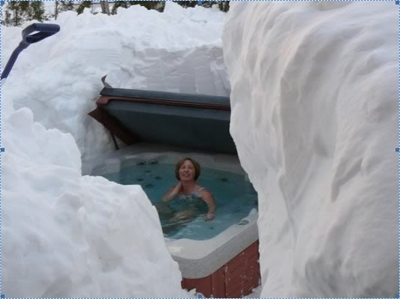
Key Word
640
343
Priorities
Haggai
Notes:
Soaking in the tub is obviously her priority! But you have to give someone credit for the great amount of effort to clear the snow.

Slide 86
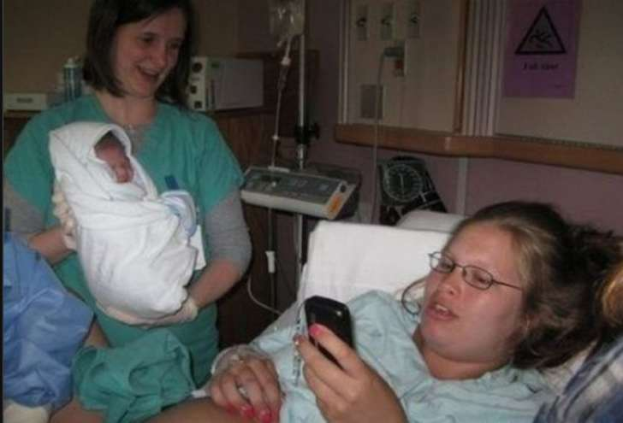
Key Word
640
343
Priorities
Haggai

Slide 87
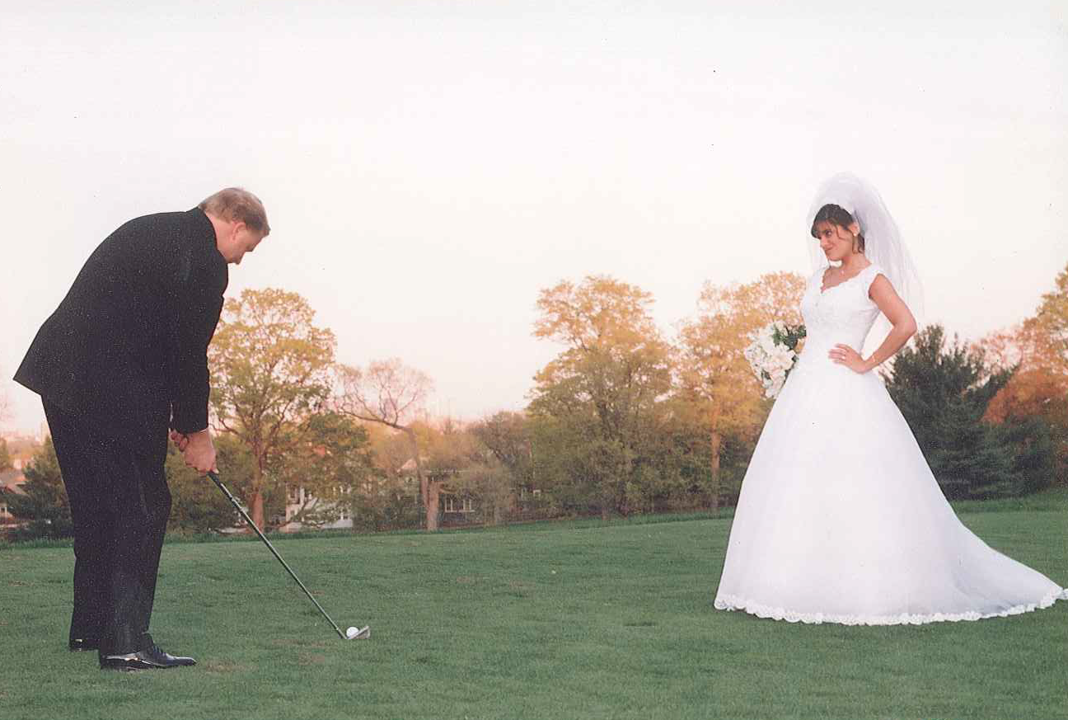
Key Word
640
343
Priorities
Haggai

Slide 88
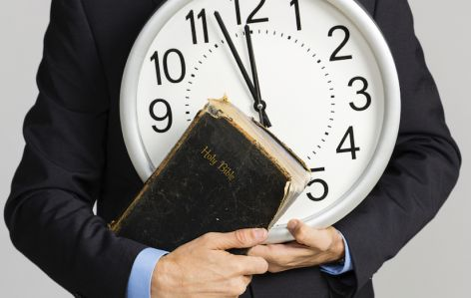
Prioritize Your Time

Slide 89
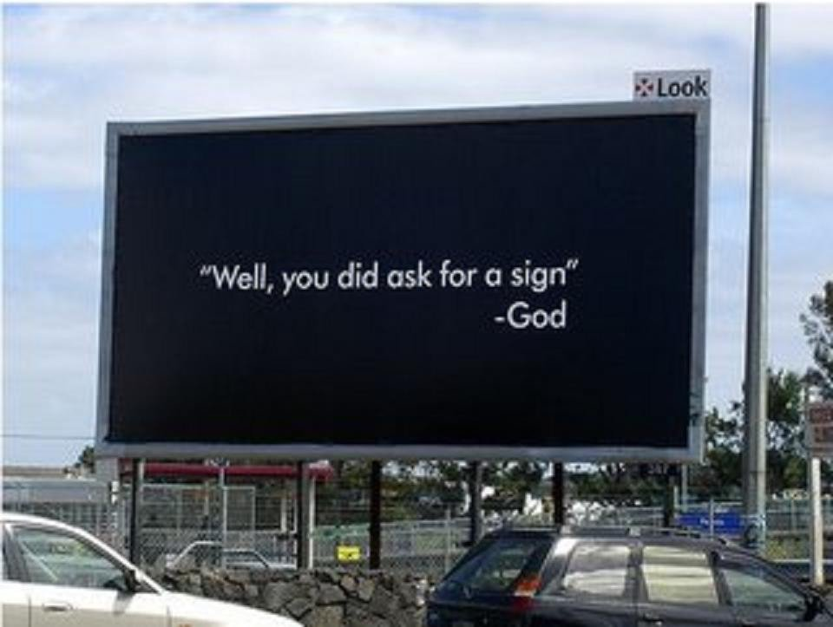
"Well, you did ask for a sign"
—God

Slide 90
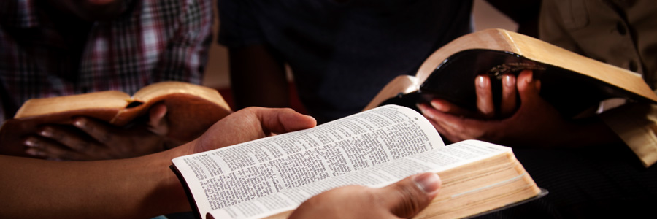
God still speaks. Read his words.

Slide 91

God still speaks when we are still.

Slide 92
How can you restore God's
BLESSING when you only see his discipline?
Haggai
Notes:
This short book will show how you can restore God’s blessing when you only see his discipline. The first thing you need to do is to…

Slide 93
1. Realign your priorities.
been hurt — be restored
RESTORATION
Haggai 1
Notes:
Seeking your own comforts first invites the LORD's reproof.

Slide 94
Slides on
Haggai 2

Slide 95
2. Recall God's presence.
Haggai 2:1-9
Notes:
If you have trusted Christ, the LORD guarantees that he is with you—so don't forget that.

Slide 96

"Then on October 17 of that same year, the LORD sent another message through the prophet Haggai. 'Say this to Zerubbabel son of Shealtiel, governor of Judah, and to Jeshua son of Jehozadak, the high priest, and to the remnant of God's people there in the land'"
(Haggai 2:1-2 NLT).

Slide 97
Dates in Haggai
8/29
1:1
9/21
1:15
10/17
2:1
Aug
Sep
Oct
Nov
Dec
520 B.C.

Slide 98
"'Does anyone remember this house—this Temple—in its former splendor? How, in comparison, does it look to you now? It must seem like nothing at all! ⁴But now the LORD says: Be strong, Zerubbabel. Be strong, Jeshua son of Jehozadak, the high priest. Be strong, all you people still left in the land. And now get to work, for I am with you, says the LORD of Heaven's Armies. ⁵My Spirit remains among you, just as I promised when you came out of Egypt. So do not be afraid'"
(Haggai 2:3-5 NLT).

Slide 99
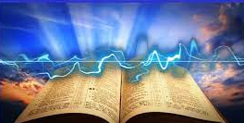
"For this is what the LORD of Heaven's Armies says: In just a little while I will again shake the heavens and the earth, the oceans and the dry land" (Haggai 2:6 NLT).

Slide 100

"I will shake all the nations, and the treasures of all the nations will be brought to this Temple. I will fill this place with glory, says the LORD of Heaven's Armies" (Haggai 2:7 NLT).
——————THE———————
MILLENNIAL TEMPLE

Slide 101
1st Temple - Solomon

Slide 102
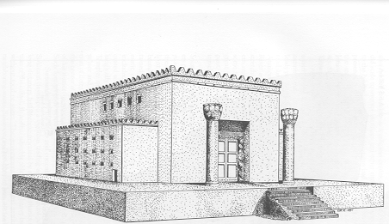
2nd Temple - Zerubbabel

Slide 103

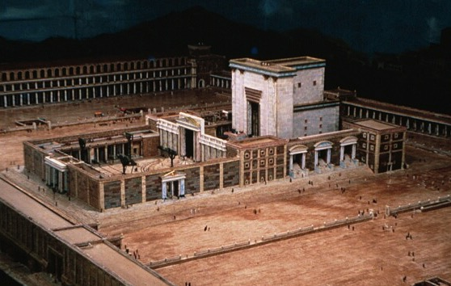
2nd Temple - Herod

Slide 104
God's Presence in Temple Rebuilding
Admonition 1:1-15
Consolation 2:1-9
Affirmation 2:10-19
Anticipation 2:20-23
Haggai
Present 1-5
Response 12-15
Rebuke 1-11
Building
Blessings
520 B. C.
First things first

Slide 105
"The silver is mine, and the gold is mine, says the LORD of Heaven's Armies.
⁹The future glory of this Temple will be greater than its past glory, says the LORD of Heaven's Armies.
And in this place I will bring peace. I, the LORD of Heaven's Armies, have spoken!"
(Haggai 2:8-9 NLT).

Slide 106

Oracle 2: Assurance
642
Despite their poverty and inferior rebuilding of the temple, God reminded them of his previous promise that he will be with them and encouraged them to continue (2:1-5).
He will shake the heavens and use all the silver and gold of nations to beautify and glorify the temple (2:6-9)

Slide 107
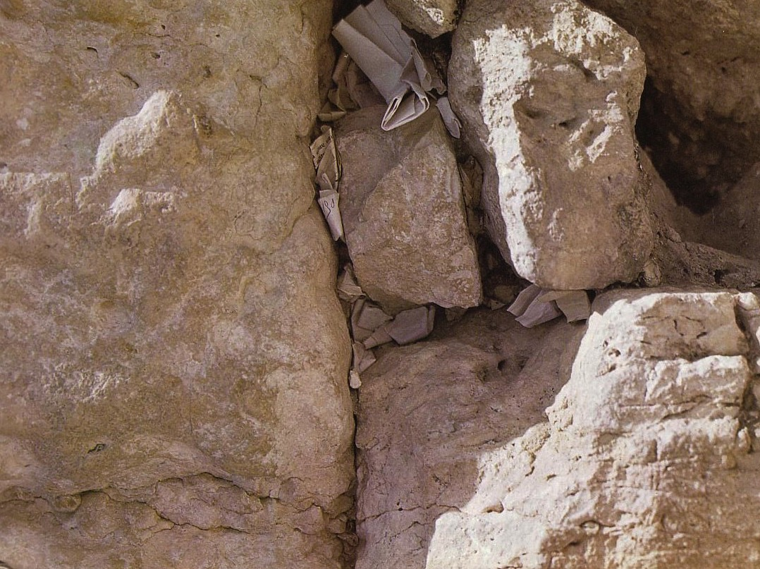
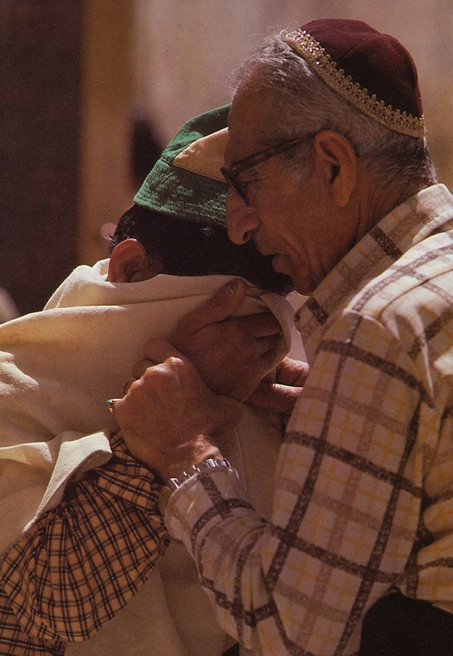
Prayers for the Third Temple
While praying for temple restoration Jews needed a common place to bring themselves "together" (syn) to preserve their "way of life" (agoge). Thus the "synagogue" was born.

Slide 108
"I will fill this house with glory" (2:7)
Admonition 1:1-15
Consolation 2:1-9
Affirmation 2:10-19
Anticipation 2:20-23
Haggai
Present 1-5
Future 6-9
Response 12-15
Rebuke 1-11
Building
Blessings
520 B. C.
First things first

Slide 109
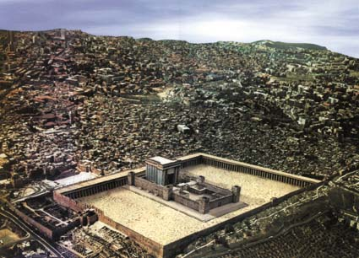
3rd Temple - Tribulation

Slide 110
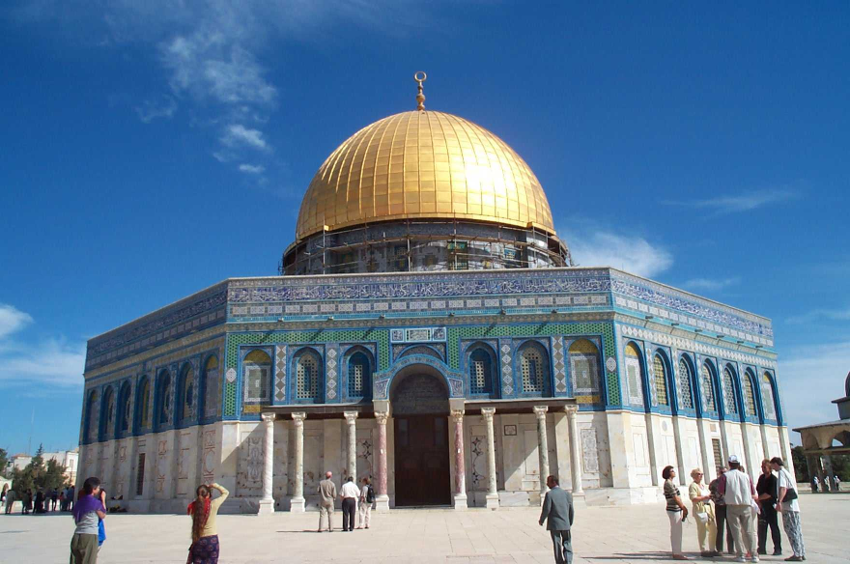
Replace This with a Temple?
Good luck!

Slide 111
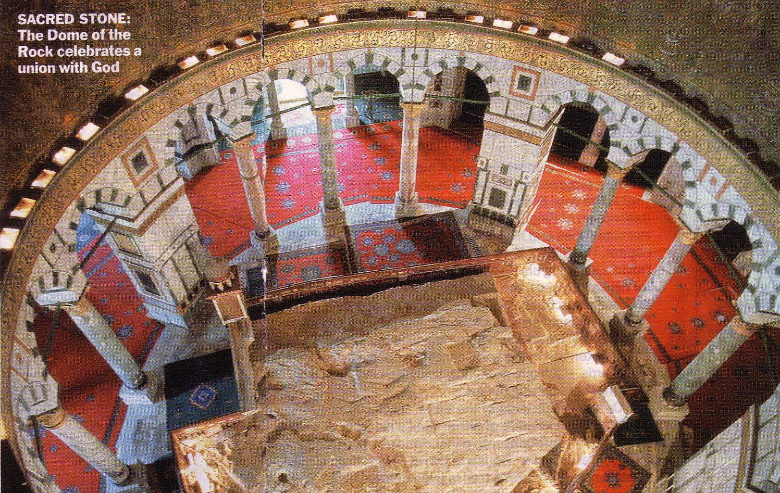
The Rock Inside
SACRED STONE:
The celebrates a union with God
24

Slide 112

Modern Temple Mount
644a
Northern Location
Eastern Gate
Traditional Location
N
E
W
S

Slide 113

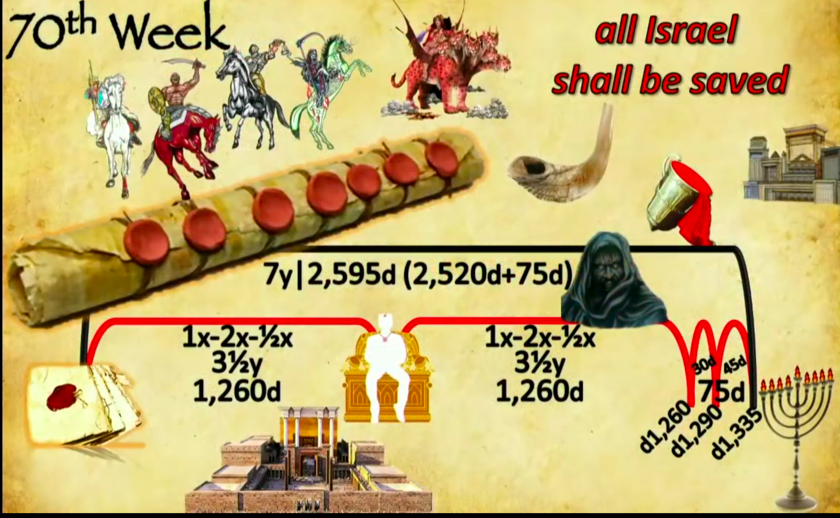
Events of the 70th "Week"
556
70th "Week"
All Israel
shall be saved
2018 09 23 John Haller's Prophecy Update
"Surveillance Society” (https://www.youtube.com/watch?v=GE35KQWKCWw)
"He will confirm a covenant with many for one 'seven.' In the middle of the 'seven' he will put an end to sacrifice and offering. And on a wing [of the temple] he will set up an abomination that causes desolation, until the end that is decreed is poured out on him" (Daniel 9:27 NIV).
Notes:
Parallel texts build upon this teaching by saying that the Antichrist will set up this abomination that causes desolation (Matt 24:15) where he will declare himself to be God:
“He will exalt himself and defy everything that people call god and every object of worship. He will even sit in the temple of God, claiming that he himself is God” (2 Thess 2:4 NLT).
“Then the beast was allowed to speak great blasphemies against God. And he was given authority to do whatever he wanted for forty-two months. ⁶ And he spoke terrible words of blasphemy against God, slandering his name and his dwelling—that is, those who dwell in heaven. ⁷ And the beast was allowed to wage war against God’s holy people and to conquer them. And he was given authority to rule over every tribe and people and language and nation. ⁸ And all the people who belong to this world worshiped the beast. They are the ones whose names were not written in the Book of Life that belongs to the Lamb who was slaughtered before the world was made” (Rev 13:5-8 NLT).
______________
OS-27-Daniel-330
OS-Ezekiel 40-48-Slide 16
OS-37-Haggai-96

Slide 114
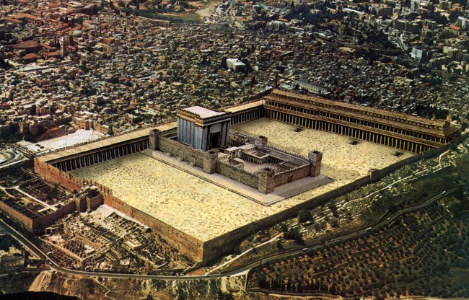
Antichrist will make a 7-year treaty with Israel
This will likely enable the rebuilding of the Jerusalem temple
Artwork by Sunny Chandra
Notes:
The 70th week of Daniel 9:27 is believed by nearly all scholars to depict a seven-year period. Since this “ruler to come” will set up a desecration in the temple and this event is still future, it must mean that the present temple rebuilding preparations in Jerusalem right now will be successful in building the temple on its original spot.
______________
OS-27-Daniel-331
OS-Ezekiel 40-48-Slide 17
OS-37-Haggai-97

Slide 115
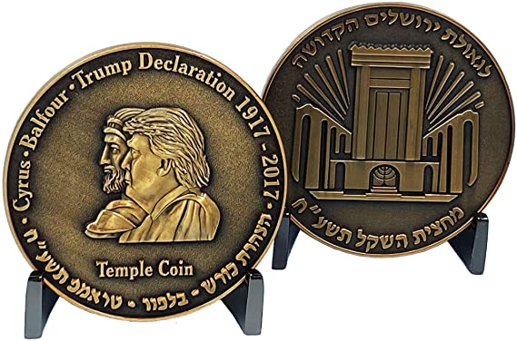
In 2017, Israel Commemorated President Trump’s Efforts to Rebuild the Temple
This ½ shekel preparation for the Third Temple is compared to Cyrus Helping Build the Second Temple in 539 BC
Artwork by Sunny Chandra
Notes:
The 70th week of Daniel 9:27 is believed by nearly all scholars to depict a seven-year period. Since this “ruler to come” will set up a desecration in the temple and this event is still future, it must mean that the present temple rebuilding preparations in Jerusalem right now will be successful in building the temple on its original spot.
______________
OS-27-Daniel-332
OS-Ezekiel 40-48-Slide 18
OS-37-Haggai-98

Slide 116
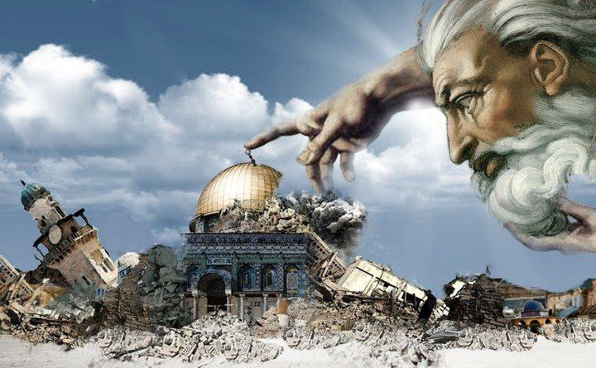
Antichrist will make a 7-year treaty with Israel
This will likely enable the rebuilding of the Jerusalem temple
Artwork by Sunny Chandra
Notes:
The traditional spot for the temple is the exact spot where the Dome of the Rock was constructed by Muslims in the late AD 690s. But will this be easily demolished by one who the world will accept as a peaceful negotiator? That seems unlikely.
______________
OS-27-Daniel-333
OS-Ezekiel 40-48-Slide 19
OS-37-Haggai-99

Slide 117
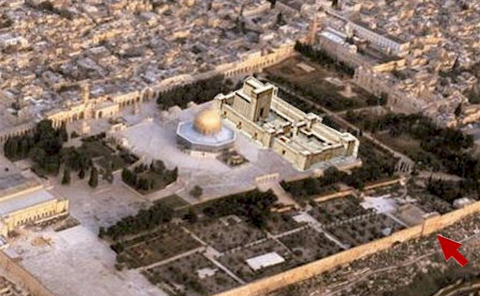
Antichrist will make a 7-year treaty with Israel
This will likely enable the rebuilding of the Jerusalem temple
Artwork by Sunny Chandra
Notes:
Some propose that this deceitful ruler will negotiate a deal to have the temple built right next to the Dome. Rabbis like Asher Kaufman have proposed the northern site as the original site of Solomon’s temple, partly because it gives a straight shot towards the Eastern Gate.
______________
OS-27-Daniel-334
OS-Ezekiel 40-48-Slide 20
OS-37-Haggai-100

Slide 118
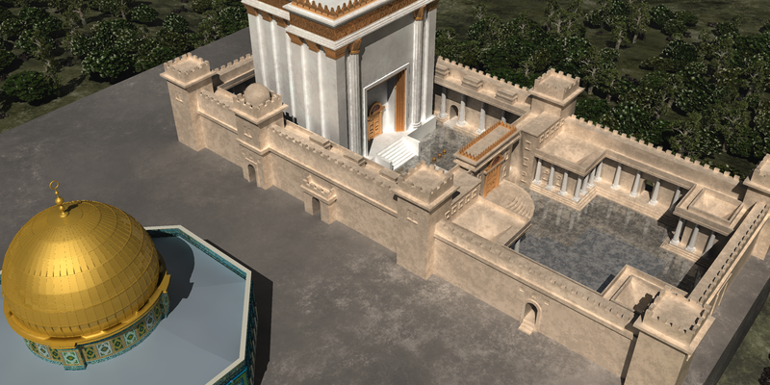
Antichrist will make a 7-year treaty with Israel
This will likely enable the rebuilding of the Jerusalem temple
Artwork by Sunny Chandra
Notes:
Building these adjacent would certainly be the result of a master negotiator!
___________
OS-27-Daniel-335
OS-Ezekiel 40-48-Slide 21
OS-37-Haggai-101

Slide 119
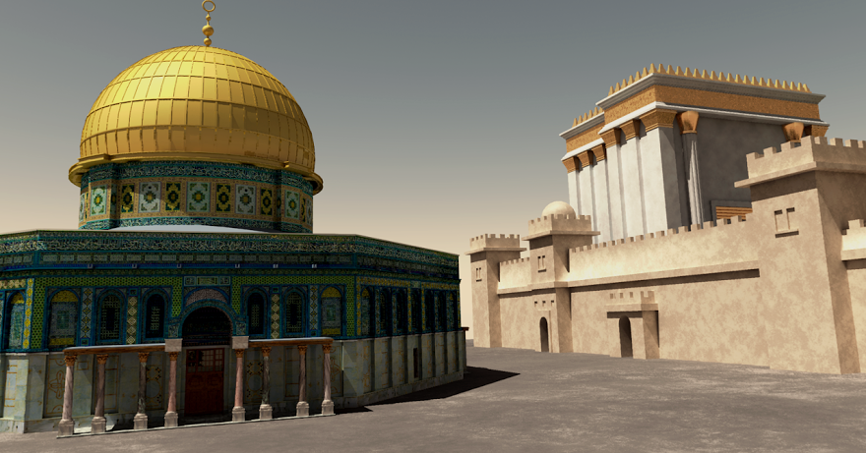
Antichrist will make a 7-year treaty with Israel
This will likely enable the rebuilding of the Jerusalem temple
Artwork by Sunny Chandra
Notes:
Perhaps such a feat would underscore the unity of all religions—a major tenant of the one-world religion that will lead to global worship of the Antichrist as the messianic figure at the focus of that one-world government.
___________
OS-27-Daniel-336
OS-Ezekiel 40-48-Slide 22
OS-37-Haggai-102

Slide 120

Ezekiel
The Temple of Ezekiel 40–47

Slide 121

God's Glory Will Return!

Slide 122


The Glory Returns
502
656
Ezekiel

Slide 123

The Eastern Gate (Ezek. 43:1-4 NLT)
"After this, the man brought me back around to the east gateway. ²Suddenly, the glory of the God of Israel appeared from the east. The sound of his coming was like the roar of rushing waters, and the whole landscape shone with his glory. ³This vision was just like the others I had seen, first by the Kebar River and then when he came to destroy Jerusalem. I fell face down on the ground. ⁴And the glory of the LORD came into the Temple through the east gateway."

Slide 124



Problems Either Way!
525
Premillennial:
Sacrifices for Sin
(Ezek. 40:39) in Light of Christ's Death
Amillennial:
Abandon Normal Hermeneutic for Ezekiel 40-48
Amillennial:
Abandon Normal Hermeneutic for Ezekiel 40-48

Slide 125
Why Millennial Sacrifices?
527
Pre-Cross:
Looked toward Christ's Death
Post-Cross:
Look back on Christ's Death
Theocratic: like confession of sin (1 John 1:9)
Memorial: like Lord's Supper that looks back
Paul offered a temple sacrifice in AD 57 (Acts 21:26) without seeing a "digression problem"

Slide 126

Theological Themes
House of God vs. Presence of God
Some scholars suggest that Haggai "took the superstitious view that God had not blessed his people merely because they had not begun to rebuild the temple" (Knight).

Slide 127
A Response
Haggai's theology was not based on the superstitious view of the temple but rooted in the Mosaic covenant curses and blessings (cf. Lev. 26; Deut. 28).
Haggai believed God is the Creator and sustainer of the earth and he is in control of the history, so the people were afflicted due to their failure in keeping the covenant.

Slide 128

What did neglect of temple rebuilding really mean?
The temple was not merely a building but an explicit expression of God's presence. Haggai did not contradict the pre-exilic prophets, such as Jeremiah 7:4 who rebuked Israelites for a false trust in the temple.
Therefore, the rejection of rebuilding was a rejection of the presence of God, while the willingness to build the temple was an act of trust and obedience to God.

Slide 129
What did neglect of temple rebuilding really mean?
The temple was a necessary identifying mark for the Jewish community as well as the centre of worship.
Haggai reminded them that only putting God as the first priority would lead them to sanctification, not through their deeds and offerings.
Only with this right attitude could temple rebuilding serve as an outward expression of God's dwelling among his people and their proper response to God.

Slide 130

Recall that God also has promised you his presence today.

Slide 131

God's Presence
Therefore, the larger context of Haggai's message concerns the presence of God.
Coggins notes, "God gives assurance of His lasting presence with them by recounting the past history of his dealings with them (' the promise that I made you when you came out of Egypt'), by assuring the present reality ('my Spirit abides among you; fear not'), and by promising a sign of future glory ('I will shake all nations, so that the treasures of all nations shall come in' [2:21])."

Slide 132

The LORD of Hosts
The divine name Yahweh (LORD) occurs 34 times in the 38 verses of this book, and 14 of these stress divine omnipotence with the name the LORD of Hosts.
The LORD will yield up the nations' treasures to beautify and glorify his temple. He will shake the heaven and earth to do a great and cosmic thing.

Slide 133


"Don't love money; be satisfied with what you have. For God has said,
'I will never fail you. I will never abandon you'"
(Hebrews 13:5 NLT).
Notes:
"Let's look at just a few facts: Americans have 3 times more space than they did 50 years ago. Yet there's a booming $22 Billion dollar/year Storage Space industry. Which means we have, on average, more than 3 times the stuff, still need extra storage and are willing to pay extra for it. At the same time, credit card debt levels and, not surprisingly, stress levels have gone way up.
Also not surprisingly, happiness levels have flatlined in the last 50 years. Human greed was, perhaps, more glaringly visible than ever before, as the direct source of the last Global Recession. Has humanity looked at that and drastically changed it's MO? Have we looked at ourselves, and wondered how much of that stuff might have trickled into the Church?"
Money Talk – 4 Ways To Stop Loving Money
06/02/2014
http://austinchristian.org/money-talk-4-ways-to-stop-loving-money/

Slide 134
How can you restore God's
BLESSING when you only see his discipline?
Haggai
Notes:
This short book will show how you can restore God’s blessing when you only see his discipline. The first thing you need to do is to…

Slide 135
1. Realign your priorities.
been hurt — be restored
RESTORATION
Haggai 1
Notes:
Seeking your own comforts first invites the LORD's reproof.

Slide 136
2. Recall God's presence.
Haggai 2:1-9
Notes:
If you have trusted Christ, the LORD guarantees that he is with you—so don't forget that.

Slide 137
3. Renew your worship.
Haggai 2:10-19
Notes:
Recommit yourself to give glory to God alone.

Slide 138
Dates in Haggai (2:10, 18, 20)
8/29
1:1
9/21
1:15
10/17
2:1
12/18
2:10, 18, 20
Aug
Sep
Oct
Nov
Dec
520 B.C.

Slide 139
Divine Discipline (2:10-17)
Admonition 1:1-15
Consolation 2:1-9
Affirmation 2:10-19
Anticipation 2:20-23
Haggai
Present 1-5
Future 6-9
Response 12-15
Blight 10-17
Rebuke 1-11
Building
Blessings
520 B. C.
First things first

Slide 140
"On December 18 of the second year of King Darius's reign, the LORD sent this message to the prophet Haggai: ¹¹'This is what the LORD of Heaven's Armies says. Ask the priests this question about the law: ¹²'If one of you is carrying some meat from a holy sacrifice in his robes and his robe happens to brush against some bread or stew, wine or olive oil, or any other kind of food, will it also become holy?'" The priests replied, 'No.'
¹³Then Haggai asked, 'If someone becomes ceremonially unclean by touching a dead person and then touches any of these foods, will the food be defiled?' And the priests answered, 'Yes'"
(Haggai 2:10-13 NLT).

Slide 141
"Then Haggai responded, 'That is how it is with this people and this nation, says the LORD. Everything they do and everything they offer is defiled by their sin. ¹⁵Look at what was happening to you before you began to lay the foundation of the LORD's Temple. ¹⁶When you hoped for a twenty-bushel crop, you harvested only ten. When you expected to draw fifty gallons from the winepress, you found only twenty. ¹⁷I sent blight and mildew and hail to destroy everything you worked so hard to produce. Even so, you refused to return to me, says the LORD” (Haggai 2:14-17 NLT).

Slide 142
Divine Blessing (2:18-19)
Admonition 1:1-15
Consolation 2:1-9
Affirmation 2:10-19
Anticipation 2:20-23
Haggai
Present 1-5
Future 6-9
Response 12-15
Blessing 18-19
Rebuke 1-11
Blight 10-17
Building
Blessings
520 B. C.
First things first

Slide 143

"Think about this eighteenth day of December, the day when the foundation of the LORD's Temple was laid. Think carefully. ¹⁹I am giving you a promise now while the seed is still in the barn. You have not yet harvested your grain, and your grapevines, fig trees, pomegranates, and olive trees have not yet produced their crops. But from this day onward I will bless you'" (Haggai 2:18-19 NLT).

Slide 144

Oracle 3: Accusation
643
The problem: works and offerings are a false trust in human efforts and do not ensure acceptance by the LORD (2:10-14).
The consequences: economic shortage (2:16-17).
The response: The people responded by laying the temple foundation (2:18-19).

Slide 145

What does God think about your worship?
Notes:
We watch movies that destroy God’s values and then come to worship the next day.
Some believers withhold their tithe so they can have a better vacation.
Defiled worship today includes singing while trying to convince God to let you marry an unbeliever.

Slide 146
How can you restore God's
BLESSING when you only see his discipline?

Slide 147
4. Re-envision God's kingdom.
Haggai 2:20-23
Notes:
Focus again on the fantastic future the LORD has for you.

Slide 148

"On that same day, December 18, the LORD sent this second message to Haggai: ²¹'Tell Zerubbabel, the governor of Judah, that I am about to shake the heavens and the earth. ²²I will overthrow royal thrones and destroy the power of foreign kingdoms. I will overturn their chariots and riders. The horses will fall, and their riders will kill each other"
(Haggai 2:20-22 NLT).

Slide 149
Military Victory (2:20-22)
Admonition 1:1-15
Consolation 2:1-9
Affirmation 2:10-19
Anticipation 2:20-23
Haggai
Present 1-5
Future 6-9
Response 12-15
Blessing 18-19
Rebuke 1-11
Blight 10-17
Global 20-22
Building
Blessings
520 B. C.
First things first

Slide 150

"But when this happens, says the LORD of Heaven's Armies, I will honor you, Zerubbabel son of Shealtiel, my servant. I will make you like a signet ring on my finger, says the LORD, for I have chosen you. I, the LORD of Heaven's Armies, have spoken!" (Haggai 2:23 NLT).

Slide 151

Oracle 4: Assurance
643
Again, God will shake the heavens and overthrow the nations (2:20-22)
He will also exalt the Davidic
line through Zerubbabel
(2:23)

Slide 152
Zerubbabel Blessed (2:23)
Admonition 1:1-15
Consolation 2:1-9
Affirmation 2:10-19
Anticipation 2:20-23
Haggai
Present 1-5
Future 6-9
Response 12-15
Blessing 18-19
Rebuke 1-11
Blight 10-17
Personal 23
Global 20-22
Building
Blessings
520 B. C.
First things first

Slide 153

Messianic Teaching in Haggai
Zerubbabel appears at the start and the end:
The first oracle (1:1) refers to Zerubbabel for recon-struction of the temple
The last oracle (2:21) again refers to him, with the promise that God will rebuild the house of David through him
In 2:23 he is God's "servant" and "signet ring", both terms used of the Davidic king (Ps. 89:3, Jer. 22:24).

Slide 154


The Signet Ring
Impression from a Welsh signet ring found at Raglan, 15th century
Notes:
Impression at www.gtj.org.uk/ en/blowup7/14517 and the ring at www.ancientcoinvault.com/ modules.php?set_albu...

Slide 155
Zerubbabel's Authority
647
Haggai portrayed the Messiah when God said to Zerubbabel, "I will make you like my signet ring, for I have chosen you" (2:23). As a signet ring denoted authority, so Zerubbabel became the center of the Messianic line where both Joseph and Mary's lines merged:
David
In both genealogies the father of Zerubbabel is Shealtiel, but each genealogy follows a different son of Zerubbabel until they end with Joseph and Mary. This makes Zerubbabel and his father the common link in each lineage.
Solomon
Nathan
Shealtiel
(Matt. 1:12)
(Luke 3:27)
Zerubbabel
Joseph
Mary
Jesus
Talk Thru the Bible, 285

Slide 156

Significance of David-Zerubbabel Parallel
647
The parallel of David to Zerubbabel is outstanding, for David wanted to build the temple, but in response the LORD promised to build the king's house.
This similarity shows that the messianic element fits the context of the book.

Slide 157

Prophetic Messianic Elements
Zerubbabel disappeared as a key leader soon after Haggai's prophecy was given.
The prophecy concerning Zerubbabel related to the legitimate king of the future, for it is the chosen "Son of God," to whom will be granted power and authority over all the nations (Pss. 2, 110; Matt. 28:18).

Slide 158

Do you want God's blessing?
You will also inherit the kingdom when you are faithful now.

Slide 159
Barry Huddleston, The Acrostic Summarized Bible (Grand Rapids: Baker, 1992)
Haggai
1 God's temple needs building
2 Older temple less glorious

Slide 160
Two Types of Inheritance
"Now if we are children, then we are heirs—heirs of God and co-heirs with Christ, if indeed we share in his sufferings in order that we may also share in his glory"
(Rom. 8:17 NIV).
= Salvation
= Reward
Notes:
Being "heirs of God" and "co-heirs with Christ" are different blessings in Romans 8:17. We know this because the latter has a conditional "if"—"if indeed we share in his sufferings."
All Christians are "heirs of God" by faith in Jesus Christ, leading to salvation. This means that they all have eternal life and a new standing (position) with God as sons. Paul explains this much in Romans 8.
But not all believers share in his sufferings, as Paul notes in 1 Corinthians 2:14–3:5 which shows many to be carnal (fleshly), or not walking with Christ in a consistent manner as is true of the "spiritual man." However, those Christians that sacrifice for Christ will also suffer with Christ and then "share in his glory" as "co-heirs with Christ," meaning that they will reign with him on the earth after Jesus returns (1 Cor 6:1-2; Rev 20:4-6).
________
Common-264
OP-04-Numbers-93
OS-04-Numbers-155
OS-37-Haggai-160
OS-06-Joshua-182
NP-02-Inheritance NT Summary-11
NS-Rom5-8-Slide149
NS-19-Hebrews-66, 193
SA-15-Inheritance-35

Slide 161
How can you restore God's
BLESSING when you only see his discipline?
Haggai
Notes:
This short book will show how you can restore God’s blessing when you only see his discipline. The first thing you need to do is to…

Slide 162
Main Idea
ALIGNMENT
Align with God's priorities.
Haggai
Notes:
God will restore you when you value what he values.

Slide 163
1. Realign your priorities.
been hurt — be restored
RESTORATION
Haggai 1
Notes:
Seeking your own comforts first invites the LORD's reproof.

Slide 164
2. Recall God's presence.
Haggai 2:1-9
Notes:
If you have trusted Christ, the LORD guarantees that he is with you—so don't forget that.

Slide 165
3. Renew your worship.
Haggai 2:10-19
Notes:
Recommit yourself to give glory to God alone.

Slide 166
4. Re-envision God's kingdom.
Haggai 2:20-23
Notes:
Focus again on the fantastic future the LORD has for you.

Slide 167
Key Verse
640
(God to Judah) "'You expected much, but see, it turned out to be little. What you brought home, I blew away. Why?' declares the LORD Almighty. 'Because of my house, which remains a ruin, while each of you is busy with his own house'" (Haggai 1:9).
Haggai

Slide 168
Haggai Kingdom Statement
343
Judah must get the right priorities (1:9) for blessing in the Messiah's kingdom.

Slide 169
Eternal Priorities
God
God's Word
Souls of People
Notes:
• Which matters more? God or Money?
Do you give proportionally to God’s supply?
Do you incur credit card debt so you can live above your means?
Don’t pursue personal prosperity more than you pursue God’s work.
Honestly, which is more important to you—God? or money?
• God’s Word
How is your Bible reading?
What is your goal in God’s Word? Have you committed to reading a chapter a day? Have you committed to reading a verse a day? If you don’t have a target, you are sure to miss it.
• Souls of People
Are you committed to getting to minister to God’s people here at this church? How?
How much are you praying for the lost?
_______________
OS-00-OT Book Overviews-740
OS-35-Haggai-19

Slide 170
Black

Slide 171


OT Preaching link at BibleStudyDownloads.org
Get this presentation for free!
Notes:
OT Survey (os)

Slide 172

The Lord directs the history and life of his people
God is the controlling and sustaining power of the practical affairs of lives. He involves in the economic and social affairs, so that everything works out for his will.

Slide 173

Misplaced Priorities
One of the most outstanding messages in this book is the failure in keeping correct priorities and the consequences that follow.
The people failed to put God's priority before their own. Since this was not merely a personal failure, but a national one, the whole nation suffered in every aspect of their lives.

Slide 174

The Role of the Prophet as the Lord's Messenger
Haggai is the second smallest book in the OT, but it has a great significance.
Although his ministry was only lasted only a few months in 520 BC "in a time of deep decline and discouragement, his single-minded and ardent preaching again gave the people of God new perspectives on their relationship with God and on the promised blessings."

Slide 175

What is most important?
640

Slide 176

Spiritual Over Material Priorities
"In encouraging the people to rebuild the temple, Haggai gave them a new spiritual center, without which they would have perished as the people of God in the vortex of history."
Haggai challenges the materialistic worldview and provides an accurate, sharp and spiritual perspective to interpret the situation. God is the creator and sustainer of this world, so the economics and social problems cannot be left merely to the professionals and philosophies of this world.

Slide 177

Application
640
Let God be God in your life and society.
—He should be your first priority, more important than what you do and offer.
—He should be the center of your interpretation and understanding of the world and your life.
Only then can you be a faithful messenger to preach His Word to His people.

Slide 178
REVIEW QUIZ on Haggai
Haggai's messages were written in ____ B.C.
Haggai deals with ________ the _______.
A key person in this book is __________.
Haggai's message is similar to Jesus' words in ___________.

Slide 179
REVIEW QUIZ on Haggai
Haggai's messages were written in 520 B.C.
Haggai deals with ________ the _______.
A key person in this book is __________.
Haggai's message is similar to Jesus' words in ___________.

Slide 180
REVIEW QUIZ on Haggai
Haggai's messages were written in 520 B.C.
Haggai deals with rebuilding the Temple.
A key person in this book is __________.
Haggai's message is similar to Jesus' words in ___________.

Slide 181
REVIEW QUIZ on Haggai
Haggai's messages were written in 520 B.C.
Haggai deals with rebuilding the Temple.
A key person in this book is Zerubbabel.
Haggai's message is similar to Jesus' words in ___________.

Slide 182
REVIEW QUIZ on Haggai
Haggai's messages were written in 520 B.C.
Haggai deals with rebuilding the Temple.
A key person in this book is Zerubbabel.
Haggai's message is similar to Jesus' words in Matthew 6:33.

Slide 183
Black

Slide 184
OT Survey link at BibleStudyDownloads.org
Get this presentation for free!
Notes:
OT Survey (os)

