Slide 1

The Day of YHWH
Zephaniah
Dr. Rick Griffith • Jordan Evangelical Theological Seminary • BibleStudyDownloads.org
Adapted from the 22 Feb 2002 class presentation by Ong Bee Yong
Notes:
Each morning the darkness is overcome with daylight. This is an excellent picture of what God will do in the days ahead in what the Bible calls “The Day of the LORD.” Here is the key theme of Zephaniah.

Slide 2
Key Word
634
343
Day
Zephaniah
Notes:
Often "day" refers to a period of time, as in Genesis 2:4 (NASB). Zephaniah uses this term more than any other prophet, expanded as “The Day of the LORD.”

Slide 3
Theme
634
Day of the LORD
Zephaniah
Notes:
It is called the LORD's day in that Yahweh is the one who warns of this period, the one who initiates it, and the one who will bring Israel and the nations through it.

Slide 4
Key Verse
634
"Gather together…before the day of the LORD's wrath comes upon you. Seek the LORD, all you humble of the land, you who do what he commands. Seek righteousness, seek humility; perhaps you will be sheltered on the day of the LORD's anger" (2:1-3).
Zephaniah
Notes:
Note that this "Day" is one of wrath and anger. Zephaniah saw it primarily in negative terms, although the judgment of the period will also be followed by salvation and blessing.

Slide 5

Kingdom Statement
343
Judah should repent because of a future day of judgment (1:1–3:8) and blessing (3:9-20) on the whole earth caused by God as King.
Zephaniah

Slide 6

Summary Statement
634
346
The day of the LORD judgment upon Judah, the surrounding nations, and the entire earth warns Judah to repent due to God's righteousness and his promise of a remnant in a national restoration.
Zephaniah

Slide 7

Covenant
347d
After discipline of Jerusalem (3:1-7) and the nations (2:4-15; 3:8), Israel will be restored and prosper in fulfillment of the land and new covenants (3:19-20).
Zephaniah

Slide 8

Redemption
347d
The "day of the LORD" is not only retribution (1:14; etc.) but salvation and restoration as well (2:7; 3:17, 20).
Zephaniah

Slide 9

Messiah
347d
Jesus referred to his second advent as a sweeping away of the wicked (1:3 in Matt. 13:41) and a time of distress for Israel (1:15 in Matt. 24:21).
Zephaniah

Slide 10
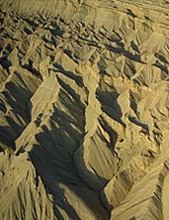
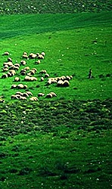
Day of the LORD
Zephaniah:
634
Judgment | Salvation
1:1–3:8 | 3:9-20
Day of Punishment | Day of Praise
D-Day | V-Day
Destruction | Deliverance
Ruin | Restoration
God's Righteousness | God's Faithfulness
Warning | Encouragement
Earth 1:1-3 | Judah 1:4–2:3 | Nations 2:4-15 | Jerusalem 3:1-7 | Earth 3:8 |  | Remnant Regathered 3:9-10 | Redeemed & Restored 3:11-20
Judah, Nations, & the Whole Earth (about 630 BC)

Slide 11
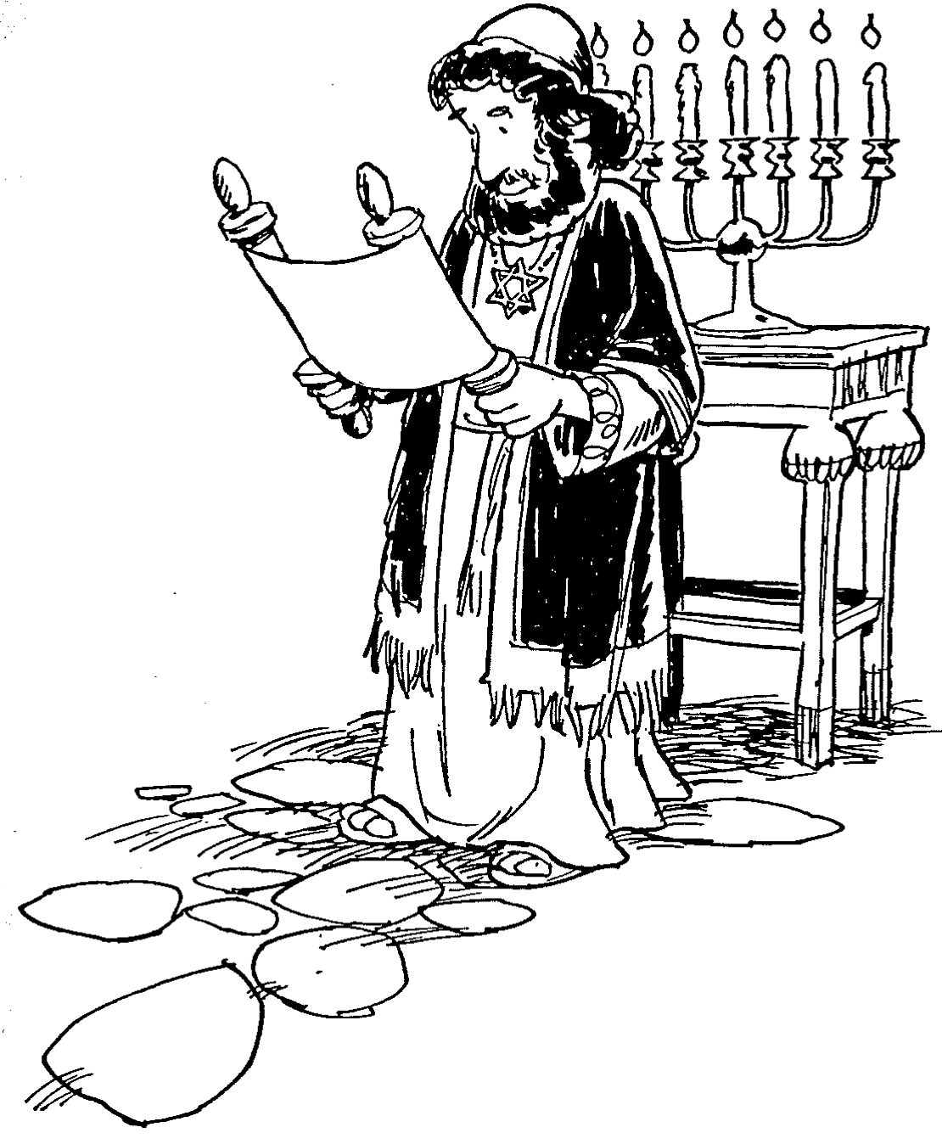
Barry Huddleston, The Acrostic Summarized Bible (Grand Rapids: Baker, 1992)
Zephaniah
1 Judah’s day of wrath
2 Enemies of Judah punished
3 Wrath and coming judgment

Slide 12

Be Hopeful
Zephaniah
Dr. Rick Griffith, Crossroads International Church Singapore
BibleStudyDownloads.org

Slide 13

Balance
Zephaniah

Slide 14
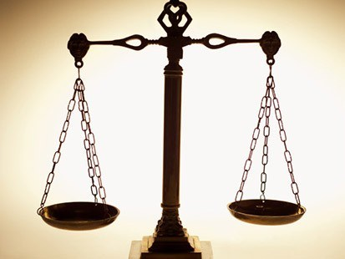
How should we respond to the LORD’s balance?
Zephaniah
Judgment
Deliverance
Repentance
Hope

Slide 15
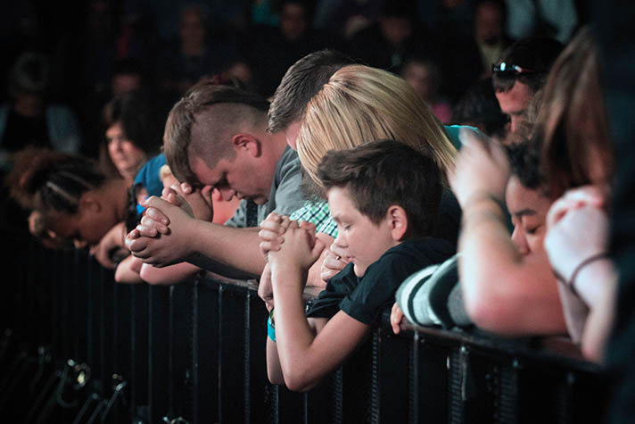
I. God’s future judgment warns us to repent.
Zephaniah 1:1–3:8
Notes:
The LORD will hold you accountable, so change your mind about him now.

Slide 16

II. God’s future deliverance encourages us to hope.
Zephaniah 3:9-20
Notes:
The LORD will reward you, so live with anticipation now .

Slide 17

Main Idea
Be hopeful yet repentant.
Zephaniah
Notes:
Balance your anticipation with right thinking.

Slide 18

Application
1. God's wrath against evildoers should warn us who have turned away.
While God is compassionate and loving, He is also a God of justice and holiness.
In similar times of national calamity today, divine discipline should rouse the indifferent and purify the good.
Zephaniah

Slide 19
2. God's People as a Sacrifice to Him.
Sacrifice was well understood in Jerusalem. Offerings were made to the one true God, and when the people rebelled against God or had become corrupt, they also offered to the idols.
But now YHWH declared through Zephaniah that the faithless, corrupt and indifferent people should themselves be sacrificed (1:7-8).
We also must examine our lives. We easily quote Romans 12:1-2, "…offering ourselves as a living sacrifice…." but have we truly reckoned what it means to live our lives in holy reverence for the LORD – in purity as a living sacrifice to YHWH?
Zephaniah

Slide 20
Black

Slide 21

OT Pre-exilic Prophets on Chart
232 & 342
Obadiah
Jeremiah
Jonah
Amos
Hosea
Isaiah
Micah
Nahum
Zeph
Joel
Hab
Chart of Old Testament Kings and Prophets
John C. Whitcomb, 4th rev. ed., Winona Lake, IN: BMH Books, 1962, 1968, p. 2

Slide 22
Contrasting Zephaniah, Habakkuk, and Lamentations
633
Zephaniah | Habakkuk | Lamentations
Decades before the fall of Jerusalem (ca. 630) | Just before the fall of Jerusalem (ca. 607-605) | Just after the fall of Jerusalem (586)
God will judge | God, when will you judge? | God has judged
Preview of trouble | Promise of trouble | Presence of trouble
Notes:
Chronologically, these writings appear in the order of Zephaniah, Habakkuk, and Lamentations. Yet they address the issue of God judging sin in Judah.
___________________
OS-25-Lamentations-148
OS-35-Habakkuk-161
OS-36-Zephaniah-22

Slide 23
Contrasting Zephaniah, Habakkuk, and Lamentations
633
Zephaniah | Habakkuk | Lamentations
Declaration | Dialogue | Dirge
Day of the LORD | Dominion of the LORD | Destruction of the LORD
God is in your midst (3:15, 17) | God is your strength (3:19) | God is your portion (3:24)
Notes:
Chronologically, these writings appear in the order of Zephaniah, Habakkuk, and Lamentations. Yet they address the issue of God judging sin in Judah.
___________________
OS-25-Lamentations-149
OS-35-Habakkuk-162
OS-36-Zephaniah-23

Slide 24
Historical Context
Zephaniah literally means "YHWH hides"
Occasion: Reign of Josiah, Judean King
Josiah => 16th King (640 – 609 BC)
Previous Kings
Manasseh and his son Amon => godless & wicked
Tried to bring a reform to restore the worship of YHWH
Reform only began in 622 BC. which was 18 years after Josiah took over! Only a remnant heeded the call to return to God
Zephaniah spoke! 630 BC

Slide 25
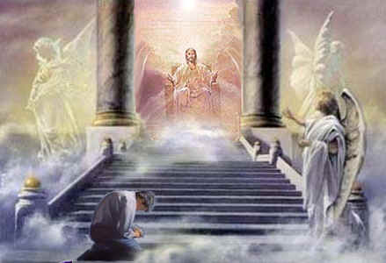
Zephaniah Overview
Introduction
I. Historical Context
II. Time
III. Theological Themes
1. The Day of Yahweh
2. Universalism
3. Messianic Prophecy
4. God's Presence
5. Creation & 'Decreation'
6. Land in the eyes of the prophets
7. The Remnant
IV. Who are the groups of people prophesized against?
V. Fulfillment of Prophecies
VI. Applications

Slide 26

NT Discipline
Notes:
Did death came to defiant believers in the NT? There are actually several examples. Likewise, discipline at least this severe would come to rejecting the Christ the Hebrews knew (10:28-31).

Slide 27
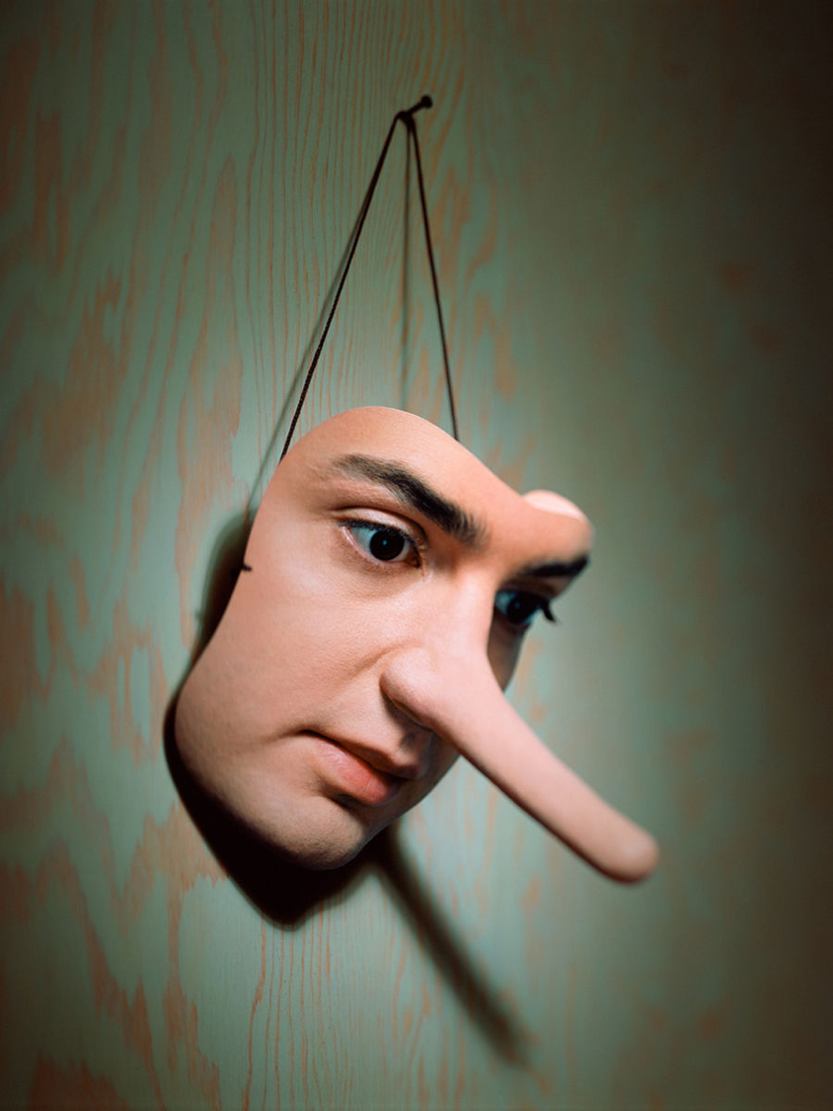
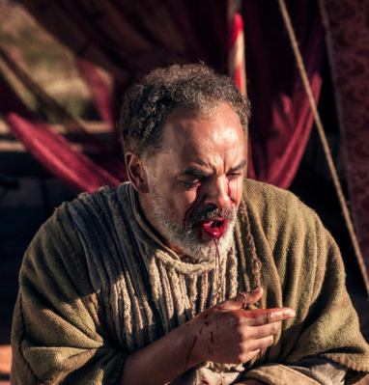
Ananias & Sapphira
Acts 5

Slide 28

1 Corinthians 11:30-32 (NLT)
³⁰ That is why many among you are weak and sick, and a number of you have fallen asleep. ³¹But if we judged ourselves, we would not come under judgment. ³²When we are judged by the Lord, we are being disciplined so that we will not be condemned with the world.
Notes:
28

Slide 29

Rewards can be lost!
"Watch out that you do not lose what we have worked so hard to achieve. Be diligent so that you receive your full reward" (2 John 8 NLT)
"I have given you an open door that no one can shut" (3:8)

Slide 30
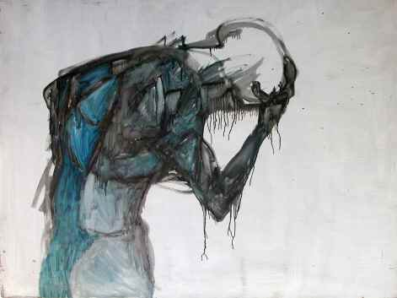
Some sin leads to premature death (1 John 5:16-17 NIV)
“If anyone sees his brother commit a sin that does not lead to death, he should pray and God will give him life. I refer to those whose sin does not lead to death. There is a sin that leads to death. I am not saying that he should pray about that. ¹⁷All wrongdoing is sin, and there is sin that does not lead to death.”

Slide 31
"For we know the one who said,
'I will take revenge.
I will pay them back.'
He also said,
'The LORD will judge his own people.'
³¹It is a terrible thing to fall into the hands of the living God"
(Hebrews 10:30-31 NLT).

Slide 32
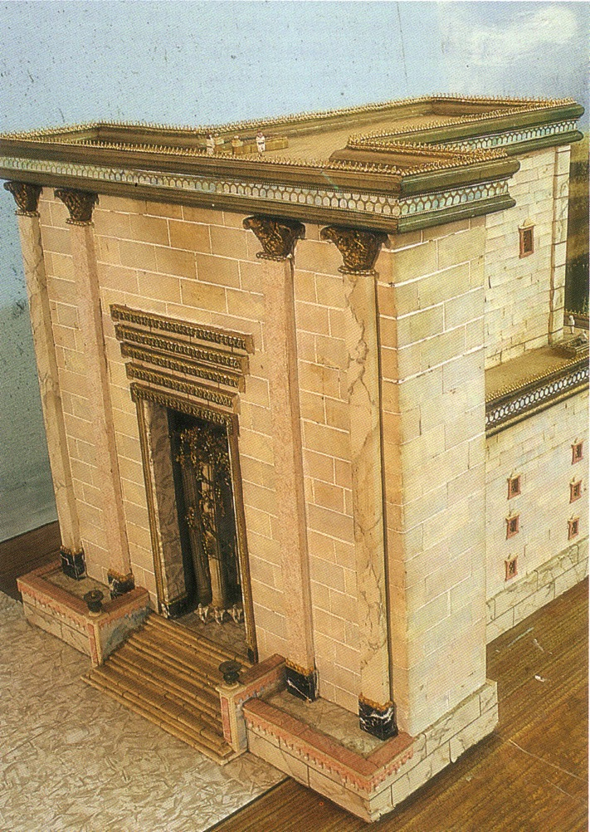
The Temple Sanctuary

Slide 33
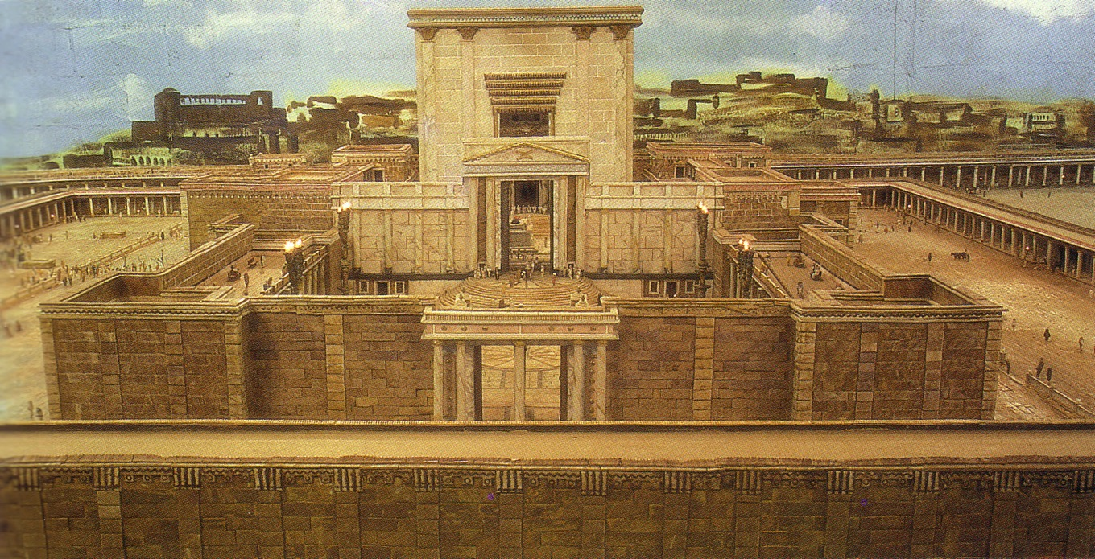
The Temple from the east

Slide 34
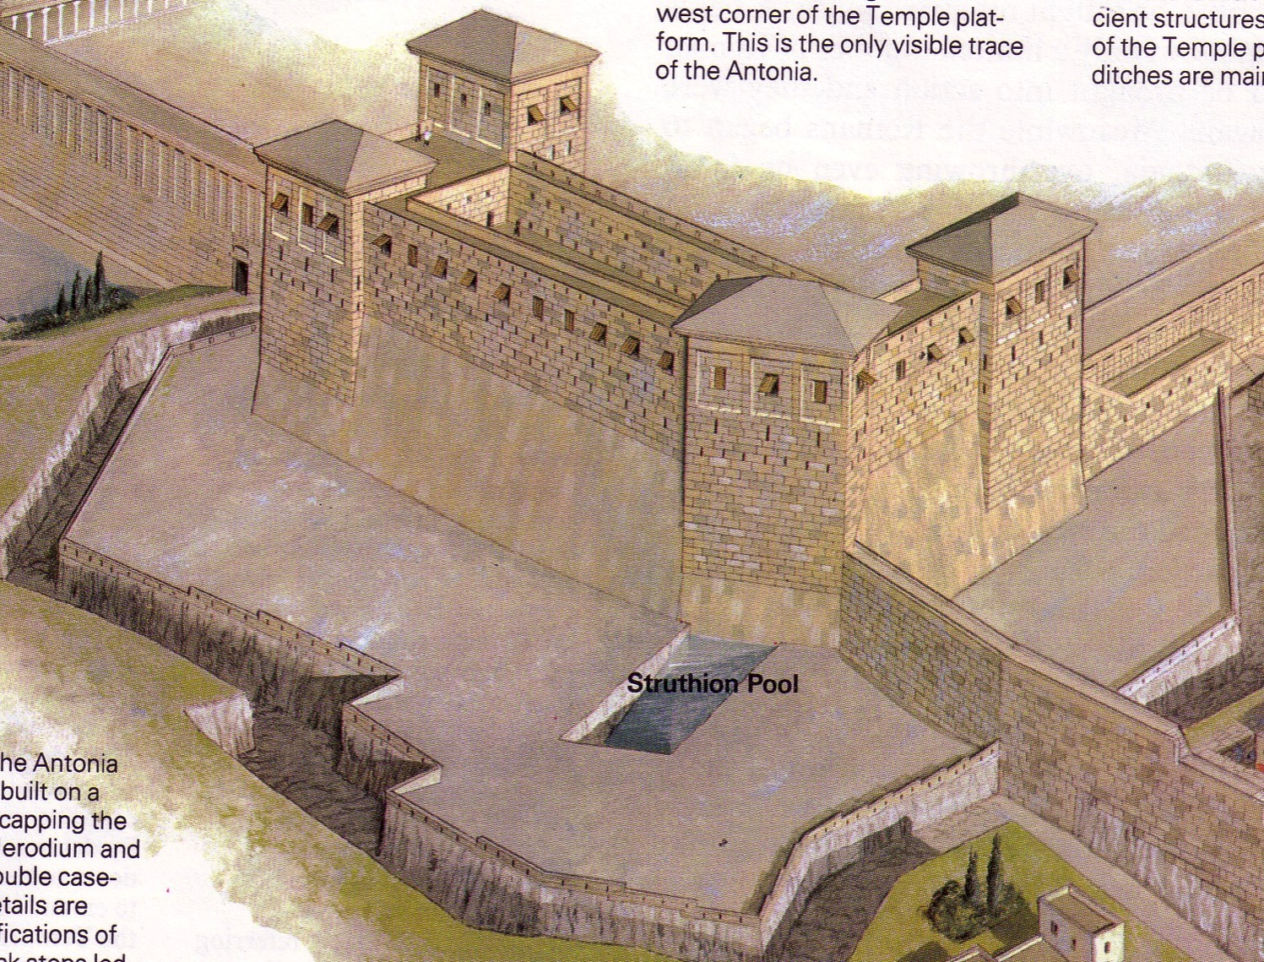
Antonia Fortress

Slide 35
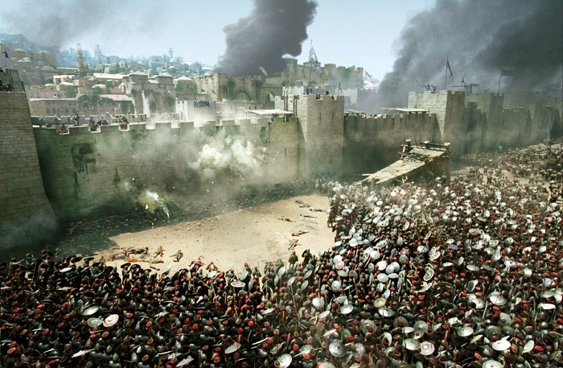
Antonia Fortress Leveled

Slide 36
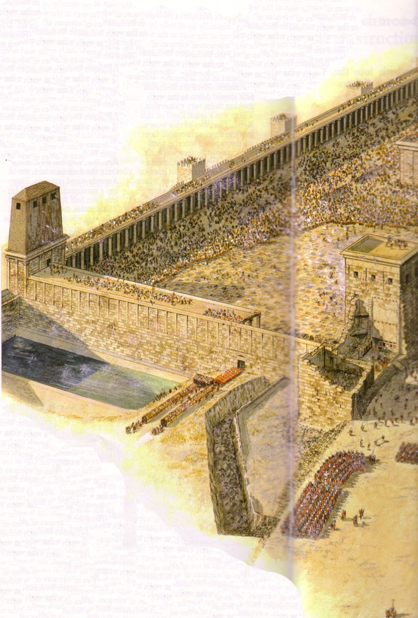
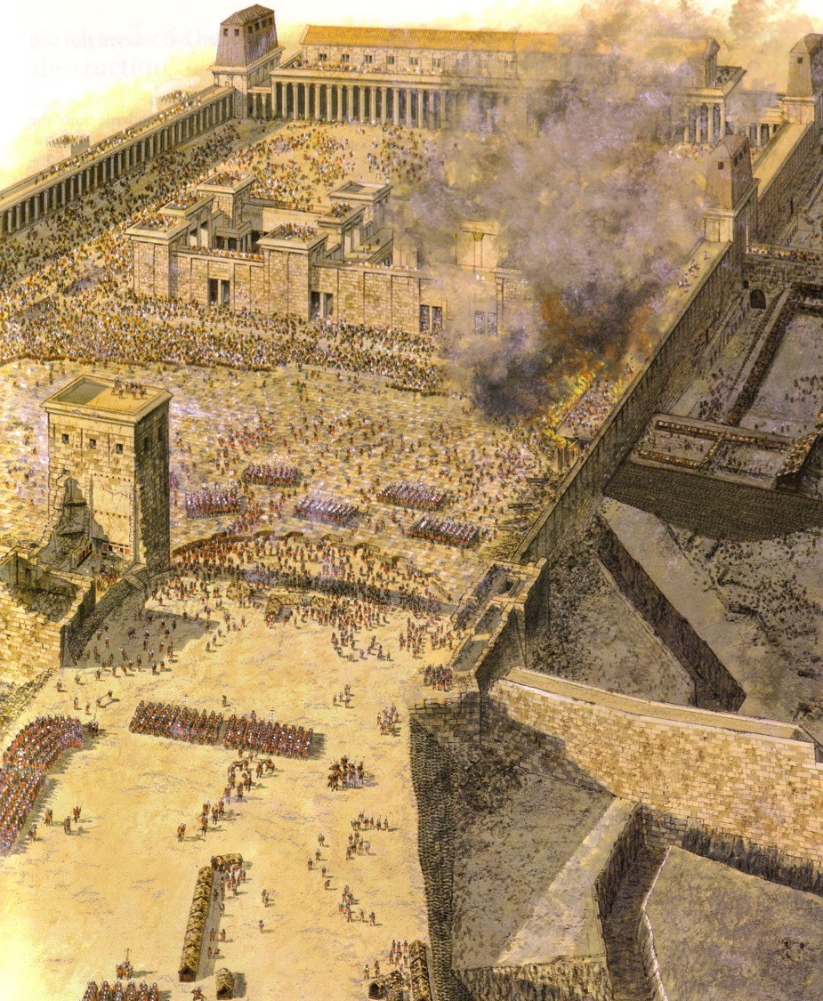
Antonia Fortress Leveled

Slide 37
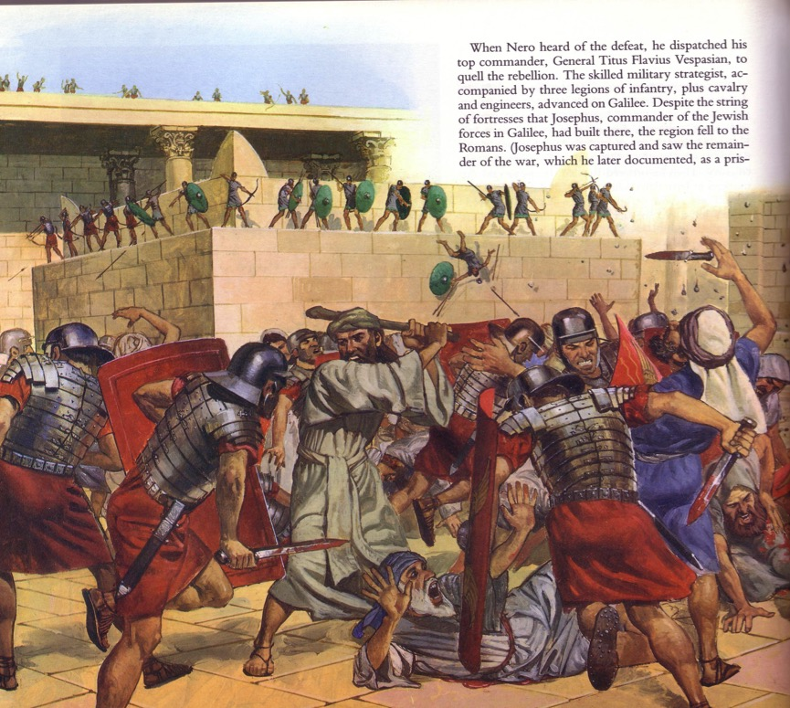
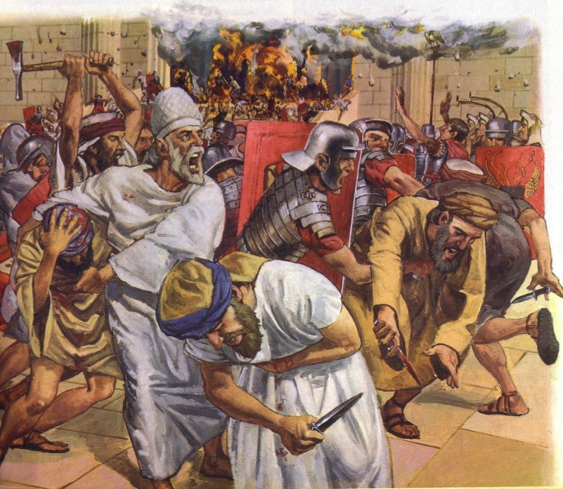
The Temple Assault

Slide 38

The Fire
"Dear friends, if we deliberately continue sinning after we have received knowledge of the truth, there is no longer any sacrifice that will cover these sins. ²⁷ There is only the terrible expectation of God's judgment and the raging fire that will consume his enemies" (Hebrews 10:26-27 NLT).
Hell fire?
No, Jerusalem fire!
Notes:
What would be God’s judgment on these readers if they turned away?
• Verses 26-27 define God's judgment as “the raging fire that will consume his enemies." The readers would not be forgiven and would be judged with unbelievers. But when and how?
• Most commentaries claim that this means the readers would go to hell.
But is this hell fire? If so, that would mean these Christians would then go to hell! This is against all that the NT teaches about believers having eternal life.
• No, it refers to Jerusalem fire! Their salvation was secure—but their apostasy would lead to being killed along with the unbelieving Jews who stayed in Jerusalem to protect them temple! The letter consistently calls them believers, but they would bear a punishment of unbelievers by identifying with them. Yet the fire of 10:27 is not hell fire but Jerusalem fire. It was not eternal fire but temporal fire that would take their lives along with the godless who gave their lives in AD 70 while trying to preserve a temple system that was already a generation obsolete.
__________
Common-465
BE-58-Hebrews Be Uncompromising-80
BS-09-Read Paragraphs-33
ES-10-Other Events at the Rapture-52
HS-03-Spirit Ministries to Believer-19
NP-19-Hebrews Be Uncompromising-80
NS-19-Hebrews-421, 458
OS-36-Zephaniah-38
SA-09-Perseverance-42, 66
SA-14-Eternal Security-66
SA-15-Inheritance-169

Slide 39
Hebrews 8:13
"By calling this covenant 'new,'
he has made the first one obsolete; and what is obsolete and aging will soon disappear."
Obsolete
AD 33
Hebrews Written
AD 67-68
Disappeared
AD 70

Slide 40
Be Hopeful
The Book of Zephaniah
Dr. Rick Griffith, Crossroads International Church Singapore
BibleStudyDownloads.org

Slide 41
Balance
Notes:
We all need balance but it’s hard to achieve.
Ask anyone if they want to live a balanced life, and the chances are that he or she will say, “Yes, I want balance. I see the dangers of extremism.”

Slide 42

Work & Home Life Balance
Notes:
We all hear much about the balance of home and work life.

Slide 43

Eating Balance
Notes:
And, of course, there is the balance in eating.
That means we should eat just as many bad things as good things, right?

Slide 44
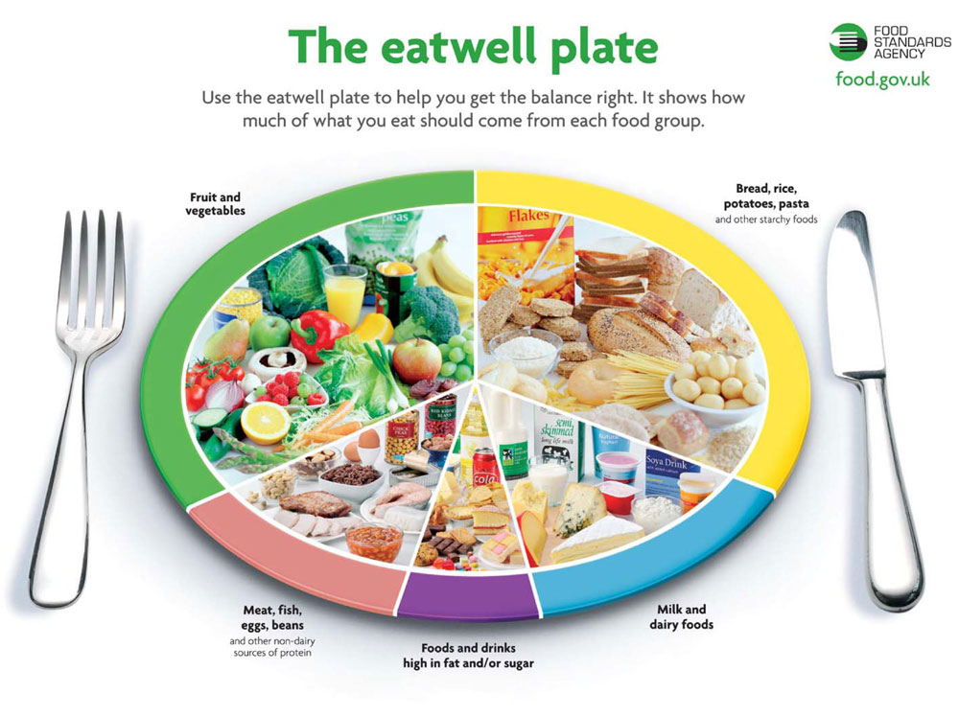
Balance
Notes:
Seriously, “The Eatwell Plate” is bad grammar but good in that it includes fruit and vegetables, starches, dairy, as well as food and drinks high in fat and/or sugar—plus meat, fish, eggs, and beans.

Slide 45

Balance
Notes:
Yet we all know balance doesn’t come easily—in eating, in work life/home life, in just about any area of life.

Slide 46

Balance
Notes:
Most of us want balance in our lives, yet we strive to know how to do it. The reality is that balance comes from being in a perpetual state of imbalance from the extremes.

Slide 47
Is your view of God balanced?
Notes:
Is your view of God balanced? He certainly is the perfect balance, but do you see him that way? As we consider how this applies to what we think of God, each age has had its extremes.

Slide 48
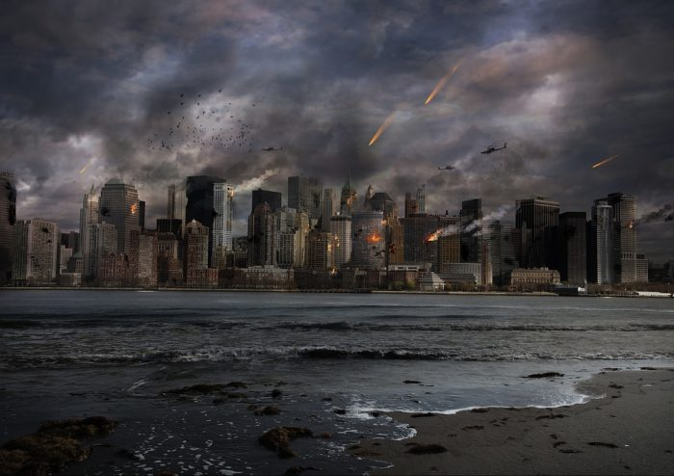
God is Judge
Notes:
At some points in history, the judgment of God took precedence. He was only seen as a fair and vengeful ruler intent on striking all who do not fear him.

Slide 49
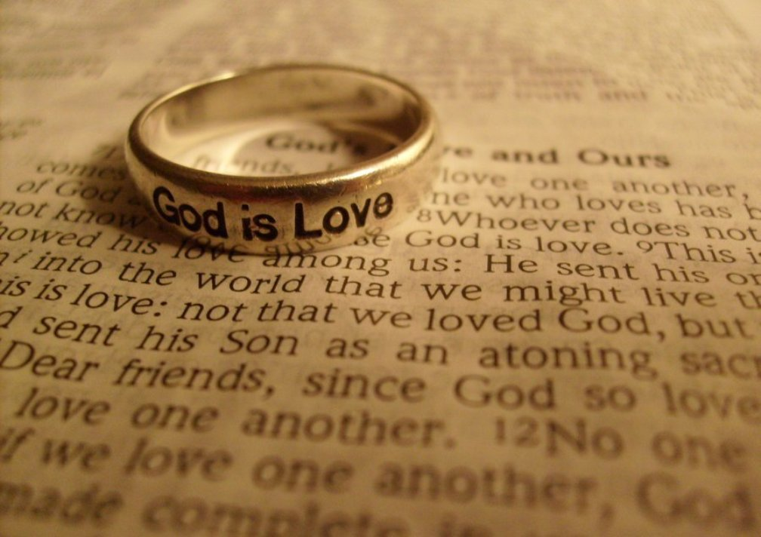
God is Love

Slide 50
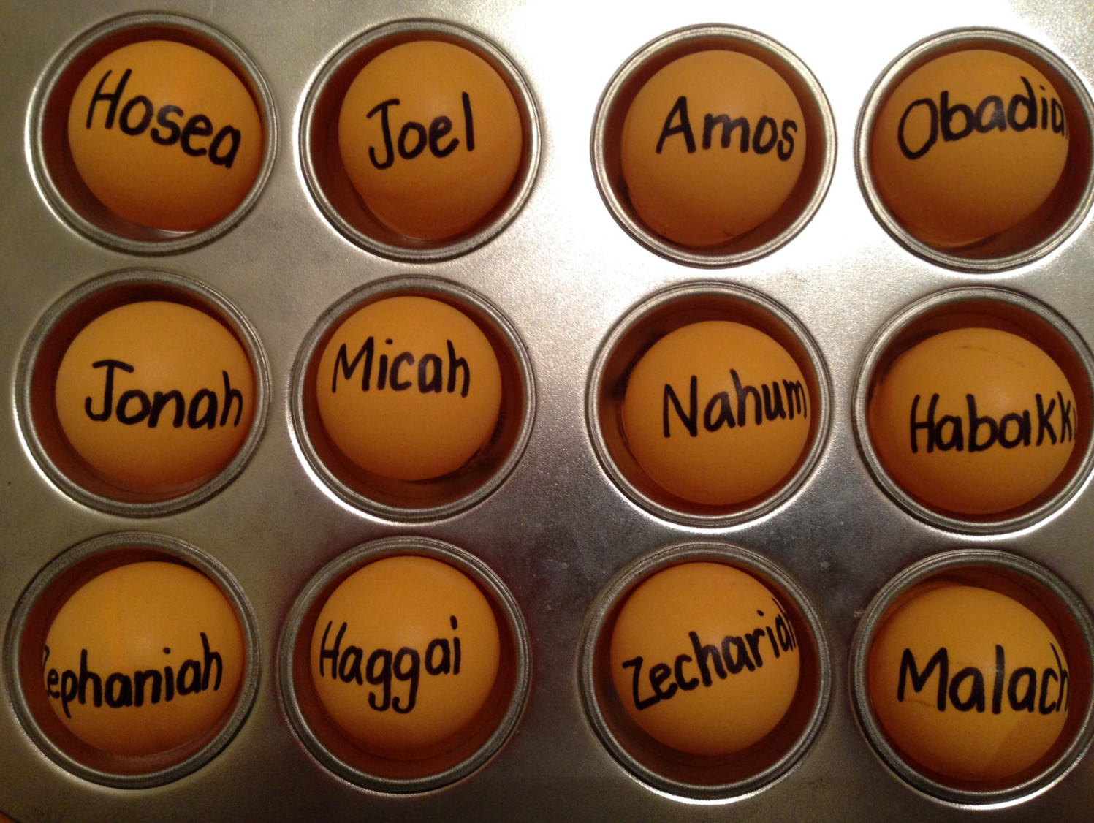
Be...
Loyal
Just
Humble
Caring
Generous
Patient
Hopeful

Slide 51
The Twelve
562
Minor Prophets
Hosea | Amos | Obad | Micah | Zeph | Hab | Joel | Jonah | Nahum | Zech | Haggai | Mal
 |  |  |  |   |  |  |  | 
755- 710 | 767- 753 | 845 | 735- 710 | 630 | 607- 605 | 590 | 760 | 660 | 538 | 520 | 425
Israel |  | Judah |  |  |  |  | Assyria |  | Judah
Pre-Exile |  |  |  |  |  |  |  |  | Post-Exile
~ 420 years
Destruction of Jerusalem & Temple

Slide 52
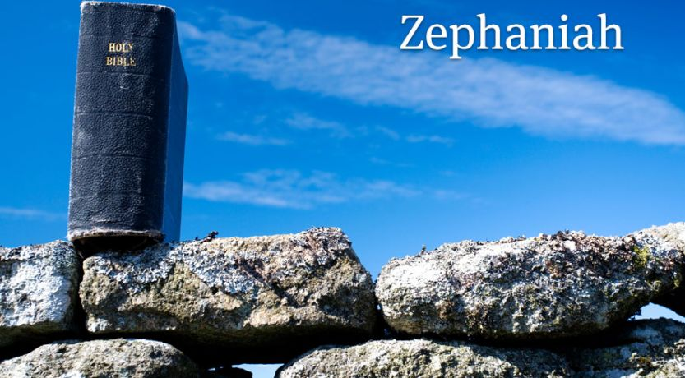
Zephaniah

Slide 53
Key Word
634
343
Day
Zephaniah

Slide 54
Zephaniah: Day of the LORD
634
Judgment | Salvation
1:1–3:8 | 3:9-20
Day of Punishment | Day of Praise
D-Day | V-Day
Destruction | Deliverance
Ruin | Restoration
God's Righteousness | God's Faithfulness
Warning | Encouragement
Earth 1:1-3 | Judah 1:4–2:3 | Nations 2:4-15 | Jerusalem 3:1-7 | Earth 3:8 |  | Remnant Regathered 3:9-10 | Redeemed & Restored 3:11-20
Judah, Nations, & the Whole Earth (about 630 BC)

Slide 55
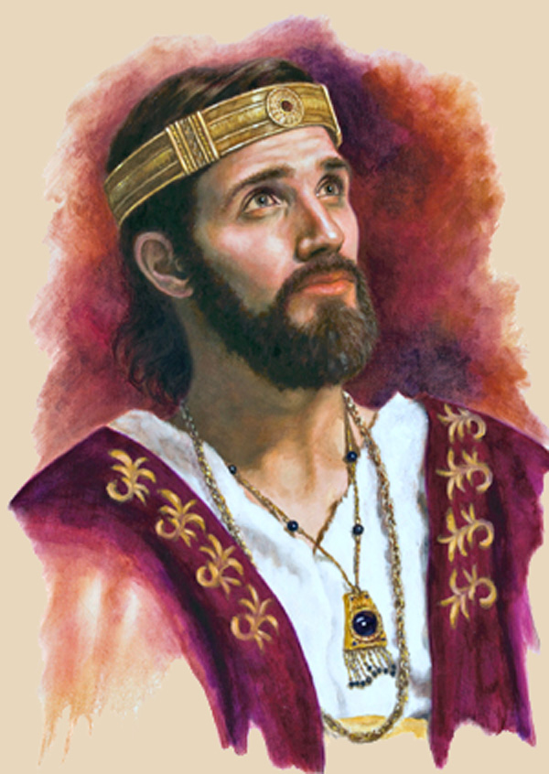
"The LORD gave this message to Zephaniah when Josiah son of Amon was king of Judah"
(Zephaniah 1:1a NLT).
Josiah

Slide 56
The Judean Kings
477
1. Rehoboam 2. Abijam 3. Asa + 4. Jehoshaphat + 5. Jehoram 6. Ahaziah 7. Athaliah (queen) 8. Joash + 9. Amaziah + 10. Uzziah/Azariah + | 11. Jotham + 12. Ahaz 13. Hezekiah (best king) + 14. Manasseh (worst king) 15. Amon 16. Josiah + 17. Jehoahaz 18. Jehoiakim 19. Jehoiachin 20. Zedekiah
3 months
has
11 years
Kim's
3 months
chin
11 years
+ Good Ruler

Slide 57
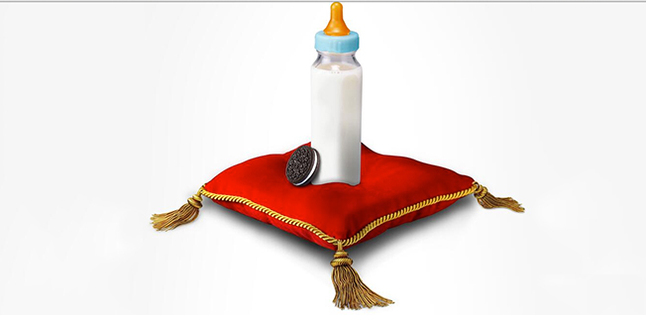
"The LORD gave this message to Zephaniah when Josiah son of Amon was king of Judah.
Zephaniah was the son of Cushi, son of Gedaliah, son of Amariah, son of Hezekiah"
(Zephaniah 1:1 NLT).

Slide 58
Zephaniah was of Royal Birth!
238
Hezekiah
King of Judah
(Line of David)
Sons who Did Not Rule
Sons who Ruled
Manasseh
Amariah
Amon
Gedaliah
Josiah
Cushi
Zephaniah
Righteous in white; Godless in yellow

Slide 59
Placing the Prophets
Placing the Prophets
342
Key Dates
931
Obadiah
722
Jonah
Amos
Hosea
Isaiah
Micah
Nahum
Zephaniah
586

Slide 60
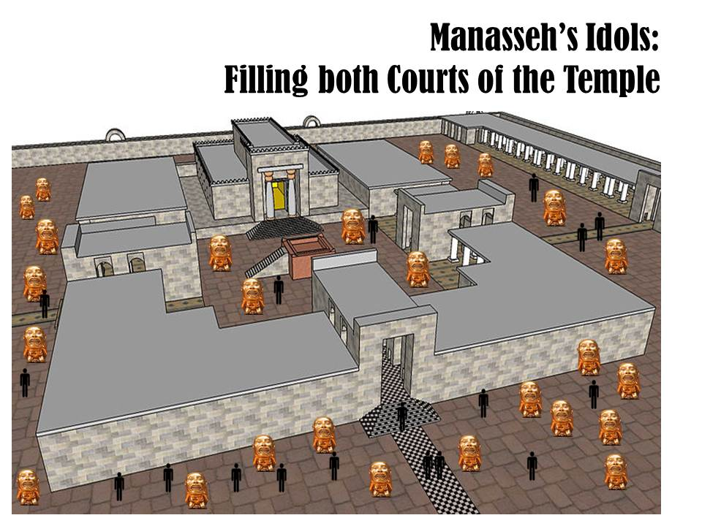
Zephaniah preached just after Manasseh filled both courts with idols

Slide 61
Jerusalem's Fall
Jerusalem's Fall
232
342
560
Key Dates
627
Jeremiah
605
Daniel
597
Ezekiel
586
538
Zephaniah
Joel
630
Lamentations
Habakkuk
590
606

Slide 62
How should we respond to the LORD’s balance?
Judgment
Deliverance
Repentance

Slide 63
I. God’s future judgment warns us to repent.
Zephaniah 1:1–3:8
Notes:
The LORD will hold you accountable, so change your mind about him now.

Slide 64
Slides on
Zephaniah 1

Slide 65
Zephaniah: Day of the LORD
634
Judgment | Salvation
1:1–3:8 | 3:9-20
Day of Punishment | Day of Praise
D-Day | V-Day
Destruction | Deliverance
Ruin | Restoration
God's Righteousness | God's Faithfulness
Warning | Encouragement
Earth 1:1-3 | Judah 1:4–2:3 | Nations 2:4-15 | Jerusalem 3:1-7 | Earth 3:8 |  | Remnant Regathered 3:9-10 | Redeemed & Restored 3:11-20
Judah, Nations, & the Whole Earth (about 630 BC)

Slide 66
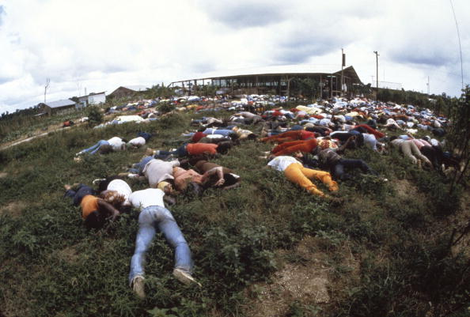
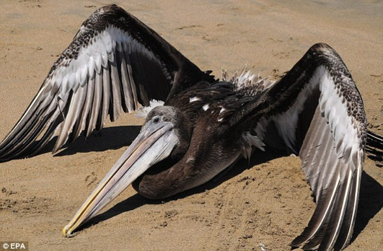
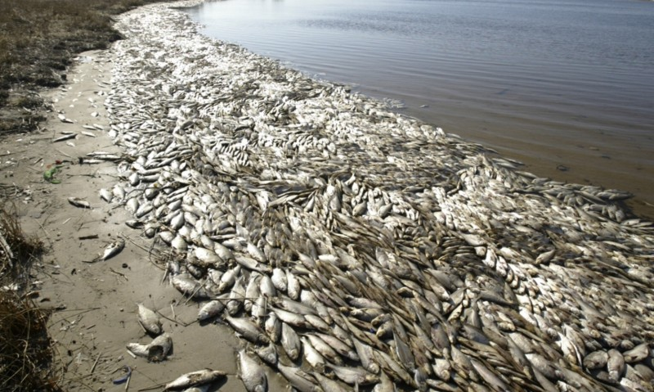
Judgment
"'I will sweep away everything from the face of the earth," says the LORD.
³"I will sweep away
people and animals alike.
I will sweep away the
birds of the sky and the
fish in the sea.
I will reduce the wicked to heaps of rubble, and I will wipe humanity from the face of the earth,' says the LORD" (Zeph. 1:2-3).

Slide 67

Woman
God's Creation…Day 6
"So God created man in his own image
in the image of God he created him
male and female he created them" (Gen. 1:27).

Slide 68
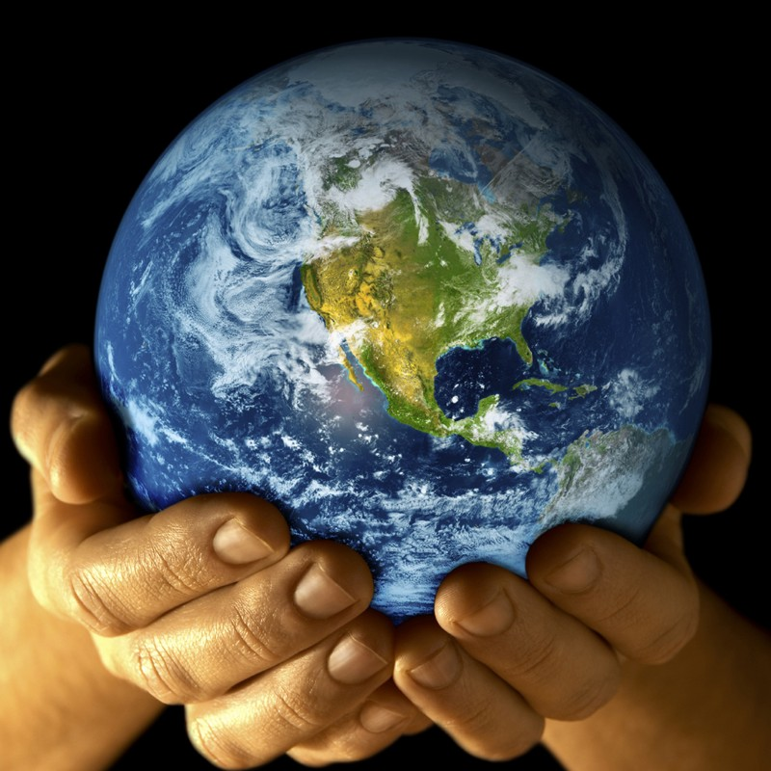
Mandate
448
and over the birds of the air
"And God blessed them, and God said to them, 'Be fruitful and multiply, and fill the earth and subdue it;
and have dominion over the fish of the sea
and over every living thing that
moves upon the earth'" (Gen. 1:28 NLT).

Slide 69
Judgment
"'I will sweep away everything from the face of the earth," says the LORD.
³"I will sweep away
people and animals alike.
I will sweep away the
birds of the sky and the
fish in the sea.
I will reduce the wicked to heaps of rubble, and I will wipe humanity from the face of the earth,' says the LORD" (Zeph. 1:2-3).

Slide 70
Zephaniah: Day of the LORD
634
Judgment | Salvation
1:1–3:8 | 3:9-20
Day of Punishment | Day of Praise
D-Day | V-Day
Destruction | Deliverance
Ruin | Restoration
God's Righteousness | God's Faithfulness
Warning | Encouragement
Earth 1:1-3 | Judah 1:4–2:3 | Nations 2:4-15 | Jerusalem 3:1-7 | Earth 3:8 |  | Remnant Regathered 3:9-10 | Redeemed & Restored 3:11-20
Judah, Nations, & the Whole Earth (about 630 BC)

Slide 71
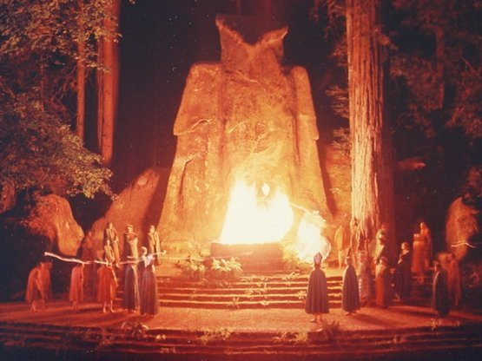
"I will crush Judah and Jerusalem with my fist and destroy every last trace of their Baal worship. I will put an end to all the idolatrous priests, so that even the memory of them will disappear'”
(Zephaniah 1:4 NLT).

Slide 72
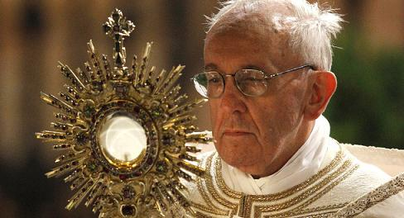
"For they go up to their roofs and bow down to the sun, moon, and stars. They claim to follow the LORD, but then they worship Molech, too'"
(Zephaniah 1:5 NLT).
Pope Francis worshipping the sun god

Slide 73
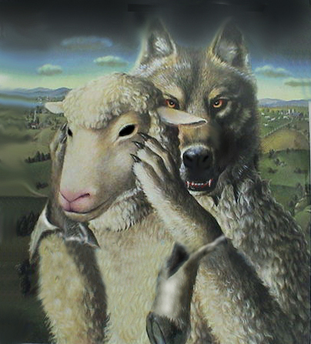
False Prophets

Slide 74
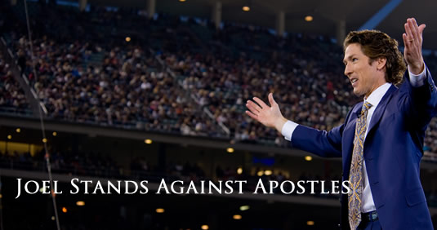
False Prophets
Osteen stands against apostles
Notes:
According to Joel Osteen – Pastor of Lakewood Church in Houston, Texas, these first century apostles are wrong and outdated and he has come out boldly to imply that Apostles Paul, Peter, and John who wrote much of the New Testament were wrong and need to be corrected and rebuked.
When asked directly by Oprah Winfrey if people who are openly practicing homosexuals are accepted into the Kingdom, Joel Osteen responded with “Absolutely, anybody is.”
Joel Osteen Rebukes Apostles Paul, Peter, and John
Written by Peter Michael Martinez – August 27, 2013
http://unitedforawakening.com/joel-osteen-rebukes-apostles-paul-peter-and-john/
Accessed 26 March 2017

Slide 75
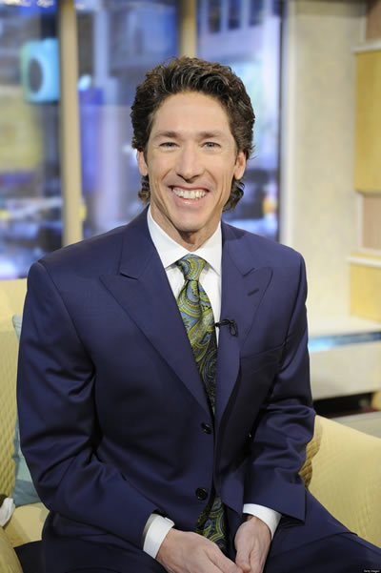
False Prophets
Notes:
Joel does acknowledge that some things are “sin” but says, “I don’t address these things from the pulpit. They only come up in interviews.” When asked by Piers Morgan if openly practicing gay/homosexual people will be accepted into heaven, Joel Osteen responded, “I believe they will.”
Joel Osteen Rebukes Apostles Paul, Peter, and John
Written by Peter Michael Martinez – August 27, 2013
http://unitedforawakening.com/joel-osteen-rebukes-apostles-paul-peter-and-john/
Accessed 26 March 2017

Slide 76
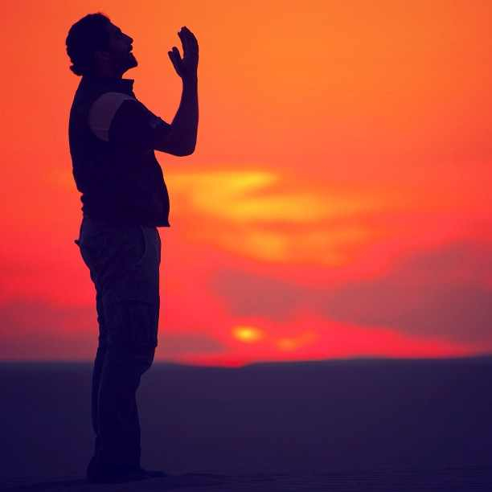
"'And I will destroy those who used to worship me but now no longer do.
They no longer ask for the LORD's guidance or seek my blessings'"
(Zephaniah 1:6 NLT).

Slide 77
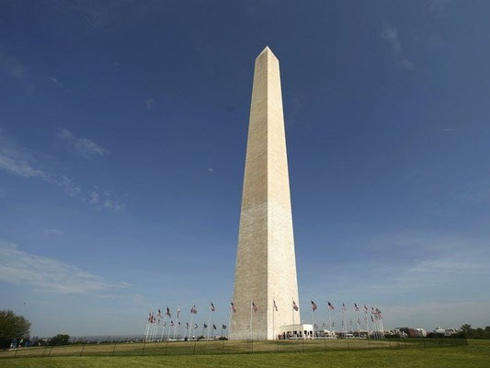
"Stand in silence in the presence of the Sovereign LORD, for the awesome day of the LORD's judgment is near.
The LORD has prepared his people for a great slaughter and has chosen their executioners"
(Zephaniah 1:7 NLT).

Slide 78

"'On that day of judgment,' says the LORD,
'I will punish the leaders and princes of Judah and all those following pagan customs.
⁹Yes, I will punish those who participate in pagan worship ceremonies, and those who fill their masters' houses with violence and deceit"
(Zephaniah 1:8-9 NLT).

Slide 79
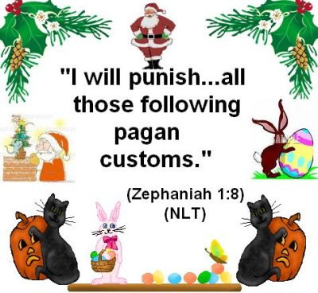
Zephaniah 1:8 (NLT)
"I will punish…all those following pagan customs"
????
Notes:
Judgment will come on the princes and aristocracy who evidence their disobedience by adopting foreign dress and practices (1:7-8).

Slide 80
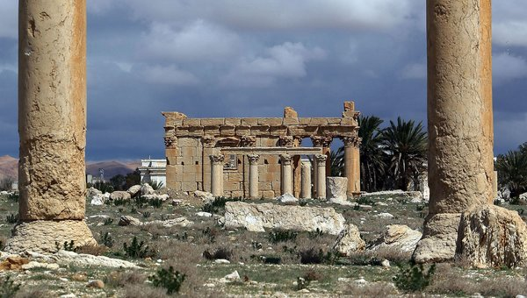
"'On that day,' says the LORD, 'a cry of alarm will come from the Fish Gate and echo throughout the New Quarter of the city. And a great crash will sound from the hills. ¹¹Wail in sorrow, all you who live in the market area, for all the merchants and traders will be destroyed" (Zephaniah 1:10-11 NLT).

Slide 81
"I will search with lanterns in Jerusalem's darkest corners to punish those who sit complacent in their sins. They think the LORD will do nothing to them, either good or bad.
¹³So their property will be plundered, their homes will be ransacked.
They will build new homes but never live in them.
They will plant vineyards but never drink wine from them"
(Zephaniah 1:12-13 NLT).

Slide 82
"That terrible day of the LORD is near.
Swiftly it comes— a day of bitter tears, a day when even strong men will cry out.
¹⁵It will be a day when the LORD's anger is poured out— a day of terrible distress and anguish, a day of ruin and desolation, a day of darkness and gloom, a day of clouds and blackness,
¹⁶a day of trumpet calls and battle cries.
Down go the walled cities and the strongest battlements!"
(Zephaniah 1:14-16 NLT).
day

Slide 83
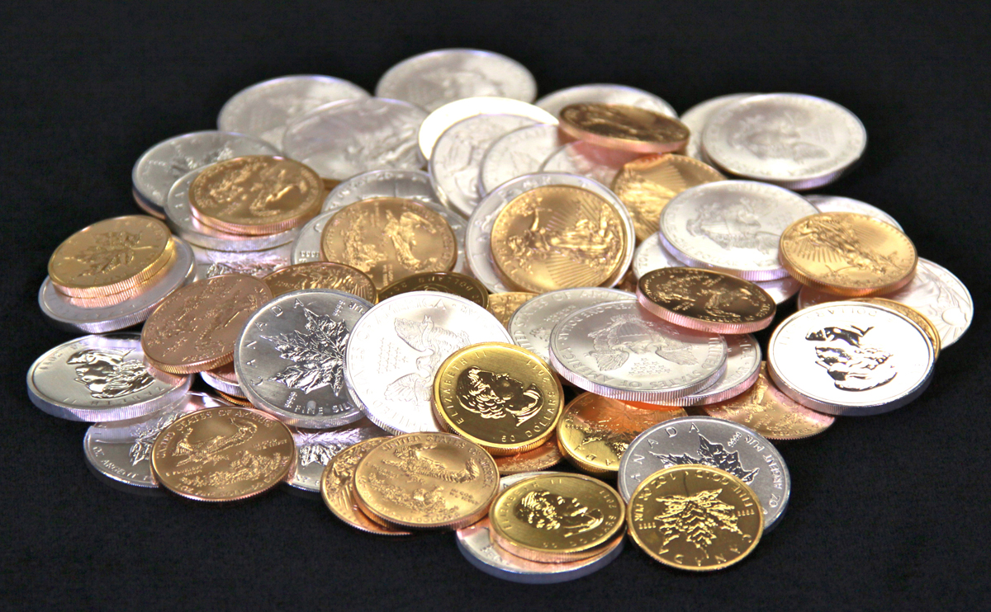
"Because you have sinned against the LORD,
I will make you grope around like the blind.
Your blood will be poured into the dust, and your bodies will lie rotting on the ground.
¹⁸Your silver and gold will not save you on that day of the LORD's anger.
For the whole land will be devoured by the fire of his jealousy.
He will make a terrifying end of all the people on earth"
(Zephaniah 1:17-18 NLT).

Slide 84
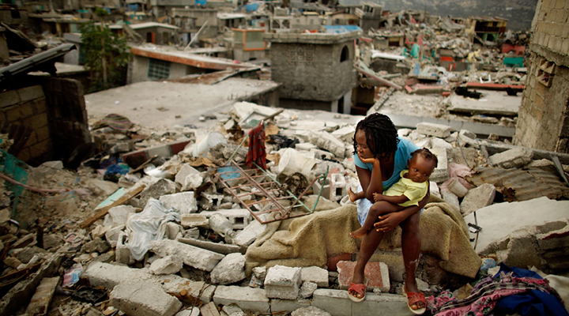
Earthquakes

Slide 85
Slides on
Zephaniah 2

Slide 86
"Gather together—yes, gather together, you shameless nation.
²Gather before judgment begins, before your time to repent is blown away like chaff.
Act now, before the fierce fury of the LORD falls and the terrible day of the LORD's anger begins.
³Seek the LORD, all who are humble, and follow his commands.
Seek to do what is right and to live humbly.
Perhaps even yet the LORD will protect you— protect you from his anger on that day of destruction" (Zephaniah 2:1-3 NLT).

Slide 87
Zephaniah: Day of the LORD
634
Judgment | Salvation
1:1–3:8 | 3:9-20
Day of Punishment | Day of Praise
D-Day | V-Day
Destruction | Deliverance
Ruin | Restoration
God's Righteousness | God's Faithfulness
Warning | Encouragement
Earth 1:1-3 | Judah 1:4–2:3 | Nations 2:4-15 | Jerusalem 3:1-7 | Earth 3:8 |  | Remnant Regathered 3:9-10 | Redeemed & Restored 3:11-20
Judah, Nations, & the Whole Earth (about 630 BC)

Slide 88

Judgment of the Nations (Zephaniah 2:4-15)
637
Assyria
Philistia
(2:4-7)
Ammon
Moab (2:8-11)
Ethiopia
Notes:
___________
Common-341
OS-36-Zephaniah-86

Slide 89
Judgment of Philistia
(Zephaniah 2:4-7)
637
Philistia

Slide 90
"Gaza and Ashkelon will be abandoned,
Ashdod and Ekron torn down.
⁵And what sorrow awaits you Philistines who live along the coast and in the land of Canaan, for this judgment is against you, too!
The LORD will destroy you until not one of you is left.
⁶The Philistine coast will become a wilderness pasture, a place of shepherd camps and enclosures for sheep and goats.
⁷The remnant of the tribe of Judah will pasture there.
They will rest at night in the abandoned houses in Ashkelon. For the LORD their God will visit his people in kindness and restore their prosperity again” (Zephaniah 2:4-7 NLT).

Slide 91
Judgment of Moab & Ammon
(Zephaniah 2:8-11)
637
Ammon
Moab

Slide 92
"'I have heard the taunts of the Moabites and the insults of the Ammonites, mocking my people and invading their borders.
⁹Now, as surely as I live,' says the LORD of Heaven's Armies, the God of Israel,
'Moab and Ammon will be destroyed— destroyed as completely as Sodom and Gomorrah.
Their land will become a place of stinging nettles, salt pits, and eternal desolation.
The remnant of my people will plunder them and take their land'"
(Zephaniah 2:8-9 NLT).

Slide 93
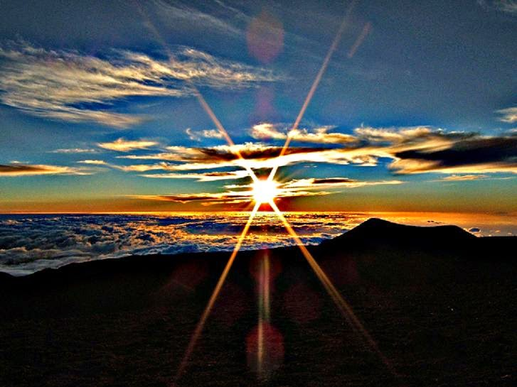
"They will receive the wages of their pride, for they have scoffed at the people of the Lord of Heaven's Armies. ¹¹The LORD will terrify them as he destroys all the gods in the land.
Then nations around the world will worship the LORD, each in their own land"
(Zephaniah 2:10-11 NLT).

Slide 94
Judgment of Ethiopia
(Zephaniah 2:12)
637
Ethiopia

Slide 95
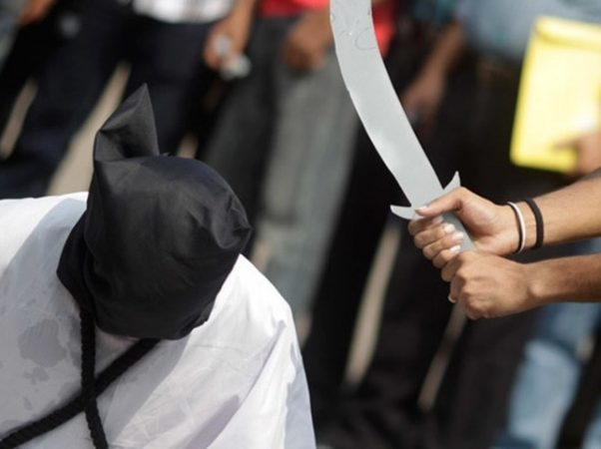
"'You Ethiopians will also be slaughtered by my sword,' says the LORD"
(Zephaniah 2:12 NLT).

Slide 96
Judgment of Assyria
(Zephaniah 2:13-15)
637
Assyria

Slide 97
"And the LORD will strike the lands of the north with his fist, destroying the land of Assyria.
He will make its great capital, Nineveh, a desolate wasteland, parched like a desert.
¹⁴The proud city will become a pasture for flocks and herds, and all sorts of wild animals will settle there.
The desert owl and screech owl will roost on its ruined columns, their calls echoing through the gaping windows.
Rubble will block all the doorways, and the cedar paneling will be exposed to the weather” (Zephaniah 2:13-14 NLT).

Slide 98

Nineveh's Water System Destroyed
637
"And He will stretch out His hand against the north and destroy Assyria, and He will make Nineveh a desolation, parched like the wilderness" (Zeph. 2:13)
The prophesied destruction of Nineveh (Zeph. 2:13), the capital of Assyria in what is now Iraq, fell in 612 BC into the hands of the neighboring Babylonians, with the whole empire taken by 605 BC. The prediction that God would leave Nineveh "dry as a desert" is remarkable in view of the fame of the city's great irrigation system.

Slide 99
The Assyrian Threat
Assyrian Expansion
Nineveh
Mediterranean
Sea
Syria
Israel
Judah
Persian
Gulf
Egypt

Slide 100

100 Years Later…
ASSYRIA
Tiglath-Pilesar
Assyria Strong
Jonah 760
Nahum 660
Nineveh's Fall 612
Israel's Fall 722
Zephaniah 630
1100
900
850
800
750
700
650
600
Nineveh's Relapse
Notes:
Nineveh was weak in Jonah’s time, but then grew incredibly strong 100 years later once again.
But how strong? What was next on God’s calendar?
———————
OS-00_OT Book Overviews-675
OS-34-Nahum-15
OS-36-Zephaniah-98

Slide 101
Nahum, Zephaniah, & Their Contemporaries
560
660 650 640 630 620 610 600 590 580 570 560 550 540 530 520
Ashuretililani
Sinsharishkun
Ashuruballit ii
Kings of Assyria
Ashurbanipal
Fall of Nineveh
663 BC
Fall of Thebes
Nahum
660
612
609 605 539
World powers
Assyrian
Fall of Jerusalem
Babylonian
Persian
Zephaniah
630
Jehoiakim
zedekiah
586
Kings of Judah
Manasseh
Josiah
Captivity of Judah to Babylon (586)
Return from Exile
Amon
Jehoahaz
Jehoiachin
Habakkuk
606
Notes:
Nahum, Zephaniah, and Habakkuk ministered in turbulent times of transition from Assyria to Babylon near the end of Judah's surviving kingdom (Israel had been destroyed a century earlier). Judah saw their final godly king Josiah killed in 609 while God raised up many prophets to warn the people. In addition to Nahum, Zephaniah, and Habakkuk, others not depicted here include Jeremiah and Joel in Judah and Ezekiel and Daniel in Babylon.
_____________
Common-409
BE-35-Habakkuk-17
OS-34-Nahum-36
OS-35-Habakkuk-43
OS-36-Zephaniah-60

Slide 102
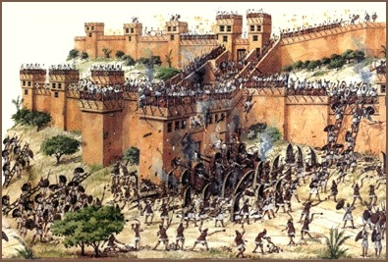
Nineveh:
Destroyed by Flood and Fire

Slide 103
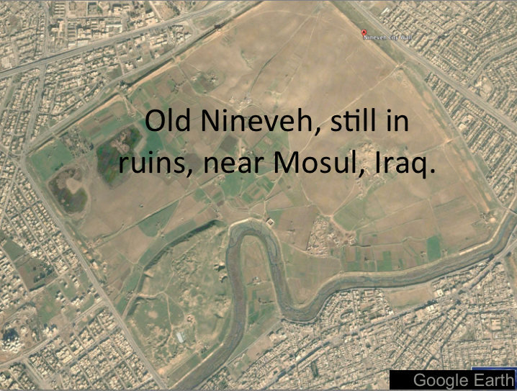
Modern Map
Mosul, Iraq, surrounds Nineveh’s ancient ruins
Notes:
OS-34-Nahum-112
OS-36-Zephaniah-101

Slide 104

"This is the boisterous city, once so secure.
'I am the greatest!' it boasted.
'No other city can compare with me!'
But now, look how it has become an utter ruin, a haven for wild animals.
Everyone passing by will laugh in derision and shake a defiant fist"
(Zephaniah 2:15 NLT).

Slide 105
Zephaniah: Day of the LORD
634
Judgment | Salvation
1:1–3:8 | 3:9-20
Day of Punishment | Day of Praise
D-Day | V-Day
Destruction | Deliverance
Ruin | Restoration
God's Righteousness | God's Faithfulness
Warning | Encouragement
Earth 1:1-3 | Judah 1:4–2:3 | Nations 2:4-15 | Jerusalem 3:1-7 | Earth 3:8 |  | Remnant Regathered 3:9-10 | Redeemed & Restored 3:11-20
Judah, Nations, & the Whole Earth (about 630 BC)

Slide 106
Slides on
Zephaniah 3

Slide 107
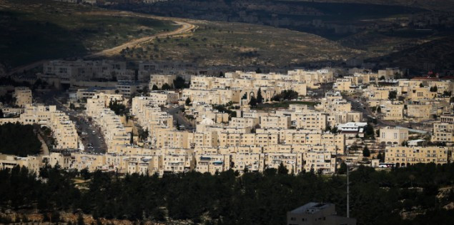
"What sorrow awaits rebellious, polluted Jerusalem, the city of violence and crime!
²No one can tell it anything; it refuses all correction.
It does not trust in the LORD or draw near to its God"
(Zephaniah 3:1-2 NLT).

Slide 108
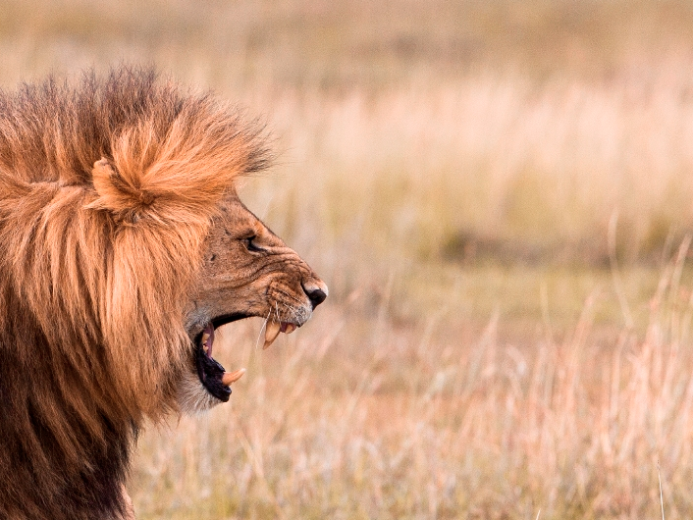
"Its leaders are like roaring lions hunting for their victims.
Its judges are like ravenous wolves at evening time, who by dawn have left no trace of their prey"
(Zephaniah 3:3 NLT).

Slide 109

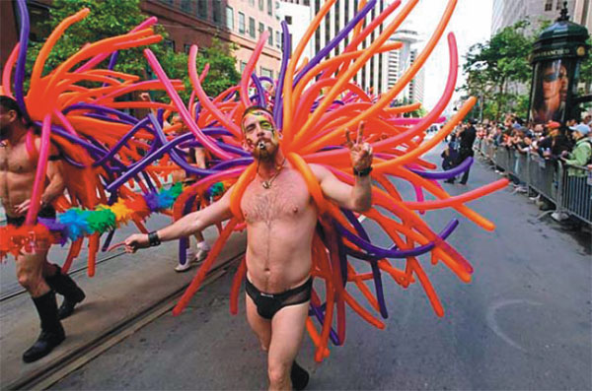
"[Jerusalem's] prophets are arrogant liars seeking their own gain.
Its priests defile the Temple by disobeying God's instructions.
⁵But the LORD is still there in the city, and he does no wrong.
Day by day he hands down justice, and he does not fail.
But the wicked know no shame"
(Zephaniah 3:4-5 NLT).

Slide 110
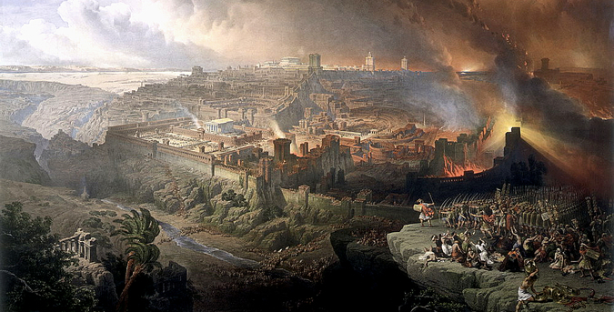
"I have wiped out many nations, devastating their fortress walls and towers.
Their streets are now deserted; their cities lie in silent ruin.
There are no survivors—none at all"
(Zephaniah 3:6 NLT).

Slide 111
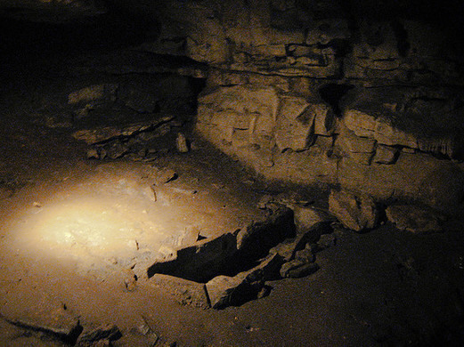
"I thought,
'Surely they will have reverence for me now!
Surely they will listen to my warnings.
Then I won't need to strike again, destroying their homes.'
But no, they get up early to continue their evil deeds"
(Zephaniah 3:7 NLT).

Slide 112
Zephaniah: Day of the LORD
634
Judgment | Salvation
1:1–3:8 | 3:9-20
Day of Punishment | Day of Praise
D-Day | V-Day
Destruction | Deliverance
Ruin | Restoration
God's Righteousness | God's Faithfulness
Warning | Encouragement
Earth 1:1-3 | Judah 1:4–2:3 | Nations 2:4-15 | Jerusalem 3:1-7 | Earth 3:8 |  | Remnant Regathered 3:9-10 | Redeemed & Restored 3:11-20
Judah, Nations, & the Whole Earth (about 630 BC)

Slide 113
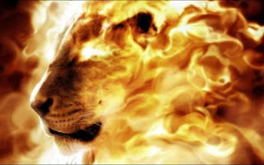
"'Therefore, be patient,' says the LORD.
'Soon I will stand and accuse these evil nations.
For I have decided to gather the kingdoms of the earth and pour out my fiercest anger and fury on them. All the earth will be devoured by the fire of my jealousy"
(Zephaniah 3:8 NLT).

Slide 114
PEOPLE ON
EARTH
HATE TO HEAR THE WORD REPENT!
THOSE IN
HADES
WISH THEY COULD
HEAR IT
JUST ONCE MORE
Notes:
Repentance literally means a change of mind—don’t trust yourself but change your mind to trust God instead. The “fruits of repentance” then mean a change of behavior based on whom you lean on. The basics are in 2:3:
Seek the LORD. Don’t seek idols.
Seek righteousness. Don’t seek what is expedient.
Seek humility. Don’t lift up yourself but lift up others.
Have you changed your mind about whom you trust—and that shows in a humble, pure life?
The NT in 1 Corinthians 3 says that your works will be like materials set on fire. That’s a severe warning. Only the lasting ones will last and be rewarded.

Slide 115
How should we respond to the LORD’s balance?
Judgment
Deliverance
Repentance
Hope

Slide 116
II. God’s future deliverance encourages us to hope.
Zephaniah 3:9-20
Notes:
The LORD will reward you, so live with anticipation now .

Slide 117

Ethiopia Worship
(Zephaniah 3:9-11)
"Then I will purify the speech of all people, so that everyone can worship the LORD together. ¹⁰My scattered people who live beyond the rivers of Ethiopia will come to present their offerings. ¹¹On that day you will no longer need to be ashamed, for you will no longer be rebels against me. I will remove all proud and arrogant people from among you. There will be no more haughtiness on my holy mountain."
Israel
Ethiopia

Slide 118


Solomon's & Ezekiel's Temples Contrasted
518
Notes:
118
One suggestion is that this is Solomon's temple (Adam Clarke, "Ezekiel," in Clarke's Commentary, 4:535), but this view has several flaws.
First, the dimensions of these two temples are different. While Solomon's temple was fairly small (90 feet long, 30 feet wide, and 45 feet high), Ezekiel's temple measures much larger (175 feet long and 87.5 feet wide). This is the minimum measurement based upon Ezekiel 41:13 using Ezekiel's long (21-inch) cubit explained in 40:5 (cf. 43:13) where a rod is equal to 6 long cubits, each of which is an 18-inch cubit plus a 3-inch handbreadth; therefore, a rod must be 10.5 feet long since 6 cubits at 21 inches equals 126 inches, or 10.5 feet. Nowhere does the account provide the height of the temple although the entire temple area is enclosed by a wall one rod ("stalk, reed" BDB 889d) in height (40:5), or 10.5 feet. (If the measurement is with the normal, or shorter [18-inch] cubit, the temple dimensions must be adjusted slightly to 150 feet by 75 feet.) This issue becomes even more confusing as the temple area measurements in 42:16-19 are plagued with textual difficulties. In each verse the MT measures in "rods" (NASB, NIV margin, KJV, NKJV, Ampl), but the LXX follows the Qere which reads the transposed "cubits" (NIV, RSV, GNB). Therefore, a single temple court side in the MT is "500 rods" or 5250 feet, but in the LXX it is "500 cubits" or 875 feet (using the long cubit). Furthermore, the situation is complicated by the fact that Ezekiel uses the cubit (40:5b, 9, 11–42:20; etc.), the rod (40:3, 5a-7; 42:16-19), and an ellipsis (45:1-6; 48:8-21, 30-35) for measurement. Most commentators agree that the cubit is the proper unit since use of the rod would make four sides of the temple area nearly one mile in length, an unlikely size. For further study on the measurements of the temple in cubits see Theo G. Soares, "Ezekiel's Temple," BW 14 (1899): 93-103. Adhering to the rod view is Cameron M. MacKay, "The City and the Sanctuary: Ezekiel 48," PTR 20 (1922): 399-417 (cf. MacKay, "Prolegomena to Ezekiel 40–48," ET 55 (1943/44): 292-95), who advocates an enormous temple situated in the Valley of Shechem (cf. MacKay, "Ezekiel's Sanctuary and Wellhausen's Theory," PTR 20 [1922]: 661-65, which argues against the documentary hypothesis). MacKay's first article (pp. 399-417) is critiqued by W. F. Lofthouse, "The City and the Sanctuary," ET 34 (1922/23): 198-202 and rebutted by MacKay in "The City and the Sanctuary," ET 34 (1922/23): 475-76. In either case, whether rods or cubits are used, the temple is one that has never been constructed in Israel.
Solomon's temple measurements in 1 Kings 6:2 are noted at 60, 20, and 30 cubits; the above measurements in feet were obtained by multiplying these three lengths by the standard 18 inches per cubit. "The square of the temple in 42:20 is six times as large as the circuit of the wall enclosing the old temple, and, in fact, is larger than the former city itself” (Hobart E. Freeman, An Introduction to the Old Testament Prophets, 313).
Second, if this description depicted the former temple, it must be asked what hope Ezekiel could offer his oppressed brethren by reminding them of the glory of Solomon's temple which at that time lay in ruins. Third, the Books of Kings and Chronicles already provide detailed descriptions of Solomon's temple, so another record would be unnecessary. For these reasons, Ezekiel's temple is not the same as Solomon's.

Slide 119

View from Above
517
6. Outer Court Northern Gateway - 40:20-23
7. Outer Court Eastern Gateway - 40:6-16
8. Outer Court Southern Gateway - 40:24-27
9. Inner Court Northern Gateway - 40:35-37
10. Inner Court Eastern Gateway - 40:32-34
11. Inner Court Southern Gateway - 40:28-31
www.pauljab.net/temple/ TemplePictures.html
Notes:
119
Note that at least 4 of Solomon’s temples fit into Ezekiel’s—maybe even 5-6 of them. Ezekiel is obviously not describing the first temple built by Solomon.

Slide 120


Ezekiel's temple won't fit on the present Temple Mount!
521
656
www.pauljab.net/temple/ TemplePictures.html
Notes:
If we take the larger view (see previous tow slides), the side of Ezekiel’s temple court would be nearly a mile long. Even the shorter rod view is too large.

Slide 121




Which temple for Ezekiel?
520
Solomon
Zerubbabel/Herod
Three
Literal
Views
Conditional
Millennial
Church
Notes:
Ezekiel 40–46 has at least five different interpretations but the only one that takes the text at face value is that this temple with these dimensions has not yet been built—so it must happen in the future millennium.
The conditional view says that the people did not truly believe in the Lord sufficiently, so God never built it and will not do so in the future. But hundreds of verses in the Prophets speak of a believing Israel in the future. See the Isaiah 60–66 slides on the restoration of Israel.

Slide 122



Problems Either Way!
525
Premillennial:
Sacrifices for Sin
(Ezek. 40:39) in Light of Christ's Death
Amillennial:
Abandon Normal Meaning of Gates, Doors, Walls, Sacrifices
Notes:
We should not stop the normal way we read words in Ezekiel just because we feel uncomfortable with the idea of future sacrifices. Spiritualizing these chapters leads to even greater problems in determining what is meant by these parts of the temple and sacrifices when the Bible does not tell us what else they mean other than the plain use of words and phrases.

Slide 123

OT Forgiveness of Sin
121b
Pipe = Relationship with God (never changing)
Sin
Clog = Fellowship with God (hindered by sin)
Sacrifices = Confession of Sin (sin was forgiven to restore fellowship but relationship was never threatened)
Notes:
The Israelite relationship with God can be compared to a pipe.
Occasionally the pipe got a clog—like sin—that hindered their fellowship with God.
Did OT believers still have a relationship with God when they sinned? Yes!
Sin did not hinder their relationship with God but their fellowship with Him.
OT sacrifices did not establish a relationship with God but rather they restored their fellowship with God
_____
OP-02-Lev-28
OS-04-Num-29
OS-26-Ezek40-43-slide 73
NS-23-1Jn-58
SA-03-Biblical Terms-9

Slide 124
NT Forgiveness of Sin
121b
"If we confess our sins,
He is faithful and righteous to forgive us our sins and to cleanse us from all unrighteousness"
(1 John 1:9 NAU)
Pipe = Relationship with God (never changing)
Sin
Clog = Fellowship with God (hindered by sin)
Christ's Sacrifice = The Basis for Confession of Sin (sin is forgiven to restore fellowship but relationship has never been never threatened)
Notes:
Our relationship with God can be compared to a pipe.
Occasionally the pipe gets a clog—like sin—that hinders our fellowship with God.
Do we still have a relationship with God when we sin? Yes!
Sin does not hinder our relationship with God but our fellowship with Him.
_________
OB-38-Salvation-11
OS-03-Leviticus-56, 72, 130
OS-04-Numbers-30
NS-23-1Jn-59
SA-03-Biblical Terms-9

Slide 125
Millennial Forgiveness of Sin
121b
"The man said to me, ‘These are the kitchens to be used by the Temple assistants to boil the sacrifices offered by the people’"
(Ezekiel 46:24 NLT)
Pipe = Relationship with God (never changing)
Sin
Clog = Fellowship with God (hindered by sin)
Christ's Sacrifice = The Basis for Confession of Sin (sin is forgiven to restore fellowship but relationship has never been never threatened)
Notes:
Sacrifices in the millennium—like all sacrifices throughout history—will not in themselves forgive sin. They will—like all sacrifices throughout history—only point to the Lord Jesus as the final sacrifice for sin. Offering them will be a form of confession of sin.

Slide 126
Why Millennial Sacrifices?
527
Pre-Cross:
Looked toward Christ's Death
Post-Cross:
Look back on Christ's Death
Theocratic: like confession of sin (1 John 1:9)
Memorial: like Lord's Supper that looks back
Paul offered a temple sacrifice in AD 57 (Acts 21:26) without seeing a "digression problem"
Notes:
Since Paul offered a sacrifice, he was indicating that sacrifices in and of themselves are not the problem. They all look to Jesus, so they are not needed (Heb 10:18) as only Christ's sacrifice atones for sin. Yet they can be used for confession of sin both pre-cross and post-cross.

Slide 127

"Those who are left will be the lowly and humble, for it is they who trust in the name of the LORD.
¹³The remnant of Israel will do no wrong; they will never tell lies or deceive one another.
They will eat and sleep in safety, and no one will make them afraid"
(Zephaniah 3:12-13 NLT).

Slide 128

"Sing, O daughter of Zion; shout aloud, O Israel!
Be glad and rejoice with all your heart,
O daughter of Jerusalem!
¹⁵For the LORD will remove his hand of judgment and will disperse the armies of your enemy.
And the LORD himself, the King of Israel, will live among you!
At last your troubles will be over, and you will never again fear disaster"
(Zephaniah 3:14-15 NLT).

Slide 129

"On that day the announcement to Jerusalem will be,
'Cheer up, Zion! Don't be afraid!
¹⁷For the LORD your God is living among you.
He is a mighty savior.
He will take delight in you with gladness.
With his love, he will calm all your fears.
He will rejoice over you with joyful songs'"
(Zephaniah 3:16-17 NLT).

Slide 130

Zephaniah 3:17

Slide 131

The LORD your God
is with you,
he is mighty
to save.
He will take
great delight
in you,
he will quiet you
with his love,
he will rejoice over you
with singing.
Zephaniah 3:17 (NIV)

Slide 132
Yahweh your God
is there with you,
the warrior-Savior.
He will rejoice
over you
with happy song,
he will renew you
by his love,
he will dance
with shouts of joy
over you.
Zephaniah 3:17 (NJB)

Slide 133

"I will gather you who mourn for the appointed festivals; you will be disgraced no more.
¹⁹And I will deal severely with all who have oppressed you.
I will save the weak and helpless ones;
I will bring together those who were chased away.
I will give glory and fame to my former exiles, wherever they have been mocked and shamed"
(Zephaniah 3:18-19 NLT).

Slide 134


Should we follow the festivals or Colossians 2:16-17?
"I will gather you who mourn for the appointed festivals; you will be disgraced no more"
(Zeph. 3:18 NLT).
Jewish Festivals

Slide 135

Jewish: The Law is Good
but…

Slide 136

No Legalism!
"So don't let anyone condemn you for what you eat or drink, or for not celebrating certain holy days or new moon ceremonies or Sabbaths. ¹⁷For these rules are only shadows of the reality yet to come. And Christ himself is that reality" (Col. 2:16-17 NLT)

Slide 137

"On that day I will gather you together and bring you home again.
I will give you a good name, a name of distinction, among all the nations of the earth, as I restore your fortunes before their very eyes.
I, the LORD, have spoken!"
(Zephaniah 3:20 NLT).

Slide 138
III. Theological Themes
636
1. The Day of Yahweh
2. Universalism
3. Messianic Prophecy
4. God's Presence
5. Creation & 'Decreation'
6. Land in the eyes of the prophets
7. The Remnant

Slide 139
Theological Themes
636
639
1. The Day of YHWH
Concept that appears in every prophetical writing in the OT
In Zephaniah:
The Day of YHWH is noted 23 times in 3 chapters
Variations: "The Day of YHWH," "Day," etc.
"The Day" is
  a. Imminent (1:14)
  b. Day of terror (1:15)
  c. Judgment for sins (1:17)
  d. Universal judgment (1:2-3, 2:4-15; 3:8)
  e. Great convulsion of nature (1:15)
  f. Remnant redeemed (3:16-17)

Slide 140

Hope
Notes:
At the confirmation of Neil Gorsuch, President Trump and his advisors bowed to give thanks to God. Prayer in the government is certainly not out of line, for prayer has been offered each morning at the beginning of the Senate for over 200 years!

Slide 141

Judgment!

Slide 142

Blessing!

Slide 143


The Day of the LORD
638-639
Judgment
+
Blessing
Tribulation
Millennium
Rev. 6–19
Rev. 20
7 years
1000 years
Notes:
The Day of the LORD theme appears in every prophetic writing except Jonah. It has a dual emphasis where judgment is followed by blessing. In the near fulfillment, it warns of the judgment of Israel in the Assyrian captivity or of Judah in the Babylonian exile.
But the ultimate referent is the the judgment of the whole earth for a short period, followed by a long era of blessing. Daniel 9:27 identifies this judgment as lasting seven years. Daniel also divides that period into two segments lasting 3.5 years (Dan 7:25; 12:7; Rev. 12:14) which Revelation calls “42 months” (Rev 13:5) or “1260 days” (Rev 12:6).
The NT builds upon this common OT teaching regarding the blessing period. When we get to Rev 20:1-6, we see that the blessing of the kingdom era will last 1000 years.
————————————
OS-29-Joel-86, 157
OS-36-Zephaniah-135

Slide 144
A Dispensational Timeline
OT Survey page 437
Rapture
(1 Thess 4:13-18)
2nd Advent
(Zech 14:3-5)
Great White Throne
(Rev 20:11-14)
Day of the LORD
Church Age
Tribulation
(Zech 14:1-2)
Millennium
(Zech 14:6-21)
Gog & Magog
(Armageddon)
(Ezek 38–39)
Gog and Magog
Revisited
(Rev 20:7-10)
"How awful that day will be! None will be like it. It will be a time of Jacob's trouble but he will be saved out of it"
(Jer 30:7)
Notes:
144
The next event on God's prophetic calendar is for the church age to end with the Rapture. Shortly after this, the Day of the Lord will begin with the Antichrist signing a covenant with Israel (Dan 9:27; 2 Thess 2:1-12). Jeremiah 30:7 called this "Day" or period the "time of Jacob's trouble" or era of great persecution of Jews. Yet the second coming will bring in phase 2 of the "Day of the Lord" where all Israel at that time will be saved (Rom 11:26-27). This 1000 years of blessing on earth will be preceded and followed by two major battles and ending in the Great White Throne Judgment.
So how does this give you hope?
Does it affect how you use your money? Do you “lay up for yourself treasures in heaven” as a result?
How does it impact your use of time? Do you say, “That movie isn’t necessarily wrong, but I could use my time much better by investing God’s Word into others!”
______
Common-342
ES-26-Restoration of Israel-284
JE-09-Return of Christ-36
JE-10-Christ's Rule-40
OS-23-Isaiah 1-12-Slide 87
OS-26-Ezekiel 1-39-Slide 247
OS-26-Ezekiel 40-43-Slide 24
OS-29-Joel-87
OS-31-Obadiah-154
OS-36-Zephaniah-86
OS-39-Zechariah-158, 167, 184
NS-22-Rev4-6-slide 117
NS-22-Rev20-22-slide 137

Slide 145
Kingdom & Covenants Timeline
22
CH-34a
OS1-22
OS2-337
NS-9g
SA-19
34a
Dr. Rick Griffith • BibleStudyDownloads.org
22
Kingdom Teaching...
Adam rules with God (Gen. 1:26, 28; 2:19)
Satan begins rule as god of this world (Gen. 3:15;
2 Cor. 4:4)
God covenants with Abraham to reestablish man's rule via Israel as a "kingdom of priests" (Gen. 12:1-3; Exod. 19:6)
Israel's failure to witness to nations as a kingdom of priests is judged via exile under foreign rule
Israel rejects Messiah's offer of kingdom (Matt. 12:41-42; 23:37-39)
Jesus extends His kingdom in mystery form to the Church (Matt. 13)
Christ subdues Israel's enemies and nation believes (Rom. 11:26-27)
Christ rules over everything with saints (Eph. 1:9-10; Rev. 20:1-6; 22:5b)
337
9g
Fall of Man (Gen. 3)
Noahic Covenant
19
Genesis 6:18; 9:8-17
Land Covenant
ISRAEL
CHURCH
MESSIANIC KINGDOM
(National Focus)
The "New Man" (Eph. 2:15)
Millennial Eternal
land
Genesis 15:18 (cf. Deut. 30:1-10) promises:
Land from Wadi of Egypt to Euphrates River (Isa. 27:12)
Eternal possession of land (Gen. 17:8) after exile/restoration
Whole world blessed via the land (Isa. 14:1-2)
Israel judged for rejecting Messiah by dispersion away from land for 19 centuries
(AD 70–AD 1948) but now partially restored (Ezek. 37:1-7)
Full restoration (Ezek. 37:8-28) Jerusalem world capital
(Isa. 2:1-5)
New Jerusalem
(Rev. 21–22)
Davidic Covenant
Christ is Head over his Church, which is a spiritual temple (Eph. 2:19-22; 2 Cor. 6:16)
Christ reigns over the world
(Isa. 11)
with saints (Rev. 5:10; 20:4-6)
Christ hands kingdom over to Father (1
Cor. 15:24)
Genesis 12:1-3
2 Samuel 7:12-16 promises:
Sons ("house" never wiped out)
Kingdom (political dynasty)
Throne (right to rule by descendants)
Temple (son to build it)
seed
Abrahamic Covenant
New Covenant
All
things made new!
(Rev. 21:5)
All 5 elements fulfilled in national restoration (Zech. 8)
Jeremiah 31:31-34 promises:
Forgiveness
Indwelling Spirit
New heart, nature, mind
Reunification of Israel and Judah
No need for evangelism
Mosaic Law is replaced with first three elements of the New Covenant (Luke 22:20; 2 Cor. 3:6)
blessing
Mosaic Covenant
Law abolished, fulfilled, and replaced at the cross (Rom. 7:1-6;
1 Cor. 9:19-21; Heb. 8:13)
12th Edition
5 March 2023
Temporary (Gal. 3:19) and conditional (Deut. 28) to reveal sin (Rom. 7:7) and regulate Israel (Gal. 3:23-25)
Scripture has a dual kingdom-covenant theme. Israel's role from Abraham to Christ expands to include the Church (continuity) yet the Church never replaces the nation as the "new Israel" (discontinuity). Israel will enjoy world prominence after trusting Christ at His second coming.
Notes:
This complicated chart combines the two themes of Kingdom and Covenants. God's kingdom rule extends to humanity across the ages at the top. Also, God's covenant (promise) to Noah still applies today never to flood the entire earth. But the major part shows the unfolding of the Abrahamic Covenant in its land, Davidic, and New Covenant promises—partially fulfilled in the present, but fully completed in the Messianic Kingdom. This will happen in the Millennial Age and especially in the Eternal State.
• This chart also shows that the Old (Mosaic) Covenant was replaced by the New Covenant because believers have died to the Law (Rom 7:1-6).
All agree that a partial fulfillment of the covenant to Abraham exists now to the Church in the indwelling Holy Spirit and forgiveness of sins (Jer 31:31-34)—and the ultimate fulfillment will be in the eternal state.
The main area of disagreement relates to the time period from now to eternity. Will there be a literal land, throne, and worldwide blessing to national (ethnic) Israel before the eternal kingdom? This chart shows verses answering YES to that question in a present partial fulfillment and a future full fulfillment in the normal sense of language in the verses cited. But the messianic kingdom will be in two stages—first in a millennial fulfillment to last 1000 years, but then, after that, the eternal stage in the new Jerusalem after the destruction of our present heavens and earth (Rev 21–22). What an amazing future remains for those who trust Jesus!
____________
Common Slides-168
BT-01-OT Biblical Theology-25
CH-02-Nature-103-p34a
ES-13-Tribulation-23
ES-27-Kingdom_&_Covenants_Timeline-1
CH-02-Nature-103-p34a
OC-10-Chronology-42
OS-00-Intro & Biblical Theology-25 & 90
OS-00-Pentateuch-18
OS-02-Exodus-267-p22
OS-05-Deut-279, 300
OS-10-2Sam-96-p22
OS-12-Kings & Prophets Charts-25
OS-13-1 Chron-46
OS-23-Isaiah-97-p337
OS-24-Jeremiah-174-p337
OS-23-Isaiah-97-p337
OS-28-Hosea-49
OS-31-Obadiah-164
OS-36-Zephaniah-143
OS-38-Zechariah-220
05-Acts1-2-slide 45
NS-09-Gal-143-p9g
NS-19-Hebrews-342-p9g
SA-08-Mosaic Law-19-p38a

Slide 146

III. Theological Themes
1. The Day of Yahweh
2. Universalism
3. Messianic Prophecy
4. God's Presence
5. Creation & 'Decreation'
6. Land in the eyes of the prophets
7. The Remnant

Slide 147
2. Universalism
637
Judgment: Worldwide
Terror of the Day will fall upon all
Earth
3:8
Jerusalem
3:1-7
Earth
1:1-3
Assyria
2:13-15
Judah
1:4–2:3
Moab
2:8-11
Ammon
2:8-11
Cush
2:12
Philistia
2:4-7

Slide 148
Zephaniah
The Day of the LORD

Slide 149
Key Word
634
343
Day
Zephaniah

Slide 150
How should we respond to the LORD’s balance?
Judgment
Deliverance
Repentance
Hope

Slide 151
Main Idea
Be hopeful yet repentant.
Zephaniah
Notes:
Balance your anticipation with right thinking.

Slide 152
Zephaniah Kingdom Statement
343
Judah should repent because of a future day of judgment (1:1–3:8) and blessing (3:9-20) on the whole earth caused by God as King.

Slide 153
Zephaniah
Summary Statement
634
346
Zephaniah prophesies the day of the LORD judgment upon Judah, the surrounding nations, and the entire earth to exhort Judah to repent due to God's righteousness and His promise of a remnant in a national restoration.

Slide 154
I. God’s future judgment warns us to repent.
Zephaniah 1:1–3:8
Notes:
The LORD will hold you accountable, so change your mind about him now.

Slide 155
II. God’s future deliverance encourages us to hope.
Zephaniah 3:9-20
Notes:
The LORD will reward you, so live with anticipation now .

Slide 156
Key Verse
634
"Gather together…before the day of the LORD's wrath comes upon you. Seek the LORD, all you humble of the land, you who do what he commands. Seek righteousness, seek humility; perhaps you will be sheltered on the day of the LORD's anger" (Zephaniah 2:1-3).
Zephaniah

Slide 157
God sings over you (Zephaniah 3:17)!

Slide 158

"The LORD your God is with you, he is mighty to save. He will take great delight in you, he will quiet you with his love, he will rejoice over you with singing"
(Zephaniah 3:17)

Slide 159
Black

Slide 160


OT Preaching link at BibleStudyDownloads.org
Get this presentation and script for free!

Slide 161
Keys
Key Word: Day
Key Verse: "Gather together…before the day of the LORD's wrath comes upon you. Seek the LORD, all you humble of the land, you who do what he commands. Seek righteousness, seek humility; perhaps you will be sheltered on the day of the LORD's anger" (Zeph. 2:1-3).
Summary Statement:
Zephaniah prophesies the day of the LORD judgment upon Judah, the surrounding nations, and the entire earth to exhort Judah to repent because of God's righteous character and His promise of a remnant in a national restoration.
Application:
If you insist on living like a pagan, then you will die like a pagan (Huang Sabin)
634

Slide 162
III. Theological Themes
1. The Day of Yahweh
2. Universalism
3. Messianic Prophecy
4. God's Presence
5. Creation & 'Decreation'
6. Land in the eyes of the prophets
7. The Remnant

Slide 163

3. Messianic Prophecy
Messianic King not mentioned by Zephaniah
Pictures the glories of the Messianic Age (3:14-20)

Slide 164
III. Theological Themes
1. The Day of Yahweh
2. Universalism
3. Messianic Prophecy
4. God's Presence
5. Creation & 'Decreation'
6. Land in the eyes of the prophets
7. The Remnant

Slide 165
4. God's Presence
Centrality of God's presence:
1:1 opens with God's covenant name—YHWH
3:20 closes with YHWH
Chapters in between shows God's intervention into human history in a mighty transforming way (Judgment 1:1–3:8; Restoration/Salvation 3:9-20 )

Slide 166
III. Theological Themes
1. The Day of Yahweh
2. Universalism
3. Messianic Prophecy
4. God's Presence
5. Creation & 'Decreation'
6. Land in the eyes of the prophets
7. The Remnant

Slide 167

5. Creation & 'Decreation'
God is present in the Creation:
1:1 - 3:8 Shows God's judgment upon His creation. God would not hesitate to bring about a period of 'decreating' or 'uncreating' (esp 1:3)
Judgment is severe.
YHWH's destruction "will be just as bleak as his creating was abundant" (Greg A. King)
It seems that the earth will return its initial stage of mess and formlessness and devoid of life (Gen. 1:2).
Order of creation reversed in Zephaniah

Slide 168
III. Theological Themes
1. The Day of Yahweh
2. Universalism
3. Messianic Prophecy
4. God's Presence
5. Creation & 'Decreation'
6. Land in the eyes of the prophets
7. The Remnant

Slide 169
6. Land in the eyes of the prophets
Zephaniah confirmed the past teaching that continual occupancy of the land is tied to obedience. Land is a gift from God.
After Judah and Israel were divided, prophecies were given against the people for their harlotry (running after other gods).
During Josiah's reign: Baal was still worshipped, and high places were flourishing (1:4), hosts of heaven were adored upon the housetops (1:5) and multitudes had turned entirely from following YHWH (1:6).

Slide 170
Results of Manasseh's Evil Reign
6. Land in the eyes of the prophets (continued)
During Manasseh's evil 55-year reign:
People turned skeptical during his cruel rule; hearts turned indifferent towards God.
"YHWH will not do good, neither will he do evil"
1:12
Religious leaders became misleaders (3:4)
Though a remnant had turned back to God or remained faithful, this was insufficient to avert the awful judgment upon the nation (thankfully, though, these would be hidden in the day of YHWH's wrath).

Slide 171
III. Theological Themes
1. The Day of Yahweh
2. Universalism
3. Messianic Prophecy
4. God's Presence
5. Creation & 'Decreation'
6. Land in the eyes of the prophets
7. The Remnant

Slide 172
7. Faithfulness & righteousness of the remnant
Their reward: Salvation from terror of the Day
Their identity: those "righteous and ethical in their interaction with and treatment of others"

Slide 173
Application
1. God's wrath against evildoers should warn us who have turned away
While God is compassionate and loving, He is also a God of justice and holiness.
In similar times of national calamity today, divine discipline should rouse the indifferent and purify the good.
Zephaniah

Slide 174
2. God's People as a Sacrifice to Him
Sacrifice was well understood in Jerusalem. Offerings were made to the one true God, and when the people rebelled against God or had become corrupt, they also offered to the idols.
But now YHWH declared through Zephaniah that the faithless, corrupt and indifferent people should themselves be sacrificed (1:7).
We also must examine our lives. We easily quote Romans 12:1-2, "…offering ourselves as a living sacrifice…." but have we truly reckoned what it means to live our lives in holy reverence for the LORD – in purity as a living sacrifice to YHWH?
Zephaniah

Slide 175

Conclusion
The minor prophets are by no means insignificant.
The call to constantly return to YHWH is still ringing loud and clear today.
If you insist on living like a pagan, then you will die like a pagan
~ Huang Sabin

Slide 176
Black

Slide 177
OT Survey link at BibleStudyDownloads.org
Get this presentation and script for free!

