Slide 1
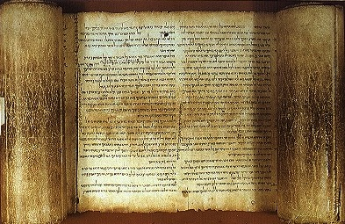


Micah
Judgment for Exploitation
Judgment for Exploitation
Dr. Rick Griffith • Jordan Evangelical Theological Seminary • BibleStudyDownloads.org

Slide 2
Key Word
615
343
Exploitation
Micah

Slide 3
Theme
615
Judgment on Israel & Judah for Exploitation
Micah

Slide 4
Key Verse
615
"He has shown you, O man, what is good. And what does the LORD require of you? To act justly and to love mercy and to walk humbly with your God" (6:8).
Micah

Slide 5

Kingdom Statement
343
God will judge His people for exploiting their poor but after their repentance He will bless them in the messianic kingdom (2:12-13; 4:1–5:15; 7:7-20).
Micah

Slide 6

Summary Statement
615
346
God indicts Israel and Judah for wickedness and exploitation of the poor and declares a judgment in exile to motivate them to repent but promises vindication and kingdom blessing under Messiah in fulfillment of the Abrahamic Covenant.
Micah

Slide 7

Covenant
347d
Each of Micah's three judgment-hope cycles disciplines for Mosaic covenant neglect but ends with blessings in the Abrahamic covenant (2:12-13; 4–5; 7:7-20).
Micah

Slide 8

Redemption
347d
God will follow chastisement from Judah's sin with redemption from exile (4:10; 5:6) accompanied by wonders as in the Exodus (7:15).
Micah

Slide 9

Messiah
347d
Despite being eternal, Messiah will be born in Bethlehem (5:2) and later reign righteously over the world (2:12-13; 4:1-8; 5:4-5).
Micah

Slide 10
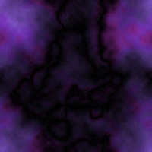
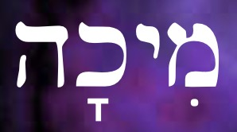
Book Chart
MICAH
615
Judgment on Israel and Judah for Exploitation
Judgment on Israel & Judah for Exploitation
Israel's Exploitation
Leader's Exploitation
Wicked Ritualism
Chapters 1–2
"Hear…" (1:2)
Chapters 3–5
"Hear…" (3:1)
Chapters 6–7
"Hear…" (6:1)
Punishment then Blessing
Punishment then Blessing
Punishment then Blessing
Wealth
(2:1-2, 8-12)
Wealth
(3:1-3, 9-11)
Wealth
(6:10-12; 7:16)
Destruction of Samaria and Judah
1:2-16
Judgment for Exploitation
2:1-11
Regathering
2:12-13
Judgment for Exploitation
Chap 3
Messianic Blessing
4–5
Religious and Ritual Exploitation
6:1-8
Wickedness
6:9–7:6
Confidence
7:7-20
Israel and Judah
735-710 BC (Before, During, and After the Fall of Israel)

Slide 11
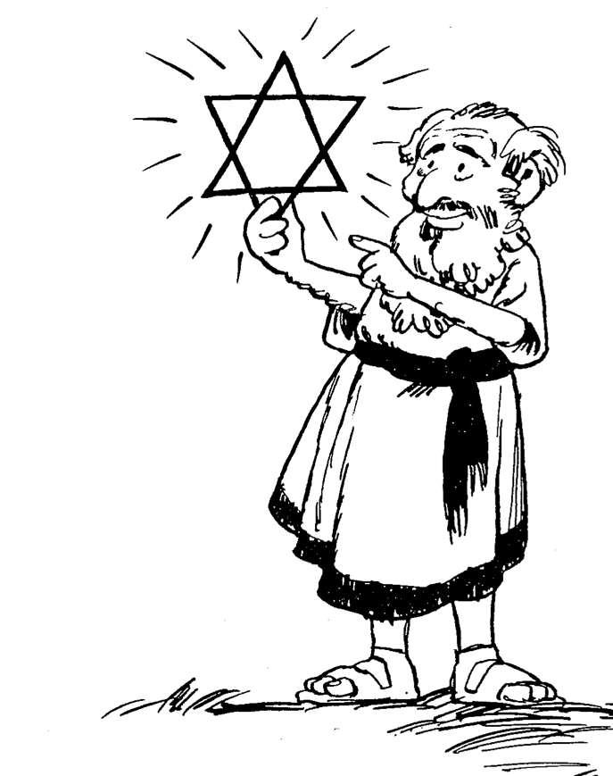
Barry Huddleston, The Acrostic Summarized Bible (Grand Rapids: Baker, 1992)
Micah
1 Messages against Samaria, Jerusalem
2 Evils of Israel's people
3 Sins of Israel's leaders
4 Sovereign king in Zion
5 Introduction of Bethlehem's Messiah
6 Actions of injustice rebuked
7 Hope in God's future

Slide 12

Be Generous
The Prophecy of Micah
Dr. Rick Griffith, Crossroads International Church Singapore
BibleStudyDownloads.org

Slide 13
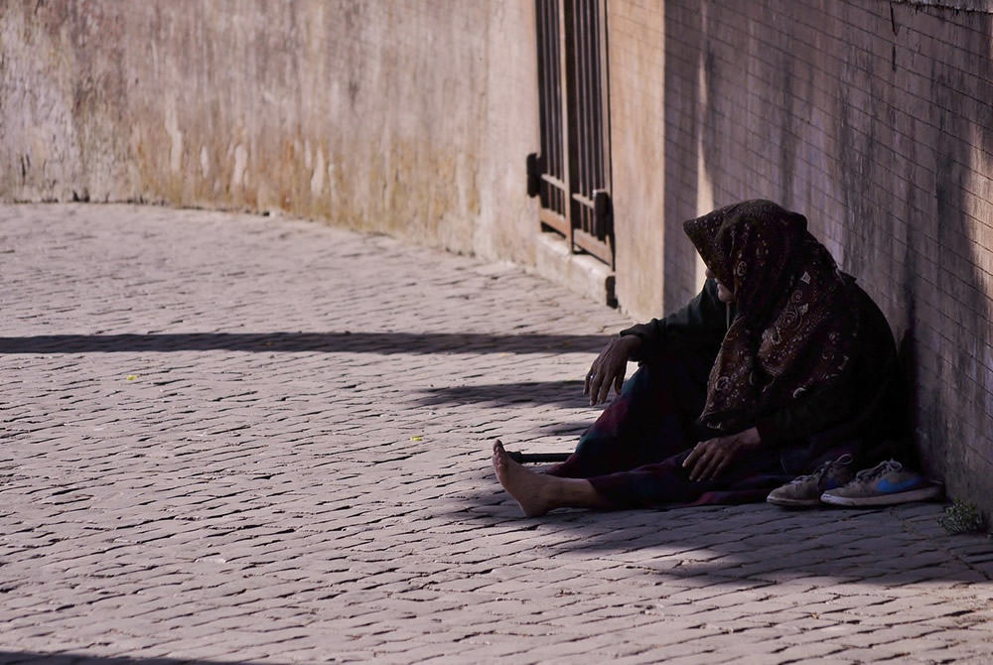
Why does God want you to be generous to the poor?
Micah

Slide 14
3 SERMONS
"LISTEN!"
(1:2)
I. God rewards the generous
(1–2).
MICAH: WHY YOU SHOULD BE GENEROUS

Slide 15
3 SERMONS
II. God comforts the generous (3–5).
"LISTEN!"
(1:2)
"LISTEN!"
(3:1)
MICAH: WHY YOU SHOULD BE GENEROUS

Slide 16
3 SERMONS
III. God gives hope to the generous
(6–7).
"LISTEN!"
(1:2)
"LISTEN!"
(3:1)
"LISTEN!"
(6:1)
MICAH: WHY YOU SHOULD BE GENEROUS

Slide 17
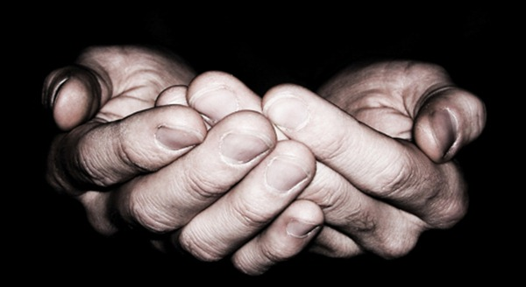
Main Idea of Micah
Be generous to others and God will be generous to you.

Slide 18

How can you better help those with less money than you?
Micah

Slide 19

Don't harden your heart.
Micah

Slide 20
Black

Slide 21

Interesting Facts

Slide 22
Who Wrote About Whom?
341
Prophets to Judah, Israel, Edom, and Assyria
Prophets to Judah | Prophets to Israel | Prophets to Edom | Prophets to Assyria
Before the Exile—in Judah Habakkuk Isaiah Joel Jeremiah Micah Zephaniah Lamentations | Hosea Amos | Obadiah | Jonah Nahum
During the Exile—in Babylon Ezekiel Daniel
After the Exile—in Judah Haggai Zechariah Malachi
Adapted from Bible Knowledge Commentary, 1:1027
Notes:
22

Slide 23
Internal Evidences
Interesting Facts
616
Micah 1:1 provides very helpful information on the book's authorship, dating, purpose and setting.

Slide 24
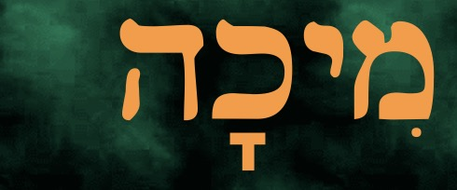
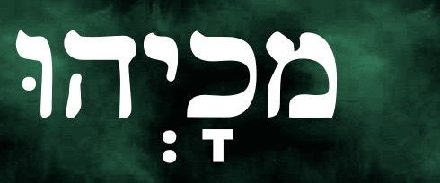
What's in the name?
Interesting Facts
616
hk'ymi
Micah and Micaiah
are the Greek and Latin titles of the book
shortened version of Why>k'm (Michayahu) meaning ("Who is like Yahweh?") in 7:18

Slide 25
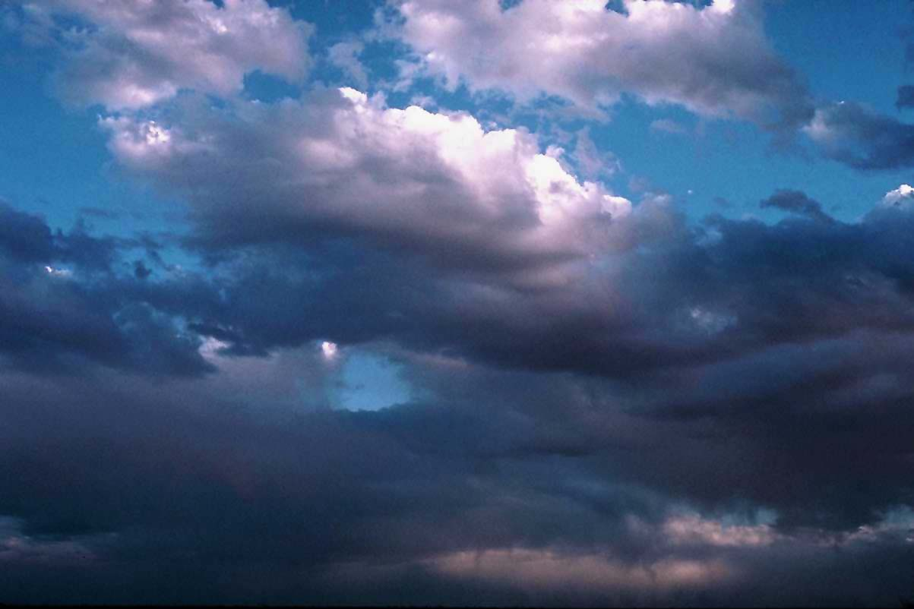
Song Based on Micah 7:18
Who Is There Like You?
Who is there like You O God?
You who created us in Your likeness
Who is there like You O God?
It's an honor to stand and worship You
We lift our hands to the great I am
Who was and Who is and is to come
We lift our hands to the great I am
Who can compare with You?

Slide 26
Date
Interesting Facts
616
prophesied under Jotham (739-731), Ahaz (735-715), and Hezekiah (715-686).
The date of his prophecies therefore range from 735-710 BC.

Slide 27

Divided Kingdom
931 BC
Assyrian Captivity
722 BC
Jesus
4 BC
Hezekiah’s Reign Ends
687 BC
David
1000 BC
Jotham II
750 BC
Micah’s Prophetic Career

Slide 28

Chart of OT Kings & Prophets
232 & 342

Slide 29
Place in the Canon?
Interesting Facts
616
In chronology:
6th book among THE TWELVE or Minor Prophets in the Hebrew Canon
3rd in the LXX

Slide 30
Exploitation––Judgment––Restoration
Interesting Facts
617
A third of the book of Micah exposes the sins of his countrymen, another third illustrates the punishment God is about to send and the last third speaks about the hope of restoration once the discipline has ended.

Slide 31
Setting
Interesting Facts
616
(2 Kings 15:32-19:37; 2 Chron. 27:1-32:23)
Economic prosperity
Internal decay - social wrongs
Canaanite idol worship
Assyrian threat

Slide 32
Black Lives Matter
Of course they do.
Dr. Rick Griffith • BibleStudyDownloads.org
Notes:
This sequence of 16 slides appear in three OT Survey presentations:
23-Isaiah 1–23 slides 31-46
30-Amos slides 25-40
33-Micah slides 32-47

Slide 33

BLM on the Streets
Justice
Social Justice
Why all the protests and riots in 2020?

Slide 34

At Trump Tower, New York City
Justice
Social Justice

Slide 35
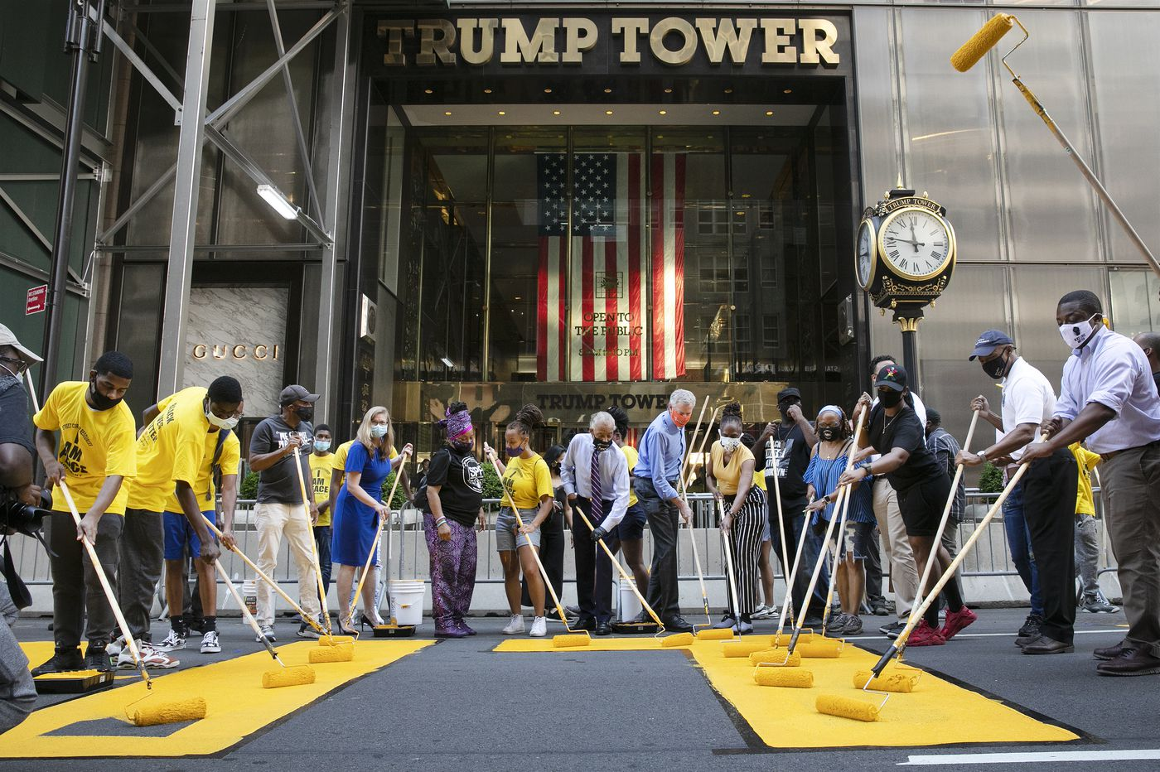
Politicians Joined the Protests
Justice
Social Justice
NYC Mayor DeBlasio

Slide 36

The Former BLM Website
We disrupt the Western-prescribed nuclear family structure requirement by supporting each other as extended families and “villages” that collectively care for one another, especially our children, to the degree that mothers, parents, and children are comfortable.
We foster a queer‐affirming network. When we gather, we do so with the intention of freeing ourselves from the tight grip of heteronormative thinking, or rather, the belief that all in the world are heterosexual (unless s/he or they disclose otherwise).
https://blacklivesmatter.com/about/ on 25 July 2020 (but boxes above deleted in Aug 2020)
Notes:
Here is the BLM website in July 2020 when the USA thought that it was a peaceful movement highlighting injustice to black people.
• Few people actually looked at this BLM website to see the boxed texts above arguing that a family with a father and mother was “Western” and not comfortable—nor normal as homosexuality is just as normal.
But once evangelical teachers actually accessed the site, the boxes disappeared along with many other disturbing tenants of the movement.

Slide 37
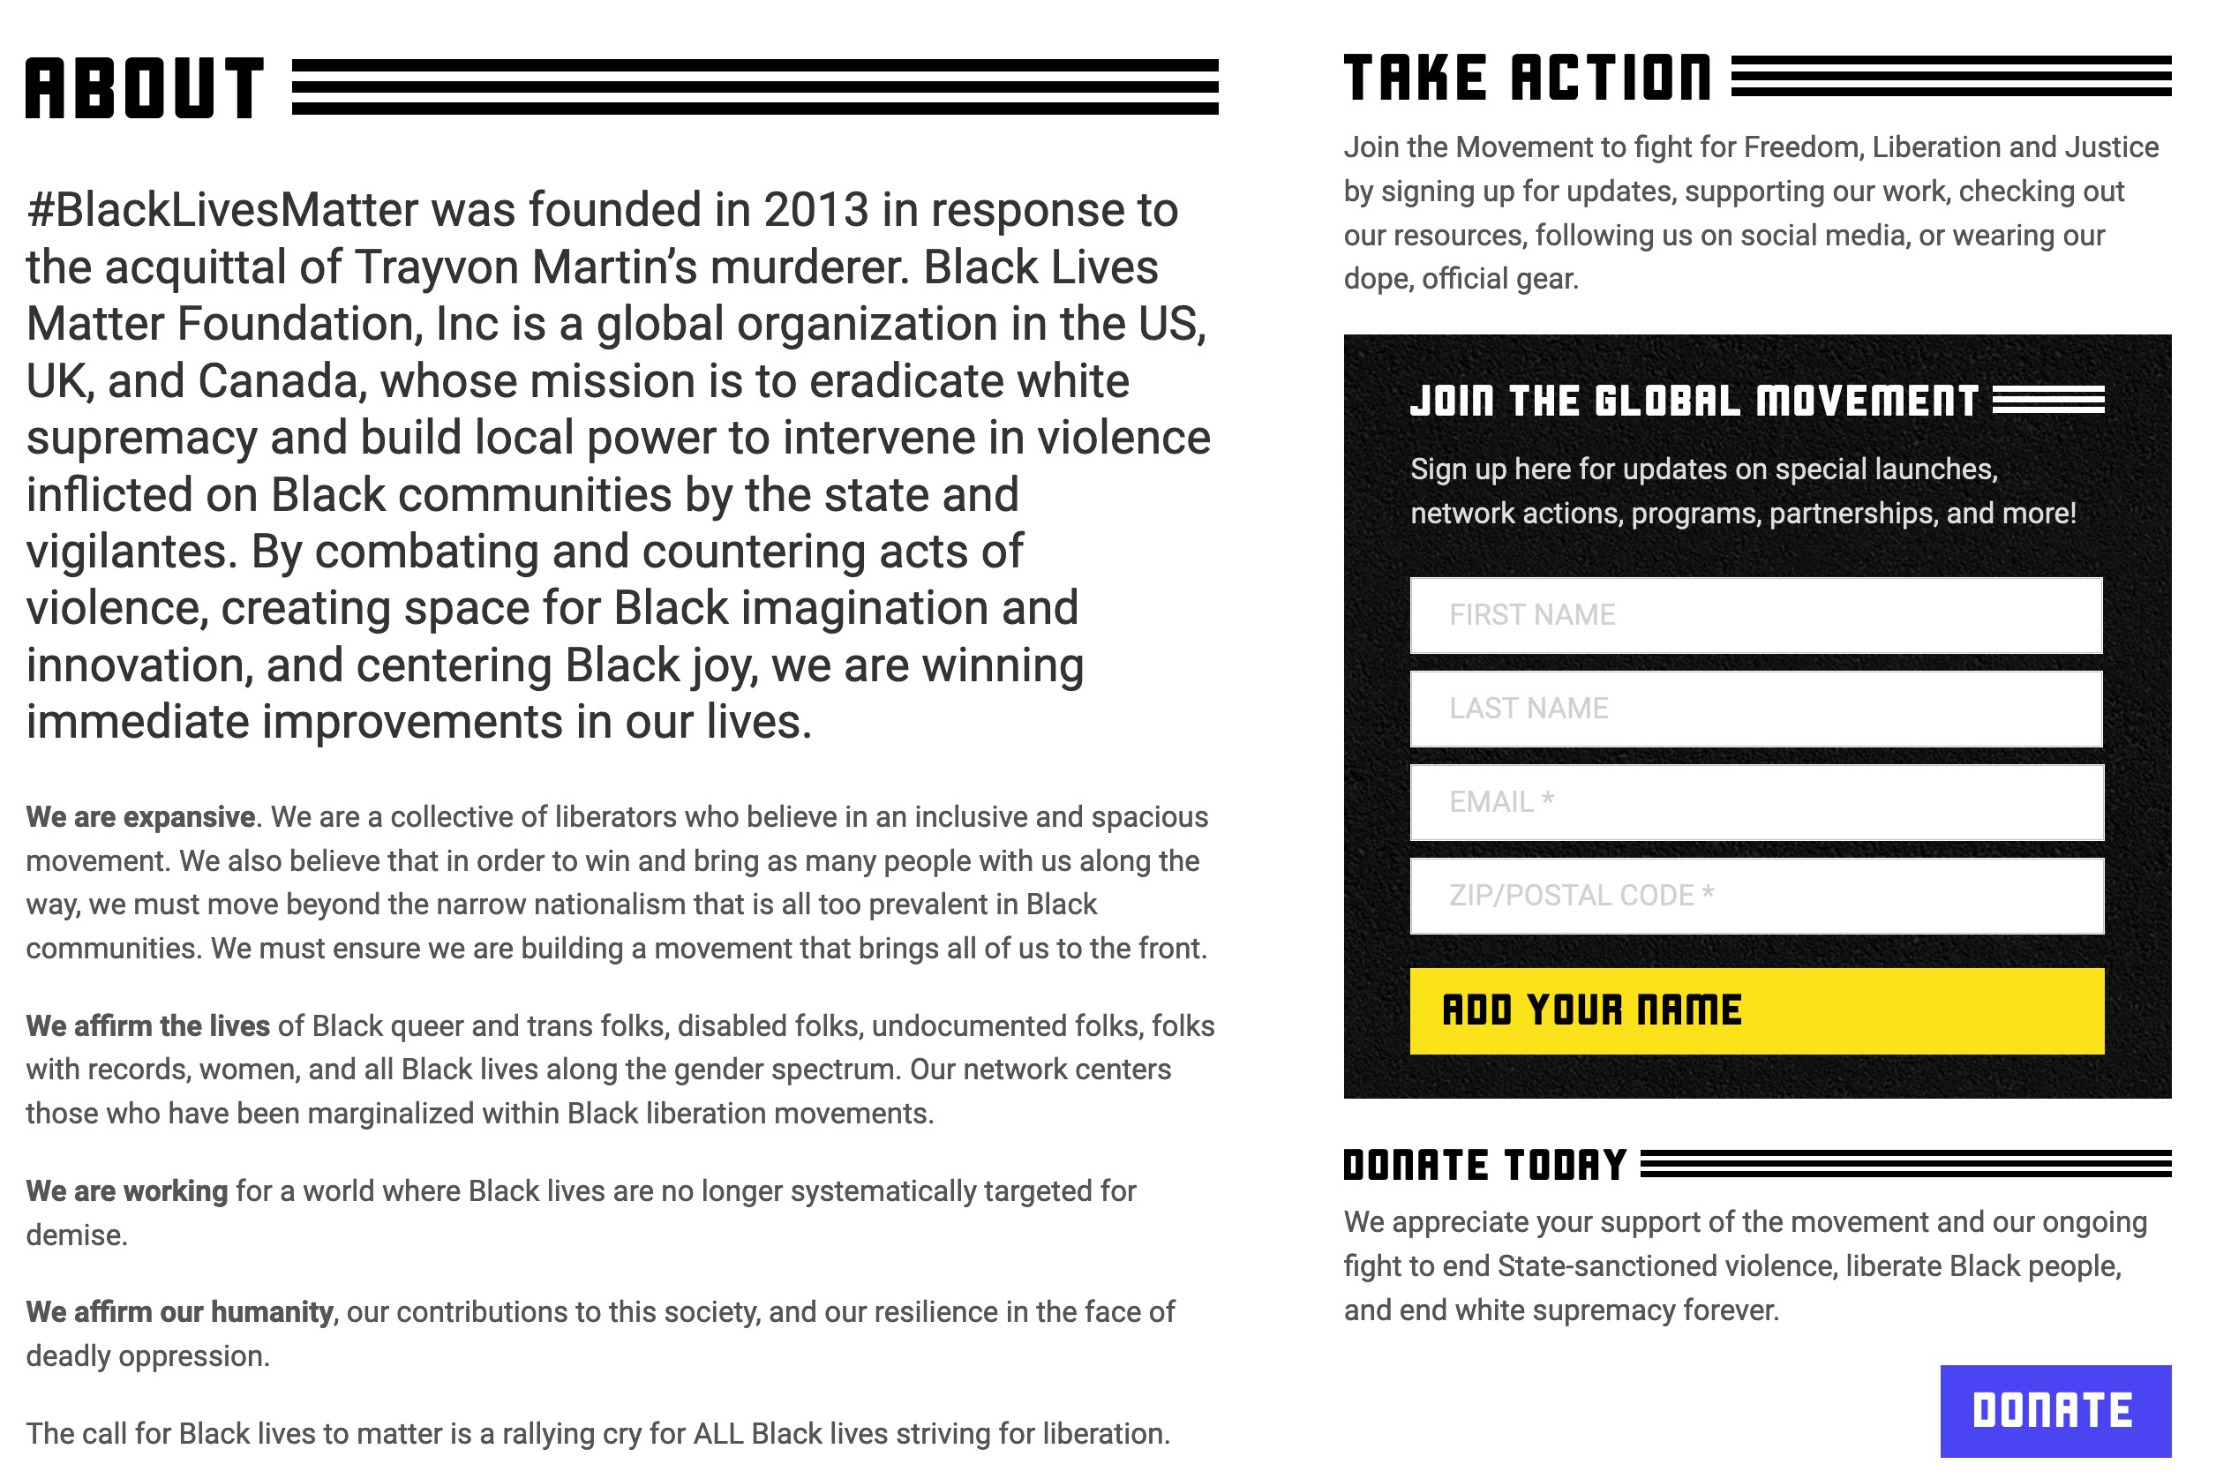
Black Lives Matter Website Updated
BLM is “combating and countering acts of violence” as BLM protests burn down the cities of America!
“We are expansive…beyond the narrow nationalism…in Black communities” says they should not be patriotic Americans.
“We affirm the lives of Black queer and trans folks…and all Black lives along the gender spectrum.”
“We are working for a world where Black lives are no longer systematically targeted for demise.”
https://blacklivesmatter.com/about/ on 3 Oct 2020
Notes:
The BLM website was thus scrubbed to affirm that
• BLM is “combating and countering acts of violence” as BLM protests burn down the cities of America!
Now only four tenants exist, though even these are problematic.
• “We are expansive…beyond the narrow nationalism…in Black communities” says they should not be patriotic Americans.
• “We affirm the lives of Black queer and trans folks…and all Black lives along the gender spectrum.”
• “We are working for a world where Black lives are no longer systematically targeted for demise.”

Slide 38
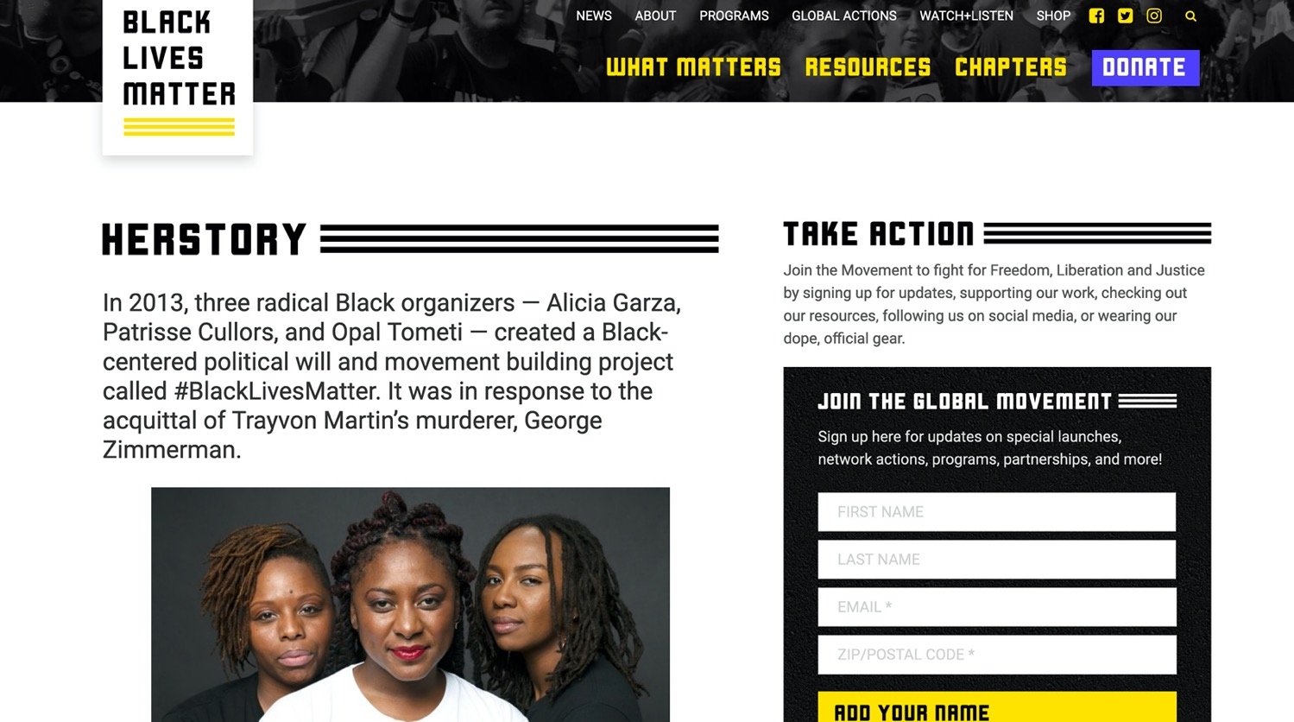
BLM Founders
In 2013, three radical Black organizers — Alicia Garza, Patrisse Cullors, and Opal Tometi — created a Black-centered political will and movement building project called #BlackLivesMatter. It was in response to the acquittal of Trayvon Martin’s murderer, George Zimmerman.
Alicia Garza
Patrisse Cullors
Opal Tometi
Lesbian
Lesbian
https://blacklivesmatter.com/about/ on 25 July 2020
Notes:
https://www.momsrising.org/blog/users/patrisse-cullors
Accessed 25 July 2020
Patrisse Cullors
Senior Fellow for Maternal Mortality
Patrisse Cullors is an artist, organizer, and freedom fighter living and working in Los Angeles, CA. Internationally known as a co-founder of Black Lives Matter, Patrisse is also the founder and a board member of Los Angeles based organization Dignity and Power Now, and the director for truth and reinvestment at the Ella Baker Center for Human Rights. She is also active in many other social justice organizations including Black Organizing for Leadership and Dignity.
A self-described wife of Harriet Tubman, Patrisse Cullors has always been traveling on the path to freedom. Growing up with several of her loved ones experiencing incarceration and brutality at the hands of the state and coming out as queer at an early age, she has since worked tirelessly promoting law enforcement accountability across the world while focusing on addressing trauma and building on the resilience and health of the communities most affected.
When Patrisse was 16 years old, she came out as queer and moved out of her home in the Valley. She formed close connections with other young, queer, women who were dealing with the challenges of poverty and being Black and Brown in the USA.
————————
https://qz.com/1391762/black-lives-matter-co-founder-alicia-garzas-definition-of-power/
How the leader of Black Lives Matter defines “power”
September 16, 2018
By Leah FesslerReporter, Quartz at Work
Alicia Garza did not intend to start the Black Lives Matter movement when she posted on Facebook after George Zimmerman, a 34-year-old mixed race man, was acquitted for murdering Trayvon Martin, a 17-year-old black child, in Sanford Florida, in February 2012. Martin was unarmed, carrying only Skittles and an ice tea.
“When George Zimmerman was acquitted… I wrote a post on Facebook that we later called ‘A Love Letter to Black People,'” said Garza, the co-founder of Black Lives Matter, while speaking at the Lesbians Who Tech Summit in New York on Sept. 13.
Garza, a black queer woman, is an Oakland-based organizer, writer, and public speaker who is currently the special projects director for the National Domestic Workers Alliance, the nation’s leading voice for dignity and fairness for the millions of domestic workers in the United States.

Slide 39
Is God Concerned for Social Justice?
“The LORD is a God of social justice.” That’s the message in maybe most churches and synagogues in America and the West today. But here’s the problem. The Bible doesn’t actually say that. It says in Isaiah, “The LORD [is a God of] justice” [Isa 5:16]. You’ll find a lot of references to justice in the Bible. But you’ll never find it preceded by the word “social.” But you’re probably thinking, “What’s the difference? Isn’t God the God of justice and social justice?” Well, not if he is consistent.
You see, God cannot be the God of “justice” and “social justice” because social justice is not just.
Justice is getting what you deserve without favor.
Social justice is getting what you don’t deserve because you are favored.
Justice is blind.
Social justice is not.
Jan Markel, “The Church: Hijacked and Infiltrated,” podcast 25 July 2020
https://www.oneplace.com/ministries/understanding-the-times/ accessed 25 July 2020
Notes:
“Let’s say a man robs a store. Justice demands but one thing—that he be tried in a court of justice and, if he is found guilty, punished.
That is not how social justice works. Social justice doesn’t only ask if the person is guilty. It asks about his economic condition. Is he poor or wealthy? About his upbringing: What kind of childhood did he have? About his race or ethnicity: Is he a member of a group that has been historically oppressed?
Justice demands that everyone be equal under the law. Social justice demands that everyone be equal—period—economically, socially, and in every other possible way. Justice asks, “Who did it?” Social justice asks, “Why did he do it?”

Slide 40
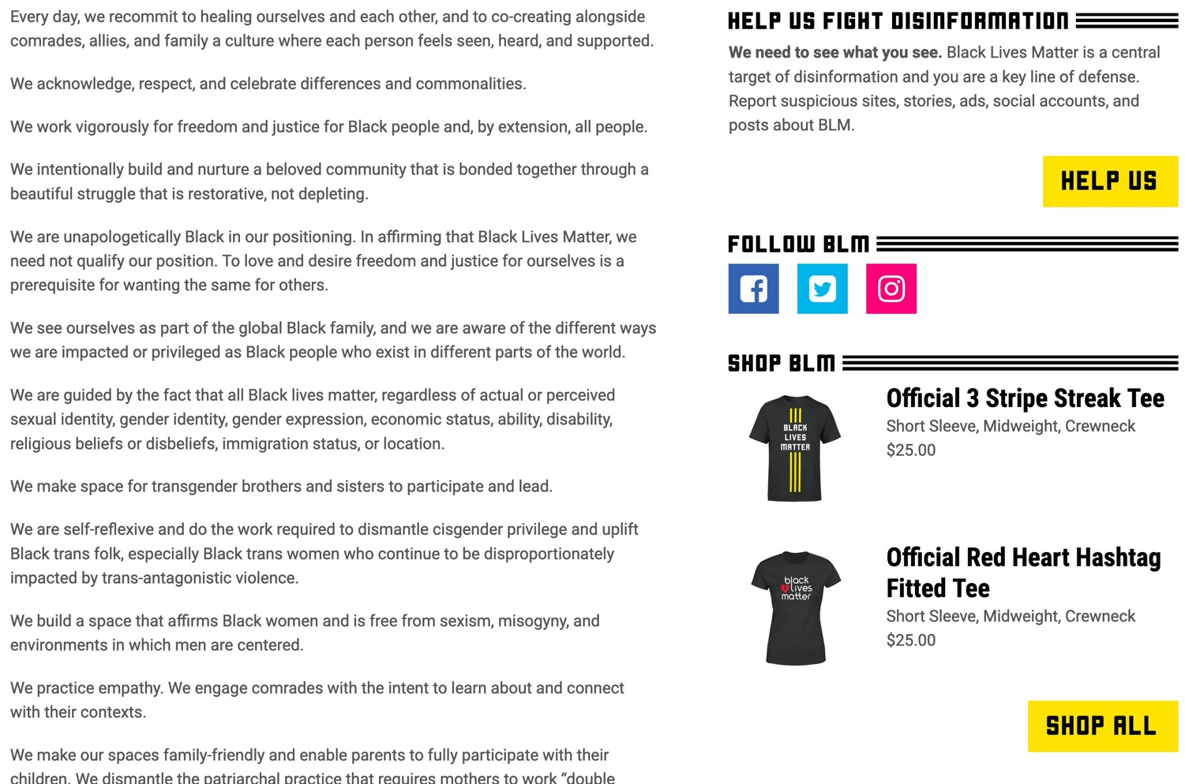
Black Lives Matter
HELP US FIGHT DISINFORMATION
We need to see what you see. Black Lives Matter is a central target of disinformation and you are a key line of defense. Report suspicious sites, stories, ads, social accounts, and posts about BLM.
Notes:
BLM knows that they must control the narrative, so they shut down all forms of opposition. Those who disagree get protesters outside their homes to threaten the families of people who expose their Marxist agenda, and they find out about such people through this link on their website.

Slide 41
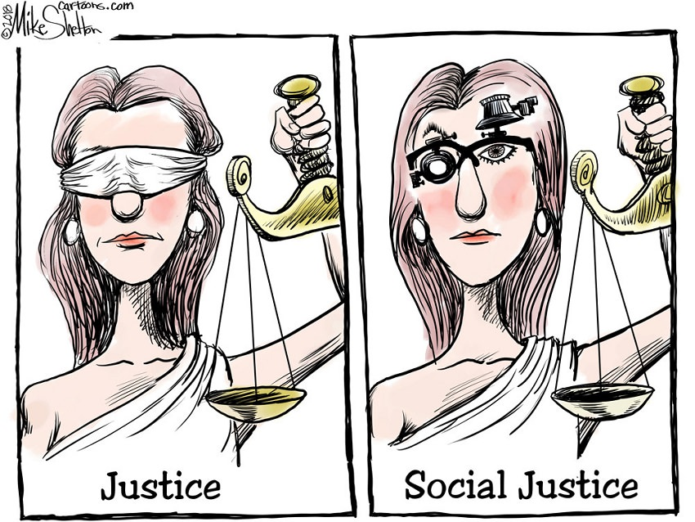
Types of Justice
Justice
Social Justice
Notes:
The OT prophets like Amos and Isaiah and Micah and others did not prescribe a different form of “justice” based on ethnicity or wealth. Justice is blind and applies equally to all.

Slide 42
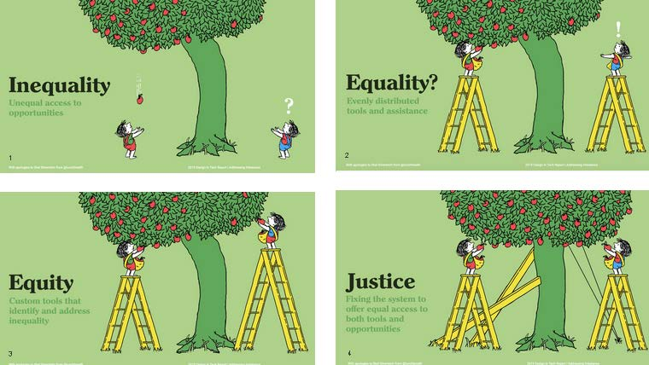
Distinguishing Terms
Inequality
Unequal access to opportunities
Equality?
Evenly distributed tools and assistance
Justice
Fixing the system to offer equal access to both tools and opportunities
Equity
Custom tools that identify and address inequality
Tony Ruth cited by John Maeda, “2019 Design in Tech Report” (https://designintech.report/2019/03/11/%F0%9F%93%B1design-in-tech-report-2019-section-6-addressing-imbalance/)
Notes:
How we define terms is very important. Here is one depiction popular in 2020. Some USA examples:
• INEQUALITY: Blacks were slaves until 1865 and could not go to evangelical seminaries until the 1960s.
• EQUALITY: Laws in the 1960s allowed blacks into all schools—but they didn't have the money so the system (tree) still tilted towards whites.
• EQUITY: Scholarships were then offered to blacks for schooling—but the system (tree) still tilted towards whites, who had a better education before seminary.
• JUSTICE: Schools do not even know the ethnicity of applicants are thus are blind to any favoritism.

Slide 43
Critiquing the Inequality Tree
Inequality
Unequal access to opportunities
Richard Leong, “The problem with that new equity vs. equality cartoon you’re sharing,” 26 May 2020 (https://medium.com/@leong.richard212/the-problem-with-that-new-equity-vs-equality-cartoon-youre-sharing-f1ebdfc793e8)
Notes:
“In this first panel, inequality is shown as a bent over tree with the apples growing on only one side. The figure on the right stands questioning while the one on the left effortlessly waits to catch falling apples. My first issue here is that using a bent tree as a metaphor for inequality suggests that today’s staggering levels of inequality are at some level natural and to be expected, just as one expects a tree to grow naturally, when nothing could be further from the truth. As I write this in May of 2020, the coronavirus has killed three black Americans for every one white American, a disparity that goes back to redlining and the exclusion of black WWII veterans from the benefits of the GI Bill. There is nothing accidental about today’s inequality. It is a reflection of intentional systems of oppression established in the past that continue today to privilege rich white men.”

Slide 44
Critiquing the Justice Tree
Justice
Fixing the system to offer equal access to both tools and opportunities
Richard Leong, “The problem with that new equity vs. equality cartoon you’re sharing,” 26 May 2020 (https://medium.com/@leong.richard212/the-problem-with-that-new-equity-vs-equality-cartoon-youre-sharing-f1ebdfc793e8)
Notes:
“Armed with our understanding that this tree didn’t just grow this way, that somebody (probably the ancestors of the one on the left) must have manipulated the tree to grow to one side, we can extend this critique to how justice is depicted. With braces and a pulley, the tree has now been balanced out and both figures can access an equal distribution of fruit. This is lovely, but I’m confused as to why the ladders would be necessary at all if the system is truly bent towards justice? Moreover, I’m most concerned with how this depiction implies that broken and unjust systems are salvageable — that with a little bit of push and pull they can be “fixed” as the caption relates.
This simply isn’t true. Driving equity and justice isn’t about tinkering with systems that just ended up being imbalanced, it’s about dismantling oppressive systems that are working exactly as they were designed. I often tell people, we are building a world that has never existed before. To achieve justice we must be open to change that can be deeply radical and transformative.
This is why I begin DEI work not with statistics and strategic plans, but with individual conversations. If they are to take the challenge of equity work seriously, leaders must exemplify self-awareness, open-mindedness, and the courage to listen and change when challenged.
There are a host of other questions we could discuss about these cartoons. What should it look like if not a tree? What does it look like when there are not two people trying to pick apples, but two entire communities? Thinking about history and restorative justice, where was this tree planted and should it be moved?
If it feels like I’m making this incredibly complicated, that’s because it really is that complicated.”

Slide 45
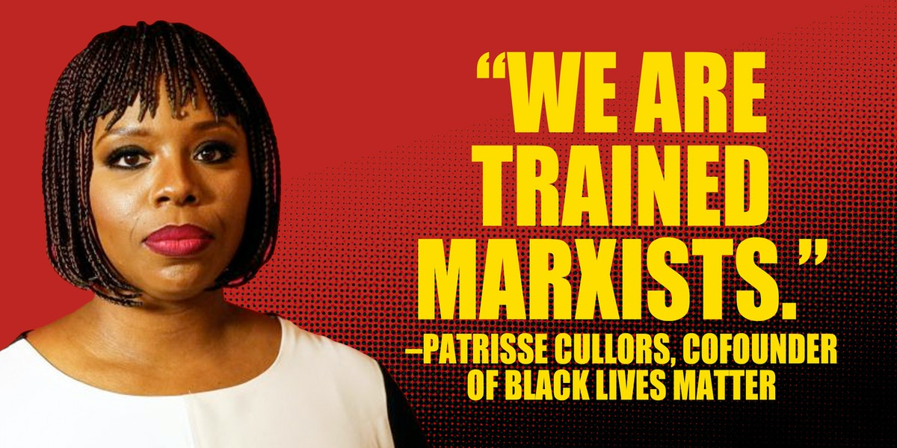
Communist Ideology
Justice
Social Justice
Notes:
In Racial Reconciliation, What Matters Is Truth
Black Lives Matter has roots in radical Marxism and "fundamental transformation."
Robin Smith • Jun. 22, 2020 • The Patriot Post
https://patriotpost.us/articles/71566-in-racial-reconciliation-what-matters-is-truth-2020-06-22
Accessed 4 October 2020
"Last week, a prominent black supremacist declared that she and her colleague “are trained organizers.” In fact, she said, “We are trained Marxists. We are super versed on ideological theories.”
In Marxism, capitalism is framed to be an exploitive, oppressive societal problem. A communist economy, the goal of Marxism, emphasizes cooperative ownership of property with no private-property rights or personal wealth. The popular slogan of Karl Marx sums it up: “From each according to his ability, to each according to his needs.” But that doesn’t fully reflect the fact that the German economist, along with his comrade, Friedrich Engels, coauthor of The Communist Manifesto, taught that socialism was the necessary first step to communism where all divisions of class would be erased.
Patrisse Cullors, one of the two cofounders of the so-called “Black Lives Matter” movement, made clear their Marxist foundation. The other founder, Alicia Garza, in a 2018 feature on Blackpast.org, has already identified herself as “a queer social justice activist and a Marxist.”
Thinking they are aiding racial and social justice, corporate giants and the political left are now carelessly funding these “trained Marxists” who lead 16 chapters of BLM in the U.S. and Canada in the disruption of commerce and the destruction of small and large businesses. No one is defending racism or the deaths of innocent black men, but BLM and antifa have hijacked the emotions stirred by select recent deaths to promote the very behaviors and practices that keep minorities trapped in government dependency.
Andrew Klavan of The Daily Wire wrote in an analysis of the Black Lives Matter movement that “The Racial Matrix” is “an entirely false narrative in which just those very prescriptions that will make black lives worse provide whites a sense of virtue while continuing the Democrat destruction of actual black lives.”
Neither BLM tactics of anger-baiting nor the virtue signaling of guilty whites will help. We should instead be identifying problems, working with leaders for solutions, and moving the underprivileged toward independence.
BLM as an organized movement has a Marxist devotion to a new world order destroying America’s economic freedom and, even more contemptibly, the freedoms of individual Americans. Its own website uses the word “comrades” to describe a new order where “we disrupt the Western-prescribed nuclear family structure requirement by supporting each other as extended families and villages that collectively care for one another.” BLM makes it clear that encouraging self-reliance and freedom from government dependency is not at all a priority. These radicals have no belief that an intact family, personal property, personal wealth, and achievement are healthy rights. And because of this, they do not promote a sense of personal accomplishment or greater attainment in the next generation. Our government housing projects are, in many cases, now full of third- and fourth-generation residents.
Many blacks are tired of BLM’s leftist political agenda because it will only lead to harm for their community. Niger Innis recently exploded, “I’ll be g-dd-mned if you use the suffering and misery of black Americans and our legacy to the United States of America as your shield and use us as cannon fodder when your agenda really has not a d—n thing to do with saving black lives.” Leo Terrell, racial activist and lawyer, insisted that a “criminal element” has taken over the protest movement that began with the death of George Floyd.
Ultimately, what will succeed in healing the racial divide is not the Marxist lies being peddled. It’s authentic truth that withstands subjective opinion and bias.”

Slide 46

Marxists Need Capitalists
MY, WHAT BIG TEETH YOU HAVE
Justice
Social Justice
Notes:
BLM needs the business community but corporate America does NOT need any more looting of their businesses, scaring away customers, and destruction of the livelihood of small business owners who are both white and black.

Slide 47
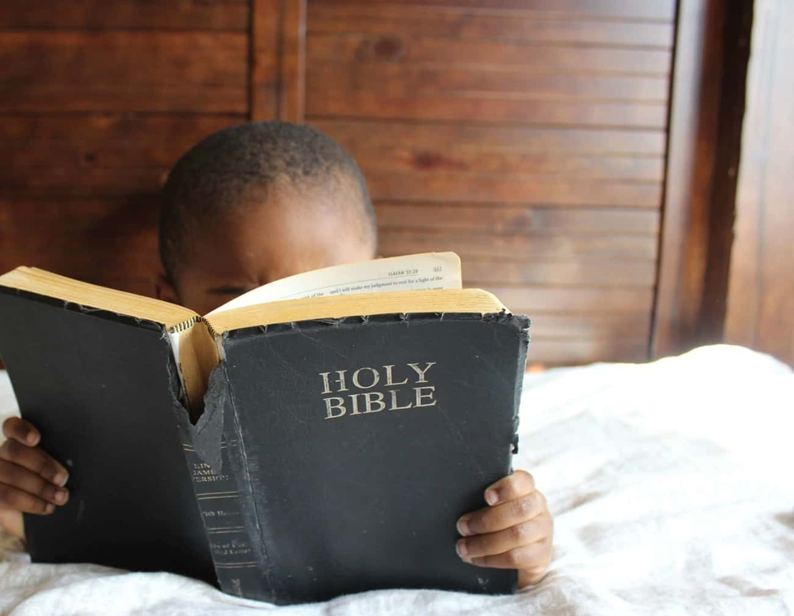
Evaluating BLM Biblically
BLM rejects God like all Marxist philosophies
BLM rejects the family
BLM rejects country
BLM disrespects property
God says to live in peace—not riot against others
(1 Tim 2:24)
Notes:
Who cares what you and I think of the BLM Movement? What really matters is what God says.

Slide 48
Be Generous
The Prophecy of Micah
Dr. Rick Griffith, Crossroads International Church Singapore
BibleStudyDownloads.org

Slide 49
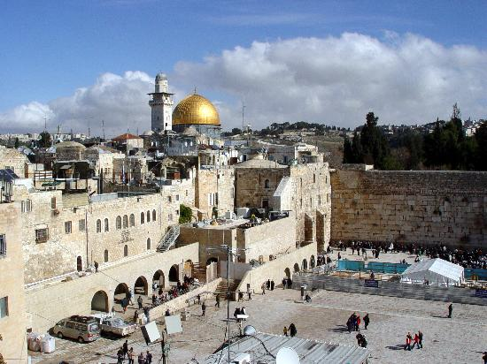
Jerusalem
December 1995
Notes:
God met me in Jerusalem in December 1995.
You see, at that time I had served on the faculty of Singapore Bible College for four years and I started teaching some courses for the fourth time––that can lose its challenge.
But the chance came to lead trips to Israel. I'd never been there before, but 25 daring souls braved to pay the $3000 to come with me.
But at the antiquities shop in Jerusalem I was stunned to see one of my tour members argue with the shop owner about the price of an artifact. "What? You want $20? I saw this for $18 down the street!"
I was so embarrassed that I left the shop, sat down on the curb, and pouted like Elijah. "What are you doing here, Rick?" I sensed God say to me (not audibly, yet still real).
"Lord, I'm bringing Your people to Your land to get to know Your Word."
"No, you're not," I sensed God saying to me. "You can't afford to come Israel so you rounded up 25 wealthy people to pay your way."
Then it struck me how little time Jesus spent in Jerusalem. Sure, he was a faithful Jew who made the required pilgrimages three times a year––and he spent the last week of his life in Jerusalem since he came there to die. But Jesus wasn't impressed with the wealth and power of Jerusalem.
Instead, he wanted to change the world through the poor. Jesus said that he had come to preach the gospel to the poor. And, as I thought about it, I realized that Jesus spent most of his ministry up in the poor north, in Galilee. He spent his time and energy in what people considered to be the place for roughnecks and insurrectionists.
Then I thought about the students that I had at SBC up to that point. I realized that the ones who came from the wealthy churches had to return back to their wealthy churches to pay back these churches for their support during seminary.
However, the ones from the poor countries returned to their countries had a tremendous impact for the cause of Christ.
So I said to the Lord, "OK, Lord, what do you want me to do? Where do you want me to go?"

Slide 50
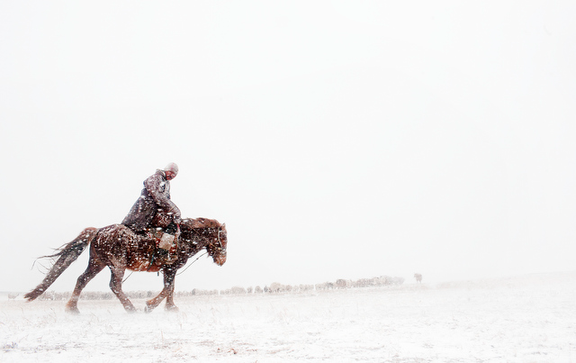
Mongolia
December 1995
Notes:
Then God put on my mind Mongolia. "Mongolia? Are you telling me to go to Outer Mongolia? I don't know a soul in Mongolia!"

Slide 51
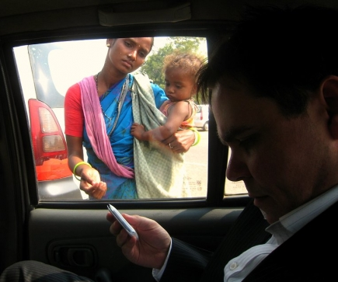
To what extent has your money insulated you?
Notes:
How much time do you devote to your possessions?
Do you own things—or do things own you?
Do you have more friends with less money than you now than you had five years ago?
What goals do you have to use your money for the poor?
Do you believe God wants you to be generous to the poor? He certainly does!

Slide 52
Why does God want you to be generous to the poor?

Slide 53

Background

Slide 54

THE
MINOR
PROPHETS

Slide 55
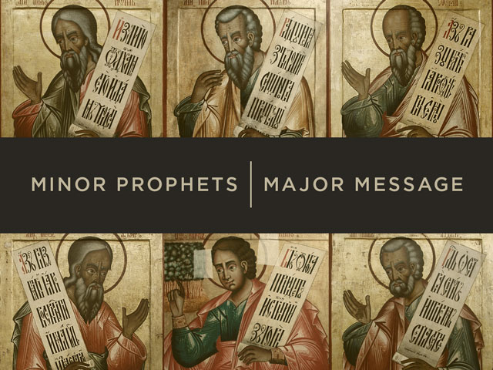
Minor Prophets | Major Message

Slide 56
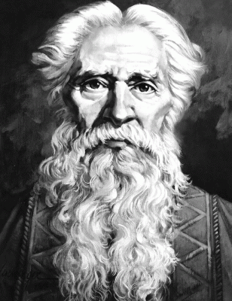
Author
Interesting Facts
616
Micah of Moresheth

Slide 57

The split in 1 Kings would soon leave Judah as the Survivng Kingdom

Slide 58
Chart of OT Kings & Prophets
232 & 342
Notes:
God called Micah to speak for him during the most turbulent period the northern nation ever experienced—a time when Israel actually was destroyed by the Assyrians.

Slide 59
The Assyrian Threat
454
Assyrian Expansion
Nineveh
Mediterranean
Sea
Aram
Israel
Judah
Isaiah 7
Persian
Gulf
Egypt
Notes:
59

Slide 60
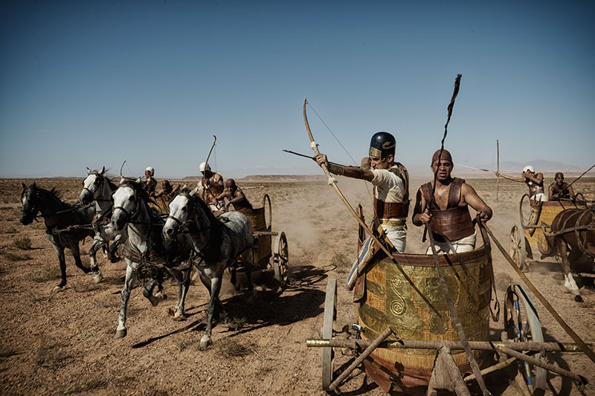
Assyrians conquered Israel in Micah’s Time

Slide 61
When Hosea, Isaiah & Micah Wrote
453
End of the
Kings of Israel
Pekah
Hoshea
Kings of Judah
Uzziah
Jotham
Ahaz
Hezekiah
Isaiah's 60-Year Ministry
(739-680 BC)
Notes:
61

Slide 62
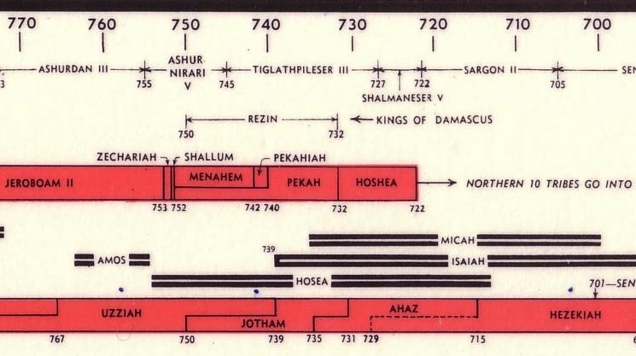
OT Kings & Prophets at Israel's Fall
232 & 342
John C. Whitcomb, 4th ed. (Winona Lake, IN: BMH Books, 1968), 2
HIM = Hosea + Isaiah + Micah

Slide 63
MICAH'S 3 SERMONS
"LISTEN!"
(1:2)
"LISTEN!"
(3:1)
"LISTEN!"
(6:1)
WHY YOU SHOULD BE GENEROUS
Notes:
Today will have an overview of the whole book of Micah where we’ll see three reasons to be generous. These will appear in three sermons in Micah’s prophecy, each that begins with the word “Listen!”

Slide 64

Keep in mind...
BE GENEROUS:
DON'T ASK WHAT'S IN IT FOR YOU.
ASK WHAT'S IN IT FOR THEM.
Notes:
In essence he says three times to have a heart for the poor—but there are also three benefits to us as well.

Slide 65
Slides on
Micah 1

Slide 66
3 SERMONS
"LISTEN!"
(1:2)
I. God rewards the generous
(1–2).
MICAH: WHY YOU SHOULD BE GENEROUS

Slide 67
Structure of Micah
620
Judgment
1:1-7
• God
• Micah
Hope
• God
• Micah
Adapted from Homer Heater, Dallas Seminary

Slide 68
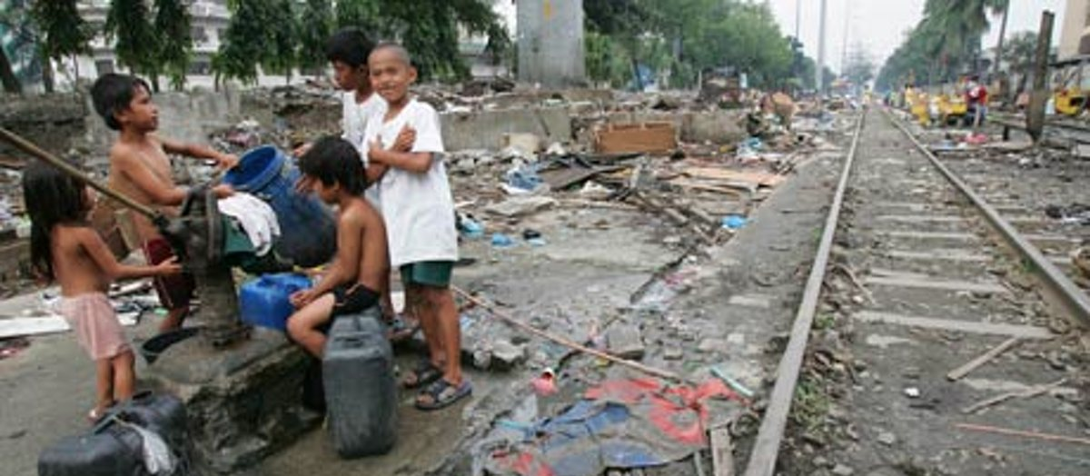
"Attention! Let all the people of the world listen! Let the earth and everything in it hear. The Sovereign LORD is making accusations against you; the LORD speaks from his holy Temple" (1:2 NLT).

Slide 69
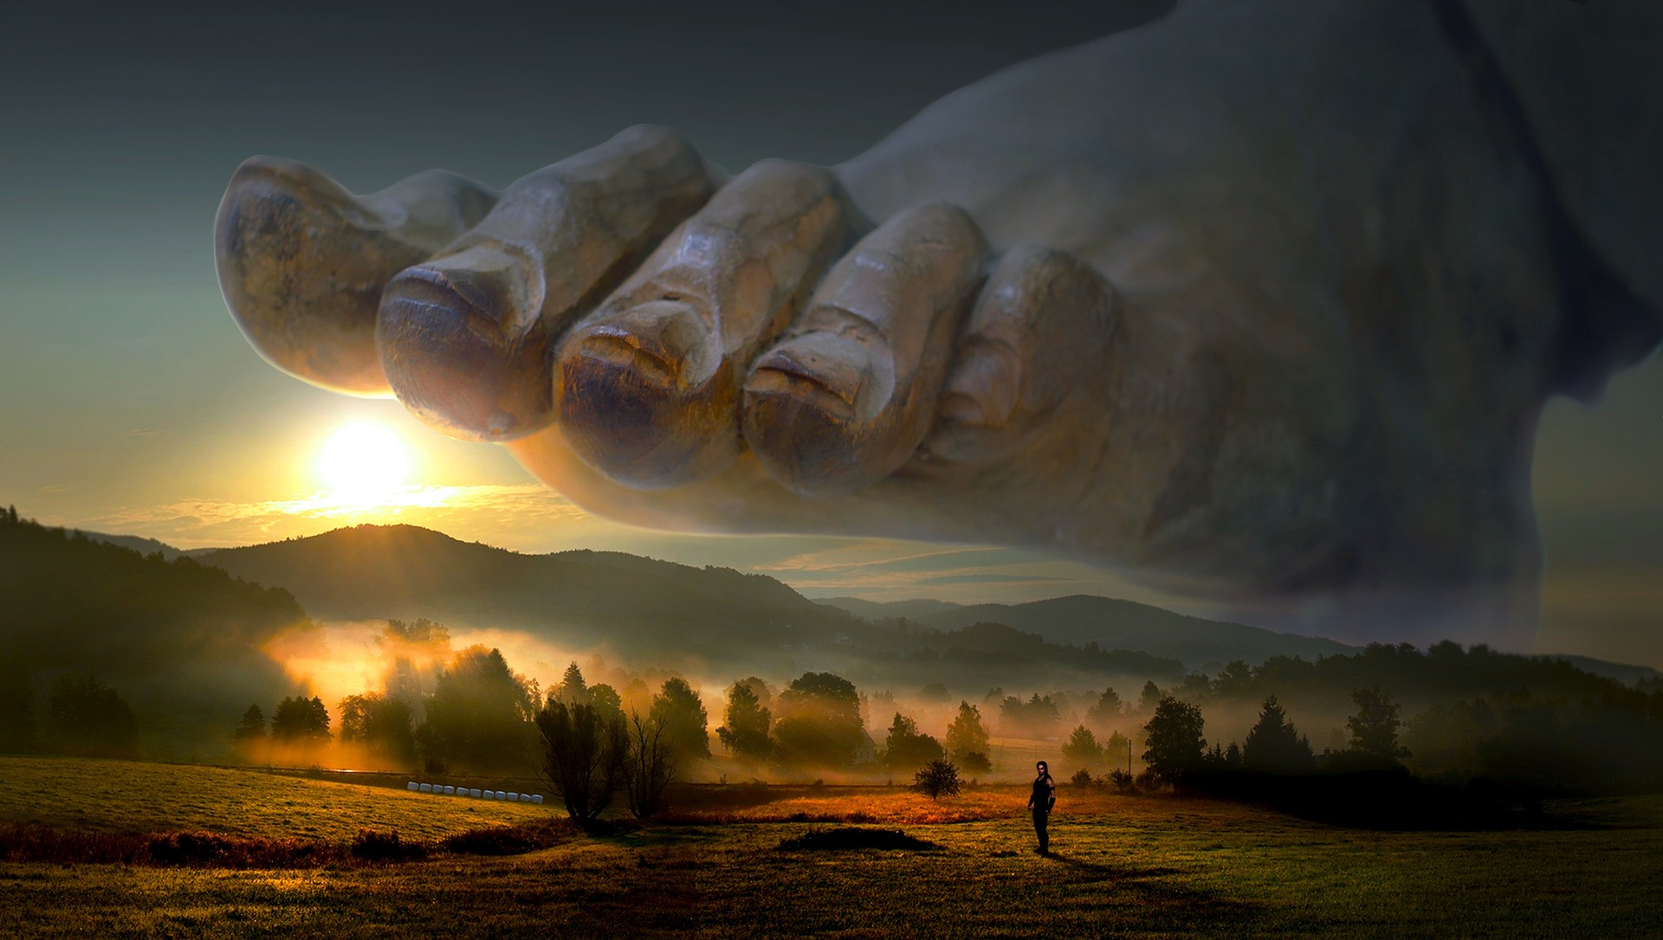
"Look! The LORD is coming!
He leaves his throne in heaven and tramples the heights of the earth.
⁴The mountains melt beneath his feet
and flow into the valleys
like wax in a fire,
like water pouring down a hill."
(Micah 1:3-4 NLT).

Slide 70
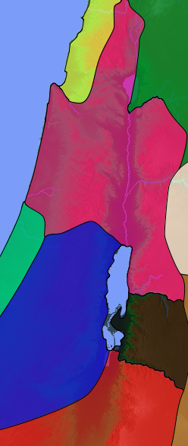
"And why is this happening?
Because of the rebellion of Israel—yes, the sins of the whole nation.
Who is to blame for Israel’s rebellion? Samaria, its capital city! Where is the center of idolatry in Judah?
In Jerusalem, its capital!"
(Micah 1:5-6 NLT).
Samaria
Jerusalem

Slide 71
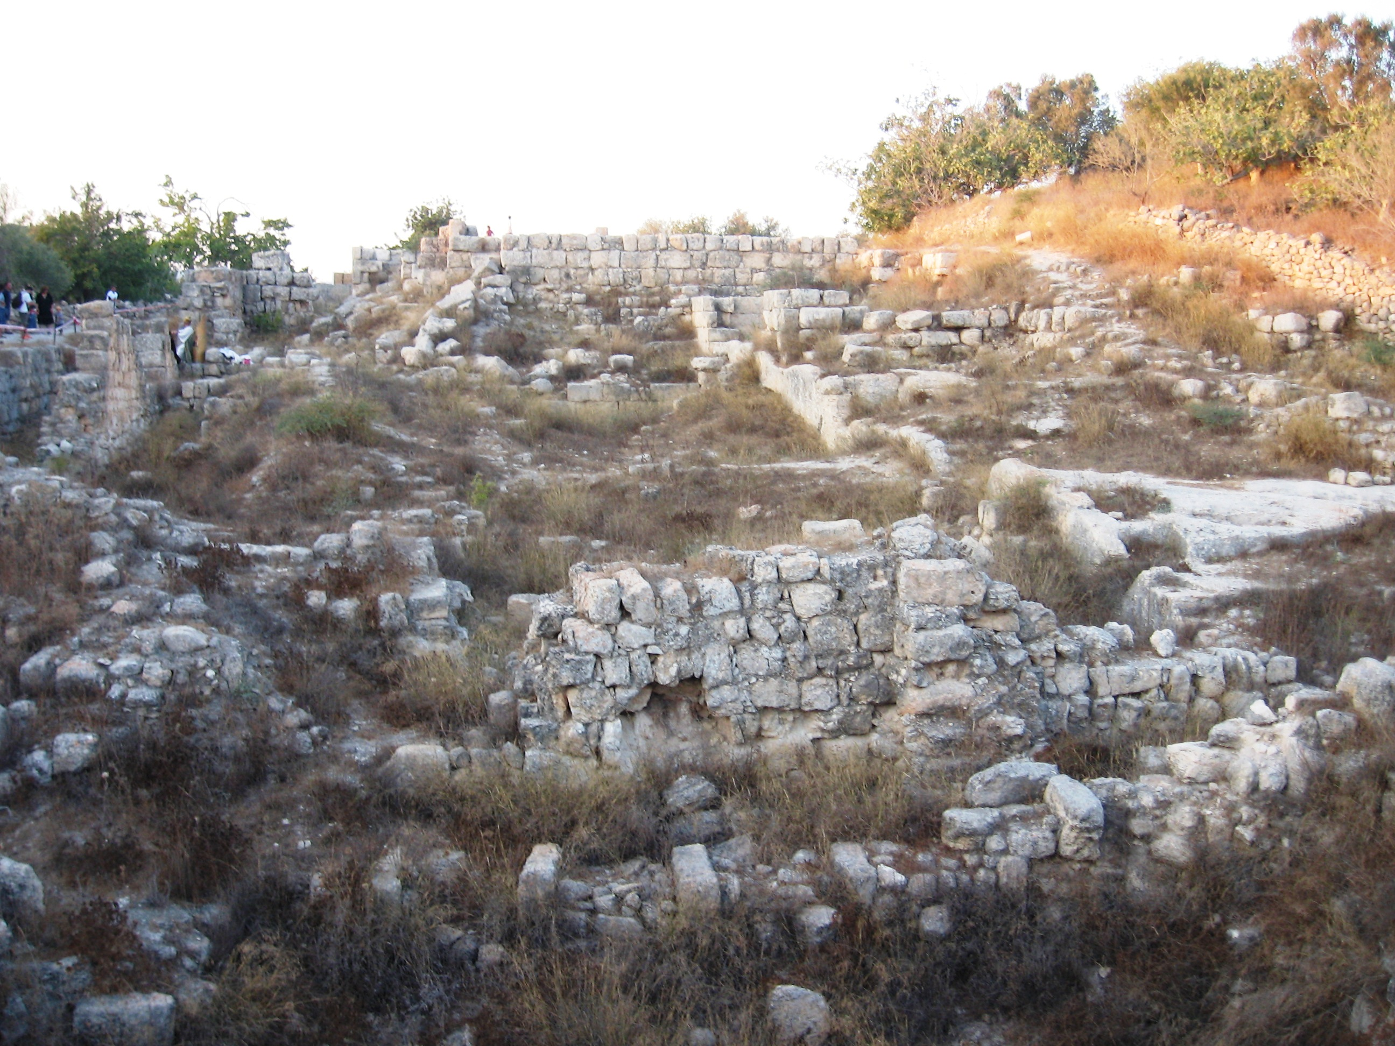
"So I, the LORD, will make the city of Samaria a heap of ruins.
Her streets will be plowed up for planting vineyards.
I will roll the stones of her walls into the valley below, exposing her foundations"
(Micah 1:7 NLT).

Slide 72
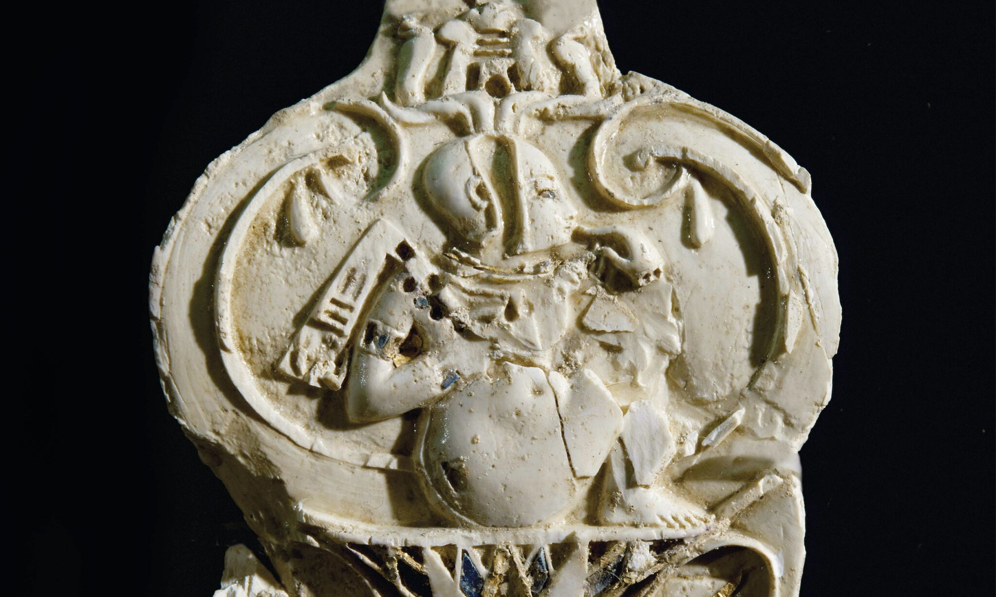
"All her carved images will be smashed.
All her sacred treasures will be burned.
These things were bought with the money earned by her prostitution, and they will now be carried away to pay prostitutes elsewhere"
(Micah 1:8 NLT).
Notes:
Samaria Ivories — Proof of the Bible?
Does a treasure trove of ivories uncovered in ancient Samaria fit the biblical description of King Ahab’s ‘ivory house’?
By Jude Flurry • December 18, 2021
https://armstronginstitute.org/394-samaria-ivories-proof-of-the-bible
Accessed 18 Apr 2023

Slide 73
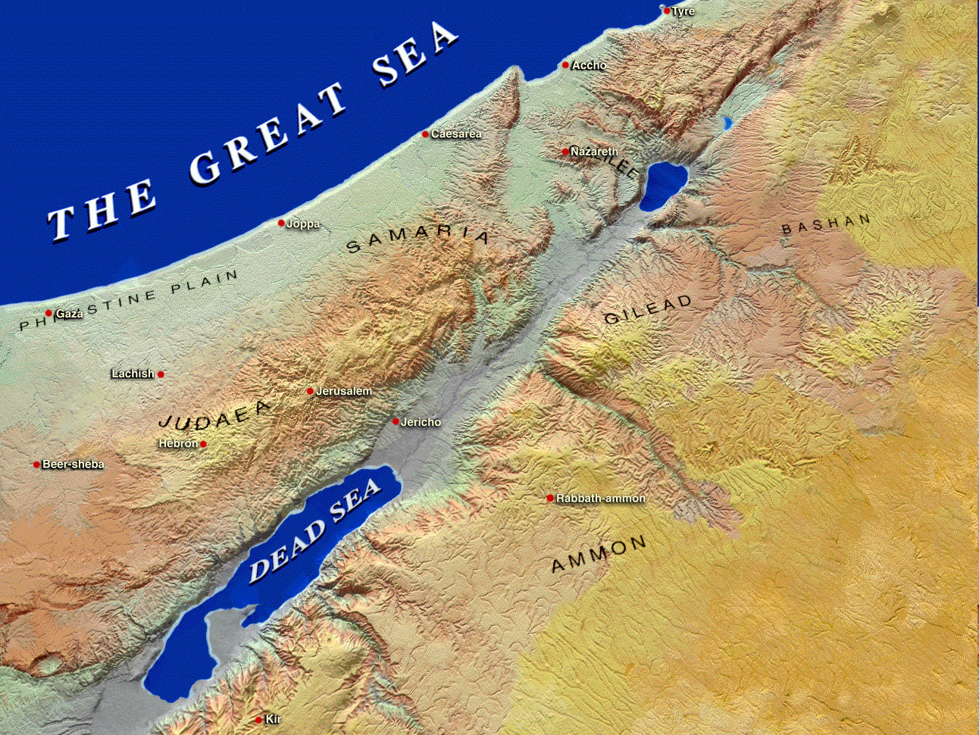
Moresheth-gath
Israel
Samaria
"So I, the Lord, will make the city of Samaria a heap of ruins…" (1:6)
Jerusalem
Judah
"Oh, people of Judah, shave your heads in sorrow,
for the children you love will be snatched away.
Make yourselves as bald as a vulture,
for your little ones will be exiled to distant lands" (1:16).

Slide 74
hk'ymi Micah's Lament
Judgment for Exploitation
Judgment for Exploitation
hk'ymi Micah

Slide 75
Structure of Micah
620
Judgment
1:1-7
• God
"Therefore, I will mourn and lament.
I will walk around barefoot and naked.
I will howl like a jackal
and moan like an owl" (1:8 NLT).
• Micah
1:8-16
Hope
• God
• Micah
Adapted from Homer Heater, Dallas Seminary

Slide 76
Key Word
615
343
Exploitation
Micah

Slide 77
Slides on
Micah 2

Slide 78
Structure of Micah
620
Judgment
1:1-7
2:1-5
• God
• Micah
1:8-16
Hope
• God
• Micah
Adapted from Homer Heater, Dallas Seminary

Slide 79
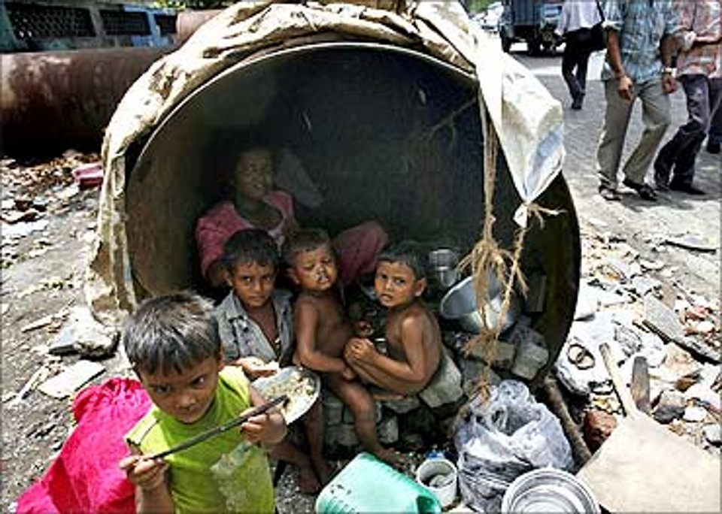
"What sorrow awaits you who lie awake at night, thinking up evil plans. You rise at dawn and hurry to carry them out, simply because you have the power to do so. ²When you want a piece of land, you find a way to seize it. When you want someone’s house, you take it by fraud and violence. You cheat a man of his property, stealing his family’s inheritance" (Micah 2:1-2 NLT).

Slide 80
"But this is what the LORD says:
'I will reward your evil with evil; you won’t be able to pull your neck out of the noose.
You will no longer walk around proudly, for it will be a terrible time'"
(Micah 2:3 NLT).

Slide 81
"In that day your enemies will make fun of you by singing this song of despair about you:
'We are finished, completely ruined!
God has confiscated our land, taking it from us.
He has given our fields to those who betrayed us.'
⁵Others will set your boundaries then, and the LORD’s people will have no say in how the land is divided"
(Micah 2:4-5 NLT).

Slide 82
Structure of Micah
620
Judgment
1:1-7
2:1-5
• God
• Micah
1:8-16
2:6-11
Hope
• God
• Micah
Adapted from Homer Heater, Dallas Seminary

Slide 83
"'Don’t say such things,' the people respond.
'Don’t prophesy like that.
Such disasters will never come our way!'"
(Micah 2:6 NLT).

Slide 84
"Should you talk that way, O family of Israel? Will the LORD’s Spirit have patience with such behavior?
If you would do what is right, you would find my words comforting"
(Micah 2:7 NLT).

Slide 85
"Yet to this very hour my people rise against me like an enemy! You steal the shirts right off the backs of those who trusted you, making them as ragged as men returning from battle"
(Micah 2:8 NLT).

Slide 86
"You have evicted women from their pleasant homes and forever stripped their children of all that God would give them"
(Micah 2:9 NLT).

Slide 87
"Up! Begone!
This is no longer your land and home, for you have filled it with sin and ruined it completely.
¹¹Suppose a prophet full of lies would say to you, 'I’ll preach to you the joys of wine and alcohol!' That’s just the kind of prophet you would like!"
(Micah 2:10-11 NLT).

Slide 88
Structure of Micah
620
Judgment
1:1-7
2:1-5
• God
• Micah
1:8-16
2:6-11
Hope
2:12-
13
• God
• Micah
Adapted from Homer Heater, Dallas Seminary

Slide 89
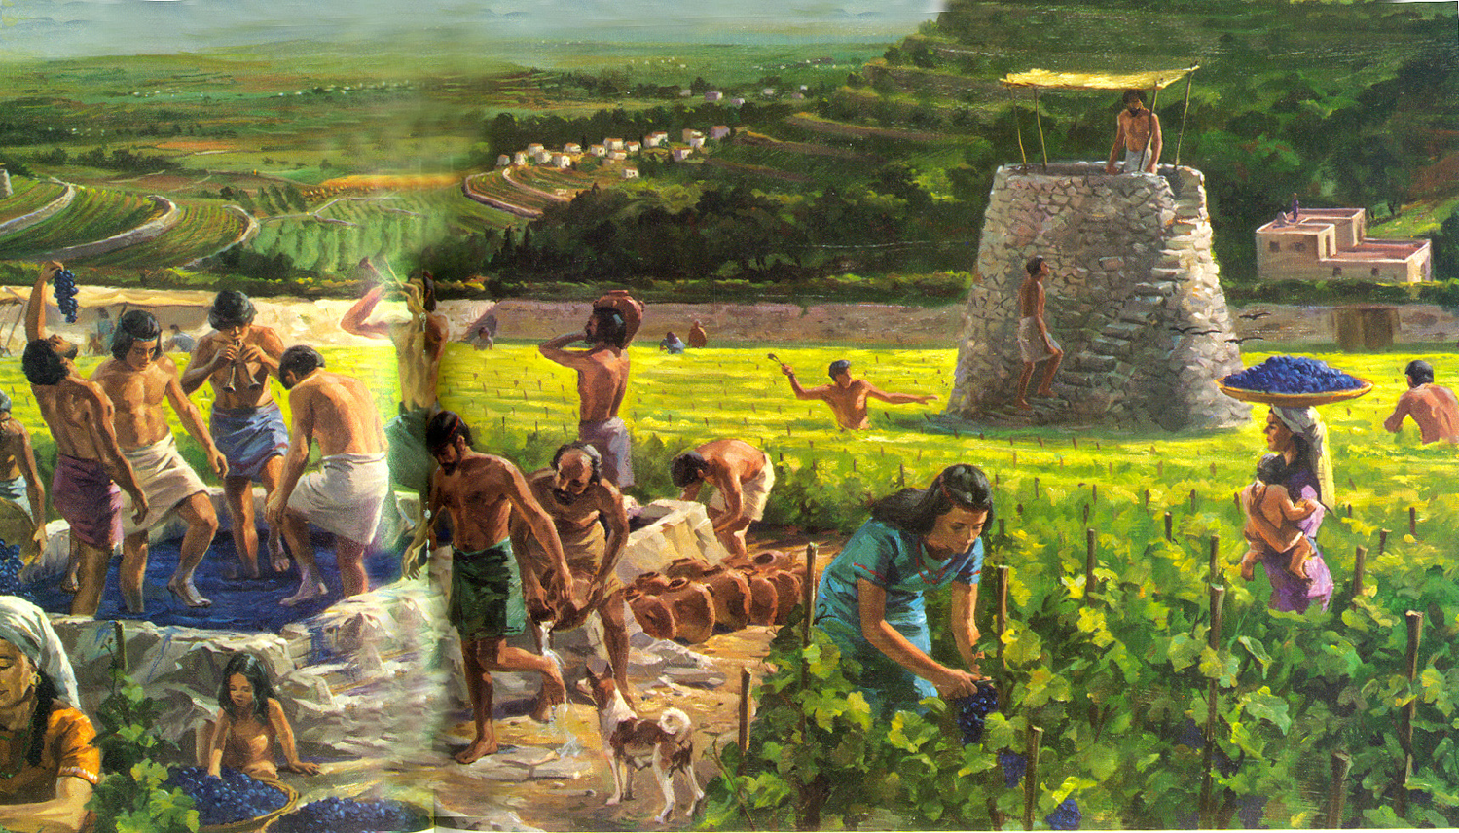
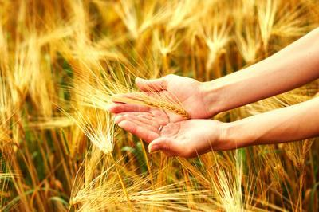

"Someday, O Israel, I will gather you; I will gather the remnant who are left. I will bring you together again like sheep in a pen, like a flock in its pasture. Yes, your land will again be filled with noisy crowds!"
(Micah 2:12 NLT).

Slide 90
"Your leader will break out and lead you out of exile, out through the gates of the enemy cities, back to your own land. Your king will lead you; the LORD himself will guide you" (Micah 2:13 NLT).

Slide 91
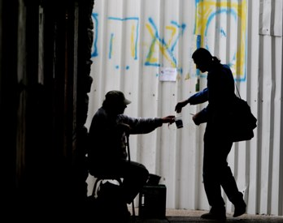
What about us?
God will judge or bless us based on how we treat the poor.

Slide 92

Teaching Ministry 1997-2017
MONGOLIA
JORDAN
KOREA
CHINA
NEPAL
MYANMAR
INDIA
THAILAND
VIETNAM
MALAYSIA
SRI LANKA
SINGAPORE
SBC
INDONESIA
Notes:
From 1997-Sep 2017 God has seen fit to grant me the privilege to train pastors in 12 other countries on 62 trips. Often pastors in the US team-teach with me on these trips.

Slide 93

Dies den Engelsen

Slide 94


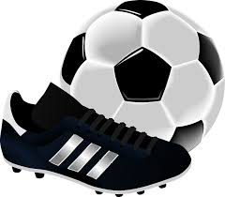
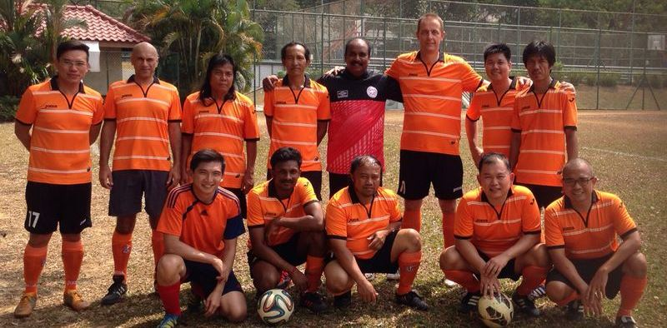

Slide 95






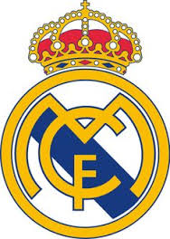

Favourite team ?
Chak Kropop Po Mongkol

Slide 96


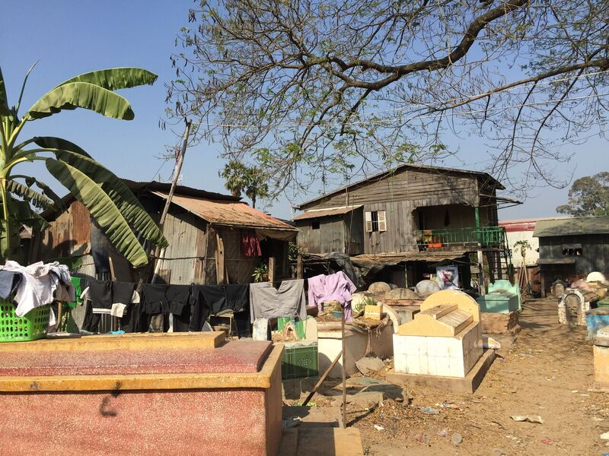
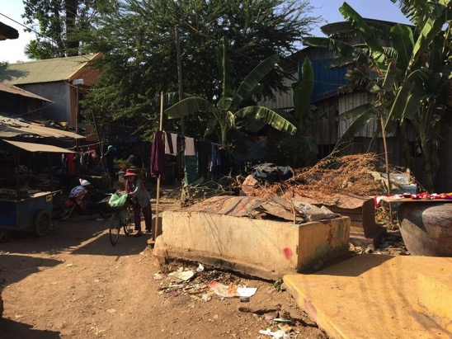
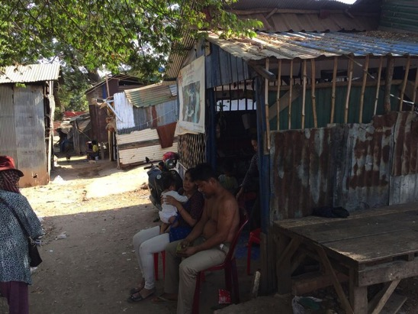

Slide 97

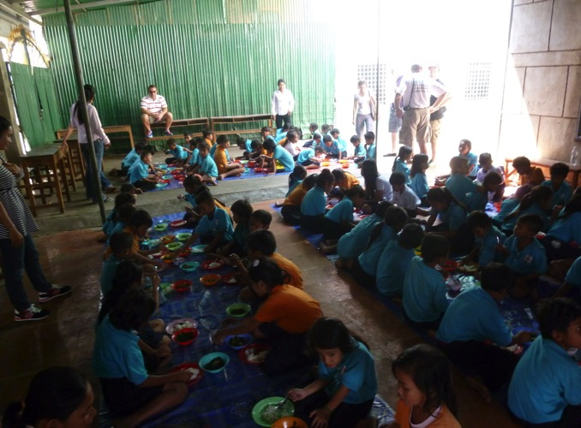
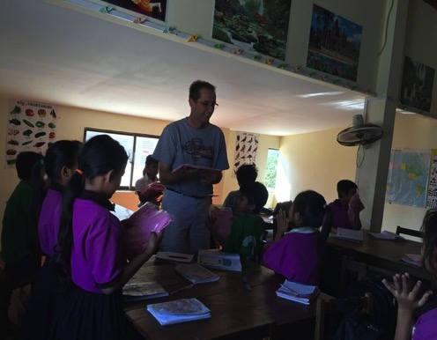
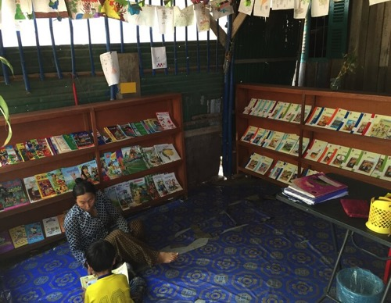

Indochina Starfish Foundation
Education
Medical Care
Nutritious food
School Uniforms
Incentive to the family
Community Service

Slide 98

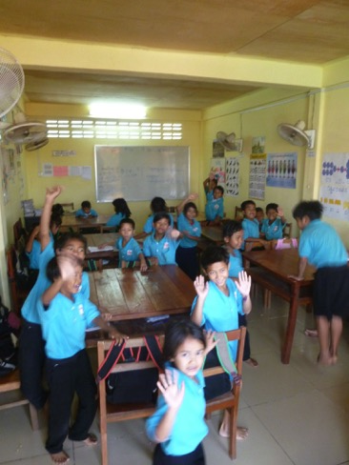
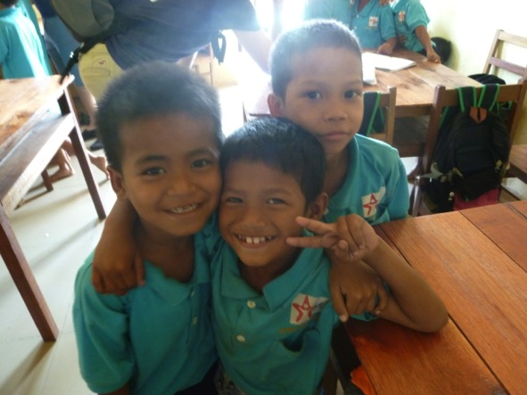
Integration
into
Cambodian Society

Slide 99

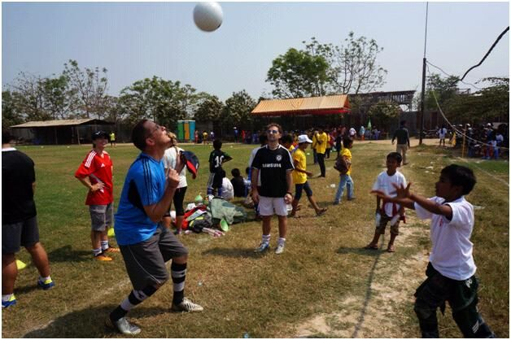

?

Slide 100


Slide 101
Back To Rick
and the Sermon on Micah

Slide 102

Get others out of their bind.

Slide 103
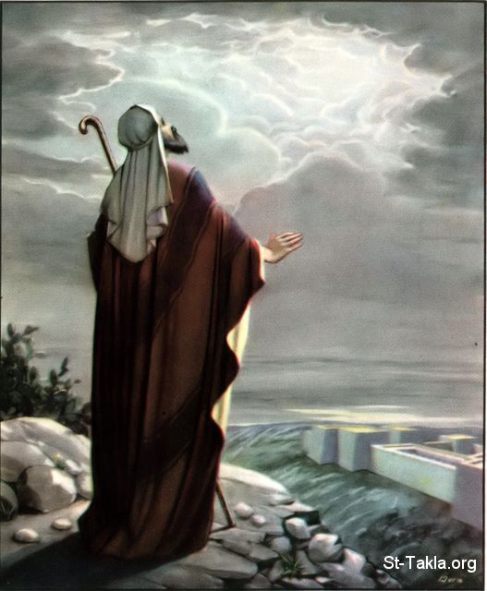
Foretelling Emphasis
Interesting Facts
616
Micah has one of the highest foretelling proportions of the prophetic books (70% of the content). It predicts:
the falls of Samaria and Jerusalem
the future restoration via a remnant leading into the messianic age

Slide 104

Problems & Tips in Interpreting Prophecy
438
Inaccurate Presuppositions
Prophets were mainly covenant enforcers based on the Mosaic law
Ethical
Forthtelling
Mosaic Covenant
Predictive
Foretelling
Abrahamic Covenant

Slide 105
The Prophetic Message
438
The prophets were not pushovers. They went against the tide to preach the word of Yahweh to a rebellious nation.

Slide 106
The Prophetic Message
The Prophetic Message
A major concern posed by the prophets was idolatry.
But they also had social and economic concerns.
They spoke pronouncements of judgments to steer the nation away from the curses.

Slide 107
3 SERMONS
"LISTEN!"
(1:2)
I. God rewards the generous
(1–2).
MICAH: WHY YOU SHOULD BE GENEROUS

Slide 108
MICAH'S 3 SERMONS
II. God comforts the generous (3–5).
"LISTEN!"
(1:2)
"LISTEN!"
(3:1)
WHY YOU SHOULD BE GENEROUS

Slide 109
Slides on
Micah 3

Slide 110
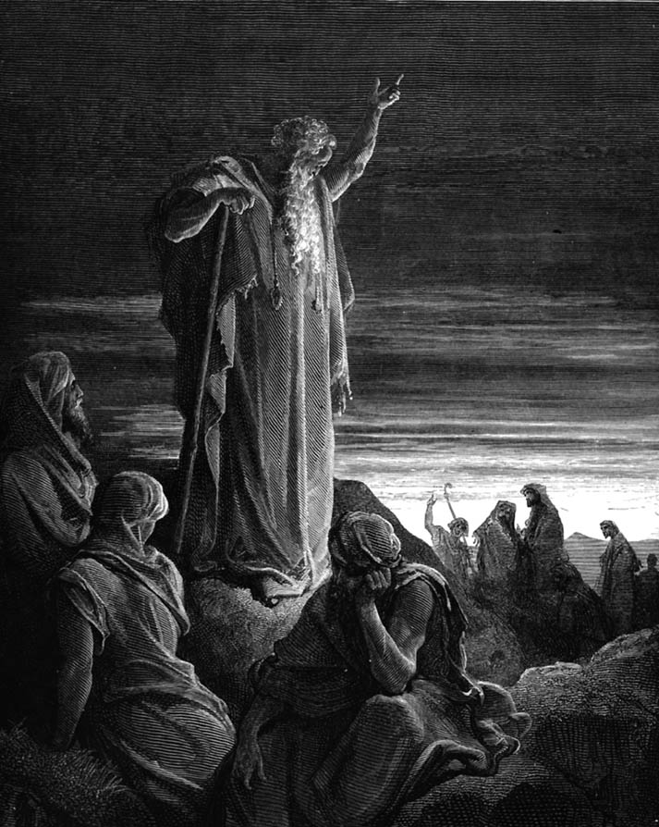
Micah Preached Courageously
Judgment for Exploitation
Judgment for Exploitation

Slide 111
Structure of Micah
620
Judgment
1:1-7
2:1-5
3:1-4
• God
• Micah
1:8-16
2:6-11
Hope
2:12-
13
• God
• Micah
Adapted from Homer Heater, Dallas Seminary

Slide 112
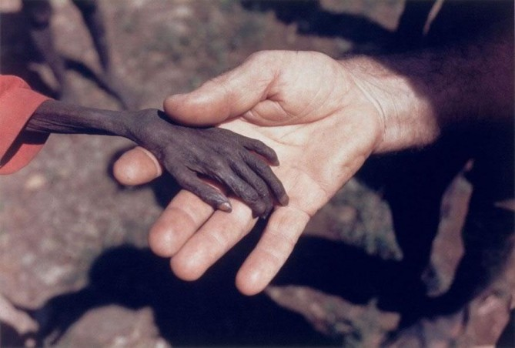
Micah Taught Compassion
Notes:
Here the hand of a missionary reaches out to a starving boy

Slide 113
Micah championed the poor and oppressed
Interesting Facts
616
Social injustice sins in this book include:
Oppression (2:1-2)
Bribery in judges, prophets & priests (3:11)
Exploitation of the powerless (3:2-3)
Covetousness (2:8-9)
Cheating (3:9)
Violence (3:10)
Pride (1:16; 2:6)

Slide 114
Structure of Micah
620
Judgment
1:1-7
2:1-5
3:1-4
• God
• Micah
1:8-16
2:6-11
3:5-12
Hope
2:12-
13
• God
• Micah
Adapted from Homer Heater, Dallas Seminary

Slide 115
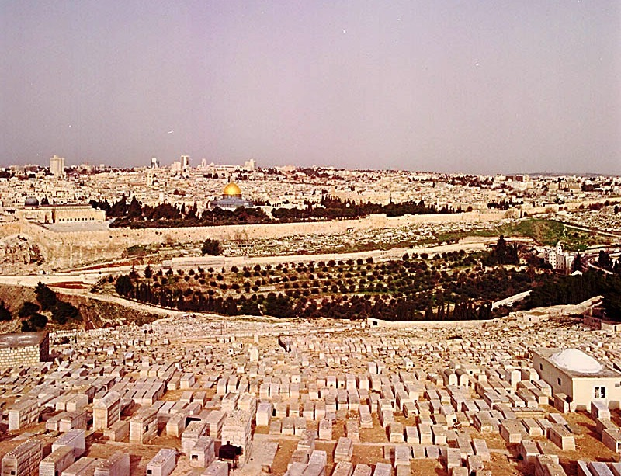
Micah 3:12 on Jerusalem's Fall
"Micah of Moresheth prophesied in the days of Hezekiah king of Judah. He told all the people of Judah, 'This is what the LORD Almighty says:
"Zion will be plowed like a field,
Jerusalem will become a heap of rubble, the temple hill a mound overgrown with thickets."'"
Jeremiah 26:18 (NIV)

Slide 116
Slides on
Micah 4

Slide 117
Structure of Micah
620
Judgment
1:1-7
2:1-5
3:1-4
• God
• Micah
1:8-16
2:6-11
3:5-12
Hope
2:12-
13
4:1–5:15
• God
• Micah
Adapted from Homer Heater, Dallas Seminary

Slide 118
Barry Huddleston, The Acrostic Summarized Bible (Grand Rapids: Baker, 1992)
Micah
1 Messages against Samaria, Jerusalem
2 Evils of Israel's people
3 Sins of Israel's leaders
4 Sovereign king in Zion
5 Introduction of Bethlehem's Messiah
6 Actions of injustice rebuked
7 Hope in God's future

Slide 119
Placing the Prophet
h
Micah
740-700 BC
United Kingdom
1050-930
Divided Kingdom
930-722
Solitary Kingdom
722-586
Post- Exile
536-425
1100
1050
1000
950
900
850
800
7 5 0
7 0 0
650
600
550
500
450
Exile 586-536

Slide 120
Micah & Isaiah Alike
616
Exact parallels
Messiah prominent
Wrote from Jerusalem
Wrote about both Israel and Judah
Influenced Hezekiah
Stressed the kingdom
Contemporaneous

Slide 121

Millennial Jerusalem (Isaiah)
106
"The law will go out from Zion,
the word of the LORD from Jerusalem"
––Isaiah 2:3

Slide 122
Millennial Jerusalem (Micah)
106
"For out of Zion shall go forth the law, and the word of the LORD from Jerusalem"
––Micah 4:2

Slide 123
Who copied whom?
ESV Isaiah 2:2 It shall come to pass in the latter days that the mountain of the house of the LORD shall be established as the highest of the mountains, and shall be lifted up above the hills; and all the nations shall flow to it,
ESV Micah 4:1 It shall come to pass in the latter days that the mountain of the house of the LORD shall be established as the highest of the mountains, and it shall be lifted up above the hills; and peoples shall flow to it,
Notes:
123

Slide 124
Who copied whom?
ESV Isaiah 2:3 and many peoples shall come, and say: "Come, let us go up to the mountain of the LORD, to the house of the God of Jacob, that he may teach us his ways and that we may walk in his paths." For out of Zion shall go the law, and the word of the LORD from Jerusalem.
ESV Micah 4:2 and many nations shall come, and say: "Come, let us go up to the mountain of the LORD, to the house of the God of Jacob, that he may teach us his ways and that we may walk in his paths." For out of Zion shall go forth the law, and the word of the LORD from Jerusalem.
Notes:
124

Slide 125
Who copied whom?
ESV Isaiah 2:4 He shall judge between the nations, and shall decide disputes for many peoples; and they shall beat their swords into plowshares, and their spears into pruning hooks; nation shall not lift up sword against nation, neither shall they learn war anymore.
ESV Micah 4:3 He shall judge between many peoples, and shall decide for strong nations afar off; and they shall beat their swords into plowshares, and their spears into pruning hooks; nation shall not lift up sword against nation, neither shall they learn war anymore.
Notes:
125

Slide 126
Who copied whom?
ESV Isaiah 2:5
O house of Jacob,
come, let us walk
in the light of the LORD.
ESV Micah 4:4
but they shall sit every man under his vine and under his fig tree, and no one shall make them afraid, for the mouth of the LORD of hosts has spoken.
Notes:
126
The two prophets diverge after the promise of peace worldwide.

Slide 127

United Nations Building, New York
Notes:
The UN was established in 1948 as man's best attempt to bring peace to the world. Since that time the world has seen more wars than any other period, with only 14 days counted where there was no war going on somewhere on the globe.

Slide 128


United Nations Building (New York)
Notes:
The UN goal is a lofty one—a time when people will "beat their swords into ploughshares" as noted in Isaiah 2:4 (cf. Micah 4:3; Joel 3:10). In other words, the effort and money invested now into weapons of war such as the sword will no longer be needed when Christ rules the earth. Instead, with the crops so abundant and the world at peace, it will make sense to turn war instruments into farming implements.
• Added to the art is a gun with its barrel tied into a knot.
"Let Us Beat Swords into Plowshares
But first...
What is a plowshare?!
A plowshare is part of a plow. It is the leading edge that cuts
into the earth when turning over the dirt.
Let Us Beat Swords into Plowshares was sculpted
by Yevgeny Vuchetich. It was donated to the UN by the USSR in 1959.
The sculpture stands in the garden of the UN Headquarters."
https://sites.google.com/site/cdaunexploration/let-us-beat-swords-into-plowshares
Accessed 8 July 2015

Slide 129

United Nations Building, New York
ESV Isaiah 2:4 …they shall beat their swords into plowshares, and their spears into pruning hooks; nation shall not lift up sword against nation, neither shall they learn war anymore.
ESV Micah 4:3 …they shall beat their swords into plowshares, and their spears into pruning hooks; nation shall not lift up sword against nation, neither shall they learn war anymore.
Notes:
Isaiah 2:4 (cf. Micah 4:3; Joel 3:10) is inscribed on the wall in front of the UN building in New York.

Slide 130

Wolves now love
…to kill

Slide 131


Isaiah 11:6-9
473a
⁶ And the wolf will dwell with the lamb, and the leopard will lie down with the young goat, and the calf and the young lion and the fatling together.
Notes:
131

Slide 132

Isaiah 11:6-9
473a
⁶ And the wolf will dwell with the lamb, and the leopard will lie down with the young goat, and the calf and the young lion and the fatling together; and a little boy will lead them.
Notes:
132

Slide 133

Isaiah 11:6-9
473a
⁷ Also the cow and the bear will graze, their young will lie down together, and the lion will eat straw like the ox.
Notes:
133

Slide 134

Isaiah 11:6-9
473a
⁸ The nursing child will play by the hole of the cobra, and the weaned child will put his hand on the viper's den.
⁹ They will not hurt or destroy in all My holy mountain, for the earth will be full of the knowledge of the LORD as the waters cover the sea.
Notes:
134
http://dailybuzzlive.com/archives/5613
Snake Tries to Eat Baby. Watch Video Before Reading! Now you may be outraged by this video and think that the parents need to have their child taken away for child abuse, but before you jump to any conclusions take a second to read about a culture that most of us know nothing about. - See more at: http://dailybuzzlive.com/archives/5613#sthash.m31WN86t.dpuf
You may think that this baby is some type of super human, being able to withstand sharp poisonous snake bites, it would pretty awesome if this were true. The snake in the video is actually defanged and has no poison whatsoever. In India, as well as Nepal, some Hindus actually worship snakes. This is called Nag Panchami and many children from this culture grow up with and around snakes. Some people even keep and feed them as though they were their children. - See more at: http://dailybuzzlive.com/archives/5613#sthash.m31WN86t.dpuf

Slide 135

"Lions, Tigers & Bears! Oh, My!"
Notes:
Isaiah 2:6 already noted that people will be at peace with one another in millennium when Jesus rules the earth. Now, in Isaiah 11, he goes way beyond this level of peace even to include the animal kingdom. People understandably fear lions, tigers and bears. They are among the most fierce in the animal kingdom. No wonder Dorothy in The Wizard of Oz proclaimed as they entered the forest, "Lions, tigers and bears! Oh, My!"

Slide 136

"Lions, Tigers & Bears! Oh, My!"
Notes:
In "The Wizard of Oz," Dorothy exclaims with fear upon thinking that she would have to travel through the forest to get to Oz, "Lions, tigers and bears! Oh, My!" Yes, these are dangerous animals—most of the time!
• We may think that all carnivorous animals must kill to eat, but a peaceful environment even today can be instructive that peace in the animal kingdom doesn’t even have to wait until the millennium.
"An American black bear, a Bengal tiger and an African lion were the victims of animal cruelty...."
________________
How An Abused Lion, Tiger And Bear Became An Unlikely Family (PHOTOS)
The Huffington Post | By Alexandra Zaslow
Posted: 12/03/2013 12:28 pm EST Updated: 12/04/2013 11:57 am EST
http://www.huffingtonpost.com/2013/12/03/lion-tiger-bear-negligence_n_4374091.html
Accessed 30 Sep 2015

Slide 137

Baloo the Bear, Leo the Lion, and Shere Khan the Tiger (all three known as BLT)
Notes:
"Baloo the bear, Leo the lion, and Shere Khan the tiger (all three known as BLT) were brought together as 2-month-old cubs and have grown up as a family."
_______________
How An Abused Lion, Tiger And Bear Became An Unlikely Family (PHOTOS)
The Huffington Post | By Alexandra Zaslow
Posted: 12/03/2013 12:28 pm EST Updated: 12/04/2013 11:57 am EST
http://www.huffingtonpost.com/2013/12/03/lion-tiger-bear-negligence_n_4374091.html
Accessed 30 Sep 2015

Slide 138

"Lions, Tigers & Bears! Oh, My!"
Notes:
"The trio was originally owned by a drug dealer who didn't properly care for them, leading to neglect, poor health and severe injuries."
_______________
How An Abused Lion, Tiger And Bear Became An Unlikely Family (PHOTOS)
The Huffington Post | By Alexandra Zaslow
Posted: 12/03/2013 12:28 pm EST Updated: 12/04/2013 11:57 am EST
http://www.huffingtonpost.com/2013/12/03/lion-tiger-bear-negligence_n_4374091.html
Accessed 30 Sep 2015

Slide 139


"Lions, Tigers & Bears! Oh, My!"
Notes:
"In 2001, Noah's Ark Animal Sanctuary, a nonprofit that cares for animals in need, came to the rescue, and took them to Locust Grove, Georgia, [USA], where they were treated for injuries."
_______________
How An Abused Lion, Tiger And Bear Became An Unlikely Family (PHOTOS)
The Huffington Post | By Alexandra Zaslow
Posted: 12/03/2013 12:28 pm EST Updated: 12/04/2013 11:57 am EST
http://www.huffingtonpost.com/2013/12/03/lion-tiger-bear-negligence_n_4374091.html
Accessed 30 Sep 2015

Slide 140

"Lions, Tigers & Bears! Oh, My!"
Notes:
"We could have separated them," Diane Smith, assistant director of the Noah's Ark Zoo told the Telegraph. "But since they came as a kind of family, the zoo decided to keep them together."
_______________
How An Abused Lion, Tiger And Bear Became An Unlikely Family (PHOTOS)
The Huffington Post | By Alexandra Zaslow
Posted: 12/03/2013 12:28 pm EST Updated: 12/04/2013 11:57 am EST
http://www.huffingtonpost.com/2013/12/03/lion-tiger-bear-negligence_n_4374091.html
Accessed 30 Sep 2015

Slide 141

"Lions, Tigers & Bears! Oh, My!"
Notes:
"Baloo required greater care than his two friends -- his former owner had put a harness on him and didn't adjust it as he grew, leading to a deformity, Imgur reports."
_______________
How An Abused Lion, Tiger And Bear Became An Unlikely Family (PHOTOS)
The Huffington Post | By Alexandra Zaslow
Posted: 12/03/2013 12:28 pm EST Updated: 12/04/2013 11:57 am EST
http://www.huffingtonpost.com/2013/12/03/lion-tiger-bear-negligence_n_4374091.html
Accessed 30 Sep 2015

Slide 142

"Lions, Tigers & Bears! Oh, My!"
Notes:
"After arriving in Georgia, Baloo had the harness surgically removed."
_______________
How An Abused Lion, Tiger And Bear Became An Unlikely Family (PHOTOS)
The Huffington Post | By Alexandra Zaslow
Posted: 12/03/2013 12:28 pm EST Updated: 12/04/2013 11:57 am EST
http://www.huffingtonpost.com/2013/12/03/lion-tiger-bear-negligence_n_4374091.html
Accessed 30 Sep 2015

Slide 143
"Lions, Tigers & Bears! Oh, My!"
Notes:
"Given that the trio had found comfort in each other during their years of mistreatment, The Sanctuary's staff realized that they couldn't be separated and fenced them in together."
_______________
How An Abused Lion, Tiger And Bear Became An Unlikely Family (PHOTOS)
The Huffington Post | By Alexandra Zaslow
Posted: 12/03/2013 12:28 pm EST Updated: 12/04/2013 11:57 am EST
http://www.huffingtonpost.com/2013/12/03/lion-tiger-bear-negligence_n_4374091.html
Accessed 30 Sep 2015

Slide 144

"Lions, Tigers & Bears! Oh, My!"
Notes:
"Unfortunately, the government passed new federal regulations requiring big cat enclosures to have 16 foot fences put up, which would take effect in October [2013]. Baloo, Leo and Shere Khan's fence was only 8 feet high. If these regulations weren't met, the three animals would have to split up. Rebuilding the fence would cost $489,000."
_______________
How An Abused Lion, Tiger And Bear Became An Unlikely Family (PHOTOS)
The Huffington Post | By Alexandra Zaslow
Posted: 12/03/2013 12:28 pm EST Updated: 12/04/2013 11:57 am EST
http://www.huffingtonpost.com/2013/12/03/lion-tiger-bear-negligence_n_4374091.html
Accessed 30 Sep 2015

Slide 145

"Lions, Tigers & Bears! Oh, My!"
Notes:
"With October slowly approaching, The Sanctuary entered a contest to help raise money. On August 15, CrowdRise, an online fundraising site, teamed up with RYOT, a social news platform to announce a challenge called #STARTARYOT, according to ncronline.com. They offered $75,000 to the nonprofit that raised the most money in five weeks."
_______________
How An Abused Lion, Tiger And Bear Became An Unlikely Family (PHOTOS)
The Huffington Post | By Alexandra Zaslow
Posted: 12/03/2013 12:28 pm EST Updated: 12/04/2013 11:57 am EST
http://www.huffingtonpost.com/2013/12/03/lion-tiger-bear-negligence_n_4374091.html
Accessed 30 Sep 2015

Slide 146

"Lions, Tigers & Bears! Oh, My!"
Notes:
"On Oct. 10, they had announced that Noah's Ark Animal Sanctuary had won. They even received an extra $10,000 for attracting the most unique visitors during the last week of the challenge.
Additionally, they were able to raise $362,269 through crowd-funding. The installment company even agreed to discount the price of the new fence.
And once more, all is right in the BLT-land."
_______________
How An Abused Lion, Tiger And Bear Became An Unlikely Family (PHOTOS)
The Huffington Post | By Alexandra Zaslow
Posted: 12/03/2013 12:28 pm EST Updated: 12/04/2013 11:57 am EST
http://www.huffingtonpost.com/2013/12/03/lion-tiger-bear-negligence_n_4374091.html
Accessed 30 Sep 2015

Slide 147

Micah 4:6-7 NLT
"In that coming day,” says the LORD, “I will gather together those who are lame, those who have been exiles, and those whom I have filled with grief. ⁷Those who are weak will survive as a remnant; those who were exiles will become a strong nation. Then I, the LORD, will rule from Jerusalem [Hebrew Mount Zion] as their king forever."

Slide 148

Micah 4:8 NLT
"As for you, Jerusalem, the citadel of God’s people, your royal might and power will come back to you again. The kingship will be restored to my precious Jerusalem."

Slide 149
Mini-Isaiah
Interesting Facts
616

Slide 150
Kingdom & Covenants Timeline
22 &
337
9g
Kingdom Teaching...
Adam rules with God (Gen. 1:26, 28; 2:19)
Satan rules as god of this world (Gen. 3:15;
2 Cor. 4:4)
God covenants with Abraham to reestablish man's rule via Israel as a "kingdom of priests" (Gen. 12:1-3; Exod. 19:6)
Israel's failure to witness to nations as a kingdom of priests is judged via exile under foreign rule
Israel rejects Messiah's offer of kingdom (Matt. 12:41-42; 23:37-39)
Jesus extends His kingdom in mystery form to the Church (Matt. 13)
Christ subdues Israel's enemies and nation believes (Rom. 11:26-27)
Christ rules over everything with saints (Eph. 1:9-10; Rev. 20:1-6; 22:5b)
Fall of Man (Gen. 3)
Noahic Covenant
Genesis 6:18; 9:8-17
Land Covenant
ISRAEL
CHURCH
MESSIANIC KINGDOM
(National Focus)
The "New Man" (Eph. 2:15)
Millennial Eternal
land
Genesis 15:18 (cf. Deut. 30:1-10) promises:
Land from Wadi of Egypt to Euphrates River (Isa. 27:12)
Eternal possession of land (Gen. 17:8) after exile/restoration
Whole world blessed via the land (Isa. 14:1-2)
Israel judged for rejecting Messiah by dispersion away from land for 19 centuries
(AD 70–AD 1948) but now partially restored (Ezek. 37:1-7)
Full restoration (Ezek. 37:8-28) Jerusalem world capital
(Isa. 2:1-5)
New Jerusalem
(Rev. 21–22)
Davidic Covenant
Christ is Head over His Church, which is a spiritual temple (Eph. 2:19-22; 2 Cor. 6:16)
Christ reigns over the world
(Isa. 11)
with saints (Rev. 5:10; 20:4-6)
Christ hands kingdom over to Father (1
Cor. 15:24)
Abrahamic Covenant
2 Samuel 7:12-16 promises perpetual:
Sons ("house" never wiped out)
Kingdom (political dynasty)
Throne (right to rule by descendants)
Temple (son to build it)
Genesis 12:1-3
seed
New Covenant
All
things made new!
(Rev. 21:5)
All 5 elements fulfilled in national restoration (Zech. 8)
Jeremiah 31:31-34 promises:
Forgiveness
Indwelling Spirit
New heart, nature, mind
Reunification of Israel and Judah
No need for evangelism
Mosaic Law replaced with first three elements of the New Covenant (Luke 22:20; 2 Cor. 3:6)
blessing
Mosaic Covenant
Law abolished, fulfilled, and replaced at the cross (Rom. 7:1-6;1 Cor. 9:19-21; Heb. 8:13)
Sixth Edition
15 June 2012
Temporary (Gal. 3:19) and conditional (Deut. 28) to reveal sin (Rom. 7:7) and regulate Israel (Gal. 3:23-25)
Scripture has a dual kingdom-covenant emphasis. Israel's role from Abraham to Christ expands to include the Church (continuity) yet the Church never replaces the nation as the "new Israel" (discontinuity). Israel will again enjoy world prominence after trusting in Christ at His second coming.
Notes:
Slides 13 and 127 repeated

Slide 151
Slides on
Micah 5

Slide 152
Christ in Micah
Interesting Facts
616
Micah 5:2 is the only OT prophecy that predicts the birthplace of the Messiah as Bethlehem.
Micah also gives the best descriptions of the righteous reign of Christ over the whole world (2:12-13; 4:1-8; 5:4-5).

Slide 153

Bethlehem
"And you, O Bethlehem in the land of Judah, are not least among the ruling cities of Judah, for a ruler will come from you who will be the shepherd for my people Israel"
(Micah 5:2 quoted in Matthew 2:6 NLT)

Slide 154

Journey to Bethlehem

Slide 155

One King 19/30
Jesus was easily identifiable

Slide 156

One King 18/30
Wise men came from the East

Slide 157

Gifts

Slide 158

The Jewish leaders ignored Him (Matt 2:4-6)

Slide 159





Bethlehem is only 8 kilometers
(6 miles) south of Jerusalem
Bethlehem
Close Jews
Distant Gentiles

Slide 160

Jewish Loss of Land

Slide 161

The Unseen Hand
Israel’s Enemies
Israel
Notes:
The Messiah will reunite and restore the nation (5:2-3).
The Messiah will care for the people and give them security (5:4).
The Messiah will destroy Israel’s enemies (5:5-9).
The Messiah will purge Israel of reliance on military power (5:10-11).
The Messiah will destroy false worship within Israel (5:12-15).

Slide 162

"The remnant left in Israel will take their place among the nations.
They will be like a lion among the animals of the forest, like a strong young lion among flocks of sheep and goats, pouncing and tearing as they go with no rescuer in sight. ⁹The people of Israel will stand up to their foes, and all their enemies will be wiped out" (Micah 5:8-9 NLT).
Jesus the Victor
(Revelation 19:11)

Slide 163

Mount of Olives
Eastern Gate
Kidron Valley

Slide 164
Slides on
Micah 6

Slide 165
MICAH'S 3 SERMONS
III. God gives hope to the generous (Micah 6–7).
"LISTEN!"
(1:2)
"LISTEN!"
(3:1)
"LISTEN!"
(6:1)
WHY YOU SHOULD BE GENEROUS

Slide 166
Structure of Micah
620
Judgment
1:1-7
2:1-5
3:1-4
6:1-5
• God
• Micah
1:8-16
2:6-11
3:5-12
Hope
2:12-
13
4:1–5:15
• God
• Micah
Adapted from Homer Heater, Dallas Seminary

Slide 167
Courtroom Drama
Interesting Facts
619
Micah 6:1-8 represents God indicting his people for a breach of covenant. This is presented before the primary witnesses, the mountains, and reminds them of the "saving acts of Yahweh."

Slide 168

"Day in Court"
Micah
Walk Through The Bible ©1989

Slide 169
Structure of Micah
620
Judgment
1:1-7
2:1-5
3:1-4
6:1-5
• God
• Micah
1:8-16
2:6-11
3:5-12
6:6-8
Hope
2:12-
13
4:1–5:15
• God
• Micah
Adapted from Homer Heater, Dallas Seminary

Slide 170
Key Verse
615
"He has shown you, O man, what is good. And what does the LORD require of you? To act justly and to love mercy and to walk humbly with your God" (Micah 6:8).
Micah

Slide 171

Our emphasis on Micah 6:8
Interesting Facts
616
Destruction
Introduction to Micah
Bits that people like to quote
6:8
Notes:
Micah has much to say about judgment upon Judah and the messianic kingdom. However, the exploitation of God’s people has become the focus in the teaching of the book by most preachers and teachers. This makes Micah 6:8 to most preached verse.

Slide 172
Micah 6:8 Song
He has shown you, O man,
what is good and what the LORD requires you (2x)
To act justly,
And to love mercy,
And to walk humbly with your God.

Slide 173

Micah 6:8
~d'a' ^l. dyGIhi Micah 6:8
vreAD hw"hy>-hm'W bAJ-hm;
tb;h]a;w> jP'v.mi tAf[]-~ai yKi ^M.mi
@ `^yh,l{a/-~[i tk,l, [;nEc.h;w> ds,x,

Slide 174
Structure of Micah
620
Judgment
1:1-7
2:1-5
3:1-4
6:1-5
6:9-16
• God
• Micah
1:8-16
2:6-11
3:5-12
6:6-8
Hope
2:12-
13
4:1–5:15
• God
• Micah
Adapted from Homer Heater, Dallas Seminary

Slide 175

Exploitation
"What shall I say about the homes of the wicked filled with treasures gained by cheating? What about the disgusting practice of measuring out grain with dishonest measures?
¹¹How can I tolerate your merchants who use dishonest scales and weights? ¹²The rich among you have become wealthy through extortion and violence. Your citizens are so used to lying that their tongues can no longer tell the truth" (6:10-12 NLT).

Slide 176
Slides on
Micah 7

Slide 177
Structure of Micah
620
Judgment
1:1-7
2:1-5
3:1-4
6:1-5
6:9-16
• God
• Micah
1:8-16
2:6-11
3:5-12
6:6-8
7:1-6
Hope
2:12-
13
4:1–5:15
• God
• Micah
Adapted from Homer Heater, Dallas Seminary

Slide 178

"How miserable I am!
I feel like the fruit picker after the harvest who can find nothing to eat.
Not a cluster of grapes or a single early fig can be found to satisfy my hunger"
(Micah 7:1 NLT).
Exploitation

Slide 179

"The godly people have all disappeared; not one honest person is left on the earth. They are all murderers, setting traps even for their own brothers"
(Micah 7:2 NLT).
Exploitation

Slide 180

"Both their hands are equally skilled at doing evil! Officials and judges alike demand bribes. The people with influence get what they want, and together they scheme to twist justice" (Micah 7:3 NLT).
Exploitation

Slide 181


Exploitation
"Even the best of them is like a brier; the most honest is as dangerous as a hedge of thorns. But your judgment day is coming swiftly now. Your time of punishment is here, a time of confusion" (Micah 7:4 NLT).

Slide 182

Exploitation
"Don’t trust anyone—
not your best friend or even your wife!
⁶For the son despises his father.
The daughter defies her mother.
The daughter-in-law defies her mother-in-law. Your enemies are right in your own household!" (Micah 7:5-6 NLT).

Slide 183
Structure of Micah
620
Judgment
1:1-7
2:1-5
3:1-4
6:1-5
6:9-16
• God
• Micah
1:8-16
2:6-11
3:5-12
6:6-8
7:1-6
Hope
2:12-
13
4:1–5:15
• God
• Micah
7:7-20
Adapted from Homer Heater, Dallas Seminary

Slide 184

"As for me, I look to the LORD for help.
I wait confidently for God to save me, and my God will certainly hear me"
(Micah 7:7 NLT).

Slide 185

Borders of the Land Promised to Abraham
531e
Syria
Lebanon
Israel
Jordan
Genesis 15:18
"On that day the LORD made a covenant with Abram, saying, 'To your offspring I give this land, from the river of Egypt to the great river, the river Euphrates'" (ESV)
India
Egypt
Notes:
God’s promised land stretched northeard from the small wadi of Egypt south in the Sinai to the large Euphrates River in the far north—a HUGE piece of real estate! When today’s boundaries are placed over this land we can see the struggle modern Israel has to claim land from Egypt, Lebanon, Syria and possibly even Jordan on the other side of the Jordan River.

Slide 186
Millennial Jerusalem (Isaiah)
106
"The law will go out from Zion,
the word of the LORD from Jerusalem"
––Isaiah 2:3

Slide 187
Millennial Jerusalem (Micah)
106
"For out of Zion shall go forth the law, and the word of the LORD from Jerusalem"
––Micah 4:2

Slide 188
Millennial Israel Will Bless Nations
531e
Mountains
Assyria
"In that day, Israel, your cities will be rebuilt, and your borders will be extended. ¹²People from many lands will come and honor you— from Assyria all the way to the towns of Egypt, from Egypt all the way to the Euphrates River, and from distant seas and mountains"
(Micah 7:11-12 NLT)
Seas
Israel
Jordan
Egypt
Notes:
God’s promised land stretched northeard from the small wadi of Egypt south in the Sinai to the large Euphrates River in the far north—a HUGE piece of real estate! When today’s boundaries are placed over this land we can see the struggle modern Israel has to claim land from Egypt, Lebanon, Syria and possibly even Jordan on the other side of the Jordan River.

Slide 189
"Where is another God like you, who pardons the guilt of the remnant, overlooking the sins of his special people?
You will not stay angry with your people forever, because you delight in showing unfailing love"
(Micah 7:18 NLT).

Slide 190
"Once again you will have compassion on us. You will trample our sins under your feet and throw them into the depths of the ocean!
²⁰You will show us your faithfulness and unfailing love as you promised to our ancestors Abraham and Jacob long ago"
(Micah 7:19-20 NLT).

Slide 191
Why does God want you to be generous to the poor?

Slide 192
Main Idea
Be generous to others and God will be generous to you.

Slide 193
MICAH'S 3 SERMONS
"LISTEN!"
(1:2)
I. God rewards the generous
(1–2).
WHY YOU SHOULD BE GENEROUS

Slide 194
MICAH'S 3 SERMONS
II. God comforts the generous (3–5).
"LISTEN!"
(1:2)
"LISTEN!"
(3:1)
WHY YOU SHOULD BE GENEROUS

Slide 195
MICAH'S 3 SERMONS
III. God gives hope to the generous (Micah 6–7).
"LISTEN!"
(1:2)
"LISTEN!"
(3:1)
"LISTEN!"
(6:1)
WHY YOU SHOULD BE GENEROUS

Slide 196
How can you better help those with less money than you?

Slide 197

Learning with Lori
Sundays in March & April 2:10-3:30
Notes:
197
197

Slide 198

Take a mission trip.

Slide 199

Pay for a meal.

Slide 200

This 99-Year-Old Man Begs Every Day And Gives It All Away To Churches And Orphanages
Notes:
http://www.huffingtonpost.com/2014/02/27/dobri-dobrev_n_4867974.html
IMPACT 02/27/2014 04:10 pm ET | Updated Mar 14, 2014
To the unfamiliar passerby, Dobri Dobrev, 99, may come off as a haggard beggar who depends on the kindness of strangers to get by in life.
But, for the residents of Sofia, Bulgaria, Dobrev is nothing of the sort. Rather, the area’s fixture has been called a “saint” and a “divine stranger,” according to a website dedicated to Dobrev.
Dobrev lost most of his hearing during World War II, according to Yahoo News Canada. He lives more than 15 miles outside of Sofia, a distance he used to trek by foot, but he now relies on the bus, according to SaintDobry.com. He spends his days asking people for money, but he doesn’t keep a cent.
The generous guy lives off of his monthly pension of 80 euros (about $100) and gives all his donations to institutions that are most dear to him: churches and orphanages.
Photo credit: Laura / Panoramio
Last year, Reddit user Nullvoid123 wrote on the site that he has met Dobrev a number of times and that the beneficent man said he once “did a bad thing,” and is now trying to make up for his past transgressions by helping others.
Dobrev has made a number of generous donations throughout the years to churches, but one of his largest gifts was when he gave 35,700 lev (more than $24,000) to the St. Alexander Nevsky Cathedral, according to a video released by the church. He has also been known to give money to orphanages to help them pay their utility bills.
“The good will is just and true. Everything in it is good,” Dobrev said in the film “Mite,” which was produced in 2000. “We must not lie, nor steal, nor commit adultery. We must love each other as God loves us.”

Slide 201

This 99-Year-Old Man Begs Every Day And Gives It All Away To Churches And Orphanages
Notes:
http://www.huffingtonpost.com/2014/02/27/dobri-dobrev_n_4867974.html
IMPACT 02/27/2014 04:10 pm ET | Updated Mar 14, 2014
To the unfamiliar passerby, Dobri Dobrev, 99, may come off as a haggard beggar who depends on the kindness of strangers to get by in life.
But, for the residents of Sofia, Bulgaria, Dobrev is nothing of the sort. Rather, the area’s fixture has been called a “saint” and a “divine stranger,” according to a website dedicated to Dobrev.
Dobrev lost most of his hearing during World War II, according to Yahoo News Canada. He lives more than 15 miles outside of Sofia, a distance he used to trek by foot, but he now relies on the bus, according to SaintDobry.com. He spends his days asking people for money, but he doesn’t keep a cent.
The generous guy lives off of his monthly pension of 80 euros (about $100) and gives all his donations to institutions that are most dear to him: churches and orphanages.
Photo credit: Laura / Panoramio
Last year, Reddit user Nullvoid123 wrote on the site that he has met Dobrev a number of times and that the beneficent man said he once “did a bad thing,” and is now trying to make up for his past transgressions by helping others.
Dobrev has made a number of generous donations throughout the years to churches, but one of his largest gifts was when he gave 35,700 lev (more than $24,000) to the St. Alexander Nevsky Cathedral, according to a video released by the church. He has also been known to give money to orphanages to help them pay their utility bills.
“The good will is just and true. Everything in it is good,” Dobrev said in the film “Mite,” which was produced in 2000. “We must not lie, nor steal, nor commit adultery. We must love each other as God loves us.”

Slide 202

This 99-Year-Old Man Begs Every Day And Gives It All Away To Churches And Orphanages
Notes:
http://www.huffingtonpost.com/2014/02/27/dobri-dobrev_n_4867974.html
IMPACT 02/27/2014 04:10 pm ET | Updated Mar 14, 2014
To the unfamiliar passerby, Dobri Dobrev, 99, may come off as a haggard beggar who depends on the kindness of strangers to get by in life.
But, for the residents of Sofia, Bulgaria, Dobrev is nothing of the sort. Rather, the area’s fixture has been called a “saint” and a “divine stranger,” according to a website dedicated to Dobrev.
Dobrev lost most of his hearing during World War II, according to Yahoo News Canada. He lives more than 15 miles outside of Sofia, a distance he used to trek by foot, but he now relies on the bus, according to SaintDobry.com. He spends his days asking people for money, but he doesn’t keep a cent.
The generous guy lives off of his monthly pension of 80 euros (about $100) and gives all his donations to institutions that are most dear to him: churches and orphanages.
Photo credit: Laura / Panoramio
Last year, Reddit user Nullvoid123 wrote on the site that he has met Dobrev a number of times and that the beneficent man said he once “did a bad thing,” and is now trying to make up for his past transgressions by helping others.
Dobrev has made a number of generous donations throughout the years to churches, but one of his largest gifts was when he gave 35,700 lev (more than $24,000) to the St. Alexander Nevsky Cathedral, according to a video released by the church. He has also been known to give money to orphanages to help them pay their utility bills.
“The good will is just and true. Everything in it is good,” Dobrev said in the film “Mite,” which was produced in 2000. “We must not lie, nor steal, nor commit adultery. We must love each other as God loves us.”

Slide 203



Slide 204


Slide 205
Don't harden your heart.

Slide 206

Be generous.

Slide 207

Feed the hungry.

Slide 208


Give.

Slide 209

Care.

Slide 210

Listen.

Slide 211
Black

Slide 212


OT Sermons link at BibleStudyDownloads.org
Get this presentation and script for free!

Slide 213
Book Chart
MICAH hk'ymi
615
Judgment on Israel and Judah for Exploitation
Judgment on Israel & Judah for Exploitation
Israel's Exploitation
Leader's Exploitation
Wicked Ritualism
Chapters 1–2
"Hear…" (1:2)
Chapters 3–5
"Hear…" (3:1)
Chapters 6–7
"Hear…" (6:1)
Punishment then Blessing
Punishment then Blessing
Punishment then Blessing
Wealth
(2:1-2, 8-12)
Wealth
(3:1-3, 9-11)
Wealth
(6:10-12; 7:16)
Destruction of Samaria and Judah
1:2-16
Judgment for Exploitation
2:1-11
Regathering
2:12-13
Judgment for Exploitation
Chap 3
Messianic Blessing
4–5
Religious and Ritual Exploitation
6:1-8
Wickedness
6:9–7:6
Confidence
7:7-20
Israel and Judah
735-710 BC (Before, During, and After the Fall of Israel)

Slide 214
Interpretative Issues
Interesting Facts
616
Modern Critical Study
Literary criticism by Ewald in 1867
Redaction criticism - Micah's final form claimed to be a process of growth over time - Mays, Willi Plein (1971), van der Woude, Renaud (1977) and Wolff.
Willis (1969) found three sections beginning with the imperative "hear" at 1:2; 3:1 and 6:1 and each having a threat of judgment followed by a promise of salvation.

Slide 215
Identity & MSS
Interesting Facts
616
Is Micah a prophet or an elder of the people?
Badly preserved manuscript

Slide 216
Theological Value
Interesting Facts
616
Character of God
Doctrine of remnant
Messianic prophecy

Slide 217
Application
Interesting Facts
615
How is the situation in Micah's time like our society today? In Church?
How does knowing God's character reflected in Micah affect our daily life and philosophy?
What does it mean to act justly and to love mercy and to walk humbly with your God?

Slide 218
REVIEW QUIZ on Micah
Micah was from the _______ kingdom.
Micah's name means "Who is like ___ ______?"
Micah was a contemporary of ______.
This book teaches God's concern for social ______.

Slide 219
REVIEW QUIZ on Micah
Micah was from the southern kingdom.
Micah's name means "Who is like ___ ______?"
Micah was a contemporary of ______.
This book teaches God's concern for social ______.

Slide 220
REVIEW QUIZ on Micah
Micah was from the southern kingdom.
Micah's name means "Who is like
the Lord?"
Micah was a contemporary of ______.
This book teaches God's concern for social ______.

Slide 221
REVIEW QUIZ on Micah
Micah was from the southern kingdom.
Micah's name means "Who is like
the Lord?"
Micah was a contemporary of
Isaiah.
This book teaches God's concern for social ______.

Slide 222
REVIEW QUIZ on Micah
Micah was from the southern kingdom.
Micah's name means "Who is like
the Lord?"
Micah was a contemporary of
Isaiah.
This book teaches God's concern for social justice.

Slide 223
Black

Slide 224
OT Survey link at BibleStudyDownloads.org
Get this presentation for free!

