Slide 1

Title Slide
JONAH
Dr. Rick Griffith • Jordan Evangelical Theological Seminary • BibleStudyDownloads.org
Notes:
The movie Jaws scared many people from swimming in the ocean. But in the book of Jonah, the prophet was saved by a fish in the ocean!

Slide 2
Key Word
599
343
Compassion
Jonah
Notes:
This key word stems from 4:2 and 4:11 to show that we should imitate God’s care for those whom we think do not deserve his mercy

Slide 3
Theme
599
God's Compassion on Gentiles
Jonah
Notes:
The LORD (his covenant name towards Israel) also cares equally for those who are not his people of promise

Slide 4
Key Verse
599
"[Jonah] prayed to the LORD, "O LORD, is this not what I said when I was still at home? That is why I was so quick to flee to Tarshish. I knew that you are a gracious and compassionate God, slow to anger and abounding in love, a God who relents from sending calamity" (4:2).
Jonah

Slide 5

Kingdom Statement
343
God is shown as a compassionate King in Jonah's failure to serve as His divine representative to Nineveh (4:10-11), noting Israel's same sin towards all Gentiles.
Jonah

Slide 6

Summary Statement
599
346
Jonah's disobedience and indifference towards Nineveh symbolize these sins in Israel and depict God's sovereignty and compassion for responsive Gentiles to remind Israel of its missionary purpose to the nations.
Jonah

Slide 7

Covenant
347d
God's covenant was made to Abraham and the nation that came from him, but God invites all Gentiles who trust in the LORD of Israel to enter with Israel in this covenant (2:8; cf. Gen. 12:3).
Jonah

Slide 8

Redemption
347d
Redemption from death exists for sailors by acts of honor (1:13-15), for Jonah by the fish (1:17) and plant (4:6-8) and for Nineveh by repentance (3:10) to show God redeems all who trust Him.
Jonah

Slide 9

Messiah
347d
Christ cared for Jew and Gentile alike in his death, burial and resurrection depicted in Jonah's three-day fish ordeal, as Jonah is the only prophet that Jesus compared to himself (Matt. 12:39-41).
Jonah

Slide 10

Book Chart
Jonah
God's Compassion on Gentiles
Disobeys Missionary Mandate |  |  |  | Obeys Missionary Mandate
Chapters 1—2 |  |  |  | Chapters 3—4
God's Mercy on Jonah |  |  |  | God's Mercy on Nineveh
The Great Sea |  |  |  | The Great City
Commis-sioning 1:1-2 | Disobed-ience 1:3 |  | Conse-quences 1:4–2:10 | Recommis-sioning 3:1-2 | Obed-ience 3:3-4 |  | Conse-quences 3:5–4:10
"Go!" | "No!" |  | "So Row!" "Lo!" | "Go!" | "Yo!" |  | "Whoa!" "Oh No!"
Jonah's Perversity Chapter 1 (Wants to die) |  | Jonah's Prayer Chapter 2 (Wants to live) |  | Jonah's Preaching Chapter 3 (Wants to live) |  | Jonah's Pouting Chapter 4 (Wants to die)
about 760 BC
599
Notes:
Jonah’s response to God’s command to “Go!”
is a definite rejection (“No!”) with two results:
• “So Row!” shows the problems his disobedience causes for the sailors
• “Lo!” is Jonah’s surprise in worship that God would spare him despite his disobedience
“Go!” of 3:1 recalls the exact same command to go to Nineveh as in 1:1
“Yo!” is the definite “Yes!” response of Jonah that shows he had really changed
“Whoa!” is another surprise in the narrative where Jonah didn’t expect all of Nineveh to believe in God
“Oh, No!” is the final surprising response from Jonah as in chapter 2, but negative this time as he is disappointed in God’s mercy

Slide 11

Barry Huddleston, The Acrostic Summarized Bible (Grand Rapids: Baker, 1992)
Jonah
1 Flight from God’s presence
2 Intercession from within fish
3 Sackcloth worn in Nineveh
4 Human failure of Jonah

Slide 12

Be Caring
Jonah
Dr. Rick Griffith • Crossroads International Church Singapore
BibleStudyDownloads.org
Notes:
To be caring is another way to say to be compassionate

Slide 13
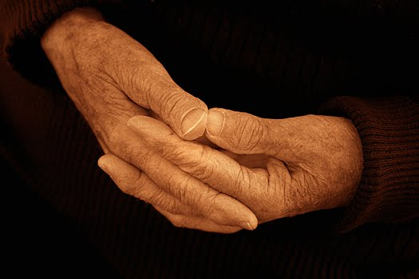
How does God want us to respond to unresponsive people?
Notes:
How does God want us to respond to unresponsive people? Such an incident is all too common. In fact, today we will take a look at a biblical character with this same unfeeling attitude. As we do so, I believe that God will challenge us with four principles on our own need to show compassion for other people.

Slide 14
"Go! No! So Row!"
Jonah 1
God turns events to show us His compassion for people.
Notes:
The Lord shows His care for people by events that get our attention.

Slide 15
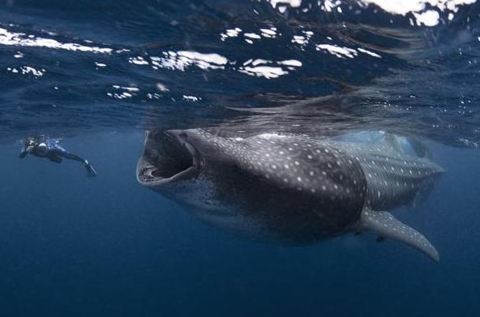
"Lo!" Jonah 2
Thank God for His compassion on you—despite your sin.
Notes:
15
Your response to God's mercy on you as a sinful creature should be gratefulness.

Slide 16
"Go! Yo! Whoa!"
Jonah 3
Share God's message since people are responsive.
Notes:
16
Do not assume that people will reject God—give them a chance by sharing God’s love with them.

Slide 17
"Oh, No!" Jonah 4
Show greater compassion on people than things
Notes:
17
Care for people more than anything else—God does!

Slide 18
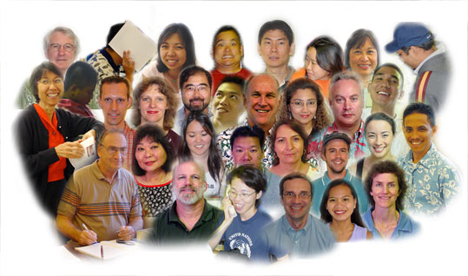
The Point of Jonah:
599
Make people the highest priority in your life.
Responding to God's heart means catching His heart for the lost.
Notes:
People are God's first concern—so people should be our first concern.
Imitate God's compassion for people by considering people more important than things.
Do you need to let some plates break?

Slide 19

Thought Questions
599
What parallels do you see between your life and Jonah?
What causes Christians—especially older ones—to lose their compassion for the lost?
What practices have you found helpful to maintain your compassion for unbelievers?
Notes:
19

Slide 20
Black
Notes:
20
Let's bow in prayer. But before we pray, honestly consider two questions:
Do others know you as compassionate—a "people person"? Why or why not?
2. What concern in your life hinders your concern for people? Studies? Perfectionism? A hobby which gobbles all your time? Not being able to say "no" to non-people-oriented tasks?
"Father, thank you for setting the example in your compassion on us. But help us to follow well in this area. May our comfort of persons be more important than our personal comforts. Show us how temporal things of this world really are—and how eternal people are—those for whom your Son died. In His precious name, Amen."

Slide 21
What's Most Important?
MOST
THE
IMPORTANT
THING
Notes:
What do you think is the most important thing we do as believers? Worship? Evangelism? Fellowship? Bible study? Prayer? A few weeks ago a man inquiring about our church asked me, "So what is most important to your church? What is unique?" If he had asked you, what would you have said? Tell the person next to you your answer in the next two minutes.
I told him one word: LOVE!
One of the teachers of religious law was standing there listening to Jesus debate. He realized that Jesus had answered well, so he asked, "Of all the commandments, which is the most important?" Jesus answered…

Slide 22

What's Most Important?
Mark 12:29-31 • Jesus replied, "The most important commandment is this: 'Listen, O Israel! The Lord our God is the one and only Lord. ³⁰ And you must love the Lord your God with all your heart, all your soul, all your mind, and all your strength.'
³¹ The second is equally important:
'Love your neighbor as yourself.'
No other commandment is greater than these."
Notes:
One of the teachers of religious law was standing there listening to the debate. He realized that Jesus had answered well, so he asked, "Of all the commandments, which is the most important?" Jesus answered…

Slide 23

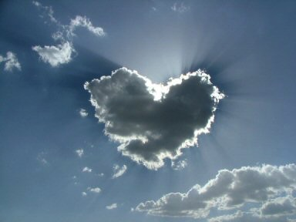


Our Vision is to…
Love God
Love the Church
Love the Nations
Notes:
• Love God
Where it starts—and ends—is in our call to LOVE. As Paul noted, "The greatest of these is love" (1 Cor. 13:13).
What is the most important thing we do as a church? It begins with loving the God who loves us.
• Love Church
Do you genuinely love him? If you don't, then nothing else you do counts, really.
The second thing He said right after this: to love your neighbor as yourself.
• Love Nations
But who is your neighbor? It starts right here in the body—to love the church—but then it extends from this "close neighbor" to those who are out of the reach of this fellowship where we love the nations. Our leadership is committed to make all that we do revolve around one of these three priorities.

Slide 24
Be Caring
The Book of Jonah
Dr. Rick Griffith, Crossroads International Church Singapore
BibleStudyDownloads.org

Slide 25

A missed opportunity
Notes:
In June 1991 a car in Singapore's East Coast area hit a 70-year-old Chinese man. The owner of the car was relieved to find a doctor at his clinic just a short distance away. When the doctor was begged to try to save the man's life, he replied that he was too busy, didn't have the right equipment, and needed the victim's approval or his family's approval before he would treat him. The doctor never tried to see the old man, who died five hours later.

Slide 26

Do you care for people?
Notes:
I was shocked to read the account in the newspaper. How could anyone be so unfeeling—especially someone who has given himself to the "people's profession"? Would you have helped him? Do you care for people?

Slide 27
How does God want us to respond to unresponsive people?
Notes:
How does God want us to respond to unresponsive people? Such an incident is all too common. In fact, today we will take a look at a biblical character with this same unfeeling attitude. As we do so, I believe that God will challenge us with four principles on our own need to show compassion for other people.

Slide 28
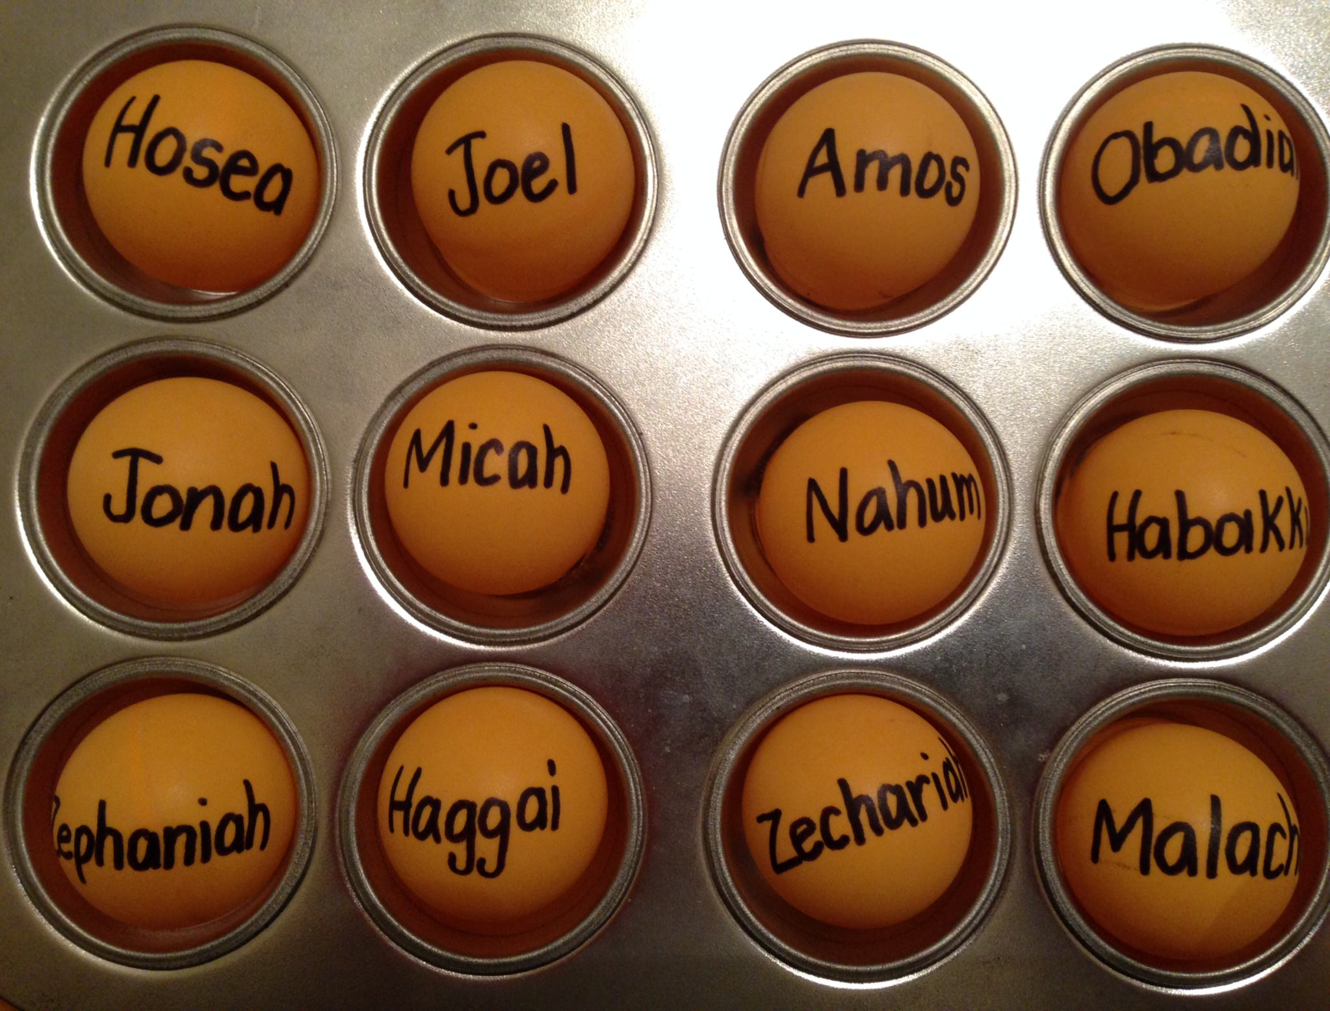
The Twelve
Courage to Confront Culture
—A Preaching Series on the Minor Prophets—
Notes:
Today we continue with part 2 of our series on the Minor Prophets that I'm calling simply "The Twelve."

Slide 29
Be...
Humble
Caring

Slide 30
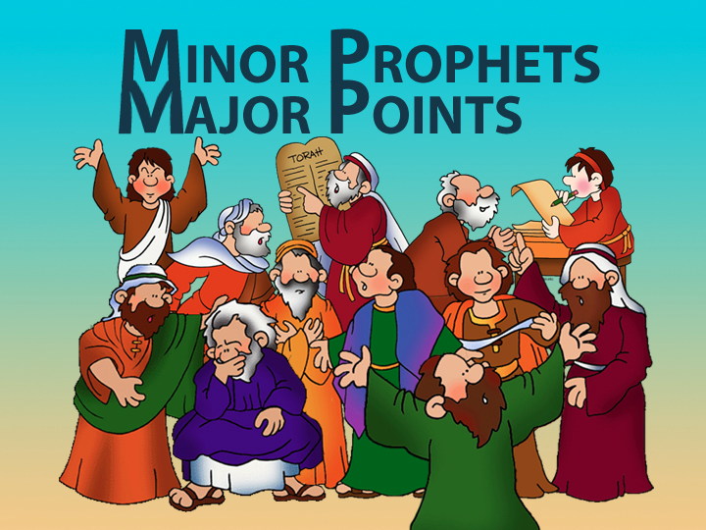
Minor Prophets—Major Points

Slide 31
Title Slide
JONAH

Slide 32
Unique Elements in Jonah
600
Unique Elements in Jonah
    Jonah speaks entirely through the experience of a prophet—not his words.
    Jonah is the only prophet in Scripture who tried to run from God.
    Jonah is the only entire biblical book on Israel's response to the Gentile nations.
    4. The historicity of Jonah has been denied by many scholars.

Slide 33
"Go! No! So Row!"
Jonah 1
God turns events to show us His compassion for people.
Notes:
The Lord shows His care for people by events that get our attention.

Slide 34
Jonah 1: Go!
604
God commands His people to tell the wicked how much He hates their sin (1-2).
Notes:
God commissioned Jonah to share His righteousness to Nineveh (1:1-2).

Slide 35
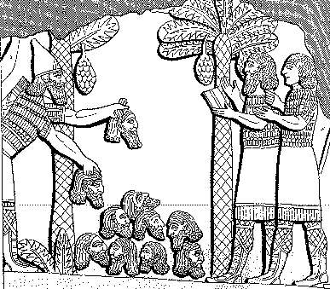
Assyrian Brutality
Assyrian
614
Brutality
"A pyramid of heads I reared in front of his city. Their youths and their maidens I burnt up in the flames."
Shalmaneser, 859-824 BC
= 80 years before Jonah, in
Luckenbill, Ancient Records of Assyria and Babylonia, 1:213

Slide 36
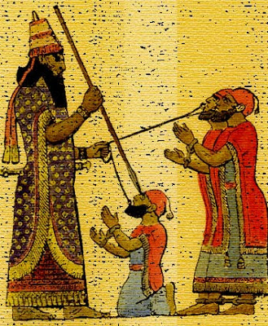
Treatment of Captured Kings
614
"Assyrian execution might involve tortures such as flaying…pulling out the lying tongue, burning, or…"
"I pierced his chin with my keen hand dagger. Through his jaw… I passed a rope, put a dog chain upon him and made him occupy a kennel."
Ashurbanipal, 669-626 BC
= 100 years after Jonah, in
Luckenbill, Ancient Records of
Assyria & Babylonia, 2:319

Slide 37

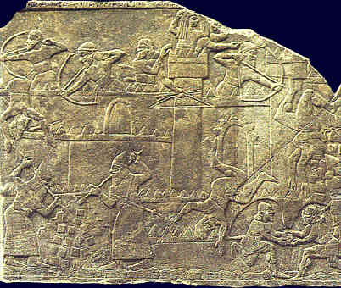
Siege & Attack
614
Siege & Attack!
See H. Hunt, "Sixth Century Siege Warfare," Biblical Illustrator (Fall '96): 43-45

Slide 38
Esarhaddon's Ego (660 BC)
614
"I am powerful, I am all powerful,
I am a hero, I am gigantic, I am colossal, I am honored, I am magnified, I am without equal among all kings, the chosen one of Asshur, Nabu, and Marduk!"
Luckenbill, Ancient Records of Assyria and Babylonia, 2:226

Slide 39
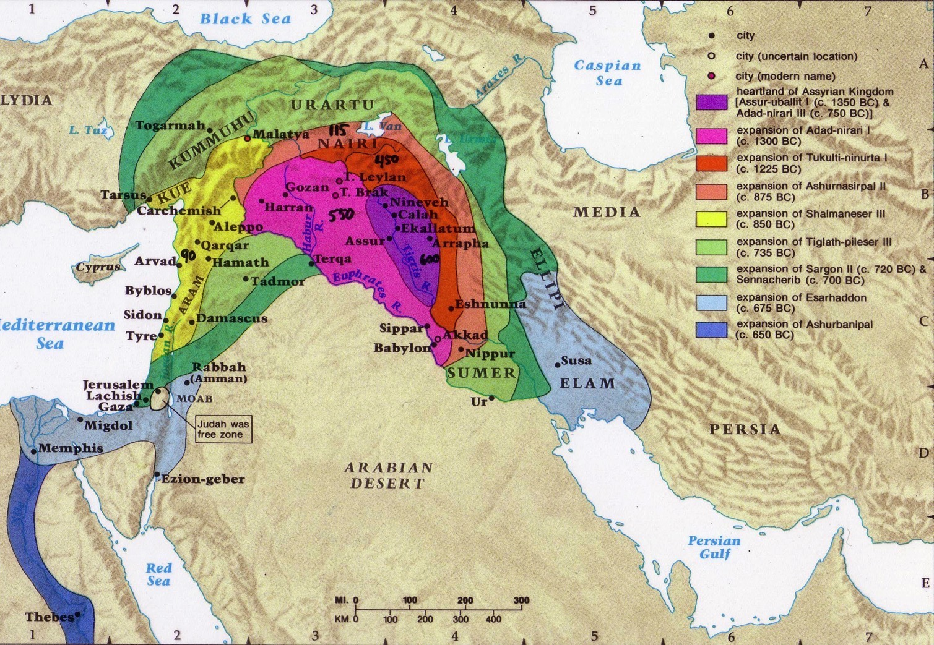
Assyrian Expansion
607

Slide 40
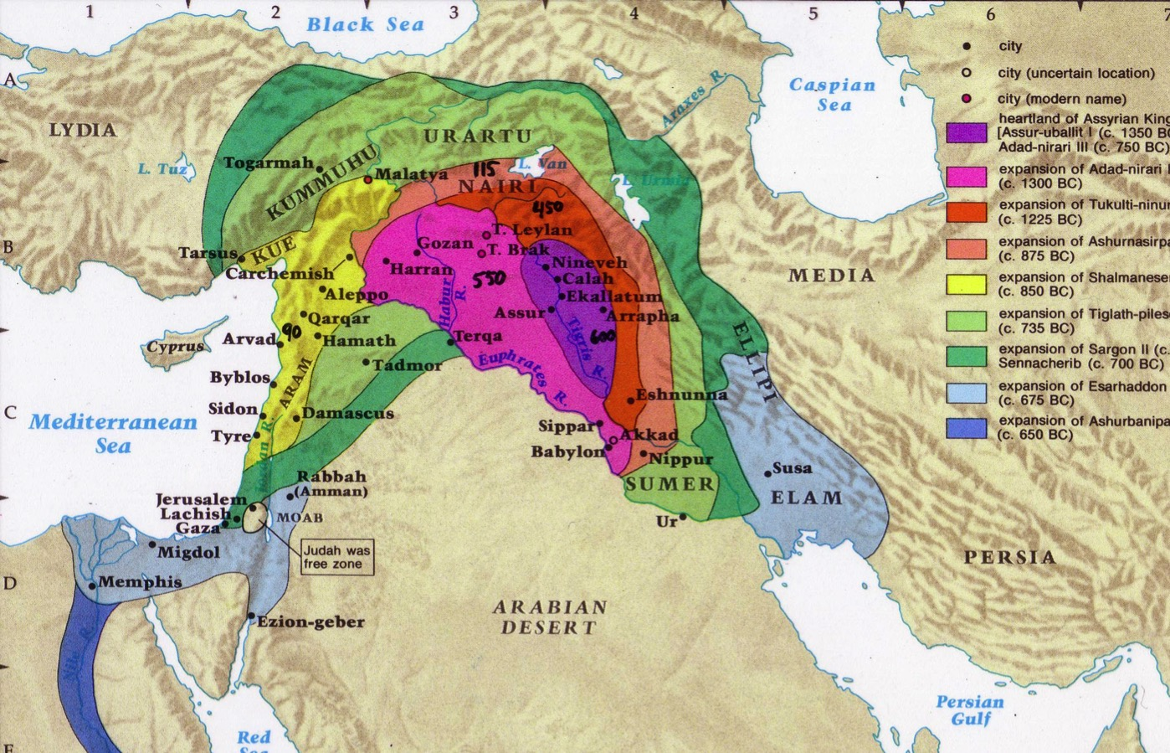
Assyrian Developments
And the king of Assyria transported groups of people from Babylon, Cuthah, Avva, Hamath, and Sepharvaim and resettled them in the towns of Samaria, replacing the people of Israel. So the Assyrians took over Samaria and the other towns of Israel
(2 Kings 17:24).
Finally, in the ninth year of King Hoshea's reign, Samaria fell, and the people of Israel were exiled to Assyria. They were settled in colonies in Halah, along the banks of the Habor River in Gozan, and among the cities of the Medes
(2 Kings 17:6).
48
Fall of Samaria
Rise of Samaritans
Beitzel, Moody Atlas of Bible Lands, 1st ed., 139
Notes:
• Fall of Samaria: Assyria conquered in all directions, but especially westward, including Israel when Samaria fell in 722 BC.
• "Finally..." (17:6): Most of the people were deported to other lands, but a few remained.
• Rise of Samaritans: Assyrians brought other conquered peoples into Israel’s territory.
• "And the king..." (17:24): Intermarriage between the few remaining Jews and these pagan peoples brought about a mixed race of half-Jews and half-Gentiles. They were named after the former capital and thus called Samaritans. Full-blooded Jews despised them.
______________
Common-415
OS-12-2 Kings-250
OS-14-2 Chron-346
OS-23-Isaiah13-23—slide 71
OS-24-Jeremiah-242
OS-32-Jonah-40
NB-05 Politics 2 Ptolemies to 63 BC (Pompey)-4

Slide 41
The Setting: Assyrian Might
443
Strong 883-783
Strong 745-626
Weak 790-745
900
850
800
750
70 0
65 0
600
550
500
Jonah

Slide 42
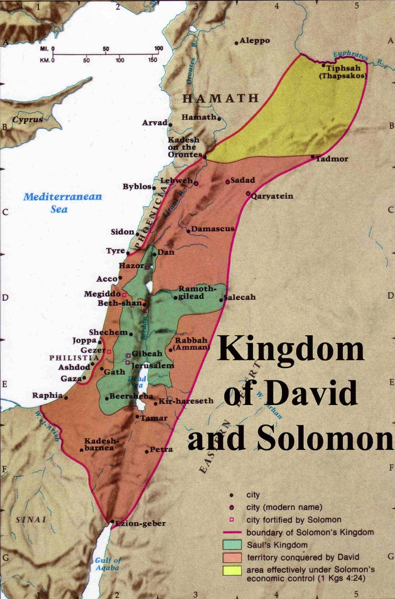
Expansion under Jeroboam II
446
Jeroboam II
"Jeroboam II recovered the territories of Israel between Lebo-hamath and the Dead Sea,* just as the Lord, the God of Israel, had promised through Jonah son of Amittai, the prophet from Gath-hepher."
(2 Kings 14:25 NLT).
* Hebrew the sea of the Arabah
Jeroboam I (930 BC)
Kingdom of Saul
Kingdom of David
Notes:
The boundaries under Jeroboam II went even farther than David and Solomon, who only had tribute sent from Hamath.
____________
BE-32-Jonah-16
OS-30-Amos-14
OS-32-Jonah-40

Slide 43

God loves you and offers a wonderful plan for your life?
Notes:
Not exactly Law #1: God loves you and has a wonderful plan for your life

Slide 44
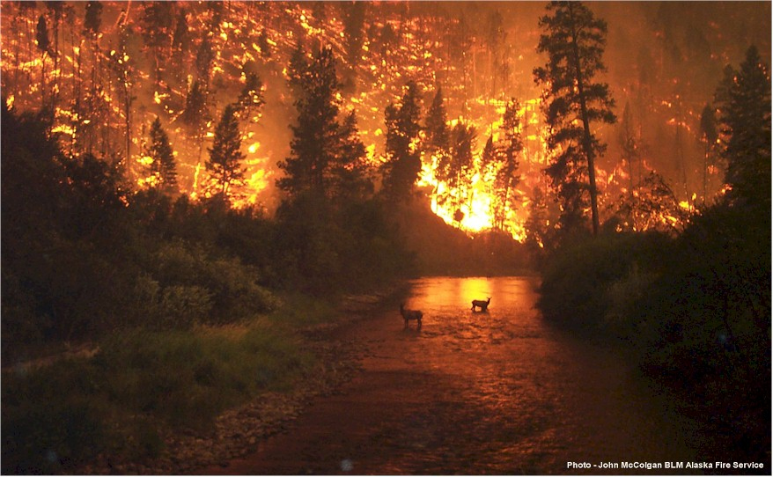
What a Message…
Jonah's Message…
"Nineveh's bad and God's mad!
You better turn or you're gonna burn!"

Slide 45

Israel's Strategic Location
Notes:
Jonah sought to leave the strategic location of Israel and flee to the remote area of Tarshish (modern day Spain). When we try to run away from God, we run away from having an influence for him in our world.

Slide 46
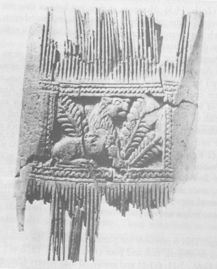
Ivory Comb
Ivory comb from Megiddo, representative of the wealth and luxury assailed by Amos (3:15; 6:4)
––Oriental Institute, University of Chicago
Notes:
Jonah lived at the time of Amos—a period of great luxury and its associated insulation from the needs of common people.

Slide 47
Summary of Jonah's Time
600
Circumstances Summary
Date: During the reign of Jeroboam II of Israel
(2 Kings 14:25; 758 BC)
Setting:
1. Assyria in temporary decline due to
internal dissension
2. Israel's borders expanded tremendously
3. A narrow, nationalistic focus in Israel,
which enjoyed its prosperity

Slide 48
Jonah 1: Go! No!
God commands His people to tell the wicked how much He hates their sin (1-2).
God's people often don't want to tell bad people that they're bad (3).

Slide 49
Where would Jonah go?
Tarshish
Nineveh
Gath-Hepher
Joppa

Slide 50
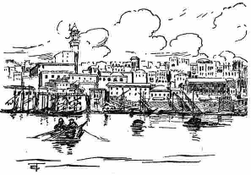
Joppa was an important seaport
Going down to Joppa was the way to get out of Israel by ship—unlike Peter 800 years later

Slide 51
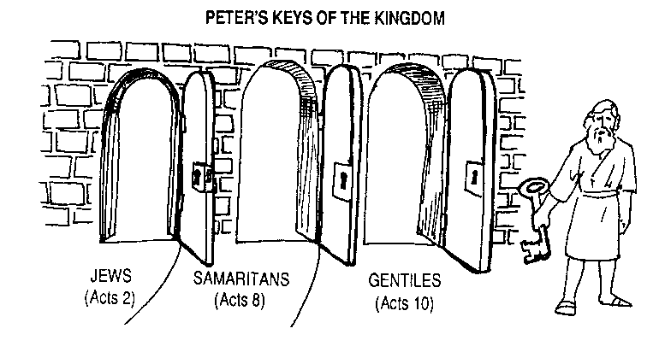
Q: How did God overcome the prejudice in the Church at Jerusalem?
A: Gradually
PETER'S KEYS OF THE KINGDOM
JEWS
SAMARITANS
GENTILES
Acts 2
Acts 8
Acts 10
AD 33
AD 35
AD 40
Notes:
God wisely led that Jerusalem church step-by-step so they could handle his big heart!
I suspect that if Samaritans and Gentiles were forced into the church too soon this would split the early church into three separate groups.

Slide 52
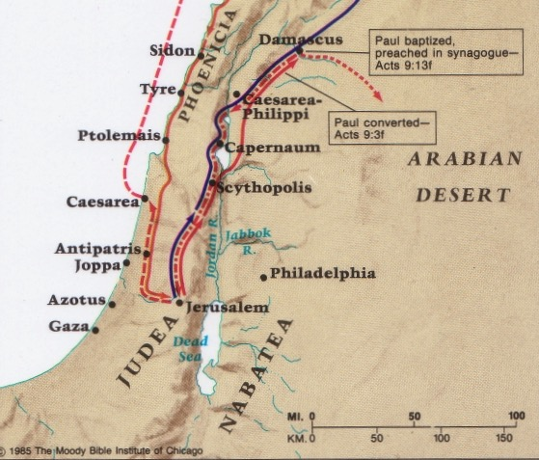
Peter was not like Jonah at Joppa
Caesarea
Joppa

Slide 53
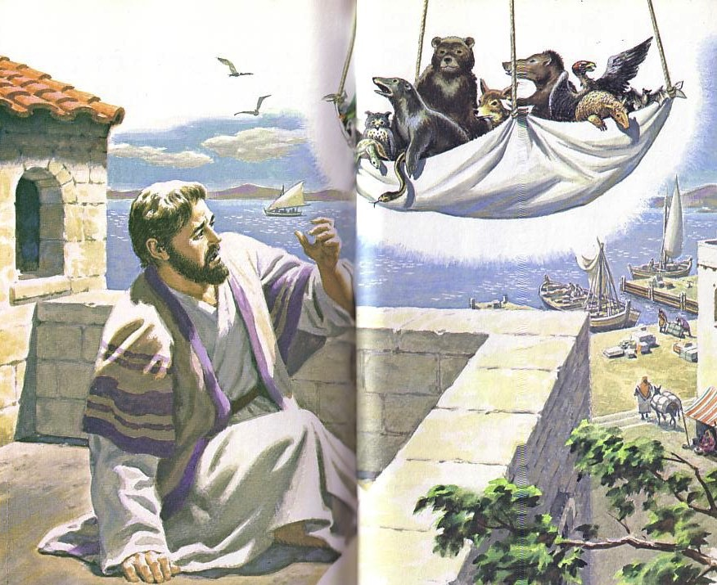
"Get up, Peter! Kill and eat!"

Slide 54
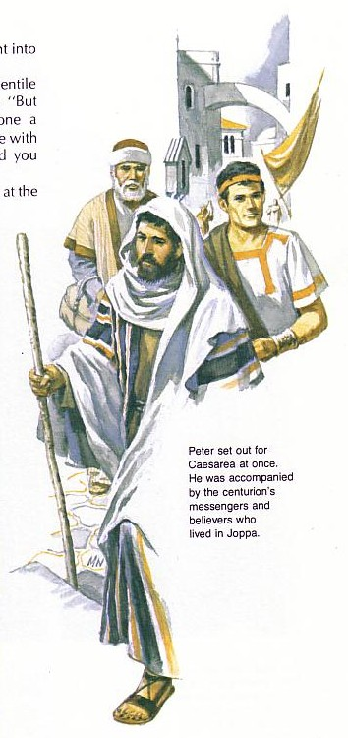
"What's God going to do to these unclean men?"
Peter must have wondered why God wanted him to go with the servants of Cornelius

Slide 55
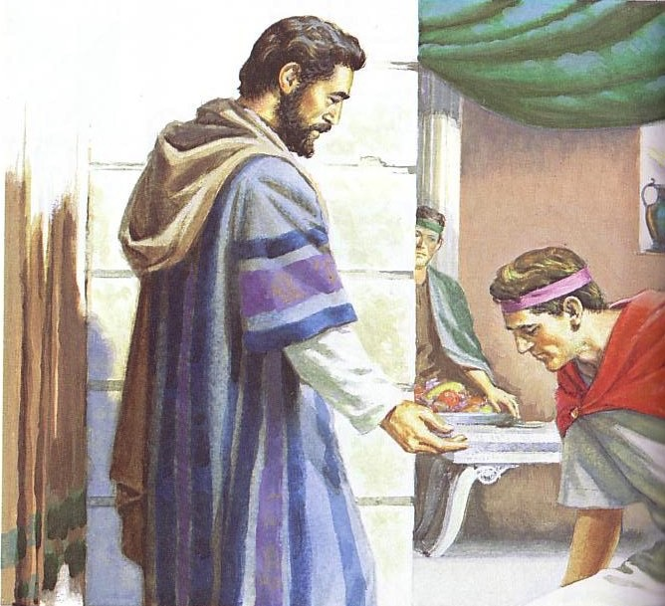
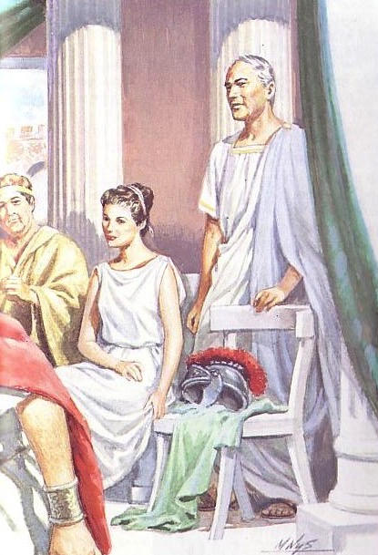
Cornelius bows to Peter

Slide 56
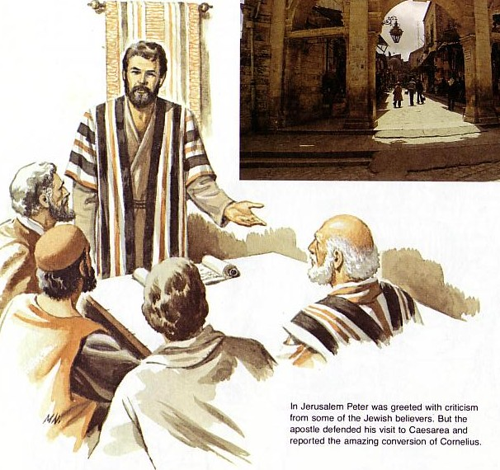
Peter defends his lack of prejudice

Slide 57
Black
Notes:
Israel became naval-gazing, arrogant, and sinful (a mission field herself!)
We also disobey God by avoiding witnessing for Him (in break room, airplane seat, to neighbor or family member)

Slide 58
Jonah 1: Go! No! So Row!
God commands His people to tell the wicked how much He hates their sin (1-2).
God's people often don't want to tell bad people that they're bad (3).
Neglecting evangelism brings consequences (4-16).

Slide 59
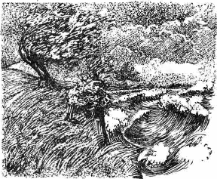
Raging Sea
Notes:
⁴ But the Lord hurled a powerful wind over the sea, causing a violent storm that threatened to break the ship apart. NLT

Slide 60
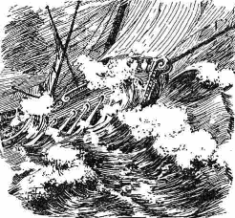
Ship Threatened to Break
Notes:
The Hebrew reads that the ship itself threatened to break up!

Slide 61
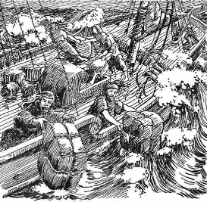
Cargo Overboard
Notes:
⁵ Fearing for their lives, the desperate sailors shouted to their gods for help and threw the cargo overboard to lighten the ship. NTL
The Bible in Pictures, drawn in 1922 but free to copy at www.creationism.org/books/

Slide 62
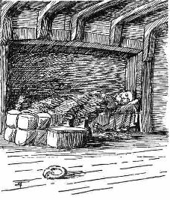
Jonah Sleeping
Notes:
But all this time Jonah was sound asleep down in the hold. ⁶ So the captain went down after him. "How can you sleep at a time like this?" he shouted. "Get up and pray to your god! Maybe he will pay attention to us and spare our lives."
NLT, Jon 1:5-6.
The Bible in Pictures, drawn in 1922 but free to copy at www.creationism.org/books/

Slide 63
Black
⁷ Then the crew cast lots to see which of them had offended the gods and caused the terrible storm. When they did this, the lots identified Jonah as the culprit.
⁸ "Why has this awful storm come down on us?" they demanded. "Who are you? What is your line of work? What country are you from? What is your nationality?"
⁹ Jonah answered, "I am a Hebrew, and
I worship the Lord, the God of heaven, who made the sea and the land" (1:7-9 NLT).

Slide 64
Black
Notes:
¹⁰ The sailors were terrified when they heard this, for he had already told them he was running away from the Lord. "Oh, why did you do it?" they groaned. ¹¹ And since the storm was getting worse all the time, they asked him, "What should we do to you to stop this storm?"
¹² "Throw me into the sea," Jonah said, "and it will become calm again. I know that this terrible storm is all my fault." (1:10-12 NLT)

Slide 65
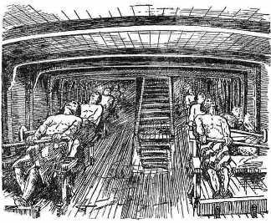
Sailors Rowing
Notes:
¹³ Instead, the sailors rowed even harder to get the ship to the land. But the stormy sea was too violent for them, and they couldn't make it (1:13 NLT).
The Bible in Pictures, drawn in 1922 but free to copy at www.creationism.org/books/

Slide 66
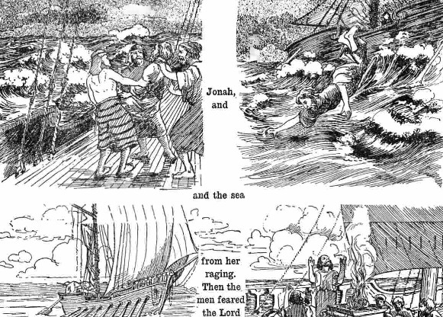
Jonah Overboard
Notes:
¹⁴ Then they cried out to the Lord, Jonah's God. "O Lord," they pleaded, "don't make us die for this man's sin. And don't hold us responsible for his death. O Lord, you have sent this storm upon him for your own good reasons."
¹⁵ Then the sailors picked Jonah up and threw him into the raging sea, and the storm stopped at once! ¹⁶ The sailors were awestruck by the Lord's great power, and they offered him a sacrifice and vowed to serve him (Jon 1:14-16 NLT).

Slide 67
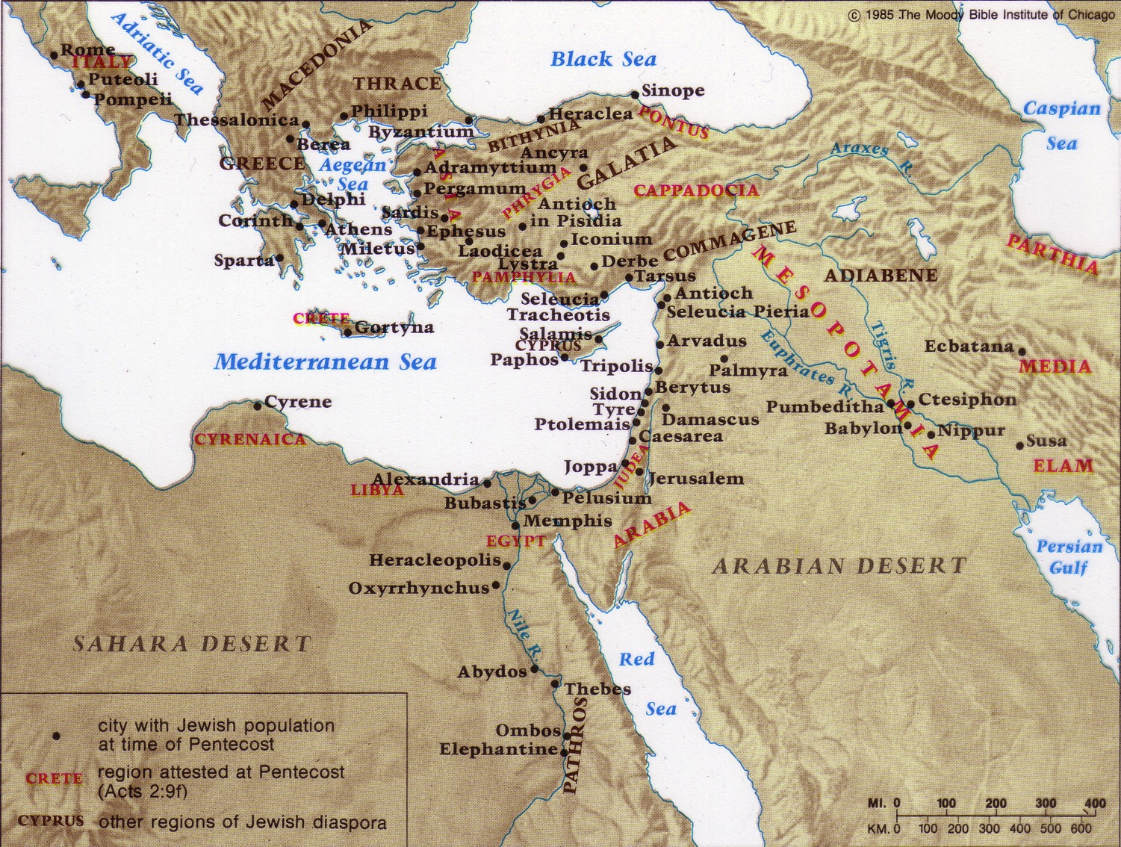
The Jewish Diaspora
40,000 Jews in Rome alone!
83%
17%
Notes:
Only 17% of the Jews in the Roman Empire lived in Israel.
The other 83% lived scattered throughout the realm.
When Jesus was born in the time of Augustus, Rome alone had 40,000 Jews.
God had spread them throughout the known world to be His witnesses, but they, like Jonah, failed.

Slide 68
Main Idea of Jonah 1
Neglecting evangelism brings consequences
God still uses means today to show us His seriousness about evangelism

Slide 69
God often used invasions of His people to convert the invaders!
Periods of Christian Expansion
Period 1
Period 2
Period 3
Period 4
Period 5
Ends of
Earth
Romans
Barbarians
Vikings
Saracens
0
400
800
1200
1600
2000
Ralph Winter, The World Christian Movement

Slide 70
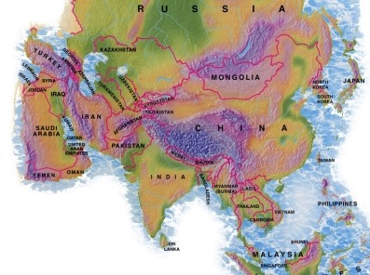
4.89 million people
1.68 million foreigners!
Notes:
Dr Rick started this church in 2006 to help reach the many receptive internationals who moved to Singapore.

Slide 71

Our Vision
Love the Nations
Love the Church
Love God
Notes:
Love is most important (1 Cor 13:13) and repentance will restore a church.
LOVE GOD: God wants our church to trust him.
We still don’t see our need for him as we don’t see our need to pray.
LOVE THE CHURCH: We also need to be involved in his work: teaching, accountability groups, finances, etc.
LOVE THE NATIONS: The heart of the Great Commission to disciple all countries is based on love for God and his people.
——————————
Common-294
BE-05-Deut-82
OP-05-Deut-71
OS-05-Deut-155, 237
OS-29-Joel-128
OS-32-Jonah-71
NS-02-Mark1-8-slide 111
NS-03-Luke1-12—slide 401

Slide 72

Mercedes-Benz
Notes:
One Mercedes-Benz commercial shows their car colliding with a cement wall during a safety test. Someone then asks the company spokesman why they do not enforce their patent on the Mercedes-Benz energy-absorbing body, a design evidently copied by other companies because of its success. He replies matter-of-factly, "Because some things in life are too important not to share."
How true. That also includes the gospel of salvation, which saves people from far more than auto collisions.
Jim Beranek, Leadership magazine

Slide 73
Black

Slide 74

Jonah 1 Small Group Questions
Can you share an example of how God got your attention when you disobeyed in evangelism?
2. Do other people sometimes suffer for our disobedience? How?
3. Why do you sometimes disobey God's Word by refusing to share your faith?
4. What practical steps can you take to change?

Slide 75

Important Matters
600
I. Introduction
A. Date and Setting
B. Nineveh
C. Characteristics and Chart
II. Issues
A. Historicity and Literary Type
B. Why Jonah Ran and the Importance of 4:2
C. The Book of Jonah Mentioned by Jesus
III. Implications / Messages

Slide 76
Placing the Prophets
342
Placing the Prophets
Key Dates
931
Obadiah
722
Jonah
Amos
Hosea
Isaiah
Micah
Nahum
Zephaniah
Jeremiah
Lamentations
Joel
Daniel
Haggai
Habakkuk
Ezekiel
Zechariah
Malachi
586
Notes:
God raised up prophets to speak to the issues of their day for four centuries from the 800s to the 400s BC.
_______________
Common-308
OS-11-1 Kings-186
OS-12-2 Kings-51
OS-13-1 Chron-232
OS-14-2 Chron-40
OS-14-Reasons for Exile-30
OS-23-Prophets Intro-13
OS-28-Hosea-33
OS-32-Jonah-76
OS-34-Nahum-37
OS-35-Haggai-45

Slide 77
Book Chart
God's Compassion on Gentiles
Disobeys Missionary Mandate |  |  |  | Obeys Missionary Mandate
Chapters 1—2 |  |  |  | Chapters 3—4
God's Mercy on Jonah |  |  |  | God's Mercy on Nineveh
The Great Sea |  |  |  | The Great City
Commis-sioning 1:1-2 | Disobed-ience 1:3 |  | Conse-quences 1:4–2:10 | Recommis-sioning 3:1-2 | Obed-ience 3:3-4 |  | Conse-quences 3:5–4:10
"Go!" | "No!" |  | "So Row!" "Lo!" | "Go!" | "Yo!" |  | "Whoa!" "Oh No!"
Jonah's Perversity Chapter 1 (Wants to die) |  | Jonah's Prayer Chapter 2 (Wants to live) |  | Jonah's Preaching Chapter 3 (Wants to live) |  | Jonah's Pouting Chapter 4 (Wants to die)
about 760 BC
599

Slide 78
"Lo!" Jonah 2
Thank God for His compassion on you—despite your sin.
Notes:
78
Your response to God's mercy on you as a sinful creature should be gratefulness.

Slide 79
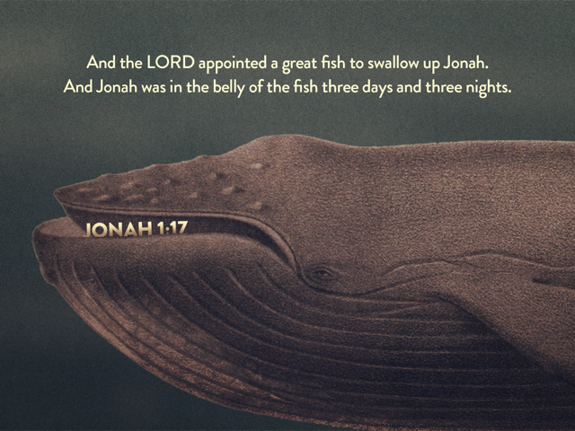
JONAH 1:17
And the LORD appointed a great fish to swallow up Jonah.
And Jonah was in the belly of the fish for three days and three nights.

Slide 80
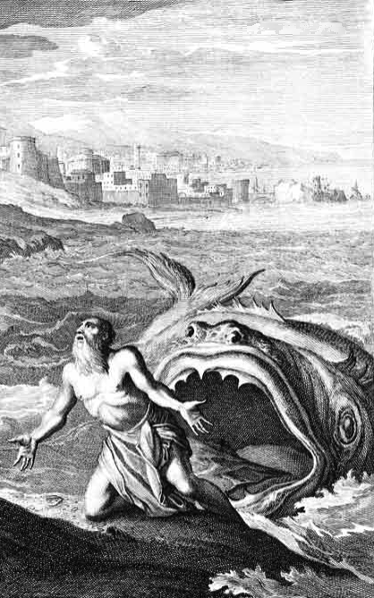
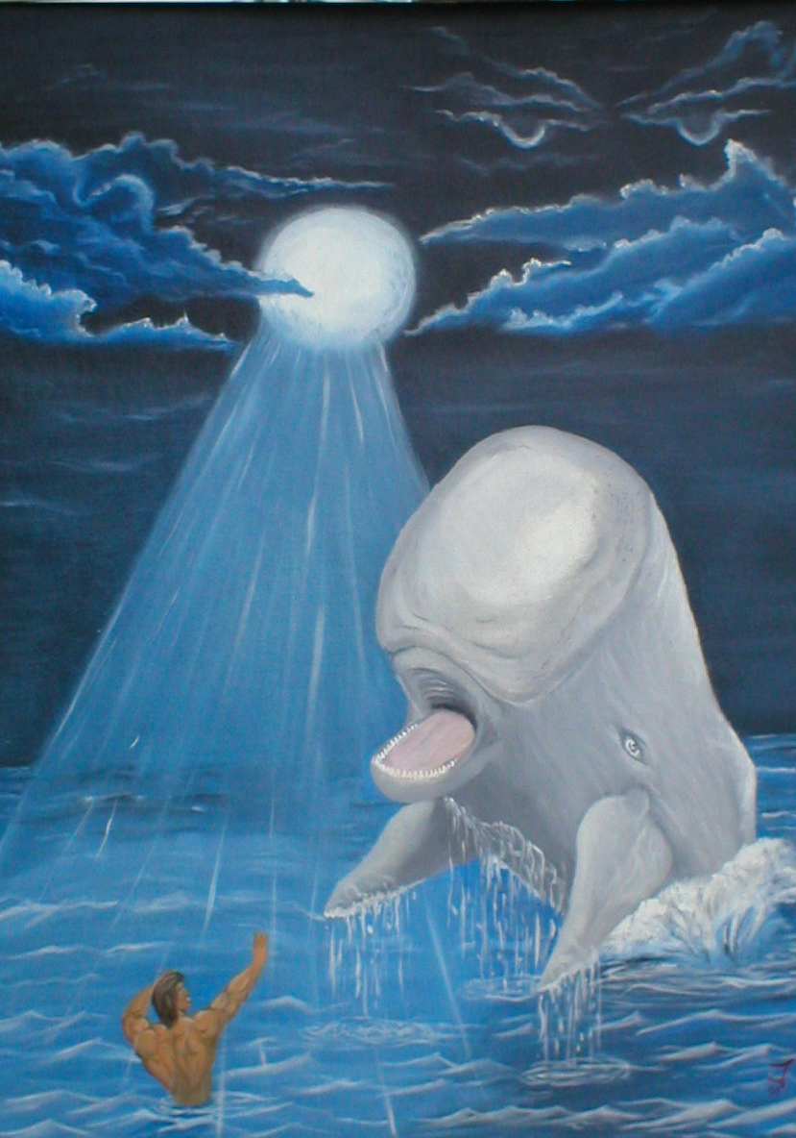
Huge Fish?
or Whale?
The Bible:
Dag ("fish")
Notes:
80

Slide 81
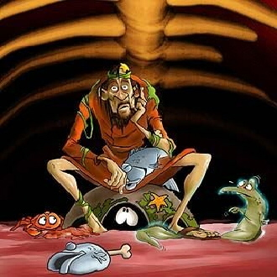
Inside the Fish
Notes:
81
What would he eat? I hope he liked sea food!
Could he really breathe in there? Wouldn't the oxygen run out?
No, provided an eco-system!

Slide 82
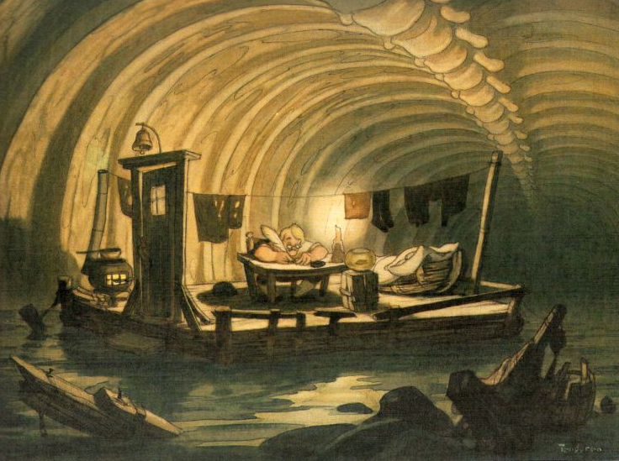
Inside the Fish
Notes:
82
Some think that Jonah had a writing ministry because of the things written in chapter 2. But I tend to think that these were written down later!
I'm not sure that he had a desk and lamp inside the fish.
Actually, the next slide is the best picture that I have seen that shows what it look like inside the fish…

Slide 83
Black
Notes:
83
Yeah, this is what it look like inside the fish.
But sometimes in the dark we see the light!
This is what happened to Jonah where the light finally turned on in his thinking.
We have this recorded in chapter 2.

Slide 84
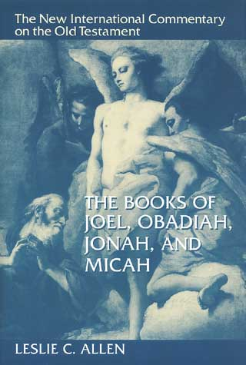
"Evangelical" Unbelievers?
"…the author's intention is other than simply to describe historical facts"
(p. 176).
Notes:
84

Slide 85
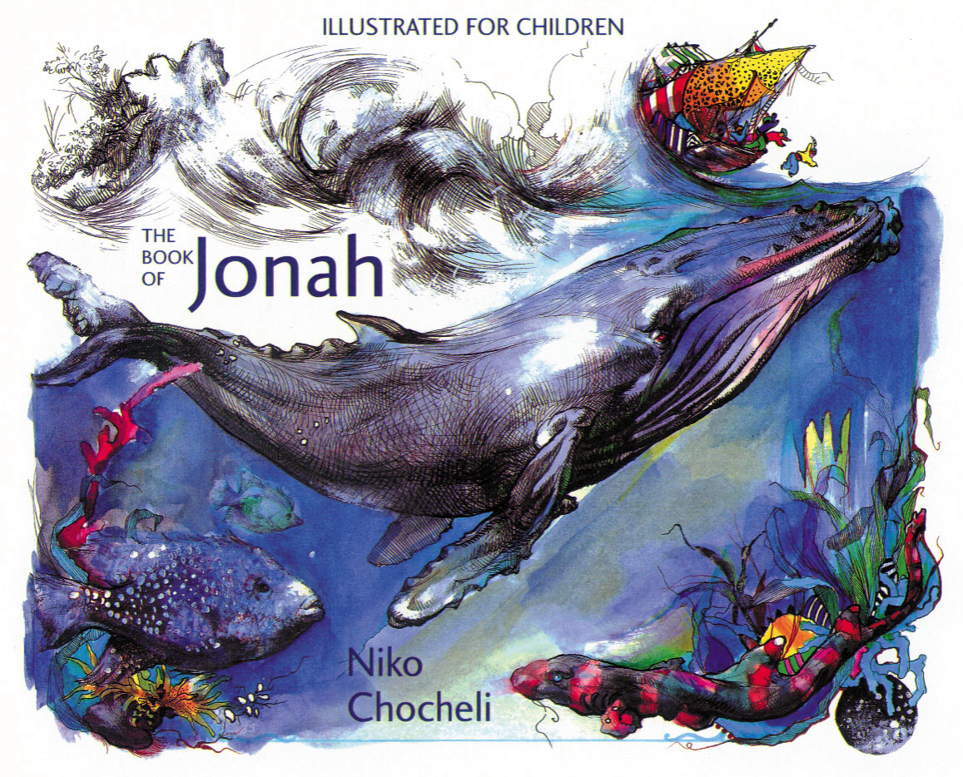
Is Jonah simply just a good story for kids?
601
Believe it or not?
Notes:
85
James Bartley

Slide 86
Why not accept Jonah?
601-3
The historicity of Jonah has been denied by many people over three issues:
1. Three days in a great fish (1:17)
2. All of Nineveh repenting (3:5)
3. Nineveh so big it had 120,000 people (4:11)
But:
Jonah is noted in 2 Kings 14:25 as a historical figure (prophet)
Jesus Himself upheld the historicity of the book (Matt. 12:39-41)
Notes:
86
The three main problems people have with the book of Jonah are actually easily answered.
Just because we haven’t seen something happen ourselves doesn’t mean that it couldn’t or didn’t happen in the past.
These are problems only for those who reject the miraculous.

Slide 87
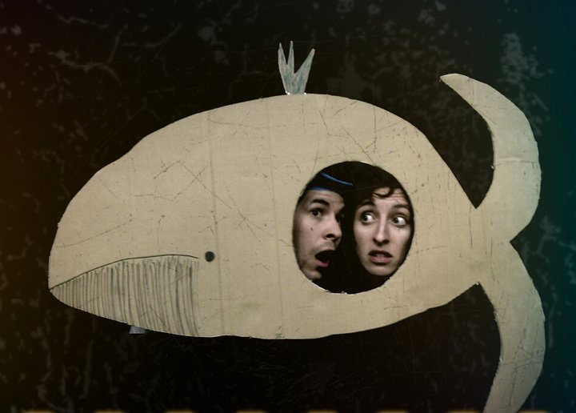
Expected Responses:
Anger?
Pride?
Suicidal Depression?
Notes:
87
So I take the fish account to be true, but what kind of response would one expect Jonah to have in this situation?
Anger? "God, I obeyed you concerning the prophecy about Jeroboam. Why do I have to go through all this torment just for one lousy act of disobedience?"
Pride? "Well, look here! How often does God help drowning people by getting them swallowed by a huge fish? I must really be special to the Lord!"
Suicidal Depression? "What?! Inside a fish? Why didn't I die from drowning? I'd rather have died quickly from drowning than to starve to death inside this marine monster! I hate sea food—and now, I AM sea food!"

Slide 88
The Ten Million Dollar Question
The Ten Million Dollar Question
How should we respond to God's goodness despite our sin?

Slide 89
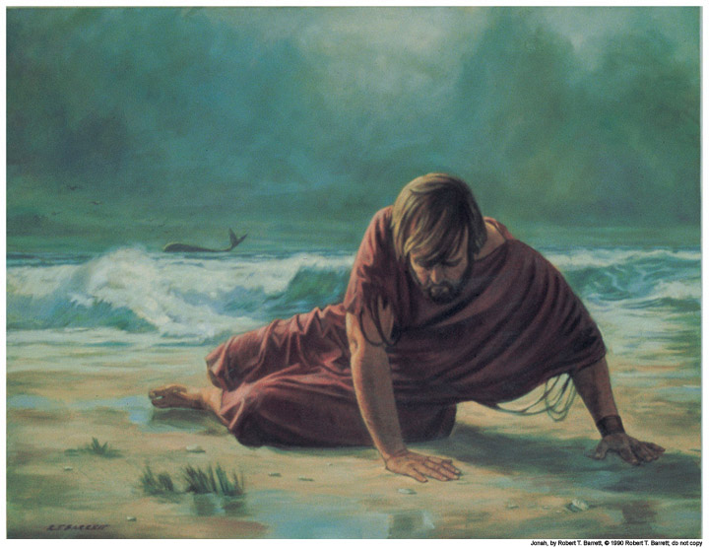
Jonah thanked God for delivering him from drowning (1:17–2:10)
Wouldn't you?

Slide 90
Judgment?
Deliverance!
Notes:
90
Was the fish God's judgment on Jonah? Not at all!
It was the means of deliverance!

Slide 91
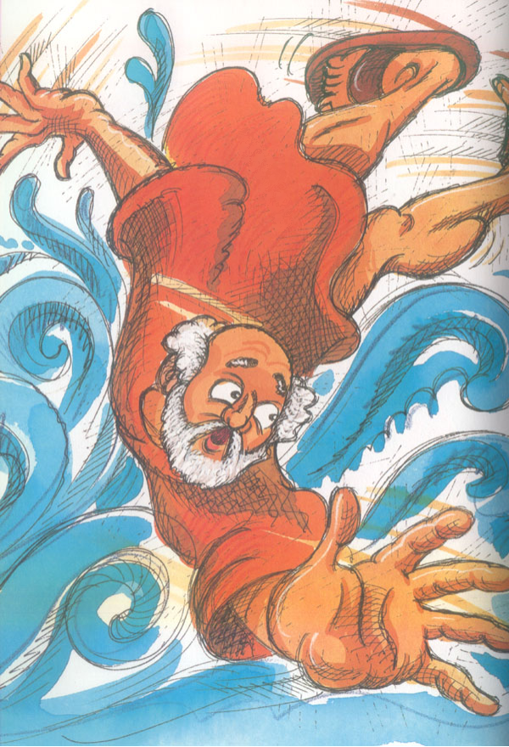
Thanksgiving Psalm
Prayer (1-2)
Lament (3-7)
Vow (8-9)
Jonah 2
Notes:
91
Jonah 2 sounds much like a psalm in the book of Psalms. That is because it has the typical Hebrew structure of a thanksgiving psalm.

Slide 92
Thanksgiving Psalm
Prayer (1-2)
"In my distress I called to the LORD and he answered me…"
Jonah 2
Notes:
92

Slide 93
Thanksgiving Psalm
Prayer (1-2)
Lament (3-7)
"You hurled me…"
(2:3, cf. 1:4, 5, 12, 15)
Jonah 2
Notes:
93

Slide 94
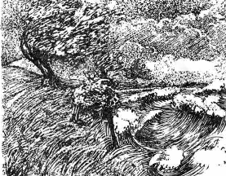
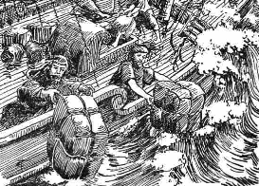
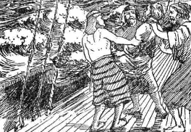
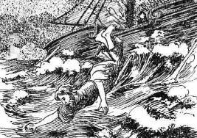
"To hurl" in Jonah
God "hurled a storm" (1:4)
Sailors "hurled the cargo" (1:5)
"Hurl me"
(1:12)
"They hurled Jonah" (1:15)
"You hurled me" (2:3)
Notes:
Jonah has several plays on words that bring forth the narrative in a creative way.

Slide 95
"Arise" in Jonah
"Arise and pray to your god" (1:6)
"Arise and go to Nineveh" (1:1)

Slide 96
"Down" in Jonah
"went down to Joppa" (1:3a)
"had gone down below deck" (1:5)
"sank down to the roots of the mountains" (2:6)

Slide 97
Black
Notes:
97
Jonah expresses hope to see temple twice in the psalm—verses 4 and 7.
He says that hope finally occurred "when my life was ebbing away" (2:7). The Hebrew here conveys the idea of growing faint or losing consciousness (cf. Pss. 142:3; 143:4; Alexander, TOTC, 117).
In other words, he is now finally turning "up"! While in total darkness, he is finally seeing the light!

Slide 98
Thanksgiving Psalm
Prayer (1-2)
Lament (3-7)
Vow (8-9)
Jonah 2
Notes:
98

Slide 99

Jonah's Vow
"But I, with a song of thanksgiving, will sacrifice to you. What I have vowed I will make good. Salvation comes from the LORD" (2:9 NIV)

Slide 100

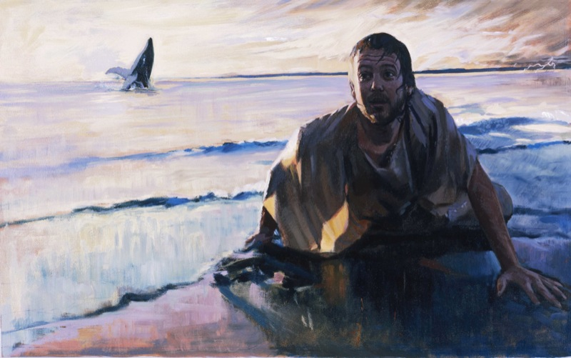
The Result? Jonah Vomited
DRESSING
THE
STAGE
MS
SG
ER
"THE LAND"
DS
PG
RS
Handbook pg. 15-16
25
Notes:
100

Slide 101
The Ten Million Dollar Question
The Ten Million Dollar Question
How should we respond to God's goodness despite our sin?

Slide 102
We should thank God that He spares us despite our disobedience

Slide 103


What better motivates you to right living?
Quiz Time. . .
Grace? or
Law?
Support your answer!

Slide 104
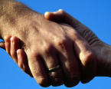
Distinguishing some key terms…
Grace: God gives us what we don't deserve
Mercy: God doesn't give us what we do deserve
Justice: God gives us what we do deserve
Notes:
104
So what have I learned? Everything I am, have, and do—it's all because of God's grace. Who would have ever thought that this shy boy—from a broken home whose parents and those they have married have endured 12 divorces—who would ever thought that this guy would be privileged to serve Him at SBC and beyond?

Slide 105
Black
Notes:
105
Think how good God is to us erring creatures---1000 sins a year!
But God's grace overshadows his justice on the cross.
Grace prevents premature death too: 234 traffic deaths, immune system

Slide 106

This is My Life
A Family Album
Notes:
106
Today instead of the usual chapel message I thought I'd share something I know something about—what God has done in my own life

Slide 107
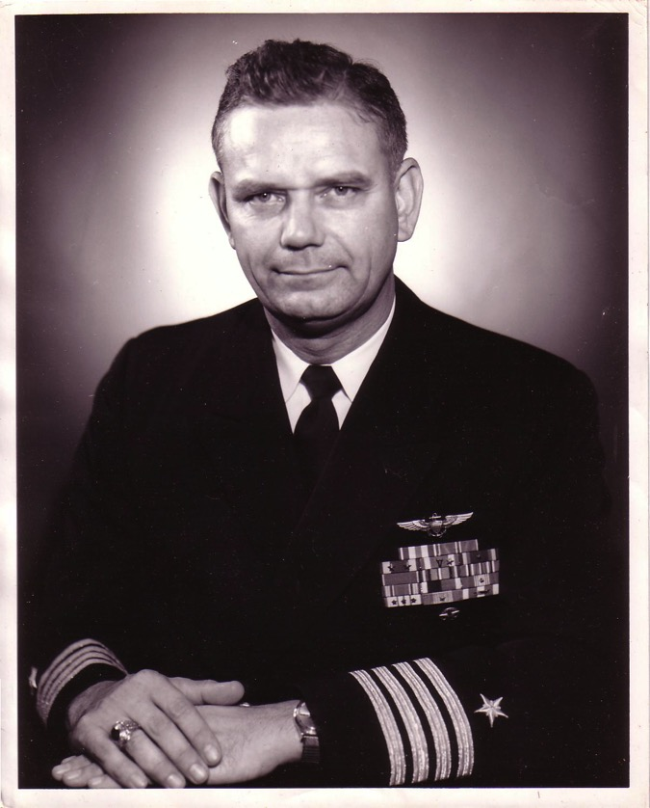
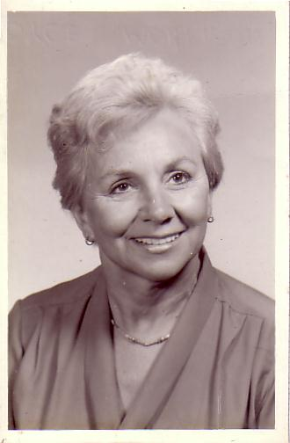
The Marriage
Navy Lieutenant
Harold F. Griffith (alias Dad)
Navy Ensign
Joyce I. Griffith (alias Mom)
Notes:
107
The story, of course, must begin with my parents who met in the Navy.
They had a baby boy (my older brother Bob) and then were transferred to Japan.

Slide 108
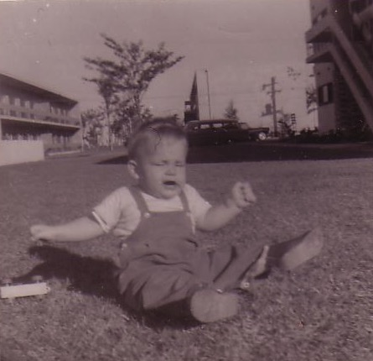
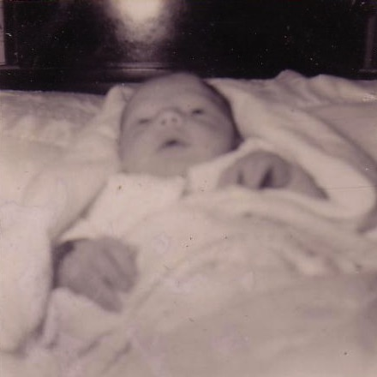
Baby Ricky
"Unto us a child is born… unto us a son is given…"
Tokyo, 1958
Notes:
108
That's where I made my appearance. I was born in Japan at a very young age… as an MK (Military Kid)

Slide 109




The Family Grew & Moved…
Notes:
109
After my sister's birth there 19 months later we moved to a strange land—California!

Slide 110

San Francisco Bay Area
Alameda
SF
Castro Valley
Hayward
Notes:
110
We first lived in Alameda across the bay from San Francisco, then later in two other cities.

Slide 111
The Divorce
1962
Navy Commander
Harold F. Griffith (alias Dad)
Social Worker
Joyce I. Griffith (alias Mom)
Notes:
111
After my younger brother's birth my Mom concluded that my Dad was actually married to the Navy, so she divorced him. Ironically, she became a social worker to help other families put their lives together.

Slide 112

Divorce for Mom was tough…
Bobby, 6
Ricky, 4
Kathy, 3
Tommy, 1
Notes:
112
Those weren't easy years being a single mother with four kids ages 6 and under. Yes, that's me—the good looking one with the sucker!

Slide 113




Renewal Under Bill
Notes:
113
Three or four years later my Mom met Bill—another divorcee with three children. They married once when I was on vacation to see my real Dad.

Slide 114





One Year of Water Skiing…
& One Year of Church…
1966-1968
Notes:
114
Life began to turn around. Bill played sports with us and even took us to church for a year.

Slide 115

Another Divorce…
Notes:
115
But the arguments with my Mom became unbearable so my Mom divorced him too.

Slide 116




But We Had Each Other…
Notes:
116
You may think I was lonely—but I had my big brother Bob and my sister Kathie. My little brother Tom was a pest.

Slide 117


Our Family of 5 (1972)
Notes:
117
But we learned to live without a Dad again while my real Dad married a third time—eventually five times total!

Slide 118






School Pictures
Kindergarten
Grade 1
Grade 2
Grade 3
Grade 4
Grade 5
Notes:
118
Life went on and, despite my rotten family background, I sensed that there was a God—so I figured that I better be a good boy. I obeyed my parents and did well in school and sports over the years.

Slide 119


Baseball
Notes:
119
Of course, when Sunday morning came, I still played baseball.

Slide 120




Peppy Sports
Notes:
120
My siblings and I even dressed our dog Peppy up to play baseball—as well as hiking, football, and basketball. Yes, don't remind me that my hands are in the basketball picture. My brother didn't frame it right!

Slide 121


My Spiritual Journey
Notes:
121
It's been said that our view of the Heavenly Father follows our view of our earthly father. My father was an important man who achieved the rank of Captain. He loved me but was always far away fighting in Vietnam, so I saw God the same—One who loved me but was far away doing important things.

Slide 122


Searching in the 70s…
Love
Notes:
122
I was too young to be a hippie, but I did identify with the search for love and peace. I painted in bright fluorescent colors the love and peace signs on my bedroom wall, turned on my black light, laid on my bed and said "groovy," "far out," and other things hoping that real peace would fill my heart. It didn't!

Slide 123


The influence of friends
John
Terry
Notes:
123
So I tried and tried to be good—but I always knew I was failing to live up to my own expectations let alone God's! Then two friends at school told me I could never be good enough—and that I needed to trust Christ by faith. When I saw the reality of the Christian life in their own families (especially their fathers), I finally trusted Christ at age 13.

Slide 124
Finally I understood
Grace
to me
Grace set me free from trying to be "good enough" for God!
Notes:
124
For the first time in my life I had peace with God—His grace set me free from the nagging knowledge that I couldn't make it alone.

Slide 125
What I've learned over the years…
All
that I am
that I have
that I can do
is due to God's grace!
Notes:
125
So, what have I learned? Everything I am, have, and do—it's all because of God's grace. Who would have ever thought that this shy boy—from a broken home whose parents and those they have married have endured 12 divorces—who would ever thought that this guy would be privileged to serve Him most of his adult life in the Philippines, Singapore, Jordan, and beyond?

Slide 126
Black
Notes:
126

Slide 127

The Big Idea
The Big Idea
Thank God
His mercy overshadows His justice

Slide 128
Black
Notes:
128

Slide 129
Jonah 2 Small Group Question
What does "Thank God His mercy overshadows His justice" mean to you personally?

Slide 130
Jonah 2 Small Group Questions
What are some different ways you respond to difficulties God allows in your life?
2. Explain what "Thank God His mercy overshadows His justice" means to you personally.
3. Describe what you think life would be like for you now had you not become a Christian.
What tangible way can you respond to His call for you to share Him with others?

Slide 131

Only By Grace 1/5
Words & lyrics by Gerrit Gustafson

Slide 132

Only by Grace 1 of 4
Only by grace can we enter
Only by grace can we stand
Not by our human endeavor
But by the blood of the Lamb

Slide 133

Only by Grace 2 of 4
Into Your presence You call us
Call us to come
Into Your presence You draw us
And now by Your grace we come
Now by Your grace we come

Slide 134

Only by Grace 3 of 4
Lord, if You marked our transgressions
who would stand?
But thanks to Your grace
we are cleansed by the blood of the Lamb

Slide 135

Only by Grace 4 of 4
Only by grace can we enter
And now by Your grace we come
Now by Your grace we come
Now by Your grace we come

Slide 136
Black

Slide 137
"Go! Yo! Whoa!"
Jonah 3
Share God's message since people are responsive.
Notes:
137

Slide 138

Success - Failure
SUCCESS
FAILURE
Notes:
138
Susan's HS reunion
Christopher Lee HK business cards
Dad's 25th HS reunion

Slide 139

Failure of Logic
FAILURE OF LOGIC
This is why we can't have nice things
Notes:
139

Slide 140

When your best isn't good enough
FAILURE
Notes:
140

Slide 141

If at first you don't succeed, failure may be your style
LOSING
If at first you don't succeed,
failure may be your style
If at first you don't succeed,
failure may be your style
Notes:
141

Slide 142

We can't spell failure without U.
FAILURE
Notes:
142

Slide 143

Sometimes you just don't have an excuse
FAILURE
Notes:
143

Slide 144

Do you fear
f
a
i
l
u
r
e
?
Notes:
144
One western journalist referred to Singapore as a "city of fear"—fear of breaking the law, dear of not making the grade, fear of not having enough money, etc.
Years ago Lee Kuan Yew noted that Singaporeans are not risk-takers in business.

Slide 145

Many Fear Evangelism!
"When I was a kid I would go up to someone's porch, ring the doorbell, and run like the dickens. I still do it, except now our church calls it 'outreach training.'"

Slide 146
How does God look at failure–especially in evangelism?
Notes:
What does the Lord think of us when we ignore his promptings to witness?
How does he respond when we are unfaithful in bringing his message?
146

Slide 147

Jonah failed to go
Notes:
If anyone knows about failure, it's Jonah !
147

Slide 148
Book Chart
God's Compassion on Gentiles
Disobeys Missionary Mandate |  |  |  | Obeys Missionary Mandate
Chapters 1—2 |  |  |  | Chapters 3—4
God's Mercy on Jonah |  |  |  | God's Mercy on Nineveh
The Great Sea |  |  |  | The Great City
Commis-sioning 1:1-2 | Diso-bedience 1:3 | Conse-quences 1:4–2:10 |  | Recommis-sioning 3:1-2 | Obed-ience 3:3-4 | Conse-quences 3:5–4:10
"Go!" | "No!" | "So Row!" "Lo!" |  | "Go!" | "Yo!" | "Whoa!" "Oh, No!"
Jonah's Perversity Chapter 1 |  |  | Jonah's Prayer Chapter 2 | Jonah's Preaching Chapter 3 |  | Jonah's Pouting Chapter 4
about 760 BC
599
Notes:
148
We've seen already in chapters 1–2 how he disobeyed God's missionary mandate. God said "Go!" and Jonah said "No!"
But God got his attention. God said "So Row!" and Jonah ended up feeling a bit "down in the mouth." Inside the black darkness of a fish, Jonah saw the light and said "Lo!" We stopped last week at 2:9 where he vowed to go to Nineveh.

Slide 149

Jonah 3: Go!
GO! God is the God of the second chance for unfaithful messengers (1-2).
Notes:
149
In his grace he doesn't beat us over the head when we fail to witness—he often gives us more opportunities
Then the Lord spoke to Jonah a second time: ² "Get up and go to the great city of Nineveh, and deliver the message I have given you." (3:1-2 NLT)

Slide 150
"You cannot find a single place in Scripture where a man was ever sent to do a work in which he failed"
––D. L. Moody

Slide 151

"Experience is a wonderful thing.
It enables you to recognize a mistake when you make it again."
Notes:
B. God, in His compassion for us, provides second opportunities even after we initially fail.
151

Slide 152

The God of the "Second Chance"
Abraham
Moses
David
Paul
John Mark

Slide 153

Failure is an event—Not a person
Notes:
153

Slide 154
Jonah 3: Go! Yo!
GO! God is the God of the second chance for unfaithful messengers (1-2).
YO! God's people especially need to declare His message to those who have never heard (3-4).
Notes:
154

Slide 155
Black
Notes:
155
³ This time Jonah obeyed the Lord's command and went to Nineveh, a city so large that it took three days to see it all.*
⁴ On the day Jonah entered the city, he shouted to the crowds: "Forty days from now Nineveh will be destroyed!" (3:3-4 NLT)

Slide 156


The Nineveh Metropolis
602
Rehoboth Ir
Size of Singapore
Nineveh Proper
The Great City of Nineveh
Resen
Calah
Genesis 10:11-12
0
kilometers
20
Notes:
There's a problem here regarding the three-day's journey (cf. OTS, 602). Nineveh's inner wall was less than eight miles, so the diameter of the city was only two miles—hardly a three-day journey. One day's journey in the open was usually 15-20 miles (Hannah, BKC, 1:1463).
But this isn't really a problem in either of two ways:
"The great city of Nineveh" (1:2; 3:2; cf. 4:11) almost surely included three other towns in the vicinity as well. Four cities (Nineveh, Rehoboth Ir, Calah, and Resen) are mentioned in Genesis 10:11-12 as "the great city" and they still exist today with different names (Kouyunjik, Khorsbad, Nimroud, and Karamles). This can be observed on the following map by Austin Henry Layard, Nineveh and Its Remains, 2:40.
If we superimpose a map of Singapore over it, we can see that walking through Nineveh would be like walking in Singapore from the far north in Yishun to Harbourfront in the south. That could take 3 days easily!
156

Slide 157


"Now 40 days and Nineveh overturned!"
(Hebrew message in 5 words)
Notes:
157
http://www.mythfolklore.net/lahaye/150/LaHaye1728Figures150JonahIII4JonahEntersNiniveh.jpg

Slide 158
What's Most Important?
Mark 12:29-31 -- Jesus replied, "The most important commandment is this: 'Listen, O Israel! The Lord our God is the one and only Lord. ³⁰ And you must love the Lord your God with all your heart, all your soul, all your mind, and all your strength.'
³¹ The second is equally important:
'Love your neighbor as yourself.' No other commandment is greater than these."
Notes:
We also must obey by sharing God's message with those who have never heard.
This reminds me of our church vision, based on Christ's words in Mark 12:29…
158

Slide 159
Our Vision is to…
Love God
Love the Church
Love the Nations
Notes:
• Love God
Where it starts—and ends—is in our call to LOVE. As Paul noted, "The greatest of these is love" (1 Cor. 13:13).
What is the most important thing we do as a church? It begins with loving the God who loves us.
• Love Church
Do you genuinely love him? If you don't, then nothing else you do counts, really.
The second thing He said right after this: to love your neighbor as yourself.
• Love Nations
But who is your neighbor? It starts right here in the body—to love the church—but then it extends from this "close neighbor" to those who are out of the reach of this fellowship where we love the nations. Our leadership is committed to make all that we do revolve around one of these three priorities.
159

Slide 160
The Candle
Judgment for Exploitation
Judgment for Exploitation

Slide 161
And the best evangelist is…
Notes:
161
Susan used to take Chinese lessons from a woman from Beijing. I remember once meeting her husband. When he found out that I was a Bible college lecturer, he said, "Well, you definitely aren't one I'm going to talk to about religion!"
My neighbor Kevin said basically the same thing when I asked him about the differences between Catholicism and Christianity.
"I'm paid to be good—you're good for nothin'!"
You have more opportunities than me—take them!
Now what results from sharing God's love?

Slide 162
Jonah 3: Go! Yo! Whoa!
GO! God is the God of the second chance for unfaithful messengers (1-2).
YO! God's people especially need to declare His message to those who have never heard (3-4).
WHOA! The results of sharing about God are often surprisingly positive (5-10).
Notes:
162
⁵ The people of Nineveh believed God's message, and from the greatest to the least, they declared a fast and put on burlap to show their sorrow.
⁶ When the king of Nineveh heard what Jonah was saying, he stepped down from his throne and took off his royal robes. He dressed himself in burlap and sat on a heap of ashes. ⁷ Then the king and his nobles sent this decree throughout the city:
"No one, not even the animals from your herds and flocks, may eat or drink anything at all. ⁸ People and animals alike must wear garments of mourning, and everyone must pray earnestly to God. They must turn from their evil ways and stop all their violence. ⁹ Who can tell? Perhaps even yet God will change his mind and hold back his fierce anger from destroying us."
¹⁰ When God saw what they had done and how they had put a stop to their evil ways, he changed his mind and did not carry out the destruction he had threatened (3:5-10 NLT)

Slide 163

Historicity

Slide 164




"What did I do?"
Jonah 3:5-10
Notes:
164
⁵ The people of Nineveh believed God's message, and from the greatest to the least, they declared a fast and put on burlap to show their sorrow.
⁶ When the king of Nineveh heard what Jonah was saying, he stepped down from his throne and took off his royal robes. He dressed himself in burlap and sat on a heap of ashes. ⁷ Then the king and his nobles sent this decree throughout the city:
"No one, not even the animals from your herds and flocks, may eat or drink anything at all. ⁸ People and animals alike must wear garments of mourning, and everyone must pray earnestly to God. They must turn from their evil ways and stop all their violence. ⁹ Who can tell? Perhaps even yet God will change his mind and hold back his fierce anger from destroying us."
¹⁰ When God saw what they had done and how they had put a stop to their evil ways, he changed his mind and did not carry out the destruction he had threatened (3:5-10 NLT)

Slide 165

Jonah in Wonderland?
"And what a wonderful result followed his preaching! The greatest prophets in Israel had not been able to accomplish anything like this… We are in wonderland! Surely this is not the record of actual historical events nor was it ever intended as such. It is a sin against the author to treat as literal prose what he intended as poetry"
(Julius A. Bewer, A Critical and Exegetical Commentary on Jonah, ICC, 3-4).
Notes:
165
http://www.mythfolklore.net/lahaye/150/LaHaye1728Figures150JonahIII4JonahEntersNiniveh.jpg

Slide 166
Preparation for Repentance?
605
Events Leading to Nineveh's Repentance in 758 BC:
787 Monotheistic worship of Nabu started
765 Plague throughout Assyria
763 Revolt in the city of Asshur
763 Eclipse of the sun
762 Revolt in the city of Asshur
761 Revolt in the city of Arrapha
760 Revolt in the city of Arrapha
759 Another plague
758 "Peace in the land" (repentance under Jonah?)
Notes:
166

Slide 167

Jonah was a sign to Nineveh (Luke 11:30)
Notes:
167
Biblia Latina. Illuminated Manuscript Bible. [Northern Italy], 1273.
http://www.smu.edu/bridwell/publications/ryrie_catalog/4_1n.jpg

Slide 168

The God of Surprises!
Notes:
168

Slide 169
Black
Notes:
169
Mongolia-Beijing-Singapore flight delay – 4 people, 1 PRC (Fiji)
Tom Roxas witnessed to Nino's murderer
"If you don't show, you'll never know!"

Slide 170
People are more responsive than you think!
The Main Idea of Jonah 3

Slide 171

Your failures do not define you
Your Failures Do Not Define You
Notes:
Don't let possible failure in evangelism keep you from sharing because people are more positive than we generally think !
171

Slide 172
Black
Notes:
172
Oftentimes the worse the people are, the more they see their need to trust Christ!
Who do you know that's "impossible" to trust Christ? Remember that the greatest missionary—Paul—was also the least likely to become a Christian!
Prayer

Slide 173
Jonah 3 Small Group Questions
What non-Christian do you know whom you think won't respond positively to the gospel, so you haven't yet shared Christ with this person?
How could your reluctance to share with the above person show your God is too small?
How do you think that person will respond to your sharing about Christ?

Slide 174
Black
Notes:
Oftentimes the worse the people are, the more they see their need to trust Christ!
Who do you know that's "impossible" to trust Christ? Remember that the greatest missionary—Paul—was also the least likely to become a Christian!
Prayer

Slide 175
Finally I understood
Grace
to me
Grace set me free from trying to be "good enough" for God!
Notes:
For the first time in my life I had peace with God—His grace set me free from the nagging knowledge that I couldn't make it alone.

Slide 176


The Big Move
Castro Valley
Hayward
Notes:
But what about my friends who thought I was already a good guy? What would I tell them? God solved this by moving my family to the next town. I went to a school where I hardly knew anyone and it helped me start to make new friends and be known as a Christian.

Slide 177

A New Start
Grace
to others
Dean
Notes:
My first week at school I met Dean. He was spiritually hungry and soon trusted Christ. Within three years most of my secondary school friends had heard the gospel from me, Dean, and the other new believers. Dean is now the senior editor for Focus on the Family in Colorado Springs!

Slide 178
Black

Slide 179
Unique Elements in Jonah
600
Unique Elements in Jonah
    Jonah speaks entirely through the experience of a prophet—not his words.
    Jonah is the only prophet in Scripture who tried to run from God.
    Jonah is the only entire biblical book on Israel's response to the Gentile nations.
    4. The historicity of Jonah has been denied by many scholars.

Slide 180
"Oh, No!" Jonah 4
Show greater compassion on people than things
Notes:
180

Slide 181
Black
Notes:
181
Chinese man hit by car
"Get as many people in the workplace as possible!"—even mothers of small children.
The Straits Times: "economically unproductive mothers."
"Keep up on all your work!"—your job, school assignments, ministry projects—so that making people priority becomes a real task in itself!
Evan told me that he recently received 1000 emails daily!

Slide 182

How can we show compassion?
Notes:
Sometimes I'm so overwhelmed with tasks I ask my wife, "Honey, who was it that died recently? It seems that some has, but I can't remember who it was."
Don't you find it tough to find time to visit the sick?
How about people who visit your home? Even relatives? I've heard that fish and relatives both have one thing in common—after three days they both begin to stink! But doesn't that kind of attitude betray our lack of compassion on people so that task always takes priority over people?
Today we will take a look at a biblical character that had the same unfeeling attitude as the East Coast doctor. As we do so I believe that God has something to say to us about how we can show compassion on others (subject).

Slide 183
Where would Jonah go?
Tarshish
Nineveh
Gath-Hepher
Joppa

Slide 184
Thanksgiving Psalm
Prayer (1-2)
Lament (3-7)
Vow (8-9)
Jonah 2
Notes:
184

Slide 185
The Result? Jonah Vomited
DRESSING
THE
STAGE
MS
SG
ER
"THE LAND"
DS
PG
RS
Handbook pg. 15-16
25
Notes:
185

Slide 186
"What did I do?"
Jonah 3:5-10
Notes:
186
⁵ The people of Nineveh believed God's message, and from the greatest to the least, they declared a fast and put on burlap to show their sorrow.
⁶ When the king of Nineveh heard what Jonah was saying, he stepped down from his throne and took off his royal robes. He dressed himself in burlap and sat on a heap of ashes. ⁷ Then the king and his nobles sent this decree throughout the city:
"No one, not even the animals from your herds and flocks, may eat or drink anything at all. ⁸ People and animals alike must wear garments of mourning, and everyone must pray earnestly to God. They must turn from their evil ways and stop all their violence. ⁹ Who can tell? Perhaps even yet God will change his mind and hold back his fierce anger from destroying us."
¹⁰ When God saw what they had done and how they had put a stop to their evil ways, he changed his mind and did not carry out the destruction he had threatened (3:5-10 NLT)

Slide 187
Book Chart
God's Compassion on Gentiles
Disobeys Missionary Mandate |  |  |  | Obeys Missionary Mandate
Chapters 1—2 |  |  |  | Chapters 3—4
God's Mercy on Jonah |  |  |  | God's Mercy on Nineveh
The Great Sea |  |  |  | The Great City
Commis-sioning 1:1-2 | Disobed-ience 1:3 |  | Conse-quences 1:4–2:10 | Recommis-sioning 3:1-2 | Obed-ience 3:3-4 |  | Conse-quences 3:5–4:10
"Go!" | "No!" |  | "So Row!" "Lo!" | "Go!" | "Yo!" |  | "Whoa!" "Oh No!"
Jonah's Perversity Chapter 1 |  | Jonah's Prayer Chapter 2 |  | Jonah's Preaching Chapter 3 |  | Jonah's Pouting Chapter 4
about 760 BC
599
Notes:
187

Slide 188

Jonah's Prophet Priorities Problem
How important was Nineveh?
Notes:
188

Slide 189
Jonah got uptight about things and forgot about people (4:1-9).

Slide 190
A. God's concern was for Nineveh, but its salvation made Jonah angry (4:1-4).
603
Key Verse
"[Jonah] prayed to the LORD, "O LORD, is this not what I said when I was still at home? That is why I was so quick to flee to Tarshish. I knew that you are a gracious and compassionate God, slow to anger and abounding in love, a God who relents from sending calamity" (4:2)
Notes:
190
Jonah's theology about God is correct—and I think 4:2 is the key verse of the book.
Most of us fear failure, but Jonah feared success! He feared that the Ninevites might repent—and they did!
But why was he angry? He wanted the people judged!

Slide 191

Dear God, I beg you!
Give me the Wisdom
to understand my boss.
Give me the Love
to forgive him.
Give me the Patience
to understand his deeds.
But Dearest God,
Don't give me the Power.
Because if you give me the Power…
I'll break his head
Notes:
Jonah was powerless too.

Slide 192

Hudson Taylor
Notes:
192
Like God, Hudson Taylor was a man who had compassion on lost people too [adapted from Hudson Taylor, A Retrospect, 85-87, in Evangelism notes, 18]:
Among the passengers on board the boat was one intelligent man, who in the course of his travels had been a good deal abroad, and had even visited England, where he went by the name of Peter. As might be expected he had heard something of the Gospel, but had never experienced its saving power. On the previous evening I had drawn him into earnest conversation about his soul's salvation. The man listened with attention, and was even moved to tears, but still no definite result was apparent. I was pleased, therefore, when he asked … to accompany me, and to hear me preach.
I went into the cabin of the boat to prepare tracts and books for distribution on landing with my Chinese friend, when suddenly I was startled by a splash and cry from without. I sprang on deck and took in the situation at a glance. Peter was gone! The other men were all there, on board, looking helplessly at the spot where he had disappeared, but making no effort to save him. A strong wind was carrying the junk rapidly forward in spite of a steady current in the opposite direction, and the low-lying shrub less shore afforded no landmark to indicate how far we had left the drowning man behind.
I instantly let down the sail and leapt overboard in the hope of finding him. Unsuccessful, I looked around in agonizing suspense, and saw close to me a fishing-boat with a peculiar drag-net furnished with hooks, which I knew would bring him up.
"Come!" I cried, as hope revived in my heart. "Come and drag over this spot directly; a man is drowning just here!"
"Veh bin" (It is not convenient), was the unfeeling answer.
"Don't talk of convenience!" I cried in an agony; "a man is drowning I tell you!"
"We are busy fishing," they responded, "and cannot come."
"Never mind your fishing," I said, "I will give you more money than many a day's fishing will bring; only come—come at once!"
"How much money will you give us?"
"We cannot stay to discuss that now! Come, or it will be too late. I will give you five dollars."
"We won't do it for that," replied the men. "Give us twenty dollars, and we will drag."
"I do not possess so much; do come quickly, and I will give you all I have!"
"How much may that be?"
"I don't know exactly, about fourteen dollars."
At last, but even then slowly enough, the boat was paddled over, and the net let down. Less than a minute sufficed to bring up the body of the missing man. The fisherman were clamorous and indignant because their exorbitant demand was delayed while efforts at resuscitation were being made. But all was in vain—life was extinct.
To myself this incident was profoundly sad and full of significance, suggesting a far more mournful reality. Were not those fishermen actually guilty of this poor Chinaman's death, in that they had the means of saving him at hand, if they would have but used them? Assuredly they were guilty. And yet, let us pause [before] we pronounce judgment against them lest a greater than Nathan answer, "Thou art the man." Is it so hard-hearted, so wicked a thing to neglect to save the body? [Isn't he much worse who leaves the soul to perish, and like Cain says], "Am I my brother's keeper?"
The Lord Jesus commands, commands me, commands you, my brother, and you, my sister. "Go," says He, "go ye into all the world, and preach the Gospel to every creature." Shall we say to Him, "No, it is not convenient"? shall we tell Him that we are busy fishing and cannot go? that we have bought a piece of ground and cannot go? that we have purchased five yoke of oxen, or married, or are engaged in other and more interesting pursuits, and cannot go? [Before] long "we must all appear before the judgment seat of Christ; that every one may receive the things done in his body." Let us remember, let us pray for, let us labour for the unevangelised Chinese; or we shall sin against our own souls.

Slide 193

Jonah Pouted
Jonah's concern was for a plant, so its destruction made him angry (4:5-9)
Notes:
I wonder how long he planned on staying there—forty days like in 3:4?

Slide 194

Jonah went to the east of the city
Notes:
194
You would think he would go west back to Israel, right?

Slide 195

Why did Jonah sit east of the city?
607
Perhaps he thought God's judgment was going to come from Jerusalem on the west and he didn't want to be in the way!
Notes:
195

Slide 196

Feast of Tabernacles (Shelters)
Notes:
He knew how to make shelters since he did this once a year for the Feast of Booths when Israelites lived for a whole week in a small shelter outside their homes

Slide 197

Attack & Burn
Notes:
Some think this is a castor oil plant that grows 8 feet in five months.
But this is a miraculous one that grew in but a few minutes or hours.
197

Slide 198
A play on words
God...
612
• "appointed a fish" (1:17)
• "appointed a plant" (4:6)
• "appointed a worm" (4:7)
• "appointed a wind" (4:8)
Notes:
There's a word play in Jonah with the word "appoint"…
198

Slide 199
Attack & Burn!
• "the worm attacked the plant" (4:7)
• "the sun attacked Jonah's head" (4:8)
Notes:
There's another word play here because it literally says,
"The worm attacked the plant and the sun attacked Jonah."
What a turn of events…
199

Slide 200

What a turn of events…
Chapter 1: Jonah's message…
"Nineveh's bad and God's mad!
You better turn or you're gonna burn!"
Chapter 4: Jonah's mean…
"God's glad and Jonah's mad!
Nineveh has turned & Jonah's burned!"

Slide 201


Put people over things (4:10-11)
Notes:
We should be "people people" rather than "things people."
Read verses 10-11
201

Slide 202

Things? or People?
Notes:
A. We, like Jonah, are often more concerned about things than people (4:10).
Actually, we don't try to be concerned for earthly things—we just try to be concerned for everything all at once. Reminds me of the old TV show where a man put a plate on a stick and begun to spin it. He got it going and then did the same with a second plate. On and on until he had about five plates. Of course, plate #1 began to wobble, so he went back to it to give it another spin. As each plate was about to fall, he'd spin it more. Eventually he had 10 plates spinning on sticks!
This reminds me of my life. Once I get a few things "spinning" well, others begin to wobble and I have to give them attention. It takes a great deal of energy to keep all the plates spinning at the same time!

Slide 203

4:10 NLT
Things? or People?
Then the Lord said, "You feel sorry about the plant, though you did nothing to put it there. It came quickly and died quickly" (4:10 NLT).
Notes:
Jonah was not spinning plates here, though.
He was actually enjoying the blessings of God's goodness. The Lord pointed out that he didn't plant or care for this plant.
I guess we also can get used to God's goodness and resent it when he takes something away—as if we deserved this blessing.
In the meantime, we are crazy about improving everything—almost.
Must we have a car—or a better car?
Renovating the kitchen tile in their house seems to really matter to people now!
A farmer advertised, "Farmer seeks wife—with tractor. When applying, please send picture…of tractor" (PRIORITIES marriage).
During a professional golf tournament, a branch fell at the green, killing a spectator below. A reporter interviewed the pro afterwards, who commented, "At that point, all of a sudden, making a 3-foot putt didn't really matter anymore" (PRIORITIES death rearranges)
203

Slide 204

Only Three Things are Eternal
God
God's Word
People
So where should you invest your life?

Slide 205

Shouldn't I have pity on the 120,000 people of Nineveh?
JONAH
GOD
120,000 to judge
"You had pity on the plant…
120,000 to save
Barbarians
Naïve
Who cares for their animals?
"I do"
… and the animals as well?"
Notes:
205
B. We need to be like God, who is always more concerned about people than things (4:11).

Slide 206


How can you have God's compassion for people?
Your time
Your money
Your view
Your ear
"If you don't share, then you don't care"
Notes:
Your time—keep an open door for conversation. Are you available when someone wants to talk? Or do the numerous tasks get in the way? While preparing this message, a neighbor of mine came over six nights in a row to talk about difficulties he's having with his son. So many times I wanted to say, "Hey, I can't afford this much time with you. I have to go prepare a message on giving people priority!"
Your money—is it invested in things or people? Do you give God your first fruits or your leftovers after you spend money on yourself?
Your view—how do you see people? We often see people's attractiveness, social status, or race. But I encourage you to see people not for what they are now, but what they will become after death—see that person as radiant, happy, eternally blessed in a place beyond imagination, or see the person as despondent, wretched, eternally suffering among flames. Take every chance to share the gospel.
Your ear—To see if you are compassionate, ask the person closest to you, "Am I a person of compassion?" Ask him or her right now if he or she is right next to you. Look for a nod and then the other person can ask the same question of you. If you're afraid to ask the question, you already know the answer.
206

Slide 207
The Point of Jonah:
599
Make people the highest priority in your life.
Responding to God's heart means catching His heart for the lost.
Notes:
People are God's first concern—so people should be our first concern.
Imitate God's compassion for people by considering people more important than things.
Do you need to let some plates break?

Slide 208



The Life-Saving Station
Notes:
208
"On a dangerous seacoast where shipwrecks often occur there once was a life-saving station. The building was just a hut, but the devoted members went daily out to sea and saved many persons who otherwise would have drowned. As more people were saved, more crews were trained, and more lives saved. The little life-saving station grew.
However, some of those saved years before became concerned that the building was inadequately supplied. So they threw away the cots and bought beds, feeling that those saved from the sea should have a more comfortable place. Soon the building became very lavishly furnished and the members used it as sort or a club. Fewer members were interested in going out on life-saving missions so crews were hired to do this work. Yet there still was a liturgical lifeboat in the meeting room where the club's meetings were held.
Soon after this, a large ship was wrecked on their coast. The hired crews brought boatloads of people into the building. They were wet, half-drowned, and had different colored skin. The club was in chaos, as this hindered the normal social life of the club, so the property committee immediately had shabby building built outside rather than letting these people into their beautiful building.
At the next meeting there was a split in the membership. Most of the members wanted to stop life-saving activities altogether, as this was a hindrance to the club's activities. Others insisted that they were still called a life-saving station, but they were voted down and told that if they wanted to save the kinds of people ship-wrecked in those waters, they should begin their own life-saving station down the coast. They did.
History continued to repeat itself. The new station soon evolved into a club, and yet another life-saving station was formed. Shipwrecks are still frequent in those waters, but most of the people drown."
As told by Mike Yaconelli

Slide 209
Black
Notes:
209
Let's bow in prayer. But before we pray, honestly consider two questions:
Do others know you as compassionate—a "people person"? Why or why not?
2. What concern in your life hinders your concern for people? Studies? Perfectionism? A hobby which gobbles all your time? Not being able to say "no" to non-people-oriented tasks?
"Father, thank you for setting the example in your compassion on us. But help us to follow well in this area. May our comfort of persons be more important than our personal comforts. Show us how temporal things of this world really are—and how eternal people are—those for whom your Son died. In His precious name, Amen."

Slide 210


OT Preaching link at BibleStudyDownloads.org
Get this presentation for free!
Notes:
OT Survey (os)

Slide 211
Thought Questions
599
What parallels do you see between your life and Jonah?
What causes Christians—especially older ones—to lose their compassion for the lost?
What practices have you found helpful to maintain your compassion for unbelievers?
Notes:
211

Slide 212
h
Jonah
Nahum
760
663
660
612
United Kingdom
1050-930
Divided Kingdom
930-722
Solitary Kingdom
722-586
Post- Exile
536-425
1100
1050
1000
950
900
850
800
7 5 0
7 0 0
650
600
550
500
450
Exile 586-536
Notes:
______________
OS-32-Jonah-211
OS-34-Nahum-33

Slide 213
100 Years Later…
ASSYRIA
Tiglath-Pilesar
Assyria Strong
Jonah 760
Nahum 660
Nineveh's Fall 612
Israel's Fall 722
Zephaniah 630
1100
900
850
800
750
700
650
600
Nineveh's Relapse
Notes:
Nineveh was weak in Jonah’s time, but then grew incredibly strong 100 years later once again.
But how strong? What was next on God’s calendar?
———————
Common-410
OS-00_OT Book Overviews-675
OS-32-Jonah-213
OS-34-Nahum-15
OS-36-Zephaniah-98

Slide 214
Black
Notes:
214
Let's bow in prayer. But before we pray, honestly consider two questions:
Do others know you as compassionate—a "people person"? Why or why not?
2. What concern in your life hinders your concern for people? Studies? Perfectionism? A hobby which gobbles all your time? Not being able to say "no" to non-people-oriented tasks?
"Father, thank you for setting the example in your compassion on us. But help us to follow well in this area. May our comfort of persons be more important than our personal comforts. Show us how temporal things of this world really are—and how eternal people are—those for whom your Son died. In His precious name, Amen."

Slide 215
OT Survey link at BibleStudyDownloads.org
Get this presentation for free!
Notes:
OT Survey (os)

