Slide 1
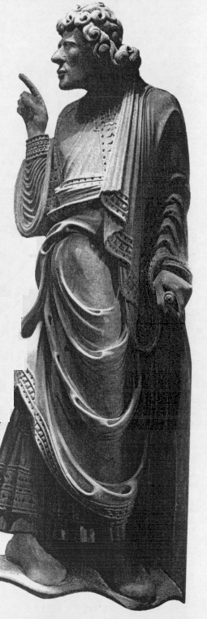
THE BOOK OF
OBADIAH
A CALL TO HUMILITY FOR GOD'S PEOPLE
Dr. Rick Griffith • Jordan Evangelical Theological Seminary • BibleStudyDownloads.org
Notes:
Perhaps the root of all sin is PRIDE.
Pride goes back to Lucifer who wanted to be God, and Eve sought to be like God.
Israel was so proud that the nation worshipped idols, which is actually the worship of self since idols don't complain about it!

Slide 2
Key Word
594
343
Edom
Obadiah
Notes:
All nations are proud, but Edom may take first place in this arena.

Slide 3
Theme
594
Edom's Destruction for Opposing Judah
Obadiah
Notes:
God knows how silly it is for any nation to be proud, so he appointed Obadiah to call out this sin of pride in Edom. God said that Edom would be destroyed for pride shown in contributing to Israel's downfall.

Slide 4
Key Verse
594
Judgment on Edom: (God to Edom) "Because of the violence against your brother Jacob [Judah], you will be covered with shame; you will be destroyed forever" (v. 10).
Blessing on Israel: "Deliverers will go up on Mount Zion [Jerusalem] to govern the mountains of Esau. And the kingdom will be the LORD's" (v. 21).
Obadiah
Notes:
God expected Edom to defend Judah (Israel) against attackers since they descended from the brothers Esau and Jacob. But the Edomites did the opposite, so God would end their existence.
But Israel was the covenant nation of the LORD, so eventually, rulers of Jerusalem would rule over the land area of Edom in the millennial kingdom.

Slide 5

Kingdom Statement
343
As universal King, God will judge Edom and all nations who oppose His nation.
Obadiah
Notes:
The LORD fights against all who fight against his rule because he knows that his rule over us is best.

Slide 6

Summary Statement
594
346
Destructions of both Edom in the near future and all nations in the day of the LORD will come as God's judgment for their opposing Judah, but Judah can be comforted with a promise of blessing due to God's protection in the Land Covenant.
Obadiah
Notes:
Edom serves as a type of "future Edoms" in the nations of the world who will be judged when God fulfills the land promise of the Abrahamic covenant.

Slide 7

Covenant
347c
Christ's return will enact the Land Covenant with its expanded land boundaries (17-21) after God judges Edom for oppressing his covenant people.
Obadiah
Notes:
The expansion of Israel's land to the southern boundary of the Wadi of Egypt and the northern boundary of the Euphrates River will fulfill Genesis 15:18. This will include Edom's land on the southern end.

Slide 8

Redemption
347c
Deliverance for Judah (17, 21) will come through the destruction of Edom and other Gentiles that fight against God's people (10).
Obadiah
Notes:
God's salvation is not only spiritual as it includes the deliverance of believing Jews in their southern section where Edom will be destroyed.

Slide 9

Messiah
347c
Christ will judge not only Edom but all nations (15-16) before he reigns with the other deliverers (21).
Obadiah
Notes:
Verses 15-16 depict all countries under the image of Edom—so the judgment that Edom will experience is only a foretaste of the judgment of all nations.

Slide 10
Obadiah Summary Chart
594
Edom's Destruction for Opposing Judah
Edom's Destruction |  |  | Day of the LORD
Verses 1-14 |  |  | Verses 15-21
Judgment on Edom |  |  | Blessing on Judah
Proud Esau Defeats Defenseless Jacob |  |  | Powerful Jacob Defeats Humbled Esau
Edom's Contempt & Crimes |  |  | Edom's Condemnation & Calamities
Past |  |  | Future
Author | Judgment | Reasons | Destruction | Possession
Inspired Title 1a | Humbling Prophesied 1b-9 | Judgment for Injustices 10-14 | Judgment on Modern Enemies 15-16 | Blessing on Modern Israel 17-21
Notes:
The smaller judgment of a single nation (Edom) up to verse 14 will expand to the Day of the LORD judgment on all nations when Judah (Israel) is blessed at the return of Christ (verses 15-21).

Slide 11
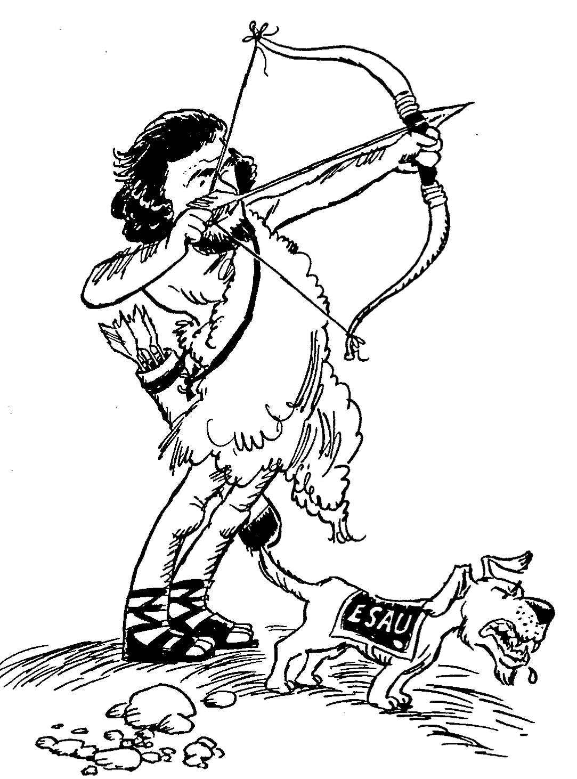
Barry Huddleston, The Acrostic Summarized Bible (Grand Rapids: Baker, 1992)
Obadiah
Verses
1-9 Edom's doom is prophesied
10-14 Sins of the Edomites
15-16 Accountability of all nations
17-21 Ultimate restoration of Israel
Notes:
Esau—the "Red Man"—lived in the "red area" of Edom, a treacherous terrain, just like his unpredictable temperament.
The doom of his people (1-9) due to their betrayal of their brothers in Israel (10-14) depicts worldwide judgment (15-16) but blessing on Israel (17-21).

Slide 12

OBADIAH
BE HUMBLE
Dr. Rick Griffith • Jordan Evangelical Theological Seminary • BibleStudyDownloads.org
Notes:
Pride is one of the stupidest of all sins, for how can man even begin to compare himself with God?

Slide 13

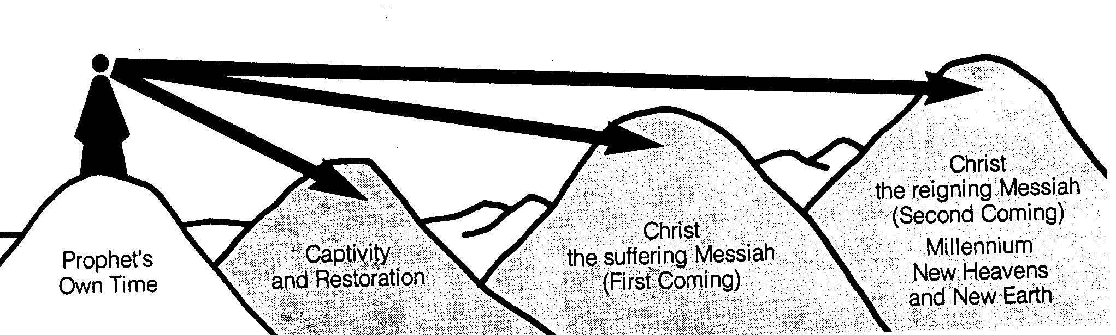
Time Periods of the Prophets
442
New Heavens & New Earth
Christ's Second Coming to Reign in Millennium
Christ's First Coming to Suffer
Exile & Return
Prophet's Own Time
Adapted significantly from Salem Kirban, Charts on Revelation (1979), 49
Notes:
The prophets often looked to the future, but did not know how far their prophecies referred. It is like a person standing on mountain looking into the distance and seeing what appears to be the same mountain. However, the person standing at these same mountains from the side can clearly see significant gaps between the peaks. Such is the viewpoint that we have thousands of years later. Generally there existed five time periods, including the prophet’s own era.
____________
Common Slides English-151
BE-31-Obadiah-64
OS-OT_Book_Overviews-782_pp42a_and_347a-613
OS-23-Prophets_Introduction-19
OS-31-Obadiah-13

Slide 14

To Whom the Prophets Ministered
443
Assyria
Jonah
Phoenicia
Nahum
Aram
Babylon & Persia
Ezekiel
Daniel
Hosea
Israel
Amos
Ammon
Habakkuk
Micah
Judah
Isaiah
Zephaniah
Jeremiah
(Lamentations)
Joel
Haggai
Moab
Zechariah
Malachi
Egypt
Edom
Obadiah
Notes:
The prophets ministered all over the place geographically.
OS-12-Prophets Intro-14
OS-31-Obadiah-14, 40

Slide 15
Placing the Prophetical Books
445
S "O" S
Pre-Exile
(800-606 BC)
Exile
(606-536 BC)
Post-Exile
(536-400 BC)
S
O
L
O
M
O
N
D
A
V
I
D
Israel
Hosea
Amos
Assyria
Jonah
Nahum
S
A
U
L
"HA"
"NAH"
Jews in Jerusalem
Haggai
Zechariah
Malachi
Judah
Habakkuk
Isaiah
Jeremiah
Joel
Micah
Zephaniah
Lamentations
Jews in Exile
Ezekiel
Daniel
Edom
Obadiah
"HIJJMZL"
"IE"
(In Exile)
"HaZeMa"
(final
OT books)
"BAD"
The Daily Walk
Adapted from Walk Thru the Old Testament
Walk Thru the Bible Press, 1978
Notes:
• The UK (United Kingdom) had the kings Saul, David, and Solomon.
• Yet the UK had warning signs as SDS almost looks like SOS
• Sure enough, the UK split and Israel resulted in its own "Brexit" in the north
• This began the Pre-Exile prophets because these kingdoms would later go into exile
• Meanwhile, Judah in the south would remain until the end of the OT era
• Israel was the first to say "HA" to God in rejection
• So God sent Hosea and Amos (this way we can remember their names!)
• Meanwhile, Assyria was even worse—but God called Jonah and Nahum to warn Assyria.
• After first repenting under Jonah, Assyrians later said "NAH" so God sent both JoNAH and NAHum to warn them.
• Of course, Edom was a blood relative to Israel and Edomites should have known better, so they were really BAD.
• Thus, God sent them OBADiah.
• Jews in Exile included only Ezekiel and Daniel
• They were the only two prophets with IE in their name = In Exile.
• But God brought the people of Judah back as Jews in Jerusalem
• God raised up 3 prophets with the memory device HaZeMa: Haggai, Zechariah, and Malachi.
• But we can't forget the largest group of prophets back in the Pre-Exile times, but how can we remember all 7 of them?
• Fortunately, singing Twinkle, Twinkle with their first letters gives HIJJMZL, which, sung over and over, is unforgettable.
______________
Common Slides English-189
OS-00-OT Book Overviews-616
OS-12-Kings & Prophets Charts-18
OS-23-Prophets Intro-12
OS-24-Jeremiah-28
OS-31-Obadiah-14

Slide 16
How does God respond to
PRIDE
????
Obadiah
Notes:
The middle letter in English of the word PRIDE shows the focus of this sin: I. Pride concerns itself with me, myself, and I alone.

Slide 17
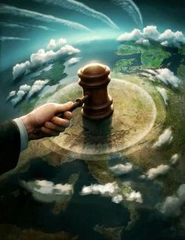
I. God judges the proud.
Obadiah 1-14
Notes:
The LORD pushes down those who exalt themselves.

Slide 18
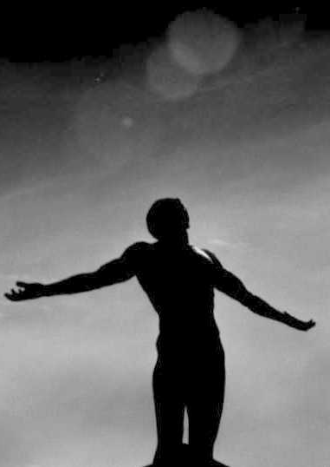
II. God blesses the humble.
Obadiah 15-21
Notes:
The LORD honors those who see their rightful, meek position beneath him.

Slide 19
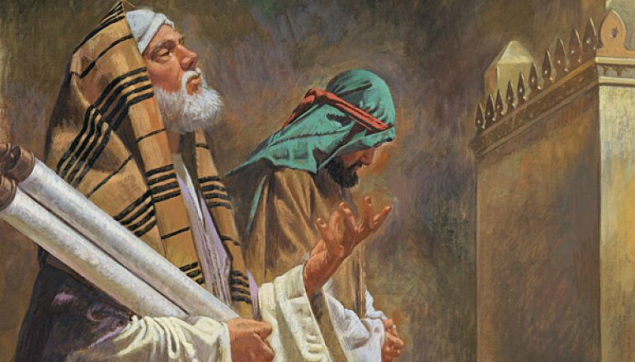
—Main Idea of Obadiah—
God humbles the proud
but exalts the humble
Notes:
The NT Pharisee proudly exclaimed, "Thank God that I am not like that sinner over there. I fast twice a week, etc."
But we all will end up humble. Either we humble ourselves, or God will have to humble us!

Slide 20
Black

Slide 21
Placing the Prophets
Placing the Prophets
342
Key Dates
931
Obadiah
722
Jonah
Amos
Hosea
Isaiah
Micah
Nahum
Zephaniah
Jeremiah
Lamentations
Joel
Daniel
Haggai
Habakkuk
Ezekiel
Zechariah
Malachi
586

Slide 22
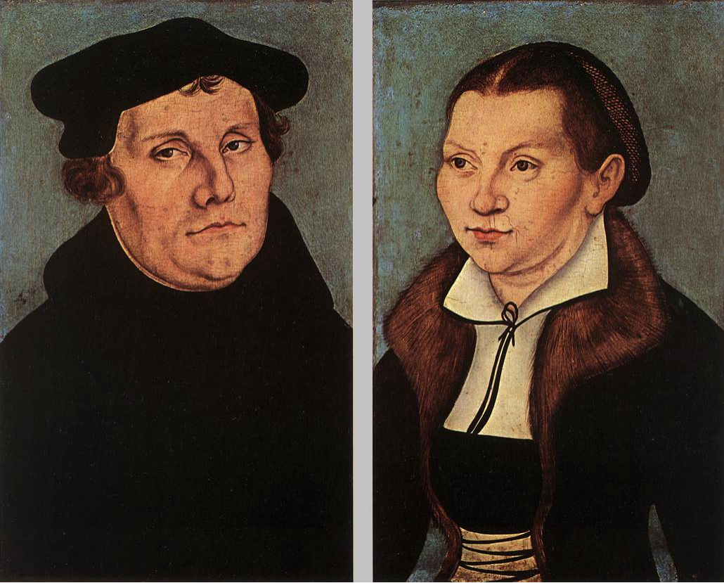
Luther on the Prophets
"The prophets have a queer way of talking, like people who, instead of proceeding in an orderly manner, ramble off from one thing to the next, so that you cannot make head or tail with them or see what they are getting at."
Notes:
Quoted by Gerhard von Rad, Old Testament Theology (New York: ET, 1962), 2:33.

Slide 23

Problems & Tips in Interpreting Prophecy
438
Inaccurate Presuppositions
Prophets were mainly covenant enforcers based on the Mosaic law
Ethical
Forthtelling
Mosaic Covenant
Predictive
Foretelling
Abrahamic Covenant

Slide 24
The Prophetic Message
438
The prophets were not pushovers. They went against the tide to preach the word of Yahweh to a rebellious nation.

Slide 25
The Prophetic Message
The Prophetic Message
A major concern posed by the prophets was idolatry.
But they also had social and economic concerns.
They spoke pronouncements of judgments to steer the nation away from the curses.

Slide 26
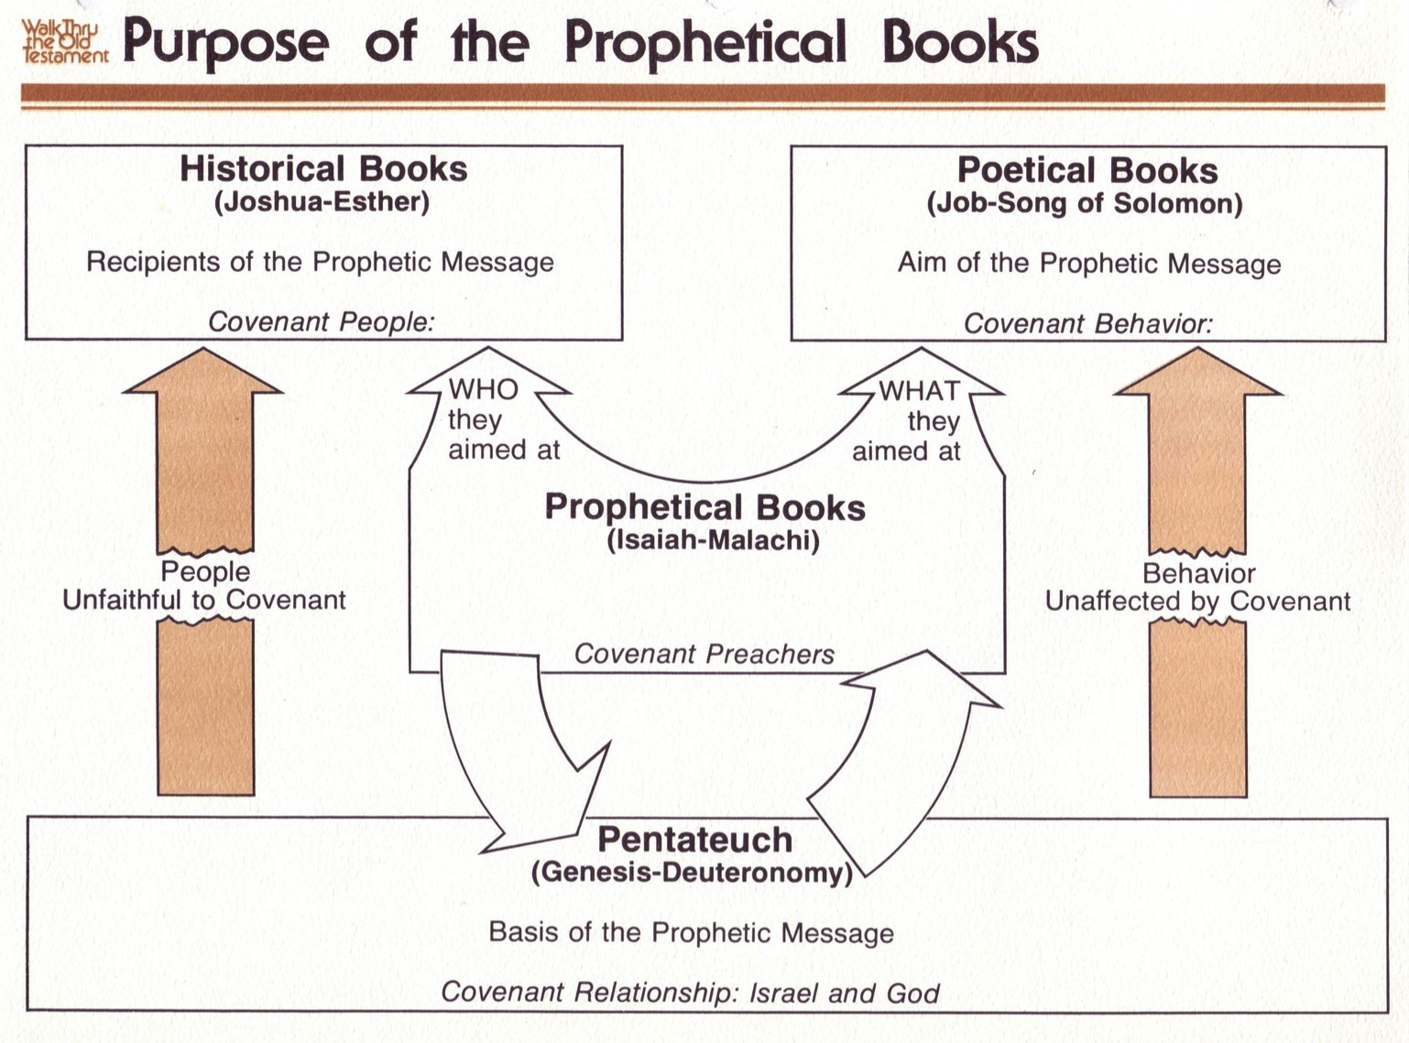
Purpose of the Prophetic Books
50b440
Historical Books
(Joshua-Esther)
Recipients of the Prophetic Message
Covenant People
Poetical Books
(Job-Song of Solomon)
Aim of the Prophetic Message
Covenant Behavior
WHO they aimed at
WHAT they aimed at
Prophetical Books
(Isaiah-Malachi)
Covenant Preachers
People
Unfaithful to Covenant
Behavior
Unaffected by Covenant
FORTHTELLING
Mosaic Covenant
Pentateuch
(Genesis-Deuteronomy)
Basis of the Prophetic Message
Covenant Relationship: Israel & God
Deut. 28; Lev. 26
Conditional
Judgment
Notes:
00-Intro & Biblical Theology-slide 18
00_OT Book Themes under Isaiah section
28-Hosea-slide 54
31-Obadiah-slide 26

Slide 27
Blessings & Curses
The Mosaic Covenant (Deut 28; cf. Lev 26)
154
220
Your towns and your fields
will be blessed (3)
Your towns and your fields
will be cursed (16)
Your children and your crops
will be blessed (4)
Your children and your crops
will be cursed (17)
Your fruit baskets and bread-boards will be blessed (5)
Your fruit baskets and bread-boards will be cursed (18)
Wherever you go and whatever you do, you will be blessed (6)
Wherever you go and whatever you do, you will be cursed (19)
Your enemies will attack you from one direction, but they will scatter from you in seven! (7)
You will attack your enemies from one direction, but you will scatter from them in seven! (25)
You will lend to many nations, but you will never need to borrow from them (12)
They will lend to money to you, but you will not lend to them
(44)

Slide 28
Prophetic Curses
154
220
Why?
Exile
Deut. 28
Notes:
Jeremiah's prophecy and Lamentations record his eyewitness account of Babylon's siege and destruction of Jerusalem for the nation's sin, the Holy Spirit moved him to record an historical compilation which provides the context and justification for God's judgment upon these two nations. The leaders and the people sinned through ungodliness and idolatry, and true to the curses of Deut. 28, God gave the people the consequences of their obedience.

Slide 29
Purpose of the Prophetic Books
50b440
Historical Books
(Joshua-Esther)
Recipients of the Prophetic Message
Covenant People
Poetical Books
(Job-Song of Solomon)
Aim of the Prophetic Message
Covenant Behavior
WHO they aimed at
WHAT they aimed at
Prophetical Books
(Isaiah-Malachi)
Covenant Preachers
People
Unfaithful to Covenant
Behavior
Unaffected by Covenant
FORTHTELLING
FORETELLING
Mosaic Covenant
Pentateuch
(Genesis-Deuteronomy)
Basis of the Prophetic Message
Covenant Relationship: Israel & God
Abrahamic Covenant
Deut. 28; Lev. 26
Gen. 12:1-3; 15:18
Conditional
Unconditional
Judgment
Blessing
Notes:
00-Intro & Biblical Theology-slide 18
00_OT Book Themes under Isaiah section
28-Hosea-slide 54
31-Obadiah-slide 26

Slide 30
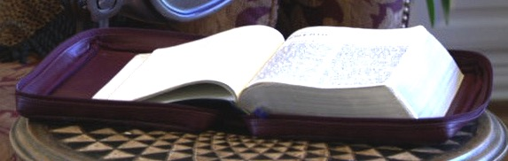
Literal * Eternal * Unconditional
Gen. 13:15; Gen. 15
7
Abrahamic Covenant
Gen. 12:1-3
LAND SEED BLESSING
ABRAHAM
The CALL
L - S - B
• LITERAL
• ETERNAL
• UNCONDITIONAL
Handbook pg. 19-24
16
3

Slide 31
Topography of Israel
http://www.studylight.org/se/maps/browse.cgi?st=51&pn=11

Slide 32
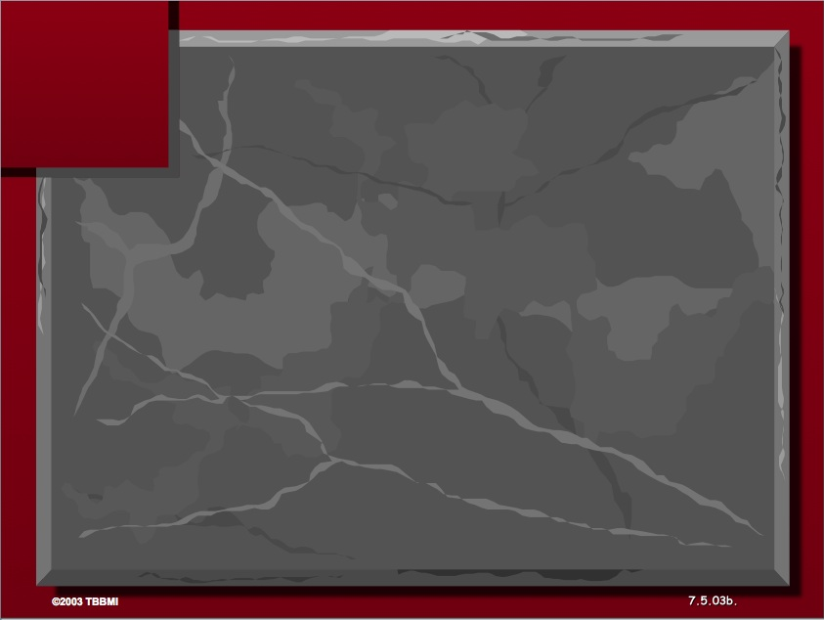
The Elements Expanded
60
7
Abrahamic Covenant
Gen. 12:1-3
LAND SEED BLESSING
ABRAHAM
The CALL
L - S - B
12:1
12:2
12:3
"L-S-B"
Handbook pg. 19-24
15

Slide 33
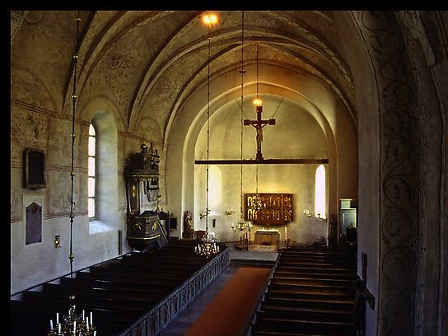
Types of Unconditional Covenants
60
Abrahamic
Land
Davidic
New
Land | Seed | Blessing
Physical | Political | Spiritual
Deut. 30 | 2 Sam. 7 | Jer. 31

Slide 34
Deuteronomy 30:1-4
44
7
EXILE & RETURN PROMISED
¹ When all these blessings and curses I have set before you come upon you and you take them to heart wherever the Lord your God disperses you among the nations, ²and when you and your children return to the Lord your God and obey him with all your heart and with all your soul according to everything I command you today, ³then the Lord your God will restore your fortunes and have compassion on you and gather you again from all the nations where he scattered you. ⁴Even if you have been banished to the most distant land under the heavens, from there the Lord your God will gather you and bring you back (NIV).
27

Slide 35
Deuteronomy 30
7
THE LAND PROMISES
⁵ He will bring you to the land that belonged to your fathers, and you will take possession of it. He will make you more prosperous and numerous than your fathers.
⁶ The Lord your God will circumcise your hearts and the hearts of your descendants so that you may love him with all your heart and with all your soul, and live. (NIV)
MOSES
Exodus
Sinai
M - C - C
Kadesh Barnea
40
40
5 Sermons
Handbook pg. 26-29
27

Slide 36
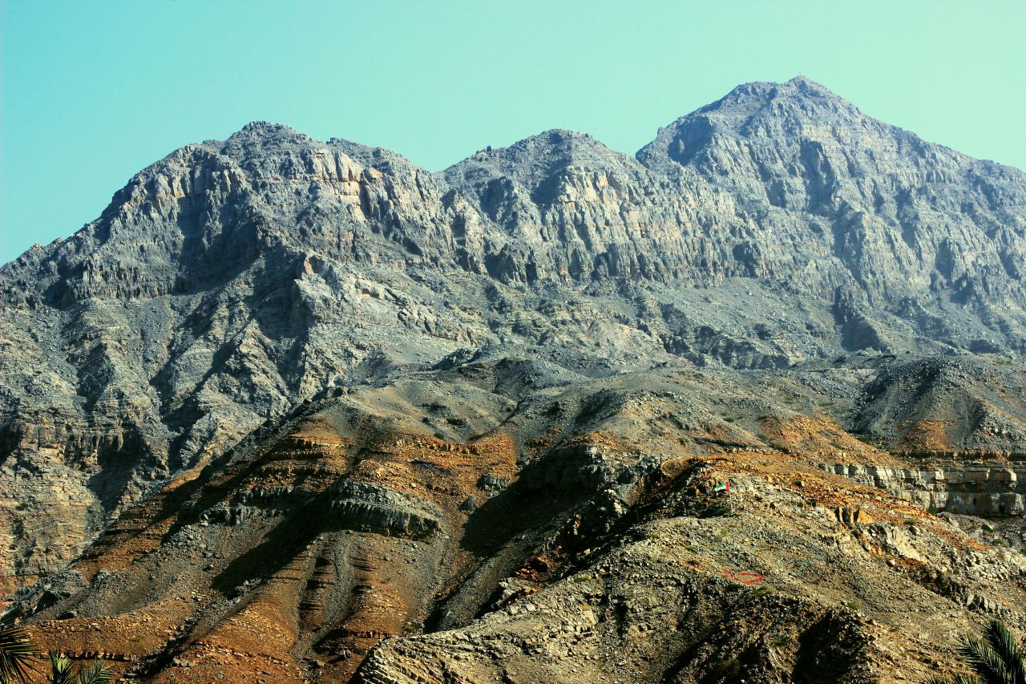
Approaching a Summit
Notes:
When we approach the summit of a mountain range, it looks like the peaks continually go upward.

Slide 37
Time Periods of the Prophets
442
New Heavens & New Earth
Christ's Second Coming to Reign in Millennium
Christ's First Coming to Suffer
Exile & Return
Prophet's Own Time
Adapted significantly from Salem Kirban, Charts on Revelation (1979), 49
Notes:
However, there might be significant gaps between the peaks. These were not seen by the prophets who only knew that they spoke of the future, but did not know how far their prophecies referred. Generally there existed five time periods, inlduing the prophet's own era.

Slide 38
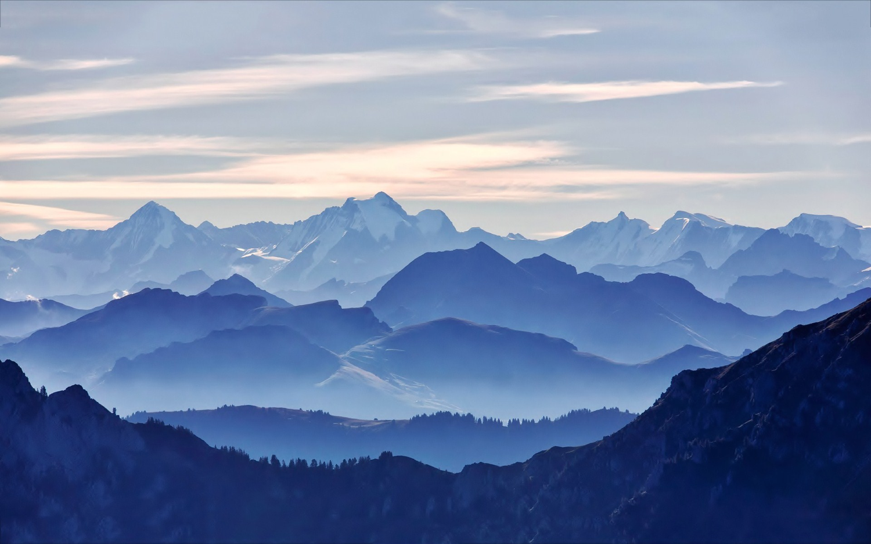
We See the Valleys
Notes:
From our vantage point, we clearly see that the Messiah would come twice. It’s like being able to see the valleys between each set of peaks. However, the prophets did not see these valleys but only saw the future as a whole.

Slide 39
Placing the Prophetical Books
445
S "O" S
Pre-Exile
(800-606 BC)
Exile
(606-536 BC)
Post-Exile
(536-400 BC)
S
O
L
O
M
O
N
D
A
V
I
D
Israel
Hosea
Amos
Assyria
Jonah
Nahum
S
A
U
L
"HA"
"NAH"
Jews in Jerusalem
Haggai
Zechariah
Malachi
Judah
Habakkuk
Isaiah
Jeremiah
Joel
Micah
Zephaniah
Lamentations
Jews in Exile
Ezekiel
Daniel
Edom
Obadiah
"HIJJMZL"
"IE"
(In Exile)
"HaZeMa"
(final
OT books)
"BAD"
The Daily Walk
Adapted from Walk Thru the Old Testament
Walk Thru the Bible Press, 1978
Notes:
The UK (United Kingdom) had the kings Saul, David, and Solomon.
Yet the UK had warning signs as SDS almost looks like SOS
Sure enough, the UK split with Israel in its own "Brexit" in the north
This began the Pre-Exile prophets
Israel was the first to say "HA" to God in rejection, so God sent Hosea and Amos
Meanwhile, Assyria was even worse. After first repenting under Jonah, they later said "NAH" so God sent both JoNAH and NAHum to warn them.
Of course, Edom as a blood relative to Israel and should have known better, so they were really BAD. Thus, God sent them OBADiah.
Jews in Exile included only Ezekiel and Daniel, who were the only two prophets with IE in their name = In Exile.
But God brought the people of Judah back as Jews in Jerusalem and raised up 3 prophets with the memory divice HaZeMa.
But we can't forget th largest group of prophets back in the Pre-Exile times, but how can we remember all 7 of them?
Fortunately, singing Twinkle, Twinkle with their first letters gives HIJJMZL, which, sung over and over, is unforgettable.

Slide 40
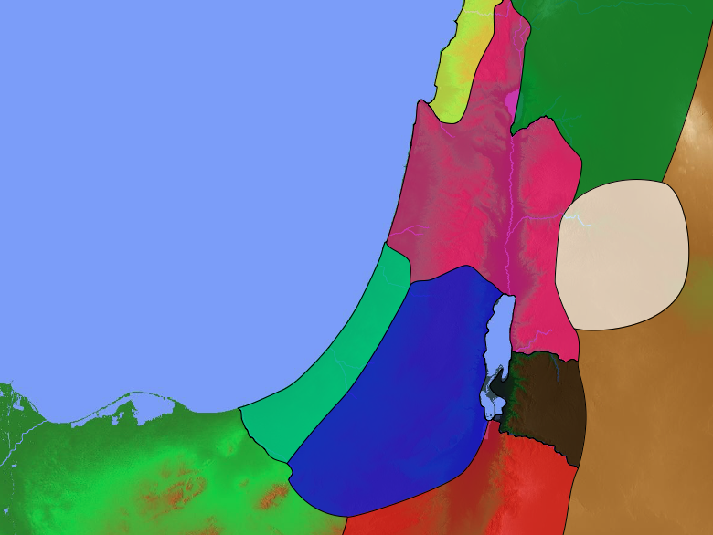
To Whom the Prophets Ministered
443
Assyria
Jonah
Phoenicia
Nahum
Aram
Babylon & Persia
Ezekiel
Daniel
Hosea
Israel
Amos
Ammon
Habakkuk
Micah
Judah
Isaiah
Zephaniah
Jeremiah
(Lamentations)
Joel
Haggai
Moab
Zechariah
Malachi
Egypt
Edom
Obadiah
Notes:
OS-31-Obadiah-14, 40

Slide 41
Obadiah
OBADIAH
Characteristics
Occasion
Map
Author
Date
Audience
Purpose
Key Verses
Issues
Summary Chart
Summary Statement
Applications
Theology

Slide 42

Characteristics
596
One of the 12 Minor Prophets
Shortest Book of the OT – 21 verses
Earliest of the prophetic writings
Only entire book in Scripture devoted to Edom's destruction

Slide 43
Obadiah Summary Chart
594
Edom's Destruction for Opposing Judah
Edom's Destruction |  |  | Day of the LORD
Verses 1-14 |  |  | Verses 15-21
Judgment on Edom |  |  | Blessing on Judah
Proud Esau Defeats Defenseless Jacob |  |  | Powerful Jacob Defeats Humbled Esau
Edom's Contempt & Crimes |  |  | Edom's Condemnation & Calamities
Past |  |  | Future
Author | Judgment | Reasons | Destruction | Possession
Inspired Title 1a | Humbling Prophesied 1b-9 | Judgment for Injustices 10-14 | Judgment on Modern Enemies 15-16 | Blessing on Modern Israel 17-21

Slide 44
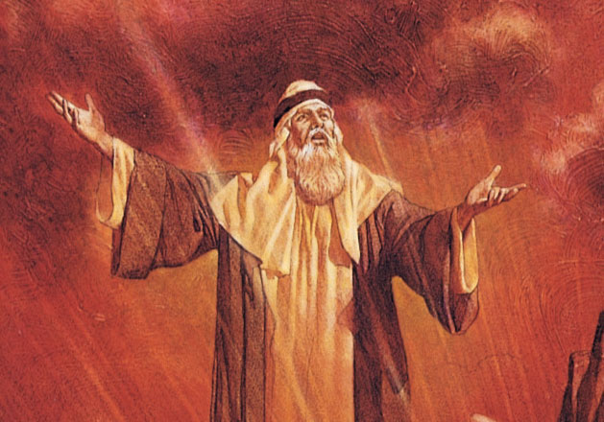
Authorship: External Evidence
595
Most probably:
  Ahab's servant who hid the prophets of God in a cave (1 Kings 18:3)
One of the three prophets who wrote exclusively about a non-Jewish nation
  Habakkuk wrote about Babylon
  Nahum wrote about Assyria
  Obadiah wrote about Edom

Slide 45
Authorship: External Evidence
595
Common name – 12 times in OT
Different possibilities
    Ahab's servant who hid the prophets of God in a cave (1 Kings 18:3)
    Jehoshaphat's official sent by the king to teach the law in Judah (2 Chron. 17:7)
    Josiah's temple repair overseer who was a Levite (2 Chron. 34:12)
    Ezra's leader who returned from the Exile (Ezra 8:9)
    A priest involved in the revival of Nehemiah's time (Neh. 10:5)
Most probably option 1 – Identified by Talmud and followed by Jerome

Slide 46
Internal Evidence
595
No evidence for the exact author – "The vision of Obadiah" (1:1a) - NOT clear
No mention of his father's name, home region, or the reign of a king
Probably lived in the southern kingdom
Probably not from a royal or priestly line

Slide 47
Audience
595
Originally delivered to the southern kingdom and not to Edom itself.
  Because of the mention of the Jerusalem (vv. 11, 20; "Mt. Zion" in vv. 17, 21) and Judah (v. 12; "Jacob" in vv. 17-18)

Slide 48
Issues
?
If the Book of Obadiah is inspired Scripture, then why is it not quoted in the NT?
Is the prophecy of Obadiah simply an expression of Jewish nationalism?

Slide 49
OBADIAH
BE HUMBLE
Dr. Rick Griffith • Singapore Bible College
BibleStudyDownloads.org

Slide 50
We all hate pride.
Yet we all struggle with it.
Notes:
We all hate pride. At least we hate it in others!
• Yet we all struggle with it. Do you agree?
Yet perhaps a more important question is this…

Slide 51
Why do you think we all struggle with
PRIDE
????
Notes:
Tell your answer to the person next to you in the next 60 seconds.

Slide 52
How does God respond to
PRIDE
????
Notes:
Does God hate pride too?

Slide 53

OT Bookshelf
Old Testament
Genesis - Malachi
Law (5)
History (12)
Poetry (5)
Prophecy (17)
Major 5 Minor 12
Notes:
We try to preach from various sections of Scripture here at this church. In recent years, we have series on Genesis (Law), Judges (History), Poetry (Ecclesiastes), and Isaiah, Jeremiah, and Daniel (Major Prophets). Sounds like time to get into the Minor Prophets, right?

Slide 54
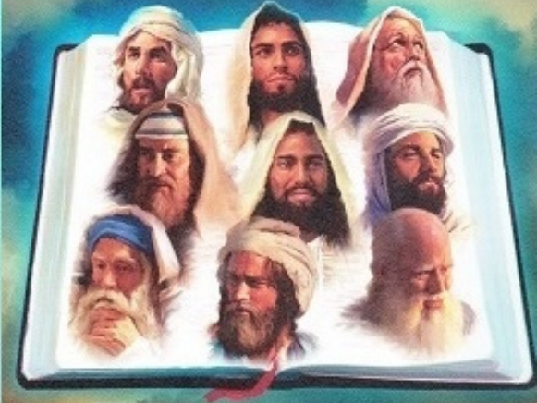
The Twelve
Courage to Confront Culture
—A Preaching Series on the Minor Prophets—
Notes:
These twelve preaches courageously confronted their culture, each one writing one book. Since they were so small, the Jews bound them together into a single scroll that they simply called "The Twelve."

Slide 55

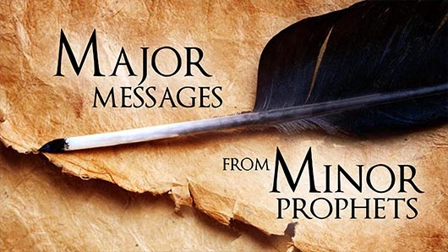
What do these men have to offer us?
Major
MESSAGES
FROM
Minor
PROPHETS
Notes:
One preacher called these "Major Messages from Minor Prophets." Yes, they are small books, but each has a punch you wouldn't believe until you go into them.
So that's what we will do the next 12 times I preach, interspersed with messages from Romans from Andrew and some miscellaneous ones from others.

Slide 56
How does God respond to
PRIDE
????

Slide 57
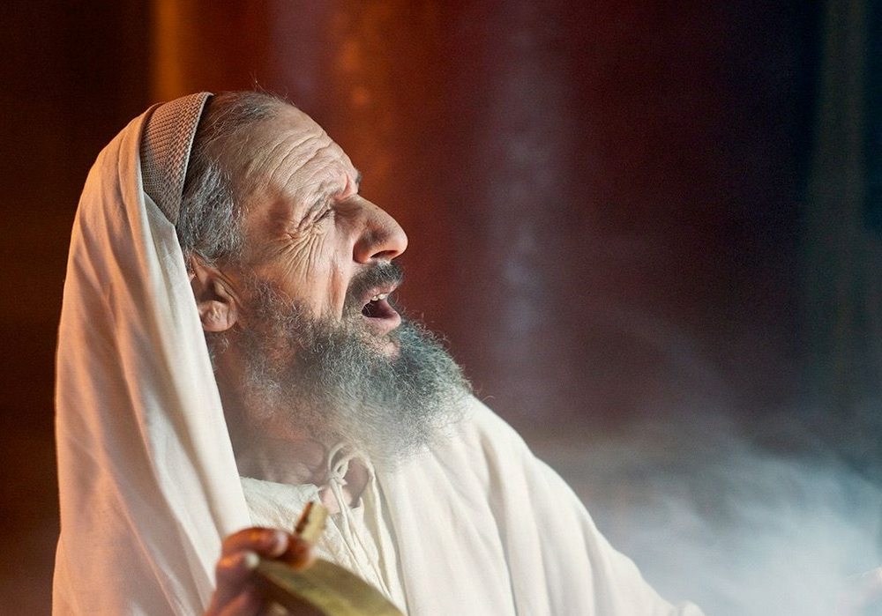
"The vision of Obadiah"
(Obadiah 1 NIV).
No king = No Time Period
Notes:
Unlike all of the prophets except Joel, Obadiah does not give the name of the king while he prophesied. This makes it tough to know when he wrote.

Slide 58
Different Dates Proposed
595
?
845 735 586 450 BC
Only indication of date (vv. 10-14)
The best date seems to be ca. 845 BC

Slide 59
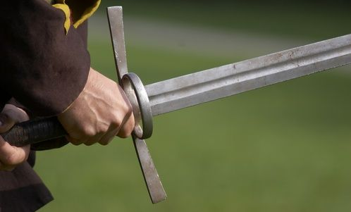
"Because of the violence against your brother Jacob, you will be covered with shame; you will be destroyed forever”
(Obadiah 10 NIV).

Slide 60
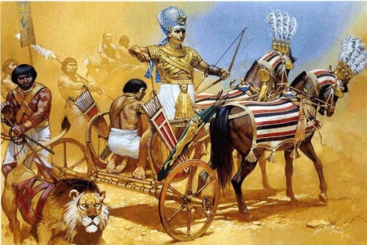
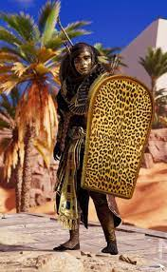
"On the day you stood aloof while strangers carried off his wealth and foreigners entered his gates and cast lots for Jerusalem, you were like one of them” (Obadiah 11 NIV).
Shishak

Slide 61
"But when Rehoboam was firmly established and strong, he abandoned the Law of the LORD, and all Israel followed him in this sin. ² Because they were unfaithful to the LORD, King Shishak of Egypt came up and attacked Jerusalem in the fifth year of King Rehoboam’s reign. ³ He came with 1,200 chariots, 60,000 horses, and a countless army of foot soldiers, including Libyans, Sukkites, and Ethiopians" (2 Chron 12:1-3 NLT).
Egyptian Warrior

Slide 62
"Shishak conquered Judah’s fortified towns and then advanced to attack Jerusalem. ⁵ The prophet Shemaiah then met with Rehoboam and Judah’s leaders, who had all fled to Jerusalem because of Shishak. Shemaiah told them, 'This is what the LORD says: You have abandoned me, so I am abandoning you to Shishak.' ⁶ Then the leaders of Israel and the king humbled themselves and said, 'The LORD is right in doing this to us!'" (2 Chron 12:4-6 NLT).
Egyptian Warrior

Slide 63
"When the LORD saw their change of heart, he gave this message to Shemaiah: 'Since the people have humbled themselves, I will not completely destroy them and will soon give them some relief. I will not use Shishak to pour out my anger on Jerusalem.
⁸ But they will become his subjects, so they will know the difference between serving me and serving earthly rulers'"
(2 Chron 12:7-8 NLT).
Egyptian Warrior

Slide 64
"So King Shishak of Egypt came up and attacked Jerusalem. He ransacked the treasuries of the LORD’s Temple and the royal palace; he stole everything, including all the gold shields Solomon had made"
(2 Chron 12:9 NLT).
Egyptian Warrior

Slide 65
How does God respond to
PRIDE
????

Slide 66
Obadiah Summary Chart
594
Edom's Destruction for Opposing Judah
Edom's Destruction |  |  | Day of the LORD
Verses 1-14 |  |  | Verses 15-21
Judgment on Edom |  |  | Blessing on Judah
Proud Esau Defeats Defenseless Jacob |  |  | Powerful Jacob Defeats Humbled Esau
Edom's Contempt & Crimes |  |  | Edom's Condemnation & Calamities
Past |  |  | Future
Author | Judgment | Reasons | Destruction | Possession
Inspired Title 1a | Humbling Prophesied 1b-9 | Judgment for Injustices 10-14 | Judgment on Modern Enemies 15-16 | Blessing on Modern Israel 17-21

Slide 67
Slides on
Obadiah 1-14

Slide 68
I. God judges the proud.
Obadiah 1-14
Notes:
The LORD pushes down those who exalt themselves.

Slide 69
"The vision of Obadiah"
(Obadiah 1 NIV).
No king = No Time Period
Notes:
Unlike all of the prophets except Joel, Obadiah does not give the name of the king while he prophesied. This makes it tough to know when he wrote.

Slide 70
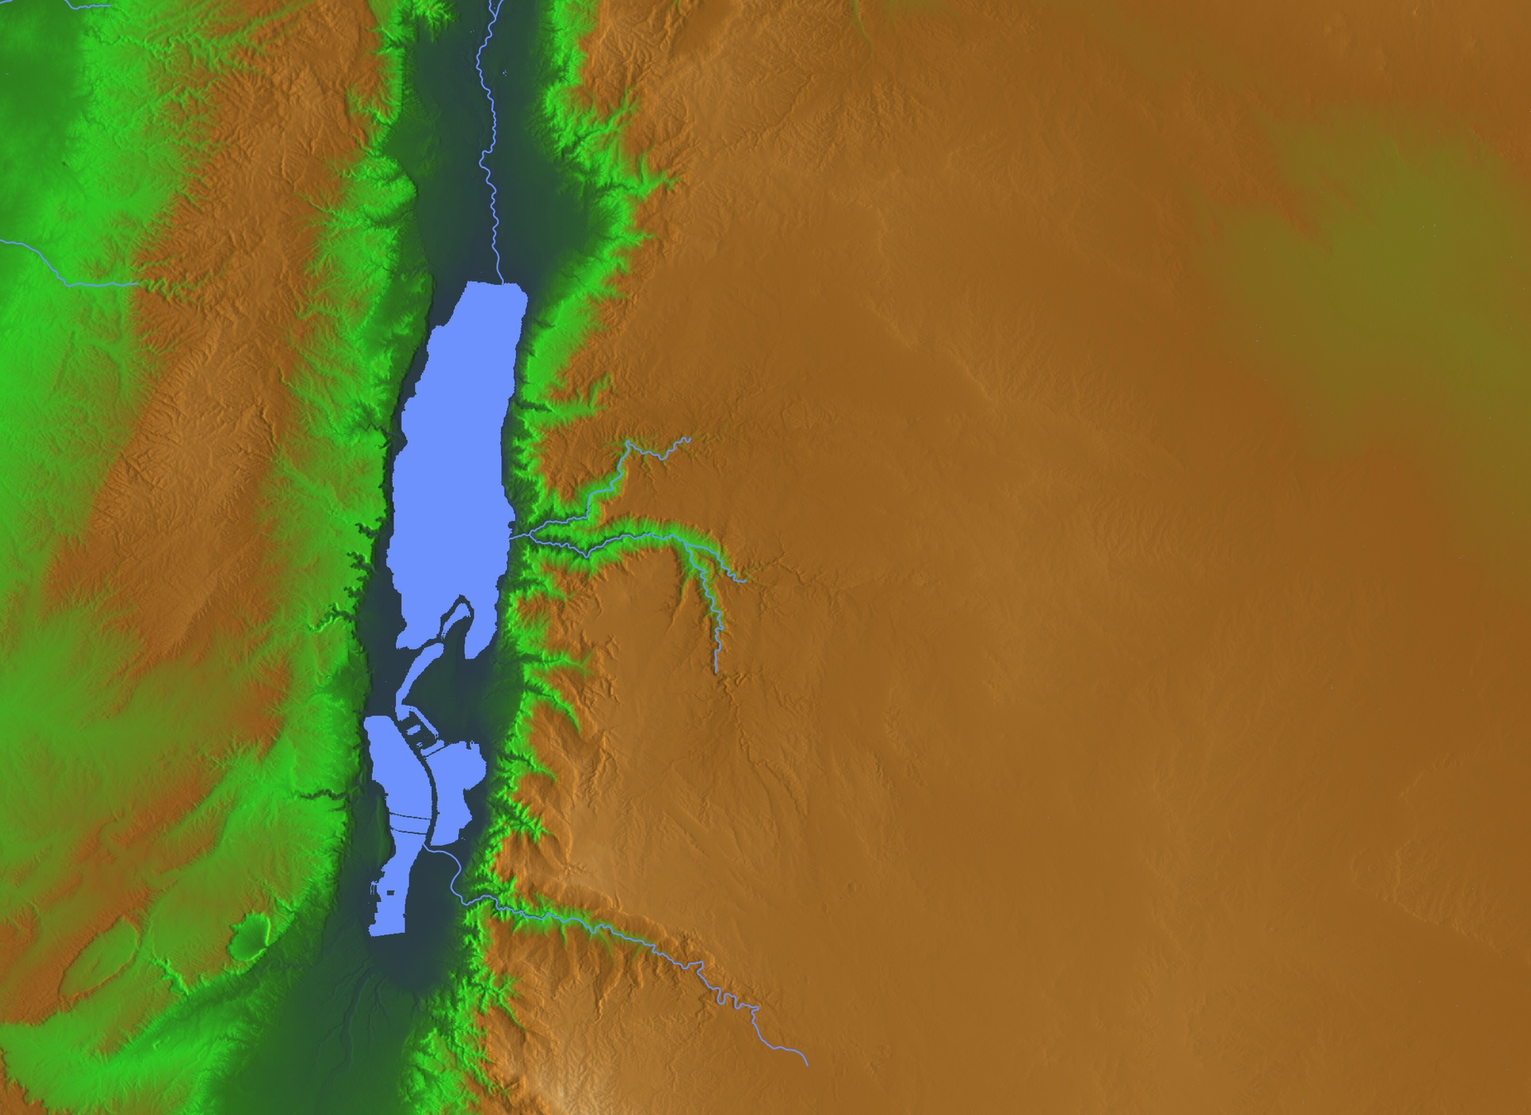
"This is what the Sovereign LORD says about Edom"
(Obadiah 1b NIV).
ISRAEL
EDOM

Slide 71
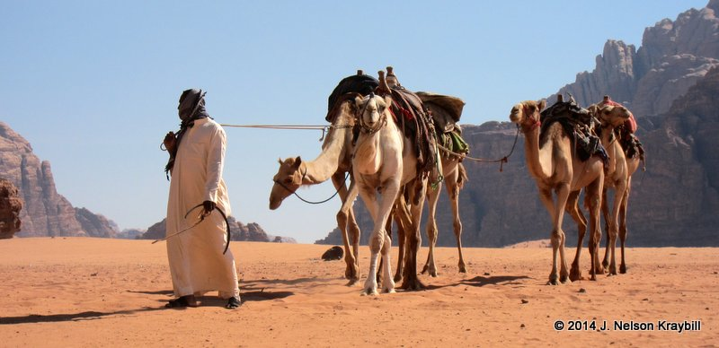
"We have heard a message from the LORD:
An envoy was sent to the nations to say,
'Rise, and let us go against her for battle'—"
(Obadiah 1c NIV).
Notes:
God invites the nations to come and judge Edom (1b) [which occurred as the Nabateans, Jews under John Hyrcanus, and Romans under Titus all contributed to the annihilation of the Edomites].

Slide 72
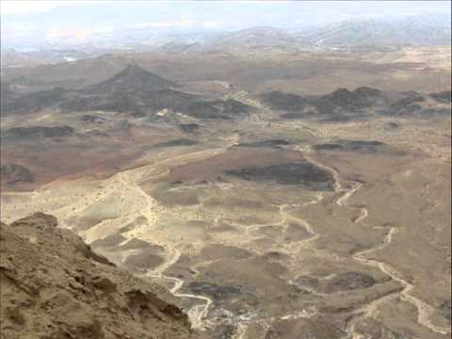
"See, I will make you small among the nations; you will be utterly despised"
(Obadiah 2 NIV).

Slide 73
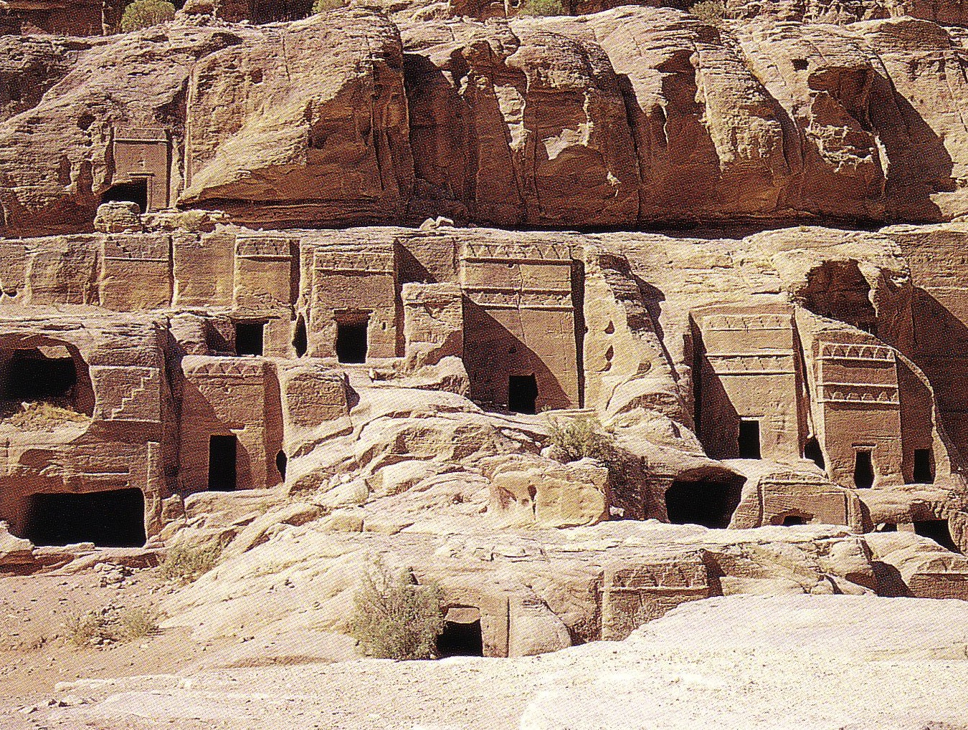
"The pride of your heart has deceived you, you who live in the clefts of the rock, in your lofty dwelling, who say in your heart, 'Who will bring me down to the ground?'" (Obadiah 3)
598c
Notes:
The LORD describes Edom's destruction aided by deceptive allies and involving a humiliating slaughter and plundering (1b-9). Note the Fulfillment: The Nabateans around 500 BC were invited to an Edomite banquet but deceived, slaughtered and plundered the Edomites.
God describes Edomite destruction by the nations as being brought low in humiliation from arrogant dwellings high in the rocks and as a fallen eagle (1b-4).

Slide 74


Geographical Setting
444
598d
Jacob
Israel
Esau
Edom
Notes:
God blessed both Jacob and Esau to become fathers of the respective nations of Israel and Edom.
____________
Common-174
OS-01-Gen21-36-slide 97
OS-31-Obadiah-75

Slide 75
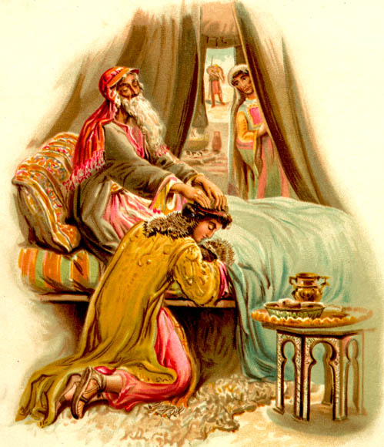
Genesis 27:1-40
God chose Jacob,
not Esau

Slide 76
Purpose
597
The book of Obadiah has a twofold purpose:
to delineate God's judgment on Edom for its lack of brotherly concern for Judah
to set forth the final triumph of right in the Day of the LORD

Slide 77
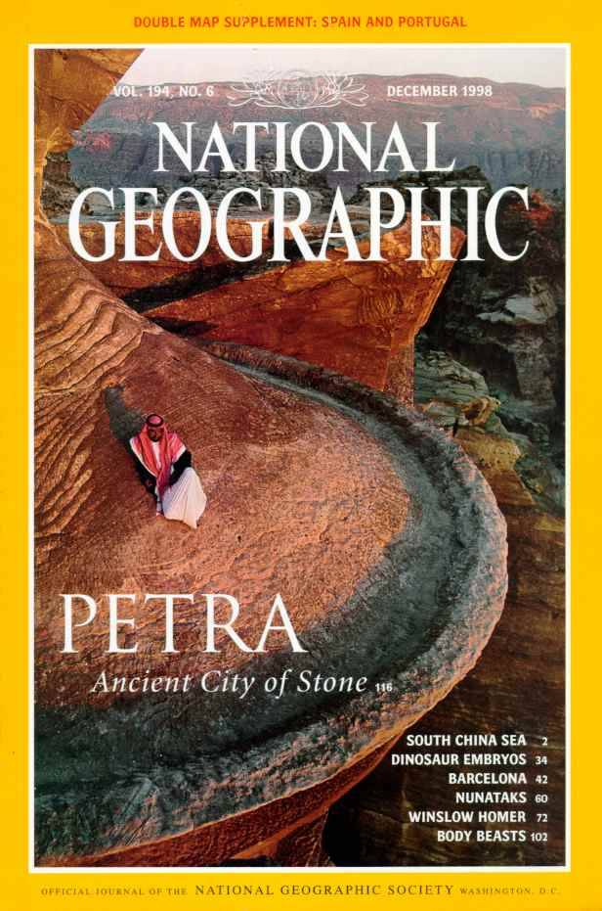
National Geographic has several articles on Petra back to 1907
Here's Dec. 1998

Slide 78
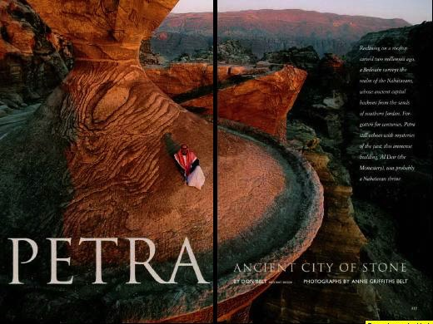
Petra Article Front Page

Slide 79
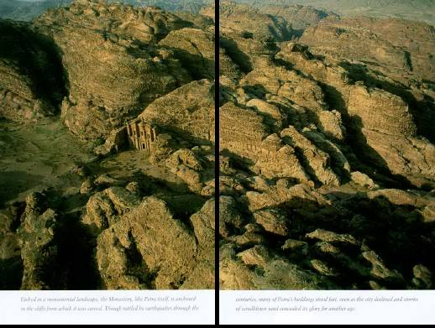
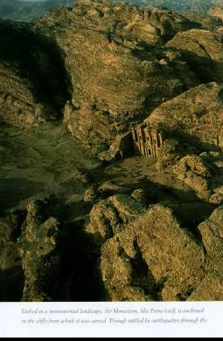
Imagine living in this terrain!

Slide 80
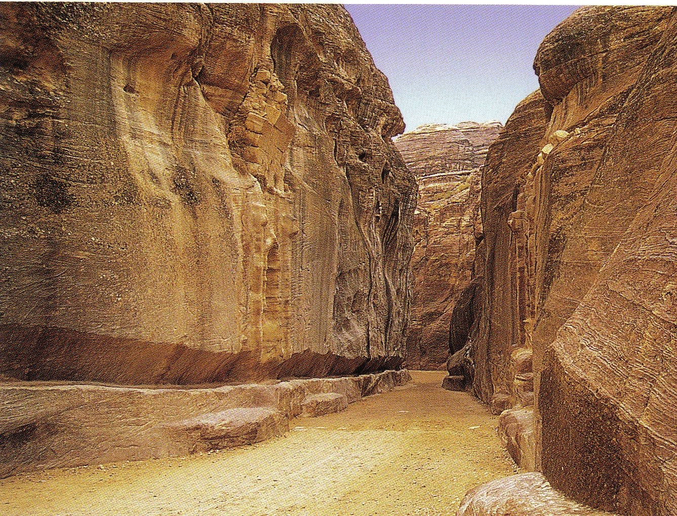
The Siq
(pronounced "seek")
598c
The only entrance to Petra
Water Course

Slide 81
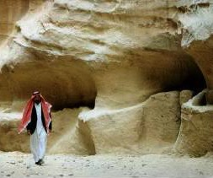
Water channels were buried for centuries

Slide 82
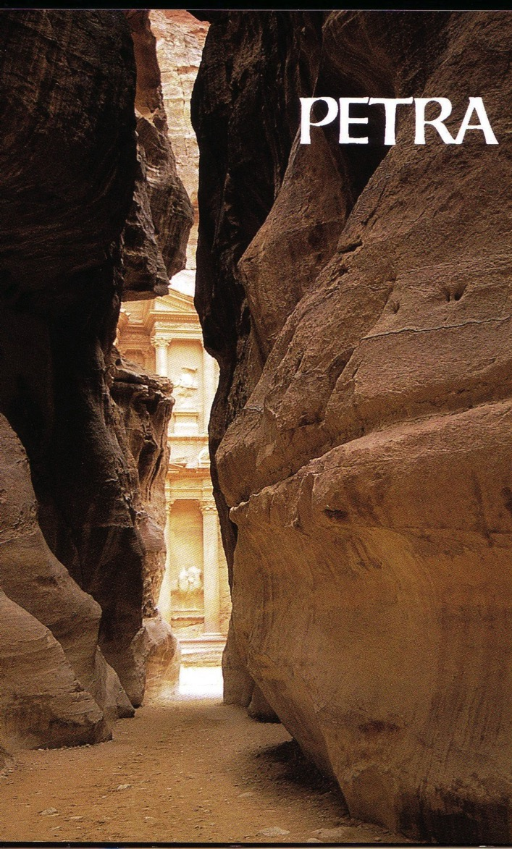
Exit of the Siq
598b

Slide 83
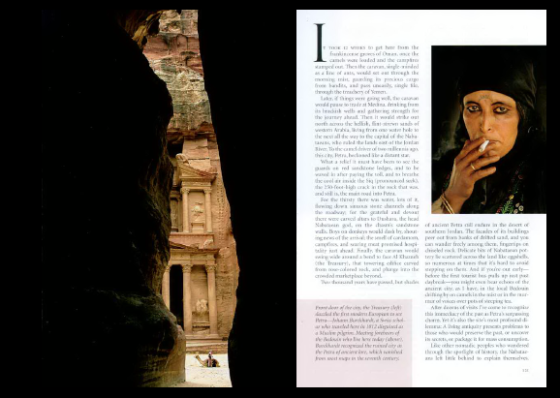
Dark Siq Exit

Slide 84
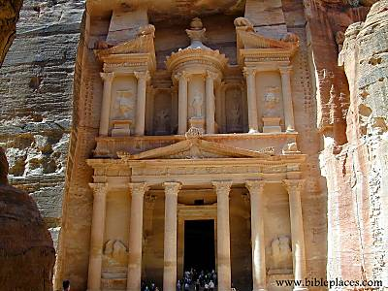
The Treasury
598b

Slide 85
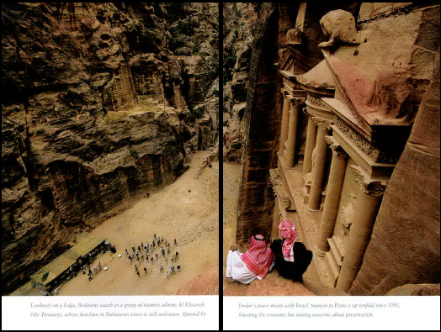
From atop the Treasury

Slide 86
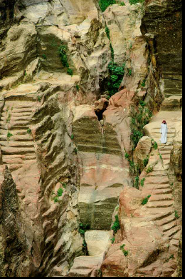
Nabataean engineers ingeniously collected the mere 6 inches of annual rainfall.

Slide 87
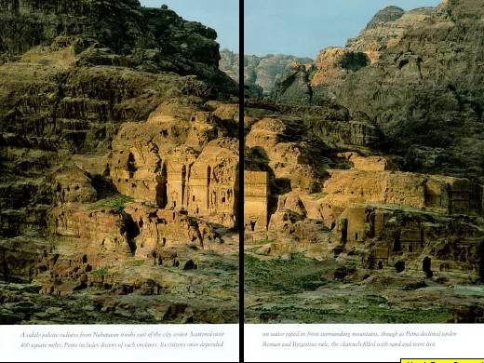
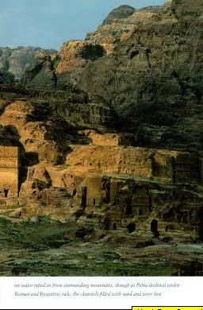
Nabatean tombs east of the city center

Slide 88
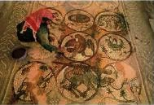
Byzantine Church Mosaic (5th century)

Slide 89
"The pride of your heart has deceived you, you who live in the clefts of the rock, in your lofty dwelling, who say in your heart, 'Who will bring me down to the ground?'" (Obadiah 3)
598c

Slide 90
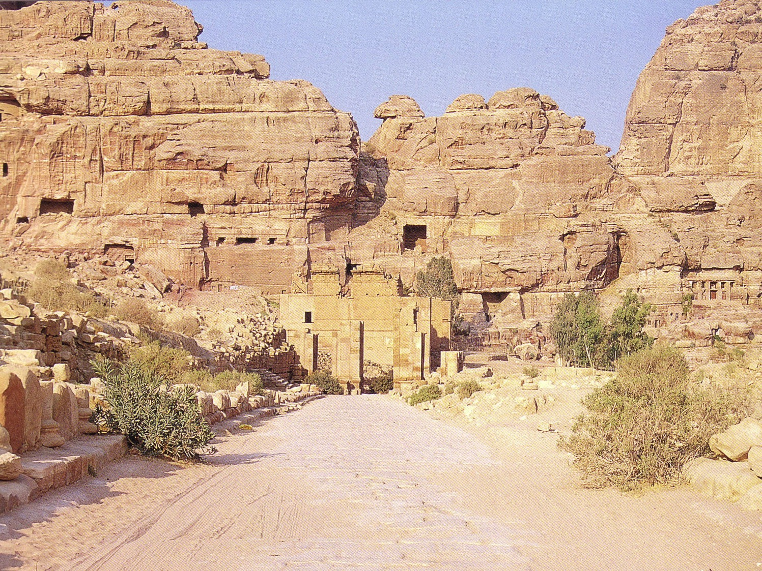
Colonnade Envisioned
598c

Slide 91
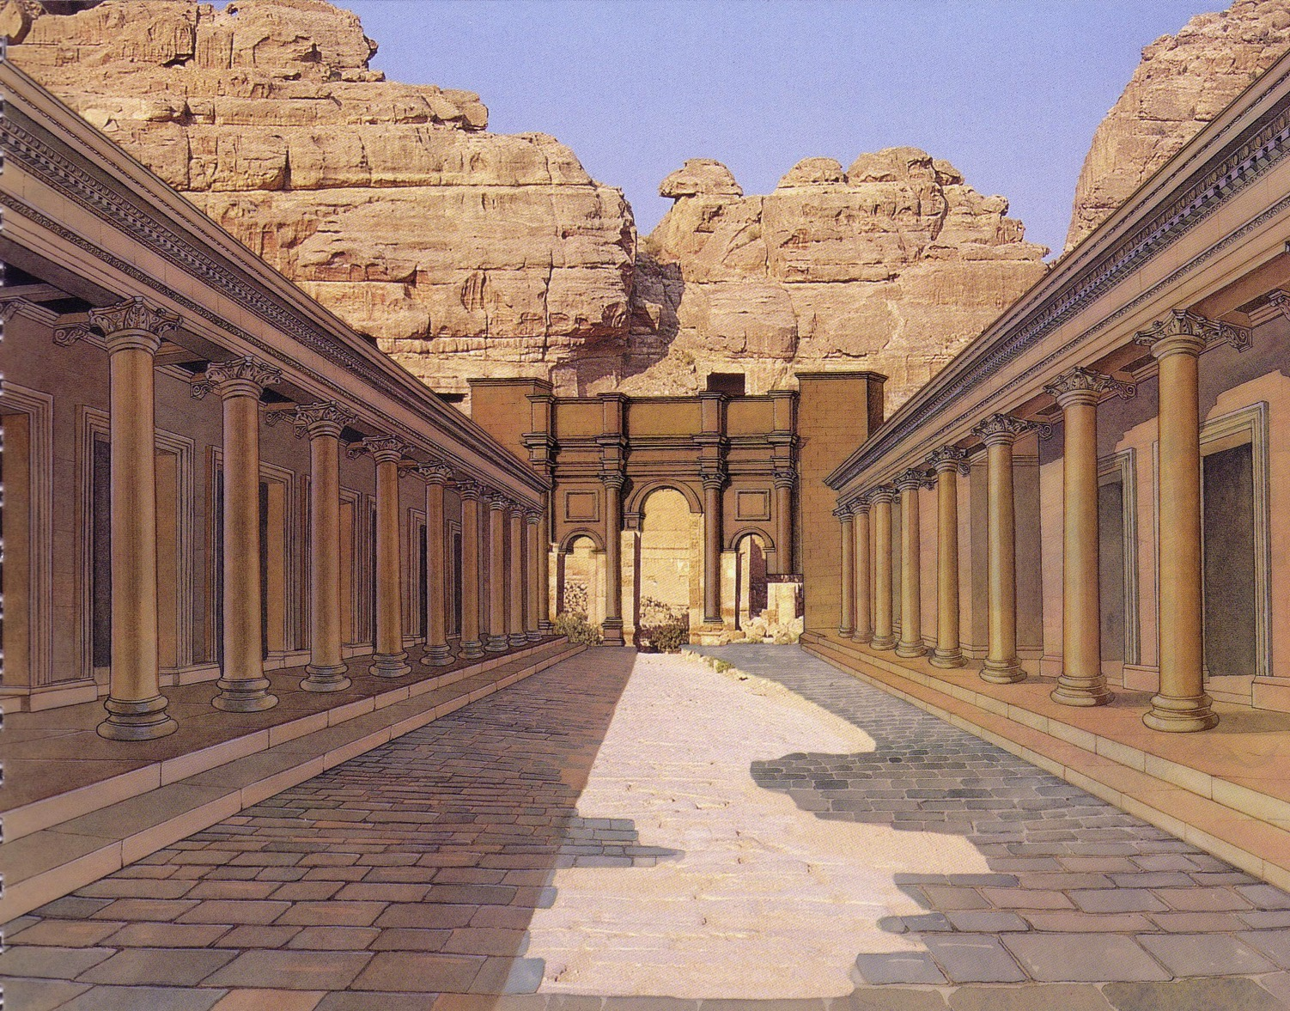
Colonnade Realized
598c

Slide 92
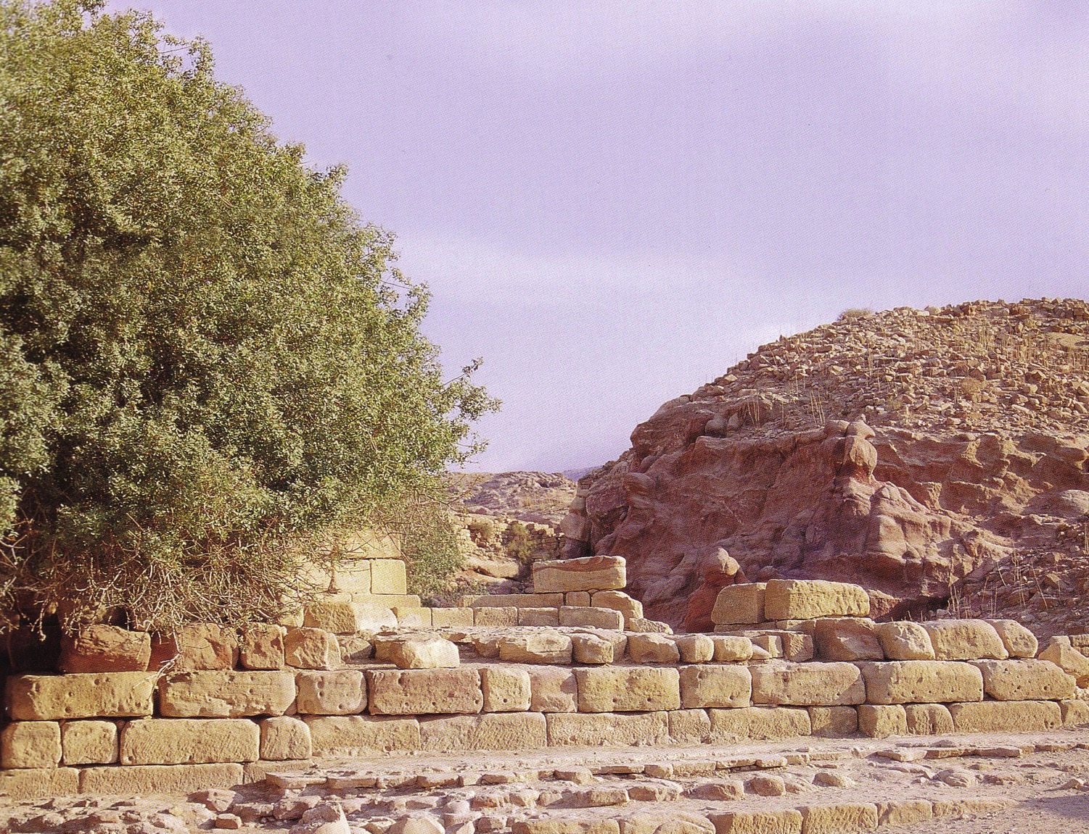
Nymphaleon

Slide 93
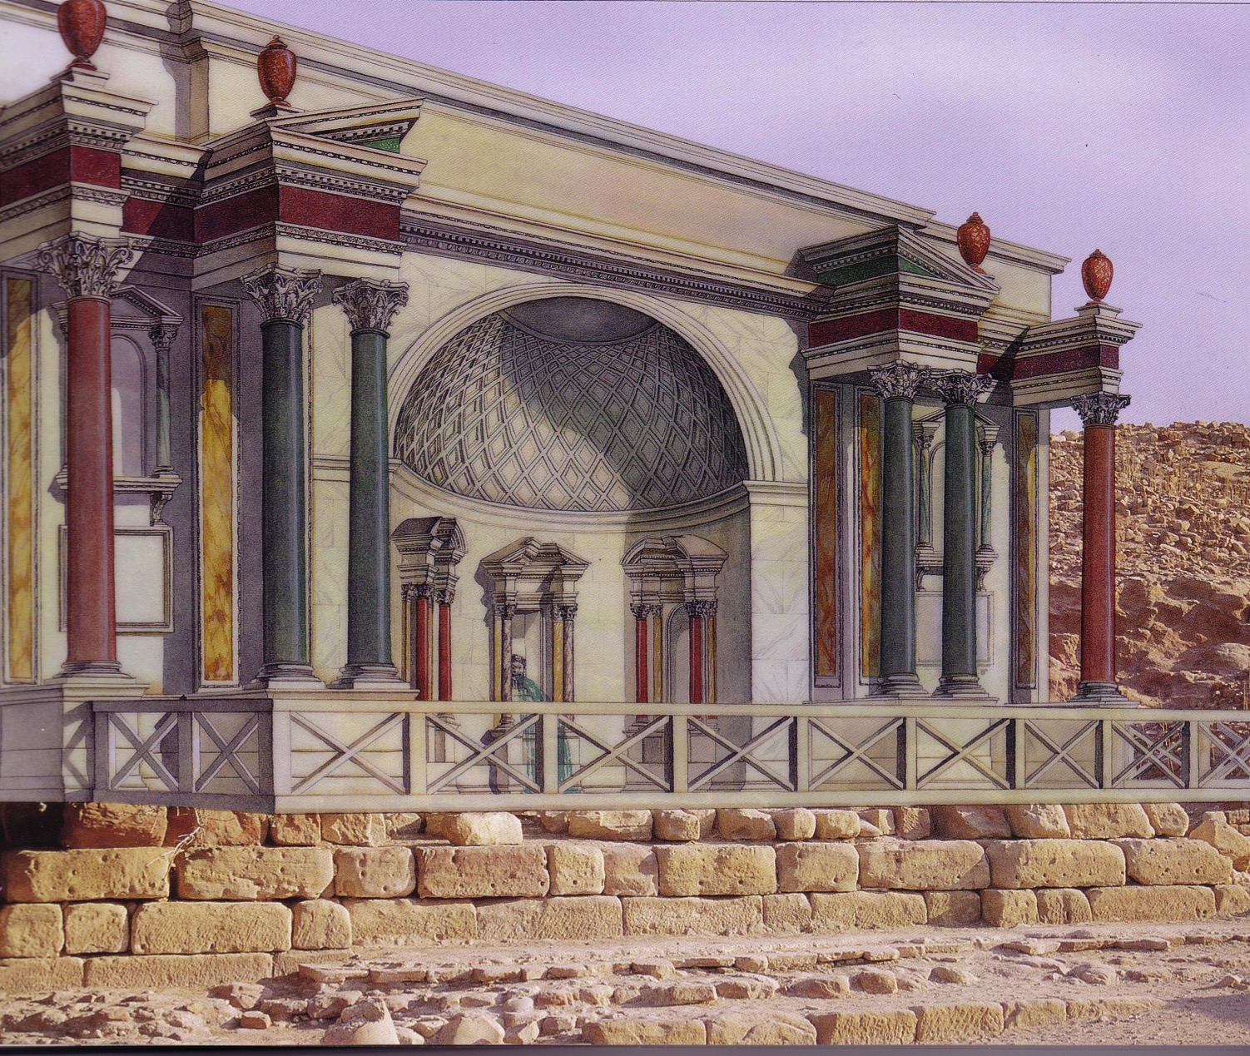
Nymphaleon

Slide 94
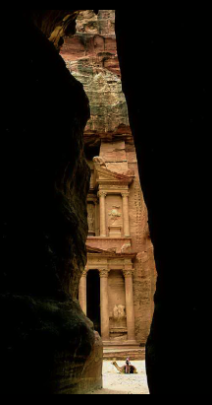
Who Lived at Petra?
Horites (Gen. 14:6):
Pre-1850 (“hill country of Seir”)
Edomites (Amos 1:12):
1850-552 BC (“Sela” Heb. “rock”)
Nabataeans (not in Bible)
552 BC-AD 106 (“Petra” Gr. “rock”)
Romans (post-NT)
Post-AD 106 (“Hadriana”)

Slide 95


Egypt to Mesopotamia Trade

Slide 96
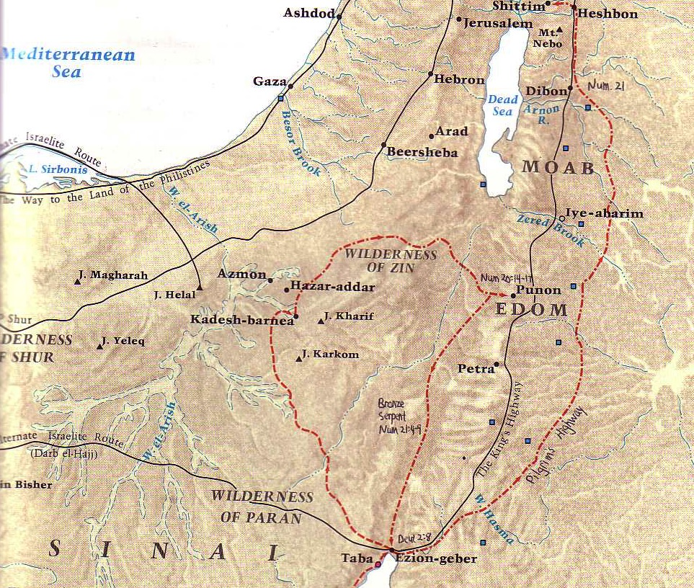
The King's Highway
54
Petra
Barry Beitzel,
Moody Atlas of Bible Lands, 87

Slide 97
The Spice Trade
Petra

Slide 98
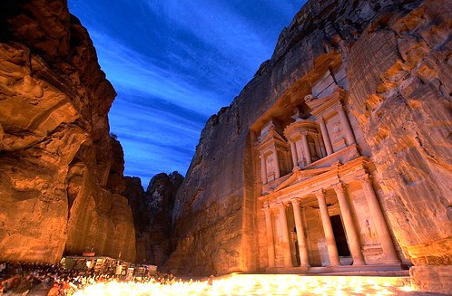
Jordan’s City of Petra is one of the
7 New Wonders of the World
Music: "Helwa Already Baladi" (My Country is Beautiful) Singer: Dalidá

Slide 99
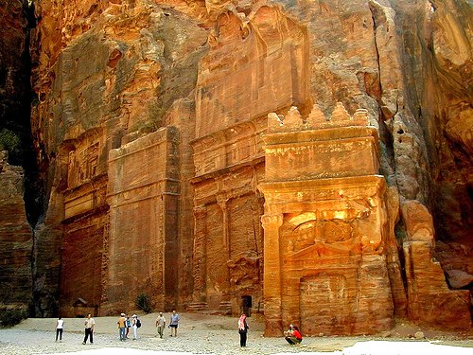
For 600 years it was thought that this city, in the middle of the desert of Jordan, was not real but only legendary like the Atlantis and Troy

Slide 100
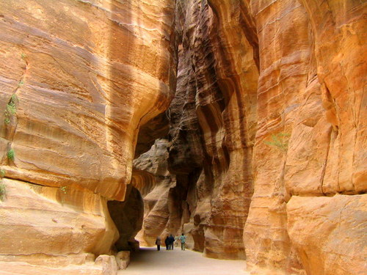
The Swiss explorer who managed to find it in the 19th century had to travel through impressive paths as this among mountains of stone.

Slide 101
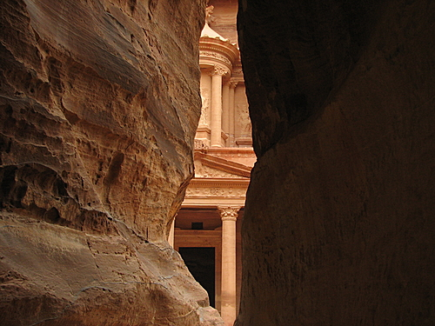
Imagine his emotions when, upon arriving for the first time, he saw this scene!

Slide 102

The Palace of Petra, a temple in Greek style (Hellenic), is also called "The Treasury" and is 42 meters high

Slide 103

It was carved completely in calcareous rock.

Slide 104

But the palace
is only one among
the many magnificent
constructions in Petra,
all carved in
calcareous rock.

Slide 105

Petra was constructed in the 6th century BC
by the Nabateans during the Persian Empire.

Slide 106

The Nabateans were Bedouins that lived on the commerce of spices, like incense, myrrh and aromatic plants.

Slide 107

By the year AD 60 Petra was conquered and became part of the Roman Empire.

Slide 108

Through the years,
the wind has left
its contribution,
carving the most
beautiful forms
in the mountains of
calcareous rock.

Slide 109

Petra was utilized for the final scene of the movies Indiana Jones and The Last Crusade

Slide 110

Note the details
in the interior carvings

Slide 111

The colors in the stones are natural.

Slide 112




The natural colored geological composition of the sand is favorable for "natural paintings" such as these.

Slide 113





These formations found in the walls of some mountains take one’s breath away!

Slide 114


The Nabateans also carved a sophisticated hydraulic system with tunnels and tanks of water to bring water to Petra

Slide 115

This theater, in Greek-Roman style, sat 4,000 spectators.

Slide 116

In AD 551 a second great earthquake destroyed almost all the city, so Petra was never again inhabited.

Slide 117

Jordan’s City of Petra is one of the 7 New Wonders of the World

Slide 118

“Though you soar like the eagle and make your nest among the stars, from there I will bring you down,” declares the LORD.
Obadiah 4 (NIV)

Slide 119

"Though you soar like the eagle and make your nest among the stars, from there I will bring you down,” declares the LORD (Obadiah 4 NIV).

Slide 120

"If thieves came at night and robbed you (what a disaster awaits you!), they would not take everything. Those who harvest grapes always leave a few for the poor. But your enemies will wipe you out completely!”
(Obadiah 5 NLT).

Slide 121

"Every nook and cranny of Edom will be searched and looted. Every treasure will be found and taken”
(Obadiah 6 NLT).

Slide 122

"All your allies will turn against you. They will help to chase you from your land. They will promise you peace while plotting to deceive and destroy you. Your trusted friends will set traps for you, and you won't even know about it" (Obadiah 7 NLT).

Slide 123

"'At that time not a single wise person will be left in the whole land of Edom,' says the LORD. 'For on the mountains of Edom I will destroy everyone who has understanding'"
(Obadiah 8 NLT).

Slide 124

"The mightiest warriors of Teman will be terrified, and everyone on the mountains of Edom will be cut down in the slaughter"
(Obadiah 9 NLT).

Slide 125
"Because of the violence against your brother Jacob, you will be covered with shame; you will be destroyed forever”
(Obadiah 10 NIV).

Slide 126
"On the day you stood aloof while strangers carried off his wealth and foreigners entered his gates and cast lots for Jerusalem, you were like one of them” (Obadiah 11 NIV).
Shishak

Slide 127
"But when Rehoboam was firmly established and strong, he abandoned the Law of the LORD, and all Israel followed him in this sin. ² Because they were unfaithful to the LORD, King Shishak of Egypt came up and attacked Jerusalem in the fifth year of King Rehoboam’s reign. ³ He came with 1,200 chariots, 60,000 horses, and a countless army of foot soldiers, including Libyans, Sukkites, and Ethiopians" (2 Chron 12:1-3 NLT).
Egyptian Warrior

Slide 128
"Shishak conquered Judah’s fortified towns and then advanced to attack Jerusalem. ⁵ The prophet Shemaiah then met with Rehoboam and Judah’s leaders, who had all fled to Jerusalem because of Shishak. Shemaiah told them, 'This is what the LORD says: You have abandoned me, so I am abandoning you to Shishak.' ⁶ Then the leaders of Israel and the king humbled themselves and said, 'The LORD is right in doing this to us!'" (2 Chron 12:4-6 NLT).
Egyptian Warrior

Slide 129
"When the LORD saw their change of heart, he gave this message to Shemaiah: 'Since the people have humbled themselves, I will not completely destroy them and will soon give them some relief. I will not use Shishak to pour out my anger on Jerusalem.
⁸ But they will become his subjects, so they will know the difference between serving me and serving earthly rulers'"
(2 Chron 12:7-8 NLT).
Egyptian Warrior

Slide 130
"So King Shishak of Egypt came up and attacked Jerusalem. He ransacked the treasuries of the LORD’s Temple and the royal palace; he stole everything, including all the gold shields Solomon had made"
(2 Chron 12:9 NLT).
Egyptian Warrior

Slide 131

Edom's Excuse
Am I my brother's keeper?
OBADIAH

Slide 132

"You should not look down on your brother in the day of his misfortune, nor rejoice over the people of Judah in the day of their destruction, nor boast so much in the day of their trouble”
(Obadiah 12 NIV).
NEVER
look down on others unless you're
HELPING THEM UP

Slide 133

"You should not march through the gates of my people in the day of their disaster, nor look down on them in their calamity in the day of their disaster, nor seize their wealth in the day of their disaster" (Obadiah 13 NIV).

Slide 134

"You should not wait at the crossroads to cut down their fugitives, nor hand over their survivors in the day of their trouble" (Obadiah 14 NIV).

Slide 135


"God resists
the proud…
…but gives grace to the humble."
1 Peter 5:5b (NIV)

Slide 136

…so that at the proper time he may exalt you."
"Humble yourselves, therefore, under the mighty hand of God…
1 Peter 5:6

Slide 137

The Rainbow
A PROMISE OF GOD,
NOT A SYMBOL OF PRIDE

Slide 138

Proverbs 16:5 (NIV)
"The LORD detests all the proud of heart. Be sure of this: They will not go unpunished."

Slide 139

"Pride goes before destruction and a haughty spirit before a fall."
Pride goes before destruction,
a haughty spirit before a fall.
Proverbs 16:18
Proverbs 16:18 (NIV)

Slide 140
Broken People
145-146
Henry Blackaby
PROUD, UNBROKEN PEOPLE
BROKEN PEOPLE
Keep people at arms length
Risk getting close to others/willing to take the risks of loving intimately
Quick to blame others
Accept personal responsibility – can see where they were wrong
Unapproachable
"Easy to be entreated"
Defensive when criticized
Receive criticism with a humble, open heart
Concerned with being "respectable"
Concerned with being real
Concerned about what others think
All that matters is what God knows
Work to maintain image/protect reputation
Die to own reputation
Find it difficult to share
their spiritual needs with others
Willing to be open / transparent with others
Want to be sure nobody finds out
about their sin.
Willing to be exposed (Once broken, you don't care who knows – nothing to lose!)
Notes:
BE-31-Obadiah-54
OS-04-Numbers-272
OS-31-Obadiah-129

Slide 141
Broken People
145-146
Henry Blackaby
PROUD, UNBROKEN PEOPLE
BROKEN PEOPLE
Have a hard time saying, "I was wrong; will you please forgive me?"
Are quick to admit failure and to seek forgiveness
When confessing sin, deal in generalities
Deal in specifics
Concerned about the consequences
of their sins
Grieved over the cause / root of their sins
Remorseful over their sin—
got caught / found out
Repentant over sin (forsake it)
When there is a misunderstanding or conflict, wait for the other to come & ask forgiveness
Take the initiative to be reconciled;
see if they can get to the cross first!
Compare themselves with others
and feel deserving of honor
Compare themselves to the holiness of God and feel desperate need for mercy
Blind to their true heart condition
Walk in the light
Don't think they have anything to repent of
Continual heart attitude of repentance
Don't think they need revival
(think everybody else does!)
Continually sense their need for a fresh
encounter with the filling of His Spirit
Notes:
BE-31-Obadiah-55
OS-04-Numbers-273
OS-31-Obadiah-130

Slide 142
I. God judges the proud.
Obadiah 1-14
Notes:
The LORD pushes down those who exalt themselves.

Slide 143
How does God respond to
HUMILITY
????

Slide 144
Key Verses
594
Judgment on Edom
  (God to Edom) "Because of the violence against your brother Jacob [Judah], you will be covered with shame; you will be destroyed forever" (v. 10)
Blessing on Israel
  "Deliverers will go up on Mount Zion [Jerusalem] to govern the mountains of Esau. And the kingdom will be the LORD's" (v. 21)

Slide 145
Slides on
Obadiah 15-21

Slide 146
II. God blesses the humble.
Obadiah 15-21

Slide 147

"The day of the LORD is near for all nations.
As you have done, it will be done to you; your deeds will return upon your own head" (Obadiah 15 NIV).
The Day of the Lord

Slide 148

"Just as you swallowed up my people on my holy mountain, so you and the surrounding nations will swallow the punishment I pour out on you. Yes, all you nations will drink and stagger and disappear from history"
(Obadiah 16 NLT).

Slide 149
Reversal in Obadiah
140
Edom Over Israel
Israel Over Edom
Judah
1-14
15-21
Edom

Slide 150
Approaching a Summit
Notes:
When we approach the summit of a mountain range, it looks like the peaks continually go upward.

Slide 151
Time Periods of the Prophets
442
New Heavens & New Earth
Christ's Second Coming to Reign in Millennium
Christ's First Coming to Suffer
Exile & Return
Prophet's Own Time
Adapted significantly from Salem Kirban, Charts on Revelation (1979), 49
Notes:
However, there might be significant gaps between the peaks. These were not seen by the prophets who only knew that they spoke of the future, but did not know how far their prophecies referred. Generally there existed five time periods, inlduing the prophet's own era.

Slide 152
We See the Valleys
Notes:
From our vantage point, we clearly see that the Messiah would come twice. It's like being able to see the valleys between each set of peaks. However, the prophets did not see these valleys but only saw the future as a whole.

Slide 153
A Dispensational Timeline
437
Great
White
Throne
(Rev. 20:11-14)
Rapture
(1 Thess. 4:13-18)
2nd Advent
(Zech. 14:3-5)
Day of the LORD
Church Age
Tribulation
(Zech. 14:1-2)
Millennium
(Zech. 14:6-21)
Gog & Magog
(Armageddon)
(Ezek. 38–39)
Gog and Magog
Revisited
(Rev. 20:7-10)
Notes:
153

Slide 154
Reversal in Obadiah
140
"But Jerusalem will become a refuge for those who escape;
it will be a holy place.
And the people of Israel will come back to reclaim their inheritance"
(Obadiah 17 NLT).
Judah
Edom

Slide 155
Reversal in Obadiah
140
"The people of Israel will be a raging fire, and Edom a field of dry stubble. The descendants of Joseph will be a flame roaring across the field, devouring everything. There will be no survivors in Edom. I, the LORD, have spoken"
(Obadiah 18 NLT).
Judah
Edom

Slide 156

Is There a Future for Ethnic Jews?
155q
Notes:
OS-31-Obadiah-145

Slide 157

7
Gen. 17
ABRAHAM
ABRAHAM
ca. 2000 B.C.
The CALL
AC
L - S - B
AJMJ
I - I
Gen. 12:1-3
ABRAHAM
The CALL
L - S - B
I - I
ISHMAEL & ISAAC
Handbook pg. 19-24
28
Notes:
So…the letters I and I appear on ABRAHAM's file folder. From these two sons of Abraham….ISHMAEL and ISAAC...
right here at this crucial historic point…the terrible Jewish-Arab conflict of our own time begins some 4,000 years ago...around 2000 B.C.

Slide 158
7
ABRAHAM
ABRAHAM
ca. 2000 B.C.
The CALL
AC
L - S - B
AJMJ
Gen. 12:1-3
I - I
ABRAHAM
The CALL
L - S - B
I - I
ARABIC PEOPLES
THROUGH ISHMAEL
JEWISH PEOPLE
THROUGH ISAAC
Handbook pg. 19-24
29
2
Notes:
Because...
//// …ISHMAEL is recognized today as the father of the Arab nations…through ABRAHAM…
//// while ISAAC, of course, is revered as one of the founding patriarchs of the Jews…also through ABRAHAM!

Slide 159
7
ABRAHAM
ABRAHAM
ca. 2000 B.C.
The CALL
AC
L - S - B
AJMJ
Gen. 12:1-3
I - I
ABRAHAM
The CALL
L - S - B
I - I
ARABIC PEOPLES
THROUGH ISHMAEL
JEWISH PEOPLE
THROUGH ISAAC
Handbook pg. 19-24
30
Notes:
There is enormous conflict between the two half-brothers and their mothers. And as we watch or read today's news, we see that that age-old turmoil begun in ABRAHAM's tent 4,000 years ago continues today! Both the Jews and the Arabs claim ABRAHAM as the beginning point of their respective peoples!

Slide 160
7
Gen. 22:2; 2 Chr. 3:1
WHICH SON?
"Then God said, "Take your son, your only son, Isaac, whom you love, and go to the region of Moriah. Sacrifice him there as a burnt offering, on one of the mountains I will tell you about." Genesis 22:2
ABRAHAM
The CALL
L - S - B
I - I
NIV study note: :"In the Hebrew text, "Isaac" follows the clause "whom you love," in order to heighten the effect: "your son, your only son, whom you love -- Isaac." Isaac was the only "son of the Promise."
2 Chr 3:1 The author identifies this site with the Temple mount [locating today's Dome of the Rock].
Handbook pg. 19-24
31
3
Notes:
The question then arises: how do we know WHICH SON was REALLY the inheritor of the Abrahamic promises? Look at Genesis 22:2…
//// "The God said, "Take your son, your only son, Isaac, whom you love, and go to the region of Moriah. Sacrifice him there as a burnt offering, on one of the mountains I will tell you about."
//// Look at this study note from the NIV translation: "In the Hebrew text, "Isaac" follows the clause "whom you love," in order to heighten the effect: "your son, your only son, whom you love – Isaac." Isaac was the only "son of the Promise."
//// Here also, you'll find in Second Chronicles 3:1 that God identifies Moriah with the Temple mount, which, today, is the site of the Moslem Dome of the Rock." Much more on that location a little later.

Slide 161
7
Gen. 17:20-21
WHICH SON?
"And as for Ishmael, I have heard you. Behold I have blessed him, and will make him fruitful, and will multiply him exceedingly. He shall beget twelve princes, and I will make him a great nation. But My covenant I will establish with Isaac, whom Sarah shall bear to you at this set time next year."
Gen. 17:20-21 (NKJV)
ABRAHAM
The CALL
L - S - B
But My covenant I will establish
I - I
with Isaac
Handbook pg. 19-24
32
2
Notes:
But Ishmael was not forgotten…not at all!
//// Genesis 17: 20-21…"And as for Ishmael, I have heard you. Behold I have blessed him, and will make him fruitful, and will multiply him exceedingly. He shall beget twelve princes, and I will make him a great nation.
//// But My covenant I will establish with Isaac, whom Sarah shall bear to you at this set time next year."

Slide 162

COMPARE THE GIFTS TODAY…
ISAAC
ABRAHAM
ISHMAEL
The CALL
L - S - B
I - I
WHY THE ENORMOUS DIFFERENCE?
Handbook pg. 19-24
33
3
Notes:
It's interesting to compare those gifts today…
//// Generally speaking…here are the lands populated today by the descendants of Ishmael…the lands of the Middle East.
//// But then…compare that with the descendants of Isaac in the Middle East…right there in tiny Israel.
//// Why the enormous difference?

Slide 163

7
COMPARE THE GEOGRAPHY…
Israel and…
ABRAHAM
The CALL
L - S - B
The Arab World
I - I
Handbook pg. 19-24
34
Notes:
Practically speaking…just compare the geography…today's Israel versus the rest of the Arab world!

Slide 164

7
COMPARE THE GEOGRAPHY…
ABRAHAM
The CALL
L - S - B
I - I
MOHAMMED VERSUS ISAAC!
Handbook pg. 19-24
35
Notes:
But there is something else at work here. Compare the Middle Eastern influence of Ishmael's descendant, Mohammed, founder of Islam…with that of Isaac, the great Israelite patriarch, and the brother of Ishmael!

Slide 165






7
COMPARE THE GEOGRAPHY…
ISRAEL and…
ISRAEL and…
Australia
ISRAEL and…
France
California
ISRAEL and…
ISRAEL and…
Singapore
ABRAHAM
The CALL
L - S - B
I - I
Maine
Maps drawn to same scale with Israel in blue
Handbook, pages 19-24
4
36
9.65.03b.
Notes:
In today's geopolitical world…compare the size of tiny Israel with
Australia…
//// Israel with France…
//// Israel and the United States' state of Maine…or
//// Israel and California.
//// The width of Singapore and Israel are about the same.

Slide 166

7
ISRAEL and…
THE UNITED STATES
ABRAHAM
The CALL
L - S - B
I - I
DOES THIS SEEM FAIR?
Handbook pg. 19-24
37
Notes:
And finally…even when Israel is compared to the entire United States…from the north to the south…from east to west: when it comes to size alone, there is enormous disparity between Isaac and Ishmael! Why is this so? How can we explain it?

Slide 167
7
"…the Ishmaelites were given more land and ultimately more wealth than Israelites. This was true in their past history, not to mention the vast oil wealth of modern times. And spiritual salvation has always been open to the Ishmaelites.
ABRAHAM
The CALL
L - S - B
I - I
Hal Lindsey, The Everlasting Hatred: The Roots of Jihad (2002), 65
Handbook pg. 19-24
38
Notes:
Look at this passage from Hal Lindsay's 2002 book, The Everlasting Hatred: The Roots of Jihad:
"…the Ishmaelites were given more land and ultimately more wealth than Israelites. This was true in their past history, not to mention the vast oil wealth of modern times. And spiritual salvation has always been open to the Ishmaelites."
[Continue to the next part of the passage below.]

Slide 168
7
"…the Ishmaelites were given more land and ultimately more wealth than Israelites. This was true in their past history, not to mention the vast oil wealth of modern times. And spiritual salvation has always been open to the Ishmaelites.
But God's covenant, which concerned His spiritual purposes, was only for Isaac and his descendants. The physical blessings promised to Isaac were to facilitate God's spiritual call for the nation that would come from him." [Emphasis added]
ABRAHAM
The CALL
L - S - B
I - I
Hal Lindsey, The Everlasting Hatred: The Roots of Jihad, 2002, p. 65
Handbook pg. 19-24
39
Notes:
"But God's covenant, which concerned His spiritual purposes, was only for Isaac and his descendants. The physical blessings promised to Isaac were to facilitate God's spiritual call for the nation that would come from him."

Slide 169
7
LEBANON
Mediterranean Sea
DESCENDANTS OF ISAAC
SYRIA
Sea of Galilee
IRAQ
Haifa
Nazareth
Netanya
JORDAN
Tel Aviv-Jaffa
AMMAN
JERUSALEM
Jericho
Gaza
Hebron
Dead Sea
ABRAHAM
Beersheba
The CALL
ISRAEL
L - S - B
I - I
DESCENDANTS OF ISHMAEL
EGYPT
SAUDI ARABIA
Eilat
Al' Aqaba
Gulf of Aqaba
ISHMAEL & ISAAC IN TODAY'S ISRAEL
Handbook pg. 19-24
40
2
Notes:
And inside the ancient Land right now…
//// Here, the descendants of Isaac
//// and the descendants of Ishmael continue today -- that endless conflict begun in Abraham's tent in ancient Palestine or Canaan – or Israel -- so long ago. Jewish Israel is engulfed by the descendants of Ishmael in surrounding countries on all sides! The implications of that circumstance in our own day are enormous.

Slide 170

Borders of the Land Promised to Abraham
531e
Syria
Lebanon
Israel
Jordan
Genesis 15:18
"On that day the LORD made a covenant with Abram, saying, 'To your offspring I give this land, from the river of Egypt to the great river, the river Euphrates'" (ESV)
India
Egypt
Notes:
God’s promised land stretched northward from the small wadi of Egypt south in the Sinai to the large Euphrates River in the far north—a HUGE piece of real estate! When today’s boundaries are placed over this land we can see the struggle modern Israel has to claim land from Egypt, Lebanon, Syria and possibly even Jordan on the other side of the Jordan River.
_____________
Common English-72
BE-31-Obadiah-83
OC-19-Daniel Authorship-?
OS-01-Gen12
OS-04-Numbers-235
OS-17-Esther-16
OS-31-Obadiah-159

Slide 171
God's Promise
(vv. 19-20 NIV84)
Zarephath
"People from the Negev will occupy the mountains of Esau, and people from the foothills will possess the land of the Philistines. They will occupy the fields of Ephraim and Samaria, and Benjamin will possess Gilead.
²⁰This company of Israelite exiles who are in Canaan will possess [the land] as far as Zarephath; the exiles from Jerusalem who are in Sepharad will possess the towns of the Negev."
444
598d
Gilead
Samaria
Ephraim
Benjamin
Philistines
Foothills
Negev
Esau

Slide 172
Bible Lands Blank Map
Where was Sepharad (v. 20)?
Spain?
Sardis, Asia Minor?
Media?
Hesperides, Libya?
"…the exiles from Jerusalem who are in Sepharad will possess the towns of the Negev."
© EBibleTeacher.com
Notes:
"Others exiled from Jerusalem to Sepharad, will possess ... the Negev. Suggestions on the location of Sepharad include two countries (Spain, Media) and two cities (Hesperides in Libya, and Sardis in Asia Minor). Sardis seems preferable. It may be the same as the Akkadian Sapardu. If Sepharad is to be identified with Sardis, then Jews there will be returning a distance of almost 400 miles to the Negev. At the beginning of the Millennium Israelites will return to their land from these and other lands, and their territory will be expanded" (Walter L. Baker, "Obadiah," in The Bible Knowledge Commentary, on Obadiah v. 20).

Slide 173
God's Promise
(v. 20
NIV84)
"People from the Negev will occupy the mountains of Esau, and people from the foothills will possess the land of the Philistines. They will occupy the fields of Ephraim and Samaria, and Benjamin will possess Gilead.
²⁰This company of Israelite exiles who are in Canaan will possess [the land] as far as Zarephath; the exiles from Jerusalem who are in Sepharad will possess the towns of the Negev."
444
598d
Negev

Slide 174
God's Promise
(v. 21 NIV84)
"Deliverers will go up on Mount Zion to govern the mountains of Esau. And the kingdom will be the LORD's."
444
598d
Zion
Esau

Slide 175
Kingdom & Covenants Timeline
22 &
337
9g
Dr. Rick Griffith • Singapore Bible College • BibleStudyDownloads.org
Kingdom Teaching...
Adam rules with God (Gen. 1:26, 28; 2:19)
Satan begins rule as god of this world (Gen. 3:15;
2 Cor. 4:4)
God covenants with Abraham to reestablish man's rule via Israel as a "kingdom of priests" (Gen. 12:1-3; Exod. 19:6)
Israel's failure to witness to nations as a kingdom of priests is judged via exile under foreign rule
Israel rejects Messiah's offer of kingdom (Matt. 12:41-42; 23:37-39)
Jesus extends His kingdom in mystery form to the Church (Matt. 13)
Christ subdues Israel's enemies and nation believes (Rom. 11:26-27)
Christ rules over everything with saints (Eph. 1:9-10; Rev. 20:1-6; 22:5b)
Fall of Man (Gen. 3)
Noahic Covenant
Genesis 6:18; 9:8-17
Land Covenant
ISRAEL
CHURCH
MESSIANIC KINGDOM
(National Focus)
The "New Man" (Eph. 2:15)
Millennial Eternal
land
Genesis 15:18 (cf. Deut. 30:1-10) promises:
Land from Wadi of Egypt to Euphrates River (Isa. 27:12)
Eternal possession of land (Gen. 17:8) after exile/restoration
Whole world blessed via the land (Isa. 14:1-2)
Israel judged for rejecting Messiah by dispersion away from land for 19 centuries
(AD 70–AD 1948) but now partially restored (Ezek. 37:1-7)
Full restoration (Ezek. 37:8-28) Jerusalem world capital
(Isa. 2:1-5)
New Jerusalem
(Rev. 21–22)
Davidic Covenant
Christ is Head over His Church, which is a spiritual temple (Eph. 2:19-22; 2 Cor. 6:16)
Christ reigns over the world
(Isa. 11)
with saints (Rev. 5:10; 20:4-6)
Christ hands kingdom over to Father (1
Cor. 15:24)
Genesis 12:1-3
2 Samuel 7:12-16 promises:
Sons ("house" never wiped out)
Kingdom (political dynasty)
Throne (right to rule by descendants)
Temple (son to build it)
seed
Abrahamic Covenant
New Covenant
All
things made new!
(Rev. 21:5)
All 5 elements fulfilled in national restoration (Zech. 8)
Jeremiah 31:31-34 promises:
Forgiveness
Indwelling Spirit
New heart, nature, mind
Reunification of Israel and Judah
No need for evangelism
Mosaic Law replaced with first three elements of the New Covenant (Luke 22:20; 2 Cor. 3:6)
blessing
Mosaic Covenant
Law abolished, fulfilled, and replaced at the cross (Rom. 7:1-6;1 Cor. 9:19-21; Heb. 8:13)
Eighth Edition
29 Aug 2016
Temporary (Gal. 3:19) and conditional (Deut. 28) to reveal sin (Rom. 7:7) and regulate Israel (Gal. 3:23-25)
Scripture has a dual kingdom-covenant theme. Israel's role from Abraham to Christ expands to include the Church (continuity) yet the Church never replaces the nation as the "new Israel" (discontinuity). Israel will again enjoy world prominence after trusting Christ at His second coming.
Notes:
Slides 13 and 127 repeated

Slide 176
How does God respond to
PRIDE
????

Slide 177
I. God judges the proud.
Obadiah 1-14
Notes:
The LORD pushes down those who exalt themselves.

Slide 178
II. God blesses the humble.
Obadiah 15-21

Slide 179
—Main Idea of Obadiah—
God humbles the proud
but exalts the humble

Slide 180
Calls to Humility
594
God judges the prideful who try to destroy his people.
God "does unto you" as you have "done unto others" (v. 15).
The eventual and final fate of Edom is the fate of all the wicked – death.
The eventual and final reward of God's people is life abundant.

Slide 181

"The LORD Almighty has a day in store for all the proud and lofty, for all that is exalted (and they will be humbled)."
Isaiah 2:12 (NIV)

Slide 182

and whoever humbles himself
will be exalted."
"For whoever exalts himself
will be humbled
Matthew 23:12 (NIV)

Slide 183

"But he gives us more grace.
That is why Scripture says:
'God opposes the proud but gives grace to the humble.'"
James 4:6 (NIV)

Slide 184

Humility does not mean you think less of yourself.
It means you think of yourself less.
—Ken Blanchard—
In what area of your life do you need to curb pride?

Slide 185
Black

Slide 186


OT Preaching • BibleStudyDownloads.org
Get this presentation and script for free!
Notes:
OT Survey (os)

Slide 187
Broken People
145-146
Henry Blackaby
PROUD, UNBROKEN PEOPLE
BROKEN PEOPLE
Focus on the failures of others
Overwhelmed with sense of their own
spiritual need
Self-righteous; have a critical, fault-finding
spirit; look at own life/faults through a
telescope but others with a microscope
Compassionate; forgiving; look for the
best in others
Look down on others
Esteem all others better than self
Independent/self-sufficient spirit
Dependent spirit/recognize need for
others
Maintain control; must be my way
Surrender control
Have to prove that they are right
Willing to yield the right to be right!
Claim rights
Yield rights
Demanding spirit
Giving spirit
Self-protective of time, rights, reputation
Self-denying
Notes:
BE-31-Obadiah-89
OS-04-Numbers-274
OS-31-Obadiah-176

Slide 188
Broken People
145-146
Henry Blackaby
PROUD, UNBROKEN PEOPLE
BROKEN PEOPLE
Desire to be served
Motivated to serve others
Desire to be a success
Desire to be faithful
to make others a success
Desire for self-advancement
Desire to promote others
Driven to be recognized/appreciated
Sense of unworthiness; thrilled to be
used at all; eager for others to get credit
Wounded when others are promoted
and they are overlooked
Rejoice when others are lifted up
"The ministry is privileged to have me!"
"I don't deserve to serve in this
ministry!"
Think of what they can do for God
Know that they have
nothing to offer God
Feel confident in how much they know
Humbled by how much they have to
learn
Self-conscious
Not concerned with self at all
Notes:
BE-31-Obadiah-90
OS-04-Numbers-275
OS-31-Obadiah-177

Slide 189

Occasion
595
Obadiah prophesies a message of judgment upon Edom as a comfort to the people of Judah who have seen Edom gloat over the recent devastation of Jerusalem by the Philistines and Arabs.

Slide 190
Summary Statement
594
Destructions of both Edom in the near future and all nations in the day of the LORD will come as God's judgment for their opposing Judah, but Judah can be comforted with a promise of blessing due to God's protection in the Land Covenant.

Slide 191
Verses 1-14
597
The LORD through Obadiah describes Edom's future destruction for doing injustices to Judah to comfort Judah with His protective hand.
Verses 15-21
Obadiah describes the day of the LORD as God's judgment on end times nations who opposed Judah but His blessing upon Judah to comfort His people with His faithfulness to the Land Covenant.

Slide 192
Theology
597
It gives hope for God's people: Obadiah gave the people concrete hope in that he declared the defeat of a perennial enemy, Edom.
  Judah can be assured of God's justice in that Edom would be humiliated.
  God has not forsaken his people.
God is just and faithful to his covenant with Israel.
Edom stands as a type of all who oppose the purposes of the LORD. Whatever Obadiah says about Edom applies equally to any nation that sets itself against the LORD and His people.

Slide 193
Obadiah
Jeremiah 49
¹We have heard a message from the LORD: An envoy was sent to the nations to say, "Rise, and let us go against her
for battle"—
¹⁴I have heard a message from the LORD: An envoy
was sent to the
nations to say,
"Assemble yourselves to attack it! Rise up for battle!"

Slide 194
Obadiah
Jeremiah 49
³The pride of
your heart has deceived you,
you who live in the clefts of the rocks and make your home on the heights,
¹⁶. . . the pride of your heart have deceived you,
you who live in the clefts of the rocks, who occupy the heights of the hill.

Slide 195
Obadiah
Jeremiah 49
⁴Though you . . . make your nest among the stars, from there I will bring you down," declares the LORD.
¹⁶Though you
build your nest
as high as the eagle's, from there I will
bring you down,"
declares the LORD.

Slide 196
Obadiah
Jeremiah 49
⁵If grape pickers came to you,
would they not leave a few grapes?
⁹If grape pickers came to you,
would they not leave a few grapes?

Slide 197
Problem #1
The NT writers quote literally hundreds of citations from every major section of the OT. Yet, the Book of Obadiah is not quoted even once. If it is inspired, then why isn't it cited at least once?

Slide 198
Solution
  Many OT books are not directly quoted in the NT (e.g., Ruth, 1-2 Chronicles, Esther, Song of Songs and Ecclesiastes). However, all these books were considered inspired by both Jews and Christians.
  Being quoted in the NT was not a test for the inspiration in the OT. Rather, it was whether it was written by a spokesperson accredited by God and accepted by His people. Obadiah meets this test.
  NT writers had no occasion to quote from every OT book. Few Christians now quote 1 Kings, yet the NT did (Rom. 11:4). Indeed, few believers ever cite 2 or 3 John, and yet they were part of the inspired Word. How often a book is quoted does not determine whether it is inspired.

Slide 199
Problem #2
Obadiah is a message of divine moral judgment on the nations. Of the 21 verses in this book…
16 pronounce judgment against Edom
5 prophesy Israel's future triumph over Edom
But isn't this simply Jewish nationalism rather than a revelation of God?

Slide 200
Solution
  The Book of Obadiah reveals the sovereignty of God amid national disgrace and defeat. The impotence of God's people against their enemies reflected upon the power of the God of Israel. Was Yahweh a defeated God? Was He powerless to resist the enemies of His people?
  "No!" is Obadiah's resounding reply! The God of Israel will keep His promises even though the future looks black. The nations have not understood that their temporary victory over God's people was the very work of God.

Slide 201
Solution
  The message of Obadiah is that Israel's God is always in complete control, and He accomplishes His purpose. It is a message of faith, hope, and triumph against the enemies of God.
  But the triumph of Israel will be a blessing to all nations. Israel's apostasy brought judgment.
  "For if [Israel's] rejection is the reconciliation of the world, what will their acceptance be but life from the dead? (Rom. 11:15).

Slide 202
Solution
  This book is not simply an expression of Jewish nationalism.
  It declares the faithfulness of God as a testimony to His moral justice by which He will ultimately establish justice in the earth.

Slide 203
Black

Slide 204
OT Survey link at BibleStudyDownloads.org
Get this presentation for free!
Notes:
OT Survey (os)

