Slide 1
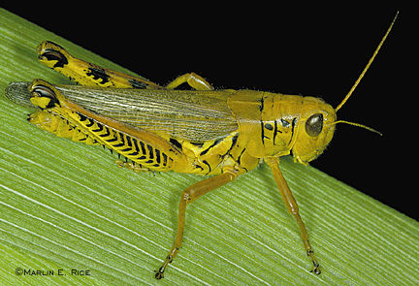
Joel Title
Joel
Dr. Rick Griffith • Jordan Evangelical Theological Seminary • BibleStudyDownloads.org

Slide 2
Key Word
575
343
Locust
Joel

Slide 3
Theme
575
Day of the LORD
Joel

Slide 4
Key Verse
575
"…The day of the LORD is great; it is dreadful. Who can endure it? 'Even now,' declares the LORD, 'return to me with all your heart, with fasting and weeping and mourning'" (2:11b-12).
Joel

Slide 5

Kingdom Statement
343
God disciplined Israel via locusts (1) and will do so again via other means (2:1-17) but ultimately he will restore the nation's rule after repentance (2:18–3:21).
Joel

Slide 6

Summary Statement
575
346
A recent judgment of Judah by locusts should cause the people to repent as a more dreadful day of the LORD will come in a Babylonian invasion, yet God promises forgiveness, deliverance, and restoration by judging the nations.
Joel

Slide 7

Covenant
347c
God's promise to dwell in Jerusalem forever (3:17-21) and send his Spirit (2:18-32) is rooted in his covenant to protect Jerusalem as his chosen city (1 Kings 8:23-61; cf. Rev. 21:3).
Joel

Slide 8

Redemption
347c
Salvation from God's judgments (1:1-2:17) will come only on a repentant Israel who calls on the name of the LORD (2:32; cf. 2:12-14).
Joel

Slide 9

Messiah
347c
Christ's judging role in the Valley of Jehoshaphat (3:2, 12; cf. Matt. 25) balances his sending of the Spirit (2:28-32; cf. John 16:7-15; Acts 1:8) at Pentecost (Acts 2:16-21).
Joel

Slide 10
Outline 4 (Griffith)
575
Day of the LORD
"Locust" Plagues
Blessing
1:1–2:17
2:18–3:21
Zion's Discipline
Zion's Deliverance
The LORD fights against Israel
The LORD fights for Israel
Intro
1:1-3
Repent from literal locusts
1:4-20
Repent from Babylonian/ Armageddon "locusts"
2:1-17
Forgiveness after repentance
2:18-27
Spiritual awakening
2:28–3:21
Lamentation
1:1–2:17
Salvation
2:18-32
Judgment
3:1-21
Past
Future
Judah
Joel
c. 590 BC
Past
Future
Judah
c. 590 BC

Slide 11
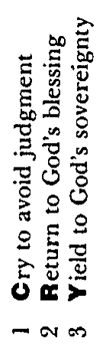
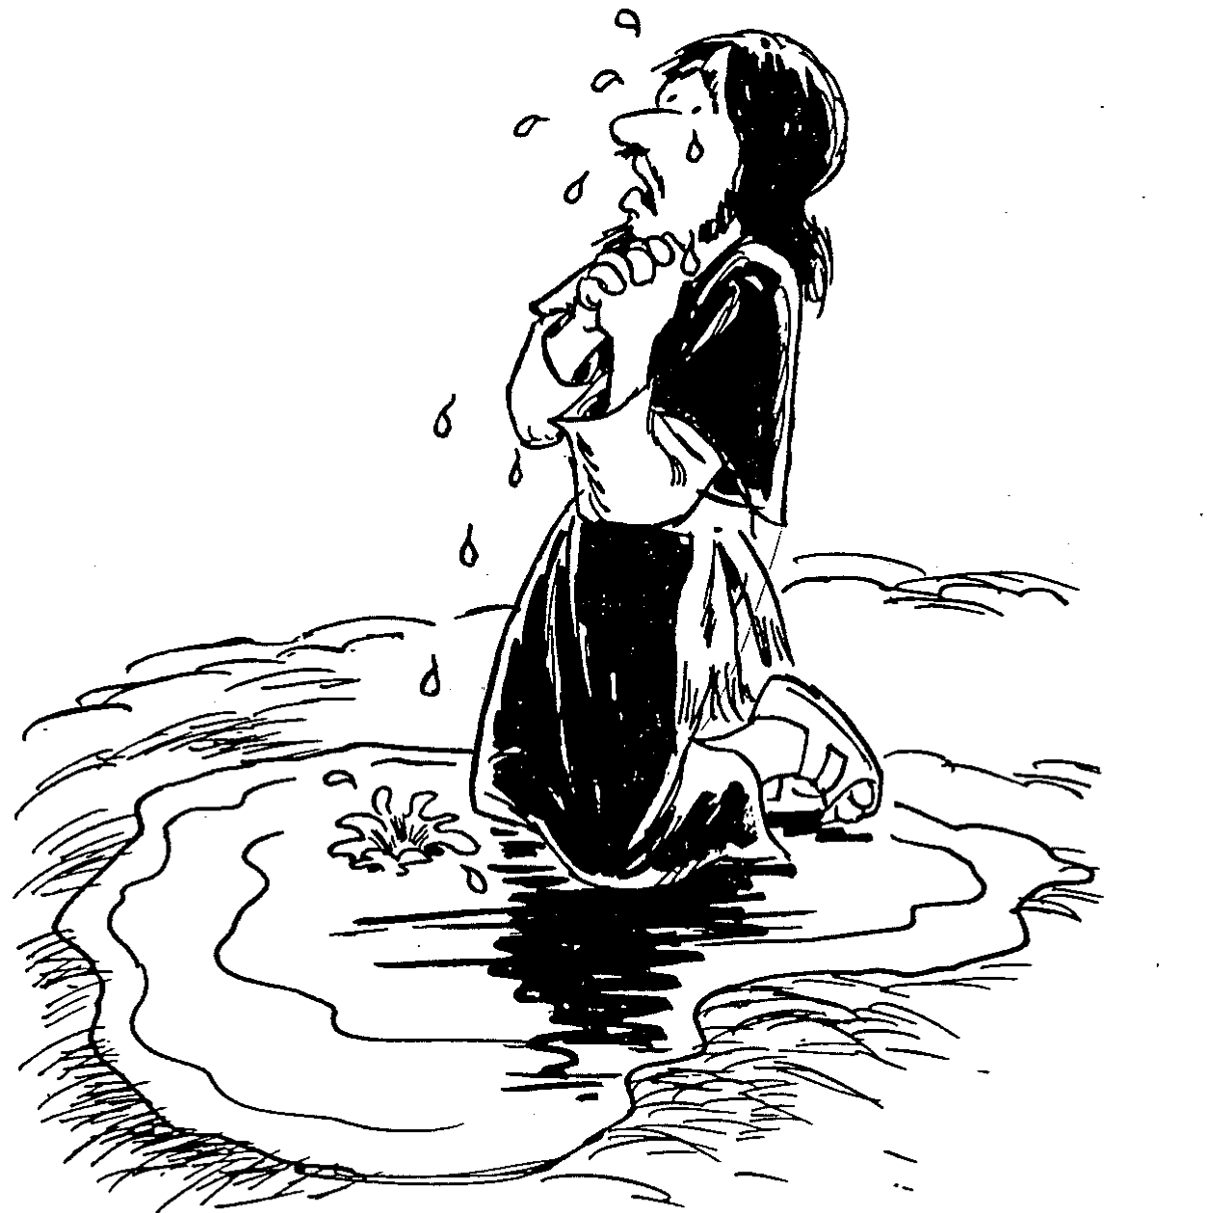
Barry Huddleston, The Acrostic Summarized Bible (Grand Rapids: Baker, 1992)
Joel
1 Cry to avoid judgment
2 Return to God’s blessing
3 Yield to God’s sovereignty

Slide 12

Be Disciplined
The Book of
Joel
Dr. Rick Griffith, Crossroads International Church Singapore
BibleStudyDownloads.org

Slide 13
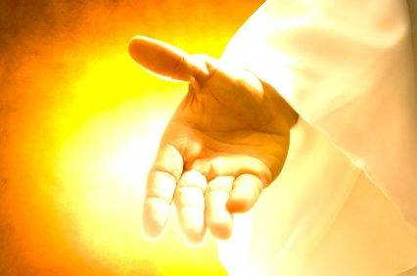
What should we do when we are disciplined?
Joel
Notes:
So back to our original question…

Slide 14

I. Discipline should bring repentance.
Joel 1:1–2:17
Notes:
Times of difficulty are great times to change our perspective.

Slide 15
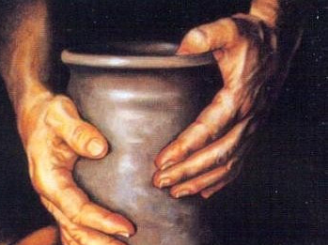
II. Repentance will bring restoration.
Joel 2:18–3:21
Notes:
Changing our minds about God leads to changing our future.

Slide 16

Main Idea
Joel
Discipline
Repentance
Restoration
Let discipline bring repentance and repentance bring restoration.

Slide 17

Questions to Consider
1. Do you need God to strip you of everything before you repent? (Huang Sabin)
Joel

Slide 18
Questions to Consider
2. Is God disciplining you to get your attention on him once again?
Joel

Slide 19
Questions to Consider
3. Have you considered fasting (1:14; 2:12) or do you think fasting isn’t for our modern age? Why wouldn’t it be?
Joel

Slide 20
Black

Slide 21

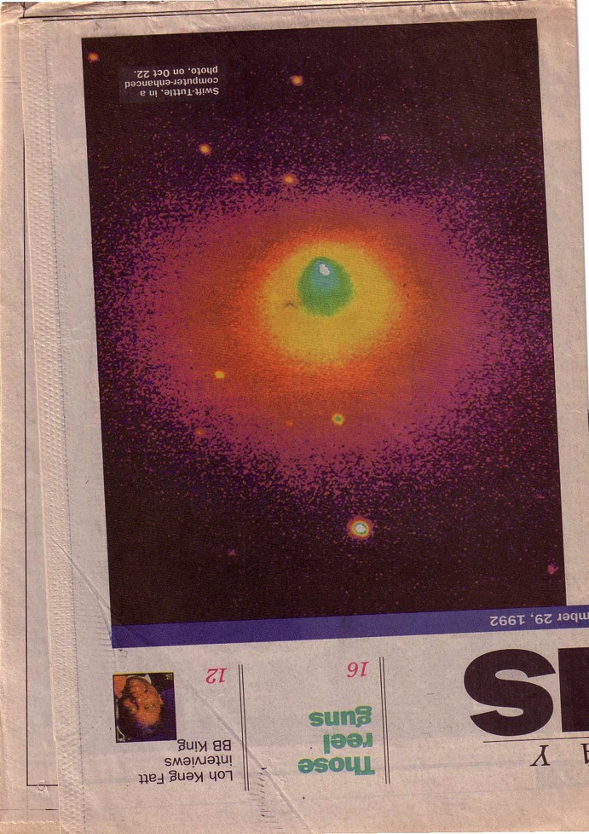
Judgment is Coming!
How does this report make you feel?
How does this report make you feel now?

Slide 22
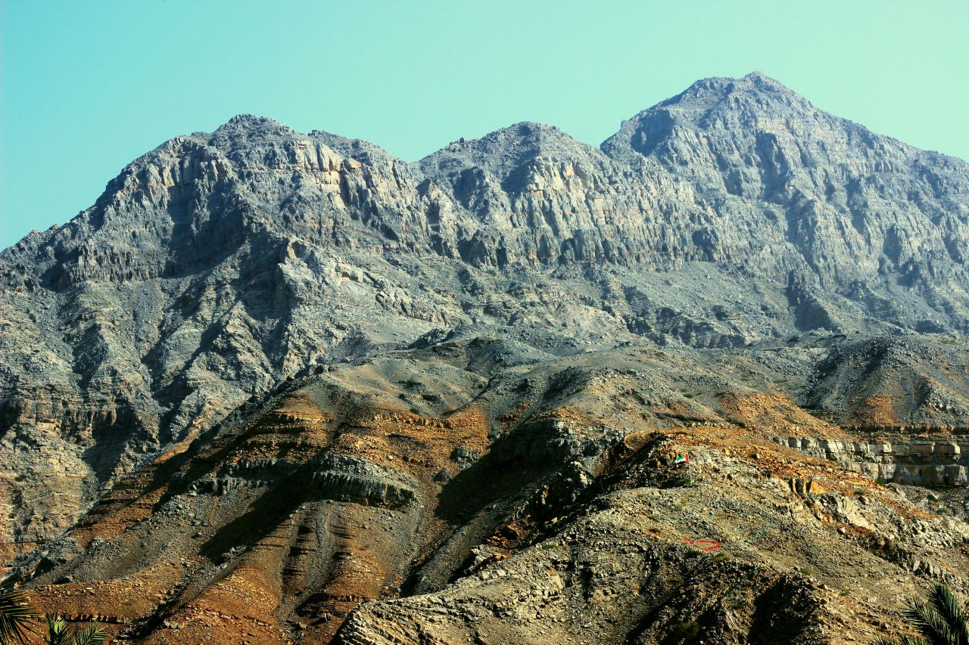
Approaching a Summit
Notes:
When we approach the summit of a mountain range, it looks like the peaks continually go upward.

Slide 23

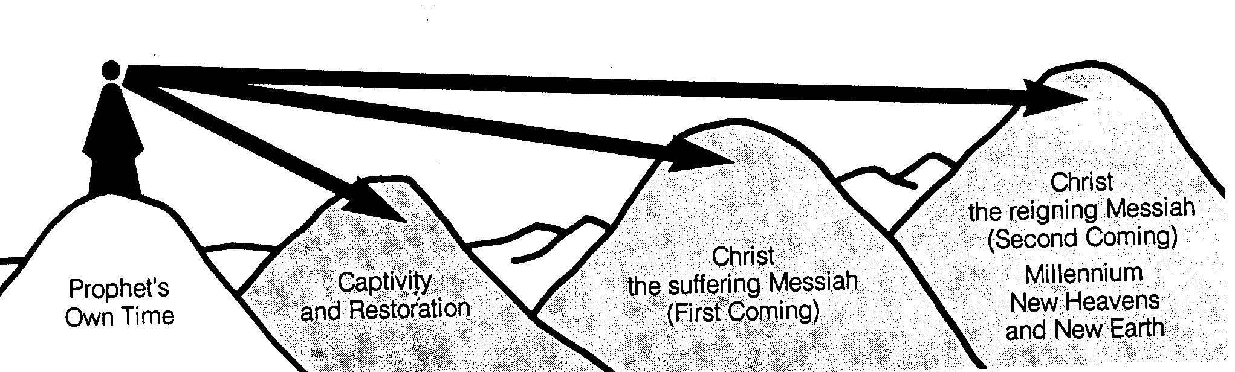
Time Periods of the Prophets
442
New Heavens & New Earth
Christ's Second Coming to Reign in Millennium
Christ's First Coming to Suffer
Exile & Return
Prophet's Own Time
Adapted significantly from Salem Kirban, Charts on Revelation (1979), 49
Notes:
However, there might be significant gaps between the peaks. These were not seen by the prophets who only knew that they spoke of the future, but did not know how far their prophecies referred. Generally there existed five time periods, inlduing the prophet’s own era.

Slide 24
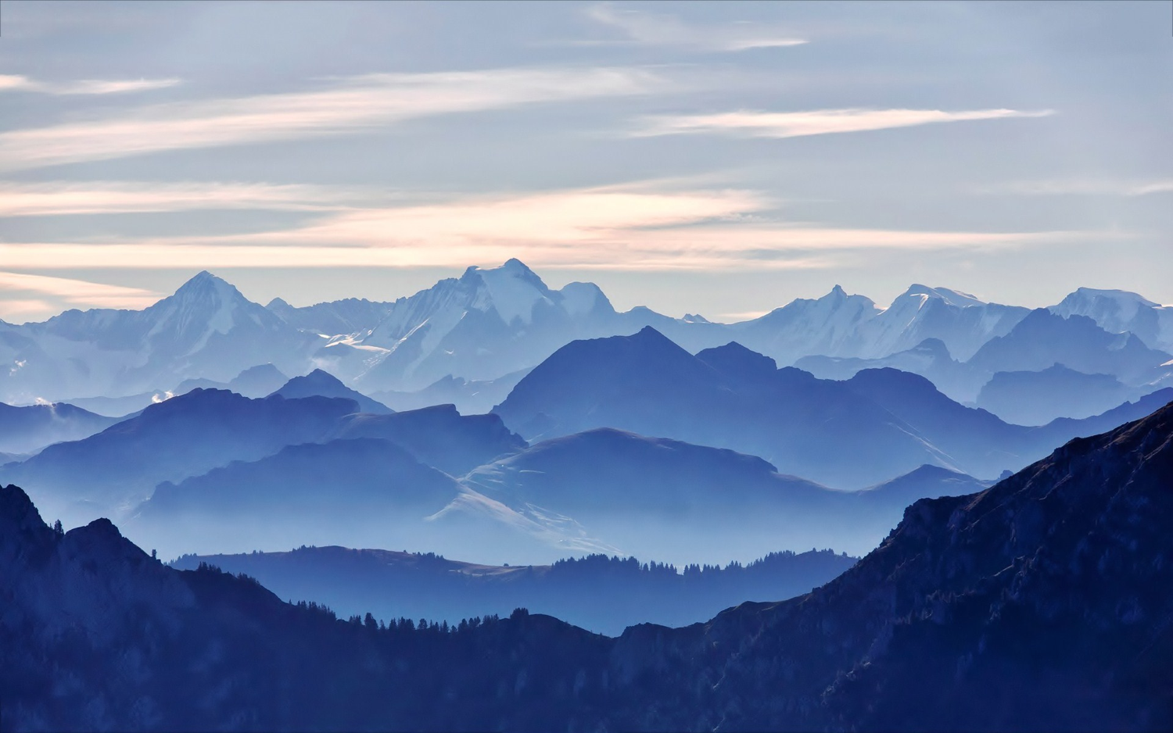
We See the Valleys
Notes:
From our vantage point, we clearly see that the Messiah would come twice. It’s like being able to see the valleys between each set of peaks. However, the prophets did not see these valleys but only saw the future as a whole.

Slide 25
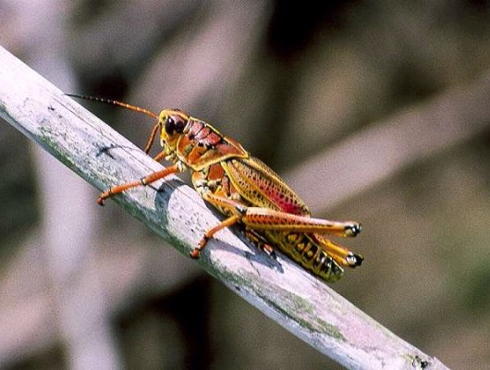
II. Structure and Outline
Outline
Outline
I. Introduction
III. Approaching NT
IV. Problem Text
V. Theological Values
VI. Application

Slide 26
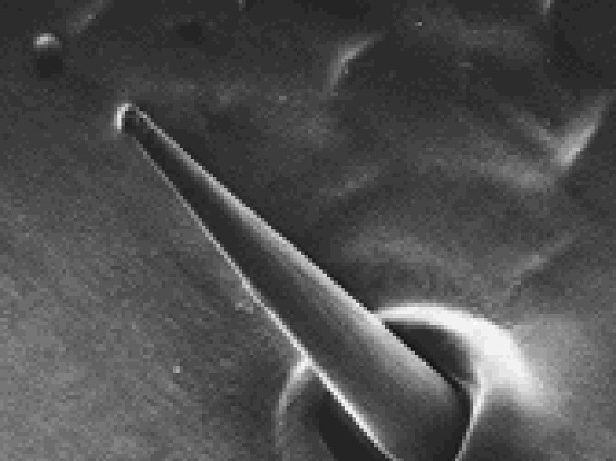
Introduction Overview
577
I. Introduction to the Book
A. Title
B. Authorship
C. Date
D. Recipients
E. Occasion
F. Canonicity and Text
G. Unity
Locust taste receptor

Slide 27
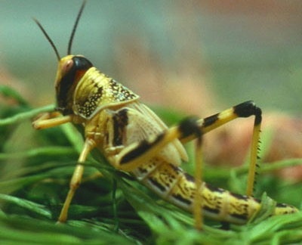

Introduction to Joel
A. Title
576
laeÞAy (Yo'el): "Yahweh is God"
Other related meanings may be "strong willed" and "take refuge"
B. Authorship (Internal Evidence)
Son of Pethuel (1:1)
Lived near Jerusalem (cf. 1:9, 13-14; 2:15-17, 23, 32; 3:1, 5-6, 16-17, 20-21)
Temple prophet (cf. 1:13-14; 2:17)

Slide 28
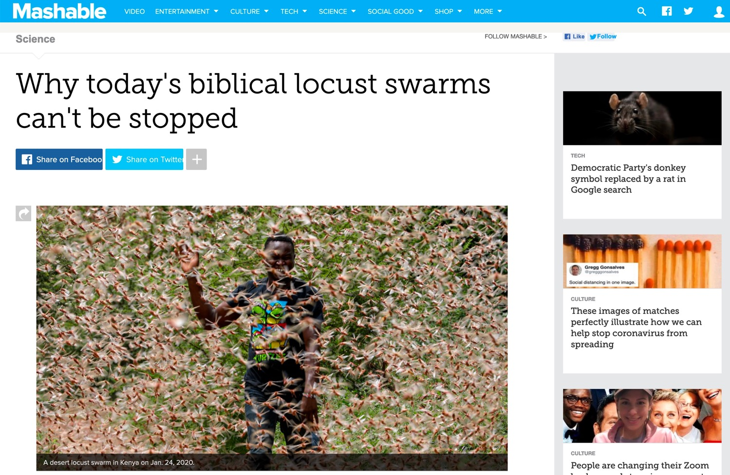
2020 Kenyan Locusts
Locust swarms in Kenya on Jan. 24.
Notes:
WHOLE ARTICLE BROKEN INTO PARTS IN FOLLOWING SLIDES:
In 1937, aboard slowly-moving trains, the Army National Guard used flamethrowers in an attempt to quell a relentless plague of locusts crossing through Colorado.
But the flamethrowers failed. And so did explosives. The locusts easily endured, devouring farmland.
Over 80 years later, great locust swarms still can't be contained. Last week, the U.N. announced that desert locusts — the most devastating type — descended upon East Africa, and over the coming months the insects may increase their populations by a whopping 500-fold. "Kenya has not faced a locust threat of this magnitude in 70 years," the U.N. said.
A single swarm of locusts, which are voracious grasshopper species that can spread over 460-square miles of land, have been a scourge — at least through the eyes of humans — for thousands of years. In more modern times, the British formed an anti-locust unit at the height of World War II to combat the pests in Africa and the Middle East, and a New York Times reporter pondered, in 1976, if "swarms that darken the sky" and "denude the land of crops" could be eliminated by progressing technology. Still today, the locust affliction continues.
"It's not surprising to me that we still don’t have a grip on this," said Iain Couzin, the director of the Max Planck Institute of Animal Behavior who researches locust swarms.
Today, the best humanity can do is try and predict where the swarms will form before a massive population outbreak can occur and ultimately consume vast tracts of crops, which are often rural people's sustenance. "You need to catch it early," said Rick Overson, the research coordinator at Arizona State University's Global Locust Initiative.
Locust swarms in Kenya on Jan. 24.
Image: Ben Curtis / AP / Shutterstock
Desert locust movements and prediction released on Jan. 28, 2020.
Image: UN Fao
Once locusts grow wings as mature adults, there's no turning back. "They’re powerful fliers," said Overson. "They can be in one country and move to another by the end of the week." And "during plagues" of the desert locust, the U.N. notes swarms can "affect 20 percent of the Earth's land, more than 65 of the world's poorest countries, and potentially damage the livelihood of one-tenth of the world's population."
After an outbreak occurs or the swarming begins, the blunt strategy is often to drop millions of liters of chemical pesticides on the insects, which is bad for the environment and human health, Overson explained.
But identifying exactly where the locusts start to swarm can be enormously daunting, especially when it comes to desert locusts in Africa and neighboring areas, which naturally inhabit remote, mostly-uninhabited regions some 16 million square kilometers, or over 6 million square miles, in size. The creatures usually live solitary lives, but, when the right environmental conditions align (like after a good rainy season), the creatures become intensely attracted to each other, change color, and often grow longer wings and become more muscular. They transform into a formidable swarm.
"Locusts are highly cannibalistic" "We’re not going to solve this problem as a human society anytime soon," Overson said.
Critically, humanity shouldn't endeavor to completely wipe out locust swarms, just because their populations can explode. After all, locust swarms are wild, natural phenomena. Attempting to eliminate the insects, even if that were possible, could have unforeseen, cascading environmental consequences. "It's one of the wonders of the natural world," said Couzin."We don't want to stop them. We just want to manage them."
Locust swarms have similarities to wildfires, explained Overson. Sure, no one wants their house to burn down. But wide-scale suppression of wildfire, a natural phenomenon, has resulted in vastly overgrown forests, contributing to explosive infernos in the Western U.S. What might killing billions of locusts do? It's best not to find out.
To fend off some super-swarms from devouring human food, the primary mission today is prediction. The Food and Agricultural Organization of the United Nations currently strives to forecast the swarms. Where will the locusts strike? Locust populations can explode after the right rains, at the right times, or after mild winters, explained Overson.
But, there's a slew of other things to better account for stressed Couzin. "We’re at the tip of the iceberg of what we need to know" for better predictions, he said, like how billions of insects will react to changing weather, what there is to eat hundreds of miles ahead — and how much locusts will eat each other.
The green "recession area" is where locusts naturally live, before swarming.
Image: nasa
A Kenyan farmer picks up a desert locust in Jan. 2020.
Image: DAI KUROKAWA / EPA-EFE / Shutterstock
"Locusts are highly cannibalistic," explained Couzin, noting that they start cannibalizing when swarming begins and food starts to vanish. "As soon as resources are limited they turn on each other."
Though locust swarms impact about one in 10 people on Earth, there's a glaring lack of funding for swarm research. In part, this is because the swarms exist in boom and bust cycles, so there might be less research interest in the years, or sometimes decades, between outbreaks. What's more, Couzin pointed out that locust swarms usually aren't descending upon the rich world. "It's affecting poor people," he said, so there's a lack of interest from wealthier nations.
Humanity, though, isn't a completely hapless observer as clouds of locusts come swarming from the horizon. It's quite likely civilization is giving these swarms a boost, both Couzin and Overson agreed.
"We’re trying to change the dogma that humans are passive victims of locust swarms," said Overson.
SEE ALSO: Why Australia won't escape its vicious fire spiral
We irrigate vast tracts of land, providing locusts with the carbohydrate-rich foods they (and we) love. Climate change might make swarms more extreme, as rainfall events become more intense on a warming planet, perhaps giving rise to swarms feeding on plentiful growth following deluges. These questions demand more research.
In the coming months, locusts in East Africa will devour plants and croplands before their food runs out and they fade away — until the next swarm. It's what they're destined to do.
"It's quite extraordinary," said Couzin. "The locusts have found this trick to survive in booms and busts."
"It works well for them," he added. "Unfortunately, it doesn't work well for us."
Why today's biblical locust swarms can't be stopped
By Mark Kaufman Jan 28, 2020
https://mashable.com/article/locust-swarm-africa-explained/
Accessed 17 March 2020

Slide 29
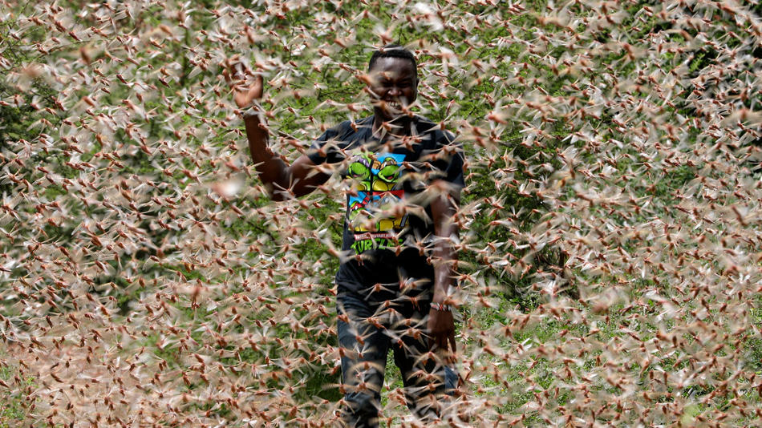
2020 Kenyan Locusts
A desert locust swarm in Kenya on Jan. 24, 2020.
Notes:
In 1937, aboard slowly-moving trains, the Army National Guard used flamethrowers in an attempt to quell a relentless plague of locusts crossing through Colorado.
But the flamethrowers failed. And so did explosives. The locusts easily endured, devouring farmland.
Over 80 years later, great locust swarms still can't be contained. Last week, the U.N. announced that desert locusts — the most devastating type — descended upon East Africa, and over the coming months the insects may increase their populations by a whopping 500-fold. "Kenya has not faced a locust threat of this magnitude in 70 years," the U.N. said.
Why today's biblical locust swarms can't be stopped
By Mark Kaufman Jan 28, 2020
https://mashable.com/article/locust-swarm-africa-explained/
Accessed 17 March 2020

Slide 30
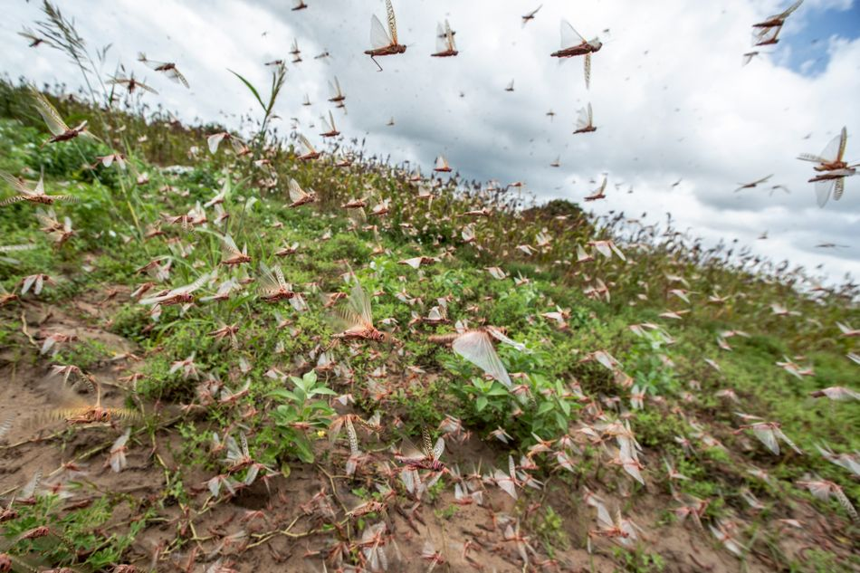
2020 Kenyan Locusts
Locust swarms in Kenya on Jan. 24.
Notes:
A single swarm of locusts, which are voracious grasshopper species that can spread over 460-square miles of land, have been a scourge — at least through the eyes of humans — for thousands of years. In more modern times, the British formed an anti-locust unit at the height of World War II to combat the pests in Africa and the Middle East, and a New York Times reporter pondered, in 1976, if "swarms that darken the sky" and "denude the land of crops" could be eliminated by progressing technology. Still today, the locust affliction continues.
"It's not surprising to me that we still don’t have a grip on this," said Iain Couzin, the director of the Max Planck Institute of Animal Behavior who researches locust swarms.
Today, the best humanity can do is try and predict where the swarms will form before a massive population outbreak can occur and ultimately consume vast tracts of crops, which are often rural people's sustenance. "You need to catch it early," said Rick Overson, the research coordinator at Arizona State University's Global Locust Initiative.
Locust swarms in Kenya on Jan. 24.
Image: Ben Curtis / AP / Shutterstock
Why today's biblical locust swarms can't be stopped
By Mark Kaufman Jan 28, 2020
https://mashable.com/article/locust-swarm-africa-explained/
Accessed 17 March 2020

Slide 31
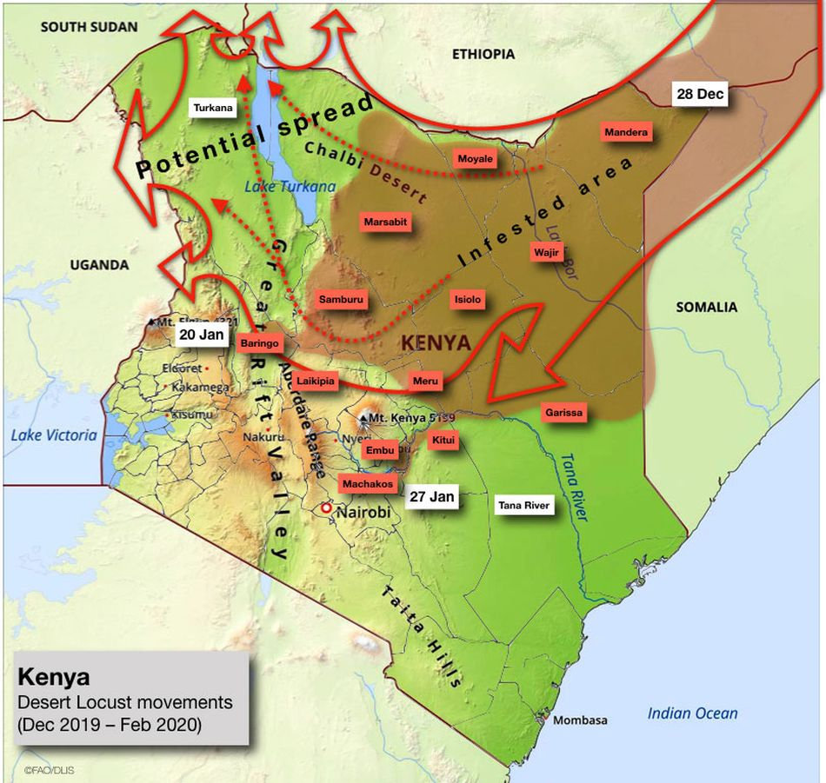
2020 Kenyan Locusts
Desert locust movements and prediction released on Jan. 28, 2020
Notes:
Once locusts grow wings as mature adults, there's no turning back. "They’re powerful fliers," said Overson. "They can be in one country and move to another by the end of the week." And "during plagues" of the desert locust, the U.N. notes swarms can "affect 20 percent of the Earth's land, more than 65 of the world's poorest countries, and potentially damage the livelihood of one-tenth of the world's population."
After an outbreak occurs or the swarming begins, the blunt strategy is often to drop millions of liters of chemical pesticides on the insects, which is bad for the environment and human health, Overson explained.
But identifying exactly where the locusts start to swarm can be enormously daunting, especially when it comes to desert locusts in Africa and neighboring areas, which naturally inhabit remote, mostly-uninhabited regions some 16 million square kilometers, or over 6 million square miles, in size. The creatures usually live solitary lives, but, when the right environmental conditions align (like after a good rainy season), the creatures become intensely attracted to each other, change color, and often grow longer wings and become more muscular. They transform into a formidable swarm.
"Locusts are highly cannibalistic" "We’re not going to solve this problem as a human society anytime soon," Overson said.
Critically, humanity shouldn't endeavor to completely wipe out locust swarms, just because their populations can explode. After all, locust swarms are wild, natural phenomena. Attempting to eliminate the insects, even if that were possible, could have unforeseen, cascading environmental consequences. "It's one of the wonders of the natural world," said Couzin."We don't want to stop them. We just want to manage them."
Why today's biblical locust swarms can't be stopped
By Mark Kaufman Jan 28, 2020
https://mashable.com/article/locust-swarm-africa-explained/
Accessed 17 March 2020

Slide 32
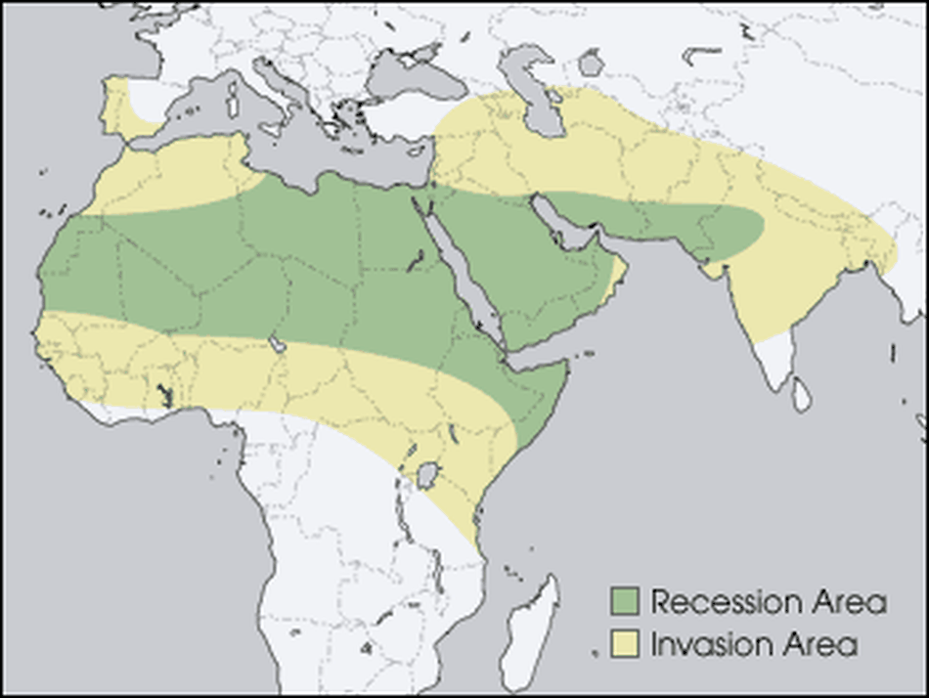
2020 Kenyan Locusts
The green "recession area" is where locusts naturally live, before swarming
Notes:
Locust swarms have similarities to wildfires, explained Overson. Sure, no one wants their house to burn down. But wide-scale suppression of wildfire, a natural phenomenon, has resulted in vastly overgrown forests, contributing to explosive infernos in the Western U.S. What might killing billions of locusts do? It's best not to find out.
To fend off some super-swarms from devouring human food, the primary mission today is prediction. The Food and Agricultural Organization of the United Nations currently strives to forecast the swarms. Where will the locusts strike? Locust populations can explode after the right rains, at the right times, or after mild winters, explained Overson.
But, there's a slew of other things to better account for stressed Couzin. "We’re at the tip of the iceberg of what we need to know" for better predictions, he said, like how billions of insects will react to changing weather, what there is to eat hundreds of miles ahead — and how much locusts will eat each other.
The green "recession area" is where locusts naturally live, before swarming.
Image: nasa
Why today's biblical locust swarms can't be stopped
By Mark Kaufman Jan 28, 2020
https://mashable.com/article/locust-swarm-africa-explained/
Accessed 17 March 2020

Slide 33
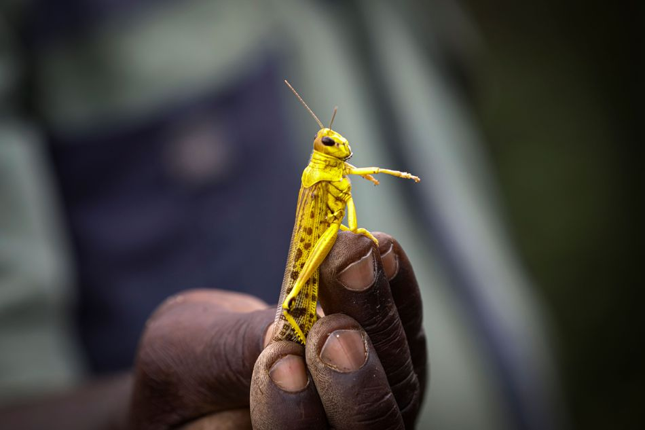
2020 Kenyan Locusts
A Kenyan farmer picks up a desert locust in Jan. 2020.
Notes:
Though locust swarms impact about one in 10 people on Earth, there's a glaring lack of funding for swarm research. In part, this is because the swarms exist in boom and bust cycles, so there might be less research interest in the years, or sometimes decades, between outbreaks. What's more, Couzin pointed out that locust swarms usually aren't descending upon the rich world. "It's affecting poor people," he said, so there's a lack of interest from wealthier nations.
Humanity, though, isn't a completely hapless observer as clouds of locusts come swarming from the horizon. It's quite likely civilization is giving these swarms a boost, both Couzin and Overson agreed.
"We’re trying to change the dogma that humans are passive victims of locust swarms," said Overson.
SEE ALSO: Why Australia won't escape its vicious fire spiral
We irrigate vast tracts of land, providing locusts with the carbohydrate-rich foods they (and we) love. Climate change might make swarms more extreme, as rainfall events become more intense on a warming planet, perhaps giving rise to swarms feeding on plentiful growth following deluges. These questions demand more research.
In the coming months, locusts in East Africa will devour plants and croplands before their food runs out and they fade away — until the next swarm. It's what they're destined to do.
"It's quite extraordinary," said Couzin. "The locusts have found this trick to survive in booms and busts."
"It works well for them," he added. "Unfortunately, it doesn't work well for us."
Why today's biblical locust swarms can't be stopped
By Mark Kaufman Jan 28, 2020
https://mashable.com/article/locust-swarm-africa-explained/
Accessed 17 March 2020

Slide 34
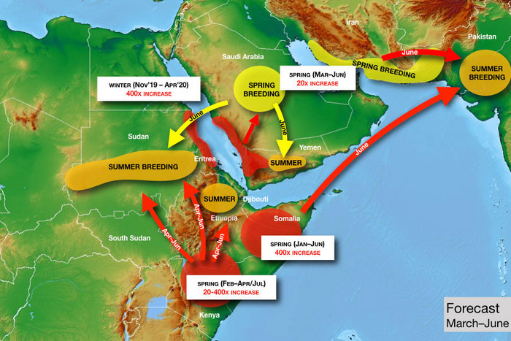
2020 Kenyan Locusts
Photo: United Nations
Notes:
just asking questions Mar. 14, 2020
So There’s a Locust Plague Too?
By Matt Stieb
A volunteer sprays pesticide in eastern Kenya — which is suffering from its worst locust outbreak in 70 years. Photo: Tony Karumba/AFP via Getty Images
It’d be easy to quip biblically about the simultaneous breakout of pandemic and plague if not for the vast human toll that the intercontinental crises are exacting. As the coronavirus continues to spread on six continents, a desert locust outbreak has inundated East Africa with hundreds of billions of bugs, causing food shortages in Kenya, Somalia, and Ethiopia. “It was like an umbrella had covered the sky,” Joseph Katone Leparole, a 68-year-old living in central Kenya, told the New York Times.
In our age of overlapping crises, it shouldn’t be a surprise that climate change can be identified as a factor in the upsurge, the technical term used for such a natural disaster that is just below plague. It began in 2018, when a pair of cyclones came in from the Indian Ocean and hit the “empty quarter” of the Arabian peninsula — the vast desert region near the borders of Saudi Arabia, Yemen, and Oman. In a speech before the African Union in February, U.N. general secretary António Guterres explained the unfortunate cycle: “Warmer seas mean more cyclones, generating the perfect breeding ground for locusts.”
“When you have rains associated with cyclones, they’re much stronger than normal,” said Keith Cressman, the senior locust-forecasting officer at the United Nations’ Food and Agriculture Organization. “When those rains fall in desert areas with sandy soil, that will flood the soil. Once those floods recede, the soil retains so much moisture that it allows desert locust females to lay their eggs probably for a period of around six months.”
From these ideal conditions, the bugs moved south into Yemen (already in a food crisis, Yemenis turned to them as a protein source) and into the Horn of Africa. The spread was rapid: A single locust can travel up to 90 miles in a day and eat its own weight in plant matter, of which there was a bounty, thanks to the excessive rains. They also turned north, across the Persian Gulf into Iran, and into India and Pakistan last summer. National emergencies have been declared in Pakistan, Jordan, and Somalia to help mobilize a response: The only effective control operation once a swarm is in motion is to spray pesticide directly on the bugs from the air.
To help understand the crisis, Intelligencer spoke with the FAO’s Cressman about some of the bugs’ idiosyncrasies and what to expect in the coming months.
Today Only! Save 60% on unlimited access to Intelligencer and everything else New York
LEARN MORE » The FAO projects that the number of locusts could grow 400 times by June if not treated. Could you break that down?
The life cycle of a locust is about three months, so after three months the adults are ready to lay eggs again. With each three-month generation, there’s a 20-fold increase in locust numbers. Locust females lay around 300 or more eggs — more than 90 percent of them die or the resulting hoppers don’t make it to adulthood. Out of all that breeding, for every single female locust there’s about 20 locusts in the new generation that make it. It’s an exponential increase, so after three months you have 20 times, after six months you have 20 squared, so that’s 400 times. After nine months, you’d have 20 cubed, which is 8,000 times. When you get that type of exponential breeding, then those locust numbers rapidly increase, and that’s how swarms form, basically.
So with these new generations, countries in East Africa that have already been inundated could face even more locusts?
Absolutely. There’s a generation in progress now and breeding in Ethiopia, Somalia, and in Kenya. Conditions will probably remain favorable there because of a cyclone in northeastern Somalia in December. Conditions are probably favorable in those three countries until June, so that will allow another generation to occur before then.
How are the outbreaks in Pakistan, Iran, and China connected to those in East Africa?
For China, it’s a completely different species — apples and oranges. But the one in Iran and Pakistan, yes. What’s going on now in Pakistan is old swarms leftover from last summer that have been slowly maturing and now they’re ready to lay eggs, not in the deserts on the border of India and Pakistan but in the desert closer to Iran and Afghanistan.
There’s an FAO map that shows them traveling directionally from the horn of Africa over Arabian sea. Can they travel over water?
No problem. In the late ’80s, they went from West Africa to the Caribbean. They crossed the Atlantic in about ten days.
Photo: United Nations
How does that work if there’s no food?
They eat a lot before or after! The way it worked crossing the Atlantic was, they had enough fuel in the tanks but still needed to rest sometimes, so they’d rest onboard ships, and then they’d take off again. If there weren’t any ships, they’d land on the surface of the ocean, and then a second swarm would come and land on top of the first swarm and rest, and the second swarm would take off and continue flying and the first swarm would drown.
My impression was that they choose to go where food is. Do they have choice as a unit where they’re going or is it randomized by wind?
They seem to decide whether they want to take off or fly with the prevailing wind or not, in which case they’ll sit on the ground. They can somehow sense winds when they come from different directions, but they can’t fly like birds against the wind. So they are a victim of the wind, but still they do control motion to an extent.
Without human intervention, how does a locust outbreak end?
There would have to be a failure of the seasonal rains — that’s usually how mother nature helps to bring these things under control. Sometimes the winds will push locusts into areas they just don’t want to be in. For instance, if they got pushed further into the Democratic Republic of the Congo or into cold areas where they would die, or areas that are very tropical where they would pick up a lot of pathogens and die. They’re very susceptible to funguses. Like those guys that got pushed across the Atlantic ocean in the ’80s, they died immediately when they landed.
What happens in a country like Iran where there’s a simultaneous outbreak of locusts and the coronavirus.
Fortunately, different parts of the government are responding, so the Ministry of Agriculture is dealing with locusts and the Ministry of Health has to deal with the coronavirus. The resources and manpower are in completely different sectors of the economy. But any additional challenges that a country faces, they can have impacts on the control operations, and they might not be as effective as hoped.
What about states in open conflict or with major security issues, like Yemen or Somalia?
Yemen is very critical because it’s a frontline country for desert locusts. Desert locusts are there every year, and there’s a number of different breeding areas along the coast in the wintertime in the interior. It’s a country that has a really spectacular habitat for desert locusts, and when it rains, those locusts take advantage of it.
That’s probably one of the reasons why the locust infestation shifted from the empty corridor in 2019 across to the Horn of Africa in the summer, because they stopped off in Yemen for a generation of breeding in the spring. Because of the conflict, there’s very little that can be done. It’s just not safe for the national locust teams to to operate throughout the country to undertake the survey for control operations. There are a few limited areas they can work in, but it simply isn’t enough.
Fortunately, in Somalia, the key locust breeding areas are in the north of the country, which is a region that’s much easier to operate in. It’s much safer, so national teams can get in there and do the survey and control operations. However, in the south and central parts of the country, it is much more challenging. Those parts of the country don’t see locusts often, maybe once every few decades, so they also have very little capacity.
What about in South Sudan, where there is already a food shortage?
The good news is, it’s not really their typical habitat. It’s not dry enough, and they don’t have so much sandy soil. It’s more of a clay soil, and there’s much more vegetation cover, so this makes it hard for the females to find bare, empty places to lay their eggs. And we’ve seen this with those locusts that got into northeastern Uganda and the southeast of South Sudan: They flew around, and the females became so desperate that they just kind of dropped their eggs on top of the soil, which means that they immediately dry out and die. Desert locusts don’t do this very often. These guys are masters of survival. They’re professionals, so this means that those females are really desperate. So probably South Sudan is much more of a transit zone. Later on in the spring, a new generation of swarms will likely form in northern Kenya. Once it drys out there, they will be moving back into Somalia, back into Ethiopia, and probably into north Sudan to get really into the Sahara and the deserts they prefer.
What’s the most effective form of prevention and treatment if an outbreak is already in motion?
When you have these cyclones, it comes back to climate change: We’re starting to see more patterns of severe weather, which means unusually heavy rainfall, cyclones,t hese things. You can’t prevent them really. So we’re going to have to develop better mechanisms to respond to them better. Basically it means that countries are going to have to be very well prepared. To visit a wildfire metaphor, you need to have a lot of good fire stations with well trained crews and fire trucks — it’s the same with desert locusts. You need to have a good national locust program that’s well-equipped, well-trained, well-funded so that they can respond to these situations. But it’s probably too idealist to think these nations are always going to have sufficient resources. At one point, it will probably overwhelm capacities — that’s what’s happened now in Kenya, Somalia, and Ethiopia. Then the international community has to step in.
The U.N. is calling for $138 million to mitigate the crisis. What does the allocation of that money look like?
Roughly, it’s about half for control operations — that’s upscaling the aerial control operations and getting in more aircraft, more ground logistical teams, supplemented by ground control like vehicles, sprayers, pesticide. The other half is basically to protect the livelihoods or to help those who have already been damaged to help them to recover. This can be seed packages to farmers if their initial crop has been lost. For pastures, it would be animal feed, because there’s a lot of pastoralists in the Horn of Africa who rely on pastures for their grazing animals.
What are the most concerning and the most hopeful aspects about the upsurge as it stands today?
The greatest concern is where it’s occurring, in the Horn of Africa — which is already extremely vulnerable to any slight disruption to food security and livelihood, simply because they’ve had a series of droughts in the past. Now they’ve got floods and heavy rains, and on top of that, locusts. No. 2 is that the swarms are in countries that either do not have very robust national programs or don’t have them at all. Kenya has seen locusts twice in the last 70 years — don’t expect it to have a strong locust program compared to a country that has to deal with locusts every year that’s much better.
Maybe the silver lining here is that they’re not going to stay in the Horn of Africa forever. Desert locusts are migratory in nature. When they move, they’ll move back north and into those countries where they are normally present — like Sudan, Eritrea, Saudi Arabia, Oman, Iran, Pakistan, India, and Egypt — and those countries have much stronger national programs to address them.
Sign Up for the Intelligencer Newsletter
intelligencer is a Vox Media Network. © 2020 Vox Media, Inc. All rights reserved.
https://nymag.com/intelligencer/2020/03/a-u-n-locust-forecaster-explains-the-crisis-in-east-africa.html
Accessed 17 March 2020

Slide 35
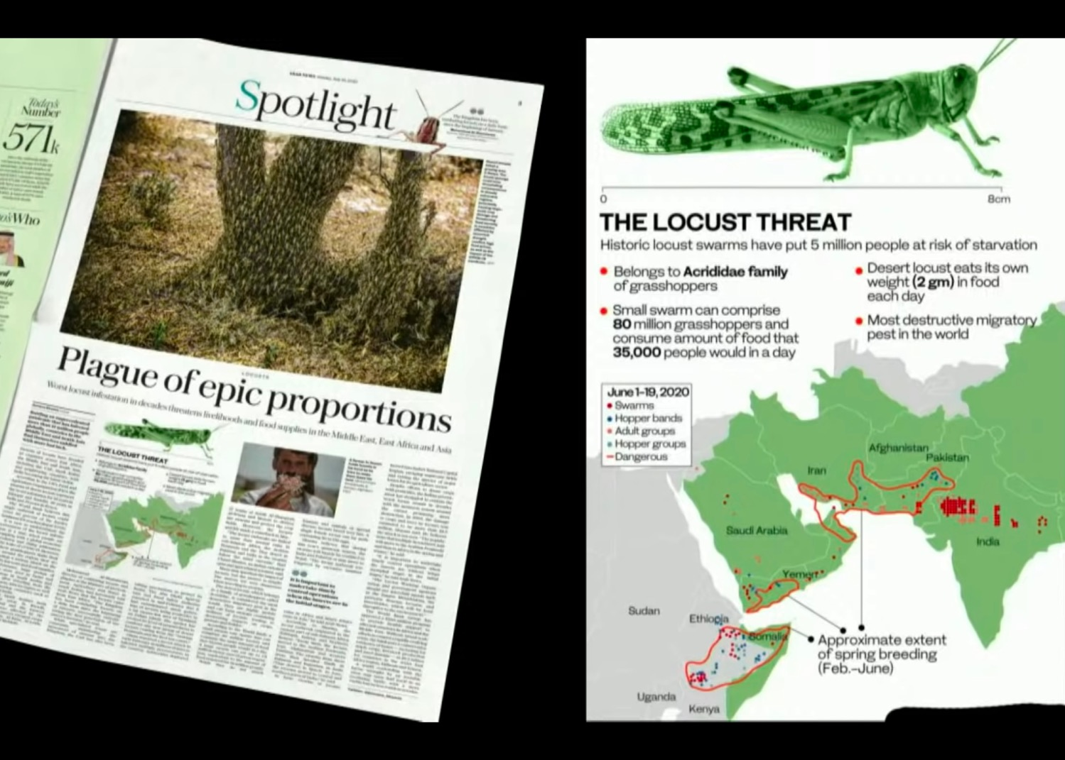
2020 Expanded Locusts

Slide 36
Be Disciplined
The Book of
Joel
Dr. Rick Griffith, Crossroads International Church Singapore
BibleStudyDownloads.org

Slide 37

Discipline
Notes:
Be disciplined or you will be disciplined.

Slide 38

Discipline
Notes:
This is true because any good leader disciplines those he cares about, and ultimately, God is the best disciplinarian.

Slide 39

Be disciplined or you will be disciplined.
Notes:
Which better describes your life now? Disciplining yourself or being disciplined by God?
If your experiences are sweet, thank God. Maybe you are disciplining yourself so God doesn’t have to get your attention. But if your experiences are sour, thank God also. Maybe this is just what you need for God to get your attention. Are you listening?

Slide 40
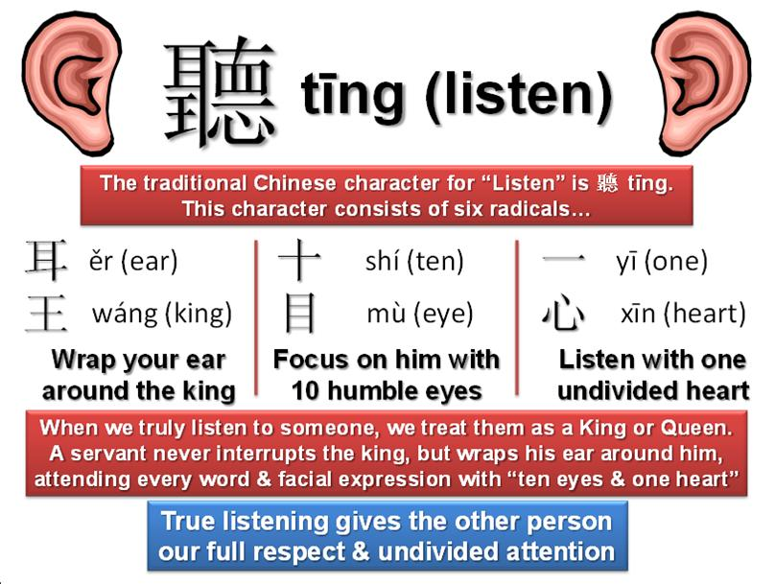
"Hear this, you leaders of the people.
Listen, all who live in the land"
(Joel 1:2a NLT).
The traditional Chinese character for "listen" consists of six radicals
When we truly listen to someone, we treat them as a king or queen. A servant never interrupts the king, but wraps his ear around him, attending every word & facial expression with "ten eyes & one heart"
True listening gives the other person our full respect and undivided attention.
Notes:
Are you really listening to what God is trying to tell you in your life?
Maybe he is trying to discipline you.

Slide 41
What should we do when we are disciplined?
Notes:
What should we do when we are disciplined?
Do you catch my double meaning here?

Slide 42

Background

Slide 43

"The LORD gave this message to Zephaniah when Josiah son of Amon was king of Judah.
Zephaniah was the son of Cushi, son of Gedaliah, son of Amariah, son of Hezekiah"
(Zephaniah 1:1 NLT).

Slide 44
Zephaniah was of Royal Birth!
238
Hezekiah
King of Judah
(Line of David)
Sons who Did Not Rule
Sons who Ruled
Manasseh
Amariah
Amon
Gedaliah
Josiah
Cushi
Zephaniah
Righteous in white; Godless in yellow

Slide 45
Placing the Prophets
Placing the Prophets
342
Key Dates
931
Obadiah
722
Jonah
Amos
Hosea
Isaiah
Micah
Nahum
Zephaniah
Joel
586
Notes:
Although I cannot be dogmatic about dating Joel, the best option is that Joel prophesied after the Babylonians took 10,000 people of Judah captive in 597 BC.
However, he doesn’t mention the fall of Jerusalem in 586 BC. Therefore, he seemed to have ministered during this 11-year period just after a locust invasion and drought.

Slide 46

"They threw dice to decide which of my people would be their slaves.
They traded boys to obtain prostitutes and sold girls for enough wine to get drunk"
(Joel 3:3 NLT).
Notes:
Ar

Slide 47
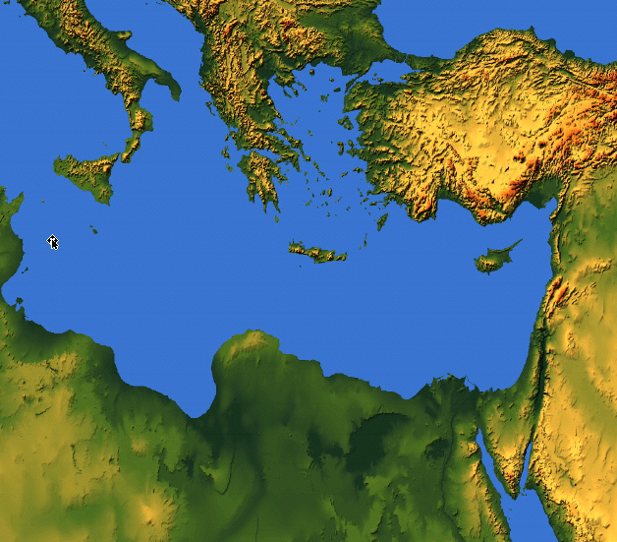

The Sale of Judeans to the Greeks
"What do you have against me, Tyre and Sidon and you cities of Philistia? Are you trying to take revenge on me? If you are, then watch out! I will strike swiftly and pay you back for everything you have done. ⁵You have taken my silver and gold and all my precious treasures, and have carried them off to your pagan temples" (Joel 3:4-5 NLT).
219
Sidon
Tyre
Judah
Philistia
Notes:
Joel also mentions selling people to Greeks, which also happened only after about 600 BC when Greece became strong.

Slide 48
The Sale of Judeans to the Greeks
"You have sold the people of Judah and Jerusalem to the Greeks, so they could take them far from their homeland"
(Joel 3:6 NLT).
219
Greeks
Sidon
Tyre
Greeks were not a strong power until around 600-500 BC so Joel probably has a later date
Judah
Philistia

Slide 49
Jerusalem's Fall
Jerusalem's Fall
232
342
560
Key Dates
627
Jeremiah
605
Daniel
597
Ezekiel
586
538
Zephaniah
Joel
630
Lamentations
Habakkuk
590
606
Notes:
In our study of the Minor Prophets we are now near the time of the destruction of Jerusalem in 586 BC under Nebuchadnezzar. This was one of the two key times the city was destroyed as God’s discipline of his wayward people.

Slide 50
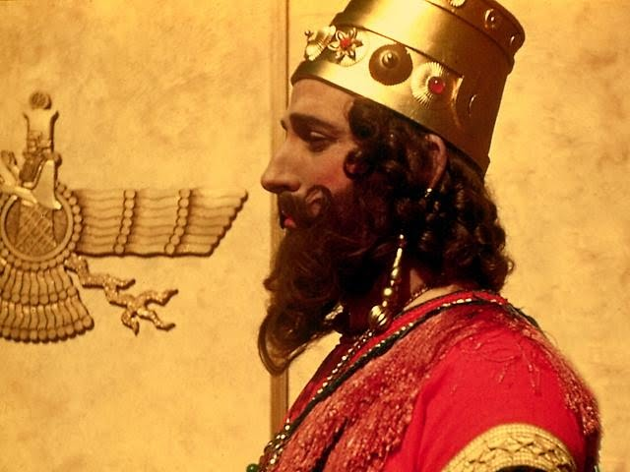
Joel Preached During King Nebuchadnezzar's Reign
Notes:
God's instrument of discipline was this pagan Babylonian king.

Slide 51

1. What to do now
2. How this will turn out
"TO DO" list for today
Notes:
Today we’ll see what to do about present difficulties, and then how these will all turn out in the end.

Slide 52
What should we do when we are disciplined?
Notes:
First, what should we do when we are disciplined?

Slide 53
I. Discipline should bring repentance.
Joel 1:1–2:17
Notes:
Times of difficulty are great times to change our perspective.

Slide 54
Joel
Devastation 1:1–2:17
Deliverance 2:18–3:21
Restoration 2:18-32
Blessing 3:17-21
Judgment 3:1-16
Disasters 1:1-20
Invasion 2:1-17
History
Prophecy
The Day of the LORD

Slide 55
Slides on
Joel 1

Slide 56

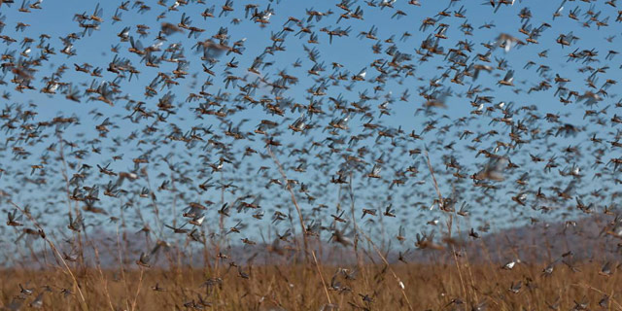
"Tell them about the locusts."
No king noted = no date noted
"The LORD gave this message to Joel son of Pethuel"
(Joel 1:1 NLT).
"OK."

Slide 57
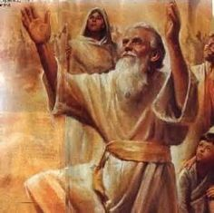
The Name "Joel" = LORD God
"Jo" = Jehovah = LORD
"El" = Elohim = God

Slide 58
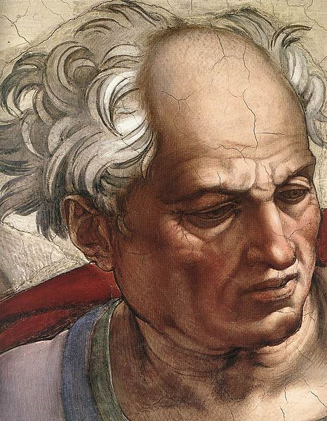
"Hear this, you leaders of the people.
Listen, all who live in the land. In all your history, has anything like this happened before?
³Tell your children about it in the years to come, and let your children tell their children.
Pass the story down from generation to generation"
(Joel 1:2-3 NLT).

Slide 59
Barry Huddleston, The Acrostic Summarized Bible (Grand Rapids: Baker, 1992)
Joel
1 Cry to avoid judgment
2 Return to God's blessing
3 Yield to God's sovereignty

Slide 60
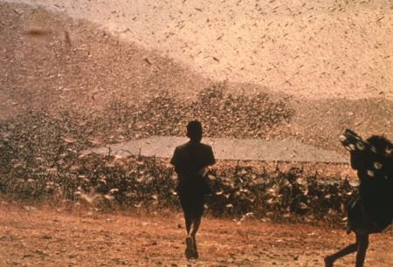
Date & Recipients
577
C. Date: late pre-exilic time period (between 597 and 586 BC).
D. Recipients: people in Judah due to many references to Zion and the Temple (1:9, 13-14; 2:15-17, 23, 32; 3:1, 5-6, 16-17, 20-21).

Slide 61
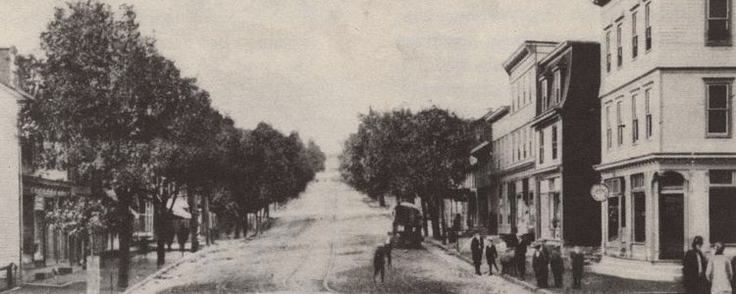
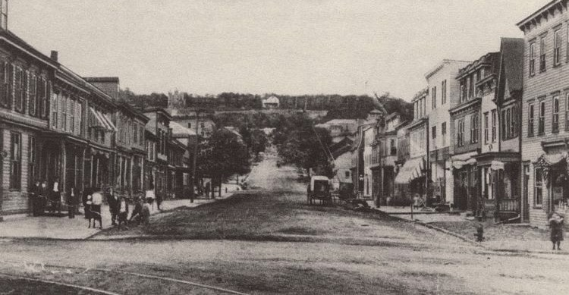
A Modern Locust Invasion
(Centralia, Pennsylvania, USA)
Before Locust Invasion
After Locust Invasion

Slide 62
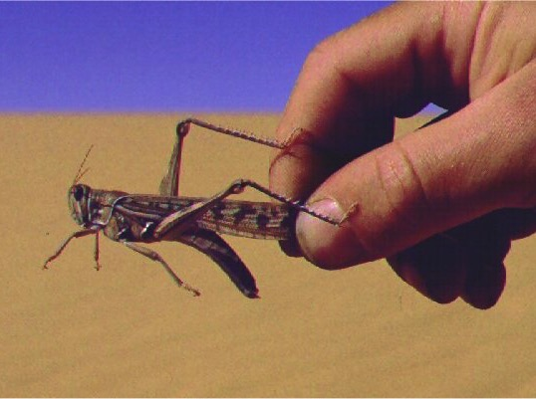
E. Occasion
577
A recent locust plague had invaded Judah

Slide 63
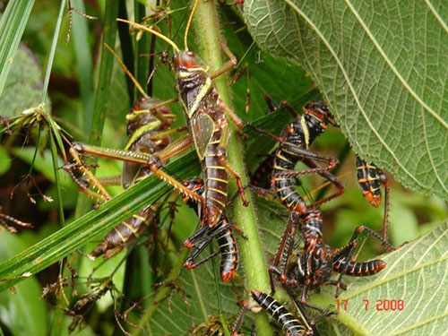
"After the cutting locusts finished eating the crops, the swarming locusts took what was left!
After them came the hopping locusts, and then the stripping locusts, too!"
(Joel 1:4 NLT).

Slide 64
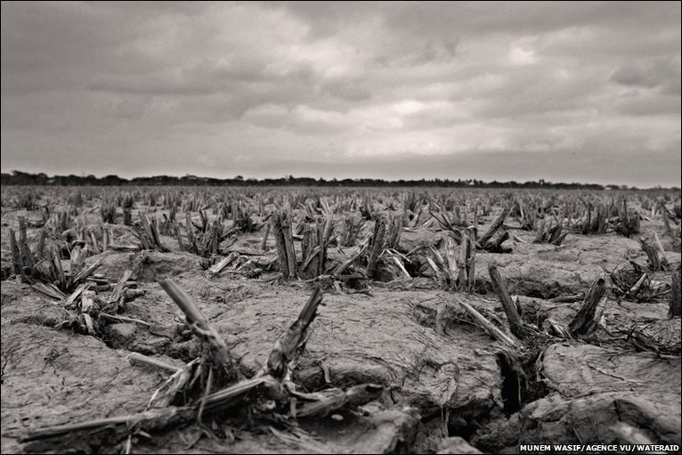
"Wake up, you drunkards, and weep!
Wail, all you wine-drinkers!
All the grapes are ruined, and all your sweet wine is gone"
(Joel 1:5 NLT).

Slide 65
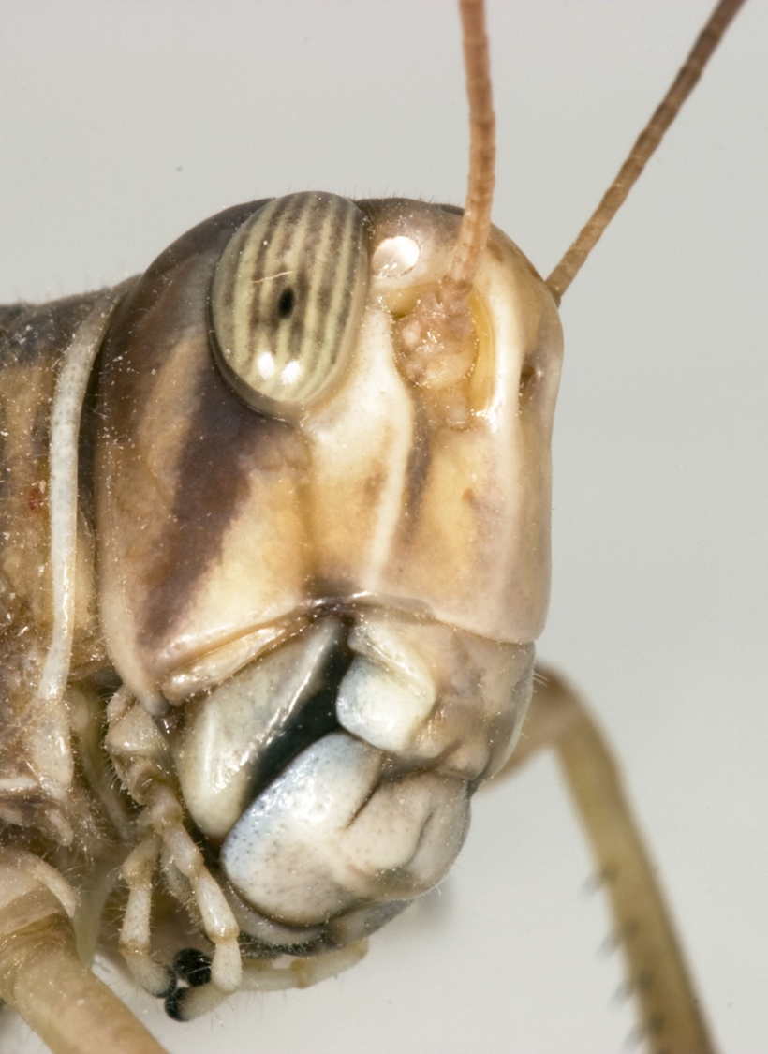
"A vast army of locusts has invaded my land, a terrible army too numerous to count.
Its teeth are like lions' teeth, its fangs like those of a lioness"
(Joel 1:6 NLT).

Slide 66
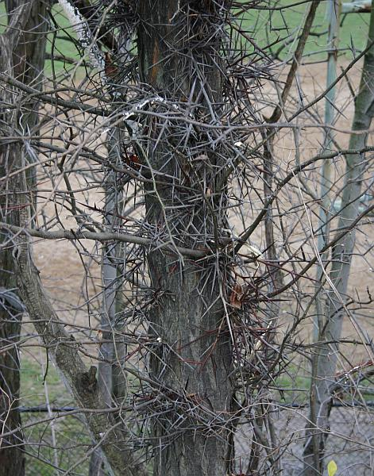
"It has destroyed my grapevines and ruined my fig trees, stripping their bark and destroying it, leaving the branches white and bare"
(Joel 1:7 NLT).

Slide 67
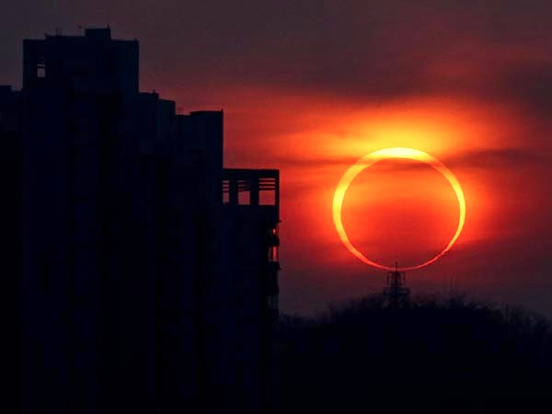
The Day of the LORD (Joel 1:15 NLT).
"The day of the LORD is near,
the day when destruction comes from the Almighty.
How terrible that day will be!"

Slide 68
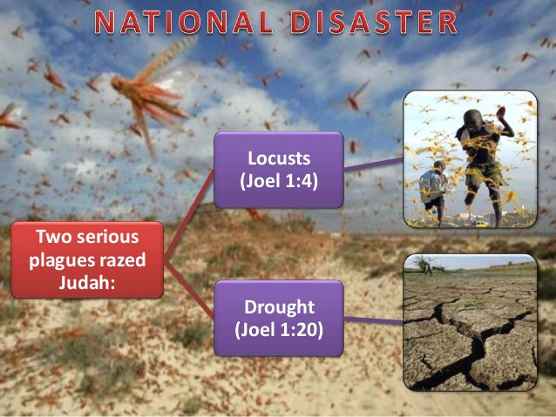
NATIONAL DISASTERS IN JOEL 1
Locusts
(Joel 1:4)
Two serious plagues razed Judah:
Drought
(Joel 1:20)

Slide 69
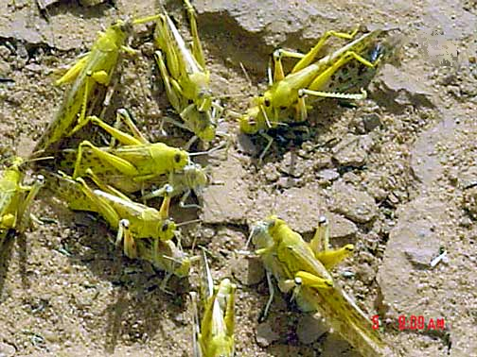
Mature adults copulating
Notes:
Mali: mature gregarious adults copulating (Tamesna, 11/03) http://www.fao.org/NEWS/GLOBAL/LOCUSTS/outbreakpix03.htm

Slide 70
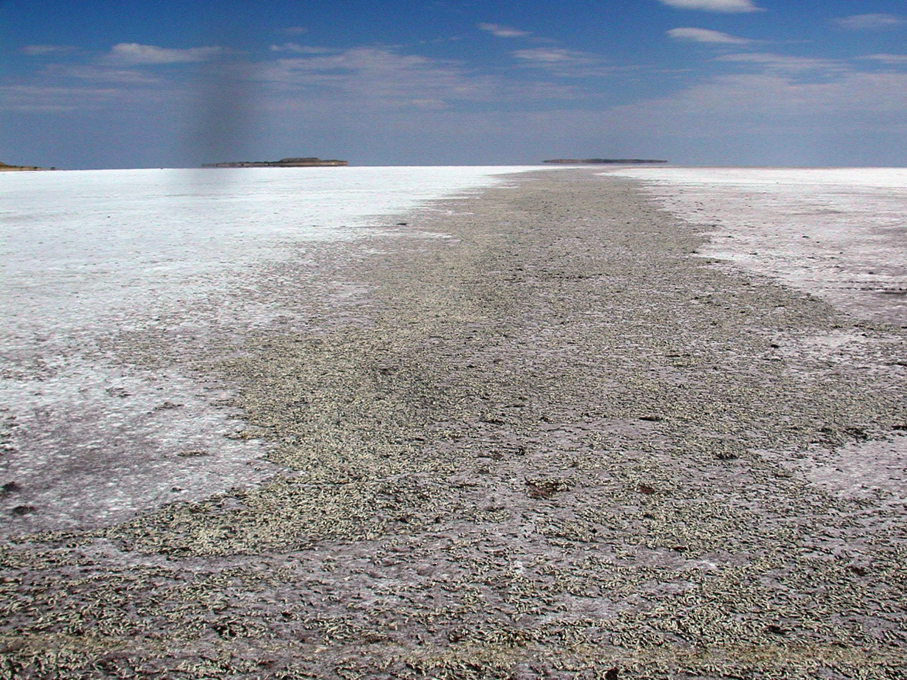
Locust Grave Yard, Salt Lake, Utah

Slide 71

Key Word
577
Locust

Slide 72
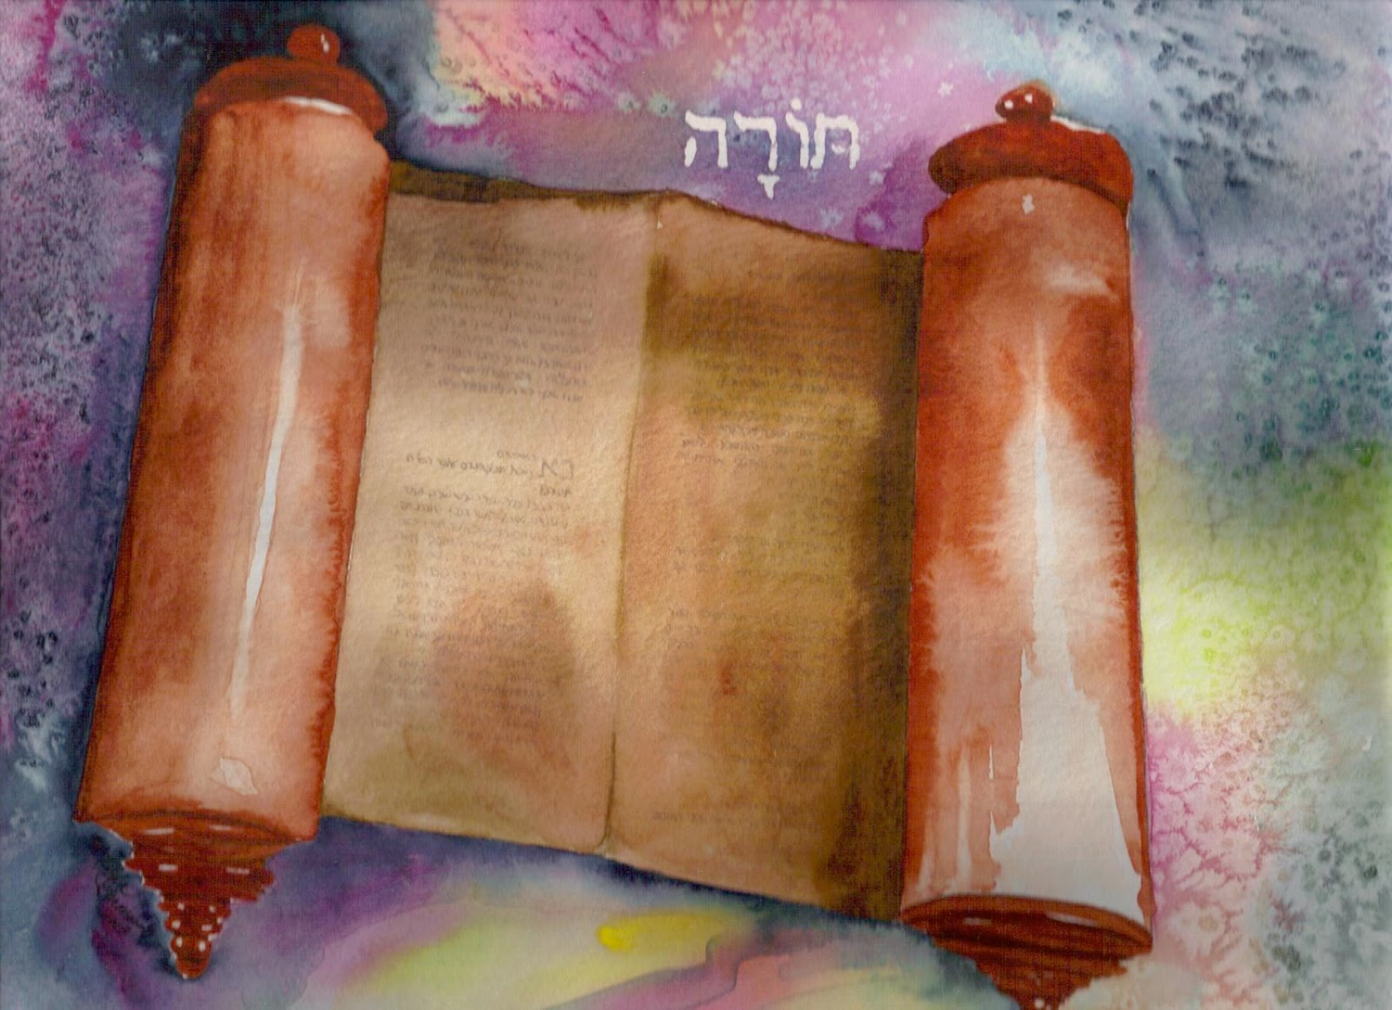
So what does the Torah say about locusts?

Slide 73
Blessings & Curses
577
154
220
Deut. 28
Your towns and your fields
will be blessed (3)
Your towns and your fields
will be cursed (16)
Your children and your crops
will be blessed (4)
Your children and your crops
will be cursed (17)
Your fruit baskets and bread-boards will be blessed (5)
Your fruit baskets and bread-boards will be cursed (18)
Wherever you go and whatever you do, you will be blessed (6)
Wherever you go and whatever you do, you will be cursed (19)
Your enemies will attack you from one direction, but they will scatter from you in seven! (7)
You will attack your enemies from one direction, but you will scatter from them in seven! (25)
You will lend to many nations, but you will never need to borrow from them (12)
They will lend to money to you, but you will not lend to them
(44)

Slide 74
Prophetic Curses
577
154
220
Why?
Exile
Deut. 28
Notes:
The curses of prophets like Joel are based on God's warnings to Israel hundreds of years earlier in Deut 28.

Slide 75
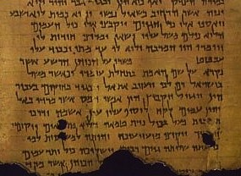
What Did a Locust Plague Mean?
577
NLT Deuteronomy 28:38 "You will plant much but harvest little, for locusts will eat your crops."

Slide 76
Slides on
Joel 2

Slide 77
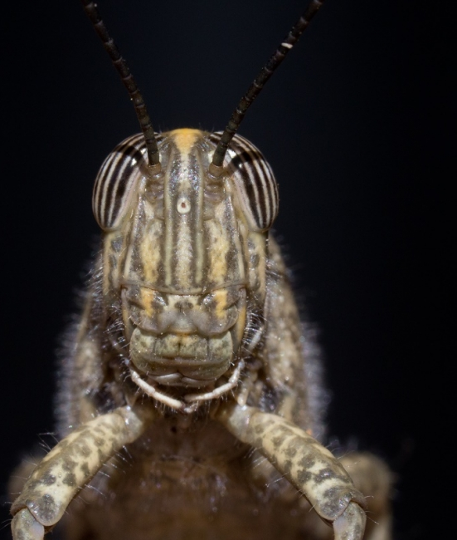
"Sound the alarm in Jerusalem!
Raise the battle cry on my holy mountain!
Let everyone tremble in fear because the day of the LORD is upon us" (Joel 2:1 NLT).

Slide 78
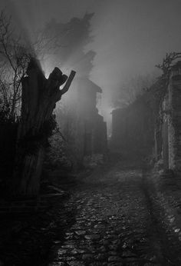
"[The day of the LORD]… is a day of darkness and gloom, a day of thick clouds and deep blackness.
Suddenly, like dawn spreading across the mountains, a great and mighty army appears.
Nothing like it has been seen before or will ever be seen again"
(Joel 2:2 NLT).

Slide 79
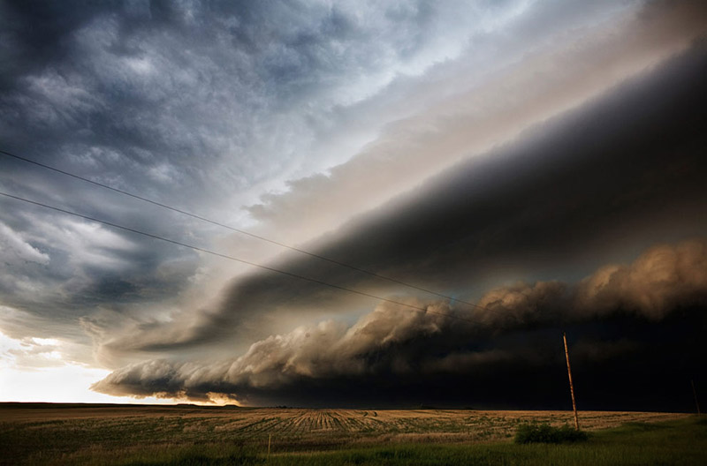
"Fire burns in front of them, and flames follow after them.
Ahead of them the land lies as beautiful as the Garden of Eden.
Behind them is nothing but desolation; not one thing escapes"
(Joel 2:3 NLT).

Slide 80
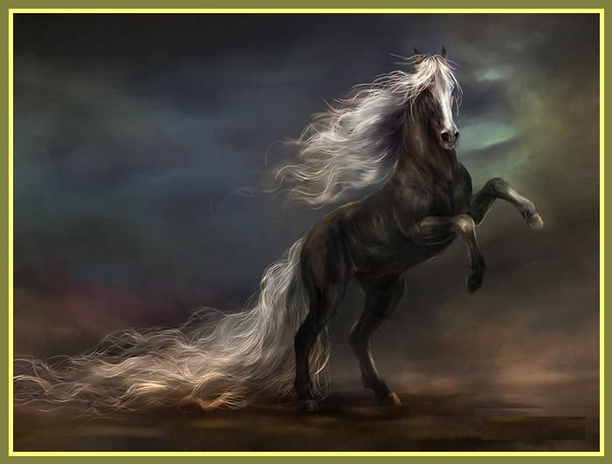
"They look like horses; they charge forward like war horses"
(Joel 2:4 NLT).

Slide 81
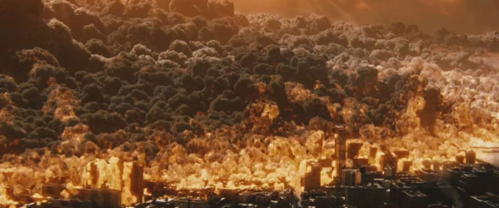
"Look at them as they leap along the mountaintops. Listen to the noise they make—like the rumbling of chariots, like the roar of fire sweeping across a field of stubble, or like a mighty army moving into battle"
(Joel 2:5 NLT).

Slide 82
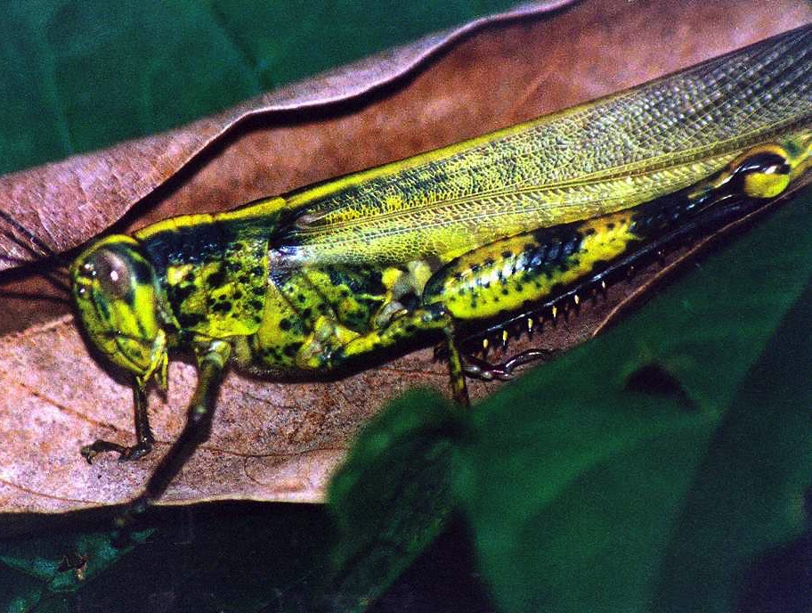
Key Verse
575
". . . The day of the LORD is great; it is dreadful. Who can endure it? 'Even now,' declares the LORD, 'return to me with all your heart, with fasting and weeping and mourning" (Joel 2:11b-12)

Slide 83
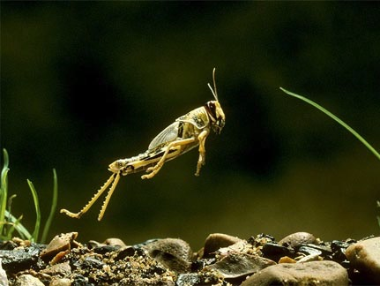
What are the "locusts" of Joel 2:1-11?
578
Both Locusts and Armies?
Supernatural Creatures?
Literal Locusts?
Figurative of One Army?
Figurative of Many Armies?
Notes:
Desert leaping locust

Slide 84
Joel
Devastation 1:1–2:17
Deliverance 2:18–3:21
Restoration 2:18-32
Blessing 3:17-21
Judgment 3:1-16
Disasters 1:1-20
Invasion 2:1-17
History
Prophecy
The Day of the LORD

Slide 85
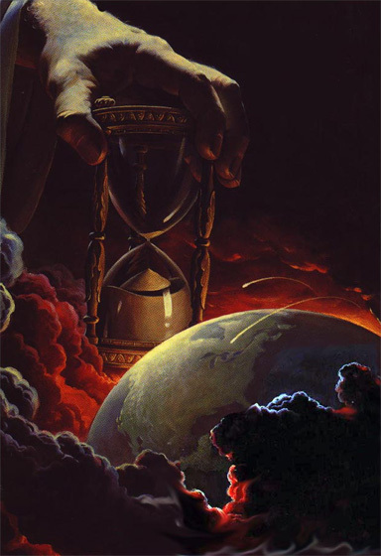
Why Future?
578
1. Imagery heightened: earthquake, signs in skies (Joel 2:10, 30-31; Matt. 24:29)

Slide 86

Why Future?
578
1. Imagery heightened: earthquake, signs in skies (Joel 2:10, 30-31; Matt. 24:29)
2. "Army" (Joel 2:2, 11)

Slide 87
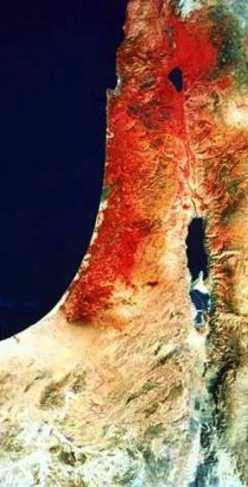
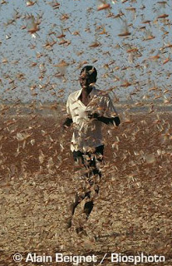
Why Future?
578
1. Imagery heightened: earthquake, signs in skies (Joel 2:10, 30-31; Matt. 24:29)
2. "Army" (Joel 2:2, 11)
3. Locusts never invade from the north like this "army"
(Joel 2:20)
4. The "northern one" (Joel 2:20) matches eschatological enemies invading from the north (Zech. 6:8, etc.)

Slide 88

Judgment!

Slide 89

Blessing!

Slide 90


The Day of the LORD
638-639
Judgment
+
Blessing
Tribulation
Millennium
Rev. 6–19
Rev. 20
7 years
1000 years

Slide 91
A Dispensational Timeline
437
Great
White
Throne
(Rev. 20:11-14)
Rapture
(1 Thess. 4:13-18)
2nd Advent
(Zech. 14:3-5)
Day of the LORD
Church Age
Tribulation
(Zech. 14:1-2)
Millennium
(Zech. 14:6-21)
Gog & Magog
(Armageddon)
(Ezek. 38–39)
Gog and Magog
Revisited
(Rev. 20:7-10)
Notes:
91

Slide 92
What to do?
"'Even now,' declares the LORD,
'return to me with all your heart, with fasting and weeping and mourning.'
Rend your heart and not your garments. Return to the LORD your God, for he is gracious and compassionate, slow to anger and abounding in love, and he relents from sending calamity"
(Joel 2:12-13 NIV).

Slide 93

Do you reject God's discipline?
Notes:
God’s disciplining us should motivate us to seek the Lord.

Slide 94

God & the USA
Notes:
The moral height of the USA was in the 1950s. The USA rebuilt its former enemies Japan and Germany, adopted “In God We Trust” as the national motto, and began to see many turn to Christ under Billy Graham as well send out missionaries to the nations.
Home > 2015 > July
Jul 3, 2015
God and Country: Americans' Views of God's 'Relationship' with the U.S
What do Americans think about the United States and God? Fascinating new data. |
Ed Stetzer
http://www.christianitytoday.com/edstetzer/2015/july/god-and-country-new-research-on-americans-views-of-country.html
Accessed 9 April 2017
Happy Fourth of July weekend folks, my American readers!
Two hundred thirty-nine years ago tomorrow, Congress adopted the Declaration of Independence, nearly a month before it would eventually be signed. I hope you're having a fun weekend, getting to enjoy some time with family and friends.
As I explained in a post last year:
Christians are, in a sense, dual citizens-- of the Kingdom and of the nation where they live. I live in a country that is not without fault, but I am proud to be a citizen of that nation. I teach my children to be proud of their nation-- not unaware of its challenges-- and patriotic citizens.
Just this week, LifeWay Research released some new data on how Americans view their country and how God relates with it. Here's an excerpt from our report:
In a nation founded on religious liberty, most Americans believe God has a special relationship with the United States, and they’re optimistic the best is yet to come.
Despite headlines lamenting the global decline of the United States since the Cold War, 54 percent of Americans believe the nation is on the upswing, according to a September survey by LifeWay Research. Only 4 in 10 think “America’s best days are behind us.”
And though the U.S. Constitution makes no mention of God, 53 percent of Americans say they believe God and the nation have a special relationship, a concept stretching back to Pilgrim days. Even a third of atheists, agnostics, and those with no religious preference believe America has a special relationship with God.
“‘God Bless America’ is more than a song or a prayer for many Americans,” said Ed Stetzer, executive director of LifeWay Research. “It is a belief that God has blessed America beyond what is typical for nations throughout history. I am sure that would spawn many theological conversations, but it’s important to note most Americans think God has a special relationship with their country.”
Christianity Today reported on the data, and added additional research, in their article, "God and America: It's Complicated," explaining, "A third of Americans say the United States is a Christian nation. But more than half say the country has a special relationship with the Almighty."
Christianity Today also included a link to my post providing cautions about combining patriotism and worship, where I explained the importance of patriotism (and not just in the U.S.), but also cautioned, "If your church service was driven more by America than by Jesus, I think you need a change."
Here are a couple of the graphs depicting the major findings:
One of the most interesting parts of the survey was the gender divide among the views:
Women are significantly more likely than men to believe God has a special relationship with the United States. While 49 percent of men have that view, the number rises to 58 percent for women.
LifeWay Research also found differences by age, race, geography, education, and religious preference.
Nearly two-thirds (63 percent) of Americans 45-54 years old think God has a special relationship with the United States, a belief shared by 48 percent of those 18-44.
Belief in a special relationship is also high among:
African-Americans, at 62 percent, compared to whites at 51 percent. Southerners, at 59 percent, compared to 49 percent of Midwesterners and 50 percent of Westerners. Those with a high school degree or less, at 66 percent. For those with some college, the rate drops to 51 percent. It drops further to 40 percent of those with a bachelor’s degree and 29 percent of those with a graduate degree. Evangelical Christians are the most likely to believe in a special relationship, with 67 percent agreeing. Among evangelicals 45 and older, the share soars to 71 percent.
“Americans, particularly those in more religious segments or geography, are most likely to believe in this special relationship,” Stetzer said. “But, considering the history of the nation, from Manifest Destiny to Ronald Reagan’s ‘City on a Hill’ speech, it’s not surprising this long-held theme continues today.”
A lot of this, of course, is rooted in our sense of American exceptionalism. Here's a bit on that from our report, including a thought from me:
Both ends of the political spectrum—from President Obama to the Republican Party platform—have touted American exceptionalism, the belief that the United States plays a unique role in human history. For some, the concept includes the idea of a special relationship with God, although beliefs about the nature of the relationship vary.
“Some Christians view America as an archetype of biblical Israel, chosen and uniquely blessed by God,” Stetzer said. “That’s why Christians sometimes speak of God ‘healing our land,’ when most theologians say this American ‘land’ is not in the same category as the ‘land’ of biblical Israel.”
What do you think? Is America exceptional? Does God have a special relationship with the United States? Comment below.
Click here to see the full research report.
Support our work. Subscribe to CT and get one year free.

Slide 95

God's Discipline of the USA
Notes:
But the 1960s became a turning point: corporations wanting to prolong the Vietnam War to make more money off it, making it illegal to pray and read the Bible in schools, chaos in the many riots, and assassinations of key leaders like John F Kenney and Martin Luther King.
The last straw was America turning its back on Israel in recent years, even sponsoring a conference against Israel in January 2017 a week before the change of power in Washington.

Slide 96

God's Discipline of the USA
THE PROBLEM IS NOT GUNS!
It is hearts without God, homes without discipline, schools without prayer, and courts without justice.
Notes:
As a result, the USA has been in horrible disarray: 78 million abortions, half of births to unwed mothers, 110 million people with STDs, disrespect around the world, involved in the longest war in US history in Afghanistan and Iraq, etc.
The USA has been under the disciplining hand of God in order that the country might turn back to him.

Slide 97

Discipline of Individuals
The Dept. of Lessons Learned
The Dept. of Lessons Re-Learned
The Dept. of…Oh, for Crying Out Loud!
Notes:
Some of us could share our stories.
Some have played with sin until we finally got disgusted with ourselves.
Others of us have become complacent so that we hardly give God a thought until Sunday.

Slide 98

I DON’T MAKE EXCUSES
I MAKE RESULTS
Notes:
The result? We lack love, joy, peace, patience, kindness, goodness, faithfulness, gentleness and self-control. How could we expect the fruit of the Spirit without being controlled by the Spirit?
God is calling us to repentance—a change of mind in whom we trust. He also wants to see in us the fruits of repentance—a change of actions that reveal we really did change our mind.

Slide 99
I. Discipline should bring repentance.
Joel 1:1–2:17
Notes:
Times of difficulty are great times to change our perspective.

Slide 100
II. Repentance will bring restoration.
Joel 2:18–3:21
Notes:
Changing our minds about God leads to changing our future.

Slide 101
Joel
Devastation 1:1–2:17
Deliverance 2:18–3:21
Restoration 2:18-32
Blessing 3:17-21
Judgment 3:1-16
Disasters 1:1-20
Invasion 2:1-17
History
Prophecy
The Day of the LORD

Slide 102

Israel’s repentance will bring forgiveness, deliverance and restoration (Joel 2:18–3:21).

Slide 103


"Then the LORD will pity his people and jealously guard the honor of his land. ¹⁹The LORD will reply, 'Look! I am sending you grain and new wine and olive oil, enough to satisfy your needs. You will no longer be an object of mockery among the surrounding nations'"
(Joel 2:18-19 NLT).
Notes:
Israel’s repentance will bring forgiveness and blessing (2:18-27).

Slide 104
God's Future Protection of Israel
219
"'I will drive away these armies from the north. I will send them into the parched wastelands. Those in the front will be driven into the Dead Sea, and those at the rear into the Mediterranean.
The stench of their rotting bodies will rise over the land.'
Surely the Lord has done great things!"
(Joel 2:20 NLT).
The North
Israel

Slide 105
Contrasting Joel 1 and 2:21-27
582
Adapted from an Anonymous Handout (Dallas Seminary, 1985)
 | In Joel’s Day | In the Day of the LORD
Land | Mourned (1:10) | Will rejoice and be glad (2:21)
Animals | Groaned, wandered, were hungry (1:18) | Will not be afraid (2:22a)
Fields & Orchards | Were barren & nonproductive (1:7, 10-12) | Will grow and be fruitful and productive (2:22)
Rain | Drought with dryness causing fire (1:20) | Will pour down in abundance (2:23)
Grain, Wine, Oil | Ruined and dried (1:10) | Will be plentiful (2:24)
Crops | Damaged by locusts (1:4) | Damage will be replaced with productivity (2:25-26)

Slide 106


Land Contrasts in Joel 2:21-27
582
Mourned
"...The land mourns…"
(Joel 1:10 NAU).
Will be glad
"Do not fear, O land, rejoice and be glad,
For the LORD has done great things" (Joel 2:21 NAU).

Slide 107


Animal Contrasts in Joel 2:21-27
582
Groaned, wandered, hungry
"How the animals moan with hunger! The herds of cattle wander about confused, because they have no pasture. The flocks of sheep and goats bleat in misery" (Joel 1:18 NLT).
Will not be afraid
"Don't be afraid, you animals of the field, for the wilderness pastures will soon be green"
(Joel 2:22a NLT).

Slide 108


Fields Contrasts in Joel 2:21-27
582
Barren and unproductive
"It has destroyed my grapevines and ruined my fig trees, stripping their bark and destroying it, leaving the branches white and bare" (Joel 1:7; cf. 1:10-12 NLT).
Will grow…fruitful and productive
"The trees will again be filled with fruit; fig trees and grapevines will be loaded down once more" (Joel 2:22b NLT).

Slide 109


Rain Contrasts in Joel 2:21-27
582
Drought (dryness caused fire)
"Even the wild animals cry out to you because the streams have dried up, and fire has consumed the wilderness pastures"
(Joel 1:20 NLT).
Will pour down in abundance
"Rejoice, you people of Jerusalem! Rejoice in the LORD your God! For the rain he sends demonstrates his faithfulness" (Joel 2:23 NLT).

Slide 110


Grain, Wine & Oil in Joel 2:21-27
582
Ruined and dried
"The fields are ruined, the land is stripped bare. The grain is destroyed, the grapes have shriveled, and the olive oil is gone"
(Joel 1:10 NLT).
Will be plentiful
"The threshing floors will again be piled high with grain, and the presses will overflow with new wine and olive oil"
(Joel 2:24 NLT).

Slide 111


Crop Contrasts in Joel 2:21-27
582
Damaged by locusts
"After the cutting locusts finished eating the crops, the swarming locusts took what was left! After them came the hopping locusts, and then the stripping locusts, too!" (Joel 1:4 NLT).
Productive
"The LORD says, 'I will give you back what you lost to the swarming locusts, the hopping locusts, the stripping locusts, and the cutting locusts. It was I who sent this great destroying army against you…"
(Joel 2:25-26 NLT).

Slide 112

Eschatological Terms in Joel
Sanctify…proclaim (1:14; 3:9)
For the Day of Yahweh is close (1:15; 2:12; 3:14)
Yahweh's Day is coming (2:1; 2:31)
Darkness (2:2; 2:31)
An escape (2:3; 2:32)
Heavens and earth quake (2:10; 3:16)
Darkening of sun, moon, stars (2:10; 3:15)
Yahweh utters his voice (2:11; 3:16)
Yahweh's Day, great and fearful (2:11; 2:31)
Gather (2:16; 3:2)
My people and my heritage (2:17; 3:2)

Slide 113

Joel 2:28-29 in Acts 2:16-21
579
"This is that which was spoken by the prophet Joel…"
(Acts 2:16)
Notes:
In the day of the LORD, God will send the indwelling of the Spirit upon all Jews and celestial signs [when the Jewish nation repents at the return of Christ] (Joel 2:28-32).

Slide 114

Joel 2:28-29; Acts 2:17-18 NLT
"Then, after doing all those things, I will pour out my Spirit upon all people. Your sons and daughters will prophesy. Your old men will dream dreams, and your young men will see visions.
²⁹In those days I will pour out my Spirit even on servants—men and women alike."
579

Slide 115

Joel 2:28-29 in the NT (cf. Acts 2)
579
Some say this means "All the LORD's people would be prophets"—but is this what Joel said?
No, he said only many types of prophets would exist.

Slide 116

Joel 2:30-31; Acts 2:19-20 NLT
"And I will cause wonders in the heavens and on the earth—blood and fire and columns of smoke.
³¹The sun will become dark, and the moon will turn blood red before that great and terrible day of the LORD arrives."
579
Notes:
God notes these phenomena in the skies which were NOT at Pentecost in Acts 2. This clues us in that only the first part of the prophecy was fulfilled then in the outpouring of the Spirit. The rest will be fulfilled when Christ returns and the “terrible day of the LORD arrives.”

Slide 117
Joel 2:32; Acts 2:21 NLT
"But everyone who calls on the name of the LORD will be saved, for some on Mount Zion in Jerusalem will escape, just as the LORD has said. These will be among the survivors whom the LORD has called."
579

Slide 118

IV. Problems
5 Views of Joel 2:28-32 Fulfillment:
Termination at Pentecost
Fulfillment at Pentecost
Non-fulfillment or Eschatological view
Typical Fulfillment view
Continuous Fulfillment view

Slide 119

The Gospel is for the
Whole World
“The Spirit of Christ is the spirit of missions, and the nearer we get to Him, the more intensely missionary we must become.”
—Henry Martyn—
Notes:
“Another reason for this gift of tongues was to let the people know that the Gospel was for the whole world. God wants to speak to every person in his or her own language and give the saving message of salvation in Jesus Christ. The emphasis in the Book of Acts is on worldwide evangelization, ‘unto the uttermost part of the earth’ (Acts 1:8). ‘The Spirit of Christ is the spirit of missions,’ said Henry Martyn, ‘and the nearer we get to Him, the more intensely missionary we must become’” (Wiersbe, BEC).

Slide 120


Slide 121


This Photo by Unknown Author is licensed under CC BY-SA
This Photo by Unknown Author is licensed under CC BY

Slide 122
Slides on
Joel 3
Notes:
When God restores Israel as a nation He will judge the nations for abusing Judah (3:1-16).

Slide 123

"'At the time of those events,' says the LORD,
'when I restore the prosperity of Judah and Jerusalem,
²I will gather the armies of the world into the valley of Jehoshaphat'"
(Joel 3:1-2a NLT).

Slide 124



"There I will judge them for harming my people, my special possession, for scattering my people among the nations, and for dividing up my land"
(Joel 3:2b NLT).
Haifa
Tel Aviv
PALESTINE
I S R A E L
Jerusalem
PALESTINE
EGYPT
Negev
Desert
JORDAN
Notes:
This verse teaches that, at the return of Christ when the prosperity of Israel is restored and the nations judged (Joel 3:1-2a), Gentile armies will be judged for three crimes:
Harming Israel
Scattering Jews among the nations, and
Dividing Israel into various parts.
The 2020 peace accords between Israel and Bahrain and between Israel and UAE were accomplished on the condition that Israel keep the land divided among Israel and the Palestinians.

Slide 125

6th Grade Map Test
(Curriculum of UN Rights Watch Association, 2021)
Notes:
Notice how the word "Israel" does not even appear on this UN Map test.

Slide 126

Types of Unconditional Covenants
60
Abrahamic
Land
Davidic
New
Land | Seed | Blessing
Physical | Political | Spiritual
Deut. 30 | 2 Sam. 7 | Jer. 31
Notes:
OS-10-2Sam-93
OS-29-Joel-122

Slide 127

Covenants of Promise
BLESSING
Walt Russell, Playing with Fire, p. 121
Amplified by
Abrahamic
Davidic
Administrative Covenants
How to experience the blessing
Mosaic Israel's terms of obedience
Superseded by
New Terms of obedience under Messiah
Walt Russell, Playing with Fire
Notes:
OS-12-2Sam-79
OS-29-Joel-123

Slide 128
"They threw dice to decide which of my people would be their slaves.
They traded boys to obtain prostitutes and sold girls for enough wine to get drunk"
(Joel 3:3 NLT).

Slide 129
Tyre & Sidon to be Judged
"What do you have against me, Tyre and Sidon and you cities of Philistia? Are you trying to take revenge on me? If you are, then watch out! I will strike swiftly and pay you back for everything you have done. ⁵You have taken my silver and gold and all my precious treasures, and have carried them off to your pagan temples" (Joel 3:4-5 NLT).
219
Sidon
Tyre
Judah
Philistia

Slide 130
The Sale of Judeans to the Greeks
"You have sold the people of Judah and Jerusalem to the Greeks, so they could take them far from their homeland"
(Joel 3:6 NLT).
219
Greeks
Sidon
Tyre
Judah
Philistia

Slide 131
The Restoration of Judah
"But I will bring them back from all the places to which you sold them, and I will pay you back for everything you have done. ⁸I will sell your sons and daughters to the people of Judah, and they will sell them to the people of Arabia, a nation far away. I, the LORD, have spoken!"
(Joel 3:7-8 NLT).
219
Greeks
Sidon
Tyre
Judah
Arabia

Slide 132

"Say to the nations far and wide:
'Get ready for war!
Call out your best warriors.
Let all your fighting men advance for the attack.
¹⁰Hammer your plowshares into swords
and your pruning hooks into spears.
Train even your weaklings to be warriors.
¹¹Come quickly, all you nations everywhere.
Gather together in the valley.'
And now, O LORD, call out your warriors!"
(Joel 3:9-11 NLT).

Slide 133

"Let the nations be called to arms.
Let them march to the valley of Jehoshaphat.
There I, the LORD, will sit to pronounce judgment on them all.
¹³Swing the sickle, for the harvest is ripe.
Come, tread the grapes, for the winepress is full.
The storage vats are overflowing with the wickedness of these people"
(Joel 3:12-13 NLT).

Slide 134

"Thousands upon thousands are waiting in the valley of decision.
There the day of the LORD will soon arrive.
¹⁵The sun and moon will grow dark, and the stars will no longer shine"
(Joel 3:14-15 NLT).

Slide 135

"The LORD's voice will roar from Zion and thunder from Jerusalem, and the heavens and the earth will shake.
But the LORD will be a refuge for his people, a strong fortress for the people of Israel"
(Joel 3:16 NLT).

Slide 136

"Then you will know that I, the LORD your God, live in Zion, my holy mountain.
Jerusalem will be holy forever, and foreign armies will never conquer her again"
(Joel 3:17 NLT).

Slide 137

Israel’s Prosperity
"In that day the mountains will drip with sweet wine,
and the hills will flow with milk.
Water will fill the streambeds of Judah,
and a fountain will burst forth from the LORD's Temple,
watering the arid valley of acacias"
(Joel 3:18 NLT).

Slide 138

The River from Ezekiel's Temple
(47:1-12)

Slide 139

The River & the Land (Ezekiel 47:1)
519
The river that starts on the south side of the temple entrance
Wayne ODonnell • "Ezekiel 40–48: Tour of Ezekiel's Temple" • http://bible.ag/en/enezekieltranscript.htm
Notes:
"Ezekiel 47-48. The River and the Land
See Picture #32. The river that starts on the south side of the temple entrance.
Ezekiel 47:1, "Afterward he brought me again unto the door of the house," the temple, "and, behold, waters issued out from under the threshold of the house eastward: for the forefront of the house stood toward the east, and the waters came down from under from the right side of the house, at the south side of the altar." Picture #32 shows a trickle of water flowing from south side of the threshold of the temple. "The right side of the house" is the south side, since the temple faces east."
Wayne ODonnell, "Ezekiel 40–48: Tour of Ezekiel's Temple"
http://bible.ag/en/mr4web.html#EZanchor-anchor
Recorded December 30, 2007
Accessed 30 Aug 2016

Slide 140

The Beginning of the River (Ezekiel 47:2)
519
The river flowing out the south side of the outer east gate
Wayne ODonnell • "Ezekiel 40–48: Tour of Ezekiel's Temple" • http://bible.ag/en/enezekieltranscript.htm
Notes:
"See Picture #33. The river flowing out the south side of the outer east gate.
Ezekiel 47:2, "Then brought he me out of the way of the gate northward, and led me about [around] the way without [outside] unto the utter [outer] gate by the way that looketh eastward; and, behold, there ran out waters on the right side." "The right side" of the gate is the south side, since the gate faces east. Why did the angel take Ezekiel out the north gate and around when he wanted to show him something outside the outer east gate? Why didn't he just take him through the outer east gate? Well, remember, the outside of the outer east gate has been sealed. So in Picture #33, we are outside the outer east gate where we started this tour, and we see the waters from the temple coming from the south side."
Wayne ODonnell, "Ezekiel 40–48: Tour of Ezekiel's Temple"
http://bible.ag/en/mr4web.html#EZanchor-anchor
Recorded December 30, 2007
Accessed 30 Aug 2016

Slide 141

The River from Ezekiel's Temple (47:1-12)
"In my vision, the man brought me back to the entrance of the Temple. There I saw a stream flowing east from beneath the door of the Temple and passing to the right of the altar on its south side"
(Ezek. 47:1 NLT).
Notes:
Bible Study Pictures and Notes for Ezekiel 38-40
http://www.jesuslovesyoutoday.org/bible_study_pictures_and_notes/ezekiel_38-40
Accessed 30 Aug 2016

Slide 142

The River from Ezekiel's Temple (47:1-12)
"In my vision, the man brought me back to the entrance of the Temple. There I saw a stream flowing east from beneath the door of the Temple and passing to the right of the altar on its south side"
(Ezek. 47:1 NLT).

Slide 143

The River from Ezekiel's Temple (47:1-12)
"In my vision, the man brought me back to the entrance of the Temple. There I saw a stream flowing east from beneath the door of the Temple and passing to the right of the altar on its south side"
(Ezek. 47:1 NLT).

Slide 144

The River Gets Deeper (Ezekiel 47:3-5)
519
The river flowing east from the temple compound gets deeper and wider
Wayne ODonnell • "Ezekiel 40–48: Tour of Ezekiel's Temple" • http://bible.ag/en/enezekieltranscript.htm
Notes:
"See Picture #34. The river flowing east from the temple compound and getting deeper and wider.
Ezekiel 47:3-5, "And when the man that had the line in his hand went forth eastward, he measured a thousand cubits, and he brought me through the waters; the waters were to the ankles. Again he measured a thousand, and brought me through the waters; the waters were to the knees. Again he measured a thousand, and brought me through; the waters were to the loins. Afterward he measured a thousand; and it was a river that I could not pass over: for the waters were risen, waters to swim in." The waters get deeper and deeper as they flow east. The angel is using the flax string to measure each 1000 cubit stretch. The angel gets to stay on dry ground, while Ezekiel has to go through the water.
This passage is another reason why the word "reeds" in Ezekiel 42:16-19 seems incongruous. If the angel brought the flax line to measure long distances, like these 1,000 cubit stretches, why would he use the reed to measure 500 reeds, or 3,000 cubits, in Ezekiel 42? But if the word "reeds" was not in the original in 42:16-19, then the 500 cubit outside wall of the temple compound in Ezekiel 42 was the longest distance the angel measured with the reed, and we could assume all longer distances were measured with the flax line, which would probably be in common medium cubits.
Ezekiel 47:7-8, "Now when I had returned, ... then said he unto me, These waters issue out toward the east country, and go down into the desert, and go into the sea: which being brought forth into the sea, the waters shall be healed." The river from the temple goes down to the Dead Sea, and heals their salty waters.
Ezekiel 47:9-11, "And it shall come to pass, that every thing ... whithersoever the rivers shall come, shall live ... And ... fishers shall stand upon it from Engedi even unto Eneglaim, ... their fish shall be according to their kinds, as the fish of the great sea [the Mediterranean], exceeding many. But the miry places thereof and the marshes thereof shall not be healed; they shall be given to salt." There's no fish in the Dead Sea today, but there will be great fishing there soon.
Ezekiel 47:12, "And by the river upon the bank ... shall grow all trees for meat, whose leaf shall not fade, neither shall the fruit thereof be consumed: it shall bring forth new fruit according to his months, because their waters they issued out of the sanctuary: and the fruit thereof shall be for meat, and the leaf thereof for medicine." The trees that are watered by the river from the temple will have leaves that provide healing, so no one will remain sick.
Not only will the waters go east and down to the Dead Sea, but half will go towards the Mediterranean Sea. Zechariah 14:8, "And it shall be in that day, that living waters shall go out from Jerusalem; half of them toward the former sea, and half of them toward the hinder sea: in summer [dryer season] and in winter [wetter season] shall it be."
In the east, the river can go down the great valley through the split in the Mount of Olives we talked about earlier to the Dead Sea. In the west, the waters from the temple, which may be at the highest point on the mountain, may first water the rest of the mountain via irrigation channels and so forth, before being gathered at the western base of the mountain to flow on to the Mediterranean. "Look upon Zion, the city of our solemnities, there the glorious LORD will be unto us a place of broad rivers and streams; wherein shall go no galley with oars, neither shall gallant ship pass thereby," Is33:20,21. See picture #36. "I am the LORD your God dwelling in Zion, my holy mountain: ... in that day ... a fountain shall come forth out of the house of the LORD, and shall water the valley of Shittim," Joel3:17-18."
Wayne ODonnell, "Ezekiel 40–48: Tour of Ezekiel's Temple"
http://bible.ag/en/mr4web.html#EZanchor-anchor
Recorded December 30, 2007
Accessed 30 Aug 2016
"The pictures in this chapter were taken from a video tour of a computer-generated model of the future Messianic Kingdom temple. The video tour is available from http://bible.ag. You can also download the computer model and the software to view it from Google SketchUp Warehouse, and walk through it yourself."

Slide 145

The River from Ezekiel's Temple (47:1-12)
"Measuring as he went, he took me along the stream for 1,750 feet and then led me across. The water was up to my ankles"
(Ezek. 47:3 NLT).

Slide 146

The River from Ezekiel's Temple (47:1-12)
"He measured off another 1,750 feet and led me across again. This time the water was up to my knees"
(Ezek. 47:4a NLT).

Slide 147

The River from Ezekiel's Temple (47:1-12)
"After another 1,750 feet, it was up to my waist"
(Ezek. 47:4b NLT).

Slide 148

The River from Ezekiel's Temple (47:1-12)
"Then he measured another 1,750 feet, and the river was too deep to walk across. It was deep enough to swim in, but too deep to walk through"
(Ezek. 47:5 NLT).

Slide 149

The Millennial River
Geba
Millennial Temple
Rebuilt Jerusalem
Rimmon
Dead Sea
Marshes
Ezekiel 47:1-12
Notes:
At his return, Jesus will split the Mount of Olives in half (Zechariah 14:4), making a large east-west valley for which to channel water eastward from Temple Mount all the way to the Dead Sea.

Slide 150
The Millennial River
Geba
Millennial Temple
Rebuilt Jerusalem
Rimmon
Dead Sea
Marshes
Zechariah 14:8
On that day life-giving waters will flow out from Jerusalem, half toward the Dead Sea and half toward the Mediterranean, flowing continuously in both summer and winter.
Notes:
NLT 2nd ed
The Millennial River from the Temple appears in Ezekiel 47:1-10, but also in Joel 3:17 and Zechariah 14:8. Ezekiel notes only the water flowing eastward, but Zechariah 14:8 adds that westward water will also reach the Mediterranean.

Slide 151
The Millennial River
Geba
Millennial Temple
Rebuilt Jerusalem
Rimmon
Dead Sea
Marshes
Joel 3:17
In that day the mountains will drip with sweet wine,
and the hills will flow with milk.
Water will fill the streambeds of Judah,
and a fountain will burst forth from the LORD’s Temple,
watering the arid valley of acacias.
Notes:
NLT 2nd ed
The Millennial River from the Temple appears in Ezekiel 47:1-10, but also in Joel 3:17 and Zechariah 14:8.

Slide 152

Crops from a Fresh Water Oasis
550
Ezekiel 47:10
Notes:
Israel grows crops next to the Dead Sea today. How?
• An underground oasis!

Slide 153

Israel's Neighbors
Israel
Egypt
"But Egypt will become a wasteland
and Edom will become a wilderness,
because they attacked the people of Judah
and killed innocent people in their land"
(Joel 3:19 NLT).
Edom

Slide 154

"But Judah will be filled with people forever, and Jerusalem will endure through all generations.
²¹I will pardon my people's crimes, which I have not yet pardoned; and I, the LORD, will make my home in Jerusalem with my people" (Joel 3:20-21 NLT).

Slide 155

Your trust in the Lord alone will bring his blessing

Slide 156
God's Restoration of the USA
Notes:
Repentance will bring restoration in a nation: Repentance in the USA is bringing about his blessing.
In April 2016, Samuel Alito, the most conservative Supreme Court justice, died suddenly, and his body was pronounced dead by a coroner who never actually saw the body, then the body was cremated within hours. This set the stage for a huge showdown on whether the Court would shift to the Left for the next generation.

Slide 157

US Counties: Red Conservative + Blue Liberal
Notes:
The breaking point came in 2016 when the USA had a candidate (Hillary Clinton) running for office under FBI investigation who destroyed 30,000 government documents.
God brought American Christians to this breaking point. Franklin Graham devoted the year to 50 prayer vigils—one on the steps of each capital of each state in the USA.
Election night in Nov 2016 showed a huge lead for Clinton until a massive prayer effort nationwide surged at about 8-9 PM, when it totally shifted.
The result? From 2008-2016, over 1000 liberal elected officials were removed from office, culminating in the first Republican president, House and Senate in nearly 100 years in 2016. Only 17 of the 50 state governors were liberal in 2016.

Slide 158

Neil Gorsuch
Notes:
The culmination came on 7 April 2017 when Neil Gorsuch was confirmed to the Court, restoring the 5-4 Constitutional edge. This was by far the most enduring act President Trump had in his 4-year term of office from 2016-2020. He later went on to appoint two more Justices in this four-year term.

Slide 159

Our Vision
Love the Nations
Love the Church
Love God
Notes:
Repentance will bring restoration in a church: God wants our church to really trust him.
We still don’t see our need for him as we don’t see our need to pray.
We also need to be involved in his work: missions, teaching, accountability groups, finances, etc.
——————————
BE-05-Deut-82
OP-05-Deut-71
OS-05-Deut-237
OS-29-Joel-159

Slide 160
What should we do when we are disciplined?
Notes:
So back to our original question…

Slide 161
Main Idea of Joel
Discipline
Repentance
Restoration
Let discipline bring repentance and repentance bring restoration.
Notes:
God makes things difficult so we refocus on him and this change of mind renews our lives.

Slide 162
I. Discipline should bring repentance.
Joel 1:1–2:17
Notes:
Times of difficulty are great times to change our perspective.

Slide 163
II. Repentance will bring restoration.
Joel 2:18–3:21
Notes:
Changing our minds about God leads to changing our future.

Slide 164

Be disciplined or you will be disciplined.
Notes:
The book Celebration of Discipline shows the value of spiritual disciplines.

Slide 165

Accept God's discipline.
My son, do not despise the LORD’s discipline and do not resent his rebuke, because the LORD disciplines those he loves, as a father the son he delights in.
Proverbs 3:11-12

Slide 166
Questions to Consider
1. Do you need God to strip you of everything before you repent? (Huang Sabin)

Slide 167
Questions to Consider
2. Is God disciplining you to get your attention on him once again?

Slide 168
Questions to Consider
3. Have you considered fasting (1:14; 2:12) or do you think fasting isn’t for our modern age? Why wouldn’t it be?

Slide 169
Black

Slide 170


OT Preaching • BibleStudyDownloads.org
Get this presentation and script for free!
Notes:
OT Survey (os)

Slide 171

F. Canonicity and Text of Joel
• No serious problems exist on canonicity and text
• LXX, Peshitta, and Latin Vulgate diverge only slightly from the MT and from one another.
• The recently found portion of Joel from Wadi Murabba'at stands in the tradition of the MT.
• Minor additions to the text in the LXX (1:5, 8, 18; 2:12; 3:1) are of questionable value.
• Supposed corruptions in the MT (1:7, 17-18; 2:11; 3:11) are of doubtful status.

Slide 172
G. Unity of Joel
Doubted
  B. Duhm, "Anmerkungen zu den zwolf Propheten," ZAW 31 (1911): 1-43, 184-88 claims only the nonapocalyptic sections of chapters 1 and 2.
  Others agree such as Bewer, upholding only the nonapocalyptic sections of chapters 1 and 2, along with 2:28-31a, 3:2a; and 3:9-14a.
Upheld
  However, more recent scholars (Allen, Chary, Kapelrud, Keller, Myers, Rudolph, Stuart, Thompson, Weiser, Wolff) view the book as single authorship.
  Yet, there are minor redactional additions.

Slide 173

Denial of Unity of Joel
One Prophecy?
Supposed literary differences
Difference in thought or outlook
One Joel?

Slide 174
However, a careful look shows…
A consistency of style and vocabulary
Supposed different outlook cannot be proved
A single unifying theme: the locust plague
"The Day of the LORD," rather than betraying a different hand, serves to unite historical occurrence with spiritual lesson
All the extant Hebrew MSS and the ancient versions attest to the unity of the book

Slide 175

V. Theological Value
Notion of God
Worship
Judgment
Eschatology
DAY OF THE LORD

Slide 176
The Day of the LORD
638-639
Judgment
+
Blessing
Tribulation
Millennium
Rev. 6–19
Rev. 20
7 years
1000 years

Slide 177

REVIEW QUIZ on Joel
Joel uses the imagery of a _____ plague.
The expression, "day of the LORD," occurs _ times in this book.
T F Joel's writing is precisely dated.
Joel 2:28-32 is cited by what New Testament character (_____), at which Old Testament feast (_______)?

Slide 178
REVIEW QUIZ on Joel
Joel uses the imagery of a locust plague.
The expression, "day of the LORD," occurs _ times in this book.
T F Joel's writing is precisely dated.
Joel 2:28-32 is cited by what New Testament character (_____), at which Old Testament feast (_______)?

Slide 179
REVIEW QUIZ on Joel
Joel uses the imagery of a locust plague.
The expression, "day of the LORD," occurs 5 times in this book.
T F Joel's writing is precisely dated.
Joel 2:28-32 is cited by what New Testament character (_____), at which Old Testament feast (_______)?

Slide 180
REVIEW QUIZ on Joel
Joel uses the imagery of a locust plague.
The expression, "day of the LORD," occurs 5 times in this book.
T F Joel's writing is precisely dated.
Joel 2:28-32 is cited by what New Testament character (_____), at which Old Testament feast (_______)?

Slide 181
REVIEW QUIZ on Joel
Joel uses the imagery of a locust plague.
The expression, "day of the LORD," occurs 5 times in this book.
T F Joel's writing is precisely dated.
Joel 2:28-32 is cited by what New Testament character (Peter), at which Old Testament feast (Pentecost)?

Slide 182
II. Structure
A. Williamson's tabular revision of Allen's analysis
Part I. 1:2-2:17
A. 1:2-20
B. 2:1-17
PARALLEL
Part II. 2:18-3:21
A. 2:18-32
B. 3:1-21
PARALLEL

Slide 183

C. Structural Relations (Finley)
Call to Repent (1:2-14)// Gift of the Spirit (2:28-29)
Day of the Lord (1:15-2:2a) // Day of the Lord (2:28-32)
The Lord's Army (2:2b-11)// The Nation's Armies (3:1-3)
God's Covenant Mercy (2:12-14)// God's Covenant Concern (3:4-8)
Call to Repent (2:15-17) // Call to Holy War (3:9-11)
Lord's Response (2:18-20) // Lord's Response (3:12-17)
Renewed Blessing (2:21-27) // Renewed Blessing (3:18-21)

Slide 184
D. Outline 1 (Patterson)
Joel's Present Instructions: Based on the Locust Plague (1:1-2:27)
II. God's Future Intentions: The Eschatological Program (2:28-3:21)

Slide 185
E. Outline 2 (McComiskey)
The Locust Plague: The Immediate Disaster (1:2-20)
II. The Day of the Lord: The Impending Disaster (2:1-17)
III. The Lord's Answer (2:18-3:21)

Slide 186
Outline 3 (Finley)
Locust in the Land (1:1-14)
Judgment in the Land (1:15-2:11)
Mercy in the Land (2:12-27)
Wonders in the Earth (2:28-32)
V. Judgment in the Earth (3:1-21)

Slide 187
Joel
Devastation 1:1–2:17
Deliverance 2:18–3:21
Restoration 2:18-32
Blessing 3:17-21
Judgment 3:1-16
Disasters 1:1-20
Invasion 2:1-17
History
Prophecy
The Day of the LORD

Slide 188

VI. Application
576
Summary Statement:
A recent judgment of Judah by locusts should cause the people to repent as a more dreadful day of the LORD will come in a Babylonian invasion and at Armageddon, yet God promises forgiveness, deliverance, and restoration by judging the nations.
Do you need God to strip you of everything before you repent? (Huang Sabin)

Slide 189
Black

Slide 190
OT Survey link at BibleStudyDownloads.org
Get this presentation for free!
Notes:
OT Survey (os)

