Slide 1

– HOSEA –
The Prophet of a Failed Marriage
Dr. Rick Griffith • Jordan Evangelical Theological Seminary • BibleStudyDownloads.org
Notes:
Gomer appears to have committed adultery after bearing three children rather than like the wedding flight in the picture. Yet Hosea knew in advance that she would become an adulterous.

Slide 2
Key Word
565
343
Loyal
Hosea
Notes:
The key vow one makes in the marriage ceremony is loyalty—to be faithful to one's spouse. This is what makes the story of Hosea tragic yet instructive. The main Hebrew term hesed depicts covenant loyalty as in marriage, despite earlier renderings such as lovingkindness or mercy.

Slide 3
Theme
565
God's Loyalty
to Israel
Hosea
Notes:
This prophecy pictures the northern nation of Israel as God's wife to whom he is faithful despite her lack of loyalty to him.

Slide 4
Key Verse
565
(God about Israel) "I will plant her for myself in the land; I will show my love (hesed) to the one called 'Not my loved one.' I will say to those called 'Not my people,' 'You are my people'; and they will say, 'You are my God'" (2:23).
Hosea
Notes:
This verse speaks not of God's initial "marriage" to Israel to bring her into the land of Canaan, but rather the return of the nation after a period of unfaithfulness. God's loyal love (hesed) will restore the people even though they had for centuries not shown hesed to him.

Slide 5

Kingdom Statement
343
Despite God's discipline of Israel for rejecting Him, God remains loyal to the nation as a motivation for the nation to submit to His rule as a loving Husband.
Hosea
Notes:
Israel's lack of loyal love over the millennia does not cancel God's persistent loyal love that will yet bless them with the kingdom in the land as depicted in Hosea 14.

Slide 6

Summary Statement
565
346
A personal marriage tragedy illustrates God's faithful reception of His unfaithful people who show lack of knowledge of God, rejection of loyal love, and faithlessness to His covenant, to motivate them to repentance.
Hosea
Notes:
The heart of the book (Hosea 4–13) highlights these three sins that God will forgive.
God’s lawsuit against Israel (4:1-3) promises judgment for lacking covenantal knowledge of God (4:4–6:3), loving loyalty (6:4–11:11), and faithfulness (11:12–13:16).

Slide 7

Covenant
347c
God's loyal love (Heb. hesed) is a covenant where He remains true to his promises of restoration (2:19) despite Israel's lack of covenant love (4:1; 6:4, 6; 10:12; 12:6[7]).
Hosea
Notes:
True loyal love gets tested when the object of that love does not reciprocate it. God is love, so he cannot go back on his covenant love despite our sins.

Slide 8

Redemption
347c
The redemption of Gomer from the slave market (ch. 3) pictures God's redeeming love of the spiritually adulterous nation of Israel (1:7; 13:14).
Hosea
Notes:
Redemption is best seen when the one bought back does not deserve it. When Hosea paid good money to redeem his unfaithful wife, he taught that God would do the same for Israel in the future.

Slide 9

Messiah
347c
Christ's redeeming work (ch. 3) appears in calling Israel out of Egypt (11:1), which is a type of Jesus returning to Israel with his parents (Matt. 2:15).
Hosea
Notes:
The Exodus is a type of Jesus bringing sinners out of slavery to sin, so Matthew draws this parallel. As Jesus did this for the Church, so, in the prophecy of Hosea, he will redeem a believing Israel in the future when he returns in the Second Coming.

Slide 10

God's Loyalty to Israel
565
Unfaithful Gomer | Unfaithful Israel
Faithful Hosea | Faithful LORD
Marriage of Hosea | Message of Hosea
Personal | National
Chapters 1–3 | Chapters 4–14
Hosea
Notes:
The simple outline depicts Hosea's restoring Gomer (1–3) as parallel to the LORD restoring Israel (4–14). The pivot comes in chapter 4 when we realize that the story is about God and Israel more than it is about Hosea and Gomer.
___________
OS-28-Hosea-10, 80

Slide 11
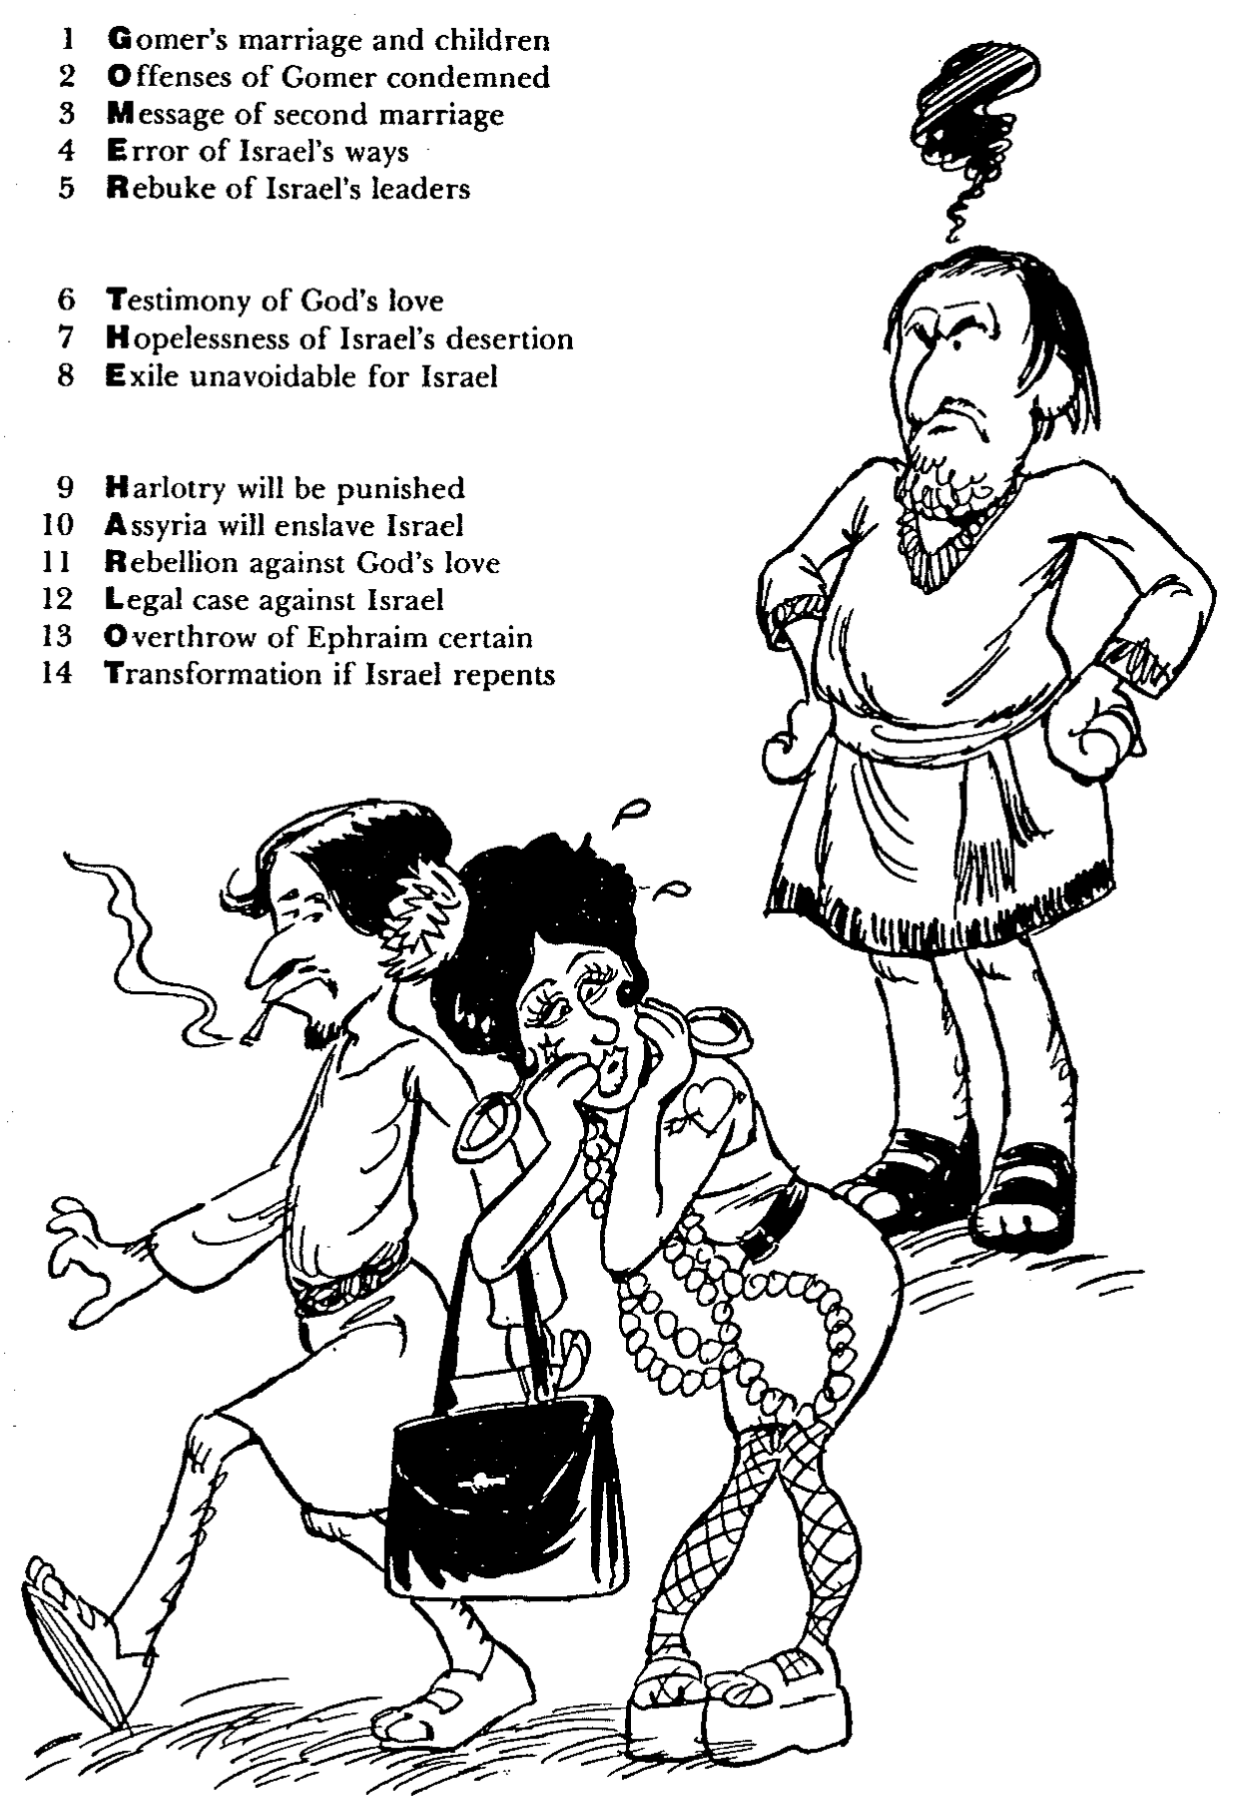
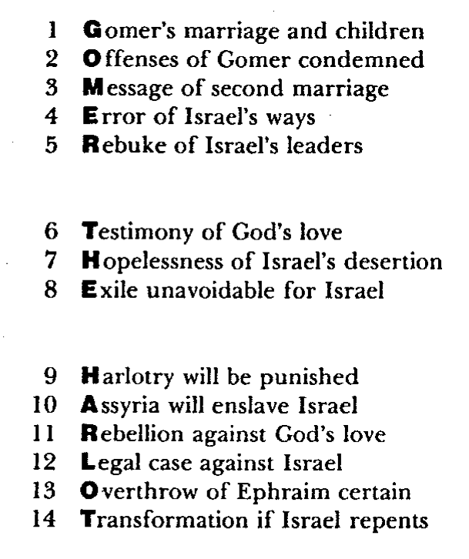
Barry Huddleston, The Acrostic Summarized Bible (Grand Rapids: Baker, 1992)
1 Inception of the world
2 Newlyweds placed in Eden
3 Temptation and man's fall
4 Hatred and first murder
5 Entire genealogy of Adam
6 Lessons on proper priorities
7 Outline for personal relationships
8 Faith of the centurion
Hosea
29 Genealogy of Jesus Christ
30 Opposition of King Herod
31 Spirit's descent upon Jesus
32 Power over Satan's temptations
33 Expounding Sermon on Mount
34 Lessons on proper priorities
35 Outline for personal relationships
36 Faith of the centurion
9 Matthew's call from Jesus
10 Apostles sent to preach
11 Testimony about John's message
12 True Messiah called demonic
13 Hidden message of parables
14 Execution of the Baptist
15 Wisdom is answering Pharisees
37 Matthew's call from Jesus
38 Apostles sent to preach
39 Testimony about John's message
40 True Messiah called demonic
41 Hidden message of parables
42 Execution of the Baptist
43 Wisdom is answering Pharisees
16 Keys of the kingdom
17 Impact of Jesus' transfiguration
18 Need for true forgiveness
19 Grounds for divorce clarified
20 Opportunities in the vineyard
21 Fig tree is cursed
44 Keys of the kingdom
45 Impact of Jesus' transfiguration
46 Need for true forgiveness
47 Grounds for divorce clarified
48 Opportunities in the vineyard
49 Fig tree is cursed
22 Taxes paid to Caesar
23 Hypocrisy denounced by "woes"
24 Events of second coming
25 Judgment of the nations
26 Events on Calvary's eve
27 Way of the cross
28 Savior's resurrection and commission
50 Taxes paid to Caesar
51 Hypocrisy denounced by "woes"
52 Events of second coming
53 Judgment of the nations
54 Events on Calvary's eve
55 Way of the cross
56 Savior's resurrection and commission
Notes:
God's jealous love for an adulterous nation is better seen by us on the human level when we see a faithful husband restore his unfaithful wife.

Slide 12

Be Loyal
The Message of the Book of Hosea
Dr. Rick Griffith • Crossroads International Church Singapore
BibleStudyDownloads.org
Notes:
Few people are loyal in our day—to their nation, to their employer, to their spouse, and especially to their God.

Slide 13

Are you loyal?
Notes:
Are you loyal? What evidence can you marshal to defend yourself?

Slide 14

How does God motivate us to be loyal to him?
2 Ways
Notes:
Today we’ll see two ways God moves us to be loyal to him.

Slide 15
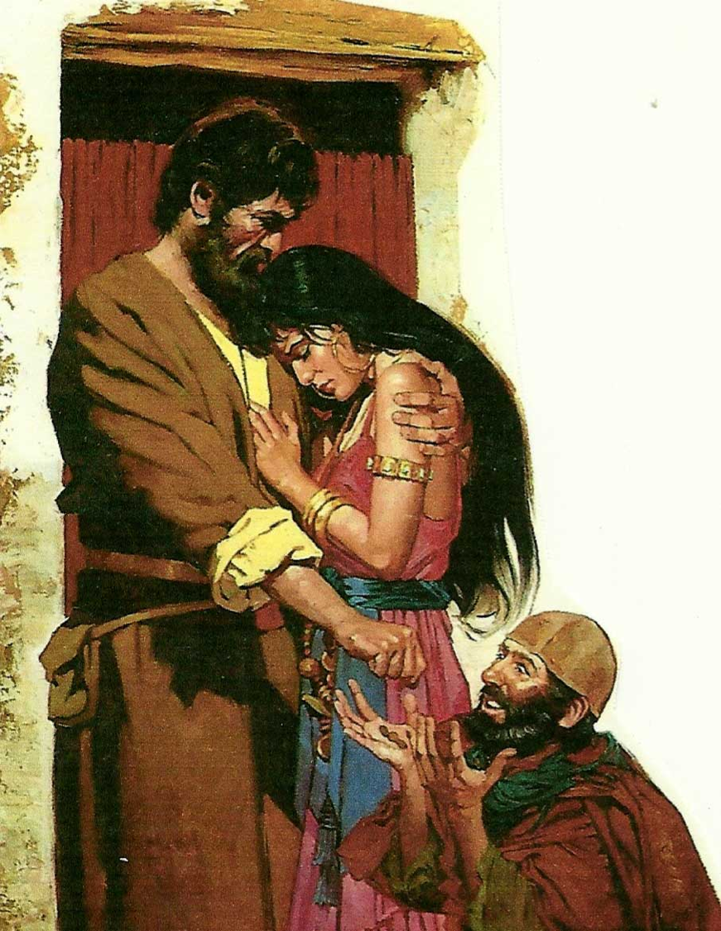
I. God motivates loyalty by examples.
Hosea 1–3
Notes:
The LORD gives great illustrations of what it means to committed.

Slide 16

II. God motivates loyalty by balancing correction and blessings.
Hosea 4–14
Notes:
The LORD pairs his penalties with his gifts.
God is loyal to Israel by both discipline and restoration (Hosea 4–14).

Slide 17

"Hear the word of the LORD,
O people of Israel!
The LORD has brought charges against you, saying:
'There is no faithfulness, no kindness (hesed), no knowledge of God in your land"
(Hosea 4:1 NLT).
4:4–6:3
6:4–11:11
11:12–13:16
Notes:
God’s lawsuit against Israel (4:1-3) provides the outline for the next ten chapters. It promises judgment for lacking covenantal knowledge of God (4:4–6:3), loving loyalty (6:4–11:11), and faithfulness (11:12–13:16).
____________
OS-28-Hosea-17, 84

Slide 18

Main Idea
God is loyal to you,
so be loyal to him
Hosea
Notes:
The LORD sets the example in the way he treated Israel and how he treats us.
___________
OS-28-Hosea-18, 181

Slide 19
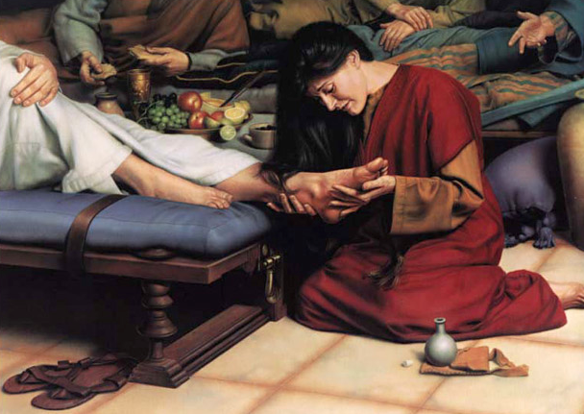
How are you doing at being loyal to your loyal Lord?
Notes:
Have you trusted him to take away your sin?

Slide 20
Black

Slide 21

Chart of OT Kings & Prophets
342

Slide 22
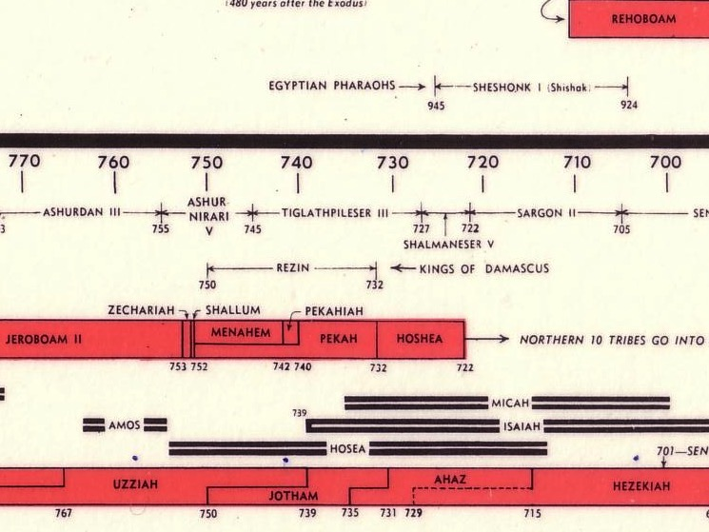

Chart of OT Kings & Prophets
232 & 342

Slide 23

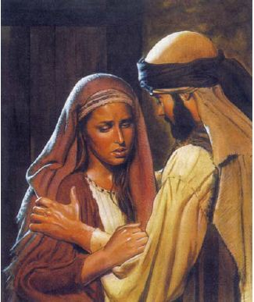
Did you know…?
566
Hosea was the only writing prophet
from Israel sent to Israel
Hosea was the only prophet on record
married to an adulterous woman
His book is the longest of the minor
prophets before the Exile
Author
The book claims to be written by Hosea himself (1:1)
Very little is known of the prophet, including his birthplace, home and occupation
He possibly was a baker (see 7:4ff)
He was more likely a farmer since he drew much of his imagery from the garden and farm

Slide 24

RESUME OF HOSEA
566
Name: Hosea (The Lord Saves)
Family: Father - Beeri
Wife - Gomer
1st Child - Jezreel
2nd Child - Lo-ruhamah
3rd Child - Lo-ammi
Vocation: Prophet to the Northern Kingdom

Slide 25

To Whom the Prophets Ministered
443
Assyria
Jonah
Phoenicia
Nahum
Aram
Babylon & Persia
Ezekiel
Daniel
Hosea
Israel
Amos
Ammon
Habakkuk
Micah
Judah
Isaiah
Zephaniah
Jeremiah
(Lamentations)
Joel
Haggai
Moab
Zechariah
Egypt
Malachi
Edom
Obadiah
Notes:
The prophets ministered all over the place geographically.
____________
Common-325
OS-12-Prophets Intro-14
OS-28-Hosea-25
OS-31-Obadiah-14, 40

Slide 26
Contrasting Hosea and Amos
590
HOSEA | AMOS
Professional Prophet (1:1) | Nonprofessional Prophet (7:14)
National from Israel (7:5) | Missionary from Judah (1:1)
Concern: Religious Idolatry (Worship) | Concern: Social Injustice (Walk)
Israel's Unfaithfulness | Israel's Injustice
God's Faithfulness | God's Justice
God's Grace | God's Righteousness
God's Loyal Love (Hesed) | God's Judgment
Sympathetic Tone | Stern Tone
Compassionate (11:1) | Coarse (4:1)
Difficult Structure | Simple Structure
Israel Lacks Knowledge | Israel Lacks Morality
"Know God" (4:1, 6; 6:6) | "Seek God" (5:4, 6)
Notes:
Hosea and Amos both prophesied to the northern nation of Israel near the end of this kingdom, but notable differences also exist between them.
_______________
OS-28-Hosea-26
OS-30-Amos-172

Slide 27
Be Loyal
The Message of the Book of Hosea
Dr. Rick Griffith • Crossroads International Church Singapore
BibleStudyDownloads.org

Slide 28

Loyalty
Notes:
Loyalty has fallen on hard times. People aren’t very loyal anymore.
People switch jobs all the time.
We aren’t committed (loyal) to institutions.
We aren’t even committed (loyal) to our marriages.

Slide 29
Are you loyal?
Notes:
Are you loyal? What evidence can you marshal to defend yourself?

Slide 30

Loyal Relationships
Notes:
Do you show loyalty to others?

Slide 31

Are you loyal to God?
Notes:
Do you show loyalty to God?

Slide 32
How does God motivate us to be loyal to him?

Slide 33
Placing the Prophets
Placing the Prophets
342
Key Dates
931
Obadiah
722
Jonah
Amos
Hosea
Isaiah
Micah
586
Notes:
Israel hadn’t been very loyal for 200 years. Prophets who ministered at the same time as the beginning of Hosea’s preaching included Amos and Jonah.

Slide 34
Perils of Prosperity
592
 | Jonah | Amos | Hosea
Responsibility Addressed | Evangelistic | Social | Spiritual
Israel's Problem | Myopia | Injustice | Adultery
God's Attribute | Compassion | Justice | Faithfulness
Key Word | Compassion | Injustice | Loyal
Summary | God cares even for cruel Gentiles, so you should too! | God is fair with you, so you should be fair with others! | God is loyal to you, so be loyal to him.
Modern Parallels | Failure in Mission Responsibility | Oppression of Maids & Foreign Workers | Church's God is Modernity (Methods)
Date of Ministry (approx.) | 785-758 Beginning of Jeroboam's Reign | 767-753 Middle of Jeroboam's Reign | 755-710 End of Jeroboam's Reign
Notes:
The northern nation of Israel was in a period of prosperity.

Slide 35
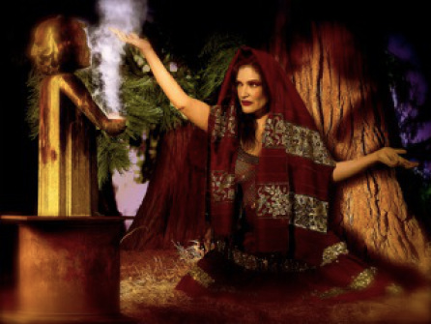
The Idolatry of Israel
Notes:
However, it also had a long history of idolatry. Finally, it was time to pay for their crimes against God, and Hosea acted as his messenger.

Slide 36
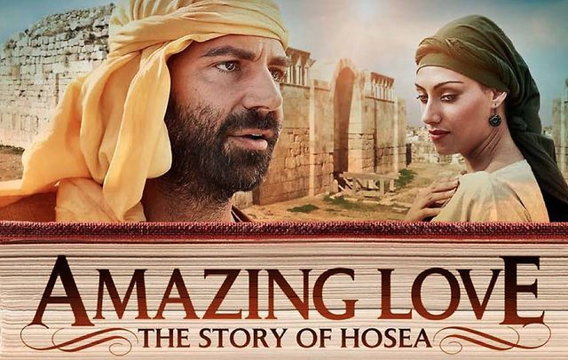
Amazing Love
Notes:
Hosea not only taught the message. His very life was the message, for his marriage pictured God’s “marriage” to Israel.

Slide 37
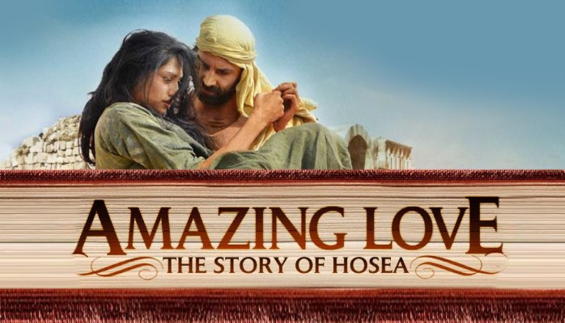
Amazing Love
Notes:
The context was one of flagrant immorality, yet Hosea showed the opposite in his unrelenting commitment to his wayward wife.

Slide 38
How does God motivate us to be loyal to him?
2 Ways
Notes:
Today we’ll see two ways God moves us to be loyal to him

Slide 39
Key Word
565
343
Loyal
Hosea
Notes:
The book of Hosea can be summed up in one word: loyalty. This is the Hebrew word hesed that refers to covenant love shown in keeping promises.

Slide 40
I. God motivates loyalty by examples.
Hosea 1–3
Notes:
The LORD gives great illustrations of what it means to committed.

Slide 41
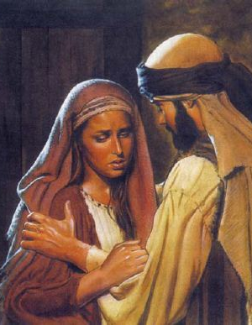
Hosea showed amazing loyalty in his failed marriage (Hosea 1–3).

Slide 42
Slides on
Hosea 1
Notes:
Hosea's adulterous wife Gomer bears three children before the Assyrian deportation who symbolize God's rejection of Israel, yet God promises restoration due to His commitment to the Abrahamic Covenant (1:1–2:1).

Slide 43
When Hosea Wrote (1:1)
453
Kings of Israel
Jeroboam
Pekah
Hoshea
Kings of Judah
Uzziah
Jotham
Ahaz
Hezekiah
Hosea's 45-Year Ministry
(755-710 BC)
Notes:
43
The date of the prophecy as a 45-year period before, during, and after the Assyrian deportation shows God's last minute warnings to His wayward people, Israel (1:1).

Slide 44

Hosea 1:2 NLT
"When the LORD first began speaking to Israel through Hosea, he said to him, 'Go and marry a prostitute, so that some of her children will be conceived in prostitution. This will illustrate how Israel has acted like a prostitute by turning against the LORD and worshiping other gods.'"
Notes:
Hosea obeys God's instructions to marry Gomer and she bears three children during her adultery who symbolize God's rejection of Israel and compassion on Judah (1:2-9).

Slide 45

Gomer took off for other lovers…
Notes:
Hosea obeys God's instructions to marry Gomer and while she is committing adultery…

Slide 46
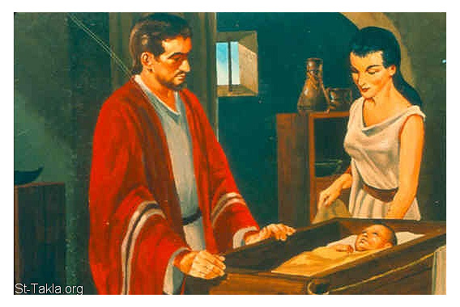
What about Gomer's children?
573
Notes:
While she is committing adultery, they have children with strange names.

Slide 47
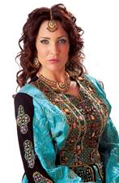
Gomer's Children
573
Text | Hosea 1:2-5 | Hosea 1:6-7 | Hosea 1:8
Name | Jezreel | Lo-Ruhamah | Lo-Ammi
Sex | Boy | Girl | Boy
Translation | "He [God] scatters" | "No compassion" | "Not My people"
Notes:
First is a son named "God scatters" to predict God's dispersion of the house of Jehu for his murder of Ahaziah and his relatives (1:2-5; cf. 2 Kings 9:27ff.).
Gomer then bears a daughter named "Not loved" to illustrate God's compassion upon Judah but His lack of compassion upon Israel (1:6-7).
Gomer finally bears a son named "Not my people" to illustrate God's rejection of the northern nation of Israel (1:8-9).

Slide 48
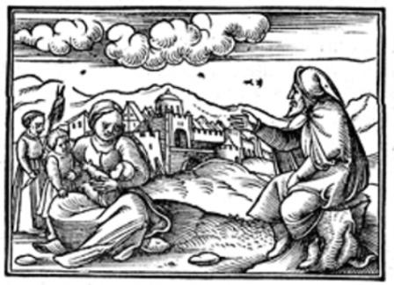
What about Gomer's children?
573
Notes:
Imagine calling your kinds such strnage names today!

Slide 49
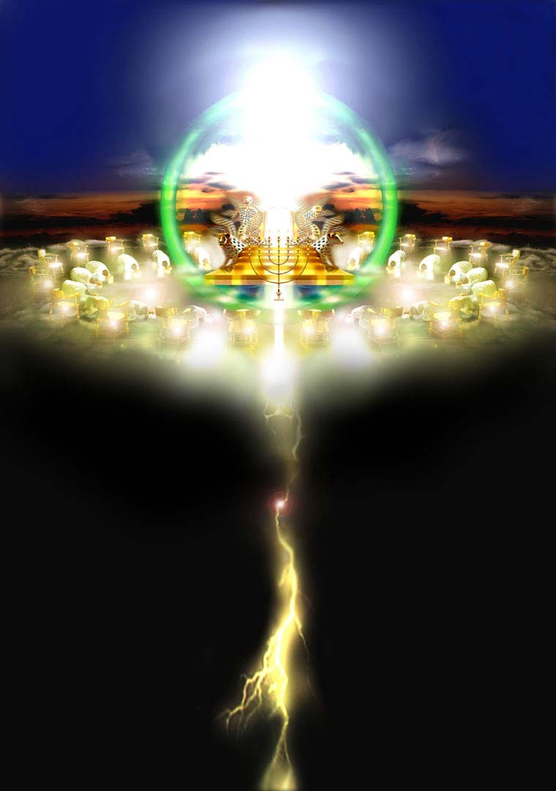
FUTURE SIGNIFICANCE OF HOSEA
Notes:
The northern nation of Israel never returned to its land, even when Judah returned from Babylon to the restored southern kingdom of Judah. But Hosea sees a day when God will bring back his wayward "wife" to her land.

Slide 50
Kingdom & Covenants Timeline
22
CH-34a
OS1-22
OS2-337
NS-9g
SA-19
34a
Dr. Rick Griffith • BibleStudyDownloads.org
22
Kingdom Teaching...
Adam rules with God (Gen. 1:26, 28; 2:19)
Satan begins rule as god of this world (Gen. 3:15;
2 Cor. 4:4)
God covenants with Abraham to reestablish man's rule via Israel as a "kingdom of priests" (Gen. 12:1-3; Exod. 19:6)
Israel's failure to witness to nations as a kingdom of priests is judged via exile under foreign rule
Israel rejects Messiah's offer of kingdom (Matt. 12:41-42; 23:37-39)
Jesus extends His kingdom in mystery form to the Church (Matt. 13)
Christ subdues Israel's enemies and nation believes (Rom. 11:26-27)
Christ rules over everything with saints (Eph. 1:9-10; Rev. 20:1-6; 22:5b)
337
9g
Fall of Man (Gen. 3)
Noahic Covenant
19
Genesis 6:18; 9:8-17
Land Covenant
ISRAEL
CHURCH
MESSIANIC KINGDOM
(National Focus)
The "New Man" (Eph. 2:15)
Millennial Eternal
land
Genesis 15:18 (cf. Deut. 30:1-10) promises:
Land from Wadi of Egypt to Euphrates River (Isa. 27:12)
Eternal possession of land (Gen. 17:8) after exile/restoration
Whole world blessed via the land (Isa. 14:1-2)
Israel judged for rejecting Messiah by dispersion away from land for 19 centuries
(AD 70–AD 1948) but now partially restored (Ezek. 37:1-7)
Full restoration (Ezek. 37:8-28) Jerusalem world capital
(Isa. 2:1-5)
New Jerusalem
(Rev. 21–22)
Davidic Covenant
Christ is Head over His Church, which is a spiritual temple (Eph. 2:19-22; 2 Cor. 6:16)
Christ reigns over the world
(Isa. 11)
with saints (Rev. 5:10; 20:4-6)
Christ hands kingdom over to Father (1
Cor. 15:24)
Genesis 12:1-3
2 Samuel 7:12-16 promises:
Sons ("house" never wiped out)
Kingdom (political dynasty)
Throne (right to rule by descendants)
Temple (son to build it)
seed
Abrahamic Covenant
New Covenant
All
things made new!
(Rev. 21:5)
All 5 elements fulfilled in national restoration (Zech. 8)
Jeremiah 31:31-34 promises:
Forgiveness
Indwelling Spirit
New heart, nature, mind
Reunification of Israel and Judah
No need for evangelism
Mosaic Law replaced with first three elements of the New Covenant (Luke 22:20; 2 Cor. 3:6)
blessing
Mosaic Covenant
Law abolished, fulfilled, and replaced at the cross (Rom. 7:1-6;
1 Cor. 9:19-21; Heb. 8:13)
10th Edition
10 Nov 2020
Temporary (Gal. 3:19) and conditional (Deut. 28) to reveal sin (Rom. 7:7) and regulate Israel (Gal. 3:23-25)
Scripture has a dual kingdom-covenant theme. Israel's role from Abraham to Christ expands to include the Church (continuity) yet the Church never replaces the nation as the "new Israel" (discontinuity). Israel will enjoy world prominence after trusting Christ at His second coming.
Notes:
All agree that a partial fulfillment of the covenant to Abraham exists now to the Church in the indwelling Holy Spirit and forgiveness of sins (Jer 31:31-34)—and the ultimate fulfillment will be in the eternal state.
The main area of disagreement relates to the time period from now to eternity. Will there be a literal land, throne, and worldwide blessing to national (ethnic) Israel before the eternal kingdom? This chart shows verses giving a resounding YES to that question in a present partial fulfillment and a future full fulfillment in the normal sense of language in the verses cited. But the messianic kingdom will be in two stages—first in a millennial fulfillment to last 1000 years, but then, after that, the eternal stage in the new Jerusalem after the destruction of our present heavens and earth (Rev 21–22). What an amazing future remains for those who trust Jesus!
____________
Common English-7
CH-02-Nature-103-p34a
OS-00-Intro & Biblical Theology-25 & 90
OS-02-Exodus-267-p22
OS-05-Deut-248-p22
OS-10-2Sam-96-p22
OS-24-Jeremiah-174-p337
OS-23-Isaiah 1-12-slide 97-p337
OS-23-Isaiah 60-66-slide 38-p337
NS-09-Gal-143-p9g
NS-19-Hebrews-342-p9g
SA-08-Mosaic Law-19-p38a

Slide 51
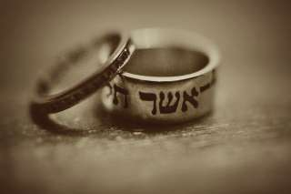
Israel's Future Restoration (Hosea 1:10–2:1)
569
Despite God's discipline, God tells Hosea that He will eventually restore the nation in the following ways:
  Numerical growth (1:10a)
  Spiritual restoration (1:10b)
  National unification (1:11a)
  Civic centralization (1:11b)
  Territorial occupation (1:11c)
  Divine blessing (2:1)
These promises have not been fulfilled yet. Texts like these show God makes these types of promises about a literal future kingdom where Israel will occupy the land in peace and experience God's blessings. If you don't believe in a millennium, you have to ignore these passages or say that they have already been fulfilled in history or are going to be fulfilled in the church.
Notes:
God promises Israel a restored population, relationship, and land as His beloved people because of His faithfulness to the Abrahamic Covenant (Hosea 1:10–2:1).

Slide 52
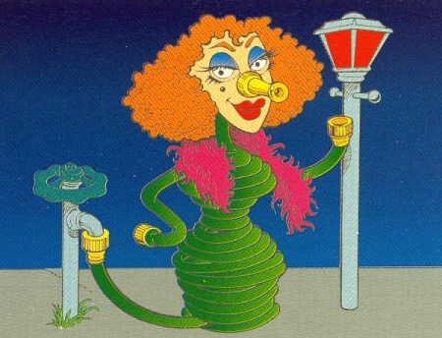
Hose - eh - ah
"Harlot"
Hosea
Walk Through The Bible ©1989

Slide 53
Timeline
Hosea 755-710 BC
United Kingdom
1050-930
Divided Kingdom
930-722
Solitary Kingdom
722-586
Post- Exile
536-425
1100
1050
1000
950
900
850
800
7 5 0
7 0 0
650
600
550
500
450
Exile 586-536

Slide 54
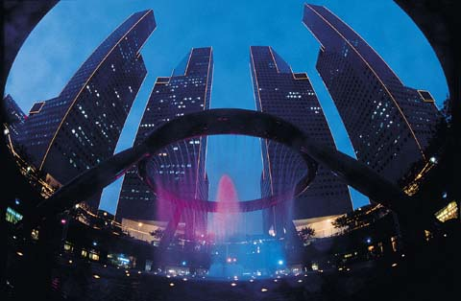
Life During Hosea's Time
566
Hosea ministered to the Northern Kingdom for a quarter of a century before the Assyrian invasion and deportation.
Israel had reached its zenith politically and militarily. As a result, she mostly had commercial interests.
Economic progress made many people wealthy, but they desired more and more luxury items.
The world power Assyria was rising to greatness (9:5,6) while Hosea ministered during the reigns Jeroboam II and Uzziah to Hezekiah (715-687 BC).
However, with the death of Jeroboam II (782-753 BC), the Northern Kingdom suffered political turmoil and the entire country was thrown into an unstable condition.
Eventually the country was invaded by Tiglath-Pileser.

Slide 55
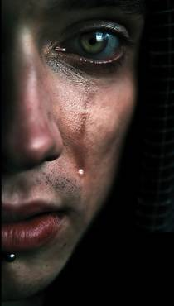
Critical Arguments: Marry a Harlot?
567
God commanded Hosea to take an adulterous wife (1:2) but this poses many problems (see Deut. 22:20-22). What does this mean?
There are three major views:
He married a woman who later become a harlot
He married a woman who was already a harlot
This is all allegorical (i.e., no actual adultery) so immorality is a symbol for idolatry

Slide 56
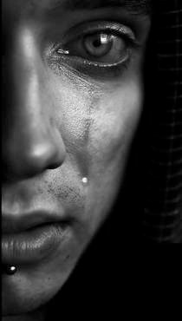
Literal View Support
567
Critical Arguments: Marry a Harlot?
  It reads like history.
  The names Gomer and Diblaim have no symbolism.
  "Harlot" is the best illustration of the Children of Israel.
  Hosea's love is like God's love for His people.
Allegorical View Problems
  It does not resolve the issue. The same moral problem remains of marrying a harlot (but is marrying a harlot a moral problem?).
  The children had symbolic names (possible literally).
  Some ask if such a marriage was conceivable. Would it destroy the effectiveness of Hosea's message? (No, as Hosea's own life was NOT tainted.)

Slide 57
Slides on
Hosea 2
Notes:
God promises that Israel will once again be called His beloved people because of His faithfulness to the Abrahamic Covenant (2:1).

Slide 58
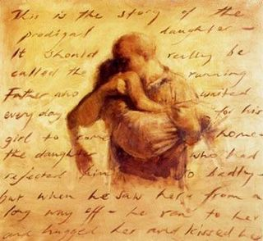
Hosea 2:1 NLT
"In that day you will call your brothers Ammi—‘My people.’ And you will call your sisters Ruhamah—‘The ones I love.’'"

Slide 59

Hosea 2:2-3 NLT
"But now bring charges against Israel
—your mother—
for she is no longer my wife,
and I am no longer her husband.
Tell her to remove the prostitute's makeup from her face
and the clothing that exposes her breasts.
³ Otherwise, I will strip her as naked
as she was on the day she was born.
I will leave her to die of thirst,
as in a dry and barren wilderness."

Slide 60
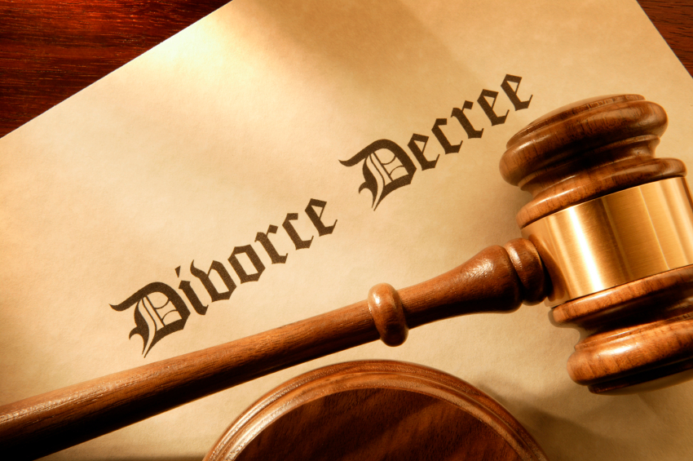
Did Hosea Divorce Gomer?
574
Notes:
Does God calling Israel “Not my people” and “she is not my wife” (2:2) mean Hosea divorced Gomer

Slide 61

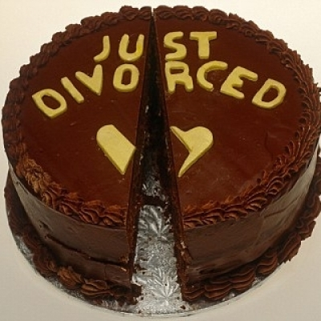
Arguments For & Against Hosea Divorcing Gomer
574
Notes:
I have a one-page study on this, but I will spare you the details and give a simple “No.”

Slide 62
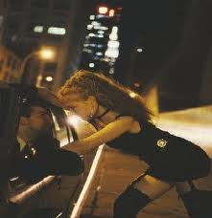
Hosea 2:5 NLT
"Their mother is a shameless prostitute and became pregnant in a shameful way. She said, 'I'll run after other lovers and sell myself to them for food and water, for clothing of wool and linen, and for olive oil and drinks.'"
Notes:
God does not minimize her sins.

Slide 63
Hosea 2:14
"But then I will win her back once again. I will lead her into the desert and speak tenderly to her there."
Notes:
But God does discipline her and then bring her back.

Slide 64
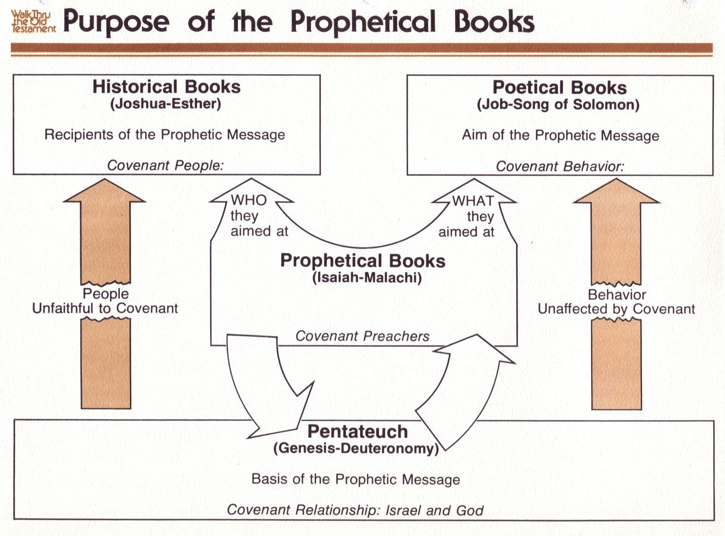
Purpose of the Prophetic Books
50b440
Historical Books
(Joshua-Esther)
Recipients of the Prophetic Message
Covenant People
Poetical Books
(Job-Song of Solomon)
Aim of the Prophetic Message
Covenant Behavior
WHO they aimed at
WHAT they aimed at
Prophetical Books
(Isaiah-Malachi)
Covenant Preachers
People
Unfaithful to Covenant
Behavior
Unaffected by Covenant
FORTHTELLING
FORETELLING
Mosaic Covenant
Pentateuch
(Genesis-Deuteronomy)
Basis of the Prophetic Message
Covenant Relationship: Israel & God
Abrahamic Covenant
Deut. 28; Lev. 26
Gen. 12:1-3; 15:18
Conditional
Unconditional
Judgment
Blessing
Notes:
The OT prophets are typically not taught in most churches and yet play a crucial role in the OT to link the Historical, Poetic, and Pentateuch sections. These covenant preachers fit into the end of OT chronology and thus look back at both the Abrahamic and Mosaic covenants in their blessing and judgment aspects, respectively. This includes both the forthtelling role to warn Israel of the conditions of the Mosaic requirements (Lev 26; Deut 28), as well as the foretelling role to remind the nation of unconditional blessings of the Abrahamic promises (Gen 12 & 15).
———————————————————
Common Slides English-153
00-Intro & Biblical Theology-slide 18
00_OT Book Overviews under Isaiah section-453
23-Prophets Intro-27
23-Isaiah_1-12-Slide 13
28-Hosea-74
31-Obadiah-26

Slide 65
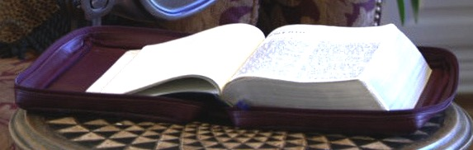
Literal * Eternal * Unconditional
Gen. 13:15; Gen. 15
7
Abrahamic Covenant
Gen. 12:1-3
LAND SEED BLESSING
ABRAHAM
The CALL
L - S - B
• LITERAL
• ETERNAL
• UNCONDITIONAL
Handbook pg. 19-24
16
3
Notes:
God’s strategy to woo Israel back to himself after they trust the Baals was to reject them, withhold their crops, and promise restoration due to His commitment to the Abrahamic Covenant (2:2-23).

Slide 66
Prophetic Curses
154
220
Why?
Exile
Deut. 28
Notes:
God’s formal legal accusation against the people of Israel for their idolatry (adultery) officially declares His temporary rejection of them as His people (2:2a).

Slide 67
Blessings & Curses
154
220
Deut. 28
Your towns and your fields
will be blessed (3)
Your towns and your fields
will be cursed (16)
Your children and your crops
will be blessed (4)
Your children and your crops
will be cursed (17)
Your fruit baskets and bread-boards will be blessed (5)
Your fruit baskets and bread-boards will be cursed (18)
Wherever you go and whatever you do, you will be blessed (6)
Wherever you go and whatever you do, you will be cursed (19)
Your enemies will attack you from one direction, but they will scatter from you in seven! (7)
You will attack your enemies from one direction, but you will scatter from them in seven! (25)
You will lend to many nations, but you will never need to borrow from them (12)
They will lend to money to you, but you will not lend to them
(44)
Notes:
God will make life difficult due to Israel’s idolatry (adultery) so the people would see that following God again is best (Hosea 2:2b-7).
God warns that since the nation trusted the Baals for their crops, He would destroy them that Israel might acknowledge His Lordship (Hosea 2:8-13).
Around 1400 BC, God warned in Deut 28 not to have any other gods….
The parallels between the individual blessings and cursings are just too obvious!
———————
BE-05-Deuteronomy-89
OS-05-Deuteronomy-242
OS-12-2 Kings-97
OS-14-2 Chron-62
OS-23-Prophets Intro-25
OS-24-Jeremiah-243
OS-25-Lamentations-72

Slide 68

Hosea 2:16-17
"When that day comes," says the LORD,
"you will call me 'my husband'
instead of 'my master.'
¹⁷ O Israel, I will wipe the many names of Baal from your lips,
and you will never mention them again" (NLT).
Notes:
God promises to woo His "wife" Israel back to Himself again because of His commitment to the Abrahamic Covenant (2:14-20).
God promises to restore the covenant relationship with His faithless "wife" Israel because of His commitment to the Abrahamic Covenant (2:21-23).

Slide 69
Slides on
Hosea 3
Notes:
Hosea redeems Gomer from prostitution and quarantines her to depict God's future restoration of Israel after being away from the land (Hosea 3).

Slide 70
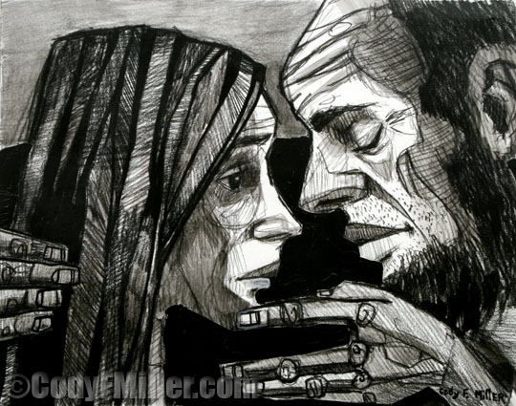
Restoration
Notes:
Hosea redeems Gomer from prostitution by paying her debts and quarantines her from other men (3:1-3).

Slide 71
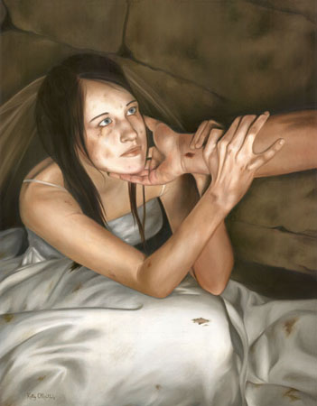
Hosea 3:1 NLT
"Then the LORD said to me, 'Go and love your wife again, even though she commits adultery with another lover. This will illustrate that the LORD still loves Israel, even though the people have turned to other gods and love to worship them.'"

Slide 72
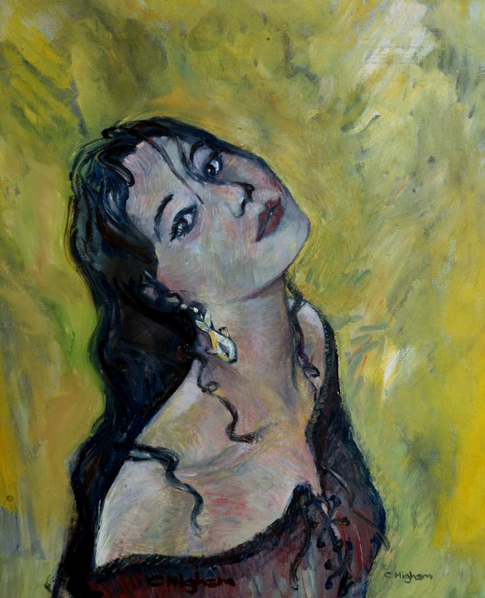
Hosea 3:2-3 NLT
"So I bought her back for fifteen pieces of silver and five bushels of barley and a measure of wine. ³Then I said to her, 'You must live in my house for many days and stop your prostitution. During this time, you will not have sexual relations with anyone, not even with me.'"

Slide 73
The Redemption Price
GOMER THE HARLOT
(Hos. 3:2)
ISRAEL THE HARLOT
(cp. Jer. 3:1-5)
15 Shekels of Silver
+ A Homer & a Half of Barley
Hosea 3:2
= 1 Unfaithful Gomer

Slide 74

Harlot Imagery in Hosea & Jeremiah
569
GOMER THE HARLOT (Hos. 2)
ISRAEL THE HARLOT (cp. Jer. 3:1-5)
Not Recognizing Hosea as the Source of Love
Dryness (2:3)
Pride
Expecting Hosea to Love Her
Lust - Blaming Gomer
Not Recognizing God as the Source of Life (Jer. 2:27)
Dryness (Jer. 3:3)
Pride (Jer. 3:3)
Expecting God To Bless Them
Anger - Blaming God

Slide 75
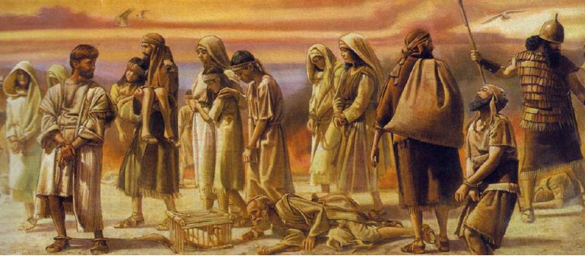
Hosea 3:4-5 NLT
"This shows that Israel will go a long time without a king or prince, and without sacrifices, sacred pillars, priests, or even idols! ⁵But afterward the people will return and devote themselves to the LORD their God and to David's descendant, their king. In the last days, they will tremble in awe of the LORD and of his goodness."
Notes:
Hosea's restoration of Gomer depicts God's future restoration of Israel after the nation returns to God “in the last days” (3:4-6).

Slide 76
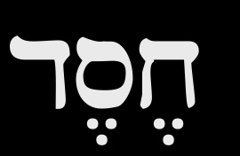

The Meaning of Hesed ds,x,
567
KJV: "lovingkindness," "mercy," "goodness"
Nelson Glueck (1927): "covenant loyalty"
Key Word for Hosea: Loyal
Key Verse for Hosea:
"At that time I will plant a crop of Israelites
and raise them for myself.
I will show love
to those I called 'Not loved.'
And to those I called 'Not my people,'
I will say, 'Now you are my people.'
And they will reply, 'You are our God!' " (2:23 NLT)
Notes:
Hosea uses a Hebrew equivalent for the English word “love” (hesed) six times in his short writing (2:19; 4:1; 6:4, 6; 10:12; 12:6 [7]). Other prophets use the same word, such as Isaiah (8 times) and Jeremiah (6 times), but Hosea uses this term more frequently than any other prophet (proportionally, considering his small book size). The term is found three times in Ruth (1:8, 2:20, and 3:10).
What really does hesed mean? The KJV often translates it as “lovingkindness” (2:19) or “mercy” (4:1; 6:6; 10:12; 12:6) but sometimes “goodness” (6:4) and “kindness” (Joel 2:13). The NASB emphasizes these last two translations while the NIV agrees and adds the concept of acts of devotion, unfailing love, great love, unfailing kindness, favor, devout, faithful, grace, loyalty, approval, lovingkindness, and many other terms! It is an important term since it is used nearly 250 times in the OT.
What really does hesed mean? The KJV often translates it as “lovingkindness” (2:19) or “mercy” (4:1; 6:6; 10:12; 12:6) but sometimes “goodness” (6:4) and “kindness” (Joel 2:13). The NASB emphasizes these last two translations while the NIV agrees and adds the concept of acts of devotion, unfailing love, great love, unfailing kindness, favor, devout, faithful, grace, loyalty, approval, lovingkindness, and many other terms! It is an important term since it is used nearly 250 times in the OT.
________
OS-08-Ruth-25
OS-28-Hosea-75

Slide 77
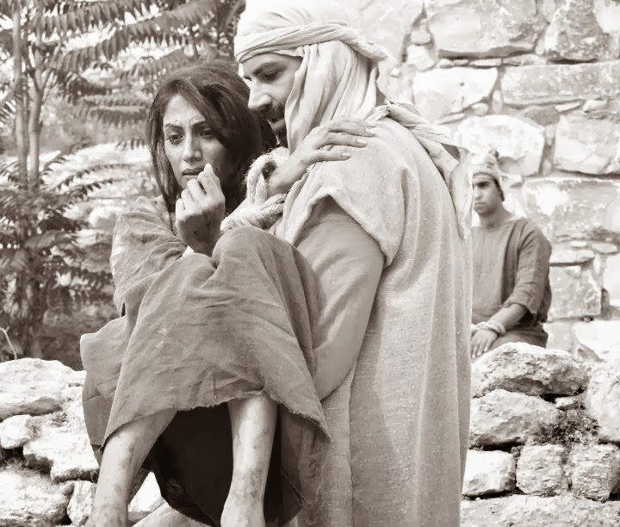
"Scripture" (6: NLT).
Notes:
My study of Hosea follows Glueck’s view that interprets the term as referring to covenant loyalty. In particular, the Mosaic Covenant is in view which obligates both God and Israel to certain requirements (cf. Exod. 19–20), including Israel’s blessings for obedience and curses for disobedience (Deut. 28). Therefore, God continues to show commitment and mercy towards the nation (based upon the Abrahamic Covenant) and Israel should respond by showing loyalty towards God by following the Mosaic stipulations.

Slide 78

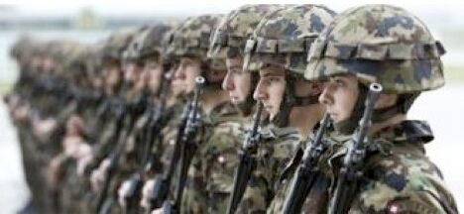
Others model God’s type of loyalty for us.
Notes:
We often feel that God owes us something because he hasn’t been loyal to us. Yet the opposite is true. We owe God everything because he has never once failed us!
He often shows that loyalty through significant people. Who has been the best example of loyalty to you in your own life? Your mother? Your father? Your spouse?
Let that person exemplify God’s loyalty to you! Then show that same loyalty to him.

Slide 79
I. God motivates loyalty by examples.
Hosea 1–3
Notes:
The LORD gives great illustrations of what it means to committed.

Slide 80
Hosea: God's Loyalty to Israel
565
Unfaithful Gomer | Unfaithful Israel
Faithful Hosea | Faithful LORD
Marriage of Hosea | Message of Hosea
Personal | National
Chapters 1–3 | Chapters 4–14
Notes:
The simple outline depicts Hosea's restoring Gomer (1–3) as parallel to the LORD restoring Israel (4–14). The pivot comes in chapter 4 when we realize that the story is about God and Israel more than it is about Hosea and Gomer.
___________
OS-28-Hosea-10, 80

Slide 81
II. God motivates loyalty by balancing correction and blessings.
Hosea 4–14
Notes:
The LORD pairs his penalties with his gifts.
God is loyal to Israel by both discipline and restoration (Hosea 4–14).

Slide 82
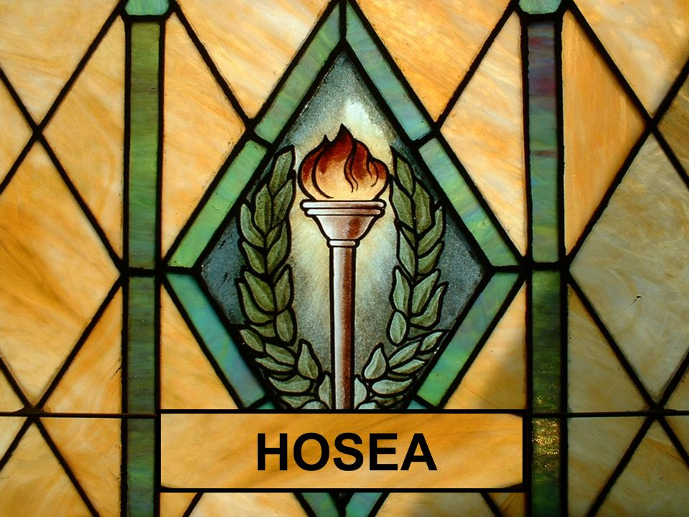
He punished Israel as he promised in his covenant with Moses (Hosea 4–13).
Notes:
We see in the OT a delicate balance between the discipline of the Mosaic Covenant (Deut 28) and the blessings of the Abrahamic Covenant (Gen 12:3).

Slide 83
Slides on
Hosea 4

Slide 84
"Hear the word of the LORD,
O people of Israel!
The LORD has brought charges against you, saying:
'There is no faithfulness, no kindness (hesed), no knowledge of God in your land"
(Hosea 4:1 NLT).
4:4–6:3
6:4–11:11
11:12–13:16
Notes:
God’s lawsuit against Israel (4:1-3) provides the outline for the next ten chapters. It promises judgment for lacking covenantal knowledge of God (4:4–6:3), loving loyalty (6:4–11:11), and faithfulness (11:12–13:16).
____________
OS-28-Hosea-17, 84

Slide 85
"Hear the word of the LORD,
O people of Israel!
The LORD has brought charges against you, saying:
'There is no faithfulness, no kindness (hesed), no knowledge of God in your land"
(Hosea 4:1 NLT).
4:4–6:3
Notes:
God will judge Israel and Judah for lack of spiritual knowledge, resulting in prostitution and idolatry, but promises to accept them when they repent (4:4–6:3).

Slide 86
Parallels with the Ten Commandments
HOSEA 4:2
Ten Commandments
(Exodus 20)
Lying
Murder
Stealing
Adultery
Commandment 9 (20:16)
Commandment 6 (20:13)
Commandment 8 (20:15)
Commandment 7 (20:14)

Slide 87
Slides on
Hosea 5

Slide 88
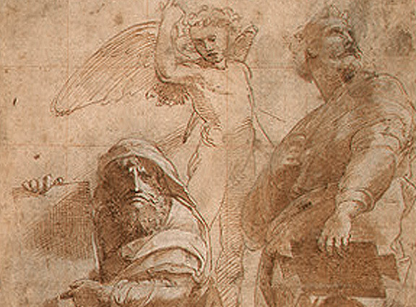
PSYCHOLOGICAL DOWNSPIRAL (5:4-15)
"Their pride will not permit them to return to the LORD" (5:4)
"When they seek the LORD, they will not find him" (5:6)
God said that He will go back to His place "until they admit their guilt" (5:15a)
Notes:
Lack of knowledge in both Judah and Israel prevents them from repenting of prostitution and idolatry, but God promises that they will eventually repent and seek Him (Hosea 5).

Slide 89
Slides on
Hosea 6

Slide 90
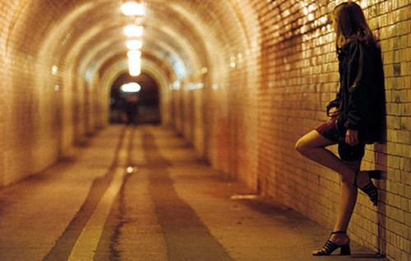
Israel went after other lovers instead of knowing her true husband, the LORD

Slide 91

"Come, let us return to the LORD. He has torn us to pieces but he will heal us"
(Hosea 6:1 NLT).
Notes:
Hosea encourages the nation to repent because of God's willingness to accept them back (6:1-3).

Slide 92
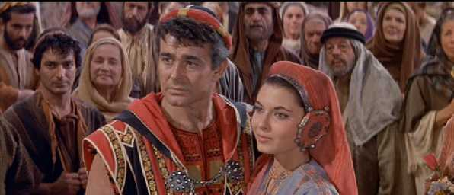
Eschatological Significance - Hosea 6:1-3
One of the several promises of restoration
God will never completely and finally destroy his people
A remnant will remain, rescued from exile
Passage not limited to OT––Restoration finds partial fulfillment in NT
In essence, it is an invitation to (re)acceptance by God of a people (note that the language here is plural and corporate, not singular and individual)

Slide 93

Eschatological Significance - Hosea 6:1-3
It touches on:
a) Doctrine of sin, as forgiveness is part of the promise of restoration
b) Doctrine of the future of Israel, as God's faithfulness to his people as a corporate entity is promised here
c) Doctrine of God (main emphasis) - His healing (v. 1), His restoration (v. 2), and His faithfulness (v. 3)

Slide 94
"Hear the word of the LORD,
O people of Israel!
The LORD has brought charges against you, saying:
'There is no faithfulness, no kindness (hesed), no knowledge of God in your land"
(Hosea 4:1 NLT).
4:4–6:3
6:4–11:11
Notes:
God will judge Israel for substituting loving loyalty (hesed) to God's covenant with formalistic sacrifice, idolatry, wickedness, and alliances (6:4–11:11).

Slide 95
Theological Covenants
19
GOD
Father
Covenant of Redemption
between Father, Son, & Spirit
Son
Spirit
Covenant of Works
between God & Adam
ADAM
Covenant of Grace
between God & elect sinners
ELECT
SINNERS
Robert Lightner, The Last Days Handbook, 76

Slide 96
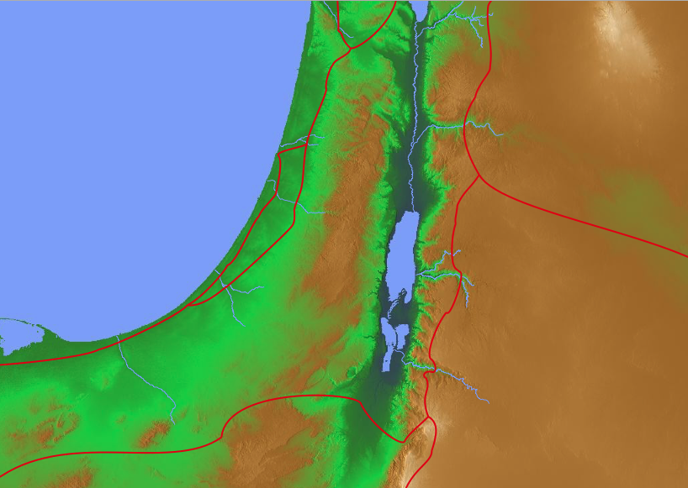
Hosea 6:7 Translations
Adam
"But like Adam, you broke my covenant and betrayed my trust"
(NLT).
"But like Adam, they have transgressed the covenant. There they have dealt treacherously against Me"
(NAU).
"But they like men have transgressed the covenant: there have they dealt treacherously against me"
(KJV).
"But at Adam, they have transgressed the covenant. There they have dealt treacherously against Me"
(RSV).
Notes:
"6:7. Rather than pleasing God, the people had broken the covenant and been unfaithful (bagad ; cf. comments on 5:7) to God. The Hebrew word for like Adam has been translated variously. "At Adam" (RSV) requires a slight change in the Hebrew and suggests a geographical place near the Jordan River. The presence of the word there in the next line, as well as references to other places in 6:8-9, might support this reading. "Like men" (KJV) takes the Hebrew adam in its widely attested generic sense, rather than as a proper name. In this case a comparison is made with fallen mankind, whose propensity to be unfaithful is well established (cf. Isa. 40:6-8, man's hesed ["glory," Isa. 40:6] is as transitory as grass and flowers that wither in the sun). On the other hand, the NIV and the NASB suggest a comparison with the first man, Adam, who blatantly violated God's requirement by eating from the forbidden tree" (BKC, 1:1394).

Slide 97
Slides on
Hosea 7

Slide 98
HOSEA 7 - Physician & Painter
MISSING THE TARGET!
Badness being exposed (7:1-3)
Bread baking in oven (7:4-8)
Before balding sets in (7:9-10)
Bird-brained sense! (7:11-14)
Bows bent - can't shoot straight! (7:15-16 cp. Ps 78:57)

Slide 99
Believers today commit spiritual adultery by compromising with atheists
So how do Christians miss the target today?

Slide 100

Engaging the Atheists
A Seminar to Strengthen Your Faith and the Faith of Others
Dr. Rick Griffith • Singapore Bible College • www.biblestudydownloads.com
Notes:
What is the best apologetic for Jesus in an anti-God world?
That is the question that I have been asked to address in this seminar called "Engaging the Atheists."
So what advice would you give me in facilitating a seminar like this? How do you address atheists?
Should we focus on proving the existence of God?

Slide 101
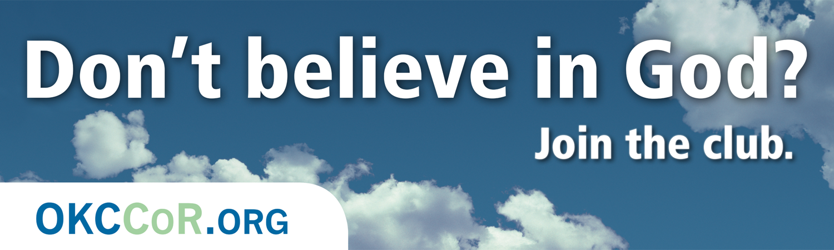
Don't believe in God? Join the club.
1
Notes:
Atheists directly attack Christmas…

Slide 102

Millions of Americans are living happily without religion. CFI. LivingWithoutReligion.org
1
Notes:
One billboard is quite blatant about our rejection of God …
____________
The Center for Inquiry is an organization of humanists, skeptics, freethinkers, and atheists all working together at the public policy and grassroots levels to advance science and secularism.

Slide 103

"God free, happy, and inspired by wonder."
1

Slide 104
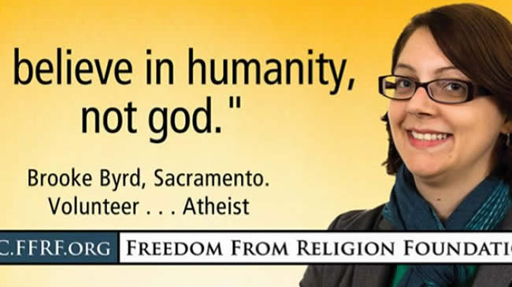
"Believe in humanity, not god."
1

Slide 105
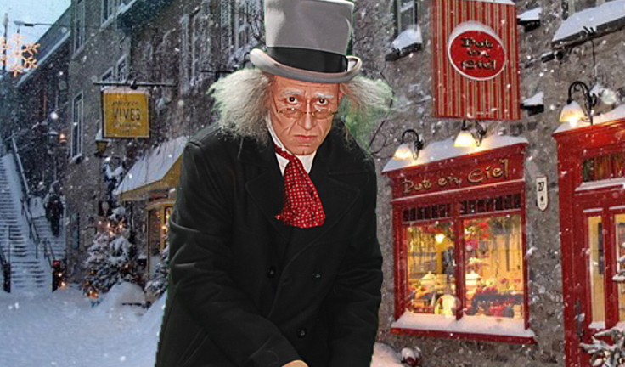
Humbug.
1
Notes:
The world not only ignores the Christ of Christmas, but attacks him in direct and indirect ways

Slide 106
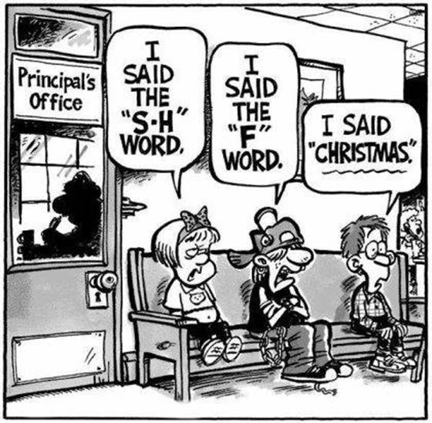
Christmas Shunned
1
I said the
"S-H" word
I said the "F" word
Principal's Office
I said "Christmas."
Notes:
In some places we get punished for even mentioning Christmas. At the principal's office, one child says, "I said the 'S-H' word," another says, "I said the 'F' word," and still another declares, 'I said 'Christmas.'"

Slide 107
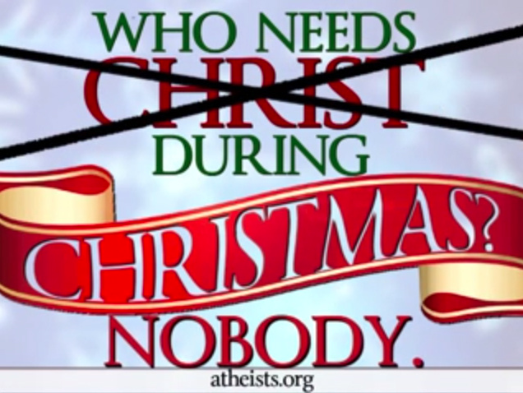
Who Needs Christ During Christmas? Nobody.
1
Notes:
Satan still tries to make think we don't need God today.

Slide 108
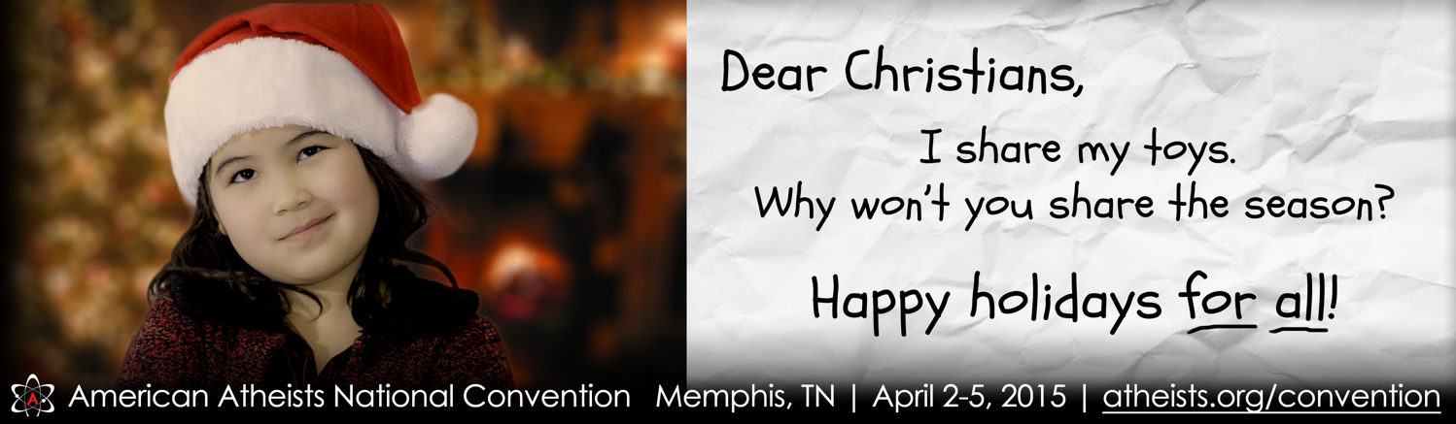
Dear Christians, I share my toys. Why won't you share the season? Happy holidays for all!
1
Notes:
Today we also doubt God's goodness by saying God holds us back. One atheist billboard states, "Dear Christians, I share my toys. Why won't you share the season? Happy holidays for all!" Do you see the assumption here? Christians want God's goodness only for them—so we don't believe God is good to share with all!

Slide 109
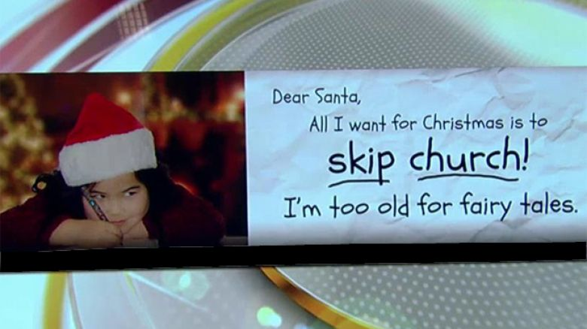
Dear Santa, All I want for Christmas is skip church! I'm too old for fairy tales.
1
Notes:
Another writes, "Dear Santa, All I want for Christmas is to skip church! I'm too old for fairy tales." Some see the biblical story of the Fall as a fairy tale so that we don't want to be exposed to why God says death exists in our world. Ironic isn't? She writes to the fairy tale Santa and says she doesn't want to believe in God!

Slide 110
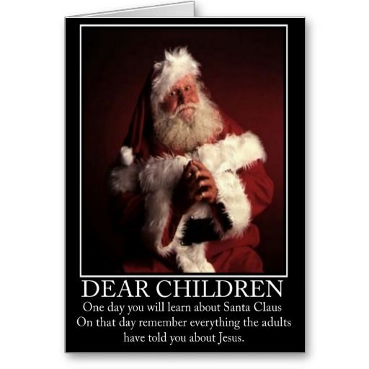
Atheist Christmas Card
1
DEAR CHILDREN
One day you will learn about Santa Claus. On that day remember everything the adults told you about Jesus.
Notes:
… such as in Christmas cards that equate Jesus and Santa [read card].

Slide 111
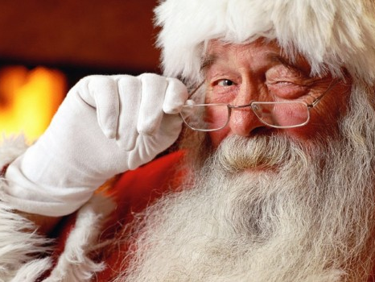
Santa
1
Notes:
But the fact is that Santa is based on Jesus and, as one blogger notes, "The history of Santa can be a way to teach kids about giving to others. The secular version of Santa that we know today is based on St. Nicholas, who was a Christian man that lived in the third century. When his parents died, they left him a large inheritance and rather than spend it on himself, he decided to give all his money away in an effort to obey Jesus's words to take care of the poor and sick. Some of the traditions that we associate with Santa are based on the stories of St. Nicholas. For example, leaving stockings out for Santa came from tales of St. Nicholas throwing bags of gold through open windows (which apparently sometimes landed in socks and shoes that were left by the fire)." (http://www.tommynelson.com/can-santa-jesus-coexist/).

Slide 112
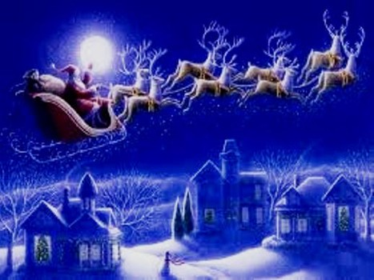
What to do?
1
Notes:
Do you know what you should do when you see the Christ of Christmas maligned?
• Should you rise up and kill those who dishonor him? No.
• Should you just do nothing and hope it will go away? No.
• Should you do something in between? If so, then what?

Slide 113
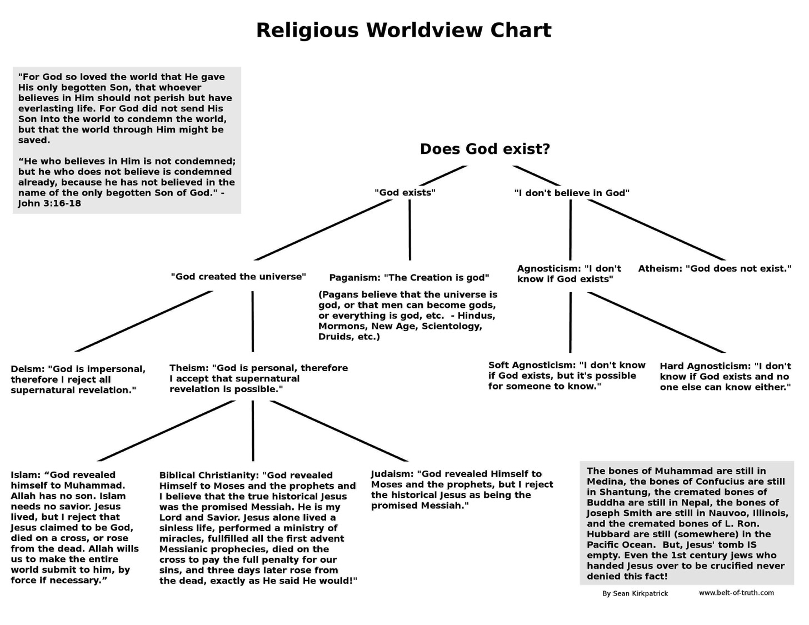
Kirkpatrick Worldview Chart
1

Slide 114
Ten Possible Worldviews
2
Indecision
(agnosticism)
Decision
No Divine
(atheism)
Divine
Many gods
(polytheism)
One God
Finite
Infinite
Impersonal
(panentheism)
Personal
(finite Godism)
Impersonal
(pantheism)
Personal
Miracles
(theism)
No Miracles
(deism)
Adapted from:
• Peter Kreeft
• Norman Geisler
• William D. Watkins
Triune
(Christian theism)
Unipersonal
(Unitarianism)
Notes:
“The chart is based in part on Peter Kreeft, “Introduction: Why Debate the Existence of God?” in Does God Exist? The Debate Between Theists and Atheists, by J. P. Moreland and Kai Nielsen (Buffalo: Prometheus Books, 1993), 15, and in part on Norman Geisler and William D. Watkins, Worlds Apart: A Handbook on World Views, 2d ed. (Grand Rapids: Baker, 1989), 16. It should be noted that in practice religions sometimes combine elements of more than one of these worldviews. For example, some forms of Hinduism affirm both pantheism and polytheism” (Kenneth D. Boa and Robert M. Bowman, Jr., “7. The Rationality of the Christian Worldview” https://bible.org/seriespage/7-rationality-christian-worldview#P33_10908 accessed 30 Sept 2015, footnote 13).

Slide 115

Worldviews:
How does God relate to the world?
2

Slide 116
Agnosticism:
We cannot be sure if a God is involved in our world (Confucius, Kant, Dewey, Bertrand Russell, Carl Sagan)
2
?
God?
?
?
?
?
?
?

Slide 117
Atheism:
No God exists or is involved in our world (Dawkins, philosophical Buddhism)
2

Slide 118
Polytheism:
Many gods relate to the worlds (Ancient Near East, Greek & Roman mythology, Mormons)
god
2
god
god
god
god

Slide 119
Panentheism:
A finite impersonal god is in the world (animism, Native American religion)
2
God

Slide 120
Finite Godism:
A finite personal god interacts with the world (Kushner)
god
2

Slide 121
Pantheism:
An infinite impersonal god is the world itself (Hinduism, Star Wars)
2
GOD

Slide 122
Deism:
God created the world but left it alone so no miracles occur (Jefferson, Franklin)
2
God

Slide 123
Christian Theism:
The Triune God loves our world and works miracles (Biblical view)
Father
2
God
Son
Spirit

Slide 124
Unipersonal Theism:
The Unitarian God relates to our world and works miracles (Islam, Jehovah Witnesses)
God
2

Slide 125
The Quick Guide for Dealing with Atheists
All Knowledge
Notes:
1. Draw a circle with a radius from the edge to the center.
2. Say, "This circle represents all the knowledge of the universe, known and unknown."
3. Hand the pen to the atheist and say, "Please draw a second line from the center to show what piece of the pie represents your own knowledge of all that can be known."
4. Humble atheists will draw a sliver to show they know about 1%. Arrogant atheists will claim to know up to half of all knowledge. I have never seen anyone draw more than half.
5. Say, "Since you know only _____% of the world's knowledge, would you not agree that God can exist in the majority of the pie that you do not know about?"
6. Whether you friend admits it or not, by claiming that he does not know everything, he has just switched from an atheist to an agnostic. God can exist outside of his knowledge.

Slide 126
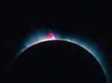
Jesus has always been God
3
"In the beginning
was the Word,
and the Word was with God,
and the Word was God"
(John 1:1)
Notes:
Scripture is very clear that Jesus is God. Christians have always believed this key doctrine called the deity of Christ.

Slide 127

God became man in Jesus
3
"So the Word became human and lived here on earth among us. He was full of unfailing love and faithfulness. And we have seen his glory, the glory of the only Son of the Father" (John 1:14 NLT)
Notes:
Any doubt as to who is meant by the "Word" is erased once we reached verse 14, which clearly shows the at "Word was God" means that Jews was God.

Slide 128

Answer the Critics
3
"But in your hearts set apart Christ as Lord. Always be prepared to give an answer to everyone who asks you to give the reason for the hope that you have. But do this with gentleness and respect."
1 Peter 3:15
Notes:
Peter tells us the foundation on which to respond (Christ's Lordship of our lives), the "what" to do (answer based on hope), and the "how" to do this (gently and respectfully). This is our desire as we respond to The Da Vinci Code.

Slide 129
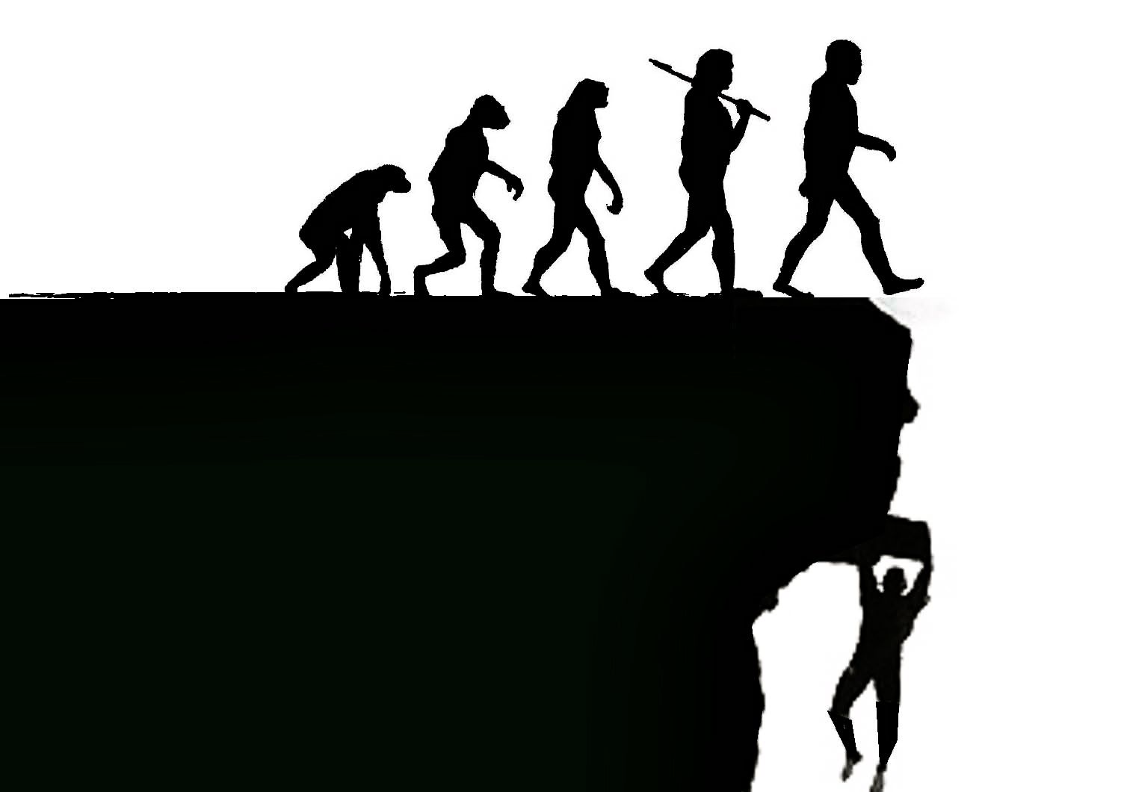
Atheism is a faith system
3

Slide 130

Atheism is a faith system
3

Slide 131

Creation: The Argument from Design
3

Slide 132

ATHEISM
3
In the beginning there was nothing…
and then it exploded.

Slide 133

ATHEISM
3
The religious belief in a spontaneous, causeless, sourceless, purposeless, meaningless existence.

Slide 134

Are our computers and smart phones designed?
3

Slide 135

Is this building designed?
3

Slide 136

Is this baby designed?
3

Slide 137

Did this turtle get here by itself?
3
If not, what is your explanation?

Slide 138

Atheism
5

Slide 139

We must deal with facts instead of speculation
6

Slide 140

"Can we, just for a moment, Your Honor, ignore the facts?"
6
Notes:
Should we emphasize the reliability of the Bible? I don't want to be like the guy pleading before the judge, "Can we, just for a moment, Your Honor, ignore the facts?" I want to deal with facts to help atheists to see the truth of God, but how?

Slide 141

No genealogies?
6

Slide 142

The Moral Argument: Why do atheists believe in morality?
6
5

Slide 143

Richard Dawkins
6

Slide 144

The Moral Argument: Why do atheists believe in morality?
6

Slide 145
"The fool says in his heart,
'There is no God'"
(Psalm 14:1)
Why is this true?

Slide 146

The Moral Argument: Why do atheists believe in morality?
6

Slide 147

Mark Twain
6

Slide 148

Ben Stein Interview of Richard Dawkins
6
His View on Origins

Slide 149
Black
Notes:
149

Slide 150


The Reliability of the Bible: Attacks Against Scripture
7
Since the early church false teaching has tried to undermine our faith
Presentation_ID
150
150
© 2003 Cisco Systems, Inc. All rights reserved.
150
Notes:
Yet still the deity of Christ has always been attacked but the unbelieving world.

Slide 151

Attacks Continue
7
The Bible is continually attacked
However, discoveries continue to verify its accuracy

Slide 152

Is the Bible reliable?
7
Brown accuses via the mouth of "historian" Leigh Teabing…
"The Bible is a product of man, my dear. Not of God… [It] has evolved through countless translations, additions, and revisions. History has never had a definitive version of the book."
DVC, 195
Notes:
We are led to believe that some versions of the Bible have differing numbers of books--and that the fact that the Bible has been translated into more languages than any other book makes it suspect. No, this is a sign of worldwide recognition of it as the Word of God.

Slide 153

We trust ourselves instead of God.
7
Praying won't help.
Doing will.
Notes:
We need to be saved from our independence that leads to sin [restated].

Slide 154

We trust ourselves instead of God.
7
Lead with your heart.
Not with your Bible.
Notes:
So why do we die? Because since the beginning we have trusted ourselves instead of God.

Slide 155



Some liberal scholars redefine Christianity
7
Elaine Pagels teaches at Princeton that first century Christianity was also Gnostic!
Notes:
Pagels is a strong proponent of Gnostic thought which believed that salvation was not by faith in Christ but by receiving a supposed "secret knowledge" from God.

Slide 156

Smearing History
7
Dan Brown
"Gospel"
Matthew
Mark
Luke
John
Selected for their "Male Bias"
Supposed 80 Gospels!
Matthew
Mark
Luke
John
Gospel
Truth
18 Heretical Gospels Written
1st Cent.
AD 325
Council of Nicaea
Notes:
In reality, of the 20 issues discussed at Nicaea, not one of them related to the correct books for the NT.

Slide 157
Clearing History
7
Acceptance of the Four Gospels Before Nicaea
Individuals
Didache (120-150)
Papias (130-140)
Pseudo-Barnabas (70-130)
Clement of Rome (95-97)
Polycarp (110-150)
Irenaeus (130-202)
X= Citation
or allusion
Hermas (115-140)
O= Named
as authentic
Matthew
Mark
Luke
John
X
X
X
X
X
O
X
X
X
O
X
X
X
O
X
X
X
O
Gospel of Thomas
AD 50-140
Gospel of Judas
AD 170?
1st Cent.
AD 325
Council of Nicaea
Geisler & Nix, Introduction to the Bible (Chicago: Moody, 1968)
Notes:
This is found in H. Wayne House, Chronological & Background Charts to the New Testament, It is also the last page of the notes for this seminar. The point here is that our four gospels were consistently cited whereas "Brown's Gnostic gospels" were likely not even written until the second century (even if Thomas appeared as early as AD 50 it was still deemed heretical).

Slide 158

Irenaeus (AD 180)
7
"They declare that Judas the traitor was thoroughly acquainted with these things, and that he alone, knowing the truth as no others did, accomplished the mystery of the betrayal; by him all things, both earthly and heavenly, were thus thrown into confusion. They produce a fictitious history of this kind, which they style the Gospel of Judas."
Against Heresies 1.31.1
Notes:
http://www.ccel.org/fathers2/ANF-01/anf01-60.htm#P7477_2003920

Slide 159
Irenaeus (AD 180)
7
"It is not possible that the Gospels can be either more or fewer in number than they are. For, since there are four zones of the world… and four principal winds… it is fitting that [the Church] should have four pillars…." (then he lists Matthew, Mark, Luke & John)
Against Heresies 3.11.8
Notes:
http://www.ccel.org/fathers2/ANF-01/anf01-60.htm#P7477_2003920

Slide 160
Irenaeus (AD 180)
7
"Matthew also issued a written Gospel among the Hebrews in their own dialect, while Peter and Paul were preaching at Rome, and laying the foundations of the Church. After their departure, Mark, the disciple and interpreter of Peter, did also hand down to us in writing what had been preached by Peter. Luke also, the companion of Paul, recorded in a book the Gospel preached by him. Afterwards, John, the disciple of the Lord, who also had leaned upon His breast, did himself publish a Gospel during his residence at Ephesus in Asia."
Against Heresies 3.1
Notes:
http://www.ccel.org/fathers2/ANF-01/anf01-60.htm#P7477_2003920

Slide 161
Clearing History
7
Acceptance of the Four Gospels Before Nicaea
Individuals
Canons
Translations
Origen (185-254)
Didache (120-150)
Papias (130-140)
Pseudo-Barnabas (70-130)
Clement of Rome (95-97)
Polycarp (110-150)
Justin Martyr (150-155)
Irenaeus (130-202)
Hermas (115-140)
Marcion (140)
Cyril of Jerusalem (315-386)
Tatian Diatesseron (170)
Old Latin (150-170)
Muratonian (170)
Barococcio (206)
Old Syriac (200)
X= Citation
or allusion
Apostolic (300)
O= Named
as authentic
Matthew
Mark
Luke
John
O
O
O
X
X
X
X
X
O
X
X
O
O
O
O
X
X
X
O
X
X
O
O
O
O
O
O
O
X
X
X
O
X
X
O
O
O
O
O
O
O
O
X
X
X
O
O
X
O
O
O
O
O
O
O
Gospel of Thomas
AD 50-140
Gospel of Judas
AD 170?
1st Cent.
AD 325
Council of Nicaea
Geisler & Nix, Introduction to the Bible (Chicago: Moody, 1968)
Notes:
This is found in H. Wayne House, Chronological & Background Charts to the New Testament, It is also the last page of the notes for this seminar. The point here is that our four gospels were consistently cited whereas "Brown's Gnostic gospels" were likely not even written until the second century (even if Thomas appeared as early as AD 40 it was still deemed heretical).

Slide 162

NT Canon during 1st 4C
For Further Details see...
17
The NT Canon in the First Four Centuries
H. Wayne House, Chronological & Background Charts to the NT
Notes:
This page appears at the end of your notes. Note that the first council that officially affirmed our 27 NT books was not Nicaea, but Hippo in 393.

Slide 163
NT Canonicity
Requirements
7
What did it take for early documents to be considered Scripture?
Written by Apostle (or under an Apostle)
Widely Accepted (used by churches)
Theologically Sound (no false doctrine)
None of these applied to the books Dan Brown says were the "real Scripture," such as the Gospel of Philip & Gospel of Thomas
Notes:
The "canon" or "rule" meant the officially recognized books of Scripture. None of the councils DETERMINED this list. They only AFFIRMED what the church had believed for generations.

Slide 164
Slides on
Hosea 8

Slide 165
Slides on
Hosea 9

Slide 166
Slides on
Hosea 10

Slide 167

Hosea 10:1 NLT
"But the richer
the people get,
the more pagan altars they build.
The more bountiful their harvests,
the more beautiful their sacred pillars."
"How prosperous Israel is—
a luxuriant vine loaded with fruit."

Slide 168
Slides on
Hosea 11

Slide 169

Case Study:
Hosea 11:1 in Matthew 2:15
Who does "son" refer to in each passage?
What difference does this make?
What is Matthew's message for us?
Is it faithful to the OT context and message?
Israel
(Hos. 11:1)
Jesus
(Matt. 2:15)

Slide 170
Case Study:
Hosea 11:1 in Matthew 2:15
Hosea called Israel God's "son," but Israel was a disobedient son.
Matthew calls Jesus God's Son, but He is an obedient Son. Unlike Israel, Jesus was perfect in every instance where Israel failed.
Israel
(Hos. 11:1)
Jesus
(Matt. 2:15)

Slide 171
"Hear the word of the LORD,
O people of Israel!
The LORD has brought charges against you, saying:
'There is no faithfulness, no kindness (hesed), no knowledge of God in your land"
(Hosea 4:1 NLT).
4:4–6:3
6:4–11:11
11:12–13:16
Notes:
God warns Israel of judgment for its faithlessness to the covenant to motivate the people to seek God as Jacob did at Bethel (11:12–13:16).

Slide 172
Slides on
Hosea 12
Notes:
God warns Israel against faithlessness to the covenant shown in its pride to motivate the people to seek God as Jacob did at Bethel (11:12–12:14).

Slide 173
Slides on
Hosea 13
Notes:
God warns that the people's unfaithfulness to the covenant seen in its false worship throughout its history will result in a coming destruction (Hosea 13).

Slide 174

"The people of Samaria must bear the consequences of their guilt because they rebelled against their God"
(Hosea 13:16 NLT).

Slide 175
Slides on
Hosea 14
Notes:
He will bless Israel as he promised in his covenant with Abraham (Hosea 14).
The nation must repent and turn to Him rather than to idols or alliances (14:1-3).
God promises to heal Israel's apostasy and make the nation fruitful again (14:4-7).
Since He alone provides prosperity, there is no value in clinging to idols (14:8).
The wise and righteous who understand the prophecy must obey the ways of the LORD (14:9).

Slide 176

God balances discipline with blessings today too!
HOSEA
FROM BROKEN TO BRAND NEW

Slide 177

FROM BROKEN
Notes:
He disciplines us like a loving father. Hebrews 12 reminds us of his discipline.

Slide 178

TO BRAND NEW
Notes:
He disciplines us like a loving father. Hebrews 12 reminds us of his discipline.

Slide 179
God balances discipline with blessings today too!
HOSEA
FROM BROKEN TO BRAND NEW

Slide 180
How does God motivate us to be loyal to him?
Notes:
So how does God motivate us to be loyal to him? It’s none other than his own loyalty first!

Slide 181
Main Idea
God is loyal to you,
so be loyal to him
Hosea
Notes:
The LORD sets the example in the way he treated Israel and how he treats us.
___________
OS-28-Hosea-18, 181

Slide 182
Simply put...
565
343
Be Loyal
Hosea
Notes:
He encourages us to be loyal to him by first being loyal to us (MI restated).

Slide 183
How does God motivate us to be loyal to him?
2 Ways

Slide 184
I. God motivates loyalty by examples.
Hosea 1–3
Notes:
The LORD gives great illustrations of what it means to committed.

Slide 185
II. God motivates loyalty by balancing correction and blessings.
Hosea 4–14
Notes:
The LORD pairs his penalties with his gifts.
God is loyal to Israel by both discipline and restoration (Hosea 4–14).

Slide 186
How are you doing at being loyal to your loyal Lord?
Notes:
Have you trusted him to take away your sin?

Slide 187


Revelation 2:4 (NIV)
"Yet I hold this against you:
You have forsaken
your first love."

Slide 188
1 John 2:15 (NIV)
"Do not love the world or anything in the world. If anyone loves the world, the love of the Father is not in him."

Slide 189
1 John 2:16-17 (NIV)
"For everything in the world—the cravings of sinful man, the lust of his eyes and the boasting of what he has and does—comes not from the Father but from the world. The world and its desires pass away, but the man who does the will of God lives forever."

Slide 190
James 4:4 (NIV)
"You adulterous people, don't you know that friendship with the world is hatred toward God? Anyone who chooses to be a friend of the world becomes an enemy of God."

Slide 191
Black

Slide 192


OT Preaching link at BibleStudyDownloads.org
Get this presentation and script for free!
Notes:
OT Preaching (op)

Slide 193
Deut. 28: Blessings & Curses
Your towns and your fields
will be blessed (3)
Your towns and your fields
will be cursed (16)
Your children and your crops
will be blessed (4)
Your children and your crops
will be cursed (18)
Your fruit baskets and bread-boards will be blessed (5)
Your fruit baskets and bread-boards will be cursed (17)
Wherever you go and whatever you do, you will be blessed (6)
Wherever you go and whatever you do, you will be cursed (19)
Your enemies will attack you from one direction, but they will scatter from you in seven! (7)
You will attack your enemies from one direction, but you will scatter from them in seven! (25)
You will lend to many nations, but you will never need to borrow from them (12)
They will lend to money to you, but you will not lend to them
(44)
Notes:
Around 1400 BC, God warned in Deut 28 not to have any other gods….
The parallels between the individual blessings and cursings are just too obvious!
———————
BE-05-Deuteronomy-89
OS-05-Deuteronomy-242
OS-12-2 Kings-97
OS-14-2 Chron-62
OS-23-Prophets Intro-25
OS-24-Jeremiah-243
OS-25-Lamentations-72

Slide 194
Prophetic Curses
154
220
Why?
Exile
Deut. 28
Notes:
Later in the OT we see justification for God's judgment on Israel. The leaders and the people sinned through ungodliness and idolatry, and true to the curses of Deut. 28, God gave the people the consequences of their obedience by exiling them to Babylon.
Jeremiah's prophecy and Lamentations record his eyewitness account of Babylon's siege and destruction of Jerusalem for the nation's sin, the Holy Spirit moved him to record an historical compilation which provides the context and justification for God's judgment upon these two nations. The leaders and the people sinned through ungodliness and idolatry, and true to the curses of Deut. 28, God gave the people the consequences of their obedience.
——————————
BE-05-Deuteronomy-90
OS-05-Deuteronomy-252
OS-12-2 Kings-98
OS-23-Prophets Intro-26
OS-24-Jeremiah-244
OS-25-Lamentations-73

Slide 195


Time Periods of the Prophets
442
New Heavens & New Earth
Christ's Second Coming to Reign in Millennium
Christ's First Coming to Suffer
Exile & Return
Prophet's Own Time
Adapted significantly from Salem Kirban, Charts on Revelation (1979), 49
Notes:
The prophets often looked to the future, but did not know how far their prophecies referred. It is like a person standing on mountain looking into the distance and seeing what appears to be the same mountain. However, the person standing at these same mountains from the side can clearly see significant gaps between the peaks. Such is the viewpoint that we have thousands of years later. Generally there existed five time periods, including the prophet’s own era.
____________
Common Slides English-151
BE-31-Obadiah-64
OS-OT_Book_Overviews-782_pp42a_and_347a-613
OS-23-Prophets_Introduction-19
OS-31-Obadiah-13

Slide 196
Placing the Prophetical Books
445
S "O" S
Pre-Exile
(800-606 BC)
Exile
(606-536 BC)
Post-Exile
(536-400 BC)
S
O
L
O
M
O
N
D
A
V
I
D
Israel
Hosea
Amos
Assyria
Jonah
Nahum
S
A
U
L
"HA"
"NAH"
Jews in Jerusalem
Haggai
Zechariah
Malachi
Judah
Habakkuk
Isaiah
Jeremiah
Joel
Micah
Zephaniah
Lamentations
Jews in Exile
Ezekiel
Daniel
Edom
Obadiah
"HIJJMZL"
"IE"
(In Exile)
"HaZeMa"
(final
OT books)
"BAD"
The Daily Walk
Adapted from Walk Thru the Old Testament
Walk Thru the Bible Press, 1978
Notes:
The UK (United Kingdom) had the kings Saul, David, and Solomon.
Yet the UK had warning signs as SDS almost looks like SOS
Sure enough, the UK split with Israel in its own "Brexit" in the north
This began the Pre-Exile prophets
Israel was the first to say "HA" to God in rejection, so God sent Hosea and Amos
Meanwhile, Assyria was even worse. After first repenting under Jonah, they later said "NAH" so God sent both JoNAH and NAHum to warn them.
Of course, Edom as a blood relative to Israel and should have known better, so they were really BAD. Thus, God sent them OBADiah.
Jews in Exile included only Ezekiel and Daniel, who were the only two prophets with IE in their name = In Exile.
But God brought the people of Judah back as Jews in Jerusalem and raised up 3 prophets with the memory device HaZeMa.
But we can't forget th largest group of prophets back in the Pre-Exile times, but how can we remember all 7 of them?
Fortunately, singing Twinkle, Twinkle with their first letters gives HIJJMZL, which, sung over and over, is unforgettable.
______________
Common Slides English-147
Kings & Prophets Charts-18
23-Prophets Intro-12
OS-24-Jeremiah-28
OS-31-Obadiah-14

Slide 197


The Day of the LORD
638-639
Judgment
+
Blessing
Tribulation
Millennium
Rev. 6–19
Rev. 20
7 years
1000 years
Notes:
The Day of the LORD theme appears in every prophetic writing except Jonah. It has a dual emphasis where judgment is followed by blessing. In the near fulfillment, it warns of the judgment of Israel in the Assyrian captivity or of Judah in the Babylonian exile.
But the ultimate referent is the the judgment of the whole earth for a short period, followed by a long era of blessing. Daniel 9:27 identifies this judgment as lasting seven years. Daniel also divides that period into two segments lasting 3.5 years (Dan 7:25; 12:7; Rev. 12:14) which Revelation calls “42 months” (Rev 13:5) or “1260 days” (Rev 12:6).
The NT builds upon this common OT teaching regarding the blessing period. When we get to Rev 20:1-6, we see that the blessing of the kingdom era will last 1000 years.
————————————
OS-29-Joel-86-
OS-36-Zephaniah-135

Slide 198

Our Vision
Love the Nations
Love the Church
Love God
Notes:
Repentance will bring restoration in a church: God wants our church to really trust him.
We still don’t see our need for him as we don’t see our need to pray.
We also need to be involved in his work: missions, teaching, accountability groups, finances, etc.
——————————
OS-29-Joel-128
OP-05-Deut-71

Slide 199
A Dispensational Timeline
OT Survey page 437
Great White
Throne
(Rev 20:11-14)
Rapture
(1 Thess 4:13-18)
2nd Advent
(Zech 14:3-5)
Day of the LORD
Church Age
Tribulation
(Zech 14:1-2)
Millennium
(Zech 14:6-21)
Gog & Magog
(Armageddon)
(Ezek 38–39)
Gog and Magog
Revisited
(Rev 20:7-10)
Notes:
199
OS-23-Isaiah 1-12-Slide 87
OS-26-Ezekiel 1-39-Slide 247
OS-29-Joel-87
OS-31-Obadiah-142
OS-39-Zechariah-158, 168, 184
NS-22-Rev20-22

Slide 200
Is there a future for ethnic believing Israel?
Dispensational
Premillennialism
Amillennialism &
Postmillennialism
Church & Israel distinct
Israel has a future
Church is new Israel
Israel has no future
Covenant
Premillennialism
Notes:
200
Covenant premillennialism seeks to bridge between dispensationalism and the amil/postmil views. Their advocates have largely convinced believers that it was the first view taught I the early church, so they are also called historic premil. But since the covenant premil view is posttrib in its view of the Tribulation, this would imply that the early church was posttrib. In reality, most of the early fathers believed in imminency that leads to a pretrib position, though none of these terms were yet coined.
In any event, both premil views believe in a prophetic future for ethnic Israel, though the covenant view does this inconsistently while seeking also to hold the opposite view that the Church is the “new Israel.”
__________
FU-07-Premil/Dispensational-10
NS-06-Romans9-11-slide

Slide 201
Black

Slide 202
OT Survey link at BibleStudyDownloads.org
Get this presentation for free!
Notes:
OT Survey (os)

