Slide 1
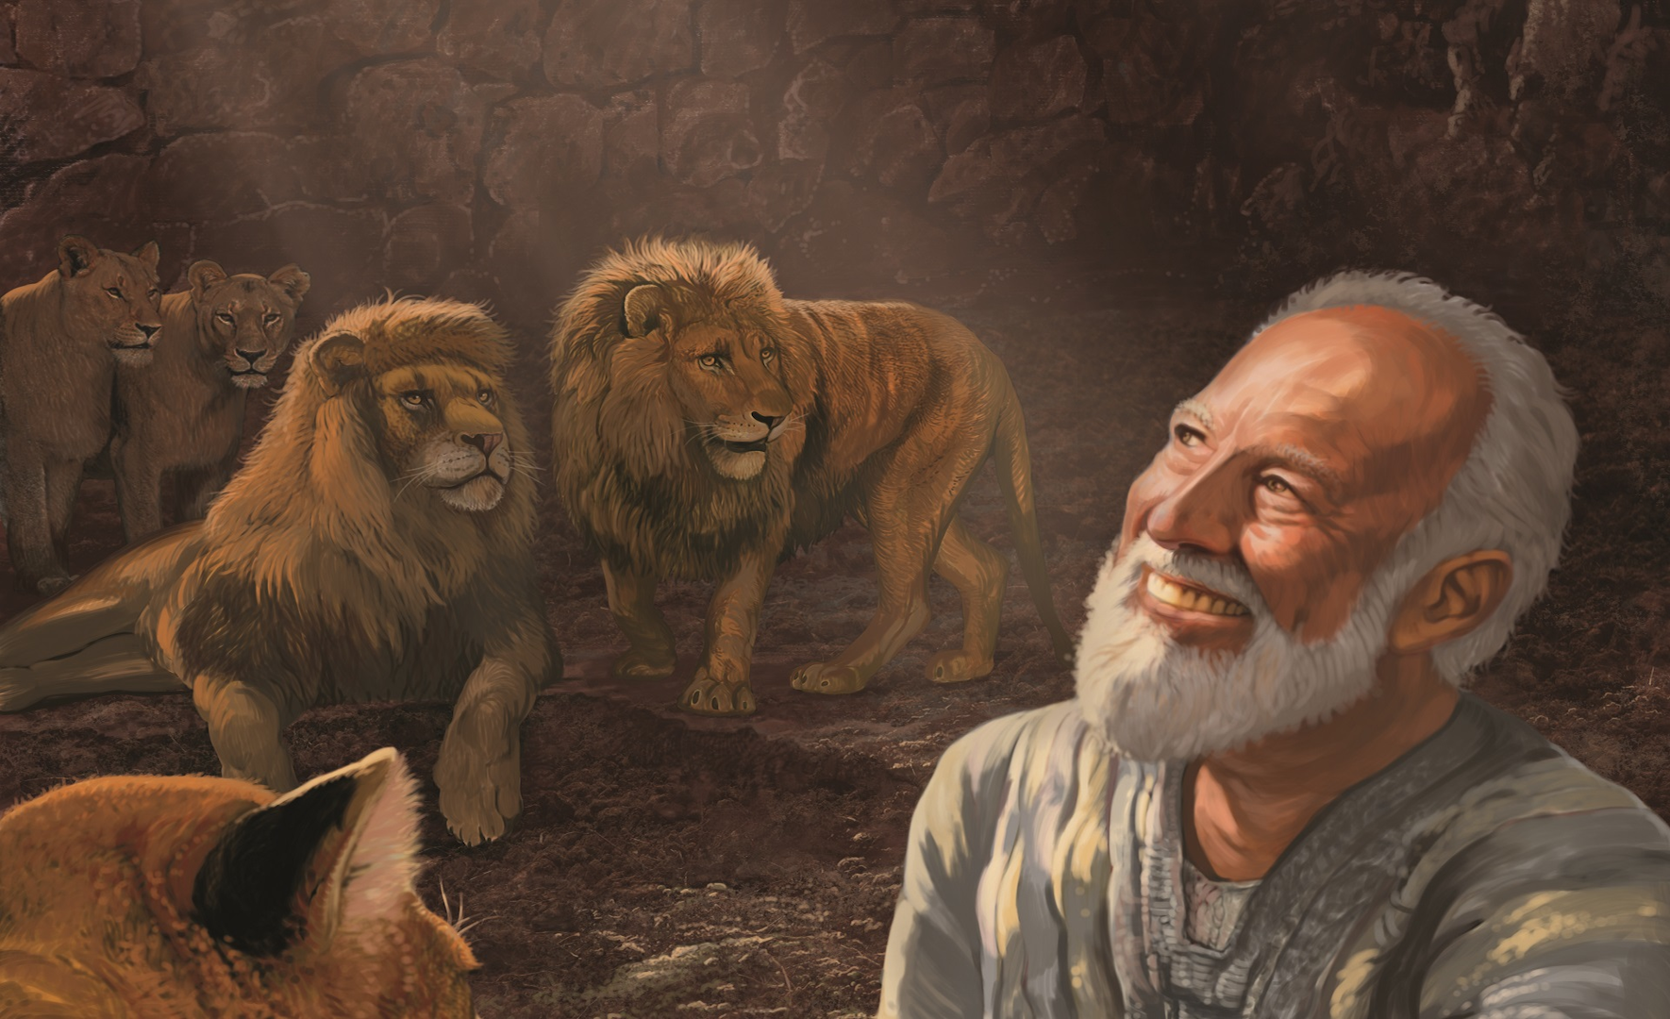
Daniel Authorship
Sixth or Second Century BC?
Dr. Rick Griffith • Jordan Evangelical Theological Seminary
BibleStudyDownloads.org

Slide 2
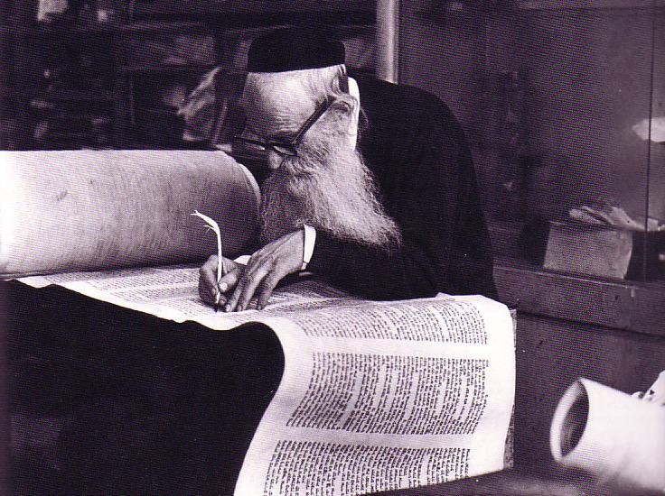
Who Wrote Daniel?
533
Internal evidence: 7:2–12:13 (1st person); 8:1; 9:2; 12:5
External evidence: Ezek. 14:14, 20; Matt. 24:15

Slide 3
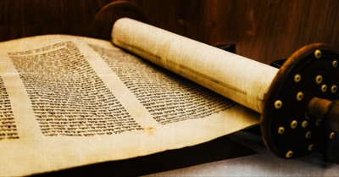
Support for Mosaic Authorship
Internal

Slide 4
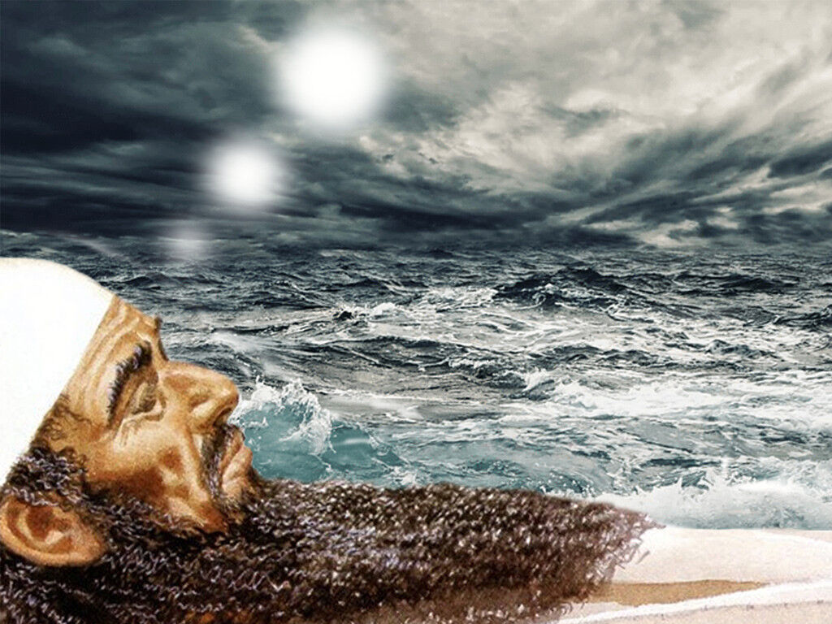
Daniel 7:2 is 1st Person
"Earlier, during the first year of King Belshazzar’s reign in Babylon, Daniel had a dream and saw visions as he lay in his bed. He wrote down the dream, and this is what he saw. ² In my vision that night, I, Daniel, saw a great storm churning the surface of a great sea, with strong winds blowing from every direction" (NLT).

Slide 5
The Journey to Exile & Back
Aleppo
Babylon
Babylonia
Jerusalem

Slide 6
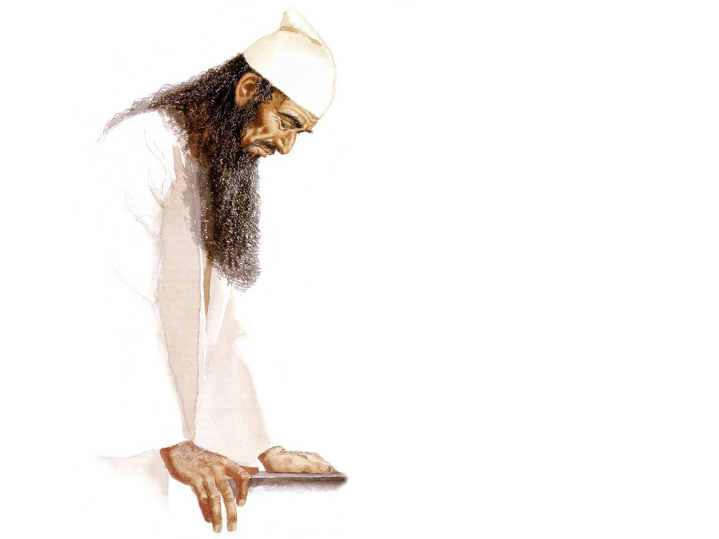
Daniel 8:1 is 1st Person
"During the third year of King Belshazzar’s reign, I, Daniel, saw another vision, following the one that had already appeared to me" (NLT).

Slide 7
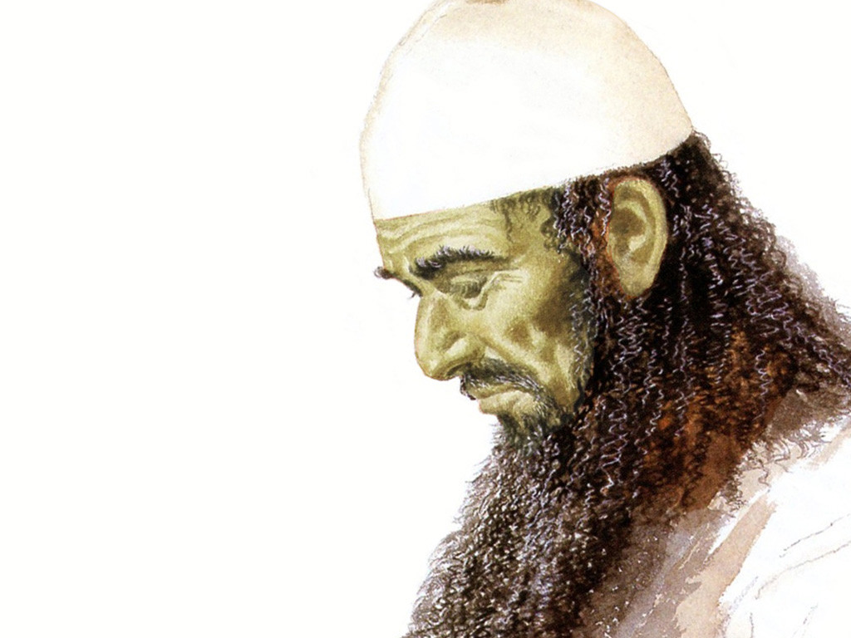
Daniel 9:2 is 1st Person
"During the first year of [Darius’s] reign, I, Daniel, learned from reading the word of the LORD, as revealed to Jeremiah the prophet, that Jerusalem must lie desolate for 70 years" (NLT).

Slide 8
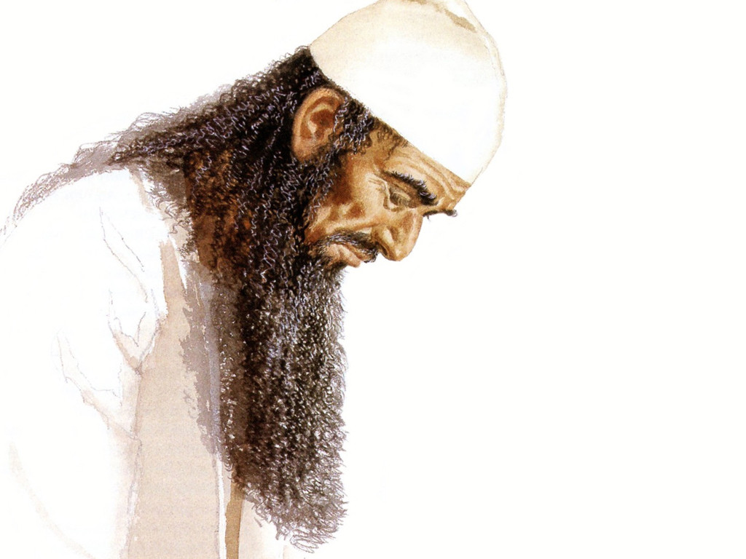
Daniel 12:5 is 1st Person
"Then I, Daniel, looked and saw two others standing on opposite banks of the river" (NLT).

Slide 9
The Date of Daniel
Daniel's Ministry (1:1; 10:1)
605-536
Daniel's Prophecies (Dan 2–11)
605-AD 70
Antiochus Desecrates Temple
167-164
600
550
500
450
400
350
300
2 5 0
2 0 0
150
100
50
BC/AD
50
Critics see historical events recorded as "prophecies"
Critics Date Daniel after 164

Slide 10
Timeline of the Exile
605
70 Years
536
Ezekiel 592-572 (20)
Daniel 605-537 (68)
Jeremiah 626-586 (40)
Belshazzar 550-539 (11)
Babylonian kings
Nabonidus 555-539 (16)
Prophets
Neriglissar 559-555 (4)
Evil-Merodach 561-560 (1)
Nebuchadnezzar 605-561 (44)
Nabopolassar 630-605 (25)
650
600
550
500 BC

Slide 11
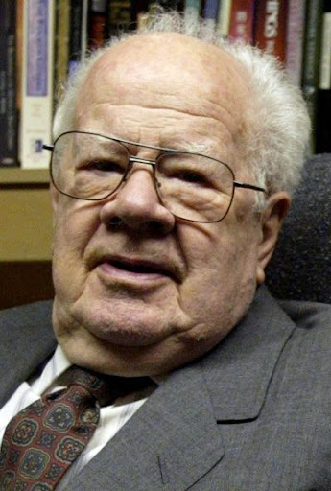
Dwight J. Pentecost, "Daniel,” in The Bible Knowledge Commentary; ed. John F. Walvoord and Roy B. Zuck; Accordance electronic ed. 2 vols.; Wheaton: Victor Books, 1985), 1:1324.
“Daniel’s familiarity with the individuals spoken of in the book and with the historical events and customs mentioned in the book necessitates a sixth-century date for the book. The minute details included in the book could hardly have been retained accurately by oral tradition for some 400 years, as suggested by those who postulate a late date for the book.”
Notes:
Seminary professor J. Dwight Pentecost taught until age 98
Dr. J. Dwight Pentecost (MONA REEDER - 87389)By dallasnews Administrator https://www.dallasnews.com/news/obituaries/2014/05/06/seminary-professor-j-dwight-pentecost-taught-until-age-98/
11:11 PM on May 5, 2014 CDT
The Rev. J. Dwight Pentecost taught more than 10,000 students during his decades at the Dallas Theological Seminary. He taught like he preached, without notes and from the Bible.
The distinguished professor emeritus of Bible exposition taught his last class in December, when he was 98.
Featured on Dallas News
Texas Gov. Greg Abbott scolds Austin for overly ‘stringent’ COVID-19 rules that nix veterans’ parade Gov. Greg Abbott on Tuesday blasted Austin officials for imposing overly restrictive COVID-19…
Pentecost, 99, died April 28 of natural causes at the Forum at Park Lane in Dallas.
A celebration of his life will be at 3 p.m. Wednesday on the seminary campus. Private graveside services were at Restland Memorial Park.
“Dr. ‘P’ — as we affectionately called him — was an inspiration to so many and an institution in his own time,” said seminary president Mark L. Bailey.
“We who have had the privilege to sit under him or teach beside him have all come to know and appreciate the whole of the Bible that our beloved friend believed so thoroughly and taught so faithfully for so many years — all centered in the words and works of Jesus Christ,” Bailey said.
Born in Chester, Pa., Pentecost was 10 when he realized God intended for him to become a minister, he said. His ancestors changed the family name to Pentecost after fleeing the persecutions of French Protestants in 1573. The family arrived in England on Pentecost, the seventh Sunday after Easter, when Christians celebrate the descent of the Holy Spirit on the apostles.
Pentecost attended Hampden-Sydney College in Virginia. He came to Dallas after a summer youth conference where he met a man who had an impressive knowledge of the Bible.
“I wanted to be able to handle the Bible like he did,” Pentecost said in 2005. “So I asked him where he learned how to do that, and he told me he studied at the Dallas seminary.”
In the fall of 1937, Pentecost became the 100th student to enroll at Dallas Theological Seminary, which had been open 12 years then. He earned his master’s degree in 1941 and returned to Pennsylvania, where he was a pastor and taught for eight years at the Philadelphia Bible Institute.
The young pastor devoted two hours each morning to studying Greek, theology and the Bible. He decided he should become a professor.
“While I loved my involvement with people as their shepherd, I felt that I could multiply that effect through teaching,” he said.
Pentecost returned to Dallas and earned his doctorate at the seminary in 1956. While a student, he taught theology, Greek and Bible exposition.
In 1958, he joined the seminary faculty. He was also senior pastor at Grace Bible Church in Dallas from the mid-1950s to 1973.
In 2012, Pentecost missed class for the first time after he fell and broke his leg. Three months later, he was back in the classroom, seminary officials said.
Pentecost authored or co-authored more than 20 books.
His wife of 62 years, Dorothy Pentecost, died in 2000, and a daughter, Gwen Arnold, died in 2011.
Pentecost is survived by a daughter, Jane Fenby of Florida, and two grandchildren.
Memorials may be made to the Dallas Theological Seminary, 3909 Swiss Ave., Dallas, Texas 75204.

Slide 12
"Some critics hold that since God’s name Yahweh is not used by Daniel and since the name was commonly used in Daniel’s day by others, the book must have been written at a later time."
"However, this objection fails to note that in chapter 9 this name is used eight times (Dan. 9:2, 4, 8, 10, 13-14 [thrice], 20). The name for God an author used in a given passage was determined by his content, not by popular custom."
—Pentecost, BKC, 1:1325
Notes:
Some have objected to Daniel’s sixth-century date on the grounds that the book is included in the Writings, the third section of the Hebrew Bible, rather than among the Prophets, the second division. The last prophetic book (Malachi) was written in the fifth century B.C. Those arguing for a late date for Daniel allege that if his book were written in the sixth century, it would have been included in the second division (the Prophets) rather than relegated to the third (the Writings). However, as previously noted, the prophets were set apart by God as His messengers with a special ministry to the nation Israel. Since Daniel was counted by his contemporaries as a governmental leader rather than a prophet, his writings were included in the third division rather than in the second. Thus the status of the author rather than the date of his book determined the division in which his book was included in the Hebrew Bible.
Some critics hold that since God’s name Yahweh is not used by Daniel and since the name was commonly used in Daniel’s day by others, the book must have been written at a later time. However, this objection fails to note that in chapter 9 this name is used eight times (Dan. 9:2, 4, 8, 10, 13-14 [thrice], 20). The name for God an author used in a given passage was determined by his content, not by popular custom.
Some have objected to Daniel’s authorship because of supposed historical errors found in the book. Some have asserted, for instance, that Nebuchadnezzar was not the father of Belshazzar, as indicated in Daniel 5:2, 11, 13, 18 (cf. v. 22). They argue that if Daniel had written the book, he would not have made such an error. However, it has been demonstrated that a royal successor to the throne was called a “son” (5:22) even if he had no blood relationship to an earlier king. (See the chart “Kings of the Neo-Babylonian Empire.”)
Again objection is made to Daniel’s authorship because the writer refers in 1:21 to the time of Daniel’s death. However, 1:21 does not state when Daniel died; it states that he “remained there” (in Babylon) till Cyrus’ first year. Cyrus’ decree liberated the Jews from their exile in Babylon, thus bringing the 70-year Captivity to a near end. Daniel 1:21 is simply pointing out that Daniel lived through the span of the Captivity. The verse does not specify the time of his death. In fact he lived on into at least Cyrus’ third year (10:1).

Slide 13
"Again objection is made to Daniel’s authorship because the writer refers in 1:21 to the time of Daniel’s death."
"However, 1:21 does not state when Daniel died; it states that he 'remained there' (in Babylon) till Cyrus’ first year. Cyrus’ decree liberated the Jews from their exile in Babylon, thus bringing the 70-year Captivity to a near end. Daniel 1:21 is simply pointing out that Daniel lived through the span of the Captivity. The verse does not specify the time of his death. In fact he lived on into at least Cyrus’ third year (10:1)."
—Pentecost, BKC, 1:1325
Notes:
Some have objected to Daniel’s sixth-century date on the grounds that the book is included in the Writings, the third section of the Hebrew Bible, rather than among the Prophets, the second division. The last prophetic book (Malachi) was written in the fifth century B.C. Those arguing for a late date for Daniel allege that if his book were written in the sixth century, it would have been included in the second division (the Prophets) rather than relegated to the third (the Writings). However, as previously noted, the prophets were set apart by God as His messengers with a special ministry to the nation Israel. Since Daniel was counted by his contemporaries as a governmental leader rather than a prophet, his writings were included in the third division rather than in the second. Thus the status of the author rather than the date of his book determined the division in which his book was included in the Hebrew Bible.
Some critics hold that since God’s name Yahweh is not used by Daniel and since the name was commonly used in Daniel’s day by others, the book must have been written at a later time. However, this objection fails to note that in chapter 9 this name is used eight times (Dan. 9:2, 4, 8, 10, 13-14 [thrice], 20). The name for God an author used in a given passage was determined by his content, not by popular custom.
Some have objected to Daniel’s authorship because of supposed historical errors found in the book. Some have asserted, for instance, that Nebuchadnezzar was not the father of Belshazzar, as indicated in Daniel 5:2, 11, 13, 18 (cf. v. 22). They argue that if Daniel had written the book, he would not have made such an error. However, it has been demonstrated that a royal successor to the throne was called a “son” (5:22) even if he had no blood relationship to an earlier king. (See the chart “Kings of the Neo-Babylonian Empire.”)
Again objection is made to Daniel’s authorship because the writer refers in 1:21 to the time of Daniel’s death. However, 1:21 does not state when Daniel died; it states that he “remained there” (in Babylon) till Cyrus’ first year. Cyrus’ decree liberated the Jews from their exile in Babylon, thus bringing the 70-year Captivity to a near end. Daniel 1:21 is simply pointing out that Daniel lived through the span of the Captivity. The verse does not specify the time of his death. In fact he lived on into at least Cyrus’ third year (10:1).

Slide 14
Support for Mosaic Authorship
External
External
External
External
External

Slide 15
Timeline of the Exile
605
70 Years
536
Ezekiel 592-572 (20)
Daniel 605-537 (68)
Jeremiah 626-586 (40)
Ezekiel notes Daniel as his contemporary on par with Job in the 580s BC (four centuries before 164 BC), so Daniel was well-known—not a myth!
Ezek. 14:14 Even if Noah, Daniel, and Job were there, their righteousness would save no one but themselves, says the Sovereign LORD.
Ezek. 14:20 As surely as I live, says the Sovereign LORD, even if Noah, Daniel, and Job were there, they wouldn’t be able to save their own sons or daughters. They alone would be saved by their righteousness.
Belshazzar 550-539 (11)
Babylonian kings
Nabonidus 555-539 (16)
Prophets
Neriglissar 559-555 (4)
Evil-Merodach 561-560 (1)
Nebuchadnezzar 605-561 (44)
Nabopolassar 630-605 (25)
650
600
550
500 BC

Slide 16
Daniel 9:25-27 (NLT)
86b-d
²⁵ Now listen and understand! Seven sets of seven plus sixty-two sets of seven will pass from the time the command is given to rebuild Jerusalem until a ruler—the Anointed One—comes. Jerusalem will be rebuilt with streets and strong defenses, despite the perilous times.
²⁶ "After this period of sixty-two sets of seven, the Anointed One will be killed, appearing to have accomplished nothing, and a ruler will arise whose armies will destroy the city and the Temple. The end will come with a flood, and war and its miseries are decreed from that time to the very end. ²⁷ The ruler will make a treaty with the people for a period of one set of seven, but after half this time, he will put an end to the sacrifices and offerings. And as a climax to all his terrible deeds, he will set up a sacrilegious object that causes desecration, until the fate decreed for this defiler is finally poured out on him."

Slide 17
1. Critical View
555
Jer. 25:11-12
605/ 586 BC
Cy-rus De-cree
538 BC
Mur-der of Oni-as
171 BC
Anti-ochus De-se-cra-tion
167 BC
Tem-ple Re-ded-ica-tion
164 BC
Critical
7 wks
62 weeks
1 wk
Critique of Critical View:
Weeks add up to 422 or 441 years (not 490)
Antiochus was hardly a Messianic figure!
Antiochus IV made no covenant with Israel
Prophecy seen only as imaginative prediction

Slide 18
The Seventy "Weeks" of Daniel
551
Anointed One
Decree
69 sevens = 483 years
7 sevens 62 sevens
1 seven
= 7 years
444 BC – 395 BC
395 BC – AD 33

Slide 19
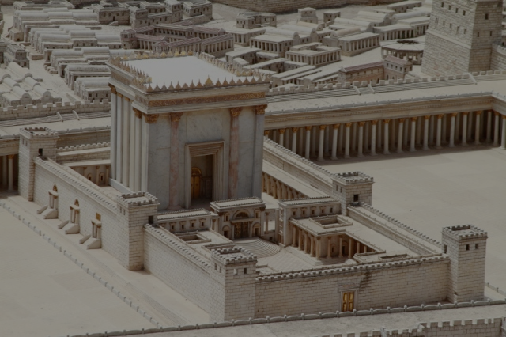
Matthew 24:15 (NLT)
"'The day is coming when you will see what Daniel the prophet spoke about—the sacrilegious object that causes desecration standing in the Holy Place.' (Reader, pay attention!)."
Jesus says that Daniel 9:27 was written by Daniel
Notes:
Some critics say Antiochus IV fulfilled Dan 9:27 in 167 BC when he desecrated the temple by offering a pig on the altar. Yet Jesus noted that the fulfillment was still future. I will take the word of Jesus over the critics.

Slide 20
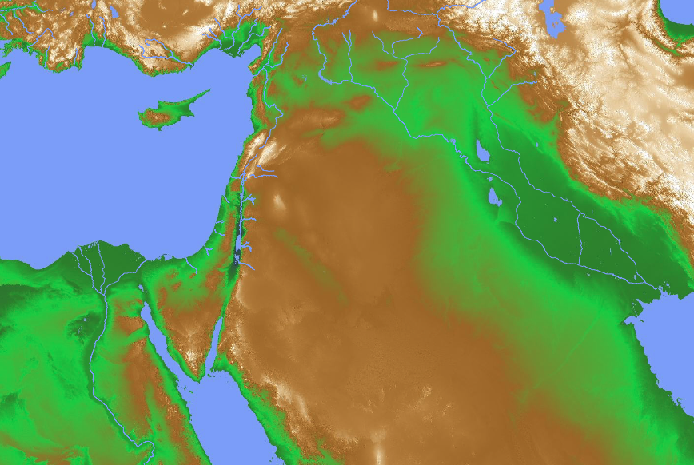
Confirmed ANE Chronologies
“…The Hebrew writers in Kings, etc., have their Assyrian and Babylonian monarchs impeccably in the right order…” (Kitchen, 23)
Mesopotamia: • Old Babylon (1432-1180) • Assyria (912-609) • Neo-Babylon (626-539)
Israel (dates confirmed)
“…﻿Taharqa reigned from 690 to 664, Necho II from 610 to 595, and Hophra from 589 to 570, all in sequence alongside their Hebrew contemporaries…” (Kitchen, 23)
Egypt (1550/1540-525)
Notes:
“﻿The framework of ancient Near Eastern history in this epoch is provided by the two major hearths of complex civilization of that day, namely, Mesopotamia (Assyria and Babylonia) on the east and Egypt to the southwest. Before Alexander the Great (336-323) we have the Persian Empire, which ended the independence of Babylon in 539 (by Cyrus) and (for a time) of Egypt in 525 (by Cambyses). All these dates are firm and universally accepted. In Mesopotamia the Neo-Babylonian kings ruled Babylonia from 626 to 539. Overlapping at the end and preceding them, the kings of Assyria are dated to the year from 912 down to 648 (eponym lists, 911/910ff., plus king lists), and to the final end of Assyria in 609. Before 912 Assyrian dates are closely correct back to 1180, before which a dispute over three or thirteen years for Ninurta-apil-ekur gives a maximum ten-year variation back to 1432/1422 for the accession of Enlil-nasir II. Thus from 1180 (and quite closely from the late fifteenth century) Assyrian dates provide a firm backbone of dating other, less securely fixed regions in the Near East.61
On the other side of the area, Egypt also makes a valuable contribution, essentially independent of Mesopotamia. Thus, before the Persian conquest in 525, the Twenty-Sixth (Saite) Dynasty reigned to the year during 664 to 525. The reign of Tanutamun was contemporary with the Twenty-Sixth Dynasty, and the Twenty-Third and Twenty-Fourth Dynasties were wholly contemporary with the Twenty-Second and with each other; so none of these affect the flow of successive dates. Before the Twenty-Sixth Dynasty, Taharqa of the Twenty-Fifth (Kushite/Nubian) Dynasty reigned from 690 to 664. Before this date, it is now clear that Shebitku reigned from at least 702 (and perhaps 706), and his predecessor Shabaka for fourteen years, thirteen over Egypt, maximally 719/minimally 715 to 702. Before him in Egypt, but not ending before 716 (Osorkon IV = Shilkanni of an Assyrian text in 716), the Twenty-Second (Libyan) Dynasty reigned an absolute minimum of close to 230 years, beginning with Shoshenq I (“Shishak”) from 945 (or extremely close to it). Note that this Egyptian chronology stands independently of both the Assyrian and Hebrew data.
Before 945, the Twenty-First Dynasty goes back to 1070 within a year or so. Earlier still, the Ramesside Nineteenth and Twentieth Dynasties (New Kingdom) go back to firm dates of 1279-1213 (not 1212!) for Ramesses II, and for the preceding Eighteenth Dynasty and start of the New Kingdom to either 1550 or 1540 (again, varying because of a king [Tuthmosis II] who reigned either three or thirteen years).62”
Kenneth A. Kitchen, On the Reliability of the Old Testament (Grand Rapids, MI: Eerdmans, 2003), 22-23 (Kindle Edition Loc 780-796 of 14432)
Loc 804 in the black boxes above

Slide 21
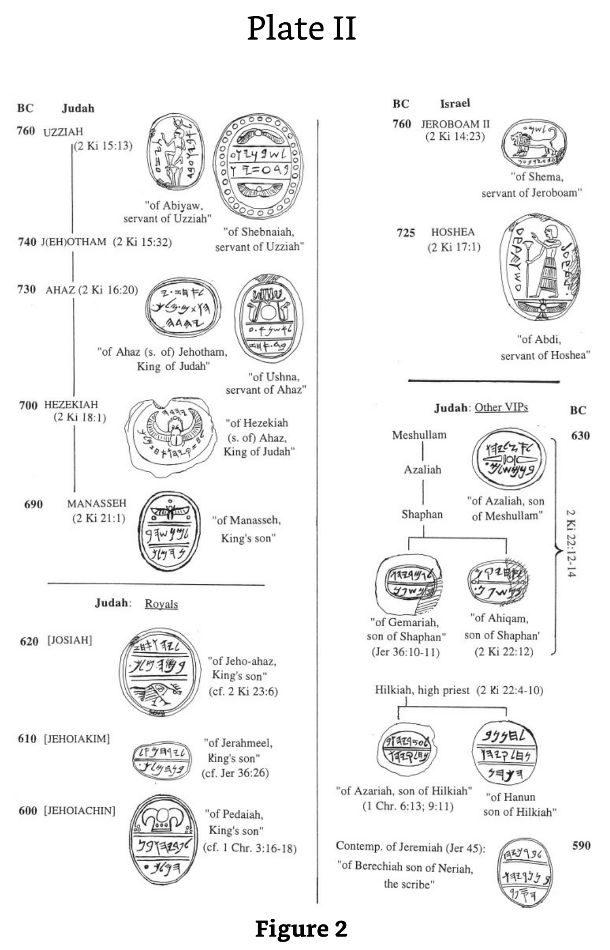
17 Seals Attesting to Jewish Kings
These seals with many close-ups in the following slides show ample archaeological support for the monarchies of Israel and Judah. The same is true for the kings of Babylon noted in Daniel’s prophecy.
Kenneth A. Kitchen, On the Reliability of the Old Testament (Grand Rapids, MI: Eerdmans, 2003), 16-21, 604
Notes:
﻿”3. KINGS OF ISRAEL AND JUDAH IN LOCAL RECORDS (LR) A. KINGS OF ISRAEL The famous seal of “Shema servant [= minister of state] of Jeroboam” is almost universally recognized to belong to the reign of Jeroboam II of Israel (cf. fig. 2); attempts to date it to Jeroboam I are unconvincing. The Samaria ostraca (main lot) belong also to this period, and maybe to this particular reign.44 To Shallum (I) (or much less likely, his Judean namesake, Jehoahaz III/Shallum II) may just possibly be attributed an eighth-century cylindrical seal stone of royal style (kingly figure, winged discs, etc.).45 As for Hoshea, to his reign belongs the seal of one “Abdi, servant of Hoshea” (fig. 2).46 B. KINGS OF JUDAH (i) Azariah/Uzziah, Jotham, Ahaz To the reign of Azariah/Uzziah belong two seals, of the state ministers (“servants”) Shebaniah (Shebanyau) and Abiah (Abiyau).47 Jotham is attested as Jehotham and father of Ahaz on a recently discovered seal impression (“bulla”) that bears the text “Belonging to Ahaz (son of) Jehotham [= long form of Jotham], King of Judah.”48 A seal of this reign is known, of Ushna servant of Ahaz (for these, cf. fig. 2).49 For Ahaz as father of Hezekiah, see under Hezekiah. (ii) Hezekiah (Fig. 2) His name is mentioned on another recently discovered bulla, which reads: “Belonging to Hezekiah (son of) Ahaz, King of Judah,” and with it can now be matched a damaged bulla that bore the same text.50 To these royal stamps can be added no less than three bullae of “servants” of Hezekiah: of Jehozarah son of Hilkiah, of Azariah son of Jeho’abi, and of one on which the name has been lost.51 Among inscriptions without the royal name but belonging to this time should certainly belong the famous Siloam tunnel inscription (cf. 2 Kings 20:20; 2 Chron. 32:30), and likewise the tomb inscription of the royal steward (“he who is over the house”), […]iah, highly likely to have been [Shebna]iah — and the same as Shebna (abbreviated form of this name), the royal steward of Hezekiah’s day, condemned by the prophet Isaiah (Isa. 22:15-25).52 (iii) Manasseh As a young prince he may have had his own personal seal for official purposes. Such a seal may be seen in a known seal inscribed “belonging to Manasseh, son of the king” (fig. 2), the latter being Hezekiah.53 (iv) Josiah Several items may well belong to this reign, although they are without certainty and do not rank as firm evidence. But they can be conveniently set out here as a good example of items that (in almost every case) clearly belong to the later seventh (to early sixth) century in Judah. In this short period the choice of reigns is sometimes limited by year dates, too high to be anyone but either Manasseh or Josiah in practice. These are: (a) Ostracon Mousaieff 1, which required payment of three shekels of silver to “the House [= temple] of the LORD [YHWH]” in the name of ’Ashiah/’Oshiah the king, via a man [Z]echariah. The script is either eighth (so, Cross) or seventh century (so, Yardeni). In the former case, ’Ashiah/’Oshiah is a variant of Joash, king of Judah; in the latter case, of Josiah, which is the latest date possible. In Josiah’s time a Levite named Zechariah was concerned with repairs to the Jerusalem temple (cf. 2 Chron. 34:12), so the later dating might well allow of our two Zechariahs being the same man.54 (b) Seal stones and impressions. These include both fiscal and personal seals. One fiscal seal is dated to a royal “Year 26” in late seventh-/early sixth-century script. Therefore its editors date it to Josiah, the only king who reigned that long, then. (However, it should be said that as Manasseh supposedly reigned fifty-five years, he cannot be ruled out absolutely.) Exactly similar fiscal stamps include dates in Years 13, 14, and 20 (another in a Year 3 is different).55 The personal seals include (fig. 2): one of a king’s son Jeho-ahaz, probably Josiah’s eventual successor; one of Azaliah son of Meshullam (father of Shaphan) (cf. 2 Kings 22:3); one of Ahikam son of Shaphan, this reign or Jehoiakim’s (cf. 2 Kings 22:12-14; Jer. 26:24); a seal stone in ring, of Hanan son of Hilkiah, (high) priest in Jerusalem (cf. 2 Kings 22:8, 10).56 (v) Jehoiakim and Jehoiachin Attributable to Jehoiakim’s reign (fig. 2) may be the seal of the king’s son Jerahmeel and a bulla from a second seal of the same man. Such a man was son of King Jehoiakim and involved with the prophet Jeremiah (Jer. 36:26). An impression or bulla of “Gemariah son of Shaphan” recalls the man of this name and filiation under Jehoiakim in Jer. 36:10-11.57 For the seal of Gemariah’s brother Ahikam, see above under Josiah. For Baruch in this reign and the next two, see under Zedekiah, below. We have also the seal of the king’s son Pedaiah, readily identifiable as one of the sons of Jehoiachin, named in 1 Chron. 3:16-18.58 Cf. fig. 2. (vi) Zedekiah Here a series of personal seals belong to people who bear the names of characters active in this reign. Most famous are two bullae from seals of “Berechiah [= Baruch], son of Neriah the scribe,” well known as the prophet Jeremiah’s faithful secretary (Jer. 32:12; 36; 43:1-7; 45). Cf. Fig. 2. Malkijah the king’s son (Jer. 38:6) may be the same man as the owner of CWSS, 55, no. 15. Seraiah son of Neriah appears to be Baruch’s brother; Azariah son of Hilkiah would be brother of Hanan (cf. under Josiah); cf. 1 Chron. 6:13; 9:11. Gedaliah “who is over the house” may have been the Gedaliah who briefly governed Judah after the Babylonian conquest in 586 (cf. 2 Kings 25:22-25). One or another of four seal owners Jaazaniah, one being “servant of the king,” may again have been the army officer active in 586 (2 Kings 25:23). A king’s son, Elishama, had descendants active at the fall of Jerusalem (2 Kings 25:25; Jer. 41:1); his probable seal would then date anytime from Josiah onward.59 A major inscriptional source at this time is the collection of ostraca found in the ruins of Lachish, known as the “Lachish Letters.” Archaeologically they date from the last days of Lachish before it was destroyed by Nebuchadrezzar’s troops.60
Kenneth A. Kitchen, On the Reliability of the Old Testament (Grand Rapids, MI: Eerdmans, 2003), 16-21, 604 (Kindle Edition Loc 716-772 of 14432)

Slide 22
Seals of Uzziah & Jotham
“quote”
BC
Judah
760
UZZIAH (2 Ki 15:13)
“of Abiyaw, servant of Uzziah”
“of Shebnaiah, servant of Uzziah”
740
J(EH)OTHAM (2 Ki 15:32)
Notes:
﻿”3. KINGS OF ISRAEL AND JUDAH IN LOCAL RECORDS (LR) A. KINGS OF ISRAEL The famous seal of “Shema servant [= minister of state] of Jeroboam” is almost universally recognized to belong to the reign of Jeroboam II of Israel (cf. fig. 2); attempts to date it to Jeroboam I are unconvincing. The Samaria ostraca (main lot) belong also to this period, and maybe to this particular reign.44 To Shallum (I) (or much less likely, his Judean namesake, Jehoahaz III/Shallum II) may just possibly be attributed an eighth-century cylindrical seal stone of royal style (kingly figure, winged discs, etc.).45 As for Hoshea, to his reign belongs the seal of one “Abdi, servant of Hoshea” (fig. 2).46 B. KINGS OF JUDAH (i) Azariah/Uzziah, Jotham, Ahaz To the reign of Azariah/Uzziah belong two seals, of the state ministers (“servants”) Shebaniah (Shebanyau) and Abiah (Abiyau).47 Jotham is attested as Jehotham and father of Ahaz on a recently discovered seal impression (“bulla”) that bears the text “Belonging to Ahaz (son of) Jehotham [= long form of Jotham], King of Judah.”48 A seal of this reign is known, of Ushna servant of Ahaz (for these, cf. fig. 2).49 For Ahaz as father of Hezekiah, see under Hezekiah. (ii) Hezekiah (Fig. 2) His name is mentioned on another recently discovered bulla, which reads: “Belonging to Hezekiah (son of) Ahaz, King of Judah,” and with it can now be matched a damaged bulla that bore the same text.50 To these royal stamps can be added no less than three bullae of “servants” of Hezekiah: of Jehozarah son of Hilkiah, of Azariah son of Jeho’abi, and of one on which the name has been lost.51 Among inscriptions without the royal name but belonging to this time should certainly belong the famous Siloam tunnel inscription (cf. 2 Kings 20:20; 2 Chron. 32:30), and likewise the tomb inscription of the royal steward (“he who is over the house”), […]iah, highly likely to have been [Shebna]iah — and the same as Shebna (abbreviated form of this name), the royal steward of Hezekiah’s day, condemned by the prophet Isaiah (Isa. 22:15-25).52 (iii) Manasseh As a young prince he may have had his own personal seal for official purposes. Such a seal may be seen in a known seal inscribed “belonging to Manasseh, son of the king” (fig. 2), the latter being Hezekiah.53 (iv) Josiah Several items may well belong to this reign, although they are without certainty and do not rank as firm evidence. But they can be conveniently set out here as a good example of items that (in almost every case) clearly belong to the later seventh (to early sixth) century in Judah. In this short period the choice of reigns is sometimes limited by year dates, too high to be anyone but either Manasseh or Josiah in practice. These are: (a) Ostracon Mousaieff 1, which required payment of three shekels of silver to “the House [= temple] of the LORD [YHWH]” in the name of ’Ashiah/’Oshiah the king, via a man [Z]echariah. The script is either eighth (so, Cross) or seventh century (so, Yardeni). In the former case, ’Ashiah/’Oshiah is a variant of Joash, king of Judah; in the latter case, of Josiah, which is the latest date possible. In Josiah’s time a Levite named Zechariah was concerned with repairs to the Jerusalem temple (cf. 2 Chron. 34:12), so the later dating might well allow of our two Zechariahs being the same man.54 (b) Seal stones and impressions. These include both fiscal and personal seals. One fiscal seal is dated to a royal “Year 26” in late seventh-/early sixth-century script. Therefore its editors date it to Josiah, the only king who reigned that long, then. (However, it should be said that as Manasseh supposedly reigned fifty-five years, he cannot be ruled out absolutely.) Exactly similar fiscal stamps include dates in Years 13, 14, and 20 (another in a Year 3 is different).55 The personal seals include (fig. 2): one of a king’s son Jeho-ahaz, probably Josiah’s eventual successor; one of Azaliah son of Meshullam (father of Shaphan) (cf. 2 Kings 22:3); one of Ahikam son of Shaphan, this reign or Jehoiakim’s (cf. 2 Kings 22:12-14; Jer. 26:24); a seal stone in ring, of Hanan son of Hilkiah, (high) priest in Jerusalem (cf. 2 Kings 22:8, 10).56 (v) Jehoiakim and Jehoiachin Attributable to Jehoiakim’s reign (fig. 2) may be the seal of the king’s son Jerahmeel and a bulla from a second seal of the same man. Such a man was son of King Jehoiakim and involved with the prophet Jeremiah (Jer. 36:26). An impression or bulla of “Gemariah son of Shaphan” recalls the man of this name and filiation under Jehoiakim in Jer. 36:10-11.57 For the seal of Gemariah’s brother Ahikam, see above under Josiah. For Baruch in this reign and the next two, see under Zedekiah, below. We have also the seal of the king’s son Pedaiah, readily identifiable as one of the sons of Jehoiachin, named in 1 Chron. 3:16-18.58 Cf. fig. 2. (vi) Zedekiah Here a series of personal seals belong to people who bear the names of characters active in this reign. Most famous are two bullae from seals of “Berechiah [= Baruch], son of Neriah the scribe,” well known as the prophet Jeremiah’s faithful secretary (Jer. 32:12; 36; 43:1-7; 45). Cf. Fig. 2. Malkijah the king’s son (Jer. 38:6) may be the same man as the owner of CWSS, 55, no. 15. Seraiah son of Neriah appears to be Baruch’s brother; Azariah son of Hilkiah would be brother of Hanan (cf. under Josiah); cf. 1 Chron. 6:13; 9:11. Gedaliah “who is over the house” may have been the Gedaliah who briefly governed Judah after the Babylonian conquest in 586 (cf. 2 Kings 25:22-25). One or another of four seal owners Jaazaniah, one being “servant of the king,” may again have been the army officer active in 586 (2 Kings 25:23). A king’s son, Elishama, had descendants active at the fall of Jerusalem (2 Kings 25:25; Jer. 41:1); his probable seal would then date anytime from Josiah onward.59 A major inscriptional source at this time is the collection of ostraca found in the ruins of Lachish, known as the “Lachish Letters.” Archaeologically they date from the last days of Lachish before it was destroyed by Nebuchadrezzar’s troops.60
Kenneth A. Kitchen, On the Reliability of the Old Testament (Grand Rapids, MI: Eerdmans, 2003), 16-21, 604 (Kindle Edition Loc 716-772 of 14432)

Slide 23
Seals of Jeroboam II & Hoshea
BC
Israel
760
JEROBOAM II (2 Ki 14:23)
“of Shema, servant of Jeroboam”
725
HOSHEA (2 Ki 17:1)
“of Abdi, servant of Hoshea”
Notes:
﻿”3. KINGS OF ISRAEL AND JUDAH IN LOCAL RECORDS (LR) A. KINGS OF ISRAEL The famous seal of “Shema servant [= minister of state] of Jeroboam” is almost universally recognized to belong to the reign of Jeroboam II of Israel (cf. fig. 2); attempts to date it to Jeroboam I are unconvincing. The Samaria ostraca (main lot) belong also to this period, and maybe to this particular reign.44 To Shallum (I) (or much less likely, his Judean namesake, Jehoahaz III/Shallum II) may just possibly be attributed an eighth-century cylindrical seal stone of royal style (kingly figure, winged discs, etc.).45 As for Hoshea, to his reign belongs the seal of one “Abdi, servant of Hoshea” (fig. 2).46 B. KINGS OF JUDAH (i) Azariah/Uzziah, Jotham, Ahaz To the reign of Azariah/Uzziah belong two seals, of the state ministers (“servants”) Shebaniah (Shebanyau) and Abiah (Abiyau).47 Jotham is attested as Jehotham and father of Ahaz on a recently discovered seal impression (“bulla”) that bears the text “Belonging to Ahaz (son of) Jehotham [= long form of Jotham], King of Judah.”48 A seal of this reign is known, of Ushna servant of Ahaz (for these, cf. fig. 2).49 For Ahaz as father of Hezekiah, see under Hezekiah. (ii) Hezekiah (Fig. 2) His name is mentioned on another recently discovered bulla, which reads: “Belonging to Hezekiah (son of) Ahaz, King of Judah,” and with it can now be matched a damaged bulla that bore the same text.50 To these royal stamps can be added no less than three bullae of “servants” of Hezekiah: of Jehozarah son of Hilkiah, of Azariah son of Jeho’abi, and of one on which the name has been lost.51 Among inscriptions without the royal name but belonging to this time should certainly belong the famous Siloam tunnel inscription (cf. 2 Kings 20:20; 2 Chron. 32:30), and likewise the tomb inscription of the royal steward (“he who is over the house”), […]iah, highly likely to have been [Shebna]iah — and the same as Shebna (abbreviated form of this name), the royal steward of Hezekiah’s day, condemned by the prophet Isaiah (Isa. 22:15-25).52 (iii) Manasseh As a young prince he may have had his own personal seal for official purposes. Such a seal may be seen in a known seal inscribed “belonging to Manasseh, son of the king” (fig. 2), the latter being Hezekiah.53 (iv) Josiah Several items may well belong to this reign, although they are without certainty and do not rank as firm evidence. But they can be conveniently set out here as a good example of items that (in almost every case) clearly belong to the later seventh (to early sixth) century in Judah. In this short period the choice of reigns is sometimes limited by year dates, too high to be anyone but either Manasseh or Josiah in practice. These are: (a) Ostracon Mousaieff 1, which required payment of three shekels of silver to “the House [= temple] of the LORD [YHWH]” in the name of ’Ashiah/’Oshiah the king, via a man [Z]echariah. The script is either eighth (so, Cross) or seventh century (so, Yardeni). In the former case, ’Ashiah/’Oshiah is a variant of Joash, king of Judah; in the latter case, of Josiah, which is the latest date possible. In Josiah’s time a Levite named Zechariah was concerned with repairs to the Jerusalem temple (cf. 2 Chron. 34:12), so the later dating might well allow of our two Zechariahs being the same man.54 (b) Seal stones and impressions. These include both fiscal and personal seals. One fiscal seal is dated to a royal “Year 26” in late seventh-/early sixth-century script. Therefore its editors date it to Josiah, the only king who reigned that long, then. (However, it should be said that as Manasseh supposedly reigned fifty-five years, he cannot be ruled out absolutely.) Exactly similar fiscal stamps include dates in Years 13, 14, and 20 (another in a Year 3 is different).55 The personal seals include (fig. 2): one of a king’s son Jeho-ahaz, probably Josiah’s eventual successor; one of Azaliah son of Meshullam (father of Shaphan) (cf. 2 Kings 22:3); one of Ahikam son of Shaphan, this reign or Jehoiakim’s (cf. 2 Kings 22:12-14; Jer. 26:24); a seal stone in ring, of Hanan son of Hilkiah, (high) priest in Jerusalem (cf. 2 Kings 22:8, 10).56 (v) Jehoiakim and Jehoiachin Attributable to Jehoiakim’s reign (fig. 2) may be the seal of the king’s son Jerahmeel and a bulla from a second seal of the same man. Such a man was son of King Jehoiakim and involved with the prophet Jeremiah (Jer. 36:26). An impression or bulla of “Gemariah son of Shaphan” recalls the man of this name and filiation under Jehoiakim in Jer. 36:10-11.57 For the seal of Gemariah’s brother Ahikam, see above under Josiah. For Baruch in this reign and the next two, see under Zedekiah, below. We have also the seal of the king’s son Pedaiah, readily identifiable as one of the sons of Jehoiachin, named in 1 Chron. 3:16-18.58 Cf. fig. 2. (vi) Zedekiah Here a series of personal seals belong to people who bear the names of characters active in this reign. Most famous are two bullae from seals of “Berechiah [= Baruch], son of Neriah the scribe,” well known as the prophet Jeremiah’s faithful secretary (Jer. 32:12; 36; 43:1-7; 45). Cf. Fig. 2. Malkijah the king’s son (Jer. 38:6) may be the same man as the owner of CWSS, 55, no. 15. Seraiah son of Neriah appears to be Baruch’s brother; Azariah son of Hilkiah would be brother of Hanan (cf. under Josiah); cf. 1 Chron. 6:13; 9:11. Gedaliah “who is over the house” may have been the Gedaliah who briefly governed Judah after the Babylonian conquest in 586 (cf. 2 Kings 25:22-25). One or another of four seal owners Jaazaniah, one being “servant of the king,” may again have been the army officer active in 586 (2 Kings 25:23). A king’s son, Elishama, had descendants active at the fall of Jerusalem (2 Kings 25:25; Jer. 41:1); his probable seal would then date anytime from Josiah onward.59 A major inscriptional source at this time is the collection of ostraca found in the ruins of Lachish, known as the “Lachish Letters.” Archaeologically they date from the last days of Lachish before it was destroyed by Nebuchadrezzar’s troops.60
Kenneth A. Kitchen, On the Reliability of the Old Testament (Grand Rapids, MI: Eerdmans, 2003), 16-21, 604 (Kindle Edition Loc 716-772 of 14432)

Slide 24
Seals of Ahaz & Hezekiah
730
AHAZ (2 Ki 16:20)
“of Ahaz (s. of) Jehotham, King of Judah”
“of Ushna, servant of Ahaz”
700
HEZEKIAH (2 Ki 18:1)
“of Hezekiah, (s. of) Ahaz, King of Judah”
Notes:
﻿”3. KINGS OF ISRAEL AND JUDAH IN LOCAL RECORDS (LR) A. KINGS OF ISRAEL The famous seal of “Shema servant [= minister of state] of Jeroboam” is almost universally recognized to belong to the reign of Jeroboam II of Israel (cf. fig. 2); attempts to date it to Jeroboam I are unconvincing. The Samaria ostraca (main lot) belong also to this period, and maybe to this particular reign.44 To Shallum (I) (or much less likely, his Judean namesake, Jehoahaz III/Shallum II) may just possibly be attributed an eighth-century cylindrical seal stone of royal style (kingly figure, winged discs, etc.).45 As for Hoshea, to his reign belongs the seal of one “Abdi, servant of Hoshea” (fig. 2).46 B. KINGS OF JUDAH (i) Azariah/Uzziah, Jotham, Ahaz To the reign of Azariah/Uzziah belong two seals, of the state ministers (“servants”) Shebaniah (Shebanyau) and Abiah (Abiyau).47 Jotham is attested as Jehotham and father of Ahaz on a recently discovered seal impression (“bulla”) that bears the text “Belonging to Ahaz (son of) Jehotham [= long form of Jotham], King of Judah.”48 A seal of this reign is known, of Ushna servant of Ahaz (for these, cf. fig. 2).49 For Ahaz as father of Hezekiah, see under Hezekiah. (ii) Hezekiah (Fig. 2) His name is mentioned on another recently discovered bulla, which reads: “Belonging to Hezekiah (son of) Ahaz, King of Judah,” and with it can now be matched a damaged bulla that bore the same text.50 To these royal stamps can be added no less than three bullae of “servants” of Hezekiah: of Jehozarah son of Hilkiah, of Azariah son of Jeho’abi, and of one on which the name has been lost.51 Among inscriptions without the royal name but belonging to this time should certainly belong the famous Siloam tunnel inscription (cf. 2 Kings 20:20; 2 Chron. 32:30), and likewise the tomb inscription of the royal steward (“he who is over the house”), […]iah, highly likely to have been [Shebna]iah — and the same as Shebna (abbreviated form of this name), the royal steward of Hezekiah’s day, condemned by the prophet Isaiah (Isa. 22:15-25).52 (iii) Manasseh As a young prince he may have had his own personal seal for official purposes. Such a seal may be seen in a known seal inscribed “belonging to Manasseh, son of the king” (fig. 2), the latter being Hezekiah.53 (iv) Josiah Several items may well belong to this reign, although they are without certainty and do not rank as firm evidence. But they can be conveniently set out here as a good example of items that (in almost every case) clearly belong to the later seventh (to early sixth) century in Judah. In this short period the choice of reigns is sometimes limited by year dates, too high to be anyone but either Manasseh or Josiah in practice. These are: (a) Ostracon Mousaieff 1, which required payment of three shekels of silver to “the House [= temple] of the LORD [YHWH]” in the name of ’Ashiah/’Oshiah the king, via a man [Z]echariah. The script is either eighth (so, Cross) or seventh century (so, Yardeni). In the former case, ’Ashiah/’Oshiah is a variant of Joash, king of Judah; in the latter case, of Josiah, which is the latest date possible. In Josiah’s time a Levite named Zechariah was concerned with repairs to the Jerusalem temple (cf. 2 Chron. 34:12), so the later dating might well allow of our two Zechariahs being the same man.54 (b) Seal stones and impressions. These include both fiscal and personal seals. One fiscal seal is dated to a royal “Year 26” in late seventh-/early sixth-century script. Therefore its editors date it to Josiah, the only king who reigned that long, then. (However, it should be said that as Manasseh supposedly reigned fifty-five years, he cannot be ruled out absolutely.) Exactly similar fiscal stamps include dates in Years 13, 14, and 20 (another in a Year 3 is different).55 The personal seals include (fig. 2): one of a king’s son Jeho-ahaz, probably Josiah’s eventual successor; one of Azaliah son of Meshullam (father of Shaphan) (cf. 2 Kings 22:3); one of Ahikam son of Shaphan, this reign or Jehoiakim’s (cf. 2 Kings 22:12-14; Jer. 26:24); a seal stone in ring, of Hanan son of Hilkiah, (high) priest in Jerusalem (cf. 2 Kings 22:8, 10).56 (v) Jehoiakim and Jehoiachin Attributable to Jehoiakim’s reign (fig. 2) may be the seal of the king’s son Jerahmeel and a bulla from a second seal of the same man. Such a man was son of King Jehoiakim and involved with the prophet Jeremiah (Jer. 36:26). An impression or bulla of “Gemariah son of Shaphan” recalls the man of this name and filiation under Jehoiakim in Jer. 36:10-11.57 For the seal of Gemariah’s brother Ahikam, see above under Josiah. For Baruch in this reign and the next two, see under Zedekiah, below. We have also the seal of the king’s son Pedaiah, readily identifiable as one of the sons of Jehoiachin, named in 1 Chron. 3:16-18.58 Cf. fig. 2. (vi) Zedekiah Here a series of personal seals belong to people who bear the names of characters active in this reign. Most famous are two bullae from seals of “Berechiah [= Baruch], son of Neriah the scribe,” well known as the prophet Jeremiah’s faithful secretary (Jer. 32:12; 36; 43:1-7; 45). Cf. Fig. 2. Malkijah the king’s son (Jer. 38:6) may be the same man as the owner of CWSS, 55, no. 15. Seraiah son of Neriah appears to be Baruch’s brother; Azariah son of Hilkiah would be brother of Hanan (cf. under Josiah); cf. 1 Chron. 6:13; 9:11. Gedaliah “who is over the house” may have been the Gedaliah who briefly governed Judah after the Babylonian conquest in 586 (cf. 2 Kings 25:22-25). One or another of four seal owners Jaazaniah, one being “servant of the king,” may again have been the army officer active in 586 (2 Kings 25:23). A king’s son, Elishama, had descendants active at the fall of Jerusalem (2 Kings 25:25; Jer. 41:1); his probable seal would then date anytime from Josiah onward.59 A major inscriptional source at this time is the collection of ostraca found in the ruins of Lachish, known as the “Lachish Letters.” Archaeologically they date from the last days of Lachish before it was destroyed by Nebuchadrezzar’s troops.60
Kenneth A. Kitchen, On the Reliability of the Old Testament (Grand Rapids, MI: Eerdmans, 2003), 16-21, 604 (Kindle Edition Loc 716-772 of 14432)

Slide 25
Seals of Other Judah VIPS
Meshullam
630
Azaliah
“of Azaliah, son of Meshullam”
Shaphan
2 Ki 22:12-14
“of Gemariah, son of Shaphan”
(Jer 36:10-11)
“of Ahiqam, son of Shaphan”
(2 Ki 22:12)
Notes:
﻿”3. KINGS OF ISRAEL AND JUDAH IN LOCAL RECORDS (LR) A. KINGS OF ISRAEL The famous seal of “Shema servant [= minister of state] of Jeroboam” is almost universally recognized to belong to the reign of Jeroboam II of Israel (cf. fig. 2); attempts to date it to Jeroboam I are unconvincing. The Samaria ostraca (main lot) belong also to this period, and maybe to this particular reign.44 To Shallum (I) (or much less likely, his Judean namesake, Jehoahaz III/Shallum II) may just possibly be attributed an eighth-century cylindrical seal stone of royal style (kingly figure, winged discs, etc.).45 As for Hoshea, to his reign belongs the seal of one “Abdi, servant of Hoshea” (fig. 2).46 B. KINGS OF JUDAH (i) Azariah/Uzziah, Jotham, Ahaz To the reign of Azariah/Uzziah belong two seals, of the state ministers (“servants”) Shebaniah (Shebanyau) and Abiah (Abiyau).47 Jotham is attested as Jehotham and father of Ahaz on a recently discovered seal impression (“bulla”) that bears the text “Belonging to Ahaz (son of) Jehotham [= long form of Jotham], King of Judah.”48 A seal of this reign is known, of Ushna servant of Ahaz (for these, cf. fig. 2).49 For Ahaz as father of Hezekiah, see under Hezekiah. (ii) Hezekiah (Fig. 2) His name is mentioned on another recently discovered bulla, which reads: “Belonging to Hezekiah (son of) Ahaz, King of Judah,” and with it can now be matched a damaged bulla that bore the same text.50 To these royal stamps can be added no less than three bullae of “servants” of Hezekiah: of Jehozarah son of Hilkiah, of Azariah son of Jeho’abi, and of one on which the name has been lost.51 Among inscriptions without the royal name but belonging to this time should certainly belong the famous Siloam tunnel inscription (cf. 2 Kings 20:20; 2 Chron. 32:30), and likewise the tomb inscription of the royal steward (“he who is over the house”), […]iah, highly likely to have been [Shebna]iah — and the same as Shebna (abbreviated form of this name), the royal steward of Hezekiah’s day, condemned by the prophet Isaiah (Isa. 22:15-25).52 (iii) Manasseh As a young prince he may have had his own personal seal for official purposes. Such a seal may be seen in a known seal inscribed “belonging to Manasseh, son of the king” (fig. 2), the latter being Hezekiah.53 (iv) Josiah Several items may well belong to this reign, although they are without certainty and do not rank as firm evidence. But they can be conveniently set out here as a good example of items that (in almost every case) clearly belong to the later seventh (to early sixth) century in Judah. In this short period the choice of reigns is sometimes limited by year dates, too high to be anyone but either Manasseh or Josiah in practice. These are: (a) Ostracon Mousaieff 1, which required payment of three shekels of silver to “the House [= temple] of the LORD [YHWH]” in the name of ’Ashiah/’Oshiah the king, via a man [Z]echariah. The script is either eighth (so, Cross) or seventh century (so, Yardeni). In the former case, ’Ashiah/’Oshiah is a variant of Joash, king of Judah; in the latter case, of Josiah, which is the latest date possible. In Josiah’s time a Levite named Zechariah was concerned with repairs to the Jerusalem temple (cf. 2 Chron. 34:12), so the later dating might well allow of our two Zechariahs being the same man.54 (b) Seal stones and impressions. These include both fiscal and personal seals. One fiscal seal is dated to a royal “Year 26” in late seventh-/early sixth-century script. Therefore its editors date it to Josiah, the only king who reigned that long, then. (However, it should be said that as Manasseh supposedly reigned fifty-five years, he cannot be ruled out absolutely.) Exactly similar fiscal stamps include dates in Years 13, 14, and 20 (another in a Year 3 is different).55 The personal seals include (fig. 2): one of a king’s son Jeho-ahaz, probably Josiah’s eventual successor; one of Azaliah son of Meshullam (father of Shaphan) (cf. 2 Kings 22:3); one of Ahikam son of Shaphan, this reign or Jehoiakim’s (cf. 2 Kings 22:12-14; Jer. 26:24); a seal stone in ring, of Hanan son of Hilkiah, (high) priest in Jerusalem (cf. 2 Kings 22:8, 10).56 (v) Jehoiakim and Jehoiachin Attributable to Jehoiakim’s reign (fig. 2) may be the seal of the king’s son Jerahmeel and a bulla from a second seal of the same man. Such a man was son of King Jehoiakim and involved with the prophet Jeremiah (Jer. 36:26). An impression or bulla of “Gemariah son of Shaphan” recalls the man of this name and filiation under Jehoiakim in Jer. 36:10-11.57 For the seal of Gemariah’s brother Ahikam, see above under Josiah. For Baruch in this reign and the next two, see under Zedekiah, below. We have also the seal of the king’s son Pedaiah, readily identifiable as one of the sons of Jehoiachin, named in 1 Chron. 3:16-18.58 Cf. fig. 2. (vi) Zedekiah Here a series of personal seals belong to people who bear the names of characters active in this reign. Most famous are two bullae from seals of “Berechiah [= Baruch], son of Neriah the scribe,” well known as the prophet Jeremiah’s faithful secretary (Jer. 32:12; 36; 43:1-7; 45). Cf. Fig. 2. Malkijah the king’s son (Jer. 38:6) may be the same man as the owner of CWSS, 55, no. 15. Seraiah son of Neriah appears to be Baruch’s brother; Azariah son of Hilkiah would be brother of Hanan (cf. under Josiah); cf. 1 Chron. 6:13; 9:11. Gedaliah “who is over the house” may have been the Gedaliah who briefly governed Judah after the Babylonian conquest in 586 (cf. 2 Kings 25:22-25). One or another of four seal owners Jaazaniah, one being “servant of the king,” may again have been the army officer active in 586 (2 Kings 25:23). A king’s son, Elishama, had descendants active at the fall of Jerusalem (2 Kings 25:25; Jer. 41:1); his probable seal would then date anytime from Josiah onward.59 A major inscriptional source at this time is the collection of ostraca found in the ruins of Lachish, known as the “Lachish Letters.” Archaeologically they date from the last days of Lachish before it was destroyed by Nebuchadrezzar’s troops.60
Kenneth A. Kitchen, On the Reliability of the Old Testament (Grand Rapids, MI: Eerdmans, 2003), 16-21, 604 (Kindle Edition Loc 716-772 of 14432)

Slide 26
Daniel in OT History
Daniel 605-536 BC
United Kingdom
1050-930
Divided Kingdom
930-722
Solitary Kingdom
722-586
Post- Exile
536-425
1100
1050
1000
950
900
850
800
7 5 0
7 0 0
650
600
550
500
450
Exile 586-536

Slide 27
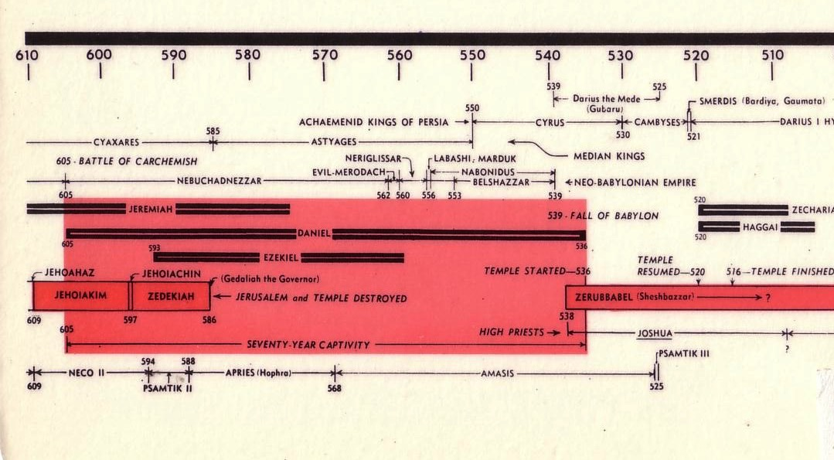
Chart of the Exile
232 & 342
The Babylonian Exile
John C. Whitcomb, 4th rev. ed., Winona Lake, IN: BMH Books, 1962, 1968

Slide 28
Chart of the Exile
232 & 342
The Babylonian Exile
John C. Whitcomb, 4th rev. ed., Winona Lake, IN: BMH Books, 1962, 1968

Slide 29
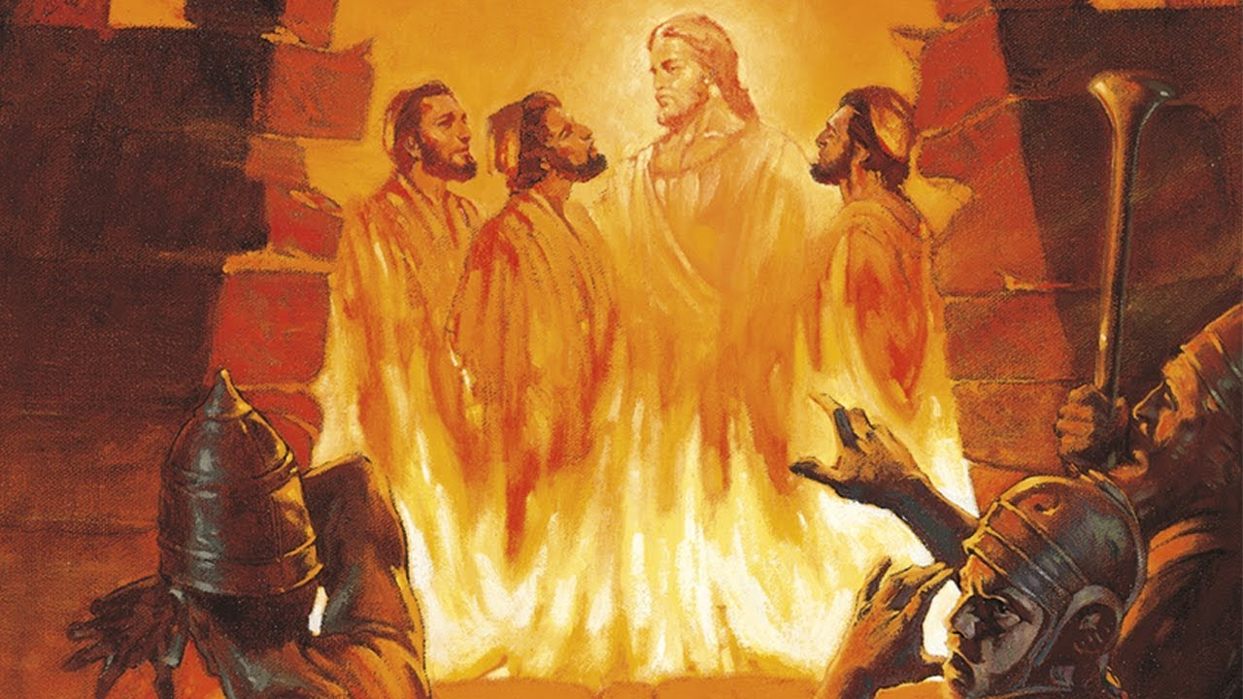
The Fiery Furnace

Slide 30
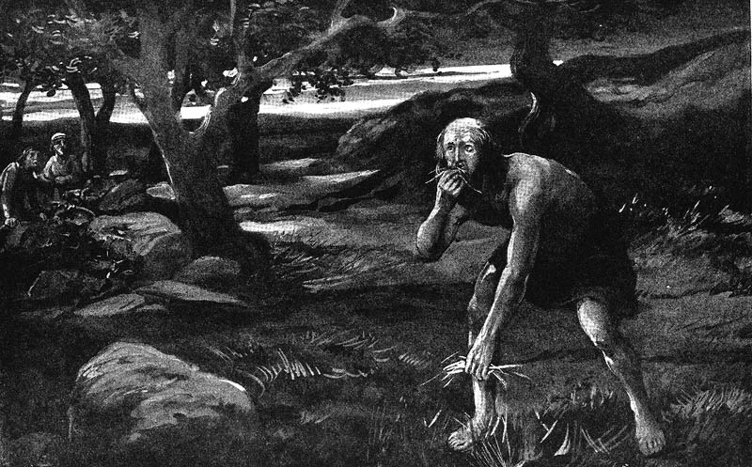
Involuntary Vegetarianism
Notes:
The result was involuntary vegetarianism. Daniel chose vegetarianism in chapter 1, but God gave the king no choice in the matter!

Slide 31
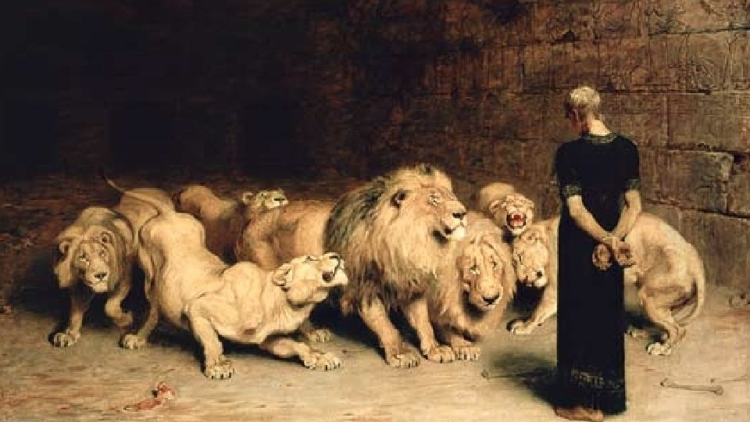
Are these tales?
"The observation that the book contains many historical inaccuracies is the most important clue for the fact that the book originated in the second century. These inaccuracies are explained once it is realized that the writer wrote about the events of her own period, the second century."
M. Nel, “A Literary-Historical Analysis of Daniel 2: Two Powers in Opposition,” Acta Theologica 22 (2002): 78; cited by Tanner, Daniel, 2

Slide 32
The Date of Daniel
Daniel's Ministry (1:1; 10:1)
605-536
Daniel's Prophecies (Dan 2–11)
605-AD 70
Antiochus Desecrates Temple
167-164
600
550
500
450
400
350
300
2 5 0
2 0 0
150
100
50
BC/AD
50
Critics see historical events recorded as "prophecies"
Critics Date Daniel after 164

Slide 33
"Some have objected to Daniel’s authorship because of supposed historical errors found in the book. Some have asserted, for instance, that Nebuchadnezzar was not the father of Belshazzar, as indicated in Daniel 5:2, 11, 13, 18 (cf. v. 22). They argue that if Daniel had written the book, he would not have made such an error."
"However, it has been demonstrated that a royal successor to the throne was called a 'son' (5:22) even if he had no blood relationship to an earlier king."
—Pentecost, BKC, 1:1325
Notes:
Some have objected to Daniel’s sixth-century date on the grounds that the book is included in the Writings, the third section of the Hebrew Bible, rather than among the Prophets, the second division. The last prophetic book (Malachi) was written in the fifth century B.C. Those arguing for a late date for Daniel allege that if his book were written in the sixth century, it would have been included in the second division (the Prophets) rather than relegated to the third (the Writings). However, as previously noted, the prophets were set apart by God as His messengers with a special ministry to the nation Israel. Since Daniel was counted by his contemporaries as a governmental leader rather than a prophet, his writings were included in the third division rather than in the second. Thus the status of the author rather than the date of his book determined the division in which his book was included in the Hebrew Bible.
Some critics hold that since God’s name Yahweh is not used by Daniel and since the name was commonly used in Daniel’s day by others, the book must have been written at a later time. However, this objection fails to note that in chapter 9 this name is used eight times (Dan. 9:2, 4, 8, 10, 13-14 [thrice], 20). The name for God an author used in a given passage was determined by his content, not by popular custom.
Some have objected to Daniel’s authorship because of supposed historical errors found in the book. Some have asserted, for instance, that Nebuchadnezzar was not the father of Belshazzar, as indicated in Daniel 5:2, 11, 13, 18 (cf. v. 22). They argue that if Daniel had written the book, he would not have made such an error. However, it has been demonstrated that a royal successor to the throne was called a “son” (5:22) even if he had no blood relationship to an earlier king. (See the chart “Kings of the Neo-Babylonian Empire.”)
Again objection is made to Daniel’s authorship because the writer refers in 1:21 to the time of Daniel’s death. However, 1:21 does not state when Daniel died; it states that he “remained there” (in Babylon) till Cyrus’ first year. Cyrus’ decree liberated the Jews from their exile in Babylon, thus bringing the 70-year Captivity to a near end. Daniel 1:21 is simply pointing out that Daniel lived through the span of the Captivity. The verse does not specify the time of his death. In fact he lived on into at least Cyrus’ third year (10:1).

Slide 34
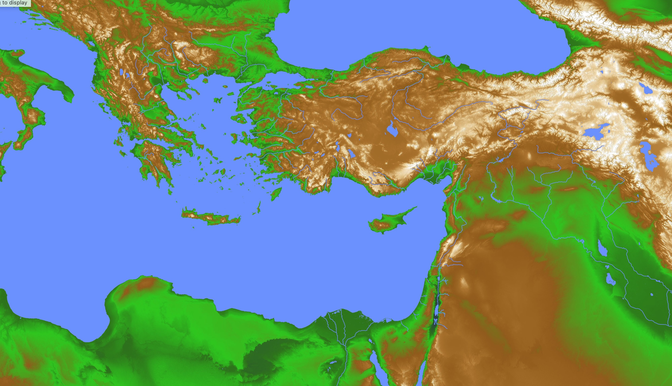
Greek & Persian Loan Words in Daniel
28
Greece
Persia
"Then a herald shouted out, 'People of all races and nations and languages, listen to the king’s command! ⁵ When you hear the sound of the horn, flute, zither, lyre, harp, pipes, and other musical instruments, bow to the ground to worship King Nebuchadnezzar’s gold statue. ⁶ Anyone who refuses to obey will immediately be thrown into a blazing furnace'" (Daniel 3:4-6 NLT).
—How do we explain these many Greek and Persian words in 600 BC before the Greek and Roman empires were established?
Babylon

Slide 35
Greek & Persian Loan Words in Daniel
28
Greece
Persia
"A number of other objections have been raised against the early date for the book. For example, some argue that the several Persian and Greek words in the book indicate that it must have been written much later than the sixth century B.C. However, archeology has revealed that commerce existed between Greece and Babylon even before Daniel’s day. This would explain the presence of Greek words. And the Persian words in the book were from an official or literary form of the Persian language which was in wide use throughout the Near East. (Cf. D.J. Wiseman et al., Notes on Some Problems in the Book of Daniel, pp. 23-7, 35-50.)"
Babylon
Pentecost, BKC, 1:1325
Notes:
Dwight J. Pentecost, "Daniel,” in The Bible Knowledge Commentary; ed. John F. Walvoord and Roy B. Zuck; Accordance electronic ed. 2 vols.; Wheaton: Victor Books, 1985), 1:1325.

Slide 36
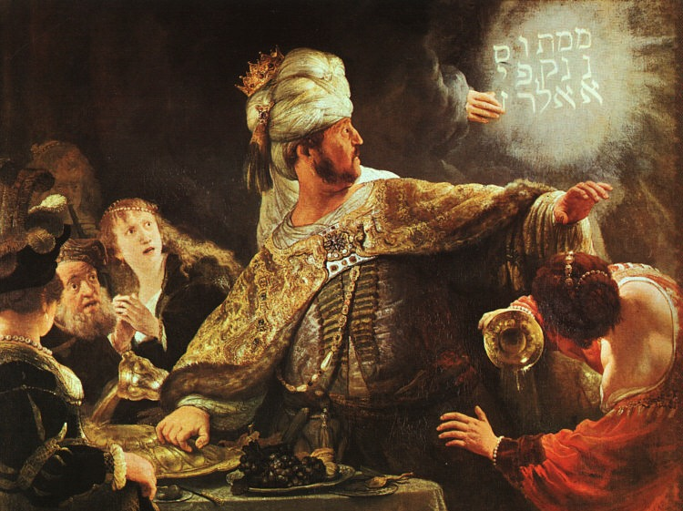
Belshazzar Humbled
Rembrandt
Notes:
In 539 BC Belshazzar denied God's sovereignty at a huge party by praising false gods while drinking from the temple goblets (5:1-4).
God hid his judgment due to Belshazzar’s pride in an unreadable wall inscription that the wise men could not decipher (5:5-9).
God helped Daniel interpret the inscription as his judgment on Belshazzar’s pride and wisdom for the humble (5:10-28).

Slide 37
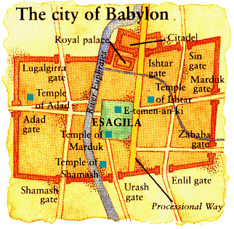
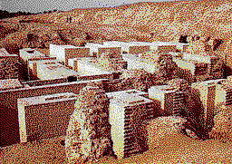
BABYLON FELL in 539 BC
510a
Persians entered under the water gates!
The City of Babylon
Daniel 5
(Belshazzar's Feast)
Notes:
"Babylon was being besieged by the Persian army, led by Ugbaru, governor of Gutium, while Belshazzar, inside the city, was giving a great banquet for 1,000 of his nobles. Belshazzar's name means "Bel (another name for the god Marduk) has protected the king." Perhaps the banquet was given to show Belshazzar's contempt for the Persians and to allay his people's fears. Archeologists have excavated a large hall in Babylon 55 feet wide and 165 feet long that had plastered walls. Such a room would have been sufficient to house a gathering of this size. Belshazzar considered his city secure from assault because of its massive walls. Within the city were supplies that would sustain it for 20 years. Therefore the king felt he had little cause for concern."
Dwight Pentecost, “Daniel,” eds. John F. Walvoord, Roy B. Zuck and Dallas Theological Seminary, The Bible Knowledge Commentary : An Exposition of the Scriptures (Wheaton, IL: Victor Books, 1983-1985), 1:1344.

Slide 38
Babylon's Fall (Herodotus)
544b
The History of the Persian Wars 1.191 (430 BC)
"[Cyrus] placed a portion of his army at the point where the river enters the city, and another body at the back of the place where it issues forth, with orders to march into the town by the bed of the stream, as soon as the water became shallow enough: he then himself drew off with the unwarlike portion of his host, and made for the place where Nitocris dug the basin for the river, where he did exactly what she had done formerly: he turned the Euphrates by a canal into the basin, which was then a marsh, on which the river sank to such an extent that the natural bed of the stream became fordable.
"Hereupon the Persians who had been left for the purpose at Babylon by the river-side, entered the stream, which had now sunk so as to reach about midway up a man's thigh, and thus got into the town.

Slide 39
Babylon's Fall (Herodotus)
544b
"Had the Babylonians been apprised of what Cyrus was about, or had they noticed their danger, they would never have allowed the Persians to enter the city, but would have destroyed them utterly; for they would have made fast all the street-gates which gave upon the river, and mounting upon the walls along both sides of the stream, would so have caught the enemy, as it were, in a trap. But, as it was, the Persians came upon them by surprise and so took the city. Owing to the vast size of the place, the inhabitants of the central parts (as the residents at Babylon declare) long after the outer portions of the town were taken, knew nothing of what had chanced, but as they were engaged in a festival, continued dancing and reveling until they learnt the capture but too certainly. Such, then, were the circumstances of the first taking of Babylon."
The History of the Persian Wars 1.191 (written over a century later in 430 BC)
Notes:
The Greek historian Herodotus describes the fall of Babylon in the same manner as does Daniel 5 with a surprise attack while the Babylonians had a party or festival

Slide 40
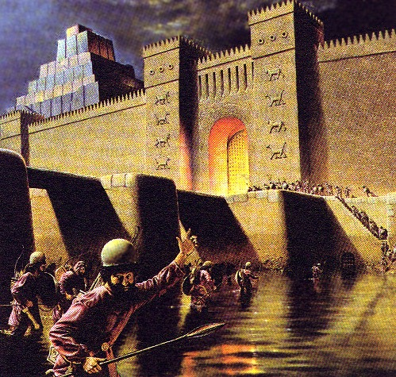
Daniel 5:30-31
“That same night Belshazzar the Chaldean king was slain. So Darius the Mede received the kingdom”
Daniel 5:30-31

Slide 41
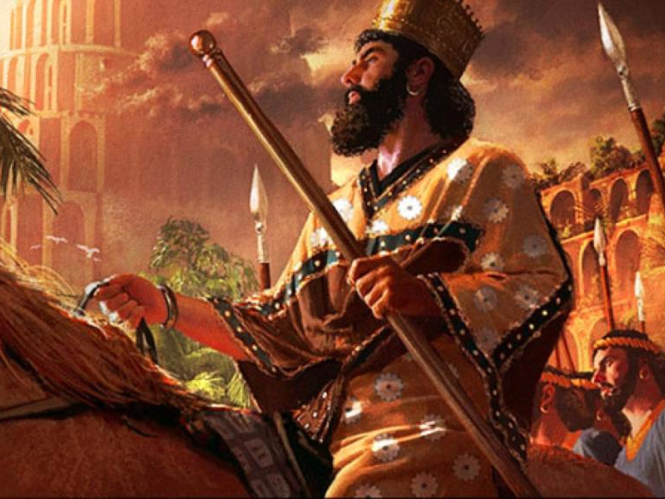
Cyrus Conquers Babylon
539 BC
Notes:
Daniel was promoted to Babylon’s third position to show God's pleasure with those who accept his sovereignty (5:29).
Belshazzar lost his kingdom that night to Darius the Mede [in the reign of Cyrus the Persian, 6:28] for denying God's rule (5:30).

Slide 42
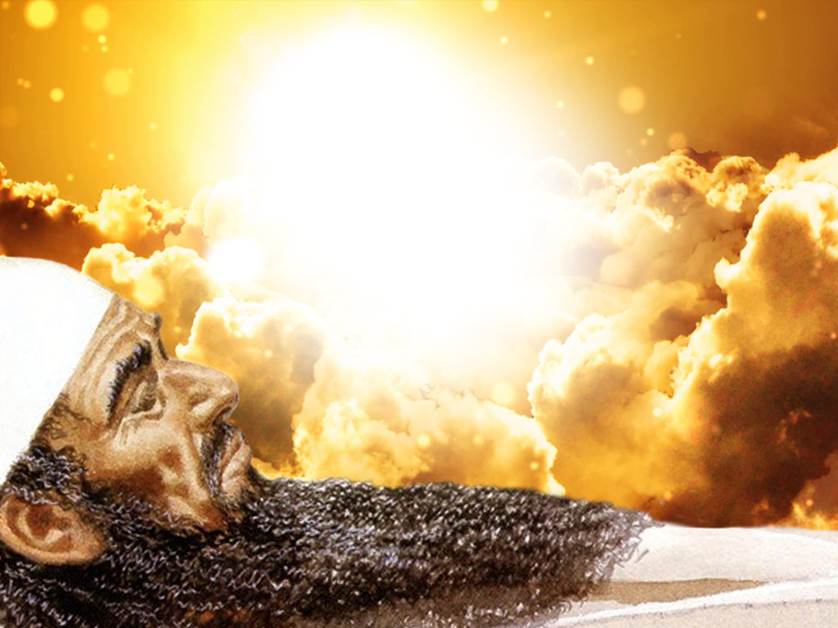
Critics Especially Doubt Visions of Daniel 7–12 (apocalyptic denied for 600 BC)
—Your response?

Slide 43
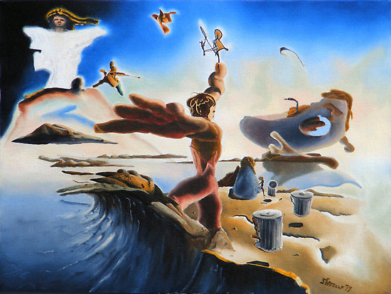
Revelation is the only apocalyptic NT writing
Isn’t Daniel too early for apocalyptic writing?
End times
p. 322 Point D
Warnings (not repentance)
Pessimism
Triumph of God
Secrecy
Determinism

Slide 44
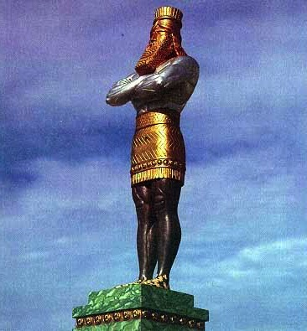
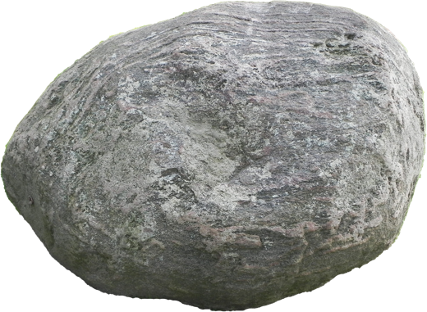
The Image of Daniel 2 is Apocalyptic too
Gold
Babylon
Silver
Persia
Bronze
Greece
Iron
Rome
Iron & Clay
Antichrist
Stone
Kingdom
Notes:
\While Babylon was depicted by gold, even Babylon would fall to Christ’s kingdom!

Slide 45
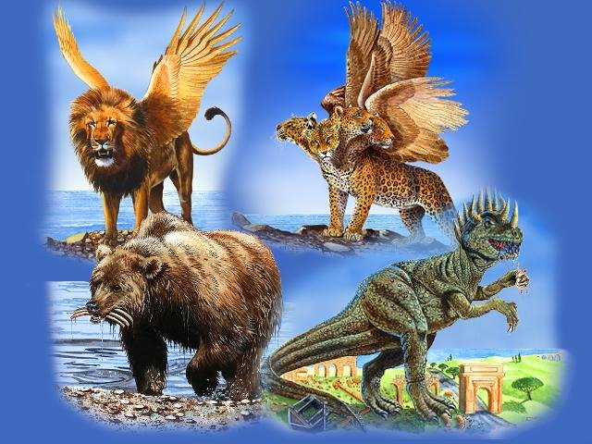
Nations in Daniel 7
Babylon
Greece
Rome
Medo-Persia

Slide 46
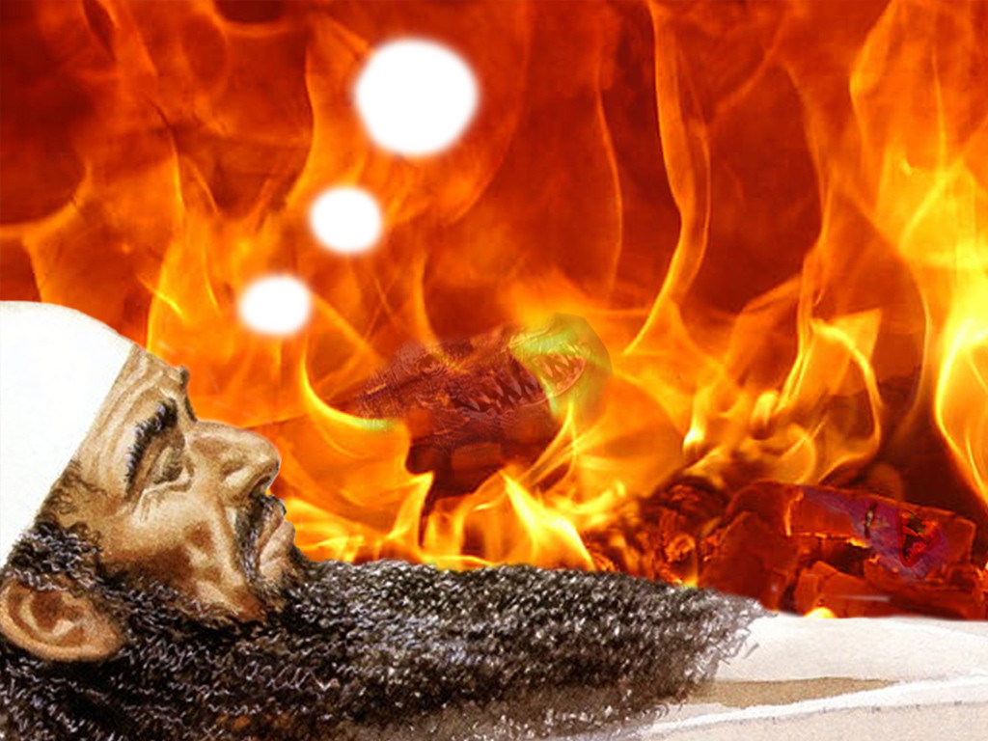
How is it legitimate to accept the Daniel 2 prediction of the four future nations but doubt the same in Daniel 7?

Slide 47
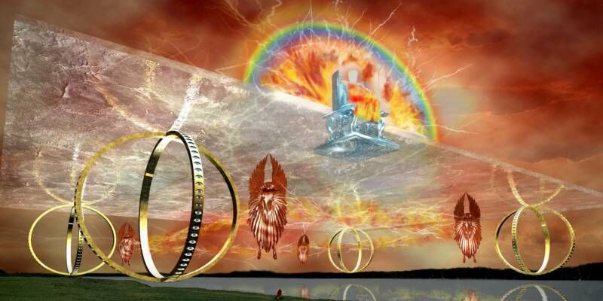
Ezekiel 1
Another apocalyptic vision at the time of Daniel
Notes:
Before Jerusalem’s fall, Ezekiel sees a vision of God’s glory to show his sovereignty and holiness as the basis for the book (Ezek 1).
“A further objection is based on the apocalyptic literature found in the book. Such literature appeared prolifically in Israel in the later time of the Maccabees (literature that is not part of the biblical canon); therefore many scholars infer that the book must have been written in that period (168-134 B.C.). However, as already noted (see “Literary Form”), apocalyptic literature is found in the Book of Ezekiel and he, like Daniel, was a sixth-century prophet.”
Dwight J. Pentecost, "Daniel,” in The Bible Knowledge Commentary; ed. John F. Walvoord and Roy B. Zuck; Accordance electronic ed. 2 vols.; Wheaton: Victor Books, 1985), 1:1325.
_____
Picture from http://ldsscriptureteachings.org/2012/05/02/ezekiels-vision-ezekiel-1-3/

Slide 48
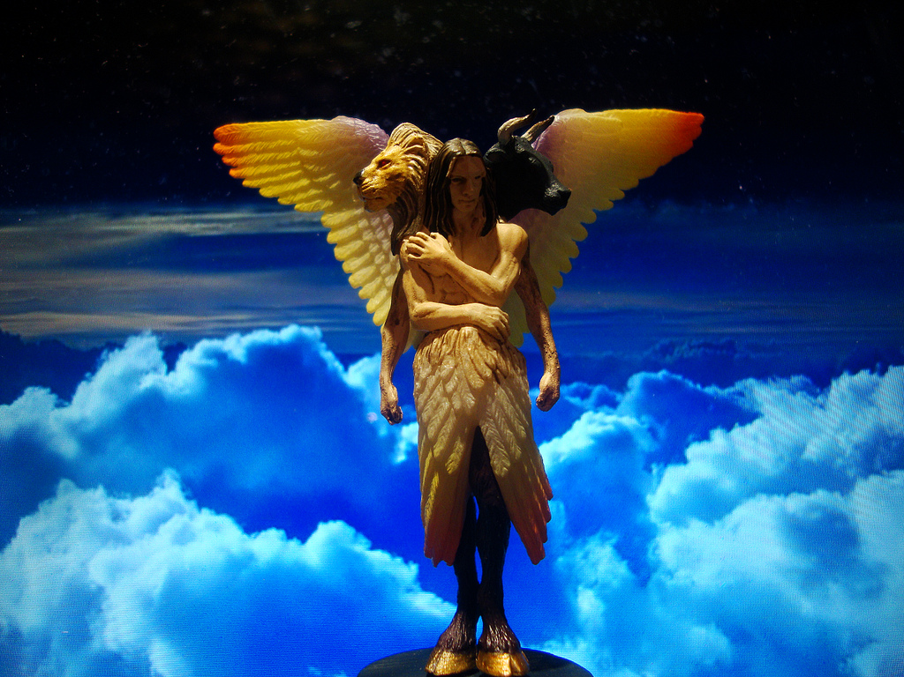
Creatures with Four Faces (Ezekiel 1:11 NLT)
367
"Such were their faces. They each had two wings spreading out upward, each wing touching that of the creature on either side; and each had two other wings covering its body."
Notes:
"I believe that these special creatures symbolize God's creation and are related to God's covenant with Noah (Gen. 9:8–17). The faces of the living creatures parallel God's statement in Genesis 9:10—His covenant is with Noah (the face of the man), the fowl (the face of the eagle), the cattle (the face of the calf), and the beasts of the earth (the face of the lion)" (Wiersbe on Revelation 4:7).

Slide 49
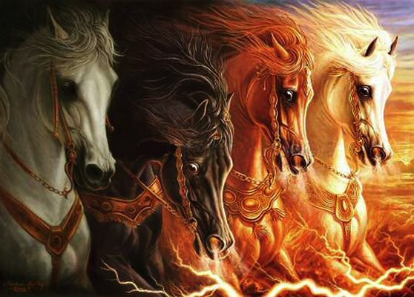
Zechariah 1:8 expands in Revelation 6:1-4

Slide 50
"Some have objected to Daniel’s sixth-century date on the grounds that the book is included in the Writings, the third section of the Hebrew Bible, rather than among the Prophets, the second division. The last prophetic book (Malachi) was written in the fifth century B.C. Those arguing for a late date for Daniel allege that if his book were written in the sixth century, it would have been included in the second division (the Prophets) rather than relegated to the third (the Writings)."
Your response?
—Pentecost, BKC, 1:1325
Notes:
Some have objected to Daniel’s sixth-century date on the grounds that the book is included in the Writings, the third section of the Hebrew Bible, rather than among the Prophets, the second division. The last prophetic book (Malachi) was written in the fifth century B.C. Those arguing for a late date for Daniel allege that if his book were written in the sixth century, it would have been included in the second division (the Prophets) rather than relegated to the third (the Writings). However, as previously noted, the prophets were set apart by God as His messengers with a special ministry to the nation Israel. Since Daniel was counted by his contemporaries as a governmental leader rather than a prophet, his writings were included in the third division rather than in the second. Thus the status of the author rather than the date of his book determined the division in which his book was included in the Hebrew Bible.
Some critics hold that since God’s name Yahweh is not used by Daniel and since the name was commonly used in Daniel’s day by others, the book must have been written at a later time. However, this objection fails to note that in chapter 9 this name is used eight times (Dan. 9:2, 4, 8, 10, 13-14 [thrice], 20). The name for God an author used in a given passage was determined by his content, not by popular custom.
Some have objected to Daniel’s authorship because of supposed historical errors found in the book. Some have asserted, for instance, that Nebuchadnezzar was not the father of Belshazzar, as indicated in Daniel 5:2, 11, 13, 18 (cf. v. 22). They argue that if Daniel had written the book, he would not have made such an error. However, it has been demonstrated that a royal successor to the throne was called a “son” (5:22) even if he had no blood relationship to an earlier king. (See the chart “Kings of the Neo-Babylonian Empire.”)
Again objection is made to Daniel’s authorship because the writer refers in 1:21 to the time of Daniel’s death. However, 1:21 does not state when Daniel died; it states that he “remained there” (in Babylon) till Cyrus’ first year. Cyrus’ decree liberated the Jews from their exile in Babylon, thus bringing the 70-year Captivity to a near end. Daniel 1:21 is simply pointing out that Daniel lived through the span of the Captivity. The verse does not specify the time of his death. In fact he lived on into at least Cyrus’ third year (10:1).

Slide 51
"However, as previously noted, the prophets were set apart by God as His messengers with a special ministry to the nation Israel. Since Daniel was counted by his contemporaries as a governmental leader rather than a prophet, his writings were included in the third division rather than in the second. Thus the status of the author rather than the date of his book determined the division in which his book was included in the Hebrew Bible."
—Pentecost, BKC, 1:1325
Notes:
Some have objected to Daniel’s sixth-century date on the grounds that the book is included in the Writings, the third section of the Hebrew Bible, rather than among the Prophets, the second division. The last prophetic book (Malachi) was written in the fifth century B.C. Those arguing for a late date for Daniel allege that if his book were written in the sixth century, it would have been included in the second division (the Prophets) rather than relegated to the third (the Writings). However, as previously noted, the prophets were set apart by God as His messengers with a special ministry to the nation Israel. Since Daniel was counted by his contemporaries as a governmental leader rather than a prophet, his writings were included in the third division rather than in the second. Thus the status of the author rather than the date of his book determined the division in which his book was included in the Hebrew Bible.
Some critics hold that since God’s name Yahweh is not used by Daniel and since the name was commonly used in Daniel’s day by others, the book must have been written at a later time. However, this objection fails to note that in chapter 9 this name is used eight times (Dan. 9:2, 4, 8, 10, 13-14 [thrice], 20). The name for God an author used in a given passage was determined by his content, not by popular custom.
Some have objected to Daniel’s authorship because of supposed historical errors found in the book. Some have asserted, for instance, that Nebuchadnezzar was not the father of Belshazzar, as indicated in Daniel 5:2, 11, 13, 18 (cf. v. 22). They argue that if Daniel had written the book, he would not have made such an error. However, it has been demonstrated that a royal successor to the throne was called a “son” (5:22) even if he had no blood relationship to an earlier king. (See the chart “Kings of the Neo-Babylonian Empire.”)
Again objection is made to Daniel’s authorship because the writer refers in 1:21 to the time of Daniel’s death. However, 1:21 does not state when Daniel died; it states that he “remained there” (in Babylon) till Cyrus’ first year. Cyrus’ decree liberated the Jews from their exile in Babylon, thus bringing the 70-year Captivity to a near end. Daniel 1:21 is simply pointing out that Daniel lived through the span of the Captivity. The verse does not specify the time of his death. In fact he lived on into at least Cyrus’ third year (10:1).

Slide 52
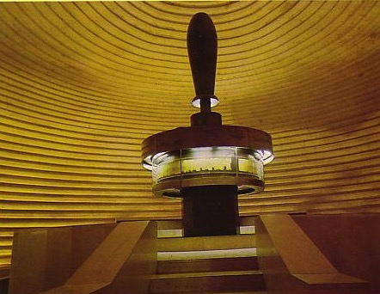
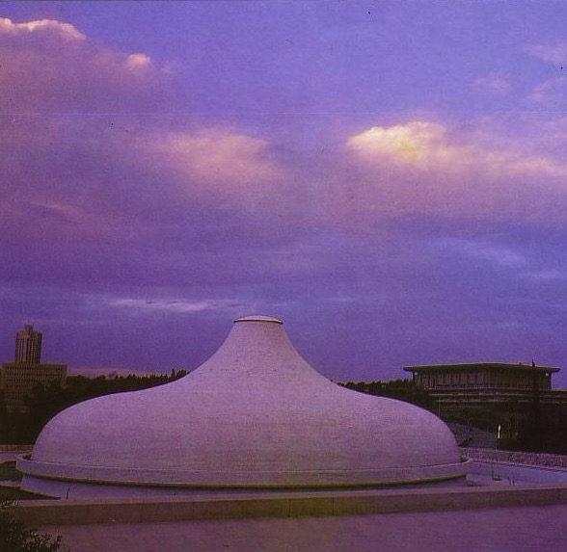
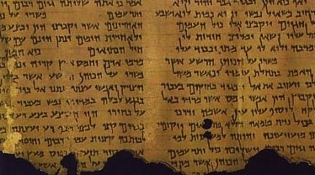
Shrine of the Book
Significance of the Dead Sea Scrolls
534
The DSS proves the conservative dating of OT books
When was Daniel written?
Conservatives
560 BC
DSS Daniel copy
200-100 BC
Liberals
164 BC
Notes:
“The fact that manuscript fragments from the Book of Daniel were found in Qumran, written perhaps in the second century B.C., preclude the notion that Daniel was written in 165 B.C., as many critics suggest. Not enough time would have been available for the book to have reached the Essene community in Qumran and for it to have been copied there.”
Dwight J. Pentecost, Daniel (The Bible Knowledge Commentary; ed. John F. Walvoord and Roy B. Zuck; Accordance electronic ed. 2 vols.; Wheaton: Victor Books, 1985), 1:1324.

Slide 53
But could Daniel have had an advanced theology of angels and the resurrection?
—Another argument of the critics
Notes:
Further objection is made to an early date because of the advanced theology in the book. Critics claim that frequent references to angels and a reference to the resurrection of the dead (12:2) necessitates a late postexilic date for the book. This, however, overlooks the fact that angels are frequently referred to throughout Israel’s long history and that resurrection is mentioned in passages such as Psalm 16:10 and Isaiah 26:19, which certainly predate the time of Daniel”
Dwight J. Pentecost, "Daniel,” in The Bible Knowledge Commentary; ed. John F. Walvoord and Roy B. Zuck; Accordance electronic ed. 2 vols.; Wheaton: Victor Books, 1985), 1:1325.

Slide 54
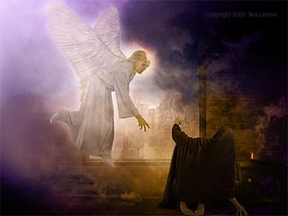
Michael will arise (Daniel 12:1)
Notes:
These prophecies will bless Israel in the Tribulation and reveal judgment for unbelievers to encourage Israel with God's rule (12:4-14).

Slide 55
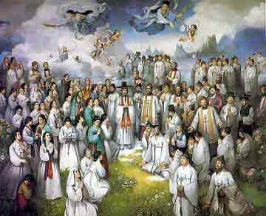
Judgment of Old Testament Saints
FU 160
"Now at that time Michael, the great prince who stands guard over the sons of your people, will arise. And there will be a time of distress such as never occurred since there was a nation until that time; and at that time your people, everyone who is found written in the book, will be rescued. ²Many of those who sleep in the dust of the ground will awake, these to everlasting life, but the others to disgrace and everlasting contempt. ³Those who have insight will shine brightly like the brightness of the expanse of heaven, and those who lead the many to righteousness, like the stars forever and ever" (Daniel 12:1-3 NAU).
Notes:
____________
OS-Daniel
FU-Resurrections

Slide 56
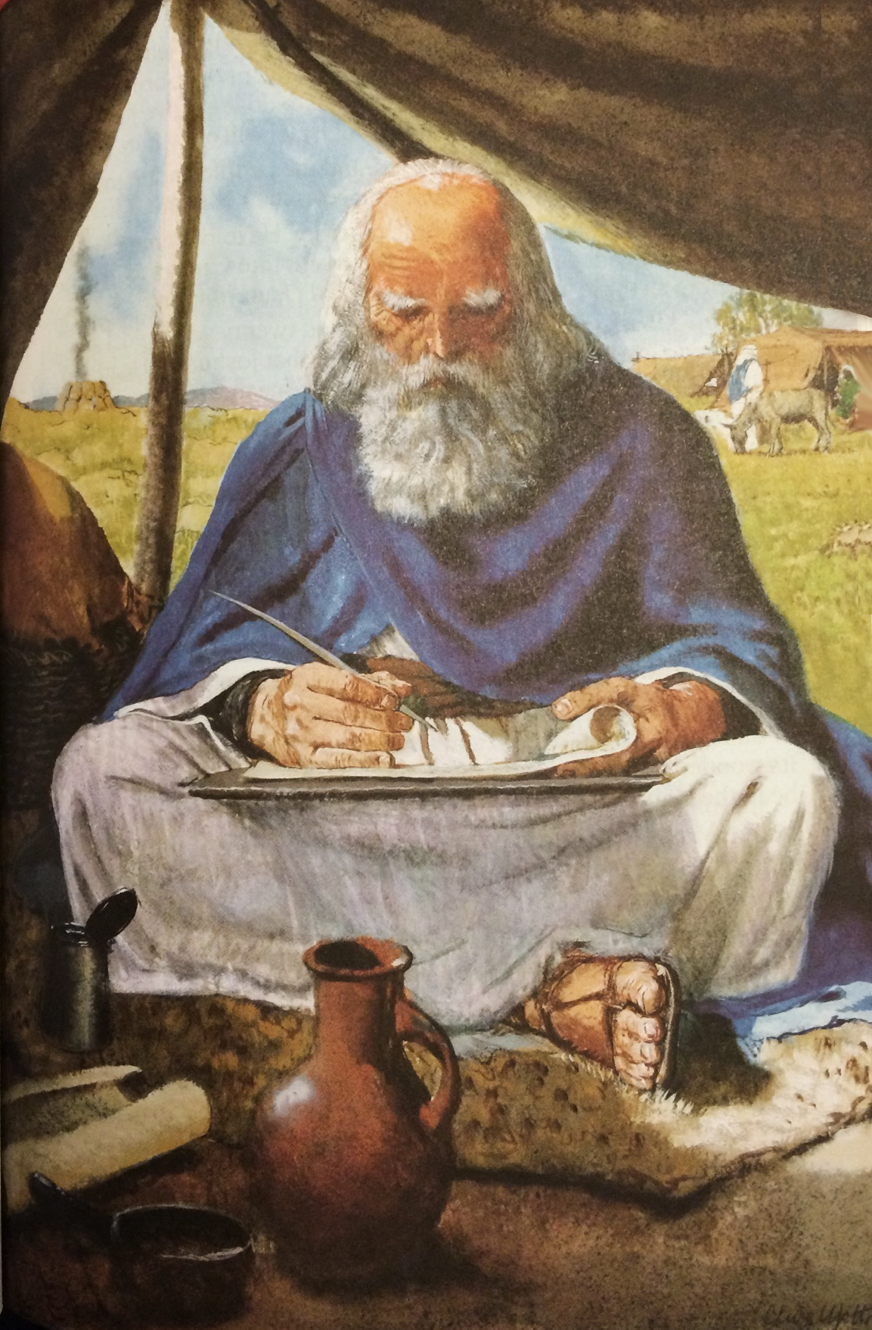
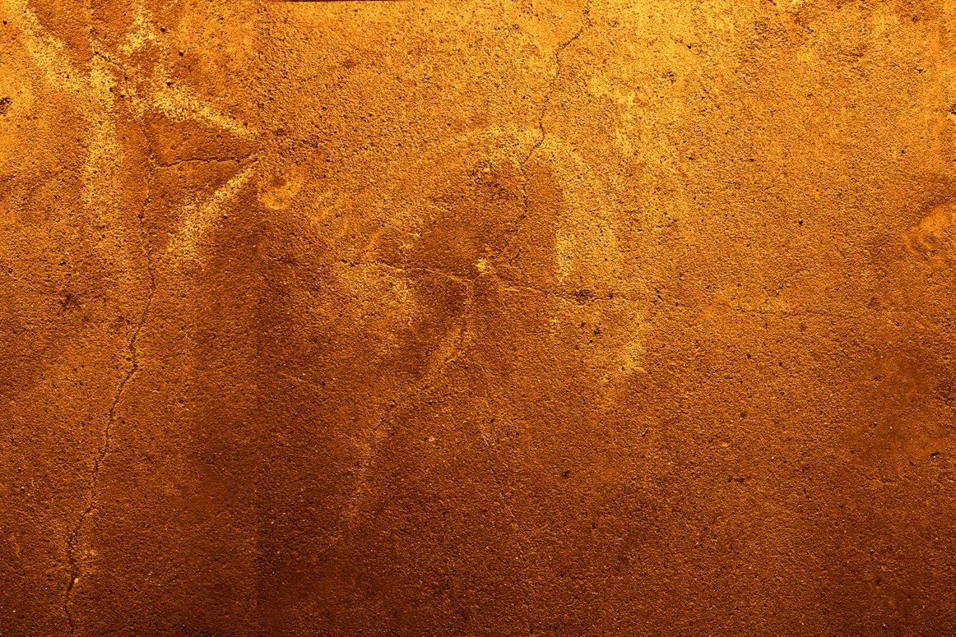
“Your dead will live; Their corpses will rise. You who lie in the dust, awake and shout for joy, for your dew is as the dew of the dawn, and the earth will give birth to the departed spirits.”
Isaiah 26:19

Slide 57
"For you will not leave my soul among the dead or allow your holy one to rot in the grave" (Psalm 16:10 NLT).
Peter noted this as predictive prophecy of the resurrection of Christ (Acts 2)

Slide 58
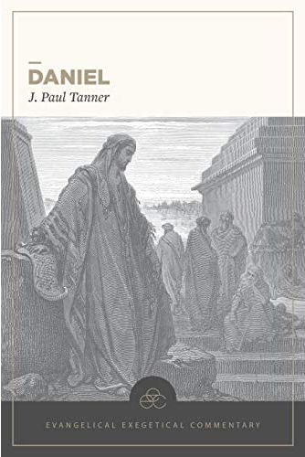
J. Paul Tanner
—Finally, a substantial evangelical commentary on Daniel
Daniel, Evangelical Exegetical Commentary (Bellingham, WA: Lexham Press, 2020)

Slide 59
Conclusion
Do you have any doubts that Daniel wrote the book bearing his name?

Slide 60
Black

Slide 61
Critical Studies of the OT link at BibleStudyDownloads.org
Get this presentation and script for free!

