Slide 1
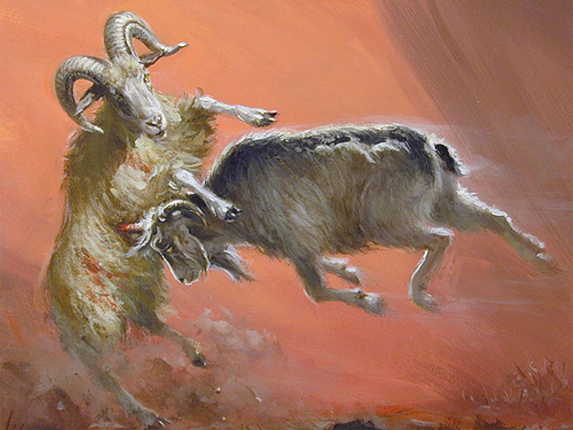
DANIEL 8–12
Dr. Rick Griffith • Jordan Evangelical Theological Seminary
BibleStudyDownloads.org

Slide 2
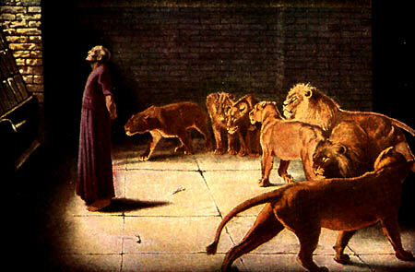
THE BOOK OF DANIEL
Dr. Rick Griffith • Jordan Evangelical Theological Seminary
BibleStudyDownloads.org

Slide 3
Key Word
532
343
Sovereignty
Daniel
Notes:
Daniel repeatedly shows God as the highest ruler—in contrast to Babylonian kings who continually exalt themselves in pride but are humbled in various ways.

Slide 4
Theme
532
Universal Sovereignty in Times of the Gentiles
Daniel
Notes:
The phrase “the times of the Gentiles” does not appear in Daniel but Jesus used this phrase in Luke 21:24 (see slide 21) to refer to the period designated by Daniel when Gentile nations will rule over Jerusalem until Christ reigns from this city. It began when Nebuchadnezzar destroyed Jerusalem in 586 BC and will continue until Messiah rules over the city.

Slide 5
Key Verse
532
(Daniel to God) "…Praise be to the name of God for ever and ever; wisdom and power are his. He changes times and seasons; he sets up kings and deposes them…"
(2:20-21a).
Daniel
Notes:
Many kings utter similar declarations with Daniel’s prophecy as well.

Slide 6

Kingdom Statement
343
God's sovereignty remains steadfast despite the rise and fall of many nations until the establishment of kingdom blessing under His Messianic Ruler (9:24-27).
Daniel
Notes:
Daniel 9:24-27 (NLT): “A period of seventy sets of seven has been decreed for your people and your holy city to finish their rebellion, to put an end to their sin, to atone for their guilt, to bring in everlasting righteousness, to confirm the prophetic vision, and to anoint the Most Holy Place. ²⁵ Now listen and understand! Seven sets of seven plus sixty-two sets of seven will pass from the time the command is given to rebuild Jerusalem until a ruler—the Anointed One—comes. Jerusalem will be rebuilt with streets and strong defenses, despite the perilous times.
²⁶ After this period of sixty-two sets of seven, the Anointed One will be killed, appearing to have accomplished nothing, and a ruler will arise whose armies will destroy the city and the Temple. The end will come with a flood, and war and its miseries are decreed from that time to the very end. ²⁷ The ruler will make a treaty with the people for a period of one set of seven, but after half this time, he will put an end to the sacrifices and offerings. And as a climax to all his terrible deeds, he will set up a sacrilegious object that causes desecration, until the fate decreed for this defiler is finally poured out on him.”
________________

Slide 7

Summary Statement
532
346
The Judean exiles should be encouraged of God's sovereign control over all nations to preserve Israel between Nebuchadnezzar's invasion of Jerusalem (605 BC) and the establishment of the Kingdom blessings under the Messiah.
Daniel
Notes:
Those forced from Jerusalem and brought to Babylon are actually servants of the High God! His rule over the world has not changed, but he is only using the Babylonian invasion of Israel for his purposes from 605 BC until Jesus reigns from Jerusalem after he returns to bless a believing Israel and Gentiles.

Slide 8

Covenant
347c
The covenant of an imposter Messiah (9:27) in the mold of Antiochus (Dan. 11:22-32) will be squelched (11:36-45) and replaced with the True Messiah who alone keeps his covenants (9:4).
Daniel
Notes:
Who really keeps his promises? The Antichrist will make a 7-year agreement with Israel (9:27) but will break it just as Antiochus IV did in Jerusalem in 167-164 BC. As his rule over the city lasted but three years, so the future ruler will have only limited control until Jesus brings in the new covenant (cf. Jer 31:31-34).

Slide 9

Redemption
347c
God alone saves (3:17, 29; 6:27) since all other kingdoms and rulers are ultimately powerless.
Daniel
Notes:
The saving acts of God in Daniel are not salvation from sin but deliverance from danger. But the same God does both!
Dan. 3:17 If we are thrown into the blazing furnace, the God whom we serve is able to save us. He will rescue us from your power, Your Majesty.
Dan. 3:29 Therefore, I make this decree: If any people, whatever their race or nation or language, speak a word against the God of Shadrach, Meshach, and Abednego, they will be torn limb from limb, and their houses will be turned into heaps of rubble. There is no other god who can rescue like this!”
Dan. 6:27 He rescues and saves his people;
he performs miraculous signs and wonders
in the heavens and on earth.
He has rescued Daniel
from the power of the lions.”

Slide 10

Messiah
347c
Predicting the date of the triumphal entry and later death (9:25-26) proves Christ will also defeat the world's kingdoms (2:34-35, 44) to rule (7:13-14) as King (10:5-9; cf. Rev. 1:12-16).
Daniel
Notes:
No OT prophecy is more specific than Daniel 9:25-26 which gives the exact date when Jesus was presented to Israel in the Triumphal Entry on 30 March AD 33. This shows his victory over all other kings as the One to whom is given authority over the world (Dan 7:13-14).

Slide 11

Outline of Daniel
532
UNIVERSAL SOVEREIGNTY IN TIMES OF THE GENTILES
Sovereignty over Daniel |  |  | Sovereignty over Gentiles |  |  |  |  |  | Sovereignty over Jews
Chapter 1 |  |  | Chapters 2–7 |  |  |  |  |  | Chapters 8–12
Narrative |  |  | Visions in Narrative |  |  |  |  |  | Vision
Hebrew |  |  | Aramaic |  |  |  |  |  | Hebrew
Gentile Names for God |  |  | Gentile Names for God |  |  |  |  |  | Jewish Names for God
Third person ("Daniel") |  |  | Third person ("Daniel") |  |  |  |  |  | First person ("I")
Daniel's Example |  |  | Daniel Interprets King's Dreams |  |  |  |  |  | Angel Interprets Daniel's Dreams
The Man Daniel |  |  | Images |  | Kings |  |  |  | Israel's Future
Exile 1:1-7 | Food 1:8-16 | Exalted 1:17-21 | Varied 2 Promoted | Gold 3 Furnace | Neb. 4 Exile | Bel. 5 Party | Dar. 6 Lions | All 7 Beasts | Medo- Persia To Greece 8 | Return to Seventy "7s" 9 | Intertest-ament Period to Tribulation 10–12
Babylon
605-536 BC
Notes:
Not surprisingly, the center section of the prophecy that relates to Gentile nations from chapters 2–7 is written in Aramaic, the trade language of the day. Note also how the writing begins and ends with the Jewish people, which would have been of great concern to Daniel.

Slide 12
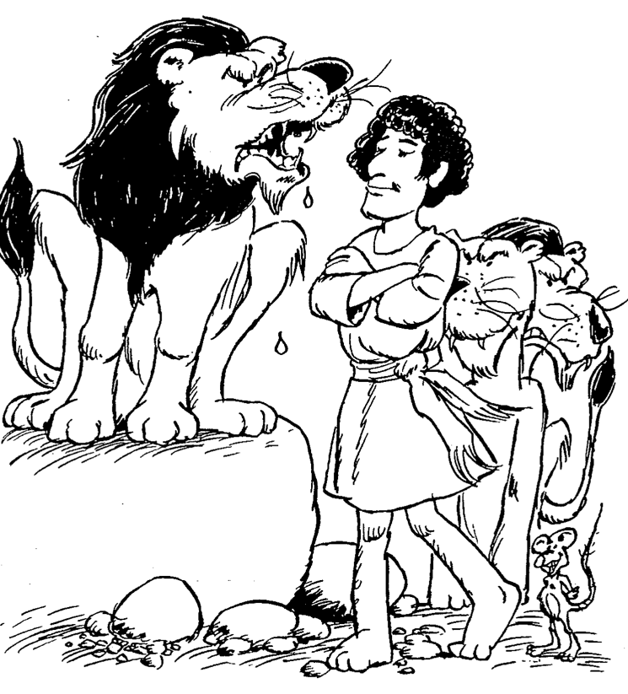
Barry Huddleston, The Acrostic Summarized Bible (Grand Rapids: Baker, 1992)
Daniel
1 Daniel favored by Nebuchadnezzar
2 Answer to king’s dream
3 Nebuchadnezzar’s furnace of fire
4 Interpretation of tree vision
5 Events at Belshazzar’s feast
6 Lion’s den of Darius
7 Scenes of coming kingdom
8 Features of four beasts
9 Appointing the seventy weeks
10 Interpreting the final vision
11 Terror of the king
12 Horror of end times
Notes:
The man Daniel models trust in God even when the nation where he served was conquered by the Persians (5:30). He repeatedly gave credit to God for the ability to interpret dreams and visions, which spoke volumes to kings used to subordinates exalting themselves to obtain higher rank, money, and authority.

Slide 13

Be Confident
Daniel
Dr. Rick Griffith • Crossroads International Church Singapore
CICFamily.com • BibleStudyDownloads.org
Notes:
Everyone is talking about how to be more confident today.

Slide 14

What do you need to know to be truly confident?
Three truths...
Notes:
Today we will see that Daniel placed his confidence not in himself but in God.
• In his book we will see three truths that will help us, like Daniel, be confident that God is working.

Slide 15

I. God rules over you
(Dan 1).
Notes:
You can be confident when you know that…
The LORD controls what happens to you as an individual.

Slide 16
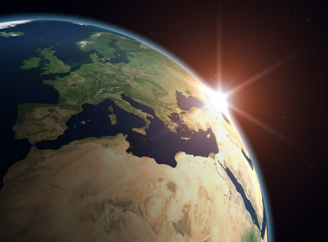
II. God rules over all nations (Dan 2–7).
Notes:
The LORD controls what happens to the peoples of the world.

Slide 17
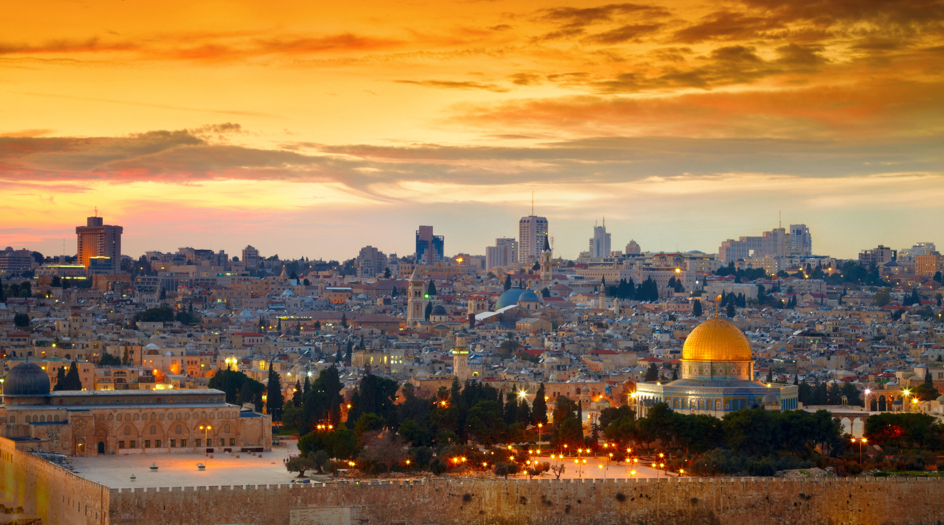
III. God rules over Israel’s future (Dan 8–12).
Notes:
The LORD controls the prophetic fulfillments for his people in the days ahead.

Slide 18
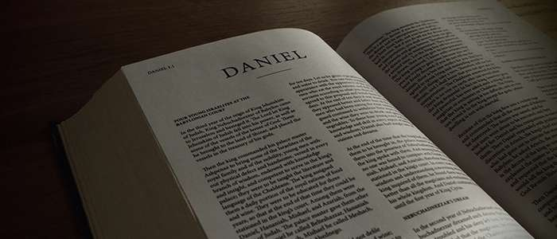
——Main Idea of Daniel——
God controls each level.
Notes:
What do you need to know to be truly confident?
Do you rest in this reality that the LORD doesn't need your help in running the universe? He sets up kings and takes them down—and he does the same in our lives.

Slide 19

70 Weeks Implications
The kingdom would not follow the return
The Tribulation will last 7 years
The Messiah would die before AD 70
The Antichrist will come in the end times
Daniel 9:24-27
Notes:
Why is it important to correctly understand these four verses as referring to Jesus in 9:25-26 but Antichrist in 9:27?
Gabriel told Daniel that the people would go back to Jerusalem shortly—but he also told them that 9:24 would not be fulfilled for 490 years. So there would NOT be a descendant of David ruling the Jews once they returned, although Jehoiachin had seven sons and his line continued for ten generations (1 Chronicles 3:17-24).
Daniel 9:27 is the only verse in the Bible stating the Tribulation period as seven years. All other texts relate to 3.5 years, 1260 or 12290 days, of equivalents.
The "Anointed One" would be cut off (or die) after the 69th week, but the ruler would destroy Jerusalem in the gap between the 69th and 70th weeks. This means that the Messiah had to come in the first century, despite many Jews missing him. Titus destroyed the city in AD 70, so Messiah had to precede this event.
Since the 70th week is future—verified as still future by Jesus in Matthew 24:15—the Antichrist ("he" of 9:27) would be like the "ruler who will come" (9:26) and thus cannot be Antiochus (167-164 BC) nor Jesus.

Slide 20
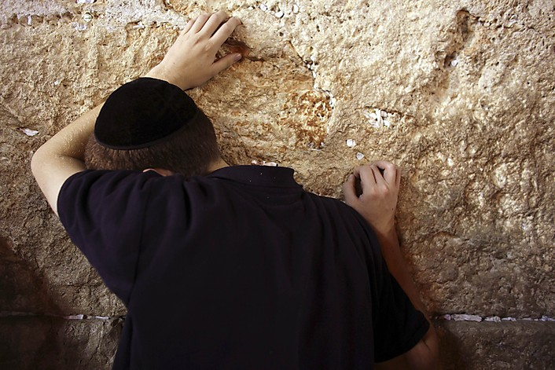
Application
Recognize God's sovereignty over all authority in history
Resist evil without compromising
Trust God for your ultimate salvation so that you can endure to the end (12:2, 3, 12; cf. Rev. 12:11)
Seek God in prayer and intercession
Live a godly life
Notes:
Our world today is not unlike that of Daniel. We also need to see that God is not up for election. He rules over all nations and he rules over you—so recognize his powerful care, trust him to forgive your sins by trusting in Christ’s death for you, and reorient your life around him.

Slide 21
Black

Slide 22
Slides on
Daniel 8
Notes:
The animal vision of Alexander the Great over the Medo-Persian Empire and Antiochus IV defiling the temple foretell the same by Antichrist (Dan 8).

Slide 23
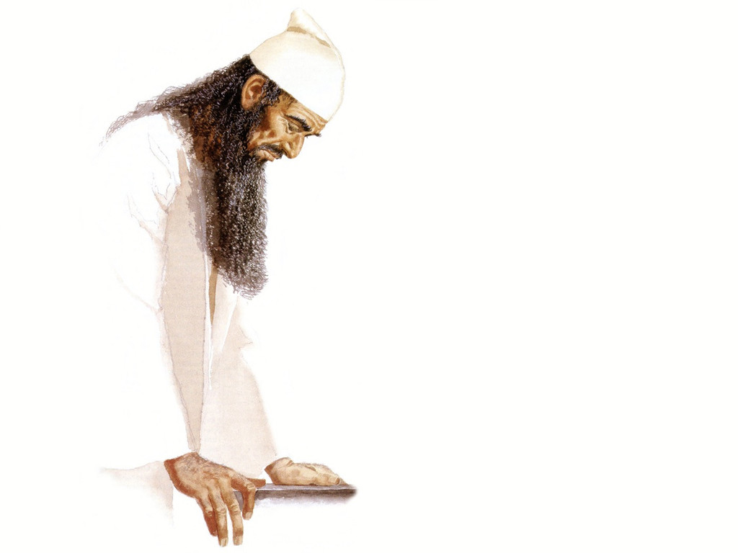
Daniel 8:1 is 1st Person
"During the third year of King Belshazzar’s reign,
I, Daniel, saw another vision, following the one that had already appeared to me"
(NLT).

Slide 24
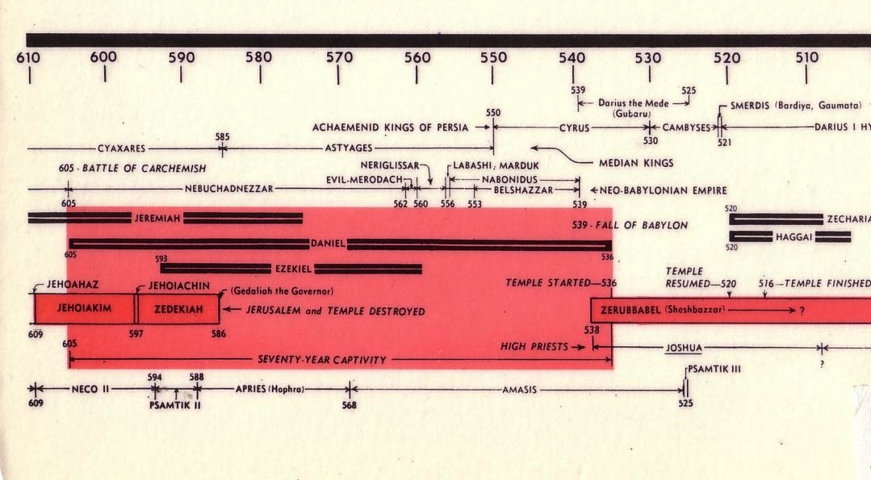
Chart of the Exile
232 & 342
"In the third year of the reign of Belshazzar the king a vision appeared to me, Daniel, subsequent to the one which appeared to me previously"
(Dan 8:1 NAU).
The Babylonian Exile
John C. Whitcomb, 4th rev. ed., Winona Lake, IN: BMH Books, 1962, 1968

Slide 25

The Persian Empire
Map of the Persian Empire
317
Barry J. Beitzel, Moody Atlas of Bible Lands, 150-51
"I looked in the vision, and while I was looking I was in the citadel of Susa, which is in the province of Elam; and I looked in the vision and I myself was beside the Ulai Canal" (Dan 8:2 NAU).
^{Susa}
The Persian Empire in the 5th century BC
extended "from India and Ethiopia" (Esther 1:1)
The boundaries of the empire that Cyrus II initiated
and Darius I consolidated stretched from Greece to India
Notes:
The Jews needed to renew their commitment to God based on his commitment to them over the ages. Yet they also needed to see God working in their lives right then as they lived outside the land of Israel.
Cyrus ruled over an absolutely ENORMOUS kingdom that eventually stretched from Greece in the west and India in the east. From his capital at Susa he had control over 127 provinces! God moved his heart to initiate a return to the land not only for the Jews but for other conquered peoples—as long as they would pray for the welfare of the king and his sons.
__________________
OS-15-Ezra-50, 82
OS-17-Esther-82
OS-27-Daniel-342

Slide 26

Daniel 8
Can God know the future almost 300 years in advance?
Well, of course He can!

Slide 27
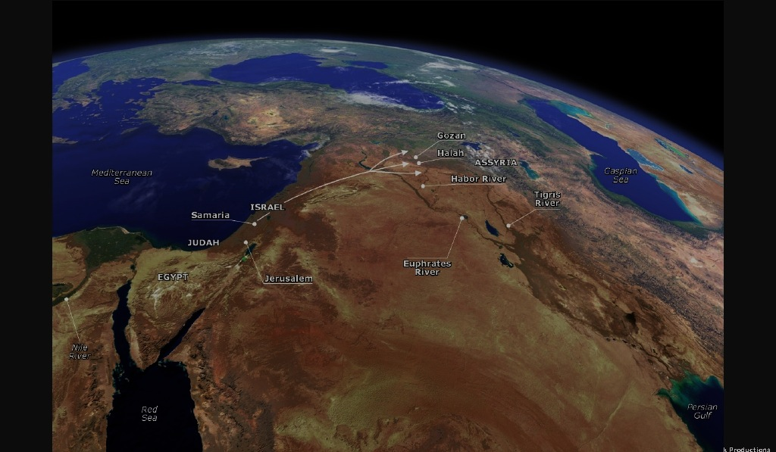
Flow of Daniel 8
539
Chapter 8
vv. 3-4 The powerful ram with two horns (Persia)
5-7 A goat defeats a ram (Alex over Persians)
8 Horn replaced by four horns (Alex's generals)
9-12 The small horn (Antiochus IV Epiphanes)
        His Career
        His Defeat
        His Fury
        His death (cf. v. 25)
13-14 The Maccabees and Hanukkah (167-164 BC)
15-27 The interpretation

Slide 28
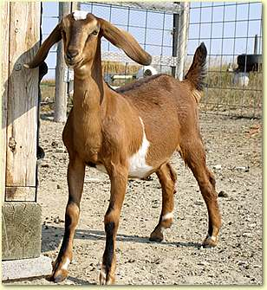
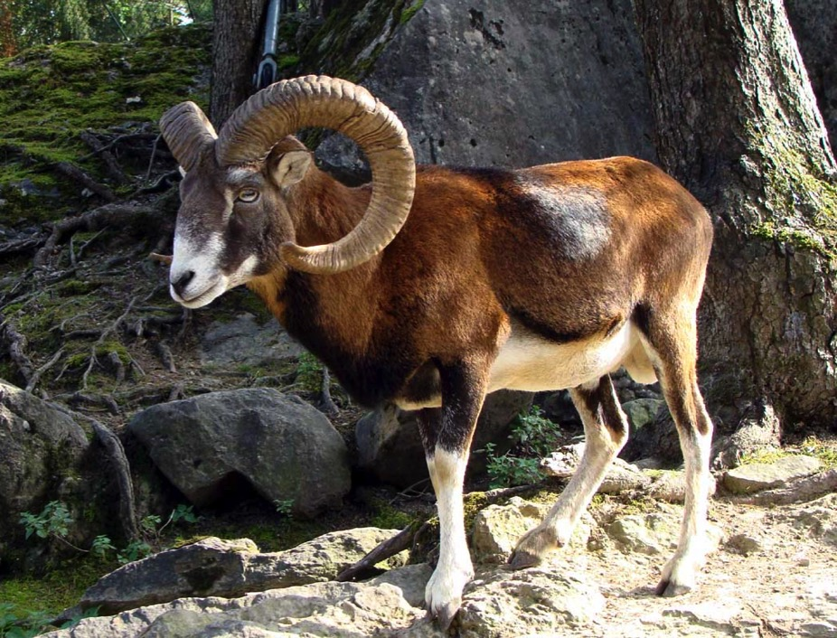
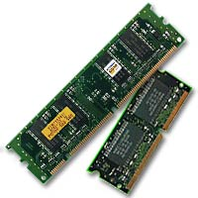
Which is stronger & faster?
557
Goat?
Ram?

Slide 29
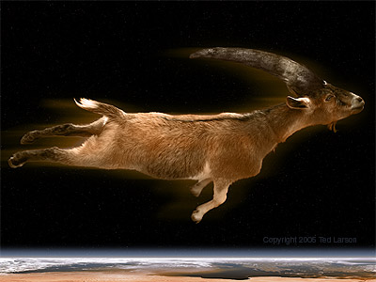
A goat never touching the ground (Dan. 8:5)?
557

Slide 30
Goat Beats Ram (Dan. 8:7)?
557

Slide 31
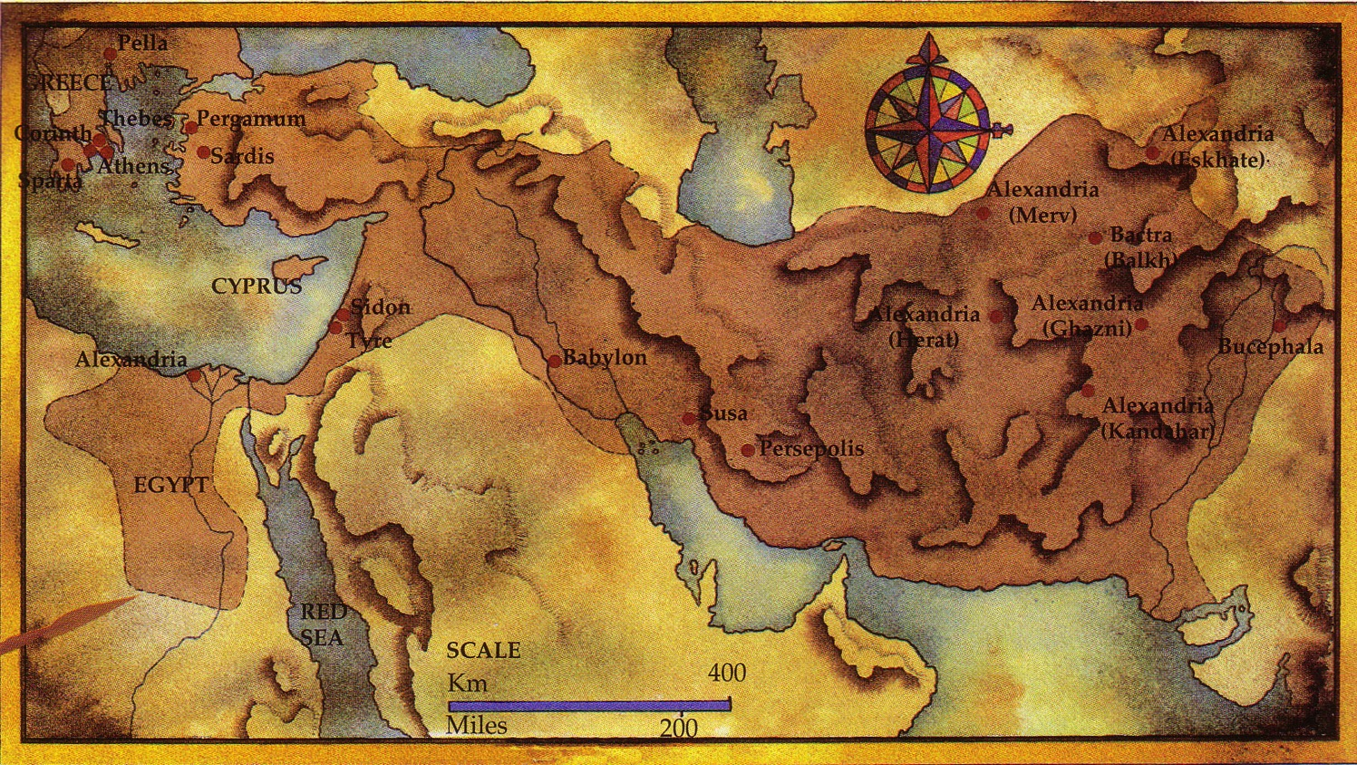
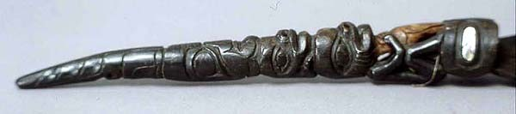
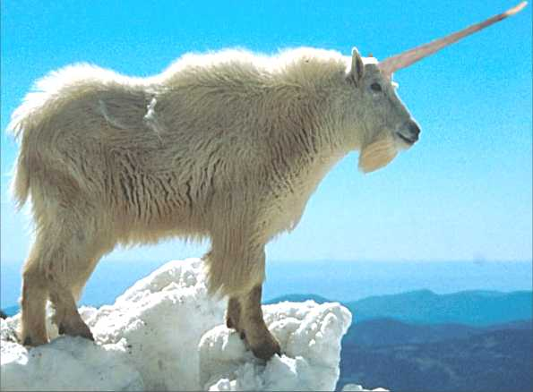
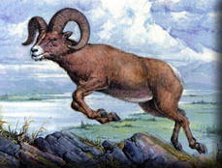
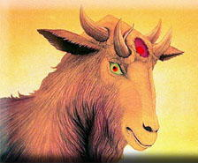
The Ram and Goat (Daniel 8:1-8)
557
Notes:
Daniel sees a vision of a goat defeating a ram but being replaced by four horns with one gaining power and desecrating the temple (8:1-14).

Slide 32
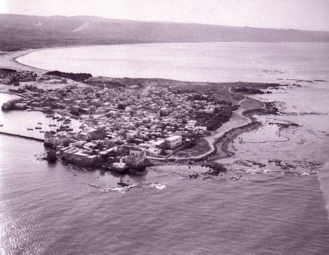
Alexander's Conquests
557
Notes:
Alexander would advance westward just like Daniel predicted, but his troops refused to enter India, so he turned back to Babylon, his favorite city.
At Babylon he was at the center of his empire where he could see the entirety of his conquests—and there he died.
Therefore, the goat (Alexander the Great) over the ram (Medo-Persia) will lead to the Seleucid Antiochus IV desecrating the temple like Antichrist (8:15-26; cf. 9:27).

Slide 33
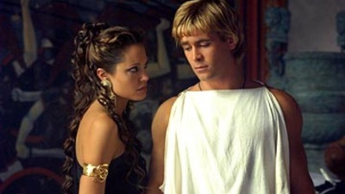
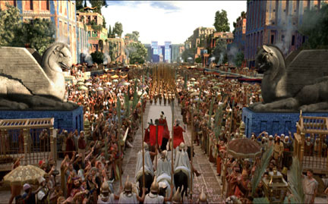
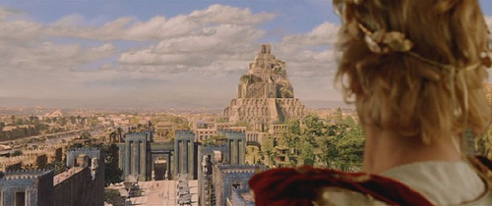
His Downfall
Due to Pride:
Desire for worship
Wine
Women
Song
Notes:
Sadly, Alexander could conquer most of the known world but he could not conquer himself.
At Babylon, his excesses led to his demise.

Slide 34
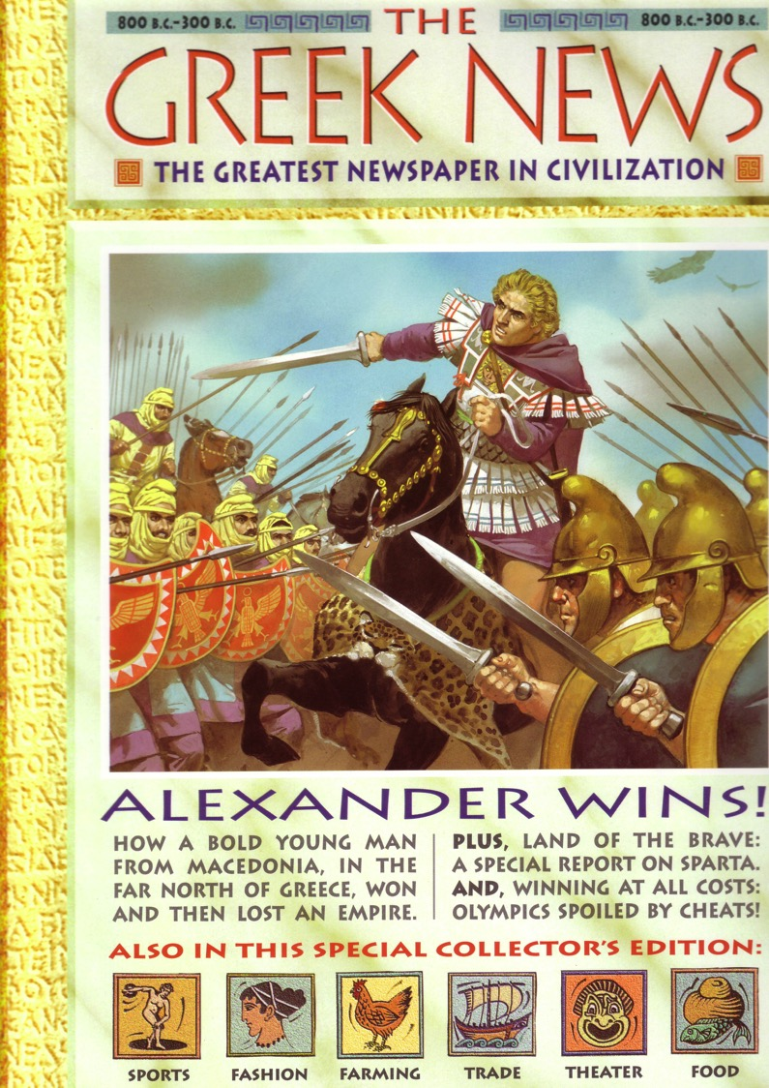
Alexander Made Headlines…
539

Slide 35
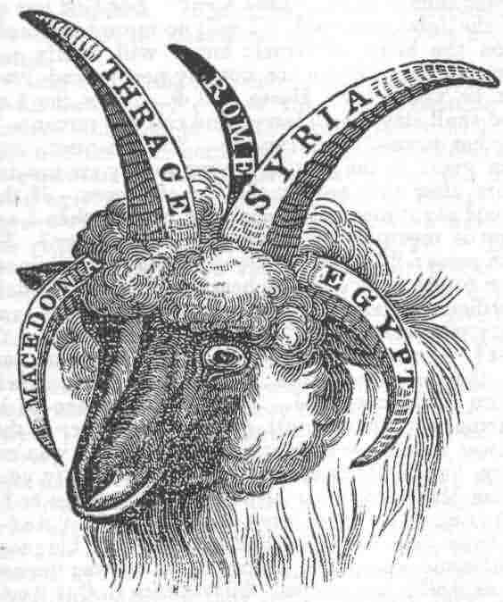
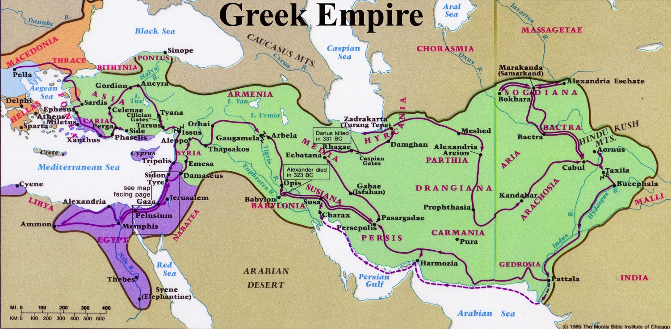
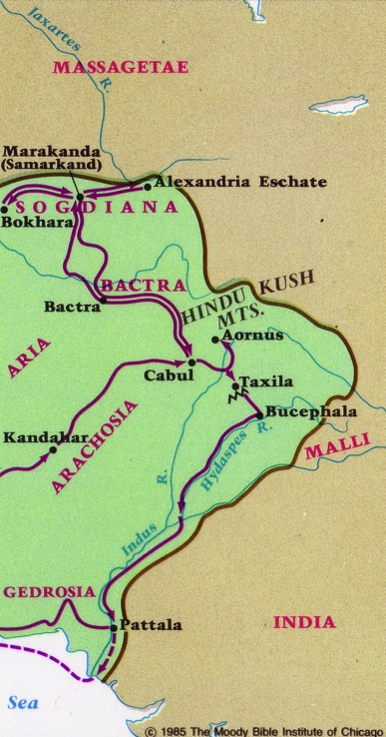
After Alexander…
557
Greek Empire
Cassander
Lysimacus
Ptolemy
Seleucus
"And the he-goat is the king of Greece; and the great horn between his eyes is the first king. As for the horn that was broken, in place of which four others arose, four kingdoms shall arise from his nation but not with his power" (Daniel 8:21-22 RSV)
Notes:
God amazingly predicted Greek history 300 years in advance.

Slide 36

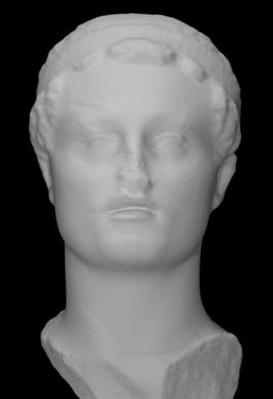
The Little Horn
(Daniel 8:9)
Antiochus IV
Epiphanes
(170-164 BC)
“Out of one of them came forth a rather small horn which grew exceedingly great toward the south, toward the east, and toward the Beautiful Land” (NAU).
Notes:
⁸ The goat became very powerful. But at the height of his power, his large horn was broken off. In the large horn’s place grew four prominent horns pointing in the four directions of the earth. ⁹ Then from one of the prominent horns came a small horn whose power grew very great. It extended toward the south and the east and toward the glorious land of Israel. ¹⁰ Its power reached to the heavens, where it attacked the heavenly army, throwing some of the heavenly beings and some of the stars to the ground and trampling them. ¹¹ It even challenged the Commander of heaven’s army by canceling the daily sacrifices offered to him and by destroying his Temple. ¹² The army of heaven was restrained from responding to this rebellion. So the daily sacrifice was halted, and truth was overthrown. The horn succeeded in everything it did.*
¹³ Then I heard two holy ones talking to each other. One of them asked, “How long will the events of this vision last? How long will the rebellion that causes desecration stop the daily sacrifices? How long will the Temple and heaven’s army be trampled on?”
¹⁴ The other replied, “It will take 2,300 evenings and mornings; then the Temple will be made right again.”
* 8:11–12 The meaning of the Hebrew for these verses is uncertain.
Tyndale House Publishers, Holy Bible: New Living Translation (Carol Stream, IL: Tyndale House Publishers, 2015), Daniel 8:8–14.

Slide 37
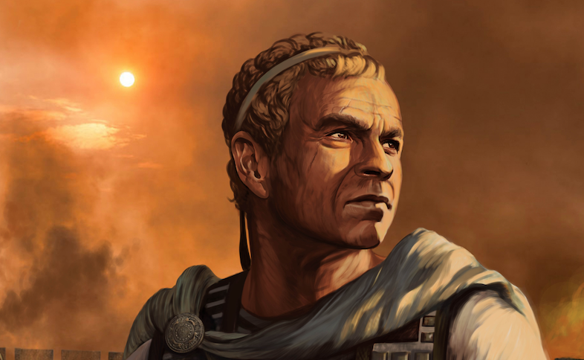
Antiochus IV Epiphanes (170-164 BC) will harm the Jerusalem sacrifice for 2300 evenings and mornings
“How long will the vision about the regular sacrifice apply, while the transgression causes horror, so as to allow both the holy place and the host to be trampled?”
¹⁴ He said to me, “For 2,300 evenings and mornings; then the holy place will be properly restored”
(Daniel 8:13b-14 NASB).
Notes:
8:23–25. Years later from among one of the four horns (kings) there would arise, Gabriel said, a severe (stern-faced) and cunning king (a master of intrigue; cf. deceit, v. 25). A powerful ruler, he would devastate property and destroy people in order to expand his kingdom. The holy people, the nation Israel (cf. “saints,” 7:18, 22, 27), would be a special target of his oppression. In subjugating Israel, many would lose their lives just when they thought they were safe. His antagonism against Israel would also be against her God, the Prince of princes. Yet this mighty conqueror himself would be destroyed by supernatural power. His rise was not his own doing (8:24) and his downfall was not by human means (he died insane in Persia in 163 BC.).
The king referred to here is known as Antiochus IV Epiphanes. After murdering his brother, who had inherited the throne in the Seleucid dynasty, he came to power in 175 BC. In 170 BC Ptolemy VI of Egypt sought to recover territory then ruled over by Antiochus. So Antiochus invaded Egypt and defeated Ptolemy VI and proclaimed himself king in Egypt. This was his growth “in power to the south” (v. 9). On his return from this conquest, trouble broke out in Jerusalem so he decided to subdue Jerusalem (“the Beautiful Land,” v. 9; cf. 11:16, 41). The people were subjugated, the temple desecrated, and the temple treasury plundered.
From this conquest Antiochus returned to Egypt in 168 but was forced by Rome to evacuate Egypt. On his return he determined to make the land of Israel a buffer state between himself and Egypt. He attacked and burned Jerusalem, killing multitudes (cf. 8:10). The Jews were forbidden to follow the Mosaic Law in observing the Sabbath, their annual feasts, and traditional sacrifices, and circumcision of children (cf. v. 11). Altars to idols were set up in Jerusalem and on December 16, 167 BC the Jews were ordered to offer unclean sacrifices and to eat swine’s flesh or be penalized by death. (Though his friends called him Epiphanes [“the Illustrious One”] no wonder the Jews called him Epimanes [“the Madman”].) (For more on the role of Antiochus IV Epiphanes see comments on 11:21–35.)
J. Dwight Pentecost, “Daniel,” in The Bible Knowledge Commentary: An Exposition of the Scriptures, ed. J. F. Walvoord and R. B. Zuck, vol. 1 (Wheaton, IL: Victor Books, 1985), 1357–1358.

Slide 38

The Date of Daniel
Daniel's Ministry (1:1; 10:1)
605-536
Daniel's Prophecies (Dan 2–11)
605-AD 70
Antiochus Desecrates Temple
167-164
600
550
500
450
400
350
300
2 5 0
2 0 0
150
100
50
BC/AD
50
Critics see historical events recorded as "prophecies"
Critics Date Daniel after 164

Slide 39
What is meant by the 2300?
“How long will the vision about the regular sacrifice apply, while the transgression causes horror, so as to allow both the holy place and the host to be trampled?”
¹⁴ He said to me, “For 2,300 evenings and mornings; then the holy place will be properly restored”
(Daniel 8:13b-14 NASB).
2300 years?
2300 days?
2300 evenings and mornings?

Slide 40
2300 Evenings & Mornings
(Two options in Daniel 8:14, 26)
2300 Days (6.4 years)
2300 evenings and mornings
1150 Evenings
1150 Mornings
3½ YEARS
3 YEARS
Jerusalem
First Invaded
170 BC
Jerusalem
Desecrated
Dec 167 BC
Jerusalem
Delivered
Dec 164 BC
Antiochus Against Jerusalem
Notes:
Antiochus’ desecration of the temple was to last 2,300 evenings and mornings before its cleansing (8:14). Some take the 2,300 evenings and mornings to mean 2,300 days, that is, a little more than six years. In this interpretation, the six years were from Antiochus’ first incursion into Jerusalem (170 BC) to the refurbishing and restoring of the temple by Judas Maccabeus in late 164. A second interpretation seems preferable. Rather than each evening and each morning representing a day, the reference may be to evening and morning sacrifices, which were interrupted by Antiochus’ desecration (cf. “the daily sacrifice,” vv. 11–21). With two sacrifices made daily, the 2,300 offerings would cover 1,150 days or three years (of 360 days each) plus 70 days. This is the time from Antiochus’ desecration of the temple (December 16, 167 BC) to the refurbishing and restoring of the temple by Judas Maccabeus in late 164 and on into 163 BC when all the Jewish sacrifices were fully restored and religious independence gained for Judah. Whichever interpretation it is that one accepts, the figure of 2,300 was a literal one and so the time period was literally fulfilled.
There is no question among expositors that Antiochus is in view in this prophecy. What was prophesied was fulfilled literally through him. However, the prophecy looks beyond Antiochus to a future person (the Antichrist) of whom Antiochus is only a foreshadowing. This coming one is said to “stand against the Prince of princes” (v. 25). This can be none other than the Lord Jesus Christ. Thus the prophecy must go beyond Antiochus and look forward to the coming of one whose ministry will parallel that of Antiochus.
J. Dwight Pentecost, “Daniel,” in The Bible Knowledge Commentary: An Exposition of the Scriptures, ed. J. F. Walvoord and R. B. Zuck, vol. 1 (Wheaton, IL: Victor Books, 1985), 1357–1359.

Slide 41

Dan. 8:26 alone (besides Gen 1) has “evening & morning”
––with a literal view
“The vision of the evenings and mornings which has been told is true; But keep the vision secret, for it pertains to many days in the future” (NASB).

Slide 42
Slides on
Daniel 9

Slide 43
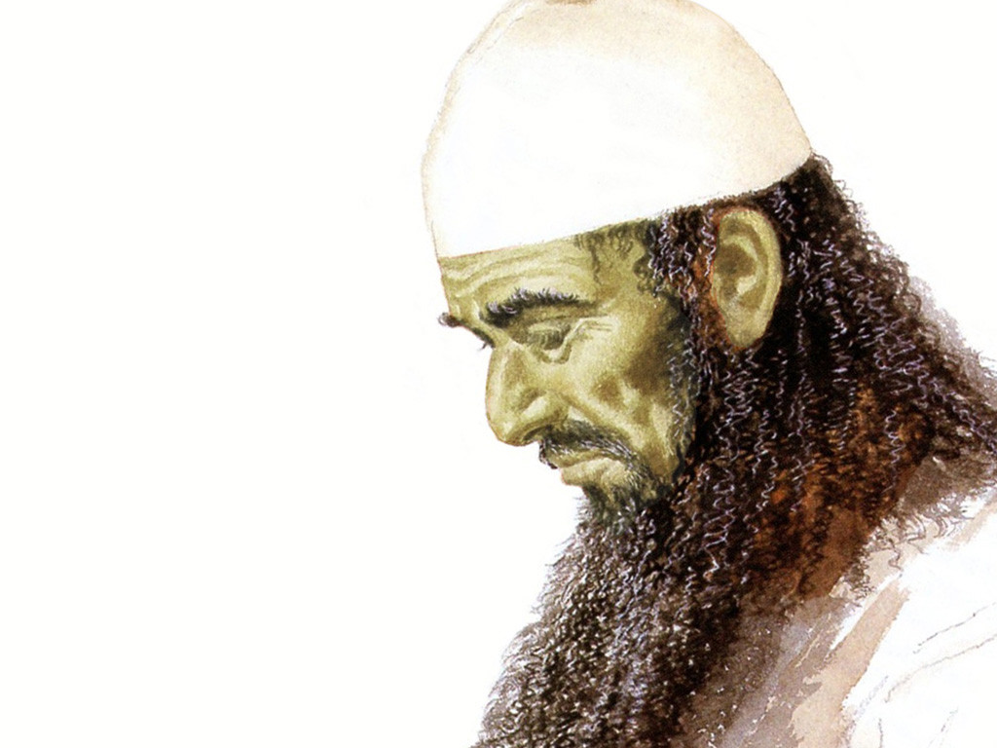
Daniel 9:2 is 1st Person
"During the first year of [Darius’s] reign,
I, Daniel, learned from reading the word of the LORD, as revealed to Jeremiah the prophet, that Jerusalem must lie desolate for 70 years" (NLT).

Slide 44
Chapter 9
Daniel
Prophetic 2–12
Hebrew
Gentiles 2–7
Israel 8–12
Aramaic
Hebrew
Interpreter
Beasts 7
Horns 8
Prayer 9
Statue 2
Idol 3
Tree 4
Hand 5
Lions 6
Inquirer
Personal 1
605-536 B.C.
Judgment
Consolation
God rules the world
Notes:
Daniel confessed Israel's sin before the 70 "sevens" vision where God revealed that the full restoration would need Messiah to come twice (Dan 9).

Slide 45
Two 70-Year Exiles
560
People Exile
605
586
539
536
516
Temple Exile
"This entire land will become a desolate wasteland. Israel and her neighboring lands will serve the king of Babylon for seventy years. ¹²Then, after the seventy years of captivity are over, I will punish the king of Babylon and his people for their sins," says the Lord. I will make the country of the Babylonians a wasteland forever"
(Jeremiah 25:11-12).
Notes:
In 539 BC under the rule of Darius, Daniel read Jeremiah 25:11-12 that limited the exile to 70 years (605-536 BC), or only three years away (9:1-2). But another way to see the 70 years is that the temple lay in ruins from 586 until 516 when the second temple was completed.
Jeremiah does not tell us the exact years that begin and end the 70-year exile.
But we can actually determine this in two ways—either the exile of the people beginning with Daniel’s deportation (605) to the people fully returning in 536, or the exile of the temple from its destruction in 586 to its rebuilding in 516.
_____________________
Common English Slides-194
BE-27-Daniel-89
ES-26-Restoration of Israel-186
OS-00-OT Book Overviews-294
OS-12-Kings & Prophets Charts-26
OS-12-2Kings-287
OS-14-2Chron-287
OS-15-Ezra-14
OS-Esther
OS-24-Jeremiah-53, 140
OS-27-Daniel-150, 362, 364
OS-37-Haggai-32
OS-Zechariah-14

Slide 46
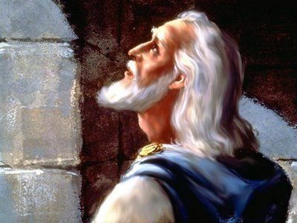
Chapter 9 Outline
539
Daniel's prayer: How long? (9:1-19)
Notes:
The nearness of restoration compelled Daniel to confess God’s just judgment of Israel's sins and ask God to restore Jerusalem’s temple (9:3-19).

Slide 47
The 70-Year Exile
560
People Exile
605
586
539
536
516
Daniel taken captive
(Dan. 1:1-6)
1st year of Darius the Mede (Dan. 9:1)

Slide 48
Chart of the Exile
232 & 342
The Babylonian Exile
John C. Whitcomb, 4th rev. ed., Winona Lake, IN: BMH Books, 1962, 1968

Slide 49
Chapter 9 Outline
539
Daniel's prayer: How long? (9:1-19)
God's reply: 70 x 7 (9:20-27)
There exist 4 major views on the 70 weeks

Slide 50
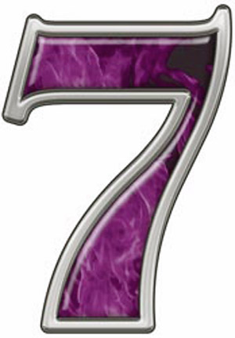
The Number of
540
Completion
Creation Gen. 2:2
Rain Gen. 7:4
Sabbath Ex. 20:10
Jericho Josh. 6:4
Sons Job 1:2; Ruth 4:15
Prophecy Dan. 9:24
Forgive Matt. 18:21

Slide 51
Before the Curtain Closes (9:24 NLT)
540
“A period of seventy sets of seven has been decreed for your people and your holy city
to finish their rebellion,
to put an end to their sin,
to atone for their guilt,
to bring in everlasting righteousness,
to confirm the prophetic vision, and
to anoint the Most Holy Place."
Tribulation
Millennium
These were NOT fulfilled in the first century––so the 70th week must have a future fulfillment
Notes:
Gabriel brought to Daniel the 70 "sevens" vision where God revealed that the full restoration would need Messiah to come twice (9:20-27).

Slide 52

Jews will be sought (Zech. 8:23)
649
"This is what the Lord of Heaven's Armies says: In those days ten men from different nations and languages of the world will clutch at the sleeve of one Jew. And they will say, 'Please let us walk with you, for we have heard that God is with you'" (NLT).

Slide 53
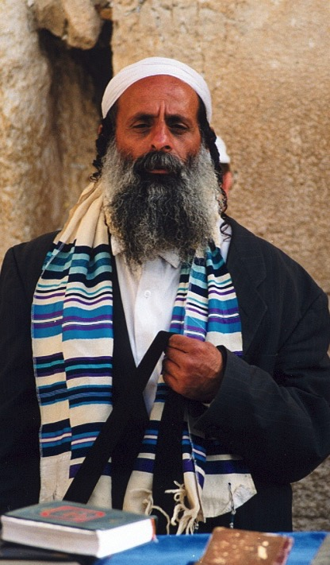
"All Israel will be saved" (Rom. 11:25-27)
NTS 155w
²⁵I do not want you to be ignorant of this mystery, brothers, so that you may not be conceited: Israel has experienced a hardening in part until the full number of the Gentiles has come in.
²⁶And so all Israel will be saved, as it is written:
"The deliverer will come from Zion; he will turn godlessness away from Jacob.
²⁷And this is my covenant with them when I take away their sins."

Slide 54

70 "Weeks" in Daniel 9:25-27
551
Decree
Anointed One
69 sevens = 483 years
7 sevens + 62 sevens
1 seven
= 7 years
"Know and understand this: From the issuing of the decree to restore and rebuild Jerusalem until the Anointed One, the ruler, comes, there will be seven 'sevens,' and sixty-two 'sevens.' It will be rebuilt with streets and a trench, but in times of trouble. ²⁶After the sixty-two 'sevens,' the Anointed One will be cut off and will have nothing. The people of the ruler who will come will destroy the city and the sanctuary. The end will come like a flood: War will continue until the end, and desolations have been decreed" (Dan. 9:25-26 NIV).
Notes:
Gabriel brought to Daniel the 70 "sevens" vision where God revealed that the full restoration would need Messiah to come twice (9:20-27).

Slide 55
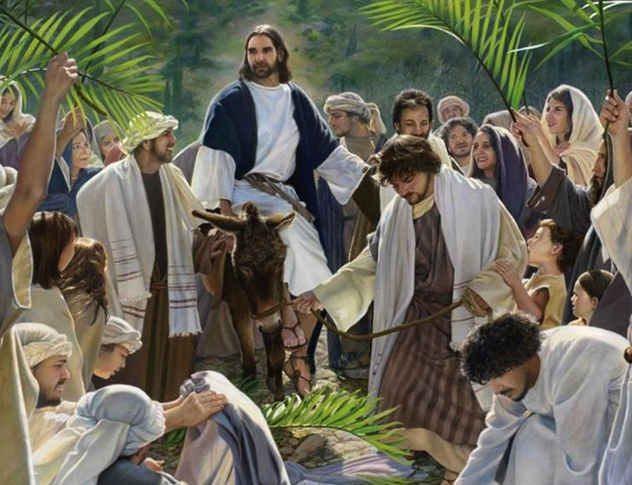
Triumphal Entry: "Anointed One comes"
Zech. 9:9
Dan. 9:25
30 March AD 33
Notes:
Gabriel told Daniel that the Messiah would come 173,880 days after the decree of Artaxerxes. This works out to be on 30 March AD 33 when Jesus came into Jerusalem to present himself as Israel’s king— the most specific fulfillment of Bible prophecy in the Bible!

Slide 56
4 Views on the 70 "Weeks"
554
Jer. 25:11-12
605/ 586 BC
Cy-rus
De-cree
538 BC
Art. 2nd
De-cree
444 BC
Jeru-sa-lem
Re-built
395 BC
Mur-der
of
Oni-as
171 BC
Anti-ochus
De-se-cra-tion
167 BC
Tem-ple
Re-ded-ica-tion
164 BC
Christ Death
AD
33
Titus
De-stroy
Jeru-sa-lem
AD 70
Church Age
7
Yr.
Trib-ula-tion
Mil-len-nial
King-dom
Critical
7 wks
62 weeks
1 wk
Symbolic
7 wks
62 weeks
1 wk
Messianic
7 wks
62 weeks
1 wk
Premillennial
7 wks
62 weeks
1 wk

Slide 57
1. Critical View
555
Jer. 25:11-12
605/ 586 BC
Cy-rus
De-cree
538 BC
Mur-der
of
Oni-as
171 BC
Anti-ochus
De-se-cra-tion
167 BC
Tem-ple
Re-ded-ica-tion
164 BC
Critical
7 wks
62 weeks
1 wk
Critique of Critical View:
  Weeks add up to 422 or 441 years (not 490)
  Antiochus was hardly a Messianic figure!
  Antiochus IV made no covenant with Israel
  Prophecy seen only as imaginative prediction

Slide 58
2. Amillennial Symbolic View
555
Cy-rus
De-cree
538 BC
Art. 2nd
De-cree
444 BC
Church Age
7
Yr.
Trib-ula-tion
Symbolic
7 wks
62 weeks
1 wk
70 seen as indefinite era to lead people to salvation
7 as a mark of divine work, symbolizing completion
  First 7 years begins with the Cyrus decree (538 BC)
  The 62 weeks = the gospel is preached
  The final week = Antichrist rule, Christ lost influence
  70 years end in Christ's second coming

Slide 59
2. Amillennial Symbolic View
555
Cy-rus
De-cree
538 BC
Art. 2nd
De-cree
444 BC
Church Age
7
Yr.
Trib-ula-tion
Symbolic
7 wks
62 weeks
1 wk
Critique of the Symbolic View
  70x7 seen as for all people, not exclusive to Israel
  Glosses over details of prophetic elements
  Cyrus's decree was closest to the time Daniel's prayer but did not restore Jerusalem but only the temple

Slide 60
3. Messianic/Historic View
555
Cy-rus
De-cree
538 BC
Art. 2nd
De-cree
444 BC
Christ Death
AD
33
Titus
De-stroy
Jeru-sa-lem
AD 70
Messianic
7 wks
62 weeks
1 wk
7 wks starts from Cyrus decree
62 wks ends at Christ's first advent (9:26 occurs after this)
Final week – Death of Christ abolished sacrifice
Destruction of Jerusalem in AD 70
  Rejects the gap theory
  The final prince not seen as the Antichrist but as Christ
  Sees Abomination of Desolation (Matt 24:15) as fulfilled in AD 70 (then Matthew wrote about it)

Slide 61
3. Messianic/Historic View
555
Cy-rus
De-cree
538 BC
Art. 2nd
De-cree
444 BC
Christ Death
AD
33
Titus
De-stroy
Jeru-sa-lem
AD 70
Messianic
7 wks
62 weeks
1 wk
Critique of the Messianic View
  Interpretation as new covenant (Heb. 8:13) and desolation (Dan. 9:25-26) lacking
  Does not account for Antichrist in Rev 13:5 who will rule 42 months.
  2 Thess. 2:4 says Antichrist (not Christ) will claim deity in temple
  However, Young does see 11:40-44 as referring to Antichrist (Young, 248, 251)

Slide 62
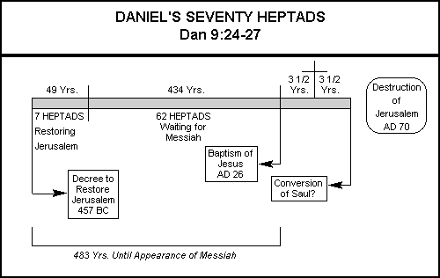
Messianic View of James E. Smith
Problems?
The one who stops the sacrifice (Dan. 9:27) also desecrates the temple (cf. 2 Thess. 2:4; Rev. 13:5)
The Major Prophets (Joplin, MO: College Press, 1995), LOGOS electronic version chart 22

Slide 63
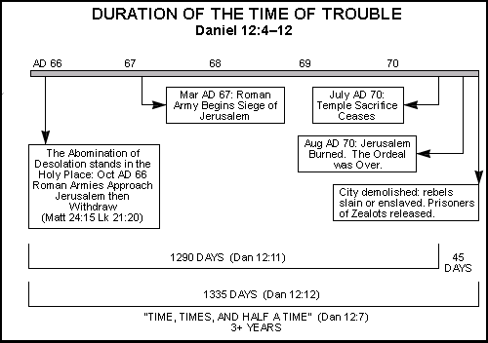
Messianic View of James E. Smith
Problems?
Travel and knowledge did not vastly increase in AD 60s (Dan. 12:2)
No abomination stood in the temple in AD 66
The Major Prophets (Joplin, MO: College Press, 1995), LOGOS electronic version chart 24

Slide 64
4. Premillennial View
555
Jer. 25:11-12
605/ 586 BC
Cy-rus
De-cree
538 BC
Art. 2nd
De-cree
444 BC
Jeru-sa-lem
Re-built
395 BC
Mur-der
of
Oni-as
171 BC
Anti-ochus
De-se-cra-tion
167 BC
Tem-ple
Re-ded-ica-tion
164 BC
Christ Death
AD
33
Titus
De-stroy
Jeru-sa-lem
AD 70
Church Age
7
Yr.
Trib-ula-tion
Mil-len-nial
King-dom
Premillennial
7 wks
62 weeks
1 wk
7 weeks began at Artaxerxes's 444 BC decree to Nehemiah
62 weeks end with Christ's Triumphal Entry
Gap = the church age = times of Gentiles (note Jesus' prophecy in Luke 21:24)
The final week = 7 year Tribulation

Slide 65
The Seventy "Weeks" of Daniel
551
Anointed One
Decree
69 sevens = 483 years
7 sevens 62 sevens
1 seven
= 7 years
444 BC
– 395 BC
395 BC
– AD 33

Slide 66
Questions on the Premillennial View
555
Which decree is in 9:25? Four options:
  (1) Cyrus decree to rebuild the temple (2 Chron. 36: 22-23; Ezra 1:1-4; 6:1-5);
  (2) Darius decree confirming the decree of Cyrus (Ezra 6:6-12);
  (3) Artaxerxes decree #1 (Ezra 7:11-26);
  (4) Artaxerxes decree #2 given to Nehemiah authorizing the rebuilding of the city (Neh. 2:1-8).
Why do we hold that the decree is Artaxerxes #2 in his 20th year (444 BC)? This is because Neh. 2:12-17 pictures Jerusalem in ruins at this time.

Slide 67
Times of the Gentiles (Luke 21:24)
551
"TIMES OF THE GENTILES"
Luke 21:24
KINGDOM OF JUDAH
THE RESTORATION PERIOD
THE 4 CENTURIES BETWEEN THE TESTAMENTS
CHURCH PERIOD
Acts 15:14-18
Rom. 11:25
"The Throne of the LORD"
Jer. 3:17
Isa. 62:6-7
586 BC
AD 70
BABYLON
PERSIA
GREECE
ROME
538 BC
333 BC
63 BC
"AMONG MANY NATIONS"
"Her sun is gone down while it was yet day" Jer. 15:9
"Because they have forsaken the covenant of the Lord" Jer. 22:8-9
2 Kings 25:8-12
Jer. 15:4, 22:29-30, 30:24
Ezek. 10:4, 28. 11:22-25, 14:22-23
Ezekiel 6:8
Hosea 3:4-5
Hosea 8:8
Amos 9:8-9
Jer. 31:35-37
Jer. 46: 27-28
Jer. 51:5
"I will perform the good thing that I have promised to the house of Israel and to the house of Judah"
Jer. 33:7-14
Isa. 4:2-6
Ezek. 43:1-9
Zech. 2:10-13
Zech. 8:1-8
“Jerusalem will be trampled on by the Gentiles until the times of the Gentiles are fulfilled” (Jesus in Luke 21:24 NIV)
Adapted from Raymond Ludwigson, A Survey of Bible Prophecy
Notes:
The phrase “times of the Gentiles” is not in Daniel. But the concept is throughout his prophecy. It refers to the period when Israel would have no king over its land—beginning around the time of Jerusalem’s destruction and lasting until Jesus rules over the nation after his return.

Slide 68
Daniel 9:25-27 (NLT)
86b-d
²⁵ Now listen and understand! Seven sets of seven plus sixty-two sets of seven will pass from the time the command is given to rebuild Jerusalem until a ruler—the Anointed One—comes. Jerusalem will be rebuilt with streets and strong defenses, despite the perilous times.
²⁶ "After this period of sixty-two sets of seven, the Anointed One will be killed, appearing to have accomplished nothing, and a ruler will arise whose armies will destroy the city and the Temple. The end will come with a flood, and war and its miseries are decreed from that time to the very end. ²⁷ The ruler will make a treaty with the people for a period of one set of seven, but after half this time, he will put an end to the sacrifices and offerings. And as a climax to all his terrible deeds, he will set up a sacrilegious object that causes desecration, until the fate decreed for this defiler is finally poured out on him."

Slide 69
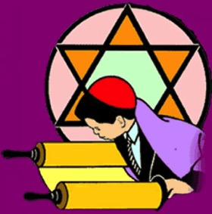

An Astonishing Prediction!
553
The Jewish calendar has 360 days per year
69 Jewish "weeks" of 483 years = 476 solar years
Issue of the decree on 5 March 444 BC after 476 solar years ends on 30 March 33. This is the exact date of Christ's Triumphant Entry!
Compare Daniel 9:27 with Revelation 13:5, 14-15 where half of a "7" is 3 and ½ years or 42 months

Slide 70
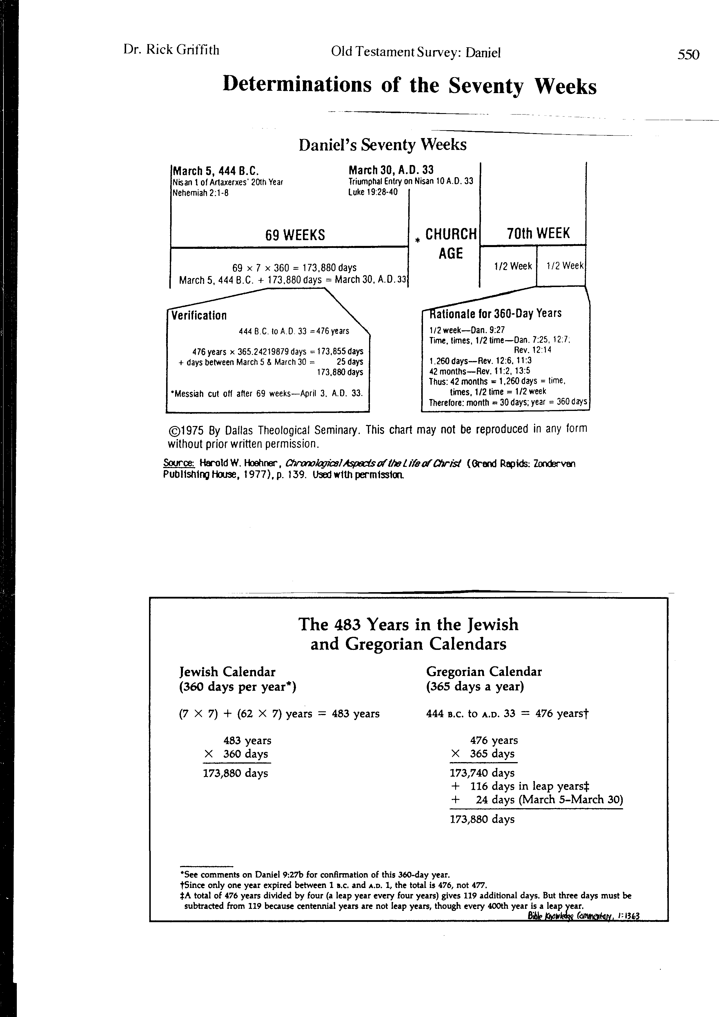
Determinations of the Seventy Weeks
553
J. Dwight Pentecost, “Daniel,” in The Bible Knowledge Commentary, 1:1363

Slide 71
Determinations of the Seventy Weeks
553
Harold Hoehner, Chronological Aspects of the Life of Christ,139

Slide 72

An Ominous Day:
Luke 19:41-42 NAU
"When He approached Jerusalem, He saw the city and wept over it, ⁴²saying, 'If you had known in this day, even you, the things which make for peace! But now they have been hidden from your eyes.'"

Slide 73
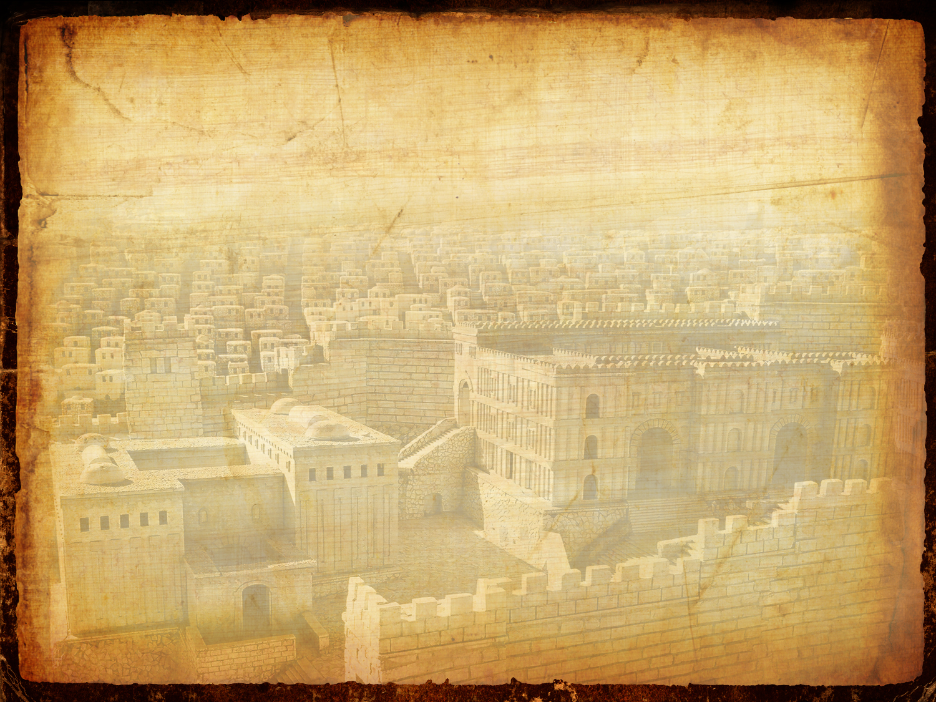
An Ominous Day:
Luke 10:43-44 NAU
"For the days will come upon you when your enemies will throw up a barricade against you, and surround you and hem you in on every side, ⁴⁴and they will level you to the ground and your children within you, and they will not leave in you one stone upon another, because you did not recognize the time of your visitation."

Slide 74
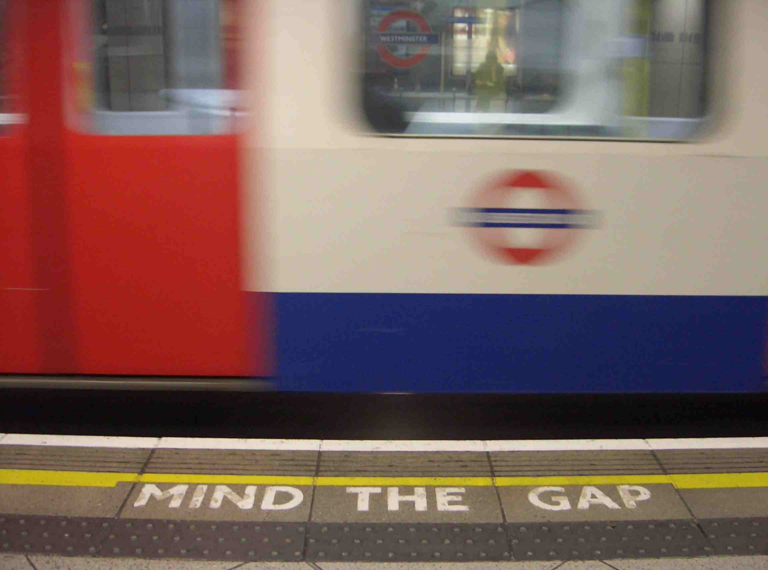

Mind the Gap

Slide 75
Why the Gap?
552
Six Reasons
Why must there be a gap
between the end of the 69th week
and the beginning of the 70th week?
Anointed One
Decree
69 sevens = 483 years
7 sevens 62 sevens
1 seven
= 7 years
444 BC
– 395 BC
395 BC
– AD 33
Notes:
For a dispensational interpretation of each of these six phrases see the exegetical outline of Daniel 9:24 on the preceding pages.

Slide 76
Why the Gap?
540
552a
Reason #1
Six Reasons
The six prophecies in Daniel 9:24 could not have been fulfilled at Christ's first advent.
These prophecies relate not to the church but to Israel.
Has Israel finished sinning (24a)? No.
Has Israel had atonement for her sins (24b-c)? No.
Has Israel seen everlasting righteousness (24d)? No.
Paul still saw this as future for Israel (Rom. 11:25-27).
Has vision and prophecy culminated (24e)? No.
Has the holy of holies* been anointed yet (24f)? No.
* Although the phrase "most holy" has been sometimes interpreted to mean Christ's anointing (e.g., Young, The Prophecy of Daniel, 201), these are technical words always translated in the Old Testament as "holy of holies." The clear referent is the consecration of the millennial temple (cf. Ezek. 40–46).
Notes:
For a dispensational interpretation of each of these six phrases see the exegetical outline of Daniel 9:24 on the preceding pages.

Slide 77
Before the Curtain Closes (9:24 NLT)
540
“A period of seventy sets of seven has been decreed for your people and your holy city
to finish their rebellion,
to put an end to their sin,
to atone for their guilt,
to bring in everlasting righteousness,
to confirm the prophetic vision, and
to anoint the Most Holy Place."
Tribulation
Millennium
These were NOT fulfilled in the first century––so the 70 weeks must have a future fulfillment

Slide 78
Why the Gap?
541
552a
Reason #2
Six Reasons
The first word of verse 26, "after" (וְאַחֲרֵ֤י), indicates a gap. This gap occurs after the culmination of the sixty-ninth week at the cutting off of Messiah at Christ's crucifixion after the Triumphal Entry.
Church Age: "The end will come with a flood, and war and its miseries are decreed from that time to the very end" (9:26b)
Christ’s Death
AD 33
Titus
Destroys
Jerusalem
AD 70
7 Yr.
Tribulation
7 wks
62 weeks
1 wk
The traditional-historical school sees Christ's baptism ending the 69 weeks and His death at the middle of the 70th week. If this were so, the text would read that the cutting off of Messiah would occur "during" or "in the midst of" the seventieth week. However, verse 26 says that several events must occur before the beginning of the 70th week, such as Jerusalem’s destruction and many wars.

Slide 79
Daniel 9:25-27 (NLT)
86b-d
²⁵ Now listen and understand! Seven sets of seven plus sixty-two sets of seven will pass from the time the command is given to rebuild Jerusalem until a ruler—the Anointed One—comes. Jerusalem will be rebuilt with streets and strong defenses, despite the perilous times.
²⁶ "After this period of sixty-two sets of seven, the Anointed One will be killed, appearing to have accomplished nothing, and a ruler will arise whose armies will destroy the city and the Temple. The end will come with a flood, and war and its miseries are decreed from that time to the very end. ²⁷ The ruler will make a treaty with the people for a period of one set of seven, but after half this time, he will put an end to the sacrifices and offerings. And as a climax to all his terrible deeds, he will set up a sacrilegious object that causes desecration, until the fate decreed for this defiler is finally poured out on him."

Slide 80
Why the Gap?
541
552a
Reason #3
Six Reasons
The idea of gaps may seem strange to the 21st century mind, but this was not true of the Jewish mindset.
For example, Isaiah 61:1-2 records the two advents of Christ in a single context. Christ quoted the portion of this passage relating to His first advent in Luke 4:18-19, thus revealing that a separation of many years appears.
Concerning the Jewish mindset, Gundry notes, "The possibility of a gap between the sixty-ninth and seventieth weeks is established by the well-accepted OT phenomenon of prophetic perspective, in which gaps such as that between the first and second advents were not perceived" (Robert H. Gundry, The Church and the Tribulation [Grand Rapids: Zondervan, 1973], 190).
Notes:
For a dispensational interpretation of each of these six phrases see the exegetical outline of Daniel 9:24 on the preceding pages.

Slide 81
Why the Gap?
541
552a
Reason #4
Six Reasons
The person who confirms the covenant in Daniel 9:27 cannot be Christ.
The "He" in this verse looks back at "the prince who is to come" in the previous verse (Titus in AD 70) as its antecedent.
Also, if Christ is the confirmer of the covenant, then what covenant did He confirm and then break? Certainly not the new covenant!
Notes:
This covenantal perspective finds recent support by Meredith G. Kline, "The Covenant of the Seventieth Week,” in The Law and the Prophets: Old Testament Studies Prepared in Honor of Oswald Thompson Allis, ed. by John H. Skilton (Nutley, NJ, 1974), 452-69, esp. 461-69; cited by Hoehner, Chronological Aspects of the Life of Christ, 132.

Slide 82
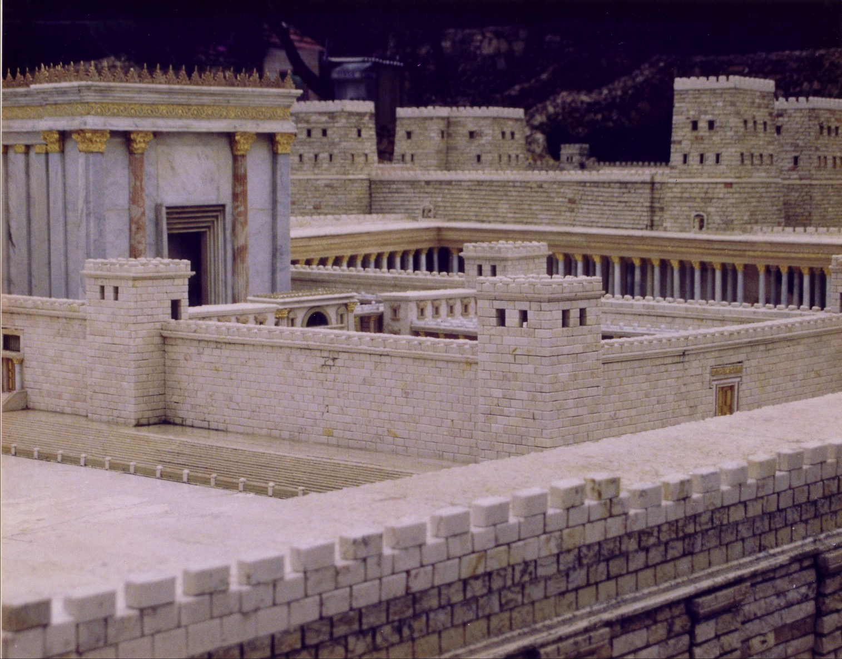
The Temple Stood Until AD 70

Slide 83
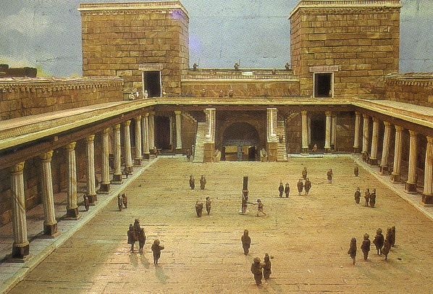
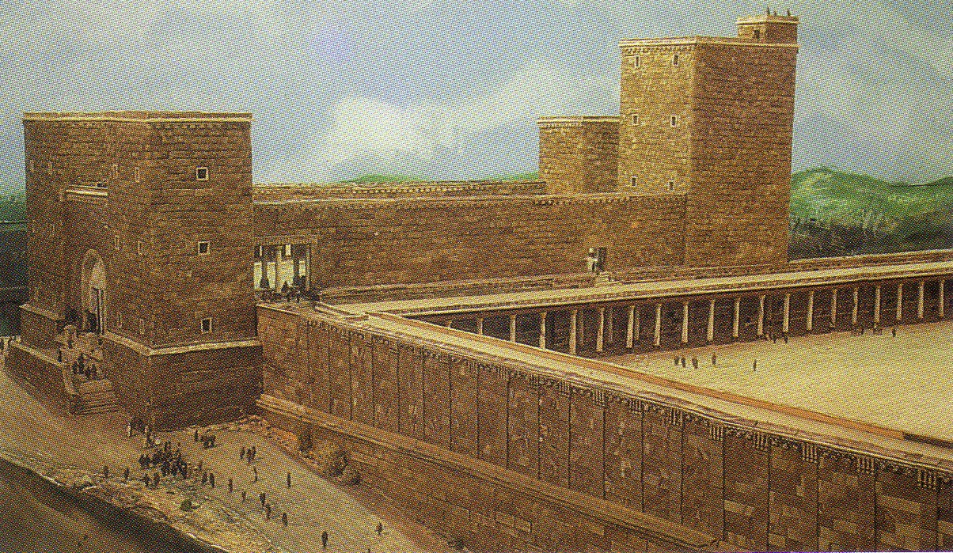
Antonia Fortress

Slide 84
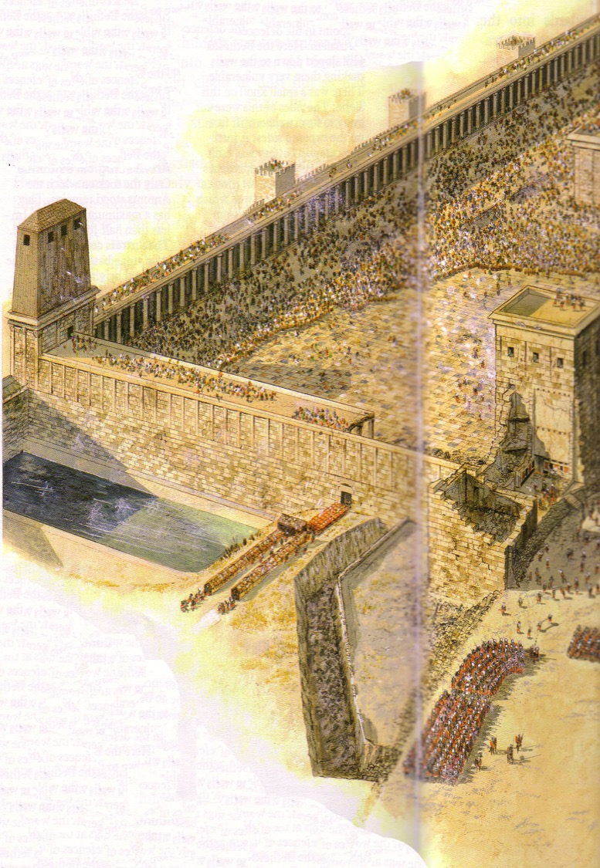
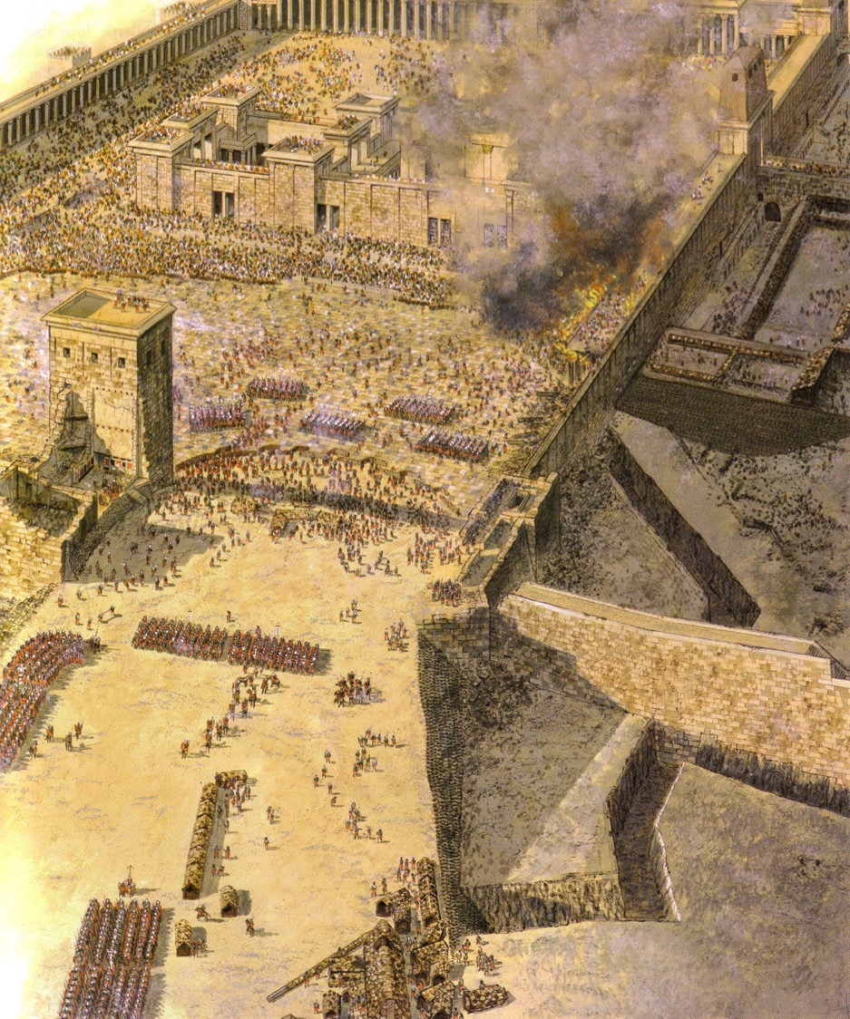
Temple Assault by Titus, the "ruler [who] ruler will arise whose armies will destroy the city and the Temple" (9:26)
Sept. AD 70

Slide 85
Why the Gap?
541
552a
Reason #5
Six Reasons
Since Christ's death did not "put an end to sacrifice and offering" (Dan. 9:27), a gap must exist between the 69th and 70th weeks.
The Jews continued the sacrificial system until God stopped their abhorrent practice with Titus' destruction of the temple in AD 70.

Slide 86
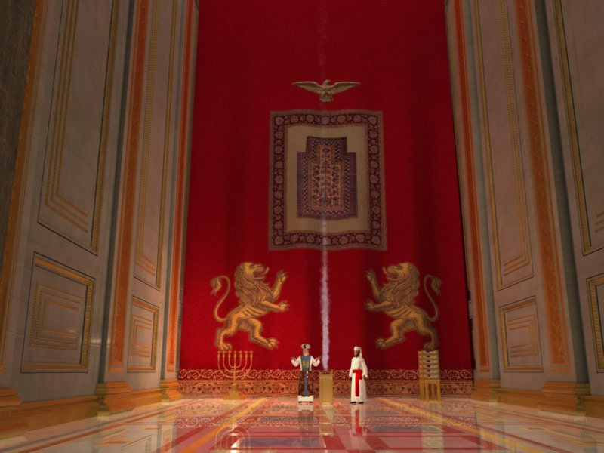
The Temple Veil

Slide 87
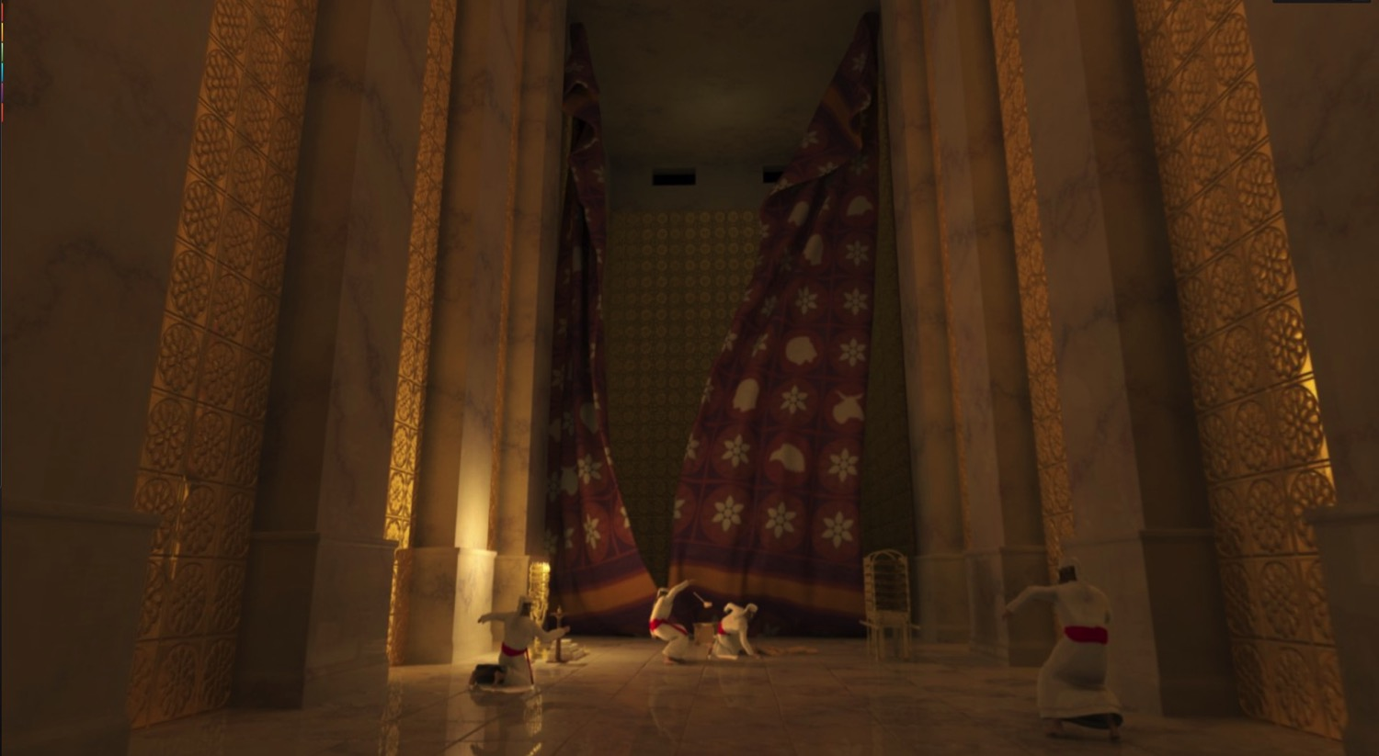
The Temple Veil Torn (Matt. 27:51)
It must have been sown up from AD 33-70

Slide 88
Why the Gap?
541
552a
Reason #6
Six Reasons
Parallel prophecies also have a gap:
Jesus said in Matthew 24:15 that the abomination of desolation will occur after His earthly ministry.
The wicked person of Daniel 9:27 has striking parallels with the future wicked man in Daniel 7:25; Revelation 12, 13, 19.
The events of the second half of the 70th week (Dan. 9:27b) correlate with those of the latter half of the future Tribulation period in Rev. 13:4, 6, 12, 14-15

Slide 89
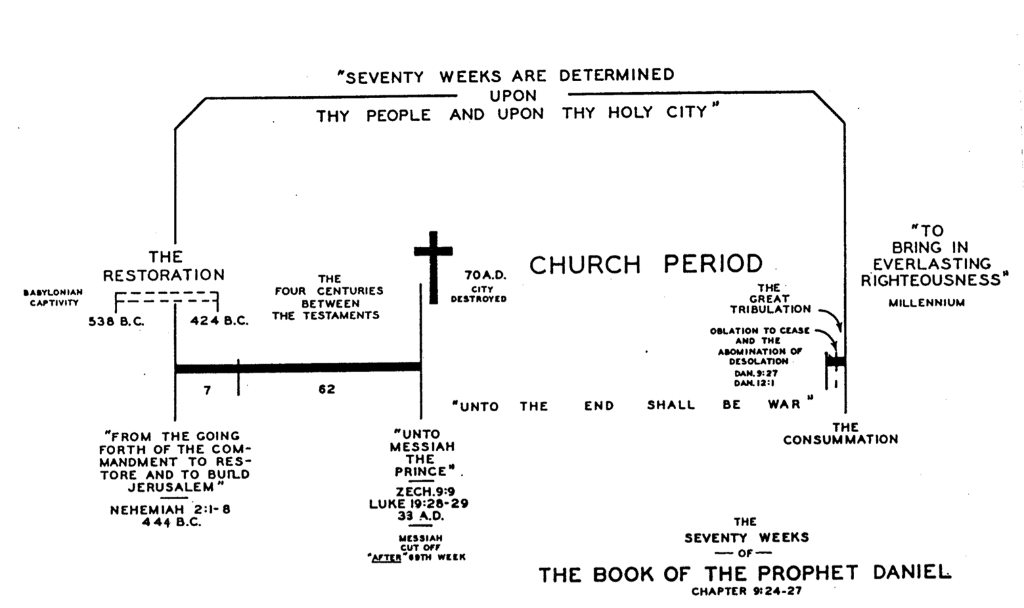
Daniel's 70 Weeks (Dan. 9:24-27)
552
69 Weeks
444 BC
AD 33

Slide 90

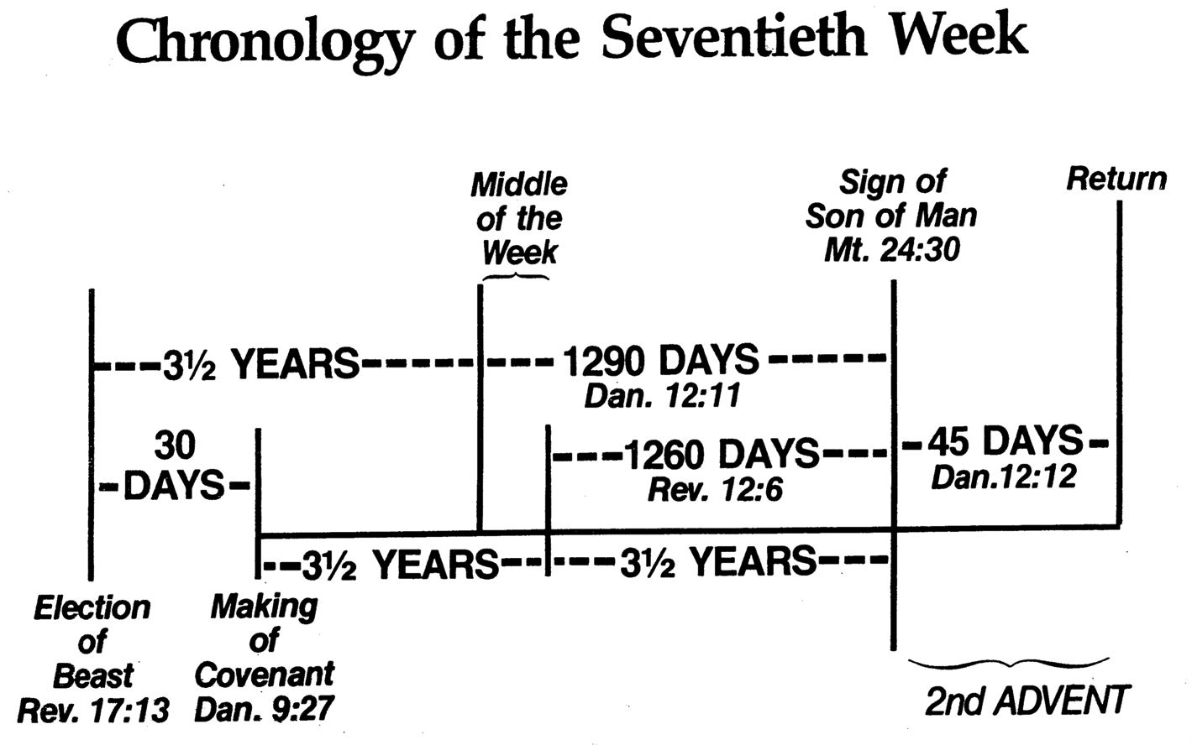
Chronology of the 70th "Week"
556
Adapted from J. Dwight Pentecost, Dallas Theological Seminary, 1988
Middle of the Week
Sign of
Son of Man
Matt. 24:30
Christ's Return Complete
3½ YEARS
1290 DAYS
Dan. 12:11
30 DAYS
30 DAYS
1260 DAYS
45 DAYS
Rev. 12:6
Dan. 12:12
3½ YEARS
3½ YEARS
Election
of Beast
Rev. 17:13
Covenant Made
Dan. 9:27a
Covenant Broken
Dan. 9:27b
The Great Tribulation
2nd ADVENT
The Tribulation
"He will confirm a covenant with many for one 'seven.' In the middle of the 'seven' he will put an end to sacrifice and offering. And on a wing [of the temple] he will set up an abomination that causes desolation, until the end that is decreed is poured out on him" (Daniel 9:27 NIV).
Notes:
The final of the 70 "weeks" also will last seven years and is the focus of Daniel's prophecies more than any other period. Revelation later builds on the foundation that Daniel established.
______________
Common-404
BE-27-Daniel-117
OS-27-Daniel-407, 499
NS-22-Rev7-12-slide 99

Slide 91
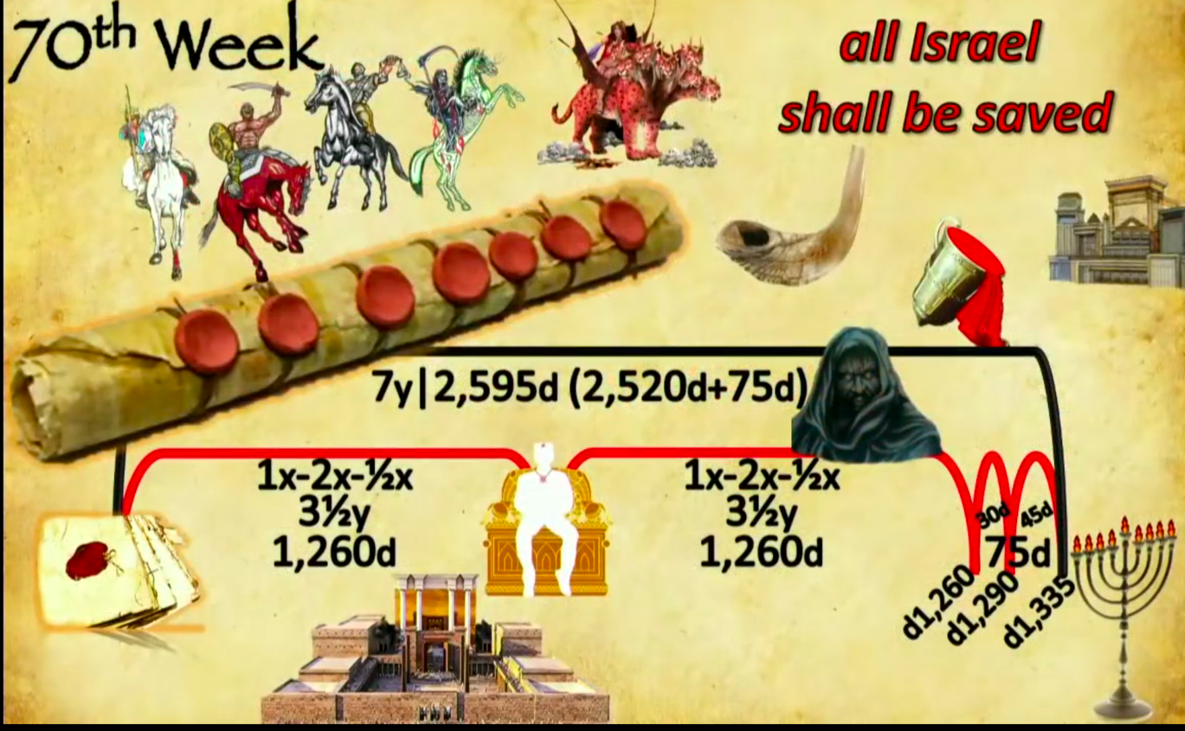
Events of the 70th "Week"
556
70th "Week"
All Israel
shall be saved
2018 09 23 John Haller's Prophecy Update
"Surveillance Society” (https://www.youtube.com/watch?v=GE35KQWKCWw)
"He will confirm a covenant with many for one 'seven.' In the middle of the 'seven' he will put an end to sacrifice and offering. And on a wing [of the temple] he will set up an abomination that causes desolation, until the end that is decreed is poured out on him" (Daniel 9:27 NIV).
Notes:
Parallel texts build upon this teaching by saying that the Antichrist will set up this abomination that causes desolation (Matt 24:15) where he will declare himself to be God:
“He will exalt himself and defy everything that people call god and every object of worship. He will even sit in the temple of God, claiming that he himself is God” (2 Thess 2:4 NLT).
“Then the beast was allowed to speak great blasphemies against God. And he was given authority to do whatever he wanted for forty-two months. ⁶ And he spoke terrible words of blasphemy against God, slandering his name and his dwelling—that is, those who dwell in heaven. ⁷ And the beast was allowed to wage war against God’s holy people and to conquer them. And he was given authority to rule over every tribe and people and language and nation. ⁸ And all the people who belong to this world worshiped the beast. They are the ones whose names were not written in the Book of Life that belongs to the Lamb who was slaughtered before the world was made” (Rev 13:5-8 NLT).
______________
OS-27-Daniel-330
OS-Ezekiel 40-48-Slide 16
OS-37-Haggai-96

Slide 92

Antichrist will make a 7-year treaty with Israel
This will likely enable the rebuilding of the Jerusalem temple
Artwork by Sunny Chandra
Notes:
The 70th week of Daniel 9:27 is believed by nearly all scholars to depict a seven-year period. Since this “ruler to come” will set up a desecration in the temple and this event is still future, it must mean that the present temple rebuilding preparations in Jerusalem right now will be successful in building the temple on its original spot.
______________
OS-27-Daniel-331
OS-Ezekiel 40-48-Slide 17
OS-37-Haggai-97

Slide 93

In 2017, Israel Commemorated President Trump’s Efforts to Rebuild the Temple
This ½ shekel preparation for the Third Temple is compared to Cyrus Helping Build the Second Temple in 539 BC
Artwork by Sunny Chandra
Notes:
The 70th week of Daniel 9:27 is believed by nearly all scholars to depict a seven-year period. Since this “ruler to come” will set up a desecration in the temple and this event is still future, it must mean that the present temple rebuilding preparations in Jerusalem will be successful in building the temple in its original spot.
______________
OS-23-Isaiah43-48-slide 54
OS-26-Ezekiel 40-48-Slide 18
OS-27-Daniel-410
OS-37-Haggai-98

Slide 94

Antichrist will make a 7-year treaty with Israel
This will likely enable the rebuilding of the Jerusalem temple
Artwork by Sunny Chandra
Notes:
The traditional spot for the temple is the exact spot where the Dome of the Rock was constructed by Muslims in the late AD 690s. But will this be easily demolished by one who the world will accept as a peaceful negotiator? That seems unlikely.
______________
OS-27-Daniel-333
OS-Ezekiel 40-48-Slide 19
OS-37-Haggai-99

Slide 95

Antichrist will make a 7-year treaty with Israel
This will likely enable the rebuilding of the Jerusalem temple
Artwork by Sunny Chandra
Notes:
Some propose that this deceitful ruler will negotiate a deal to have the temple built right next to the Dome. Rabbis like Asher Kaufman have proposed the northern site as the original site of Solomon’s temple, partly because it gives a straight shot towards the Eastern Gate.
______________
OS-27-Daniel-334
OS-Ezekiel 40-48-Slide 20
OS-37-Haggai-100

Slide 96

Antichrist will make a 7-year treaty with Israel
This will likely enable the rebuilding of the Jerusalem temple
Artwork by Sunny Chandra
Notes:
Building these adjacent would certainly be the result of a master negotiator!
___________
OS-27-Daniel-335
OS-Ezekiel 40-48-Slide 21
OS-37-Haggai-101

Slide 97

Antichrist will make a 7-year treaty with Israel
This will likely enable the rebuilding of the Jerusalem temple
Artwork by Sunny Chandra
Notes:
Perhaps such a feat would underscore the unity of all religions—a major tenant of the one-world religion that will lead to global worship of the Antichrist as the messianic figure at the focus of that one-world government.
___________
OS-27-Daniel-336
OS-Ezekiel 40-48-Slide 22
OS-37-Haggai-102

Slide 98
70 Weeks Implications
The kingdom would not follow the return
The Tribulation will last 7 years
The Messiah would die before AD 70
The Antichrist will come in the end times
Daniel 9:25-27
Notes:
Why is it important to correctly understand these three verses as referring to Jesus in 9:25-26 but Antichrist in 9:27?
Gabriel told Daniel that the people would go back to Jerusalem shortly—but he also told them that 9:24 would not be fulfilled for 490 years. So there would NOT be a descendant of David ruling the Jews once they returned, although Jehoiachin had seven sons and his line continued for ten generations (1 Chronicles 3:17-24).
Daniel 9:27 is the only verse in the Bible stating the Tribulation period as seven years. All other texts relate to 3.5 years, 1260 or 12290 days, of equivalents.
The "Anointed One" would be cut off (or die) after the 69th week, but the ruler would destroy Jerusalem in the gap between the 69th and 70th weeks. This means that the Messiah had to come in the first century, despite many Jews missing him. Titus destroyed the city in AD 70, so Messiah had to precede this event.
Since the 70th week is future—verified as still future by Jesus in Matthew 24:15—the Antichrist ("he" of 9:27) would be like the "ruler who will come" (9:26) and thus cannot be Antiochus (167-164 BC) nor Jesus.
———
OS-00-Book Charts-546
OS-27-Daniel-18, 415

Slide 99

24
Millennial Jerusalem
"The law will go out from Zion,
the word of the LORD from Jerusalem"
—Isaiah 2:3
Notes:
99
Isaiah predicted a one-world government with Jerusalem as its capital. This city of God’s presence will be the focus of worldwide worship of God though his son Jesus on the throne in Jerusalem. The Antichrist will seek to pre-empt this by declaring himself to be this leader, but he will be defeated so that Jesus can take his rightful place as the world’s political King and religious Saviour.

Slide 100
Chapters 10–12
Daniel
Prophetic 2–12
Hebrew
Gentiles 2–7
Israel 8–12
Aramaic
Hebrew
Beasts 7
Horns 8
Prayer 9
Message
10–12
Interpreter
Inquirer
Statue 2
Idol 3
Tree 4
Hand 5
Lions 6
Personal 1
605-536 B.C.
Judgment
Consolation
God rules the world

Slide 101
Slides on
Daniel 10

Slide 102

Daniel 10
541
Daniel's prayer and fasting for 21 days (10:1-13a)

Slide 103


The Postexilic Era
295
296
560
The Postexilic Era
Temple work
Prophets:
Haggai
Zechariah
Malachi
605
586
539
536
520
516
483-473
444-425
Others:
Zerubbabel
Esther
Ezra
Nehemiah
Persian Kings:
Cyrus
Darius
Xerxes
Artaxerxes
Notes:
The Post-Exilic Era was actually three separate periods:
(1) Temple rebuilding led by Zerubbabel, Haggai, and Zechariah in two parts under Cyrus and Darius,
(2) The saving of the nation from destruction by Esther about 30 years later under Xerxes, and
(3) The restoration of Jerusalem’s walls and gates by Nehemiah another 70 years after that under Artaxerxes.
Zechariah 7:1 took place in King Darius's second year, in 520 BC (cf. 1:1).
_________
Common English slides-187
Common Arabic Slides-153
OS-12-Kings & Prophets Charts-24
OS-15-Ezra-36
OS-16-Nehemiah-94
OS-17-Esther-16, 75
OS-27-Daniel-420
OS-35-Haggai-43
OS-38-Zechariah-14, 46, 121
OS-39-Malachi-13, 56

Slide 104

Daniel 10:4

Slide 105

Daniel 10:5
Notes:
“Evangelicals holding to the view that the “certain man” of Dan 10:4–9 is a theophany of the Lord Jesus Christ include Keil (410), Young (225), Walvoord (1971 ed., 243; 2012 ed., 306–7), C. Feinberg (141), Campbell (153–54), and Miller (281– 82). On the other hand, Pentecost (1365) interprets this as Gabriel, while Leupold (447–48), Archer (123), Wood (268), and Hill (180) view him as an unknown angel. Keil (411) reported that Hengstenberg and some rabbis understood this one to be the angel Michael” (J. Paul Tanner, Daniel, Evangelical Exegetical Commentary, 620, n. 347). Tanner also sees this man as the preincarnate Jesus Christ (p. 625).

Slide 106

Gabriel? (Daniel 10:4-12)
Notes:
https://whatshotn.wordpress.com/tag/pray/

Slide 107

The Prince of Persia (Daniel 10:13a)
Notes:
https://whatshotn.wordpress.com/tag/pray/

Slide 108


The Persian Era

Slide 109

Michael (Daniel 10:13b)
Notes:
https://whatshotn.wordpress.com/tag/pray/

Slide 110

Angels

Slide 111
Daniel 10
541
Daniel's prayer and fasting for 21 days (10:1-13a)
Victory Over Satan’s opposition to Israel's restoration (10:13b-20)
  Persia, Samaritans (book of Ezra)
  Haman (book of Esther)
  Greeks, Romans, Arabs, Hitler, UN, etc.
The certainty of the prophecies = God prevails (10:21)

Slide 112

Do satanic angels exercise powerful authority over cities today also?

Slide 113
Slides on
Daniel 11

Slide 114

Daniel 11 Prophecies

Slide 115

Chapter 11
542
Previews intertestamental & end times history
Intertestamental History––11:1-35 has over 100 prophecies of the Persian and Greek Empires from Alexander the Great to Antiochus IV fighting over the land of Israel
End Times History––11:36-45 prophesies the Antichrist's final assault on Israel

Slide 116

Intertestamental History (11:1-35)
542
The Persian Empire (11:1-2)
“I have been standing beside Michael to support and strengthen him since the first year of the reign of Darius the Mede.). ²’Now then, I will reveal the truth to you. Three more Persian kings will reign, to be succeeded by a fourth, far richer than the others. He will use his wealth to stir up everyone to fight against the kingdom of Greece’” (11:1-2 NLT).

Slide 117
The Postexilic Era
295
296
560
The Postexilic Era
“I have been standing beside Michael to support and strengthen him since the first year of the reign of Darius the Mede.) ²Now then, I will reveal the truth to you. Three more Persian kings will reign, to be succeeded by a fourth, far richer than the others. He will use his wealth to stir up everyone to fight against the kingdom of Greece”
(Daniel 11:1-2 NLT).
Temple work
Prophets:
Haggai
Zechariah
Malachi
605
586
539
536
520
516
483-473
444-425
Others:
Zerubbabel
Esther
Ezra
Nehemiah
Pseudo-Smerdis
Cambyses
Persian Kings:
Cyrus/Darius the Mede
Darius I
Xerxes I
Artaxerxes
Notes:
“Cyrus was the first of the Persian kings to rule following Israel’s deliverance from the Babylonian captivity. The three kings mentioned in v. 2 refer to his successors: Cambyses (ca. 530–522 BC), Pseudo-Smerdis (ca. 522 BC), and Darius I Hystaspes (ca. 522–486 BC). Although Cyrus himself served relatively wisely as the first of the Persian kings, the fourth king, Xerxes I (485–465 BC), launched a major invasion against the kingdom of Greece. This Xerxes I is the same as King Ahasuerus of the book of Esther” (Tanner, Daniel, 645-46).

Slide 118
Chart of the Exile
232 & 342
The Babylonian Exile
John C. Whitcomb, 4th rev. ed., Winona Lake, IN: BMH Books, 1962, 1968

Slide 119

OT Pre-exilic Prophets on Chart
232 & 342
Obadiah
Jeremiah
Jonah
Amos
Hosea
Isaiah
Micah
Nahum
Zeph
Joel
Hab
Chart of Old Testament Kings and Prophets
John C. Whitcomb, 4th rev. ed., Winona Lake, IN: BMH Books, 1962, 1968, p. 2

Slide 120

OT Post-exilic Prophets on Chart
232 & 342
Chart of Old Testament Kings and Prophets
John C. Whitcomb, 4th rev. ed., Winona Lake, IN: BMH Books, 1962, 1968, p. 2

Slide 121

The Persian Era
Xerxes tried to conquer Greece (Dan. 11:2)

Slide 122
Chronology of the Persian Period
313
John H. Walton, Chronological and Background Charts of the OT, 2d ed., 70
PERSIAN KING
DATES
BIBLICAL CORRELATION
GREEK CORRELATION
CYRUS
539-530
Return of Zerubbabel &
Jeshua (Ezra 1–3)
CAMBYSES
530-522
Rebuilding at Jerusalem stopped (Ezra 4)
DARIUS I
522-486
Haggai & Zechariah prophesy (520)
Temple completed (516)
(Ezra 5–6)
Greeks defeat Persians at Marathon (490)
XERXES
486-464
Story of Esther
(Esther 1–9)
Persians defeat Greeks at Thermopylae (480) but reversed at Salamis (480), Herodotus 485-425
ARTAXERXES I
464-423
Return of Ezra (458)
(Ezra 7–10)
Return of Nehemiah (445)
(Nehemiah 1–2)
Prophecy of Malachi (433)
Golden Age (461-431)
Pericles (460-429)
Athens rules

Slide 123

The Pinnacle of Greek History
Democracy & Building the Parthenon
Notes:
The background to Esther is the rise of democracy in Greece in the preceding century. It was based on the natural hill in Athens.

Slide 124

The Acropolis
Notes:
On this outcrop called the Acropolis was the center of Greek pagan religion that focused on the goddes Athena.

Slide 125

A Target for Persia…
Democracy & Building the Parthenon
Notes:
The Parthenon was considered the pinnacle of all buildings with so-called perfect proportions.

Slide 126

The Acropolis Today
Notes:
Although it doesn’t look like much today…

Slide 127

The Pinnacle of Greek History
Athena (goddess of wisdom) inside the Parthenon
Notes:
Inside the Parthenon was a gold-plated statue of the goddess of wisdom, Athena.

Slide 128

The Pinnacle of Greek History
Athena (goddess of wisdom) inside the Parthenon
Notes:
How ironic that the builders who sought wisdom from Athena lacked the wisdom to avoid idolatry!

Slide 129

Persian Invasions of Greece (500-479 BC)
Notes:
Xerxes followed the lead of his predecessor and father, Darius I, who a decade earlier had invaded Greece and was defeated at Marathon (490 BC).
“The Battle of Marathon (Greek: Μάχη τοῦ Μαραθῶνος, Machē tou Marathōnos) took place in 490 BC, during the first Persian invasion of Greece. It was fought between the citizens of Athens, aided by Plataea, and a Persian force commanded by Datis and Artaphernes. The battle was the culmination of the first attempt by Persia, under King Darius I, to subjugate Greece. The Greek army decisively defeated the more numerous Persians, marking a turning point in the Greco-Persian Wars.
The first Persian invasion was a response to Greek involvement in the Ionian Revolt, when Athens and Eretria had sent a force to support the cities of Ionia in their attempt to overthrow Persian rule. The Athenians and Eretrians had succeeded in capturing and burning Sardis, but they were then forced to retreat with heavy losses. In response to this raid, Darius swore to burn down Athens and Eretria. According to Herodotus, Darius asked for his bow, he placed an arrow upon the string and he discharged it upwards towards heaven, and as he shot into the air he said: "Zeus, grant me to take vengeance upon the Athenians!". Also he charged one of his servants, to say to him, every day before dinner, three times: "Master, remember the Athenians."^{[3]}
At the time of the battle, Sparta and Athens were the two largest city states. Once the Ionian revolt was finally crushed by the Persian victory at the Battle of Lade in 494 BC, Darius began plans to subjugate Greece. In 490 BC, he sent a naval task force under Datis and Artaphernes across the Aegean, to subjugate the Cyclades, and then to make punitive attacks on Athens and Eretria. Reaching Euboea in mid-summer after a successful campaign in the Aegean, the Persians proceeded to besiege and capture Eretria. The Persian force then sailed for Attica, landing in the bay near the town of Marathon. The Athenians, joined by a small force from Plataea, marched to Marathon, and succeeded in blocking the two exits from the plain of Marathon. The Athenians also sent a message asking for support to the Spartans. However, at the time the Spartans were involved in a religious festival and gave this as a reason for refusing to aid the Athenians.
https://en.wikipedia.org/wiki/Battle_of_Marathon
Accessed 13 Sep 2016

Slide 130

The Battle of Marathon (490 BC)
Greece defeated the Persians
Notes:
“The Battle of Marathon…
The Greeks could not hope to face the superior Persian cavalry; however, the location chosen was surrounded by marshes and mountains and so the cavalry was unable to join the main Persian army. Miltiades, the Greek general, ordered a general attack against the Persians. He reinforced his flanks, luring the Persians' best fighters into his centre.”
https://en.wikipedia.org/wiki/Battle_of_Marathon
Accessed 13 Sep 2016

Slide 131

The Battle of Marathon (490 BC)
Greece defeated the Persians
Notes:
“The Battle of Marathon…
The inward wheeling flanks enveloped the Persians, routing them.”
https://en.wikipedia.org/wiki/Battle_of_Marathon
Accessed 13 Sep 2016

Slide 132

The Battle of Marathon (490 BC)
Greece defeated the Persians
Notes:
“The Battle of Marathon…
The Persian army broke in panic towards their ships, and large numbers were slaughtered. The defeat at Marathon marked the end of the first Persian invasion of Greece, and the Persian force retreated to Asia. Darius then began raising a huge new army with which he meant to completely subjugate Greece; however, in 486 BC, his Egyptian subjects revolted, indefinitely postponing any Greek expedition. After Darius died, his son Xerxes I restarted the preparations for a second invasion of Greece, which finally began in 480 BC.
https://en.wikipedia.org/wiki/Battle_of_Marathon
Accessed 13 Sep 2016

Slide 133


The Battle of Marathon (490 BC)
Greece defeated the Persians
Notes:
“The Battle of Marathon was a watershed in the Greco-Persian wars, showing the Greeks that the Persians could be beaten; the eventual Greek triumph in these wars can be seen to begin at Marathon. The battle also showed the Greeks that they were able to win battles without the Spartans, as they had heavily relied on Sparta previously. This win was largely due to the Athenians, and Marathon raised Greek esteem of them. Since the following two hundred years saw the rise of the Classical Greek civilization, which has been enduringly influential in western society, the Battle of Marathon is often seen as a pivotal moment in Mediterranean and European history.
The battle is perhaps now more famous as the inspiration for the marathon race. Although thought to be historically inaccurate, the legend of the Greek messenger Pheidippides running to Athens with news of the victory became the inspiration for this athletic event, introduced at the 1896 Athens Olympics, and originally run between Marathon and Athens.”
https://en.wikipedia.org/wiki/Battle_of_Marathon
Accessed 13 Sep 2016

Slide 134
Persian Invasions of Greece = Frustrated Xerxes
Greeks defeat Persians at Marathon (490)
Xerxes
7-day banquet where Queen Vashti deposed
(483)
Persians defeat Greeks at Thermopylae but reversed at Salamis
(Sept 480)
Book of Esther 483-473
490
489
488
487
486
485
484
483
482
481
480
479
478
477
Darius
522-486
Xerxes
486-464

Slide 135

The Battle of Thermopylae
(480 BC)
Thermopylae
Bay of Salamis
Notes:
“The Battle of Thermopylae (/θərˈmɒpᵻliː/ thər-MOP-i-lee; Greek: Μάχη τῶν Θερμοπυλῶν, Machē tōn Thermopylōn) was fought between an alliance of Greek city-states, led by King Leonidas of Sparta, and the Persian Empire of Xerxes I over the course of three days, during the second Persian invasion of Greece. It took place simultaneously with the naval battle at Artemisium, in August or September 480 BC, at the narrow coastal pass of Thermopylae ("The Hot Gates"). The Persian invasion was a delayed response to the defeat of the first Persian invasion of Greece, which had been ended by the Athenian victory at the Battle of Marathon in 490 BC. Xerxes had amassed a huge army and navy, and set out to conquer all of Greece. The Athenian general Themistocles had proposed that the allied Greeks block the advance of the Persian army at the pass of Thermopylae, and simultaneously block the Persian navy at the Straits of Artemisium.
A Greek force of approximately 7,000 men marched north to block the pass in the middle of 480 BC. The Persian army, alleged by the ancient sources to have numbered over one million, but today considered to have been much smaller (various figures are given by scholars, ranging between about 100,000 and 150,000),^{[8][9]} arrived at the pass in late August or early September. The vastly outnumbered Greeks held off the Persians for seven days (including three of battle) before the rear-guard was annihilated in one of history's most famous last stands. During two full days of battle, the small force led by Leonidas blocked the only road by which the massive Persian army could pass. After the second day, a local resident named Ephialtes betrayed the Greeks by revealing that a small path led behind the Greek lines. Leonidas, aware that his force was being outflanked, dismissed the bulk of the Greek army and remained to guard their retreat with 300 Spartans, 700 Thespians, 400 Thebans, and perhaps a few hundred others, most of whom were killed.
At Artemisium, the Greek navy, under the command of the Athenian politician Themistocles, received news of the defeat. Since the Greek strategy required both Thermopylae and Artemisium to be held, and given their losses, it was decided to withdraw to Salamis. The Persians overran Boeotia and then captured the evacuated Athens. The Greek fleet—seeking a decisive victory over the Persian armada—attacked and defeated the invaders at the Battle of Salamis in late 480 BC. Fearful of being trapped in Europe, Xerxes withdrew with much of his army to Asia (losing most to starvation and disease), leaving Mardonius to attempt to complete the conquest of Greece. However, the following year saw a Greek army decisively defeat the Persians at the Battle of Plataea, thereby ending the Persian invasion.
Both ancient and modern writers have used the Battle of Thermopylae as an example of the power of a patriotic army defending its native soil. The performance of the defenders is also used as an example of the advantages of training, equipment, and good use of terrain as force multipliers and has become a symbol of courage against overwhelming odds.”
https://en.wikipedia.org/wiki/Battle_of_Thermopylae
Accessed 12 Sep 2016

Slide 136

The Greek Trireme
Small but fast and deadly

Slide 137

The Battle of Salamis (480 BC)

Slide 138

The Battle of Salamis (480 BC)

Slide 139

The Battle of Salamis (480 BC)
Casualties: Greeks lost 40 ships
Persians: 200-300. Victory at Salamis ended Xerxes' invasion and preserved Greek freedom

Slide 140
Persian Invasions of Greece = Frustrated Xerxes
Greeks defeat Persians at Marathon (490)
Xerxes
7-day banquet where Queen Vashti deposed
(483)
Persians defeat Greeks at Thermopylae but reversed at Salamis
(Sept 480)
Esther became queen after a 4-year beauty contest
(Dec 480 or Jan 479)
Book of Esther 483-473
490
489
488
487
486
485
484
483
482
481
480
479
478
477
Darius
522-486
Xerxes
486-464

Slide 141
Key Dates Related to the Book of Esther
314
Reference
Date
Event
–
486
Xerxes' reign began
1:3
483
(3rd year of Xerxes)
Xerxes 7-day banquet for his nobles & officials where Queen Vashti was deposed
–
482-479
Xerxes led disastrous campaigns against Greece, esp. at navy Battle of Salamis (480); recorded by Greek historian Herodotus (7.8)
2:16
Dec 479 or Jan 478
Esther became queen after a 4-year beauty contest
3:7
Early April 474
In the 5th year of Esther's reign, Haman & the astrologers (5:10, 14; 6:12-13) cast the pur (lot) to determine the day to exterminate the Jews 11 months later (7 March 473)
3:12
April 17, 474
(13th of Nisan)
Xerxes' 1st edict (to destroy the Jews) informed everyone of the fateful day, royal secretaries wrote it out in the various languages of the empire

Slide 142



The Persian Era
57, 59
Returns
Developments
Temple
People
Walls

Slide 143
Alexander's Conquests (11:3)
557

Slide 144
His Downfall
Due to Pride Shown in Desire for:
Worship
Wine
Women
Song

Slide 145
After Alexander…
557
Greek Empire
Cassander
Lysimacus
Ptolemy
Seleucus
"And the he-goat is the king of Greece; and the great horn between his eyes is the first king. As for the horn that was broken, in place of which four others arose, four kingdoms shall arise from his nation but not with his power" (Daniel 8:21-22 RSV; cf. 11:4)

Slide 146
Intertestamental History (11:1-35)
542
The Persian Empire (11:1-2)
The Greek Empire from Alexander the Great to Antiochus IV (11:3-35)
Alexander the Great until after his death, his empire is divided among the four generals: Cassander, Lysimachus, Ptolemy and Seleucus (11:3-4)
Ptolemies and the Seleucids battle (11:5-20)
Antiochus IV forces Jews to be Greeks (11:21-32a)
Mattathias and his sons, the Maccabees, revolt against Antiochus IV (11:32b-35)

Slide 147

Ptolemies and Seleucids
558

Slide 148
Ptolemies and Seleucids
558

Slide 149
Ptolemies and Seleucids
558

Slide 150
Ptolemaic & Seleucid Kings (11:5-35)
558
Ptolemies (Kings of the South)
Seleucids (Kings of the North)
Ptolemy II Philadelphus (285–246): Signed treaty of peace and gave his daughter Berenice to Antiochus II. Died after his daughter's death (v. 6).
Antiochus II Theos (246-226): Disposed of Laodice to marry Berenice. Laodice killed Berenice and her infant son (v. 6), and eventually poisoned Theos and put her own son Callinicus on the throne.

Slide 151
Ptolemaic & Seleucid Kings (11:5-35)
558
Ptolemy v. Epiphanes (204-181): After Antiochus attacked, General Scopas of Egypt launched counter-offensive and punished pro-Seleucid Jews, but was later defeated (v. 14). Antiochus gave his daughter Cleopatra to Ptolemy V when she was under age 10 (v. 17) hoping to control both kingdoms. Cleopatra sided with her husband. They gave birth to Ptolemy VI.

Slide 152
Ptolemaic & Seleucid Kings (11:5-35)
558
10-11, 13, 15-19 Antiochus III the Great (223-187): Son of Callinicus. Won title "the Great" because of his military exploits. Suppressed a revolt by his governor Molon and then launched an attack on Palestine, but was beaten by the smaller army of Ptolemy IV (v. 11), which returned Palestine to Ptolemy IV.

Slide 153
Ptolemaic & Seleucid Kings (11:5-35)
558
When Ptolemy IV died, Antiochus III attacked his 4 yr. old son Ptolemy V and invaded Palestine. After defeating Scopas, Antiochus conquered Thrace and its coastlands with his strong navy. But in supporting the Aetolians against the Romans, he was defeated by the Roman commander (v. 18) and compelled to pay Rome tribute annually.

Slide 154



Antiochus IV
65
Daniel 11:29-30 "At the time appointed he shall return and come into the south, but it shall not be this time as it was before. For ships of Kittim shall come against him, and he shall be afraid and withdraw, and shall turn back and be enraged and take action against the holy covenant. He shall turn back and pay attention to those who forsake the holy covenant."

Slide 155

“And forces from him will arise, dese-crate the sanctuary fortress, and do away with the regular sacrifice. And they will set up the Abomination of Desolation.”
Daniel 11:31
Notes:
Antiochus IV forced Jewish priests to offer a pig on the altar of the Jerusalem temple in 167 BC! This was so offensive to the Jews that it ignited the Maccabean Revolt that overthrew these Greek forces three years later. This event was AFTER Daniel's prophecy (Dan 9:27) but Jesus still referred to it as in the future in his day (Matt 24:15). Therefore, what Antiochus did was but a foreshadowing of an even more offensive offering of the Antichrist at the mid-point of the Tribulation.
(Slide from Randall Price)
______________
OD-05-Matt_24v15_The_Temple_Desecration_(Randall_Price)-5
OS-27-Daniel-495
NS-01-Matt15-28—slide 151
NS-27-Rev 4-6—slide 135

Slide 156






Jerusalem Hellenization (Daniel 11:31-35)
65
Dec 167- Dec 164
Hanukkiah
Menorah
The Feast of Lights (Dedication)
Notes:
• Jews had long held the Law sacred, but...
• Antiochus IV prohibited the law in Jerusalem itself!
• He also forced Jewish priests to offer a pig on the altar of the Jerusalem temple in 167 BC
This fulfilled Dan. 11:31 — “His army will take over the Temple fortress, pollute the sanctuary, put a stop to the daily sacrifices, and set up the sacrilegious object that causes desecration. 32 He will flatter and win over those who have violated the covenant. But the people who know their God will be strong and will resist him.
Dan. 11:33 “Wise leaders will give instruction to many, but these teachers will die by fire and sword, or they will be jailed and robbed. 34 During these persecutions, little help will arrive, and many who join them will not be sincere. 35 And some of the wise will fall victim to persecution. In this way, they will be refined and cleansed and made pure until the time of the end, for the appointed time is still to come.” (NLT).
• The revolt against took three years (167-164 BC).
• In the final battle to reclaim the temple, the lampstands in the temple had enough oil for only one day but miraculously lasted EIGHT days! Jews commemorate this in the annual Hanukkah celebration of eight days each December.
• Rather than light the normal 7-branched menorah, they light with the 8-branched Hanukkiah lampstand. This is also called the Feast of Lights, Feast of Dedication, or Feast of Rededication. Jesus declared himself as the Light of the World during this festival in John 8.
__________________
OS-27-Daniel-496

Slide 157
Ptolemaic & Seleucid Kings (11:5-35)
558
The second son of Antiochus III was named Antiochus IV. He was taken hostage to Rome. While trying to pillage the Temple in Elymais to pay his tribute to Rome, he was killed by the angry locals.

Slide 158







Maps of Intertestamental Empires
52

Slide 159
Intertestament Timeline
96
Persian 539-331
Greek 331-143
Hasmonean 143-63
Roman 63-330
Ptolemaic 323-198
Seleucid 198-143
Maccabean 167-143
450
400
350
300
2 5 0
2 0 0
150
100
1
Alexander 331-323

Slide 160

Greek Rule over Israel
60
Alexander
Struggle for Supremacy
Hellenistic Empire Developments

Slide 161


After Alexander… 4 Kingdoms
64
Cassander
Lysimacus
Seleucus
Ptolemy

Slide 162

Greek Cities in Israel
Beitzel, 153

Slide 163

NT Boundaries in Israel
Beitzel, 19

Slide 164
Ptolemies & Seleucids Over Israel
63
Sword
Peace
Seleucus
Ptolemy
Notes:
Greek rule over Israel fell into two distinct periods alliterated in English by P and S:
• Ptolemies ruled with Peace
• Seleucids ruled with the Sword
______________
NB-05-Politics 2 Ptolemies-20
OS-27-Daniel-503

Slide 165

Greek Era Significance
62, 65, 95
Ptolemaic (301-198)
Seleucid (198-143)
Religious Freedom
Rise of Sanhedrin
Peaceful Hellenization
Greek Language
Septuagint (LXX)
High Priesthood
Rise of Hasidim

Slide 166
Jerusalem Hellenization
65
Dec 167- Dec 164
Hanukkiah
Menorah
The Feast of Lights (Dedication)

Slide 167
Greek Era Significance
62, 65, 95
Ptolemaic (301-198)
Seleucid (198-143)
Religious Freedom
Rise of Sanhedrin
Peaceful Hellenization
Greek Language
Septuagint (LXX)
High Priesthood
Rise of Hasidim
Temple desecration
Maccabean Revolt

Slide 168

End Times History (11:36-45)
542
The final section (11:36-45) refers to the Antichrist. Antiochus IV is not in view because:
  The leader in these verses is simply called "the king" (11:36), so a different leader is likely (= "little horn" of 7:28; "the ruler" of 9:26).
  The god Antiochus set up was Zeus but 11:37 notes that this king will disregard his heritage.
  An attack on Egypt will bring war with Rome (11:40-44), which Antiochus did not do.
  Antiochus IV was in serious financial difficulty so the wealth of 11:43 was not true of him.
  Antiochus IV died at Tabae in Persia, not in Israel (11:45).

Slide 169

Daniel 11:40
543
Israel's enemies will invade her land

Slide 170

Daniel 11:40-45
543
Even ships in the Mediterranean will join the battle

Slide 171


West Meets East (Dan. 11:44)
543

Slide 172

Christ will defeat Antichrist (Dan. 11:45)

Slide 173
Slides on
Daniel 12
Notes:
Israel's future will see Antichrist’s self-deification and military power end at Christ’s Second Coming to show God's rule over all nations (11:36–12:3).

Slide 174
Israel’s Future
Notes:
These prophecies will bless Israel in the Tribulation and reveal judgment for unbelievers to encourage Israel with God's rule (12:4-14).

Slide 175

Michael will arise (Daniel 12:1)
Notes:
These prophecies will bless Israel in the Tribulation and reveal judgment for unbelievers to encourage Israel with God's rule (12:4-14).

Slide 176

Judgment of Old Testament Saints
FU 160
"Now at that time Michael, the great prince who stands guard over the sons of your people, will arise. And there will be a time of distress such as never occurred since there was a nation until that time; and at that time your people, everyone who is found written in the book, will be rescued. ²Many of those who sleep in the dust of the ground will awake, these to everlasting life, but the others to disgrace and everlasting contempt. ³Those who have insight will shine brightly like the brightness of the expanse of heaven, and those who lead the many to righteousness, like the stars forever and ever"
(Daniel 12:1-3 NAU).
Notes:
____________
OS-Daniel
FU-Resurrections

Slide 177

“Those who are wise will shine as bright as the sky, and those who lead many to righteousness will shine like the stars forever” (Daniel 12:3 NLT).

Slide 178




“But you, Daniel, keep this prophecy a secret; seal up the book until the time of the end, when many will rush here and there, and knowledge will increase” (Daniel 12:4 NLT)

Slide 179
Daniel 12:4-16
543
The revelation given to Daniel is sealed up for the end time (Dan. 12:4)
The great tribulation (Dan. 12:1; cf. Matt. 24:21)
"After which" => the resurrection
Endure to the end to be blessed (Matt. 24:14)
When Daniel asked for the time of these events, the reply was:
  The time, times, half a time (Dan. 7:25; 12:7; Rev. 11:2; 13:5; 12:6, 14) = 1 yr. + 2 yrs. + ½ yr. = 3.5 years
  The end, the power of Israel broken (Dan. 12:7; Zech. 14:12-16; Rev. 19:15-19)
What are the 1290 and 1335 days???
Notes:
Gabriel told Daniel to seal up these prophecies until the Tribulation when travel and knowledge will increase rapidly (Dan 12:4).
Gabriel declared that a 3.5-year Great Tribulation will lead unbelievers to punishment and Israel will enter the Kingdom (Dan 12:5-13).
—The setting was Daniel's observations of two angels standing on opposite sides of the Tigris River (Dan 12:5; cf. 10:4).
—The Great Tribulation will last 3.5 years or 1260 days (Dan 12:6-7).
—The Great Tribulation will judge unbelievers worshipping Antichrist but bless Israel with the kingdom (Dan 12:8-13).

Slide 180

Daniel 12:5 is 1st Person
"Then I, Daniel, looked and saw two others standing on opposite banks of the river" (NLT).

Slide 181


The 3.5-Year Great Tribulation
Time
Times
Half a Time
1
2
3
1/2
“It will go on for a time, times, and half a time.
When the shattering of the holy people has finally come to an end,
all these things will have happened”
(Daniel 12:7b NLT; cf. Revelation 12:14).
Notes:
“Then there will be a time of anguish greater than any since nations first came into existence” (12:1) is the reason this has been called the Great Tribulation.

Slide 182

Equal Periods are Based on the Jewish Month of 30 Days
“time, times, & half a time” in years
(Dan 7:25; 12:7; Rev. 12:14)
1
(12 mo.)
2
(12 mo.)
3
(12 mo.)
½
(6 mo.)
=
“42 months”
(Rev 13:5)
42 months
(12 + 12 + 12 + 6 = 42 months)
=
1260 days
(42 mo. x 30 days = 1260 days)
“1260 days”
(Rev 12:6)

Slide 183
Chronology of the 70th "Week"
556
Adapted from J. Dwight Pentecost, Dallas Theological Seminary, 1988
Middle of the Week
Sign of
Son of Man
Matt. 24:30
Christ's Return Complete
1335 DAYS
Dan. 12:12
3½ YEARS
1290 DAYS
Dan. 12:11
30 DAYS
30 DAYS
1260 DAYS
45 DAYS
Rev. 12:6
Dan. 12:12
3½ YEARS
3½ YEARS
Election
of Beast
Rev. 17:13
Covenant Made
Dan. 9:27a
Covenant Broken
Dan. 9:27b
2nd ADVENT
The Great Tribulation
The Tribulation
Notes:
The final of the 70 "weeks" also will last seven years and is the focus of Daniel's prophecies more than any other period. Revelation later builds on the foundation that Daniel established.
______________
Common-404
BE-27-Daniel-117
OS-27-Daniel-407, 499
NS-22-Rev7-12-slide 99

Slide 184
Theology of Daniel 8–12
God is sovereign over history
God sets times and boundaries for people and nations (cf. Acts 17:26-27)
God is sovereign over all powers in the heavenly and the earthly realm (cf. Job)
God's people are engaged in God's purposes through prayer and fasting
Humility and concern for the glory of God and the destiny of his people (Dan. 9:18, 19, 23) is highly esteemed
Effectual prayer is motivated by God's glory (Dan. 9:17-19) and identifies itself with God's people (Dan. 9:5, 9, 10)

Slide 185
Theology of Daniel 8–12 (cont'd)
God hears the prayers of the saints (9:2,15,16,23).
God brings down the proud and arrogant and those who oppose Him (11:18, 19, 45)
God has a plan for his people to bless them (9:24).
A consecrated life listens to God's voice (9:2, 23)
God uses evil to establish His purpose for his people
God's Kingdom is the goal of all human history
God wants his people to persevere in hard times (11:32, 33; 12:3)
God prepares His people for the times ahead.
God will discipline His people (cf. Matt. 5:13)

Slide 186

Applying Daniel 8–12
544a
Be confident that God still rules over Israel today.
Notes:
We lose confidence when we lose sight that God has Israel under his control.
The book of Daniel reminds us to be confident in God like Daniel.

Slide 187
What do you need to know to be truly confident?
Notes:
The answer, of course, is that Daniel placed his confidence not in himself but in God. In his book are three areas where God has control, so, like Daniel, we can be confident that God is working.

Slide 188
——Main Idea of Daniel——
God controls each level.
Notes:
What do you need to know to be truly confident?
Do you rest in this reality that the LORD doesn't need your help in running the universe? He sets up kings and takes them down—and he does the same in our lives.

Slide 189
I. God rules over you
(Dan 1).
Notes:
You can be confident when you know that…
The LORD controls what happens to you as an individual.

Slide 190
II. God rules over all nations (Dan 2–7).
Notes:
The LORD controls what happens to the peoples of the world.

Slide 191
III. God rules over Israel’s future (Dan 8–12).
Notes:
The LORD controls the prophetic fulfillments for his people in the days ahead.

Slide 192

Daniel is a book of faith and courage stemming from the Sovereign God!
Notes:
Where do you need to be confident of God’s rule in your life today?
Do you feel that you are under someone else’s thumb at home, school, work or somewhere else?
Can you now see that since God is over these authorities, he also can help you live with confidence even though you cannot control the circumstances?

Slide 193
Application
Recognize God's sovereignty over all authority in history
Resist evil without compromising
Trust God for your ultimate salvation so that you can endure to the end (12:2, 3, 12; cf. Rev. 12:11)
Seek God in prayer and intercession
Live a godly life
Notes:
Do you feel that you are under someone else’s thumb at home, school, work or somewhere else?
Can you now see that since God is over these authorities, he also can help you live with confidence even though you cannot control the circumstances?
Be confident of God’s rule over everything today.

Slide 194
Black

Slide 195


OT Preaching link at BibleStudyDownloads.org
Get this presentation and script for free!

Slide 196






Self-Made Idols Are Useless
Babylon & Us
Whatcha doin’ here, kid?
…Just enjoying God’s creation.
Have you ever seen God?
It must take incredible faith to believe in a God you can’t see.
Then how do you know that he even exists?
…It’s called faith.
THAT, TAKES INCREDIBLE FAITH.
Nope.
I just know.
Not really.
Notes:
Idolatry does not make sense either in Babylon's time or ours today.
(Translators—Move the various panels to the side to translate them, and then return them to the center.)
_______________________
Common-408
OB-Babylonians
OS-01-Gen4-12-slide 185
OS-23-Isa43-48-slide 34
OS-26-Ezek40-48-slide 190
OS-27-Daniel-512

Slide 197



By Puje
SINGAPORE BIBLE COLLEGE
OT THEOLOGY 3
M.DIV. 3
PRESENTED BY PUJE
DR. GRIFFITH

Slide 199
OT Survey link at BibleStudyDownloads.org
Get this presentation for free!
Notes:
OT Survey (os)

