Slide 1
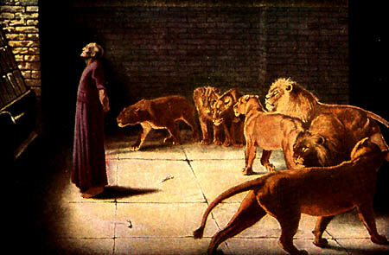
DANIEL 2–7
Dr. Rick Griffith • Jordan Evangelical Theological Seminary
BibleStudyDownloads.org

Slide 2
Key Word
532
343
Sovereignty
Daniel
Notes:
Daniel repeatedly shows God as the highest ruler—in contrast to Babylonian kings who continually exalt themselves in pride but are humbled in various ways.

Slide 3
Theme
532
Universal Sovereignty in Times of the Gentiles
Daniel
Notes:
The phrase “the times of the Gentiles” does not appear in Daniel but Jesus used this phrase in Luke 21:24 (see slide 21) to refer to the period designated by Daniel when Gentile nations will rule over Jerusalem until Christ reigns from this city. It began when Nebuchadnezzar destroyed Jerusalem in 586 BC and will continue until Messiah rules over the city.

Slide 4
Key Verse
532
(Daniel to God) "…Praise be to the name of God for ever and ever; wisdom and power are his. He changes times and seasons; he sets up kings and deposes them…"
(2:20-21a).
Daniel
Notes:
Many kings utter similar declarations with Daniel’s prophecy as well.

Slide 5

Kingdom Statement
343
God's sovereignty remains steadfast despite the rise and fall of many nations until the establishment of kingdom blessing under His Messianic Ruler (9:24-27).
Daniel
Notes:
Daniel 9:24-27 (NLT): “A period of seventy sets of seven has been decreed for your people and your holy city to finish their rebellion, to put an end to their sin, to atone for their guilt, to bring in everlasting righteousness, to confirm the prophetic vision, and to anoint the Most Holy Place. ²⁵ Now listen and understand! Seven sets of seven plus sixty-two sets of seven will pass from the time the command is given to rebuild Jerusalem until a ruler—the Anointed One—comes. Jerusalem will be rebuilt with streets and strong defenses, despite the perilous times.
²⁶ After this period of sixty-two sets of seven, the Anointed One will be killed, appearing to have accomplished nothing, and a ruler will arise whose armies will destroy the city and the Temple. The end will come with a flood, and war and its miseries are decreed from that time to the very end. ²⁷ The ruler will make a treaty with the people for a period of one set of seven, but after half this time, he will put an end to the sacrifices and offerings. And as a climax to all his terrible deeds, he will set up a sacrilegious object that causes desecration, until the fate decreed for this defiler is finally poured out on him.”
________________

Slide 6

Summary Statement
532
346
The Judean exiles should be encouraged of God's sovereign control over all nations to preserve Israel between Nebuchadnezzar's invasion of Jerusalem (605 BC) and the establishment of the Kingdom blessings under the Messiah.
Daniel
Notes:
Those forced from Jerusalem and brought to Babylon are actually servants of the High God! His rule over the world has not changed, but he is only using the Babylonian invasion of Israel for his purposes from 605 BC until Jesus reigns from Jerusalem after he returns to bless a believing Israel and Gentiles.

Slide 7

Covenant
347c
The covenant of an imposter Messiah (9:27) in the mold of Antiochus (Dan. 11:22-32) will be squelched (11:36-45) and replaced with the True Messiah who alone keeps his covenants (9:4).
Daniel
Notes:
Who really keeps his promises? The Antichrist will make a 7-year agreement with Israel (9:27) but will break it just as Antiochus IV did in Jerusalem in 167-164 BC. As his rule over the city lasted but three years, so the future ruler will have only limited control until Jesus brings in the new covenant (cf. Jer 31:31-34).

Slide 8

Redemption
347c
God alone saves (3:17, 29; 6:27) since all other kingdoms and rulers are ultimately powerless.
Daniel
Notes:
The saving acts of God in Daniel are not salvation from sin but deliverance from danger. But the same God does both!
Dan. 3:17 If we are thrown into the blazing furnace, the God whom we serve is able to save us. He will rescue us from your power, Your Majesty.
Dan. 3:29 Therefore, I make this decree: If any people, whatever their race or nation or language, speak a word against the God of Shadrach, Meshach, and Abednego, they will be torn limb from limb, and their houses will be turned into heaps of rubble. There is no other god who can rescue like this!”
Dan. 6:27 He rescues and saves his people;
he performs miraculous signs and wonders
in the heavens and on earth.
He has rescued Daniel
from the power of the lions.”

Slide 9

Messiah
347c
Predicting the date of the triumphal entry and later death (9:25-26) proves Christ will also defeat the world's kingdoms (2:34-35, 44) to rule (7:13-14) as King (10:5-9; cf. Rev. 1:12-16).
Daniel
Notes:
No OT prophecy is more specific than Daniel 9:25-26 which gives the exact date when Jesus was presented to Israel in the Triumphal Entry on 30 March AD 33. This shows his victory over all other kings as the One to whom is given authority over the world (Dan 7:13-14).

Slide 10

Outline of Daniel
532
UNIVERSAL SOVEREIGNTY IN TIMES OF THE GENTILES
Sovereignty over Daniel |  |  | Sovereignty over Gentiles |  |  |  |  |  | Sovereignty over Jews
Chapter 1 |  |  | Chapters 2–7 |  |  |  |  |  | Chapters 8–12
Narrative |  |  | Visions in Narrative |  |  |  |  |  | Vision
Hebrew |  |  | Aramaic |  |  |  |  |  | Hebrew
Gentile Names for God |  |  | Gentile Names for God |  |  |  |  |  | Jewish Names for God
Third person ("Daniel") |  |  | Third person ("Daniel") |  |  |  |  |  | First person ("I")
Daniel's Example |  |  | Daniel Interprets King's Dreams |  |  |  |  |  | Angel Interprets Daniel's Dreams
The Man Daniel |  |  | Images |  | Kings |  |  |  | Israel's Future
Exile 1:1-7 | Food 1:8-16 | Exalted 1:17-21 | Varied 2 Promoted | Gold 3 Furnace | Neb. 4 Exile | Bel. 5 Party | Dar. 6 Lions | All 7 Beasts | Medo- Persia To Greece 8 | Return to Seventy "7s" 9 | Intertest-ament Period to Tribulation 10–12
Babylon
605-536 BC
Notes:
Not surprisingly, the center section of the prophecy that relates to Gentile nations from chapters 2–7 is written in Aramaic, the trade language of the day. Note also how the writing begins and ends with the Jewish people, which would have been of great concern to Daniel.

Slide 11
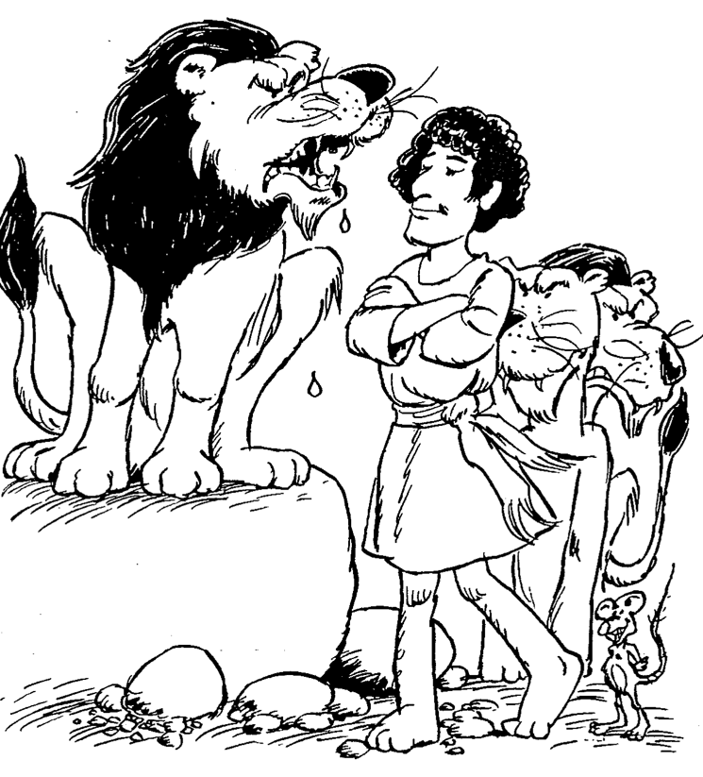
Barry Huddleston, The Acrostic Summarized Bible (Grand Rapids: Baker, 1992)
Daniel
1 Daniel favored by Nebuchadnezzar
2 Answer to king’s dream
3 Nebuchadnezzar’s furnace of fire
4 Interpretation of tree vision
5 Events at Belshazzar’s feast
6 Lion’s den of Darius
7 Scenes of coming kingdom
8 Features of four beasts
9 Appointing the seventy weeks
10 Interpreting the final vision
11 Terror of the king
12 Horror of end times
Notes:
The man Daniel models trust in God even when the nation where he served was conquered by the Persians (5:30). He repeatedly gave credit to God for the ability to interpret dreams and visions, which spoke volumes to kings used to subordinates exalting themselves to obtain higher rank, money, and authority.

Slide 12

Be Confident
Daniel
Dr. Rick Griffith • Crossroads International Church Singapore
CICFamily.com • BibleStudyDownloads.org
Notes:
Everyone is talking about how to be more confident today.

Slide 13

What do you need to know to be truly confident?
Three truths...
Notes:
Today we will see that Daniel placed his confidence not in himself but in God.
• In his book we will see three truths that will help us, like Daniel, be confident that God is working.

Slide 14

I. God rules over you
(Dan 1).
Notes:
You can be confident when you know that…
The LORD controls what happens to you as an individual.

Slide 15
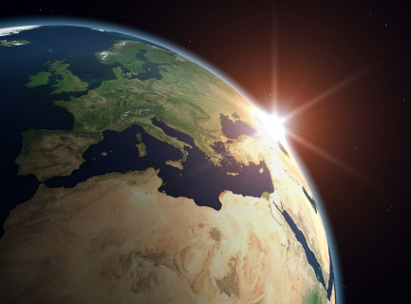
II. God rules over all nations (Dan 2–7).
Notes:
The LORD controls what happens to the peoples of the world.

Slide 16
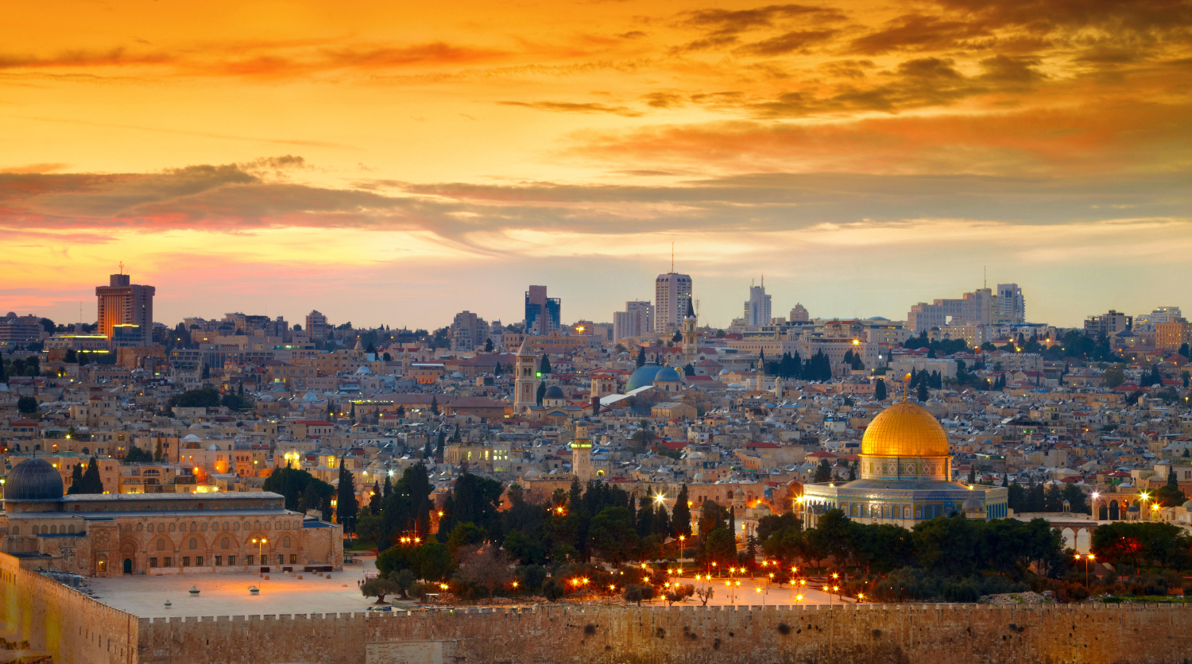
III. God rules over Israel’s future (Dan 8–12).
Notes:
The LORD controls the prophetic fulfillments for his people in the days ahead.

Slide 17
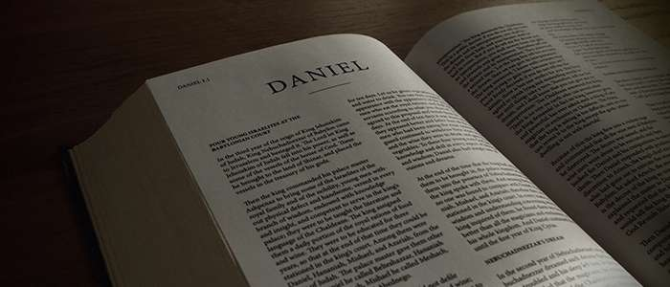
——Main Idea of Daniel——
God controls each level.
Notes:
What do you need to know to be truly confident?
Do you rest in this reality that the LORD doesn't need your help in running the universe? He sets up kings and takes them down—and he does the same in our lives.

Slide 18

70 Weeks Implications
The kingdom would not follow the return
The Tribulation will last 7 years
The Messiah would die before AD 70
The Antichrist will come in the end times
Daniel 9:24-27
Notes:
Why is it important to correctly understand these four verses as referring to Jesus in 9:25-26 but Antichrist in 9:27?
Gabriel told Daniel that the people would go back to Jerusalem shortly—but he also told them that 9:24 would not be fulfilled for 490 years. So there would NOT be a descendant of David ruling the Jews once they returned, although Jehoiachin had seven sons and his line continued for ten generations (1 Chronicles 3:17-24).
Daniel 9:27 is the only verse in the Bible stating the Tribulation period as seven years. All other texts relate to 3.5 years, 1260 or 12290 days, of equivalents.
The "Anointed One" would be cut off (or die) after the 69th week, but the ruler would destroy Jerusalem in the gap between the 69th and 70th weeks. This means that the Messiah had to come in the first century, despite many Jews missing him. Titus destroyed the city in AD 70, so Messiah had to precede this event.
Since the 70th week is future—verified as still future by Jesus in Matthew 24:15—the Antichrist ("he" of 9:27) would be like the "ruler who will come" (9:26) and thus cannot be Antiochus (167-164 BC) nor Jesus.

Slide 19
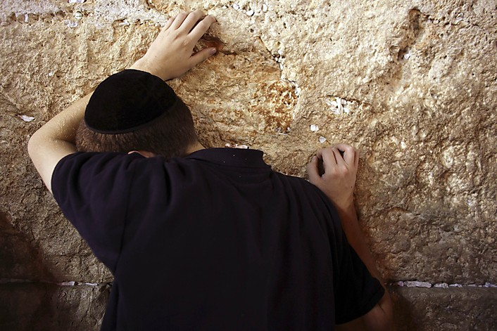
Application
Recognize God's sovereignty over all authority in history
Resist evil without compromising
Trust God for your ultimate salvation so that you can endure to the end (12:2, 3, 12; cf. Rev. 12:11)
Seek God in prayer and intercession
Live a godly life
Notes:
Our world today is not unlike that of Daniel. We also need to see that God is not up for election. He rules over all nations and he rules over you—so recognize his powerful care, trust him to forgive your sins by trusting in Christ’s death for you, and reorient your life around him.

Slide 20
Black

Slide 21
Slides on
Daniel 2

Slide 22
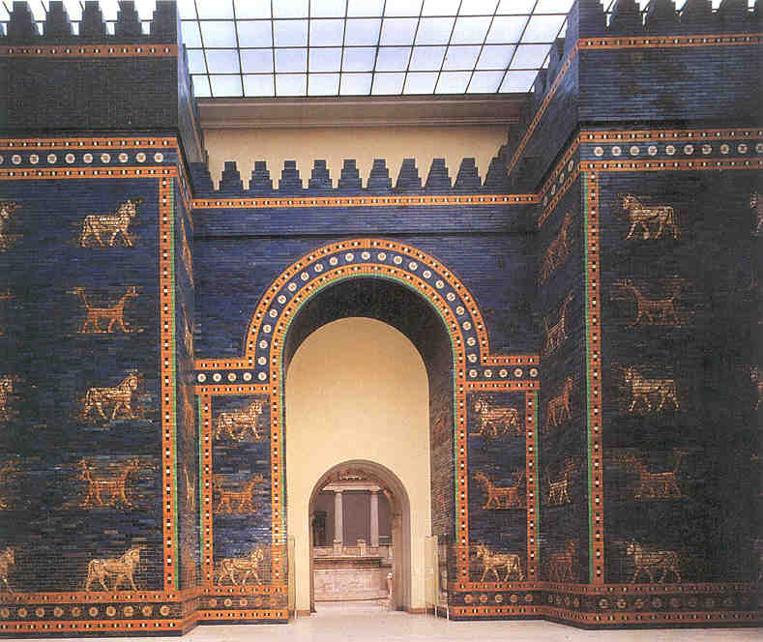
The Point of Daniel 2–7
544a
The exiles could confidently trust God’s sovereignty over the nations seen in Daniel's devotion and prophecy of "the times of the Gentiles" (Dan 2–7).
Daniel saw world history
—in advance!

Slide 23
Chapter 2
Daniel
Prophetic 2–12
Hebrew
Gentiles 2–7
Aramaic
Interpreter
Personal 1
Statue 2
605-536 B.C.
Notes:
Nebuchadnezzar recognized God's sovereignty in his dream of the destruction of a statue revealed by Daniel (Dan 2).

Slide 24
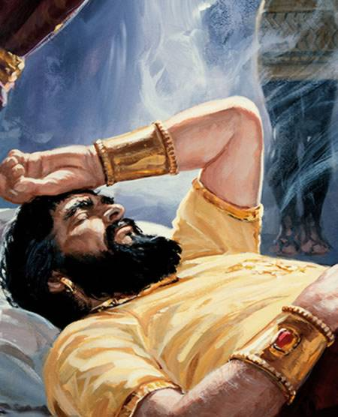
Dreaming of an Image
Notes:
In 604 BC Nebuchadnezzar had a dream that his wise men could not discern as they did not know God (2:1-13).

Slide 25
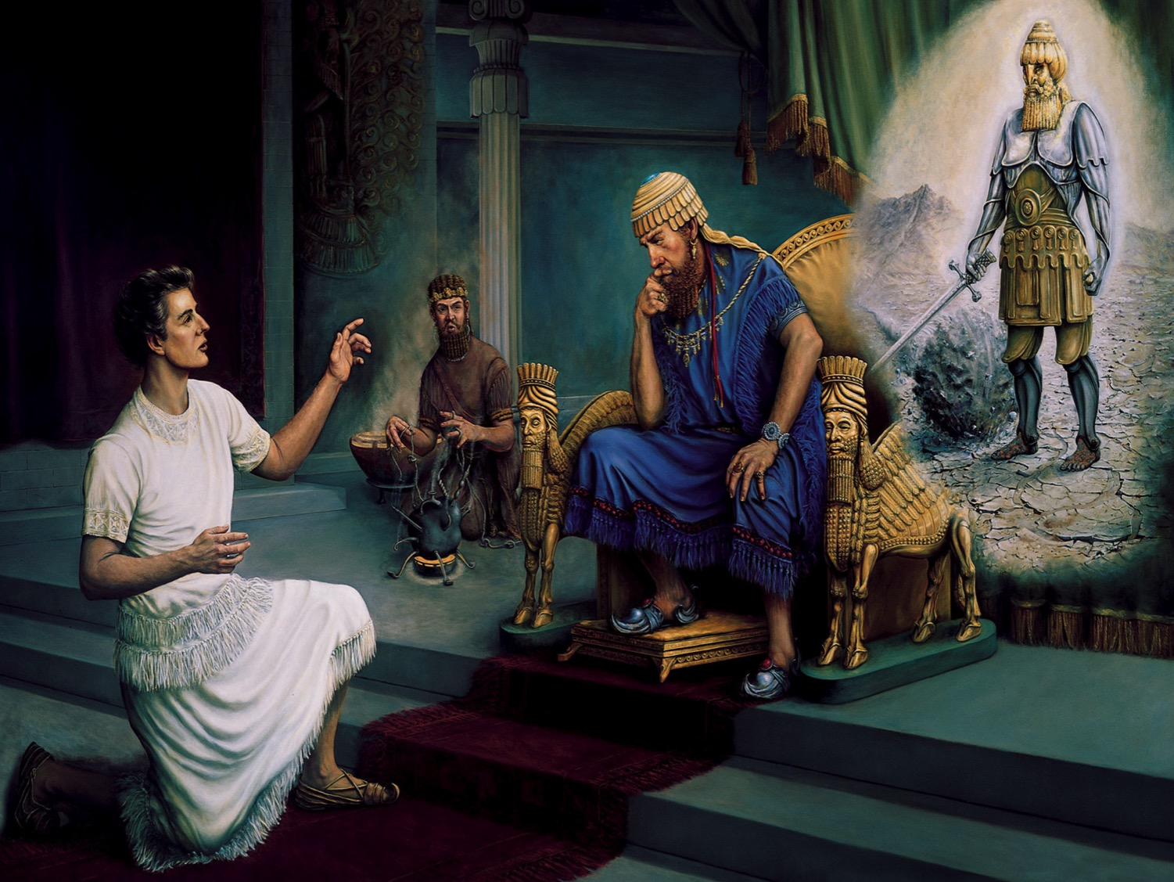
Daniel's Reputation
Daniel 1-2, 4-5
A Person of Integrity
An Interpreter of Dreams
A Prophet of God
A Highly Respected Leader
Notes:
But Daniel revealed and interpreted the dream of the destruction of a multi-material image to show God's sovereignty (2:14-45).

Slide 26
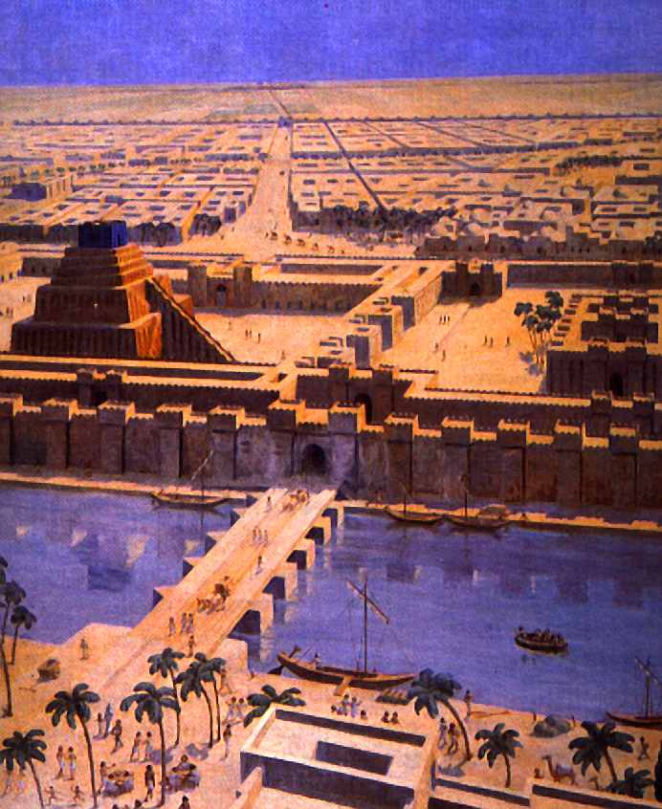
Babylon
Notes:
The dream rightfully gave Babylon prominence. How?

Slide 27
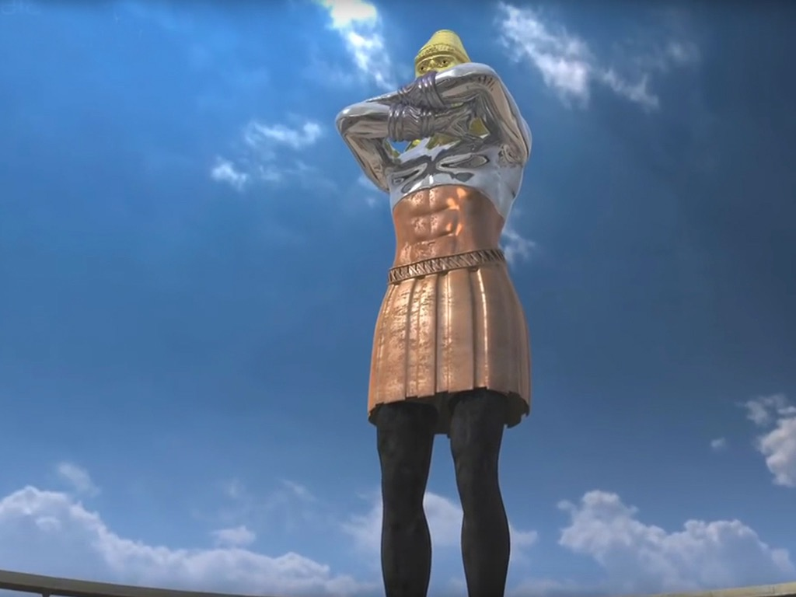

Free
Bible
images
REVELATION TV
NEBUCHADNEZZAR’S DREAM
Daniel 2:1-49

Slide 28
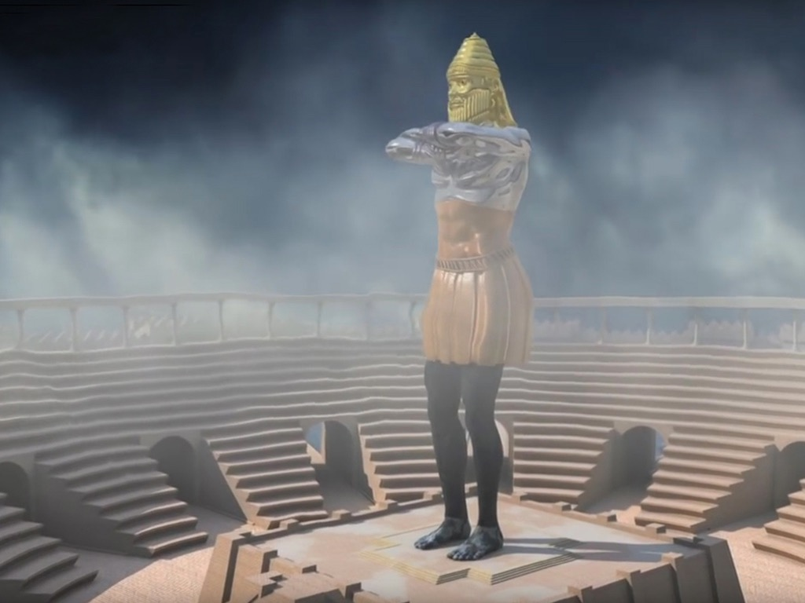

Slide 30
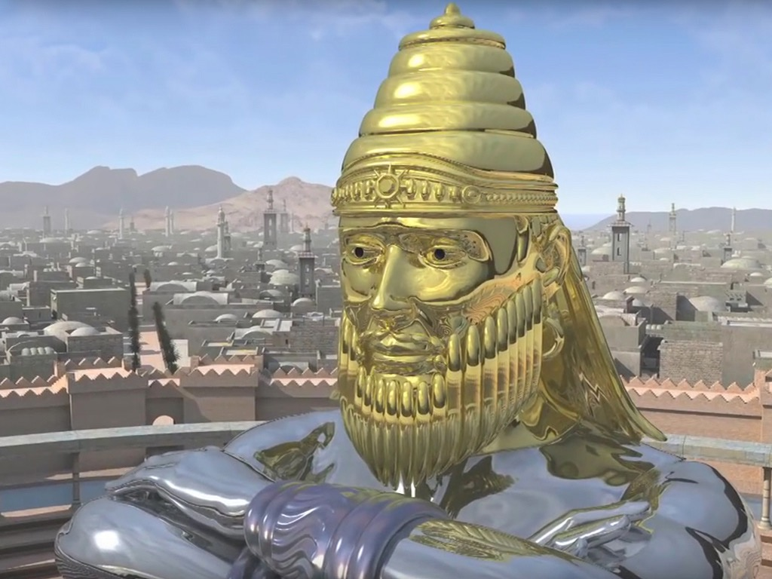

Slide 31
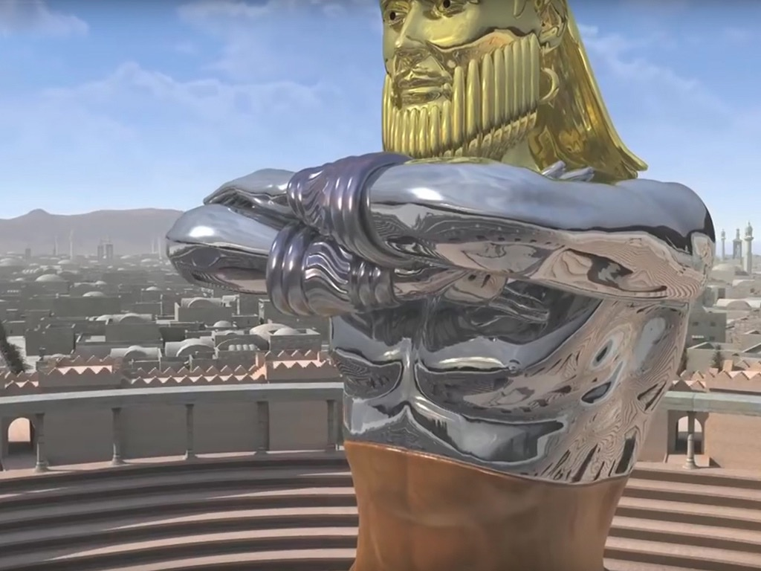

Slide 32
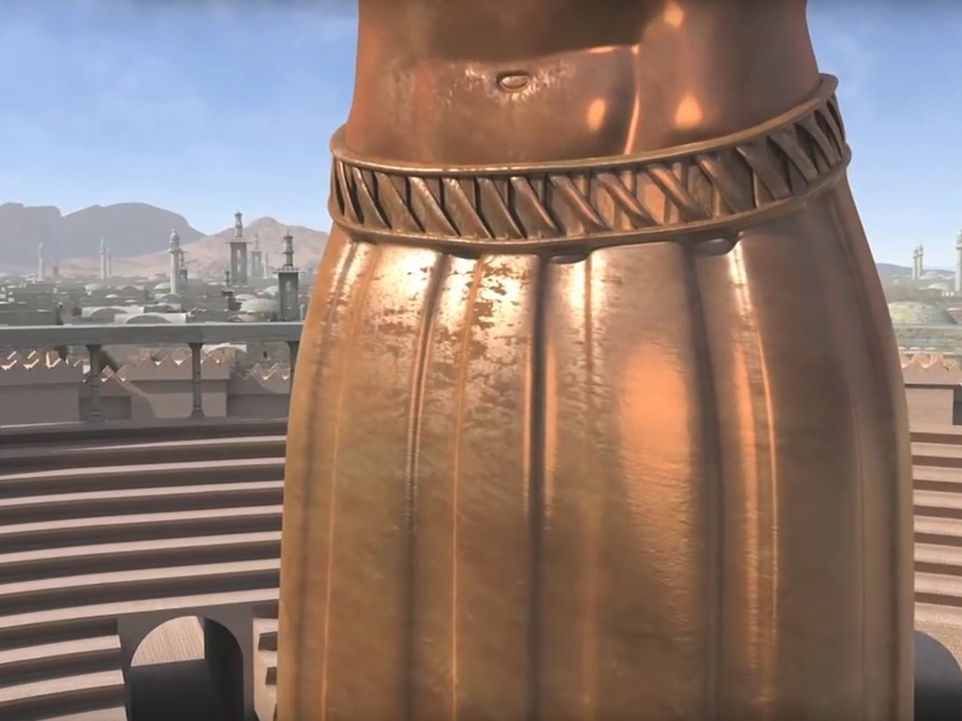

Slide 33
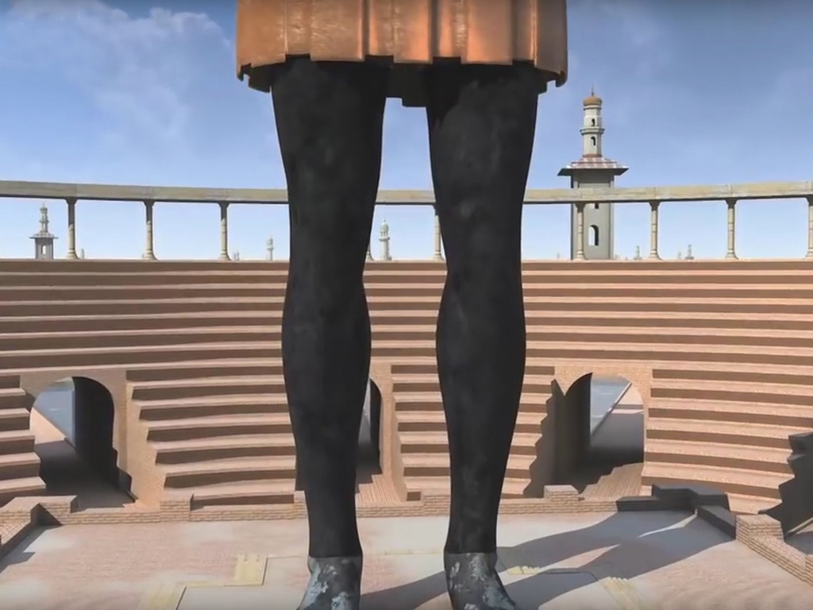

Slide 34
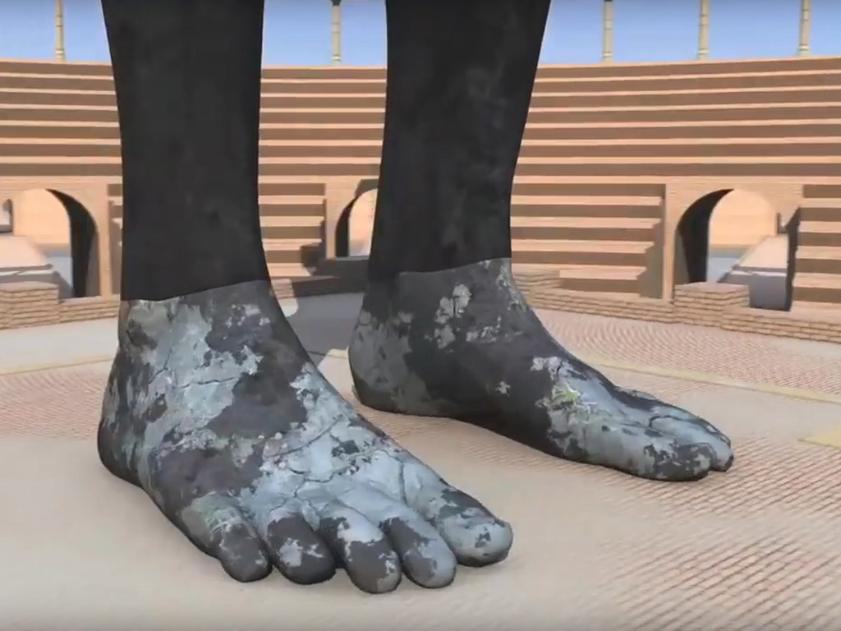

Slide 35
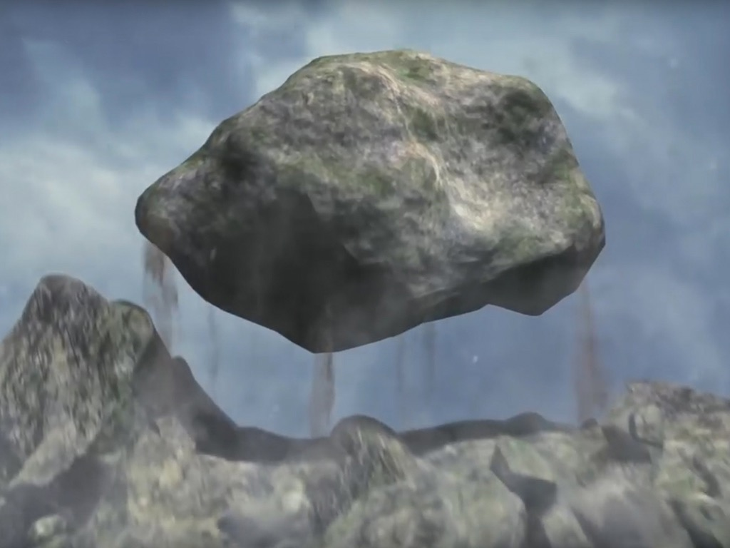

Slide 36
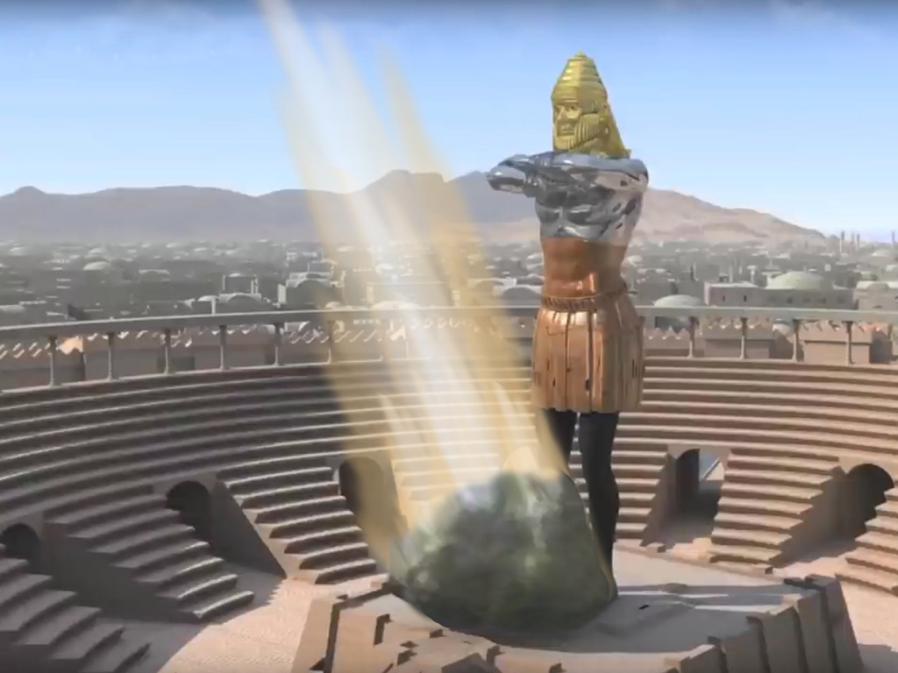

Slide 37
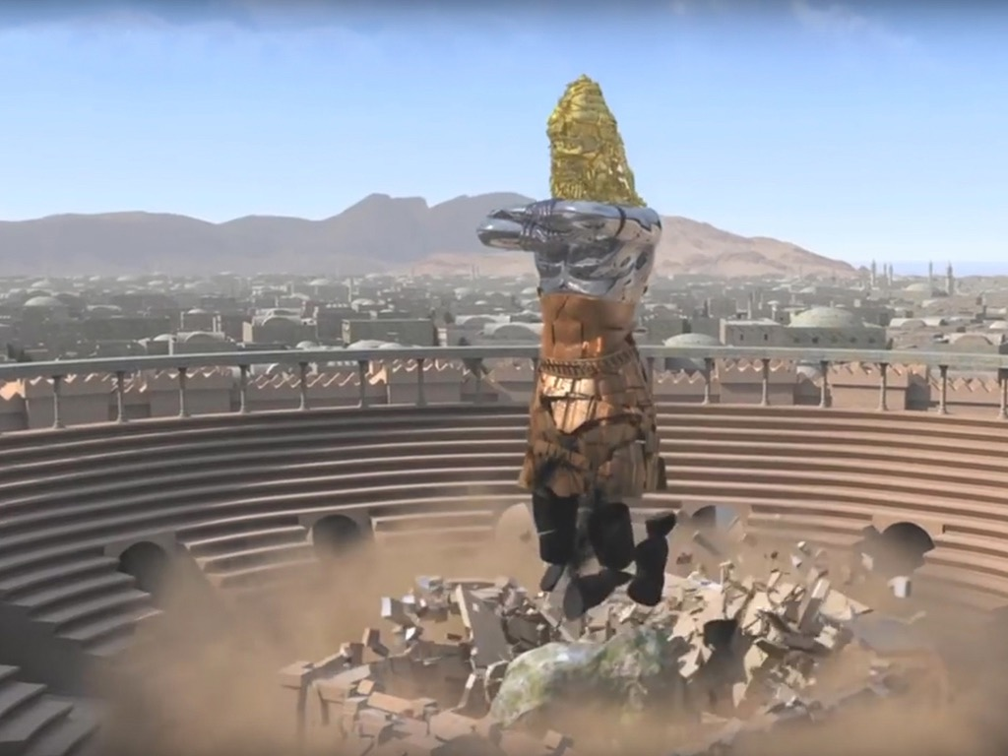

Slide 38
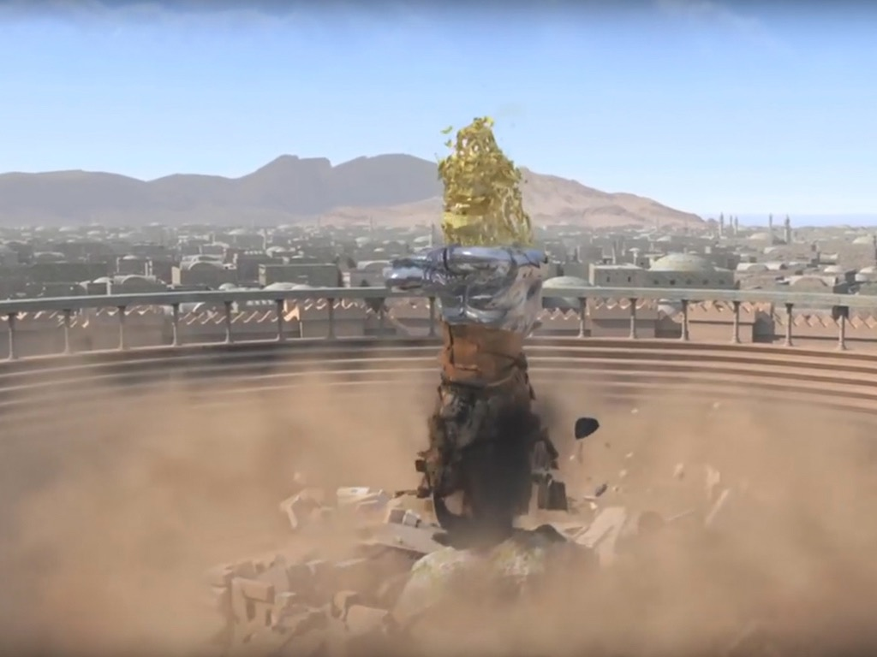

Slide 39
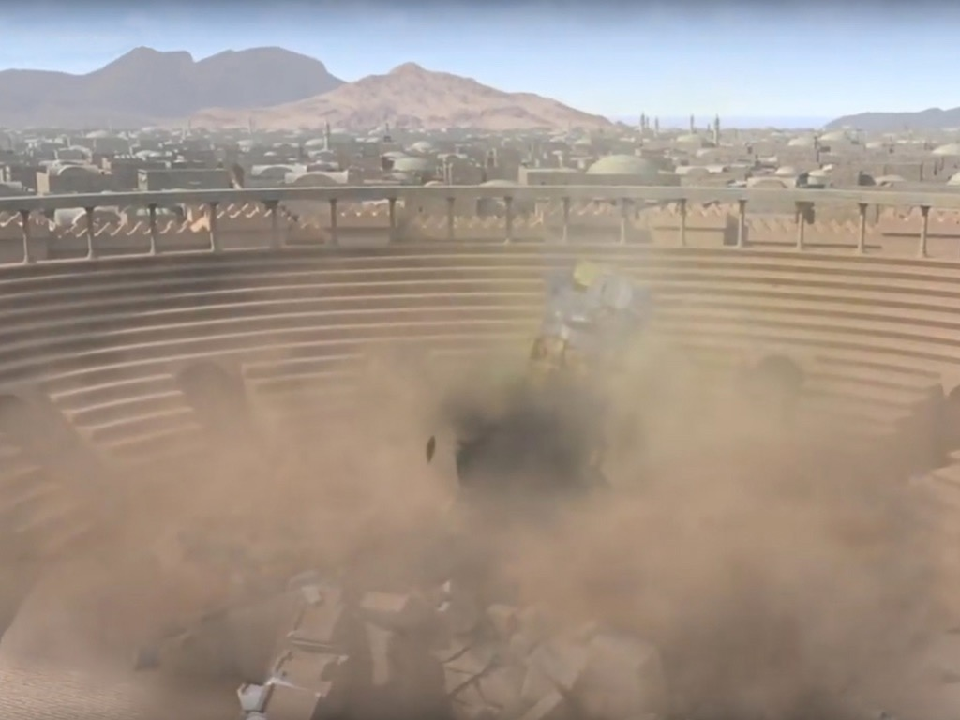

Slide 40


Slide 41
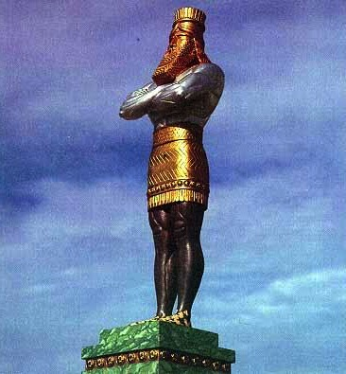
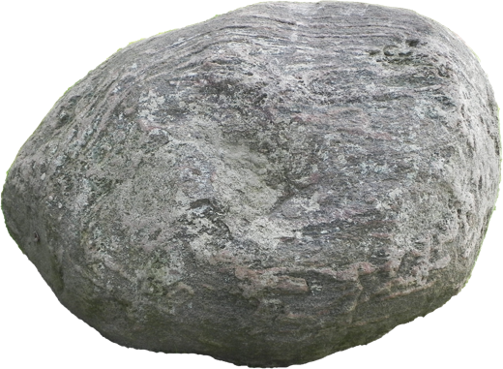
The Image of Daniel 2
Gold
Babylon
Silver
Persia
Bronze
Greece
Iron
Rome
Iron & Clay
Antichrist
Stone
Kingdom
Notes:
\While Babylon was depicted by gold, even Babylon would fall to Christ’s kingdom!

Slide 42
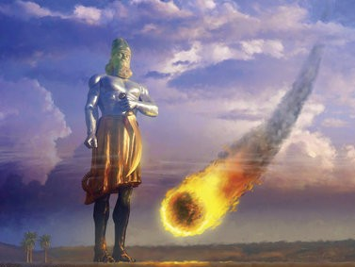
What is Christ's Kingdom?

Slide 43
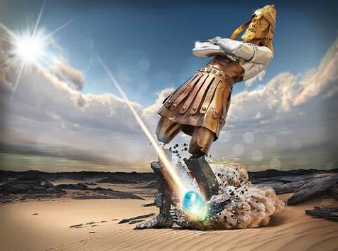
Note that ALL of the kingdoms will fall at the same time!
Notes:
The dream tells us that each of these kingdoms still survives in some form: Babylon mystery religion in the Catholic Church; Persian administration; Greek influence in democracy, philosophy, language, arts, and sports; and Roman influence in Romance languages, the government republic and the power of warfare.

Slide 44
Slides on
Daniel 3

Slide 45
Chapter 3
Daniel
Prophetic 2–12
Hebrew
Gentiles 2–7
Aramaic
Interpreter
Personal 1
Statue 2
Idol 3
605-536 B.C.
God rules the world
Notes:
Nebuchadnezzar admitted God's sovereignty after he saved Daniel's friends from fire for not worshipping a gold statue (Dan 3).

Slide 46
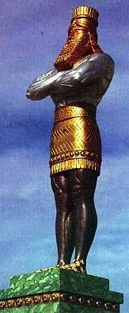
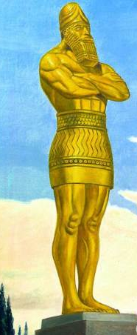
Statues can become a bad habit
Daniel 2
Many materials
Daniel 3
All Gold at
9 x 90 feet!
Notes:
Nebuchadnezzar erected a gold image in self-worship that was worshiped by all the peoples of Babylon (3:1-7).

Slide 47
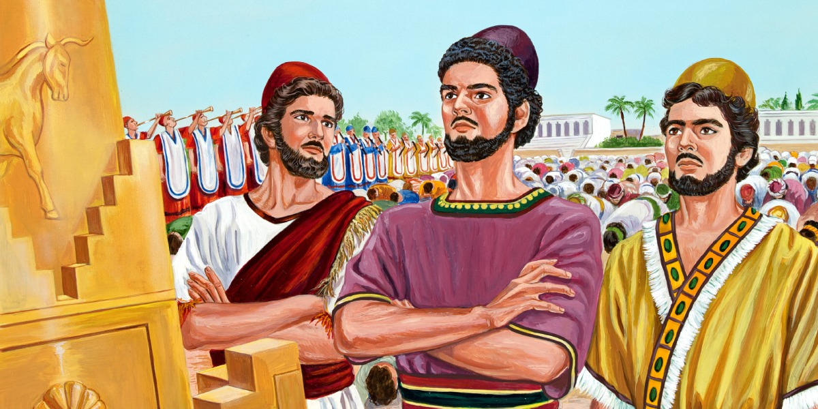
Hananiah, Mishael, Azariah
(Shadrach, Meshach and Abednego)
Notes:
Shadrach, Meshach and Abednego refuse to worship the image to show Israel and Babylon loyalty to the true God (3:8-23).

Slide 48
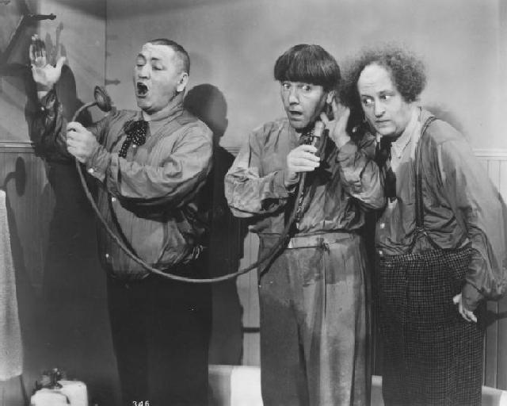
Shadrach, Meshach, Abednego

Slide 49
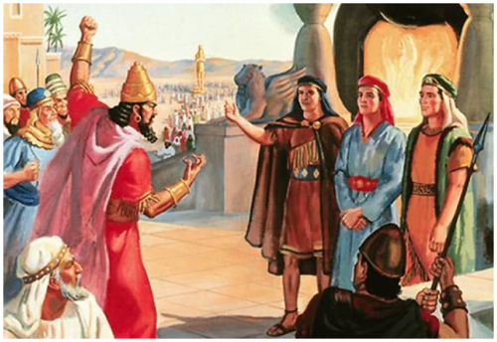
The Edict (Daniel 3)

Slide 50
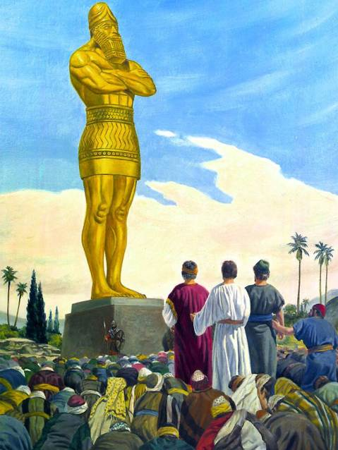
Standing Alone

Slide 51
Where were the other Jews?
“The LORD will exile you and your king to a nation unknown to you and your ancestors. There in exile you will worship gods of wood and stone!”
(Deut. 28:36 NLT)

Slide 52
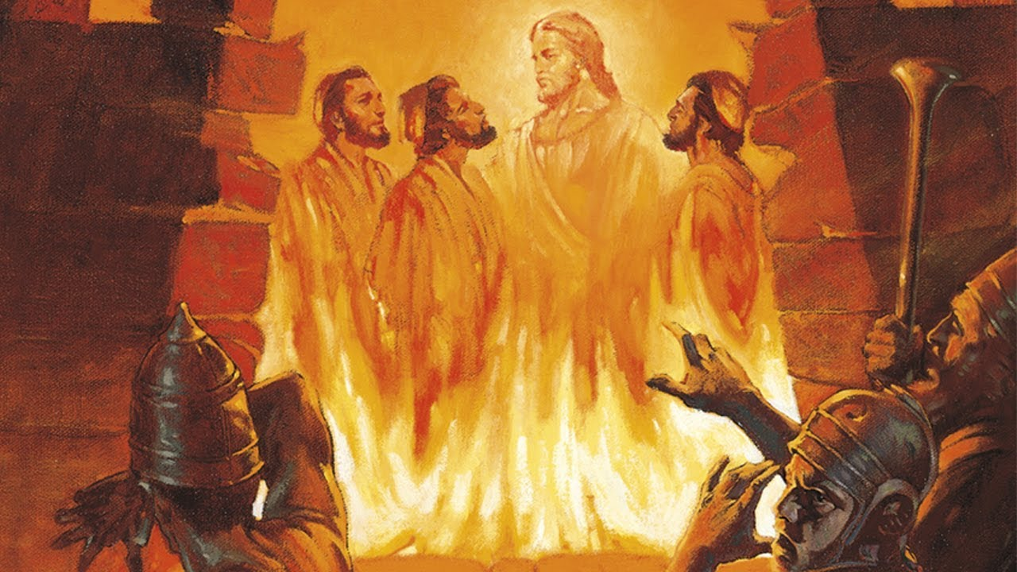
The Fiery Furnace

Slide 53
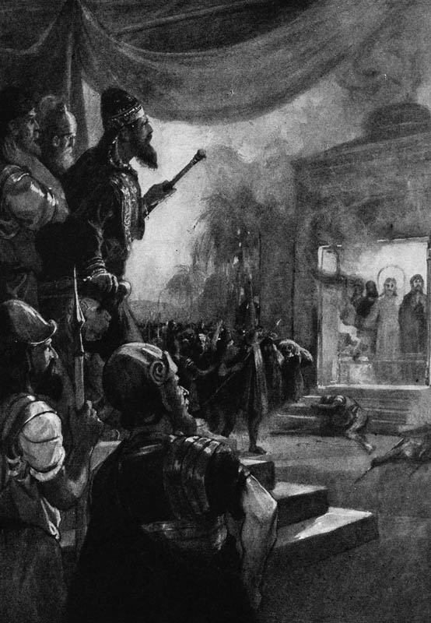
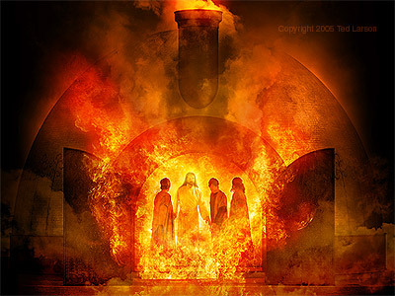
"I see four men..."

Slide 54
Slides on
Daniel 4

Slide 55
Chapter 4
Daniel
Prophetic 2–12
Hebrew
Gentiles 2–7
Aramaic
Interpreter
Personal 1
Statue 2
Idol 3
Tree 4
605-536 B.C.
Judgment
God rules the world
Notes:
Nebuchadnezzar again recognized God's sovereignty over Babylon and all nations, but this time based on his own experience (Dan 4).

Slide 56
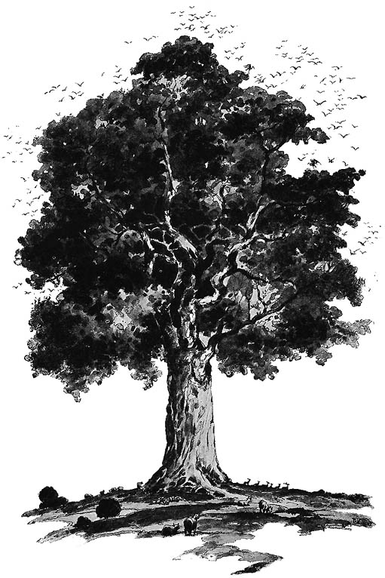
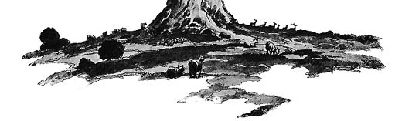
The Tree of Daniel 4
Notes:
Nebuchadnezzar made the proclamations about God in chapters 2-3 but he didn't really take them to heart personally. His arrogance of being a majestic tree was tempered by Daniel's prophecy that he would be cut down, but that could be avoided if he humbled himself. Fat chance of that!

Slide 57
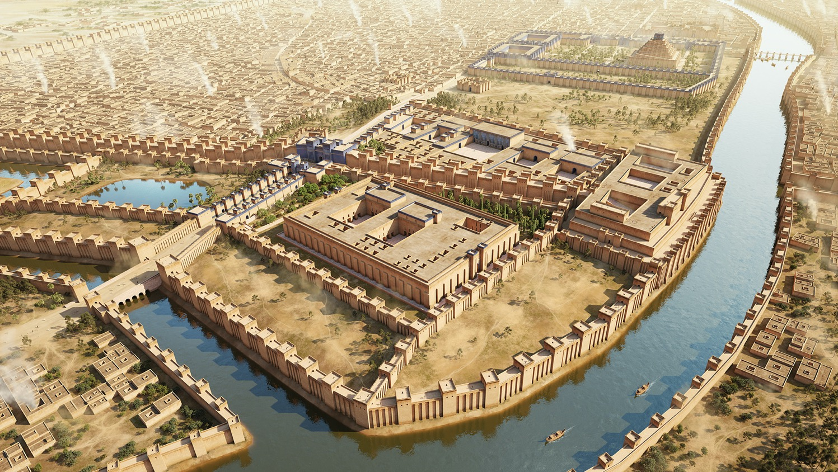
“The king reflected and said, ‘Is this not Babylon the Great, which I myself have built as a royal residence by the might of my power and for the glory of my majesty?’”
Daniel 4:30

Slide 58
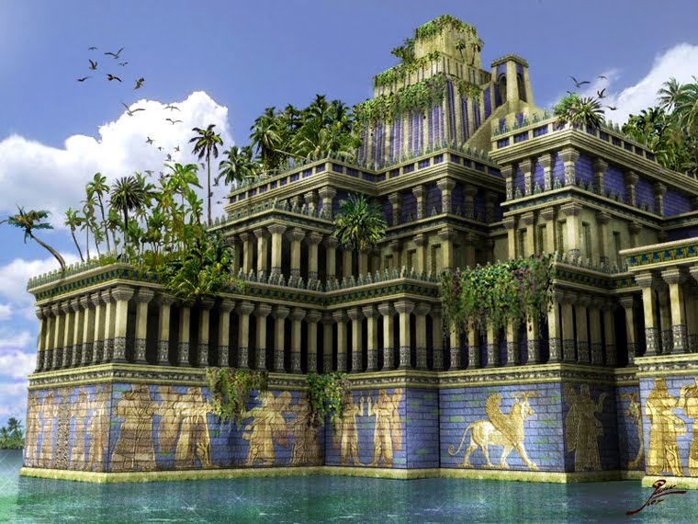
Hanging Gardens of Babylon

Slide 59
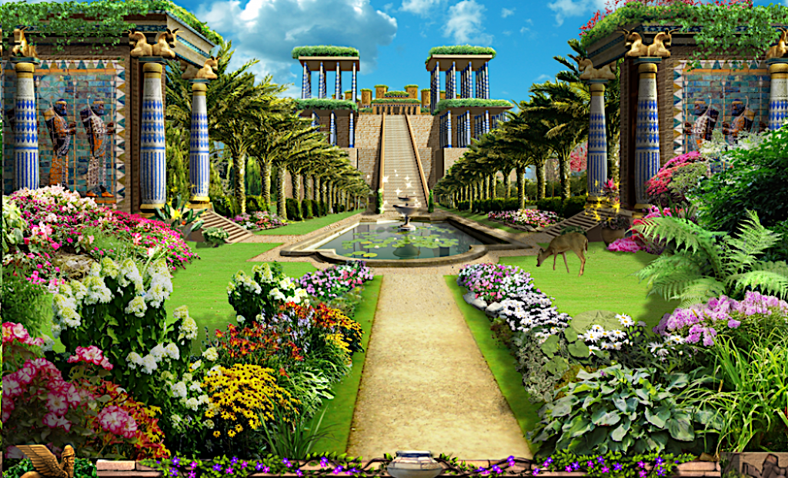
Hanging Gardens of Babylon

Slide 60
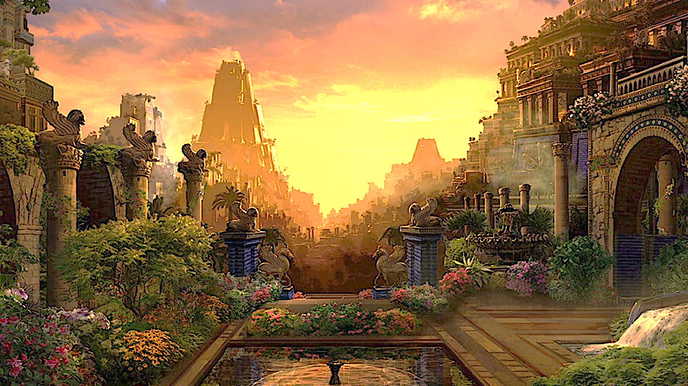
“for the form of this world is passing away.” 1 Corinthians 7:31
“For the sun rises with a scorching wind, and withers the grass; and its flower falls off, and the beauty of its appearance is destroyed; so too the rich man in the midst of his pursuits will fade away.”
James 1:11

Slide 61
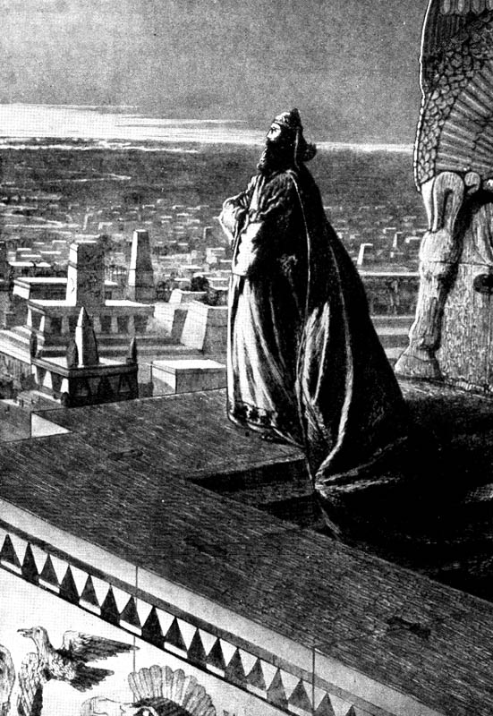
Nebuchadnezzar Exalts Himself (4:30)
"As he looked out across the city, he said, 'Look at this great city of Babylon! By my own mighty power, I have built this beautiful city as my royal residence to display my majestic splendor.'"
Notes:
Had he really built Babylon? No, it was being built for almost 2000 years since the time of Nimrod in Genesis 10!
He uttered too many "I" and "my" statements and not a single statement about God's blessing.

Slide 62
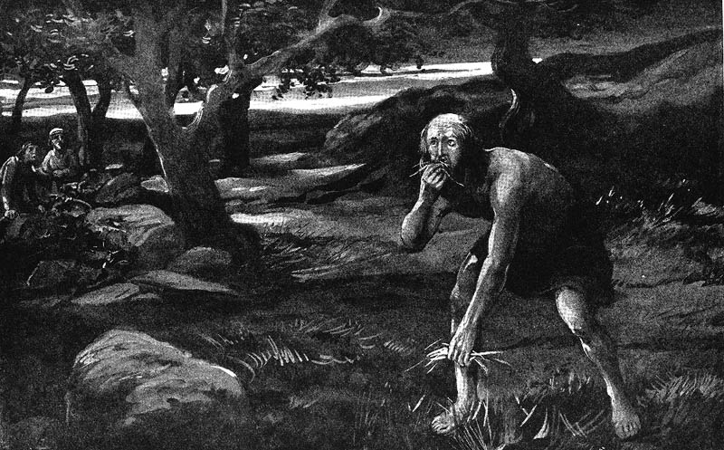
Involuntary Vegetarianism
Notes:
The result was involuntary vegetarianism. Daniel chose vegetarianism in chapter 1, but God gave the king no choice in the matter!

Slide 63
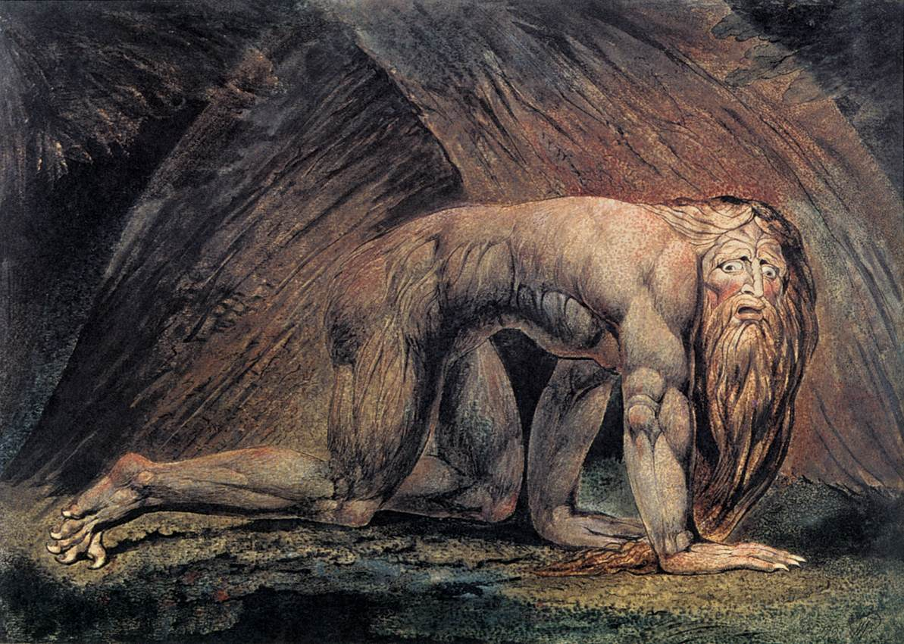
He lived as an animal
Famous Painting "Nebuchadnezzar" by William Blake
Notes:
His hair grew and nails were not trimmed for seven years. Likewise, my wife calls me Nebuchadnezzar when my nails get too long.

Slide 64
Jerusalem's Fall
Jerusalem's Fall
232
342
560
Key Dates
627
Jeremiah
605
Daniel
597
Ezekiel
586
538
Zephaniah
Joel
630
Lamentations
Habakkuk
590
606
Notes:
God raised up at least six prophets in association with the destruction of the first temple in 586 BC (many say 587 BC). Four spoke in Judah itself, which Daniel and Ezekiel ministered to those already brought to Babylon, as they were.

Slide 65
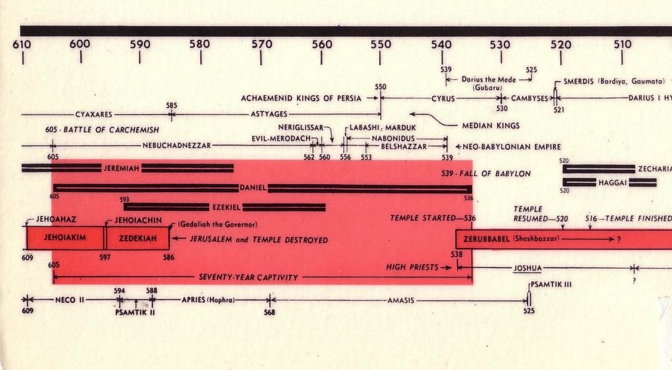
Chart of the Exile
232 & 342
The Babylonian Exile
John C. Whitcomb, 4th rev. ed., Winona Lake, IN: BMH Books, 1962, 1968

Slide 66
Chart of the Exile
232 & 342
The Babylonian Exile
John C. Whitcomb, 4th rev. ed., Winona Lake, IN: BMH Books, 1962, 1968

Slide 67
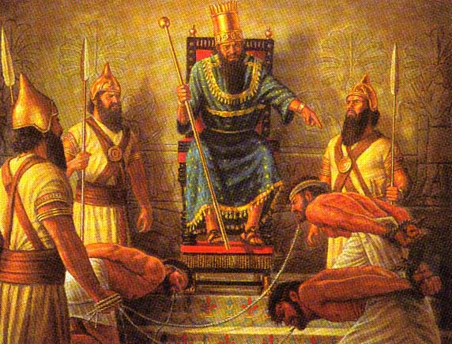
Israelite Captives
586 BC
Notes:
Babylonians brought back to Babylon those who survived the destruction of Jerusalem and the temple.
————————————
OS-27-Daniel-280

Slide 68
Neo-Babylonian Kings
342
1
Neriglissar
560-556 (4 yrs.)
Nabopolassar
625-605 (20 yrs.)
Conquered Nineveh
4
5
Labashi-Marduk
556 (9 months)
2
Nebuchadnezzar
605-561 (44 yrs.)
Conquered Judah
6
Nabonidus
556-539
(17 yrs.)
Tema
3
Self-Imposed Exile
Evil-Merodach
561-560 (2 yrs.)
Released Jehoiakim
(2 Kings 25:27)
7
Belshazzar
553-539
(14 yrs.)
First Dynasty in white
Others in yellow
Notes:
The point here is that, after Nabopolassar, kings came and went but Daniel remained throughout! He lasted even beyond Belshazzar into the Persian era once Cyrus conquered Babylon.
____________
Source: Matthias Henze, The Madness of King Nebuchadnezzar: The ancient Near Eastern Origins and Early History of Interpretation of Daniel 4, Supplements to the Journal for the study of Judaism, vol. 61 (Leiden, The Netherlands: Brill), 57.

Slide 69
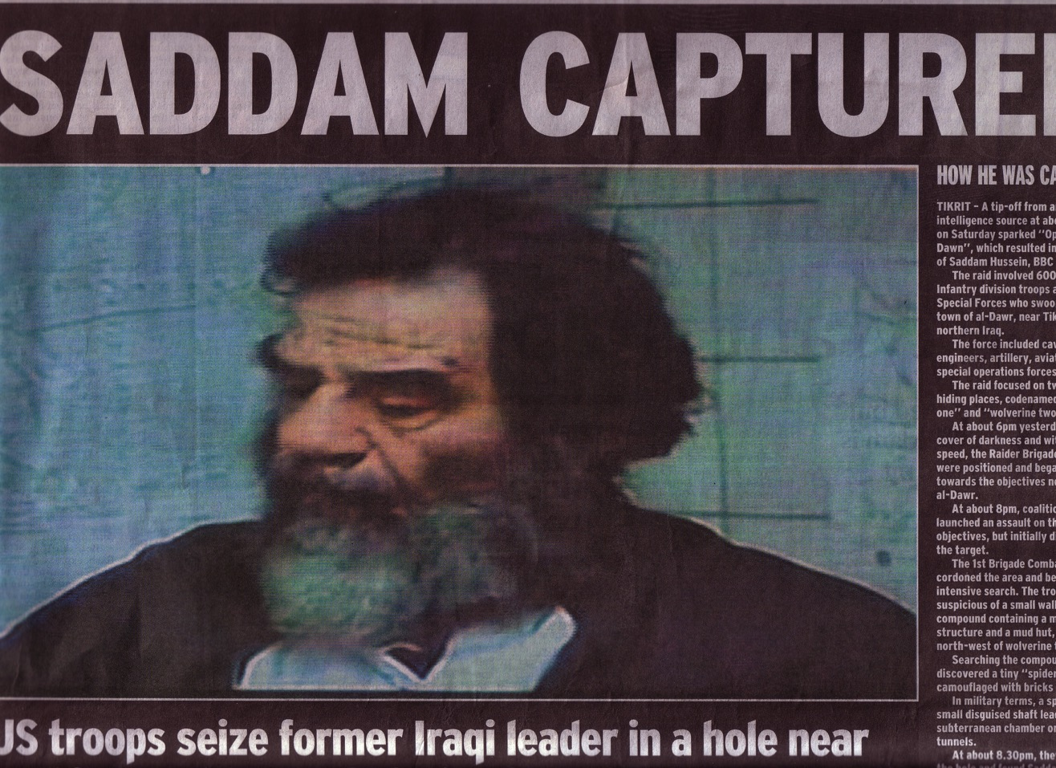

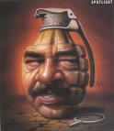
All rulers who exalt themselves will be humbled
Saddam saw himself as the "New Nebuchadnezzar." This included his end!

Slide 70
Chiasm in Daniel 2–7
536
outline
1 NARRATIVE
1:1-7 Exile
1:8-16 Food
1:17-21 Exaltation
2–7 VISIONS IN NARRATIVE
2 Kingdom: "Image" of history destroyed
3 Deliverance from fiery furnace
4 Nebuchadnezzar humbled
5 Belshazzar humbled
6 Deliverance from lion's den
7 Kingdom: "Beasts" of history destroyed
Chiasm

Slide 71
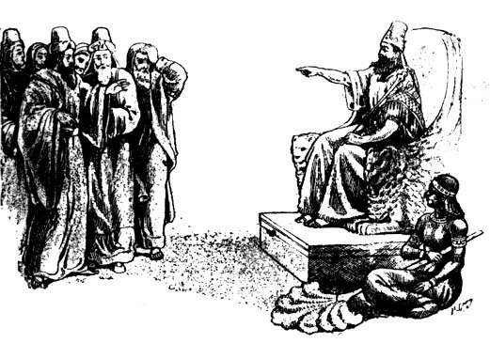
Nebuchadnezzar Humbled
"But at the end of that period, I, Nebuchadnezzar, raised my eyes toward heaven and my reason returned to me, and I blessed the Most High and praised and honored Him who lives forever; For His dominion is an everlasting dominion, And His kingdom [endures] from generation to generation.
All the inhabitants of the earth are accounted as nothing, but He does according to His will in the host of heaven.
And [among] the inhabitants of earth…no one can ward off His hand or say to Him, 'What have You done?'
At that time my reason returned to me. And my majesty and splendor were restored to me for the glory of my kingdom, and my counselors and my nobles began seeking me out; so I was reestablished in my sovereignty, and surpassing greatness was added to me.
'Now I, Nebuchadnezzar, praise, exalt and honor the King of heaven, for all His works are true and His ways just, and He is able to humble those who walk in pride.'"
Daniel 4:34-37

Slide 72
Slides on
Daniel 5

Slide 73
Chapter 5
Daniel
Prophetic 2–12
Hebrew
Gentiles 2–7
Israel 8–12
Aramaic
Hebrew
Interpreter
Inquirer
Statue 2
Idol 3
Tree 4
Hand 5
Personal 1
605-536 B.C.
Judgment
Consolation
God rules the world
Notes:
Belshazzar’s denial of God's sovereignty led to death while Daniel was honored to show God is pleased with those who follow him (Dan 5).

Slide 74

Belshazzar Humbled
Rembrandt
Notes:
In 539 BC Belshazzar denied God's sovereignty at a huge party by praising false gods while drinking from the temple goblets (5:1-4).
God hid his judgment due to Belshazzar’s pride in an unreadable wall inscription that the wise men could not decipher (5:5-9).
God helped Daniel interpret the inscription as his judgment on Belshazzar’s pride and wisdom for the humble (5:10-28).

Slide 75



BABYLON FELL in 539 BC
510a
Persians entered under the water gates!
Daniel 5
(Belshazzar's Feast)
Notes:
"Babylon was being besieged by the Persian army, led by Ugbaru, governor of Gutium, while Belshazzar, inside the city, was giving a great banquet for 1,000 of his nobles. Belshazzar's name means "Bel (another name for the god Marduk) has protected the king." Perhaps the banquet was given to show Belshazzar's contempt for the Persians and to allay his people's fears. Archeologists have excavated a large hall in Babylon 55 feet wide and 165 feet long that had plastered walls. Such a room would have been sufficient to house a gathering of this size. Belshazzar considered his city secure from assault because of its massive walls. Within the city were supplies that would sustain it for 20 years. Therefore the king felt he had little cause for concern."
Dwight Pentecost, “Daniel,” eds. John F. Walvoord, Roy B. Zuck and Dallas Theological Seminary, The Bible Knowledge Commentary : An Exposition of the Scriptures (Wheaton, IL: Victor Books, 1983-1985), 1:1344.

Slide 76
Babylon's Fall (Herodotus)
544b
The History of the Persian Wars 1.191 (430 BC)
"[Cyrus] placed a portion of his army at the point where the river enters the city, and another body at the back of the place where it issues forth, with orders to march into the town by the bed of the stream, as soon as the water became shallow enough: he then himself drew off with the unwarlike portion of his host, and made for the place where Nitocris dug the basin for the river, where he did exactly what she had done formerly: he turned the Euphrates by a canal into the basin, which was then a marsh, on which the river sank to such an extent that the natural bed of the stream became fordable.
"Hereupon the Persians who had been left for the purpose at Babylon by the river-side, entered the stream, which had now sunk so as to reach about midway up a man's thigh, and thus got into the town.

Slide 77
Babylon's Fall (Herodotus)
544b
"Had the Babylonians been apprised of what Cyrus was about, or had they noticed their danger, they would never have allowed the Persians to enter the city, but would have destroyed them utterly; for they would have made fast all the street-gates which gave upon the river, and mounting upon the walls along both sides of the stream, would so have caught the enemy, as it were, in a trap. But, as it was, the Persians came upon them by surprise and so took the city. Owing to the vast size of the place, the inhabitants of the central parts (as the residents at Babylon declare) long after the outer portions of the town were taken, knew nothing of what had chanced, but as they were engaged in a festival, continued dancing and reveling until they learnt the capture but too certainly. Such, then, were the circumstances of the first taking of Babylon."
The History of the Persian Wars 1.191 (written over a century later in 430 BC)

Slide 78
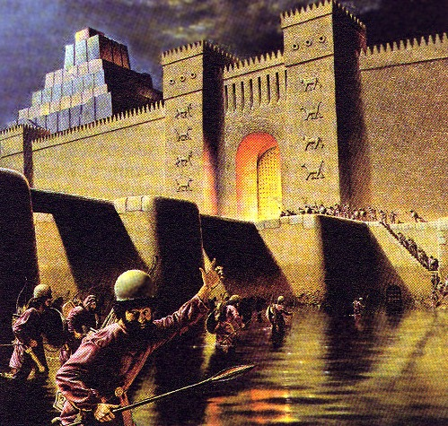
“That same night Belshazzar the Chaldean king was slain. So Darius the Mede received the kingdom”
Daniel 5:30-31

Slide 79

Cyrus Conquers Babylon
539 BC
Notes:
Daniel was promoted to Babylon’s third position to show God's pleasure with those who accept his sovereignty (5:29).
Belshazzar lost his kingdom that night to Darius the Mede [in the reign of Cyrus the Persian, 6:28] for denying God's rule (5:30).

Slide 80
Slides on
Daniel 6

Slide 81
Chapter 6
Daniel
Prophetic 2–12
Hebrew
Gentiles 2–7
Aramaic
Interpreter
Statue 2
Idol 3
Tree 4
Hand 5
Lions 6
Personal 1
605-536 B.C.
Judgment
God rules the world
Notes:
Darius admitted God's rule after seeing Daniel delivered from the lion's den for refusing to petition any god or man except Darius (Dan 6).

Slide 82


Daniel prayed eastward with windows open to Jerusalem (Daniel 6)
Notes:
The apostles acted like Daniel, who was told to pray to no “other god” except King Darius, who couldn’t hear his prayers anyway, so Daniel also obeyed the higher authority (Dan 6).
But we must be prepared to suffer for doing what is right—so God gave us the letter of 1 Peter, since Peter, after all, is the one of those who refused to obey the Sanhedrin.
______________
When you act in accord with God’s will, you need not fear the results. This doesn’t mean that you parade your righteousness, or you always spout off your beliefs. Daniel was known for his integrity and commitment to keep the Jewish food laws—but he also did not want to be known as one who prayed to pagan deities to save his head.
_________________
OS-27-Daniel-295
NS-05-Acts3-8—107

Slide 83

Hungry lions (but not for Daniel)
Notes:
Daniel got a good’s night’s sleep with all the warm lions. But the king tossed and turned all night without rest on his comfortable bed!

Slide 84

Darius Humbled
Darius the Mede conquered Belshazzar (grandson of Nebuchadnezzar). Darius also acknowledged God's sovereignty:
"I make a decree that in all the dominion of my kingdom men are to fear and tremble before the God of Daniel; For He is the living God and enduring forever, and His kingdom is one which will not be destroyed and His dominion [will be] forever. He delivers and rescues and performs signs and wonders in heaven and on earth, who has [also] delivered Daniel from the power of the lions."
Daniel 6:26-27

Slide 85
Slides on
Daniel 7

Slide 86
Outline of Daniel
532
UNIVERSAL SOVEREIGNTY IN TIMES OF THE GENTILES
Sovereignty over Daniel |  |  | Sovereignty over Gentiles |  |  |  |  |  | Sovereignty over Jews
Chapter 1 |  |  | Chapters 2–7 |  |  |  |  |  | Chapters 8–12
Narrative |  |  | Visions in Narrative |  |  |  |  |  | Vision
Hebrew |  |  | Aramaic |  |  |  |  |  | Hebrew
Gentile Names for God |  |  | Gentile Names for God |  |  |  |  |  | Jewish Names for God
Third person ("Daniel") |  |  | Third person ("Daniel") |  |  |  |  |  | First person ("I")
Daniel's Example |  |  | Daniel Interprets King's Dreams |  |  |  |  |  | Angel Interprets Daniel's Dreams
The Man Daniel |  |  | Images |  | Kings |  |  |  | Israel's Future
Exile 1:1-7 | Food 1:8-16 | Exalted 1:17-21 | Varied 2 Promoted | Gold 3 Furnace | Neb. 4 Exile | Bel. 5 Party | Dar. 6 Lions | All 7 Beasts | Medo- Persia To Greece 8 | Return to Seventy "7s" 9 | Intertest-ament Period to Tribulation 10–12
Babylon
605-536 BC

Slide 87
Where's the main division of the book?
outline
Since beasts represent nations in both chapters 7 and 8, some scholars link these two chapters. This makes the major division of the book at 1–6 and 7–12.
But the division of 1–7 and 8–12 better sees the book as a whole.
How is this?

Slide 88
Support for Dividing Daniel Between Chapters 7 & 8
outline
Daniel 1–7
The Aramaic part is chapters 2–7 (not 1–6). Therefore, a division after chapter 7 treats the book the way it presents itself. An example of the link is that the Aramaic word for God (Hla]) in chapters 1–6 also appears in chapter 7.
2. The man Daniel appears in the third person in chapters 1–7. But chapters 8–12 are written in the first person.
3. Chapters 1–7 focus on Gentiles whereas in chapters 8–12 Daniel's visions all focus on Jews.

Slide 89
Chapter 7
Daniel
Prophetic 2–12
Hebrew
Gentiles 2–7
Israel 8–12
Aramaic
Hebrew
Interpreter
Inquirer
Statue 2
Idol 3
Tree 4
Hand 5
Lions 6
Personal 1
Beasts 7
605-536 B.C.
Judgment
Consolation
God rules the world

Slide 90

Four Beasts of Daniel 7

Slide 91

Daniel 7:2 is 1st Person
"Earlier, during the first year of King Belshazzar’s reign in Babylon, Daniel had a dream and saw visions as he lay in his bed. He wrote down the dream, and this is what he saw.
² In my vision that night,
I, Daniel, saw a great storm churning the surface of a great sea, with strong winds blowing from every direction"
(NLT).

Slide 92


Slide 93


Slide 94


Slide 95


Slide 96


Slide 97


Slide 98

Nations in Daniel 7
Babylon
Greece
Rome
Medo-Persia

Slide 99

Correlation with Daniel
479
Daniel 7:1-8 | Revelation 13:1-2; 17:9-12
Four beasts (lion, bear, leopard, terrible beast with ten horns) | One beast that is like a leopard, bear, and lion (13:2) with ten horns (13:1; 17:3)
Seven heads representing four successive kingdoms | Seven heads representing seven successive kingdoms
Four kingdoms | Seven kingdoms
Ten horns (v. 7) | Ten horns (13:1; 17:3,12)
Mark L. Hitchcock, “A Critique of the Preterist View of Revelation 17:9-11 and Nero,” Bibliotheca Sacra 164 (July-September 2007): 484
Notes:
_________
OS-27-Daniel-312
NC-13-Preterism-24
NS-27-REv13-19—slide 118

Slide 100

Another view on the 7 kings
Egypt
Assyria
Turkish Ottoman Empire
Babylon
Greece (with 4 Generals)
Medo-Persia
Rome
Revelation 17:3, 12

Slide 101

Eight Successive Kingdoms (Revelation 17:10-11)
479
Egypt (Pharaohs)
Assyria (Assyrian kings)
3. Neo-Babylonia (Nebuchadnezzar)
4. Medo-Persia (Cyrus)
5. Greece (Alexander the Great)
6. Rome (Caesars; "one is")
7. Reunited Roman Empire (ten kings; "not yet")
8. Final Gentile world kingdom (the Antichrist)
Mark L. Hitchcock, “A Critique of the Preterist View of Revelation 17:9-11 and Nero,” Bibliotheca Sacra 164 (July-September 2007): 484

Slide 102
Support for Successive Kingdoms View
479-480
"The successive-kingdoms view avoids the nebulous nature of the symbolic view, is consistent with the Old Testament imagery from Daniel 7, and provides a consistent interpretation of the eight kings. For these reasons this is the preferred view. Therefore Revelation 17:9-11 offers no support for the early date of Revelation based on the idea that Nero is the sixth king."
Mark L. Hitchcock, “A Critique of the Preterist View of Revelation 17:9-11 and Nero,” Bibliotheca Sacra 164 (July-September 2007): 484

Slide 103


Rev. 17:10 has no reference to Nero or Domitian as Beale affirms.
480
Nero (A.D. 37-68)
Domitian (A.D. 81-96)

Slide 104



Control of the World Political System:
10
398
10
10
10
10
10
10
10
10
10
7 Heads
Roman
Consecutive
Past
17:9-11
10 Kings
Worldwide
Simultaneous
Future
17:12
Beast (8th King)
Worldwide
Controls 10 Kings
Future
17:13

Slide 105
Daniel 8
Daniel
Prophetic 2–12
Hebrew
Gentiles 2–7
Israel 8–12
Aramaic
Hebrew
Interpreter
Inquirer
Statue 2
Idol 3
Tree 4
Hand 5
Lions 6
Beasts 7
Horns 8
Personal 1
605-536 B.C.
Judgment
Consolation
God rules the world

Slide 106

THEOLOGY OF DANIEL 1-7
The King of Babylon (605-562) said:
Darius the Mede (son of Ahasuerus) ruled after the death of Belshazzar, said:
WHY?
"I make a decree that in all the dominion of my kingdom men are to fear and tremble before the God of Daniel."
(Daniel 6:26-27)
"Now I, Nebuchadnezzar, praise, exalt and honor the King of heaven, for all His works are true and His ways just, and He is able to humble those who walk in pride."
(Daniel 4:34-37)

Slide 107
I. GOD IS SOVEREIGN OVER ALL PEOPLE
King Nebuchadnezzar's act of besieging the Jerusalem was not only by his own might and strength, but it was God who had given King Jehoiakim into his hand (1:1-2).
In the third year of the reign of Jehoiakim king of Judah, Nebuchadnezzar king of Babylon came to Jerusalem and besieged it. The Lord gave Jehoiakim king of Judah into his hand, along with some of the vessels of the house of God; and he brought them to the land of Shinar, to the house of his god, and he brought the vessels into the treasury of his god.
2. God granted Daniel favor and compassion in the sight of the commander of the officials, when Daniel steadfastly resisted the cultural pressure to compromise (1:9).
Now God granted Daniel favor and compassion in the sight of the commander of the officials

Slide 108

I. GOD IS SOVEREIGN OVER ALL PEOPLE
3. God gave the four Jewish youth intelligence in many fields and Daniel could understand all visions and dreams.
"As for these four youths, God gave them knowledge and intelligence in every [branch of] literature and wisdom; Daniel even understood all [kinds of] visions and dreams" (1:17).
4. The God of Shadrach, Meshach, and Abednego controlled the forces of nature to humble Nebuchadnezzar through the furnace (ch. 3) and Darius through Daniel in the lions' den (ch. 6).

Slide 109

I. GOD IS SOVEREIGN OVER ALL PEOPLE
5. God gave Daniel ability to interpret dreams and visions that perplexed the nobles and wise men in Babylon (chs. 2, 4, 5)
6. By handwriting on the wall God showed His sovereign control over nations and individual rulers (ch. 5)

Slide 110
I. GOD IS SOVEREIGN OVER ALL PEOPLE
7. Daniel not only prophesied against Babylon but also later empires that opposed God and oppressed His people everywhere (ch. 2). Rulers of the world fight against the kingdom of God!
Daniel answered the king, "As for the mystery about which the king has inquired, neither wise men, conjurers, magicians [nor] diviners are able to declare [it] to the king. However, there is a God in heaven who reveals mysteries, and He has made known to King Nebuchadnezzar what will take place in the latter days. This was your dream and the visions in your mind [while] on your bed" (2:27-28).
8. Daniel had a vision of four beasts (nations) that threatened to exterminate God's people. But the Ancient of Days prevailed to establish an eternal kingdom for his people. Thus, God's sovereignty is shown in human history (ch. 7).

Slide 111
II. PERSECUTION OF THE FAITHFUL
Daniel's friends: Shadrach, Meshach and Abednego replied to the king, "O Nebuchadnezzar, we do not need to give you an answer concerning this matter.
If it be [so], our God whom we serve is able to deliver us from the furnace of blazing fire; and He will deliver us out of your hand, O king. But [even] if [He does] not, let it be known to you, O king, that we are not going to serve your gods or worship the golden image that you have set up."
Daniel 3:16-18
… and they were thrown into the midst of the furnace of blazing fire

Slide 112

II. PERSECUTION OF THE FAITHFUL
"Then the commissioners and satraps began trying to find a ground of accusation against Daniel in regard to government affairs; but they could find no ground of accusation or... corruption, inasmuch as he was faithful, and no negligence or corruption was... found in him. Then these men said, 'We will not find any ground of accusation against this Daniel unless we find [it] against him with regard to the law of his God.'…
"Then the king gave orders, and Daniel was brought in and cast into the lions' den. The king… said to Daniel, 'Your God whom you constantly serve will Himself deliver you'" (Daniel 6:4-5, 16).

Slide 113

II. PERSECUTION OF THE FAITHFUL
WHY?
… were they thrown into the midst of the blazing furnace?
. . . was Daniel cast into the lions' den?

Slide 114

II. PERSECUTION OF THE FAITHFUL
1. Suffering persecution will occur in each believer's life who is standing on the law of God. Loyalty to God's Word brings us even death (chs. 3, 6), but God will vindicate us through resurrection and judgment at the end as ch. 12 depicts.
2. Through every circumstance of life it is possible to live a life of faith and victory with God's help (3:24-27; 6:19-24). This is living under the sovereignty of God.

Slide 115
II. PERSECUTION OF THE FAITHFUL
1. Persecution will occur in each believer's life who is standing on the law of God. Loyalty to God's Word brings us even death (ch. 3, 6), but God will vindicate us through resurrection and judgment at the end as ch. 12 depicts.
2. Through every circumstance of life we can live a life of faith and victory with God's help (3:24-27; 6:19-24). This is living under the sovereignty of God.
3. The NT teaches even more on the suffering of God's people:
"Blessed are the persecuted … for theirs is the kingdom of God" (Matt. 5:10-12)
"All who desire to live godly in Christ Jesus will be persecuted" (2 Tim. 3:12)

Slide 116
II. PERSECUTION OF THE FAITHFUL
"…If they persecuted Me they will also persecute you…"
(John 15:20)

Slide 117

III. GOD JUDGES THE PROUD
Nebuchadnezzar said:
"Is it true, Shadrach, Meshach and Abed-nego, that you do not serve my gods or worship the golden image that I have set up?
… But if you do not worship, you will immediately be cast into the midst of a furnace of blazing fire; and what god is there who can deliver you out of my hands?"
Daniel 3:14-15

Slide 118


III. GOD JUDGES THE PROUD
Then they brought the gold vessels that had been taken out of the temple, the house of God which [was] in Jerusalem; and the king and his nobles, his wives and his concubines drank from them.
They drank the wine and praised the gods of gold and silver, of bronze, iron, wood and stone…
That same night Belshazzar the Chaldean king was slain.
Daniel 5:3-4, 30

Slide 119
III. GOD JUDGES THE PROUD
MAN'S PRIDE… refuses to depend on God and be subject to Him, but attributes to self the honor due to him, This the very root… of sin."
I. H. Marshall, New Bible Dictionary (IVP, 1995), 995
Woe to the rebellious children…
Who proceed down to Egypt
Without consulting Me,
To take refuge in the safety of Pharaoh
And to seek shelter in the shadow of Egypt! (Isa. 30:1-2)
Woe to those who go down to Egypt for help. [And] rely on horses, and trust in chariots because they are many and in horsemen because they are very strong, but they do not look to the Holy One of Israel, nor seek the Lord! …
Return to Him from whom you have deeply defected, O sons of Israel
(Isa. 31:1,6)
Chapter 1:
God sent Babylon to besiege Jerusalem because of Judah's pride.
This contrasted with the obedient people of God. Daniel and his three friends did not want to go against the law of God.
And I will pronounce My judgments on them concerning all their wickedness, whereby they have forsaken Me and have offered sacrifices to other gods, and worshipped the works of their own hands (Jer. 1:16)

Slide 120
III. GOD JUDGES THE PROUD
Chapter 2:
Nebuchadnezzar's dream was revealed to Daniel by God alone. This contrasts with human pride which has no ability to discern God's message.
"The Chaldeans answered the king and said, 'There is not a man on earth who could declare the matter for the king, inasmuch as no great king or ruler has [ever] asked anything like this of any magician, conjurer or Chaldean.'
'Moreover, the thing which the king demands is difficult, and there is no one else who could declare it to the king except gods, whose dwelling place is not with [mortal] flesh'" (2:10-11).
2. The mighty kingdoms are destroyed by other kingdoms, but God's kingdom will never be destroyed. Human pride will finally be destroyed!

Slide 121
III. GOD JUDGES THE PROUD
In the days of those kings the God of heaven will set up a kingdom which will never be destroyed, and [that] kingdom will not be left for another people; it will crush and put an end to all these kingdoms, but it will itself endure forever. Inasmuch as you saw that a stone was cut out of the mountain without hands and that it crushed the iron, the bronze, the clay, the silver and the gold, the great God has made known to the king what will take place in the future; so the dream is true and its interpretation is trustworthy.
Daniel 2:44-45

Slide 122
III. GOD JUDGES THE PROUD
Chapter 3:
Nebuchadnezzar's pride is subdued by God's miraculous work in protecting Daniel's 3 friends.
His arrogant proclamation
in v. 7 is contrasted with his humble proclamation in v. 29.
Verse 7:
"Therefore at that time, when all the peoples heard the sound of the horn, flute, lyre, trigon, psaltery, bagpipe and all kinds of music, all the peoples, nations and [men of every] language fell down [and] worshiped the golden image that Nebuchadnezzar the king had set up."
Verse 29:
"Therefore I make a decree that any people, nation or tongue that speaks anything offensive against the God of Shadrach, Meshach and Abednego shall be torn limb from limb and their houses reduced to a rubbish heap, inasmuch as there is no other god who is able to deliver in this way."

Slide 123

III. GOD JUDGES THE PROUD
Chapter 4:
"The tree that you saw, which became large and grew strong, whose height reached to the sky and was visible to all the earth and whose foliage [was] beautiful and its fruit abundant, and in which [was] food for all, under which the beasts of the field dwelt and in whose branches the birds of the sky lodged-- it IS YOU, O KING; for you have become great and grown strong, and your majesty has become great and reached to the sky and your dominion to the end of the earth."
4:20-22
God gave Nebuchadnezzar a dream of a large tree.
Through the interpretation of Daniel, God showed how fragile human pride and might is.

Slide 124

III. GOD JUDGES THE PROUD
"This is the interpretation, O king, and this is the decree of the Most High, which has come upon my lord the king, that you be driven away from mankind and your dwelling place BE WITH THE BEASTS OF THE FIELD, and you be given grass to eat like cattle and be drenched with the dew of heaven; and seven periods of time will pass over you, UNTIL YOU RECOGNIZE THAT THE MOST HIGH IS RULER OVER THE REALM OF MANKIND and bestows it on whomever He wishes" (4:24-25).

Slide 125


III. GOD JUDGES THE PROUD
Chapter 5:
xcvxcv
Belshazzar's arrogance was subdued, for he was using the temple vessels and praising gods of idolatry.
MENE, MENE, TEKEL, UPHARSIN
"This is the interpretation of the message:
`MENE'--God has numbered your kingdom and put an end to it.
`TEKEL'--you have been weighed on the scales and found deficient. `PERES'--your kingdom has been divided and given over to the Medes and Persians… That same night Belshazzar the Chaldean king was slain" (5:26-28, 30).

Slide 126

III. GOD JUDGES THE PROUD
Chapter 6:
Daniel's fellow officers were jealous of Daniel and tricked King Darius to cast Daniel into lions' den. The death of the his accusers in the same den instead of Daniel contrasts human pride with honoring God.
"The king then gave orders, and they brought those men who had maliciously accused Daniel, and they cast them, their children and their wives into the lions' den; and they had not reached the bottom of the den before the lions overpowered them and crushed all their bones" (6:24).

Slide 127


III. GOD JUDGES THE PROUD
Chapter 7:
Four great beasts in Daniel's vision symbolize kings or kingdoms who will arise from the earth. But these kingdoms will be finally destroyed. God will give His people an everlasting kingdom when Jesus returns and establishes it. Human pride will be destroyed.
"Then the sovereignty, the dominion and the greatness of [all] the kingdoms under the whole heaven will be given to the people of the saints of the Highest One; His kingdom [will be] an everlasting kingdom, and all the dominions will serve and obey Him"
(Dan. 7:27; Rev. 13)

Slide 128

IV. GOD'S MESSIAH OF THE WORLD
Israel saw their Messiah as only over Israel and victorious over Israel's enemies.
ISRAEL
THE NATIONS
The Book of Daniel corrects this narrow view by presenting the Messiah as universal and victorious over evil in general.

Slide 129
IV. GOD'S MESSIAH OF THE WORLD
"And behold, with the clouds of heaven One like a Son of Man was coming, and He came up to the Ancient of Days and was presented before Him. And to Him was given dominion, glory and a kingdom, that all the peoples, nations and [men of every] language might serve Him. His dominion is an everlasting dominion which will not pass away; And His kingdom is one which will not be destroyed."
Dan. 7:13-14

Slide 130
Four Beasts of Daniel 7

Slide 131

Beast 1: Winged Lion (Babylon)

Slide 132

Beast 2: Bear (Medo-Persia)

Slide 133

Beast 3: Leopard (Greece)

Slide 134

Beast 4: Terrifying (Rome)
Daniel 7:7

Slide 135

Little Horn on Beast 4 (Antichrist)
Daniel 7:8

Slide 136

Little Horn on Beast 4 (Antichrist)
Daniel 7:8

Slide 137


World Empires in Daniel
545
Bible Visual Resource Book, 133

Slide 138
The Neo-Babylonian Empire
545

Slide 139
Control of the World Political System:
10
398
10
10
10
10
10
10
10
10
10
7 Heads
Roman
Consecutive
Past
Rev. 17:9-11
10 Kings
Worldwide
Simultaneous
Future
Rev. 17:12
Beast (8th King)
Worldwide
Controls 10 Kings
Future
Rev. 17:13

Slide 140

The Son of Man & Ancient of Days
“I watched as thrones were put in place
and the Ancient One sat down to judge.
His clothing was as white as snow,
his hair like purest wool.
He sat on a fiery throne
with wheels of blazing fire,
¹⁰ and a river of fire was pouring out,
flowing from his presence.
Millions of angels ministered to him;
many millions stood to attend him.
Then the court began its session,
and the books were opened”
(Daniel 7:9-10 NLT)

Slide 141

The Son of Man & Ancient of Days
“As my vision continued that night, I saw someone like a son of man coming with the clouds of heaven. He approached the Ancient One and was led into his presence” (Daniel 7:13 NLT)

Slide 142

The Son of Man & Ancient of Days
“He was given authority, honor, and sovereignty over all the nations of the world, so that people of every race and nation and language would obey him. His rule is eternal—it will never end. His kingdom will never be destroyed” (Daniel 7:14 NLT)

Slide 143

Applying Daniel 2–7
544a
Be confident that God still rules over all nations today.
Notes:
We lose confidence when we lose sight that God has the nations under his control.
The book of Daniel reminds us to be confident in God like Daniel and his three friends.
Rely on Daniel’s interpretation of kings’ dreams.
God has his nations under control of who he wants to use and when.

Slide 144
What do you need to know to be truly confident?
Notes:
The answer, of course, is that Daniel placed his confidence not in himself but in God. In his book we will see three truths that will help us, like Daniel, be confident that God is working.

Slide 145
I. God rules over you
(Dan 1).
Notes:
You can be confident when you know that…
The LORD controls what happens to you as an individual.

Slide 146
II. God rules over all nations (Dan 2–7).
Notes:
The LORD controls what happens to the peoples of the world.

Slide 147
III. God rules over Israel’s future (Dan 8–12).
Notes:
The LORD controls the prophetic fulfillments for his people in the days ahead.

Slide 148
The Point of Daniel 8–12
544a
The exiles could confidently trust God’s sovereignty over Israel in "the times of the Gentiles" by being faithful to his covenant (Dan 8–12).
Daniel saw Jewish history
—in advance!
Notes:
Daniel prophesied that many in history will oppose Israel but not prevail.

Slide 149
What do you need to know to be truly confident?
Notes:
The answer, of course, is that Daniel placed his confidence not in himself but in God. In his book are three areas where God has control, so, like Daniel, we can be confident that God is working.

Slide 150
——Main Idea of Daniel——
God controls each level.
Notes:
What do you need to know to be truly confident?
Do you rest in this reality that the LORD doesn't need your help in running the universe? He sets up kings and takes them down—and he does the same in our lives.

Slide 151
I. God rules over you
(Dan 1).
Notes:
You can be confident when you know that…
The LORD controls what happens to you as an individual.

Slide 152
II. God rules over all nations (Dan 2–7).
Notes:
The LORD controls what happens to the peoples of the world.

Slide 153
III. God rules over Israel’s future (Dan 8–12).
Notes:
The LORD controls the prophetic fulfillments for his people in the days ahead.

Slide 154

Daniel is a book of faith and courage stemming from the Sovereign God!
Notes:
Where do you need to be confident of God’s rule in your life today?
Do you feel that you are under someone else’s thumb at home, school, work or somewhere else?
Can you now see that since God is over these authorities, he also can help you live with confidence even though you cannot control the circumstances?

Slide 155
Application
Recognize God's sovereignty over all authority in history
Resist evil without compromising
Trust God for your ultimate salvation so that you can endure to the end (12:2, 3, 12; cf. Rev. 12:11)
Seek God in prayer and intercession
Live a godly life
Notes:
Do you feel that you are under someone else’s thumb at home, school, work or somewhere else?
Can you now see that since God is over these authorities, he also can help you live with confidence even though you cannot control the circumstances?
Be confident of God’s rule over everything today.

Slide 156
Black

Slide 157


OT Preaching link at BibleStudyDownloads.org
Get this presentation and script for free!

Slide 158






Self-Made Idols Are Useless
Babylon & Us
Whatcha doin’ here, kid?
…Just enjoying God’s creation.
Have you ever seen God?
It must take incredible faith to believe in a God you can’t see.
Then how do you know that he even exists?
…It’s called faith.
THAT, TAKES INCREDIBLE FAITH.
Nope.
I just know.
Not really.
Notes:
Idolatry does not make sense either in Babylon's time or ours today.
(Translators—Move the various panels to the side to translate them, and then return them to the center.)
_______________________
Common-408
OB-Babylonians
OS-01-Gen4-12-slide 185
OS-23-Isa43-48-slide 34
OS-26-Ezek40-48-slide 190
OS-27-Daniel-512

Slide 159



By Puje
SINGAPORE BIBLE COLLEGE
OT THEOLOGY 3
M.DIV. 3
PRESENTED BY PUJE
DR. GRIFFITH

Slide 161
OT Survey link at BibleStudyDownloads.org
Get this presentation for free!
Notes:
OT Survey (os)

