Slide 1
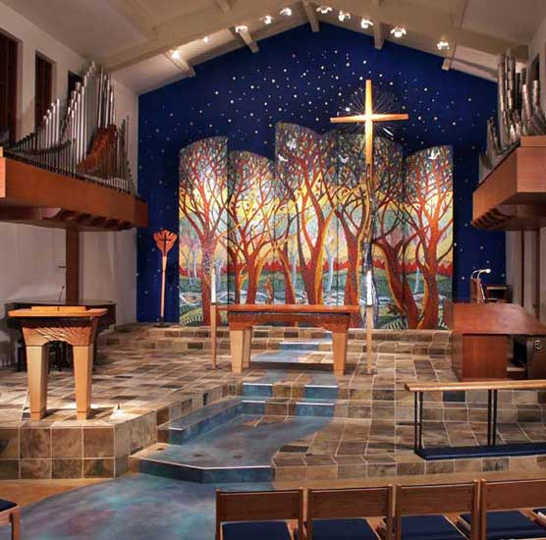
Ezekiel 44–48
Anticipate
Glory
in a New Earth
Dr. Rick Griffith • Jordan Evangelical Theological Seminary • BibleStudyDownloads.org

Slide 2
But after the Tribulation, the temple will be destroyed and replaced by Ezekiel’s temple in the millennium
(the fourth era of the temple)
Artwork by Sunny Chandra

Slide 3
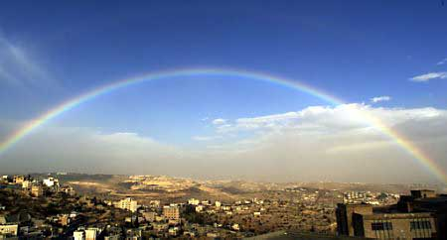
The Restored Community
New Temple (40–43)
New Worship (44–46)
New Territories (47–48)

Slide 4


The Glory Returns
502
Ezekiel 43
656

Slide 5
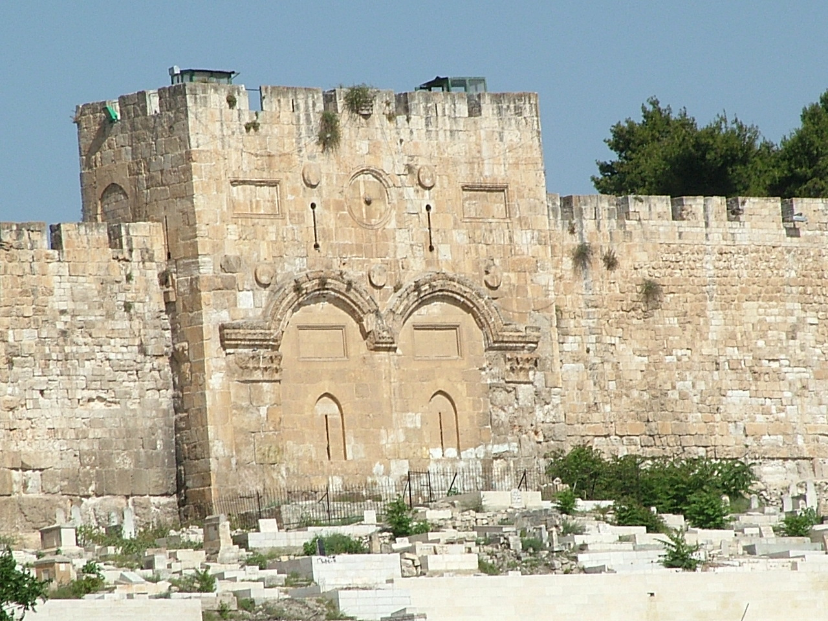
The Eastern Gate (Ezekiel 43:1 NLT)
"After this, the man brought me back around to the east gateway."

Slide 6
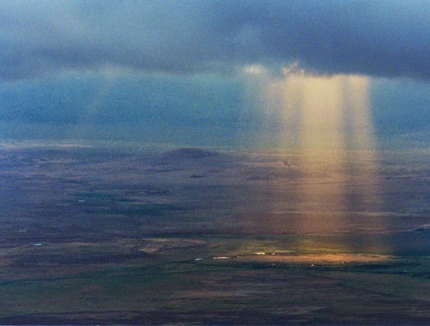
God's Glory Will Return (43:1-2)!
The Eastern Gate (Ezekiel 43:2-3 NLT)
"Suddenly, the glory of the God of Israel appeared from the east. The sound of his coming was like the roar of rushing waters, and the whole landscape shone with his glory.
³ This vision was just like the others I had seen, first by the Kebar River and then when he came to destroy Jerusalem. I fell face down on the ground."

Slide 7
The Eastern Gate (Ezekiel 43:4 NLT)
"And the glory of the LORD came into the Temple through the east gateway."

Slide 8
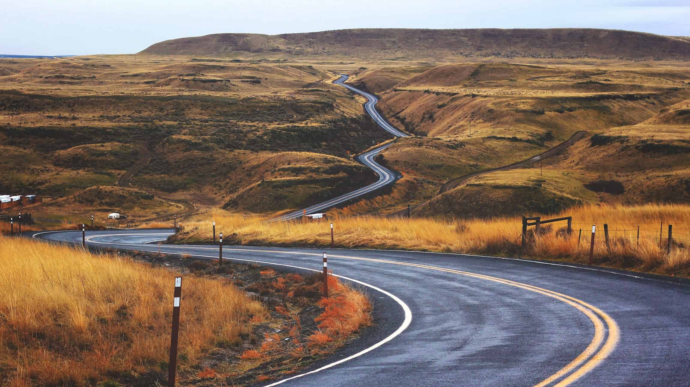
How will God show us his faithfulness in the future?

Slide 9
Ezekiel 40–48
God's Future Faithfulness
God will live with us again
(40–43)
God will help people confess sin
(44–46)

Slide 10

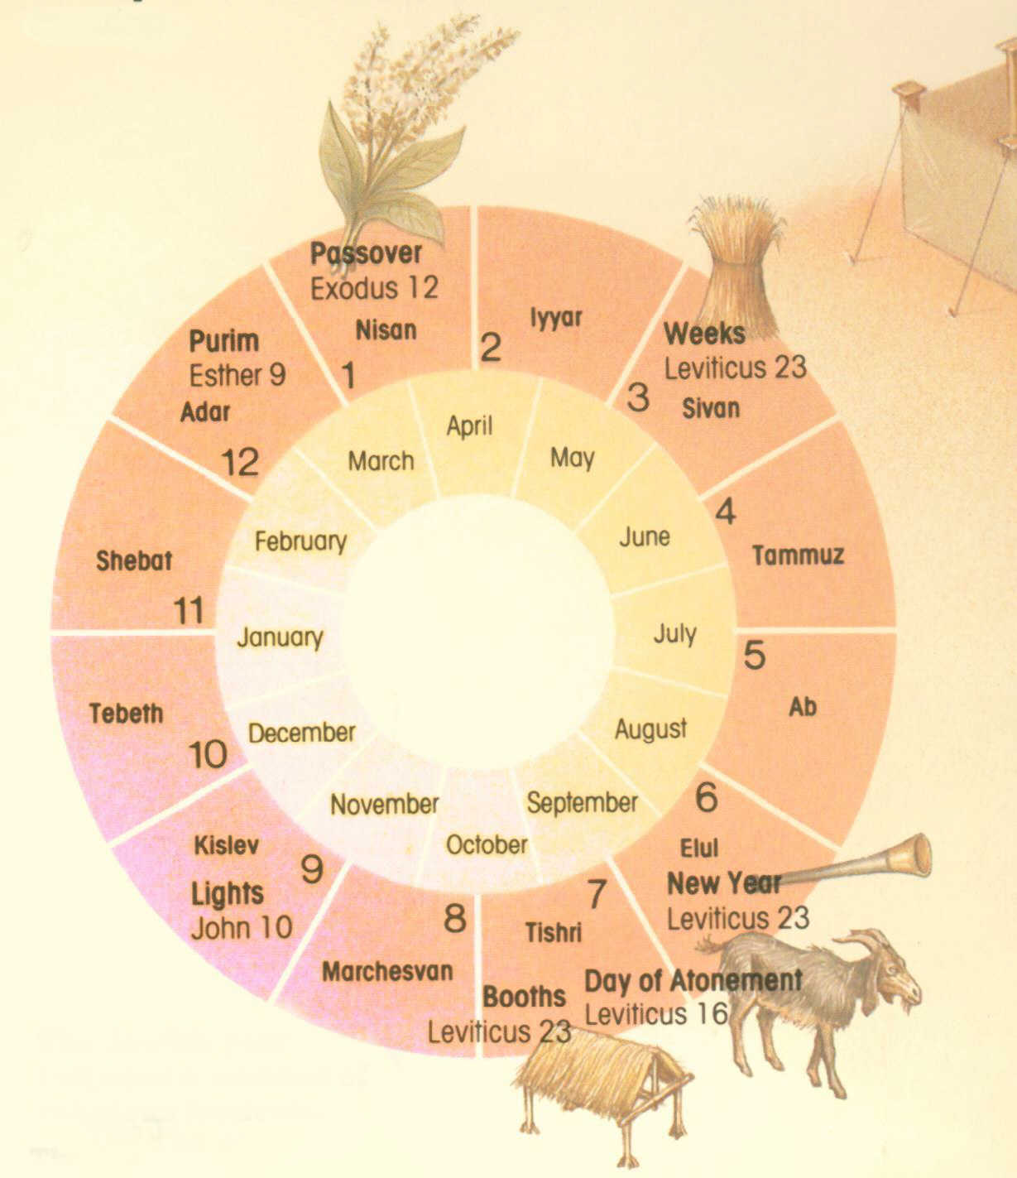
The Seven Feasts
Leviticus 23;
Deuteronomy 16
Passover
Unleavened Bread
Firstfruits
Pentecost
Trumpets
Atonement
Tabernacles
1 Nisan
2 Iyar
3 Sivan
4 Tammuz
5 Av
6 Ellul
7 Tishri
8 Cheshvan
9 Kislev
10 Tevet
11 Shevat
12 Adar
Notes:
God commanded seven annual feasts for Israel.
_________
OS-03-Leviticus-264
OS-26-Ezek44-48-slide 10

Slide 11
Slides on
Ezekiel 44

Slide 12
Feasts Contrasted
530
Mosaic Order
(Lev 23)
Millennial Order
(Ezek 40–45)
Passover (Lamb Offered)
Passover
1 Nisan
2 Iyar
3 Sivan
4 Tammuz
5 Av
6 Elul
7 Tishri
8 Cheshvan
9 Kislev
10 Tevet
11 Shevat
12 Adar
Unleavened Bread
Unleavened Bread
1 Nisan
2 Iyar
3 Sivan
4 Tammuz
5 Av
6 Elul
7 Tishri
8 Cheshvan
9 Kislev
10 Tevet
11 Shevat
12 Adar
Firstfruits
Sin Offering
Pentecost
Tabernacles
Tabernacles
Atonement
Trumpets
Sin Offering
Notes:
The annual Hebrew calendar of Leviticus 23 will find a partial repetition in the millennium.
• This was especially seen at the Day of Atonement among the seven annual feasts (Lev 23; Deut 16).
• But in the millennium only the first and last will be celebrated. Passover with Unleavened Bread will occur annually for seven days as in the past (Ezek 45:21), as will Tabernacles (Zech 14:16).
• As the sin offering in the Day of Atonement was central to the year, so this offering will be central to millennial worship. However, there will be no Day of Atonement then as the blood of Jesus is the final atonement for sin.
• Instead, the sin offering will be offered to commemorate Christ’s death, yet at Passover (Ezek 45:21-25). This is because there will be no ark of the covenant in the millennial temple (Jer 3:16, “’And when your land is once more filled with people,’ says the Lord, ‘you will no longer wish for ‘the good old days’ when you possessed the Ark of the Lord’s Covenant. You will not miss those days or even remember them, and there will be no need to rebuild the Ark”). Passover will be a fitting time to look back on Israel’s redemption from Egypt (Exod 12) as well as redemption from sin through Christ (1 Cor 5:7).
The Passover Lamb previously offered at Passover will have been fulfilled by Christ, yet the need for ongoing forgiveness related to ongoing sin will require a sin offering for the prince and those in mortal bodies (Ezek 40:39; 43:19, 21-22, 25).
One must not take the prophecy of Ezekiel in isolation, for millennial sacrifices are affirmed elsewhere in the prophetic writings. Isaiah notes that God will accept burnt offerings from both Israelites (Isa. 60:7; 66:20) and foreigners who bind themselves to the LORD (Isa. 56:6-7). Zechariah's last verse of his prophecy after the return of Christ (Zech 14:4) also affirms the presence of millennial sacrifices in the temple (Zech. 14:21).

Slide 13
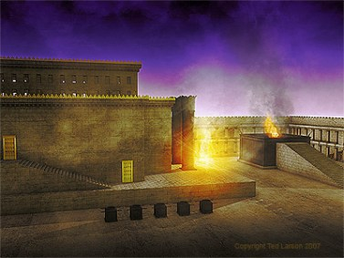
Ezekiel 10:4 NLT
"Then the glory of the LORD rose up from above the cherubim and went over to the door of the Temple. The Temple was filled with this cloud of glory, and the courtyard glowed brightly with the glory of the LORD."
Notes:
Why was God's glory leaving the temple and going into the courtyard? Ezekiel 11 shows pagan ceremonies right in the temple itself!

Slide 14
The Eastern Gate (Ezek. 44:1-2 NLT)
"Then the man brought me back to the east gateway in the outer wall of the Temple area, but it was closed. ² And the LORD said to me, 'This gate must remain closed; it will never again be opened. No one will ever open it and pass through, for the LORD, the God of Israel, has entered here. Therefore, it must always remain shut.'"

Slide 15
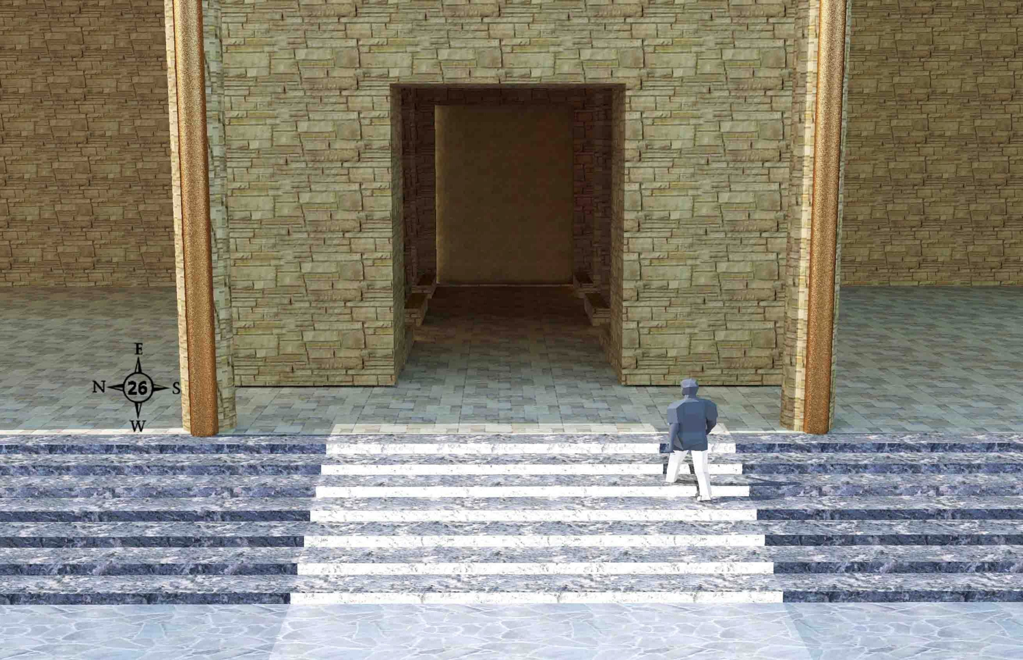
Entering the East Gate (44:1-3)
519
Prince David entering the outer east gateway from the porch on the outer court side
Wayne ODonnell • "Ezekiel 40–48: Tour of Ezekiel's Temple" • http://bible.ag/en/enezekieltranscript.htm
Notes:
"See Picture #26. Prince David entering the outer east gate from the porch on the outer court side. The gate is sealed up on the outside because the shekinah glory entered the temple compound through that gate. The light on the steps is shining from the shekinah glory in the temple through the east inner gate behind him.
Ezekiel 44:1-3, "Then he brought me back the way of the gate of the outward sanctuary which looketh toward the east; and it was shut. Then said the LORD unto me; This gate shall be shut, it shall not be opened, and no man shall enter in by it; because the LORD, the God of Israel, hath entered in by it, therefore it shall be shut." The outside of the outer east gate will be sealed after the shekinah glory enters through it. This gate does not yet exist. People confuse it with the sealed eastern gate in Jerusalem today, and say it will be unsealed for Messiah to enter by. That is the opposite of what scripture teaches here, that a future gate will be sealed after the Messiah enters through it, with the shekinah glory.
"It is for the prince; the prince, he shall sit in it to eat bread before the LORD; he shall enter by the way of the porch of that gate, and shall go out by the way of the same." The prince gets to use this sealed gate to sit and eat in. He will have a nice view of the inner east gate and the temple from here, and be out of the sun. He has to enter and leave the gate through the porch because the outside doorway is sealed.
The prince is Prince David. He will be a king to Israel, but a prince to Yeshua, the King of Kings. Jeremiah 30:9, "They shall serve the LORD their God, and David their king, whom I will raise up unto them," along with all the other people whose bodies are resurrected before the kingdom is established.
Serving under David, in either the federal or tribal governments, will be the resurrected and glorified twelve apostles, including Paul in place of Judas. "And Jesus said unto them, Verily I say unto you, That ye which have followed me, in the regeneration when the Son of man shall sit in the throne of his glory, ye also shall sit upon twelve thrones, judging the twelve tribes of Israel," Mt19:28."
Wayne ODonnell, "Ezekiel 40–48: Tour of Ezekiel's Temple"
http://bible.ag/en/mr4web.html#EZanchor-anchor
Recorded December 30, 2007
Accessed 30 Aug 2016

Slide 16
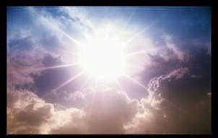
Key Word for Ezekiel
500
Glory
Notes:
In Ezekiel the key word is GLORY! The whole book is about God’s presence with the nation, departing from them and returning in the last days in the millennial temple.

Slide 17
Slides on
Ezekiel 45

Slide 18


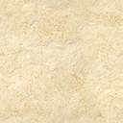
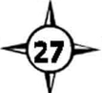
The Surrounding Land (45:1-8)
519
< 25,000 cubits >
< 10,000 cubits >
Priests 45:1, 3-4
The Temple
+ Border
600 x 600 cu
45:2
Prince David
45:7-8
Prince David
45:7-8
< 5,000 >
City 45:6
N
< 10,000 cubits >
Levites 45:5
W
E
S
Wayne ODonnell • "Ezekiel 40–48: Tour of Ezekiel's Temple" • http://bible.ag/en/enezekieltranscript.htm
Notes:
"See picture #27. The Holy Section of the Land.
For the Priests: 25,000 x 10,000. "Moreover, when ye shall divide by lot the land for inheritance, ye shall offer an oblation unto the LORD, an holy portion of the land: the length shall be the length of five and twenty thousand reeds, and the breadth shall be ten thousand ... The holy portion of the land shall be for the priests, ... a place for their houses, and an holy place for the sanctuary," Ez45:1-3. There is a 25,000 by 10,000 area, shown at the top of picture #27, for the priests' houses and the temple compound. Notice that the word "reeds," in verse 45, is in italics, meaning it was added by the King James translators to help us. But in picture #27, I put all the measurements in cubits, rather than reeds.
Except for the four verses in Ezekiel 42:16-19, which we looked at already, every other measurement in the book, in which the unit of measure is explicitly stated, that is greater than one reed long, is given in cubits. The following five verses say something is exactly one reed long: 40:5; 40:6; 40:7; 40:8; and 41:8. And the following three verses say something is more than one reed long, but the word "reed" is in italics to show it was added by the translators: 42:20; 45:1; and 48:8.
The reason the translators added the word "reeds" in verse 1, is because the next verse talks about the 500 x 500 temple compound area, and in 42:16-19, the outer-most portion of the temple area, according to the Hebrew text, is a 500 reed (3,000 cubit) wall around and further out from the temple compound.
Temple Compound: 500 x 500 something. Either 600 cubits square including the border, or 500 reeds + 50 cubits square including the border. "Of this [in the priests' portion] there shall be for the sanctuary five hundred in length, with five hundred in breadth, square round about; and fifty cubits round about for the suburbs thereof," Ez45:2. The small black square labeled "The Temple + Border" within the priests' rectangle in picture #27.
Notice the word "cubits" is specifically mentioned for the "suburbs," or 'border,' of the sanctuary. If the unit of measurement in this chapter is cubits, the 50 cubit border goes around the temple compound, making the total temple area 600 x 600 cubits (50 more on each side of the 500 cubits). If the unit of measurement in this chapter is reeds, the 50 cubit border goes around the 500 reed wall, making the total temple area 500 reeds plus 50 cubits.
This is another reason why it is more natural, to assume the measurements in this chapter are in cubits. Most of the measurements we have seen so far, have been in fairly round numbers, not something like 500 reeds + 50 cubits. Also, a 50 cubit border around a 500 cubit area (10%) is more in perspective, than a 50 cubit border around a 3,000 cubit (500 reed) area (0.01667%). In chapter 48, we'll see that the city is a 4,500 x 4,500 area with a 250 border around it (5.56%) so the total area comes out to a nice round 5,000 (4,500 + 250 on each side).
Also, if the angel's purpose in chapter 42:15-20, had been to measure the adjacent land around the temple, why wouldn't he have told us about the 50 cubit border at that time along with the measurement of the outlying 3,000 cubit wall. But if his purpose was only to give us the overall dimensions of the temple compound, after having given us the detailed internal measurements of its parts, it is understandable that he did not mention the 50 cubit border at that time, but waited until he was dealing with the placement of the temple within the land.
For the Levites: 25,000 x 10,000. "And the five and twenty thousand of length, and the ten thousand of breadth shall also the Levites, the ministers of the house, have for themselves," Ez45:5. The bottom white rectangular area on the mountain in picture #27. Ezekiel is not listing the portions in geographical order, but rather in order of importance. Priests and sanctuary first, then Levites, and next the city.
For the City: 5000 x 25,000. "And ye shall appoint the possession of the city five thousand broad, and five and twenty thousand long, over against the oblation of the holy portion: it shall be for the whole house of Israel," Ez45:6. The central 5,000 by 25,000 area in picture #27.
For Prince David: "And a portion shall be for the prince on the one side and on the other side of the oblation of the holy portion, and of the possession of the city, ... from the west border unto the east border," Ez45:7. The land shown on the far right and left of picture #27, is for the resurrected Prince David and his descendants.
This land might also pay the expenses of his federal government (versus the tribal governments). "Moreover the prince shall not take of the people's inheritance by oppression, to thrust them out of their possession ... that my people be not scattered every man from his possession," Ez46:17-18."
Wayne ODonnell, "Ezekiel 40–48: Tour of Ezekiel's Temple"
http://bible.ag/en/mr4web.html#EZanchor-anchor
Recorded December 30, 2007
Accessed 30 Aug 2016

Slide 19
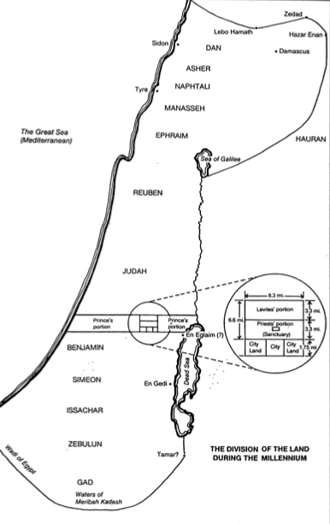
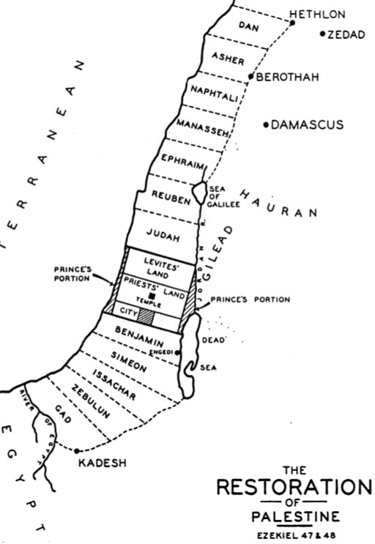
End Time Geography
531d
531e
Highlighted in blue from
Ezek. 45:1-8; 48:9-22
R. Ludwigson, A Survey of Bible Prophecy, 56
Charles Dyer, ”Ezekiel,” in Bible Knowledge Commentary, 1:1314
Notes:
The significant differences between the two depictions of the leadership territory is due to two views on the measuring rod used.

Slide 20
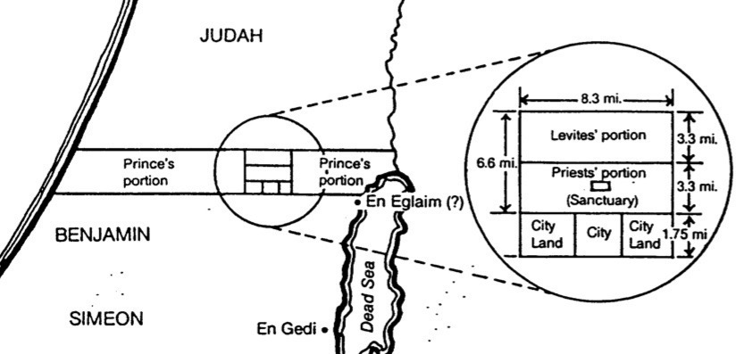
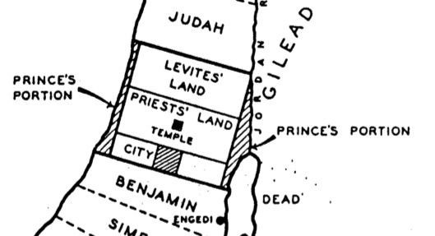
Priests, Levites & Prince Comparisons
531d-e
Charles Dyer, ”Ezekiel,” in Bible Knowledge Commentary, 1:1314
Highlighted in blue from
Ezek. 45:1-8; 48:9-22
R. Ludwigson, A Survey of Bible Prophecy, 56
Notes:
This is the minimum measurement based upon Ezekiel 41:13 using Ezekiel's long (21-inch) cubit explained in 40:5 (cf. 43:13) where a rod is equal to 6 long cubits, each of which is an 18-inch cubit plus a 3-inch handbreadth; therefore, a rod must be 10.5 feet long since 6 cubits at 21 inches equals 126 inches, or 10.5 feet. Nowhere does the account provide the height of the temple although the entire temple area is enclosed by a wall one rod (hn<q;, "stalk, reed" BDB 889d) in height (40:5), or 10.5 feet. (If the measurement is with the normal, or shorter [18-inch] cubit, the temple dimensions must be adjusted slightly to 150 feet by 75 feet.) This issue becomes even more confusing as the temple area measurements in 42:16-19 are plagued with textual difficulties. In each verse the MT measures in "rods" (~ynIq;; cf. NASB, NIV margin, KJV, NKJV, Ampl), but the LXX follows the Qere which reads the transposed "cubits" (twam; cf. NIV, RSV, GNB). Therefore, a single temple court side in the MT is "500 rods" (~ynIq; t/mae-vmej}) or 5250 feet, but in the LXX it is "500 cubits" (pentakosi,ouς) or 875 feet (using the long cubit). Furthermore, the situation is complicated by the fact that Ezekiel uses the cubit (40:5b, 9, 11–42:20; etc.), the rod (40:3, 5a-7; 42:16-19), and an ellipsis (45:1-6; 48:8-21, 30-35) for measurement. Most commentators agree that the cubit is the proper unit since use of the rod would make four sides of the temple area nearly one mile in length, an unlikely size. For further study on the measurements of the temple in cubits see Theo G. Soares, "Ezekiel's Temple," BW 14 (1899): 93-103. Adhering to the rod view is Cameron M. MacKay, "The City and the Sanctuary: Ezekiel 48," PTR 20 (1922): 399-417 (cf. MacKay, "Prolegomena to Ezekiel 40–48," ET 55 (1943/44): 292-95), who advocates an enormous temple situated in the Valley of Shechem (cf. MacKay, "Ezekiel's Sanctuary and Wellhausen's Theory," PTR 20 [1922]: 661-65, which argues against the documentary hypothesis). MacKay's first article (pp. 399-417) is critiqued by W. F. Lofthouse, "The City and the Sanctuary," ET 34 (1922/23): 198-202 and rebutted by MacKay in "The City and the Sanctuary," ET 34 (1922/23): 475-76. In either case, whether rods or cubits are used, the temple is one that has never been constructed in Israel.

Slide 21
Slides on
Ezekiel 46

Slide 22
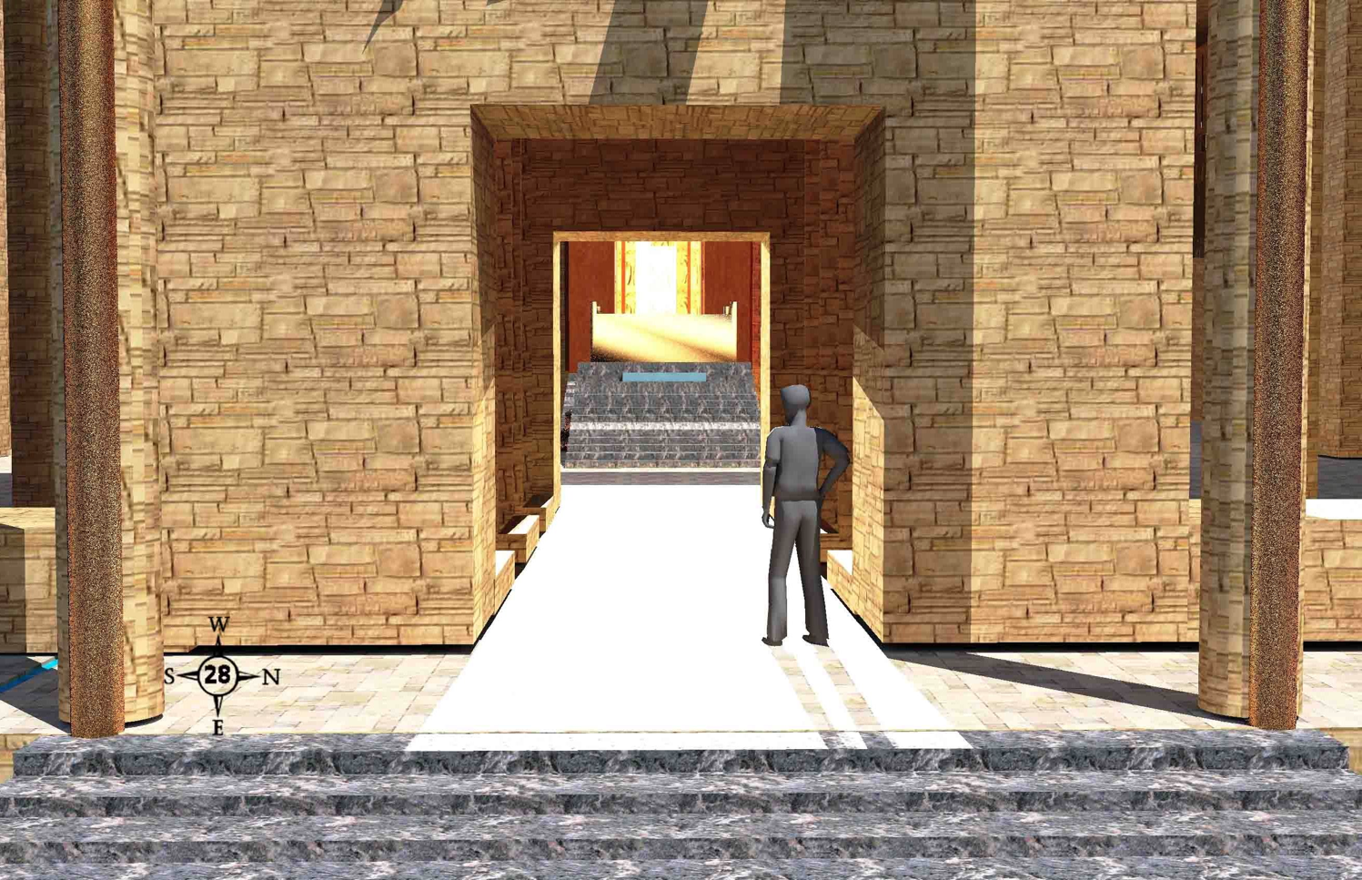
Seeing Shekinah Glory (46:1-3)
519
Prince David stands on the inner east gate porch. Light is from the shekinah glory in the temple as we look west into the inner court and the temple.
Wayne ODonnell • "Ezekiel 40–48: Tour of Ezekiel's Temple" • http://bible.ag/en/enezekieltranscript.htm
Notes:
"See Picture #28. Prince David standing on the porch of the inner east gate. The light is from the shekinah glory in the temple. We are looking west into the inner court and the temple.
Ezekiel 46:1-3,"The gate of the inner court that looketh toward the east shall be shut the six working days; but on the sabbath it shall be opened, and in the day of the new moon it shall be opened. And the prince shall enter by the way of the porch of that gate without, and shall stand by the post of the gate, and the priests shall prepare his burnt offering and his peace offerings, and he shall worship at the threshold of the gate: then he shall go forth; but the gate shall not be shut until the evening. Likewise the people of the land shall worship at the door of this gate before the LORD in the sabbaths and in the new moons." Most of the time, the inner east gate will be closed. But on Sabbaths and new moons, it will be open. Then the prince can go up on the porch, and watch as the priests offer his sacrifices. But that means he can't go into the inner court, even though he is in his resurrected and glorified body, and so we won't be able to either."
Wayne ODonnell, "Ezekiel 40–48: Tour of Ezekiel's Temple"
http://bible.ag/en/mr4web.html#EZanchor-anchor
Recorded December 30, 2007
Accessed 30 Aug 2016

Slide 23
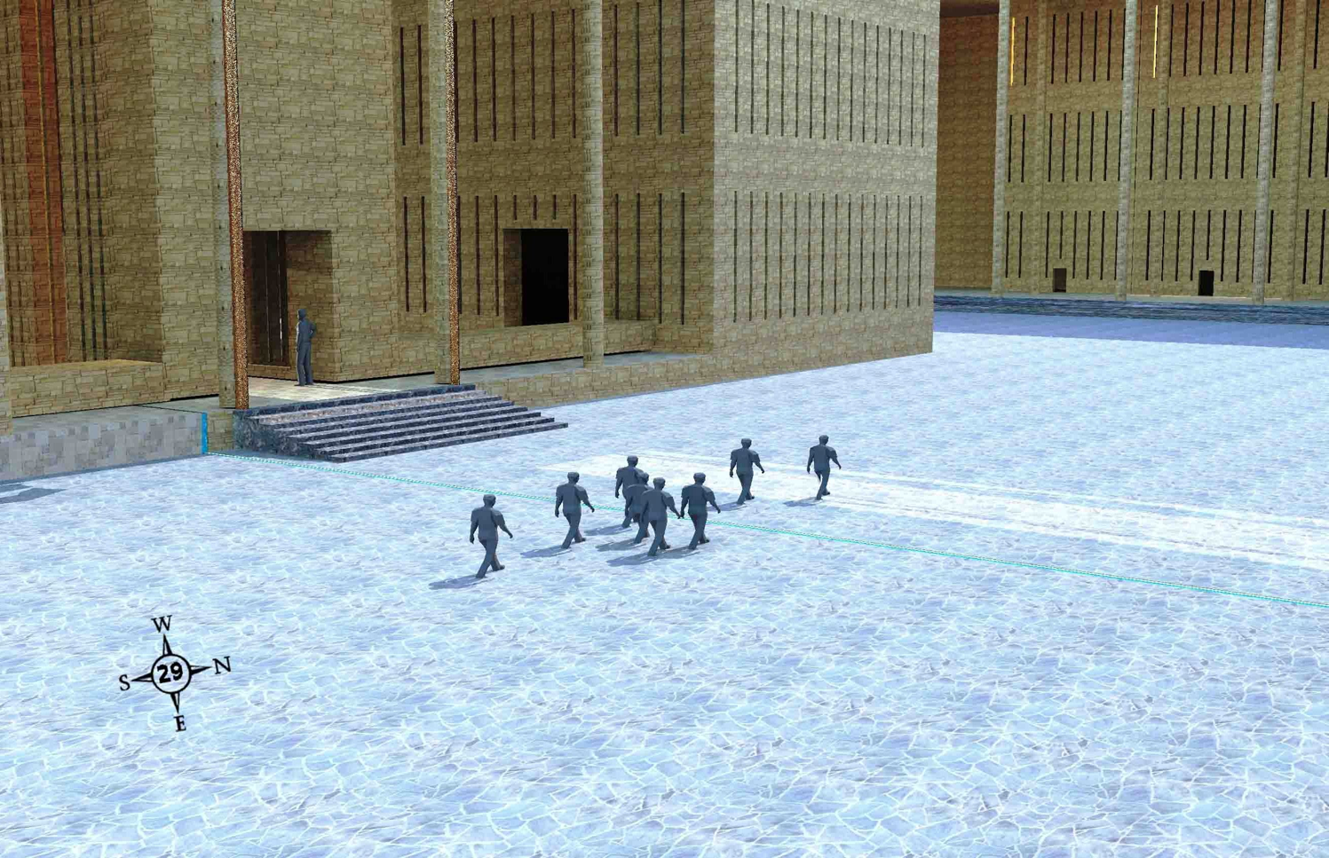
Exit Opposite Outer Gate (46:8-12)
People who enter the outer court of the temple compound by the outer south gate walk past the inner east gate, to exit by the outer north gate.
Wayne ODonnell • "Ezekiel 40–48: Tour of Ezekiel's Temple" • http://bible.ag/en/enezekieltranscript.htm
Notes:
"See Picture #29. People who entered the outer court of the temple compound by the outer south gate, walking past the inner east gate, to exit by the outer north gate.
Ezekiel 46:8-12, "When the people of the land shall come before the LORD in the solemn feasts, he that entereth in by the way of the north gate to worship shall go out by the way of the south gate; and he that entereth by the way of the south gate shall go forth by the way of the north gate: he shall not return by the way of the gate whereby he came in." People will enter the temple compound by the north gate and go out by the south, or they will go in by the south and out by the north. Do you remember why no one will enter or exit by the outer east gate?
Ezekiel 46:8 only talks about "the people of the land," meaning the Jewish people and probably the Gentiles who dwell among them in Israel. But Zechariah says that the Gentiles outside the land will go to Jerusalem to celebrate the feast of tabernacles. Zechariah 14:16-17, "It shall come to pass, that every one that is left of all the nations which came against Jerusalem, shall even go up from year to year to worship the King, the LORD of hosts, and to keep the feast of tabernacles. And it shall be, that whoso will not come up of all the families of the earth unto Jerusalem to worship the King, the LORD of hosts, even upon them shall be no rain." So I don't expect to be living in the land of Israel during the Messianic Kingdom. I expect to be laboring in one of the Gentile nations, but I expect to come up for the feast of tabernacles with other people from my nation whenever it's my turn.
Isaiah 66:20-21 may indicate some Gentiles may serve as priests and 'Levites' in the temple. "And they [saved Gentiles] shall bring all your brethren for an offering unto the LORD out of all nations ... to my holy mountain Jerusalem, and I will also take of them for priests and for Levites." More likely, "take of them" refers to taking priests and Levites from among the Jewish people brought back by the Gentiles. Would Gibeonites and Nethinim (temple servants) be referred to as 'Levites?' If God does take any Gentiles as priests and 'Levites', they will at least need to be born again spiritually, and circumcised physically, according to Ezekiel 44:9.
"Thus saith the Lord GOD; No stranger, uncircumcised in heart, nor uncircumcised in flesh, shall enter into my sanctuary, of any stranger that is among the children of Israel," Ez44:9. This probably indicates that no unsaved men, even descendants of Zadok, will be able to serve as priests and Levites in the temple. It probably does not indicate exclusion of anyone from the temple compound. It would be more feasible to verify circumcision of heart and flesh as a prerequisite to priesthood than to temple compound access.
Zechariah concludes and summarizes his book by saying, "Every pot in Jerusalem and in Judah shall be holiness unto the LORD of hosts: and all they that sacrifice shall come and take of them, and seethe therein: and in that day there shall be no more the Canaanite in the house of the LORD of hosts," Zech14:21. There will certainly be some people of Canaanite descent in the kingdom, who enter by resurrection, and who enter in unglorified bodies at the end of the tribulation period and their descendants born during the kingdom, and they will probably have entrance to the temple compound, though perhaps none any longer as temple servants. Probably this verse means that, whereas most priests and Levites in the temple throughout history have been unbelievers, and to God this was equivalent to Canaanites like the Gibeonites serving in the temple, in the kingdom the priests and Levites will be both descendants of Levi and, more importantly, regenerate of heart."
Wayne ODonnell, "Ezekiel 40–48: Tour of Ezekiel's Temple"
http://bible.ag/en/mr4web.html#EZanchor-anchor
Recorded December 30, 2007
Accessed 30 Aug 2016

Slide 24
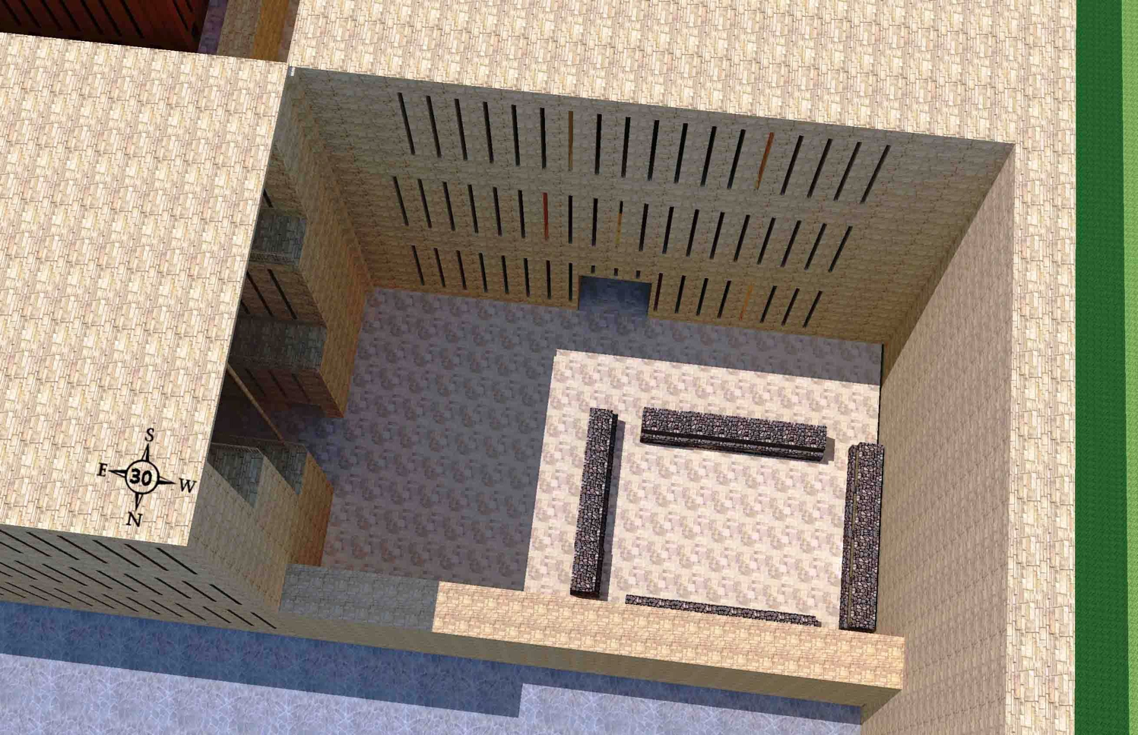
Priest Boiling Places (46:19-20)
Looking down on the priests' boiling places at the extreme west end of the northern upper pavement by the west building and the 3-tiered priest's chambers.
Wayne ODonnell • "Ezekiel 40–48: Tour of Ezekiel's Temple" • http://bible.ag/en/enezekieltranscript.htm
Notes:
"See Picture #30. Looking down on the priests' boiling places at the extreme west end of the northern upper pavement by the west building and the 3-tiered priest's chambers.
Ezekiel 46:19-20, "After he brought me through the entry, which was at the side of the gate," through a side arch of the inner north gate, "into the holy chambers of the priests, which looked toward the north, and, behold, there was a place on the two sides westward," the west ends of the upper pavement on both the north and south of the temple. "Then said he unto me, This is the place where the priests shall boil the trespass offering and the sin offering, where they shall bake the meat offering; that they bear them not out into the utter [outer] court, to sanctify the people." The priests have their own places to boil and bake sacrifices, separate from the people, so they don't take any holiness out to the people; just as we saw how in Ezekiel 42:13-14, they had to change their clothes before going out to the people."
Wayne ODonnell, "Ezekiel 40–48: Tour of Ezekiel's Temple"
http://bible.ag/en/mr4web.html#EZanchor-anchor
Recorded December 30, 2007
Accessed 30 Aug 2016

Slide 25
Northwest Boiling Place (Ezekiel 46:21-24)
519
The northwest boiling place for the peoples' sacrifices with 4 mini-courts like this one in each corner of the outer court
Wayne ODonnell • "Ezekiel 40–48: Tour of Ezekiel's Temple" • http://bible.ag/en/enezekieltranscript.htm
Notes:
"See Picture #31. The northwest boiling place for the peoples' sacrifices. There are 4 mini-courts like this one; one in each corner of the outer court.
Ezekiel 46:21-24, "Then he brought me forth into the utter [outer] court, and caused me to pass by the four corners of the court; and, behold, in every corner of the court there was a court ... forty cubits long and thirty broad.... And there was a row of building round about in them, ... and it was made with boiling places under the rows round about. Then said he unto me, These are the places of them that boil, where the ministers of the house shall boil the sacrifice of the people." Four 40x30 cubit mini-courts, one in each corner of the outer court, for the priests to come out and boil the peoples' sacrifices, because the people cannot enter into the inner court, where the priests offer other sacrifices."
Wayne ODonnell, "Ezekiel 40–48: Tour of Ezekiel's Temple"
http://bible.ag/en/mr4web.html#EZanchor-anchor
Recorded December 30, 2007
Accessed 30 Aug 2016
_________
Common-210
OS-26-Ezek44-48-slide 25

Slide 26
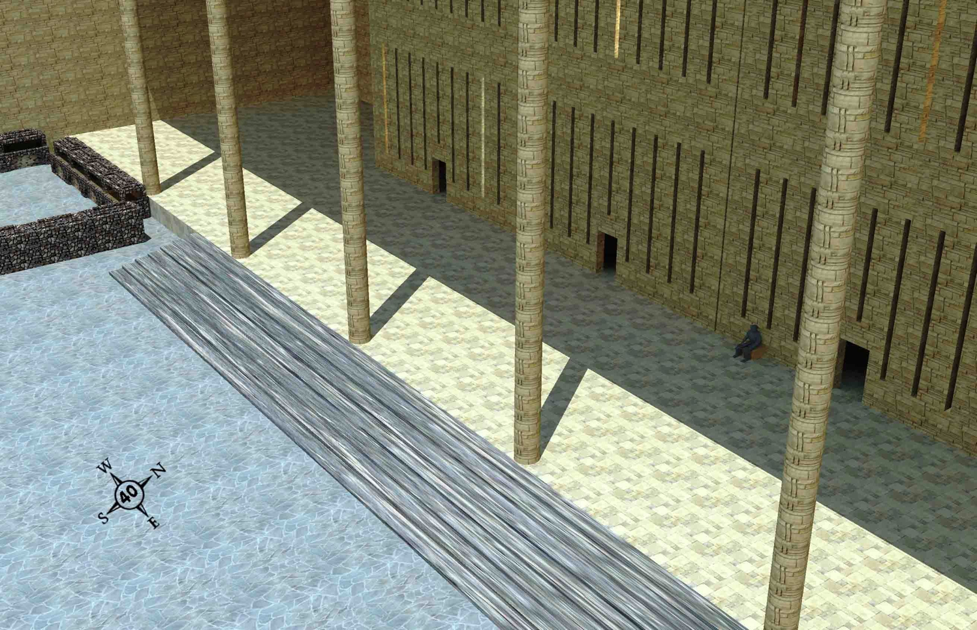
Northeast Room
519
The third room from the northeast corner of the temple compound on the lower pavement
Wayne ODonnell • "Ezekiel 40–48: Tour of Ezekiel's Temple" • http://bible.ag/en/enezekieltranscript.htm
Notes:
"Application
Jesus said, "Verily, verily, I say unto thee, Except a man be born again, he cannot see the kingdom of God," Jn3:3. You definitely want to see the kingdom of God. And you won't see it unless you are born again.
"As Moses lifted up the serpent in the wilderness, even so must the Son of man be lifted up: that," whosoever looks to him in faith, "whosoever believeth in him should not perish, but have eternal life. For God so loved the world, that he gave his only begotten Son, that whosoever believeth in him should not perish, but have everlasting life," Jn3:14-16.
"He that believes on the Son has everlasting life," Jn3:36; not he that goes to church, or he that is good, because "there is none that doeth good, no, not one," Rm3:12; Ps53:3. "All have sinned and come short of glory of God," Rm3:23. But he that simply "believes on the Son," and takes God at his Word that Jesus' sacrifice and death for our sake as our substitute was sufficient, has everlasting life.
Call upon the Lord (Rm10:13), and tell him that you accept his sacrifice, that you put your faith in him and in what he did for you, and that you take him at his word to give you everlasting life.
For those who already know the Lord, knowing about the kingdom will help us to be willing to suffer. Paul said, "What advantageth it me, if the dead rise not?" 1Cor15:32. But he was able to fight with beasts at Ephesus because he knew that any damage to his body was temporary. It would be raised again and be in the kingdom. He knew he will see these buildings and the other things that the Bible prophesies about the kingdom.
And knowing about the kingdom helps us to labor confidently. "Therefore, my beloved brethren, be ye stedfast, unmoveable, always abounding in the work of the Lord, forasmuch as ye know that your labour is not in vain in the Lord," 1Cor15:58. We have a sure and certain destination.
See Picture #40. The third room from the northeast corner of the temple compound on the lower pavement.
For those who are interested in meeting, let's meet, if our schedules permit, at the third room from the northeast corner of the temple compound, on the lower pavement, on 3/3/3 AK (After Kingdom); the third year, third month, and third day after the start of the kingdom. I don't know if we will be allowed to meet at that location, but if not, and you are interested in meeting with us, try to meet as close to there as possible, perhaps just outside the outer north gate. Remember, 3/3/3 AK. You can't get there unless you use John 3:3. You have to be born again to enter the kingdom.
So that is our presentation of the temple. I pray that it will be used for your benefit to know the Lord and to be more fruitful in his service."
Wayne ODonnell, "Ezekiel 40–48: Tour of Ezekiel's Temple"
http://bible.ag/en/mr4web.html#EZanchor-anchor
Recorded December 30, 2007
Accessed 30 Aug 2016

Slide 27
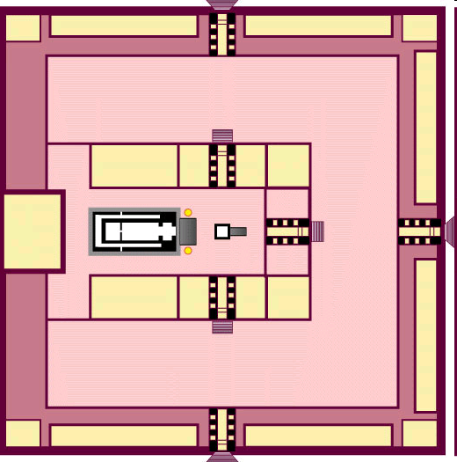
Ezekiel's Temple
517

Slide 28


Solomon's & Ezekiel's Temples Contrasted
518
Notes:
28
One suggestion is that this is Solomon's temple (Adam Clarke, "Ezekiel," in Clarke's Commentary, 4:535), but this view has several flaws.
First, the dimensions of these two temples are different. While Solomon's temple was fairly small (90 feet long, 30 feet wide, and 45 feet high), Ezekiel's temple measures much larger (175 feet long and 87.5 feet wide). This is the minimum measurement based upon Ezekiel 41:13 using Ezekiel's long (21-inch) cubit explained in 40:5 (cf. 43:13) where a rod is equal to 6 long cubits, each of which is an 18-inch cubit plus a 3-inch handbreadth; therefore, a rod must be 10.5 feet long since 6 cubits at 21 inches equals 126 inches, or 10.5 feet. Nowhere does the account provide the height of the temple although the entire temple area is enclosed by a wall one rod ("stalk, reed" BDB 889d) in height (40:5), or 10.5 feet. (If the measurement is with the normal, or shorter [18-inch] cubit, the temple dimensions must be adjusted slightly to 150 feet by 75 feet.) This issue becomes even more confusing as the temple area measurements in 42:16-19 are plagued with textual difficulties. In each verse the MT measures in "rods" (NASB, NIV margin, KJV, NKJV, Ampl), but the LXX follows the Qere which reads the transposed "cubits" (NIV, RSV, GNB). Therefore, a single temple court side in the MT is "500 rods" or 5250 feet, but in the LXX it is "500 cubits" or 875 feet (using the long cubit). Furthermore, the situation is complicated by the fact that Ezekiel uses the cubit (40:5b, 9, 11–42:20; etc.), the rod (40:3, 5a-7; 42:16-19), and an ellipsis (45:1-6; 48:8-21, 30-35) for measurement. Most commentators agree that the cubit is the proper unit since use of the rod would make four sides of the temple area nearly one mile in length, an unlikely size. For further study on the measurements of the temple in cubits see Theo G. Soares, "Ezekiel's Temple," BW 14 (1899): 93-103. Adhering to the rod view is Cameron M. MacKay, "The City and the Sanctuary: Ezekiel 48," PTR 20 (1922): 399-417 (cf. MacKay, "Prolegomena to Ezekiel 40–48," ET 55 (1943/44): 292-95), who advocates an enormous temple situated in the Valley of Shechem (cf. MacKay, "Ezekiel's Sanctuary and Wellhausen's Theory," PTR 20 [1922]: 661-65, which argues against the documentary hypothesis). MacKay's first article (pp. 399-417) is critiqued by W. F. Lofthouse, "The City and the Sanctuary," ET 34 (1922/23): 198-202 and rebutted by MacKay in "The City and the Sanctuary," ET 34 (1922/23): 475-76. In either case, whether rods or cubits are used, the temple is one that has never been constructed in Israel.
Solomon's temple measurements in 1 Kings 6:2 are noted at 60, 20, and 30 cubits; the above measurements in feet were obtained by multiplying these three lengths by the standard 18 inches per cubit. "The square of the temple in 42:20 is six times as large as the circuit of the wall enclosing the old temple, and, in fact, is larger than the former city itself” (Hobart E. Freeman, An Introduction to the Old Testament Prophets, 313).
Second, if this description depicted the former temple, it must be asked what hope Ezekiel could offer his oppressed brethren by reminding them of the glory of Solomon's temple which at that time lay in ruins. Third, the Books of Kings and Chronicles already provide detailed descriptions of Solomon's temple, so another record would be unnecessary. For these reasons, Ezekiel's temple is not the same as Solomon's.

Slide 29
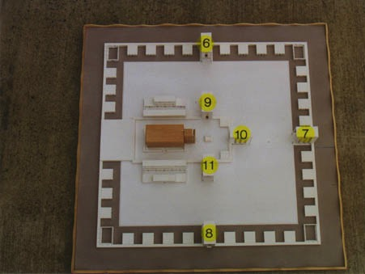
View from Above
517
6. Outer Court Northern Gateway - 40:20-23
7. Outer Court Eastern Gateway - 40:6-16
8. Outer Court Southern Gateway - 40:24-27
9. Inner Court Northern Gateway - 40:35-37
10. Inner Court Eastern Gateway - 40:32-34
11. Inner Court Southern Gateway - 40:28-31
www.pauljab.net/temple/ TemplePictures.html
Notes:
29
Note that at least 4 of Solomon’s temples fit into Ezekiel’s—maybe even 5-6 of them. Ezekiel is obviously not describing the first temple built by Solomon.

Slide 30

Ezekiel's temple won't fit on the present Temple Mount!
521
656
www.pauljab.net/temple/ TemplePictures.html
Notes:
If we take the larger view, the side of Ezekiel’s temple court would be nearly a mile long. Even the shorter rod view is too large.

Slide 31
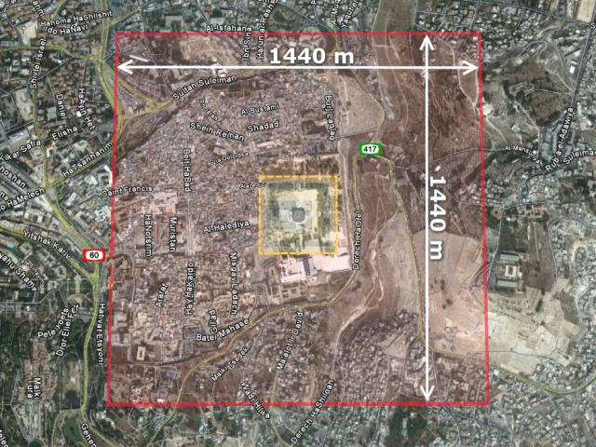
The Temple Area Over Present Jerusalem
521
656
"Ezekiel's Temple: Tour of the Temple of Ezekiel's Vision" • http://ezekiel-temple.narod.ru/ezekiel_45.htm • This group plans to build the temple in the desert of Israel!
Notes:
The larger (rod) view would make the temple area about the size of the modern city.
——————_
Accessed 31 August 2016

Slide 32
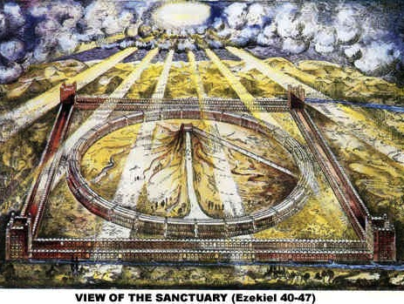
View of the Sanctuary (Ezekiel 40-48)
521
www.antipas.org/.../ezekiels_temple/ ezekiels_temple.html
Notes:
Ezekiel's depiction matches Isaiah 2…
Is. 2:2 In the last days, the mountain of the LORD’s house
will be the highest of all—
the most important place on earth.
It will be raised above the other hills,
and people from all over the world will stream there to worship.
³ People from many nations will come and say,
“Come, let us go up to the mountain of the LORD,
to the house of Jacob’s God.
There he will teach us his ways,
and we will walk in his paths.”
For the LORD’s teaching will go out from Zion;
his word will go out from Jerusalem.
⁴ The LORD will mediate between nations
and will settle international disputes.
They will hammer their swords into plowshares
and their spears into pruning hooks.
Nation will no longer fight against nation,
nor train for war anymore.

Slide 33
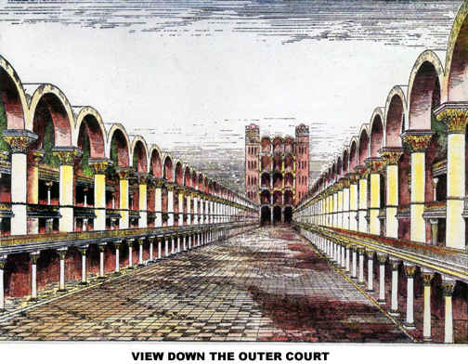
View Down the Outer Court
Notes:
If you think Solomon's temple was glorious, how much more so Ezekiel's!

Slide 34
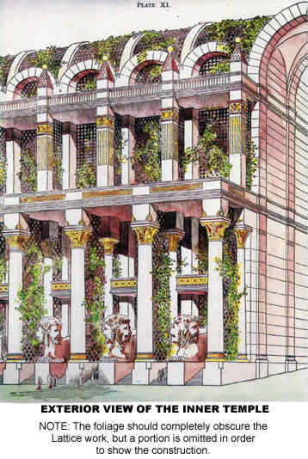
Exterior View of the Inner Temple

Slide 35
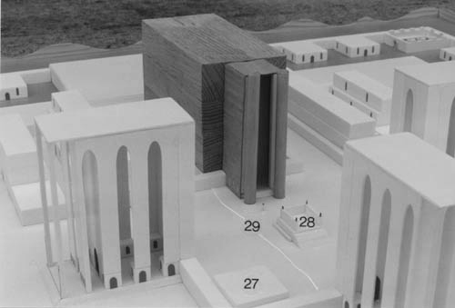
Ezekiel's Temple & Gates (Ezek. 40–43)

Slide 36
The Eschatological Significance of the Sabbath
23
529
NS 266k
A visual summary of the ThD dissertation by Richard James Griffith, Dallas Theological Seminary, 1990
Christ’s Second Coming in
2 Phases
Pre-Fall
Pre-Mosaic
Mosaic
Church
Tribulation
Millennial Kingdom
Eternity
Creation
Fall of Man
Mount Sinai
Death of Christ
Rapture
Revelation
Rev 20:1-6
Eternity
6 Days
(Work)
Gen 1
7th Day
(Rest)
Gen 2:1-3
Law Instituted
Exod 20
Law Abolished
Rom 7:1-6
Gal 3:19, 23-29
1 Cor 9:20
2 Cor 3:6-11
Daniel’s 70th Week of 70-Week Prophecy
Dan 9:27
Some Aspects of Law Reinstituted
Ezek 40–48
God’s Work
Work of Creation
Gen 1
Work of Sustaining
John 5:17
Work of Recreation
Rev 21–22
Israel Repeatedly Rejected God’s Offer of the Promised Land Rest…
God’s Rest
Not Resting
Rests from Creative Activity
Gen 2:2-3
Rest Stops by Sin
Rest Linked to Canaan
Gen 12; 1-3; 15:18;
Deut 30:1-10
Rejected in Wilderness
Gen 14:23;
Heb 3:9
Rejected in David’s Time
Ps 95:7b-11
Rejected in Messiah
Matt 23:37-39
Rejected in Peter’s Sermon
Acts 3:19-20
Rest Accepted & Reinstituted
Heb 3:7–4:11
Israel’s Sabbath
No Sabbath for Mankind
Israel’s Sabbath Anticipated
Gen 2:3
Sabbath Instituted
Exod 16
Neh 9:13-14
Sign of Mosaic Covenant
Exod 31:13, 17;
Ezek 20:12, 20
Sabbath Abolished
Col 2:16-17
Gal 4:9-10
Rom 14:5
Hos 2:11
Lord’s Day Instituted
Acts 20:7
1 Cor 16:1-2
Rev 1:10
Sabbath Reinstituted
Matt 24:20
Sabbath Reinstituted
Ezek 46:1
Isa 66:23
Transition Begins
Transition Completed
Israel’s National History
Nation Established at Mt Sinai
Exod 19
69 Weeks
（483 years）
444 BC-AD 33
Dan 9:25
Nation Set Aside in
Church Age Gap: “Times of the Gentiles”
Dan 9:26
Luke 21:24
1 Week
(7 Years)
AD ??
Dan 9:27
Nation Repents, Believes in Messiah, Re-established
Ezek 36–39
Kingdom Typology
Kingdom Language
Gen 1
Abrahamic & Land Covenants
Gen 12:1-3; 15:18
Deut 30:1-10
Sabbath Looks Back at Creation & Redemption
Exod 20:8-11
Deut 5:12-15
Sabbath Looks Forward & Typifies Kingdom
Heb 4:9
Lev 23:1-3
Sabbath Typifies in a Dual Sense
Notes:
God worked in six 24-hour days to create the earth, but his rest on Day 7 had no "evening and morning," so he continues to rest from his creative (but not his sustaining) work. Humans entered that rest until the Fall, but since then have repeatedly rejected his offers to enter that rest. Then rest is located in Canaan, so the seventh day Sabbath looked back to creation in Exodus 20 and to redemption from Egypt in Deut 5. Yet Israel repeatedly rejected full entrance into God's Canaan rest—even unto today—through unbelief. But Hebrews 4:9 promises future Canaan rest for all who believe. The Sabbath thus looks forward to the 100-year Canaan rest in a typological sense.
See Richard James Griffith, "The Eschatological Significance of the Sabbath," ThD diss., Dallas Theological Seminary, 1990, available for free download as file #28 at https://biblestudydownloads.org/resource/future/
________
Common Arabic-438
Common English-233
ES-07-Premillennialism-02
ES-07-Dispensational Premillennialism-2
ES-26-Restoration of Israel-207
OB-25-Feasts-80
OS-00-Intro-41
OS-01-Gen1-3-slide 157
OS-02-Exodus-320
OS-06-Joshua-190
OS-26-Ezek 44-48-slide 36
NS-19-Hebrews-201

Slide 37
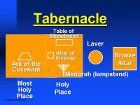
Comparing the Furniture
530a
Moses's
Tabernacle
Solomon's
Temple
Ezekiel's
Temple
Altar of Burnt Offering
(Ezek. 43:13-27)
Ark of the Covenant
(Exod. 25:22)
Ark of the Covenant
(1 Kings 8:21)
Contrasting Centers of Worship:
Focal Point of the Temples:
The Tabernacle Ark brought into Solomon's temple gives way to Ezekiel's Altar
Missing Millennial Furniture:
Ark of covenant (Jer. 3:16-17), veil, lampstand, table of showbread, & laver

Slide 38
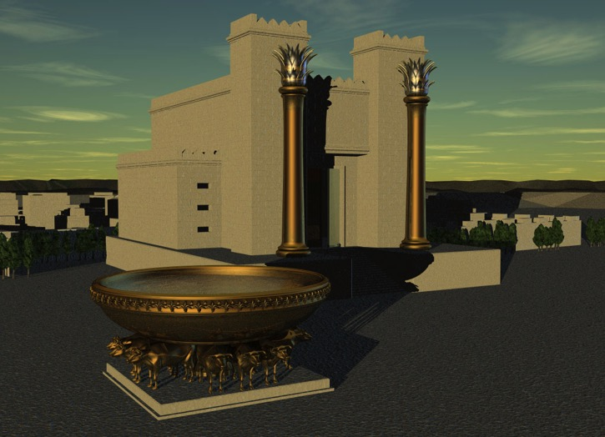
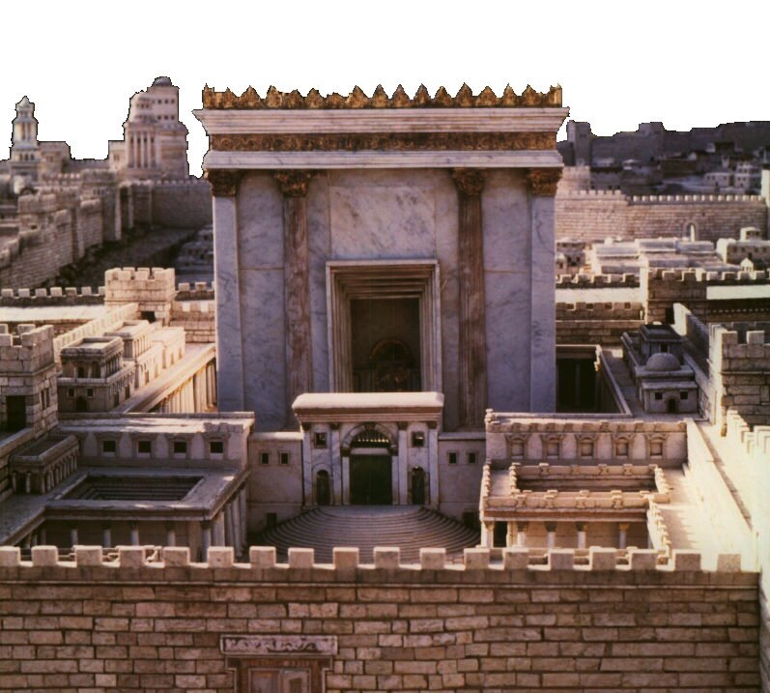
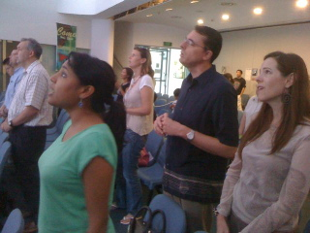
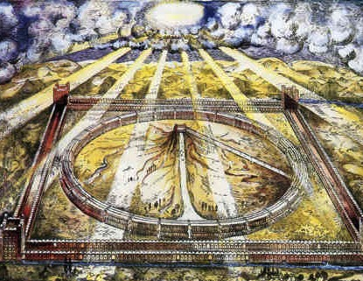
Which temple for Ezekiel?
520
Solomon
Zerubbabel/Herod
Three
Literal
Views
Conditional
Millennial
Church
Notes:
Ezekiel 40–46 has at least five different interpretations but the only one that takes the text at face value is that this temple with these dimensions has not yet been built—so it must happen in the future millennium.
The conditional view says that the people did not truly believe in the Lord sufficiently, so God never built it and will not do so in the future. But hundreds of verses in the Prophets speak of a believing Israel in the future. See the Isaiah 60–66 slides on the restoration of Israel.

Slide 39
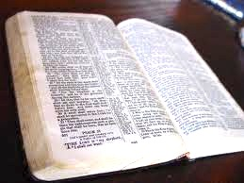
Interpretations of 40–48
Literal/Historical: The First Temple
Literal/Historical: Zerubbabel's Temple
Literal/Historical: Herod's Temple
Symbolic/Present: The Church
Apocalyptic/Present: The Idealized Temple
Literal/Future: The Millennium Temple
Literal/Eternal: The Kingdom of God

Slide 40
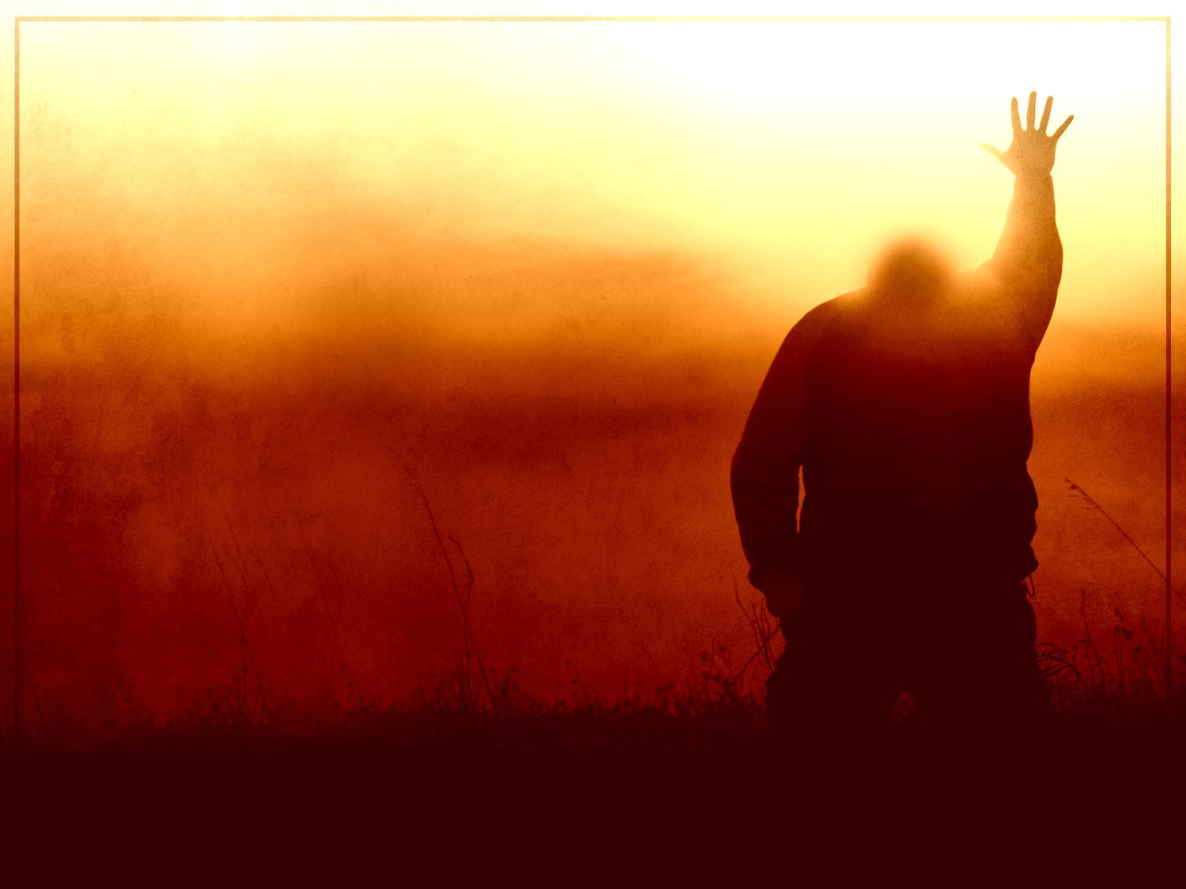
"And when sins have been forgiven, there is no need to offer any more sacrifices"
(Heb. 10:18 NLT).

Slide 41
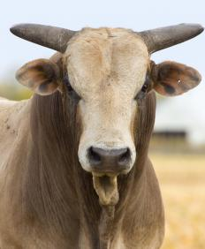
"For without the shedding of blood, there is no forgiveness"
(Heb. 9:22b NLT).

Slide 42
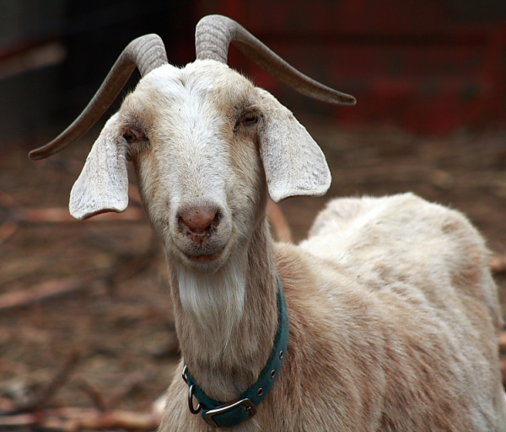
"But instead, those sacrifices actually reminded them of their sins year after year. ⁴For it is not possible for the blood of bulls and goats to take away sins"
(Heb. 10:3-4 NLT).

Slide 43
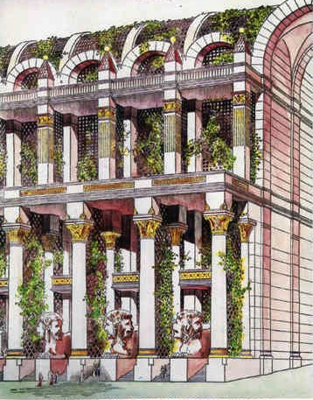
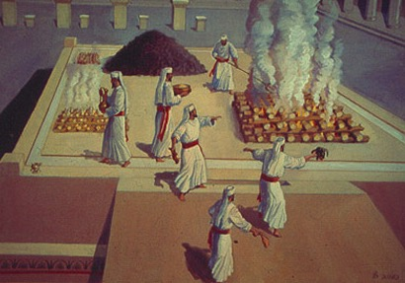
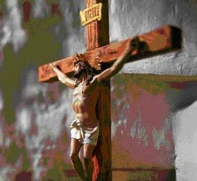
Problems Either Way!
525
Premillennial:
Sacrifices for Sin
(Ezek. 40:39) in Light of Christ's Death
Amillennial:
Abandon Normal Meaning of Gates, Doors, Walls, Sacrifices
Notes:
We should not stop the normal way we read words in Ezekiel just because we feel uncomfortable with the idea of future sacrifices. Spiritualizing these chapters leads to even greater problems in determining what is meant by these parts of the temple and sacrifices when the Bible does not tell us what else they mean other than the plain use of words and phrases.

Slide 44
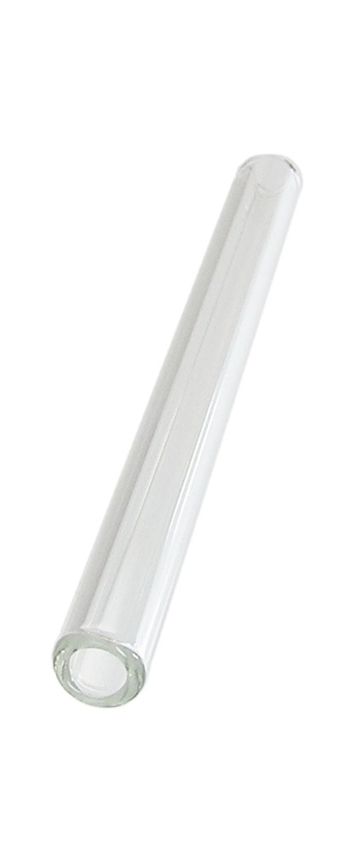
OT Forgiveness of Sin
121b
Pipe = Relationship with God (never changing)
Sin
Clog = Fellowship with God (hindered by sin)
Sacrifices = Confession of Sin (sin was forgiven to restore fellowship but relationship was never threatened)
Notes:
The Israelite relationship with God can be compared to a pipe.
Occasionally the pipe got a clog—like sin—that hindered their fellowship with God.
Did OT believers still have a relationship with God when they sinned? Yes!
Sin did not hinder their relationship with God but their fellowship with Him.
OT sacrifices did not establish a relationship with God but rather they restored their fellowship with God
_____
OP-02-Lev-28
OS-04-Num-29
OS-26-Ezek40-43-slide 73
NS-23-1Jn-58
SA-03-Biblical Terms-9

Slide 45
NT Forgiveness of Sin
121b
"If we confess our sins,
He is faithful and righteous to forgive us our sins and to cleanse us from all unrighteousness"
(1 John 1:9 NAU)
Pipe = Relationship with God (never changing)
Sin
Clog = Fellowship with God (hindered by sin)
Christ's Sacrifice = The Basis for Confession of Sin (sin is forgiven to restore fellowship but relationship has never been never threatened)
Notes:
Our relationship with God can be compared to a pipe.
Occasionally the pipe gets a clog—like sin—that hinders our fellowship with God.
Do we still have a relationship with God when we sin? Yes!
Sin does not hinder our relationship with God but our fellowship with Him.
_________
OB-38-Salvation-11
OS-03-Leviticus-56, 72, 130
OS-04-Numbers-30
NS-23-1Jn-59
SA-03-Biblical Terms-9

Slide 46
Millennial Forgiveness of Sin
121b
"The man said to me, ‘These are the kitchens to be used by the Temple assistants to boil the sacrifices offered by the people’"
(Ezekiel 46:24 NLT)
Pipe = Relationship with God (never changing)
Sin
Clog = Fellowship with God (hindered by sin)
Christ's Sacrifice = The Basis for Confession of Sin (sin is forgiven to restore fellowship but relationship has never been never threatened)
Notes:
Sacrifices in the millennium—like all sacrifices throughout history—will not in themselves forgive sin. Like all sacrifices throughout history, they will only point to the Lord Jesus as the final sacrifice for sin. Offering them will be a form of confession of sin.
_________
OB-38-Salvation-11
OS-03-Leviticus-56, 72, 130
OS-04-Numbers-30
OS-36-Zephaniah-123
NS-23-1Jn-59
SA-03-Biblical Terms-9

Slide 47
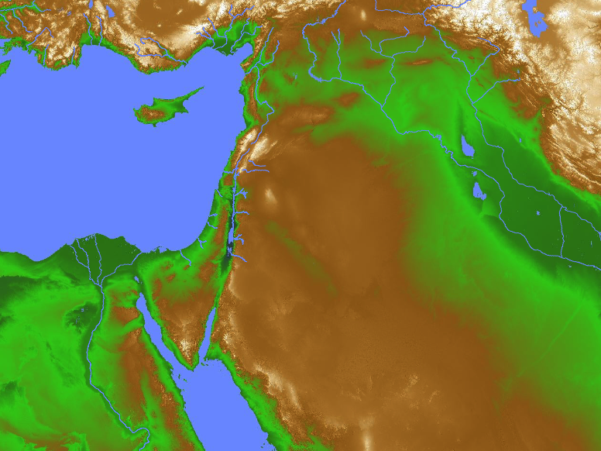
Ethiopia Worship
(Zephaniah 3:9-11)
"Then I will purify the speech of all people, so that everyone can worship the LORD together. ¹⁰My scattered people who live beyond the rivers of Ethiopia will come to present their offerings. ¹¹On that day you will no longer need to be ashamed, for you will no longer be rebels against me. I will remove all proud and arrogant people from among you. There will be no more haughtiness on my holy mountain."
Israel
Ethiopia

Slide 48
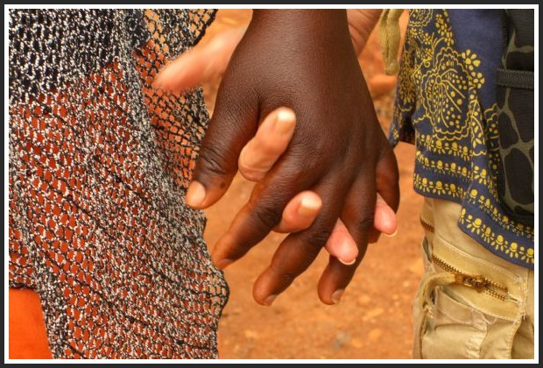
Millennial Worship
"In the end, the enemies of Jerusalem who survive the plague will go up to Jerusalem each year to worship the King... and to celebrate the Festival of Shelters. ¹⁷Any nation in the world that refuses to come to Jerusalem to worship the King... will have no rain. ¹⁸If the people of Egypt refuse to attend the festival, the LORD will punish them with the same plague that he sends on the other nations who refuse to go. ¹⁹Egypt and the other nations will all be punished if they don't go to celebrate the Festival of Shelters"
(Zechariah 14:16-19 NLT).

Slide 49
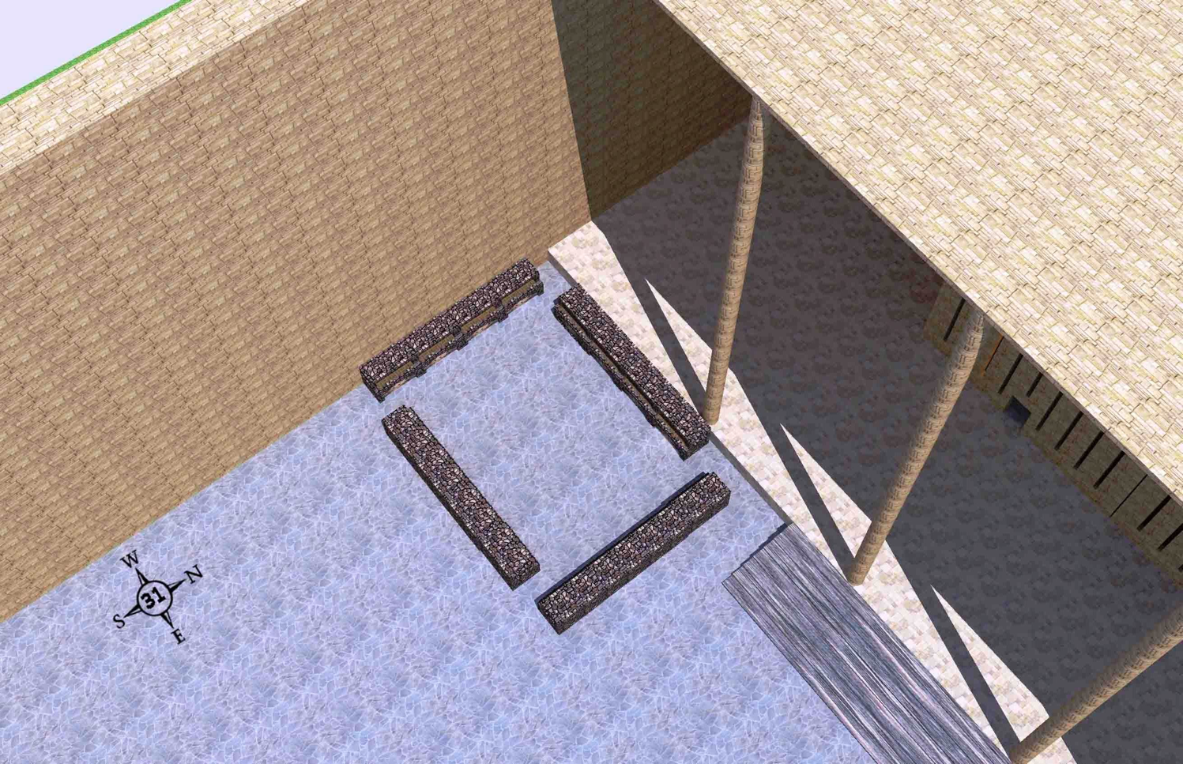
Northwest Boiling Place
(Ezekiel 46:21-24)
The northwest boiling place for the peoples' sacrifices with 4 mini-courts like this one in each corner of the outer court
Wayne ODonnell • "Ezekiel 40–48: Tour of Ezekiel's Temple" • http://bible.ag/en/enezekieltranscript.htm
Notes:
"See Picture #31. The northwest boiling place for the peoples' sacrifices. There are 4 mini-courts like this one; one in each corner of the outer court.
Ezekiel 46:21-24, "Then he brought me forth into the utter [outer] court, and caused me to pass by the four corners of the court; and, behold, in every corner of the court there was a court ... forty cubits long and thirty broad .... And there was a row of building round about in them, ... and it was made with boiling places under the rows round about. Then said he unto me, These are the places of them that boil, where the ministers of the house shall boil the sacrifice of the people." Four 40x30 cubit mini-courts, one in each corner of the outer court, for the priests to come out and boil the peoples' sacrifices, because the people cannot enter into the inner court, where the priests offer other sacrifices."
Wayne ODonnell, "Ezekiel 40–48: Tour of Ezekiel's Temple"
http://bible.ag/en/mr4web.html#EZanchor-anchor
Recorded December 30, 2007
Accessed 30 Aug 2016

Slide 50
Why Millennial Sacrifices?
527
Pre-Cross:
Looked toward Christ's Death
Post-Cross:
Look back on Christ's Death
Theocratic: like confession of sin (1 John 1:9)
Memorial: like Lord's Supper that looks back
Paul offered a temple sacrifice in AD 57 (Acts 21:26) without seeing a "digression problem"
Notes:
Since Paul offered a sacrifice, he was indicating that sacrifices in and of themselves are not the problem. They all look to Jesus, so they are not needed (Heb 10:18) as only Christ's sacrifice atones for sin. Yet they can be used for confession of sin both pre-cross and post-cross.

Slide 51
Patriarchal Family Tree
Kingly Line
91
Terah
Haran
Nahor
Abraham
Lot
Bethuel
(of Hagar) Ishmael
(of Sarah) Isaac
Laban Rebekah
married
Esau
Jacob
Leah
Rachel
(of Leah) Reuben, Simeon, Levi,
Judah, Issachar, Zebulun
(of Zilpah) Gad, Asher
(of Bilhah) Dan, Naphtali
(of Rachel)
Benjamin, Joseph
Manasseh
Ephraim
Red: Judah was not the firstborn, yet Jacob prophesied the kings of Israel would come from Judah (Gen 49:10).

Slide 52
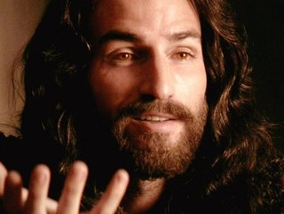
Who is the Prince in Ezekiel 40–48?
531
I. Not Christ
Needs sin offerings (45:22)
Offerings by others (46:2)
Has sons (46:16-18)
Jesus is King, not prince

Slide 53
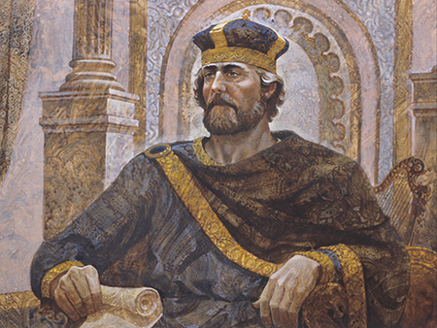
Who is the Prince in Ezekiel 40–48?
531
II. Human Serving Under Christ
Jesus still most prominent
Not ruling on David's throne
Has religious (not ruling) role
All human leaders sin

Slide 54



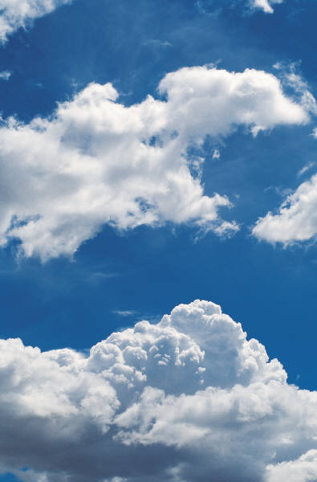


The Spirit Leaves & Returns
656
Ezek. 8:4; 9:3; 10:4; 10:18-19; 11:23
Luke 19:37; 24:50; Acts 1:10
Acts 1:11; Zech. 14:4; Ezek. 43:1-5

Slide 55
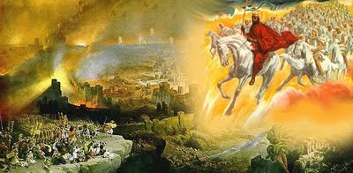
The Second Coming
"On that day, his feet will stand on the Mount of Olives east of Jerusalem"
(Zech. 14:4).

Slide 56
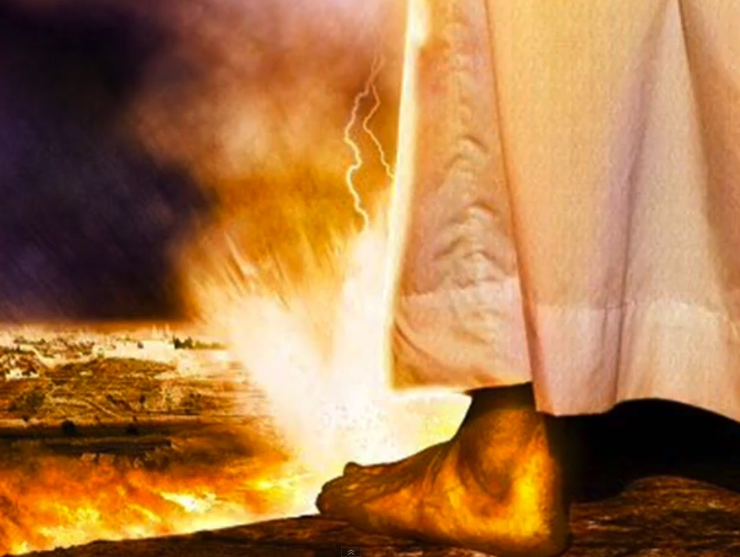
The Second Coming
"On that day, his feet will stand on the Mount of Olives east of Jerusalem…"
(Zech. 14:4a).

Slide 57
Slides on
Ezekiel 47

Slide 58
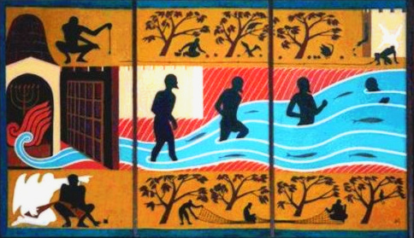
The River from Ezekiel's Temple
(47:1-12)

Slide 59
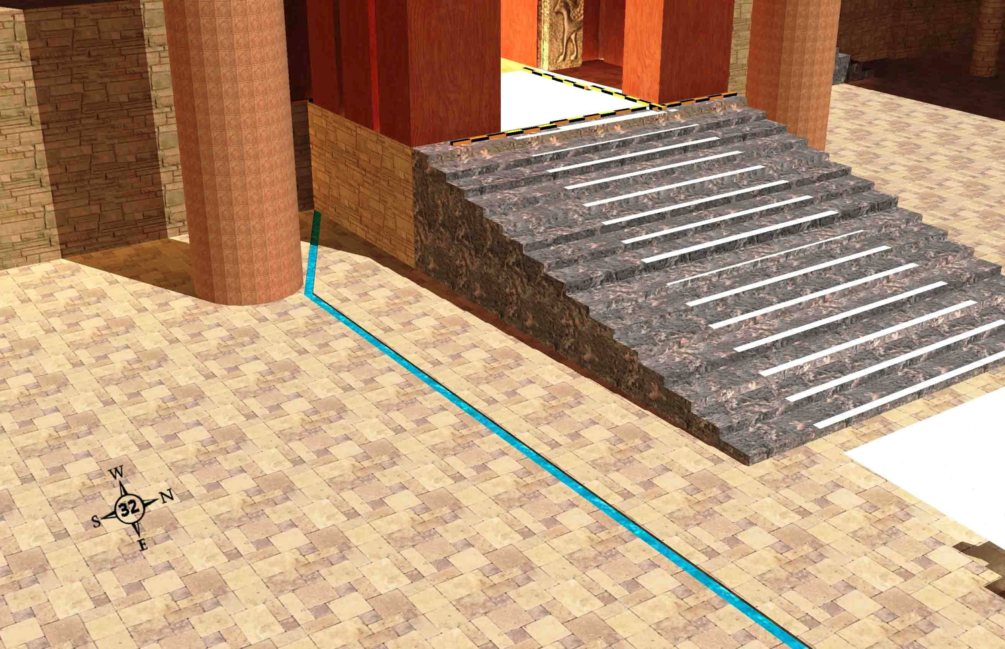
The River & the Land (Ezekiel 47:1)
519
The river that starts on the south side of the temple entrance
Wayne ODonnell • "Ezekiel 40–48: Tour of Ezekiel's Temple" • http://bible.ag/en/enezekieltranscript.htm
Notes:
"Ezekiel 47-48. The River and the Land
See Picture #32. The river that starts on the south side of the temple entrance.
Ezekiel 47:1, "Afterward he brought me again unto the door of the house," the temple, "and, behold, waters issued out from under the threshold of the house eastward: for the forefront of the house stood toward the east, and the waters came down from under from the right side of the house, at the south side of the altar." Picture #32 shows a trickle of water flowing from south side of the threshold of the temple. "The right side of the house" is the south side, since the temple faces east."
Wayne ODonnell, "Ezekiel 40–48: Tour of Ezekiel's Temple"
http://bible.ag/en/mr4web.html#EZanchor-anchor
Recorded December 30, 2007
Accessed 30 Aug 2016

Slide 60
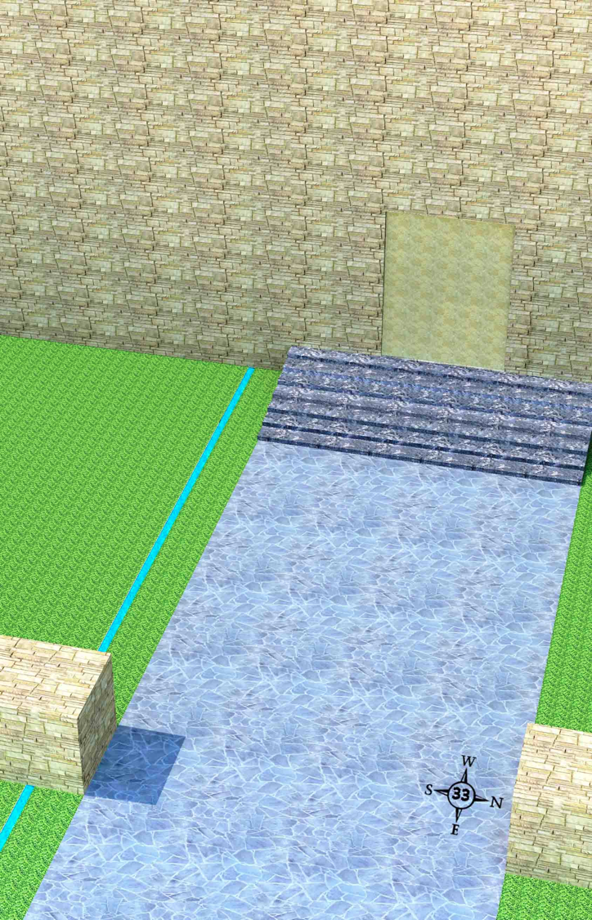
The Beginning of the River (Ezekiel 47:2)
519
The river flowing out the south side of the outer east gate
Wayne ODonnell • "Ezekiel 40–48: Tour of Ezekiel's Temple" • http://bible.ag/en/enezekieltranscript.htm
Notes:
"See Picture #33. The river flowing out the south side of the outer east gate.
Ezekiel 47:2, "Then brought he me out of the way of the gate northward, and led me about [around] the way without [outside] unto the utter [outer] gate by the way that looketh eastward; and, behold, there ran out waters on the right side." "The right side" of the gate is the south side, since the gate faces east. Why did the angel take Ezekiel out the north gate and around when he wanted to show him something outside the outer east gate? Why didn't he just take him through the outer east gate? Well, remember, the outside of the outer east gate has been sealed. So in Picture #33, we are outside the outer east gate where we started this tour, and we see the waters from the temple coming from the south side."
Wayne ODonnell, "Ezekiel 40–48: Tour of Ezekiel's Temple"
http://bible.ag/en/mr4web.html#EZanchor-anchor
Recorded December 30, 2007
Accessed 30 Aug 2016

Slide 61

The River from Ezekiel's Temple (47:1-12)
"In my vision, the man brought me back to the entrance of the Temple. There I saw a stream flowing east from beneath the door of the Temple and passing to the right of the altar on its south side"
(Ezek. 47:1 NLT).
Notes:
Bible Study Pictures and Notes for Ezekiel 38-40
http://www.jesuslovesyoutoday.org/bible_study_pictures_and_notes/ezekiel_38-40
Accessed 30 Aug 2016

Slide 62
The River from Ezekiel's Temple (47:1-12)
"In my vision, the man brought me back to the entrance of the Temple. There I saw a stream flowing east from beneath the door of the Temple and passing to the right of the altar on its south side"
(Ezek. 47:1 NLT).

Slide 63

The River from Ezekiel's Temple (47:1-12)
"In my vision, the man brought me back to the entrance of the Temple. There I saw a stream flowing east from beneath the door of the Temple and passing to the right of the altar on its south side"
(Ezek. 47:1 NLT).

Slide 64

The River Gets Deeper (Ezekiel 47:3-5)
519
The river flowing east from the temple compound gets deeper and wider
Wayne ODonnell • "Ezekiel 40–48: Tour of Ezekiel's Temple" • http://bible.ag/en/enezekieltranscript.htm
Notes:
"See Picture #34. The river flowing east from the temple compound and getting deeper and wider.
Ezekiel 47:3-5, "And when the man that had the line in his hand went forth eastward, he measured a thousand cubits, and he brought me through the waters; the waters were to the ankles. Again, he measured a thousand, and brought me through the waters; the waters were to the knees. Again he measured a thousand, and brought me through; the waters were to the loins. Afterward he measured a thousand; and it was a river that I could not pass over: for the waters were risen, waters to swim in." The waters get deeper and deeper as they flow east. The angel is using the flax string to measure each 1000-cubit stretch. The angel gets to stay on dry ground, while Ezekiel has to go through the water.
This passage is another reason why the word "reeds" in Ezekiel 42:16-19 seems incongruous. If the angel brought the flax line to measure long distances, like these 1,000 cubit stretches, why would he use the reed to measure 500 reeds, or 3,000 cubits, in Ezekiel 42? But if the word "reeds" was not in the original in 42:16-19, then the 500 cubit outside wall of the temple compound in Ezekiel 42 was the longest distance the angel measured with the reed, and we could assume all longer distances were measured with the flax line, which would probably be in common medium cubits.
Ezekiel 47:7-8, "Now when I had returned, ... then said he unto me, These waters issue out toward the east country, and go down into the desert, and go into the sea: which being brought forth into the sea, the waters shall be healed." The river from the temple goes down to the Dead Sea, and heals their salty waters.
Ezekiel 47:9-11, "And it shall come to pass, that everything ... whithersoever the rivers shall come, shall live ... And ... fishers shall stand upon it from Engedi even unto Eneglaim, ... their fish shall be according to their kinds, as the fish of the great sea [the Mediterranean], exceeding many. But the miry places thereof and the marshes thereof shall not be healed; they shall be given to salt." There's no fish in the Dead Sea today, but there will be great fishing there soon.
Ezekiel 47:12, "And by the river upon the bank ... shall grow all trees for meat, whose leaf shall not fade, neither shall the fruit thereof be consumed: it shall bring forth new fruit according to his months, because their waters they issued out of the sanctuary: and the fruit thereof shall be for meat, and the leaf thereof for medicine." The trees that are watered by the river from the temple will have leaves that provide healing, so no one will remain sick.
Not only will the waters go east and down to the Dead Sea, but half will go towards the Mediterranean Sea. Zechariah 14:8, "And it shall be in that day, that living waters shall go out from Jerusalem; half of them toward the former sea, and half of them toward the hinder sea: in summer [dryer season] and in winter [wetter season] shall it be."
In the east, the river can go down the great valley through the split in the Mount of Olives we talked about earlier to the Dead Sea. In the west, the waters from the temple, which may be at the highest point on the mountain, may first water the rest of the mountain via irrigation channels and so forth, before being gathered at the western base of the mountain to flow on to the Mediterranean. "Look upon Zion, the city of our solemnities, there the glorious LORD will be unto us a place of broad rivers and streams; wherein shall go no galley with oars, neither shall gallant ship pass thereby," Is 33:20,21. See picture #36. "I am the LORD your God dwelling in Zion, my holy mountain: ... in that day ... a fountain shall come forth out of the house of the LORD, and shall water the valley of Shittim," Joel 3:17-18."
Wayne ODonnell, "Ezekiel 40–48: Tour of Ezekiel's Temple"
http://bible.ag/en/mr4web.html#EZanchor-anchor
Recorded December 30, 2007
Accessed 30 Aug 2016
"The pictures in this chapter were taken from a video tour of a computer-generated model of the future Messianic Kingdom temple. The video tour is available from http://bible.ag. You can also download the computer model and the software to view it from Google SketchUp Warehouse, and walk through it yourself."

Slide 65

The River from Ezekiel's Temple (47:1-12)
"Measuring as he went, he took me along the stream for 1,750 feet and then led me across. The water was up to my ankles"
(Ezek. 47:3 NLT).

Slide 66

The River from Ezekiel's Temple (47:1-12)
"He measured off another 1,750 feet and led me across again. This time the water was up to my knees"
(Ezek. 47:4a NLT).

Slide 67

The River from Ezekiel's Temple (47:1-12)
"After another 1,750 feet, it was up to my waist"
(Ezek. 47:4b NLT).

Slide 68

The River from Ezekiel's Temple (47:1-12)
"Then he measured another 1,750 feet, and the river was too deep to walk across. It was deep enough to swim in, but too deep to walk through"
(Ezek. 47:5 NLT).

Slide 69

Crops from a Fresh Water Oasis
550
Ezekiel 47:10

Slide 70

The Millennial River
Geba
Millennial Temple
Rebuilt Jerusalem
Rimmon
Dead Sea
Marshes
Ezekiel 47:1-12
Notes:
At his return, Jesus will split the Mount of Olives in half (Zechariah 14:4), making a large east-west valley for which to channel water eastward from Temple Mount all the way to the Dead Sea.

Slide 71
The Millennial River
Geba
Millennial Temple
Rebuilt Jerusalem
Rimmon
Dead Sea
Marshes
Zechariah 14:8
On that day life-giving waters will flow out from Jerusalem, half toward the Dead Sea and half toward the Mediterranean, flowing continuously in both summer and winter.
Notes:
NLT 2nd ed
The Millennial River from the Temple appears in Ezekiel 47:1-10, but also in Joel 3:17 and Zechariah 14:8. Ezekiel notes only the water flowing eastward, but Zechariah adds that westward water will also reach the Mediterranean.

Slide 72
The Millennial River
Geba
Millennial Temple
Rebuilt Jerusalem
Rimmon
Dead Sea
Marshes
Joel 3:17
In that day the mountains will drip with sweet wine,
and the hills will flow with milk.
Water will fill the streambeds of Judah,
and a fountain will burst forth from the LORD’s Temple,
watering the arid valley of acacias.
Notes:
NLT 2nd ed
The Millennial River from the Temple appears in Ezekiel 47:1-10, but also in Joel 3:17 and Zechariah 14:8.

Slide 73

Israel’s Prosperity
"In that day the mountains will drip with sweet wine,
and the hills will flow with milk.
Water will fill the streambeds of Judah,
and a fountain will burst forth from the LORD's Temple,
watering the arid valley of acacias"
(Joel 3:18 NLT).

Slide 74
Topography of Israel
http://www.studylight.org/se/maps/browse.cgi?st=51&pn=11

Slide 75

The Elements Expanded
60
7
Abrahamic Covenant
Gen. 12:1-3
LAND SEED BLESSING
ABRAHAM
The CALL
L - S - B
12:1
12:2
12:3
"L-S-B"
Handbook pg. 19-24
15

Slide 76

Literal - Eternal - Unconditional
Gen. 13:15; Gen. 15
60
7
Abrahamic Covenant
Gen. 12:1-3
LAND SEED BLESSING
ABRAHAM
The CALL
L - S - B
• LITERAL
• ETERNAL
• UNCONDITIONAL
Handbook pg. 19-24
16
3

Slide 77

Types of Unconditional Covenants
60
Abrahamic
Land
Davidic
New
Land | Seed | Blessing
Physical | Political | Spiritual
Deut. 30 | 2 Sam. 7 | Jer. 31

Slide 78
Kingdom & Covenants Timeline
9g
CH-Add
OS-22
OS-337
NS-9g
Dr. Rick Griffith • Singapore Bible College • BibleStudyDownloads.org
Kingdom Teaching...
Adam rules with God (Gen. 1:26, 28; 2:19)
Satan begins rule as god of this world (Gen. 3:15;
2 Cor. 4:4)
God covenants with Abraham to reestablish man's rule via Israel as a "kingdom of priests" (Gen. 12:1-3; Exod. 19:6)
Israel's failure to witness to nations as a kingdom of priests is judged via exile under foreign rule
Israel rejects Messiah's offer of kingdom (Matt. 12:41-42; 23:37-39)
Jesus extends His kingdom in mystery form to the Church (Matt. 13)
Christ subdues Israel's enemies and nation believes (Rom. 11:26-27)
Christ rules over everything with saints (Eph. 1:9-10; Rev. 20:1-6; 22:5b)
Fall of Man (Gen. 3)
Noahic Covenant
Genesis 6:18; 9:8-17
Land Covenant
ISRAEL
CHURCH
MESSIANIC KINGDOM
(National Focus)
The "New Man" (Eph. 2:15)
Millennial Eternal
22 &
337
land
Genesis 15:18 (cf. Deut. 30:1-10) promises:
Land from Wadi of Egypt to Euphrates River (Isa. 27:12)
Eternal possession of land (Gen. 17:8) after exile/restoration
Whole world blessed via the land (Isa. 14:1-2)
Israel judged for rejecting Messiah by dispersion away from land for 19 centuries
(AD 70–AD 1948) but now partially restored (Ezek. 37:1-7)
Full restoration (Ezek. 37:8-28) Jerusalem world capital
(Isa. 2:1-5)
New Jerusalem
(Rev. 21–22)
Davidic Covenant
Christ is Head over His Church, which is a spiritual temple (Eph. 2:19-22; 2 Cor. 6:16)
Christ reigns over the world
(Isa. 11)
with saints (Rev. 5:10; 20:4-6)
Christ hands kingdom over to Father (1
Cor. 15:24)
Genesis 12:1-3
2 Samuel 7:12-16 promises:
Sons ("house" never wiped out)
Kingdom (political dynasty)
Throne (right to rule by descendants)
Temple (son to build it)
seed
Abrahamic Covenant
New Covenant
All
things made new!
(Rev. 21:5)
All 5 elements fulfilled in national restoration (Zech. 8)
Jeremiah 31:31-34 promises:
Forgiveness
Indwelling Spirit
New heart, nature, mind
Reunification of Israel and Judah
No need for evangelism
Mosaic Law replaced with first three elements of the New Covenant (Luke 22:20; 2 Cor. 3:6)
blessing
Mosaic Covenant
Law abolished, fulfilled, and replaced at the cross (Rom. 7:1-6;
1 Cor. 9:19-21; Heb. 8:13)
10th Edition
10 Nov 2020
Temporary (Gal. 3:19) and conditional (Deut. 28) to reveal sin (Rom. 7:7) and regulate Israel (Gal. 3:23-25)
Scripture has a dual kingdom-covenant theme. Israel's role from Abraham to Christ expands to include the Church (continuity) yet the Church never replaces the nation as the "new Israel" (discontinuity). Israel will enjoy world prominence after trusting Christ at His second coming.
Notes:
All agree that a partial fulfillment of the covenant to Abraham exists now to the Church in the indwelling Holy Spirit and forgiveness of sins (Jer 31:31-34)—and the ultimate fulfillment will be in the eternal state.
The main area of disagreement relates to the time period from now to eternity. Will there be a literal land, throne, and worldwide blessing to national (ethnic) Israel before the eternal kingdom? This chart shows verses giving a resounding YES to that question in a present partial fulfillment and a future full fulfillment in the normal sense of language in the verses cited. But the messianic kingdom will be in two stages—first in a millennial fulfillment to last 1000 years, but then, after that, the eternal stage in the new Jerusalem after the destruction of our present heavens and earth (Rev 21–22). What an amazing future remains for those who trust Jesus!
____________
CH-02-Nature-103
OS-02-Exodus-267-p22
OS-05-Deut-248-p22
OS-10-2Sam-96-p22
OS-23-Isaiah-97
OS-24-Jeremiah-174
OS-26-Ezekiel_1-39-slide 208
OS-26-Ezekiel_40-48-slide 124
NS-09-Gal-125
NS-19-Hebrews-319
SA-08-Mosaic Law-19

Slide 79

Millennial Kingdom Boundaries
(47:13-20)
Land Allotment in the Millennium According to Ezekiel
Mediterranean
Sea
Damascus
Hauran
Gilead
Tamar

Slide 80
Shared Land with Jews & Gentiles
“’You are to distribute this land among yourselves according to the tribes of Israel. ²²You are to allot it as an inheritance for yourselves and for the aliens who have settled among you and who have children. You are to consider them as native-born Israelites; along with you they are to be allotted an inheritance among the tribes of Israel. ²³In whatever tribe the alien settles, there you are to give him his inheritance,’ declares the Sovereign LORD”
(Ezekiel 47:21-23 NLT).
Notes:
This is millennial and not today. No one argues for distributing the land to the twelve tribes today, but they only say that the land should be shared with Gentiles today.
_____________
OS-23-Isaiah49-59—slide 79
OS-26-Ezek44-48—slide 80

Slide 81
Slides on
Ezekiel 48

Slide 82

Borders of the Land Promised to Abraham
531e
Syria
Lebanon
Israel
Genesis 15:18
"On that day the LORD made a covenant with Abram, saying, 'To your offspring I give this land, from the river of Egypt to the great river, the river Euphrates'" (ESV)
India
Egypt
Notes:
God’s promised land stretched northward from the small wadi of Egypt south in the Sinai to the large Euphrates River in the far north—a HUGE piece of real estate! When today’s boundaries are placed over this land we can see the struggle modern Israel has to claim land from Egypt, Lebanon, and Syria.
—————
OS-01-Gen4-20-slide
OS-26-Ezek44-47-slide 82 on Ezek 47

Slide 83
Eternal Land for Abraham’s Descendants
Genesis 17:7-8 (NIV)
"I will establish my covenant as an everlasting covenant between me and you and your descendants after you for the generations to come, to be your God and the God of your descendants after you. ⁸The whole land of Canaan, where you are now an alien, I will give as an everlasting possession to you and your descendants after you; and I will be their God."
Israel
Notes:
The only way that this could be an eternal possession of Abraham's descendants is for the nation to return to the land, live there in the millennium, and then the eternal state renovation will be one of this actual earth so that the new Jerusalem lies at this same spot.

Slide 84


Tribal Redistribution
Dan
531d
531e
Asher
After Conquest
(Josh. 13)
Millennial Israel
(Ezekiel
47-48)
Naphtali
Manasseh
Ephraim
Reuben
Judah
Leaders & Temple
Benjamin
Simeon
Issachar
Zebulun
Gad
Notes:
The millennial tribes will be the same as in Joshua's time, but all allotments will lie west of the Jordan River and in equal divisions. Ezekiel 47–48 shows that, in the millennium, the 12 tribal allotments under Joshua will all lie on the west side of the Jordan River. Among them also will live Gentiles with equal privileges. As there exist no distinctions between Jews and Gentiles today in the Church (Galatians 3:28), so the same will be true in the land shared between these groups in the Millennium. God's plan has no second-class citizens:
"You are to distribute this land among yourselves according to the tribes of Israel. ²²You are to allot it as an inheritance for yourselves and for the aliens who have settled among you and who have children. You are to consider them as native-born Israelites; along with you, they are to be allotted an inheritance among the tribes of Israel. ²³In whatever tribe the alien settles, there you are to give him his inheritance,’ declares the Sovereign LORD"
(Ezekiel 47:21-23 NLT).
______________
OS-06-Joshua-184
OS-26-Ezek44-48-slide 80

Slide 85

Land Portions (48:1-7)
531e
Portions of land for the tribes of Israel going straight across from east to west. I have not tried to present accurate boundaries, but rather to show the general arrangement of the tribal portions. For example, the Golan Heights will probably be within the borders of Israel, though the picture doesn't show it that way.
Wayne ODonnell • "Ezekiel 40–48: Tour of Ezekiel's Temple" • http://bible.ag/en/enezekieltranscript.htm
Notes:
"See Picture #35. Portions of land for the tribes of Israel going straight across from east to west. I have not tried to present accurate boundaries, but rather to show the general arrangement of the tribal portions. For example, the Golan Heights will probably be within the borders of Israel, though the picture doesn't show it that way.
Northern Boundaries. Ezekiel 48:1, "Now these are the names of the tribes. From the north end to the coast of the way of Hethlon, as one goeth to Hamath, Hazarenan, the border of Damascus northward, to the coast of Hamath." Hamath is present day Hama in Syria. The northern border of Israel during the Messianic Kingdom will extend to about the present northern border of Lebanon. Present day Lebanon will be part of millennial Israel.
Seven Northern Tribes. Ezekiel 48:2-7, "These are his sides east and west; a portion for Dan. And by the border of Dan, from the east side unto the west side, a portion for Asher. And by the border of Asher, from the east side even unto the west side, a portion for Naphtali. And by ... Naphtali, ... a portion for Manasseh. And by ... Manasseh, ... a portion for Ephraim. And by ... Ephraim, ... a portion for Reuben. And by ... Reuben, ... a portion for Judah." Each tribe's portion will extend completely across from the western boundaries, like the Jordan River, to the Mediterranean Sea.
Today most Jewish people don't know which tribe they are descended from, the exception being some descendants of priests and Levites who have family names like Cohen, the Hebrew word for priest, or Levi. But now we have genetic tests, and anyway the Lord knows the genealogy of everyone. Jewish tradition says that when Elijah returns before the Messianic Kingdom is set up, he will provide Jewish people with their tribal identities.
So although physical things like genealogies have no relevance in the church age or for spiritual salvation; in the future, genealogies will be important again, at least in determining how physically close to the shekinah glory a person will be able to live.
Some Gentiles, possibly proselytes, will dwell among the tribes in the land, "in what tribe the stranger sojourneth, there shall ye give him his inheritance," Ez47:23. And some Gentiles in their natural bodies during the kingdom will become servants to Israelites so they can live in the land. "Strangers shall stand and feed your flocks, and the sons of the alien shall be your plowmen and your vinedressers ... For your shame, ye shall have double [blessing, joy, inheritance, etc.]," Is60:1-61:7."
Wayne ODonnell, "Ezekiel 40–48: Tour of Ezekiel's Temple"
http://bible.ag/en/mr4web.html#EZanchor-anchor
Recorded December 30, 2007
Accessed 30 Aug 2016

Slide 86

Populations by Tribe
171
Asher
53,400
Naphtali
45,400
Numbers 26
Joshua 13:1–19:48
Zebulun
60,500
Manasseh
Issachar
64,300
Manasseh
52,700
Levi
23,000
Spread Throughout Israel
Gad
40,500
Ephraim
32,500
Dan
64,400
Benjamin
45,600
Reuben
43,730
Judah
76,500
Simeon
22,200

Slide 87
End Time Geography
531d
531e
Highlighted in blue from
Ezek. 45:1-8; 48:9-22
THE
RESTORATION
OF PALESTINE
Ezekiel 47–48
THE DIVISION OF THE LAND DURING THE MILLENNIUM
Raymond Ludwigson, A Survey of Bible Prophecy, 56
Charles Dyer, "Ezekiel," in The Bible Knowledge Commentary, 1:1314
Notes:
The significant differences between the two depictions of the leadership territory is due to two views on the measuring rod used.
Note that the holy land of the Temple Mount today lies south of Benjamin and north of Judah. However, the millennial location will the same, but Judah will shift NORTH of the temple area and Benjamin shift SOUTH so that these two tribes will switch places and yet still keep the temple in between them.
_____________
ES-26-Restoration of Israel-
OS-06-Joshua-185
OS-26-Ezek44-48-slide 83

Slide 88
Priests, Levites & Prince Comparisons
531d-e
Highlighted in blue from
Ezek. 45:1-8; 48:9-22

Slide 89

You can't have this area in the sea
521
656
"Ezekiel's Temple: Tour of the Temple of Ezekiel's Vision" • http://ezekiel-temple.narod.ru/ezekiel_45.htm • This group plans to build the temple in the desert of Israel!
Notes:
They say (with poor English!):
"Why is the Temple according to the prophecy of Ezekiel can not be built in Jerusalem?"
1. Ezekiel 40:2
The Temple is located on the south side of the mountain.
Solomon's Temple was built in the north-east side of Mount Zion. On the south side of Mount Zion is the steep rock.
Ezekiel's Mountain is "very high."
Mount Zion looks like a hill.
- Where to get a high mountain which has a gently sloping southern slope? This would be another mountain, not Zion.
Accessed 31 August 2016
Ezek 45:2 Of this there shall be for the sanctuary five hundred in length, with five hundred in breadth, square round about; and fifty cubits round about for the suburbs thereof.
3 And of this measure shalt thou measure the length of five and twenty thousand, and the breadth of ten thousand: and in it shall be the sanctuary and the most holy place.
2 "Out of this there shall be for the holy place a square round about five hundred by five hundred cubits, and fifty cubits for its open space round about.
3 "From this area you shall measure a length of 25,000 cubits and a width of 10,000 cubits; and in it shall be the sanctuary, the most holy place.

Slide 90

Some want the Temple in the Desert!
521
656
"Ezekiel's Temple: Tour of the Temple of Ezekiel's Vision" • http://ezekiel-temple.narod.ru/ezekiel_45.htm • This group plans to build the temple in the desert of Israel!
Notes:
Accessed 31 August 2016
Ezek 45:2 Of this there shall be for the sanctuary five hundred in length, with five hundred in breadth, square round about; and fifty cubits round about for the suburbs thereof.
3 And of this measure shalt thou measure the length of five and twenty thousand, and the breadth of ten thousand: and in it shall be the sanctuary and the most holy place.
2 "Out of this there shall be for the holy place a square round about five hundred by five hundred cubits, and fifty cubits for its open space round about.
3 "From this area you shall measure a length of 25,000 cubits and a width of 10,000 cubits; and in it shall be the sanctuary, the most holy place.

Slide 91

The Temple Area Moved South Over Present Israel
521
656
"Ezekiel's Temple: Tour of the Temple of Ezekiel's Vision" • http://ezekiel-temple.narod.ru/ezekiel_45.htm • This group plans to build the temple in the desert of Israel!
Notes:
Accessed 31 August 2016

Slide 92


Some plan for the Temple in the Desert!
521
656
"Ezekiel's Temple: Tour of the Temple of Ezekiel's Vision" • http://ezekiel-temple.narod.ru/ezekiel_45.htm • This group plans to build the temple in the desert of Israel!
Notes:
Accessed 31 August 2016

Slide 93
Some want the Temple in the Desert!
521
656
"Ezekiel's Temple: Tour of the Temple of Ezekiel's Vision" • http://ezekiel-temple.narod.ru/ezekiel_45.htm • This group plans to build the temple in the desert of Israel!
Notes:
Accessed 31 August 2016
Ezek 45:2 Of this there shall be for the sanctuary five hundred in length, with five hundred in breadth, square round about; and fifty cubits round about for the suburbs thereof.
3 And of this measure shalt thou measure the length of five and twenty thousand, and the breadth of ten thousand: and in it shall be the sanctuary and the most holy place.
2 "Out of this there shall be for the holy place a square round about five hundred by five hundred cubits, and fifty cubits for its open space round about.
3 "From this area you shall measure a length of 25,000 cubits and a width of 10,000 cubits; and in it shall be the sanctuary, the most holy place.

Slide 94
The Temple Area Over Present Jerusalem
521
656
"Ezekiel's Temple: Tour of the Temple of Ezekiel's Vision" • http://ezekiel-temple.narod.ru/ezekiel_45.htm • This group plans to build the temple in the desert of Israel!
Notes:
Accessed 31 August 2016

Slide 95

Some want the Temple in the Desert!
521
656
"Ezekiel's Temple: Tour of the Temple of Ezekiel's Vision" • http://ezekiel-temple.narod.ru/ezekiel_45.htm • This group plans to build the temple in the desert of Israel!
Notes:
Accessed 31 August 2016
Ezek 45:2 Of this there shall be for the sanctuary five hundred in length, with five hundred in breadth, square round about; and fifty cubits round about for the suburbs thereof.
3 And of this measure shalt thou measure the length of five and twenty thousand, and the breadth of ten thousand: and in it shall be the sanctuary and the most holy place.
2 "Out of this there shall be for the holy place a square round about five hundred by five hundred cubits, and fifty cubits for its open space round about.
3 "From this area you shall measure a length of 25,000 cubits and a width of 10,000 cubits; and in it shall be the sanctuary, the most holy place.

Slide 96


Some want the Temple in the Desert!
521
656
"Ezekiel's Temple: Tour of the Temple of Ezekiel's Vision" • http://ezekiel-temple.narod.ru/ezekiel_45.htm • This group plans to build the temple in the desert of Israel!
Notes:
Accessed 31 August 2016
Ezek 45:2 Of this there shall be for the sanctuary five hundred in length, with five hundred in breadth, square round about; and fifty cubits round about for the suburbs thereof.
3 And of this measure shalt thou measure the length of five and twenty thousand, and the breadth of ten thousand: and in it shall be the sanctuary and the most holy place.
2 "Out of this there shall be for the holy place a square round about five hundred by five hundred cubits, and fifty cubits for its open space round about.
3 "From this area you shall measure a length of 25,000 cubits and a width of 10,000 cubits; and in it shall be the sanctuary, the most holy place.

Slide 97

Some want the Temple in the Desert!
521
656
"Ezekiel's Temple: Tour of the Temple of Ezekiel's Vision" • http://ezekiel-temple.narod.ru/ezekiel_45.htm • This group plans to build the temple in the desert of Israel!
Notes:
Accessed 31 August 2016
Ezek 45:2 Of this there shall be for the sanctuary five hundred in length, with five hundred in breadth, square round about; and fifty cubits round about for the suburbs thereof.
3 And of this measure shalt thou measure the length of five and twenty thousand, and the breadth of ten thousand: and in it shall be the sanctuary and the most holy place.
2 "Out of this there shall be for the holy place a square round about five hundred by five hundred cubits, and fifty cubits for its open space round about.
3 "From this area you shall measure a length of 25,000 cubits and a width of 10,000 cubits; and in it shall be the sanctuary, the most holy place.

Slide 98

Some want the Temple in the Desert!
521
656
"Ezekiel's Temple: Tour of the Temple of Ezekiel's Vision" • http://ezekiel-temple.narod.ru/ezekiel_45.htm • This group plans to build the temple in the desert of Israel!
Notes:
Accessed 31 August 2016
Ezek 45:2 Of this there shall be for the sanctuary five hundred in length, with five hundred in breadth, square round about; and fifty cubits round about for the suburbs thereof.
3 And of this measure shalt thou measure the length of five and twenty thousand, and the breadth of ten thousand: and in it shall be the sanctuary and the most holy place.
2 "Out of this there shall be for the holy place a square round about five hundred by five hundred cubits, and fifty cubits for its open space round about.
3 "From this area you shall measure a length of 25,000 cubits and a width of 10,000 cubits; and in it shall be the sanctuary, the most holy place.

Slide 99

Some want the Temple in the Desert!
521
656
"Ezekiel's Temple: Tour of the Temple of Ezekiel's Vision" • http://ezekiel-temple.narod.ru/ezekiel_45.htm • This group plans to build the temple in the desert of Israel!
Notes:
Accessed 31 August 2016
Ezek 45:2 Of this there shall be for the sanctuary five hundred in length, with five hundred in breadth, square round about; and fifty cubits round about for the suburbs thereof.
3 And of this measure shalt thou measure the length of five and twenty thousand, and the breadth of ten thousand: and in it shall be the sanctuary and the most holy place.
2 "Out of this there shall be for the holy place a square round about five hundred by five hundred cubits, and fifty cubits for its open space round about.
3 "From this area you shall measure a length of 25,000 cubits and a width of 10,000 cubits; and in it shall be the sanctuary, the most holy place.

Slide 100

Central Location
531d
OT Jerusalem was in Benjamin north of Judah but close to the northern tribes
Jerusalem
Notes:
100
Some say Jerusalem was in the "navel" of Israel, meaning the center!

Slide 101

Jerusalem was a Border City
531d
The OT border between Benjamin and Judah ran just south of the city
Benjamin
Judah

Slide 102

The Priestly Portion (48:8-21)
531e
Division of the land on and beside the mountain of the Lord
Wayne ODonnell • "Ezekiel 40–48: Tour of Ezekiel's Temple" • http://bible.ag/en/enezekieltranscript.htm
Notes:
"See picture #36. Division of the land on and beside the mountain of the Lord.
Now we have a repeat of the description of the holy portion of the land that we saw in chapter 45, but with some added details.
Levi (Including the Priests), Prince David, and the Temple Compound. Ezekiel 48:8, "And by the border of Judah, from the east side unto the west side, shall be the offering which ye shall offer of five and twenty thousand reeds in breadth, and in length as one of the other parts, from the east side unto the west side: and the sanctuary shall be in the midst of it." Just like each tribe's portion is a strip of land going all the way from the east to the west border, the land offering is a 25,000 broad strip, that goes all the way from the east border to the west border.
Here in chapter 48, we have, like in 45:1-8, a long passage with many dimensions, with no unit of measure provided. Once again, the KJV translators have tried to help us out by adding the word "reeds" in verse 8, near the mention of the sanctuary, which was said to be measured in reeds in 42:16-19.
It is interesting that the Lord could easily have provided us one mention of the word "reeds" in 45:1-8, and one mention here in chapter 48, just as the translators have done. Instead, if 42:16-19 is not a gloss, we have to refer back to those four verses to know what these units of measures are. What could be the Lord's purpose in making the interpretation so indirect? Did he want to leave open the possibility of a 'cubit' interpretation for those who might stumble in faith at the huge sizes of a 'reed' interpretation?
On the other hand, if 42:16-19 is a gloss, and the gloss had not been made, there would be no mystery in the text, and the interpretation would be straightforward, because the unit of measure throughout this entire vision has been cubits. As mentioned earlier, apart from 42:16-19, only verses 40:5; 40:6; 40:7; 40:8; and 41:8 measured anything in reeds, and all five measurements were exactly one reed long.
Ezekiel 48:9-11, "The oblation that ye shall offer unto the LORD shall be of five and twenty thousand in length, and of ten thousand in breadth ... and the sanctuary of the LORD shall be in the midst thereof. It shall be for the priests that are sanctified of the sons of Zadok; which have kept my charge, which went not astray when the children of Israel went astray, as the Levites went astray." The 25,000 by 10,000 cubit portion for the priests, is specifically for the sons of Zadok. It includes the temple compound. I did not show the temple compound centered in the middle of the priests' portion, because the Hebrew word translated "in the midst thereof" in the KJV, simply means "in it."
Ezekiel 48:12-14, "And this oblation of the land that is offered shall be unto them a thing most holy by the border of the Levites. And over against the border of the priests the Levites shall have five and twenty thousand in length, and ten thousand in breadth ... And they shall not sell of it, neither exchange, nor alienate the firstfruits of the land: for it is holy unto the LORD."
When Ezekiel was delineating the tribal portions, he kept using the Hebrew word "al," meaning "on" or "against," to show that each portion was right next to and up against the previous one. "By ['al'] the border of Dan ... a portion for Asher, ... by ['al'] the border of Asher ... a portion for Naphtali, ... by ['al'] the border of Naphtali ... a portion for Manasseh, [etc.] ... by ['al'] the border of Judah ... shall be the offering, ... it shall be for the priests," Ez48:2-8. If Ezekiel went on using 'al,' "by the border of the priests, a portion for Levi; by the border of the Levites, a portion for the city, by the border of the city, a portion for Benjamin," we would know the order of the sub-portions within the holy portion.
But the sub-portions within the holy portion of the land are described in order of importance, not in geographical order. The portion of the Levites does not lie next to the portion of the priests, because Ezekiel changes from the Hebrew word 'al,' meaning 'against,' to the Hebrew word 'el,' meaning 'to' or 'towards,' and also to the Hebrew word 'umah,' meaning 'corresponding to' or 'parallel to,' but not necessarily up against, as in 2 Samuel 16:13, "As David and his men went by the way, Shimei went along on the hill's side over against ['umah'] him, and cursed as he went, and threw stones at him, and cast dust."
He says, "A thing most holy [the priests' portion] by ["towards"; 'el,' not 'al'] the border of the Levites. And over against ["corresponding to," 'umah'] the border of the priests, the Levites," Ez48:12-13. This shows that the Levites portion is probably not right next to the priests' portion; the city is probably in between.
Ezekiel 48:15-17, "And the five thousand, that are left in the breadth over against the five and twenty thousand, shall be a profane place for the city, for dwelling, and for suburbs: and the city shall be in the midst thereof. And these shall be the measures thereof; the north side ... and the south side ... and on the east side ... and the west side four thousand and five hundred. And the suburbs of the city shall be toward the north ... and toward the south ... and toward the east ... and toward the west two hundred and fifty." The city will be 4,500 x 4,500, with a 250 cubit border all around, for a total size of 5,000 x 5000 cubits square.
Ezekiel 48:18-19, "And the residue in length over against the oblation of the holy portion shall be ten thousand eastward, and ten thousand westward: ... and the increase thereof shall be for food unto them that serve the city. And they that serve the city shall serve it out of all the tribes of Israel." On both sides of the city, there is a 5,000 by 10,000 cubit area left over, to be used for growing food for the city. The city will be inhabited with people from all the tribes, even though each tribe has its own portion elsewhere.
Ezekiel 48:20, "All the oblation ['offering' of the land] shall be five and twenty thousand by five and twenty thousand: ye shall offer the holy oblation foursquare, with ['including'] the [profane] possession of the city." The total of the priests' portion with the temple, the Levites' portion, and Jerusalem's portion, is 25,000 by 25,000 square.
Ezekiel 48:21, "And the residue shall be for the prince, on the one side and on the other of the [25,000 x 25,000] holy oblation, and of the possession of the city; over against the five and twenty thousand of the oblation toward the east border, and westward over against the five and twenty thousand toward the west border." On each side of the 25,000 by 25,000 square area, running to the Mediterranean Sea on the west, and to the Jordan River and the Dead Sea (or shall we call it the Living Sea by this time) on the east, shall be a 25,000 cubit wide portion for David, and his descendants, and his government expenses."
Wayne ODonnell, "Ezekiel 40–48: Tour of Ezekiel's Temple"
http://bible.ag/en/mr4web.html#EZanchor-anchor
Recorded December 30, 2007
Accessed 30 Aug 2016

Slide 103

The Plain & Holy Portion in Cubits
(Zech. 14:10)
531e
Wayne ODonnell • "Ezekiel 40–48: Tour of Ezekiel's Temple" • http://bible.ag/en/enezekieltranscript.htm
Notes:
"See picture #37. The Plain and the Holy Portion in Cubits.
Zechariah says the plain that the mountain of the Lord will sit upon will extend from Geba (see picture #37), Jaba today, about 6 miles northeast of Jerusalem; to Rimmon (see picture #37), probably En-Rimmon, about 36 miles southeast of Jerusalem, near Beersheba.
"All the land shall be turned into a plain from Geba to Rimmon south of Jerusalem. She shall be raised up and inhabited in her place from Benjamin's Gate to the place of the First Gate and the Corner Gate, and from the Tower of Hananel to the king's winepresses," NKJV Zech14:10. All the Judean Mountains, which you can see within the dashed oval in the center of picture #37, will be leveled; but the Samarian Hills, the area within the dashed oval to the right of picture #37, will remain. Jerusalem will be lifted up "in her place"; probably with the same geographical features that are there now, only higher.
How much higher? The current elevation of Jerusalem is about 2,500 feet. Altitude sickness, in our present time at least, begins around 8,000 feet. The highest alpine tree line in the world is at about 17,000 feet, so that's not an issue. So probably, the mountain of the Lord's house will be less than 8,000 feet high. But in addition to Jerusalem being raised, other mountains in the earth will be lowered, so the mountain at Jerusalem will be the highest, and yet still have a pleasant environment.
In picture #37, the temple, the very tiny black square at the northeast corner of the city square, is located on the temple mount; and the northeast corner of the city, the small square in the middle of the mountain, is at the location of the original city of Jerusalem (the city of David)."
Wayne ODonnell, "Ezekiel 40–48: Tour of Ezekiel's Temple"
http://bible.ag/en/mr4web.html#EZanchor-anchor
Recorded December 30, 2007
Accessed 30 Aug 2016

Slide 104

The Plain & Holy Portion in Reeds
(Zech. 14:10)
531e
Wayne ODonnell • "Ezekiel 40–48: Tour of Ezekiel's Temple" • http://bible.ag/en/enezekieltranscript.htm
Notes:
"See picture #38. The Plain and the Holy Portion in Reeds.
Although I used a lot of space describing why it seems a scribe may have added the word "reeds" four times to the Hebrew of Ezekiel 42:16-19; it may very well be that "reeds" is the correct reading, so I have presented picture #38 as a possible representation of the holy portion of the land in reeds. However, I used a reed of 6 medium cubits, rather than 6 long cubits, in preparing picture #38.
Again, the temple, the very tiny black square at the northeast corner of the city, is located on the temple mount; and the city's northeast corner is at the location of the original city of Jerusalem (the city of David).
If the measurements are in reeds, the land boundaries for the priests, Levites, the city, and the prince would probably have to extend beyond the mountain of the Lord, because otherwise the mountain would have to extend over the Dead Sea. Now, I have no problem believing the God who made the earth can make major changes to the land of Israel before the Messianic Kingdom is set up. But when God describes the borders of messianic Israel as being from the Jordan River to the Mediterranean Sea, it doesn't sound like he is talking about a repositioned Jordan River and Mediterranean Sea. "From the land of Israel by Jordan, ... this is the east side. ... The west side also shall be the great sea." Ez47:18-20."
Wayne ODonnell, "Ezekiel 40–48: Tour of Ezekiel's Temple"
http://bible.ag/en/mr4web.html#EZanchor-anchor
Recorded December 30, 2007
Accessed 30 Aug 2016

Slide 105

The Priests & Temple
531e
Zechariah 1:10-11, 14-17; Ezekiel 48:22-35
Wayne ODonnell • "Ezekiel 40–48: Tour of Ezekiel's Temple" • http://bible.ag/en/enezekieltranscript.htm
Notes:
"See picture #39. Jerusalem in Cubits.
Picture #39 shows Jerusalem "raised up and inhabited in her place," Zech14:10, with her existing geography intact, and the large valley through the mount of Olives, with the east river flowing down it, as a way up to the city on the mountain of the Lord's house.
The measurements are in cubits, because if the measurements were in reeds, a 250 reed border around the city where there can be no houses would cover all of what is shown as "The City" in picture #39, and more. In that case, the inhabited part of the city couldn't include the original Jerusalem, the city of David, or any of the landmarks mentioned in Zechariah 14:10, "from Benjamin's Gate to the place of the First Gate and the Corner Gate, and from the Tower of Hananel to the king's winepresses. The people shall dwell in it. ... Jerusalem shall be safely inhabited," Zech14:10-11.
It is hard to tell where those old gates and landmarks were. They may be south of the temple mount, because what we call the "Old City" today, was actually the "New City" before, part of it even being called "Bezetha," meaning "New City". Picture #39 shows where the "So-called 'Old' City" is today, and also where the "So-called Mt. Zion" is today. But the real Mt. Zion, and the original location of Jerusalem, and an area called the "Ophel," is marked as "Zion & City of David" and "Levi Gate" in the picture. The city was located there because it had access to the Gihon Spring from tunnels within its fortifications, which made the city very difficult to capture by siege.
Or, alternatively, if the landmarks Zechariah 14:10-11 talks about were north of the temple mount, then perhaps the verses refer to priests dwelling in those places in the future.
God made many promises regarding Zion and Jerusalem, and it sounds like he is referring to the same Zion and Jerusalem that we know of, not ones in new locations. "Thus saith the LORD of hosts; I am jealous for Jerusalem and for Zion with a great jealousy ... I am returned to Jerusalem with mercies: my house shall be built in it, ... and a line shall be stretched forth upon Jerusalem ... The LORD shall yet comfort Zion, and shall yet choose Jerusalem," Zech1:14-17.
Picture #39 tries to place the altar of the future temple compound, in the same location as the altar of the first and second temples. As far as I can see from 2 Samuel 24, it is the altar's location that is important to be the same, rather than the location of the holy of holies being the same, even though the future altar has steps to the east, and the previous altars had ramps to the south.
David built the altar on the threshing floor where the plague stopped at Jerusalem, and it was the location of the altar that determined the location of the most holy place. Also, it is the altar, rather than the most holy place, that is at the exact center of the future temple. The message of these chapters in Ezekiel, and the meaning of the Messianic Kingdom and the mountain of the Lord's house, is not only that God is holy, but that God who is holy will dwell with men, and that is only made possible by the altar, or more specifically, by what it symbolizes, the substitutionary death of Yeshua.
There are various theories as to where the 1st and 2nd temples stood on the temple mount. I used a southern placement, with the assumption that the Antonia Fortress was located where the Dome of the Rock is now, as you can see in picture #39.
Southern Tribes. Ezekiel 48:22-27, "As for the rest of the tribes, from the east side unto the west side, Benjamin shall have a portion. And by the border of Benjamin, from the east side unto the west side, Simeon shall have a portion. And by ... Simeon, ... Issachar a portion. And by ... Issachar, ... Zebulun a portion. And by the border of Zebulun, from the east side unto the west side, Gad a portion."
Southern Border. Ezekiel 48:28, "And by the border of Gad, at the south side southward, the border shall be even from Tamar unto the waters of strife in Kadesh, and to the river toward the great sea. This is the land which ye shall divide by lot unto the tribes of Israel for inheritance." The southern border will extend to the Brook of Egypt, the Wadi el-Arish.
Ezekiel 48:30-34, "And the gates of the city shall be after the names of the tribes of Israel: three gates northward; Reuben, ... Judah, ... Levi. And at the east side ... Joseph ... Benjamin ... Dan. And at the south side ... Simeon ... Issachar ... Zebulun. At the west side ... Gad ... Asher ... Naphtali." Jerusalem will have three gates on each side, named after the twelve tribes. The name of Levi, which is often left out when naming the 12 tribes, will be included; and Ephraim and Manasseh, which are often named separately when naming the 12 tribes, will be represented as "Joseph." In picture #39, I showed four of these gates, starting with the Reuben Gate in the northwest, and going clockwise to the Joseph gate.
Ezekiel 48:35, "And the name of the city from that day shall be, The LORD is there." Jerusalem will be given a new name "from that day" than it has during our day. It will be called "Jehovah Shammah," meaning "Jehovah Is There." 'There', not 'here', since most of the world's population will be referring to it while living outside the land.
Jehovah Shammah is what this is all about. The place will be special, because the Lord will be there, and God has allowed us to see some of it in advance, and we will be going there various times during the Messianic Kingdom."
Wayne ODonnell, "Ezekiel 40–48: Tour of Ezekiel's Temple"
http://bible.ag/en/mr4web.html#EZanchor-anchor
Recorded December 30, 2007
Accessed 30 Aug 2016

Slide 106
Patriarchal Family Tree
Patriarchal Family Tree
91
Terah
Haran
Nahor
Abraham
Lot
Bethuel
(of Hagar) Ishmael
(of Sarah) Isaac
Laban Rebekah
married
Esau
Jacob
Leah
Rachel
(of Leah) Reuben, Simeon, Levi,
Judah, Issachar, Zebulun
(of Zilpah) Gad,
Asher
(of Bilhah) Dan, Naphtali
(of Rachel)
Benjamin, Joseph
Manasseh
Ephraim
Green = line of blessing with rights of firstborn even though none of these were born first (1 Chron. 5:1-2)

Slide 107
Tribal Boundaries of Israel
Naphtali
171
Asher
Zebulun
Manasseh
Issachar
Joshua 13:1–19:48
Manasseh
Gad
Ephraim
Dan
Ammon
Benjamin
Reuben
Judah
Simeon
Moab
Eastern tribes
Firstborn double portion & kingly tribe
Seven tribal allotments by lot
Neighboring nations related by blood
Edom

Slide 108
Tribal Redistribution
Dan
531e
146
147
Asher
After Conquest
(Josh. 13)
Millennial Israel
(Ezek.
47–48)
Naphtali
Manasseh
Ephraim
Reuben
Judah
Leaders & Temple
Benjamin
Simeon
Issachar
Millennial Jerusalem in Ezekiel 47 retains its central location but is south (not north) of Judah
Zebulun
Gad

Slide 109

Another View of the Eastern Border
Tim LaHaye
This would bring the border all the way back to Abraham's original home at Ur

Slide 110

Will Israel's millennial border go all the way east to the Euphrates River?

Slide 111
Land Portions (48:1-7)
531e
"Portions of land for the tribes of Israel going straight across from east to west. I have not tried to present accurate boundaries, but rather to show the general arrangement of the tribal portions. For example, the Golan Heights will probably be within the borders of Israel, though the picture doesn't show it that way."
Wayne ODonnell • "Ezekiel 40–48: Tour of Ezekiel's Temple" • http://bible.ag/en/enezekieltranscript.htm
Notes:
"See Picture #35. Portions of land for the tribes of Israel going straight across from east to west. I have not tried to present accurate boundaries, but rather to show the general arrangement of the tribal portions. For example, the Golan Heights will probably be within the borders of Israel, though the picture doesn't show it that way.
Northern Boundaries. Ezekiel 48:1, "Now these are the names of the tribes. From the north end to the coast of the way of Hethlon, as one goeth to Hamath, Hazarenan, the border of Damascus northward, to the coast of Hamath." Hamath is present day Hama in Syria. The northern border of Israel during the Messianic Kingdom will extend to about the present northern border of Lebanon. Present day Lebanon will be part of millennial Israel.
Seven Northern Tribes. Ezekiel 48:2-7, "These are his sides east and west; a portion for Dan. And by the border of Dan, from the east side unto the west side, a portion for Asher. And by the border of Asher, from the east side even unto the west side, a portion for Naphtali. And by ... Naphtali, ... a portion for Manasseh. And by ... Manasseh, ... a portion for Ephraim. And by ... Ephraim, ... a portion for Reuben. And by ... Reuben, ... a portion for Judah." Each tribe's portion will extend completely across from the western boundaries, like the Jordan River, to the Mediterranean Sea.
Today most Jewish people don't know which tribe they are descended from, the exception being some descendants of priests and Levites who have family names like Cohen, the Hebrew word for priest, or Levi. But now we have genetic tests, and anyway the Lord knows the genealogy of everyone. Jewish tradition says that when Elijah returns before the Messianic Kingdom is set up, he will provide Jewish people with their tribal identities.
So although physical things like genealogies have no relevance in the church age or for spiritual salvation; in the future, genealogies will be important again, at least in determining how physically close to the shekinah glory a person will be able to live.
Some Gentiles, possibly proselytes, will dwell among the tribes in the land, "in what tribe the stranger sojourneth, there shall ye give him his inheritance," Ez47:23. And some Gentiles in their natural bodies during the kingdom will become servants to Israelites so they can live in the land. "Strangers shall stand and feed your flocks, and the sons of the alien shall be your plowmen and your vinedressers ... For your shame, ye shall have double [blessing, joy, inheritance, etc.]," Is60:1-61:7."
Wayne ODonnell, "Ezekiel 40–48: Tour of Ezekiel's Temple"
http://bible.ag/en/mr4web.html#EZanchor-anchor
Recorded December 30, 2007
Accessed 30 Aug 2016

Slide 112
A Mediating View is Probably Most Accurate
Damascus
Hauran
Ezekiel 47:18 says, "The eastern border starts at a point between Hauran and Damascus and runs south along the Jordan River between Israel and Gilead, past the Dead Sea and as far south as Tamar. This will be the eastern border."
Gilead
Tamar
Notes:
But see Jeremiah 50:18-20…
Therefore, this is what the LORD of Heaven’s Armies,
the God of Israel, says:
“Now I will punish the king of Babylon and his land,
just as I punished the king of Assyria.
19 And I will bring Israel home again to its own land,
to feed in the fields of Carmel and Bashan,
and to be satisfied once more
in the hill country of Ephraim and Gilead.
20 In those days,” says the LORD,
“no sin will be found in Israel or in Judah,
for I will forgive the remnant I preserve.

Slide 113
Support for the Future Millennial Rest in Hebrews 4
NTS 266i
The context
The land promise
Other Scripture
Extra-biblical references
Hebrews 4:8 time period
An objection rebuffed

Slide 114

Millennial Jerusalem (Isaiah)
106
"The law will go out from Zion,
the word of the LORD from Jerusalem"
––Isaiah 2:3

Slide 115
Borders of the Land Promised to Abraham
61
531e
Syria
Lebanon
Israel
Jordan
Genesis 15:18
"On that day the LORD made a covenant with Abram, saying, 'To your offspring I give this land, from the river of Egypt to the great river, the river Euphrates'" (ESV)
India
Egypt
Notes:
God’s promised land stretched northward from the small wadi of Egypt south in the Sinai to the large Euphrates River in the far north—a HUGE piece of real estate! When today’s boundaries are placed over this land, we can see the struggle modern Israel has to claim land from Egypt, Lebanon, Syria and possibly even Jordan on the other side of the Jordan River.
"The promise of the land to Abraham and the patriarchs of Israel is widely attested (Gen 12:1; 15:18–21; 17:8; 26:3; 28:4, 13; 35:12; 48:6, 16, 21–22; Exod 3:8, 17; 6:8; 13:5; 23:23, 28–33; 33:1–3; 34:11; Num 34:29; Deut 1:7–8; 3:21; 7:16, 19; 9:1–3; 11:23–25; 31:3–8; Josh 1:2–5)."
Mark F. Rooker, “The Book of Joshua,” in The World and the Word: An Introduction to the Old Testament (Nashville, TN: B&H Academic, 2011), 284–285.
______________
Common Arabic-136
Common English-95
BE-31-Obadiah-83
BG-13-Present & Future-6
OS-01-Gen4-20 (Gen 12)-221
OS-04-Numbers-235
OS-06-Joshua-21
OS-17-Esther-16
OS-31-Obadiah-159

Slide 116
7
Gen. 22:2; 2 Chr. 3:1
WHICH SON?
"Then God said, ‘Take your son, your only son, Isaac, whom you love, and go to the region of Moriah. Sacrifice him there as a burnt offering, on one of the mountains I will tell you about.’" Genesis 22:2
ABRAHAM
The CALL
L - S - B
I - I
NIV study note: In the Hebrew text, "Isaac" follows the clause "whom you love," in order to heighten the effect: "your son, your only son, whom you love -- Isaac." Isaac was the only "son of the Promise."
2 Chr 3:1 The author identifies this site with the Temple mount [locating today's Dome of the Rock].
Handbook pg. 19-24
31
3
Notes:
The question then arises: how do we know WHICH SON was REALLY the inheritor of the Abrahamic promises? Look at Genesis 22:2…
//// "The God said, "Take your son, your only son, Isaac, whom you love, and go to the region of Moriah. Sacrifice him there as a burnt offering, on one of the mountains I will tell you about."
//// Look at this study note from the NIV translation: "In the Hebrew text, "Isaac" follows the clause "whom you love," in order to heighten the effect: "your son, your only son, whom you love – Isaac." Isaac was the only "son of the Promise."
//// Here also, you'll find in Second Chronicles 3:1 that God identifies Moriah with the Temple mount, which, today, is the site of the Moslem Dome of the Rock." Much more on that location a little later.

Slide 117
7
Gen. 17:20-21
WHICH SON?
"And as for Ishmael, I have heard you. Behold I have blessed him, and will make him fruitful, and will multiply him exceedingly. He shall beget twelve princes, and I will make him a great nation. But My covenant I will establish with Isaac, whom Sarah shall bear to you at this set time next year."
Gen. 17:20-21 (NKJV)
ABRAHAM
The CALL
L - S - B
But My covenant I will establish
I - I
with Isaac
Handbook pg. 19-24
32
2
Notes:
But Ishmael was not forgotten…not at all!
//// Genesis 17: 20-21…"And as for Ishmael, I have heard you. Behold I have blessed him, and will make him fruitful, and will multiply him exceedingly. He shall beget twelve princes, and I will make him a great nation.
//// But My covenant I will establish with Isaac, whom Sarah shall bear to you at this set time next year."

Slide 118

COMPARE THE GIFTS TODAY…
ISAAC
ABRAHAM
ISHMAEL
The CALL
L - S - B
I - I
WHY THE ENORMOUS DIFFERENCE?
Handbook pg. 19-24
33
3
Notes:
It's interesting to compare those gifts today…
//// Generally speaking…here are the lands populated today by the descendants of Ishmael…the lands of the Middle East.
//// But then…compare that with the descendants of Isaac in the Middle East…right there in tiny Israel.
//// Why the enormous difference?

Slide 119

7
COMPARE THE GEOGRAPHY…
Israel and…
ABRAHAM
The CALL
L - S - B
The Arab World
I - I
Handbook pg. 19-24
34
Notes:
Practically speaking…just compare the geography…today's Israel versus the rest of the Arab world!

Slide 120

7
COMPARE THE GEOGRAPHY…
ABRAHAM
The CALL
L - S - B
I - I
MOHAMMED VERSUS ISAAC!
Handbook pg. 19-24
35
Notes:
But there is something else at work here. Compare the Middle Eastern influence of Ishmael's descendant, Mohammed, founder of Islam…with that of Isaac, the great Israelite patriarch, and the brother of Ishmael!

Slide 121
Millennial Israel Will Bless Nations
531e
Mountains
Assyria
"In that day, Israel, your cities will be rebuilt, and your borders will be extended. ¹²People from many lands will come and honor you— from Assyria all the way to the towns of Egypt, from Egypt all the way to the Euphrates River, and from distant seas and mountains”
(Micah 7:11-12 NLT)
Seas
Israel
Jordan
Egypt
Notes:
God’s promised land stretched northeard from the small wadi of Egypt south in the Sinai to the large Euphrates River in the far north—a HUGE piece of real estate! When today’s boundaries are placed over this land we can see the struggle modern Israel has to claim land from Egypt, Lebanon, Syria and possibly even Jordan on the other side of the Jordan River.

Slide 122
Where would we be without God's…
Presence?
Forgiveness?
Fairness?
Notes:
We might think that we are fair, but each of our judgments is flawed and biased. Only God can judge and he will choose to allocate fair boundaries.
But what about Gentiles? Is this land only for Jews? Not at all…

Slide 123
Shared Land with Jews & Gentiles
"You are to distribute this land among yourselves according to the tribes of Israel. ²²You are to allot it as an inheritance for yourselves and for the aliens who have settled among you and who have children. You are to consider them as native-born Israelites; along with you, they are to be allotted an inheritance among the tribes of Israel. ²³In whatever tribe the alien settles, there you are to give him his inheritance,’ declares the Sovereign LORD"
(Ezekiel 47:21-23 NLT).
Notes:
As there exist no distinctions between Jews and Gentiles today in the Church (Galatians 3:28), so the same will be true in the land shared between these groups in the Millennium. God's plan has no second-class citizens.

Slide 124

Babylonian Rule over Palestine
56
Deportations
Developments
Separation
Synagogue
No more idolatry
Beitzel, Moody Atlas of Bible Lands, 1st ed., 145
Notes:
• Babylonians deported those left in Jerusalem to Babylon (cf. Dan 1).
• Jews in Babylon resulted in the term “Judaism,” with three key developments:
• They resisted intermarriage with the pagan peoples.
• They established local places of teaching (but no sacrifices) called synagogues (=“together marketplace”)
• Despite living in the most idolatrous city ever, they were cured of idol worship!
______________
OS-12-2 Kings-241
OS-14-2 Chron-317
OS-25-Jeremiah-237
NB-05 Politics 2 Ptolemies to 63 BC (Pompey)-5

Slide 125

Things are not falling apart—they are falling together.
Notes:
God has restored Israel and is preparing nations to attack Israel to fulfill Ezek 38–39.
Serve the Lord Jesus like he really is coming back to reward you.

Slide 126

Ezekiel 38 shows a Turkey-Iran-Russia Alliance Against Israel
TEXT

Slide 127

Ezekiel 38 shows a Turkey-Iran-Russia Alliance Against Israel
TEXT

Slide 128

Trilateral Summit on 7 Sept 2018
TEXT
Notes:
Watchman Report: Why Russia, Iran, and Turkey have to make their move against Israel very soon.
Why Russia, Iran, and Turkey have to make their move against Israel very soon!
https://ai-tube.com/videoai/Th_XDmQA2Cp
Accessed 23 Sep 2018
Pastor J.D. talks about why Russia, Iran, and Turkey have to make their move against Israel very soon.
http://www.calvarychapelkaneohe.com/
All the signs of the last days are converging at the same time. Bible Prophecy is happening right before our eyes and like birth pains, the predicted events are happening more frequently and more intently. Never, in the history throughout the world have so many forces, including economic, scientific, techno-logic, ecologic, cultural, geopolitical, moral, spiritual and religion, converged together to bring this world that's already teetering over the edge into the abyss, to a point of no return. Jesus said when you see all these signs happening, know that I am near, even at the door.
For more in-depth studies, commentary, and analysis of Bible Prophecy and End Times events visit our web site www.prophecyupdate.com and sign-up for our free newsletter…

Slide 129

Third Temple Plans are in Place Now
TEXT

Slide 130

The Priesthood is Being Prepared
TEXT

Slide 131

A Red Heifer was born 28 August 2018
Jewish Group Says End Times Biblical Prophecy Fulfilled, Flawless 'Red Heifer' Could Signal the Third Temple
“In Jewish theology, the red heifer is essential to the rebuilding of the third Holy Temple in Jerusalem and will be needed to be sacrificed to complete the ritual of purification for the Temple.”
Notes:
The Temple Institute has announced the birth of a flawless all-red heifer that could pave the way for the fulfillment of a major End Times biblical prophecy.
The reddish-colored female calf was reportedly born in Israel on August 28 and is being raised in accordance with the Jewish laws of the Torah, according to the Temple Institute.
In Jewish theology, the red heifer is essential to the rebuilding of the third Holy Temple in Jerusalem and will be needed to be sacrificed to complete the ritual of purification for the Temple.
Related
Sounding the Shofar, a Call to Repentance
A Sign of the End Times? Another Blood Moon Appears July 27
'The Trump Prophecy' Hitting Theaters: How God Told This Firefighter His Plan for America
'Super Blue Blood Moon' Over Jerusalem: Does It Have Prophetic Significance?
Jews believe this event is part of the process that would mark the coming of the Messiah and the final judgment.
But the significance of the red heifer also relates to Christians who believe the completion of the third Temple is a symbol heralding the second coming of Jesus Christ.
READ: Sounding the Shofar, a Call to Repentance
It is claimed there have only been nine true red heifers, and the 10th will herald the construction of the third Temple. Several red heifers have been born in the past, but have been disqualified for not meeting the Biblical requirements.
Israel News reports this year's newborn red heifer was certified by a board of rabbis one week after its birth.
"If there has been no red heifer for the past 2,000 years, perhaps it is because the time was not right; Israel was far from being ready," Rabbi Chaim Richman, the international director of the Temple Institute, wrote on their website. For one thing, the modern state of Israel wasn't reestablished until 1948. This year marked the 70th anniversary of that historic event.
Rabbi Richman continued, "But now what could it mean for the times we live in, to have the means for purification so close at hand? With the words of Maimonides in mind, we cannot help but wonder and pray: If there are now red heifers, is ours the era that will need them?"
To meet requirements, the heifer must be born from a natural birth and be entirely red with no more than two non-red hairs on its body. It must also never have been used for any labor or have been impregnated.
The Bible refers to the red heifer in Numbers 19 which begins, "And the Lord spoke to Moses and Aaron, saying: This is the ordinance of the Torah which the Lord has decreed, saying, Speak to the children of Israel and have them bring you a red heifer without defect, in which there is no blemish, and upon which never came a yoke..."
The rabbis emphasized that the heifer could, at any time, acquire a blemish rendering it unsuitable. They will be inspecting the calf periodically to verify its condition.
Jewish tradition requires the heifer to be three-to-four years old when it is used for the purification and rebuilding the Temple, so that could also affect a possible End Times timeline.
Meanwhile, there's a verse about that heifer and purification in the New Testament of the Bible, and it's all about salvation.
"The blood of goats and bulls and the ashes of a heifer sprinkled on those who are ceremonially unclean sanctify them so that they are outwardly clean. How much more, then, will the blood of Christ, who through the eternal Spirit offered himself unblemished to God, cleanse our consciences from acts that lead to death, so that we may serve the living God!" - ‭‭Hebrews‬ ‭9:13-14‬ ‭NIV
09-16-2018 by Kayla Root
CBN News
https://www1.cbn.com/cbnnews/world/2018/september/jewish-group-says-end-times-biblical-prophecy-fulfilled-first-flawless-red-heifer-could-signal-the-third-temple
Accessed 23 Sep 2018

Slide 132
How will God show us his faithfulness in the future?
We will see God's glory in a new order in the millennium.
Notes:
This is not the pagan, man-centered "New World Order" espoused today. No, this is God-centered based on his faithful design. So how should we live now?

Slide 133
Ezekiel 44–48
Anticipate
Glory
in a New Earth
Dr. Rick Griffith • Jordan Evangelical Theological Seminary • BibleStudyDownloads.org

Slide 134
Ezekiel 40–48
God's Future Faithfulness
God will live with us again
(40–43)
God will help people confess sin
(44–46)
God will allot his land justly
(47–48)
Notes:
God's presence will be among us.
God's provision for sin will help those in their mortal flesh.
God's place of rest will be allocated for Jew and Gentile.

Slide 135

God's glory will be seen in your life to the extent to which you are willing.
Notes:
—He is faithful to be the ultimate gentleman who will not force himself into your life.
—But he is also faithful to remain the King of the Universe who does not need your permission.
—Are you drawing closer to God? What evidence is there for that? How is he speaking to you to better anticipate his faithfulness in the future?

Slide 136

How can you be expectant of God’s glory once again in your life?
3 STEPS
Notes:
Through the entire book of Ezekiel, we will see three steps to expect God’s glory to return in your life.
What is the first step to expect God’s glory to return in your life? To see a solution, we must first confess there is a problem, so…

Slide 137
STEPS TO GOD'S GLORY
1—Admit that God’s glory left (Ezek 1–24).
ADMIT
Notes:
The sense of God's presence will not remain when we insist on sin.

Slide 138
STEPS TO GOD'S GLORY
2—Allow God to handle all rivals to his glory (Ezek 25–32).
ADMIT
ALLOW
Notes:
Know that the Shekinah presence of the LORD will purge all forms of darkness.

Slide 139
STEPS TO GOD'S GLORY
3—Anticipate God’s glory to return (Ezek 33–48).
ADMIT
ALLOW
ANTICIPATE
Notes:
Live as if the future really does include God’s blessing once again.

Slide 140
Expect God to discipline and restore you for his glory.
ADMIT
ALLOW
ANTICIPATE
MAIN IDEA OF EZEKIEL
Notes:
Live as if the future really does include God’s blessing once again.
Act like God will transform your present discipline into his future glory.

Slide 141

Applications
How do you reveal the glory of God in your life?
How has God disciplined you for your sin but restored you by His grace?
How do you see his hand in world events today?
Will you return to him so he can return to you?
Notes:
Are you expectant?

Slide 142
Black

Slide 143


OT Preaching link at BibleStudyDownloads.org
Get this presentation and script for free!

Slide 144

Theological Themes
God
  God of Israel
  Holiness of God
  Faithful to covenant
  Spirit of Yahweh
  Glory of Yahweh
Individual Responsibility
Restoration
  New covenant
  New physical order
  Edenic ideals

Slide 145

Summary
Reunion of Judah and Israel
Enemies Defeated
Shekinah Glory Returned
Temple Rebuilt
Order of Worship Restored
Redemption (Forgiveness of Sins)
All will know that I am Yahweh
Territories Restored
Indwelling Spirit
Obedience Guaranteed
New Heart
Shepherd of Israel

Slide 147

OT Survey link at biblestudydownloads.org
Get this presentation for free!

