Slide 1
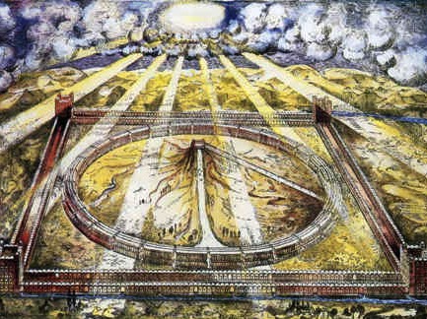
Ezekiel 40–43
Anticipate
Glory
in a New Order
Dr. Rick Griffith • Jordan Evangelical Theological Seminary • BibleStudyDownloads.org

Slide 2
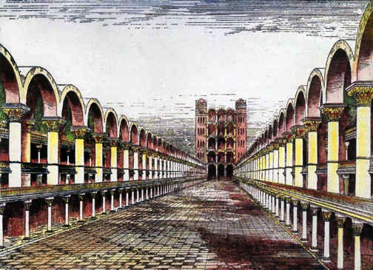
The Kingdom & Millennialism
Eschatology
Dr. Rick Griffith • Singapore Bible College • BibleStudyDownloads.org

Slide 3
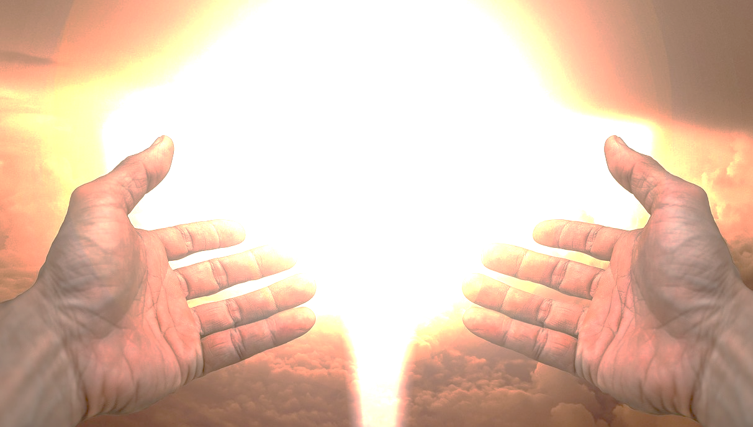
God has always been as close as we have wanted.
Agree or Disagree?
Notes:
God has always been as close as we have wanted. Do you agree or disagree? Tell the person next to you for 30 seconds.

Slide 4

Far from God?
Who moved?
Notes:
As a new Christian, I used to see the bumper sticker that read “Far from God? Who moved?”

Slide 5
"Now the earth was formless and empty, darkness was over the surface of the deep…"
"…and the Spirit of God was hovering over the waters."
Genesis 1:2 NIV
Notes:
From Eden to Exile, the LORD was faithful to be as present as the people allowed.
His Spirit hovered over creation even before he created man.
_________
The Spirit presided over creation (Gen 1:2).
But what is God’s glory? The idea is one of God’s weight or God’s presence. Remember where his presence is first mentioned in the second verse of the Bible?

Slide 6
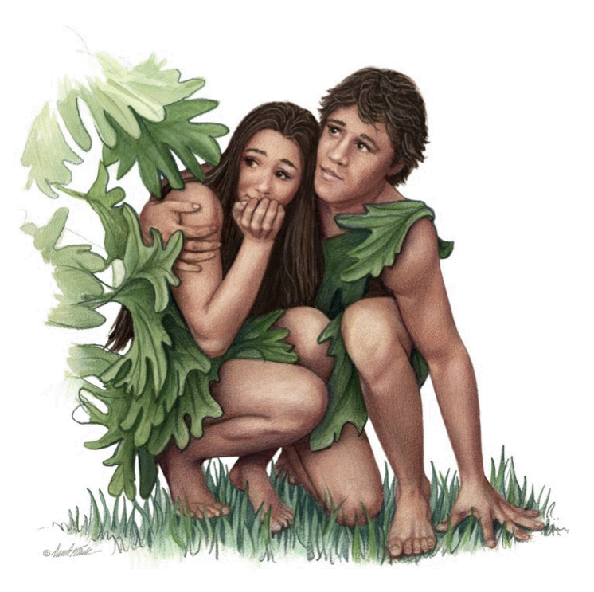
"When the cool evening breezes were blowing, the man and his wife heard the LORD God walking about in the garden. So they hid from the LORD God among the trees. ⁹Then the LORD God called to the man, 'Where are you?'" (Gen 3:8-9 NLT).
Notes:
God went looking for Adam—not Adam looking for God (3:8-11).

Slide 7

The Tabernacle
7
God sets up a place for Him to dwell as King
MOSES
Exodus
Sinai
M - C - C
Kadesh Barnea
40
The Tabernacle in the Wilderness
Handbook pg. 26-29
2
16
Notes:
God’s glory or presence then appeared at the tabernacle made for him to dwell as king.

Slide 8
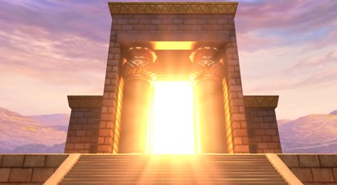
Glory in Solomon's Temple
Notes:
God then set up a home in the temple to be with his people.

Slide 9
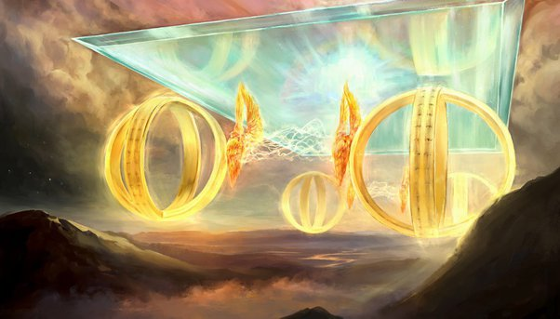
Ezekiel 1:28a
"This is what the glory of the LORD looked like to me. When I saw it, I fell face down on the ground, and I heard someone’s voice speaking to me."
Notes:
Ezekiel saw God’s glory.

Slide 10
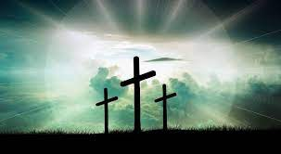
Has God been faithful to you in the past? How?
Notes:
God has been faithful to be close to us.
Has God been faithful to you in the past? How?
He provided forgiveness in Jesus.
He has met all my needs.
He gave my life purpose.

Slide 11
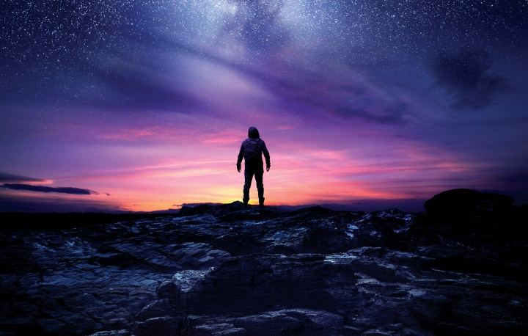
Will God be faithful to you in the future? How?
Notes:
Will God be faithful to you in the future? How?
He will continue to give me eternal life.
He will give me a glorified body.

Slide 12
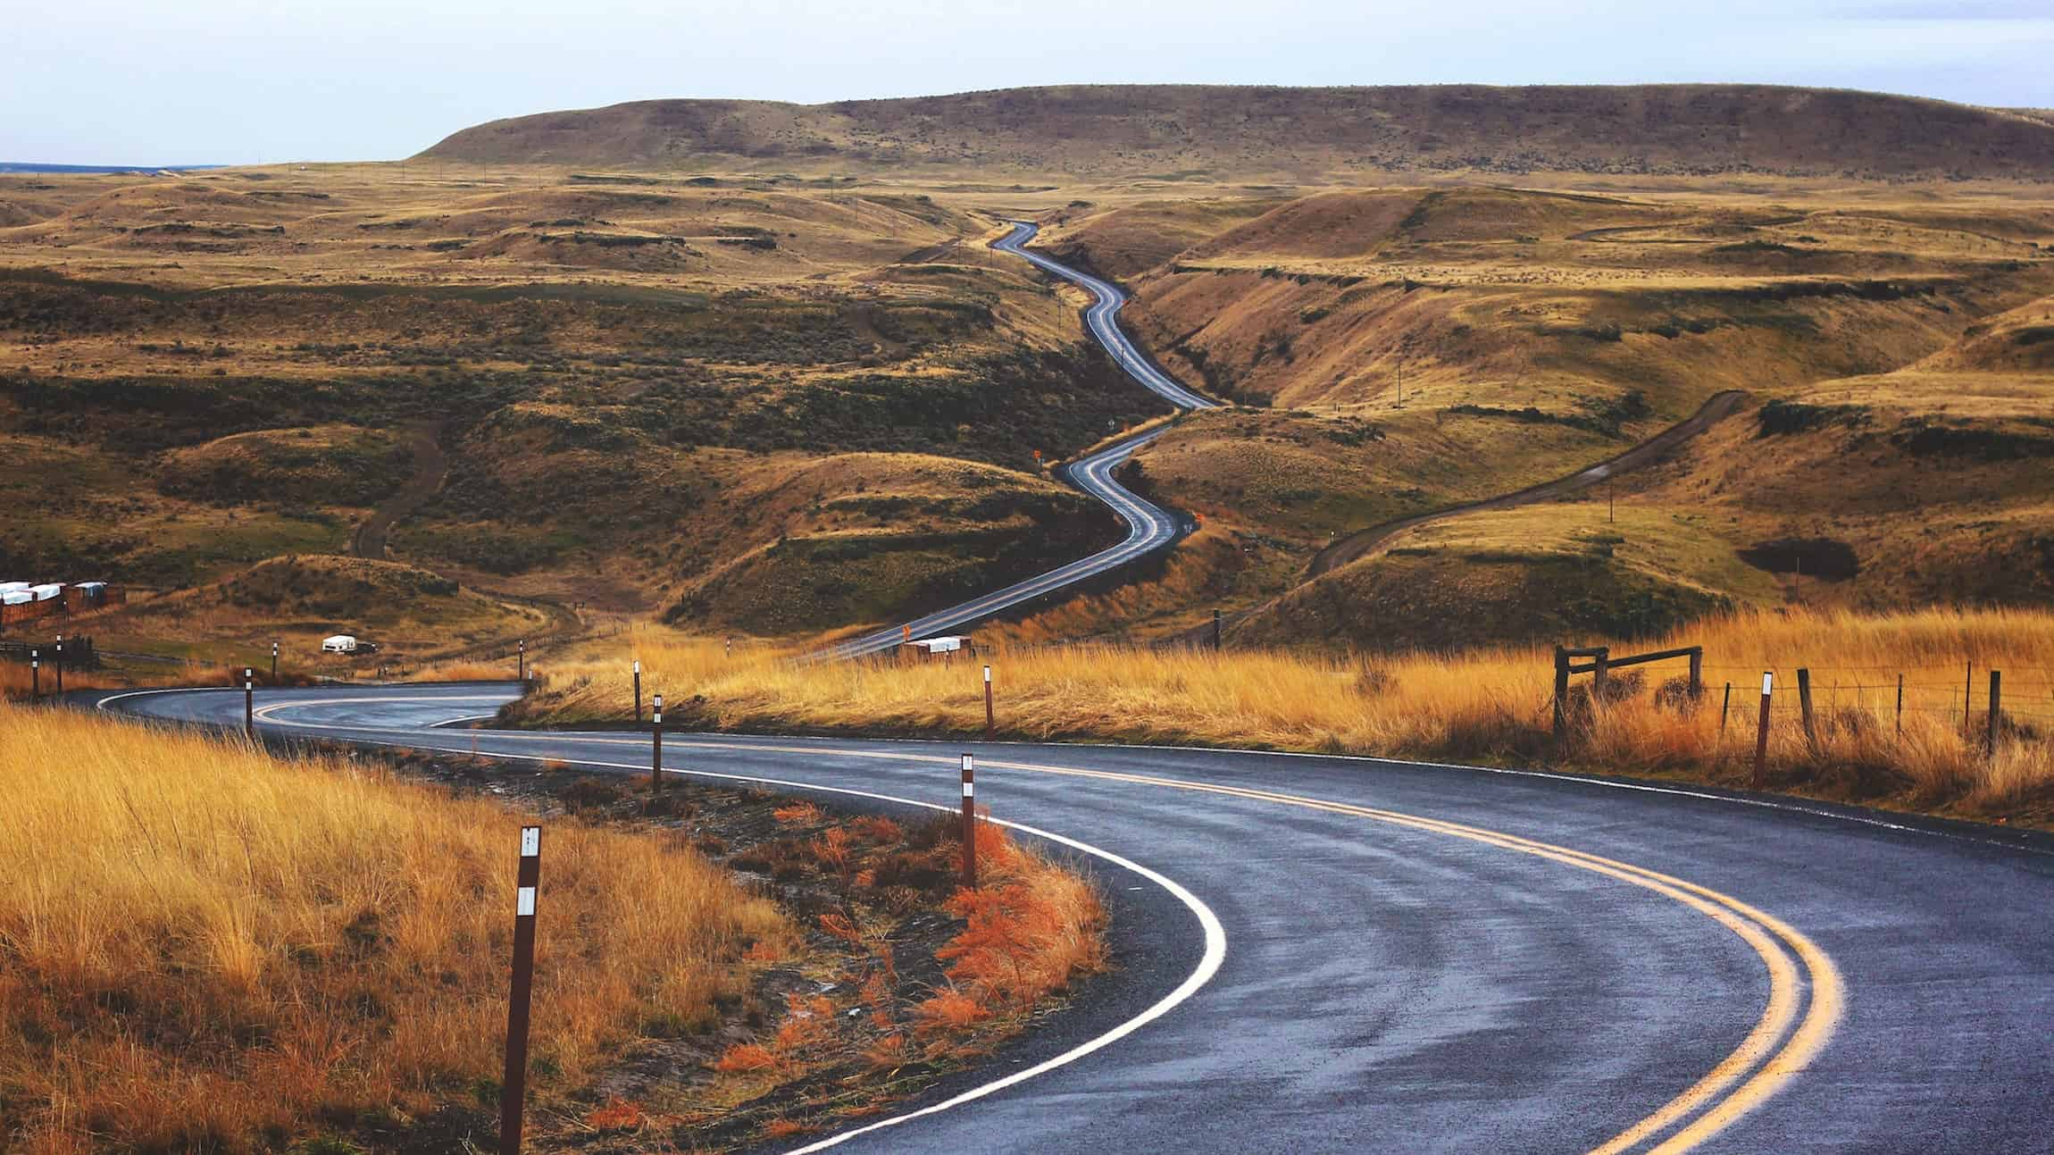
How will God show us his faithfulness in the future?
Notes:
In what ways will we see the goodness of the LORD in the days ahead?

Slide 13

What's the Future for the Dome and World Geography in the Kingdom after Messiah Comes?

Slide 14

2 Kings 25:1-21
DRESSING
THE
STAGE
MS
N(A)
H
SG
C
ER
B
J
MN
ROYALTY
DS
S - D - S
••• SPLIT •••
E
North South
Israel
Judah
KB
U
10 2
THE SOUTHERN KINGDOM:
JUDAH (586 B.C.)
THE BABYLONIAN EXILE
THE PROPHETS
20-J 20-R
200
350
Assyria
Babylon
MS
PG
RS
Handbook pg. 32-37
51
2
Notes:
Then, in the terrible onslaught of 586 BC, JUDAH, herself,
//// faces the invasion of the BABYLONIANS under King Nebuchadnezzar. All of Jerusalem -- including SOLOMON's great Temple -- is completely destroyed by the Babylonians. This is that second and important specific date to remember…586 B.C.
//// The SOUTHERN KINGDOM OF JUDAH is carried away into the famous Babylonian CAPTIVITY, sometimes called the EXILE.

Slide 15
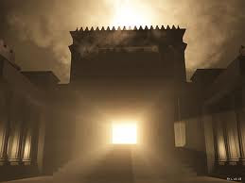
God's Glory Left Solomon's Temple

Slide 16

Solomon's Temple
502
Ezekiel 10:18-19
Notes:
“Then the glory of the Lord moved out from the door of the Temple and hovered above the cherubim. 19 And as I watched, the cherubim flew with their wheels to the east gate of the Lord’s Temple. And the glory of the God of Israel hovered above them” (Ezek 10:18-19 NLT).

Slide 17

The Glory Left
502
656
Ezekiel 11:23
Notes:
“Then the glory of the Lord went up from the city and stopped above the mountain to the east” (Ezek 11:23 NLT).

Slide 18
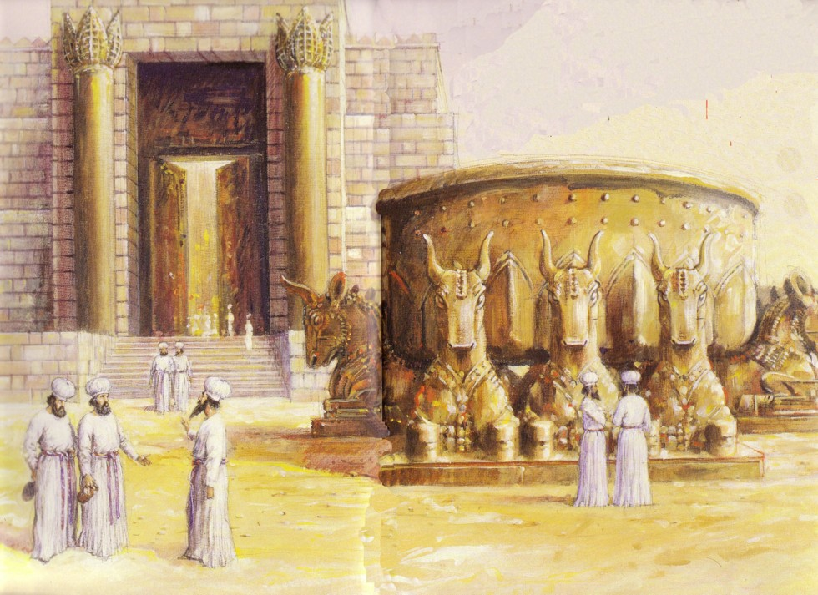
Jews Maintained Holiness at the Basin
586 BC: Temple Destroyed!

Slide 19
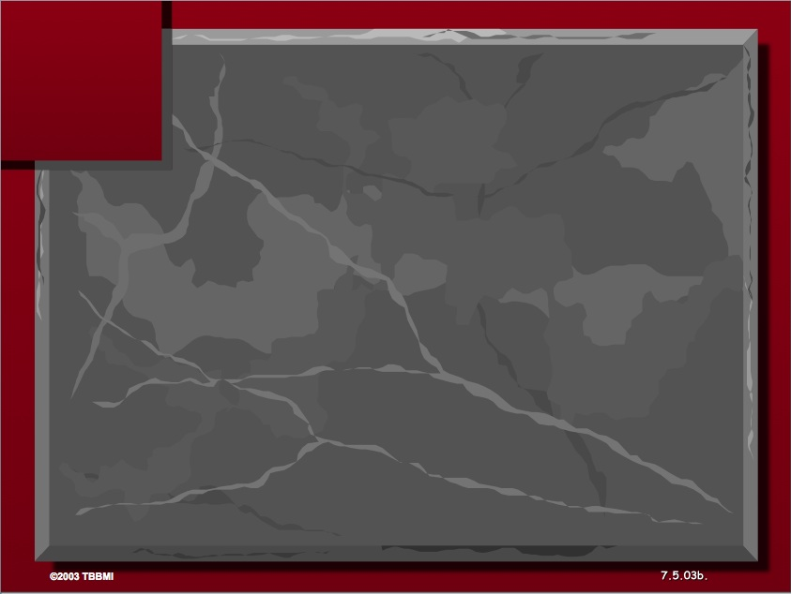
The Elements Expanded
60
7
Abrahamic Covenant
Gen. 12:1-3
LAND SEED BLESSING
ABRAHAM
The CALL
L - S - B
12:1
12:2
12:3
"L-S-B"
Handbook pg. 19-24
15
Notes:
Yet God’s promise to Abraham remained for a place to live for offspring, a king to rule, and blessing with all people.

Slide 20
Deut. 28: Blessings & Curses
Your towns and your fields
will be blessed (3)
Your towns and your fields
will be cursed (16)
Your children and your crops
will be blessed (4)
Your children and your crops
will be cursed (18)
Your fruit baskets and bread-boards will be blessed (5)
Your fruit baskets and bread-boards will be cursed (17)
Wherever you go and whatever you do, you will be blessed (6)
Wherever you go and whatever you do, you will be cursed (19)
Your enemies will attack you from one direction, but they will scatter from you in seven! (7)
You will attack your enemies from one direction, but you will scatter from them in seven! (25)
You will lend to many nations, but you will never need to borrow from them (12)
They will lend to money to you, but you will not lend to them
(44)
Notes:
Around 1400 BC, God warned in Deut 28 not to have any other gods….
The parallels between the individual blessings and cursings are just too obvious!
———————
OS-05-Deuteronomy-242
OS-12-2 Kings-97
OS-14-2 Chron-62

Slide 21
Prophetic Curses
154
220
Why?
Exile
Deut. 28
Notes:
Later in the OT we see justification for God's judgment on Israel. The leaders and the people sinned through ungodliness and idolatry, and true to the curses of Deut. 28, God gave the people the consequences of their obedience by exiling them to Babylon.
———————
OS-05-Deuteronomy-243
OS-12-2 Kings-98

Slide 22
Grace in Exile
256
Jehoiachin
(Jeconiah/Coniah)
597 (ruled 3 mos.)
Shealtiel
Pedaiah
Jekamiah
Nedabiah
Malkiram
Shenazzar
Hoshama
Zerubbabel
1 Chronicles 3:17-19
Notes:
His promise to David of his line forever was still valid through their king living among them.
Even though the king was in exile, he wasn't in prison by himself! Judah's King Jehoiachin fathered SEVEN sons! God was preserving the line of David, just as he said he would until that line came to Jesus.
______
1Chr. 3:16 The successors of Jehoiakim were his son Jehoiachin and his brother Zedekiah.ª
Descendants of Jehoiachin
1Chr. 3:17 The sons of Jehoiachin,ª who was taken prisoner by the Babylonians, were Shealtiel, 18 Malkiram, Pedaiah, Shenazzar, Jekamiah, Hoshama, and Nedabiah.
1Chr. 3:19 The sons of Pedaiah were Zerubbabel and Shimei.
The sons of Zerubbabel were Meshullam and Hananiah. (Their sister was Shelomith.) 20 His five other sons were Hashubah, Ohel, Berekiah, Hasadiah, and Jushab-hesed.
1Chr. 3:21 The sons of Hananiah were Pelatiah and Jeshaiah. Jeshaiah’s son was Rephaiah. Rephaiah’s son was Arnan. Arnan’s son was Obadiah. Obadiah’s son was Shecaniah.
1Chr. 3:22 The descendants of Shecaniah were Shemaiah and his sons, Hattush, Igal, Bariah, Neariah, and Shaphat—six in all.
1Chr. 3:23 The sons of Neariah were Elioenai, Hizkiah, and Azrikam—three in all.
1Chr. 3:24 The sons of Elioenai were Hodaviah, Eliashib, Pelaiah, Akkub, Johanan, Delaiah, and Anani—seven in all.
_____
OS-12-2Kings-231
OS-14-2Chron-82

Slide 23

The Lineage of
Jehoiachin/ Jeconiah/
Coniah
(1 Chron 3:17-24)
Jehoiachin
Pedaiah
+ 6 brothers
Zerubbabel
+ 1 brother (Shimei)
Hananiah
+ 6 brothers + 1 sister
Shecaniah
+ 5 brothers
Shemaiah
+ 0 brothers
Neariah
+ 5 brothers
Elioenai
+ 2 brothers
Hodaviah
+ 6 brothers
Notes:
This Davidic line actually is recorded in 1 Chronicles for nine generations to the end of OT history. God promised David an eternal dynasty never to be wiped out, so we see if continue here until Matthew 1 and Luke 3 continue it further to Jesus.
_____
It is difficult to tell if 3:21 mentions Hananiah’s 6 sons (Shecaniah + 5 brothers) or whether these 6 men were descendants in 6 generations. As Chronicles ends around 440-400 BC and the above has 9 generations (9 x 25 years old at son’s birth=175 years), this would already bring the account from Jehoiachin’s exile in 597 to around 422 BC (597 – 175 = 422 BC). Adding another 5 generations would bring the genealogy to about 300 BC. This is possible but unlikely and would be problematic to reconcile with the other Bible genealogies.
———————
“2. DESCENDANTS OF SOLOMON (3:10-24)
3:10-24. This list of Solomon’s descendants is in effect a list of Judah’s kings from Solomon through Zedekiah (vv. 10-16) and their exilic and postexilic continuation (vv. 17-24). Athaliah, the queen who ruled between Ahaziah and Joash, is not mentioned (v. 11). That is because she was only a political usurper and was not in the true dynastic succession (cf. 2 Kings 11). Of the sons of Josiah, Johanan (1 Chron. 3:15) is otherwise unknown. He cannot be Jehoahaz (2 Kings 23:31) because Jehoahaz was [Vol. 1, p. 595] younger than Jehoiakim (cf. 2 Kings 23:36). This means that Shallum (1 Chron. 3:15) is identical to Jehoahaz who, though the next-to-youngest son of Josiah, preceded his brothers on the throne (cf. Jer. 22:11-12).
The remainder of the succession followed by the chronicler is Jeconiah (Heb.; cf. NIV marg. of 1 Chron. 3:16; also known as Jehoiachin; cf. v. 17 and 2 Kings 24:8, and Coniah, Jer. 22:24, marg.). Then came Pedaiah (1 Chron. 3:18), Zerubbabel (v. 19), Hananiah (v. 19), Shecaniah (v. 21), Shemaiah (v. 22), Elioenai (v. 23), and Hodaviah (v. 24).
Three difficulties here must be addressed. First, Zerubbabel (v. 19) is elsewhere called the son of Shealtiel, not the son of Pedaiah (Ezra 3:2, 8; 5:2; Neh. 12:1; Hag. 1:12, 14; 2:2, 23; Matt. 1:12; Luke 3:27). Since Shealtiel and Pedaiah were brothers (1 Chron. 3:17-18) the best solution seems to be that Shealtiel died early on and his role of dynastic succession was assumed by his younger brother Pedaiah. The second problem concerns Luke’s account of the genealogy in which he identifies Shealtiel as the son of Neri, whose descent is not from Solomon but from David’s son Nathan (Luke 3:27-31). The answer may lie in the possibility that since Jeconiah had no male heir to sit on the throne (cf. Jer. 22:30), a daughter of Jeconiah married Neri, son of Melki (Luke 3:27-28; not the Melki of Luke 3:24), of the line of Nathan. Legally Shealtiel, as grandson of Jeconiah, would continue the Davidic dynasty through Solomon, a viewpoint espoused by Matthew (Matt. 1:6-12).
The third conflict appears in Zerubbabel’s line. The chronicler lists Zerubbabel’s seven sons and one daughter (1 Chron. 3:19b-20). But none of them is mentioned in the genealogies of either Matthew or Luke. Matthew, who traces Jesus’ descent from David through Solomon, wrote that the son of Zerubbabel was Abiud (Matt. 1:13). Luke, viewing it through Nathan, said Rhesa was that son (Luke 3:27). It is entirely possible, of course, that the Shealtiel and Zerubbabel of Luke are not the same as those of 1 Chronicles and that Luke preserves a genealogy of Mary straight from David through Nathan, a line of succession that has no other connection with the chronicler’s genealogy (cf. comments on Luke 3:27). This would preclude the suggested solution to the second problem previously mentioned (and would, in fact, eliminate the problem altogether). This still leaves the variance between 1 Chronicles 3:19b-20 and Matthew 1:13. One may conjecture that Abiud is another name for one of the seven sons of Zerubbabel listed in Chronicles or that his name is missing from that list to begin with. That such a thing is possible may be seen in 1 Chronicles 3:22 where the historian wrote that Shemaiah had six sons but listed only five names” (Eugene Merrill, “1 Chronicles,” in The Bible Knowledge Commentary [Wheaton, IL: Victor, 1985], 1:594-95).

Slide 24
God's Future Plan
OT Survey page 437
Great White
Throne
(Rev 20:11-14)
Rapture
(1 Thess 4:13-18)
2nd Advent
(Zech 14:3-5)
Day of the LORD
Church Age
Tribulation
(Zech 14:1-2)
Millennium
(Zech 14:6-21)
Gog & Magog
(Armageddon)
(Ezek 38–39)
Gog and Magog
Revisited
(Rev 20:7-10)
Notes:
24
Most of us have heard a lot about the various periods ahead but the one least studied is the Millennium.
________
OS-23-Isaiah 1-12-Slide 87
OS-26-Ezekiel 1-39-Slide 247
OS-29-Joel-87
OS-31-Obadiah-142
OS-39-Zechariah-158, 168, 184
NS-22-Rev20-22

Slide 25

Jewish life then revolved around Solomon's temple for 400 years (959-586 BC)

Slide 26
Jews Maintained Holiness at the Basin
586 BC: Temple Destroyed!

Slide 27


After temple rebuilding, in NT Passovers 100,000 Jews visited the Temple!
AD 70: Temple Destroyed Again!

Slide 28

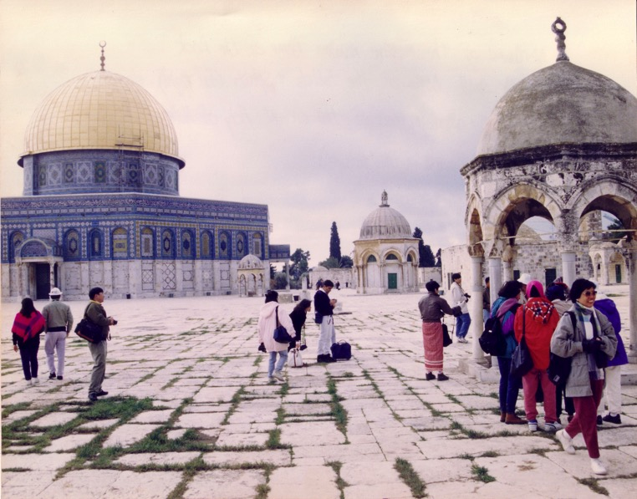

Muslim Control
135
Mosque of Omar
(Dome of the Rock)
Al-Aksa Mosque

Slide 29
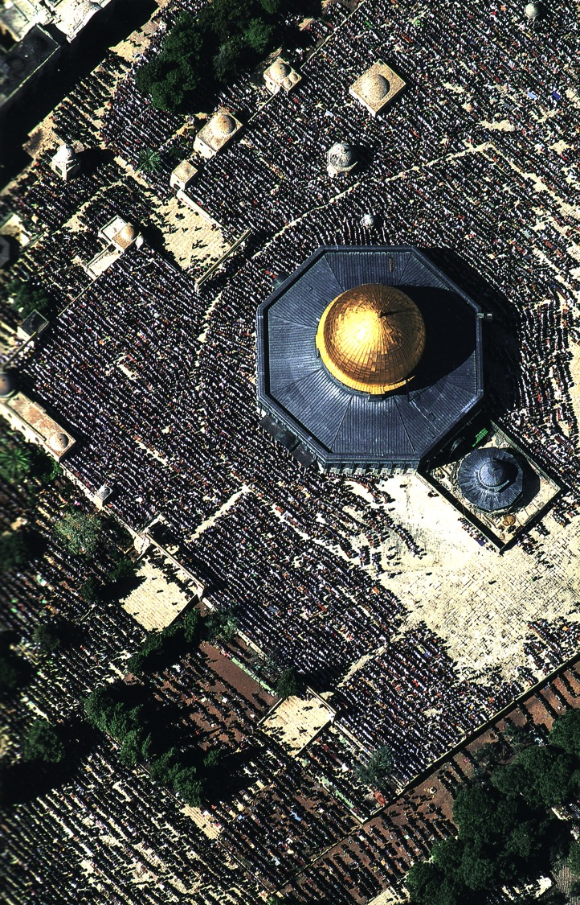
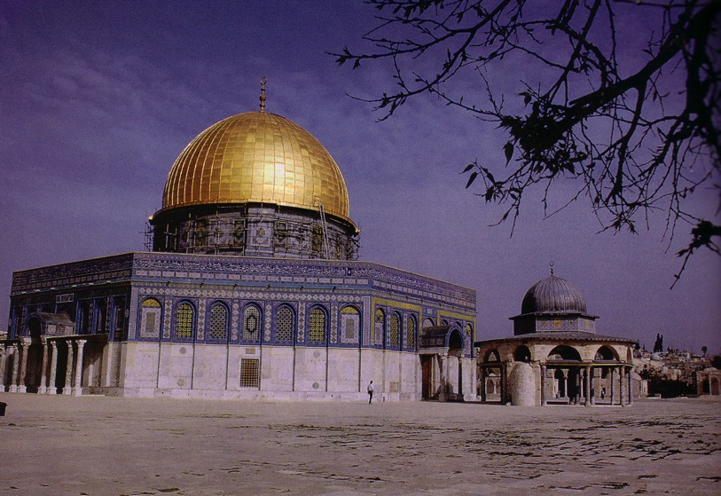
Muslim Prayers at the Dome
135

Slide 30
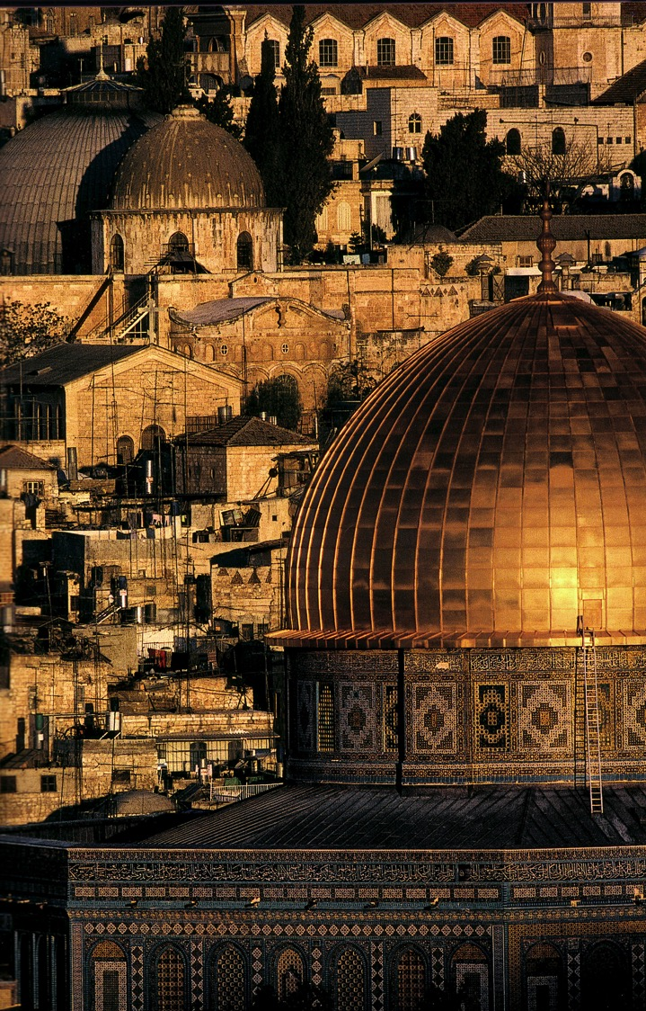
A Dome to Outshine the Dome

Slide 31
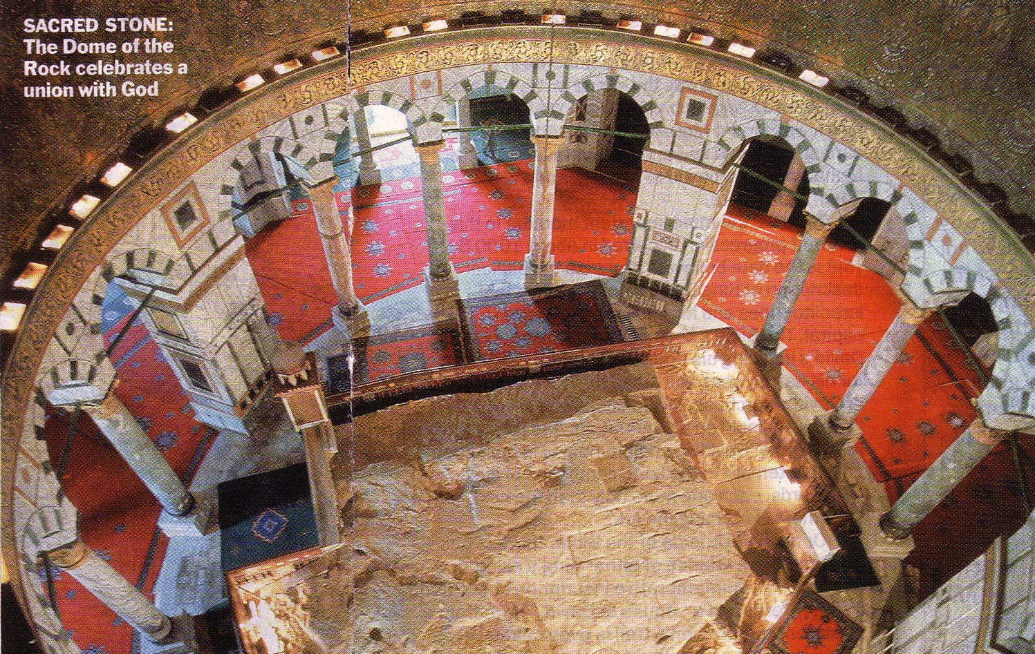
The Rock Inside
137

Slide 32
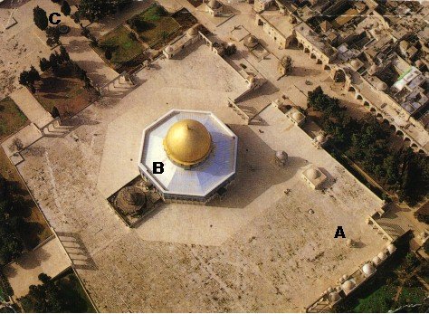
An Imposing Structure

Slide 33

Modern Temple Mount
131

Slide 34


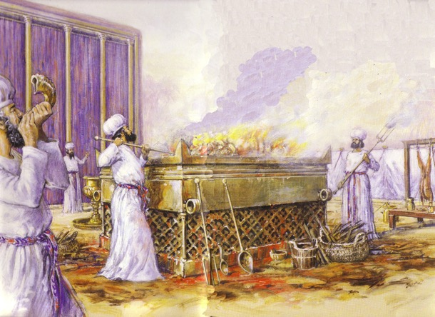
Jewish Western Wall
128

Slide 35
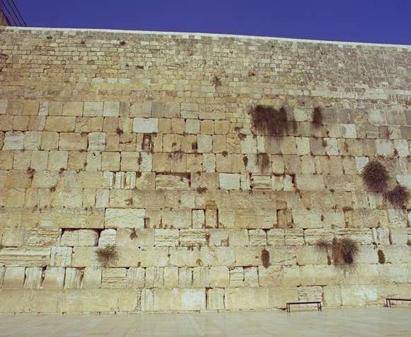
The Western Wall
128

Slide 36

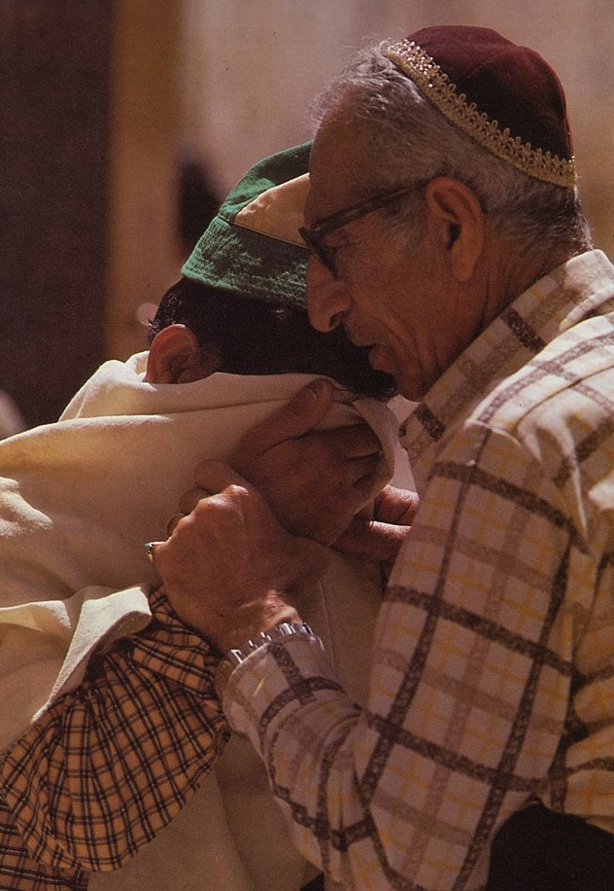
Prayers for the Third Temple

Slide 37
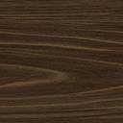
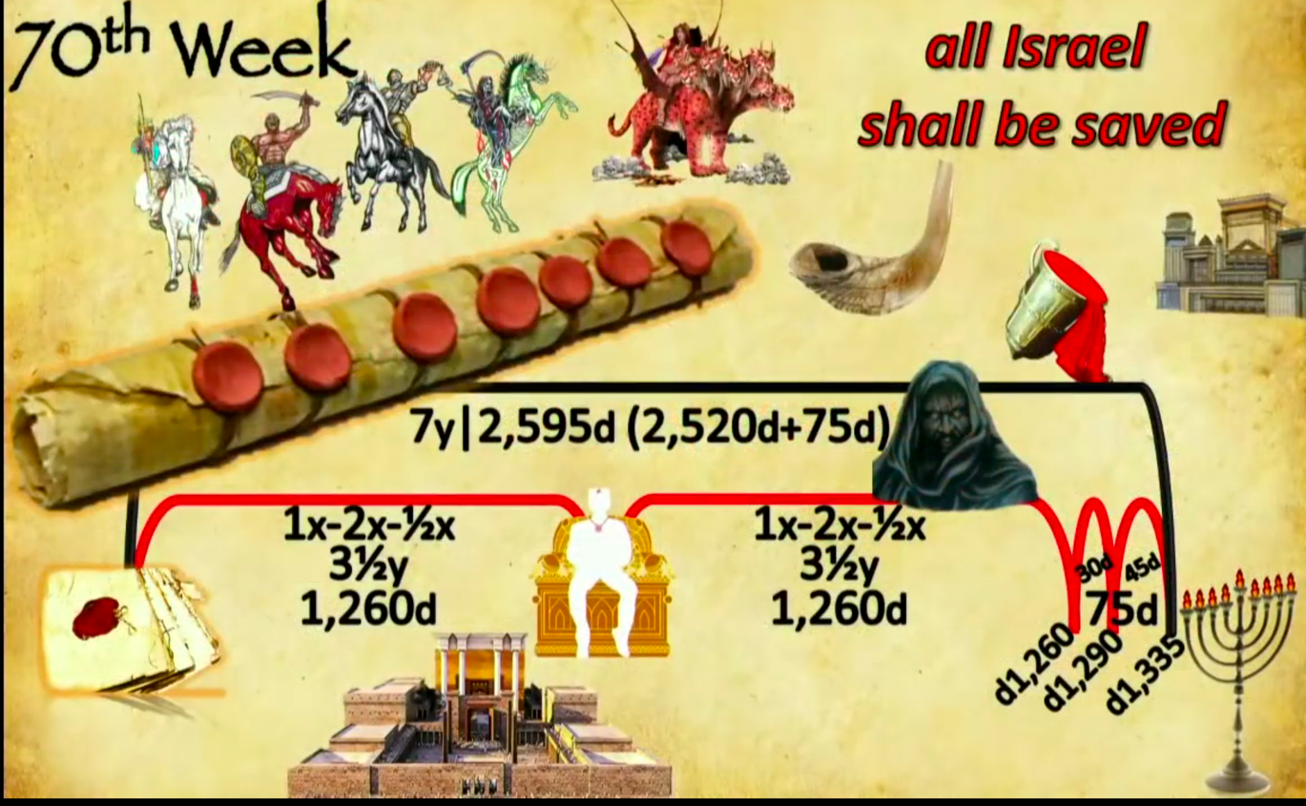
Events of the 70th "Week"
556
70th "Week"
All Israel
shall be saved
2018 09 23 John Haller's Prophecy Update
"Surveillance Society” (https://www.youtube.com/watch?v=GE35KQWKCWw)
"He will confirm a covenant with many for one 'seven.' In the middle of the 'seven' he will put an end to sacrifice and offering. And on a wing [of the temple] he will set up an abomination that causes desolation, until the end that is decreed is poured out on him" (Daniel 9:27 NIV).
Notes:
Parallel texts build upon this teaching by saying that the Antichrist will set up this abomination that causes desolation (Matt 24:15) where he will declare himself to be God:
“He will exalt himself and defy everything that people call god and every object of worship. He will even sit in the temple of God, claiming that he himself is God” (2 Thess 2:4 NLT).
“Then the beast was allowed to speak great blasphemies against God. And he was given authority to do whatever he wanted for forty-two months. ⁶ And he spoke terrible words of blasphemy against God, slandering his name and his dwelling—that is, those who dwell in heaven. ⁷ And the beast was allowed to wage war against God’s holy people and to conquer them. And he was given authority to rule over every tribe and people and language and nation. ⁸ And all the people who belong to this world worshiped the beast. They are the ones whose names were not written in the Book of Life that belongs to the Lamb who was slaughtered before the world was made” (Rev 13:5-8 NLT).
______________
OS-27-Daniel-330
OS-Ezekiel 40-48-Slide 16
OS-37-Haggai-96

Slide 38
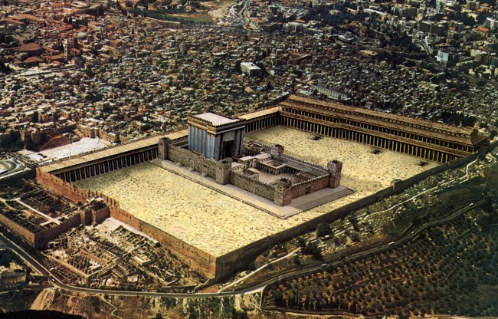
Antichrist will make a 7-year treaty with Israel
This will likely enable the rebuilding of the Jerusalem temple
Artwork by Sunny Chandra
Notes:
The 70th week of Daniel 9:27 is believed by nearly all scholars to depict a seven-year period. Since this “ruler to come” will set up a desecration in the temple and this event is still future, it must mean that the present temple rebuilding preparations in Jerusalem right now will be successful in building the temple on its original spot.
______________
OS-27-Daniel-331
OS-Ezekiel 40-48-Slide 17
OS-37-Haggai-97

Slide 39
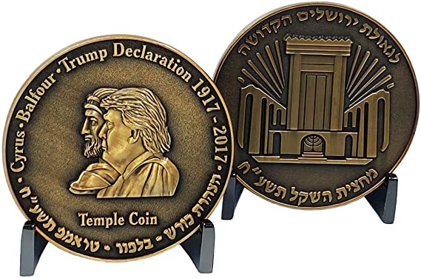
In 2017, Israel Commemorated President Trump’s Efforts to Rebuild the Temple
This ½ shekel preparation for the Third Temple is compared to Cyrus Helping Build the Second Temple in 539 BC
Artwork by Sunny Chandra
Notes:
The 70th week of Daniel 9:27 is believed by nearly all scholars to depict a seven-year period. Since this “ruler to come” will set up a desecration in the temple and this event is still future, it must mean that the present temple rebuilding preparations in Jerusalem right now will be successful in building the temple on its original spot.
______________
OS-27-Daniel-332
OS-Ezekiel 40-48-Slide 18
OS-37-Haggai-98

Slide 40
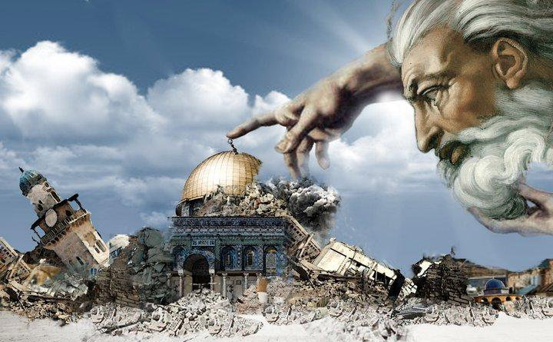
Antichrist will make a 7-year treaty with Israel
This will likely enable the rebuilding of the Jerusalem temple
Artwork by Sunny Chandra
Notes:
The traditional spot for the temple is the exact spot where the Dome of the Rock was constructed by Muslims in the late AD 690s. But will this be easily demolished by one who the world will accept as a peaceful negotiator? That seems unlikely.
______________
OS-27-Daniel-333
OS-Ezekiel 40-48-Slide 19
OS-37-Haggai-99

Slide 41
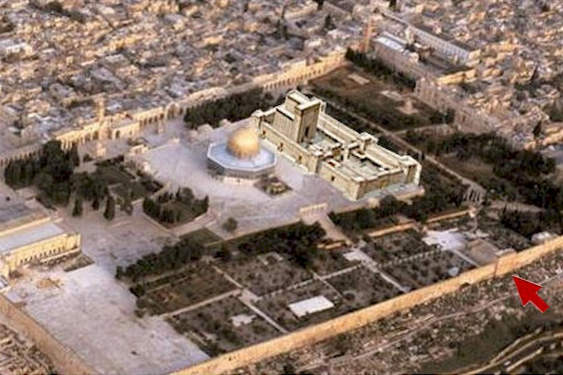
Antichrist will make a 7-year treaty with Israel
This will likely enable the rebuilding of the Jerusalem temple
Artwork by Sunny Chandra
Notes:
Some propose that this deceitful ruler will negotiate a deal to have the temple built right next to the Dome. Rabbis like Asher Kaufman have proposed the northern site as the original site of Solomon’s temple, partly because it gives a straight shot towards the Eastern Gate.
______________
OS-27-Daniel-334
OS-Ezekiel 40-48-Slide 20
OS-37-Haggai-100

Slide 42
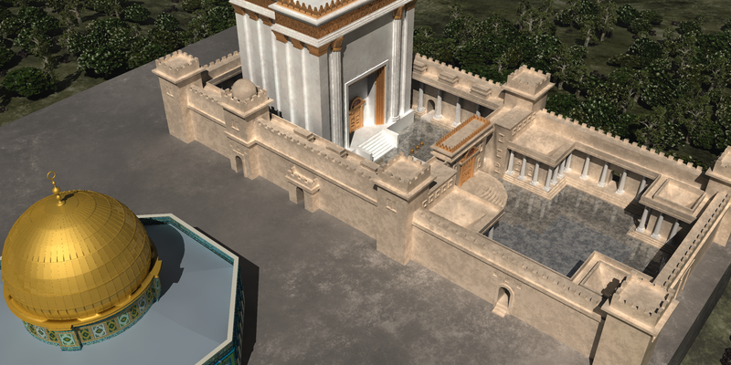
Antichrist will make a 7-year treaty with Israel
This will likely enable the rebuilding of the Jerusalem temple
Artwork by Sunny Chandra
Notes:
Building these adjacent would certainly be the result of a master negotiator!
___________
OS-27-Daniel-335
OS-Ezekiel 40-48-Slide 21
OS-37-Haggai-101

Slide 43
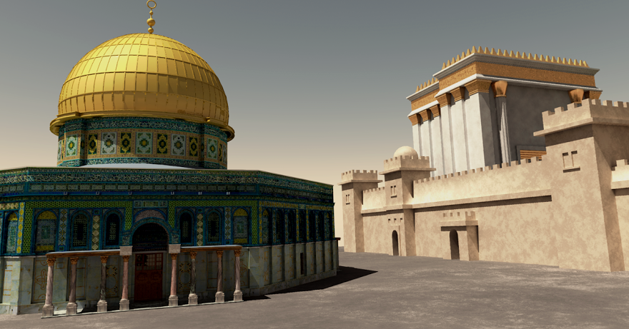
Antichrist will make a 7-year treaty with Israel
This will likely enable the rebuilding of the Jerusalem temple
Artwork by Sunny Chandra
Notes:
Perhaps such a feat would underscore the unity of all religions—a major tenant of the one-world religion that will lead to global worship of the Antichrist as the messianic figure at the focus of that one-world government.
___________
OS-27-Daniel-336
OS-Ezekiel 40-48-Slide 22
OS-37-Haggai-102

Slide 44
But after the Tribulation, the temple will be destroyed and replaced by Ezekiel’s temple in the millennium
(the fourth era of the temple)
Artwork by Sunny Chandra

Slide 45
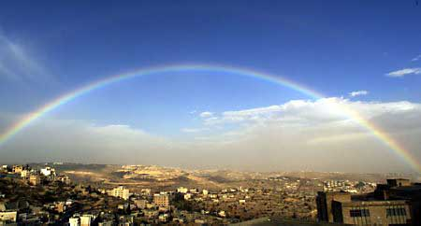
Israel's Restored Community
New Temple (40–43)
New Worship (44–46)
New Territories (47–48)

Slide 46
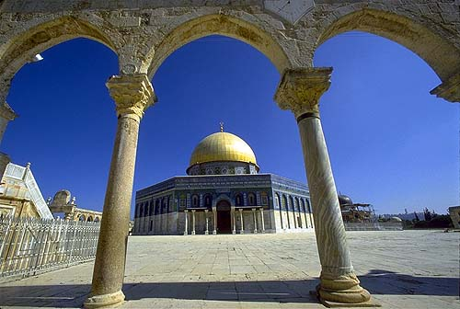
"Rebuild the Temple"
June 7, 1967

Slide 47
Timeline to the Kingdom and Temple Described in Ezekiel 40–48
530a
Heaven
New Heaven
7+ Years
Resurrection & Catching Away of Church Believers
1 Thess 4：16-17
Return with Christ
Rev 9：11-21
Earth
Current Period
7-Year Tribulation Period
75 Days Resurrection of Tribulation & OT Believers
1000-Year Messianic Kingdom with Temple
Rev 20:4; Ezek 40–48
Final Rebellion Resurrection & Judgment of Unbelievers
New Earth
Rev 21：1-3
Ezekiel's temple will be built after Christ's return
Adapted from Wayne ODonnell • "Ezekiel 40 - 48: Tour of Ezekiel's Temple" http://bible.ag/en/enEzekieltranscript.htm
Notes:
"See Picture #1. Timeline to the Kingdom and Temple Described in Ezekiel 40-48.
As Picture #1 shows, we are currently in the bottom left part labeled "Current Period." A "7-Year Tribulation Period" is probably going to begin very soon. Before that time there will be a "Resurrection and Catching Away of Church Believers" who will wait out the tribulation in heaven and then "Return With Christ" at the end of the tribulation period.
Revelation 19:11-16 says, "Behold a white horse; and he that sat upon him," that's Yeshua, Jesus, "and the armies which were in heaven followed him," that's us, "clothed in fine linen, white and clean. And out of his mouth goeth a sharp sword, that with it he should smite the [Gentile] nations: and he shall rule them with a rod of iron." He will smite the Gentile nations when he returns to defend Israel (see my references to Zechariah 12-14 in my Matthew and Romans 9-11 surveys) at the end of the "7-Year Tribulation Period," and he will rule the nations with a rod of iron during the "1000-Year Messianic Kingdom." "And he hath on his vesture and on his thigh a name written, KING OF KINGS," because during the kingdom, there will be multiple nations, each with their own king, but Yeshua, ruling from Jerusalem, will be king over all kings.
Then, after the kingdom, there will be a "New Heaven" and "New Earth," as shown on the right side of the diagram. Revelation 21:1-3, "I saw a new heaven and a new earth, ... and ... new Jerusalem, coming down from God out of heaven." If new Jerusalem comes down from God out of heaven, it has to come to the earth, because there is only heaven and earth. "And I heard ... behold, the tabernacle of God is with men ...." God is going to come down and make his tabernacle with men; men are not going up to spend eternity in tabernacles in heaven. "And he will dwell with them." We are not going to dwell with him in heaven. He is going to dwell with us on the new earth forever. The place Jesus prepares for us in heaven (Jn14:2-3), may not come down to earth until after the kingdom in the New Jerusalem, but we will be on earth during the kingdom also (Mt19:28).
So get the idea out of your mind that you are going to be in heaven for eternity. We are in heaven for only a very brief time. Even the people who died a thousand years ago in the Lord, and their spirits are in heaven, their bodies are still with us here on earth. And after the resurrection it is a very brief layover in heaven before returning to earth with Christ and entering the Messianic Kingdom. So we could use a lot less songs about walking around heaven with Jesus, and a lot more songs about what it is going to be like in the kingdom.
Since we are going to be spending so much time in the kingdom, we should learn about it; and the new earth is going to have a lot of similarities to the kingdom, although there are some differences. I know God wants us to learn about the kingdom, because he has told us so much about it in Isaiah, Jeremiah, Ezekiel, the minor prophets, the psalms, and so forth. And the benefit of learning about the kingdom, is that it will help you persevere through trials, and help you labor more fervently.
God could have given us just an overview of the kingdom in these last 9 chapters of Ezekiel, but instead they focus a lot on one building, the temple, so that if we know this one building that will be at the center of the kingdom in a very detailed way, the entire kingdom will all be very real and solid to us, so that our sure hope of entering the kingdom in the future will help us in our trials and labors today.
Ezekiel 40:1-2. The Mountain
When Ezekiel first arrived in the future at the land of Israel, he saw a very high mountain. Now, there is no high mountain in Israel today, but there will be geological changes before the Messianic Kingdom. Isaiah 2:2 says, "It shall come to pass in the last days, that the mountain of the LORD'S house," meaning the mountain that will have the Lord's house, the temple, on it, "shall be established in the top of the mountains." That means it is going to be the highest mountain in the world. Ezekiel 20:40 says, "For in mine holy mountain, in the mountain of the height of Israel, saith the Lord GOD, there shall all the house of Israel, all of them in the land, serve me."
Zechariah 14:1-10 talks about the geological changes that will be necessary. "Behold, the day of the LORD cometh." 'Day of the Lord' is another name for the seven year tribulation period; and it is also called 'the time of Jacob's trouble' (Jer30:7). Verse 2, "I will gather all nations against Jerusalem to battle ... then shall the LORD go forth, and fight against those nations." The Messiah, Yeshua, returns with us and smites the armies of the Gentile nations, as we saw in Revelation 19.
"And his feet shall stand in that day upon the mount of Olives, which is before Jerusalem on the east." That is also where Yeshua, Jesus, left the earth from (Acts1:9-12). "And the mount of Olives shall cleave in the midst thereof toward the east and toward the west, and there shall be a very great valley," running east and west, "and half of the mountain shall remove toward the north, and half of it toward the south ... and the LORD my God shall come," in the person of Messiah at the end of the tribulation period, "and all the saints," that's us, returning with Christ.
"All the land shall be turned as a plain from Geba to Rimmon south of Jerusalem: and it [probably Jerusalem, not the plain] shall be lifted up, and inhabited in her place." So all the mountains around Jerusalem, and to the south of it in the land of Israel, will be lowered, and leveled into a plain, but Jerusalem will raised up higher than it is now, and other mountains around the world will be lowered, not to a plain, but until their peaks are lower than Jerusalem's mountain."
Wayne ODonnell, "Ezekiel 40–48: Tour of Ezekiel's Temple"
http://bible.ag/en/mr4web.html#EZanchor-anchor
Recorded December 30, 2007
Accessed 30 Aug 2016

Slide 48
How will God show us his faithfulness in the future?
3 ways
Notes:
Ezekiel 40–48 addresses that middle era between our present age and the eternal state. In this period, God will show his faithfulness once again.

Slide 49
Ezekiel 40–48
God's Future Faithfulness
God will live with us again
(40–43)
Notes:
(What is the first way we will see God’s faithfulness in the future?)
I. God will live with us again (Ezek 40–43).
[His people will experience his presence on earth.]
The millennial temple will be filled with God's glory (Ezek 40–43).

Slide 50
Slides on
Ezekiel 40

Slide 51
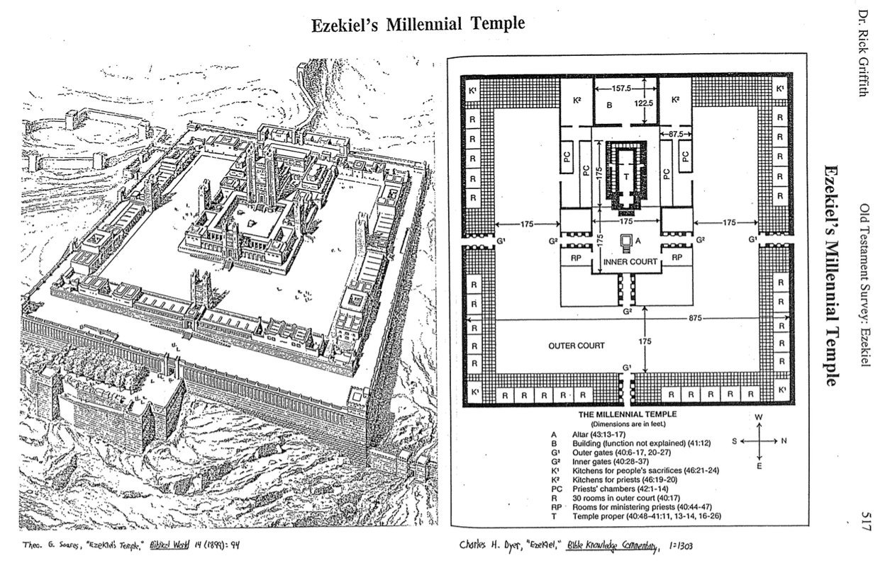
Ezekiel's Millennial Temple
517
Theo. G. Soares, "Ezekiel's Temple"
Biblical World 14 (1899): 94
Charles Dyer, "Ezekiel,"
in The Bible Knowledge Commentary, 1:1303

Slide 52
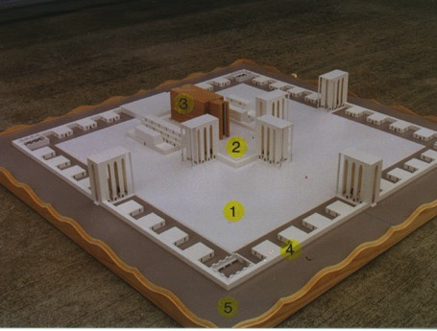
The Five Sections
517
1. Outer Court - 40:17-19
2. Inner Court - 40:44-47
3. The Temple or Sanctuary - 41:1-26
4. Wall around the outside of the temple - 40:5 (42:15-20; 45:2)
5. Fifty cubits of open space - 45:2
www.pauljab.net/temple/ TemplePictures.html
Notes:
Ezekiel's temple will be like the first two temples in that it will be surrounded by both inner and outer courts, although the height of the gates is not given and thus is left to the imagination.

Slide 53
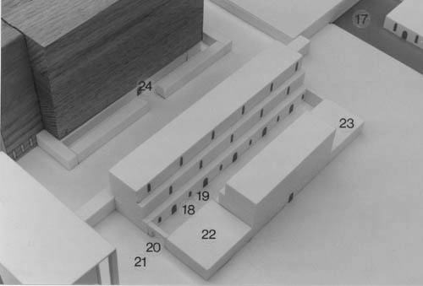
Rooms Next to the Temple
"The room beside the south inner gate is for the priests in charge of the altar—the descendants of Zadok—for they alone of all the Levites may approach the LORD to minister to him"
(Ezek 40:46 NLT).

Slide 54
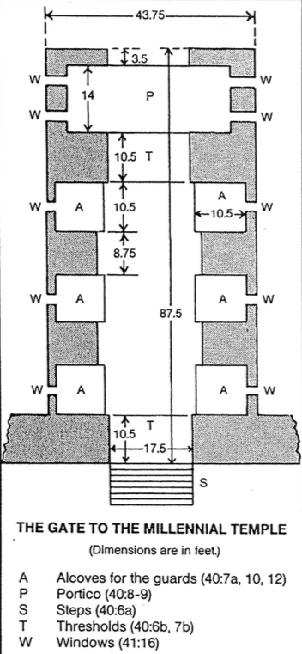
The Eastern Gate (40:7-16)
519
Charles Dyer, "Ezekiel,"
in The Bible Knowledge Commentary, 1:1305

Slide 55
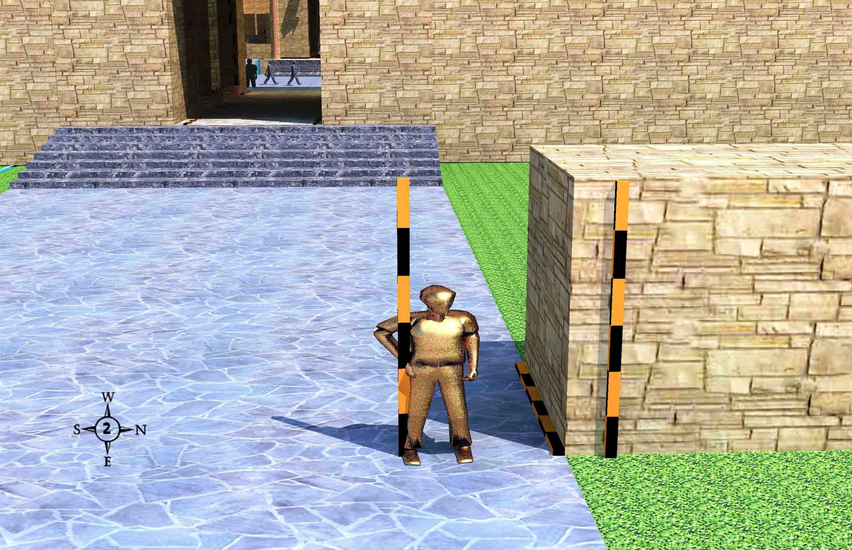
The Outer East Gate (40:3-12)
519
An angel with a measuring rod and a flax cord by the border wall outside the outer east gate
Wayne ODonnell • "Ezekiel 40–48: Tour of Ezekiel's Temple" • http://bible.ag/en/enezekieltranscript.htm
Notes:
"Ezekiel 40:3-12. The Outer East Gate
See Picture #2. An angel with a measuring rod and a flax cord standing by the border wall outside the outer east gate.
After seeing the mountain, the next thing Ezekiel saw as he got close to the temple compound was an angel standing by a wall. Ezekiel 40:3-5, "He brought me thither, and, behold, there was a man, whose appearance was like the appearance of brass." That means he was an angel. He looked like a man, but he was shining brightly. Most angels don't have wings, or they wouldn't look like men. Only cherubim and seraphim have wings.
He had, "a line of flax in his hand," which was for measuring long distances, "and a measuring reed," which was for measuring short distances. "And he stood in the gate, ... and behold a wall on the outside of the house round about, and in the man's hand a measuring reed of six cubits long by the cubit and an hand breadth." There were three kinds of cubits in Israel during that time, a short, medium, and a long cubit. The short cubit was about 15", the medium cubit was a short cubit plus one handbreadth, or about 18", and the long cubit was a medium cubit plus one handbreadth, or about 21". If the medium cubit was the most commonly-used cubit, then the measuring stick the angel had was probably of long cubits, which was the medium cubit "and an hand breadth," Ez40:5. So to get a general idea how long things are as we go through this tour, just multiply the cubits by 2; each long cubit equals almost two feet.
Ezekiel 40:5, "So he measured the breadth of the building, one reed," see the 6-cubit rod lying on the ground, "and the height one reed," see the vertical 6-cubit rod against the front of the wall. 'Building' in verse 5 means something built, including a wall. It doesn't have to have a room and a roof."
Wayne ODonnell, "Ezekiel 40–48: Tour of Ezekiel's Temple"
http://bible.ag/en/mr4web.html#EZanchor-anchor
Recorded December 30, 2007
Accessed 30 Aug 2016

Slide 56
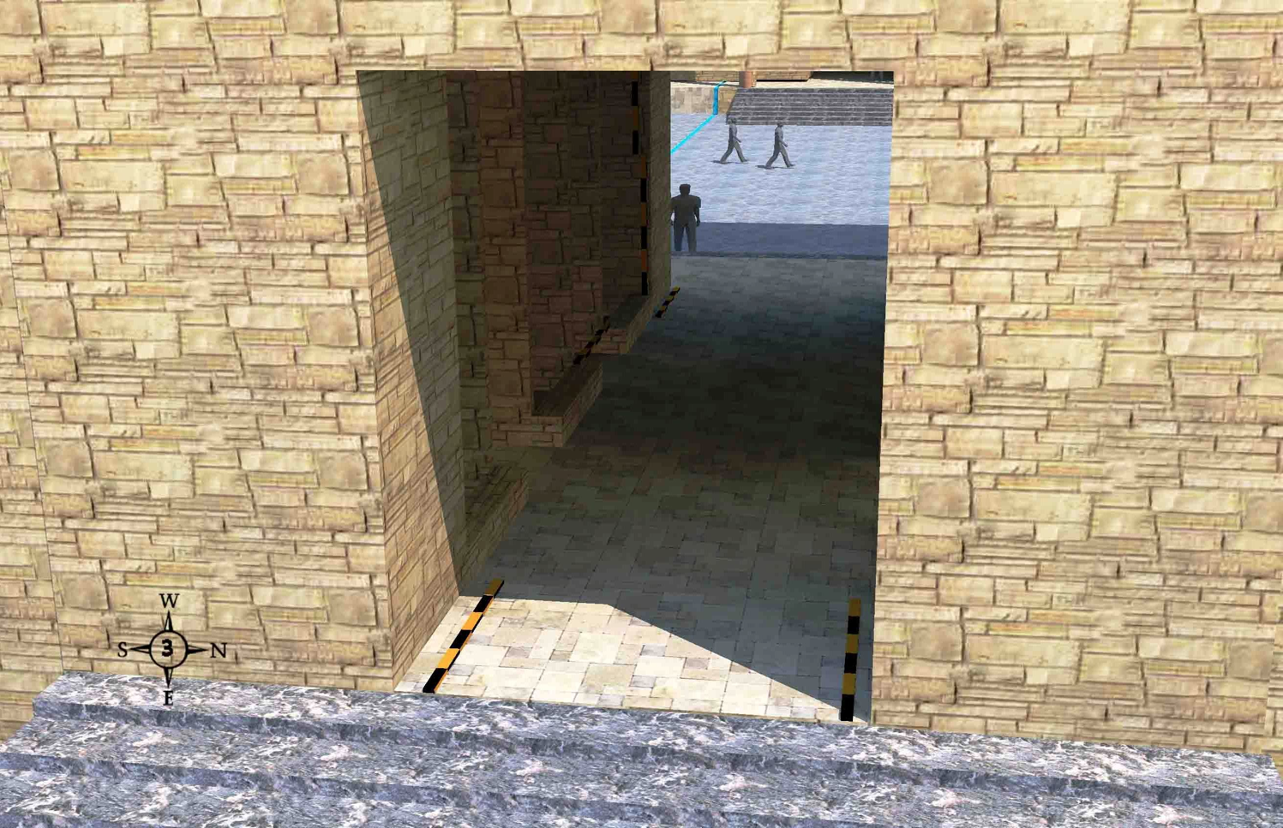
Threshold of the Outer East Gate
(Ezekiel 40:6)
519
Outside the temple, approaching from the east, and facing west, 7 stairs lead up to the gate, but not all are visible at the bottom of the picture.
Wayne ODonnell • "Ezekiel 40–48: Tour of Ezekiel's Temple" • http://bible.ag/en/enezekieltranscript.htm
Notes:
"See Picture #3. The threshold of the outer east gate. We are outside the temple compound, approaching it from the east, and facing west. There are 7 stairs leading up to the gate, though they are not all visible at the bottom of the picture.
The angel moves from the low border wall to the outer east gate of the temple compound. "Then came he unto the gate which looketh toward the east, and went up the stairs thereof, and measured the threshold of the gate, which was one reed broad; and the other threshold of the gate, which was one reed broad," Ez40:6. Although 40:3 said that "he stood in the gate," he must have been standing at the low wall just outside the gate that we just looked at, because only now the angel "came" to the gate "and went up the stairs." Notice there are stairs, but no porch, here on the outside of the gate.
I interpreted "the other threshold" to mean 'the other side of the threshold' (like in Ez:40:48), as you see from the measuring rods in the picture."
Wayne ODonnell, "Ezekiel 40–48: Tour of Ezekiel's Temple"
http://bible.ag/en/mr4web.html#EZanchor-anchor
Recorded December 30, 2007
Accessed 30 Aug 2016

Slide 57
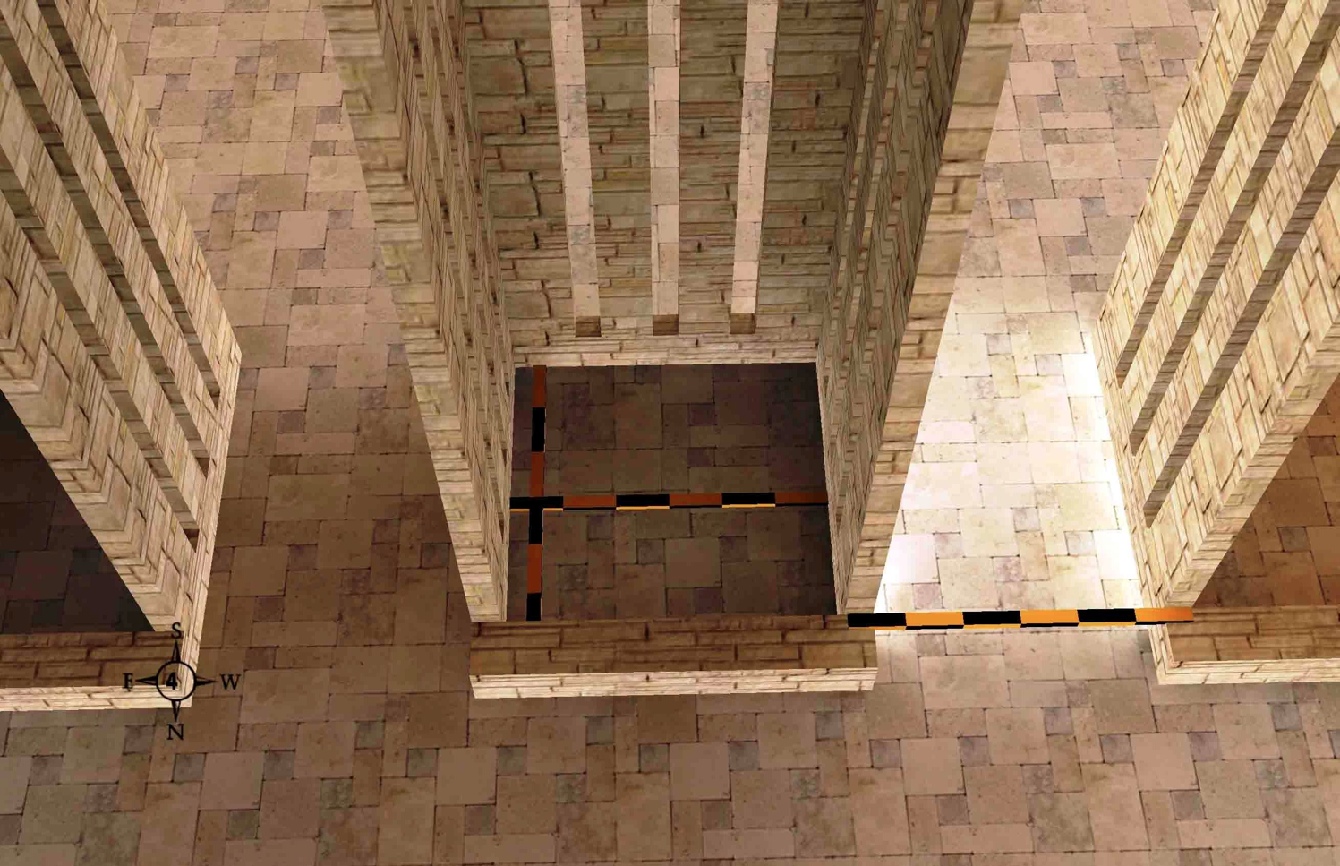
The Guardrooms (40:7)
519
Wayne ODonnell • "Ezekiel 40–48: Tour of Ezekiel's Temple" • http://bible.ag/en/enezekieltranscript.htm
Text
Notes:
"See Picture #4. 6x6 cubit guardrooms with 5 cubit spaces between them inside the outer east gate.
Inside the gate, the angel measures some small rooms. Ezekiel 40:7, "Every little chamber was one reed long, and one reed broad." So the inside dimensions of each chamber are six cubits long and six cubits broad, as shown by the crossed measuring rods in the picture. These are probably guard rooms, because when you have a lot of people in an area, you need to keep things orderly.
"And between the little chambers were five cubits." The five cubit spaces between the chambers are probably so you can exit the gate onto the pavement along the sides of the gate without necessarily going all the way through the gate. As you can see from the rod in the picture, if you include the half cubit walls on each side of the space between the guardrooms, the total is 6 cubits; but not counting the thickness of the walls, the side passageways are 5 cubits wide."
Wayne ODonnell, "Ezekiel 40–48: Tour of Ezekiel's Temple"
http://bible.ag/en/mr4web.html#EZanchor-anchor
Recorded December 30, 2007
Accessed 30 Aug 2016

Slide 58
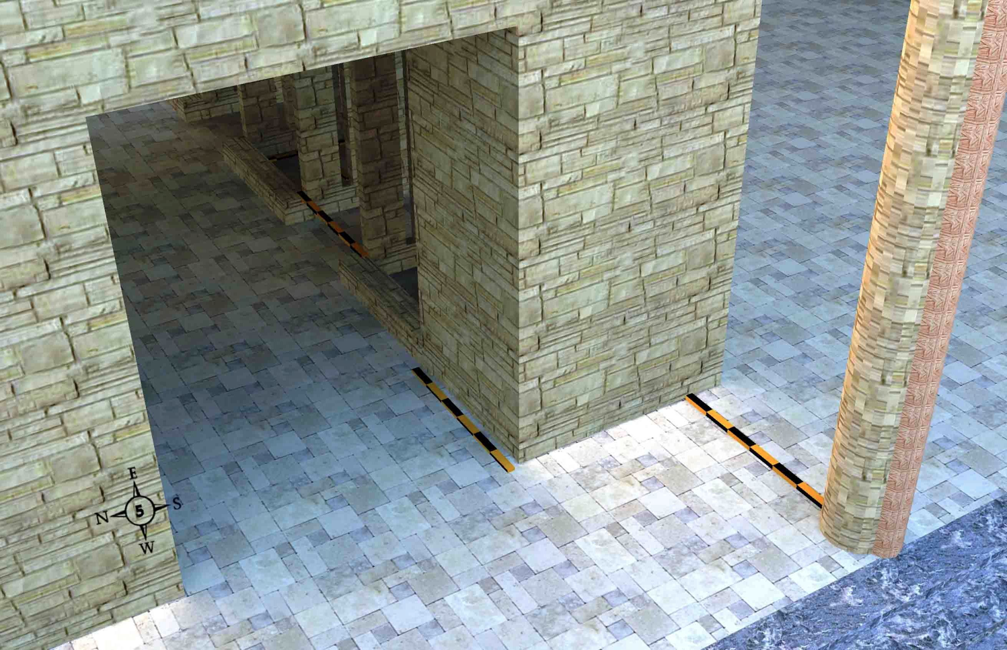
The Inner Threshold (40:7-9)
519
The inner threshold, porch, and one of the two posts on the temple compound side of the outer east gate
Wayne ODonnell • "Ezekiel 40–48: Tour of Ezekiel's Temple" • http://bible.ag/en/enezekieltranscript.htm
Notes:
"See Picture #5. The inner threshold, porch, and one of the two posts on the temple compound side of the outer east gate. We are inside the temple compound and facing southeast.
Proceeding on through the outer east gate, in Ezekiel 40:7-9, the angel measures the porch and threshold "within," meaning towards the inside of the temple compound. "The threshold of the gate by the porch of the gate within was one reed. He measured also the porch of the gate within, one reed. Then measured he the porch of the gate, eight cubits; and the posts thereof, two cubits." The picture shows a two cubit post. You add on one reed, six cubits, for the porch; so the total breadth of the porch is eight cubits.
"And the porch of the gate was inward." The gate has only one porch, and it is on the inside end of the gateway, the part that is towards the center of the temple compound. Remember that when we first approached the gate, there was no porch at the outside doorway.
Just a word of warning here so you don't get confused later: although this porch is on the inside end of the gate, when you step down from this porch, you are in the 'outer' court, because there is another courtyard at the very center of the temple compound called the 'inner' court. So remember that the outer courtyard is still inside the temple compound. We had to come through this outer gate to get into the outer courtyard."
Wayne ODonnell, "Ezekiel 40–48: Tour of Ezekiel's Temple"
http://bible.ag/en/mr4web.html#EZanchor-anchor
Recorded December 30, 2007
Accessed 30 Aug 2016

Slide 59
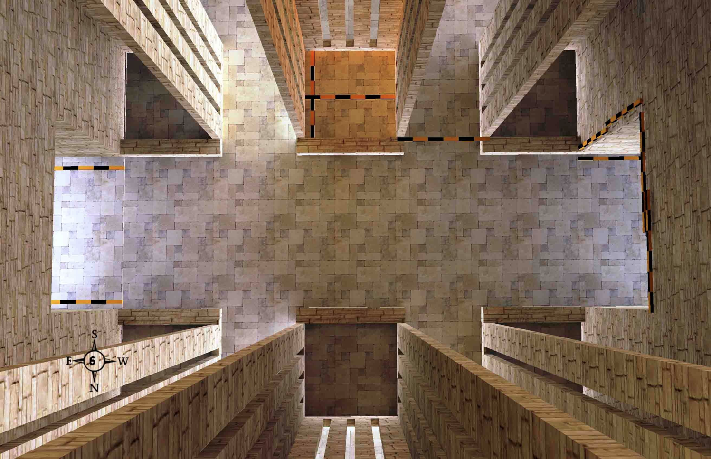
Five Problems with Non-Literal Views
522
Difficulty: Symbolism is impossible to determine without indicators in the text
Inconsistency: Seeing 6x6 as church stability means 5x6 is church instability
Inefficiency: Why say the church is stable over and over?
Uncertainty: Does "many chambers" mean "many mansions" (John 14:1) or churches?
Partiality: If "5 cubits" = "5 covenants" then why not 6 separate 6x6 chambers equals Antichrist (cf. Rev. 13:18)?
Wayne ODonnell • "Ezekiel 40–48: Tour of Ezekiel's Temple" • http://bible.ag/en/enezekieltranscript.htm
Notes:
"Problems with Non-Literal Interpretations
I want to pause, now, to consider some principles of Biblical interpretation. I believe that the literal method is the correct method of interpretation, and that it is incorrect to use a symbolical method of interpretation. I want to present five problems with the non-literal, symbolical, or spiritualizing, method of interpretation; and I will use some quotes from Matthew Henry's Concise Commentary and a quote from Dr. Peter Pett, whose writings I found on the internet, to illustrate these problems.
1. Difficulty: The first problem is difficulty. Matthew Henry says, "Here is a vision beginning at chapter 40 which is justly looked upon to be one of the most difficult portions in all the book of God." Yes, Matthew Henry and all interpreters who use the symbolic approach have great difficulty with chapters 40 through 48 of Ezekiel. It causes them a lot of pain, because it is very difficult to give symbolic meaning to all these cubits.
Now if you use the literal method, the interpretation is quite easy. The 6x6 room, as shown in the picture above, represents a 6x6 room. And this should be easier than, say, Romans or Ephesians, but not for people who approach this passage symbolically. Their problem is that they are using the wrong approach, and they are using the wrong approach because their doctrinal biases don't allow them to believe that God could have a temple in store for Israel in the future.
2. Inconsistency: The second problem is inconsistency. Matthew Henry says, "The chambers, as they were each of them foursquare, denoting their stability." So, he says that because the chamber is 6x6, it is less likely to fall over, and therefore it denotes the stability of the Church. Well, he is being inconsistent, because right next to each 6x6 room, we have a 5x6 area, called the "space between the chambers," as shown above, and he doesn't say those non-square areas denote the instability of the Church, for good reason.
3. Inefficiency: Matthew Henry's interpretation is also inefficient, because if the first 6x6 chamber means the church is stable, then the second one means the church is stable, the third one means the church is stable, the fourth one means the church is stable, the fifth one means the church is stable, and the sixth one means the church is stable. And there are five more gates we have yet to go through, each with six 6x6 rooms. And every other square area of the temple compound means the same thing. So it is very inefficient, because God could have said it in a much simpler way. Ezekiel could have just written, "I saw the temple, and it was foursquare," and then we would know the Church is stable. Or God could have just said, "The Church is stable." But the scribes through all the years have copied this, and people have been memorizing these chapters, and all these cubits would really be unnecessary here if it was just teaching that the Church is stable.
4. Uncertainty: The fourth problem is uncertainty. Matthew Henry says, "The chambers were very many." I'm not sure 6 is very many, or even counting the other 5 gates, I'm not sure 36 is very many. But Matthew Henry says, "For in our Father's house there are many mansions." I hope there's more than 36. Then he says, "Some make these chambers to represent the particular congregations of believers which are parts of the great temple, the universal Church." So some non-literal interpreters think that these chambers represent separate congregations on earth. I hope there's more than 36 of these, too.
But Matthew Henry has a problem. His problem is that he likes his own interpretation, about the rooms in heaven, but he also really likes this other interpretation about particular congregations of believers on earth, and he can't decide which is right. And that is the problem with symbolic interpretation; nobody knows who is right. We can come up with another hundred possible meanings for what these chambers might represent, and no one would ever know which interpretation was right.
You can basically make a passage mean anything you want it to mean if you use symbolic interpretation. And if something can mean anything, then it really means nothing. Now, the Bible does use symbolism sometimes, but it explains the symbolism it uses. It doesn't make us resort to guesswork.
5. Partiality: The fifth problem is partiality. Dr. Peter Pett says, "Five cubits," and he is referring to those five cubits in the spaces between the guard rooms. "Five is the number of covenant. It is, thus, prominent in this heavenly temple. There were five fingers to the hand with which covenants were confirmed." So Peter is very into covenants, and so this five cubit length attracted his attention. But that is the problem with symbolic interpretation. No person who uses the symbolic method is capable of giving meaning to all the cubits in the temple compound, so they only give meaning to some that catch their fancy. But a person who uses a literal method of interpretation has no problem using all the cubits, because if you leave any out, the building has gaps.
And Peter is convinced that 5 is the number of covenant. I'm not convinced of that, but I am convinced that the Bible teaches that 6 is the number of man. And Peter failed to point out that there are six 6x6 chambers in each gateway. In picture #6, there are three 6 cubit long areas on one side of the gateway passage, 6, 6, 6, which we know is the number of Antichrist; and there are three 6 cubit long areas on the other side of the passage. So with the Antichrist on both sides of all the entrances to the temple, does that mean the temple is a trap? Obviously, I'm being sarcastic, but these are the kinds of inconsistencies and problems we get into if we don't interpret the Word of God literally."
Wayne ODonnell, "Ezekiel 40–48: Tour of Ezekiel's Temple"
http://bible.ag/en/mr4web.html#EZanchor-anchor
Recorded December 30, 2007
Accessed 30 Aug 2016

Slide 60
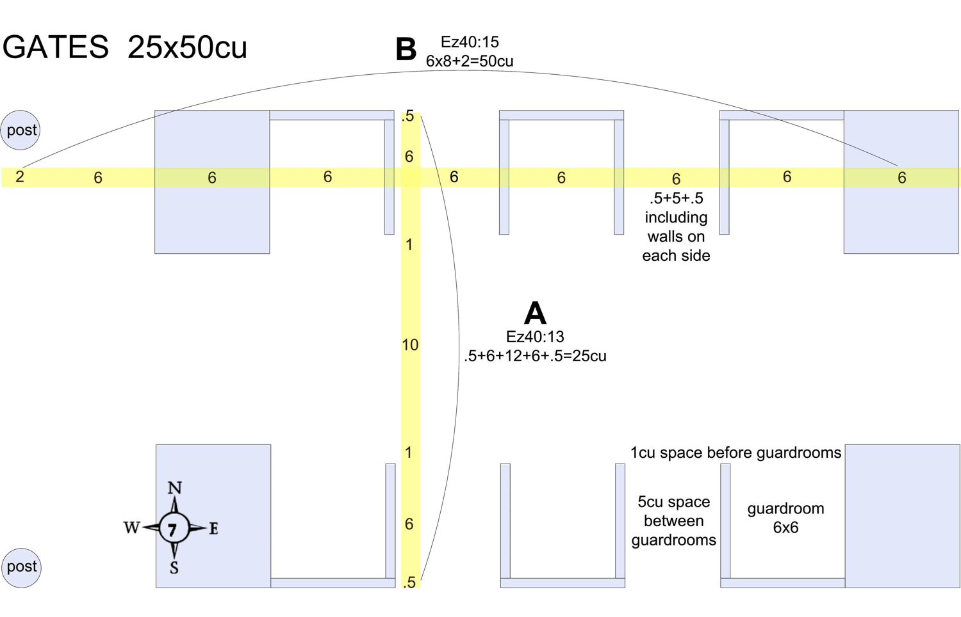
Each Gate is the Same (Ezekiel 40:13-15)
519
Wayne ODonnell • "Ezekiel 40–48: Tour of Ezekiel's Temple" • http://bible.ag/en/enezekieltranscript.htm
Notes:
"Ezekiel 40:13-16. The Outer East Gate Continued
See Picture #7. Diagram of the outer east gate.
Next the angel provides the overall dimensions of the outer east gate. Ezekiel 40:13-15, "He measured then the gate from the roof of one little chamber to the roof of another," and he may have actually measured the floor to get that measurement, "the breadth was five and twenty cubits, door against door," meaning door 'facing' door. We saw that the doors of the guard chambers faced each other. And for the height, "He made also posts of threescore cubits, even unto the post of the court round about the gate," meaning the post is 60 cubits tall and it is the same height as the posts of the pavement on the sides of the gate. Now for the length. "From the face of the gate of the entrance, unto the face of the porch of the inner gate, were fifty cubits." So from the outside entrance, which had no porch, to the front of the porch facing into the temple compound, were 50 cubits.
For the width, as shown in letter A in the picture, the passageway is 10 cubits, and 7.5 on each side makes 25. The 7.5 is made up of 6 for the inside of the guard chamber, plus .5 cubits for the width of the outside walls, and 1 cubit for the space or barrier in front of the guard chambers.
For the length of the gate, as shown in letter B, starting at the right side of the picture, there are 6 cubits for the outer threshold, 6 for each of the three guard rooms, 6 for each of two spaces between the guard rooms if you include the thickness of the .5 cubit wall on each side (.5+5+.5), 6 cubits for the inner threshold, a 6 cubit porch, and a 2 cubit post. So there are eight 6's, equals 48, plus 2 for the post, equals 50 cubits. So the dominant numbers for the gate are 6 and 5."
Wayne ODonnell, "Ezekiel 40–48: Tour of Ezekiel's Temple"
http://bible.ag/en/mr4web.html#EZanchor-anchor
Recorded December 30, 2007
Accessed 30 Aug 2016

Slide 61
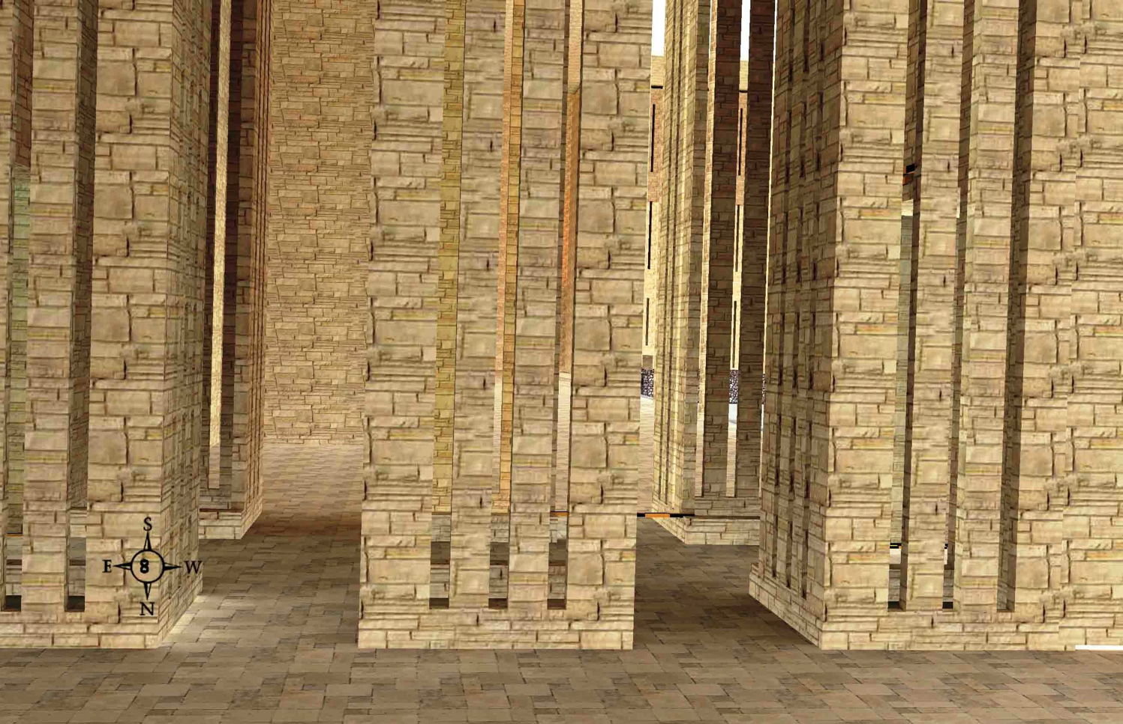
The Outer East Gate (40:13-16)
519
Narrow windows all around inside the outer east gate
Wayne ODonnell • "Ezekiel 40–48: Tour of Ezekiel's Temple" • http://bible.ag/en/enezekieltranscript.htm
Notes:
"See Picture #8. Narrow windows all around inside the outer east gate.
Ezekiel 40:16, "And there were narrow windows to the little chambers, and to their posts within the gate round about, and likewise to the arches: and windows were round about inward." The "arches" are the five cubit wide spaces through the sides of the gate. The purpose of the windows is probably to allow the guards to see out, and see everything that is going on, and let some natural light in; and yet the windows are narrow enough so that no one can get through and interfere with the guards' work."
Wayne ODonnell, "Ezekiel 40–48: Tour of Ezekiel's Temple"
http://bible.ag/en/mr4web.html#EZanchor-anchor
Recorded December 30, 2007
Accessed 30 Aug 2016

Slide 62
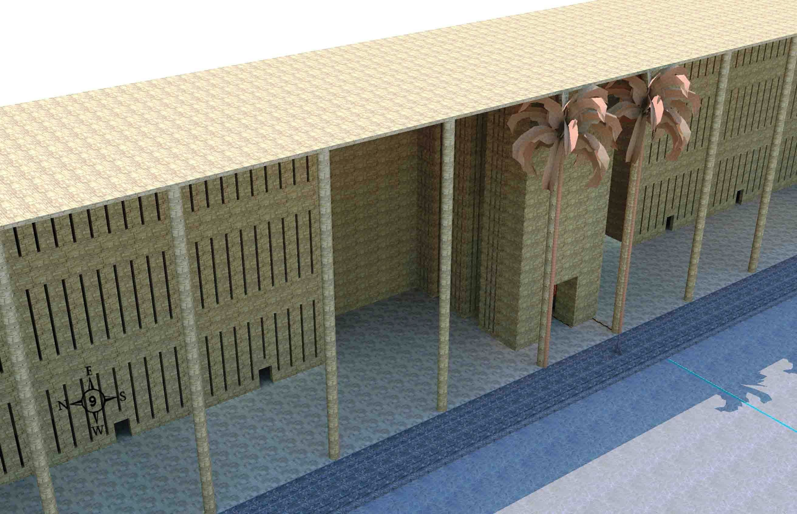
Porch of Outer Court (40:17-27)
519
The porch of the outer east gate with its palm tree ornaments and some of the 30 chambers on the lower pavement
Wayne ODonnell • "Ezekiel 40–48: Tour of Ezekiel's Temple" • http://bible.ag/en/enezekieltranscript.htm
Notes:
"See Picture #9. The porch of the outer east gate with its palm tree ornaments and some of the 30 chambers on the lower pavement.
"And upon each post were palm trees," Ez40:16. The palm tree ornaments are on each gate porch to give a visual indication as to where the doors are, so you can tell at a glance where the gates of the building are.
Ezekiel 40:17-27. The Outer Court
"Then brought he me into the outward [outer] court, and, lo, there were chambers, and a pavement made for the court round about: thirty chambers were upon the pavement. And the pavement by the side of the gates over against the length of the gates was the lower pavement," Ez40:17-18. Picture #9 shows some of the thirty chambers on the lower pavement. The lower pavement is 50 cubits wide, because it goes alongside the gate, which is 50 cubits long. It is called the lower pavement because there are only seven steps up to it, whereas we will see later that there is an upper pavement, that has eight steps up to it, and so that pavement is higher. However, my model shows even the 'lower pavement' of the outer court to be higher than the 'outer court' proper shown in the bottom right of the picture.
It may be that the outer court should be on the same level as the lower pavement. Ezekiel 40 seems to mention only one set of steps for each gate. I made the lower pavement higher than the outer court in the model to distinguish it from the outer court. But perhaps the roof over the pavement or something else could distinguish it from the outer court. But if the outer court was level with the lower pavement, then the outer gates' porches might not seem like porches."
Wayne ODonnell, "Ezekiel 40–48: Tour of Ezekiel's Temple"
http://bible.ag/en/mr4web.html#EZanchor-anchor
Recorded December 30, 2007
Accessed 30 Aug 2016

Slide 63
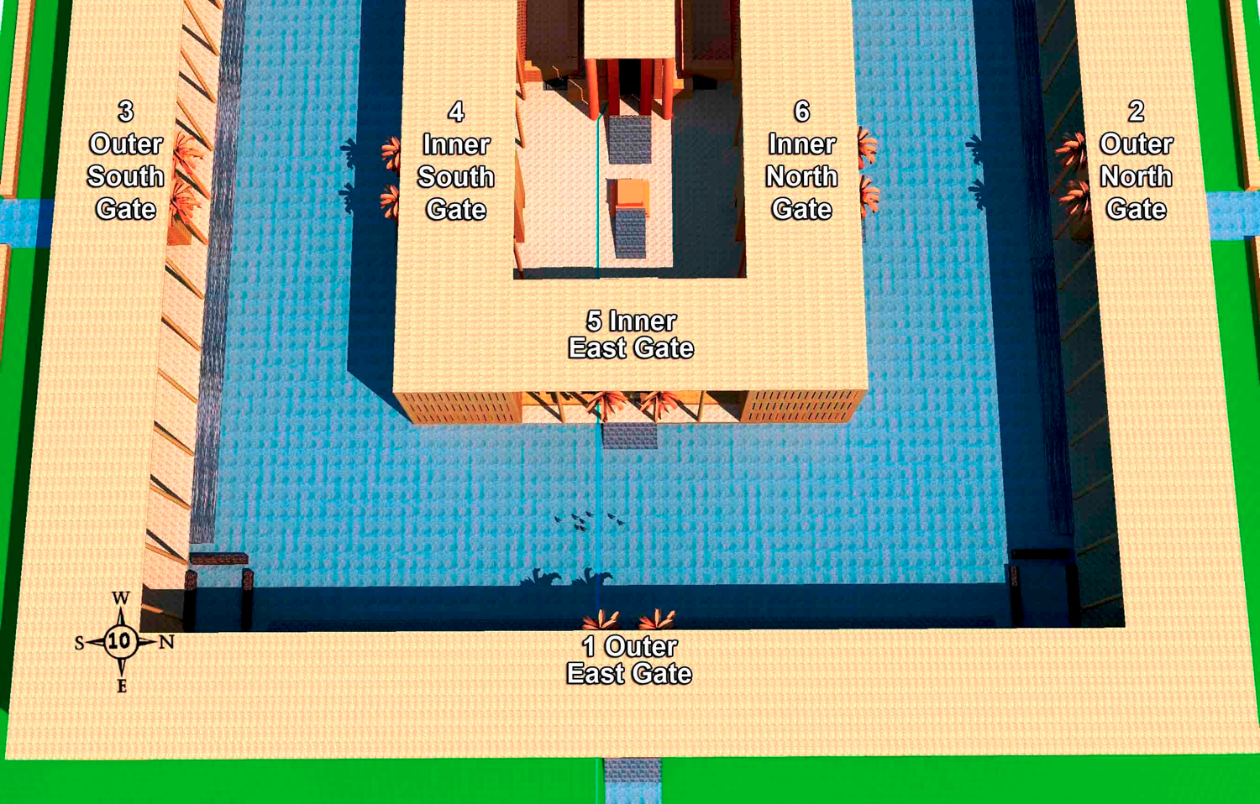
Temple
519
The 100-cubit wide outer court with palm tree ornaments on the porches of the outer and inner gates facing each other
Wayne ODonnell • "Ezekiel 40–48: Tour of Ezekiel's Temple" • http://bible.ag/en/enezekieltranscript.htm
Notes:
"See Picture #10. The 100 cubit wide outer court showing the palm tree ornaments on the porches of the outer and inner gates facing each other.
"Then he measured the breadth from the forefront of the lower gate unto the forefront of the inner court without, an hundred cubits eastward and northward," Ez40:19. The outer east gate is called the "lower gate" here, possibly because the outer gates are 1 step lower than the inner gates. The "inner court without" means the outside of the inner court including the inner gates. So from #1 to #5, and from #6 to #2, in picture #10, is 100 cubits. So the inner court is 100 cubits wide all the way around.
There are a total of 6 gates in the temple compound; 3 outer gates and 3 inner gates. The picture shows the order in which the angel showed them to Ezekiel. We entered through the outer east gate (#1). Then the angel showed Ezekiel the outer north gate (#2), the outer south gate (#3), the inner south gate (#4), the inner east gate (#5), and then the inner north gate (#6).
Notice how the 3 outer gates have their porches and palm tree ornaments facing towards the center of the temple compound, while the inner court gates have their porches and palm tree ornaments facing away from the center of the temple compound, so the porches all face each other across the outer court.
The outer north gate was "after the measure of the first gate," Ez40:21; meaning it had the same measurements as the outer east one that we looked at in detail, 50 by 25 cubits, and "seven steps," Ez40:22. And the outer south gate is also "according to these measures," Ez40:24, 50 by 25."
Wayne ODonnell, "Ezekiel 40–48: Tour of Ezekiel's Temple"
http://bible.ag/en/mr4web.html#EZanchor-anchor
Recorded December 30, 2007
Accessed 30 Aug 2016

Slide 64
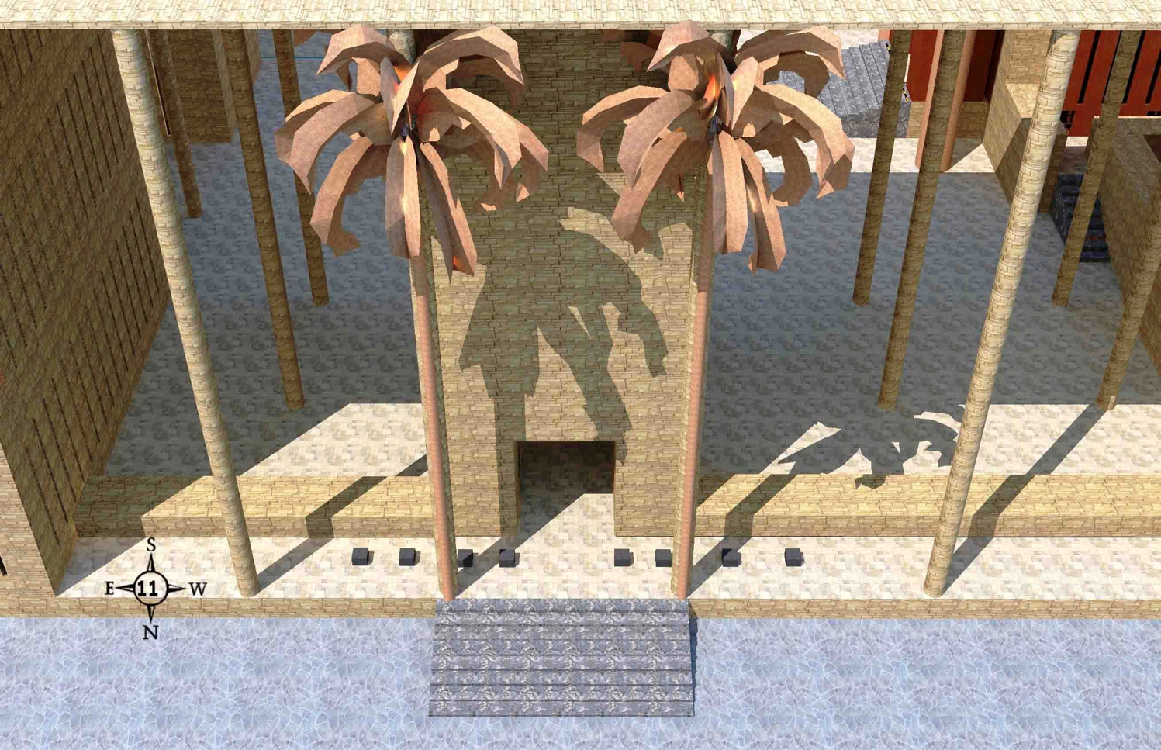
The Inner Court (40:28-49)
519
The tables on the outer court side
of the inner north gate
Wayne ODonnell • "Ezekiel 40–48: Tour of Ezekiel's Temple" • http://bible.ag/en/enezekieltranscript.htm
Notes:
"Ezekiel 40:28-49. The Inner Court
See Picture #11. The tables on the outer court side of the inner north gate.
The inner south is also "according to these measures," Ez40:28, of the outer gates, but it has eight steps up to its porch from the outer court. Then the angel took Ezekiel through the inner south gate and into the inner court. He measured the inner east gate from the inner court side, "according to these measures," Ez40:32.
The inner north gate has the same measurements also, but then the angel takes Ezekiel from the inner court, through the inner north gate to the outer court side and "four tables were on this side, and four tables on that side, by the side of the gate; eight tables, whereupon they slew their sacrifices," Ez40:41.
Why sacrifices during the Messianic Kingdom? Because sacrifices never took away sin. Only Jesus, who took our place, and suffered the wrath of God for us, could do that. God, being a just God, cannot justify the unrighteous apart from that. Today, in the Lord's Supper, the bread and wine remind us of what the Lord did for us on the cross. We have the Lord's Supper "until he comes," 1Cor11:26. He said, "I will not drink henceforth of this fruit of the vine until that day when I drink it new with you in my Father's kingdom," Mt26:29. After he returns, Israel's offering of these animal sacrifices will be the method of remembering what the Lord did for us. And this will last until the new heaven and new earth, because during the Messianic Kingdom there will still be those that don't know the Lord, and there will be a final rebellion and final judgment at the end of the Messianic Kingdom, so there will need to be this reminder and warning of the tragedy of sin and death."
Wayne ODonnell, "Ezekiel 40–48: Tour of Ezekiel's Temple"
http://bible.ag/en/mr4web.html#EZanchor-anchor
Recorded December 30, 2007
Accessed 30 Aug 2016

Slide 65
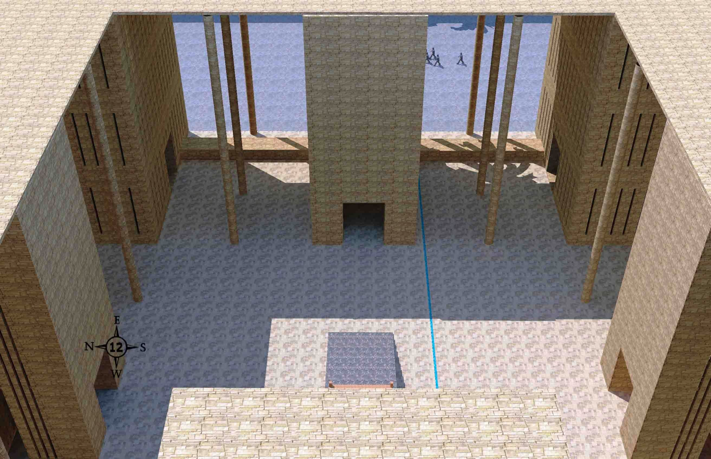
Singer Chambers (40:44-46)
519
Chambers of the singers in the inner court, one on the north with its door facing south (top left corner) and one on the south with its door facing north (top right corner)
Wayne ODonnell • "Ezekiel 40–48: Tour of Ezekiel's Temple" • http://bible.ag/en/enezekieltranscript.htm
Notes:
"See Picture #12. Chambers of the singers in the inner court, one on the north with its door facing south (top left corner of picture) and one on the south with its door facing north (top right corner of picture).
Ezekiel 40:44-46, "And without the inner gate," possibly meaning through the arches in the side of the gate, "were the chambers of the singers in the inner court, which was at the side of the north gate; and their prospect was toward the south: one at the side of the east gate having the prospect toward the north."
In my model, the north chambers are (37.5 cubits clockwise) to the side of the north gate, and the south chambers are (37.5 cubits clockwise) to the side of the east gate.
Notice there are no porches on the inside of the inner gates. The inner gates, with their porches facing outward, are reversed, mirror images, of the outer gates, except for the steps.
I should have made the 'inner court' area in the model the same color as the 'outer court' area, rather than the same color as the 50 cubit wide 'upper pavement' alongside the inner gates, to avoid confusion."
Wayne ODonnell, "Ezekiel 40–48: Tour of Ezekiel's Temple"
http://bible.ag/en/mr4web.html#EZanchor-anchor
Recorded December 30, 2007
Accessed 30 Aug 2016

Slide 66
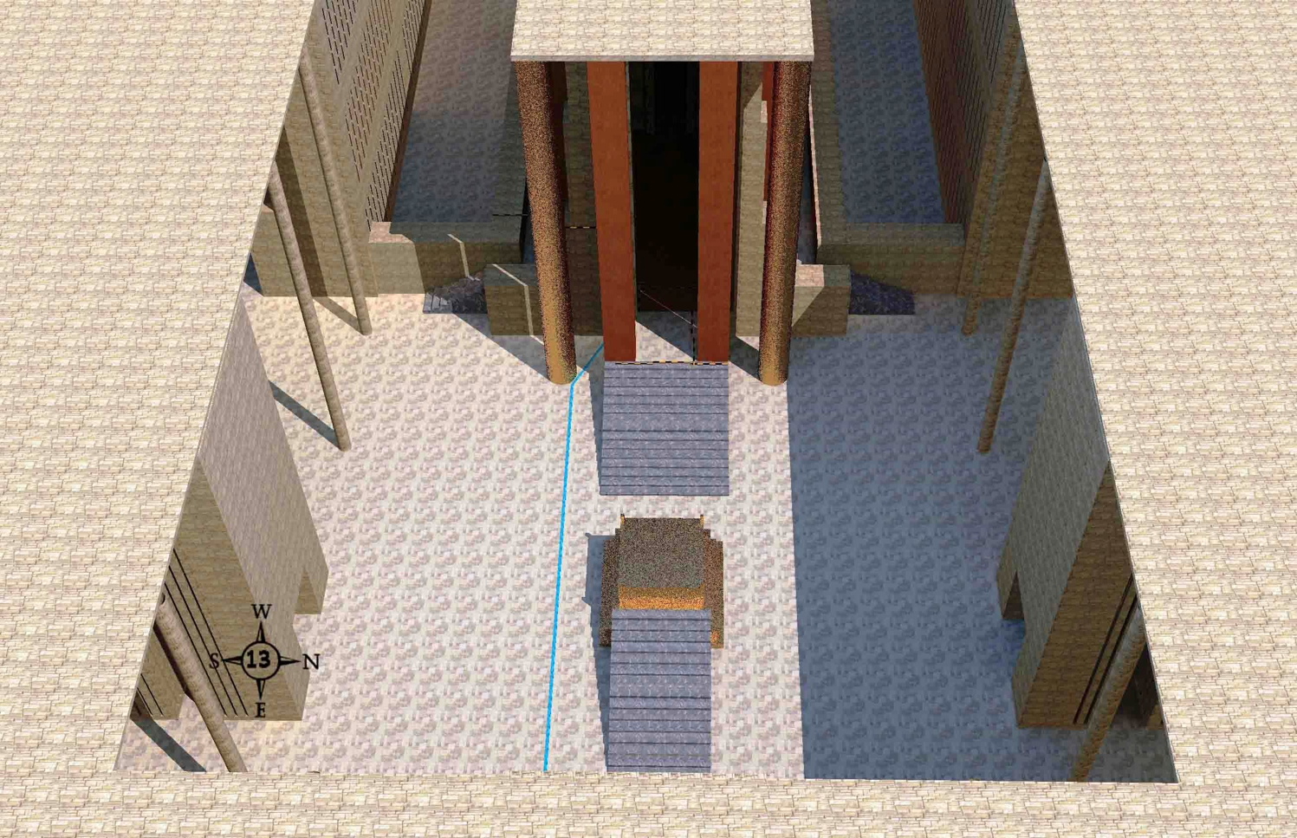
Inner Court & Altar (40:47)
519
The 100 x 100 cubit inner court altar at the center and the temple at the top of the picture
Wayne ODonnell • "Ezekiel 40–48: Tour of Ezekiel's Temple" • http://bible.ag/en/enezekieltranscript.htm
Notes:
"See Picture #13. The 100 x 100 cubit inner court with the altar at the center and the temple at the top of the picture.
Ezekiel 40:47, "So he measured the court, an hundred cubits long, and an hundred cubits broad, foursquare," 100 x 100 (and we know what Matthew Henry would say foursquare symbolizes), "and the altar that was before the house," meaning before the temple. Up to this point, we have been looking at the temple compound, not the temple; but in this picture we see the door to the temple itself, called "the house" in this verse."
Wayne ODonnell, "Ezekiel 40–48: Tour of Ezekiel's Temple"
http://bible.ag/en/mr4web.html#EZanchor-anchor
Recorded December 30, 2007
Accessed 30 Aug 2016

Slide 67
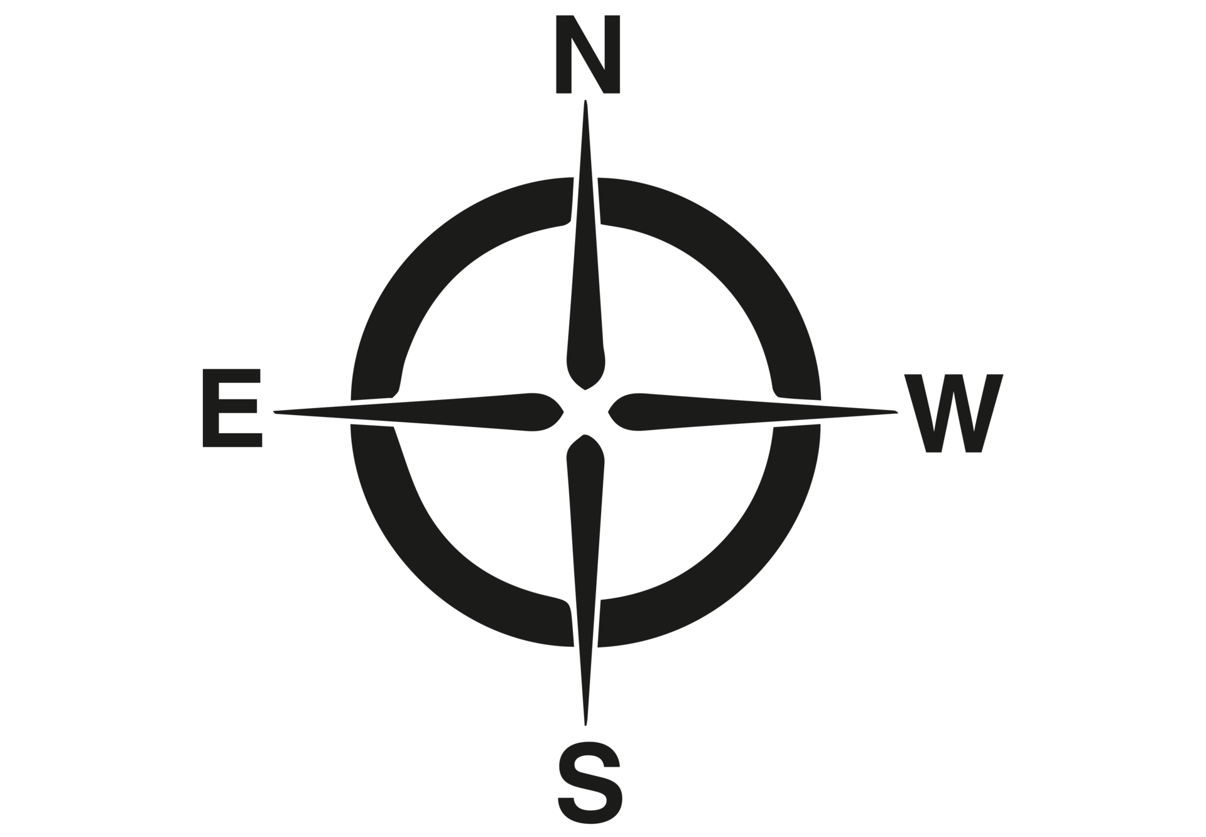
Ezekiel's Temple Compound
500x500 cubits with 50-cubit border
519
border 50
lower pavement
north inner gate
50
outer court
100
200+100+200=500
north inner gate
upper pavement
50
200+100+200=500
200
100
50
100
50
temple, separate place,
& west building
inner court
east inner gate
east outer gate
upper pavement
south inner gate
50
outer court
100
lower pavement
south outer gate
50
all gates
25x50
border 50
Wayne ODonnell • "Ezekiel 40–48: Tour of Ezekiel's Temple" • http://bible.ag/en/enezekieltranscript.htm
Notes:
"See Picture #14. Diagram of the entire temple compound.
From east to west, starting at A in the picture, and leaving out the 50 cubit border, there are 50 cubits for the outer east gate and the lower pavement on both sides, 100 for the outer court, and 50 for the inner east gate and the upper pavement on both sides, which subtotals 200. Then 100 for the inner court, and 200 for the temple area (100 for the temple and 100 for the west building and separate place which we will look at later). So 200 + 100 + 200 = 500.
From north to south, starting at B in the picture, and leaving out the 50 cubit border, there are 50 cubits for the outer north gate and the lower pavement on both sides, 100 for the outer court, and 50 for the inner north gate and the upper pavement on both sides, which subtotals 200. Then there are 100 for the inner court. And then 50 for the inner south gate and the upper pavement on both sides, 100 for the outer court, and 50 for the outer south gate and lower pavement on both sides, which subtotals 200. So 200 + 100 + 200 = 500. So the dominant numbers are 50 and 100.
We started our tour at the wall at the outside of the eastern border, and then entered the outer court through the east outer gate. We looked at the outer court and the inner court. Now we are going to look at the temple, the separate place, and the west building."
Wayne ODonnell, "Ezekiel 40–48: Tour of Ezekiel's Temple"
http://bible.ag/en/mr4web.html#EZanchor-anchor
Recorded December 30, 2007
Accessed 30 Aug 2016

Slide 68
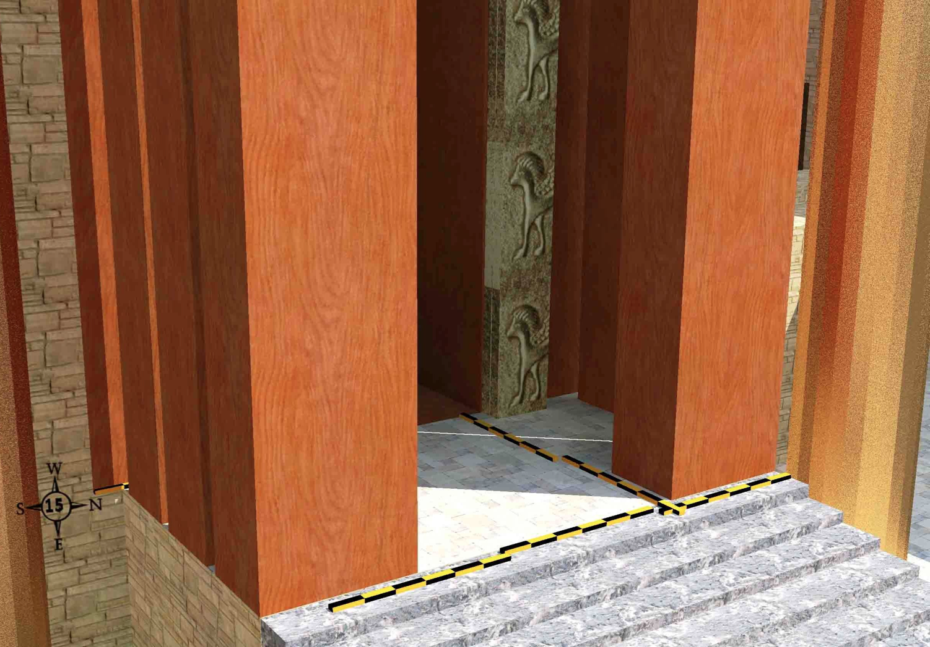
The Temple Porch (40:48-49)
519
Wayne ODonnell • "Ezekiel 40–48: Tour of Ezekiel's Temple" • http://bible.ag/en/enezekieltranscript.htm
Notes:
"Ezekiel 41. The Temple
See Picture #15. The temple porch.
Ezekiel 40:48-49, "And he brought me to the porch of the house, and measured each post of the porch, five cubits on this side, and five cubits on that side: and the breadth of the gate was three cubits on this side, and three cubits on that side. The length of the porch was twenty cubits, and the breadth eleven cubits, and he brought me by the steps whereby they went up to it: and there were pillars by the posts, one on this side, and another on that side." Verse 48 should start a new chapter, because Ezekiel begins talking about the temple in that verse.
In the picture, you can see from the measuring rods, that the rectangular posts on each side of the porch are 5 cubits by 3 cubits. The length of the porch is 20 cubits across the front of the temple. 'Length' is always the long measurement for any particular area under consideration, no matter which direction it faces. And the breadth, the shorter measurement of the porch, is 11 cubits deep. And there is one large, special pillar beside the porch on each side."
Wayne ODonnell, "Ezekiel 40–48: Tour of Ezekiel's Temple"
http://bible.ag/en/mr4web.html#EZanchor-anchor
Recorded December 30, 2007
Accessed 30 Aug 2016

Slide 69
Slides on
Ezekiel 41

Slide 70
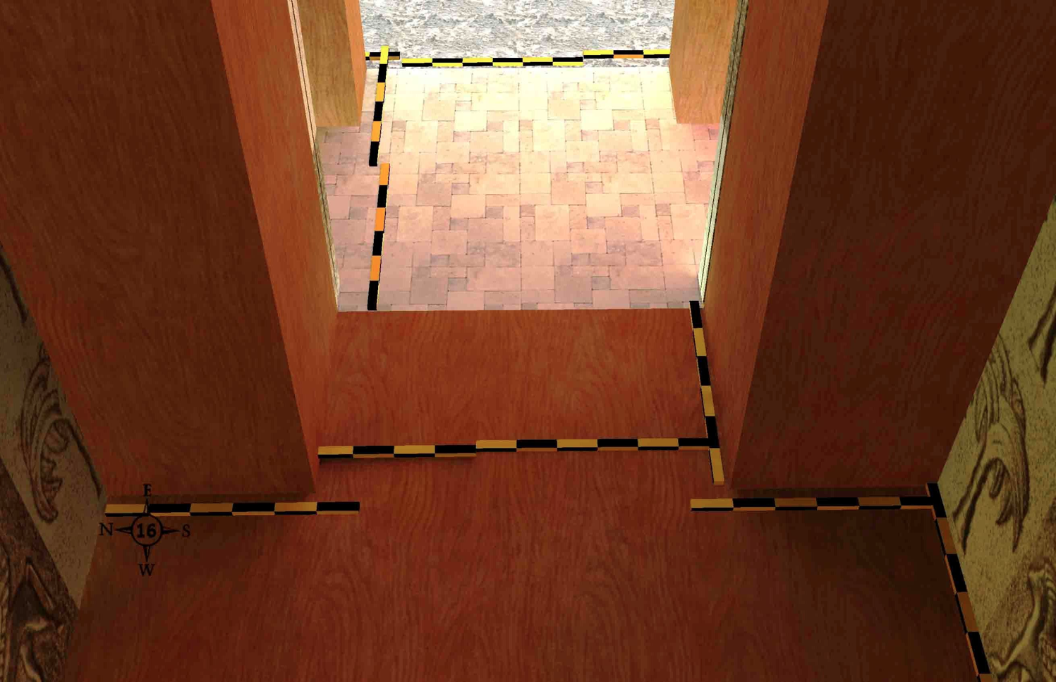
Looking Out (41:1-2, 21)
519
Inside the holy place looking out towards the temple porch
Wayne ODonnell • "Ezekiel 40–48: Tour of Ezekiel's Temple" • http://bible.ag/en/enezekieltranscript.htm
Notes:
"See Picture #16. Inside the holy place, looking back out towards the temple porch.
Ezekiel 41:1, "Afterward he brought me to the temple, and measured the posts, six cubits broad on the one side, and six cubits broad on the other side, which was the breadth of the tabernacle."
The posts of the doorway are 6 cubits square, as confirmed by Ez41:21, "the posts of the temple were squared." We see only 5 cubits of them on each side in the picture, because they extend 1 cubit into the 6 cubit wide temple walls, "which was the breadth of the tabernacle," Ez41:1.
"And the breadth of the door was ten cubits; and the sides of the door were five cubits on the one side, and five cubits on the other side," Ez41:2. The doorway is 10 cubits wide, as you can see from the measuring rods. And we see only 5 cubits of the 6 cubit wide door posts on each side of the doorway, for the reason explained above."
Wayne ODonnell, "Ezekiel 40–48: Tour of Ezekiel's Temple"
http://bible.ag/en/mr4web.html#EZanchor-anchor
Recorded December 30, 2007
Accessed 30 Aug 2016

Slide 71

The Holy Place (41:2b)
519
The 20x40 cubit temple room from above
Wayne ODonnell • "Ezekiel 40–48: Tour of Ezekiel's Temple" • http://bible.ag/en/enezekieltranscript.htm
Notes:
"See Picture #17. Looking down on the 20 x 40 cubit holy place in the temple.
"And he measured the length thereof, forty cubits: and the breadth, twenty cubits," Ez41:2b. The whole room of the holy place is two 20 x 20 cubit square areas; in other words, 40 cubits by 20 cubits."
Wayne ODonnell, "Ezekiel 40–48: Tour of Ezekiel's Temple"
http://bible.ag/en/mr4web.html#EZanchor-anchor
Recorded December 30, 2007
Accessed 30 Aug 2016

Slide 72

Holy to Most Holy Place (41:3)
519
In the holy place of the temple, looking towards the door to the most holy place
Wayne ODonnell • "Ezekiel 40–48: Tour of Ezekiel's Temple" • http://bible.ag/en/enezekieltranscript.htm
Notes:
"See Picture #18. In the holy place of the temple, looking towards the door to the most holy place.
"Then went he inward, and measured the post of the door, two cubits; and the door, six cubits; and the breadth of the door, seven cubits," Ez41:3. The angel measured the entrance to the most holy place. The wood door posts are 2 cubits wide; you can see a little of their wood behind the folding doors. The temple wall on each side of them is an additional 5 cubits, so 7 cubits on each side of the 6 cubit wide doorway."
Wayne ODonnell, "Ezekiel 40–48: Tour of Ezekiel's Temple"
http://bible.ag/en/mr4web.html#EZanchor-anchor
Recorded December 30, 2007
Accessed 30 Aug 2016

Slide 73

The Most Holy Place (41:4)
519
The 20x20 cubit sacred room from above
Wayne ODonnell • "Ezekiel 40–48: Tour of Ezekiel's Temple" • http://bible.ag/en/enezekieltranscript.htm
Notes:
"See Picture #19. The most holy place.
"So he measured the length thereof, twenty cubits; and the breadth, twenty cubits, before the temple: and he said unto me, This is the most holy place," Ez41:4. Inside the most holy place, the length is 20 cubits and the breadth 20 cubits."
Wayne ODonnell, "Ezekiel 40–48: Tour of Ezekiel's Temple"
http://bible.ag/en/mr4web.html#EZanchor-anchor
Recorded December 30, 2007
Accessed 30 Aug 2016

Slide 74

The Southwest Front Corner
(41:5-7, 8-11)
519
Wayne ODonnell • "Ezekiel 40–48: Tour of Ezekiel's Temple" • http://bible.ag/en/enezekieltranscript.htm
Notes:
"See Picture #20. The southeast front corner of the temple: 1) 6-cubit temple wall, 2) narrower 5-cubit temple wall, 3) 4-cubit side chambers, 4) wider 5-cubit side chambers, 5) 6-cubit foundation of the temple, 6) side chambers' 6-cubit outer wall 7) side chambers' 5-cubit walkway, 8) 20-cubit separate place, 9) southern door to side chambers.
Next, we go around the outside of the temple. Ezekiel 41:5-7, "He measured the wall of the house, six cubits," on the bottom level, but the temple wall gets narrower on the higher levels, as you can see if you compare #1 to #2 in the picture. (One cubit of the front of the temple wall is made up of part of the 6x6 cubit square wood temple post, as we discussed earlier and as you can see in the shadow of the pillar.)
"And the breadth of every side chamber, four cubits, round about the house on every side," on the bottom level, but the side chambers get wider on the higher levels, as you can see if you compare #3 to #4 in the picture.
"And the side chambers were three, one over another, and thirty in order," three stories tall, thirty rooms per story as you go around the temple. "And they entered into the wall which was of the house," as you see in #4, "... that they might have hold, but they had not hold in the wall of the house." Starting at the bottom, each story of the chambers was wider, and the temple wall likewise narrower, so the chambers could sit securely against the temple without being attached by nails or anything.
Ezekiel 41:8-11, "I saw also the height of the house round about: the foundations of the side chambers were a full reed of six great cubits." You can see the six cubit foundation by the vertical rod leaning against the stairs near #5 in the picture. So temple sits higher than everything else in the temple compound. "The thickness of the wall, which was for the side chamber without, was five cubits," meaning the outside wall going around the side chambers, labeled #6, is five cubits thick. "And that which was left was the place of the side chambers that were within." 'That which was left' is the 5 cubit wide walkway, labeled #7, that provides access to the side chambers.
"And between the chambers was the wideness of twenty cubits round about the house on every side," marked with #8. We'll see this 20 cubit area, called the Separate Place, around the temple better in a minute.
"And the doors of the side chambers were toward the place that was left, one door toward the north, and another door toward the south," we see the doorway to the south at #9 for access to the chambers' walkway, "and the breadth of the place that was left," #7 again, "was five cubits round about."
Wayne ODonnell, "Ezekiel 40–48: Tour of Ezekiel's Temple"
http://bible.ag/en/mr4web.html#EZanchor-anchor
Recorded December 30, 2007
Accessed 30 Aug 2016

Slide 75

Temple Area on the West (41:12)
519
The text does not explain the purpose of the West Building
Wayne ODonnell • "Ezekiel 40–48: Tour of Ezekiel's Temple" • http://bible.ag/en/enezekieltranscript.htm
Notes:
"See Picture #21. The west building is to the left, the temple to the right, and the 20 cubit separate place in between. You can also see the low side chambers' wall and some of the 5-cubit walkway around the sides and back of the temple. The buildings that border the separate place at the top and bottom of the picture are 3-tiered priests' chambers.
Ezekiel 41:12, "Now the building that was before the separate place at the end toward the west was seventy cubits broad; and the wall of the building was five cubits thick round about, and the length thereof ninety cubits." The west building is 70 by 90 in its internal dimensions. It's got a five cubit thick wall all around which makes it 100 long and 80 wide in its external dimensions. When you add the 20 cubits of the 'separate place' in front of it to its external width, the total area is 100 by 100 cubits square."
Wayne ODonnell, "Ezekiel 40–48: Tour of Ezekiel's Temple"
http://bible.ag/en/mr4web.html#EZanchor-anchor
Recorded December 30, 2007
Accessed 30 Aug 2016

Slide 76

Temple Area on the West (41:12)
The text does not explain the purpose of the West Building
Wayne ODonnell • "Ezekiel 40–48: Tour of Ezekiel's Temple" • http://bible.ag/en/enezekieltranscript.htm
Notes:
"See Picture #22. Diagram of the temple, the separate place, and the west building.
Next the angel measured the overall dimensions of the temple area, including the separate place and the west building. First going east to west, Ezekiel 41:13, "So he measured the house [the temple], an hundred cubits long, and the separate place, and the building [the west building], with the walls thereof, an hundred cubits long." Starting at A in picture 22, we see the temple is 100 cubits long comprised of five 20's. The porch plus the dividing wall between the holy place and the most holy place equals 20 cubits (3+8+6+3), the holy place is 40 cubits long (or two 20's), the most holy place is 20 cubits, and the temple wall and side chambers on the west are 20 cubits (6+4+5+5=20). And then the separate place plus the west building is 100 cubits (20+5+70+5).
"Also the breadth of the face of the house, and of the separate place toward the east, an hundred cubits," Ez41:14. Next he measures 100 cubits north to south across the front of the temple. Starting at B in the picture, the separate place on the north is 20; the side chambers and temple wall, 20 (5+5+4+6); the holy place, 20; the temple wall and side chambers, 20 (6+4+5+5); and the separate place on the south is 20.
And finally, the separate place is 100 cubits long against all three buildings on the west, north, and south, as shown by the three letter C's in the picture. On the west, "he measured the length of the building [the west building] over against the separate place which was behind it." On the north and south along the 3-tiered priests' galleries, "and the galleries thereof on the one side and on the other side." All three measurements each measured "an hundred cubits," as also did "the inner temple and the porches of the court," Ez41:15, as we saw in verse 13. So the dominant numbers for the temple area are 20 and 100.
To me, this careful measuring, first east to west, then north to south, and finally this additional check around the perimeter of the separate place, is another evidence of the inspiration of the scriptures. It would have been very difficult for Ezekiel to have thought all this up by himself, and have it fit together, especially without 3D drawing software.
Now the angel takes us back into the temple for some additional details. The walls were covered with cherubs and palm tree decorations. Ezekiel 41:18-25, "It was made with cherubims and palm trees, so that a palm tree was between a cherub and a cherub; and every cherub had two faces; so that the face of a man was toward the palm tree on the one side, and the face of a young lion toward the palm tree on the other side: it was made through all the house round about. From the ground unto above the door were cherubims and palm trees made, and on the wall of the temple." You can see these decorations in picture #18. I didn't have any pictures of two-faced cherubs to use in the model, so the ones on the walls in the pictures have only the lion face. (Some cherubs, like those in Ezekiel 1, have 4 faces. Satan is a fallen cherub. Some speculate he may be of the two-faced variety.)
"The altar of wood was three cubits high, and the length thereof two cubits; and the corners thereof, and the length thereof, and the walls thereof, were of wood: and he said unto me, This is the table that is before the LORD." You can also see the altar in picture #18 (though it's hard to see because I made it the same color as the floor and door posts).
"And the temple and the sanctuary had two doors." I'm assuming that means two doors each; two at the outside of the temple and two for the most holy place. "And the doors had two leaves apiece, two turning leaves; two leaves for the one door, and two leaves for the other door." So you can see the two folding doors for the sanctuary, or most holy place, in picture #18; and you can see one of the two folding doors of the temple in picture #15. "And there were made on them, on the doors of the temple, cherubims and palm trees, like as were made upon the walls."
Ezekiel 41:25-26, "And there were thick planks upon the face of the porch without, and there were narrow windows and palm trees on the one side and on the other side, on the sides of the porch, and upon the side chambers of the house, and thick planks." You can also see the thick planks and narrow windows of the temple porch in picture #15. It seems they should have palm trees on them, but not cherubs."
Wayne ODonnell, "Ezekiel 40–48: Tour of Ezekiel's Temple"
http://bible.ag/en/mr4web.html#EZanchor-anchor
Recorded December 30, 2007
Accessed 30 Aug 2016

Slide 77
Slides on
Ezekiel 42

Slide 78

3-Tiered Priest Chambers & Overall Dimensions (42:7-8, 13-14)
519
A 50-cubit 3-tiered building and a 100-cubit 3-tiered building of priests' chambers facing each other with a walkway between them. These in the picture are the northern ones on the west side of the inner north gate between the outer court and the separate place of the temple.
Wayne ODonnell • "Ezekiel 40–48: Tour of Ezekiel's Temple" • http://bible.ag/en/enezekieltranscript.htm
Notes:
"Ezekiel 42. 3-Tiered Priests' Chambers & Overall Dimensions
See Picture #23. A 50-cubit 3-tiered building and a 100-cubit 3-tiered building of priests' chambers facing each other with a walkway between them. These in the picture are the northern ones on the west side of the inner north gate between the outer court and the separate place of the temple.
Ezekiel 42:7-8, "The wall that was without over against the chambers, toward the utter [outer] court on the forepart of the chambers, the length thereof was fifty cubits. For the length of the chambers that were in the utter [outer] court was fifty cubits: and, lo, before the temple were an hundred cubits." In picture 23, we are looking at two buildings on the upper pavement on the west side of the inner north gate. The two buildings are not the same length. The one "toward the utter [outer] court" is only 50 cubits long, while the one along the separate place "before the temple" is 100 cubits long.
Ezekiel 42:13-14, "Then said he unto me, The north chambers and the south chambers," there is a mirror image of them on the west side of the inner south gate also, "which are before the separate place, they be holy chambers, where the priests that approach unto the LORD shall eat the most holy things ... When the priests enter therein, then shall they not go out of the holy place into the utter [outer] court, but there they shall lay their garments wherein they minister; for they are holy; and shall put on other garments, and shall approach to those things which are for the people." So we have some locker rooms for the priests here. They have to leave their holy clothes in the inner court area, and put on other clothes, before going out to the people in the outer court.
Perhaps the 50-cubit long building by the outer court, in picture #23, should be slid to the left (east), in my model, since the purpose of these buildings is to separate the priests from the people, rather than to provide space for interaction between the priests and the people.
After the angel measures the 3-tiered priest's chambers on the upper pavement, he takes Ezekiel outside the outer eastern gate, the one by which he had first entered the temple compound. This is Ezekiel's first time out of the temple compound since he started the tour. And the reason the angel now takes him outside, is that he had finished measuring the inside. There are still a few details that will be measured, in relation to sacrifices, but he is done measuring all the temple compound buildings. "Now when he had made an end of measuring the inner house, he brought me forth toward the gate whose prospect is toward the east, and measured it round about," Ez42:15.
What does Ezekiel mean by saying the angel measured "it round about?" If he means the gate and the wall the gate goes through, the wall of the temple compound, then we know from adding the internal measurements, as we did in pictures #14 and #22, that the wall of the temple compound is 500 cubits square. But while some versions, like the NIV, which follow the Greek Septuagint translation, use the word "cubits" in the following verses; the KJV and ASV, follow the Masoretic Hebrew text, and use the word "rods" in the following verses.
"He measured the east side with the measuring reed, five hundred reeds [unit of measure omitted, Septuagint], with the measuring reed round about. He measured the north side, five hundred reeds [cubits, Septuagint] ... the south side, five hundred reeds [unit of measure omitted, Septuagint] ... the west side ... five hundred reeds [cubits, Septuagint] ... it had a wall round about, five hundred reeds [unit of measure added by translators] long, and five hundred broad, to make a separation between the sanctuary and the profane place," Ez42:16-20. Five hundred reeds would be 3,000 cubits, since the angel's measuring reed is six cubits long (Ez40:5). So if the angel is measuring a 3,000 cubit wall, he must be measuring another wall out around the temple compound, rather than measuring the outside of the temple compound itself.
However, if the angel is not providing the overall dimensions of the temple compound here, then it is not provided anywhere; and the normal pattern in the book is to give the detailed dimensions, and then provide the overall dimensions.
For example, in Ezekiel 40:6-12, we learned the detailed measurements of the parts of the outer east gate: outer threshold, 6; guardrooms and spaces between, 6+5+6+5+6; inner threshold, 6; porch, 6; and porch pillars, 2; equals 48 cubits long. Then in verse 13, we learned the overall length of 50 cubits, and could thereby determine that the 4 walls of the guardrooms along the spaces are each 1/2 cubit thick to total 50 cubits.
And in Ezekiel 40:48 - 41:12, we learned the detailed measurements of the temple: porch, 11; door posts, and front temple wall, 6; holy place, 40; most holy place, 20; back temple wall, 6; side chambers, 4; walkway, 5; wall around side chambers, 5; equals 97 cubits. Then in verse 13, we learned the overall length of the temple is 100 cubits, and could thereby determine that the wall between the holy place and the most holy place is 3 cubits thick.
Also, although we haven't covered it yet, Ezekiel gives the detailed dimensions of the parts of the holy district in 48:9-19, and then gives the overall dimensions in 48:20. So, it would make sense, after having given us all the details of the interior of the temple compound, that he would then also confirm the overall measurement to be 500 cubits all around.
It is commonly agreed, that there is at least one scribal error in the Hebrew in this passage. In the Hebrew, verse 16 says, "He measured the east side with the measuring reed, five cubit reeds." It looks like a scribe accidentally wrote the word "emot," meaning "cubit," in place of "meot," meaning "hundred." It's probably a scribal error, and not an indication that the angel now started to use a 5-cubit rod instead of a 6-cubit rod, because then we would have no length provided for the east side, even though the north, south, and west sides were said to be 500 reeds.
Perhaps a scribe copied the word "reeds" from the marginal notes of a manuscript, into the Hebrew text, in verses 16 through 19. If the word "reeds" was not in the original, verse 16 would read, "He measured the east side with the measuring reed; five hundred with the measuring reed round about." Then the interpretation would be that the angel measured 500 cubits, but with the emphasis that he used the long-cubit reed, and not, as might be supposed since the measurement is long, the flax line, which could possibly be in regular-length cubits.
It would seem most straightforward and simple, to assume that when the angel finished measuring the interior of the temple compound, and exited it via the outer east gate, and measured "it all around," vs. 15, that he measured the outside of the temple compound, especially since the measurement came out to 500 x 500, which is the overall size of the temple compound, and especially since that overall measurement is provided nowhere else in the book.
However, while it might be understandable that a scribe could write "emot" for "meot," it is not as likely a scribe would have added the word "reeds" four times in verses 16 to 19. Nevertheless, there are additional difficulties with the idea of a 500 reed wall, as we will see later.
The Hebrew text is to be preferred over the Septuagint translation whenever possible, because God not only inspired the words of the scriptures, but also preserved them to every generation. "The words of the LORD are pure words, ... O LORD, thou shalt preserve them from this generation for ever," Ps12:6-7. The Holy Spirit didn't just inspire and preserve, the 'ideas' of scripture, but the very words. "Not in the words which man's wisdom teacheth, but [in the words] which the Holy Ghost teacheth," 1Cor2:13.
That's also why it's not possible that the New Testament was originally written in Hebrew, as some of our beloved Messianic Jewish brethren suggest. It just seems that way, because the writers were Jewish, and thought in Aramaic, but they wrote in Greek. The New Testament couldn't have been written in Hebrew, because there are no Hebrew New Testament manuscripts, except for some late medieval works of the Gospel of Matthew, that may have been translated from Greek to Hebrew for the benefit of Jewish people, as our Messianic Jewish brethren do today."
Wayne ODonnell, "Ezekiel 40–48: Tour of Ezekiel's Temple"
http://bible.ag/en/mr4web.html#EZanchor-anchor
Recorded December 30, 2007
Accessed 30 Aug 2016

Slide 79
Ezekiel's Millennial Temple (42:15-20)
517
Theo. G. Soares, "Ezekiel's Temple"
Biblical World 14 (1899): 94
Charles Dyer, "Ezekiel,"
in The Bible Knowledge Commentary, 1:1303

Slide 80
Slides on
Ezekiel 43

Slide 81

The Glory Returns
502
Ezekiel 43
656

Slide 82

The Eastern Gate (Ezekiel 43:1 NLT)
"After this, the man brought me back around to the east gateway."

Slide 83

God's Glory Will Return (43:1-2)!
The Eastern Gate (Ezekiel 43:2-3 NLT)
"Suddenly, the glory of the God of Israel appeared from the east. The sound of his coming was like the roar of rushing waters, and the whole landscape shone with his glory.
³ This vision was just like the others I had seen, first by the Kebar River and then when he came to destroy Jerusalem. I fell face down on the ground."

Slide 84
The Eastern Gate (Ezekiel 43:4 NLT)
"And the glory of the LORD came into the Temple through the east gateway."

Slide 85

God's Presence (43:5-6)
519
Wayne ODonnell • "Ezekiel 40–48: Tour of Ezekiel's Temple" • http://bible.ag/en/enezekieltranscript.htm
Notes:
Wayne ODonnell, "Ezekiel 40–48: Tour of Ezekiel's Temple"
http://bible.ag/en/mr4web.html#EZanchor-anchor
Recorded December 30, 2007
Accessed 30 Aug 2016

Slide 86






The Spirit Leaves & Returns
656
Ezek. 8:4; 9:3; 10:4; 10:18-19; 11:23
Luke 19:37; 24:50; Acts 1:10
Acts 1:11; Zech. 14:4; Ezek. 43:1-5
Notes:
The Mount of Olives repeatedly plays a vital role in biblical prophecy. Ezekiel last saw the glory of God leave the temple and land on this mount. More than 500 years later, some Galilean Jews last proclaimed Jesus as Messiah on the Mount of Olives at the Triumphal Entry (Luke 19:37) days before Jerusalem's leaders had him crucified, but Christ rose and returned to the Mount of Olives and ascended from there (Acts 1:10). The next time Jesus will be seen on earth is at this same Mount of Olives (Acts 1:11)!
The Kidron Valley below the mount is likely the Valley of Jehoshaphat where Jesus will judge the nations (Joel 3).
_____________
Common-400
BE-38-Zechariah-126
ES-13-Tribulation-19
ES-26-Restoration of Israel-299
OS-26-Ezek1-39-slide 178
OS-26-Ezek40-43-slide 86
OS-38-Zechariah-179
LC-06-Official Presentation-33
NS-01-Matt15-28-slide 112
NS-03-Luke13-24-slide 111
NS-Acts1-2-slide 215

Slide 87

The Second Coming
"On that day, his feet will stand on the Mount of Olives east of Jerusalem…"
(Zechariah 14:4a).

Slide 88

Altar (43:13-17)
519

Slide 89

Altar (43:13-17)
519
Charles Dyer, "Ezekiel,"
in The Bible Knowledge Commentary, 1:1307

Slide 90

The Altar (43:13-17)
519
The large brass altar before the temple at the center of the inner court
Wayne ODonnell • "Ezekiel 40–48: Tour of Ezekiel's Temple" • http://bible.ag/en/enezekieltranscript.htm
Notes:
"See Picture #25. The large brass altar before the temple at the center of the inner court.
Ezekiel 43:13-17, "And these are the measures of the altar ... the bottom shall be a cubit [high], and the breadth [of the bottom ledge] a cubit, and the border thereof by the edge thereof round about shall be a span: and this shall be the higher place of the altar. And from the bottom upon the ground even to the lower settle shall be two cubits [high], and the breadth [of the ledge] one cubit; and from the lesser [lower] settle even to the greater settle shall be four cubits [high], and the breadth [of the ledge] one cubit. So the altar shall be four cubits [high]; and from the altar and upward shall be four horns. And the altar shall be twelve cubits long, twelve broad, square in the four squares thereof. And the [lower] settle shall be fourteen cubits long and fourteen broad in the four squares thereof; and the border about it shall be half a cubit; and the bottom thereof shall be a cubit about; and his stairs shall look toward the east."
The stairs in the model should go all the way to the top of the altar, as a ramp reportedly did in the previous temples. This would be necessary because wood and large pieces of animals need to be carried to the top of the altar, which is very large for all the different work that needs to be performed there, and which cannot all be performed from the 2 foot wide topmost ledge."
Wayne ODonnell, "Ezekiel 40–48: Tour of Ezekiel's Temple"
http://bible.ag/en/mr4web.html#EZanchor-anchor
Recorded December 30, 2007
Accessed 30 Aug 2016

Slide 91
The Second Coming
"On that day, his feet will stand on the Mount of Olives east of Jerusalem…"
(Zechariah 14:4a).

Slide 92
Key Verse
500
(God to Israel) "For I will take you out of the nations; I will gather you from all the countries and bring you back into your own land. I will sprinkle clean water on you, and you will be clean; I will cleanse you from all your impurities and from all your idols. I will give you a new heart and put a new spirit within you; I will remove your heart of stone and give you a heart of flesh. And I will put my Spirit in you and move you to follow my decrees and be careful to keep my laws" (36:24-27).
Ezekiel

Slide 93
Where would we be without God's…
Presence?
Notes:
Believers underestimate God’s presence with us. We haven’t really grasped how fantastic the Spirit indwelling us is God truly among us.

Slide 94

Tongues of Fire (Acts 2:3)

Slide 95

"Do you not know that your body is a temple of the Holy Spirit, who is in you, whom you have received from God? You are not your own; ²⁰ you were bought at a price. Therefore honor God with your body"
(1 Cor 6:19-20 NIV).
Notes:
One of the greatest ways we witness for Jesus is how we treat our bodies.

Slide 96
How will God show us his faithfulness in the future?

Slide 97
Ezekiel 40–48
God's Future Faithfulness
God will live with us again
(40–43)
God will help people confess sin
(44–46)

Slide 98

Hebrew Calendars
The Exodus Night:
While the Israelites were still in the land of Egypt, the LORD gave the following instructions to Moses and Aaron: ²"From now on, this month will be the first month of the year for you" (Exod. 12:1-2)
134
1 Nisan
2 Iyar
3 Sivan
4 Tammuz
5 Av
6 Elul
7 Tishri
8 Cheshvan
9 Kislev
10 Tevet
11 Shevat
12 Adar
Mar-Apr
Sacred Calendar Begins
Civil Calendar Begins
Sep-Oct

Slide 99



Bible Feasts
134
Holy Day Celebrations in the Old Testament
Lev 23; Deut 16

Slide 100
Feasts Historically Looked Backward to Israel's Past
134
1 Nisan
2 Iyar
3 Sivan
4 Tammuz
5 Av
6 Elul
7 Tishri
8 Cheshvan
9 Kislev
10 Tevet
11 Shevat
12 Adar
Passover
Unleavened Bread
Firstfruits
Pentecost
Tabernacles/Booths
Day of Atonement
Trumpets
3 Pilgrimage Feasts

Slide 101
Feasts Also Prophetically Look Forward to Israel's Future
134
1 Nisan
2 Iyar
3 Sivan
4 Tammuz
5 Av
6 Elul
7 Tishri
8 Cheshvan
9 Kislev
10 Tevet
11 Shevat
12 Adar
Passover
Redemption
Unleavened Bread
Separation
Firstfruits
Resurrection
Pentecost
Spirit
Kingdom
Tabernacles/Booths
Repentance
Day of Atonement
Rapture
Trumpets
3 Pilgrimage Feasts

Slide 102
Leviticus 23 Feasts
134
1 Nisan
2 Iyar
3 Sivan
4 Tammuz
5 Av
6 Ellul
7 Tishri
8 Cheshvan
9 Kislev
10 Tevet
11 Shevat
12 Adar
(Passover)
Redemption
(Unleavened Bread)
Separation
(Firstfruits)
Resurrection
WINTER
SUMMER
(Pentecost)
Spirit
Kingdom
(Tabernacles/Booths)
Repentance
(Day of Atonement)
Rapture
(Trumpets)
3 Pilgrimage Feasts

Slide 103

The Seven Feasts
Leviticus 23;
Deuternonomy 16
Passover
Unleavened Bread
Firstfruits
Pentecost
Trumpets
Atonement
Tabernacles
1 Nisan
2 Iyar
3 Sivan
4 Tammuz
5 Av
6 Ellul
7 Tishri
8 Cheshvan
9 Kislev
10 Tevet
11 Shevat
12 Adar
Notes:
#80 in original file

Slide 104
Feasts Contrasted
530
Mosaic Order
(Lev 23)
Millennial Order
(Ezek 40–45)
Passover (Lamb Offered)
Passover
1 Nisan
2 Iyar
3 Sivan
4 Tammuz
5 Av
6 Elul
7 Tishri
8 Cheshvan
9 Kislev
10 Tevet
11 Shevat
12 Adar
Unleavened Bread
Unleavened Bread
1 Nisan
2 Iyar
3 Sivan
4 Tammuz
5 Av
6 Elul
7 Tishri
8 Cheshvan
9 Kislev
10 Tevet
11 Shevat
12 Adar
Firstfruits
Sin Offering
Pentecost
Tabernacles
Tabernacles
Atonement
Trumpets
Sin Offering
Notes:
The annual Hebrew calendar of Leviticus 23 will find a partial repetition in the millennium.
• This was especially seen at the Day of Atonement among the seven annual feasts (Lev 23; Deut 16).
• But in the millennium only the first and last will be celebrated. Passover with Unleavened Bread will occur annually for seven days as in the past (Ezek 45:21), as will Tabernacles (Zech 14:16).
• As the sin offering in the Day of Atonement was central to the year, so this offering will be central to millennial worship. However, there will be no Day of Atonement then as the blood of Jesus is the final atonement for sin.
• Instead, the sin offering will be offered to commemorate Christ’s death, yet at Passover (Ezek 45:21-25). This is because there will be no ark of the covenant in the millennial temple (Jer 3:16, “’And when your land is once more filled with people,’ says the Lord, ‘you will no longer wish for ‘the good old days’ when you possessed the Ark of the Lord’s Covenant. You will not miss those days or even remember them, and there will be no need to rebuild the Ark”). Passover will be a fitting time to look back on Israel’s redemption from Egypt (Exod 12) as well as redemption from sin through Christ (1 Cor 5:7).
The Passover Lamb previously offered at Passover will have been fulfilled by Christ, yet the need for ongoing forgiveness related to ongoing sin will require a sin offering for the prince and those in mortal bodies (Ezek 40:39; 43:19, 21-22, 25).
One must not take the prophecy of Ezekiel in isolation, for millennial sacrifices are affirmed elsewhere in the prophetic writings. Isaiah notes that God will accept burnt offerings from both Israelites (Isa. 60:7; 66:20) and foreigners who bind themselves to the LORD (Isa. 56:6-7). Zechariah's last verse of his prophecy after the return of Christ (Zech 14:4) also affirms the presence of millennial sacrifices in the temple (Zech. 14:21).

Slide 105

A Prophetic Weekend
NTS 39
Thursday
Friday
Saturday
Sunday
Galilean
Passover
Unleavened Bread
Firstfruits
Judean
Passover
Unleavened Bread
Firstfruits
Last Supper
Crucifixion
Resurrection
2 April 33
3 April 33
5 April 33
Notes:
Leviticus 23 gives the order of three key feasts of Israel: • Passover, • Unleavened Bread, and • Firstfruits.
• But how could Jesus have Passover Thursday night but then die at 3 PM the next day on Friday when the Passover lambs were being slaughtered? And why did the Jewish leaders want the bodies off the cross quickly as Passover was approaching when Jesus had already celebrated Passover the night before?
• The answer is that Galilean Jews celebrated Passover the day before • Judean Jews. Since his disciples were Galileans, Jesus naturally celebrated on their timetable.
• The Feast of Unleavened Bread always began the day after Passover (Lev 23:5-6).
• Then Firstfruits followed sometime later on the first Sabbath after the first crops began to ripen (Lev 23:11). It indicated that millions of additional sheaves would follow until the entire harvest came in at Pentecost. In AD 33, these three celebrations occurred one after another on three consecutive days!
The significance is astonishing. • Christ predicted his death at the Last Supper Thursday night. • Then Jesus died on the Judean Passover • so that believers can live a life without yeast (Unleavened Bread), • which immediately followed with his resurrection on Firstfruits as he is the first and only human ever to obtain a glorified body as an installment for millions more to follow (1 Cor 15:20)!
We know these dates to be • 2 April 33 for the Thursday night Passover, • 3 April 33 was the day of his crucifixion, and • Jesus rose from the dead on the Feast of Firstfruits on 5 April 33.
————————————
OS-26-Ezek40-48-Slide67

Slide 106

Millennial Jerusalem (Isaiah)
106
"The law will go out from Zion,
the word of the LORD from Jerusalem"
––Isaiah 2:3

Slide 107

Millennial Israel Will Bless Nations
531e
Mountains
Assyria
"In that day, Israel, your cities will be rebuilt, and your borders will be extended. ¹²People from many lands will come and honor you— from Assyria all the way to the towns of Egypt, from Egypt all the way to the Euphrates River, and from distant seas and mountains”
(Micah 7:11-12 NLT)
Seas
Israel
Jordan
Egypt
Notes:
God’s promised land stretched northward from the small wadi of Egypt south in the Sinai to the large Euphrates River in the far north—a HUGE piece of real estate! When today’s boundaries are placed over this land we can see the struggle modern Israel has to claim land from Egypt, Lebanon, Syria and possibly even Jordan on the other side of the Jordan River.

Slide 108

Things are not falling apart—they are falling together.
Notes:
God has restored Israel and is preparing nations to attack Israel to fulfill Ezek 38–39.
Serve the Lord Jesus like he really is coming back to reward you.

Slide 109

Ezekiel 38 shows a Turkey-Iran-Russia Alliance Against Israel
TEXT

Slide 110

Ezekiel 38 shows a Turkey-Iran-Russia Alliance Against Israel
TEXT

Slide 111

Trilateral Summit on 7 Sept 2018
TEXT
Notes:
Watchman Report: Why Russia, Iran, and Turkey have to make their move against Israel very soon.
Why Russia, Iran, and Turkey have to make their move against Israel very soon!
https://ai-tube.com/videoai/Th_XDmQA2Cp
Accessed 23 Sep 2018
Pastor J.D. talks about why Russia, Iran, and Turkey have to make their move against Israel very soon.
http://www.calvarychapelkaneohe.com/
All the signs of the last days are converging at the same time. Bible Prophecy is happening right before our eyes and like birth pains, the predicted events are happening more frequently and more intently. Never, in the history throughout the world have so many forces, including economic, scientific, techno-logic, ecologic, cultural, geopolitical, moral, spiritual and religion, converged together to bring this world that's already teetering over the edge into the abyss, to a point of no return. Jesus said when you see all these signs happening, know that I am near, even at the door.
For more in-depth studies, commentary, and analysis of Bible Prophecy and End Times events visit our web site www.prophecyupdate.com and sign-up for our free newsletter…

Slide 112

Third Temple Plans are in Place Now
TEXT

Slide 113

The Priesthood is Being Prepared
TEXT

Slide 114

A Red Heifer was born 28 August 2018
Jewish Group Says End Times Biblical Prophecy Fulfilled, Flawless 'Red Heifer' Could Signal the Third Temple
“In Jewish theology, the red heifer is essential to the rebuilding of the third Holy Temple in Jerusalem and will be needed to be sacrificed to complete the ritual of purification for the Temple.”
Notes:
The Temple Institute has announced the birth of a flawless all-red heifer that could pave the way for the fulfillment of a major End Times biblical prophecy.
The reddish-colored female calf was reportedly born in Israel on August 28 and is being raised in accordance with the Jewish laws of the Torah, according to the Temple Institute.
In Jewish theology, the red heifer is essential to the rebuilding of the third Holy Temple in Jerusalem and will be needed to be sacrificed to complete the ritual of purification for the Temple.
Related
Sounding the Shofar, a Call to Repentance
A Sign of the End Times? Another Blood Moon Appears July 27
'The Trump Prophecy' Hitting Theaters: How God Told This Firefighter His Plan for America
'Super Blue Blood Moon' Over Jerusalem: Does It Have Prophetic Significance?
Jews believe this event is part of the process that would mark the coming of the Messiah and the final judgment.
But the significance of the red heifer also relates to Christians who believe the completion of the third Temple is a symbol heralding the second coming of Jesus Christ.
READ: Sounding the Shofar, a Call to Repentance
It is claimed there have only been nine true red heifers, and the 10th will herald the construction of the third Temple. Several red heifers have been born in the past, but have been disqualified for not meeting the Biblical requirements.
Israel News reports this year's newborn red heifer was certified by a board of rabbis one week after its birth.
"If there has been no red heifer for the past 2,000 years, perhaps it is because the time was not right; Israel was far from being ready," Rabbi Chaim Richman, the international director of the Temple Institute, wrote on their website. For one thing, the modern state of Israel wasn't reestablished until 1948. This year marked the 70th anniversary of that historic event.
Rabbi Richman continued, "But now what could it mean for the times we live in, to have the means for purification so close at hand? With the words of Maimonides in mind, we cannot help but wonder and pray: If there are now red heifers, is ours the era that will need them?"
To meet requirements, the heifer must be born from a natural birth and be entirely red with no more than two non-red hairs on its body. It must also never have been used for any labor or have been impregnated.
The Bible refers to the red heifer in Numbers 19 which begins, "And the Lord spoke to Moses and Aaron, saying: This is the ordinance of the Torah which the Lord has decreed, saying, Speak to the children of Israel and have them bring you a red heifer without defect, in which there is no blemish, and upon which never came a yoke..."
The rabbis emphasized that the heifer could, at any time, acquire a blemish rendering it unsuitable. They will be inspecting the calf periodically to verify its condition.
Jewish tradition requires the heifer to be three-to-four years old when it is used for the purification and rebuilding the Temple, so that could also affect a possible End Times timeline.
Meanwhile, there's a verse about that heifer and purification in the New Testament of the Bible, and it's all about salvation.
"The blood of goats and bulls and the ashes of a heifer sprinkled on those who are ceremonially unclean sanctify them so that they are outwardly clean. How much more, then, will the blood of Christ, who through the eternal Spirit offered himself unblemished to God, cleanse our consciences from acts that lead to death, so that we may serve the living God!" - ‭‭Hebrews‬ ‭9:13-14‬ ‭NIV
09-16-2018 by Kayla Root
CBN News
https://www1.cbn.com/cbnnews/world/2018/september/jewish-group-says-end-times-biblical-prophecy-fulfilled-first-flawless-red-heifer-could-signal-the-third-temple
Accessed 23 Sep 2018

Slide 115

How can you be expectant of God’s glory once again in your life?
3 STEPS
Notes:
Through the entire book of Ezekiel, we will see three steps to expect God’s glory to return in your life.
What is the first step to expect God’s glory to return in your life? To see a solution, we must first confess there is a problem, so…

Slide 116
STEPS TO GOD'S GLORY
1—Admit that God’s glory left (Ezek 1–24).
ADMIT
Notes:
The sense of God's presence will not remain when we insist on sin.

Slide 117
STEPS TO GOD'S GLORY
2—Allow God to handle all rivals to his glory (Ezek 25–32).
ADMIT
ALLOW
Notes:
Know that the Shekinah presence of the LORD will purge all forms of darkness.

Slide 118
STEPS TO GOD'S GLORY
3—Anticipate God’s glory to return (Ezek 33–48).
ADMIT
ALLOW
ANTICIPATE
Notes:
Live as if the future really does include God’s blessing once again.

Slide 119
Expect God to discipline and restore you for his glory.
ADMIT
ALLOW
ANTICIPATE
MAIN IDEA OF EZEKIEL
Notes:
Live as if the future really does include God’s blessing once again.
Act like God will transform your present discipline into his future glory.

Slide 120
How will God show us his faithfulness in the future?
We will see God's glory in a new order in the millennium.
Notes:
This is not the pagan, man-centered "New World Order" espoused today. No, this is God-centered based on his faithful design. So how should we live now?

Slide 121
Ezekiel 40–48
Anticipate
Glory
in a New Order
Notes:
Look forward to God's own presence in a totally new system where sin can still be confessed by those in mortal bodies and where we live together in a fair land allotment.

Slide 122
Ezekiel 40–48
God's Future Faithfulness
God will live with us again
(40–43)
God will help people confess sin
(44–46)
God will allot his land justly
(47–48)
Notes:
God's presence will be among us.
God's provision for sin will help those in their mortal flesh.
God's place of rest will be allocated for Jew and Gentile.

Slide 123

God's glory will be seen in your life to the extent to which you are willing.
Notes:
—He is faithful to be the ultimate gentleman who will not force himself into your life.
—But he is also faithful to remain the King of the Universe who does not need your permission.
—Are you drawing closer to God? What evidence is there for that? How is he speaking to you to better anticipate his faithfulness in the future?

Slide 124

Applications
How do you reveal the glory of God in your life?
How has God disciplined you for your sin but restored you by His grace?
How do you see his hand in world events today?
Will you return to him so he can return to you?
Notes:
Are you expectant?

Slide 125
Black

Slide 126

OT Survey link at biblestudydownloads.org
Get this presentation for free!

