Slide 1
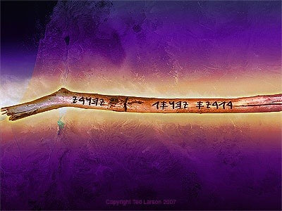
Anticipate
Glory in a New Life
Ezekiel 33–39
Dr. Rick Griffith • Amman International Church
AmmanChurch.org • BibleStudyDownloads.org
Notes:
As God's people, we should never say, "Well, that can't happen!" Instead, we should expect God to show up once again to give a brand new reality to those who trust him—whether Jew or Gentile (restatement).

Slide 2

People want to know the future…
Notes:
Interest: People want to know the future because their present is pretty dismal.
Need: What about you? Do you want to know the future?
What would you like to know?
How many of you would like to know your personal pains and gains?
What would result if you knew your personal future? Knowing the difficulties ahead might make you fearful or not appreciate life now. But if you knew the blessings in advance, you might live there instead of here in the present.

Slide 3
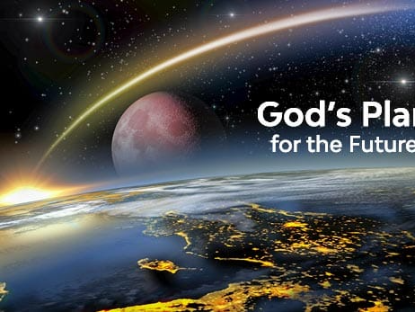
What is
God's Plan for the future?
Notes:
So, isn’t it better to know God’s grand plan?
Don’t you need to anticipate the future in broad strokes?
Background: God has told us in advance about the big picture.

Slide 4
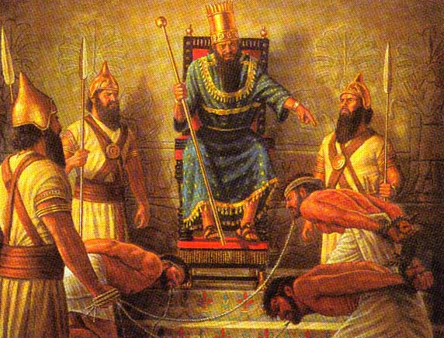
Israelite Captives
Notes:
Today we will see that Israel was in exile with God’s glory having left the temple.

Slide 5
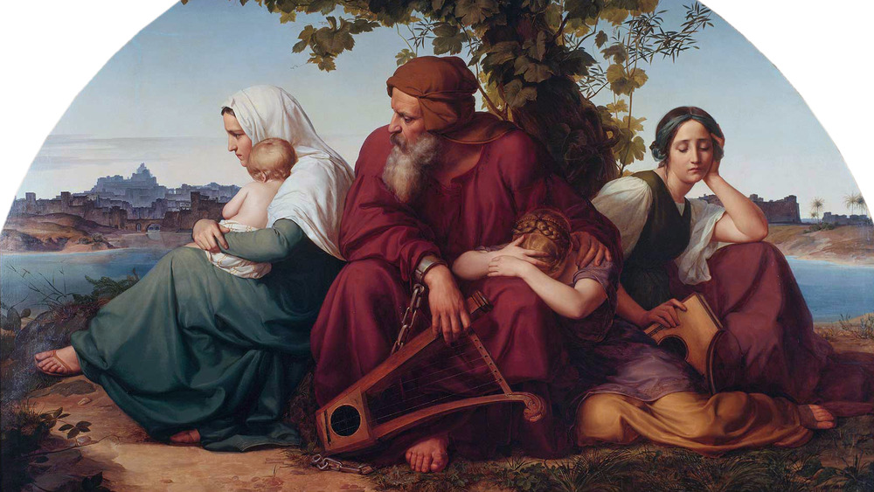
Psalm 137
By the rivers of Babylon, we sat and wept / when we remembered Zion / There on the poplars we hung our harps / for there our captors asked us for songs / our tormentors demanded songs of joy
Notes:
Psalm 137 pictures this time when the Babylonian tormentors asked for the happy songs of Zion, or Jerusalem.

Slide 6
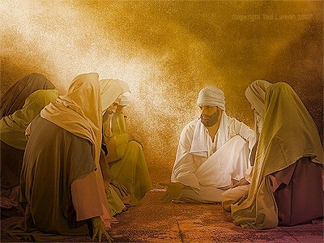
"Son of man, write down today’s date, because on this very day the king of Babylon is beginning his attack against Jerusalem" (Ezekiel 24:2 NLT).
Notes:
Now the city of Jerusalem was already under attack and would fall (24:2).

Slide 7
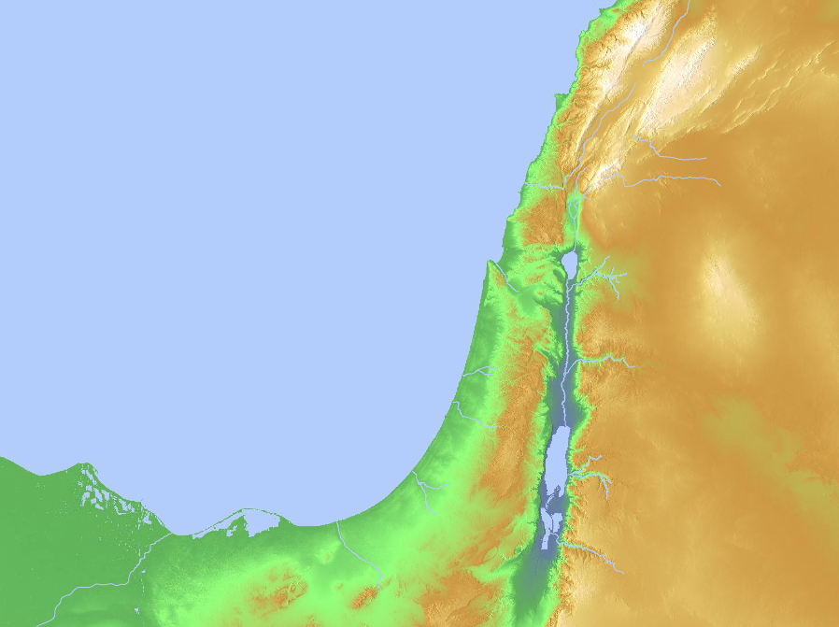
"This is what the Sovereign LORD says: Because the people of Moab have said that Judah is just like all the other nations, ⁹ I will open up their eastern flank and wipe out their glorious frontier towns—Beth-jeshimoth, Baal-meon, and Kiriathaim. ¹⁰ And I will hand Moab over to nomads from the eastern deserts, just as I handed over Ammon..."
Moab
(25:8-11)
Notes:
Yet Moab had the audacity to say that Judah was like all other nations‚ so God would judge them for this.

Slide 8
"But this is what the Sovereign LORD also says: At the end of the forty years I will bring the Egyptians home again from the nations to which they have been scattered. ¹⁴ I will restore the prosperity of Egypt and bring its people back to the land of Pathros in southern Egypt from which they came. But Egypt will remain an unimportant, minor kingdom. ¹⁵ It will be the lowliest of all the nations, never again great enough to rise above its neighbors"
—Ezekiel 29:13-15 NLT—
Egypt
(29–32)
Notes:
And God promises that Egypt—the superpower of the day—would be the lowliest of nations even until today!

Slide 9
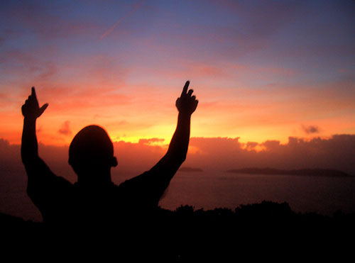
Be Expectant
Ezekiel
Notes:
God told exiles details so they could “Be Expectant,” the title of our series on Ezekiel. They could—and we can—be expectant of God’s glory once again.

Slide 10
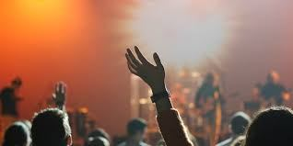
How can you be expectant of God’s glory once again in your life?
Notes:
What can you do to restore that sense of blessing that you used to have—those times when the presence of the Lord was real? This isn't simply a feeling, for that time may have been one of the most difficult periods of your life. Yet you knew that God was showing himself to you in new ways, there was a sense of expectancy at what he would do next. How can that return?

Slide 11
STEPS TO GOD'S GLORY
1—Admit that God’s glory left (Ezek 1–24).
ADMIT
Notes:
The sense of God's presence will not remain when we insist on sin.

Slide 12
STEPS TO GOD'S GLORY
2—Allow God to handle all rivals to his glory (Ezek 25–32).
ADMIT
ALLOW
Notes:
Know that the Shekinah presence of the LORD will purge all forms of darkness.

Slide 13
Nations to Be Judged (Ezekiel 25–32)
Sidon
(28:20-26)
Tyre
(26:1–28:19)
Ammon
(25:1-7)
Philistia
(25:15-17)
Moab
(25:8-11)
Egypt
(29–32)
Edom
(25:12-14)
Notes:
This would happen after God judged the nations—which already occurred within decades of Ezekiel's writing.
——————
God will judge Ammon for rejoicing at the temple’s destruction to show his sovereignty (25:1-7).
God will judge Moab for thinking that Israel was like all of the other nations to show God's sovereignty (25:8-11).
God will judge Edom for avenging Judah to show God's sovereignty (25:12-14).
God will judge Philistia for avenging Judah to show God's sovereignty (25:15-17).
God will judge Tyre so it will never be rebuilt due to its pride in its beauty, power, trade, and leaders to show God's sovereignty (26:1–28:19).
God will judge Sidon for maliciousness against Judah to show his sovereignty by gaining glory in the judgment (28:20-26).
God will judge Egypt by Nebuchadnezzar who will take exiles to Babylon to show God's sovereignty (Ezek 29–32; fulfilled in 571 BC).

Slide 14

Main Idea of Ezekiel 25–32
Allow God to handle all rivals.
Notes:
In other words, accept his judgment.

Slide 15
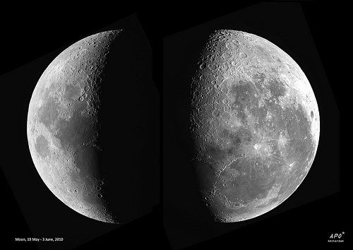
Phases of Ezekiel's Ministry
Phase One (1–32)
  Ezekiel 3:17
  Ezekiel 24:25-27
Phase Two (33–48)
  Ezekiel 33:7
  Ezekiel 33:21-22
Notes:
Phase One showed Ezekiel's messages before Jerusalem fell when his wife lived but he couldn't speak.
Phase Two records Ezekiel as a widower able to speak once again after Jerusalem fell.

Slide 16
STEPS TO GOD'S GLORY
3—Anticipate God’s glory to return (Ezek 33–48).
ADMIT
ALLOW
ANTICIPATE
Notes:
Live as if the future really does include God’s blessing once again.

Slide 17
Chart of Ezekiel
500
Sovereign Departing and Return of Glory
Glory Departs 1–24 |  | Nations Judged (No Glory) 25–32 |  |  | Glory Returns 33–48
Exile |  | Sovereignty Vindicated |  |  | Restoration
Judgment of Judah |  | Judgment of Nations |  |  | Blessing of Israel
Judah's Fall |  | Judah's Foes |  |  | Judah's Future
Before the Siege |  | During the Siege |  |  | After the Siege
Call in glory 1–3 | Pre-exile Hopeless-ness 4–24 | Ammon, Moab, Edom, Philistia 25 | Tyre and Sidon 26–28 | Egypt 29–32 | New Life 33–39 | New Order 40–48
Babylon (592-570 BC)
Notes:
Live as if the future really does include God’s blessing once again (Ezek 33–48).

Slide 18

Restoration
Q: Why must there be restoration?
A: God promised to restore to Israel:
— Land
— New heart (a heart of flesh)
— Ability to keep His word
Notes:
We restore pictures to their former glory—and even better!
God will do this with a nation!

Slide 19
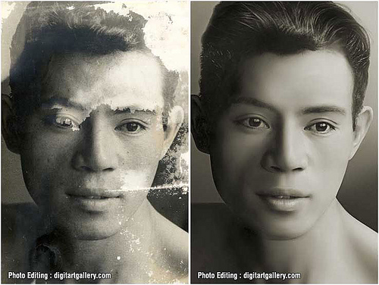
Restorations (33–48)
How God Will Restore Israel in the End Times (33–39)
A Vision of the Restored Community (40–48)
Notes:
The nation will experience a new life (33–39).
Then the community will have a new order (40–48).

Slide 20
God will give new life
(Ezekiel 33–39)
Preparing for Glory…
God will restore
Israel
(33–37)
God will protect
Israel
(38–39)
Notes:
The nation will first come back to life in the land (33–37).
Then they will see miraculous intervention by God against attackers (38–39).

Slide 21
God will give new life
(Ezekiel 33–39)
Preparing for Glory…
God will restore
Israel
(33–37)
…to the land led by Jesus
Notes:
[The Jews must return to their homeland under Messiah.]

Slide 22
Slides on
Ezekiel 33

Slide 23
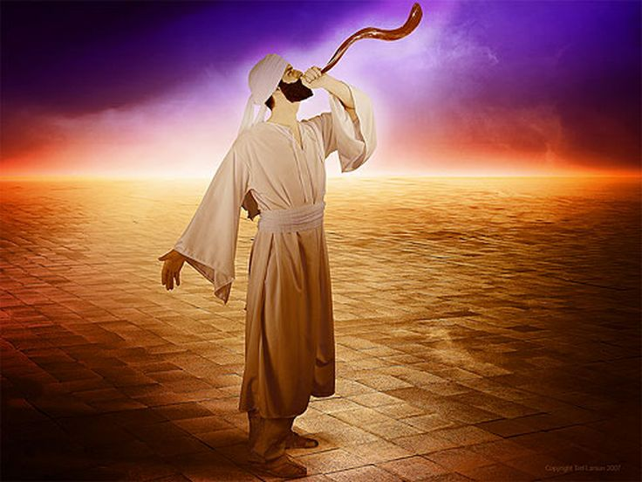
The Watchman (Ezekiel 33)
Notes:
Ezekiel was a watchman to help his people turn from sin (Ezek 33).
Ezekiel was responsible to tell his people the results of living in sin (33:1-20).

Slide 24
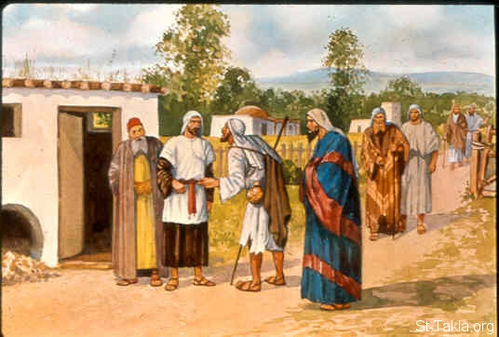
Ezekiel 33:21
"On January 8, during the twelfth year of our captivity [585 BC], a survivor from Jerusalem came to me and said,
'The city has fallen!'" (NLT)
Notes:
A survivor traveled months to tell Ezekiel of Jerusalem’s fall in 586 BC (33:21).

Slide 25
Slides on
Ezekiel 34
Notes:
Jesus will replace Judah’s self-serving shepherds (Ezek 34).

Slide 26
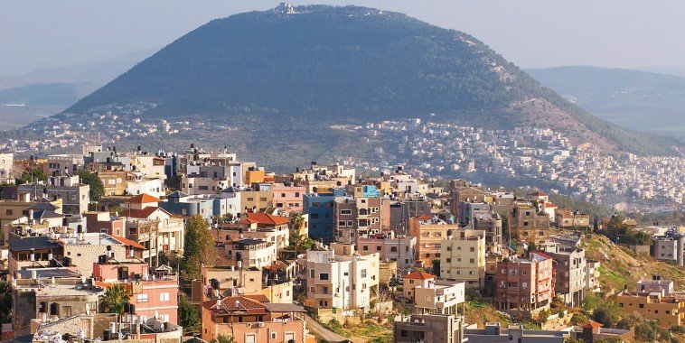
The Restoration of Israel
Reappointment of Ezekiel (33)
Restoration of Leadership (34)

Slide 27
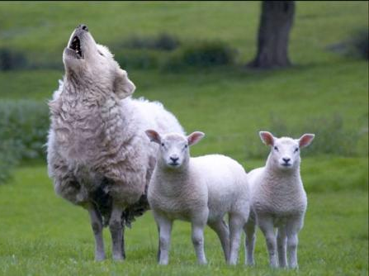
"Son of man, prophesy against the shepherds, the leaders of Israel. Give them this message from the Sovereign LORD: What sorrow awaits you shepherds who feed yourselves instead of your flocks. Shouldn’t shepherds feed their sheep?"
Ezekiel 34:2 NLT
The False Shepherds
Notes:
False shepherds howl like a wolf and feed only themselves (34:1-10).

Slide 28

ABUSIVE SHEPHERDS
What does it look like today when the spiritual leader cares more about himself than those he leads?
Notes:
Some spiritual leaders today also abuse the flock.

Slide 29
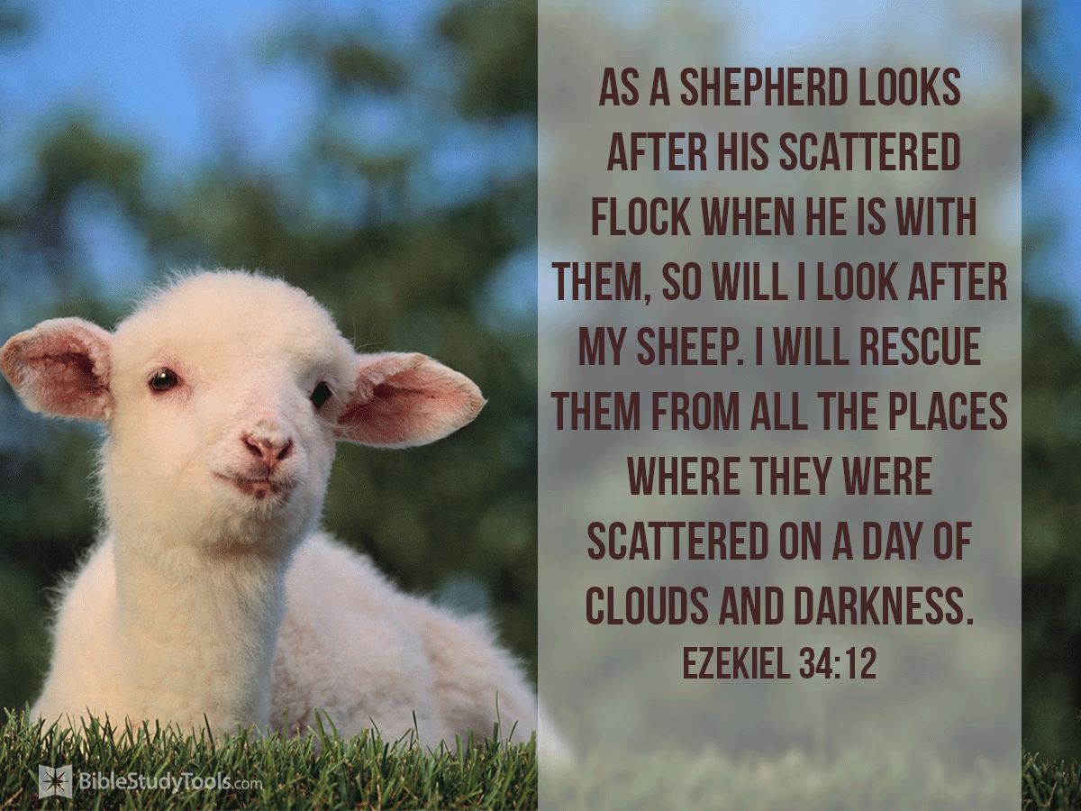
"As a shepherd looks after his scattered flock when he is with them, so will I look after my sheep. I will rescue them from all the places where they were scattered on a day of clouds and darkness."
Ezekiel 34:12
The True Shepherd
Notes:
But Jesus will be the true shepherd who cares for Israel (34:11-24).
He will gather Jews scattered across the earth (34:12)

Slide 30
"Then I will set over them one shepherd, My servant David, and he will feed them; he will feed them himself and be their shepherd."
Ezekiel 34:23
Notes:
Jesus will teach restored Jews truth (34:23).

Slide 31
"And My servant David will be king over them, and they will all have one shepherd; and they will walk in My ordinances, and keep My statutes, and observe them. And they shall live on the land that I gave to Jacob My servant, in which your fathers lived; and they will live on it, they, and their sons, and their sons’ sons, forever; and David My servant shall be their prince forever. And I will make a covenant of peace with them; it will be an everlasting covenant with them."
Ezekiel 37:24–26
Notes:
Jesus is the servant David who will be king over believing Jews and bring a lasting peace.

Slide 32

Restoration of Leadership (Ezek. 34)
Messiah will regather his people (12-13a)
He will feed his people (13b, 14b, 23b, 29)
He will settle his people in their own land (14)
He will nurse his people to health (15-16a)
He will shepherd his people with justice (16b-22)
He will be the one true shepherd (23)
He will be a prince in the line of David (24)
He will give them peace and security (25-31)
Notes:
He will restore to Israel the type of leadership the nation has always needed (animate 8 items).
It should be fairly obvious that this restoration under Messiah has not happened yet—the return to the land at the end of the OT was only a partial return. It never had any Davidic kings who did these things.

Slide 33
Slides on
Ezekiel 35

Slide 34
The Restoration of Israel
Reappointment of Ezekiel (33)
Restoration of Leadership (34)
Restoration of the LORD's Land (35:1–36:15)

Slide 35
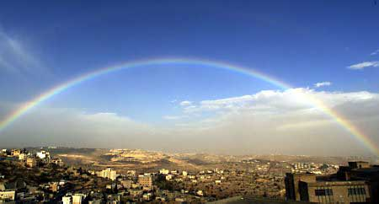
Restoration of the LORD's Land
35:1-15 (Edom) | 36:1-15 (Israel)
Prophecy against Mount Seir Edom becomes a wasteland Edom possesses Israel's land Edom's towns are in ruins Yahweh against Edom Israel suffers Edom's scorn Edom will suffer bloodshed | Prophecy to mountains of Israel Israel becomes fruitful Israel will possess back her land Israel's towns inhabited/rebuilt Yahweh shows concern to Israel Edom will suffer scorn in return Israel will be safe from bloodshed

Slide 36
Slides on
Ezekiel 36
Notes:
God will restore Israel to her land in belief (Ezek 36–37).

Slide 37
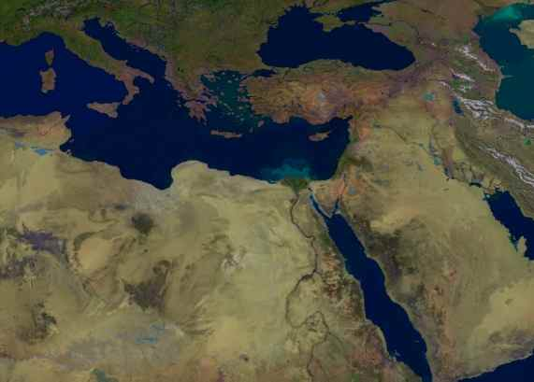
Ezekiel 36:22
219
I am bringing you back, but not because you deserve it. I am doing it to protect my holy name, on which you brought shame while you were scattered among
the nations.
Israel
But WHY
would you restore Israel?
Notes:
Why would God restore Israel?
Because Jews are better than the rest of us? Not at all.
God will restore to protect his holy name!

Slide 38
The Restoration of Israel
Reappointment of Ezekiel (33)
Restoration of Leadership (34)
Restoration of the LORD's Land (35:1–36:15)
Restoration of the LORD's Honor (36:16-38)

Slide 39
Key Verse
500
(God to Israel) "For I will take you out of the nations; I will gather you from all the countries and bring you back into your own land. I will sprinkle clean water on you, and you will be clean; I will cleanse you from all your impurities and from all your idols. I will give you a new heart and put a new spirit within you; I will remove your heart of stone and give you a heart of flesh. And I will put my Spirit in you and move you to follow my decrees and be careful to keep my laws" (36:24-27).
Ezekiel
Notes:
Restoration physically to the land will be followed by restoration spiritually under a new—not the old Mosaic—covenant.

Slide 40
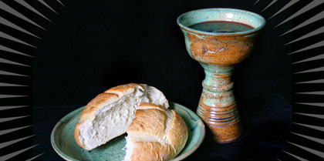
The Glory of the
New Covenant
Notes:
The old covenant was so glorious at Mount Sinai that the people couldn't stand to hear God's powerful voice.
But the new covenant is even more amazing—and is depicted in the cup of the Lord's supper.

Slide 41

"Then I will sprinkle clean water on you, and you will be clean. Your filth will be washed away, and you will no longer worship idols. And I will give you a new heart, and I will put a new spirit in you. I will take out your stony, stubborn heart and give you a tender, responsive heart. And I will put my Spirit in you so that you will follow my decrees and be careful to obey my regulations."
Ezekiel 36:25-27
Notes:
The new covenant includes spiritual birth, a new heart, and the Holy Spirit inside us to give us an obedient human spirit.

Slide 42

The New Covenant
Notes:
Parents make promises to their children like a covenant. The obedient child trusts in these promises.
Likewise, God has made a new promise to us so we can obey him internally rather than just external observance.

Slide 43
Contrasting the Covenants (2 Cor. 3–4)
Old Covenant | New Covenant
initiated by Moses (3:8) | initiated by Christ (3:4)
of the letter (3:6a) | of the Spirit (3:6a, 18b)
kills (3:6b, 7a) | gives life (3:6b)
engraved on stone (3:3b, 7a) | engraved on hearts (3:3b; Jer. 31:33
glorious (3:7a) | more glorious (3:8, 10)
glory faded (3:7b, 11a, 13b) | glory ever-increases (3:11b, 18)
condemns men (3:9a) | brings righteousness (3:9b)
deception (3:13) | boldness (3:12)
veiled face of Moses (3:13b) | unveiled faces (3:13a, 18a)
veiled minds (3:14a) | unveiled minds (3:14b; 4:3-6)
veiled hearts (3:15) | unveiled hearts (3:16)
dullness (3:14a) | freedom (3:17)
Moses reflected God's glory | all saints reflect Christ's glory (3:17)
non-transforming (3:7) | transforming (3:18)
lack of zeal (3:13) | confidence, steadfastness (3:4-5; 4:1)
deception (3:13) | sincerity (4:2)
NTS 166c
Notes:
Paul saw the Mosaic Covenant as amazingly glorious—but also failing in comparison to what God has done in Christ.

Slide 44
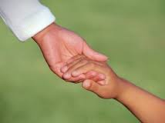
The New Covenant in Ezekiel 36
Restoration to the land (36:24, 28, 33)
Cleansing from sin (36:25)
A responsive heart (36:26)
Indwelling of the Spirit (36:27a)
Motivation and ability for obedience (36:27b)

Slide 45
Kingdom & Covenants Timeline
22
CH-34a
OS1-22
OS2-337
NS-9g
SA-19
34a
Dr. Rick Griffith • BibleStudyDownloads.org
22
Kingdom Teaching...
Adam rules with God (Gen. 1:26, 28; 2:19)
Satan begins rule as god of this world (Gen. 3:15;
2 Cor. 4:4)
God covenants with Abraham to reestablish man's rule via Israel as a "kingdom of priests" (Gen. 12:1-3; Exod. 19:6)
Israel's failure to witness to nations as a kingdom of priests is judged via exile under foreign rule
Israel rejects Messiah's offer of kingdom (Matt. 12:41-42; 23:37-39)
Jesus extends His kingdom in mystery form to the Church (Matt. 13)
Christ subdues Israel's enemies and nation believes (Rom. 11:26-27)
Christ rules over everything with saints (Eph. 1:9-10; Rev. 20:1-6; 22:5b)
337
9g
Fall of Man (Gen. 3)
Noahic Covenant
19
Genesis 6:18; 9:8-17
Land Covenant
ISRAEL
CHURCH
MESSIANIC KINGDOM
(National Focus)
The "New Man" (Eph. 2:15)
Millennial Eternal
land
Genesis 15:18 (cf. Deut. 30:1-10) promises:
Land from Wadi of Egypt to Euphrates River (Isa. 27:12)
Eternal possession of land (Gen. 17:8) after exile/restoration
Whole world blessed via the land (Isa. 14:1-2)
Israel judged for rejecting Messiah by dispersion away from land for 19 centuries
(AD 70–AD 1948) but now partially restored (Ezek. 37:1-7)
Full restoration (Ezek. 37:8-28) Jerusalem world capital
(Isa. 2:1-5)
New Jerusalem
(Rev. 21–22)
Davidic Covenant
Christ is Head over His Church, which is a spiritual temple (Eph. 2:19-22; 2 Cor. 6:16)
Christ reigns over the world
(Isa. 11)
with saints (Rev. 5:10; 20:4-6)
Christ hands kingdom over to Father (1
Cor. 15:24)
Genesis 12:1-3
2 Samuel 7:12-16 promises:
Sons ("house" never wiped out)
Kingdom (political dynasty)
Throne (right to rule by descendants)
Temple (son to build it)
seed
Abrahamic Covenant
New Covenant
All
things made new!
(Rev. 21:5)
All 5 elements fulfilled in national restoration (Zech. 8)
Jeremiah 31:31-34 promises:
Forgiveness
Indwelling Spirit
New heart, nature, mind
Reunification of Israel and Judah
No need for evangelism
Mosaic Law replaced with first three elements of the New Covenant (Luke 22:20; 2 Cor. 3:6)
blessing
Mosaic Covenant
Law abolished, fulfilled, and replaced at the cross (Rom. 7:1-6;
1 Cor. 9:19-21; Heb. 8:13)
10th Edition
10 Nov 2020
Temporary (Gal. 3:19) and conditional (Deut. 28) to reveal sin (Rom. 7:7) and regulate Israel (Gal. 3:23-25)
Scripture has a dual kingdom-covenant theme. Israel's role from Abraham to Christ expands to include the Church (continuity) yet the Church never replaces the nation as the "new Israel" (discontinuity). Israel will enjoy world prominence after trusting Christ at His second coming.
Notes:
All agree that a partial fulfillment of the covenant to Abraham exists now to the Church in the indwelling Holy Spirit and forgiveness of sins (Jer 31:31-34)—and the ultimate fulfillment will be in the eternal state.
The main area of disagreement relates to the time period from now to eternity. Will there be a literal land, throne, and worldwide blessing to national (ethnic) Israel before the eternal kingdom? This chart shows verses giving a resounding YES to that question in a present partial fulfillment and a future full fulfillment in the normal sense of language in the verses cited. But the messianic kingdom will be in two stages—first in a millennial fulfillment to last 1000 years, but then, after that, the eternal stage in the new Jerusalem after the destruction of our present heavens and earth (Rev 21–22). What an amazing future remains for those who trust Jesus!
____________
Common English-51
CH-02-Nature-103-p34a
OC-10-Chronology-42
OS-00-Intro & Biblical Theology-25 & 90
OS-02-Exodus-267-p22
OS-05-Deut-248-p22
OS-10-2Sam-96-p22
OS-12-Kings & Prophets Charts-25
OS-13-1 Chron-46
OS-23-Isaiah-97-p337
OS-24-Jeremiah-174-p337
OS-23-Isaiah-97-p337
OS-28-Hosea-49
OS-31-Obadiah-164
05-Acts1-2-slide 45
NS-09-Gal-143-p9g
NS-19-Hebrews-342-p9g
SA-08-Mosaic Law-19-p38a

Slide 46
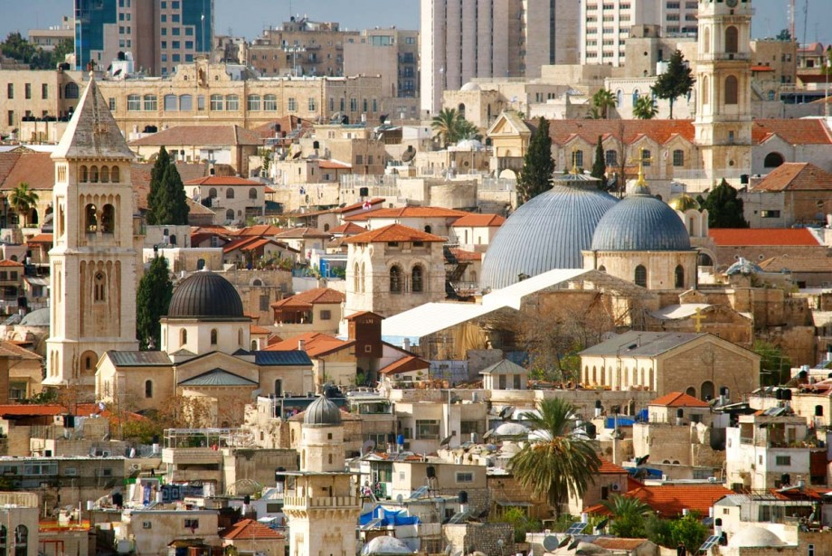
Restoration of the Lord's Honor
Re-gathering of Israel from surrounding nations
Removing of impurities & idolatries
Replacing of a new heart/spirit upon Israel
Residing of the Spirit guarantees obedience
Reenacting covenant promise to Israel
Returning great productivity in Israel
Remembering & loathing of sins by Israel
Ezekiel 36:16-38

Slide 47
Slides on
Ezekiel 37
Notes:
The 1948 return in unbelief began to fulfill the Land Covenant (37:1-14).

Slide 48
The Restoration of Israel
Reappointment of Ezekiel (33)
Restoration of Leadership (34)
Restoration of the LORD's Land (35:1–36:15)
Restoration of the LORD's Honor (36:16-38)
Restoration of the LORD's People (37)

Slide 49
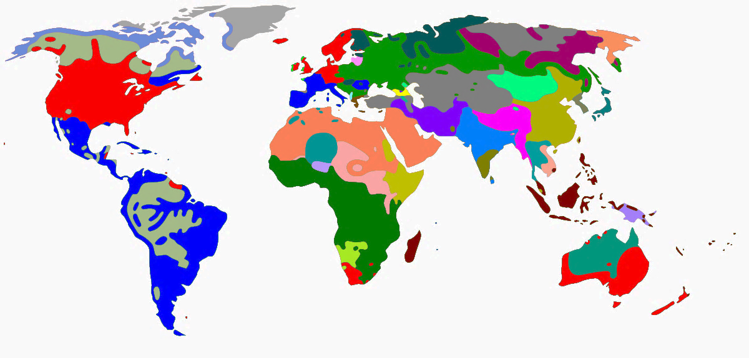
How could God get 15 million Jews back to the land?
Israel
Notes:
For nearly 20 centuries, Jews were spread throughout the countries of the world and integrated into many societies while speaking numerous languages. Returning to their ancient homeland was hardly an attractive idea. Comfort has a way of desensitizing us to pursue difficulty.

Slide 50

When are the signs of Christ's return?
They come in the Tribulation
Notes:
People sometimes ask me if there are any fulfilled prophecies that need to precede the Rapture. Not really. We don’t need to see any signs as the Rapture will take us by surprise. The signs relate to the Tribulation to follow. But think about this idea…

Slide 51
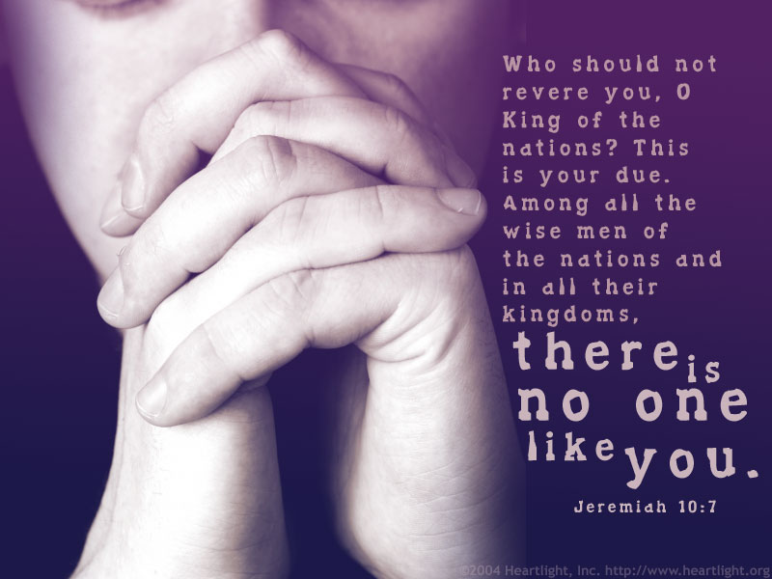
But can God restore Israel as a nation?
508
Notes:
Jeremiah also notes that Israel will be restored as a nation even after many centuries:
Jer. 30:20 Their children will prosper as they did long ago.
I will establish them as a nation before me,
and I will punish anyone who hurts them.

Slide 52
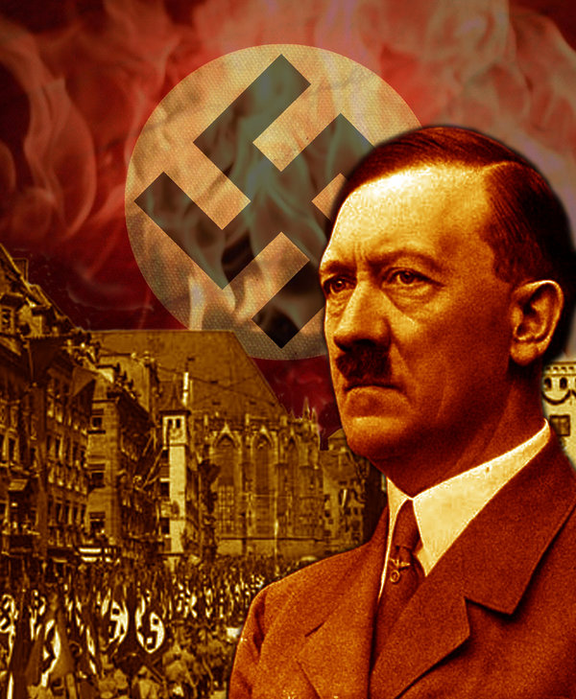
Hitler motivated the Jews to go to their homeland!
Notes:
The very opposite happened to what Hitler tried to do. He sought to kill the Jews and pushed them out of his land.

Slide 53
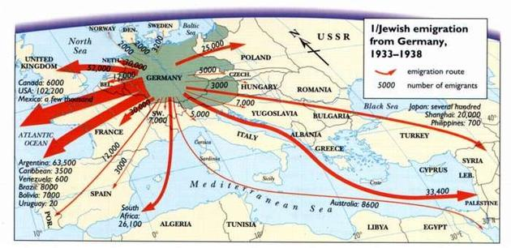
Hitler motivated the Jews to go to their homeland!
Jewish emigration from Germany
1933-1938
Route
GERMANY
Number
Notes:
Hitler sought to eradicate the Jews, but God sought to eradicate Hitler. He committed suicide in 1945 and three years later the Jews established their homeland in Israel! God told Abraham, "I will bless those who bless you and curse those who curse you" (Gen 12:3). Hitler's attempt to curse the Jews led to him being cursed.

Slide 54

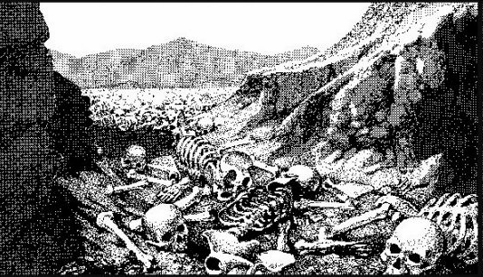
The Dry Bones of Ezekiel 37
508
What do they mean?
When is the fulfillment?
Notes:
Ezekiel 37 has one of the most amazing depictions in Scripture with bones coming to life.

Slide 55
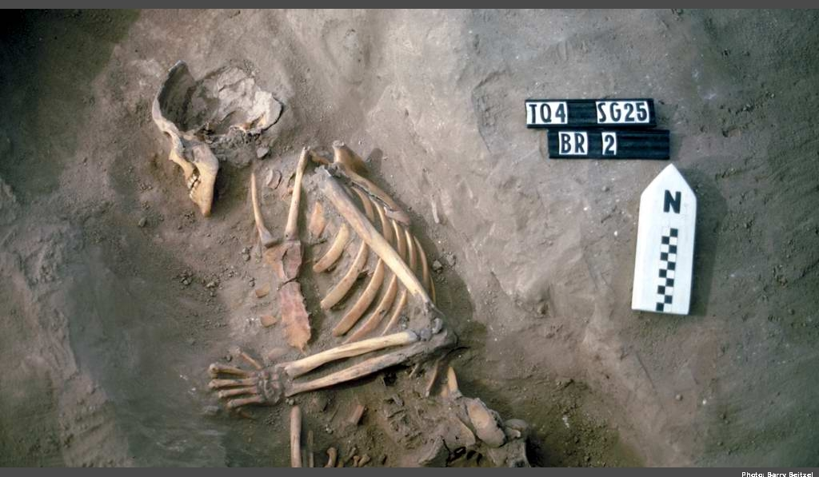
The Valley of Dry Bones (Ezekiel 37)
Notes:
Imagine a skeleton standing up on its own, growing flesh, and then coming alive.

Slide 56
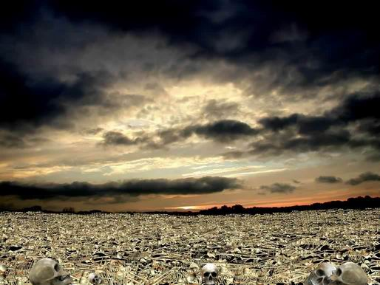
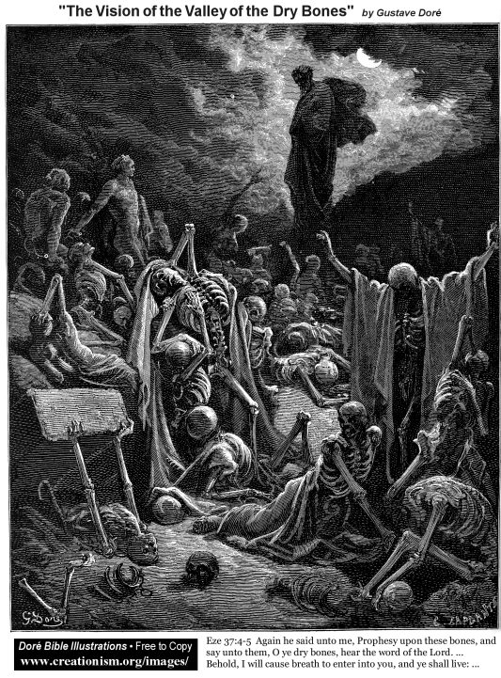
The Valley of Dry Bones (Ezek. 37)
Stage 1:
Return in Unbelief
Notes:
God predicted a two-stage return to the land—first in unbelief…

Slide 57
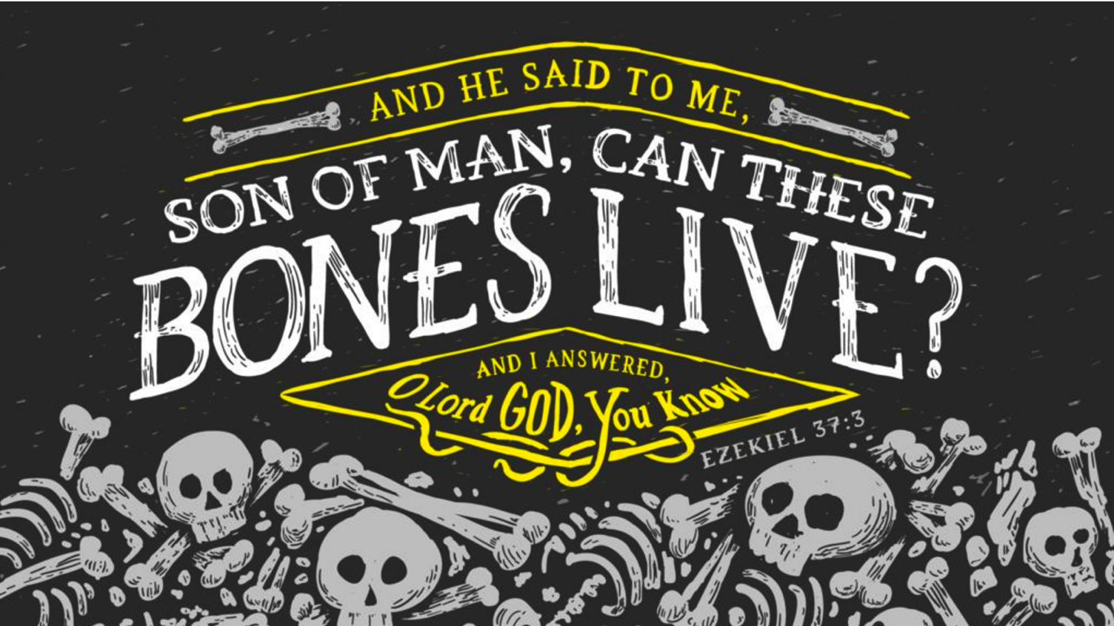
Son of man, can these bones live?
* Don't try that on the final exam
Notes:
The angel asked Ezekiel this question—and his doubt is shown by convincing the angel to answer his own question.

Slide 58
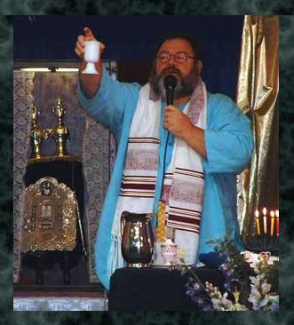
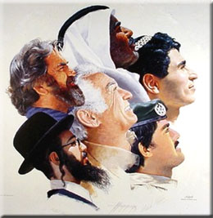
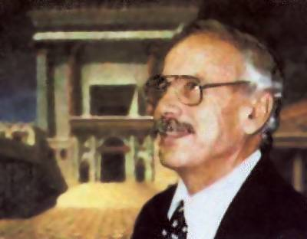
The Valley of Dry Bones (Ezek. 37)
Stage 1:
Return in Unbelief
Stage 2:
Trust in Messiah
Notes:
God predicted a two-stage return to the land—first in unbelief…
• but then later they will believe in a single day (Zech 3:9; 9:16).

Slide 59
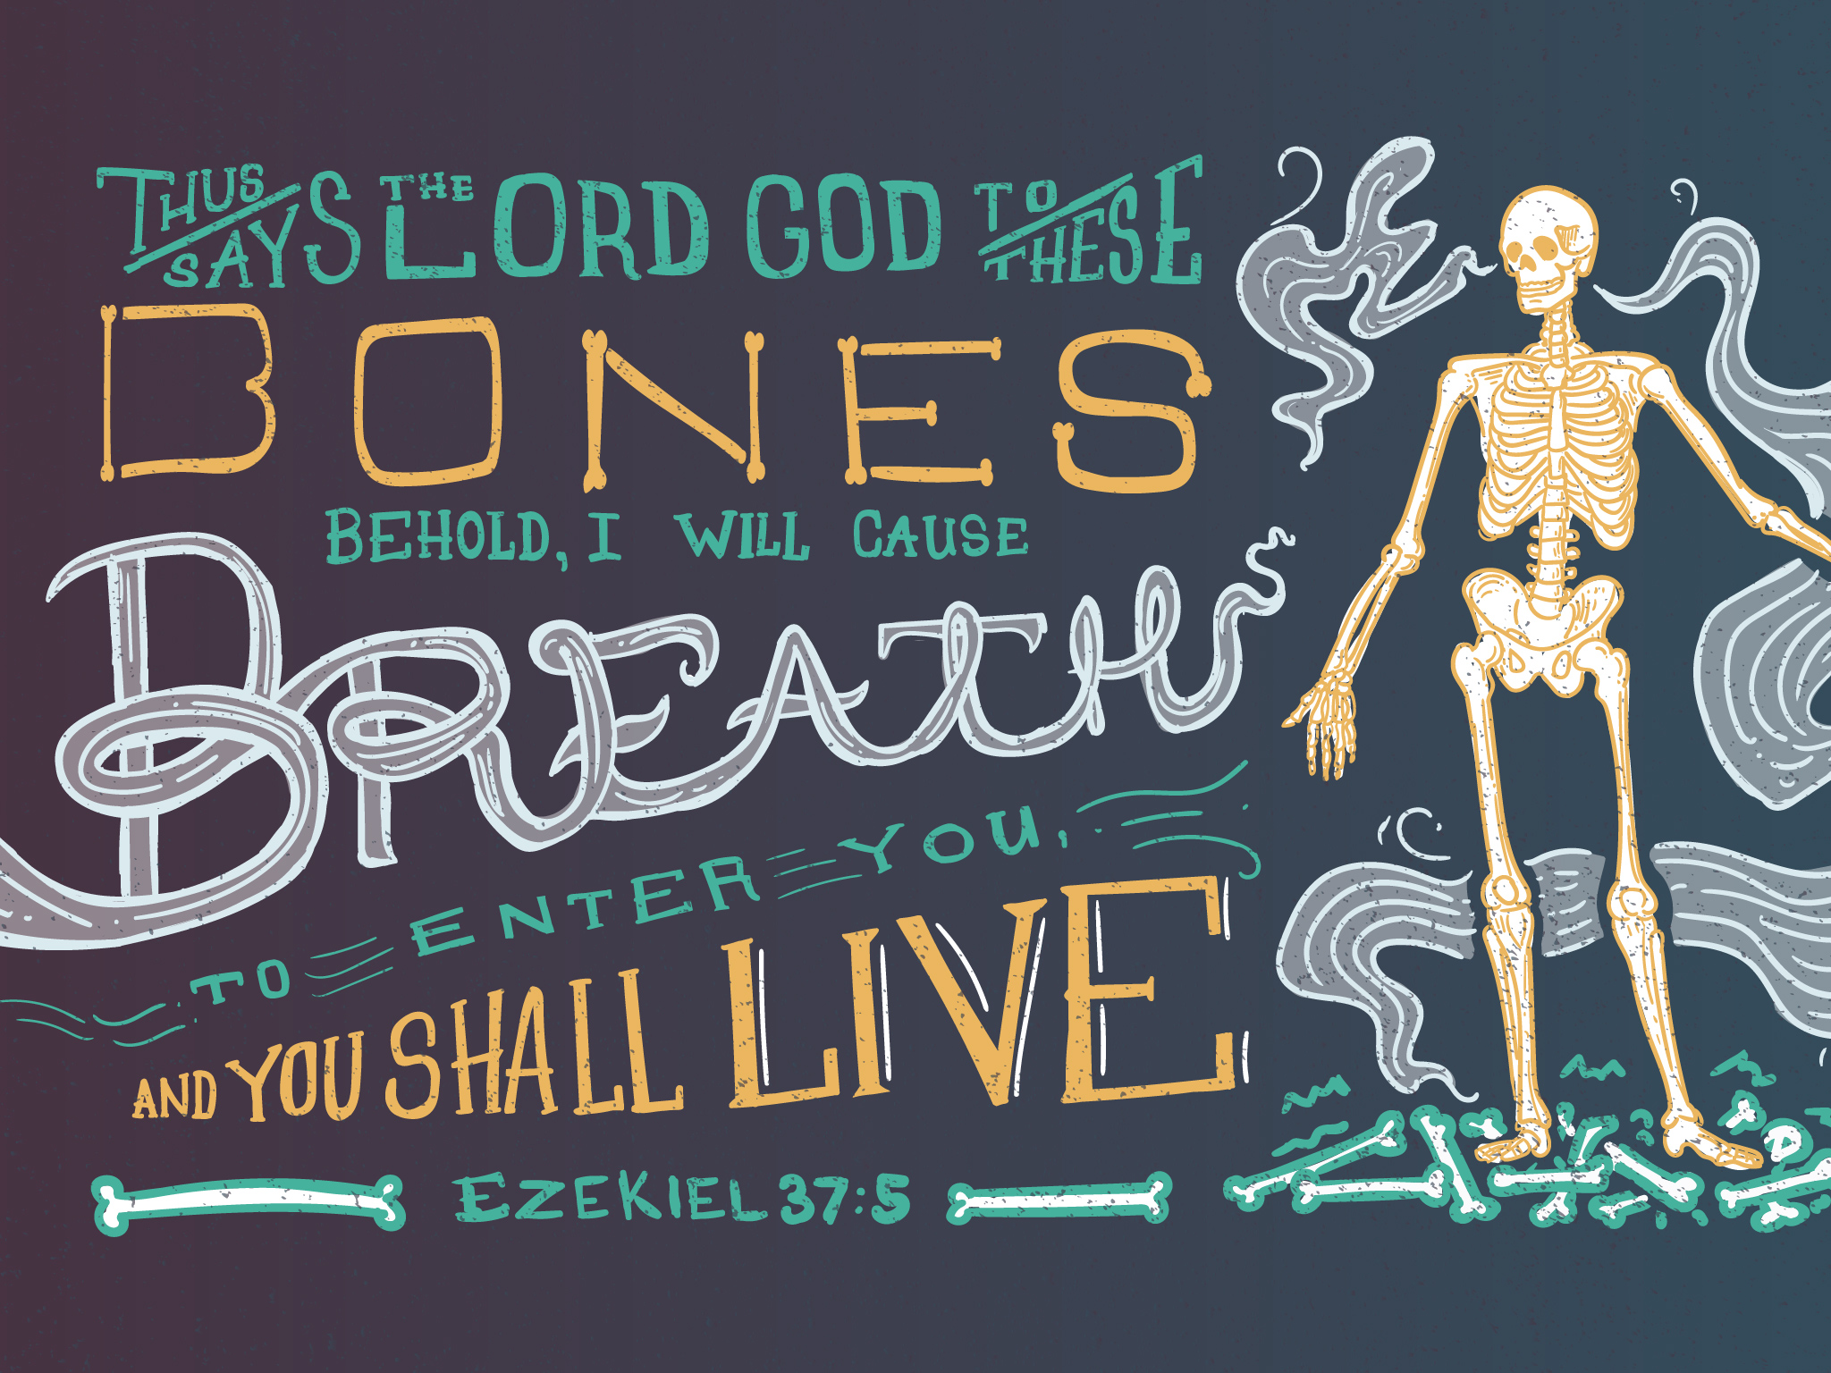
Ezekiel 37:5
* Don't try that on the final exam
Notes:
God will breathe life into Israel!

Slide 60
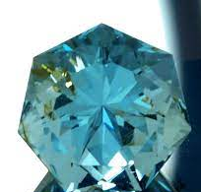
"Now look at the jewel I have set before Jeshua, a single stone with seven facets. I will engrave an inscription on it, says the LORD of Heaven’s Armies, and
I will remove the sins of this land in a single day"
(Zechariah 3:9 NLT).
Notes:
In fact, the Jewish people will believe in a single day (Zech 3:9; 9:16)

Slide 61

A Hebrew Play on Words
"Prophesy to the
breath" (37:5, 9)
"Prophesy to the
Spirit" (37:14)
=
Hebrew insert
"breath, wind, Spirit"
Gen. 2:7
Greek insert
"breath, wind, Spirit"
John 3:5, 8; 2 Thess 2:8
=
Notes:
Amazingly, the same three meanings of the Hebrew ruah are replicated in the Greek pneuma.
This probably is not true of any other Hebrew and Greek words.
So the angel told Ezekiel twice to prophesy to the ruah, but it is correct to translate it as "Spirit" the second time.
The point, of course, is that the Spirit gives life and breath to individuals—and will do so to Israel also in the last days.

Slide 62

Exiles & Returns
508
Exile
to
Babylon
by
King
Nebuchad-nezzar
(586 BC)
Exile
to
Nations
by
Roman
General
Titus
(AD 70)
Return
to
Israel
by
King
Cyrus
(516 BC)
Return
to
Israel
by
Zionists
(AD 1948)
Ezekiel's Time (597 BC)
But how do we know Ezekiel 37 relates to this second exile and return?
Notes:
Israel returned to the land TWO times since Ezekiel lived. (Isaiah served even a century earlier.)
• The people were exiled to Babylon in 586 BC.
• And the first return was 516 BC at the end of our OT.
• But they were exiled a second time in AD 70 and went to many nations of the world.
• And their second return culminated in the State of Israel in 1948.
Now, which return was Ezekiel predicting? I say the second one.
But how do we know Ezekiel 37 relates to this second exile and return?
———————————
OS-23-Isaiah1-12—slide 354
OS-23-Ezek 33-38—slide 62

Slide 63

How will there be a second return?
33-34
"I will put my Spirit in you, and you will live again and return home to your own land. Then you will know that I, the LORD, have spoken, and I have done what I said. Yes, the LORD has spoken!'"
Israel will trust in her Messiah (Ezekiel 37:14)

Slide 64
How will there be a second return?
33-34
Reunification of Israel & Judah (37:15-23)
"I will unify them into one nation on the mountains of Israel. One king will rule them all; no longer will they be divided into two nations or into two kingdoms"
(Ezekiel 37:22 NLT).
Notes:
There will also be a reunification of Israel and Judah (Ezekiel 37:15-23).

Slide 65
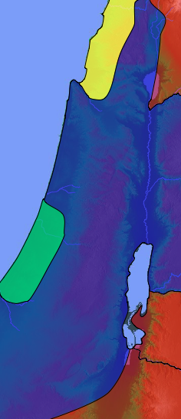
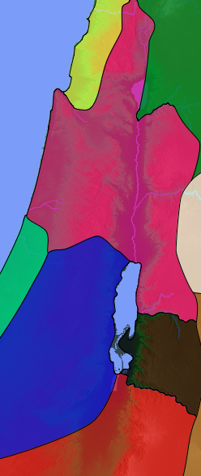
United to Divided to United Again
1 Kings 11
1 Kings 12
Ezekiel 37:15-23
Israel
Israel
Israel
Judah
Notes:
The nation was originally united under Saul, David, and Solomon.
• But it split after Rehoboam rejected Jeroboam and it remained divided for the rest of the OT. The tribes came back led by Zerubbabel, but not under a king of Israel.
• Yet God's people will reunite once again under the Messiah Jesus.
___________
Common-291
OS-Ezek33-39-slide 65

Slide 66

Two Sticks (Ezekiel 37:15-28)
Notes:
“Again a message came to me from the LORD: 16 “Son of man, take a piece of wood and carve on it these words: ‘This represents Judah and its allied tribes.’ Then take another piece and carve these words on it: ‘This represents Ephraim and the northern tribes of Israel.’” (37:15-16 NLT).

Slide 67
Two Sticks (Ezekiel 37:15-28)
Israel
Judah
Notes:
“Now hold them together in your hand as if they were one piece of wood. 18 When your people ask you what your actions mean, 19 say to them, ‘This is what the Sovereign Lord says: I will take Ephraim and the northern tribes and join them to Judah. I will make them one piece of wood in my hand.’” (37:17-19 NLT).

Slide 68
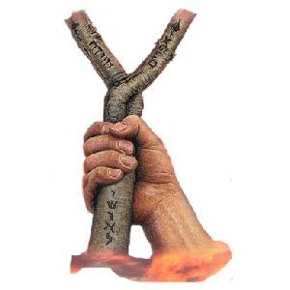
Two Sticks (Ezekiel 37:15-28)
Notes:
Messiah will rule Judah and Israel together to fulfill the Davidic Covenant (2 Sam. 7:13-14) and show God's holiness (37:15-28).
“Then hold out the pieces of wood you have inscribed, so the people can see them. 21 And give them this message from the Sovereign Lord: I will gather the people of Israel from among the nations. I will bring them home to their own land from the places where they have been scattered. 22 I will unify them into one nation on the mountains of Israel. One king will rule them all; no longer will they be divided into two nations or into two kingdoms. 23 They will never again pollute themselves with their idols and vile images and rebellion, for I will save them from their sinful backsliding. I will cleanse them. Then they will truly be my people, and I will be their God.
Ezek. 37:24 “My servant David will be their king, and they will have only one shepherd. They will obey my regulations and be careful to keep my decrees. 25 They will live in the land I gave my servant Jacob, the land where their ancestors lived. They and their children and their grandchildren after them will live there forever, generation after generation. And my servant David will be their prince forever. 26 And I will make a covenant of peace with them, an everlasting covenant. I will give them their land and increase their numbers, and I will put my Temple among them forever. 27 I will make my home among them. I will be their God, and they will be my people. 28 And when my Temple is among them forever, the nations will know that I am the Lord, who makes Israel holy.”
—Ezek 37:20-28 NLT

Slide 69
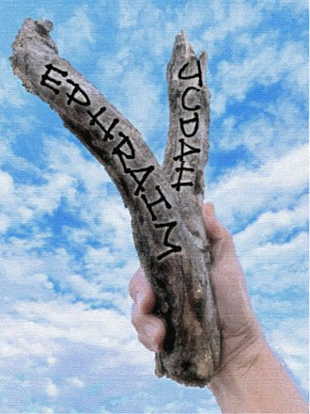
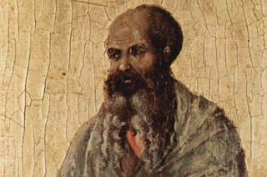
One Stick
This Photo by Unknown Author is licensed under CC BY-SA

Slide 70
Two Sticks (Ezek 37:15-28)
Notes:
“Again a message came to me from the LORD: 16 “Son of man, take a piece of wood and carve on it these words: ‘This represents Judah and its allied tribes.’ Then take another piece and carve these words on it: ‘This represents Ephraim and the northern tribes of Israel.’” (37:15-16 NLT).

Slide 71
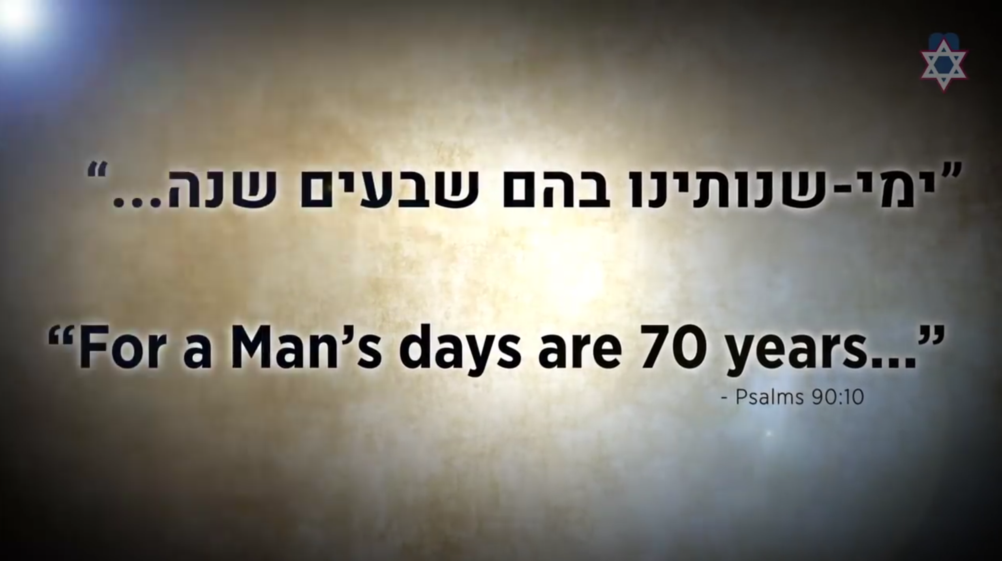
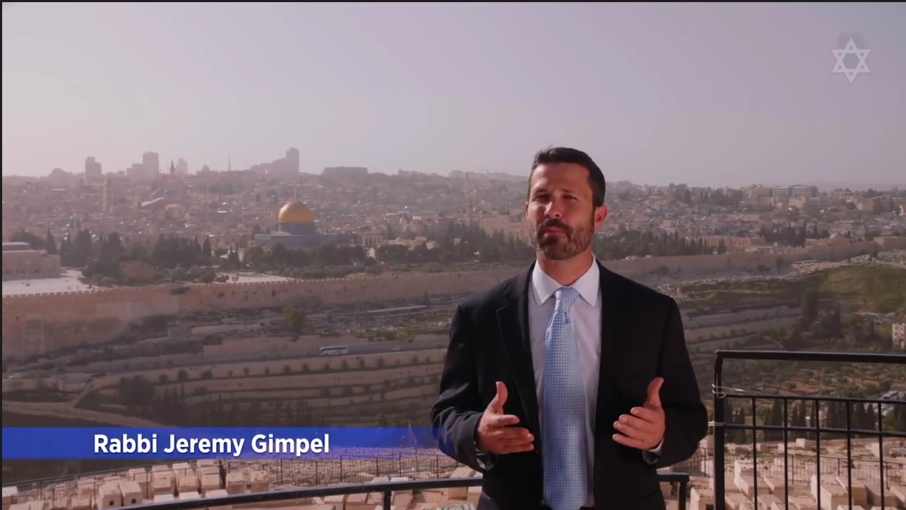
In 2018 Israel celebrated 70 years of return!
Notes:
26-Ezekiel-Israel's 70th - Do You See The Miracle.mp4 at
http://biblestudydownloads.org/files/eng/os/26-Ezekiel-Israel's%2070th%20-%20Do%20You%20See%20The%20Miracle.mp4

Slide 72
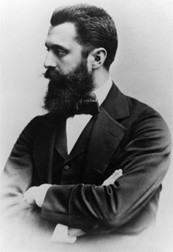
Theodore Herzl
First Zionist Congress
1897
Notes:
That 1948 return actually began with the First Zionist Congress by Theodore Herzl in 1897.

Slide 73

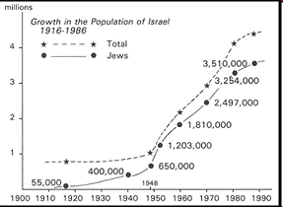
Jews Return in the 20th Century
195b
www.bibleweb.org/ MEastStudies/Sem3.htm
millions
Growth in the Population of Israel
1916-1986
Total
Jews
Notes:
www.bibleweb.org/ MEastStudies/Sem3.htm

Slide 74
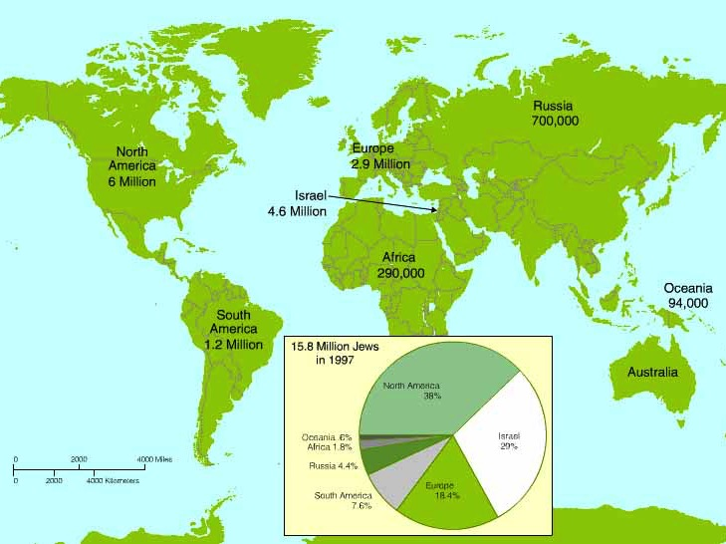
Worldwide Jewish Population in 1997
Note that most Jews still haven't returned to Israel
15.8 Million Jews in 1997
North America
38%
Oceania .8%
Israel
29%
Africa 1.8%
Russia 4.4%
Europe
18.4%
South America 7.6%

Slide 75
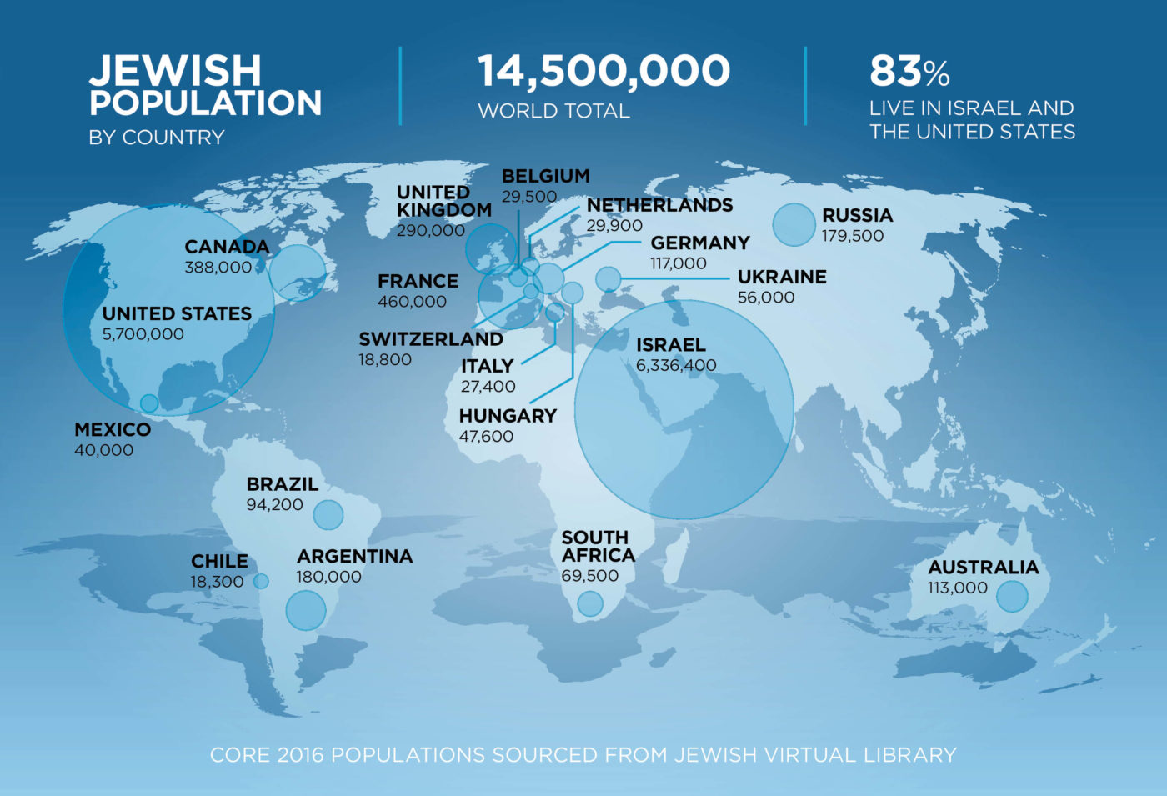
Worldwide Jewish Population in 2016
JEWISH
POPULATION
BY COUNTRY
14,500,000
WORLD TOTAL
83%
LIVE IN ISRAEL AND
THE UNITED STATES
Note that most Jews still haven't returned to Israel

Slide 76
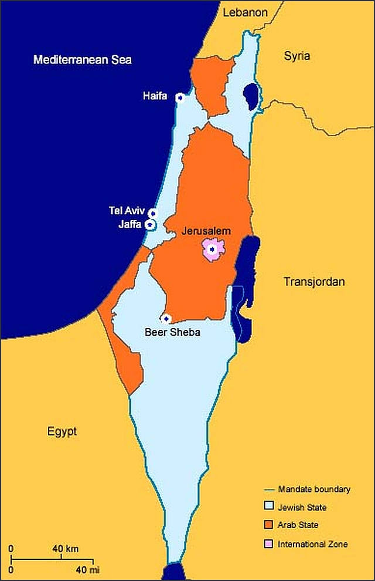
To return to the land of Israel, Jews had to become a nation once again (1948)

Slide 77
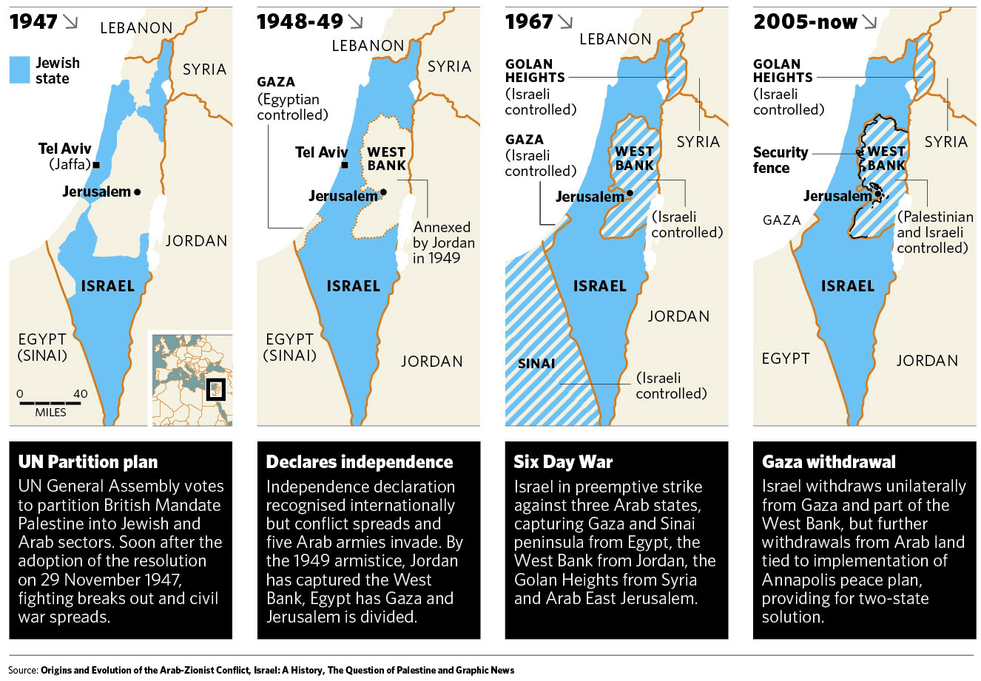
Israel regained ancient borders in stages (1947-2005)
http://kmhouseindia.blogspot.com/2012/11/palestinian-statehood-bid.html

Slide 78
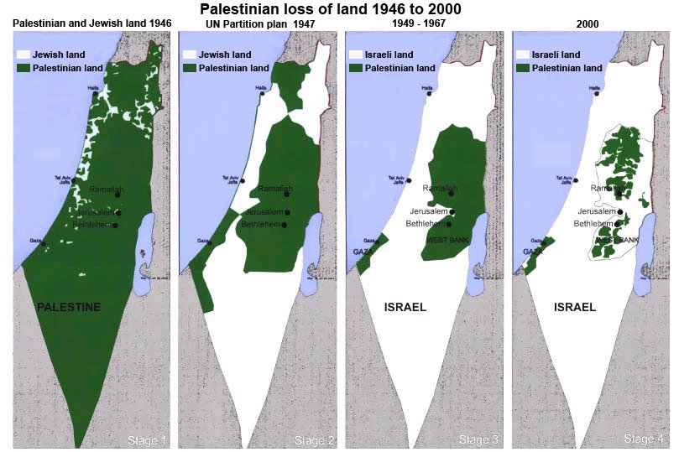
Israel regained ancient borders in stages (1946-2000)
http://tema1tema.blogspot.com/2011/05/stop-israeli-war-crimes-yells-woman-at.html

Slide 79
Jews also needed to regain Jerusalem, which they did in the
Six-Day War (1967)
Foundation for Middle East Peace
(March 2002)

Slide 80
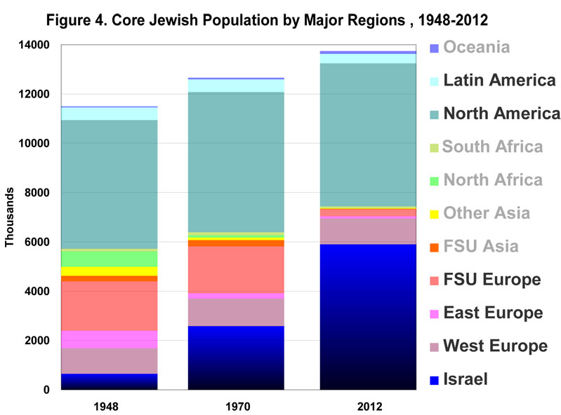
Jewish Population by Major Regions (1948-2012)
14
Oceania
7 million outside Israel
Latin America
12
North America
10
10 million outside Israel
South Africa
11 million outside Israel
8
North Africa
Millions
Other Asia
6
FSU Asia
God is bringing His people back!
4
FSU Europe
East Europe
2
West Europe
0
Israel
1948
1970
2012
––Jews for Jesus
Notes:
David Brickner, "Israel's Salvation" (Jews for Jesus Publication, 8 July 2013) at http://www.jewsforjesus.org/images/population-israel-800w.jpg accessed 17 July 2013

Slide 81
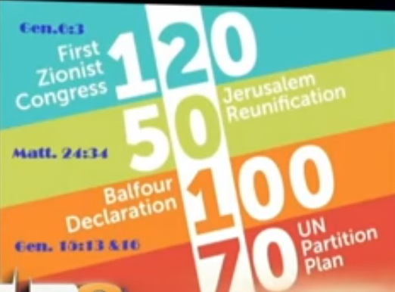
The year 2017 was significant for Israel
Gen 6:3
120
First
Zionist
Congress
Jerusalem
Reunification
50
Matt 24:34
100
Balfour
Declaration
UN
Partition
Plan
Gen 15:13, 16
70
Notes:
See https://www.youtube.com/watch?v=_JF9cWmjgEc for PM Benjamin Netanyahu UN speech speech on these dates at 18:00 minutes:
1897 First Zionist Congress under Theodore Hertzel started bringing Jews back to Israel exactly 120 years ago (Gen 6:3 gave 120 years limit to man relating to the Flood)
1967 Six-Day War captured Jerusalem 50-year generation 50 years ago (Matt 24:34 says "this generation will not pass away until all these things have happened")
1917 Balfour Declaration of UK divided Middle East into present countries one 100-year generation ago to prepare for Jewish state 100 years ago (Gen 15:13 notes a 400-year slavery, which Gen 15:17 identifies as 4 generations of 100 years each)
1947 UN Partition Plan granted minimal boundaries for modern Israel 70 years ago, similar to the 70-year exile from the land from 605-536 BC
These four key modern events lead us to the year 2017 as paramount for Israel.
________
The above image and article below is reproduced from:
Reformation and Jubilees?
Posted on July 10, 2017 by Richard A. Volunteer
Accessed 20 Oct 2017
"Blow the Shofar in Zion, and sound an alarm on My Holy Mountain! Let all the inhabitants of the land tremble, For the day of the LORD, is coming; Surely it is near… (Joel 2:1)
The Feast of Trumpets falls on Sept 21, 2017, and Yom Kippur is 10 days later….
The U.N. declared International Day of Peace “just happens” to be September 21, 2017. The Theme this year “just happens” to be peace and safety.
It is 70 years from 1947 which was the rebirth of Israel. – On 29 November 1947, the UN General Assembly adopted the Plan as Resolution 181
It is the 50th anniversary or year of Jubilee for Jerusalem. It was liberated in 1967 when Jerusalem was recaptured by Israel from the Jordanians. Fifty years earlier Jerusalem was liberated by Allenby in 1917 and 400 years earlier in the Turks conquered Jerusalem in 1517.
It is the 70th anniversary of the Dead Sea Scrolls – early 1947
It is the 100th anniversary of the Balfour declaration – On November 2, 1917, Foreign Secretary Arthur James Balfour writes a letter expressing the British government’s support for a Jewish homeland in Palestine.
It is the 120th anniversary of the First Zionist Congress – “In Basel, I founded the Jewish state,” Zionist visionary Theodor Herzl said in 1897 of the First Zionist Congress.
It is the 500th anniversary of the Reformation – Catholics and Lutherans will celebrate Reformation Day Oct 31st, 2017 in Jerusalem. They will begin to set aside differences that started with Luther actions on Oct 31, 1517, in Wittenberg Germany.
It is 120 Jubilees from Adam.
It is 40 Jubilees since Christ’s death.
It is 70 Jubilees since Exodus (1483 B.C).
It marks year 5777 on the Jewish calendar.
So we pay attention and we note the time….for God moves in time and with design and order.
No – I make no attempt to interpret the mind of God and His inscrutable plans. I do know that ‘coincidence” is not a Kosher word….We only pray to be part of whatever He plans to do among His people and we prepare spiritually."

Slide 82

How will there be a second return?
33-34
The Messiah will lead them (Ezekiel 37:24)
"My servant David will be their king, and they will have only one shepherd. They will obey my regulations and be careful to keep my decrees."

Slide 83

How will there be a second return?
33-34
The Messiah will rule forever (37:25)
"And David My servant shall be their prince forever."
Ezekiel 37:25

Slide 84

How will there be a second return?
33-34
Permanent temple (Ezekiel 37:26b, 28)
"I will put my Temple among them forever…. ²⁸ And when my Temple is among them forever, the nations will know that I am the LORD, who makes Israel holy."

Slide 85


The Postexilic Era
295
296
560
The Postexilic Era
Temple work
Prophets:
Haggai
Zechariah
Malachi
605
586
539
536
520
516
483-473
444-425
72 years
Others:
Zerubbabel
Esther
Ezra
Nehemiah
Persian Kings:
Cyrus
Darius
Xerxes
Artaxerxes
Notes:
The Post-Exilic Era involved three separate periods:
(1) Temple rebuilding led by Zerubbabel, Haggai, and Zechariah in two parts under Cyrus and Darius,
(2) The saving of the nation from destruction by Esther about 30 years later under Xerxes, and
(3) The restoration of Jerusalem’s walls and gates by Nehemiah another 72 years after that under Artaxerxes.
_________
Common-321
BE-37-Haggai-15
BE-39-Malachi-21
OS-12-Kings & Prophets Charts-24
OS-15-Ezra-36
OS-16-Nehemiah-94, 156
OS-17-Esther-16, 75
OS-26-Ezek33-39—slide 85
OS-27-Daniel-340
OS-37-Haggai-43
OS-38-Zechariah-46, 121
OS-39-Malachi-13, 56

Slide 86

Post-Exilic Prophecy
How will there be a second return?
33-34
Assyria
Postexilic prophecy (Zechariah 10:9-10)
"Though I have scattered them like seeds among the nations, they will still remember me in distant lands. They and their children will survive and return again to Israel.
¹⁰ I will bring them back from Egypt and gather them from Assyria. I will resettle them in Gilead and Lebanon until there is no more room for them all."
Lebanon
Gilead
Egypt
Notes:
Even Lebanon and Gilead across the Jordan will have the Jewish remnant that returns—but that will still make it crowded!
_________
OS-28-Ezek33-39-slide 85
OS-36-Zechariah-

Slide 87

God will restore Israel to the land twice!
How will there be a second return?
33-34
Second re-gathering (Isaiah 11:11)
“In that day the LORD will reach out his hand a second time to reclaim the remnant that is left of his people from Assyria, from Lower Egypt, from Upper Egypt, from Cush, from Elam, from Babylonia, from Hamath, and from the islands of the sea”
(Isaiah 11:11 NIV).
Assyria
Babylonia
Islands of the Sea
Elam
Israel
Lower Egypt
Upper Egypt
Cush
Notes:
God predicts the second return (AD 1948) even before the first exile (586 BC)!
________
OS-23-Isa1-12—slide 353
OS-26-Ezek33-38—slide 87

Slide 88

Returns to the Land
473d
 | First Return | Second Return
Dates in Exile | 605-536 BC (Jer. 25:11) | AD 132-1948 (Jews excluded from Israel by Romans to UN Mandate)
Period Returned | 538 BC – AD 132 | AD 1948 – Present
Place of Origin | Babylon (Ezra 2:1) | Many nations (Isa. 11:11)
People Returned | Only Judah (Ezra 2:64; Neh. 11:1) | Israel & Judah return as a united nation (Jer. 30:3; 31:31)
The Valley of Elah, near Adullam
Notes:
The OT prophets often blur the two returns of Jews back to the land of Israel promised to Abraham. Perhaps separating them in the following manner may help.
_______________
ES-26-Restoration of Israel-178
OS-23-Isaiah1-12—slide 376
OS-26-Ezekiel33-39—slide 88

Slide 89
Returns to the Land
473d
 | First Return | Second Return
Israel Before Return | Prosperous (Jer. 29:4-7) | “Time of trouble” (Jer. 30:7; Matt. 24:4-14)
Nations Before Return | Victorious (Dan. 7:1-4) | Ruling over Israel in “times of the Gentiles” (Luke 21:24)
Nations at Return | Supportive (Ezra 1:1-4) | Judged (Dan. 2:44; 7:19-26; Jer. 30:6; Zech. 14:2-3; Rev. 19:11-21)
The Valley of Elah, near Adullam
Notes:
The OT prophets often blur the two returns of Jews back to the land of Israel promised to Abraham. Perhaps separating them in the following manner may help.
_______________
ES-26-Restoration of Israel-179
OS-23-Isaiah1-12—slide 377
OS-26-Ezekiel33-39—slide 89

Slide 90
Returns to the Land
473d
 | First Return | Second Return
Conditions Following:
–– Freedoms | Subjects of Persia, Greece, & Rome (Dan. 7) | “No longer will foreigners enslave them” (Jer. 30:8)
–– Wars | Many (Dan. 11:1-35) | None (Isa. 2:4; Jer. 30:10)
–– Covenant | Mosaic (Jer. 31:32) | New (Jer. 31:31)
–– Temple | Second (Ezra 6:15( | Ezekiel’s (Ezek. 40:48)
The Valley of Elah, near Adullam
Notes:
The OT prophets often blur the two returns of Jews back to the land of Israel promised to Abraham. Perhaps separating them in the following manner may help.
_______________
ES-26-Restoration of Israel-180
OS-23-Isaiah1-12—slide 378
OS-26-Ezekiel33-39—slide 90

Slide 91
Returns to the Land
473d
 | First Return | Second Return
Conditions Following:
–– Boundaries | Judah later expanded to Galilee (e.g., Matt. 2:2) | Wadi of Egypt to Euphrates River (Isa. 27:12; cf. Gen 15:18)
–– Palace | None (Ezra 4:4) | Rebuilt (Jer. 30:18b)
–– King | None (Hos. 3:4) | Christ (Isa. 9:6; 11:1-5; Mic. 5:2)
–– Emotions | Regret (Mal. 3:14) | Comfort & joy (Jer. 31:13)
The Valley of Elah, near Adullam
Notes:
The OT prophets often blur the two returns of Jews back to the land of Israel promised to Abraham. Perhaps separating them in the following manner may help.
_______________
ES-26-Restoration of Israel-181
OS-23-Isaiah1-12—slide 379
OS-26-Ezekiel33-39—slide 91

Slide 92

Why does Ezekiel depict the second return?
33-34
Israel will trust in her Messiah (37:14)
Reunification of Israel & Judah (37:15-23)
The Messiah will lead them (37:24)
The Messiah will rule "forever" (37:25)
Permanent temple (37:26b, 28)
Postexilic prophecy (Zech. 10:9-10)
Second re-gathering (Isa. 11:11)

Slide 93


Interpreting Ezekiel's Prophecy
508
Vision |  | Meaning
bones | = | house of Israel
dried bones | = | hope gone, cut off
bones together | = | Jews return to Israel
breath in them | = | God's Spirit in Israel
Adapted from www.bibleweb.org/ MEastStudies/Sem3.htm

Slide 94

Restoration of the LORD's People
Re-gathering of Israel back into their own land
Reuniting of two nations into one
Ruling of Israel under one king
Rescuing of Israel from her sins
Recommitment of Israel to obey Yahweh's laws
Reestablishing covenant of peace with Israel
Residing of Yahweh in Israel's midst
Recognition of Yahweh's holiness by all
Ezekiel 36–37

Slide 95
God will give new life
(Ezekiel 33–39)
Preparing for Glory…
God will restore
Israel
(33–37)
God will protect
Israel
(38–39)
Notes:
(So God will restore Israel to the land. But will other nations oppose Israel’s restoration?
• Yes, but this will lead to the second way that God will prepare for his glory to return. He will protect them. But how?)

Slide 96
God will give new life
(Ezekiel 33–39)
Preparing for Glory…
…by destroying her enemies
God will protect
Israel
(38–39)
Notes:
[The LORD will defeat an alliance of nations.]

Slide 97
Slides on
Ezekiel 38
Notes:
A northern Arab alliance will attack Israel with great might (38:1-16).

Slide 98

Alliances Supporting Israel in December 2020
Notes:
Current alliances supporting Israel will fail.

Slide 99

Opposition to Israel will only increase
Notes:
Opposition is sure to rise in the days ahead.
———————
33-Micah-Netanyahu UN Speech Slams Antisemitism Sep 22 2016.mp4 at http://biblestudydownloads.org/files/eng/os/33-Micah-Netanyahu%20UN%20Speech%20Slams%20Antisemitism%20Sep%2022%202016.mp4

Slide 100
The Restoration of Israel
Reappointment of Ezekiel (33)
Restoration of Leadership (34)
Restoration of the LORD's Land (35:1–36:15)
Restoration of the LORD's Honor (36:16-38)
Restoration of the LORD's People (37)
Restoration of Peace and Security (38–39)

Slide 101

Restoration of Peace & Security
The LORD will bring Gog against Israel
Gog will execute his evil scheme to invade Israel
Gog and his army will come from the north
The LORD will display His might against Gog
Israel will plunder and bury Gog's fallen army
The birds and beasts will feast on the fallen army
Israel will enjoy peace and security in the land
Ezekiel 38–39

Slide 102

Who is Gog?
Ezekiel 38–39
Many suggestions have been made.
Land areas of Meshech and Tubal cover areas in Turkey, Russia, and Iran
Is Gog and Magog in Ezek 38–39 the same as the Gog and Magog in Rev 20:8?
Notes:
Gog is probably Russia with northern Arab nations.
But Revelation 20:7-10 also mentions Gog and Magog in a war, so is it the same as Ezekiel?

Slide 103
Reasons Ezekiel's Gog & Magog is different from
John's Gog & Magog in Revelation 20:7-10
512a
Revelation 20:8
Gog & Magog = nations
Revelation 20:8
Gog & Magog v. Messiah
Revelation 20:10
Satan cast into lake of fire
Revelation 20:7-10
Events fit after millennium in 20:1-6
Ezekiel 38:2
Gog = Prince
Magog = Land
Ezekiel 38:16
Gog against Israel
Ezekiel 39:17-20
Great feast of corpses
Ezekiel 38:39
Events fit before restored
millennial temple (ch. 40)
Notes:
At least four differences exist between the two passages.

Slide 104
Slides on
Ezekiel 39
Notes:
God will protect Israel in the Tribulation to show his rule (38:17–39:29).

Slide 105

When Will Gog's Invasion Occur?
511b-512
Differing Views:
Passage entirely symbolic
Before Tribulation
Middle of Tribulation
End of Tribulation
Between end of Tribulation & Millennium
After Millennium
Combination of 4th and 6th views
Notes:
At least 7 different views exist when the invasion occurs.

Slide 106
A Dispensational Timeline
OT Survey page 437
Rapture
(1 Thess 4:13-18)
2nd Advent
(Zech 14:3-5)
Great White Throne
(Rev 20:11-14)
Day of the LORD
Church Age
Tribulation
(Zech 14:1-2)
Millennium
(Zech 14:6-21)
Gog & Magog
(Armageddon)
(Ezek 38–39)
Gog and Magog
Revisited
(Rev 20:7-10)
"How awful that day will be! None will be like it. It will be a time of Jacob's trouble, but he will be saved out of it"
(Jer 30:7)
Notes:
106
The next event on God's prophetic calendar is for the church age to end with the Rapture. Shortly after this, the Day of the Lord will begin with the Antichrist signing a covenant with Israel (Dan 9:27; 2 Thess 2:1-12). Jeremiah 30:7 called this "Day" or period the "time of Jacob's trouble" or era of great persecution of Jews. Yet the second coming will bring in phase 2 of the "Day of the Lord" where all Israel at that time will be saved (Rom 11:26-27). This 1000 years of blessing on earth will be preceded and followed by two major battles and ending in the Great White Throne Judgment.
So how does this give you hope?
Does it affect how you use your money? Do you “lay up for yourself treasures in heaven” as a result?
How does it impact your use of time? Do you say, “That movie isn’t necessarily wrong, but I could use my time much better by investing God’s Word into others!”?
______
Common-342
ES-26-Restoration of Israel-126, 334, 346, 362
JE-09-Return of Christ-36
JE-10-Christ's Rule-40
OS-23-Isaiah 1-12-Slide 87
OS-24-Jeremiah-161
OS-26-Ezekiel 1-39-Slide 247
OS-26-Ezekiel_33-39—slide 102
OS-26-Ezekiel 40-43-Slide 24
OS-29-Joel-87
OS-31-Obadiah-154
OS-36-Zephaniah-86
OS-39-Zechariah-158, 167, 184
OS-39-Malachi-137
NS-22-Rev4-6-slide 117
NS-22-Rev20-22-slide 137

Slide 107
How can you be expectant of God’s glory once again in your life?
Notes:
What can you do to restore that sense of blessing that you used to have—those times when the presence of the Lord was real? This isn't simply a feeling, for that time may have been one of the most difficult periods of your life. Yet you knew that God was showing himself to you in new ways, there was a sense of expectancy at what he would do next. How can that return?

Slide 108
STEPS TO GOD'S GLORY
1—Admit that God’s glory left (Ezek 1–24).
ADMIT
Notes:
The sense of God's presence will not remain when we insist on sin.

Slide 109
STEPS TO GOD'S GLORY
2—Allow God to handle all rivals to his glory (Ezek 25–32).
ADMIT
ALLOW
Notes:
Know that the Shekinah presence of the LORD will purge all forms of darkness.

Slide 110
STEPS TO GOD'S GLORY
3—Anticipate God’s glory to return (Ezek 33–48).
ADMIT
ALLOW
ANTICIPATE
Notes:
Live as if the future really does include God’s blessing once again.

Slide 111
Expect God to discipline and restore you for his glory.
ADMIT
ALLOW
ANTICIPATE
MAIN IDEA OF EZEKIEL
Notes:
Live as if the future really does include God’s blessing once again.
Act like God will transform your present discipline into his future glory.

Slide 112
God will give new life
(Ezekiel 33–39)
Preparing for Glory…
God will restore
Israel
(33–37)
…to the land led by Jesus
Notes:
[The Jews must return to their homeland under Messiah.]

Slide 113
God will give new life
(Ezekiel 33–39)
Preparing for Glory…
…by destroying her enemies
God will protect
Israel
(38–39)
Notes:
[The LORD will defeat an alliance of nations.]

Slide 114
Anticipate
Glory in a New Life
Ezekiel 33–39
Main Idea
Notes:
As God's people, we should never say, "Well, that can't happen!" Instead, we should expect God to show up once again to give a brand new reality to those who trust him—whether Jew or Gentile (restatement).

Slide 115

Theological Themes
God
  God of Israel
  Holiness of God
  Faithful to covenant
  Spirit of Yahweh
  Glory of Yahweh
Individual Responsibility
Restoration
  New covenant
  New physical order
  Edenic ideals

Slide 116

Summary
Reunion of Judah and Israel
Enemies Defeated
Shekinah Glory Returned
Temple Rebuilt
Order of Worship Restored
Redemption (Forgiveness of Sins)
All will know that I am Yahweh
Territories Restored
Indwelling Spirit
Obedience Guaranteed
New Heart
Shepherd of Israel

Slide 117

God's breath (Spirit) enters people today
Has he entered you?
Notes:
God's breath (Spirit) enters people today, so receive this new life by accepting God’s “breath” in you.
This comes by simple trust in Jesus as the Substitute for your sin.
When we say “yes” to him, his Spirit actually comes inside us and gives us new life.

Slide 118

You will reign with the Lion of Judah
…if you are faithful now!
Notes:
For those who have already trusted Christ, anticipate reigning with Christ if you are faithful now!

Slide 119

Applications
How do you reveal the glory of God in your life?
How has God disciplined you for your sin but restored you by His grace?
Do you see his hand in world events today?
Will you return to him so he can return to you?
Notes:
Are you expectant?

Slide 120
Black

Slide 121


OT Survey link at BibleStudyDownloads.org
Get this presentation and script for free!

