Slide 1

Allow God to Judge
Ezekiel 25–32
Dr. Rick Griffith • Amman International Church
AmmanChurch.org • BibleStudyDownloads.org

Slide 2
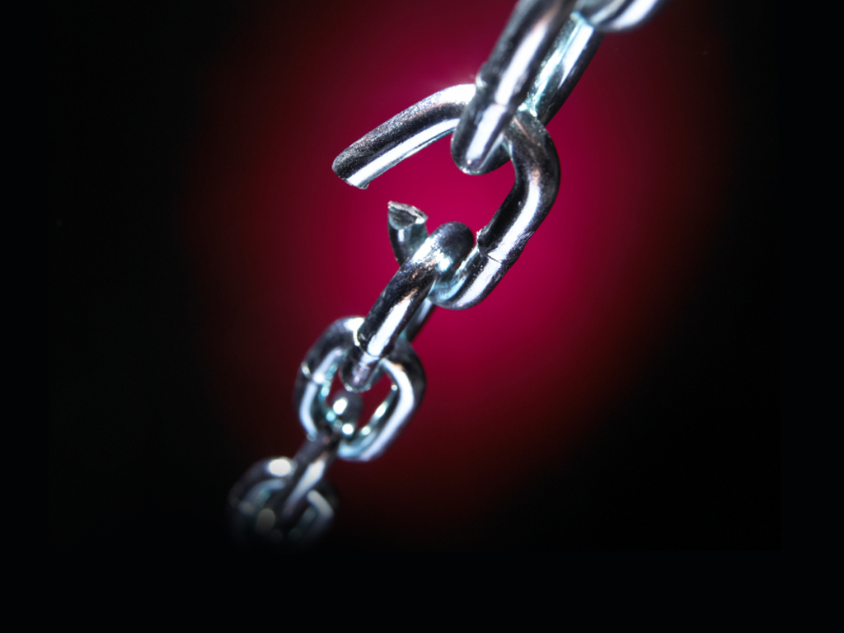
Feeling weak?
Notes:
Interest: We often feel like we are the weak ones.

Slide 3



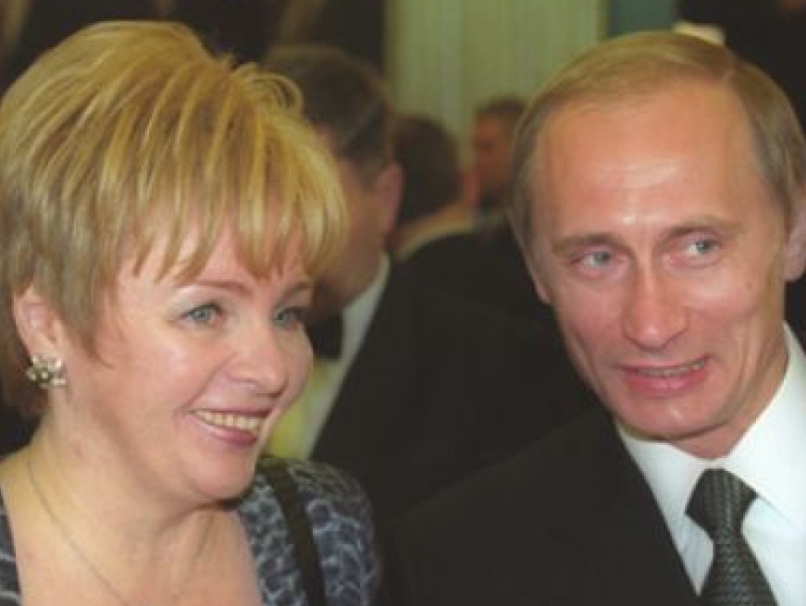
Multi-Billionaires
Elon Musk
Bill Gates
Jeff Bezos
Vladimir Putin
Notes:
We have billionaires with amazing wealth while we struggle financially.
______________
Elon Musk’s Ex-Wife Denies Being Hand-Chosen By Ghislaine Maxwell To Be His ‘Child Bride’
6 July 2020
https://brobible.com/culture/article/elon-musk-wife-denies-ghislaine-maxwell/
Tesla and SpaceX founder Elon Musk has had himself quite a past couple of months.
He had a kid with his partner Grimes and named him something so bizarre that even she can’t explain properly.
Then he denied having a threesome with actresses Amber Heard and Cara Delevingne while Heard was married to Johnny Depp.
And now, his ex-wife, actress and model Talulah Riley, has felt the need to go on record stating that despite rumors, Jeffrey Epstein companion Ghislaine Maxwell did not hand-choose her to be Musk’s child bride back in 2008 when she was 23 and Musk was 36.
Here’s how their love story goes.
Riley and Musk began dating in 2008. Then in 2010 the couple got married. In January 2012, Musk announced the marriage was over and they got divorced. In July 2013, Musk and Riley got married for a second time. In December 2014, Musk once again filed for divorce. Then he withdrew his filing. Then she filed for divorce in March 2016. The couple’s second divorce became official in October of 2016.
The actress, now 34, and who many will recognized from her role playing Angela on Westworld, apparently heard some rumors following Maxwell’s arrest that Epstein’s cohort procured her to be Musk’s child bride back in the day.
————————
Bill Gates, wife Melinda announce divorce after 27 years of their marriage
https://www.indiatvnews.com/lifestyle/people-bill-gates-wife-melinda-gates-announce-divorce-after-27-years-of-their-marriage-net-worth-children-memes-702346
Bill Gates and his wife Melinda Gates revealed their decision of taking divorce in a joint statement which was shared by the Microsoft co-founder on Twitter. “After a great deal of thought and a lot of work on our relationship, we have made the decision to end our marriage. Over the last 27 years, we have raised three incredible children and built a foundation that works all over the world to enable people to lead healthy, productive lives,” read the statement.
Edited by: India TV Lifestyle Desk
New Delhi Updated on: May 04, 2021 12:50 IST
___________
Jeff Bezos' ex-wife MacKenzie's post-divorce revenge
Not since Jennifer Aniston has a wronged woman done so much right
By Maureen Callahan New York Post
https://www.foxbusiness.com/business-leaders/jeff-bezos-ex-wife-mackenzies-post-divorce-reven
Published August 3, 2020
MacKenzie Scott, the fourth-richest woman in the world, announced on Tuesday that she has dropped Bezos from her name and donated $1.7 billion to 119 nonprofits, with an emphasis on racial equality, marginalized groups and economic mobility.
JEFF BEZOS NABS BEVERLY HILLS ESTATE NEXT TO HIS RECORD-SETTING $165M COMPOUND
Meanwhile, her ex-husband, Amazon founder Jeff Bezos — who publicly left MacKenzie for her close friend Lauren Sanchez — spent the week dropping $10 million on an LA home, just near the $165 million mansion he bought from David Geffen.
On Friday, Amazon posted a second-quarter profit of $5.2 billion, the biggest in its 26-year-history, due to a pandemic that is otherwise ravaging the economy.
Days earlier, Bezos testified before Congress in an antitrust hearing, seeking to downplay Amazon’s global dominance while casually snacking on camera.
Video
“Just like the world needs small companies, it also needs big ones,” Bezos said.
Such a smug, reductive assertion, but one typical of a Big Tech overlord who knows his money will buy all the lawmakers it needs to keep Amazon intact.
WHAT’S HOUSE HUNTING LIKE FOR THE WORLD’S RICHEST MAN
This is the arrogance Bezos deems publicly acceptable. Can you imagine what he’s like in private? As a husband?
Amazon CEO Jeff Bezos, right along with American news anchor Lauren Sanchez poses for photographs during a blue carpet event organized by Amazon Prime Video in Mumbai, India, Thursday, Jan. 16, 2020. (AP Photo/Rafiq Maqbool)
“I love you, alive girl,” a still-married Bezos texted Sanchez in 2018. “I will show you with my body, and my lips and my eyes, very soon.”
“I want to get a little drunk with you tonight,” went another text to Sanchez amid raunchy selfies. “Not falling down. Just a little drunk. I want to talk to you and plan with you. Listen and laugh. I basically WANT TO BE WITH YOU!!!”
“You make me better,” read another. “You’re meant for me. I know it more clearly than I’ve ever known anything.”
LONDON, ENGLAND: Jeff Bezos and his partner, Lauren Sanchez, look on from the Royal Box on Centre Court on Day 13 of The Championships - Wimbledon 2019 at the All England Lawn Tennis and Croquet Club on July 14, 2019 in London, England. (Photo by Sim
Those texts wound up splashed all over the National Enquirer, and federal investigators told The Wall Street Journal that the sexts were leaked by none other than Sanchez’s brother, who got a $200,000 payday from the tabloid. (Her brother denies the claims.)
WEST HOLLYWOOD, CA: (L-R) CEO of Amazon Jeff Bezos and writer MacKenzie Bezos attend the Amazon Studios Oscar Celebration at Delilah on February 26, 2017 in West Hollywood, California. (Photo by Jerod Harris/Getty Images)
For MacKenzie, these indiscretions must have dealt the same blow that the infamous W cover (and accompanying 60-page spread) of Brad Pitt and Angelina Jolie playing happy families did to Aniston.
JEFF BEZOS SETS NEW LA REAL ESTATE RECORD WITH $165M BEVERLY HILLS BUY
Especially as Bezos’ sexts were written months before MacKenzie and Bezos celebrated their 25th wedding anniversary in Miami.
Imagine MacKenzie’s humiliation. Imagine what she must have done to hide the worst from their four children while Bezos and Sanchez kept flying all over the country, checking out multimillion-dollar homes and parading their status as Big Tech’s Most Scandalous Couple.
LOS ANGELES, CA: WME's Patrick Whitesell, Lauren Sanchez and Amazon CEO Jeff Bezos attend Jeff Bezos and Matt Damon's "Manchester By The Sea" Holiday Party on December 3, 2016 in Los Angeles, California. (Photo by Todd Williamson/Getty Images for Ama
When MacKenzie married Bezos in 1993, he was just another computer nerd.
“I do remember the first time I heard him laugh,” she told the Seattle Post-Intelligencer in 2005. “I met him at the hedge fund where we worked in New York … I would hear him laughing all day. I fell in love with his laugh.”
At the time, MacKenzie was publicizing her debut novel, which took her eight years to write while she raised small children. Little is known of her story, but clearly she put her ambitions on hold so Bezos could pursue world domination.
After Jeff got himself a midlife mogul makeover in 2017 and began seeing Sanchez, a former host on “So You Think You Can Dance,” MacKenzie said nothing.
FILE - In this March 4, 2018 file photo, Jeff Bezos and wife MacKenzie Bezos arrive at the Vanity Fair Oscar Party in Beverly Hills, Calif. (Photo by Evan Agostini/Invision/AP, File)
She maintained her dignity, got a great divorce lawyer and walked away with more money than she’ll ever need (current worth: $62.3 billion).
GET FOX BUSINESS ON THE GO BY CLICKING HERE
Their divorce was settled out of court, which kept the custody arrangement for their three minor kids secret. She signed the Giving Pledge and said on Tuesday, in part:
“Like many, I watched the first half of 2020 with a mixture of heartbreak and horror.”
Subtext: My ex-husband soullessly profits from this pandemic while firing workers who are refused bathroom breaks and basic human dignity.
She also wrote: “There’s no question in my mind that anyone’s personal wealth is the product of a collective effort” — ahem — “and of social structures which present opportunities to some people, and obstacles to countless others.”
Bezos is notoriously stingy when it comes to charitable giving, preferring to compete with Elon Musk over colonizing space.
As Aniston infamously said of ex-husband Brad Pitt in 2005, “There‘s a sensitivity chip that’s missing.”
It’s hard to think of a more apt description of Bezos — or a better post-divorce life awaiting MacKenzie than the one she has designed for herself.
____________
Where is Putin’s family right now? Confirmed one thing before approving Ukraine invasion; What happened to Russians who went to find his girlfriend?
Thursday 03 March, 2022 | 3:17 PMfamily-oneMOSCOW: Russian President Vladimir Putin is the prince of tactics
Read full news at https://keralakaumudi.com/en/news/news.php?id=763488&u=where-is-putin%E2%80%99s-family-right-now-confirmed-one-thing-before-approving-ukraine-invasion-what-happened-to-russians-who-went-to-find-his-girlfriend
The first thing Putin did after sending troops to Ukraine was to make his family safe. He had shifted his family to a secret underground bunker in Siberia, prior to the Ukraine invasion… Putin's wife was Lyudmila Skrebneva, a former air hostess. They were married in 1983 and got divorced in 2013.

Slide 4

How are Christians doing here?
Economy
Arts
Government
Media
Education
Religion
Notes:
In which area are we experiencing victory? It seems that Satan controls just about every domain—education, government, economy, arts, media, and even religion.
We aren’t doing a great job in any of these.
But how is God doing in running the world?

Slide 5

How is God doing running the world?

Slide 6
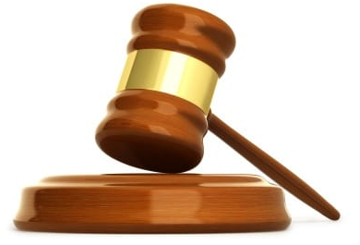
4 Reasons God is a Bad Judge
—Jeremy Myers
"God is a terrible judge. Seriously. If He served in any court in our country, He would probably wind up in prison. I am not trying to malign God; I am just stating the way things are. Look at the facts."
Notes:
https://redeeminggod.com/god-is-a-bad-judge/#comments
Accessed 9 June 2022
God is a terrible judge. Seriously. If He served in any court in our country, He would probably wind up in prison.
I am not trying to malign God; I am just stating the way things are.
Look at the facts:
1. God is the judge of the world, but the world is in quite a mess.
NT Wright put it this way: “What on earth might it mean today to speak of Jesus being ‘king’ or ‘in charge,’ in view of the fact that so many things in the world give no hint of such a thing?” (Simply Jesus, 55).
Have you looked around the world recently? Does it look like God is in charge? Nope. In fact, for this very reason, many theologians think that God is “in charge” in name only, and that Satan is still the the one pulling the strings. God will not be fully in charge, they say, until the new heavens and the new earth.
Yes, well, though there is some truth in that perspective, the fact of the matter is that most of the New Testament seems to lead us to believe that God truly is in charge, not just in name, but in practice as well. Of course, what does it mean to be “in charge”? Nobody disputes that God is “in control.” What is disputed is, “How?”
Is it absolute control (entailing the loss of freedom), mind control (hardly), crowd control (I like that image), ultimate control (certainly)? Most seem to use the word in the sense of absolute control, and that is deeply unfortunate language (Creation Untamed, 62).
2. It takes God way too long to pass judgment.
When God pronounces judgment on someone (or a group of someones), we expect fireballs and lightning bolts to fall out of heaven right then and there. But they never do. God waits. And waits. And waits.
And while He waits, the evil persists and grows. People suffer and die. And we begin to think that maybe God didn’t mean what He said.
God pronounced judgment on the people living during the days of Noah (Gen 6:5, 11-13). But he let this evil continue for another 120 years (Gen 5:32; 6:3; 7:6). One wonders how many women got raped during that 120 years? How many people murdered? How many slaves tortured? How many children molested? If “the wickedness of man was great in the earth, and every intent of the thoughts of his heart was only evil continually” (Gen 6:5), imagine the evil that continued to take place during those 120 years?!
Actually, don’t imagine it. It is too depressing and shocking.
This is why biblical writer after writer call on God to act, to judge, to pay attention, to look at the suffering. God says one thing, and we wait for justice to appear, but it never does. God seems to sit idly by while evil goes unchecked and his judgments go unenforced. Which raises the second point.
3. When God does make a judgment, He is way too lenient.
Even when God does pass judgment, it often seems that His decisions are way too lenient.
Sometimes God seems like a parent who just doesn’t want to admit that his child is doing anything wrong. While all the world is saying, “Kill them! Lock them up! Send them away forever!” God gives “slaps on the wrist” over and over, sometimes to the point of embarrassment. He literally lets people get away with murder, and frequently, much worse than murder.
Terence Fretheim writes about the leniency of God this way:
God is more like a parent, openly anguished over what to do about a wayward child. (e.g., Hosea 6:4, “What shall I do with you?” and 11:1-9). What would courtrooms be like if judges were to display such personal anguish and anger? To mix metaphors: if God is viewed as the divine judge behind the bench, remember that God is also the spouse of the accused one in the dock! Objectivity or neutrality goes out the door!
Sure, theologians tell us that a day is coming when all will be set straight and all wrongs will be corrected. But what comfort is for the woman who was raped now, and lives her whole life in shame and fear without ever seeing justice? What comfort is some sort of future retribution for the child who has been abused since birth?
It is none. At least, none I can discern.
There is certainly something about all this that I do not understand with God, but I have trouble figuring out how it will make a little girl feel better when she was raped and beaten continually from the time she was two years old until she died at age 16 to get to heaven and look down upon the earth and see her abuser living a rich life and for God to say to her, “Don’t worry. I’ll discipline him some day. But for now, let him enjoy his steak dinners, his vacations, his fancy houses, and all the other girls he is going to rape.”
WHAT?!!!!
4. God allows His judgments to be influenced by people.
God sets out to obliterate everybody in Sodom and Gomorrah, but Abraham gets him to agree to not destroy these cities if 10 righteous people can be found in them.
God decided to destroy Israel for their insolence, but Moses persuades Him to hold off.
God tells Jonah to preach judgment upon Nineveh, but because they show some signs of repentance, He holds off for a couple hundred years while they continue to run roughshod over the entire Ancient World (some repentance that was!).
So it seems that God makes a judgment and then backs off of His decisions when people complain, or when they show the least little sign of remorse for what they have done. What kind of judgments are these if God can be so easily and quickly turned away from what He had decided to do?
One wonders if God would have held back the flood during the days of Noah if the people would have shown some signs of remorse.
What is the solution to all this?
There are only a few things that can be said in the face of all this (seemingly) divine injustice. At least, here is how I try to make sense of it in my own mind.
God alone knows everything about everyone.
Based on what God knows about people, He forgives and loves them still, and is patient with them.
I do not know everything about everyone.
If I did, maybe I would see (as God does) why some people deserve extra grace, patience, and longsuffering.
This is partly why it is so dangerous for us, as mere humans, to pass judgement and condemnation on others. We do not see what God sees. We do not know what God knows. If the only Being in the universe Who knows everything about everybody refused to pounce on people every time they go against His will (and thank God He doesn’t do this with us, either!), who are we to think we can rightly judge and condemn another person based on our extremely limited knowledge of what has happened in their lives?
Yes, yes, the law courts and our government must pass judgment. I am not talking about that at all. I am talking about us as individuals trying to sit in judgment on other people about the decisions they have made in their own lives. Look, when we fail in life, we want other people to give us the benefit of the doubt. We see some of the things that have happened to us in life and how these things led us to make bad decisions, which led to even more bad decisions, and sometimes even good decisions which went wrong, so that we ended up doing something terrible. We see some of this in our own lives, and want grace, mercy, and understanding from others. And God, who sees all, gives it. So let us, as God’s people, try to show the same grace, mercy, and patience toward others as we hope they would show toward us.
This isn’t a solution to the problem of evil, but simply a willingness to reserve judgment and trust in the goodness and graciousness of God.
So it seems that the problem is not so much with God, but with our own limited understanding and knowledge. We do not see or know all that God sees and knows.
In the end, it is not exactly that God is a bad judge, as much as He is a merciful and compassionate judge, slow to anger and abounding in love.

Slide 7
4 Reasons God is a Bad Judge
—Jeremy Myers
1. God is the judge of the world,
but the world is in quite a mess.
2. It takes God way too long to pass judgment.
3. When God does make a judgment,
He is way too lenient.
4. God allows His judgments to be influenced by people.
Notes:
https://redeeminggod.com/god-is-a-bad-judge/#comments
Accessed 9 June 2022
God is a terrible judge. Seriously. If He served in any court in our country, He would probably wind up in prison.
I am not trying to malign God; I am just stating the way things are.
Look at the facts:
1. God is the judge of the world, but the world is in quite a mess.
NT Wright put it this way: “What on earth might it mean today to speak of Jesus being ‘king’ or ‘in charge,’ in view of the fact that so many things in the world give no hint of such a thing?” (Simply Jesus, 55).
Have you looked around the world recently? Does it look like God is in charge? Nope. In fact, for this very reason, many theologians think that God is “in charge” in name only, and that Satan is still the the one pulling the strings. God will not be fully in charge, they say, until the new heavens and the new earth.
Yes, well, though there is some truth in that perspective, the fact of the matter is that most of the New Testament seems to lead us to believe that God truly is in charge, not just in name, but in practice as well. Of course, what does it mean to be “in charge”? Nobody disputes that God is “in control.” What is disputed is, “How?”
Is it absolute control (entailing the loss of freedom), mind control (hardly), crowd control (I like that image), ultimate control (certainly)? Most seem to use the word in the sense of absolute control, and that is deeply unfortunate language (Creation Untamed, 62).
2. It takes God way too long to pass judgment.
When God pronounces judgment on someone (or a group of someones), we expect fireballs and lightning bolts to fall out of heaven right then and there. But they never do. God waits. And waits. And waits.
And while He waits, the evil persists and grows. People suffer and die. And we begin to think that maybe God didn’t mean what He said.
God pronounced judgment on the people living during the days of Noah (Gen 6:5, 11-13). But he let this evil continue for another 120 years (Gen 5:32; 6:3; 7:6). One wonders how many women got raped during that 120 years? How many people murdered? How many slaves tortured? How many children molested? If “the wickedness of man was great in the earth, and every intent of the thoughts of his heart was only evil continually” (Gen 6:5), imagine the evil that continued to take place during those 120 years?!
Actually, don’t imagine it. It is too depressing and shocking.
This is why biblical writer after writer call on God to act, to judge, to pay attention, to look at the suffering. God says one thing, and we wait for justice to appear, but it never does. God seems to sit idly by while evil goes unchecked and his judgments go unenforced. Which raises the second point.
3. When God does make a judgment, He is way too lenient.
Even when God does pass judgment, it often seems that His decisions are way too lenient.
Sometimes God seems like a parent who just doesn’t want to admit that his child is doing anything wrong. While all the world is saying, “Kill them! Lock them up! Send them away forever!” God gives “slaps on the wrist” over and over, sometimes to the point of embarrassment. He literally lets people get away with murder, and frequently, much worse than murder.
Terence Fretheim writes about the leniency of God this way:
God is more like a parent, openly anguished over what to do about a wayward child. (e.g., Hosea 6:4, “What shall I do with you?” and 11:1-9). What would courtrooms be like if judges were to display such personal anguish and anger? To mix metaphors: if God is viewed as the divine judge behind the bench, remember that God is also the spouse of the accused one in the dock! Objectivity or neutrality goes out the door!
Sure, theologians tell us that a day is coming when all will be set straight and all wrongs will be corrected. But what comfort is for the woman who was raped now, and lives her whole life in shame and fear without ever seeing justice? What comfort is some sort of future retribution for the child who has been abused since birth?
It is none. At least, none I can discern.
There is certainly something about all this that I do not understand with God, but I have trouble figuring out how it will make a little girl feel better when she was raped and beaten continually from the time she was two years old until she died at age 16 to get to heaven and look down upon the earth and see her abuser living a rich life and for God to say to her, “Don’t worry. I’ll discipline him some day. But for now, let him enjoy his steak dinners, his vacations, his fancy houses, and all the other girls he is going to rape.”
WHAT?!!!!
4. God allows His judgments to be influenced by people.
God sets out to obliterate everybody in Sodom and Gomorrah, but Abraham gets him to agree to not destroy these cities if 10 righteous people can be found in them.
God decided to destroy Israel for their insolence, but Moses persuades Him to hold off.
God tells Jonah to preach judgment upon Nineveh, but because they show some signs of repentance, He holds off for a couple hundred years while they continue to run roughshod over the entire Ancient World (some repentance that was!).
So it seems that God makes a judgment and then backs off of His decisions when people complain, or when they show the least little sign of remorse for what they have done. What kind of judgments are these if God can be so easily and quickly turned away from what He had decided to do?
One wonders if God would have held back the flood during the days of Noah if the people would have shown some signs of remorse.
What is the solution to all this?
There are only a few things that can be said in the face of all this (seemingly) divine injustice. At least, here is how I try to make sense of it in my own mind.
God alone knows everything about everyone.
Based on what God knows about people, He forgives and loves them still, and is patient with them.
I do not know everything about everyone.
If I did, maybe I would see (as God does) why some people deserve extra grace, patience, and longsuffering.
This is partly why it is so dangerous for us, as mere humans, to pass judgement and condemnation on others. We do not see what God sees. We do not know what God knows. If the only Being in the universe Who knows everything about everybody refused to pounce on people every time they go against His will (and thank God He doesn’t do this with us, either!), who are we to think we can rightly judge and condemn another person based on our extremely limited knowledge of what has happened in their lives?
Yes, yes, the law courts and our government must pass judgment. I am not talking about that at all. I am talking about us as individuals trying to sit in judgment on other people about the decisions they have made in their own lives. Look, when we fail in life, we want other people to give us the benefit of the doubt. We see some of the things that have happened to us in life and how these things led us to make bad decisions, which led to even more bad decisions, and sometimes even good decisions which went wrong, so that we ended up doing something terrible. We see some of this in our own lives, and want grace, mercy, and understanding from others. And God, who sees all, gives it. So let us, as God’s people, try to show the same grace, mercy, and patience toward others as we hope they would show toward us.
This isn’t a solution to the problem of evil, but simply a willingness to reserve judgment and trust in the goodness and graciousness of God.
So it seems that the problem is not so much with God, but with our own limited understanding and knowledge. We do not see or know all that God sees and knows.
In the end, it is not exactly that God is a bad judge, as much as He is a merciful and compassionate judge, slow to anger and abounding in love.

Slide 8

How should we act when we feel we’re on the losing side?
Notes:
What can we do during those times when we feel so weak and insignificant?

Slide 9

Sin
JUDGMENT
IDOLATRY
WRATH
D A N I E L
E Z E K I E L
PUNISHMENT
SIN
DISOBEDIENCE
Notes:
Ezekiel was an exile wondering about the future of his country. Israel was at its lowest point ever, having been kicked out of their land. What hope was there for exiled Israel?

Slide 10
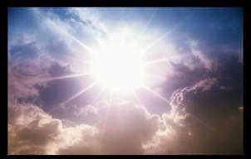
Share His
Glory
Ezekiel 1–3
Dr. Rick Griffith • Amman International Church
AmmanChurch.org • BibleStudyDownloads.org
Notes:
We have seen in the first 24 chapters how God will not give his people Israel a simple pass—he will judge them severely. Ezekiel 1–3 shows his glory to the prophet to start the book.

Slide 11

Admit His
Glory
Left
Ezekiel 4–24
Dr. Rick Griffith • Amman International Church
AmmanChurch.org • BibleStudyDownloads.org
Notes:
And in Ezekiel 4–24 the main thing that they must admit is that God’s glory has left the temple after being present with them for nearly 400 years.

Slide 12
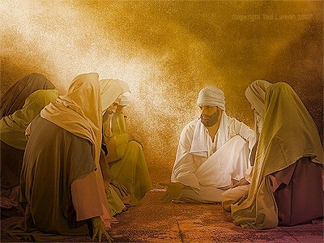
"Son of man, write down today’s date, because on this very day the king of Babylon is beginning his attack against Jerusalem" (Ezekiel 24:2 NLT).
Notes:
Now the city of Jerusalem was already under attack and would fall (24:2).

Slide 13
Chart of Ezekiel
500
Sovereign Departing and Return of Glory
Glory Departs 1–24 |  | Nations Judged (No Glory) 25–32 |  |  | Glory Returns 33–48
Exile |  | Sovereignty Vindicated |  |  | Restoration
Judgment of Judah |  | Judgment of Nations |  |  | Blessing of Israel
Judah's Fall |  | Judah's Foes |  |  | Judah's Future
Before the Siege |  | During the Siege |  |  | After the Siege
Call in glory 1–3 | Pre-exile Hopeless-ness 4–24 | Ammon, Moab, Edom, Philistia 25 | Tyre and Sidon 26–28 | Egypt 29–32 | New Life 33–39 | New Order 40–48
Babylon (592-570 BC)
Notes:
Know that the Shekinah presence of the LORD will purge all forms of darkness (Ezek 25–32).
If God will hold his own nation responsible, then he will certainly hold to account those nations that have rejected him.

Slide 14
Allow God to Judge
Ezekiel 25–32
Dr. Rick Griffith • Amman International Church
AmmanChurch.org • BibleStudyDownloads.org
Notes:
So, for seven chapters, Ezekiel now turns his attention to the countries surrounding Israel to declare that God will not be mocked by them either—so Israel must allow him to handle all rivals to his sovereign rule (title slide repeated).

Slide 15
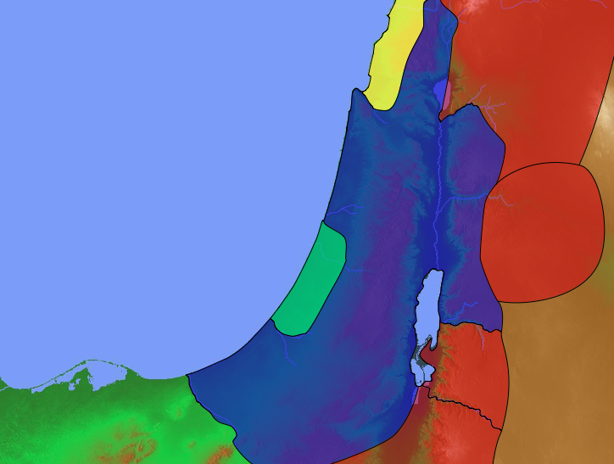
Solomon's Pagan Wives
Sidon
140
1 Kings 11:1 Now King Solomon loved many foreign women. Besides Pharaoh’s daughter, he married women from Moab, Ammon, Edom, Sidon, and from among the Hittites.
Hittite
Israel
Ammon
Moab
Egypt
Edom
Notes:
The historical context is not one of ignorance but knowledge.
God had already judged Solomon for marrying into these countries and worshipping the gods of these nations.

Slide 16
Solomon's Pagan Wives
Sidon
140
Hittites
Israel
Ammon
Moab
Egypt
Edom
Notes:
The wives from the six nations that Solomon married form the acrostic S-H-A-M-E plus Egypt.

Slide 17
False Gods Surrounding Israel
Ashtoreth
140
Sidon
Baal
"Solomon has abandoned me and worshiped Ashtoreth, the goddess of the Sidonians; Chemosh, the god of Moab; and Molech, the god of the Ammonites"
(1 Kings 11:33a NLT).
Molech
Israel
Ammon
Dagon
Philistia
Chemosh
Moab
Ra, Horus, Amon, etc.
Qos, etc.
Egypt
Edom
Notes:
Solomon's problem with marrying pagan women was that they brought their gods to Jerusalem so that Solomon ended up worshipping these false gods.

Slide 18
How should we act when we feel we’re on the losing side?
Notes:
How should we handle our “no glory” times?
What can we do during those times when we feel so weak and insignificant?
Preview: Today we will see how God would deal with all Israel’s rivals on every side—and then we will see how he will do the same in our lives also.

Slide 19
Ezekiel 25–32
Israel should see God’s glory in his reasons for destroying their enemies.
Notes:
(What hope was there for exiled Israel? What should Israel do?)
I. See God’s glory in his reasons for destroying their enemies (Ezek 25–32).
[Israel would see why God would show his sovereignty over each rebel nation.]

Slide 20
Slides on
Ezekiel 25
Notes:
God promised to destroy Israel’s enemies (Ezek 25–32).

Slide 21
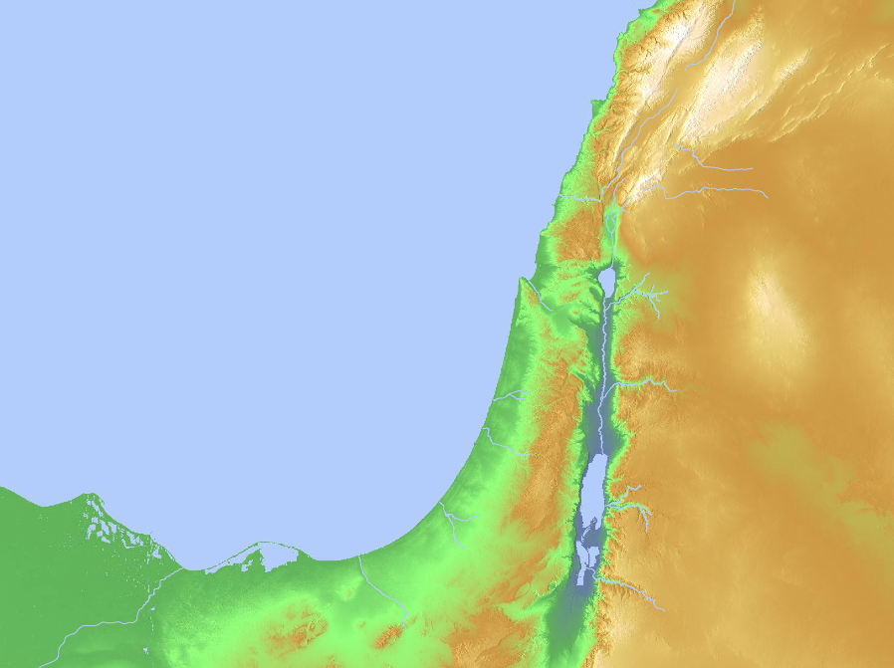
Nations to Be Judged (Ezekiel 25–32)
Sidon
(28:20-26)
Tyre
(26:1–28:19)
Ammon
(25:1-7)
Philistia
(25:15-17)
Moab
(25:8-11)
Egypt
(29–32)
Edom
(25:12-14)
Notes:
God will judge Ammon for rejoicing at the temple’s destruction to show his sovereignty (25:1-7).
God will judge Moab for thinking that Israel was like all of the other nations to show God's sovereignty (25:8-11).
God will judge Edom for avenging Judah to show God's sovereignty (25:12-14).
God will judge Philistia for avenging Judah to show God's sovereignty (25:15-17).
God will judge Tyre so it will never be rebuilt due to its pride in its beauty, power, trade, and leaders to show God's sovereignty (26:1–28:19).
God will judge Sidon for maliciousness against Judah to show his sovereignty by gaining glory in the judgment (28:20-26).
God will judge Egypt by Nebuchadnezzar who will take exiles to Babylon to show God's sovereignty (Ezek 29–32; fulfilled in 571 BC).

Slide 22
Ammon
(25:1-7)
Notes:
Ammon rejoiced at the temple’s destruction (25:1-7).

Slide 23
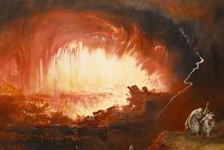
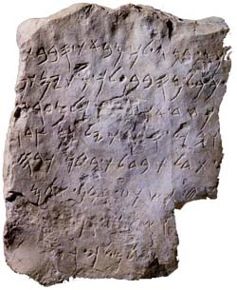
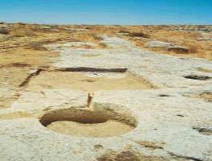
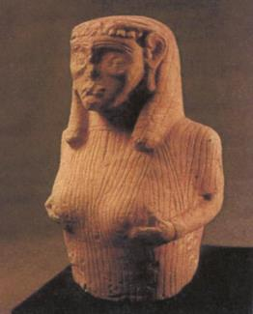
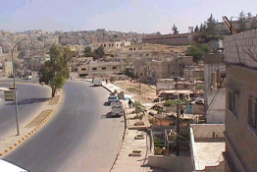

Ammonites
Dr. Rick Griffith • Jordan Evangelical Theological Seminary • BibleStudyDownloads.org

Slide 24

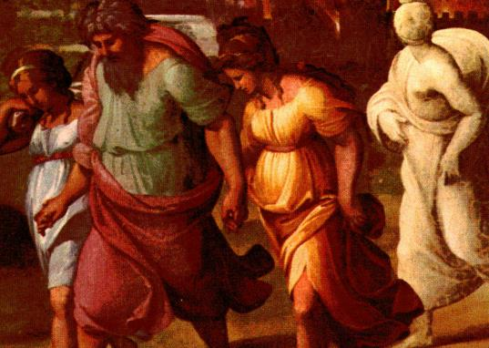
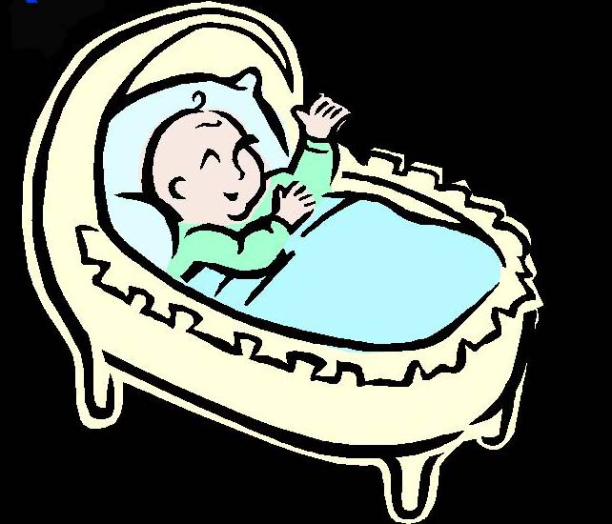
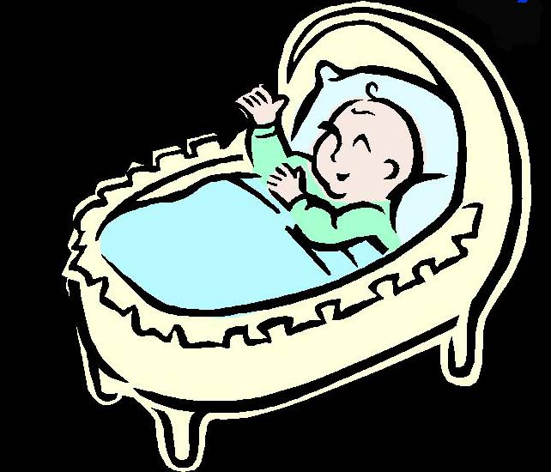
Genesis 19:36-38
95
my name is Moab
my name is Ben-Ammi
Genesis 19:36-38
³⁶ So both of Lot's daughters became pregnant by their father.
³⁷ The older daughter had a son, and she named him Moab, he is the father of the Moabites today.
³⁸ The younger daughter also had a son, and she named him Ben-Ammi; he is the father of the Ammonites of today.
Notes:
Ammon started

Slide 25
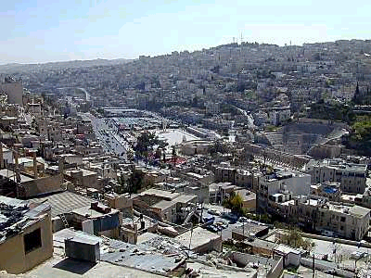
Amman
Built on seven hills
One of the world's oldest continuously inhabited cities
Became Ammonite capital of Rabbath-Ammon by 1200 BC
Renamed Philadelphia in 400 BC
Philadelphia taken by Roman vassal King Herod in 30 BC
Arabian armies of Islam took over around the year AD 635

Slide 26
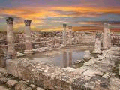
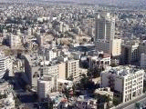
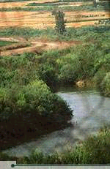
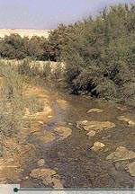
Salt
Salt (near Amman) is said to be the final resting place of Job. Also Jethro, the Midianite father-in-law of Moses, is said to be buried in a tomb near Salt in Wadi Shu'ayb.
Jordan River

Slide 27
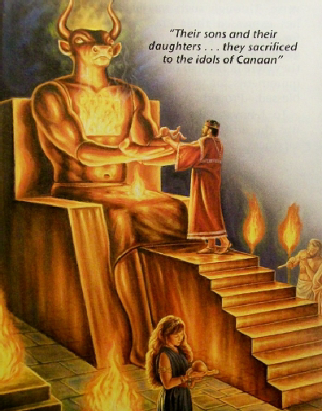
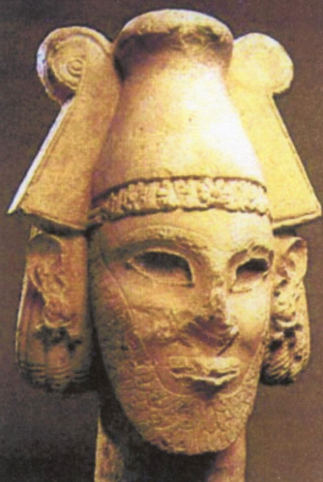

Molech Child Sacrifice
95
Notes:
The saddest reality about Amman is that live babies used to be offered on the altars to Molech downtown.

Slide 28
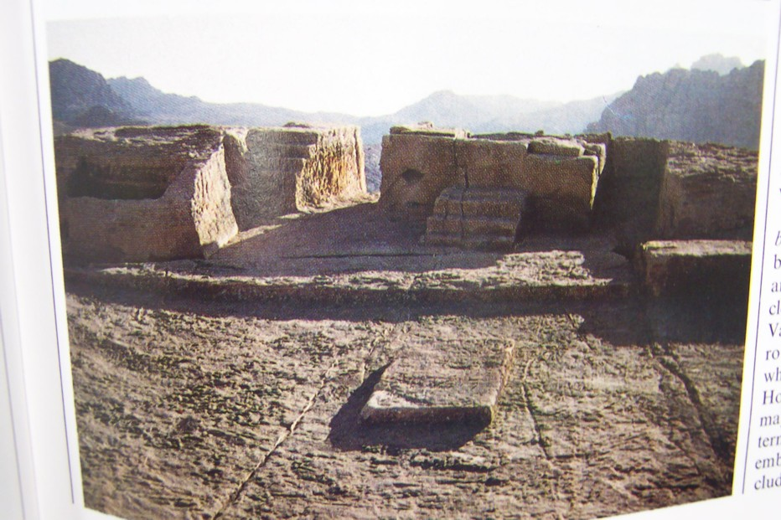
Imported Idolatry
96
Solomon erected a high place just outside Jerusalem for the worship of Molech, the god of the Ammonites.

Slide 29
"This is what the Sovereign LORD says: Because you clapped and danced and cheered with glee at the destruction of my people,
⁷ I will raise my fist of judgment against you. I will give you as plunder to many nations. I will cut you off from being a nation and destroy you completely. Then you will know that I am the LORD."
Ammon
(25:1-7)
Notes:
But Ammon’s recent rejoicing over the temple destruction was the sin that God said would be punished.

Slide 30
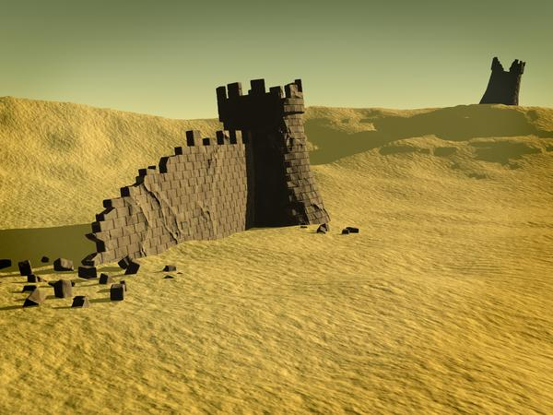
The Fall of Ammon
Nebuchadnezzar conducted a small campaign against Ammonites in his 23rd year (582-581)
96
The Ammonites soon ceased to be a nation, but the people existed well into Hellenistic times.
Notes:
God had the last word about Ammon, as the Babylonians destroyed the place about a decade after this prophecy in Ezekiel 25:1-7.

Slide 31
Moab
(25:8-11)
Notes:
Moab still has the same name today—like Amman.

Slide 32

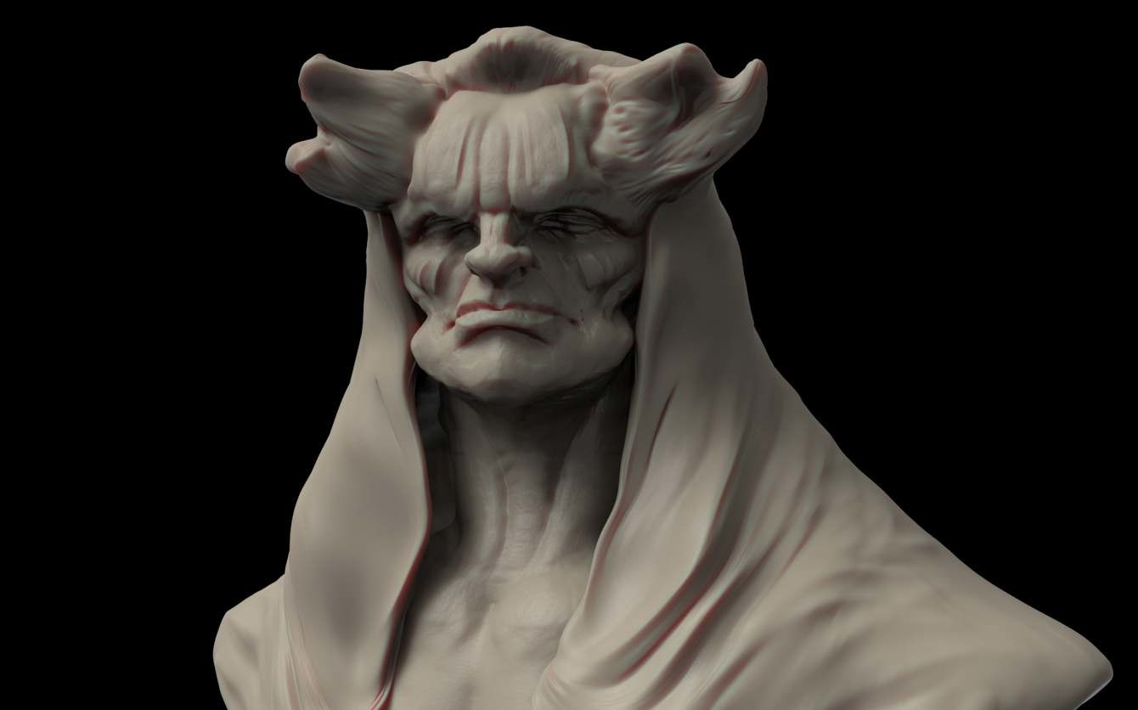
Moabite Deities
98
Chemosh
chief deity, national god, warrior god
god who provided for all aspects of life
1 Kings 11:7, Num 21:27-30
Astarte
mother goddess
Ashtar-Chemosh mentioned
in the Mesha inscription
Notes:
Their worship of Chemosh was also horrible.

Slide 33
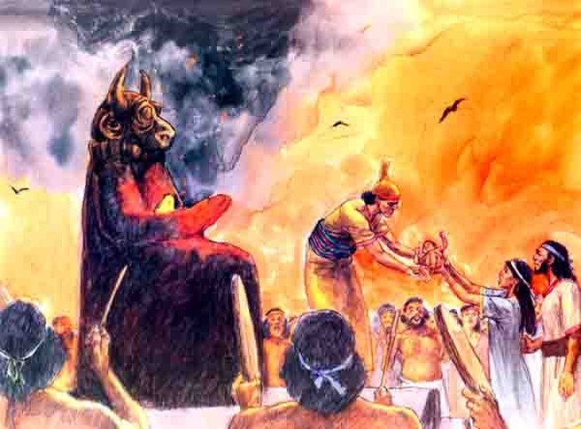
Child Sacrifice to Chemosh
98
Notes:
Moab was like Ammon in its child sacrifice.

Slide 34
"This is what the Sovereign LORD says: Because the people of Moab have said that Judah is just like all the other nations, ⁹ I will open up their eastern flank and wipe out their glorious frontier towns—Beth-jeshimoth, Baal-meon, and Kiriathaim. ¹⁰ And I will hand Moab over to nomads from the eastern deserts, just as I handed over Ammon..."
Moab
(Ezekiel 25:8-11)
Notes:
Yet Moab had the audacity to say that Judah was like all other nations‚ so God would judge them for this.

Slide 35
Edom
(25:12-14)
Notes:
Edom avenged Judah (25:12-14).

Slide 36
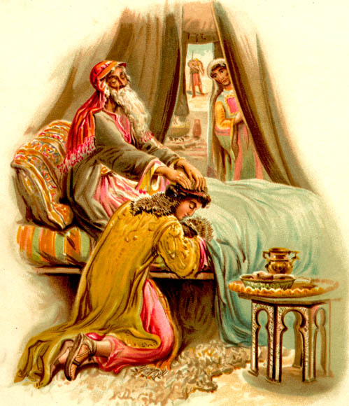
God chose Jacob over Esau
101
Genesis 27

Slide 37


Geography
101
Jacob
Israel
Esau
Edom

Slide 38

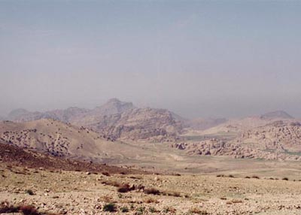
A Desolate Land

Slide 39
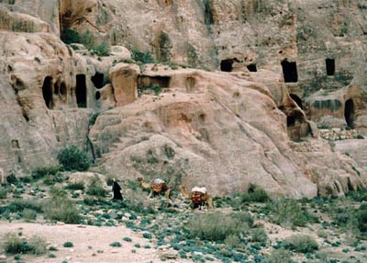
Rock Dwellers of Petra
Notes:
Petra was the capital within the rocks.

Slide 40
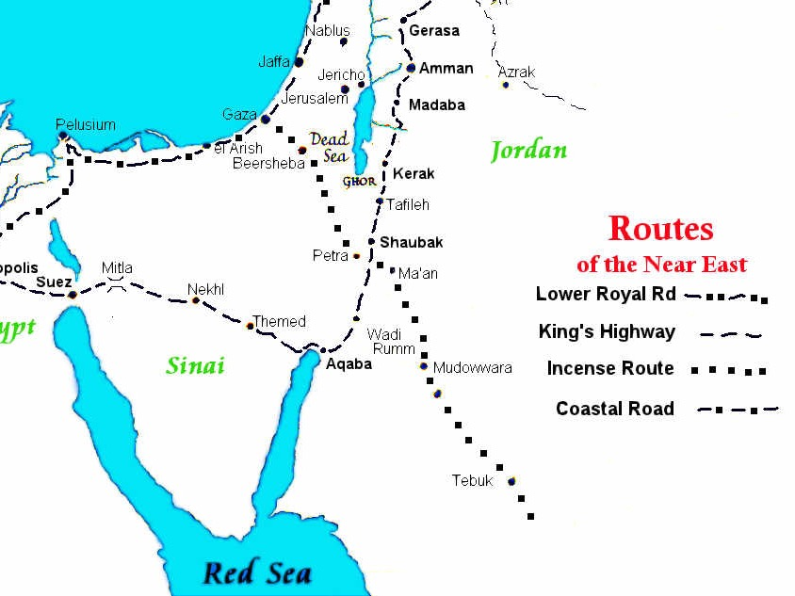
Crossroads of Trade Routes
ROUTES
of the Near East
Petra
King's Highway
Spice Route
Coastal Road
Notes:
Petra controlled both the north-south trade and the east-west Spice trade from India to Europe.

Slide 41
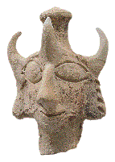
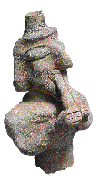
Deity
The three-horned headdress of the figurine has no known parallel.
Double-flute player is believed to be made by the same artisan in the same workshop
Notes:
Their false deity had three horns.

Slide 42
"This is what the Sovereign LORD says: The people of Edom have sinned greatly by avenging themselves against the people of Judah. ¹³ Therefore, says the Sovereign LORD, I will raise my fist of judgment against Edom. I will wipe out its people and animals with the sword. I will make a wasteland of everything from Teman to Dedan. ¹⁴ I will accomplish this by the hand of my people of Israel. They will carry out my vengeance with anger, and Edom will know that this vengeance is from me. I, the Sovereign LORD, have spoken!"
Edom
(25:12-14)
Notes:
God said that they had sinned greatly by avenging themselves against the people of Judah (25:12).

Slide 43
Philistia
(25:15-17)
Notes:
Most of us have heard much about the Philistines since Goliath was a Philistine.

Slide 44
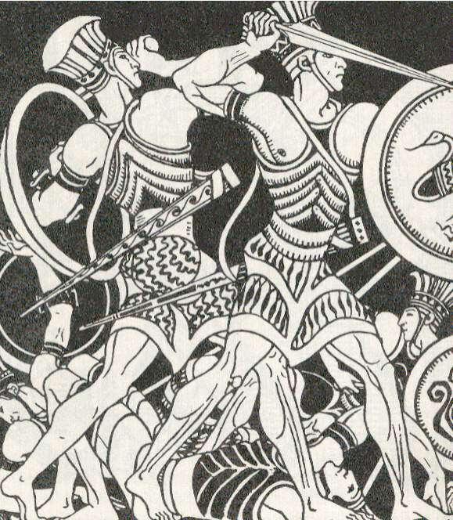
Philistines were a fearsome people
Notes:
The had a military advantage over Israel—not that this was wrong…

Slide 45
"This is what the Sovereign LORD says: The people of Philistia have acted against Judah out of bitter revenge and long-standing contempt. ¹⁶ Therefore... ¹⁷ I will execute terrible vengeance against them to punish them for what they have done. And when I have inflicted my revenge, they will know that I am the LORD."
Philistia
(25:15-17)
Notes:
But God declared that Philistia fought not to protect themselves but out of revenge and contempt.
____________
OB-14-Philistines-46
OS-26-Ezek25-32—slide 45

Slide 46
Slides on
Ezekiel 26

Slide 47
Tyre
(26:1–28:19)
Notes:
Tyre took pride in its beauty, power, trade, and leaders (26:1–28:19).

Slide 48
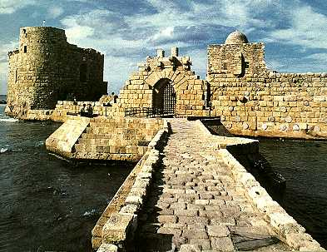
The Phoenicians
The Phoenicians
Notes:
Tyre of Phoenicia was the most significant seaport city in the ancient world.

Slide 49
Tyre, Capital of the Phoenicians
OTB 115
Phoenicia – from Greek 'phoinix'
meaning purple red
A mighty seaport
Purposes: Gain better understanding
    Relationship with Israel
    Impact on the nations around them
    Lessons we can learn from them

Slide 50
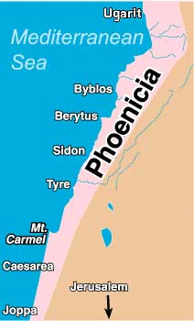
Geography
115
115
of Phoenicia
Strip of land between the Mediterranean Sea and mountains
Fertile crops
Heart of the region:
Tyre, Sidon and Byblos

Slide 51
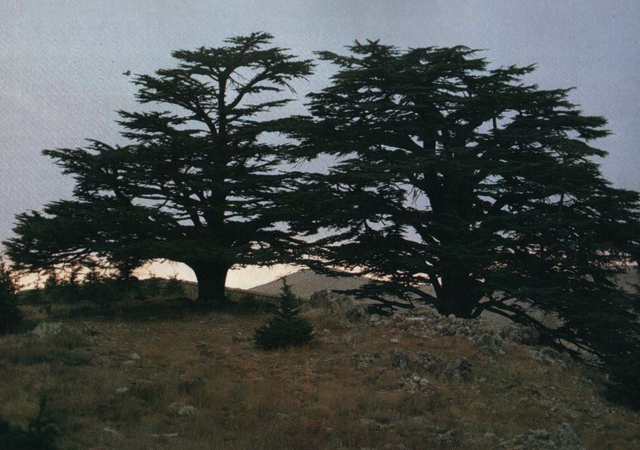
Cedars of Lebanon
115
Notes:
Cedars of Lebanon were the premier trees of antiquity used for Solomon’s temple.

Slide 52
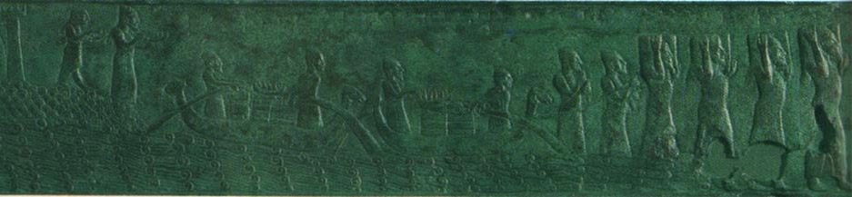
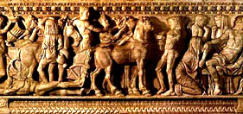
History
115
3000 BC => First Phoenician settlement
1800 BC => Under Egyptian control
1600 BC => Trading with foreign cities
1400 BC => Under Hittite control
1200 BC => Independent & colonizing
800 BC => Under Assyrians
585 BC => Conquered by Nebuchadnezzar
332 BC => Conquered by Alexander
64 BC => Absorbed into Roman empire

Slide 53
"Son of man, Tyre has rejoiced over the fall of Jerusalem, saying…"
Tyre
(Ezekiel 26:1–28:19)
"'Ha! She who was the gateway to the rich trade routes to the east has been broken,
and I am the heir! Because she has been made desolate, I will become wealthy!'" (26:1-2 NLT)

Slide 54
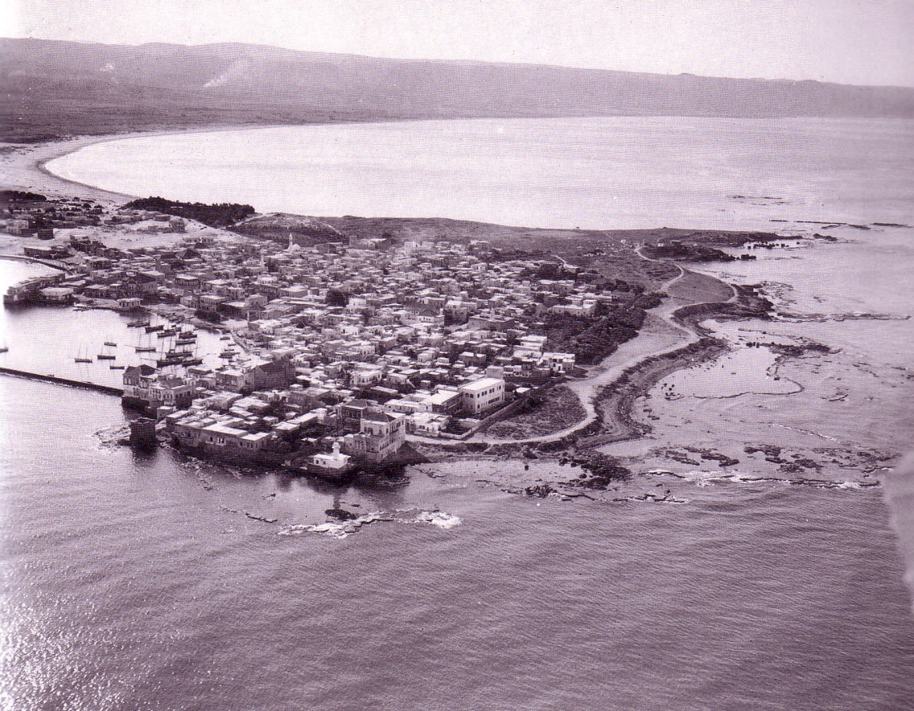
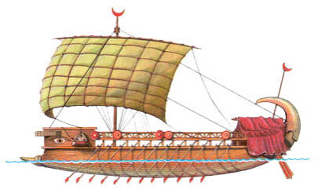
Phoenician Coastal Plain
Tyre
Notes:
Tyre had both a mainland and island fortress that took Babylon 13 years to conquer—but they did it.
_______
Charles H. Dyer, "Ezekiel," in The Bible Knowledge Commentary, 1:1278-1279: "26:7-14. God said He would bring from the north ... Nebuchadnezzar. Tyre's gloating over Jerusalem's fall would be short-lived. The king who destroyed Jerusalem would also attack Tyre. After defeating Jerusalem, Nebuchadnezzar moved his army north to Tyre in 585 B.C. and besieged the city for 13 years till all settlements on the mainland were destroyed. Tyre could hold out for all those years because her navy brought in supplies that would otherwise have been depleted. Nebuchadnezzar destroyed mainland Tyre (depicted graphically by Ezekiel, vv. 8-12), but not the island stronghold. However, other evidence indicates that the island surrendered to Nebuchadnezzar in 573-572 B.C. That year Baal II succeeded Ethbaal III to the throne of Tyre. Most likely this was a political move by Nebuchadnezzar to remove the rebellious king and install a loyal vassal king. Some think Ethbaal III was deported to Babylon, but 28:8-9 seems to indicate that Nebuchadnezzar assassinated him."

Slide 55
Slides on
Ezekiel 27

Slide 56
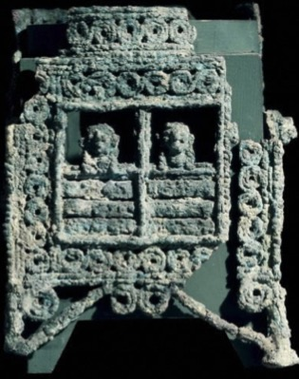
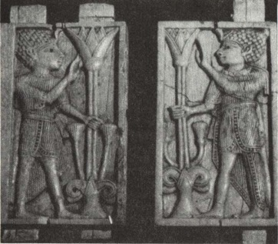
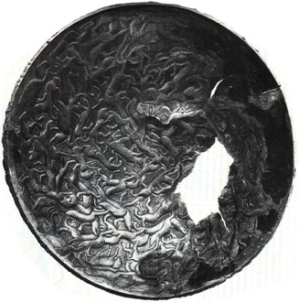
Trade of Tyre
(Isaiah 23)
119
Imported raw materials from faraway countries and exported finished products:
Bronze – exported to Assyria, Cyprus, Greece, and Italy
Ivory – imported from Syria then exported finished products to the west
Also glass workings, wool stuffs dyed in purple, etc.

Slide 57
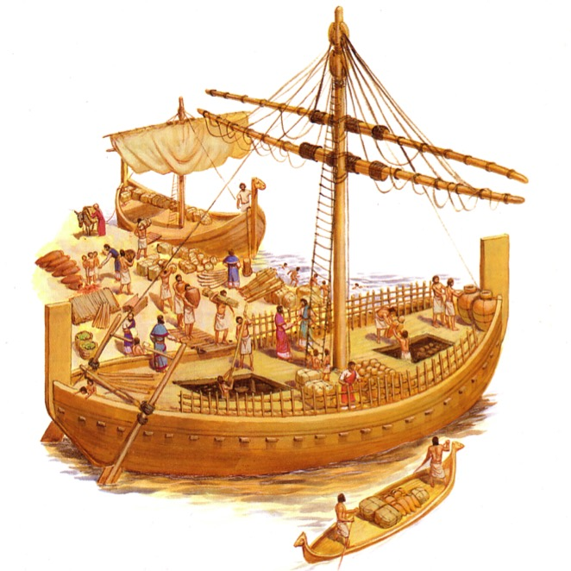
The Trade of Phoenicia
119
Commercially astute: used trade treaties & political alliances:
Trade with David (2 Sam. 5:11; 1 Kings 5:1)
King Hiram helped Solomon in building and overseas ventures
Export of oil, wine and timber
Called a harlot (Isa. 23:16-17)

Slide 58
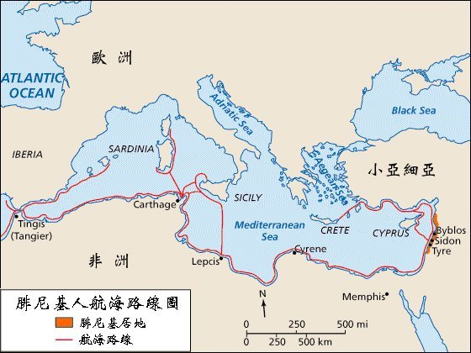
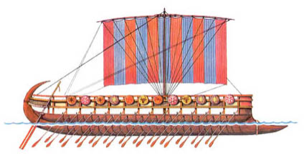
Phoenician Colonies
"Tarshish sent merchants to buy your wares in exchange for silver, iron, tin, and lead. ¹³Merchants from Greece, Tubal, and Meshech brought slaves and articles of bronze to trade with you"
(Ezekiel 27:12 NLT).
119
EUROPE
(Tarshish)
ASIA MINOR
AFRICA
Tyre
Phoenician Shipping Routes
Land of Phoenicia
Trade Routes
Notes:
Quality ships enabled Tyrians to travel all the way to Tarshish—modern Spain—to buy precious metals and slaves on the way to Greece.
———————
The Phoenicians were the master shipbuilders and sailors of antiquity. Their ability to conquer the seas gave them an empire of colonies spanning the Mediterranean. This brought untold wealth to them, despite being on the geographical edge of the "Great Sea," or the Mediterranean.
_____________
The men of Tyre and Sidon sailed the seas better than anyone in antiquity, establishing trading ports throughout the Mediterranean. No wonder Solomon hired them to also sail the Red Sea down to modern Yemen to acquire gold (2 Chron 9). Isaiah 23 later prophesied their destruction for their pride.
_____________
OB-15-Phoencians-12
OS-14-2Chron-132
OS-23-Isaiah13-23-slide 140
OS-26-Ezek25-32—slide 58

Slide 59
Slides on
Ezekiel 28

Slide 60

Difficult Passages
"son of man" (2:1 & 93 times)
"Spirit within you" (36:26-27)
"prince of Tyre" (28:2)
Notes:
The prince of Tyre would be overthrown for his claim to be God in order to prove God's sovereignty (28:1-10).

Slide 61
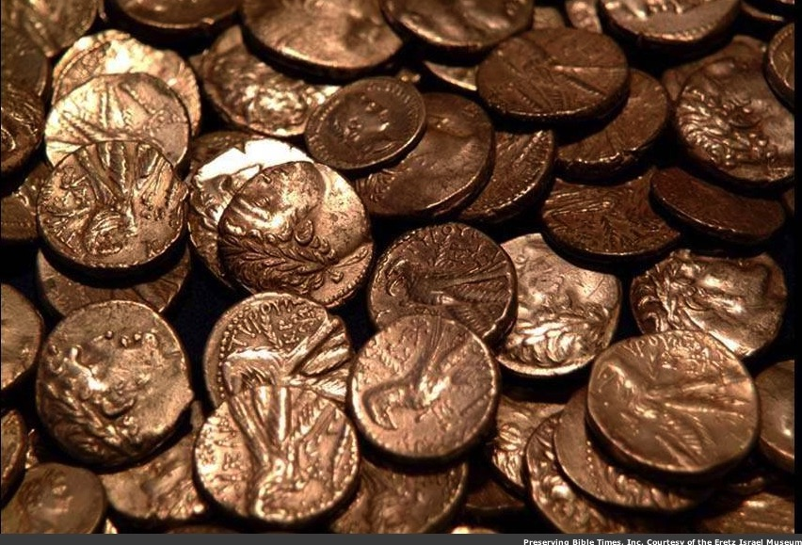
Who was the King of Tyre (Isaiah 23)?
Tyrian coins
Notes:
Some think him only the human king. Other say he was Satan. Probably he was the human king who acted like Satan long before him in his pride and splendor.
__________
OB-14-Phonecians-14
OS-23-Isaiah13-23-slide 143
OS-Ezek25-32—slide 61

Slide 62
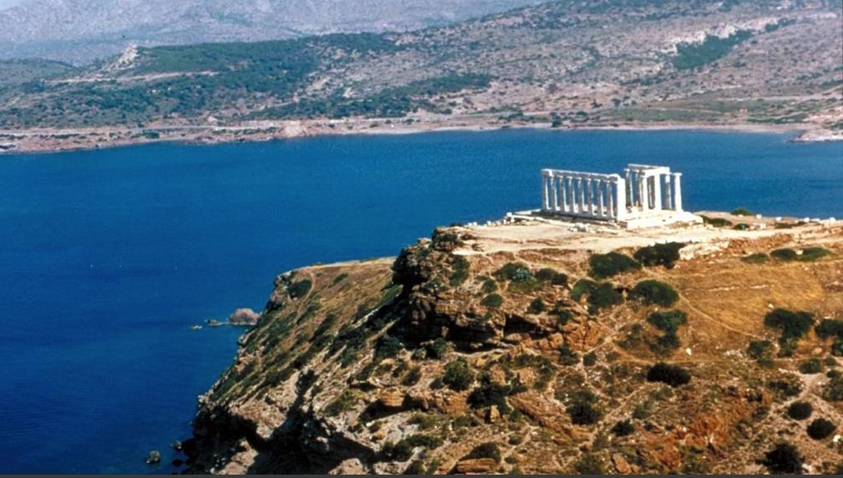
Poseidon's Temple
"Son of man, give the prince of Tyre this message from the Sovereign LORD:
'In your great pride, you claim, "I am a god! I sit on a divine throne in the heart of the sea." But you are only a man and not a god,
though you boast that you are a god.'"
Tyre's king regarded himself as the god of the sea (Ezek. 28:2 NLT)
Notes:
Phoenicia's key city of Tyre was not humble about its influence and wealth. Its boasting about being the god of the sea led later to enshrine this in the temple of the Greek god of the sea, Poseidon.

Slide 63
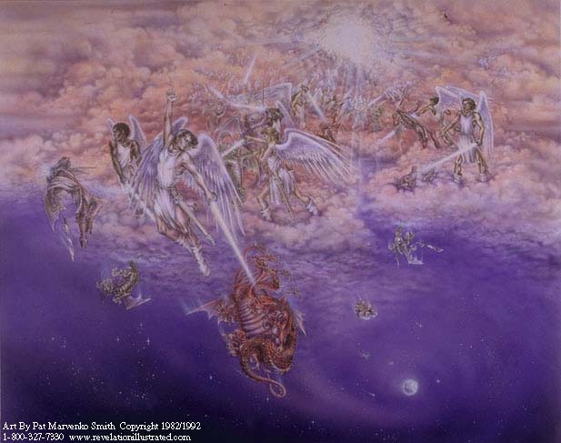
Satan cast down
(cf. Rev. 12:7-13)
² "Son of man, give the prince of Tyre this message from the Sovereign LORD:
"In your great pride you claim, 'I am a god! I sit on a divine throne in the heart of the sea.' But you are only a man and not a god, though you boast that you are a god" (Ezekiel 28:2).
Notes:
Like the king of Tyre, Satan also boasted of divine rights. The true God threw both Satan and Tyre's prince down.

Slide 64
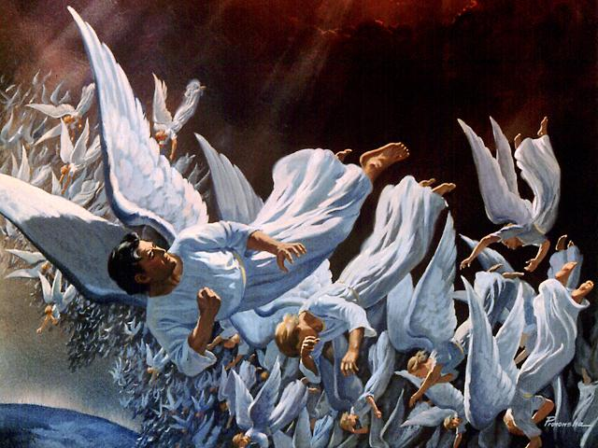
Fall of Lucifer, the Shining Star
(cf. Rev. 12:7-9)
³ You regard yourself as wiser than Daniel
and think no secret is hidden from you.
⁴ With your wisdom and understanding you have amassed great wealth—
gold and silver for your treasuries.
⁵ Yes, your wisdom has made you very rich,
and your riches have made you very proud" (Ezekiel 28:3-5)
Notes:
Daniel's name had already become proverbial, despite him being contemporary to Ezekiel.
Sadly, wealth and beauty and power often bring pride—first true of Satan and now true on earth (28:3-5).

Slide 65

The angels pursue
"You were the model of perfection, full of wisdom and exquisite in beauty. ¹³ You were in Eden, the garden of God… ¹⁵You were blameless in all you did from the day you were created until the day evil was found in you"
(Ezekiel 28:12-15)
Fall of Lucifer, the Shining Star
(cf. Rev. 12:7-9)
Notes:
The pride of the king of Tyre reflected that of Lucifer himself (28:12-15).

Slide 66
The angels pursue
¹⁶Your rich commerce led you to violence,
and you sinned.
So I banished you in disgrace
from the mountain of God.
I expelled you, O mighty guardian,
from your place among the stones of fire.
¹⁷Your heart was filled with pride
because of all your beauty.
Your wisdom was corrupted
by your love of splendor.
So I threw you to the ground and
exposed you to the curious gaze of kings"
(Ezek. 28:16-17)
Notes:
As the king of Tyre was to be banished, so Lucifer was expelled from heaven years before (28:16-17).

Slide 67
"I am your enemy, O Sidon...
²³ I will send a plague against you, and blood will be spilled in your streets.
The attack will come from every direction, and your people will lie slaughtered within your walls. Then everyone will know that I am the LORD. ²⁴ No longer will Israel’s scornful neighbors prick and tear at her like briers and thorns. For then they will know that I am the Sovereign LORD."
Sidon
(28:20-26)
Notes:
Sidon showed maliciousness against Judah (28:20-26).
This Phoenician city north of Tyre was also wealthy and powerful.
But God said that judgment would come via plague and war due to oppressing Israel.

Slide 68
Slides on
Ezekiel 29
Notes:
Egypt would be exiled for 40 years due to her violence and pride but then restored to a weak standing among the nations (29:1-16).

Slide 69

Egypt was deemed strong
Notes:
Egypt showed violence and pride (Ezek 29–32; fulfilled in 571 BC).
———————————
Before the Babylonians beat Egypt at the Battle of Carchemish in 609 BC, the Egyptians were the superpower of the day. They had a massive, strong army with chariots.
Israel was tempted to trust them instead of the LORD, so Isaiah 30–31 warns against falling against them like trying to steady one's balance by grasping a reed that pierces the hand.
A century later, Ezekiel was still telling the people of Judah not to trust Egypt for security (Ezek 29–32).
Jeremiah was even forced by his own people to go to Egypt to escape the Babylonians AFTER the fall of Jerusalem!
________
OS-23-Isa24-39-slide 88
OS-26-Ezek1-39-slide 183

Slide 70
"On January 7, during the tenth year of King Jehoiachin’s captivity [587 BC], this message came to me from the LORD:
²'Son of man, turn and face Egypt and prophesy against Pharaoh the king and all the people of Egypt'"
—Ezekiel 29:1-2 NLT—
Egypt
(29–32)
Notes:
But God was stronger than Egypt.

Slide 71


"Thus says the LORD God,
I am your enemy, O Pharaoh, king of Egypt— you great monster, lurking in the streams of the Nile.
For you have said, 'The Nile River is mine;
I made it for myself.'" (Ezekiel 29:3 NLT).
Notes:
God likens Egypt to a huge but clumsy water monster.

Slide 72
"But this is what the Sovereign LORD also says: At the end of the forty years I will bring the Egyptians home again from the nations to which they have been scattered. ¹⁴ I will restore the prosperity of Egypt and bring its people back to the land of Pathros in southern Egypt from which they came. But Egypt will remain an unimportant, minor kingdom. ¹⁵ It will be the lowliest of all the nations, never again great enough to rise above its neighbors"
—Ezekiel 29:13-15 NLT—
Egypt
(29–32)
Notes:
And God promises that Egypt—the superpower of the day—would be the lowliest of nations even until today!

Slide 73

Babylon to Conquer Egypt (571 BC)
"Son of man, the army of King Nebuchadnezzar of Babylon fought so hard against Tyre that the warriors’ heads were rubbed bare and their shoulders were raw and blistered. Yet Nebuchadnezzar and his army won no plunder to compensate them for all their work"
(Ezekiel 29:18 NLT).
Tyre
Egypt
Notes:
Ironically, the conqueror got no pay from the wealthiest city of all (29:18)!

Slide 74
Babylon to Conquer Egypt (571 BC)
"Therefore, this is what the Sovereign LORD says: I will give the land of Egypt to Nebuchadnezzar, king of Babylon. He will carry off its wealth, plundering everything it has so he can pay his army. ²⁰ Yes, I have given him the land of Egypt as a reward for his work, says the Sovereign LORD, because he was working for me when he destroyed Tyre"
(Ezekiel 29:19-20 NLT).
Tyre
Egypt
Notes:
But God would pay Babylon for Tyre by defeating Egypt (29:19-21).

Slide 75
Slides on
Ezekiel 30

Slide 76

But Egypt was unreliable
"'What sorrow awaits my rebellious children,'
says the LORD.
'You make plans that are contrary to mine.
You make alliances not directed by my Spirit,
thus piling up your sins.
² For without consulting me,
you have gone down to Egypt for help.
You have put your trust in Pharaoh’s protection.
You have tried to hide in his shade.
³ But by trusting Pharaoh, you will be humiliated,
and by depending on him, you will be disgraced'"
(Isaiah 30:1-3 NLT).
Notes:
Before the Babylonians beat Egypt at the Battle of Carchemish in 609 BC, the Egyptians were the superpower of the day. They had a massive, strong army with chariots.
Israel was tempted to trust them instead of the LORD, so Isaiah 30–31 warns against falling against them like trying to steady one's balance by grasping a reed that pierces the hand.
A century later, Ezekiel was still telling the people of Judah not to trust Egypt for security (Ezek 29–32).
Jeremiah was even forced by his own people to go to Egypt to escape the Babylonians AFTER the fall of Jerusalem!
________
OS-23-Isa24-39-slide 89
OS-26-Ezek1-39-slide 185

Slide 77

Egypt and Allies Destroyed
"A sword will come against Egypt,
and those who are slaughtered will cover the ground.
Its wealth will be carried away
and its foundations destroyed…"
—Ezekiel 30:4 NLT

Slide 78

Egypt and Allies Destroyed
Lydia
"…The land of Ethiopia will be ravished.
⁵ Ethiopia, Libya, Lydia, all Arabia,
and all their other allies
will be destroyed in that war."
(Ezekiel 30:4-5 NLT).
Libya
Arabia
Egypt
Ethiopia

Slide 79
Slides on
Ezekiel 31

Slide 80

Do not trust Egypt
“What sorrow awaits those who look to Egypt for help,
trusting their horses, chariots, and charioteers
and depending on the strength of human armies
instead of looking to the LORD,
the Holy One of Israel”
(Isaiah 31:1 NLT).
Notes:
Before the Babylonians beat Egypt at the Battle of Carchemish in 609 BC, the Egyptians were the superpower of the day. They had a massive, strong army with chariots.
Israel was tempted to trust them instead of the LORD, so Isaiah 30–31 warns against falling against them like trying to steady one's balance by grasping a reed that pierces the hand.
A century later, Ezekiel was still telling the people of Judah not to trust Egypt for security (Ezek 29–32).
Jeremiah was even forced by his own people to go to Egypt to escape the Babylonians AFTER the fall of Jerusalem!
________
OS-23-Isa24-39-slide 91
OS-26-Ezek1-39-slide 187

Slide 81

Babylon to Ruin Egypt
"Therefore, this is what the Sovereign LORD says: Because Egypt became proud and arrogant, and because it set itself so high above the others, with its top reaching to the clouds, ¹¹ I will hand it over to a mighty nation that will destroy it as its wickedness deserves. I have already discarded it"
(Ezekiel 31:10-11 NLT).
Notes:
Egypt was like a towering cedar with deep roots—but it would be cut down.

Slide 82
Slides on
Ezekiel 32

Slide 83

Egypt in Hades
"Son of man, weep for the hordes of Egypt and for the other mighty nations. For I will send them down to the world below in company with those who descend to the pit. ¹⁹ Say to them,
‘O Egypt, are you lovelier than the other nations?
No! So go down to the pit and lie there among the outcasts"
(Ezekiel 32:18-19 NLT).
Notes:
God lamented the downfall of Pharaoh by Babylon to show his sovereign workings in poetic form (32:1-16).
Babylon would destroy Egypt as it did Assyria, Persia (Elam), Meshech, Tubal, Edom, and Sidon to show God's sovereignty (32:17-32).

Slide 84

How can you be expectant of God’s glory once again in your life?
Notes:
What can you do to restore that sense of blessing that you used to have—those times when the presence of the Lord was real? This isn't simply a feeling, for that time may have been one of the most difficult periods of your life. Yet you knew that God was showing himself to you in new ways, there was a sense of expectancy at what he would do next. How can that return?

Slide 85
STEPS TO GOD'S GLORY
1—Admit that God’s glory left (Ezek 1–24).
ADMIT
Notes:
The sense of God's presence will not remain when we insist on sin.

Slide 86
STEPS TO GOD'S GLORY
2—Allow God to handle all rivals to his glory (Ezek 25–32).
ADMIT
ALLOW
Notes:
Know that the Shekinah presence of the LORD will purge all forms of darkness.

Slide 87
God still judges nations because they are still responsible
Sovereign Departing and Return of Glory
Glory Departs 1–24 |  | Nations Judged (No Glory) 25–32 |  |  | Glory Returns 33–48
Exile |  | Sovereignty Vindicated |  |  | Restoration
Judgment of Judah |  | Judgment of Nations |  |  | Blessing of Israel
Judah's Fall |  | Judah's Foes |  |  | Judah's Future
Before the Siege |  | During the Siege |  |  | After the Siege
Call in glory 1–3 | Pre-exile Hopeless-ness 4–24 | Ammon, Moab, Edom, Philistia 25 | Tyre and Sidon 26–28 | Egypt 29–32 | New Life 33–39 | New Order 40–48
Babylon (592-570 BC)
Notes:
Know that the Shekinah presence of the LORD will purge all forms of darkness (Ezek 25–32).

Slide 88

The Big Ten
Notes:
God still judges nations because they are still responsible.
The nations in Ezekiel’s day still knew at least nine of “The Big Ten” (Commandments) but ignored them.

Slide 89

Why must there be judgment?
That people may repent
2. That people may know God speaks and acts
3. That God may prove Himself holy
4. That God may show Himself just
5. That God may purge people and prepare them for future restoration
God is still just (fair)—so there must be judgment
Notes:
God is still just (fair)—so there must be judgment.
There are at least five reasons for judgment.

Slide 90

Can you render the world correct judgment?
Can you render the world correct judgement?
Notes:
Is God unjust about anything he does?
We can’t even decide how to spell the word!
Are we able to determine justice instead of the creator of the world?
If God is not the standard for justice, then who is that standard? You? Me?

Slide 91

"They wear pride like a jeweled necklace and clothe themselves with cruelty" (Psalm 73:6 NLT).
Notes:
He will do what is right those who wear pride like a necklace (Psalm 73:6).

Slide 92
How should we act when we feel we’re on the losing side?
Notes:
How should we handle our “no glory” times?
What can we do during those times when we feel so weak and insignificant?

Slide 93

Main Idea of Ezekiel 25–32
Allow God to handle all rivals.
Notes:
In other words, accept his judgment.

Slide 94
Be Patient
Don’t put in the microwave what God has in the crockpot.
Notes:
When you want God to act now… wait.

Slide 95

God’s glory will not shine with competitors in your life.
Invest with biblical values.
Notes:
Tech stocks are down but the attack against oil has made many wealthy.
Envoy Financial has values-based investments.
——————————
One wonders why Israel ever trusted any of these nations that were doomed themselves.
But the same question can be asked of us: Why do we trust anything or anyone other than Almighty God? Why trust something weaker that does not have our best interest in mind?
Who will be king in your life?

Slide 96
Multi-Billionaires
2012, 2014, 2016
2021
Elon Musk
Bill Gates
Jeff Bezos
Vladimir Putin
2020
2013
Notes:
The four multi-billionaires have all been divorced.
———————
Elon Musk’s Ex-Wife Denies Being Hand-Chosen By Ghislaine Maxwell To Be His ‘Child Bride’
6 July 2020
https://brobible.com/culture/article/elon-musk-wife-denies-ghislaine-maxwell/
Tesla and SpaceX founder Elon Musk has had himself quite a past couple of months.
He had a kid with his partner Grimes and named him something so bizarre that even she can’t explain properly.
Then he denied having a threesome with actresses Amber Heard and Cara Delevingne while Heard was married to Johnny Depp.
And now, his ex-wife, actress and model Talulah Riley, has felt the need to go on record stating that despite rumors, Jeffrey Epstein companion Ghislaine Maxwell did not hand-choose her to be Musk’s child bride back in 2008 when she was 23 and Musk was 36.
Here’s how their love story goes.
Riley and Musk began dating in 2008. Then in 2010 the couple got married. In January 2012, Musk announced the marriage was over and they got divorced. In July 2013, Musk and Riley got married for a second time. In December 2014, Musk once again filed for divorce. Then he withdrew his filing. Then she filed for divorce in March 2016. The couple’s second divorce became official in October of 2016.
The actress, now 34, and who many will recognized from her role playing Angela on Westworld, apparently heard some rumors following Maxwell’s arrest that Epstein’s cohort procured her to be Musk’s child bride back in the day.
————————
Bill Gates, wife Melinda announce divorce after 27 years of their marriage
https://www.indiatvnews.com/lifestyle/people-bill-gates-wife-melinda-gates-announce-divorce-after-27-years-of-their-marriage-net-worth-children-memes-702346
Bill Gates and his wife Melinda Gates revealed their decision of taking divorce in a joint statement which was shared by the Microsoft co-founder on Twitter. “After a great deal of thought and a lot of work on our relationship, we have made the decision to end our marriage. Over the last 27 years, we have raised three incredible children and built a foundation that works all over the world to enable people to lead healthy, productive lives,” read the statement.
Edited by: India TV Lifestyle Desk
New Delhi Updated on: May 04, 2021 12:50 IST
___________
Jeff Bezos' ex-wife MacKenzie's post-divorce revenge
Not since Jennifer Aniston has a wronged woman done so much right
By Maureen Callahan New York Post
https://www.foxbusiness.com/business-leaders/jeff-bezos-ex-wife-mackenzies-post-divorce-reven
Published August 3, 2020
MacKenzie Scott, the fourth-richest woman in the world, announced on Tuesday that she has dropped Bezos from her name and donated $1.7 billion to 119 nonprofits, with an emphasis on racial equality, marginalized groups and economic mobility.
JEFF BEZOS NABS BEVERLY HILLS ESTATE NEXT TO HIS RECORD-SETTING $165M COMPOUND
Meanwhile, her ex-husband, Amazon founder Jeff Bezos — who publicly left MacKenzie for her close friend Lauren Sanchez — spent the week dropping $10 million on an LA home, just near the $165 million mansion he bought from David Geffen.
On Friday, Amazon posted a second-quarter profit of $5.2 billion, the biggest in its 26-year-history, due to a pandemic that is otherwise ravaging the economy.
Days earlier, Bezos testified before Congress in an antitrust hearing, seeking to downplay Amazon’s global dominance while casually snacking on camera.
Video
“Just like the world needs small companies, it also needs big ones,” Bezos said.
Such a smug, reductive assertion, but one typical of a Big Tech overlord who knows his money will buy all the lawmakers it needs to keep Amazon intact.
WHAT’S HOUSE HUNTING LIKE FOR THE WORLD’S RICHEST MAN
This is the arrogance Bezos deems publicly acceptable. Can you imagine what he’s like in private? As a husband?
Amazon CEO Jeff Bezos, right along with American news anchor Lauren Sanchez poses for photographs during a blue carpet event organized by Amazon Prime Video in Mumbai, India, Thursday, Jan. 16, 2020. (AP Photo/Rafiq Maqbool)
“I love you, alive girl,” a still-married Bezos texted Sanchez in 2018. “I will show you with my body, and my lips and my eyes, very soon.”
“I want to get a little drunk with you tonight,” went another text to Sanchez amid raunchy selfies. “Not falling down. Just a little drunk. I want to talk to you and plan with you. Listen and laugh. I basically WANT TO BE WITH YOU!!!”
“You make me better,” read another. “You’re meant for me. I know it more clearly than I’ve ever known anything.”
LONDON, ENGLAND: Jeff Bezos and his partner, Lauren Sanchez, look on from the Royal Box on Centre Court on Day 13 of The Championships - Wimbledon 2019 at the All England Lawn Tennis and Croquet Club on July 14, 2019 in London, England. (Photo by Sim
Those texts wound up splashed all over the National Enquirer, and federal investigators told The Wall Street Journal that the sexts were leaked by none other than Sanchez’s brother, who got a $200,000 payday from the tabloid. (Her brother denies the claims.)
WEST HOLLYWOOD, CA: (L-R) CEO of Amazon Jeff Bezos and writer MacKenzie Bezos attend the Amazon Studios Oscar Celebration at Delilah on February 26, 2017 in West Hollywood, California. (Photo by Jerod Harris/Getty Images)
For MacKenzie, these indiscretions must have dealt the same blow that the infamous W cover (and accompanying 60-page spread) of Brad Pitt and Angelina Jolie playing happy families did to Aniston.
JEFF BEZOS SETS NEW LA REAL ESTATE RECORD WITH $165M BEVERLY HILLS BUY
Especially as Bezos’ sexts were written months before MacKenzie and Bezos celebrated their 25th wedding anniversary in Miami.
Imagine MacKenzie’s humiliation. Imagine what she must have done to hide the worst from their four children while Bezos and Sanchez kept flying all over the country, checking out multimillion-dollar homes and parading their status as Big Tech’s Most Scandalous Couple.
LOS ANGELES, CA: WME's Patrick Whitesell, Lauren Sanchez and Amazon CEO Jeff Bezos attend Jeff Bezos and Matt Damon's "Manchester By The Sea" Holiday Party on December 3, 2016 in Los Angeles, California. (Photo by Todd Williamson/Getty Images for Ama
When MacKenzie married Bezos in 1993, he was just another computer nerd.
“I do remember the first time I heard him laugh,” she told the Seattle Post-Intelligencer in 2005. “I met him at the hedge fund where we worked in New York … I would hear him laughing all day. I fell in love with his laugh.”
At the time, MacKenzie was publicizing her debut novel, which took her eight years to write while she raised small children. Little is known of her story, but clearly she put her ambitions on hold so Bezos could pursue world domination.
After Jeff got himself a midlife mogul makeover in 2017 and began seeing Sanchez, a former host on “So You Think You Can Dance,” MacKenzie said nothing.
FILE - In this March 4, 2018 file photo, Jeff Bezos and wife MacKenzie Bezos arrive at the Vanity Fair Oscar Party in Beverly Hills, Calif. (Photo by Evan Agostini/Invision/AP, File)
She maintained her dignity, got a great divorce lawyer and walked away with more money than she’ll ever need (current worth: $62.3 billion).
GET FOX BUSINESS ON THE GO BY CLICKING HERE
Their divorce was settled out of court, which kept the custody arrangement for their three minor kids secret. She signed the Giving Pledge and said on Tuesday, in part:
“Like many, I watched the first half of 2020 with a mixture of heartbreak and horror.”
Subtext: My ex-husband soullessly profits from this pandemic while firing workers who are refused bathroom breaks and basic human dignity.
She also wrote: “There’s no question in my mind that anyone’s personal wealth is the product of a collective effort” — ahem — “and of social structures which present opportunities to some people, and obstacles to countless others.”
Bezos is notoriously stingy when it comes to charitable giving, preferring to compete with Elon Musk over colonizing space.
As Aniston infamously said of ex-husband Brad Pitt in 2005, “There‘s a sensitivity chip that’s missing.”
It’s hard to think of a more apt description of Bezos — or a better post-divorce life awaiting MacKenzie than the one she has designed for herself.
____________
Where is Putin’s family right now? Confirmed one thing before approving Ukraine invasion; What happened to Russians who went to find his girlfriend?
Thursday 03 March, 2022 | 3:17 PMfamily-oneMOSCOW: Russian President Vladimir Putin is the prince of tactics
Read full news at https://keralakaumudi.com/en/news/news.php?id=763488&u=where-is-putin%E2%80%99s-family-right-now-confirmed-one-thing-before-approving-ukraine-invasion-what-happened-to-russians-who-went-to-find-his-girlfriend
The first thing Putin did after sending troops to Ukraine was to make his family safe. He had shifted his family to a secret underground bunker in Siberia, prior to the Ukraine invasion… Putin's wife was Lyudmila Skrebneva, a former air hostess. They were married in 1983 and got divorced in 2013.

Slide 97
Proverbs 28:5 NLT
"Evil people don’t understand justice,
but those who follow the LORD understand completely."

Slide 98
Main Idea of Ezekiel 25–32
Allow God to handle all rivals.

Slide 99
"That’s the whole story. Here now is my final conclusion: Fear God and obey his commands, for this is everyone’s duty. ¹⁴God will judge us for everything we do, including every secret thing, whether good or bad"
(Ecclesiastes 12:13-14 NLT).
Notes:
Fear God and keep his commandments—because God will judge us (Eccl 12:13-14).

Slide 100
Black

Slide 101


OT Survey link at BibleStudyDownloads.org
Get this presentation and script for free!

Slide 102

Theological Themes
God
  God of Israel
  Holiness of God
  Faithful to covenant
  Spirit of Yahweh
  Glory of Yahweh
Individual Responsibility
Restoration
  New covenant
  New physical order
  Edenic ideals

Slide 103

Summary
Reunion of Judah and Israel
Enemies Defeated
Shekinah Glory Returned
Temple Rebuilt
Order of Worship Restored
Redemption (Forgiveness of Sins)
All will know that I am Yahweh
Territories Restored
Indwelling Spirit
Obedience Guaranteed
New Heart
Shepherd of Israel

Slide 105

OT Survey link at BibleStudyDownloads.org
Get this presentation for free!

