Slide 1
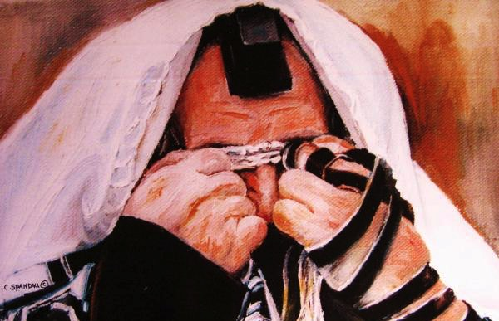
L A M E N T A T I O N S
Dr. Rick Griffith • Jordan Evangelical Theological Seminary • BibleStudyDownloads.org

Slide 2
Key Word
493
343
Confession
Lamentations

Slide 3
Theme
493
Emotions of and
Reasons for the Fall
Lamentations

Slide 4
Key Verse
493
"Because of the LORD's great love we are not consumed,
for his compassions never fail.
They are new every morning;
great is your faithfulness" (3:22-23).
Lamentations

Slide 5

Kingdom Statement
343
Jeremiah tells of the siege and reasons for Jerusalem's fall (1–4) as a model of confession for the nation to be restored under God's rule (5).
Lamentations

Slide 6

Summary Statement
493
346
Jeremiah expresses in deeply emotional terms the siege conditions and reasons God caused the fall of Jerusalem as a model of national confession that the remnant would repent and trust God for his restoration.
Lamentations

Slide 7

Covenant
347b
Even while destroying Jerusalem for its sin (1:1–2:22), God was faithful to his covenant to Abraham by not permanently ending Judah despite it being deserved (3:22-23).
Lamentations

Slide 8

Redemption
347b
Times of distress should motivate patience for God's salvation (3:26) rather than deliverance by man (4:17).
Lamentations

Slide 9

Messiah
347b
Jeremiah identified with Jerusalem's distress (1:12; 3:19) and was despised by his enemies (2:15-16; 3:14, 30) though innocent of sin as a type of Christ who also wept over the city's plight while personally bearing its pain (Matt. 23:37-38).
Lamentations

Slide 10
Lamentations
493
Five ways to repent…
Emotions of and Reasons for the Fall
Fall Described |  | Judgment Acknowledged |  | Jeremiah's Feelings | Trusting Leaders | Prayer
Chapter 1 |  | Chapter 2 |  | Chapter 3 | Chapter 4 | Chapter 5
The Suffering |  | The Cause |  | The Hope | The Reason | The Lament
3 Line Acrostic (22 verses) |  | 3 Line Acrostic (22 verses) |  | 1 Line Acrostic (66 verses) | 2 Line Acrostic (22 verses) | 1 Line Not Acrostic (22 verses)
People |  | God |  | Prophet | God | People
Third Person Singular ("she") 1:1-11 | First Person Singular ("I") 1:12-22 | Third Person Singular ("she") 2:1-10 | First Person Singular ("I") 2:11–4:22 |  |  | First Person Plural ("us/our") 5:1-22
Jerusalem (586 BC)
Admit
your
need
Admit
your
fault
Hope
in
God
Distrust your
leaders
Keep
looking
forward
Notes:
1—Do you confess that your sin has put you into a sad state?
2—Do you say the same thing that God says about your sin?
3—Do you have misplaced hope—or is it in God alone?
4—Do you put more trust in men than in God?
5—Do you pray for restoration?

Slide 11
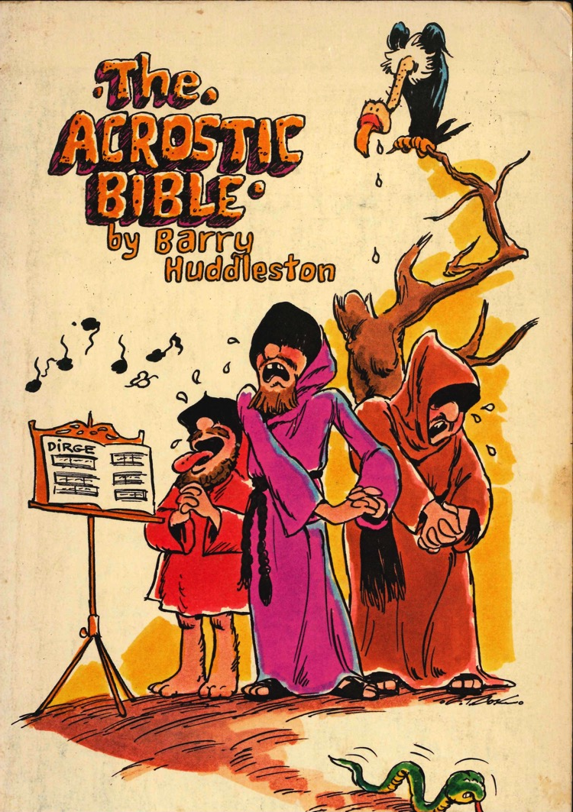
Barry Huddleston, The Acrostic Summarized Bible (Grand Rapids: Baker, 1992)
Lamentations
1 Desolation of Jerusalem announced
2 Israel’s misery is lamented
3 Reminder of God’s mercy
4 Grimness of Israel’s sin
5 Exiles pray for Mercy

Slide 12

Be Repentant
Lamentations
Dr. Rick Griffith • Crossroads International Church Singapore
CICFamily.com • BibleStudyDownloads.org

Slide 13

How should you repent?
How should you change your mind about evil, Jesus, and your sin?
Notes:
Here is where the book of Lamentations can help.

Slide 14
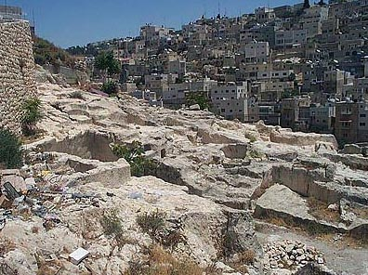
Jeremiah's Two Glimpses of Jerusalem's Fall
494
Fall of Jerusalem
Book of Jeremiah
—————
Looking Ahead
(Warning)
Book of Lamentations
—————
Looking
Back
(Mourning)
—The Daily Walk
Notes:
Jeremiah’s prophecy is like the other pre-exilic prophets who urged the people to repent before the devastation of Jerusalem. But Lamentations is unique in its view looking back at God’s judgment.

Slide 15
Acrostic Structure
1
2
3
4
5
495
AAA
BBB
CCC
DDD
EEE
FFF
GGG
HHH
III
Note: The Hebrew alphabet has 22 consonants
A
B
C
A
B
C
A
B
C
Verses
22
22
66
22
22
Notes:
Lamentations is also the only Bible book whose basic structure forms an acrostic. All chapters (except chapter 3) have 22 verses, each beginning with successive letters of the Hebrew alphabet (except chapter 5). Chapter 3 has 66 verses with each letter repeated three times. The pattern may be for easy memorization or to emphasize the complete nature of suffering for sin (Dyer, BKC, 1:1211).

Slide 16

Chiastic Structure
495
1
2
3
4
5
Jeremiah's Response
The Lord's Anger
God's Judgment
Focal Point
Jerusalem's Desolation
Remnant Response
Notes:
Not only does the book use multiple acrostics but it has a chiastic structure as well. In other words, certain elements reappear in a deliberate order later in the book. Chapters 1 and 5 both depict Jerusalem’s destruction from the viewpoint of the inhabitants, chapters 2 and 4 both describe God’s view, and the center of the book (chap. 3) shows Jeremiah’s response.
The point of drawing attention to chapter 3 is to instruct each of us to imitate Jeremiah's individual response of repentance. Do you just let your calamity pass without really learning from it or do you fall upon God in a spirit of genuine remorse for your sin?

Slide 17

"I remember my affliction and my wandering, the bitterness and the gall.
²⁰I well remember them, and my soul is downcast within me.
²¹Yet this I call to mind and therefore I have hope:
²²Because of the LORD's great love we are not consumed, for his compassions never fail.
²³They are new every morning; great is your faithfulness.
²⁴I say to myself, 'The LORD is my portion; therefore I will wait for him'"
(3:19-24 NLT).
Lamentations
Notes:
The heart of the book gives us comfort that God knows what he is doing completely—even when we are being judged by him!

Slide 18
Main Idea
Be repentant over your sin by changing your mind to view sin as God does.
Lamentations
Notes:
We need to realign our thinking about our doing wrong—our depravity. God doesn’t excuse it, so neither should we.

Slide 19
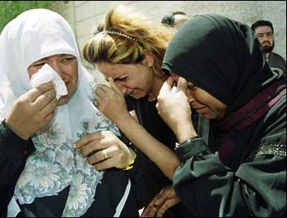
Application
493
Beware lest you think you stand and begin to take God's grace for granted.
When we are punished by God, our only hope lies in turning to our "Enemy"
(Huang Sabin)

Slide 21
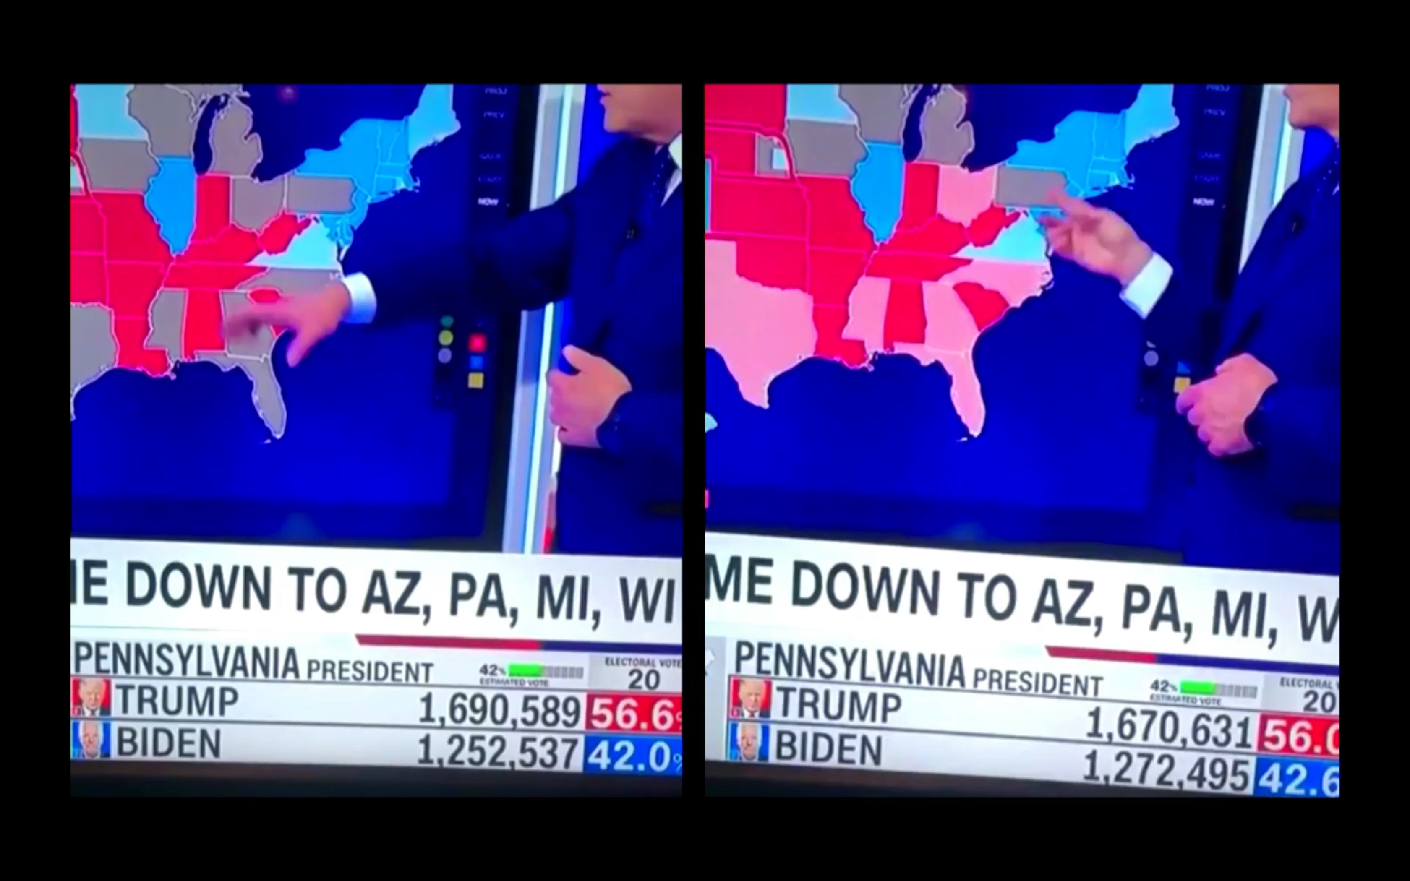
USA Election 2020
Before Updating
After Updating
Notes:
Do you notice anything curious about the number of Trump votes before and after the computer updated?
It makes sense that there are about 20,000 more ballots for Biden after the updating since more ballots were processed.
But why did Trump LOSE about 20,000 votes? Something fishy is going on here. Every updating should RAISE the number of ballots for each candidate, right?

Slide 22
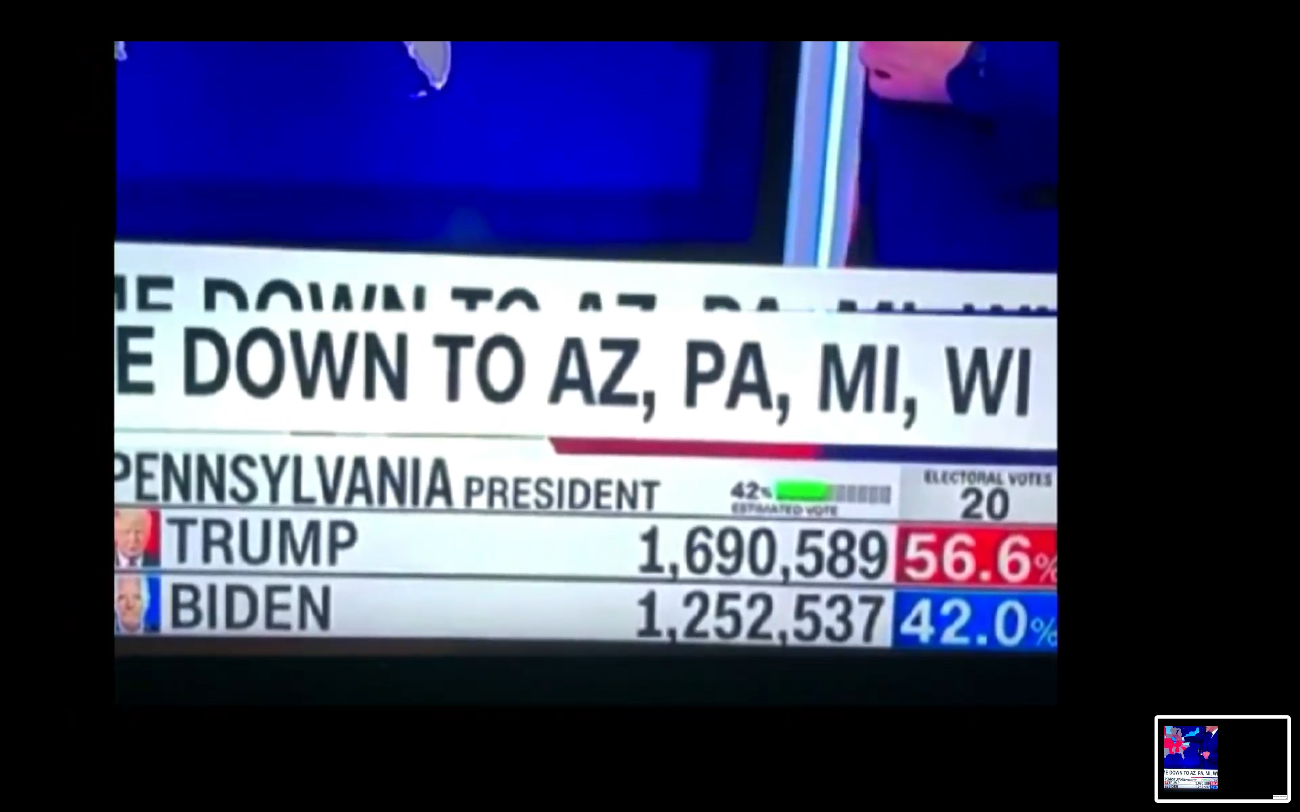
USA Election 2020
Notes:
Here is a close-up that shows Trump with 1,690,589 votes.

Slide 23
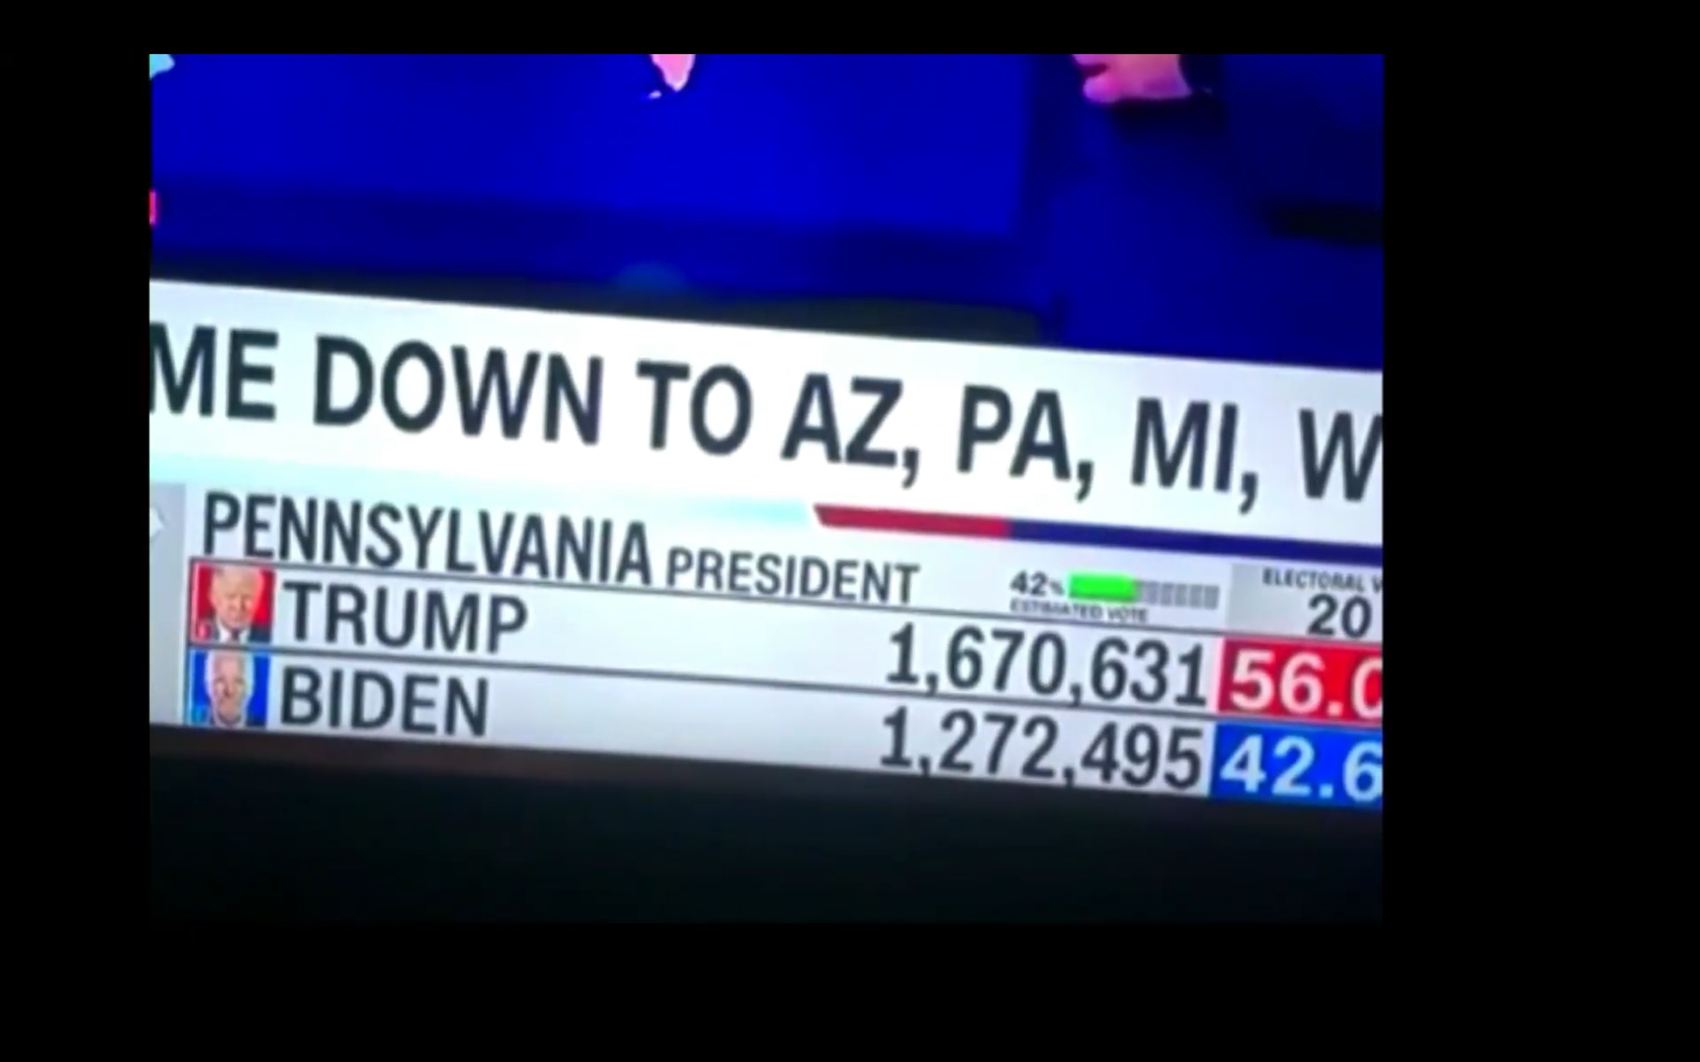
USA Election 2020
Notes:
Here is a close-up that shows Trump with 1,670,631 votes. This brought his share from 56.6% down to 56.0%.
Since nearly 20,000 votes transferred from Trump to Biden, the share of votes for Biden went up from 42.0% to 42.6%.

Slide 24
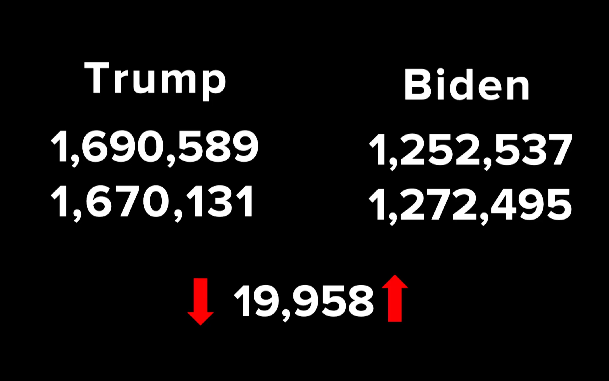
USA Election 2020
Notes:
Dominion Voting Systems computers have come under scrutiny in many elections in recent years. This should not be surprising as the computer transferred 19,958 votes from Trump to Biden in a millisecond.
Could it be an accident or coincidence that Trump lost the EXACT same number of votes that Biden gained? This is no accident.
No wonder the Trump Campaign contested the election.

Slide 25

USA Election 2020 Video Interview
Notes:
Lou Dobbs interviewed Sidney Powell of the Trump Campaign on 14 Nov 2020— just 11 days after the 3 Nov 2020 election. She is, in essence, the Conservative “Pit Bull” unleased on the Biden Campaign.
Sidney Powell With Lou Dobbs: Release The Kraken [literally, the sea monster released by Zeus in the movie “Clash of the Titans” but figuratively referring to the might of lawsuits against bad agents within the US Federal government that rigged the 2020 election]
1,350,501 views
•Nov 14, 2020 (accessed 17 Nov 2020)
https://www.youtube.com/watch?v=SFCXPw1t17o

Slide 26
Newsflash
2 Kings 25:8-12
On the seventh day of the fifth month, in the nineteenth year of Nebuchadnezzar king of Babylon, Nebuzaradan commander of the imperial guard, an official of the king of Babylon, came to Jerusalem. He set fire to the temple of the LORD, the royal palace and all the houses of Jerusalem. Every important building he burned down. The whole Babylonian army, under the commander of the imperial guard, broke down the walls around Jerusalem. Nebuzaradan the commander of the guard carried into exile the people who remained in the city, along with the rest of the populace and those who had gone over to the king of Babylon. But the commander left behind some of the poorest people of the land to work the vineyards and fields.

Slide 27
Babylonians break through
the wall.
2. Zedekiah and his troops flee and are captured
Nelson's 3-D Bible mapbook

Slide 28
3. Temple and other buildings burned and walls destroyed by the Babylonian commander
4. The people are taken into exile.
Nelson's 3-D Bible mapbook

Slide 29
5. Temple valuables are taken away.
6. Jeremiah is released.
Nelson's 3-D Bible mapbook

Slide 30

Timeline
Jeremiah 627-580 B. C.
United Kingdom
1050-930
Divided Kingdom
930-722
Solitary Kingdom
722-586
Post- Exile
536-425
1100
1050
1000
950
900
850
800
7 5 0
7 0 0
650
600
550
500
450
Exile 586-536

Slide 31
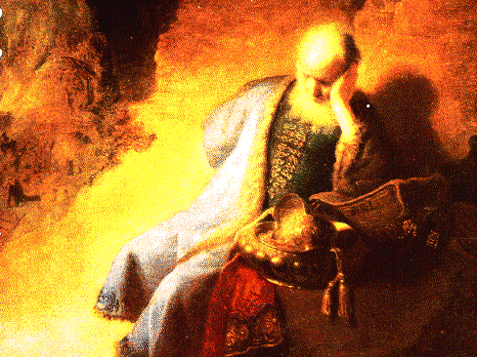
Author
494
Jeremiah based on…
Style and Vocabulary
Tradition & Testimony
Eyewitness Account
LXX

Slide 32
Author
494
Unknown?
MT
Modern scholars
Solidarity
Permits Wider Audience?

Slide 33
"The prophet Jeremiah composed funeral songs for Josiah, and to this day choirs still sing these sad songs about his death. These songs of sorrow have become a tradition and are recorded in The Book of Laments"
(2 Chron 35:25 NLT).

Slide 34
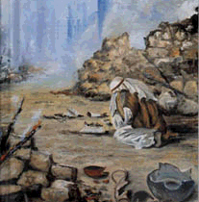
Purpose
497
Expression of grief
Confession of sin
Remembrance of causes of judgment & God's faithfulness

Slide 35
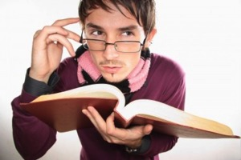
Structure Options
 | Hillers | NIVSB | Griffith
1 | Is there any pain like my pain? | Jerusalem's Misery and Desolation | Fall Described
2 | The Lord has become like an enemy | The Lord's Anger Against His People | Judgment Acknowledged
3 | Every man | Judah's Complaint – and the Basis for Consolation | Jeremiah's Feelings
4 | The limit of suffering | Contrast between Zion's past and Present | Trusting Leaders
5 | Prayer | Judah's Appeal for God's Forgiveness | Prayer

Slide 36

Structure
495
Multiple Acrostics & Chiastic in Structure:
Chapters 1–2 and 4–5 have 22 verses each
Chapters 1–4 are all acrostics
Chapter 3 is a triple acrostic of 66 verses.

Slide 37
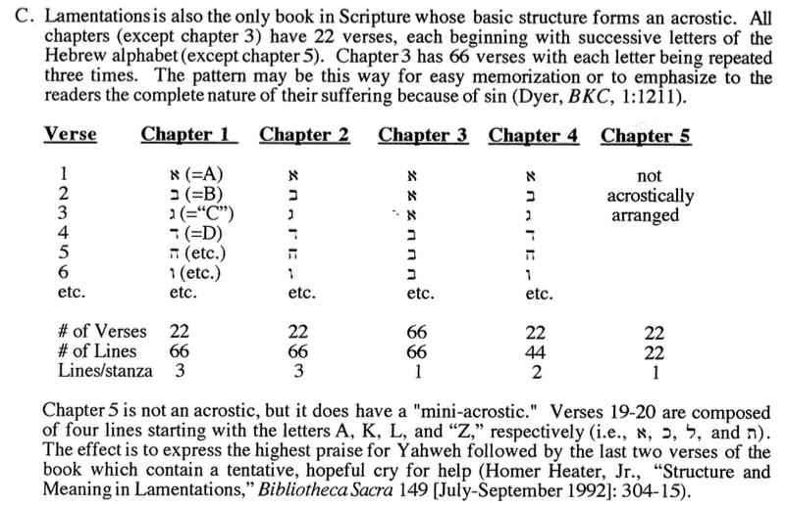
Structure
495

Slide 38
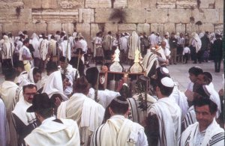
Traditional Use
9th of Ab Destructions of Jerusalem (586 BC & AD 70)
Bar Kochba Loss at Betar (AD 135)
Spain’s Expulsion of Jews (AD 1492)
Wailing Wall
Catholic Communion
Notes:
Both times Jerusalem was destroyed while under Jewish rule happened on the same day of the year—the ninth day of the month of Ab. Thus, this is a fitting day to read Lamentations aloud publicly.
Other times and places the book is read include these above.

Slide 39
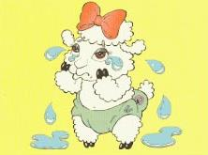
“Lamb-entations”
“Tears”
Walk Through The Bible ©1989

Slide 40
Be Repentant
Lamentations
Dr. Rick Griffith • Crossroads International Church Singapore
CICFamily.com • BibleStudyDownloads.org

Slide 41
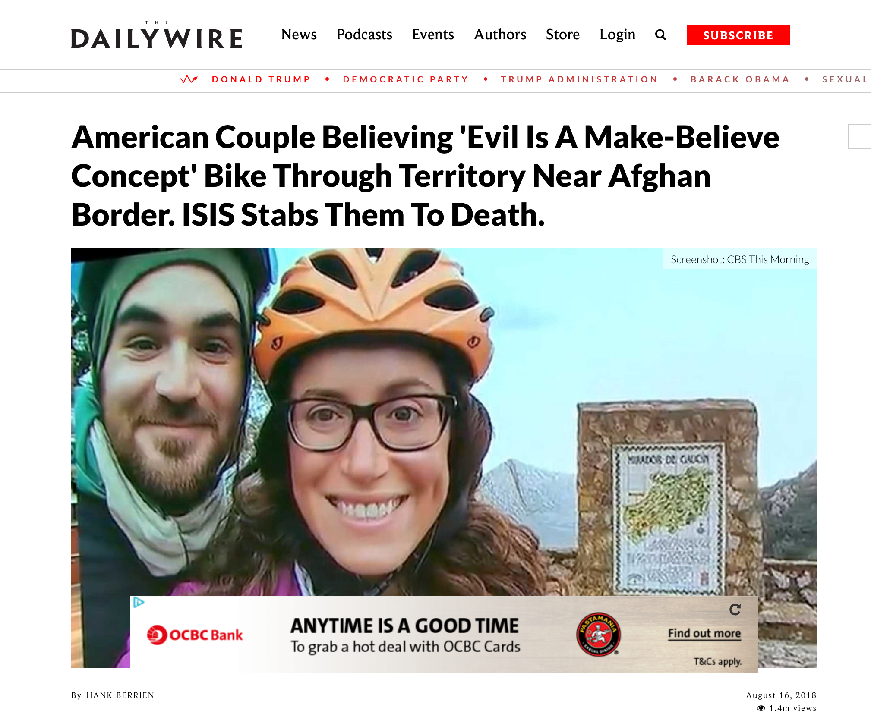
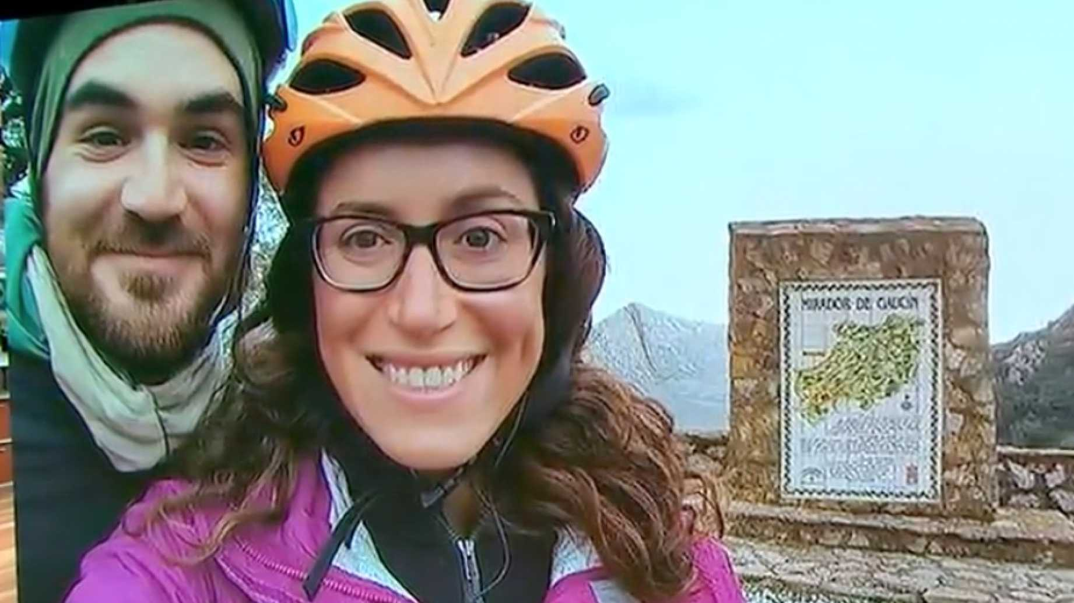
Notes:
“A young American couple who took a year-long bike trip around the world…
Jay Austin and Lauren Geoghegan, 29, quit their jobs last year [2017] in order to make their trip. [Jay] was a vegan who worked for the U.S. Department of Housing and Urban Development; [Lauren], a vegetarian who worked in the Georgetown University admissions office.
Austin had a personal blog on which he wrote in June 2017, “I’ve grown tired of spending the best hours of my day in front of a glowing rectangle, of coloring the best years of my life in swaths of grey and beige. I’ve missed too many sunsets while my back was turned. Too many thunderstorms went unwatched, too many gentle breezes unnoticed.”
Their trip, which lasted 369 days, took them from the southernmost tip of Africa in Capetown, South Africa, to Namibia, Botswana, Zambia, Malawi, Tanzania, Egypt, Morocco, Spain, France, Italy, Croatia, Montenegro, Kosovo, Turkey, Kazakhstan, Kyrgyzstan, and finally Tajikistan, where they were [riding] with two other cyclists, one from Switzerland and the other from the Netherlands.
While in Morocco, Austin wrote…
________
American Couple Believing 'Evil Is A Make-Believe Concept' Bike Through Territory Near Afghan Border. ISIS Stabs Them To Death.
https://www.dailywire.com/news/34581/american-couple-believing-evil-make-believe-hank-berrien
Screenshot: CBS This Morning
By Hank Berrien
August 16, 2018 1.4m views
Accessed 15 Sep 2018

Slide 42
American Couple Believing 'Evil Is A Make-Believe Concept' Bike Through Territory Near Afghan Border. ISIS Stabs Them To Death.
…You watch the news and you read the papers and you're led to believe that the world is a big, scary place. People, the narrative goes, are not to be trusted. People are bad. People are evil. People are axe murderers and monsters and worse.
I don't buy it. Evil is a make-believe concept we've invented to deal with the complexities of fellow humans holding values and beliefs and perspectives different than our own—it's easier to dismiss an opinion as abhorrent than strive to understand it. Badness exists, sure, but even that's quite rare. By and large, humans are kind. Self-interested sometimes, myopic sometimes, but kind. Generous and wonderful and kind. No greater revelation has come from our journey than this.
—June 2017 Jay Austin blog entry in Morocco
Notes:
…You watch the news and you read the papers and you're led to believe that the world is a big, scary place. People, the narrative goes, are not to be trusted. People are bad. People are evil. People are axe murderers and monsters and worse.
I don't buy it. Evil is a make-believe concept we've invented to deal with the complexities of fellow humans holding values and beliefs and perspectives different than our own—it's easier to dismiss an opinion as abhorrent than strive to understand it. Badness exists, sure, but even that's quite rare. By and large, humans are kind. Self-interested sometimes, myopic sometimes, but kind. Generous and wonderful and kind. No greater revelation has come from our journey than this.
______________
EXTRA (not for sermon):
Austin also had some contemptuous words for President Trump:
On the television across the room, Al Jazeera plays softly. Donald Trump has just announced his plans to move an embassy from Tel Aviv to Jerusalem, and the Muslim world is visibly upset. Leaving Rabat a week earlier, we'd pedalled right by a massive peaceful demonstration against the relocation. The television broadcasts footage of protests just like that one stewing up all across the Maghreb, the Middle East, and beyond. As a clip plays of a sullen Trump waddling across the screen, I do my best to disappear into the soft plush of the couch cushion behind me. But American as we may be, no one here seems to mind.
Then, on July 29, 2018, as they were riding their bikes with two other cyclists in Tajikistan, five men exited their car and stabbed all the bicyclists to death.
The New York Times reported:
A grainy cellphone clip recorded by a driver shows what happened next: The men’s Daewoo sedan passes the cyclists and then makes a sharp U-turn. It doubles back, and aims directly for the bikers, ramming into them and lurching over their fallen forms. In all, four people were killed: Mr. Austin, Ms. Geoghegan and cyclists from Switzerland and the Netherlands. Two days later, the Islamic State released a video showing five men it identified as the attackers, sitting before the ISIS flag. They face the camera and make a vow: to kill “disbelievers.”
CBS News added, “ISIS followed an initial claim of responsibility in print with a video showing the five purported attackers pledging allegiance to ISIS leader Abu Bakr al-Baghdadi.”
Update: This article originally said the bikers rode through ISIS territory. They were biking through an area of Tajikistan which is "near ISIS territory" according to pluralist.com.
American Couple Believing 'Evil Is A Make-Believe Concept' Bike Through Territory Near Afghan Border. ISIS Stabs Them To Death.
https://www.dailywire.com/news/34581/american-couple-believing-evil-make-believe-hank-berrien
Screenshot: CBS This Morning
By Hank Berrien
August 16, 2018 1.4m views
Accessed 15 Sep 2018

Slide 43
American Couple Believing 'Evil Is A Make-Believe Concept' Bike Through Territory Near Afghan Border. ISIS Stabs Them To Death.
Notes:
Well, now I will show you the title of the article about them: “American Couple Believing 'Evil Is A Make-Believe Concept' Bike Through Territory Near Afghan Border. ISIS Stabs Them To Death.”
This couple raises a life-and-death question…
________
American Couple Believing 'Evil Is A Make-Believe Concept' Bike Through Territory Near Afghan Border. ISIS Stabs Them To Death.
https://www.dailywire.com/news/34581/american-couple-believing-evil-make-believe-hank-berrien
Screenshot: CBS This Morning
By Hank Berrien
August 16, 2018 1.4m views
Accessed 15 Sep 2018

Slide 44
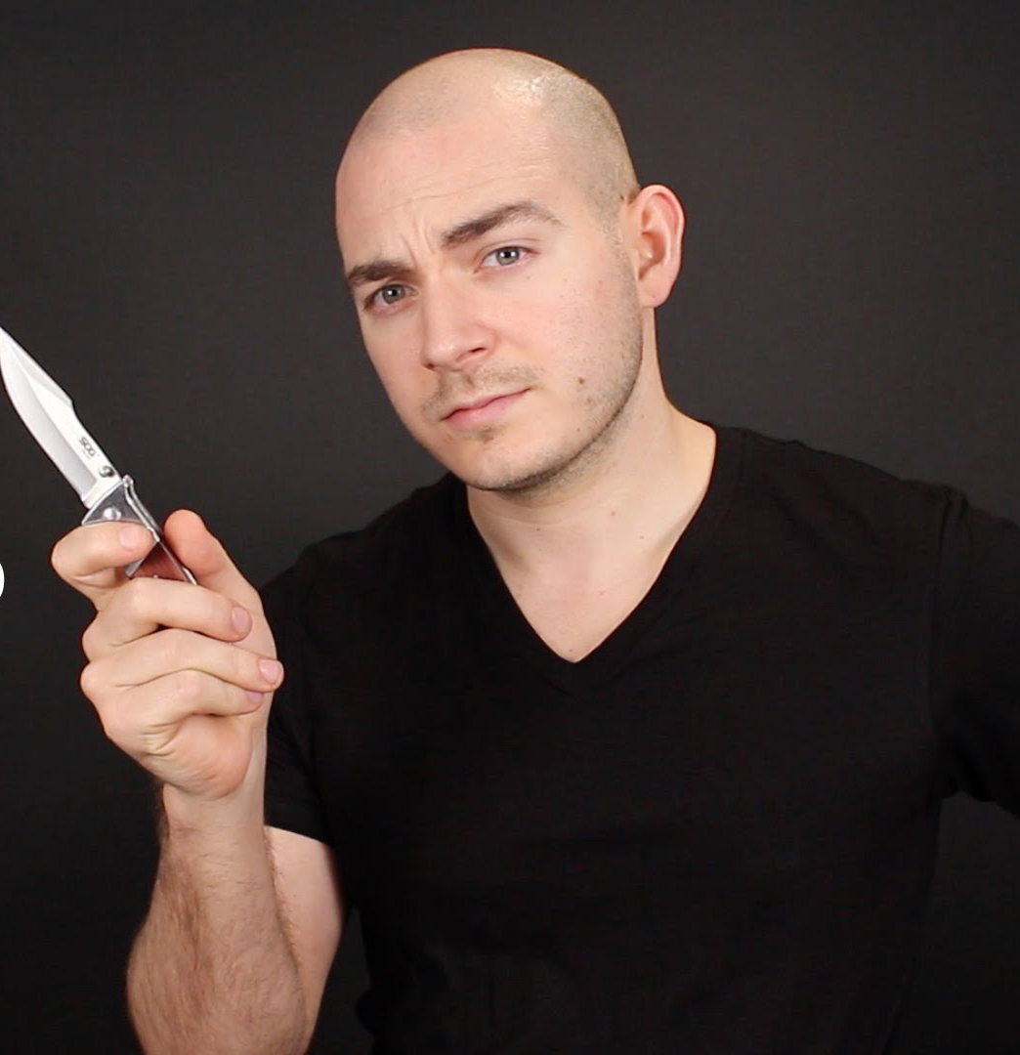
Does evil exist?
Notes:
The simple answer is, ”Yes. Evil exists. In fact, it exists in you and me.” This is why we must repent.

Slide 45
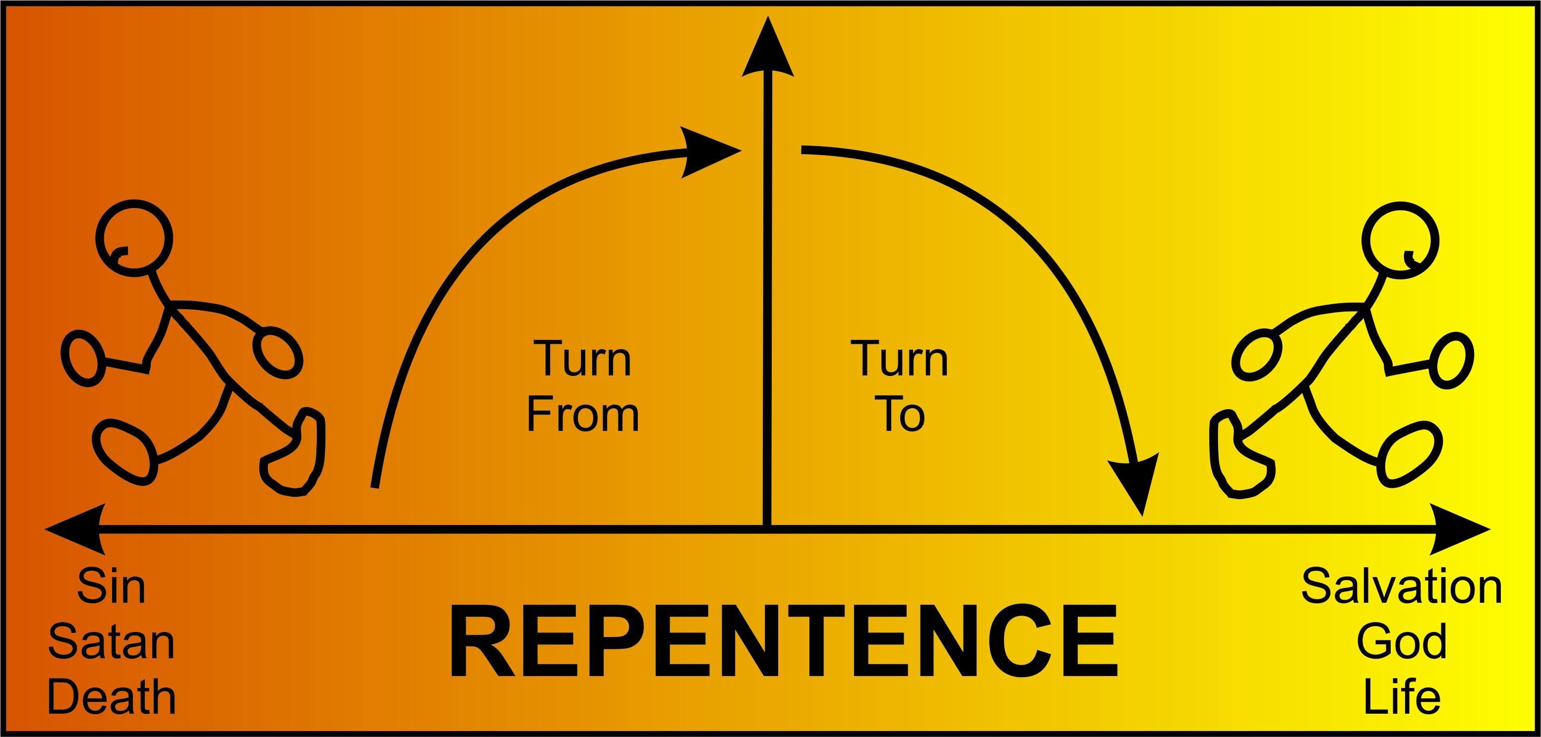
REPENTANCE?
Turn
From
Turn
To
Sin
Satan
Death
Salvation
God
Life
Notes:
But what does it mean to repent? Perhaps you have been told that repentance means “to turn”—to turn from sin, Satan, and death to turn to salvation, God, and life. But is that correct?

Slide 46
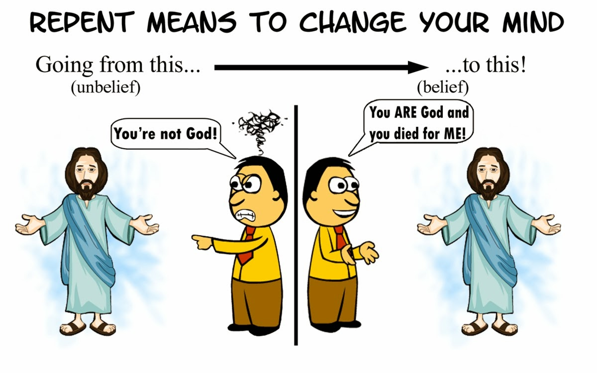
Repent Means to Change Your Mind
Going from this…
(unbelief)
to this…
(belief)
You’re not God!
You ARE God and you died for ME!
Notes:
Biblically, repentance means to change your mind about who Jesus is and what saves you. It means going from unbelief where we say Jesus is not God to belief that Jesus is God and died for us.

Slide 47
How should you repent?
How should you change your mind about evil, Jesus, and your sin?
Notes:
Here is where the book of Lamentations can help.

Slide 48
Jeremiah's Two Glimpses of Jerusalem's Fall
494
Fall of Jerusalem
Book of Jeremiah
—————
Looking Ahead
(Warning)
Book of Lamentations
—————
Looking
Back
(Mourning)
—The Daily Walk

Slide 49
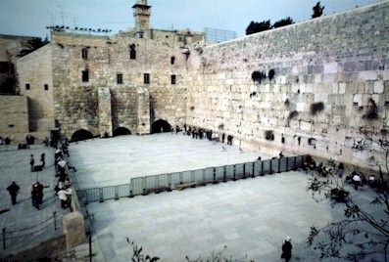
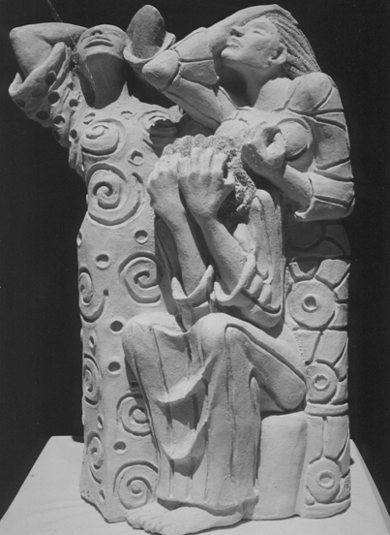
L A M E N T A T I O N S
Notes:
The city is destroyed. Now what should Judah do?

Slide 50
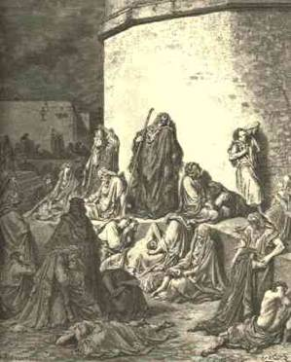
Historical Background
494
Directly after Jerusalem's destruction in 586 BC
Davidic King – the Lord's anointed – deposed and exiled
All but poorest exiled
Temple desecrated and burned
Perspective needed

Slide 51
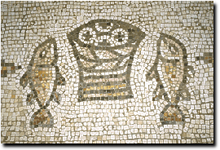
Genre
495
Kings
Concrete details
Facts
Lamentations
vivid sensory imagery
dates and names lacking
no sequential ordering
verse not prose
no names for the slain
no private grief shown

Slide 52

Name and Place
494
494
427
Hebrew Title
Heb: "eka"
Eng: "How terrible! Alas!"
Five Scrolls
Lamentations
Ruth
Ecclesiastes
Song of Songs
Esther
Feast Read:
9th of Ab
Pentecost
Tabernacles
Passover
Purim

Slide 53
Acrostic Structure
1
2
3
4
5
495
AAA
BBB
CCC
DDD
EEE
FFF
GGG
HHH
III
Note: The Hebrew alphabet has 22 consonants
A
B
C
A
B
C
A
B
C
Verses
22
22
66
22
22
Notes:
Lamentations is also the only Bible book whose basic structure forms an acrostic. All chapters (except chapter 3) have 22 verses, each beginning with successive letters of the Hebrew alphabet (except chapter 5). Chapter 3 has 66 verses with each letter repeated three times. The pattern may be for easy memorization or to emphasize the complete nature of suffering for sin (Dyer, BKC, 1:1211).

Slide 54
Chiastic Structure
495
1
2
3
4
5
Jeremiah's Response
The Lord's Anger
God's Judgment
Focal Point
Jerusalem's Desolation
Remnant Response
Notes:
Not only does the book use multiple acrostics but it has a chiastic structure as well. In other words, certain elements reappear in a deliberate order later in the book. Chapters 1 and 5 both depict Jerusalem’s destruction from the viewpoint of the inhabitants, chapters 2 and 4 both describe God’s view, and the center of the book (chap. 3) shows Jeremiah’s response.
The point of drawing attention to chapter 3 is to instruct each of us to imitate Jeremiah's individual response of repentance. Do you just let your calamity pass without really learning from it or do you fall upon God in a spirit of genuine remorse for your sin?

Slide 55
Lamentations
493
Five ways to repent…
Emotions of and Reasons for the Fall
Fall Described |  | Judgment Acknowledged |  | Jeremiah's Feelings | Trusting Leaders | Prayer
Chapter 1 |  | Chapter 2 |  | Chapter 3 | Chapter 4 | Chapter 5
The Suffering |  | The Cause |  | The Hope | The Reason | The Lament
3 Line Acrostic (22 verses) |  | 3 Line Acrostic (22 verses) |  | 1 Line Acrostic (66 verses) | 2 Line Acrostic (22 verses) | 1 Line Not Acrostic (22 verses)
People |  | God |  | Prophet | God | People
Third Person Singular ("she") 1:1-11 | First Person Singular ("I") 1:12-22 | Third Person Singular ("she") 2:1-10 | First Person Singular ("I") 2:11–4:22 |  |  | First Person Plural ("us/our") 5:1-22
Jerusalem (586 BC)
Notes:
Lamentations gives five ways to repent—for the Jews and for us.

Slide 56
Slides on
Lamentations 1

Slide 57
Lamentations
493
Five ways to repent…
Emotions of and Reasons for the Fall
Fall Described |  | Judgment Acknowledged |  | Jeremiah's Feelings | Trusting Leaders | Prayer
Chapter 1 |  | Chapter 2 |  | Chapter 3 | Chapter 4 | Chapter 5
The Suffering |  | The Cause |  | The Hope | The Reason | The Lament
3 Line Acrostic (22 verses) |  | 3 Line Acrostic (22 verses) |  | 1 Line Acrostic (66 verses) | 2 Line Acrostic (22 verses) | 1 Line Not Acrostic (22 verses)
People |  | God |  | Prophet | God | People
Third Person Singular ("she") 1:1-11 | First Person Singular ("I") 1:12-22 | Third Person Singular ("she") 2:1-10 | First Person Singular ("I") 2:11–4:22 |  |  | First Person Plural ("us/our") 5:1-22
Jerusalem (586 BC)
Admit
your
need
Notes:
Don’t cover up the price of your sin.

Slide 58
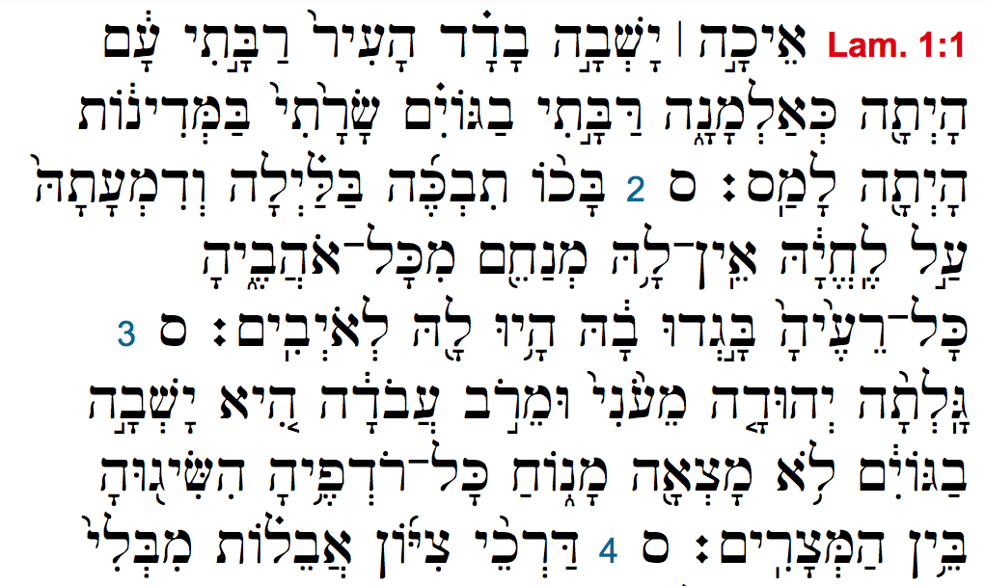
Lamentations 1 Hebrew Acrostic
= "A"
= "B"
= "C"
= "D"
Notes:
Each verse begins with the next letter of the Hebrew alphabet. Verse 1 with the Hebrew equivalent of "A," verse 2 with "B," etc.

Slide 59
"[Alas!] How deserted lies the city, once so full of people!
How like a widow is she, who once was great among the nations!
She who was queen among the provinces has now become a slave.
² Bitterly she weeps at night, tears are upon her cheeks.
Among all her lovers there is none to comfort her.
All her friends have betrayed her; they have become her enemies.
³ [Coming] after affliction and harsh labor,
Judah has gone into exile.
She dwells among the nations; she finds no resting place.
All who pursue her have overtaken her in the midst of her distress"
(Lamentations 1:1-3 NIV adapted).
= "A"
= "B"
= "C"
Notes:
Here is what it would look like in English.

Slide 60
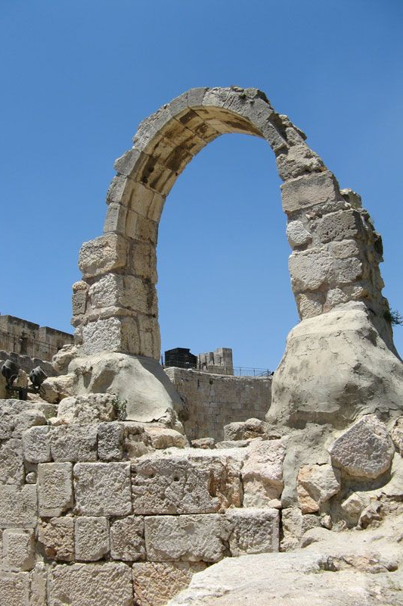
"The roads to Jerusalem are in mourning, for crowds no longer come to celebrate the festivals.
The city gates are silent, her priests groan, her young women are crying— how bitter is her fate!"
(Lam 1:4 NLT).
Notes:
Jerusalem’s rebellion against God led to a horrible siege (Lam 1).

Slide 61
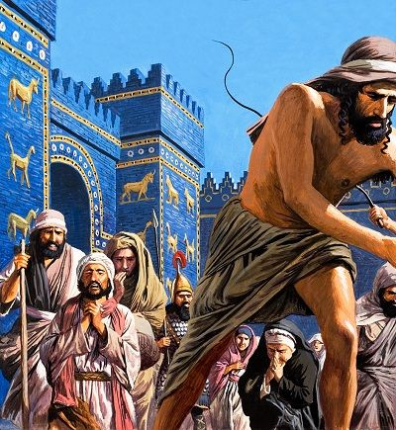
"Her oppressors have become her masters, and her enemies prosper, for the LORD has punished Jerusalem for her many sins.
Her children have been captured and taken away to distant lands"
(Lam 1:5 NLT).
Notes:
The fall of Jerusalem from prominence to lowliness reminds the nation of the heights the city enjoyed by grace before God's judgment (1:1-11).

Slide 62
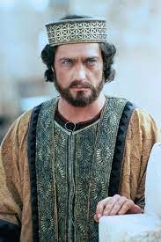
"All the majesty of beautiful Jerusalem has been stripped away.
Her princes are like starving deer searching for pasture.
They are too weak to run from the pursuing enemy"
(Lam 1:6 NLT).
Notes:
The fall of Jerusalem from prominence to lowliness reminds the nation of the heights the city enjoyed by grace before God's judgment (1:1-11).

Slide 63
Parallels between Lamentations
and Deuteronomy
496
Lamentations |  | Deuteronomy
1:3 | She dwells among the nations; she finds no resting place. | 28:65 | Among those nations you will find no repose, no resting place for the sole of your foot.
1:5 | Her foes have become her masters. | 28:44 | He will be the head, but you will be the tail.
1:5 | Her children have gone into exile, captive before the foe. | 28:32 | Your sons and daughters will be given to another nation.
1:6 | In weakness they have fled before the pursuer. | 28:25 | The LORD will cause you to be defeated before your enemies. You will come at them from one direction but flee from them in seven.
1:18 | My young men and maidens have gone into exile. | 28:41 | You will have sons and daughters but you will not keep them, because they will go into captivity.
Bible Knowledge Commentary, 1:1209
Notes:
God had told Israel over 800 years before that he would judge his people for their sin in the "Blessings and Cursings" chapter of Deuteronomy 28. The parallels are striking, almost quoting these warnings of Moses word-for-word. Through this God was telling them, "I told you so!” Lamentations refers back to Deuteronomy 28 at least 15 times!

Slide 64
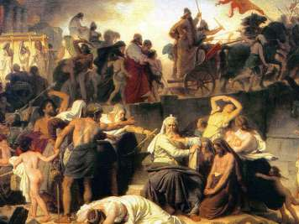
"In the days of her affliction and wandering
Jerusalem remembers all the treasures that were hers in days of old.
When her people fell into enemy hands, there was no one to help her.
Her enemies looked at her and laughed at her destruction"
(Lam 1:7 NLT).
Notes:
The fall of Jerusalem from prominence to lowliness reminds the nation of the heights the city enjoyed by grace before God's judgment (1:1-11).

Slide 65
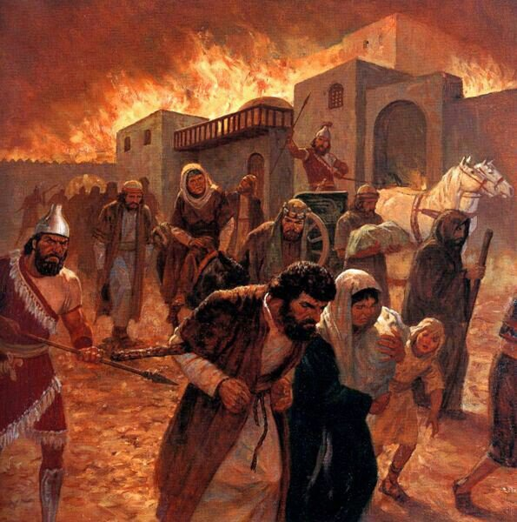
"Jerusalem has sinned greatly and so has become unclean.
All who honored her despise her, for they have seen her nakedness; she herself groans and turns away"
(Lam 1:8 NLT).
Notes:
The fall of Jerusalem from prominence to lowliness reminds the nation of the heights the city enjoyed by grace before God's judgment (1:1-11).

Slide 66
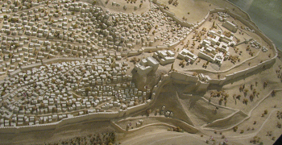
"Her filthiness clung to her skirts; she did not consider her future.
Her fall was astounding; there was none to comfort her.
'Look, O LORD, on my affliction, for the enemy has triumphed'"
(Lam 1:9 NLT).
Notes:
The fall of Jerusalem from prominence to lowliness reminds the nation of the heights the city enjoyed by grace before God's judgment (1:1-11).

Slide 67
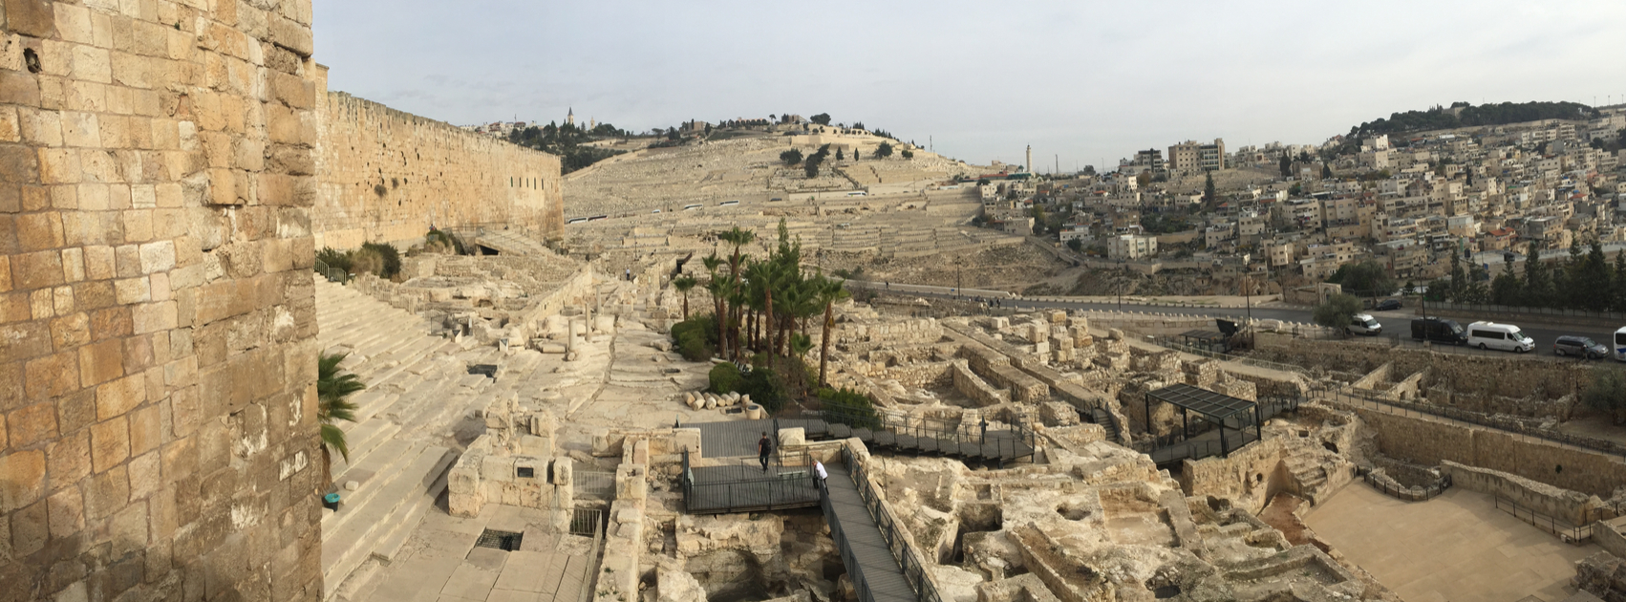
"The enemy laid hands on all her treasures; she saw pagan nations enter her sanctuary— those you had forbidden to enter your assembly"
(Lam 1:10 NLT).
Notes:
The fall of Jerusalem from prominence to lowliness reminds the nation of the heights the city enjoyed by grace before God's judgment (1:1-11).

Slide 68
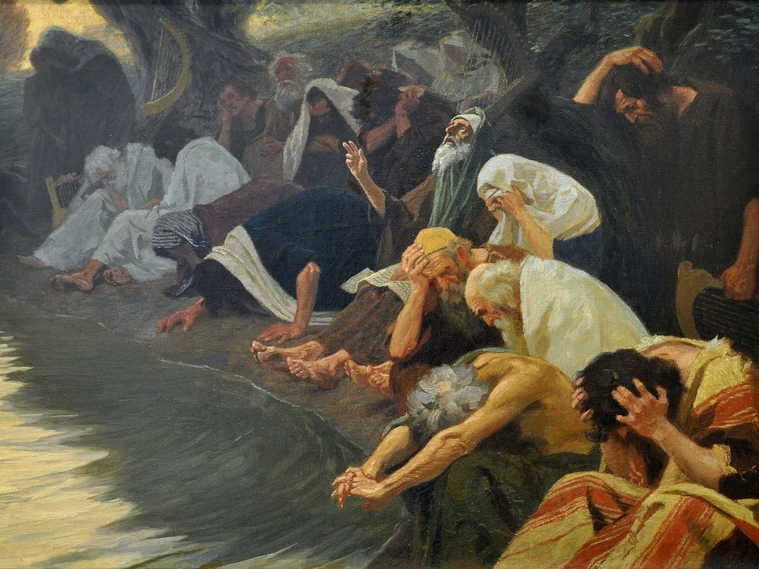
"All her people groan as they search for bread; they barter their treasures for food to keep themselves alive.
'Look, O LORD, and consider, for I am despised.'"
(Lam 1:11 NLT).
Notes:
The fall of Jerusalem from prominence to lowliness reminds the nation of the heights the city enjoyed by grace before God's judgment (1:1-11).

Slide 69
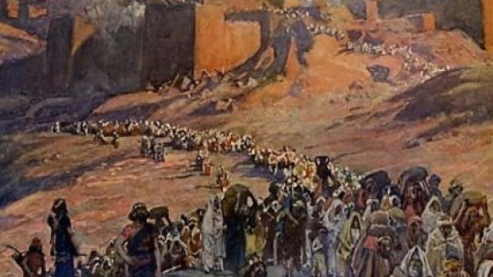
"He has sent fire from heaven that burns in my bones. He has placed a trap in my path and turned me back. He has left me devastated, racked with sickness all day long"
(Lam 1:12 NLT).
Notes:
Jerusalem confesses her deserved desolation with the agony the people feel over the awful effects of rebellion against God (1:12-22).
Here the language switches from third person (“it”) to first person (“I”) as if the city could speak for itself.

Slide 70
"He has sent fire from heaven that burns in my bones. He has placed a trap in my path and turned me back. He has left me devastated, racked with sickness all day long"
(Lam 1:13 NLT).
Notes:
Jerusalem confesses her deserved desolation with the agony the people feel over the awful effects of rebellion against God (1:12-22).
Here the language switches from third person (“it”) to first person (“I”) as if the city could speak for itself.

Slide 71
Lamentations
493
Five ways to repent…
Emotions of and Reasons for the Fall
Fall Described |  | Judgment Acknowledged |  | Jeremiah's Feelings | Trusting Leaders | Prayer
Chapter 1 |  | Chapter 2 |  | Chapter 3 | Chapter 4 | Chapter 5
The Suffering |  | The Cause |  | The Hope | The Reason | The Lament
3 Line Acrostic (22 verses) |  | 3 Line Acrostic (22 verses) |  | 1 Line Acrostic (66 verses) | 2 Line Acrostic (22 verses) | 1 Line Not Acrostic (22 verses)
People |  | God |  | Prophet | God | People
Third Person Singular ("she") 1:1-11 | First Person Singular ("I") 1:12-22 | Third Person Singular ("she") 2:1-10 | First Person Singular ("I") 2:11–4:22 |  |  | First Person Plural ("us/our") 5:1-22
Jerusalem (586 BC)
Admit
your
need
Do you confess that your sin has put you into a sad state?
Notes:
When was the last time you confessed a sin to God?
Was that a while back because you sin less now—or because you are growing colder to God?

Slide 72
Slides on
Lamentations 2

Slide 73
Lamentations
493
Five ways to repent…
Emotions of and Reasons for the Fall
Fall Described |  | Judgment Acknowledged |  | Jeremiah's Feelings | Trusting Leaders | Prayer
Chapter 1 |  | Chapter 2 |  | Chapter 3 | Chapter 4 | Chapter 5
The Suffering |  | The Cause |  | The Hope | The Reason | The Lament
3 Line Acrostic (22 verses) |  | 3 Line Acrostic (22 verses) |  | 1 Line Acrostic (66 verses) | 2 Line Acrostic (22 verses) | 1 Line Not Acrostic (22 verses)
People |  | God |  | Prophet | God | People
Third Person Singular ("she") 1:1-11 | First Person Singular ("I") 1:12-22 | Third Person Singular ("she") 2:1-10 | First Person Singular ("I") 2:11–4:22 |  |  | First Person Plural ("us/our") 5:1-22
Jerusalem (586 BC)
Admit
your
need
Admit
your
fault
Notes:
Don’t make excuses by blaming someone else for your sin.

Slide 74
"The Lord in his anger has cast a dark shadow over beautiful Jerusalem.
The fairest of Israel's cities lies in the dust, thrown down from the heights of heaven.
In his day of great anger, the Lord has shown no mercy even to his Temple" (Lam 2:1 NLT).
Notes:
God said that he caused Jerusalem's destruction (Lam 2).
2:1-2 is Adonai (“Lord”) rather than the normal Yahweh (“LORD”).

Slide 75
"Without mercy the Lord has destroyed every home in Israel.
In his anger he has broken down the fortress walls of beautiful Jerusalem.
He has brought them to the ground, dishonoring the kingdom and its rulers"
(Lam 2:2 NLT).
Notes:
God caused the destruction of the city and its covenantal institutions to help his people see this as his judgment (2:1-10).
2:1-2 is Adonai (“Lord”) rather than the normal Yahweh (“LORD”).

Slide 76
"All the strength of Israel vanishes beneath his fierce anger.
The Lord has withdrawn his protection as the enemy attacks.
He consumes the whole land of Israel like a raging fire"
(Lam 2:3 NLT).

Slide 77
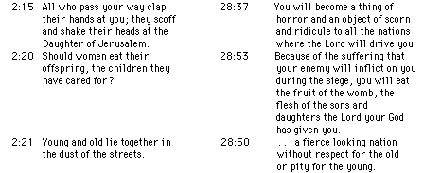
Parallels between Lamentations
and Deuteronomy
496
Lamentations |  | Deuteronomy
2:15 | All who pass your way clap their hands at you; they scoff and shake their heads at the Daughter of Jerusalem. | 28:37 | You will become a thing of horror and an object of scorn and ridicule to all the nations where the LORD will drive you.
2:20 | Should women eat their offspring, the children they have cared for? | 28:53 | Because of the suffering that your enemy will inflict on you during the siege, you will eat the fruit of the womb, the flesh of the sons and daughters the LORD your God has given you.
2:21 | Young and old lie together in the dust of the streets. | 28:50 | …a fierce-looking nation without respect for the old or pity for the young.
Bible Knowledge Commentary, 1:1209

Slide 78
Blessings & Curses (Deut. 28)
Your towns and your fields
will be blessed (3)
Your towns and your fields
will be cursed (16)
Your children and your crops
will be blessed (4)
Your children and your crops
will be cursed (17)
Your fruit baskets and bread-boards will be blessed (5)
Your fruit baskets and bread-boards will be cursed (18)
Wherever you go and whatever you do, you will be blessed (6)
Wherever you go and whatever you do, you will be cursed (19)
Your enemies will attack you from one direction, but they will scatter from you in seven! (7)
You will attack your enemies from one direction, but you will scatter from them in seven! (25)
You will lend to many nations, but you will never need to borrow from them (12)
They will lend to money to you, but you will not lend to them
(44)

Slide 79
Prophetic Curses
220
Why?
Exile
Deut 28
Notes:
Jeremiah's prophecy and Lamentations record his eyewitness account of Babylon's siege and destruction of Jerusalem for the nation's sin, the Holy Spirit moved him to record an historical compilation which provides the context and justification for God's judgment upon these two nations. The leaders and the people sinned through ungodliness and idolatry, and true to the curses of Deut. 28, God gave the people the consequences of their obedience.

Slide 80
Lamentations 2:15 (NIV)
    "Is this the city that was called
    the perfection of beauty,
    the joy of the whole earth?"
Notes:
Jeremiah laments the city's condition so that all would admit this as God’s judgment and seek his mercy (2:11-22).

Slide 81
"But it is the LORD who did just as he planned.
He has fulfilled the promises of disaster he made long ago.
He has destroyed Jerusalem without mercy.
He has caused her enemies to gloat over her and has given them power over her"
(Lam 2:17 NLT).
Notes:
God caused the destruction of the city and its covenantal institutions to help his people see this as his judgment (2:1-10).
2:1-2 is Adonai (“Lord”) rather than the normal Yahweh (“LORD”).

Slide 82
Lamentations
493
Five ways to repent…
Emotions of and Reasons for the Fall
Fall Described |  | Judgment Acknowledged |  | Jeremiah's Feelings | Trusting Leaders | Prayer
Chapter 1 |  | Chapter 2 |  | Chapter 3 | Chapter 4 | Chapter 5
The Suffering |  | The Cause |  | The Hope | The Reason | The Lament
3 Line Acrostic (22 verses) |  | 3 Line Acrostic (22 verses) |  | 1 Line Acrostic (66 verses) | 2 Line Acrostic (22 verses) | 1 Line Not Acrostic (22 verses)
People |  | God |  | Prophet | God | People
Third Person Singular ("she") 1:1-11 | First Person Singular ("I") 1:12-22 | Third Person Singular ("she") 2:1-10 | First Person Singular ("I") 2:11–4:22 |  |  | First Person Plural ("us/our") 5:1-22
Jerusalem (586 BC)
Admit
your
need
Admit
your
fault
Do you say the same thing that God says about your sin?
Notes:
James Boice says, “If you keep close to God, you will keep from sin.
But if you sin persistently, you will fall away from God. Then you will rename the sin.
You will not talk about pride, the great sin; you will call it “self-esteem,” “self-worth,” or what is “due to me.”
You will not talk about gluttony and materialism; you will talk about “the good life.”
You will not talk about disobedience; you will talk about “shortcomings.”
You will not talk about the Ten Commandments and your violation of them; you will talk about your “mistakes.”
It is only when you draw close to God that these things will become increasingly sinful in your sight”
(https://www.ligonier.org/blog/renaming-sin/).
Likewise, we also refuse to use the word “immorality” as if there is no absolute standard.

Slide 83
Slides on
Lamentations 3

Slide 84
Lamentations
493
Five ways to repent…
Emotions of and Reasons for the Fall
Fall Described |  | Judgment Acknowledged |  | Jeremiah's Feelings | Trusting Leaders | Prayer
Chapter 1 |  | Chapter 2 |  | Chapter 3 | Chapter 4 | Chapter 5
The Suffering |  | The Cause |  | The Hope | The Reason | The Lament
3 Line Acrostic (22 verses) |  | 3 Line Acrostic (22 verses) |  | 1 Line Acrostic (66 verses) | 2 Line Acrostic (22 verses) | 1 Line Not Acrostic (22 verses)
People |  | God |  | Prophet | God | People
Third Person Singular ("she") 1:1-11 | First Person Singular ("I") 1:12-22 | Third Person Singular ("she") 2:1-10 | First Person Singular ("I") 2:11–4:22 |  |  | First Person Plural ("us/our") 5:1-22
Jerusalem (586 BC)
Admit
your
need
Admit
your
fault
Hope
in
God
Notes:
Express your trust in the LORD alone.

Slide 85
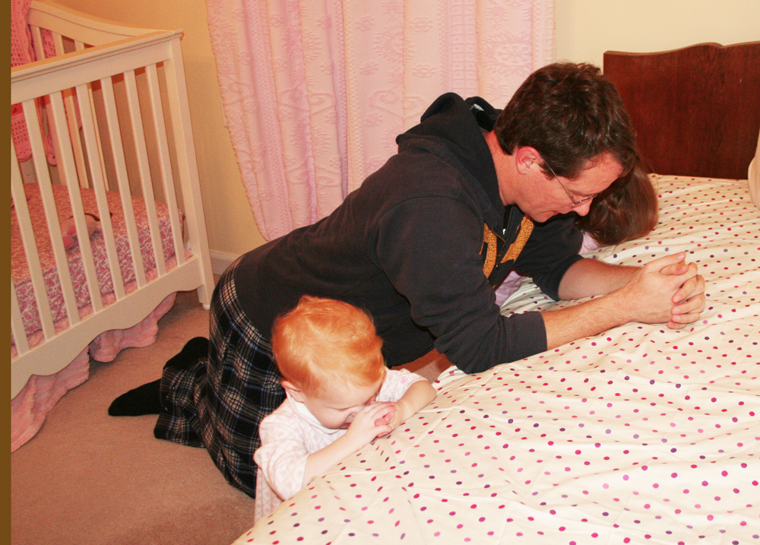
Chapter 3 is a Model of Confession
Notes:
We all need models of prayer!

Slide 86
Lamentations 1 Hebrew Acrostic
= "A"
= "B"
= "C"
= "D"
Notes:
Remember that chapter 1 had a succession of beginning letters starting with the equivalent of letter A?

Slide 87
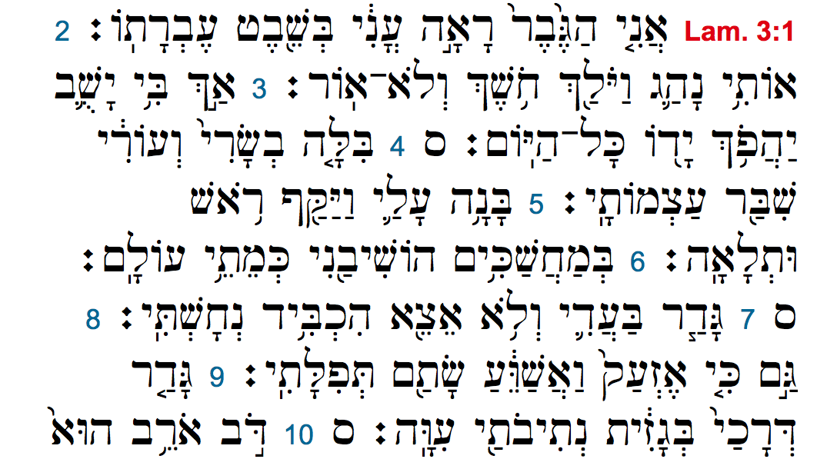
Lamentations 3 Hebrew Acrostic
= "A"
= "A"
= "A"
= "B"
= "B"
= "B"
= "C"
= "C"
= "C"
= "D"
Notes:
Now in chapter 3 we see the letter “A” beginning three verses in a row, then “B” three verses, etc.

Slide 88
"I am the one who has seen the afflictions that come from the rod of the LORD's anger.
² He has led me into darkness, shutting out all light.
³ He has turned his hand against me again and again, all day long"
(Lam 3:1-3 NLT).
Notes:
Jeremiah repents in his affliction that his confidence is in God (Lam 3).

Slide 89
"He has made my skin and flesh grow old.
He has broken my bones.
⁵ He has besieged and surrounded me with anguish and distress.
⁶ He has buried me in a dark place, like those long dead"
(Lam 3:4-6 NLT).
Notes:
Jeremiah describes his afflictions in general, poetic terms to identify with the suffering people (3:1-18).

Slide 90
"He has walled me in, and I cannot escape.
He has bound me in heavy chains.
⁸ And though I cry and shout, he has shut out my prayers.
⁹ He has blocked my way with a high stone wall; he has made my road crooked"
(Lam 3:7-9 NLT).

Slide 91
"I remember my affliction and my wandering, the bitterness and the gall.
²⁰I well remember them, and my soul is downcast within me.
²¹Yet this I call to mind and therefore I have hope:
²²Because of the LORD's great love we are not consumed, for his compassions never fail.
²³They are new every morning; great is your faithfulness.
²⁴I say to myself, 'The LORD is my portion; therefore I will wait for him'"
(Lam 3:19-24 NLT).
Notes:
Jeremiah puts his hope in God to model how to pray for mercy (3:19-39).

Slide 92
"The LORD is good to those whose hope is in him, to the one who seeks him;
²⁶it is good to wait quietly for the salvation of the LORD.
²⁷It is good for a man to bear the yoke while he is young.
²⁸Let him sit alone in silence, for the LORD has laid it on him.
²⁹Let him bury his face in the dust— there may yet be hope.”
(Lam 3:25-29 NLT)

Slide 93
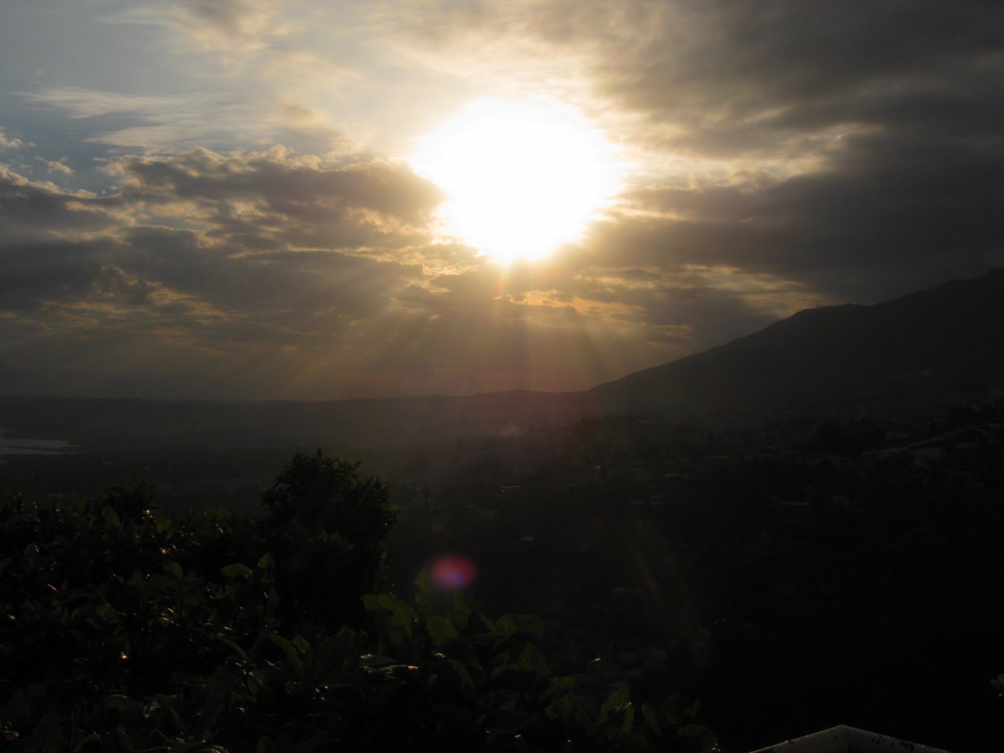

Great is Thy Faithfulness
(Lamentations 3:22-23)
Notes:
The hymn writer put Lamentations 3:22-23 into a personalize form to reassure us also that God has provided all we need each new morning.

Slide 94

Great is Thy faithfulness 2/6
Great is Thy faithfulness!
Great is Thy faithfulness!
Morning by morning new mercies I see!
All I have needed
Thy hand hath provided;
Great is Thy faithfulness,
Lord, unto me!

Slide 95

Great is Thy faithfulness 3/6
Summer and winter
and springtime and harvest,
Sun, moon and stars
in their courses above
Join with all nature in manifold witness
To Thy great faithfulness,
mercy and love

Slide 96
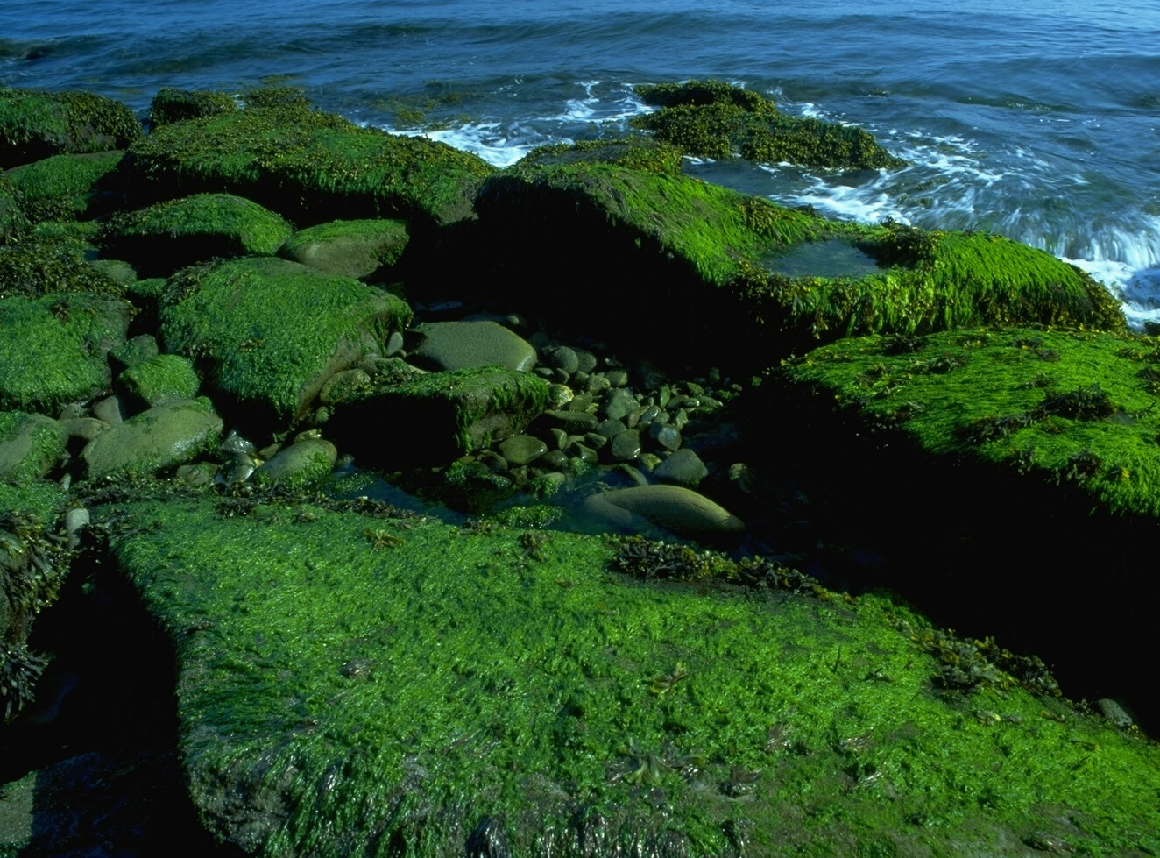
Great is Thy faithfulness 4/6
Great is Thy faithfulness!
Great is Thy faithfulness!
Morning by morning new mercies I see!
All I have needed
Thy hand hath provided;
Great is Thy faithfulness,
Lord, unto me!
Notes:
The hymn writer put Lamentations 3:22-23 into a personalize form to reassure us also that God has provided all we need each new morning.

Slide 97
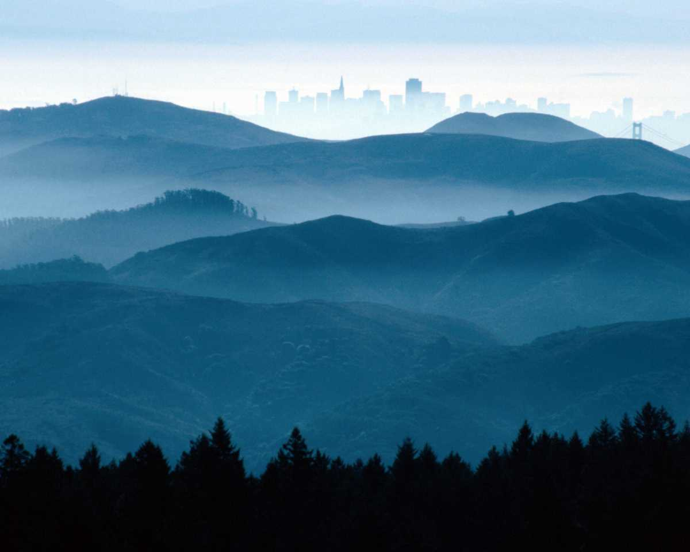
Great is Thy faithfulness 5/6
Pardon for sin and
a peace that endureth;
Thine own dear presence
to cheer and to guide.
Strength for today
and bright hope for tomorrow;
Blessings all mine,
with ten thousand beside!

Slide 98
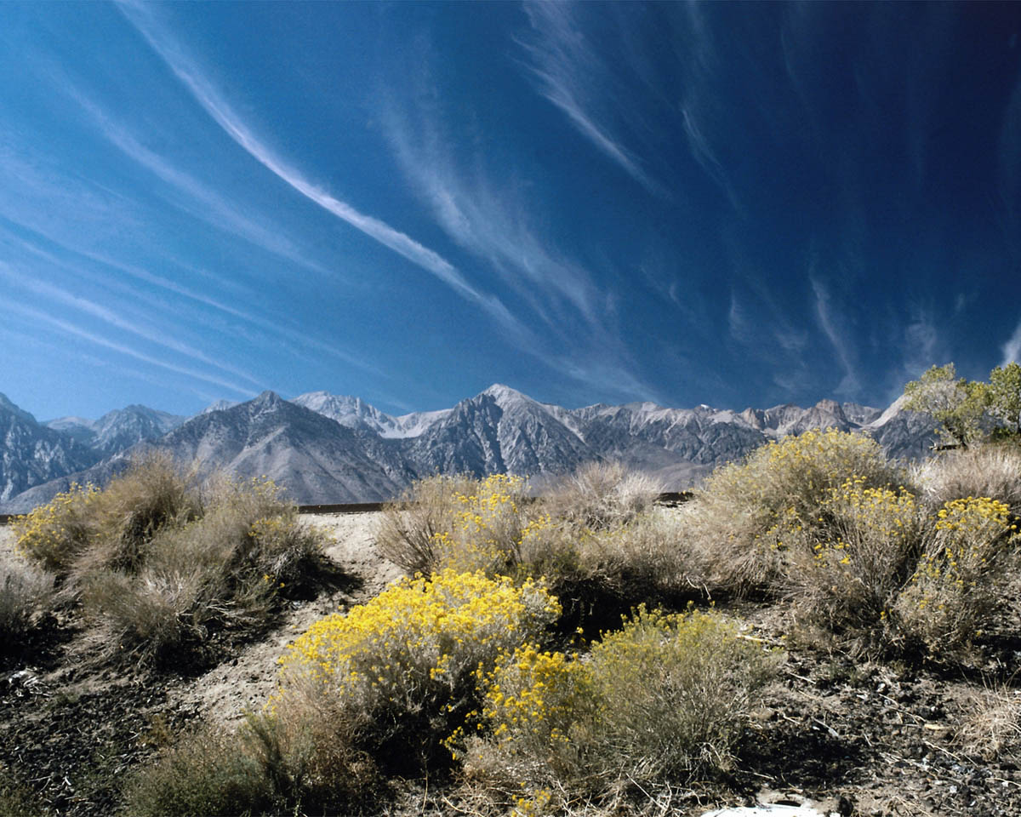
Great is Thy faithfulness 6/6
Great is Thy faithfulness!
Great is Thy faithfulness!
Morning by morning new mercies I see!
All I have needed
Thy hand hath provided;
Great is Thy faithfulness,
Lord, unto me!

Slide 99
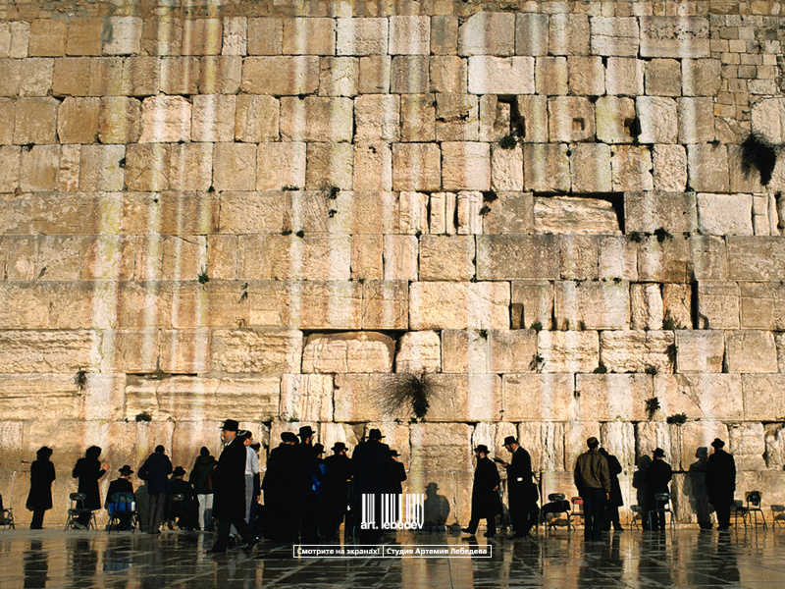
Structure
Midpoint = 3:31-36
"For men are not cast off by the Lord forever. For he does not willingly bring affliction or grief to the children of men. To crush underfoot all prisoners in the land, to deny a man his rights before the Most High, to deprive a man of justice – would not the Lord see such things?"
Faith rises from the ashes of disaster.

Slide 100
Lamentations
493
Five ways to repent…
Emotions of and Reasons for the Fall
Fall Described |  | Judgment Acknowledged |  | Jeremiah's Feelings | Trusting Leaders | Prayer
Chapter 1 |  | Chapter 2 |  | Chapter 3 | Chapter 4 | Chapter 5
The Suffering |  | The Cause |  | The Hope | The Reason | The Lament
3 Line Acrostic (22 verses) |  | 3 Line Acrostic (22 verses) |  | 1 Line Acrostic (66 verses) | 2 Line Acrostic (22 verses) | 1 Line Not Acrostic (22 verses)
People |  | God |  | Prophet | God | People
Third Person Singular ("she") 1:1-11 | First Person Singular ("I") 1:12-22 | Third Person Singular ("she") 2:1-10 | First Person Singular ("I") 2:11–4:22 |  |  | First Person Plural ("us/our") 5:1-22
Jerusalem (586 BC)
Admit
your
need
Admit
your
fault
Hope
in
God
Do you have misplaced hope—or is it in God alone?
Notes:
Do you sing, “Great is YOUR Faithfulness”?
Or do you sing, “Great is MY Faithfulness”?
Are you placing your trust in Jesus alone as your hope in God?

Slide 101
Slides on
Lamentations 4

Slide 102
Lamentations
493
Five ways to repent…
Emotions of and Reasons for the Fall
Fall Described |  | Judgment Acknowledged |  | Jeremiah's Feelings | Trusting Leaders | Prayer
Chapter 1 |  | Chapter 2 |  | Chapter 3 | Chapter 4 | Chapter 5
The Suffering |  | The Cause |  | The Hope | The Reason | The Lament
3 Line Acrostic (22 verses) |  | 3 Line Acrostic (22 verses) |  | 1 Line Acrostic (66 verses) | 2 Line Acrostic (22 verses) | 1 Line Not Acrostic (22 verses)
People |  | God |  | Prophet | God | People
Third Person Singular ("she") 1:1-11 | First Person Singular ("I") 1:12-22 | Third Person Singular ("she") 2:1-10 | First Person Singular ("I") 2:11–4:22 |  |  | First Person Plural ("us/our") 5:1-22
Jerusalem (586 BC)
Admit
your
need
Admit
your
fault
Hope
in
God
Distrust your
leaders
Notes:
Hmmm, this sounds incriminating but I also can’t ultimately trust my leaders.

Slide 103
"How the gold has lost its luster!
Even the finest gold has become dull.
The sacred gemstones lie scattered in the streets!"
(Lam 4:1 NLT).
Notes:
Jerusalem’s pre-siege glory contrasts with the contemptible siege conditions to recall God's wrath for breaking their covenant (4:1-11).

Slide 104
"See how the precious children of Jerusalem, worth their weight in fine gold, are now treated like pots of clay made by a common potter"
(Lam 4:2 NLT).

Slide 105
"Even the jackals feed their young, but not my people Israel.
They ignore their children's cries, like ostriches in the desert"
(Lam 4:3 NLT).

Slide 106
"Not a king in all the earth— no one in all the world— would have believed that an enemy could march through the gates of Jerusalem.
¹³ Yet it happened because of the sins of her prophets and the sins of her priests, who defiled the city by shedding innocent blood"
(Lam 4:12-13 NLT).
Notes:
The city fell because the people trusted their prophets, priests, elders, alliances, and king rather than God but they can trust him now (4:12-20).

Slide 107
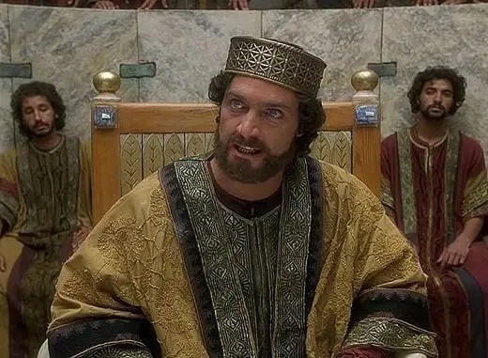
"Our king—the LORD’s anointed, the very life of our nation— was caught in their snares.
We had thought that his shadow would protect us against any nation on earth!"
(Lam 4:20 NLT).

Slide 108
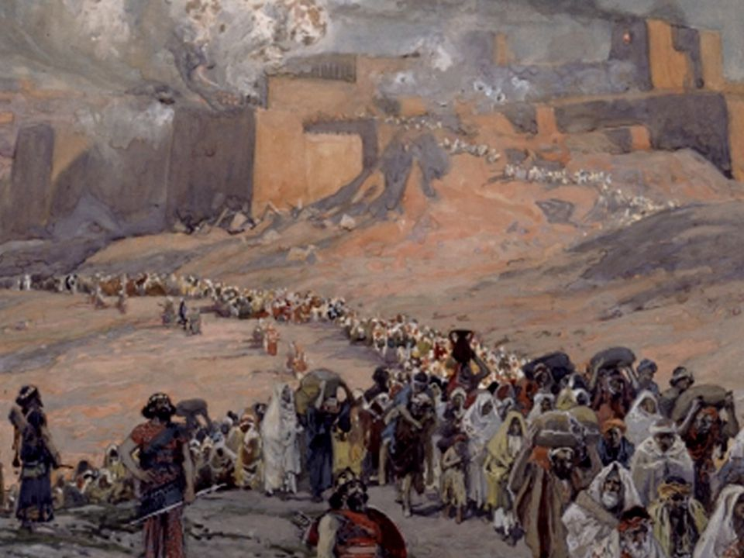
Reasons for the
Babylonian Exile
The key reason was the idolatry practiced by the leaders

Slide 109
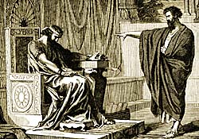
Jeremiah to King Jehoiakim
Jeremiah 15:1
"Even if Moses and Samuel were to stand before Me, My heart would not go out to this people. Send them away from My presence! Let them go!"
Notes:
"Even if Moses and Samuel were to stand before Me, My heart would not go out to this people. Send them away from My presence! Let them go!"

Slide 110
Jeremiah to King Jehoiakim
Jeremiah 15:4
"I will make them abhorrent to all the kingdoms of the earth because of what Manasseh son of Hezekiah king of Judah did in Jerusalem."
Notes:
"I will make them abhorrent to all the kingdoms of the earth because of what Manasseh son of Hezekiah king of Judah did in Jerusalem."

Slide 111
Jeremiah to King Jehoiakim
Jeremiah 16:11-13
"...Your fathers forsook me… and did not keep my law. But you have behaved more wickedly than your fathers… instead of obeying Me. So I will throw you out of this land into a land neither you nor your fathers have known, and there you will serve other gods day and night, for I will show you no favour."
Notes:
"...Your fathers forsook me… and did not keep my law. But you have behaved more wickedly than your fathers… instead of obeying Me. So I will throw you out of this land into a land neither you nor your fathers have known, and there you will serve other gods day and night, for I will show you no favour."

Slide 112
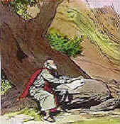
Jeremiah to King Zedekiah
Jeremiah 27:12, 13
"I gave the same message to Zedekiah king of Judah. I said, "Bow your neck under the yoke of the king of Babylon; serve him and his people, and you will live. Why will you and your people die by the sword, famine, and plague with which the Lord has threatened any nation that will not serve the King of Babylon?"
Notes:
"I gave the same message to Zedekiah king of Judah. I said, "Bow your neck under the yoke of the king of Babylon; serve him and his people, and you will live. Why will you and your people die by the sword, famine, and plague with which the Lord has threatened any nation that will not serve the King of Babylon?"

Slide 113
Parallelism in Lamentations 4:1-11
498
4:1-6 |  | 4:7-11
4:1-2 | The value of the sons of Zion has become despised. | 4:7-8 | The value of the princes has become despised.
4:3-5 | The little children and adults suffer. | 4:9-10 | The little children and adults suffer.
4:6 | Conclusion: The calamity is God's punishment. | 4:11 | Conclusion: The calamity is God's punishment.
Bible Knowledge Commentary, 1:1219

Slide 114
Parallels between Lamentations
and Deuteronomy
496
Lamentations |  | Deuteronomy
4:10 | With their own hands, compassionate women have cooked their own children. | 28:56-57 | The most gentle and sensitive woman among you… will begrudge the husband she loves and her own son or daughter the afterbirth from her womb and the children she bears. For she intends to eat them secretly during the siege.
Bible Knowledge Commentary, 1:1209

Slide 115
The Assyrian Threat
454
Assyrian Expansion
Nineveh
Mediterranean
Sea
Aram
Israel
Judah
Isaiah 7
Persian
Gulf
Egypt
Notes:
115
Nineveh repented 100 years earlier than Nahum under Jonah, but then went back to its sin.
Assyrians invaded Israel 60 years earlier than Nahum during Isaiah's day and scattered the people.
Then they destroyed 46 towns of Judah—all but Jerusalem in 701 BC!
———————
Common English-157
OS-23-Isaiah1-12-slide 107
OS-34-Nahum-38

Slide 116

Judgment on the 12-Nation Coalition (Isa 13–23)
457
Babylon
Philistia
Moab
Damascus (Syria)
Israel
Ethiopia
Egypt
Babylon by the Sea
Edom
Arabia
Jerusalem (Judah)
Tyre
Assyria
Phoenicia
Syria
Israel
Babylon
Judah
Philistia
Moab
Babylon by the Sea
Egypt
Edom
Arabia
Ethiopia
Notes:
The temptation for Ahab in Isaiah's time was to trust in a coalition of other nations to fight Assyria—yet God told them to trust him instead. Why? All these nations would fall to Assyria since God had appointed it. The Assyrians later destroyed the northern nation of Israel during Isaiah’s lifetime—as well as 46 cities of Judah.
In such a time of calamity, whom would Judah trust?

Slide 117
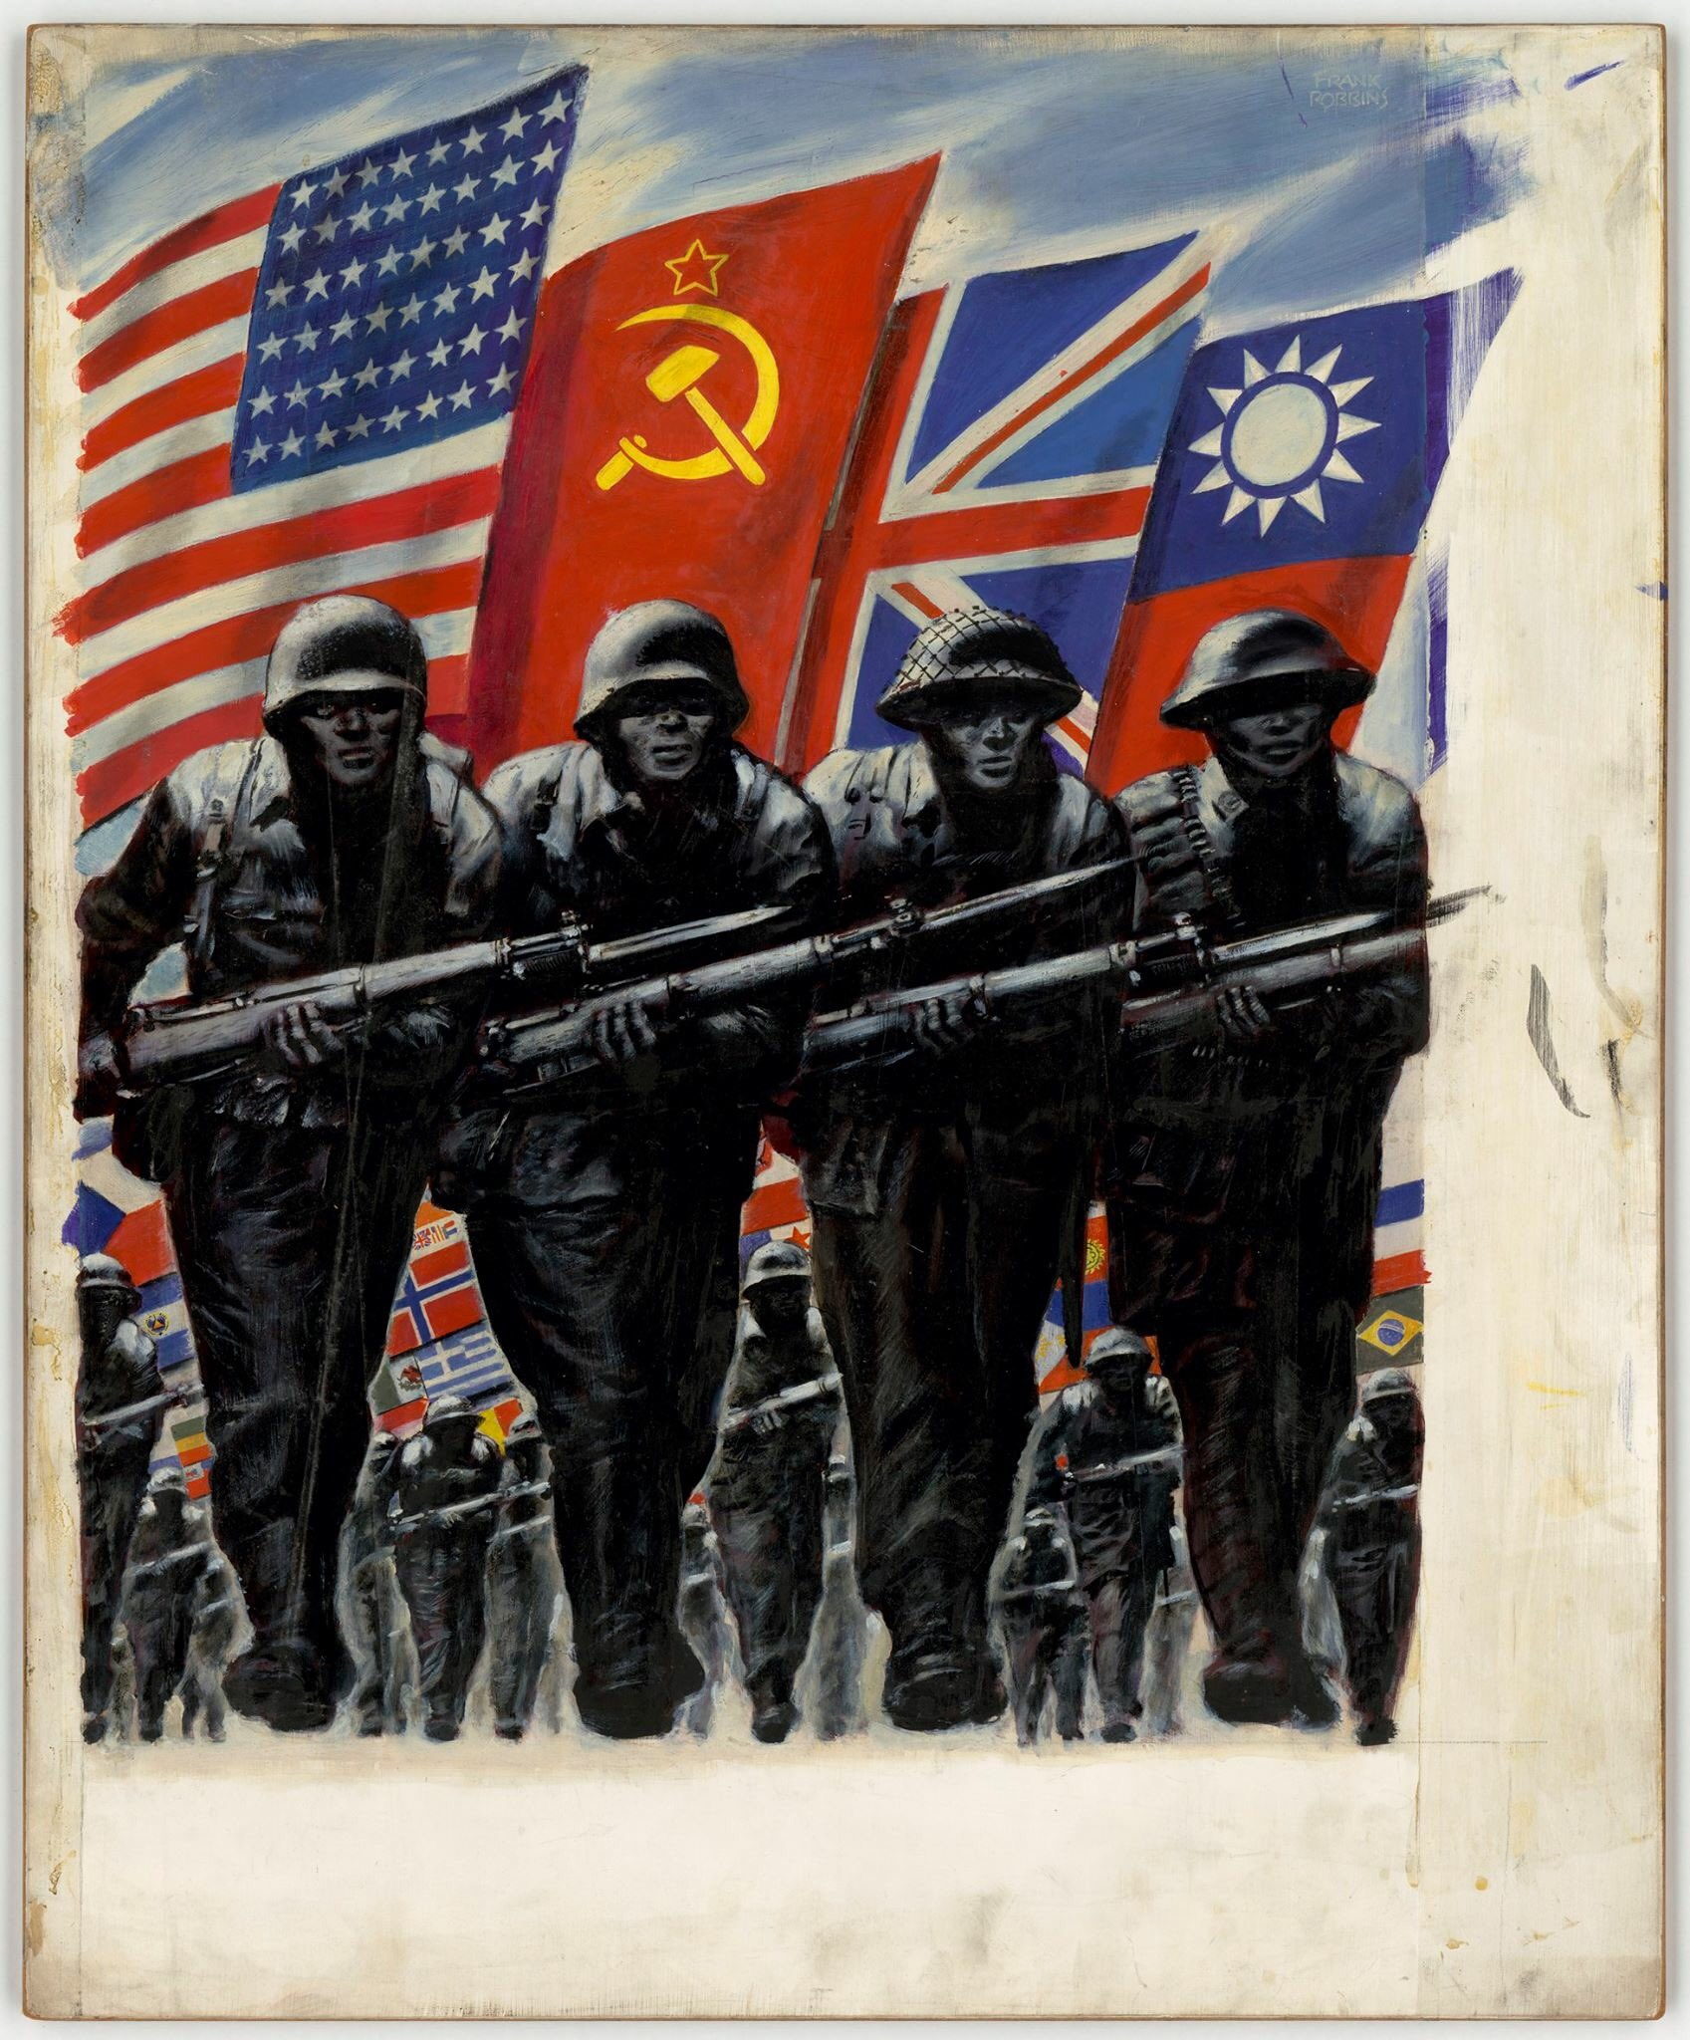
"We looked in vain for our allies to come and save us, but we were looking to nations that could not help us"
(Lam 4:17 NLT).

Slide 118
The Babylonian Threat
Babylonian Expansion
Mediterranean
Sea
Syria
Babylon
Israel
Judah
586 BC
Persian
Gulf
Egypt
Notes:
OS-25-Lamentations-116

Slide 119
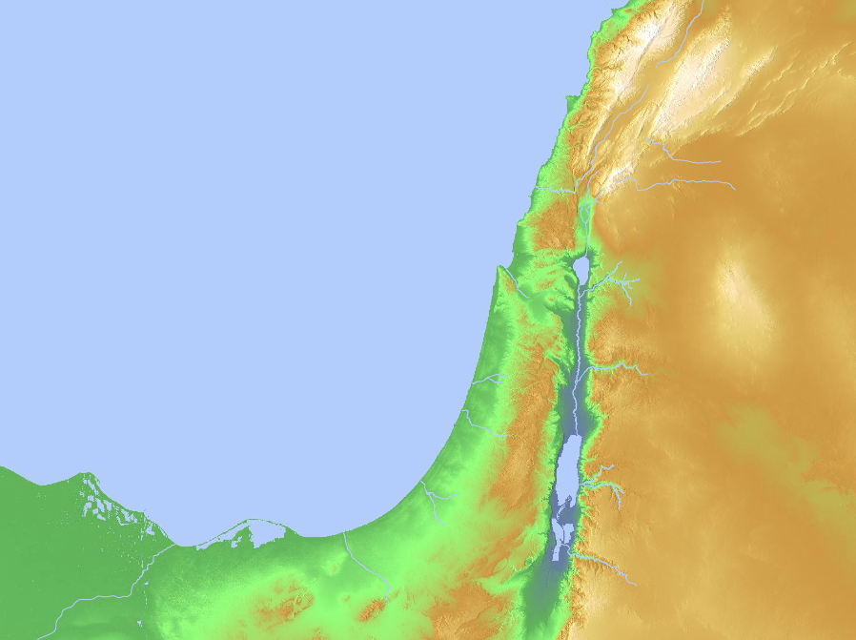
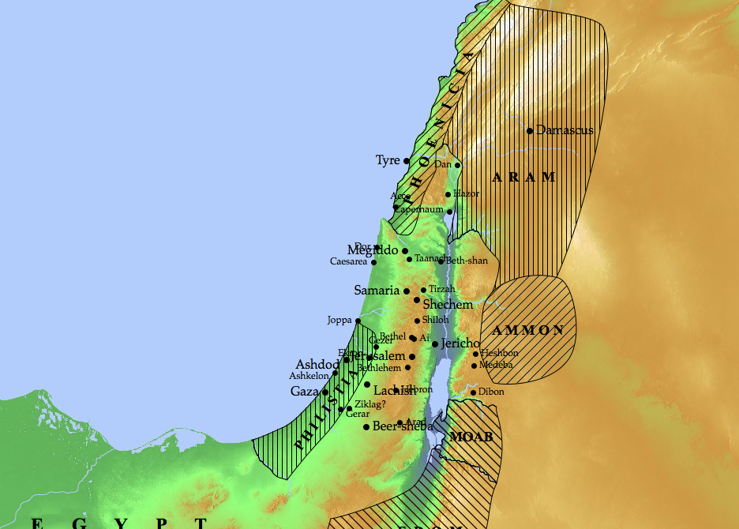
Nations to Be Judged (Ezekiel 25–32)
Sidon
(28:20-26)
Tyre
(26:1–28:19)
Ammon
(25:1-7)
Philistia
(25:15-17)
Moab
(25:8-11)
Egypt
(29–32)
Edom
(25:12-14)
Notes:
God will judge Ammon for rejoicing at the temple’s destruction to show his sovereignty (25:1-7).
God will judge Moab for thinking that Israel was like all of the other nations to show God's sovereignty (25:8-11).
God will judge Edom for avenging Judah to show God's sovereignty (25:12-14).
God will judge Philistia for avenging Judah to show God's sovereignty (25:15-17).
God will judge Tyre so it will never be rebuilt due to its pride in its beauty, power, trade, and leaders to show God's sovereignty (26:1–28:19).
God will judge Sidon for maliciousness against Judah to show his sovereignty by gaining glory in the judgment (28:20-26).
God will judge Egypt by Nebuchadnezzar who will take exiles to Babylon to show God's sovereignty (Ezek 29–32; fulfilled in 571 BC).

Slide 120
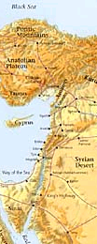
Nations Prophesied Against (Jeremiah 46–51)
485
1. EGYPT (46:1-27) - To be defeated by Babylonians
2. PHILISTIA (47:1-7) - To be overrun by Egyptians
3. MOAB (48:1-47) - To be conquered by Babylon
4. AMMON (49:1-6) - To be destroyed and re-established in
the millennium.
5. EDOM (49:7-22) - To become as Sodom and Gomorrah
6. DAMASCUS (49:23-27) - To be destroyed in a single day
7. KEDAR & HAZOR (49:28-35) - To be destroyed by Nebuchadnezzar
8. ELAM (49:34-39) - To be overrun by Nebuchadnezzar and
re-established during the millennium
9. BABYLON (50:1–51:64) - Final destruction of the empire
Notes:
However, more than just the people of Judah alone, there were prophecies that were addressed to the other non-Israelite cities in those days.

Slide 121
Judgment of the Nations (Jeremiah 46–51)
637
Damascus
(49:23-27)
Babylon
(50–51)
Philistia
(47:1-7)
Elam
(49:34-39)
Ammon (49:1-6)
Moab (48:1-47)
Egypt
(Jer 46)
Edom (49:7-22)
Kedar & Hazor
(49:28-35)

Slide 122

Judgment Against the Nations
(Amos 1–2)
591
Phoenicia
Syria
Amos declared the sins and penalties of Israel and 7 surrounding countries for their sins against God's people, Israel
Israel
Ammon
Philistia
Judah
Moab
Edom
Notes:
Amos declared the sins and penalties of Israel and 7 surrounding countries for their sins against God's people, Israel
______
Common Slides Arabic-245
BE-30-Amos-28
OS-26-Ezek1-39-slide 162
OS-30-Amos-68

Slide 123
Judgment of the Nations (Zephaniah 2:4-15)
637
Assyria
Philistia
(2:4-7)
Moab (2:8-11)
Edom
Ethiopia

Slide 124
"We looked in vain for our allies to come and save us, but we were looking to nations that could not help us"
(Lam 4:17 NLT).

Slide 125
Contrasts Between Edom & Israel in Lamentations 4:21-22
499
Present Condition
Future Condition
Fall of Jerusalem
Edom
Rejoicing—————
Israel Punished
Israel Restored
—————
Edom Punished
Bible Knowledge Commentary, 1:1221
Notes:
Jeremiah sarcastically calls on Edom to rejoice over Jerusalem's doom but warns of their coming judgment as God is fair to all (4:21-22).

Slide 126
Lamentations
493
Five ways to repent…
Emotions of and Reasons for the Fall
Fall Described |  | Judgment Acknowledged |  | Jeremiah's Feelings | Trusting Leaders | Prayer
Chapter 1 |  | Chapter 2 |  | Chapter 3 | Chapter 4 | Chapter 5
The Suffering |  | The Cause |  | The Hope | The Reason | The Lament
3 Line Acrostic (22 verses) |  | 3 Line Acrostic (22 verses) |  | 1 Line Acrostic (66 verses) | 2 Line Acrostic (22 verses) | 1 Line Not Acrostic (22 verses)
People |  | God |  | Prophet | God | People
Third Person Singular ("she") 1:1-11 | First Person Singular ("I") 1:12-22 | Third Person Singular ("she") 2:1-10 | First Person Singular ("I") 2:11–4:22 |  |  | First Person Plural ("us/our") 5:1-22
Jerusalem (586 BC)
Admit
your
need
Admit
your
fault
Hope
in
God
Distrust your
leaders
Do you put more trust in your pastor than in God?
Notes:
Do you check what I say by the Bible or do you just accept what I say as the truth?
Do you read more of the Bible to yourself than I read to you?

Slide 127
Slides on
Lamentations 5

Slide 128
Lamentations
493
Five ways to repent…
Emotions of and Reasons for the Fall
Fall Described |  | Judgment Acknowledged |  | Jeremiah's Feelings | Trusting Leaders | Prayer
Chapter 1 |  | Chapter 2 |  | Chapter 3 | Chapter 4 | Chapter 5
The Suffering |  | The Cause |  | The Hope | The Reason | The Lament
3 Line Acrostic (22 verses) |  | 3 Line Acrostic (22 verses) |  | 1 Line Acrostic (66 verses) | 2 Line Acrostic (22 verses) | 1 Line Not Acrostic (22 verses)
People |  | God |  | Prophet | God | People
Third Person Singular ("she") 1:1-11 | First Person Singular ("I") 1:12-22 | Third Person Singular ("she") 2:1-10 | First Person Singular ("I") 2:11–4:22 |  |  | First Person Plural ("us/our") 5:1-22
Jerusalem (586 BC)
Admit
your
need
Admit
your
fault
Hope
in
God
Distrust your
leaders
Keep
looking
forward
Notes:
Trust that God will indeed restore you.

Slide 129
"LORD, remember what has happened to us.
See how we have been disgraced!
² Our inheritance has been turned over to strangers, our homes to foreigners.
³ We are orphaned and fatherless.
Our mothers are widowed"
(Lam 5:1-3 NLT).
Notes:
The city (“us/our”) laments to God so the remnant will feel their suffering (5:1-15).

Slide 130
"We have to pay for water to drink, and even firewood is expensive.
⁵ Those who pursue us are at our heels; we are exhausted but are given no rest.
⁶ We submitted to Egypt and Assyria to get enough food to survive.
⁷ Our ancestors sinned, but they have died— and we are suffering the punishment they deserved!” (Lam 5:4-7 NLT).

Slide 131
"Slaves have now become our masters; there is no one left to rescue us.
⁹ We hunt for food at the risk of our lives, for violence rules the countryside.
¹⁰ The famine has blackened our skin as though baked in an oven"
(Lam 5:8-10 NLT).

Slide 132
Parallels between Lamentations
and Deuteronomy
496
Lamentations |  | Deuteronomy
5:2 | Our inheritance has been turned over to aliens, our homes to foreigners. | 28:30 | You will build a house, but you will not live in it.
5:5 | We are weary and find no rest. | 28:65 | Among those nations, you will find no repose.
5:10 | Our skin is as hot as an oven, feverish from hunger. | 28:48 | In hunger and thirst… you will serve the enemies the LORD sends against you.
Bible Knowledge Commentary, 1:1209

Slide 133
"Our enemies rape the women in Jerusalem and the young girls in all the towns of Judah.
¹² Our princes are being hanged by their thumbs, and our elders are treated with contempt.
¹³ Young men are led away to work at millstones, and boys stagger under heavy loads of wood.
¹⁴ The elders no longer sit in the city gates; the young men no longer dance and sing.
¹⁵ Joy has left our hearts; our dancing has turned to mourning"
(Lam 5:11-15 NLT).

Slide 134
"The garlands have fallen from our heads.
Weep for us because we have sinned.
¹⁷ Our hearts are sick and weary, and our eyes grow dim with tears.
¹⁸ For Jerusalem is empty and desolate, a place haunted by jackals"
(Lam 5:16-18 NLT).
Notes:
The city (“us/our”) confesses sin to exhort the remnant to repent (5:16-18).

Slide 135
Parallels between Lamentations
and Deuteronomy
496
Lamentations |  | Deuteronomy
5:11 | Women have been ravished in Zion and virgins in the towns of Judah. | 28:30 | You will be pledged to be married to a woman, but another will take her and ravish her.
5:12 | Elders are shown no respect. | 28:50 | …a fierce-looking nation without respect for the old…
5:18 | Mount Zion… lies desolate, with jackals prowling over it. | 28:26 | Your carcasses will be food for all the birds of the air and the beasts of the earth, and there will be no one to frighten them away.
Bible Knowledge Commentary, 1:1209

Slide 136
"But LORD, you remain the same forever!
Your throne continues from generation to generation.
²⁰ Why do you continue to forget us?
Why have you abandoned us for so long?
²¹ Restore us,
O LORD, and bring us back to you again!
Give us back the joys we once had!
²² Or have you utterly rejected us?
Are you angry with us still?"
(Lam 5:19-22 NLT).
Notes:
The city (“us/our”) prays for restoration to encourage the remnant to hope for renewal (5:19-22).

Slide 137
Lamentations
493
Five ways to repent…
Emotions of and Reasons for the Fall
Fall Described |  | Judgment Acknowledged |  | Jeremiah's Feelings | Trusting Leaders | Prayer
Chapter 1 |  | Chapter 2 |  | Chapter 3 | Chapter 4 | Chapter 5
The Suffering |  | The Cause |  | The Hope | The Reason | The Lament
3 Line Acrostic (22 verses) |  | 3 Line Acrostic (22 verses) |  | 1 Line Acrostic (66 verses) | 2 Line Acrostic (22 verses) | 1 Line Not Acrostic (22 verses)
People |  | God |  | Prophet | God | People
Third Person Singular ("she") 1:1-11 | First Person Singular ("I") 1:12-22 | Third Person Singular ("she") 2:1-10 | First Person Singular ("I") 2:11–4:22 |  |  | First Person Plural ("us/our") 5:1-22
Jerusalem (586 BC)
Admit
your
need
Admit
your
fault
Hope
in
God
Distrust your
leaders
Keep
looking
forward
Do you pray for restoration?
Notes:
Trust that God will indeed restore you.

Slide 138
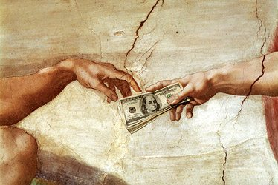

Notes:
Joel Osteen wrote the book entitled Your Best Life Now.
• John MacArthur’s comment on this was, “If you are living your best life now, then you are headed for hell.”

Slide 139

Notes:
Do you believe that your best days are ahead? You can if you trust in God’s full restoration of your life at death or the return of Christ.
Trust in the most trustworthy of all people—the only one who died for your sins and then proved it by rising from the dead!

Slide 140
How should you repent?
How should you change your mind about evil, Jesus, and your sin?
Notes:
The book of Lamentations can help us see in real terms what repentance looks like.

Slide 141
Main Idea of Lamentations
Be repentant over your sin by changing your mind to view sin as God does.
Notes:
We need to realign our thinking about our doing wrong—our depravity. God doesn’t excuse it, so neither should we.

Slide 142
Lamentations
493
Five ways to repent…
Emotions of and Reasons for the Fall
Fall Described |  | Judgment Acknowledged |  | Jeremiah's Feelings | Trusting Leaders | Prayer
Chapter 1 |  | Chapter 2 |  | Chapter 3 | Chapter 4 | Chapter 5
The Suffering |  | The Cause |  | The Hope | The Reason | The Lament
3 Line Acrostic (22 verses) |  | 3 Line Acrostic (22 verses) |  | 1 Line Acrostic (66 verses) | 2 Line Acrostic (22 verses) | 1 Line Not Acrostic (22 verses)
People |  | God |  | Prophet | God | People
Third Person Singular ("she") 1:1-11 | First Person Singular ("I") 1:12-22 | Third Person Singular ("she") 2:1-10 | First Person Singular ("I") 2:11–4:22 |  |  | First Person Plural ("us/our") 5:1-22
Jerusalem (586 BC)
Admit
your
need
Admit
your
fault
Hope
in
God
Distrust your
leaders
Keep
looking
forward
Notes:
1—Do you confess that your sin has put you into a sad state?
2—Do you say the same thing that God says about your sin?
3—Do you have misplaced hope—or is it in God alone?
4—Do you put more trust in me than in God?
5—Do you pray for restoration?

Slide 143
American Couple Believing 'Evil Is A Make-Believe Concept' Bike Through Territory Near Afghan Border. ISIS Stabs Them To Death.
Notes:
Remember the young American couple who took a year-long bike trip around the world, believing that evil was a make-believe concept? They took a fatal route in Tajikistan near the Afghan border, where alleged ISIS terrorists stabbed them to death. They let their guard down, not believing that evil was just around the corner.
________
American Couple Believing 'Evil Is A Make-Believe Concept' Bike Through Territory Near Afghan Border. ISIS Stabs Them To Death.
https://www.dailywire.com/news/34581/american-couple-believing-evil-make-believe-hank-berrien
Screenshot: CBS This Morning
By Hank Berrien
August 16, 2018 1.4m views
Accessed 15 Sep 2018

Slide 144
Application
493
Beware lest you think you stand and begin to take God's grace for granted.
When we are punished by God, our only hope lies in turning to our "Enemy"
(Huang Sabin)

Slide 145
Just trust me.
—God

Slide 146
Black

Slide 147


OT Preaching link at BibleStudyDownloads.org
Get this presentation and script for free!

Slide 148

Theology
The Inviolability of Jerusalem
The Day of YHWH
Realized Wrath
Results of Sin
The LORD as "Enemy"
YHWH's Transcendence
Universalization
Job vs. Lamentations

Slide 149
Contrasting Zephaniah, Habakkuk, and Lamentations
633
Zephaniah | Habakkuk | Lamentations
Decades before the fall of Jerusalem (ca. 630) | Just before the fall of Jerusalem (ca. 607-605) | Just after the fall of Jerusalem (586)
God will judge | God, when will you judge? | God has judged
Preview of trouble | Promise of trouble | Presence of trouble
Notes:
Chronologically, these writings appear in the order of Zephaniah, Habakkuk, and Lamentations. Yet they address the issue of God judging sin in Judah.
___________________
OS-25-Lamentations-148
OS-35-Habakkuk-161
OS-36-Zephaniah-22

Slide 150
Contrasting Zephaniah, Habakkuk, and Lamentations
633
Zephaniah | Habakkuk | Lamentations
Declaration | Dialogue | Dirge
Day of the LORD | Dominion of the LORD | Destruction of the LORD
God is in your midst (3:15, 17) | God is your strength (3:19) | God is your portion (3:24)
Notes:
Chronologically, these writings appear in the order of Zephaniah, Habakkuk, and Lamentations. Yet they address the issue of God judging sin in Judah.
___________________
OS-25-Lamentations-149
OS-35-Habakkuk-162
OS-36-Zephaniah-23

Slide 151
Theology
8. Job vs. Lamentations
Job | Jerusalem
Undeserved | Deserved
No Historical Setting | Definite Historical Setting
Severity of Attack Prompts a question as to God's apparent lack of mercy. Explicit (Job 9:22-25) | Severity of Attack Prompts a question as to God's apparent lack of mercy. Implicit (2:2,17,21; 3:43)

Slide 152
Theology
The Inviolability of Jerusalem
The Day of YHWH
Realized Wrath
Results of Sin
The LORD as "Enemy"
YHWH's Transcendence
Universalization
Job and Lamentations
Faith Rises from Ashes of Disaster
God is Just, not Irrational

Slide 153

Canonical Context
Realisation &
Retribution
"Restore us to yourself,
O LORD, that we may return; renew our days as of old" (5:21)

Slide 154

Psalm 48:1-2 (NIV)
    "Great
    is the LORD,
    and
    most worthy
    of praise,
    in the city of our God,
    his holy mountain.
    It is beautiful in its loftiness,
the joy of the whole earth."

Slide 155

Psalm 102:14 (NIV)
    "For her stones are dear to your servants;
    her very dust moves them to pity.'

Slide 156

Psalm 137:5-6 (NIV)
    "If I forget you, O Jerusalem, may my right hand forget its skill.
    May my tongue cling
    to the roof of my mouth
    if I do not remember you,
    if I do not consider Jerusalem
    my highest joy.'

Slide 157
A
M O D E R N
L A M E N T A T I O N

Slide 158

The Twin Towers

Slide 159

The Pentagon

Slide 160

The Dust Aftermath

Slide 161

Remaining Firefighters

Slide 162

The Street

Slide 163

The Clean-up

Slide 164

The Statue of Liberty

Slide 166
OT Survey link at BibleStudyDownloads.org
Get this presentation for free!
Notes:
OT Survey (os)

