Slide 1
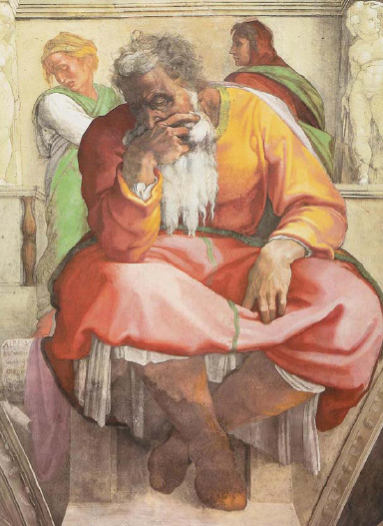
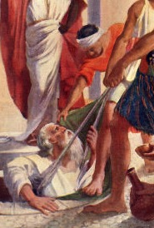
JEREMIAH
"THE WEEPING PROPHET" OR "THE PROPHET OF HOPE"?
Dr. Rick Griffith • Jordan Evangelical Theological Seminary • BibleStudyDownloads.org

Slide 2
Key Word
474
343
Inevitable
Jeremiah
Notes:
By the time we get to Jeremiah, God proclaims that the exile will definitely come. It is inevitable.

Slide 3
Theme
474
Deserved Captivity & Undeserved Restoration
Jeremiah
Notes:
Jeremiah’s theme is that captivity is deserved but also the restoration is undeserved and will also happen.

Slide 4
Key Verse
474
"…For the LORD our God has doomed us to perish and given us poisoned water to drink, because we have sinned against him" (8:14b).
Jeremiah
Notes:
Judgment was because of Judah’s sin, as the key verse indicates in 8:14.

Slide 5

Kingdom Statement
343
The judgment of Jerusalem was inevitable due to her refusal to obey the old covenant (1–19), yet after a 70-year captivity (25:11-12) and judgment on the Gentiles, Israel will submit to God's rule under a new covenant (30–33).
Jeremiah

Slide 6

Summary Statement
474
346
The deserved fall of Jerusalem, 70-year captivity, judgment of Gentiles, and restoration under a new covenant give hope and exhort Judah to accept God's inevitable discipline by yielding to Babylon.
Jeremiah

Slide 7

Covenant
347b
The old covenant tablets of stone leading to Israel's judgment will be replaced with a new covenant of blessing through the Holy Spirit's indwelling their hearts after repentance and forgiveness (31:31-33).
Jeremiah

Slide 8

Redemption
347b
Redemption in a spiritual renewal (chapters 30–33) awaits Israel after her unfaithfulness ends, which is a redemption that will occur because Israel will never cease to exist as a nation (31:35-37).
Jeremiah

Slide 9

Messiah
347b
The Shepherd Messiah and Righteous Branch (23:1-8) and the new covenant he brings (31:31-33) point to Christ's rule and the forgiveness in his blood he portrayed in the Lord's supper (Luke 22:20).
Jeremiah

Slide 10
Jeremiah Book Chart
474
Deserved Captivity & Undeserved Restoration
Prophetic Call | Judah's Judgment Deserved |  |  |  | Nations' Judgment Deserved |  |  |  | Jerusalem's Fall
Chapter 1 | Chapters 2–45 |  |  |  | Chapters 46–51 |  |  |  | Chapter 52
Commission | Condemnation & Comfort |  |  |  | Condemnation |  |  |  | Captivity
Judgment but God's presence 1 | Pre-Fall 2–38 | Fall 39 | Post-Fall 40–44 | Baruch 45 | Southwest 46–47 | East 48:1–49:22 | North 49:23-33 | Northeast 49:34– 51:64 | Fall 52:1-30 | Rise 52:31-34
Prologue | Ministry |  |  |  |  |  |  |  | Epilogue
Judah |  |  |  |  | Nations |  |  |  | Babylon
c. 627-580 BC
Notes:
The book is divided into 4 main sections. After the first section in chapter 1 on Jeremiah's call, his person and identity, Jeremiah got down to work very quickly in Chapter 2. Many object lessons run through the 2nd segment where God asks Jeremiah to do unusual things. These give the Judeans an obvious reminder of what they had not done and their failure to return and repent before God. However, buried between this segment in chapters 30-33 is a message of hope in a future restoration, often called Book of Comfort. Embedded here is also the new covenant. After that from chapter 34 onwards are warning after warning against disobedience. But interestingly, chapter 45 records an incident where Barush was encouraged 20 years earlier but is placed here to encourage and show God's sovereignty. This is also a reminder of the encouragement that God gave to Jeremiah in 1:19.. The next segment includes prophecies against the nations that persecuted Judah, many of which where fulfilled while some remain still future. The prophecies end with Babylon, empahsizing how God would very certainly destroy them. This brought hope to the Israelites at that time when they couldn't see beyond their suffering and subjugation. So the reality that future judgment lay ahead for Babylon was also an important encouragement for them to know that their God was a just God.

Slide 11
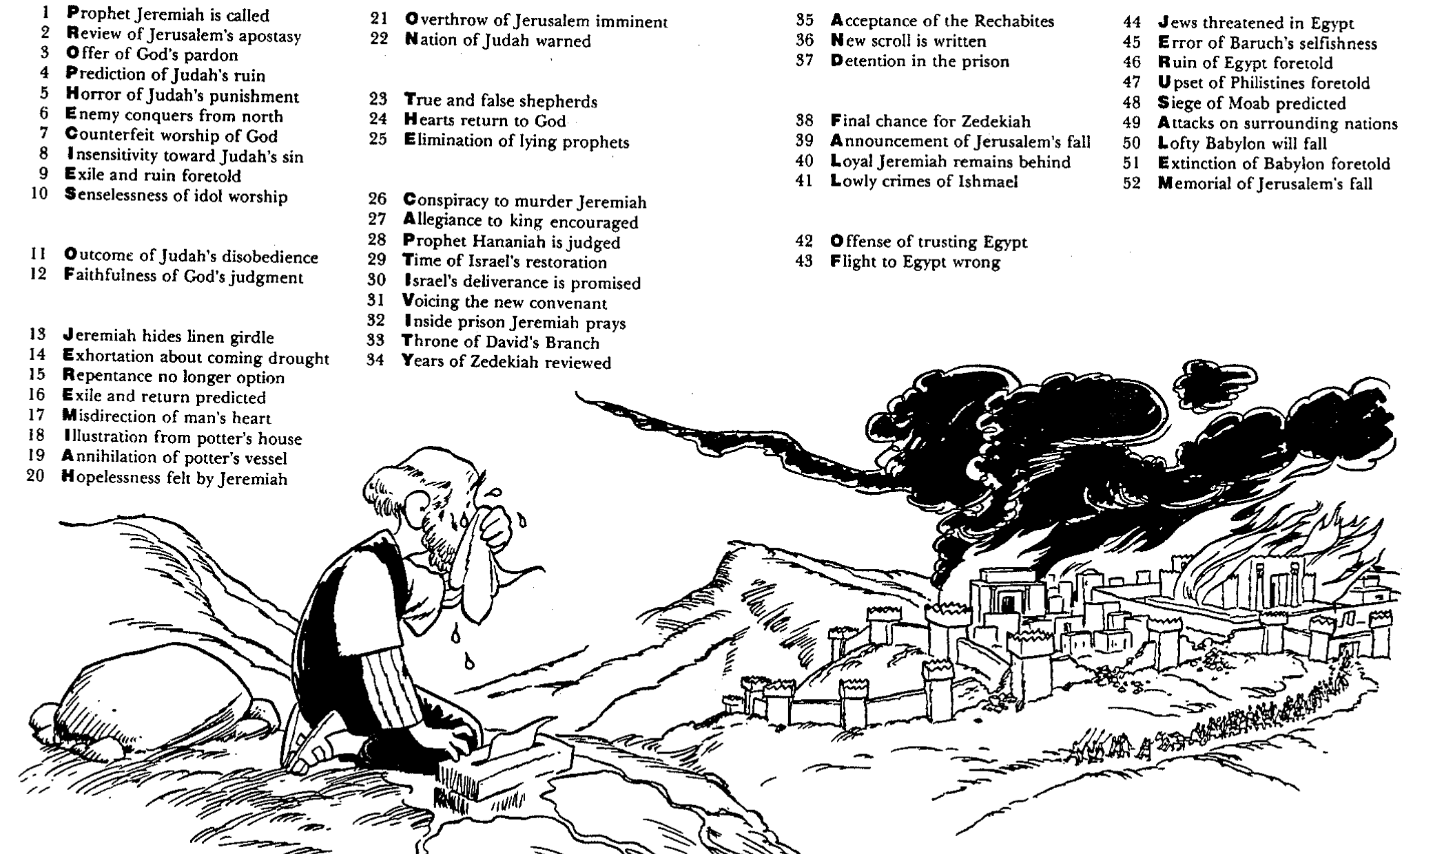
Barry Huddleston, The Acrostic Summarized Bible (Grand Rapids: Baker, 1992)
1 Inception of the world
2 Newlyweds placed in Eden
3 Temptation and man's fall
4 Hatred and first murder
5 Entire genealogy of Adam
6 Lessons on proper priorities
7 Outline for personal relationships
8 Faith of the centurion
Jeremiah
29 Genealogy of Jesus Christ
30 Opposition of King Herod
31 Spirit's descent upon Jesus
32 Power over Satan's temptations
33 Expounding Sermon on Mount
34 Lessons on proper priorities
35 Outline for personal relationships
36 Faith of the centurion
9 Matthew's call from Jesus
10 Apostles sent to preach
11 Testimony about John's message
12 True Messiah called demonic
13 Hidden message of parables
14 Execution of the Baptist
15 Wisdom is answering Pharisees
37 Matthew's call from Jesus
38 Apostles sent to preach
39 Testimony about John's message
40 True Messiah called demonic
41 Hidden message of parables
42 Execution of the Baptist
43 Wisdom is answering Pharisees
16 Keys of the kingdom
17 Impact of Jesus' transfiguration
18 Need for true forgiveness
19 Grounds for divorce clarified
20 Opportunities in the vineyard
21 Fig tree is cursed
44 Keys of the kingdom
45 Impact of Jesus' transfiguration
46 Need for true forgiveness
47 Grounds for divorce clarified
48 Opportunities in the vineyard
49 Fig tree is cursed
22 Taxes paid to Caesar
23 Hypocrisy denounced by "woes"
24 Events of second coming
25 Judgment of the nations
26 Events on Calvary's eve
27 Way of the cross
28 Savior's resurrection and commission
50 Taxes paid to Caesar
51 Hypocrisy denounced by "woes"
52 Events of second coming
53 Judgment of the nations
54 Events on Calvary's eve
55 Way of the cross
56 Savior's resurrection and commission
Notes:
Translate the chapter content on the side panels. Then move the white box underneath above to the top above the text, then shift translated text from the sides onto the slide on top of the white text boxes.

Slide 12
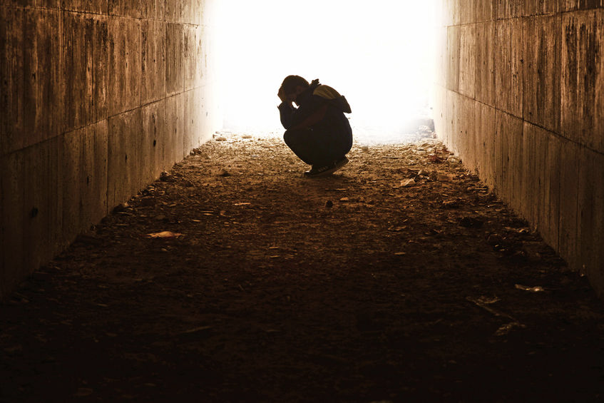
Be Comforted
Jeremiah
Dr. Rick Griffith • Crossroads International Church Singapore
CICFamily.com • BibleStudyDownloads.org

Slide 13
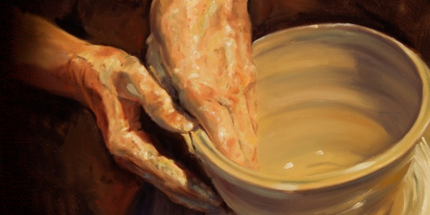
How does God comfort even those he disciplines?
Notes:
In what ways can we see God's compassion even when he has to punish sin?

Slide 14
Main Idea of Jeremiah
God works within his own limits so we will submit to his discipline.
Notes:
Be encouraged that the LORD restrains his own punishing our sin for us to return to him.

Slide 15
I. God calls messengers who are honest with us (Jer 1).
How does God comfort even those he disciplines?
Notes:
The LORD assures that he has a representative who tells us both his discipline and restoration.

Slide 16
II. God has limited discipline but unlimited blessing
(Jer 2–45).
How does God comfort even those he disciplines?
Notes:
The LORD's punishment is always less than his rewards.

Slide 17
III. God applies the same standard to all people
(Jer 46–51).
How does God comfort even those he disciplines?
Notes:
He will judge unbelievers as well as his own people.

Slide 18
IV. God balances justice with mercy (Jer 52).
How does God comfort even those he disciplines?
Notes:
He judges but also restores.

Slide 19

Are You Part of the Faithful Remnant?
NO HOPE?
  Do you put your hope in your faithful and merciful God?
  Do you look forward to the Day of the LORD and the complete restoration it promises?
or...

Slide 21

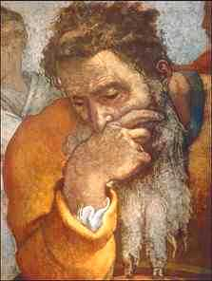
Overview
Background
Outline
Application

Slide 22
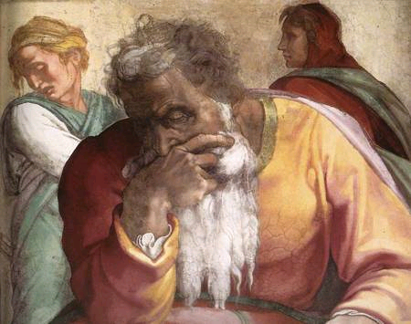
1. BACKGROUND OF JEREMIAH

Slide 23
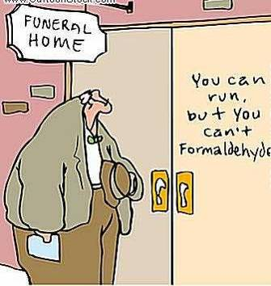
Ever felt like the future is uncertain?
JEREMIAH
=
INEVITABLE
Captivity
+
Restoration

Slide 24
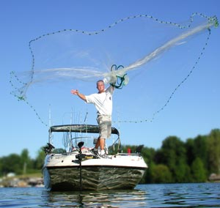
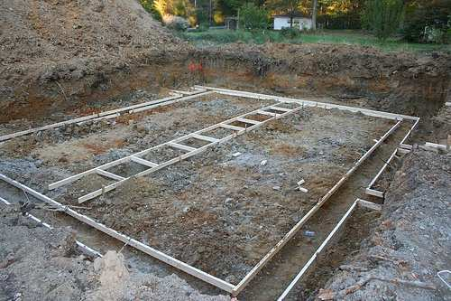
Jeremiah - Yirməyāhū in Hebrew
475
From either of 2 roots meaning
"cast, shoot" or "loosen":
"Yahweh establishes,
appoints or sends"
2. "Yahweh throws,"
perhaps in the sense of
laying a foundation

Slide 25
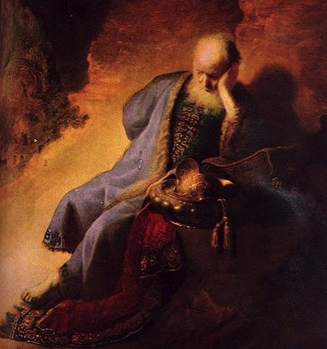
Who was Jeremiah?
Rembrandt van Rijn –
Jeremiah Lamenting
the Destruction of Jerusalem

Slide 26
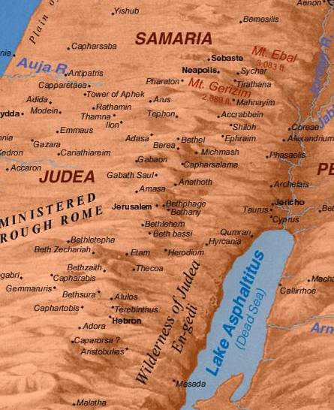
Biography:
485
Son of Hilkiah, a priest (Jer. 1:1)
Lived in town of Anathoth
3 miles (5 km.) NE of Jerusalem
Began his ministry around 20 years old
Was well-off enough to buy a field (Jer. 32)

Slide 27

Authorship
475
 | Yes, it was Jeremiah! | No, it was not Jeremiah!
External Evidence | 1) Explicitly: Daniel 9:2 Matthew 2:17-18 2) Implicitly in Matt. 21:13; Mark 11:17; Luke 19:46, Rom. 11:27 and Heb. 8:8-13 3) The Talmud, Josephus, and Ecclesiasticus | Chap 52 is nearly identical to 2 Kings 24:18–25:30 It is likely that chap 52 was recorded by the same author as the 2 Kings postscript under the direction of the Holy Spirit
Internal Evidence | Jer. 1:1, 11, 23; 29:27; 32:7-9. Jeremiah is clearly identified with the biographical information provided. | 51:64 says "the words of Jeremiah end here."

Slide 28
Placing the Prophetical Books
445
S "O" S
Pre-Exile
(800-606 BC)
Exile
(606-536 BC)
Post-Exile
(536-400 BC)
S
O
L
O
M
O
N
D
A
V
I
D
Israel
Hosea
Amos
Assyria
Jonah
Nahum
S
A
U
L
"HA"
"NAH"
Jews in Jerusalem
Haggai
Zechariah
Malachi
Judah
Habakkuk
Isaiah
Jeremiah
Joel
Micah
Zephaniah
Lamentations
Jews in Exile
Ezekiel
Daniel
Edom
Obadiah
"HIJJMZL"
"IE"
(In Exile)
"HaZeMa"
(final
OT books)
"BAD"
The Daily Walk
Adapted from Walk Thru the Old Testament
Walk Thru the Bible Press, 1978
Notes:
The UK (United Kingdom) had the kings Saul, David, and Solomon.
Yet the UK had warning signs as SDS almost looks like SOS
Sure enough, the UK split with Israel in its own "Brexit" in the north
This began the Pre-Exile prophets
Israel was the first to say "HA" to God in rejection, so God sent Hosea and Amos
Meanwhile, Assyria was even worse. After first repenting under Jonah, they later said "NAH" so God sent both JoNAH and NAHum to warn them.
Of course, Edom as a blood relative to Israel and should have known better, so they were really BAD. Thus, God sent them OBADiah.
Jews in Exile included only Ezekiel and Daniel, who were the only two prophets with IE in their name = In Exile.
But God brought the people of Judah back as Jews in Jerusalem and raised up 3 prophets with the memory device HaZeMa.
But we can't forget th largest group of prophets back in the Pre-Exile times, but how can we remember all 7 of them?
Fortunately, singing Twinkle, Twinkle with their first letters gives HIJJMZL, which, sung over and over, is unforgettable.
______________
Common Slides English-147
Kings & Prophets Charts-18
23-Prophets Intro-12
OS-24-Jeremiah-28
OS-31-Obadiah-14

Slide 29
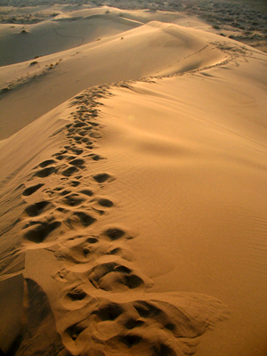
Jeremiah in the Line of Prophets
344
Obadiah - Edom
Jonah - Compassion
Amos - Injustice
Hosea - Loyal
Isaiah - Restoration
Micah - Exploitation
Nahum - Nineveh
Habakkuk - Faith
Zephaniah - Day
Joel - Locusts
Jeremiah – Inevitable
→ Lamentations
→ Daniel, Ezekiel (Exile)

Slide 30

Ample Warning For Judah
735-710 BC Micah: Judah will suffer exile for exploitation of poor
c. 630 BC Zephaniah: Day of the Lord is coming - Repent!
4 decades before Jerusalem's fall
607-5 BC Habakkuk: Judah will be disciplined by Babylon
590 BC Joel: Judgment by locusts should cause repentance before Babylon's invasion
627-580 BC Jeremiah: Judgment is inevitable.
70 years captivity!

Slide 31
Length of Prophetic Ministries
Isaiah
65 Years
Hosea
45 Years
Jeremiah
40+ Years
Micah
25 Years
Notes:
Jeremiah reveals himself as author and reveals that his ministry lasted over four decades from Josiah's thirteenth year (627 BC) to the exile (1:1-3; 586 BC).

Slide 32
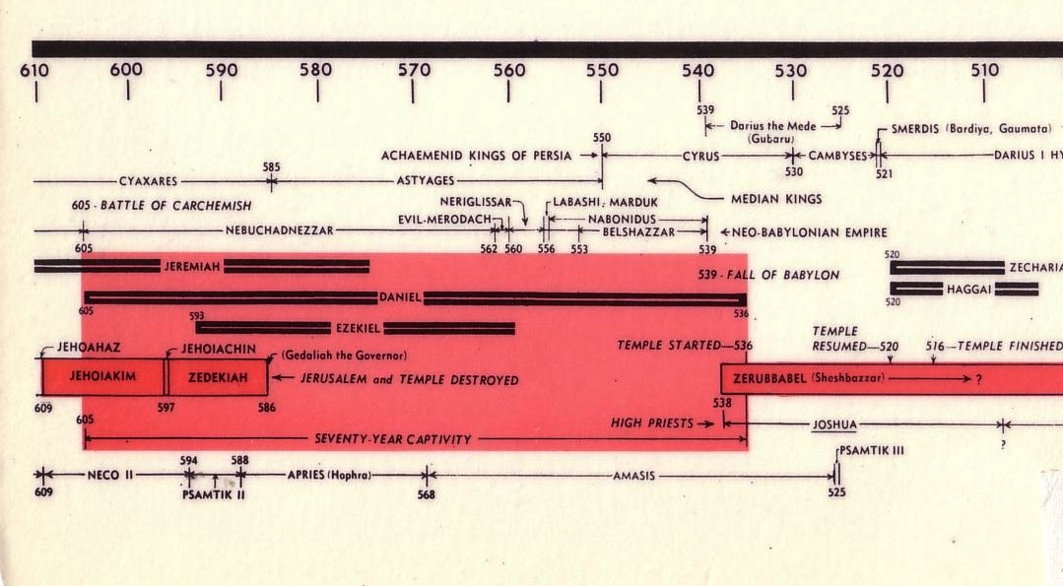
Chart of the Exile
232 & 342
The Babylonian Exile
John C. Whitcomb, 4th rev. ed., Winona Lake, IN: BMH Books, 1962, 1968

Slide 33
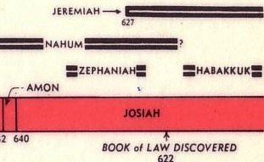
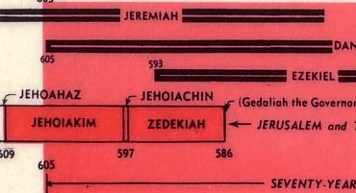
Chart of OT Kings & Prophets
342

Slide 34
Chronology of Jeremiah
560
475
PERIODS OF PROPHETIC MINISTRY
627-622
608-605
593-586
586-585
627
609
605
597
586
Major Events:
Josiah's death
Babylonian invasion
Babylonian deportation
Babylonian exile
1
2
3
Call
Daniel ministers in Babylon
Kings of Judah:
Ezekiel ministers in Babylon
Josiah
(640-609)
Jehoahaz
(609)
Jehoiakim
(608-598)
Jehoiachin
(598-597)
Zedekiah
(597-586)
3 months
11 years
3 months
11 years
Jeremiah prophesied from the 13th year of Josiah (627 BC)
past the fall of Judah (586 BC) to about 580 BC.
His ministry spanned 4 decades and the reigns of 5 kings of Judah.
Notes:
Same slide in:
OS-24-Jeremiah-34
OS-25-Lamentations-7

Slide 35
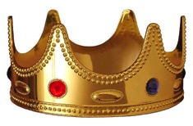
Rulers He Ministered Under
485
475-6
1. JOSIAH - Judah's last godly king
2. JEHOAHAZ - (son of Josiah) Weak ruler deposed by Pharaoh Neco in 3 mos.
2. JEHOIAKIM - (son of Josiah) Ungodly, Bible burning king
3. JEHOIACHIN - (son of Jehoiakim) a ninety-day wonder judged by God
4. ZEDEKIAH - (uncle of Jehoiachin) Judah's final king
5. NEBUCHADNEZZAR - Great Babylonian conqueror
6. GEDALIAH – Babylonian-appointed governor of occupied city of Jerusalem
7. JOHANAN - Successor of Gedaliah who was assassinated

Slide 36
An Evil End to Judah
256
1
Josiah
640-609
(31 yrs.)
Good king in white
Evil kings in yellow
3
5
2
Johanan
(no rule)
Jehoiakim (Eliakim)
609-597
(11 yrs.)
Zedekiah
(Mattaniah)
597-586
(11 yrs.)
Jehoahaz
(Shallum)
609
(3 mos.)
4
Jehoiachin
(Jeconiah/Coniah)
597
(3 mos.)
Babylon
Exiled
Notes:
The last five kings of Judah comprised only three generations. That's because it was such a turbulent time that two of them served only 3 months each! Josiah was the final good king with a long rule of 31 years,
• but his son Jehoahaz ruled only three months before getting exiled to Egypt, the rising superpower
• who replaced him with his brother Jehoiakim. However, Egypt lost to Babylon, the rising competitor to the north, so the third generation here in the person of
• Jehoiachin also reigned only 3 months like his uncle Jehoahaz. Jehoiachin was then exiled ahead of the rest of Judah to Babylon, and his other uncle,
• Zedekiah, became Judah's puppet king under Babylon. But none of these last four kings would submit to the LORD, and Zedekiah was the last Jewish king to this day. Jeremiah tried to get him to submit to God's discipline, but to no avail. In 586 the city was destroyed, temple was raided and made into ruins, and 10,000 people were forcably exiled to Babylon.

Slide 37
Josiah's Sons & Prophets
232
342
Daniel
605
Ezekiel
City Fell
Jehoahaz
Josiah
Jehoiakim
Jehoiachin
Zedekiah
609
597
586
(3 mos.)
(11 yrs.)
(3 mos.)
(11 yrs.)
Jeremiah
627
Brief Puppet Kings
Notes:
Jeremiah was the only prophet to live through the 586 BC fall of Jerusalem. God called him to show God’s compassion even in Judah’s darkest hours. How? Josiah was the last good king, who died in 609. • After him the reigns of his descendants alternated between 3 months• to 11 years • to 3 months • to 11 years once again! • But God spoke to these godless kings through three major prophets. Jeremiah was the only one to preach in Jerusalem until the city fell in 586, • while Daniel was taken to Babylon in 605 • and Ezekiel in 597.

Slide 38
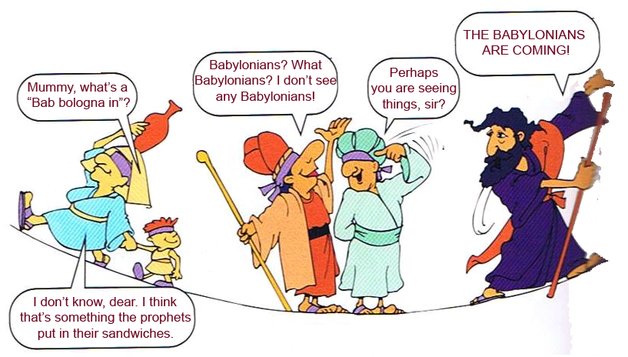
Bab bologna in – who??
RED ALERT!
RED ALERT!
Or what?? Something prophets put in their sandwiches??
Notes:
The people in Israel were not too concerned about Babylon, in fact they thought they were secure in their successes

Slide 39
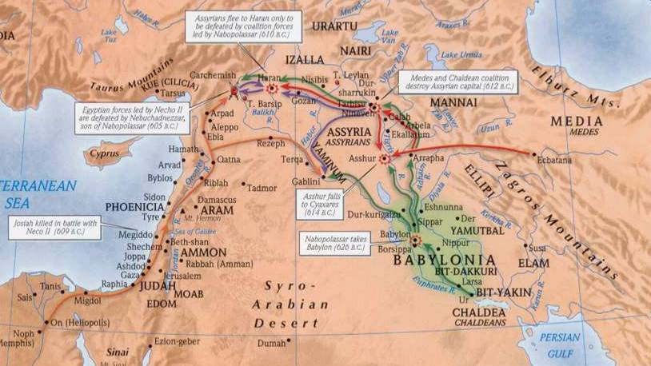
Geography of Jeremiah
475-6
1
3
2
1. Assyria: Since 722 BC, Assyria dominated Jerusalem.
2. Babylon: In 612 BC Nineveh, Assyria's capital, fell to Babylon. This meant Judah would be subject to Babylon.
3. Egypt: Assyria-Babylon conflicts gave Egypt control of Israel. Pharaoh Neco killed Josiah of Judah in 609 BC, then his son Jehoahaz ruled 3 months. Neco replaced him with his brother Jehoiakim.

Slide 40
Geography of Jeremiah
475-6
Geography of Jeremiah
4
1
3
2
4. Babylon: When Egypt was defeated by Nebuchadnezzar of Babylon at the Battle of Carchemish (605 BC), Jehoiakim switched allegiance from Egypt to Babylon.

Slide 41
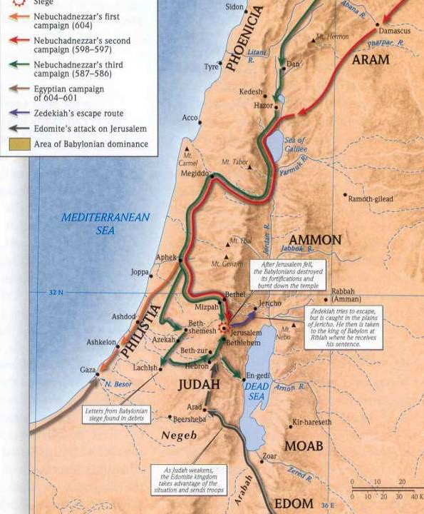
Campaigns
475-6
Egypt: Four years later
(601 BC), Egypt defeated Nebuchadnezzar and Jehoiakim switched his allegiance back to Egypt. What a mistake!
Babylon: In 597 BC Nebuchadnezzar attacked Jerusalem and killed Jehoiakim. He was replaced with Jehoiachin but 3 months later he deported him to Babylon with 10,000 others.
  He was replaced with his uncle Zedekiah, who ruled 11 years until the siege and fall of Jerusalem in 586 BC.
Notes:
Brown arrows from bottom represent the Egyptian campaign

Slide 42
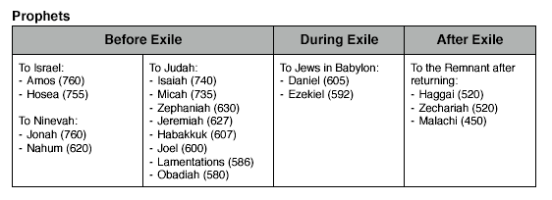
Who Were the Recipients? (1)
475
Notes:
A recap of which books were written to whom, as we see from this chart, Jeremiah is written to Judah. Let's take a closer look.

Slide 43
Who Were the Recipients? (2)
475
Exiles in
Babylon
before the Fall:
Encouragement
Jer. 29
Judah
before
the Fall:
WARNING
Exiles
after
the Fall
Jer. 38-44, 52
Notes:
Jeremiah addressed the people of Judah: (1) as a warning before the Fall, (2) as an encouragement to Exiles before the Fall, and (3) to Exiles after the Fall. The different widths of the circles represent the relative numbers of people.

Slide 44
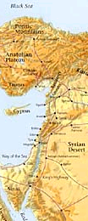
Nations Prophesied Against (Jer. 46–51)
485
1. EGYPT (46:1-27) - To be defeated by Babylonians
2. PHILISTIA (47:1-6) - To be overrun by Egyptians
3. MOAB (48:1-47) - To be conquered by Babylon
4. AMMON (49:1-6) - To be destroyed and re-established in the millennium.
5. EDOM (49:7-22) - To become as Sodom and Gomorrah
6. DAMASCUS (49:23-27) - To be destroyed in a single day
7. KEDAR & HAZOR (49:28-35) - To be destroyed by Nebuchadnezzar
8. ELAM (49:34-39) - To be overrun by Nebuchadnezzar and
re-established during the millennium.
9. BABYLON (50:1-51:64) - Final destruction of the empire
Notes:
God held accountable more than just the people of Judah alone. Jeremiah also addresses prophecies to the other non-Israelite cities during his time around 600 BC.
_________
BE-24-Jeremiah-71
OS-23-Isa13-23-slide 2
OS-24-Jeremiah-44, 229

Slide 45
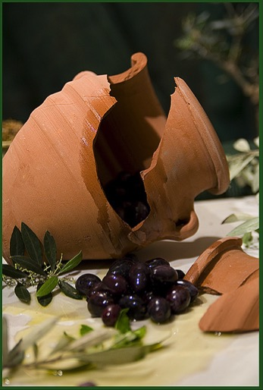
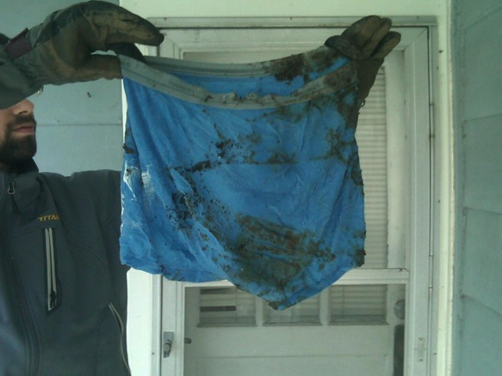
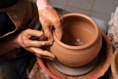
Unique Characteristics
476
Symbolic Acts
Broken Jar (Jer. 19)
Potter's Clay (Jer. 18)
Rotten Underwear (Jer. 13)

Slide 46
Unique Characteristics
476
Symbolic Acts
Literary Types
MT versus LXX

Slide 47
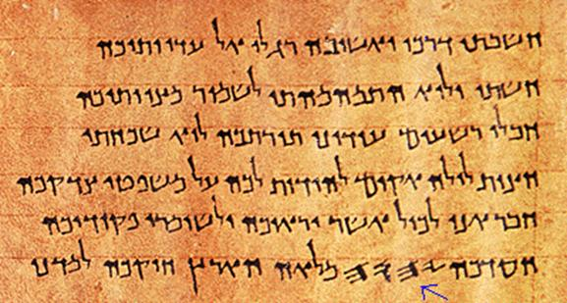
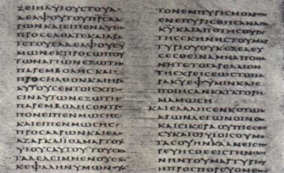
MT versus LXX
476
MT
(Heb.)
LXX
(Gr.)
1/8 shorter than MT

Slide 48
Unique Characteristics
476
Symbolic Acts
Literary Types
MT versus LXX
New Covenant

Slide 49
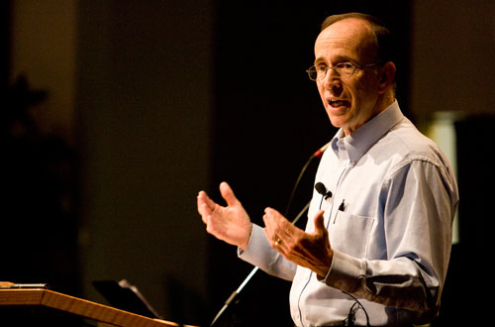
"How to Get Rid of the Jews"
³⁵ This is what the LORD says,
he who appoints the sun
to shine by day,
who decrees the moon and stars
to shine by night,
who stirs up the sea
so that its waves roar—
the LORD Almighty is his name:
³⁶ "Only if these decrees vanish
from my sight," declares the LORD,
"will the descendants of Israel ever cease
to be a nation before me."
³⁷ This is what the LORD says:
"Only if the heavens above can be measured
and the foundations of the earth below be searched out
will I reject all the descendants of Israel
because of all they have done,"
declares the LORD (Jer. 31:35-37 NIV).
Notes:
A pastor once announced to his congregation, • "Next week I will speak on the topic of 'How to Get Rid of the Jews.'" The news spread throughout the small town to the extent that on the next Sunday, after the doors had closed and just before a packed service began, the doors opened again and into the church walked the city's chief rabbi, followed by two of his lawyers! They walked down the center aisle all the way to the front, then took seats in the very front row.
The service continued with songs, prayers, offering and finally the pastor stood at the pulpit. "I am thrilled to see so many at church today, including our distinguished rabbi and his friends. My topic today is 'How to Get Rid of the Jews.' The text is from Jeremiah, chapter 31. Please turn in your Bibles to Jeremiah 31, verse 35.'" [Animate slide and read vv. 35-37]
At this point, the rabbi smiled, the pastor winked, the congregation sighed in relief, and the lawyers realized that their job was over.
God was clear to Jeremiah that his covenant with the Jews is an eternal covenant, not dependent on them. He promised a New Covenant that assures that at some future point the nation will again trust in him by believing in Messiah, after which God will forgive their sins.
A pastor once announced to his congregation, • "Next week I will speak on the topic of 'How to Get Rid of the Jews.'" The news spread throughout the small town to the extent that on the next Sunday, after the doors had closed and just before a packed service began, the doors opened again and into the church walked the city's chief rabbi, followed by two of his lawyers! They walked down the center aisle all the way to the front, then took seats in the very front row.
The service continued with songs, prayers, offering and finally the pastor stood at the pulpit. "I am thrilled to see so many at church today, including our distinguished rabbi and his friends. My topic today is 'How to Get Rid of the Jews.' The text is from Jeremiah, chapter 31. Please turn in your Bibles to Jeremiah 31, verse 35.'" [Animate slide and read vv. 35-37]
At this point, the rabbi smiled, the pastor winked, the congregation sighed in relief, and the lawyers realized that their job was over.
God was clear to Jeremiah that his covenant with the Jews is an eternal covenant, not dependent on them. He promised a New Covenant that assures that at some future point the nation will again trust in him by believing in Messiah, after which God will forgive their sins.
That God will never abandon Israel is also taught elsewhere:
Jer. 33:23 The LORD gave another message to Jeremiah. He said, ²⁴ “Have you noticed what people are saying?—‘The LORD chose Judah and Israel and then abandoned them!’ They are sneering and saying that Israel is not worthy to be counted as a nation. ²⁵ But this is what the LORD says: I would no more reject my people than I would change my laws that govern night and day, earth and sky. ²⁶ I will never abandon the descendants of Jacob or David, my servant, or change the plan that David’s descendants will rule the descendants of Abraham, Isaac, and Jacob. Instead, I will restore them to their land and have mercy on them.”
Lev. 26:40 “But at last my people will confess their sins and the sins of their ancestors for betraying me and being hostile toward me. ⁴¹ When I have turned their hostility back on them and brought them to the land of their enemies, then at last their stubborn hearts will be humbled, and they will pay for their sins. ⁴² Then I will remember my covenant with Jacob and my covenant with Isaac and my covenant with Abraham, and I will remember the land. ⁴³ For the land must be abandoned to enjoy its years of Sabbath rest as it lies deserted. At last the people will pay for their sins, for they have continually rejected my regulations and despised my decrees.
Lev. 26:44 “But despite all this, I will not utterly reject or despise them while they are in exile in the land of their enemies. I will not cancel my covenant with them by wiping them out, for I am the LORD their God. ⁴⁵ For their sakes I will remember my ancient covenant with their ancestors, whom I brought out of the land of Egypt in the sight of all the nations, that I might be their God. I am the LORD.”
See also The Restoration of Israel PPT file at https://biblestudydownloads.org/resource/future/
____________
Common-381
OS-24-Jeremiah-49, 162

Slide 50
Unique Characteristics
476
Symbolic Acts
Literary Types
MT versus LXX
New Covenant
Logical Arrangement

Slide 51
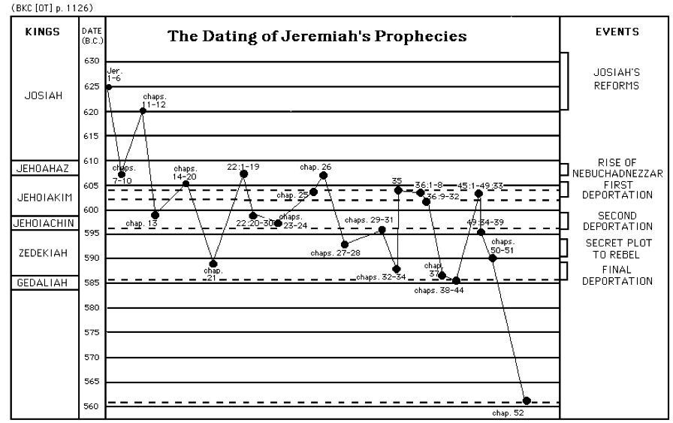
Structure is Logical not Chronological
477
KINGS
The Dating of Jeremiah’s Prophecies
EVENTS
Josiah’s
Reforms
JOSIAH
JEHOAHAZ
Rise of Nebuchadnezzar
JEHOIAKIM
First Deportation
JEHOIACHIN
Second Deportation
ZEDEKIAH
Secret Plot to Rebel
GEDALIAH
Final Deportation
Notes:
Jeremiah's prophecies were written down not in chronological order, but rather in a seemingly haphazard way, as shown in this chart. However, as we read the book of Jeremiah we can see that there is a logical flow in what and who it was trying to address.

Slide 52
Unique Characteristics
476
Symbolic Acts
Literary Types
MT versus LXX
New Covenant
Logical Arrangement
70-year Prophecy

Slide 53

Two 70-Year Exiles
560
People Exile
605
586
539
536
516
Temple Exile
"This entire land will become a desolate wasteland. Israel and her neighboring lands will serve the king of Babylon for seventy years. ¹²Then, after the seventy years of captivity are over, I will punish the king of Babylon and his people for their sins," says the Lord. I will make the country of the Babylonians a wasteland forever"
(Jer. 25:11-12).
Notes:
The 70-year exile of Judah can be figured in two ways—either the exile of the people beginning with Daniel’s deportation (605) to the people fully returning in 536, or the exile of the temple from its destruction in 586 to its rebuilding in 516.
_____________________
OS-12-Kings & Prophets Charts-25
OS-12-2Kings-287
OS-14-2Chron-287
OS-27-Daniel-340
OS-24-Jeremiah-53, 139

Slide 54
Unique Characteristics
476-478
Symbolic Acts
Literary Types
MT versus LXX
New Covenant
Logical Arrangement
70-year Prophecy
Recorded Jerusalem's Fall Twice

Slide 55
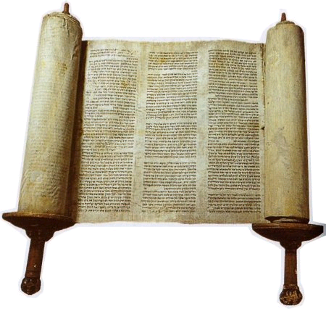
The Outline of Jeremiah

Slide 56
Jeremiah Book Chart
474
Deserved Captivity & Undeserved Restoration
Prophetic Call | Judah's Judgment Deserved |  |  |  | Nations' Judgment Deserved |  |  |  | Jerusalem's Fall
Chapter 1 | Chapters 2–45 |  |  |  | Chapters 46–51 |  |  |  | Chapter 52
Commission | Condemnation & Comfort |  |  |  | Condemnation |  |  |  | Captivity
Judgment but God's presence | Pre-Fall 2–38 | Fall 39 | Post-Fall 40–44 | Baruch 45 | Southwest 46–47 | East 48:1–49:22 | North 49:23-33 | Northeast 49:34– 51:64 | Fall 52:1-30 | Rise 52:31-34
Prologue | Ministry |  |  |  |  |  |  |  | Epilogue
Judah |  |  |  |  | Nations |  |  |  | Babylon
c. 627-580 BC
Notes:
The book is divided into 4 main sections. After the first section in chapter 1 on Jeremiah's call, his person and identity, Jeremiah got down to work very quickly in Chapter 2. Many object lessons run through the 2nd segment where God asks Jeremiah to do unusual things. These give the Judeans an obvious reminder of what they had not done and their failure to return and repent before God. However, buried between this segment in chapters 30-33 is a message of hope in a future restoration, often called Book of Comfort. Embedded here is also the new covenant. After that from chapter 34 onwards are warning after warning against disobedience. But interestingly, chapter 45 records an incident where Barush was encouraged 20 years earlier but is placed here to encourage and show God's sovereignty. This is also a reminder of the encouragement that God gave to Jeremiah in 1:19.. The next segment includes prophecies against the nations that persecuted Judah, many of which where fulfilled while some remain still future. The prophecies end with Babylon, empahsizing how God would very certainly destroy them. This brought hope to the Israelites at that time when they couldn't see beyond their suffering and subjugation. So the reality that future judgment lay ahead for Babylon was also an important encouragement for them to know that their God was a just God.

Slide 57
Unique Characteristics
476-478
Symbolic Acts
Literary Types
MT versus LXX
New Covenant
Logical Arrangement
70-year Prophecy
Recorded Jerusalem's Fall Twice
Lived through Jerusalem's Fall

Slide 58
Jerusalem's Fall
Jerusalem's Fall
232
342
560
Key Dates
627
Jeremiah
605
Daniel
597
Ezekiel
586
538
Zephaniah
Joel
630
Lamentations
Habakkuk
590
606
Notes:
God raised up at least six prophets in association with the destruction of the first temple in 586 BC (many say 587 BC). Four spoke in Judah itself, which Daniel and Ezekiel ministered to those already brought to Babylon, as they were.

Slide 59
Unique Characteristics
476-478
Symbolic Acts
Literary Types
MT versus LXX
New Covenant
Logical Arrangement
70-year Prophecy
Recorded Jerusalem's Fall Twice
Lived through Jerusalem's Fall
Longest prophetic book (Psalms is the longest overall)

Slide 60
Longest Books of the Bible
478
Book | Chapters | Verses | Words
Psalms | 150 | 2461 | 43,743
Jeremiah | 52 | 1364 | 42,659
Ezekiel | 48 | 1273 | 39,407
Genesis | 50 | 1533 | 38,267
Isaiah | 66 | 1292 | 37,044
http://www.kneeholedesk.com/Pages/Did_You_Know/Books_of_the_Bible.html

Slide 61
Unique Characteristics
478
Longest OT quote in the NT (Jer. 31:31-34 in Heb. 8:8-13)
Inevitable

Slide 62
How was judgment inevitable?
478
1. The people are encouraged to repent only up until chapter 19 (e.g., 15:19; 17:24; 18:8; cf. 5:3; 8:6). Yet after this point no exhortations to repent are forthcoming.
2. Jeremiah was instructed by God not even to pray for the people of Judah (11:14; 14:11).
3. Jeremiah told the people that each could individually have life instead of death if he/she would surrender to the Babylonians, but the destruction still would come on the nation as a whole (21:8-9; 24:1-10; 27:5-12, 16-17; 32:5; 38:17-23; 42:9-22; 52:24-27).

Slide 63
How was judgment inevitable?
478
4. God's determination of the length of the captivity at 70 years indicates that judgment was unavoidable (25:11-12; 29:10).
5. Jeremiah smashed a pot to illustrate that God's decision to destroy the city was not retractable (19:1-2, 10-11).
6. Jeremiah instructed those already in exile to settle down (29:4-14) in contrast to the false prophet Hananiah, who said the exile would only last two years (28:1-3, 10-12). This indicates that the "die was already cast" and even repentance of the people could not forestall God's judging hand.

Slide 64
Unique Characteristics
478
Longest OT quote in the NT (Jer. 31:31-34 in Heb. 8:8-13)
Inevitable
Deuteronomy 28 fulfillments
Dictation to Baruch
Autobiography
Matthew 27:9 quotes Jeremiah 19:1-13 (or perhaps Jer. 18:2-12 or 32:6-9) along with Zechariah 11:12-13 but attributes it to the better known prophet Jeremiah

Slide 65

Trivia Summary
476
Different types of literary material—such as poetic discourse (30–31), prose discourse (32–33) and prose narrative (46–51)
Jeremiah 31:31-34 is the longest OT quote in the NT (Heb. 8:8-13)

Slide 66

Key Facts
474
Summary Statement
Jeremiah prophesies at great personal cost the deserved fall of Jerusalem, seventy year captivity, judgment of Gentiles, and restoration under a new covenant, to give hope and exhort Judah to accept God's inevitable discipline by yielding to Babylon.
Key Word
INEVITABLE
Key Verse
"… For the LORD our God has doomed us to perish and given us poisoned water to drink, because we have sinned against him" (Jeremiah 8:14b)

Slide 67
Be Comforted
Jeremiah
Dr. Rick Griffith • Crossroads International Church Singapore
CICFamily.com • BibleStudyDownloads.org

Slide 68
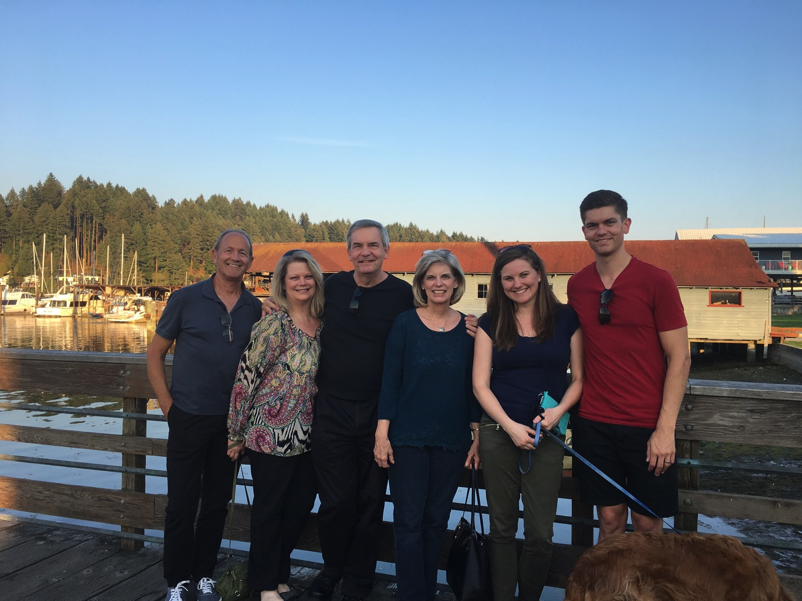
3-days travel, 4-day visit
Notes:
It is wonderful to be with you all again after taking a week off to be with my family in the USA. This is a first for us—three days of flying to have four and half days with my family—but when a $4000 trip costs only $100 now since our son is a pilot, we had little excuse not to go!

Slide 69

We all need to be comforted
Notes:
We had special times with our youngest son John and Susan's mother.

Slide 70

3-day travel, 4-day visit
Notes:
John even showed off his climbing skills.

Slide 71
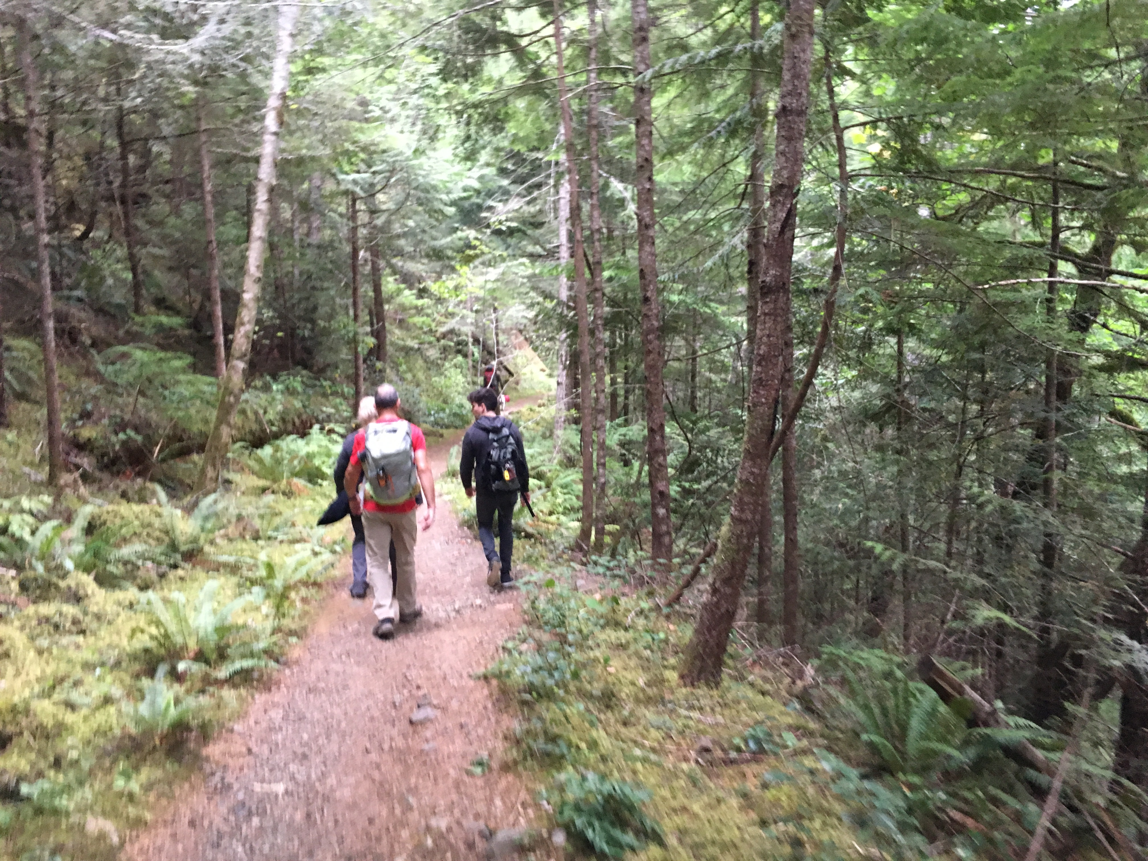
3-day travel, 4-day visit
Notes:
We got in some hiking…

Slide 72
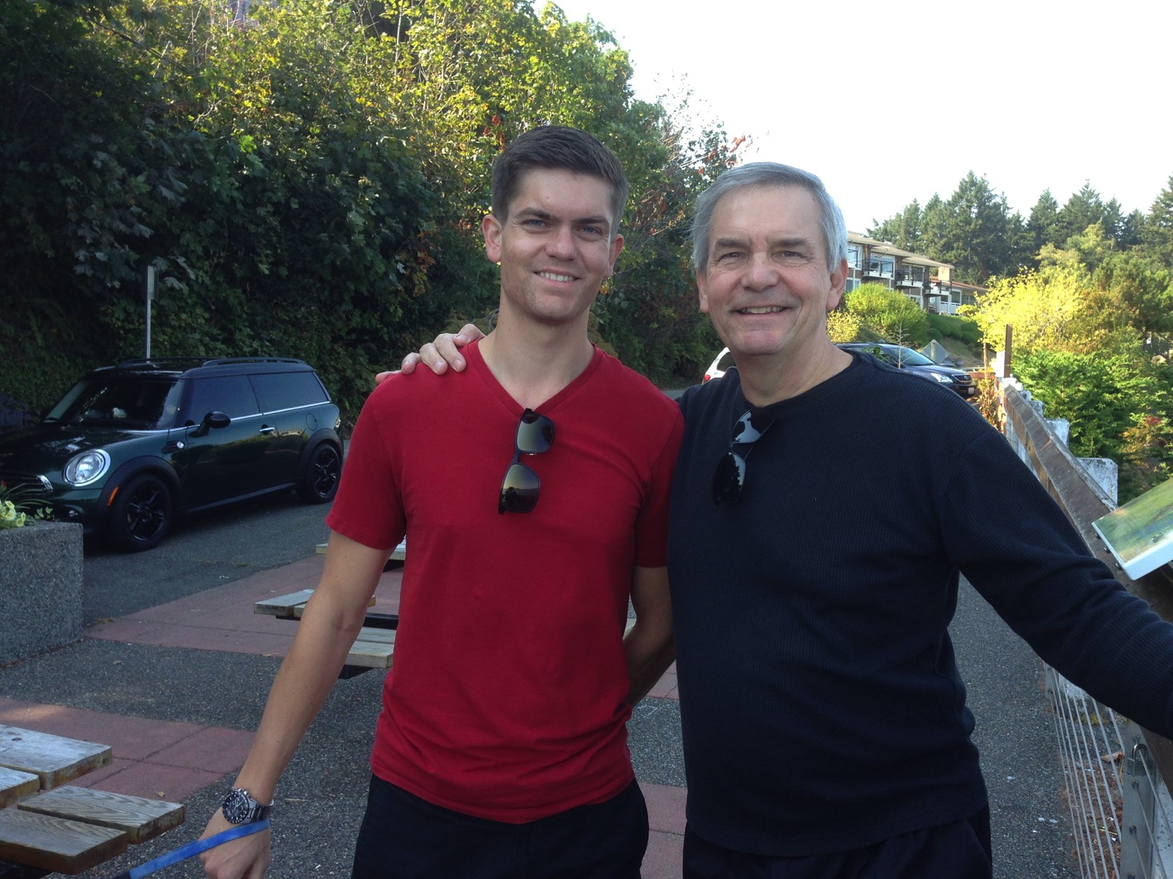
We all need to be comforted
Notes:
This was due to our United pilot son, Stephen.

Slide 73

Let's Study Through Scripture
The Bible: Book by Book
Notes:
As we study the Scripture book-by-book, today we come to the book of Jeremiah.

Slide 74
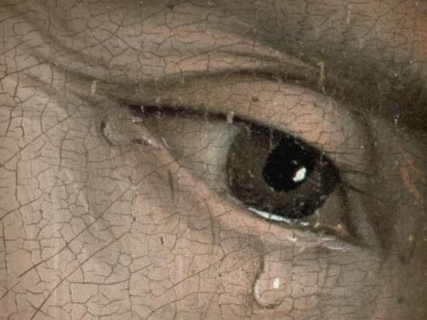
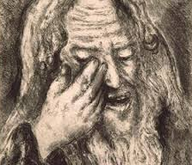
"The Weeping Prophet"
Notes:
Jeremiah was the only prophet to live through the 586 BC fall of Jerusalem. God called him to show God’s compassion even in Judah’s darkest hours. Jeremiah is known as "The Weeping Prophet." I suspect you would weep also if you saw your country ravaged and destroyed before your very eyes and you were powerless to stop it. It actually makes sense that God would call one like him who experienced such loss to be one who teaches us the need to be comforted.

Slide 75

We all need to be comforted
Notes:
That’s because we all need to be comforted at various times of our lives. This is true for women, of course, but not only for women.

Slide 76
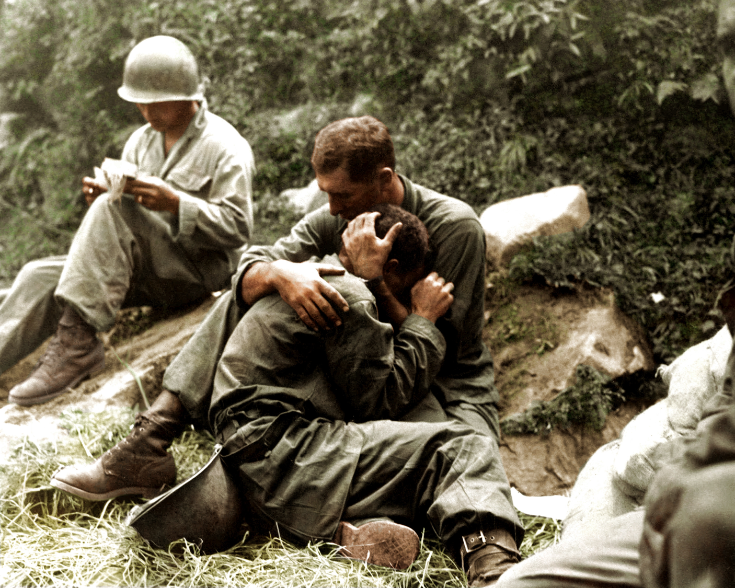
We all need to be comforted
Notes:
Men also need comfort many times.

Slide 77
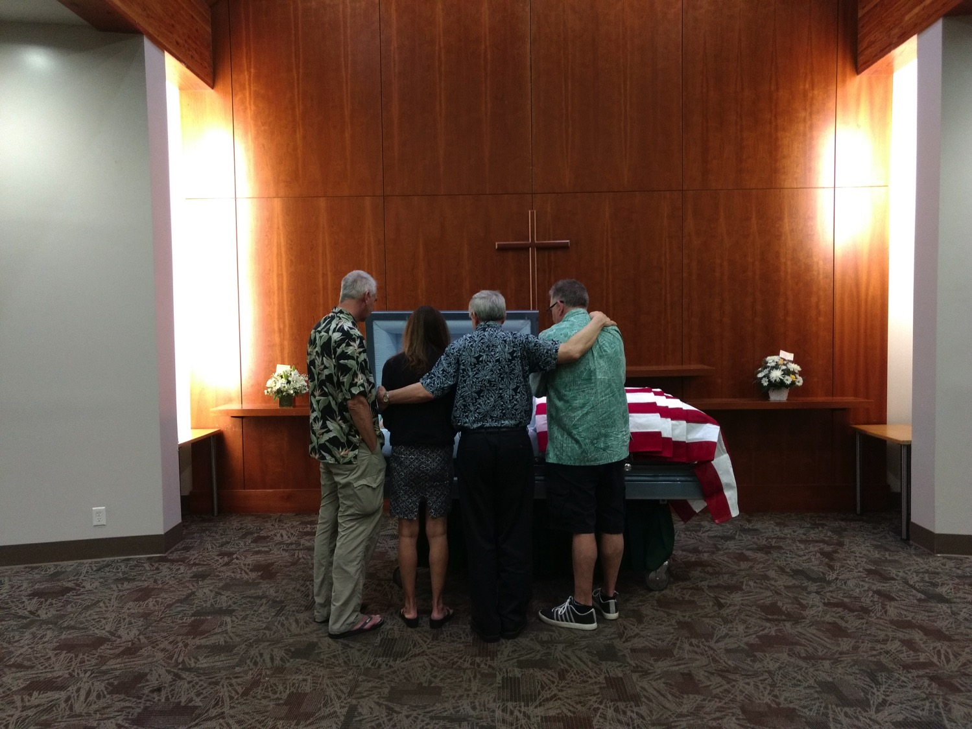
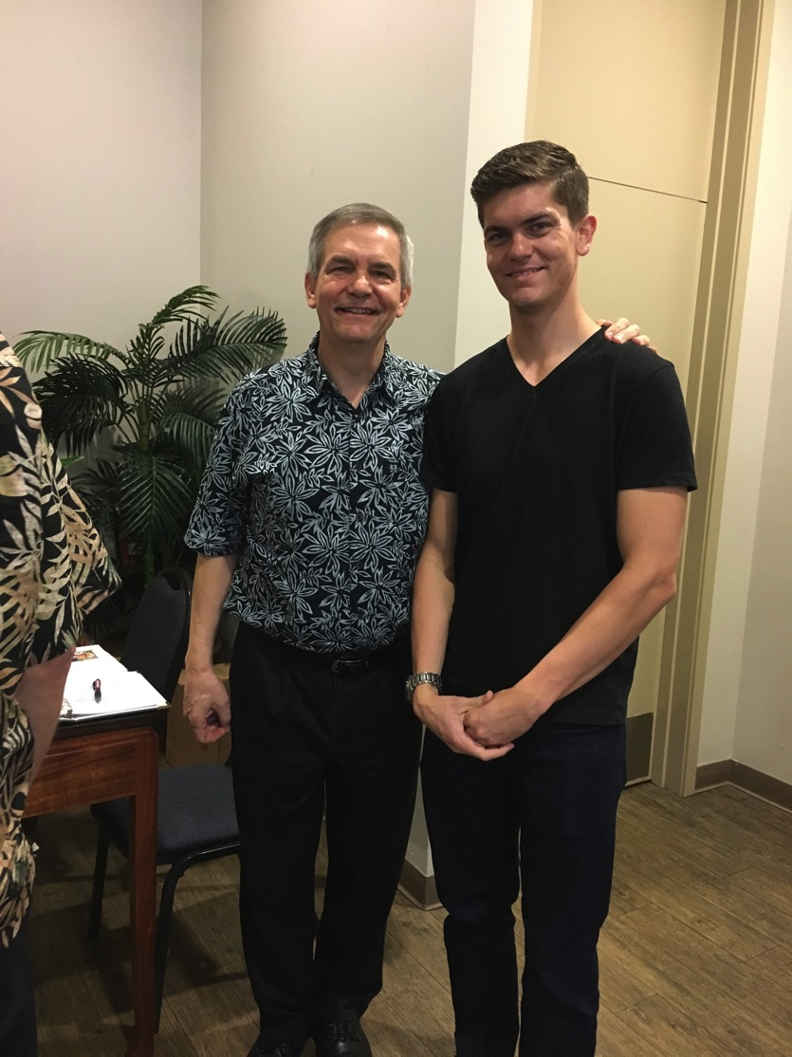
We all need to be comforted
Notes:
As one who often gives comfort, I found myself as one needing to be on the receiving end in January. It was challenging to be both the son and the officiating minister at my father’s memorial service,
• but God granted comfort from this same son, Stephen, who made the effort to fly to be there as a support.

Slide 78
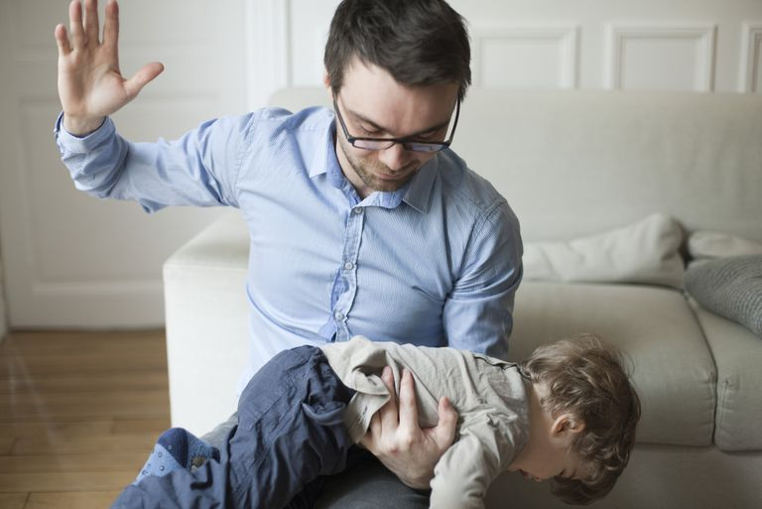
Balance discipline with comfort.
Notes:
Of course, we all know that life is not only about comfort. One of the signs of growing up is to realize that we must balance discipline with comfort.
Discipline shows us when we are off track and need to realign.

Slide 79
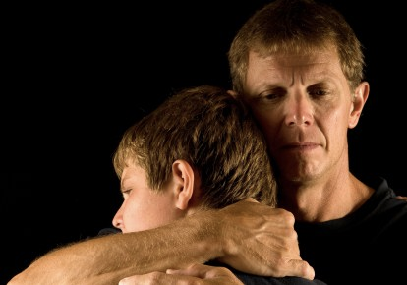
Balance discipline with comfort.
Notes:
But comfort helps us feel appreciated and loved.

Slide 80

Discipline.
Notes:
What images or memories come to your mind when you hear the word "discipline"?
When you were growing up, were you disciplined in a balanced way?
Did you receive mostly harsh discipline?
Or did your parents give you no discipline at all?
Or did you experience a good balance where standards (the principle of the thing) were matched with support? Did you receive comfort along with the discipline?

Slide 81
How does God comfort even those he disciplines?
Notes:
In what ways can we see God's compassion even when he has to punish sin?
A good father does not discipline in harshness and then reject and neglect his child.
Like the best earthly father, God wants us to realize that, despite his discipline, he also offers his comfort.

Slide 82
Josiah's Sons & Prophets
232
342
Daniel
605
Ezekiel
City Fell
Jehoahaz
Josiah
Jehoiakim
Jehoiachin
Zedekiah
609
597
586
(3 mos.)
(11 yrs.)
(3 mos.)
(11 yrs.)
Jeremiah
627
Brief Puppet Kings
Notes:
Jeremiah was the only prophet to live through the 586 BC fall of Jerusalem. God called him to show God’s compassion even in Judah’s darkest hours. How? Josiah was the last good king, who died in 609. • After him the reigns of his descendants alternated between 3 months• to 11 years • to 3 months • to 11 years once again! • But God spoke to these godless kings through three major prophets. Jeremiah was the only one to preach in Jerusalem until the city fell in 586, • while Daniel was taken to Babylon in 605 • and Ezekiel in 597.
———————
OS-12-2Kings-220
OS-14-2Chron-283
OS-23-Jeremiah-82

Slide 83
Key Word
474
343
Inevitable
Jeremiah
Notes:
By the time we get to Jeremiah, God proclaims that the exile will definitely come. It is inevitable.

Slide 84
Theme
474
Deserved Captivity & Undeserved Restoration
Jeremiah
Notes:
Jeremiah’s theme is that captivity is deserved but also the restoration is undeserved and will also happen.

Slide 85
Key Verse
474
"…For the LORD our God has doomed us to perish and given us poisoned water to drink, because we have sinned against him" (8:14b).
Jeremiah
Notes:
Judgment was because of Judah’s sin, as the key verse indicates in 8:14.

Slide 86
Be Comforted
Jeremiah
Dr. Rick Griffith • Crossroads International Church Singapore
CICFamily.com • BibleStudyDownloads.org

Slide 87
How does God comfort even those he disciplines?
4 ways...
Notes:
In what ways can we see God's compassion even when he has to punish sin?

Slide 88
I. God calls messengers who are honest with us (Jer 1).
How does God comfort even those he disciplines?
Notes:
He appoints candid people to show us both his discipline and restoration.

Slide 89
Slides on
Jeremiah 1

Slide 90
Length of Prophetic Ministries
Isaiah
65 Years
Hosea
45 Years
Jeremiah
40+ Years
Micah
25 Years
Notes:
Jeremiah reveals himself as author and reveals that his ministry lasted over four decades from Josiah's thirteenth year (627 BC) to the exile (1:1-3; 586 BC).

Slide 91
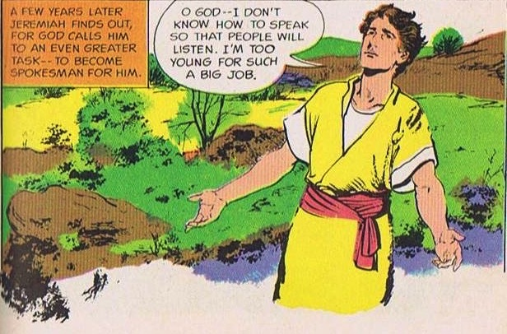
God Calls and Commissions Jeremiah
King Josiah's reign and reforms did not last.
God calls a YOUNG MAN!
Jer. 1:4-9
Source: The Picture Bible (Chariot Books, David C Cook, 1978)
Notes:
When God called and commissioned him to be a prophet Jeremiah was a young man, maybe a teenager, in the thirteenth year of King Josiah's reign. But he protests that he is too young for such a big job.

Slide 92

God's Assurance to Jeremiah
"Before I formed you in the womb
I knew you, before you were born
I set you apart;
I appointed you as a prophet to
the nations…
Do not say, 'I am only a child.'
You must go to everyone I send you to and say whatever I command you. Do not be afraid of them for I am with you and will rescue you… Now, I have put my words in your mouth …
Jer. 1:5, 7-9
Notes:
God assured Jeremiah – He knew, set apart, appointed him. And said he would put His words into His mouth. The Lord reached out His hand and touched his mouth. He is to stand up against nations and kingdoms, uproot and tear them down. He is to build up and plant others.
Jeremiah’s success was not determined by the size of his “church”!
In fact, like Isaiah, Ezekiel, and, frankly, all the prophets, his success was in saying and doing what God commanded to a stubborn and rebellious people who were bent on their own way all their days until the Babylonians stormed the gates of their capital—and remained stubborn and rebellious even afterwards.

Slide 93
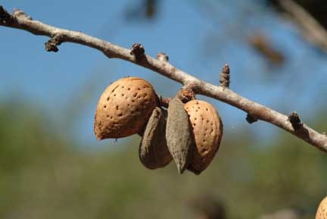
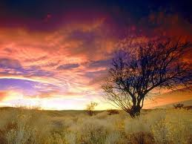
Object Lesson #1 – Almond Tree
God is watching to see that His Word is fulfilled.
("watching" sounds like "almond tree" in Hebrew)
Jer. 1:11-13
Notes:
God uses many object lessons to teach Jeremiah and the people. God shows him the branch of an almond tree. The sign was a play on words. The word for almond tree sounds like God is watching over the fulfilment of His Word, thus assuring Jeremiah that God will accomplish His word.

Slide 94
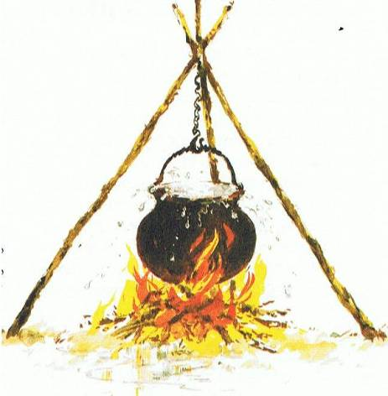
Object Lesson #2 – Boiling Pot
Over-boiling pot,
tilting from north –
Invaders from the north are going to overflow Judah and destroy
Jerusalem.
Jer. 1:13-19
Picture Source: The Children's Bible in 365 stories, Lion Publishing, 1985
Notes:
Next, God shows a boiling pot, overflowing, tiliting from the north, symbolizing the disaster God would pour onto the land using invaders from the north to destroy Jerusalem and Judah. But God assures Jeremiah of His presence and encourages him to speak without fear of God's message.

Slide 95
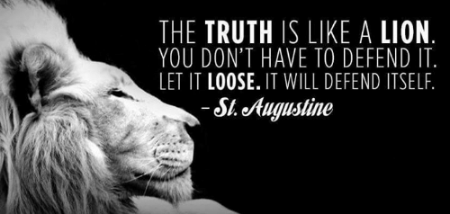
Is God trying to comfort you through his truthful messengers?
Notes:
I will be honest with you—my main goal is to be honest with you!
That honest truth includes both the things we like to hear and those things that we do not like.
• St. Augustine said, “The truth is like a lion. You don’t have to defend it. Let it loose. It will defend itself.”
My prayer is that those of us who need comfort will find it here today. God is, after, the “God of all comfort” (2 Cor). That is the “building up” aspect of pastoral ministry. I have come to build you up.
But God has also called me to “tear down.” That means that God’s primary goal in your life is not to make you comfortable. It is to make you like his son Jesus. That will take some tearing down of patterns that hinder Christlikeness in us.

Slide 96
How does God comfort even those he disciplines?
Notes:
In what ways can we see God's compassion even when he has to punish sin?

Slide 97
I. God calls messengers who are honest with us (Jer 1).
How does God comfort even those he disciplines?
Notes:
He appoints candid people to show us both his discipline and restoration.

Slide 98
II. God has limited discipline but unlimited blessing
(Jer 2–45).
How does God comfort even those he disciplines?
Notes:
The LORD's punishment is always less than his rewards.

Slide 99
Slides on
Jeremiah 2
Notes:
God comforted Judah throughout Jerusalem's fall that the 70-year exile would result in a new covenant (Jer 2–45).
God indicts the nation for its sinful treatment of God seen in its ingratitude, idolatry, immorality, and irrationality (Jer 2; see esp. 2:10-11).

Slide 100


Judah's Relationship With God
A young bride
Unfaithful …. many lovers,
one named Baal
Jer. 2–4
Notes:
So, Jeremiah prophesies before the fall of Jerusalem. He proclaims God has just reasons for judging the nation – its punishment is deserved! God reminds them of the days He blessed them. But they have been idolatrous and spiritually rebellious.
• Judah is like an unfaithful wife who defiled herself with her lovers, to follow Baal and many other gods. He likens Israel and Judah to two sisters. Judah did not learn anything from Israel's judgment! Judgment will come from Babylon, so repent!

Slide 101
Slides on
Jeremiah 3

Slide 102
Slides on
Jeremiah 4

Slide 103
Slides on
Jeremiah 5

Slide 104
Slides on
Jeremiah 6
Notes:
God calls the nation to repent from spiritual adultery to motivate the people to escape the impending judgment of the Babylonians (Jer 3–6).

Slide 105
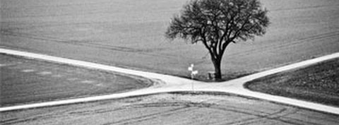
"This is what the LORD says:
'Stand at the crossroads and look; ask for the ancient paths, ask where the good way is, and walk in it, and you will find rest for your souls'"
(Jeremiah 6:16a NIV).
Notes:
This verse reminds us of some of our key priorities based on this theme verse for Crossroads International Church:
1. We must look out for people in need going through various crossroads in their lives.
2. We must prioritize that which is proven and not be pursuing every new fad that comes down the road.
3. We must instead pursue the Word of God, making the Bible central to all we do—and obey it.
4. We must be a place of rest for people in the very stressed out country of Singapore.

Slide 106
Slides on
Jeremiah 7
Notes:
Jeremiah's temple address aims to convince the people to turn from their false reliance on the temple and idolatry to avoid impending judgment (Jer 7–10).

Slide 107
Worthless Public Worship
Trusted in empty words
And "God will not destroy the temple"
God tells Jeremiah to ...
Stop praying for Judah
Their evil had become unthinkable.
They even sacrificed their own children!
Jer. 7–8
Notes:
Jeremiah preaches at the temple as people came by to worship. He warns them they are trusting in the empty words to save them, thinking God will not allow the temple to be destroyed. They think God will bless Judah no matter how they lived just because of the Davidic covenant. God instructs Jeremiah to stop praying for the people. Their evil had become unthinkable and were even sacrificing their children to pagan gods.

Slide 108
Slides on
Jeremiah 8

Slide 109

Judgment is imminent & terrible!
He weeps …..
His lament models the kind of repentance God desires of the entire nation.
Jer. 8–10
Notes:
God is shocked at Judah. Animals observed God's laws, but not God's people. God details the coming judgment for the nation's idolatry. It will be imminent and terrible. The enemy will devastate the land. Jeremiah mourns Judah's sad spiritual state and his lament models the kind of repentance God wants of the entire nation.

Slide 110
Slides on
Jeremiah 9

Slide 111
Slides on
Jeremiah 10

Slide 112
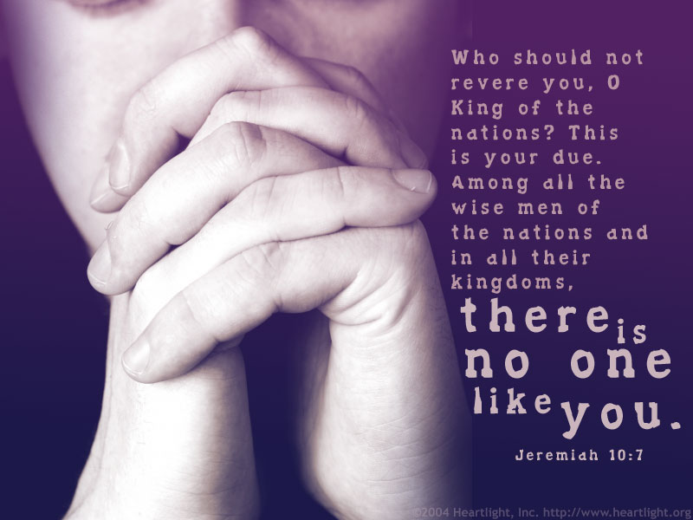
Jeremiah 10:7
Who should not revere you, O King of the nations? This is your due. Among all the wise men of the nations and in all their kingdoms, there is no one like you.
Notes:
God is unique and thus due proper worship.
_____________________
HS-03-The_Spirit_Ministries_to_the_Unbeliever-47
OS-24-Jeremiah-112

Slide 113
Slides on
Jeremiah 11

Slide 114
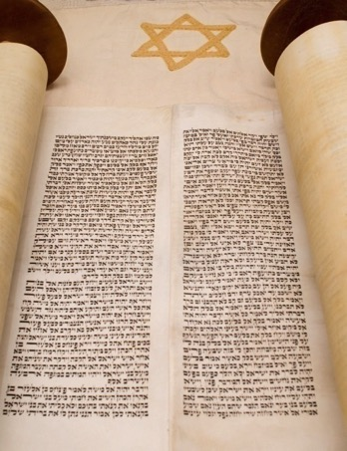

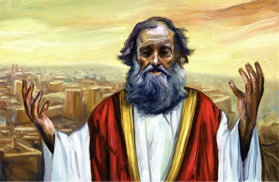
Covenant, Conspiracies & Complaints
Men from Anathoth
conspire to kill him
Jeremiah preaches
Covenant broken
Jeremiah complains
to God;
God encourages him
Jer. 11–12
Notes:
Jeremiah preaches the covenant sermon to proclaim that Judah has violated God's covenant through its idolatry. What is their response? The men of Anathoth, Jeremiah's own home town, plot against his life because they do not like what they hear. Jeremiah struggles from their mocking and persecution. He complains to God about the prosperity of the wicked but God encourages him and warns him to continue. God says, Worse events are coming, but the destruction will bring Judah to repent.

Slide 115
Slides on
Jeremiah 12

Slide 116
Slides on
Jeremiah 13

Slide 117

Object lessons – signs of judgment
Like a ruined waistband rotting in rock crevice, Judah strayed from God, being exposed to pagan influences, and is now spiritually worthless.
Fill jugs with wine! Get drunk! – God will have no mercy and compassion when they suffer.
Jer. 13
Notes:
More object lessons ! God shows signs of judgment. He instructs Jeremiah to purchase a linen waistband and hide in some rocks by the river. After some time, Jeremiah went to retrieve the waistband which had rotted. God said the people were like the waistband. He had bound them to Himself, but they had strayed away after other gods. Through their exposure to such pagan influences, they are now spiritually worthless to Him. Jeremiah also commands the people to 'drink it up!'. The Lord will bring spiritual drunkenness to Judah – He will not have compassion on them when they suffer sin's consequences.

Slide 118
Slides on
Jeremiah 14

Slide 119
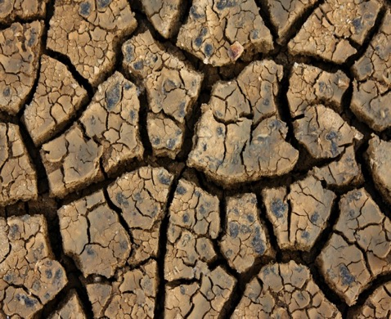
Hard times follow …
God sends a drought to warn Judah of judgment and need to repent.
God told Jeremiah not to pray for them!
No marriage,
No funerals,
No parties
for Jeremiah
Jer. 14–16
Notes:
God sends a drought to turn the people back to him. The ground cracked, and water became so scarce that animals deserted their young. Jeremiah prays for the people, but God tells him not to. He has to deal severely with them so they would know the seriousness of their sin. Did God reject Judah forever, Jeremiah wonders. Also, God restricts marriage, attendance to funerals or parties upon Jeremiah because of the impending disasters.

Slide 120
Slides on
Jeremiah 15

Slide 121

Jeremiah to King Jehoiakim
Jeremiah 15:1
"Even if Moses and Samuel were to stand before Me, My heart would not go out to this people. Send them away from My presence! Let them go!"
Notes:
"Even if Moses and Samuel were to stand before Me, My heart would not go out to this people. Send them away from My presence! Let them go!"

Slide 122
Jeremiah to King Jehoiakim
Jeremiah 15:4
"I will make them abhorrent to all the kingdoms of the earth because of what Manasseh son of Hezekiah king of Judah did in Jerusalem."
Notes:
"I will make them abhorrent to all the kingdoms of the earth because of what Manasseh son of Hezekiah king of Judah did in Jerusalem."

Slide 123
Slides on
Jeremiah 16

Slide 124
Jeremiah to King Jehoiakim
Jeremiah 16:11-13
"...Your fathers forsook me… and did not keep my law. But you have behaved more wickedly than your fathers… instead of obeying Me. So I will throw you out of this land into a land neither you nor your fathers have known, and there you will serve other gods day and night, for I will show you no favour."
Notes:
"...Your fathers forsook me… and did not keep my law. But you have behaved more wickedly than your fathers… instead of obeying Me. So I will throw you out of this land into a land neither you nor your fathers have known, and there you will serve other gods day and night, for I will show you no favour."

Slide 125
Slides on
Jeremiah 17

Slide 126
Slides on
Jeremiah 18

Slide 127
I am the Potter, you are the Clay
O house of Israel, can I not do with you as this potter does? (v. 6)
If that nation I warned repents of its evil, then I will relent and not inflict on it the disaster I had planned (v. 8)
Jer. 18
Notes:
God sends Jeremiah to the potter's house and gives a message there. The Lord shapes the nations according to His sovereign purpose. God is sovereign like a potter with the clay. People should not be presumptuous. God promises blessing to a nation, but will cancel the blessing if the nation turns against Him. But if the nation repents of its evil, He will relent of the disaster.

Slide 128
Slides on
Jeremiah 19

Slide 129

Object lesson #? What the..??
You have forsaken me for other gods and shed innocent blood. I will smash you like the pot by your enemy.
Picture Source: The Children's Bible in 365 stories, Lion Publishing, 1985
Jer. 19
Notes:
Jeremiah takes an earthenware jar from the potter's house to the Hinnom Valley in Jerusalem. He warns Judah of the terrible disaster that will come for they people abandoned the Lord to worship idols. They shed innocent blood and sacrificed their children. He describes the inevitable judgment to come – people will run out of food and turn to cannibalism. Corpses would lie everywhere and become food for wild animals. Jeremiah smashes the jar, symbolizing Jerusalem's seemingly irreversible destruction.

Slide 130
Slides on
Jeremiah 20

Slide 131

False Prophets & Priests Oppose Jeremiah
Jeremiah is beaten and placed in stocks by Pashhur, chief officer of the temple.
Jer. 20:1-3
After release, Baruch, a young scribe, offers to help him.
Picture Source: The Picture Bible, Chariot Books, David C Cook, 1978
Notes:
Pashhur reacts angrily to Jeremiahs' words against Jerusalem and Judah. He has Jeremiah beaten and locked in the public stocks. But Jeremiah is released, and pronounces judgment against Pashhur and his family. Jeremiah laments to God for his suffering. Eventually, Baruch, a young scribe offers to help him.

Slide 132

Seal of Immer
This seal was used by Immer, father of Pashur in Jeremiah 20:1 (ESV)—"When the priest Pashhur son of Immer, the official in charge of the temple of the Lord, heard Jeremiah prophesying these things, he had Jeremiah the prophet beaten and put in the stocks at the Upper Gate of Benjamin at the Lord’s temple."
The clay sealing (Bulla) of Hiṣilyahu son of Immer, a member of the priestly Immer family, who served in the administration of the Temple treasury.
Notes:
Picture & Article: https://www.jewishpress.com/news/israel/kingdom-of-judahs-temple-and-royal-treasuries-revealed/2022/01/09/
Another Article: https://patternsofevidence.com/2022/03/04/clay-seals-with-biblical-names-found/?utm_campaign=Thinker%20Update-%20Clay%20Seals%20Inscribed%20with%20Biblical%20Names%20Found%20in%20Jerusalem%20%28QWZ8rd%29&utm_medium=email&utm_source=Email%20List%20-%20120%20day%20engaged&_kx=YXo9ToML2ZYOgon6TelWR-8ViwFBWyLgU5_VbrbI4qIK9K_Zu4S0ObP0z8EYm_4b.WEfJdA

Slide 133
Slides on
Jeremiah 21

Slide 134

Jeremiah prophesies against Judah's leaders and false prophets, but they refuse to listen
WARNING ! WARNING!
Jer. 21–23
Source: The Picture Bible, Chariot Books, David C Cook, 1978
Notes:
Jeremiah continues to preach God's messages. He prophesies judgments against Judah's kings and leaders and false prophets, but promises that the Messiah will come to lead the nation justly. (Zedekiah will be judged and God will reject his request to save them from Babylon; Jehoahaz will die in exile, Jehoiakim will die a terrible death without burial, Jehoiachin will be judged by not having any immediate descendants on the throne). The false prophets and priests have disgraced God's temple and spoken lies.

Slide 135
Slides on
Jeremiah 22

Slide 136
Slides on
Jeremiah 23

Slide 137
Slides on
Jeremiah 24

Slide 138

No Repentance in Jerusalem after Nebuchadnezzar
Depiction of People Through Figs at the Temple
Good figs
– Exiles in Babylon who had begun to repent
– God will take care of them and bring them back
Bad, rotten figs
– King Zedekiah and his court and all people in Jerusalem
– Still plotting and scheming against Babylon
– Not fit to keep
Jeremiah 24
Picture Source: The Children's Bible in 365 stories, Lion Publishing, 1985
Notes:
God uses another object lesson of two baskets of figs in front of the temple. The good figs are those in Babylon whom God will protect, bless and one day restore. The bad figs symbolizes Zedekiah and those who remained in Jerusalem who still refused to submit to Babylon rule. This faithless group will die by sword, famine and disease.

Slide 139

Jeremiah's Application: "Leave Jerusalem"
Jeremiah 24 portrayed all the Jews as two types of figs during Babylon's siege:
The "bad figs" who refused to submit to God's discipline by the Babylonians would disobey God by staying in the city and dying.
The "good figs" would spare their lives by leaving the city to surrender to the Babylonians outside!
AD 70 was no different!
Jews as figs:
good
bad
Babylonians
Jeremiah 24 Figs

Slide 140
Slides on
Jeremiah 25

Slide 141


Nebuchadnezzar comes (597 BC)
70-year captivity
predicted
Takes exiles and King Jehoiachin away. Places Zedekiah on throne, gives another chance for Judah to submit to Babylon.
Picture Source: The Children's Bible in 365 stories, Lion Publishing, 1985
Jer. 24–25
Notes:
Now 8 years after Jeremiah's prophecy about Nebuchadnezzar, Nebuchadnezzar came and took King Jehoiachin away with many other exiles. He placed his uncle, Zedekiah (Josiah's other son) in charge and gave Judah one more chance to submit to Babylon's rule.
• Here God revealed to Jeremiah the 70 years captivity.

Slide 142
Two 70-Year Exiles
560
People Exile
605
586
539
536
516
Temple Exile
"This entire land will become a desolate wasteland. Israel and her neighboring lands will serve the king of Babylon for seventy years. ¹²Then, after the seventy years of captivity are over, I will punish the king of Babylon and his people for their sins," says the Lord. I will make the country of the Babylonians a wasteland forever"
(Jer. 25:11-12).
Notes:
The 70-year exile of Judah can be figured in two ways—either the exile of the people beginning with Daniel’s deportation (605) to the people fully returning in 536, or the exile of the temple from its destruction in 586 to its rebuilding in 516.
_____________________
OS-12-Kings & Prophets Charts-25
OS-12-2Kings-287
OS-14-2Chron-287
OS-27-Daniel-340
OS-24-Jeremiah-53, 139

Slide 143
Nebuchadnezzar's Six Deportations to Babylon
492
Size | Date | King of Judah | Number taken | Key Captives | Results/ Comments
1 Minor | 605 BC | Jehoiakim | Few (Dan 1:3) | Daniel, 3 friends & nobility & royalty | Tribute imposed. Egypt powerful.
2 Moderate | 598 BC | Jehoiakim | 3023 (Jer. 52:28) |  | Minor deportation
3 Major | 597 BC | Jehoiachin | 10,000 (2 Kings 24:14) | Jehoiachin, Ezekiel, Mordecai | Neb. deports many; installs Zedekiah
4 Minor | 587 BC | Zedekiah | 832 (Jer. 52:29) |  | Before destruction
5 Major | 586 BC | Zedekiah | ca. 10,400 (2 Kings 25:11) | Zedekiah | Jerusalem & temple destroyed
6 Minor | 582 BC |  | 745 (Jer. 52:30) |  | 4 years after Jerusalem's destruction
Notes:
Nebuchadnezzar actually had SIX deportations to Babylon. The 597 BC deportation was the third of the six and the first of 2 major deportations, with 10,000 people deported.
_____________________
OS-12-Kings & Prophets Charts-25
OS-12-2Kings-286
OS-14-2Chron-283
OS-24-Jeremiah-140

Slide 144
Chart of the Exile
232 & 342
The Babylonian Exile
John C. Whitcomb, 4th rev. ed., Winona Lake, IN: BMH Books, 1962, 1968

Slide 145

Jeremiah (25:11-12) vs. Hananiah (28:2-3)
True
False
"You'll
stay 70
years!"
"You'll return in 2 years!"
Lived 23 years more (51:64)
Died 2 months later (28:17)

Slide 146
Slides on
Jeremiah 26

Slide 147
Slides on
Jeremiah 27
Notes:
Jerusalem’s leaders reject Jeremiah and lead to captivity as unavoidable (Jer 26–29).

Slide 148

Jeremiah to King Zedekiah
Jeremiah 27:12, 13
"I gave the same message to Zedekiah king of Judah. I said, "Bow your neck under the yoke of the king of Babylon; serve him and his people, and you will live. Why will you and your people die by the sword, famine, and plague with which the Lord has threatened any nation that will not serve the King of Babylon?"
Notes:
"I gave the same message to Zedekiah king of Judah. I said, "Bow your neck under the yoke of the king of Babylon; serve him and his people, and you will live. Why will you and your people die by the sword, famine, and plague with which the Lord has threatened any nation that will not serve the King of Babylon?"

Slide 149


Jerusalem's leaders resist Babylon's rule
Jeremiah wears a yoke to symbolize Judah's
future submission to Babylon.
Jer. 27–28
Notes:
At the beginning of Zedekiah's reign, there is talk of revolt against Babylon. As animals wore a yoke to inndicate their submissions, • so God instructs Jeremiah to wear a yoke to symbolize Judah's future submission to Babylon. God will place all nations under Nebuchadnezzar's yoke; any nation that resisted would perish. He urges the king not to listen to the false prophets.

Slide 150
Slides on
Jeremiah 28
Notes:
The false prophets continued to predict peace for the rebellious people in chapter 28.

Slide 151
Jeremiah (25:11-12) vs. Hananiah (28:2-3)
True
False
"You'll
stay 70
years!"
"You'll return in 2 years!"
Lived 23 years more (51:64)
Died 2 months later (28:17)
Notes:
One way you can tell a false prophet is if he only predicts good news!

Slide 152
Slides on
Jeremiah 29

Slide 153

How are Prophets Different?
437b-c
Biblical
Pagan
Unsolicited
Divination
Divine call
Prophet himself
Anywhere
Cultic place
Forth-telling
Fore-telling

Slide 154

False prophecies change
I am absolutely certain that the world will end today!!!

Slide 155

Opposition by False Prophets
The false prophet Hananiah breaks Jeremiah's yoke to symbolize God breaking Babylon's power and claims that the captivity will be only two years. Two months later, he dies.
The false prophet Shemaiah also preaches against Jeremiah.
Jer. 28–29
Notes:
Jeremiah faces serious opposition from false prophets. Hananiah seizes Jeremiah's yoke and breaks it, claiming God would break Babylon's power and the captivity is not 70 years, but only 2 years. Well, he pays for his lies with his own life. He dies 2 months later. After him, Shemaiah the false prophet also opposes Jeremiah.

Slide 156

How are Prophets Different?
437cb
Biblical
Pagan
Godly character
Immoral
Mostly men
Mostly women
Inspired
Own thoughts
Own style
Demon possessed

Slide 157

How are Prophets Different?
437d-e
Biblical
Pagan
Godly Motive
Financial Gain
Original messages
Plagiarism
100% accurate
Errors of fulfillment
Persecuted
Exalted

Slide 158

Contrasts Between Biblical & Pagan Prophecy
437e
Thought Questions:
Which difference between these two types was most significant to you?
Why?

Slide 159
Slides on
Jeremiah 30
Notes:
Israel’s future restoration with a new covenant (The Book of Comfort) should encourage the remnant that God has not forgotten his promises (Jer 30–33).

Slide 160

Book of Comfort & New Covenant
Jer. 30–33
Jeremiah redeems a field (Jer. 32) – a sign of hope!
God has not cast aside His people!
A glorious future would follow their judgment.
They will return to the land.
Notes:
Scholars refer to Jeremiah 30–33 as the Book of Comfort or Book of Consolation. Jeremiah's prophecies contained strong words against God's sinful people. But God has not cast aside His people nor forgotten His covenant. He promises a glorious future would follow their judgment and they will return to the land. The Lord instructs Jeremiah to buy a field in Jerusalem from his cousin, Hanamel, as a sign of hope. The land will once again have value and God's people will return to claim it again.

Slide 161

How could God get 15 million Jews back to the land?
Israel
Notes:
For nearly 20 centuries, Jews were spread throughout the countries of the world and integrated into many societies while speaking numerous languages. Returning to their ancient homeland was hardly an attractive idea. Comfort has a way of desensitizing us to pursue difficulty.
_________________
Common-498
ES-26-Restoration of Israel-125, 159
OS-24-Jeremiah-160
OS-26-Ezekiel_33-39—slide 49

Slide 162
A Dispensational Timeline
OT Survey page 437
Rapture
(1 Thess 4:13-18)
2nd Advent
(Zech 14:3-5)
Great White Throne
(Rev 20:11-14)
Day of the LORD
Church Age
Tribulation
(Zech 14:1-2)
Millennium
(Zech 14:6-21)
Gog & Magog
(Armageddon)
(Ezek 38–39)
Gog and Magog
Revisited
(Rev 20:7-10)
"How awful that day will be! None will be like it. It will be a time of Jacob's trouble, but he will be saved out of it"
(Jer 30:7)
Notes:
162
The next event on God's prophetic calendar is for the church age to end with the Rapture. Shortly after this, the Day of the Lord will begin with the Antichrist signing a covenant with Israel (Dan 9:27; 2 Thess 2:1-12). Jeremiah 30:7 called this "Day" or period the "time of Jacob's trouble" or era of great persecution of Jews. Yet the second coming will bring in phase 2 of the "Day of the Lord" where all Israel at that time will be saved (Rom 11:26-27). This 1000 years of blessing on earth will be preceded and followed by two major battles and ending in the Great White Throne Judgment.
So how does this give you hope?
Does it affect how you use your money? Do you “lay up for yourself treasures in heaven” as a result?
How does it impact your use of time? Do you say, “That movie isn’t necessarily wrong, but I could use my time much better by investing God’s Word into others!”?
______
Common-342
ES-26-Restoration of Israel-126, 334, 346, 362
JE-09-Return of Christ-36
JE-10-Christ's Rule-40
OS-23-Isaiah 1-12-Slide 87
OS-24-Jeremiah-161
OS-26-Ezekiel 1-39-Slide 247
OS-26-Ezekiel_33-39—slide 102
OS-26-Ezekiel 40-43-Slide 24
OS-29-Joel-87
OS-31-Obadiah-154
OS-36-Zephaniah-86
OS-39-Zechariah-158, 167, 184
OS-39-Malachi-137
NS-22-Rev4-6-slide 117
NS-22-Rev20-22-slide 137

Slide 163

"For in that day," says the LORD of Heaven’s Armies,
"I will break the yoke from their necks and snap their chains. Foreigners will no longer be their masters.
⁹ For my people will serve the LORD their God
and their king descended from David—
the king I will raise up for them" (Jer 30:8-9 NLT)

Slide 164

"They will have their own ruler again,
and he will come from their own people.
I will invite him to approach me," says the LORD,
"for who would dare to come unless invited?
²² You will be my people,
and I will be your God."
(Jer 30:21-22 NLT)

Slide 165
Slides on
Jeremiah 31
Notes:
Israel and Judah will be reunited in the land with a new heart under a new covenant [after Messiah’s second coming] (Jer 30–31).

Slide 166
"How to Get Rid of the Jews"
³⁵ This is what the LORD says,
he who appoints the sun
to shine by day,
who decrees the moon and stars
to shine by night,
who stirs up the sea
so that its waves roar—
the LORD Almighty is his name:
³⁶ "Only if these decrees vanish
from my sight," declares the LORD,
"will the descendants of Israel ever cease
to be a nation before me."
³⁷ This is what the LORD says:
"Only if the heavens above can be measured
and the foundations of the earth below be searched out
will I reject all the descendants of Israel
because of all they have done,"
declares the LORD (Jer. 31:35-37 NIV).
Notes:
A pastor once announced to his congregation, • "Next week I will speak on the topic of 'How to Get Rid of the Jews.'" The news spread throughout the small town to the extent that on the next Sunday, after the doors had closed and just before a packed service began, the doors opened again and into the church walked the city's chief rabbi, followed by two of his lawyers! They walked down the center aisle all the way to the front, then took seats in the very front row.
The service continued with songs, prayers, offering and finally the pastor stood at the pulpit. "I am thrilled to see so many at church today, including our distinguished rabbi and his friends. My topic today is 'How to Get Rid of the Jews.' The text is from Jeremiah, chapter 31. Please turn in your Bibles to Jeremiah 31, verse 35.'" [Animate slide and read vv. 35-37]
At this point, the rabbi smiled, the pastor winked, the congregation sighed in relief, and the lawyers realized that their job was over.
God was clear to Jeremiah that his covenant with the Jews is an eternal covenant, not dependent on them. He promised a New Covenant that assures that at some future point the nation will again trust in him by believing in Messiah, after which God will forgive their sins.
A pastor once announced to his congregation, • "Next week I will speak on the topic of 'How to Get Rid of the Jews.'" The news spread throughout the small town to the extent that on the next Sunday, after the doors had closed and just before a packed service began, the doors opened again and into the church walked the city's chief rabbi, followed by two of his lawyers! They walked down the center aisle all the way to the front, then took seats in the very front row.
The service continued with songs, prayers, offering and finally the pastor stood at the pulpit. "I am thrilled to see so many at church today, including our distinguished rabbi and his friends. My topic today is 'How to Get Rid of the Jews.' The text is from Jeremiah, chapter 31. Please turn in your Bibles to Jeremiah 31, verse 35.'" [Animate slide and read vv. 35-37]
At this point, the rabbi smiled, the pastor winked, the congregation sighed in relief, and the lawyers realized that their job was over.
God was clear to Jeremiah that his covenant with the Jews is an eternal covenant, not dependent on them. He promised a New Covenant that assures that at some future point the nation will again trust in him by believing in Messiah, after which God will forgive their sins.
That God will never abandon Israel is also taught elsewhere:
Jer. 33:23 The LORD gave another message to Jeremiah. He said, ²⁴ “Have you noticed what people are saying?—‘The LORD chose Judah and Israel and then abandoned them!’ They are sneering and saying that Israel is not worthy to be counted as a nation. ²⁵ But this is what the LORD says: I would no more reject my people than I would change my laws that govern night and day, earth and sky. ²⁶ I will never abandon the descendants of Jacob or David, my servant, or change the plan that David’s descendants will rule the descendants of Abraham, Isaac, and Jacob. Instead, I will restore them to their land and have mercy on them.”
Lev. 26:40 “But at last my people will confess their sins and the sins of their ancestors for betraying me and being hostile toward me. ⁴¹ When I have turned their hostility back on them and brought them to the land of their enemies, then at last their stubborn hearts will be humbled, and they will pay for their sins. ⁴² Then I will remember my covenant with Jacob and my covenant with Isaac and my covenant with Abraham, and I will remember the land. ⁴³ For the land must be abandoned to enjoy its years of Sabbath rest as it lies deserted. At last the people will pay for their sins, for they have continually rejected my regulations and despised my decrees.
Lev. 26:44 “But despite all this, I will not utterly reject or despise them while they are in exile in the land of their enemies. I will not cancel my covenant with them by wiping them out, for I am the LORD their God. ⁴⁵ For their sakes I will remember my ancient covenant with their ancestors, whom I brought out of the land of Egypt in the sight of all the nations, that I might be their God. I am the LORD.”
See also The Restoration of Israel PPT file at https://biblestudydownloads.org/resource/future/
____________
Common-381
OS-24-Jeremiah-49, 162

Slide 167



New Covenant & Branch of David
Branch of David – New King
and Priest - Jer. 33
New Covenant – law written on our hearts and Spirit to guide - Jer. 31
Notes:
These wonderful chapters contain the New Covenant where God will forgive Judah's sins, God's laws will be written on their hearts and His Spirit will guide them. Jeremiah also prophesies restoration of Judah under the new King from the Branch of David's line and promises to bless the priesthood.

Slide 168

The New Covenant
(Jeremiah 31:31-34)
IN BRIEF
Notes:
These verses are the key verses on the New Covenant in the whole Bible.
_______
Common-384
BE-24-Jeremiah-58
FU-05-Biblical Covenants-27
OS-24-Jeremiah-162
NS-08-2 Corinthians-79
NS-19-Hebrews-333

Slide 169
Four Unconditional Biblical Covenants
476
ABRAHAMIC
Genesis 12:1-3
BLESSING
LAND
SEED
LAND
Deut. 30:1-10
DAVIDIC
2 Sam. 7:12-16
NEW
Jer. 31:31-34
The new covenant is God's unconditional amplification of the blessing promise in the Abrahamic Covenant where Judah and Israel will experience national and spiritual redemption.
Notes:
Three covenants amplify the Abrahamic covenant. The new covenant was one of them.
(cf. Deut. 30:1-10) promises:
Land from Wadi of Egypt to Euphrates River (Isa. 27:12)
Eternal possession of land (Gen. 17:8) after exile/restoration
Whole world blessed via the land (Isa. 14:1-2)
2 Samuel 7:12-16 promises perpetual:
Sons ("house" never wiped out)
Kingdom (political dynasty)
Throne (right to rule by descendants)
Temple (son to build it)
Jeremiah 31:31-34 promises:
Forgiveness
Indwelling Spirit
New heart, nature, mind
Reunification of Israel and Judah
No need for evangelism
__________
Common-385
BE-24-Jeremiah-59
FU-05-Biblical Covenants-28
OS-24-Jeremiah-163
NS-08-2 Corinthians-80
NS-19-Hebrews-334

Slide 170

The New Covenant
Jeremiah 31:31-34
³¹"The time is coming," declares the LORD, "when I will make a new covenant with the house of Israel and with the house of Judah.
³²It will not be like the covenant I made with their forefathers when I took them by the hand to lead them out of Egypt, because they broke my covenant, though I was a husband to them," declares the LORD.
³³"This is the covenant I will make with the house of Israel after that time," declares the LORD.
Notes:
Jeremiah anticipates a time when the divided nation is once again united (31:33) and also believes in the Lord (31:34). This has not happened since Jeremiah's time. The people did return to the land in 538 BC, but they certainly did not "all know me" (31:33) nor did they receive forgiveness as a nation when they rejected Messiah Jesus. While some new covenant elements are being fulfilled now since the cup of the Lord's supper celebrates forgiveness for those who believe (Luke 22:20-22), the ultimate fulfillment of this promise awaits Israel's trust in Jesus in the future at his return.
__________
Common-386
BE-24-Jeremiah-60
FU-05-Biblical Covenants-29
OS-24-Jeremiah-166
NS-08-2 Corinthians-81
NS-19-Hebrews-335

Slide 171
The New Covenant
Jeremiah 31:31-34
^{33b} "I will put my law within them, and I will write it on their hearts. And I will be their God, and they shall be my people. ³⁴ And no longer shall each one teach his neighbor and each his brother, saying, 'Know the LORD,' for they shall all know me, from the least of them to the greatest, declares the LORD. For I will forgive their iniquity, and I will remember their sin no more."
Notes:
Verse 34 looks forward to a time when everyone in Israel is saved (all know me) and forgiven. Zechariah repeatedly promises this to happen in a single day!
Zech. 3:9 Now look at the jewel I have set before Jeshua, a single stone with seven facets. I will engrave an inscription on it, says the LORD of Heaven’s Armies, and I will remove the sins of this land in a single day.
Zech. 12:6 “On that day I will make the clans of Judah like a flame that sets a woodpile ablaze or like a burning torch among sheaves of grain. They will burn up all the neighboring nations right and left, while the people living in Jerusalem remain secure.
Zech. 12:11 The sorrow and mourning in Jerusalem on that day will be like the great mourning for Hadad-Rimmon in the valley of Megiddo.
Zech. 14:4 On that day his feet will stand on the Mount of Olives, east of Jerusalem. And the Mount of Olives will split apart, making a wide valley running from east to west. Half the mountain will move toward the north and half toward the south.
Zech. 14:6 On that day the sources of light will no longer shine, ⁷ yet there will be continuous day! Only the LORD knows how this could happen. There will be no normal day and night, for at evening time it will still be light.
__________
Common-387
BE-24-Jeremiah-61
FU-05-Biblical Covenants-30
OS-24-Jeremiah-167
NS-08-2 Corinthians-82
NS-19-Hebrews-33

Slide 172

Unconditional Nature
477
Eternal (Jer. 31:36, 40; 32:40; 50:5; Isa 61:2. 8-9; 24:5; Ezek. 37:26)
Amplification of the Abrahamic Covenant, which is unconditional
Unqualified "I will" statements of God
"God's love is unconditional. But you must act now. Offer may be withdrawn at any time. Void where prohibited by law."
Notes:
How do we know that it was unconditional? Here are at least three reasons.
By "unconditional" we mean not that nothing else has to happen, for there is a time element here in that the new covenant will not be put into effect until Israel believes. The term "unconditional" means that no conditions can cause God to be unfaithful to his promise.
__________
Common-388
BE-24-Jeremiah-62
FU-05-Biblical Covenants-31
OS-24-Jeremiah-166
NS-08-2 Corinthians-83
NS-19-Hebrews-34

Slide 173


… This cup is the
NEW COVENANT in my blood, which is POURED OUT for you.
The cup (not baptism) is the new covenant sign
LUKE 22:20
Notes:
The Passover had its "cup of redemption" that referred to the salvation of Israel from slavery in Egypt. But Jesus changed the familiar wording on the night of the Last Supper to apply this "cup of redemption" not simply to political redemption. He declared himself as the fulfillment of this cup as it ultimately celebrates redemption in HIS blood as the TRUE Passover Lamb!
__________
Common-389
BE-24-Jeremiah-62?
FU-05-Biblical Covenants-31?
OS-24-Jeremiah-169
NS-03-Luke13-24-slide 161
NS-08-2 Corinthians-83?
NS-19-Hebrews-34?

Slide 174
How could Jesus apply the new covenant promises to his disciples when the other provisions were not fulfilled then?
(What about Israel and Judah reunified? What about all people knowing God?)
Notes:
We must reconcile these seemingly contradictory applications.
__________
Common-390
BE-24-Jeremiah-62?
FU-05-Biblical Covenants-31?
OS-24-Jeremiah-170
NS-03-Luke13-24-slide 161
NS-08-2 Corinthians-83?
NS-19-Hebrews-34?

Slide 175
How to Reconcile?
Jeremiah 31:31-34 (for Israel)
'everlasting covenant'
'a new heart'
'a new spirit'
'a covenant of peace'
'a covenant'
Luke 22:20 (for church)
Notes:
We must reconcile these seemingly contradictory applications.
__________
Common-391
BE-24-Jeremiah-62?
FU-05-Biblical Covenants-31?
OS-24-Jeremiah-171
NS-08-2 Corinthians-83?
NS-19-Hebrews-34?

Slide 176

Provisions
477
FULFILLED
Indwelling of the Holy Spirit
(Jer. 31:33 with Ezek. 36:27)
New nature, heart & mind
(Jer. 31:33; Isa. 59:21)
Forgiveness of sins
(Jer. 31:34b)
NOT YET FULFILLED
Everyone will know the Lord
(Jer. 31:34a)
Israel and Judah will be reunited (Jer. 31:31)
Notes:
Scholars debate about how far or when or to whom the covenant refers. This is because Jeremiah 31 declares the covenant is for Israel and Judah but in the New Testament, it is declared for the church (Luke 22:20; 1 Cor 11:25; 2 Cor.3:6; Heb 8:8;9:15).
So questions arise. Is there a new covenant? Is it especially for the church? Or is it only for Israel? Or were there two covenants? Or are these promises built upon each other?
__________
Common-392
BE-24-Jeremiah-62
FU-05-Biblical Covenants-33
OS-24-Jeremiah-172
NS-08-2 Corinthians-83
NS-19-Hebrews-338

Slide 177

Views on the Time of Fulfillment
477
Amillennialists often say all of the provisions of the New Covenant are being realized now in the church which they consider the "new Israel." But are they?
1. Partial Fulfillment in the present church age
Only one New Covenant for Israel (Darby)
Two New Covenants: one for Israel and one for the church (Chafer)
One New Covenant with a two fold- application: primarily to Israel, secondarily to the Church
2. Complete fulfillment after the return of Christ
Notes:
Ignores NT, Christ's words, Paul's teachings
Ignore present work of the Holy Spirit cue cards
1)Cannot reconcile same terminology for OT and NT covenants.
2) The distinctions are too sharp.
View most modern pre-mils take. Deals with both OT/NT data, forgiveness and the holy spirit are blessings that we experience now.
Ignoring OT data between the distinctions between church and Israel
__________
Common-393
BE-24-Jeremiah-62?
FU-05-Biblical Covenants-31?
OS-24-Jeremiah-170
NS-03-Luke13-24-slide 161
NS-08-2 Corinthians-83?
NS-19-Hebrews-34?

Slide 178
Views on the New Covenant
490
View | Explanation | Group | Problems
Restated Mosaic | There is no new Covenant | Critical | OC/NC distinction in text ignored OC=conditional, NC= unconditional OC=temporal, NC=eternal OC=external, NC=internal OC=no enablement, NC=enablement NC=peace, prosperity, sanctuary and Spirit
Church Alone | No Israel Participation | Amil / Postmil | Ignores OT data - Israel =Church NC introduced not equal to fulfilled to Israel Present need to know YHWH AD 70 Jerusalem vs. Jer. 31:40
Notes:
Here are two unacceptable views on the new covenant (NC) that do not distinguish between it and the old covenant (OC0.
__________
Common-394
BE-24-Jeremiah-62?
FU-05-Biblical Covenants-31?
OS-24-Jeremiah-170
NS-03-Luke13-24-slide 161
NS-08-2 Corinthians-83?
NS-19-Hebrews-34?

Slide 179
Views on the New Covenant (2)
490
View | Explanation | Group | Problems
Israel Alone | No Church Participation | Misc/ Classical Dispensational | Ignores NT Data Christ's Last Supper words Paul's statements in Romans Hebrews application to Church Ignores present work of Spirit
Two New Covenants | NC for Israel NC for Church | Early 1900s Dispensational | Same terminology for OT & NT NCs Israel/Church distinction too sharp Basis of forgiveness is the same If 2NCs then there's no OC for Church Church doesn't possess Israel's promises
Church Participation | Primarily for Israel Secondarily for the Church | Misc / Present Dispensational | Support Primary fulfillment future – Rom 11 Deals with both OT and NT data Forgiveness/ Spirit =Blessings now NC has new law Rebuttals to above views
Notes:
179
The first two views have too many problems.
__________
Common-395
BE-24-Jeremiah-62?
FU-05-Biblical Covenants-31?
OS-24-Jeremiah-170
NS-03-Luke13-24-slide 161
NS-08-2 Corinthians-83?
NS-19-Hebrews-34?

Slide 180

"This cup is the new covenant in my blood" (لوقا 22:20)
Refers back to Jeremiah 31:31-34
The new covenant replaces the old
The church participates in the covenant promised to Israel
Never does Scripture say that the church replaces Israel since God has not rejected the nation (Rom. 11:1; cf. Jer. 31:35-37)
Notes:
Christians are therefore no longer under the old covenant of Moses. But that does not mean there is no future fulfillment of this new covenant to a believing Israel.
__________
Common-396
BE-24-Jeremiah-62?
FU-05-Biblical Covenants-31?
OS-24-Jeremiah-169
NS-03-Luke13-24-slide 161
NS-08-2 Corinthians-83?
NS-19-Hebrews-34?

Slide 181
Contrasting the Covenants (2 Cor. 3–4)
166c
Old Covenant | New Covenant
initiated by Moses (3:8) | initiated by Christ (3:4)
of the letter (3:6a) | of the Spirit (3:6a, 18b)
kills (3:6b, 7a) | gives life (3:6b)
engraved on stone (3:3b, 7a) | engraved on hearts (3:3b; Jer. 31:33)
glorious (3:7a) | more glorious (3:8, 10)
glory faded (3:7b, 11a, 13b) | glory ever-increases (3:11b, 18)
condemns men (3:9a) | brings righteousness (3:9b)
deception (3:13) | boldness (3:12)
veiled face of Moses (3:13b) | unveiled faces (3:13a, 18a)
veiled minds (3:14a) | unveiled minds (3:14b; 4:3-6)
veiled hearts (3:15) | unveiled hearts (3:16)
dullness (3:14a) | freedom (3:17)
Moses reflected God's glory | all believers reflect Son's glory (3:17)
non-transforming (3:7) | transforming (3:18)
lack of zeal (3:13) | confidence, steadfastness (3:4-5; 4:1)
deception (3:13) | sincerity (4:2)
Notes:
Paul's ministry was deemed even greater than Moses's since the glory of the new covenant is greater than that of the Mosaic covenant (2 Cor 3).
_____________
Common-397
OS-24-Jeremiah-177
NS-08-2Cor-85

Slide 182
Signs of the Covenants
166e
Covenant | Definition | Promise | Fulfillment | Sign
Noahic | Unconditional promise not to flood earth again | Gen. 9:12-17 | No more sea (Rev. 21:1) | Rainbow (Gen. 9:12-17)
Abrahamic | Promise to provide Israel a land, rule, and spiritual blessing | Gen. 12:1-3; 15:13-18 | Continues at present (Gal. 3:17) but Israel still has a future (Rom. 11:25-27) | Circumcision (Gen. 17:11)
Mosaic | Conditional stipulations for blessing on Israel | Exod. 19-31; Deut. 28 | Death of Christ (Rom. 7:4-6) | Sabbath (Exod. 31:13)
Land | Promise of physical land from the Wadi of Egypt to the River Euphrates | Deut. 30:1-10 | Land blessed (Amos 9:13-15) | No sign (that I know of)
Davidic | Promise of eternal, political rule of a descendant of David | 2 Sam. 7:12-17 | Rule renewed (Amos 9:11-12) | Christ seated at the Father's right hand (Acts 2:34-36)
New | Promise of spiritual indwelling of the Spirit ("law written on hearts"), forgiveness, and total evangelization of Israel | Jer. 31:31-34 | Paul & the Apostles (2 Cor. 3–4) All Israel saved (Rom. 11:26-27) | Cup of the Lord's Supper (Luke 22:20; 1 Cor. 11:25)
Notes:
Each of God's promises had an accompanying sign or visible evidence of his covenant faithfulness, except perhaps the Land Covenant, although even it promises the exile of the nation (Deut 30:1-10).
____________
Common-397
OS-24-Jeremiah-177
NS-08-2Cor-89

Slide 183


"Old" Replaced by "New"
NTS 266hh
Wayne Grudem, Systematic Theology, 521
"What then is the 'old covenant' in contrast with the 'new covenant' in Christ? It is not the whole of the Old Testament, because the covenants with Abraham and David are never called 'old' in the New Testament. Rather, only the covenant under Moses, the covenant made at Mount Sinai (Ex. 19-24) is called the 'old covenant' (2 Cor. 3:14; cf. Heb. 8:6, 13), to be replaced by the "new covenant" in Christ (Luke 22:20; 1 Cor. 11:25; 2 Cor. 3:6; Heb. 8:8, 13; 9:15; 12:24)."
Notes:
What covenant does Jesus mediate that is far better than the old (8:6)?
Christians are not under the covenant with Moses. We are new covenant believers.
_____________
Common English-150
BE-05-Deut-46
CH-02-Nature, etc.-104
FU-05-Biblical Covenants-34
OS-02-Exodus-370, 463
OS-05-Deut-185
OS-24-Jeremiah-177
NS-08-2 Corinthians-41
NS-09-Galatians-144
NS-19-Hebrews-298, 344

Slide 184
Kingdom & Covenants Timeline
22
CH-34a
OS1-22
OS2-337
NS-9g
SA-19
34a
Dr. Rick Griffith • BibleStudyDownloads.org
22
Kingdom Teaching...
Adam rules with God (Gen. 1:26, 28; 2:19)
Satan begins rule as god of this world (Gen. 3:15;
2 Cor. 4:4)
God covenants with Abraham to reestablish man's rule via Israel as a "kingdom of priests" (Gen. 12:1-3; Exod. 19:6)
Israel's failure to witness to nations as a kingdom of priests is judged via exile under foreign rule
Israel rejects Messiah's offer of kingdom (Matt. 12:41-42; 23:37-39)
Jesus extends His kingdom in mystery form to the Church (Matt. 13)
Christ subdues Israel's enemies and nation believes (Rom. 11:26-27)
Christ rules over everything with saints (Eph. 1:9-10; Rev. 20:1-6; 22:5b)
337
9g
Fall of Man (Gen. 3)
Noahic Covenant
19
Genesis 6:18; 9:8-17
Land Covenant
ISRAEL
CHURCH
MESSIANIC KINGDOM
(National Focus)
The "New Man" (Eph. 2:15)
Millennial Eternal
land
Genesis 15:18 (cf. Deut. 30:1-10) promises:
Land from Wadi of Egypt to Euphrates River (Isa. 27:12)
Eternal possession of land (Gen. 17:8) after exile/restoration
Whole world blessed via the land (Isa. 14:1-2)
Israel judged for rejecting Messiah by dispersion away from land for 19 centuries
(AD 70–AD 1948) but now partially restored (Ezek. 37:1-7)
Full restoration (Ezek. 37:8-28) Jerusalem world capital
(Isa. 2:1-5)
New Jerusalem
(Rev. 21–22)
Davidic Covenant
Christ is Head over his Church, which is a spiritual temple (Eph. 2:19-22; 2 Cor. 6:16)
Christ reigns over the world
(Isa. 11)
with saints (Rev. 5:10; 20:4-6)
Christ hands kingdom over to Father (1
Cor. 15:24)
Genesis 12:1-3
2 Samuel 7:12-16 promises:
Sons ("house" never wiped out)
Kingdom (political dynasty)
Throne (right to rule by descendants)
Temple (son to build it)
seed
Abrahamic Covenant
New Covenant
All
things made new!
(Rev. 21:5)
All 5 elements fulfilled in national restoration (Zech. 8)
Jeremiah 31:31-34 promises:
Forgiveness
Indwelling Spirit
New heart, nature, mind
Reunification of Israel and Judah
No need for evangelism
Mosaic Law is replaced with first three elements of the New Covenant (Luke 22:20; 2 Cor. 3:6)
blessing
Mosaic Covenant
Law abolished, fulfilled, and replaced at the cross (Rom. 7:1-6;
1 Cor. 9:19-21; Heb. 8:13)
12th Edition
5 March 2023
Temporary (Gal. 3:19) and conditional (Deut. 28) to reveal sin (Rom. 7:7) and regulate Israel (Gal. 3:23-25)
Scripture has a dual kingdom-covenant theme. Israel's role from Abraham to Christ expands to include the Church (continuity) yet the Church never replaces the nation as the "new Israel" (discontinuity). Israel will enjoy world prominence after trusting Christ at His second coming.
Notes:
This complicated chart combines the two themes of Kingdom and Covenants. God's kingdom rule extends to humanity across the ages at the top. Also, God's covenant (promise) to Noah still applies today never to flood the entire earth. But the major part shows the unfolding of the Abrahamic Covenant in its land, Davidic, and New Covenant promises—partially fulfilled in the present, but fully completed in the Messianic Kingdom. This will happen in the Millennial Age and especially in the Eternal State.
• This chart also shows that the Old (Mosaic) Covenant was replaced by the New Covenant because believers have died to the Law (Rom 7:1-6).
All agree that a partial fulfillment of the covenant to Abraham exists now to the Church in the indwelling Holy Spirit and forgiveness of sins (Jer 31:31-34)—and the ultimate fulfillment will be in the eternal state.
The main area of disagreement relates to the time period from now to eternity. Will there be a literal land, throne, and worldwide blessing to national (ethnic) Israel before the eternal kingdom? This chart shows verses answering YES to that question in a present partial fulfillment and a future full fulfillment in the normal sense of language in the verses cited. But the messianic kingdom will be in two stages—first in a millennial fulfillment to last 1000 years, but then, after that, the eternal stage in the new Jerusalem after the destruction of our present heavens and earth (Rev 21–22). What an amazing future remains for those who trust Jesus!
____________
Common-151
BT-01-OT Biblical Theology-25
CH-02-Nature-103-p34a
ES-13-Tribulation-23
ES-27-Kingdom_&_Covenants_Timeline-1
CH-02-Nature-103-p34a
OC-10-Chronology-42
OS-00-Intro & Biblical Theology-25 & 90
OS-00-Pentateuch-18
OS-02-Exodus-267-p22
OS-05-Deut-279, 300
OS-10-2Sam-96-p22
OS-12-Kings & Prophets Charts-25
OS-13-1 Chron-46
OS-23-Isaiah-97-p337
OS-24-Jeremiah-178-p337
OS-23-Isaiah-97-p337
OS-28-Hosea-49
OS-31-Obadiah-164
OS-36-Zephaniah-143
OS-38-Zechariah-220
05-Acts1-2-slide 45
NS-09-Gal-143-p9g
NS-19-Hebrews-342-p9g
SA-08-Mosaic Law-19-p38a

Slide 185

Do you focus on God’s unlimited comfort or his limited discipline?
Notes:
You might ask, “Well which should I focus on? God has both, right?”
Yes, he does. Whatever your concern today, he offers you his unlimited comfort in this Book of Comfort. He cannot care for you more than he does right now!
But he also offers you his limited discipline. He will hold you accountable for how you live—not for salvation, since that is by faith in our Lord Jesus Christ—but accountable for your actions that lead to reward in the coming kingdom. Like the farmer who prunes his plant for greater yield later, he may be trimming you down in discipline for your glorious future.

Slide 186
Slides on
Jeremiah 32

Slide 187

Why You Should Do Crazy Things
Dr. Rick Griffith
Singapore Bible College
Jer. 32

Slide 188



Black
Authorities
Money
Friends

Slide 189

Our Subject…
What should you do
when God asks you to do something
crazy?
Jeremiah 32

Slide 190
The Babylonian Threat
Babylonian Expansion
Mediterranean
Sea
Syria
Babylon
Israel
Judah
586 BC
Persian
Gulf
Egypt

Slide 191
King Zedekiah's Accusations (32:3-5)
Verse 3:
"Jerusalem Fall?
That's negative!"
Jews as figs:
Verses 4-5a:
"Me captured?
That's treason!"
good
bad
Verse 5b:
"Stop fighting?
That's cowardice"!
Babylonians
Jeremiah 24 Figs
Notes:
Jeremiah 24 portrayed all the Jews as two types of figs:
The "bad figs" who refused to submit to God's discipline by the Babylonians would disobey Goxd by staying in the city and dying
The "good figs" whose lives would be spared would leave the city and surrender to the Babylonians outside!

Slide 192

Leviticus 25:25
"If one of your countrymen becomes poor and sells some of his property, his nearest relative is to come and redeem what his countryman has sold"
Notes:
What is the significance of buying a field?
Leviticus 25:25 says that if a person becomes so poor that he has to sell his land, his nearest relative must buy it.
Anathoth was Jeremiah's hometown four kilometers north of Jerusalem. Since he was the closest relative, God's will was for him to buy the land.

Slide 193

587 BC
Aram
Israel
Anathoth
Jerusalem
Judah
Notes:
But what's really significant is he needed to buy the field at this time! Why?
Anathoth was in Babylonian hands! Waste money to buy enemy land?!
I bet King Zedekiah was sitting there thinking Jeremiah was a lunatic to even consider this bad debt loss!

Slide 194

Singapore, January 1942
Your hometown in Kranji
Japanese Occupied in Green
Free Zone in Orange

Slide 195

I. Jeremiah bought a seemingly useless field when God told him to (1-12)

Slide 196

II. When God asks you to do something "crazy…"
do it!

Slide 197

SBC Estimated Cost
Singapore Bible College
Academic Block
Estimated S$8.5 million
Notes:
Years ago at SBC we embarked on an aggressive building project called Project Nehemiah during the huge 1998 economic downturn. People said, "You're crazy! How in the world can you raise the needed S$8.5 million?"
We replied, "We're training 403 students now, but God wants us to train more students and train them better. We're confident that to do this we need a new academic block. Like the biblical Nehemiah, we too must expand."
So even though some said it was a dumb time to build, we built in His name.

Slide 198

Learn Spanish for Chinese?
圣经...
基要
La Biblia Simpatica?
Notes:
Learn Spanish in school and then minister to Chinese.

Slide 199

James Kanaganayagam
Notes:
[Work in a menial job that's below your abilities.]
One of our Sri Lankan students a few years back was James Kanaganayagam. He married a woman named Shevanthi Senanayaki Kanaganayagam who was a year behind him in school, so he needed to find work for a year until she graduated.
The only job available was to duplicate cassettes for a Christian tape ministry. He was paid pitiful wages, was treated unethically, and had to learn all kinds of things about audio-visual ministry that he didn't want to learn. After all, he was trained and qualified to be a pastor, not a cassette duplicator!
Though humanly James considered this plan "crazy," He also knew it was God's will since he knew God called him to live with his wife (1 Pet. 3:7), so he did it.

Slide 200

ICS
• Christian school began in 1993
• 13 students
• S$23,000/mo. lease signed with S$1000

Slide 201

III. Doing crazy things shows you're fitting into His plans (13-44)

Slide 202
Return from Babylon
Mediterranean
Sea
Babylon
Syria
Israel
Judah
538 BC
Egypt
Persian
Gulf

Slide 203
SBC Actual Cost
Singapore Bible College
Academic Block
Estimated S$8.5 million
Actual S$5.8 million
Notes:
At SBC, due to the economic slowdown, our new S$8.5 building ended up costing only S$5.8 million! We saved nearly S$3 million and now have 500 students!

Slide 204
Spanish was Very Useful
Greek
Hebrew
French
German
La Biblia Simpatica?
Notes:
What about my learning Spanish? This helped me learn French, German, Greek, and Hebrew to make it through my seven-year tribulation at Dallas Seminary.

Slide 205



Back to the Bible
Notes:
And what happened to James Kanaganayagam after returning to Sri Lanka? There was an opening for director of Back to the Bible Radio Ministry in Colombo. They were looking for a native Sri Lankan with both biblical training and broad experience in multimedia ministry! James told me that had he not worked for 3M (Miserable Media Ministry—not the real name!), he would never know how to direct his staff of 36 production engineers, announcers, script writers, and the like. He is now the International Director of BBTB for the entire world!

Slide 206

Susan at ICS
• Librarian
• Music teacher
• Art teacher
Notes:
But at times we don't know why God has us do "crazy" things.
I don't know why God called me to help start International Community School, but now ICS has 460 students and it provided Susan ministry opportunities for years—plus trained our sons.

Slide 207


Schooling for 400 + Our Sons

Slide 208

When God asks you to do something "crazy," do it!
It shows you're fitting into His plans.
Main Idea of Jeremiah 32
Notes:
So the point of this passage is still clear: When God asks you to do something "crazy," do it! It shows you're fitting into His plans (Main Idea). Don't misunderstand me. Not every crazy idea is God's will, but only those in line with His Word.

Slide 209

What "field" does God want you to buy?
Notes:
What "field" is God telling you to buy? What "crazy" demand is He making of you? Let's bow together and consider what He's asking us to do…
Trust a crucified man who died for you 2000 years ago?
Share the gospel with that person whom you "just know won't respond"?
Learn one language and then witness in another?
Start a new ministry—or stay in your ministry—that others may think ludicrous?
Spend your money on what others may think stupid?

Slide 210
Slides on
Jeremiah 33

Slide 211
“Then this message came to Jeremiah from the LORD: ²⁰ 'This is what the LORD says: If you can break my covenant with the day and the night so that one does not follow the other, ²¹ only then will my covenant with my servant David be broken. Only then will he no longer have a descendant to reign on his throne. The same is true for my covenant with the Levitical priests who minister before me. ²² And as the stars of the sky cannot be counted and the sand on the seashore cannot be measured, so I will multiply the descendants of my servant David and the Levites who minister before me.'”
—Jeremiah 33:19-22 NLT—

Slide 212
“The LORD gave another message to Jeremiah. He said, ²⁴ ‘Have you noticed what people are saying?—“The LORD chose Judah and Israel and then abandoned them!” They are sneering and saying that Israel is not worthy to be counted as a nation. ²⁵ But this is what the LORD says: I would no more reject my people than I would change my laws that govern night and day, earth and sky. ²⁶ I will never abandon the descendants of Jacob or David, my servant, or change the plan that David’s descendants will rule the descendants of Abraham, Isaac, and Jacob. Instead, I will restore them to their land and have mercy on them.”
—Jeremiah 33:23-26 NLT—

Slide 213
Slides on
Jeremiah 34

Slide 214
Slides on
Jeremiah 35

Slide 215
Slides on
Jeremiah 36

Slide 216

Jeremiah's Messages Recorded
Jeremiah dictates his prophetic words to his scribe Baruch for him to read to Judah's officials.
Jer. 36:2
Notes:
Flashback !! During Jehoiakim's days, God had instructed Jeremiah to prepare a scroll that contained all the prophetic words Jeremiah had received. Baruch read the scroll to many of Judah's officials who insisted the king heard the message.

Slide 217

The King's Response
King Jehoiakim cut and burned Jeremiah's original manuscript…
So Jeremiah and Baruch wrote another one!
Jer. 36:21-23
Notes:
The king showed his utter contempt for God's words by cutting the scroll into pieces and casting them into the fire. Unfazed, Jeremiah rewrites an expanded prophecy to show how God's word cannot be thwarted.

Slide 218
Slides on
Jeremiah 37

Slide 219

Jeremiah's Imprisonment
Enemies accuse Jeremiah of defecting to the Babylonians so he is put into a dungeon.
Zedekiah calls for him, but refuses to listen to his message, "Babylonians will return! Surrender!"
He is later thrown into a cistern. Ebed-melech rescues him by pleading before the king.
Jer. 37–38
Picture Source: The Children's Bible in 365 stories, Lion Publishing, 1985
Notes:
Jeremiah continues to proclaim faithfully God's message of judgment to Zedekiah who refuses to listen to his message. He is accused of defecting to the Babylonians, put into a dungeon, and later a cistern. But he is rescued by God's foreign servant, Ebed-Melech, who is later spared for protecting Jeremiah's life, showing benefits of obedience.

Slide 220
Slides on
Jeremiah 38

Slide 221
Slides on
Jeremiah 39

Slide 222


Jerusalem's Fall … inevitable!!
Jer. 39
Notes:
The terrible hour Jeremiah had prophesied finally came. Babylonians breach Jerusalem's walls and capture the city. Jerusalem's fall fulfils God's promise of destruction upon disobedient Israelites. It is inevitable!! Zedekiah and his officials are captured and Zedekiah blinded. The last thing Zedekiah ever saw was the death of his sons.

Slide 223
Jeremiah Book Chart
474
Deserved Captivity & Undeserved Restoration
Prophetic Call | Judah's Judgment Deserved |  |  |  | Nations' Judgment Deserved |  |  |  | Jerusalem's Fall
Chapter 1 | Chapters 2–45 |  |  |  | Chapters 46–51 |  |  |  | Chapter 52
Commission | Condemnation & Comfort |  |  |  | Condemnation |  |  |  | Captivity
Judgment but God's presence | Pre-Fall 2–38 | Fall 39 | Post-Fall 40–44 | Baruch 45 | Southwest 46–47 | East 48:1–49:22 | North 49:23-33 | Northeast 49:34– 51:64 | Fall 52:1-30 | Rise 52:31-34
Prologue | Ministry |  |  |  |  |  |  |  | Epilogue
Judah |  |  |  |  | Nations |  |  |  | Babylon
c. 627-580 BC
Notes:
The book is divided into 4 main sections. After the first section in chapter 1 on Jeremiah's call, his person and identity, Jeremiah got down to work very quickly in Chapter 2. Many object lessons run through the 2nd segment where God asks Jeremiah to do unusual things. These give the Judeans an obvious reminder of what they had not done and their failure to return and repent before God. However, buried between this segment in chapters 30-33 is a message of hope in a future restoration, often called Book of Comfort. Embedded here is also the new covenant. After that from chapter 34 onwards are warning after warning against disobedience. But interestingly, chapter 45 records an incident where Barush was encouraged 20 years earlier but is placed here to encourage and show God's sovereignty. This is also a reminder of the encouragement that God gave to Jeremiah in 1:19.. The next segment includes prophecies against the nations that persecuted Judah, many of which where fulfilled while some remain still future. The prophecies end with Babylon, empahsizing how God would very certainly destroy them. This brought hope to the Israelites at that time when they couldn't see beyond their suffering and subjugation. So the reality that future judgment lay ahead for Babylon was also an important encouragement for them to know that their God was a just God.

Slide 224
Jerusalem's Fall
232
&
342
Jerusalem's Fall
Key Dates
627
Jeremiah
605
Daniel
597
Ezekiel
586
538
Joel
Lamentations
Habakkuk
Notes:
God raised up at least six prophets in association with the destruction of the first temple in 586 BC (many say 587 BC). Four spoke in Judah itself, which Daniel and Ezekiel ministered to those already brought to Babylon, as they were.
____________
OS-12-2Kings-219
OS-14-2Chron-282
OS-24-Jeremiah-213

Slide 225
Slides on
Jeremiah 40

Slide 226

After Jerusalem's Fall ….
Jeremiah ministers
to remnant in Judah and Egypt:
Gedaliah (governor) murdered (40–41)
Exhorts Judah to remain under Babylon and not go to Egypt (42)
Ignored and forced to go to Egypt (43–44)
Rebukes and warns in Egypt
Baruch comforted (45)
Jer. 40–45
Notes:
Nebuchadnezzar appoints Gedaliah as governor of Judah. He is murdered within 2 months. The people seek Jeremiah's advice, who tells them to stay in the land and not run off to Egypt, but they ignore him and force him to go to Egypt with them. Jeremiah continues to rebuke the remnant in Egypt.

Slide 227
Slides on
Jeremiah 41

Slide 228
Slides on
Jeremiah 42

Slide 229
Slides on
Jeremiah 43

Slide 230
Slides on
Jeremiah 44

Slide 231
Slides on
Jeremiah 45

Slide 232
How does God comfort even those he disciplines?
Notes:
In what ways can we see God's compassion even when he has to punish sin?

Slide 233
I. God calls messengers who are honest with us (Jer 1).
How does God comfort even those he disciplines?
Notes:
He appoints candid people to show us both his discipline and restoration.

Slide 234
II. God has limited discipline but unlimited blessing
(Jer 2–45).
How does God comfort even those he disciplines?
Notes:
The LORD's punishment is always less than his rewards.

Slide 235
III. God applies the same standard to all people
(Jer 46–51).
How does God comfort even those he disciplines?
Notes:
He will judge unbelievers as well as his own people.

Slide 236
Slides on
Jeremiah 46

Slide 237

Judgment on the 12-Nation Coalition (Isa 13–23)
457
Babylon
Philistia
Moab
Damascus (Syria)
Israel
Ethiopia
Egypt
Babylon by the Sea
Edom
Arabia
Jerusalem (Judah)
Tyre
Assyria
Phoenicia
Syria
Israel
Babylon
Judah
Philistia
Moab
Babylon by the Sea
Egypt
Edom
Arabia
Ethiopia
Notes:
The temptation for Ahab in Isaiah's time was to trust in a coalition of other nations to fight Assyria—yet God told them to trust him instead. Why? All these nations would fall to Assyria since God had appointed it. The Assyrians later destroyed the northern nation of Israel during Isaiah’s lifetime—as well as 46 cities of Judah.
In such a time of calamity, whom would Judah trust?

Slide 238


Nations to Be Judged (Ezekiel 25–32)
Sidon
(28:20-26)
Tyre
(26:1–28:19)
Ammon
(25:1-7)
Philistia
(25:15-17)
Moab
(25:8-11)
Egypt
(29–32)
Edom
(25:12-14)
Notes:
God will judge Ammon for rejoicing at the temple’s destruction to show his sovereignty (25:1-7).
God will judge Moab for thinking that Israel was like all of the other nations to show God's sovereignty (25:8-11).
God will judge Edom for avenging Judah to show God's sovereignty (25:12-14).
God will judge Philistia for avenging Judah to show God's sovereignty (25:15-17).
God will judge Tyre so it will never be rebuilt due to its pride in its beauty, power, trade, and leaders to show God's sovereignty (26:1–28:19).
God will judge Sidon for maliciousness against Judah to show his sovereignty by gaining glory in the judgment (28:20-26).
God will judge Egypt by Nebuchadnezzar who will take exiles to Babylon to show God's sovereignty (Ezek 29–32; fulfilled in 571 BC).

Slide 239
Nations Prophesied Against (Jeremiah 46–51)
485
1. EGYPT (46:1-27) - To be defeated by Babylonians
2. PHILISTIA (47:1-7) - To be overrun by Egyptians
3. MOAB (48:1-47) - To be conquered by Babylon
4. AMMON (49:1-6) - To be destroyed and re-established in
the millennium.
5. EDOM (49:7-22) - To become as Sodom and Gomorrah
6. DAMASCUS (49:23-27) - To be destroyed in a single day
7. KEDAR & HAZOR (49:28-35) - To be destroyed by Nebuchadnezzar
8. ELAM (49:34-39) - To be overrun by Nebuchadnezzar and
re-established during the millennium
9. BABYLON (50:1–51:64) - Final destruction of the empire
Notes:
However, more than just the people of Judah alone, there were prophecies that were addressed to the other non-Israelite cities in those days.

Slide 240
Judgment of the Nations (Jeremiah 46–51)
637
Egypt
(Jer 46)

Slide 241

Do you recognize that God has been fair with you?
Notes:
None of these nations received the same level of revelation that Israel got, but they still were responsible based on the moral law that God has put into the heart of every person. They should not have persecuted Israel.
Likewise, God has been and will be fair to you. Now “fair” doesn’t mean that every one of us has had the same experiences in life. It only means that the way God has dealt with you is just—as he dealt fairly with these nations who refused him.

Slide 242
Slides on
Jeremiah 47

Slide 243

Assyrian Developments
And the king of Assyria transported groups of people from Babylon, Cuthah, Avva, Hamath, and Sepharvaim and resettled them in the towns of Samaria, replacing the people of Israel. So the Assyrians took over Samaria and the other towns of Israel
(2 Kings 17:24).
Finally, in the ninth year of King Hoshea's reign, Samaria fell, and the people of Israel were exiled to Assyria. They were settled in colonies in Halah, along the banks of the Habor River in Gozan, and among the cities of the Medes
(2 Kings 17:6).
48
Fall of Samaria
Rise of Samaritans
Beitzel, Moody Atlas of Bible Lands, 1st ed., 139

Slide 244
Judgment of the Nations (Jeremiah 46–51)
637
Philistia
(47:1-7)
Egypt
(Jer 46)

Slide 245

Babylonian Rule over Palestine
56
Deportations
Developments
Separation
Synagogue
No more idolatry
Beitzel, Moody Atlas of Bible Lands, 1st ed., 145
Notes:
• Babylonians deported those left in Jerusalem to Babylon (cf. Dan 1).
• Jews in Babylon resulted in the term “Judaism,” with three key developments:
• They resisted intermarriage with the pagan peoples.
• They established local places of teaching (but no sacrifices) called synagogues (=“together marketplace”)
• Despite living in the most idolatrous city ever, they were cured of idol worship!
______________
OS-12-2 Kings-241
OS-14-2 Chron-317
OS-25-Jeremiah-237
NB-05 Politics 2 Ptolemies to 63 BC (Pompey)-5

Slide 246
Slides on
Jeremiah 48

Slide 247
Judgment of the Nations (Jeremiah 46–51)
637
Philistia
(47:1-7)
Moab (48:1-47)
Egypt
(Jer 46)

Slide 248
Slides on
Jeremiah 49

Slide 249
Judgment of the Nations (Jeremiah 46–51)
637
Damascus
(49:23-27)
Philistia
(47:1-7)
Elam
(49:34-39)
Ammon (49:1-6)
Moab (48:1-47)
Egypt
(Jer 46)
Edom (49:7-22)
Kedar & Hazor
(49:28-35)

Slide 250
Slides on
Jeremiah 50

Slide 251
Judgment of the Nations (Jeremiah 46–51)
637
Damascus
(49:23-27)
Babylon
(50–51)
Philistia
(47:1-7)
Elam
(49:34-39)
Ammon (49:1-6)
Moab (48:1-47)
Egypt
(Jer 46)
Edom (49:7-22)
Kedar & Hazor
(49:28-35)
Notes:
God had decreed in Jeremiah's time that Jerusalem would be destroyed, which brought rejoicing by nearby nations such as Ammon and Edom. However, they also would face the wrath of Babylon and thus were not worthy of Jerusalem's trust.
Jer. 27:1 This message came to Jeremiah from the LORD early in the reign of Zedekiah son of Josiah, king of Judah.
Jer. 27:2 This is what the LORD said to me: “Make a yoke, and fasten it on your neck with leather straps. ³ Then send messages to the kings of Edom, Moab, Ammon, Tyre, and Sidon through their ambassadors who have come to see King Zedekiah in Jerusalem. ⁴ Give them this message for their masters: ‘This is what the LORD of Heaven’s Armies, the God of Israel, says: ⁵ With my great strength and powerful arm I made the earth and all its people and every animal. I can give these things of mine to anyone I choose. ⁶ Now I will give your countries to King Nebuchadnezzar of Babylon, who is my servant. I have put everything, even the wild animals, under his control. ⁷ All the nations will serve him, his son, and his grandson until his time is up. Then many nations and great kings will conquer and rule over Babylon. ⁸ So you must submit to Babylon’s king and serve him; put your neck under Babylon’s yoke! I will punish any nation that refuses to be his slave, says the LORD. I will send war, famine, and disease upon that nation until Babylon has conquered it.
____________
OS-24-Jeremiah-243
OS-25-Lamentations-122

Slide 252
Slides on
Jeremiah 51

Slide 253
Slides on
Jeremiah 52
Notes:
God balanced Jerusalem’s fall with Jehoiachin’s elevation so the exiles would see that they also would be elevated in a return to the land (Jer 52).

Slide 254
IV. God balances justice with mercy (Jer 52).
How does God comfort even those he disciplines?
Notes:
He judges but also restores.

Slide 255
Deut. 28: Blessings & Curses
Your towns and your fields
will be blessed (3)
Your towns and your fields
will be cursed (16)
Your children and your crops
will be blessed (4)
Your children and your crops
will be cursed (18)
Your fruit baskets and bread-boards will be blessed (5)
Your fruit baskets and bread-boards will be cursed (17)
Wherever you go and whatever you do, you will be blessed (6)
Wherever you go and whatever you do, you will be cursed (19)
Your enemies will attack you from one direction, but they will scatter from you in seven! (7)
You will attack your enemies from one direction, but you will scatter from them in seven! (25)
You will lend to many nations, but you will never need to borrow from them (12)
They will lend to money to you, but you will not lend to them
(44)
Notes:
Around 1400 BC, God warned in Deut 28 not to have any other gods….
The parallels between the individual blessings and cursings are just too obvious!
———————
OS-05-Deuteronomy-242
OS-12-2 Kings-97
OS-14-2 Chron-62
OS-23-Prophets Intro-25
OS-24-Jeremiah-243

Slide 256
Prophetic Curses
154
220
Why?
Exile
Deut. 28
Notes:
Later in the OT we see justification for God's judgment on Israel. The leaders and the people sinned through ungodliness and idolatry, and true to the curses of Deut. 28, God gave the people the consequences of their obedience by exiling them to Babylon.
Jeremiah's prophecy and Lamentations record his eyewitness account of Babylon's siege and destruction of Jerusalem for the nation's sin, the Holy Spirit moved him to record an historical compilation which provides the context and justification for God's judgment upon these two nations. The leaders and the people sinned through ungodliness and idolatry, and true to the curses of Deut. 28, God gave the people the consequences of their obedience.
——————————
OS-05-Deuteronomy-252
OS-12-2 Kings-98
OS-23-Prophets Intro-26
OS-24-Jeremiah-244

Slide 257
An Evil End to Judah
256
1
Josiah
640-609
(31 yrs.)
Good king in white
Evil kings in yellow
3
5
2
Johanan
(no rule)
Jehoiakim (Eliakim)
609-597
(11 yrs.)
Zedekiah
(Mattaniah)
597-586
(11 yrs.)
Jehoahaz
(Shallum)
609
(3 mos.)
4
Jehoiachin
(Jeconiah/Coniah)
597
(3 mos.)
Babylon
Exiled
Notes:
The last five kings of Judah comprised only three generations. That's because it was such a turbulent time that two of them served only 3 months each! Josiah was the final good king with a long rule of 31 years,
• but his son Jehoahaz ruled only three months before getting exiled to Egypt, the rising superpower
• who replaced him with his brother Jehoiakim. However, Egypt lost to Babylon, the rising competitor to the north, so the third generation here in the person of
• Jehoiachin also reigned only 3 months like his uncle Jehoahaz. Jehoiachin was then exiled ahead of the rest of Judah to Babylon, and his other uncle,
• Zedekiah, became Judah's puppet king under Babylon. But none of these last four kings would submit to the LORD, and Zedekiah was the last Jewish king to this day. Jeremiah tried to get him to submit to God's discipline, but to no avail. In 586 the city was destroyed, temple was raided and made into ruins, and 10,000 people were forcably exiled to Babylon.

Slide 258
Jeremiah Book Chart
474
Deserved Captivity & Undeserved Restoration
Prophetic Call | Judah's Judgment Deserved |  |  |  | Nations' Judgment Deserved |  |  |  | Jerusalem's Fall
Chapter 1 | Chapters 2–45 |  |  |  | Chapters 46–51 |  |  |  | Chapter 52
Commission | Condemnation & Comfort |  |  |  | Condemnation |  |  |  | Captivity
Judgment but God's presence | Pre-Fall 2–38 | Fall 39 | Post-Fall 40–44 | Baruch 45 | Southwest 46–47 | East 48:1–49:22 | North 49:23-33 | Northeast 49:34– 51:64 | Fall 52:1-30 | Rise 52:31-34
Prologue | Ministry |  |  |  |  |  |  |  | Epilogue
Judah |  |  |  |  | Nations |  |  |  | Babylon
c. 627-580 BC
Notes:
The book is divided into 4 main sections. After the first section in chapter 1 on Jeremiah's call, his person and identity, Jeremiah got down to work very quickly in Chapter 2. Many object lessons run through the 2nd segment where God asks Jeremiah to do unusual things. These give the Judeans an obvious reminder of what they had not done and their failure to return and repent before God. However, buried between this segment in chapters 30-33 is a message of hope in a future restoration, often called Book of Comfort. Embedded here is also the new covenant. After that from chapter 34 onwards are warning after warning against disobedience. But interestingly, chapter 45 records an incident where Barush was encouraged 20 years earlier but is placed here to encourage and show God's sovereignty. This is also a reminder of the encouragement that God gave to Jeremiah in 1:19.. The next segment includes prophecies against the nations that persecuted Judah, many of which where fulfilled while some remain still future. The prophecies end with Babylon, empahsizing how God would very certainly destroy them. This brought hope to the Israelites at that time when they couldn't see beyond their suffering and subjugation. So the reality that future judgment lay ahead for Babylon was also an important encouragement for them to know that their God was a just God.

Slide 259
Jerusalem's Fall
Jerusalem's Fall
232
342
560
Key Dates
627
Jeremiah
605
Daniel
597
Ezekiel
586
538
Zephaniah
Joel
630
Lamentations
Habakkuk
590
606
Notes:
God raised up at least six prophets in association with the destruction of the first temple in 586 BC (many say 587 BC). Four spoke in Judah itself, which Daniel and Ezekiel ministered to those already brought to Babylon, as they were.

Slide 260

Do you focus on God’s discipline instead of his mercy in your life?
Notes:
Few, if any, of us has had our country totally destroyed, though this still happens today in places like Iraq, Syria, Lebanon, and even closer to home like Jakarta in 1998 when a fourth of the city was destroyed. Yet even in these situations, God has shown his mercy. Many have trusted Christ by being expulse from their country.
But on a more personal level, do you think more of God’s judgment or his grace in your own life? Do you realize have much he has blessed you? The old song tells us to “count your many blessings, count them one by one.” Do you?

Slide 261
How does God comfort even those he disciplines?
Notes:
In what ways can we see God's compassion even when he has to punish sin?

Slide 262
Main Idea of Jeremiah
God works within his own limits so we will submit to his discipline.
Notes:
Be encouraged that the LORD restrains his own punishing our sin for us to return to him.

Slide 263
I. God calls messengers who are honest with us (Jer 1).
How does God comfort even those he disciplines?
Notes:
The LORD assures that he has a representative who tells us both his discipline and restoration.

Slide 264
II. God has limited discipline but unlimited blessing
(Jer 2–45).
How does God comfort even those he disciplines?
Notes:
The LORD's punishment is always less than his rewards.

Slide 265
III. God applies the same standard to all people
(Jer 46–51).
How does God comfort even those he disciplines?
Notes:
He will judge unbelievers as well as his own people.

Slide 266
IV. God balances justice with mercy (Jer 52).
How does God comfort even those he disciplines?
Notes:
He judges but also restores.

Slide 267

APPLICATIONS
Notes:
Where does Jeremiah show up in our lives today?

Slide 268

APPLICATION #1: ARE YOU LIKE JEREMIAH?
The prophet Jeremiah's life illustrates how costly serving the Lord can be.

Slide 269

Jeremiah's Difficult & Sacrificial Ministry
Preached for 40+ years
Noted people's sins to show God's justice
Preached accepting God's discipline by submitting to 70-year Babylonian captivity
Commanded to remain unmarried (16:2)
Persecuted by his family, hometown people and the religious world
Thrown into prison (37:5)
Carried off by force to Egypt where he continued to preach against sin (43:1-7)
Notes:
• He remained faithful over the long haul—are you?
• He did not shy away or reinterpret God’s difficult words to those who needed to see he was fair (just) to them for their sins
• His message was so out-of-the-ordinary that he even told his people to give up during war
• Singleness may not have been his preference, but he submitted to God’s will here
• His family rejected him, as did his hometown people. - Therefore thus says the LORD concerning the men of Anathoth, who seek your life, and say, "Do not prophesy in the name of the LORD, or you will die by our hand"
• He was thrown into prison after being accused of being in league with the enemy by Zedekiah
• He was forced to go to Egypt. How would you feel if you were forced to do something against your own will?
After the fall, facing the prospect of real trouble from Babylon, the people sought Jeremiah's advice.
Jeremiah told God wanted them to stay in the land but they rejected his counsel.
A large group still fled to Egypt, taking Jeremiah and Baruch.
Even in Egypt, Jeremiah continued to prophesy that God would use Babylon to judge Egypt.

Slide 270
God's Assurance to Jeremiah
"Before I formed you in the womb
I knew you, before you were born
I set you apart;
I appointed you as a prophet to
the nations…
Do not say, 'I am only a child.'
You must go to everyone I send you to and say whatever I command you. Do not be afraid of them for I am with you and will rescue you… Now, I have put my words in your mouth …
Jer. 1:5,7-9
Notes:
God assures Jeremiah – He knew, set apart, appointed him. And said he would put His words into His mouth. The Lord reached out His hand and touched his mouth. He is to stand up against nations and kingdoms, uproot and tear them down. He is to build up and plant others.

Slide 271

Are You Like Jeremiah?
  How does Jeremiah's costly service convict you of what you need to do to be more faithful and obedient to God?
  Do you question your calling? Do you resent the task God has given you to do?

Slide 272

APPLICATION #2: ARE YOU LIKE JUDAH?
If we choose to continue to sin we'll eventually come to the point where God's discipline is inevitable.

Slide 273
Judah's Sin
"Even the stork that flies across the sky knows the time of her migration, as do the turtledove, the swallow, and the crane. They all return at the proper time each year.
But not my people! They do not know the LORD’s laws."
Animals observe God's laws but not God's people.
People act as though they have never heard His laws.
Jeremiah 8:7 NLT
Notes:
Judah’s sin focused on “I” priorities: ingratitude, idolatry, immorality, irrationality

Slide 274

Judah's Sin Eventually Resulted in God's Discipline
  Judah's kings and leaders were judged and punished. Jeremiah 22
2. Jews endured 70 years of Babylonian exile. Jeremiah 25:11
  God also judged nations that persecuted Judah.
  Jeremiah 46–51
Notes:
Jehoahaz will be judged through his death in exile (22:10-12).
Jehoiakim will be judged through a terrible death without burial (22:13-23).
Jehoiachin will be judged by not having any of his immediate descendents sit upon the throne (22:24-30)

Slide 275

Are You Like Judah?
  In what area of your life do you continue in sin or resist repenting?
  Do you accept God's just discipline?

Slide 276

APPLICATION #3: ARE YOU LIKE THE FAITHFUL REMNANT?
There is hope after discipline because God's justice is balanced with mercy and faithfulness.

Slide 277

Nature of Judgment in Jeremiah
1. Against both Judah and Gentile Nations
2. Reveals God's justice, sovereignty, faithfulness and mercy
3. Balanced with hope in New Covenant and Restoration

Slide 278
Are You Part of the Faithful Remnant?
NO HOPE?
  Do you put your hope in your faithful and merciful God?
  Do you look forward to the Day of the LORD and the complete restoration it promises?
or...

Slide 279
How Then Should You Live?
Notes:
OS-24-Jeremiah-269

Slide 280
Black

Slide 281


OT Preaching link at BibleStudyDownloads.org
Get this presentation and script for free!

Slide 282

A Great Movie on Jeremiah
Notes:
See https://www.youtube.com/watch?v=lV2LadwSbMA
Jeremiah - 1998 - Full Movie - Patrick Dempsey - Jeremiah Bible Movie - Jeremiah the Prophet movie
Uploaded by Bible Truth
Review at http://www.tower.com/bible-jeremiah-patrick-dempsey-dvd/wapi/107038227
The overwhelming conclusion of this 94-minute movie is that being a prophet is tough. Jeremiah (Patrick Dempsey) is repeatedly imprisoned and beaten, dropped into a muddy well face first, and forced to witness the stabbing death of his fiancée. And all for repeating messages from God, most of them urging the Judeans to submit to Babylon's King Nebuchadnezzar (Klaus Maria Brandauer). Dempsey gives an earnest performance, ably assisted by a strong supporting cast. Writer-director Harry Winer spends the first part of the film on Jeremiah's formative years of visions, moving on to his contentious relationship with King Zedekiah, who ultimately--and tragically--listened to his general (Oliver Reed) rather than the prophet. This bleak film ends with the fall of Jerusalem to the Babylonians and Jeremiah's self-comforting thought that the city will rise again. Parents should be aware of some disturbing violence: in addition to Jeremiah's fiancée's murder, Zedekiah sees his sons fatally stabbed before he has his eyes blinded. –adapted from Kimberly Heinrichs

Slide 284
OT Survey link at BibleStudyDownloads.org
Get this presentation for free!
Notes:
OT Survey (os)

