Slide 1
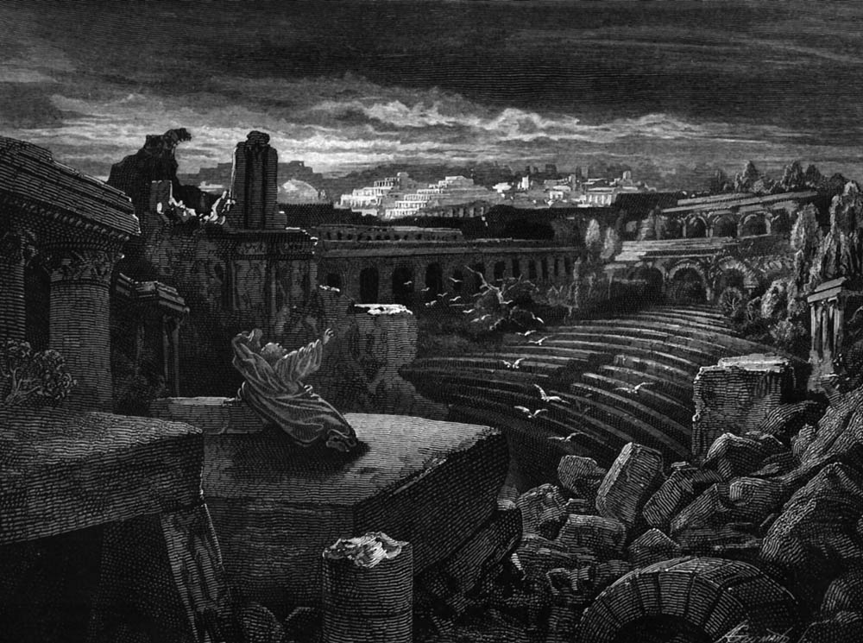
An Undaunted Voice in a Spiritual Wilderness
Prophetic Ministry
in the Old Testament
Adapted from Aaron Chan
Dr. Rick Griffith • Jordan Evangelical Theological Seminary • BibleStudyDownloads.org

Slide 2
SCOPE
The Rise of Prophetic Ministry
Types of Prophecy
The Prophetic Message
A Contemporary Call for an Age-Old Ministry

Slide 3

The Rise of the Prophetic Ministry

Slide 4
Patriarchal Times
Israel came under the dynamic leadership of Moses, Joshua and the judges
Moses took up the role of prophet (Deut. 18:15)
Later prophets found their prototype in Moses

Slide 5

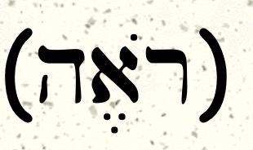
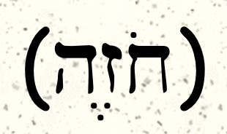
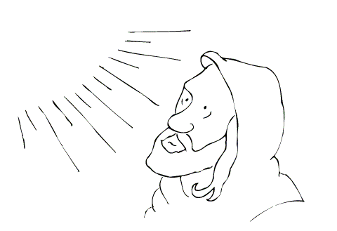
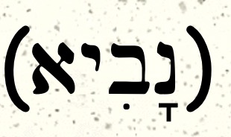
Four terms associated to people with prophetic traits
"Man of God”
"Seer”
"Visionary”
"Prophet”
Notes:
• Man of God: Pagan prophets need not be moral
• Seer: They had insight into God's plans (Saul's donkeys)
• Visionary: God granted them visions
• Prophet: They were called & they spoke for God (related to word for mouth)

Slide 6
Relation to Literature & Monarchy
Non- Literary
"Man of God"
"Seer"
Rise of the Monarchy
"Visionary"
"Prophet"
Literary

Slide 7
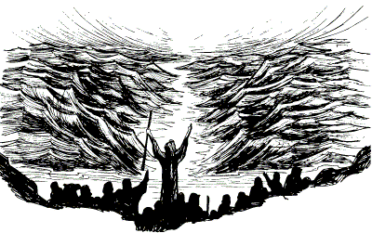
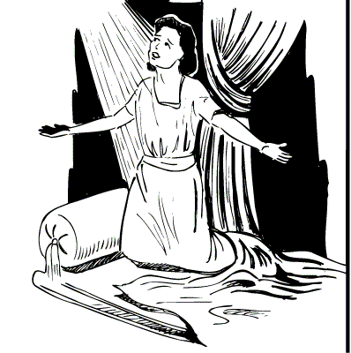
Prophets from Moses to Samuel
Moses
as prophet
Transiting from days of Judges
to the days of the Kings …
Samuel
as Israel's
"first" prophet
( 1 Sam 9:9)

Slide 8
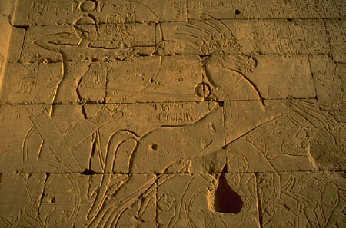
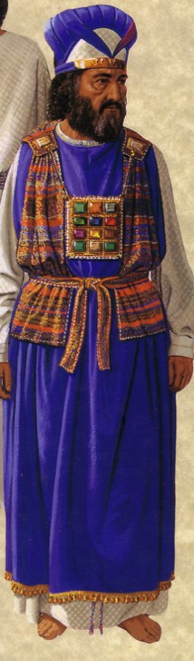
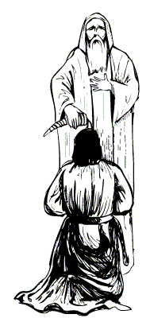
Prophets in the Monarchy
Israel's monarchy was facilitated by:
The anointed priest
The anointed prophet
The anointed king

Slide 9
Types of Prophecy
Non-Literary
  Those whose words have not been preserved in books that carry their names
  Nathan, Elijah, Elisha, etc.
Literary
  Those whose words have been preserved in written form under their names

Slide 10
Literary prophets
Can be divided into three distinct periods.
  Assyrian
  Babylonian
  Persian

Slide 11
Prophetic Timeline
Assyrian
810
721
Obadiah Jonah Amos
Hosea Micah Isaiah
Babylonian
625
539
Zephaniah Habakkuk Nahum
Joel Jeremiah Ezekiel Daniel
Persian
550
Haggai
Zechariah Malachi
1000
900
800
700
600
500
400
BC

Slide 12
Placing the Prophetical Books
445
S "O" S
Pre-Exile
(800-606 BC)
Exile
(606-536 BC)
Post-Exile
(536-400 BC)
S
O
L
O
M
O
N
D
A
V
I
D
Israel
Hosea
Amos
Assyria
Jonah
Nahum
S
A
U
L
"HA"
"NAH"
Jews in Jerusalem
Haggai
Zechariah
Malachi
Judah
Habakkuk
Isaiah
Jeremiah
Joel
Micah
Zephaniah
Lamentations
Jews in Exile
Ezekiel
Daniel
Edom
Obadiah
"HIJJMZL"
"IE"
(In Exile)
"HaZeMa"
(final
OT books)
"BAD"
The Daily Walk
Adapted from Walk Thru the Old Testament
Walk Thru the Bible Press, 1978
Notes:
• The UK (United Kingdom) had the kings Saul, David, and Solomon.
• Yet the UK had warning signs as SDS almost looks like SOS
• Sure enough, the UK split and Israel resulted in its own "Brexit" in the north
• This began the Pre-Exile prophets because these kingdoms would later go into exile
• Meanwhile, Judah in the south would remain until the end of the OT era
• Israel was the first to say "HA" to God in rejection
• So God sent Hosea and Amos (this way we can remember their names!)
• Meanwhile, Assyria was even worse—but God called Jonah and Nahum to warn Assyria.
• After first repenting under Jonah, Assyrians later said "NAH" so God sent both JoNAH and NAHum to warn them.
• Of course, Edom was a blood relative to Israel and Edomites should have known better, so they were really BAD.
• Thus, God sent them OBADiah.
• Jews in Exile included only Ezekiel and Daniel
• They were the only two prophets with IE in their name = In Exile.
• But God brought the people of Judah back as Jews in Jerusalem
• God raised up 3 prophets with the memory device HaZeMa: Haggai, Zechariah, and Malachi.
• But we can't forget the largest group of prophets back in the Pre-Exile times, but how can we remember all 7 of them?
• Fortunately, singing Twinkle, Twinkle with their first letters gives HIJJMZL, which, sung over and over, is unforgettable.
______________
Common Slides English-189
OS-00-OT Book Overviews-616
OS-12-Kings & Prophets Charts-18
OS-23-Prophets Intro-12
OS-24-Jeremiah-28
OS-31-Obadiah-14

Slide 13
Placing the Prophets
342
Placing the Prophets
Key Dates
931
Obadiah
722
Jonah
Amos
Hosea
Isaiah
Micah
Nahum
Zephaniah
Jeremiah
Lamentations
Joel
Daniel
Haggai
Habakkuk
Ezekiel
Zechariah
Malachi
586
Notes:
Three prophets preached prior to Israel's fall, and three during that fall. Ninevehin 760 BC, which was repented 100 years earlier than Nahum under Jonah but then went back to its sin in 660 BC. Assyrians had invaded Israel 60 years earlier than Nahum during Isaiah's day and scattered the people. Then they destroyed 46 towns of Judah—all but Jerusalem in 701 BC! But Judah had far more warning than Israel with many more prophets before and during Jerusalem's fall. Even after the fall of Judah, God sent three messengers to his people during exile (Lamentations, Daniel, Ezekiel) and three more after they returned. What more could he have done?
———————
Common-412
OS-11-1 Kings-186
OS-12-2 Kings-51
OS-13-1 Chron-232
OS-14-2 Chron-40
OS-23-Prophets Intro-13
OS-23-Isaiah1-12-slide 107
OS-34-Nahum-37

Slide 14

To Whom the Prophets Ministered
443
Assyria
Jonah
Phoenicia
Nahum
Aram
Babylon & Persia
Ezekiel
Daniel
Hosea
Israel
Amos
Ammon
Habakkuk
Micah
Judah
Isaiah
Zephaniah
Jeremiah
(Lamentations)
Joel
Haggai
Moab
Zechariah
Egypt
Malachi
Edom
Obadiah
Notes:
The prophets ministered all over the place geographically.
____________
Common-325
OS-12-Prophets Intro-14
OS-31-Obadiah-14, 40

Slide 15
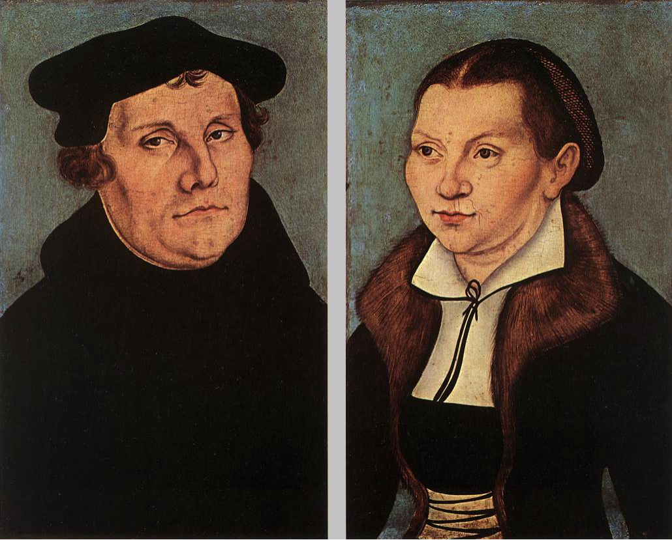
Luther on the Prophets
"The prophets have a queer way of talking, like people who, instead of proceeding in an orderly manner, ramble off from one thing to the next, so that you cannot make head or tail with them or see what they are getting at."
Notes:
Quoted by Gerhard von Rad, Old Testament Theology (New York: ET, 1962), 2:33.

Slide 16
Contrasting Amil & Premil Views on the Prophets
472
 | Amillennial | Premillennial
Time of the Kingdom | Present church age (after Christ’s first coming) | Future millennial age (after Christ’s second coming)
Interpretive Approach | Symbolic rather than literal view of texts is allowed and even encouraged in prophetic genre | Normal, grammatical sense of language is used (figures of speech all have literal referents)
References to Israel | May mean Israel or the church, which is deemed the “new Israel” | “Israel” always means Israel (the ethnic seed of Jacob)

Slide 17
Contrasting Amil & Premil Views on the Prophets
472
 | Amillennial | Premillennial
Location of Christ’s Reign | Either heaven or the new earth in eternal state (= Rev. 21:1) | A renewed earth (but not the new earth of Rev. 21:1)
Political Subjects of Christ’s Reign | The church in heaven and earth before the Second Coming, then on the new earth only after this | All people on earth from Jerusalem as the capital of the world (Isa. 2:3)
Spiritual Life | Some see Jews repenting in mass numbers | Israel & Gentiles repentant and cleansed (Ezek. 36)

Slide 18
Contrasting Amil & Premil Views on the Prophets
472
 | Amillennial | Premillennial
Topographical Changes | Apocalyptic upheaval at the return of Christ seen in a symbolic sense (or not addressed at all) | Mt. Olives split (Zech. 14:4-5), temple at highest point (Isa. 2:2) with river flowing from it (Joel 3:18; Ezek. 47)
Geography | The church spreads the gospel throughout the earth | Tribes of Israel allotted new land boundaries with Gentiles among them in equal status (Ezek. 47–48)
Physical Life | The present age has life-spans generally under 100 years with death inevitable for all people | Most people live past 100 years (Isa. 65:20), babies still born (Isa. 44:3), death only for those in mortal bodies but many live in glorified bodies

Slide 19
Contrasting Amil & Premil Views on the Prophets
472
 | Amillennial | Premillennial
Social Life (Isa. 11:6-9) | Animals symbolize peace between believers and animals today or in the eternal state (OTS, 473a) | Peace between people and animals on a renewed earth (cf. Isa. 2:4)
Religious Life | A millennial temple and sacrifices viewed as contradicting Hebrews 9 and deemed obsolete | Millennial temple (Ezek. 40–43) with sacrifices memorial of Christ (Ezek. 44–46)
Intellectual Life | Knowledge of God heightened worldwide as the gospel advances | Worldwide knowledge of God where all people are believers at the start of the millennium (Jer. 31:34)
Emotional Life | Christ gives joy now to all believers | Jerusalem a city of joy (Isa. 9:1-4)

Slide 20

Problems & Tips in Interpreting Prophecy
438
Inaccurate Presuppositions
Prophets were mainly covenant enforcers based on the Mosaic law
Ethical
Forthtelling
Mosaic Covenant
Predictive
Foretelling
Abrahamic Covenant
Notes:
________________
BS-14-OT Literature-58
OS-23-Prophets Intro-20

Slide 21
Difficulties Interpreting Prophets
120
Incomplete Background Data
Historical Distance
Lack of Appreciation for Poetry
Unfamiliarity with Prophetic Books
Ignorance of Eschatology
Dual Eschatological Viewpoint
Notes:
________________
BS-14-OT Literature-60
OS-23-Prophets Intro-21

Slide 22
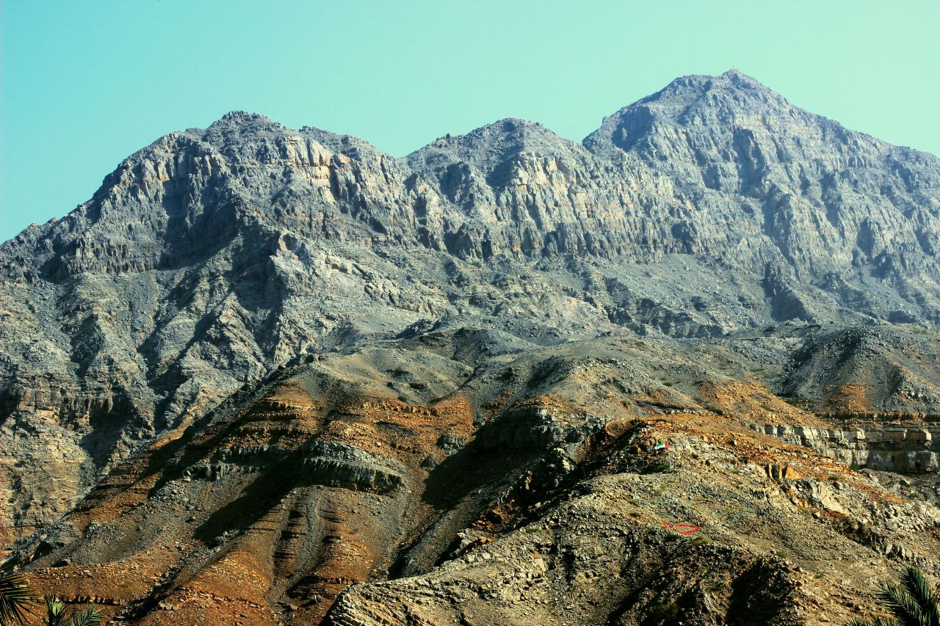
Approaching a Summit

Slide 23

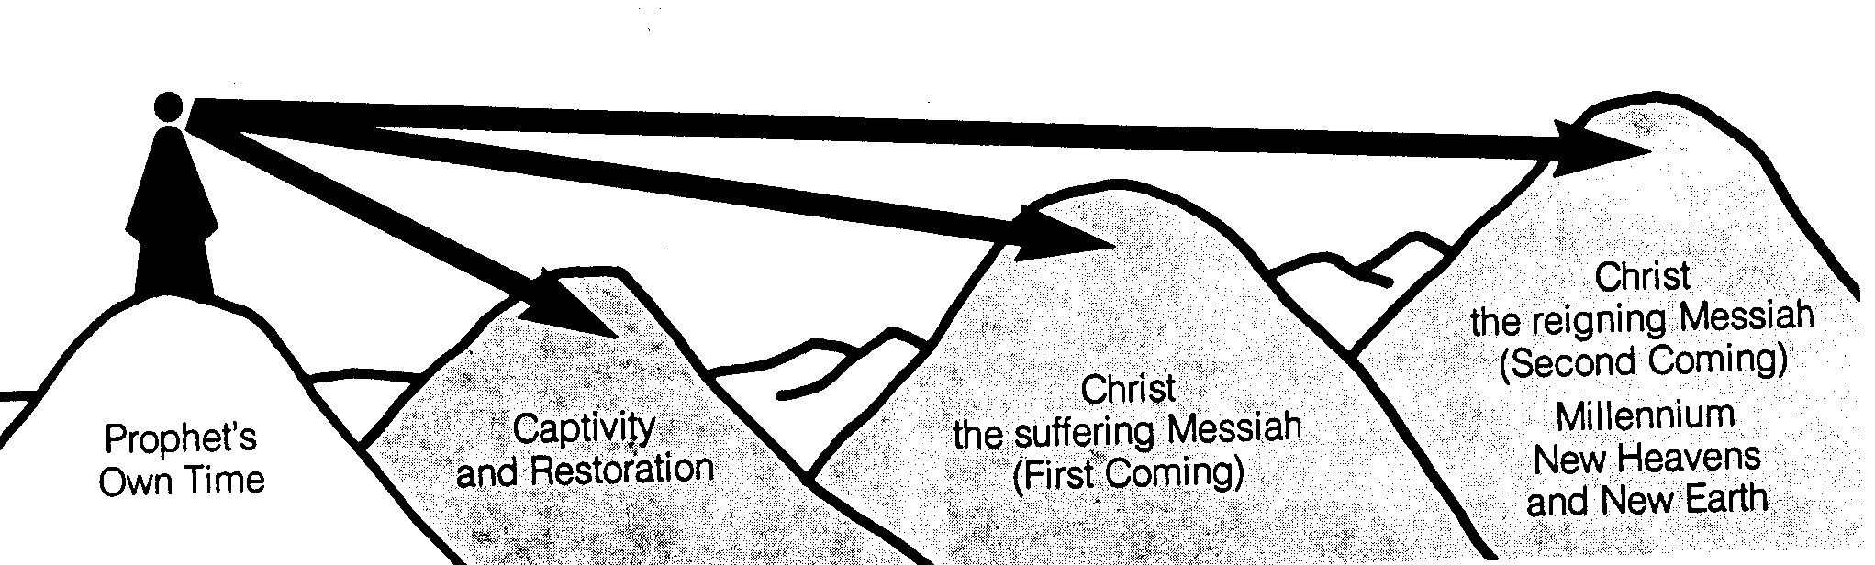
Time Periods of the Prophets
Isaiah:
442
7–8
39–40
52–53
2, 11
25:8
New Heavens & New Earth
Christ's Second Coming to Reign in Millennium
Christ's First Coming to Suffer
Exile & Return
Prophet's Own Time
Adapted significantly from Salem Kirban, Charts on Revelation (1979), 49
Notes:
The prophets often looked to the future but did not know how far their prophecies referred. It is like a person standing on a mountain looking into the distance and seeing what appears to be the same mountain. However, the person standing at these same mountains from the side can clearly see significant gaps between the peaks. Such is the viewpoint that we have thousands of years later. There generally existed five time periods, including the prophet’s own era. Isaiah especially prophesied of each of these time periods in the chapters above.
____________
Common-334
BE-31-Obadiah-64
OS-OT_Book_Overviews-782_pp42a_and_347a-613
OS-23-Prophets_Introduction-19
OS-23-Isaiah1-12—slide 357
OS-31-Obadiah-13

Slide 24

We See the Valleys

Slide 25
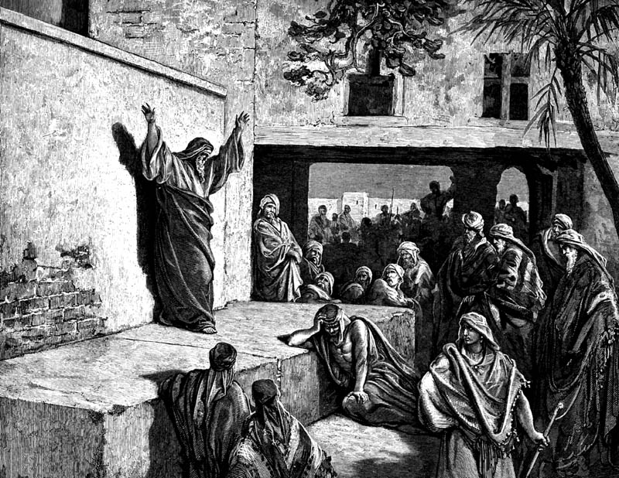
The Prophetic Message

Slide 26
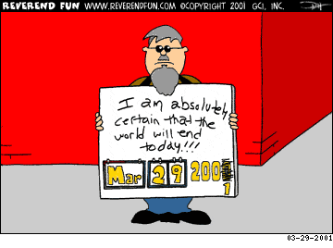
Modern False Prophecy

Slide 27
The Prophetic Message
438
The prophets were not pushovers. They went against the tide to preach the word of Yahweh to a rebellious nation.

Slide 28
The Prophetic Message
The Prophetic Message
A major concern posed by the prophets was idolatry.
But they also had social and economic concerns.
They spoke pronouncements of judgments to steer the nation away from the curses.

Slide 29
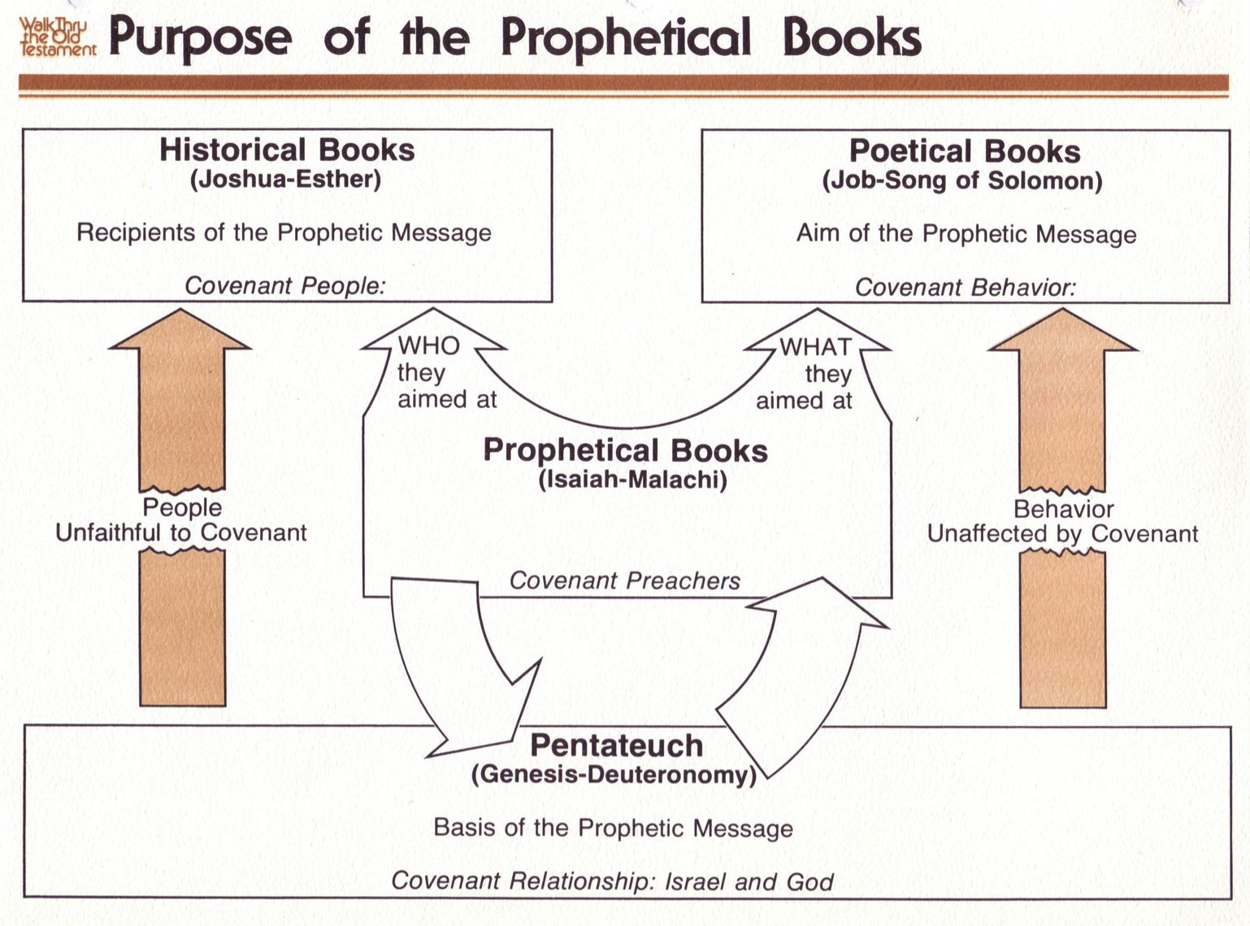
Purpose of the Prophetic Books
50b440
Historical Books
(Joshua-Esther)
Recipients of the Prophetic Message
Covenant People
Poetical Books
(Job-Song of Solomon)
Aim of the Prophetic Message
Covenant Behavior
WHO they aimed at
WHAT they aimed at
Prophetical Books
(Isaiah-Malachi)
Covenant Preachers
People
Unfaithful to Covenant
Behavior
Unaffected by Covenant
FORTHTELLING
Mosaic Covenant
Pentateuch
(Genesis-Deuteronomy)
Basis of the Prophetic Message
Covenant Relationship: Israel & God
Deut. 28; Lev. 26
Conditional
Judgment
Notes:
00-Intro & Biblical Theology-slide 18
00_OT Book Themes under Isaiah section
28-Hosea-slide 54
31-Obadiah-slide 26

Slide 30
Deut. 28: Blessings & Curses
Your towns and your fields
will be blessed (3)
Your towns and your fields
will be cursed (16)
Your children and your crops
will be blessed (4)
Your children and your crops
will be cursed (18)
Your fruit baskets and bread-boards will be blessed (5)
Your fruit baskets and bread-boards will be cursed (17)
Wherever you go and whatever you do, you will be blessed (6)
Wherever you go and whatever you do, you will be cursed (19)
Your enemies will attack you from one direction, but they will scatter from you in seven! (7)
You will attack your enemies from one direction, but you will scatter from them in seven! (25)
You will lend to many nations, but you will never need to borrow from them (12)
They will lend to money to you, but you will not lend to them
(44)
Notes:
Around 1400 BC, God warned in Deut 28 not to have any other gods….
The parallels between the individual blessings and cursings are just too obvious!
———————
OS-05-Deuteronomy-242
OS-12-2 Kings-97
OS-14-2 Chron-62
OS-23-Prophets Intro-25
OS-24-Jeremiah-243

Slide 31
Prophetic Curses
154
220
Why?
Exile
Deut. 28
Notes:
Later in the OT we see justification for God's judgment on Israel. The leaders and the people sinned through ungodliness and idolatry, and true to the curses of Deut. 28, God gave the people the consequences of their obedience by exiling them to Babylon.
Jeremiah's prophecy and Lamentations record his eyewitness account of Babylon's siege and destruction of Jerusalem for the nation's sin, the Holy Spirit moved him to record an historical compilation which provides the context and justification for God's judgment upon these two nations. The leaders and the people sinned through ungodliness and idolatry, and true to the curses of Deut. 28, God gave the people the consequences of their obedience.
——————————
OS-05-Deuteronomy-252
OS-12-2 Kings-98
OS-23-Prophets Intro-26
OS-24-Jeremiah-244

Slide 32
Purpose of the Prophetic Books
50b440
Historical Books
(Joshua-Esther)
Recipients of the Prophetic Message
Covenant People
Poetical Books
(Job-Song of Solomon)
Aim of the Prophetic Message
Covenant Behavior
WHO they aimed at
WHAT they aimed at
Prophetical Books
(Isaiah-Malachi)
Covenant Preachers
People
Unfaithful to Covenant
Behavior
Unaffected by Covenant
FORTHTELLING
FORETELLING
Mosaic Covenant
Pentateuch
(Genesis-Deuteronomy)
Basis of the Prophetic Message
Covenant Relationship: Israel & God
Abrahamic Covenant
Deut. 28; Lev. 26
Gen. 12:1-3; 15:18
Conditional
Unconditional
Judgment
Blessing
Notes:
00-Intro & Biblical Theology-slide 18
00_OT Book Themes under Isaiah section
22-Isaiah-13
28-Hosea-slide 54
31-Obadiah-slide 26

Slide 33
Covenant Ethics in Mosaic Law
Prophets applied the Mosaic law to three dimensions of Israel's life:
Theological angle
Christopher Wright
Mosaic Law
Economic angle
Social angle

Slide 34
The Prophetic Message
Against idolatry
  Deut 5:7-10; Isaiah. 40:12-31
For Social Justice
  Deut 15 and 17; Micah 6:8; Amos 2:6-8, 5:12
Against economic exploitation
  Lev 25:42, 53-55; Micah 2:8; Amos 2:6

Slide 35
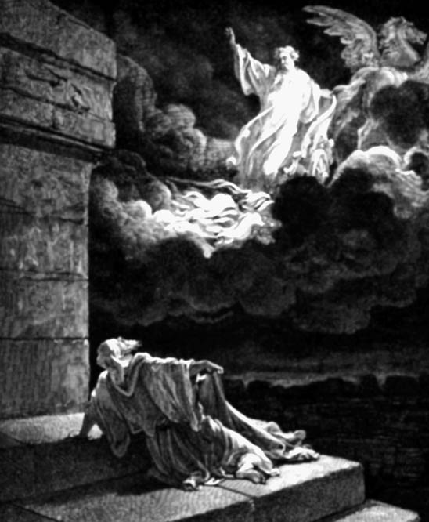
A Contemporary Call for an Age Old Ministry
God granted the prophets extraordinary visions forward in time.
The prophets were master exegetes of the signs of the times.
They saw military invasions, locust plagues & famine not as mere natural occurrences…
These were God's razor-sharp punishment from a moral perspective.
And they preached it with all their hearts!!

Slide 36
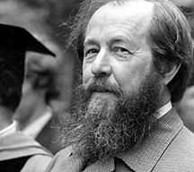
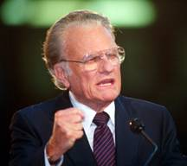
Contemporary "Prophetic" Voices
Aleksandr Solzhenitsyn attributed the massive suffering in twentieth-century Russia due to a society that forgot God.
Billy Graham related the social problems in the US to a spiritual decline.

Slide 37
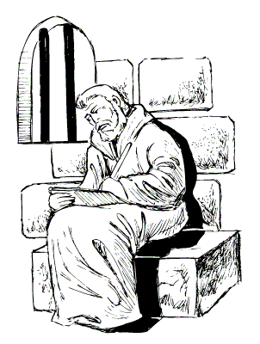
Timothy's "Prophetic" Role
Paul charged Timothy:
"Preach the Word; Be ready in season and out of season. Reprove, rebuke, exhort, with great patience."
"For the time will come when they will not endure sound doctrine; but wanting to have their ears tickled, they will accumulate for themselves teachers in accordance to their own desires."
2 Tim 3:2-3

Slide 38
Black

Slide 39


OT Survey link at BibleStudyDownloads.org
Get this presentation for free!
Notes:
OT Survey (os)

