Slide 1
Prophecy
Class Presentation for Dr. Rick Griffith, Singapore Bible College
BibleStudyDownloads.org

Slide 2
Prophets - Who are they?
My Heart is devoted to God
I am the man!
I spoke thru parables,
songs, etc, etc
I tell God’s truth to
my generation
I am a messenger
I am called by God

Slide 3

When?
Prophesied between 800 – 450 BC
Where?
Assyria, Babylon and Persia

Slide 4
Common Theme

Slide 5
1. Covenant Obligation
        A call to return to God and his Word
  A call to personal holiness
  A call to be at peace with each other

Slide 6

2. Day of the Lord
        Referred to God’s judgment on unbelievers
        Cleansing and purging of God’s people
        Salvation of God’s people

Slide 7


3. Concept of Messiah

Slide 8
Test for True Prophets
A prophet’s message had to be consistent
What he prophesied must come true

Slide 9
. 840-830 BC .

Slide 10
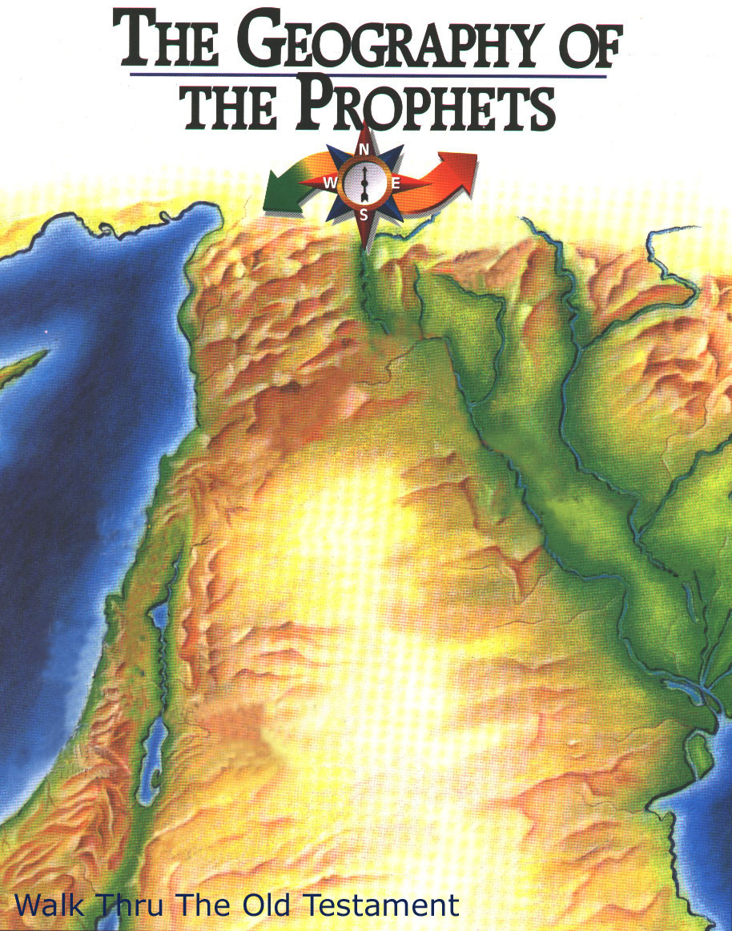
. Obadiah .
Assyria
Whom? Edomites
When? 840 - 830 BC
Where? Edom
Why?
Edom’s Destruction for Opposing Judah
Israel
Jews in Babylonia
Judah
Jews in Jerusalem
Edom
Obadiah

Slide 11
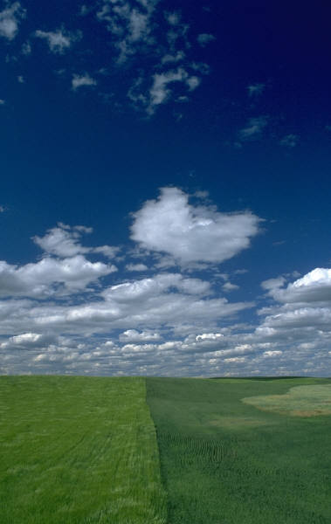
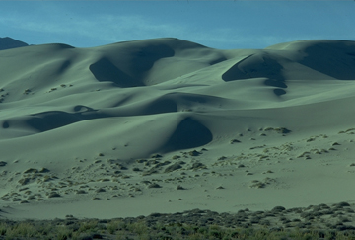
. Obadiah .
What happened?
Judgment on Edom
Blessings on Judah

Slide 12

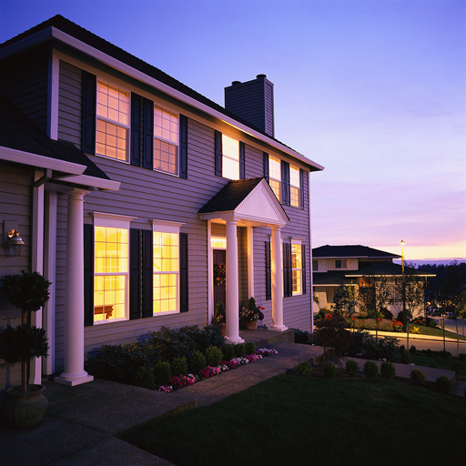
. Obadiah .
How to apply?
Are we arrogant when we have all these?
God judges the prideful
who try to destroy His people
Bachelor In Theology

Slide 13
. 830 - 820 BC .

Slide 14
. Joel .
Assyria
Whom? Judah
When?
830-820 BC
Where? Judah
Why?
Day of the Lord
Israel
Jews in Babylonia
Judah
Joel
Jews in Jerusalem
Edom
Obadiah

Slide 15
. Joel .
What happened?
. Locusts .

Slide 16
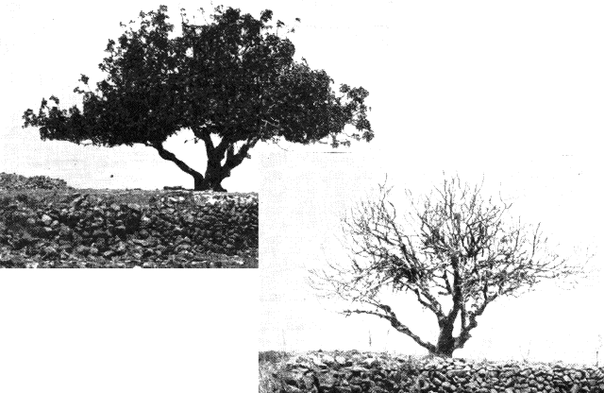

. Joel .
How to apply?
Do you want God to strip you of everything
before you repent?

Slide 17
. 780 - 760 BC .

Slide 18
. Jonah .
Assyria
Jonah
Whom? Assyria
When? 780 - 760 BC
Where? Nineveh
Why?
God’s Compassion
on the Gentiles
Israel
Jews in Babylonia
Judah
Joel
Jews in Jerusalem
Edom
Obadiah

Slide 19
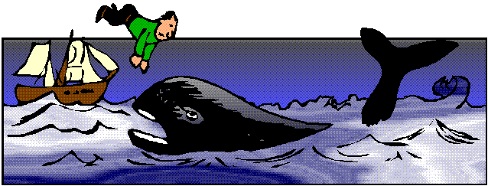
. Jonah .
What happened?

Slide 20

. Jonah .
How to apply?
Responding to
God’s heart means
catching His heart
for the lost.
For the
Lost

Slide 21
. 755 - 750 BC .

Slide 22
. Amos .
Assyria
Jonah
Whom? Israel
When?
755 - 750 BC
Where? Israel
Why?
Judgment for
Social Injustice
Assyria
Jonah
Israel
Jews in Babylonia
Amos
Judah
Joel
Joel
Jews in Jerusalem
Edom
Obadiah

Slide 23
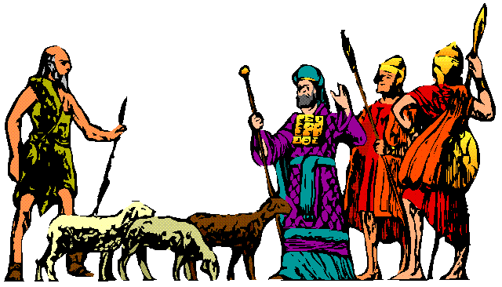
. Amos .
What happened?
Amos the shepherd prophet

Slide 24

. Amos .
How to apply?
Prosperous Christians must not wink at
Social Injustice.

Slide 25
. 760 - 710 BC .

Slide 26
. Hosea .
Assyria
Jonah
Whom? Israel
When?
760 - 710 BC
Where? Israel
Why?
God’s Loyalty to
Repentant Israel
Assyria
Jonah
Israel
Jews in Babylonia
Amos
Hosea
Judah
Joel
Joel
Jews in Jerusalem
Edom
Obadiah

Slide 27
. Hosea .
Dear Hubby Hosea,
I am writing to say that I am leaving you and our three children. My heart yearns for other loves. The pull of being in the lime-light at the brothel is stronger. I love silver and gold more than my love for you or the children. Therefore I will leave them to your loving care. Please love them for us both.
Yours unfaithfully,
Gomer
What happened?
Gomer’s
letter to Hosea

Slide 28

Dearly beloved Gomer,
My heart broke that you have left me to pursue after other loves. The Lord God of Israel has told me to take myself a wife of harlotry. In obedience I took you as my wife and you have bore me three wonderful children; Jezreel, Lo-Ruhamah and Lo-Ammi. Now, I could not retain you to stay because the temptations of this world have seduced you.
I cried to the Lord God of Israel and He said to me, “Go, and show your love to your wife again though she is loved by another. Love her like I love the Israelites, though they turn to other gods and love the raisin cakes of the pagans”. Although you are unfaithful, my commitments to you remain unchanged. I will come and take you. You are to live with me many days; you must not be a prostitute or be intimate with any man and I will live with you
Yours faithfully,
Hosea
. Hosea .
What happened?
Hosea’s letter to
Gomer

Slide 29

. Hosea .
God’s loyal love is tough love so that He’ll
do what it takes to bring us back to Him
How to Apply?

Slide 30
. 740 - 690 BC .

Slide 31
Act 1

Slide 32

452
. Isaiah .
Key Verse
Lift up your eyes to the heavens,
look at the earth beneath;
the heavens will vanish like smoke, the earth will wear out like a garment and its inhabitants die like flies.
But my salvation will last forever,
my righteousness will never fail.
~ Isaiah 51:6

Slide 33
. Isaiah .
Assyria
Jonah
Whom? Judah
When?
740 -690 BC
Where? Judah
Why?
Restoration of the
Created Order
Israel
Jews in Babylonia
Amos
Hosea
Judah
Joel
Isaiah
Jews in Jerusalem
Edom
Obadiah

Slide 34
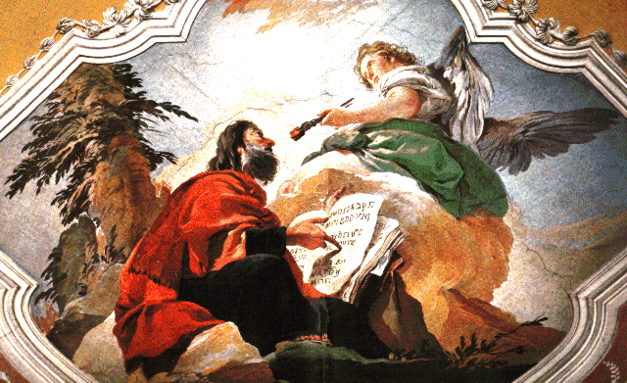
. Isaiah .
What happened?

Slide 35

. Isaiah .
How to Apply?
Priority list
God
Church
Family
...
...
...
...
…
…
..
The future restoration of the earth should
cause us to get our priorities right now

Slide 36
Commercial break

Slide 37

His Discipline

Slide 38
. 735 - 700 BC .

Slide 39
. Micah .
Assyria
Jonah
Whom? Judah
When?
735 -700 BC
Where? Judah
Why?
Judgment on
Israel and Judah
for Exploitation
Israel
Jews in Babylonia
Amos
Hosea
Judah
Joel
Isaiah
Jews in Jerusalem
Micah
Edom
Obadiah

Slide 40
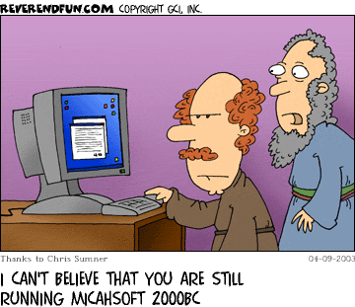
. Micah .
What happened?

Slide 41

. Micah .
How to Apply?
Show justice, mercy, and humility rather than
getting rich by making others poor.

Slide 42
. 650 - 620 BC .

Slide 43
. Nahum .
Assyria
Jonah
Whom? Nineveh
When?
650 - 620 BC
Where? Assyria
Why?
Nineveh Destruction
Nahum
Israel
Jews in Babylonia
Amos
Hosea
Judah
Joel
Isaiah
Jews in Jerusalem
Micah
Edom
Obadiah

Slide 44
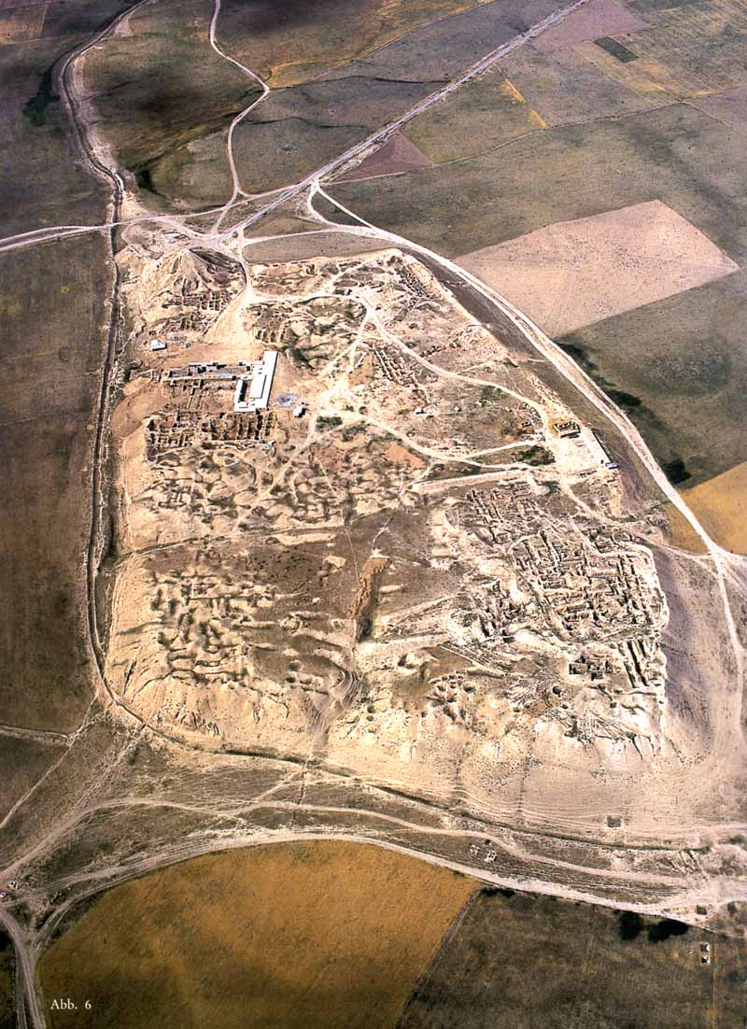
. Nahum .
What happened?
Ruins of Nineveh

Slide 45
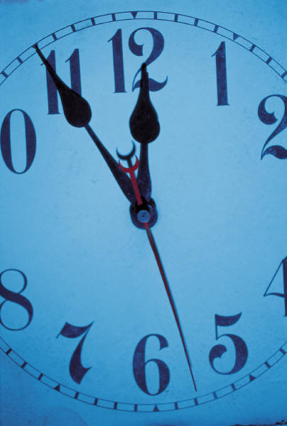
. Nahum .
How to Apply?
Do not mistake the patience of God as the
impotence of God
God is always on time.

Slide 46
. 630 - 620 BC .

Slide 47
. Zephaniah .
Assyria
Jonah
Whom? Judah
When?
630-620 BC
Where? Judah
Why?
Day of the LORD
Nahum
Israel
Jews in Babylonia
Amos
Hosea
Judah
Joel
Isaiah
Jews in Jerusalem
Micah
Zephaniah
Edom
Obadiah

Slide 48

. Zephaniah .
What happened?
The last good king in Judah
Josiah

Slide 49
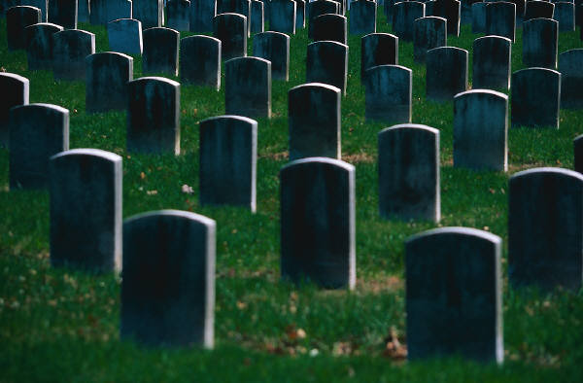
. Zephaniah .
How to Apply?
If you insist on living like as pagan,
then you will die like a pagan.

Slide 50
. 620 - 605 BC .

Slide 51
. Habakkuk .
Assyria
Jonah
Whom? Judah
When?
620 - 605 BC
Where? Judah
Why?
Babylon’s
destruction
Nahum
Israel
Jews in Babylonia
Amos
Hosea
Judah
Joel
Isaiah
Jews in Jerusalem
Micah
Zephaniah
Habakkuk
Edom
Obadiah

Slide 52

. Habakkuk .
What happened?
Why do the wicked prosper?

Slide 53
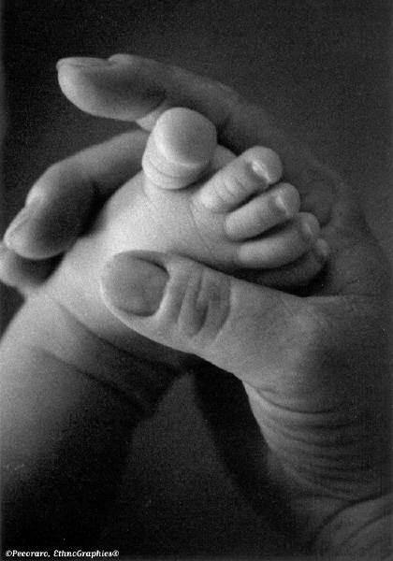

. Habakkuk .
Assignments
How to Apply?
Do you trust in God despite the perplexities of your life?
Hermeneutics
Grades
Relationships
Field Education

Slide 54
. 625 - 585 BC .

Slide 55
Act 2

Slide 56

474
. Jeremiah .
Key Verse
For the Lord Our God has doomed us to perish and given us poisoned water to drink, because we have sinned against him.
~ Jeremiah 8:14b

Slide 57
. Jeremiah .
Whom?
Judah and the
nations
When?
625 - 585 BC
Where? Judah
Why? Deserved
Captivity and
Undeserved
Restoration
Assyria
Jonah
Nahum
Israel
Jews in Babylonia
Amos
Hosea
Judah
Joel
Isaiah
Jews in Jerusalem
Micah
Zephaniah
Habakkuk
Edom
Jeremiah
Obadiah

Slide 58
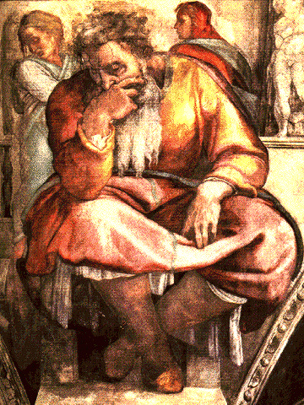
. Jeremiah .
What happened?
The Prophet Jeremiah, Michelangelo. Sistine Chapel, Pauline Chapel

Slide 59
. Jeremiah .
How to Apply?
If we choose to continue in sin we’ll eventually
come to a point where God’s discipline is
inevitable
God’s Discipline
Sin

Slide 60
. 585 - 580 BC .

Slide 61
Great is Thy Faithfulness

Slide 62
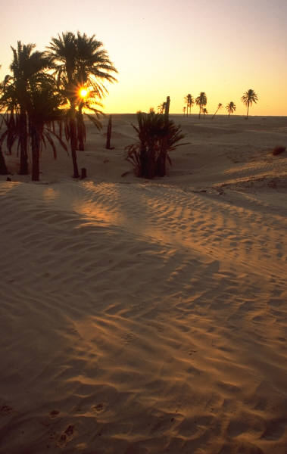
493
. Lamentations .
Key Verse
Because of the LORD’s great love we are not consumed, for his compassions never fail. They are new every morning; great is your faithfulness
~ Jeremiah 8:14b

Slide 63
. Lamentations .
Assyria
Jonah
Whom? Judah
When?
585 - 580 BC
Where? Judah
Why?
Emotions of and
Reasons for the
Fall
Nahum
Israel
Jews in Babylonia
Amos
Hosea
Judah
Joel
Isaiah
Jews in Jerusalem
Micah
Zephaniah
Edom
Habakkuk
Obadiah
Jeremiah
Lamentations

Slide 64
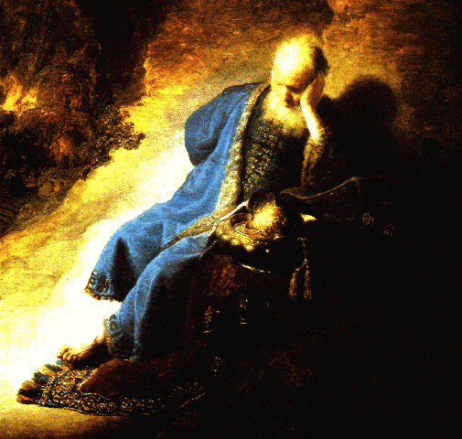
. Lamentations .
What happened?
Jeremiah lamented
the devastation
of Jerusalem

Slide 65

493
. Lamentations .
How to Apply?
When we are punished by God, our only hope
lies in turning to our ‘Enemy’

Slide 66
Commercial break
Again…

Slide 67
His Discipline

Slide 68
. 593 - 570 BC .

Slide 69
Act 3

Slide 70
Key Verse
For I will take you out of the nations;
I will gather you from all the countries and bring you back into your own land.
I will sprinkle clean water on you, and you will be clean;
I will cleanse you from all your impurities and from all your idols.
I will give you a new heart and put a new spirit in you;
I will remove from you your heart of stone and give you a heart of flesh. And I will put my Spirit in you and move you to follow my decrees and be careful to keep my laws.
~ Ezekiel 36:24-27
500
. Ezekiel .

Slide 71
. Ezekiel .
Assyria
Jonah
Whom?
Exiles in Babylon
When?
593 - 570 BC
Where? Babylon
Why?
Sovereign Departing
and Return of Glory
Nahum
Israel
Jews in Babylonia
Amos
Ezekiel
Hosea
Judah
Joel
Isaiah
Jews in Jerusalem
Micah
Zephaniah
Edom
Habakkuk
Obadiah
Jeremiah
Lamentations

Slide 72
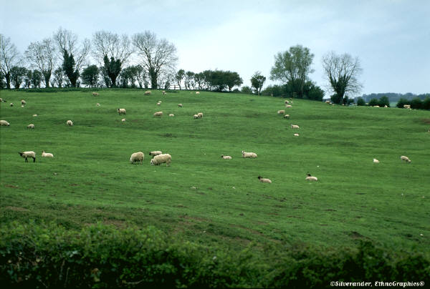
. Ezekiel .
What happened?
God promised to restore to the land those
who remained faithful to him.

Slide 73
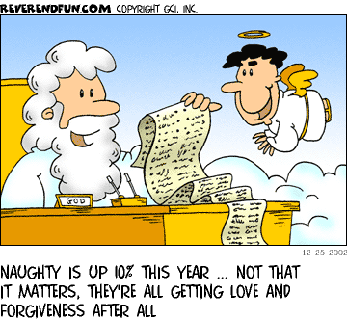
500
. Ezekiel .
How to Apply?
God disciplines us for our sin but restores us by
His Grace

Slide 74
. 606 - 530 BC .

Slide 75
Act 4

Slide 76
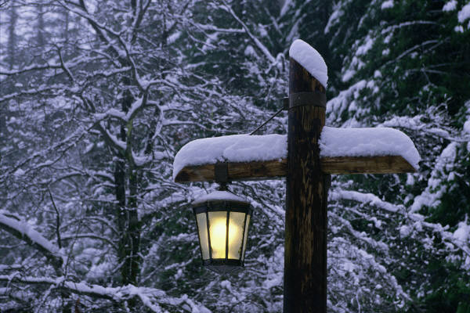
532
. Daniel .
Key Verse
Praise be to the name of God for ever and ever; wisdom and power are his.
He changes times and seasons; he sets up kings and deposes them…
~ Daniel 2:20-21a

Slide 77
. Daniel .
Assyria
Jonah
Whom?
Exiles in Babylon
When?
606 - 530 BC
Where? Babylon
Why?
Universal
Sovereignty in
Times of the Gentiles
Nahum
Israel
Jews in Babylonia
Amos
Ezekiel
Hosea
Daniel
Judah
Joel
Isaiah
Jews in Jerusalem
Micah
Zephaniah
Edom
Habakkuk
Obadiah
Jeremiah
Lamentations

Slide 78
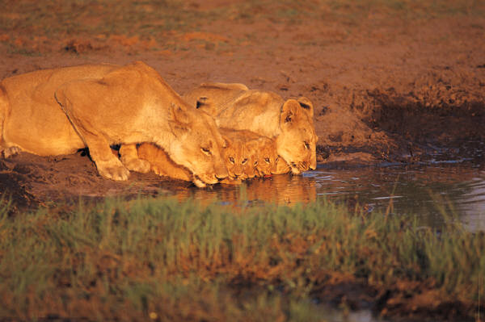
. Daniel .
What happened?
God is sovereign

Slide 79
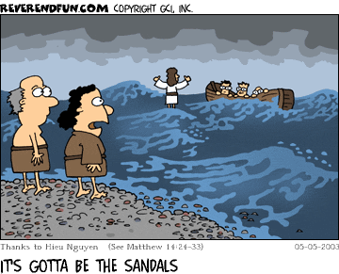
500
. Daniel .
How to Apply?
Believers need not fear political and personal
trouble since God rules all nations.

Slide 80
. 520 BC .

Slide 81
. Haggai .
Assyria
Jonah
Whom? Judah
When? 820 BC
Where? Judah
Why?
Drought for
Neglected Temple
Rebuilding
Nahum
Israel
Jews in Babylonia
Amos
Ezekiel
Hosea
Daniel
Judah
Joel
Isaiah
Jews in Jerusalem
Micah
Haggai
Zephaniah
Edom
Habakkuk
Obadiah
Jeremiah
Lamentations

Slide 82
. Haggai .
What happened?
The Ruin

Slide 83
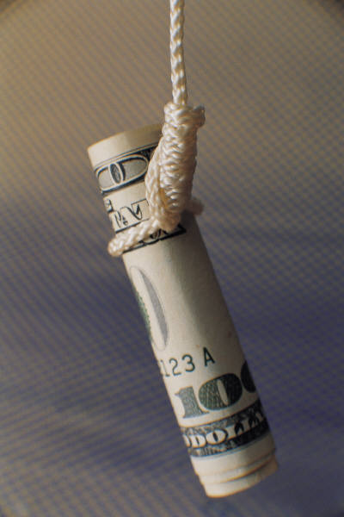
640
. Haggai .
How to Apply?
GOD
Which is more important to you?
Don’t pursue personal prosperity more than
you pursue God’s work.

Slide 84
. 520 - 480 BC .

Slide 85
. Zechariah .
Assyria
Jonah
Whom? Judah
When?
520 – 480 BC
Where? Judah
Why?
Rebuild temple
For Messiah
Nahum
Israel
Jews in Babylonia
Amos
Ezekiel
Hosea
Daniel
Judah
Joel
Isaiah
Jews in Jerusalem
Micah
Haggai
Zephaniah
Edom
Zechariah
Habakkuk
Obadiah
Jeremiah
Lamentations

Slide 86
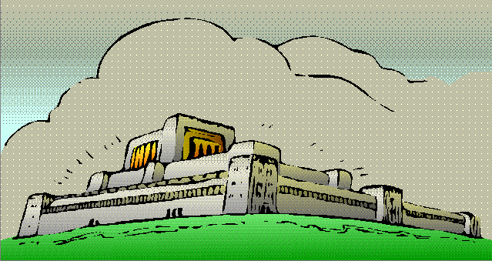
649
. Zechariah .
What happened?
Rebuilt Temple for Messiah

Slide 87
649
. Zechariah .
How to Apply?
Does your future reign with Christ affect how you
make decisions today?

Slide 88
. 430 - 420 BC .

Slide 89
. Malachi .
Assyria
Jonah
Whom? Judah
When?
430 - 420 BC
Where? Judah
Why?
Warning of
Judgment for
Hypocrisy
Nahum
Israel
Jews in Babylonia
Amos
Ezekiel
Hosea
Daniel
Judah
Joel
Isaiah
Jews in Jerusalem
Micah
Haggai
Zephaniah
Edom
Zechariah
Habakkuk
Obadiah
Jeremiah
Malachi
Lamentations

Slide 90
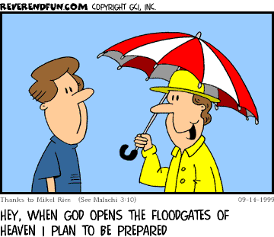
. Malachi .
What happened?
“Bring the whole tithe into the storehouse, that there may be food in my house. Test me in this," says the LORD Almighty, "and see if I will not throw open the floodgates of heaven and pour out so much blessing that you will not have room enough for it.” Malachi 3:10

Slide 91
. Malachi .
How to Apply?
Fear God by repenting of
superficial religious activities so you won’t get disciplined.

Slide 92
Find us Faithful

Slide 93
We're pilgrims on the journey
Of the narrow road
And those who've gone before us line the way
Cheering on the faithful, encouraging the weary
Their lives a stirring testament to God's sustaining grace

Slide 94
Surrounded by so great a cloud of witnesses
Let us run the race not only for the prize
But as those who've gone before us
Let us leave to those behind us
The heritage of faithfulness passed on through godly lives

Slide 95
(Chorus)
Oh may all who come behind us find us faithful
May the fire of our devotion light their way
May the footprints that we leave
Lead them to believe
And the lives we live inspire them to obey
Oh may all who come behind us find us faithful

Slide 96
After all our hopes and dreams have come and gone
And our children sift though all we've left behind
May the clues that they discover and the memories they uncover
Become the light that leads them to the road we each must find

Slide 97
(Chorus)
Oh may all who come behind us find us faithful
May the fire of our devotion light their way
May the footprints that we leave
Lead them to believe
And the lives we live inspire them to obey
Oh may all who come behind us find us faithful

Slide 98
His Servants
Connie Tong
Yoanita
Kim Fah
Vial Za Thawng
Vincent Lim

Slide 99
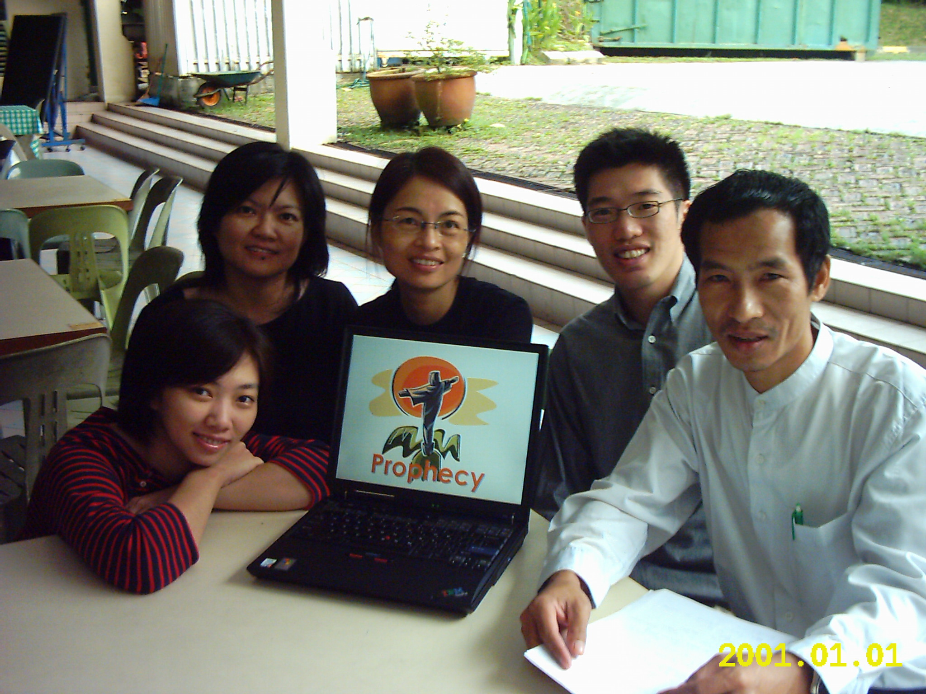
His Servants

Slide 100
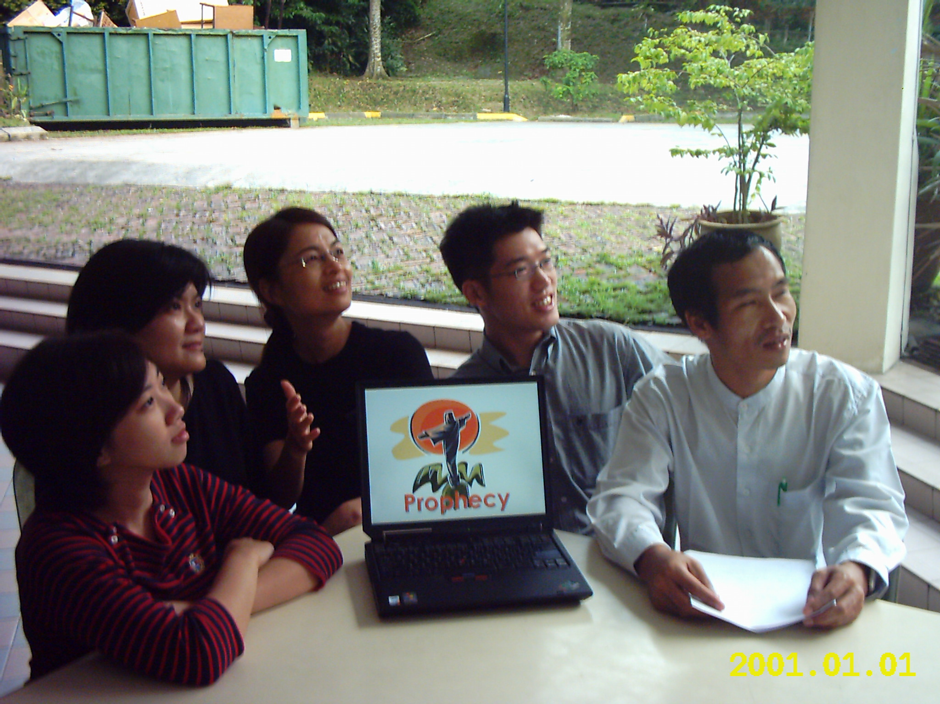
His Servants

Slide 101
"Ask faith to look through the keyhole of the promise and tell you what it sees there laid up for him that overcomes; ask it to listen and tell you whether it cannot hear the shout of those
crowned saints receiving the reward of all their services and sufferings here on earth. And do you stand on the other side afraid to wet your foot with those sufferings and temptations,
which, like a little trickle of water, run between you and glory?"
—William Gurnall, The Christian In Complete Armor

Slide 102
Black

Slide 103


OT Survey link at BibleStudyDownloads.org
Get this presentation for free!
Notes:
OT Survey (os)

