Slide 1
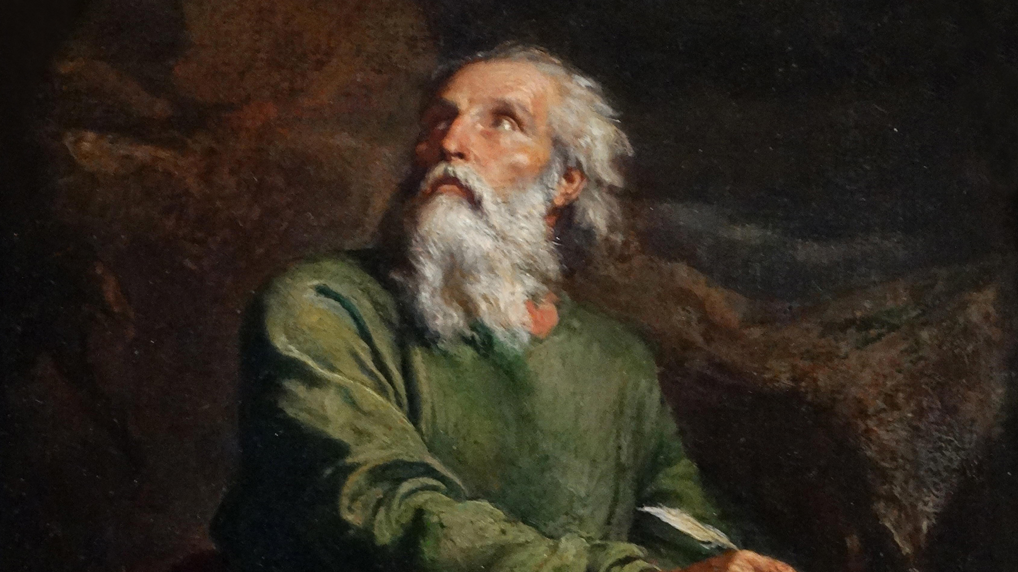
Isaiah Authorship
Who wrote Isaiah?
Dr. Rick Griffith • Jordan Evangelical Theological Seminary
BibleStudyDownloads.org

Slide 2
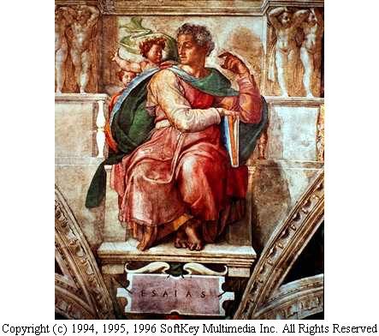
ISAIAH
Sistine Chapel
Notes:
2

Slide 3
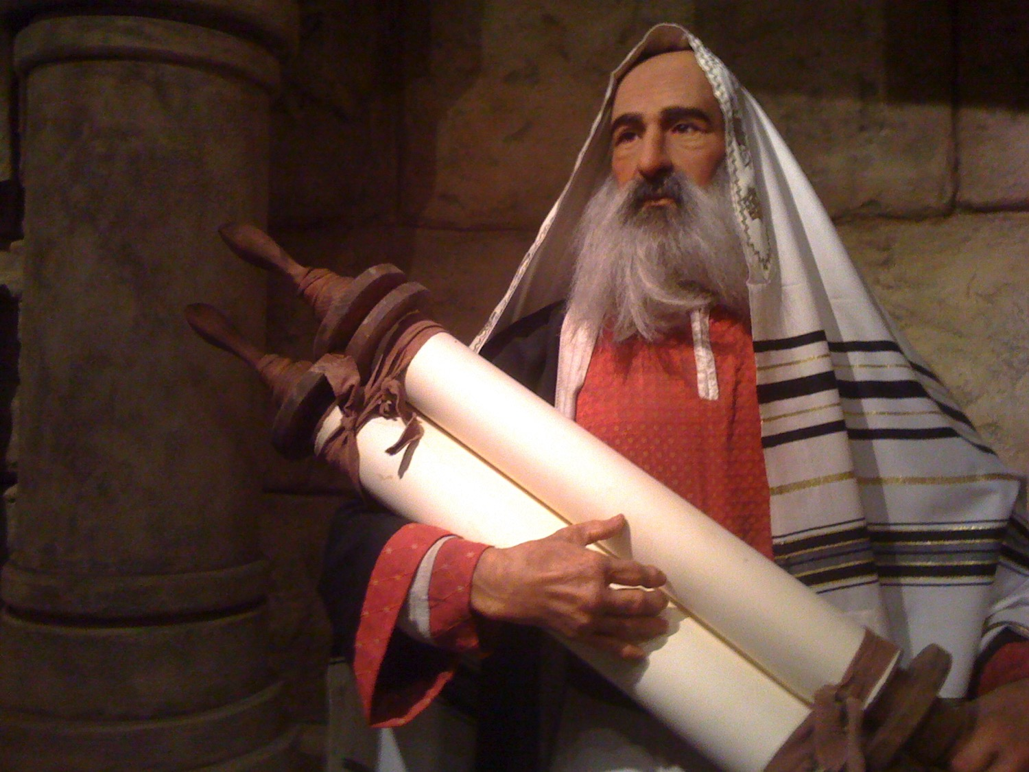
Who was Isaiah?

Slide 4
453
WHO WAS ISAIAH?
His name means "the LORD is salvation" or "the LORD saves"
Son of Amoz and traditionally believed to be a cousin of King Uzziah, and possibly had access to the royal court
Tradition records that he was martyred by being sawn in two.
Notes:
4

Slide 5
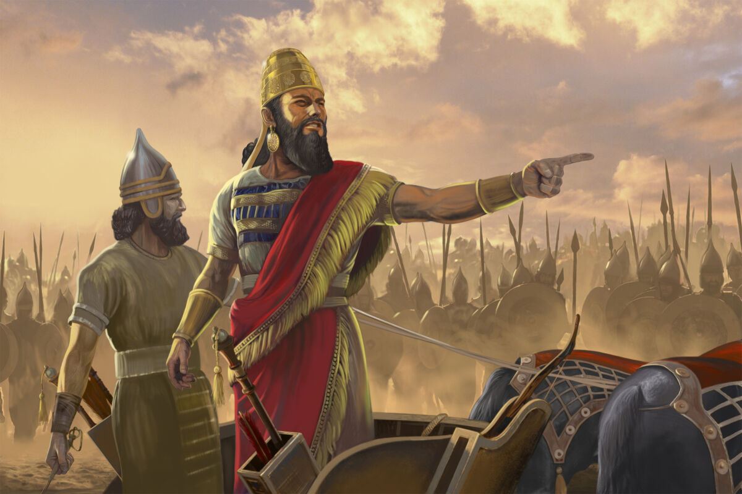
Isaiah wrote during the Assyrian invasions about 700 BC

Slide 6
Placing the Prophets
342
Placing the Prophets
Key Dates
931
Obadiah
722
Jonah
Amos
Hosea
Isaiah
Micah
586

Slide 7


Chart of OT Kings & Prophets
232 & 342
John C. Whitcomb, 4th ed. (Winona Lake, IN: BMH Books, 1968), 2

Slide 8
The Assyrian Threat
454
Assyrian Expansion
Nineveh
Mediterranean
Sea
Aram
Israel
Judah
Isaiah 7
Persian
Gulf
Egypt
Notes:
8
Isaiah lived in Judah to see the Assyrian kingdom expand by stages to conquer all of the nations north of him—including the northern kingdom of Israel in 722/721 BC.

Slide 9
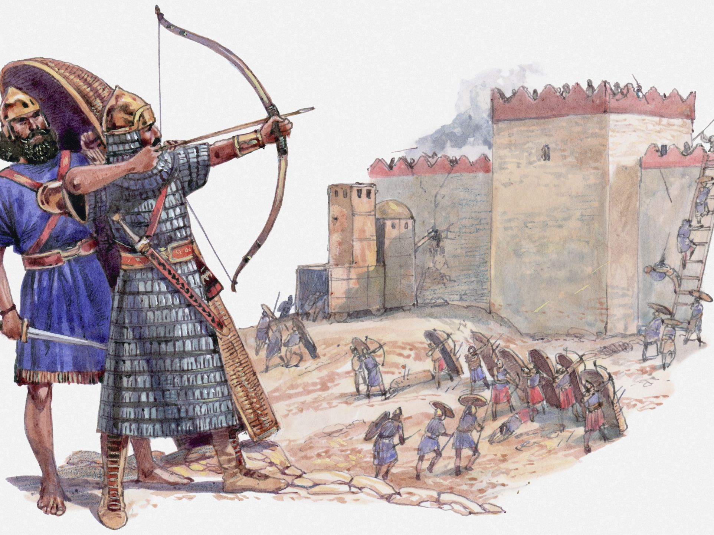
Assyrians ruined 46 cities of Judah
Notes:
As Isaiah served the LORD in Jerusalem, every other city in Judah was conquered one by one.

Slide 10

When Isaiah Wrote
453
End of the
Kings of Israel
Pekah
Hoshea
Kings of Judah
Uzziah
Jotham
Ahaz
Hezekiah
Isaiah's 60-Year Ministry
(739-680 BC)
Notes:
10

Slide 11
453
Who wrote Isaiah?
Accusations:
1. Background
2. Style & theology
Isaiah
3. Messiah
4. Captivity & Cyrus
Notes:
11
1. Accusation: Chapters 1–39 have an Assyrian background but chapters 40–66 have a Babylonian background.
2. Accusation: The language, style, and theology of the two sections differ radically.
3. Accusation: Messiah is presented as King in chapters 1–39 but as Suffering Servant in chapters 40–66.
4. Accusation: Isaiah could not have predicted the Babylonian captivity and return under Cyrus who is specifically mentioned by name (Isa 44–45) 160 years in advance.

Slide 12
453
Deutero-Isaiah?
1–39 40–66
Isaiah
Notes:
12
Since Isaiah 1–39 differ in many ways from Isaiah 40–66, most scholars (e.g., S. R. Driver, Intro. to Lit. of OT, 204-8, 230-46; Robert H. Pfeiffer, Intro. to OT, 415-16, 452-81, etc.) since the rise of modern scholarship in the nineteenth century have challenged the book’s unity. They say that each of these two parts had a different author, the second part being written by a "Deutero-Isaiah" after the Babylonian captivity (586 BC).

Slide 13
453
Deutero-Isaiah?
1–39 40–66
Trito-Isaiah?
1–39 40–55 56–66
Isaiah
Notes:
13
Some even say it had three authors (Isaiah 1–39, 40–55, 56–66), the last section being written by “Trito-Isaiah”). However, conservatives have repeatedly defended the book’s unity (e.g., Edward J. Young, Book of Isaiah, 3:538-49; R. K. Harrison, Intro. to the OT, 764-800; cf. Archer, Merrill, etc.):

Slide 14
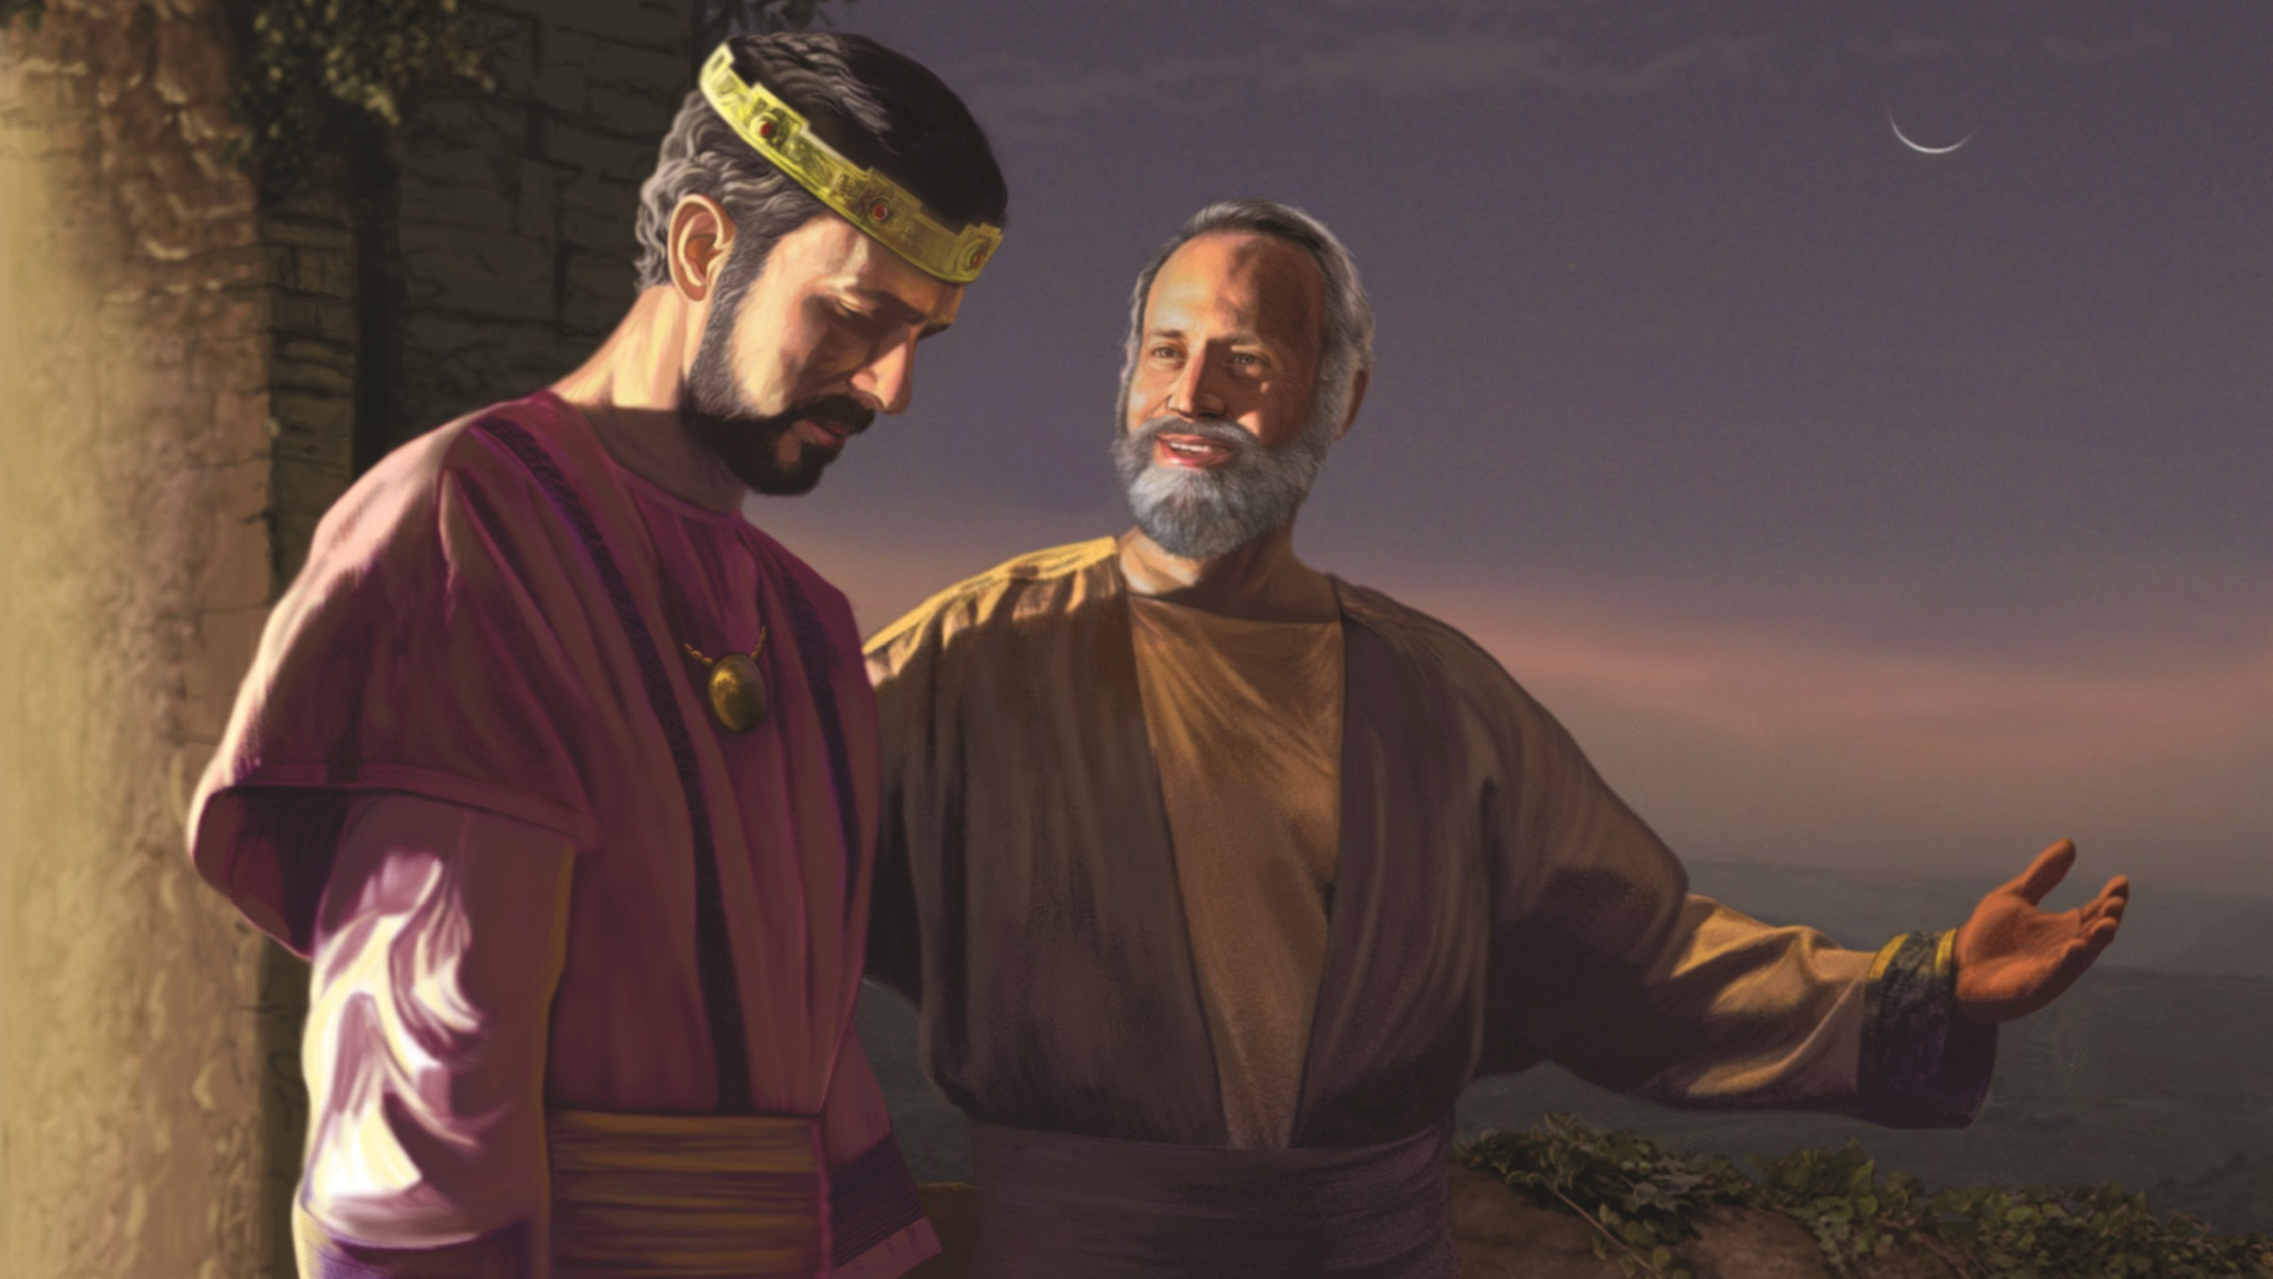
What arguments support Isaiah as author of the whole book?

Slide 15
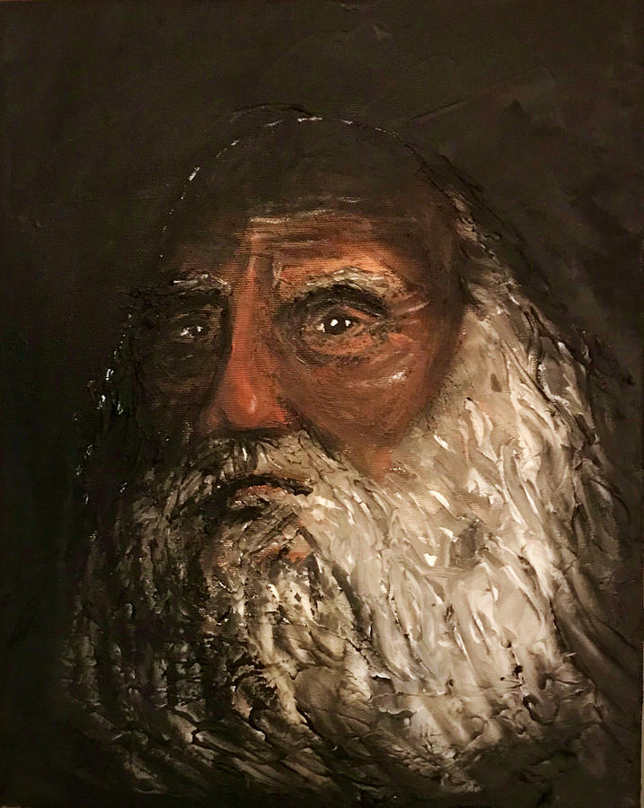
Literary
Arguments
Evidence for Isaiah’s Authorship

Slide 16
453
Deutero-Isaiah?
1–39 40–66
Trito-Isaiah?
1–39 40–55 56–66
"Uno" Isaiah?
1–66
Responses:
1. Background
Isaiah
Notes:
16

Slide 17
Chart of OT Kings & Prophets
232 & 342
Assyria Strong
Babylon Strong
Chart of Old Testament Kings & Prophets
John C. Whitcomb, 4th ed. (Winona Lake, IN: BMH Books, 1968), 2

Slide 18
453
Deutero-Isaiah?
1–39 40–66
Accusation:
Assyrian Background
(Isa 1–39)
Babylonian Background
(Isa 40–66)
Responses:
1. Background
Isaiah
Rebuttal:
Babylon Noted 9 Times in
1–39
Babylon Noted Only 4 Times in
40–66
Keep due to animation bug!
Notes:
18
1. Accusation: Chapters 1–39 have an Assyrian background but chapters 40–66 have a Babylonian background.
Response: Babylon is mentioned more than twice as often in chapters 1–39 than in 40–66. The only shift is one of perspective from a present to a future time. Besides, Isaiah may have prophesied chapters 1–39 before Assyria conquered Israel and then preached chapters 40–66 afterwards concerning Babylon.

Slide 19
453
Deutero-Isaiah?
1–39 40–66
Trito-Isaiah?
1–39 40–55 56–66
"Uno" Isaiah?
1–66
Responses:
1. Background
2. Style & theology
Isaiah
Notes:
19
2. Accusation: The language, style, and theology of the two sections differ radically.
Response: The differences are exaggerated by critics and can be explained by different emphases (condemnation verses consolation). Critics often will not admit that content, time of writing, and circumstances normally affect an author's style.

Slide 20
Isaiah:
Restoration of the Created Order
Judgment (and Salvation) |  |  |  | Salvation (and Judgment)
Chapters 1–39 |  |  |  | Chapters 40–66
Assyrian Invasion |  |  |  | Babylonian Captivity
Prophecy |  |  | History | Prophecy
Mostly Condemnation |  |  | Inter-lude | Mostly Consolation
Violations & deliverance 1–12 | Judgment on the nations 13–23 | Worldwide judgment & blessing 24–35 | Salvation sickness & sin 36–39 | Shepherd of Israel 40–48 | Suffering Servant 49–57 | God's Initiative 58–59 | Restoration under Messiah 60–66
Judah
739-681 BC (Before, during and after Israel's fall to Assyria in 722 BC)
452
"The Holy One of Israel" (12x)
"The Holy One of Israel" (13x)
"Truly the mouth of the LORD has spoken"
"Truly the mouth of the LORD has spoken” also here
40-50 other phrases
Same 40-50 other phrases
Notes:
20
Critics lead us to believe that the same author could not write both of judgment and salvation. Yet:
Many authors do this today.
The differences between the sections are over-emphasized when in reality Isaiah 1–39 speaks of condemnation but also includes a deliverance section (chapters 7–12), and Isaiah 40–66 emphasizes salvation but even ends with judgment in the final verses.
—————
Paul Tanner Notes:
Notice the use of the title "The Holy One of Israel" in Isaiah. This occurs 12x in ch 1—39 and 13x in 40—66. Given that the title only occurs six other times in the rest of the OT, this even distribution within Isaiah strongly argues for one author.
There are 40-50 other phrases that appear in both sections (e.g., "Truly the mouth of the LORD has spoken").

Slide 21
﻿“The supposed three ‘books’ of 1–39, 40–55, and 56–66 have often been alleged to show traces of different periods of composition. There can be little doubt of 1–39 belonging to the later eighth century, having numerous links with that epoch. But that 40–55 is based in Babylon is simply not true. As scholars of various stripes have been compelled to observe, those chapters betray no firsthand knowledge of the metropolis of Babylon (mentioned only four times in these chapters, and only once actually implying a Hebrew exile, 48:20 — contrasted with nine times in 1–39!), but belong in the milieu of the Levant, not least Palestine.”
—K. A. Kitchen, On the Reliability of the Old Testament
(Eerdmans, 2003), location 8294 of 14432, Kindle Edition.
Notes:
21

Slide 22
453
Deutero-Isaiah in the DSS scroll?
1–33 34–66
Isaiah
Notes:
22

Slide 23
﻿“In tussles over unity and multiplicity in Isaiah, and supposed divisions at chapters 39/40, 55/56, etc., almost nobody has bothered to look for tangible textual evidence.”
K. Kitchen, On the Reliability of the OT, chapter 8, location 8279 of 14432, Kindle ed.
1–33
34–66
Isaiah
Notes:
23

Slide 24
﻿“In the Dead Sea Scrolls there is just one positive indication, in the great, intact scroll of Isaiah, one of the first scrolls published. In this scroll, when he came to the end of what we today call chapter 33 (at 33:24), the ancient scribe deliberately left a blank space (equal to three lines’ depth)”
K. Kitchen, On the Reliability of the OT, chapter 8, location 8279 of 14432, Kindle ed.
1–33
34–66
Isaiah
Notes:
24

Slide 25
﻿“…marking a break at the end of his column, before beginning a new column with what is now 34:1. This is very close to the midpoint of the entire book as he had it, and as we have it. The early scribe had some reason to divide here — but saw no reason to divide at either what is now 39/40 or 55/56, we may note.”
K. Kitchen, On the Reliability of the OT, chapter 8, location 8279 of 14432, Kindle ed.
1–33
34–66
Isaiah
Notes:
25

Slide 26
453
Deutero-Isaiah?
1–39 40–66
Trito-Isaiah?
1–39 40–55 56–66
"Uno" Isaiah?
1–66
Responses:
1. Background
2. Style & theology
Isaiah
3. Messiah
Notes:
26
3. Accusation: Messiah is presented as King in chapters 1–39 but as Suffering Servant in chapters 40–66.
Response: These two concepts are not contradictory and both depict each section.

Slide 27
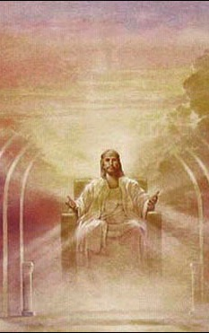
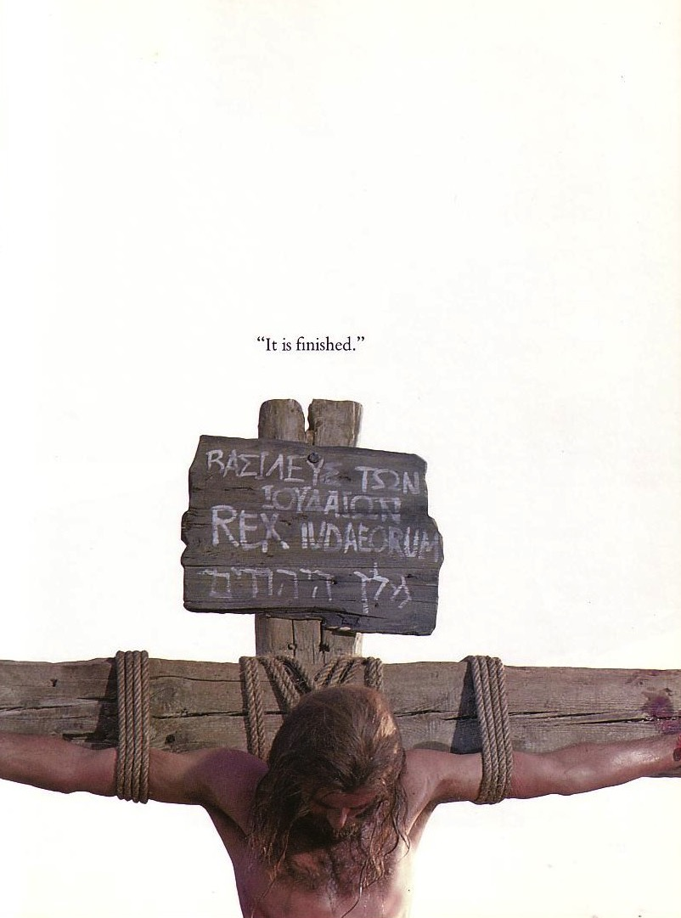

The Same Messiah?
"He will rule with fairness and justice from the throne of his ancestor David for all eternity"
(Isaiah 9:7)
"He was despised and rejected—a man of sorrows, acquainted with deepest grief…"
(Isaiah 53:3)
Notes:
27
Jewish scholars of the intertestamental period could not reconcile Isaiah's two seemingly contradictory depictions of the Messiah. Therefore, some thought there existed two Messiahs—one to rule and one to suffer. Others said Isaiah 53 depicted not the Messiah but the suffering Jewish people.

Slide 28
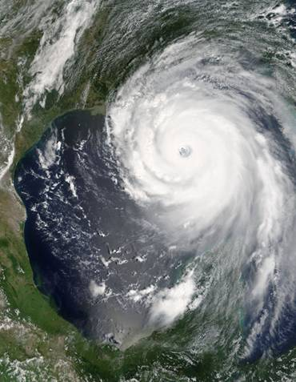
Is Nostradamus a prophet?
Did this predict Hurricane Katrina?
"The cities of Tours, Orleans, Blois, Angers, Reims and Nantes are troubled by sudden change. Tents will be pitched by (people) of foreign tongues; rivers, darts at Rennes, shaking of land and sea."
(Century 1, Quatrain 50)
<http://www.nostradamus101.com/prophecies/part3/P1/>
Notes:
28
Ironically, it is easy for those who deny Isaiah lived in 700 BC to blindly accept that Nostradamus from 500 years ago was a prophet when his writings were ambiguous at best.

Slide 29
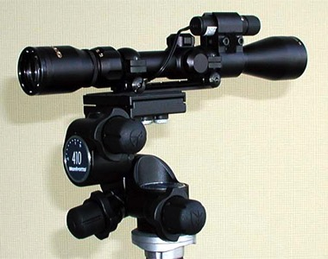
The accuracy of Isaiah's prophecies:
"Therefore this is what the LORD says concerning the king of Assyria: 'He will not enter this city or shoot an arrow here. He will not come before it with shield or build a siege ramp against it. By the way that he came he will return; he will not enter this city,' declares the LORD" (Isa. 37:33-34).
Notes:
29
In contrast to the ambiguous Nostradamus, Isaiah was amazingly specific.

Slide 30
The accuracy of Isaiah's prophecies:
"Then the angel of the LORD went out and put to death 185,000 men in the Assyrian camp. When the people got up the next morning―there were all the dead bodies! So Sennacherib king of Assyria broke camp and withdrew" (Isa. 37:36-37).
Notes:
30
What the LORD said about Jerusalem not being attacked by the Assyrians who had destroyed hundreds of other cities was fulfilled to the letter! The Assyrian camp saw 186.000 soldiers killed in a single night!

Slide 31
453
Deutero-Isaiah?
1–39 40–66
Trito-Isaiah?
1–39 40–55 56–66
"Uno" Isaiah?
1–66
Responses:
1. Background
2. Style & theology
Isaiah
3. Messiah
4. Captivity & Cyrus
Notes:
31
4. Accusation: Isaiah could not have predicted the Babylonian captivity and return under Cyrus who is specifically mentioned by name (Isa 44–45) 150 years in advance.
Response: The accusation assumes that God cannot predict accurately, despite his claim to know the future (42:9). It also does not answer how many of Isaiah's prophecies were fulfilled even hundreds of years later in Jesus Christ (e.g., Isa 53).

Slide 32
Chart of OT Kings & Prophets
232 & 342
Isaiah lived about 700 BC
So how did he know of the 600 BC captivity?
And the 539 BC return under Cyrus?
Chart of Old Testament Kings & Prophets
John C. Whitcomb, 4th ed. (Winona Lake, IN: BMH Books, 1968), 2

Slide 33
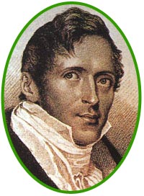
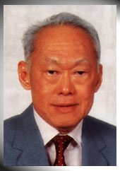
Amazing Prophecies
460
??
Stamford Raffles (1819)
Lee Kwan Yew (1959)
Did you hear that Raffles wrote 140 years before Lee Kwan Yew, "Behold, a man named Lee will arise to make Singapore its own country…"?
Notes:
Do you know why you did not hear of this prophecy? Because it never happened!
But what if it did? What if Raffles predicted the actual name of the founder of modern Singapore—and specified that he would rebuild the nation following World War II?
Wouldn’t that be amazing—perhaps even divinely inspired?

Slide 34
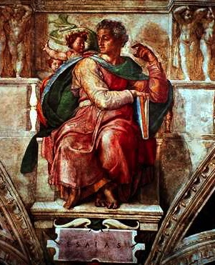
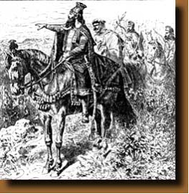
Amazing Prophecies
460
An Amazing Prophecy
41:2, 25
44:28
45:1-2
45:13-15
Isaiah (700 BC)
Cyrus (539 BC)
"When I say of Cyrus, 'He is my shepherd,' he will certainly do as I say.
He will command, 'Rebuild Jerusalem'; he will say, 'Restore the Temple' "
(Isa. 44:28 NLT)
Notes:
God inspired Isaiah’s prediction some 160 years before Cyrus the Persian sent the Jews back from Babylon and restored Jerusalem. Cyrus not only commanded the restoration of the temple in Ezra 1:2, but he funded the effort!
Isaiah notes the victories of Cyrus but not by name in 41:2, 25, but then specifically gives the name of Cyrus SIX times in his prophecy (NLT). Look these up in your Bible:
Is. 44:28 When I say of Cyrus, ‘He is my shepherd,’
he will certainly do as I say.
He will command, ‘Rebuild Jerusalem’;
he will say, ‘Restore the Temple.’”
Is. 45:1 This is what the LORD says to Cyrus, his anointed one,
whose right hand he will empower.
Before him, mighty kings will be paralyzed with fear.
Their fortress gates will be opened,
never to shut again.
2 This is what the LORD says:
“I will go before you, Cyrus,
and level the mountains.
I will smash down gates of bronze
and cut through bars of iron.
Is. 45:13 I will raise up Cyrus to fulfill my righteous purpose,
and I will guide his actions.
He will restore my city and free my captive people—
without seeking a reward!
I, the LORD of Heaven’s Armies, have spoken!”
Is. 48:14 Have any of your idols ever told you this?
Come, all of you, and listen:
The LORD has chosen Cyrus as his ally.
He will use him to put an end to the empire of Babylon
and to destroy the Babylonian armies.
Is. 48:15 “I have said it: I am calling Cyrus!
I will send him on this errand and will help him succeed.

Slide 35
Archaeological Arguments
Evidence for Isaiah’s Authorship

Slide 36
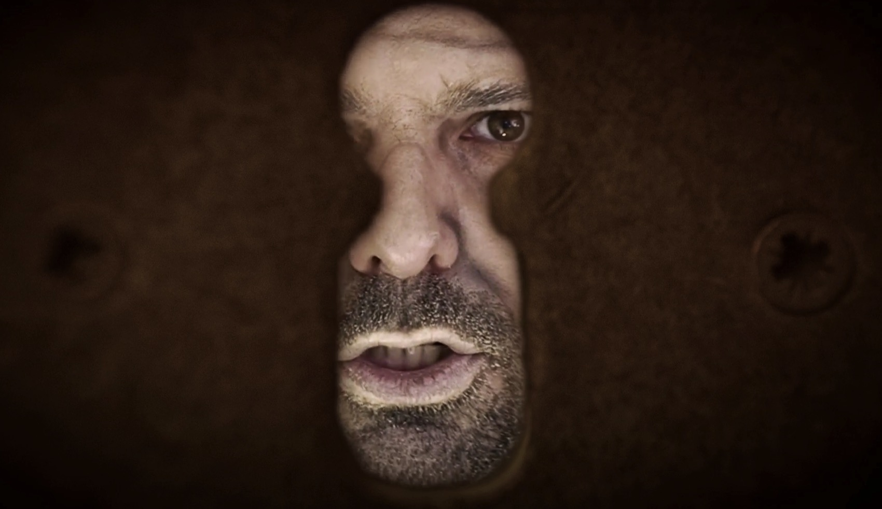
Evidence for Isaiah’s Authorship
• Assyrian records show their king Sennacherib threatening Hezekiah (701 BC)

Slide 37
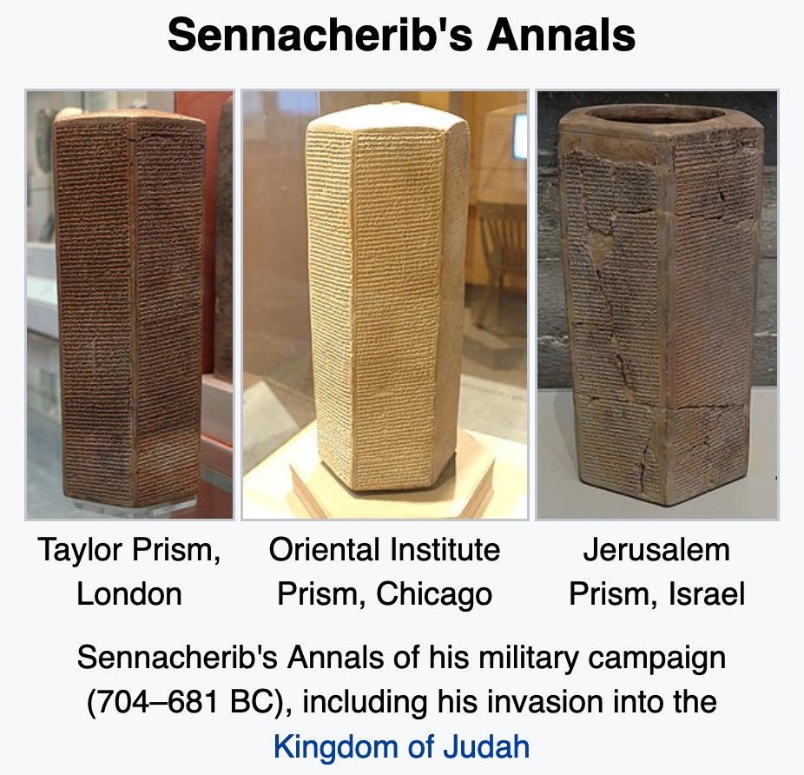
Evidence for Isaiah’s Authorship
Three Copies of Sennacherib’s Annals
Taylor Prism,
London
Oriental Institute Prism, Chicago
Jerusalem Prism,
Israel
Sennacherib’s Annals record his military campaign (704-681 BC), including his invasion into the Kingdom of Judah

Slide 38
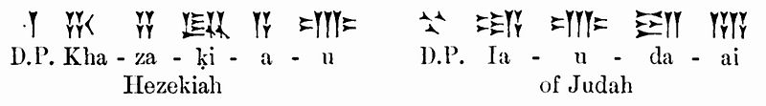
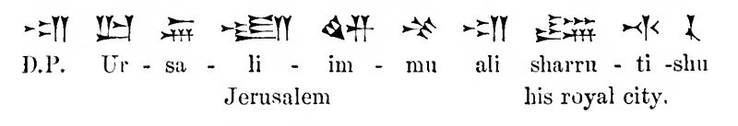
Evidence for Isaiah’s Authorship
Three Copies of Sennacherib’s Annals
Hezekiah
of Judah
Jerusalem
his royal city.

Slide 39
Evidence for Isaiah’s Authorship
"As for the king of Judah, Hezekiah, who had not submitted to my authority, I besieged and captured forty-six of his fortified cities, along with many smaller towns, taken in battle with my battering rams.... I took as plunder 200,150 people, both small and great, male and female, along with a great number of animals including horses, mules, donkeys, camels, oxen, and sheep. As for Hezekiah, I shut him up like a caged bird in his royal city of Jerusalem. I then constructed a series of fortresses around him, and I did not allow anyone to come out of the city gates. His towns which I captured I gave to the kings of Ashod, Ekron, and Gaza.”
—Sennacherib’s Annals—
i.e., Sennacherib could not conquer Jerusalem!
—See Isa 37:36-38;
2 Kings 19—

Slide 40
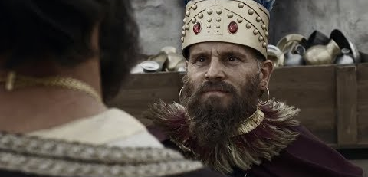
Evidence for Isaiah’s Authorship
• Hezekiah and Isaiah lived at the same time (701 BC)

Slide 41
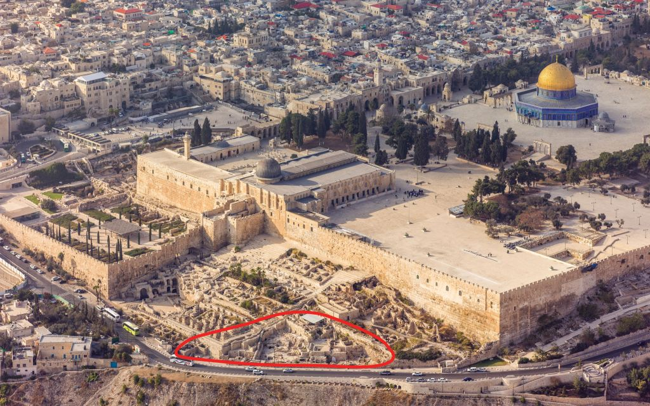
Evidence for Isaiah’s Authorship
• Hezekiah and Isaiah artefacts are found in the same strata
The Ophel excavations at the foot of the southern wall of the Temple Mount in Jerusalem (courtesy of Andrew Shiva)

Slide 42
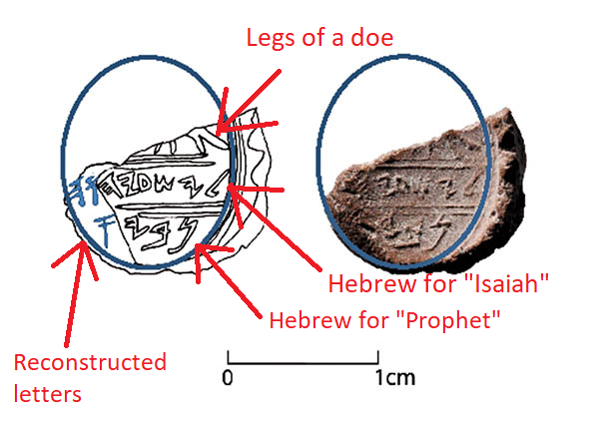
“In find of biblical proportions, seal of Prophet Isaiah said found in Jerusalem”
Legs of a doe
Hebrew for “Isaiah”
Hebrew for “Prophet”
Reconstructed letters
Chanced upon near a seal identified with King Hezekiah, a tiny clay piece may be the first-ever proof of the prophet, though a missing letter leaves room for doubt
By Amanda Borschel-Dan • 22 February 2018, 7:00 am
Notes:
Image Credit: https://theresurgent.com/2018/03/14/did-archeologists-discover-isaiah-the-prophets-personal-seal/
Article:
In find of biblical proportions, seal of Prophet Isaiah said found in Jerusalem
Chanced upon near a seal identified with King Hezekiah, a tiny clay piece may be the first-ever proof of the prophet, though a missing letter leaves room for doubt
By Amanda Borschel-Dan • 22 February 2018, 7:00 am
https://www.timesofisrael.com/in-find-of-biblical-proportions-proof-of-prophet-isaiah-believed-unearthed/
Accessed 1 Nov 2021
The hand of the Prophet Isaiah himself may have created an 8th century BCE seal impression discovered in First Temple remains near Jerusalem’s Temple Mount, according to Hebrew University archaeologist Dr. Eilat Mazar.
“We appear to have discovered a seal impression, which may have belonged to the prophet Isaiah, in a scientific, archaeological excavation,” said Mazar this week in a press release announcing the breathtaking discovery.
Mazar’s team uncovered the minuscule bulla, or seal impression, during renewed excavations at the Ophel, located at the foot of the southern wall of the Temple Mount in Jerusalem. The discovery was published on Wednesday in an article, “Is This the Prophet Isaiah’s Signature?” as part of a massive March-June issue of the Biblical Archaeology Review dedicated to its recently retired founding editor, Hershel Shanks.
The clay impression is inscribed with letters and what appears to be a grazing doe, “a motif of blessing and protection found in Judah, particularly in Jerusalem,” according to the BAR article.
Isaiah Bulla, a 2,700-year-old clay seal impression which potentially belonged to the biblical prophet Isaiah. (Ouria Tadmor/© Eilat Mazar)
The oval-shaped bulla, however, is not intact. On its legible portion, there is an inscription with First Temple Hebrew letters that seem to spell out the name l’Yesha’yah[u] (Belonging to Isaiah). On a line below, there is the partial word nvy, which presumably spells out “prophet.”
“Because the bulla has been slightly damaged at the end of the word nvy, it is not known if it originally ended with the Hebrew letter aleph, which would have resulted in the Hebrew word for ‘prophet’ and would have definitively identified the seal as the signature of the prophet Isaiah,” Mazar said.
Archaeologist Eilat Mazar in the 2018 winter Ophel Excavations in Jerusalem. (YouTube screenshot)
In the BAR article, Mazar leaves room for the possibility that the inscription on the Isaiah bulla does not refer to the biblical prophet. “Without an aleph at the end, the word nvy is most likely just a personal name. Although it does not appear in the Bible, it does appear on seals and a seal impression on a jar handle, all from unprovenanced, private collections.”
“The name of Isaiah, however, is clear,” she said.
Millennia-old connections between a prophet and his king
The most well-known of the biblical prophets, Isaiah is thought by scholars to have been active circa in the late 8th century and early 7th century BCE.
The Isaiah bulla was discovered in wet-sifted material that was taken from an Iron Age layer close to bedrock that was near a foundation trench cut for a wall of a Herodian vault. The material was found close to a structure that was first discovered in 1986-87 and is today thought to have been a “royal bakery.”
Picture: The Ophel excavations at the foot of the southern wall of the Temple Mount in Jerusalem (courtesy of Andrew Shiva)
It was found only 10 feet away from where in 2015 Mazar’s team discovered an important, intact bulla with the inscription “of King Hezekiah of Judah.” The 12th king of the Kingdom of Judah, King Hezekiah ruled from circa 727 BCE-698 BCE, during the period in which the northern Kingdom of Israel fell to the Assyrians in 721 BCE. Some 20 years later, Hezekiah successfully fought off the Assyrian siege of Jerusalem, in part due to fortifications and a water channel which can still be seen today.
A seal impression of King Hezekiah unearthed in the Ophel excavations at the foot of the southern wall of the Temple Mount, conducted by the Hebrew University of Jerusalem’s Institute of Archaeology (ourtesy of Eilat Mazar; photo by Ouria Tadmor)
Upon the discovery of the Hezekiah bulla in 2015, Mazar called the artifact “the closest as ever that we can get to something that was most likely held by King Hezekiah himself.”
This week Mazar said in a press release released by BAR that it is logical that the Isaiah and Hezekiah bullae would be discovered in such close proximity.
“If it is the case that this bulla is indeed that of the prophet Isaiah, then it should not come as a surprise to discover this bulla next to one bearing King Hezekiah’s name given the symbiotic relationship of the prophet Isaiah and King Hezekiah described in the Bible,” said Mazar.
There are several biblical instances of interactions between Isaiah and Hezekiah which indicate the prophet was a spiritual advisor to the king. He consoled the ruler that the Israelites would survive the siege. In the BAR article, Mazar writes, “The names of King Hezekiah and the prophet Isaiah are mentioned in one breath 14 of the 29 times the name of Isaiah is recalled (2 Kings 19–20; Isaiah 37–39). No other figure was closer to King Hezekiah than the prophet Isaiah.”
Picture: Dara Horn walking through Hezekiah’s Tunnel in Jerusalem, August 2017. (Brendan Schulman)
The Hezekiah and Isaiah bullae join other similar finds from previous excavations. Digging in 2005-2008 at the summit of the City of David in a large structure which may have been the palace of biblical King David, she discovered a clay impression with a First Temple Hebrew inscription bearing the name of a high-ranking Israelite official who is recorded by the biblical Jeremiah, “Jehucal, son of Shelemiah, son of Shovi.” Years later, a few meters from the Jehucal bulla, she found a seal impression belonging to a second high-ranking official, “Gedaliah, son of Pashur,” who is also found in Jeremiah. Dozens more bullae have been discovered.
Mazar recently reopened the Ophel excavation and is currently digging in the House of the Medallion, which she excavated in 2013, and a rare untouched Second Temple-period cave.
The find has not been peer reviewed and some have already begun to push back against Mazar’s hypothesis, noting that the lack of an aleph after the nvy leaves room for doubt.
“The critically important letter that would be needed to confirm that the second word is the title ‘prophet’ is an aleph. But no aleph is legible on this bulla, and so that reading cannot be confirmed at all,” Semitic languages professor Christopher Rollston told National Geographic.
Picture: Isaiah, in an illustration from the Providence Lithograph Company (Wikipedia)
“The assumption that this is a [seal] of Isaiah the prophet is scintillating, but it is certainly not something that we should assume is at all certain,” he added. “It’s not.”
Israeli epigrapher Dr. Haggai Misgav took to Facebook to express his skepticism over the possibility of this bulla having belonged to the Prophet Isaiah. Echoing Rollston’s concerns over the missing “aleph,” the Hebrew University lecturer wrote that since the impression would have been tied to a sack of goods, it is highly unlikely the title “prophet” would have been used at all.
“But as always there is no shortage of those who jump on the finds with cries of, ‘Hurray, we have proven the Bible,'” writes Misgav.
While Mazar herself admits that the missing aleph can be problematic, she says the discovery is important nonetheless.
“Whether or not the bulla we found in the Ophel excavations is the bulla of the prophet Isaiah, it remains, nevertheless, a unique and fantastic discovery,” writes Mazar in the BAR article.
“Finding this bulla leads us to consider the personality and the proximity of the prophet Isaiah as one of the closest advisers to King Hezekiah — not only with regard to the events of his time, but also in assessing them from an informed perspective and foreseeing their influence over future events,” she writes.
A gift fit for a true friend to archaeologists
On his way to catch a plane, the new editor of the Biblical Archaeology Review, Dr. Robert Cargill, told The Times of Israel that the publication of the exciting new find in his magazine “came about by very fortunate timing.”
Picture: Dr. Robert Cargill, editor of the Biblical Archaeology Review. (courtesy)
As Cargill was preparing the double issue of BAR in honor of founding editor Shanks, he approached Mazar to ask her for a contribution.
“She said, ‘Your timing couldn’t be better,'” related Cargill. Mazar was getting ready to publish this new discovery. “She allowed us to publish it as a gift to Hershel [Shanks] to say thank you for his support of archaeology and Israel,” said Cargill.
The magazine was first published in 1975 and has focused, sometimes controversially, on finds that claim to offer insights into the ancient workings of the Holy Land — often in approachable articles written by top scholars.
Shanks, not an archaeologist himself, is a lawyer by training. But in the past four decades, he has written innumerable articles and several books about ancient Israel and biblical archaeology.
Standing in front of the Ophel excavation are (from left) Suzanne Singer, the former BAR Managing Editor; Israeli archaeologist Dr. Gabriel Barkay; Hershel Shanks, BAR Editor Emeritus who recently retired as Editor; and Israeli archaeologist Dr. Eilat Mazar. (Eilat Mazar)
In part of her “gift” to Shanks, Mazar wrote: “Like the prophet Isaiah, Hershel is very caring and enthusiastic about current events pertaining to Israel and the greater Near East, in this case those relating to excavations, discoveries, and studies of Biblical archaeology… Creating this valuable link between scholars and the public in the sphere of Biblical archaeology was his ‘prophetic’ vision.”
Cargill, a religious studies assistant professor at University of Iowa, said he respected Mazar’s “careful, responsible treatment” of the bulla in the BAR article.
“She didn’t rush to conclusively say she had found the seal of Isaiah… In our article she gives the possible alternatives,” said Cargill, who called himself “a natural skeptic.”
Drawing by Reut Livyatan Ben-Arie of the Isaiah Bulla, a 2,700-year-old clay seal impression which potentially belonged to the biblical prophet Isaiah. (Illustration: Reut Livyatan Ben-Arie/© Eilat Mazar; Photo by Ouria Tadmor/© Eilat Mazar)
“But if you’re asking me, I think she’s got it. You’re looking at the first archaeological reference of the prophet Isaiah outside of the Bible,” said Cargill. “It’s amazing.”

Slide 43
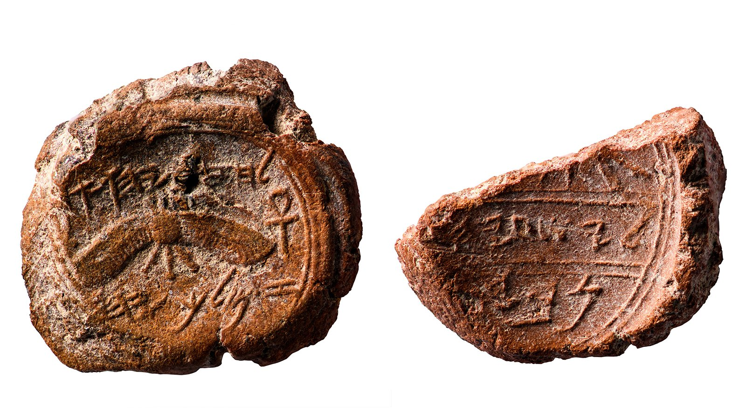

Isaiah’s seal
Hezekiah’s seal
Same strata
•
10 feet apart!
“It was found only 10 feet away from where in 2015 Mazar’s team discovered an important, intact bulla with the inscription ‘of King Hezekiah of Judah.’ The 12th king of the Kingdom of Judah, King Hezekiah, ruled from circa 727 BCE-698 BCE, during the period in which the northern Kingdom of Israel fell to the Assyrians in 721 BCE. Some 20 years later, Hezekiah successfully fought off the Assyrian siege of Jerusalem, in part due to fortifications and a water channel which can still be seen today.”
(https://www.timesofisrael.com/in-find-of-biblical-proportions-proof-of-prophet-isaiah-believed-unearthed/)

Slide 44
New Testament Quotations
Evidence for Isaiah’s Authorship

Slide 45
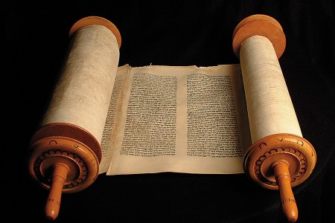
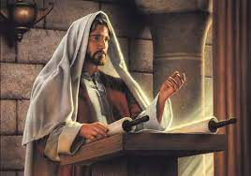
Isaiah Identified by Name in the NT
Isaiah
Jesus & NT Writers

Slide 46
Matthew:
"The prophet Isaiah was speaking about John when he said…"
(Matt 3:3a NLT).
"He is a voice shouting in the wilderness,
'Prepare the way for the LORD’s coming!
Clear the road for him!'"
(Matt 3:3b;
cf. Isaiah 40:3 NLT).

Slide 47
Luke:
"Isaiah had spoken of John when he said…"
(Luke 3:4a NLT).
"He is a voice shouting in the wilderness,
‘Prepare the way for the LORD’s coming!
Clear the road for him!’"
(Luke 3:4b;
cf. Isaiah 40:3 NLT).

Slide 48
John:
"But despite all the miraculous signs Jesus had done, most of the people still did not believe in him. ³⁸This is exactly what Isaiah the prophet had predicted…"
(John 12:37-38a NLT).
"LORD, who has believed our message?
To whom has the LORD revealed his powerful arm?" (John 12:38b; cf. Isaiah 53:1 NLT).
John attributes
Isaiah 53 to Isaiah
Notes:
From Paul Tanner Notes:
“The New Testament authors (including Jesus!) make frequent reference to Isaiah and attribute the quotation to the prophet Isaiah. Note that Jn 12:38-41 quotes Isa 53:1 and 6:9, and attributes them both to Isaiah (cf. Mt 3:3; 12:17; Lk 3:4; Acts 8:28; Rom 9:27-33; 10:16-21).”

Slide 49
John:
"But the people couldn’t believe, for as Isaiah also said…"
(John 12:39 NLT).
"The Lord has blinded their eyes
and hardened their hearts—
so that their eyes cannot see,
and their hearts cannot understand,
and they cannot turn to me
and have me heal them" (John 12:40; cf. Isaiah 6:10 NLT).
John attributes
Isaiah 6 to Isaiah

Slide 50
Paul:
"And concerning Israel, Isaiah the prophet cried out…"
(Rom 9:27a NLT).
"Though the people of Israel are as numerous as the sand of the seashore,
only a remnant will be saved"
(Rom 9:27b;
cf. Isaiah 10:22 NLT).

Slide 51
Jesus:
"This fulfills the prophecy of Isaiah that says…"
(Matt 13:14a NLT).
"When you hear what I say,
you will not understand.
When you see what I do,
you will not comprehend"
(Matt 13:14b;
cf. Isaiah 6:9 NLT).

Slide 52
Conclusion on
Isaiah’s Authorship
There exists no legitimate reason to doubt that Isaiah wrote the prophecy bearing his name—whether linguistic or archaeological or in NT quotations attributed to him.

Slide 53
Black

Slide 54


Critical Studies of the OT link at BibleStudyDownloads.org
Get this presentation and script for free!

