Slide 1
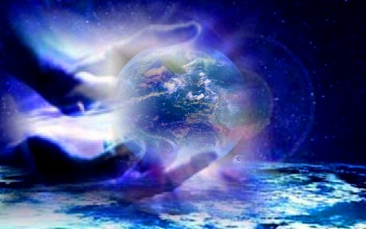
Isaiah 60–66
Dr. Rick Griffith • Jordan Evangelical Theological Seminary • BibleStudyDownloads.org
Notes:
1

Slide 2
Isaiah 40–66 Structure
469
Adapted from John A. Martin, Dallas Seminary
Comfort
Deliverance
Encouragement
Cleansing
Condition
for
Jews
for
Gentiles
from
Sin
of
Glory
40–45
46–48
49–52
53
54–57
58–59
60–66
Deliverance from
Babylon
Deliverance from
Sin
Deliverance in the
Millennium
Notes:
2

Slide 3

How will God complete his plan for all creation?
Notes:
By what means will the LORD restore the entire universe (restatement)?

Slide 4
Be Complete
Judgment
1–39
God will judge those who reject him (Isaiah 1–39).
Notes:
The LORD will deal with unbelievers in a just manner (restatement).

Slide 5
Be Complete
Judgment
Salvation
1–39
40–66
God will save those who trust him (Isaiah 40–66).
Notes:
The LORD will deliver the people who believe in him (restatement).

Slide 6
Key Word
452
343
Restoration
Isaiah

Slide 7
Theme
452
Restoration
of the Created Order
Isaiah

Slide 8

Kingdom Statement
343
After the Jews are judged and believe in the Messianic King (1–39), God will restore the whole created order under the rule of His Son (40–66).
Isaiah

Slide 9
Slides on
Isaiah 60

Slide 10
Isaiah 40–66 Structure
469
Adapted from John A. Martin, Dallas Seminary
Comfort
Deliverance
Encouragement
Cleansing
Condition
for
Jews
for
Gentiles
from
Sin
of
Glory
40–45
46–48
49–52
53
54–57
58–59
60–66
Deliverance from
Babylon
Deliverance from
Sin
Deliverance in the
Millennium
Notes:
10

Slide 11
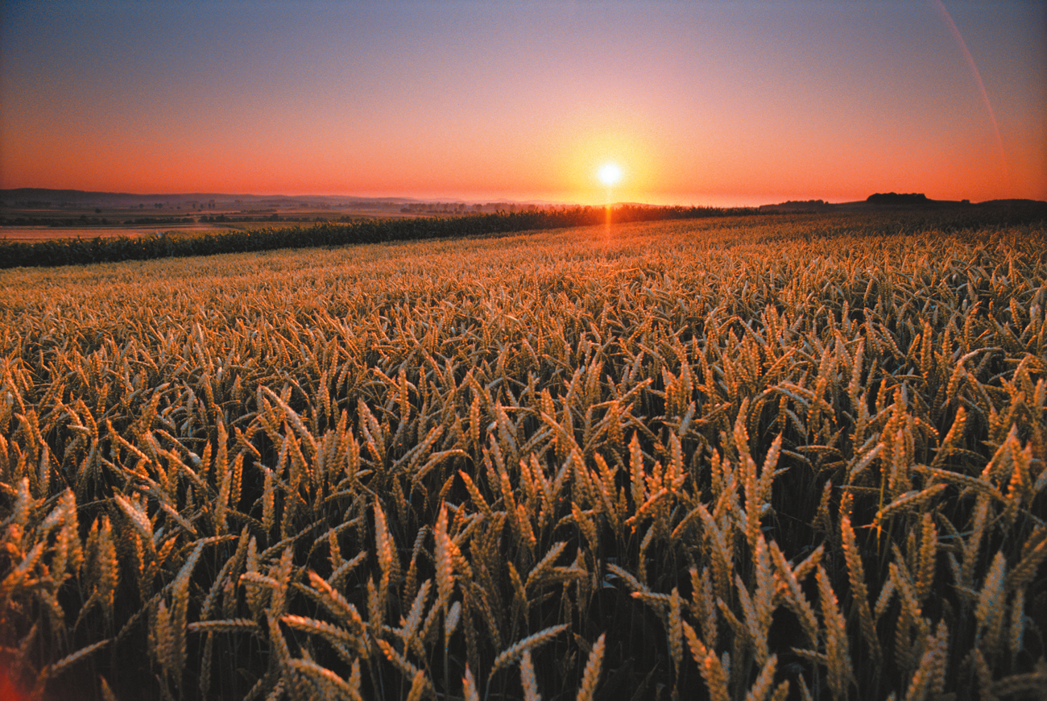
Israel’s glorious restoration in the millennium reveals that he will fulfill every promise in the Abrahamic Covenant (Isaiah 60–66).
God promises Israel a glorious future of prosperity and peace in the kingdom (Isa 60).

Slide 12
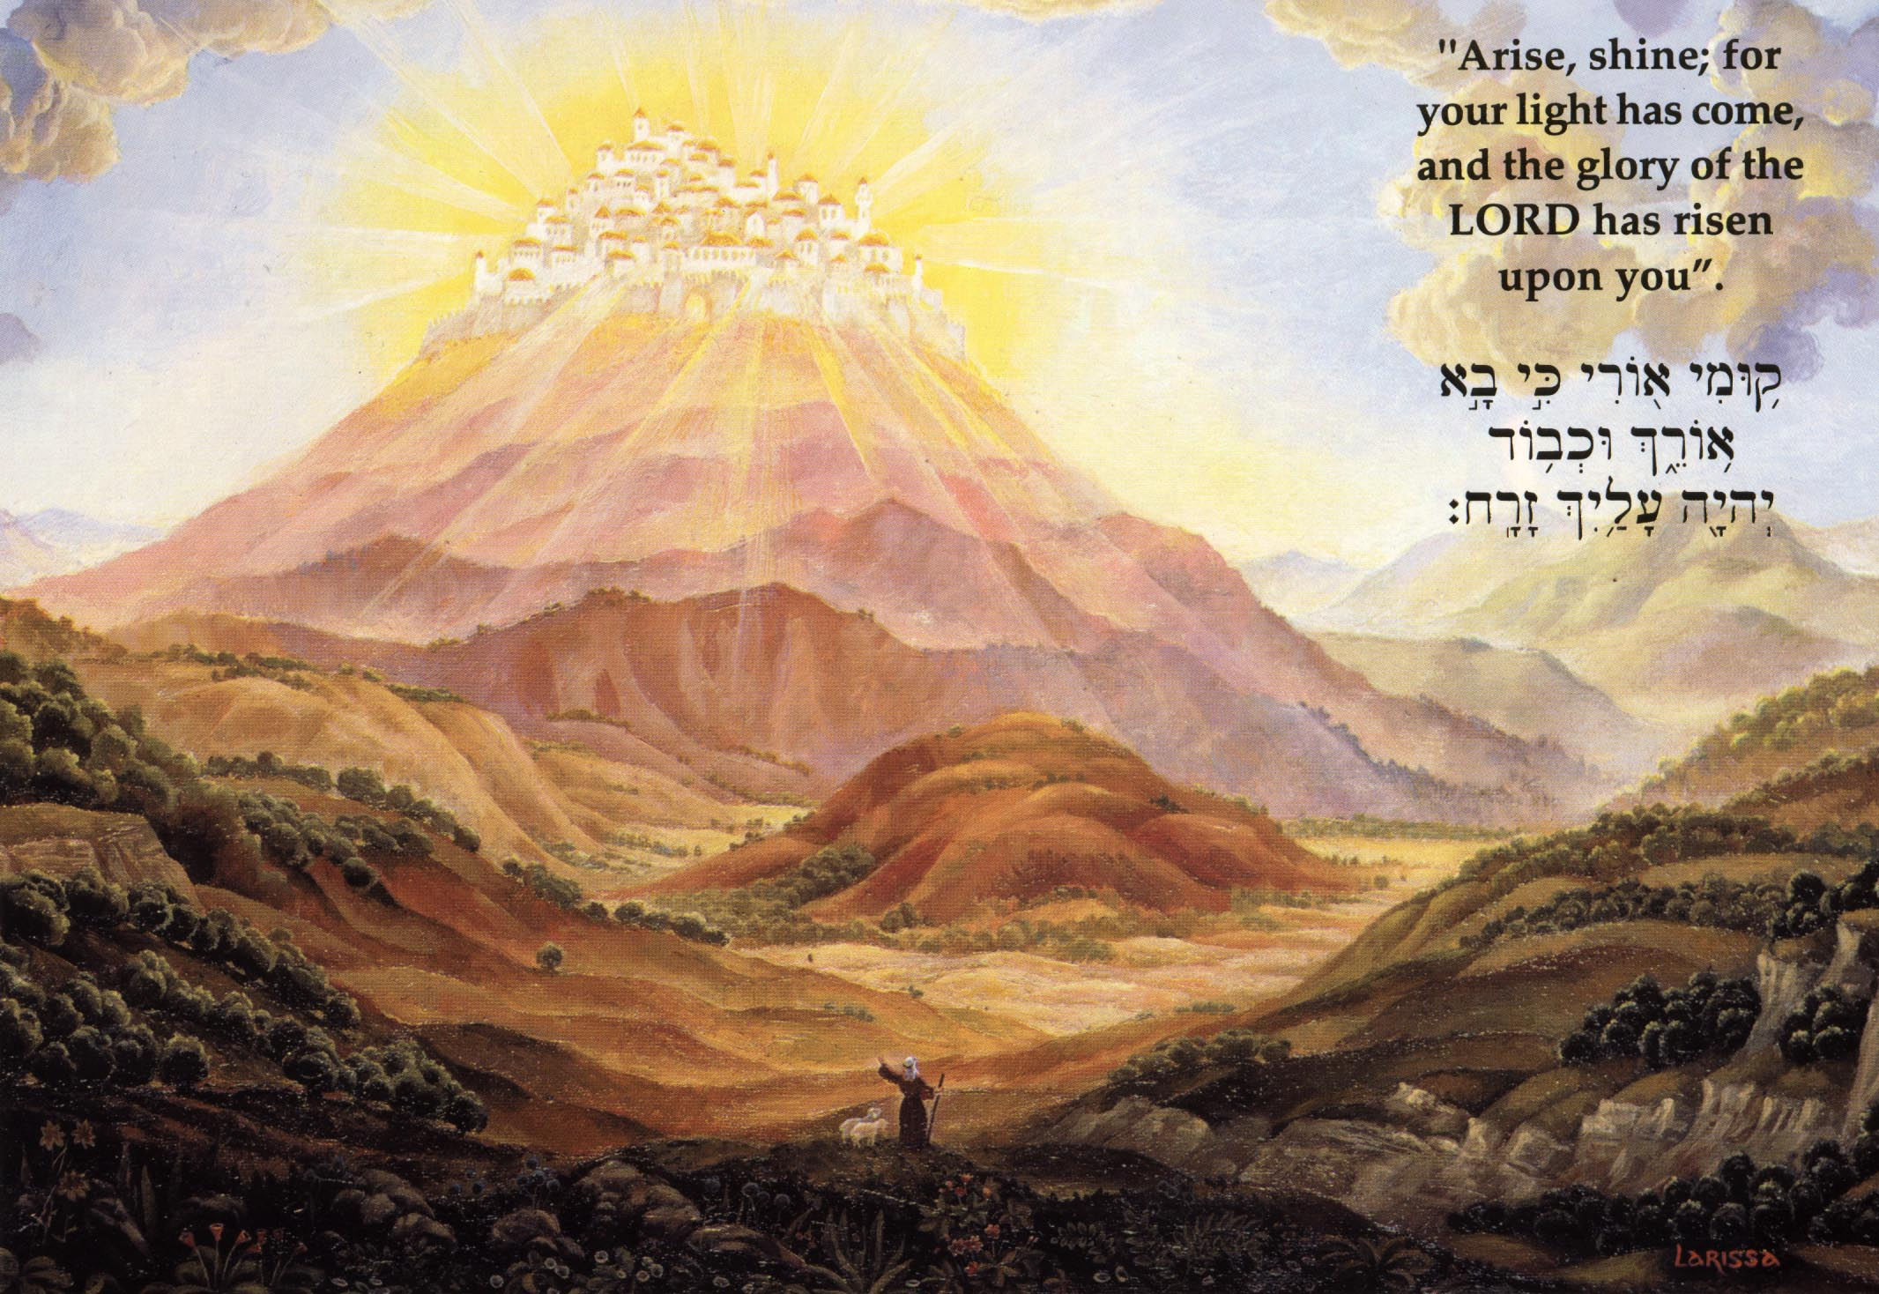
“Arise, shine; for your light has come, and the glory of the LORD has risen upon you. For behold, darkness will cover the earth, and deep darkness the peoples; But the LORD will rise upon you, and His glory will appear upon you.”
Isaiah 60:1–2
“All the land will be changed into a plain from Geba to Rimmon south of Jerusalem; but Jerusalem will rise and remain on its site … And people will live in it, and there will be no more curse, for Jerusalem will dwell in security.”
Zechariah 14:10-11

Slide 13
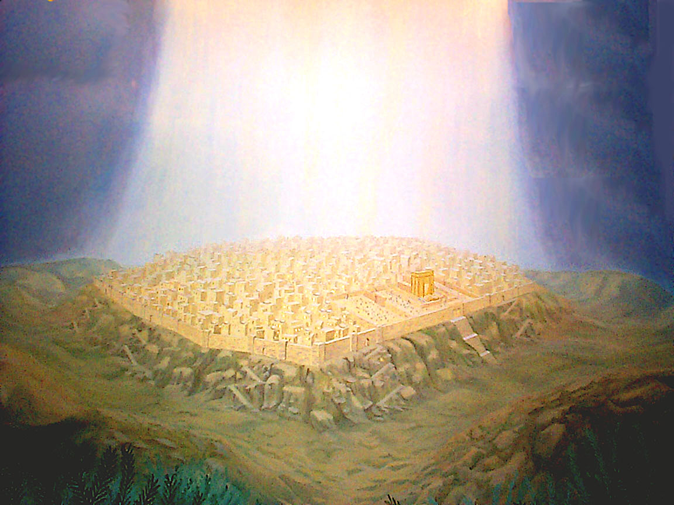
“But the LORD will rise upon you, and His glory
will appear upon you.”
Isaiah 60:2
“… I will set up one of your descendants after you, who shall be of your sons; and I will establish his kingdom. He shall build for Me a house, and I will establish his throne forever. I will be his father, and he shall be My son; and I will not take My lovingkindness away from him … But I will settle him in My house and in My kingdom forever, and his throne shall be established forever.” 1 Chronicles 17:11-14

Slide 14
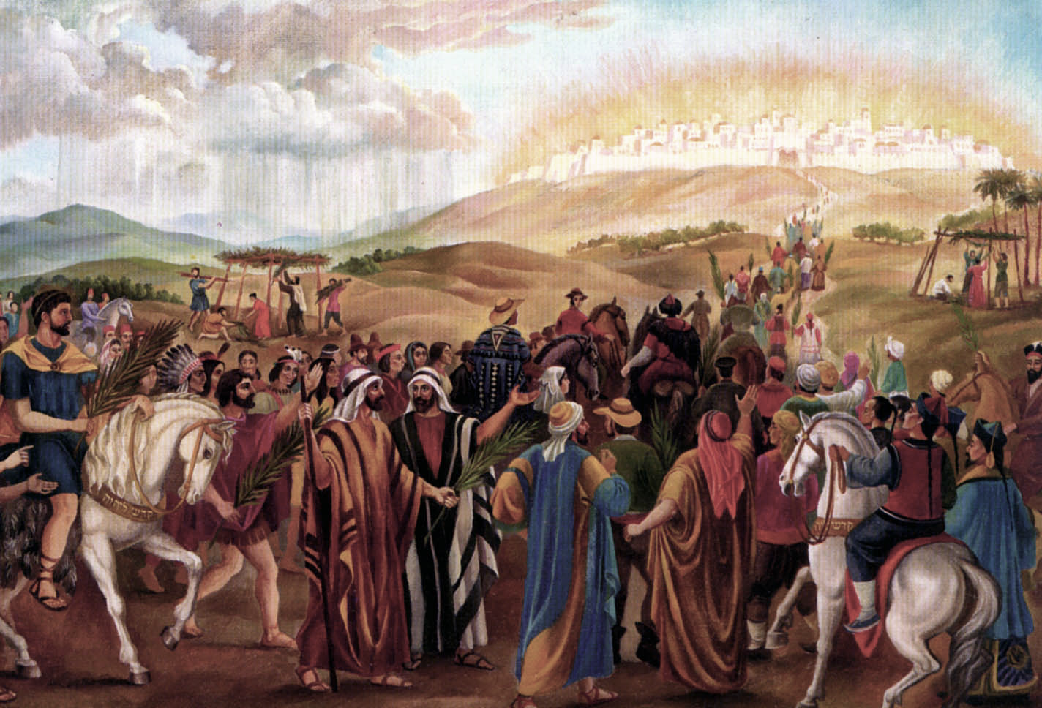
“And nations will come to your light, and kings to the brightness of your rising. Lift up your eyes round about you and see; They all gather together, they come to you. Your sons will come from afar, and your daughters will be carried in arms.” Isaiah 60:3-4

Slide 15
“Then you will see and be radiant, and your heart will thrill and rejoice; Because the abundance of the sea will be turned to you, the wealth of the nations will come to you.” Isaiah 60:5

Slide 16
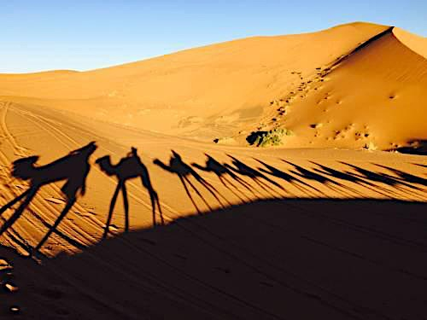
“A multitude of camels will cover you, The young camels of Midian and Ephah; All those from Sheba will come; They will bring gold and frankincense, And will bear good news of the praises of the LORD.” Isaiah 60:6

Slide 17
“All the flocks of Kedar will be gathered together to you, the rams of Nebaioth will minister to you…” Isaiah 60:7a

Slide 18
“They will go up with acceptance on My altar, and I shall glorify My glorious house.” Isaiah 60:7b

Slide 19
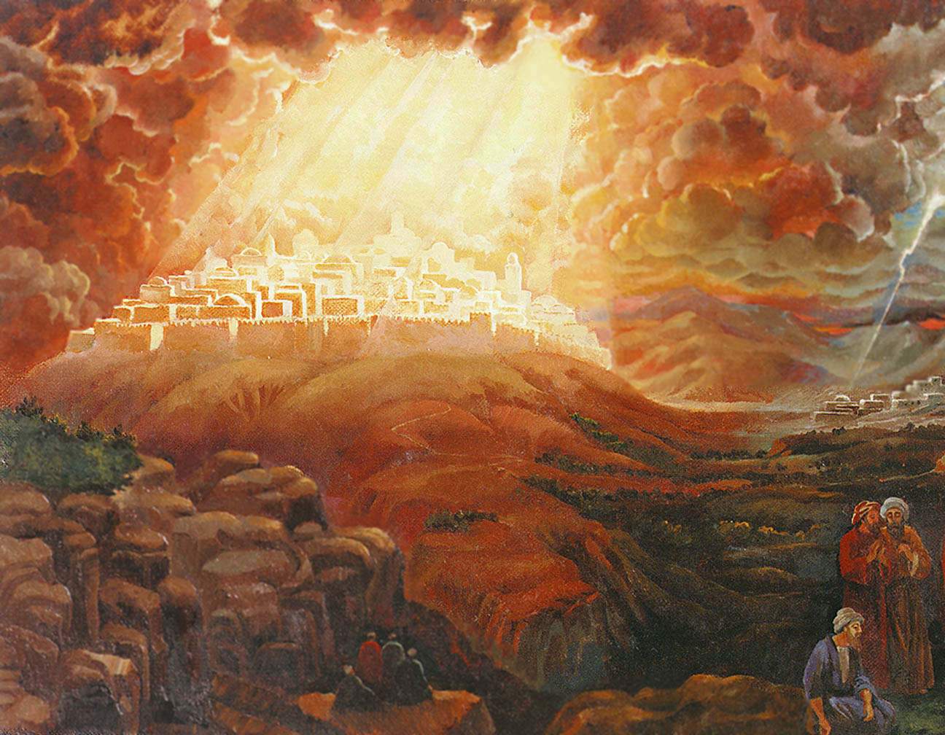
“Thus says the LORD, ‘I will return to Zion and dwell in the midst of Jerusalem. Then Jerusalem will be called the City of Truth, and the mountain of the LORD of hosts will be called the Holy Mountain.” Zechariah 8:3

Slide 20
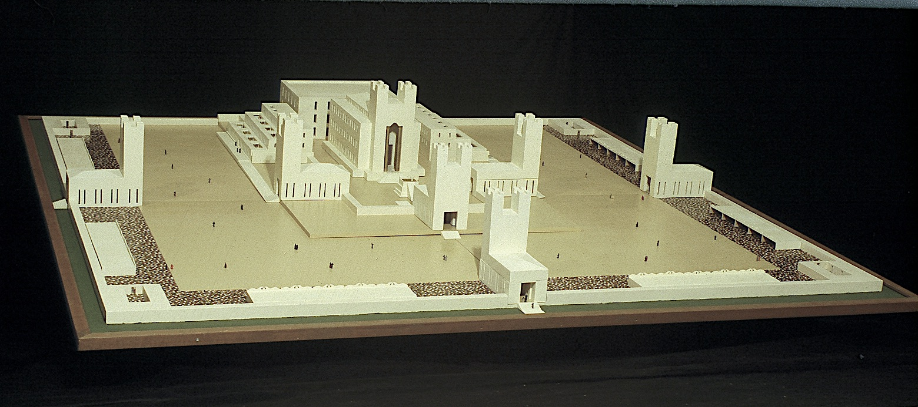

Slide 21
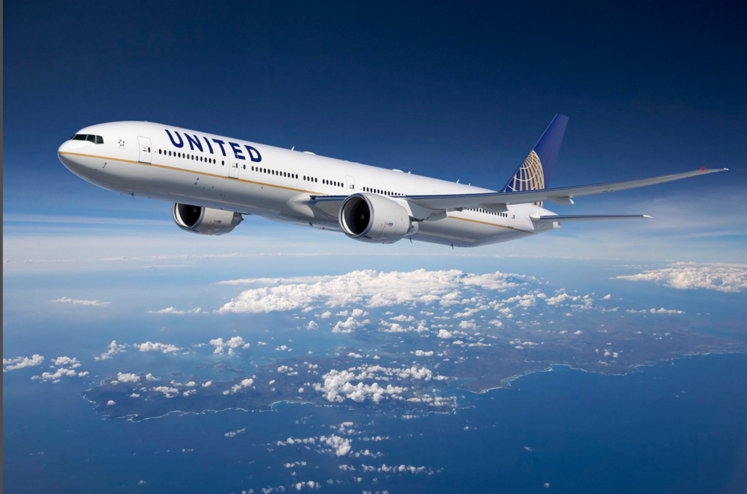
“Who are these who fly like a cloud, and like the doves to their lattices? Surely the coastlands will wait for Me; And the ships of Tarshish will come first, to bring your sons from afar, their silver and their gold with them….” Isaiah 60:8

Slide 22
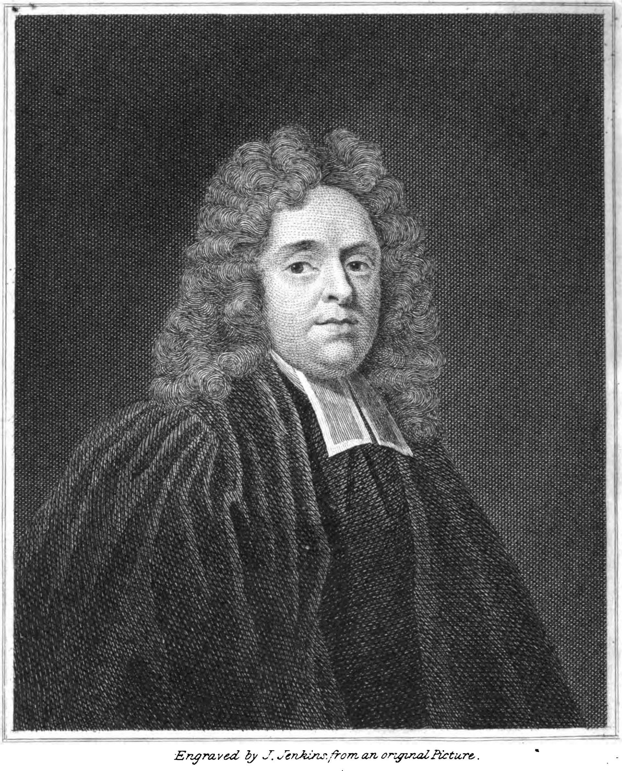
Amillennial Spiritualization
Isaiah 60:1-8. As far as we have the knowledge of God in us, and the favour of God towards us, our light is come. And if God’s glory is seen upon us to our honour, we ought, not only with our lips, but in our lives, to return its praise. We meet with nothing in the history of the Jews which can be deemed a fulfilment of the prophecy in this chapter; we must conclude it relates principally to future events. It predicts the purity and enlargement of the church. The conversion of souls is here described. They fly to Christ, to the church, to the word and ordinances, as doves to their own home; thither they fly for refuge and shelter, thither they fly for rest. What a pleasant sight to see poor souls hastening to Christ!
Matthew Henry (1662-1714)

Slide 23
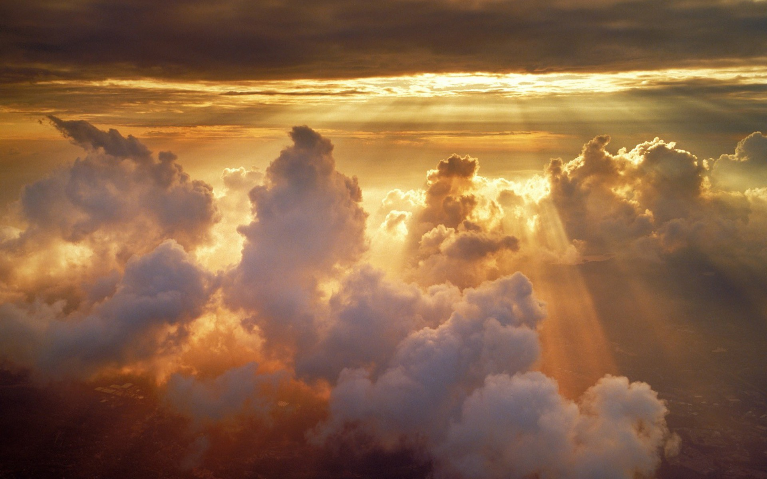
קְדוֹשׁ יִשְׂרָאֵל
“for the name of the LORD your God,
and for the Holy One of Israel
because He has glorified you.”
Isaiah 60:9
“And they will call you the city of the LORD,
the Zion of the Holy One of Israel.”
Isaiah 60:14
“And we have believed and have come to know that You (Jesus) are the Holy One of God.”
John 6:69

Slide 24
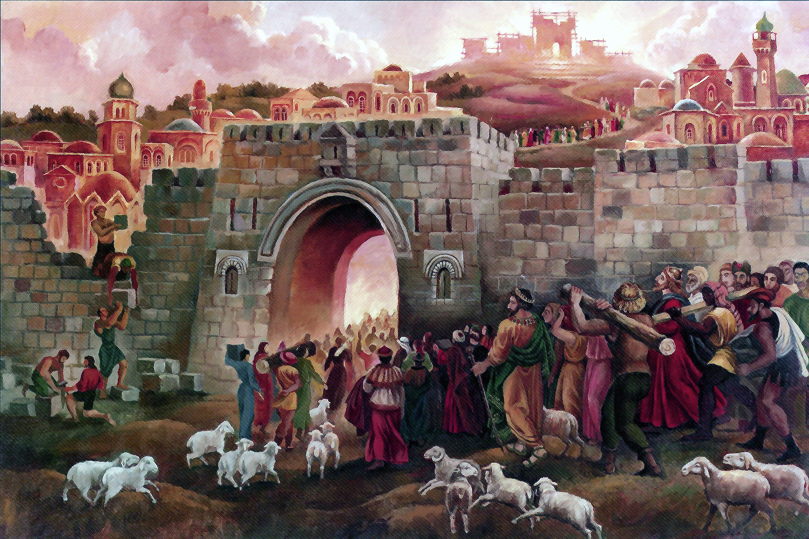
“And foreigners will build up your walls, And their kings will minister to you; For in My wrath I struck you, and in My favor I have had compassion on you. And your gates will be open continually; They will not be closed day or night, so that men may bring to you the wealth of the nations, with their kings led in procession. For the nation and the kingdom which will not serve you will perish, and the nations will be utterly ruined.” Isaiah 60:10–12

Slide 25
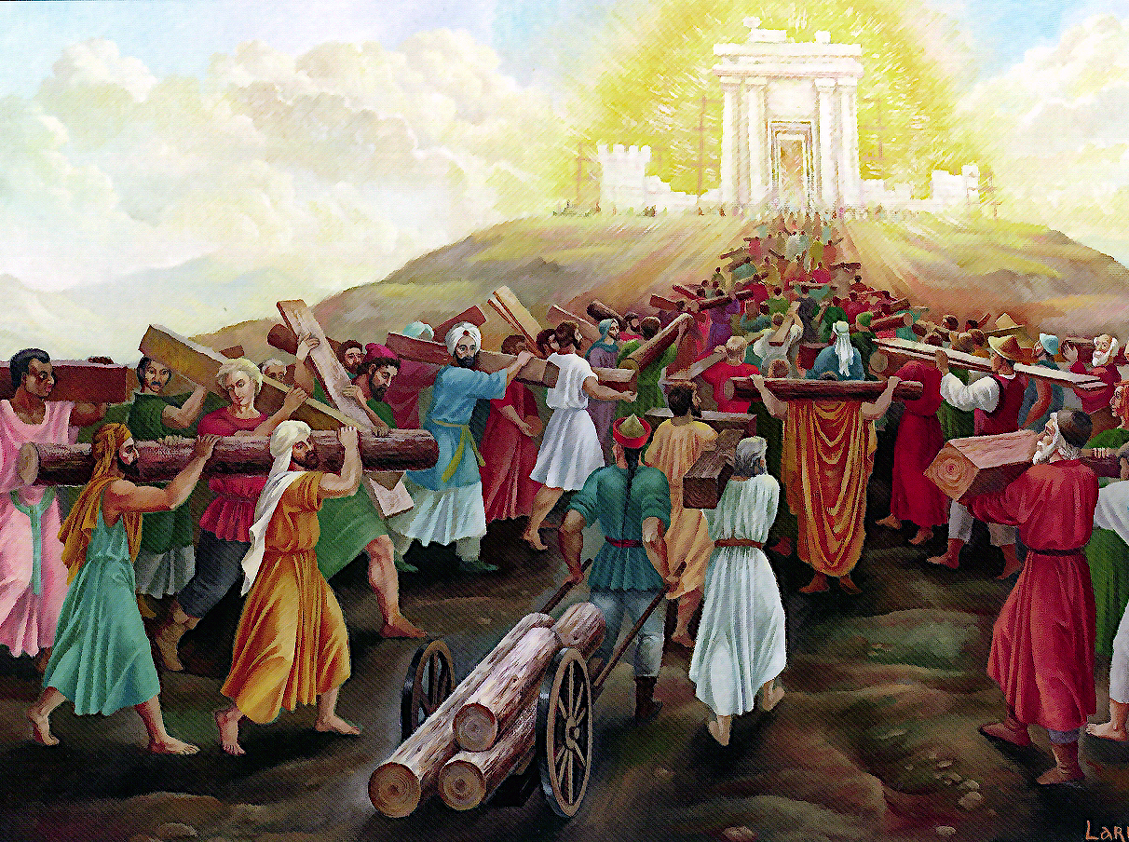
“For the nation and the kingdom which will not serve you will perish… The glory of Lebanon will come to you, the juniper, the box tree, and the cypress together, to beautify the place of My Sanctuary; and I shall make the place of My feet glorious.” Isaiah 60:13

Slide 26
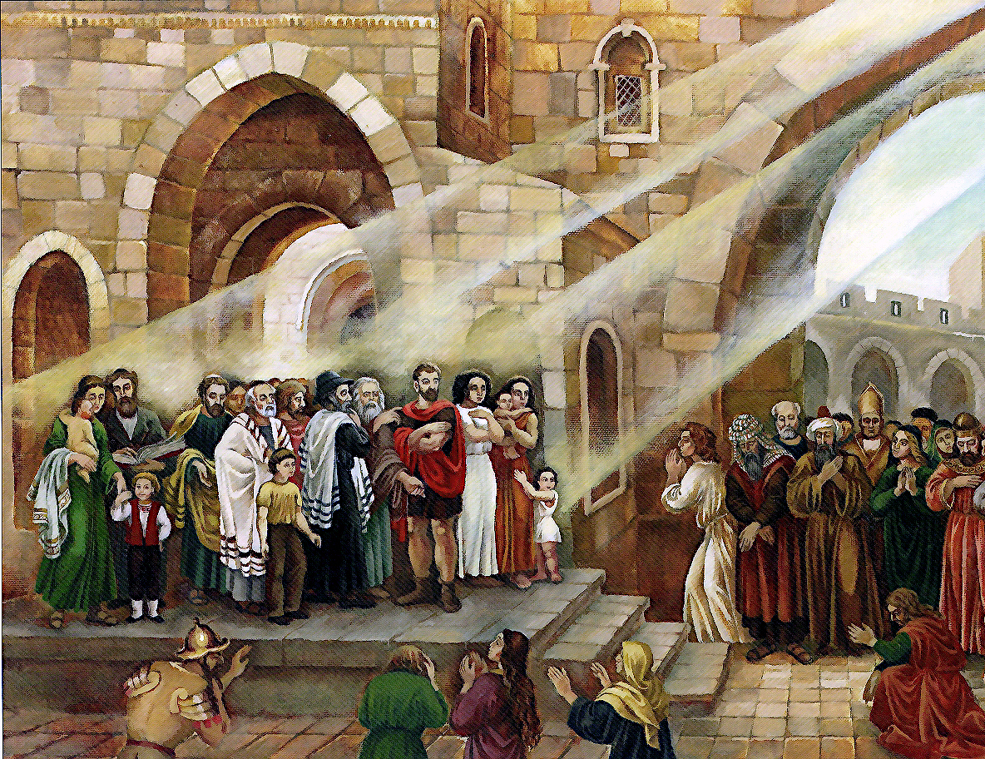
“The sons of those who afflicted you will come bowing to you, and those who despised you will bow themselves at the soles of your feet; and they will call you the city of the LORD, the Zion of the Holy One of Israel.” Isaiah 60:14

Slide 27
Amillennial Spiritualization
Isaiah 60:9-14. God will be very gracious. We must begin with his promise, thence all mercies take rise. Many shall be brought into the church, even from far countries. Christ is always ready to receive all who come to him; and the gate of mercy is always open, night and day. All that are about the church shall be made serviceable to it. But those who will not be subject to Christ’s golden sceptre, to his word and Spirit, who will not be kept in by the laws and rules of his family, shall be broken in pieces by his iron rod. The peculiar advantages of every nation, and of every description of men, shall join to beautify the church of Christ. We must suppose this to be accomplished in the beauties of holiness, and the graces and comforts of the Spirit, with which gospel ordinances are adorned and enriched. Blessed be his name, the gates of Zion are ever open to returning sinners.
Matthew Henry (1662-1714)

Slide 28

Isaiah 60:15–17 NLT
"Though you were once despised and hated,
with no one traveling through you,
I will make you beautiful forever,
a joy to all generations.
¹⁶ Powerful kings and mighty nations
will satisfy your every need,
as though you were a child
nursing at the breast of a queen.
You will know at last that I, the LORD,
am your Savior and your Redeemer,
the Mighty One of Israel.
¹⁷ I will exchange your bronze for gold,
your iron for silver, your wood for bronze,
and your stones for iron.
I will make peace your leader
and righteousness your ruler."

Slide 29
Isaiah 60:18-20 NLT
"Violence will disappear from your land;
the desolation and destruction of war will end.
Salvation will surround you like city walls,
and praise will be on the lips of all who enter there.
¹⁹ No longer will you need the sun to shine by day,
nor the moon to give its light by night,
for the LORD your God will be your everlasting light,
and your God will be your glory.
²⁰ Your sun will never set;
your moon will not go down.
For the LORD will be your everlasting light.
Your days of mourning will come to an end."

Slide 30
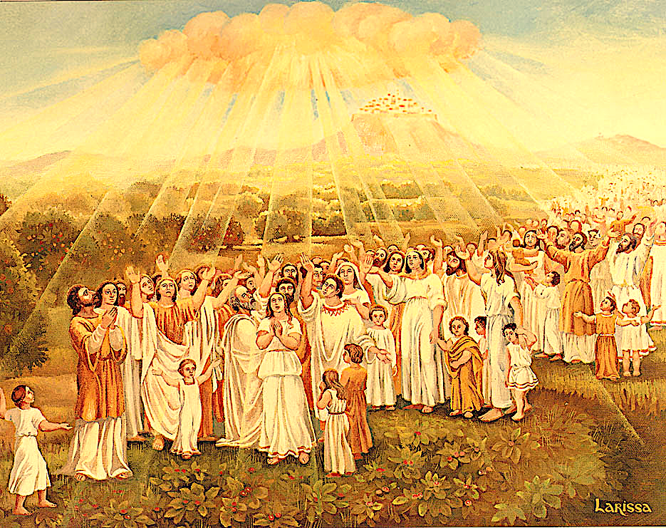
“All your people will be righteous.
They will possess their land forever,
for I will plant them there with my own hands
in order to bring myself glory.
²² The smallest family will become a thousand people,
and the tiniest group will become a mighty nation.
At the right time, I, the LORD, will make it happen.”
Isaiah 60:21-22 NLT

Slide 31
Slides on
Isaiah 61

Slide 32
Israel’s glorious restoration in the millennium reveals that he will fulfill every promise in the Abrahamic Covenant (Isaiah 60–66).
God promises Israel a glorious future of prosperity and peace in the kingdom (Isa 60).
2. God promises the Servant will prepare Jerusalem for the Father to usher in the millennium (61:1–63:6).

Slide 33
Freedom for Those God Favors
“The Spirit of the Sovereign LORD is upon me,
for the LORD has anointed me
to bring good news to the poor.
He has sent me to comfort the brokenhearted
and to proclaim that captives will be released
and prisoners will be freed.
² He has sent me to tell those who mourn
that the time of the LORD’s favor has come,
and with it, the day of God’s anger against their enemies.”
—Isaiah 61:1-2 NLT—

Slide 34
Jews Will Believe at Christ’s Return
461d
D. Israel’s spiritual restoration
1. Israel cleansed by God’s judgment before the kingdom (1:25; 4:2-4; 29:1-4; 30:26b; 31:6-7)
2. Israel reunited and regathered to the land (11:10-13, 15-16; 43:1, 5; 49:6; 61:4; 65:8-9)
3. Israel victorious over enemies (2:12-21; 11:14; 24:21-23; 41:11-14; 45:14; 61:2; 66:14b)
4. Israel free from oppression (14:3-6; 42:6-7; 49:8-9)
5. Israel believing in Messiah (10:20-22; 25:8-9; 26:1-2; 27:9, 12-13; 29:23; 40:9; 45:17, 25; 52:3, 6-7, 9-11; 54:7-10; 62:12)
6. Israel forgiven, redeemed and righteous (1:25-27; 2:3; 4:3-4; 33:24; 44:22-24; 45:25; 48:17; 63:16)
7. Israel blessed and rewarded by Christ (19:25; 40:10; 62:11; 61:8)
8. Israel comforted by Christ (12:1-2; 40:1-2, 11; 49:12; 51:3; 65:18-19; 66:11-13)
9. Israel filled/empowered by Holy Spirit as never before (32:15; 44:3; 59:21)
10. Israel’s covenants fulfilled (42:6; 49:8; 54:10; 61:8)
a. Abrahamic (19:25; 41:8-10)
b. Davidic (9:7; 11:1-2; 55:3)
c. Land (11:11-16; 65:9)
d. New (32:15; 44:3; 49:6; 59:21; 66:22)

Slide 35
Jews Will Believe at Christ’s Return
461d
“In that day the remnant left in Israel,
the survivors in the house of Jacob,
will no longer depend on allies
who seek to destroy them.
But they will faithfully trust the LORD,
the Holy One of Israel.
²¹ A remnant will return;
yes, the remnant of Jacob will return to the Mighty God.
²² But though the people of Israel are as numerous
as the sand of the seashore,
only a remnant of them will return.
The LORD has rightly decided to destroy his people.”
—Isaiah 10:20-22 NLT—

Slide 36
Jews Will Believe at Christ’s Return
461d
“He will swallow up death forever!
The Sovereign LORD will wipe away all tears.
He will remove forever all insults and mockery
against his land and people.
The LORD has spoken!
⁹ In that day the people will proclaim,
‘This is our God!
We trusted in him, and he saved us!
This is the LORD, in whom we trusted.
Let us rejoice in the salvation he brings!’”
—Isaiah 25:8-9 NLT—

Slide 37
Jews Will Believe at Christ’s Return
461d
“In that day, everyone in the land of Judah will sing this song:
Our city is strong!
We are surrounded by the walls of God’s salvation.
² Open the gates to all who are righteous;
allow the faithful to enter.”
—Isaiah 26:1-2 NLT—

Slide 38
Jews Will Believe at Christ’s Return
461d
“The LORD did this to purge Israel’s wickedness,
to take away all her sin.
As a result, all the pagan altars will be crushed to dust.
No Asherah pole or pagan shrine will be left standing…
¹² Yet the time will come when the LORD will gather them together like handpicked grain. One by one he will gather them—from the Euphrates River in the east to the Brook of Egypt in the west. ¹³ In that day the great trumpet will sound. Many who were dying in exile in Assyria and Egypt will return to Jerusalem to worship the LORD on his holy mountain.”
—Isaiah 27:9, 12-13 NLT—
Notes:
Verse 12 notes the same boundaries for Israel in Genesis 15:18. These boundaries will be fulfilled at the return of Christ.

Slide 39
Jews Will Believe at Christ’s Return
461d
“For when they see their many children
and all the blessings I have given them,
they will recognize the holiness of the Holy One of Jacob.
They will stand in awe of the God of Israel.”
—Isaiah 29:23 NLT—

Slide 40
Jews Will Believe at Christ’s Return
461d
“But the LORD will save the people of Israel
with eternal salvation.
Throughout everlasting ages,
they will never again be humiliated and disgraced.”
—Isaiah 45:17 NLT—
“In the LORD all the generations of Israel will be justified,
and in him they will boast.”
—Isaiah 45:25 NLT—

Slide 41
Jews Will Believe at Christ’s Return
461d
“³ For this is what the LORD says:
‘When I sold you into exile,
I received no payment.
Now I can redeem you
without having to pay for you…’
“⁶ But I will reveal my name to my people, and they will come to know its power. Then at last they will recognize that I am the one who speaks to them.
⁷ How beautiful on the mountains
are the feet of the messenger who brings good news,
the good news of peace and salvation,
the news that the God of Israel reigns!”
—Isaiah 52:3, 6-7 NLT—

Slide 42
Jews Will Believe at Christ’s Return
461d
“Let the ruins of Jerusalem break into joyful song,
for the LORD has comforted his people.
He has redeemed Jerusalem.
¹⁰ The LORD has demonstrated his holy power
before the eyes of all the nations.
All the ends of the earth will see
the victory of our God.
¹¹ Get out! Get out and leave your captivity,
where everything you touch is unclean.
Get out of there and purify yourselves,
you who carry home the sacred objects of the LORD.”
—Isaiah 52:9-11 NLT—

Slide 43
Jews Will Believe at Christ’s Return
461d
“‘For a brief moment I abandoned you,
but with great compassion I will take you back.
⁸ In a burst of anger I turned my face away for a little while.
But with everlasting love I will have compassion on you,’
says the LORD, your Redeemer.
⁹ Just as I swore in the time of Noah
that I would never again let a flood cover the earth,
so now I swear
that I will never again be angry and punish you.
¹⁰ For the mountains may move
and the hills disappear,
but even then my faithful love for you will remain.
My covenant of blessing will never be broken,”
says the LORD, who has mercy on you.”
—Isaiah 54:7-10 NLT—

Slide 44
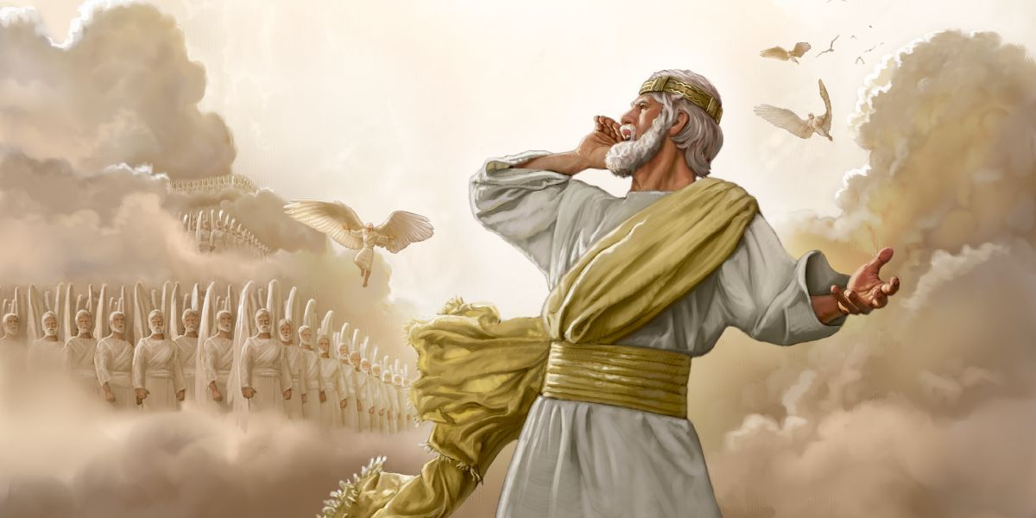
Jews Will Believe at Christ’s Return
461d
"They will be called 'The Holy People'
and 'The People Redeemed by the LORD.'
And Jerusalem will be known as 'The Desirable Place'
and 'The City No Longer Forsaken.'"
—Isaiah 62:12 NLT—

Slide 45
Jews Will Believe at Christ’s Return
461d
D. Israel’s spiritual restoration
1. Israel cleansed by God’s judgment before the kingdom (1:25; 4:2-4; 29:1-4; 30:26b; 31:6-7)
2. Israel reunited and regathered to the land (11:10-13, 15-16; 43:1, 5; 49:6; 61:4; 65:8-9)
3. Israel victorious over enemies (2:12-21; 11:14; 24:21-23; 41:11-14; 45:14; 61:2; 66:14b)
4. Israel free from oppression (14:3-6; 42:6-7; 49:8-9)
5. Israel believing in Messiah (10:20-22; 25:8-9; 26:1-2; 27:9, 12-13; 29:23; 40:9; 45:17, 25; 52:3, 6-7, 9-11; 54:7-10; 62:12)
6. Israel forgiven, redeemed and righteous (1:25-27; 2:3; 4:3-4; 33:24; 44:22-24; 45:25; 48:17; 63:16)
7. Israel blessed and rewarded by Christ (19:25; 40:10; 62:11; 61:8)
8. Israel comforted by Christ (12:1-2; 40:1-2, 11; 49:12; 51:3; 65:18-19; 66:11-13)
9. Israel filled/empowered by Holy Spirit as never before (32:15; 44:3; 59:21)
10. Israel’s covenants fulfilled (42:6; 49:8; 54:10; 61:8)
a. Abrahamic (19:25; 41:8-10)
b. Davidic (9:7; 11:1-2; 55:3)
c. Land (11:11-16; 65:9)
d. New (32:15; 44:3; 49:6; 59:21; 66:22)

Slide 46
Slides on
Isaiah 62

Slide 47
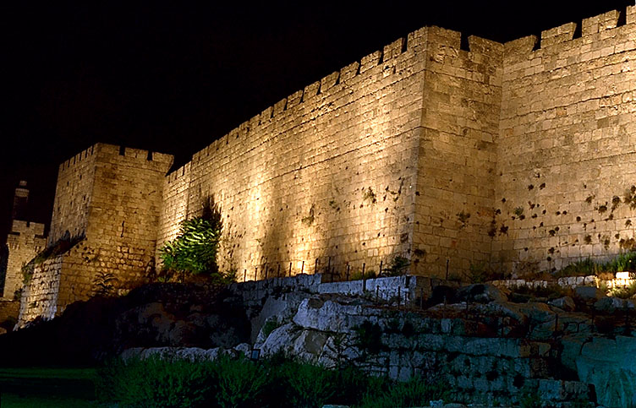
"O Jerusalem, I have posted watchmen on your walls; they will pray day and night, continually.
Take no rest, all you who pray to the LORD. ⁷Give the LORD no rest until he completes his work, until he makes Jerusalem the pride of the earth" (Isa. 62:6-7 NLT).
Notes:
God commands us to pray for the peace of Jerusalem here and in Psalm 122:6.
______
Common-381
ES-26-Restoration of Israel-78
OS-23-Isaiah60-66-slide 28

Slide 48
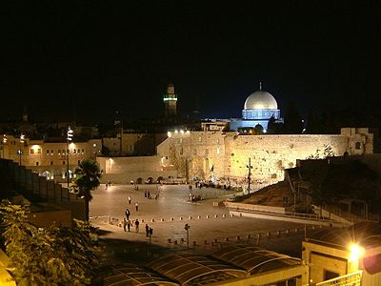
"The LORD has sworn to Jerusalem by his own strength: 'I will never again hand you over to your enemies. Never again will foreign warriors come and take away your grain and new wine'"
(Isa. 62:8 NLT).
Notes:
God ultimately promises to protect Jerusalem from foreign enemies. It hasn't happened yet, but it will!
______
Common-382
ES-26-Restoration of Israel-79
OS-23-Isaiah60-66-slide 29

Slide 49
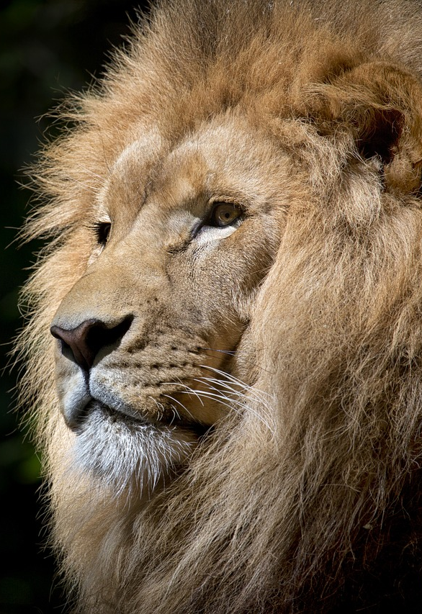
"'Awake, O sword, against my shepherd, the man who is my partner,' says the LORD of Heaven's Armies. 'Strike down the shepherd, and the sheep will be scattered, and I will turn against the lambs. ⁸ Two-thirds of the people in the land will be cut off and die,' says the LORD. 'But one-third will be left in the land'"
(Zechariah 13:7-8 NLT).

Slide 50
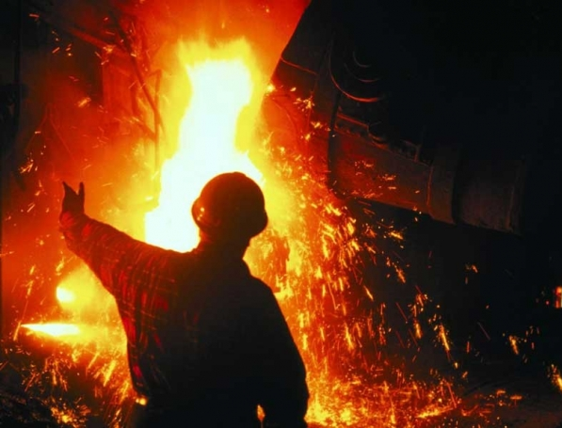
"I will bring that group through the fire and make them pure.
I will refine them like silver and purify them like gold.
They will call on my name, and I will answer them.
I will say, 'These are my people,' and they will say, 'The LORD is our God'"
(Zechariah 13:9 NLT).

Slide 51
Only a Remnant of Jews Saved
“And concerning Israel, Isaiah the prophet cried out,
‘Though the people of Israel are as numerous as the sand of the seashore,
only a remnant will be saved.
²⁸ For the LORD will carry out his sentence upon the earth
quickly and with finality’”
(Romans 9:27-28, quoting Isaiah 10:22-23 LXX NLT).

Slide 52
Only a Remnant of Jews Saved
“And Isaiah said the same thing in another place:
‘If the LORD of Heaven’s Armies
had not spared a few of our children,
we would have been wiped out like Sodom,
destroyed like Gomorrah’”
(Romans 9:29, quoting Isaiah 1:9 LXX NLT).

Slide 53
Only a Remnant of Jews Saved
“I am placing a stone in Jerusalem that makes people stumble,
a rock that makes them fall.
But anyone who trusts in him
will never be disgraced”
(Romans 9:33, quoting Isaiah 8:14; 28:16 LXX NLT).

Slide 54
Only a Remnant of Jews Saved
“But regarding Israel, God said,
‘All day long I opened my arms to them,
but they were disobedient and rebellious’”
(Romans 10:21, quoting Isaiah 65:2 LXX NLT).

Slide 55
Only a Remnant of Jews Saved
“So this is the situation: Most of the people of Israel have not found the favor of God they are looking for so earnestly.
A few have—the ones God has chosen—but the hearts of the rest were hardened. ⁸ As the Scriptures say,
‘God has put them into a deep sleep.
To this day he has shut their eyes so they do not see, and closed their ears so they do not hear’”
(Romans 11:7-8, quoting Isaiah 29:10; Deut 29:4 NLT).

Slide 56
Only a Remnant of Jews Saved
“And so all Israel will be saved. As the Scriptures say,
‘The one who rescues will come from Jerusalem,
and he will turn Israel away from ungodliness.
²⁷ And this is my covenant with them,
that I will take away their sins’”
(Romans 11:26-27, quoting Isaiah 59:20-21 LXX NLT).

Slide 57
Only a Remnant of Jews Saved
For the Scriptures say,
“‘As surely as I live,’ says the LORD,
‘every knee will bend to me,
and every tongue will declare allegiance to God.’”
(Romans 14:11, quoting Isaiah 49:18; 55:23 LXX NLT).

Slide 58
Slides on
Isaiah 63

Slide 59
Israel’s glorious restoration in the millennium reveals that he will fulfill every promise in the Abrahamic Covenant (Isaiah 60–66).
God promises Israel a glorious future of prosperity and peace in the kingdom (Isa 60).
2. God promises the Servant will prepare Jerusalem for the Father to usher in the millennium (61:1–63:6).
3. Israel’s remnant prays for forgiveness and restoration, resulting in God’s answer with judgment and restoration (63:7–65:25).
Israel’s remnant prays for forgiveness from past rebellion and for future restoration (63:7–64:12).
b. God gives his reasons for judging the people but also his promise to restore them in the millennium (Isa 65).

Slide 60
“Who is this who comes from Edom, from the city of Bozrah, with his clothing stained red? Who is this in royal robes, marching in his great strength? It is I, the LORD, announcing your salvation! It is I, the LORD, who has the power to save!
² Why are your clothes so red, as if you have been treading out grapes? ³ I have been treading the winepress alone; no one was there to help me. In my anger I have trampled my enemies
as if they were grapes. In my fury I have trampled my foes. Their blood has stained my clothes. ⁴ For the time has come for me to avenge my people, to ransom them from their oppressors. ⁵ I was amazed to see that no one intervened to help the oppressed. So I myself stepped in to save them with my strong arm, and my wrath sustained me.
⁶ I crushed the nations in my anger
and made them stagger and fall to the ground,
spilling their blood upon the earth.”
Isaiah 63:1–6 NLT

Slide 61
Kingdom & Covenants Timeline
22
CH-34a
OS1-22
OS2-337
NS-9g
SA-19
34a
Dr. Rick Griffith • BibleStudyDownloads.org
22
Kingdom Teaching...
Adam rules with God (Gen. 1:26, 28; 2:19)
Satan begins rule as god of this world (Gen. 3:15;
2 Cor. 4:4)
God covenants with Abraham to reestablish man's rule via Israel as a "kingdom of priests" (Gen. 12:1-3; Exod. 19:6)
Israel's failure to witness to nations as a kingdom of priests is judged via exile under foreign rule
Israel rejects Messiah's offer of kingdom (Matt. 12:41-42; 23:37-39)
Jesus extends His kingdom in mystery form to the Church (Matt. 13)
Christ subdues Israel's enemies and nation believes (Rom. 11:26-27)
Christ rules over everything with saints (Eph. 1:9-10; Rev. 20:1-6; 22:5b)
337
9g
Fall of Man (Gen. 3)
Noahic Covenant
19
Genesis 6:18; 9:8-17
Land Covenant
ISRAEL
CHURCH
MESSIANIC KINGDOM
(National Focus)
The "New Man" (Eph. 2:15)
Millennial Eternal
land
Genesis 15:18 (cf. Deut. 30:1-10) promises:
Land from Wadi of Egypt to Euphrates River (Isa. 27:12)
Eternal possession of land (Gen. 17:8) after exile/restoration
Whole world blessed via the land (Isa. 14:1-2)
Israel judged for rejecting Messiah by dispersion away from land for 19 centuries
(AD 70–AD 1948) but now partially restored (Ezek. 37:1-7)
Full restoration (Ezek. 37:8-28) Jerusalem world capital
(Isa. 2:1-5)
New Jerusalem
(Rev. 21–22)
Davidic Covenant
Christ is Head over His Church, which is a spiritual temple (Eph. 2:19-22; 2 Cor. 6:16)
Christ reigns over the world
(Isa. 11)
with saints (Rev. 5:10; 20:4-6)
Christ hands kingdom over to Father (1
Cor. 15:24)
Genesis 12:1-3
2 Samuel 7:12-16 promises:
Sons ("house" never wiped out)
Kingdom (political dynasty)
Throne (right to rule by descendants)
Temple (son to build it)
seed
Abrahamic Covenant
New Covenant
All
things made new!
(Rev. 21:5)
All 5 elements fulfilled in national restoration (Zech. 8)
Jeremiah 31:31-34 promises:
Forgiveness
Indwelling Spirit
New heart, nature, mind
Reunification of Israel and Judah
No need for evangelism
Mosaic Law replaced with first three elements of the New Covenant (Luke 22:20; 2 Cor. 3:6)
blessing
Mosaic Covenant
Law abolished, fulfilled, and replaced at the cross (Rom. 7:1-6;
1 Cor. 9:19-21; Heb. 8:13)
10th Edition
10 Nov 2020
Temporary (Gal. 3:19) and conditional (Deut. 28) to reveal sin (Rom. 7:7) and regulate Israel (Gal. 3:23-25)
Scripture has a dual kingdom-covenant theme. Israel's role from Abraham to Christ expands to include the Church (continuity) yet the Church never replaces the nation as the "new Israel" (discontinuity). Israel will enjoy world prominence after trusting Christ at His second coming.
Notes:
All agree that a partial fulfillment of the covenant to Abraham exists now to the Church in the indwelling Holy Spirit and forgiveness of sins (Jer 31:31-34)—and the ultimate fulfillment will be in the eternal state.
The main area of disagreement relates to the time period from now to eternity. Will there be a literal land, throne, and worldwide blessing to national (ethnic) Israel before the eternal kingdom? This chart shows verses giving a resounding YES to that question in a present partial fulfillment and a future full fulfillment in the normal sense of language in the verses cited. But the messianic kingdom will be in two stages—first in a millennial fulfillment to last 1000 years, but then, after that, the eternal stage in the new Jerusalem after the destruction of our present heavens and earth (Rev 21–22). What an amazing future remains for those who trust Jesus!
____________
Common English-7
CH-02-Nature-103-p34a
OS-00-Intro & Biblical Theology-25 & 90
OS-02-Exodus-267-p22
OS-05-Deut-248-p22
OS-10-2Sam-96-p22
OS-24-Jeremiah-174-p337
OS-23-Isaiah 1-12-slide 97-p337
OS-23-Isaiah 60-66-slide 38-p337
NS-09-Gal-143-p9g
NS-19-Hebrews-342-p9g
SA-08-Mosaic Law-19-p38a

Slide 62
Slides on
Isaiah 64

Slide 63

The Kingdom of God
34
460
The Eternal Kingdom
False Kingdom of Satan
Soteriological Line
Theocratic Kingdom on Earth
Eden | Conscience
Human Government
Patriarchs | Judges | Kings | Prophets | Christ | Grace
Millennium
Israel | Times of Gentiles
Covenants
Abrahamic Covenant
Land Covenant
Davidic Covenant
New Covenant
Dispensations (Tests of Obedience)
Inno-cence | Conscience
Human Government
Promise | Law (Gal. 3:19) | Grace
Millennium
Adapted from J. Dwight Pentecost, Thy Kingdom Come, 323
Notes:
Common Slides-64
OS-00-00-Intro_&_Biblical_Theology-93_eng_os_6987_v7/Slide 39
OS-23-Isaiah_24-39/Slide 262 on Supplements
OS-23-Isaiah_49-59/Slide 169 on Supplements
OS-23-Isaiah_60-66/Slide 43 on Isaiah 64
OS-23-Isaiah_60-66/Slide 96 on Supplements

Slide 64
Slides on
Isaiah 65

Slide 65

THEOLOGY IN ISAIAH
Eschatology (cont'd)
3. THE NEW HEAVEN AND NEW EARTH : A New Jerusalem
+ The Creation of New Things (65:17) - renewal of the present heaven and earth after Christ's 2nd coming (24:19-23; 34:4)
+ The Creation of a New Jerusalem (65:17-18)
+ The Splendour of a New Jerusalem (60:13)
+ The Absence of Tears and Sorrow (25:8; 35:10)
+ Longevity and the Decrease of Death (25:8; 65:20)
+ The Absence of Light from the Sun and Moon (24:23; 60:19-20)
Notes:
65

Slide 66
THEOLOGY IN ISAIAH
Eschatology (cont'd)
4. ETERNAL PUNISHMENT
- Everlasting Burning (34:10; 66:24)
- Everlasting Torment (50:11)
Notes:
66

Slide 67

469
Isaiah's Eschatology
Adapted from John A. Martin, Dallas Seminary
God
Cry out to God for:
• forgiveness
• deliverance (intervention requested)‏
Appearance of God's Glory:
• New Covenant
• Enemies Judged
(intervention granted)‏
Restoration of Nation
Physical Healing
Restoration of Earth
Universal Peace
Israel's Persecution Leads to Realization of Sin
Notes:
67

Slide 68
Isaiah 65:17-18a (NLT)
"Look! I am creating new heavens and a new earth, and no one will even think about the old ones anymore. ¹⁸Be glad; rejoice forever in my creation!"
Notes:
68

Slide 69

Isaiah 65:18b-19 (NLT)
"And look! I will create Jerusalem as a place of happiness. Her people will be a source of joy. ¹⁹I will rejoice over Jerusalem and delight in my people. And the sound of weeping and crying will be heard in it no more."
Notes:
69

Slide 70
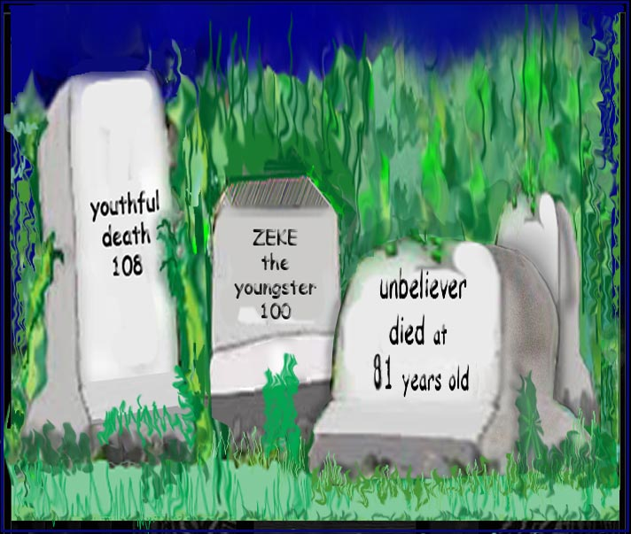
Incredibly Long Life (Isaiah 65:20 NLT)!
"Never again will there be in [Jerusalem] an infant who lives but a few days, or an old man who does not live out his years; he who dies at a hundred will be thought a mere youth; he who fails to reach a hundred will be considered accursed."
Notes:
70

Slide 71
Two "New Heaven(s) & New Earth"
473
2nd Advent
(Isa. 60:2; 61:11)
Great White Throne
(Rev. 20:11-14)
Church Age
Millennium
(Isa. 2:4; 65:20)
Eternal State
(Rev. 22:5)
Isaiah's
New Heavens
& New Earth
(Isa. 54–66)
John's
New Heaven
& New Earth
(Rev. 21–22)
Notes:
71

Slide 72
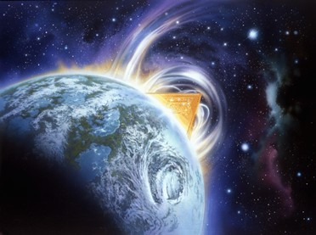
"Then I saw a new heaven and a new earth, for the old heaven and the old earth had disappeared"
(Rev 21:1a NLT).
NTS 449
473

Slide 73
Isaiah v. John on the
New Heaven(s) and New Earth
NTS 449
473
 | Isaiah's New Heavens and New Earth (Isa. 65:17; 66:22) | John's New Heaven and New Earth (Rev. 21:1)
English Term | Plural: "new heavens" | Singular: "new heaven"
Time Period | Millennium | Eternal State
Life span of Inhabitants | Extended yet not infinite life (65:20) | Eternal Life
Death | Possible, though dying at 100 years old is "young" (65:20; cf. 66:24)! | No death (Rev. 21:4) as death is abolished at the Great White Throne Judgment (Rev. 20:14)
Notes:
73

Slide 74
Isaiah v. John on the
New Heaven(s) and New Earth
NTS 449
473
 | Isaiah's New Heavens and New Earth (Isa. 65:17; 66:22) | John's New Heaven and New Earth (Rev. 21:1)
Marriage & Childbirth | Possible (65:23) | Impossible (Matt. 22:30)
Activity | Building of houses and planting of vineyards (65:21) | Christ claimed that he would prepare a place for us (John 14:1f.).
Animal Activity | Peaceful cohabitation of wild animals (65:25a) | No animals are noted by John or in any other text on heaven
Associated City | Protection of God in Jerusalem (65:25b) | Focus is the new Jerusalem (Rev. 20–21)
Notes:
74

Slide 75
Isaiah v. John on the
New Heaven(s) and New Earth
NTS 449
473
 | Isaiah's New Heavens and New Earth (Isa. 65:17; 66:22) | John's New Heaven and New Earth (Rev. 21:1)
Gathering of Nations | Brought to Jerusalem to see God's glory (66:18-20; cf. Zech. 14:16-19) | God's glory provides light for the nations (21:23-24)
Priesthood & Temple | Has a temple, priests, and Levites (66:20-21; cf. Ezek. 40—43) | Has no temple (21:22), so by implication no priests are needed
Celebrations | New Moon and the Sabbath (56:6-7a; 66:23) | No need for these since there will be no need for rest in eternity
Notes:
75

Slide 76
Isaiah v. John on the
New Heaven(s) and New Earth
NTS 449
473
 | Isaiah's New Heavens and New Earth (Isa. 65:17; 66:22) | John's New Heaven and New Earth (Rev. 21:1)
Time | Still existent | Abolished with night (Rev. 22:5), so rest every seven "days" is absurd.
Place of Worship | Jerusalem (65:23) | Throne of God (22:3-4)
Notes:
76

Slide 77

"Thy Kingdom Come"
Notes:
One of the highest prayers that Jesus commanded was for us to pray for his kingdom to come. This means that we better understand what this means!
__________
OS-23-Isaiah1-12—slide 349
NS-01-Matt1-14-slide 87

Slide 78


Should we pray…
"Thy Kingdom come"?
Notes:
We should learn that the kingdom is so we can pray for it to happen.
________
OS-10-Davidic Covenant-08
OS-23-Isaiah1-12—slide 350
NS-01-Matt1-14-slide 88

Slide 79
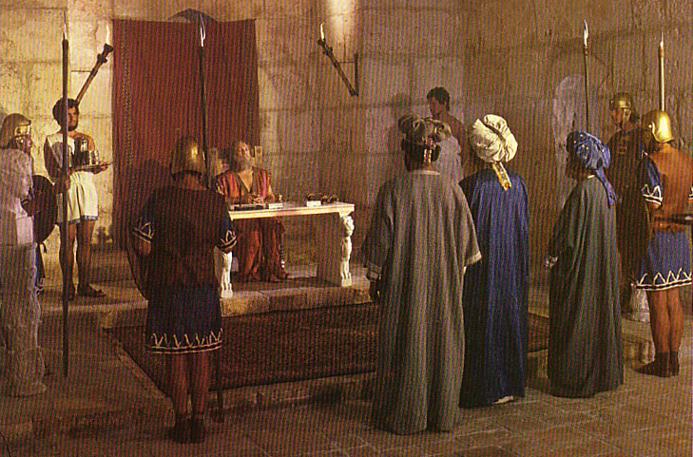
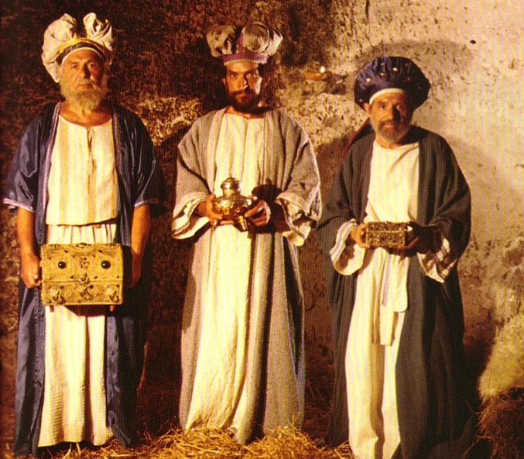
What Kind of Kingdom Did Isaiah
(and Matthew) Envision?
78b
Political
Physical
Emotional
Intellectual
Spiritual
Notes:
What did the magi mean when they asked for the location of the newborn "king of the Jews"?
Were they looking for the ruler of a spiritual kingdom?
Did King Herod feel threatened by the beginning of a spiritual kingdom in nearby Bethlehem?
What would the people have thought when they heard the word "kingdom"?
One key problem in our understanding is that we ask whether "kingdom" is spiritual or literal. This is a false dichotomy as if it cannot be both. In fact, no one can enter the literal kingdom apart from a spiritual rebirth.
The prophet who wrote most about the kingdom was undoubtedly Isaiah, the "prince of the prophets." His book is the first of the prophets and also the longest. So what does Isaiah say about this kingdom? This will help us understand what Jews of the first-century thought, for Isaiah impacted their view tremendously.
So, our assumption here is that Matthew's use of the kingdom is the same as Isaiah's. One should assume that they are the same unless otherwise noted. Isaiah saw this kingdom of Messiah as a
• political,
• earthly entity (physical), but it also has
• emotional and
• intellectual aspects and is available only to those who qualify spiritually by placing their faith in the Messiah.
The following is copied from pages 461b-d in the OT Survey Isaiah notes. It took Dr Rick Griffith three days of reading Isaiah to compile this list of more than 100 verses in Isaiah (these were glorious days ☺).
See PPT for many of these verses below in The Restoration of Israel PPT presentation #26 in English at https://biblestudydownloads.org/resource/future/ and in Arabic at https://biblestudydownloads.org/resource/%d8%b9%d9%84%d9%85-%d8%a7%d9%84%d8%a3%d8%ae%d8%b1%d9%88%d9%8a%d8%a7%d8%aa/.
The Kingdom in Isaiah
Christians often talk about Jesus as king. It is especially discussed about Him being born king at Christmas. But this raises two important questions:
1. What kind of kingdom does Jesus bring as king? Many (esp. amillennialists) say that this is only a spiritual kingdom with no earthly or physical aspects, but others (esp. premillennialists) note many dimensions of the kingdom: spiritual, physical, political, etc.
2. What kind of kingdom did both John (Matt. 3:2) and Jesus (Matt. 4:17) mean when they preached, "Repent, for the kingdom of heaven is near"? Like the OT prophets, they said that Jews needed to turn from sin to enter the kingdom (Deut. 30:1-2). Had the nation repented, then this fulfillment would have occurred (Deut. 30:3-10). One should assume that this kingdom was the same kingdom that the OT prophets preached. Otherwise, Jesus and John would have misled the people.
Since Israel rejected this kingdom, Christ will not rule over it until the nation believes (see verses below in the “Spiritual” section). So after Israel finally believes in the future and Christ returns to establish his kingdom on earth (Rev. 19), what will this new period look like? Revelation 20:1-6 reveals the length of this era as 1000 years when saints will rule (cf. Rev. 5:10) and Satan will be bound from deceiving the nations (cf. Rev. 20:1-3). However, Isaiah gives the best total picture of what the kingdom will be like with more information than any other book in Scripture. This is the correct background one should know to understand Matthew’s concept of the kingdom.
I. Political
A. Jerusalem
1. Capital of the earth (2:2b)
2. A safe refuge for people (14:32; 25:4; 26:1-4; 32:18; 33:20-24; 35:9; 60:18; 62:8-9; 66:12)
3. City of glory without unbelievers (33:24b; 35:8-10; 52:1-3, 6)
4. Accessible (11:15-16; 33:21; 35:8; 60:15)
B. Israel’s Political Blessings
1. Enemies judged by Messiah (2:12-21; 24:21-23; 29:20-21; 45:14; 61:2; 66:24)
2. Exalted above the Gentiles (2:3; 14:1-2; 18:7; 49:22-23; 60:5, 14-17; 61:5-9; 62:1-4)
3. Serves as a nation of witnesses for God (44:8, 21)
C. Messiah’s Rule
1. His Second Advent precedes the kingdom (60:2; 61:11)
2. Extent of his rule
a. Rules on David’s throne as Davidic covenant fulfilled (4:2; 9:6-7; 16:5a)
b. Rules as King over the world (9:6-7; 11:3-5; 16:5; 24:21-23; 40:10)
c. Rules as King from Jerusalem (2:3; 24:23b; 33:17-22)
3. Nature of his rule
a. Rules gloriously (4:2; 24:23; 35:2; 40:5; 60:1, 2)
b. Rules wisely (11:2)
c. Rules meekly (42:3)
d. Rules righteously (32:1)
e. Rules nations with justice (9:7; 11:5; 16:5b; 32:1; 42:1, 4)
f. Rule unquestioned (11:4; 25:1-5; 29:17-21; 30:30-33; 42:13; 49:24-26; 66:14-19)
g. Rule in kingdom merges with eternal state (9:7; 33:20)
D. Other Rulers
1. Elders or rulers serve with Messiah in Jerusalem (24:23b; 32:1)
2. Judges serving as counselors (1:26)
3. Positions of responsibility given as rewards (40:10)
E. Worldwide peace rather than war (2:4; 9:4-7; 32:17-18; 55:12; 54:13; 60:18)
II. Physical
A. Earth and heavens renewed (65:17; 66:22)
1. Sun and moon
a. Light from both diminished in the Tribulation (13:10)
b. Sun still rises (41:25; 45:6; 59:19)
c. Moonshine equals the sun, which itself is seven times brighter (30:26)
d. Yet the sun and moon less intense and not harmful (24:23a; 49:10)
e. Both sun and moon finally eradicated in the eternal state (60:19-20)
2. Land of Israel
a. Borders enlarged (26:15; 33:17; 54:2-3; 61:7)
b. Land rebuilt after destruction (32:16-18; 49:8, 19; 61:4-5)
c. Much rainfall and water in the desert (30:23-25; 35:1-2, 6-7; 41:17-18; 49:10b)
d. Broad rivers flowing from the temple (33:20-21)
e. Animals blessed with much food (30:23)
f. Crops abundant (27:6; 35:1-2, 6-7) with the Genesis 3:17-19; Romans 8:19-22 curse on the earth removed (11:6-9; 35:9; 65:25)
g. Verdant trees replace thorn bushes and briers (55:13)
h. Mountain trees in previous desert wastelands (41:19)
i. Beautiful and prosperous from many nations‘ wealth (60:5; 61:6; 62:3; 66:10-12)
j. Glorified (60:1-9)
3. Jerusalem
a. Topographical changes with temple mount at city’s high point (2:2)
b. Cloud of smoke and pillar of fire protects Jerusalem (4:5-6)
c. Temple mount holy (11:9; 27:13; 56:7; 57:13; 65:25; 66:20)
B. Humans living in unique circumstances
1. Some Israelites living in glorified bodies after tribulation (26:19-20)
2. Babies still born to those in mortal bodies (44:3; 61:9; 65:20, 23)
3. Longevity of life where immaturity is rare but death is still existent (65:20)
4. Food for people plentiful (30:23; 62:8-9; 65:21-22)
5. Protection from harm with wild animals tamed (11:6-9; 35:9; 41:8-14; 65:25)
6. Work existent but always protective (62:8-9; 65:21-23)
7. Blind, deaf, lame, and mute all healed (29:17-19; 35:5-6)
8. Illness in Jerusalem eradicated (33:24; 65:23)
9. Death eventually destroyed in Jerusalem (25:7)
III. Emotional
A. Strength replaces fear (35:3-4; 41:10, 13-14)
B. Joy and gladness replace weeping, sorrow and sighing (9:1-4; 12:3, 6; 25:8-9; 30:29; 35:10; 42:10-11; 45:25; 52:8-9; 55:12; 60:15; 61:3, 7; 65:18-19; 66:10-11, 14)
C. Israel’s sentiment
1. The name “Israel” replaced with the new names Hephzibah (Heb. “my delight is in her”) and Beulah (Heb. “married”; 62:2)
2. Israel no longer feeling shame (25:8; 29:22)
3. Israel the praise of the earth (43:4; 62:7, 10) due to unique “marriage” to the LORD (54:1, 4-7; 62:5 NIV margin)
4. Israel singing (14:7; 30:29; 42:10-11; 52:9)
IV. Intellectual
A. Knowledge fills the earth based on the fear of the Lord (2:3; 11:9; 33:6)
B. Knowledge of God’s work seen in mountain trees flourishing in the desert (41:19)
C People taught by the Lord himself (49:10; 54:13)
D. Teachers succeed in providing direction (30:20-21)
E. People listen, understand, and articulate God’s values (32:3-4)
IV. Spiritual
A. Satan bound (14:15)
B. Gentiles (Church)
1. Converted (16:5; 18:7; 49:6; 55:5; 60:3)
2. Disciplined for sin (19:19-22)
C. Jerusalem
1. Righteousness and holiness in the city (1:26-27; 4:3-4; 11:4-5; 35:8-9; 42:1-4; 52:1; 60:21; 61:3b) and desert (32:16)
2. Justice in the city (29:18-24; 65:21-23) and desert (32:16)
D. Israel’s spiritual restoration
1. Israel cleansed by God’s judgment before the kingdom (1:25; 4:2-4; 29:1-4; 30:26b; 31:6-7)
2. Israel reunited and regathered to the land (11:10-13, 15-16; 43:1, 5; 49:6; 61:4; 65:8-9)
3. Israel victorious over enemies (2:12-21; 11:14; 24:21-23; 41:11-14; 45:14; 61:2; 66:14b)
4. Israel free from oppression (14:3-6; 42:6-7; 49:8-9)
5. Israel believing in Messiah (10:20-22; 25:8-9; 26:1-2; 27:9, 12-13; 29:23; 40:9; 45:17, 25; 52:3, 6-7, 9-11; 54:7-10; 62:12)
6. Israel forgiven, redeemed and righteous (1:25-27; 2:3; 4:3-4; 33:24; 44:22-24; 45:25; 48:17; 63:16)
7. Israel blessed and rewarded by Christ (19:25; 40:10; 62:11; 61:8)
8. Israel comforted by Christ (12:1-2; 40:1-2, 11; 49:12; 51:3; 65:18-19; 66:11-13)
9. Israel filled/empowered by Holy Spirit as never before (32:15; 44:3; 59:21)
10. Israel’s covenants fulfilled (42:6; 49:8; 54:10; 61:8)
a. Abrahamic (19:25; 41:8-10)
b. Davidic (9:7; 11:1-2; 55:3)
c. Land (11:11-16; 65:9)
d. New (32:15; 44:3; 49:6; 59:21; 66:22)
E. Millennial worship
1. Israel worshipping the true God (12:1-6; 25:9–26:19; 56:7)
2. Jerusalem as the capital of nations’ (Gentile) worship (2:2-4; 11:12; 27:13; 30:29; 44:22-24)
3. The whole earth knows God–at least initially (11:9b)
4. Temple worship (56:5)
5. Priests and Levites serving the Lord (61:6; 66:21)
6. Animal sacrifices (56:7; 66:20-23)
7. Monthly New Moon celebrations (66:23)
8. Reinstitution of the Sabbath (56:4; 66:23)
F. Millennium absorbed into eternity
1. Kingdom age ends though salvation does not (51:6, 8)
2. Prosperity forever as a sign of God’s blessing (55:13)
3. Temple eunuchs blessed forever (56:5)
4. Both sun and moon finally eradicated in the eternal state (60:19-20)
5. Divine covenant continues on to be fulfilled in eternity (55:3; 61:8)
Concluding Applications
Since we will rule the world, we better start showing discernment now (1 Cor. 6:1-3)
Since this world must last 1000 more years (Rev. 20:1-6), we should take good care of it.
Work for Christ now before the 1000-year Sabbath comes with its restful service (Heb. 4:9-11).
Unless there is a clear change in the definition, shouldn't we assume that Matthew understood the kingdom in the same manner as Isaiah? This "prince of the prophets" wrote more about the kingdom than any prophet 700 years earlier.
________
OS-10-Davidic Covenant-08
OS-23-Isaiah1-12—slide 351
OS-23-Isaiah60-66—slide 59
NS-01-Matt1-14-slide 89

Slide 80

Not a new idea!
"Many passages speak of the second coming of Christ being followed by a reign of righteousness on earth
(Pss. 2; 24; 72; 96; Isa. 2; 9:6-7; 11-12; 63:1-6; 65-66; Jer. 23:5-6; 30:8-11; Dan. 2:44; 7:13-14; Hosea 3:4-5; Amos 9:11-15; Micah 4:1-8; Zeph. 3:14-20; Zech. 8:1-8; 14:1-9; Matt. 19:28; 25:31-46; Acts 15:16-18; Rom. 11:25-27; Jude 14-15; Rev. 2:25-28; 19:11-20:6)."
—John Walvoord, "Revelation," in The Bible Knowledge Commentary, 2:978
Notes:
We should learn that the kingdom is so we can pray for it to happen.
________
OS-10-Davidic Covenant-08
OS-23-Isaiah1-12—slide 352
NS-01-Matt1-14-slide 88

Slide 81
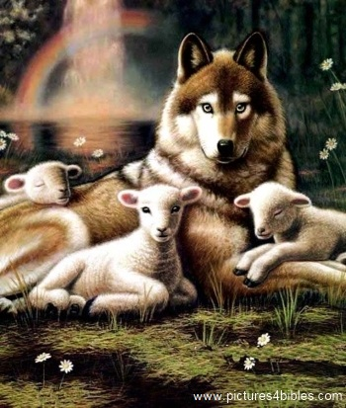
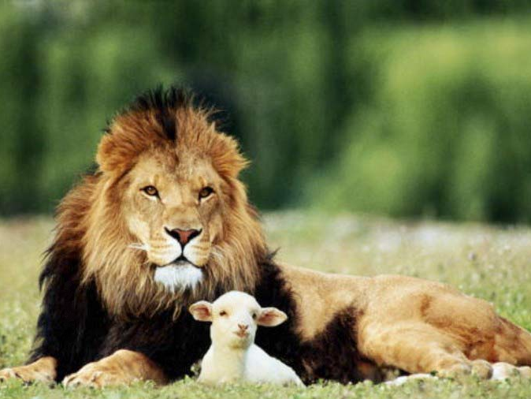
Isaiah 11:6-9
473a
⁶ And the wolf will dwell with the lamb, and the leopard will lie down with the young goat, and the calf and the young lion and the fatling together.
Notes:
81

Slide 82
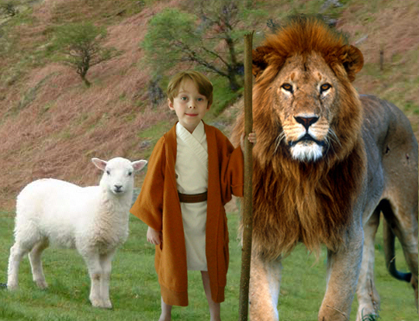
Isaiah 11:6-9
473a
⁶ And the wolf will dwell with the lamb, and the leopard will lie down with the young goat, and the calf and the young lion and the fatling together; and a little boy will lead them.
Notes:
82

Slide 83
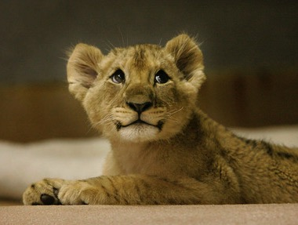
Isaiah 11:6-9
473a
⁷ Also the cow and the bear will graze, their young will lie down together, and the lion will eat straw like the ox.
Notes:
83

Slide 84
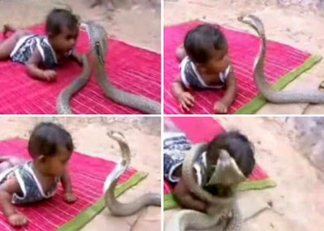
Isaiah 11:6-9
473a
⁸ The nursing child will play by the hole of the cobra, and the weaned child will put his hand on the viper's den.
⁹ They will not hurt or destroy in all My holy mountain, for the earth will be full of the knowledge of the LORD as the waters cover the sea.
Notes:
84
http://dailybuzzlive.com/archives/5613
Snake Tries to Eat Baby. Watch Video Before Reading! Now you may be outraged by this video and think that the parents need to have their child taken away for child abuse, but before you jump to any conclusions take a second to read about a culture that most of us know nothing about. - See more at: http://dailybuzzlive.com/archives/5613#sthash.m31WN86t.dpuf
You may think that this baby is some type of super human, being able to withstand sharp poisonous snake bites, it would pretty awesome if this were true. The snake in the video is actually defanged and has no poison whatsoever. In India, as well as Nepal, some Hindus actually worship snakes. This is called Nag Panchami and many children from this culture grow up with and around snakes. Some people even keep and feed them as though they were their children. - See more at: http://dailybuzzlive.com/archives/5613#sthash.m31WN86t.dpuf

Slide 85
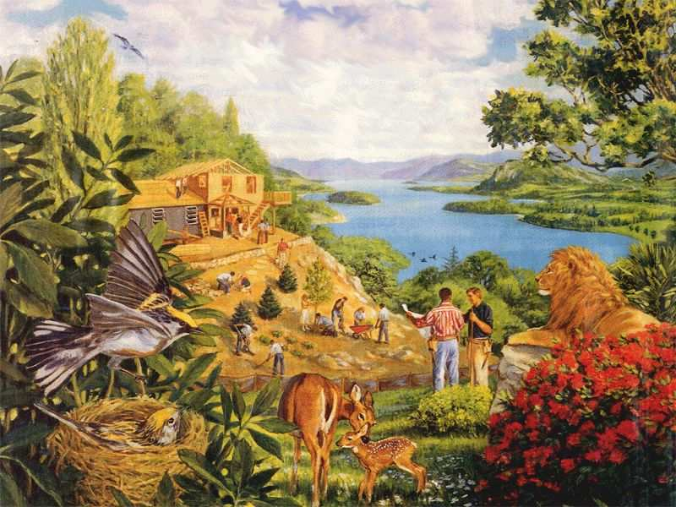
Rebuilding brings…
473a
Notes:
85

Slide 86
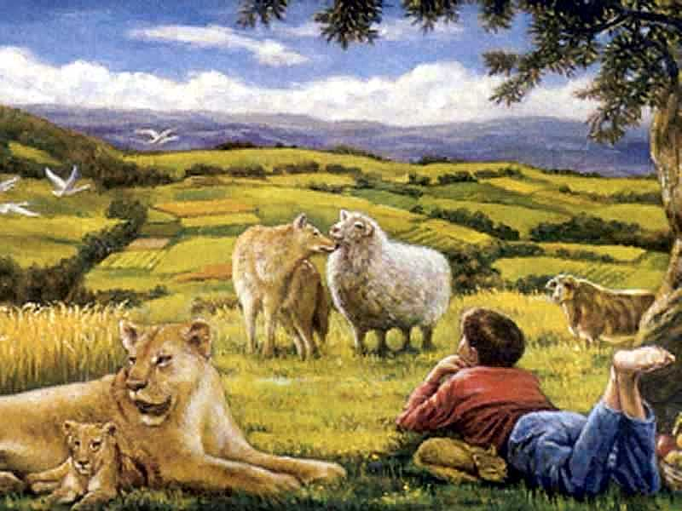
…a totally renewed earth!
473a
Notes:
86

Slide 87
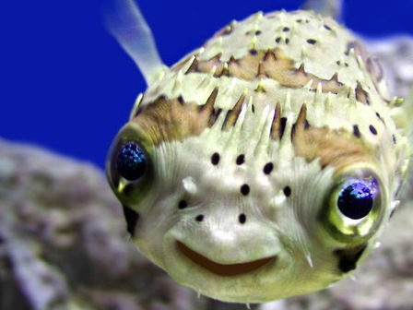
Romans 8:19-21
"The creation waits in eager expectation for the sons of God to be revealed. . . The creation itself will be liberated from its bondage to decay and brought into the glorious freedom of the children of God."
Notes:
87

Slide 88
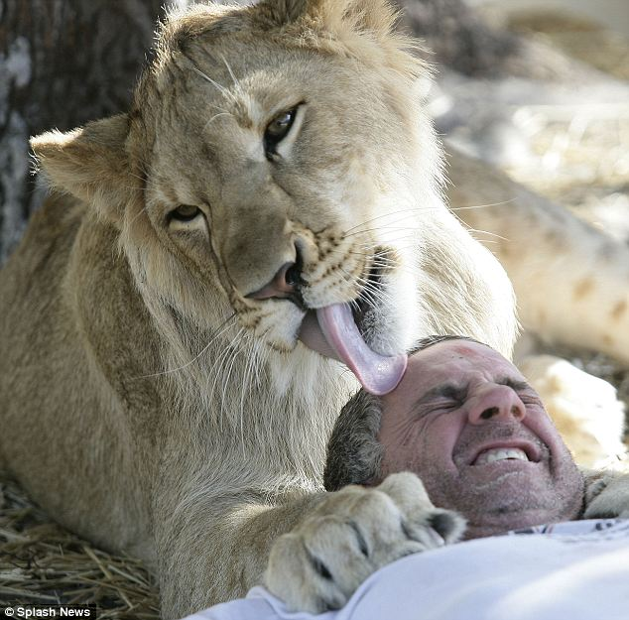
Romans 8:19-21
"The creation waits in eager expectation for the sons of God to be revealed. . . The creation itself will be liberated from its bondage to decay and brought into the glorious freedom of the children of God."
Notes:
88
http://forums.sgclub.com/singapore/now_whats_dinner_326313.html accessed 22 July 2015
Now, what's for dinner? Owner of wildlife sanctuary climbs into the lions' den for A MONTH...
Now, what's for dinner? Owner of wildlife sanctuary climbs into the lions' den for A MONTH to raise money
By GAVIN ALLEN
Last updated at 1:09 PM on 13th January 2011
It's the kind of lovingly playful lick on the head you would expect to see a young cat bestow on its owner.
But this is a lion, and Jim Jablon is not in his own home - he's literally in the lions' den.
These incredible pictures show just how well the Florida man is getting along with his new housemates Lea, an 18-month-old African lion, and Ed, a ten-month-old black-maned lion.
Scroll down for video
In the lion's den: Jim Jablon is living with two lions for the whole of January to raise money for his wildlife shelter
Who's the king of the jungle? Jablon shares a yawn with his housemate
The 42-year-old Army vet and single father has caused a stir worldwide with his promise to spend the entire month of January living with the two lions at the centre he runs, Wildlife Rehabilitation of Hernando County, Florida.
These images of Jablon come from day five of the challenge, during which he will eat 'regular cooked food,' rationed to one square meal a day, which will be served in the evening when Lea and Ed are devouring 14lb of raw meat as their dinner.
So far his biggest problem has been keeping his trousers on.
'Every time I bend over they go for my butt,' he said.
'Their teeth rip my pants right off. I've been through six pairs already.'
Jablon is also sleeping in the 12ft-high, 3,000sq ft enclosure on a bed on hay - or somewhere harder to reach if things get a bit too hairy.
Lion down: Jablon is eating and sleeping at the enclosure, although he isn't yet certain if he will stay on the straw bed
Aw, get off: Jablon never turns an animal away from the refuge, relying on volunteers and the help of his 13-year-old daughter
'I may have to construct a bed in one of the trees, just out of their reach or come up with another idea, depending on what they make of me being there,' he said.
'After all, lions generally sleep for 18-20 hours a day so I'm going to be getting a lot of rest.
'But I'll be ever-vigilant and I will have a small fenced-off safety area in the corner if it looks like they're getting too aggressive or I feel things are getting too dangerous.
The stunt is a way to raise funds for Jablon's animal refuge, which cares for injured or orphaned animals in the hope of giving them the chance to be returned to the wild.
He opened the site in 1999 and was soon caring for raccoons, injured deer, bobcats, coyotes, snakes, eagles and owls.
But soon the animals being brought in were getting increasingly larger and exotic – alligators, monkeys and big cats, including lions, tigers, lynx and pumas.
Jablon, originally from Long Island, New York, tries to ensure he never turns an animal away from the refuge, relying on volunteers and the help of his 13-year-old daughter Chelsey.
But as the facility has grown in size, the cost of feeding and looking after the increasing number of animals and the cost of their medical care has also risen rapidly, leading to Mr Jablon's unusual plan.
'I was looking for a way to raise funds to help the animals and I am constantly striving to look at what makes them happy, at what stimulates them, so I thought living with them for a month would help both causes,' he said.
'I couldn't survive without donations and hopefully this event will let people know I'm here and that I need help in helping the animals.'
'If the lions were fully grown I wouldn't be doing this.
'I feel they are still at the size and development stage where I can control them but, yes, they're big, and I have to take great care.
'I don't train my animals to do tricks and be with other people.
'I try to give them natural lives, so once they get to be a little bigger I will not be coming in with them.'
Jablon began living with the lions at midnight on New Year's Eve and will leave the den on January 31.
You can watch a live feed of his time in the cage at http://wrohflorida.com

Slide 89

461b
Millennial Jerusalem
"The law will go out from Zion,
the word of the LORD from Jerusalem"
--Isaiah 2:3
Notes:
89

Slide 90
473c
Why Am I Premillennial?
The best hermeneutic is a normal, literal, historical, and grammatical reading of a text
Rev. 19 (Christ's return) is before Rev. 20 (Christ's rule)‏
Natural way to see the 1000 years (20:1-6)‏
OT prophets saw a future period which is neither the present age nor heaven
  Animal kingdom tamed (Isa. 11:6-9)‏
  Long life but still death (Isa. 65:20)‏
Notes:
90

Slide 91
473a
Incredibly Long Life!
NLT Isaiah 65:20 "No longer will babies die when only a few days old. No longer will adults die before they have lived a full life. No longer will people be considered old at one hundred! Only sinners will die that young!"
Notes:
91

Slide 92



Patriarch's long lives
90
Ages of people when they died
Adam
930 Years
Methuselah
969 Years
Noah
950 Years
Shem
600 Years
The Flood explains why life spans shortened
Abraham
175 Years
Moses
120 Years
David
70 Years
John Morris, Noah's Ark and the Ararat Adventure, 10
Notes:
Perhaps the atmosphere changed so dramatically after the Flood that it shortened human lifespans.
________________
OS-01-Gen4-20—slide 55
OS-23-Isaiah1-12—slide 110
OS-23-Isaiah60-66—slide 73

Slide 93
473c
Why Am I Premillennial?
The best hermeneutic is a normal, literal, historical, and grammatical reading of a text
Rev. 19 (Christ's return) is before Rev. 20 (Christ's rule)‏
Natural way to see the 1000 years (20:1-6)‏
OT prophets saw a future period which is neither the present age nor heaven
  Animal kingdom tamed (Isa. 11:6-9)‏
  Long life but still death (Isa. 65:20)‏
  Yearly observances after Messiah's return (Zech. 14:15-17)‏
Notes:
93

Slide 94
Differences Between the Millennium and Heaven
191
 | Millennium | Heaven
Duration | 1000 years (Rev. 20:1-6) | Eternal (Rev. 22:5)
Death | Possible (Isa. 65:20) | Impossible (Rev. 21:4)
Longevity of Life | "Never again will there be an infant who lives a few days. He who dies at a hundred will be thought a mere youth" (Isa. 65:20) | No aging (Rev. 21:4 implied)
Sin Nature | Active (Rev. 20:7-9) | Abolished (Rev. 21:27)
Inhabitants | Initially Christian, but later includes unbelievers––no living with angels? (Matt. 25:34; Rev. 20:7-9) | Saints and angels alone (Rev. 21:27)
Millennium
(Rev. 20)
vs.
Heaven
(Rev. 21-22)
Notes:
These two periods are often confused, so hopefully, these contrasts will distinguish them. Isaiah's final two chapters speak much about the millennium while Revelation 21–22 most addresses the eternal state of heaven.
___________
OS-23-Isaiah60-66—slide 75
NS-27-Rev20-22—slide 195

Slide 95
Differences Between the Millennium and Heaven
191
 | Millennium | Heaven
Bodies | Mortal and immortal living together (Isa. 65:20; 1 Cor. 15:42-44) | Only immortal (glorified) (1 Cor. 15:42-44)
Satan | Bound, but then released after 1000 years (Rev. 20:3, 7) | In lake of burning sulfur, never to be released again (Rev. 20:10)
Political & Religious Centre | Jerusalem (Isa. 2:2-3; Micah 4:1-2, 7) | New Jerusalem (Rev. 21)
Place | Earth (Rev. 5:10) | New heavens and new earth (Rev. 21:1)
Key Passages | Psalm 72; Isaiah 2; 11; 65–66; Revelation 20:1-6 | Revelation 21–22
Millennium
(Rev. 20)
vs.
Heaven
(Rev. 21-22)
Notes:
These two periods are often confused, so hopefully, these contrasts will distinguish them. Isaiah's final two chapters speak much about the millennium while Revelation 21–22 most addresses the eternal state of heaven.
___________
OS-23-Isaiah60-66—slide 76
NS-27-Rev20-22—slide 196

Slide 96
Slides on
Isaiah 66

Slide 97
Israel’s glorious restoration in the millennium reveals that he will fulfill every promise in the Abrahamic Covenant (Isaiah 60–66).
God promises Israel a glorious future of prosperity and peace in the kingdom (Isa 60).
2. God promises the Servant will prepare Jerusalem for the Father to usher in the millennium (61:1–63:6).
3. Israel’s remnant prays for forgiveness and restoration, resulting in God’s answer with judgment and restoration (63:7–65:25).
Israel’s remnant prays for forgiveness from past rebellion and for future restoration (63:7–64:12).
b. God gives his reasons for judging the people but also his promise to restore them in the millennium (Isa 65).
4. God promises Israel restoration to the land and descendants in the millennium to fulfill his promises in the Abrahamic Covenant (Isa 66).

Slide 98

Isaiah 66:1–2
This is what the Lord says:
“Heaven is my throne,
and the earth is my footstool.
Where is the house you will build for me?
Where will my resting place be?

Slide 99
Isaiah 66:1–2
² Has not my hand made all these things,
and so they came into being?”
declares the LORD.
“These are the ones I look on with favor:
those who are humble
and contrite in spirit,
and who tremble at my word.”

Slide 100
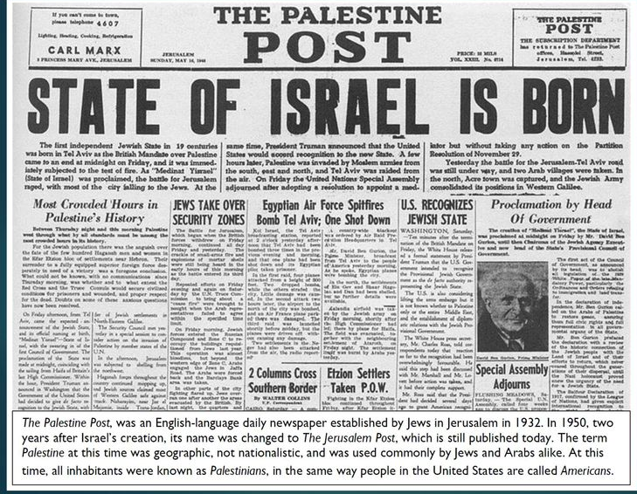
14 May 1948
"Who has ever seen anything as strange as this?
Who ever heard of such a thing?
Has a nation ever been born in a single day?
Has a country ever come forth in a mere moment?
But by the time Jerusalem’s birth pains begin,
her children will be born."
Isaiah 66:8 (NLT)
Notes:
100
Though obviously many events prepared for it in advance, Israel became a nation on the single day of 14 May 1948.
________
OS-23-Isaiah60-66-slide 78
OS-38-Zechariah-84

Slide 101
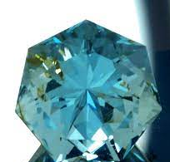
"Now look at the jewel I have set before Jeshua, a single stone with seven facets. I will engrave an inscription on it, says the LORD of Heaven’s Armies, and
I will remove the sins of this land in a single day"
(Zechariah 3:9 NLT).
Notes:
Israel became a nation in one day on 14 May 1948, but the Jews saw themselves as an ethnic rather than a religious people. Even today, about 30% of Jewish immigrants from Russia are atheists. Yet God promises in Zechariah 3:9 to remove the sins of the nation also on a single day.

Slide 102
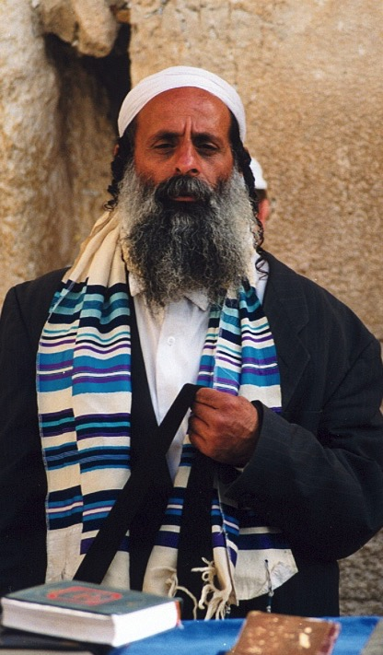
"All Israel will be saved" (Rom. 11:25-27)
NTS 155w
²⁵I do not want you to be ignorant of this mystery, brothers, so that you may not be conceited: Israel has experienced a hardening in part until the full number of the Gentiles has come in.
²⁶And so all Israel will be saved, as it is written:
"The deliverer will come from Zion; he will turn godlessness away from Jacob.
²⁷And this is my covenant with them when I take away their sins."
Notes:
Zechariah 3:9 says that Israel will believe in Jesus as Messiah in a single day at the end of the Tribulation when "All Israel will be saved" (Rom 11:25-26).
___________________
Arabic Common Slides-339
OS-38-Zechariah-83
NS-06-Rom9-13-slide 50
NS-22-Rev13-19-slide 53

Slide 103
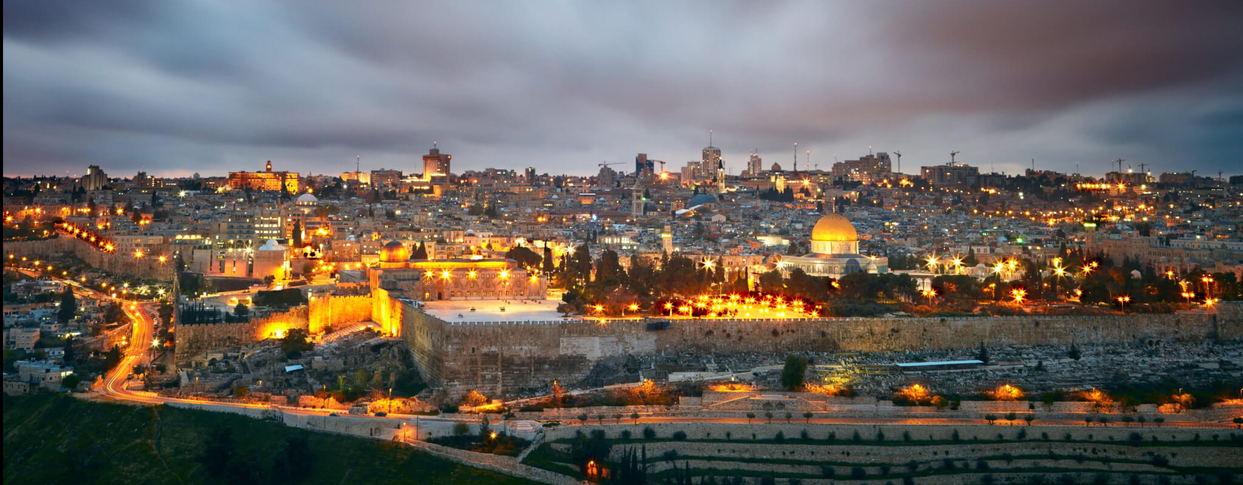
Isaiah 66:20-21 (NLT)
"'They will bring the remnant of your people back from every nation. They will bring them to my holy mountain in Jerusalem as an offering to the LORD. They will ride on horses, in chariots and wagons, and on mules and camels,” says the LORD. ²¹"And I will appoint some of them to be my priests and Levites. I, the LORD, have spoken!"
Notes:
103

Slide 104
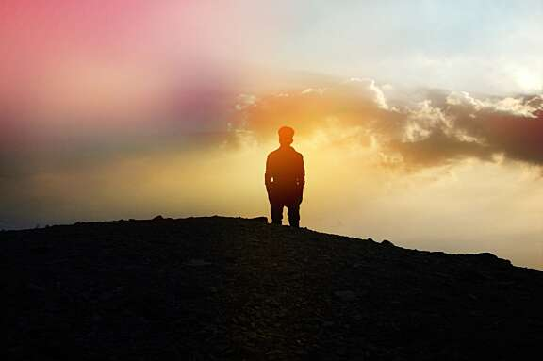
Isaiah 66:22 (NLT)
"'As surely as my new heavens and earth will remain, so will you always be my people, with a name that will never disappear,' says the LORD."
Notes:
104

Slide 105
How will God complete his plan for all creation?
Notes:
By what means will the LORD restore the entire universe (restatement)?

Slide 106
Be Complete
Judgment
1–39
God will judge those who reject him (Isaiah 1–39).
Notes:
The LORD will deal with unbelievers in a just manner (restatement).

Slide 107
Be Complete
Judgment
Salvation
1–39
40–66
God will save those who trust him (Isaiah 40–66).
Notes:
The LORD will deliver the people who believe in him (restatement).

Slide 108
The Main Idea of Isaiah
Judgment
Salvation
1–39
40–66
God will both judge and save his creation.
Notes:
The LORD will deal justly and mercifully with all that he made (restatement).

Slide 109
Key Word
452
343
Restoration
Isaiah
Notes:
So what should we do? God will restore the entire earth! This has implications!

Slide 110
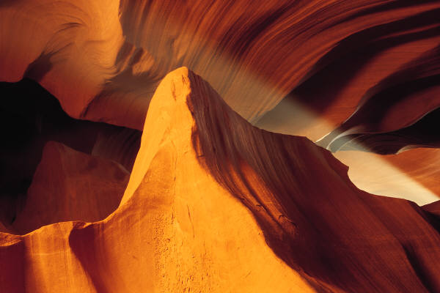
452
APPLICATION
The future restoration of the earth should cause us to get our priorities right now
So realize that God is preparing you for your future rule now!
Notes:
110

Slide 111

Jesus Shall Reign
Words: Isaac Watts (Public Domain)
CCLI Song #11026168
Music: 2008 Van Ness Press, Inc.
(Admin. by Music Services, Inc.)
CIC CCLI Licence # 277507
Notes:
In the late 1600s and early 1700s, Isaac Watts was an English Christian minister, hymn writer, and theologian. He was a prolific and popular hymn writer and is credited with some 750 hymns. His theology showed that he believed in a literal millennium where Jesus would rule even with a renewed sacrificial system. This is evident in his 1719 hymn "Jesus Shall Reign." Note the future—that Jesus shall rule in the days ahead.
_______________
OS-23-Isaiah_24-39/Slides 249-254
OS-23-Isaiah_60-66/Slides 83-88
http://www.lyricsondemand.com/miscellaneouslyrics/christianlyrics/jesusshallreignwhereerthesunlyrics.html

Slide 112
Jesus Shall Reign
Jesus shall reign where'er the sun
Doth his successive journeys run
His Kingdom stretch from shore to shore,
Till moons shall wax and wane no more.
To Him shall endless prayer be made.
And princes throng to crown His head,
His name like sweet perfume shall rise
With every morning sacrifice.
Notes:
Watts understood that Christ's future rule would be over the entire earth and would be so until the moon no longer waxed and waned. Since the eternal state will have neither sun nor moon (Rev. 21:4), Watts was referring to the earthly reign of Christ in the future millennium after the Second Coming.
______________
http://www.lyricsondemand.com/miscellaneouslyrics/christianlyrics/jesusshallreignwhereerthesunlyrics.html

Slide 113
Jesus Shall Reign
He shall reign in glory
crowned with grace and might.
Bless His name and
praise the Sovereign King!
He shall reign forever
with His chosen bride,
And all the earth shall sing
that Jesus is the King!
Notes:
http://www.lyricsondemand.com/miscellaneouslyrics/christianlyrics/jesusshallreignwhereerthesunlyrics.html

Slide 114
Jesus Shall Reign
People and realms of every tongue
Dwell on His love with sweetest song;
And infant voices shall proclaim
Their early blessings on His name.
Blessings abound where'er He reigns:
The prisoner leaps to lose his chains,
The weary find eternal rest,
And all the sons of want are blest.
Notes:
http://www.lyricsondemand.com/miscellaneouslyrics/christianlyrics/jesusshallreignwhereerthesunlyrics.html

Slide 115
Jesus Shall Reign
He shall reign in glory
crowned with grace and might.
Bless His name and
praise the Sovereign King!
He shall reign forever
with His chosen bride,
And all the earth shall sing
that Jesus is the King!
Notes:
http://www.lyricsondemand.com/miscellaneouslyrics/christianlyrics/jesusshallreignwhereerthesunlyrics.html

Slide 116
Jesus Shall Reign
Where He displays His healing power
Death and the curse are known no more;
In Him the tribes of Adam boast
More blessings than their father lost.
Let every creature rise and bring
Peculiar honors to our King;
Angels descend with songs again,
And earth repeat the loud Amen.
Notes:
http://www.lyricsondemand.com/miscellaneouslyrics/christianlyrics/jesusshallreignwhereerthesunlyrics.html

Slide 117
Black

Slide 118


OT Preaching link at BibleStudyDownloads.org
Get this presentation and script for free!

Slide 119
ISSUES IN ISAIAH
Isaiah has many problem passages such as:
Authorship - Deutero-Isaiah?, Trito-Isaiah?
Mountain of the LORD? Micah copied from Isaiah or vice versa? (2:1)
What does "Be ever hearing but never understanding" (6:9) mean?
Was the sign to Ahaz a virgin or young woman (7:14)? Who was she?
Which age is depicted when the wolf lives with the lamb (11:6)?
Was Israel regathered to fulfil 11:12; 14:1-2; 49:22-23?
Does 65:20 describe eternity or an earthly millennial rule?
Will temple sacrifices (56:5) be reinstituted (56:7; 66:20-23)?
Will the Sabbath be reinstituted (56:4; 66:23)?
Notes:
119
OS-23-Isaiah_24-39/Slide 262 on Supplements
OS-23-Isaiah_60-66/Slide 96 on Supplements

Slide 120
Parallel OT & NT Structure
34
Foundation
Past
Present
Future
OT
Torah
History
Wisdom
Prophecy
NT
Gospels
Acts
Epistles
Revelation
Erich Zenger, Einleitung in das Alte Testament (Stuttgart: W. Kohlehammer, 1995), 34; cited in Gregory Goswell, "Two Testaments in Parallel: The Influence of the Old Testament on the Structuring of the New Testament Canon," JETS 56 (2013): 461.
Notes:
OS-00-Intro & Biblical Theology-17
OS-23-Isaiah_60-66/Slide 92 on Supplements

Slide 121

Structure of the Old Testament
Walk Thru the OT
36
( )
( )
( )
History
17
Poetry
5
Prophecy
17
5
Genesis
Exodus
Leviticus
Numbers
Deuteronomy
Joshua
Judges
Ruth
1 Samuel
2 Samuel
1 Kings
2 Kings
1 Chronicles
2 Chronicles
Ezra
Nehemiah
Esther
Job
Psalms
Proverbs
Ecclesiastes
Song of Solomon
Isaiah
Jeremiah
Lamentations
Ezekiel
Daniel
Hosea
Joel
Amos
Obadiah
Jonah
Micah
Nahum
Habakkuk
Zephaniah
Haggai
Zechariah
Malachi
Major
( )
Exodus
Exile
( )
Law
5
Pre-Exilic
History
Pre-Exilic
Prophets
12
Number of books in the OT:
3 + 9
39
27
Minor
Number of books in the NT:
( )
3 x 9
( )
66
Narrative
Number of books in the Bible:
Exile
Exile
Post-Exilic
History
Post-Exilic
Prophets
12
Events
Experience
Expectation
Actions
Axioms
Alarms
What people did
What people felt
What people should do
Notes:
The Christian arrangement of the OT shows many parallels in structure. The 17 historical books parallel the 17 prophetical books, and both sections are divided after the first 5 books, which is itself parallel to the 5 poetic books. Even the titles of these 5 books in English become longer from Job to Song of Solomon. In the history and prophecy sections, the exile took place prior to the last three books. Finally, subdivisions associated with the second books in the history and prophecy sections (Exodus and Jeremiah) show how Jews were kicked out of Egypt and Israel, respectively. As for remembering the number of OT books, think 3+9, and the NT, 3x9.
________________
OS-00-Intro & Biblical Theology-19
OS-23-Isaiah_60-66/Slide 93 on Supplements

Slide 122
Integration of the Old Testament
Walk Thru the OT
43
Leviticus
Deuteronomy
Ruth
1 Chronicles
2 Chronicles
Esther
Historical
Genesis | Exodus | Numbers | Joshua | Judges | 1 Samuel | 2 Samuel | 1 Kings | 2 Kings
Ezra | Nehemiah
1
2
3
4
5
6
7
8
9
10
11
Psalm 137 Psalms Psalm 90
Job
Psalms
Proverbs
Poetical
Ecclesiastes
Song of Songs
To Israel:
Hosea
Amos
To Judah:
Habakkuk
Isaiah
Jeremiah
Joel
Micah
Zephaniah
Lamentations
Ezekiel
Haggai
Malachi
Daniel
Zechariah
Prophetical
To Assyria:
Jonah
Nahum
To Edom:
Obadiah
Notes:
The OT Historical Books fall into 11 periods with 6 other historical books supplementing them but not bringing the chronology forward.
The Poetic Books stretch from Job through Solomon's time, probably ending in Ecclesiastes.
Then the Prophetic Books cluster later in the OT era during the divided monarchy to the end of the OT.
• The Book of Psalms has incredible breadth, stretching over 1000 years from Psalm 90 by Moses who wrote Genesis to Psalms 137 in the Post Exilic era.
______
Common-125
OS-00-Intro & Biblical Theology-21
OS-03-Numbers-50
OS-13-1 Chron-47
OS-19-Psalms-126
OS-23-Isaiah_24-39/Slide 262 on Supplements
OS-23-Isaiah_49-59/Slide 168 on Isaiah 169
OS-23-Isaiah_60-66/Slide 99 on Supplements
OS-39-Malachi-50

Slide 123
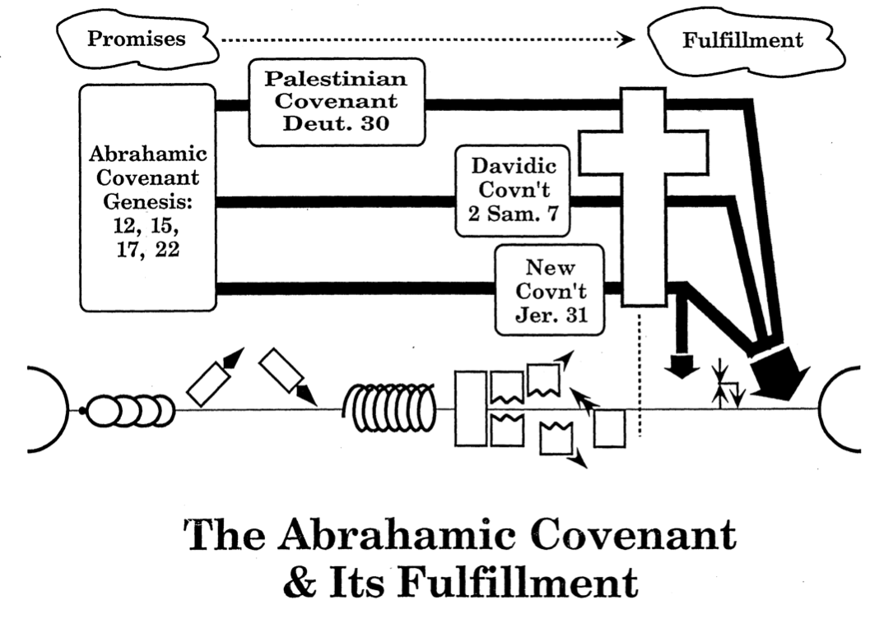
The Abrahamic Covenant
& Its Fulfillment
21
Promises
Fulfillment
Land Covenant
Deut 30
Abrahamic Covenant
Genesis 12, 15, 17, 22
Davidic Covenant
2 Sam 7
New Covenant
Jer 31
Adapted from Max Anders, Dallas Theological Seminary, 1987
Notes:
God has progressively fulfilled his promises given to Abraham. The OT records the Land, Davidic, and New Covenant promises to amplify the land, seed, and blessing promises of Genesis 12:1-3. All three await completion in the Millennium, though Jesus began the New Covenant in the Last Supper (Luke 22:20) and God has brought some of Israel back to the land in fulfillment of Ezekiel 37:1-7.
The land, Davidic, and new covenants follow chronologically from God's promise to Abraham. Scholars hotly debate the extent that each is fulfilled in our present era. This diagram shows that the new covenant is partially fulfilled today prior to the return of Jesus which is marked with the small arrows.
__________________
Common-169
ES-07-Dispensational Premillennialism-66
OS-00-00-Intro_&_Biblical_Theology-111_eng_os_6987_v17—Slide 39
OS-01-Gen4-20-slide 219
OS-23-Isaiah_24-39/Slide 263 on Supplements
OS-23-Isaiah_49-59/Slide 169 on Isaiah 169
OS-23-Isaiah_60-66/Slide 100 on Supplements

Slide 124
The Kingdom of God
34
460
The Eternal Kingdom
False Kingdom of Satan
Soteriological Line
Theocratic Kingdom on Earth
Eden | Conscience
Human Government
Patriarchs | Judges | Kings | Prophets | Christ | Grace
Millennium
Israel | Times of Gentiles
Covenants
Abrahamic Covenant
Land Covenant
Davidic Covenant
New Covenant
Dispensations (Tests of Obedience)
Inno-cence | Conscience
Human Government
Promise | Law (Gal. 3:19) | Grace
Millennium
Adapted from J. Dwight Pentecost, Thy Kingdom Come, 323
Notes:
• The Kingdom of God (KOG) is comprehensive in scope over all the universe and lasting from eternity past to eternity future.
• Satan's false kingdom as "god of this world" (2 Cor 4:4) began when he rebelled in heaven and achieved an earthly dominion over Adam and Eve in Eden, but it is not eternal as it will end after the Millennium (Rev 20:10).
• God began to offer salvation through the soteriological line of Eve in his promise of descendants to proclaim salvation until her ultimate descendant (Christ) defeats Satan (Gen 3:15) after the Millennium, when there will be no more need for salvation.
• Through the ages that have come and gone, the Theocratic Kingdom has provided leaders on earth while God Himself remains King over all as God uses Human Government for his purposes through the Millennium.
• Christ's death ended the period of the Law and introduced the period of Grace, though both law and grace are seen in each dispensation, or "administration" (Eph 3:2) of God's rule.
• The KOG through earthly authorities related to Abraham extended through his descendants that became Israel until Zedekiah's reign ended Israel's kings. Since the fall of Israel's monarchy, the "times of the Gentiles" (Luke 21:24) have seen other nations rule over Israel until Jesus begins his rightful reign in the Millennium.
• Jesus thus fulfills the Davidic Covenant, but his reign will progressively extend from his present full authority (Matt 28:18) until he defeats all opposition after the Millennium (Rev 20:7-10).
• This will complete God's promises in the Abrahamic Covenant when the Land and New Covenants also see completion.
• Through each age God enacts various tests of obedience to see whose hearts are fully committed to him.
__________________
Common-499
OS-00-00-Intro_&_Biblical_Theology-111_eng_os_6987_v17—Slide 55
OS-23-Isaiah_24-39/Slide 264 on Supplements
OS-23-Isaiah_49-59/Slide 52 on Isaiah 170
OS-23-Isaiah_60-66/Slide 101 on Supplements

Slide 125
An All-Encompassing Theme
33
Genesis 1:26-28
"Then God said, 'Let us make man in our image, in our likeness, and let them rule over the fish … birds … livestock … all the earth, and over all the creatures that move along the ground…' God blessed them and said to them, 'Be fruitful and increase in number; fill the earth and subdue it. Rule over the fish of the sea and the birds of the air and over every living creature that moves on the ground.'"
Revelation 22:5
"There will be no more night. They will not need the light of a lamp or the light of the sun, for the Lord God will give them light. And they will reign for ever and ever."
The Bible's Theme: God extends His rule to man
Command
Covenants
Fulfillment
Notes:
The Kingdom theme goes from the first to the last chapters of the Bible.
• God created us to rule creation
• and we will do that even in the new Jerusalem!
• This means that the overall theme of the Bible is that God shares his rule with us!
• Then God's command
• will finally be fulfilled.
• And the covenants will be his vehicle to accomplish this rule.
God chose believers like us to rule the world!
Throughout Scripture, we see the Kingdom of God as the primary theme from the first to the last chapter. But we also see God establishing covenants or promises, alongside his kingdom rule to enable us to see our eventual rule with him accomplished.
__________
Common-150
BT-01-OT Biblical Theology-24
OS-00-Intro-89
OS-01-Gen1-3-slide 100
OS-23-Isaiah_24-39/Slide 265 on Supplements
OS-23-Isaiah_49-59/Slide 171 on Supplements
OS-23-Isaiah_60-66/Slide 102 on Supplements
NS-05-Acts1-2-slide 45
NS-22-Rev20-22-slide

Slide 126

My View of the OT's Theme
33
The Old Testament narrates
God's restoring man to participate in His kingdom rule for His own glory
mandated in Eden but lost in the Fall
and accomplished by redeeming man
through Israel as a kingdom of priests
and ultimately through the Messiah,
who will reign as Savior and King
to fulfill the Abrahamic Covenant
Notes:
• The OT is a story more than a poetic description.
• This part in yellow italics is the main part of the main theme!
• Most descriptions of the overall theme lack kingdom ideas. But this one includes the problem
• the solution (redemption)
• the covenant nation of Israel
• the Messiah as King
• (not just Savior),
• and the Abrahamic Covenant.
__________
Common-152
BT-01-OT Biblical Theology-26
OS-00-Intro & Biblical Theolgy-104
OS-01-Gen1-3-slide 100?
OS-23-Isaiah_24-39/Slide 266 on Supplements
OS-23-Isaiah_49-59/Slide 172 on Supplements
OS-23-Isaiah_60-66/Slide 103 on Supplements
NS-05-Acts1-2-slide 45?
NS-22-Rev20-22-slide ?

Slide 128
OT Survey link at BibleStudyDownloads.org
Get this presentation for free!
Notes:
OT Survey (os)

