Slide 1
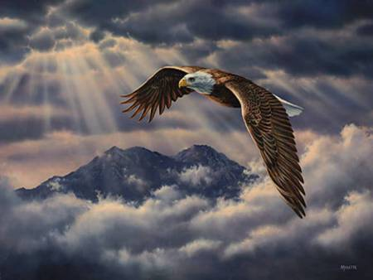
Isaiah 40–42
Dr. Rick Griffith • Jordan Evangelical Theological Seminary • BibleStudyDownloads.org
Notes:
When the storms of life come upon us - and all of us will experience them - we can rise above them by setting our minds and our belief toward God. The storms do not have to overcome us. We can allow God's power to lift us above them.
God enables us to ride the winds of the storm that bring sickness, tragedy, failure and disappointment in our lives. We can soar above the storm.
Friends, it is not the burdens of life that weigh us down. It is how we handle them.

Slide 2
Isaiah:
Restoration of the Created Order
Judgment (and Salvation) |  |  |  | Salvation (and Judgment)
Chapters 1–39 |  |  |  | Chapters 40–66
Assyrian Invasion |  |  |  | Babylonian Captivity
Prophecy |  |  | History | Prophecy
Mostly Condemnation |  |  | Inter-lude | Mostly Consolation
Violations & deliverance 1–12 | Judgment on the nations 13–23 | Worldwide judgment & blessing 24–35 | Salvation sickness & sin 36–39 | Shepherd of Israel 40–48 | Suffering Servant 49–57 | God's Initiative 58–59 | Restoration under Messiah 60–66
Judah
739-681 BC (Before, during and after Israel's fall to Assyria in 722 BC)
452
Notes:
2
Isaiah breaks down easily into two major sections. Chapters 1–39 concern the judgment that Israel and the surrounding nations faced, while chapters 40–66 comfort God's people with the salvation and restoration God promised His people. The first section was probably written before the Assyrian exile and the second after the fall of the northern kingdom. Since Judah sought its neighbors for security, both sections encourage a return to God in repentance—especially since He will restore all creation in a glorious kingdom under Messiah.

Slide 3
Isaiah 40–66 Structure
469
Adapted from John A. Martin, Dallas Seminary
Comfort
Deliverance
Encouragement
Cleansing
Condition
for Jews
for Gentiles
from Sin
of Glory
40–45
46–48
49–52
53
54–57
58–59
60–66
Deliverance from Babylon
Deliverance from Sin
Deliverance in the Millennium
Notes:
3

Slide 4
How will God complete his plan for all creation?
Notes:
By what means will the LORD restore the entire universe (restatement)?

Slide 5
Be Complete
Judgment
1–39
God will judge those who reject him (Isaiah 1–39).
Notes:
The LORD will deal with unbelievers in a just manner (restatement).

Slide 6
Be Complete
Judgment
Salvation
1–39
40–66
God will save those who trust him (Isaiah 40–66).
Notes:
The LORD will deliver the people who believe in him (restatement).

Slide 7
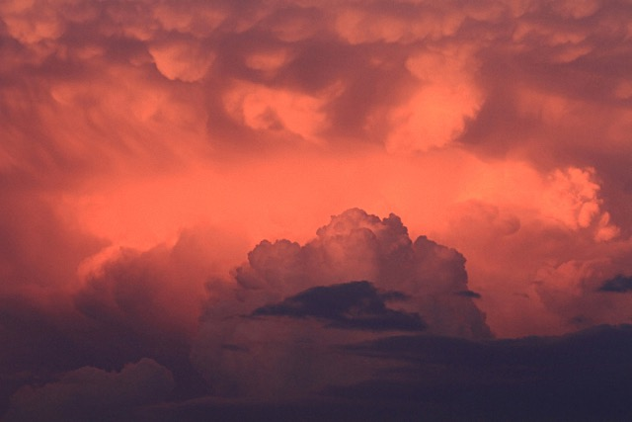
Isaiah's Historical Interlude
Isaiah 1–35
Historical Interlude
Isaiah 40–66
ASSYRIA
36–37
38–39
BABYLON
Ahaz
Hezekiah
Messiah
trust in
man
trust in
GOD
trust in the
God-man
Theological Bridge Between Sections
Adapted from Dr Randall Price, TRBC Isaiah, Lesson 39 – Isaiah 36, slide 5
Notes:
The bad news of chapters 1–35 now transitions within the four chapters of Isaiah 36–39 over to the good news of chapters 40–66.

Slide 8
Slides on Isaiah 40

Slide 9
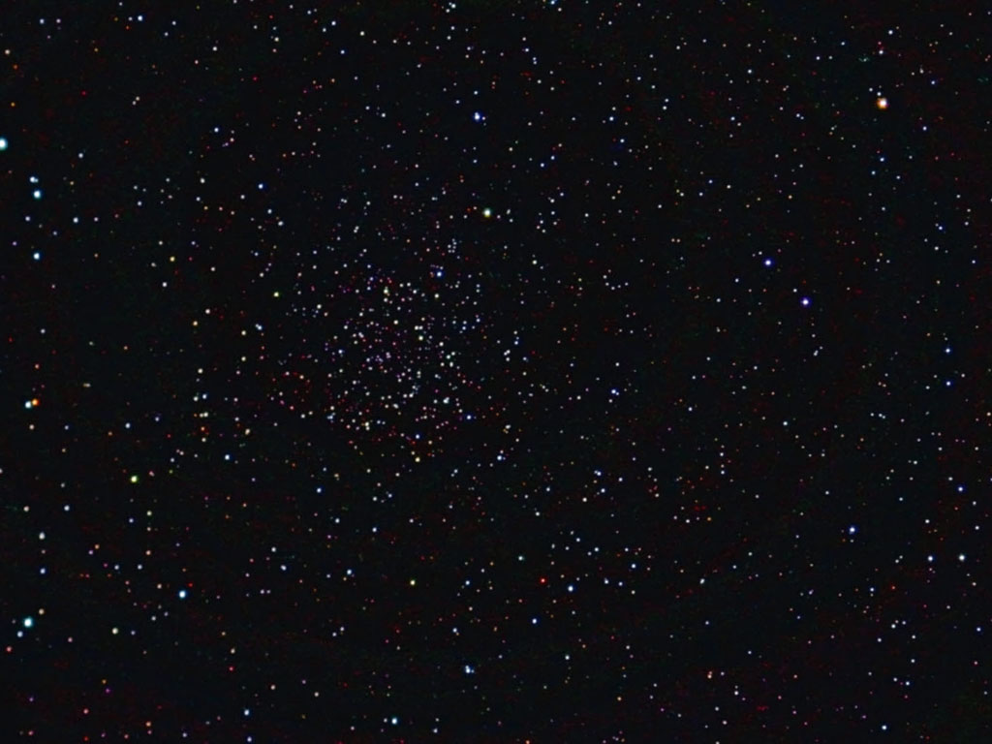
The Babylonians believed the stars directed people's destiny and events on earth.
Notes:
9
Babylon was big into astronomy and astrology.

Slide 10
Look Up!
Isaiah 40

Slide 11
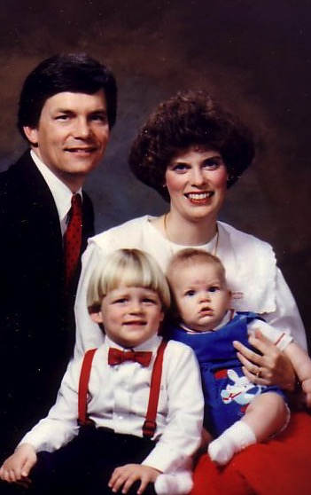
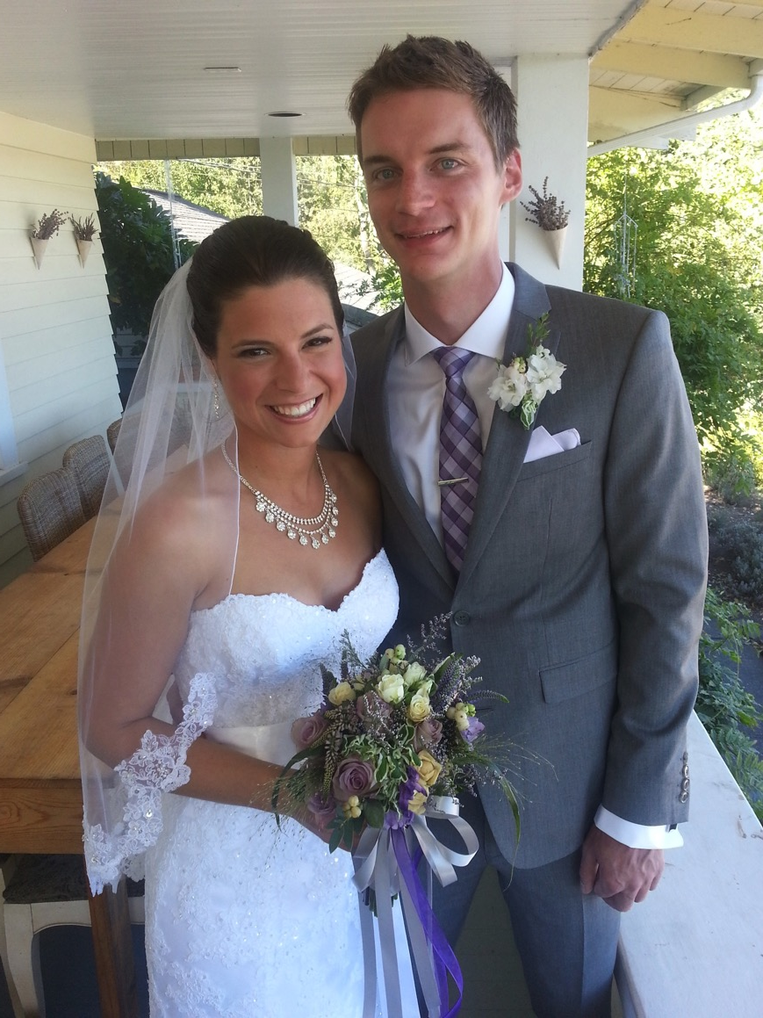
1991: Move to Singapore
Rick, 33
Susan, 30+
Kurt, 4
Stephen, 1
Notes:
Susan and I have seen God do some amazing things lately.
We came to SBC in 1991—but our oldest son got married on 12 September 2104!

Slide 12
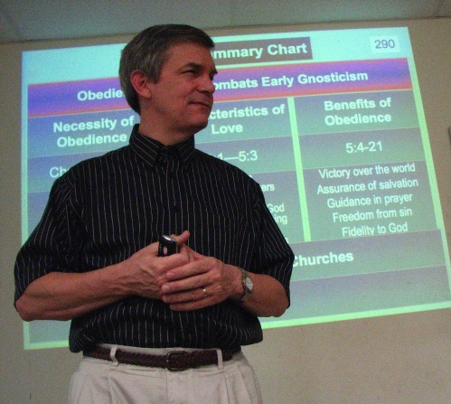
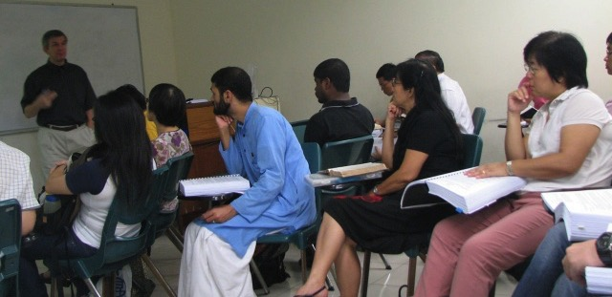
Singapore Bible College
Notes:
I'm blessed to still teach at Singapore Bible College and lead the DMin studies.

Slide 13
Susan Mentors Student Wives

Slide 14
Temptations to Look Down
• How much longer does the Lord want us to pastor and teach in Singapore?
• How will John graduate debt free next year?
• Will we ever own a house or have money to retire?

Slide 15
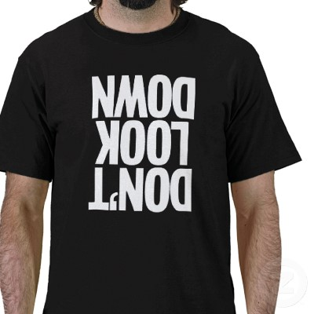
Don't Look Down
Notes:
We are tempted to look down when things don't go our way

Slide 16
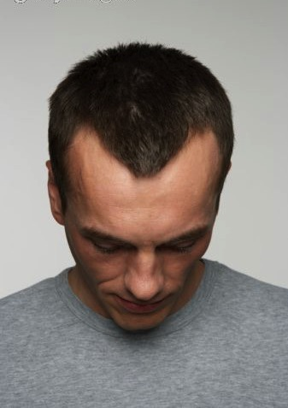
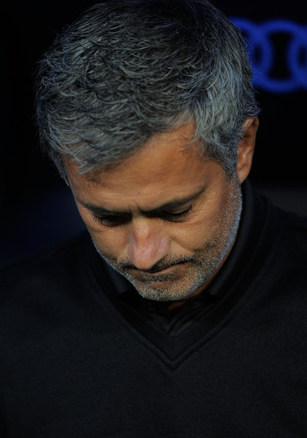
What causes you
Transition?
Finances?
Physical?
Relational?
… to look down?
Notes:
Are you—like us—also going through a major life transition—kids coming or going, adjusting to being a student, moving house, etc.?
Is your major struggle right now financial? Times are tough in the present economy.
Maybe you struggle with a physical ailment—your "thorn in the flesh" you have prayed about for years?
Or perhaps your struggle is relational—parents or kids far from God, or a friend or other relative out of sync with you?
Raise your hand if a struggle comes to mind. Really? Some of you don't even have one issue in your life?

Slide 17
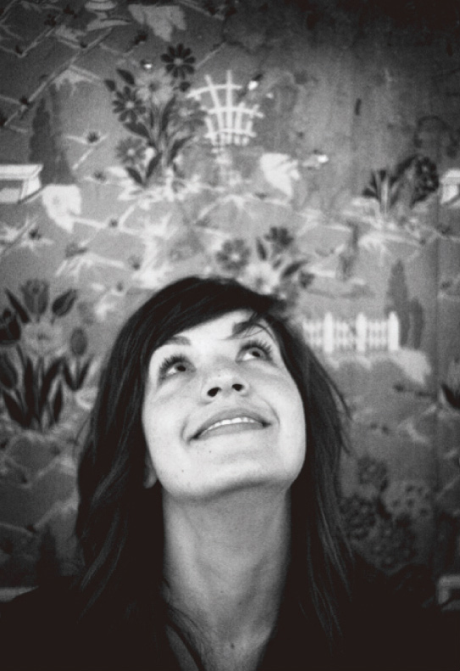
How can you look up to the LORD during your struggle?
Notes:
Now, in light of the challenge that you are facing, let's address this question: How can you look up to the LORD during your struggle?

Slide 18
Timeline
Isaiah 740-680 BC
342
United Kingdom 1050-930
Divided Kingdom 930-722
1100
1050
1000
950
900
850
800
7 5 0
7 0 0
650
600
550
500
450
Notes:
18
Isaiah lived in a time when people in Judah were tempted to look down.

Slide 19
The Assyrian Threat
Assyrian Expansion
Nineveh
MediterraneanSea
Syria
Israel
Judah
PersianGulf
Egypt
Notes:
19
The Assyrian army had conquered every nation north of Judah in Isaiah's time. That would be like living to see the countries north of yours conquered by a foreign power.

Slide 20
Timeline
Isaiah 740-680 BC
United Kingdom 1050-930
Divided Kingdom 930-722
Solitary Kingdom 722-586
Post-Exile 536-425
1100
1050
1000
950
900
850
800
7 5 0
7 0 0
650
600
550
500
450
Exile 586-536
Notes:
20
Worse than that, his own land of Judah would also be conquered and the people sent into exile. Some 46 cities of Judah were destroyed during Isaiah’s life!

Slide 21
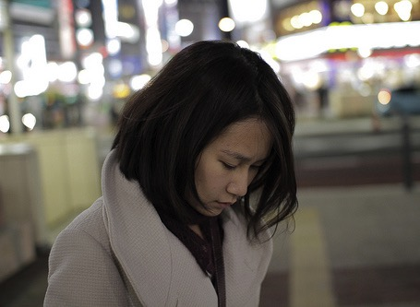
Isaiah 40: Three ways to look up…
Notes:
Isaiah 40 told them how they could look up, so we will se in this chapter three ways we should look up to God in our tough times. The first way we can look up to God amidst our difficulty is to…

Slide 22
I. Know that He cares (1-11).
Notes:
Realize that God has compassion on you and your situation.

Slide 23
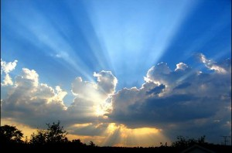
A. God would tenderly replace His discipline with His glory and Word (40:1-11).

Slide 24
Isaiah 40:1
Notes:
God's discipline would end after the exile (1-2).
"Comfort, comfort" refers to being restored.

Slide 25
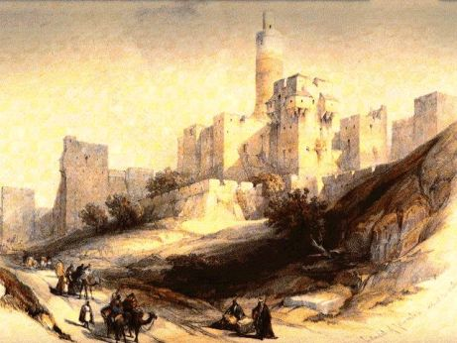
Isaiah 40:2 NLT
"Speak tenderly to Jerusalem.
Tell her that her sad days are gone
and her sins are pardoned.
Yes, the LORD has punished her twice over for all her sins."
Notes:
That would happen because the discipline was complete.

Slide 26
Isaiah: Restoration of the Created Order
Judgment (and Salvation) | Salvation (and Judgment)
Chapters 1–39 | Chapters 40–66
Notes:
26
This begins the section half of Isaiah's book, emphasizing God's salvation.

Slide 27
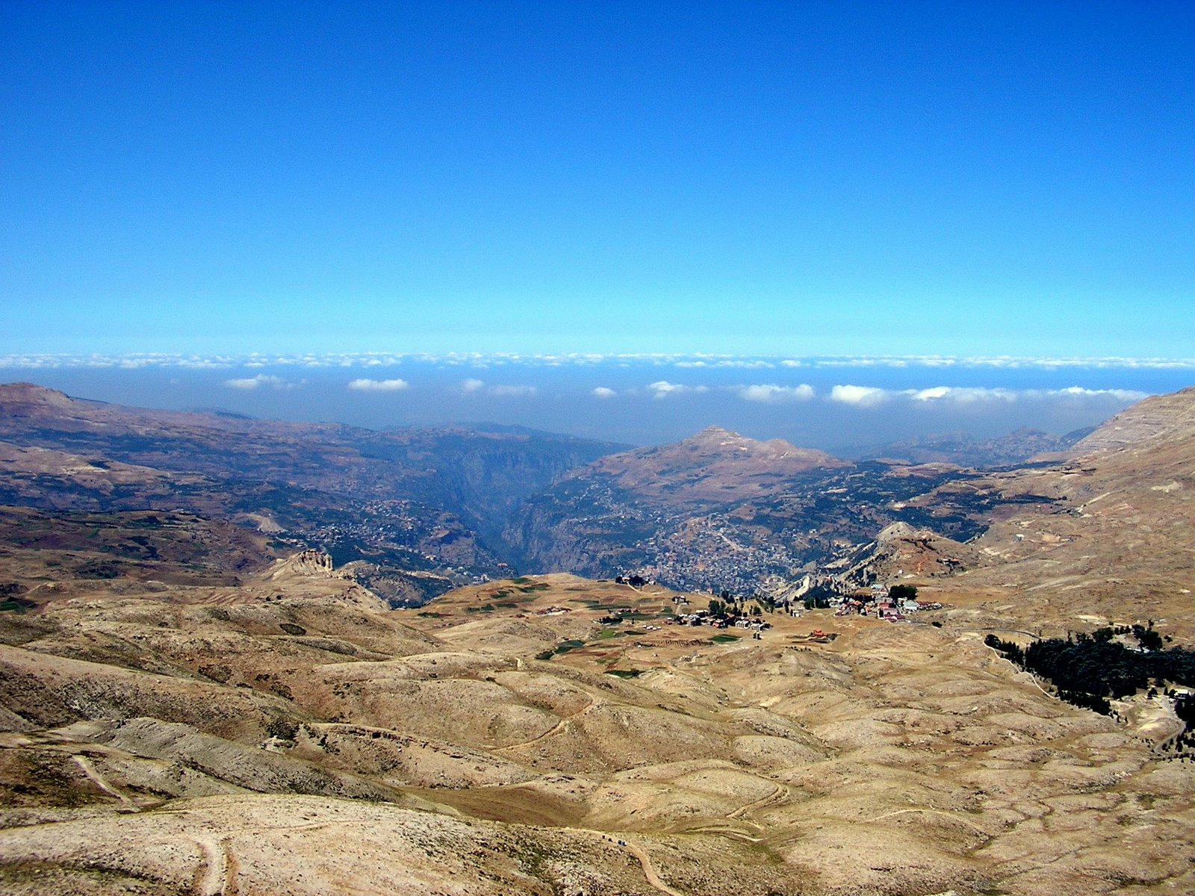
God's glory would be seen with His Word (40:3-8).

Slide 28
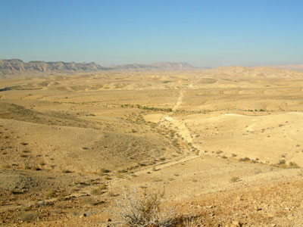
Isaiah 40:3
Listen! It's the voice of someone shouting,
"Clear the way through the wilderness
for the LORD! Make a straight highway through the wasteland for our God!
Notes:
Isaiah's voice prepared the people to see God's glory when the Messiah came (3-5).

Slide 29
Isaiah 40:4-5
⁴Fill in the valleys, and level the mountains and hills. Straighten the curves, and smooth out the rough places. ⁵Then the glory of the LORD will be revealed, and all people will see it together. The LORD has spoken!"

Slide 30
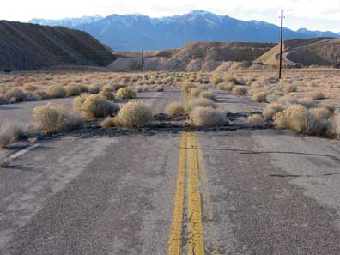
Rough Riders
Notes:
Most of us would never "welcome" an important person with a messed up road!

Slide 31
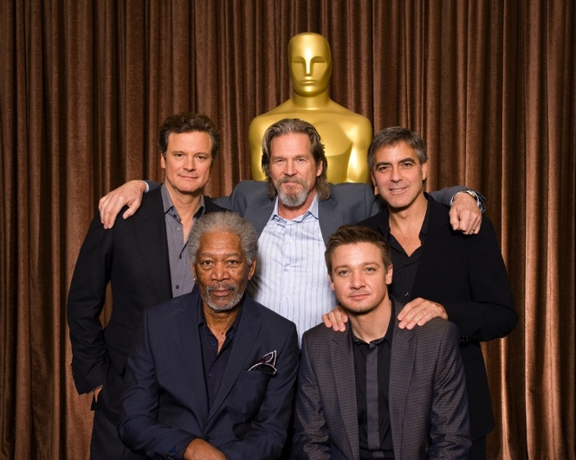
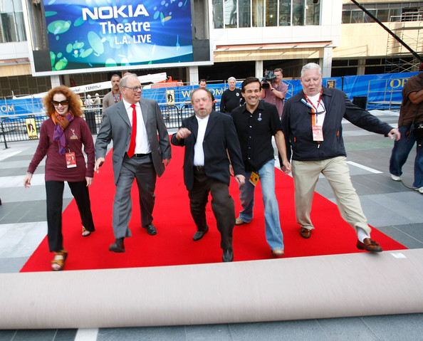
"Roll out the red carpet!"
Notes:
We say it as "roll out the red carpet" to show respect for our president or Academy Awards nominees. How much more so we should prepare for God!

Slide 32
Isaiah 40:6 NLT
A voice said, "Shout!"
I asked, "What should I shout?" "Shout that people are like the grass.
Their beauty fades as quickly
as the flowers in a field.
Notes:
God's voice contrasted man's temporary, changing nature with God's eternal, unchanging Word (6-8).

Slide 33
Isaiah 40:7-8 NLT
⁷The grass withers and the flowers fade
beneath the breath of the LORD.
And so it is with people.
⁸The grass withers and the flowers fade,
but the word of our God stands forever."

Slide 34
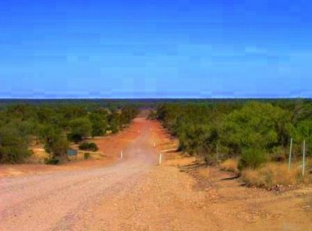
God cared for Judah tenderly (40:9 NLT)
神满有慈爱地看顾犹大 (40:9)
O Zion, messenger of good news, shout from the mountaintops!
Shout it louder, O Jerusalem.
Shout, and do not be afraid. Tell the towns of Judah,
"Your God is coming!"
Notes:
God cared for Judah tenderly (9-11).

Slide 35
God cared for Judah tenderly (40:10 NLT)
神满有慈爱地看顾犹大 (40:10)
¹⁰Yes, the Sovereign LORD is coming in power.
He will rule with a powerful arm. See, he brings his reward with him as he comes.

Slide 36
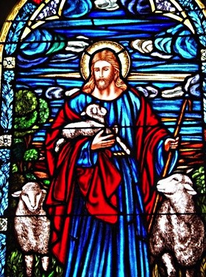
Isaiah 40:11 NLT
He will feed his flock like a shepherd. He will carry the lambs in his arms, holding them close to his heart. He will gently lead the mother sheep with their young.

Slide 37
Do you feel that God cares for you?
Notes:
Do you feel that God cares for your struggle right now?

Slide 38
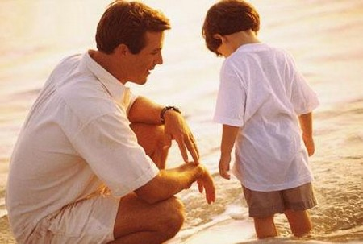
Loving Discipline (Heb. 12:5-6 NLT)
"My child, don't make light of the LORD's discipline, and don't give up when he corrects you. ⁶For the LORD disciplines those he loves,
and he punishes each one he accepts as his child."
Notes:
Even if you believe God is disciplining you like He did to Israel, this itself means He cares for you. Hebrews 12 says…

Slide 39
Loving Discipline (Heb. 12:7 NLT)
⁷As you endure this divine discipline, remember that God is treating you as his own children. Who ever heard of a child who is never disciplined by its father?

Slide 40
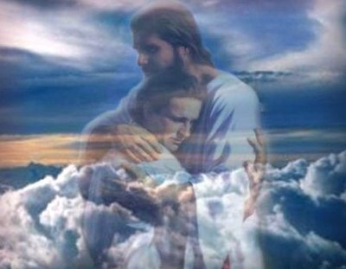
Title
Notes:
So think now of the struggle that you identified at the beginning of this message. Have you been fooled by the enemy into thinking God doesn't care about you in this?

Slide 41
I. Know that He cares (1-11).
Notes:
I hope not! These first 11 verses say He does care—more than you'll ever know! (So let's not get duped into thinking that He is just not able to help you, which brings us to the second way we can look up to God amidst our difficulty, which is to…)

Slide 42
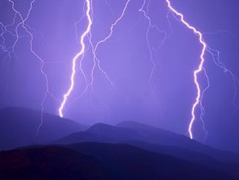
II. Know that He's able (12-26).
Notes:
Realize that God has no limits in your situation.

Slide 43
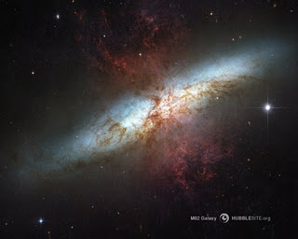
A. God rules the world with all power (12-26).

Slide 44
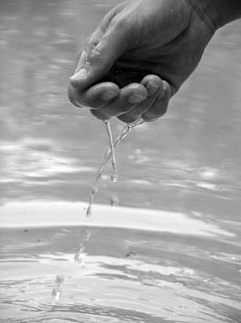
Isaiah 40:12a NLT
1. He's bigger than anything (12-13).
"Who else has held the oceans in his hand?"
Notes:
He's bigger than anything, including the largest items of creation—like oceans (12a).

Slide 45
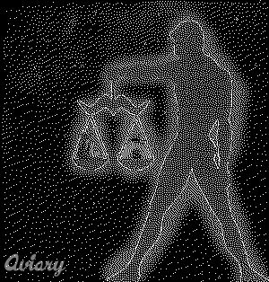
Isaiah 40:12b NLT
Who has measured off the heavens with his fingers? Who else knows the weight of the earth
or has weighed the mountains and hills on a scale?
Notes:
He's bigger than outer space, the earth, mountains, and hills (12b).

Slide 46
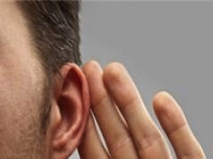
He's wiser than anyone (40:13-14 NLT).
Who is able to advise the Spirit of the LORD? Who knows enough to give him advice or teach him? ¹⁴Has the LORD ever needed anyone's advice? Does he need instruction about what is good? Did someone teach him what is right or show him the path of justice?

Slide 47
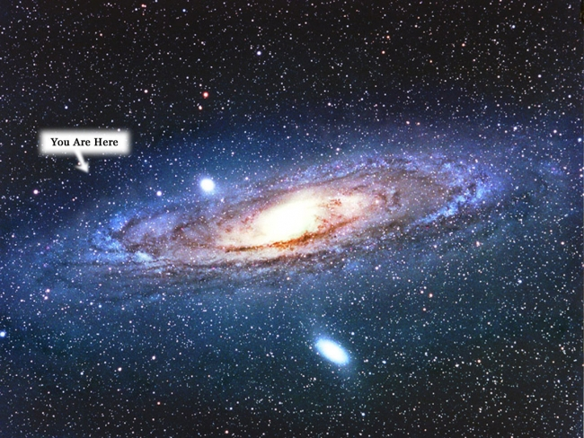
He's incomparable (15-26).
You are here.

Slide 48
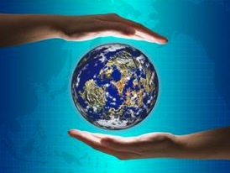
Isaiah 40:15 NLT
No, for all the nations of the world are but a drop in the bucket. They are nothing more than dust on the scales. He picks up the whole earth as though it were a grain of sand.
Notes:
The nations are nothing compared to God.

Slide 49
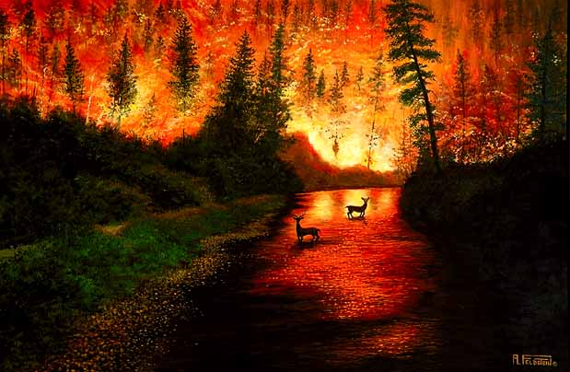
All the wood in Lebanon's forests and all Lebanon's animals would not be enough to make a burnt offering worthy of our God.
Isaiah 40:16 NLT
Notes:
49
The best forests are nothing compared to God.

Slide 50
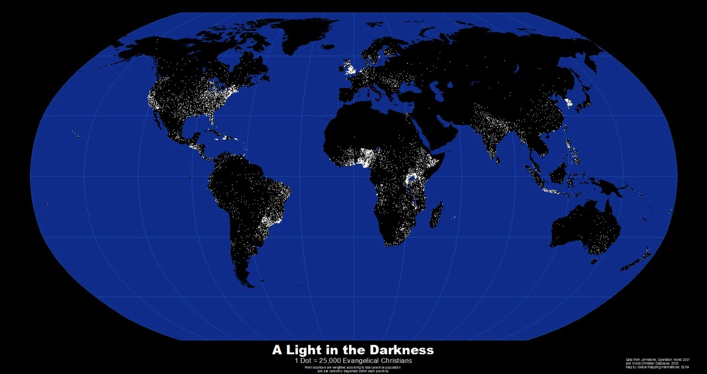
Isaiah 40:17 NLT
The nations of the world are worth nothing to him. In his eyes they count for less than nothing—mere emptiness and froth.
Notes:
The earth itself is nothing compared to God.

Slide 51
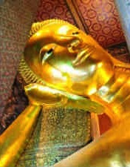
Isaiah 40:18-19 NLT
To whom can you compare God? What image can you find to resemble him? ¹⁹Can he be compared to an idol formed in a mold,
overlaid with gold, and decorated with silver chains?
Notes:
No one or nothing compares to God (18-26).
Idols don't compare to him (18-20).

Slide 52
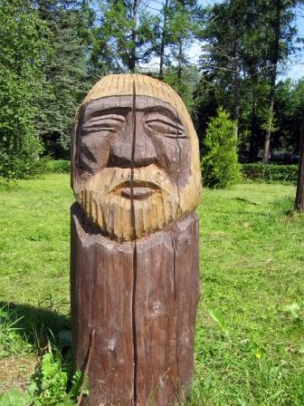
Isaiah 40:20 NLT
Or if people are too poor for that, they might at least choose wood that won't decay and a skilled craftsman to carve an image that won't fall down!

Slide 53
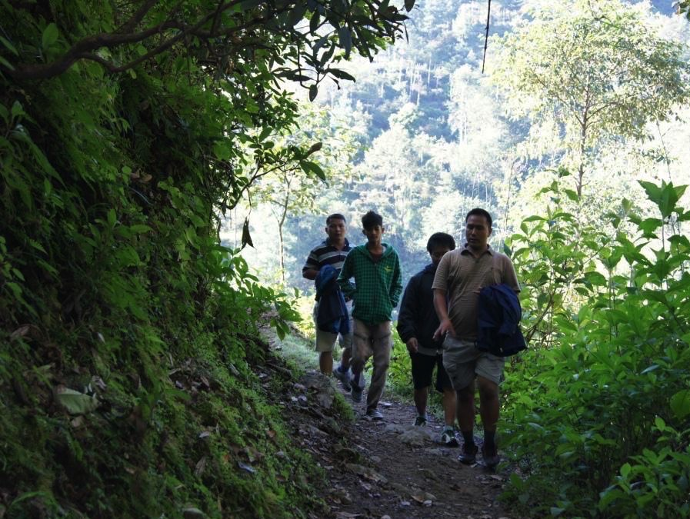
Pastor Ananda in Nepal
Notes:
My student Ananda recently had his own experience with idols while hiking up the mountains in Nepal.

Slide 54
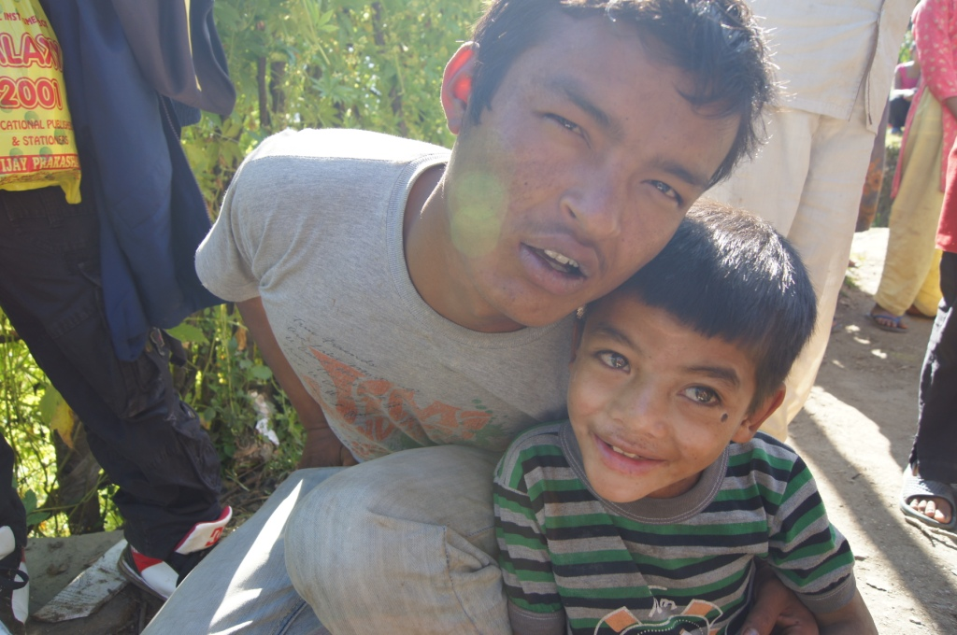
Demon-Possessed Dil Bahadur
Notes:
He encountered a demon-possessed man named Dil Bahadur

Slide 55
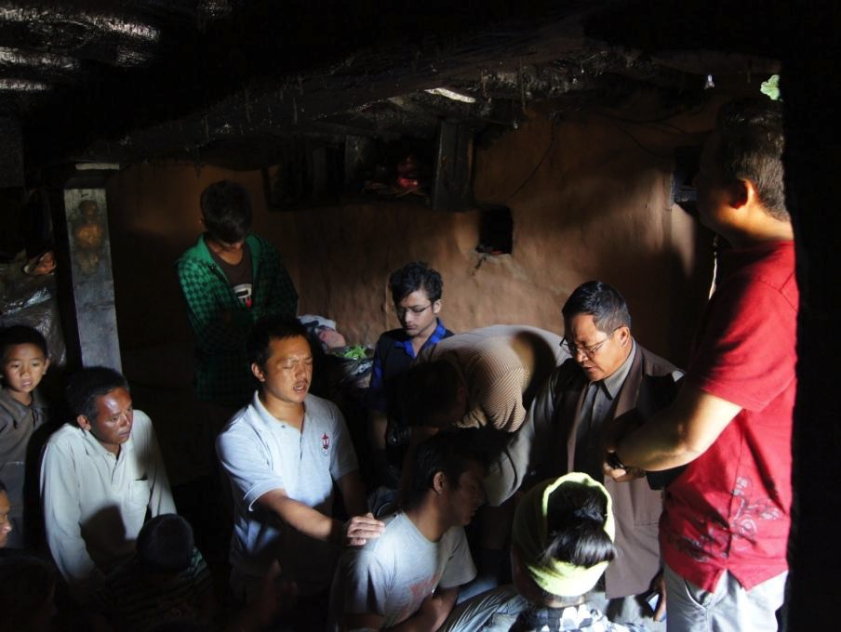
Praying to Cast Out the Demon
Notes:
This involved 15 church members who made the hike with him.

Slide 56
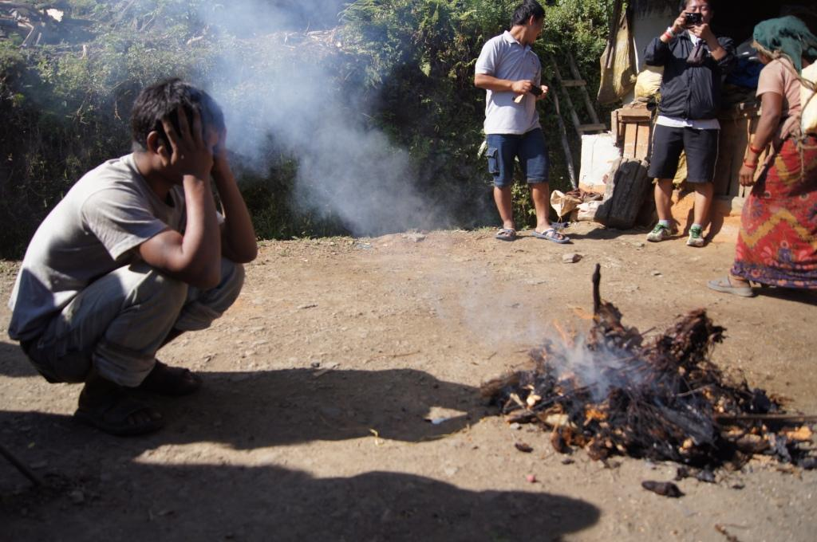
Idol Burning
Notes:
The great victory was to see Dil burn his idols.

Slide 57
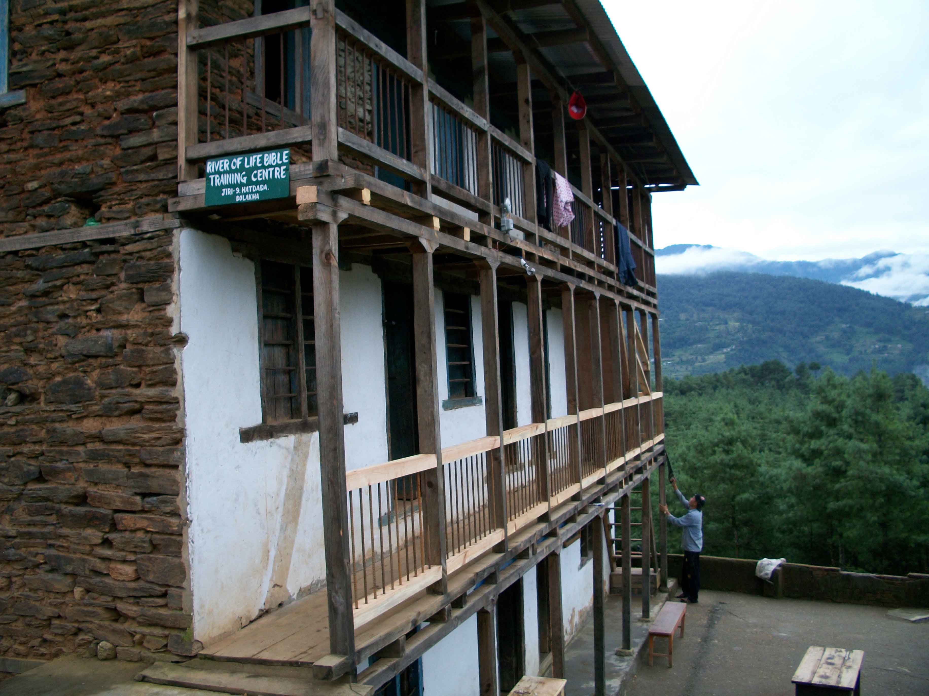
Pastor Ananda in Nepal
River of Life Bible Training Centre, Nepal
Notes:
Pastor Ananda continues training others to do the same at the River of Life Bible Training Centre

Slide 58
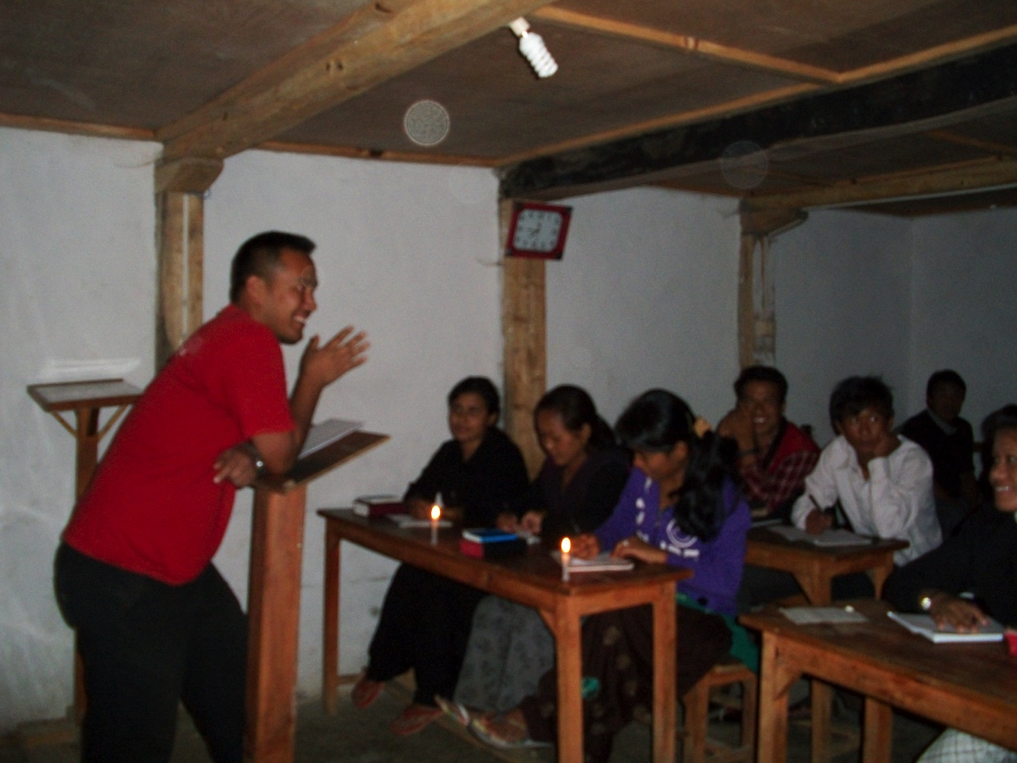
Pastor Ananda Teaching
Notes:
What a joy to see him teach others what I've taught him.

Slide 59
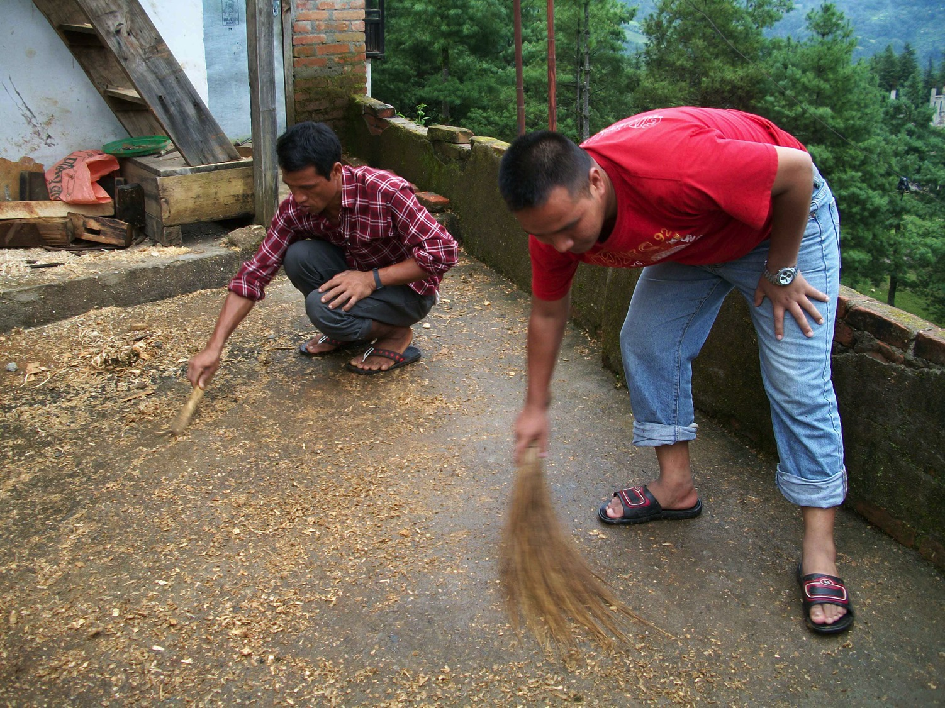
Pastor Ananda in Nepal
Notes:
Ananda also serves his people in practical ways.

Slide 60
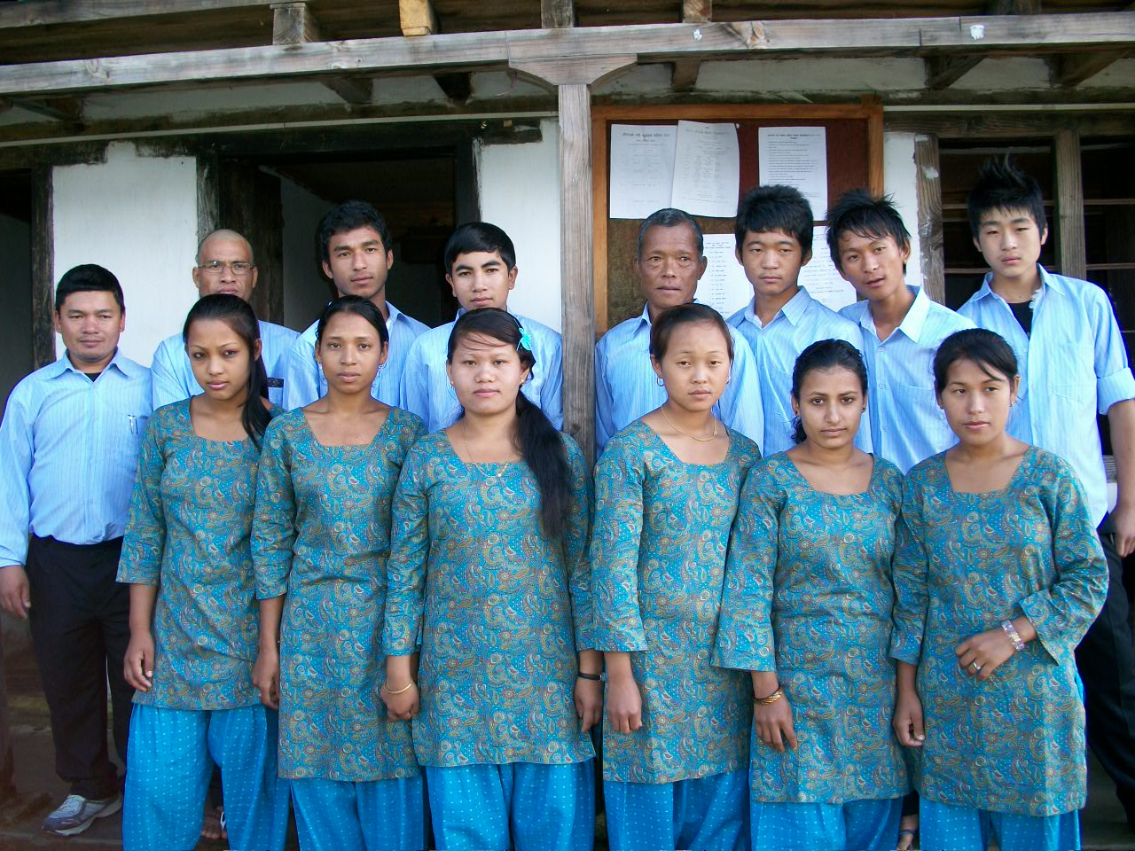
RLBTC 6th Batch of Students
Notes:
He continues training young people who have turned from idols to Jesus so they can help others do the same.

Slide 61
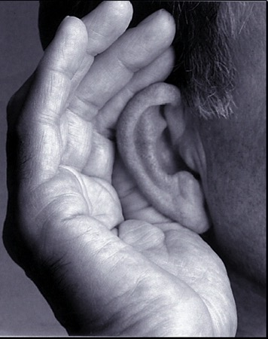
Isaiah 40:21 NLT
Haven't you heard? Don't you understand?
Are you deaf to the words of God—
the words he gave before the world began? Are you so ignorant?
Notes:
The earth and heavens don't compare to him (21-22).

Slide 62
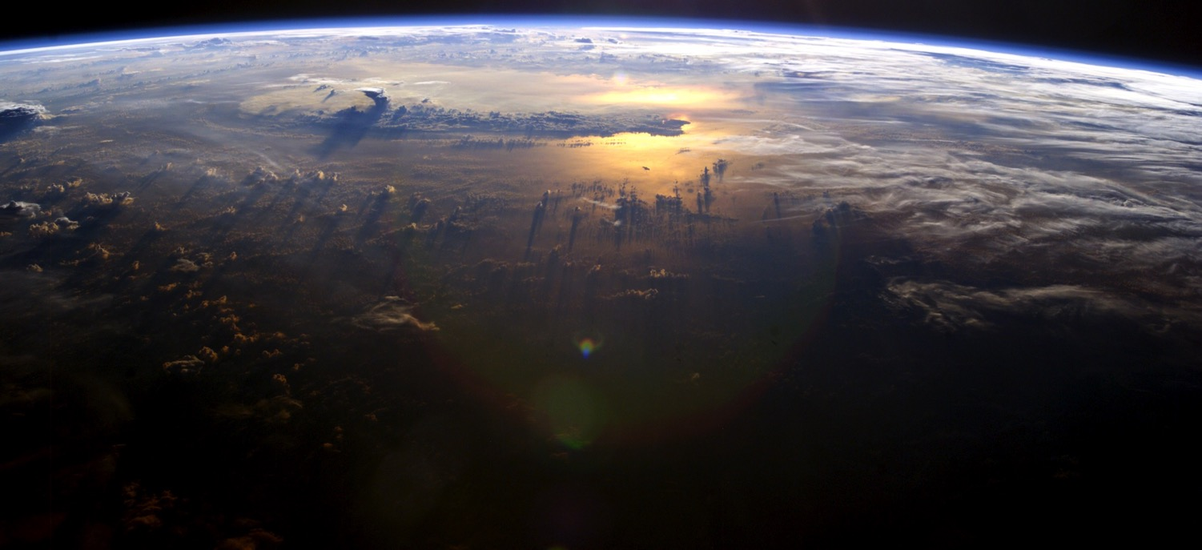
Isaiah 40:22 NLT
God sits above the circle of the earth. The people below seem like grasshoppers to him! He spreads out the heavens like a curtain and makes his tent from them.
Notes:
The earth and heavens don't compare to him (21-22).

Slide 63
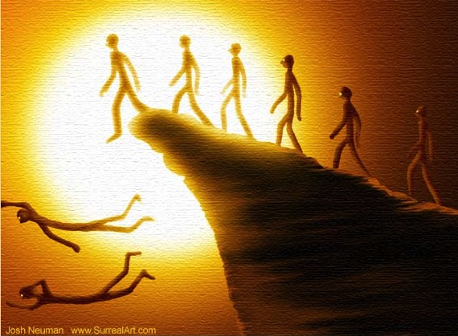
Isaiah 40:23-24 NLT
²³He judges the great people of the world and brings them all to nothing. ²⁴They hardly get started, barely taking root, when he blows on them and they wither. The wind carries them off like chaff.
Notes:
Celebrities don't compare to him (23-24).

Slide 64
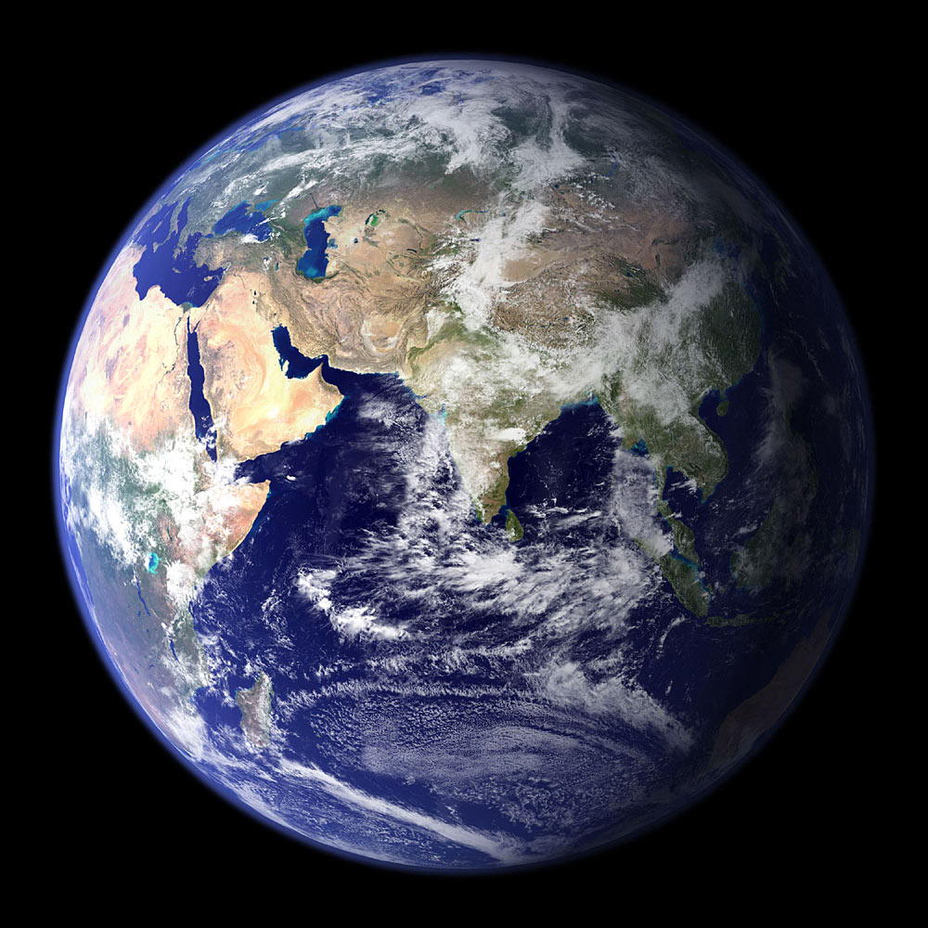
Isaiah 40:25 NLT
"To whom will you compare me? Who is my equal?" asks the Holy One.
Notes:
Stars don't compare to him (25-26).

Slide 65
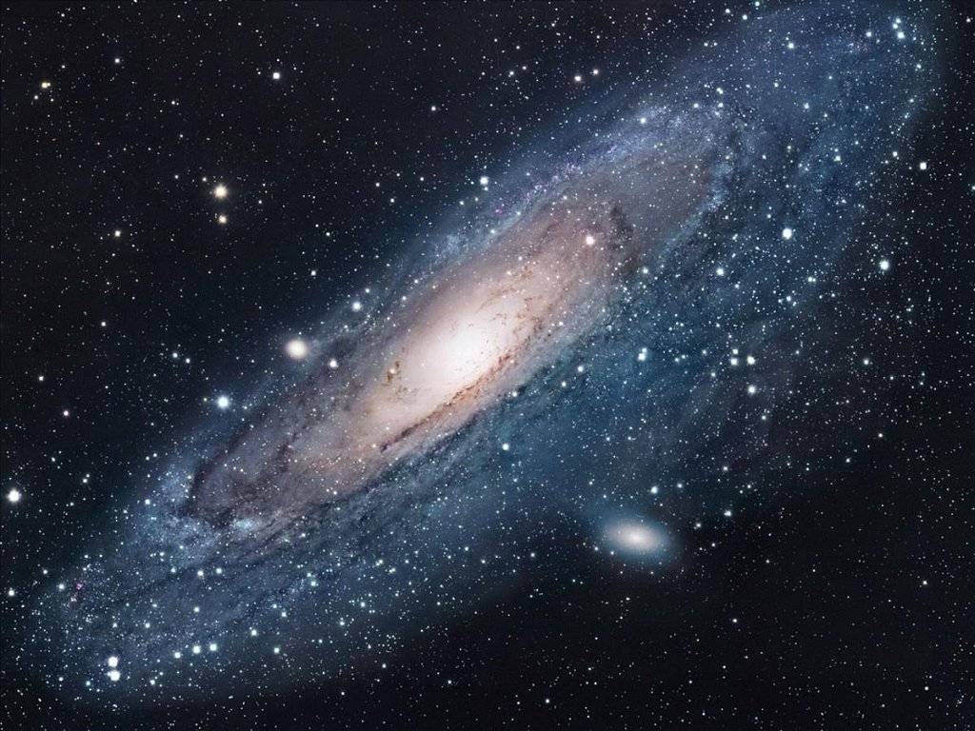
"Look up into the heavens. Who created all the stars? He brings them out like an army, one after another, calling each by its name."
Is He Bigger?
"Because of his great power and incomparable strength, not a single one is missing" (Isa. 40:26 NLT).
Notes:
65
Think of the struggle you face right now. Is it small or big? That depends upon what you compare it to!
• Is God bigger? Of course!

Slide 66
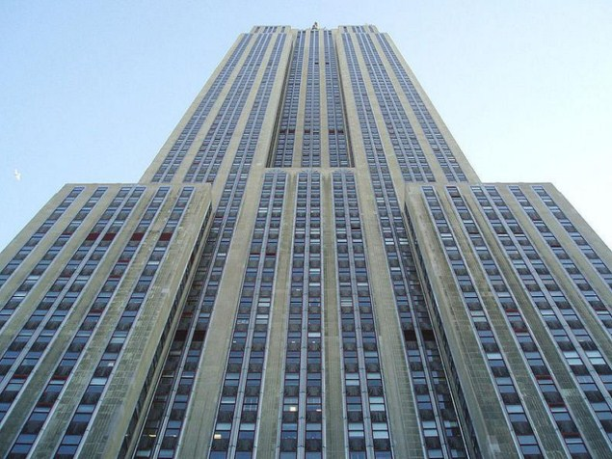
A building with its own zip code!
Notes:
When standing below a huge building, you feel very small.

Slide 67
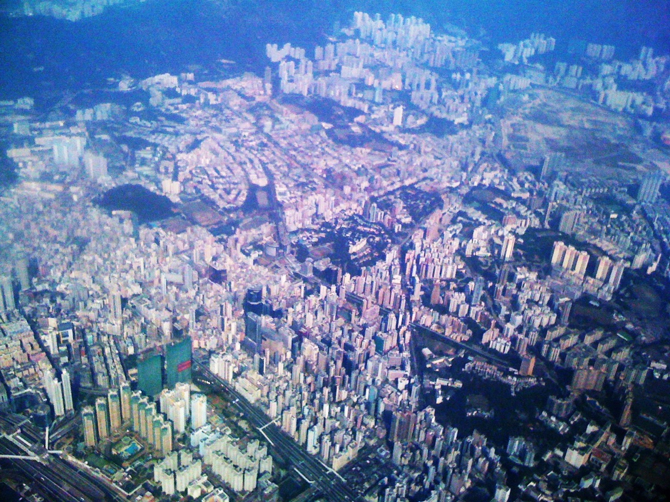
Hong Kong from my flight
Notes:
But hop into a jet as I did in Hong Kong last time and looked back. Even the most humongous buildings are actually quite tiny!
The same applies to your struggle and mine. From our perspective, it may look huge. But we need to see our issues in light of God's largeness!

Slide 68
I. Know that He cares (1-11).
Notes:
So to look up during our struggle, we need to realize two things: that God cares…

Slide 69
II. Know that He's able (12-26).
Notes:
…and that God is able. But is that enough? No, because just knowing these won't change us. That's why the passage closes with the encouragement to…

Slide 70
III. Trust in His strength (27-31).
Notes:
Rely on the power that God provides in your situation.

Slide 71
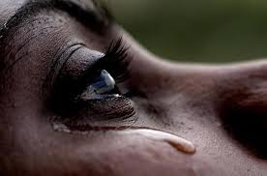
Isaiah 40:27 NLT
O Jacob, how can you say the LORD does not see your troubles?
O Israel, how can you say God ignores your rights?
Notes:
Don't have a pity party!

Slide 72
Isaiah 40:28 NLT
Have you never heard? Have you never understood? The LORD is the everlasting God, the Creator of all the earth. He never grows weak or weary. No one can measure the depths of his understanding.
Notes:
Since God never grows tired, He can strengthen you (28-31).

Slide 73
Isaiah 40:29-30 NLT
²⁹He gives power to the weak and strength to the powerless.
³⁰Even youths will become weak and tired, and young men will fall in exhaustion.

Slide 74
Isaiah 40:31 NLT
But those who trust in the LORD will find new strength.
They will soar high on wings like eagles.
They will run and not grow weary.
They will walk and not faint.
Notes:
Did you know an eagle knows when a storm is approaching long before it breaks?

Slide 75
Isaiah 40:31 NLT
…They will soar high on wings like eagles…
Notes:
The eagle will fly to some high spot and wait for the winds to come. When the storm hits, it sets its wings so that the wind will pick it up and lift it above the storm. While the storm rages below, the eagle is soaring above it. It doesn't escape the storm. It uses it to lift it higher. It rises on the storm's winds!

Slide 76
Eagle Above Clouds
It is not the burdens of life that weigh us down––it is how we handle them.
Notes:
When the storms of life come upon us - and all of us will experience them - we can rise above them by setting our minds and our belief toward God. The storms do not have to overcome us. We can allow God's power to lift us above them.
God enables us to ride the winds of the storm that bring sickness, tragedy, failure and disappointment in our lives. We can soar above the storm.
Friends, it is not the burdens of life that weigh us down. It is how we handle them.

Slide 77
Main Idea of Isaiah 40
He cares and He's able, so trust Him!
Notes:
So what's the point of Isaiah 40? Simply, He cares and He's able, so trust Him.

Slide 78
How can you trust God with your struggle right now?
JUST LOOK UP
GOD IS CLOSER THAN YOU THINK

Slide 79
The Gaze-Glance Principle
Seeking God's Hand
God
Elton & Shirley Gillam, The Restoration of Biblical Prayer (Greely, CO: Chambers College Press, 2009), 33
Glance
Our Request
Gaze
Notes:
Follow the Gaze-Glance Principle. This is a simple, biblical way of looking up.
When a struggle comes into our lives, we normally gaze at this request with occasional, quick glances to God for his help. We ask him to remove the problem because we are only seeking His hand. We're only seeking what He can give us.

Slide 80
The Gaze-Glance Principle
Seeking God's Face
God
Elton & Shirley Gillam, The Restoration of Biblical Prayer (Greely, CO: Chambers College Press, 2009), 33
Gaze
Our Request
Glance
Notes:
But Isaiah 40 tells us to shift our focus. We should gaze at God and only glance at our request. This is seeking His face instead of seeking His hand. When and if He removes the problem becomes His business, so we don't end up resenting Him.
Where has your focus been concerning the issue that concerns you?
• Have you been gazing at God or gazing at your problem?
• Have you been seeking God's face or seeking God's hand?

Slide 81
Isaiah 40 Summary
460
Judah could personalize God’s care and power despite the coming discipline in exile by trusting him for all the strength they needed.
Notes:
81
God's majesty and gentle shepherding of Israel comforts Judah since she will have suffered enough by the end of her exile in 539 BC.

Slide 82
Isaiah 40–66 Structure
469
Adapted from John A. Martin, Dallas Seminary
Comfort
40–45
Deliverance from Babylon
Notes:
82

Slide 83
Slides on Isaiah 41

Slide 84
Reject Babylon’s idols.
Isaiah 40–48
God, how should we respond to you delivering us from Babylon?
Notes:
40 Comfort/Sovereignty 40:10f. Power, shepherd
41 Cyrus/Israel = Servant
42 Servants contrasted 42:1-3 Spirit, meek, just
43:1–44:5 Restoration
44:6–45:25 God's uniqueness vs. idols
46–48 Babylon's destruction

Slide 85
God lays out his case.
“Listen in silence before me, you lands beyond the sea.
Bring your strongest arguments.
Come now and speak.
The court is ready for your case” (Isaiah 41:1 NLT).

Slide 86
Cyrus Prophesied
“Who has stirred up this king from the east,
rightly calling him to God’s service?
Who gives this man victory over many nations
and permits him to trample their kings underfoot?
With his sword, he reduces armies to dust.
With his bow, he scatters them like chaff before the wind” (Isaiah 41:2 NLT).

Slide 87
“He delivers up nations before him, and subdues kings. He makes them like dust with his sword, as the wind-driven chaff with his bow. He pursues them, passing on in safety, by a way he had not been traversing with his feet.” Isaiah 41:2b-3
Cyrus moved from country to country, conquering every king in his path. Around 550 BC he unified the Medes and Persians to defeat the powerful kingdom of Lydia (Asia Minor) in 546 BC. Turning south to Babylon, his army under the command of Darius conquered the city in 539 BC.

Slide 88
The emperor was killed in battle from a wound inflicted from a poisonous arrow during a campaign against the Massagetes of central Asia. Cyrus’ body was brought back to Pasargade in Persia; his tomb, which still exists, consists of a single chamber built on a foundation course of six steps.
The body was placed in a golden sarcophagus, and the tomb bore the inscription. He is considered as one of the most respected world leaders to date. He always fought side by side with his soldiers and never left them alone in the battlefield.
Tomb of Cyrus the Great

Slide 89
Policies of Cyrus the Great
Cyrus Cylinder
"I am Cyrus, king of the universe…"
"Nabonidus, the king who did not fear me…"
"Since the gods of foreign lands made permanent sanctuaries which are now dilapidated, I returned people to their lands and made provisions to rebuild"
Notes:
This small cylinder details the priorities of Cyrus the Great.

Slide 90
“Now that I put the crown of kingdom of Persia, Babylon, and the nations of the four directions on the head with the help of god I announce that I will respect the traditions, customs and religions of the nations of my empire and never let any of my governors and subordinates look down on or insult them until I am alive. From now on, till god grants me the kingdom favor, I will impose my monarchy on no nation. Each is free to accept it , and if any one of them rejects it, I never resolve on war to reign. Until I am the king of Persia, Babylon, and the nations of the four directions, I [will] never let anyone oppress any others, and if it occurs, I will take his or her right back and penalize the oppressor.”

Slide 91
“And until I am the monarch, I will never let anyone take possession of movable and landed properties of the others by force or without compensation. [While] I am alive, I [will] prevent unpaid, forced labor. Today, I announce that everyone is free to choose a religion. People are free to live in all regions and take up a job provided that they never violate other’s rights. No one [can] be penalized for his or her relatives’ faults. I prevent slavery and my governors and subordinates are obliged to prohibit exchanging men and women as slaves within their own ruling domains. Such traditions should be exterminated the world over. I implore to god to make me succeed in fulfilling my obligations to the nations of Persia, Babylon, and the ones of the four directions.”

Slide 92
Amazing Prophecies
460
??
Stamford Raffles (1819)
Lee Kwan Yew (1959)
Did you hear that Raffles wrote 140 years before Lee Kwan Yew, "Behold, a man named Lee will arise to make Singapore its own country…"?
Notes:
Do you know why you did not hear of this prophecy? Because it never happened!
But what if it did? What if Raffles predicted the actual name of the founder of modern Singapore—and specified that he would rebuild the nation following World War II?
Wouldn’t that be amazing—perhaps even divinely inspired?

Slide 93
Amazing Prophecies
460
An Amazing Prophecy
41:2-3, 25
44:28
45:1-2
45:13-15
Isaiah (700 BC)
Cyrus (539 BC)
"When I say of Cyrus, 'He is my shepherd,' he will certainly do as I say.
He will command, 'Rebuild Jerusalem'; he will say, 'Restore the Temple' " (Isa. 44:28 NLT)
Notes:
This is what God did with Isaiah’s prediction some 160 years before Cyrus the Persian sent the Jews back from Babylon and restored Jerusalem. Cyrus not only commanded the restoration of the temple in Ezra 1:2, but he funded the effort!
Isaiah notes the victories of Cyrus but not by name in 41:2, 25, but then specifically gives the name of Cyrus SIX times in his prophecy (NLT). Look these up in your Bible:
Is. 44:28 When I say of Cyrus, ‘He is my shepherd,’
he will certainly do as I say.
He will command, ‘Rebuild Jerusalem’;
he will say, ‘Restore the Temple.’”
Is. 45:1 This is what the LORD says to Cyrus, his anointed one,
whose right hand he will empower.
Before him, mighty kings will be paralyzed with fear.
Their fortress gates will be opened,
never to shut again.
2 This is what the LORD says:
“I will go before you, Cyrus,
and level the mountains.
I will smash down gates of bronze
and cut through bars of iron.
Is. 45:13 I will raise up Cyrus to fulfill my righteous purpose,
and I will guide his actions.
He will restore my city and free my captive people—
without seeking a reward!
I, the LORD of Heaven’s Armies, have spoken!”
Is. 48:14 Have any of your idols ever told you this?
Come, all of you, and listen:
The LORD has chosen Cyrus as his ally.
He will use him to put an end to the empire of Babylon
and to destroy the Babylonian armies.
Is. 48:15 “I have said it: I am calling Cyrus!
I will send him on this errand and will help him succeed.

Slide 94
Is Nostradamus a prophet?
Did this predict Hurricane Katrina?
"The cities of Tours, Orleans, Blois, Angers, Reims and Nantes are troubled by sudden change. Tents will be pitched by (people) of foreign tongues; rivers, darts at Rennes, shaking of land and sea."
(Century 1, Quatrain 50)
<http://www.nostradamus101.com/prophecies/part3/P1/>
Notes:
94

Slide 95
Cyrus Destroyed Babylon
Belshazzar’s Feast (Daniel 5)

Slide 96
On 12 Oct 539 BC, after Cyrus' engineers diverted the waters of the Euphrates, the soldiers entered Babylon without fighting.

Slide 97
“It is I who says of Cyrus, ‘He is My shepherd! And he will perform all My desire.’ And he declares of Jerusalem, ‘She will be built,’ and of the Temple, ‘Your foundation will be laid. Thus says the LORD to Cyrus His anointed, Whom I have taken by the right hand, to subdue nations before him, and to loose the loins of kings; to open doors before him so that gates will not be shut: I will go before you and make the rough places smooth; I will shatter the doors of bronze, and cut through their iron bars. And I will give you the treasures of darkness, and hidden wealth of secret places, in order that you may know that it is I, the LORD, the God of Israel, who calls you by your name.” Isaiah 44:28-45:3
God’s Shepherd Cyrus

Slide 98
“Anointed”
Mashiach (Messiah)

Slide 99
God’s “anointed,” whether a patriarch (Ps. 105:15), priest (Lev. 4:3, 5, 16), king (1 Sam. 24:6; 2 Sam. 1:14, 16), or prophet (1 Kgs. 19:16) was a person chosen and “set apart” (the act of ”anointing” with oil) to do a special work for God. In the case of Cyrus, he was set apart to serve God’s purpose in releasing the captive Jews and returning them to Jerusalem to rebuild the Temple, as He had promised: “‘Then it will be when seventy years are completed I will punish the king of Babylon and that nation,’ declares the LORD, ‘for their iniquity, and the land of the Chaldeans; and I will make it an everlasting desolation’” (Jeremiah 25:12). God would subdue nations before Cyrus and give him the wealth of those nations in order that Cyrus would come to recognize that Israel’s God had done this for him.
The Meaning of “Anointed”

Slide 100
CYRUS CYLINDER
“I am Cyrus, king of the world, great king, legitimate king, king of Babylon, king of Sumer and Akkad, king of the four rims (of the earth), son of Cambyses, great king, king of Anshan, descendant of Teispes, great king, king of Anshan, family (which) always (exercised) kingship.”
What: Clay cylinder, 22.5 cm by 10 cm, inscribed with arguably the world’s first known human rights charter
Antiquity: 539 BC when Persian emperor Cyrus conquered Babylon
Contents: Freedom of worship for all, call for repatriation of deportees
Place: London Museum

Slide 101
In 2017, Israel Commemorated President Trump’s Efforts to Rebuild the Temple
This ½ shekel preparation for the Third Temple is compared to Cyrus Helping Build the Second Temple in 539 BC
Artwork by Sunny Chandra
Notes:
The 70th week of Daniel 9:27 is believed by nearly all scholars to depict a seven-year period. Since this “ruler to come” will set up a desecration in the temple and this event is still future, it must mean that the present temple rebuilding preparations in Jerusalem will be successful in building the temple in its original spot.
______________
OS-23-Isaiah43-48-slide 54
OS-26-Ezekiel 40-48-Slide 18
OS-27-Daniel-410
OS-37-Haggai-98

Slide 102
Is Trump a Cyrus?
Neither claimed to be a Jew/Christian, but they worked tirelessly for biblical causes

Slide 103
“Who has performed and accomplished it, calling forth the generations from the beginning?
The focus is on time. God is the same God to the first generations of man as the very last. He is always God for all time.
‘I, the LORD, am the first, and with the last. I am He.’”
Isaiah 41:4

Slide 104
“So the craftsman encourages the smelter, and he who smooths metal with the hammer encourages him who beats the anvil, saying of the soldering, ‘It is good’; And he fastens it with nails, that it should not totter.’” Isaiah 41:7
In their desperation in wake of Cyrus’ advance, the nations made new idols in an attempt to protect them.

Slide 105
God’s Servant Israel
“But you, Israel, My servant, Jacob whom I have chosen, descendant of Abraham My friend, you whom I have taken from the ends of the earth, and called from its remotest parts, and said to you, ‘You are My servant, I have chosen you and not rejected you. ‘Do not fear, for I am with you; Do not anxiously look about you, for I am your God. I will strengthen you, surely I will help you, surely I will uphold you with My righteous right hand.’”
Isaiah 41:8–10

Slide 106
Israel the servant nation should not fear since God is sovereign over Babylon’s puny idols as he will appoint Cyrus (41:25) as the only one who knows the future.
460
Isaiah 41 Summary
Notes:
106

Slide 107
Slides on Isaiah 42

Slide 108
Isaiah 42 Summary
460
God's contrasts Israel (42:19) with Messiah (42:1) as servants to show the first will be judged but the second will be victorious to rule the world.
Notes:
108

Slide 109
The Meek Servant Messiah
“Look at my servant, whom I strengthen.
He is my chosen one, who pleases me.
I have put my Spirit upon him.
He will bring justice to the nations” (Isaiah 42:1 NLT).

Slide 110
The Meek Servant Messiah
“² He will not shout
or raise his voice in public.
³ He will not crush the weakest reed
or put out a flickering candle.
He will bring justice to all who have been wronged” (Isaiah 42:2-3 NLT).

Slide 111
The Meek Servant Messiah
“He will not falter or lose heart
until justice prevails throughout the earth.
Even distant lands beyond the sea will wait for his instruction” (Isaiah 42:4 NLT).

Slide 112
The Meek Servant Messiah
“God, the LORD, created the heavens and stretched them out.
He created the earth and everything in it.
He gives breath to everyone,
life to everyone who walks the earth.
And it is he who says’” (Isaiah 42:5 NLT).

Slide 113
The Meek Servant Messiah
“I, the LORD, have called you to demonstrate my righteousness.
I will take you by the hand and guard you,
and I will give you to my people, Israel,
as a symbol of my covenant with them.
And you will be a light to guide the nations.’” (Isaiah 42:6 NLT).

Slide 114
The Meek Servant Messiah
“You will open the eyes of the blind.
You will free the captives from prison,
releasing those who sit in dark dungeons.’” (Isaiah 42:7 NLT).

Slide 115
The Blind Servant Israel
“Who is as blind as my own people, my servant?
Who is as deaf as my messenger?
Who is as blind as my chosen people,
the servant of the LORD?
²⁰ You see and recognize what is right
but refuse to act on it.
You hear with your ears,
but you don’t really listen” (Isaiah 42:19-20 NLT).

Slide 116
If our greatest need had been information,
God would have sent us an educator;
If our greatest need had been technology,
God would have sent us a scientist;
If our greatest need had been money,
God would have sent us an economist;
If our greatest need had been security,
God would have sent us a soldier;
But our greatest need was forgiveness,
So God sent us a Savior.

Slide 117
How will God complete his plan for all creation?
Notes:
By what means will the LORD restore the entire universe (restatement)?

Slide 118
Be Complete
Judgment
1–39
God will judge those who reject him (Isaiah 1–39).
Notes:
The LORD will deal with unbelievers in a just manner (restatement).

Slide 119
Be Complete
Judgment
Salvation
1–39
40–66
God will save those who trust him (Isaiah 40–66).
Notes:
The LORD will deliver the people who believe in him (restatement).

Slide 120
The Main Idea of Isaiah
Judgment
Salvation
1–39
40–66
God will both judge and save his creation.
Notes:
The LORD will deal justly and mercifully with all that he made (restatement).

Slide 121
Key Word
452
343
Restoration
Isaiah
Notes:
So what should we do? God will restore the entire earth! This has implications!

Slide 122
452
APPLICATION
The future restoration of the earth should cause us to get our priorities right now
So realize that God is preparing you for your future rule now!
Notes:
122

Slide 123
Jesus Shall Reign
Words: Isaac Watts (Public Domain)
CCLI Song #11026168
Music: 2008 Van Ness Press, Inc. (Admin. by Music Services, Inc.)
CIC CCLI Licence # 277507
Notes:
In the late 1600s and early 1700s, Isaac Watts was an English Christian minister, hymn writer, and theologian. He was a prolific and popular hymn writer and is credited with some 750 hymns. His theology showed that he believed in a literal millennium where Jesus would rule even with a renewed sacrificial system. This is evident in his 1719 humn "Jesus Shall Reign." Note the future—that Jesus shall rule in the days ahead.
http://www.lyricsondemand.com/miscellaneouslyrics/christianlyrics/jesusshallreignwhereerthesunlyrics.html

Slide 124
Jesus Shall Reign
Jesus shall reign where'er the sun Doth his successive journeys run His Kingdom stretch from shore to shore, Till moons shall wax and wane no more.
To Him shall endless prayer be made. And princes throng to crown His head, His name like sweet perfume shall rise With every morning sacrifice.
Notes:
Watts understood that Christ's future rule would be over the entire earth and would be so until the moon no longer waxed and waned. Since the eternal state will have neither sun nor moon (Rev. 21:4), Watts was referring to the earthly reign of Christ in the future millennium after the Second Coming.
______________
http://www.lyricsondemand.com/miscellaneouslyrics/christianlyrics/jesusshallreignwhereerthesunlyrics.html

Slide 125
Jesus Shall Reign
He shall reign in glory crowned with grace and might.
Bless His name and praise the Sovereign King!
He shall reign forever with His chosen bride,
And all the earth shall sing that Jesus is the King!
Notes:
http://www.lyricsondemand.com/miscellaneouslyrics/christianlyrics/jesusshallreignwhereerthesunlyrics.html

Slide 126
Jesus Shall Reign
People and realms of every tongue Dwell on His love with sweetest song; And infant voices shall proclaim Their early blessings on His name. Blessings abound where'er He reigns: The prisoner leaps to lose his chains, The weary find eternal rest, And all the sons of want are blest.
Notes:
http://www.lyricsondemand.com/miscellaneouslyrics/christianlyrics/jesusshallreignwhereerthesunlyrics.html

Slide 127
Jesus Shall Reign
He shall reign in glory crowned with grace and might.
Bless His name and praise the Sovereign King!
He shall reign forever with His chosen bride,
And all the earth shall sing that Jesus is the King!
Notes:
http://www.lyricsondemand.com/miscellaneouslyrics/christianlyrics/jesusshallreignwhereerthesunlyrics.html

Slide 128
Jesus Shall Reign
Where He displays His healing power Death and the curse are known no more; In Him the tribes of Adam boast More blessings than their father lost. Let every creature rise and bring Peculiar honors to our King; Angels descend with songs again, And earth repeat the loud Amen.
Notes:
http://www.lyricsondemand.com/miscellaneouslyrics/christianlyrics/jesusshallreignwhereerthesunlyrics.html

Slide 129
Black

Slide 130
OT Survey link at BibleStudyDownloads.org
Get this presentation and script for free!

