Slide 1

Judgment on the 12-Nation Coalition
457
Babylon
Philistia
Moab
Damascus (Syria)
Israel
Ethiopia
Egypt
Babylon by the Sea
Edom
Arabia
Jerusalem (Judah)
Tyre
Assyria
Phoenicia
Syria
Israel
Babylon
Judah
Philistia
Babylon by the Sea
Moab
Egypt
Edom
Isaiah 13–23
Sudan
Arabia
Dr. Rick Griffith • Jordan Evangelical Theological Seminary • BibleStudyDownloads.org
Notes:
The temptation for Ahab in Isaiah's time was to trust in a coalition of other nations to fight Assyria—yet God told them to trust him instead. Why? All these nations would fall to Assyria since God had appointed it. The Assyrians later destroyed the northern nation of Israel during Isaiah’s lifetime—as well as 46 cities of Judah.
In such a time of calamity, whom would Judah trust?
So, for 11 chapters, God tells Judah not to trust in…
13:1–14:27 Babylon
14:28-32 Philistia
15–16 Moab
17 Damascus/Israel
18 Ethiopia
19–20 Egypt
21:1-10 Babylon by the Sea
21:11-12 Edom
21:13-17 Arabia
22 Jerusalem
23 Tyre
___________
Common-335
OS-23-Isa13-23-slide 1

Slide 2
Judgment on the 12-Nation Coalition
457
Assyria
Phoenicia
Ahaz should not trust in the twelve-nation coalition since Assyria will defeat it as God's agent of judgment (Isa 13–23).
Syria
Israel
Babylon
Judah
Philistia
Babylon by the Sea
Moab
Egypt
Edom
Isaiah 13–23
Sudan
Arabia
Dr. Rick Griffith • Jordan Evangelical Theological Seminary • BibleStudyDownloads.org

Slide 3
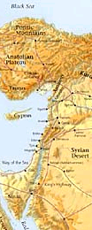
Nations Prophesied Against (Jeremiah 46–51)
485
1. EGYPT (46:1-27) - To be defeated by Babylonians
2. PHILISTIA (47:1-7) - To be overrun by Egyptians
3. MOAB (48:1-47) - To be conquered by Babylon
4. AMMON (49:1-6) - To be destroyed and re-established in
the millennium.
5. EDOM (49:7-22) - To become as Sodom and Gomorrah
6. DAMASCUS (49:23-27) - To be destroyed in a single day
7. KEDAR & HAZOR (49:28-35) - To be destroyed by Nebuchadnezzar
8. ELAM (49:34-39) - To be overrun by Nebuchadnezzar and
re-established during the millennium
9. BABYLON (50:1–51:64) - Final destruction of the empire
Notes:
However, more than just the people of Judah alone, there were prophecies that were addressed to the other non-Israelite cities in those days.
____
Common-337
OS-23-Isaiah1-12—slide 2
OS-24-Jeremiah-241

Slide 4
Slides on
Isaiah 13
Notes:
Beginning in Isaiah 13, we see that Ahaz should not trust in the twelve-nation coalition since Assyria will defeat it as God's agent of judgment (Isa 13–23).

Slide 5

Phoenicians
Syrians
Left Stage
Life in
Ancient Israel
Right Stage
Romans
Desert Peoples,
The "ites"
Sea Peoples,
The "ians" (mostly)‏
Babylonians
Gileadites
Assyrians
Ammonites
Israelites
Philistines
Moabites
Egyptians
Amalekites
Edomites
Notes:
5

Slide 6
Judgment on the 12-Nation Coalition (Isa 13–23)
457
Assyria
Babylon
13:1–14:27
Can Judah trust Babylon to protect them from Assyria?
No—Babylon itself is doomed!
Notes:
The temptation for Ahab in Isaiah's time was to trust in a coalition of other nations to fight Assyria—yet God told them to trust him instead. Why? All these nations would fall to Assyria since God had appointed it. The Assyrians later destroyed the northern nation of Israel during Isaiah’s lifetime—as well as 46 cities of Judah.
In such a time of calamity, whom would Judah trust?
13:1–14:27 Babylon
14:28-32 Philistia
15–16 Moab
17 Damascus/Israel
18 Ethiopia
19–20 Egypt
21:1-10 Babylon by the Sea
21:11-12 Edom
21:13-17 Arabia
22 Jerusalem
23 Tyre

Slide 7
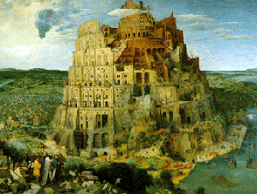
The Plan for
Babylon
Isaiah 13:1-14:23

Slide 8
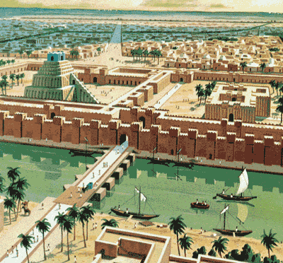
136
Babylon
The Name
The Location
The Tower of Babel

Slide 9
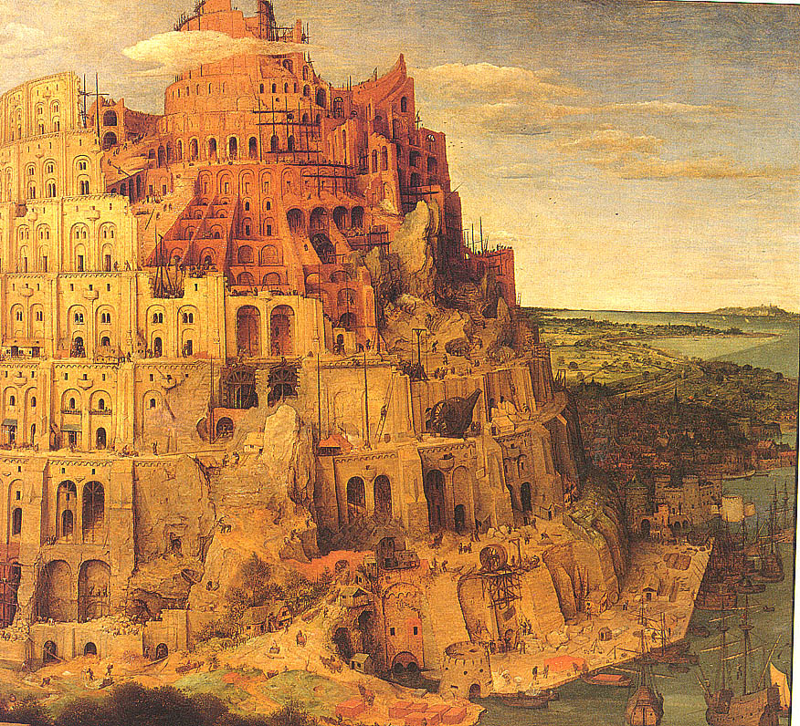
Bab-el
"Gate of God"
“Isaiah son of Amoz received this message concerning the destruction of Babylon”
Isaiah 13:1 NLT

Slide 10

RELIGION
138
Babylonians had many gods – Sumerian, Akkadian, imports from mountainous regions (N & E of Meso.) – which reflected their needs and fears
Marduk (Bel / Baal)
1. Son of Ea (wisdom)
2. Chief of Babylon's gods (rising sun)
3. Temples & a huge ziggurat (the temple of Esgalia)
4. Wife called Sarpanitu / Son - Nabu
5. Sacred number 10 / Planet Jupiter
6. Statue of pure gold – Babylon
7. Made men and fashioned the world

Slide 11
RELIGION
138
OTHER BABYLONIAN GODS
Pantheons – overlapped many cities
Every street bore the name of one of the gods
SIN (Sumerian Nanna) – moon god
ISHTAR (goddess of Venus) – war and love
SHAMASH (sun god) - In charge of justice
ANU (Sumerian An) – god of heavens
ENLIL – King of the lands
ADAD (weather god) - In charge of the weather
EA (Sumerian Enki) – god of wisdom & magic

Slide 12
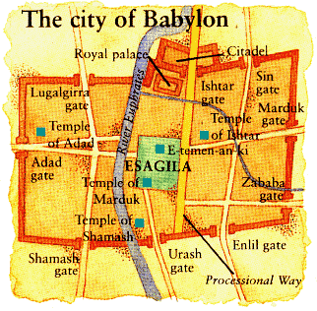
RELIGION
139
Where were the gods?
Everywhere!

Slide 13
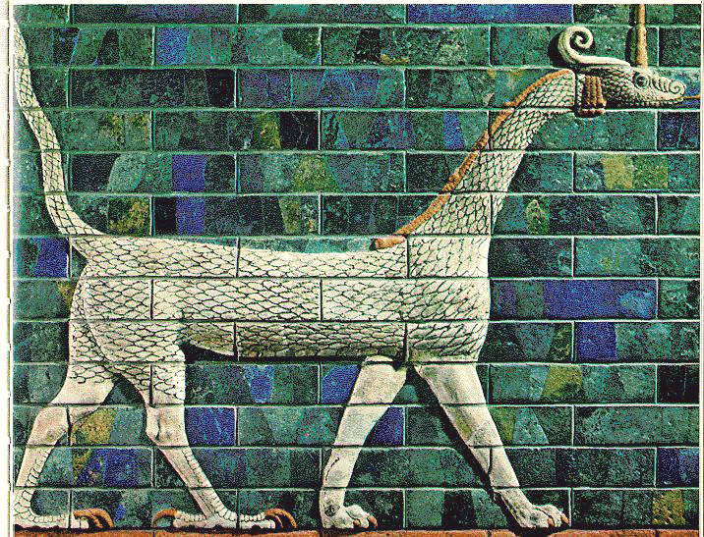
RELIGION
139
Temples and Rituals
A RELIGIOUS METROPOLIS
53 temples of the chief gods
55 chapels of Marduk
300 chapels for earthly deities
600 for heavenly deities
180 altars for the goddess Ishtar
180 for gods Nergal and Adad
12 other altars for different gods
Babylon, the mother of prostitutes and of the abominations of the earth
(Revelation 17:5)

Slide 14
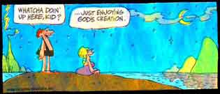
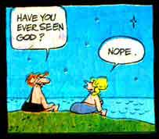
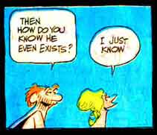
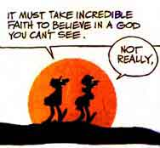
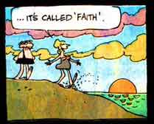
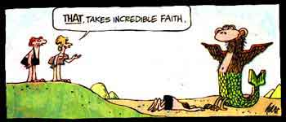
Self-Made Idols Are Useless
Babylon & Us
Whatcha doin’ here, kid?
…Just enjoying God’s creation.
Have you ever seen God?
It must take incredible faith to believe in a God you can’t see.
Then how do you know that he even exists?
…It’s called faith.
THAT, TAKES INCREDIBLE FAITH.
Nope.
I just know.
Not really.

Slide 15
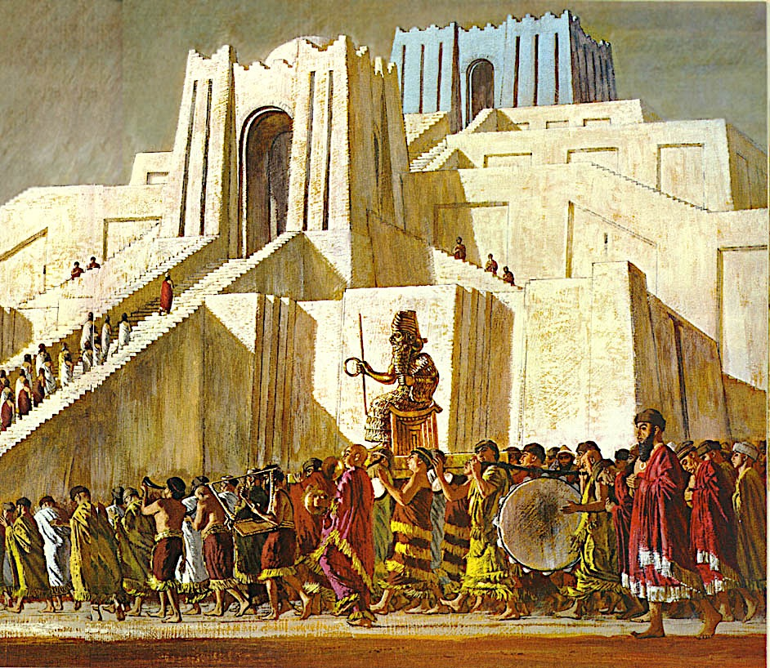
Notes:
Babylonians were a proud people devoted to processions up to their many temples dedicated to numerous gods within the city.

Slide 16
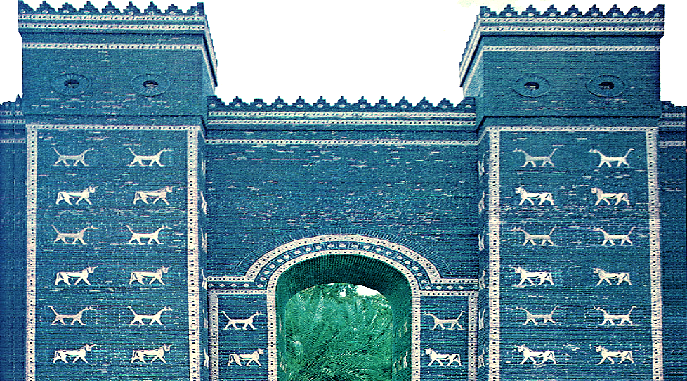
Ishtar Gate
Notes:
Ishtar Gate was the impressive blue gate on Procession Way where people would enter the city of Babylon.

Slide 17
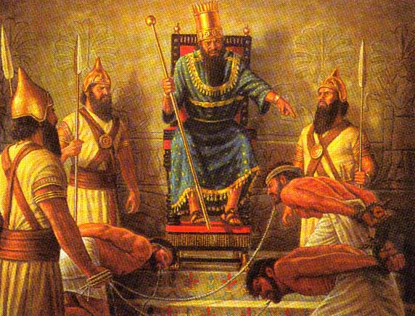
Israelite Captives
Notes:
Isaiah looked to the day that Babylon would capture Jerusalem and bring Judean captives back to Babylon.

Slide 18
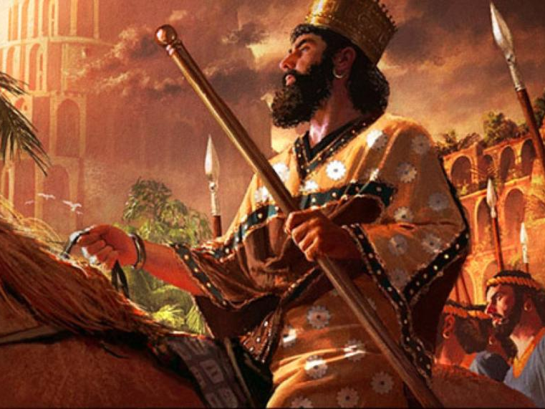
Cyrus Also Conquered Babylon
(539 BC)
“Raise a signal flag on a bare hilltop.
Call up an army against Babylon.
Wave your hand to encourage them
as they march into the palaces of the high and mighty.
³ I, the LORD, have dedicated these soldiers for this task.
Yes, I have called mighty warriors to express my anger,
and they will rejoice when I am exalted.”
Assyrians Conquered Babylon
(689 BC)
Isaiah 13:2-3 NLT
Notes:
“In Isaiah’s day, that judgment was coming because of the tremendous political turmoil of the next several decades that would culminate with the fall of Babylon to the Assyrians in 689 B.C.” (BKC).
Babylon would then hit a resurgence only to be conquered again 150 years later by Cyrus the Persian with Darius the Mede in 539 BC.
Daniel was promoted to Babylon’s third position to show God's pleasure with those who accept his sovereignty (Dan 5:29).
Belshazzar lost his kingdom that night to Darius the Mede [in the reign of Cyrus the Persian, 6:28] for denying God's rule (Dan 5:30).

Slide 19
“Hear the noise on the mountains!
Listen, as the vast armies march!
It is the noise and shouting of many nations. The LORD of Heaven’s Armies has called this army together.
⁵ They come from distant countries,
from beyond the farthest horizons.
They are the LORD’s weapons to carry out his anger. With them he will destroy the whole land. ⁶ Scream in terror, for the day of the LORD has arrived—the time for the Almighty to destroy.”
Isaiah 13:4–6 NLT

Slide 20
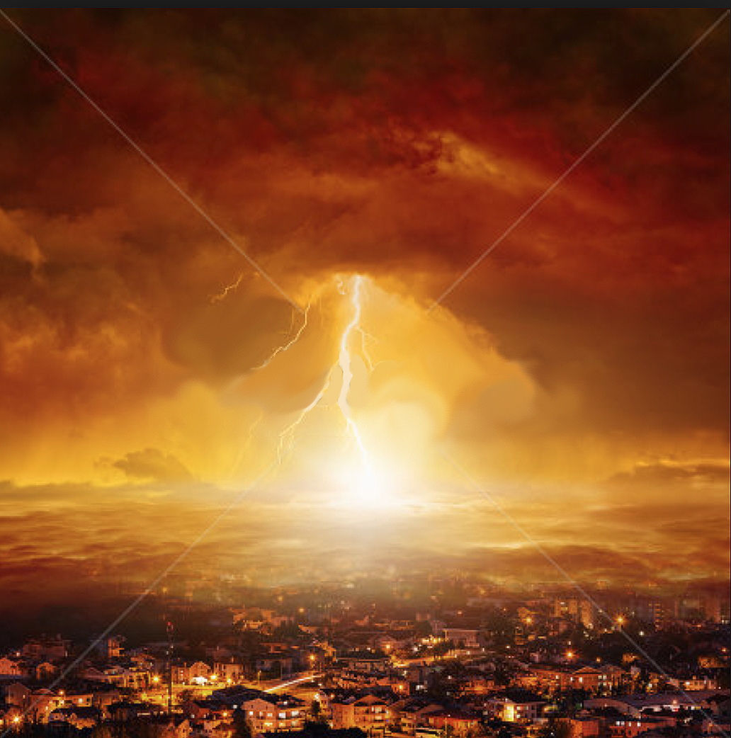
The Tribulation Judgments
“Therefore all hands will fall limp, and every man’s heart will melt. And they will be terrified. Pains and anguish will take hold of them; They will writhe like a woman in labor. They will look at one another in astonishment, their faces aflame. Behold, the day of the LORD is coming, cruel, with fury and burning anger, to make the land a desolation; and He will exterminate its sinners from it. For the stars of heaven and their constellations will not flash forth their light; The sun will be dark when it rises, and the moon will not shed its light. Thus I will punish the world for its evil, and the wicked for their iniquity; I will also put an end to the arrogance of the proud, and abase the haughtiness of the ruthless. I will make mortal man scarcer than pure gold, and mankind than the gold of Ophir. Therefore I shall make the heavens tremble, and the earth will be shaken from its place at the fury of the LORD of hosts in the day of his burning anger.”
Isaiah 13:7–13

Slide 21
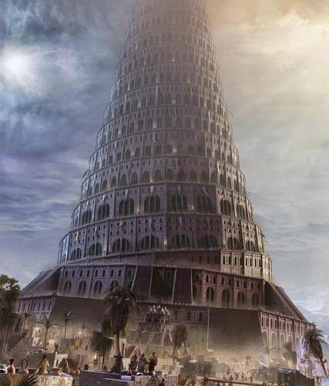
Medes will Conquer Babylon
(539 BC)
“Look, I will stir up the Medes against Babylon.
They cannot be tempted by silver
or bribed with gold.
¹⁸ The attacking armies will shoot down the young men with arrows.
They will have no mercy on helpless babies
and will show no compassion for children” (Isaiah 13:17-18 NLT).
Notes:
"The statement I will stir up against them the Medes (v. 17) has caused much discussion among Bible students. Many interpreters, because of the mention of the fall of Babylon (v. 19), assume that Isaiah was (in vv. 17-18) prophesying Babylon’s fall in 539 (cf. Dan. 5:30-31) to the Medes and Persians. However, that view has some difficulties. In the Medo-Persian takeover in 539 there was very little change in the city; it was not destroyed so it continued on much as it had been. But Isaiah 13:19-22 speaks of the destruction of Babylon. Also the word “them” [NASB, NIV), against whom the Medes were stirred up (v. 17), were the Assyrians (referred to in vv. 14-16), not the Babylonians. It seems better, then, to understand this section as dealing with events pertaining to the Assyrians’ sack of Babylon in December 689 B.C. As Seth Erlandsson has noted, “The histories of the Medes, Elamites, and Babylonians converge around the year 700 in the struggle against the Assyrian world power and ... Babylon assumes a particularly central position in that great historical drama from the latter years of the 8th century down to the fall of Babylon in 689” (The Burden of Babylon: A Study of Isaiah 13:2-14:23. Lund, Sweden: C.W.K. Glerrup, 1970, pp. 91-2).
—John A. Martin, "Isaiah," in The Bible Knowledge Commentary, eds. John F. Walvoord and Roy B. Zuck (Accordance electronic ed. 2 vols.; Wheaton: Victor Books, 1985), 1:1060.

Slide 22
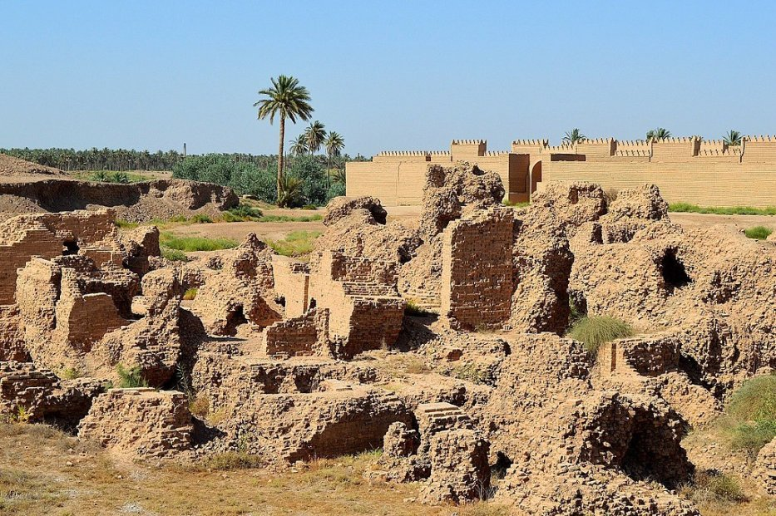
Utter Destruction!
“Babylon, the most glorious of kingdoms,
the flower of Chaldean pride,
will be devastated like Sodom and Gomorrah
when God destroyed them”
(Isaiah 13:19 NLT).
Notes:
Against the supposed 689 BC defeat of Babylon by the Assyrians (see previous slide) is verse 19, which prophesies a complete destruction of the city. This occurred in 539 rather than the earlier 689, for the city has not been rebuilt since 539.

Slide 23
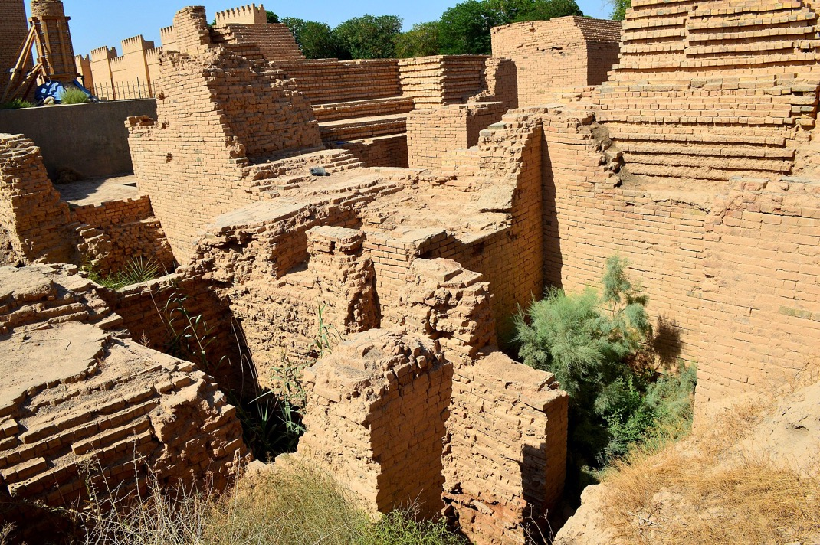
Utter Destruction!
“Babylon will never be inhabited again.
It will remain empty for generation after generation.
Nomads will refuse to camp there,
and shepherds will not bed down their sheep”
(Isaiah 13:20 NLT).

Slide 24

Belshazzar Humbled
Rembrandt
Notes:
In 539 BC Belshazzar denied God's sovereignty at a huge party by praising false gods while drinking from the temple goblets (Dan 5:1-4).
God hid his judgment due to Belshazzar’s pride in an unreadable wall inscription that the wise men could not decipher (5:5-9).
God helped Daniel interpret the inscription as his judgment on Belshazzar’s pride and wisdom for the humble (5:10-28).
__________
OS-23-Isaiah13-23-slide 23
OS-27-Daniel-124
OS-35-Habakkuk-168

Slide 25



145
Fall of Babylon
BABYLON FELL (539 BC)
Cyrus entered under the water gates
Daniel 5
(Belshazzar's Feast)
Notes:
"Babylon was being besieged by the Persian army, led by Ugbaru, governor of Gutium, while Belshazzar, inside the city, was giving a great banquet for 1,000 of his nobles. Belshazzar's name means "Bel (another name for the god Marduk) has protected the king." Perhaps the banquet was given to show Belshazzar's contempt for the Persians and to allay his people's fears. Archeologists have excavated a large hall in Babylon 55 feet wide and 165 feet long that had plastered walls. Such a room would have been sufficient to house a gathering of this size. Belshazzar considered his city secure from assault because of its massive walls. Within the city were supplies that would sustain it for 20 years. Therefore the king felt he had little cause for concern."
Dwight Pentecost, “Daniel,” eds. John F. Walvoord, Roy B. Zuck and Dallas Theological Seminary, The Bible Knowledge Commentary : An Exposition of the Scriptures (Wheaton, IL: Victor Books, 1983-1985), 1:1344.
__________
Common-405
OS-23-Isaiah13-23-slide 24
OS-27-Daniel-125
OS-35-Habakkuk-169

Slide 26
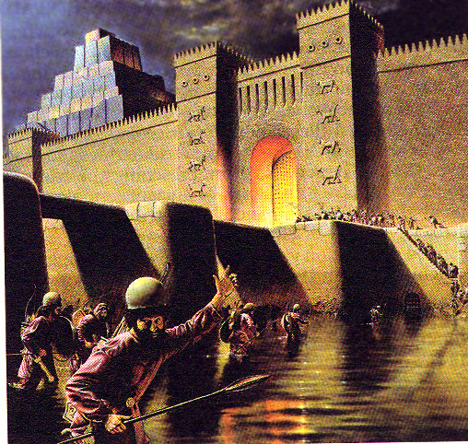
“That same night Belshazzar the Chaldean king was slain. So Darius the Mede received the kingdom.”
Daniel 5:30-31
Notes:
During Belshazzar's great party, the Medes and Persians diverted the Euphrates upstream to lower the moat around Babylon. This made it easy to conquer in but a few hours!

Slide 27
Babylon's Fall (Herodotus)
544b
The History of the Persian Wars 1.191 (430 BC)
"[Cyrus] placed a portion of his army at the point where the river enters the city, and another body at the back of the place where it issues forth, with orders to march into the town by the bed of the stream, as soon as the water became shallow enough: he then himself drew off with the unwarlike portion of his host, and made for the place where Nitocris dug the basin for the river, where he did exactly what she had done formerly: he turned the Euphrates by a canal into the basin, which was then a marsh, on which the river sank to such an extent that the natural bed of the stream became fordable.
"Hereupon the Persians who had been left for the purpose at Babylon by the river-side, entered the stream, which had now sunk so as to reach about midway up a man's thigh, and thus got into the town.
Notes:
Herodotus was a reputable Greek historian who recorded the unsuccessful Persian invasion of Greece and the later fall of Babylon.
__________
Common-406
OS-27-Daniel-126
OS-35-Habakkuk-170

Slide 28
Babylon's Fall (Herodotus)
544b
"Had the Babylonians been apprised of what Cyrus was about, or had they noticed their danger, they would never have allowed the Persians to enter the city, but would have destroyed them utterly; for they would have made fast all the street-gates which gave upon the river, and mounting upon the walls along both sides of the stream, would so have caught the enemy, as it were, in a trap. But, as it was, the Persians came upon them by surprise and so took the city. Owing to the vast size of the place, the inhabitants of the central parts (as the residents at Babylon declare) long after the outer portions of the town were taken, knew nothing of what had chanced, but as they were engaged in a festival, continued dancing and reveling until they learnt the capture but too certainly. Such, then, were the circumstances of the first taking of Babylon."
The History of the Persian Wars 1.191 (written over a century later in 430 BC)
Notes:
The Greek historian Herodotus describes the fall of Babylon in the same manner as does Daniel 5 with a surprise attack while the Babylonians had a party or festival.
__________
Common-407
OS-27-Daniel-127
OS-35-Habakkuk-171

Slide 29
When was this prophecy fulfilled?
1. When Babylonian empire ended
538 B.C. by Cyrus (Medes & Persians) when overthrew city

Slide 30
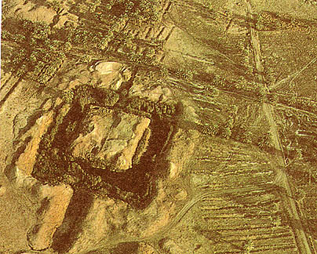
“Desert animals will move into the ruined city, and the houses will be haunted by howling creatures.
Owls will live among the ruins,
and wild goats will go there to dance.
²² Hyenas will howl in its fortresses, and jackals will make dens in its luxurious palaces.
Babylon’s days are numbered;
its time of destruction will soon arrive”
Isaiah 13:21–22 NLT
Present-day Hillah, Babil Governorate, Iraq
53 miles south of Baghdad

Slide 31
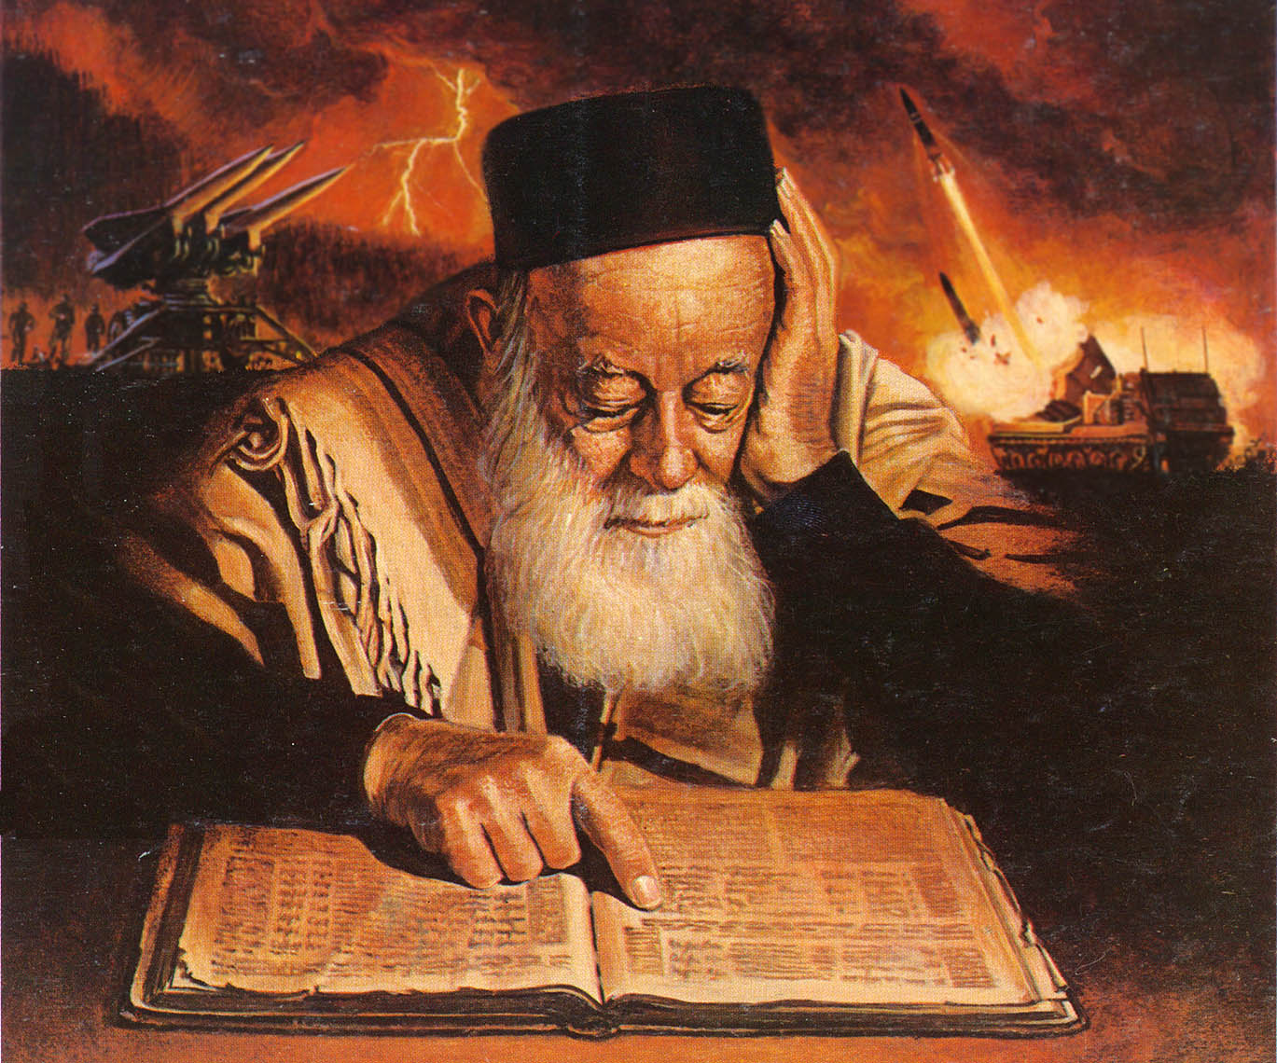
“Her fateful time also will soon come and her days will not be prolonged.” Isaiah 13:22b

Slide 32
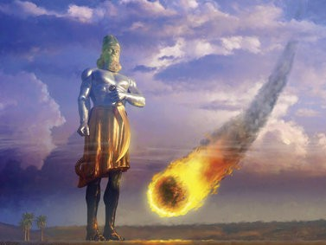
When was this prophecy fulfilled?
When Babylon as a symbol for evil is destroyed
End of Tribulation when Antichrist is overthrown

Slide 33
“Fallen, fallen is Babylon the great! … and were crying out as they saw the smoke of her burning, saying, ‘What city is like the great city? … for in one hour she has been laid waste!’”
Revelation 18:2, 19

Slide 34
God’s Plan for Babylon
Babylon fell, but will arise in the future that it may fall forever. Babylon falls that Israel may rise and that Israel’s Savior may come. Isaiah assures us that the Evil Empire will come to an end and the Everlasting Empire of the Righteous King of kings will come and never end. That is God’s word and we will witness it one day.

Slide 35
Slides on
Isaiah 14

Slide 36
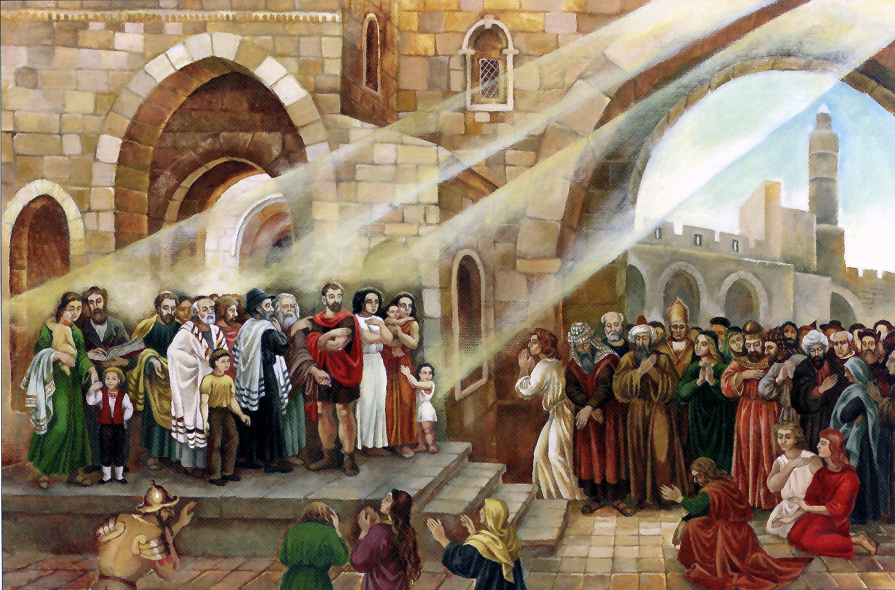
“But the LORD will have mercy on the descendants of Jacob. He will choose Israel as his special people once again. He will bring them back to settle once again in their own land. And people from many different nations will come and join them there and unite with the people of Israel. ² The nations of the world will help the people of Israel to return, and those who come to live in the LORD’s land will serve them. Those who captured Israel will themselves be captured, and Israel will rule over its enemies.”
Isaiah 14:1–2 NLT

Slide 37
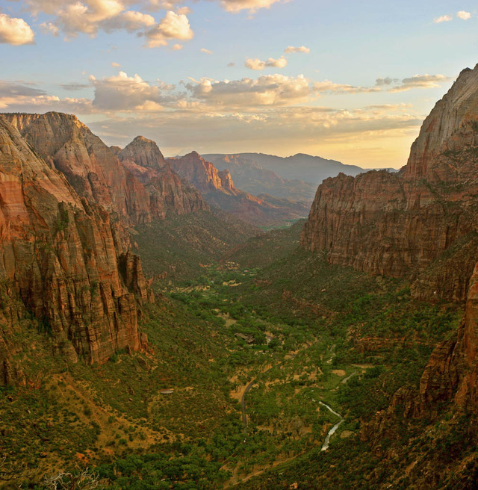
Isaiah 14:2-3 (NLT)
"The nations of the world will help the people of Israel to return, and those who come to live in the LORD’s land will serve them. Those who captured Israel will themselves be captured, and Israel will rule over its enemies. ³In that wonderful day when the LORD gives his people rest from sorrow and fear, from slavery and chains"
Notes:
Isaiah 14:2-3 say that God will give the nation rest from pain and turmoil and harsh service in which it has been enslaved.

Slide 38
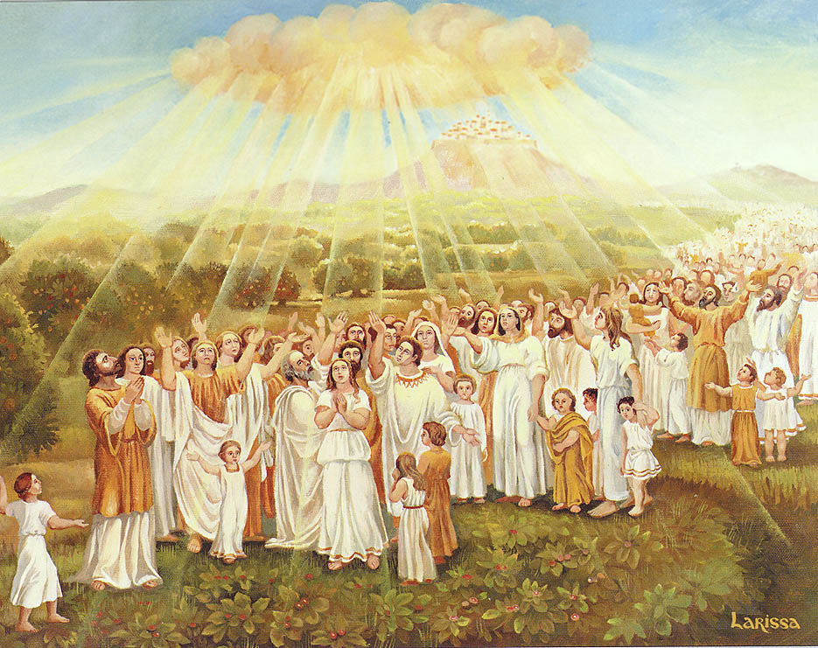
THE MILLENNIUM
Triumphal Taunt
Parable against Pride

Slide 39
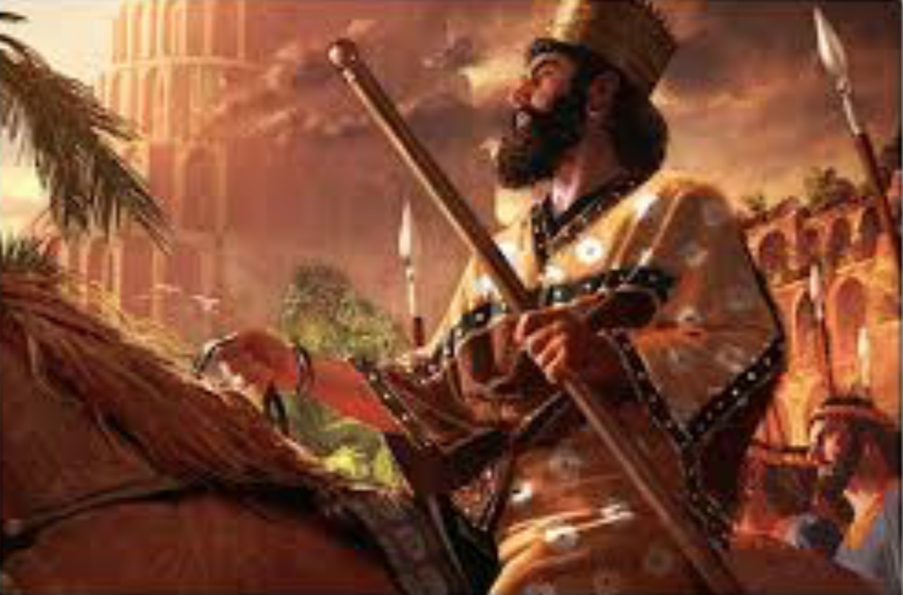
The Punishment of the King of Babylon
“How the oppressor has ceased, and how fury has ceased! The LORD has broken the staff of the wicked, the scepter of rulers which used to strike the peoples in fury with unceasing strokes, which subdued the nations in anger with unrestrained persecution.”
Isaiah 14:5–6

Slide 40
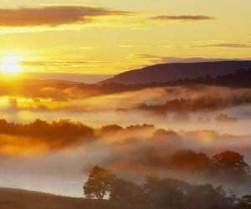
Eschatological Sense of
Security and Safety
“The whole earth is at rest and is quiet; They break forth into shouts of joy. ‘Even the cypress trees rejoice over you, and the cedars of Lebanon, saying, ‘Since you were laid low, no tree cutter comes up against us.’” Isaiah 14:7–8

Slide 41
“Sheol from beneath is excited over you to meet you when you come; It arouses for you the spirits of the dead, all the leaders of the earth; It raises all the kings of the nations from their thrones. They will all respond and say to you, ‘Even you have been made weak as we, you have become like us. Your pomp and the music of your harps have been brought down to Sheol; Maggots are spread out as your bed beneath you, and worms are your covering.’” Isaiah 14:9–11

Slide 42
“How you have fallen from heaven, O star of the morning, son of the dawn! You have been cut down to the earth, you who have weakened the nations! But you said in your heart, I will ascend to heaven; I will raise my throne above the stars of God, I will sit on the mount of the assembly in the recesses of the north. I will ascend above the heights of the clouds; I will make myself like the Most High. Nevertheless you will be thrust down to Sheol, to the recesses of the pit.” Isaiah 14:12-15

Slide 43
The Five “I Wills” of Satan
“But you said in your heart, ‘I will ascend to heaven; I will raise my throne above the stars of God, and I will sit on the mount of assembly In the recesses of the north. ‘I will ascend above the heights of the clouds; I will make myself like the Most High.’” Isaiah 14:13–14

Slide 44
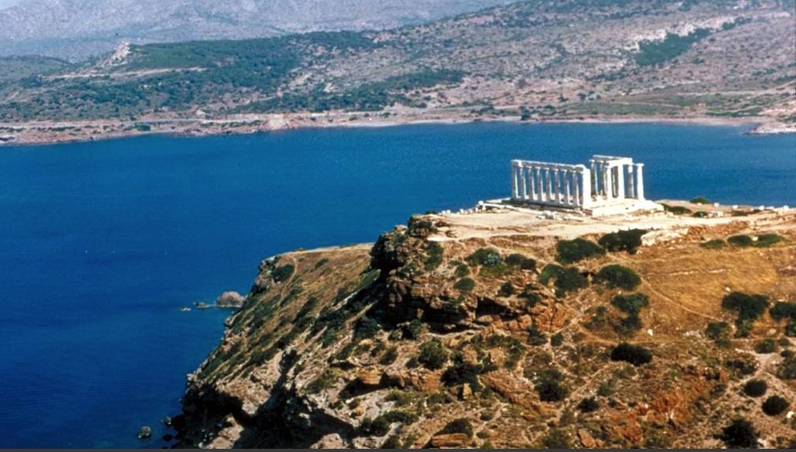
Poseidon's Temple
"Son of man, give the prince of Tyre this message from the Sovereign LORD:
'In your great pride, you claim, "I am a god! I sit on a divine throne in the heart of the sea." But you are only a man and not a god,
though you boast that you are a god.'"
Tyre's king regarded himself as the god of the sea (Ezek. 28:2 NLT)
Notes:
Phoenicia's key city of Tyre was not humble about its influence and wealth. Its boasting about being the god of the sea led later to enshrine this in the temple of the Greek god of the sea, Poseidon.

Slide 45
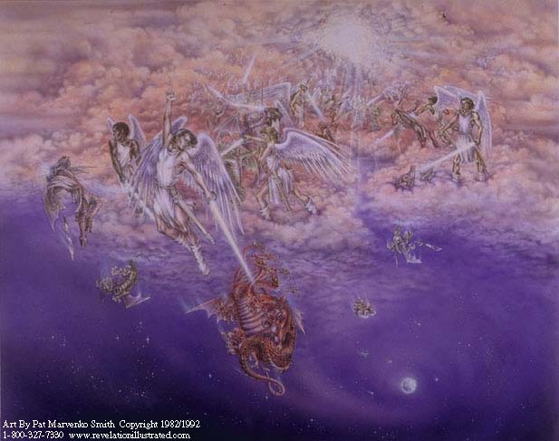
Satan cast down
(cf. Rev. 12:7-13)
² "Son of man, give the prince of Tyre this message from the Sovereign LORD:
"In your great pride you claim, 'I am a god! I sit on a divine throne in the heart of the sea.' But you are only a man and not a god, though you boast that you are a god" (Ezekiel 28:2).
Notes:
Like the king of Tyre, Satan also boasted of divine rights. The true God threw both Satan and Tyre's prince down.

Slide 46
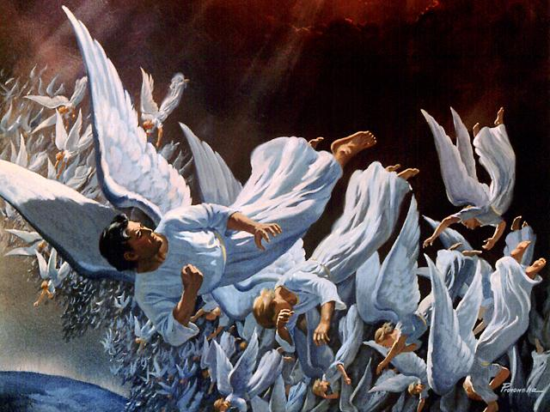
Fall of Lucifer, the Shining Star
(cf. Rev. 12:7-9)
³ You regard yourself as wiser than Daniel
and think no secret is hidden from you.
⁴ With your wisdom and understanding you have amassed great wealth—
gold and silver for your treasuries.
⁵ Yes, your wisdom has made you very rich,
and your riches have made you very proud" (Ezekiel 28:3-5)
Notes:
Daniel's name had already become proverbial, despite him being contemporary to Ezekiel.
Sadly, wealth and beauty and power often bring pride—first true of Satan and now true on earth (28:3-5).

Slide 47
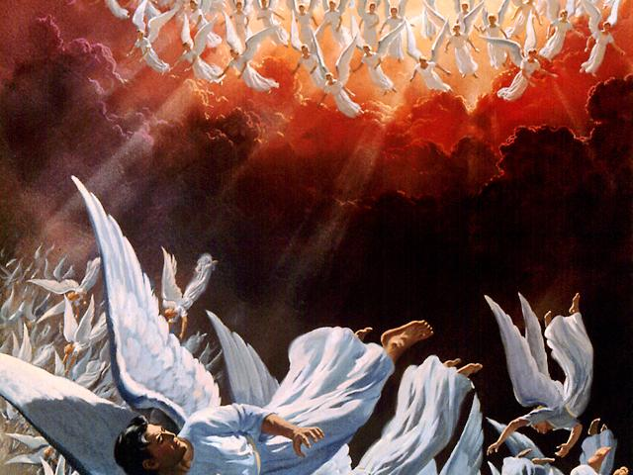
The angels pursue
"You were the model of perfection, full of wisdom and exquisite in beauty. ¹³ You were in Eden, the garden of God… ¹⁵You were blameless in all you did from the day you were created until the day evil was found in you"
(Ezekiel 28:12-15)
Fall of Lucifer, the Shining Star
(cf. Rev. 12:7-9)
Notes:
The pride of the king of Tyre reflected that of Lucifer himself (28:12-15).

Slide 48
The angels pursue
¹⁶Your rich commerce led you to violence,
and you sinned.
So I banished you in disgrace
from the mountain of God.
I expelled you, O mighty guardian,
from your place among the stones of fire.
¹⁷Your heart was filled with pride
because of all your beauty.
Your wisdom was corrupted
by your love of splendor.
So I threw you to the ground and
exposed you to the curious gaze of kings"
(Ezek. 28:16-17)
Notes:
As the king of Tyre was to be banished, so Lucifer was expelled from heaven years before (28:16-17).

Slide 49
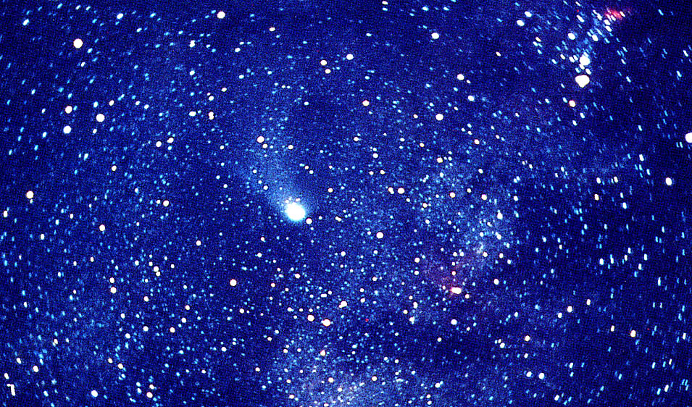
Five
"I wills"
Pride of Place
Pride of Power
Pride of Position
Pride of Presence
Pride of Person

Slide 50
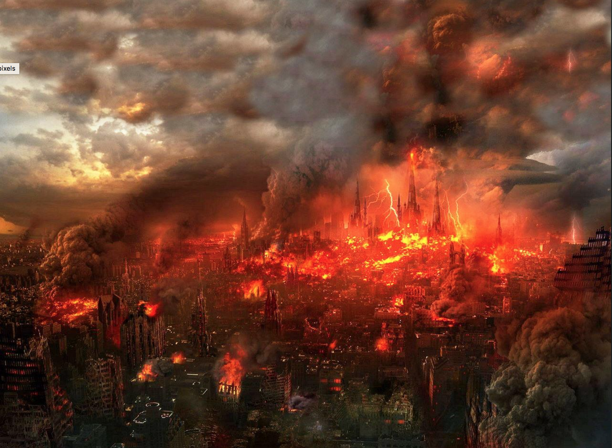
The Site of Babylon’s Destruction
“And I will rise up against them, declares the LORD of hosts, and will cut off from Babylon name and survivors, offspring and posterity, declares the LORD. I will also make it a possession for the hedgehog, and swamps of water, and I will sweep it with the broom of destruction, declares the LORD of hosts.” Isaiah 14:22–23

Slide 51
Judgment on the 12-Nation Coalition (Isa 13–23)
457
Assyria
Babylon
Philistia
14:28-32
Notes:
The temptation for Ahab in Isaiah's time was to trust in a coalition of other nations to fight Assyria—yet God told them to trust him instead. Why? All these nations would fall to Assyria since God had appointed it. The Assyrians later destroyed the northern nation of Israel during Isaiah’s lifetime—as well as 46 cities of Judah.
In such a time of calamity, whom would Judah trust?
13:1–14:27 Babylon
14:28-32 Philistia
15–16 Moab
17 Damascus/Israel
18 Ethiopia
19–20 Egypt
21:1-10 Babylon by the Sea
21:11-12 Edom
21:13-17 Arabia
22 Jerusalem
23 Tyre

Slide 52
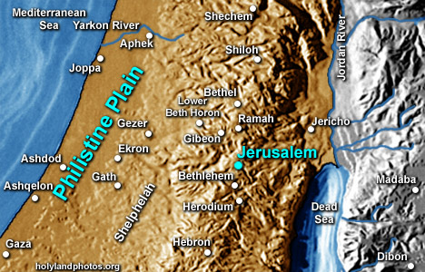
Geography of Philistia
105
The first three – Ashkelon, Ashdod, Gaza – were all situated on or beside the sea-coast, straddling the line of the Via Maris (Way of the Sea).
The other two – Gath and Ekron – were inland cities on the plain somewhere east of the three coastal cities; but archaeologists have not agreed on the original location of these two cities.

Slide 53
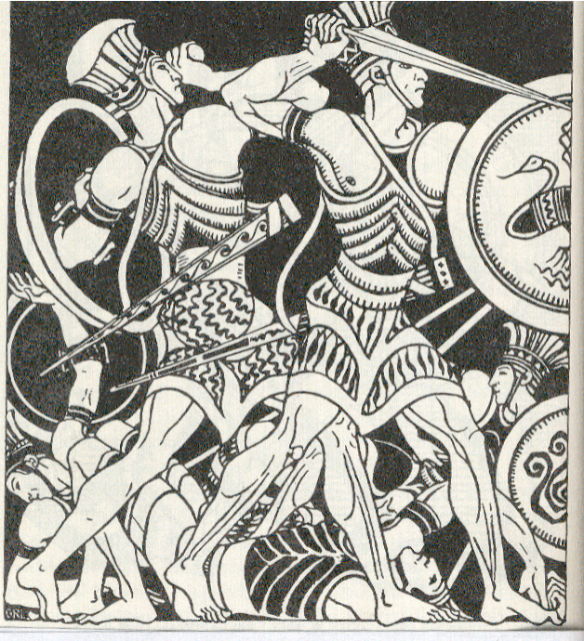
Philistines were a fearsome people

Slide 54
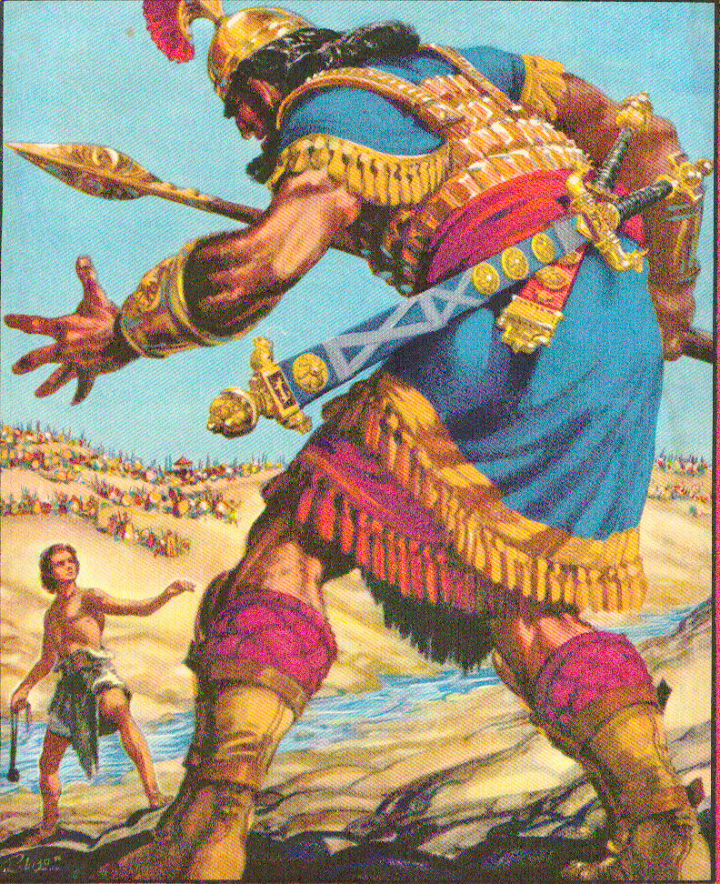
Goliath's Armor
112
Bronze Helmet
Iron point
[Wood] Spear Shaft
Bronze Armor
Bronze Javelin
Bronze
Greaves

Slide 55
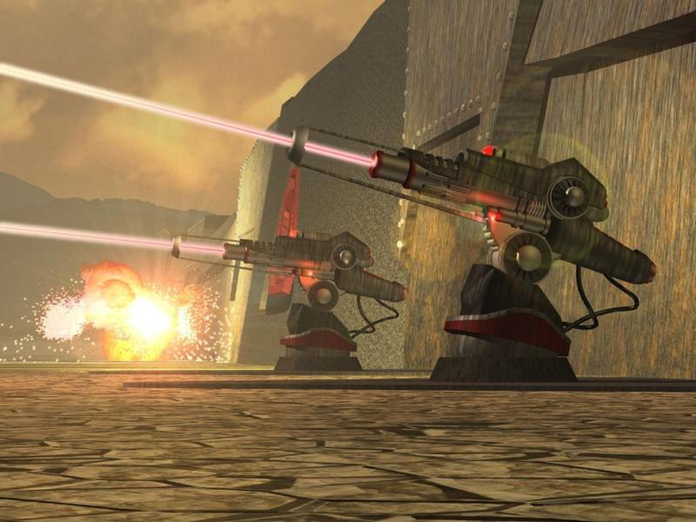
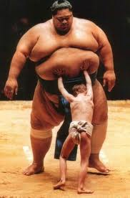
The Philistine Military Capacities (1 Sam 17:5-7)
112
Bronze helmet
Bronze coat of scale armor (5000 shekels = 57.5 kgs)
Bronze greaves (7 kgs)
Bronze javelin
Spear shaft with iron point (600 shekels = 11.5 kgs)
Shield

Slide 56
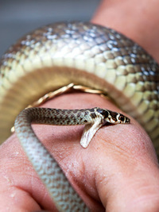
Philistine False Confidence
“This message came to me the year King Ahaz died:
²⁹ Do not rejoice, you Philistines,
that the rod that struck you is broken—that the king who attacked you is dead.
For from that snake a more poisonous snake will be born,
a fiery serpent to destroy you!”
(Isa 14:28-29 NLT).
Notes:
Babylon conquered Assyria which made the Philistines glad.

Slide 57
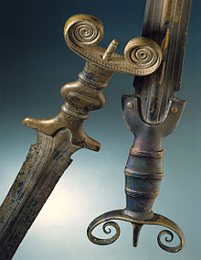
Babylon to Conquer Philistia
“I will feed the poor in my pasture;
the needy will lie down in peace.
But as for you,
I will wipe you out with famine
and destroy the few who remain.
³¹ Wail at the gates!
Weep in the cities!
Melt with fear, you Philistines!
A powerful army comes like smoke from the north.
Each soldier rushes forward eager to fight” (Isa 14:30-31 NLT).
Notes:
But the Babylon that conquered Assyria will also conquer Philistia!

Slide 58
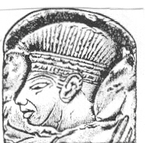
P
entapolis: Ashkelon, Ashdod, Gaza, Gath, Ekron
H
am's descendants
I
srael's enemy
L
arge scale migration
I
Samuel 17 (David & Goliath)‏
S
ea People
T
emples
I
ron spear
N
Dago
was one of their deities
E
(2) AG
(Ashkelon, Ashdod, Gaza, Gath and Ekron)‏
Notes:
58

Slide 59
Slides on
Isaiah 15

Slide 60
Judgment on the 12-Nation Coalition (Isa 13–23)
457
Assyria
Babylon
Philistia
Moab
15–16
Notes:
The temptation for Ahab in Isaiah's time was to trust in a coalition of other nations to fight Assyria—yet God told them to trust him instead. Why? All these nations would fall to Assyria since God had appointed it. The Assyrians later destroyed the northern nation of Israel during Isaiah’s lifetime—as well as 46 cities of Judah.
In such a time of calamity, whom would Judah trust?
13:1–14:27 Babylon
14:28-32 Philistia
15–16 Moab
17 Damascus/Israel
18 Ethiopia
19–20 Egypt
21:1-10 Babylon by the Sea
21:11-12 Edom
21:13-17 Arabia
22 Jerusalem
23 Tyre

Slide 61
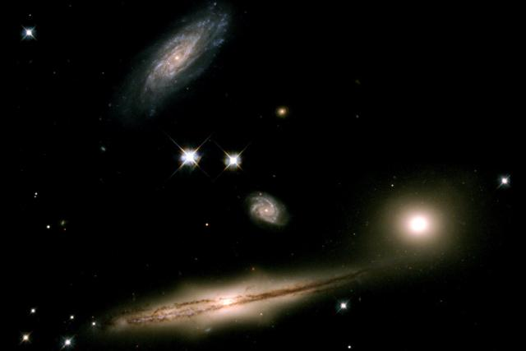
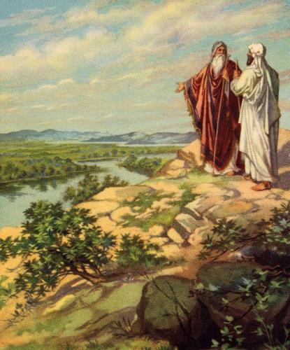
Origin of Moabites
17
Noah
Shem
7 Generations
Terah
Abraham and Lot
Abraham
Nahor
Haran
Lot
Milcah
Iscah
Eldest
Daughter
Youngest
Daughter
Moab
Ben-Ammi

Slide 62
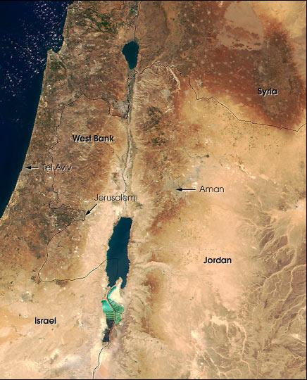
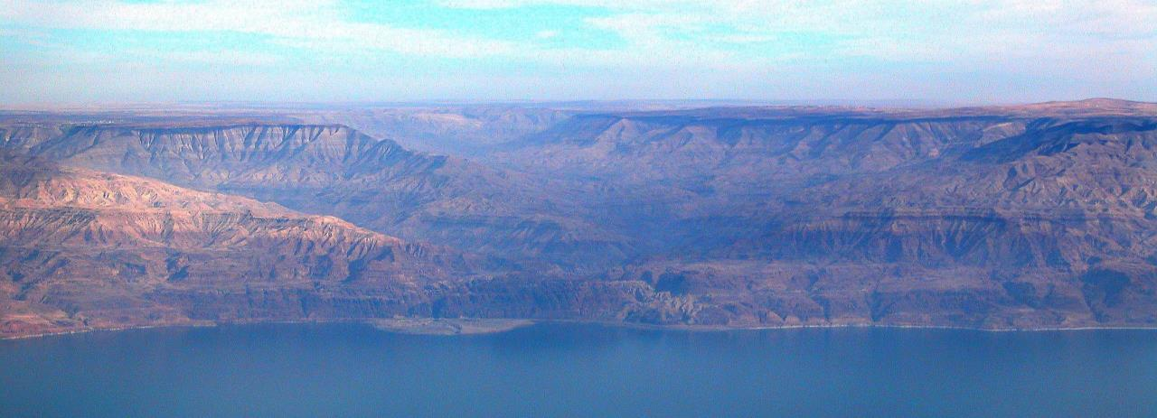
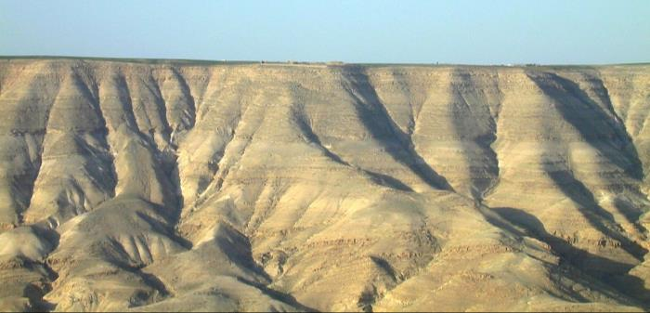
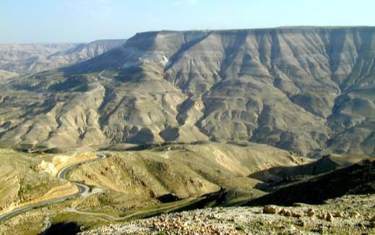
The Arnon Gorge
100
Looking North
Northern Plateau
Wadi al Majib (Arnon Gorge)
Looking South
Moab Proper
(Central Plateau)

Slide 63
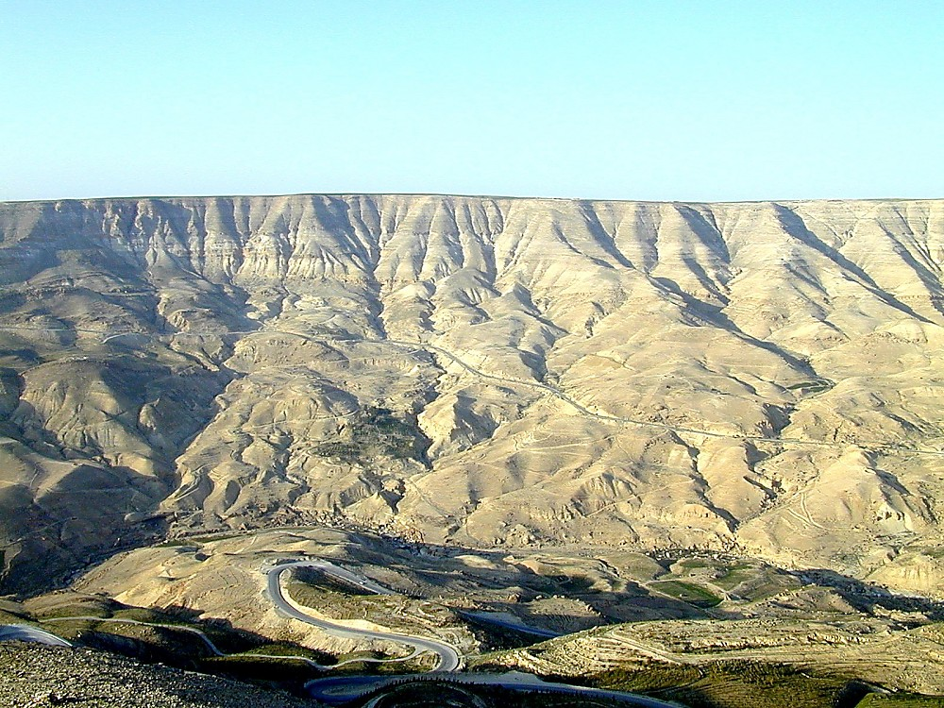

Arnon River view to north
Arnon River view to north
Notes:
Jeremiah 48:20 (NIV) “Moab is disgraced, for she is shattered. Wail and cry out! Announce by the Arnon that Moab is destroyed.”

Slide 64

Arnon River view to north
Plateaus on Both Sides

Slide 65


Moabite Deities
98
Chemosh
chief deity, national god, warrior god
god who provided for all aspects of life
1 Kings 11:7, Num 21:27-30
Astarte
mother goddess
Ashtar-Chemosh mentioned
in the Mesha inscription

Slide 66


Israel's Sin at Baal Peor
99
“While Israel was staying in Shittim, the men began to indulge in sexual immorality with Moabite women, who invited them to the sacrifices to their gods. The people ate and bowed down before these gods. So Israel joined in worshiping the Baal of Peor. And the LORD's anger burned against them.”
Numbers 25:1-3

Slide 67

Child Sacrifice to Chemosh
98

Slide 68
Slides on
Isaiah 16

Slide 69
Babylon to Conquer Moab
“Send lambs from Sela as tribute
to the ruler of the land.
Send them through the desert
to the mountain of beautiful Zion.
² The women of Moab are left like homeless birds
at the shallow crossings of the Arnon River.
^{3 ’}Help us,’ they cry.
‘Defend us against our enemies.
Protect us from their relentless attack.
Do not betray us now that we have escaped.
⁴ Let our refugees stay among you.
Hide them from our enemies until the terror is past’” (Isa 16:2-4a NLT).

Slide 70

Messiah to Rule After Judgment of Moab
“When oppression and destruction have ended
and enemy raiders have disappeared,
⁵ then God will establish one of David’s descendants as king.
He will rule with mercy and truth.
He will always do what is just
and be eager to do what is right” (Isa 16:4b-5 NLT).

Slide 71
Slides on
Isaiah 17

Slide 72
Judgment on the 12-Nation Coalition (Isa 13–23)
457
Assyria
Syria
17
Babylon
Philistia
Moab
Notes:
The temptation for Ahab in Isaiah's time was to trust in a coalition of other nations to fight Assyria—yet God told them to trust him instead. Why? All these nations would fall to Assyria since God had appointed it. The Assyrians later destroyed the northern nation of Israel during Isaiah’s lifetime—as well as 46 cities of Judah.
In such a time of calamity, whom would Judah trust?
13:1–14:27 Babylon
14:28-32 Philistia
15–16 Moab
17 Damascus/Israel
18 Ethiopia
19–20 Egypt
21:1-10 Babylon by the Sea
21:11-12 Edom
21:13-17 Arabia
22 Jerusalem
23 Tyre

Slide 73
Peoples of the OT - Arameans
Identity – Who were they?
Descended from Aram (grandson of Nahor). Nahor and Abraham were brothers, both descended from Shem, the son of Noah
Laban and his brother, Bethuel, were Arameans (Gen 25:20)
Abraham was a wandering Aramean. Refer to OT Backgrounds page 17 chart on the relationship between Jacob (Israel) and Arameans (Deut. 26:5)
Farmers and villagers with no political centralization
Notes:
73

Slide 74
Peoples of the OT - Arameans
Central and Southern Syria
Aram Damascus:
"… the Syrians of Damascus came to help Hadadezer, king of Zobar…"(2 Sam. 8:5).
  In the Hebrew Bible, it is called 'Aram'
  Other translations called it 'Syria'
  Aram Damascus is the part of the Aramean world that had the greatest effect on biblical Israel
  It was also the most powerful state that bordered Israel.
Notes:
74

Slide 75

Damascus, Capital of Aram (Syria) Judged
“This message came to me concerning Damascus:
‘Look, the city of Damascus will disappear!
It will become a heap of ruins’” (Isa 17:1 NLT).

Slide 76
Judgment on the 12-Nation Coalition (Isa 13–23)
457
Assyria
Syria
Israel
17
Babylon
Philistia
Moab
Notes:
The temptation for Ahab in Isaiah's time was to trust in a coalition of other nations to fight Assyria—yet God told them to trust him instead. Why? All these nations would fall to Assyria since God had appointed it. The Assyrians later destroyed the northern nation of Israel during Isaiah’s lifetime—as well as 46 cities of Judah.
In such a time of calamity, whom would Judah trust?
13:1–14:27 Babylon
14:28-32 Philistia
15–16 Moab
17 Damascus/Israel
18 Ethiopia
19–20 Egypt
21:1-10 Babylon by the Sea
21:11-12 Edom
21:13-17 Arabia
22 Jerusalem
23 Tyre

Slide 77

Israel Also Judged with Damascus
“‘The towns of Aroer will be deserted.
Flocks will graze in the streets and lie down undisturbed,
with no one to chase them away.
³ The fortified towns of Israel will also be destroyed,
and the royal power of Damascus will end.
All that remains of Syria
will share the fate of Israel’s departed glory,’
declares the LORD of Heaven’s Armies”
(Isaiah 17:2-3 NLT).
Notes:
“Damascus would become a heap of ruins, no longer a city. Since Aroer was a city in Moab, the words the cities of Aroer are difficult to understand. Some Septuagint (Greek) manuscripts read that Damascus and her cities will be “abandoned forever.” With the cities around Damascus deserted, animals will make the ruins their home (17:2) . Both Ephraim, representing Israel, and Damascus, representing Aram (cf. 7:8), would be defeated (17:3). Assyria defeated Aram in 732 and Israel in 722” (John A. Martin, “Isaiah,” in The Bible Knowledge Commentary, 1:1064, bold text from the NIV).

Slide 78

Assyrian Developments
And the king of Assyria transported groups of people from Babylon, Cuthah, Avva, Hamath, and Sepharvaim and resettled them in the towns of Samaria, replacing the people of Israel. So the Assyrians took over Samaria and the other towns of Israel
(2 Kings 17:24).
Finally, in the ninth year of King Hoshea's reign, Samaria fell, and the people of Israel were exiled to Assyria. They were settled in colonies in Halah, along the banks of the Habor River in Gozan, and among the cities of the Medes
(2 Kings 17:6).
48
Fall of Samaria
Rise of Samaritans
Beitzel, Moody Atlas of Bible Lands, 1st ed., 139

Slide 79
Slides on
Isaiah 18

Slide 80

Judgment on the 12-Nation Coalition (Isa 13–23)
457
Assyria
“Listen, Ethiopia [Sudan]—
land of fluttering sails
that lies at the headwaters of the Nile,
² that sends ambassadors
in swift boats down the river.
Go, swift messengers!
Take a message to a tall,
smooth-skinned people,
who are feared far and wide
for their conquests and destruction,
and whose land is divided by rivers”
(Isaiah 18:1-2 NLT)
Syria
Israel
Babylon
Philistia
Moab
18
Sudan
Notes:
"18:1-2. The message in chapter 18 is directed against the land of whirring wings, the nation of Cush. (On the word woe; see comments on “Oh” in 17:12 and comments on 3:9.) The whirring wings may refer to locusts. Cush included modern-day southern Egypt, Sudan, and northern Ethiopia. Apparently the Cushites sent envoys in swift-moving papyrus boats (cf. Job 9:26) to suggest that Israel form an alliance with them against the Assyrians. The Cushites, a people who were tall, fearsome, and aggressive, spoke a language that would have sounded strange to Hebrews because it was non-Semitic. Like Egypt, Cush is divided by rivers (cf. Isa. 18:7) that is, by branches of the Nile. Nothing is known elsewhere in the Bible or from extrabiblical sources about any contacts of this nation with Israel in a joint venture against Assyria."
—John A. Martin, "Isaiah," in The Bible Knowledge Commentary (eds. John F. Walvoord and Roy B. Zuck; Accordance electronic ed. 2 vols.; Wheaton: Victor Books, 1985), 1:1065.

Slide 81

Two Suggested Locations of Eden
21
Barry Beitzel, Moody Atlas of Bible Lands, 75
Genesis 2:10-14
Eden
Mt Ararat
Tigris
Euphrates
Gihon?
(Ethiopia)
Pishon?
(Saudi Arabia)
Notes:
We don't know the exact location of Eden as it was destroyed later in the Flood.
——————
OS-01-Gen1-3-slide158
OS-01-Gen4-20-slide 119
OS-23_Isaiah13-23-slide 73

Slide 82
Mesopotamian Cush First Noted in Genesis 2
457
Eden
Pishon
Gihon
Havilah?
Cush?
“A river flowed from the land of Eden, watering the garden and then dividing into four branches. ¹¹The first branch, called the Pishon, flowed around the entire land of Havilah, where gold is found. ¹²The gold of that land is exceptionally pure; aromatic resin and onyx stone are also found there. ¹³The second branch, called the Gihon, flowed around the entire land of Cush” (Genesis 2:10-13 NLT)
Egypt
Sudan
Notes:
Ancient Cush overlapped present Libya, Egypt, and Sudan as seen on the next slide.
————
Cush in the OT (NLT version):
Gen. 2:13 The second branch, called the Gihon, flowed around the entire land of Cush.
Gen. 10:6 The descendants of Ham were Cush, Mizraim, Put, and Canaan.
Gen. 10:7 The descendants of Cush were Seba, Havilah, Sabtah, Raamah, and Sabteca. The descendants of Raamah were Sheba and Dedan.
Gen. 10:8 Cush was also the ancestor of Nimrod, who was the first heroic warrior on earth.
1Chr. 1:8 The descendants of Ham were Cush, Mizraim,ª Put, and Canaan.
1Chr. 1:9 The descendants of Cush were Seba, Havilah, Sabtah, Raamah, and Sabteca. The descendants of Raamah were Sheba and Dedan. ¹⁰ Cush was also the ancestor of Nimrod, who was the first heroic warrior on earth.
Psa. 7:0 A psalmª of David, which he sang to the LORD concerning Cush of the tribe of Benjamin.
——————
OS-01-Gen1-3-slide 159
OS-01-Gen4-20-slide 121
OS-23_Isaiah13-23-slide 73

Slide 83

Rodinia––The World That Perished
The transformation of Adam's world into today's world
Notes:
God initially made the world as a single land mass that creationists call Rodinia.
____________
OS-01-Gen1-3—slide 73
OS-23-Isaiah13-23—slide 75

Slide 84

THE WORLD THAT PERISHED
The transformation of Adam's world into today's world
Notes:
Most geologists—both believers and unbelievers—recognize that Rodinia broke apart. Evolutionists believe it took place only a centimeter per year, which is the present rate or continental shift. But there is no reason that it could not have occurred at a much faster rate during Noah's Flood, which required about a 12-miles-per-hour shift from a single land mass into the continents of today.
____________
OS-01-Gen1-3—slide 77
OS-23-Isaiah13-23—slide 76

Slide 85

Correct Location of Cush
Cush
This is not the Cush of Genesis but a later settlement between Egypt and Sudan as part of Nubia stretching from Aswan, Egypt to Khartoum, Sudan
http://arab-israelites.tripod.com/cush2.htm
Notes:
We often think of ancient Cush as covering modern Ethiopia, but this map says otherwise as it does not even include a part of Ethiopia.
——————
OS-01-Gen1-3-slide160
OS-01-Gen4-20-slide 121
OS-23_Isaiah13-23-slide 76

Slide 86

Assyrians to Be Destroyed
“All you people of the world,
everyone who lives on the earth—
when I raise my battle flag on the mountain, look!
When I blow the ram’s horn, listen!
⁴ For the LORD has told me this:
‘I will watch quietly from my dwelling place—
as quietly as the heat rises on a summer day,
or as the morning dew forms during the harvest’”
(Isaiah 18:3-4 NLT).
Notes:
"18:3. The prophet exhorted the Cushites to go back home and not try to form an alliance because the Lord would defeat the enemy at the proper time. The Cushites represented all the people of the world who desired to see the Assyrians fall. But the Lord promised through Isaiah that when the time would come to fight the Assyrians they would know it and would see the enemy fall."
—John A. Martin, "Isaiah," in The Bible Knowledge Commentary (eds. John F. Walvoord and Roy B. Zuck; Accordance electronic ed. 2 vols.; Wheaton: Victor Books, 1985), 1:1065.

Slide 87

Assyrians to Be Destroyed
“Even before you begin your attack,
while your plans are ripening like grapes,
the LORD will cut off your new growth with pruning shears. He will snip off and discard your spreading branches” (Isaiah 18:5 NLT).
Notes:
"18:4-6. God’s plans would linger much like the summer heat and harvest dew. The LORD told Isaiah that He would wait till the proper time to cut off the enemy. Isaiah had already been given the reason for this (10:12, 25, 32). But the Assyrian army first had to complete the task God gave them, to punish the people of Israel by taking them captive. However, once God’s purposes had been accomplished, He would intervene and cut them [the Assyrians] off (18:5) just when they, like grapes, were beginning to ripen, to extend their empire. They would be killed and would be left on the mountains as food for wild birds in the summer and wild animals in the winter."
—John A. Martin, "Isaiah," in The Bible Knowledge Commentary (eds. John F. Walvoord and Roy B. Zuck; Accordance electronic ed. 2 vols.; Wheaton: Victor Books, 1985), 1:1065.

Slide 88

Assyrians to Be Destroyed
“Your mighty army will be left dead in the fields
for the mountain vultures and wild animals.
The vultures will tear at the corpses all summer.
The wild animals will gnaw at the bones all winter”
(Isaiah 18:6 NLT).
Notes:
"ETHIOPIA (18:1–7)
The original text has “Cush,” a land that covers the area now occupied by Ethiopia, the Sudan, and Somalia. Isaiah called it “a land of whirring wings” (v. 1 NIV), not only because of the insects that infested the land, but also because of the frantic diplomatic activity going on as the nation sought alliances to protect themselves from Assyria. He pictures the ambassadors in their light, swift boats, going to the African nations for help. But God tells them to go back home (v. 2) because He would deal with Assyria Himself, apart from the help of any army.
In contrast to the frantic human activity on earth is the calm patience of God in heaven (v. 4) as He awaits the right time to reap the harvest of judgment. Assyria is pictured as a ripening vine that will never survive, for God will cut it down (v. 5). In verse 6, Isaiah describes the feast that God spreads for the birds and beasts, the corpses of 185,000 Assyrian soldiers (37:36). (See Revelation 14:14–20; 19:17–21, where these same two images are used for end-time judgments.)"
[Warren Wiersbe, Isaiah, p. 63]

Slide 89
Sudanese Worship at Jerusalem
“At that time the LORD of Heaven’s Armies will receive gifts from this land divided by rivers, from this tall, smooth-skinned people, who are feared far and wide for their conquests and destruction. They will bring the gifts to Jerusalem, where the LORD of Heaven’s Armies dwells”
(Isaiah 18:7 NLT).
Jerusalem
Sudan
Notes:
"18:7. After the Assyrian defeat, the LORD would cause the people of Cush (cf. vv. 1-2) to take gifts to the Lord at Mount Zion, where His name dwelt (see comments on Deut. 12:5). Whether this occurred after the fall of Assyria is not known. Possibly Isaiah was speaking of the millennial kingdom when peoples from around the world will worship the LORD (cf. Zech. 14:16) because of His gracious acts."
—John A. Martin, "Isaiah," in The Bible Knowledge Commentary (eds. John F. Walvoord and Roy B. Zuck; Accordance electronic ed. 2 vols.; Wheaton: Victor Books, 1985), 1:1065.

Slide 90
Slides on
Isaiah 19

Slide 91
Judgment on the 12-Nation Coalition (Isa 13–23)
457
Assyria
Syria
Israel
Babylon
Philistia
Moab
Egypt
19–20
Sudan
Notes:
The temptation for Ahab in Isaiah's time was to trust in a coalition of other nations to fight Assyria—yet God told them to trust him instead. Why? All these nations would fall to Assyria since God had appointed it. The Assyrians later destroyed the northern nation of Israel during Isaiah’s lifetime—as well as 46 cities of Judah.
In such a time of calamity, whom would Judah trust?
13:1–14:27 Babylon
14:28-32 Philistia
15–16 Moab
17 Damascus/Israel
18 Ethiopia
19–20 Egypt
21:1-10 Babylon by the Sea
21:11-12 Edom
21:13-17 Arabia
22 Jerusalem
23 Tyre

Slide 92


Egypt Judged (Isaiah 19–20)
“This message came to me concerning Egypt:
Look! The LORD is advancing against Egypt,
riding on a swift cloud.
The idols of Egypt tremble.
The hearts of the Egyptians melt with fear”
(Isaiah 19:1 NLT).

Slide 93

Egyptian Civil War
“I will make Egyptian fight against Egyptian—
brother against brother,
neighbor against neighbor, city against city,
province against province”
(Isaiah 19:2 NLT).

Slide 94
Judgment on the 12-Nation Coalition (Isa 13–23)
457
Assyria
Syria
Israel
"In that day Egypt and Assyria will be connected by a highway. The Egyptians and Assyrians will move freely between their lands, and they will both worship God. ²⁴ In that day Israel will be the third, along with Egypt and Assyria, a blessing in the midst of the earth. ²⁵ For the LORD of Heaven’s Armies will say, 'Blessed be Egypt, my people. Blessed be Assyria, the land I have made. Blessed be Israel, my special possession!'"
(Isaiah 19:23-25 NLT)
Babylon
Philistia
Moab
Egypt
Sudan
Notes:
The temptation for Ahab in Isaiah's time was to trust in a coalition of other nations to fight Assyria—yet God told them to trust him instead. Why? All these nations would fall to Assyria since God had appointed it. The Assyrians later destroyed the northern nation of Israel during Isaiah’s lifetime—as well as 46 cities of Judah.
In such a time of calamity, whom would Judah trust?
13:1–14:27 Babylon
14:28-32 Philistia
15–16 Moab
17 Damascus/Israel
18 Ethiopia
19–20 Egypt
21:1-10 Babylon by the Sea
21:11-12 Edom
21:13-17 Arabia
22 Jerusalem
23 Tyre

Slide 95
Slides on
Isaiah 20

Slide 96

"Ultimate" Power

Slide 97

Who has greater power – Pharaoh or Yahweh?

Slide 98

Why is the Exodus so significant?
God is more powerful than Egypt's gods (12:29, 37)!
God fulfilled his promise to the day (12:40-41;
cf. Gen. 15:15)
Typology of Passover lamb (12:3-5, 27, 43,
46; cf. John 1:29; 19:36; 1 Cor 5:7-8)

Slide 99
Why is the Exodus so significant?
Beginning of the nation (6:6-8)
New calendar (12:2)
Response of faith to receive new life

Slide 100

Isaiah as an Example to Egypt
“In the year when King Sargon of Assyria sent his commander in chief to capture the Philistine city of Ashdod, ² the LORD told Isaiah son of Amoz, ‘Take off the burlap you have been wearing, and remove your sandals.’ Isaiah did as he was told and walked around naked and barefoot.
³ Then the LORD said, ‘My servant Isaiah has been walking around naked and barefoot for the last three years. This is a sign—a symbol of the terrible troubles I will bring upon Egypt and Ethiopia’”
(Isaiah 20:1-3 NLT).

Slide 101
Don’t Trust Philistines Either
457
Assyria
Syria
Israel
“For the king of Assyria will take away the Egyptians and Ethiopians as prisoners. He will make them walk naked and barefoot, both young and old, their buttocks bared, to the shame of Egypt. ⁵ Then the Philistines will be thrown into panic, for they counted on the power of Ethiopia and boasted of their allies in Egypt! ⁶ They will say, ‘If this can happen to Egypt, what chance do we have? We were counting on Egypt to protect us from the king of Assyria’” (Isaiah 20:4-6 NLT)
Babylon
Philistia
Moab
Egypt
Sudan
Notes:
The temptation for Ahab in Isaiah's time was to trust in a coalition of other nations to fight Assyria—yet God told them to trust him instead. Why? All these nations would fall to Assyria since God had appointed it. The Assyrians later destroyed the northern nation of Israel during Isaiah’s lifetime—as well as 46 cities of Judah.
In such a time of calamity, whom would Judah trust?
13:1–14:27 Babylon
14:28-32 Philistia
15–16 Moab
17 Damascus/Israel
18 Ethiopia
19–20 Egypt
21:1-10 Babylon by the Sea
21:11-12 Edom
21:13-17 Arabia
22 Jerusalem
23 Tyre

Slide 102
Slides on
Isaiah 21

Slide 103
Judgment on the 12-Nation Coalition (Isa 13–23)
457
Assyria
Syria
Israel
Babylon
Philistia
Moab
Babylon by the Sea
Egypt
21:1-10
Sudan
Notes:
The temptation for Ahab in Isaiah's time was to trust in a coalition of other nations to fight Assyria—yet God told them to trust him instead. Why? All these nations would fall to Assyria since God had appointed it. The Assyrians later destroyed the northern nation of Israel during Isaiah’s lifetime—as well as 46 cities of Judah.
In such a time of calamity, whom would Judah trust?
13:1–14:27 Babylon
14:28-32 Philistia
15–16 Moab
17 Damascus/Israel
18 Ethiopia
19–20 Egypt
21:1-10 Babylon by the Sea
21:11-12 Edom
21:13-17 Arabia
22 Jerusalem
23 Tyre

Slide 104
Babylon by the Sea
“An oracle concerning the Desert by the Sea:
Like whirlwinds sweeping through the southland,
an invader comes from the desert,
from a land of terror” (Isaiah 21:1 NIV).
“21:1. In this oracle (see comments on 13:1) Isaiah pictured an invasion of the Desert by the Sea (i.e., Babylon by the Persian Gulf) as being like an approaching desert storm. The invader was probably Marduk-apal-iddina (Merodach-Baladan) who arose suddenly from the desert regions to revolt against Assyria”
(John A. Martin, “Isaiah,” in BKC, 1:1068).
Notes:
NLT—“This message came to me concerning Babylon—the desert by the sea:
Disaster is roaring down on you from the desert,
like a whirlwind sweeping in from the Negev.
2 I see a terrifying vision:
I see the betrayer betraying,
the destroyer destroying.
Go ahead, you Elamites and Medes,
attack and lay siege.
I will make an end
to all the groaning Babylon caused” (Isa 21:1-2 NLT).

Slide 105
Babylon by the Sea
“A dire vision has been shown to me:
The traitor betrays, the looter takes loot.
Elam, attack! Media, lay siege!
I will bring to an end all the groaning she caused”
(Isa 21:2 NIV).
“21:2. God gave Isaiah a vision about the Babylonian uprising against Assyria. The prophet heard the battle cry for Elam and Media (north of Elam) to attack Babylon and free it from Assyria. I refers to the invader in the vision (see comments on v. 1); he said he would stop the groaning ... caused by the traitor, the Assyrian Empire which had caused most nations in the region to ‘groan’ under the devastation caused by her conquests. Apparently Marduk-apal-iddina felt that he would be able to stop the Assyrian advance and thereby liberate the entire region” (John A. Martin, “Isaiah,” in BKC, 1:1068).
Notes:
NLT—“This message came to me concerning Babylon—the desert by the sea:
Disaster is roaring down on you from the desert,
like a whirlwind sweeping in from the Negev.
2 I see a terrifying vision:
I see the betrayer betraying,
the destroyer destroying.
Go ahead, you Elamites and Medes,
attack and lay siege.
I will make an end
to all the groaning Babylon caused” (Isa 21:1-2 NLT).

Slide 106
Judgment on the 12-Nation Coalition (Isa 13–23)
457
Assyria
Syria
Israel
Babylon
Philistia
Moab
Babylon by the Sea
Egypt
Edom
21:11-12
Sudan
Notes:
The temptation for Ahab in Isaiah's time was to trust in a coalition of other nations to fight Assyria—yet God told them to trust him instead. Why? All these nations would fall to Assyria since God had appointed it. The Assyrians later destroyed the northern nation of Israel during Isaiah’s lifetime—as well as 46 cities of Judah.
In such a time of calamity, whom would Judah trust?
13:1–14:27 Babylon
14:28-32 Philistia
15–16 Moab
17 Damascus/Israel
18 Ethiopia
19–20 Egypt
21:1-10 Babylon by the Sea
21:11-12 Edom
21:13-17 Arabia
22 Jerusalem
23 Tyre

Slide 107
Against Dumah (Heb.) or Edom (LXX)
“This message came to me concerning Edom:
Someone from Edom keeps calling to me,
‘Watchman, how much longer until morning?
When will the night be over?’
¹² The watchman replies,
‘Morning is coming, but night will soon return.
If you wish to ask again, then come back and ask’”
(Isaiah 21:11-12 NLT).

Slide 108


Identity:
101
Where was Edom?
Who were the Edomites?

Slide 109


Geography
101
Jacob
Israel
Esau
Edom

Slide 110

Edom
Three possible origins of the name:
  Red sandstone cliffs of the country
  Esau's red hair at birth
  Red pottage which Esau took in exchange for his inheritance
Land occupied by Esau's descendants, formerly the land of Seir
Referred to as Mount Seir and Idumea in the Bible
Notes:
110

Slide 111

Conquered by Babylon
c. 601 BC Edom became a Babylonian tributary

Slide 112
Glad About Fall of Judah (586 BC)
102
6a2
Rejoiced over the fall of Judah
(Obadiah 11-14; Psalm 137:7; Lam. 4:21-22)

Slide 113

Prophecies of Being Judged
102
6a2
OT prophets foretold judgment on Edom for her bitter hatred
(Amos 1:11-12; Jer. 49:7-22; Lam. 4:21-22; Obad. 10ff;
Ezek. 25:12-14; 35:1-15)
Fall of Judah (586 BC)

Slide 114


Fall of Judah (586 BC)
102
6a2
Took advantage of Judah’s calamity to migrate into the heart of southern Judah,
South of Hebron
(Ezek. 35:10-12).

Slide 115

Annihilation
c. 552 BC (Babylonian Rule)
The last monarch, Nabonidus, recorded a siege of the Edomite city of Bozrah

Slide 116
Judgment on the 12-Nation Coalition (Isa 13–23)
457
Assyria
Syria
Israel
Babylon
Philistia
Moab
Babylon by the Sea
Egypt
Edom
Arabia
21:13-17
Sudan
Notes:
The temptation for Ahab in Isaiah's time was to trust in a coalition of other nations to fight Assyria—yet God told them to trust him instead. Why? All these nations would fall to Assyria since God had appointed it. The Assyrians later destroyed the northern nation of Israel during Isaiah’s lifetime—as well as 46 cities of Judah.
In such a time of calamity, whom would Judah trust?
13:1–14:27 Babylon
14:28-32 Philistia
15–16 Moab
17 Damascus/Israel
18 Ethiopia
19–20 Egypt
21:1-10 Babylon by the Sea
21:11-12 Edom
21:13-17 Arabia
22 Jerusalem
23 Tyre

Slide 117

Arabia Destroyed by Babylon
“This message came to me concerning Arabia:
O caravans from Dedan,
hide in the deserts of Arabia.
¹⁴ O people of Tema,
bring water to these thirsty people,
food to these weary refugees.
¹⁵ They have fled from the sword,
from the drawn sword,
from the bent bow
and the terrors of battle”
(Isaiah 21:13-15 NLT).

Slide 118

Who are the Arabs?
What country do they live in?
What do they do?
What do they eat?
What do they wear?

Slide 119

The Table of Nations
60
Pt. 6
NOAH
Japheth
HAM
SHEM
Caucasians
Canaanites
Semites
Europeans &
East Indians
Africans &
Asians
Jews &
Arabs
Genesis 10

Slide 120

Who are the Arabs?
152e
Noah
Shem
Eber
Peleg
Joktan
Joktan
Terah
Abraham
Isaac
Ishmael

Slide 121

1st source
152e
Joktan/Kahtan
Almodad (Morad)
Father-in-law of Ishmael
Gen. 10:26-29
1 Chron. 1:20-23
Sheleph (Shelif)
Hazarmaveth
Jerah (Haramawt)
Hadoram
Uzal
Queen of Sheba
Dikla
Obal
Abimael (Mael/Mali)
Sheba
Descendants colonised India and opened trade routes toward Arabia & Africa
Ophir
Havilah (Khawlan)
Jobab

Slide 122

Who are the Arabs?
152e
Noah
Shem
Eber
Peleg
Joktan
Terah
Abraham
Isaac
Ishmael
Ishmael

Slide 123

The Angel and Hagar
152f

Slide 124
152f
"The angel added, 'I will so increase your descendants that they will be too numerous to count.' The angel of the LORD also said to her:
'You are now with child
and you will have a son
You shall name him Ishmael,
for the LORD has heard of your misery.
He will be a wild donkey of a man;
his hand will be against everyone
and everyone's hand against him,
and he will live in hostility
toward all his brothers.’"
~ Genesis 16:10-12

Slide 125
2nd source
152f
Ishmael
Nebaioth (Nabataeans)
King Herod's mother; founded Babylon
Kedar
Adbeel
Gen. 25:13-15
1 Chron. 1:29-31
Mibsam
Ancestor of Mohammed
Mishma (Masamani)
Dumah
Massa (Masani)
Hadad
Tema
Jetur
Naphish
Kedemah

Slide 126
Who are the Arabs?
152e
Noah
Shem
Eber
Peleg
Joktan
Terah
Abraham
Abraham
Isaac
Ishmael

Slide 127
3rd source
152g
Gen. 25: 2-3
1 Chron. 1:32
Abraham
Zimran
Descendants colonized Ethiopia
Jokshan
Medan
Jethro, Moses' father–in–law
Midian (Midianites)
Ishbak
Shuah

Slide 128

Present Day Arab Countries
Surrounding Israel
152g
Ancient Arabia
Notes:
The map shows the present day distribution of Arab nations around Israel, however, for the purposes of this study, we would only focus on Ancient Arabia, which was the land of the original Arabs who played a significant role in the economy of the middle east at that time.

Slide 129

3 Main Zones of Ancient Arabia
152h
1. Arabia Petraea
(Arabia ruled from Petra)
Parts of Syria and Jordan
2. Arabia Deserta (Desert Arabia)
Saudi Arabia
3. Arabia Felix
(Happy Arabia)
Yemen and Oman
Arabia Petraea
Arabia Deserta
Arabia Felix
Notes:
Information taken from http://nabataea.net/arabia.html
There are 3 main zones of Ancient Arabia. These were the areas as mentioned in my earlier slides where the descendents of Shem were located.
The first zone, which probably had a greater impact on Israel would be Arabia Petraea.
This region included parts of present day Syria and Jordan.
The second zone, was Arabia Deserta, present day Saudi Arabia.
And the third zone, was Arabia Felix, present day Yemen and Oman.

Slide 130
Arabs to Be Judged
"The Lord [Adonai] said to me,
'Within a year, counting each day,
all the glory of Kedar will come to an end.
¹⁷Only a few of its courageous archers will survive.
I, the LORD, the God of Israel, have spoken!'"
(Isaiah 21:16-17 NLT).

Slide 131
Slides on
Isaiah 22

Slide 132
Judgment on the 12-Nation Coalition (Isa 13–23)
457
Assyria
Syria
Israel
22
Babylon
Judah
Philistia
Moab
Babylon by the Sea
Egypt
Edom
Arabia
Sudan
Notes:
The temptation for Ahab in Isaiah's time was to trust in a coalition of other nations to fight Assyria—yet God told them to trust him instead. Why? All these nations would fall to Assyria since God had appointed it. The Assyrians later destroyed the northern nation of Israel during Isaiah’s lifetime—as well as 46 cities of Judah.
In such a time of calamity, whom would Judah trust?
13:1–14:27 Babylon
14:28-32 Philistia
15–16 Moab
17 Damascus/Israel
18 Ethiopia
19–20 Egypt
21:1-10 Babylon by the Sea
21:11-12 Edom
21:13-17 Arabia
22 Jerusalem
23 Tyre

Slide 133

Jerusalem’s Valley of Vision
“This message came to me concerning Jerusalem—the Valley of Vision:
What is happening?
Why is everyone running to the rooftops?
² The whole city is in a terrible uproar.
What do I see in this reveling city?
Bodies are lying everywhere,
killed not in battle but by famine and disease.
³ All your leaders have fled.
They surrendered without resistance.
The people tried to slip away,
but they were captured, too”
(Isaiah 22:1-3 NLT).

Slide 134

Old City and Kidron Valley from north
Old City and Kidron Valley from North (BiblePlaces.com)

Slide 135
Slides on
Isaiah 23

Slide 136
Judgment on the 12-Nation Coalition (Isa 13–23)
457
23
Assyria
Phoenicia
Syria
Israel
Babylon
Judah
Philistia
Moab
Babylon by the Sea
Egypt
Edom
Arabia
Sudan
Notes:
The temptation for Ahab in Isaiah's time was to trust in a coalition of other nations to fight Assyria—yet God told them to trust him instead. Why? All these nations would fall to Assyria since God had appointed it. The Assyrians later destroyed the northern nation of Israel during Isaiah’s lifetime—as well as 46 cities of Judah.
In such a time of calamity, whom would Judah trust?
13:1–14:27 Babylon
14:28-32 Philistia
15–16 Moab
17 Damascus/Israel
18 Ethiopia
19–20 Egypt
21:1-10 Babylon by the Sea
21:11-12 Edom
21:13-17 Arabia
22 Jerusalem
23 Tyre

Slide 137

Tyre Destroyed
Phoenicia
“This message came to me concerning Tyre:
Weep, O ships of Tarshish,
for the harbor and houses of Tyre are gone!
The rumors you heard in Cyprus are all true”
(Isaiah 23:1 NLT).
Notes:
137
The men of Tyre and Sidon sailed the seas better than anyone in antiquity, establishing trading ports throughout the Mediterranean. No wonder Solomon hired them to also sail the Red Sea down to modern Yemen to acquire gold (2 Chron 9). Isaiah 23 later prophesied their destruction for their pride.
_____________
OS-14-2Chron-132
OS-23-Isaiah13-23-slide 129

Slide 138
Geography...
of Phoenicia
Strip of land between the Mediterranean Sea and mountains
'a fertile ground'
Heart of the region:
Tyre, Sidon and Byblos
Notes:
138
The men of Tyre and Sidon sailed the seas better than anyone in antiquity, establishing trading ports throughout the Mediterranean. No wonder Solomon hired them to also sail the Red Sea down to modern Yemen to acquire gold (2 Chron 9). Isaiah 23 later prophesied their destruction for their pride.
_____________
OS-14-2Chron-132
OS-23-Isaiah13-23-slide 130

Slide 139



Trade...
Exported crafts and imported raw materials from faraway countries:
bronze – exported to Assyria, Cyprus, Greece, Italy
ivory – imported from Syria and re-exported finished product to the west
Also glass workings, wool stuffs dyed in purple, etc.
Notes:
139
The men of Tyre and Sidon sailed the seas better than anyone in antiquity, establishing trading ports throughout the Mediterranean. No wonder Solomon hired them to also sail the Red Sea down to modern Yemen to acquire gold (2 Chron 9). Isaiah 23 later prophesied their destruction for their pride.
_____________
OS-14-2Chron-132
OS-23-Isaiah13-23-slide 131

Slide 140


Phoenician Colonies
"Tarshish sent merchants to buy your wares in exchange for silver, iron, tin, and lead. ¹³Merchants from Greece, Tubal, and Meshech brought slaves and articles of bronze to trade with you"
(Ezekiel 27:12 NLT).
119
EUROPE
(Tarshish)
ASIA MINOR
AFRICA
Tyre
Phoenician Shipping Routes
Land of Phoenicia
Trade Routes
Notes:
Quality ships enabled Tyrians to travel all the way to Tarshish—modern Spain—to buy precious metals and slaves on the way to Greece.
———————
The Phoenicians were the master shipbuilders and sailors of antiquity. Their ability to conquer the seas gave them an empire of colonies spanning the Mediterranean. This brought untold wealth to them, despite being on the geographical edge of the "Great Sea," or the Mediterranean.
_____________
The men of Tyre and Sidon sailed the seas better than anyone in antiquity, establishing trading ports throughout the Mediterranean. No wonder Solomon hired them to also sail the Red Sea down to modern Yemen to acquire gold (2 Chron 9). Isaiah 23 later prophesied their destruction for their pride.
_____________
OB-15-Phoencians-12
OS-14-2Chron-132
OS-23-Isaiah13-23-slide 140
OS-26-Ezek25-32—slide 58

Slide 141

Ancient Phoenician Ship
Notes:
141
The men of Tyre and Sidon sailed the seas better than anyone in antiquity, establishing trading ports throughout the Mediterranean. No wonder Solomon hired them to also sail the Red Sea down to modern Yemen to acquire gold (2 Chron 9). Isaiah 23 later prophesied their destruction for their pride.
_____________
OS-14-2Chron-133
OS-23-Isaiah13-23-slide 133

Slide 142

The Trade of Phoenicia
119
Commercially astute: used trade treaties & political alliances:
Trade with David (2 Sam. 5:11; 1 Kings 5:1)
King Hiram helped Solomon in building and overseas ventures
Export of oil, wine and timber
Called a harlot (Isa. 23:16-17)
Notes:
The men of Tyre and Sidon sailed the seas better than anyone in antiquity, establishing trading ports throughout the Mediterranean. No wonder Solomon hired them to also sail the Red Sea down to modern Yemen to acquire gold (2 Chron 9). Isaiah 23 later prophesied their destruction for their pride.
_____________
OB-15-Phoenicians-15
OS-14-2Chron-134
OS-23-Isaiah13-23-slide 134
OS-Ezek25-32—slide 57

Slide 143

Who was the King of Tyre (Isaiah 23)?
Tyrian coins
Notes:
Some think him only the human king. Other say he was Satan. Probably he was the human king who acted like Satan long before him in his pride and splendor.
__________
OB-14-Phonecians-14
OS-23-Isaiah13-23-slide 143
OS-Ezek25-32—slide 61

Slide 144
Poseidon's Temple
"Son of man, give the prince of Tyre this message from the Sovereign LORD:
'In your great pride, you claim, "I am a god! I sit on a divine throne in the heart of the sea." But you are only a man and not a god,
though you boast that you are a god.'"
Tyre's king regarded himself as the god of the sea (Ezek. 28:2 NLT)
Notes:
Phoenicia's key city of Tyre was not humble about its influence and wealth. Its boasting about being the god of the sea led later to enshrine this in the temple of the Greek god of the sea, Poseidon.

Slide 145
Satan cast down
(cf. Rev. 12:7-13)
² "Son of man, give the prince of Tyre this message from the Sovereign LORD:
"In your great pride you claim, 'I am a god! I sit on a divine throne in the heart of the sea.' But you are only a man and not a god, though you boast that you are a god" (Ezekiel 28:2).
Notes:
Like the king of Tyre, Satan also boasted of divine rights. The true God threw both Satan and Tyre's prince down.

Slide 146
Fall of Lucifer, the Shining Star
(cf. Rev. 12:7-9)
³ You regard yourself as wiser than Daniel
and think no secret is hidden from you.
⁴ With your wisdom and understanding you have amassed great wealth—
gold and silver for your treasuries.
⁵ Yes, your wisdom has made you very rich,
and your riches have made you very proud" (Ezekiel 28:3-5)
Notes:
Daniel's name had already become proverbial, despite him being contemporary to Ezekiel.
Sadly, wealth and beauty and power often bring pride—first true of Satan and now true on earth (28:3-5).

Slide 147
The angels pursue
"You were the model of perfection, full of wisdom and exquisite in beauty. ¹³ You were in Eden, the garden of God… ¹⁵You were blameless in all you did from the day you were created until the day evil was found in you"
(Ezekiel 28:12-15)
Fall of Lucifer, the Shining Star
(cf. Rev. 12:7-9)
Notes:
The pride of the king of Tyre reflected that of Lucifer himself (28:12-15).

Slide 148
The angels pursue
¹⁶Your rich commerce led you to violence,
and you sinned.
So I banished you in disgrace
from the mountain of God.
I expelled you, O mighty guardian,
from your place among the stones of fire.
¹⁷Your heart was filled with pride
because of all your beauty.
Your wisdom was corrupted
by your love of splendor.
So I threw you to the ground and
exposed you to the curious gaze of kings"
(Ezek. 28:16-17)
Notes:
As the king of Tyre was to be banished, so Lucifer was expelled from heaven years before (28:16-17).

Slide 149
Black

Slide 150


OT Survey link at BibleStudyDownloads.org
Get this presentation for free!
Notes:
OT Survey (os)

