Slide 1
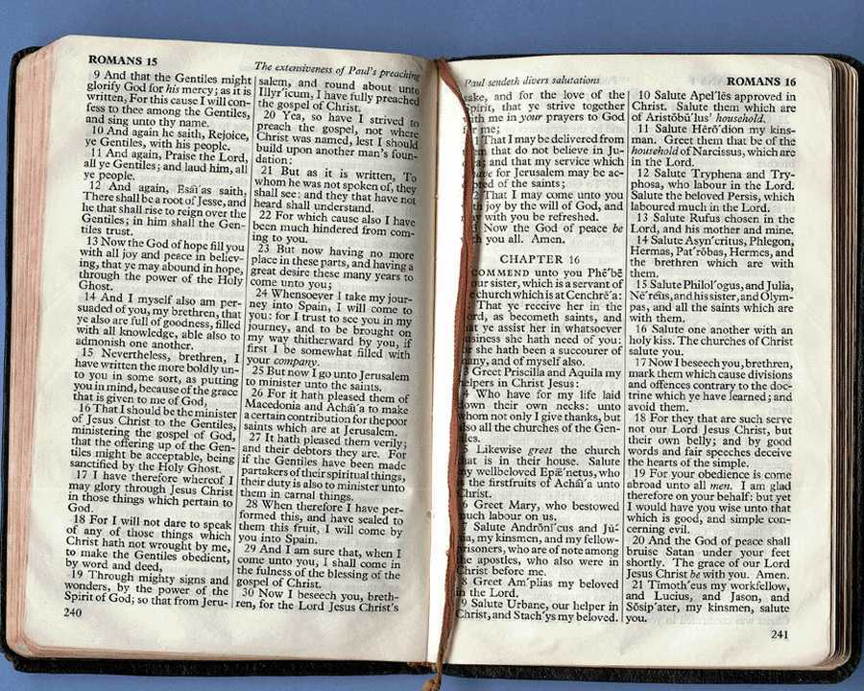
Biblical vs. Pagan Prophecy
437a
Pagan
Jewish
Christian
Dr. Rick Griffith • Jordan Evangelical Theological Seminary • BibleStudyDownloads.org

Slide 2
PROPHECY
PROPHECY
What differences between pagan and biblical prophecy did you notice?

Slide 3
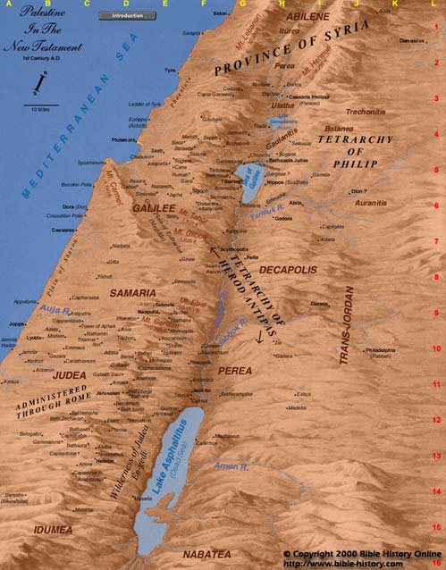
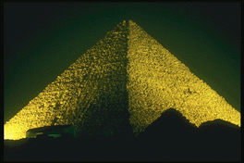
The Way of the Sea
Aram
Israel
Ramoth-Gilead
Megiddo
Judah
Egypt

Slide 4
1 Kings 22
The Aramean Threat
Mesopotamia
Aram
Ben-Hadad
What contrasts are there here between true and false prophecy?
The
Great
Sea
Israel
Ahab
Judah
Jehoshaphat
Persian
Gulf
Egypt

Slide 5

“Oh, Lord, use me as You will
—especially as your advisor!”

Slide 6
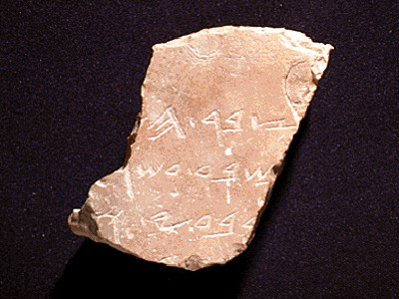
Definitions
437a
Hebrew: nabi
a mouthpiece for God
“spokesman, speaker, prophet”
Greek:
prophetes
“one who speaks for God, proclaiming what God wants to make known”

Slide 7
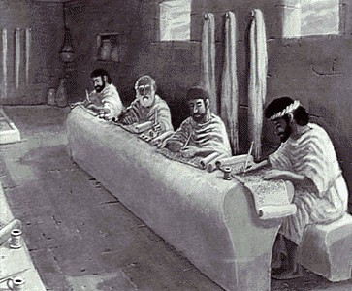
Why Are Requirements of True Prophecy Necessary?
437a
God's character demands accuracy concerning His Word.
False prophets were executed (Deut. 18:21-22).

Slide 8
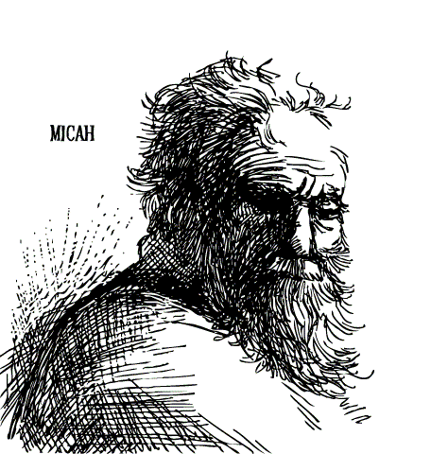
Prophecy of a Prophet given through Moses (Deut. 18:15)
“I will raise up a prophet like you from among their fellow Israelites. I will put my words in his mouth, and he will tell the people everything I command him.”

Slide 9
Tests of a True Prophet (Deut. 18:18-20)
Predictions 100% true
Worships the LORD

Slide 10
Why Are Requirements of True Prophecy Necessary?
437a
God's character demands accuracy concerning His Word.
False prophets were executed (Deut 18:21-22).
Many today claim to utter prophecies from God—so we must be able to discern truth from error.
Equipping comes from knowing God's Word (2 Tim. 3:16-17).

Slide 11

WHY IS GOD'S WORD SO VITAL?
All Scripture is God-breathed and is useful for teaching, rebuking, correcting and training in righteousness, so that the man of God may be thoroughly equipped for every good work.
2 Timothy 3:16-17 (NIV)

Slide 12

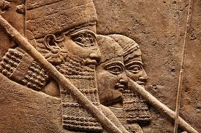
Did Only Israel Have Prophets?
437ag
  Akkadian Prophecies (history as “prophecy”)
“A ruler will arise, he will rule for thirteen years. There will be an attack of Elam against Akkad, and the booty of Akkad will be carried off…. A ruler will arise, his days will be few, and he will not rule the land.”
ANET, 608 (Arnold/Beyer, 208)
Notes:
James Pritchard, Ancient Near Eastern Texts Relating to the Old Testament (Princeton, NJ: Univ. Press, 1969), 608; cited in Arnold/Beyer, Encountering the OT, 345. Mari material also from Arnold/Beyer, 345.

Slide 13
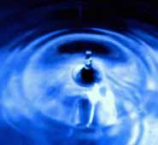
Did Only Israel Have Prophets?
437a
  Akkadian Prophecies (history as “prophecy”)
Babylonian Omen Texts
Lecanomancy (observing oil dropped in water)
“If I throw oil into water and the oil divides itself into two––the sick person will die; for the campaign: the army will not return”
(Arnold/Beyer, 218)
Notes:
James Pritchard, Ancient Near Eastern Texts Relating to the Old Testament (Princeton, NJ: Univ. Press, 1969), 608; cited in Arnold/Beyer, Encountering the OT, 345. Mari material also from Arnold/Beyer, 345.

Slide 14
Did Only Israel Have Prophets?
437a
  Akkadian Prophecies (history as “prophecy”)
Babylonian Omen Texts
Lecanomacy (observing oil dropped in water)
Libanomancy (seeing smoke rise from censer)
Aleuromancy (seeing flour scattered on water)
Extispicy (observing entrails of sacrificed animal)
“If the entire liver is anomalous––Omen of the king of Akkad regarding catastrophe”
(Arnold/Beyer, 218)
Notes:
James Pritchard, Ancient Near Eastern Texts Relating to the Old Testament (Princeton, NJ: Univ. Press, 1969), 608; cited in Arnold/Beyer, Encountering the OT, 345. Mari material also from Arnold/Beyer, 345.

Slide 15
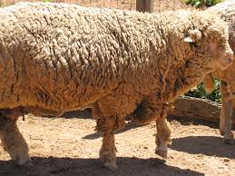
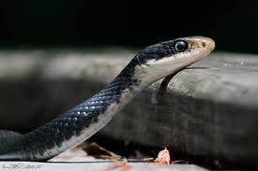
Did Only Israel Have Prophets?
437a
  Akkadian Prophecies (history as “prophecy”)
Babylonian Omen Texts
“If a sheep bites his right foot
––raids of the enemy will be constant against my land.”
“If a snake crosses from the right of a man to the left of a man––he will have a good name.”
“If a snake crosses from the left of a man to the right of a man––he will have a bad name.”
(Arnold/Beyer, 219)
Notes:
James Pritchard, Ancient Near Eastern Texts Relating to the Old Testament (Princeton, NJ: Univ. Press, 1969), 608; cited in Arnold/Beyer, Encountering the OT, 345. Mari material also from Arnold/Beyer, 345.

Slide 16

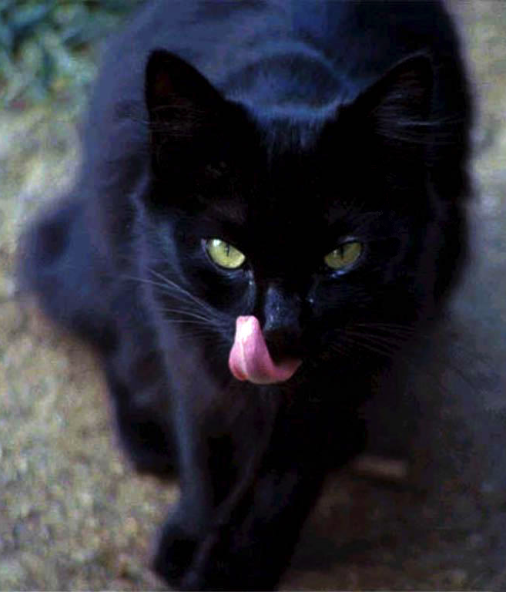
Babylonian Omen Texts
437a
“If a black cat is seen in a man's house––that land will experience good fortune.”
“If a white cat is seen in a man's house––for that land hardship will seize it.”
(Arnold/Beyer, 219)
Notes:
James Pritchard, Ancient Near Eastern Texts Relating to the Old Testament (Princeton, NJ: Univ. Press, 1969), 608; cited in Arnold/Beyer, Encountering the OT, 345. Mari material also from Arnold/Beyer, 345.

Slide 17
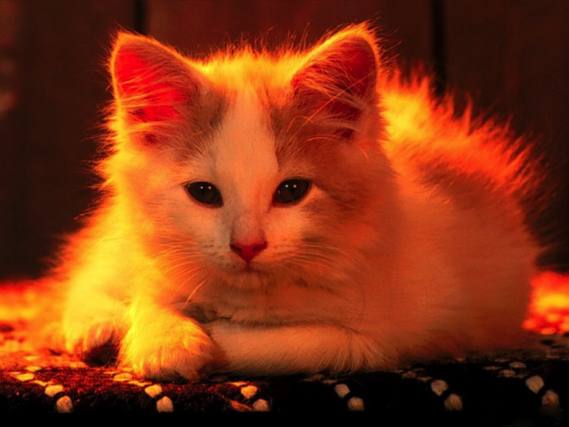

Babylonian Omen Texts
437a
“If a yellow cat is seen in a man's house––that land will have a year of good fortune.”
“If a red cat is seen in a man's house––that land will be rich.”
(Arnold/Beyer, 219)
Notes:
James Pritchard, Ancient Near Eastern Texts Relating to the Old Testament (Princeton, NJ: Univ. Press, 1969), 608; cited in Arnold/Beyer, Encountering the OT, 345. Mari material also from Arnold/Beyer, 345.

Slide 18

Babylonian Omen Texts
437a
“If a multicolored cat is seen in a man's house––that land will not prosper.”
(Arnold/Beyer, 219)
Notes:
James Pritchard, Ancient Near Eastern Texts Relating to the Old Testament (Princeton, NJ: Univ. Press, 1969), 608; cited in Arnold/Beyer, Encountering the OT, 345. Mari material also from Arnold/Beyer, 345.

Slide 19

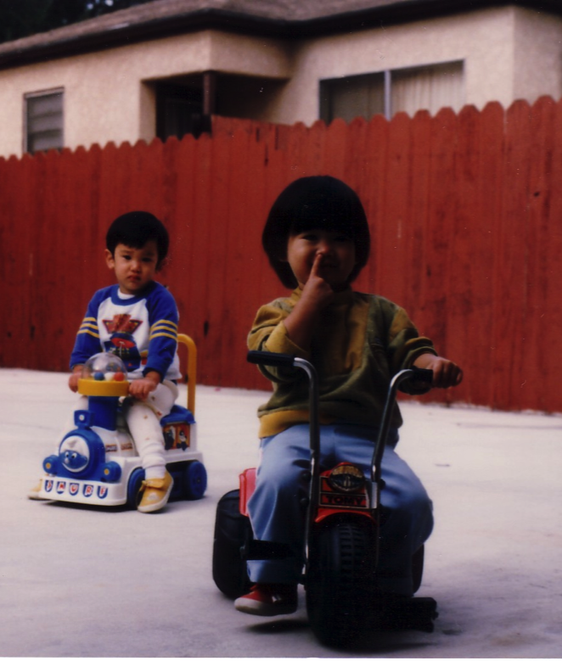
Babylonian Omen Texts
437a
“If a man scrapes dirt from his nose––his adversary will submit [to him].”
(Arnold/Beyer, 219)
Notes:
James Pritchard, Ancient Near Eastern Texts Relating to the Old Testament (Princeton, NJ: Univ. Press, 1969), 608; cited in Arnold/Beyer, Encountering the OT, 345. Mari material also from Arnold/Beyer, 345.

Slide 20
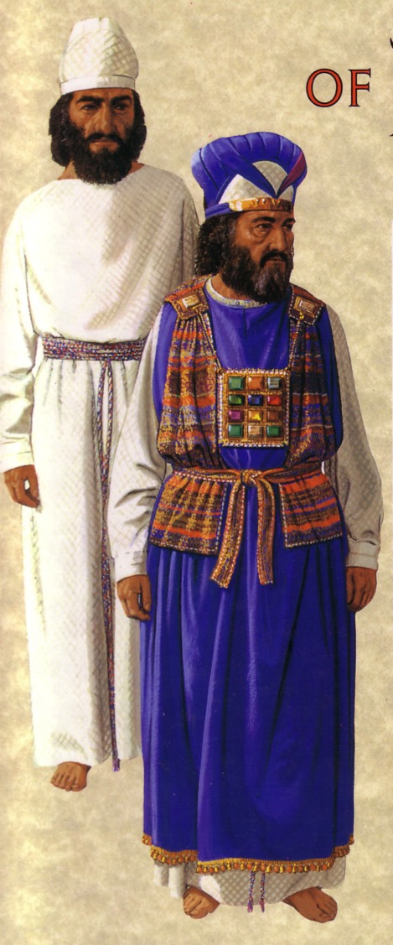
What about Urim & Thummin?
How did this differ from pagan divination?
Objective
God-ordained
Exodus 28

Slide 21
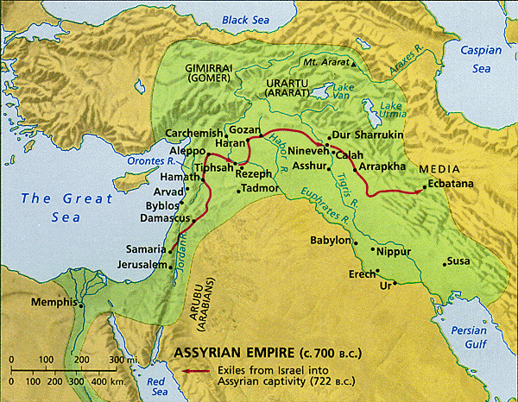
Did Only Israel Have Prophets?
437a
  Akkadian Prophecies (history as “prophecy”)
Babylonian Omen Texts
  Mari Prophecy Texts (1800-1760 BC)
Mari ecstatics told King Zimri-Lim:
Council on expeditions
Warnings on rebellions
Promises of victory over enemies
Encouragements to serve the deity
Mari
Notes:
James Pritchard, Ancient Near Eastern Texts Relating to the Old Testament (Princeton, NJ: Univ. Press, 1969), 608; cited in Arnold/Beyer, Encountering the OT, 345. Mari material also from Arnold/Beyer, 345.

Slide 22
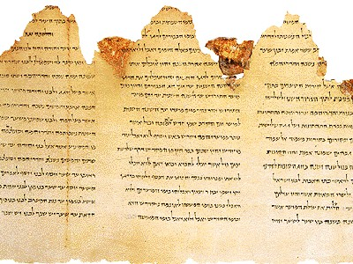
Common Elements of
True & False Prophecy
437a
Call
Signs
Content
Style

Slide 23
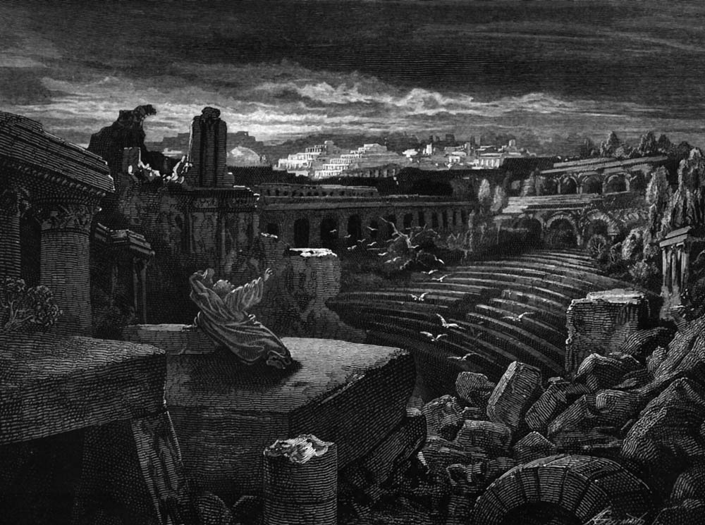
Similarity in Content
"Chemosh said to me, 'Go, take Nebo from Israel.' So I went by night, and fought against it from break of dawn till noon; and I took it and slew all in it, seven thousand men and women…”
King Mesha Stele, lines 11-12
(830 BC “victory over Omri” in 2 Kings 3)
—Arnold/Beyer, 162; cf. ANET (1969), 320-21

Slide 24
What modern superstitions can you think of?

Slide 25
How can God's people know his will?
The advice of the world often looks very attractive!
So God gave Israel many ways to tell if a message was from him.

Slide 26
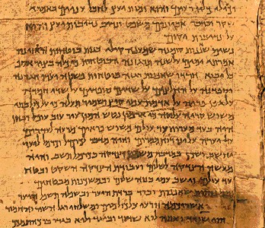
How are Prophets Different?
437b-c
Biblical
Pagan
Unsolicited
Divination
Divine call
Prophet himself
Anywhere
Cultic place
Forth-telling
Fore-telling

Slide 27
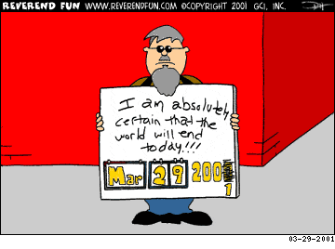
False prophecies change
I am absolutely certain that the world will end today!!!

Slide 28
How are Prophets Different?
437cb
Biblical
Pagan
Godly character
Immoral
Mostly men
Mostly women
Inspired
Own thoughts
Own style
Demon possessed

Slide 29
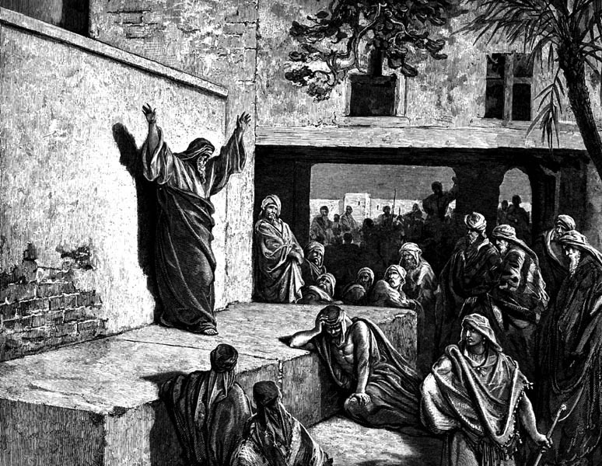
Jeremiah (25:11-12) vs. Hananiah (28:2-3)
True
False
“You'll
stay 70
years!”
“You'll return in 2 years!”
Lived 23 years more (51:64)
Died 2 months later (28:17)

Slide 30
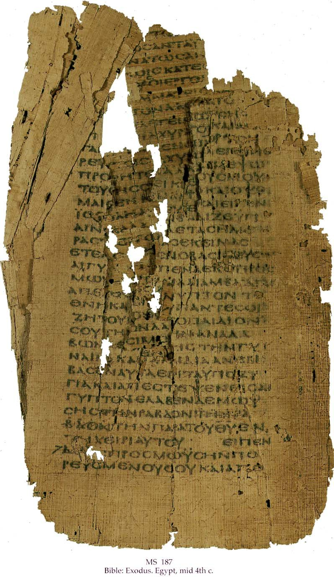
How are Prophets Different?
437d-e
Biblical
Pagan
Godly Motive
Financial Gain
Original messages
Plagiarism
100% accurate
Errors of fulfillment
Persecuted
Exalted

Slide 31

Contrasts Between Biblical & Pagan Prophecy
437e
Thought Questions:
Which difference between these two types was most significant to you?
Why?

Slide 32

What is Prophecy?
“knowing this first of all, that no prophecy of Scripture comes from someone's own interpretation. For no prophecy was ever produced by the will of man, but men spoke from God as they were carried along by the Holy Spirit”
2 Peter 1:20-21 (ESV)

Slide 33
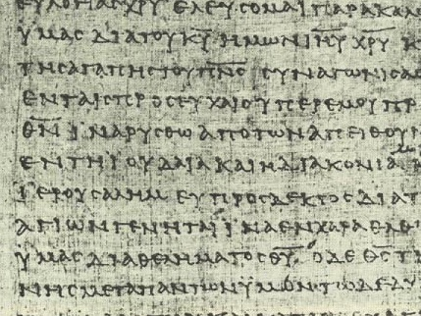
DISCUSSION GROUP A
437f
What should a church do with a so-called prophet who:
predicts false events
falls into moral sin, or
leads people to false gods?

Slide 34

DISCUSSION GROUP B
437f
Is prophecy “telling something that God has spontaneously brought to mind” (Wayne Grudem)?
Can true prophecy contain errors?
Why or why not?

Slide 35

DISCUSSION GROUP C
437f
Do you think Grudem's teaching that all believers can prophesy has biblical support (cf. 1 Cor. 12:29 vs. 14:1)?
Support your answer.

Slide 36
DISCUSSION GROUP D
437f
What would you say to someone who claimed that his prophecy is inspired but not equal in authority to Scripture?
Are there different levels of inspiration or inerrancy?

Slide 37
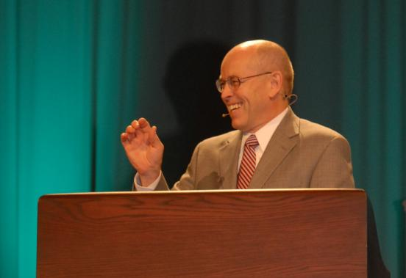
Wayne Grudem's
Definition of Prophecy
“telling something that God has spontaneously brought to mind”
“Why Christians Can Still Prophesy” Christianity Today (16 Sept 1988), 29

Slide 38
Summary of Prophetic Views
666
Grudem's View
Biblical View
Prophecy is declaring anything (true or false) that the Spirit brings to one's mind
Prophecy is declaring God's inspired and inerrant revelation to others
The above definition was invented
in 1988 by Wayne Grudem
The above definition has been the
teaching of the church for 20 centuries
OT prophets are parallel to NT apostles
OT prophets are parallel to NT prophets
God changed the definition of prophecy
from the OT to the NT
God kept the meaning of prophecy consistent between the two testaments
God gives some prophecies with errors
God gives all prophecies without errors
(2 Pet. 1:20-21)
Any believer can prophesy
Only those with the gift of prophecy can prophesy (1 Cor. 12:29)
There's two kinds of NT prophecy
(fallible and infallible)
There's one kind of NT prophecy
(infallible)
Fallible prophecy can be inspired
Fallible prophecy is false prophecy
(Deut. 13:1-5; 18:14-20)
God sometimes lies
God always tells the truth since He cannot lie (Heb. 6:18)
Notes:
Wayne A. Grudem, “Why Christians Can Still Prophesy: Scripture Encourages Us to Seek this Gift yet Today,” Christianity Today [September 16, 1988] 29; cf. Grudem's 1988 book, The Gift of Prophecy.

Slide 39

Let's hold God's Word in the highest regard!
In our personal devotional lives
In our families
In our work
In our Bible studies (including tonight)

Slide 40
Black

Slide 41
Summary of Prophetic Views
666
Grudem's View
Biblical View
Prophecy is declaring anything (true or false) that the Spirit brings to one's mind
Prophecy is declaring God's inspired and inerrant revelation to others
The above definition was invented
in 1988 by Wayne Grudem
The above definition has been the teaching of the church for 20 centuries
OT prophets are parallel to NT apostles
OT prophets are parallel to NT prophets
God changed the definition of prophecy from the OT to the NT
God kept the meaning of prophecy consistent between the two testaments
God gives some prophecies with errors
God gives all prophecies without errors
(2 Pet. 1:20-21)
Any believer can prophesy
Only those with the gift of prophecy can prophesy (1 Cor. 12:29)
There's two kinds of NT prophecy
(fallible and infallible)
There's one kind of NT prophecy
(infallible)
Fallible prophecy can be inspired
Fallible prophecy is false prophecy
(Deut. 13:1-5; 18:14-20)
God sometimes lies
God always tells the truth since He cannot lie (Heb. 6:18)

Slide 42
Tongues versus Prophecy
NTS 161m
Contrasts | Tongues | Prophecy
Speaker's Control | Inferior (14:5a) | Superior (14:1)
Relation to Other Gifts | The least important gift (12:28) | The second most important gift (12:28)
Language Used | Foreign (14:10) | Vernacular (14:19)
Corollary Gift | Interpretation of tongues (12:30; 14:27-28) | Discerning of spirits (12:10; 14:29)
Speaker's Knowledge of the Language Being Spoken | Unknown: “utters mysteries with his spirit…my spirit prays but my mind is unfruitful” (14:2b, 14) | Known: “pray with my spirit [and] with my mind” (14:15, 19)
Value (without Interpretation) | Harmful: people cannot understand and thus are not edified (14:16-17, 23, 28) | Great: people can understand and thus are edified (14:5b, 24-25)
Edification (without Interpretation) | Self only (14:4a; cf. 10:24; 12:7, 11) | Entire church (14:4b)

Slide 43
Tongues versus Prophecy
NTS 161m
Contrasts | Tongues | Prophecy
Direction of Speech is to… | God (14:2) | Men (14:3)
Result in Others | Revelation, knowledge, prophecy, word of instruction (14:6) | Strengthening, encouragement, and comfort (14:3b)
Type of Communication | Speaking (14:6), prayer (14:14), praise (14:16), singing? (14:15b) | Foretelling the future, “forthtelling” or declaring doctrinal truth (14:19)
Purpose | Sign to unbelieving Jews (14:21-22a) | Message to believers (14:22b)
Limitations | Two or three tongues messages in each service (14:27a), speak in turn (14:27b), someone must interpret (14:27c-28) | Two or three prophetic messages in each service (14:29a), speak in turn (14:30-31), weigh what is said (14:29b, 32)
Exhortation | Negative: Do not forbid tongues (14:39b) | Positive: Be eager to prophesy (14:39a)
Agent of Cessation | Self: middle voice (13:8b) | Someone other than self: passive voice (13:8a)

Slide 44
Teaching versus Prophecy
NTS 161h
Contrasts | Teaching | Prophecy
Value | Inferior: Teaching is listed after prophecy in the leadership structure of the church at Antioch (Acts 13:1) | Superior: Prophecy has a long OT history of declaring an uninterpreted word of God (2 Pet. 1:20-21) whereas teachers must interpret it
Relation to the Other Gift | A less important gift: listed after prophecy in the priority of the gifts (1 Cor. 12:28) | The second most important gift, superseded only by apostleship (1 Cor. 12:28)
Authority | Less authoritative than prophecy since the teacher must interpret the Bible | More authoritative than teaching as the spoken word is divinely inspired & uninterpreted (2 Pet. 1:20-21)
Source of Truth | God's Word (Col. 3:16) | God's Spirit (2 Pet. 1:21)
Revelatory Nature | Uninspired explanation of already revealed truth (Acts 15:35; 11:12, 26; Rom. 2:21; 15:4; Heb. 5:12) | Inspired foretelling the future or “forth-telling” (declaring doctrinal truth) received by revelation (1 Cor. 14:19, 26, 29-30; Eph. 3:5)

Slide 45
Teaching versus Prophecy
NTS 161h
Contrasts | Teaching | Prophecy
Style | Systematic | Spontaneous (Acts 11:28; 21:4, 10-11)
Limitations | No limitation on teaching is given in church services | Two or three prophetic messages per service (14:29a), speak in turn (14:30-31), weigh what is said (14:29b, 32)
Leadership Requirements | Required of elders (1 Tim. 3:2; 5:17; Tit. 1:9) since the church needs continued teaching of truth through its history | Not required of elders as this would provide too high a standard; also, revelation need not continue after the canon is complete (Rev. 22:18-19)
Foundation for the Church | No—the foundation is not interpreted messages but divinely spoken and written messages from God to apostles and prophets | Foundational with apostleship (Eph. 2:20), meaning that it need not continue through Church history as a foundation is once-for-all (e.g., no apostles today)
Cessation | No hint is given in the NT that this gift has ceased or will do so in the church age | The gift will cease by someone other than self: passive voice (1 Cor. 13:8a; cf. Spiritual Gifts notes, 29)

Slide 46
Black

Slide 47


OT Survey link at BibleStudyDownloads.org
Get this presentation for free!
Notes:
OT Backgrounds (ob)

