Slide 1
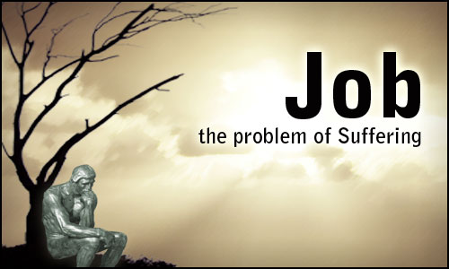
The problem of suffering
356
Job
Dr. Rick Griffith • Jordan Evangelical Theological Seminary • BibleStudyDownloads.org
Notes:
Job addresses the universal issue of how things go wrong in our world.

Slide 2
Key Word
356
343
Incomprehensibility
Job
Notes:
The human mind strives to answer why "righteous" people experience tragedy—but this answer is shrouded in darkness and thus is not comprehended by anyone except God.
We think God owes us a fair answer that makes sense to us, but we actually reject any answer he gives us because we think we deserve a life without difficulty.

Slide 3
Theme
356
God's Incomprehensibility Explains Righteous Suffering
Job
Notes:
Our priority is understanding things and that people understand us—but God is not concerned that he is understood. In the book of Job, he does not answer the questions directed at him.

Slide 4
Key Verse
356
(Elihu speaking) "The Almighty is beyond our reach and exalted in power; in his justice and great righteousness, he does not oppress. Therefore, men revere him, for does he not have regard for all the wise in heart?"
(37:23-24 NIV).
Job
Notes:
Elihu seems to get it, though he was the youngest of Job's critics. Interestingly, in Job 42 God tells Job to pray for the three friends and gives Elihu a pass. The focus of these key verses is that, despite the craziness and injustice and difficulties of this world, God is not oppressing us. He just does not rescue us from experiencing trials.

Slide 5

Kingdom Statement
343
God must have sovereign rule over man because He is incomprehensible to man in regard to the cause for suffering and other aspects of creation (38–42).
Job
Notes:
Some see the key theme of this book as God's sovereignty—and perhaps they are right—but this course uses that key word for Daniel. The book of Job teaches that God rules over all, even when we think he ought to be doing a better job.

Slide 6

Summary Statement
356
346
The proper response to righteous suffering is submission to God rather than questioning his incomprehensibility and sovereignty.
Job
Notes:
We think we need answers to our questions. But, in reality, we need to accept the fact that God has the answers but is not telling.

Slide 7

Covenant
347a
Even though he lived before God's covenant with Abraham, Job still offered sacrifices for any private cursing of his sons (1:4-5) with God's blessing (1:1-3).
Job
Notes:
Another word for "covenant" is "promise." Righteous Job took the role of a priest for his family based on the promise of God's righteous character.

Slide 8

Redemption
347a
As Job gained strength in trial since his Redeemer would vindicate him (19:25-26), so today believers can endure due to their future redemption (Romans 8:23).
Job
Notes:
Job declared, "“But as for me, I know that my Redeemer lives,
and he will stand upon the earth at last.
26 And after my body has decayed, yet in my body I will see God!" (19:25-26).
Here he amazingly saw resurrection in 2000 BC—that after his earthly body decayed, God would renew that body so he could see God bodily!

Slide 9

Messiah
347a
Job's confession of a Redeemer (19:25) and need for a mediator (9:33; 25:4; 33:23) are fulfilled in Christ (Heb. 4:15).
Job
Notes:
Job knew that he needed a ransom for his sin by someone between him and God to argue his case. Jesus alone fills the bill.

Slide 10
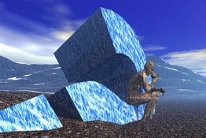
JOB
356
God’s Incomprehensibility Explains Righteous Suffering
Righteous Suffering |  |  | Unsuccessful Dialogue |  |  |  | Restoration
Chapters 1–2 |  |  | Chapters 3–41 |  |  |  | Chapter 42
Dilemma |  |  | Debate |  |  |  | Deliverance
Ruin |  |  | Reasons |  |  |  | Repentance
Prose |  |  | Poetry |  |  |  | Prose
Heaven and Earth |  |  | Land of Uz (North Arabia) |  |  |  | Heaven and Earth
Job’s Character 1:1-5 | Satan’s Assaults 1:6–2:10 | Job’s Friends 2:11-13 | Cycles 3–26 | Job 27–31 | Elihu 32–37 | God 38–41 | Obedience 42:1-9 | Blessings 42:10-17
Patriarchal Times
Notes:
The first and last sections of Job are bookends with most of the writing addressing the struggle to find out the reason for Job's suffering.

Slide 11
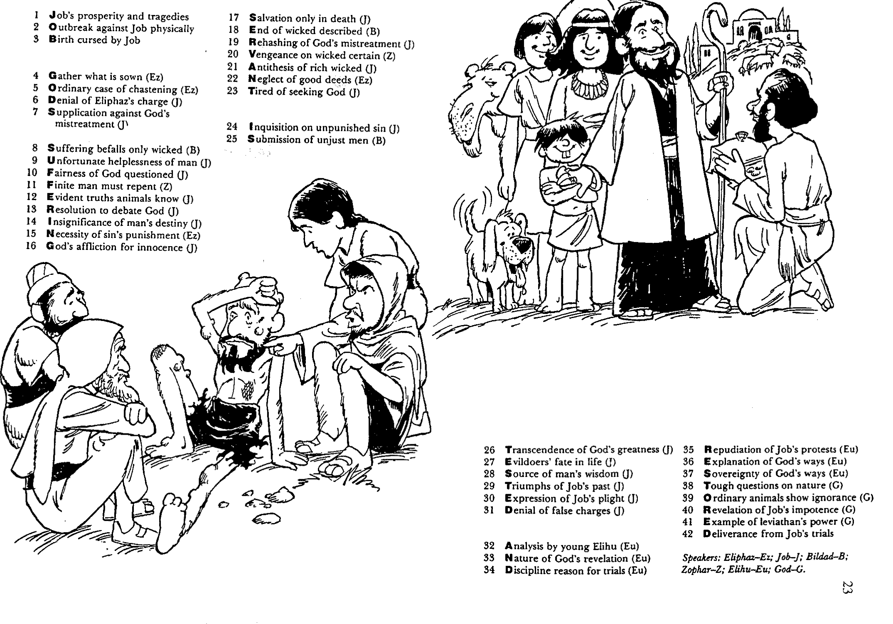
Barry Huddleston, The Acrostic Summarized Bible (Grand Rapids: Baker, 1992)
1 Inception of the world
2 Newlyweds placed in Eden
3 Temptation and man's fall
4 Hatred and first murder
5 Entire genealogy of Adam
6 Lessons on proper priorities
7 Outline for personal relationships
8 Faith of the centurion
29 Genealogy of Jesus Christ
30 Opposition of King Herod
31 Spirit's descent upon Jesus
32 Power over Satan's temptations
33 Expounding Sermon on Mount
34 Lessons on proper priorities
35 Outline for personal relationships
36 Faith of the centurion
9 Matthew's call from Jesus
10 Apostles sent to preach
11 Testimony about John's message
12 True Messiah called demonic
13 Hidden message of parables
14 Execution of the Baptist
15 Wisdom is answering Pharisees
37 Matthew's call from Jesus
38 Apostles sent to preach
39 Testimony about John's message
40 True Messiah called demonic
41 Hidden message of parables
42 Execution of the Baptist
43 Wisdom is answering Pharisees
Job
16 Keys of the kingdom
17 Impact of Jesus' transfiguration
18 Need for true forgiveness
19 Grounds for divorce clarified
20 Opportunities in the vineyard
21 Fig tree is cursed
44 Keys of the kingdom
45 Impact of Jesus' transfiguration
46 Need for true forgiveness
47 Grounds for divorce clarified
48 Opportunities in the vineyard
49 Fig tree is cursed
22 Taxes paid to Caesar
23 Hypocrisy denounced by "woes"
24 Events of second coming
25 Judgment of the nations
26 Events on Calvary's eve
27 Way of the cross
28 Savior's resurrection and commission
50 Taxes paid to Caesar
51 Hypocrisy denounced by "woes"
52 Events of second coming
53 Judgment of the nations
54 Events on Calvary's eve
55 Way of the cross
56 Savior's resurrection and commission
Notes:
Huddleston is correct here in identifying Job's godly character that God shows to be able to overcome the trials.

Slide 12

Be Submissive
Job
Dr. Rick Griffith • Crossroads International Church Singapore
CICFamily.com • BibleStudyDownloads.org
Notes:
What should we do when we don't comprehend God's purposes? Job tells us to accept his ways—especially when we cannot figure out his reasons.

Slide 13
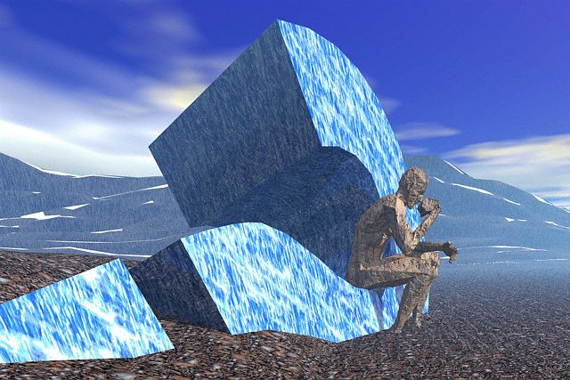
1. Why does man worship God?
More Defined...
Roy Zuck, A Biblical Theology of the OT, 219
2. How will man react to God when God seems unconcerned about his problems?
Notes:
The question in the book of Job is NOT “Why do the righteous suffer?” because this question is actually never answered in the book. Too often we say that Job teaches that righteous suffering produces character in us, but it never really says that. This is true theologically, but it isn’t taught in Job. To say such would be reading James 1:2-4 into Job.

Slide 14
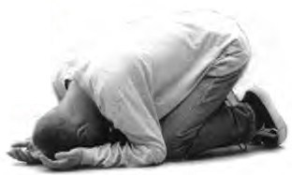
What is the proper response to righeous suffering?
Notes:
How should we act when we can't figure out seemingly undeserved difficulty?

Slide 15

I. The Setting: Suffering sometimes comes when we haven’t done anything wrong (Job 1–2).
Notes:
We haven’t deserved it, but at times pain comes nonetheless.

Slide 16

II. The Debate: We struggle with righteous suffering until God tells us to rest in his incomprehensibility
(Job 3–41).
Notes:
Wrestling with the reason for pain is natural until God says he won't tell.

Slide 17

III. The Resolution: Our proper response is to submit to God (Job 42).
Notes:
We should surrender to the Lord rather than fight him.

Slide 18

Main Idea of
JOB
Submit to God’s incomprehensibility rather than try to figure suffering out.
Notes:
Yield to the LORD by recognizing that he is under no obligation to tell you his purposes in difficulty.

Slide 19
Application
356
APPLICATION
During righteous suffering…
Do not question the reason for your plight.
Submit to God by trusting in God's wisdom.
Notes:
Do not demand a response from God to your questions that he never promises to answer.
The issue is not knowing God’s answer—which you probably wouldn’t accept anyway—but the issue is faith in him and his ways despite your ignorance.
What issue are you going through now?
Is your pain really righteous suffering?
If you need to repent, please go ahead.
If you don’t need to repent, don’t pretend you do.
How are you trying to figure your suffering out?
“If only I knew…” assumes that if you knew right, you would act right.
Are you finding the advice of friends about as helpful as the counsel of Job’s friends?
How can you submit to God by trusting in God’s wisdom?

Slide 20
Black

Slide 21

Introduction to Poetic Literature

Slide 22

340
History
POETRY
Job
Psalms
Proverbs
Ecclesiastes
Song of Solomon
Prophecy
Genesis
Exodus
Leviticus
Numbers
Deuteronomy
Isaiah
Jeremiah
Lamentations
Ezekiel
Daniel
Joshua
Judges
Ruth
1 Samuel
2 Samuel
1 Kings
2 Kings
1 Chronicles
2 Chronicles
Ezra
Nehemiah
Esther
Hosea
Joel
Amos
Obadiah
Jonah
Micah
Nahum
Habakkuk
Zephaniah
Haggai
Zechariah
Malachi
Notes:
The 5 poetic books show where the people of the historical books obey or disobey the exhortations of the prophetical books.
In English, the 5 books progressively have longer names.
_______
OS-18-Wisdom & Poetry-22
OS-18-Job-22

Slide 23

351
Wisdom vs Poetic
Contents of Writing
Style of Writing
Principle to live by
Repetition of Thought
Logic (argument, intellect, mind)
Total Being
Job, Proverbs, Ecclesiastes
Job, Proverbs, Ecclesiastes, Psalms, Song of Songs
Smaller Category (Subset)
Larger Category
Notes:
Often we use the terms wisdom and poetic interchangeably, but there are some important differences.
________
OS-18-Wisdom & Poetry-23
OS-18-Job-23

Slide 24

Walk Thru the Poetical Books
355
Ecclesiastes……..Vanity
Song…..Love in Marriage
“Wisdom can
overcome life’s vanities”
“Wisdom can
maintain a godly marriage”
Proverbs 30:31 “Charm is deceitful and beauty is vain, but a woman who fears the LORD will be praised.”
Proverbs 5:18 “Let your fountain be blessed, and rejoice in the wife of your youth.”
Proverbs............Wisdom
“The fear of the LORD
is the beginning of wisdom.”
Psalm 111:10 “The fear of the LORD is the beginning of wisdom; A good understanding have all those who do His commandments…”
Psalms..............Worship
“Worship develops the
fear of the LORD”
Job 42:2 “I know that You can do all things, and that no purpose of yours can be thwarted.”
Source:
Walk Thru the Bible Ministries
Job…...........Sovereignty
“Seeing God’s Sovereignty
causes us to worship”
Notes:
A logical progression goes from Job to Solomon's Song of Songs.
____________
OS-18-Wisdom & Poetry-24
OS-18-Job-24
OS-19-Psalms-22
OS-20-Proverbs-26
OS-21-Ecclesiastes-22
OS-22-Song-22

Slide 25

The OT Poetic Books
Job: how to suffer
Psalms: how to pray
Proverbs: how to relate
Song: how to love
Ecclesiastes: how to live
Notes:
OS-19_Wisdom & Poetry-23
OS-18-Job-25
OS-19-Psalms-23
OS-20-Proverbs-27
OS-21-Eccles-21
OS-22-Song-23

Slide 26
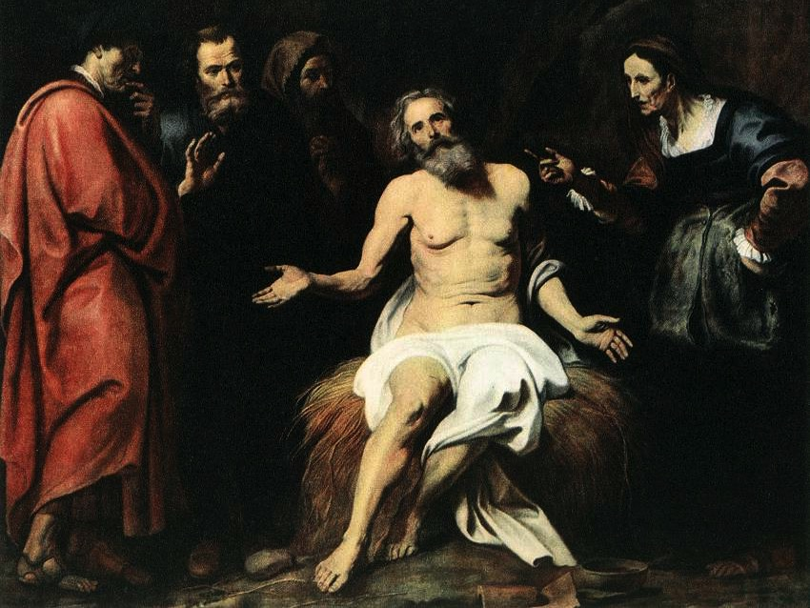

Title
357
Job (bAYai) probably means "Where is (my) Father?"
W. F. Albright
The Amarna Letters
Egyptian Execration texts

Slide 27
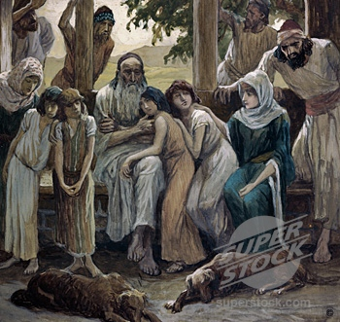
Authorship
357
External Evidence
The Syriac Bible places the book between the Pentateuch & Joshua due to the belief that Moses was the author, but the actual author remains unknown.
That Job was a real person is evident outside the book in Ezekiel 14:14, 20 & James 5:11.
Internal Evidence
Because of the authentic empathy sensed within the book, it is likely that the author experienced something of Job's suffering himself.
He was also obviously an Hebrew who had intimate knowledge of divine sovereignty & was steeped in the wisdom techniques & tradition, evident in the theme and literary devices employed.
Job himself may well have been the author, although this cannot be determined with certainty.

Slide 28
Date
357
No consensus exists among ancient rabbis or modern scholars, but several factors argue for a very early setting during patriarchal times, especially in the prose prologue (1:1–2:13) & epilogue (42:7-17).
No mention is made of the Law or Exodus & Job acted in a priestly role (1:5).
His wealth was measured in animals rather than gold.
Job lived a patriarchal life span (lived 140 years after his restoration, dying perhaps at 180-210 years old).
Job also uses pre-Law names for God: Shaddai ("the Almighty"; 5:17), and Yahweh ("the LORD"; 1:21).

Slide 29
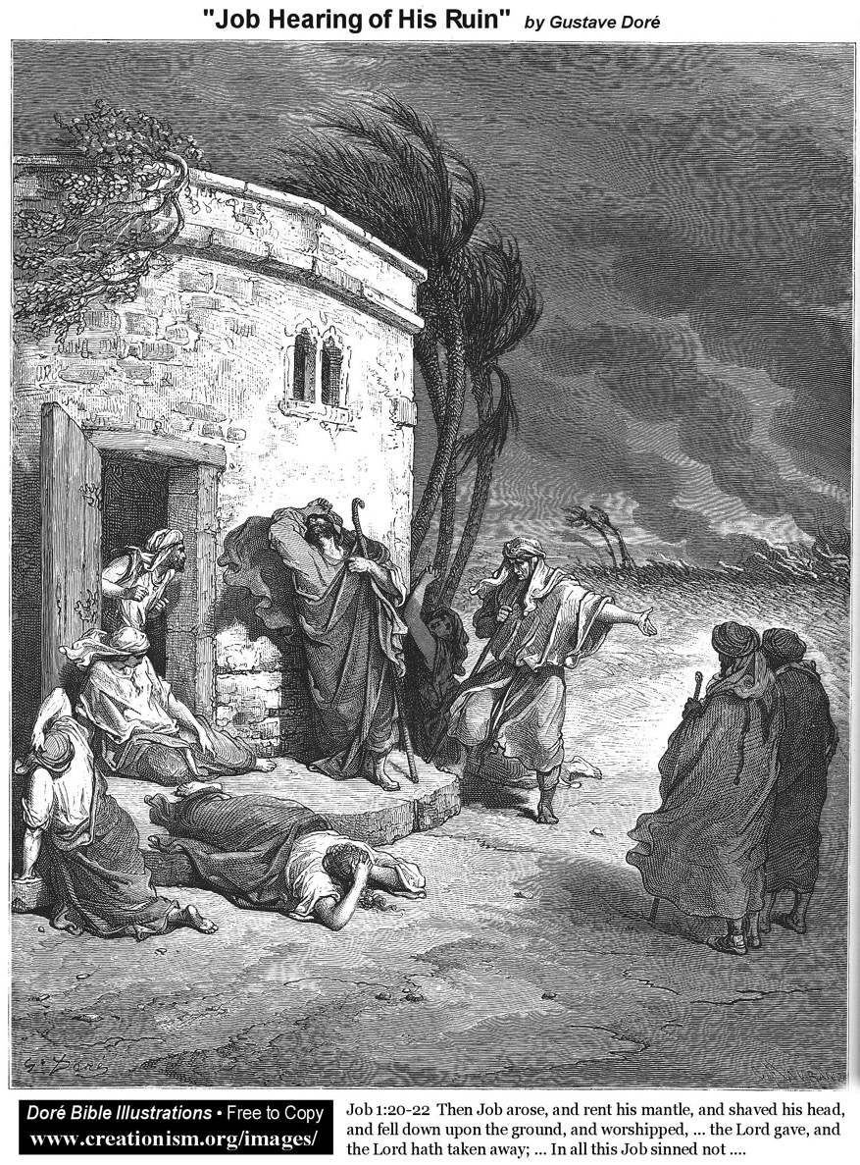
Recipients
357
The specific Jews to whom the account is originally penned can only be speculated.

Slide 30
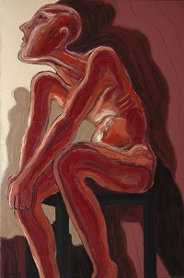
Occasion
357
Some have proposed an exilic or post-exilic date to suggest that the book was written to answer why Israel went into captivity.
But this makes little sense since Job concerns why the righteous suffer—not the unrepentant nation which received the due penalty for its sins!
The real reason the author sat down to pen this masterpiece must for now be shrouded in mystery until more information comes forth.

Slide 31

Did Job really exist?
358
No (e.g., Tremper Longman) | Yes (e.g., Rick Griffith)
It is only a thought experiment | Why not a real experiment? Job is parallel to the real men Noah & Daniel (Ezek 14:14, 20)
It is written in stylistic poetry | Why can’t Job have real poetic dialogue (cf. Song)? Many societies do this.
Job had seven sons and three daughters | Job could have actually had the ideal number of children.
Job is one of the last books of the OT— at least in its final form | What textual support shows that Job a late date? It has unity (cp. Job 1 & Job 42).
Ha Satan (“The Accuser”) in Hebrew is not a definite name as it has the article (“the”) | Portuguese has a definite article in names; Satan is the Accuser (Rev 12:10).
Notes:
Longman arguments given 19 Aug 2019 seminar, Singapore Bible College

Slide 32
Quiz: Why do we suffer?
Match the religion with its answer below.
Islam
Desire
Buddhism
There is no suffering
Hinduism
Punishment for sin
Judaism
Karma (former life)
Prosperity Gospel
God’s will (fatalism)
Christian Science
Not addressed
Christianity
God will not tell

Slide 33
JOB
356
God’s Incomprehensibility Explains Righteous Suffering
Righteous Suffering |  |  | Unsuccessful Dialogue |  |  |  | Restoration
Chapters 1–2 |  |  | Chapters 3–41 |  |  |  | Chapter 42
Dilemma |  |  | Debate |  |  |  | Deliverance
Ruin |  |  | Reasons |  |  |  | Repentance
Prose |  |  | Poetry |  |  |  | Prose
Heaven and Earth |  |  | Land of Uz (North Arabia) |  |  |  | Heaven and Earth
Job’s Character 1:1-5 | Satan’s Assaults 1:6–2:10 | Job’s Friends 2:11-13 | Cycles 3–26 | Job 27–31 | Elihu 32–37 | God 38–41 | Obedience 42:1-9 | Blessings 42:10-17
Patriarchal Times

Slide 34
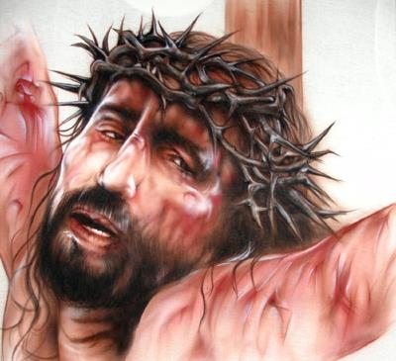
Isa 53:4-5 Surely he has borne our griefs and carried our sorrows; yet we esteemed him stricken, smitten by God, and afflicted. But he was wounded for our transgressions; he was crushed for our iniquities; upon him was the chastisement that brought us peace, and with his stripes we are healed.
Notes:
Job and Jesus are parallel in terms of innocent suffering.
_______________
OB-28-Healing-50
OS-19-Job-34
OS-23-Isaiah49-59—slide 54

Slide 35
Does Isaiah 53 speak of atonement for sin or physical healing?
Atonement for Sin | Physical Healing
Believers will face physical death but not spiritual death | Matthew 8:14-17 applies Isaiah 53:4 to physical healing
Christ came to die for our sins—not for sickness (1 Cor 15:3) | 1 Cor 15:3 refers to complete future deliverance from sin and sickness
If atonement and healing were integrated, then if we fall sick, we would doubt our salvation | Sickness closely links with effects of our fallen nature, but God forgives all our sins and heals all our diseases
Philip applied Isaiah 53 to Christ’s atonement for sin when speaking with the Ethiopian eunuch (Acts 8) | Healing and atonement of sin are not the same, yet as sins are atoned for, healing and restoration comes
Jesus quoted Isaiah 53 in Matthew 8:14-17 by using the Greek term for take away and not carried | The root word for heal in Isa 53:5 (rapha), could mean healing physically or spiritually
Peter’s quote of Isaiah 53 referred to spiritual healing | The word griefs in Isa 53:4 (choliy) is used mostly of physical healing
Notes:
Job and Jesus are parallel in terms of innocent suffering.
_______________
OB-28-Healing-51
OS-19-Job-35
OS-23-Isaiah49-59—slide 55
Adapted from a student project at Singapore Bible College

Slide 36
Job | Suffering Servant
Job is “my servant” (Job 1:8; 2:3) | God praises the Suffering Servant as he does Job (Isa 42:1)
Job is “stricken” of God (Job 19:21) | The people consider the Servant to be “stricken” of God (Isa 53:4)
Job is chastised by the Almighty (Job 5:17) | The same “chastisement” is predicted of the Servant (Isa 53:5)
Job is “despised” by compatriots (Job 19:18) | The Servant is despised and not esteemed (Isa 53:3)
Job’s friends “forget” him and his brethren “stay away” from him (Job 19:13-14) | The Suffering Servant’s compatriots “hide their faces” (Isa 53:3)
Job is “smitten” on the “cheeks” (Job 16:10) | The Servant also is “smitten” on the “cheeks” (Isa 50:6, 53:4).
Job records his experience as, “They abhor me, they flee far from me, and spare not to spit in my face” (Job 30:10, cf. Job 17:6) | The Servant does not hide his face from “spitting” (Isa 50:6 ), which is a rare word (3x) that only occurs in Job (2x) and Isaiah.
The above comparisons between Job & Suffering Servant are taken from Andrew Perry, “The Suffering Servant of Isaiah and the Suffering of Job” at http://www.christadelphian-ejbi.org/presentations/job.pdf
Notes:
Job and Jesus are parallel in terms of innocent suffering.
_______________
OB-28-Healing-52
OS-19-Job-36
OS-23-Isaiah49-59—slide 56
Adapted from a student project at Singapore Bible College

Slide 37
Job | Suffering Servant
Job claims that what has befallen him was “not for any violence” in his hands (Job 16:17) | This phrase occurs once elsewhere in Isaiah 53:9, “because he had done no violence”
Job asserts that his prayer was pure (Job 16:17) | No guile was found in the Suffering Servant’s mouth (Isa 53:9, cf. Job 31:5)
Job says that upright men are astonished or appalled at what has happened to him (Job 17:8) | “Many were appalled at thee” (Isa 52:14)
Job says that the mockers will not be “exalted” (Job 17:4) | The Suffering Servant himself is the one who would be exalted (Isa 52:13)
Job wants someone to “contend” with him ( Job 13:19) | The same question is posed by the Suffering Servant: “Who will contend with me?” (Isa 50:8)
Job complains that he is being eaten by moths (Job 13:28) | In contrast, the adversaries of the Suffering Servant would be eaten by moths (Isa 50:9)
Job rests his case with God (Job 16:19) | So does the Suffering Servant (Isa 49:4)
Notes:
Job and Jesus are parallel in terms of innocent suffering.
_______________
OB-28-Healing-53
OS-19-Job-37
OS-23-Isaiah49-59—slide 57
Adapted from a student project at Singapore Bible College

Slide 38
Be Submissive
Job
Dr. Rick Griffith • Crossroads International Church Singapore
CICFamily.com • BibleStudyDownloads.org

Slide 39
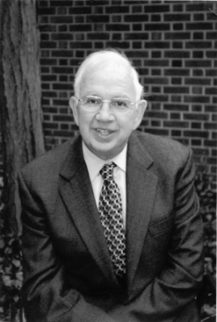
Rabbi Harold Kushner
Notes:
Rabbi Kushner was a Jewish rabbi who cared for his congregation. His people had the same kinds of issues we all face––

Slide 40
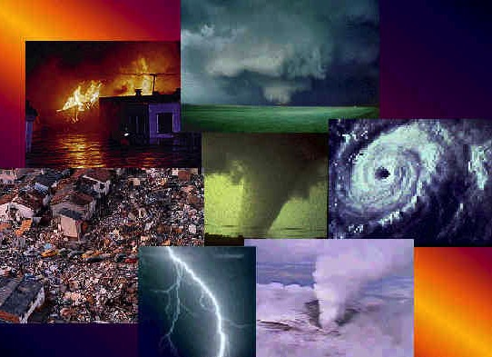

When
BAD
Things Happen to
GOOD
People
Small Group: Do you agree with this title?
Notes:
—natural disasters, sickness, divorce, death, problems with children, etc. In 1981 this led him to write the book When Bad Things Happen to Good People.
Random House says of this book, "When Harold Kushner's three-year-old son was diagnosed with a degenerative disease and that he would only live until his early teens, he was faced with one of life's most difficult questions: Why, God? Years later, Rabbi Kushner wrote this straightforward, elegant contemplation of the doubts and fears that arise when tragedy strikes. Kushner shares his wisdom as a rabbi, a parent, a reader, and a human being. Often imitated but never superseded, When Bad Things Happen to Good People is a classic that offers clear thinking and consolation in times of sorrow."
So what is his "clear thinking"? His thesis is that God is doing all He can to help people, but he can only do so much! Try to understand that God could solve your problem if he was only able to do it.
Let's not get duped into thinking that He is just not able to help you!

Slide 41
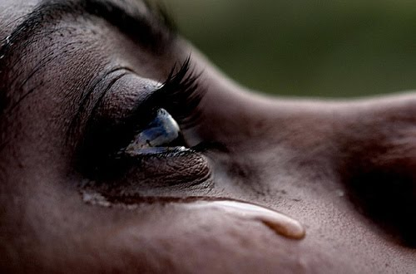
What righteous suffering have you experienced or are experiencing now?
Notes:
Think about how pain may hit you despite your innocence.
What righteous suffering have you experienced in the past?
What issue are you going through now though it is undeserved?

Slide 42
What is the proper response to righeous suffering?
Notes:
How should we act when we can't figure out seemingly undeserved difficulty?

Slide 43
The Rule of Job's Day
SIN
SUFFERING
GODLINESS
BLESSING
Notes:
In Job’s day the common belief was that suffering was always caused by sin but godliness that led to blessing. Therefore, the right response to suffering was simply to repent from sin. But is that the proper response to righteous suffering?

Slide 44
Prevailing Theology of Retribution
"The house of the wicked will be destroyed,
but the tent of the godly will flourish"
(Prov. 14:11 NLT)
"Those who fear the LORD are secure;
he will be a refuge for their children"
(Prov. 14:26 NLT)
Really?
Always?

Slide 45
JOB IN A NUTSHELL
SETTING
DEBATE
RESOLUTION
Notes:
Today we’ll see three steps to answer this question: the setting, the debate and the resolution to this problem of righteous suffering.

Slide 46
I. The Setting: Suffering sometimes comes when we haven’t done anything wrong (Job 1–2).
Notes:
We haven’t deserved it, but at times pain comes nonetheless.

Slide 47
Slides on
Job 1
Notes:
The setting regarding God's sovereignty over righteous suffering was where Job, unaware of Satan’s plot, innocently suffered great losses (Job 1–2).

Slide 48

Where Was Uz?
371
UZ?
✓
“Are you rejoicing in the land of Uz,
O people of Edom?” (Lam 4:21 NLT)
UZ?
Irving L. Jensen, Job: A Self-Study Guide, 4

Slide 49
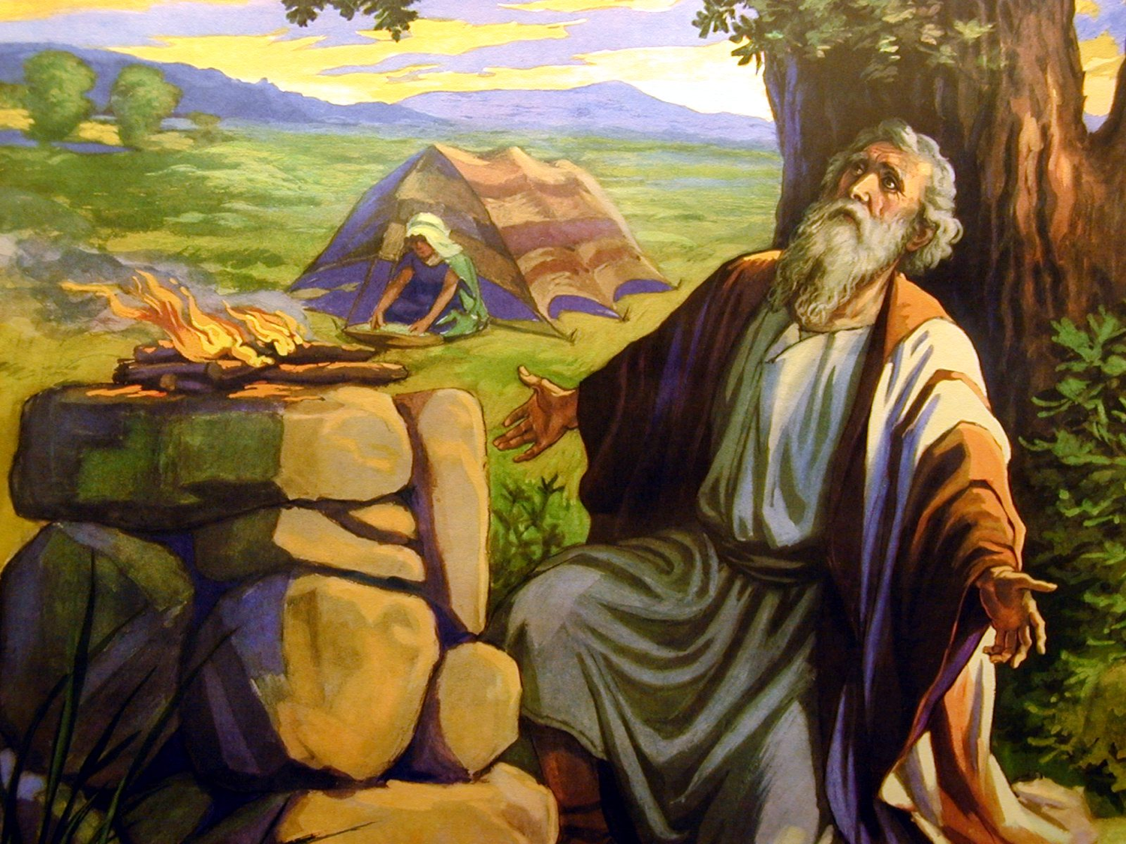
The Description of Job (1:1-5)
Scene 1
Notes:
God blessed Job's character of righteousness with great possessions to show his sovereign blessing on his life (1:1-5).
____________
Job by Bonnat from Wikipedia

Slide 50
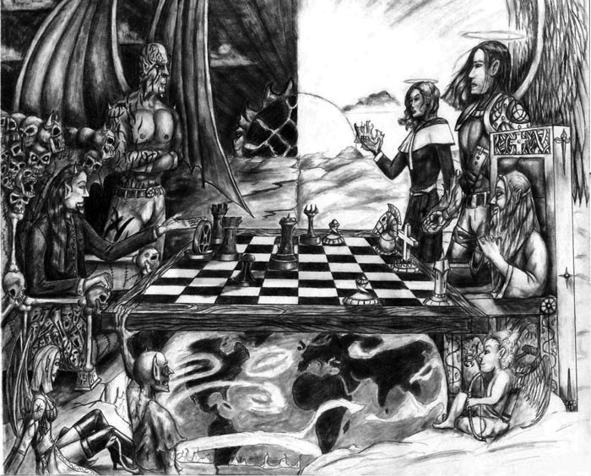
Chess
Scene 2
Notes:
Satan assaulted Job twice but he remained true to God as background for his friends' accusations against his character (1:6–2:10).

Slide 51
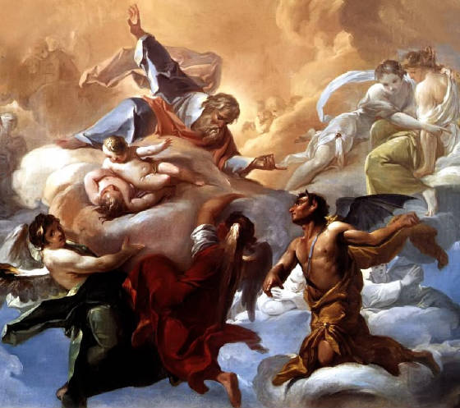
The Description of Satan (1:6-12)
Scene 3
Notes:
Satan's first assault against Job under God's sovereign limitations takes all his possessions and children, but Job responds righteously (1:6-22).
Scene 2 (Heaven): Satan’s limitations are contrasted with God’s sovereignty as he tests Job, as Satan attributes his righteousness to material blessing (1:6-12).
_______
Job by Bonnat from Wikipedia

Slide 52
Satan's Attacks in Job 1
???
 | 1 | 2 | 3 | 4
Attacker | Sabeans (1:14-15) | Fire of God (1:16) | Chaldeans (1:17) | Wind (1:18-19)
Animals Killed | 1000 oxen 500 donkeys | 7000 sheep | 3000 camels | —
People Killed | Many servants | Many servants | Many servants | 7 sons 3 daughters
Interchange | Man | God | Man | God
Satan waited until a day of celebration (1:13)
Satan didn't challenge God's limitations
Notes:
Scene 3 (Uz): Satan responds to God's permission by taking all of Job's possessions and children, but is rebuked by Job's righteous response (1:13-22).

Slide 53

"The LORD gave, the LORD took away. Blessed be his name" (1:21b).

Slide 54
Characteristics
357-358
A. The book switches from narrative (chaps. 1–2) to poetry (3:1–42:6) & then back to narrative (42:7-17).
Parallels in the Structure of the Book of Job
a. Opening narrative (chaps. 1–2)
b. Job's opening soliloquy (chap. 3)
c. The friends' disputation with Job (chaps. 4–28)
b¹. Job's closing soliloquy (chaps. 29–31)
c¹. Elihu's disputation with Job (chaps. 32–37)
c². God's disputation with Job (38:1–42:6)
a¹. Closing narrative (42:7-17)
Zuck, Bible Knowledge Commentary

Slide 55
Characteristics
357-358
B. Most of Job records men dialoguing in poetic form. This may seem strange to Western ears today, but poetic discussion is not unusual in even some cultures today.
C. The major question addressed in the book, "Why do the righteous suffer?" is never specifically answered (except because God is God)!

Slide 56
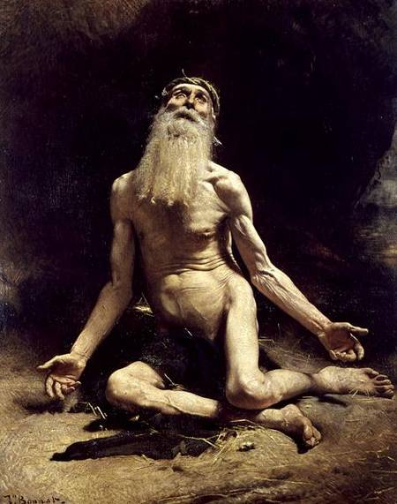
Did God answer Job?
How?
Notes:
Job by Bonnat from Wikipedia

Slide 57
JOB
356
God’s Incomprehensibility Explains Righteous Suffering
Righteous Suffering |  |  | Unsuccessful Dialogue |  |  |  | Restoration
Chapters 1–2 |  |  | Chapters 3–41 |  |  |  | Chapter 42
Dilemma |  |  | Debate |  |  |  | Deliverance
Ruin |  |  | Reasons |  |  |  | Repentance
Prose |  |  | Poetry |  |  |  | Prose
Heaven and Earth |  |  | Land of Uz (North Arabia) |  |  |  | Heaven and Earth
Job’s Character 1:1-5 | Satan’s Assaults 1:6–2:10 | Job’s Friends 2:11-13 | Cycles 3–26 | Job 27–31 | Elihu 32–37 | God 38–41 | Obedience 42:1-9 | Blessings 42:10-17
Patriarchal Times

Slide 58
Slides on
Job 2
Notes:
Satan's second assault against Job under God's sovereign limitations takes his health, but again Job responds righteously (2:1-10).

Slide 59
Scene 4
360
I. (Job 1–2) Job, unaware of Satanic intervention, innocently suffers the loss of possessions, children and health as the setting for a long dialogue on God's sovereignty over righteous suffering.
COMPARING JOB'S TWO TRIALS
Chapter 1
Chapter 2
FIRST TRIALS
FURTHER TRIALS
BANKRUPTCY & BEREAVEMENT
PHYSICAL PAIN
TOUCH HIS...
"all that he has" (1:12)
POSSESSIONS OF JOB
TOUCH HIM
"his bone & "flesh" (2:5)
PERSON OF JOB
Adapted from Irving L. Jensen, Job: A Self-Study Guide, 28
Notes:
Scene 4 (Heaven): Satan attributes Job's righteous response to God's gift of health, so God lets Satan test Job to contrast Satan's limits with God's sovereignty (2:1-6).

Slide 60
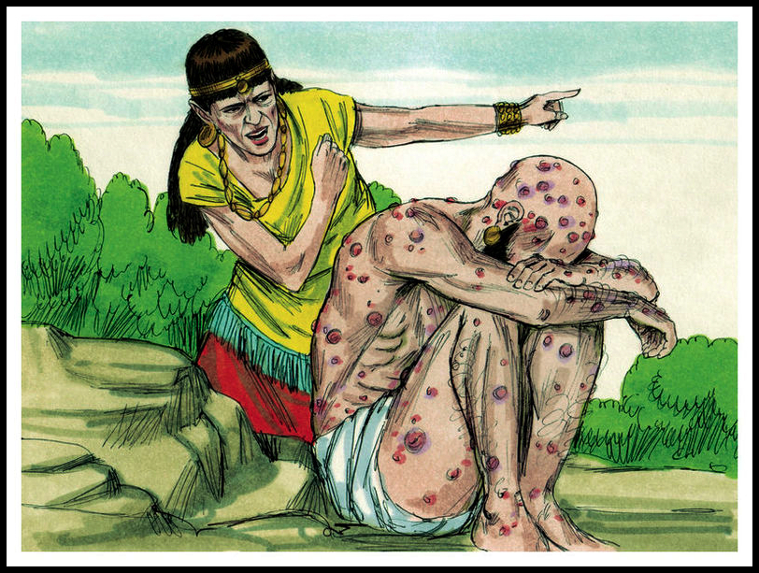
Job's Wife: "Curse God and die!" (2:9)
Scene 5
Notes:
Scene 5 (Uz): Satan responds to God's permission by hurting Job with sores and a merciless wife, yet Job again responds righteously (2:7-10).

Slide 61
Five Responses to Suffering
374
Huang Sabin, SBC, adapted
PERSON
RESPONSE
SOLUTION
MODERN
EQUIVALENT
ANSWER
1. Job's Wife
Curse God & die (2:9)
Suicide
Young people
Unacceptable
2. Three "friends"
Suffering is from sin (4:7-8)
Repentance
"Name it,
claim it"
Not always
applicable
3. Job
God's not fair & doesn't care (19:7)
Complain
Most mourners
Unbiblical
^{NLT} Job 2:9 His wife said to him, "Are you still trying to maintain your integrity? Curse God and die."
4 Elihu
Trials are for teaching (33:14-19)
Endure
Most preachers
Inadequate
5. GOD
Not 'Why?" but "Who?" (38-42)
Worship
None
Unpopular
Notes:
TRANSLATOR NOTES:
1. SEE THIS SLIDE IN SLIDE SHOW MODE TO REVEAL THE TEXT UNDER THE BLACK BOXES ABOVE.
2. SELECT THESE BLACK BOXES.
3. MOVE THESE BLACK BOXES ABOVE THE SLIDE TO SEE THE TEXT UNDER THEM.
4. TRANSLATE THE TEXT.
5. MOVE THE BLACK BOXES BACK OVER THE TEXT.
6. VIEW IN SLIDE SHOW MODE AGAIN TO MAKE SURE ANIMATIONS ARE CORRECT.
7. EDIT THE TEXT AND/OR BOXES FOR SMOOTH ANIMATIONS.

Slide 62
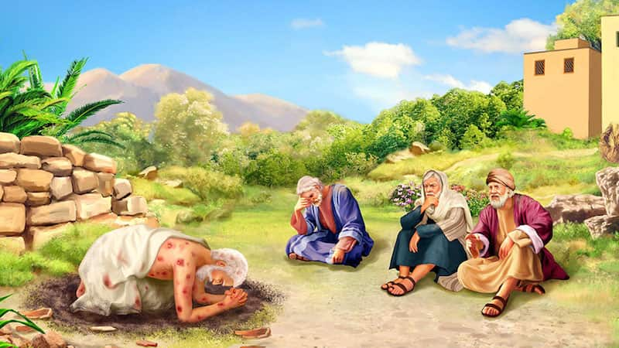
"Then they sat on the ground with him for seven days and nights. No one said a word to Job, for they saw that his suffering was too great for words" (2:13 NLT).
Notes:
Eliphaz the Temanite, Bildad the Shuhite, and Zophar the Naamathite, sat in silence with Job for a week in the custom of the day so Job could first express his grief (2:11-13).

Slide 63
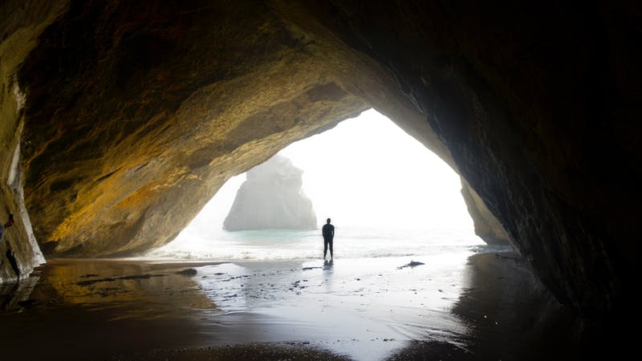
Are you experienceing righeous suffering?
Notes:
Maybe you also are living right but experiencing pain.
Many times suffering comes from sin (break the law, hurt people you love).
But perhaps you have done nothing to deserve your suffering (living for others, loving God and people).

Slide 64
What is the proper response to righeous suffering?
Notes:
How should we act when we can't figure out seemingly undeserved difficulty?

Slide 65
I. The Setting: Suffering sometimes comes when we haven’t done anything wrong (Job 1–2).
Notes:
We haven’t deserved it, but at times pain comes nonetheless.

Slide 66
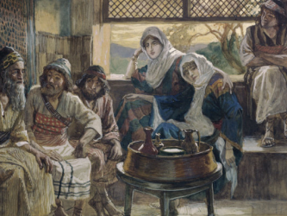
What is our typical response to righteous suffering?

Slide 67
II. The Debate: We struggle with righteous suffering until God tells us to rest in his incomprehensibility
(Job 3–41).
Notes:
Wrestling with the reason for pain is natural until God says he won't tell.

Slide 68
Slides on
Job 3
Notes:
God shut down debate by saying that this reason for righteous suffering shouldn’t be asked due to his incomprehensibility and sovereignty (Job 3–41).

Slide 69
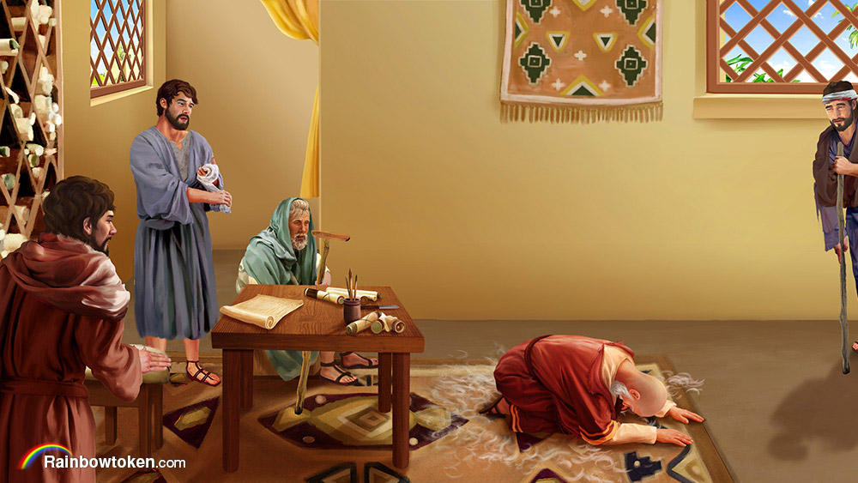
The Debate (Job 3–41)
Notes:
Job and his three friends debated in three cycles the reason for his suffering, each time getting more heated and specific, but not knowing why he suffered (Job 3–26).

Slide 70
JOB
356
God’s Incomprehensibility Explains Righteous Suffering
Righteous Suffering |  |  | Unsuccessful Dialogue |  |  |  | Restoration
Chapters 1–2 |  |  | Chapters 3–41 |  |  |  | Chapter 42
Dilemma |  |  | Debate |  |  |  | Deliverance
Ruin |  |  | Reasons |  |  |  | Repentance
Prose |  |  | Poetry |  |  |  | Prose
Heaven and Earth |  |  | Land of Uz (North Arabia) |  |  |  | Heaven and Earth
Job’s Character 1:1-5 | Satan’s Assaults 1:6–2:10 | Job’s Friends 2:11-13 | Cycles 3–26 | Job 27–31 | Elihu 32–37 | God 38–41 | Obedience 42:1-9 | Blessings 42:10-17
Patriarchal Times

Slide 71
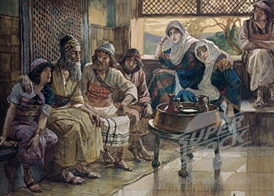
Outline
II. (Job 3–41) Job & 4 friends unsuccessfully dialogue regarding the reason for his suffering, but God declares that this question should not be asked because of His incomprehensibility & sovereignty.
360
Job 4–31 has 3 cycles of controversy. (Eliphaz begins each series & Zophar does not speak in the last series.)
First Cycle
Eliphaz
4–5
è
Job
6–7
Bildad
8
è
Job
9–10
Zophar
11
è
Job
12–14
Second Circle
Eliphaz
15
è
Job
16–17
Bildad
18
è
Job
19
Zophar
20
è
Job
21
Third Cycle
Eliphaz
22
è
Job
23–24
Bildad
25
è
Job
26–31
Irving L. Jensen, Job: A Self-Study Guide, 28

Slide 72
Slides on
Job 4

Slide 73
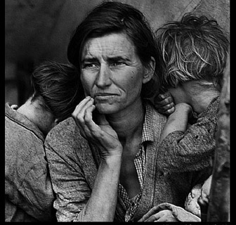
1st Cycle Eliphaz
373
1st Cycle
3–14
Eliphaz
Only the wicked suffer

Slide 74
Five Responses to Suffering
374
Huang Sabin, SBC, adapted
PERSON
RESPONSE
SOLUTION
MODERN
EQUIVALENT
ANSWER
1. Job's Wife
Curse God & die (2:9)
Suicide
Young people
Unacceptable
2. Three "friends"
Suffering is from sin (4:7-8)
Repentance
"Name it,
claim it"
Not always
applicable
3. Job
God's not fair & doesn't care (19:7)
Complain
Most mourners
Unbiblical
NIV Job 4:7 "Consider now: Who, being innocent, has ever perished? Where were the upright ever destroyed? ⁸As I have observed, those who plow evil and those who sow trouble reap it."
4 Elihu
Trials are for teaching (33:14-19)
Endure
Most preachers
Inadequate
5. GOD
Not 'Why?" but "Who?" (38-42)
Worship
None
Unpopular

Slide 75
Slides on
Job 5

Slide 76
Players in the Drama

Slide 77
Slides on
Job 6

Slide 78
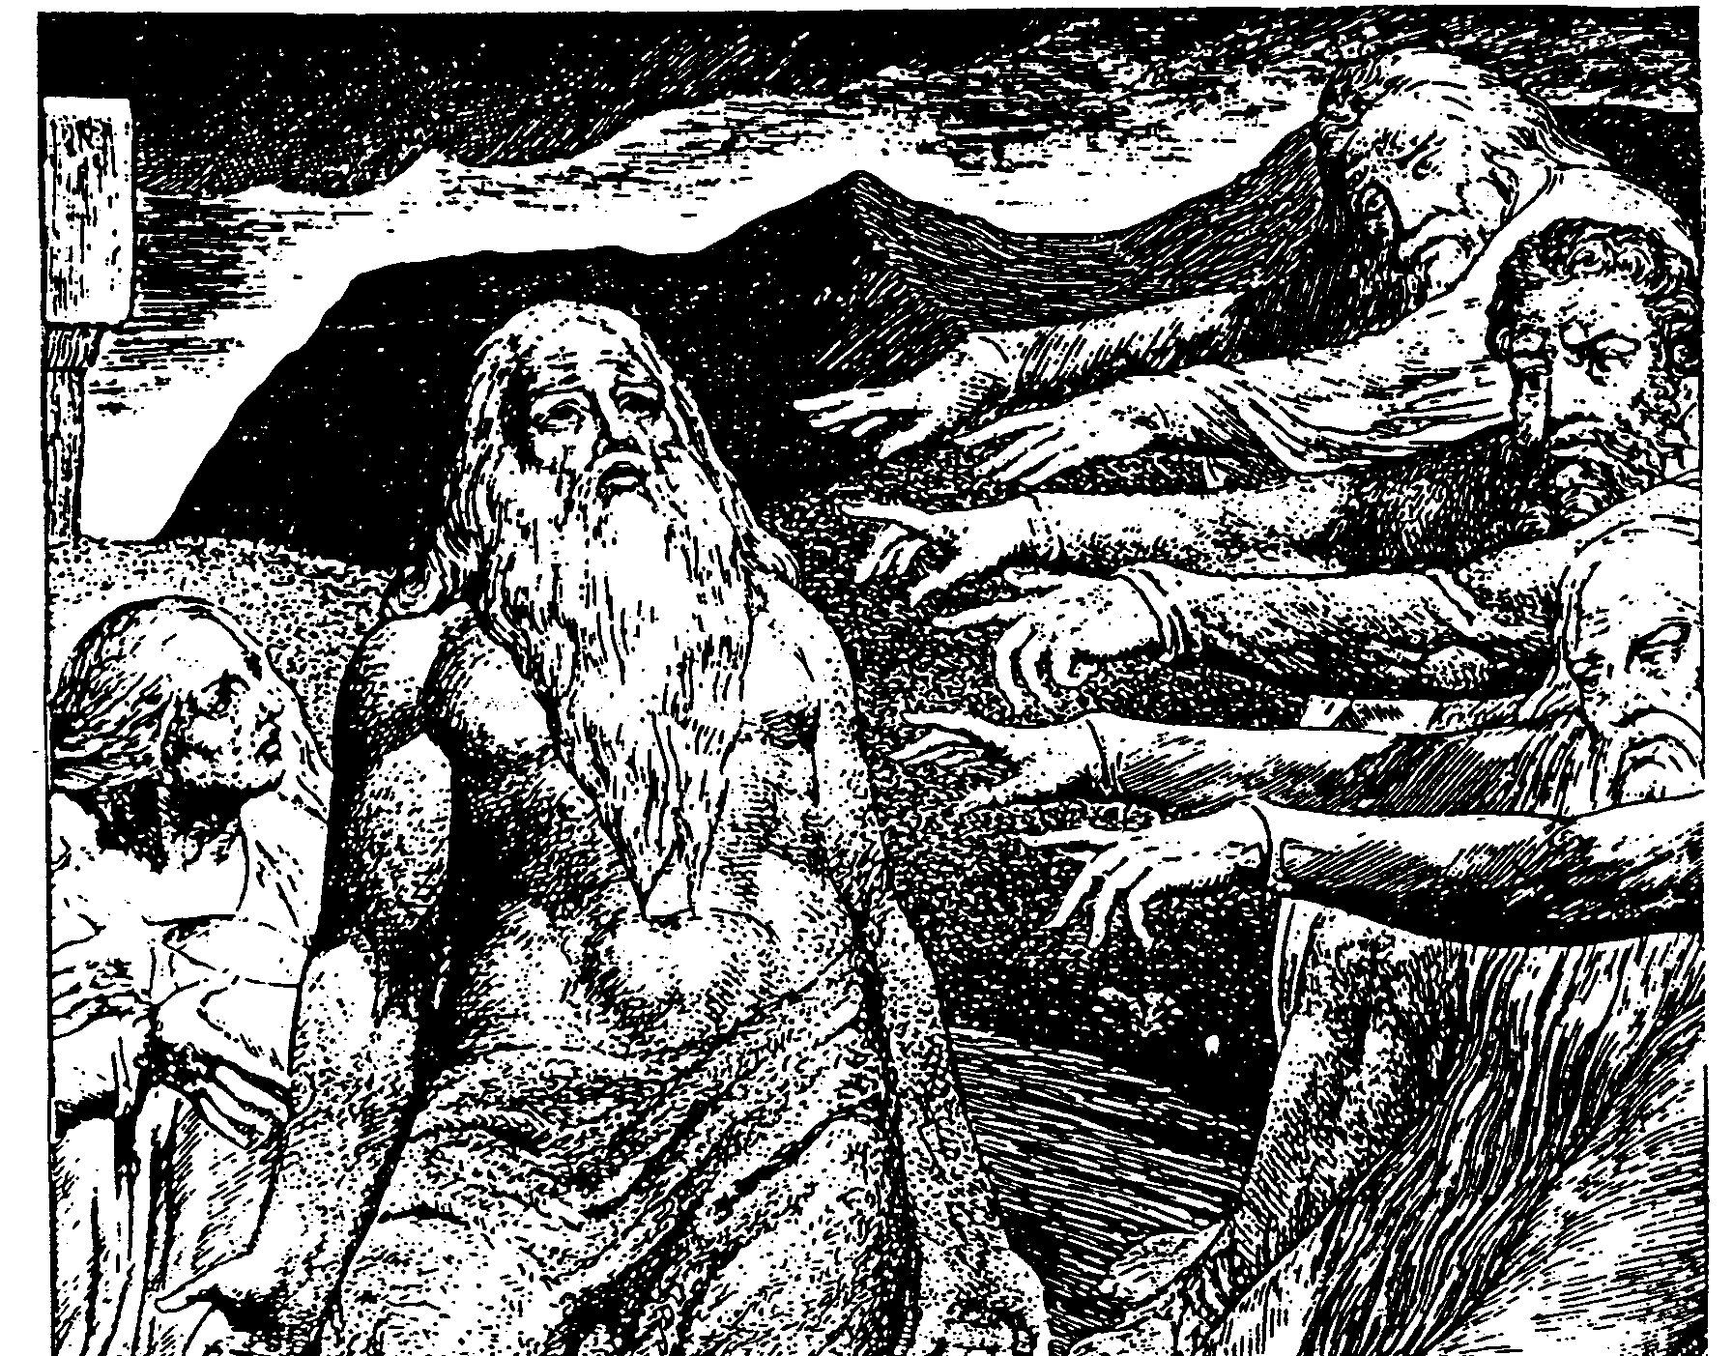
The Cycles of Debate in Job
372

Slide 79
Slides on
Job 7

Slide 80
Prevailing Theology of Retribution
"The house of the wicked will be destroyed,
but the tent of the godly will flourish"
(Prov. 14:11 NLT)
"Those who fear the LORD are secure;
he will be a refuge for their children"
(Prov. 14:26 NLT)
Really?
Always?

Slide 81
Slides on
Job 8

Slide 82
1st Cycle Bildad
373
1st Cycle
3–14
Eliphaz
Only the wicked suffer
God doesn't punish the righteous
Bildad

Slide 83
Slides on
Job 9

Slide 84
Outline
II. (Job 3–41) Job & 4 friends unsuccessfully dialogue regarding the reason for his suffering, but God declares that this question should not be asked because of His incomprehensibility & sovereignty.
360
Job 4–31 has 3 cycles of controversy. (Eliphaz begins each series & Zophar does not speak in the last series.)
First Cycle
Eliphaz
4–5
è
Job
6–7
Bildad
8
è
Job
9–10
Zophar
11
è
Job
12–14
Second Circle
Eliphaz
15
è
Job
16–17
Bildad
18
è
Job
19
Zophar
20
è
Job
21
Third Cycle
Eliphaz
22
è
Job
23–24
Bildad
25
è
Job
26–31
Irving L. Jensen, Job: A Self-Study Guide, 28

Slide 85
Slides on
Job 10

Slide 86
Outline
361
Repeated Themes in Job's Responses
First round of speeches
First speech
Second speech
Third speech
1. Disappointment in his friends
6:14-30
-
12:1-3; 13:1-12
2. Declaration of God's greatness
-
9:1-12
12:7-25
3. Disillusionment with God's ways
7:11-19
9:13–10:17
12:4-6
4. Despair with life (or desire for death)
6:8-13; 7:1-10
10:18-22
chapter 14
5. Desire for vindication with God
7:20-21
-
13:13-19
Second round of speeches
First speech
Second speech
Third speech
1. Disappointment in his friends
16:1-5; 17:3-5
19:1-4
21:1-6
2. Declaration of God's greatness
-
19:28-29
21:19-22
3. Disillusionment with God's ways
16:6-17
19:5-22
21:7-18, 23-39
4. Despair with life (or desire for Death)
17:6-16
-
-
5. Desire for vindication with God
16:18–17:2
19:23-27
-
Third round of speeches
First speech
Second speech
1. Disappointment in his friends
-
26:1-4
2. Declaration of God's greatness
23:8-17
26:5-27:12; chapter 28
3. Disillusionment with God's ways
24:1-17
-
4. Despair with life (or desire for death)
(24:18-25)*
(27:13-23)*; chapters 29–30
5. Desire for vindication with God
23:1-7
chapter 31
*The wicked die.
Zuck, Bible Knowledge Commentary, 1:728

Slide 87
Slides on
Job 11

Slide 88
1st Cycle Zophar
373
1st Cycle
3–14
Eliphaz
Only the wicked suffer
God doesn't punish the righteous
Bildad
Zophar
You're lying

Slide 89
Slides on
Job 12

Slide 90
Outline
II. (Job 3–41) Job & 4 friends unsuccessfully dialogue regarding the reason for his suffering, but God declares that this question should not be asked because of His incomprehensibility & sovereignty.
360
Job 4–31 has 3 cycles of controversy. (Eliphaz begins each series & Zophar does not speak in the last series.)
First Cycle
Eliphaz
4–5
è
Job
6–7
Bildad
8
è
Job
9–10
Zophar
11
è
Job
12–14
Second Circle
Eliphaz
15
è
Job
16–17
Bildad
18
è
Job
19
Zophar
20
è
Job
21
Third Cycle
Eliphaz
22
è
Job
23–24
Bildad
25
è
Job
26–31
Irving L. Jensen, Job: A Self-Study Guide, 28

Slide 91
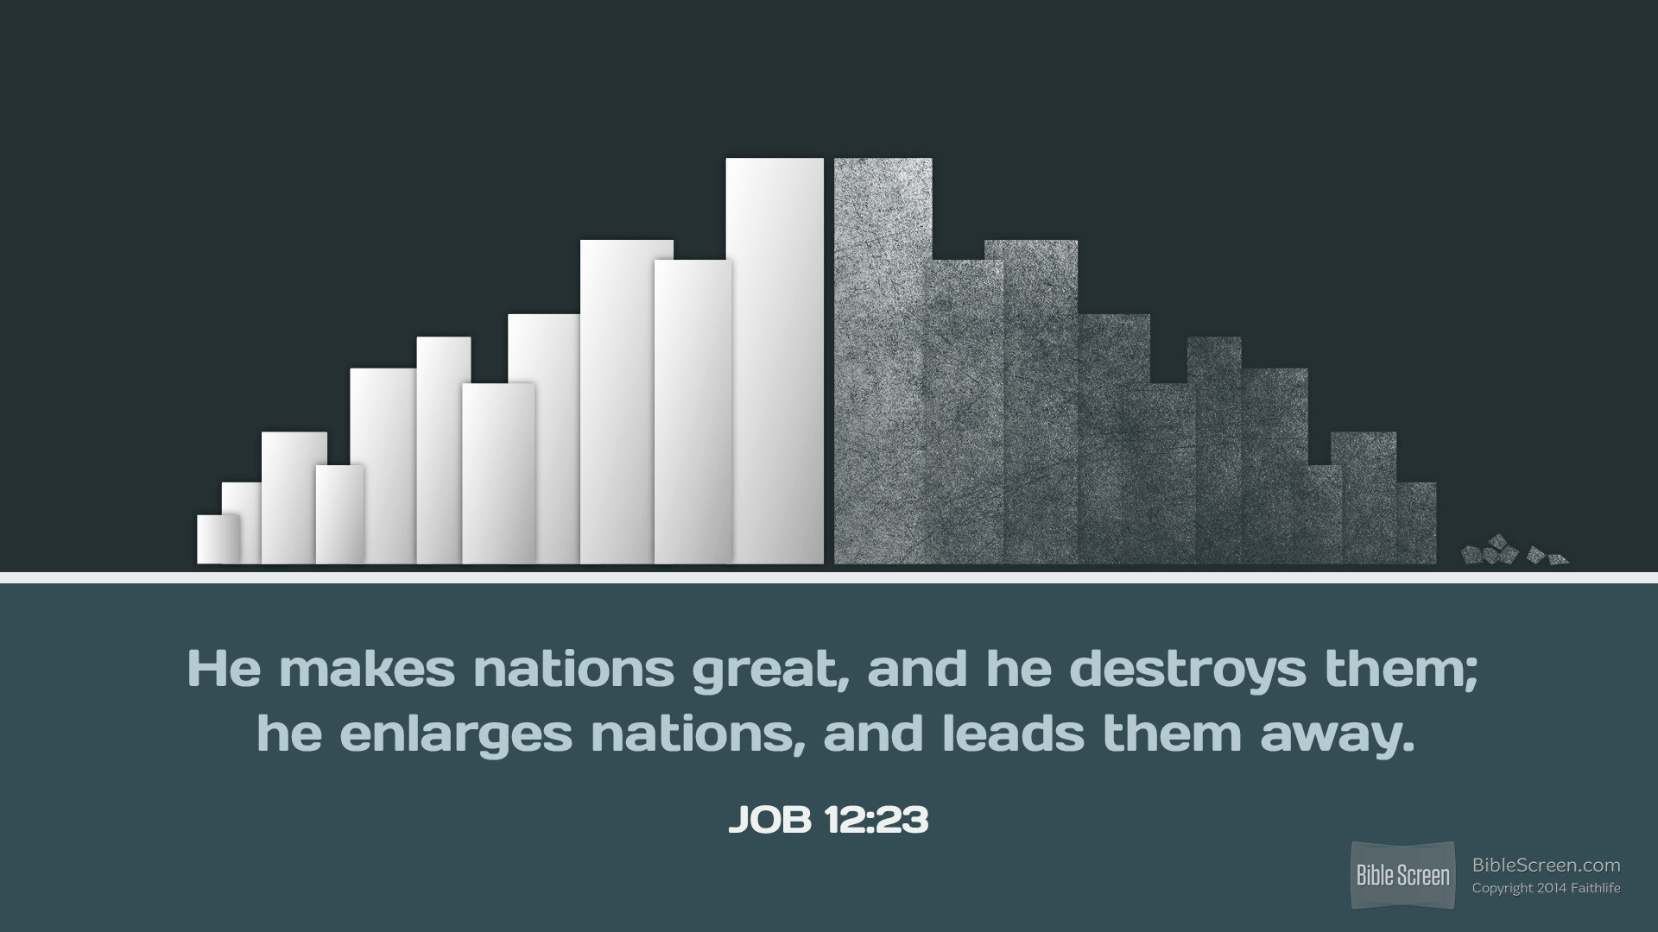
JOB 12:23
He makes nations great, and he destroys them;
he enlarges nations, and leads them away.
JOB 12:23

Slide 92
Slides on
Job 13

Slide 93
Outline
362
Job's Laments
Self-laments
Laments against God
Laments against "Enemies"
Job's opening soliloquy (chap. 3)
3:11-19, 24-26
3:20-23
3:3-10
Job's 1st speech (chaps. 6–7)
6:1-12; 7:1-10
7:12-21
6:13-20
Job's 2nd speech (chaps. 9–10)
9:25-31
9:17-23; 10:8-17
Job's 3rd speech (chaps. 12–14)
14:1-6, 7-15
13:3, 14-16, 23-27
Job's 4th speech (chaps. 16–17)
17:4-10
16:9-14
Job's 5th speech (chap. 19)
19:7-12
19:13-19
Job's 6th speech (chap. 21)
Job's 7th speech (chaps. 23–24)
23:3-12
Job's 8th speech (chaps. 26–31)
29:2-6, 12-20; 30:16-19, 24-31
30:20-23
30:1-15
Zuck, Bible Knowledge Commentary, 1:362

Slide 94
Slides on
Job 14

Slide 95
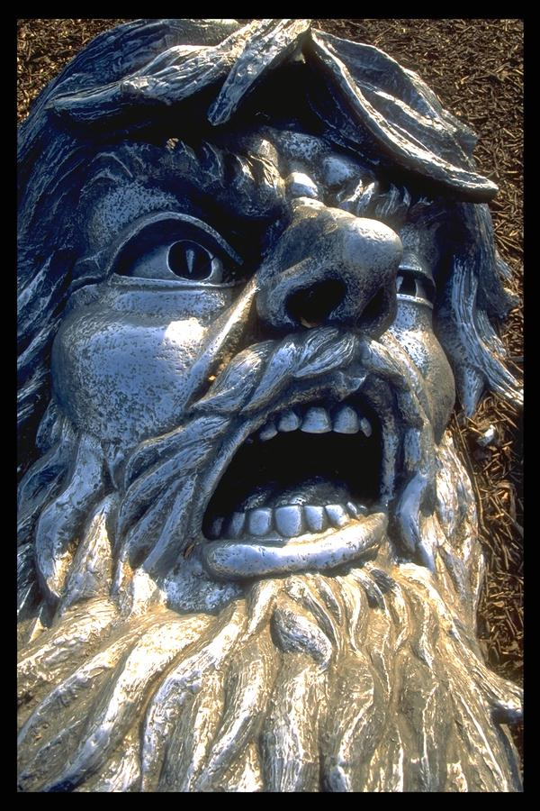
Their Basic Premise
373
Eliphaz
RETRIBUTION
Bildad
You only get what you deserve!
Zophar

Slide 96
Job's Basic Premise
373
Job
I don't deserve
what I got!

Slide 97

—Accepting God’s Will—
Job 14:7-17

Slide 98
⁷ Even a tree has more hope!
If it is cut down, it will sprout again
and grow new branches.
Job 14:7 (NLT)

Slide 99
⁸ Though its roots have grown old in the earth and its stump decays,
⁹ at the scent of water it will bud
and sprout again like a new seedling.
Job 14:8-9 (NLT)

Slide 100
¹⁰ But when people die,
their strength is gone.
They breathe their last,
and then where are they?
¹¹ As water evaporates from a lake
and a river disappears in drought,
Job 14:10-11 (NLT)

Slide 101
¹² people are laid to rest and do not rise again.
Until the heavens are no more,
they will not wake up
nor be roused from their sleep.
Job 14:12 (NLT)

Slide 102
¹³ I wish you would hide me in the grave and forget me there until your anger has passed.
But mark your calendar to think of me again!
Job 14:13 (NLT)

Slide 103
¹⁴ Can the dead live again?
If so, this would give me hope through all my years of struggle,
and I would eagerly await the release of death.
¹⁵ You would call and I would answer,
and you would yearn for me, your handiwork.
Job 14:14-15 (NLT)

Slide 104
¹⁶ For then you would guard my steps,
instead of watching for my sins.
¹⁷ My sins would be sealed in a pouch,
and you would cover my guilt.
Job 14:16-17 (NLT)

Slide 105
Slides on
Job 15

Slide 106
2d Cycle Eliphaz
373
2nd Cycle
15–21
Eliphaz
Only the wicked suffer

Slide 107
Slides on
Job 16

Slide 108
Outline
II. (Job 3–41) Job & 4 friends unsuccessfully dialogue regarding the reason for his suffering, but God declares that this question should not be asked because of His incomprehensibility & sovereignty.
360
Job 4–31 has 3 cycles of controversy. (Eliphaz begins each series & Zophar does not speak in the last series.)
First Cycle
Eliphaz
4–5
è
Job
6–7
Bildad
8
è
Job
9–10
Zophar
11
è
Job
12–14
Second Circle
Eliphaz
15
è
Job
16–17
Bildad
18
è
Job
19
Zophar
20
è
Job
21
Third Cycle
Eliphaz
22
è
Job
23–24
Bildad
25
è
Job
26–31
Irving L. Jensen, Job: A Self-Study Guide, 28

Slide 109
Slides on
Job 17

Slide 110
God's Incomprehensibility
Explains Righteous Suffering
356
Job
The problem of suffering

Slide 111
Slides on
Job 18

Slide 112
2d Cycle Eliphaz
373
2nd Cycle
15–21
Eliphaz
Only the wicked suffer
The wicked will be judged
Bildad

Slide 113
Slides on
Job 19

Slide 114
Five Responses to Suffering
374
Huang Sabin, SBC, adapted
PERSON
RESPONSE
SOLUTION
MODERN
EQUIVALENT
ANSWER
1. Job's Wife
Curse God & die (2:9)
Suicide
Young people
Unacceptable
2. Three "friends"
Suffering is from sin (4:7-8)
Repentance
"Name it,
claim it"
Not always
applicable
3. Job
God's not fair & doesn't care (19:7)
Complain
Most mourners
Unbiblical
4 Elihu
Trials are for teaching (33:14-19)
Endure
Most preachers
Inadequate
NIV Job 19:7 "Though I cry, 'I've been wronged!' I get no response; though I call for help, there is no justice.' "
5. GOD
Not 'Why?" but "Who?" (38-42)
Worship
None
Unpopular

Slide 115
Slides on
Job 20

Slide 116
2d Cycle Eliphaz
373
2nd Cycle
15–21
Eliphaz
Only the wicked suffer
The wicked will be judged
Bildad
Zophar
You're a hypocrite

Slide 117
Slides on
Job 21

Slide 118
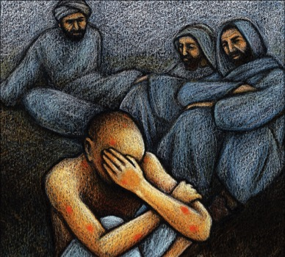
Cycles of Debate
1
2
372
3
Cycle
Tone
Implication
Insinuation
Indictment
Content
General Recommendations
Specific
Advice
Vicious
Accusations
Speakers
Eliphaz
Bildad
Zophar
Eliphaz
Bildad
Zophar
Eliphaz
Bildad
Length
12 chapters
7 chapters
10 chapters
Chapters
3–14
15–21
22–31

Slide 119
Slides on
Job 22

Slide 120
2d Cycle Bildad
373
3rd Cycle
22–31
Eliphaz
Repent of your sin

Slide 121
Slides on
Job 23

Slide 122
Outline
II. (Job 3–41) Job & 4 friends unsuccessfully dialogue regarding the reason for his suffering, but God declares that this question should not be asked because of His incomprehensibility & sovereignty.
360
Job 4–31 has 3 cycles of controversy. (Eliphaz begins each series & Zophar does not speak in the last series.)
First Cycle
Eliphaz
4–5
è
Job
6–7
Bildad
8
è
Job
9–10
Zophar
11
è
Job
12–14
Second Circle
Eliphaz
15
è
Job
16–17
Bildad
18
è
Job
19
Zophar
20
è
Job
21
Third Cycle
Eliphaz
22
è
Job
23–24
Bildad
25
è
Job
26–31
Irving L. Jensen, Job: A Self-Study Guide, 28

Slide 123
Slides on
Job 24

Slide 124
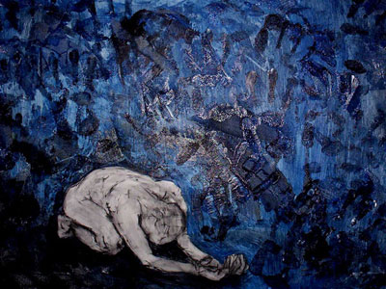
Accusation & Response (3–37)
373
Cycle 1
BILDAD
Cycle 2
8
18
25
Cycle 3
ELIPHAZ
ZOPHAR
4–5
15
22
11
20
16–17
19
12–14
21
JOB
ELIHU
9–10
23–24
6–7
26–31
32–37
3

Slide 125
Slides on
Job 25

Slide 126
2d Cycle Bildad
373
3rd Cycle
22–31
Eliphaz
Repent of your sin
How can anyone be right with God?
Bildad
Zophar

Slide 127
Slides on
Job 26

Slide 128
Slides on
Job 27

Slide 129
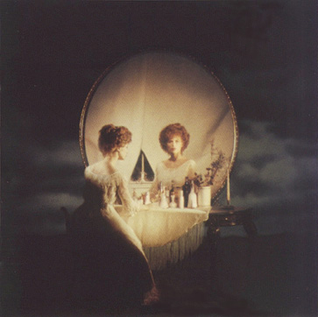
Why do the innocent suffer?
Satan:
Deserved
3 Friends:
Retribution
Elihu:
Discipline

Slide 130
Slides on
Job 28

Slide 131
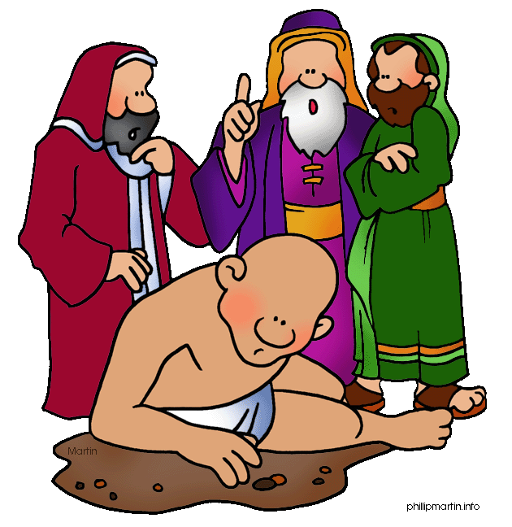
You must have sinned, so that is why God judged you. Repent and be well!
God is all powerful. He inflicted and He will heal.
How can men compare to the holiness of God? Repent!
You quack counsellors. I liked you better when you were quiet…
God is a bully. I want my lawyer… someone who stands between me and God.

Slide 132
Slides on
Job 29

Slide 133
Slides on
Job 30

Slide 134
Slides on
Job 31

Slide 135

"I made a covenant with my eyes not to look with lust at a young woman"
Job 31:1 NLT

Slide 136
Slides on
Job 32
Notes:
Elihu angrily rebuked Job and his friends saying that God need not reveal the purpose for Job's suffering although He is speaking to Job through his pain (Job 32–37).

Slide 137

Elihu's Addressees (32–37)
367
First speech
To all four (32:6-9)
To the three (32:10-14)
To Job (32:15–33:33)
Second speech
To the three (34:1-15)
To Job (34:16-37)
Third speech
To Job (35:1-3)
To the three (35:4-16)
Fourth speech
To Job (36:1–37:1)
To the three (37:2-13)
To Job (37:14-24)
Adapted at 35:4-16 from Roy B. Zuck, Bible Knowledge Commentary, 1:755

Slide 138
Outline
368
Elihu's Quotations of Job
In Elihu's First Speech
33:9a "I am pure" (cf. 6:10; 9:21; 10:7; 12:4; 16:17; 31:6).
33:9b "Without sin" (cf. 13:23; 23:11).
33:9c "I am clean and free from guilt" (cf. 9:20-21; 10:7; 27:6).
33:10a "God has found fault with me" (cf. 10:6).
33:10b "He considers me His enemy" (cf. 13:24; 19:11).
33:11a "He fastens my feet in shackles" (cf. 13:27).
33:11b "He keeps close watch on all my paths" (cf. 7:17-20; 10:14; 13:27).
In Elihu's Second Speech
34:5a "I am innocent [righteous]'" (cf. 9:15, 20; 27:6).
34:5b "God denies me justice" (cf. 19:6-7; 27:2).
34:6a "I am right" (cf. 27:5-6).
34:6b "I am guiltless" (cf. 10:7; chap. 31).
34:6d "His arrow inflicts an incurable wound" (cf. 6:4; 16:13).
34:9 "It profits a man nothing when he tries to please God" (cf. 21:15).
In Elihu's Third Speech
35:2 "I will be cleared by God" (cf. 13:18; 23:7).
35:3 "What profit is it to me, and what do I gain by not sinning?" (cf. 21:15)
In Elihu's Fourth Speech
36:23 "You [God] have done wrong" (cf. 19:6-7).
Zuck, Bible Knowledge Commentary, 1:758

Slide 139
Slides on
Job 33

Slide 140
Outline
367
Overview of Elihu's Speeches
Job's Complaints
Elihu's Answers
1. God is silent; He does not respond to me (13:22; cf. 33:13).
1st speech: God does speak – through dreams & pain (chap. 33).
2. God is unjust; He does not relieve me of my suffering
(19:6-7; 27:2; cf. 34:5-6)
2nd speech: God is just (chap. 34).
3. God is unconcerned; He does not reward me for my innocence
(10:7; cf. 35:3).
3rd speech: God is sovereign
(chap. 35)
Zuck, Bible Knowledge Commentary, 1:755-56

Slide 141
Five Responses to Suffering
374
Huang Sabin, SBC, adapted
PERSON
RESPONSE
SOLUTION
MODERN
EQUIVALENT
ANSWER
1. Job's Wife
Curse God & die (2:9)
Suicide
Young people
Unacceptable
ESV Job 33:14 For God speaks in one way, and in two, though man does not perceive it. ¹⁵In a dream, in a vision of the night. . . ¹⁹Man is also rebuked with pain on his bed and with continual strife in his bones.
2. Three "friends"
Suffering is from sin (4:7-8)
Repentance
"Name it,
claim it"
Not always
applicable
3. Job
God's not fair & doesn't care (19:7)
Complain
Most mourners
Unbiblical
4 Elihu
Trials are for teaching (33:14-19)
Endure
Most preachers
Inadequate
5. GOD
Not 'Why?" but "Who?" (38–42)
Worship
None
Unpopular

Slide 142
Advice from Job's Friends
Life Application Bible
373
Who they are
Where they spoke
How they helped
Their view of Job's pain
Their advice to Job
Job's response
God to Job's friends
Eliphaz the Temanite
Job 4–5, 15, 22
They sat in silence with Job for 7 days
(2:11-13)
Job suffers for his sin
Lay your cause before God (5:8)
Take back your false accusations (6:29)
God rebukes Job's friends (42:7)
Bildad the Shuhite
Job 8, 18, 25
Job won't admit he sinned, so he's still suffering
How long will you go on like this?
God, ... tell me what charges You have against me (10:2)
Zophar the Naamathite
Job 11, 20
Job's sin deserves even more suffering than he's experienced
Get rid of your sins (11:13,14)
I know that I will be justified (13:18)
Elihu the Buzite
Job 32–37
God is using suffering to mold Job
Be silent & I
will teach you wisdom (33:33)
No response
God does not directly address Elihu
God
Job 38–41
Told Job to be content without knowing why he suffered
Did not explain the reason for the pain
Do you still
want to argue with the Almighty? (40:2)
I was taking about things I did not understand (42:3-5)

Slide 143
Slides on
Job 34

Slide 144
Outline
367
Overview of Elihu's Speeches
Job's Complaints
Elihu's Answers
1. God is silent; He does not respond to me (13:22; cf. 33:13).
1st speech: God does speak – through dreams & pain (chap. 33).
2. God is unjust; He does not relieve me of my suffering
(19:6-7; 27:2; cf. 34:5-6)
2nd speech: God is just (chap. 34).
3. God is unconcerned; He does not reward me for my innocence
(10:7; cf. 35:3).
3rd speech: God is sovereign
(chap. 35)
Zuck, Bible Knowledge Commentary, 1:755-56

Slide 145
Slides on
Job 35

Slide 146
Outline
367
Overview of Elihu's Speeches
Job's Complaints
Elihu's Answers
1. God is silent; He does not respond to me (13:22; cf. 33:13).
1st speech: God does speak – through dreams & pain (chap. 33).
2. God is unjust; He does not relieve me of my suffering
(19:6-7; 27:2; cf. 34:5-6)
2nd speech: God is just (chap. 34).
3. God is unconcerned; He does not reward me for my innocence
(10:7; cf. 35:3).
3rd speech: God is sovereign
(chap. 35)
Zuck, Bible Knowledge Commentary, 1:755-56

Slide 147
Slides on
Job 36

Slide 148
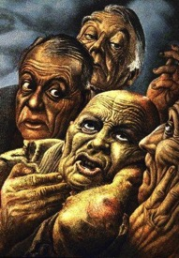
Perspectives of Job's Friends
373
Bruce Wilkinson & Kenneth Boa, Talk Thru the Bible
Eliphaz
Bildad
Zophar
Elihu
Characteristic
Theologian
Historian, legalist
Moralist, dogmatist
Young theologian, intellectual
Relies on
Observation, Experience
Tradition
Assumption
Education
Personality
Considerate
Argumentative
Rude, blunt
Perceptive, some
conceit
Voice
Philosophy
History
Orthodoxy
Logic
Argument
"If you sin,
you suffer"
"You must be sinning"
"You are sinning"
"God purifies and
teaches"
Advice to Job
Only the wicked
suffer
The wicked always
suffer
The wicked are
short-lived
Humble yourself
and submit to God
Key Verse
4:8; 5:17
8:8
20:5
37:23
Concept of God
Righteous;
punishes wicked, blesses good
Judge; immovable
lawgiver
Unbending,
merciless
Disciplinarian,
teacher

Slide 149
Slides on
Job 37

Slide 150
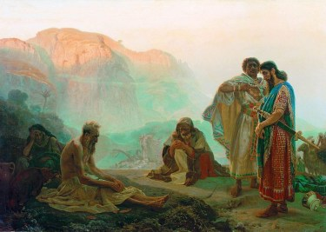
Key Verse
"The Almighty is beyond our reach and exalted in power; in his justice and great righteousness, he does not oppress. Therefore, men revere him, for does he not have regard for all the wise in heart?" (Job 37:23-24)
[Elihu talking] "The Almighty is beyond our reach and exalted in power;
in his justice and great righteousness,
he does not oppress.
²⁴Therefore, men revere him,
for does he not have regard
for all the wise in heart?"
(Job 37:23-24 NIV)
356
Notes:
Elihu seems to get it, though he was the youngest of Job's critics. Interestingly, in Job 42 God tells Job to pray for the three friends and gives Elihu a pass. The focus of these key verses is that, despite the craziness and injustice and difficulties of this world, God is not oppressing us. He just does not rescue us from experiencing trials.

Slide 151

²³ We cannot imagine the power of the Almighty;
but even though he is just and righteous,
he does not destroy us.
Job 37:23-24 NLT

Slide 152
²⁴ No wonder people everywhere fear him.
All who are wise show him reverence.
Job 37:23-24 NLT

Slide 153
Slides on
Job 38

Slide 154
Job's Mid-Term Exam (38–41)
369
Part 1 (Short Answer, 38:1–40:5): Can you answer even one of my questions?
Notes:
Job probably thought God was giving him a FINAL EXAM—but he didn't know that, even though he miserably failed this exam, he would live 140 years after it (42:16).

Slide 155
Five Responses to Suffering
374
Huang Sabin, SBC, adapted
PERSON
RESPONSE
SOLUTION
MODERN
EQUIVALENT
ANSWER
1. Job's Wife
Curse God & die (2:9)
Suicide
Young people
Unacceptable
ESV Job 38:1 Then the LORD answered Job out of the whirlwind and said: ²"Who is this that darkens counsel by words without knowledge? ³Dress for action like a man; I will question you, and you make it known to me. ⁴Where were you when I laid the foundation of the earth? Tell me, if you have understanding."
2. Three "friends"
Suffering is from sin (4:7-8)
Repentance
"Name it,
claim it"
Not always
applicable
3. Job
God's not fair & doesn't care (19:7)
Complain
Most mourners
Unbiblical
4 Elihu
Trials are for teaching (33:14-19)
Endure
Most preachers
Inadequate
5. GOD
Not 'Why?" but "Who?" (38–42)
Worship
None
Unpopular

Slide 156
Advice from Job's Friends
Life Application Bible
373
Who they are
Where they spoke
How they helped
Their view of Job's pain
Their advice to Job
Job's response
God to Job's friends
Eliphaz the Temanite
Job 4–5, 15, 22
They sat in silence with Job for 7 days
(2:11-13)
Job suffers for his sin
Lay your cause before God (5:8)
Take back your false accusations (6:29)
God rebukes Job's friends (42:7)
Bildad the Shuhite
Job 8, 18, 25
Job won't admit he sinned, so he's still suffering
How long will you go on like this?
God, ... tell me what charges You have against me (10:2)
Zophar the Naamathite
Job 11, 20
Job's sin deserves even more suffering than he's experienced
Get rid of your sins (11:13,14)
I know that I will be justified (13:18)
Elihu the Buzite
Job 32–37
God is using suffering to mold Job
Be silent & I
will teach you wisdom (33:33)
No response
God does not directly address Elihu
God
Job 38–41
Told Job to be content without knowing why he suffered
Did not explain the reason for the pain
Do you still
want to argue with the Almighty? (40:2)
I was taking about things I did not understand (42:3-5)

Slide 157


To look forward to
Part 2: Job 38–42
Preached by Dr. Jim Harmeling
at Crossroads International Church Singapore • cicfamily.com
Uploaded by Dr. Rick Griffith • Singapore Bible College
Files in many languages for free download at BibleStudyDownloads.org

Slide 158

Can you see the hidden picture?

Slide 159
To look forward to
Fixing our sight on God’s revelation of the future

Slide 160

Question 1: How do I look forward to the future when life looks like it will get worse and not better?
Question 2: How do I look forward to the future when something horrible happens without any warning?
Question 3: What kind of future am I looking forward to?

Slide 161
Question 2: How do I look forward to the future when something horrible happens without any warning?

Slide 162
!?!
Habakkuk
Job

Slide 163

Job’s good life before Job 1-2

Slide 164
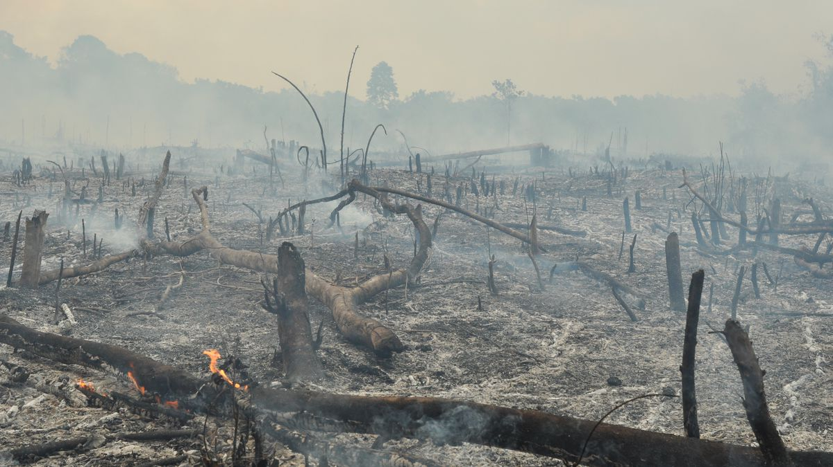
Job’s devastation (Job 1–2)

Slide 165
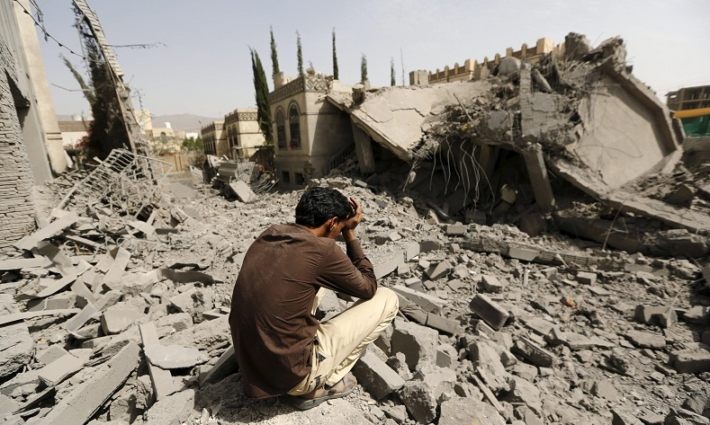
?
?
Job’s emotional turmoil (Job 3-37)

Slide 166
Job 13:22
Then call, and I will answer;
or let me speak, and you reply to me.
Job 31:35
Oh, that I had one to hear me! (Here is my signature! Let the Almighty answer me!) Oh, that I had the indictment written by my adversary!

Slide 167

Avoid “Dark Counsel” (38:1-3)
Victimization
Suicide
God is unjust

Slide 168

Ponder God’s Creative Power
(Job 38:4–41:34)

Slide 169
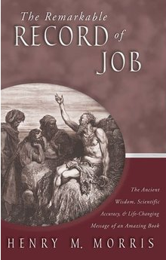
“This message, which said nothing about Job’s sufferings nor about the observing hosts in heaven, dealt instead with God’s great creation and his providential care over it.”

Slide 170
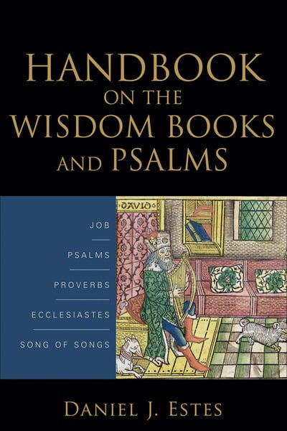
“If Job cannot understand how God governs the natural world – and he cannot – how could he expect to comprehend God’s ways with humans? Because humans in their finiteness cannot understand the workings of the creation, they should not call to account the Creator.”

Slide 171
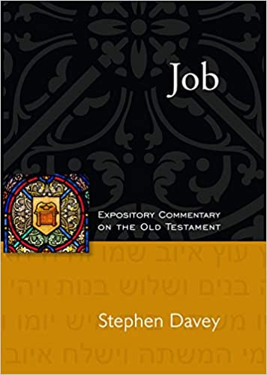
He does not condemn Job.
He does not apologize for anything that has happened.
He does not justify His allowances.
He does not offer an explanation for Job to consider.
He does not offer one word of sympathy to this grieving man.
He does not answer the question of suffering in the world.

Slide 172
He does not explain Satan’s accusation or direct involvement in Job’s losses.
He does not explain why bad things happen to good people and why good things happen to bad people.

Slide 173
Ponder God’s Creative Power
(Job 38:4–41:34)
His design (38:4-7)
His control (38:8–39:30)

Slide 174

Ocean breadth (38:8-11)

Slide 175

Sunrise (38:12-15)

Slide 176

Ocean depth (38:16-17)

Slide 177

Heaven’s height (38:18-21)

Slide 178

Flow of snow and rain (38:22-30)

Slide 179
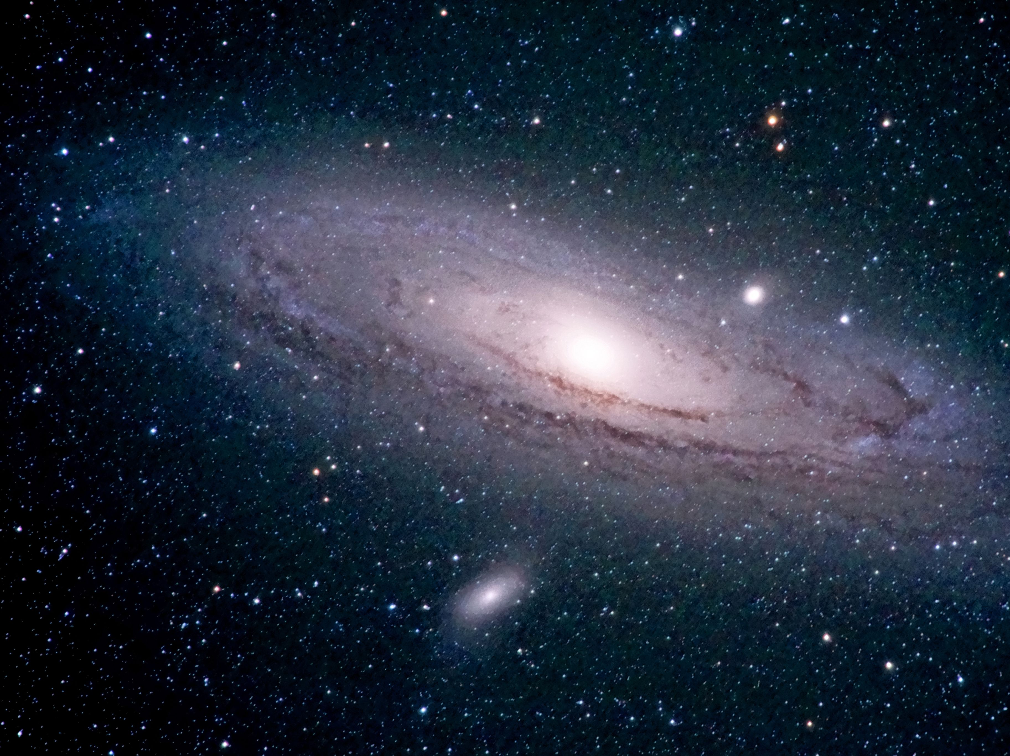
Movement of stars and weather (38:31-38)

Slide 180
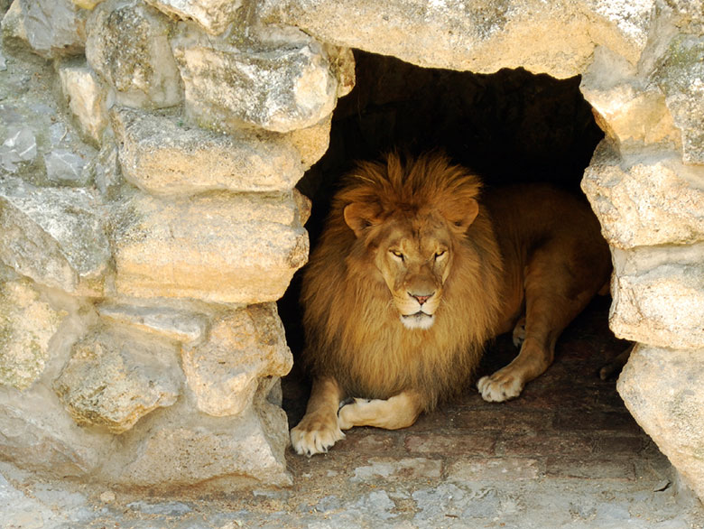
Animal provision (38:39-41)

Slide 181
Slides on
Job 39

Slide 182
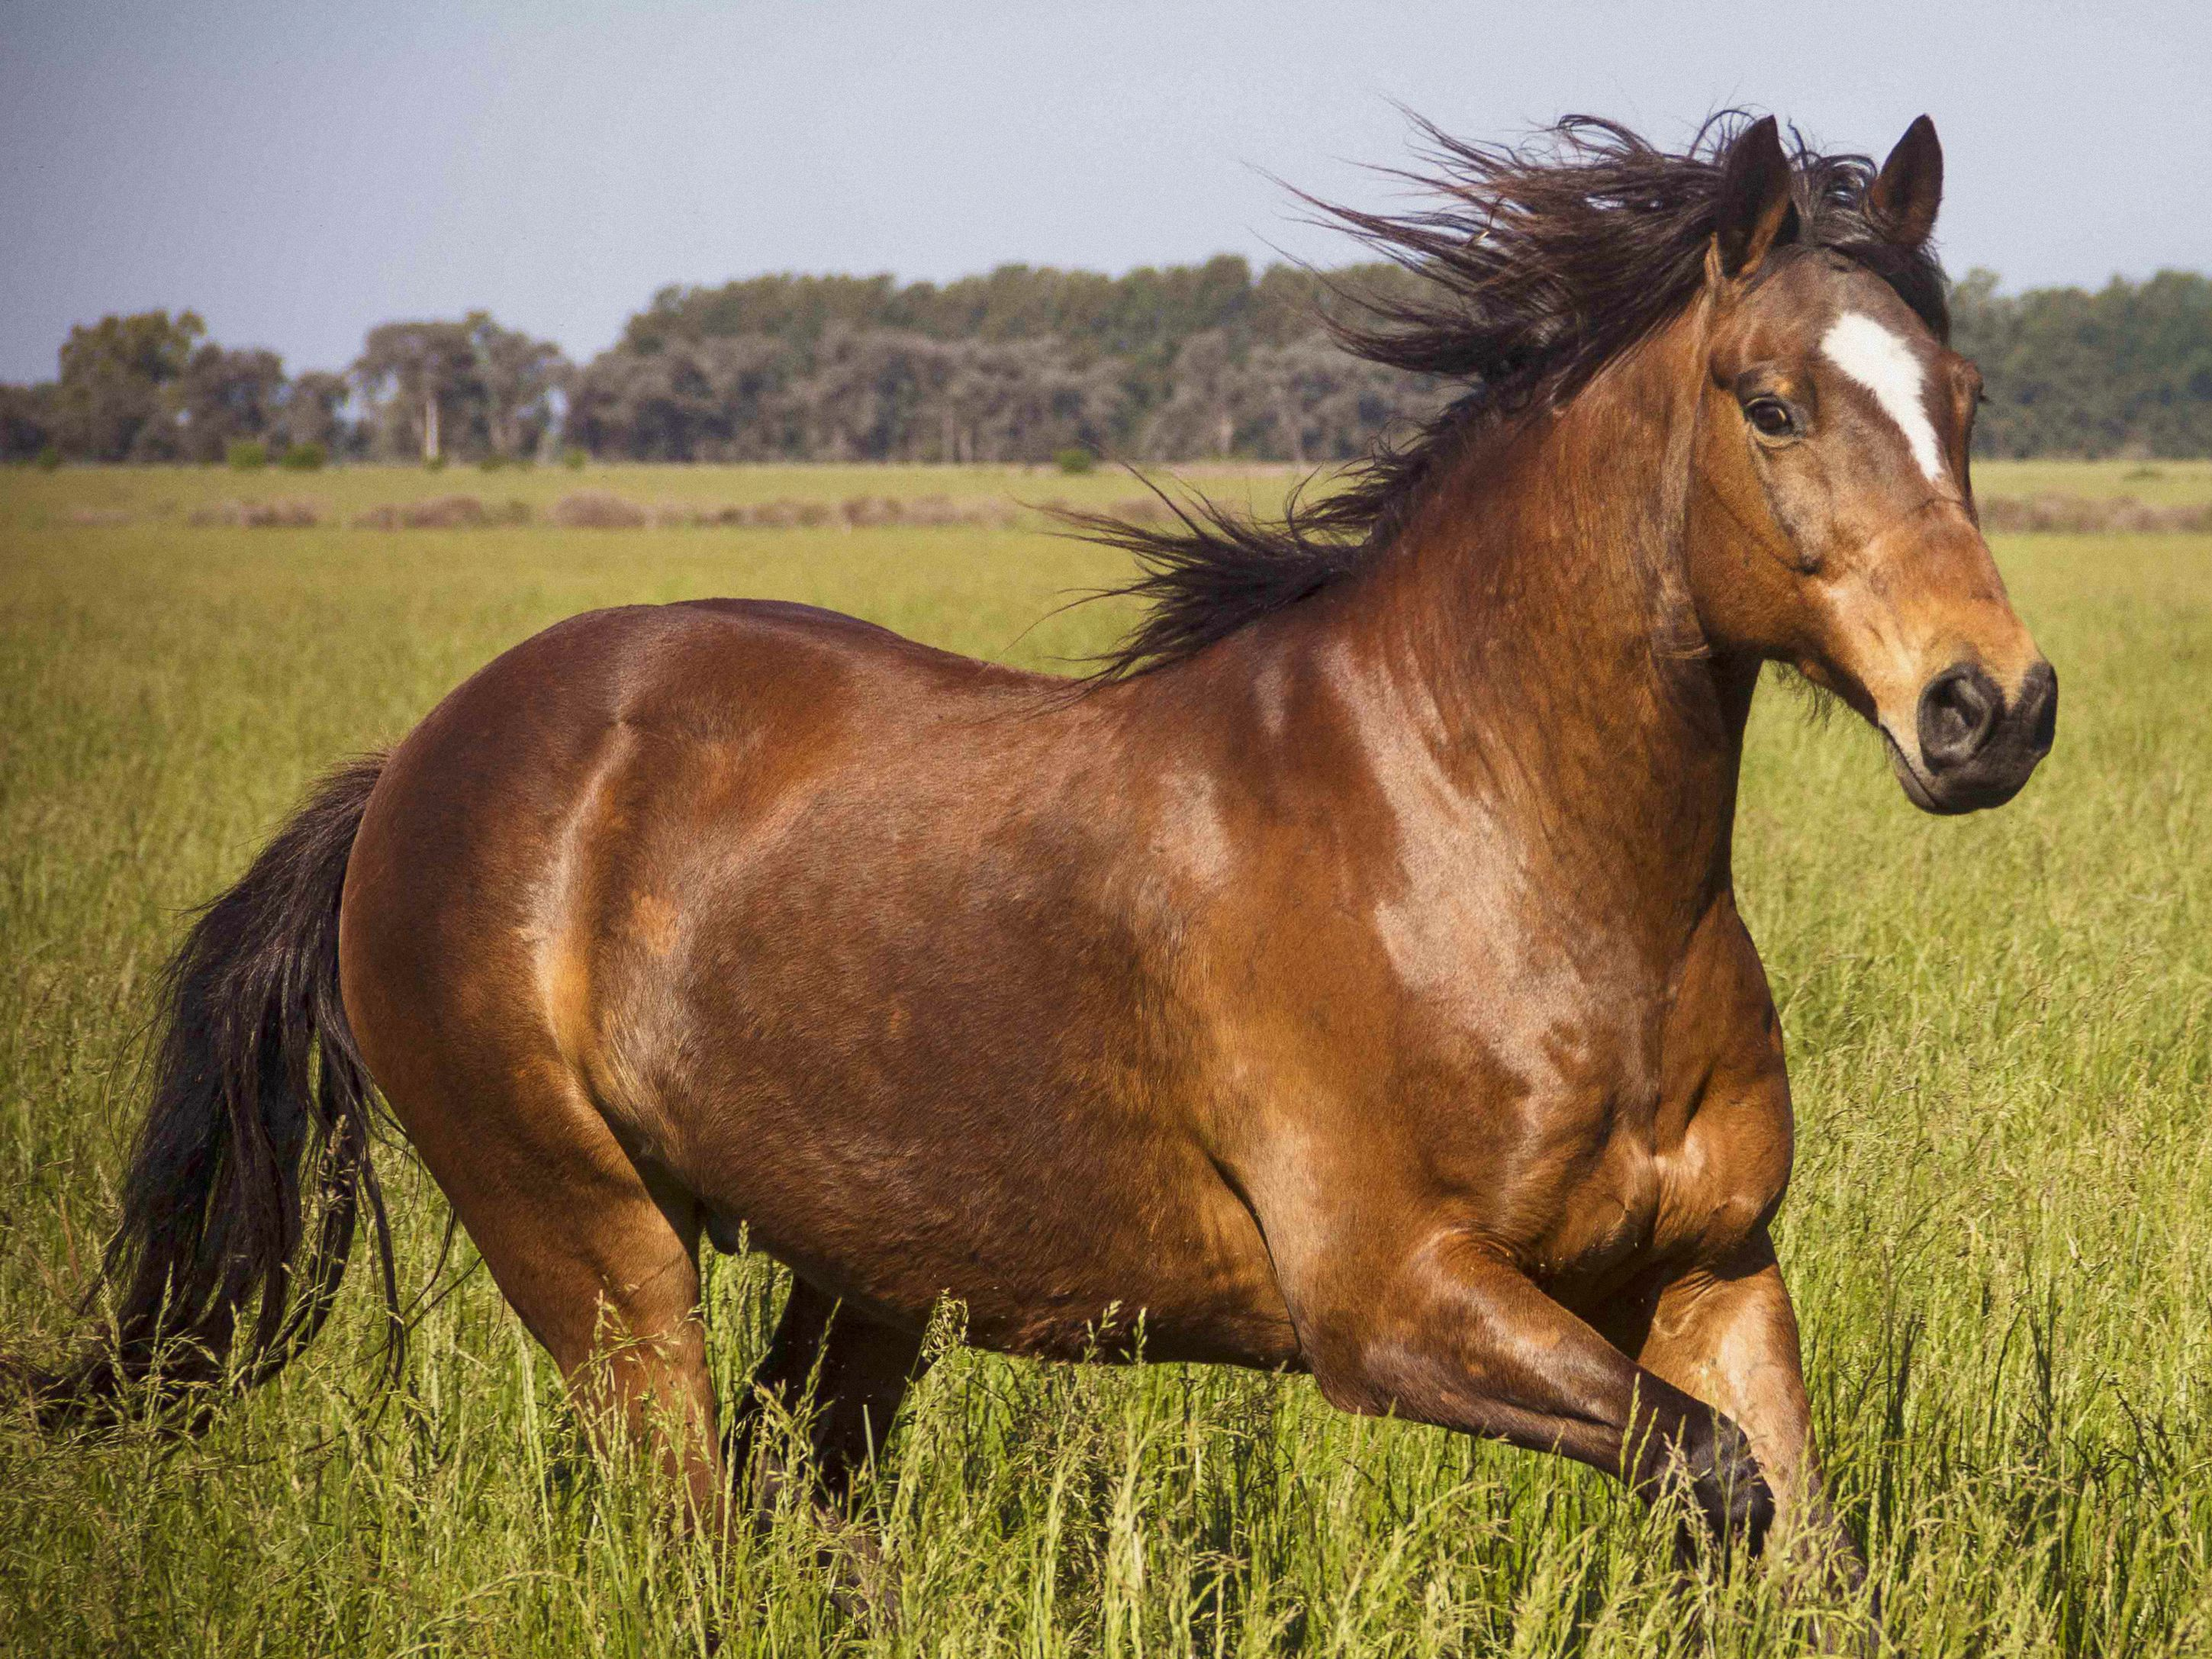
Animal design (39:1-30)

Slide 183
Slides on
Job 40

Slide 184
Ponder God’s Creative Power
(Job 38:4–41:34)
His design (38:4-7)
His control (38:8–39:30)
His might (40:6–41:34)

Slide 185
Mythology in Job
375-377
Why Would Job Refer to Mythology?
Explanation #1
Several authors opt for the explanation that Israel originally believed in a mythical concept of God which later evolved into the transcendent view of Yahweh during the kingdom period.
This is tantamount to saying that Job did not know any better when he referred to these mythical creatures. This view totally misses the point of the LORD's entire discourse in Job 38–41 where He states that He is God. Job was left dumbfounded because he knew better than to believe these silly superstitions (cf. Job 40:4-5; 42:6).
Explanation #3
The 3rd & best view is that Job used these mythical allusions merely to heighten the effect in his writing. In reference to the usage of Leviathan in Job 41:1-6, Oswalt remarks, "There seems, then, to be a double entendre in the writer's mind. He wants to make use of all the emotional connotations of the name Leviathan. He specifically uses it in order to convey on a feeling level all the overtones of God's sovereignty over nature" (p. 165).
Explanation #2
A 2nd, opposite, view is advocated by Yehezkel Kaufmann in his Religion of Israel (Chicago, 1960). "He maintains that the Hebrews were so far from being myth-makers in any period of their history that they did not even understand the nature of myth" (Oswalt, 167). His "evidence" lies in the prohibitions to pray to idols (Isaiah 44:9-20), but herein is the demise of his view. If the Hebrews were completely unfamiliar with myth, this passage would lose all its force. This explanation also does not explain the existence of the allusions to myth as well which have already been pointed out in Job.

Slide 186
Job's Mid-Term Exam (38–41)
369
Part 1 (Short Answer, 38:1–40:5):
Can you answer even one of my questions?
Part 2 (Essay Questions, 40:6–41:34):
Which of my attributes do you have (40:6-14)?
How are you stronger than Behemoth (40:15-24)?
How are you stronger than Leviathan (41)?
Notes:
Job probably thought God was giving him a FINAL EXAM—but he didn't know that, even though he miserably failed this exam, he would live 140 years after it (42:16).

Slide 187
Behemoth (Job 40:15-24)
"Look at the behemoth, which I made along with you and which feeds on grass like an ox. ¹⁶What strength he has in his loins, what power in the muscles of his belly! ¹⁷His tail sways like a cedar; the sinews of his thighs are close-knit. ¹⁸His bones are tubes of bronze, his limbs like rods of iron" (40:15-18 NIV).

Slide 188
Behemoth (Job 40:15-24)
"He ranks first among the works of God, yet his Maker can approach him with his sword.
²⁰The hills bring him their produce,
and all the wild animals play nearby.
²¹Under the lotus plants he lies,
hidden among the reeds in the marsh" (40:19-21 NIV).

Slide 189
Behemoth (Job 40:15-24)
"The lotuses conceal him in their shadow; the poplars by the stream surround him.
²³When the river rages, he is not alarmed; he is secure, though the Jordan should surge against his mouth.
²⁴Can anyone capture him by the eyes or trap him and pierce his nose?" (40:22-24 NIV).

Slide 190
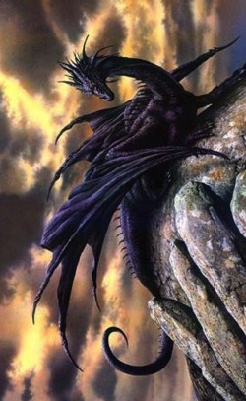
Dinosaurs in the Book of Job?
378
Behemoth (Job 40:15-24)
Strengths
Weaknesses
Mythical Monster
Behemoth is the "ferocious bullock of El" which the Ugaritic goddess Anat conquers with Leviathan.
Job refers to other mythical monsters (see preceding study)
Job can "look at the Behemoth" (40:15a)
Behemoth was made along with Job (40:15b)
God had just described other real animals
Behemoth is translated "wild beasts" in Joel 1:20 which is a non-mythological usage

Slide 191
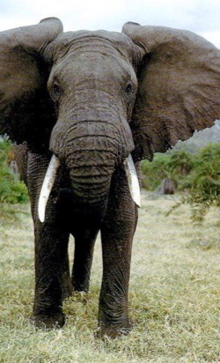
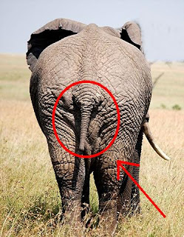
Dinosaurs in the Book of Job?
378
Elephant
Behemoth (Job 40:15-24)
Strengths
Weaknesses
Harris, Aquinas, NIV margin
Eats plants (40:15a, 20)
Habitat includes both land (40:15b, 29a) & water (40:21-23)
Tail "sways like a cedar" (40:17a) which is not the trunk or cedar branch or tail "bends down" (not "sways") or "penis stiffens"!
Behemoth's belly has powerful muscles (40:16b), but an elephant's strength is in its legs

Slide 192
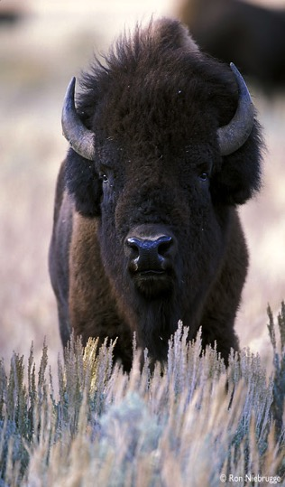
Dinosaurs in the Book of Job?
378
Behemoth (Job 40:15-24)
Strengths
Weaknesses
Hartley and Couroyer
In Palestine in 2000 BC buffaloes roamed about in Israel
Habitat includes both land (40:15b, 29a) & water (40:21-23)
Tail "sways like a cedar" (40:17a)
Hartley equates the tail with male genitals and thighs to the testicles, but himself admits that these meanings were characteristic only in later Hebrew and in the Targum, respectively.
Buffalo

Slide 193
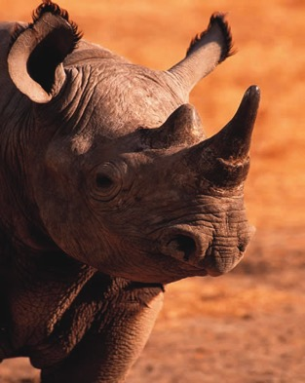
Dinosaurs in the Book of Job?
378
Rhinoceros
Behemoth (Job 40:15-24)
Strengths
Weaknesses
Northrup identifies as giant hornless rhinoceros called Baluchitherium
Texts in Job indicate that he lived in an ice age, making it extinct
Tail "sways like a cedar" (40:17a)
Northrup does not comment on the size of the rhinoceros' tail, so one must assume it resembles the small tail of a modern rhino.

Slide 194
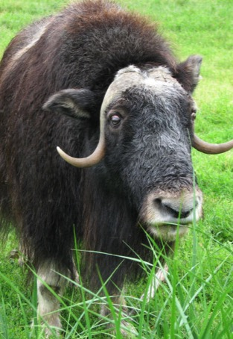
Dinosaurs in the Book of Job?
378
Behemoth (Job 40:15-24)
Strengths
Weaknesses
Kinnier Wilson says it is "ox-like" & equates it with Leviathan
Behemoth means "beasts," "cattle."
"He eats grass like an ox" (40:15b)
Cattle laugh at him—"who should laugh louder than the animals of his own kind and species?" (40:20)
Tail "sways like a cedar" (40:17a)
"Behemoth" (plural intensification) puts it in a different category than a regular ox.
Verse 20 means "all the animals play nearby." He supposes an elliptical "to lift up" here based upon the "same ellipsis" in 41:25, which he translates "lifting up of his voice" rather than "he rises [his entire body] up."
"Ox"

Slide 195
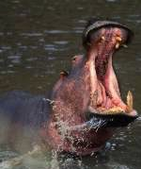
Dinosaurs in the Book of Job?
378
Behemoth (Job 40:15-24)
Strengths
Weaknesses
Zuck, Driver, NASB/NIV margins
Strength (40:16-19), herbivorous eating habits (40:15b, 20), life in the marshes (40:20-23)
Fierceness evident when trying to catch it "by the eyes" or nose when only those parts of the head show above water (40:24)
Tail "sways like a cedar" (40:17a)
Zuck (a hippopotamus advocate) admits that the hippo's tail stiffens when he is afraid (BKC, 1:771-772). In contrast, Behemoth is fearless (40:23).
The animal could not be captured or killed (40:24), but hippopotami were harpooned with barbed hooks in Egypt.
Hippopotamus

Slide 196
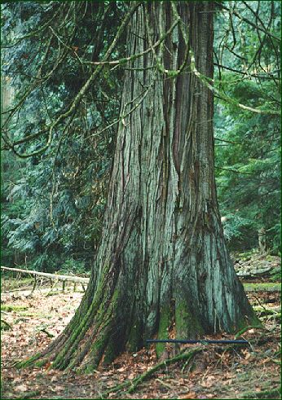
The cedar was the largest tree in the Mid-East
379

Slide 197
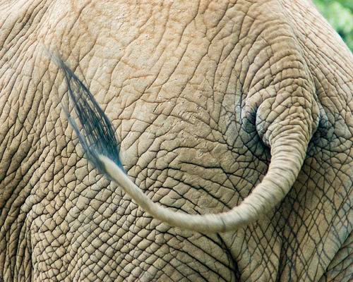
The tail of an elephant is not like a cedar!
379

Slide 198

Not like a cedar tree on a hippo either!
379

Slide 199

What's the Behemoth?
369
Look at the behemoth,
which I made along with you and which feeds on grass like an ox. What strength he has in his loins, what power in the muscles of his belly! His tail sways like a cedar; the sinews of his thighs are close-knit.
"tail like a cedar"
Job 40:15-17
WOW !
* Footnote:
Behemoth is possibly an elephant or hippopotamus.
Job 40:15-17
"tail like a cedar"

Slide 200

"…tail sways like a cedar…"
379

Slide 201

"…tail sways like a cedar…"
379

Slide 202

More like "…tail sways like a cedar…"
379

Slide 203


Dinosaurs in the Book of Job?
378
Behemoth (Job 40:15-24)
Strengths
Weaknesses
Campbell & Whitcomb specify… [Apatosaurus]; others say Diplodocus or Brachiosaurus
Plant-eating Dinosaur
Only this view explains a tail that
"sways like a cedar" (40:17).
The massive strength of dinosaurs befits Behemoth more than any animal (40:18) in its loins & belly (40:16) which certainly could not be fought by man (40:24).

Slide 204

Dinosaurs in the Book of Job?
378
Behemoth (Job 40:15-24)
Strengths
Weaknesses
The name "Behemoth" (40:15a) itself is
an intensified plural for strength unsurpassed.
Plant-eating Dinosaur
So why settle for a weaker animal than a dinosaur such as an elephant, rhinoceros, buffalo, "ox," or hippopotamus? All of these creatures fail in comparison to…

Slide 205

Apatosaurus
379
weighed 35 tons & measured 120 feet!

Slide 206

Diplodocus
379
also measured 120 feet!

Slide 207

Brachiosaurus
379
85 feet but was heavier, weighing 50 tons!

Slide 208

Dinosaurs in the Book of Job?
378
Behemoth (Job 40:15-24)
Strengths
Weaknesses
Apato-saurus
The habitat of Behemoth best describes that of a plant-eating dinosaur. This kind of dinosaur lived both on land (40:20a) & in the water (40:20b-23).
Despite Behemoth's huge size, other animals could play near it (40:20b) because it was herbivorous (40:15b). Each of the three dinosaurs mentioned above were plant-eaters.
Dinosaurs best describe animals large enough not to be afraid of a raging river (40:23) yet still able to hide their bodies underwater, concealed even under a lotus tree (40:22).

Slide 209
Dinosaurs in the Book of Job?
378
Behemoth (Job 40:15-24)
Strengths
Weaknesses
Apato-saurus
The only possible weakness of this view is if one argues that the book of Job is poetic in form & thus not to be taken literally. Yet God's other questions & descriptions of other animals in the context (Job 38–39) are taken at face value, so why not here too?
As for problems with man and dinosaurs living at the same time, see OT Survey notes, 2:76-82.

Slide 210
Slides on
Job 41

Slide 211

What's the Leviathan?
369
379
Job 41

Slide 212
Leviathan (Job 41:1-34)
"Can you pull in the leviathan with a fishhook or tie down his tongue with a rope?
²Can you put a cord through his nose
or pierce his jaw with a hook?
³Will he keep begging you for mercy?
Will he speak to you with gentle words?" (41:1-3 NIV).

Slide 213
Leviathan (Job 41:1-34)
"Will he make an agreement with you for you to take him as your slave for life?
⁵Can you make a pet of him like a bird or put him on a leash for your girls?
⁶Will traders barter for him?
Will they divide him up among the merchants?" (41:4-6 NIV).

Slide 214
Leviathan (Job 41:1-34)
"Can you fill his hide with harpoons or his head with fishing spears?
⁸If you lay a hand on him, you will remember the struggle and never do it again!
⁹Any hope of subduing him is false; the mere sight of him is overpowering.
¹⁰No one is fierce enough to rouse him. Who then is able to stand against me [God]?" (41:7-10 NIV).

Slide 215
Leviathan (Job 41:1-34)
"Who has a claim against me that I must pay? Everything under heaven belongs to me [God].
[God of Leviathan]
¹²I will not fail to speak of his limbs, his strength and his graceful form.
¹³Who can strip off his outer coat?
Who would approach him with a bridle?" (41:11-13 NIV).

Slide 216
Leviathan (Job 41:1-34)
"Who dares open the doors of his mouth, ringed about with his fearsome teeth?
¹⁵His back has rows of shields
tightly sealed together;
¹⁶each is so close to the next
that no air can pass between.
¹⁷They are joined fast to one another;
they cling together and cannot be parted" (41:14-17 NIV).

Slide 217
Leviathan (Job 41:1-34)
"His snorting throws out flashes of light; his eyes are like the rays of dawn.
¹⁹Firebrands stream from his mouth; sparks of fire shoot out.
²⁰Smoke pours from his nostrils as from a boiling pot over a fire of reeds.
²¹His breath sets coals ablaze, and flames dart from his mouth"
(41:18-21 NIV).

Slide 218
Leviathan (Job 41:1-34)
"Strength resides in his neck; dismay goes before him.
²³The folds of his flesh are tightly joined;
they are firm and immovable.
²⁴His chest is hard as rock,
hard as a lower millstone"
(41:22-24 NIV).

Slide 219
Leviathan (Job 41:1-34)
"When he rises up, the mighty are terrified;
they retreat before his thrashing.
²⁶The sword that reaches him has no effect, nor does the spear or the dart or the javelin.
²⁷Iron he treats like straw
and bronze like rotten wood"
(41:25-27 NIV).

Slide 220
Leviathan (Job 41:1-34)
"Arrows do not make him flee;
slingstones are like chaff to him.
²⁹A club seems to him but a piece of straw;
he laughs at the rattling of the lance.
³⁰His undersides are jagged potsherds, leaving a trail in the mud like a threshing sledge"
(41:28-30 NIV).

Slide 221
Leviathan (Job 41:1-34)
"He makes the depths churn like a boiling caldron
and stirs up the sea like a pot of ointment.
³²Behind him he leaves a glistening wake; one would think the deep had white hair" (41:31-32 NIV).

Slide 222
Leviathan (Job 41:1-34)
"Nothing on earth is his equal—
a creature without fear.
³⁴He looks down on all that are haughty;
he is king over all that are proud"
(41:33-34 NIV).

Slide 223

Dinosaurs in the Book of Job?
379
Leviathan (Job 41:1-34)
Strengths
Weaknesses
Mythical Sea Monster
Rowold, Harris, Smick, Pope, Tur-Sinai, Martens, & MacKenzie
Possibly the 7-headed monster Lotan found in Ugaritic poetry
Other texts refer to Leviathan as a 7-headed mythological monster (Job 3:8; Ps. 74:14)
Leviathan in Job 41 is an actual animal in the detailed description of its body (41:1-3, 12-17, 22-25, 30, 33), ferocity (41:1-34), & aquatic habitat (41:1, 7, 30-32).
The preceding context describes literal animals (esp. "which I made along with you," 40:15a)
What would God prove to Job about His power over a fanciful creature?

Slide 224




Dinosaurs in the Book of Job?
379
Whale
Leviathan (Job 41:1-34)
Strengths
Weaknesses
Driver, Aquinas, NEB
Aquatic nature (41:1, 7)
Parallel in Psalm 104:26 which refers to the sea where "ships go to & fro, & the leviathan, which you formed to frolic there."
"I will not fail to speak of his limbs" (41:12)
Jagged undersides leave a trail in the mud (41:30) does not apply to a whale
Driver excludes the ferocity of Job 41:9-11 from his discussion (whales are not as ferocious as the Leviathan)

Slide 225



Dinosaurs in the Book of Job?
379
Leviathan (Job 41:1-34)
Strengths
Weaknesses
Eerdmans (Studies in Job, 27f.)
Same support as for whale above
Each deficiency of the whale view above has even greater weight when applied to a dolphin
Dolphin

Slide 226

Dinosaurs in the Book of Job?
379
Crocodile
Leviathan (Job 41:1-34)
Strengths
Weaknesses
Most interpreters: Archer, Zuck, Smick, Dhorme, Freehof, Delitzsch, Payne, Ellison, Bodenheimer
ferocious jaw (41:2, 5, 14)
difficult to capture (41:6)
tough skin (41:13-17, 23)
scales (41:15-17)
Crocodiles do not have strong limbs (41:12)
Zuck admits crocodiles can be harpooned (BKC, 771), but not Leviathan (41:7, 26-29)
Leviathan is too large for a merchant to sell (41:6); merchants sell crocodile hides today
All animals in God's speech before Behemoth and Leviathan (38:39—39:30) are Palestinian, but the crocodile is found mostly in Egypt and probably would be unfamiliar to Job.

Slide 227
Dinosaurs in the Book of Job?
379
Crocodile
Leviathan (Job 41:1-34)
Strengths
Weaknesses
hideous movements of its eyes, nose and mouth (41:18-21)
jagged undersides (41:30)
wake in the water (41:32)
Leviathan is parallel to the monster tannin (Ps. 74:13b-14a), which refers to the crocodile of Egypt in Ezekiel 29:3-5 (Delitzsch, 365)
Meanings for tannin include "serpent, dragon, and sea-monster," but never the crocodile. It generally refers to a mythological dragon (cf. Job 7:12). Also, parallelism does not equate the two beasts anyway, but only compares their common, fierce characteristics.
This tannin (Ezek. 29:3-5) is probably not mythological but figurative for Pharaoh, who boasts of the creating the Nile.

Slide 228

Tyrannosaurus Rex
379

Slide 229

Dinosaurs in the Book of Job?
379
Leviathan (Job 41:1-34)
Strengths
Weaknesses
Marine
Dinosaur
A meat-eating marine dinosaur (e.g., Tyrannosaurus Rex, Allosaurus, or Ankylosaurus)
While a crocodile has been harpooned (cf. 41:7, 26), who would dare try to harpoon or club (41:29) a Tyrannosaurus Rex or other marine dinosaur?
Leviathan has great significance attached to his limbs (41:12).
He "rises up" & terrifies (41:25), which a Tyrannosaurus Rex or similar dinosaur could do by standing on hind legs (not true of crocodiles which cannot "look down" on others).

Slide 230
Dinosaurs in the Book of Job?
379
Leviathan (Job 41:1-34)
Strengths
Strengths
Weaknesses
Weaknesses
Marine
Dinosaur
His huge size "looks down on the haughty; he is king over all that are proud" (41:33-34); a crocodile is no king of beasts compared to Tyrannosaurus Rex.
Tyrannosaurus Rex may have been the fiercest animal which ever lived. His head was nearly 4 feet long with sharp and serrated teeth. He stood from 18 to 20 feet at 50 feet long; his weight may have been 8 tons. His massive hind feet were able to carry this tremendous weight, & the long tail served to balance him. No predator of today, including the lion & tiger, is so large, so powerful, so fierce.

Slide 231

Tyrannosaurus Rex
379
Notes:
Tyrannosaurus Rex may have been the fiercest animal which ever lived. His head was nearly 4 feet long with sharp and serrated teeth. He stood from 18 to 20 feet at 50 feet long; his weight may have been 8 tons. His massive hind feet were able to carry this tremendous weight, & the long tail served to balance him. No predator of today, including the lion & tiger, is so large, so powerful, so fierce.

Slide 232

Dinosaurs in the Book of Job?
379
Leviathan (Job 41:1-34)
Breathing fire & smoke (41:18-21) has often been deemed figurative, yet may be literal. We can't tell from dinosaur bones if they could breathe like this. Some beetles & fish do it, so it is possible that some dinosaurs may have issued forth smoke & fire.

Slide 233


Dinosaurs in the Book of Job?
379
The 9 foot Indonesian Komodo dragons eat dead carcasses of other animals (e.g., goats). The technique of an adult Komodo lizard at mealtime is like that of a power shovel… With its saw-edged teeth set in massive jaws it rips loose whole sections of carcasses & bolts them down—bones, hair, maggots & all (National Geographic, Dec. '68, 976-77).

Slide 234

Time to Redefine "Dinosaur"?
379
"Although they are now 99% extinct and seldom exceed 12 feet in length, the American alligator… attains lengths of nearly 20 feet as recently as the turn of the century (National Geographic [Jan. '67], 137). Only about 500 years ago the aepyornis, a dinosaur bird over 10 feet tall and weighing half a ton, still lived on the island of Madagascar (National Geographic [Oct. '67], 493)"
—John Whitcomb, The World That Perished, 28
Notes:
Bill Cooper, After the Flood (Chicester, England: New Wine, 1995), 131.

Slide 235

Dinosaurs Lived Recently
Behemoth––giant vegetarian
(Job 40:15-24)
Leviathan––ferocious meat eater (Job 41)
British King Morvidus was killed by a monster by being "gulped down… as a big fish swallows a little one" (336 BC)
A monster was killed in 1693 in Bedd-yr-Afanc, England
Monsters have been reported in nearly 200 places in England alone
Bill Cooper, After the Flood (Chicester, England: New Wine, 1995), 131
Notes:
Bill Cooper, After the Flood (Chicester, England: New Wine, 1995), 131.

Slide 236



Beowulf & the Creatures of Denmark
Danish poem extols Beowulf (AD 495-583)—later king for 50 yrs.
The monster Grendel ("grinder, destroyer") preyed on Danes for 12 years (AD 503-515)
This hero cleared monstrous animals from the sea lanes between Denmark and Sweden
He then pulled out Grendel's small arm, who retreated to his cave and bled to death
DENMARK

Slide 237


Japanese Fisherman's Dead Monster
(The Times 21 July 1977)
Two tons & ten meters long
Caught at 330 meters deep in the ocean near Christchurch
Plesiosaurus: huge, small-headed reptiles with long neck and four fins
Photographed and sketched by marine biologist Michihiko Yano
Captain ordered it thrown back into sea for fear of contaminating his fish.
Soon after BBC reported it to be a shark (30 July 1977)!
Duane T. Gish, Dinosaurs by Design (4730 Barnes Road, Colorado Springs, CO: Master Books and Creation-Life Publishers, 1992), 86
Enlarge and read this!
Notes:
Duane T. Gish, Dinosaurs by Design, 4730 Barnes Road, Colorado Springs, CO: Master Books and Creation-Life Publishers, 1992, 86

Slide 238

Is This a Shark?!
Bill Cooper, After the Flood, 140

Slide 239


Behemoth
Leviathan

Slide 240

Avoid “Dark Counsel” (38:1-3)
Ponder God’s Creative Power
(Job 38:4–41:34)
Be reassured of God’s justice and mercy
(Job 42:1-17)

Slide 241

“The God who sets bounds to the sea, who refreshes the desert, who feeds the ravens, who cares for the gazelle in the wilderness and the eagle in its eyrie, is the same God who now causes him seemingly thus unjustly to suffer. But if the former is worthy of adoration, the latter will also be so.”

Slide 242


To
Bright Light

Slide 243
Why do the innocent suffer?
Satan:
Deserved
3 Friends:
Retribution
Elihu:
Discipline
God:
Incomprehensibility

Slide 244
What is the proper response to righeous suffering?
Notes:
How should we act when we can't figure out seemingly undeserved difficulty?

Slide 245
I. The Setting: Suffering sometimes comes when we haven’t done anything wrong (Job 1–2).
Notes:
We haven’t deserved it, but at times pain comes nonetheless.

Slide 246
II. The Debate: We struggle with righteous suffering until God tells us to rest in his incomprehensibility
(Job 3–41).
Notes:
Wrestling with the reason for pain is natural until God says he won't tell.

Slide 247
III. The Resolution: Our proper response is to submit to God (Job 42).
Notes:
We should surrender to the Lord rather than fight him.

Slide 248
Slides on
Job 42

Slide 249

Outline
370
III. (Ch. 42) Job submits to God for His incomprehensibility and sovereignty, then prays for his friends and has restored possessions, children, and health, thus affirming God's blessing on those who accept His plan.

Slide 250
Contrasts Between Job 1 and Job 42
370
Job 1
Job 42
Description
Blameless & upright, feared God & shunned evil
Blameless yet repentant, feared God & prayed for friends
Sons
7
7
Daughters
3 (ate with brothers at feasts)
3 (more beautiful, got inheritance)
Sheep
7,000
14,000
Camels
3,000
6,000
Yoke of Oxen
500
1,000
Donkeys
500
1,000
Servants
"Large number"
Assumed large
Age
Unstated
Lived another 140 years

Slide 251
Job | Suffering Servant
Job is “my servant” (Job 1:8; 2:3) | God praises the Suffering Servant as he does Job (Isa 42:1)
Job is “stricken” of God (Job 19:21) | The people consider the Servant to be “stricken” of God (Isa 53:4)
Job is considered to be chastised by the Almighty (Job 5:17) | The same “chastisement” is predicted of the Servant (Isa 53:5)
Job is “despised” by compatriots (Job 19:18) | The Servant is despised and not esteemed (Isa 53:3)
Job’s friends “forget” him and his brethren “stay away” from him (Job 19:13-14) | The Suffering Servant’s compatriots “hide their faces” (Isa 53:3)
Job is “smitten” on the “cheeks” (Job 16:10) | The Servant also is “smitten” on the “cheeks” (Isa 50:6, 53:4).
Job records his experience as, “They abhor me, they flee far from me, and spare not to spit in my face” (Job 30:10, cf. Job 17:6) | The Servant does not hide his face from “spitting” (Isa 50:6 ), which is a rare word (3x) that only occurs in Job (2x) and Isaiah.
The above comparisons between Job & Suffering Servant are taken from Andrew Perry, “The Suffering Servant of Isaiah and the Suffering of Job” at http://www.christadelphian-ejbi.org/presentations/job.pdf

Slide 252
Job | Suffering Servant
Job claims that what has befallen him was “not for any violence” in his hands (Job 16:17) | This phrase occurs once elsewhere in Isaiah 53:9, “because he had done no violence”
Job asserts that his prayer was pure (Job 16:17) | No guile was found in the Suffering Servant’s mouth (Isa 53:9, cf. Job 31:5)
Job says that upright men are astonished or appalled at what has happened to him (Job 17:8) | “Many were appalled at thee” (Isa 52:14)
Job says that the mockers will not be “exalted” (Job 17:4) | The Suffering Servant himself is the one who would be exalted (Isa 52:13)
Job wants someone to “contend” with him ( Job 13:19) | The same question is posed by the Suffering Servant: “Who will contend with me?” (Isa 50:8)
Job complains that he is being eaten by moths (Job 13:28) | In contrast, the adversaries of the Suffering Servant would be eaten by moths (Isa 50:9)
Job rests his case with God (Job 16:19) | So does the Suffering Servant (Isa 49:4)

Slide 253

Jesus on the cross ultimately substituted for our sin of rebellion in the Fall and the sins that have been committed. His death lays the foundation for the wellness and fullness for shalom peace.

Slide 254

Satan lost his challenge
Satan used the weapon of sickness with the accusation that man will do anything to keep his life.

Slide 255

When Job had his divine encounter, he no longer pursued his restoration and healing. His suffering no longer mattered, since he knew that God’s purposes were good and higher than his sufferings.

Slide 256

The suffering servant, Jesus, was willingly crushed and broken by God. He knew that a greater good would come out of His pain—that many would be justified because He took our place of judgment.

Slide 257
Don’t long to know reasons—long to know God instead!
356
Job's suffering, dialogue with others and God, and restoration reveal that the proper response to righteous suffering is submission to God rather than questioning His incomprehensibility and sovereignty.

Slide 258
Did God answer Job?
How?
God probably will not reveal why you are suffering—so rest in your ignorance.
Notes:
God probably will not reveal why you are suffering—so rest in your ignorance.
Too often we think that God owes us a reason. He doesn’t owe us anything!
Even if he did tell the reason, we would still struggle with his justice due to our sin.
_____________
Job by Bonnat from Wikipedia

Slide 259
What is the proper response to righeous suffering?
Notes:
How should we act when we can't figure out seemingly undeserved difficulty?

Slide 260
I. The Setting: Suffering sometimes comes when we haven’t done anything wrong (Job 1–2).
Notes:
We haven’t deserved it, but at times pain comes nonetheless.

Slide 261
II. The Debate: We struggle with righteous suffering until God tells us to rest in his incomprehensibility
(Job 3–41).
Notes:
Wrestling with the reason for pain is natural until God says he won't tell.

Slide 262
III. The Resolution: Our proper response is to submit to God (Job 42).
Notes:
We should surrender to the Lord rather than fight him.

Slide 263
Main Idea of
JOB
Submit to God’s incomprehensibility rather than try to figure suffering out.
Notes:
Yield to the LORD by recognizing that he is under no obligation to tell you his purposes in difficulty.

Slide 264


Key Word
Job
356
Incomprehensibility
The problem of suffering
Notes:
James Tissot, "Job and His Three Friends."

Slide 265
Summary Statement
356
Job's suffering, dialogue with others and God, and restoration reveal that the proper response to righteous suffering is submission to God rather than questioning His incomprehensibility and sovereignty.

Slide 266
Application
356
APPLICATION
During righteous suffering…
Do not question the reason for your plight.
Submit to God by trusting in God's wisdom.
Notes:
Do not demand a response from God to your questions that he never promises to answer.
The issue is not knowing God’s answer—which you probably wouldn’t accept anyway—but the issue is faith in him and his ways despite your ignorance.
What issue are you going through now?
Is your pain really righteous suffering?
If you need to repent, please go ahead.
If you don’t need to repent, don’t pretend you do.
How are you trying to figure your suffering out?
“If only I knew…” assumes that if you knew right, you would act right.
Are you finding the advice of friends about as helpful as the counsel of Job’s friends?
How can you submit to God by trusting in God’s wisdom?

Slide 267

Don’t try to force God to tell you the things he will not tell.
"The secret things belong to the LORD our God, but the things revealed belong to us and to our children forever, that we may follow all the words of this law"
(Deut 29:29 NIV).
"The LORD our God has secrets known to no one. We are not accountable for them, but we and our children are accountable forever for all that he has revealed to us, so that we may obey all the terms of these instructions”
(Deut 29:29 NLT).
Notes:
If God answered all our questions, then he would not be God. We would be God.

Slide 268

Psalm 46:10
"Be still and know that I am God."
Notes:
Other translations say, "Cease striving…"
Only when we stop to listen will we hear from God.
Only when we hear from God—even hear God's silence—that we will know him as he truly is.
He is God. We are not. This is one of the basic rules of living in his universe.

Slide 269
Black

Slide 270


OT Preaching link at BibleStudyDownloads.org
Get this presentation and script for free!

Slide 271

Argument
358
The Book of Job begins in a narrative in which Job suffers at the hand of Satan (chs. 1–2), wrestles in prose with 4 friends & God over the cause of his suffering (chs. 3–41), & concludes again in a narrative with God vindicating him for his righteous response (ch. 42).
The bulk of the book revolves around 3 cycles of accusation by his 3 friends (chs. 3–31), Elihu (chs. 32–37), & finally God, who states that the reason for his suffering should not be asked because of the incomprehensibility and sovereignty of His ways (chs. 38–41).

Slide 272

Synthesis
358-359
God's incomprehensibility
explains righteous suffering
1–2 Righteous suffering
3–41 Unsuccessful dialogue
42 Restoration

Slide 273
Five Responses to Suffering
374
Huang Sabin, SBC, adapted
PERSON
RESPONSE
SOLUTION
MODERN
EQUIVALENT
ANSWER
1. Job's Wife
Curse God & die (2:9)
Suicide
Young people
Unacceptable
2. Three "friends"
Suffering is from sin (4:7-8)
Repentance
"Name it,
claim it"
Not always
applicable
3. Job
God's not fair & doesn't care (19:7)
Complain
Most mourners
Unbiblical
^{NLT} Job 2:9 His wife said to him, "Are you still trying to maintain your integrity? Curse God and die."
NIV Job 4:7 "Consider now: Who, being innocent, has ever perished? Where were the upright ever destroyed? ⁸As I have observed, those who plow evil and those who sow trouble reap it."
4 Elihu
Trials are for teaching (33:14-19)
Endure
Most preachers
Inadequate
5. GOD
Not 'Why?" but "Who?" (38-42)
Worship
None
Unpopular

Slide 274
Five Responses to Suffering
374
Huang Sabin, SBC, adapted
PERSON
RESPONSE
SOLUTION
MODERN
EQUIVALENT
ANSWER
1. Job's Wife
Curse God & die (2:9)
Suicide
Young people
Unacceptable
2. Three "friends"
Suffering is from sin (4:7-8)
Repentance
"Name it,
claim it"
Not always
applicable
3. Job
God's not fair & doesn't care (19:7)
Complain
Most mourners
Unbiblical
4 Elihu
Trials are for teaching (33:14-19)
Endure
Most preachers
Inadequate
NIV Job 19:7 "Though I cry, 'I've been wronged!' I get no response; though I call for help, there is no justice.' "
5. GOD
Not 'Why?" but "Who?" (38-42)
Worship
None
Unpopular

Slide 275
Five Responses to Suffering
374
Huang Sabin, SBC, adapted
PERSON
RESPONSE
SOLUTION
MODERN
EQUIVALENT
ANSWER
ESV Job 38:1 Then the LORD answered Job out of the whirlwind and said: ²"Who is this that darkens counsel by words without knowledge? ³Dress for action like a man; I will question you, and you make it known to me. ⁴Where were you when I laid the foundation of the earth? Tell me, if you have understanding."
1. Job's Wife
Curse God & die (2:9)
Suicide
Young people
Unacceptable
ESV Job 33:14 For God speaks in one way, and in two, though man does not perceive it. ¹⁵In a dream, in a vision of the night. . . ¹⁹Man is also rebuked with pain on his bed and with continual strife in his bones.
2. Three "friends"
Suffering is from sin (4:7-8)
Repentance
"Name it,
claim it"
Not always
applicable
3. Job
God's not fair & doesn't care (19:7)
Complain
Most mourners
Unbiblical
4 Elihu
Trials are for teaching (33:14-19)
Endure
Most preachers
Inadequate
5. GOD
Not 'Why?" but "Who?" (38–42)
Worship
None
Unpopular

Slide 276
Black

Slide 277
OT Survey link at BibleStudyDownloads.org
Get this presentation for free!
Notes:
OT Survey (os)

