Slide 1
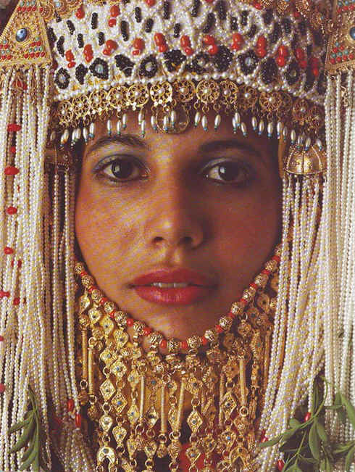
Esther
Extermination Plot Foiled
Dr. Rick Griffith • Jordan Evangelical Theological Seminary • BibleStudyDownloads.org
Notes:
To exterminate means to annihilate or destroy completely.
In Esther we see a plan to wipe out the Jews ended up being stopped.

Slide 2
Key Word
308
39
Providence
Esther
Notes:
The word providence never appears in the book itself, but the reader must conclude that the events are so unlikely that God must be behind them.
Certain words and phrases that I never use: coincidence, it just so happened, fate, I thank my lucky stars, it occurred by chance, accident, etc.

Slide 3
Theme
308
Extermination Plot Foiled
Esther
Notes:
God is never mentioned in the book, so who is it that stops this plan to wipe the Jews from the face of the earth?
The fact that God is never noted only heightens the irony—surely no one else could devise such “circumstantial” events where Mordecai is in the exact place he was, or when the king could not sleep on a particular night, or when he asks that King Ahasuerus be put back to sleep with a boring reading of his reign, or the text of his life being saved in is the passage read to him, or the timing of Haman being outside his room when the king devises his plan to exalt Mordecai, or many other “it-just-so-happened” types of events that no one could plan except God. All these lead to the Jews triumphing over the threats to their very existence.

Slide 4
Key Verse
308
(Mordecai speaking) "For if you remain silent at this time, relief and deliverance for the Jews will arise from another place, but you and your father's family will perish. And who knows but that you have come to royal position for such a time as this?" (4:14).
Esther
Notes:
Here we see the perfect balance between divine sovereignty (“deliverance from another place”) and human responsibility (“for such a time as this”).
Mordechai knew that God would keep his promise to bless the world through Israel—but he also knew that God uses people in fulfilling his plan.
Like Esther, we can either choose to rebel against God’s plan or cooperate with him. Rebellion leads to personal ruin, but obedience gives us the privilege of actually being part of what God had designed all along!

Slide 5

Kingdom Statement
39
God's providence in averting Israel's destruction showed his rule over all nations.
Esther
Notes:
Persia’s king Xerxes thinks he is sovereign to do as he wills. Still, he is actually easily manipulated by his advisers over what to do with Vashti, over Haman’s cunning to enrich the treasury and take vengeance on the Jews, over Esther’s beauty and ability to get him to do her will, etc. The king is not as powerful as he thought, for the King of kings was above every decision.

Slide 6
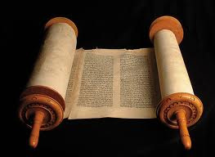
Summary Statement
308
41
An extermination of the Jewish nation plotted by Haman reverts upon his own head by God's providence through Mordecai and Esther to encourage postexilic Israel of God's continued commitment to the Abrahamic Covenant.
Esther
Notes:
Province is evidenced in nothing spiritual noted in the book—not God’s name(s), nor the law, nor prayer, nor priests or sacrifices, nor anything of a religious nature. And yet, above it all, God clearly shows his unrelenting passion to fulfil the promises of land, seed, and blessing promised to Abraham (Gen 12:1-3).

Slide 7
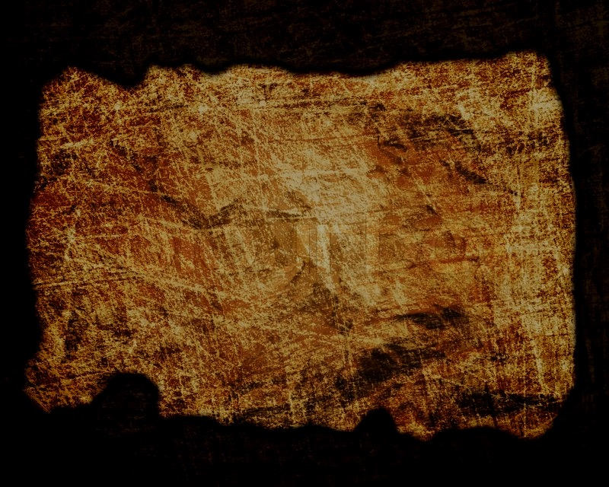
Covenant
42b
God protected Israel from extinction (4:14; cf. Jer. 31:35-37), fulfilling his covenant promise to bring the Messiah mostly behind the scenes.
Esther
Notes:
Had Haman’s plan succeeded, the Jews would have been destroyed. There would have been no return to the land of Israel, no fulfillment of the Messiah’s birth in Bethlehem (Micah 5:2), and no new covenant fulfilled as promised by Jeremiah 31 and Ezekiel 36.

Slide 8

Redemption
42b
All efforts to destroy God's redemptive plan by annihilating his redemptive people Israel will fail, as did Haman's.
Esther
Notes:
History has shown that, since the time of Esther, God is committed to saving sinful humanity. The Romans tried to stamp out the Jews and Christians, but both remain today, while Italy is a faint picture of the Roman Empire. Hitler sought to destroy the Jews, but was himself killed. Even today, nations that bless Israel are themselves blessed—such as the USA, Singapore, and Jordan. Likewise, countries seeking to destroy Israel are poorer, weaker, and more unstable.

Slide 9
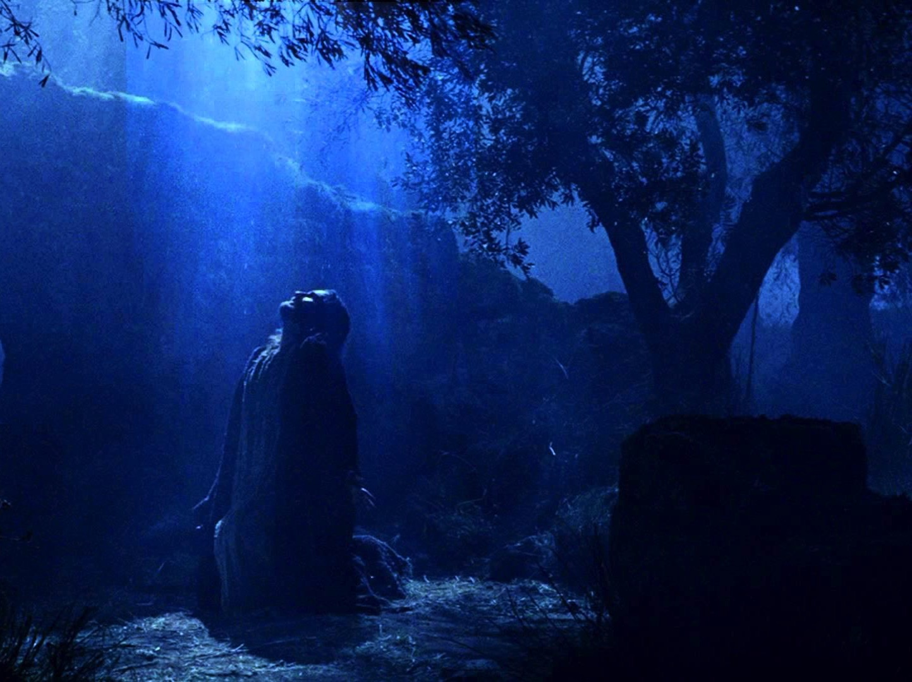
Messiah
42a
The queen’s risk of death for the Jews (4:16) and role as advocate (7:1-6) portray these roles for Christ.
Esther
Notes:
The whole book also shows how opposition to the Jews strengthened them so that the Messiah would eventually be born in Israel.

Slide 10
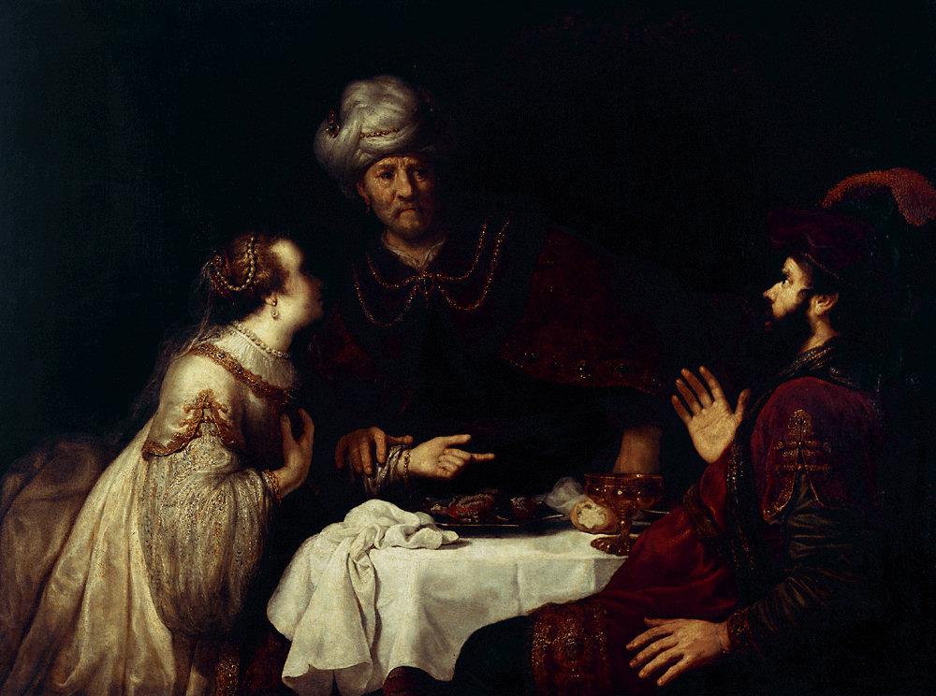
Esther
Extermination Plot Foiled |  | Principles for Growth
Plot Planned |  | Plot Foiled
Chapters 1–4 |  | Chapters 5–10
Threat |  | Triumph
Providence Prepared |  | Providence Enacted
Persecution |  | Preservation
Grave Danger |  | Great Deliverance
Feasts of Ahasuerus | Conduct 2:1-16 | Feasts of Esther & Purim | Eschatology 4:13–5:11
Esther Exalted 1:1–2:18 | Haman Plots 2:19–4:17 | Mordecai over Haman 5:1–8:2 | Mordecai over Persia 10
Persia
10 Years (483-473 BC)
308
Notes:
The turning point in the book is chapter 5. Before then, the situation keeps getting worse for the Jews, but the reversal begins in chapter 5 when the king responds favorably to Esther, leading to Haman’s downfall.

Slide 11
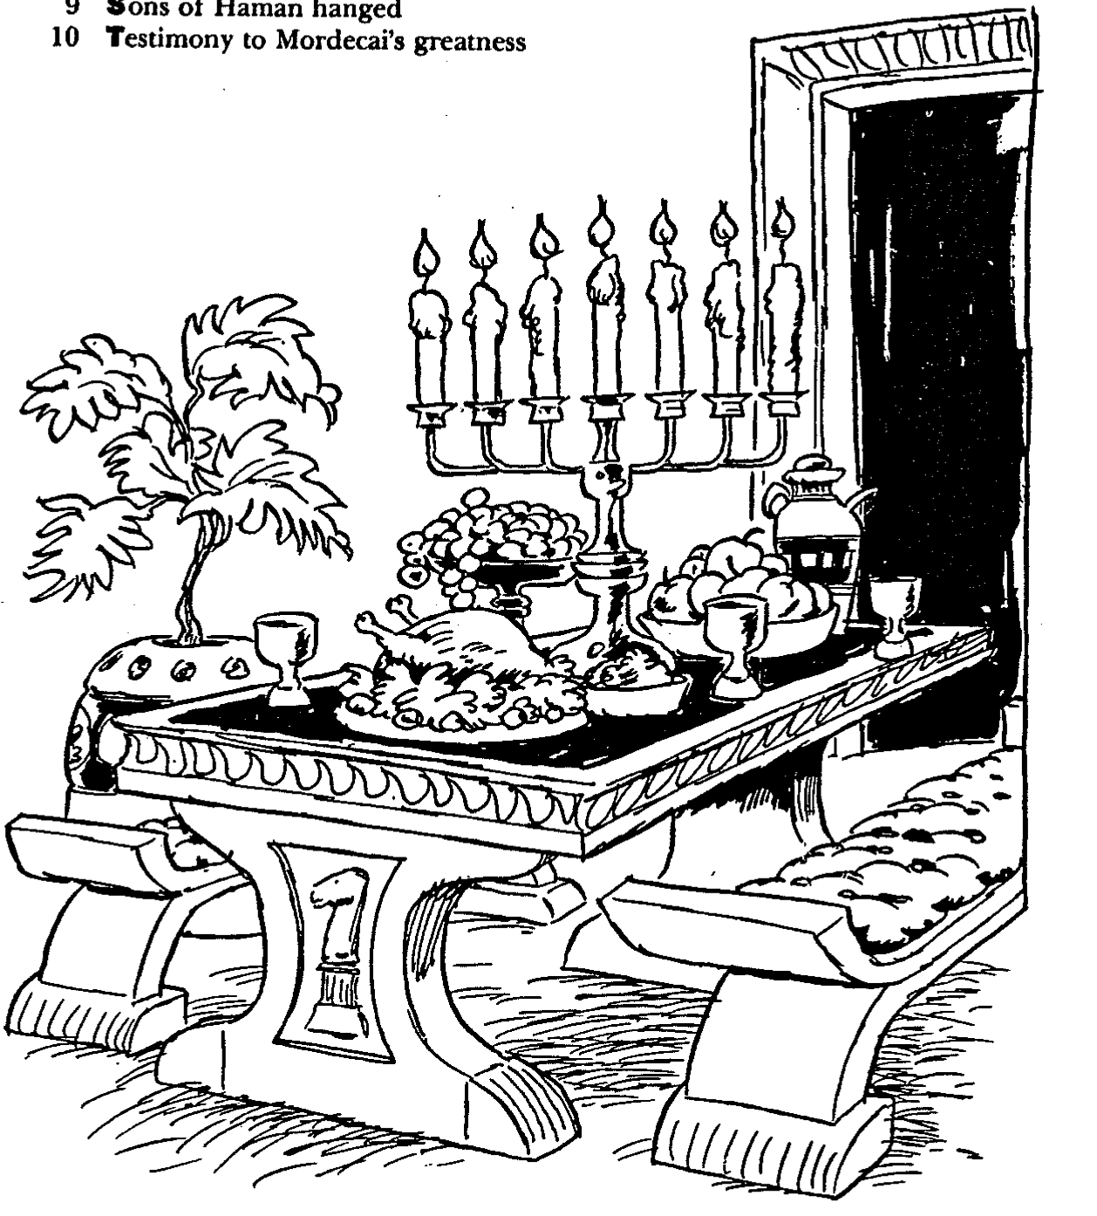
Barry Huddleston, The Acrostic Summarized Bible (Grand Rapids: Baker, 1992)
Esther
1 Persian decree against Vashti
2 Uncle Mordecai saves king
3 Revenge plotted by Haman
4 Intercession made to Esther
5 Making dinner for Ahasuerus
6 Favor shown to Mordecai
7 Esther requests her life
8 Ahasuerus gives Mordecai promotion 9 Sons of Haman hanged
10 Testimony of Mordecai’s greatness
Notes:
The book actually has 10 feasts within the 10 chapters! Even today, eating with someone is considered a clear sign of fellowship. Ironically, Esther has two meals with her adversary Haman, who thought he was being honored by the queen but was, in reality, walking into her trap to kill him.

Slide 12
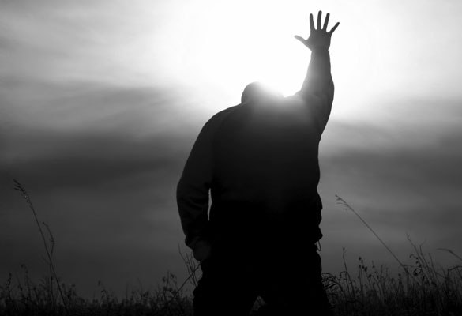
Be Committed
Esther
Dr. Rick Griffith • Crossroads International Church Singapore
CICFamily.com • BibleStudyDownloads.org
Notes:
Many examples of those committed to the Lord are in this book—Esther, Mordecai, the Jews, etc.

Slide 13

The church typically has a serious lack of commitment.
Why is that so?
Notes:
Do you think most congregations lack a zealousness for the Lord?
Why do you think? Tell your neighbor next to you.

Slide 14
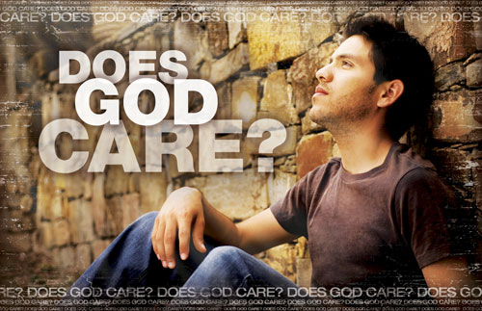
Does God Care About Those Left Behind?
Most of the Jews never returned to the land of Israel even in the Post-Exilic Period
Notes:
Does God zap us when we do not jump to serve him?
Of course not.
But does he work on the apathetic, too?

Slide 15

Why should you be committed to God?
Esther
Notes:
What reasons can you give to be dedicated, loyal, and devoted to the Lord?

Slide 16

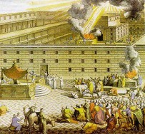
The Postexilic Era
295 296 560
The Postexilic Era
Temple work
Prophets:
Haggai
Zechariah
Malachi
605
586
539
536
520
516
483-473
444-425
Others:
Zerubbabel
Esther
Ezra
Nehemiah
Persian Kings:
Cyrus
Darius
Xerxes
Artaxerxes
Notes:
The Post-Exilic Era was actually three separate periods: (1) Temple rebuilding led by Zerubbabel, Haggai, and Zechariah in two parts under Cyrus and Darius,
(2) The saving of the nation from destruction by Esther about 30 years later under Xerxes, and
(3) The restoration of Jerusalem’s walls and gates by Nehemiah another 70 years after that under Artaxerxes.
_________
Common English slides-144
OS-00-OT Book Overviews-336
OS-15-Ezra-36
OS-16-Nehemiah-94
OS-17-Esther-16, 75

Slide 17
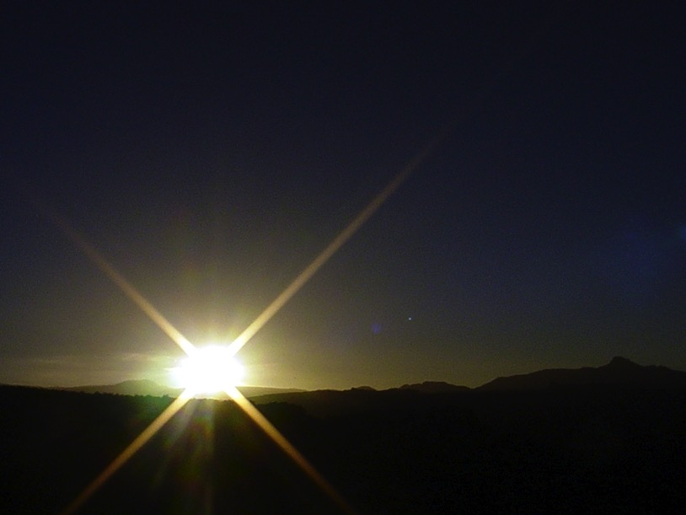
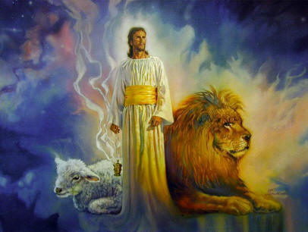
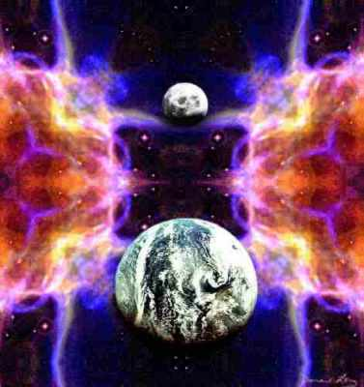
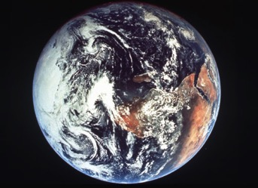
The Bible's Chiasm
446
Repeated Patterns in Reverse Order
Christ's Redemption
Christ's Rule
Man's Rule Lost at Fall
Man's Rule Restored at Millennium
Creation
New Creation
Notes:
We need to know who we are—more accurately, who God says we are—our future identity.
This is shown in the overall structure of the Bible in a chiasm—a literary pattern where earlier content is repeated in reverse order:
• Creation in Genesis 1–2 • is repeated In the Restored, New Creation in Rev 21–22
• Man was created to rule over the fish, birds, and land animals (Gen. 1:28) but he gave over his rule over to the god of this world, Satan (2 Cor. 4:4)
• But this rule will be restored during the 1000-year reign of the saints (Rev. 20:4-6)
• Christ is the central Person of history, • both as Lamb (Redeemer) • and as Lion (Ruler of all creation in the line of David)
________________
BE-17-Esther-76
OC-17-Genesis Authorship-14
OS-01-Genesis1-3-slide 243
OS-17-Esther-145
NS-27-Rev20-22-slide 206

Slide 18
God’s work faces threats (Esther 1–4).
Why be committed to God?
God’s work will triumph (Esther 5–10).
MAIN IDEA: Despite Satan’s threats, God will triumph.
Notes:
Satan is always trying to push down whatever the Lord does.
But the Lord will eventually be the victor.
It’s easier to be committed to God’s plan when we know that it will ultimately succeed.
____________
OS-17-Esther-18, 117, 121, 155

Slide 19

WHAT TO DO?
308
Use your
providentially
placed position
to help
God's people
Notes:
Every believer has a strategic place to serve Christ—a different home, workplace, geographic location, gifting, passion, and background.
No one can serve Jesus in the same way you can! Fulfill God’s purposes for you!

Slide 20
Black

Slide 21

Review Quiz
REVIEW QUIZ on Ezra-Nehemiah
The book of Ezra's two main characters are __________ and _______.
The book of Nehemiah's two main characters are _____ and _________.
The book of Ezra focuses on rebuilding the _______, Nehemiah focuses on rebuilding the _____. Both deal with reforming the _________.

Slide 22
Review Quiz
REVIEW QUIZ on Ezra-Nehemiah
The book of Ezra's two main characters are Zerubbabel and Ezra.
The book of Nehemiah's two main characters are _____ and _________.
The book of Ezra focuses on rebuilding the _______, Nehemiah focuses on rebuilding the _____. Both deal with reforming the _________.

Slide 23
Review Quiz
REVIEW QUIZ on Ezra-Nehemiah
The book of Ezra's two main characters are Zerubbabel and Ezra.
The book of Nehemiah's two main characters are Ezra and Nehemiah.
The book of Ezra focuses on rebuilding the _______, Nehemiah focuses on rebuilding the _____. Both deal with reforming the _________.

Slide 24
Review Quiz
REVIEW QUIZ on Ezra-Nehemiah
The book of Ezra's two main characters are Zerubbabel and Ezra.
The book of Nehemiah's two main characters are Ezra and Nehemiah.
The book of Ezra focuses on rebuilding the Temple, Nehemiah focuses on rebuilding the walls. Both deal with reforming the people.

Slide 25
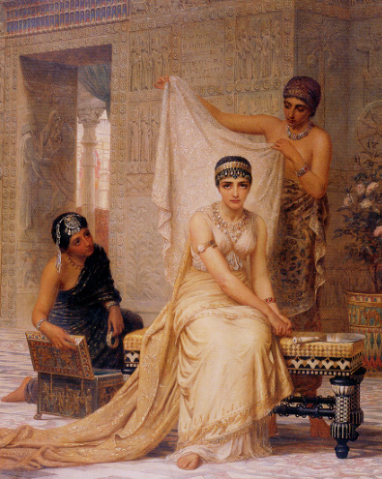
Where does Esther fit in OT history?

Slide 26

Esther
Jesus
David
Abraham
Flood
Today
Kings
Church
Tribes
3000
2000
1000
0
1000
2000
Creation
New Creation

Slide 27
Timeline
Exodus- 1 Samuel
2 Samuel – Esther
Jesus
Genesis
David
Abraham
Flood
Today
Kings
Church
Tribes
3000
2000
1000
0
1000
2000
Creation
New Creation

Slide 28
Kingdom Era
Ezra-Nehemiah
United Kingdom
1050-930
Divided Kingdom
930-722
Solitary Kingdom
722-586
Post- Exile
536-425
1100
1050
1000
950
900
850
800
7 5 0
7 0 0
650
600
550
500
450
Exile 606-536

Slide 29
Postexilic Era
Esther
United Kingdom
1050-930
Divided Kingdom
930-722
Solitary Kingdom
722-586
Post- Exile
536-425
1100
1050
1000
950
900
850
800
7 5 0
7 0 0
650
600
550
500
450
Exile 606-536

Slide 30
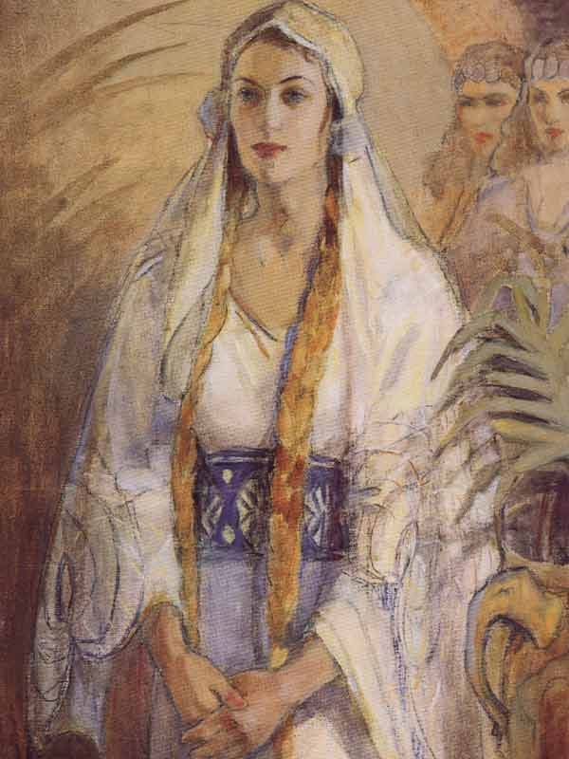
Where is Esther in the post-exilic period?

Slide 31
Chronology of the Returns
Nehemiah 444-430
Zerubbabel 537-516
Esther 483-473
Ezra 457-444
540
530
520
510
500
490
480
470
460
450
440
430
420
410
Buddha 560-477
Socrates 470-399
Confucius 551-479
Plato 427-347

Slide 32
Nebuchadnezzar's Six Deportations to Babylon
492
Size | Date | King of Judah | Number taken | Key Captives | Results/ Comments
1 Minor | 605 BC | Jehoiakim | Few (Dan 1:3) | Daniel, 3 friends & nobility & royalty | Tribute imposed. Egypt powerful.
2 Moderate | 598 BC | Jehoiakim | 3023 (Jer. 52:28) |  | Minor deportation
3 Major | 597 BC | Jehoiachin | 10,000 (2 Kings 24:14) | Jehoiachin, Ezekiel, Mordecai | Neb. deports many; installs Zedekiah
4 Minor | 587 BC | Zedekiah | 832 (Jer. 52:29) |  | Before destruction
5 Major | 586 BC | Zedekiah | ca. 10,400 (2 Kings 25:11) | Zedekiah | Jerusalem & temple destroyed
6 Minor | 582 BC |  | 745 (Jer. 52:30) |  | 4 years after Jerusalem's destruction
Notes:
Nebuchadnezzar had six deportations to Babylon. The 597 BC deportation was the third of the six and the first of 2 major deportations, with 10,000 people deported.

Slide 33
Two 70-Year Exiles
560
People Exile
605
586
539
536
516
Temple Exile
"This entire land will become a desolate wasteland. Israel and her neighboring lands will serve the king of Babylon for seventy years. ¹²Then, after the seventy years of captivity are over, I will punish the king of Babylon and his people for their sins," says the Lord. I will make the country of the Babylonians a wasteland forever" (Jeremiah 25:11-12).
Notes:
In 539 BC under the rule of Darius, Daniel read Jeremiah 25:11-12 that limited the exile to 70 years (605-536 BC), or only three years away (9:1-2). But another way to see the 70 years is that the temple lay in ruins from 586 until 516 when the second temple was completed.
Jeremiah does not tell us the exact years that begin and end the 70-year exile.
But we can determine this in two ways—either the exile of the people beginning with Daniel’s deportation (605) to the people fully returning in 536, or the exile of the temple from its destruction in 586 to its rebuilding in 516.
_____________________
Common-320
BE-27-Daniel-89
ES-26-Restoration of Israel-186
OS-00-OT Book Overviews-295, 755
OS-12-Kings & Prophets Charts-26
OS-12-2Kings-231
OS-14-2Chron-308
OS-14-Reasons for Exile-54
OS-15-Ezra-14, 35
OS-17-Esther-33
OS-24-Jeremiah-53, 141
OS-27-Daniel-94, 284, 340, 361
OS-37-Haggai-9, 32
OS-Zechariah-15

Slide 34
Chronology of the Persian Period
313
John H. Walton, Chronological and Background Charts of the OT, 2d ed., 70
PERSIAN KING
DATES
BIBLICAL CORRELATION
GREEK CORRELATION
CYRUS
539-530
Return of Zerubbabel &
Jeshua (Ezra 1–3)
CAMBYSES
530-522
Rebuilding at Jerusalem stopped (Ezra 4)
DARIUS I
522-486
Haggai & Zechariah prophesy (520)
Temple completed (516)
(Ezra 5–6)
Greeks defeat Persians at Marathon (490)
XERXES
486-464
Story of Esther
(Esther 1–9)
Persians defeat Greeks at Thermopylae (480) but reversed at Salamis (480), Herodotus 485-425
ARTAXERXES I
464-423
Return of Ezra (458)
(Ezra 7–10)
Return of Nehemiah (445)
(Nehemiah 1–2)
Prophecy of Malachi (433)
Golden Age (461-431)
Pericles (460-429)
Athens rules

Slide 35
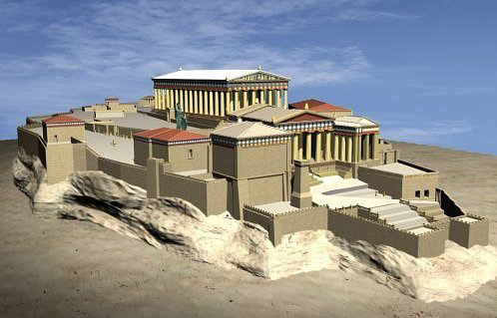
The Pinnacle of Greek History
Democracy & Building the Parthenon
Notes:
The background to Esther is the rise of democracy in Greece in the preceding century. It was based on the natural hill in Athens.

Slide 36
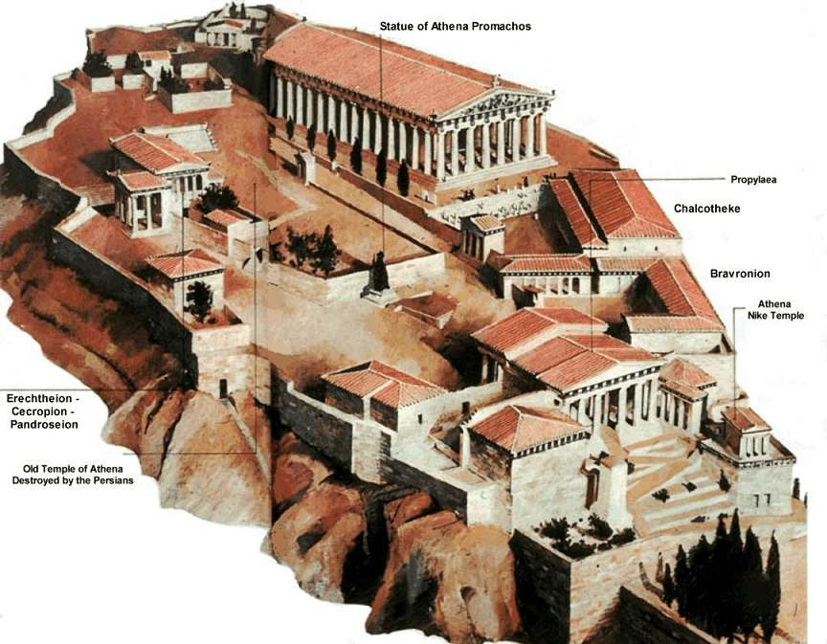
The Acropolis
Notes:
Upon this outcrop called the Acropolis was the center of Greek pagan religion that focused on the goddess Athena.

Slide 37
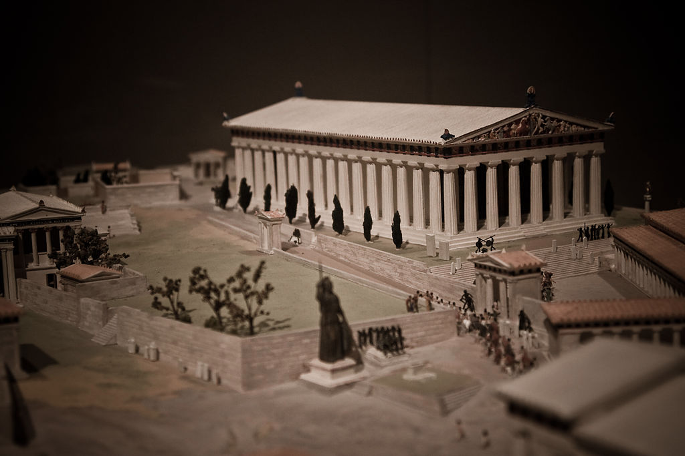
A Target for Persia…
Democracy & Building the Parthenon
Notes:
The Parthenon was considered the pinnacle of all buildings with so-called perfect proportions. This made Greece attractive to Persia so the Persians sought the wealth and influence of the Greek people and land.

Slide 38
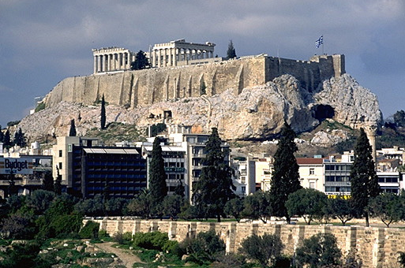
The Acropolis Today
Notes:
The Acropolis doesn’t look like much today…

Slide 39
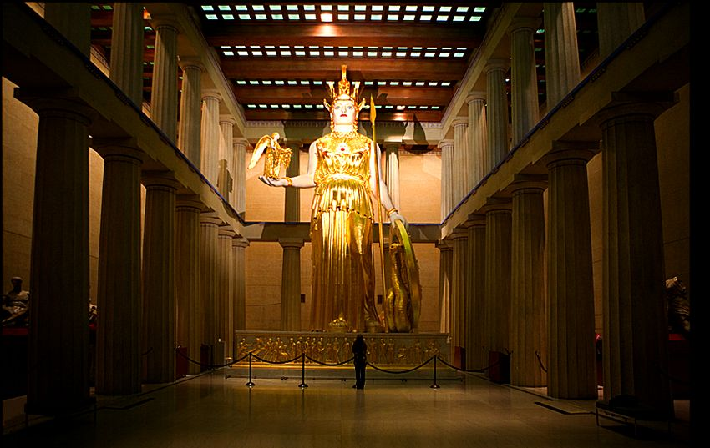
The Pinnacle of Greek History
Athena (goddess of wisdom) inside the Parthenon
Notes:
Inside the Parthenon was a gold-plated statue of the goddess of wisdom, Athena.

Slide 40
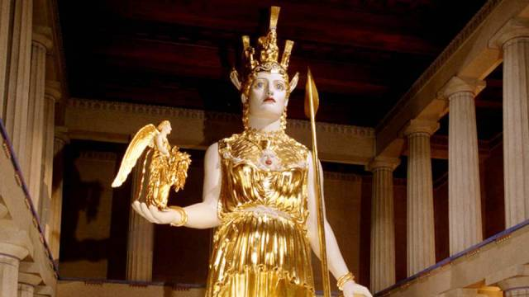
The Pinnacle of Greek History
Athena (goddess of wisdom) inside the Parthenon
Notes:
How ironic that the builders who sought wisdom from Athena lacked the wisdom to avoid idolatry!

Slide 41
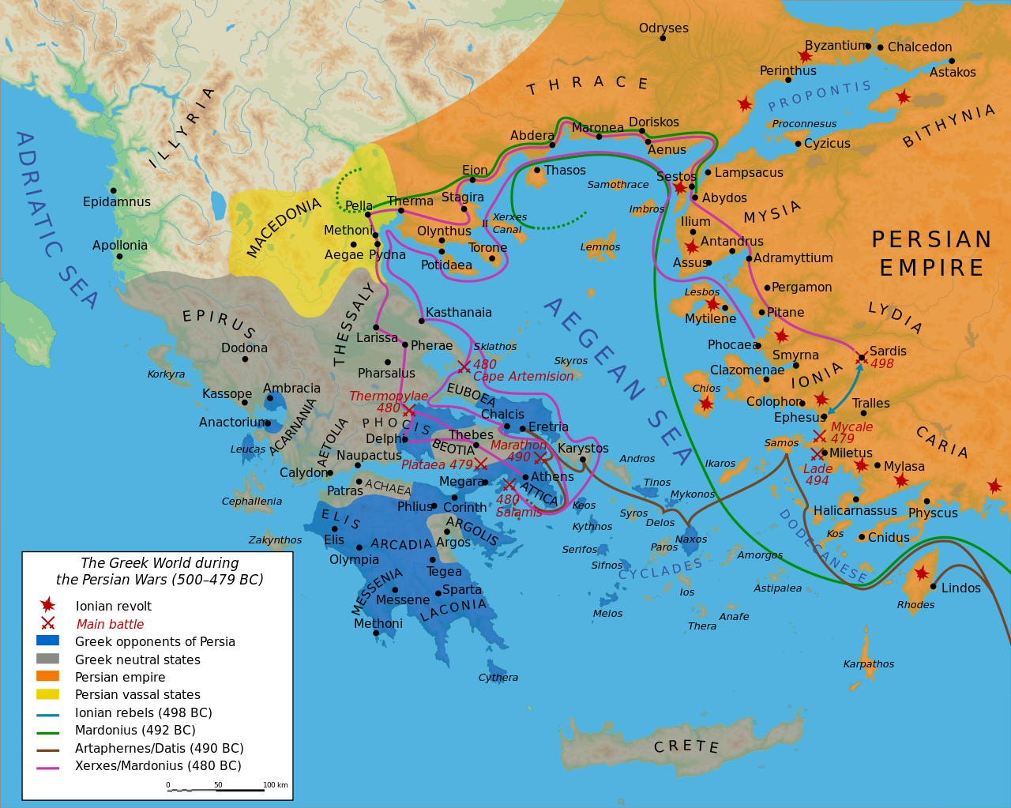
Persian Invasions of Greece (500-479 BC)
Notes:
Xerxes followed the lead of his predecessor and father, Darius I, who a decade earlier had invaded Greece and was defeated at Marathon (490 BC).
“The Battle of Marathon (Greek: Μάχη τοῦ Μαραθῶνος, Machē tou Marathōnos) took place in 490 BC, during the first Persian invasion of Greece. It was fought between the citizens of Athens, aided by Plataea, and a Persian force commanded by Datis and Artaphernes. The battle was the culmination of the first attempt by Persia, under King Darius I, to subjugate Greece. The Greek army decisively defeated the more numerous Persians, marking a turning point in the Greco-Persian Wars.
The first Persian invasion was a response to Greek involvement in the Ionian Revolt, when Athens and Eretria had sent a force to support the cities of Ionia in their attempt to overthrow Persian rule. The Athenians and Eretrians had succeeded in capturing and burning Sardis, but they were then forced to retreat with heavy losses. In response to this raid, Darius swore to burn down Athens and Eretria. According to Herodotus, Darius asked for his bow, he placed an arrow upon the string and he discharged it upwards towards heaven, and as he shot into the air he said: "Zeus, grant me to take vengeance upon the Athenians!". Also he charged one of his servants, to say to him, every day before dinner, three times: "Master, remember the Athenians."^{[3]}
At the time of the battle, Sparta and Athens were the two largest city states. Once the Ionian revolt was finally crushed by the Persian victory at the Battle of Lade in 494 BC, Darius began plans to subjugate Greece. In 490 BC, he sent a naval task force under Datis and Artaphernes across the Aegean, to subjugate the Cyclades, and then to make punitive attacks on Athens and Eretria. Reaching Euboea in mid-summer after a successful campaign in the Aegean, the Persians proceeded to besiege and capture Eretria. The Persian force then sailed for Attica, landing in the bay near the town of Marathon. The Athenians, joined by a small force from Plataea, marched to Marathon, and succeeded in blocking the two exits from the plain of Marathon. The Athenians also sent a message asking for support to the Spartans. However, at the time the Spartans were involved in a religious festival and gave this as a reason for refusing to aid the Athenians.
https://en.wikipedia.org/wiki/Battle_of_Marathon
Accessed 13 Sep 2016

Slide 42
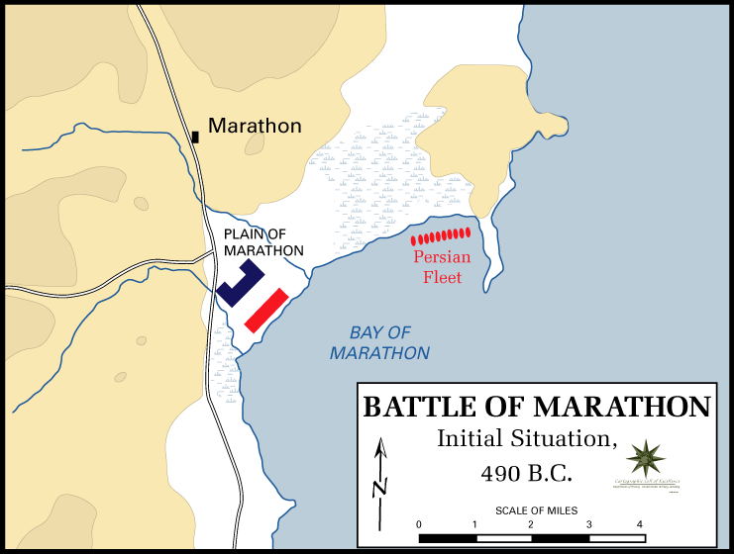
The Battle of Marathon (490 BC)
Greece defeated the Persians
Notes:
“The Battle of Marathon…
The Greeks could not hope to face the superior Persian cavalry; however, the location chosen was surrounded by marshes and mountains and so the cavalry was unable to join the main Persian army. Miltiades, the Greek general, ordered a general attack against the Persians. He reinforced his flanks, luring the Persians' best fighters into his centre.”
https://en.wikipedia.org/wiki/Battle_of_Marathon
Accessed 13 Sep 2016

Slide 43
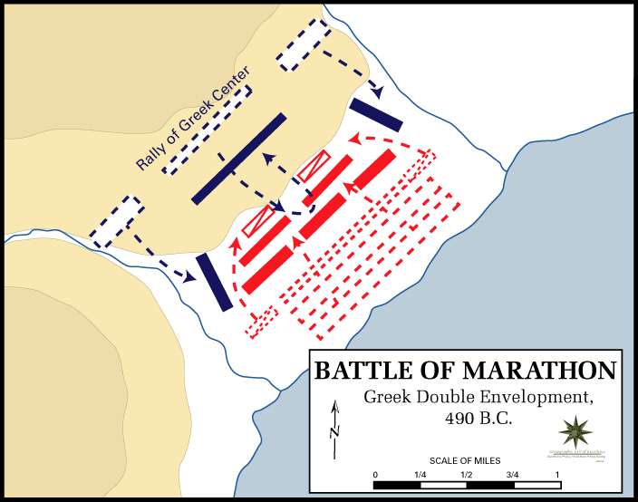
The Battle of Marathon (490 BC)
Greece defeated the Persians
Notes:
“The Battle of Marathon…
The inward wheeling flanks enveloped the Persians, routing them.”
https://en.wikipedia.org/wiki/Battle_of_Marathon
Accessed 13 Sep 2016

Slide 44
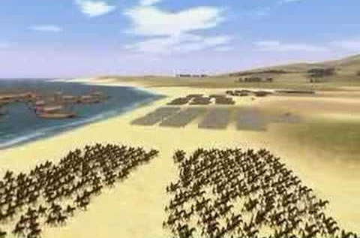
The Battle of Marathon (490 BC)
Greece defeated the Persians
Notes:
“The Battle of Marathon…
The Persian army broke in panic towards their ships, and large numbers were slaughtered. The defeat at Marathon marked the end of the first Persian invasion of Greece, and the Persian force retreated to Asia. Darius then began raising a huge new army with which he meant to completely subjugate Greece; however, in 486 BC, his Egyptian subjects revolted, indefinitely postponing any Greek expedition. After Darius died, his son Xerxes I restarted the preparations for a second invasion of Greece, which finally began in 480 BC.
https://en.wikipedia.org/wiki/Battle_of_Marathon
Accessed 13 Sep 2016

Slide 45
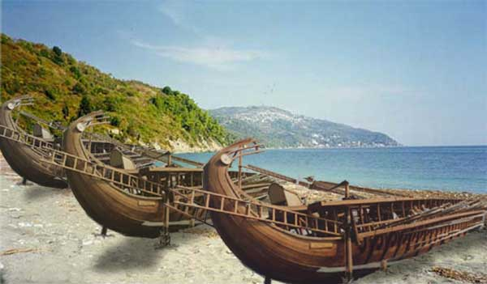
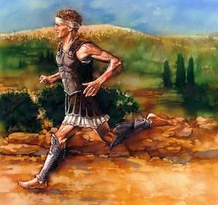
The Battle of Marathon (490 BC)
Greece defeated the Persians
Notes:
“The Battle of Marathon was a watershed in the Greco-Persian wars, showing the Greeks that the Persians could be beaten; the eventual Greek triumph in these wars can be seen to begin at Marathon. The battle also showed the Greeks that they were able to win battles without the Spartans, as they had heavily relied on Sparta previously. This win was largely due to the Athenians, and Marathon raised Greek esteem of them. Since the following two hundred years saw the rise of the Classical Greek civilization, which has been enduringly influential in western society, the Battle of Marathon is often seen as a pivotal moment in Mediterranean and European history.
The battle is perhaps now more famous as the inspiration for the marathon race. Although thought to be historically inaccurate, the legend of the Greek messenger Pheidippides running to Athens with news of the victory became the inspiration for this athletic event, introduced at the 1896 Athens Olympics, and originally run between Marathon and Athens.”
https://en.wikipedia.org/wiki/Battle_of_Marathon
Accessed 13 Sep 2016

Slide 46
Persian Invasions of Greece = Frustrated Xerxes
Greeks defeat Persians at Marathon (490)
Xerxes 7-day banquet where Queen Vashti deposed (483)
Persians defeat Greeks at Thermopylae but reversed at Salamis (Sept 480)
Book of Esther 483-473
490
489
488
487
486
485
484
483
482
481
480
479
478
477
Darius 522-486
Xerxes 486-464

Slide 47
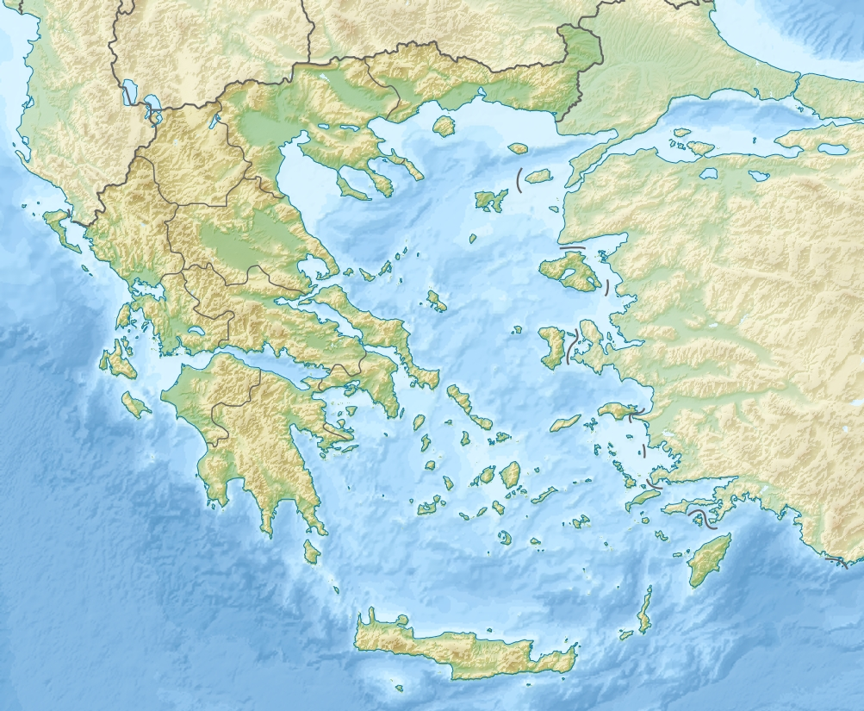
The Battle of Thermopylae (480 BC)
Persian Victory
Thermopylae
Bay of Salamis
Greek Victory
Notes:
“The Battle of Thermopylae (/θərˈmɒpᵻliː/ thər-MOP-i-lee; Greek: Μάχη τῶν Θερμοπυλῶν, Machē tōn Thermopylōn) was fought between an alliance of Greek city-states, led by King Leonidas of Sparta, and the Persian Empire of Xerxes I over the course of three days, during the second Persian invasion of Greece. It took place simultaneously with the naval battle at Artemisium, in August or September 480 BC, at the narrow coastal pass of Thermopylae ("The Hot Gates"). The Persian invasion was a delayed response to the defeat of the first Persian invasion of Greece, which had been ended by the Athenian victory at the Battle of Marathon in 490 BC. Xerxes had amassed a huge army and navy, and set out to conquer all of Greece. The Athenian general Themistocles had proposed that the allied Greeks block the advance of the Persian army at the pass of Thermopylae, and simultaneously block the Persian navy at the Straits of Artemisium.
A Greek force of approximately 7,000 men marched north to block the pass in the middle of 480 BC. The Persian army, alleged by the ancient sources to have numbered over one million, but today considered to have been much smaller (various figures are given by scholars, ranging between about 100,000 and 150,000),^{[8][9]} arrived at the pass in late August or early September. The vastly outnumbered Greeks held off the Persians for seven days (including three of battle) before the rear-guard was annihilated in one of history's most famous last stands. During two full days of battle, the small force led by Leonidas blocked the only road by which the massive Persian army could pass. After the second day, a local resident named Ephialtes betrayed the Greeks by revealing that a small path led behind the Greek lines. Leonidas, aware that his force was being outflanked, dismissed the bulk of the Greek army and remained to guard their retreat with 300 Spartans, 700 Thespians, 400 Thebans, and perhaps a few hundred others, most of whom were killed.
At Artemisium, the Greek navy, under the command of the Athenian politician Themistocles, received news of the defeat. Since the Greek strategy required both Thermopylae and Artemisium to be held, and given their losses, it was decided to withdraw to Salamis. The Persians overran Boeotia and then captured the evacuated Athens. The Greek fleet—seeking a decisive victory over the Persian armada—attacked and defeated the invaders at the Battle of Salamis in late 480 BC. Fearful of being trapped in Europe, Xerxes withdrew with much of his army to Asia (losing most to starvation and disease), leaving Mardonius to attempt to complete the conquest of Greece. However, the following year saw a Greek army decisively defeat the Persians at the Battle of Plataea, thereby ending the Persian invasion.
Both ancient and modern writers have used the Battle of Thermopylae as an example of the power of a patriotic army defending its native soil. The performance of the defenders is also used as an example of the advantages of training, equipment, and good use of terrain as force multipliers and has become a symbol of courage against overwhelming odds.”
https://en.wikipedia.org/wiki/Battle_of_Thermopylae
Accessed 12 Sep 2016

Slide 48
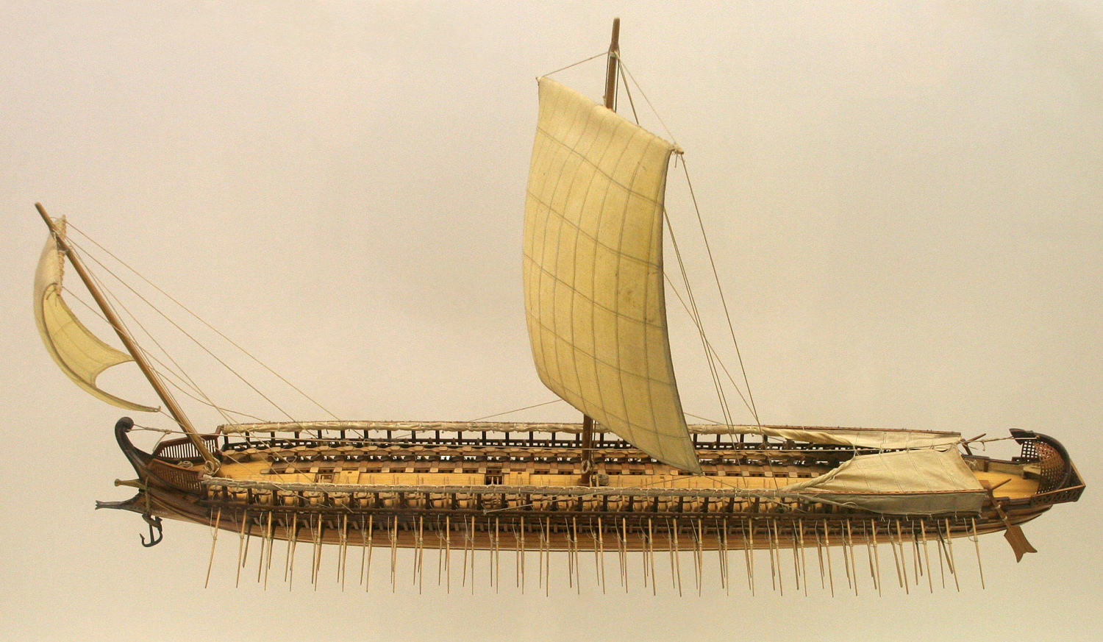
The Greek Trireme
Small but fast and deadly
Notes:
The Athenians had vast gold mines that enriched the city so that each citizen had enough money for 17 lifetimes! Persia had invaded Greece unsuccessfully in 490 BC, but the threat had not been vanquished. After much effort, the Athenians became convinced to use their resources to build many triremes, which had technological advantages over larger, heavy Persian ships.

Slide 49
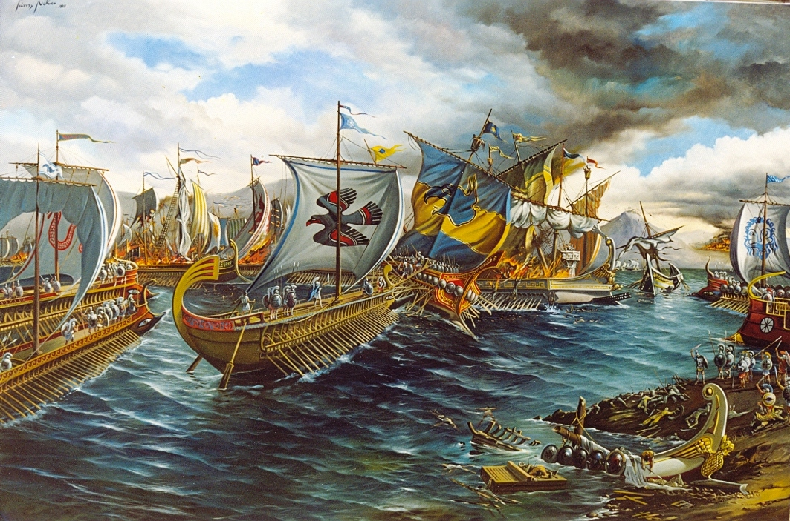
The Battle of Salamis (480 BC)
Notes:
The Greek preparation paid off. The vast Persian navy was no match for the nimble Greek ships.

Slide 50
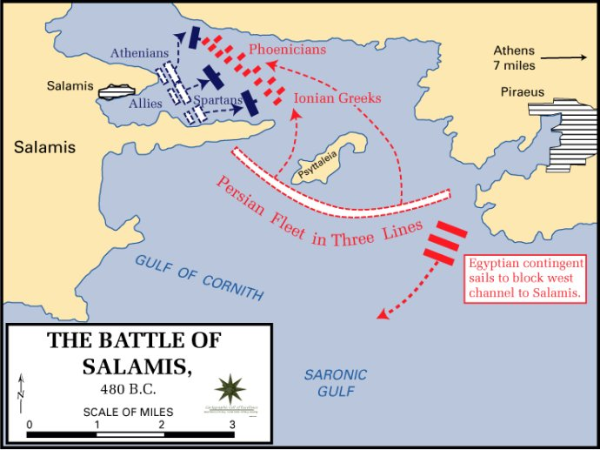
The Battle of Salamis (480 BC)
Notes:
At the Battle of Salamis, the Greeks fought valiantly to protect their homeland with the potential of getting trapped against their land.

Slide 51
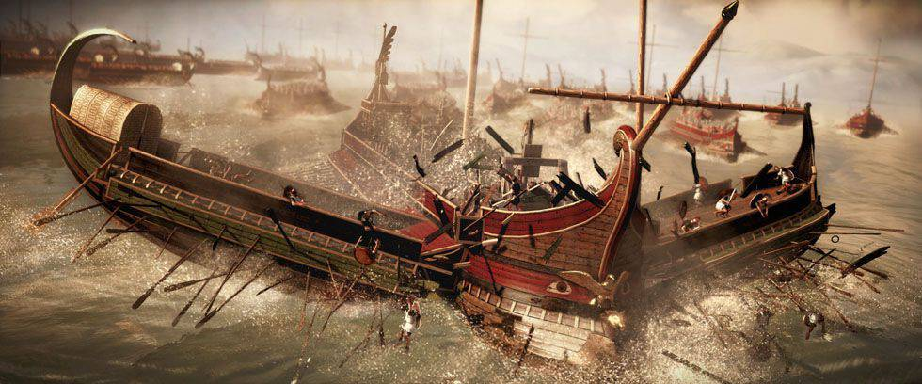
The Battle of Salamis (480 BC)
Casualties: Greeks lost 40 ships Persians: 200-300. Victory at Salamis ended Xerxes' invasion and preserved Greek freedom
Notes:
The smaller triremes out-maneuvered the Persian vessels in a massive victory.

Slide 52
Persian Invasions of Greece = Frustrated Xerxes
Greeks defeat Persians at Marathon (490)
Xerxes began to reign at Susa (486)
Xerxes 187 days of banquets where Queen Vashti deposed (483)
Persians defeat Greeks at Thermopylae but reversed at Salamis (Sept 480)
Esther became queen after a 4-year beauty contest (Dec 480 or Jan 479)
Book of Esther 483-473
490
489
488
487
486
485
484
483
482
481
480
479
478
477
Darius 522-486
Xerxes 486-464
Notes:
The chronology shows that the defeated Xerxes returned to Susa frustrated not only with his navy losses but also before the campaign when he had also been humiliated by Vashti's public dishonor of the king.
But the beauty treatments of women continued while Xerxes was gone to Greece. These women were being prepared to compete against each other as the potential queen to replace Vashti.

Slide 53
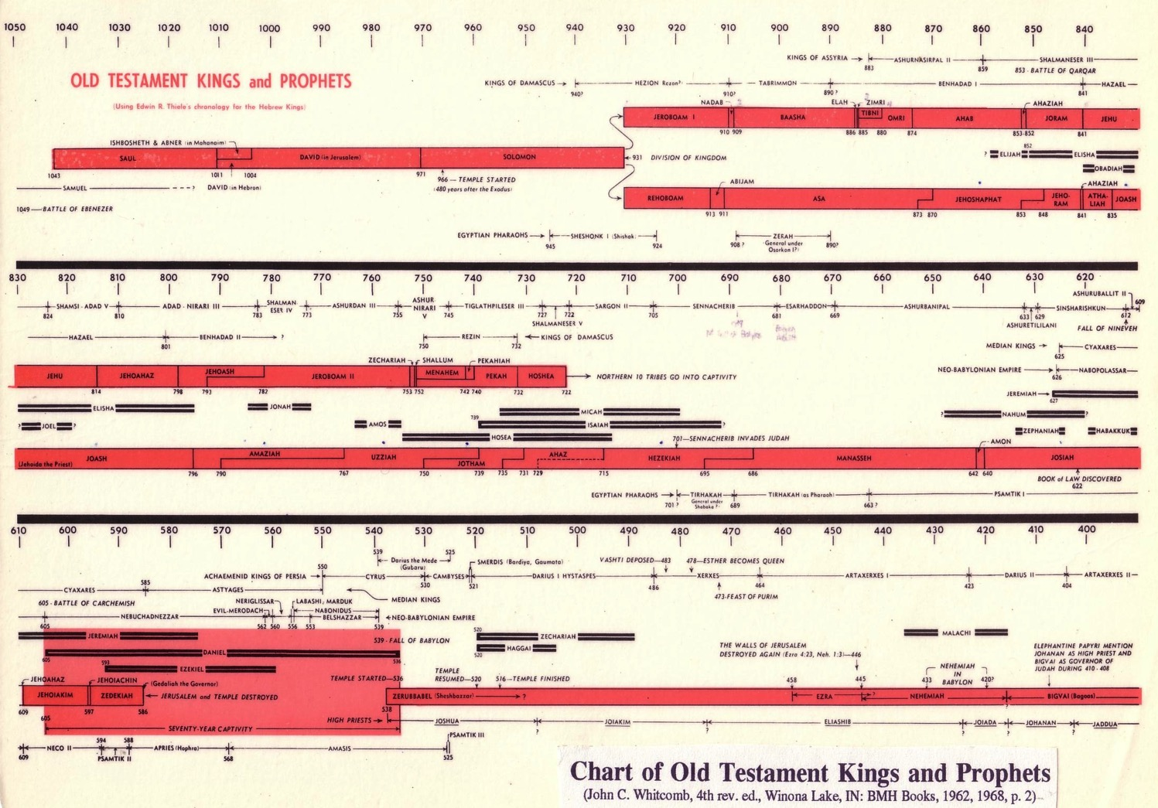
Chart of OT Kings & Prophets
232 & 342

Slide 54
Chart of OT Postexilic Era
232 & 342

Slide 55
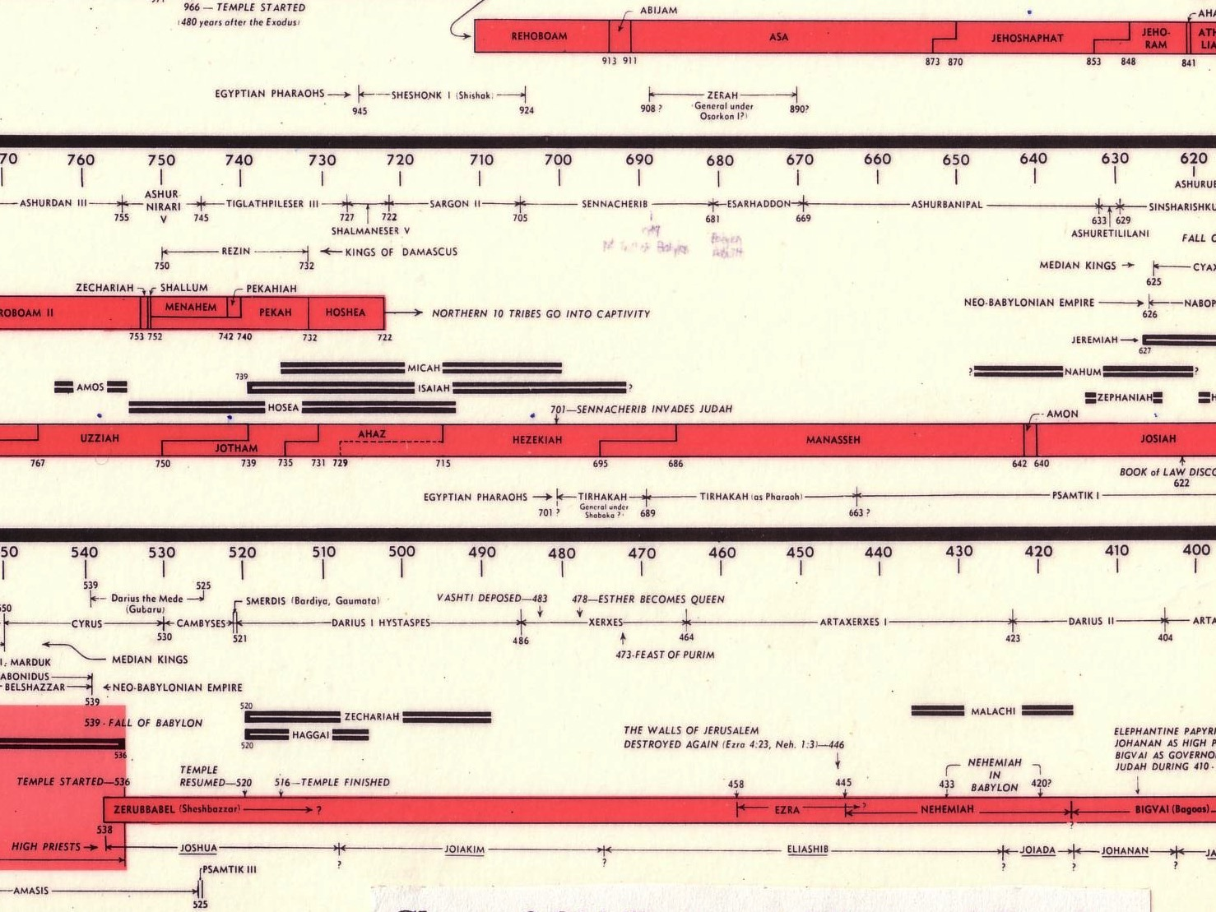
Opposition Timeline (Ezra 4; Esther 1; Neh 13)
232 342
Zerubbabel Under Cyrus 536-520 BC
Esther Under Xerxes 486 BC
Ezra Under Artaxerxes ±460 BC
Nehemiah Under Darius (internal) ±430 BC
Chart of Old Testament Kings & Prophets
John C. Whitcomb, 4th ed. (Winona Lake, IN: BMH Books, 1968), 2
Notes:
"﻿The terminology in the biblical copies of letters to and from the Persian court is directly comparable with what we find in the external, firsthand documents. Inferiors call themselves the “servant(s)” of superiors and kings; the idiom for issuing decrees (sam t’e’em) is the same; the body of the typical Official Aramaic letter begins with the phrase “Peace (sh-l-m) and much well-being I send you,” which is what is presupposed in Ezra 4:17 (lit. “Peace, etc.”), where the formula is abbreviated for brevity’s sake.39 And so on, we may also say, on this topic. The form or stage of language of Aramaic used in Ezra and Daniel is precisely that used in the Neo-Babylonian and Persian period (sixth to fourth centuries), and is currently termed Official Aramaic. In the Old Testament the sole difference is that the spelling has been consistently modernized, to bring it into line with the Aramaic otherwise in popular use among the Jews by the third century.”
K. A. Kitchen, On the Reliability of the Old Testament. Grand Rapids, MI: Eerdmans, Kindle Edition. Loc 1892 of 14432.
________
OS-37-Ezra-87
OS-38-Nehemiah-407
OS-39-Esther-54

Slide 56
Later Postexilic Era (Ezra 7–10; Neh 1–13)
232 342
Chart of Old Testament Kings & Prophets
John C. Whitcomb, 4th ed. (Winona Lake, IN: BMH Books, 1968), 2
Notes:
"﻿The terminology in the biblical copies of letters to and from the Persian court is directly comparable with what we find in the external, firsthand documents. Inferiors call themselves the “servant(s)” of superiors and kings; the idiom for issuing decrees (sam t’e’em) is the same; the body of the typical Official Aramaic letter begins with the phrase “Peace (sh-l-m) and much well-being I send you,” which is what is presupposed in Ezra 4:17 (lit. “Peace, etc.”), where the formula is abbreviated for brevity’s sake.39 And so on, we may also say, on this topic. The form or stage of language of Aramaic used in Ezra and Daniel is precisely that used in the Neo-Babylonian and Persian period (sixth to fourth centuries), and is currently termed Official Aramaic. In the Old Testament the sole difference is that the spelling has been consistently modernized, to bring it into line with the Aramaic otherwise in popular use among the Jews by the third century.”
K. A. Kitchen, On the Reliability of the Old Testament. Grand Rapids, MI: Eerdmans, Kindle Edition. Loc 1892 of 14432.
________
OS-37-Ezra-88
OS-38-Nehemiah-408
OS-39-Esther-55

Slide 57
Key Dates Related to the Book of Esther
314
Reference
Date
Event
–
486
Xerxes' reign began
1:3
483
(3rd year of Xerxes)
Xerxes 7-day banquet for his nobles & officials where Queen Vashti was deposed
–
482-479
Xerxes led disastrous campaigns against Greece, esp. at navy Battle of Salamis (480); recorded by Greek historian Herodotus (7.8)
2:16
Dec 479 or Jan 478
Esther became queen after a 4-year beauty contest
3:7
Early April 474
In the 5th year of Esther's reign, Haman & the astrologers (5:10, 14; 6:12-13) cast the pur (lot) to determine the day to exterminate the Jews 11 months later (7 March 473)
3:12
April 17, 474
(13th of Nisan)
Xerxes' 1st edict (to destroy the Jews) informed everyone of the fateful day; royal secretaries wrote it out in the various languages of the empire

Slide 58
Part 1: Feasts & Jews Threatened
A. Greatness of King Xerxes (1:1-4)
B. Feasts of King & Queens (1:5–2:18)
C. Mordecai Averts King's Death (2:21-23)
D. Promotion of Haman (3:1-6)
E. Haman's Plot & Letters (3:7-15)
F. Mordecai & Esther's Risky Appeal (4:1–5:4)
David Lang, SBC Chapel, 29 Mar 2012

Slide 59
Part 2: Mordecai Honored/Haman Hanged
G. Esther's 1st Banquet for King & Haman (5:5-8)
H. Words of Haman's Wife & Friends (5:9-14)
Focus of the Book of Esther
I. Mordecai Honored by Haman (6:1-11)
H'. Words of Haman's Wife & Friends (6:12-14)
G'. Esther's 2nd Banquet for King & Haman (7:1–8:2)
F'. Esther's Risky Appeal (8:3-7)
David Lang, SBC Chapel, 29 Mar 2012

Slide 60
Part 3: Jews Saved & Feasts
E'. Haman's Plot Foiled & Mordecai's Letters (8:8-17)
D'. Promotion of Mordecai (8:15-11)
C'. Mordecai & Esther Save Jews (9:1-19)
B'. Feasts Ordered by Mordecai & Esther (9:20-32)
A'. Greatness of Mordecai (10:1-3)
David Lang, SBC Chapel, 29 Mar 2012

Slide 61
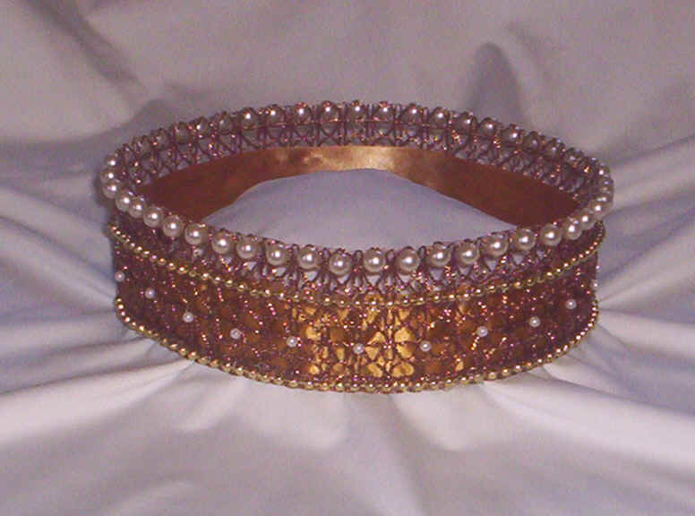
Authorship
309
External Evidence
Jewish discussions about Esther have concerned several other issues more than authorship, which remains anonymous.
Parallel passages & opinions of the Church & Synagogue on authorship have not been significant.
Internal Evidence
Since the book gives no hint who wrote it, one can only guess his identity.
The account shows such detail of Persian & Jewish life that the author must have been both Jewish & well acquainted with Persian ways.
Some suggest Ezra, Nehemiah, or Mordecai.
However, no one really knows who wrote the book.

Slide 62
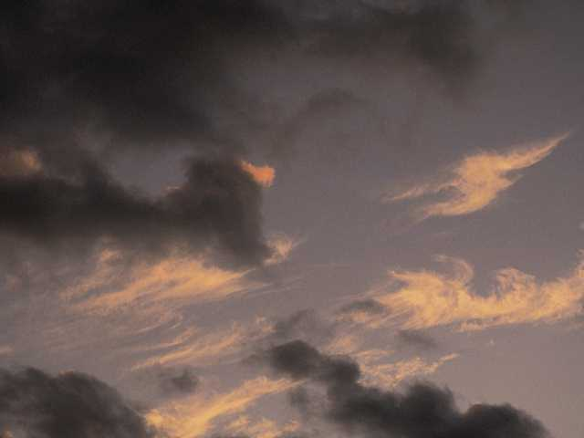
Circumstances
309
Date
Since the events of the book close at 473 BC, it is reasonable to presume a composition date shortly after this–perhaps after Xerxes' reign (ending in 464 BC) but no later than 435 BC when the palace at Susa was destroyed by fire, a significant event not mentioned in Esther.

Slide 63
Circumstances
309
Recipients
Esther's 1st readers constituted the postexilic communities during the time of Nehemiah & Malachi & the intertestamental period
These providential dealings of God on their behalf would have been a tremendous source of encouragement to both Jews in Persia as well as Jews living in Israel.

Slide 64
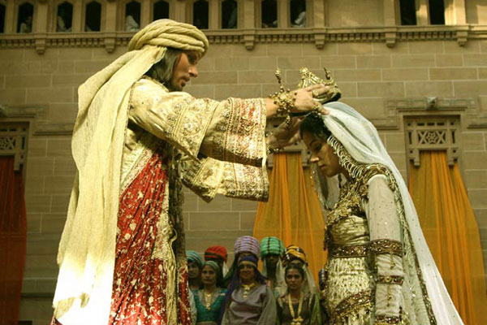
Occasion
309
The events of Esther chronicle 10 years of the 58 year gap between Ezra 6 (516 BC) & Ezra 7 (458 BC).
This story from 483-473 BC between the first return under Zerubbabel (538 BC) and the second under Ezra (458 BC).

Slide 65

Occasion
309
Without Esther the Scripture would remain silent as to the state of the majority of post-exilic Jews who chose to remain in Babylon when a small remnant of their brothers returned to the land.
The Books of Ezra & Nehemiah assert God's providential care over the small remnant that returned, while Esther reveals that God even graciously cared for these spiritually indifferent Jews whose priorities needed rearranging.

Slide 66
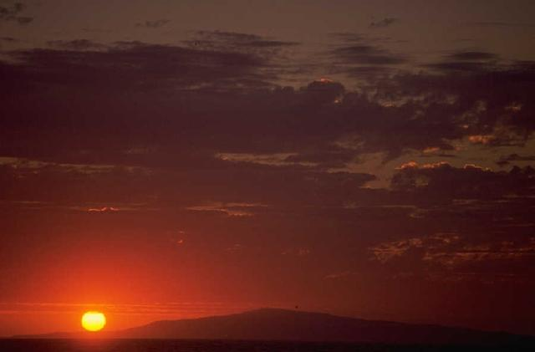
Characteristics
309
Historicity
Esther has eyewitness accounts of the Persian Empire, of which little has been verified from outside sources. Only recently has Ahasuerus been identified with Xerxes who reigned over Persia from 485-465 BC.

Slide 67
Characteristics
309
Canonicity: The usefulness of Esther has long been debated. Maimonides taught that when the Messiah comes, every book of the Jewish Scriptures would pass away but the Law & Esther, which would remain forever.
However, Martin Luther wished the book had never been written because of its many problems.
The reasons for differing opinions on the book stem from many unique characteristics:
The name of God is never mentioned in the book.
Esther is never quoted in the NT nor found in the Dead Sea Scrolls.
It never mentions the Law or sacrifices or offerings.
It never refers to prayer.
The book mentions nothing spiritual.
Its unique literary type has caused it to be placed within different sections in various collections of OT books.

Slide 68

Characteristics
310
Placement:
Esther is the only OT book on the Jews outside of the land during the times of the Gentiles (586 BC until the return of Christ).
This may explain why it appears as the last historical book in English Bibles, for while it precedes Nehemiah chronologically, the same conditions in the book continue during the time of the Gentiles until the deliverance of the Jews at the return of Christ.

Slide 69
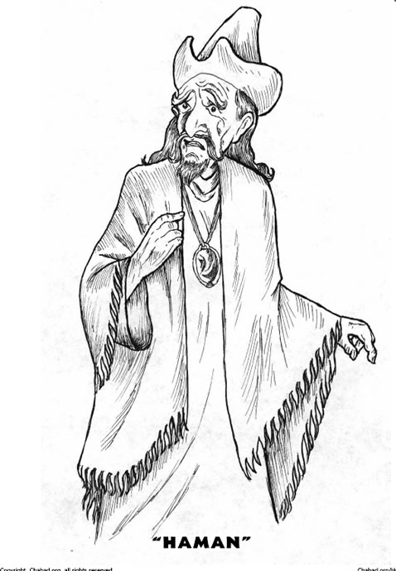
Characteristics
310
D. Lessons: The Book of Esther teaches many principles like:
Satan's purpose is to destroy the Jews by use of the nations.
God's purpose is to preserve the Jews by use of the nations.
God works in the affairs of nations to accomplish His will to preserve His people.
God works in the affairs of individuals to accomplish His will to preserve His people.

Slide 70
Interpretive Approaches
310
1. Prophetical–Esther predicts that the Jews will be preserved while outside of the land during the times of the Gentiles.
Response: Nothing is mentioned of the "times of the Gentiles" & the account is presented in a straightforward manner as history.
2. Allegorical–Esther is the story of mankind.
Response: This is ambiguous & the account is presented in a straightforward manner as historical narrative.

Slide 71
Interpretive Approaches
310
3. Typical–Esther is a divinely intended illustration of the Christian experience in the Church Age or a type of the Millennium.
Response: While this is an ingenious view, it fails in that it reads the NT back into the OT.
Historical–Esther records God's providential care of His chosen people as evidence of His commitment to the Abrahamic Covenant. The following "Argument" section will demonstrate this to be the best option.

Slide 72

Title
309
Esther (rTes.a,, 'ester) is a Persian name derived from the Persian word for "star." The meaning is fitting since Esther is the star of this book which bears her name. Her Hebrew name, Hadassah, means "myrtle(-tree)".
Notes:
"All the major Hebrew manuscript traditions know the book as “Esther” (Hb. estēr, probably related to Akkadian Ishtar, the goddess; ištaru, “goddess”; or Persian stâra).¹ The name is reflected in the LXX as Esthr and in the Vulgate as Esther or Hester, with other major ancient and modern versions employing variations of these spellings. The Hebrew name of the heroine for whom the book is named is Hadassah (hădassâ), the feminine form of a word meaning “myrtle tree” (Esth 2:7)."
Hb. Hebrew language
¹ C. A. Moore, Esther, AB (Garden City, NY: Doubleday, 1971), LI, 20.
LXX Septuagint
Eugene H. Merrill, “The Book of Esther,” in The World and the Word: An Introduction to the Old Testament (Nashville, TN: B&H Academic, 2011), 354.

Slide 73
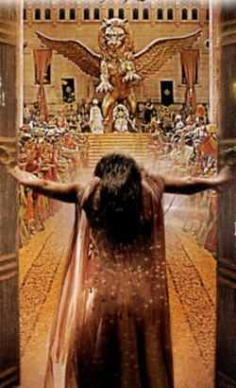
Argument
310
Esther records how a plot to exterminate the entire Jewish population is averted by God's providential workings through the godly Jewess, Queen Esther.
It cites the threat to the Jews (chs. 1–4) & the triumph of the Jews over the very ones who threatened their existence (chs. 5–10).
Chapter 9 celebrates the preservation of the nation in the Feast of Purim, which serves as an annual reminder of God's faithfulness to His people.

Slide 74

Spiritual Elements in Esther
No Law
No Sacrifices, No Temple
No Witnessing of God
No Land of Israel, No Jerusalem
No Prayer or Seeking God
No Love, No Forgiveness
No Mention of God Himself!
= No Spiritual Elements at All!

Slide 75
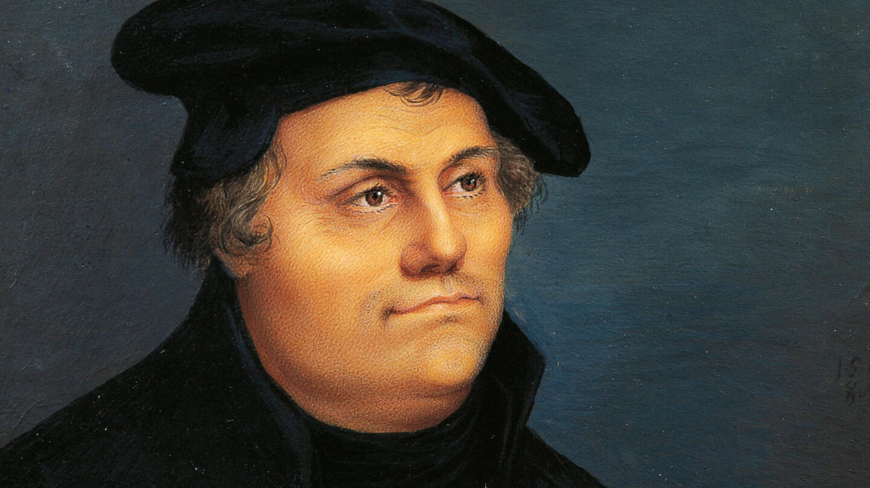
"I am so great an enemy to the second book of the Maccabees, and to Esther, that I wish they had not come to us at all, for they have too many heathen unnaturalities."
—Martin Luther
Notes:
Luther felt that Esther should not be part of the Bible due to the lack of spiritual elements in it. How do you respond to this view that was also held by many rabbis?

Slide 76
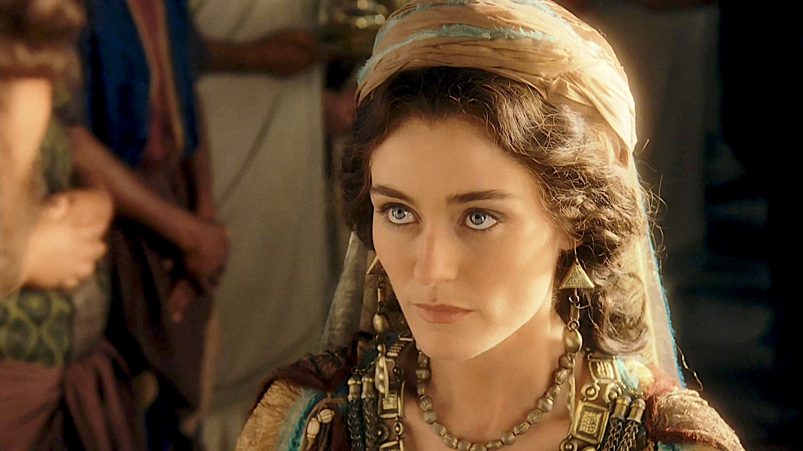
What does the lack of any spiritual elements communicate?
God is very silent but very present
Notes:
The fact that God is not mentioned may indicate that, although the people are not thinking in spiritual terms, God does! Each character approaches challenges with no thought of the LORD, and yet he still moves through their actions as he cannot forget his covenant with the nation.

Slide 77

Esther Crowned (2:17)
Notes:
“The king loved Esther more than all the women, and she found favor and kindness with him more than all the virgins, so that he set the royal crown on her head and made her queen instead of Vashti” (2:17 NLT).
Here again, we see God at work.

Slide 78
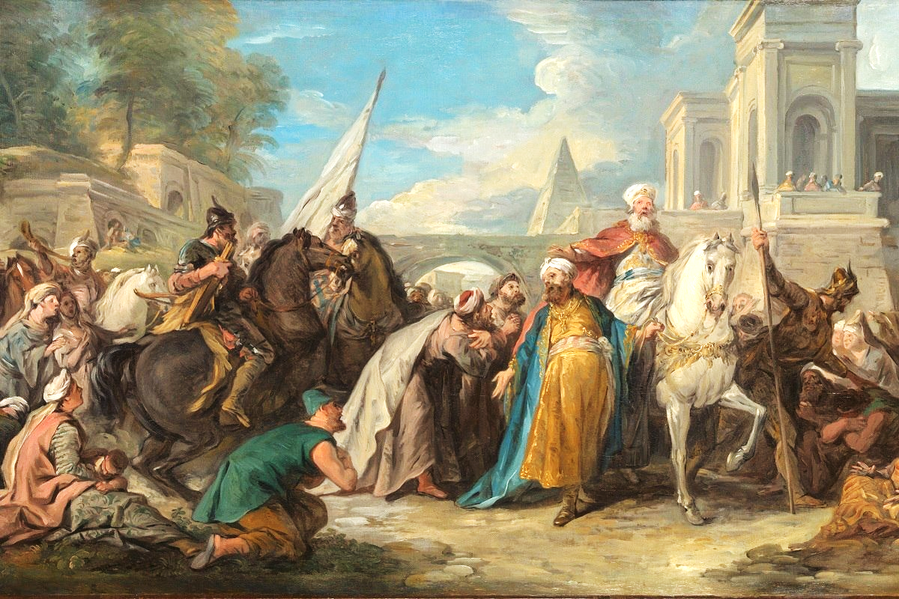
Was killing their enemies just?
“Just War Theory”
=
It is just (fair, right, allowed) to kill those who are trying to kill you or murder others
The Megillat Esther Massacre - TheTorah.com

Slide 79
Be Committed
Esther
Dr. Rick Griffith • Crossroads International Church Singapore
CICFamily.com • BibleStudyDownloads.org

Slide 80
The church typically has a serious lack of commitment.
Why is that so?
Notes:
Why do you think? Tell your neighbor next to you.

Slide 81
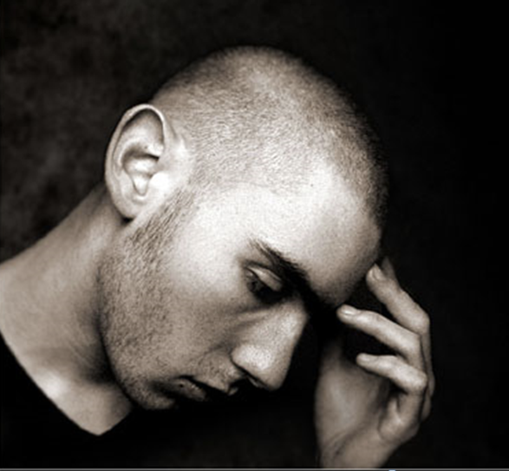
How committed are you to God’s work?
Notes:
If you were accused of being devoted to Jesus, would there be enough evidence to convict you in a court of law?

Slide 82
Why should you be committed to God?
Notes:
What reasons can you give to be dedicated, loyal and devoted to the Lord?

Slide 83

Background to Esther
NEVER GIVE UP
Notes:
Today in the book of Esther we will see that apathy can be cured.

Slide 84
The Postexilic Era
295 296 560
The Postexilic Era
Temple work
Prophets:
Haggai
Zechariah
Malachi
605
586
539
536
520
516
483-473
444-425
Others:
Zerubbabel
Esther
Ezra
Nehemiah
Persian Kings:
Cyrus
Darius
Xerxes
Artaxerxes
Notes:
The Post-Exilic Era was actually three separate periods: (1) Temple rebuilding led by Zerubbabel, Haggai, and Zechariah in two parts under Cyrus and Darius, (2) The saving of the nation from destruction by Esther about 30 years later under Xerxes, and (3) The restoration of Jerusalem’s walls and gates by Nehemiah another 70 years after that under Artaxerxes.
_________
OS-15-Ezra-36
OS-16-Nehemiah-94
OS-17-Esther-16, 75

Slide 85
Does God Care About Those Left Behind?
Most of the Jews never returned to the land of Israel even in the Post-Exilic Period
Notes:
Why didn’t they return? What would happen to them? How would God shake them out of their lethargy?

Slide 86
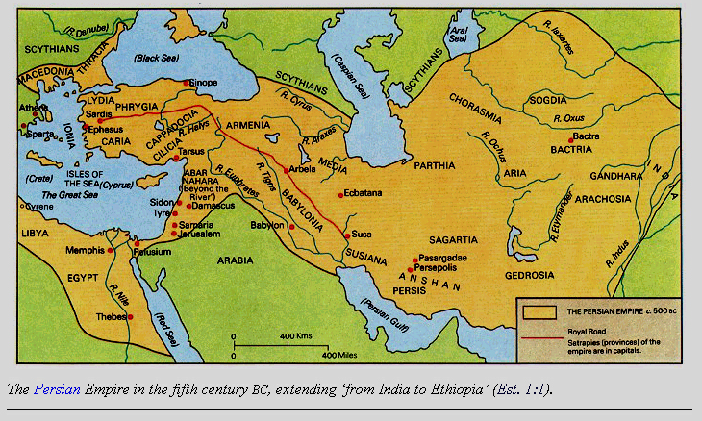
The Persian Empire
Map of the Persian Empire
317
Barry J. Beitzel, Moody Atlas of Bible Lands, 150-51
Susa
The Persian Empire in the 5th century BC extended "from India and Ethiopia" (Esther 1:1)
The boundaries of the empire that Cyrus II initiated
and Darius I consolidated stretched from Greece to India
Notes:
The Jews needed to renew their commitment to God based on his commitment to them over the ages. Yet they also needed to see God working in their lives right then as they lived outside the land of Israel.
Cyrus ruled over an absolutely ENORMOUS kingdom that eventually stretched from Greece in the west and India in the east. From his capital at Susa he had control over 127 provinces! God moved his heart to initiate a return to the land not only for the Jews but for other conquered peoples—as long as they would pray for the welfare of the king and his sons.

Slide 87
Correlation with Ezra
289
Restoring the Temple and People
Temple
Book of Esther (58 YEAR GAP)
People
Zerubbabel
Ezra
Ezra 1–6
Ezra 7–10
50,000 Return
5,000 Return
Survival
Revival
Working
Worshipping
538-516 BC (22 Years)
458-457 BC (1 Year)
External Opposition: Samaritans
Internal Opposition: Intermarriage
Return
1–2
Rebuilding
3–6
Return
7–8
Restoration
9–10
Decree
1
Returnees
2
Begins
3
Opposed
4:1–6:12
Ends
6:13-22
Qualifications
& Provisions
7
Returnees
& Protection
8
Inter- marriage
& Lament
9
Divorces
Carried Out
10

Slide 88
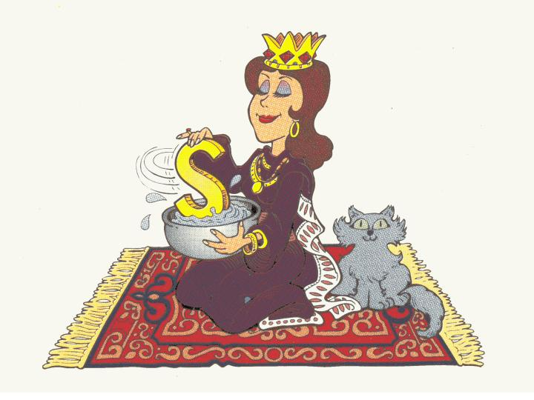
Queen of Persia
Esther:
Walk Through The Bible ©1989
Notes:
Once a pretty woman stirs an "S," you get "ES-stir"!

Slide 89
Esther Book Chart
308
Extermination Plot Foiled
Plot Planned
Plot Foiled
Chapters 1–4
Chapters 5–10
Threat
Triumph
Providence Prepared
Providence Enacted
Persecution
Preservation
Grave Danger
Great Deliverance
Feasts of Ahasuerus
Feasts of Esther & Purim
Esther Exalted
1:1–2:18
Haman Plots
2:19–4:17
Mordecai over
Haman
5:1–8:2
Jews over Enemies
8:3–9:32
Mordecai over Persia
10
Persia
10 Years (483-473 BC)

Slide 90
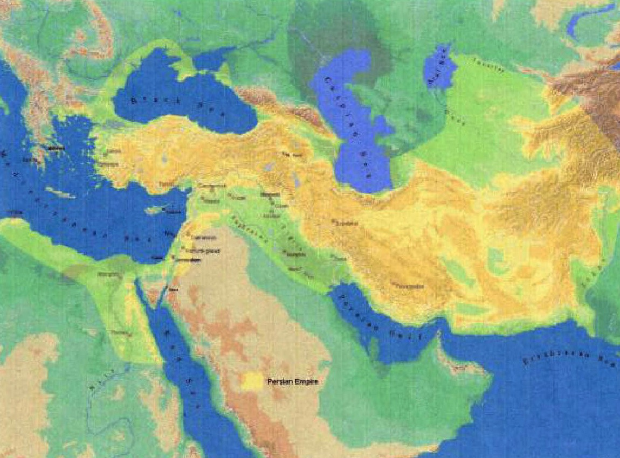
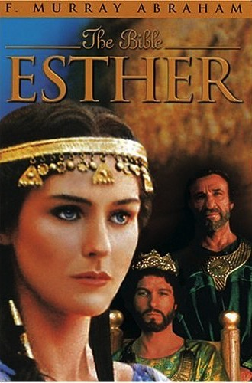
Key Word
308
Providence

Slide 91
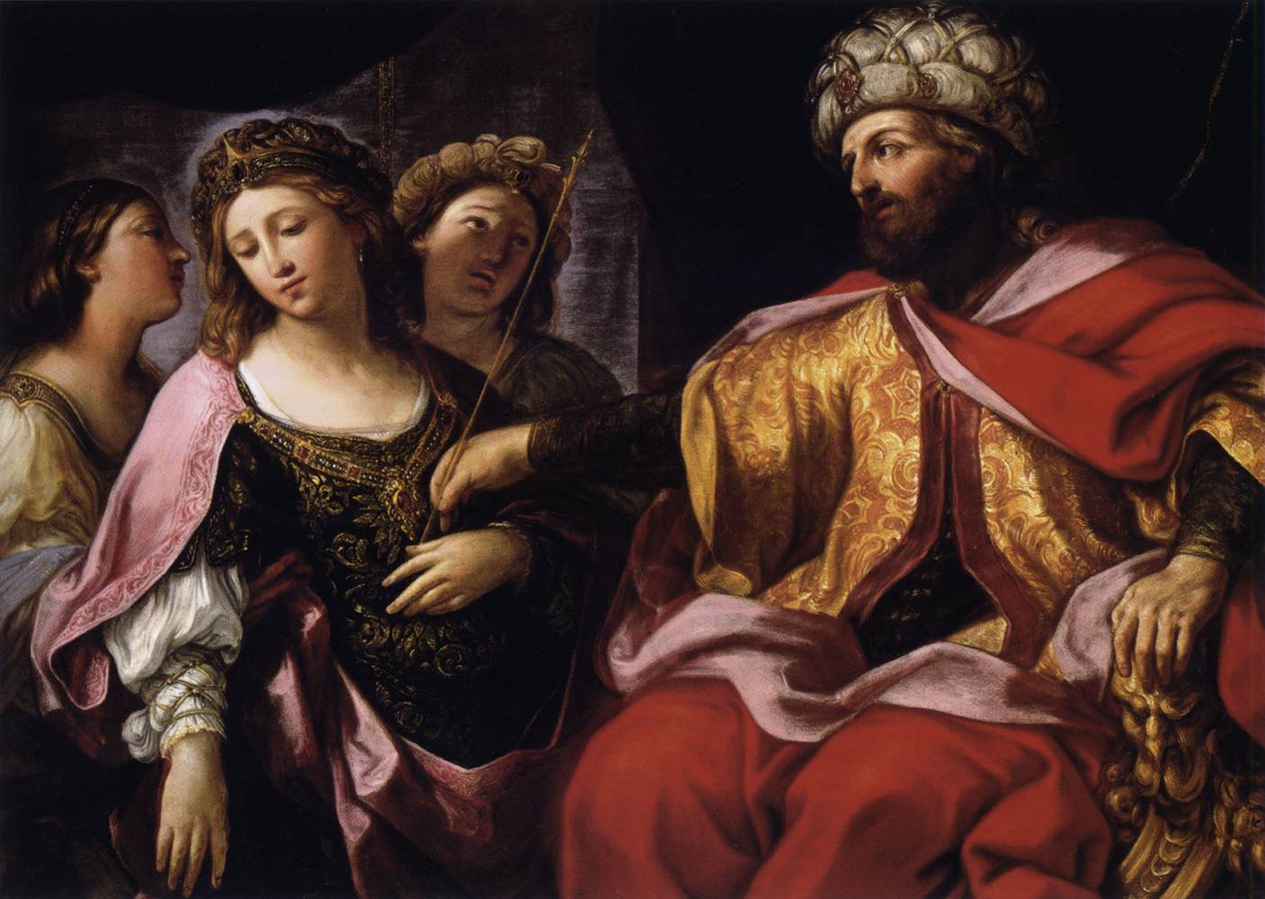
Key Verse
308
(Mordecai to Esther) "For if you remain silent at this time, relief & deliverance for the Jews will arise from another place, but you & your father's family will perish. And who knows but that you have come to royal position for such a time as this?" (Esther 4:14).

Slide 92
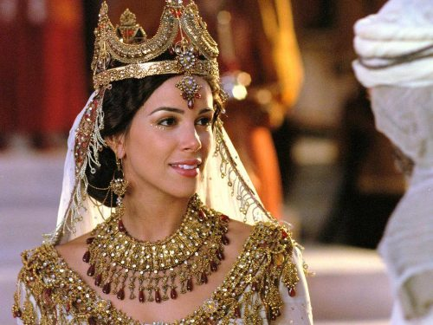
"…for such a time as this"

Slide 93

"…for such a time as this"

Slide 94

Summary Statement
308
An extermination of the Jewish nation plotted by Haman reverts upon his own head through God's providence through Mordecai & Esther to encourage postexilic Israel of God's continued commitment to the Abrahamic Covenant.

Slide 95

Synthesis
311
Extermination plot foiled
1–4 Plot planned—threat
5–10 Plot foiled—triumph

Slide 96
Why should you be committed to God?
2 REASONS
Notes:
What reasons can you give to be dedicated, loyal and devoted to the Lord?

Slide 97
God’s work faces threats (Esther 1–4).
Why be committed to God?
Notes:
Satan is always trying to push down whatever the Lord does.
God commands our wholehearted devotion as we face many obstacles while God fulfills his plan.

Slide 98
Slides on Esther 1
Notes:
Threat: God strategically placed Mordecai and Esther to thwart Haman's plot to exterminate the Jews to fulfill the Abrahamic Covenant (Esther 1–4).

Slide 99
The Persian Empire
Map of the Persian Empire
317
Barry J. Beitzel, Moody Atlas of Bible Lands, 150-51
Susa
The Persian Empire in the 5th century BC extended "from India and Ethiopia" (Esther 1:1)
The boundaries of the empire that Cyrus II initiated
and Darius I consolidated stretched from Greece to India
Notes:
Cyrus ruled over an ENORMOUS kingdom that eventually stretched from Greece in the west and India in the east. From his capital at Susa, he had control over 127 provinces! God moved his heart to initiate a return to the land not only for the Jews but for other conquered peoples—provided they would pray for the welfare of the king and his sons.
But God is bigger than Persia! Esther replaced the deposed Queen Vashti as God's intervention to save his people from annihilation as a nation (1:1–2:18).

Slide 100

King Xerxe's Unreasonable Command to Queen Vashti
Notes:
The account begins with a very frustrated King Xerxes, or Ahasuerus.

Slide 101

Vashti Upset
Notes:
Xerxes (Heb. Ahasuerus in the book) divorced his disobedient Queen Vashti, unaware of God’s plan for Esther to replace Vashti to preserve the Jews (Esther 1; 483 BC; 1:3).

Slide 102
Rise of Esther
Confusion 1–2
Vashti
483
479
Mordecai's rise
Banquets
Notes:
God actually uses the confusion of the first two chapters to bring about his plan. Sound familiar?

Slide 103

Outline
311-312
I. Haman's plot to exterminate the Jewish people becomes known to Mordecai and Esther, whom God has strategically placed, to inform Israel that apart from God it could not exist as a nation (Esther 1–4) .
Notes:
Haman’s plot to kill the Jews came just after Mordecai foiled a plot to murder the king to show God protecting Jews via Esther to uphold the Abrahamic Covenant (2:19–4:17).

Slide 104
Slides on Esther 2
Notes:
Xerxes married Esther to replace Vashti after a divinely orchestrated beauty contest in which God controlled Xerxes' taste in women to avert a disaster for the Jews (2:1-18; 479 BC).

Slide 105


The Beauty Contest
Notes:
Actually God uses a beauty contest for his plan.
• So all the beauties are gathered.
• And they were happy about that!

Slide 106

The Beauty Contest
Notes:
OK, maybe they looked better than that…

Slide 107

Mordecai the Jew (Esther 2:5)
Notes:
"At that time there was a Jewish man in the fortress of Susa whose name was Mordecai son of Jair. He was from the tribe of Benjamin and was a descendant of Kish and Shimei. ⁶ His family had been among those who, with King Jehoiachin of Judah, had been exiled from Jerusalem to Babylon by King Nebuchadnezzar" (2:5-6 NLT).

Slide 108

Mordecai's Young Cousin Esther (2:7)
Notes:
"This man had a very beautiful and lovely young cousin, Hadassah, who was also called Esther. When her father and mother died, Mordecai adopted her into his family and raised her as his own daughter" (2:7 NLT).

Slide 109

Mordecai Counsels Esther (2:10)
Notes:
"Esther had not told anyone of her nationality and family background, because Mordecai had directed her not to do so" (2:10 NLT).

Slide 110
Did Esther act honorably?
Notes:
Esther was written to show God's providential care in preserving Israel even though the nation was not actively concerned about returning to Jerusalem.
—————
"Esther kept her Jewish nationality a secret (cf. v. 20), not telling Hegai, her maids, or anyone else because Mordecai had told her not to. From this and other statements in the book it is clear the author was making the point that God protected and used Esther and Mordecai in spite of the fact that they were not living according to the Law commanded by God to the people of Israel. By Law Esther was not to marry a pagan (Deut. 7:1-4) or have sexual relations with a man who was not her husband (Ex. 20:14), and yet this was the purpose of her being included in the harem. Esther could be contrasted with Daniel who refused to eat the things from the king’s table (Dan. 1:5) because the food would include items considered unclean by the Jewish Law. Apparently Esther had no qualms about the food she ate (Es. 2:9). She certainly did not set herself apart as Daniel had done" (John A. Martin, "Esther," in The Bible Knowledge Commentary, 1:704).

Slide 111

All the King's Men
Notes:
Haman’s plot to kill the Jews came just after Mordecai foiled a plot to murder the king to show God protecting Jews via Esther to uphold the Abrahamic Covenant (2:19–4:17).
———————
“In those days, while Mordecai was sitting at the king’s gate, Bigthan and Teresh, two of the king’s officials from those who guarded the door, became angry and sought to lay hands on King Ahasuerus. 22 But the plot became known to Mordecai and he told Queen Esther, and Esther informed the king in Mordecai’s name. 23 Now when the plot was investigated and found to be so, they were both hanged on a gallows; and it was written in the Book of the Chronicles in the king’s presence” (2:21-23 NLT).

Slide 112

Eavesdropping
Esther
Confusion 1–2
Vashti
483
479
Mordecai's rise
Banquets
Notes:
God informed Mordecai of a secret assassination plot that saved Xerxes' life, as part of God’s design to exalt Mordecai later to benefit his people (2:19-23).

Slide 113
Slides on Esther 3
Notes:
Haman’s anger at Mordecai refusing to honor him convinced Xerxes to kill all Jews from Egypt to India eleven months later for God protect them instead (Esther 3).

Slide 114

Haman the Agagite (Esther 3:1-2)
Notes:
"Some time later, King Xerxes promoted Haman, son of Hammedatha the Agagite, over all the other nobles, making him the most powerful official in the empire. ² All the king’s officials would bow down before Haman to show him respect whenever he passed by, for so the king had commanded. But Mordecai refused to bow down or show him respect" (3:1-2 NLT).
"Because Haman was an Agagite, some have supposed that he was descended from Agag, king of the Amalekites (1 Sam. 15:8). However, it seems unlikely that a high-ranking Persian official would be related to a West Semite who lived 600 years earlier. Archeologists have uncovered an inscription which indicates that Agag was also the name of a province in the Persian Empire. This probably explains why Haman was called an Agagite" (John A. Martin, "Esther," Bible Knowledge Commentary, 1:705).

Slide 115

No Respect (3:1-2)
Esther
Grave Danger
Conspiracy 3–4
Confusion 1–2
Haman's rise & fall
Vashti
483
479
Mordecai's rise
Banquets
Fasting
Notes:
Haman was so stuck on himself that when Mordecai refused to stand in his presence, Haman decided to kill not only him, but ALL Jews throughout the 127 provinces of the empire! Talk a chip on his shoulder!

Slide 116
Slides on Esther 4
Notes:
Mordecai convinced Esther to risk her life for the Jews by showing that God had crowned her for this role, even if she failed, since he would still uphold the Abrahamic Covenant (Esther 4).

Slide 117
Key Verse
308
(Mordecai to Esther) "For if you remain silent at this time, relief & deliverance for the Jews will arise from another place, but you & your father's family will perish. And who knows but that you have come to royal position for such a time as this?" (Esther 4:14).
Notes:
Here we see the perfect balance between divine sovereignty (“deliverance from another place”) and human responsibility (“for such a time as this”).
Mordechai knew that God would keep his promise to bless the world through Israel—but he also knew that God uses people in fulfilling his plan.
Like Esther, we can either choose to rebel against God’s plan or cooperate with him. Rebellion leads to personal ruin, but obedience gives us the privilege of actually being part of what God had designed all along!

Slide 118
Why should you be committed to God?
Notes:
What reasons can you give to be dedicated, loyal, and devoted to the Lord?

Slide 119
God’s work faces threats (Esther 1–4).
Why be committed to God?
Notes:
Satan is always trying to push down whatever the Lord does.
God commands our wholehearted devotion as we face many obstacles while God fulfills his plan.

Slide 120

We are secure in our relationship with God—but that doesn’t mean there are no attacks!

Slide 121

We are at war.
Notes:
We are at war. The sad reality is that many of us do not realize it, so we are not committed to God as a result.

Slide 122

Crossroads
Notes:
Each of us is at a crossroads—thus our church is Crossroads International Church.
Like the Jews in the story of Esther, right now we are attacked at home, at work, and in many other arenas.
We face a challenge whether we will take God’s road at the crossroads. Too often, our problem is not that we don’t know which road is God’s road. Our issue is having the courage and commitment to do it.
Why should we be committed to God?

Slide 123
God’s work faces threats (Esther 1–4).
Why be committed to God?
God’s work will triumph (Esther 5–10).
Notes:
Satan is always trying to push down whatever the Lord does.
But the Lord will eventually be the victor.
It’s easier to be committed to God’s plan when we know that it will ultimately succeed.

Slide 124
Outline
311-312
I. Haman's plot to exterminate the Jewish people becomes known to Mordecai and Esther, whom God has strategically placed, to inform Israel that apart from God it could not exist as a nation (Esther 1–4) .
II. Haman's extermination plot reverts upon his own head through God's providential workings in Mordecai and Esther to encourage postexilic Israel of God's continued commitment to the Abrahamic Covenant (Esther 5–10) .
Notes:
Triumph: God reversed Haman's massacre plot on his own head via Mordecai and Esther to fulfill the Abrahamic Covenant (Esther 5–10).

Slide 125
Slides on Esther 5
Notes:
Mordecai overcame Haman as proof of God's faithfulness when we fear him (5:1–8:2).

Slide 126
Courage 5–7
Esther
Grave Danger
Conspiracy 3–4
Confusion 1–2
Courage 5–7
Haman's rise & fall
Vashti
483
479
Mordecai's rise
Banquets
Banquets
Fasting
Notes:
True, God is for us—but that doesn't mean it doesn't take courage on our part!

Slide 127

Esther Risked Her Life for the Jews (5:2)
Notes:
The king had not summoned Esther for over a month, and to come into his presence without an invitation risked her very life.

Slide 128

Esther 5:1-8
Notes:
It is telling that a woman is set as an example of courage here. Too often, it is the ladies who model courage before us men, even though God's plan is for the men to be the spiritual leaders. The king was obviously impressed with Esther's boldness.
Esth. 5:3 Then the king asked her, “What do you want, Queen Esther? What is your request? I will give it to you, even if it is half the kingdom!”

Slide 129

Esther invited Haman and the king to eat (5:4)
Notes:
The king enthusiastically and curiously accepted Esther's boldness, yet Esther only invited him to a banquet to put him in the proper mood to grant her request (5:1-8).

Slide 130

Esther 5:9-14
Notes:
Yet, when Haman leaves after the meal, Mordecai refused to stand for Haman, which motivated Haman to impale Mordecai.
So Haman arrogantly plotted to murder Mordecai on a 75-foot gallows as God's provision for his own death to protect the Jews (5:9-14).

Slide 131

"a sharpened pole… seventy-five feet tall” (5:14 NLT)
"a gallows built… seventy-five feet tall” (5:14 NIV, NAU)
Notes:
"Haman’s wife, Zeresh, and all his friends were no better than he was. They suggested that Haman have a gallows built that would be 75 feet high and that he have Mordecai hanged on it before the banquet so he would have nothing bothering him when he went to the feast. The gallows probably was an impaling stake, a common method of execution in the ancient world (cf. comments on 2:23). The purpose in suggesting such a tall stake was so it would be a lesson to all who saw it. The person on the stake would be visible from all directions, since he would be higher than all the trees. This spectacle would solemnly emphasize that Haman was in control (cf. 3:1) and that no one should try to stand in his way.
Haman undoubtedly felt that with Mordecai gone, there would be no organized opposition from the Jewish camp. He would be freed from his enemy forever. Here, the tension in the Haman-Mordecai conflict reached its peak. From this point on it was relieved little by little through circumstances that had already been set in motion. As the events unfold, the reader is reminded of seemingly insignificant or forgotten events that the skillful narrator had previously mentioned but had not highlighted. God was sovereignly at work behind even such a hateful act as building a gallows (cf. Acts 2:23; 4:27-28)" (John A. Martin, "Esther," Bible Knowledge Commentary, 1:708).

Slide 132
Slides on Esther 6
Notes:
Haman honored Mordecai and returned home humiliated (Esther 6).

Slide 133

Esther 6
Notes:
I can hear Haman announce under his voice, "This is what the king does for the one he wants to honor," and then Mordecai says, "Hey, say it a little louder!"

Slide 134

"Afterward Mordecai returned to the palace gate, but Haman hurried home dejected and completely humiliated” (6:12 NLT)

Slide 135
Slides on Esther 7
Notes:
Haman died on the gallows prepared for Mordecai as evidence that God protects those who fear him and punishes those who oppose him and his people (Esther 7).

Slide 136


ESTHER 7:3-4a NIV
Then Queen Esther answered, "If I have found favor with you, O king, and if it pleases your majesty, grant me my life—this is my petition. And spare my people—this is my request. ⁴For I and my people have been sold for destruction and slaughter and annihilation."
Notes:
Esth. 7:5 “Who would do such a thing?” King Xerxes demanded. “Who would be so presumptuous as to touch you?”
Esther's declaration motivated the king to request who would do such a vile deed. It was also news to both Haman and Xerxes that Esther was a Jewess!

Slide 137

"The adversary is this vile Haman" (7:6)
Notes:
Esth. 7:6 Esther replied, “This wicked Haman is our adversary and our enemy.” Haman grew pale with fright before the king and queen. ⁷ Then the king jumped to his feet in a rage and went out into the palace garden.

Slide 138

"That vile Haman…" (7:6)
Notes:
Finally, the king learned of Haman's true nature!

Slide 139

Esther 7:8
Notes:
"In despair, he fell on the couch where Queen Esther was reclining, just as the king was returning from the palace garden. The king exclaimed, “Will he even assault the queen right here in the palace, before my very eyes?” And as soon as the king spoke, his attendants covered Haman’s face, signaling his doom" (7:8 NLT).

Slide 140
"a sharpened pole… seventy-five feet tall” (5:14 NLT)
"a gallows built… seventy-five feet tall” (5:14 NIV, NAU)
Notes:
"Haman’s wife, Zeresh, and all his friends were no better than he was. They suggested that Haman have a gallows built that would be 75 feet high and that he have Mordecai hanged on it before the banquet so he would have nothing bothering him when he went to the feast. The gallows probably was an impaling stake, a common method of execution in the ancient world (cf. comments on 2:23). The purpose in suggesting such a tall stake was so it would be a lesson to all who saw it. The person on the stake would be visible from all directions, since he would be higher than all the trees. This spectacle would solemnly emphasize that Haman was in control (cf. 3:1) and that no one should try to stand in his way.
Haman undoubtedly felt that with Mordecai gone there would be no organized opposition from the Jewish camp. He would be freed from his enemy forever. Here the tension in the Haman-Mordecai conflict reached its peak. From this point on it was relieved little by little through circumstances that had already been set in motion. As the events unfold, the reader is reminded of seemingly insignificant or forgotten events that the skillful narrator had previously mentioned but had not highlighted. God was sovereignly at work behind even such a hateful act as building a gallows (cf. Acts 2:23; 4:27-28)" (John A. Martin, "Esther," Bible Knowledge Commentary, 1:708).

Slide 141
Slides on Esther 8
Notes:
Mordecai was elevated to Haman's position and appointed over Haman's estate to show that those who plot evil will only prosper the righteous (8:1-2).

Slide 142
V-Day
Esther
Grave Danger
Great Deliverance
Conspiracy 3–4
Vindication 8
Confusion 1–2
Courage 5–7
Haman's rise & fall
Jews' protection
Vashti
483
479
Mordecai's rise
473
Banquets
Feasting
Banquets
Fasting

Slide 143
Slides on Esther 9
Notes:
Israel triumphed over its enemies and began to annually celebrate the Feast of Purim as evidence of God's faithfulness to the Abrahamic Covenant (8:3–9:32).

Slide 144
V-Day
Esther
Grave Danger
Great Deliverance
Conspiracy 3–4
Vindication 8
Confusion 1–2
Courage 5–7
Victory 9–10
Haman's rise & fall
Jews' protection
Vashti
483
479
Mordecai's rise
473
Banquets
Feasting
Banquets
Fasting
Notes:
God delivered the Jews in a massive slaughter of their enemies authorized by a counter-decree for their self-defense to show God upholding the Abrahamic Covenant (8:3–9:16).

Slide 145
Purim
"Purim is a minor holiday of the Jewish calendar based upon the account in the book of Esther. The holiday is preceded by the Fast of Esther, commemorating the period of assembly and fasting before the deliverance. On Purim, according to Talmudic practice, the Megillah (Scroll of Esther) is read in the synagogue, charity is distributed, gifts of food are exchanged, and a festive meal is eaten."
"Purim," in Harper's Bible Dictionary
Notes:
Xerxes allowed Esther and Mordecai’s counter-decree for Jews to defend themselves, and God caused many Gentiles to become proselytes (8:3-17).

Slide 146

Proverbs 16:33 (NIV)
"The lot is cast into the lap, but its every decision is from the LORD."
Notes:
The Jews slaughtered at least 75,810 enemies in two days with help from royal officials to show God's faithfulness to the Abrahamic Covenant (9:1-16; Feb-Mar 473 BC).
Mordecai and Esther authorized the Feast of Purim (plural for pur, the lot thrown by Haman) to annually celebrate God’s victory over the enemies of the Jews (9:17-32).

Slide 147

The story lives on in Jewish plays each year…
Notes:
Purim is celebrated annually by Jews, where boys play Mordecai and girls play Esther.

Slide 148

Purim: Lots of Victory
Notes:
It is a festive time!

Slide 149
Slides on Esther 10
Notes:
The LORD exalted Mordecai to second place only to Xerxes for his selfless concern for the Jews, showing God's blessing on those who seek the welfare of others (Esther 10).

Slide 150
We are secure in our relationship with God—but that doesn’t mean there are no attacks!

Slide 151

We also have a future victory because God’s plan will not be thwarted.

Slide 152
Key Verse
308
(Mordecai to Esther) "For if you remain silent at this time, relief & deliverance for the Jews will arise from another place, but you & your father's family will perish. And who knows but that you have come to royal position for such a time as this?" (Esther 4:14).
Notes:
The key verse reminds us that, even if we have poor judgment and are not committed to God’s plan, “relief for the Jews will arise from another place” (Esther 4:14).

Slide 153

You can't thwart God’s sovereign plan. But you can be part of it.
Notes:
It is the same with us! You cannot thwart God’s sovereign plan! He is the king and will accomplish it with or without you. The real question is whether you will have that blessing to be reigning with him.

Slide 154
The Bible's Chiasm
446
Repeated Patterns in Reverse Order
Christ's Redemption
Christ's Rule
Man's Rule Lost at Fall
Man's Rule Restored at Millennium
Creation
New Creation
Notes:
We need to know who we are—more accurately, who God says we are—our future identity.
This is shown in the overall structure of the Bible in a chiasm—a literary pattern where earlier content is repeated in reverse order:
• Creation in Genesis 1–2 • is repeated In the Restored, New Creation in Rev 21–22
• Man was created to rule over the fish, birds, and land animals (Gen. 1:28) but he gave over his rule over to the god of this world, Satan (2 Cor. 4:4)
• But this rule will be restored during the 1000-year reign of the saints (Rev. 20:4-6)
• Christ is the central Person of history, • both as Lamb (Redeemer) • and as Lion (Ruler of all creation in the line of David)
________________
OC-17-Genesis Authorship-14
OS-01-Genesis1-3-slide 243
OS-17-Esther-17, 153
NS-27-Rev20-22-slide 206

Slide 155


Revelation 20:4-6 Diagrammed
424
^{4b}and they came to life and reigned with Christ for a thousand years.
^{4a}Then I saw thrones, and they sat on them, and judgment was given to them. And I saw the souls of those who had been beheaded because of their testimony of Jesus and because of the word of God, and those who had not worshiped the beast or his image, and had not received the mark on their forehead and on their hand…
1000 years
^{5b}This is the first resurrection. ^{6a}Blessed and holy is the one who has a part in the first resurrection; over these the second death has no power…
^{6b}but they will be priests of God and of Christ and will reign with Him for a thousand years.
^{5a}The rest of the dead did not come to life until the thousand years were completed.
Notes:
Believers will reign with Christ for 1000 years!
___________
OS-17-Esther-146
NS-27-Rev20-22-slide

Slide 156
Why should you be committed to God?
Notes:
What reasons can you give to be dedicated, loyal and devoted to the Lord?

Slide 157
God’s work faces threats (Esther 1–4).
Why be committed to God?
God’s work will triumph (Esther 5–10).
MAIN IDEA: Despite Satan’s threats, God will triumph
Notes:
Satan is always trying to push down whatever the Lord does.
But the Lord will eventually be the victor.
It’s easier to be committed to God’s plan when we know that it will ultimately succeed.

Slide 158
WHAT TO DO?
308
Use your
providentially
placed position
to help
God's people
Notes:
Where are you feeling crushed as if on the losing team? Plans at work, home, your future, your whatever…
You are not on the losing team! Be committed to God because you are actually on the winning side!
• Use your providentially placed position to help God's people. How? What advantages do you have that others do not? Language? Relationships? Money?

Slide 159

Esther's Tomb in Iran Today
Notes:
Just as one can visit Esther’s tomb in Iran today, who knows but that your courage could long be remembered in God’s service.

Slide 160
Black

Slide 161


OT Preaching link at BibleStudyDownloads.org
Get this presentation and script for free!

Slide 162

The Present Crisis [1844], James Russell Lowell
Truth forever on the scaffold, Wrong forever on the throne -
Yet that scaffold sways the future, and, behind the dim unknown,
Standeth God within the shadow, keeping watch above his own.

Slide 163

God Moves in a Mysterious Way
1. God moves in a mysterious way His wonders to perform; He plants His footsteps in the sea And rides upon the storm.
William Cowper, 1731-1800

Slide 164

God Moves in a Mysterious Way
2. Deep in unfathomable mines Of never-failing skill He treasures up His bright design And works His sovereign will.
William Cowper, 1731-1800

Slide 165

God Moves in a Mysterious Way
3. Ye fearful saints, fresh courage take; The clouds ye so much dread Are big with mercy and shall break In blessings on your head.
William Cowper, 1731-1800

Slide 166

God Moves in a Mysterious Way
4. Judge not the Lord by feeble sense. But trust Him for His grace; Behind a frowning providence He hides a smiling face.
William Cowper, 1731-1800

Slide 167

God Moves in a Mysterious Way
5. His purposes will ripen fast, Unfolding every hour; The bud may have a bitter taste, But sweet will be the flower.
William Cowper, 1731-1800

Slide 168

God Moves in a Mysterious Way
6. Blind unbelief is sure to err And scan His work in vain; God is His own Interpreter, And He will make it plain.
William Cowper, 1731-1800

Slide 169

2 Timothy 3:15 (NIV)
Esther
". . . from infancy you have known the holy Scriptures, which are able to make you wise for salvation through faith in Christ Jesus."

Slide 170

Romans 15:4 (NIV)
Esther
"For everything that was written in the past was written to teach us, so that through endurance and the encouragement of the Scriptures we might have hope."

Slide 171

1 Cor. 10:11 (NIV)
"These things happened to them as examples and were written down as warnings for us, on whom the fulfillment of the ages has come."

Slide 172
V-Day
Esther
Grave Danger
Great Deliverance
Conspiracy 3–4
Vindication 8
Confusion 1–2
Courage 5–7
Victory 9–10
Haman's rise & fall
Jews' protection
Vashti
483
479
Mordecai's rise
473
Banquets
Feasting
Banquets
Fasting

Slide 173
Chronology of the Persian Period
313
John H. Walton, Chronological and Background Charts of the OT, 2d ed., 70
PERSIAN KING
DATES
BIBLICAL CORRELATION
GREEK CORRELATION
CYRUS
539-530
Return of Zerubbabel &
Jeshua (Ezra 1–3)
CAMBYSES
530-522
Rebuilding at Jerusalem stopped (Ezra 4)
DARIUS I
522-486
Haggai & Zechariah prophesy (520)
Temple completed (516)
(Ezra 5–6)
Greeks defeat Persians at Marathon (490)
XERXES
486-464
Story of Esther
(Esther 1–9)
Persians defeat Greeks at Thermopylae (480) but reversed at Salamis (480), Herodotus 485-425
ARTAXERXES I
464-423
Return of Ezra (458)
(Ezra 7–10)
Return of Nehemiah (445)
(Nehemiah 1–2)
Prophecy of Malachi (433)
Golden Age (461-431)
Pericles (460-429)
Athens rules

Slide 174
Chronology of the Persian Period
313
John H. Walton, Chronological and Background Charts of the OT, 2d ed., 70
PERSIAN KING
DATES
BIBLICAL CORRELATION
GREEK CORRELATION
DARIUS II
423-404
Peloponnesian Wars
(431-404)
Athens falls (404)
Sparta rules
ARTAXERXES II
404-359
Socrates (470-399)
Plato (428-348)
Aristotle (384-322)
B S
I I
B L
L E
I N
C C
A E
L .
ARTAXERXES III
359-338
Philip II of Macedon defeats Greeks at Chaeronea in 338
ARSES
338-335
DARIUS III
335-331
Alexander the Great overthrows Persian Empire
ALEXANDER
336-323
Establishment of Greek Empire

Slide 175
Key Dates Related to the Book of Esther
314
Reference
Date
Event
–
486
Xerxes' reign began
1:3
483
(3rd year of Xerxes)
Xerxes 7-day banquet for his nobles & officials where Queen Vashti was deposed
–
482-479
Xerxes led disastrous campaigns against Greece, esp. at navy Battle of Salamis (480); recorded by Greek historian Herodotus (7.8)
2:16
Dec 479 or Jan 478
Esther became queen after a 4-year beauty contest
3:7
Early April 474
In the 5th year of Esther's reign, Haman & the astrologers (5:10, 14; 6:12-13) cast the pur (lot) to determine the day to exterminate the Jews 11 months later (7 March 473)
3:12
April 17, 474
(13th of Nisan)
Xerxes' 1st edict (to destroy the Jews) informed everyone of the fateful day, royal secretaries wrote it out in the various languages of the empire

Slide 176
Key Dates Related to the Book of Esther
314
Reference
Date
Event
8:9
June 25, 474
(23rd of Sivan)
Xerxes' 2nd edict (to protect the Jews) was sent out 2 months & 10 days after the 1st one on April 17
3:13
8:12
9:1, 17a
March 7, 473
(13th of Adar)
Rather than being destroyed on this day, Jews protected themselves by killing at least 75,810 enemies 8 months & 20 days after the counter-edict was signed
9:17b-18a
March 8, 473
(14th of Adar)
Jews feasted to celebrate their victory throughout the empire except in Susa where they killed their enemies one more day (today all Jews except in Jerusalem celebrate Purim this day, the 14th of Adar)
9:18b
March 9, 473
(15th of Adar)
Jews feasted in celebration of their victory in Susa (today Jews in Jerusalem celebrate Purim on this day, the 15th of Adar)
–
464
Palace at Susa destroyed by fire & Xerxes reign ended

Slide 177

Banquets Galore
Esther

Slide 178
Banquets in the Book of Esther
315
References
Hosts
Guests
Events
1
1:3-4
Xerxes
Nobles & Officials
Wealth of the kingdom displayed over 180 days
2
1:5-8
Xerxes
All the people
Wine flowed for everyone for 7 days
3
1:9
Vashti
Palace women
Vashti deposed for declining to attend Xerxes' banquet
4
2:18
Xerxes
Nobles & Officials
Esther introduced as the new queen
5
3:15
Xerxes
Haman
Annihilation of the Jews decreed by the king

Slide 179
Banquets in the Book of Esther
315
References
Hosts
Guests
Events
6
5:1-8
Esther
Xerxes & Haman
Xerxes kept in suspense as to Esther's request
7
7:1-10
Esther
Xerxes & Haman
Esther exposes Haman as seeking her life
8
8:17
Jews
Jews
Rejoicing over the king's edict on the Jews behalf & many Gentiles became Jews
9
9:17
Jews
Jews
Rejoicing over slaughter of 75,810 or more enemies of the Jews
10
9:18-32
Jews
Jews
Feast of Purim established to be an annual event through Mordecai's decree

Slide 180

Map of Esther's Canonical Status Carey A. Moore, Esther, Anchor Bible, xxvi-xxvii
316

Slide 181

Xerxes depicts the universal quest of men for power and women

Slide 182

Xerxes & Women
"Herodotus, in addition to depicting Xerxes' role in the invasion of Greece, presents an unflattering portrait of the king as an impatient, hot-tempered monarch with a wandering eye for women. According to Herodotus, Xerxes not only tried to have an affair with his brother's wife, but also did have an affair with her daughter" —Edwin Yamauchi
Notes:
Edwin Yamauchi, "The Archaeological Background of Esther," BibSac 137:546 (1980): 104; cited by J. Paul Tanner, "Esther" notes, paultanner.com, page 31.2.

Slide 183

Haman reminds us how Satan has attacked Jews throughout history

Slide 184

How the Nations Treat Israel
Hating Jews Through the Centuries
Dr. Rick Griffith • Jordan Evangelical Theological Seminary
BibleStudyDownloads.org
Notes:
The Future (Eschatology) course includes a full PPT presentation highlighting antisemitism throughout history, in like manner to that of Haman in the book of Esther. It has 165 slides, but only a few are shown below.

Slide 185
What is Antisemitism?

Slide 186

The Table of Nations
92
NOAH
Sino
Japheth
HAM
SHEM
Sin
Caucasians
Canaanites
Semites
Sinai
Europeans &
East Indians
Africans &
Asians
Jews &
Arabs
Genesis 10
Notes:
Noah’s three sons became three divisions of humanity in three major areas.
Asians stem from Canaanites in the city of Sin—not those who migrated south to the Sinai but those who migrated east to China. Here is why we have these terms of Sinai and East Asians called Sino.
_____________
ES-29-How the Nations Treat Israel-4
BG-03-Table of Nations-3
OS-01-Gen4-20-slide 149
OS-13-1Chron-74
4, 149, 150
Sura 37.99-113 claims that Abraham offered Ishmael.
The Bible promises blessing to both Ishmael and Isaac, but only Isaac is promised to BE a blessing.

Slide 187
How has the world treated the Jews?

Slide 188
How has the world treated the Jews?
Pharaohs
Philistia
Assyrians
Babylonians
Persians
Greeks
Romans
Catholics
Terrorism
Crusaders
Spaniards
Lutherans
Germans
Europeans
MENA
The UN
Neighbors
Land ownership
Canadians
US Left Wing
The World

Slide 189
Babylonians
Persecutors of Jews…

Slide 190

The Exile
Notes:
Babylonians drove Jews outside their land for 70 years.
__________
ES-29-Antisemitism-18
OS-26-Ezek1-3-slide 144
OS-27-Daniel-188

Slide 191
Greeks
Persecutors of Jews…

Slide 192





Jerusalem Hellenization
65
Dec 167- Dec 164
Hanukkiah
Menorah
The Feast of Lights (Dedication)
Notes:
Greek rule over Israel came to a height when Antiochus IV vented his anger at being defeated by Rome upon the Jews of Jerusalem.
• Jews had long considered the Torah sacred...
• But Antiochus prohibited Scripture readings.
• He even sacrificed a pig on the Jerusalem altar to desecrate it.
• For three years, the temple became a pagan altar (Dec 167-Dec 164).
• Finally, Jews took back the temple when the one-day supply of lampstand oil miraculously lasted 8 days!
• This led to victory over the Greeks and the commemoration of their victory with 8 lampstand arms (hanukkiah) instead of the normal 7-branched menorah.
• Each December, Jews celebrate their victory at the Feast of Lights or Dedication (or Rededication) to remember their oppression by the Greeks.
_______________
ES-29-Antisemitism-28
NB-05-Politics2 Ptolemies to 63 BC (Pompei)-23

Slide 193
Romans
Persecutors of Jews…

Slide 194

Romans destroyed the Jewish temple in AD 70 and made Jerusalem pagan in AD 132
Rome even renamed Israel as Palestina after the Philistines who came from the Aegean Sea to seek to erase any Jewish claim to the city!

Slide 195
Catholics
Persecutors of Jews…

Slide 196
Catholic Theology & Practice
Said "The Church is the New Israel"
Replaced Israel
Disdained Jews
Oppressed Jews

Slide 197
Terrorism
Persecutors of Jews…

Slide 198

thereligionofpeace.com
9 Nov 2023
Daily Updates of Islamic Terror Against Jews, Christians, etc.

Slide 199
Crusaders
Persecutors of Jews…

Slide 200

Jews were brought from France to lend money to build England's castles
Notes:
https://www.english-heritage.org.uk/visit/places/cliffords-tower-york/history-and-stories/massacre-of-the-jews/
The Massacre at Clifford’s Tower
England’s Jewish Population
After the Norman Conquest of 1066, a number of Jews came to England from Rouen in France. The early Norman kings needed to borrow money to build castles and secure their kingdom, but money-lending was forbidden to Christians. It was, however, permitted to Jews. These French-speaking Jews were protected by the Crown, and in time established communities in most of the principal cities of England. In the later 12th century, members of the Jewish community in Lincoln settled in York. However, there was growing hostility towards the Jewish population in England. This was in part due to public disagreements in theology between Jewish scholars and Christian churchmen. In the mid-12th century several vicious stories were spread accusing Jews of murdering Christian children. Such slanders, now known as the ‘Blood Libel’, strengthened anti-Semitic sentiment in England.
___________
An anti-Semitic portrayal of Jewish money-lenders from a 13th-century manuscript. William I brought Jewish merchants to England in the 11th century as they were able to lend money to the Crown, whereas Christians were forbidden to do so © Getty Images/Universal Images Group/Hulton Fine Art

Slide 201

Jews Burned in Clifford's Tower, England
Notes:
https://www.english-heritage.org.uk/visit/places/cliffords-tower-york/history-and-stories/massacre-of-the-jews/
The Massacre at Clifford’s Tower
One of the worst anti-Semitic massacres of the Middle Ages took place in York in 1190. The city’s entire Jewish community was trapped by an angry mob inside the tower of York Castle. Many members of the community chose to commit suicide rather than be murdered or forcibly baptised by the attackers.

Slide 202
Spaniards
Persecutors of Jews…

Slide 203

Spain Expelled All Jews
A mural depicting the movement of Torah scrolls following the expulsion from Spain. From Wilshire Boulevard Temple, Los Angeles.
Notes:
What the Jews of the Iberian Peninsula can teach us about political power & minority status
https://jewishstudies.washington.edu/jewish-history-and-thought/political-power-minority-status-jews-iberian-peninsula/

Slide 204
Lutherans
Persecutors of Jews…

Slide 205


Luther to His Followers
"My advice, therefore, is to deal kindly with the Jews and to instruct them in the Scriptures so that they may come over to us . . . We must welcome them in our midst, permit them to work and trade among us. They will then have an opportunity to witness Christian life and doctrine. Should, however, some of them still remain stubborn, what of it? Not every one of us is a good Christian."

Slide 206

After Jews Rejected the Gospel…
"Set their synagogues on fire, and whatever does not burn up should be covered or spread over with dirt so that no one may be able to see a cinder or stone of it... Their homes should likewise be broken down and destroyed… They should be put under one roof or in a stable, like gypsies, in order that they may realize that they are not masters in our land, as they boast, but miserable captives, as they complain of us incessantly before God with bitter wailing."

Slide 207
Germans
Persecutors of Jews…

Slide 208

Liberated Jewish prisoners at the Nazi concentration camp in Ebensee, Austria
Notes:
https://www.britannica.com/event/Holocaust/Artistic-responses-to-the-Holocaust

Slide 209

Hitler motivated the Jews to go to their homeland!
Notes:
The very opposite happened to what Hitler tried to do. He sought to kill the Jews and pushed them out of his land.

Slide 210

Hitler motivated the Jews to go to their homeland!
Jewish emigration from Germany 1933-1938
Route
GERMANY
Number
Notes:
Hitler sought to eradicate the Jews, but God sought to eradicate Hitler. He committed suicide in 1945 and three years later the Jews established their homeland in Israel! God told Abraham, "I will bless those who bless you and curse those who curse you" (Gen 12:3). Hitler's attempt to curse the Jews led to him being cursed.

Slide 211

A Quarter of Germans Say Jews Think They are Superior (2019)
Anti-Semitism in Germany
Percentage of respondents who answered "strongly agree"
Jewish people are like everyone else
Jews are more family-oriented than others in Germany
Jews are more loyal to Israel than to Germany
Jews still talk too much about the Holocaust
A lot of people I know have negative feelings about Jews
Jews think they are better than others
People hate Jews because of the way they behave
Jews don't care what happens to anyone else
Jews are responsible for most of the world's wars
https://www.dw.com/en/one-in-four-germans-hold-anti-semitic-beliefs-study-finds/a-50958589
Source: World Jewish Congress (WJC) Germany Anti-Semitism Assessment Study, October 2019
Notes:
Study: One in four Germans harbor anti-Semitic thoughts
Rebecca Staudenmaier
October 24, 2019
https://www.dw.com/en/one-in-four-germans-hold-anti-semitic-beliefs-study-finds/a-50958589
More than a quarter of Germans surveyed said they agreed with anti-Semitic statements, including that Jews have "too much power over the economy." Over 40% said they thought Jews "talk about the Holocaust too much."
Anti-Semitism is gaining a stronger foothold in German society, the Süddeutsche Zeitung newspaper reported on Wednesday, citing a new study from the World Jewish Congress (WJC).
Out of the 1,300 Germans who took part in the representative survey, 27% agreed with a range of anti-Semitic statements and stereotypes about Jewish people.
Some 41% said they agreed with the statement that "Jews talk about the Holocaust too much." The same portion said they believed "Jews are more loyal to Israel than to Germany."
Over 20% of respondents said they agreed that Jewish people have "too much power" over the economy, international financial markets and the media. Another 22% agreed that "people hate Jews due to the way they behave."
"These are cliches, stereotypes, envy but there is also some truth to it. Jews are successful. What's the problem with that?" Cologne Rabbi Yechiel Brukner told DW. "Why are Germans not envious that, as a percentage of the population, Jews have many more Nobel Prize winners? Why doesn't that bother anyone? What does it always concern the aspect of 'money'? Judaism places an emphasis on intellectual intelligence and that has meant that Jews are often very successful. They also work hard, but why does someone not like them for that?
"Think about this: There are still living Holocaust survivors and Germans already dare to entertain anti-Semitic thoughts — and even to take action based on them. That's incredible," Brukner added.
The survey was carried out two months ago, prior to the anti-Semitic attack targeting a synagogue in the eastern German city of Halle.
Hostility towards Jews growing among 'elites'
Anti-Semitism is also growing among the wealthy and well-educated, according to the study.
The WJC found that 18% of "elites" — respondents with at least one university degree who make at least €100,000 ($111,300) per year — agreed with anti-Semitic sentiments.
Within that group, over a quarter said they believed Jewish people have "too much power over world politics" and the economy.
Read more: German groups combating far-right extremism face uncertain future

Slide 212
Europeans
Persecutors of Jews…

Slide 213

Expulsion of Jews from Europe (1100-1600)
https://en.wikipedia.org/wiki/Antisemitism#/media/File:Expulsion_judios-en.svg

Slide 214
MENA (Middle East & North Africa)
Persecutors of Jews…

Slide 215

Jewish refugees from MENA countries (1948-2019)
https://www.reddit.com/r/MapPorn/comments/wzfk94/jewish_refugees_from_muslim_countries/?rdt=37455

Slide 216

Migration of Jews from MENA countries (1948-2021)
https://www.gov.il/en/departments/news/jewish-refugees-expelled-from-arab-lands-and-from-iran-30-november-2021
Notes:
Jewish refugees expelled from Arab lands and from Iran
Subject Foreign Policy
Secondary topic Behind the Headlines
Publish Date 30.11.2021
This Memorial Day commemorates the tragedy of people who were forced to flee their homes, part from their host cultures and leave the countries where they had lived for centuries, solely because of their Jewish identity.
On November 30th, Israel and the Jewish world remember the fate of more than 850,000 Jews who were expelled and forced out of Arab lands and Iran in the 20th century. This Memorial Day commemorates the tragedy of people who were forced to flee their homes, part from their host cultures and leave the countries where they had lived for centuries, solely because of their Jewish identity.
Thousands of Jews were forced to leave behind their properties, businesses and possessions. Jews in Iraq, Libya, Yemen and more, were compelled to leave behind their heritage, ancestors, and legacies. Many even suffered from violence, brutality and persecution.
The expulsion of countless Jewish communities from Arab countries and Iran dramatically changed the demographic composition of the Middle East and North Africa. The stories of these Jews and their communities are an integral part of modern Jewish history. Their expulsion profoundly affected the Jewish nation as a whole. It is incumbent that these stories are told.
Upon arrival to Israel, these Jewish immigrants who were forced to leave their homes overcame personal and communal tragedy and not only persevered, but thrived; many rose to important positions in the national government and in the public and private sectors. They have made an invaluable contribution to the fabric of Israeli society, and their vibrant cultures are an integral part of the colorful mosaic of the Jewish people in the Land of Israel. It is time for the world to hear their story.

Slide 217
The USA Left
Persecutors of Jews…

Slide 218

US Hate Crime Rates per 100,000 Population by Selected Ethnic and Religious Groups in 2019
Blacks
Muslims
Jews
https://www.aei.org/carpe-diem/based-on-2019-fbi-data-jews-were-2-6x-more-likely-than-blacks-and-2-2x-more-likely-than-muslims-to-be-victims-of-hate-crimes/
Notes:
Based on 2019 FBI Data, Jews Were 2.6X More Likely Than Blacks and 2.2X More Likely Than Muslims to Be Victims of Hate Crimes
By Mark J. Perry
July 06, 2021
Members of which of these groups were most likely to be a victim of a hate crime in 2019: Muslims, Blacks, or Jews? Based on media coverage, you would probably say Muslims or Blacks. According to a Google news search for the term “hate crimes” along with the name of each of those three groups, there are 291,000 results for “hate crimes” + black, 89,600 results for “hate crimes” + Muslim, and only 67,000 results for “hate crimes” + Jew. Based on news reports, you might think that blacks were much more likely than Jews to be the victim of a hate crime and that Muslims were somewhat more likely to be hate crime victims compared to Jews.
Hate crime data released last November by the FBI for 2019 reveal that there were 2,391 black/African-American victims of hate crimes, 1,032 Jewish victims, and 227 Muslim victims. Adjusting for the population of each group in 2019 (43.98 million blacks, 7.5 million Jews, and 3.61 million Muslims) the hate crime victimization rates per 100,000 population of each group were 13.8 for Jews, 6.3 for Muslims, and 5.4 for blacks (see chart above). Therefore, adjusted for population by group, American Jews were 2.6 times more likely than blacks to be a victim of a hate crime in 2019, and 2.2 times more likely than a Muslim to be a hate crime victim.
The FBI data for 2019 on anti-religion hate crimes also reveal that of the 1,715 victims of anti-religious hate crimes in the US, 1,032 were Jews (60.2% of the total) and 227 victims were Muslims (13.2% of the total). Obviously, since more than half (60.2%) of the anti-religious hate crimes in 2019 were against Jews, there were more anti-religious hate crimes against Jews (1,032) than incidents of hate crimes against all other religious groups combined (683). The FBI data also show that there were more Jewish hate crime victims in 2019 (1,032) than the number of gay men (863) and lesbians (143) who were victims of hate crimes.
Without any adjustments for population, there 4.5 times more Jewish hate crime victims (1,032) in 2019 than Muslim victims (227). And yet there are 33.7% more media reports on hate crimes against Muslims than news reports on hate crimes against Jews.
Question: Based on hate crime victimization rates and the fact that Jews are so disproportionately targeted in hate crimes compared to blacks and Muslims, is it fair to say that hate crimes against Jews are routinely under-reported by the media relative to the reporting of hate crimes against blacks and Muslims?
https://www.aei.org/carpe-diem/based-on-2019-fbi-data-jews-were-2-6x-more-likely-than-blacks-and-2-2x-more-likely-than-muslims-to-be-victims-of-hate-crimes/
Accessed 8 Nov 2023

Slide 219

Antisemitism in the USA (7-25 October 2023)
US antisemitic incidents up about 400% since Israel-Hamas war began, report says

Slide 220
Why have Jews been hated throughout history?

Slide 221

The Battle
Is there a battle between human armies?

Slide 222

Our Real Enemy
Put on all of God’s armor so that you will be able to stand firm against all strategies of the devil. ¹²For we are not fighting against flesh-and-blood enemies, but against evil rulers and authorities of the unseen world, against mighty powers in this dark world, and against evil spirits in the heavenly places.
—Ephesians 6:11-12 NLT—

Slide 223

Satan: • hates what God loves • loves what God hates
A joint 2016 prayer session was held in Gush Etzion, after the Duma arson attack
(photo credit: MARC ISRAEL SELLEM/THE JERUSALEM POST)
https://www.jpost.com/israel-news/for-jewish-agency-israeli-arabs-an-increasing-priority-445642
Notes:
God loves all people, so Satan hates all people for whom Christ died.
Picture from:
For Jewish Agency, Israeli Arabs an increasing priority
Branded as the Agency's “Global Tikkun Olam initiative,” project Ten sends Jewish youth to work in vulnerable communities around the world and in Israel.
By SAM SOKOL FEBRUARY 21, 2016 20:51 Updated: FEBRUARY 22, 2016 02:09
https://www.jpost.com/israel-news/for-jewish-agency-israeli-arabs-an-increasing-priority-445642
The Jewish Agency is seriously interested in increasing its involvement in the Israeli-Arab community and in working with Druse and Beduin, the agency’s board of governors was told during the opening of their triennial gathering in Tel Aviv on Sunday.As recently as five years ago, the agency did not employ any Druse or Arabs, while today there are 75 on the payroll and around NIS 10 million is allocated to programs among the non-Jewish minority groups in Israel, agency representatives said.“As a Zionist I believe that this is important for the future of our democracy,” agency chairman Natan Sharansky announced, addressing board members during a session on the subject.

Slide 224

Esther reminds us how God has protected Jews throughout history
Notes:
God has protected his people despite themselves. One noted postexilic scholar writes of Esther…
"She does not display the 'Judaism at any cost' spirit that distinguishes Daniel and even the apocryphal Judith. . . . She kept her secret for at least five years (cf. 2:16; 3;7). For the masquerade to last that long, she must have done more than eat, dress and live like a Persian. She must have worshipped like one!"
—Edwin Yamauchi, "The Archaeological Background of Esther," BibSac 137:546 (1980): 107; cited by J. Paul Tanner, "Esther" notes, paultanner.com, 31.2-31.3

Slide 225

Which side are you— opposing or protecting Israel?

Slide 226

Be on the side of God's Word.

Slide 227

There is only one race
—the human race.

Slide 228

God accepts all ethnicities. So should we.

Slide 229
Black

Slide 230
OT Survey link at BibleStudyDownloads.org
Get this presentation for free!
Notes:
OT Survey (os)

